Slide 1
Modifying and Using Stock Price Analysis Sheet

Slide 2
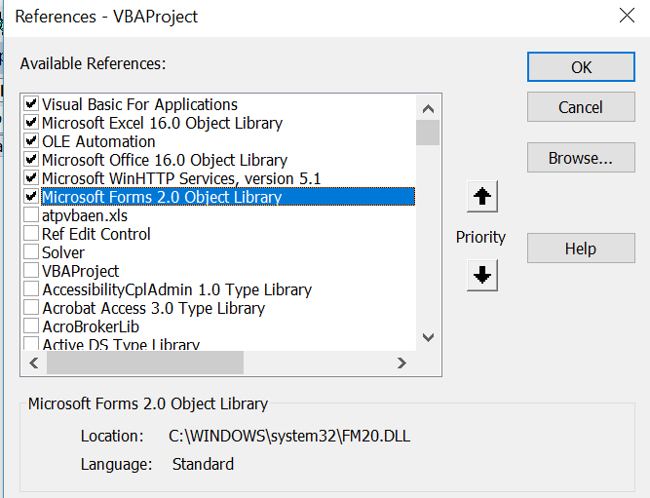
Need to Add WinHTTP Services

Slide 3
Subjects Covered in Stock Price Downloads
Summary of Using the Workbook
Concept of Base Series and Adjusting Dates
Adding Stocks and Re-setting Database
Reading from FRED with Workbooks.open
Reading from Yahoo Site with WEBREQUEST
Re-calculating Faster with Specific Range Calculations
Time Scales
Different Currencies

Slide 4
Reasons for Watching the Video
If you have Bloomberg or other tools you may not need this (although it still has things that you may not do)
See how to make flexible analysis – different stocks, currencies, time periods, statistics and keep the file working fast
Document alternative web reading methods for different files
Use these techniques for other database applications

Slide 5
Related Files with Similar Techniques
Country Database
Interest Rates
Currencies and Inflation
Commodities
Other Files

Slide 6
Compilation of Tickers and FRED Codes
One of the most painful things is not programming how to download data but finding the ticker symbols in finance.yahoo or the Federal Reserve Economic Database
The file includes different codes that you can quickly adjust

Slide 7
Video Structure
First, show you how to use the file without any technical stuff
Understanding Presentation and Excel Techniques
Documentation and Discussion of Macros to Read and Adjust Data – Please do not be intimidated by this.
Explanation of Compilation Techniques and Methods to Improve Efficiency of Calculations

Slide 8
Challenges
How to make the file efficient with so much data
How to put together data that has different formats and different dates

Slide 9
Using the Comprehensive Stock Price Workbook

Slide 10
Objectives of Tool
Compare stocks and commodity prices
Show different time periods
Adjust for Exchange Rates
Read from Different Sources to Find Worldwide Stocks
Compute IRR, Volatility and Beta for Different Periods
Apply Different Base Indices
Demonstrate Technical Issues with Reading Data

Slide 11
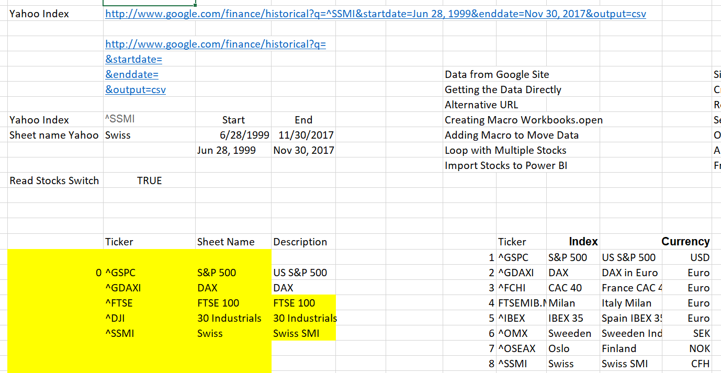
First, Go to Sheet and Select Tickers
Example of Indicies

Slide 12
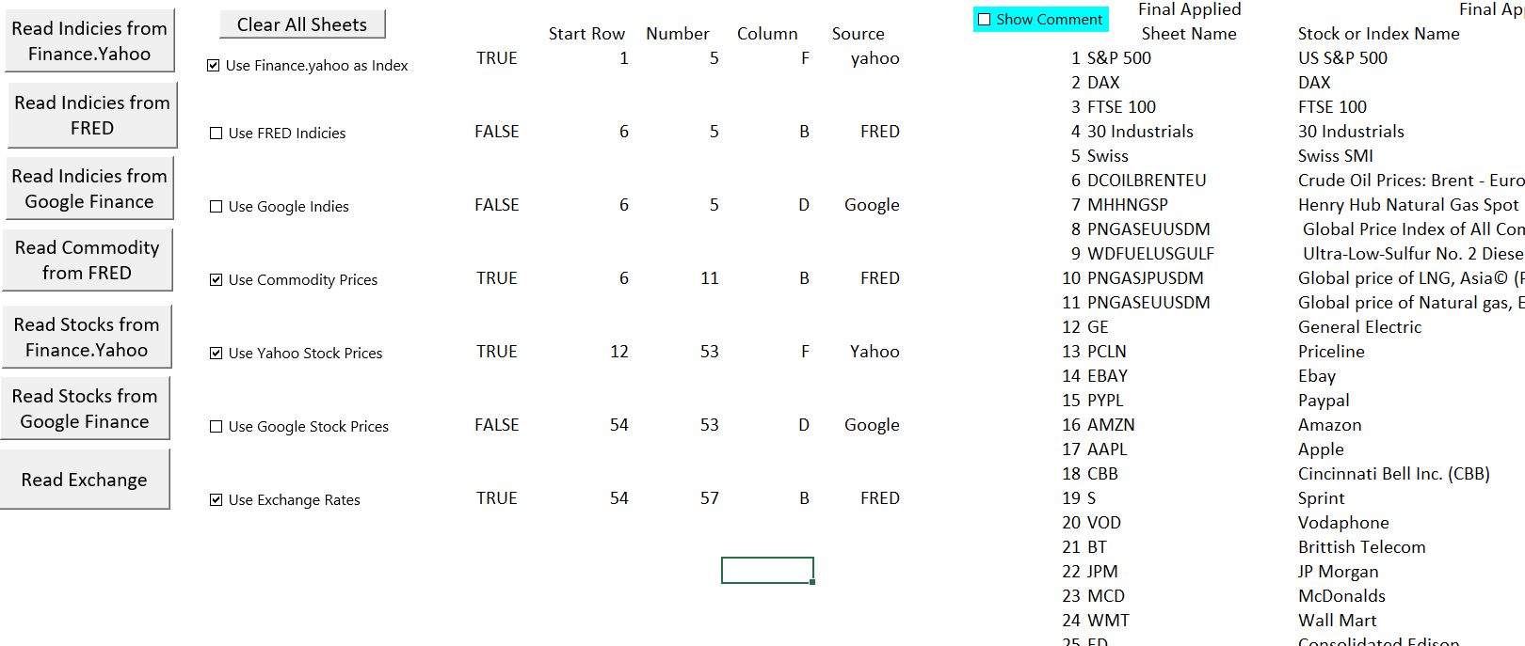
Second, Read the Data
Master List

Slide 13
Demonstration of Graphs and Outputs – One Stock and Index
GE and S&P 500

Slide 14
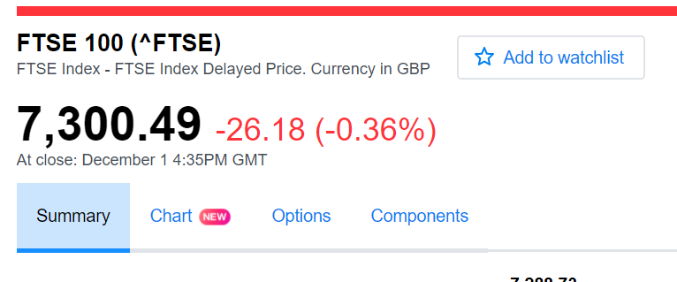
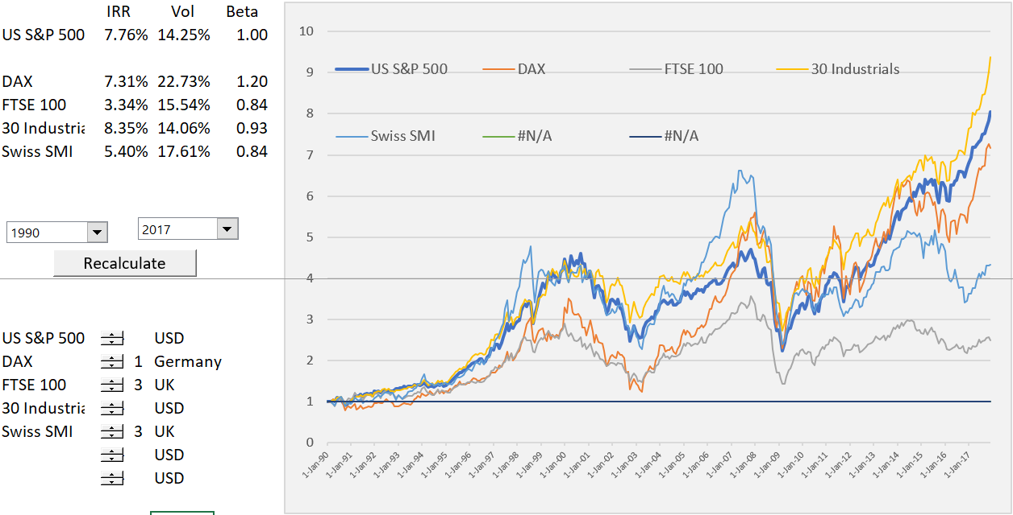
Indicies and Currencies
Need to adjust

Slide 15
Oil Stocks and Oil and Gas Index
Compare Different Commodity Prices

Slide 16
Different Electricity Company Strategies

Slide 17
Graphing Exchange Rates
Note that indices in different currencies

Slide 18
Adjusting and Working With Base Series and Dates

Slide 19
Base Series
Beta computed against the base series
Base series establishes dates
Example – S&P 500
Example – Oil Price

Slide 20
Changing the Base Index
Using Natural Gas as Index

Slide 21
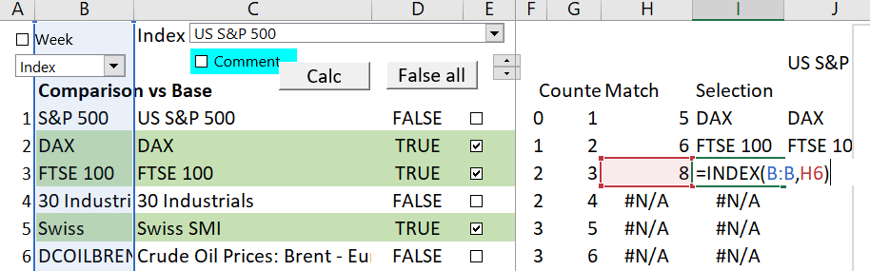
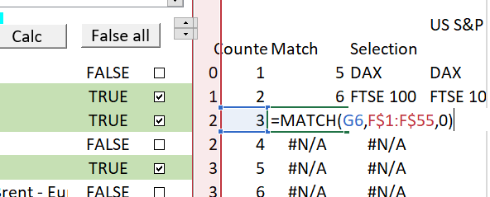
Using and Creating Checkboxes
Working with TRUE/FALSE
Count the number of TRUE’s
MATCH against a simple counter variable
Index to Put in the Stock Name

Slide 22
Adding Stocks and Re-Setting Database

Slide 23
Using Different Extraction Techniques
Clear Sheets
  Not necessary as sheets are replaced
Adding Stocks
  Select from existing lists
  Creating a master list
Re-reading
  Running the macro
Deleting or Re-using files
  Trick is to delete first and use error capture
  Only then add the sheet
  Do this all before reading the data

Slide 24
Technical Way That List is Compiled
Use the MATCH and INDEX a lot along with counting the number of items in each sheet
Create a column number so you can find the data eventually

Slide 25
Finding Stocks in Finance Yahoo
Reading Indicies and Stocks
Currencies of stocks

Slide 26
Reading from Federal Reserve Economic Database

Slide 27
Issues with Reading from FRED
Documenting Data
Finding Data

Slide 28
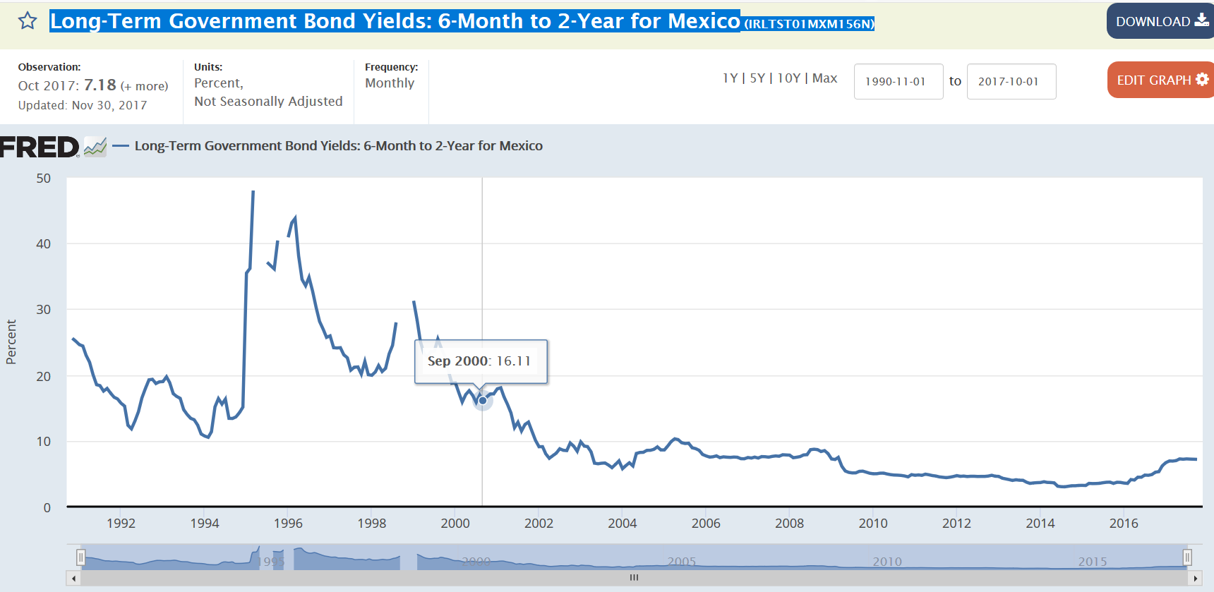
Example of Finding Data
Case – Mexico Interest Rates, Exchange Rates and Inflation Rates – Copy the Title

Slide 29
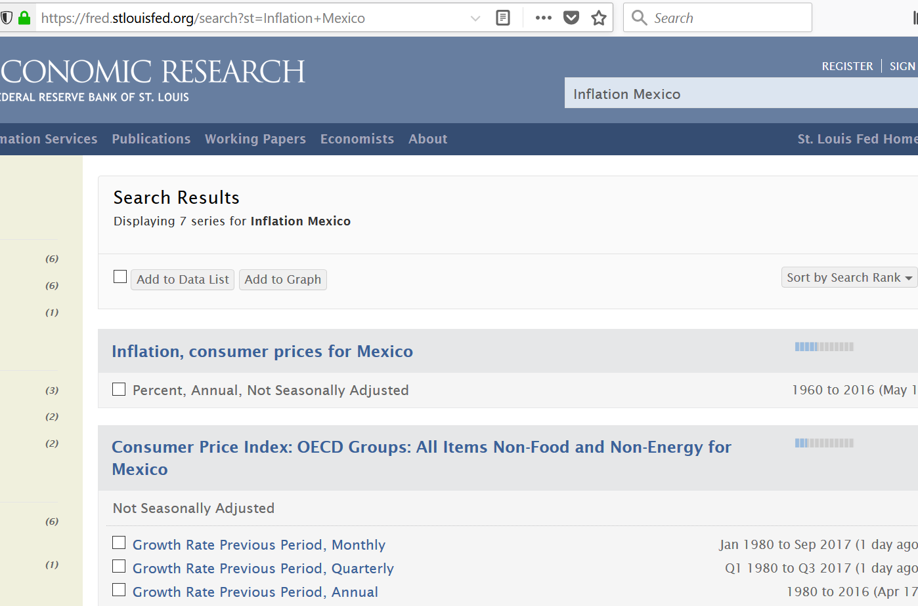
Example of Finding Inflation Rates
Search for Inflation and Copy the Titles into Exchange Rate Page

Slide 30
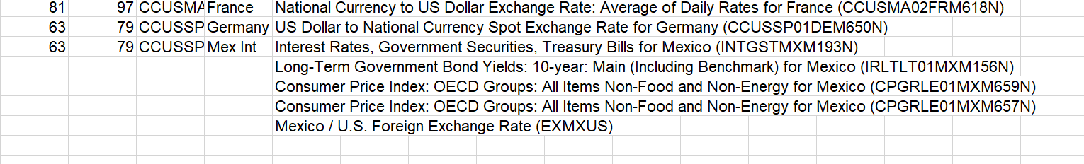
Separating Code Numbers with FRED Data
Now copy the formulas

Slide 31
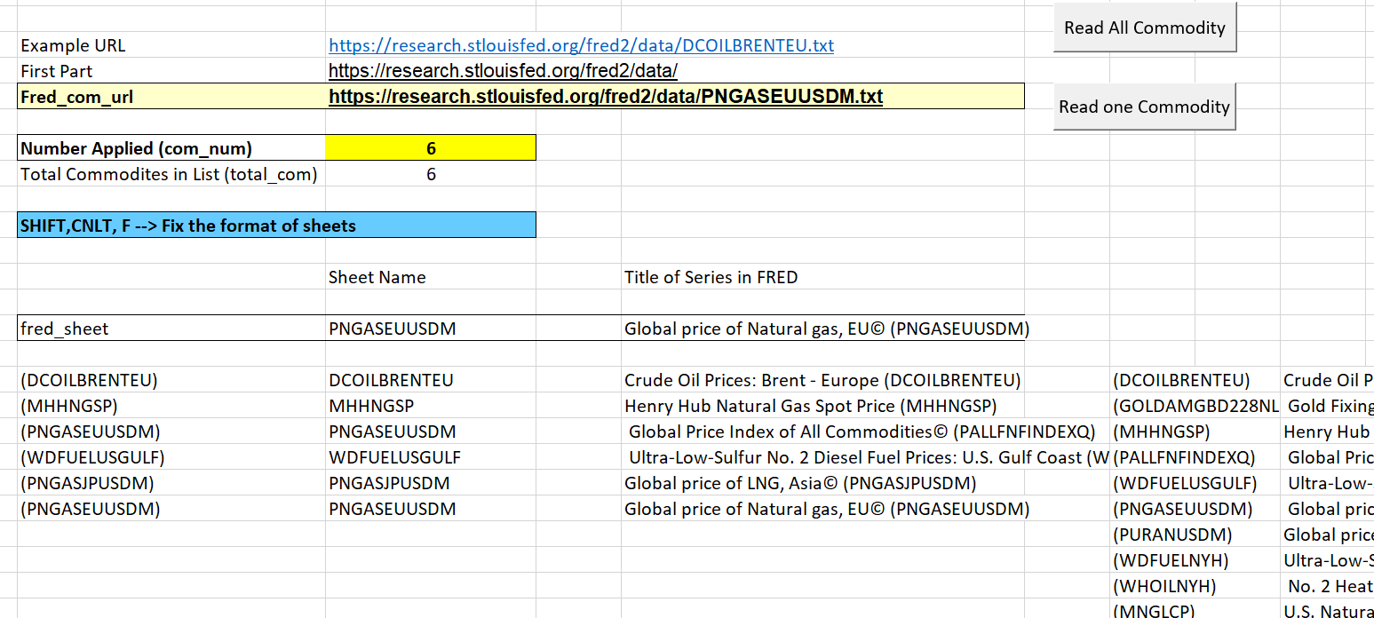
Selecting Commodity Prices
This page illustrates how to change the selection of commodity prices in the list

Slide 32
Macro to Get One Series of Data from FRED
Sub GetFredData()
Application.DisplayAlerts = False
Application.ScreenUpdating = False
base_book = ActiveWorkbook.Name
base_sheet = ActiveSheet.Name
num_sheets = Sheets.Count
Workbooks.Open (Range("fred_com_url"))
temp_book = ActiveWorkbook.Name ' this is the name of the created book
temp_sheet = ActiveSheet.Name
Columns("A:A").Select ' Text to columns so put the data in col B
Selection.TextToColumns Destination:=Range("A1"), DataType:=xlDelimited, _
TextQualifier:=xlDoubleQuote, ConsecutiveDelimiter:=True, Tab:=True, _
Semicolon:=False, Comma:=False, Space:=True, Other:=False, FieldInfo _
:=Array(Array(1, 1), Array(2, 1), Array(3, 1), Array(4, 1), Array(5, 1), Array(6, 1), _
Array(7, 1)), TrailingMinusNumbers:=True
Sheets(temp_sheet).Copy after:=Workbooks(base_book).Sheets(num_sheets)
On Error Resume Next
ActiveSheet.Name = Range("series_name") ' Create sheet name
On Error GoTo 0
Workbooks(temp_book).Close ' Close the temporary workbook
End Sub

Slide 33
Macro to Read All Commodity Prices – You Can Copy This
Sub get_all_Fred_data()
ActiveSheet.Calculate
basesheet = ActiveSheet.Name ' As usual, remember where you start so you can go back
Sheets("Commodity Prices").Select ' Need to go to the sheet to get codes
calc_status = Application.Calculation
Application.Calculation = xlCalculationManual ' Set to mannual to read more quickly
base_sheet = ActiveSheet.Name
For i = 1 To Range("total_com") ' total_com is the code number used in the index function on the sheet
On Error Resume Next
Sheets("Fred_name").Delete ' if there is an exiting sheet name, delete it so you can re-use the name
Next i
For i = 1 To Range("total_com")
Range("com_num") = i ' Change the Index counter
Sheets(base_sheet).Select ' make sure go back to the sheet with the names
ActiveSheet.Calculate
GetFredData ' this is the sub that extracts the data
Application.StatusBar = " Downloading " & Range("fred_name") & " Series " & i & " Out of " & Range("total_com").Count
Next i
Application.Calculation = calc_status ' put the calculation back
Application.StatusBar = " SHIFT, CNTL, F to Fix the format of the individual sheets"
Sheets(basesheet).Select
End Sub

Slide 34
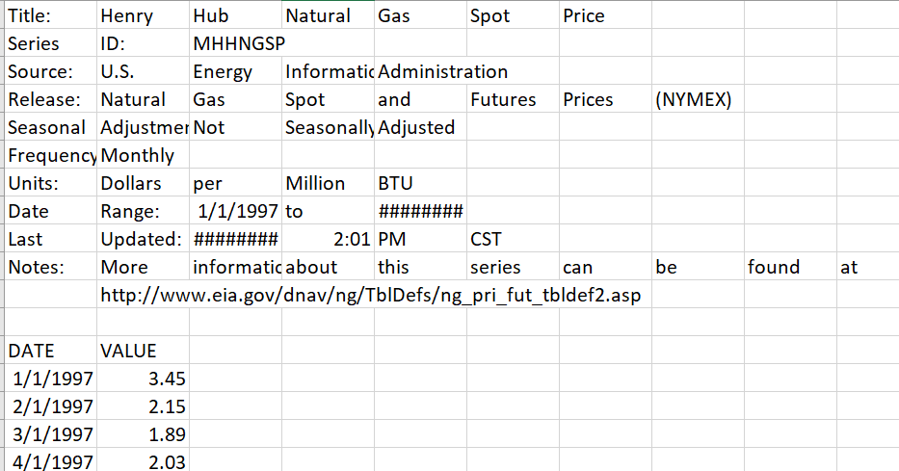
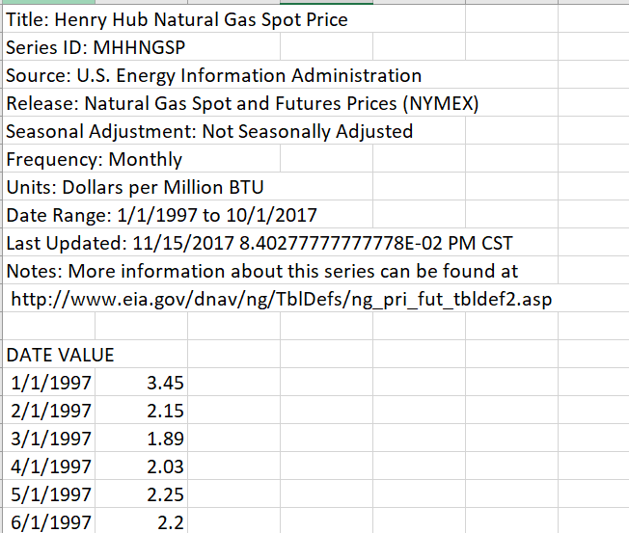
Fixing Format with Shift, CNTL, F
Assigning SHIFT,CNTL,F with On Key
Before and After Shift, CNLT, F

Slide 35
SHIFT, CNTL, F Macro – Loop to Put Together Items that are Separated with Text to Col
Sub auto_open()
Application.OnKey "^F", "format_description"
End Sub
Sub format_description()
current_status = Application.Calculation ' keep the calculation method for re-set at end
Application.Calculation = xlCalculationManual ' make mannual to go faster
min_date = WorksheetFunction.Min(Range("A:A")) ' find the smallest date for stopping adj
row_num = WorksheetFunction.Match(min_date, Range("A:A"))
' Once have the MIN, use MATCH to find the row number to STOP
For Row = 1 To row_num - 1 ' Loop around rows
For col = 2 To 15 ' Loop around cols, START at 2
Cells(Row, 1) = Cells(Row, 1) & " " & Cells(Row, col)
' Put everything back into COL 1 and put a space between
Cells(Row, col) = "" ' Put a blank in the replaced cell
Next col
Next Row
Application.Calculation = current_status ' Put the calculation back where you found it
End Sub
.

Slide 36
Reading from Finance Yahoo with WEBREQUEST

Slide 37
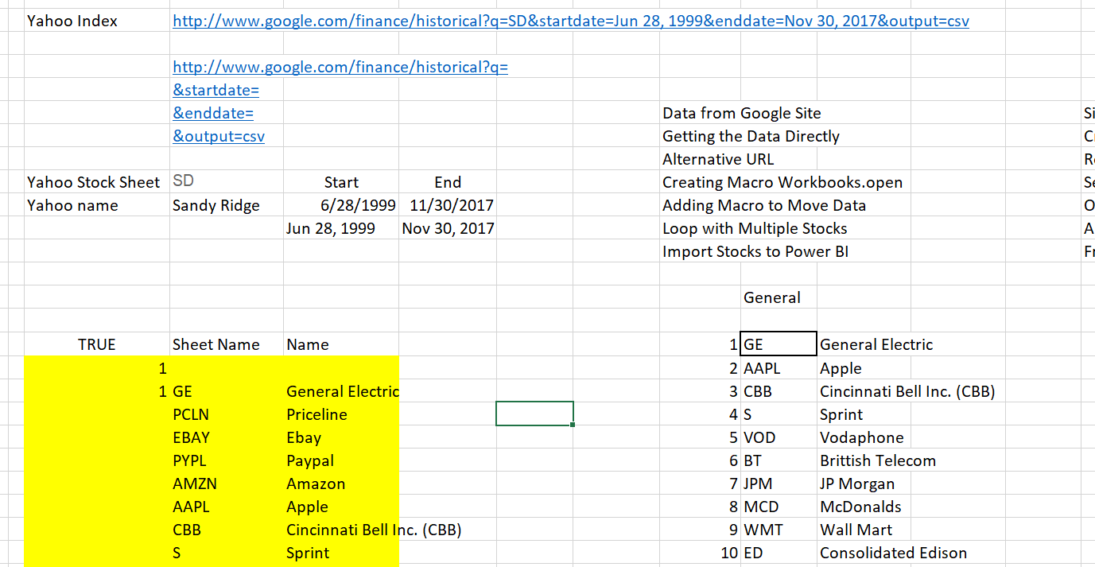
Yahoo Page and Selecting Stocks
How the URL works

Slide 38
Diagram for Process
.
Call the Initialise Routine to get the Cookie and Crumb
Call Routine to Read Each Stock with Loop and INDEX
Use WEBREQUEST to retrieve data
Clean up the data

Slide 39
Macro to Read All Yahoo Stocks (or Indicies) with Initialise
Sub read_all_yahoo_stocks()
ActiveSheet.Calculate ' Need to calcualte to get the number of stocks
base_sheet = ActiveSheet.Name ' For re-setting at the end
Sheets("Yahoo Stocks").Select ' Need specific sheet name so can read from the first sheet
initialise_cookie_yahoo_stock ' This is the pain, but you can do this only one time
For i = 1 To Range("yahoo_tickers")
Range("yahoo_counter") = i ' Re-assign the Index variable as usual
ActiveSheet.Calculate
Application.StatusBar = " Reading " & i & " " & Range("sheet_name_yahoo")
WebRequest_yahoo ' This is where you get the specific sheet
Sheets(base_sheet).Select ' go back to the base sheet to read
Next i
Sheets(base_sheet).Select
Application.StatusBar = False
End Sub

Slide 40
Macro to Read a Single Stock or Index with Yahoo
Sub WebRequest_yahoo()
Dim WebRequest As WinHttp.WinHttpRequest ' Need to define the webrequest
Dim OutRow() As String ' Place to put row by row output
Dim matrix(20000, 20000) As String ' Dimension from S&P 500 daily
Dim range_name As String
Application.Calculation = xlCalculationManual
Range("cookie_string").Calculate
Cookie = Range("cookie_string")
Range("yahoo_url").Calculate ' calculate the range name -- to get the name
WebRequestURL = Range("yahoo_url") ' Need to define the webrequest
Set WebRequest = New WinHttp.WinHttpRequest
' This is the core of the method -- you need this statement
With WebRequest 'FETCH THE DATA:
.Open "GET", WebRequestURL, False ' Need to define the URL
.setRequestHeader "Cookie", Cookie ' This is a painful part
.send
.waitForResponse (10) ' Test how long to wait -- 10 seconds is a long time
End With

Slide 41
Macro to Read Single Stock - Continued
OutRow = Split(WebRequest.ResponseText, vbLf): RowMax = UBound(OutRow) - 1
' Split a single row when hit vbLF
On Error GoTo end2:
Sheets.Add ‘ Add a new sheet
' This is for speeding up things
For i = 1 To RowMax ' Put this in the new sheet
matrix(i, 1) = OutRow(i - 1) ' Put into array to read
Next i
range_name = "A1:A" & RowMax
Range(range_name) = matrix ' Put in whole range name
clean_yahoo_stocks ' Runs text to col etc.
end2:
End Sub

Slide 42
Creating a Cookie and a Crumb – NEED OPTION BASE 1 at the Top
Option Base 1
Sub initialise_cookie()
current_status = Application.Calculation
Application.Calculation = xlCalculationManual
ActiveSheet.Calculate
Dim WebRequest As WinHttp.WinHttpRequest
Dim Crumb As String, CrumbSearchString As String, Cookie As String
Dim CrumbStartPosition As Long, CrumbEndPosition As Long
Dim CrumbTry As Integer, URLTry As Integer
Dim ParamLoop As Long
Dim WebRequestURL As String ': WebRequestURL = "https://finance.yahoo.com/lookup?s=rubbish" 'ANY s SEEMS TO WORK
'THINGS YOU MAY LIKE TO CONFIGURE:
Const RetryCrumbMax = 25 'NUMBER OF RETRIES OF TRYING TO GET A VALID CRUMB/COOKIE COMBINATION
Const RetryURLMax = 25 'NUMBER OF RETRIES OF THE DATA URL
'NOW WE NEED A COOKIE AND A CRUMB. THANKS TO Scott Lindsay AT http://www.xlautomation.com.au FOR THIS METHOD:
'IF YOU GET A USER DEFINED TYPE ERROR BELOW, GO TO THE VBA DEVELOPER Tools->References... MENU AND CHECK OFF "Microsoft WinHTTP Services"
CrumbSearchString = """CrumbStore"":{""crumb"":"""
'THIS LOOP INCLUDES BOTH THE CRUMB AND THE DATA FETCH:

Slide 43
Cookie and Crumb Continued
For CrumbTry = 0 To RetryCrumbMax
Set WebRequest = New WinHttp.WinHttpRequest 'MUST BE INSIDE THE LOOP FOR RETRY TO WORK
With WebRequest
.Open "GET", "https://finance.yahoo.com/lookup?s=^GSPC", False 'ALMOST ANY SYMBOL WORKS
.setRequestHeader "Content-Type", "application/x-www-form-urlencoded; charset=UTF-8"
.send
.waitForResponse (15)
Cookie = Split(.getResponseHeader("Set-Cookie"), ";")(0)
CrumbStartPosition = InStr(1, .ResponseText, CrumbSearchString, vbBinaryCompare) + Len(CrumbSearchString)
CrumbEndPosition = InStr(CrumbStartPosition, .ResponseText, """", vbBinaryCompare)
Crumb = Mid(.ResponseText, CrumbStartPosition, CrumbEndPosition - CrumbStartPosition)
End With
If Len(Crumb) = 11 Then Exit For 'THERE'S A VERY GOOD CHANCE AN 11 CHAR CRUMB IS VALID
Next CrumbTry
Range("crumb") = Crumb
'CONSTRUCT THE URL:
'interval=1d or 1wk or 1mo, events=dividends or events=history (prices) or events=splits
Range("cookie") = Cookie
Application.Calculation = current_status
End Sub

Slide 44
Re-Calculating Faster Using Specific Ranges

Slide 45
Things that Slow Down
Re-calculating all sheets
What slows you down – INDIRECT function
Demonstrate the speed with calculation on

Slide 46
Macro to Re-calculate with Range Names – The Order Matters
Sub summary_calc()
Application.Calculation = xlCalculationManual
Sheets("forms").Calculate ' When you change the years it is in this sheet
Range("graph_parta").Calculate
Range("graph_partd").Calculate ' Make ranges that do not include INDIRECT
Range("graph_partc").Calculate
Range("graph_partb").Calculate
Range("A12").Select ' This is all to get back to the graph
Range("A12").Activate
Range("A13").Select
Range("A13").Activate
ActiveSheet.Calculate ' There is not much in this sheet
End Sub

Slide 47
Making Flexible Time Scales

Slide 48
Different Currencies

Slide 49
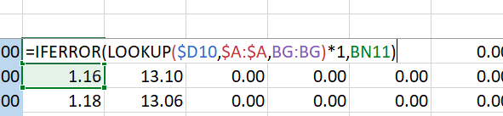
To Efficiently Read from FRED can Multiply by 1.0 and Use IFERROR
Create errors to use IFERROR

