Slide 1
General Discussion of Budgets and Forecasts in Finance: Every Subject in Finance Boils Down to Two Subjects
Every decision in finance is in one way or another derived from how much the outcome of the decision is worth.
Valuation analysis of debt or equity involves assessing
  Future cash flow levels, (cash flow is reality) and
  Risks in valuing those cash flows, whether it be the cash flow from assets, debt or equity
Future Cash Flow: forecasting is a very complex and difficult problem. In this course we will understand how to find historic cash flows so you will have a basis for your forecasts.
Risk Assessment: Coming up with a measurement of risk is extremely difficult and things like beta, value at risk and credit scoring have not worked very well.

Slide 2
History as a Guide in Financial Analysis: Project Finance versus Corporate Finance
Corporate Finance
Project Finance
Analysis is founded on history and evaluation of how companies will evolve relative to the past.
Financing is important but not necessarily the primary part of the evaluation.
Successful companies expected to continue growing.
Focus on earnings, P/E ratios, EV/EBITDA ratios and Debt/EBITDA.
Since there is no history a series of consulting and engineering studies must be evaluated.
The bank assesses whether the project works (engineering report).
Successful projects will pay of all debt from cash flow and cease to operate.
Focus on cash flow. Equity IRR and DSCR.

Slide 3
Fundamental Accounting Principles in Simple Example

Slide 4
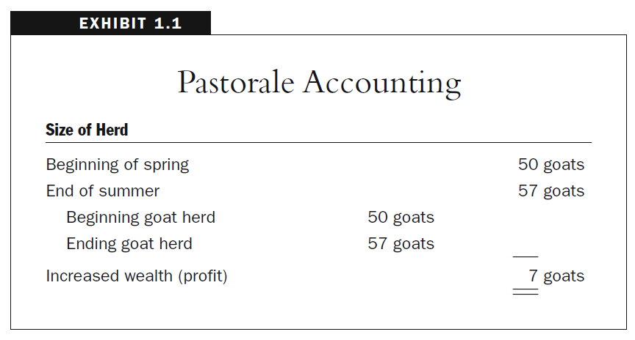
History of Accounting
Notice assets have opening and closing balance
Difference in balance is profit over a period of time

Slide 5
Understand Profits, Assets, Equity, Cash flow in a Simple Example
We begin with a street food business. In the first case our street food seller is trying starting a business and she does not take money out of her business in terms of dividends.
She has some cash at start of period
She spends some money to buy food and she sells the food for more than she pays for it. This gives here more cash at the end of the period.
Her cash is an asset – it will provide benefits to her and her family in the FUTURE
The DIFFERENCE between cash at the start of the period and cash at the end of the period is defined as PROFIT
  Equity is Cash at End of Period
  Cash comes from Selling Food and Buying Food

Slide 6
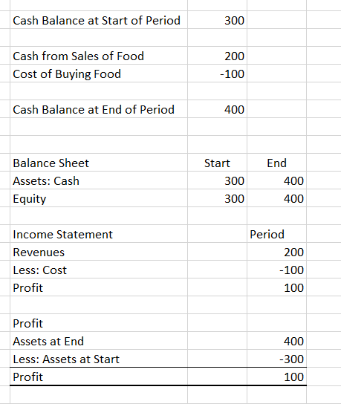

Balance Sheet and Income Statement for Simple Business
Balance sheet and income statement come from the amount of cash in the bank or in your wallet.
Balance Sheet at single date, Income Statement over period

Slide 7
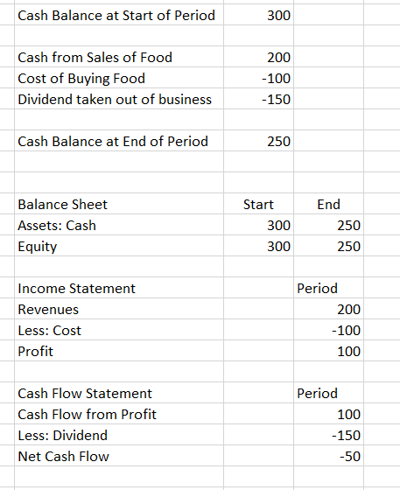

When Dividends are Included You Need a Cash Flow Statement that covers the period
She needs to eat and to have a home: so she must take cash out of the business – this is a dividend.
Now Include Cash Flow Statement
Equity Balance is the Starting contribution of 300, plus the profit of 100 minus the dividends of 75. Dividends are on the financing part of the cash flow statement
Equity Balance
Opening Balance 300
Add: Net Income 100
Less: Dividend -150
Ending Equity 250

Slide 8
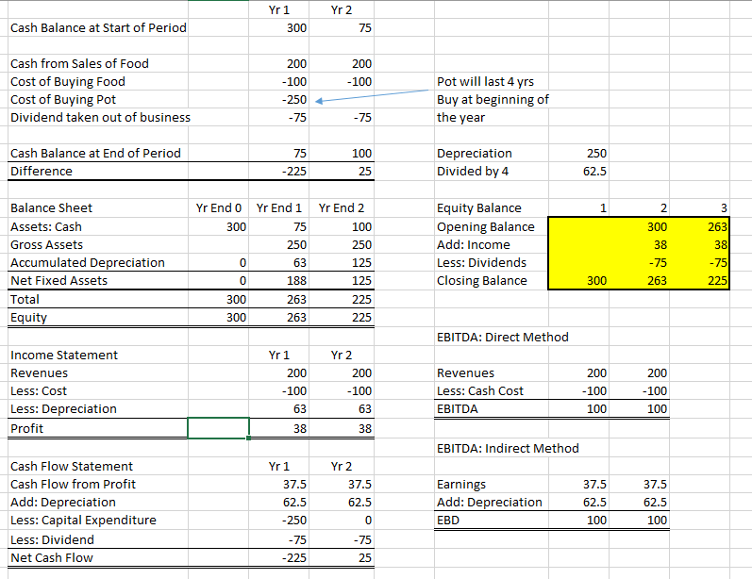
Balance Sheet and Income Statement for Simple Business – Assets and Depreciation
Accumulated depreciation adds depreciation expense from earlier period
She needs that pot to make the food. This is a capital asset. When she purchased the pot it is a capital expenditure. Now you should put the opening balance and the closing balance of plant on the balance sheet as well as accumulated depreciation

Slide 9
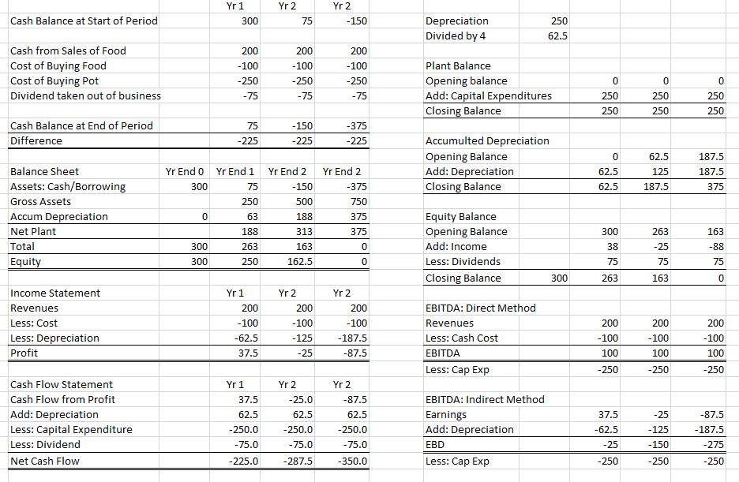
What Happens if EBITDA is Always Less Than Capital Expenditure
Note that the cash balance becomes negative quickly if EBITDA is less than Cap Exp
These are like notes to financial statements and have opening and closing balance

Slide 10
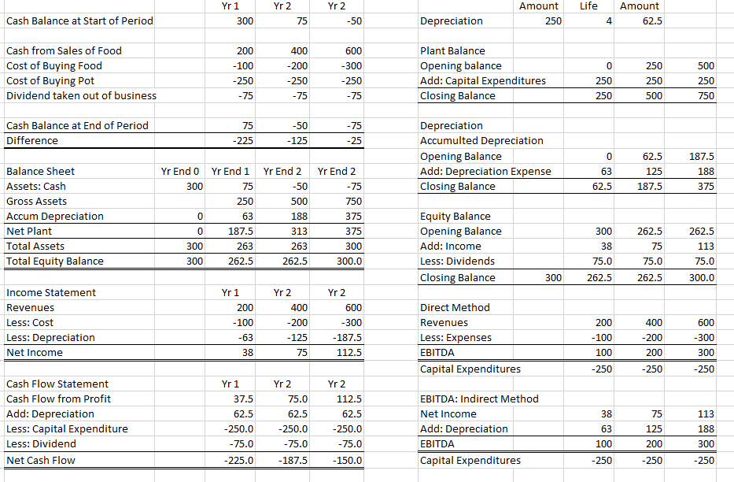
What Happens if EBITDA increases from Capital Expenditure
Note that the cash balance becomes negative quickly if EBITDA is less than Cap Exp
These are like notes to financial statements and have opening and closing balance

Slide 11
Exercise with Simple Case
For computing the simple case, use the following rules.
First: Compute the income statement and cash flow statement – fill in revenues, expenses and dividends.
Second: Fill in opening and closing balance of the balance accounts from the income statement and the cash flow statement. The opening balance is the last period closing balance.

Slide 12
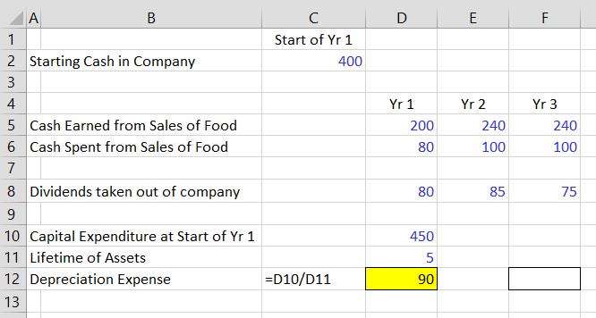
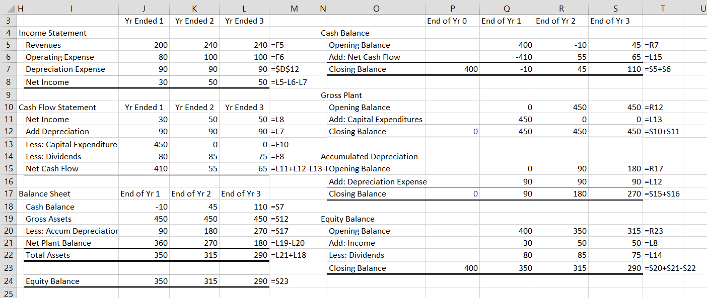
Example of Computing Financial Statements

Slide 13
Now Compare the Simple Example to Real Financial Statements –
Income Statement
Balance Sheet
Cash Flow Statement

Slide 14
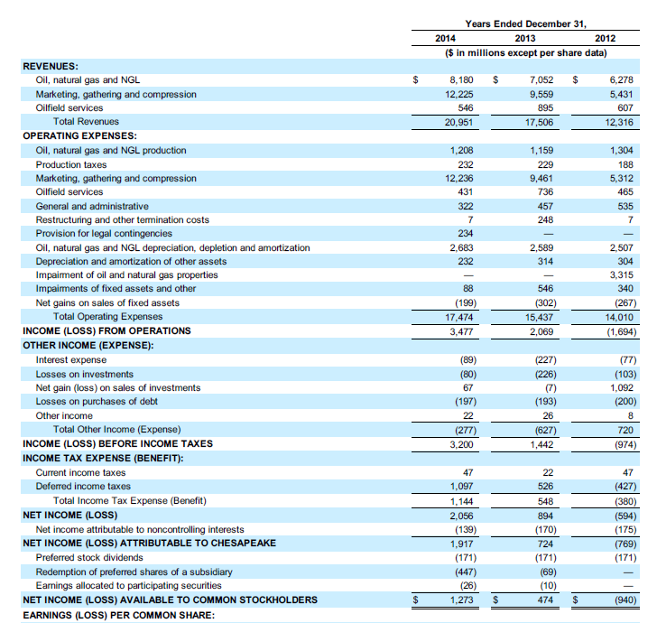
Income Statement
Note the Date: Year Ended
Revenues from Billed Amounts Not Cash Collected
How should restructuring costs be treated for EBITDA
How to treat gains, impairment and settlement
What is the true interest expense paid to banks
Where are gains and losses on derivatives
What do deferred taxes really mean
How to treat minority interests

Slide 15
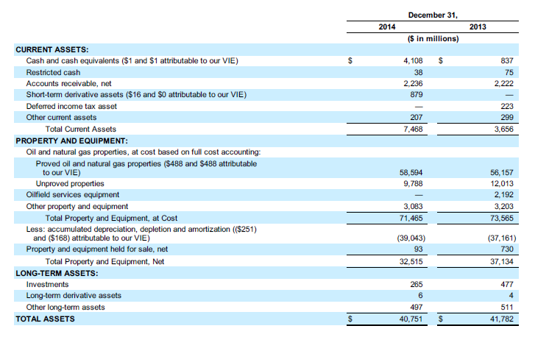
Balance Sheet
How to define cash in financial analysis
What are derivative assets
What does it mean that use full cost accounting
Why can deferred taxes be an asset
How should property held for sale be treated

Slide 16
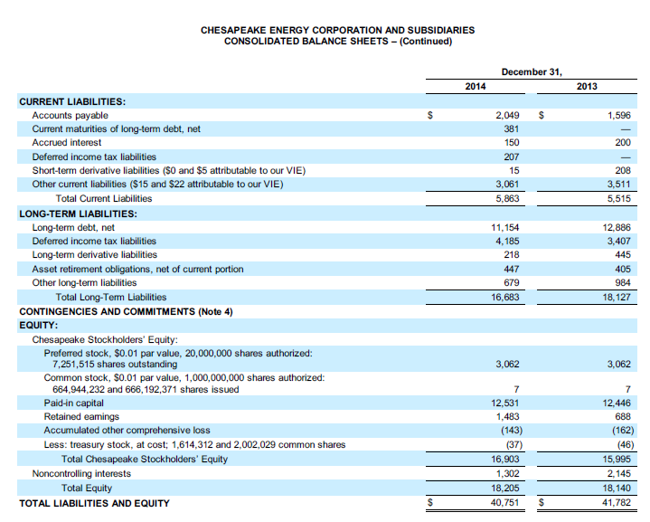
Balance Sheet - Continued
How do Liabilities instead of assets arise
What are asset retirement obligations and should they be treated as debt
What is Accumulated Other Comprehensive Income

Slide 17
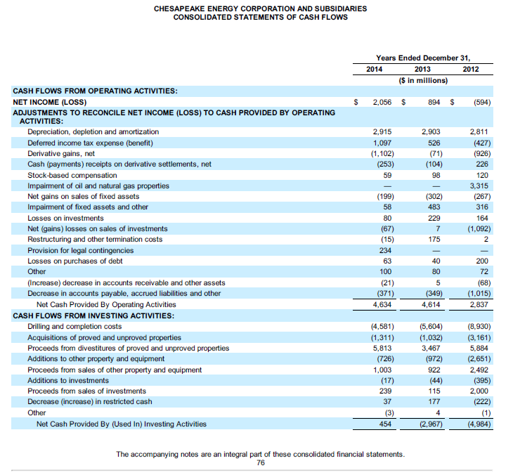
Cash Flow Statement Part 1 – Cash Flow from Operations and Cash Flow from Investing – Find the Capital Expenditures
Note the Periods
Why is the deferred tax added
Where were derivative gains and losses in income statement
How should treat the stock based compensation for EBITDA
Why are losses on sale not cash
Are Proceeds from sales non cash
What are Maintenance Capital Expenditures

Slide 18
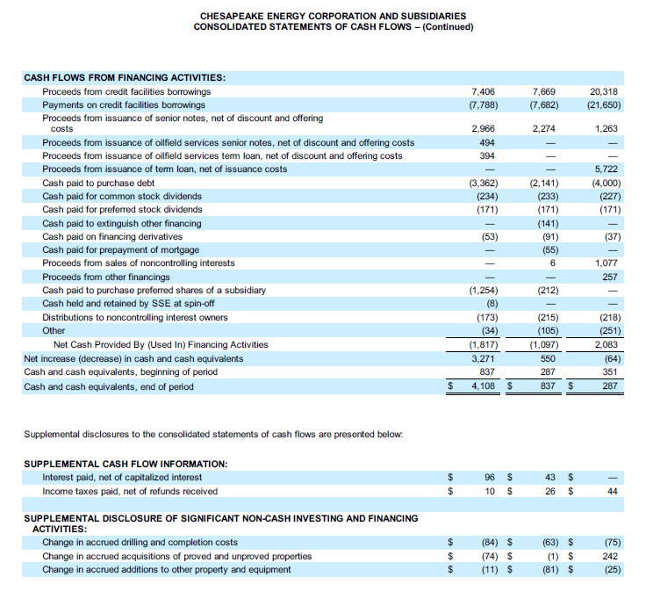
Cash Flow Statement: Dividends is part of this
Mainly has where get the money from financing and where pay money
These items do not affect EBITDA

Slide 19
Evaluating Cash Flow and EBITDA

Slide 20
EBITDA Issues Addressed in This Section
In financial statement analysis we use accounting data to find information that best helps us find the value of the company and the strength of the company from the perspective of re-paying debt. In this section the following is addressed:
  Why don’t bankers and investment bankers just use the Cash flow on the Cash Flow Statement for Cash Flow instead of EBITDA
  Is there a rule that is always used for calculating EBITDA
  How does S&P compute EBITDA and what is the basis for their calculations

Slide 21
Why are Adjustments Necessary for Financial Analysis (S&P)
S&P states that adjustments to accounting data enable better alignment of a company's reported figures with our view of underlying economic conditions.
  Comment: This means that standard and poor’s does not think you can just take numbers from the cash flow statement or the income statement to represent the ability of a company to repay its debt.
Adjustments allow a more accurate portrayal of a company's ongoing business, for example, following acquisitions or disposals, through pro forma adjustments.
  Comment: This means that we want to use the financial data to see how much the company’s basic business is earning and we do not want to count gains from sales of a business in the on-going business or EBITDA

Slide 22
This is What S&P Says About EBITDA
EBITDA aims to capture the results of a company's core operating activities
The core business activities are before interest, taxes, and the before the impact on earnings of (1) capital spending, (2) other investing and (3) financing activities.
  Comment: EBITDA is still earnings, but since it is before depreciation it can be compared to Capital Expenditures.
  Since it is before interest, it can be compared to interest
  It removes other investing like cash, so it concentrates on the core business activities of a company.

Slide 23
S&P Definition of EBITDA – Other Income Should Be Only Cash
Revenue minus operating expenses
  plus depreciation and amortization (including noncurrent asset impairment and impairment reversals).
  Include cash dividends received from investments accounted for under the equity method, and exclude the company's share of these investees' profits.

Slide 24
EBITDA as Starting Point – General Discussion
First big point about EBITDA – EBITDA cannot be found on the income statement and there is no absolute rule for computing EBITDA
  Attempt to evaluate on-going operations in a consistent manner
  Definition as revenues related to basic operations coming in versus cash expenses going out. Do not include gains on sales of assets
Computation of EBITDA and Measurement Issues
Understanding and Dissecting Trends in EBITDA
Acquiring Long-term data on EBITDA (read PDF)
Adjusting EBITDA for Exploration Expenses, Rental Expenses and Other Factors

Slide 25
Review of Chesapeake Case – Why Make Adjustments to Accounting Data in Finance
Why do we make adjustments to accounting data and use EBITDA
  Separate financing analysis from operating analysis
    EBITDA should focus on core operations (Apple example)
    EBITDA takes interest away
    EBITDA can be compared to capital expenditures (takes depreciation away)
    FFO and EBITDA used to evaluate debt repayments
  Starting point of DCF valuation is EBITDA:
    A simple definition of free cash flow for a company with no taxes and cash accounting:
      Free Cash Flow = EBITDA – Capital Expenditures
    Full Definition:
      Free Cash Flow = EBITDA – WC Changes – Capital Expenditures – Operating Taxes + Deferred Taxes + Other Items

Slide 26
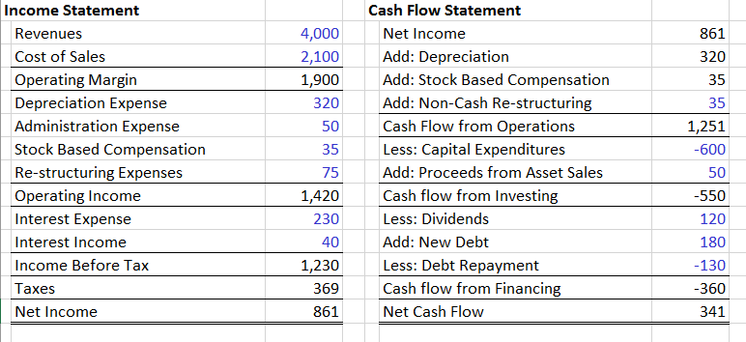
Example of EBITDA – Stock Compensation and Cash Restructuring Expenses
You can use the cash flow statement and the income statement to compute the EBITDA of a company. In this example, the company has stock price compensation and restructuring expenses.
Some of the restructuring expenses are non-cash expenses. The cash portion can be found by subtracting the amount of non-cash expenses on the cash flow statement from the total expenses on the income statement
The stock compensation should not affect EBITDA a company must either pay cash expenses or stock expenses for making sales and operating a company.
.
.
Call the stock based compensation the same as cash compensation
The cash restructuring expenses are the restructuring expenses of 75 minus the non cash amount of 35

Slide 27
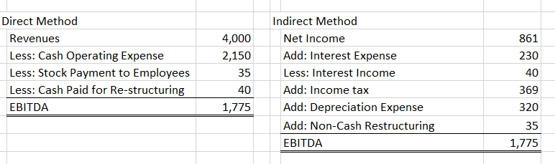
Example of EBITDA Continued – Use Direct or Indirect Method to Compute EBITDA
The EBITDA from the last slide can be computed either from starting with Net Income or starting with revenue. The cash paid for re-structuring expenses (75 minus 35) must be reflected in the direct method. For the indirect method starting with income, the non cash expenses of 35 should be added. No adjustment should be made for the stock compensation.
Non cash restructuring is from the cash flow statement
The stock payment is subtracted and the payment for restructuring is 75 minus 35

Slide 28
EBITDA has a Problem that it does not really account for project life of assets because it does not include depreciation
In simple terms, if two companies have the same EBITDA but one company has assets of 2 years and another has assets of 20 years, the relationship between EBITDA and capital expenditures.
If Project Life is 2 years, and Investment is 1000 and debt is 700.
  If Debt to EBITDA is 4, then EBITDA is 700/4 = 175. This is not enough to repay the debt because by the time 175 is paid for 2 years, the company has to raise more debt. 175 x 2 = 350
If Project Life is 20 years, and Investment is 1000 and debt is 700.
  If the Debt to EBITDA is 4 and EBITDA is 175. The 175 is easily enough to repay the debt over 20 years. 20 x 175 = 3,500.

Slide 29
Adjustments to EBITDA when Comparing Companies in an Industry if the Companies have Different Accounting Policies
Example of Adjustments to EBITDA
  Exploration Expenses (EBITDAX) for Dry Hole Costs
  Rental and Lease Payments (EBITDR) for Leasing Aircraft
EBITDA Computation
  Top Down – move other income
  Bottom-up (Indirect)
EBITDA Notes
  Interest Income out of EBITDA
  Interest Expense not in EBITDA
  Understand Non-cash Expenses
    Deferred Mining Costs
    Equity Income
    Minority Interest

Slide 30
Understanding what is Capitalizing and Expensing
When a company expenses a cost it is in the income statement as an expense. The idea is that this expense has no future benefit. For example, when a company pays an employee for preparing an accounting report this has no benefit for more than one year.
When a company capitalizes a cost it is a capital expenditure. A capital expenditure is not a cost in the income statement until it is recorded as depreciation expense. Instead it is recorded as a capital expenditure.
An example of this is the cost spent for exploration of oil, some of which do not produce oil in the future. Some companies call this a capital expenditure because the whole process of exploring will provide future benefits. Other companies call it an operating expense because it does not produce any oil.

Slide 31
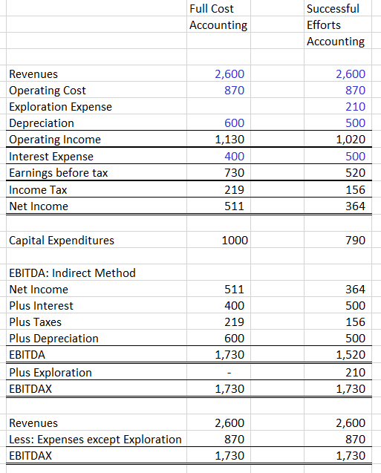
Example of Making Adjustment to EBITDA for Oil Companies
Companies that record dry hole costs as an expense are called successful efforts. Companies that capitalize the cost are called full cost companies.
Note the difference in operating cost and capital expenditures.
The EBITDA for the two companies would be different, but if you add exploration expenses and call them EBITDAX, the cash flow would be the same – as if both were full cost companies.

Slide 32
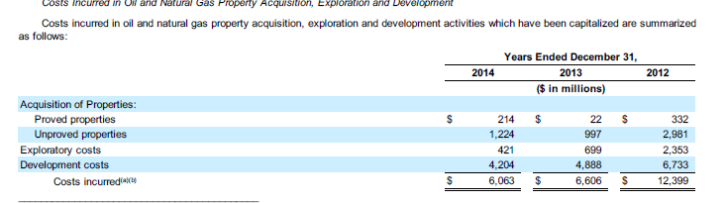
Example of the Treatment of Exploration Costs – Chesapeake Puts the Costs of Dry Holes in Capital Expenditures
If used successful methods accounting, the exploration costs would be expensed and the EBITDA would be lower.
If another company expensed exploration expenses they would have lower EBITDA but also lower depreciation.
What would happen to EBITDA, EBIT and Debt to Capital
.

Slide 33
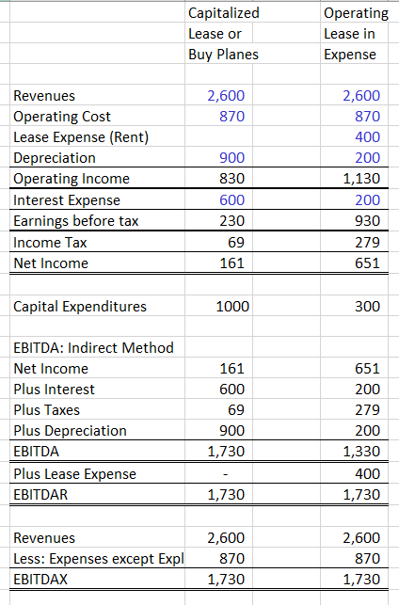
Example of Making Adjustment to EBITDA for Airline Companies
Some companies that record costs of leasing or renting planes as an expense. This is called and operating lease.
Other companies purchase planes or call the leased planes a capital lease. Note that these companies have higher and capital expenditures.
The EBITDA for the two companies would be different, but if you add rent expenses and call it EBITDAR, the cash flow would be the same – as if both had purchased planes.

Slide 34
General Problems with EBITDA in Measuring Debt that Can be Repaid from Cash Flow
EBITDA is useful in its simplicity, and can be a good reference for comparison of debt and value, but it has weaknesses:
  EBIT could be more important than DA, because must use cash for replacing depreciation and amortization (but then you do not have a number to compare with capital expenditures)
  In credit analysis, EBITDA works better for low rated credits than high rated credits because the focus is on cash flow to repay interest in the short-term. (Moody’s)
  EBITDA is a better measure for companies with long-lived assets because the assets do not have to be replaced by capital expenditures.
  EBITDA can be manipulated through accounting policies (for example if a company reduces operating expenses and includes the cost as a capital expenditure)
  EBITDA ignores changes in working capital, does not consider required re-investment, says nothing about the quality of earnings, and it ignores unique attributes of industries.

Slide 35
Adjustments to EBTIDA to Evaluate Debt Repayment: Funds from Operations versus EBITDA
Funds form Operations (FFO) =
  Net Income from Continuing Operations + Depreciation and Amortization + Deferred Tax + Other Non-Cash Items
Free Operating Cash Flow =
  FFO + (-) Increase in Working Capital excluding changes in case
Reconciliation of FFO and EBITDA
  EBITDA is NI + depreciation + interest + taxes
  FFO is NI + depreciation
  Difference is interest and taxes

Slide 36
Summary of why EBITDA is Used
  EBITDA is useful because one way to think about the fundamental operations of a company is that it makes capital expenditures to generate EBITDA. EBITDA is before depreciation and before taxes and interest while capital expenditures is before financing from debt and equity. Therefore the EBITDA that is computed before depreciation, financing and taxes can be compared to capital expenditures so as to assess whether the strategy is working.
  EBITDA is good for assessing the ability to repay debt and interest expense because EBITDA is representative of cash flow before interest meaning EBITDA can be used to assess whether debt service (interest expense and debt repayments) can be repaid.

Slide 37
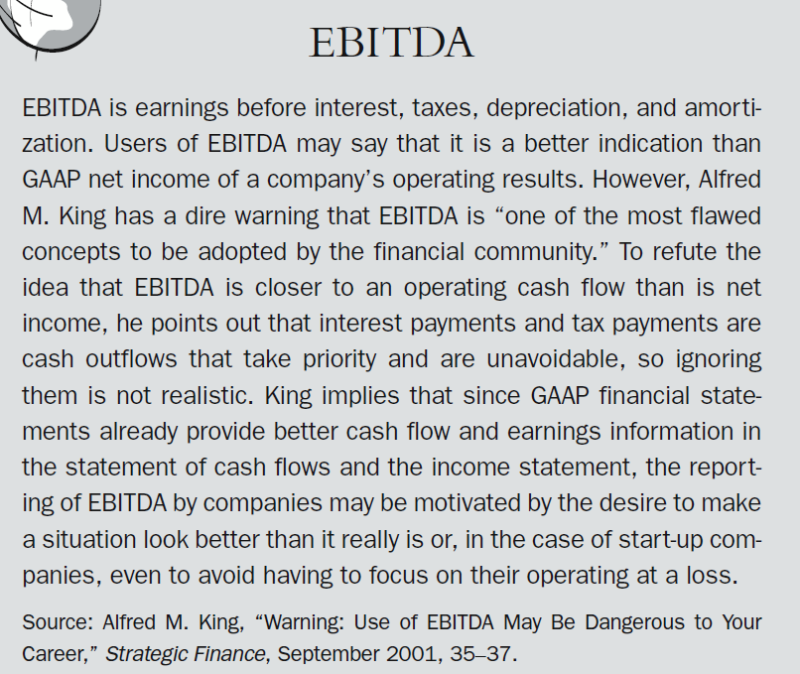
Some People do not like EBITDA – This is a quote from a book on Financial Statement Analysis (Chapter 6 of the disk)

Slide 38
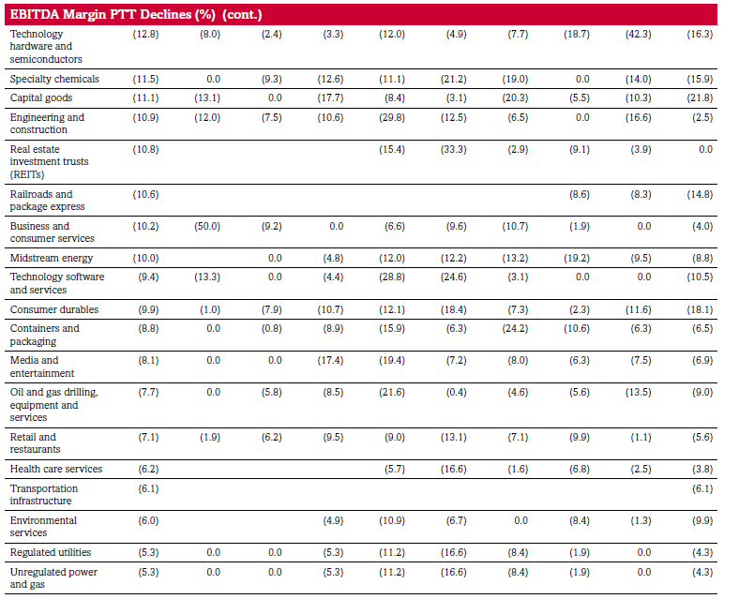
EBITDA Volatility – Peak to Trough Percent (PTT)

Slide 39
Cash Flow and Credit Analysis: Primary Source of Repayment for Credit Analysis
Project finance source of repayment is cash flow
  Cash flow after taxes and maintenance capital expenditures
  Examples
Corporate finance
  When a company grows, it would be bad to repay all debt
  Source of repayment is strong enough financial ratios to re-finance
  When markets loose confidence, companies go bankrupt
    Examples: Enron, Constellation Energy, Lehman Brothers
    How can you assess when re-financing becomes not possible

Slide 40
Assessment of EBITDA for Debt Repayment Analysis
Cash Flow that is available to really pay debt service
  Begin with EBITDA
  Subtract working capital changes required to support EBITDA
  Subtract maintenance expenditures required to keep up equipment
  Reduce by taxes
  Account for Reduction in EBITDA from asset retirement
Use Model with Cash Flow Analysis
Create Data Table to Evaluate Debt to EBITDA

Slide 41
Evaluation of EBITDA in Credit Analysis
  Assessment of EBITDA in Different Analyses
    Sufficient to Repay all Debt in Project Finance Analysis
    Sufficient to Generate Financial Ratios for Refinance in Corporate Analysis
    Sufficient to Limit Draws from Revolver in Acquisition Analysis
  EBITDA Break-even
    Potential Reductions in EBITDA
    Probability of Default
    Loss on Debt

Slide 42
Acquiring Long-term data on EBITDA (read PDF)
Samsung and Chesapeake Energy
  Download PDF
  Use Read PDF file
  Use Arrange Titles with Union Function
  Use Match and Index to Arrange Data
  Compute EBITDA

Slide 43
Short-term Cash Flow Analysis and Liquidity
Seasonality versus trends in cash flows relative to current assets and current liabilities
Fixed and Variable Costs: how changes in revenues impact profit
Cash Flows and revolving credit facilities
  Managing the working capital cycle Business cycles and businesses
    Stocking
    Selling
    Destocking
Applying and evaluating the main ratios to understand and analyse
  the Cash Conversion Cycle
  the cash position of the business
the credit-worth of the business

Slide 44
Presentation of EBITDA and FFO in Chesapeake Case Using Indirect and Direct Approach

Slide 45
Review of Chesapeake Case – Why Make Adjustments to Accounting Data in Finance
Why do we make adjustments to accounting data
  Separate financing analysis from operating analysis
    EBITDA takes interest away
    EBITDA should focus on core operations (Apple example)
    EBITDA can be compared to capital expenditures
    FFO and EBITDA used to evaluate debt repayments
  Starting point of DCF valuation is:
    Free Cash Flow = EBITDA – Capital Expenditures
    Full Definition:
    Free Cash Flow = EBITDA – WC Changes – Capital Expenditures – Operating Taxes + Deferred Taxes + Other Items

Slide 46
Adjustments in Chesapeake
Where to find capital expenditures
Add depreciation and impairment
Use cash interest expense and not capitalized interest

Slide 47
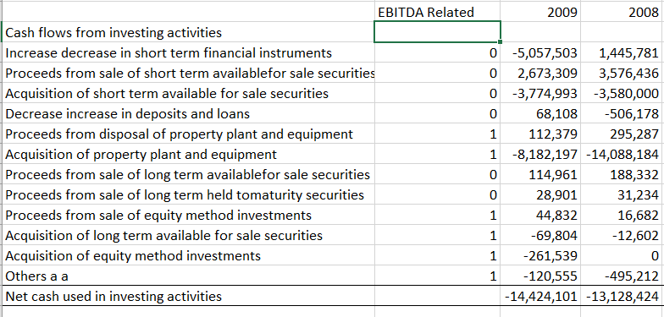
Where do you Find Capital Expenditures
Samsung: Cash flow from investing

Slide 48
Importance of Computing Interest for Financial Analysis
Interest is Used in Computing FFO
Interest is Used in Computing DSCR
Interest is Used in EBITDA/Interest Ratio

Slide 49
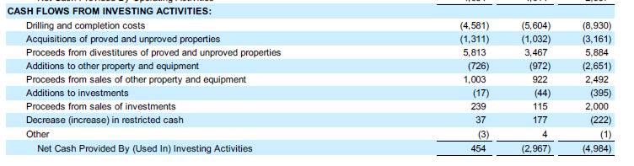
Capital Expenditures in Chesapeake
Investing section of the cash flow statement
The proceeds from sales of assets can be thought of as negative capital expenditures

Slide 50
Are Research and Development Expenditures Capital Expenditures or Operating Expenses
Remember that when a company spends money it can either call the expenses an operating expense or a capital expenditure.
If the cash outflow produces benefits for more than one year in the future, the cost should be classified as a capital expenditure and the amount becomes an asset. If it is an asset then it can be amortized, depreciated or impaired.
Research and Development is something that produces future benefits but we do not know how much. Accountants call this a capital expenditure. But financial analysts can call this a capital expenditure.

Slide 51
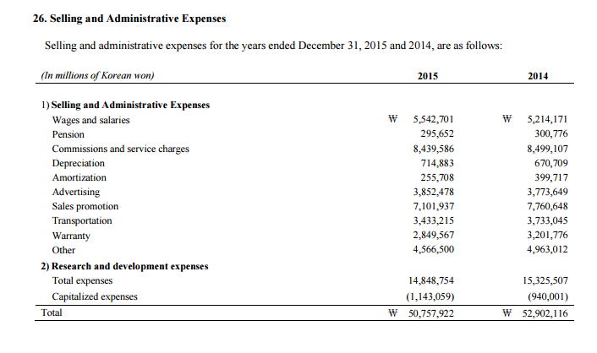
Example of R&D Expenses for Samsung – Note that they are Treated as Expenses

Slide 52
Why Can Interest be Capitalized and What doe Interest Capitalized Mean
When a company makes an outflow for an item – it pays a salary, it buys materials, it pays for fuel, it pays taxes or it pays interest, this can be accounted as either an operating expense or as a capital expenditure. Say a company pays 100,000 Won for to a construction employee. If this cost is made for building a factory or a building, the building has future benefits for many years and is a capital expenditure.
If a company pays a bank 100,000 for interest while the construction is occurring, this interest cost is also recorded as a capital expenditure as it is related to building the factory and the building is not yet earning any money.
This means that even if the 100,000 is paid to the bank, it is not recorded as an expense on the income statement.

Slide 53
Interest Expense and Capitalized Expense
Interest is paid to the lenders (sometimes it may not be paid but it increases the loan balance. This is called payment in kind).
Interest can be threated like a capital expenditure if it is paid when an asset is being constructed.
  This is capital expenditure
  This becomes depreciation expense after the plant is finished
Example of how interest capitalized increases the plant balance.
  Plant balance opening
  Add: capitalized interest
  Plant balance closing
Capitalized Interest is not Paid Recorded on Income Statement but is Capital Expenditure

Slide 54
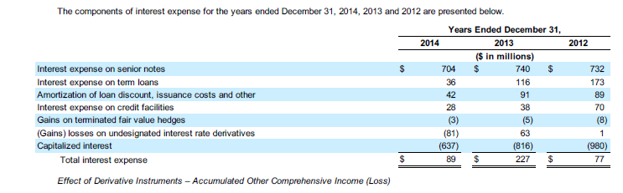
Interest to Use in Financial Analysis
Capitalised Interest:
  When an asset is being constructed, the interest expense for financing the asset is treated as a capital expenditure and eventually depreciated after the asset becomes operational.
  Capitalised interest does not appear on the income statement because it is just like a capital expenditure.
  Capital interest is still interest expense paid to lenders.
Capitalised Interest is large component

Slide 55
Treatment of Debt Issuance Costs (Standard and Poors)
If a loan is paid over many years, the fees paid for the loan are capitalized. This means the fees are not called an operating expense, but they are treated like a capital expenditure and put on the balance sheet as an asset. This seems confusing but the fees are like something that has a future benefit.
After the fees are capitalized, they are amortized like an asset is depreciated. So if a loan has a 10 year life and 1,000 are paid for fees, the amortization is 100.
Standard and Poor’s states that debt issuance costs are a form of prepaid interest, which companies record on the balance sheet and amortize as an interest expense over the term of the debt. We regard them as part of the total cost of borrowing and therefore do not deduct the amortization of debt issuance costs from reported interest.

Slide 56
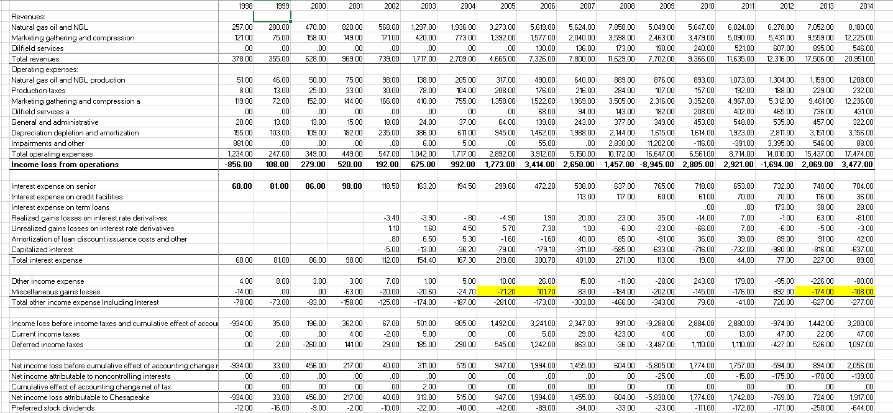
Data in Chesapeake Case

Slide 57
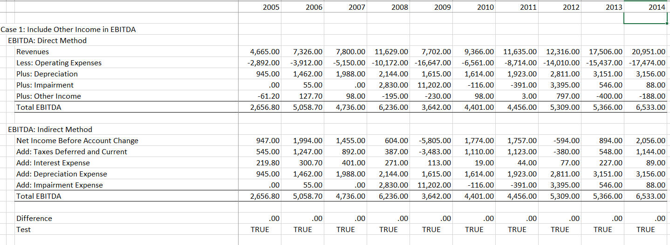
Presentation of EBITDA – Other Income Included in EBITDA
Show the exact way you compute items and reconcile the direct and the indirect method
Other Income Included in the Direct Method
TRUE is
Difference = 0

Slide 58
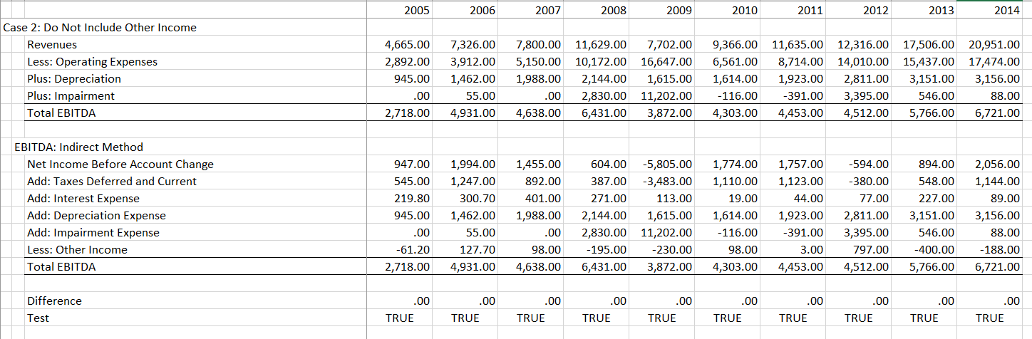
Presentation of EBITDA – Other Income Included in EBITDA
Show the exact way you compute items and reconcile the direct and the indirect method
Other Income Included in the Indirect Method
TRUE is
Difference = 0

Slide 59
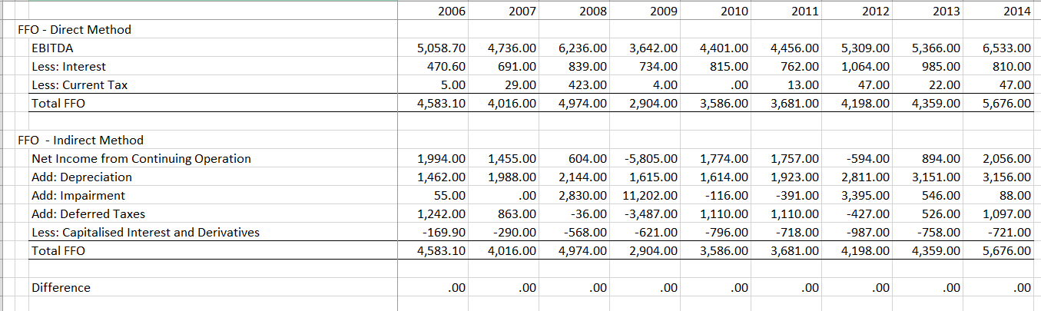
Presentation of EBITDA – Other Income Included in EBITDA
Show the exact way you compute items and reconcile the direct and the indirect method

Slide 60
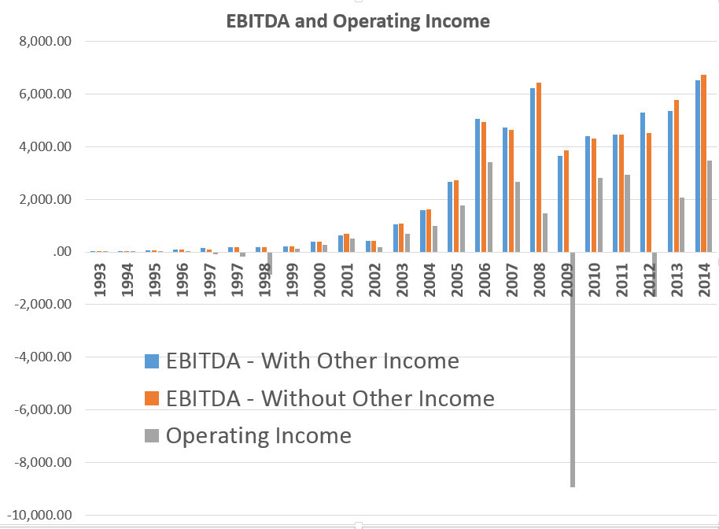
EBITDA and Operating Income
Big decline in operating income comes from the impairment expenses

Slide 61
Connection Between Financial Statements:
How does and Asset Arise on the Balance Sheet from the Income Statement and the Cash Flow Statement

Slide 62
General Approach to Connecting Balance Sheet with Income Statement and Cash Flow
Understand Asset Accounts with Opening and Closing Balance
Opening Balance at Prior Balance Sheet Date
Add or Subtract: Increase or Decrease from Profit or Loss on Income Statement
Add or Subtract: Capital Expenditure or Subtract Asset Sales that are on Cash Flow Statement
Closing Balance at Next Balance Sheet Date

Slide 63
How does an Asset Increase
An asset that is on the balance sheet is generally stated at original cost – the amount that was paid for the assets (remember the pot paid in the street food case).
An asset has future benefits:
  Examples:
    Cash can buy things
    Accounts receivable turn into cash
    Notes payable is repaid and you receive cash
    Plant assets produce income
An asset can increase:
  If you pay for the asset – for example a capital expenditure
  From making a profit – for example cash when make sales
An asset can decrease:
  If the asset is depreciated and which is a loss
  If the asset is impaired because it is deemed to have lower value
  If the asset is sold which is like a negative capital expenditure

Slide 64
Connection of Balance Sheet, Cash Flow and Income Statement, Net Plant
Gross Plant Balance
  Opening Balance of Plant on Balance Sheet
  Add: Capital Expenditures
  Less: Retirements
  Closing Balance
Accumulated Depreciation
  Opening Balance on Balance Sheet
  Add: Depreciation Expense
  Less: Retirements
  Closing Balance

Slide 65
Connection Between Balance Sheet and Income Statement using Balance Accounts
Accounts Receivable and Revenues
  Opening Balance of A/R
  Add: Revenues Recorded on Income Statement
  Less: Revenue Collected from Prior Period Income Statement
  Closing Balance of Accounts Receivable
Inventory and Cost of Goods Sold
  Opening Balance of Inventories
  Add: Purchases
  Less: Cost of Goods Sold on Income Statement
  Closing Balance

Slide 66
Connection Between Balance Sheet and Income Statement using Balance Accounts Continued
Accounts Receivable and Revenues: Example
  Opening Balance of A/R = 100
  Closing Balance of A/R = 200
  Revenue on Income Statement = 1000
  Revenue collections in cash must be 900:
    100 + 1000 = 1100 and 1100 – 200 = 900
  Formula: Revenues - Change in A/R Revenues

Slide 67
Comparing Balance Sheet and Income Statement
Since balance sheet is one day and income statement is the entire year, must compare the income statement with AVERAGE balances
  Average A/R to Revenues: Percent of Time Outstanding
  Days Outstanding (if year): Percent of Time Outstanding x Days in Year

Slide 68
Connection Between Balance Sheet and Income Statement using Balance Accounts Continued
Inventories and Cost of Sales: Example
  Opening Balance of Inventories = 100
  Closing Balance of A/R = 500
  Cash Cost of Goods Sold (not Depreciation) = 600
  Purchases Must be 1000:
    100 - 500 = -400 and actual balance is 600. 600+400 = 1000
  Formula: COGS - Change in Inventories
Comparing Balance Sheet and Income Statement
  Since balance sheet is one day and income statement is the entire year, must compare the income statement with AVERAGE balances
Average Inventory to GOGS: Percent of Time Inventories Outstanding
Days Outstanding (if year): Percent of Time Outstanding x Days in Year
What is meaning of Increase in Inventories

Slide 69
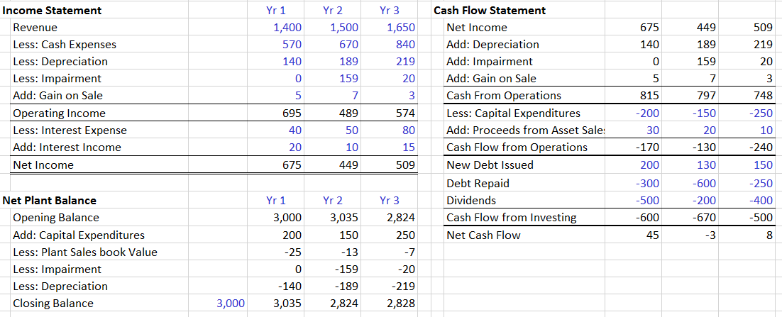
Connection Between Balance Sheet and Income Statement Example of Plant Assets
Using plant assets, the example below shows how assets increase from capital expenditures and they decrease from expense (non-cash) items on the income statement.
.
Note that the asset sales are only included at net book value and do not include gains on the sale of assets

Slide 70
Discussion of Assets:
Items that are Owned that Provide Future Benefits

Slide 71
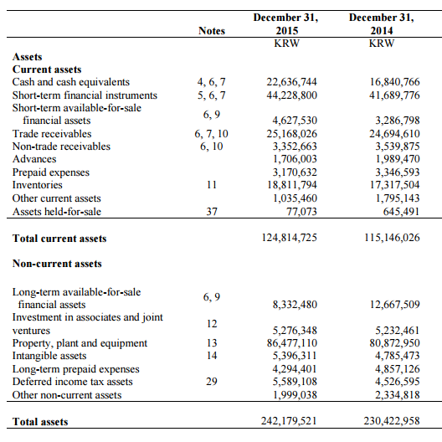
Samsung – Find the Plant Balance
Some assets at market value and some at original cost
Operating related current assets include:
Trade Receivables
Prepaid expenses
Inventories
Other Current Assets
Assets decrease in value from being sold (on the cash flow statement), or from being depreciated or from being impaired. The opening balance of plant on the balance sheet is changed by capex, depreciation, profits and other items from income statement and cash flow statement

Slide 72
Accounts Receivable and Notes Receivable
Notes Receivable or Advances are like Cash Securities – they are like making a loan and probably not related to operating the company.
What happens when the level of Accounts Receivable increase – more revenues are recorded then are collected. The higher level of accounts receivable would be collected if the company stopped operations.
With a growing company recorded revenues continue to increase and revenues recorded continue to be higher than revenues collected. Because new accounts receivable replace old accounts receivable, the accounts receivable do not turn into cash.
Accounts receivable is related to producing EBITDA. If a company that tries to collect cash faster after it makes a sale may have to reduce prices and it may have lower sales. These both affect the EBITDA.

Slide 73
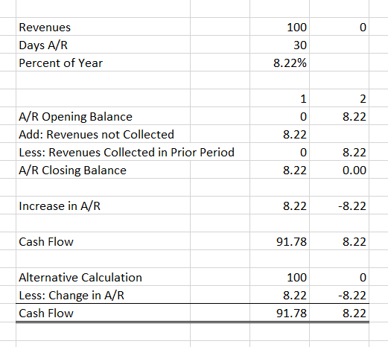
Accounts Receivable – Single Period Example
This simple example where a company stops operating shows why accounts receivable is an asset.
In the example:
  The A/R decreases in YR 2
  Cash flow is:
    Revenues
    Minus change in A/R
Increase in A/R less revenues is the same as the cash flow

Slide 74
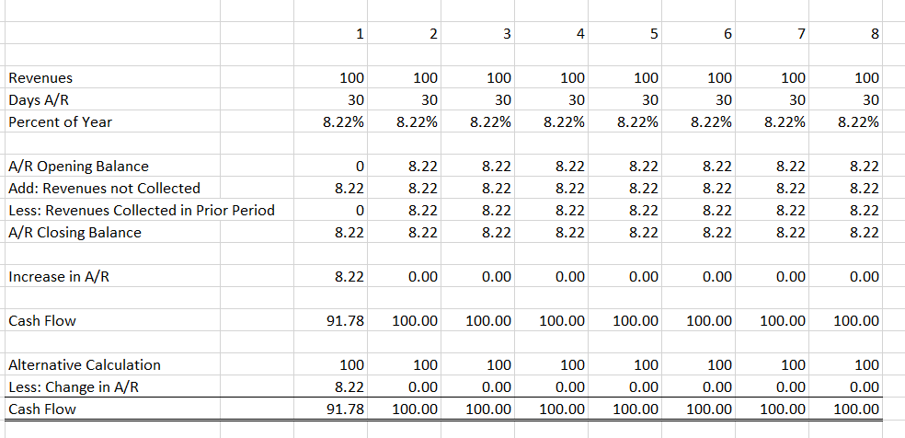
What happens to Accounts Receivable Assets with No Growth in Revenues
Shows that never really collect the accounts receivable with constant growth. This is important because of treatment of the A/R in free cash flow – A/R change is always a cash outflow.
Increases in A/R is offset by collections from prior years revenues and the A/R balance is stable – it is never repaid

Slide 75
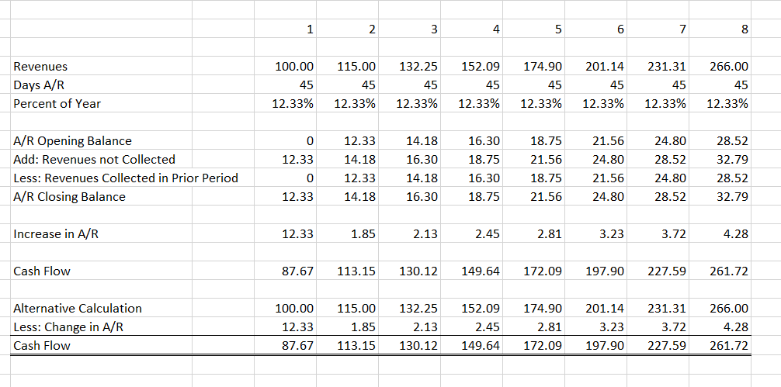
Level of Accounts Receivable when Revenues Grow – Increase in A/R is like Investment
Shows that never collect the A/R and have to increase investment. A/R change is like capital expenditure required to finance growth.
Never collect the revenues because the amount not collected is always trailing the amount paid from prior periods

Slide 76
Working Capital Changes and Financial Analysis
When computing free cash flow in future classes you will compute the change in working capital as a reduction in free cash flow.
The change in working capital is not simply the difference in total current assets and current liabilities.
Instead, the working capital items should focus only on items related to EBITDA.
  You can think of changes in accounts receivable like capital expenditures as something that is needed to earn EBITDA (the basics of a business is investing money in capital expenditures and working capital to receive EBITDA).
  Working capital changes are reductions in cash flow because revenues are recorded when billings are made and not when cash is received (this is accrual accounting).
  Changes in working capital should NOT include interest payable and dividends payable because these items are not related to operations and EBITDA.

Slide 77
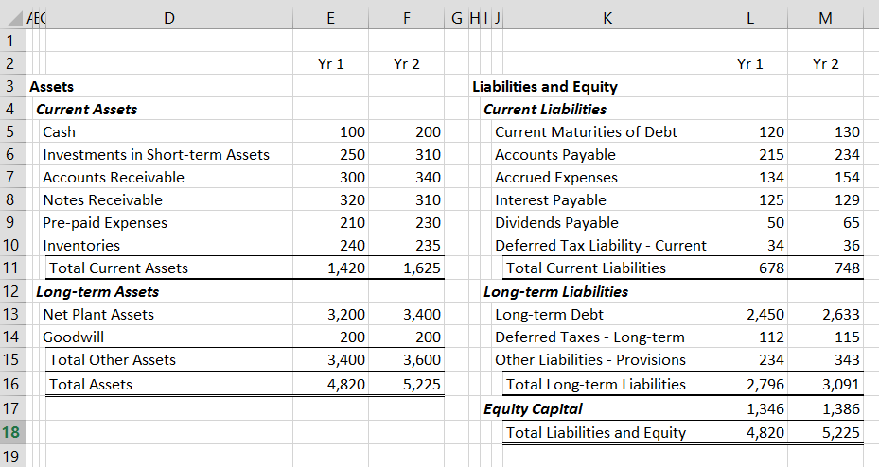
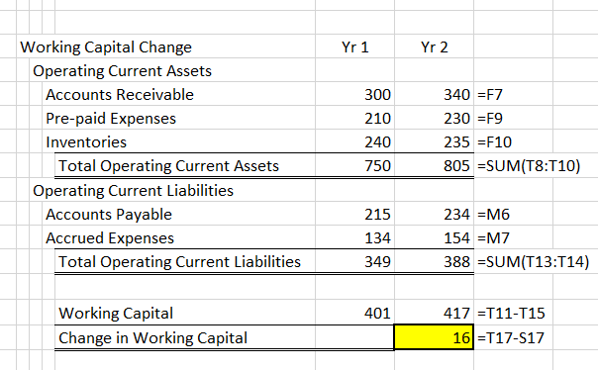
Calculation of Changes in Working Capital for Free Cash Flow
Only include accounts related to EBITDA in computing working capital changes.
First compute the current assets and current liabilities. Then compute total working capital. Finally compute the change in working capital

Slide 78
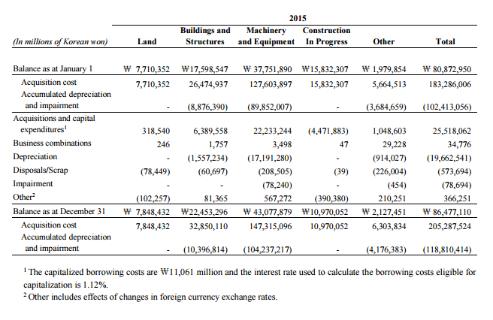
Depreciation and Plant Discussion – Samsung Example
See how impairments and accumulated depreciation affect the net plant balance
This is on the balance sheet

Slide 79
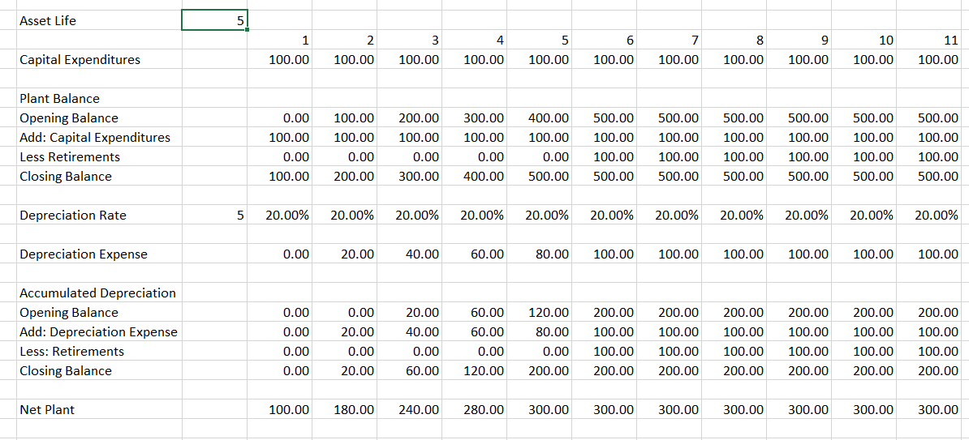
Depreciation Expense and Capital Expenditure
Note that if there is no growth, the capital expenditures equal the depreciation
Look at the opening balance of plant on the balance sheet and compute the value of the plant on the balance sheet

Slide 80
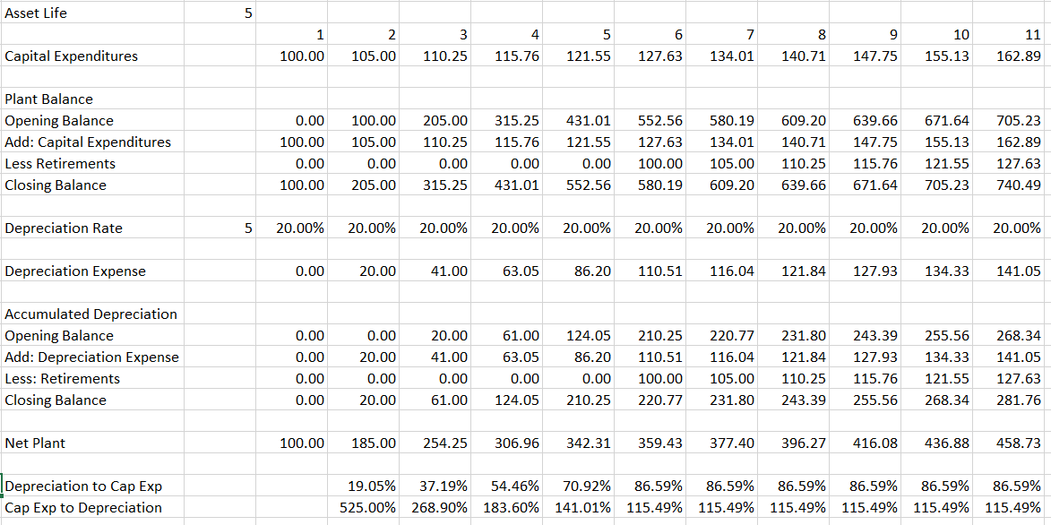
Depreciation and Capital Expenditures with Growth
If there is growth, the capital expenditures are greater than the depreciation. The process of computation is the same.

Slide 81
Assets Created from Merger and Acquisition

Slide 82
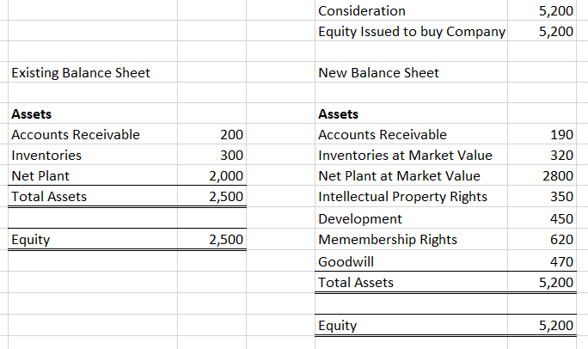
Notes on Accounting for Acquisition and Goodwill
Remove the equity of the acquired company
Re-value assets of the target company
Prepare a purchase price allocation
Goodwill is the difference left over
.
Note that the goodwill is what is left over after new equity is put on the balance sheet and the assets are valued including intangible assets, and many other items.

Slide 83
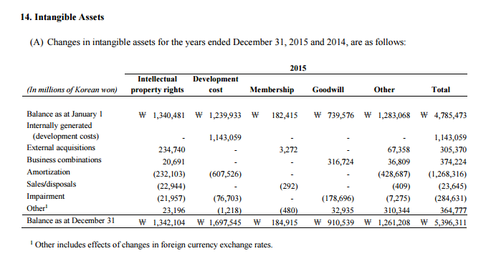
Assets Created with Merger and Acquisition
No amortization of goodwill
Other Intangible Assets are Amortized

Slide 84
Impairment of Assets
The assets created by a merger and other long-term assets are subject to impairment write-offs. The write-offs are similar to depreciation in that they write-off the asset. Impairment occurs after a company has determined that the net book value of the asset is less than the fair market value. When a company has an impairment, the value of equity and assets are reduced. This increases the debt to capital ratio and increases the return on equity.

Slide 85
Impairment Discussion
How is an asset impaired
  Example: Fixed Assets
  Example: Goodwill
  Example: Inventories
Connection
  Opening Balance of Plant
  Add: Capital Expenditures
  Less: Retirements
  Less: Impairments
  Closing Balance of Plant
Impairment Affects:
  Future Depreciation Expense
  The Equity Balance
  The Plant Balance

Slide 86
Impairment and Growth in Assets

Slide 87
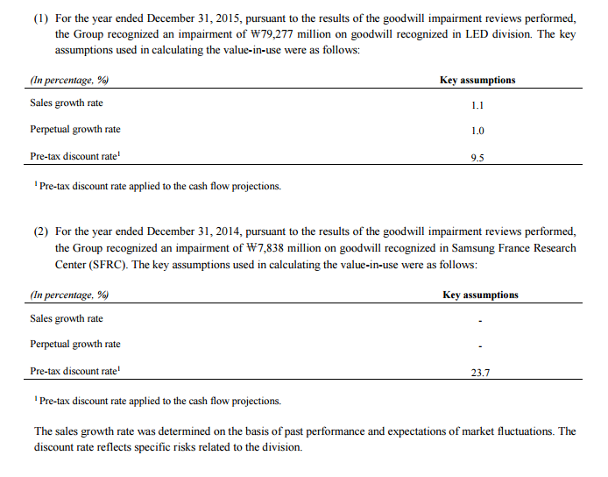
Example of Goodwill Impairment Calculation - Samsung

Slide 88
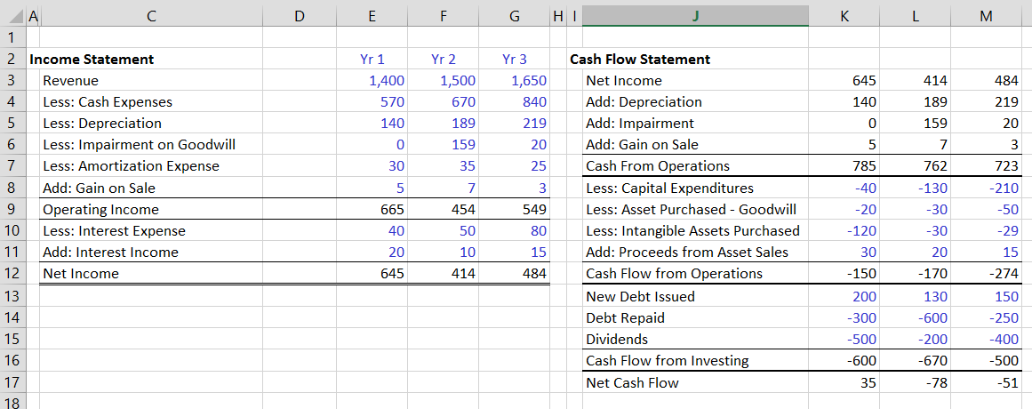
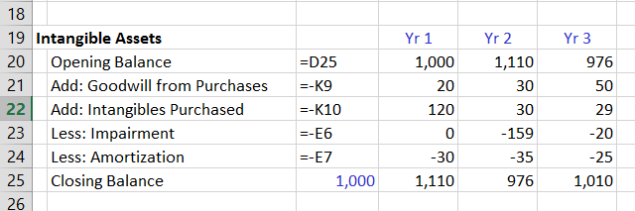
Intangible Example – Connection to Balance Sheet and Income Statement
This example shows how the intangible asset account can change from items in the cash flow statement and the income statement

Slide 89
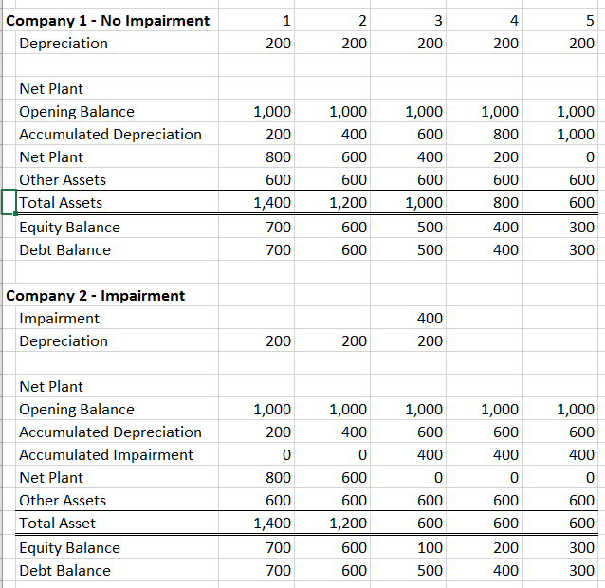
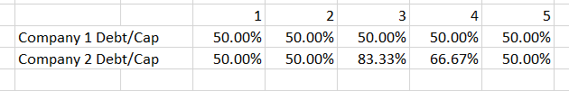
How Does Impairment Affect Equity and Debt Balance
Impairment can have big affects on the debt to capital ratio and the return on equity or return on capital discussed later. The example shows how impairment reduces the equity balance but not the debt balance.

Slide 90
Discussion of Liabilities – Items that cause costs in the future

Slide 91
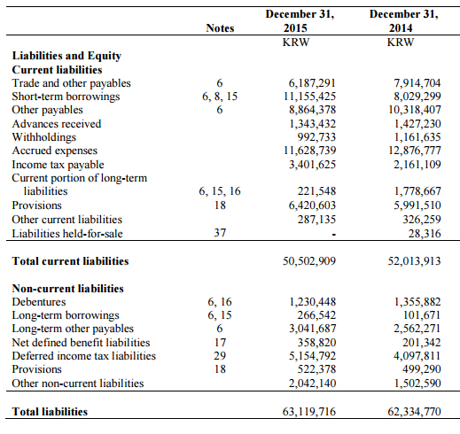
Liabilities – Some Require Repayment
Liabilities all involve some future outflow
Debt – must pay back
Payable – must pay to employee
  When making a valuation of a company, debt and other liabilities such as asset retirement obligations that represent future cash outflows should be distinguished from liabilities such as accounts payable and deferred taxes that are related to earning EBITDA and never really get paid.

Slide 92
What is Debt
Many of the analytical adjustments we make result from our view of certain implicit financing arrangements as being debt-like. Our depiction of these transactions as debt, which is often contrary to how a company reports them, affects not only the quantification of debt but also the measures of earnings and cash flows we use in our analysis. Therefore, it is instructive to understand the principles underpinning our adjustments to debt.

Slide 93
Debt Instruments
Incurred liabilities that provide no future offsetting operating benefit (such as unfunded postretirement employee benefits and self-insurance reserves);
On- and off-balance-sheet commitments for the purchase or use of long-life assets (such as lease obligations) or businesses (such as deferred purchase consideration) where the benefits of ownership are accruing to the company;
Amounts relating to certain instances when a company accelerates the monetization of assets in lieu of borrowing (such as through securitization or factoring of accounts receivable).

Slide 94
Net Debt in Valuation
In computing the value of a company you probably have computed enterprise value which is the present value of free cash flow.
  This is the value of the core operations of the company
  It does not account for the value of debts, cash and other non-core operations.
  Net deb includes cash on the balance sheet, debt on the balance sheet and many other items like derivatives and notes receivable. The amount subtracted from enterprise value is sometimes called net debt.

Slide 95
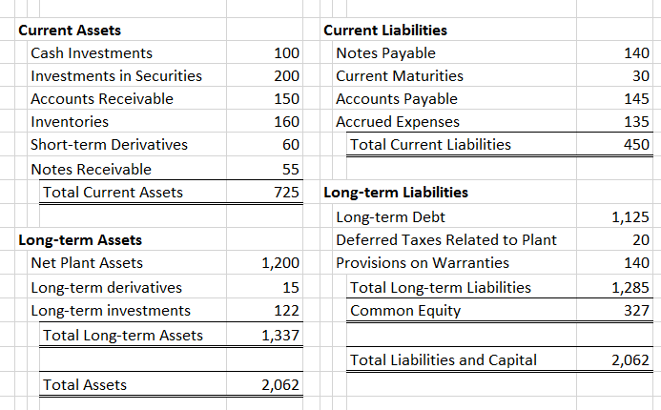
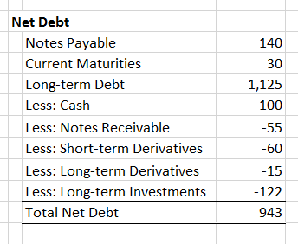
Example of Net Debt – Select Items Not Related to Core Operations
You have to work through each item in the balance sheet and decide which is related to EBITDA. Debt, cash, N/R and derivatives are not related to EBITDA and should be treated separately in valuation analysis.

Slide 96
Why are Accounts Payable not Debt
Not all incurred liabilities are added to reported debt. The adjusted debt figure excludes short-term obligations, such as accounts payable and other accrued liabilities, because we regard them as trade credit rather than the incurrence of long-term debt. However, to the extent that a company defers payment beyond the term customary for its supply chain, we may add that amount to debt.

Slide 97
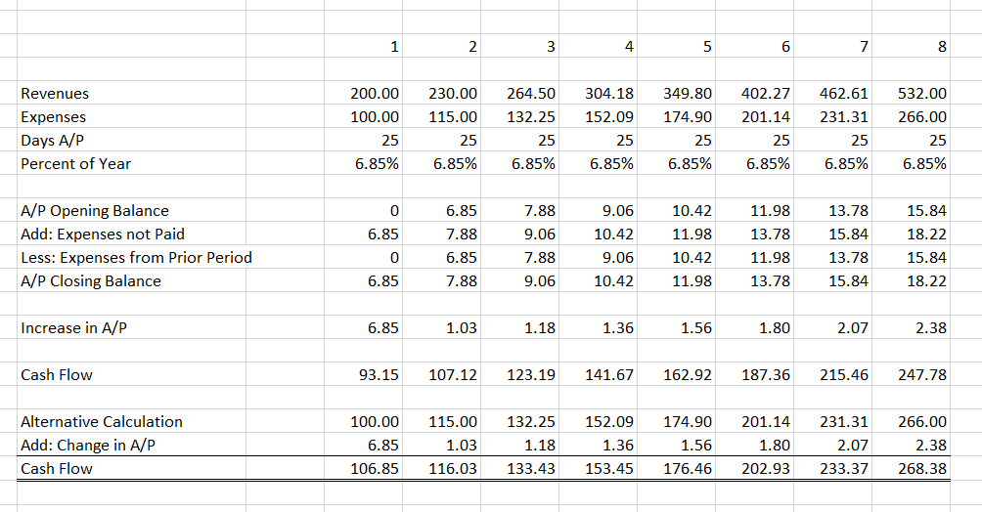
With Growing Company Accounts Payable are Not Paid

Slide 98
Asset Retirement Obligations
Asset-retirement obligations (AROs) are legal obligations associated with a company's retirement of tangible long-term assets. Examples of AROs include the cost of plugging and dismantling oil and gas wells, decommissioning nuclear power plants, and treating or storing spent nuclear fuel and capping and restoring mining and waste-disposal sites.
We treat AROs as debt-like obligations, although several characteristics distinguish them from conventional debt, including timing and measurement uncertainties.

Slide 99

Asset Retirement Obligations – Treat as Debt
Asset retirement obligations are for payments that must be made in the future
They can be part of depreciation on the income statement

Slide 100
Complex Items 1:
Deferred Tax

Slide 101
Deferred Tax Discussion - Assets
Understand Difference between Accumulated Deferred Tax and Deferred Tax on Income Statement and Cash Flow Statement
Accumulated Deferred Asset
  Opening Balance of Accumulated Deferred Tax
  Add: Deferred Assets when Taxes Paid>Taxes Recorded
  Closing Balance of Deferred Tax Asset
Idea: Will have to pay less taxes than taxes booked in future

Slide 102
Deferred Tax Discussion - Liabilities
Understand Difference between Accumulated Deferred Tax and Deferred Tax on Income Statement and Cash Flow Statement
Accumulated Deferred Liability
  Opening Balance of Accumulated Deferred Tax Liability
  Add: Deferred Assets when Taxes Paid<Taxes Recorded
  Closing Balance of Deferred Tax Asset
Idea: Will have to pay higher taxes in future

Slide 103

Other Deferred Tax Assets and Liabilities
Related to Depreciation
Why do these arise

Slide 104
Deferred Tax Balances – Depreciation Example

Slide 105
Deferred tax – Key Question
Do deferred taxes every get really paid
If the company grows, then capital expenditures increase
When capital expenditures increase, then deferred liabilities increase

Slide 106

Deferred Tax Asset and Net Operating Loss
Losses are shown as negative taxes on income statement if expected to have future gains. Results in Deferred tax asset because taxes booked are less than taxes paid and taxes paid in the future will be lower.

Slide 107

Deferred Tax Liability Never is Paid with Continuing Capital Expenditures – Not Like Repaying Debt

Slide 108

Deferred Tax Liability Increases instead of Decreases with Growth

Slide 109
Understanding the Cash Flow Statement

Slide 110
Why Can’t We Just Use Cash Flow Statement instead of EBITDA – Chesapeake Example
Note the Periods
Why is the deferred tax added
Where were derivative gains and losses in income statement
How should treat the stock based compensation for EBITDA
Why are losses on sale not cash
What are Maintenance Capital Expenditures

Slide 111
What is Cash Flow and What is EBITDA
Operating Cash Flow is 4,364
Adjust for working capital change
Adjust for interest expense
Adjust for income taxes
EBITDA is 6,721

Slide 112

Samsung Case – 2009 – Cash From Operating

Slide 113

Why Can’t We Just Use the Cash Flow Statement – Samsung Example
Samsung Cash from Operations - 2015

Slide 114
Gain and Loss on Sale of Assets and Investments

Slide 115
Accounting for Gain/Loss on Sale
When sell assets or equity securities
1. Remove asset from balance sheet at net book value
2. Increase the cash from selling the asset
3. Difference between cash and net book value is gain
4. Do not include gains from sale in EBITDA

Slide 116
Example of Asset Sale
Sell Pot in Year 2 for 200
Book Value
  Gross Assets 250
  Accum Dep 62
  Net Value 188
Gain on Sale
  Proceeds of 200 – Net Value of 188
  Gain is 12
In cash flow statement
  Net Income Including Gain, say 400
  Subtract gain on sale of 12
  Net Cash from operations 388 does not include gain
In cash flow statement have investing activities
  Include proceeds of 200

Slide 117
How to Use Cash Flow from Operation Adjustments in Computing EBITDA
Excludes other income statement activity that is nonoperating.
It aims to capture the results of a company's core operating activities before interest, taxes, and the impact on earnings of capital spending and other investing and financing activities.
Generally, this means that any income statement activity whose cash effects have been (or will be) classified as being from operating activities (excluding interest and taxes) are included in our definition of EBITDA.
Conversely, income statement activity whose cash effects have been (or will be) classified in the statement of cash flows as being from investing or financing activities is excluded from EBITDA.

Slide 118



Example of Using Cash Flow Statement to Compute EBITDA
Begin with Income Statement and Cash Flow Statement, where cash flow statement shows the non-cash income from equity income.
Note how the EBITDA can be computed from items in the cash flow statement

Slide 119


Example of Using Cash Flow Statement to Compute FFO
Begin with Income Statement and Cash Flow Statement, where cash flow statement shows the non-cash income from equity income.
Note how the FFO can be computed from items in the cash flow statement

Slide 120
Accumulated Other Comprehensive Income

Slide 121

Makes Gamble on Oil Price Going Up
The Gamble is for 3 years
If the oil price goes up then gets paid
But the oil price goes down so loses
You can monitor the value of your loss
Big Question – Should the value of the gamble be on the accounting statements

Slide 122

What is the Real Cash Income from Financial Assets
Detail of Available for Sale Financial Assets
Which items are changed on the cash flow statement and which on the income statement
Discuss the foreign exchange differences

Slide 123

Simple Case Part 1- Impairment without Reducing Income
This is incorrect – Reduce asset value and do not change income; balance sheet doesn’t balance.
Balance sheet does not balance: Change Asset value without changing income

Slide 124

Simple Case Part 2- Impairment with Impairment on Income Statement
When include impairment on the income statement the balance sheet balances
Balance sheet does not balance: Change Asset value without changing income

Slide 125

Simple Case Part 3- Write-up of Asset Value (Not Allowed by Accounts)
When increase the value because pots become more valuable. Need to include income
Balance sheet does not balance: Change Asset value without changing income

Slide 126
Some Assets are not at Original cost paid
Examples
  Samsung value of bonds when currency changes
  Samsung value of stocks when the value changes
  Chesapeake interest rate swaps
  Chesapeake oil price forward contracts
  For purposes of valuation, investment bankers need to understand the value of assets that are not part of the core operations such as derivative assets and securities held so these assets can be added to enterprise value.

Slide 127
AOCI Introduction – Value of Assets and Profit
When the value of an asset increases, there is profit
When the value of an asset decreases, there is a loss
Examples
  When cash goes up in our street food case, there was profit
  When an asset is impaired, profit goes down
  When an asset is depreciated or amortized, profit is reduced from depreciation of amortization expense
  When an asset declines in value from impairment there is a loss

Slide 128
AOCI Introduction – Cost Based Accounting
Assets and liabilities are based on depreciated original cost
  Plant assets
  Intangible Assets
  Inventories
  Debt
Example of Street Food Company
  If the value of the pot increases in the market, there is no change in the balance sheet reporting of the gross plant value of the pot.

Slide 129

Simple Case Part 4 – Put the Value of the Gamble on the Balance Sheet
When gamble on asset in you could monitor the value of your gamble – Here the Balance Sheet does not balance
Equity value should go down as lose money on the gamble
Equity value must go down from loss on income statement even if there is no cash outlfow

Slide 130

Simple Case Part 5 – Put the Value of the Gamble on the Balance Sheet and Income Statement
Now the change in value is on the income statement and the cash paid is also on the income statement

Slide 131

Now the Gamble offsets decrease in costs – this is hedge and has different accounting
Now do not put the change in value on the income statement

Slide 132

Example of Hedge versus Mark to Market Accounting
In case where the variable rates increase and the value of the interest rate swap goes up.
Note the difference in the income between the two cases and note how the cash flow is the same.
In hedge accounting the settlement is included as income.

Slide 133
Basic Idea of Derivatives
Example of Forward Contract
  Example of Oil Price Contract
  Term and Futures Price
  Valuation when Forward Price Changes over Time
Example of Interest Rates
  Valuation of Debt with Changing Interest Rates
  Valuation of Interest Rate Swap
Example of Option
  Using the Black Sholes Model
  Valuation of Band of Oil Prices

Slide 134
Interest Rate Swap
A company has a loan at a floating interest rate and would like to pay a fixed rate.
It arranges a swap where it RECIEVES floating as revenue and PAYS fixed
The profit on the swap goes UP when the floating rate goes up and the interest rate goes up
The end result of the profit on the swap and the cost of the variable interest is that the interest is fixed

Slide 135
How the Value of Derivatives Changes when Interest Rates, Commodity Prices, Exchange Rates and Stock Prices Change
If a company agrees to receive floating interest rate debt as part of an interest rate swap, if the interest rate increases, the value of the swap increases.
If a company agrees to sell oil in the future at a fixed price and if the oil price declines, then the value of the derivative increases in value.
If a company agrees to receive fixed interest rate as part of an interest rate swap and if the interest rate increases, then the value of the swap decreases.
If the company buys a call option to buy a stock at a fixed price and the stock price increases, the option increases in value and the increased value is recorded on the balance sheet.

Slide 136


Multi-Year Hedge – Mark to Market Accounting
What is the financial statement accounting for value of swap that settles in three years using mark to market.

Slide 137

Multi-Year Hedge – Hedge Accounting
What is the financial statement accounting for value of swap that settles in three years.

Slide 138
Hedge Accounting versus Mark to Market Accounting
Market to Market
  Changes in value of derivative reported on income statement- may be in operations or interest expense or other income
  When the derivative is settled, there is no income but the cash flow is affected
  No effect on other comprehensive income
Hedge Accounting
  No effect on income statement when the value of the derivative changes
  Settlement of the contract affects income

Slide 139
Implications of Hedge Accounting
Settlement of the hedge represents the true cash paid for interest
There are fewer adjustments in the cash flow statement
The balance sheet still represents the assets at market value, but the increase or decrease in value is outside the normal income statement

Slide 140
Interest Rate Swaps – Standard and Poors
It is not necessary to adjust interest expense in this case because the fair-value adjustments the company makes in the income statement generally offset each other, and settlements under the derivative are reported as an interest expense.

Slide 141

Example of Converting Floating Rate to Fixed Rate

Slide 142

Example of Converting Fixed Rate to Floating Rate

Slide 143

Multi-Year Hedge – Floating to Fixed
What is the financial statement accounting for value of swap that settles in three years.

Slide 144
Implication for Financial Analysis
The interest expense reported on the income statement includes changes in value that are non-cash
This is not the true interest expense really paid in cash
It may not be possible to find the actual settlement
Do not include the change in the value of derivative in interest expense

Slide 145
Interest Expense: Gain on Terminated Fair Value of Hedges
Interest Rate Swap:
  Notional amount of swap – can be similar to the debt outstanding
  Loss or gain on swap off-sets the interest expense so the total interest rate is fixed or floating
  Terminated fair value of hedge makes floating = fixed or fixed = floating.
  Should be part of the interest expense
Note that the Settlements are called gains or losses. This means that they are from hedge accounting
Note the gains on undesignated derivatives from mark to market

Slide 146
Mark to Market Accounting and Hedge Accounting and Comprehensive Income
When accounting for derivatives, a company can use mark to market accounting or hedge accounting depending on if the derivative qualifies for hedge accounting.
When computing EBITDA, you generally want to remove amounts associated with the changes in the value of derivatives and other assets from income.
If hedge accounting is used, the change in value is not directly on the income statement until the derivative is settled. Instead, changes are in other comprehensive income.
If mark to market accounting is used, the value of the derivative change is on the income statement for each period before it is settled. The change is not on the income statement.

Slide 147
Accounting for Changes in Value - Unrealized gains or losses on derivatives (S&P)
If a company has NOT achieved the requirements of technical hedge accounting (even though an effective economic hedge may exist), it reports all mark-to-market gains or losses related to the fair-valuing of derivative contracts in the income statement.
Although the nature of the underlying activity is often integral to EBITDA, FFO, or both, using mark-to-market accounting can distort these metrics because the derivative contract may be used to hedge several future periods.
Therefore, when we have sufficient information, we exclude the unrealized gains or losses not related to current-year activity, so that the income statement represents the economic hedge position achieved in the current financial year (that is, as if hedge accounting had been used).

Slide 148
Hedging Gains and Losses: Derivative Accounting and Debt and Effect on Income Statement
A company may issue fixed-rate debt and at the same time enter a derivative contract to synthetically create a variable-rate debt instrument. If all necessary conditions are met, companies may elect to apply fair-value hedge accounting to such an arrangement.
The effect of this accounting approach is that a company would report both the derivative instrument and the debt at fair value. Changes in the fair values of both items from one reporting date to the next (change in derivative value and change in debt value) are netted off against each other in the income statement.
When a company applies fair-value hedge accounting to debt, adjust the reported debt figure to reflect the amortized cost method.
It is not necessary to adjust interest expense in this case because the fair-value adjustments the company makes in the income statement generally offset each other, and settlements under the derivative are reported as an interest expense.

Slide 149
Balance Sheet – Find Derivative Assets
How to define cash in financial analysis
What are derivative assets
What does it mean that use full cost accounting
Why can deferred taxes be an asset
How should property held for sale be treated

Slide 150
Balance Sheet – Derivative Liabilities and AOCI
How do Liabilities instead of assets arise
What are asset retirement obligations and should they be treated as debt
What is Accumulated Other Comprehensive Income

Slide 151

Other Comprehensive Income
What does the ACOI Really Mean

Slide 152

Accumulated Other Comprehensive Income - Chesapeake
What income was used on the cash flow statement

Slide 153

Accumulated Other Comprehensive Income - Chesapeake
Note that the Net Income starting point does not include the Other Comprehensive Income

Slide 154

Other Derivative Instruments
Why was value positive in 2014 and negative in 2013

Slide 155

Derivatives other than Swaps on Balance Sheet

Slide 156

Derivatives on the Balance Sheet

Slide 157

Different Gains and Losses in Revenues
Gains on hedges came from declining oil prices

Slide 158
Different Gains and Losses in Revenues
How much of revenue came from gain on derivatives – should this be in EBITDA

Slide 159

Accounting for Oil Price Contract
Oil Contract with Mark to Market

Slide 160

Currency Valuation - Simple Case
Financial securities are valued at the balance sheet
Measured in currency of the balance sheet

Slide 161
Currency Translation
Gains and losses from currency translation are non cash items that change in value
They can be either assets (investments) or liabilities (debt)
Note concept of net debt
  Debt minus cash and cash like instruments
  Could use debt to repay cash
Translation gains or losses become cash when the debt is repaid or the asset is sold for cash

Slide 162

Gain on Foreign Currency Translation

Slide 163
Evaluating sensitivities for FX gains and losses
Foreign-currency-denominated debt is typically included in consolidated debt on the balance sheet at the amount of foreign currency, translated at the spot rate on the balance-sheet date. Many companies hedge the foreign currency exposure by entering into derivatives that fix the foreign exchange rate that will apply on the debt's repayment date.
The hedged debt principal can be restated using the "locked-in" foreign exchange rate achieved through the derivative.
The adjustment to re-state debt is about equivalent to the fair value of a derivative representing a foreign currency hedge of debt principal. But it may differ for various reasons. For example the derivative's fair value may also reflect liquidity and counterparty risk.

Slide 164
Evaluating Sensitivities for FX Gains and Losses
Companies often hedge the foreign currency exposure related to debt principal and interest simultaneously.
To make an adjustment to the debt, the amount of hedged foreign-currency-denominated debt must be known (from the balance sheet). In addition the locked-in foreign exchange rate (or locked-in principal value of outstanding debt) achieved via the hedge transaction. Alternatively, the fair value of the derivative that applies only to the principal (that is, excluding any fair value associated with hedged interest payments).
Retranslate foreign-currency-denominated debt using the locked-in foreign exchange rate (or adjust the balance-sheet value of debt to equal the locked-in principal value). Alternatively, add to or subtract from reported debt the fair value of the hedging instrument on the balance-sheet date.

Slide 165
Effects of Derivative Accounting
Constellation Energy had stated that it was hedged. But:
  $282 million of lower gross margin related to our portfolio of contracts subject to mark-to-market accounting.
  On October 31, 2008, we discontinued the use of hedge accounting for derivative contracts that previously were accounted for as cash-flow hedges within the international commodities operation. From that date, subsequent changes in fair value of those derivative contracts have been recorded in earnings. We concluded that the combination of the decline in value associated with the previously hedged transactions together with the related balances remaining in accumulated other comprehensive income, would lead to the recognition of a net loss in one or more future periods. As such, we recognized a loss of $42 million during the fourth quarter of 2008.

Slide 166
Minority and Non-Controlling Interests

Slide 167
Some Income and Assets to Different Investors
In simple example
  Brother invests in company
  Has 15% of company
  Gets 15% of dividends
  Gets 15% of income
In Income Statement
  Total Income
  Less: Income to Non-Controlling Interests
  Equity Split between Controlling and Non-Controlling

Slide 168

Minority Interest in Simple Example

Slide 169
Provisions

Slide 170
How do Provisions Arise and Where Are they on the Balance Sheet
When record revenues make provision for potential refunds and warranties
Example
  Revenues from selling TV’s
  Less: potential refunds
Note that the refunds are non-cash. They are not cash outflows.
  Record as a liability for future outflow
  When refunds occur the liability is reduced like when you pay a loan the liability from the loan is reduced
  The liability is called provisions
  Find provisions on Samsung Balance Sheet

Slide 171
How the Provision Account Works
Provision Balance
  Opening Balance
  Add: Liability from future refunds (not cash)
  Less: refunds paid
  Closing Balance
With a growing company, provisions never repaid
Treat like change in working capital

Slide 172
Review of Financial Statement Analysis

Slide 173
Asset Analysis

Slide 174
Assets Related to EBITDA and Assets Related to Financing
Some assets have nothing to do with EBITDA. Remember the case with Apple.
The USD 160 billion in cash does not make phones or i-pads or computers
If Apple sells computers they must have factories and they must have accounts receivable to allow suppliers to pay later on.
They also must have inventories to sell the goods.

Slide 175

Splitting-Up Assets to Focus on EBITDA and Core Operations

Slide 176
Samsung Case
Compute EBITDA
Compute FFO
Compute Interest Expense
  Idea – Find out what are fundamental operations of the company
  Complexities
    Depreciation and Amortisation not in Income Statement
    Impairment and Scraping of Inventories – Why is Scraping of Inventories like Impairment
    Gain on sale of investments, disposal of investments should be removed from EBITDA

Slide 177
History and Forecasts in Corporate Analysis
History in Corporate Forecasts
  Project Finance versus Corporate Finance
  Example of Financial Ratio
    Interest Coverage Ratio
    Debt Service Coverage Ratio
  Formula to Interpret Financial Ratio
    Percent Reduction in Cash Flow = (ICR-1)/ICR or (DSCR-1)/DSCR
    Cash Flow = 150, Interest is 75: Percent Reduction is 50%
    Compute Interest Coverage Ratio for Case
Problem with Using History in Financial Analysis
  Not available in project finance
  Sudden changes from historic numbers

Slide 178
Industry versus Firm Analysis to Evaluate Potential Cash Flow Variation
Industry Analysis
  Drivers of price and demand volatility
  Cost Structure of industry, fixed and variable cost
  Long-run and short-run marginal cost
  Capitals expenditures required to sustain EBITDA
  Product life cycle
  Price Bubbles: Price above LRMC
Company/Competitive Advantage Analysis
  Competitive position
  Drivers of market share
  Customer tastes
  Relative cost structure
S&P - Industry Risk, Country Risk and Competitive Position
Exercise:
Use INDEX function to see the defaults by year and by industry

Slide 179
Understanding Risks from Surplus Capacity, Volatility in Prices, Changes in Capital Expenditures
Companies where earnings show cycles of major rises and declines
Characteristics:
  Cyclical downturn in recession
  Producers over-invest at peak
  Supply rises
  Prices fall sharply when demand declines because of surplus capacity
Cash available for investment at peak
Rational behavior to not invest is limited by desire to maintain market share
Example: Rates to move a 20 foot container from Hong Kong to Northern Europe have fallen from about $12,0000 to roughly $220, creating the deepest ever crisis in the industry. (FT 08).
Examples:
Retail, property, paper, cars, chemicals, airlines, steel, primary metals, house-building, building materials, advertising, capital goods, shipping.

Slide 180
Understanding Risks from Surplus Capacity, Volatility in Prices
Demand Volatility
  Technical Definition of Volatility
  Different Distributions
  Income Elasticity
Capital Expenditure Changes
Difference between Long-Run Marginal Cost and Short-Run Marginal Cost – Driven by Capital Intensity and Operating Leverage
Capital Intensity of Assets
  Lifetime of Assets
  Revenues versus Operating Costs
Operating Leverage
Exercise: Compute volatility from data that is downloaded from the industry analysis sheet

Slide 181
Understanding Risks from Surplus Capacity, Volatility in Prices: Operating Leverage
Definition: Fixed Expenses that do not vary with sales
Definition of Fixed and Variable Costs
  Not in Financial Statements
  COGS generally includes depreciation which is fixed
  Administrative expenses are related to sales when many are fixed
  Semi-fixed expenses that change after passage of time
  Pension obligations and costs of employee reductions
Exercise:
Analysis of Fixed and Variable Expenses
  Open a Financial Statement File
  Use F11 to make graph of revenues and operating expenses
  Remove title and create scatter plot

Slide 182
Qualitative Risk: Company and Industry Economic Factors – Really Measuring the Demand Volatility
Home economy situation and trends
Overseas economies and trends
Seasonality/Weather Issues
Market and trade cycles
Specific industry factors
Market routes and distribution trends
Customer/end-user drivers
Interest and exchange rates
International trade/monetary issues
Combine these Factor with:
Barriers to entry
Capital Intensity
Operating Leverage
Construction Lag
Declining Demand
Difficult to Downsize
Rise in Input Costs
Inefficient vs. Competitors
Technical Problems
Reputational Damage
Working Capital Control
Customer Concentration

Slide 183

Qualitative Economic Risks – Economic Risks and Barriers to Entry
Definition: Prices fall because of surplus capacity; demand falls because of economic volatility; competition increases;
First Solar Case: Danger of Falling From Power House to Capital Junkie
Other cases: Solar companies, telecom companies, sub-prime crisis

Slide 184
Qualitative Risk Assessment: Obsolescence, Technological Change and Regulatory Changes
Technical Obsolescence
  Polaroid, Kodak, Maps, Guidebooks, CD players, DVD players
Impact of Internet
  Retail, Newspapers, Music, Travel Agents
Impact of EMG Competition
  Textiles, general manufacturing

Slide 185
Qualitative Technology Risk Example
Definition: Demand falls because of available new technology; capital expenditures and/or costs for new technology changes
Iridium Case
Other cases: HP, RIM, Nokia, Kodak

Slide 186
Environmental Risk Example: GDF Coal Plant in Italy
Italian police have seized control of a coal-fired power plant in Savona, shutting it down after a judge ruled in favor of arguments that the plant was responsible for 442 premature deaths between 2000 and 2007, and a further 2,000 cases of heart and lung disease. The owner of the plant, France’s GDF Suez, was deemed to have exhibited “negligent behavior” by the judge, who also said the emissions data from the plant was “unreliable”. Emissions from coal-fired plants pose well-known health risks, and GDF Suez is already under fire for its involvement in a major coal disaster in Australia, where an open cast coal mine caught fire and burned for over a month, leading to evacuations and severe health impacts on residents. The coal plant closure in Italy and mine fire in Australia have exacerbated a bad start to the year for GDF Suez, which has written down €14.9 billion in fossil assets on its books due to strong competition from renewables.

Slide 187

Political/Legal Risks
Definition: Will companies continue to honor un-economic contracts
Example: Dabhol Plant in India
Other Examples

Slide 188
Checklists – Political Risks
Ecological/environmental issues
Current and future legislation
Regulatory bodies and processes
Government term and change
Funding, and grants
International pressure groups
Austerity measures
Capital controls, wars and conflict
More licenses awarded, withdrawal of government support, sharp price reductions mandated

Slide 189
Assess Commercial Risks and their Mitigation for Individual Enterprises
Risk Matrix and Credit Memorandum
Measuring Risks is Probability Impossible
Discussion of Risks
  Classify Risks
  Define Risks
  Mitigation of Risks
  Probability and Magnitude
  Buffer to Accept Risks

Slide 190
Managerial Risk
Growth Strategy and True Competitive Advantage (First Solar)
Power House Square to Capital Destruction Square (Kalitta)
Pricing Strategies and Risks (Iridium)
Enron, VW, Constellation (Hiding Information)
Re-financing in Corporate Finance after lack of confidence in management

Slide 191
Cost Structure Risk
Understand Fixed and Variable Costs (UAL, GM)
Required Maintenance Capital Expenditures (Airlines, Nuclear Plants)
Use of Historic Trends and Danger of Multi-year Economic Expansion (1990’s, 2002-2006)
Problem: How can you really assess fixed and variable costs in financial reports
Exercise: Scatter Plot
  Use F11 and eliminate the name of the X-axis

Slide 192
Short-term Risks
Inventory Risk (Launer)
  Trading company buys gifts for sale to large retail stores. Tastes and demand changes. Left with inventory that has a lot less value.
Receivables Risk
  Sales made to customers who do not make payments because of bankruptcy.
Trade receivables age analysis
  Evaluate the accounts receivable as percent of sales
Supplier Risk
    Example: Loss of $55 million related to the bankruptcy of one of our domestic coal suppliers. During the first quarter of 2008, as a result of a default by the supplier, we terminated our derivative contracts with the supplier, reclassified the related asset to accounts receivable, and fully reserved the amount.
Danger of exposure to single customer; Inventory holding risk

Slide 193
Financial Ratios for Credit Analysis

Slide 194
Five Classes of Financial Ratios
Coverage buffer for debt service (AES Drax)
Time to Repay Debt from Stable Cash Flow
  Coverage of Collateral and Skin in Game
Liquidity ratios
Excessive or Deficient Return (Discussed in next session)

Slide 195
Pro-forma and Trend analysis
  Understanding Meaning of Ratios
  Break-even Analysis
    Use Ratio to Determine Maximum Decline in Cash Flow
  Re-financing Analysis
    Use Ratio to Determine if Company Can Re-finance in Downside Case
  Probability of Default Analysis
    Use Probability of Decline in Cash Flow with Ratio to Determine Probability of Default
    Example of DSCR

Slide 196
Liquidity vs. Solvency
Credit worthiness: Ability to honor credit obligations
(downside risk)
Solvency
Ability to meet long-term obligations
Focus:
Long-term economic risks conditions
Long-term cash flows
Extended ability to make profit
Liquidity
Ability to meet short-term obligations
Focus:
Current Financial conditions
Current cash flows
Liquidity of assets

Slide 197
Liquidity Ratios in Credit Analysis
Current Ratio
  Current Assets to Current Liabilities
  Current Assets less Inventory to Current Liabilities
Model Working Capital
  Current Assets less Cash and Temporary Securities minus Current liabilities less Short-term Debt
Liquidity Assessment
  Debt Profile (Maturities)
  Bank Lines (Availability, amount, maturity, covenants, triggers)
  Alternative Sources of Liquidity (Asset sales, dividend flexibility, capital spending flexibility)

Slide 198
Solvency Ratios in Credit Analysis
Ratios are the center of traditional credit analysis that assesses whether a company can re-pay loans. These ratios should be compared to benchmarks.
Debt Payback Ratios (Time to Repay)
  Funds from Operations to Total Debt
  Debt to EBITDA
Leverage Ratios (Skin in the Game)
  Debt to Capital (Include Short-term Debt)
  Market Debt to Market Capital
Payment Ratios (Buffer for Downside Repayment)
  Interest Coverage
  Debt Service Coverage [Cash Flow/(Interest + Principal)]

Slide 199
Philosophy and Alternative Calculations for Debt Service and Interest Coverage Ratio
The specifics of the ratios are less important than the general objective and the underlying philosophy of the ratios
The general idea is to see how low EBITDA or cash flow can go down before the debt service or interest cannot be paid
For project finance use DSCR because debt service is known from structuring debt repayments around cash flow
DSCR much less relevant in corporate finance because of bullet debt repayments

Slide 200
Buffer for Coverage of Debt Service
Alternative Ratios
  Debt Service Coverage
  EBITDA Interest Coverage
  EBIT Interest Coverage
  FFO to Interest Coverage
Formula for potential change in EBITDA or Cash Flow
Change in Cash = (1-Ratio)/Ratio

Slide 201
Buffer for Coverage of Debt Service in Project Finance (DSCR)
Alternative Debt Service Coverage Ratios for Different Types of Projects
  Electric Power: 1.3-1.4
  Resources: 1.5-2.0
  Telecoms: 1.5-2.0
  Infrastructure: 1.2-1.6
At a minimum, investment-grade merchant projects probably will have to exceed a 2.0x annual DSCR through debt maturity, but also show steadily increasing ratios. Even with 2.0x coverage levels, Standard & Poor's will need to be satisfied that the scenarios behind such forecasts are defensible. Hence, Standard & Poor's may rely on more conservative scenarios when determining its rating levels.
For more traditional contract revenue driven projects, minimum base case coverage levels should exceed 1.3x to 1.5x levels for investment-grade.

Slide 202
Time to Repay Debt from Stable Cash Flow
Debt/EBITDA (Eurotunnel)
Debt/EBIT
FFO/Debt
Example of Eurotunnel
Debt/EBITDA = 20x
Interest Rate = 10%

Slide 203
Philosophy Behind Debt to EBITDA and FFO to Debt
General philosophy is to compute the amount of time that it takes to repay debt.
Debt to EBITDA does not really measure to years of EBITDA to repay debt
  Must account for interest
  Must account for replacement capital expenditures
  Must account for maintenance capital expenditures
  Does not account for asset life
FFO to Debt
  Accounts for interest
  Does not account for other flaws

Slide 204
Coverage of Collateral and Skin in Game
  Debt to Equity
  Debt to Capital
  Loan to Value
  Project Life Coverage Ratio

Slide 205
Coverage of Collateral and Debt to Capital Ratio
The debt to capital ratio has two general ideas
  The amount of investment made by equity holders – they would not be stupid enough to put skin in the game if they did not expect to be paid
  The amount by which the net assets of the company can fall before which the value of the debt will be below the collateral value
Problems with debt ratio is that it depends on the valuation of assets on the balance sheet
  Example of goodwill and mergers
  Example of stock price assumptions in mergers

Slide 206
Determining the Correct Ratio to Use in Measuring Profit

Slide 207
Executing a Peer Group Comparison
Peer Groups for Analysis of:
  Value (Relative Valuation)
  Determining Credit Standards
Issues with Peer Groups
  Adjusting the statements for comparability
  Problems with relative valuation and peer groups
  Manipulation of peer groups
  Changes in capitalization

Slide 208
Relevance of Measuring Profitability for Credit Analysis
Some would say that the credit ratios are more important, but if there is no profit, there is no ability to repay debt
Long-term profitability should be assessed
The most important item is the danger of high rates of return
  Attract competitors
  Attract political risk
  Artificially inflated
  Subject to changes in tastes

Slide 209
ROIC versus ROE and Implications for Review of Financial Statements
Evaluate Whether Management is Doing a Good Job with Investor Funds (Not if the company is appropriately valued)
  Return on Invested Capital
  Return on Assets
  Return on Equity
  Market/Book Ratio
  Market Value/Replacement Cost
Key Issue
  Evaluate relative to risk
    ROE versus Cost of Equity
    ROIC versus WACC

Slide 210


Example of Computing ROE and ROIC

Slide 211
Interpretation of ROIC as Profit from Operations
When you measure value, you are gauging the ability of a firm to realize economic profit.
When you assess assumptions in a financial forecast, you must assess whether economic profit implicit in the assumptions can in fact be realized. For example, if the financial forecast has a very high ROIC, is that reasonable.
When you interpret financial statistics, you are gauging the strategy of the company in terms of whether economic profit is being realized. In reviewing the return on invested capital, does this demonstrate that the company has the potential to earn economic profit.

Slide 212
Danger of Assuming High ROIC can Continue Without Competitive Advantage
ROIC can be used to assess the reasonableness of projections
  For example, if ROIC is very high and the company is in a competitive business with few barriers to entry, the forecast is probably not realistic.
ROIC comes from sustainable competitive advantage and high market share
ROIC is not distorted by the leverage of the company
ROIC can be used to gauge economic profit and whether the company should grow operations
ROIC can be computed on a division basis EBIT and allocation of capital to divisions from net assets to gauge the profit of parts of the company

Slide 213

ROE and ROIC in Assessing Performance

Slide 214

Complexities in Calculation of Investment Capital

Slide 215
Financial Statement Analysis - Liquidity, Solvency and Efficiency Analysis

Slide 216
Evaluation of Ratios and Understanding Problems with Ratios
Problems Different Ratios
  Limited use of liquidity ratios in long-term loans
    Loan repayment depends on long-term profitability
    May have negative working capital
  Problems with Debt to EBITDA and re-investment requirement in capital expenditures
    Doesn’t really measure the number of years to repay debt
    Should be higher for short-term assets, but not generally considered
  Problems with Interest Coverage and Repayment of Debt
    Interest coverage does not say anything about debt repayments
  Problems with Debt to Capital and asset valuation on balance sheet
    Balance sheet can be distortive
    Does not measure cash flow
  Problems with Return on Investment with write-offs, re-structuring charges, asset sales

Slide 217


Limited Use of Liquidity Ratios: General S&P Benchmarks
Note that liquidity ratios are not mentioned in the table
For BBB companies the debt to EBITDA ratio is 2.2 time implying that if there was no interest expense and no taxes, it would take 2.2 years to repay debt. In terms of the debt to FFO, you can compute the ratio through dividing 1 by 35.9%. This number is 2.78 years or .58 years more than the debt to EBITDA.

Slide 218
  Problems with Debt to EBITDA
Variation in EBITDA
Accounting for Asset Life
Reflecting Maintenance capital expenditures
Measuring Interest Expense
Case Study: Chesapake Energy

Slide 219


Problems with Debt to EBITDA – Compare FFO to Debt and Debt to EBITA
Compute the length of time to repay debt with Debt to FFO rather than Debt to EBITDA
Assume that Maintenance Cap Exp is 10% of EBITDA and compute length of time to repay debt.

Slide 220
  Problems with Interest Coverage and Repayment of Debt
Directly measures acceptable variation in EBITDA
If the lifetime of assets is 5-years, must somehow account for the repayment over the lifetime of assets
Use of LLCR and PLCR in project finance

Slide 221
Use of Different Ratios in Different Industries and in Different Circumstances
Explain why different ratios are typically applied:
  DSCR and LLCR in Project Finance with Contracts
    Break even cash flow
    Toll road cash flow patterns
  PLCR in Project Finance In Resource Projects
    Break-even commodity price over reserve life
  Debt to EBITDA in Leverage Buyouts
    Relates to EV/EBITDA
  Debt to Capital in Stable Industries with Market Based Asset Value
  Interest Coverage in Highly Levered Transactions with Cash Sweep

Slide 222
Use of Financial Ratios in Corporate Analysis - Credit Rating Standards and Business Risk

Slide 223

Use of Different Ratios in Different Industries: Example of Using Ratios to Gauge Credit Rating
The credit ratios are shown next to the achieved ratios. Concentrate on Funds from operations ratios.
Note that based on business profile scores published by S&P

Slide 224

Use of Ratios Different Ratios in Different Industries: DSCR and Credit Ratings in Project Finance
Target rating of BBB-
Target DSCR or LLCR
Example of Toll-roads

Slide 225
Items that Distort Financial Ratios
Issues that Distort Financial Ratios
  Goodwill in Merger Transaction
  Share Valuation in Exchange Transaction
  Maintenance Expenditures in Debt to EBITDA
  Asset Impairment for Debt to Capital
  Re-structuring Charges

Slide 226
Exercise: Calculate and Interpret Key Ratios
Use File with S&P Bond Ratings
Enter the financial ratio
Then enter the business risk
Use excel functions:
INDEX
MATCH
LOOKUP
INTERPOLATE
INTERPOLATE REVERSE

Slide 227
Analyzing Distributions of Profit

Slide 228
General Discussion of Profit and Distributions
Consolidated net profit
Funding dividends and distributions in alternative financial structures
Dividend policy and capital structure
Dividends as mitigation in credit analysis

Slide 229
Shareholder Loans
Effects of shareholder loans on ability to pay dividends
Effects on taxes of corporation
Effects on taxes paid by debt and equity investors
Analyzing a share buyback’s impact on EPS and NAV

Slide 230
Evaluating Sales Revenue Generation

Slide 231
Assessing Earnings Quality
Business transactions have become increasingly complex, and so have the related accounting rules and concepts, which often involve greater reliance on subjective estimates and judgments.
Certain cash-raising transactions may be akin to borrowing if they do not follow the standard trade terms of an industry and are in lieu of conventional debt issuance.

Slide 232
Premature Revenue Recognition
Examples
  WorldCom
    Caused bankruptcy
    Revenue instead of capital
  Mobily
    Pre-paid accounts
    Resulted in Major Stock Decline
  Enron
    Recognized Future Revenues on Contracts
Allowance for doubtful accounts

Slide 233
Projecting and Analyzing Revenues
Price vs. Volume Changes
  Often difficult from financial statements
  Requires industry data
  Danger of price and volume growth
Evaluation of price with marginal cost analysis
Potential for prices to decline to short-run marginal cost
Difficulty in projecting volumes for oligopoly
Real and nominal growth
Price versus margin analysis
Exercise with Simulation Model

Slide 234

Exercise on Price and Volume Changes: Data for Prices and Volumes in Shipping
Go to St. Louis FRED data
Find the relevant URL’s
Copy the data to Excel Sheet
Create Macro to Download the Data
Key is to use the WORKBOOKS.OPEN statement in a macro together with the INDEX Function

Slide 235
Exercise on Projecting and Analysing Revenues
Effect of Demand Quantity Volatility from Peak to Trough
  Use the FRED database
  Evaluate Different Industries
  Measure Volatility
Account for Surplus Capacity
Use the Difference between SRMC and LRMC

Slide 236

Putting Things Together and Measuring the Risk Adjusted Return on Capital

Slide 237
Day 4, Session 2
Evaluating Costs and Discretionary Expenditures

Slide 238
Evaluating Costs and Discretionary Expenditures
Cost flow assumption for inventory
  Inventory restructuring (LIFO pools)
  Inventory write downs and effect on gross margin
  Shifting future expenses to the current period - provisioning
  Identifying and adjusting for Inflation profits in inventory

Slide 239
Discussion of Inventory Accounting - 1
Accounting frameworks allow companies a choice of inventory accounting method, and this leads to reporting differences within industries and among regions. The disparity is more pronounced in inventory-intensive industries, particularly when the price of inventory (such as raw materials) fluctuates significantly. This is because the method a company uses influences the amount of inventory it can charge as an expense, and therefore also its taxable income.
The inventory accounting methods are "first in first out" (FIFO), "last in first out" (LIFO), weighted-average cost, and specific identification.
Many frameworks, including IFRS, do not allow LIFO. The greatest potential disparity in financial results comes from using FIFO as opposed to LIFO. When inventory prices are rising, the LIFO method results in lower income than under FIFO because the most recent and higher cost of goods is transferred to the income statement, while the remaining inventory is shown at the older, lower cost on the balance sheet.
Different methods can also obscure a company's true performance record. For example, LIFO arguably allows for a more realistic depiction of current costs on the income statement, but showing inventory at older costs distorts the balance-sheet position. The FIFO method, on the other hand, provides a more up-to-date valuation of inventory on the balance sheet, but can significantly understate the cost of goods sold during a period of rising prices and overstate income.

Slide 240
Discussion of Inventory - 2
Reported inventory figures can be adjusted if material to our analytical process. Companies that use LIFO have to disclose what the inventory valuation would be under FIFO, through an account called the LIFO reserve. The LIFO reserve represents the cumulative effect on gross profit from the use of the LIFO method. The LIFO reserve to the reported inventory. This enables us to reflect inventory balances at approximately the current market value.
Typically, there are no adjustments to the income statement for companies that use FIFO or the average cost method because the data are generally not available.
When a company using the LIFO method has inventory balances that decrease over a period of time, LIFO liquidation may result. This means that older layers of inventory are turned into cost of goods sold as a result ("older" refers to inventory in terms of their accounting and not necessarily in a physical sense). Assuming an inflationary environment, the cost of goods sold is reduced and, as a result, income increases because of LIFO liquidation gains. To capture the true sustainable profitability of a company, we generally exclude the gains generated from LIFO liquidation from our profitability measures.

Slide 241
Evaluating the Impact of Cost Reduction on Cash Flow Profits
To generate profits or cash flow, just about everything requires some level of investment:
  Personal: Invest in education
  High Tech: Invest in research and investment
  Start-up: Invest in marketing and service or product
  Telecom: Invest in acquisitions and licenses
  Retailing or Trading: Invest in Inventories
  Banking: Invest in Loans
  Manufacturing: Invest in Capital Expenditures
If a company stops investing or makes bad investment decisions, or pays too much for investments, it will have problems in the future

Slide 242
Understanding Effects of Capitalising Costs and Depreciation
Importance of Depreciation in Financial Analysis
  Computation of ROIC
    Lower Depreciation increases NOPAT
    Lower Depreciation increases Investment
    Sometimes Requires Impairment
  Evaluating EBIT to Interest
    Lower Depreciation Increases Interest
    Reasons for EBIT/Interest vs. EBITDA/Interest
  Moving from EBITDA to Capital Expenditure
    Debt to EBITDA
    Debt to Capital

Slide 243
Examples of Evaluating the Impact of Capital Expenditure Accounting
Analysing and Evaluating the impact of
  Capitalisation of expenses (Worldcom)
  Changing depreciation over (in)-appropriate periods (Shale oil and gas)
  Deferring expenses
  Asset impairment and accelerated depreciation

Slide 244
Day 3, Session 3
Boosting Profits and Hiding Negative Trends

Slide 245
Boosting Profits and Hiding Negative Trends
Motivations
  Declining returns relative to past
  Declining returns relative to peers
Techniques to hide problems
  Use sophisticated and confusing language
  Increase gearing and hide debt
  Capitalise future profits
  Combine risky activities with safe activities

Slide 246
Case Studies of Boosting Profits and Hiding Negative Returns
Constellation Energy
  Sophisticated language
  Lenders lose confidence and cannot re-finance
  Stock price decline
  VAR does not work
LTCM
  Famous case of hedge fund
  Returns declined after methods copied
  Increased leverage
  Took risky positions instead of arbitrage

Slide 247

Case Study of Problems with Derivatives – Constellation Energy

Slide 248
Appendix:
Data on Defaults and Credit Ratings

Slide 249

Industry Date: Industry Default History

Slide 250

Moody’s Default Rates by Industry

Slide 251
Standard and Poor’s Check List for Business Risk
Does this help very much
Exercise:
Use Lookup function to rank industries

Slide 252
Risks and Causes of Project Failure
Delay in completion (increase in IDC)
Capital cost over-run
Technical Failure
Revenue Contract Default
Increased Price of Raw Materials
Loss of Competitive Position
Commodity Price Risk
Volume Risk
Overoptimistic Reserve Projections
Exchange rate
Technical Obsolescence of Plant
Financial Failure of Contractor
Uninsured Casualty Losses
US Nuclear Plants
Eurotunnel / Samsung Heavy Industries
Alstrom Combined Cycle
Dabhol; AES Drax
Austrian/California Wood Plants
Natural gas plants
Argentina Merchants
Pocantas Toll way; Subways
Philippines Project
PT Pation in Indonesia
Iridium
Hima Power Plant in India

Slide 253


Largest Defaults by Year

Slide 254

Selected Defaults including Lehman Brothers in 2008

Slide 255
Banks or Rating Agencies Value Debt with Risk Classification Systems
Map of Internal Ratings to Public Rating Agencies

