Slide 1
Summary of Tools to Analyse Solar Financing of Solar Power

Slide 2
Contents
Solar Power History
Solar Power Yield
Temperature Coefficient and Performance Ratio
Solar Power Financial Model
Solar Power Carrying Charge Analysis

Slide 3
General Objectives
Objective 1: Develop a reasonable method where you can use the temperature reported in the EU website and derive a reasonable production estimate.
01
Objective 2: Demonstrate a Financial Model with Costs and Ability to Update Circular References
02
Objective 3: Illustrate how to use Carrying Charge Analysis as a Proxy for Project Finance Model to Evaluate Tracking Cost and Benefit
03

Slide 4
Summary of Tools
Read PVINSIGHT
Read PDF to Excel for EU Website
MSE and Excel Tools for Evaluating P90, P95 etc.
Database of Actual Solar Production
Solver Analysis for Performance Ratio and Waterfall Charts
Solar Project Finance Models with Circular Reference Resolution and Re-financing
Cost of Debt and Equity Capital and Implied Inflation from Databases
Carrying Charge Analysis
LCOE Spreadsheet and Analysis

Slide 5
Solar Power History and Parameters

Slide 6
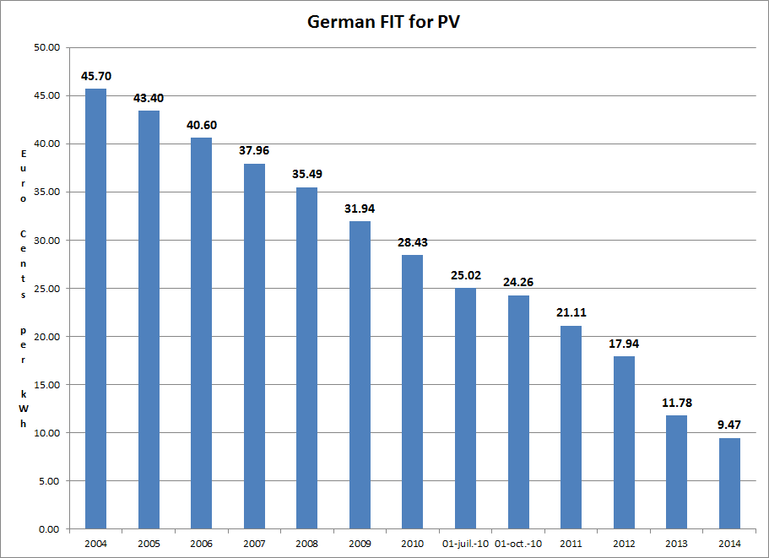
German Feed-In Tariffs

Slide 7
Merchant Prices in Germany
The feed-in tariffs were dramatically higher than wholesale prices of generation as shown in the graph.
The 45.70 (or Euro 450.7/MWH) is way off the chart.
The 9.47 or Euro 94.7/MWH is also off the scale.

Slide 8
Spanish Case and Political Risk
Higher or similar feed-in tariffs to Germany and much higher capacity factors.
Germany had limit on capacity, Spain did not.
Total Cost of 26.4 Billion Euros

Slide 9
Illustration of STC
If produced at full capacity factor (kWp) during the day and nothing at night, the capacity factor would be 50% and the yield would be 8760/2 = 4380. Just need solar patterns over the day. Don’t need anything else.

Slide 10
STC and Capacity Factor
Given that the STC at 1000 w/m2 defines the capacity, if you can find the average w/m2 for a year you can compute the capacity factor before the performance ratio:
  If you have annual data on the kWh that hits a plane (a horizontal plane or an inclined plane), then the average per hour is the total divided by 8760.
  If you have average daily data you can divide the number by 24

Slide 11
Where to Find Tools – PV Insight Read

Slide 12
Solar Power Yield

Slide 13
Solar Yield Files – Read PDF and EU Site
There are two outputs whether for PVSyst or for the EU site or for the PVWATT
Hm: Average monthly sum of global irradiation per square meter received by the modules of the given system [kWh/m²]. This could be called POA – point of access or it could be called Effective irradiance on collectors.
Em: Average monthly electricity production from the given system [kWh]. In PVSyst this is Earray or Energy Injected into the grid

Slide 14
Solar Power Yield Files
Case study on comparison of yield from alternative sources.
Problem is that there is more variation from different sources than comes from the year by year variation.
Location of files on edbodmer.com

Slide 15
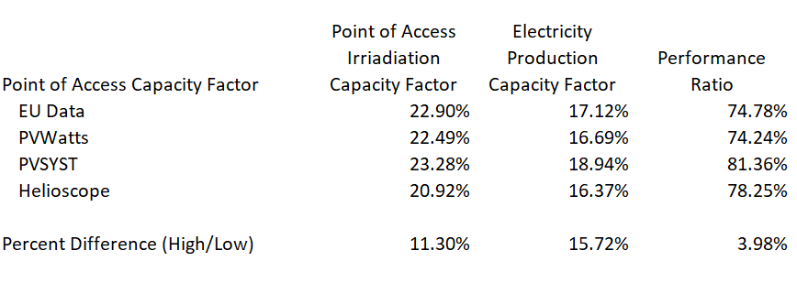
Output from EU file on Point of Access and Output to Grid
The yield analysis demonstrates that different sources can give you different results and this comes from either the point of access energy or the performance ratio.

Slide 16
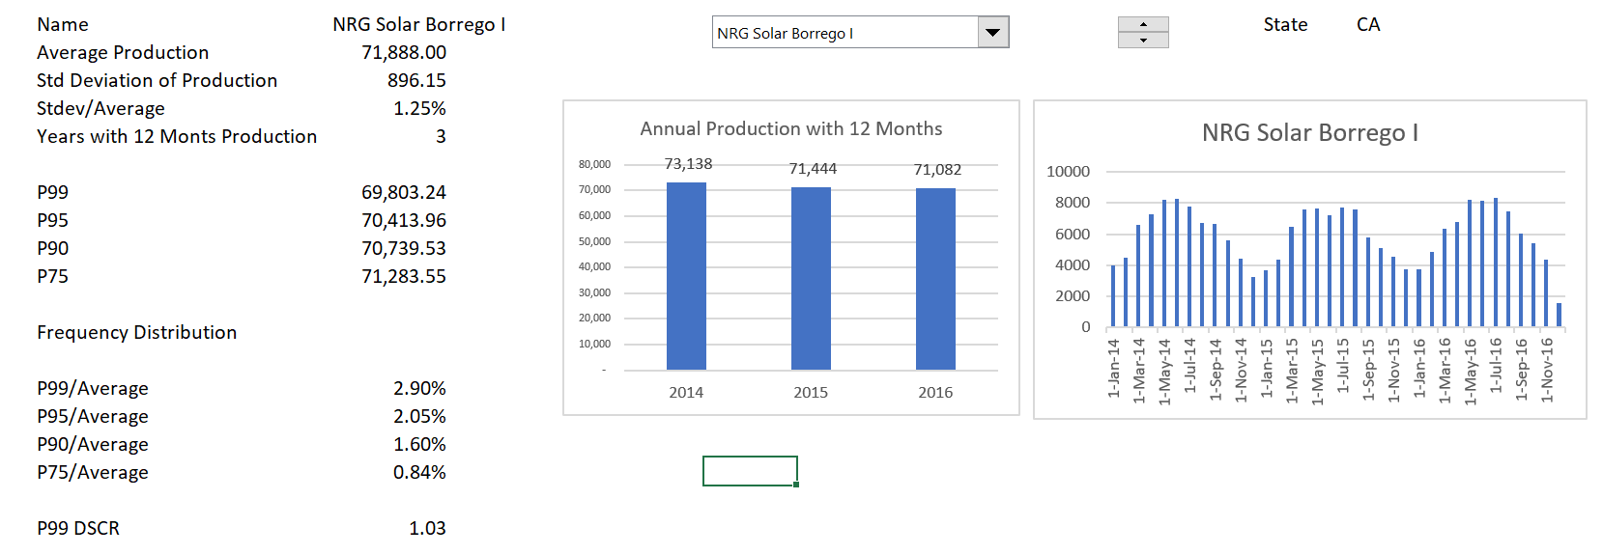
Solar Power Yield – Database of Actual Production
Note the small actual variation in solar production – the problem is the starting point and risk goes down after COD.

Slide 17
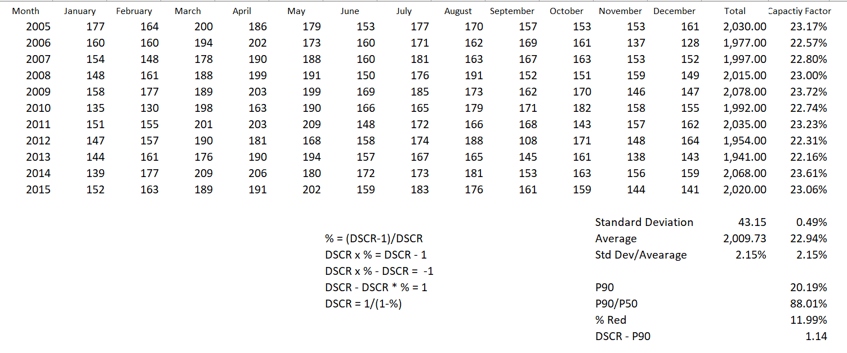
Year by Year Variation
Compute the P90 level from standard deviation and average using NORMINV

Slide 18
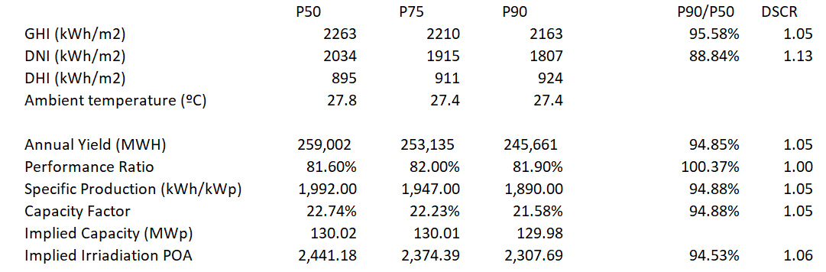
P90 and P50 DSCR with Actual Case
Actual case where P50 and P90 were estimated.

Slide 19
Performance Ratio

Slide 20
Use of Regression to Find the Implied Temperature on the Panels
Objective: Come up with a reasonable method where you can use the temperature reported in the EU website and derive a reasonable production estimate.
At the end of the section you can do the following with the EU data:
Compute the Panel Temperature from the Ambient Temperature
  For example, Panel = 20 + 1.2 * Ambient
  Apply the temperature coefficient to the panel temperature
  Use a typical loss factor for other items
  Therefore, derive a performance ratio that is a function of the temperature

Slide 21
First, Some Terms
Horizontal global irradiation
This is only useful when there is no tilt. The only case where it is optimal to have no tilt is when you are on the equator
Effective irradiance on collectors
This accounts for tilt and tracking. The capacity factor at this point is the basis for computing the performance ratio. Also called Point of Access Irradiation
Corrections for reflection (IAM) and soiling
The IAM depends on tilt and soiling is estimated. These are part of the performance ratio.
Energy injected to grid at AC
This is the final number of use in computing the performance ratio and in the final yield and capacity factor.

Slide 22
Formulas
The energy from a solar project can expressed as capacity factor or yield. The energy hitting the solar plane (point of access) can be expressed as a capacity factor – watt hour on average over the year divided by 1000.
The energy produced can also be expressed as a capacity factor:
Capacity Factor = (Energy/8760)/Capacity

Slide 23
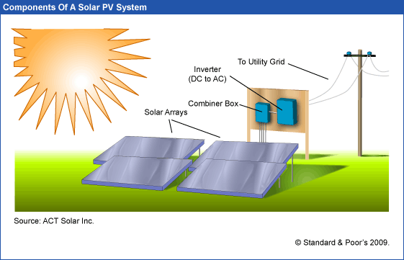
Solar PV – Inverter and Solar Arrays
Capacity Factor of Generation to Grid relative to kWp
Capacity Factor of Sunlight – Average Sunlight Divided by Capacity of Sunlight Defined as 1000 w
Performance Ratio is the Capacity Factor of the Final Divided by the Capacity Factor of Amounts that Hit the Array

Slide 24
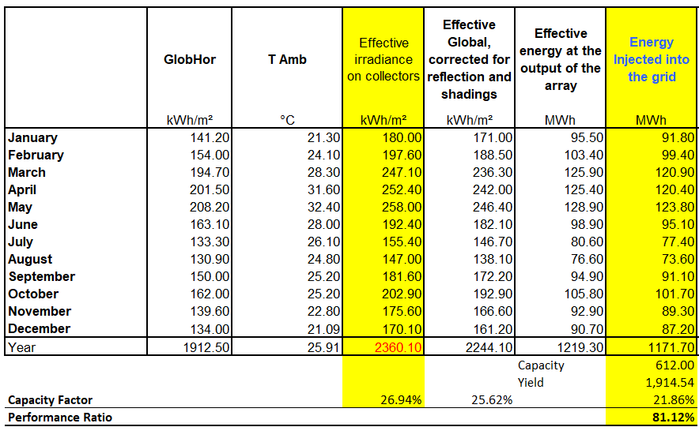
Work Through PVSyst
Can divide the energy injected to grid divided by radiation on collectors
Don’t need anything other than the column of Effective Irradiance on Collectors as well as Energy Injected into the Grid. Convert both of these to capacity factors and then divide the energy into grid by the irradiation on collectors.

Slide 25
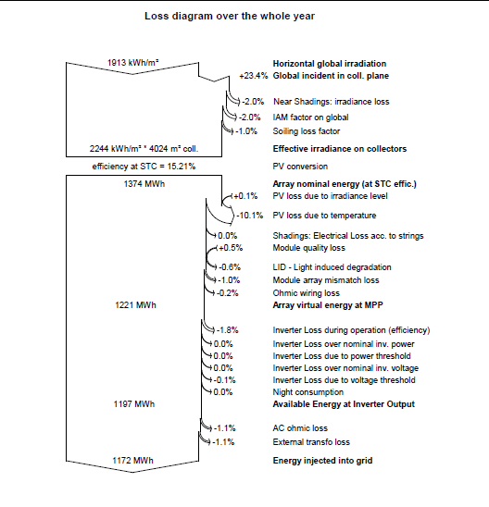
Loss Diagram Illustration
Convert loss diagram into capacity factor and compare different cases.
Difficult to compute performance ratio from these diagrams.
Generally, the loss due to temperature is the largest loss factor.

Slide 26
PVSyst and Waterfall Chart for Capacity Factor
You can use the waterfall macro to make this chart. Note the temperature coefficient is the largest negative bar.
The performance ratio is computed from dividing the final bar by the second blue bar.
PR is 22.34/26.94 or 81.12%

Slide 27
Loss Diagram for Australia
Loss diagram from using waterfall diagram macro in terms of capacity factor. Again the temperature is the biggest factor.
PR = 22.32/27.47 or 81.31%

Slide 28
Mexico Loss Factor
Again, the largest loss factor is the temperature effect.

Slide 29
Decomposing the Performance Ratio
The final capacity factor can be expressed using the formula:
Final CF = CF at POA x (1-loss1) x (1-loss2) x (1-loss3) x (1-loss4) ….
This can also be expressed as:
Final CF = CF at POA x (1-Temprature) x (1-other losses)
Since PR = Final CF/CF at POA, then
PR = (1-Temprature) x (1-other losses)

Slide 30
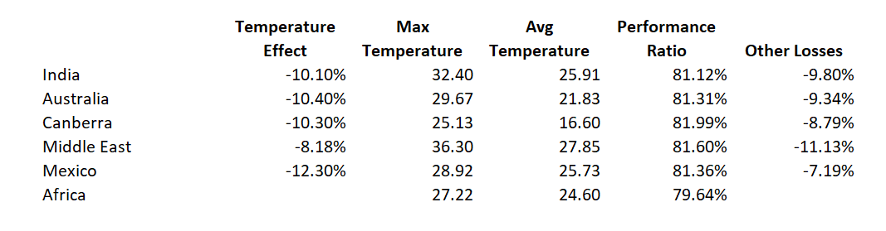
Looking for Correlation between Temperature Loss and Temperature Levels
The table below shows that expected correlations between temperature coefficient and temperature loss is not consistent.
This should be the basis for questions rather than going through the detail.

Slide 31
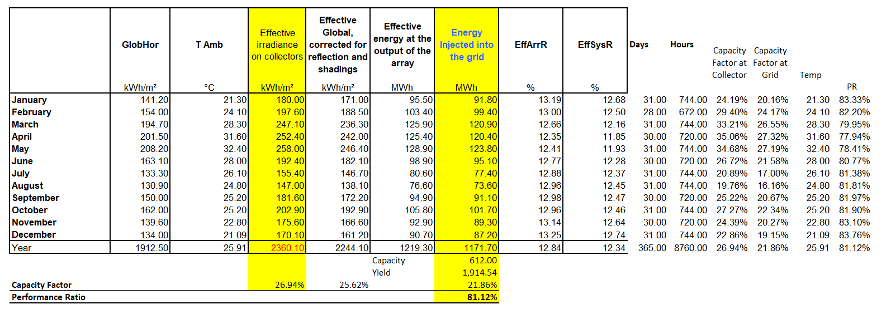
Performance Ratio within Year
The performance ratio can be computed on a month by month, recognizing that:
  PR = Final CF/CF at POA.

Slide 32
Scatter Plots of PR and Temperature
You can create scatter plots within a year and there should be a strong negative relationship. Note the temperature coefficient is about -.4 % change to C.

Slide 33
Performance Ratio and Temperature in Other Cases

Slide 34
Temperature Coefficient
The temperature coefficient is the value of the slope for the percent change in output versus the change in temperature.
  For example, the temperature coefficient of a Sharp Solar Panel NU-U230F3 is -.485% per 1 degree Celsius.
  So, for every degree above 25°C, the maximum power of the Sharp solar panel falls by .485%, for every degree below, it increases by .485%.
The problem is that the temperature is not the Ambient Temperature but the temperature of the panels.

Slide 35
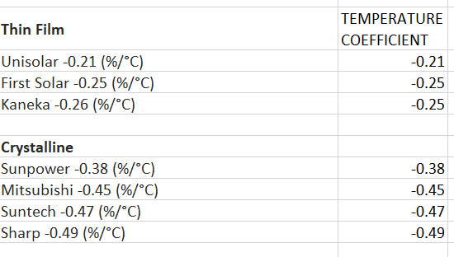
Example of Temperature Coefficient
You can find temperature coefficients – some examples are listed below.

Slide 36
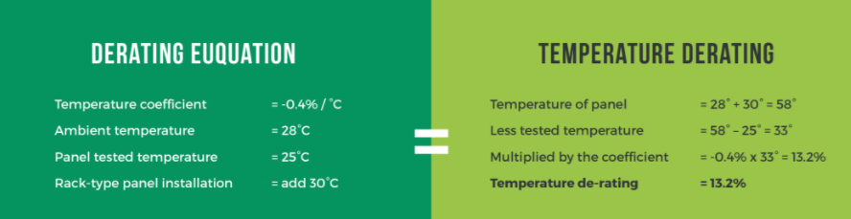
Problems with Measuring Temperature on Panels versus Ambient Temperature
Note how the example adds 30 degrees to the panel.

Slide 37
Derive Implied Panel Temperature
Percent Loss * 100 = (Panel Temp - 25) x Temperature Coefficient
Input Temperature Coefficient
Compute Loss from PR and Other Losses
Derive Panel Temperature from Equation Below
Percent Loss * 100/Temp Coefficient = (Panel -25)
Panel = Percent Loss * 100/Temp Coefficient + 25
Panel Temp = Amb Temp * Mult Factor + Constant Factor

Slide 38
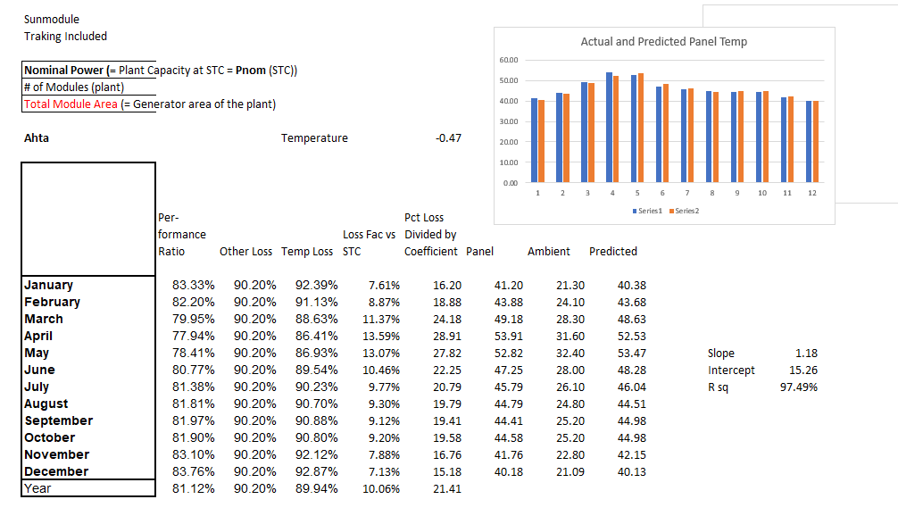
Example of Finding Implied Panel Temperature
This example works through the equations and comes up with a slope and intercept.
In this case Panel = 15.26 + Amb * 1.18

Slide 39
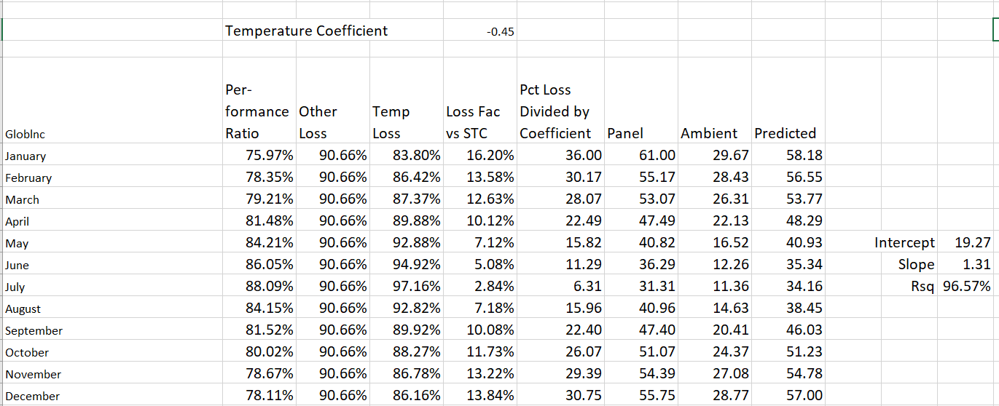
Second Example of Finding Panel Temperature
The implied panel temperature depends on input for the temperature coefficient and the performance ratio.

Slide 40
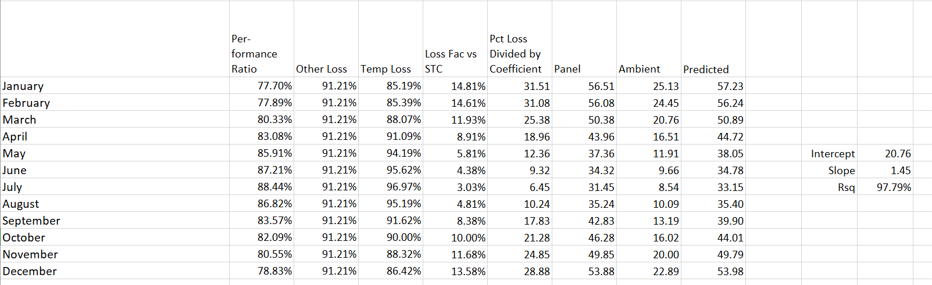
Inconsistent Results
If the results would be consistent in terms of the slope and the intercept, then an independent equation with the temperature coefficient could be applied.

Slide 41
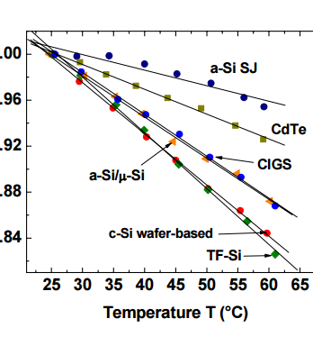
Temperature and Power Reduction
Definition – Percent Change in Production Divided by Change in Temperature

Slide 42
Capital Cost of Solar Power

Slide 43
Introduction to LCOE Analysis

Slide 44
Using PV Insight

Slide 45
Cost of Items other than Modules

Slide 46
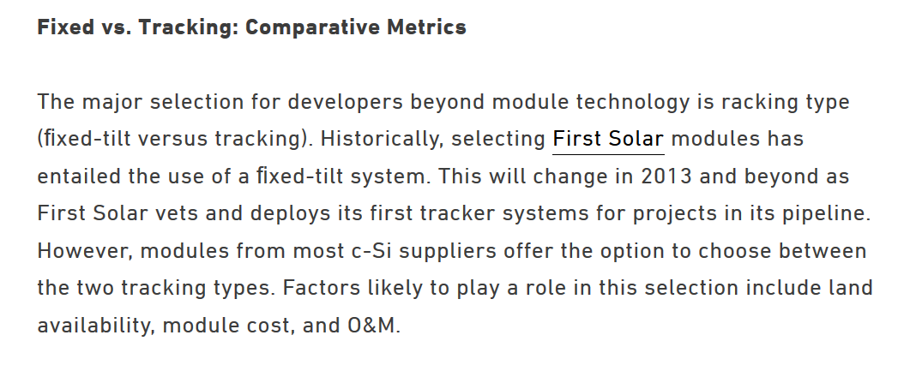
Tracking Notes
Test

Slide 48
Solar Operating and Maintenance Expenses

Slide 49
Operating and Maintenance Categories

Slide 50
Analysis of Inverter Replacement

Slide 51
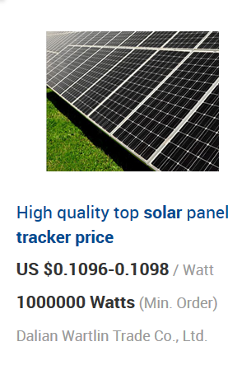
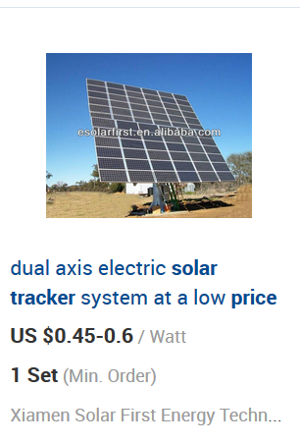
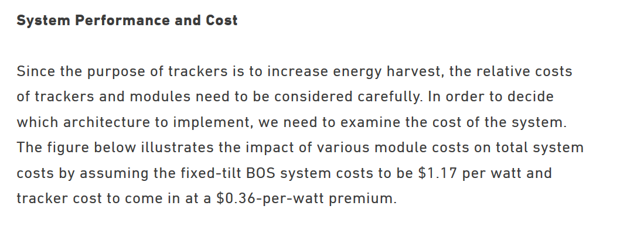
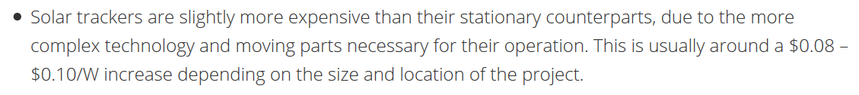
Cost of Tracking

Slide 52
Solar Project Finance Model

Slide 53
Alternative Solar Models on the Website
Solar Model Version 3
Solar Model

Slide 54
Creating a Model with User Defined Function for Circularity

Slide 55
Understanding LCOE with Carrying Charge Analysis
Example of Fuel Only and Capital Only
Inflation in Fuel Costs and PPMT
Fixing PPMT for Inflation

Slide 56
Carrying Charge in Solar Model without Re-financing

Slide 58
LCOE Analysis with Different Options and Different Cost of Capital

Slide 59
Inflation Expectations in Cost of Capital

Slide 60
Debt Cost

