Slide 1
Project Finance Modelling

Slide 2
Teaching Style for Modelling
Overall objective is to teach more complex project finance theory and concepts through modelling.
Don’t use really big template models. Instead work from blank sheet and understand sophisticated issues.
  You can find models at www.edbodmer.com
Understanding the modelling concepts is much more important than typing formulas in excel.
Review real models and their problems in each section

Slide 3
General Topics Covered
Excel Functions and Tools
Time Lines – Pre-Cod and Post-Cod
Modelling how the machine works
Modelling how any business works – investments to get operating cash flows
Modelling the depreciation expense and operating taxes for a project
Accounting principles as applied to project finance (depreciation, financial statement linkage, working capital)
Entering Fixed Debt into Model to Evaluate Funding, IDC, Fees
Incorporating DSRA, MRA, Cash Seeps into models
Sculpting, Funding, Taxes, Fees after Construction
Sensitivity Analysis (Structuring and Risk Analysis)

Slide 4
On-Line Teaching Style
Review the general finance theory and the model structure before equations.
  Review ideas with power point slides in Video. Do this because modelling is not useful unless understand the project finance concept.
  Project Finance structure discussed in Video and you enter the structure of the model – you stop watching the Video and do work yourself.
  Next Video works through financial model equations. After watching the video, you enter the equations. You can use the exercise file.

Slide 5
Why You May Want to Watch the Videos Even if You are Experienced
When I have looked over models made by the largest banks and consultants, there are many things that I think could be done much better.
UDF templates for resolving circular references made pretty easy and hopefully clearly explained.
Unintuitive results like the tax cost of development fees (that generate taxable income) when DSCR drives the debt size.

Slide 6
Modelling Religion, Excel Functions, Free Tools and Interpolate Function

Slide 7
General Philosophical Ideas About Modelling
In thinking about the philosophy of modelling, consider a presentation to client or a presentation to your boss.
  Assume that you are trying to explain how the model works in the context of a transaction and explaining how the transaction works.
  Assume you will give the model to your client or your boss for review.
  Assume that after explaining how the transaction works you would also have to explain how the model works.
For this, keeping the model flexible, accurate, structured and transparent is crucial.

Slide 8

Financial Modelling Religion and FAST
Various organisations have rules for modelling. One good technique for modelling (and maybe for your life) is FAST. (General conflict between Structure and Flexible)
F
  Flexible: Different timing, scenarios, financing techniques.
  No copy and paste macros.
A
  Accurate or appropriate.
  The balance sheet must balance
S
  Structured.
  Separate financing from operations.
T
  Transparent – short equations.
  Core model on one page.

Slide 9

What Does Flexible Really Mean
Can change any dates, development periods, construction periods, PPA periods etc.
No limits on goal seek from copy and paste macro. Copy and paste macros simply ruin the flexibility of a model.
Easy to incorporate alternative financing and operating strategies
Put together different types of presentations of sensitivity, scenario and maybe even stochastic risk analysis.

Slide 10
Examples of Flexibility
Change the lifetime of the project in a project finance model
Change the explicit period for computing cash flows in a DCF model
Including spinner boxes on the debt tenure, the debt size and the interest rate in a project finance model.

Slide 11
Creating a Flexible Summary Page to Explain a Transaction is Part of the Flexibility Principle
To make models flexible, use developer tools and create little sensitivity boxes

Slide 12
Flexible Principle and Flexible Scenario Analysis
There are many ways to make scenario analysis, but whatever you do, you should make your analysis flexible:
  You could use the scenario reporter
  You could use the INDEX and Data Table Method
  If you use some kind of VBA code, make sure it is flexible and can handle different scenarios and variables.

Slide 13
Accurate Principal
You obviously want your work to be accurate, but in a big model how can you do this.
One way is to try to have excel do the work for you. There are various tests you can put in the model, the most notable of which is that the balance sheet balances.
You can test the balance sheet balancing with a TRUE/FALSE switch that is only TRUE when the balance sheets in all of the years balance.
You can make similar mechanical checks for other things like does the debt balance go to zero and does the accumulated depreciation sum to the plant balance.

Slide 14
Accuracy Principal and Audit Page
Once you have made TRUE/FALSE tests with in your model, you can put all of the tests into a single page.
If you label the tests you can show if all of the tests pass and if not, which test failed.
You can do this in an aggregate test and put it in many places in your model.
The key is that you should have excel tell you where the errors are so you do not have to look around.

Slide 15
Accuracy Principle and Reasonable Operating Analysis
Testing that you put in reasonable assumptions and that when you change an assumption you do not get a silly result can be done with a sensitivity analysis where you test one variable at time and examine the result. This can be presented with a tornado diagram.

Slide 16
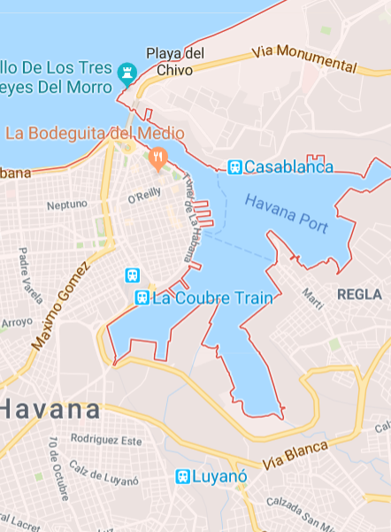
Accurate and Appropriate
Appropriate – models should be geared to objectives. May want detail like in google maps when walking. May not need detail.
Accurate – the wonderful feeling of the balance sheet balancing and debt going down to zero. But don’t overdo tests just to impress people with your excel skills.
Google Maps is like a financial model – sometimes the time estimates are way off (especially if it is the first time).
Sometimes you still get lost.

Slide 17
Structure - Summary
The biggest idea about structuring is to separate the model into an operating section and a financing section (Modigliani and Miller).
Also separate the physical part of operations from revenues, expenses and capital expenditures.
Examine different cash flows starting with pre-tax operating cash flows, to after-tax cash flows, to debt cash flows, to after-tax equity cash flows.

Slide 18
Structure of Model: Operations before Financing
Steps in a Structured Model
  Using of efficient and transparent time line
  Setting up assumptions in same order as model
  Operating assumptions before any money including resource, capacity, capacity factor and efficiency (heat rate)
  Operating analysis which is modelling PPA, EPC and O&M contracts overlaid with the operating MWH characteristics in model to derive EBITDA, Capital Expenditures and Project IRR

Slide 19
Keeping your Model (and your Life, and this course) Structured
Biggest thing about structure – Modigliani and Miller
First capacity and volumes – NO MONEY
Next Cap Exp, Revenues and Expenses – NO FINANCING
Then Cap Exp and Operating Tax – Project IRR
Financing only after Project IRR
Five Parts of Financing
Debt Size
Debt Funding
Debt Repayment
Interest and Fees
Debt Protections
Then Don’t Forget Refinancing
Finally Valuation of Equity and Outputs
Delete any outputs without affecting anything else

Slide 20
Structure: Inputs (Assumptions), Financial Calculations and Outputs
Make the Inputs in the same order and structure as the model
1
Begin Inputs with Time Line Keep time line in sight at the top
2
Core Model calculations on ONE page.
3
Why make users suffer with trace precedent
Show the natural flow
Connect the debt to cash flow
Connect the debt funding to debt balance

Slide 21
Structure of Time Lines – Use Logic and not horrible rules given to you
Understand what is best timing in model
  Project finance is a form of debt and interest expense depends on how you borrow or repay money. Model should often correspond to monthly draws where interest is increasing each month and semi-annual repayments where the stays the same for six months and then declines after a repayment is made.
  If you are modelling a tax equity transaction, then the quarterly payments of taxes may drive the model and you need to make all cash flow, income and balance sheets on a quarterly basis.

Slide 22
Structure – Keep Scenarios Separate
Keep
Keep the sensitivity analysis separate from the core model structure
Do not put
Do not put alternative scenarios in the middle of the assumptions sheet (I do this too much)
Put
Put all of the sensitivities including the time series sensitivities on a separate page so users can change them whenever they want.

Slide 23
Transparency
Idea of transparency – make the model easy to read for other people and for you when you re-open your workbook.
The biggest thing about transparency is to keep formulas simple. There is no excuse for long formulas – you can always add rows and explain what you are doing.
Other points about making models transparent include using TRUE/FALSE switches and putting drivers of formulas in columns at the left of the modelling rows.

Slide 24
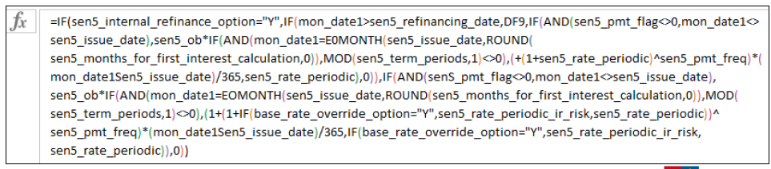

Transparency
Keep the formulas simple
No excuse at all for long formulas because it makes the concepts difficult to explain to somebody not familiar with the model.
Long formulas come about because you do not exactly understand what you are doing.

Slide 25

Transparency and Too Many Pages
Please put yourself in the position of somebody trying to understand the model.
It is so much easier to follow a model on a single page rather than:
  Switches on a separate page – put the switches (or if you want to call them flags or masks) right next to the calculations. Why force people to make silly traces.
  Connect the debt schedule with the sources and uses and also the cash flow waterfall. Why would you make people search for basic and obvious links.
Once you have the core of the model build you can of course make all of the pretty graphs you want.

Slide 26
Transparency and Benchmarking
Show key outputs
  Cost Drivers that allow benchmarking
  Maybe need to use USD as common currency
  Capital Cost expressed something like Cost/Room, Cost/Sq Meter, Cost per km, Cost per Barrel per Day
  Levelised Operating Cost per MMCF, per MWH etc.
  Capacity and Capacity Utilisation
Show some measure of economics of the project such as LCOE
Show IRR’s in real and nominal terms and maybe in different currencies. Include IRR on project, debt and equity
Show credit ratios including DSCR, LLCR and PLCR

Slide 27
Advanced Issues Included in These Slides
Flexible Dates with Fiscal Year
Using Interpolate in Volumes and Capacity Analysis
Flexible Inflation Indicies
Pre-COD EBITDA, Taxes and Working Capital
Prospective Capital Expenditure with MATCH
Use of Depreciation Functions for Continuing Capital Expenditure
Accounting for Development Fees
Funding with Pro-Rata or Equity Up-front with percent of equity up-front

Slide 28
Include Advanced Issues
UDF Circular Resolution for Funding
Inclusion of DSRA and MRA in Risk Analysis Model and Evaluation of MRA economics
Cash Flow Waterfalls with Default Measurement
Prospective LLCR with Multiple Issues
Debt Sizing with DSCR versus Debt to Capital and Template UDF
Debt Sculpting with DSRA changes, Interest Income, Taxes and Tax Deductions from Subordinated Debt
Interest Rates, Credit Spreads, PD and LGD
Re-financing with Taxes, DSRA L/C. Alternative Timing and Swap Breakage Cost
Project Sales at Different Dates, Inflation Index and IRR Upside

Slide 29
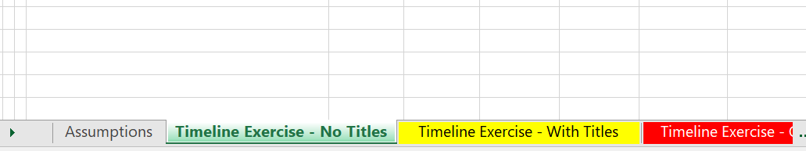
Exercise Process
Option 1: Enter your own titles and structure the model
Option 2: Use provided titles and fill in formulas
Option 3: Watch video and make sure you understand what is done

Slide 30
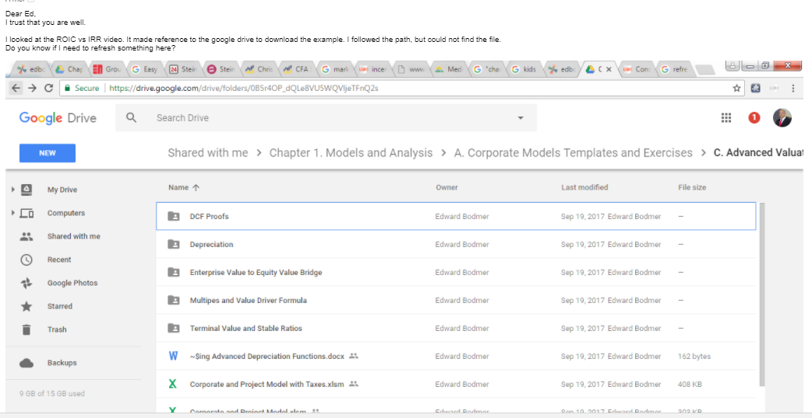
Where to Find the File
Until I am finished with these exercises I will put the file on the website. Subsequently I will put the file on the google drive.

Slide 31

No Best Practice Nonsense: Lazy Rule
There are many ways in excel to do things. Find the fastest and easiest way to do it.
  Often use short cut like Alt,E, IS
  Sometimes use the mouse
  Use entire row or column when you can
  Use TRUE/FALSE instead of IF: =1=1 is TRUE
    True is 1
    False is 0
Find the Laziest Way

Slide 32
Corilarry to Laziness Principle
Do not show-off you prowess with Excel Functions and Techniques
  A few functions are all that you need

Slide 33
Files to Use and Open
Generic Macros
Shift, CNTL, R to copy to the RIGHT
CNTL, ALT, C to colour and format
Must Enable Macros
Should say CNTL,ALT,C on the bottom of excel
Read PDF to Excel
Should say SHIFT, CNTL, A on the bottom
Enable Macros
Use Acrobat
Use Google Chrome

Slide 34
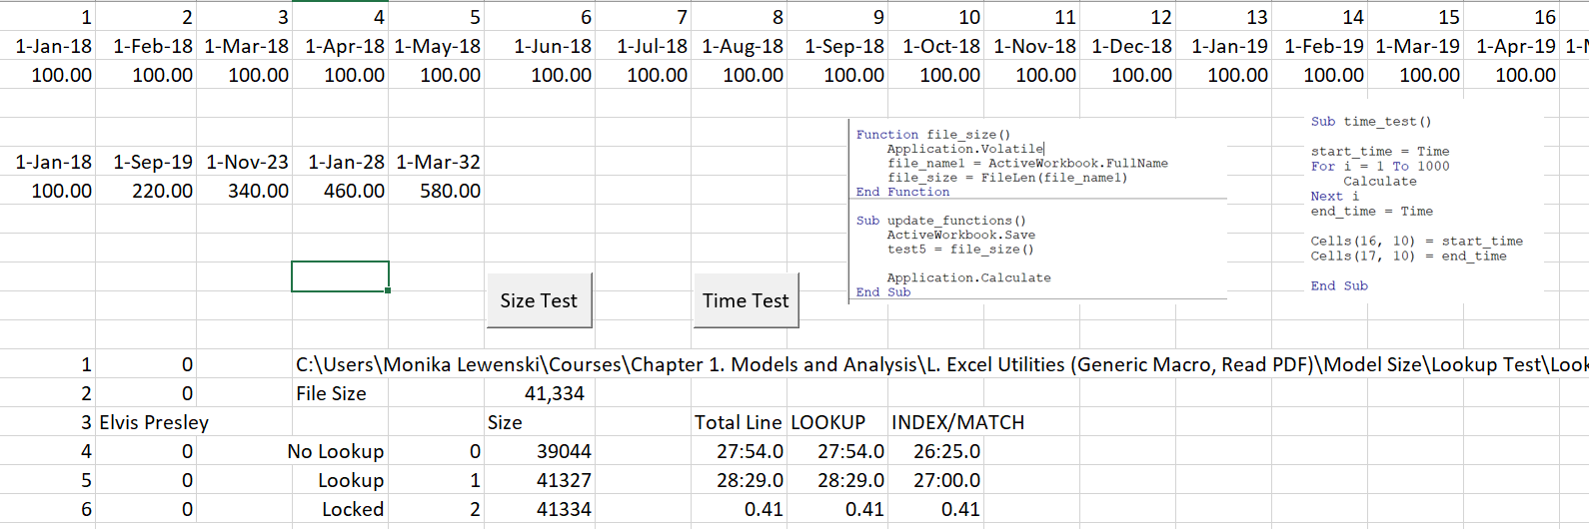
Time and Space Test for Lookup with Entire Rows instead of Locked Data
There is a program on the disk where you can test the “heaviness” of functions. This example demonstrates that using an entire row or column does not either slow things down or make the size of the file larger.

Slide 35
Part 1: Create a Time Line

Slide 36
Project Finance Model versus Corporate Modelling
First, what are you modelling
  In project finance, modelling the SPV. This can be a problem because evaluation of the counter party to contracts may be more important than evaluating the SPV. (This is a main point in the Dabhol case study).
  In corporate modelling you could model anything from a large bank to a small handbag business where the base is financial statements

Slide 37
History versus Contracts and Consultant Reports: Project Finance versus Corporate Finance
Corporate Finance
Project Finance
Analysis is founded on history and evaluation of how companies will evolve relative to the past.
Financing is important but not necessarily the primary part of the valuation.
Successful companies expected to continue growing.
Focus on earnings, P/E ratios, EV/EBITDA ratios and Debt/EBITDA.
Since there is no history a series of consulting and engineering studies must be evaluated.
The bank assesses whether the project works (engineering report). Without financing, no project.
Successful projects will pay of all debt from cash flow and cease to operate.
Focus on cash flow. Equity IRR and DSCR.

Slide 38
Project versus Corporate Finance Modelling- Timing Issues and History
A key distinction between a corporate model and a project finance model involves timing.
Corporate Finance
  In corporate finance, the financial models should begin with uploading historic financial statements.
  With the historic financials, you should prepare an analysis of history.
  This should include calculation of historic ROIC as well as many other ratios that drive assumptions such as the depreciation rate and the ratio of accounts receivable to revenues.
Project Finance
  In project finance, the big problem is there is no historic basis for making assumptions from financial statements.
  Various contracts and other analysis techniques should substitute for the historic analysis.
  This could include historic analysis of commodity prices or resources such as wind.
  Contracts that assure stable cash flows also substitute for the historic analysis.

Slide 39
Project versus Corporate Finance Modelling- Timing Issues and Terminal Value
A second key distinction between a corporate model and a project finance model involving timing involves continuing value.
Corporate Finance
  In corporate finance, the implicit assumption is that the company will last indefinitely.
  You cannot make a model that goes forever, so you must make some kind of terminal value calculation.
  The terminal value is assumed to reflect some kind of long-term stability.
Project Finance
  In project finance, the projects do not have an indefinite life.
  Modelling occurs for the entire life and generally assumes that SPV will remain in place for the project life.
  Project finance modelling involves evaluating the development period, the construction period and the operation period.

Slide 40
Project versus Corporate Finance Modelling – Credit Modelling and Credit Ratios
Corporate finance and project finance models are used in different ways to evaluate credit quality.
Project Finance
  Key analysis is of cash flows and the repayment of debt from cash flow
  Cash flow is evaluated with the DSCR, LLCR and PLCR.
  Break-even to cash flow is evaluated
Corporate Finance
  Corporate finance modelling from a credit perspective is about evaluation whether a company is strong enough to re-finance debt
  Ratios to evaluate the ability to re-finance include debt to cash flow, debt to capital and interest cover.

Slide 41
Project versus Corporate Finance Modelling – Valuation Modelling and Returns
Corporate finance and project finance models are used in different ways to evaluate valuation and returns.
Project Finance
  Key analysis is of IRR that measures the growth rate of cash flows
  In particular the equity IRR is evaluated
  Valuation if made would focus on equity cash flow as the WACC does not make sense in project finance because of changing risk.
Corporate Finance
  The analysis focuses on ROIC and ROE rather than IRR because of the increase in investment with new capital expenditures.
  Valuation using free cash flow and WACC is the main output of corporate models.

Slide 42
Project versus Corporate Finance Modelling- Changing Risk and Stages in PF versus Explicit Period in CF
Both corporate and project finance models involve stages
Corporate Finance
  Companies may have good years and bad years, but it does not make sense to assume that there is a continuing decline or increase in risk
Project Finance
  Depending on the project type, there may a continuing decline in risk
  Because of the decline risk, value changes over time.

Slide 43
Similarity in Corporate and Project Finance Modelling
Both types of models have financing separated from operations
Both models should apply FAST
Both models should put financial statements at the end with the balance sheet last

Slide 44
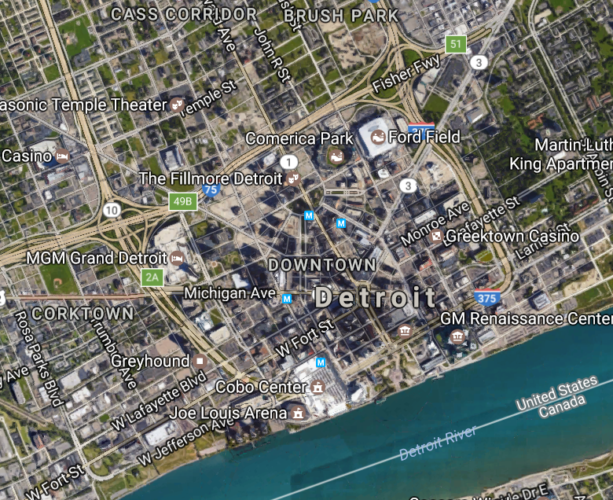
City is Like a Corporation/Project is Business
Individual Business or Family is like project Finance

Slide 45
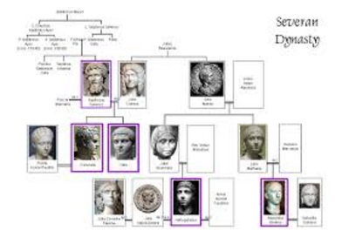
Family is Like Corporation, Person is Like Project Finance
Project finance has beginning and end. No history and no terminal value.
Person is the project
Entire Family is the Corporation

Slide 46
Time-Line is Crucial in Project Finance
A crucial Feature of Project finance is CHANGING -- DECLINING RISK
RISK
Financial Close
Completion Test

Slide 47




Project Finance Model Structure Changes at COD
Before COD, cash flow is presented in the sources and uses statement
After COD, cash flow is presented in the cash flow waterfall and the last line is dividends
Father of the bride makes commitment to pay for wedding
Commitment Fee
Development is Dating period. Probability of failure is high
Pay for Wedding with Other peoples money
Pay your Bills and re-structure your life. Stuck with PPA type contract. May default.
FC is just after engagement date
COD is Wedding Date
Decommissioning Date

Slide 48
Cash Flow Before COD – Cash is Negative and Where Do You Find It
Funding Needs
  Development Cost
  Development Fees
  Capital Expenditures
  Interest During Construction
  Fees During Construction
  DSRA Funded During Construction
  Cash for Prospective Working Capital
  Total Cash Funding Needs – Uses of Funds
Funding Sources
  Debt Financing
  Subordinated Debt Financing
  Shareholder Loan Financing
  Equity Financing
  Total Cash Funding Sources

Slide 49
Cash Flow After COD – Cash is Positive and Where Does It Go
Cash Flow after COD
  Revenues
  Less: Cash Operating Expenses
  EBITDA
  Less WC Changes
  Less Taxes
  Less On-Going Capital Expenditures
  CFADS
  Less Debt Service
  Net Cash Flow
  Less Traps and Sweeps and DSRA
  Dividends to Equity Holders

Slide 50
Putting the Two Cash Flow Statements Together at the End
Not necessary
Look at cash flow statements of corporations
Could begin with net income
Adjust for things like gains from development fees
Can use for traditional ratios such as FFO to Debt and FFO to Interest

Slide 51
Making Flexible Time Line
Keep formulas transparent with simple tests and use of switches
As key is before and after COD, include the ability to change the timing pre-COD and post-COD
Need a Pre-COD and Post-COD switch
Use the Generic Macros to Colour the TRUE and FALSE
Use SHIFT, CNTL, R to copy to the right
Use the EDATE function a lot (you can use the EOMONTH but not really necessary)
Use SHIFT,CNTL,3 to Format the dates

Slide 52
Don’t Use Too Many Functions
What functions are necessary and are not necessary
Three Key Functions for Core Model
  Lookup and not Vlookup, Hlookup or INDEX/MATCH
  Use of Index function for scenario and sensitivity analysis
  Sumif for error checking and annualising
  Offset function for DSRA and presentation
Functions for Cash Flow Waterfall
  Use of MIN and MAX instead of IF
  Necessity for sub-totals
Date Functions
  Use of ALT, EIS short-cut
  Use of EDATE and EOMONTH

Slide 53
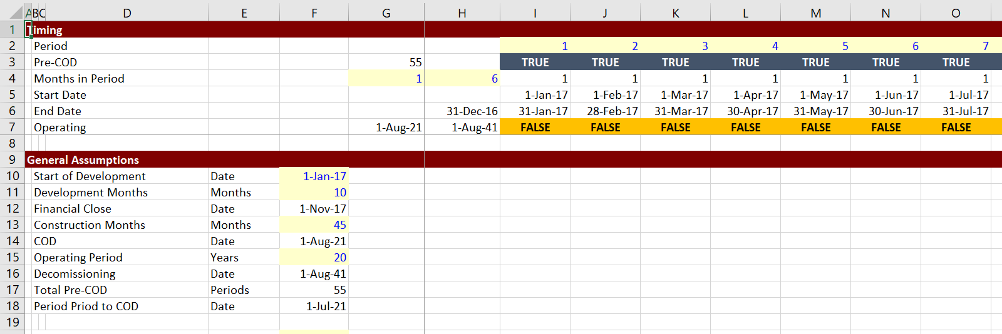
Exercise 1: Work with Dates (Use EDATE function)
Enter dates for:
  Start of development
  Months of development
  Financial Close
  Months of Construction
  Commercial Operation
  Operating Period
  Decommissioning Date

Slide 54
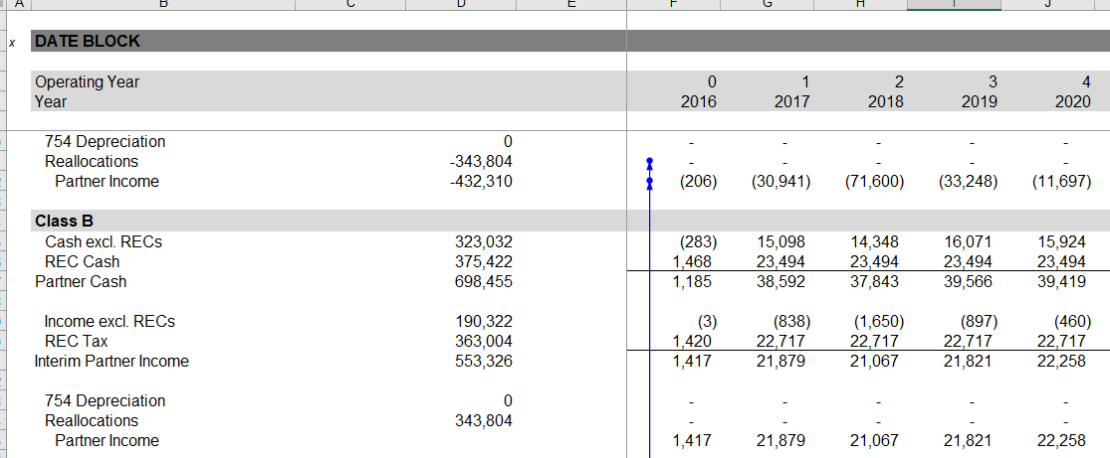
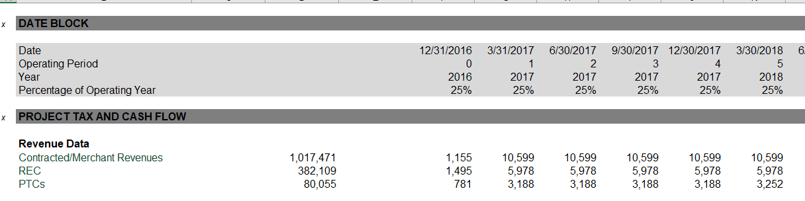
Un-Believable Bad Practice by Really Big Bank – Different Time Lines
For capital accounts that are part of the calculations, use annual. For other accounts, use quarterly.

Slide 55
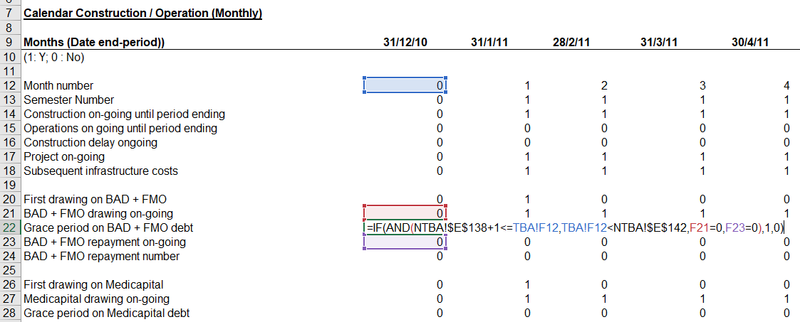
Actual Models: There is No Need At All For Complex Formulas in Timelines
Note how comes from another sheet, no documentation to the left, long formula.

Slide 56
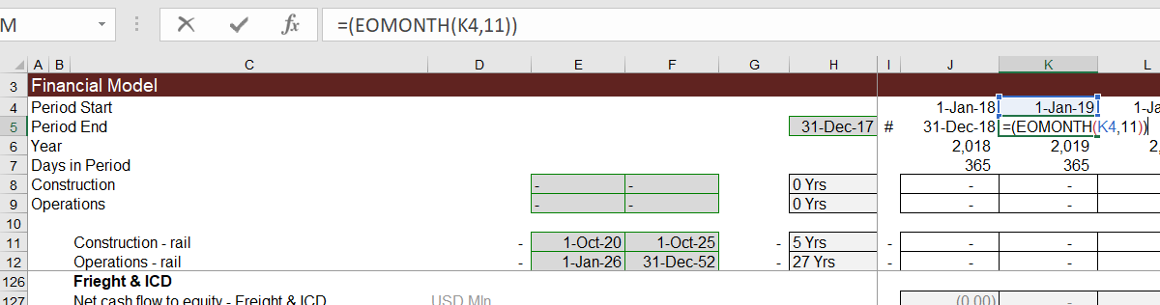
Actual Models – No Flexibility
Note that the number 11 is fixed

Slide 57
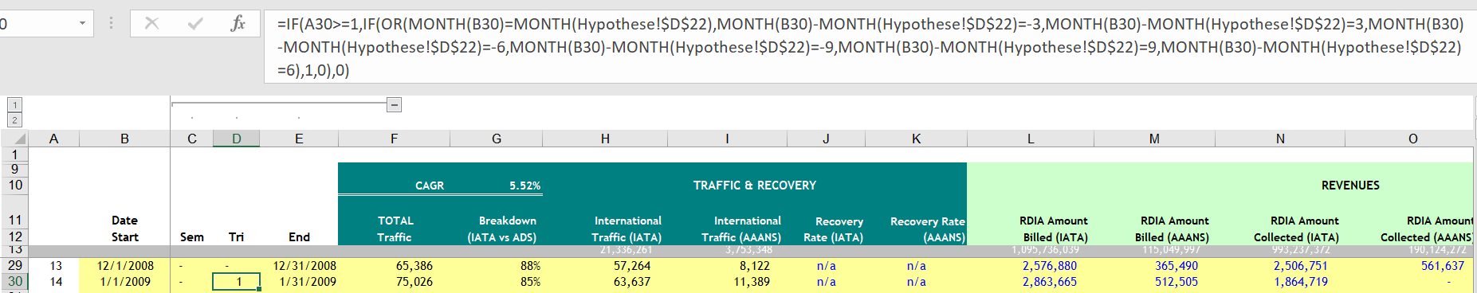
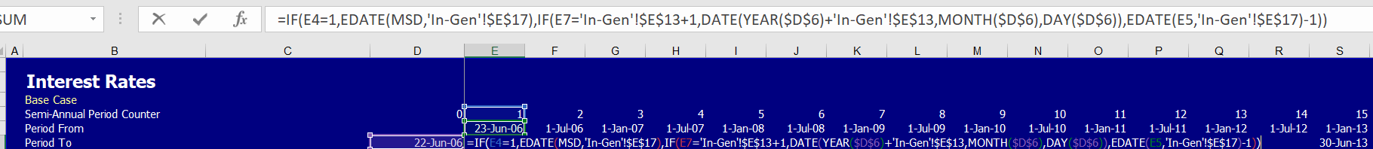
What Not to Do in Time Lines – Different Time Lines for Different Core Calculations

Slide 58
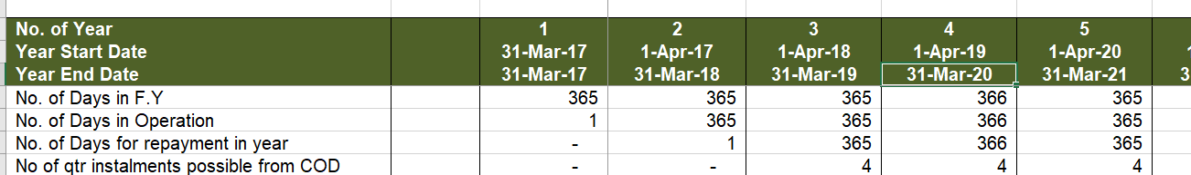
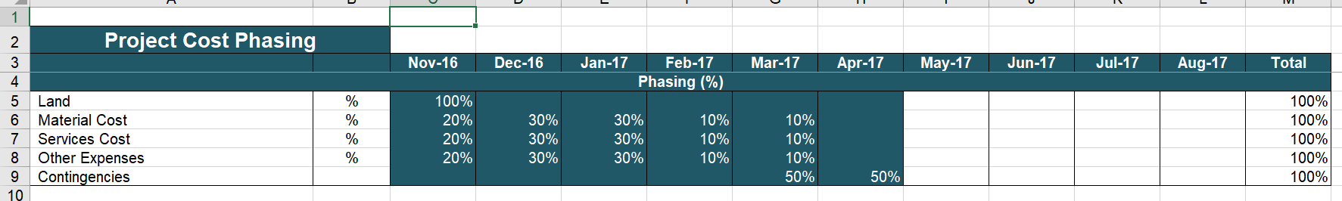
Inconsistent Time Lines in Calculation Sheets
For IRR and financial statements, you eventually need to consolidate. So keep time line in sight. This is from the bad PF model video.

Slide 59
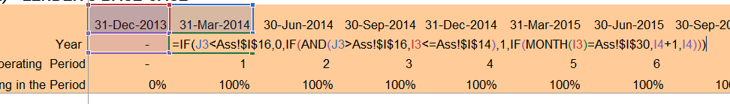
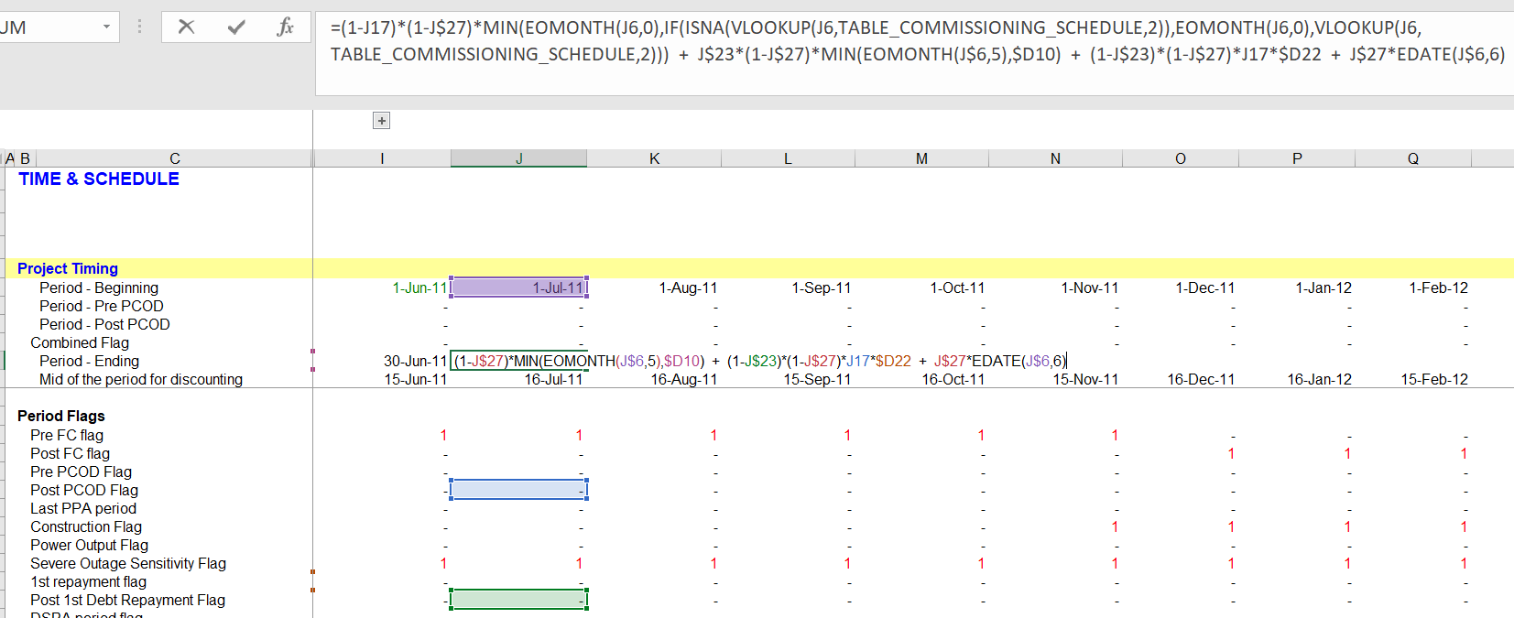
Complex Formulas for Year
You do not need such a formula for the year.

Slide 60
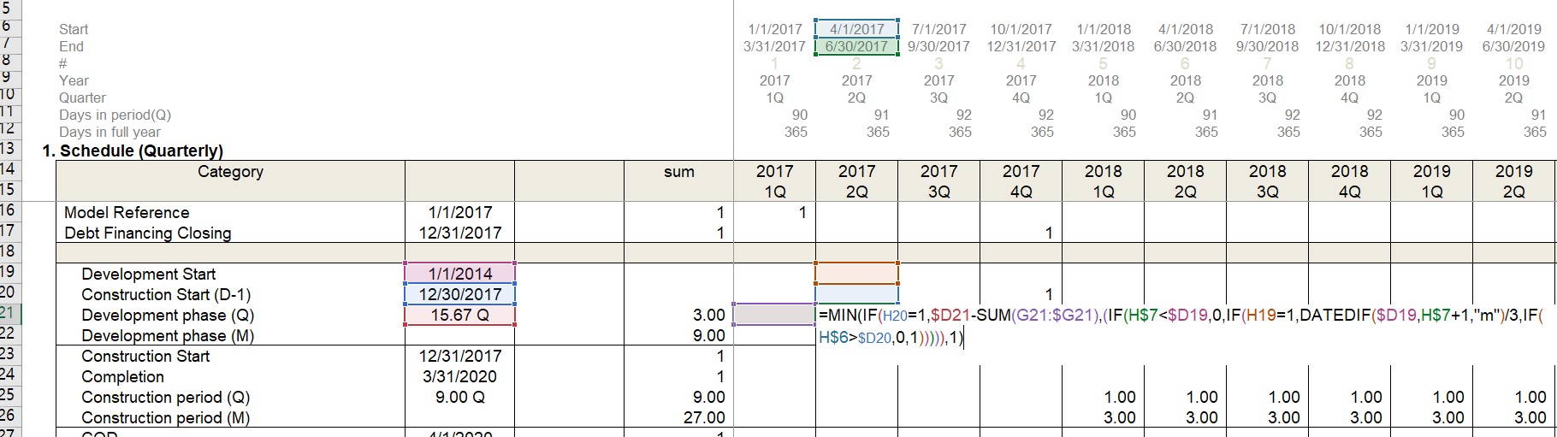
How is this necessary
All the formulas are complex like this.

Slide 61
Notes on Beginning and Ending Period
Anytime you have an opening and closing balance, the opening balance comes directly from the prior period closing balance
This means you start with the closing balance not the opening balance
Think of new years eve party. You start the year with what was in your accounts at the end of the previous year
In terms of dates this is the same thing. The start date is the previous end date plus one day.
The very first end date (begin with the end) is the start date of the model minus one day.

Slide 62

Notes on EDATE
When designing assumptions that change over time, it is best to use the beginning of a month.
  You could make models with dates between a month but that is painful and probably not worth it.
  When structuring contracts, operating expense changes, phase in periods etc., it is best to use dates and the beginning of a month.

Slide 63
Exercises with and without Titles
For each exercise including this exercise on dates, you can try three things.
  Use the tab that is labeled “No Titles.” To use this tab that is coloured green, you will have to structure the titles of the model. This is the best thing to do because structuring is so important
  Use the tab labeled “Titles.” If you do this, all you have to fill in excel formulas. To begin with titles, use the yellow tabs.
  Use the tab labeled “Completed”. If you do this, then you can just follow along with the video.

Slide 64
Fiscal Year for making readable and understandable annual sheets
To make sense of data that is presented on a monthly and then a quarterly or a semi-annual basis, it is nice to add a separate sheet that presents annual data.
For this you can use the SUMIF or the SUMIFS function. These functions require the fiscal year as a criteria.
To find the fiscal year, you need to stop six months (semi-annual) or three months (quarterly) after the COD. You can use the EDATE function and then the MONTH function.
This month that is the subsequent month the COD month, incremented is used to accumulate the fiscal year.

Slide 65
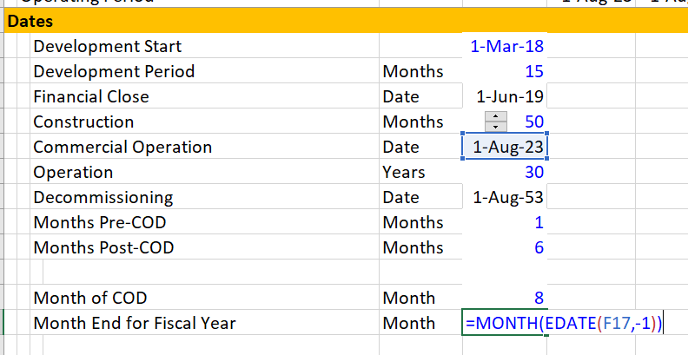
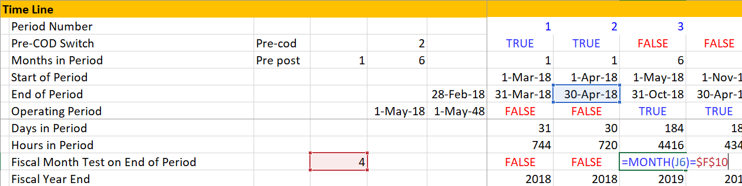
Painful Fiscal Year Problems
You can use the fiscal year end as the month before the COD end
Edate(COD,-1)
Then,
You can in the annual
part of the model, use a switch for the fiscal year change from the PRIOR PRIOR PRIOR end of month.
Finally, increment
the fiscal year with the
switch

Slide 66
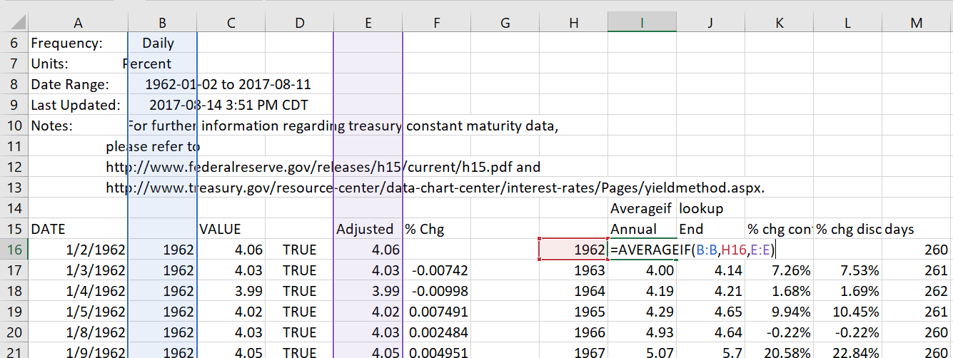
Use of AVERAGEIF, SUMIF, COUNTIF
These functions are useful in project finance model for:
  Converting periodic data by month to sum for a year
  Checking errors
  Counting or summing TRUE’s or FALSE’s

Slide 67
Now, You Do It
Use the file named David Lee
Fill in Dates for FC, COD and Decommissioning with EDATE
Start the Dates a few columns to the right so you can make TRANSPARENT descriptions of what drives each row
Create a time period with ALT E, I, S and go to about 400 to leave enough monthly and quarterly periods
Make a Pre-COD and Post COD switch first
Use this switch to define the months in period
Use the EDATE to define beginning and ending period
Compute the incremented month and create an annual page with the SUMIF function
Compute the days and hours on a periodic basis and on an annual basis

Slide 68
Project Finance Model Structure

Slide 69
What is Meant by Model Structure
The structure of a model is defined as different component parts of a model that have separate parts – for example, the debt schedule, the income statement, the depreciation analysis and so forth.
The structure of a model should reflect how the transaction is evaluated and how the company works. For corporate finance, there should be a section for historic financials and a section for terminal value.
In project finance, a central part of the structure is the timing and phases including the development phase, the construction phase and the operation phase.

Slide 70
Eight Elements of Structuring a Project Finance Model
Separate elements of structuring a project finance model involve:
  setting-up the timing,
  modelling the output and capacity of the project,
  capital expenditures and EBITDA,
  the sources and uses during the construction phase,
  the debt schedule that defines repayment and interest,
  the profit and loss and the cash flow waterfall,
  the balance sheet and
  the output statistics.

Slide 71
Model Structure and Evaluation of the Transaction
The structure of the model follows the way a project should be evaluated for structuring debt (coming up with debt size, tenor, interest rate etc.).
The risks of operating cash flow should be evaluated first, just as the operating module is the first part of a model. If you don’t know the fundamental risks faced by a project, you cannot evaluate what kind of transaction is best for the project.
Then the debt terms such as the tenor, the repayment type and the interest rate should correspond to the risks associated with operating cash flow. For example, with more operating risk, you need more cash flow.

Slide 72
Structure of Debt
In a model, debt should be structured in an organized manner. Separate components should be defined and laid out for:
the size of the debt,
the manner in which debt is funded,
the way the debt is repaid including the tenure,
the interest rates and fees that include the structure of credit spreads, and
the credit protections including covenants, DSRA and cash sweeps.

Slide 73
Scenario and Sensitivity Analysis in Modelling

Slide 74
Definition of Scenario and Sensitivity Analysis
Scenario analysis involves change a number of different variables in the model while sensitivity analysis involves changing one variable at a time.
Scenario analysis is a central component of credit analysis.
For credit, the key scenario is a reasonable downside scenario that is not too extreme but is also not optimistic.
In the downside scenario, the DSCR should remain above 1.0.
Assumptions for the downside case should be a central part of credit analysis reports.

Slide 75
Stress and Worst Case Scenarios
In evaluating credit, a number of downside scenarios should be produced.
In theory, the probability of a downside scenario can be judged, but in practice this is very difficult.
You can label more extreme cases stress cases or worst cases.
In the more extreme stress cases, the LLCR and/or the PLCR should remain above 1.0 and there may be a single year when the DSCR falls to below 1.0.

Slide 76
Mechanics of Scenario Analysis
A scenario analysis can involve using the scenario reporter where you add a new sheet and use some macros.
Instead, you can use a table that includes different cases and works with the INDEX function along with the data table tool.
The sensitivity analysis can be made in a few different ways.
  One method is to use excel forms and in particular the spinner boxes. These boxes can push up individual variables.

Slide 77
Sensitivity Analysis Mechanics with Spinner Boxes
A second method of sensitivity analysis involves adding factors that are expressed in percentages to the model. For example, the percentage of demand can be added to a model where you put in 100% for the base case.
Spinner buttons can be added to these percentage variables (you have to divide by 100 to make the spinner boxes work). Then you can perform break-even values of different important variables like traffic can be pushed down until the DSCR, LLCR or PLCR hits a value of 1.0.

Slide 78
Sensitivity Analysis with Tornado Diagram
The final method of creating sensitivity analysis involves creating a tornado diagram.
A tornado diagram shows which variables have the largest effect on statistics such as DSCR and which variables have less of an effect.
A tornado diagram can be created from a scenario page with the base, low and high cases are input. Once the three cases are made, you can make many more cases where you adjust one variable at a time.
Once you have created a big list of cases with one variable changing, the tornado diagram uses the INDEX function along with the data table tool.

Slide 79
Part 2: Model How the Project Works on a Physical Basis (No Money)

Slide 80
Capacity, Capacity Utilisation and Volumes
Just about any project has a defined amount of capacity – the maximum you can produce in some time period
The time period can be an instant – MW
The time period could be the life of a project – oil reserves
Once the capacity is defined, the manner in which you use the capacity or the capacity utilization can be specified
For example, the capacity utilization of a hotel
The production of gas reserves
Finally, the volumes produced can be computed
Traffic Volumes from Study
Electricity Production from Wind

Slide 81
Level of Detail and Sources of Data
There can be a lot of detail about how you compute volumes in supplementary sheets.
If you have detail, it is not bad to put it at the back of the workbook in other sheets.

Slide 82
Don’t Mix Up Scenarios in the Core Model
Do not do
Do not do what I have done too much, that is making different downside or upside cases for volumes and capacity utilization in the core assumptions sheet.
Put
Put only one scenario in the model and allow different scenarios to be input in the scenario page.
See
See the subsequent section on scenarios for this.

Slide 83
Set-up Assumptions with Model Dates
Sometimes no capacity until the COD and no capacity at decommissioning
Here just use the switch variables
Other situations
Some capacity and volume produced before COD and will generate income
Examples, early traffic, oil production, electricity from wind turbines
Setting-up assumptions with dates
Include the model start with zero to avoid #NA
Include the decommissioning date with zero to turn off the capacity
Complexities
Major overhauls and lost time

Slide 84
Excel Functions
We will use short-cuts, excel enhancements, TRUE/FALSE switches and only four functions.
The functions should be used in a way that you are probably not used to.
INDEX
LOOKUP (not VLOOKUP or HLOOKUP)
SUMIF (or AVERAGEIF or COUNTIF)
EDATE
MAX and MIN for Waterfalls (not IF)

Slide 85
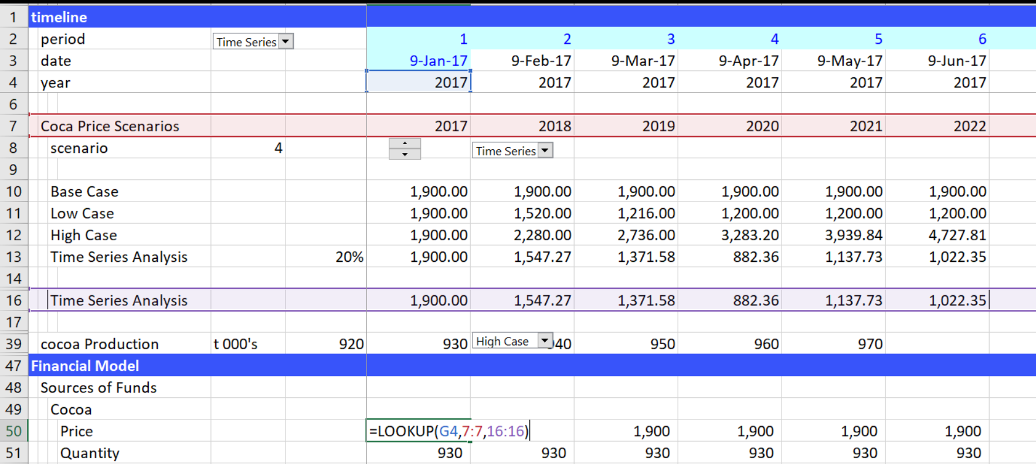
Use of LOOKUP Function
Don’t use VLOOKUP, HLOOKUP or INDEX/MATCH with models that have a time line. Instead, use the LOOKUP function with an entire row as illustrated below:

Slide 86
Get the LOOKUP INTERPOLATE Function
Works just like lookup
For UDF (user defined functions) you need to copy them – you cannot just have another sheet open
Allows smooth transitions rather than step functions
To get lookup_interpolate into your model, go to the website and open the file named interpolate lookup and follow the instructions.

Slide 87
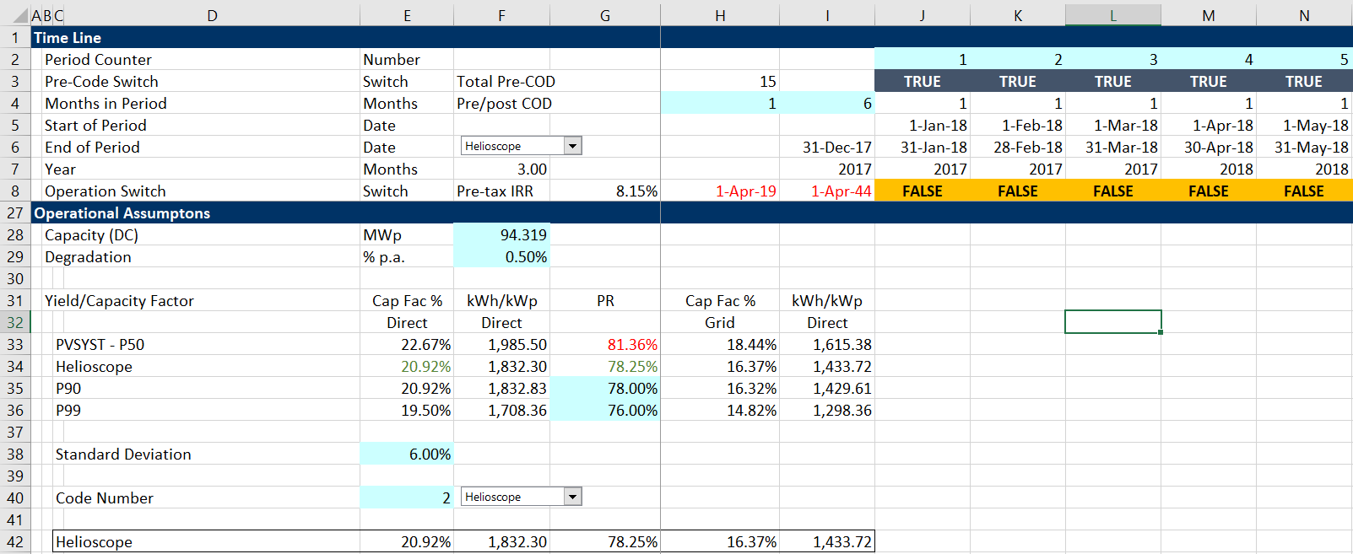
Enter Volumes and Capacity in the Model with Scenarios
How does the project work – use the example of volumes in traffic cases. Use LOOKUP and LOOKUP_INTERPOLATE

Slide 88
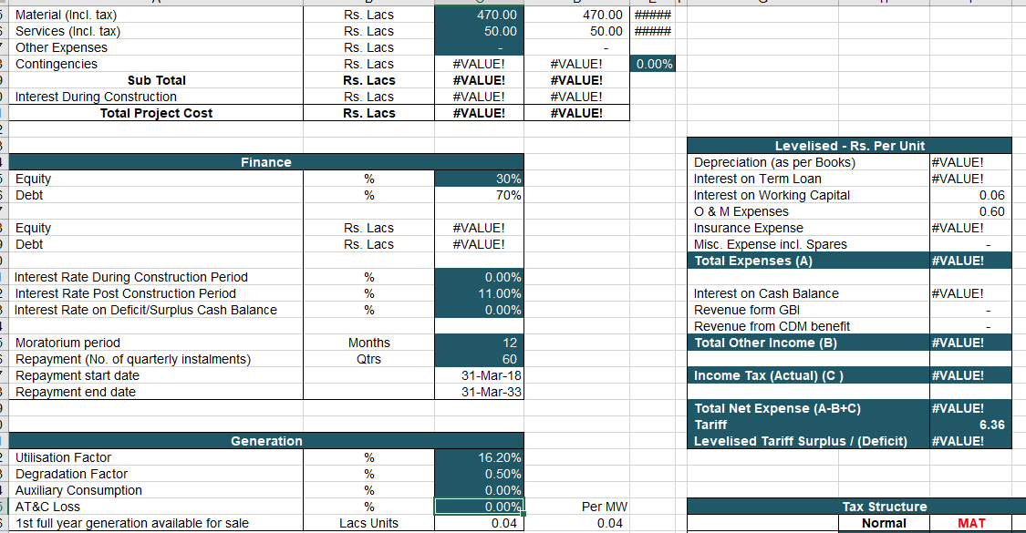
More Extreme Case of Not Putting Assumptions in Order
Show the assumptions in one column and put operations before financing, not like this example.

Slide 89
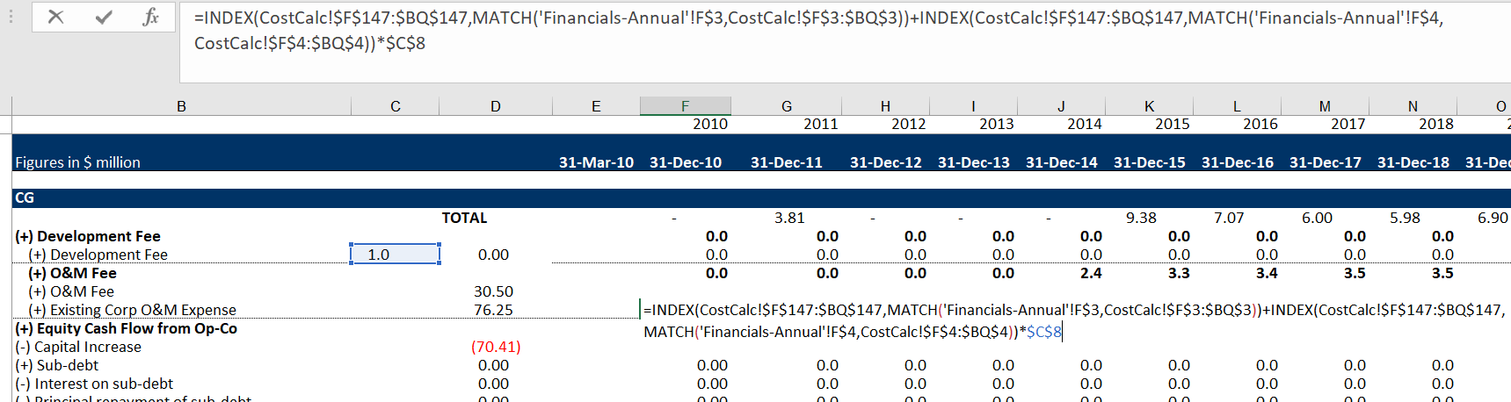
Example of Not Using LOOKUP
Using painful INDEX, MATCH when LOOKUP is much simpler

Slide 90
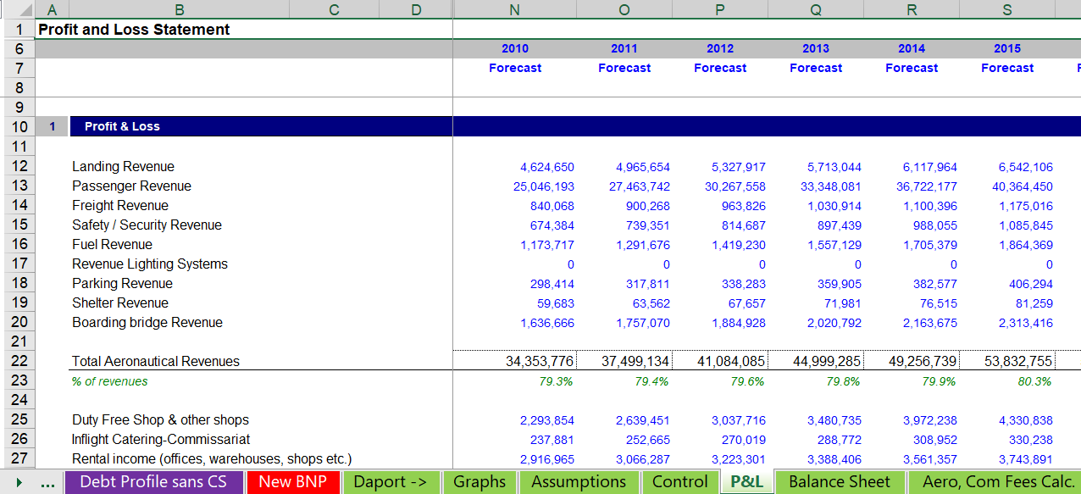
Example of What Not to Do in Model with Respect to Capacity and Volumes
Do not start with P&L and put in history switch if you have actual data.

Slide 91
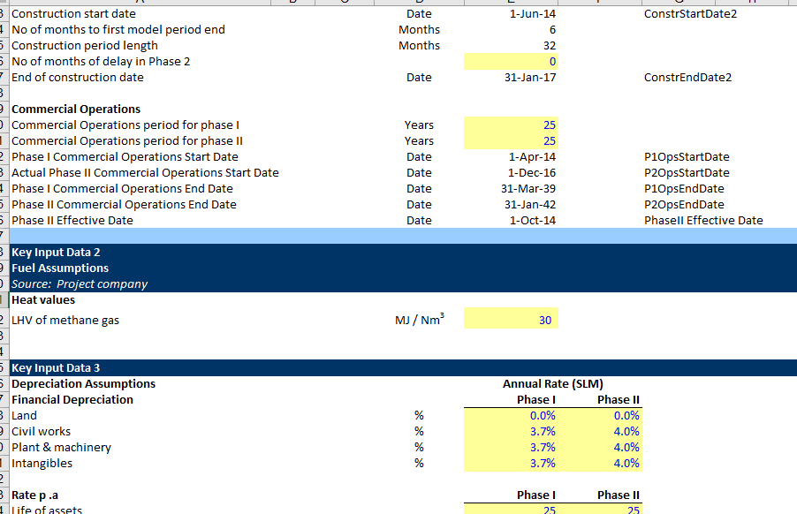
What Not to Do – Assumptions Not in Same Order as the Model Logic
Note that after the dates, comes the depreciation rates

Slide 92
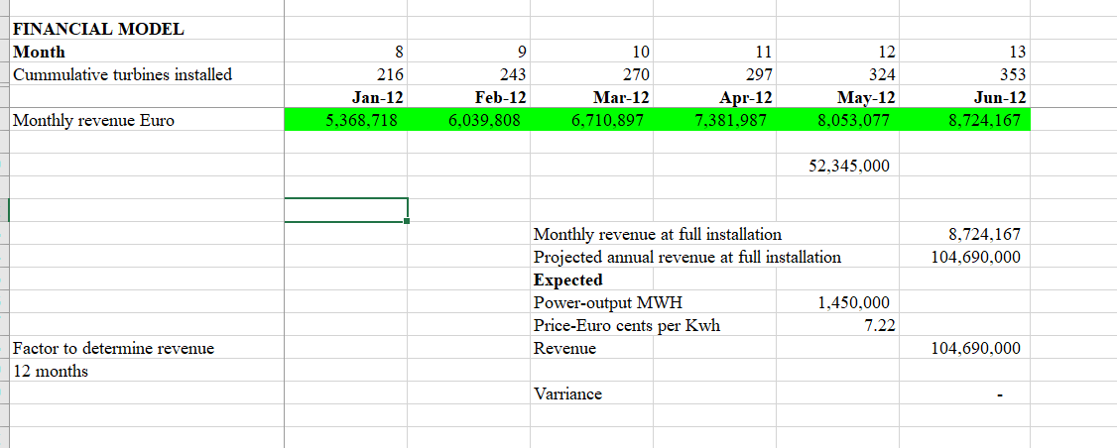
Example of Capacity and Volumes in Models
Amazingly, No Layout of Capacity and Volumes in Model

Slide 93
Now, You Do It
Begin with case that has date analysis complete and work on capacity and volumes
  Use the Look-up function for capacity with different dates
  Import the Lookup Interpolate Function and understand how to import the function into your sheet (you cannot use a function in the same way as a macro (e.g. with generic macros)

Slide 94
Part 3: Modelling Pre-tax Free Cash Flow, Capital Expenditures, Revenues, Operating Expenses and Working Capital

Slide 95
How Just About Any Business or Person Works – Make Investments to Generate Cash
In project finance this means that capital expenditures and development costs can be the first monetary items entered.
Modelling the S-curve can be painful in terms of inputs or when you create curve-fitting
To be negative with respect to delay, assume that the project is finished and stays idle until the COD – this means that you do not change the S-curve, but you do change the COD.

Slide 96

Often, the Model is Overlaying Contracts on the Way a Machine Operates
SPV is a separate corporation in the middle:
  This is what you make the model of and it may be irrelevant
SPV signs a lot of contracts that should be illustrate with solid lines
The contracts should be labeled (e.g. concession contract, EPC contract, PPA contract, O&M contract, Loan Agreement, Shareholders agreement)
Contracts should be consistent with each other with back-to-back contracts
Diagram should show direction of money and start with revenues (no revenues, no project)
Quality of off-takers should be shown on the diagram in the circles
Insurances and guarantees should can be demonstrated

Slide 97
Making Money in Different Places by Receiving Money from PPA Contracts; Dispatchable Plant
Off-taker pays money for PPA
EPC Contractor: Could be Sponsor
PPA – Four Part Tariff
LD for Delay Risk
Fixed Capacity Charge at FC
Contract O&M Charge
Contract Heat Rate
Capacity Charge with Index
Availability Penalty
Fixed Price Contract with LD
Special Purpose Corporation (IRR)
Fuel Supply Contract
Sponsor – Fuel Mgmt. Fee
Contract with Guaranteed Heat Rate and Availability Penalty
and Fixed Fee
Loan Agreement
Shareholder Agreement
O&M Contractor – Could be Sponsor
Lenders
Sponsor – Wants EIRR on SPV

Slide 98
Output Based Project Versus Availability Based Projects
Off-taker pays money for PPA
EPC Contractor: Could be Sponsor
PPA – One Part Tariff
LD for Delay Risk
Performance Ratio Penalty
Inflate prices and Index to USD
Fixed Price Contract with LD
Special Purpose Corporation (IRR)
Developer – Receives a Fee
Volume Not Covered by Contract
Contract with Guaranteed Performance Ratio
Loan Agreement
Shareholder Agreement
O&M Contractor – Could be Sponsor
Lenders
Sponsor – Wants EIRR on SPV

Slide 99
Working Capital after Revenues and Expense
Working capital inputs are simple
  Delay in collecting revenues from the time revenues are billed
  Expressed in days receivables outstanding
  Delay in paying expenses from the time expenses are recorded
Generally not to complicated
  Revenue or expense delay as percent of days in period divided by the total days in the period
  Becomes complicated when the delay is longer than the period. For example, when the period is monthly and the delay is 70 days.
Setting-up opening and closing balance for working capital

Slide 100
Process – Use Time Switches Near the Calculations
Don’t put time switches in places that are difficult to find
Use switches to compute period numbers
Can use ROUNDUP technique
Compute Working Capital Balances
End with Pre-tax Project IRR

Slide 101
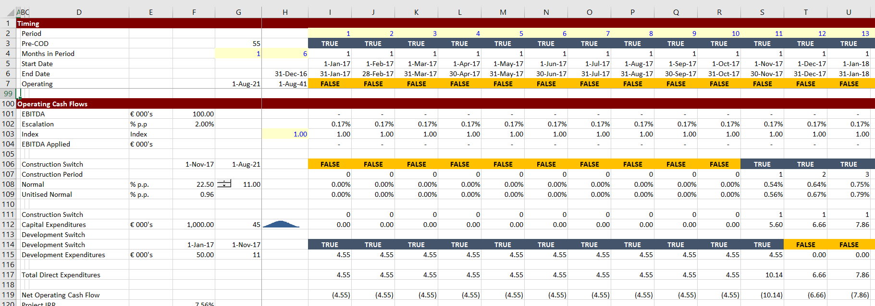
Exercise 3: Given Inputs Compute and Cap Exp to Compute Project IRR
Use switches and input values for Capital Expenditures and EBITDA (use TRUE and FALSE)

Slide 102
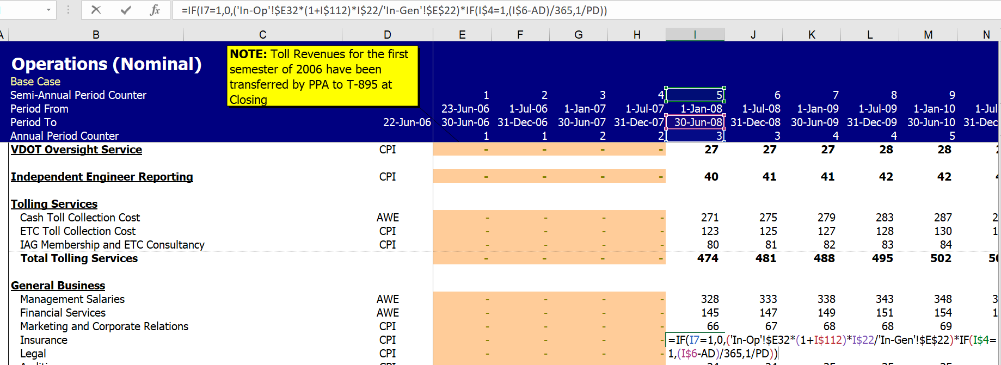
Examples of Non-Transparent Revenue and Expense Analysis

Slide 103
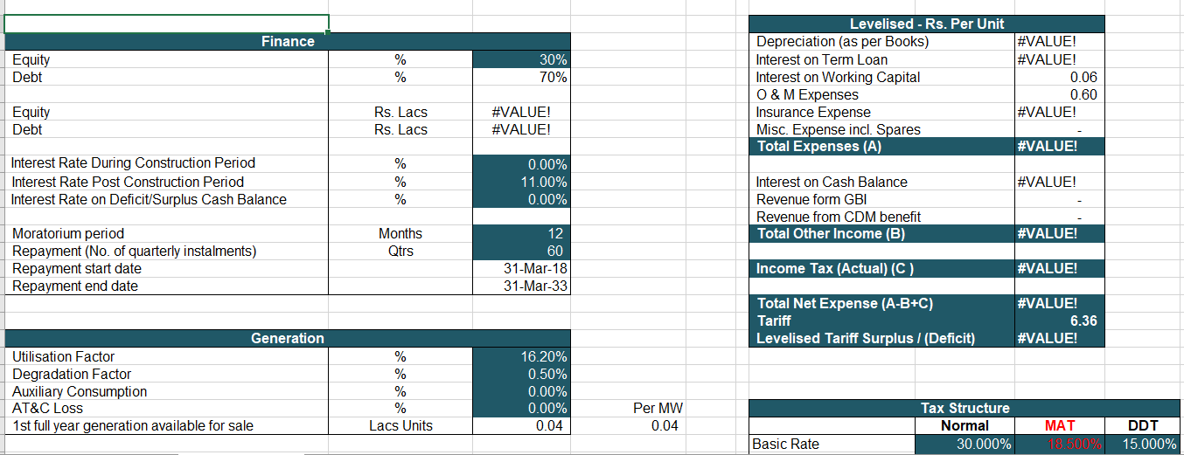
Examples of Un-Structured Revenue and Expense Analysis
Arranging Assumptions – Here the assumptions are out of order. PLEASE put the assumptions in the same order as the model and do not mix up expense and revenue assumptions.

Slide 104
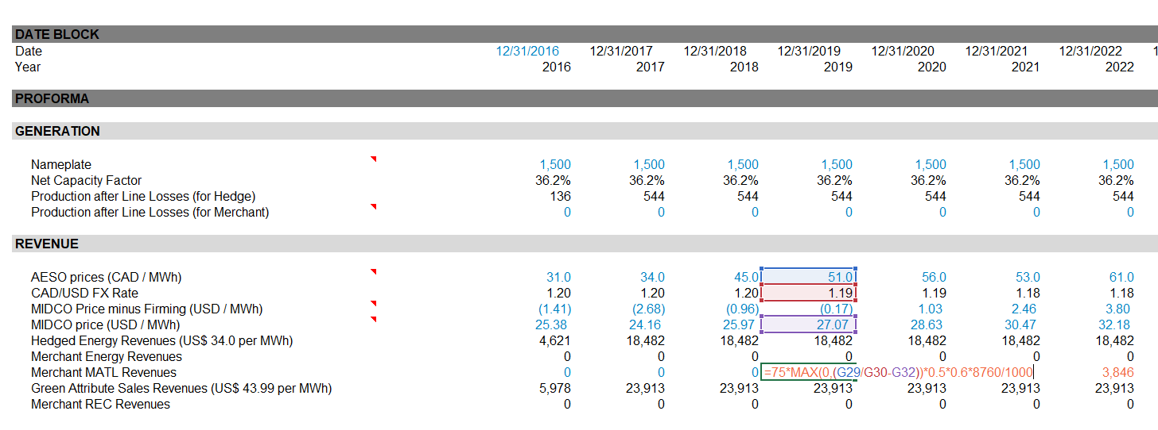
Obvious Mistake by Big Bank – Inputs Mixed Up with Calculations
How could they do this with mixing up calculations and inputs in this manner. Putting fixed numbers in the core calculations is a big crime.

Slide 105
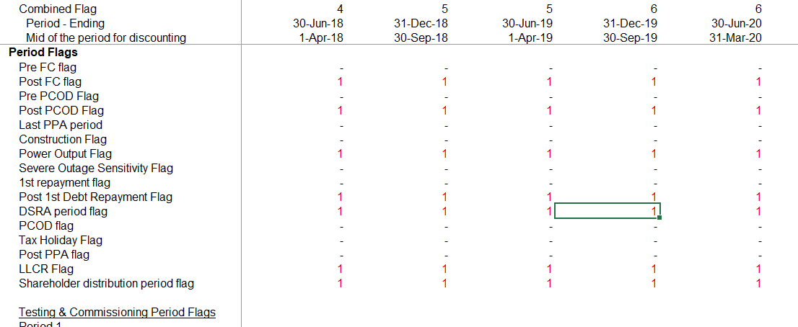
Common and Disgusting Example of Including a Separate Page or a Separate Section of Flags, Masks, Switches
The idea of transparency is to see what is going on. If you stop the PPA after a certain period and then have to go to another page to find how it works, this defeats the transparency principle.

Slide 106
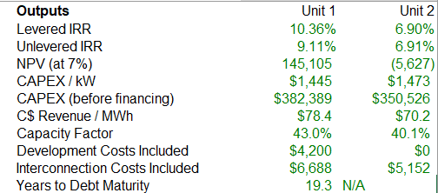
IRR Presentation in Models
Equity IRR should be a lot higher than project IRR if the interest rate is below the project IRR

Slide 107
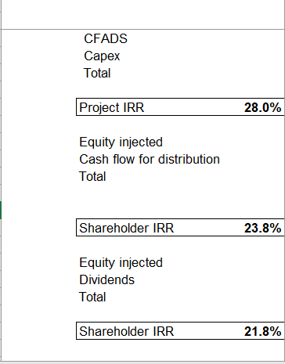
Results that Do Not Make Sense in Actual Model

Slide 108
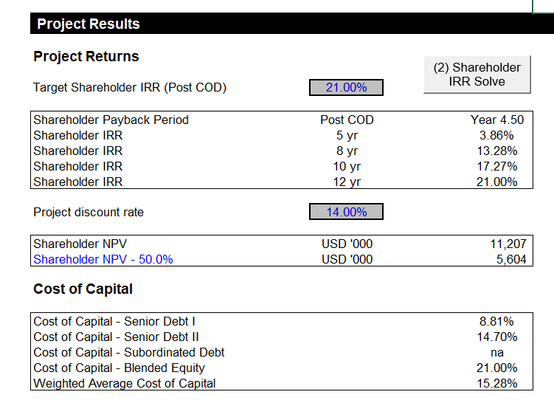
Very Typical to Have no Project IRR which is a Key Ratio for Evaluating Project Economics
Here only the equity IRR shown and irrelevant WACC

Slide 109
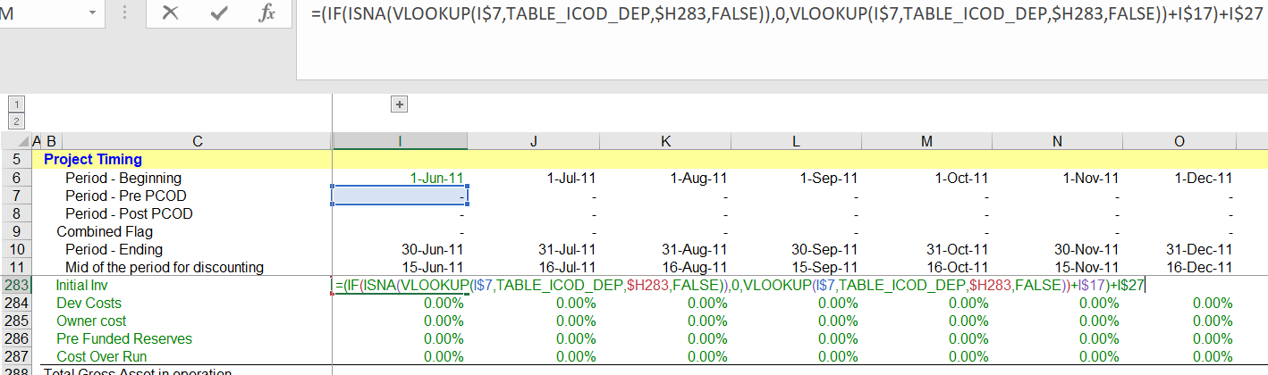
Problems with Lookup and Range Name for Data Table
Example of formula that is difficult to interpret.

Slide 110
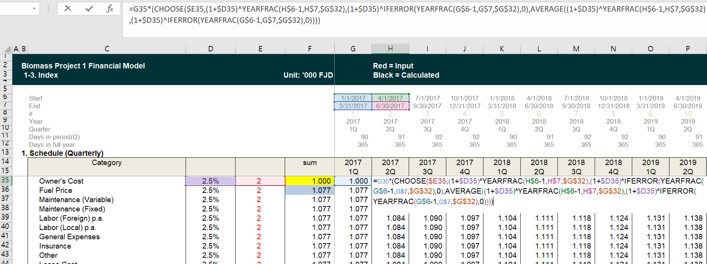
Formulas for Indexing
Put formulas next to where you use them – this should make you cringe.

Slide 111
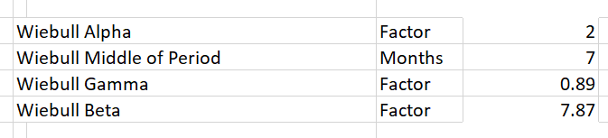
Somewhat Complex Item
Create a flexible S-curve with the Weibull distribution.
The Weibull can be just like normal or can be skewed.
You can keep the construction constant while delaying the COD.

Slide 112
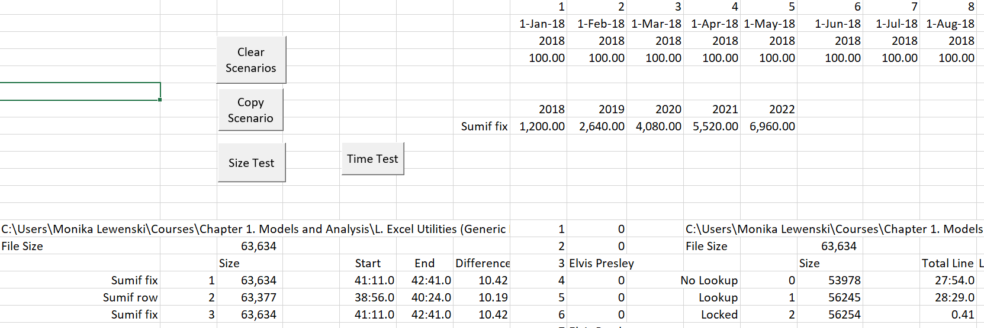
Note on Speed and Size of SUMIF with Total Line
The flow items in free cash flow – Capital Expenditures, Revenues, Expenses and Working Capital Changes can be presented in an annual page with the SUMIF function. The size and time test demonstrates that using the SUMIF with the entire row or column does not slow things down.

Slide 113
Items not Addressed in This Case that You Can Find Elsewhere
Working capital where the days of working capital extend beyond the period of the model
Exchange rates where some of the items are paid in one currency and others are paid in another currency. Put PPP and deviation from PPP exchange rates including inflation rates at the top of the of the revenue/expense and capital expenditure analysis.
Non-contract or merchant period where expenses may depend on the level of prices (real options and terminal value).

Slide 114
Now, You Do It
Use the page after the volumes and capacity have been established.
Work through inflation rates:
  Begin in correct period
  Formula: (1+annual rate)^(months/12)-1
Working capital from days in period
Include pre-tax free cash flow here – do not wait until the end of the model and try to go backwards.

Slide 115
Part 4: Operating Taxes, Depreciation and After-tax Project IRR

Slide 116
After Tax Free Cash Flow
In finance courses, valuation is computed from after-tax free cash flow
Taxes are computed without any distortions from financing
Tax effects of IDC depreciation, fee amortization, interest are excluded
If project finance is all-equity IRR, some include shareholder loans
By computing depreciation, you can put together financial statements

Slide 117
Depreciation and Capital Allowance for Tax
Depreciation, capital allowance and fixed asset module
    Notion of structured models with separate section for depreciation analysis
    Use of timing switches for depreciation and/or capital allowance
  Introduction to verification and auditing for testing balances
  Benefits of separating deprecation on interest during construction and fees from other depreciation and amortisation
      Calculation of after-tax project IRR
      Calculation of project IRR assuming alternative sale dates earlier than the retirement date
Accounting is not different just because it is project finance. You still capitalise assets that last more than one year.

Slide 118
Tax Depreciation and Book Depreciation
For calculations of IRR, DSCR, LLCR etc., the tax depreciation is important
Only reason for book depreciation is income calculations for presentation to management.
If you really want to track return, you can use economic depreciation.
  This is an advanced issue that will be addressed in the tracking actuals section
Tax Depreciation and VDB

Slide 119
Replacement Costs and Remaining Life
Replacement capital expenditures can occur from:
Expansion of wells
Inverters
Overhaul costs
Extraordinary costs
Depreciation can occur over remaining life
Need some kind of function
Array is painful
Errors from assuming tax deductible in current period

Slide 120
Accounting and Taxes
Of course taxes can be very complex and involve all sorts of adjustments when multiple jurisdictions are involved.
But in general, taxes are in one way or another derived from accounting, meaning that you should begin by understanding a few accounting principles.

Slide 121
Timing of Post-COD Capital Expenditures
To model post-COD capital expenditures that only occur for one single period, use the MATCH function with a zero for an exact match.
01
Then use IFERROR or ISNA to make TRUE/FALSE switch
02
Finally, use LOOKUP to get the data into the model.
03
Note, do not confuse the actual expenditure with the MRA account. The MRA comes after debt is added to the model.
04

Slide 122
Depreciation Function – Varying Rate
Function where the depreciation has an array and different rates by age (e.g. declining balance)
Function depreciation(capital_expenditure, depreciation_rate) As Variant
asset_life = depreciation_rate.Count ' Find Life from the depreciation rate array
cap_exp_periods = capital_expenditure.Count ' See how many cap exp periods model
ReDim Depreciation_Expense(cap_exp_periods) As Single ' Make a new array
For model_year = 1 To cap_exp_periods ' loop around each period
For vintage = 1 To cap_exp_periods ' make a second loop - square
age = model_year - vintage + 1 ' calculate the age of each exp the diagonal)
If (age > 0 And age <= asset_life) Then ' Only when asset is alive
Depreciation_Expense(model_year) = _
capital_expenditure(vintage) * depreciation_rate(age) +
Depreciation_Expense(model_year)
End If
Next vintage Note that the vintage is used for the capital expenditure
Next model_year
depreciation = Depreciation_Expense
End Function

Slide 123
Depreciation Function – Remaining Life
Function depreciation_remaining_life_3(capital_expenditure, remaining_life, max_life, factr) As Variant ' When the output is an array define as Variant
cap_exp_periods = capital_expenditure.Count ' See how many capital expenditure periods are modelled
Dim Depreciation_Expense(5000) As Single ' Make a new array variable that is the output
Dim dep_rate(5000, 5000) As Single
For vintage = 1 To cap_exp_periods ' make a second loop to evaluate asset by asset
If remaining_life(vintage) >= max_life Then
adjusted_life = max_life
dep_rate(vintage, 1) = 1 / adjusted_life * factr
For j = 2 To adjusted_life
dep_rate(vintage, j) = WorksheetFunction.Vdb(1, 0, adjusted_life, j - 1, j, factr)
Next j
Else
adjusted_life = remaining_life(vintage)
If adjusted_life < 1 Then adjusted_life = 1
dep_rate(vintage, 1) = 1 / adjusted_life * factr
For j = 2 To adjusted_life
dep_rate(vintage, j) = 1 / adjusted_life
dep_rate(vintage, j) = WorksheetFunction.Vdb(1, 0, adjusted_life, j - 1, j, factr)
Next j
End If
Next vintage

Slide 124
Depreciation and Remaining Life - Continued
For model_year = 1 To cap_exp_periods ' loop around each and make a square
For vintage = 1 To cap_exp_periods ' make a loop to evaluate asset by asset
age = model_year - vintage + 1 ' calculate the age of (the diagonal)
If (age > 0 And remaining_life(vintage) <> 0) Then ' Only when asset is alive
Depreciation_Expense(model_year) = _
capital_expenditure(vintage) * dep_rate(vintage, age) +
Depreciation_Expense(model_year)
End If
Next vintage ' Note that the vintage is usef for the capital expenditure
Next model_year
depreciation_remaining_life_3 = Depreciation_Expense
End Function

Slide 125
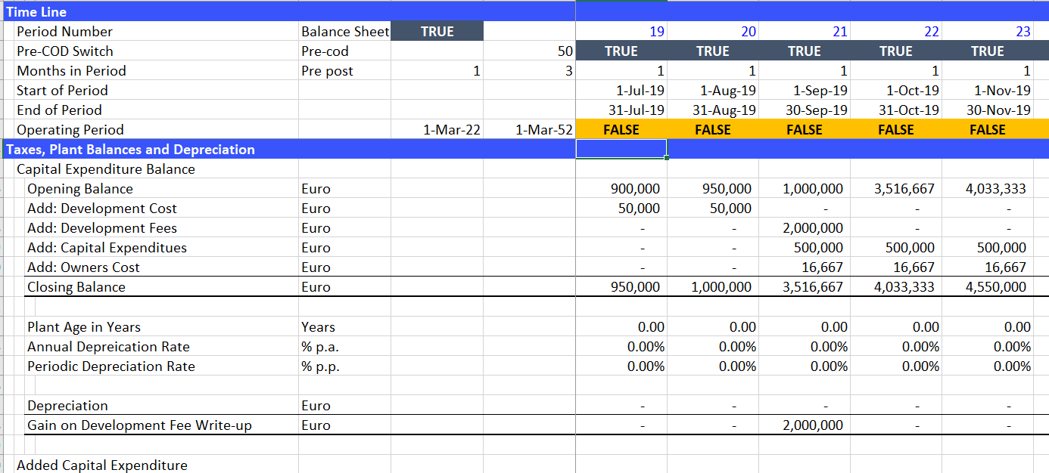
Plant Balances
When computing depreciation, compute the plant balances (you can use the plant balances for straight line depreciation). Plant balances will be plopped in the balance sheet.

Slide 126
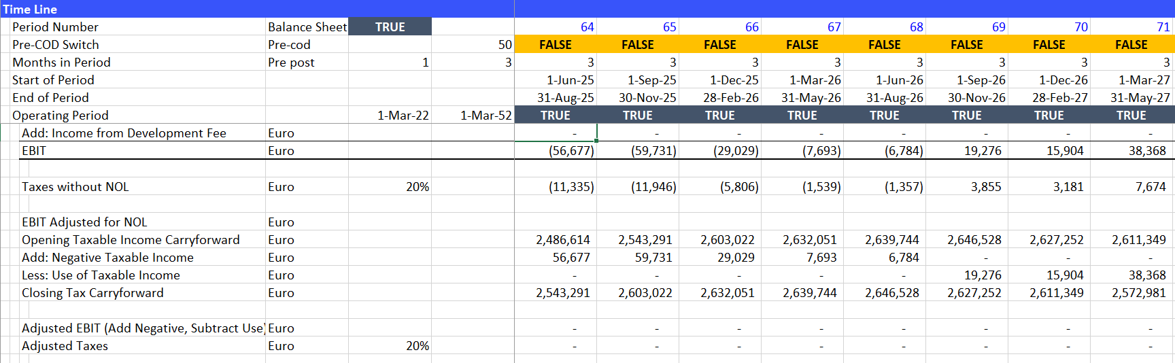
Taxes and MAX/MIN
To carryforward taxes in a simple way:
Understand that you do one thing when the taxable income is positive and another thing when the taxable income is negative.
Use the MAX function for testing positive or negative
Use the MIN function for capping amounts and not letting amounts fall below zero.

Slide 127
Development Fee and Depreciation
Development fee is simple if you pay the fee to a third party
  You record the cost of the purchase as a capital expenditure and depreciate the cost
  The seller can experience a gain on the sale of the asset which could be taxable if he does not have a carryforward.
If the development fee is with yourself
  You write-up the asset
  As this is non-cash, there must be an income offset
  In theory the asset write-up can cause taxable income, but I do not see this in models.

Slide 128
Development Fee and Tax Payments
The tax treatment of development fees, interest during construction, amortization of fees, depreciation, interest on shareholder loans and other items depends on the specific tax rules of a country.
Tax treatment can conflict with financing strategy:
Development fees increase taxes if taxes are paid on the gain from the asset write-up
It is not good to extend the construction period with multiple projects from a tax standpoint if interest deductions for taxes are delayed.

Slide 129
Owner’s Cost and Tax Payments
Owners costs are similar to development fees in terms of taxes from the perspective of the entire corporation.
Consider a hypothetical example of the CEO’s salary.
  Let’s say the CEO thinks about the project a few times when he goes to sleep.
  You then allocate part of the CEO’s salary to the project and increase the project cost with an account called owner’s cost.
  The CEO’s salary would be deducted immediately if it was not allocated to the project.
  By allocating the CEO’s salary to the project, if it is capitalised, the tax deductions are delayed.

Slide 130
Examples of Tax Errors in Models
Taxable income on development fee
Capitalization of major maintenance costs for tax purposes
Understanding that delay in recognizing interest expense (i.e. continuing IDC) is costly as is not associating pre-COD EBITDA with depreciation.
Including the effects of shareholder interest on corporate taxes (interest is taxed but dividends are not).

Slide 131
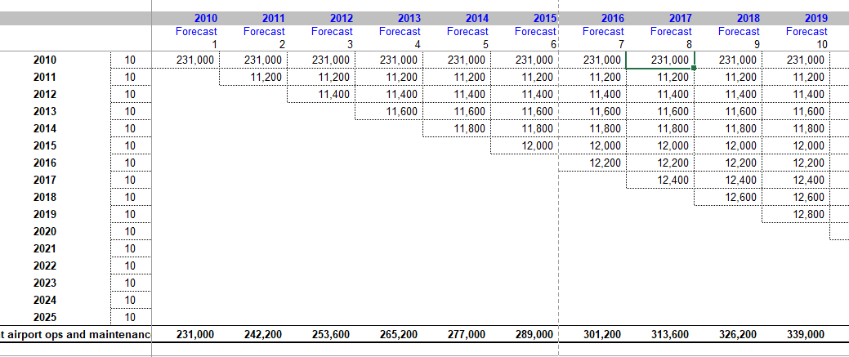
Example of Problems with Depreciation In Models – Completely Un-necessary Matrix with Straight Line Depreciation
No need for vintage with straight line depreciation. Seem to be showing off excel prowess.
Note how this is a square

Slide 132
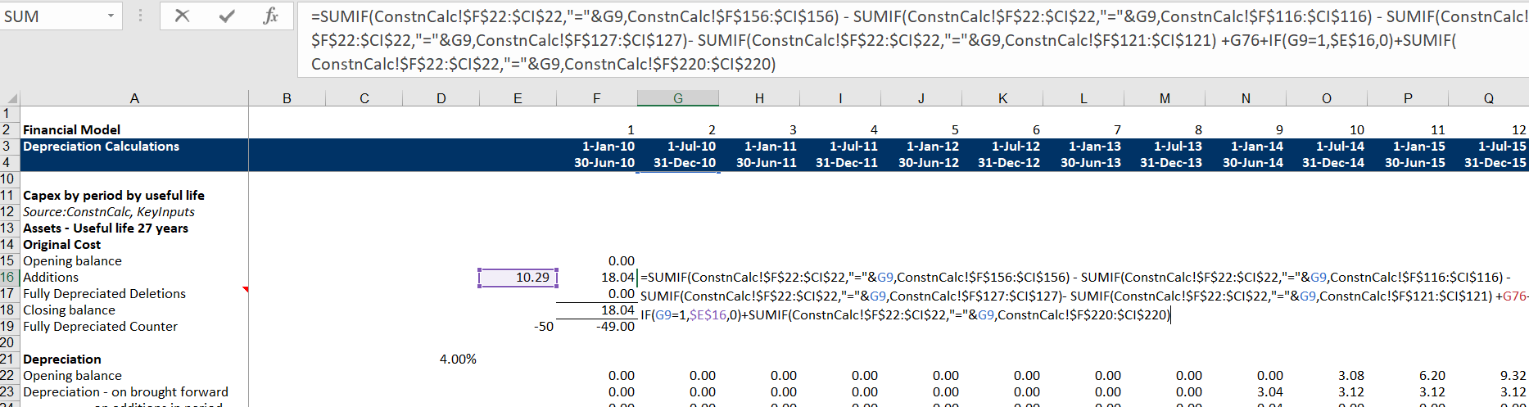
Problems with Depreciation in Models
As usual, a big problem is non-transparent and long formulas

Slide 133
Items not Addressed in Taxes
Expiration of NOL after a certain period – this is very painful because you must keep track of when the NOL is created and you cannot put it all in a big bucket. See other examples.
Tax credits from grants and whether these should be treated as a reduction in asset cost or as a contribution of equity. (A contribution of equity is much better for gearing ratios).
Differences in deprecation rates for different classes of assets (this is simple but tedious)

Slide 134
Now, You Do It
Use MATCH, IFERROR and INDEX for putting the future capital expenditures into the correct periods from the input data
Retrieve the depreciation functions and compute depreciation of the future capital expenditures
Create a plant balance and accumulated depreciation account from capital expenditures.

Slide 135
Session 5: End-to-end Model with No Debt and Financial Statements

Slide 136
Philosophy of Setting Up Model to Balance Sheet
Structure model with multiple cash flow statements, income statement and balance sheet
Include Summary Sources and Uses even though it will not be necessary until debt is added
Set-up pre-COD cash flow statement with funding needs – cash, and funding sources.
  Pre-cod income net of tax is a source of cash
Model Profit and Loss Statement
  Include pre-COD income
  Include depreciation
  Compute Net Income
Make Cash Flow Waterfall after COD
  Do not double count items in construction section
  Last line is the dividends
Compute Equity Balance
  Equity Funding from Pre-COD cash flow
  Net Income from P&L
  Dividends from Cash Flow Waterfall
Put together Balance Sheet (and Consolidated Cash Flow if you want)

Slide 137
Summary Sources and Uses
Structure like balance sheet
Include development fees and development costs. Could include gain on development fee detailed models
Include working capital pre-COD as well as EBITDA and taxes pre-COD
Income less taxes is on the equity side of the balance sheet like common equity
Use SUMIF with TRUE/FALSE and entire rows to find EBITDA, Working Capital and Equity over the Construction Period
The last line of the summary sources and uses statement is equity contributions

Slide 138
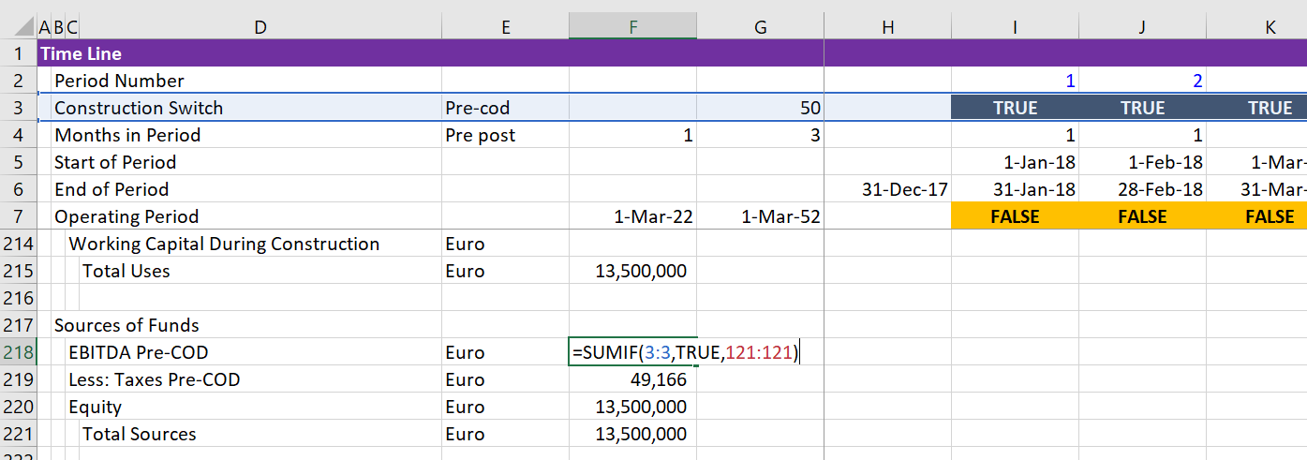
Example of Using SUMIF with TRUE/FALSE in the Summary Sources and Uses
Note how the entire row is selected and then the TRUE is the criteria. The sum row is the final row. Use for pre-COD EBITDA

Slide 139
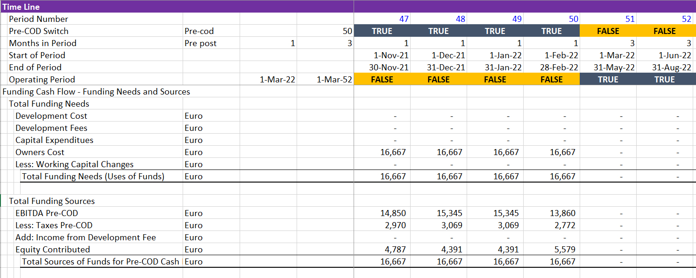
Cash Flow Pre-COD – Uses and Sources of Funds, How do you get the money into the project
Understand that there are two cash flow statements

Slide 140
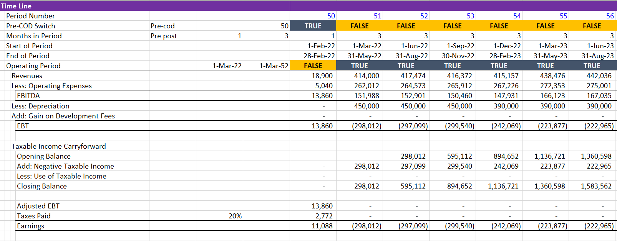
Profit and Loss Statement
Once have depreciation you can compute the P&L

Slide 141
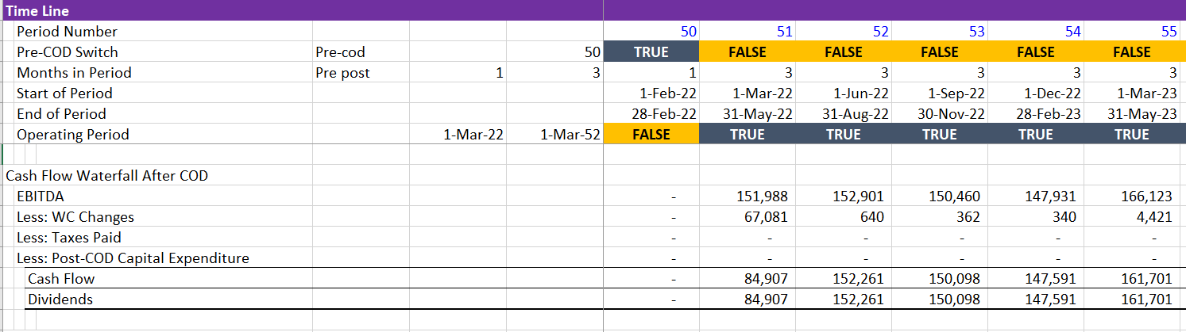
Cash Flow After COD
Note how the cash flow waterfall is a second cash flow statement that begins after COD. The P&L does not have this distinction.

Slide 142
Model Verification
Use TRUE/FALSE (or 1/0) together with AND or PRODUCT
Can overdo the checks
For balance sheet, the balance at the end of the life should go to zero as well as the assets equaling liabilities in each period.
While working on the model, put the balance sheet test at the top.

Slide 143
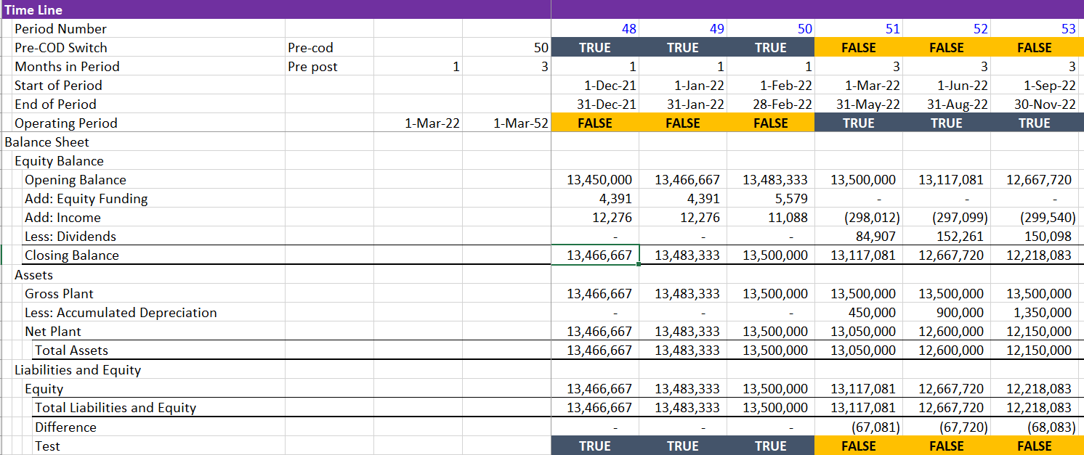
Balance Sheet
All Balance Sheet items should come from totals – no calculations other than sums
Not that does not balance in example.

Slide 144
Advantages of Putting Balance Sheet in Early
After basic balance sheet balances, you can add individual items that you add subsequently like debt, IDC, fees, MRA, DSRA, cash sweeps.
When the balance sheet does not balance, search for the difference number. If you begin and do this one by one it will be easier.

Slide 145
Examples of Bad Balance Sheet From Forcing Balance Sheet
Worst Error is forcing the balance sheet to balance with a cash account
Just about as bad is not putting a balance sheet in the model. This is quite common

Slide 146

Problems with Balance Sheet – Putting Calculations in Balance Sheet Rather than Using Balances
Every item in balance sheet should already be defined.

Slide 147

A Pretty Good Model, But Formulas in Balance Sheet
Put balance sheet on core model page

Slide 148
Section 6: Adding Debt to Model – Debt Draws with Given Amount of Debt

Slide 149
Financing Assumptions and Equations – Five Separate Items
Building a model from A-Z – Financing Assumptions and Equations
Five Parts
  Debt Size
  Debt Funding
  Debt Repayment
  Interest and Fees
  Credit Protections
Model Sections
  Uses and Sources Summary
  Funding: Uses and Sources Period by Period
  Debt Schedule: Repayment
  Debt Schedule: Interest and Fees
  Cash Flow Waterfall and Equity Cash Flow

Slide 150
Understanding the Difference between Structuring and Risk Analysis
Risk Analysis
  Debt structure given. Use the model to evaluate downside cases and whether debt can be repaid using DSCR, LLCR and PLCR. Could also use to evaluate upside from re-financing.
Structuring Analysis
  Determine the debt size, the debt repayment structure, the interest rates and debt protections from evaluating the consulting reports and engineering analysis of the project.

Slide 151


Term Sheet and Debt Size
Debt Size
For this exercise, assume that the debt size is given as a fixed amount. Debt sizing will be addressed in a subsequent chapter.

Slide 152

Debt Size Inputs and Structuring versus Risk Analysis
Later, we will develop alternative ways to measure debt size.
If the model is used for structuring, alternative and flexible methods should be used.
If the model is used for risk analysis, then you can have a simple fixed input for the amount of the debt.

Slide 153

Debt Funding from Term Sheet
Term sheet on funding from Pro-rata or Equity Up-front

Slide 154
Flexible Funding Inputs and Capitalised Interest
To make the model flexible, you can make an input for the percentage of equity funded up-front.
Funding is affected by whether the banks allow you to capitalize interest and fees. Capitalised Interest means that you do not pay interest to the bank during construction, but it rather accrues to the debt balance.
Note the difference between capitalised interest and IDC or Interest During Construction which is sometimes also called capitalised interest. It is called capitalised interest. Capitalised interest from an accounting standpoint just means that the interest (whether paid or accrued to the debt balance) is not accounted for as an expense, but rather as a part of the plant which will be depreciated after the COD.

Slide 155


Example of Inputs for Funding
The inputs for funding seem easy, but they can cause a lot of pain in modelling.
From term sheet:

Slide 156
Basic Repayment with Fixed Scheduled
After the debt size and funding are established, the inputs for repayment come next.
Subsequent sections will address sculpting and how to structure the repayment of debt. For now, we are structuring the location of debt in a model and we assume that the repayment profile is given.
If the debt is used for risk analysis rather than structuring debt, the debt repayment will be given.

Slide 157

Term Sheet Inputs for Repayment of Debt
Debt repayment involves tenor and method. Details of this will be addressed in the later sections.

Slide 158

Inputs for Maturity and Pre-Determined Repayment
In this case, use MIN function for the smallest maturity
Also use MIN with opening accumulated balance to cap the amount (use 1-accumulated balance) and accumulate with calculation itself.

Slide 159

Interest Rates in Term Sheet – Base Rate (LIBOR)
Interest rates include a base rate and a credit spread.
There is also a hedging requirement.

Slide 160


Capitalisation of Interest and Fees
The up-front fee and the commitment fee can also be defined as below.

Slide 161


Credit Spreads in the Term Sheet – The First Thing to Look For
These margins are extremely high. They are increasing to encourage re-financing. Use of these margins in the base case is irrelevant.

Slide 162

Inputs for Interest Rate and Credit Spread – Include Sensitivities in Separate Sheet
Put the credit spread from the time sheet even though it is inconsistent with the base case.
Will add alternative scenarios in scenario page.

Slide 163

Step 1 - Entering Debt Into Model
The first step is adding rows to the summary sources and uses of funds statement. Include IDC, Fees and Debt Amount as shown below.
Note that IDC and Fees are not entered yet and Capitalised Interest is part of funding sources.

Slide 164
Notion of Including Non-Cash Items in Sources and Uses
Include development fees as uses of funds even though may not be cash outflow
But, include income from development fees as source of funds
Include IDC and fees as uses of funds whether they are paid or capitalised
If they are capitalised, include them as sources of funds and also make sure the debt balance is reduced by the capitalised amounts if the fixed debt is directly or indirectly input.

Slide 165
Equity Adjustments
Often, income during construction and development fee (income) are included as part of equity funding even though these items do not involve cash that has really been funded by equity holders.
The first step should be to count how much is in the equity funding obligation per the loan agreement. This can be after the sources and uses of funds statement.
The second step is to make a detailed period by period funding analysis that is consistent with the equity funding requirement.
The final step is re-adjusting the funding analysis to determine the actual cash that equity holders contributed in order to compute equity IRR.

Slide 166

Step 2: After the Sources and Uses, Compute Cash Debt Issued and Up-Front Equity
In addition to the sources and uses, compute the up-front equity from the total equity issued and the cash debt funded adjusted for capitalised interest and fees.

Slide 167

Step 3: Funding Needs and Sources
Include capitalised interest and development fees as both a source and use like in the summary sources and uses.

Slide 168

Step 4: Compute the Equity Balance and the Remaining Equity to Find Debt and Equity Draws
Use the MIN function with the funding needs and the remaining equity balance that has not been drawn.

Slide 169

Step 5: Debt Schedule, Fees and IDC
The last step in the funding analysis is to put together the debt schedule.

Slide 170
Tricky Issues with Equity
Typical is to treat pre-COD income as equity. This means that the equity that is committed includes the pre-COD income.
Development fees are also typically included in the equity balance.
For debt, if interest and/or fees are capitalised, then you need to distinguish between debt that funds cash and debt that must be repaid from the interest capitalisation.

Slide 171
Leave Out the IDC, Interest and Fees from Financials and Check the Balance Sheet
There will be circular references from IDC and fees, but make sure everything is set-up first.
Do not include IDC and fees in the sources and uses statement.
Include debt in the balance sheet and check to make sure the balance sheet balances.

Slide 172

Why Make Life So Painful with Different Sheets
Press CNTL ~ to get formulas

Slide 173
Section 7: First Circular Reference from Debt – Funding with Fixed Debt and Problems with IDC and Fees

Slide 174
Skip Over the Copy and Past Macro or the Iteration Button and Move to UDF
Try and get straight to the point
Do not waste time with copy and paste macro
Do not waste time explaining technical details of the UDF function
Illustrate use of the function first
Demonstrate advantage of function with goal seek

Slide 175
Philosophy
Open your mind and try different ways
Don’t give up when something does not work perfectly
Redundancy is a good way to verify things
Apply FAST and efficiency principles in other aspects of modelling

Slide 176

With IDC and Fees, Finally, a Circular Reference
If equity is funded up-front, then (even if debt is given) there can be a circular reference. The amount of equity is driven in part by IDC, and fees.
But the IDC and fees are driven by the timing of debt.
The timing of debt is driven by the project cost and up-front equity.
…………………

Slide 177
Excuses for Copy and Paste Macro Instead of a User Defined Function
The UDF is too complex
The auditors will not understand it
There are too many arguments in a function
You cannot verify the function
Writing the function from scratch is very difficult

Slide 178
This is like Africa Excuses
Make UDF same as the excel – as complex as the excel – no more, no less
The UDF is in fact an auditing tool – if the UDF is not consistent with the excel, there is a good chance that there is a mistake in excel. Further, the UDF gives almost the same outputs and can be tested like a copy and paste macro.
You can verify the function by printing out all of the detail.
You do not have to re-write the function if it is written in a transparent way. Further, you can write it so it can be easily modified.

Slide 179
Template Issues
I generally do not like the idea of a template model.
  Not flexible because difficult to change
  Not structured and can mess up your structure
  Not transparent because cannot understand all of the equations
Attempt to get around these issues with flexible and as transparent as possible structured

Slide 180
Other Advantages of Template
Flexibility
  Inherent ability to test structuring sensitivities that are so difficult with copy and paste macros
Accuracy
  Built in test for model. Like Airplane with two engines – have two tests instead of one.
  Built in auditing for the model

Slide 181

Copying Template
Copy the template with tables and instructions
  Base table (optional)
  Debt Options Table
  Debt Structure Table

Slide 182

Notion of Optional Variables
You do have to enter any of the variables such as the development switch, working capital changes etc.
These variables are assigned to FALSE or zero in the function.
The optional variables hopefully allow a more flexible process.
When an item is not bold it is an optional item. You can skip over items and the process is more flexible.

Slide 183

Incorporating the UDF in Your File
Copy the UDF with ALT-F8 like you do for other situations (e.g. Interpolated, Depreciation).
Set-up a Block as the Output for the Function
Copy any number to block and then enter the function
Use the SHIFT, CNTL, ENTER to put the function together

Slide 184

Implementing the UDF
Implement the UDF with entire rows and columns

Slide 185
FAST Principles and UDF Functions
Try to make flexible to handle alternative structuring and debt techniques as well as multiple debt issues.
Try to make flexible so it is not difficult to add different calculations to the UDF
Make tests to verify the accuracy of the calculations
Make structured with different parts of the program
Try and document calculations and code so you can understand techniques

Slide 186
Difficulties with Function
The user-defined function requires you to define each input.
There is a limit on the number of variables that you can read into a user-defined function.
If there are many debt issues, you will run out of variables.
  To resolve the issue, I use a table where you must re-enter the debt data.
  This means that work is required to re-structure and define inputs.

Slide 187

Finding the Solution for Too Many Variables
Just about to give up.
Horrible function with too many variables.
Found alternative solution with table at the very bottom of discussion.

Slide 188

Reading In Tables
I have put in a general table for issues associated with debt and specific issue by issue items. The table below illustrates general items. Note there are some scalars and some time series variables.

Slide 189

Reading in Debt Issues
There can be a number of different parameters with debt facilities and there can be many different debt issues. These can be modified.

Slide 190
Link Inputs and Items in Model to Table
Part 1: Debt Options
  Development Cost
  Up-front Equity Percent
  Total Senior Debt
  DSRA parameters
  MRA Parameters
Part 2: Debt Features by Issue
  Percent of Senior/Sub Debt
  Interest Rate
  Up-Front and Commitment Fee
  Repayment

Slide 191
Mimic Funding Calculations in the UDF
Start with project uses and sources – equity is the remainder in the sources (do not know the IDC, fees, DSRA yet)
Move to financing during construction and mimic calculations with option for pro-rata or equity up-front
Next move to repayment with IDC depreciation and sculpting
As with excel sheet, do not use un-necessary functions and techniques

Slide 192

Illustration of the Function
You can work through the function as it will be very similar to the file we have been using

Slide 193
Diagram of Testing Process
Use key variable like project cost
Remember the project cost from last iteration
  Define as last project cost
Assign last project cost to project cost
Test if new project cost is equal to last project cost
Re-do all of the calculations
Yes, stop
No, continue

Slide 194

Illustration of Iteration Test
Make sure do not pass in first iteration.

Slide 195
Structure of UDF
Read in variables with option to leave out items.
Define the timing and the column numbers
Begin with the uses of funds (even though you do not know IDC etc.)
Then loop through the construction period
  Define IDC etc. from opening balance
  Define the funding needs
  Work through pro-rata and equity first funding

Slide 196
Getting Data into the Function
Attempt to be flexible
  Different debt sizing
  Different funding
  Different repayment
  Different interest rates
  Multiple debt issues
  Alternative tax rates
  Alternative definition of CFADS
  Allow balloon payments

Slide 197

Issue of Reporting in Function
The typical application of a function is to find a single variable or an array of variables. In this function I print out a whole lot of variables so you can document problems.
When the array index is Count, the entire row is presented

Slide 198

Iteration Button in Some Models
Example of circular reference in model from a really really big bank.

Slide 199

Bad Alternative to UDF – Macro with Solver
Example of using solver with circular reference.
This is really not impressive (even though I used to do it).

Slide 200


Addiction to Macro Buttons
To many macro buttons ruin transparency and flexibility

Slide 201

Example of Long Copy and Paste
Copy and paste becomes longer and longer

Slide 202

Macro for Copy and Paste

Slide 203
Section 8: Cash Flow Waterfall – Sweeps, Traps, Defaults, LLCR and PLCR

Slide 204
Repayment in Risk Analysis
Another chapter will address debt repayment and sculpting in the context of structuring analysis.
The fundamental aspect of risk analysis in this chapter is connection of debt schedule to cash flow statement. This connection can be in the form of:
  Cash Sweep
  Default and Repayment of Default
  Cash Traps with Covenants
  Cash used from MRA and DSRA’s
The mechanics other than the MRA and the DSRA are addressed in this context.

Slide 205

Examples of Sweep in Term Sheet
Cash sweeps are at the bottom of the waterfall and can employ complicated formulas. Note the term “cash flow available for distribution.”

Slide 206

Example of Cash Trap in Term Sheet
A cash trap uses the DSCR to limit distributions. Note that after monies are trapped in a reserve account, they are used to pre-pay debt in the same way as the cash sweep.

Slide 207

DSRA and MRA
The DSRA and MRA are cash accounts that are used to further protect creditors.

Slide 208

Modelling Issues
First, get the repayment of debt using a fixed repayment schedule
Make sure the closing balance goes to zero
Scheduled repayment in cash flow and balance the balance sheet.

Slide 209
Cash Flow Waterfall Modelling Issues
Step 1: Create sub-totals in the cash flow
Step 2: Use the MAX and MIN functions in the cash flow statement to cap the cash flow (the MIN function) and to do one thing if cash flow is negative and another thing if cash flow is positive.
Step 3: Connect various amounts in cash flow statement with the debt (or MRA/DSRA) schedules

Slide 210

Illustration of Cash Flow
Include sub-totals so can program MIN/MAX

Slide 211
DSRA Calculations
First, compute the repayments using PPMT function or simple level repayment.
Next, calculate the debt service and the required debt service reserve that is either the basis for the DSRA or the letter of credit that is the basis for the DSRA.
If the DSRA account is funded with cash (i.e. not an LC), then compute the funding during the pre-COD and the post-COD period.
I do the same thing in the UDF function using a second and third loop

Slide 212
Circular References and DSRA
Three types of circular references from the DSRA:
  1. With cash sweep because:
    Cash sweep affects interest expenses and debt service
    DSRA driven by debt service
    DSRA affects the cash sweep
  2. If the debt level is driven by project cost because:
    DSRA affects project cost
    Project cost drives debt
    Debt drives the DSRA
  3. Pro-rata funding
    DSRA is part of funding needs
    Funding needs drive the debt and equity issuances and IDC
    IDC drives the debt funding available

Slide 213
Resolution of Cash Sweep Problem
Two ways to resolve with economic logic and without any UDF, copy and paste etc.
Method 1: DSRA after Cash Sweep in Waterfall
Now the cash sweep is not a function of the DSRA
Method 2: Adjust interest expense for debt service to include only interest from next year’s scheduled debt service
Separate interest expense to compute DSRA requirement where interest expense is computed from earlier opening balance and scheduled (but not actual repayment)

Slide 214

Illustration of Debt Service without Prospective Interest on Cash Sweep
Go backwards and re-compute interest on previous debt balance that does not include the effects of the cash sweep.

Slide 215

Illustration of Method Moving Cash Flow Items
You could cheat and put the DSRA below the cash sweep. In this case the interest expense is not affected by the DSRA moves which go straight to dividends.

Slide 216
Circular Reference with DSRA and Funding
The funding of the DSRA can cause problems with circular reference, because:
  The DSRA affects the total funding needs
  The percent of debt is affected by the DSRA
  The DSRA changes when the amount of debt changes.
This circular reference can be resolved by:
  The iteration button – disaster
  The copy and paste – even worse
  The UDF function without template
  The UDF template

Slide 217
DSCR, LLCR and PLCR to Gauge Credit Quality

Slide 218
Idea of Risk Allocation Matrix and Use of DSCR, PLCR and LLCR to Measure Break-Even
Risk allocation matrices will be used to demonstrate how the DSCR and LLCR can be used to determine acceptable unmitigated risks:
  The formula:
  break-even cash flow reduction = (DSCR-1)/DSCR.
  Also break-even cash flow over life of loan
  BE reduction = (LLCR-1)/LLCR
  BE reduction for Project Life = (PLCR-1)/PLCR
Different project finance structures that involve:
  availability payments versus output-based revenues;
  commodity price (merchant) risk;
  traffic or volume risk (pipelines), and
  resource risk (wind, solar and run of river hydro) will be derived.
For each of the project finance types, an illustrative risk allocation matrix and project diagram will be developed.

Slide 219
LLCR Problems with Different Maturities
If interest rates are the same for different debt issues – even if they change, then the PLCR can be computed prospectively with the SUMPRODUCT or SUM method.
Computing the LLCR is similar, but the LLCR is different for different debt issues.

Slide 220

Sub-totals in Cash Flow
I suggest putting the closing balances in separate accounts and use sub-totals in the cash flow.

Slide 221

Cash Sweeps and Not Connecting the
Long formulas and not connecting to correct sheet.

Slide 222

Enter Simple Debt Structure in Model
Enter simple debt structure
  Fixed Debt to Capital
  Level Repayments
  Fixed Interest Rate
Use the MIN function for testing debt repayment
First, make sources and uses
Second, make corkscrew
Third, make simple cash flow
Fourth, compute the Equity IRR

Slide 223

Too Complex Formulas in Cash Flow
Keep in one page and formulas should only have MAX and/or MIN

Slide 224
Section 9: Risk Analysis with Model – Defaults, LLCR and PLCR

Slide 225
Fundamental Formulas for Credit in Project Finance for DSCR, LLCR and PLCR
DSCR = Cash Flow Available for Debt Service/[Debt Service]
PLCR = PV(Cash Flow Available for Debt Service)/PV(Debt Service)
LLCR = PV(Cash Flow Available for Debt Service over loan life)/PV(Debt Service)
Debt at COD = PV(Debt Service using Debt Interest Rate)
Therefore,
PLCR = PV(Cash Flow Available for Debt Service)/Debt - DSRA
LLCR = PV(Cash Flow Available for Debt Service over loan life)/Debt – DSRA
Theory
Minimum DSCR measures probability of default in one year
LLCR measures coverage over the entire loan life even if project must be re-structured
PLCR measures coverage over the entire project life and the value of the tail

Slide 226



DSCR versus LLCR versus PLCR
Level Payment and Tail
Min DSCR < LLCR < PLCR
Sculpting and Tail
DSCR = LLCR < PLCR
Sculpting and No Tail
DSCR = LLCR = PLCR

Slide 227
Valuation Metrics in Project Finance and Corporate Finance
Project Finance Investment
  Equity IRR
  Project IRR
  Equity NPV
  Project NPV
Project Finance Debt
  DSCR
  LLCR
  PLCR
Liquidity
  Debt Service Reserve
Corporate Finance Valuation
  P/E Ratio
  EV/EBITDA
  Projected Dividend and Earnings
  Free Cash Flow
Corporate Finance Debt
  Times Interest Earned
  Debt to EBITDA
  Debt to Capital
Corporate Finance Liquidity
  Current Ratio; Quick Ratio

Slide 228
Time to Repay and Debt/EBITDA
If there is no interest, taxes or capital expenditures, then the Debt/EBITDA measures the time to repay the loan.
Eurotunnel 2003:
  Debt 6,365,028
  EBITDA 298,619
  Debt to EBITDA 23.10
  Interest 340,386
  Capital Expenditures 41,118
  Working Capital Change 2,360
  Taxes 0
  Free Operating Cash Flow to Debt (61,850)
  Debt to Free Operating Cash Flow Infinity
  Implication: Debt to EBITDA does not really measure how long it takes to repay debt

Slide 229
You Can Go the Other Way to Find the DSCR
Formulas for Break-Even: Say that you want to know how big the DSCR should be to cover for an availability payment that could be reduced by 20%.
The formulas below are for DSCR; you could also use LLCR and PLCR
  Break-even cash flow = (DSCR-1)/DSCR
  BE = (DSCR-1)/DSCR
  BE x DSCR = DSCR – 1
  DSCR – BE x DSCR = 1
  DSCR * (1-BE) = 1
  DSCR = 1/(1-BE) or 1/.8 or 1.25
Note: Be careful with fixed costs. If an oil project has fixed costs you have to make a more complex formula

Slide 230

Compute DSCR, LLCR and PLCR
Assume cash flow available for debt service is the EBITDA

Slide 231
Issue with Prospective LLCR and DSCR
The problem is that you need to continue re-starting the PV factor in each prospective period.
You could do this with a big matrix but this would take up a lot of space and be painful.
Instead, can make a function that moves forward.
If the interest rate does not change, this is not necessary.

Slide 232

Complex LLCR in Models
LLCR and effective interest rate

Slide 233
Example of Using IF statements in Waterfall
How could anybody understand this thing with XNPV inside the formula and then raised to a power.

Slide 234
Section 9: DSRA and MRA

Slide 235
Selected Issues with DSRA and MRA
Fundamental set-up not so difficult
DSRA issues together with a cash flow sweep
MRA issues with taxes

Slide 236
Section 10: Debt Sculpting and Circular References from CFADS

Slide 237
Session 10: Debt Size from DSCR or Debt to Capital

Slide 238
Different Debt Sizing Options – Need to Work Through Sculpting
Case 1: ' Case 1 is when senior debt is given; senior fixed_total defined in funding
If senior_fixed_total <> 0 Then
LLCR = pv_cfads / senior_fixed_total
End If ' Only if did not enter fixed debt
If LLCR = 0 Then LLCR = 1
DSCR_Applied = LLCR ' DSCR_Applied is used in sculpting
Case 2: ' Case 2 is where the debt comes from a debt percentage
If senior_debt <> 0 Then
LLCR = pv_cfads / senior_debt
End If ' Only if did not enter fixed debt
If LLCR = 0 Then LLCR = 1
DSCR_Applied = LLCR
Case 3: ' Case 3 is from the input DSCR for sculpting
senior_debt = pv_debt_service
DSCR_Applied = DSCR_Input
Case 4: ' Case 4 is the tricky one where different constraints are used
If senior_debt <> 0 Then
LLCR = pv_cfads / senior_debt
End If ' Only if did not enter fixed debt
If LLCR = 0 Then LLCR = 1
DSCR_Applied = WorksheetFunction.Max(LLCR, DSCR_Input)
End Select

Slide 239

General Idea of Optimising Project Finance Debt
The general idea the project finance debt falls somewhere around BBB- and how credit spreads are driven by the probability that the DSCR will fall below 1.0.

Slide 240

Examples of Target DSCR for Alternative Industries
The DSCR standards or benchmarks should have an footnote that says “to meet BBB- criteria”

Slide 241
Session 11: Identifying risks when building and Analysing a model

Slide 242

Presentation
No Equity or Debt IRR

Slide 243

Sensitivity Analysis
Why use the OFFSET

Slide 244

Show where Sensitivity Comes From
The input sheet can become a bit mixed-up. Either use range names or show sheet colour.
Some are inputs and others come from different places

Slide 245
Swaps and Average Life
The average life of debt measures something like a simple payback. It does not depend on the interest rate and it measures the time at which the debt will be paid off in half.
For 10 year debt with equal installment repayments, the average life would be 5.
In this case you could make 10 swaps, each with a different swap maturity.
To approximate this you could use a 5 year swap.
The average life can be computed two ways:
  ∑ Repayment x Period of Repayment/Total Debt
  or
  ∑ Debt Balance/Total Debt

Slide 246
Use of Interest Rate File and Forward Interest Rates
To make forward interest rate projections, you could theoretically compute forward rates.
Take one example with one and two year yields. Begin with interest rates from the interest rate file.

Slide 247
Compute Implied Forward Rates
Short-term interest rates have risen, but the longer term rates have remained more constant.
To compute forward rate if have one year and two year yield:
One year yield = 1yr is given
Two year yield = 2yr is given
Implied forward rate is from:
Value = Interest 1/(1+1yr) + Interest2/(1+2fw)^2 + Par/(1+2fw)^2
Value = Par x 2yr/(1+1yr) + Par x 2yr/(1+2fw)^2 + Par(1+2fw)^2

Slide 248
Risks in Electricity Generation Operation
  Capital Cost
  Operating Cost
  Capacity Factor and Resource Analysis
  Availability
  Efficiency and Heat Rate

Slide 249
Other Risks
Risks of uneconomic plants
  Computation of LCOE
  Evaluation of political risks
  Benchmarking capital and operating costs with model
Financial and economic risks
  Risks of exchange rate changes
  Financial risks in interest rate changes

Slide 250
Benchmarking Costs
General (and not very good) sources of cost comparison:
  International Energy Agency
  Energy Information Agency
  Lazard
Difficulties
  Changes in cost
  Regional cost
  Units of measurement (wind example)
  Use of models – finding information

Slide 251
Session 4: Analysis of Different Scenarios (including sensitivity analysis)

Slide 252

Example of INDEX Function
We will make scenarios for things like:
  Variation in traffic for infrastructure projects
  Variation in price for commodity projects
  Difference in availability for availability projects
Example of Index Function

Slide 253
Excel Formulas, Short-cuts, Tables, etc.
The excel stuff is like a cookbook
Just find the instructions in a recipe book
  Review instruction in folder files
  Review with other models
  Most important, WATCH VIDEOS

Slide 254
Scenario and Sensitivity Subjects
Alternative examples of adding sensitivity and scenario analysis to a model
  Sensitivity analysis with spinner and drop down boxes
  Scenario analysis using INDEX and table
  Tornado diagrams for sensitivity presentation
  Presentation of scenario analysis with waterfall diagram
Understanding of P90, P95 etc. for computing scenario analysis in renewable analysis

Slide 255
General Idea
So, WITH ANY MODEL AT ALL, you can:
  Press Shift F11 for a new sheet
  Add a Scenario Number
  Create a Scenario Analysis
  Create a Sensitivity Analysis
  Create a Customised Scenario Analysis

Slide 256

Master Scenario Page
Most important thing for a banker, come up with a reasonable downside case

Slide 257

Master Scenario Page
Most important thing for a banker, come up with a reasonable downside case

Slide 258
Tornado Diagram
Create a tornado diagram using the TRANSPOSE function with a Data Table

Slide 259

Overuse of Vlookup
Problem of not using INDEX

Slide 260
Session 10: How to produce an analysis report for communication

Slide 261
Essentials in Summary Page
What is essential and not essential in summarising project finance
Displaying and understanding key operating drivers
  Capital Cost per kW
  Levelized cost per kWh
  Levelized cost of fixed and variable O&M
  Plant availability
  Plant efficiency
  Capacity Factor and (resource in renewable)
Understanding and presenting sources and uses to paint picture before construction
Understanding and presenting CFADS versus debt service after construction
Adding spinner boxes and drop down boxes for effective display of sensitivity and scenario analysis

Slide 262
Electricity Cost Drivers
Renewable
  Cost per kW
  O&M cost per kW-year fixed
  Including and excluding other costs
  Capacity factor or yield (kWh/kW)
  Carrying Charge
Thermal
  Cost per kW
  Heat Rate (energy content in (BTU)/output (kWh)
  Fuel price per energy content
  Fixed O&M cost per kW-year
  Variable O&M cost per MWH
  Availability Factor
  Carrying Charge
Should be presented, but generally are not

Slide 263
Use of LCOE for Comparing Items
General LCOE formula:
  Nominal LCOE = NPV(Revenues)/NPV(MWH)
  Real LCOE = NPV(Revenues)/NPV(Real MWH)
Can use formula this for any item:
  Nominal Fixed O&M = NPV(Fixed Cost)/NPV(kW)
  Real Fixed O&M = NPV(Fixed Cost)/NPV(Real kW)
  Variable O&M = NPV(Variable Cost)/NPV(kW)
.

Slide 264
No LCOE, cost per kW, O&M cost, tariff cost

Slide 265
Session 5: Life-cycle of a Financial Model

Slide 266
Adding Actuals to a Model
Building a Model During Construction Period without Actuals that is flexible for pro-rata and equity first
Difference between adding actuals in pre-COD and post COD.
Quarterly summary, user defined function and actuals.
Use of Historic Switch and Different Formulas in History.
Remaining values and automatic updates.

Slide 267
What Not to Do
I have seen models where people manually update the models with actual data by typing over the model values.
This presentation works through how to avoid this issue and automate updating of the models with actual.
Some of the concepts such as incorporating a historic switch are quite simple. Other concepts such as adjusting the circular reference function are difficult.

Slide 268
Illustration of Revised Construction Expenditure
The actual and revised line (the blue lines) demonstrate how the forecasted construction expenditures are adjusted so that the total (underneath the integral of the lines) is the total EPC cost.

Slide 269
Formulas for Adjusting Construction Expenditures
Original S-Curve
Multiplied by
TRUE/FALSE Switch
Divided by
SUMPRODUCT of S-Curve over Projected Construction Period
Multiplied by
Remaining Construction

Slide 270
Formula for Remaining Construction
Begin with Total EPC Cost
Subtract
Opening Balance of Work-in-Progress
Hold Constant in Last Historic Year

Slide 271

Historic Construction
The amount of construction expenditures during the historic actual period is the difference in the balance sheet of work in progress.
The future amount of work in progress is the prior balance plus projected construction.

Slide 272
Illustration of Debt Balance Adjustment
The actual and revised amount of debt draws are shown on the blue lines in two different assumed scenarios with respect to actual debt.
The projected debt is adjusted so that the total amount of the debt is

Slide 273

Simple Example Illustration of Remaining Funding and Remaining Debt
This example demonstrates how the total funding and the remaining debt at the date after the end of the historic period.
The key is computing the adjusted debt percent.

Slide 274
Remaining Debt Funding and Remaining Funding
Remaining debt is the amount of the debt commitment computed in the summary sources and uses less the opening balance of the debt from the balance sheet.
Remaining debt is the total project cost less the amount already funded (where funding includes IDC, fees, DSRA and other items).
Circular references are a big deal in this calculation as the total project cost and the total debt commitment is driven by the debt size itself.

Slide 275

Formulas for Adjusting Debt Draws to Meet Debt to Capital Criteria
Illustration of the computation of debt funding percent after the historic period from remaining debt and remaining funding.

Slide 276
Session 11: Project finance in Developing Country Context

Slide 277
Effect of Loan Structuring Provisions on Bidding for Projects

Slide 278
Effects of Debt Structure on the Bid Price
The effects of:
  Debt sizing,
  Debt funding
  Debt tenor,
  Debt repayment type, and
  Debt pricing (interest rates and fees)
  Debt Protections
  Context of alternative technologies.
  Items of a term sheet such as the minimum DSCR, maximum debt to capital, step-up credit spreads, debt sculpting, debt funding, DSRA’s, MRA’s and cash sweeps used to evaluate financial impacts of various financing and timing issues on the required bid price for a project.

Slide 279
Definition of Capital Intensity
Capital intensity is not just the amount of capital spent on a project
It is the capital relative to operating costs
It includes the lifetime of the project
Formula:
Capital Intensity = Capital/Revenues

Slide 280

Illustration of Effects of Debt Structuring on Capital Intensive and Non-Capital Intensive Projects

Slide 281

Alternative Debt Provisions, Bidding and Carrying Charge Rate

Slide 282
Effects of Financing on Bid Price – Capital Intensive

Slide 283
Effects of Debt Provisions on Fuel Intensive Diesel Technology

Slide 284

With Good Financing Structure can Achieve Low Costs

Slide 285
Part 12: Interest and Fees: Step-up Credit Spreads, Swap Rates and Hedging

Slide 286
Discussion of Interest and Fees
Consistent with the discussion of debt as having five components, interest and fees between the time debt draws occur and debt is fully repaid is the next topic.
Interest rates consist of credit spread and base rate.
Debt IRR is the money the lenders receive including fees, relative to the amount funded by lenders
Credit spreads can include step-ups – why they are present in many transactions and what they mean in terms of re-financing.
Loan agreements often require hedging and interest rate swaps.

Slide 287
Use of Floating Rate Debt
Project Financings are generally funded on a floating-rate basis due to the necessity for:
  Flexibility in the timing of draw downs
  Flexibility in early repayment.
Floating rates computed as the LIBOR average for the prior six months.
86% of Project Finance Loans are floating rate.
But the floating rate loans can be fixed with interest rate swaps.
Because of flexibility in take downs and repayments, there would be significant interest rate risk with fixed rate transactions.
  Extension risk
  Contraction risk

Slide 288
Swap Settlements
Bank financing in project finance generally uses floating interest rates rather than fixed rates (e.g. LIBOR plus 150-200 basis points).
Because floating rate financing can create risks particularly in projects with tight debt service cover such as PFI, projects often use interest rate swaps to convert floating rates to fixed rates.
Swaps that convert floating rate to fixed rate debt involve:
  Establishing a notional amount that corresponds to the face amount of the loan;
  Paying interest on the floating rate loans;
  Receiving settlements on the swap if the floating interest rate rises so that the effective interest rate is fixed;
  Paying settlements on the swap if the floating interest rate declines so that the effective interest rate is fixed.
  The net value of the swap is generally zero when the swap is established.

Slide 289

Example of Pricing and Changing Credit Spreads
Step-up credit spreads encourage re-financing. To not assume re-financing in a base case or upside case in inconsistent with the whole idea of increasing rates.

Slide 290
Part 12: Credit Enhancement: DSRA, MRA, Cash Flow Sweeps and Covenants

Slide 291
Financial Enhancements – Alternative Definition
Cash flow capture (dividend lock-up, cash trap) covenants
  Cause debt to be re-paid early or debt service reserves to be built-up if debt service coverage ratios are low. Bad time covenant.
Cash flow sweep covenants
  Cause debt to be re-paid early or debt service reserves to be built-up if cash flow is high (or low). Good-time covenant.
Debt service reserves
  Assure debt service can be paid if market prices or other risks cause cash flow to be low for an extended period of time.
Subordinated debt and mezzanine finance
  Protects the cash flow coverage of senior debt instruments.
Contingent equity or sponsor guarantees
  Provide for additional equity funding in downside cases.

Slide 292
Example of Covenants
DSCR Target
  Minimum Senior DSCR of 1.20x in Base Case
Lock-up Covenant
  Minimum Senior DSCR for the previous 12 months to be greater than 1.10x for distribution
Event of Default
  Minimum Senior DSCR of 1.05x
Standard Covenant
  Senior Debt not to exceed 80% of the total project costs

Slide 293
What Covenants Cannot and Can Do
Covenants cannot increase the operating cash flow of a project
Covenants cannot make a project that does not have enough cash flow to avoid default
Covenants cannot make a bad project into a good project
Covenants can change the timing of dividends
Covenants and DSCR can force liquidity into a project

Slide 294
Investors Need Some Dividends Before All Debt is Paid Off
The timing of debt service (i.e. loan interest payments and principal repayments) is one of the biggest factors that drives the rate of return for equity holders in a project. If the debt service is structured to allow no dividends until all debt is paid, return will be lower. This will generally be unacceptable to sponsors.
  The faster investors in a project are paid dividends, the better their rate of return.
  Investors therefore do not wish cash flow from operations of the project to be devoted to lenders at the expense of these dividends.
  Lenders, on the other hand, generally wish to be repaid as rapidly as possible. Striking a reasonable balance between these conflicting demands is an important part of loan negotiations.

Slide 295
Covenants and Structural Enhancements Cannot Make a Bad Project into a Good Project
The most important aspect of the underwriting process is determining whether the plant is economically sound. This means that the cost structure and the technology of the plant must be viable.
However, once a plant is determined to be economically viable, the credit quality of a transaction can be enhanced by various structural features – covenants, debt service reserves, liquidation damages, subordinated debt, contingent equity etc. The potential for structural enhancements to improve the credit quality of a transaction is described in the statement by Standard and Poor’s below:
  Project structure does not mitigate risk that a marginally economic project presents to lenders; structure in and of itself cannot elevate the debt rating of a fundamentally weak project to investment-grade levels. On the other hand, more creditworthy projects will feature covenants designed to identify changing market conditions and trigger cash trapping features to project lenders during occasional stress periods.

Slide 296

Covenants and Cash Flow Waterfall
A cash flow waterfall defines the priority of uses of cash flow that is received for a project.
The important part of a cash flow waterfall is what happens if there is not enough cash flow to pay all expenses, debt service and debt service reserve requirements. It is the area after senior debt payments and before dividends
If sufficient cash is available to pay dividends, the cash flow priority defines how and when a distribution can be made.

Slide 297
Modelling of Cash Flow Waterfall
Set-up Cash Flow Working from EBITDA to CFADS
Take away senior debt service assuming that debt service is paid
Use a lot of sub-totals for cash flow after debt service, cash flow before default, cash flow before use of DSRA etc.
Use MAX(number,0) or Max(-number,0) to test for what to do when sub-total is positive or negative
Use MIN(subtotal, opening balance) to limit the amount of sweep, DSRA use, repayment of default etc.

Slide 298
Example of Cash Flow Priority
All revenues accrued on and after the Commercial Operation Date will be deposited with the Trustee into the Operating Revenue Account. The Trustee will withdraw amounts on a monthly basis and make deposits in the following priority, but only to the extent funds are then available in the Operating Revenue Account:
  (1) the operations and maintenance expenses for the Project for such month, subject to certain limitations;
  (2) the Tax Equalization Account
  (3) (A) an amount that will not be less than the amount of interest on the Bonds to become due on such Interest Payment Date, and (B) an amount that will not be less than the amount of principal or sinking fund payment to become due on such principal or sinking fund payment date;
  (4) an amount, if any, sufficient to cause the amount on deposit in the Debt Service Reserve Account to equal the Debt Service Reserve Account Requirement;
  (5) an amount, if any, sufficient to pay amounts due pursuant to the Working Capital Facility;
  (6) an amount equal to the balance of the Operating Revenue Account shall be deposited into the Surplus Account and will be transferred monthly to the Operating Revenue Account.

Slide 299
Example of Lock-up and Cash Flow
Amounts in the Surplus Account will be annually transferred on the first business day of January to the Distribution Account and distributed to the Partnership within 90 days thereafter if:
  the Debt Service Coverage Ratio for the Project is equal to or exceeds 1.20 to 1.00 for the calendar year preceding the distribution date and is projected to be equal to or exceed 1.20 to 1.00 for the current calendar year;
  the Partnership does not have knowledge, or could not reasonably be expected to have knowledge, of the occurrence and continuance of an event of default …;
  Working Capital Facility and the Waste Supply Support Facility have been fully restored.
If not so distributed, amounts in the Distribution Account shall revert to the Surplus Account.

Slide 300
Theory of Lock-up and Cash Flow Sweep
Cash Lock-up (dividend lock-up, cash trap) is a “bad time” covenant. It stops dividends when there is not much cash left anyway.
Cash lock-up – if things are getting bad, do not allow dividends and try to get a little more protection for things getting even worse.
Program lock-ups from historic DSCR with a switch variable. Prospective lock-ups cause a circular reference that is probably not worth solving.
Cash sweeps can be though of as a “good time” covenant. They can limit dividends when there is a lot of cash available and protect the lender for later periods when there is less cash.
Cash sweeps are programmed with MAX/MIN functions and sub-totals
  MAX so the sweep occurs only when cash flow is positive
  MIN to make sure you do not sweep too much cash flow
It would not make sense to have some formula for a cash sweep that prepays debt when some low level of DSCR occurs – this is redundant with the lock-up. Ratios like Debt/EBITDA make work better.

Slide 301
Volatility and Risk Reduction from Cash Flow Sweeps
A cash sweep covenant only makes sense in situations where the cash flow is volatile and/or there are potential downward trends in prices.
  Think about a sudden 2008 type decline in cash flow. Lenders do not like to have paid dividends only to later have a default
  If cash flow is always low there is no cash flow to sweep anyway. Here the sweep will not help.
  If cash flow is always high, there is no need for the cash sweep.
To assess the effectiveness of the covenant, cases that incorporate realistic price volatility and potential price trends must be run in the model.

Slide 302
Example of Risk and Return Analysis for Cash Flow Sweep
Sweeps really help when there is a sudden decline in cash flow – when you would have paid dividends otherwise. A sweep would have reduced the default in the example below.
Dividends
Default
Default
Repayment of default

Slide 303
Economic and Financial Analysis of Cash Sweeps, Reserve Accounts and Covenants
Cash sweeps, reserve accounts and covenants can have negative effects on the equity IRR of a project.
Methods to consider the risk benefits to the bank versus the costs to sponsors are addressed.
Mechanics of cash sweep with different triggers and theory of what kinds of transactions would be relevant for cash sweep (e.g. hydro but not solar because of volatility) are addressed.
The theory of what kind of triggers make sense (Debt/EBITDA but not DSCR and operational triggers).
Contrast between cash sweeps and cash trap covenants. As with other issues, the effects of cash sweeps on equity returns should be addressed with and without re-financing assumptions.

Slide 304
Importance of Re-financing Analysis with Cash Sweep
Cash Sweeps seem to dramatically reduce the cash flow
But after the prepayments from the sweep (or even before), the project can be re-financed
You can even lock-in interest rates if you are worried about interest rate risk.
Again, re-financing changes everything – you can get you super dividends when you re-finance.

Slide 305
DSRA and Liquidity
DSRA is built to get liquidity into the project because holding cash is very expensive – often 6 months of debt service which is arbitrary
  Return on cash is about zero and opportunity cost of funds is equity or debt IRR
You can sometimes use a letter of credit instead of cash.
  Letter of credit should have a parent guarantee
  Paying an LC fee costs much less than the opportunity cost of funds
If debt size is driven by the DSCR and not the debt to capital, then the DSRA is funded by equity and not debt. This is because the level of debt is given.
If the debt to capital is high and the equity contribution is low, the DSRA can be very costly to the equity IRR because of high debt service and low equity.

Slide 306
Using the DSRA as the Final Repayment in Sculpting
Bankers should not care if the DSRA is funded by debt or equity – the idea is just to have liquidity when temporary bad things happen or to have time to restructure.
You can make the last repayment the DSRA. In this case, with sculpting, the amount of the cash flow increases and the debt also increases. This has a small positive effect on the equity IRR as shown in the next slide.

Slide 307


Example Using the DSRA as the Final Repayment in Sculpting
The example below shows the effect of using the DSRA in sculpting debt. The left hand side includes DSRA and the right hand side does not. Without DSRA the IRR is 12.65%.

Slide 308


Use of LC Instead of the DSRA
The example below shows that with a high debt to capital ratio driven by sculpting and a high IRR, the DSRA in LC can make a big difference to the equity IRR – 11.96% to 14.92% as shown below.

Slide 309
Debt Service Reserve Language
On the Closing Date, an amount equal to 10% of the original principal amount of the Bonds will be deposited in the Debt Service Reserve Account of the Debt Service Reserve Fund from the proceeds of the Bonds.
The amounts in the Debt Service Reserve Account will be used only for the purpose of making payments into the related Interest Subaccounts, the Principal Subaccounts and Sinking Fund Installment Subaccounts for the Bonds
If a disbursement is made under a Debt Service Reserve Account Facility, the Trustee shall apply amounts transferred from the Operating Revenue Account to the applicable Debt Service Reserve Account to either cause the reinstatement of the maximum limits of such Debt Service Reserve Account Facility. The Trustee will apply moneys on deposit in a Debt Service Reserve Account prior to any drawing on any Debt Service Reserve Account Facility.
In the event that any amount shall be withdrawn from a Debt Service Reserve Account for payments into an Interest Subaccount, Principal Subaccount or Sinking Fund Installment Subaccount or there exists a deficiency in a Debt Service Reserve Account which is to be reinstated, such withdrawals shall be subsequently restored from Revenues available on a pro rata basis after all required payments have been made into such Interest Subaccount,

Slide 310
Part 14: Other Project Finance Subjects: IRR problems, Risk and Value Changes over Life of Project, Resource Analysis and Debt Sizing

Slide 311
A Little Theory about Valuation and Risk of Projects
Valuation theory with respect to projects generally involves risk reduction as a project progresses through phases.
In Europe, there are many stories (but not much data) about how insurance companies purchase existing projects with operating history and are willing to accept equity IRR’s as low as 5-6%.
The idea behind a low cost of capital for mature projects is the following:
  During the development stage, expenditures occur with large risks associated with permitting, problematic wind studies, construction cost over-runs, ability to secure tariffs etc. The required equity IRR during the development stage can be 15% to account for the project not being successfully methods.
  Once the development is finished or in late stages, the risk is reduced by a large margin. However there are still risks associated with successfully completing construction at budget and on time. The reduced risk during the construction phase may reduce the required equity IRR to something like 12%
  After construction, the remaining risk for a project with a fixed price contract is that the estimated wind production will not be met. Given this risk, the discount risk is still above the cost of capital for bonds and may be in the range of 8-10%.
  Once operating history is available, the risk is not much higher than the debt cost or the interest rate on long-term bonds. With bonds yielding below 3%, a return of 6% provides a good premium for risk.

Slide 312
Re-financing and Early Project Sale
Timing strategies and sales value. How different types of projects have differences in risk reduction over time, and why wind projects probably have more of a risk reduction than other electricity projects. Show how the effects of changing risk and selling to a Yieldco can be demonstrated with measuring IRR over time with changing buyer IRRs. Demonstrate how optimal holding periods can be computed with various IRR hurdle rate assumptions.

Slide 313

Verification of Cost of Capital from Published Data in Yieldco Reports
As part of this task we have reviewed detailed financial data of Yieldco’s including prospectuses and annual financial reports. One of the last companies that we investigated was Brookfield Renewable Energy Partners (BEP). In its notes to financial statements, discount rates that are applied to both contractual cash flows and non-contracted cash flows in asset valuation are presented. It is assumed that the cost of capital represents after tax cost of capital although this is not specified in the report.

Slide 314
Equity Returns and Re-Financing

Slide 315

Transaction Multiples from Yieldco IPO’s
For valuation of assets the most relevant multiple is the EV/EBITDA ratio. This is because the EBITDA is not affected by financing and because the EV/EBITDA ratio can be computed from IPO’s of Yieldco’s. For Yieldco projects that have minimal capital expenditures and small or no growth in cash flow, the EV/EBITDA can be used to derive an implied pre-tax IRR and an overall cost of capital (this is further explained in the appendix). The IRR’s from this analysis are lower than the low case pre-tax cost of capital assumption.

Slide 316

Equity Returns for Tollroads
The following slide shows equity returns over time and how they have come down

