Slide 1
Summary of Questions from Rutger (Re-ordered and Summarised)
Financing Questions:
  Insight on common/average debt ratio and gearing
  Environmental/production loss shadow flicker
Wind/energy assessment issues:
  Period of data collecting
  Laser versus synthesis
Project management agreements
  development phase
  construction contracts (EPC),
  maintenance contracts,
  asset management contracts,
  power purchase agreements

Slide 2
Counter Party Risk and O&M Contracts
Replacement of the EPC/maintenance contractor --Consider a case where the turbine manufacturer/supplier will build the wind farm (EPC contract, full scope) and will also maintain it (the turbines, maintenance agreement).
  Is the turbine manufacturer/supplier easy to replace (for example in case of bankruptcy)?
  Can a replacement turbine manufacturer/supplier maintain the current installed turbines and replace its parts?
  Or, are parts and turbines very (brand) specific and do they need to install their own turbines (or even windmills)?
  Do these turbine manufacturers/suppliers use parts from subcontractors or is everything designed and built in-house and very specific?

Slide 3
PPA Contract Issues
During the operational phase, the purchase price equals the yearly average APX price minus the Wind Discount Factor Operation Phase (WDFOP), where:
Adjusted Market Price = APX * (1-WDFOP).
  This WDFOP takes into account the Profile and Imbalance Factor (PIF).
  The PIF is published by the Dutch Government and corrected by an improvement factor.
The formula takes into account the Dutch subsidy regime (SDE+) correctly and conforms with market.
WDFOP = SDE Profile & Imbalance Factor (SDE PIF) + Improvement Factor.
The estimation market price SDE + calculation is: average annual APX price level (multiplied by correction factors for imbalance and profile costs).
Please explain, if possible, the profile factor/costs and the improvement factor;

Slide 4
Discussion of PPA Details
In addressing Rutger’s question, I will discuss the following:
What do all of these horrible terms mean and why is there not a simple fixed price.
Is there merchant price exposure in the NL Tariff System
Can the formulas for the price be explained in a simple way.
Do the terms mean that there is some merchant price risk during the PPA period.
What are general issues associated with wind and other renewables related to energy balances.

Slide 5
Day 1 – Overview of Risk Issues Particular to Wind Projects

Slide 6
General Idea of Availability versus Output Projects
Consider a hospital – one could imagine an output project with a single price where the revenues depend on the number of patients who are in the hospital.
The hospital would hope for sick people and disease. This has little to do with the way the hospital is being managed.
If the government decides how many hospitals to build and where to build them, an availability structure could be developed where the hospital receives revenues on a fixed basis, adjusted for items such as the availability and efficiency of equipment that is under control of the management.
If an availability contract is established, the contract is more complex.

Slide 7
Risk Allocation and Drivers in PPA Agreement
Risk in Electricity Production
Plant Cost and Construction Delay
Efficiency (Heat Rate)
Fuel Price
Capacity Factor and Availability Factor from Forced and Unforced
Variable O&M Expense
Fixed O&M Expense
Carrying Charge Rate
Allocation of Risk Off-taker and IPP
IPP Controls and Takes Risk
IPP Control and Risk
Off-taker Risk
Off-taker Controls Dispatch, IPP controls Availability
IPP Control and Takes Risk
IPP Control and Risk
Off-taker

Slide 8
Begin with Fundamental Question of Risk Allocation Between Off-taker and PPA
Risk to IPP
Construction Over-run
Construction Delay
Availability
Efficiency
O&M Cost Over-runs
Capacity Amount
Price Mechanism
Fixed Capacity Charge
LD in for Delay
Availability Penalty
Heat Rate Target
O&M Fixed Price
Capacity Payment
Contract Protection
EPC Fixed Price
LD in EPC Contract
O&M Contract LD
Efficiency
O&M Cost Over-runs
EPC and O&M

Slide 9
Drivers and Contracts - Renewable
IPP Risks
Cost of Project, Time Delay and Technology Parameters
Capacity Factor Risk
O&M Risk
Interest Rate Fluctuation
Risk Mitigation
EPC Contract with Fixed Price and LD (LSTK)
NONE !!!
O&M Contract
Interest Rate Contract (Fix Rates)

Slide 10
Mitigation of Resource and Production Risk
Given there is no contract to mitigate wind risk, how can we handle the risk:
  The fundamental method is to require multiple wind studies from different consultants.
  The wind studies a lot of statistical analysis and report probabilities of different electricity volumes from wind
  The wind speed must be evaluated as well as how the wind is converted to electricity.
    For measuring wind, new methods of using a laser versus anemometer versus satellite for wind and solar
    Components of converting wind to power that can be addressed with O&M contracts
  Address with one-year and long-term P90, P95, P99
    Wake effect, turbulence, wind shear, availability, correlation, losses
    Analogy to a toll road

Slide 11
Nightmare Graph and Missing the P90 – Fitch Report

Slide 12
Project Agreements and Mitigation of Non-Resource Related Risk: Rutger Questions
Project management agreements
  Development phase
    lease agreements for land
    development costs that are reasonable
    development fees
  Construction contracts (EPC)
    EPC contractors and bankruptcy
    Change orders and cost over-runs
    Liquidated damage for delay and performance
  Maintenance contracts
    Availability guarantee
    Power curve guarantee
  Asset management contracts,
  Power Purchase Agreements
    Term of contracts and term of debt
    Merchant risk in PPA’s
    Merchant risk in Tail

Slide 13
For Risks Other than Resource Risk, Back-to-Back Contracts Can Be Used
General discussion about wind and power risk after the plant is in service.
  Wind fluctuation is a risk that contractors cannot and probably should not take.
    They would make very negative assumptions about wind and charge very high prices
    Factors such as environmental risk that can affect output and cannot be controlled also cannot be accepted
  But other factors that affect electricity production may be mitigated:
    The power curve that converts different levels of wind to electricity
    The availability of the turbines
    The degradation of blades and turbines
Systematic Losses
Wake Effect |  |  |  | 95.3%
Electric Efficiency |  |  |  | 97.0%
Blade Performance Degradation |  |  |  | 99.5%
WSM Curtailment |  |  |  | 97.0%
Turbine Performance |  |  |  | 99.8%
Availability |  |  |  | 96.8%
 |  |  |  | 86.19%
Net Turbine Capacity Factor |  |  |  | 51.71%

Slide 14
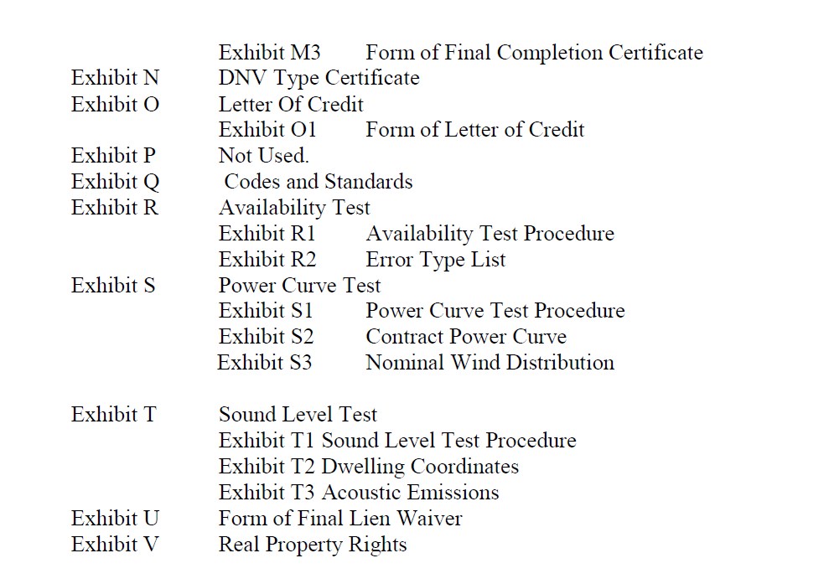
Rutger’s EPC Question
EPC Performance – Siemens Example
Items in the contract for power curve and availability

Slide 15
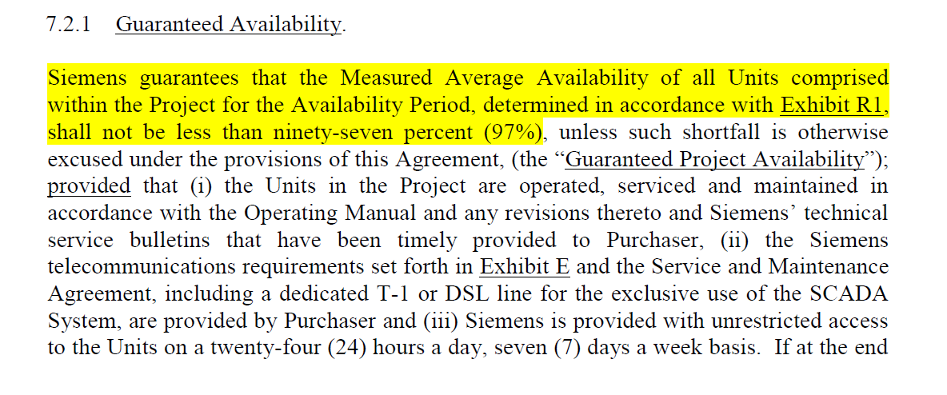
Availability in EPC Contract
Example of Availability Language

Slide 16
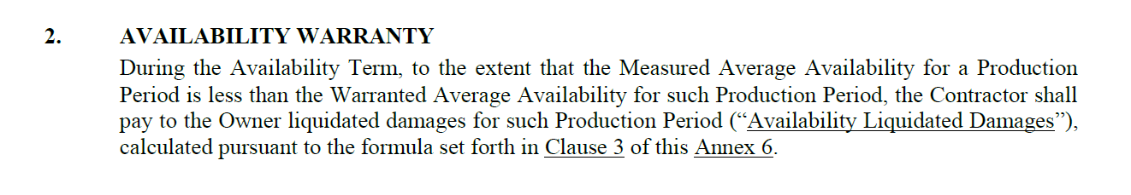
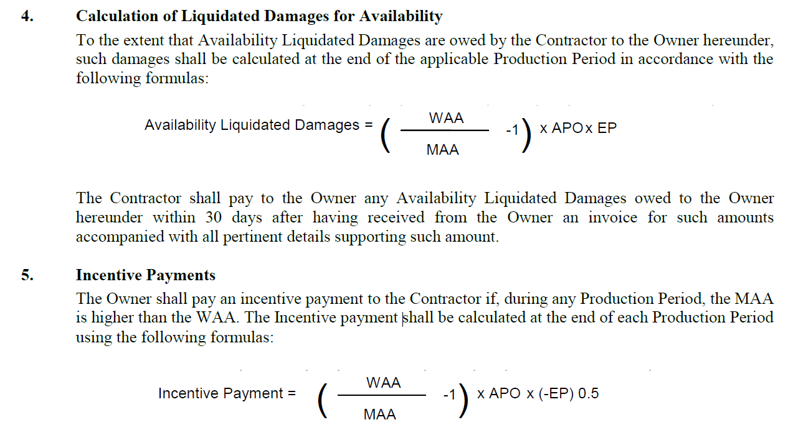
Availability Guarantee in Service Contract
Test

Slide 17
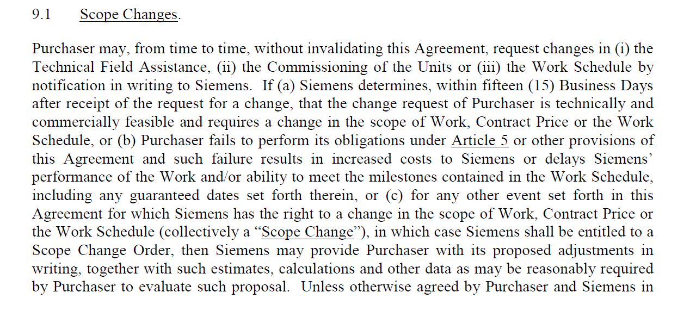
EPC Contact and Changes in Scope
Standard EPC Terms Like other Contracts

Slide 18
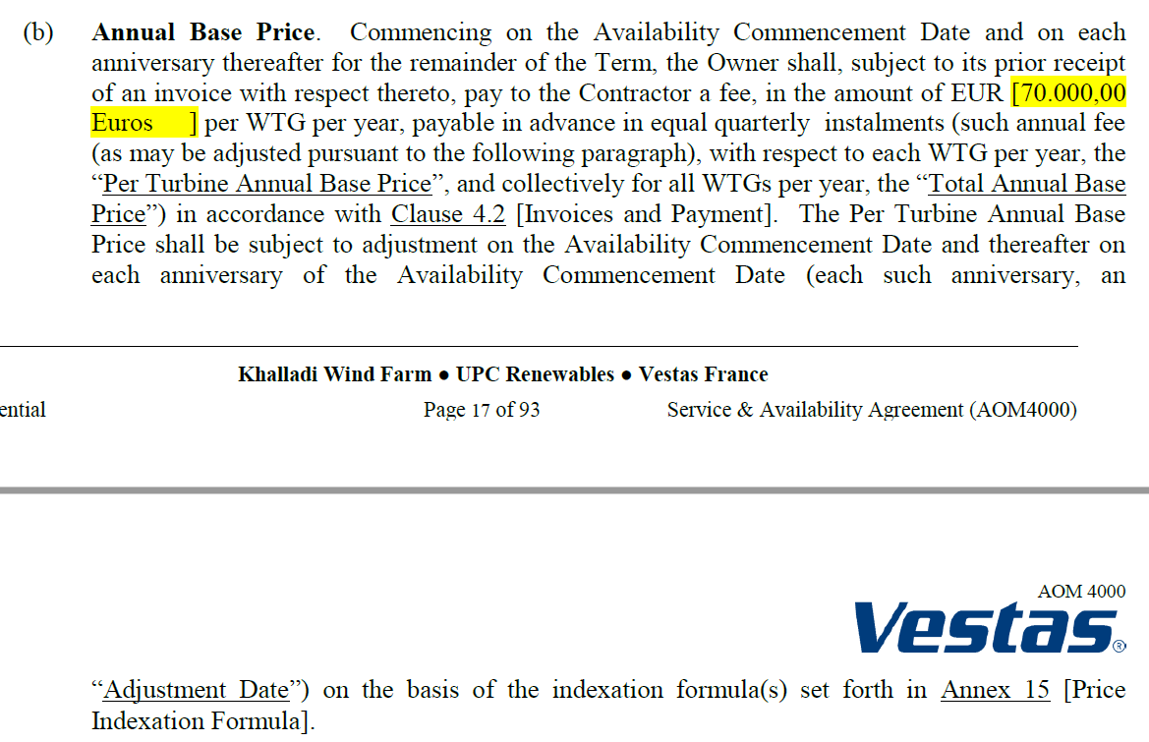
Example of Payment for Turbine Maintenance
Payment in turbine maintenance contract for warranty

Slide 19
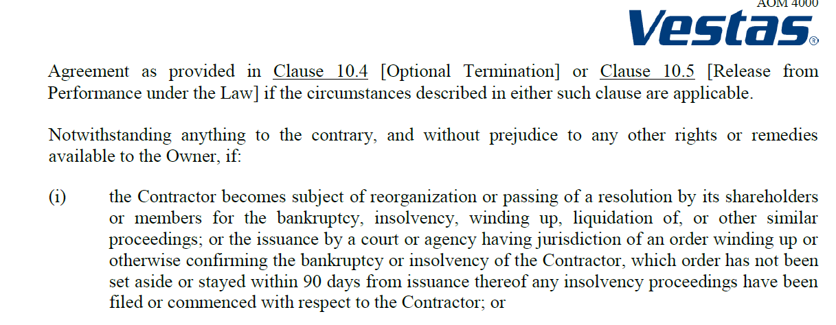
O&M Contract and Bankruptcy of O&M Contractor
Provision in Vestas Contract
  If Vestas would default, how would you measure the cost to the turbine owner
  Example in Solar Industry, Insurance for capacity and degradation. Swiss Re Insurance policies that guarantee capacity.

Slide 20
Back to Rutger’s Question about Replacement of Turbine Manufacturer
Question:
Is the turbine manufacturer/supplier (e.g. Vestas, Siemens) easy to replace (for example in case of bankruptcy), with the emphasis on the operational phase.
Replacing the turbine manufacturer is easy enough in terms of O&M, there are sufficient 3rd party O&M providers in most countries. Spare parts and blades are also not an issue for the leading manufacturers.
Note that manufacturers probably make more on the O&M than on selling turbines and as shown in subsequent sections, the high O&M costs of wind can be a big issue in economics.
I understand that a reason for the increased competitive position of off-shore wind is reduction in O&M expense.

Slide 21
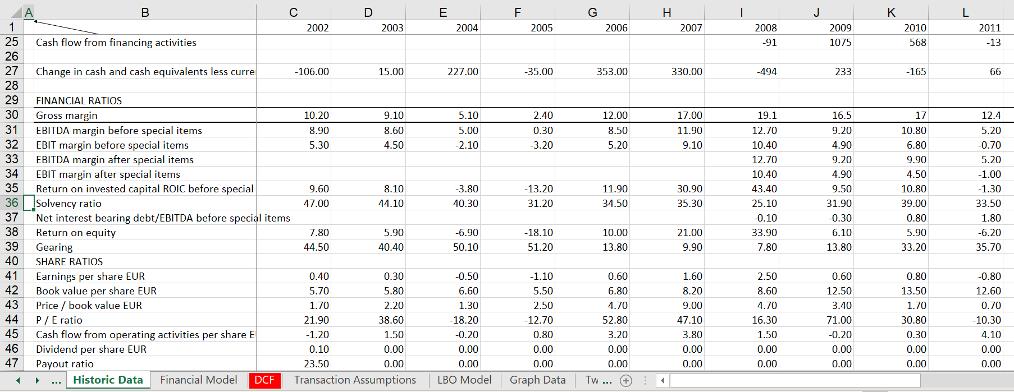
Example of Vestas Financial Problems

Slide 22
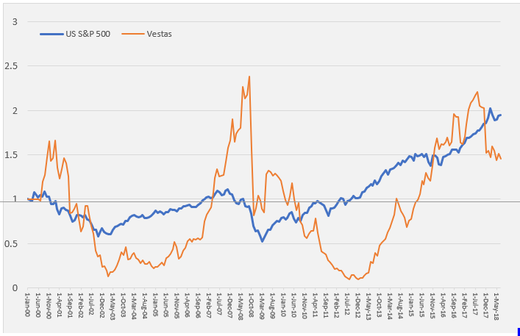
Vestas Stock Price
Illustration of the possibility of bankruptcy of suppliers

Slide 23
Protection from Bankruptcy O&M Guarantees and Parts
Continued answer to bankruptcy of O&M Provider:
The turbine providers should guaranty the availability of the turbine backed up by LDs or LCs.
  How exactly would the LD’s work – if there was a bankruptcy of Vestas and Vestas could not guarantee availability, what would be the size of the damage and how would it be calculated as part of the LD.
  Recall solar industry where bankruptcy of panel manufacturers was a big issue – seems to be much less of an issue now.
There also be an escrow in case a bank or project owner sees bankruptcy of the turbine manufacturer then they can insist on a technical escrow meaning all drawings and spare parts overview will be hold by a notary.

Slide 24
Back to Rutger’s Question, Continued
Question:
Can a replacement turbine manufacturer/supplier maintain the current installed turbines and replace its parts?
Yes.
Some project owners want to do their own O&M and only will choose a turbine manufacturer that agrees to allow third party O&M.
Not all suppliers will accept an O&M contractor different than the supplier -- Vestas and Siemens for sure insist on a 10 year O&M agreement performed by themselves. Returning revenues of course.
I think Nordex accepts 3rd party from the beginning, they won a project with this in the Netherlands.

Slide 25
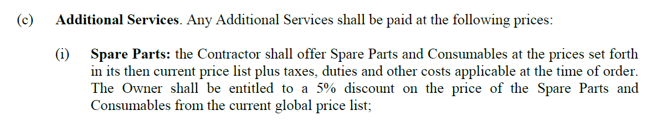
Back to Rutger’s Question
Are the O&M and replacement parts very (brand) specific and do they need to install their own turbines (or even windmills)?
Depends on the manufacturer, Enercon makes most parts themselves, others source externally, also for blades, some have their own blade factory, others use contractors
Do turbine manufacturers/suppliers use parts from subcontractors or is everything designed and built in-house and very specific?
Same as above depends on the manufacturer

Slide 26
O&M Comments from ECN and Choice of Maintenance Contracts
The variable costs (except land costs), which include guarantee and maintenance contracts, have also decreased this year.
The variable costs are approximately 0.0095 €/kWh.
It is becoming more common for turbine manufacturers to offer a choice of maintenance contracts at a fixed price per turbine. On average, these prices lie within the range of 20-30 €/kW.
The fixed annual costs are those of public liability insurance, machinery breakdown insurance, standstill insurance, network maintenance, energy use, property tax, and management and maintenance of land and roads.
ECN and DNV GL have assumed 12.4 €/kW.

Slide 27
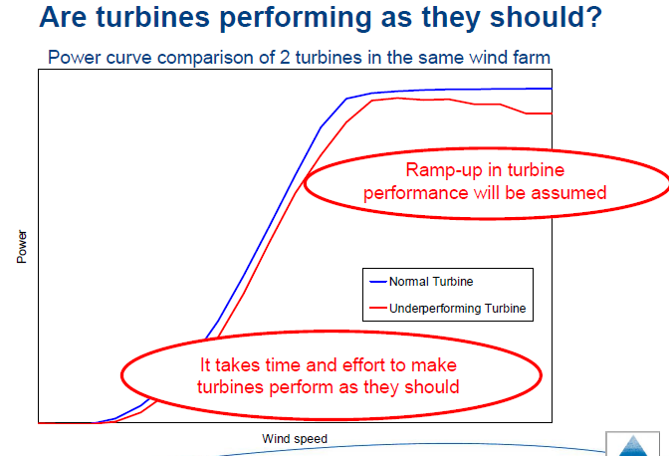
Power Curve Introduction -- Turbine Performance and Maintenance
Cannot guarantee power curve without making sure the maintenance is performed

Slide 28
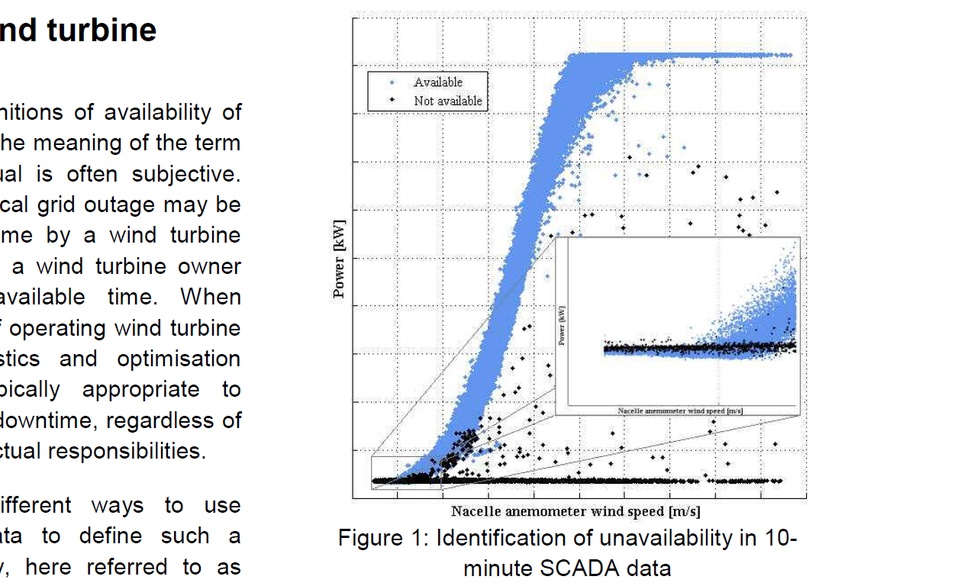
Power Curve Accuracy
This example does not look very good. There is variation around the power curve.

Slide 29
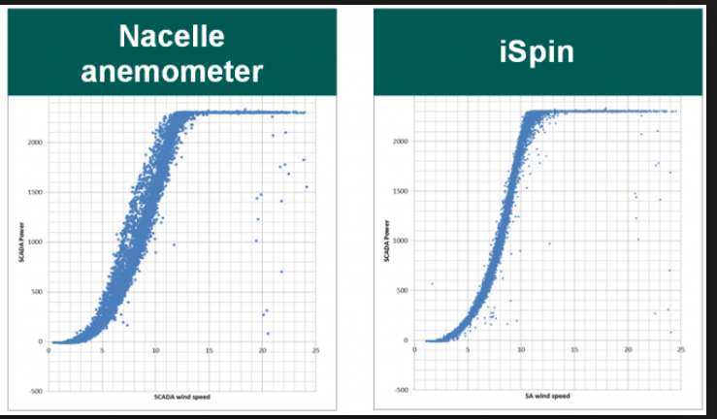
Problems in Measurement and Verification of Power Curve
Need Good Wind Measurement. Does not work from gauge on turbine.

Slide 30
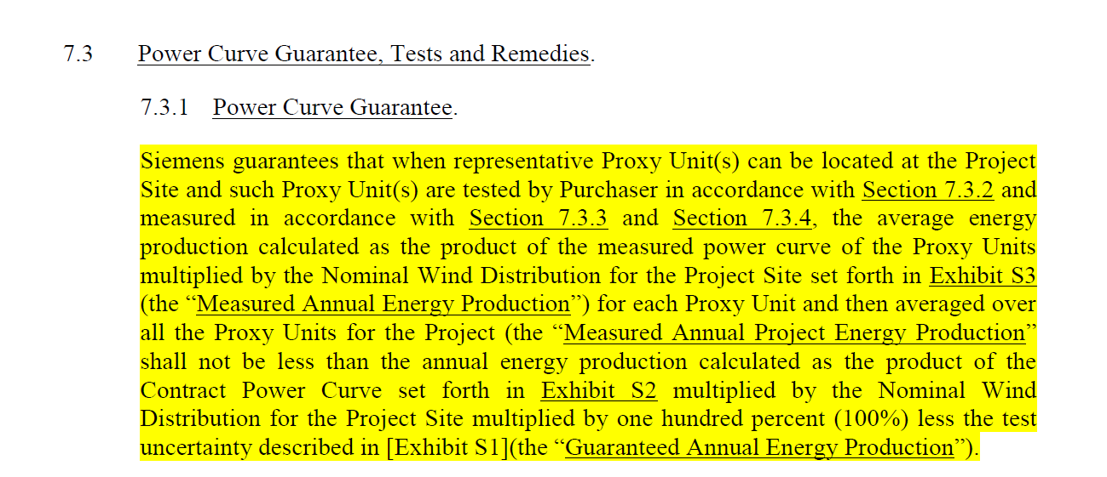
Example of Power Curve Test in EPC Contract
Example from EPC Contract – Note the Proxy Units

Slide 31
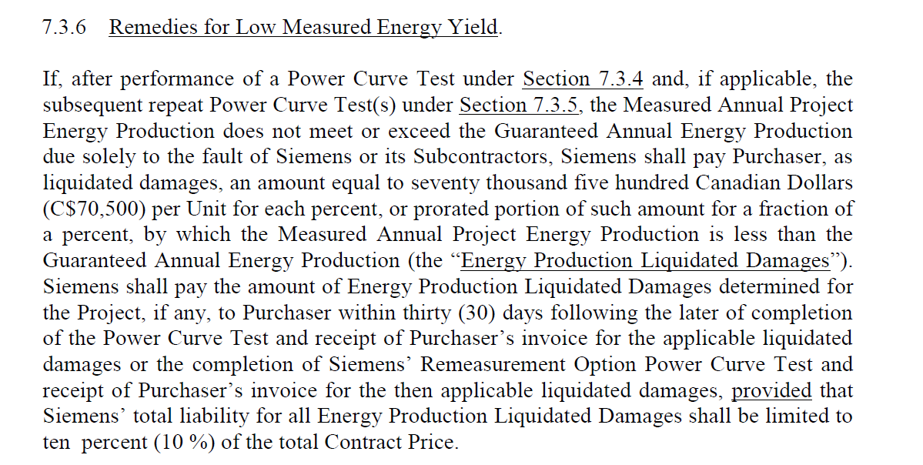
Liquidated Damages of Power Curve
Liquidated damages

Slide 32
Additional Risks: Question About Shadow Flicker
What is shadow flicker in wind and is it a big deal
Shadow flicker is the intermittent shadow casted by the moving wind blades of a wind turbine. The extent of its impact depends on the latitude of the project, time of the day, time of the year, turbine height, blade length, distance between the impacted dwelling and the turbine, the window placement of the dwelling etc.
Depends on the project and buildings in the vicinity and the rules & regulations. Some projects need to stop turbines for specific times for shadow flicker reasons.
Certain governing bodies have clear regulations on shadow flicker, e.g. max number of shadow hours casted at a dwelling. Even if there is no clear written regulations, residence (participating or not participating in the project) can express concerns during public comment period of a permitting process if there is one. Shadow flicker can be modeled using commercially available software like wind pro.

Slide 33
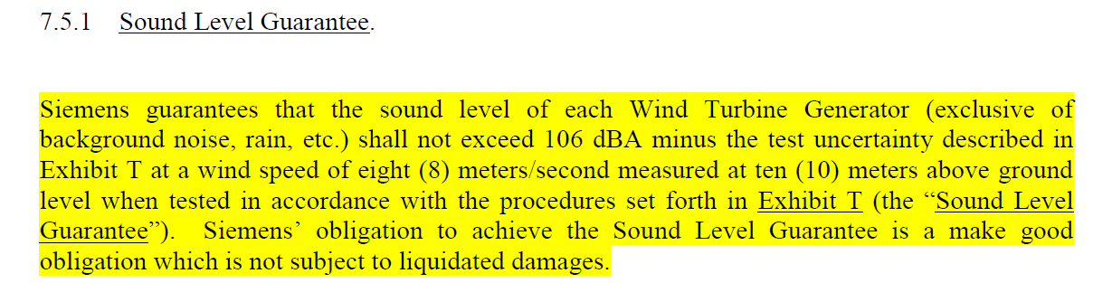
Noise from Turbines
The amount of noise from turbines can be measured and guaranteed, unlike the flicker example

Slide 34
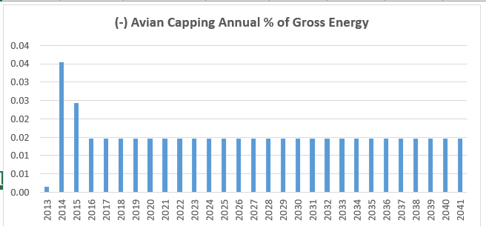
Risks from Avian Issues
Problems of birds can reduce the output of turbines.
  Example in France when must stop turbines during bird migration
  Example in Canada with reduction in generation and also costs for scientists

Slide 35
Additional Risks: Transmission Capacity
Best Wind Sites not Located in Load Centres
  Wind Producer may be responsible for transmission
  Examples of curtailment
    Lake Turkana
    Oklahoma
  Low Merchant Prices in Transmission Constrained Areas
    Example: Montana and Off-peak Prices
NL has priority dispatch for RES. In addition, in case of curtailment compensation is paid. So far, curtailment is seemingly not an issue in NL.

Slide 36
Additional Risk: Partial Exposure to Merchant Power Price
History of Merchant Power and Merchant Power Problems at the Turn of the Century
Debt Structuring with Merchant Power Risk
Examples of Merchant Power Risk in PPA Contracts

Slide 37
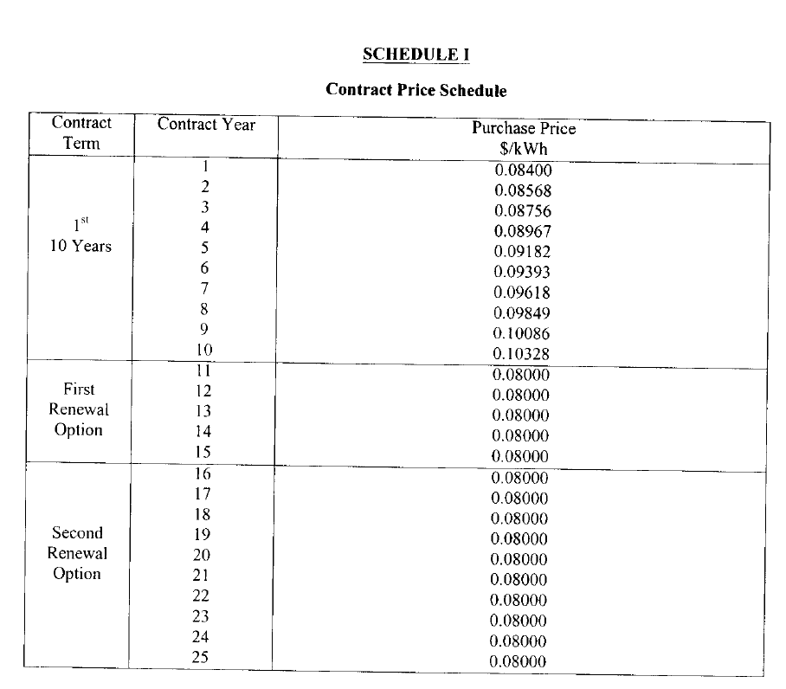
Example of Single Price Contract for Wind Power that is Contrasted with Multi-part Pricing for Availability Payment Transactions

Slide 38
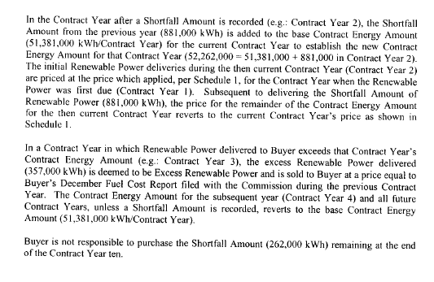
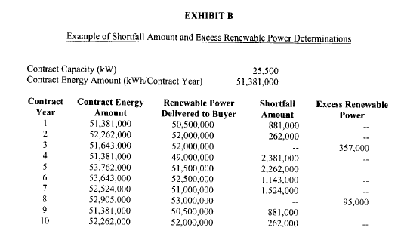
Short-fall and Excess Energy in Renewable PPA

Slide 39
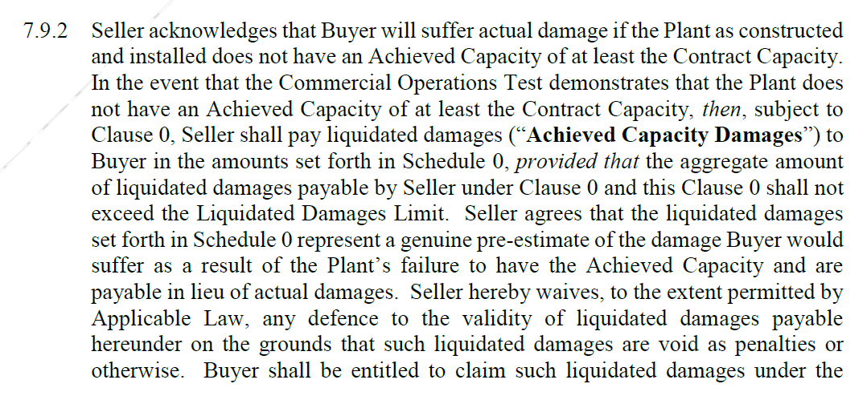
LD for Capacity in NBET Solar PPA

Slide 40
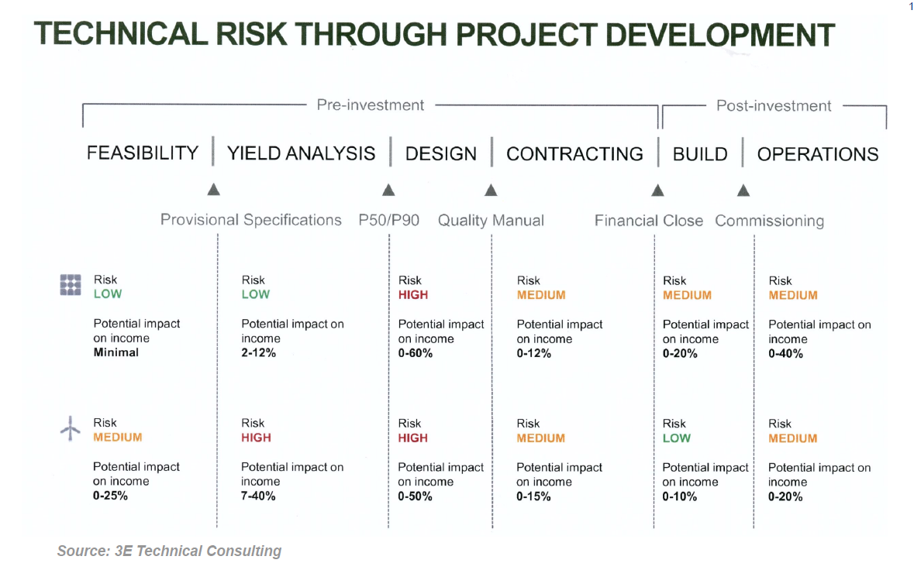
Risks and Project Development

Slide 41
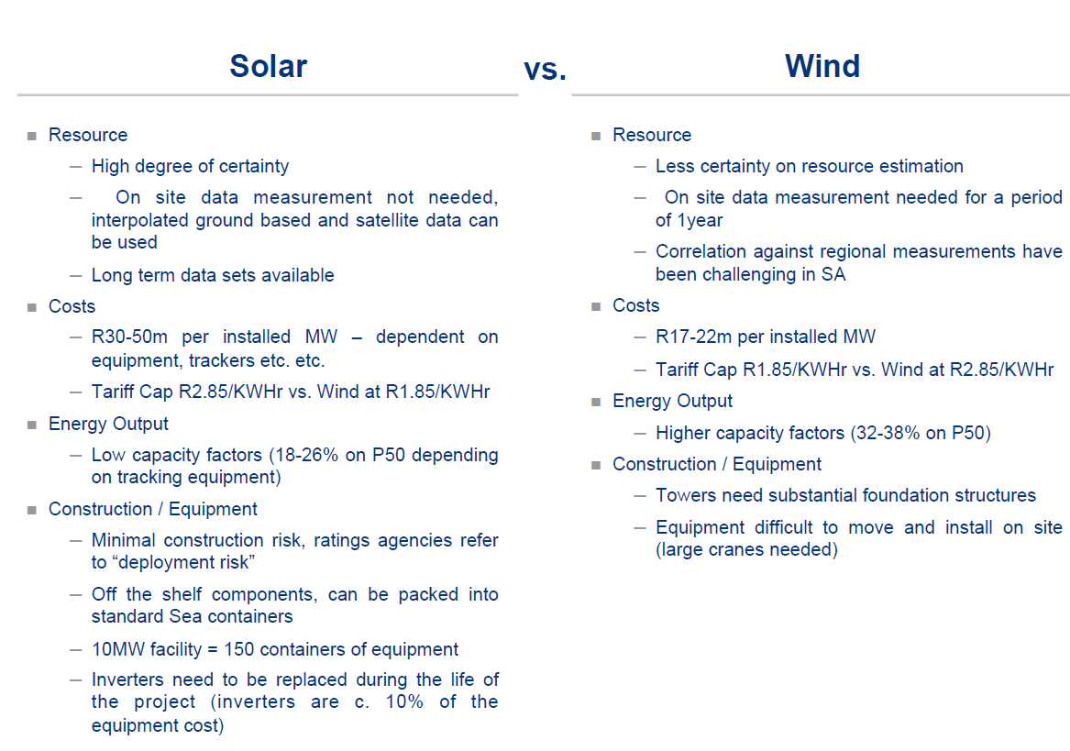
General Comparison of Wind and Solar

Slide 42
Overview of Changes in the Value and Economics of Renewable Energy with Dramatic Reductions in the Cost of Renewable Energy and Continued Need for Subsidies

Slide 43
Key Implications of This Section
LCOE is the basis of Dutch PPA Contracts
What is the LCOE of Wind and how does the LCOE compare to the APX Merchant Price
How Economic is Wind and Solar compared to other power options
Background on the Economic Drivers of Wind Power and the essential O&M cost, capital expenditures and capacity factors that should be reviewed and benchmarked

Slide 44
Basic Equations for Revenue Build Up
Electricity plants have capacity which is the ability to produce at an instant
  kW, mW, W
For producing revenue, there must be some kind of time dimension attached to the capacity
  Hours, months, years
  kW x h, kW x month, kW x year
  kWh, kW-month, kW-year
There is a basic distinction in project finance for availability and output based projects. Output base projects earn revenues on production, availability based projects earn revenue as long as the plant is available to produce even if it does not produce.
  Output based projects (renewable): revenue = price x kWh
  Availability based projects (dispatchable): revenue = price x kW-month

Slide 45
Step 1 of LCOE: Annual Carrying Charge per kW
Convert the Cost per kW which is the crucial driver of power costs for many technologies by the carrying charge rate. This gives the cost per kW-year. The carrying charge can be thought of as the amount of annual EBITDA required for an amount of up-front cost. It can also be thought of as the return on and the return of capital to carry the investment. It can also be thought of like the loan payment on a house divided by the price of the house.
Annual Carrying Charges = Cost/kW x Carrying Charge Rate

Slide 46
Step 2: Total Fixed Cost per kW-year
Add the fixed O&M costs expressed in Amount (e.g. USD) per kW-year to the annual carrying charges to derive the total annual cost per kW-year.
Total Annual Fixed Cost/kW-year = Annual Carrying Charges + Fixed O&M Cost

Slide 47
Step 3: Compute the Fixed Cost to Turn on the Lights
Compute the total fixed cost based on energy rather than capacity. To do this, you need the capacity factor (for renewable) or the availability factor for base load (assuming the plant will run whenever it is available). The hours that must be covered by the fixed cost are 8766 x capacity factor. The total annual fixed cost per MWH as the annual cost x 1000 divided by 8766 x capacity factor.
Total Annual Fixed Cost/MWH = Total Fixed Cost/kW-year x 1000/ (8766 x CF)

Slide 48
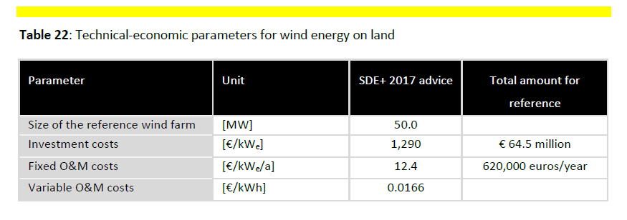
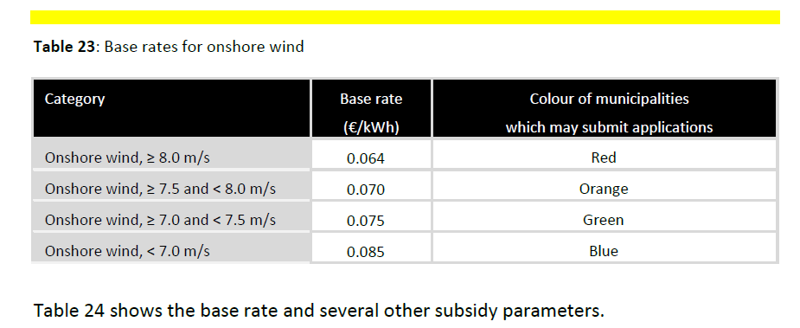
Base Rates in NL Tariff is LCOE
test

Slide 49
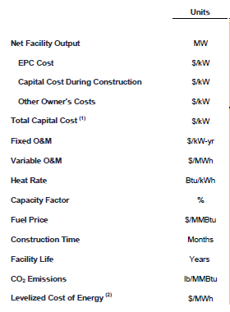
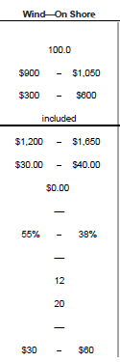
Benchmarking and Lazard Study

Slide 50
Importance of O&M Cost
General Magnitude of Costs and Importance of O&M in LCOE
Variable Cost Range USD/kWh - .0166
Multiply by 1000 to get Usual USD/MWH, 1.66
Use capacity factor of 25% with 8760 hours per year to get 2190 full load hours
Convert to USD/kW-yr (divide by 1000):
  16.6 x 2190/1000 = 36.35 USD/kw-year
Include Fixed Cost of 12.4
Total O&M Cost of 48.74/kW-year
USD to Compare 56.69/kW-year
Lazard High Range – 40/kW-year

Slide 51
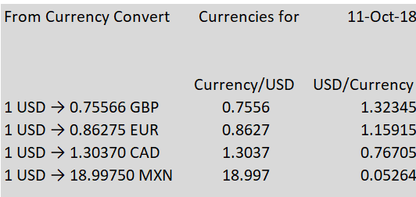
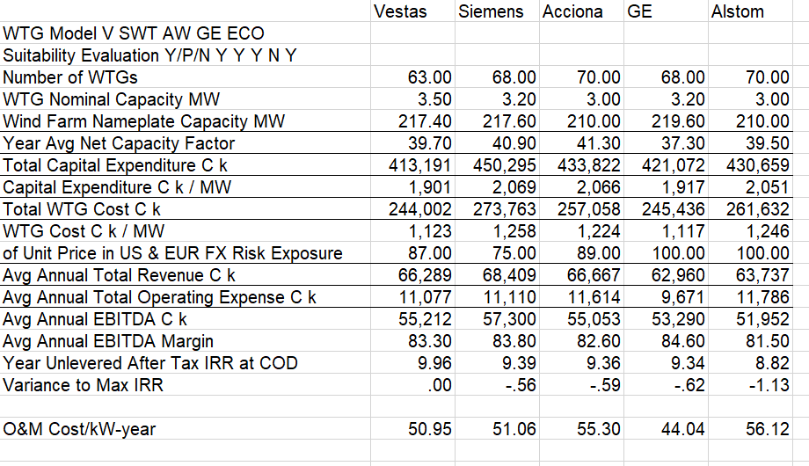
Parameters for LCOE Exercise
Work through the LCOE for wind fames using data in the table below. Need a carrying charge rate.

Slide 52
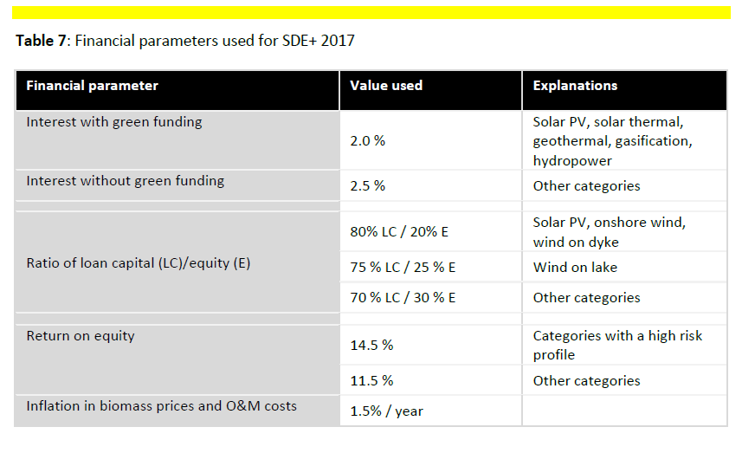
Financial Assumptions Used in Computing Base Rates
Factors other than tax rate

Slide 53
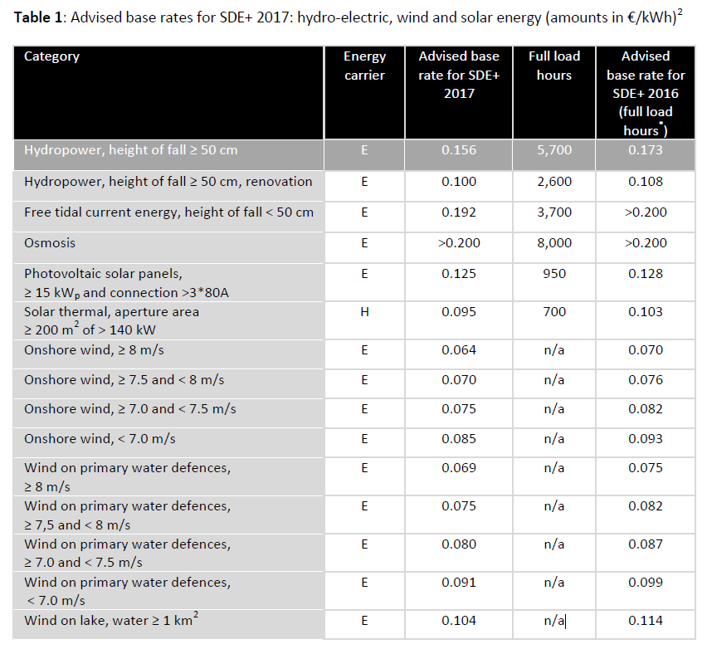
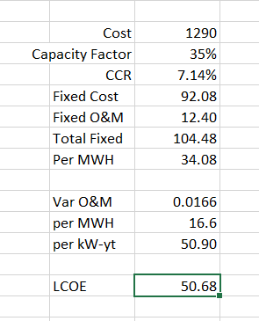
Base Tariffs for Renewable – Essentially the LCOE

Slide 54
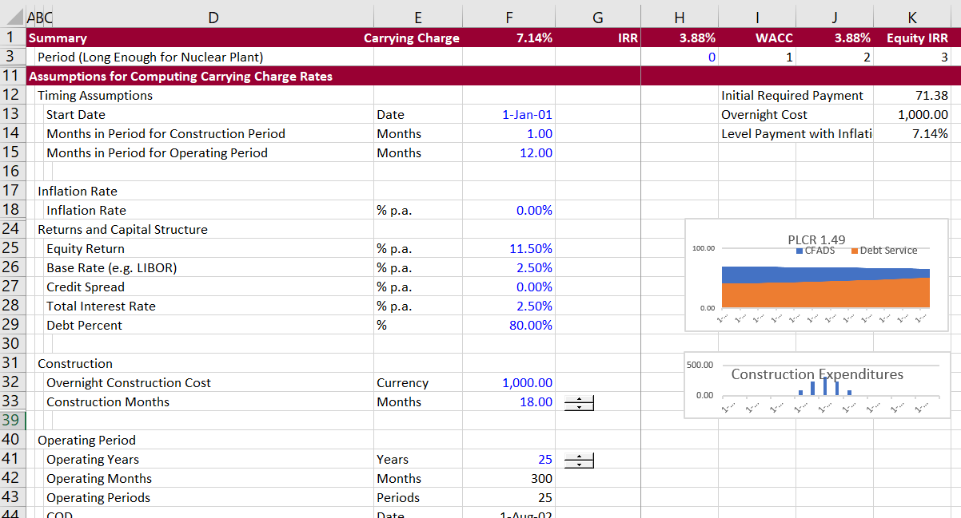
Carrying Charge Analysis and Project Finance
Illustration of CCR sheet

Slide 55
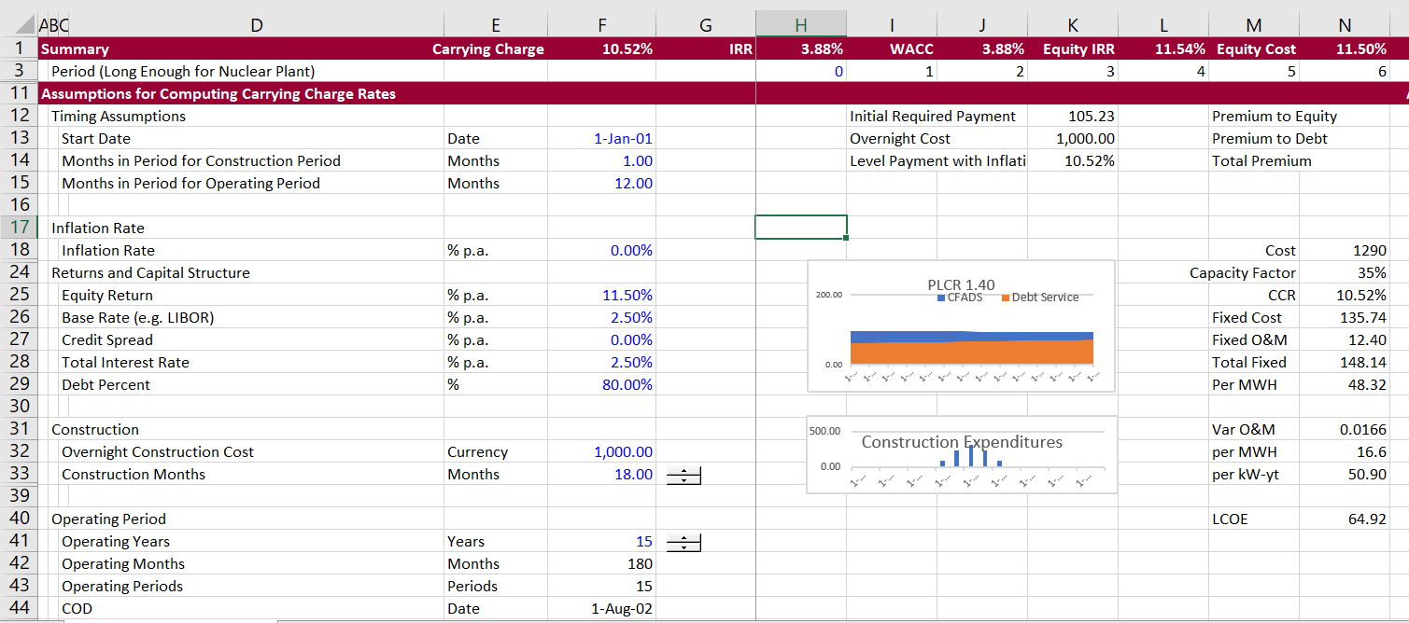
Carrying Charge Analysis and LCOE with 15 Year Life
Similar LCOE with 15 Year Life

Slide 56
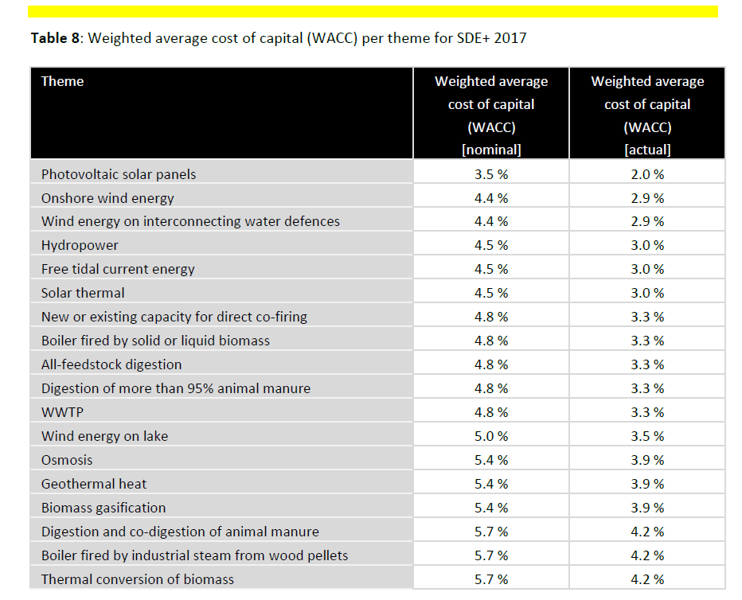
Cost of Capital in LCOE Study

Slide 57
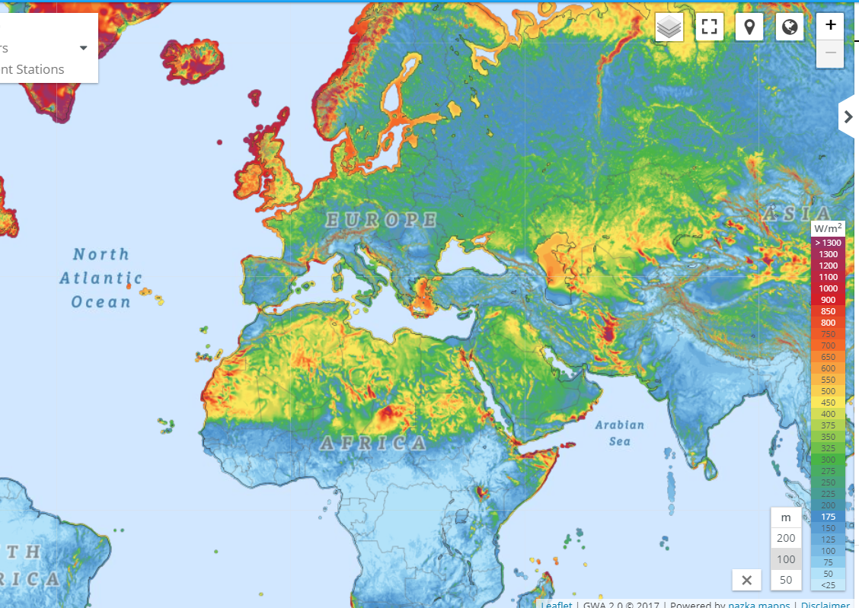
Wind Atlas

Slide 58
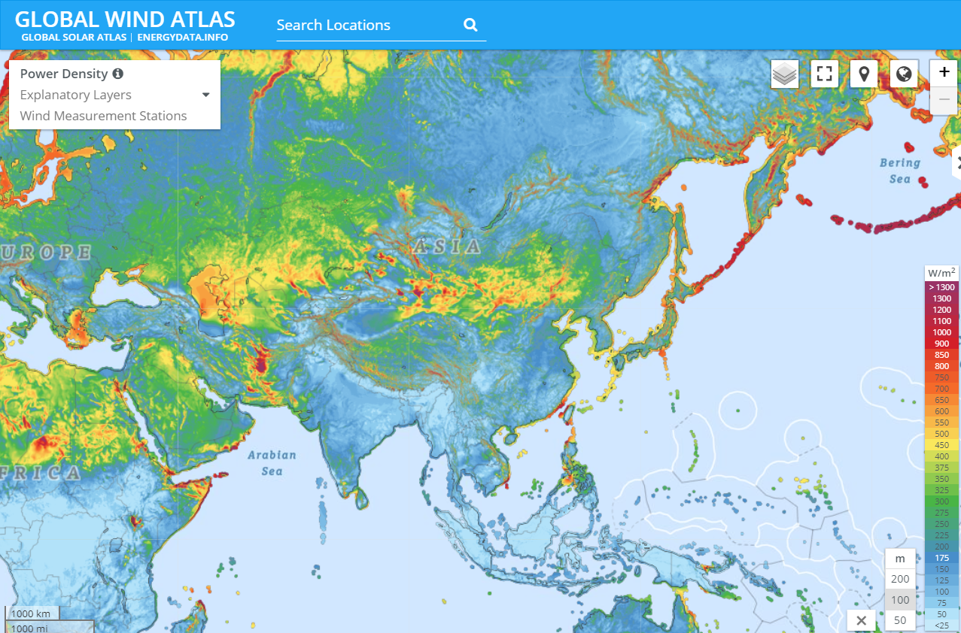
Wind Map - Asia

Slide 59
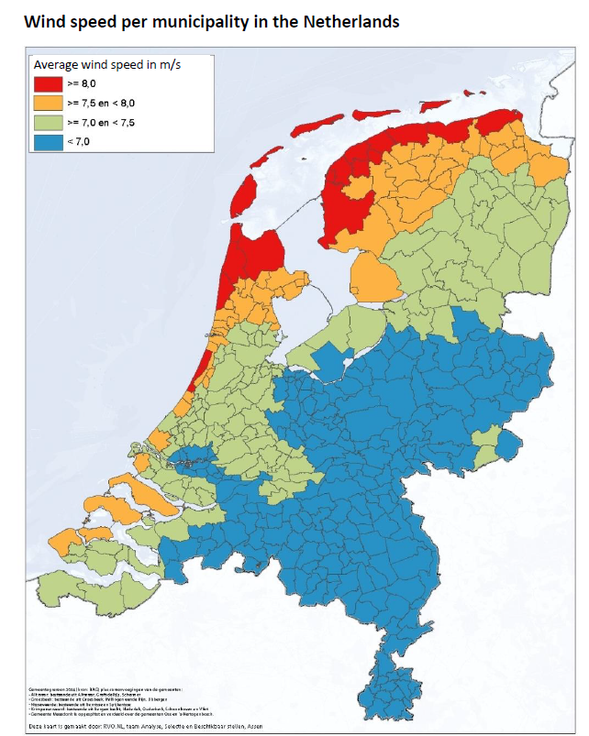
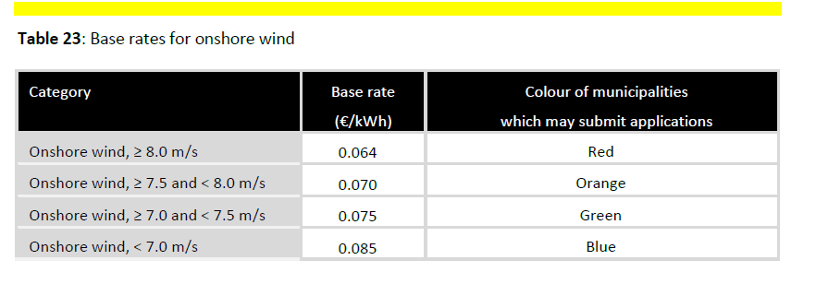
Wind Atlas from ECN

Slide 60
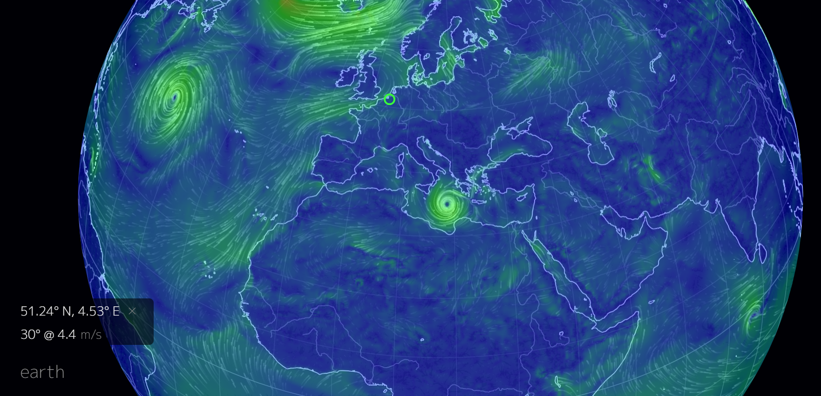
From World Wind Map

Slide 61
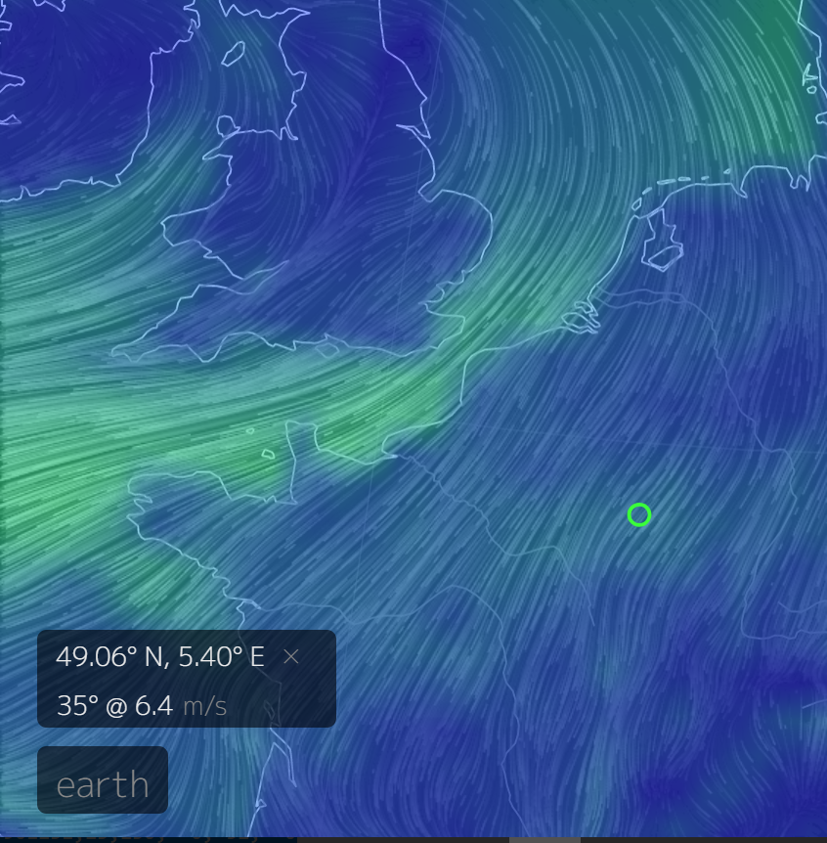
On-shore Wind Speed

Slide 62
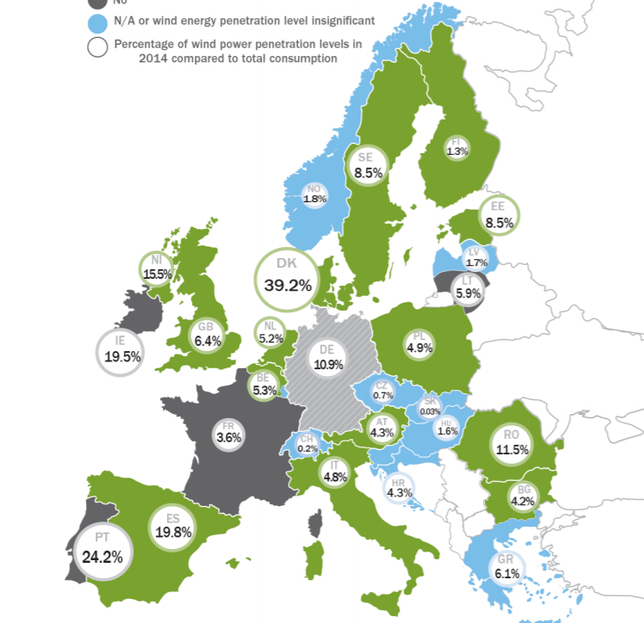
NL Compared to Other Countries

Slide 63
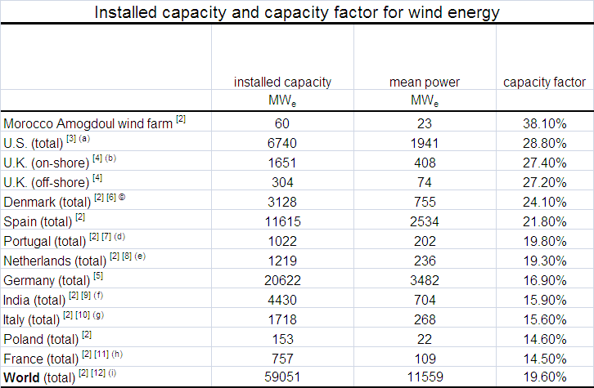
Capacity Factor Comparison – Look in Detail to LCOE Components for Benchmarking

Slide 64
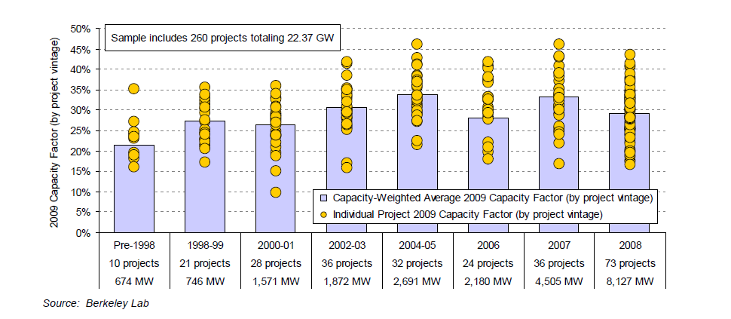
Range in Capacity Factor by Vintage of Project
.
We will see that given wind speed and improvements in turbine power curves, you could see if this what is reasonable.

Slide 65
Capital Cost per kW
Wind energy capital costs have declined steadily. A typical cost for a typical onshore wind farms has reached around $1,000/kW of installed rated capacity, and for offshore wind farms about $ 1,600/kW. The corresponding electricity costs vary due to wind speed variations, locations and different institutional frameworks in different countries.

Slide 66
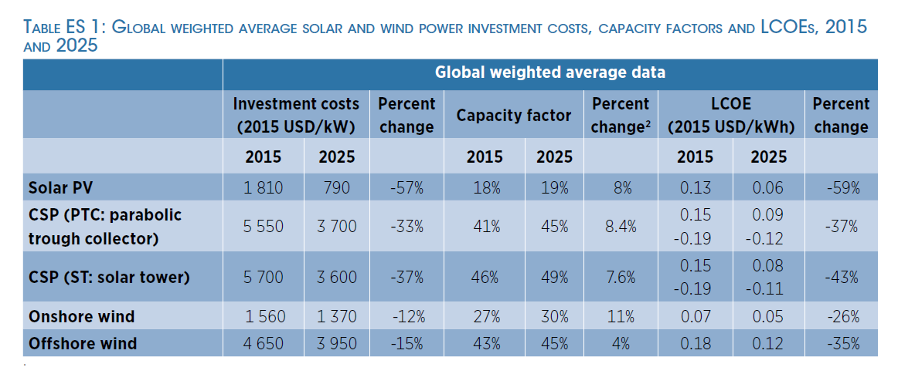
IRENA Estimated Capital Costs

Slide 67
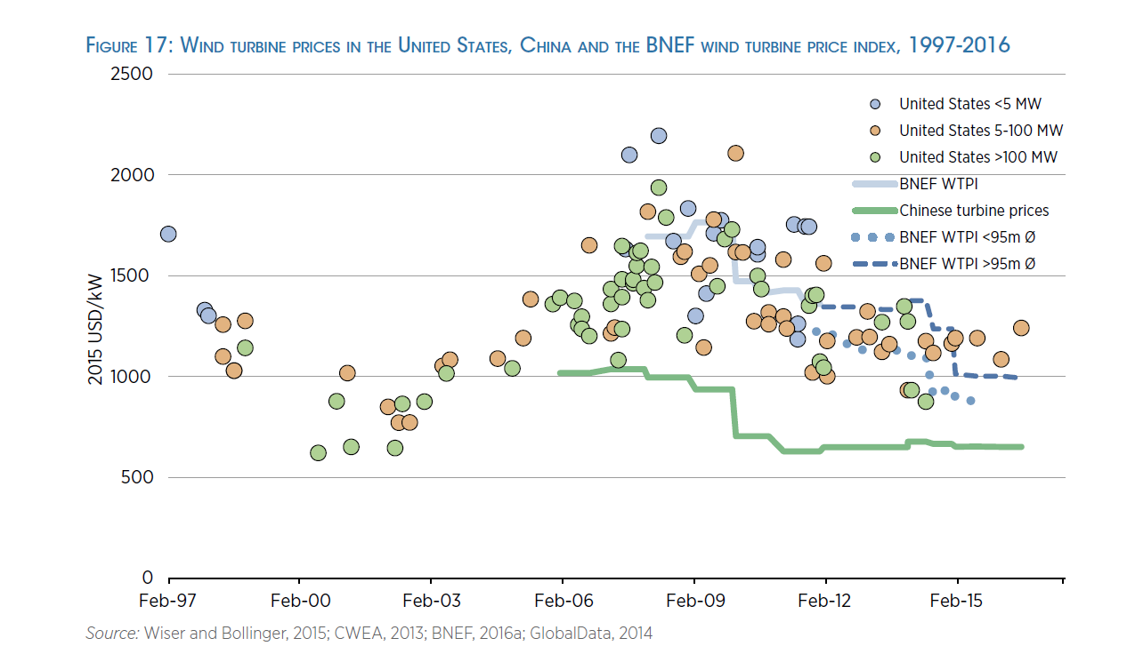
Wind Turbine – China and Other

Slide 68
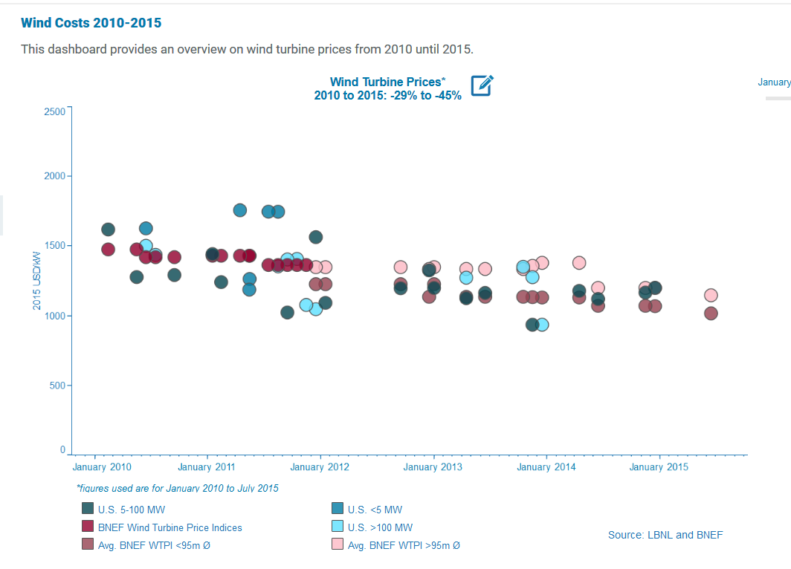
Cost of Wind Turbines

Slide 69
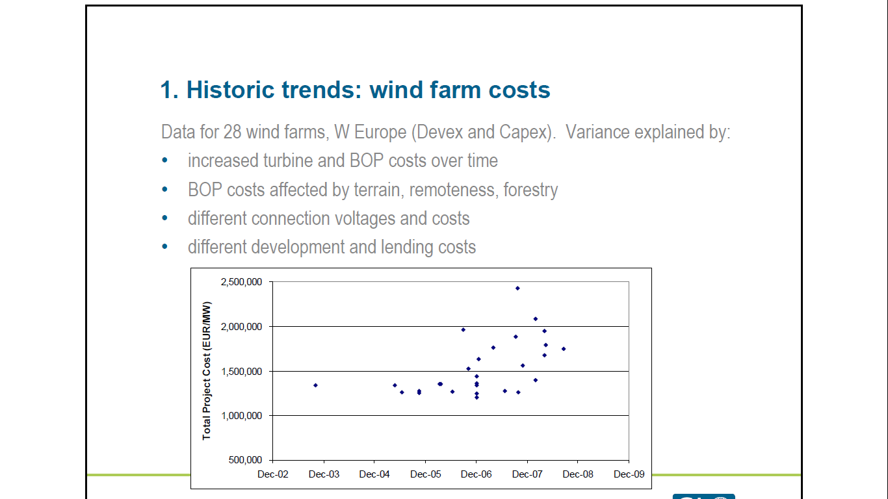
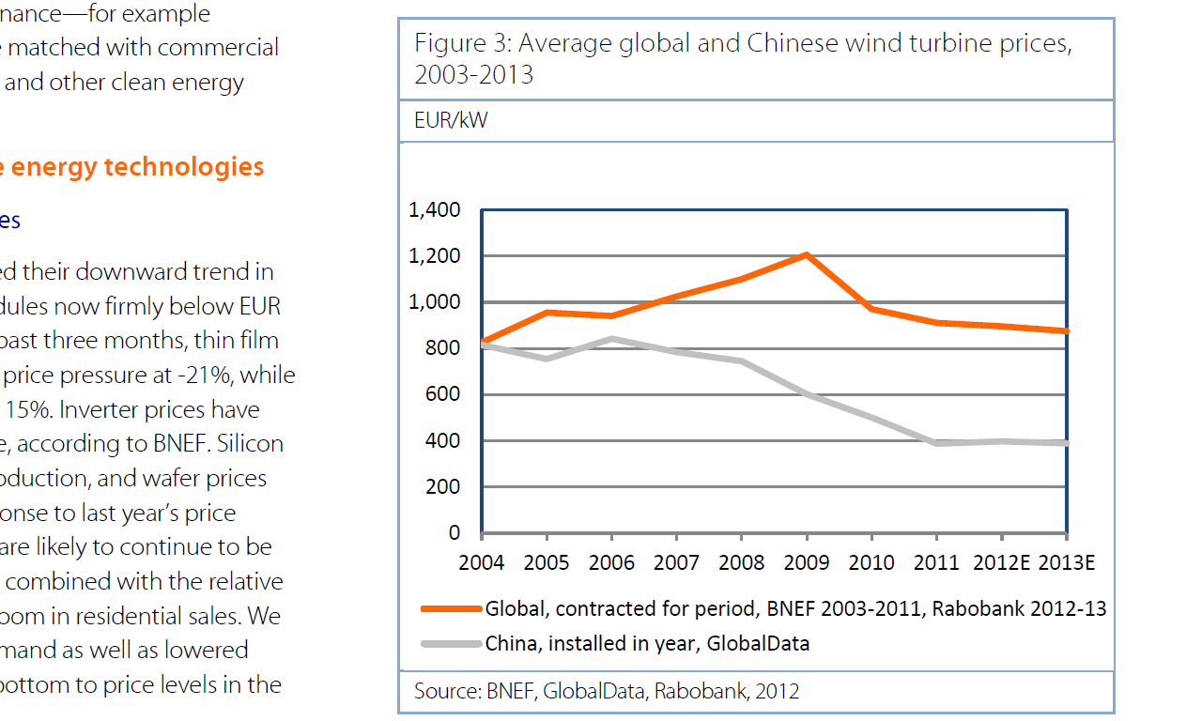
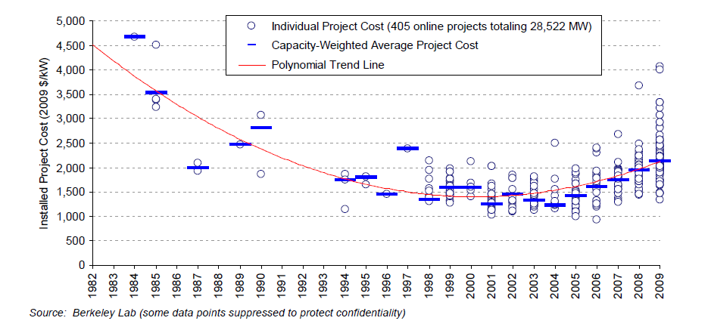
Trends in Total Project Cost including Balance of System
Cost of 1,400 Euro x 1.4 = USD 1,960/kW
Source: Case Studies On Shore

Slide 70

Capital Cost for Real Projects from IEA

Slide 71

O&M Costs from IRENA – Note the Dramatic Variation in Costs

Slide 72


Selected Examples of O&M Cost
O&M Estimates

Slide 73




Example of O&M from Turbine O&M and Other O&M
Test

Slide 74
Operation and Maintenance Cost Issues
Bankable O&M Contract
Suppliers like GE make more money on O&M contracts than on selling equipment
How much of O&M cost is fixed and how much is variable:
  Developers often use fixed and express in Amount/kW/Year
  Other sources use Amount/MWH
  Example from Ireland Below:

Slide 75


O&M Costs

Slide 76

O&M Costs per MWH
.O&M Database from U.S. -- Appears that O&M increases with age of project.

Slide 77

Operating Expense Analysis
The operating cost of a project can be measured on an absolute basis, on the basis of the kW capacity or on the basis of the MWH produced. The range in operating costs for a few projects is shown in the accompanying table.
.
.

Slide 78

Operating Cost Breakdown
.

Slide 79

Trends in Costs

Slide 80
Representative Loan Terms for On-Shore Wind, Off-Shore Wind and Solar

Slide 81
Examples of Gearing and Debt to Capital
Discuss Maximum Debt to Capital, Debt often Driven by the DSCR in European Wind
Debt to Capital in Term Sheet Case Example: 80%
Debt to Capital in Recent Canadian Bids: 75% to 85%
Debt to Capital often an Output of:
  DSCR in P50 Case
  DSCR in P90 or P99 Case

Slide 82


Debt Size From Debt to Capital and DSCR

Slide 83

Explanation of P50, P90 etc.

Slide 84
Optimistic Estimates in Wind Studies
Comment from a few years ago: An industry-wide tendency was recognized for pre-construction P50 performance estimates to be higher than actual performance;
  over-projection of turbine availability was identified as a significant contributor to this error.
Johnson C, Tindal A, LeBlanc M, Graves A & Harman K, Validation of GH North American
Energy Predictions by Comparison to Actual Production, 2008 AWEA WINDPOWER Conference, June 2008.

Slide 85
Factors that Affect Wind Production and Estimates
Incorrect Wind Speed Estimates
Incorrect Power Curves
Incorrect Site Condition Estimates
  roughness classes, described as smooth, moderate, rough, and very rough.
  These terrain classes affect the estimated wind shear exponent and effective ground level.
Weibull shape factor
Other loss factors
  (e.g., voltage drop, blade weathering).

Slide 86
Relative Production
Relative Production: Relative production (RP) is used to describe the actual performance of a small wind system compared to its predicted energy output. This metric demonstrates how well a small wind system’s future energy output can be predicted based on available estimating techniques, micro siting, wind speeds, and turbine information. Relative production is calculated as follows:
RP = AEPpredicted/RP = AEPactual
RP is calculated by dividing observed annual energy production by the predicted annual energy production. For example, if a system was predicted to produce 10,000 kWh per year and onsite meter readings indicated an AEP of 5,000 kWh, the relative production for that system would be 50 percent.
The benefit of using RP as a metric is that, by using estimated output as a basis, it implicitly includes some normalization for wind speed, turbine efficiency, and terrain conditions.

Slide 87
S&P Comments on Actual and Projected Wind Speeds
Assumptions may be wrong in any project financing, but for wind projects that only receive payments if there is wind, the wind forecast provides a principal uncertainty.
In many cases there is insufficient historical wind data to support an extrapolation of wind production for the next 20 years. Unfortunately, there is no public database available that compares actual wind outturn with the initial forecasts for individual projects. Research conducted in the industry provided general statements that few, if any, wind projects have defaulted. This apparently reassuring conclusion may, however, not be based on Standard & Poor's definition of default, which includes any missed or deferred payment of interest and principal, restructuring, or restatement of the terms and conditions of the debt that would lead to an economic loss.

Slide 88


Actual versus Expected in NaturEner

Slide 89

GH Study of Actual and Predicted
16 observations had 80% of P50. Only 7 Observations had more than 100% of P50.

Slide 90

Actual Versus Predicted Wind
In each case the production was less than realized; often as much as 40%.

Slide 91

Actual and Predicted Output
In studying larger projects, the difference is not as great, but for one of the three the production was 34% less.
.

Slide 92

NextEra Forecasts and Actual

Slide 93


Example of Actual and Estimated Production in Wind Energy Book

Slide 94

Maturity Terms

Slide 95


Cash Sweep

Slide 96

Debt Terms for Wind Farms 1

Slide 97

Debt Terms for Wind Farms 1

Slide 98

Debt Terms for Wind Farms 1

Slide 99

Debt Terms for Wind Farms 2

Slide 100

Debt Terms for Wind Farms 2

Slide 101

Debt Terms for Wind 2

Slide 102
DSCR and % P50 vs P90
Percent Decline to Break Even: (DSCR-1)/DSCR
Example: P50: 1.4; P99 1.0 → 28%
Required DSCR for Reduction: 1/(1-% Reduction)
Example: 25% Reduction → 1.33

Slide 103

Example of Wind Study – Components of Estimation

Slide 104

Compare the P50 versus P99 to DSCR from Wind Study
The difference between P50 and P99

Slide 105
P50 in the NL Feed In Tariff
The eligible full load hours (capacity factor x 8760 or FLH) are determined on the basis of estimated production output of the plant.
The bids need to include an individual, independent wind assessment of each site and the maximum number of full load hours (capacity factor) per project was determined based on the wind report and the full load hours net P50 value.
I may be out of bounds, but there is an incentive to have high P50 value so the hours will not be capped. This could have credit implications. The higher the P50 value, the less the chance of hitting subsidy problems. But this means the P50 may be B.S.

Slide 106
Banking of Production above P50 in NL Tariff
The maximum FLH (capacity factor) is defined as an annual cap, but projects can make use of banking.
  First, “unused” FLH can be transferred to the next year to compensate for years with low power production.
  Second, power production that exceeded one annual FLH cap can also be transferred to the next year (for a maximum of 25% of the FLH cap) to not miss out on subsidies in very strong years.

Slide 107
Resource Analysis for Wind and General Discussion of P90, P99, Power Curves and Wind Variation

Slide 108
Wind Studies
The first step for the project lenders is to conduct an in-depth analysis of the owner's feasibility study and possibly even hire a consultant to conduct an independent feasibility study. Such studies will analyze the wind resource data and should demonstrate the financial viability of the project. These studies will detail technical, financial and other aspects of the project and are crucial to the lender in its risk assessment of the proposed project.
Independent Engineers compute the probability of different wind availability. However, these studies are based on the wind measurements for previous years and for a particular site, and while the studies accommodate the fact that the year in which the measurements were taken may have been a particular good or bad year, there is no guarantee that there will not be substantially less wind in the future.

Slide 109
Wind Speed Risk
A potential and significant risk for any energy project is the underlying resource for its generation – in this case wind. Identifying the availability of wind is paramount. This has two aspects.
  The first is the question of whether a particular site has sufficient wind speeds. This issue is addressed by the lending banks insisting on long-term – usually at least 12 months – wind measurements, which are then used as the basis for a number of wind studies. Banks usually insist on at least two of those coming from reputable wind experts. These wind studies give an estimate of the annual electricity output of a project, based on a probability curve, usually 75% or 90%, that the project will generate x number of full load hours. Depending on the wind turbine used, there is therefore a 75% or 90% respectively, probability that the turbine will generate y kW/h per year when in service.

Slide 110
Annual Variation in Wind Speed
Due to the natural variability of wind, the annual energy yield of a given wind farm may change drastically from year to year depending on the wind regime of the area. A study undertaken has estimated that annual mean wind speeds over the long term may be assumed to be normally distributed with a standard deviation of 6%.
Implies that deviation of 14% in one of every 100 years.
Wind speed should be within one standard deviation for 6.8 years out of 10.

Slide 111


Variability in Wind → UK Wind Index in 2010 – 10% below Average
Statistical Analysis and Standard Deviation

Slide 112

Variation in Average Wind Speeds

Slide 113
Rutger’s Question on Lidar
LiDAR (light detection and ranging) or SoDAR (sound detection and ranging) are remote-sensing methods that use either light in the form of a pulsed laser or sound to measure ranges.
Ground based, remote-sensing technology often supplements ananometers because remote-sensing technology can measure winds at much greater heights.
The measurements are needed because the industry is building ever-taller turbines (80 to 100 m) to capture the stronger winds higher up.
“Is this device as accurate as my met tower?” The short answer is “yes.” Remote sensors are often more accurate than met towers. A number of validation and correlation studies have proven this.

Slide 114


Collecting Data - Traditional
Lidar and ability to collect data at different heights. Also, reliability and location issues.

Slide 115
General Comments on Rutger’s Question about Data Collection
Which method provides more accurate long term production estimate, using on-site data measured with lidar or using synthetic data supplied by vendor like 3tier.
If the on-site measurement is at least 1 year long, and then correlated to long term data set from a near by weather station, then it is more accurate then synthetic data. That is especially true if the site has a lot of terrain variation.
The problem with measurement with lidar is that often times the lidar measurement was too short (<1 yr), the equipment is not maintained, the data is not monitored and QCed on a regular basis, and data was not processed by someone who is competent for that type of analysis.

Slide 116

Lider and Laser Compared to Solar
For Solar, the use of satellite data has become standard.

Slide 117

Data Example for NL
Data for many years on an hour by hour basis

Slide 118

Wind Shear Adjustment in the NL Data
Wind Speed height = Wind Speed low x (height/low) Alpha

Slide 119
Calculation of Wind Shear Exponent
Calculation of Wind Shear Factor Using Logs
Begin with 1/7 power law; but not good enough for site specific applications

Slide 120

Errors in Wind Shear
Wind shear is the variation of wind speed with elevation. It is important to understand because it directly impacts the power available at different wind turbine hub heights.
For the site with the most complex terrain, the average annual wind shear varied up to 7% between different years.
For fairly flat terrain, many investigators have used the one-seventh power law, where α = 1/7 = .143

Slide 121
Application of Wind Shear
Step 1: Tower Height/Anemometer Height
    Eg Anom. Height 40 meters
    Tower Height 60 meters
Step 2: Wind Speed at Anom. Height
    6 Meters/Second
Step 3: Adjusted Wind Speed from Shear Exponent
    Assume Shear Exponent is .15
    (60/40)^.15 = 1.5^.15 = 1.06
    Adjusted Wind Speed: 6 x 1.06 = 6.84 Meters/Second
`

Slide 122




Netherlands Wind Speeds – Historical Variation by Year

Slide 123


More NL Wind Speeds with Variation and Percent Variation

Slide 124
Variability in Annual Wind Speed

Slide 125

Wind Speed by Hour of Day and Month of Year

Slide 126

Weibull versus Actual Versus Normal from Creating Annual Wind Distribution – Alpha 2.0; Gamma .89
Note that normal distribution produces negative values

Slide 127
Example of Fitting the Weibull Distribution

Slide 128
Increases in Turbine Size
Wind Energy the Facts
Source: Wind Energy the Facts

Slide 129
Example of the Effect of Swept Area in DK
From January 2014, the total support duration is determined in a different way, now roughly depending only 30% on capacity (full load hours) and 70% on swept area.
More precisely, the support comprises a fixed amount of 6.600 Full Load Hours but additionally 5.6 MWh are supported for every m2 of the swept area.
This support policy benefits larger blades as the support increases with the size of the swept area.

Slide 130

Siemens Wind Turbine SWT-2.3-101

Slide 131
Power Curve Comparison from Database

Slide 132

Power Curve Comparison

Slide 133

Effect of Icing on Power Curve

Slide 134

Power Curve and Wind Distribution
To predict the wind production, you need the distribution and not a single point.

Slide 135


Actual Wind Production Variation

Slide 136


More Analysis of Actual Wind Variation from Database

Slide 137



Example of Variation in Wind Speed for Italian Wind Projects

Slide 138



More Examples of Wind and Wind Compared to Hydro

Slide 139
Modelling Error versus Risks from Wind Speed Variation in Resource Studies

Slide 140

Use of Resource Analysis to Compute Probability Distributions for Project Finance

Slide 141

1-year and 10-year P90, P50 etc.

Slide 142
Example of Sources of Uncertainty

Slide 143

Biggest Problem Areas According to GH

Slide 144

Errors in Estimation from Wake Effects

Slide 145
Errors in Estimation due to Variable Winds
Most, if not all, small wind turbines have controls that put the system into standby or monitoring mode when turbine output falls below a certain level.
If the wind at a site is particularly gusty, a turbine can go through repeated on/off cycles. In these situations, the system may shut down as the wind speed decreases but, depending on its factory‐set response time, the inverter may remain in standby mode through one or more subsequent gusts.
To quantify the amount of energy lost due to standby timing, it is necessary to track wind speed and power output concurrently, keeping track of high wind speeds coinciding with standby power draw. Without measured data, there is no way to accurately estimate the magnitude of this loss.
Highly variable or turbulent winds can rapidly change not only speed but also direction. When wind direction changes, the turbine generally responds by trying to turn into the wind. Rapidly changing wind speed and direction can cause excessive “tracking” as the turbine yaws and tries to turn into the wind. During these times, the turbine rotor is not perpendicular to the wind flow and power output decreases. The magnitude of the energy loss due to this effect is difficult to estimate without detailed system monitoring, and it is not surprising that none of the commonly available estimating tools attempt to include losses for turbine tracking.

Slide 146

Feed-In Mechanics

Slide 147
Objective of Analysis of NL Tariff
Attempt to understand not only the mechanics, but the reasons that the formulas are the way they are.
In this way can answer Rutger’s question about
Market Price = APX * (1-WDFOP).
  This WDFOP takes into account the Profile and Imbalance Factor (PIF).
  The PIF is published by the Dutch Government and corrected by an improvement factor
Why would there be an adjustment for:
  Profile
  Imbalance
  Why is Imbalance published by the Dutch Government

Slide 148
PPA Contract Issues
During the operational phase, the purchase price equals the yearly average APX price minus the Wind Discount Factor Operation Phase (WDFOP), where:
Market Price for Correction Factor = APX * (1-WDFOP).
  This WDFOP takes into account the Profile and Imbalance Factor (PIF).
  The PIF is published by the Dutch Government and corrected by an improvement factor.
The formula takes into account the Dutch subsidy regime (SDE+) correctly and conforms with market.
WDFOP = SDE Profile & Imbalance Factor (SDE PIF) + Improvement Factor.
The estimation market price SDE + calculation is: average annual APX price level (multiplied by correction factors for imbalance and profile costs).
Please explain, if possible, the profile factor/costs and the improvement factor;

Slide 149
ECN Discussion of How the System Works
The SDE+ contribution you receive depends on energy price trends. If the energy price goes up, you get a lower SDE+ contribution (subsidy payment). But in this case, your energy purchaser will pay you more from selling the wind output at APX prices.
If the energy price falls, you will get a higher SDE+ contribution (subsidy), but will receive less from your energy purchaser in market prices.
The base energy price is the lower limit for the correction amount. The correction amount cannot be lower than this. If the correction amount is equal to the base energy price, the maximum subsidy is reached.

Slide 150
PPA and Merchant Prices
The FiT can be capped when the market price and subsidy combined reaches a certain level, which for example is the case in Denmark and the Netherlands.
Very simple case:
  ECN wants 7 cents per kWh as LCOE
  Project buys from market at 4 cents per kWh
  Need a subsidy amount of 3 cents.
The correction factor has to computed at the end of the year to see what where the actual prices.
If the market price (for some reason called the correction factor) would be 8 cents per kWh, then there would be no subsidy.

Slide 151
Terms in SDE+
Term Used by ECN
Alternative Term
Base Cost
Base Amount
Correction Amount
Base Energy Price
Maximum Base Amount
Target LCOE
Subsidy Payment
Adjusted Market Price
Lowest Value of Market Price
Maximum Subsidy at Low Price

Slide 152
Provisional Correction Amount (Potential Market Price of Electricity Adjusted)
The SDE+ contribution for 2018 is a provisional contribution, based on the provisional correction amount (market price) for 2018. (ECN states the market value of the energy supplied, is recorded in the correction amount.)
The correction amount (market price) will be finalised in the calendar year following the year of production
This is followed by an adjustment to subsidy payments based on advance sums already paid.
The correction amount (provisional and final market price) is re-established each year, on the basis of the evolution of the (market) energy price.
The base amount (the LCOE) applied for applies to the entire duration of the SDE+ subsidy.

Slide 153
Base Amount of Subsidy does Not Increase with Inflation and is Adjusted Annually
The ultimate subsidy payments are calculated per year based on the amount of energy produced and the actual energy price.
The SDE+ is an operating grant, such that producers of renewable energy receive financial compensation for every unit of renewable energy they generate. The scheme is a form of a feed-in-premium where the compensation is equal to the difference between the base rate (LCOE) and the market value (correction amount).

Slide 154

Example of Provisional Market Price and Base Cost or LCOE
This example is presented in the brochure. The base energy price is the lowest value of the energy price.

Slide 155

Example of Contribution From NL Above the Market Price – the SDE+
In this example, the contribution is at the maximum amount and the correction amount is the market price.

Slide 156

Example Used in DK Paper
The DK paper includes an example. The actual payment depends on the market price being above the base price.

Slide 157
Mechanics of Selling into the Market
The wind developer has to sell the electricity directly to the Dutch power market, either:
  at the power exchange (APX),
  or
  in over-the-counter contracts (OTC).
The producer receives as support (the “SDE+ contribution”).
The difference between the “correction amount” (i.e. the yearly average day-ahead electricity price at the APX with corrections for profile- and balancing costs)
and
the support level he or she applied for in the SDE+ rounds (the so called “base amount”).

Slide 158
Formula for Subsidy Payment
The SDE+ scheme reimburses:
Subsidy Payment or Provisional SDE+ =
  The base rate (the production costs of renewable electricity, renewable heat and renewable gas)
  Minus
  The correction amount (the market price of renewable electricity, renewable heat or renewable gas).
Provisional SDE+ = Base Rate (LCOE) – Correction

Slide 159

Factors of On-Shore Wind in the 2017 presentation
On-shore wind factors. Again, I was confused by base price. This is not used in the subsidy calculation unless the actual market price.

Slide 160

Illustration of Limit from Base Energy Price (should be called low limit on market price)
The base energy price is the lower limit for the correction amount. The correction amount cannot be lower than this. If the correction amount is equal to the base energy price, the maximum subsidy is reached.

Slide 161
Adjustments to Market Price
The annual average wholesale market price is used as a reference. This price is adjusted by a technology profile factor to account for the lower market value of variable RES.
In addition, the balancing costs are deducted from the correction amount to compensate for them.

Slide 162
Price Risks Covered in the Market Price
The SDE+ scheme covers additional costs for project owners for the duration of the project.
These additional costs arise due to choices as to how the SDE+ scheme is structured.
  For example, the SDE+ scheme basically covers price risks, provided that the parties sell their renewable energy on comparable exchanges.
  For electricity, this is the day-ahead market.
  The trading on these exchanges involves transaction costs, which are charged at 0.0007 €/kWh. This value is derived from trading on the APX.

Slide 163
Profile Adjustment in Correction Factor
Maximum full load hours (capacity factor) are defined to effectively limit the amount of support payments.
Maximum full load hours incentivises RES-E producers to sell their electricity (and receive support) when prices are high (i.e. the market signal demand) and/or when prices are not negative.
Support or the correction amount is received in addition to the market price.

Slide 164
Example of Profile Adjustment
A “wind factor” is included into the premium payment, taking into account the reduced market value of RES (as it usually feeds in when other RES also feed in, thereby structurally lowering its market value).
Thus, the unweighted average market price is reduced by a factor, for instance, of 0.89 for onshore wind, resulting in higher premium payments compared to the actual average annual electricity price.

Slide 165
Selection in Auction
Project developers whose bid gets selected in the SDE+ receive a sliding premium payment for a maximum amount of full load hours per year over a period of 15 years.
Thus, the SDE+ uses the pay-as-bid pricing rule.

Slide 166
Free Category
The free category gives developers the opportunity to access the SDE+ sooner as thus increase their chance to receive support.
This approach has the effect of stimulating the realisation of wind farms in less windy locations, but its main purpose is to avoid windfall profits for installations on very good sites.

Slide 167
SDE+ contribution
The cost price of the production of green energy is reflected in the base rate for the technology.
  The yield of the grey/other energy is reflected in the correction amount.
  SDE+ reimburses the difference between the cost price of green energy and the yield of the grey/other energy:
SDE+ contribution = base rate (LCOE) – Market Value correction amount.
  The level of the SDE+ contribution is dependent on changes in the energy price. At a higher energy price, you receive less SDE+ but you receive more from your energy customer.
  At a lower energy price, you receive more SDE+ and less from your energy customer. The subsidy that the Netherlands Enterprise Agency allocates to you in the decision is a maximum amount over the entire term of the subsidy (5, 8, 12 or 15 years).

Slide 168
Municipal Divisions
The Dutch municipal divisions will apply to SDE+ Autumn 2018 as of 31 December 2017 in the categories “onshore wind” and “wind on primary flood defences”
The correction amount is re-established each year.
The SDE+ compensates for the difference between the cost price and the market value of the energy supplied. The maximum SDE+ contribution is therefore equal to the base amount minus the correction amount.

Slide 169
Lower Limit on Market Prices
The base energy price is the lower limit for the correction amount. The correction amount cannot be lower than this. If the correction amount is equal to the base energy price, the maximum subsidy is reached.
The ultimate subsidy payments are calculated per year based on the amount of energy produced and the actual energy price. You will receive a subsidy up to a maximum number of full load hours per year. Subsidies are also subject to a maximum term, depending on the technology used.

Slide 170
Negative Prices
No SDE+ subsidy is given for feeding renewable electricity into the grid if the price of electricity is negative for an uninterrupted period of six hours or more. Small projects (with a nominal power of less than 500 kW per connection) or projects where the subsidy was applied for, before 1 December 2015 are exempt from this ruling. The limit for wind energy projects is 3 MW per connection to the electricity grid.
The maximum number of production hours at full load (nominal capacity) per year for which the subsidy is paid.

Slide 171
Subsidy Qualifications
Subsidies for the replacement of wind turbines are only available under the following conditions: • the nominal and actual power ratings of each new wind turbine are at least 1 MW more than those of the old one; or • the wind turbine to be replaced has been in use for 15 years at the relevant location at the time of replacement, and has been in use for at least 13 years when the subsidy is applied for.
Subsidies for the replacement of wind turbines are only available under the following conditions: • the nominal and actual power ratings of each new wind turbine are at least 1 MW more than those of the old one; or • the wind turbine to be replaced has been in use for 15 years at the relevant location at the time of replacement, and has been in use for at least 13 years when the subsidy is applied for.

Slide 172
Auction Process in NL
The Netherlands Enterprise Agency (RVO) grants the applications starting with the lowest base amount until the budget cap is reached.
The total budget of each round is capped and as soon as the entire budget has been spent. The SDE+ an annual maximum support budget is defined, but the support is levy-financed by consumers.
Auction is closed for that round and project developers might not receive support at all. On the day the budget cap is reached, the biddings are sorted on the base amount that was applied for.

Slide 173
Merchant Power Price Risk and Wind Projects

Slide 174

Data on Merchant Market from Nordpool
Nordpool Database

Slide 175
Merchant Risks in Wind Power Under NL Tariff
If the market price is very low, the subsidy declines
FiT tenure is less than the life of project.
  If the debt tenure is more than the Fit life there is merchant risk
  The value of the tail depends on merchant prices
The market price is adjusted for the profile of market prices during times of wind production. If the profile used in the correction factor is different from the actual profile, the subsidy will not compensate to the target level (this is a relatively minor issue).
If the market price that is used to sell power is different than the APX price used there could be a difference.
If the production exceeds the P50, the project is not compensated with the subsidy and receives only the market price for the production (excluding the banking stuff).

Slide 176
Comments that NL Feed-in Tariff Does not Fully Remove Merchant Risk
The SDE+ scheme removes the price risk of fluctuating electricity prices
But it does so only to a lower limit.
  If electricity prices are very low, the SDE+ scheme will no longer compensate the full financial gap.
  Accordingly, the risk of very low energy prices lies with the projects themselves.
  The price of this risk, or the costs of insuring this risk within private energy sale contracts, is referred to in this report as the base price premium.

Slide 177


Reason for Merchant Price Risk when Prices are Low
The examples below illustrate the exposure to market prices in a low price environment

Slide 178

Merchant Power in Wind Projects
Merchant Power Tail
Merchant Power and PPA Mixed
Floor of Tariff and Merchant Power Upside

Slide 179
Problem with Merchant Price Assumptions
Merchant Prices Vary by Hour
In the future, merchant prices will be lower when there is more wind (should also be happening today)
If a model assumes that merchant prices are higher than the real LCOE of a new plant, this is an inconsistent assumption.

Slide 180

Natural Gas Prices in Europe

Slide 181
Implied Heat Rate (Electricity Price Divided by Gas Price)
Low price of electricity does not justify building new gas capacity

Slide 182
Hourly Prices for a Month
To examine wind effects, look at hourly prices

Slide 183

Merchant Prices in Nordpool – Cannot Build new Wind Farm Against Prices

Slide 184
Electricity and Gas – Correlation Between Electricity and Gas with German Example

Slide 185
Denmark West
Denmark West – Area with a Lot of Wind Parks

Slide 186
Relationship Between Wind and Power Price - Hourly

Slide 187
More Months

Slide 188
More

Slide 189
More Examples

Slide 190
Wind and Electricity Price – One Day
One Day Patterns

Slide 191
Wind Speed and Electricity Price
The scatter chart shows some relationship but not strong

Slide 192
Balance Requirements and Wind

Slide 193
Balance Responsibility in NL Feed-in Tariff
In NL the Electricity Act stipulates that all connected parties must arrange their own Balance Responsibility.
The System Code states that connected parties can assign this responsibility to a legal entity who is recognised by TenneT (the transmission company) as a Balance Responsible party.
There is a cost of balancing. The cost balancing is included into the calculation of the “correction amount” (again, this is the market price), meaning the correction decreases because of the balancing cost.

Slide 194
Simple Formulas for Correction Factor Adjusted for Balance Cost
In very simple terms, without balancing, the correction amount is the following. Note that the subsidy is larger because there is a larger market price subtraction.
  Subsidy = Base Cost (LCOE) – Market Price
  Subsidy with Balancing Cost =
  Base Cost (LCOE) – Market Price - Balance Costs
Alternatively, the market price can be adjusted as in Rutger’s question:
Market Price = APX * (1-WDFOP).
  This WDFOP takes into account the Profile and Imbalance Factor (PIF).

Slide 195
Example of Balancing
System has hydro with a reservoir. When the generations are not running they can be operating like a motor – spinning.
The system also has a large thermal plant that can have a sudden outage – say the plant is 1000 MW.
If the hydro has more than the large plant, no more reserve is necessary and there is no cost to the reserve.
In this case since the reserve is available anyway, the reserve has no cost.
In scheduling units on a day ahead basis, there should enough capacity to meet load in the next day plus some reserve. When scheduling plants, there will be some plants that are not running at full capacity.

Slide 196
Plants with Surplus Spinning Reserve
Load following power plants can be hydroelectric power plants, diesel and gas engine power plants, combined cycle gas turbine power plants and steam turbine power plants that run on natural gas or heavy fuel oil, although heavy fuel oil plants make up a very small portion of the energy mix. A relatively efficient model of gas turbine that runs on natural gas can also make a decent load following plant.

Slide 197
Balancing Cost
Accurately defining and estimating the balancing cost of a single power generation technology, like wind power, is not a straightforward exercise.
  International comparisons of wind integration studies suggest that in the EU, increases in balancing costs due to wind variability and uncertainty amounts to approximately 1–4.5 €/MWh for wind energy penetrations of up to 20% of energy demand.
  This is generally a marginal fraction of the wholesale value of wind energy (about 10% or less).
  Ranges of incurred balancing costs for wind power generators are 2-3 €/MWh on average. Wind power generators already bear the extra balancing costs they cause. In certain cases, this responsibility even exceeds the costs.
  There are some notable exceptions. In Bulgaria, the range is between 10 and 24€/MWh and in Romania, if not part of a large aggregator, wind power generators pay on average 8-10€/MWh.

Slide 198
Wind and Balancing
The wind itself cannot be controlled.
Since the Dutch grid has nearly no storage capacity (e.g. pumped storage hydro), the balance between the active generators and consumers must be managed from units that are dispatchable.
When the wind fluctuates, a sudden decline could be like a generator suddenly going out of service. When the wind suddenly stops, generators elsewhere in the grid must increase or decrease their output to compensate.
Gas-fired generators ramp up and down faster and more efficiently than coal generators.

Slide 199
Hourly Electricity Price and Wind Speed
More graphs of Wind Speed and Price

Slide 200
Wind and Electricity Price
Graphs of hourly data show some relationship between wind speed and prices

Slide 201

Much Easier to Predict Wind In the Short-term Suggesting Lower Required Reserves

Slide 202
Reserves from Combined Heat and Power Capacity not Used
Small scale generators like the many CHP installations in The Netherlands also help to maintain the balance, as does time-shifting part of the power demand. The Dutch transmission systems operator TenneT contracts in advance with industrial consumers for some of its power reserve.

Slide 203
Imbalance
In DK RES-E producers are also balancing responsible (and the cost of 0.25 ct/kWh for this is added to the tariff).
The only way that potentially differing balancing responsibilities should be taken into account is in terms of differing costs which have to be included into the tariff calculation.

Slide 204

Variance in Estimated Costs

Slide 205
Implications for Credit
Some estimate is included in correction factor or adjusted market price
Actual costs depends on forecasting ability
Bad forecasts could increase the cost of imbalance relative to the amount in the correction factor.

Slide 206

Off Shore Wind

Slide 207
Off-shore -- Introduction
The potential for offshore wind is enormous, but the technical challenges are also great. The capital costs are higher than onshore, the risks are greater, the project sizes are greater and the costs of mistakes are greater.
Methods of installation and operation are already very different from onshore wind generation, with great attention being given to reliability and access.
Off-shore can have high construction risks, revenuer risks (from partial merchant), scheduling risks, wind risks (from wake effect estimation) and O&M risks (need for helicopters and ship hotels).
Cabling from Off-shore may be subject to regulated risks

Slide 208
Balance of Plant Cost for Off-Shore versus On-Shore
Source: Wind Energy the Facts

Slide 209
Costs of Grid Connection for On-Shore and Off-Shore
Difficulties in connecting wind turbines to the grid can contribute significantly to the risks and costs of a project. While the costs and risks of grid connection for onshore projects are mainly concerned with distance and the possible crossing or tunneling of rivers, roads or tracks, the situation is completely different for offshore projects.
Depending on the location of the project, cable must be laid over many kilometers of hostile and inaccessible environment and, usually, ploughed into the sea bed. As a result, costs for grid connection can constitute a very large share of the total investment in an offshore project, easily 40%. This contrasts sharply with onshore where, for most projects, costs for grid connection account for around 10% of total project cost.

Slide 210

Off-Shore Database
Source: Database of Comparative Costs

Slide 211

MW Capacity by year in Database

Slide 212

Cost per kW of Individual Plants (USD/kW)

Slide 213

Costs of Off-Shore Wind by Project

Slide 214

Average Cost per kW of Off-Shore (USD/kW)

Slide 215

Old Cost of Off-Shore Wind Estimates – Depend on Distance Off-shore

Slide 216

Distance from Shore by Year

Slide 217

Distance from Shore and Cost/kW (Excluding Early Plants)

Slide 218

Maximum Depth and Cost/kW by Year

Slide 219

Cost/kW and Depth in Meters (Excluding Early Plants)

Slide 220

Hub Height by Year

Slide 221

Turbine Size by Year

Slide 222

Operation and Maintenance Expenses for Off-Shore
Variation in estimated cost between USD 45/MWH and 22/MWH.
General rule of thumb from developer is 10% of capital cost.

Slide 223
Off-Shore O&M and Other Issues
O&M for off-shore
  Hotels
  Rule of thumb 10% of revenues
Decommissioning cost of off-shore
  Problem of replacing turbines
  Setting-up funds
Merchant risk in Feed-in tariffs
Balancing cost when selling in markets

Slide 224

Expected Capacity Factor

Slide 225
Capacity Factor Variation for Single Farm
Source: Data Base on Off-Shore Wind Farms

Slide 226


Average and Variation in Capacity Factors

Slide 227

Capacity Factor of Off-Shore Wind
Note the difference in availability

Slide 228
Availability and O&M Risk of Off Shore
If you are comfortable with assessing a 95% or 97% availability rate for a turbine in an onshore context, does that availability rate need to be discounted in your model in an offshore context?
And how much support for that assumption are you going to get in terms of contracted remedies from the O&M contractor? That is a key debate in the offshore market at the moment.
There is likely to be more downtime of machines offshore, primarily due to difficult access to the turbines. If a turbine has shut down and needs maintenance work, access to it may be delayed until there is a suitable window in the weather conditions.

Slide 229
Problems with Estimating Off-Shore Costs
Horns Rev I
  Fixed cost from Vestas
  Replacement of Equipment
  True Cost Much Higher
Costs Depend on Depth of Sea
Movement of Cranes to Construct
Swedish utility Vattenfall has confirmed that repairs will be needed at all the foundations at its Horns Rev 1 and Kentish Flats offshore wind projects, in Danish and UK waters respectively.
Denmark's Horns Rev 1 wind farm rendered inoperative by fault: Denmark’s trouble-prone Horns Rev 1 offshore wind farm has been rendered inoperative by a faulty transformer station, with the necessary parts to fix it unlikely to arrive for several weeks.

Slide 230


Hydro Power Capacity Factor and Cost

Slide 231

Other

Slide 232


Slide 233
Components of Wind Turbine that Drive Costs
Gearbox
Turbine
Cooling
Source: Wind Energy the Facts

Slide 234


Slide 235
Ability to Produce at Relatively Low Wind Speed
Spanish turbine maker Gamesa has unveiled plans for a 2MW giant-rotor model to be used on sites with lower wind speeds.
It will have a 114-metre rotor diameter with a swept area of 10,207 square metres, compared with 7,390 square metres for its G97 turbine. “We know our customers need to take more energy from 6.5-7.5 metre-per-second and even six metre-per-second sites, and they need a turbine that can get maximum energy with a low investment cost.”
It aims to install a prototype by the third quarter of 2013, with some units going to customers the same year, before moving to serial production in 2014. Expect the turbine to have a “very relevant impact” in India and China.
“We expect the turbine to do very well in all the provinces around Beijing and Shanghai where the government is pushing development, because of the problems in connecting areas with higher wind resources further away to the grid” Gamesa also expects the turbine to sell well in Brazil, in sites that are class 2 (medium speed) but have low levels of turbulence and it hopes to sell the model in Europe and the US if markets recover from 2014. The new model is a big part in meeting its aim — set in 2011 — to reduce its turbines’ average cost of energy by 30% by 2015.
Source: Current Topics

