Slide 1
Modelling Issues to Address the Corona Virus

Slide 2
Contents
Review of Stock Price Effects and Database Tools for Financial Modelling
Efficiently Modelling Alternative Scenarios in Financial Models
Case Study of Corporate Modelling with Detailed Issues Such as Inventory Bulge from Demand Reduction and Reduced Cap Exp
Long-term and Short-term Valuation Analysis with Different Terminal Methods
Project Finance and Credit Analysis Effects with Measurement of the Room to Restructure

Slide 3
Time Allocation
About 60% Corporate Finance and 40% Project Finance

Slide 4
Overview of Webinar Hour
No Idiotic Comments on Opinions About when the Crisis will be Over etc. Modelling and Measuring Uncertainty is the Issue
Show You How to Use General Modelling Tools Such as Flexible Scenario Analysis (Hopefully a Little Different than Your Approach) that May Be Useful in Financial Modelling
Demonstrate Some Detailed Modelling Mechanics that May Be Useful for Corporate Models or Project Finance
Some General Opinions on Valuation, Cost of Capital and Credit Analysis (Applies to Corporate Finance and Project Finance)

Slide 5
Some Conclusions for Corporate Fiance – Not Very Complex
Be careful with inventories (model purchases and units sold)
Don’t distort the capital expenditures; if you are cutting capital expenditures, there will be consequences
Danger of overstating discount rate and WACC with overvaluing crisis cash flows
Present scenarios carefully and make sure rebound is what you want
Structuring flexible timelines with monthly periods during the crisis

Slide 6
All of the Files Are Available
Excel Files Used in the Webinar
Corporate Model
Project Finance Model
Generic Macros for Model Structuring
File for Acquiring Financial Date
Stock Price Analysis File
I do not have time to go over all of the details in the models. You will get the models from Qasi and Hassam

Slide 7
Case Study of Company with Big Impact (72% Decline in Stock Price)

Slide 8
Section 1: Corona Virus Stock Price Effects

Slide 9
Stock Price Database for Introduction to the Corporate Model
Get the Stock Price File
Demonstrates How to Retrieve Data for Creating Databases
Illustrates Reasonable Cost of Capital for Valuation
Corona Crisis Compared to Other Crises
Beta During Crisis and Re-thinking the Cost of Capital

Slide 10
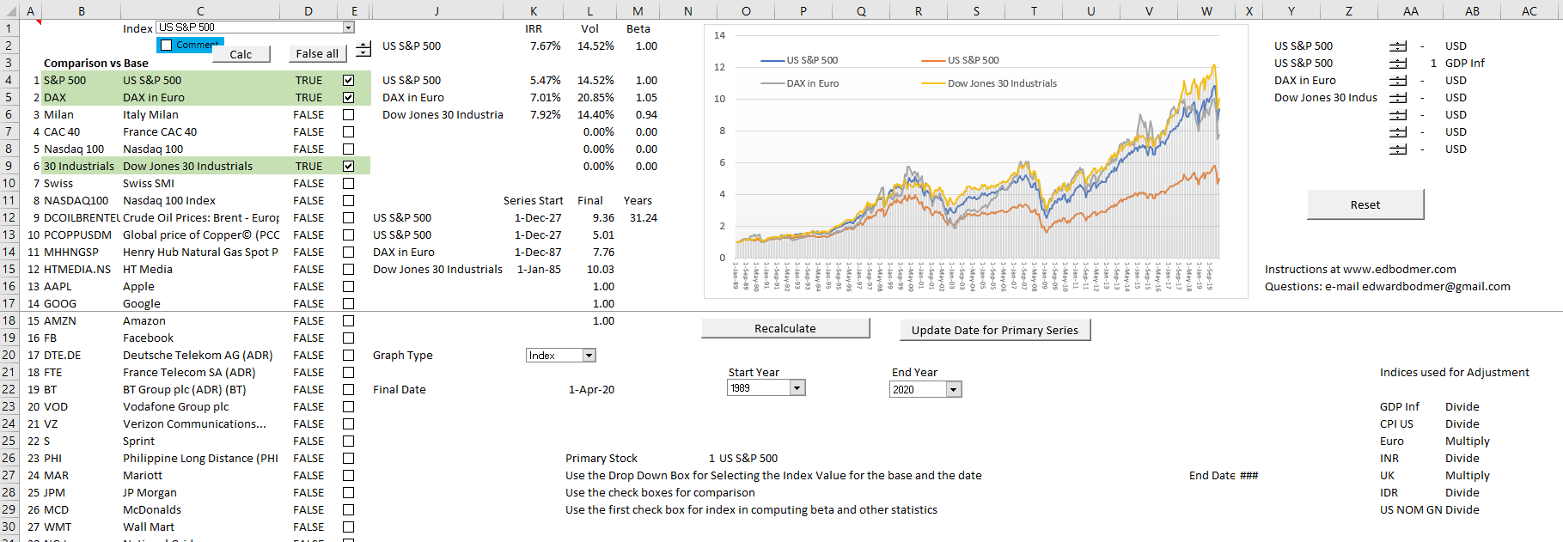
Adjusting the Stock Price Analysis
You can go to edbodmer.com and download the file. Select different stocks, make adjustments, compare to economic series.

Slide 11
Overall Stock Index and Crises
Real S&P Index since 1927. Look at crises in 1929, 1987, 2000, 2008 and 2020.

Slide 12
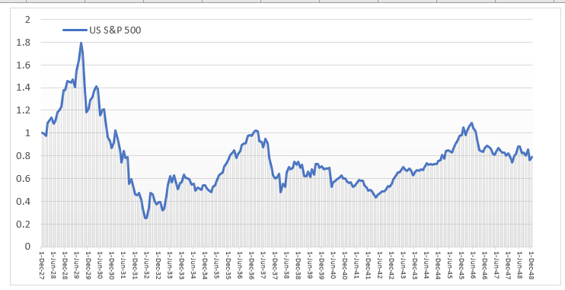
1929 Crisis – Data in Real USD
1929 Shock – Decline of 88% from 1.8 down to .2. Can you imagine losing 88% of your assets.

Slide 13
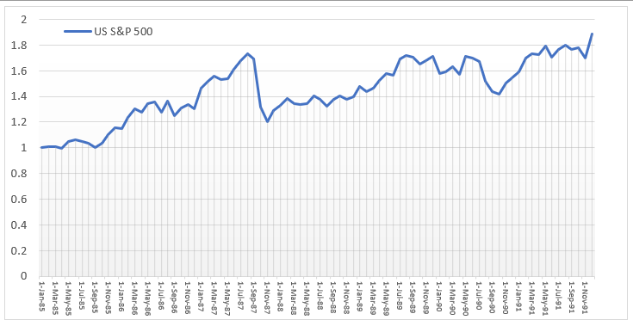
1987 Crash and Recovery
After the 1987 crash (Black Monday not black Friday), there was a complete recovery. The temporary loss was 34%.

Slide 14
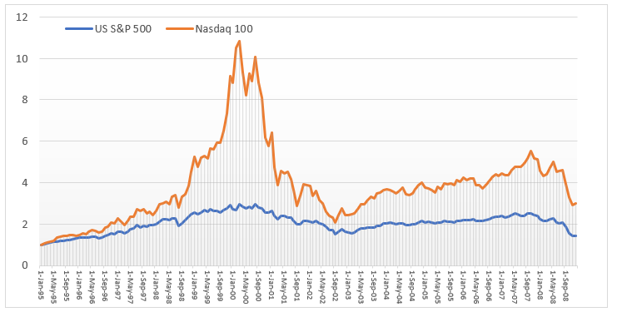
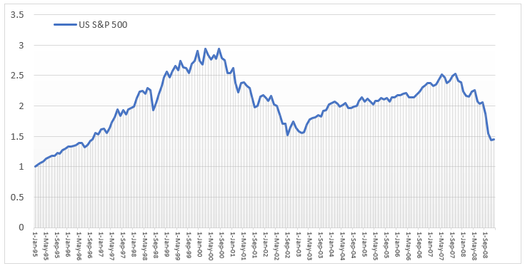
Dot Com (Telecom) Bubble
For the S&P 500 (blue line) the decline from the top to the bottom was about 50%. The S&P recovered much of its value by 2007

Slide 15
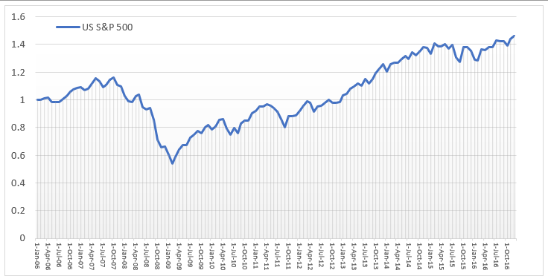
2008 and the Lehman Collapse
The decline from the high in 2007 to the bottom in 2009 was 51%. Again, the market recovered.

Slide 16
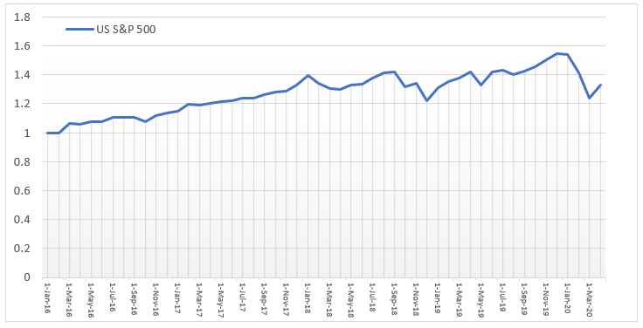
Corona Virus Compared to Others
The decline from the Corona Virus is relatively small compared to the other crashes (about 22%).

Slide 17
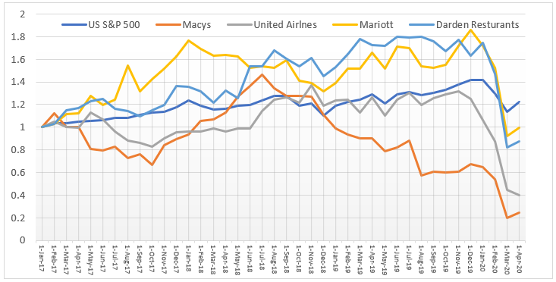
Effect on Selected Companies
Airlines, Restaurants, Department Stores, Hotels
These companies have long-term assets (planes, buildings, hotels). How much does a potentially temporary shock affect the value

Slide 18
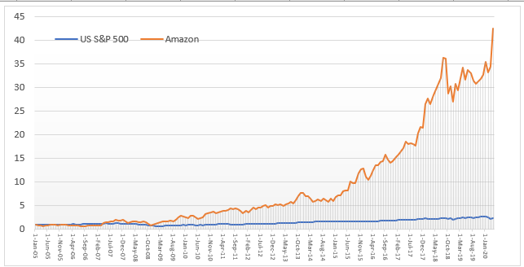
Amazon has Increased Stock Price by Contrast
IRR since 2005 is about 30%

Slide 19
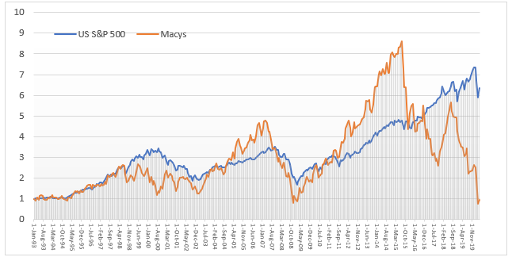
Focus on Macys
Decline in Macy’s is a 72% reduction from the Corona virus period.

Slide 20
Retrieving Financial Statement Data from MarketWatch

Slide 21
File to Read in Financial Data
To use the file that reads and analyses financial data, just put in the ticker and press the buttons. This works around the world with smaller public companies

Slide 22
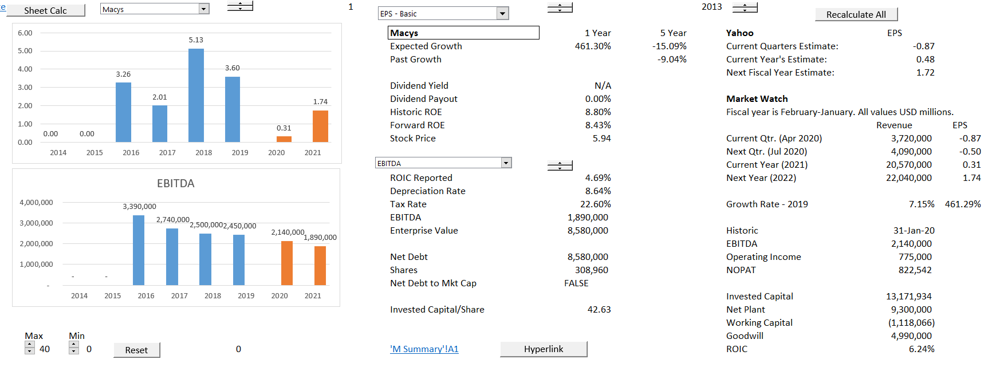
Reviewing Historic Data
Evaluate various ratios from equity perspective and free cash flow perspective. The first sheet illustrates the EPS and EBITDA.

Slide 23
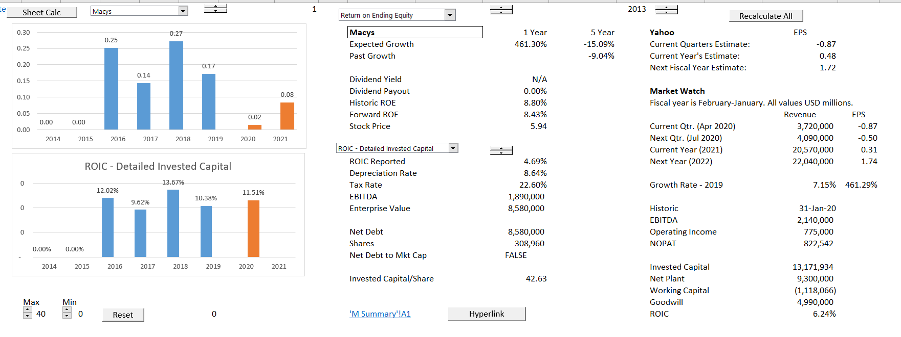
Review ROE and ROIC
You can use the ROIC to benchmark your model

Slide 24
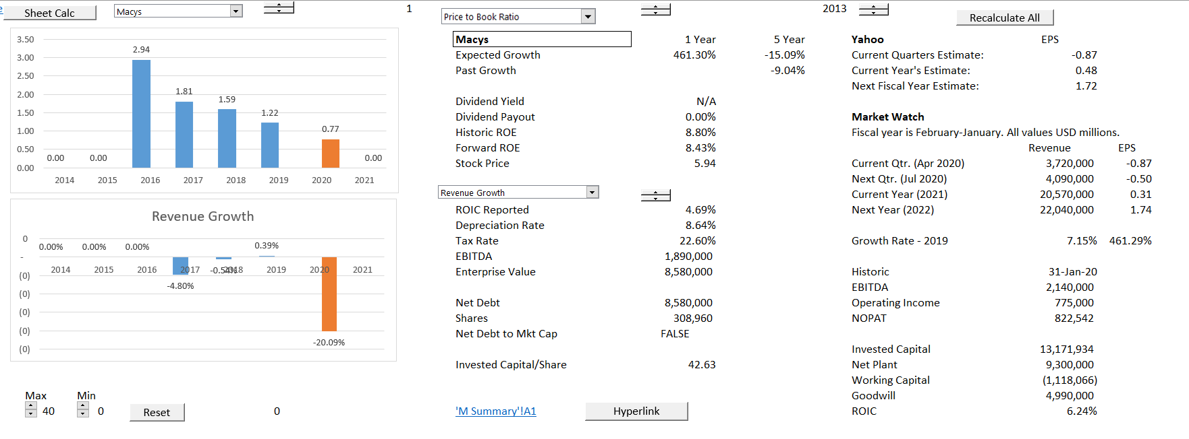
Price to Book Ratio
Evaluate the price to book to evaluate whether ROIC is greater than WACC

Slide 25
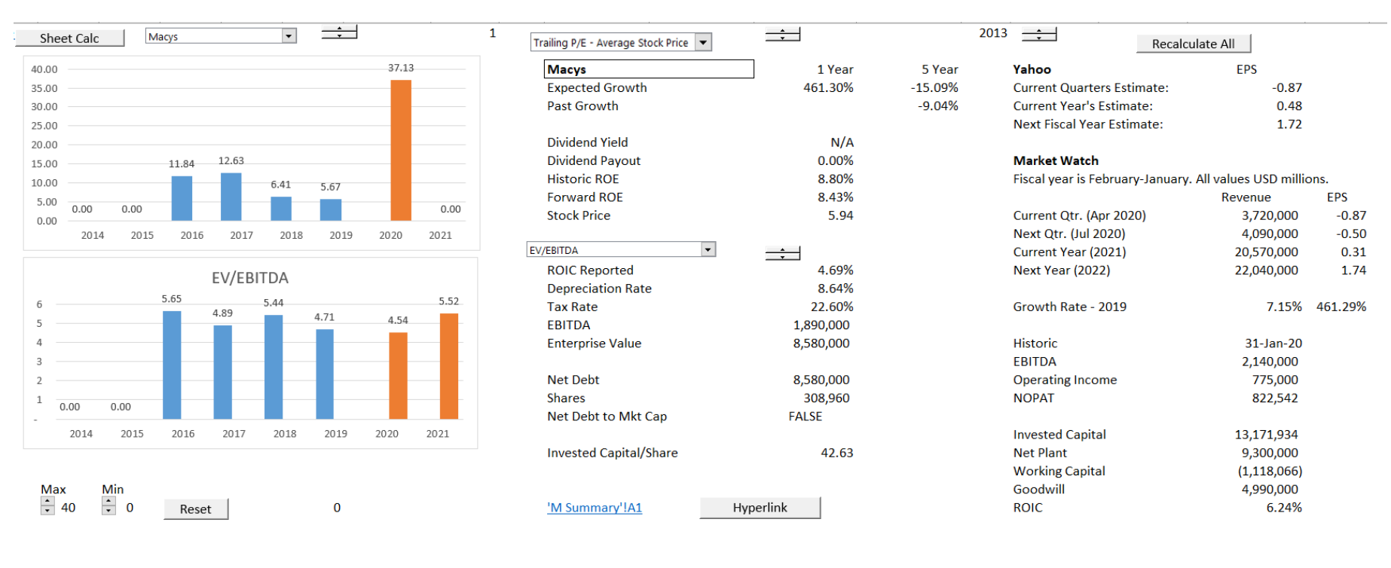
Valuation Ratios
Evaluate the P/E ratio and the EV/EBITDA ratio for valuation analysis in the financial models

Slide 26
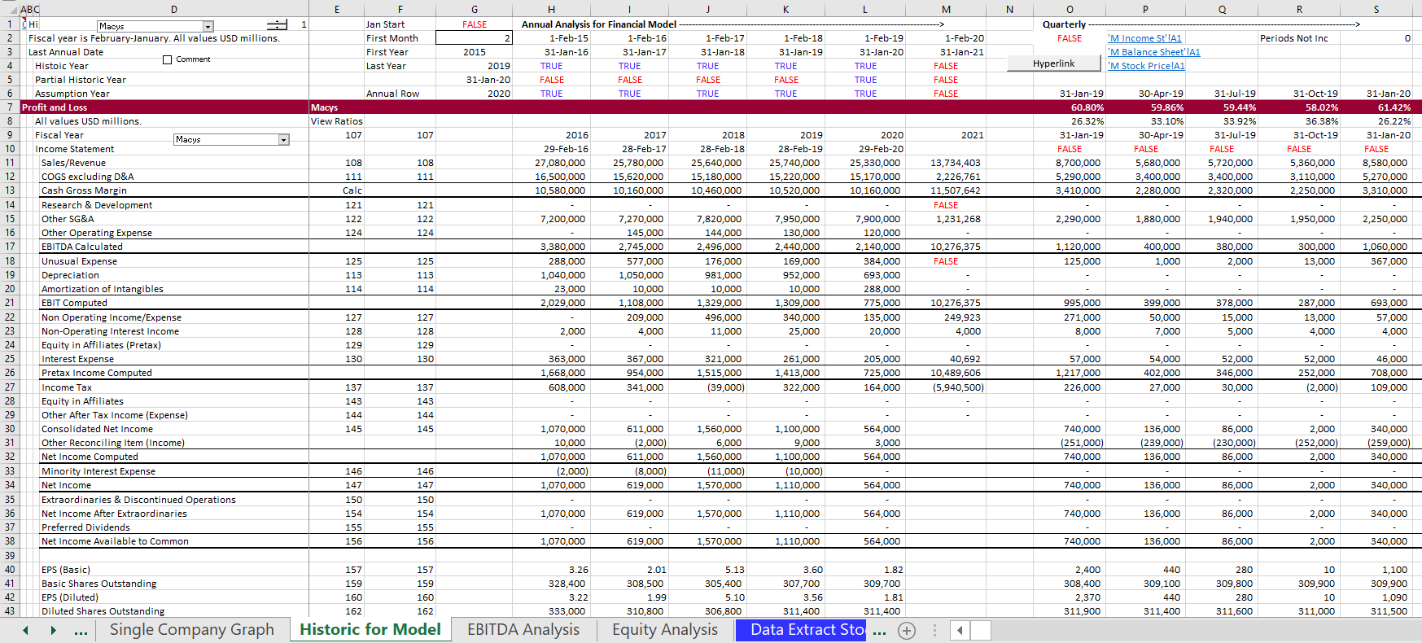
Financial Statements
You can use the financial statements as the basis for the historic part of your model. Mini demonstration.

Slide 27
Section 2: Scenario Analysis and Model Structure to Evaluate the Virus

Slide 28
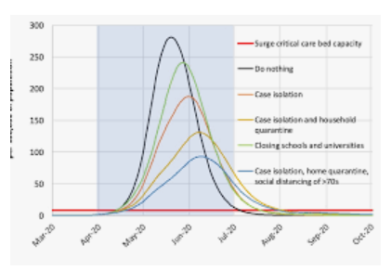
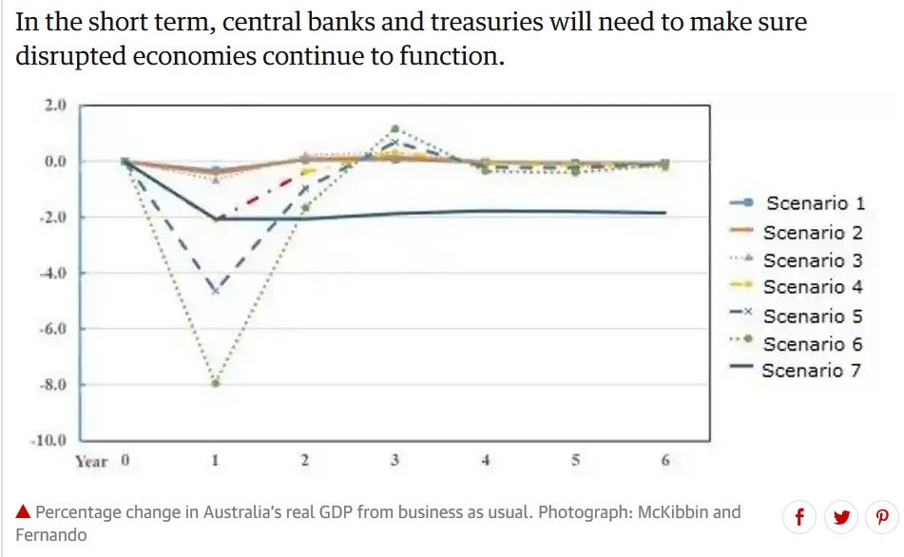
Scenarios from the Press Measuring the Effect of the Corona Virus
Virus Scenarios
Economic Forecasts

Slide 29
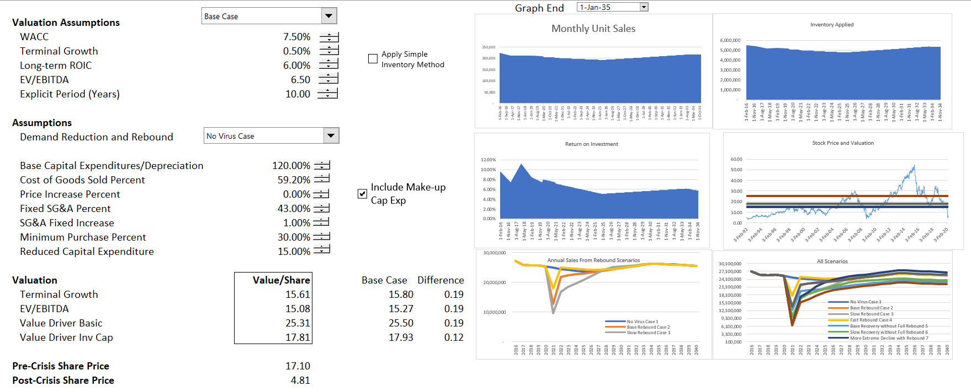
Results of Scenarios
Run sensitivity and scenario analysis

Slide 30
Creating Scenarios from Time Series Variables
Importance of Scenarios
Basic Scenario Principles
Keep Scenarios in Separate Page
Use INDEX Function
Present Scenarios with Drop Down Box
Include Sensitivity Factors
Add
Use Graphs with Data Table to Make Sure Scenarios are Reasonable

Slide 31
Initial Sales Scenarios with Full Recovery

Slide 32
All Scenarios with Different Levels of Recovery

Slide 33
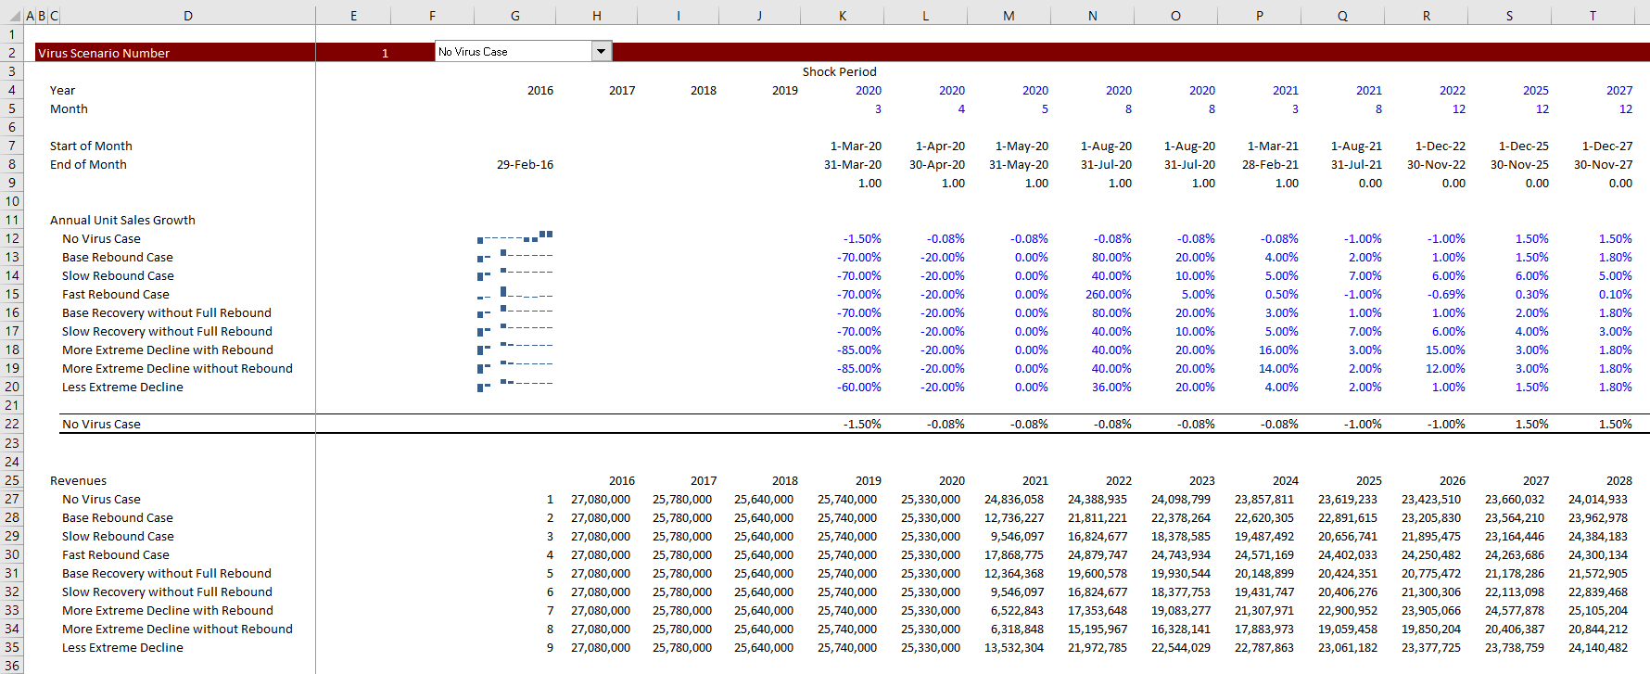
Illustration of Scenario Set-up
Put scenario in different page and use data table to understand results

Slide 34
Use Flexible Dropdown Boxes

Slide 35
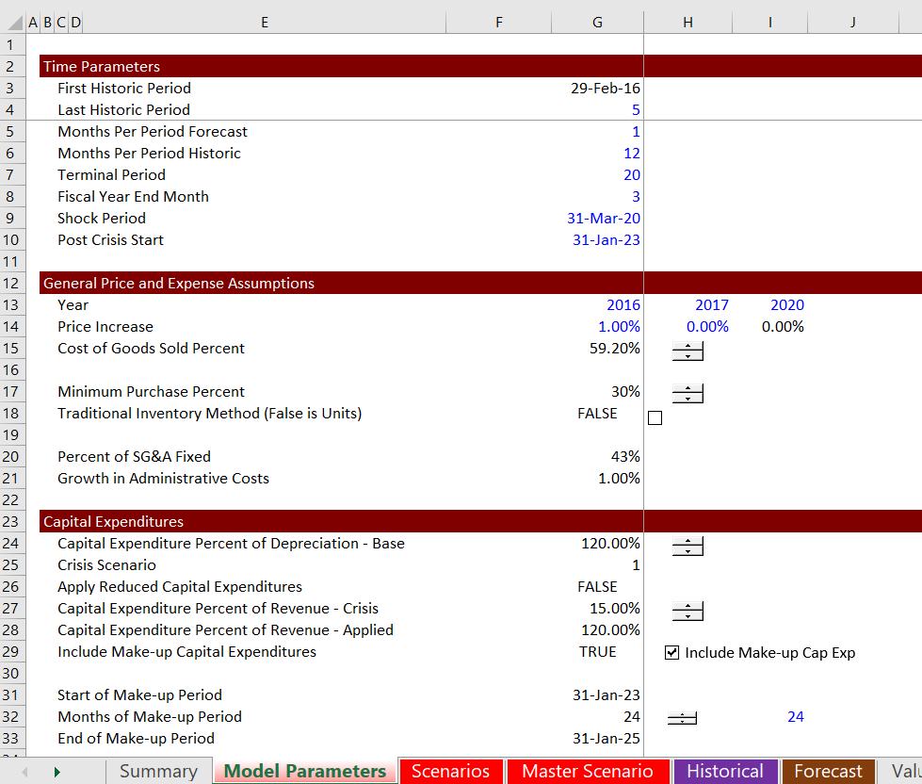
Scenario Analysis with Spinner Boxes, Resets and Scalar Variables
I used to hate the sensitivity variables, but they can be combined with scenario analysis so that you can re-set the variables

Slide 36
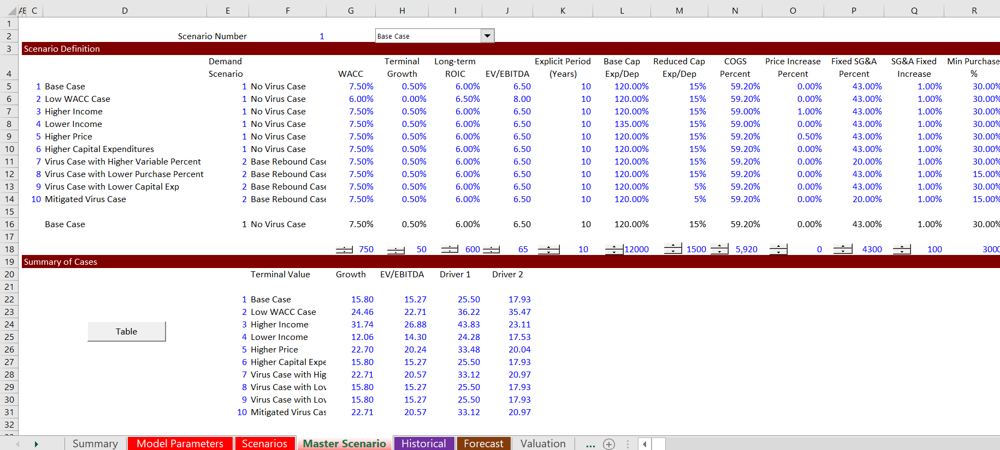
Re-Setting Scenarios and Presentation
Allow for both scenario analysis and sensitivity analysis

Slide 37
Section 3: Different Modelling Mechanics

Slide 38
General Modelling of Corona Virus
Revert to key modelling ideas of flexibility, accuracy, structuring and transparency.
This is not B.S. colouring, but thinking about how the model should really be structured and presented.
People tend to be arrogant and closed minded about changing their models. I hope you are flexible and bear with me.
I am not talking about being speedy in excel or using excel formulas like OFFSET or INDIRECT (which I love).

Slide 39
Changes in Modelling Mechanics
Problem in Modelling the Inventories
Traditional Models did not show Bulge in Inventories During 2008 Crisis
Necessity to Model Units and Not Simply Revenues and Operating Expenses
General timing issues
Fundamental breakdown between Fixed and Variable Costs (not known)
Converting model to monthly during crisis
Modelling the crisis dates

Slide 40
Flexible Timing in Models – So you can switch to Monthly
Don’t be Afraid to Add New Timing
Modelling Items on Monthly Basis
Shock Period
Adjustments to Growth Rates with (1+rate)^(months per period/12)-1
Use of Interpolate Function

Slide 41
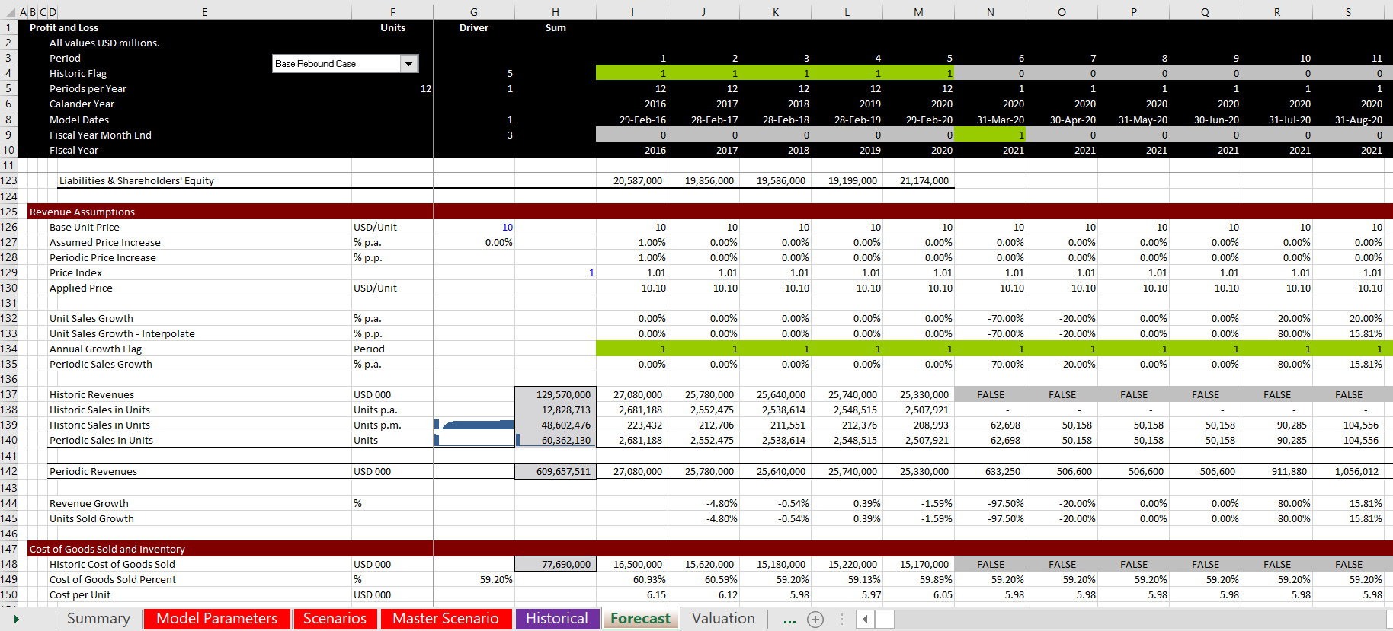
Illustration of Flexible Timing for Shock Period
Note how the timeline changes and flags are set up for the shock period

Slide 42
Focus on Variables Affected By Crisis
Many assumptions are simply historic values such as cost of goods sold percent, depreciation rate, accounts receivable percent and so forth.
Benchmark valuation to pre-crisis case and adjust certain variables such as G&A costs, capital expenditures and of course the volume of sales

Slide 43
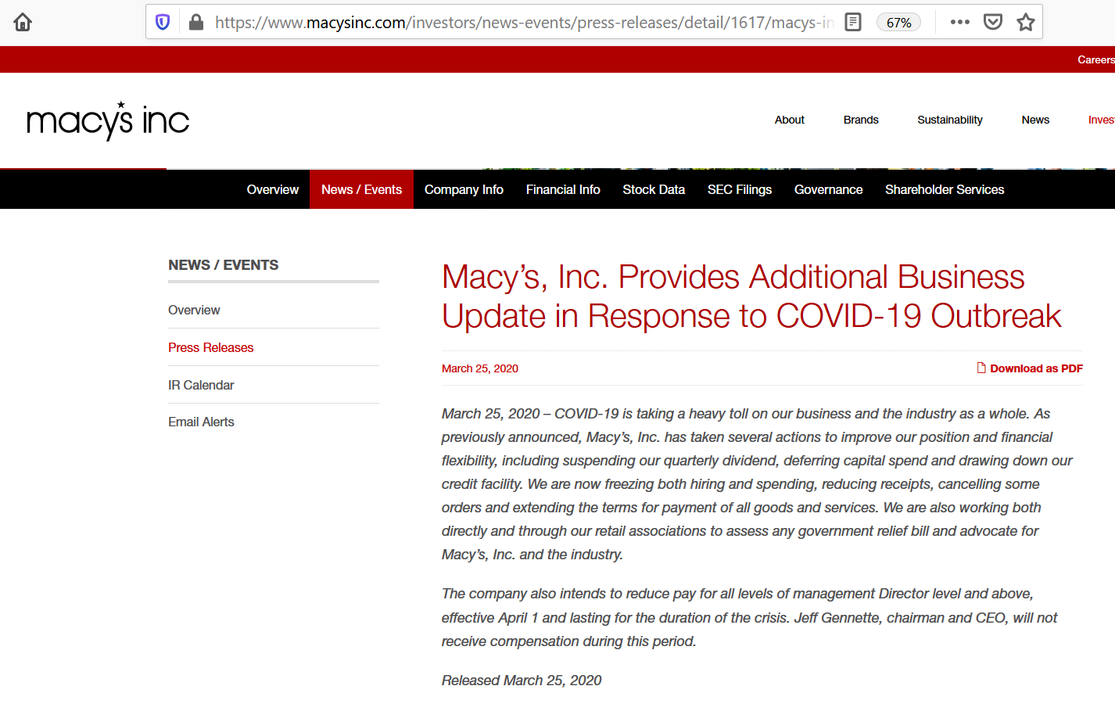
Case Study Macys Inc

Slide 44
Fixed and Variable Costs
I have tried many times to determine how much of administrative costs are fixed and variable with statistical analysis.
It virtually never works.
But the amount of variable and fixed costs is very important in times of crisis. For valuation you want costs to be variable.
Variable costs mean that you are firing people.
The best that can be done again, is to evaluate the effect of different fixed and variable cost breakdowns.
You don’t know how many costs are really fixed and variable until a crisis.

Slide 45
Illustration of Fixed and Variable Cost Differentiation for Administrative Cost
Note how some costs depend on revenues and others grow.

Slide 46
Inventory Measurement with Units
You do not need actual units; you can make general assumptions about price and quantity.
When demand suddenly drops and you have purchased your inventory already, the inventory relative to the cost of sales balloons.
To model this takes a few more lines, but you can keep track of the physical quantity of inventory and then multiply that by the implied cost of purchases.
The inventory bounce back depends on how many continued purchases are required for new fashions and products.

Slide 47
Inventory Slide 1 – Inventory as Percent of Cost of Goods Sold
Traditional method when costs of goods decline with decline in demand, you model a reduction in inventories. Note the decline in inventory.

Slide 48
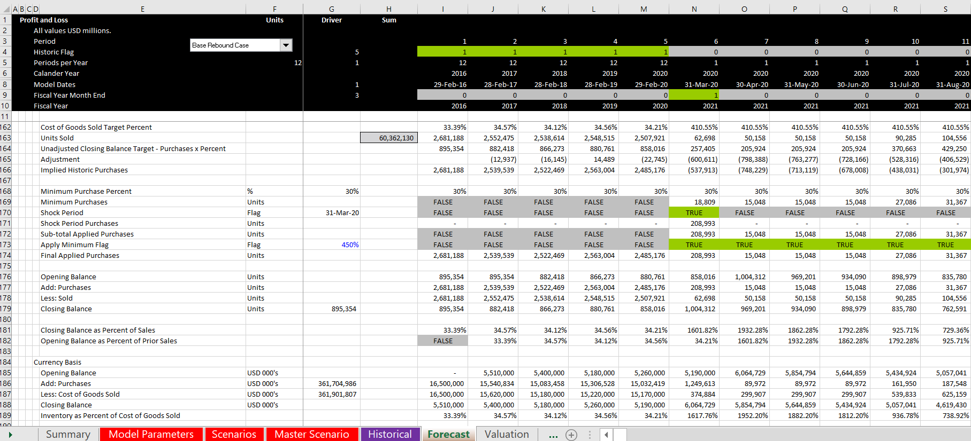
Inventory Slide 2 – Model Purchases and Sales with Units
Set-up an inventory balance and see that the inventory bulges until make lower purchases

Slide 49
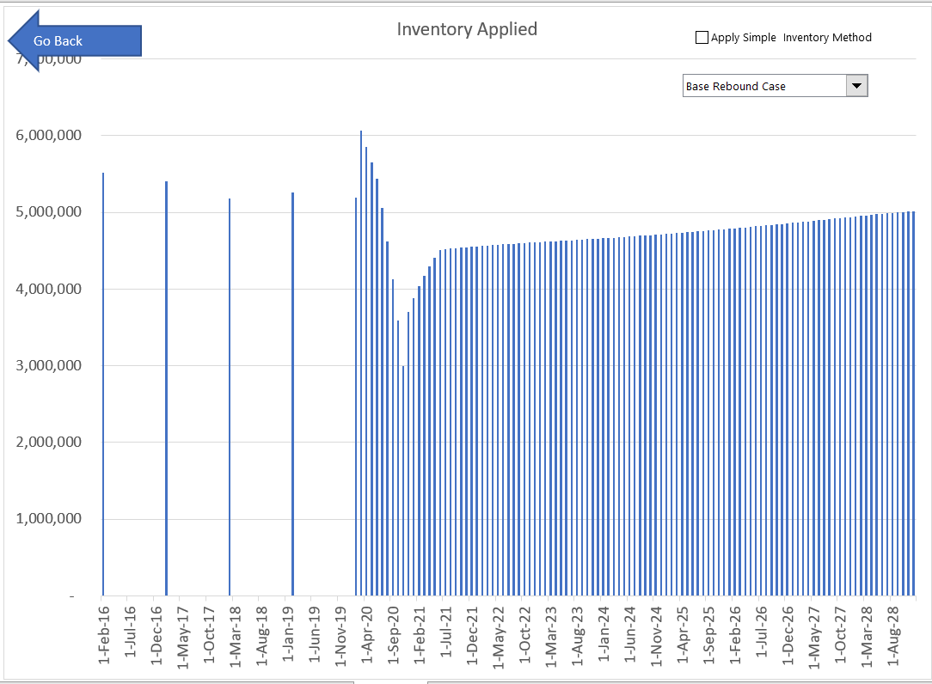
Different Inventory Methods
Notice the dramatic difference in method

Slide 50
Capital Expenditures and Depreciation
Searching for Discretionary Capital Expenditures
Need to Understand Long-term Recovery and Necessity for Capital Expenditures
Consequences of Reduction in Capital Expenditures
Should be some consequences, otherwise why would you be spending the money
The valuation should account for the capital investment
The consequences could be reduced revenues or increased subsequent capital expenditures
Careful with Using Net Depreciation with Changing Capital Expenditures
Cannot make capital expenditures as a percent of sales

Slide 51
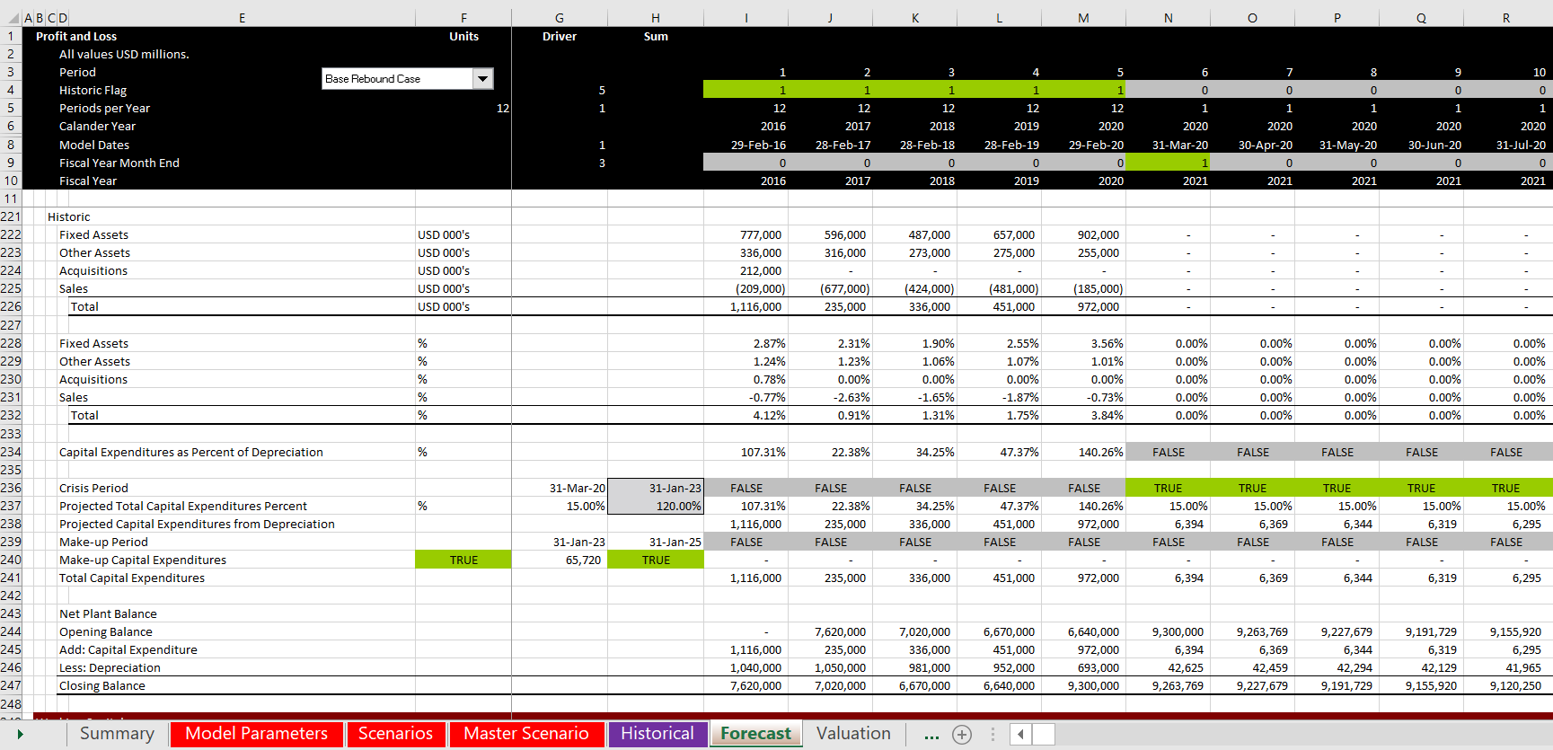
Illustration of Capital Expenditure Cuts and Make-up Capital Expenditures
Note the added line for “Make up” capital expenditures

Slide 52
Section 4: Valuation Model

Slide 53
Illustration of Impacts
Benchmark Valuation without Crisis
Effects of Different Terminal Valuation Models
Bias from Overestimation of Cost of Capital and Compensation from Overestimating Assumptions
Effects of Modelling Methods from Inventory and Capital Expenditures

Slide 54
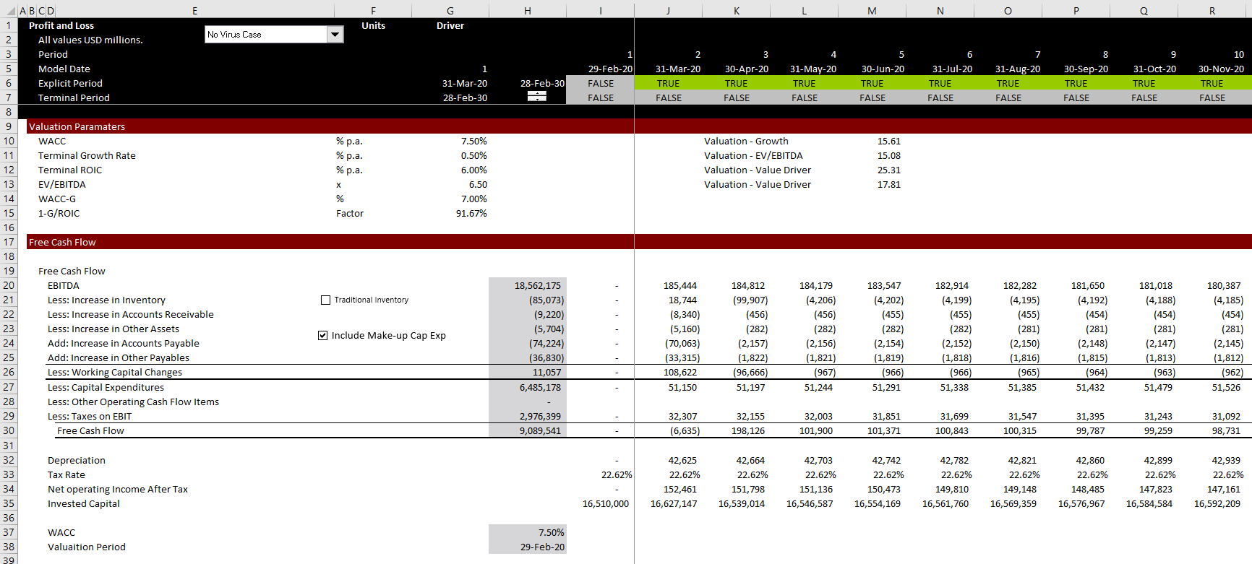
Illustration of Valuation
Base Case with correct adjustments

Slide 55
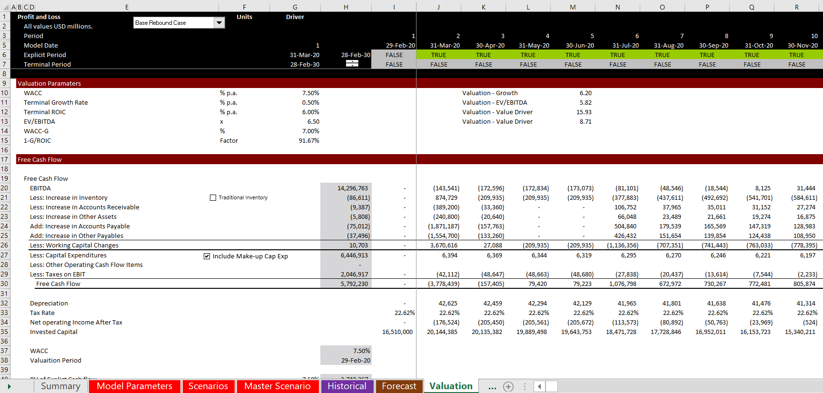
Shock Case with Correct Inventory and Capital Expenditure
Note the sum column to evaluate of cash flow items

Slide 56
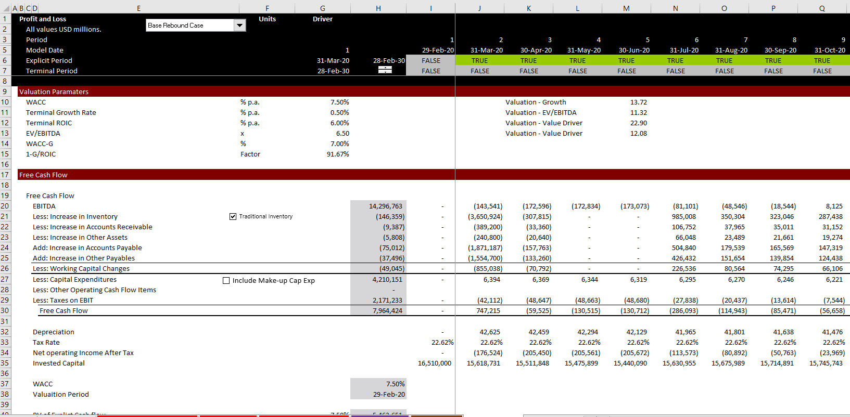
Shock Case with Incorrect Adjustments
Note difference in capital expenditures and working capital

Slide 57
Terminal Value
Gordons method
Crisis must be finished at terminal value
Careful with capital expenditures (general problem)
No reflection of return on investments
Terminal Multiple
What is the real long-term multiple
Does not reflect changes in growth rate
Value Driver
Black box and transition
Value Driver with Immediate Transition
Shows where value comes from
Less potential distortions from crisis

Slide 58
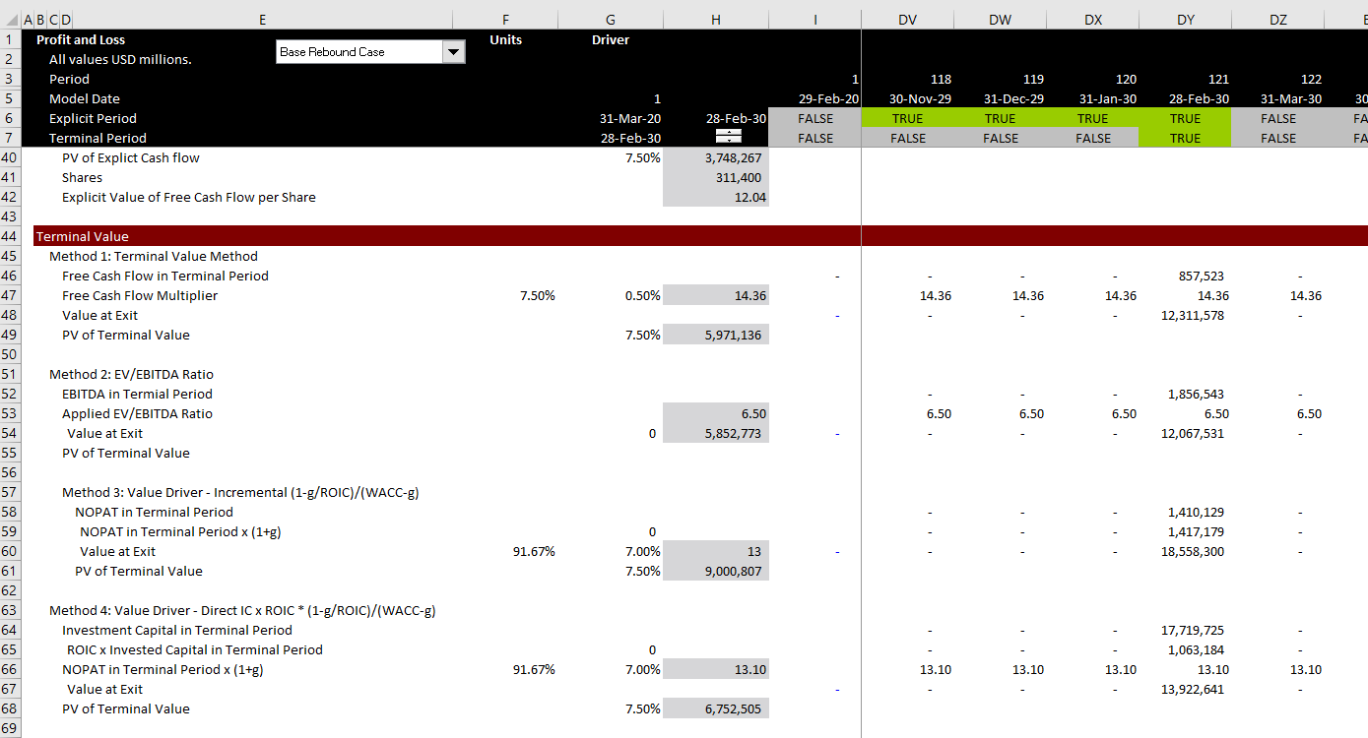
Alternative Terminal Values
Different Methods affect the ultimate value

Slide 59
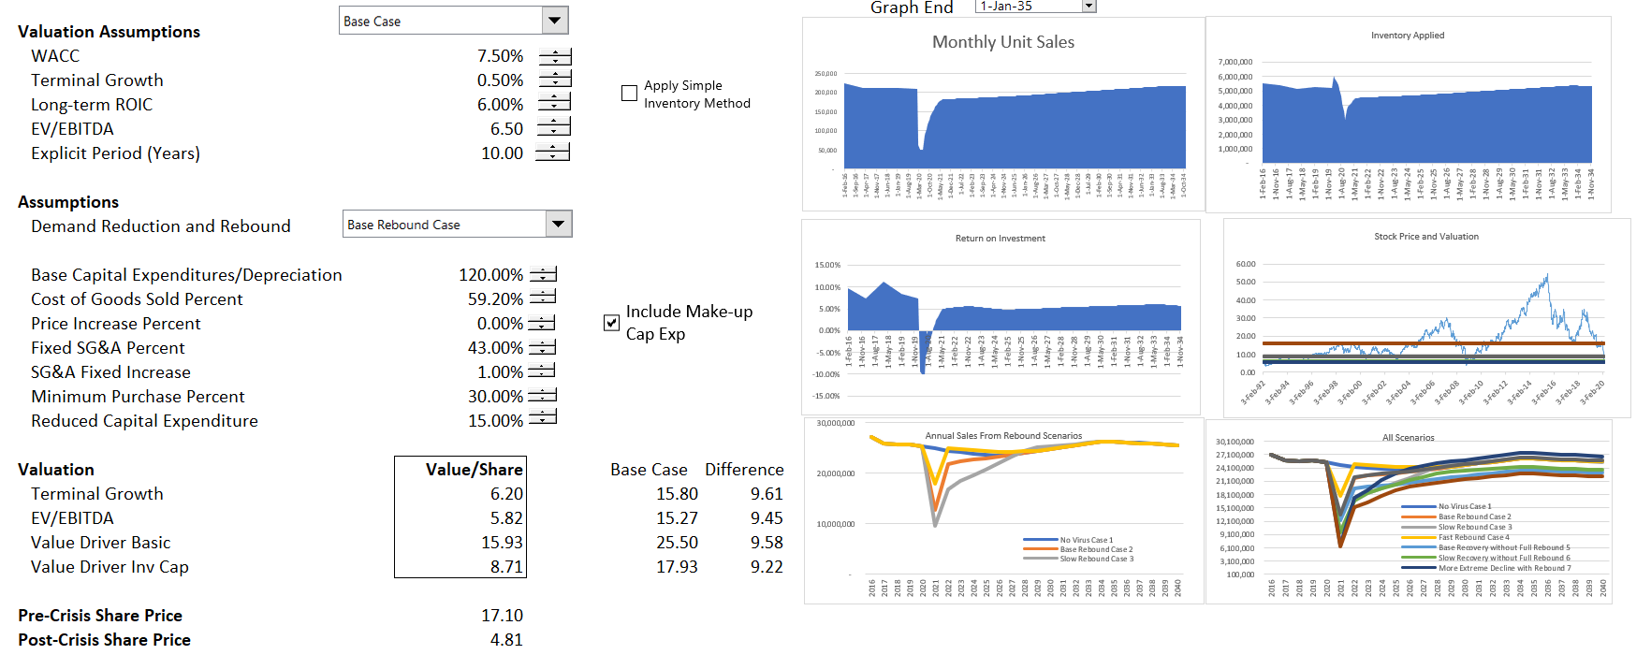
Summary and Sensitivity
Base Rebound Case

Slide 60
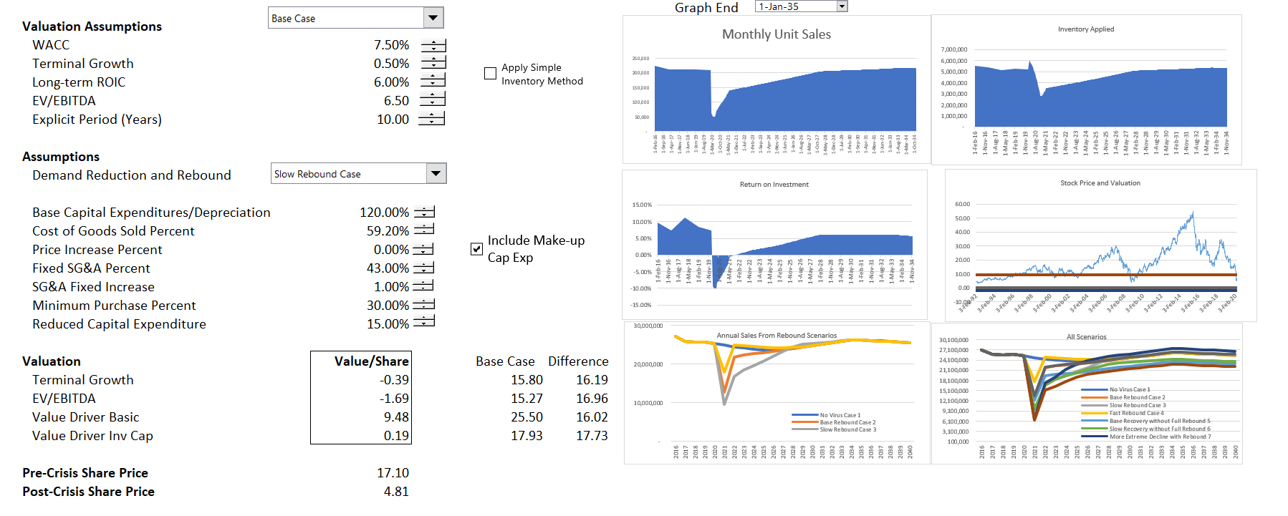
Summary and Sensitivity
Slow Rebound Case

Slide 61
Effects of Discount Rate in Different Valuation Models

