Slide 1
Chapter 1: Acquisition Modelling Introduction

Slide 2
Teaching Style for Modelling
Overall objective is to teach more complex project finance theory and concepts through modelling.
Don’t use really big template models. Instead work from blank sheet and understand sophisticated issues.
  You can find models at www.edbodmer.com
Understanding the modelling concepts is much more important than typing formulas in excel.
  If you find yourself typing formulas instead of understanding the concepts STOP TYPING (you will receive and e-mail of the completed model).

Slide 3
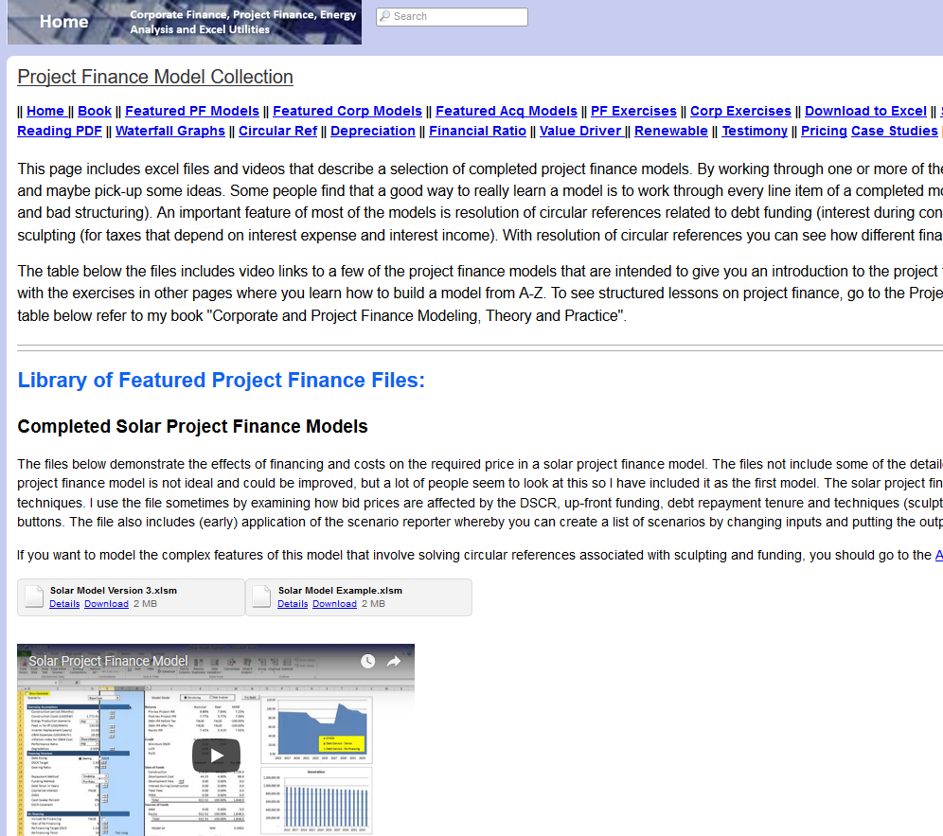
Finding Completed Template Models
Search for Corporate Finance Modelling in Google

Slide 4
Teaching Style - 2
Review the general finance theory and concepts first.
  Do this very quickly with power point slides as many of the concepts have been discussed
  Do this because modelling is not useful unless understand the project finance concept
  After discussing the modelling concept, add issues into a simple model.
Many issues are much better analysed with a simple demonstration in excel rather than a big model with 30 sheets.

Slide 5

Financial Modelling Religion and FAST
Various organisations have rules for modelling.
One good technique for modelling (and maybe for your life) is FAST. (General conflict between Structure and Flexible)
F
  Flexible: Different timing, scenarios, financing techniques.
A
  Accurate or appropriate. The balance sheet must balance
S
  Structured.
  Separate financing from operations.
T
  Transparent – short equations.

Slide 6
What does Flexibility Mean in Corporate Model
Add new history without re-doing the model
Alternative terminal value timing
Addition of different scenario analysis
Alternative valuation techniques
Different types of assumptions (e.g. A/R to sales as last year or historic average)

Slide 7
Accurate/Appropriate
Accurate and Appropriate
  Level of detail in model
  Balance sheet and other tests
  ROIC presentation

Slide 8

My Rule: Laziness Principle
There are many ways in excel to do things. Find the fastest and easiest way to do it.
  Often use short cut like Alt,E, IS
  Sometimes use the mouse
  Use entire row or column when you can
  Use TRUE/FALSE instead of IF: =1=1 is TRUE
    True is 1
    False is 0
Find the Laziest Way

Slide 9
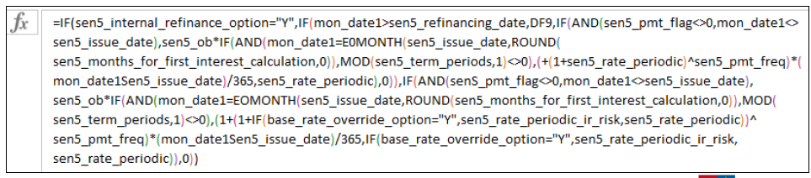
Transparency
Keep the formulas simple
No excuse at all for long formulas because it makes the concepts difficult to explain to somebody not familiar with the model.
Long formulas come about because you do not exactly understand what you are doing.

Slide 10

Excel Functions
We will use short-cuts, excel enhancements, TRUE/FALSE switches and only four functions.
The functions should be used in a way that you are probably not used to.
INDEX
LOOKUP (not VLOOKUP or HLOOKUP)
SUMIF (or AVERAGEIF or COUNTIF)
EDATE
MAX and MIN for Waterfalls (not IF)

Slide 11
Files to Use and Open
Generic Macros
Shift, CNTL, R to copy to the RIGHT
CNTL, ALT, C to colour and format
Must Enable Macros
Should say CNTL,ALT,C on the bottom of excel
Read PDF to Excel
Should say SHIFT, CNTL, A on the bottom
Enable Macros
Use Acrobat
Use Google Chrome

Slide 12
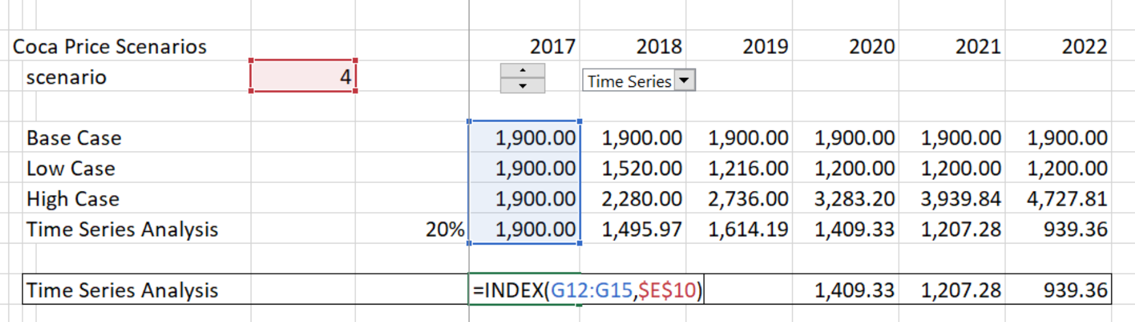
Example of INDEX Function
We will make scenarios for things like:
  Variation in traffic for infrastructure projects
  Variation in price for commodity projects
  Difference in availability for availability projects
Example of Index Function

Slide 13
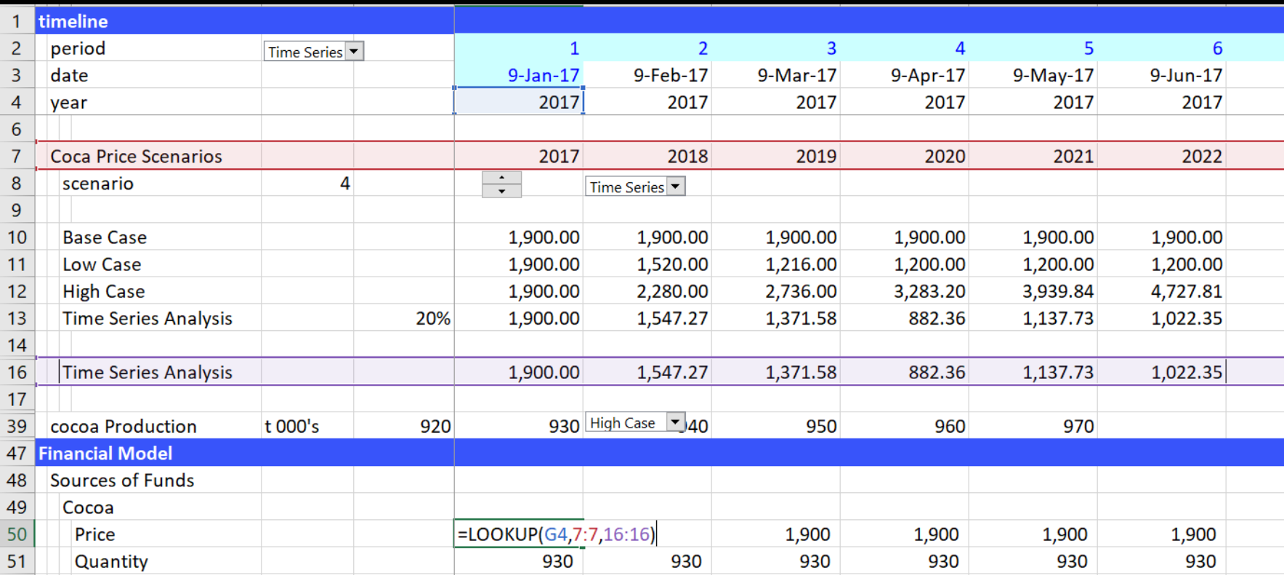
Use of LOOKUP Function
Don’t use VLOOKUP, HLOOKUP or INDEX/MATCH with models that have a time line. Instead, use the LOOKUP function with an entire row as illustrated below:

Slide 14
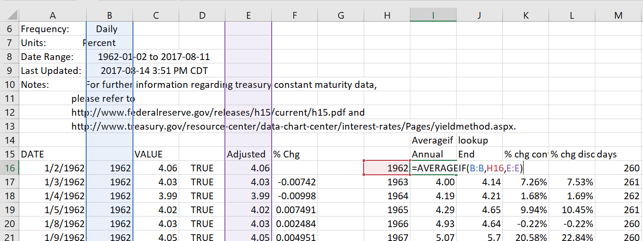
Use of AVERAGEIF, SUMIF, COUNTIF
These functions are useful in project finance model for:
  Converting periodic data by month to sum for a year
  Checking errors
  Counting TRUE’s or FALSE’s

Slide 15
Chapter 2: Difficulties in Corporate Finance Modelling

Slide 16

Valuation and Magic Potion
Calculation of Cost of Capital with CAPM and Expected Market Risk Premium
Adjustments to WACC for Tax Deduction on Interest and Debt Beta
Use of Valuation Formula: Value = Income x (1-g/ROIC)/(WACC-g)
Assumption that a Company will suddenly become a stable company in equilibrium
Myriad of adjustments for political risk, liquidity, beta mean reversion, small company risk …
Methods to Normalise Cash Flow in Terminal Period

Slide 17
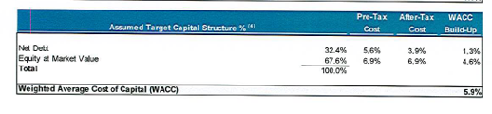
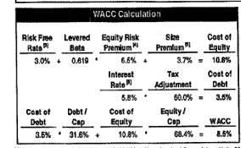
Cost of Capital in Same Transaction
Top is buy side (if negotiating would want high cost of capital). Bottom is sell side.

Slide 18
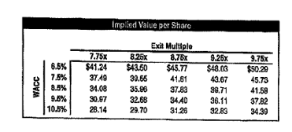
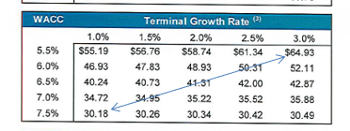
Effect of WACC on DCF
Variation in value from the cost of capital with the two cases. Note: Two way data tables are better with macro.

Slide 19
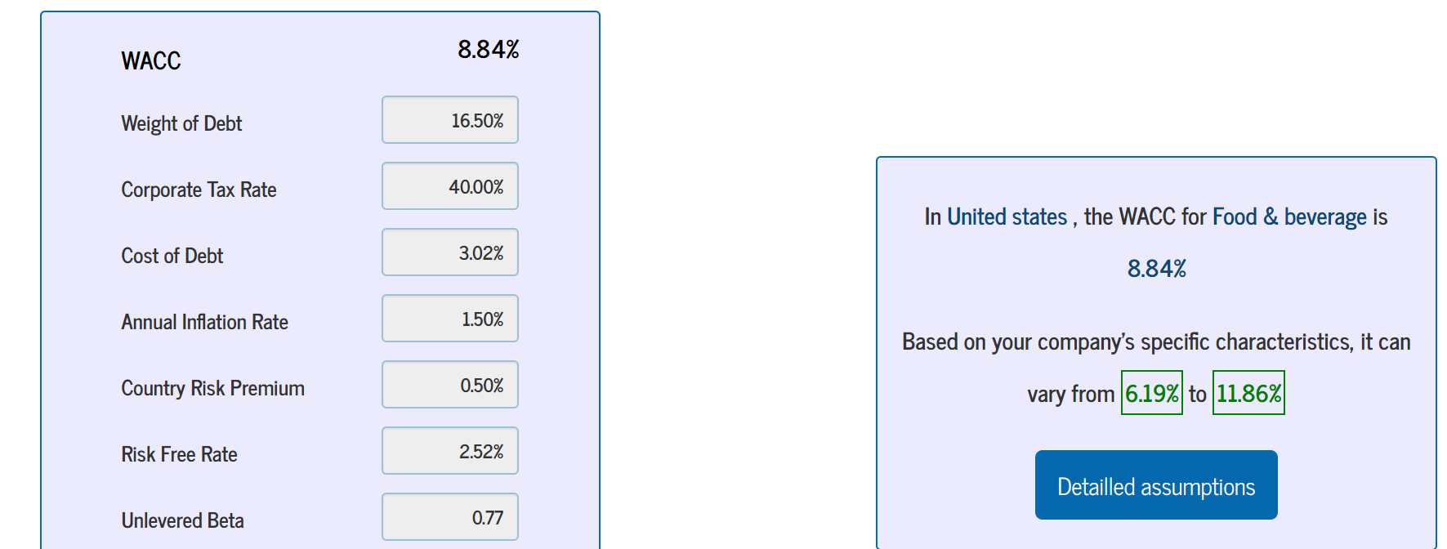
WACC Craziness
http://www.waccexpert.com/

Slide 20
Corporate Finance Ideas for Simple Company
Lets say you can find the following:
  A company with some fluctuations in return, but not too much.
  A company that grows at about the same rate in real terms as the population (e.g. a food company).
  An industry where P/E multiples and EV/EBITDA multiples are stable across companies and stable over time.
  An industry where there is quite a lot of competition and assets are not very capital intensive.

Slide 21
Companies Used in McKinsey Book and Typical Examples
Fed Ex
UPS
Heiniken
Disney
Walgreens
General Mills

Slide 22
For This Simple Company you Can Make an Elegant Financial Analysis
Start
First, start reading a lot of historic financial data from financial statements with read pdf or with workbooks.open or with sec read.
Project
Next, project variables from actual data – you can even use the historic revenue growth.
Create
After that, create nice pictures of the historic and future return on invested capital.
Apply
Finally, apply multiples or a fancy formula like (1-g/ROIC)/(WACC-g) to evaluate the terminal value. It doesn’t matter very much because you get the same answer

Slide 23
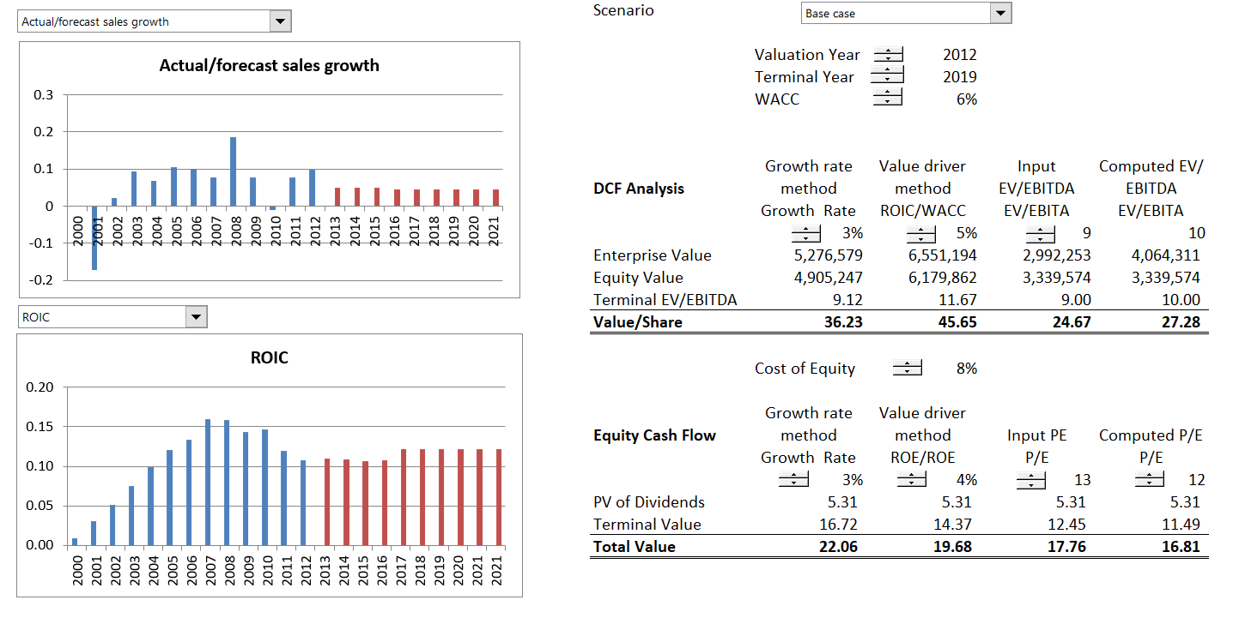
Example of Classic Company
In this case, keep ROIC in sight when make a valuation.

Slide 24
Contrast Two Companies in Evaluation of Corporate Finance
Classic Company
Mature Company with capital expenditures used to make investment.
No large write-offs, re-structuring's or asset sales.
Multiples are similar across companies in the industry and over time.
Value to Investment (price to book) ratios are stable and can be used to evaluate company management and cost of capital.
Return earned on assets invested in the past is similar to return on investment on new assets.
Tricky Situations
Investment in the form of research, operating losses and software.
Balance sheet affected by gains on asset sales, write-offs, re-structuring charges.
Multiples change a lot over time for individual companies and across a cross-section of companies.
Value to investment have little meaning as historic investment was very small compared to new investment.
Return on historic investments change as plants age and conditions change in an industry.

Slide 25
But, What happens if …
Rate of return (it could be ROIC, ROCE, ROE or any other measure), is not very relevant because:
  Returns are distorted (i.e. very high) because of large writeoffs that the company took a couple of years ago
  Invested Capital is high because of because of asset sales that resulted in gains and a higher equity.
  Businesses like construction and contracting carry risks and therefore earn returns, but little or no capital is invested, so how can you compute ROIC, ROE etc.
  Investment is in the form of research and development or operating expense to keep quasi monopoly going (e.g. Apple, Google etc.)
  Return on new investments very different from return on historic investments (e.g. Amazon investment in food delivery versus investment in websites).

Slide 26
Also, What Happens if …
A company has been growing fast and it cannot keep growing forever, but you don’t really know how long the growth will last.
  If a company grows fast and its return is greater than its cost of capital, the P/E ratio and the EV/EBITDA ratio can be very high. Do you really think you can predict the length of time the company will continue to grow.
  If you claim that you know how fast the company can keep growing you are a fraud.
  A company has been experiencing high return on invested capital because of low capital spending, but it will eventually have to replace its capital.

Slide 27
Were the “New Economy” Ideas Not So Stupid
The new economy concepts were that real options could be created if a company gains scale. These ideas were laughed at. But after 20 years, maybe some of the ideas were not so silly.
For example, “the extraordinarily high anticipated profits represented by stock prices during the Internet bubble never materialized, because there was no ‘new economy.’”
Get data from the comprehensive stock price file.
The real thing that happened during the dot.com bubble was with telecom companies
Use Amazon, Priceline, Pay Pal, EBAY

Slide 28
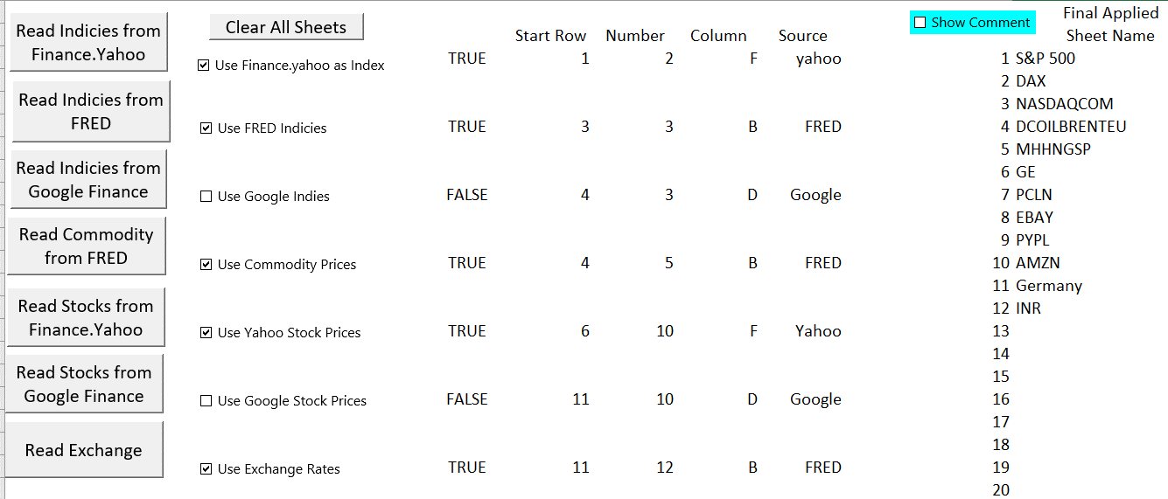
Comprehensive Stock, Commodity and Index File
You can evaluate the performance and variation in different stocks and make statistical analysis using the comprehensive stock file.

Slide 29
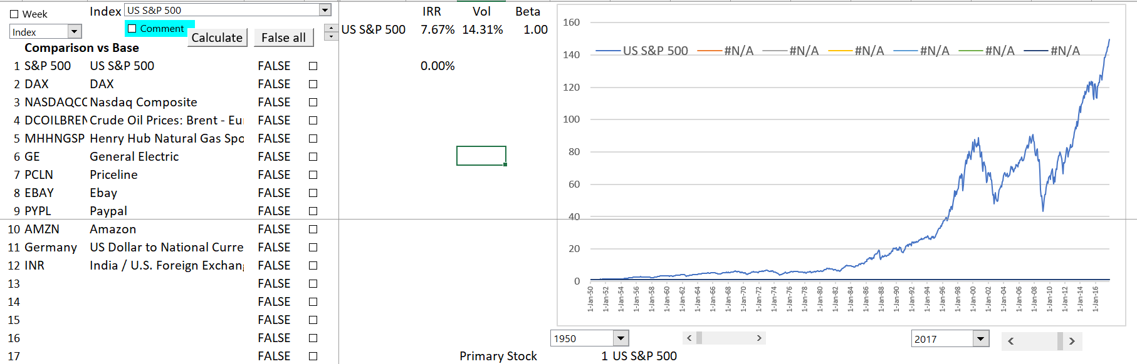
Example of Indices
S&P Index since 1950 is base.
IRR is final value (149.5) divided by initial value (1.0), raised to years – 1 (67.8 years).
Returns and volatility is affected by the time period.

Slide 30
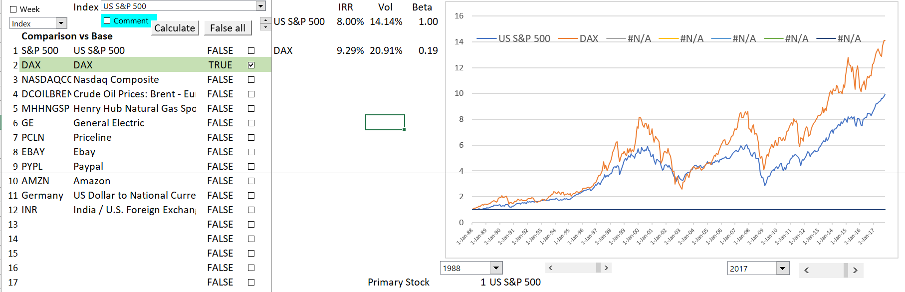
S&P 500 and DAX
This illustrates how you can compare different indices and adjust for exchange rates.

Slide 31
Fundamental Economic Question of Economic Growth and Stock Value Growth
Can stocks out-grow the overall economy in the long-run.
What has been the return on stocks (with dividend re-investment) relative overall economic growth.
If stocks do not grow faster than the economy, then investors are not compensated for taking risk.

Slide 32
Comparison of Stock Prices and Economic Indicies
Note the recent increase in stock prices relative to national income and even corporate profits. Different starting points.

Slide 33
More Comparison of Stock Prices and Economic Indicies – GNP and Median Income
Note the recent increase in stock prices relative to national income and even corporate profits. Different starting points.

Slide 34
Stock Prices of New Economy Stocks versus Old Economy Stocks
During the Internet bubble, managers and investors lost sight of what drove return on invested capital (ROIC); indeed, many forgot the importance of this ratio entirely. Many executives and investors either forgot or threw out fundamental rules of economics in the rarefied air of the Internet revolution.
The notion of “winner take all” led companies and investors to believe naively that all that mattered was getting big fast, and that they could worry about creating an effective business model later. Increasing-returns logic was also mistakenly applied to online pet supplies and grocery delivery services, even though these firms had to invest (unsustainably, eventually) in more drivers, trucks, warehouses, and inventory when their customer base grew. When the laws of economics prevailed, as they always do, it was clear that many Internet businesses did not have the unassailable competitive advantages required to earn even modest returns on invested capital.
unassailable competitive advantages = addiction to products or creating a monopoly

Slide 35
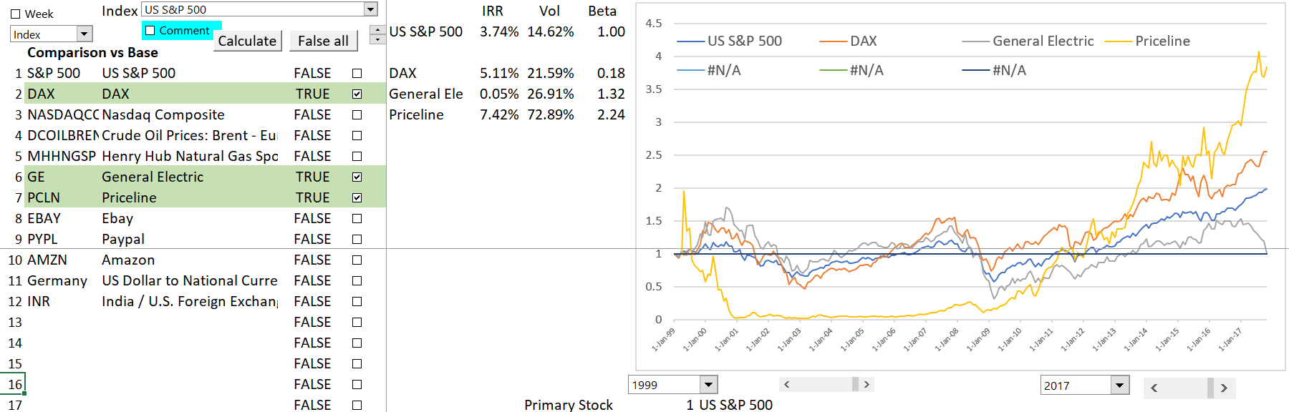
Comparison of Priceline to Old Economy Stocks
Now, begin to look at what were called “New Economy Stocks”. Begin with Priceline. It had no “unassailable” competitive advantage.

Slide 36
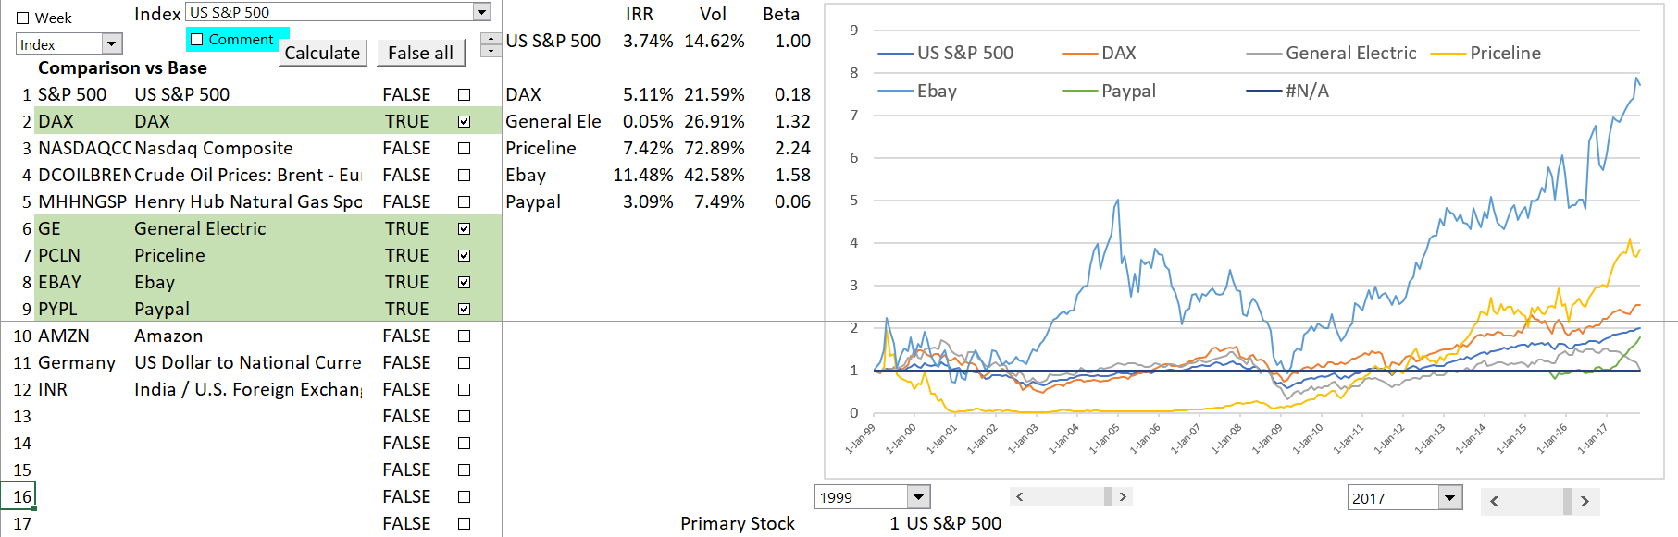
Now Add eBay
The case of eBay is more extreme.

Slide 37
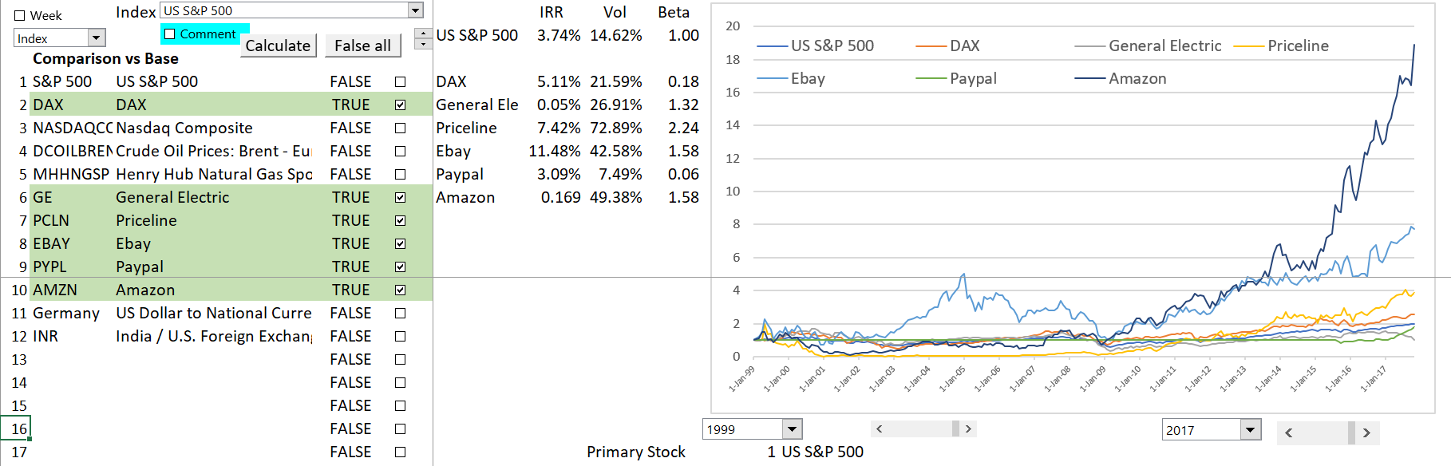
Amazon needs a lot of infrastructure and employees
Amazon dwarfs the other companies.

Slide 38
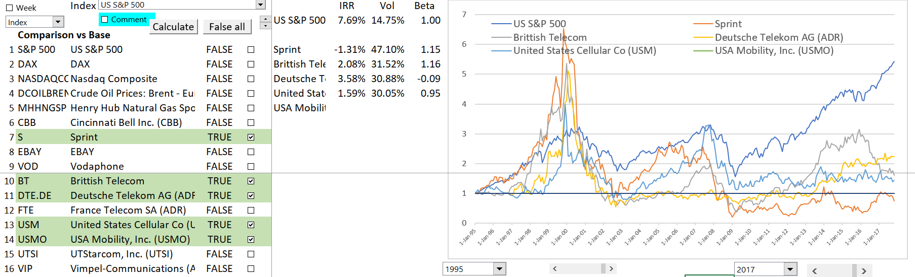
Telcom’s and the Dot.com Bubble
As shown in the graph, the stocks of the telecoms were more variable.

Slide 39
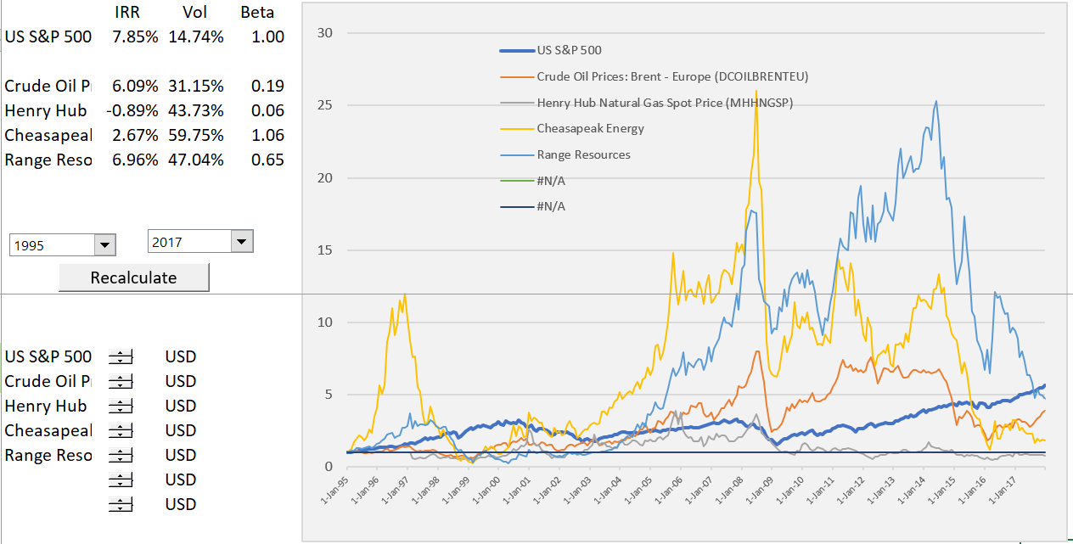
Shale Oil and Gas Stocks
Compare stocks to commodity prices – No cash flow for shale oil and gas.

Slide 40
Cost of Debt Capital and Compensation for Future Default

Slide 41
Football Field Diagram and Alternative Valuation Approaches with Different Ranges in Value

Slide 42
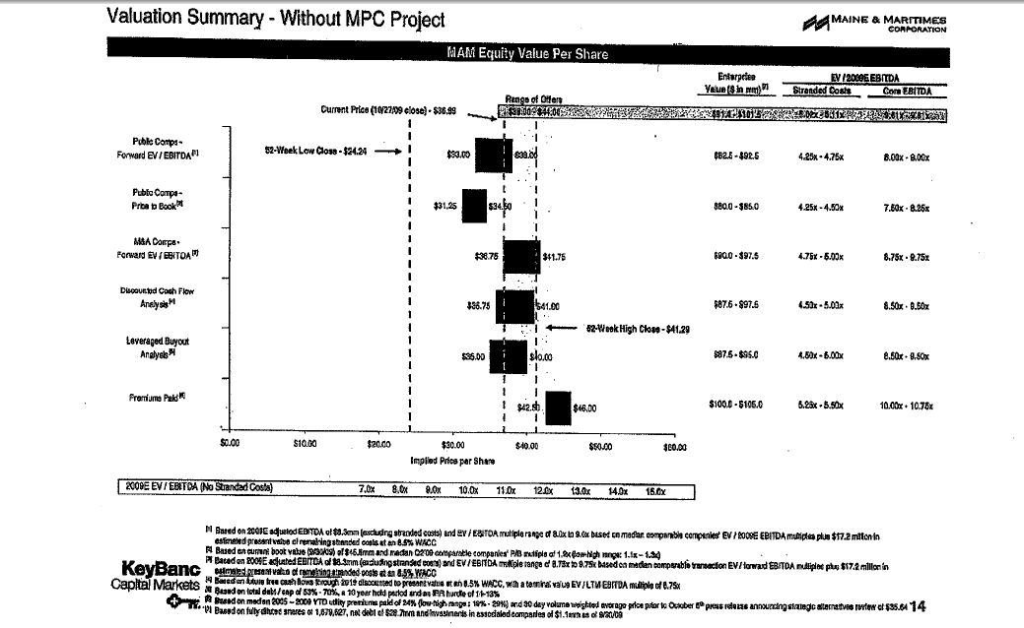
Football Field Diagram - Seller
Show the price per share and the Enterprise Value

Slide 43
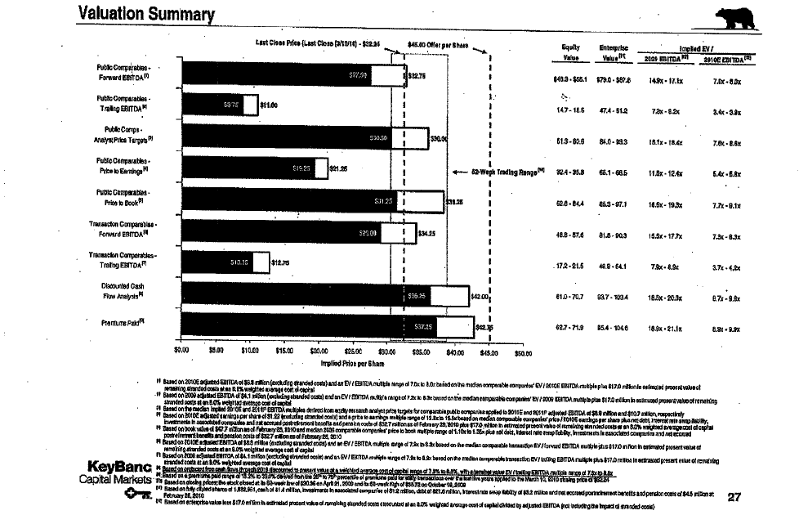
Football Field Diagram – Sell Side
Includes purchase price
Notes on forward EBITDA from Earnings Projection

Slide 44
Football Field Data Example
Look at Different Methods of Valuation
  Recognize that there is not a precise number
  Recognize that there is not a single method, but many

Slide 45
Football Field Diagram in Exercise File
Example – tricky technical part is to create space for labels

Slide 46
What do Multiples Really Mean and Evaluation of History of Multiples

Slide 47
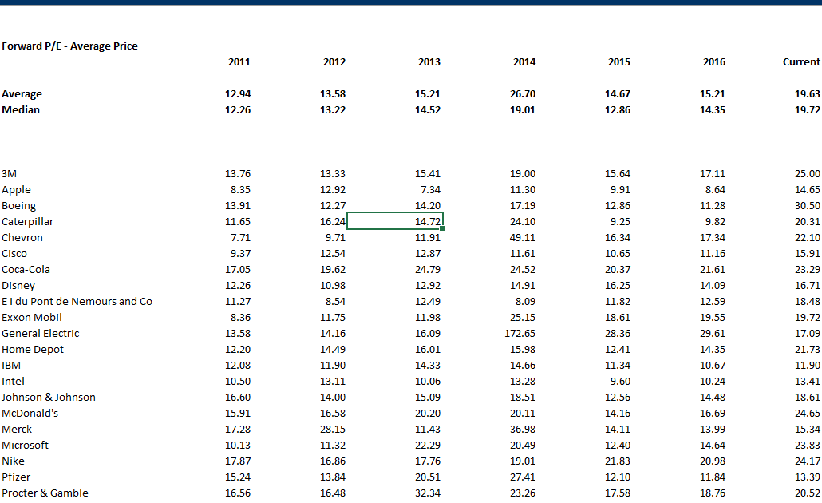
Example of P/E Ratios for Dow Companies

Slide 48
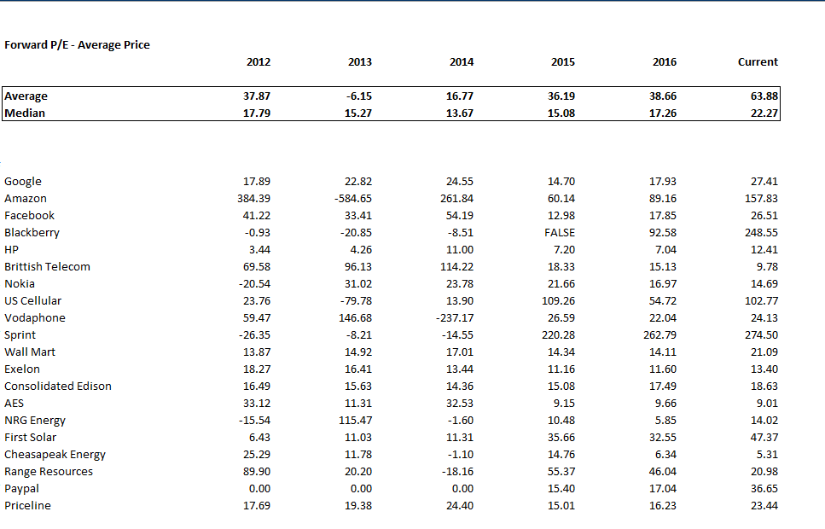
P/E Ratios for Selected Companies

Slide 49
Reported Multiples of S&P 500
Current levels are high, but you don’t know what kind of averages etc.
http://www.wsj.com/mdc/public/page/2_3021-peyield.html?mod=topnav_2_3002
https://ycharts.com/indicators/sp_500_pe_ratio
https://ycharts.com/indicators/pe10
http://www.multpl.com/shiller-pe/table

Slide 50
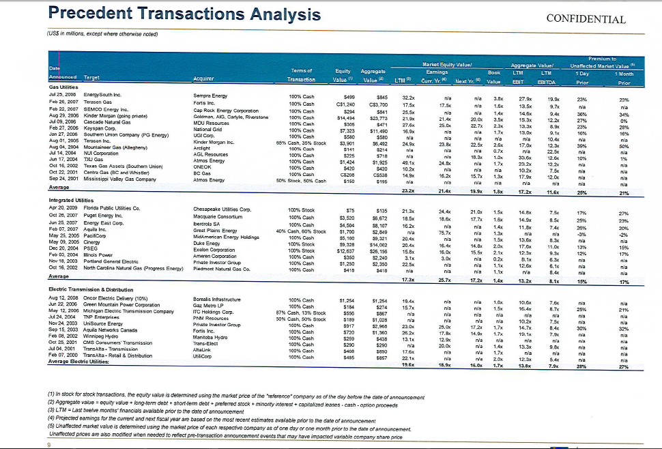
Precedent Transactions – By Industry, Buy Side
PE ratio of 16.0 and EV/EBITDA of 7.9x

Slide 51
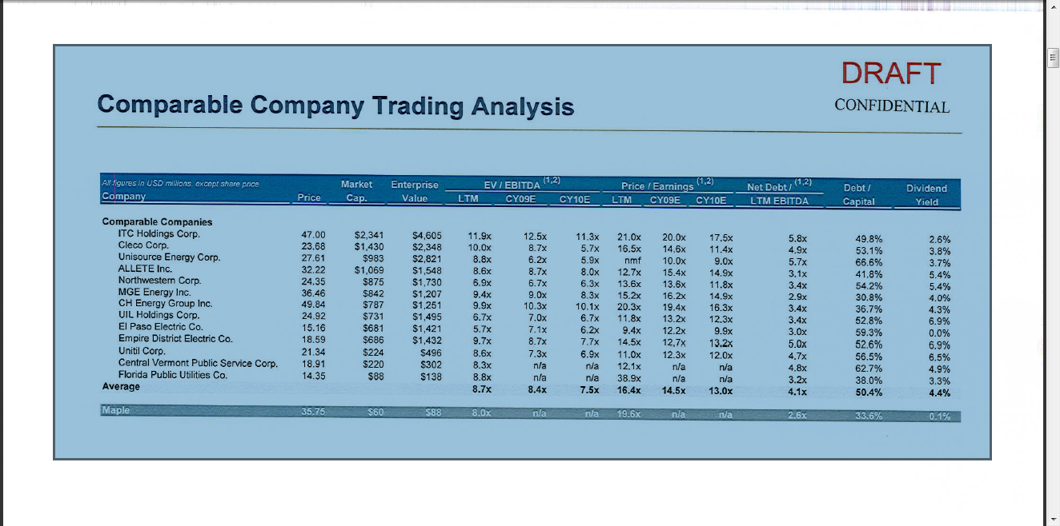
Public Comparables – Buy Side
EV/EBITDA 8.4; P/E 14.5

Slide 52
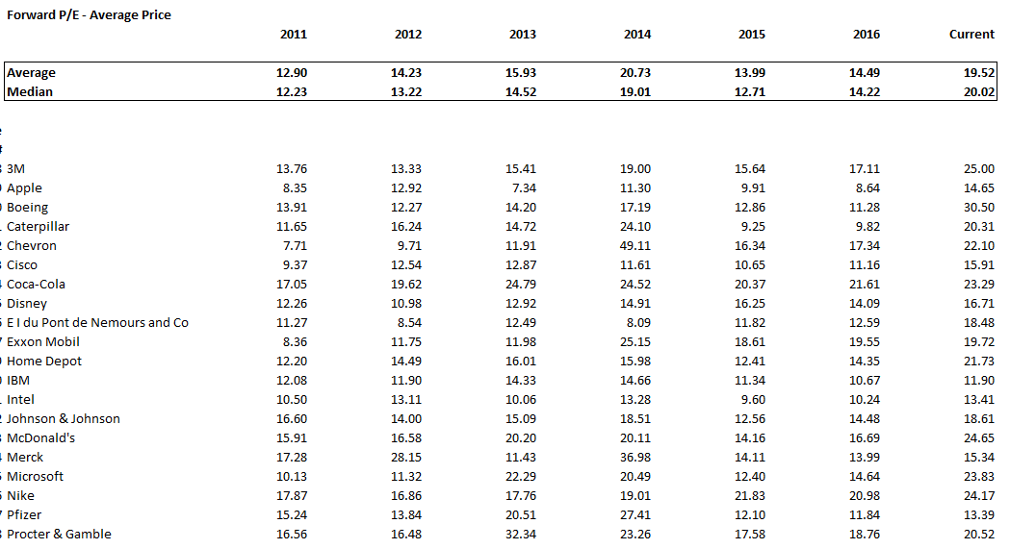
PE Ratio for Non-Financial Dow Stocks
Can see more from individual companies

Slide 53
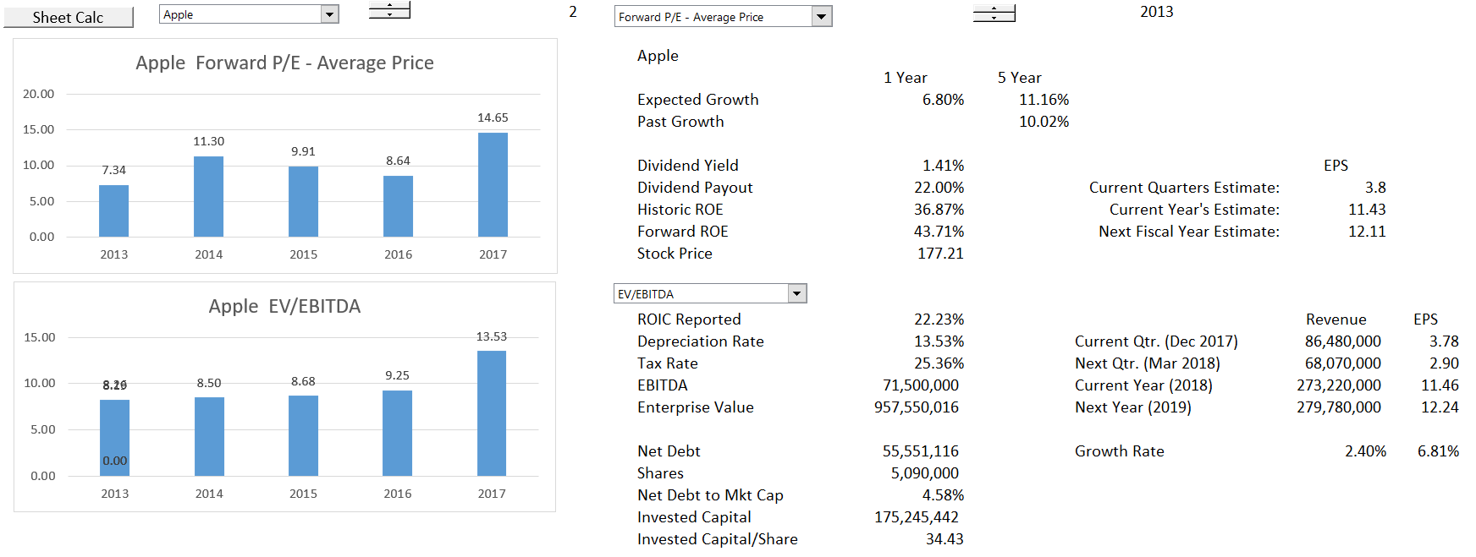
P/E and EV/EBITDA for Apple
Note the Increase in P/E and EV/EBITDA for Apple

Slide 54
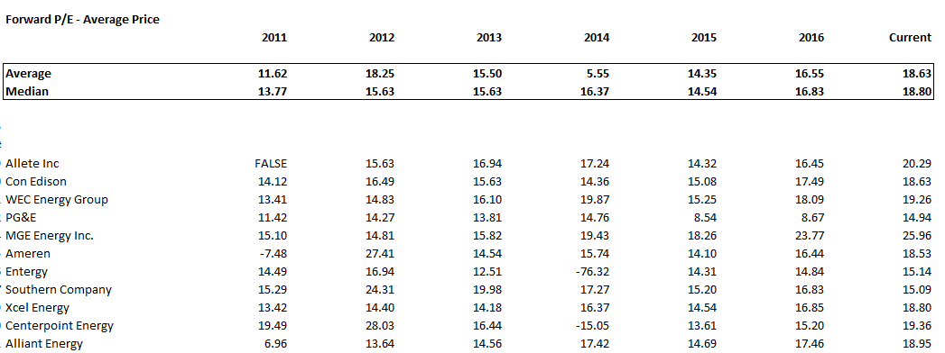
Basic Idea – Are Multiples Stable Across Companies in an Industry and Across Time
Example of boring companies in the utility industry. If have an earnings estimate than can make a stock price forecast. Change a lot over time and some outliers across the industry.

Slide 55
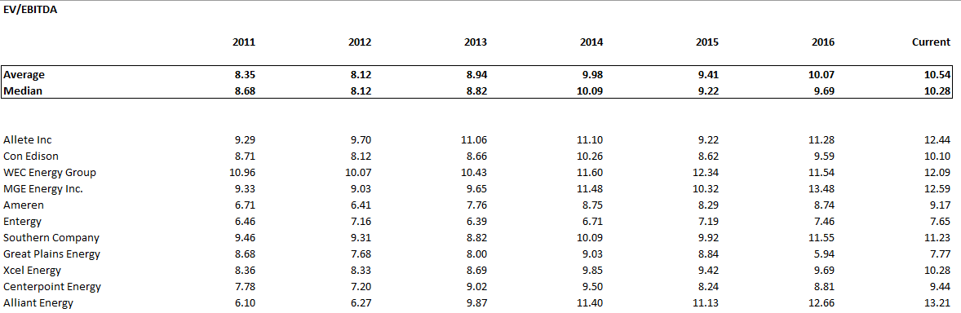
EV/EBITDA versus P/E
Is there more stability when using a proxy for cash flow and enterprise value.

Slide 56
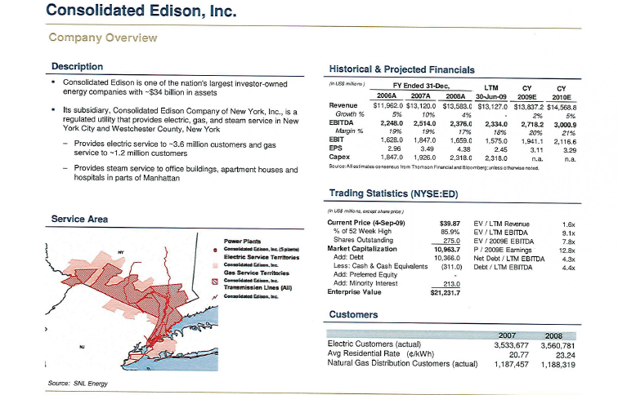
Details of Comparable Analysis

Slide 57
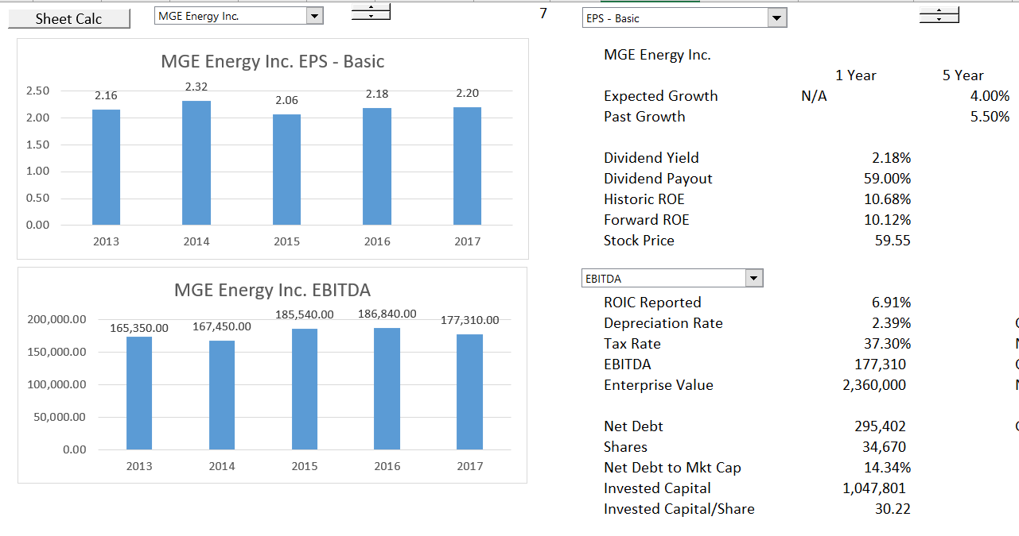
Examine Growth and then Multiples
Example with one company – little growth and boring

Slide 58
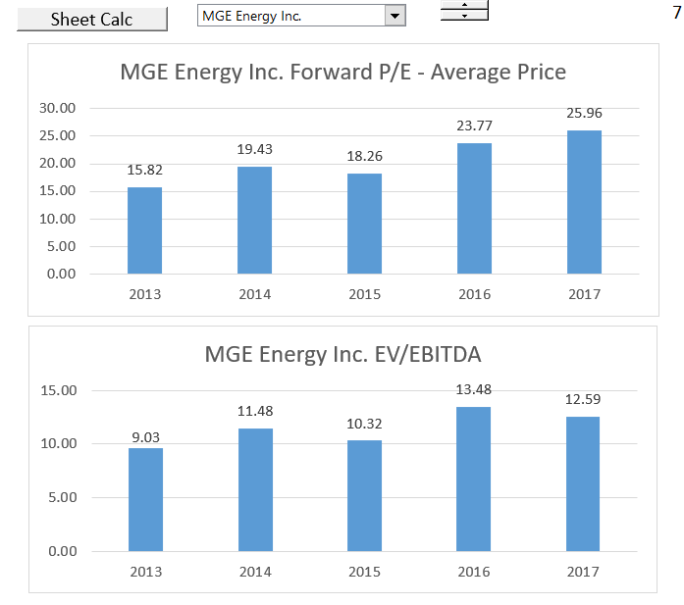
Increasing Multiples and Flat Income
Raises the issue of why multiples would increase if earnings and cash flow are stable.

Slide 59
Multiples for Beer and Other Beverages
Example of boring companies in the utility industry. If have an earnings estimate than can make a stock price forecast. Change a lot over time and some outliers across the industry.

Slide 60
Why is the P/E Ratio Higher for One Company than Another Company
Reasons for Differences in P/E
  Cost of equity capital and risk is higher for Apple than for Google
  Future growth in earnings per share and ROE is lower for Apple than for Google
  ROE for Apple with fall and ROE for Google will increase

Slide 61
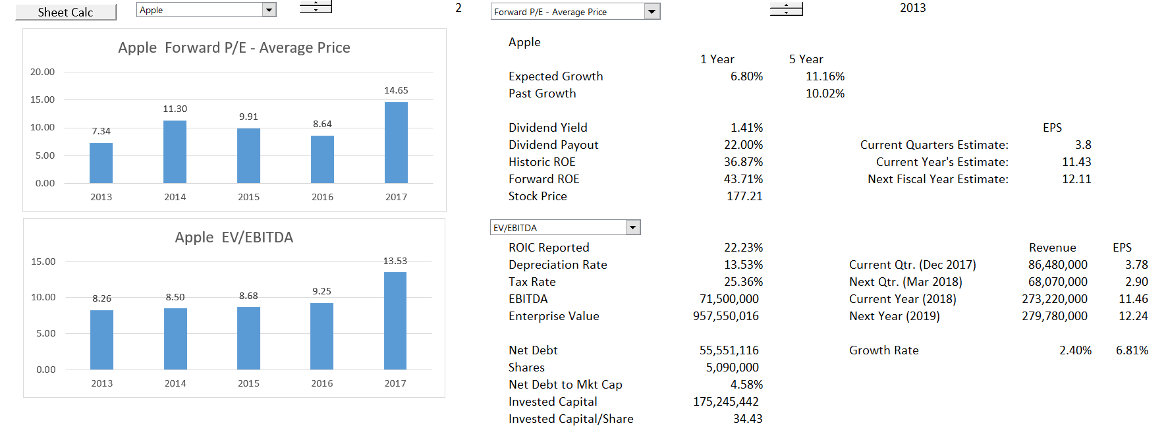
Apple Summary from Multiples File
Note the relatively low P/E

Slide 62
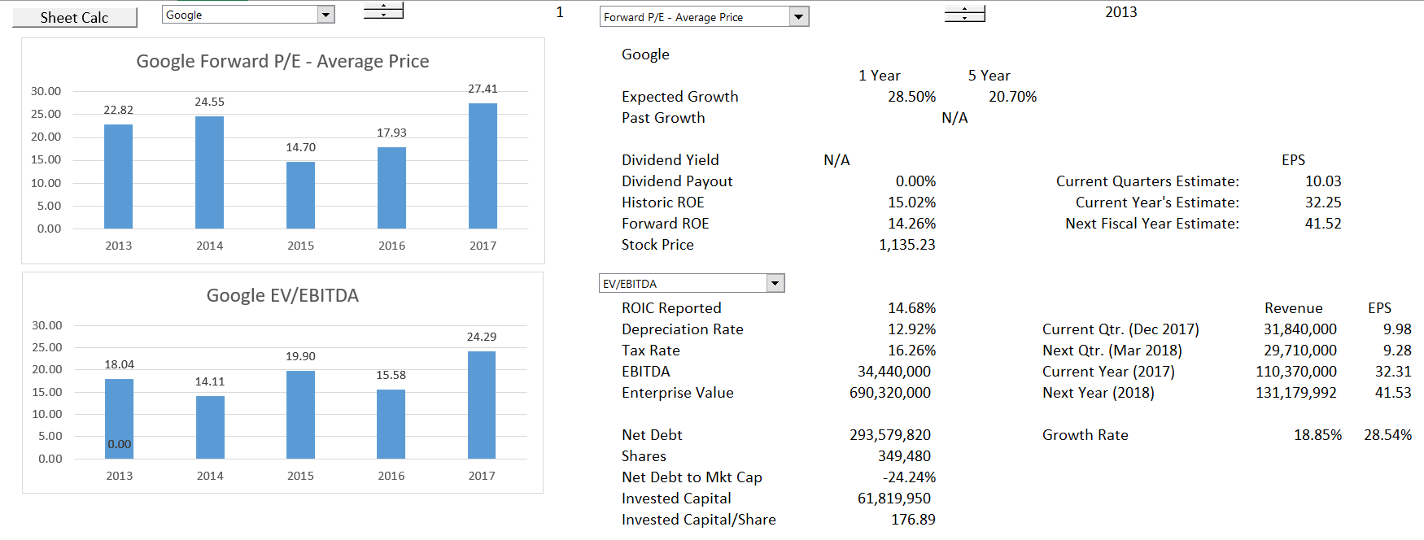
Google Summary from Multiples File
Note the relatively low P/E

Slide 63
Why is the EV/EBITDA different for Different Companies
EV/EBITDA will be lower for companies that need to replace assets more quickly. If the net investment is the same and the EBITDA is the same, the company with shorter lived assets will have to replace assets more quickly and have more capital expenditures for the same EBITDA. This means EV/EBITDA will be lower for companies with higher depreciation rates.
This means you cannot theoretically compare the EV/EBTIDA across different industries with different types of assets (and also within the industry)

Slide 64
Multiples and DCF
A leading sell-side analyst recently told us that he uses discounted cash flow to analyze and value companies but typically communicates his findings in terms of implied multiples. For example, an analyst might say Company X deserves a higher multiple than Company Y because it is expected to grow faster, earn higher margins, or generate more cash flow. Earnings multiples are also a useful sanity check for your valuation.
In practice, we always compare a company’s implied multiple based on our valuation with those of its peers to see if we can explain why its multiple is higher or lower in terms of its ROIC or growth rates.

Slide 65
Fundamental Valuation Ideas
Objective is to get monopoly profit and then to grow these profits (not making judgment about capitalism here). Value depends on the return from your investment.
  ROIC
  Growth
  Cost of Capital
There is no question about theses basic ideas and one can think of valuation as forecasting movements in these three variables.
The most difficult thing to think about is what will happen to the rate of return.
If you do not make an investment, use of ROIC does not work anymore.

Slide 66
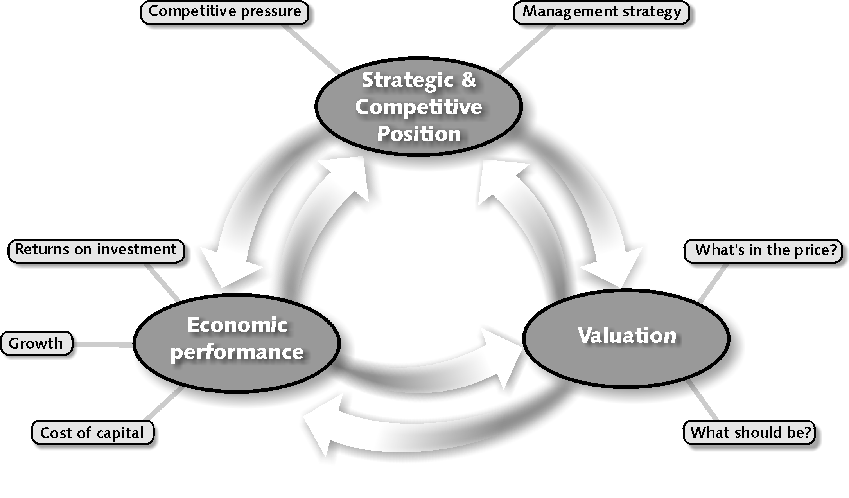
Analytical framework for Valuation – Combine Forecasts of Economic Performance with Cost of Capital
Competitive position such as pricing power and cost structure affects ROIC
In financial terms, value comes from ROIC and growth versus cost of capital
P/E ratio and other valuation come from ROIC and Growth

Slide 67
Of Course You Should Invest when Return Exceeds Cost of Capital – This is NPV Rule
The interaction between growth and ROIC is a key factor to consider when assessing the likely impact of a particular investment on a company’s overall ROIC. For example, we’ve found that some very successful, high-ROIC companies in the United States are reluctant to invest in growth if it will reduce their ROICs.
One technology company had a 30 percent operating margin and ROIC of more than 50 percent, so it didn’t want to invest in projects that might earn only 25 percent returns, fearing this would dilute its average returns.
But as the first principle of value creation would lead you to expect, even an opportunity with a 25 percent return would still create value as long as the cost of capital was lower, despite the resulting decline in average ROIC.

Slide 68
Fundamental Idea about Investment Necessary to Generate Return
If you don’t make an investment, you cannot improve your life.
If you don’t make capital expenditures, you cannot get EBITDA.
If you don’t pay for a stock, you cannot get dividends.
Even when you gamble, you must put some money down on the table.
But, what about:
  Uber: drivers make investment and all Uber has is a bit of software
  Services: You make money from your reputation (Deloitte, Cap Gemini, GE, Siemens, Law Firms, etc.)
  Construction contracts: You make money by constructing a plant and the investment in tractors etc. is very minor.

Slide 69
Quote from McKinsey Valuation Book
We (McKinsey) explain the two core principles of value creation:
  (1) the idea that return on invested capital and growth drive cash flow, which in turn drives value, and
  (2) the conservation of value principle, which says that anything that doesn’t increase cash flow doesn’t create value (unless it reduces risk).
Led to ideas about measuring all performance with return versus cost of capital and books on (ROIC-WACC) * Capital Charge

Slide 70
Two Basic Equations
Equation 1
  Value = CF(1)/k (No Growth)
  Value = CF(1)/(k-g) (Growth)
  This is just math (integral from 0 to ∞)
Equation 2
  Growth = ROE * Retention Rate
  Growth = ROE * (1-Payout)
  Payout = 1 – G/ROE

Slide 71
For Equity, All you Have to Do is Substitute
Start with Basics
  Value = D1/(k-g) Simple calculus
  DPO = (1-g/ROE) Fundamental growth
  D1 = E1 * DPO Earnings
  Value = E1 * (1-g/ROE)/(k-g)
For P/E Ratio
  Value/E1 = (1-g/ROE)/(k-g)
For P/B Ratio
  E1=Book Value * ROE1
  Value = Book Value * ROE * (1-g/ROE)/(k-g)
  Value/Book Value = (ROE-g)/(k-g)

Slide 72
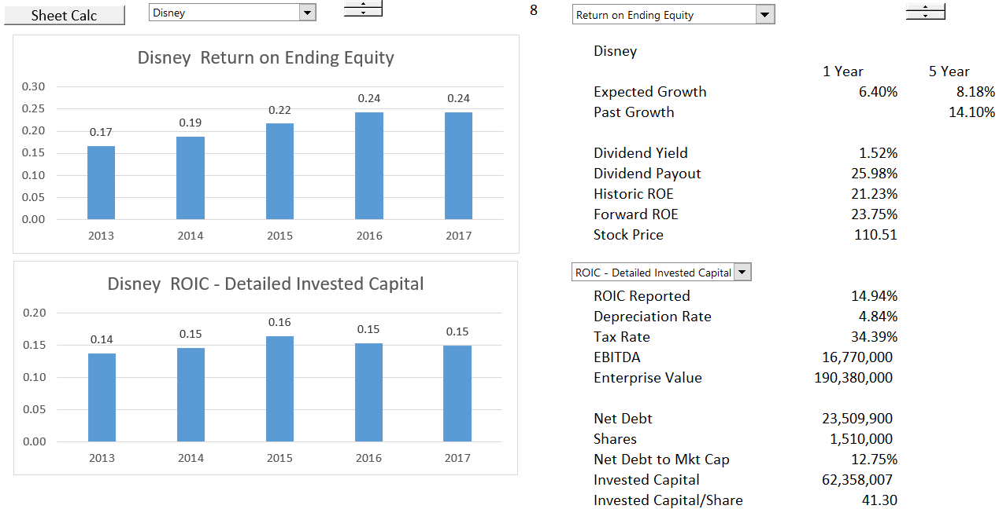
ROE and ROIC Comparison
Use ROE for exercise

Slide 73
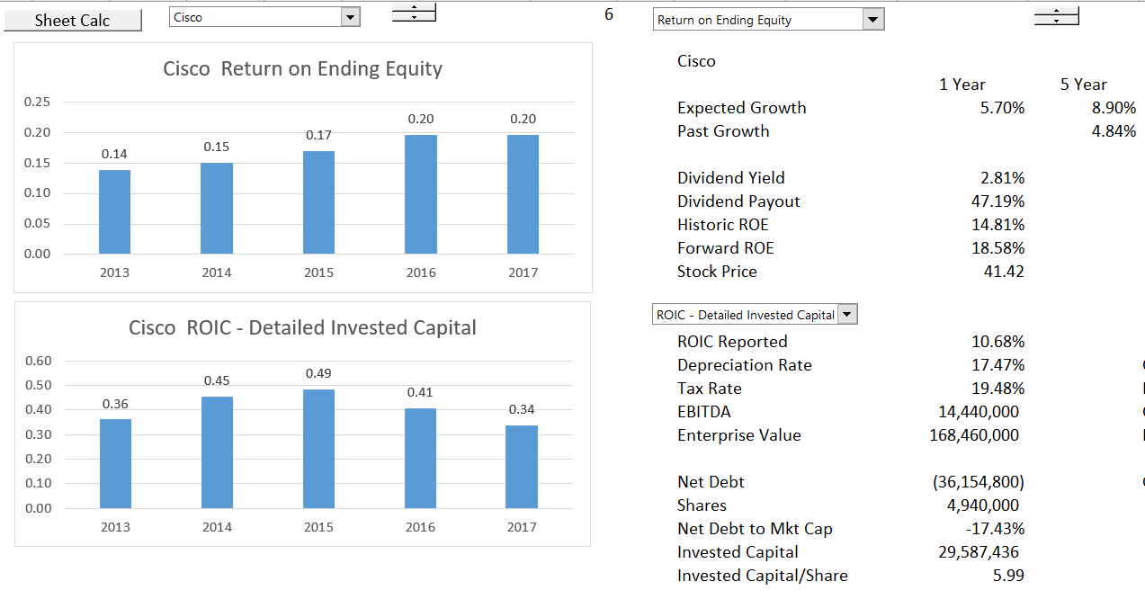
Careful Calculation of ROIC
Long-term investments should be accounted for.

Slide 74
Growth Implication
If the growth is zero, the level of the return does not matter in the valuation formulas
This is not really true when growth rate changes. A change in return makes a big difference in any case.

Slide 75
Problems with These Formulas
McKinsey Discussion of the Formula:
  This formula underpins the discounted-cash-flow (DCF) approach to valuation, and a variant of the equation lies behind the economic-profit approach (i.e. monopoly profit)….You might go so far as to say that this formula represents all there is to valuation. Everything else is mere detail.”
However, the formula is really not very good:
  Only works when ROE and g and k are constant.
  It does not work with inflation, because the value of the investment increases over time due to inflation.
  It does not work if the return on new investments is different from the return on existing investments in cases such as high technology.

Slide 76
Case 1: Valuation with Constant ROE
Very simple case of valuation:
  Return on equity and growth constant
  No adjustment for inflation (assume no inflation)
In this case, you can use the valuation formula: Value = E x (1-g/ROE)/(k-g)
You can also use the formula to evaluate implied cost of capital from P/E ratio, growth and assumed return on equity.
Silly to worry about ROE versus ROIC at this point. For now, can assume an all equity company with no net debt.

Slide 77
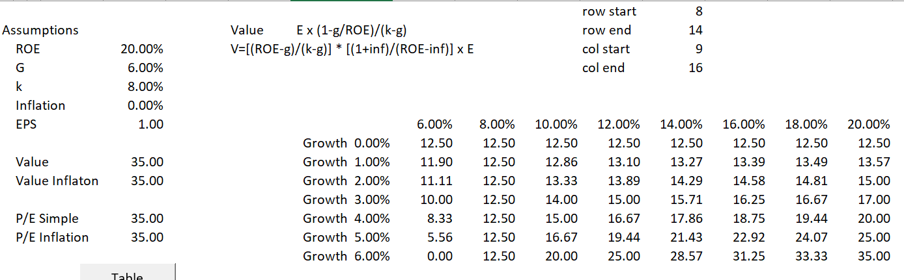
Valuation Sensitivity in Simple Case
Keep discount rate constant at 6% (the discount rate or the expected IRR is the biggest variable)
A graph of the data table demonstrates that the combination of variables makes the valuation change dramatically.

Slide 78
Sensitivity Graph with Macro Data Table
Demonstrates that the value has higher variability with respect to ROE with higher growth rate. There is a strong inter-relationship.

Slide 79
Case 2: Constant ROE with Inflation
Theory of inflation: if no growth except for inflation and constant nominal return that includes inflation, then income includes the rate of return with inflation as well as
P/E = [(ROE-g)/(k-g)] * [(1+inf)/(ROE-inf)]
This formula gives you the “real” P/E ratio from nominal inputs.
V=[(ROE-g)/(k-g)] * [(1+inf)/(ROE-inf)] x E
Proof and implication of this formula with inflation later.

Slide 80
With Inflation, the Sensitivity is more extreme
This graph shows the data table with and without inflation. Need to have growth more than inflation to create value. Difficult to evaluate interactions non-linear interactions of variables.

Slide 81
With Inflation, the Sensitivity is more extreme
There is more sensitivity to ROE in the inflation case and the case with zero growth results in value that declines.

Slide 82
Case 3: Changing ROE, Changing Growth and Changing Inflation
Cannot grow in long-term much faster than the economy.
Demonstrates the that the real issue is whether ROIC above the cost of capital can continue.
When ROIC expectations decline, then the P/E ratio falls.
To make this analysis, you cannot use the simple formula. Instead,
  In the terminal period, use the version of the formula that starts from the book value of the investment.
  Use the formulas for dividend payout as a function of growth.
  Use the INTERPOLATE LOOKUP function to gradually change Return.

Slide 83
Reasonable Estimates of Growth – Is this Graph Reasonable
The short term
Based on best estimate of likely outcome
The medium term transition to tranquillity
Assessment of industry outlook and company position
ROIC fades towards the
cost of capital
Growth fades towards GDP
The long run – tranquillity and equilibrium
Long run assumptions:
ROIC = Cost of capital
Real growth = 0%
Much of valuation involves implicitly or explicitly making growth estimates – High P/E comes from high growth
Reference: Level and persistence of growth rates

Slide 84
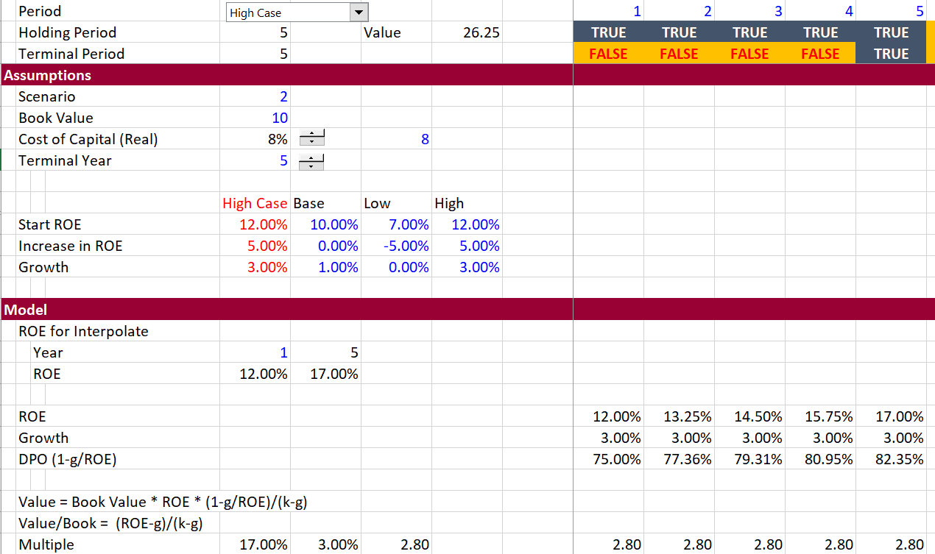
Illustration of Assumptions with Changing ROE
Set-up assumptions with increase or decrease in ROE and construct model using the market to book value formula. Set-up data for the Interpolate Lookup function.

Slide 85
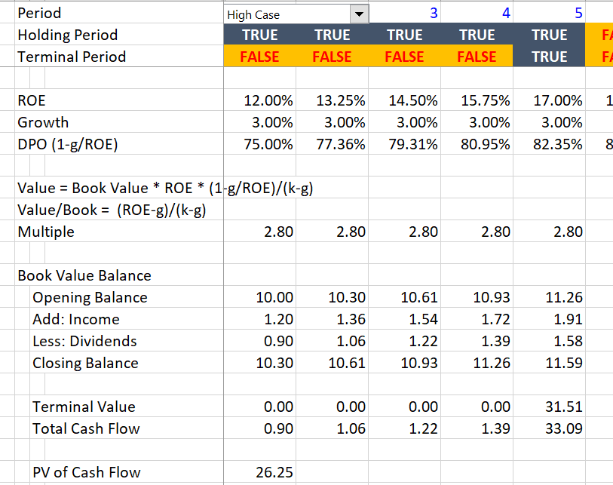
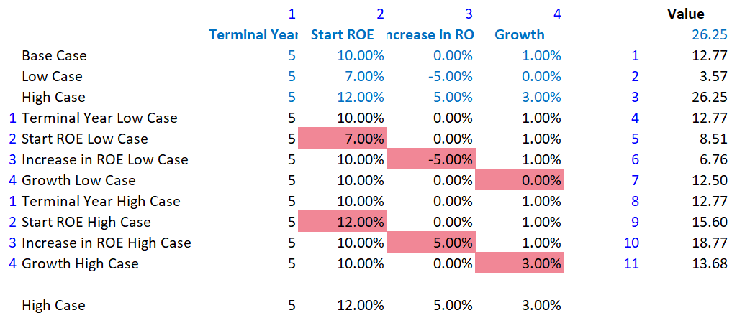
Valuation Model and Sensitivity
The valuation model is structured with switches and a sensitivity analysis is set-up.

Slide 86
Sensitivity Analysis – Use Tornado Diagram
Tornado Diagram with Alternative Cost of Capital and Terminal Value. Low cost of capital increases importance of growth. Longer terminal value means slower change in ROE.

Slide 87
Valuation Metrics in Project Finance and Corporate Finance
Project Finance Investment
  Equity IRR
  Project IRR
  Equity NPV
  Project NPV
Project Finance Debt
  DSCR
  LLCR
  PLCR
Liquidity
  Debt Service Reserve
Corporate Finance Valuation
  P/E Ratio
  EV/EBITDA
  Projected Dividend and Earnings
  Free Cash Flow
Corporate Finance Debt
  Times Interest Earned
  Debt to EBITDA
  Debt to Capital
Corporate Finance Liquidity
  Current Ratio; Quick Ratio

Slide 88
Case 4: ROIC instead of ROE
First, assume invested capital is only plant and equipment
Second, assume that invested capital includes working capital changes
Key variable is deriving the net plant depreciation rate from the growth rate and formula:
Cap Exp/Depreciation = g/Net Plant Depreciation rate + 1

Slide 89
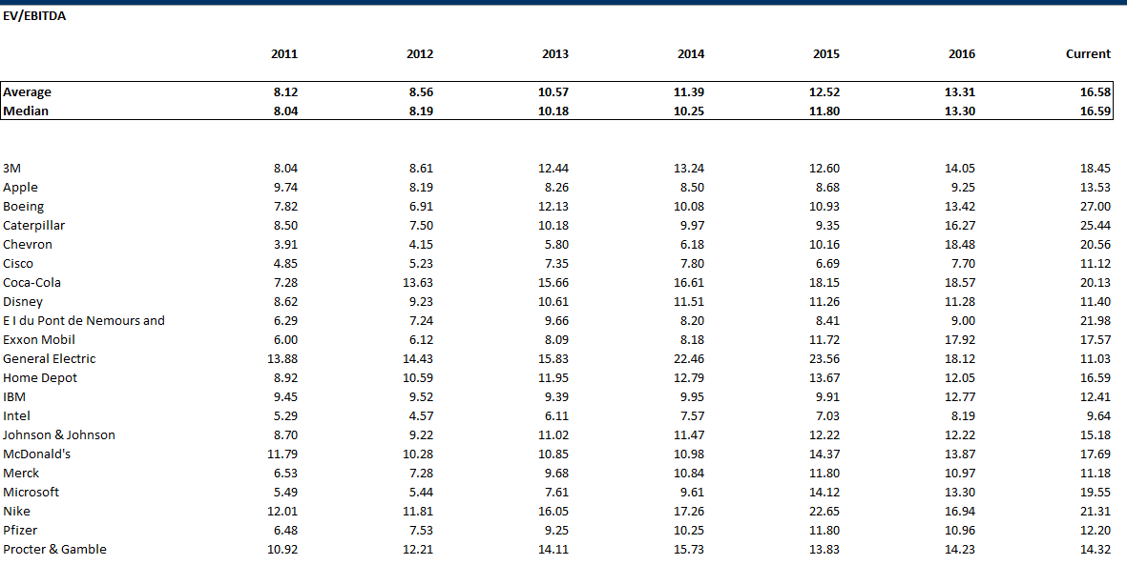
EV/EBITDA Ratio for Non-Financial Dow Stocks
Note the increase in EV/EBITDA as well as P/E. In theory EV/EBITDA more influenced by tax changes than P/Forward EPS

Slide 90
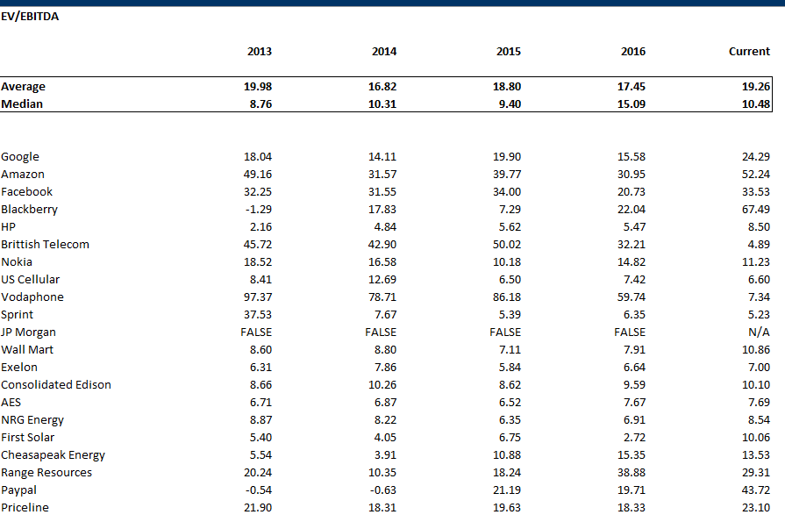
EV to EBITDA for Selected Stocks

Slide 91
Derivation of Formula
Earlier, we developed the relationship between the investment rate (IR), the company’s projected growth in NOPLAT (g), and the return on investment (ROIC):
g = ROIC × IR
Solving for IR, rather than g, leads to:
IR =g/ROIC
Now build this into the definition of free cash flow:
FCF = NOPLAT * (1 −g/ROIC)

Slide 92
Better Derivation of Formula
To derive the formula with free cash flow and ROIC begin with the formula for free cash flow:
FCF = EBITDA – Cap Exp – Tax – WC change
Now you can reconcile the FCF and NOPAT:
NOPAT = EBITDA – Dep – Tax
FCF = NOPAT – Cap Exp + Dep – WC change
Invested Capital Increase = Cap Exp – Dep + WC change +/ other items like deferred tax
Need Formulas for Cap Exp – Dep and for WC change to derive growth
Growth in WC = WC/EBITDA * g/(1-g)

Slide 93
Application of Formula
Growth in WC change = WC/EBITDA * g/(1+g)
For the growth amount of capital expenditures, you can use a formula:
Growth = Depreciation Rate on Net Plant x (Capital Expenditures/Depreciation – 1)
You can re-arrange the formula if you have the net depreciation rate you can compute the capital expenditures to depreciation.
Capital Expenditures/Depreciation = Growth/Net Depreciation Rate + 1
If you now have the depreciation expense, you can compute capital expenditures.

Slide 94
Simple Illustration of EV/EBITDA with Different Asset Lives
Assume the same ROIC, growth and WACC.
One company has 5 year assets and another company has 30 year assets.
EV/NOPAT is the same, but EV/EBITDA is different.

Slide 95
What About EV/EBIT
This can fix the capital expenditure problem, but:
  Affected by depreciation policies
  If one company has a higher tax rate, the EV/EBIT for that company will be lower (EV is affected by taxes, but EBIT is not).
This means you have to be careful in evaluating across time when the tax rate changes and
This means you have to be careful in evaluating across countries with different tax rates (note not the same as with the P/E ratio)

Slide 96
Are Multiples the Same Across Over Time
Depends on whether the following changed:
  ROE prospects
  Growth prospects
  Cost of Capital – Should be real cost of capital and not a function of nominal interest rates that are related to inflation

Slide 97
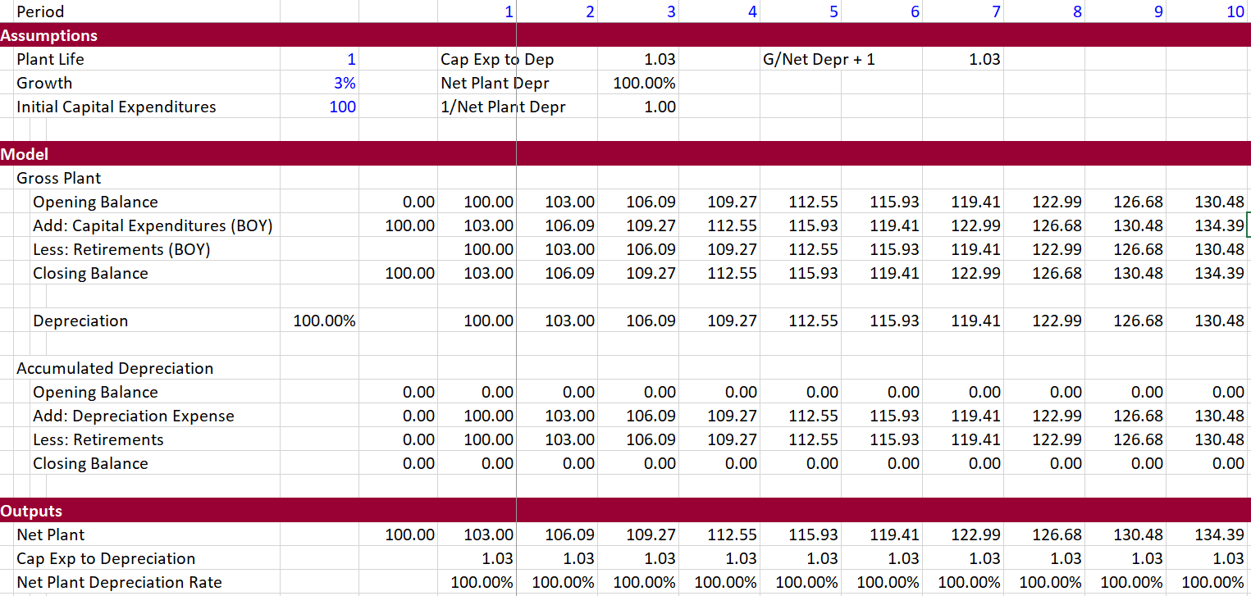
Evaluation of Net Plant Depreciation Rate and Capital Expenditures to Depreciation
The example below demonstrates how the plant ratios stabalise after a plant cycle.

Slide 98
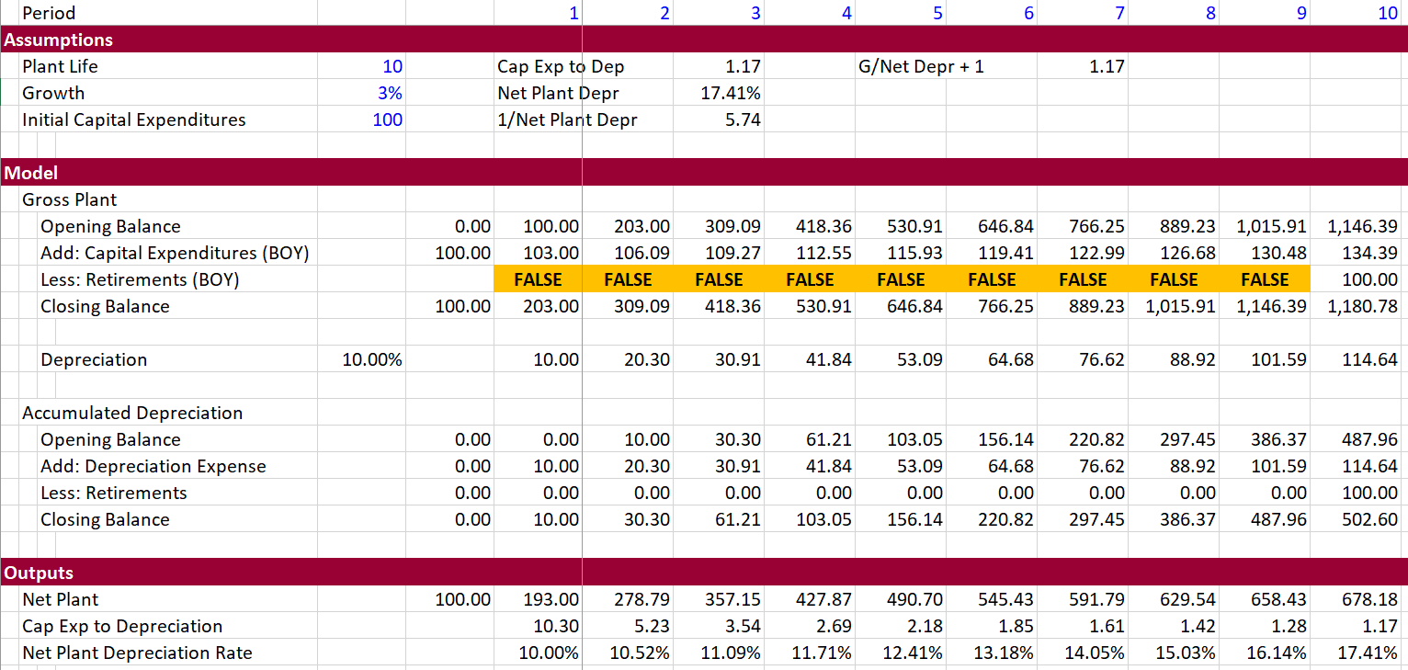
Ratios of Net Plant to Depreciation and Capital Expenditure to Depreciation with Longer Life
Note how the Cap Exp to Depreciation is defined as g/Net Plant Depr + 1

Slide 99
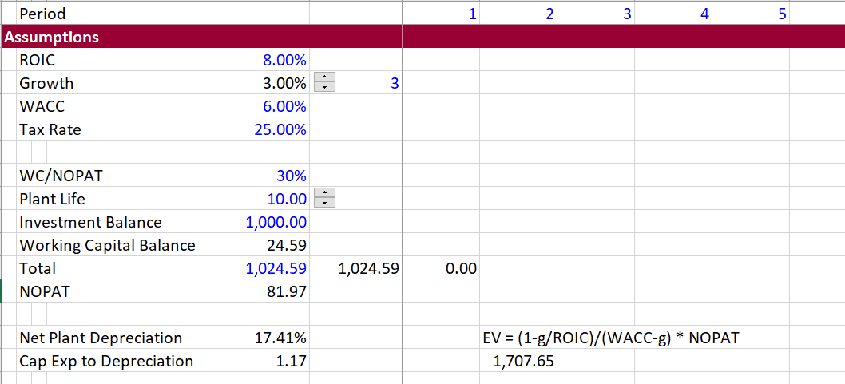
Demonstration of (1-g/ROIC)/(WACC-g) Formula
The formula can be demonstrated by using working capital ratio and net plant depreciation.

Slide 100
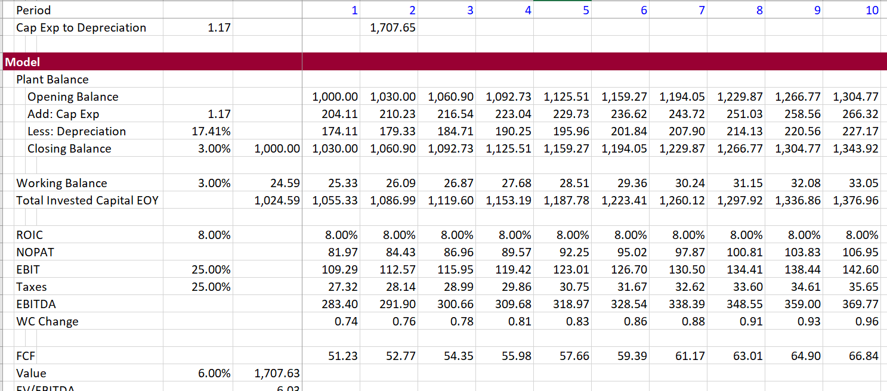
Apply Ratios to Demonstrate Model
Note how valuation result is the same as the formula (1-g/ROIC)/(WACC-g)

Slide 101
Reasons for More Complex Formulas with Cap Exp to Depreciation, Working Capital etc.
Demonstration of EV/EBITDA ratio with different asset lives, tax rates and working capital ratios
Demonstration of how the value changes when growth and ROIC changes. When ROIC changes, the net cash flow changes and different amounts of money must be plowed back into the company.

Slide 102
Return on New Capital and Return on Existing Capital
Technically, we should use the return on new, or incremental, capital, but for simplicity here, we assume that the ROIC and incremental ROIC are equal.
Technically, this formula should use the return on new invested capital (RONIC), not the company’s return on all invested capital (ROIC).
What crap: when oil prices go down, you cannot say that existing projects still maintain their existing ROIC. When Uber destroys the taxi industry, you cannot say that only new taxies earn a lower return. When the internet kills advertising for newspaper companies, one cannot say that it is only new investments that suffer.

Slide 103
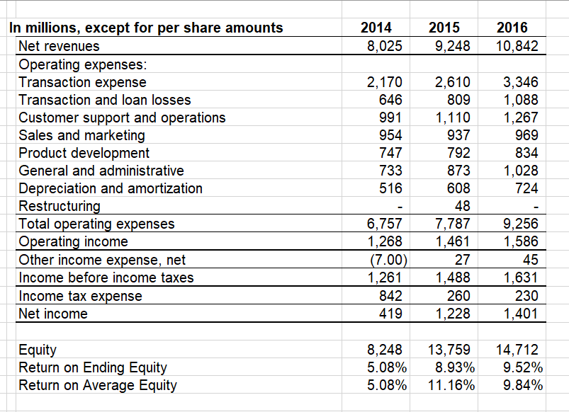
Cases where ROIC may be Different – Purchase of Companies in High Tech
Note the increase in goodwill from Elon Musk’s Pay Pal:

Slide 104
Use of Formula in DCF
The value after the explicit forecast period is referred to as the continuing value. Formulas derived from discounted cash flows using several simplifying assumptions can be used to estimate continuing value. One such formula that we recommend is as follows
Where NOPLAT=Net operating profits less adjusted taxes (in the year after the explicit forecast period)
ROICI = Incremental return on new invested capital
g = Expected perpetual growth in the company's NOPLAT
WACC = Weighted average cost of capital

Slide 105
Another Silly McKinsey Comment
We will show that high-ROIC companies typically create more value by focusing on growth, while lower-ROIC companies create more value by increasing ROIC.
Comment: Everybody of course wants high ROIC, which is just another word for monopoly profit and which is the driver of capitalist economies. If you are valuing a company you must assess the ability of a company to maintain or grow its monopoly position. That is the hard part.

Slide 106
Consultant Slide on Value Creation

Slide 107
The Value Matrix - Stock Categorisation
What is the economic reason for getting here and how long can the performance be maintained
Throwing good money after bad
Give the money to investors
Try to get out of the business

Slide 108
Crazy Idea that ROIC = WACC in Long Run
According the McKinsey: Many forecasters assume that the rate of return on new invested capital equals the cost of capital in the continuing value period, but that the company will earn returns exceeding the cost of capital during the explicit forecast period.

Slide 109
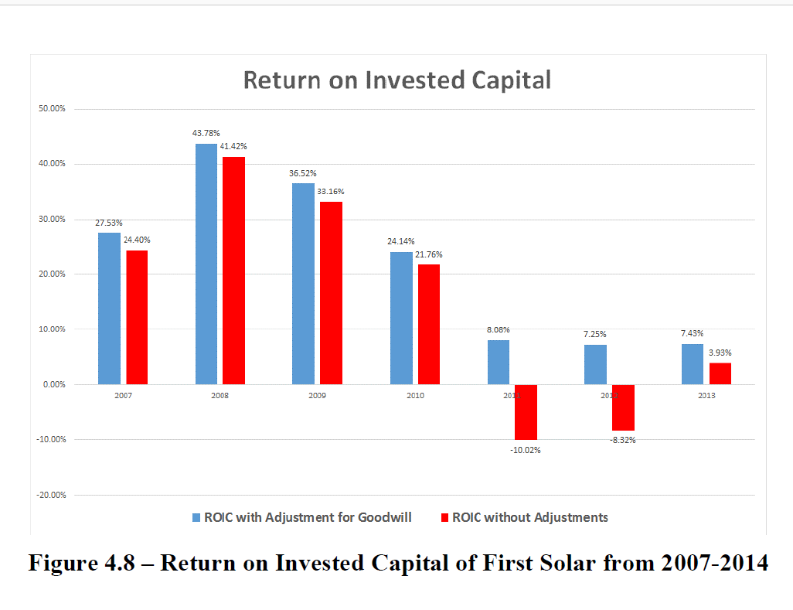
Case Study of First Solar
Changes in ROIC drove the collapse

Slide 110
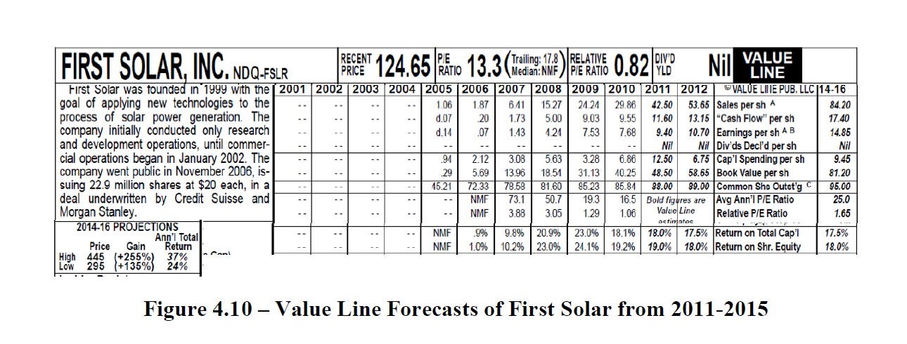


Analysts Did Not Project Changes in ROIC
Forecasted Price of more than 400.

Slide 111
Measuring the Return on Invested Capital is not Easy

Slide 112
What is the Cost of Capital
Formal Definition: The MINIMUM required return (i.e. the IRR) for an investment with the same risk.
  If a Treasury Bond is assumed to have no risk, then the cost of capital for a risk free investment is the required IRR or the yield on a bond.
You can also call the cost of capital the target IRR on an investment (that should be affected by the risk of the investment).

Slide 113
Cost of Equity Capital Methods
Implied Cost of Capital from P/E or EV/EBITDA
Implied Cost of Capital from Market to Book Ratio
Do not waste hardly any of your time on CAPM and Dividend Discount Model

Slide 114

Cost of Capital for Utility Companies
Use standard dividend growth model – depends on long-term growth

Slide 115


Standard CAPM – Equity Risk Premium
Note the subjective elements

Slide 116

Computation of WACC – Buy Side of Analysis
Note the Cost of Equity and EMRP

Slide 117
Using the Value Driver Formula to Compute the Cost of Capital
If ROE, k and g are constant, then:
P/E = (1-g/ROE)/(k-g)
    or
P/E x (k-g) = (1-g/ROE)
k-g = (1-g/ROE) / P/E
k = (1-g/ROE) / P/E
But this has the inflation bias

Slide 118

Cost of Capital from P/E Formula
Note differences in cost of capital and dependence on the expected growth rate

Slide 119
Correct for Inflation
Use the Real ROE, Real k and Real g. But also adjust the P/E Ratio for Inflation:
P/E = (1-g/ROE)/(k-g)
    or
P/E x (k-g) = (1-g/ROE)
k-g = (1-g/ROE) / P/E
k = (1-g/ROE) / P/E
But this has the inflation bias

Slide 120
Sensitivity Analysis with Given Cost of Capital
Valuation can be measured with P/E. Growth and return in combination have combined effects on the P/E ratio. Need both variables and cannot use data table when making graphs.

Slide 121
Case 2: Constant ROE with Inflation
Theory of inflation: if no growth except for inflation and constant nominal return that includes inflation, then income includes the rate of return with inflation as well as
P/E = [(ROE-g)/(k-g)] * [(1+inf)/(ROE-inf)]
This formula gives you the real P/E ratio from nominal inputs.
Observe P/E ratios that are understated in places with high inflation, because:
  The E and the P are not measured at the same date – the E is a forward number and the P is today’s price. When the E is reduced, the true P/E is higher.
  The E does not measure the loss in value from assets that are measured at book value and must be replaced at market value. When the E is adjusted to reflect the increase in value, the observed P/E is less than the corrected P/E.

Slide 122
Simple Proof that P/E should Reflect Values Adjusted for Inflation – Real Values
Say you have a company operating in a high inflation country and you measure returns, dividends and value.
Then, you simply re-state the earnings, cash flow and dividends into a hypothetical country where there is no inflation.
The re-stated dividends and the cost of capital for the no-inflation country provide the true P/E ratio.
You can compute all of your returns, dividends and book value for the inflated currency, but after you translate back with a Purchasing Power Parity exchange rate, the value of the dividends should be the same.

Slide 123
Inflation Can Be Tricky
The value driver does not work if there is inflation – even a little inflation.
Steps
  Adjust the earnings for loss in investment value
  Adjust the earnings for inflation
  Use nominal ROE and Cost of Capital
Example:
  P/E for S&P 500 is 25
  Inflation is 2%
  Book Value per Share is 12.5
  EPS is 2
  ROE is 16%
  Then the adjusted P/E for the analysis is:
    First, adjust for loss in investment value 12.5 * .02
    Second, adjust for earnings in real terms
  When you are finished, the corrected P/E

Slide 124
Observed and Computed P/E
Let’s say you observe a P/E ratio for a particular company or for the entire market or for a particular industry. This P/E ratio will be distorted by inflation.
When you put in your ROE, growth and cost of capital, you will come up with this distorted P/E ratio.
You could adjust the ROE, the growth rate and the cost of capital to real values and then you would come up with a higher P/E ratio that is correct.
Or, you could adjust the P/E ratio for inflation and re-derive the cost of capital.

Slide 125

Using Idea that when M/B = 1, ROE = Cost of Equity
This sort of analysis requires similar companies – you cannot do this for Dow 30 for example.
Formula is M/B = (ROE-g)/(k-g)
When the M/B = 1, then the ROE = k no matter what the g. For utilities cost is 5.1% to 4.88% depending on regression assumption.

Slide 126


Market to Book Ratio has Increased, Implying Lower Cost of Capital
Note the ROE and the market to book ratio

Slide 127

Regression with EV and ROIC
The same approach can be used for ROIC:
EV/Invested capital = (ROIC-g)/(WACC-g)

Slide 128
Historic Analysis and Measuring the Return on Invested Capital

Slide 129
Statement about U.S. and Asian Companies by McKinsey
The median large U.S. company earned a 19 percent ROIC in 2013, while the median large Asian company earned 8 percent.
But for the most part, Asian companies historically have focused more on growth than profitability or ROIC, which explains the large difference between their average valuation and that of U.S. companies.
Comment: Everybody of course wants a high monopoly profit. Very smart people are hired to create monopoly profits through marketing strategies (or making children and adults addicted to a product).

Slide 130
Use of Return on Invested Capital to Assess Model
The big question is what really goes into calculation of the invested capital.
The most obvious point is that surplus cash should not be in invested capital because the income associated with surplus cash is not in NOPAT.

Slide 131

You Need to Understand and Not Bias Historical Analysis as the First Step in a Forecast
Forecasts from History
  The most effective way to destroy people is to deny and obliterate their own understanding of their history.”
Forecasts from History and Manipulating History in Financial Models
  “Day by day and almost minute by minute the past was brought up to date. In this way every prediction made by the Party could be shown by documentary evidence to have been correct; nor was any item of news, or any expression of opinion, which conflicted with the needs of the moment, ever allowed to remain on record. All history was a palimpsest, scraped clean and reinscribed exactly as often as was necessary.”

Slide 132

Illustration of History and Forecast – Old Fashion Value Line
Note all of the history and financial ratios in the reports – can assess forecasts with ROE and value from P/E Ratios.
Note all of the history and that the target price is the forecast P/E x EPS

Slide 133

Historic Analysis from Marketwatch, PDF Conversion
Note all of the history and financial ratios in the reports – can assess forecasts with ROE and value from P/E Ratios.

Slide 134

Quarterly Historic Data

Slide 135

Using Historic Data to Develop Assumptions
Work through the income statement and balance sheet to develop ratios used for assumptions.

Slide 136
Forecasting Cash Flow and Fundamental Analysis of Risks and Value in Corporate Finance

Slide 137
Need to Answer Fundamental Questions about Demand Growth, Prices and Cost Structure
Demand Growth
  Volatility of demand growth
  Implications of demand volatility and capital intensity
  Implications of demand volatility and fixed operating cost
  Example: Airlines versus Retail
Price Levels and Return
  How can sustain prices that lead to high return
  Types of products (solar panels and cell phones)
  First mover and scale (Disney and merchant electric plants)
  Creating Loyalty (Coke and Fiber Optic Cable)

Slide 138
Need to Answer Fundamental Questions about Demand Growth, Prices and Cost Structure
Cost Structure
  Fixed and Variable Costs
  Comparison of Costs with Competitors
  Sustainability of Cost Advantage
  Example: Shale Gas and High Cost of Replacement
Problems with Analysis
  Very difficult to measure – some companies have sustained high ROIC
  Product life cycle shortening – how long can maintain returns from innovation
  Problems of obsolescence, changes in taste, fashion etc.

Slide 139
Still Volume and Price, But …
Have volume history from financial data, but need long-term data that covers business cycles.
Surplus capacity analysis may require knowledge of competitor capacity additions – there is no historic financial data that can be used for this.
Demand volatility is aggravated by operating leverage. It is difficult from financial statements to separate fixed and variable cost. Example of airlines and auto companies after 2000 and 2008.

Slide 140
No History and Problems with Volume Forecasts
Without volume history from financial statements, predicting revenues is extremely speculative.
In this case, that occurred around the dot com bubble, a venture financed by Motorola had a dramatic crash. The interesting thing was that how the investment bankers bought the marketing projections hook line and sinker.

Slide 141
Understand Marginal Cost and Surplus Capacity Risk
High marginal cost shale gas and shale oil producers and bankruptcy because of break-even oil price.

Slide 142
Obsolesce, Fashion, Uber
Very difficult to predict sudden changes in cost structure and/or price in an industry driven by new technology. Stock price of company that finances medallions in New York.

Slide 143
Cost of Capital

Slide 144
Free Cash Flow
Free cash flow or unleveraged cash flow:
Do not include any effects of interest expense in cash flow
Free Cash Flow
  EBITDA
  Less: Capital Expenditures
  Less: Adjustment to EBITDA for changes in working capital
  Less: Operating Taxes without interest – EBIT x Tax
    FREE CASH FLOW

Slide 145
Valuation Diagram – DCF from Free Cash Flow
Valuation using discounted cash flows requires forecasted cash flows, application of a discount rate and measurement of continuing value (also referred to as horizon value or terminal value)
Continuing Value
Cash Flow
Cash Flow
Cash Flow
Cash Flow
Discount Rate is WACC
Enterprise Value
Net Debt
Reference: Private Valuation; Valuation Mistakes
Equity Value

Slide 146
Equity Cash Flow, Debt Cash Flow, Free Cash Flow and
Cost of Equity, Cost of Debt and WACC
Equity Cash Flow and Value of Equity :
Dividends less Equity Issued
Value of Equity
PV of Cash Flows at
Cost of Equity
+
+
Debt Cash Flow and Market Value of Debt :
Net Interest plus Net Debt Payments
Value of Debt
PV of Cash Flows at
Incremental Cost of Debt
=
=
Free Cash Flow:
EBITDA – Op Taxes – Cap Exp – WC Chg
Value of Enterprise
PV of Cash Flows
At WACC

Slide 147
Terminal Value in Corporate Model
Year after explicit period to establish stable cash flows
Gordon’s
CFt x (1+g)/
(WACC-g)
History
Explicit Forecast Period
Terminal Value
EV/EBITDA that Reflects
Long-term Growth Rate and ROIC
PV of Cash
Year t
Infinity
Step 2: PV from Year t to current year
Step 1: PV to year t – End of period t, so Gordon’s method must use t+1 cash flows
Market to Book Ratio that Reflects Long-term ROE
Make sure Cash Flow in period t reflects realistic ROIC, Working Capital that reflects long-term growth and realistic capital expenditures
Valuation Date

Slide 148

Problems with DCF –
Range in Values
Note the range in values in the analyst report
The range is less when a terminal value is used, but the range is still very high
The high range exists even though there is a tight range in discount rates

Slide 149
Reconciliation of IRR and Return on Investment (Project IRR versus ROIC or Equity IRR versus ROE)

Slide 150
Basic Idea of Reconciliation
Weighted average rate of return is the same as the IRR, if:
  The rate of return is weighted by the PV of the investment balance, and;
  The discount rate applied to the year by year investment balance is the IRR itself.
  This is analogous to the fundamental IRR problem where intermediate cash flows are assumed to be re-invested at the IRR itself.

Slide 151
Weighted ROIC versus MIRR
If the cost of capital is measured by something different from the IRR, the weighted average return will be different.
  If the return is higher than the cost of capital, the weighted average return is higher than the IRR
  If the return is lower than the cost of capital, the weighted average return is lower than the IRR
  Use of MIRR does not solve the problem

Slide 152

Illustration of IRR and Rate of Return Reconciliation
Computation of PV of Investment weight
Use of Sumproduct with entire line
Weight from Investment Balance x PV Factor
The basic problem is depreciation.
This is aggravated by inflation.

Slide 153
Return on Equity over Project Life

Slide 154

Mechanics of Reconciliation – Compute Return and Weight PV of Investment
The return calculations that depend on depreciation are shown below

Slide 155

Mechanics of Reconciliation -
Compute the PV factor and then multiply the PV factor by the investment balance (beginning of year).
Then use the PV of investment for computing the weighted average ROIC with the SUMPRODUCT.
Works when discounting at the IRR (could argue that different discount rates are appropriate for providing management with ROIC given IRR).

Slide 156

Why Use Investment Weighting – Portfolio of Assets with Different Ages
The excerpt below illustrates why you should weight the ROIC by the investment balance.
When you have old investments, the lower investment balance means the ROI is less important than the new assets.

Slide 157
Use of Economic Depreciation
You can compute an alternative depreciation rate and then the ROIC will equal the IRR
If you use the economic depreciation, you can use a discount rate that equals the IRR.
You could theoretically use the economic depreciation rate and then evaluate the performance of an project finance investment over time.

Slide 158
Use of Economic Depreciation to Reconcile
Computation of economic depreciation without inflation
Use PPMT function with the IRR as the cost of capital
Computation of economic depreciation with inflation
Use of PMT in period of investment and then inflate.

Slide 159

How Economic Depreciation Makes IRR = ROI with and without Inflation
The excerpt below shows calculation of economic depreciation for a single investment. The depreciation rates can be used with a depreciation function.
The depreciation is structured to write-off the whole plant and to result in a constant return on investment

Slide 160
Implications of Economic Depreciation
There is no way companies will implement economic depreciation and allow measurement of true returns
Without economic depreciation it is very difficult to measure the true economic return
The true return can be used to evaluate the value of a company. The PV of cash flows at the true IRR as the discount rate is zero.
The IRR for a corporation is like the yield to maturity on a bond. Valuation could be computed as the [Investment x Yield]/Disc Rate

Slide 161
Difficulty in Measuring Return: IRR and ROIC in Corporate Case – No Growth
When an asset is simply replaced over a long period of time, the ROIC (or ROE) will be low in early years and then high in later years.
This is due only to the investment balance declining, in the example, the asset is replaced and the ROIC with SL depreciation goes down.
The flat line shows the ROIC when economic depreciation is used.

Slide 162
Difficulty in Interpreting Return Compared to Underlying IRR – Cases with Different Lives
With different asset lives the difference is bigger.

Slide 163


Valuation in Case with No Growth and Lumpy Investments
Due to timing of the next investment different methods of valuation produce different answers. The most correct is using the project IRR and the investment balance from economic depreciation.

Slide 164

Different Valuations with Alternative Timing
These charts show ranges in value compared to the true valuation from 400 year analysis.

Slide 165
Case With Growth
In this case assume that you start with some capital expenditures, and the capital expenditures continue to increase each year. In the first case assume that the EBITDA generated by the investment does not increase.
Looking for ROIC = IRR after constant growth, but this does not happen
If apply Value = Income x (1-G/ROIC)/(WACC-g), what level of ROIC should you use – the ROIC or IRR.
If apply Value/Investment = (ROIC-g)/(WACC-g) what level of investment and ROIC should you use.

Slide 166

Mechanics of Model with Growth
Retirements are replaced with similar assets (no inflation). Begin with project IRR and economic depreciation on a single asset.

Slide 167

ROIC and Retirements in Model
See if the ROIC converges to the IRR

Slide 168
Project IRR is not Observed with SL Depreciation
You change the growth and asset life and the IRR, and you do not get convergence. At first, before the stable period, the ROIC is below the IRR, After the asset life the ROIC is above the IRR. The shorter the life and the lower the growth the closer to the IRR.
Slow growth and short life, IRR and ROIC are similar
With economic depreciation, ROIC = IRR

Slide 169
Valuation, IRR and ROIC
Now move to the valuation with IRR and ROIC.
As in other cases, make a proof valuation with a long-term model.
In a long-term model, Value is PV of Cash Flow

Slide 170
Demonstration of Errors
Say a company just finished embarking on a large expansion. In this case, the return will be low and it will look like the company is earning less than its cost of capital.

Slide 171
Case Study – Kitty Hawk Freight Airline Company
Summary of Case
  Company embarking on purchase of new planes
  Even though assets new, the return on equity was high
  Basic question: How could you continue to earn high returns in a very competitive business.

Slide 172
DCF Analysis with Terminal Value

Slide 173
Fundamental Ideas
Objective is to get monopoly profit and then to grow these profits (not making judgment about capitalism here).
  ROIC
  Growth
  Cost of Capital
Quote from McKinsey Book
Quote from Damoradan Book

Slide 174
Now, Evaluate the Sources and with Growth
In theory, growth comes from population growth and increase in productivity driven by new innovation. Say the real growth in the economy is 2.5% from these two factors. (Of course, it is just about impossible to define productivity growth).
Growth in Spending in Economy
  Consumption
  Government Spending
  Investment by Corporations (Cap Exp)
Growth in Sources of Funds
  Salaries
  Taxes
  Profit Earned by Corporations
If the growth in profit earned by corporations exceeds the growth in the economy, then somebody has to be worse off. If growth is compounded, the situation keeps getting worse.

Slide 175
Finally, Consider the Case where Returns Exceed the Cost of Capital and Keep Growing
Say the growth in the economy is 2.5%. If profits are 8%, then we can start with a base year where everything is somehow magically stable and move forward for 10, 20 and 100 years.
The little analysis demonstrates what happens when the cost of capital is over-stated by people getting MBA degrees from Columbia or Harvard.
Of course, there is a profit incentive necessary to provide incentives and grow the economy. But the question of who gets paid for risk is much more difficult.

Slide 176
Now, Evaluate who Takes Risks in an Economy
Using fundamental principles that risk can be allocated but not prevented, the basic economic equation can be presented in terms of risk:
Growth in Spending in Economy (Defined Level of Risk)
  Consumption
  Government Spending
  Investment by Corporations (Cap Exp)
Growth in Sources of Funds (Same Level of Risk)
  Salaries (Value Reduced with Risk)
  Taxes
  Profit Earned by Corporations (Returns Increase with Risk)
If the growth in profit earned by corporations exceeds the growth in the economy, then somebody has to be worse off. If growth is compounded, the situation keeps getting worse.

Slide 177

City is Like a Corporation/Project is Business
Individual Business or Family is like project Finance

Slide 178

Family is Like Corporation, Person is Like Project Finance
Person is the project
Entire Family is the Corporation

Slide 179
General Concepts in Corporate Finance versus Project Finance
Project Finance
Evaluate entire life of project
Use investors target equity IRR as the cost of capital.
IRR measures the true economic return from the asset.
Credit analysis from cash flow analysis with DSCR, LLCR, PLCR.
Analysis all directly from cash flow and multiples such as P/E or EV/EBITDA not generally used.
Corporate Finance
Stop at some point and compute terminal value. Terminal value is subjective.
WACC is a subjective black box coming from a mysterious potion.
ROIC and ROE are affected by timing of capital expenditures and do not measure the true economic return.
Credit analysis has a lot of judgment as to whether the balance sheet is strong enough for re-financing.
Multiples used to measure long-term value.

Slide 180
Use of Project Finance Ideas in Corporate Finance
Understanding of Projects and IRR that makes-up Corporate Return
Understanding how Rate of Return can Fluctuate due to Age of Projects
Understanding Risk Changes and IRR in Corporate Finance (e.g. Synergies Risk Different from Base Assets)
Notion of Cost of Capital as Minimum Required IRR

