Slide 1
Merchant Power, Marginal Cost and Valuation

Slide 2
Terms
Independent Power Producer (IPP)
Merchant Power Plant (MPP)
Purchase Power Agreement (PPA)
Energy Conversion Agreement (ECA)
Special Purpose Vehicle (SPV) or Project Company
EPC Contract, O&M Contract, Liquidated Damages
Capacity Charge, Capacity Price, Multipart Tariff
Dispatch, Capacity Factor, Load Factor
Capital Cost Recovery Factor

Slide 3
Load Factor, Capacity Factor, Availability Factor
Load Factor
  Average Demand/Peak Demand
  Annual Energy/8760/Peak Demand
Capacity Factor for Plant
  Average Generation/Possible Generation
  Annual Generation/8760/Capacity
Availability Factor
  Hours Available/Total Hours

Slide 4
Regulatory Policy Frameworks
  Alternative Frameworks for Pricing of Electricity
    Regulated Rates
    Competitive Generation
    IPP/PPA and Single Buyer Model
    Government Ownership
  No System is Perfect
  Costs and Benefits of Each System

Slide 5
Regulated Monopoly Systems
  U.S. Model since 1920’s
  Founded from Natural Monopoly Idea
  Resulted in Gold Plating and Poor Investment Choices
  High administrative costs with multiple cases
      Time for rate case is about a year
      Intevernors and Government Agencies
  Alternative regulatory programs

Slide 6
Process in Regulated Utility Model
Step 1: Determine Revenue Requirements from Accounting Data
Step 2: Determination of Rate Classes (e.g. domestic, business and street lights)
Step 3: Compute the Cost of Service for Each Class of Service
Step 4: Compute Individual Rates in the Rate Design Process

Slide 7
Regulated Private Ownership Model
This model is used in the U.S. where monopoly companies are allowed to own generation, but their rates are subject to regulatory authorities.
Benefits
  Private companies may have more incentive to be efficient than state owned systems
  Regulatory authorities can disallow costs that are not prudent
  The process of setting rates and evaluating decisions can be transparent.
  Stability of regulatory system creates relatively low cost of capital
  Incentive regulation can be used to encourage efficient behavior.

Slide 8
Rates in Regulated and De-regulated Markets

Slide 9
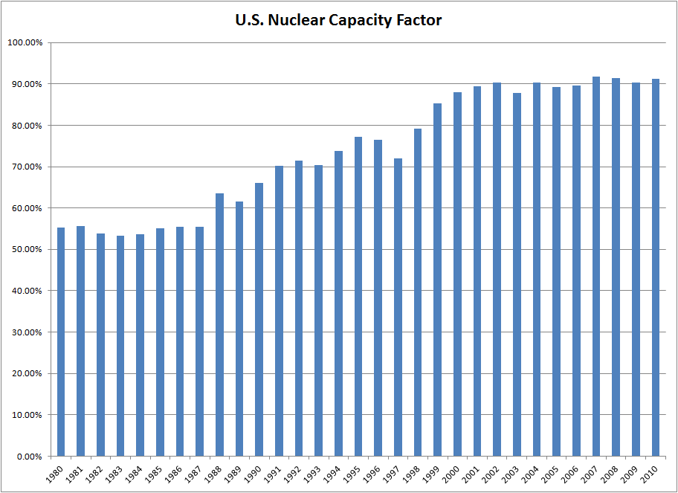
U.S. Nuclear Capacity Factor
Find Data on Disk and Upload Data

Slide 10
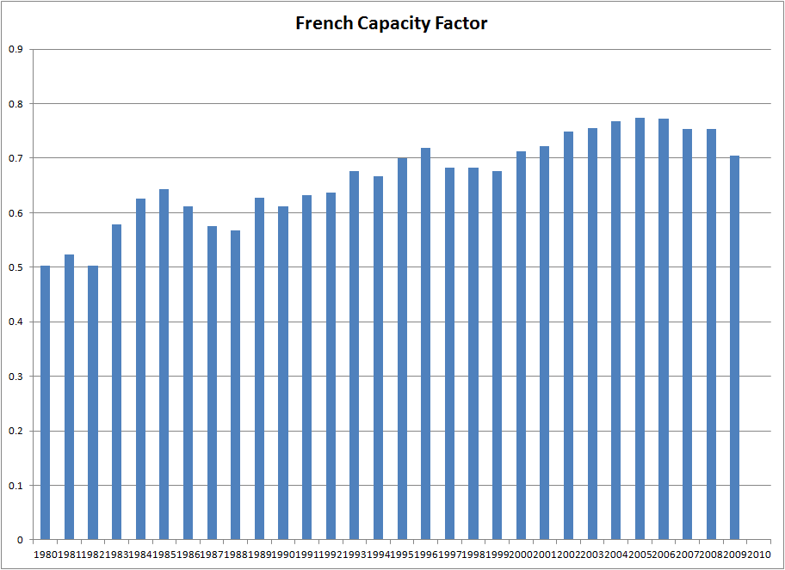
Changes in Capacity Factor

Slide 11
State Ownership Model
Benefits
  Some state-owned and -run enterprises have performed well (e.g. EDF).
  Provision of electric power is highly political and the state must have some involvement.
  Electricity is very capital intensive and the state should have a relative low cost of capital.
  Other systems have not worked and have sometimes resulted in large investor returns above the cost of capital being transferred to investors from other countries.
  In the U.S., systems owned by the government have lower rates and they were less affected by extreme movements in wholesale power prices.
  State owned systems may have the flexibility to reduce prices in times of economic crisis.

Slide 12
State Ownership Model
  Problems
    Without the forces of competition or incentives of the profit motive to improve performance many systems eventually result in excessive costs, low service quality, power shortages (e.g. Nigeria) and poor investment decisions.
    The price charged by some state systems is below the marginal cost of producing energy which can lead to over-use of electricity and take resources away from other areas of the economy.
    The inability of the state sector to finance needed expenditures on new investment and/or maintenance. Many power utilities are financially distressed because of their poor governance environment comprising endemic corruption, rampant theft of power, political interference and an inability by stakeholders to work towards long term solutions.
    State systems can be prone to corruption, gold plating of assets and prone to inefficient government intervention.

Slide 13
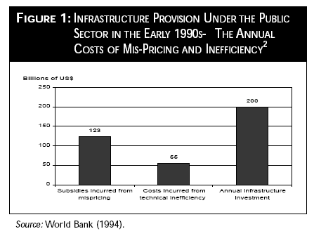
Study of Costs Associated with State Ownership

Slide 14
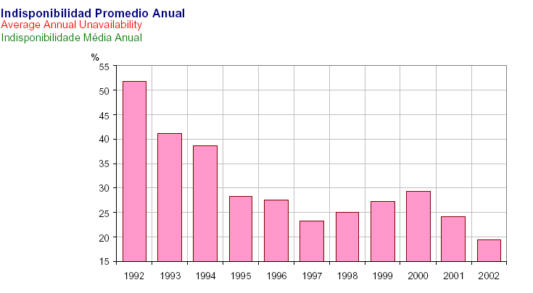
Plant Availability
Plant Availability has dramatically improved from about 60% in 1993-1994 to 75-80%

Slide 15
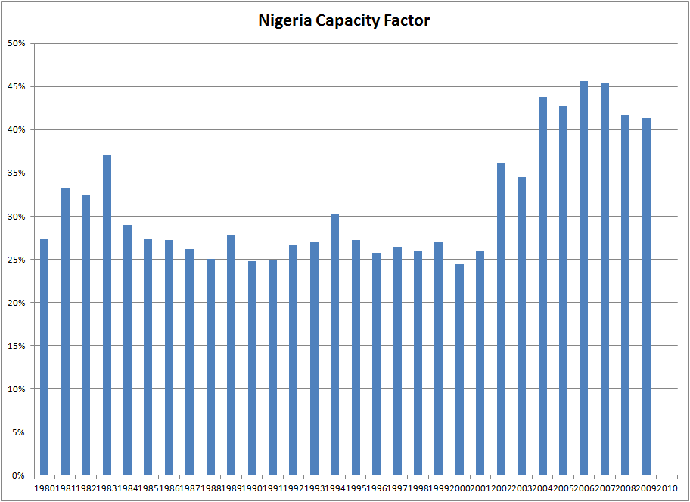
Changes in Availability in Nigeria

Slide 16
Regulated Private Ownership Model
Problems
  There are very high administrative costs of regulation
  Earned returns to private companies are typically higher than the cost of capital leading to inefficiencies and transfers of wealth
  Incentive regulation has involved game playing and large wealth transfers
  Encourages gold-plating and cost inefficiency (Averch and Johnson 1962).
  Cost of bad decisions borne by consumers
  When demand decreases, prices rise as fixed cost of the regulated utility must be covered

Slide 17
Competition at the Retail Level without Long-term Contracts
Countries around the world have used various different approaches that implement a spot market with prices that change on a hourly or half-hourly basis. In these markets, retail consumers generally have a choice as to their suppliers.
Initial markets were developed in Chile, Argentina and the U.K. These used a pool system where electricity is sold into a pool. These markets also had some kind of capacity uplift.
De-regulation is used in Latin America, parts of the U.S. and Canada, much of Europe, Singapore, Philippines and South Korea.
Many economists and politicians believe markets which do not have any monopoly generation components will create large economic benefits.

Slide 18
Full Competition - Benefits
Benefits of Competitive System
  Private entities incur risks for not building the correct mix and amount of capacity. It is the only model where investors must deal with demand and fuel price risks that are inherent in production of electric power.
  Market prices create a transparent process where investors do not concentrate resources on gaming the system, negotiating uneconomic contracts or bribing officials.
  Prices move according to supply and demand where prices fall when demand falls and they rise when demand rises. All of the other systems have the opposite effect.
  Can attract foreign capital

Slide 19
Full Competition - Problems
Problems
  Exercise of market power allows companies to extract high profits, play games and leads to inefficient outcomes.
  Cost of capital increased in this model, making renewable investments very difficult.
  Very difficult to build long-lead time plants such as nuclear plants.
  Market will not result in optimal investment decisions given the dramatic changes in value of electricity plants.
  Market prices can be very volatile.
  Benefits do not flow to consumers as suppliers lobby for capacity payments and other items that keep prices high in depressed markets
  California

Slide 20
Implementation of PURPA in California
Standard Offer No. 4 (ISO4)
A qualifying facility (QF) based on renewable energy could sign a contract based on a fixed forecast of future electricity price. Such a QF entering a contract would be guaranteed $57/MWh in 1985, $81/MWh in 1990, and $109/MWh in 1994.
After 10 years the contract price reverted to the short run avoided cost, which typically would be far lower than the fixed price guarantee.
Gas-fired cogeneration units were not treated nearly as generously but were generally paid an annual average of about $25/MWh for capacity and about $25 to $30/MWh for energy.
PPA Contracts did not have elaborate allocations of risk

Slide 21
General Policy Objectives for Electricity
Efficiency
  The amount of capacity
  The cost of constructing capacity
  The mix of capacity
  The cost of operating and maintaining capacity
  The efficiency of operating plants
Allocation of Resources
  Wasteful use of energy
  Wasteful transfer to private investors

Slide 22
History and Definition of Independent Power Production
PURPA Law (1978)
  Avoided Cost
  Bidding
Chile 1982
  Power Prices from Marginal Cost
Asia 1990’s until East Asian Crisis
  Use of IPPs with PPA contracts to Finance Power Expansion
    Philippines
    Indonesia
    Malaysia
Boom period for developing countries 1992-1997

Slide 23
Single Buyer Model with IPPs and PPAs – General Discussion
Governments authorize private investors to build plants (IPPs) to enter into contracts (PPAs) to sell power to a national power company.
  The national generation company is responsible for dispatch and balancing the system which cannot realistically be performed by multiple different companies.
PPA’s protect the investors from market risks using capacity payments and take-or-pay provisions.
Often accompanied by splitting the system into generation, transmission and distribution. Direct contracts with distribution companies often not allowed.
Prevents the state from completely exiting from key generation functions of electricity

Slide 24
Generation Cost Analysis

Slide 25
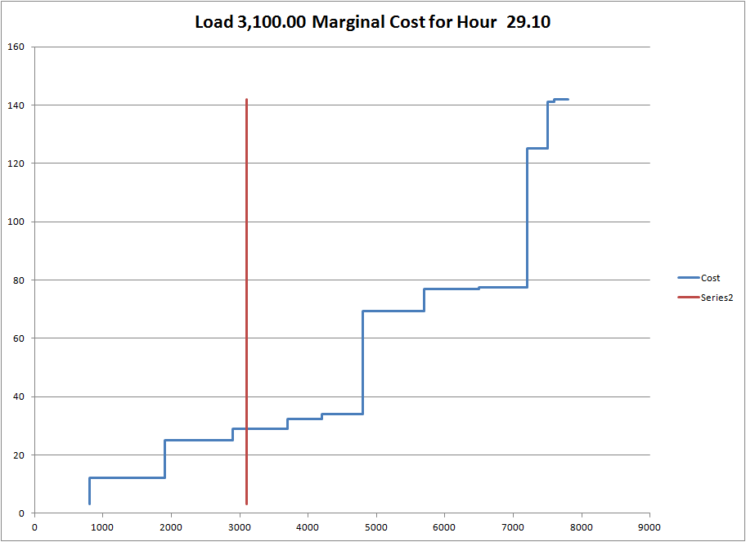
Pricing at Marginal Cost versus Average Cost

Slide 26
Illustration of Variation in Generation Cost versus Variation in Market Prices
Market Prices are Driven by the Marginal Energy Cost of the Plant
Total Generation Costs Driven by All Plants Operating on the System
  Market Prices have more Sensitivity
  Market Prices Closer Relation with Natural Gas Price
  Incentives to Build New Plants Driven by Market Prices

Slide 27
Single Buyer PPA Model – Benefits and Problems
Benefits
  Can attract private capital when governments may not have access to capital.
  With contracts, cost of capital is lower than for merchant plants in the fully competitive model.
  Efficiency in construction cost and in operation can be encouraged through using a competitive bidding process.
  Simplifies the regulatory process as wholesale price comes from actual payments to suppliers.
  Process of acquiring supply can be a transparent process using avoided cost.

Slide 28
Single Buyer PPA Model – Benefits and Problems
Problems
  Capacity expansion and capacity mix are determined by buying agency rather than entities that have their own money at risk. This arguably leads to over supply of capacity.
  Can create large contingent liabilities for the government related exchange rate changes and other items.
  Investors spend a lot of time on political issues rather than evaluating the true demand and fuel price risks associated with electric power.
  Can be prone to corruption with the numerous contracts.
  Companies are isolated from consumers and economic conditions.

Slide 29
Problems with Single Buyer or IPP Model
In many countries, the initial contracts with IPPs were concluded under non-transparent processes that attracted allegations of corruption and exposed these contracts to pressure for renegotiation that substantially reduced the investment returns for IPPs. A loss-sharing solution of lowering PPA rates in exchange for an extension of the PPA term has been the most common approach and successfully used in Pakistan, Thailand, and Guatemala.
The main risk with the single buyer model is that government can still impose noncommercial practices on the market by manipulating the single buyer. An additional risk is that government’s commitment to full reform may weaken to avoid politically controversial consequences of introducing more privatization and competition

Slide 30
IPP Financial Failures and Success
Cases in which IPPs defaulted
  Dabhol Plant in India
  Hub Project in Pakistan
  CalEnergy’s Dieng and Patuha projects in Indonesia,
  Florida Light & Power’s Karaha Bodas projects in Indonesia
Successes
  Egypt
  Thailand

Slide 31
Single Buyer Model and the Asian Financial Crisis
This optimism ended with the Asian financial crisis; itself brought on by a lack of sound investment policies, in particular, in relation to government guaranteed power purchasing agreements.
The power purchasing agreements had inadvertently converted a shortage of power supply into an oversupply, secured by take-or-pay guarantees. The result of the crisis has been a sharp contraction in private sector investment and a significant exposure of government and private sector investors to contingent liabilities.
This contraction not only limits the capacity of governments to stimulate economic growth but also has led to the deterioration or stagnation of many partially completed and privately financed public infrastructure projects.

Slide 32
Economic Ideas and History of Independent Power
Natural Monopoly and Economies of Scale
PURPA Demonstrated that Independent Power could Work
Allocate Risks to IPPs Related to Controllable Risks
Demand Risk, Fuel Price Risk and Capacity Mix Risk in Merchant Plants

Slide 33
Independent Power Production
The term "independent power producer" has been used to refer to several types of enterprises. In general, "IPP" refers to a privately developed power plant that sells electricity to a public electricity grid, often under long term contract with a state utility.
The lead actors in every IPP are private investors. The classic foreign-sponsored, project-financed IPP has taken root in more than fifty emerging countries that display wide variation in economic, political and social environments.
Where IPPs sign long term PPAs, they generally accepted construction and operating risks. IPPs are generally insulated under the terms of their PPAs against demand risk, dispatch risk, price risk, and exchange rate risk.

Slide 34
Monthly Electricity and Gas Prices – Higher Correlation

Slide 35
Historic Loads and Load Forecast

Slide 36
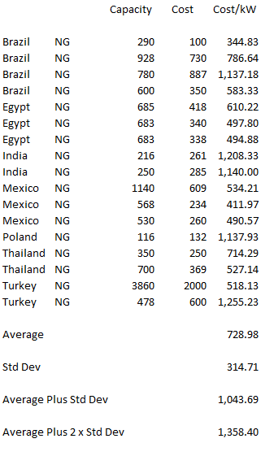
Comparative Plant Costs for Natural Gas

Slide 37
U.S. Nuclear Plants
Cost of Plants
  Early 1970’s Approximately US$ 500/kW
  Early 1980’s Approximately US$ 4,000/kW
Case of Seabrook Plant
  Bankruptcy of Public Service New Hampshire
  Escalating Costs
  Declining Plant Value
  Increasing Fixed O&M Expenses
  Worse than Expected Capacity Factors

Slide 38
Long-run versus Short-run Marginal Cost
Short-run costs assume all facilities are in place
Long-run costs account for the addition of new facilities
Prices should reflect long-run marginal costs
  Price spikes
  Capacity prices
Long-run marginal costs include hypothetical costs of renting new equipment

Slide 39
Philosophy of Marginal Cost
The argument for marginal cost depends on the price elasticity of demand.
  If people do not change their electricity usage when prices change, then nothing will change in the way the system operates and there can be no change in efficiency.
  Example of factory and imports of electricity price. If the price is below import price and factory will shut down with high electricity prices, then the factory should change the way it operates.
  If there is no price elasticity in demand then there is no argument for marginal cost.

Slide 40
Computation of Marginal Cost
Basic Idea
  Think about the costs that would have to be incurred to clear a market
  Generation Costs
    Cost to clear a market in energy is the cost of the most expensive generating unit running on a system.
    Cost to back-up energy is the lowest cost of capacity that can be purchased at current costs
  Note the use current costs instead of actual costs
  The total marginal costs do not equal actual costs

Slide 41
Drivers and Cost of Electricity – Slide 1
Plant Cost and Construction Delay (€/kW or € million/MW or €/W)
Carrying Charge Rate (% of total cost recovered in a year)
Annual Capital Cost Recovery: Plant Cost x Carrying Charge or
  Annual Charge per year
  €/kW-year = €/kW x Carrying Charge Rate
Capacity Factor (% of Time (hours per year plant is running)
  Annual Charge per hour
  Generation = kW x hours operated
  Generation = KW x 8766 hours per year x capacity factor
  Annual Charge per Hour = Annual Charge per year/hours operated
  €/MW-year = €/kW x Carrying Charge Rate x 1000/Generation

Slide 42
Plant Efficiency
Plant
Energy
Electricity
Measure of Input
BTU
kJ
Kcal
Sunlight – kWh
Wind – m/sec
Water – m3/sec
kWh
Measure of Efficiency
Heat Rate – Thermal
Efficiency – Solar, Hydro
Power Curve – Wind
Measure of Output
kWh
MWh
Wh

Slide 43
Heat Rate Discussion
In theory, the fuel charge covers the fuel cost. The fuel cost depends on the efficiency of the plant as well as the cost of fuel.
The efficiency of a plant is defined as the input of the plant that can be measured in BTU, kCal, kJ or kWh.
The output of the plant is measured in kWh or MWh.
Conversion of input to output can be BTU/kWh, kJ/kWh or kWh/kWh
BTU → ELECTRICITY PLANT → kWh
(1 BTU = 1.05 kJ, 1 BTU=kWh/3412) → PLANT → kWh
Example, 6800 BTU produces 1 kWh → Heat Rate is 6800 BTU/kWh
  6800 kBTU/MWH or 6.8 MMBTU to make MWH or (6.8 MMBTU/MWH). Alternatively: 6800/1.05 = 6476 kJ/kWh
  As 1 BTU is 1/3412 kWh, 6,800/3412 kWh in/kWh out or the efficiency is 1.99 input kWh for 1 output kWh. The efficiency is 1/1.99 or 50.25%

Slide 44
Drivers and Cost of Electricity – Slide 2
Efficiency (Heat Rate)
  Kj/kWh, BTU/MWH, kBTU/MWH, MMBTU/MWH, kWh/kWh
  Fuel Use or Resource Use = HR x Generation
  MMBTU = HR x Generation
  MMBTU = (MMBTU/kWh) x MWh
Fuel Price
  Measured in €/MMBTU, €/kJ, €/kWh
  Fuel Cost = Fuel Price x Fuel Price
  Fuel Cost/MWH = Fuel Cost/Generation
  Fuel Cost/MWH = HR x Generation x Fuel Price/Generation = HR x Fuel Cost
  Fuel Cost/MWH = HR x Fuel Price = kJ/MWH x €/kJ (kJ cancels)
Variable O&M Expense
  Cost that depends on running the plant - €/MWH
Fixed O&M Expense
  Cost independent of running the plant €/kW -year

Slide 45
Drivers and Profit and Loss Statement - Dispatchable
Cost Driver
Cost x Carrying Charge + Fuel Cost + Variable O&M + Fixed O&M
Fuel Cost – HR x Gen x Fuel Pr
Variable and Fixed O&M
Capacity Charge Revenue (€/kW-year x kW)
Portion of Capacity Charge
Portion of Capacity Charge
Portion of Capacity Charge
Portion of Capacity Charge
Profit and Loss Account
Total Revenue from Four Part Tariff
Fuel Expense
Fixed and Variable O&M Expense
EBITDA (Operating Margin)
Depreciation
Taxes
Interest
Net Income

Slide 46
Drivers and Cash Flow Statement - Dispatchable
Cost Driver
Cost x Carrying Charge + Fuel Cost + Variable O&M + Fixed O&M
Fuel Cost – HR x Gen x Fuel Pr
Variable and Fixed O&M
Capacity Charge Revenue (€/kW-year x kW)
Portion of Capacity Charge
Portion of Capacity Charge
Portion of Capacity Charge
Portion of Capacity Charge
Profit and Loss Account
Total Revenue from Four Part Tariff
Fuel Expense
Fixed and Variable O&M Expense
EBITDA (Operating Margin)
Taxes
Debt Repayment
Interest
Net Income

Slide 47
Drivers and Contracts - Dispatchable
IPP Risks
Cost of Project, Time Delay and Technology Parameters
Availability Penalty
Heat Rate Risk (Adjusted)
O&M Risk
Interest Rate Fluctuation
Risk Mitigation
EPC Contract with Fixed Price and LD (LSTK)
O&M Contract
O&M Contract with LD Provision
O&M Contract
Interest Rate Contract (Fix Rates)

Slide 48
Drivers and Contracts - Renewable
IPP Risks
Cost of Project, Time Delay and Technology Parameters
Capacity Factor Risk
O&M Risk
Interest Rate Fluctuation
Risk Mitigation
EPC Contract with Fixed Price and LD (LSTK)
NONE !!!
O&M Contract
Interest Rate Contract (Fix Rates)

Slide 49
Seven Drivers and Nuances
Plant Cost and Construction Delay
Efficiency (Heat Rate)
Fuel Price
Capacity Factor (Availability)
Variable O&M Expense
Fixed O&M Expense
Carrying Charge Rate
How to Set Delay LD
Heat Rate Curve
Fuel Price Indexing
Availability Penalties
Starts and Stops
Other
Price Indexing

Slide 50
Application of Fuel Charge
The fuel charge is expressed as $/MWH
This is divided into two components:
  $/MMBTU → Cost of Fuel
  MMBTU/MWH → Heat Rate
The total charge is the fuel cost x heat rate, or:
  Fuel Cost ($/MWH) = $/MMBTU x MMBTU/MWH
  The MMBTU cancel and you get $/MWH

Slide 51
Revenue Build-up and LCOE
LCOE is the levelized or weighted average price of electricity over the lifetime of a project
Cost of electricity is Revenue/MWH
LCOE is weighted Revenue/MWH over the lifetime of a plant
Weighting
  Cost of capital so future revenues have lower weight than current revenues
  Amount of generation so periods with more generation have more weight
Instead of detailed weighted average could use NPV formula where
LCOE = NPV of Revenues/NPV of Generation

Slide 52
Example of LCOE
Prices
  Price in Year 1 is 100
  Price in Year 2 is 200
Generation
  Generation is 500 in year 1
  Generation is 1000 in year 2
Discount Rate is 10%
  PV Factor is 1/1.1 = .909 in year 1
  PV Factor is 1/1.21 = .826 in year 2
Average price is 150
Weighted average price for Generation is: 33 x 100 + .67 x 200 = 33 + 134 = 167. This can be computed as (100 x 500+200 x 100)/1,500 or 167. This is sum of revenue/sum of generation
Weighted average price for discounting is .909 x 100 + .826 x 200 divided by (.909 + .826)
LCOE Combines weightings

Slide 53
History and Definition of Independent Power Production
PURPA Law (1978)
  Avoided Cost
  Bidding
Chile 1982
  Power Prices from Marginal Cost
Asia 1990’s until East Asian Crisis
  Use of IPPs with PPA contracts to Finance Power Expansion
    Philippines
    Indonesia
    Malaysia
Boom period for developing countries 1992-1997

Slide 54
IPP and Technical Changes
Economies of scale in generation occurred at individual plants, meaning it was more efficient to build big plants. Somewhere around the 1970’s this changed and it was clear that small plants could be efficient.
Long lead times and high capital intensity for construction plants such as nuclear plants require stability of regulation or government ownership.
In the 1980’s natural gas plants became much more efficient (the heat rates declined by 30%). With relatively low oil and natural gas prices, the natural gas combined cycle plants were more efficient than other plants at a range of capacity factors.
The natural gas plants are less capital intensive than other plants meaning the relative deployment of capital is less.

Slide 55
Economic Ideas and History of Independent Power
Natural Monopoly and Economies of Scale do not Exist in Generation
PURPA Demonstrated that Independent Power could Work
Allocate Risks to IPPs Related to Controllable Risks to Provide Incentives
Demand Risk, Fuel Price Risk and Capacity Mix Risk in Merchant Plants

Slide 56
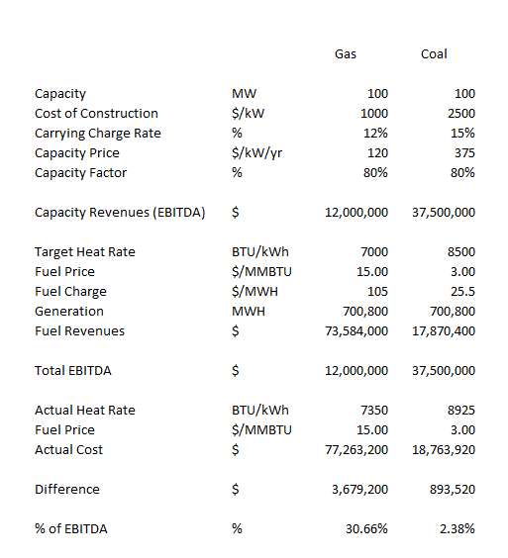
Risks for Coal and Gas Plant – Heat Rate

Slide 57
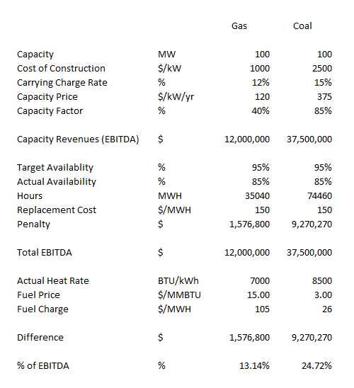
Risks for Coal and Gas Plant - Availability

Slide 58
Sources of Risk in Market Prices of Electricity and Merchant Power
Demand Volatility
Variation in Hydro and Other Renewable Resources
Changes in New Supply
Uncertainty in Fuel Supply Costs
Inefficiencies and Market Power
Changes in Technology

Slide 59
Demand Risk

Slide 60
Historic Loads and Load Forecast

Slide 61
Example of Changes in Demand

Slide 62
Errors in Demand Forecast From Using Historic Trends

Slide 63
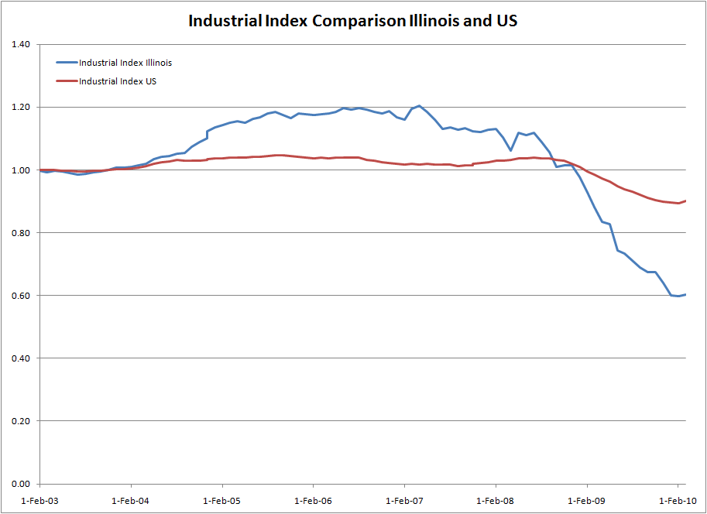
Industrial Comparison

Slide 64
Supply and Demand Balance Risk

Slide 65
Surplus Capacity Risk

Slide 66
UK Oversupply in Merchant Market

Slide 67
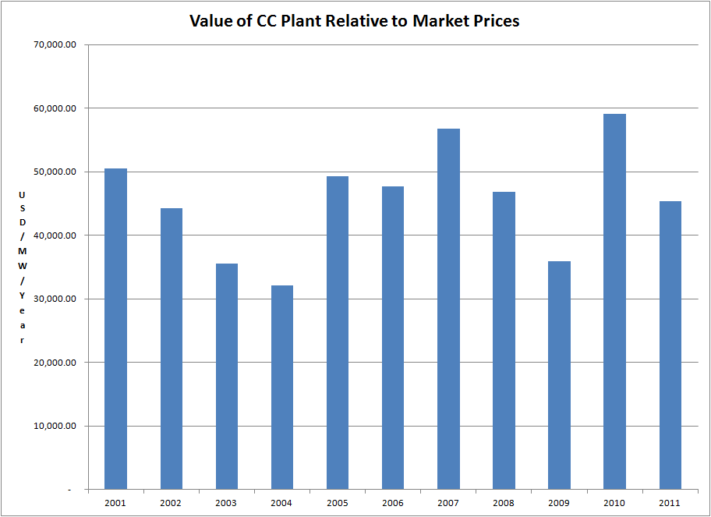
Volatility in Energy Value for NGCC – PJM Market

Slide 68
Comments on Risks Associated with Surplus Supply
A destructive consequence of operating in a fragmented industry with low barriers to entry is a susceptibility to “book-bust” cycles, not unlike mining, chemical, and pulp and paper industries.
The lumpiness with which new generation enters the market and its longevity may threaten extended time frames at the bottom of the merchant business cycle.
As merchant power industry appears to be reaching the end of a build-out period, energy merchants will likely have to confront surplus reserve margins for years to come.

Slide 69
Fuel Price Risk

Slide 70
Alternative PPA Provisions
Utility of Government Provides Fuel Supply to IPP
  Energy Conversion Agreement (ECA)
IPP Provides an Approved Fuel Plan
Fuel Price from Published Index
Gas Price from Weighted Average Gas Price of Utility Plants

Slide 71
Fuel Supply Contracts and Matching Costs
Gas supply contracts provide 100% of the expected gas requirements of the plant. The gas price components of the gas supply agreements are priced at market based indices and are structured to provide matching changes in energy payments under the PPA.
A number of events negatively impacted the business and prospects of the gas supplier resulting in downgrades in the credit ratings to non-investment grade by each of the major rating agencies.
A failure to perform under the gas supply contracts may have a material adverse effect on the SPV. While management believes that alternative natural gas supplies at market-based prices can be obtained so as to ensure against interruption, no assurance can be given that the replacement arrangements would have terms commercially equivalent to the contracts.

Slide 72
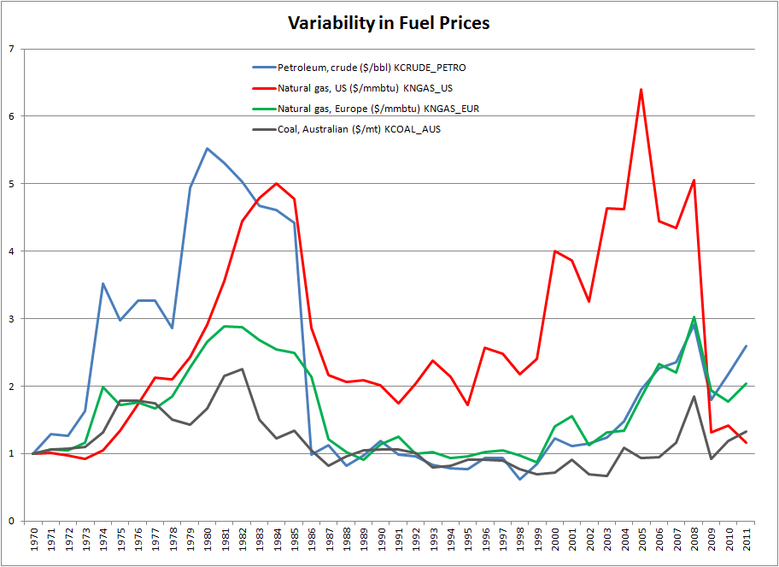
Volatility in Fuel Prices – Source World Bank Site
http://siteresources.worldbank.org/INTPROSPECTS/Resources/334934-1304428586133/PINK_DATA.xlsx

Slide 73
Oil Price Errors from EIA

Slide 74
Monthly Electricity and Gas Prices – Higher Correlation

Slide 75
General Discussion
For many areas of the world, plants on the margin are often natural gas plants
Gas plants can be less exposed to risk
Total generation cost is less sensitive to natural gas prices
Correlation between various fuel prices
Efficiency in Purchasing Fuel

Slide 76
Efficiency in Fuel Contracting
Negotiating Fuel Prices in Long-term Contracts
Predicting Long-term Prices
Contracting Fuel Transport Prices
Hedging Strategy of Fuel Prices
Appropriate Risk Allocation
  Not as simple as fuel price allocation to off-taker

Slide 77
Capacity Factor Risk – Renewable and Thermal

Slide 78
Capacity Factor
Definition – Capacity Factor versus Load Factor
  Average Generation over Time Period Divided by Maximum Potential Generation
Cause for Capacity Factor Variation
  Changes in Load
  Changes in Renewable Resources
  Changes in Scheduled Outage of Other Units
  Changes in Random Outages
  Changes in Fuel Cost
  Other

Slide 79
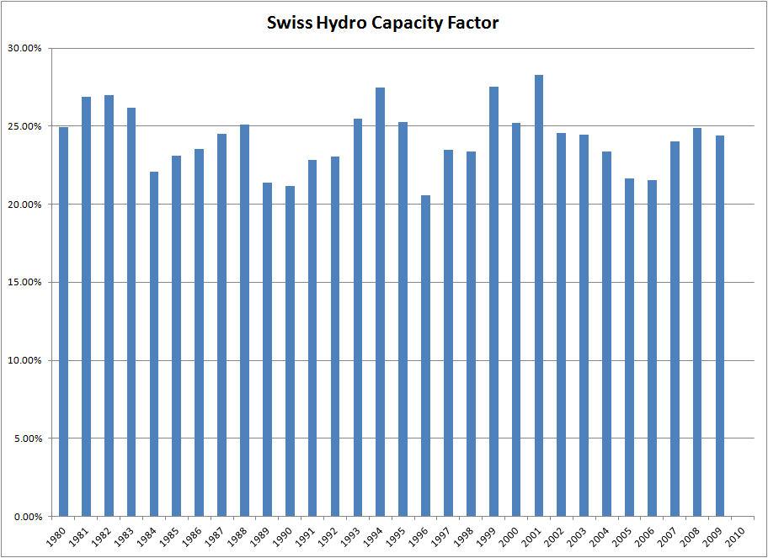
Example of Variation in Hydro Capacity Factor – Applies to Wind, Solar and Tidal
Finding Data on DVD and downloading directly to excel using
WORKBOOKS.OPEN

Slide 80
Scheduling and Dispatch of IPPs
General Problem of Scheduling and Dispatch
Because of Minimums, Start-up Costs, Ramp-up Rates and Heat Rate Curves, units must be scheduled a day in advance
PPA agreements should specify how units a scheduled a day ahead

Slide 81
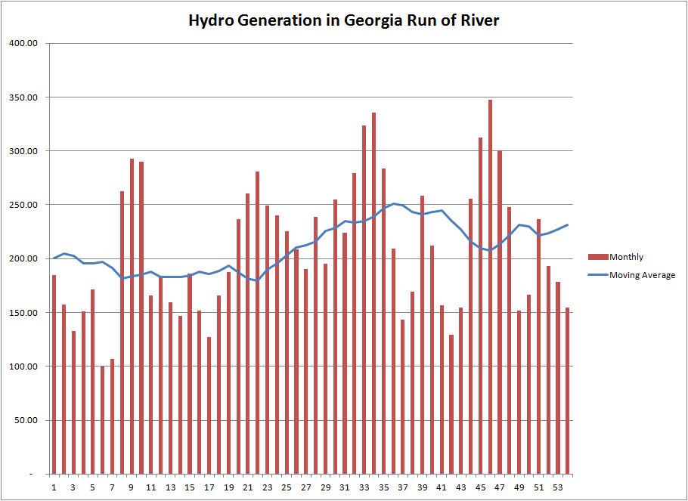
Variability in Hydro and Thermal Generation – Georgia Example

Slide 82
Availability Risk

Slide 83
Causes of Variation in Availability
Random or Forced Outage
Scheduled Maintenance Outage
  Submit schedule for approval from off-taker
  Coordination with other plants
  Calculation of optimal maintenance period
  Requirements for maintenance outage
  Penalties can be imposed for maintenance during peak periods
Problems with Preventative Maintenance
Poor Operations

Slide 84
Definition of Forced Outage
"Total Forced Outage" - during periods other than Planned Outages or Maintenance Outages, the Facility is unable to engage in Dispatch Operation, or the Facility is declared by Seller to be in a Total Forced Outage for what would otherwise be a Partial Forced Outage.
"Partial Forced Outage" - during periods other than Planned Outages or Maintenance Outages, the Facility is partially able to engage in Dispatch Operation, and has not been declared by Seller to be in a Total Forced Outage

Slide 85
Valuation of Outages
Theory: Marginal Value of Energy and Outage During Hour of Outage
Similar to Problem of Valuing Capacity
  Valuation approaches:
    Peaker Method
    Value of Lost Supply
Depends on Supply Curve
Depends on Season of Year
Depends on Hydro Availability
Depends on amount of Surplus Capacity

Slide 86
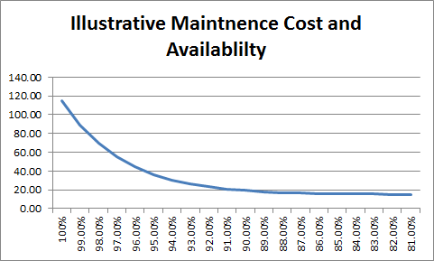
Tradeoff Between Cost and Availablitity

Slide 87
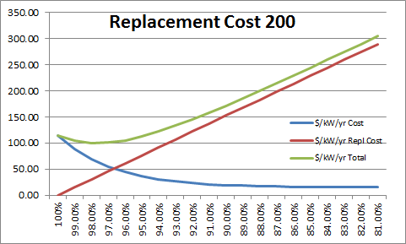
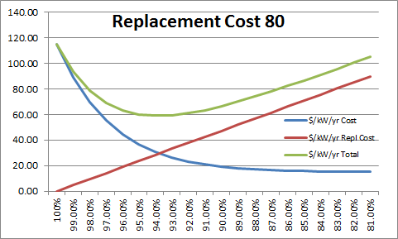
Optimisation and Minimum Cost
In Theory, Minimum is where replacement cost change = maintenance cost change

Slide 88
Theory of Cost Minimisation
IPP should not have incentive to do too much or too little maintenance
If penality is higher than the cost then will do too much maintenance
If penalty is lower than the replacment cost than will do too little mainenance

Slide 89
Theoretical Formula for Penalty
Penalty for replacement power should be:
  Penalty/MWH = (Replacement – Fuel)
  Penalty/kW-year =
    Penalty/MWH x 8760/1000

Slide 90
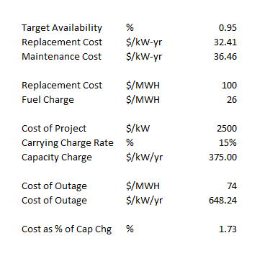
Example of Replacement Cost and Capacity Penalty

Slide 91
Capacity Factor Risk and Heat Rates

Slide 92
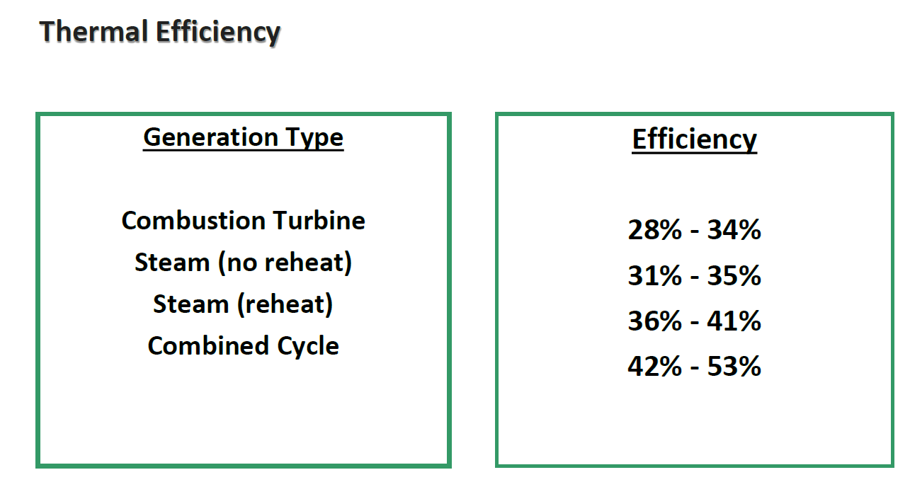
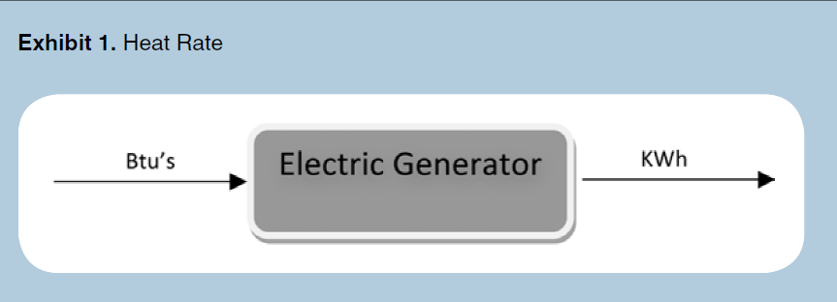
Efficiency and Heat Rate

Slide 93
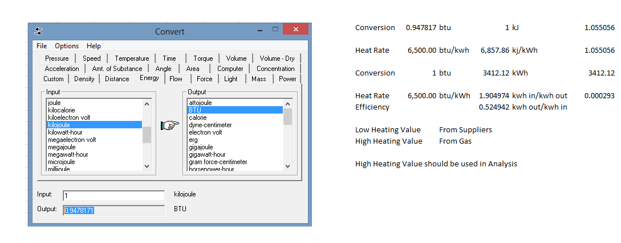
Heat Rate Conversions

Slide 94
Different Capacity Factor Incentives for Different Types of Plants
Dispatchable Plants
  Capacity Factor out of control of the SPV
  Should be available when called for dispatch
Renewable Energy
  Not Dispatchable
  Incentive to Locate Plants near best Resource
Differences in SPV Risk with and with Capacity Factor Risk

Slide 95
Heat Rate Terms
Heat Rates
  Billing Heat Rate
  Tested Heat Rate
  Average Heat Rate
  Incremental Heat Rate
  Guaranteed Heat Rate
  Effective Heat Rate
  Low Heating Value Heat Rate
  High Heating Value Heat Rate

Slide 96
Fuel Quality and Heat Rate
Differences in fuel quality can affect the heat rate
Fuel can have different heating value
Fuel quality should be defined in the fuel supply agreement

Slide 97
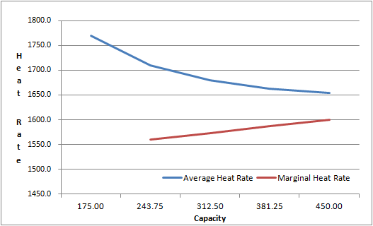
Example of Heat Rate Curves
If the plant is dispatched at different levels, the target heat rate should change

Slide 98
Compensation from Marginal and Average Heat Rate
Efficient dispatch should reflect the marginal heat rate:
  Measures the additional fuel used when additional energy is produced
  Plants should be dispatched on a portfolio basis after they are committed
  Plant with lowest marginal heat rate should be dispatched first
Compensation should be on the basis of average heat rates
  The average heat rate measures the total fuel used relative to the total energy produced
  If compensation is based on the marginal heat rate, added revenues should be collected through the capacity payment

Slide 99
Computation of Incremental and Average Heat Rate

Slide 100
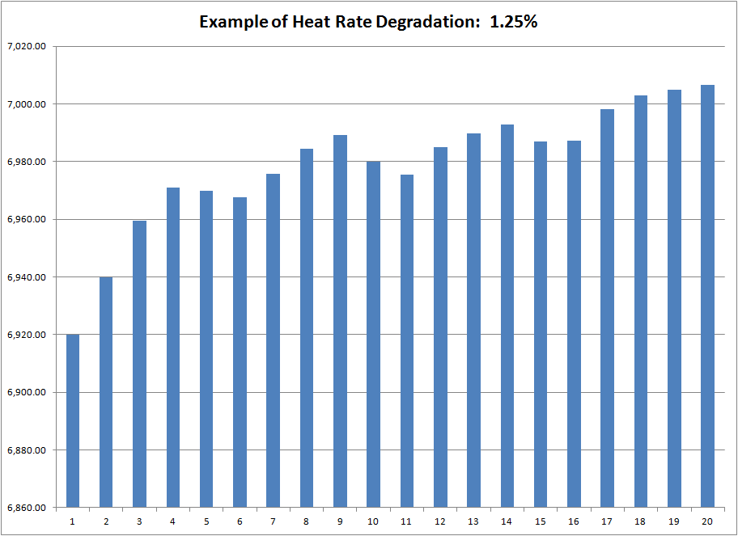
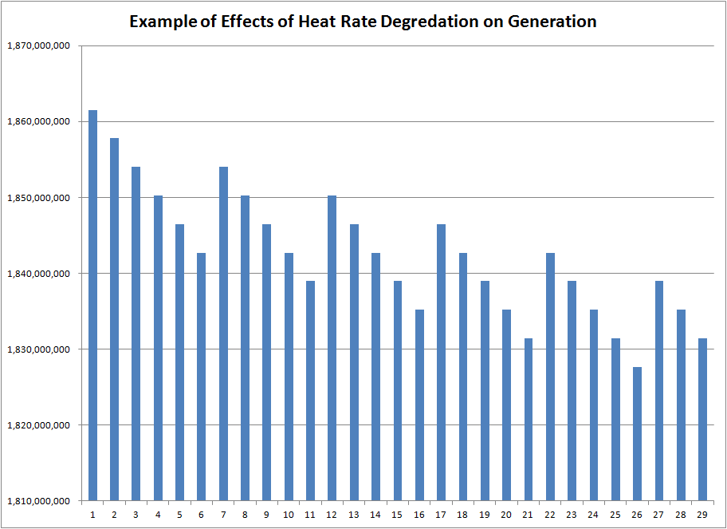
Example of Heat Rate Degradation

Slide 101
Target Heat Rate Mechanics
Projected Fuel Demand in MMBTU =
  Sum over hours (Energy in MWH x Energy x Contract Heat Rate (BTU/kWh) * Correction Factor ) / 1,000,000
Correction Factor of Specific Net Heat Rate, applicable for each respective hour depends on operating conditions, and level of the plant that is dispatched
Correction factor depends on:
  Temperature and other weather conditions
    Requires a table with different correction factors
  Capacity dispatched
    Requires a heat rate table or heat rate curve
  Fuel quality
    Requires adjustment factors

Slide 102
Target Heat Rate Formula
Advantages
  Enables compensation for different levels of dispatch which would be distorted from a constant heat rate.
  With a constant heat rate there is an incentive to dispatch too much when the marginal heat rate is low and too little when the marginal heat rate is high.
  Avoids the necessity of fuel price risk where fuel is supplied by government
Disadvantages
  Creates potential for economic inefficiency if the actual heat rate curve differs from the marginal heat rate curve.
  Creates potential for economic inefficiency if the actual level of the heat rate is different from the target level.
  Requires fuel price to determine penalties when the actual heat rate does not equal the target heat rate.
  Complex formulas.

Slide 103
Inefficiencies from Using Target Data Rather than Actual Data
Dispatch from Target Cost
If Actual Cost is Above Target Cost
  Plant will be dispatched too much
  IPP will lose money on dispatch
If Target Cost is Below Actual Cost
  Plant will not dispatch enough
  Cost of could be reduced
Same Problem Occurs from Heat Rate

Slide 104
Construction Cost and Operations and Maintenance Cost Risk

Slide 105
Cost of Risk Allocation
If apply an LSTK contract, cost-over run, delay risk and performance risk are transferred from the SPV (project company) to the EPC contractor.
  The EPC contractor should be compensated for accepting these risks.
  The premium for an LSTK contract depends in theory on the potential for cost over-runs, delays and problems with performance.
  For an NGCC, the rule of thumb is about 15%-20%.

Slide 106
Capital and Operation Cost Breakdown for Alternative Plants
Review cost data
Assume 20% premium for LSTK contract
Total levelized cost of plant
Percent of total cost related to capital cost
Optimism Bias in cost estimation
Theoretical Issue – should construction cost risk be compensated in the equity IRR if all bidders use LSTK contracts and cost is already increased for construction.

Slide 107
Long-run Marginal Cost

Slide 108
Cost Trends in Natural Gas Plants

Slide 109
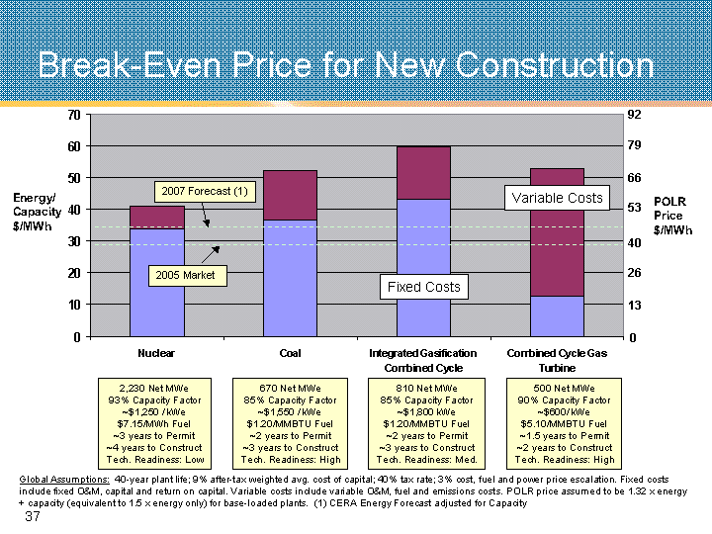
Computation of Required Prices for Different Plants

Slide 110
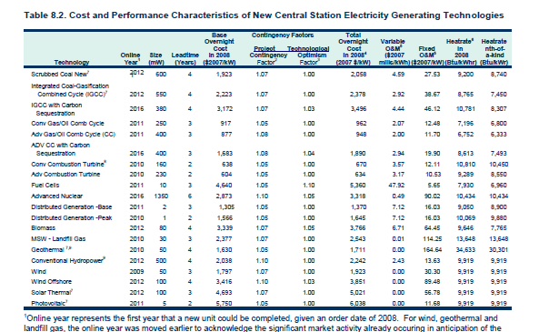
Capacity Costs from the EIA

Slide 111
Peaker Method
Assume that peaker cost should be allocated on the basis of demand, then compute the surplus cost over and above a peaking plant for each type of plant.
The peaking cost is allocated on the basis of demand
The surplus cost above the cost of a peaking plant is allocated on the basis of energy
Difficult to find the cost of peaking plants for older plants
Related Method: On-peak and off-Peak Method for allocating energy costs

Slide 112
Project Finance Analysis and Screening Curves

