Slide 1
Introduction – Project Finance in the Context of General Finance

Slide 2
Challenging/Complex Issues in Analysis of Project Finance
Target level of DSCR and IRR for various projects
Risk Analysis and determination of which risks are most important
Interpretation and trust in consulting reports including the independent engineering report
Evaluation of DSCR, LLCR, PLCR and debt to capital ratios relative to project risks
Structuring of draws from debt and equity and alternative debt repayment types
Length of debt tenor and value of re-financing options
Value of structuring provisions related to covenants, cash flow sweeps, back-up facilities and debt service reserve accounts

Slide 3
Central Question in Finance and Valuation
When making any investment or any decision, the central issue is how to make forecasts of cash flow and then assess risks with those forecasts.
  The underlying idea of project finance is to manage, quantify and understand risks – this is one of the most difficult issues in all of economics
  The central idea of project finance is to focus on cash flow from the perspectives of debt holders and equity holders
  Project finance involves many contracts, debt features and financial terms, but the underlying idea is to evaluate costs and benefits of capital intensive decisions.

Slide 4
Project Finance Background - Issues
What is the big deal about project finance – does the financing of a project affect actual investment?
Are the benefits of project finance worth the high fees received by lawyers and bankers for all of the contracts?
How should risks be evaluated and mitigated in project finance; for example how much return should be given up if contracts reduce the risk?
What are the financial criteria used to quantify project financings – what is the return required by equity investors and what are the financial ratios used by lenders?
How does one measure the cost and benefits of alternative project finance features such as cash flow sweeps, covenants, contract terms, and debt service reserves?

Slide 5
Basic Project Finance Concepts
Project finance, also known as limited-recourse or non-recourse finance, consists in financing very specific assets or projects, with the repayment coming ONLY from the cash-flow generated by that project or asset, without any claims (with some very specific exceptions) on the companies that develop these projects.
Project finance, comes from a combination of both equity and debt. The split between equity and debt depends on the individual project and, most importantly, on the risk profile of each project. The higher the risk, the greater the share of equity will be required by the lending banks. The risk of an individual project is also decisive for the level of debt which a project can take on.
The principle is simple: a bank finances a specific asset, and gets repaid only from the revenues generated by that asset, without recourse to the investors that own the project. It works well for project with well identified assets with high initial investment costs, and strong cash flows after that, like big infrastructure items (toll bridges, pipelines) and energy assets (oil fields, power plants).

Slide 6
Definition of Project Finance
Project Financing
  Project financing is a method of financing in which the lenders to a project have either no recourse or only limited recourse to the parent company that develops or “sponsors” the project.
    Non-recourse refers to the lenders’ inability to access the capital or assets of the sponsor to repay the debt incurred by the special purpose entity that owns the project.
    Limited recourse are situations in which the sponsor’s capital may be at risk only for specific purposes and in specific (limited) amounts set forth in the project financing documentation.
Wilson Sonsini Goodrich & Rosai, Project Finance Primer for Renewable Energy and Clean Tech Projects, August 2010, page 2. https://www.wsgr.com/PDFSearch/ctp_guide.pdf

Slide 7
Definition of Non-Recourse
Non-recourse lending means that project level loans are secured by the project assets and paid off entirely by the cash flows or liquidated assets from the project
The purpose of using an SPV is to help enable the establishment of non-recourse debt for the wind project
  U.S. Partnership for Renewable Energy Finance (US PREF), Renewable Energy Finance Fundamentals, page 1. http://www.camelottech.com/cmfiles/docs/uspref_renewable_energy_finance_fundamentals_v21.pdf
  Deloitte, Establishing the investment case Wind power, April 2014, page 16.

Slide 8
Debt Sizing
Project Finance is all about risk analysis
  Banks loan money depending on the difference between the cash flow and the amount of the debt service – this is the debt service coverage ratio
    The higher the risk the higher the debt service coverage ratio, because banks need a margin.
    A project with a lot of risk may have a debt service coverage ratio of 1.8 whilst a project with little risk may have a DSCR of 1.2. (Look at graphs on the next chart)
    Once you have the DSCR, you can find the level of gearing from the DSCR (using the goal seek).
  The equity IRR which is the main thing that the sponsors are concerned about depends on the debt terms
    It is better to have longer tenor
    It is better to have level debt service instead of declining debt service (annuity payments)
    It is better to have lower DSCR

Slide 9
Project Finance versus Corporate Finance
Corporate Finance
Project Finance
Analysis is founded on history and evaluation of how companies will evolve relative to the past.
Financing is important but necessarily the primary part of the evaluation.
Focus on earnings, P/E ratios, EV/EBITDA ratios and Debt/EBITDA
Since there is no history a series of consulting and engineering studies must be evaluated.
The bank assesses whether the project works (engineering report).
Focus on cash flow. Equity IRR and DSCR

Slide 10
Risk Assessment Challenge in Project Finance
Basic Problems
  Project has no history
  Long time period for debt to be repaid
  Mitigation techniques – contracts, insurance and hedging -- do not eliminate all of the risk
  Risk Increases with:
    Time
    Technological Complexity
    Number of Players
    Price Sensitivities

Slide 11
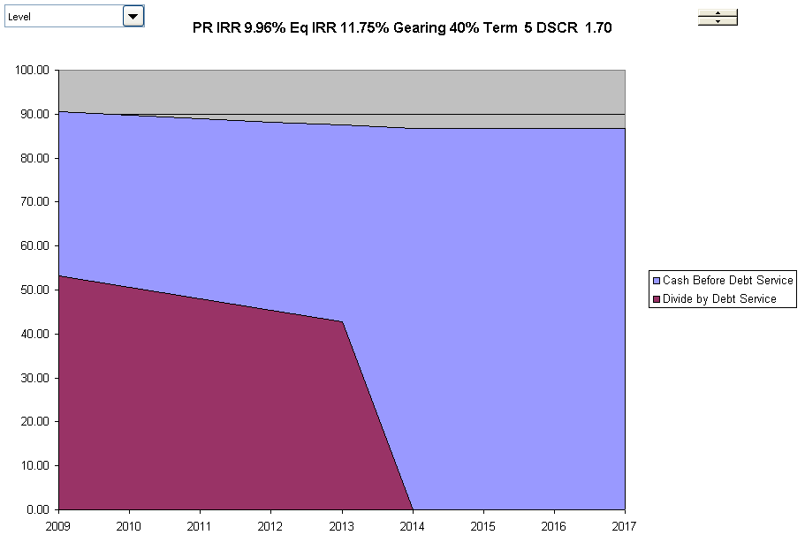
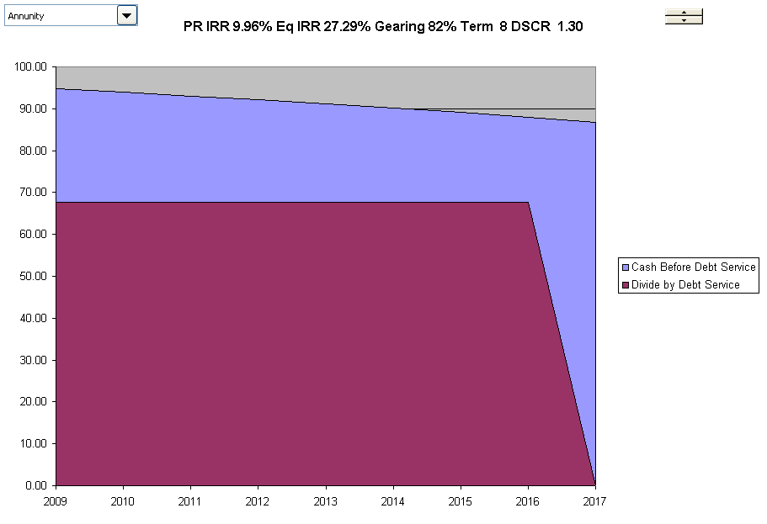
DSCR with High and Low Risk
High Risk Cash Flows
Low Risk Cash Flows
High Risk Project has higher margin, shorter-term and declining debt service. Low risk has flat debt service, and longer-term and higher IRR on Equity

Slide 12
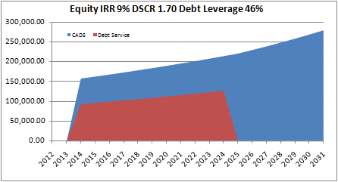
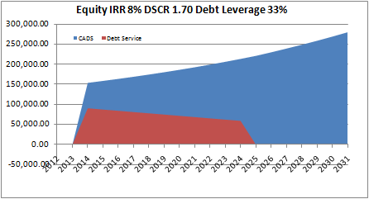
What Is Project Finance
Project Finance involves Financing of a Single Asset, from the cash flow produced by the asset. Full Recourse Projects must meet all of their obligations without reliance on corporate or parental guarantees.
Project Finance is highly leveraged at financial close because of contracts or because of cost structures that are profitable relative to commodity prices.
Project financing involves a debt funding structure that relies on future cash flows from a specific development as the primary source of repayment, with that development’s assets, rights and interests held as collateral security.
Assets financed are capital intensive – long lives, high capital cost relative to revenues, capital cost important.
Attempt to have debt tailored to the cash flow characteristics of the project as much as possible

Slide 13
Risk Analysis
Once cash flows are established in project finance, a risk analysis should be performed. This includes:
  Create a risk matrix that shows what the various risks are and whether they are mitigated.
  For the remaining risks that are not mitigated:
    Develop a sensitivity analysis that illustrates on a graph (with a spinner button) how much a variable can change before the debt cannot be re-paid.
    Develop a sensitivity table that shows how a variable is affect by different terms of the transaction (such as gearing and tenor)
    Develop a scenario analysis that shows a downside case and the level of gearing that supports cash flow in a downside case
    Add a tornado diagram or Monte Carlo simulation to extend the risk analysis

Slide 14
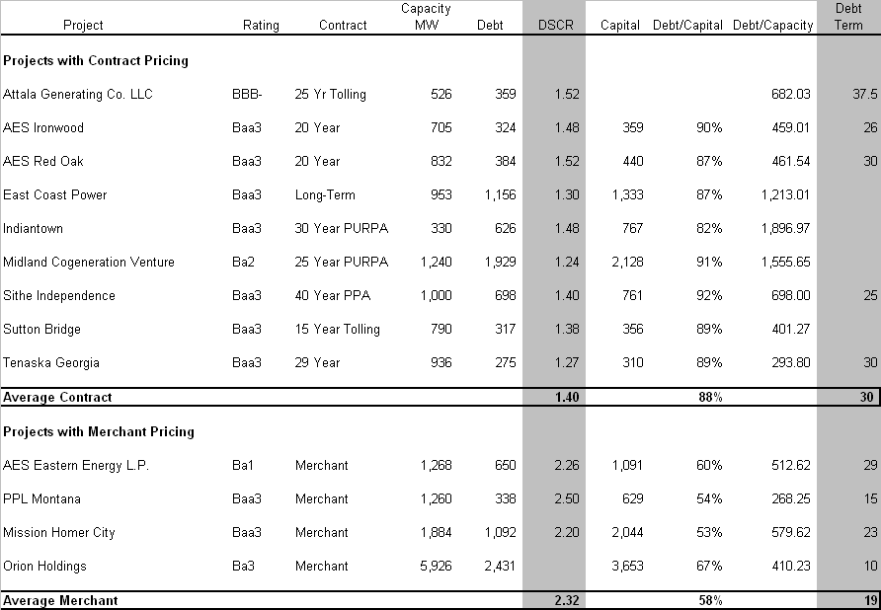
Example of Project Finance as Risk Measurement Survey of Electric Plants
Merchant generation is a cyclical, capital intensive, and commodity¬based industry that is subject to volatile cash flows. As a result, the companies in this sector generally have business profile scores that range from '8' to '10'. (Business profiles are categorized from '1' (excellent) to '10' (vulnerable).)
One could theoretically do the same thing for EPC contracts and O&M contracts

Slide 15
Sample Market Data in Different Regions
Middle East
  IRR 10-12%
  DSCR 1.2-1.3
  Debt Tenor 17 ++yrs
Africa
  IRR 18% - 20%
  DSCR 1.4-1.5
  Debt Tenor 10-15 yrs
Vietnam
  IRR 13%
  DSCR .1.3
  Debt Tenor 15 years

Slide 16
Project Finance Process Used in Investment
Project Finance Process
  In development process, develop a set of contracts with construction companies, suppliers and off-takers
  Once cash flows and contracts are defined, secure bank financing
  Assure that the return to equity holders is in line with equity returns generally known to be required for investments.
In project finance
  The projected cash flows are reviewed by financial experts outside of the company with no vested interest in the project
  The amount of gearing drives the return on the project and the gearing is in turn driven by lenders assessment of the cash flow
  The rate of return in not subjectively adjusted for risk, it is the lenders – who have their own money at risk – who drive the investment
  Specific risks can be evaluated and measured

Slide 17
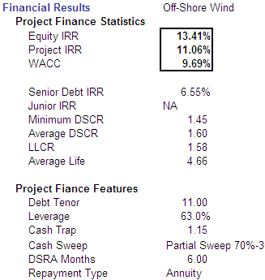
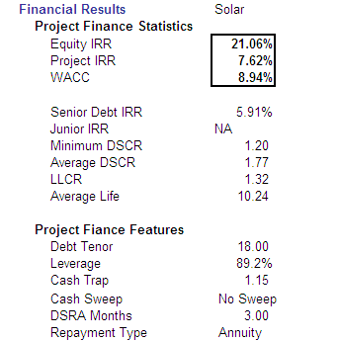
Evaluation of Project Investments with Equity IRR and Debt Capacity
PROJECT A
PROJECT B
Project IRR minus WACC – traditional finance – would make A look better

Slide 18
Problems with Project Finance
Project financing is document intensive, time consuming and expensive to complete
It imposes significant operating restriction on each project company, including its ability to make equity distributions to the sponsor/investor prior to the payment of operating expenses, debt service and a percentage “sweep” of additional cash flow
  A cash sweep is a level of payment in the distribution of project revenues in which the lenders are repaid outstanding principle with a certain percentage of excess cash after other more senior obligations have been met.
Ibid, page 10.

Slide 19
Cost of Capital for Project Finance
Deloitte: typically wind projects will be 50-70% debt financed, with onshore wind projects being typically at the higher end and offshore wind projects at the lower end of the range
Deloitte: The maturity of loans depends on the project finance structure, but often maturities of 10-15 years post-completion are obtainable at a borrowing rate of approx. 4.5-6% in the current markets, depending on the instalment plan and the risk of the project
Deloitte: Onshore wind project’ post-tax IRR requirements in pre-production typically range from 7.0%-9.5%, once in operation the post-tax IRR requirements decrease to 5.5%-7.0%
  The required rate of return is influenced by the project stage, the complexity of the project, track record of applied technology, market risk, contractual structure of the project, the climatological variations at the project site and the political climate in the country in which the project is realized.
Deloitte, Establishing the investment case Wind power, April 2014, page 22.

Slide 20
Project Finance Terms

Slide 21
Project Finance Overview
Phases
  Development Phase and Financial Close
  Construction Phase and Commercial Operation Date
  Debt Repayment Phase and Debt Tenor
  Operation Phase and Contract Completion
Contracts
  EPC Contract/Lump Sum Turnkey Construction Contract
  Off-take/Sales Contracts
  Concession Agreement
  O&M Contract
Debt Provisions
  Non-Recourse
  Cash Flow Waterfall
  Debt Service Reserve Accounts
  Cash Lock-up Covenants
  Cash Flow Sweeps

Slide 22
Project Finance Players
Independent Engineer
Insurance Consultant
Legal Counsel
Market Consultant
Financial Advisor
Lenders
Borrower
Government
Sponsors
Contractor
Equipment Suppliers
Operator
Input Supplier
Output Buyer

Slide 23
Project Finance Characteristics
Usually an new project.
High ratio of debt to capital and long debt term.
No corporate guarantees after the project begins operation.
Lenders rely on the cash flow of the project, rather than the value of the assets or the ability to re-finance.
Exposure to risk of political influence by host governments leading to use of political risk guarantees providing a cross-country assessment.
Security is the contracts, the resource rights, etc.
The project has a definite life.

Slide 24
Types of Project Finance
Power Generation
  IPP Projects
  Renewable Projects
  Merchant Projects
Oil & Gas projects
  Oil/Gas pipelines
  Liquefied Natural Gas
  Refineries
  Petrochemicals
Mining
Toll roads
Airports, Ports
Telecommunications
Other Infrastructure (Hospitals, Schools etc.)

Slide 25
Project Finance Terms
Cash flow waterfall
  The exact order between debt repayment, operating costs and taxes is usually a topic for lively negotiations....
Ring Fencing
  Legally and economically self-contained; only business is the project. Banks can step-in and take over the project. Protect business from other businesses
Special Purpose Vehicle
  Funds are not lent directly to those behind the project, but rather to a special purpose vehicle (SPV), set up for the sole purpose of owning the project and to enter into all agreements, including the loan agreement.

Slide 26
Contract Terminology
  Progress Payments
    Payments to EPC contractor verified by an independent expert acting for the lenders (or grantor)
  Drawdown of debt
    Corresponding to completion of part of the construction works
  Grace Period
    Often an additional grace period of 3-12 months after completion of construction
  Back to Back Risk Allocation
    E.g. Identical descriptions of drafting such as force majure
  Single Point Responsibility

Slide 27
More Project Finance Terms
EIRR and FIRR
  FIRR (Financial IRR)
    Rate of return from the perspective of the SPV without considering benefits that are not incorporated in cash flows
  EIRR (Economic IRR)
    Rate of return that includes items such as environmental benefits, national economy benefits and other factors not included in the IRR
Negotiation versus Bidding
  Arguments for Bidding
    Strict process focuses on competition and can reduce cost
  Arguments for Negotiation
    More flexibility allows rapid procurement and flexibility to address project specific issues

Slide 28
More Project Finance Terms
Host Country Guarantee
  Host government or local government can
    Provide guarantees
    Substantial letters of comfort for the project
  Generally for the payment of the off-take purchaser (and possibly for the input supplier)
  Host government guarantees are more difficult in India and China
  Government guarantees may be associated with BOT (versus BOO) projects

Slide 29
Financial Close
Development Phase
  Pre-qualification to financial close
  PFI Development
    Schools 25 months
    Hospitals 38 moths
    Other 47 months
Financial Close
  Financial close is the moment lenders agree to allow first drawdown, and therefore when the project moves from the development phase to implementation
  PCOD Date and COD Date

Slide 30
More Project Finance Terms
Step-in Rights (versus taking over asset)
  Step-in rights maintain the existing contracts
Availability Payments
  Often lenders want a portion of the revenue stream to be fixed based on the availability of the facility rather than the use of the facility
Government Support in PPP
  Subsidies (Viability Gap Funding)
  Risk Mitigation Instruments
  Subordinated Debt
Progress Payments
  Draw-downs during construction linked to milestones
  Verified by independent expert acting for lenders or government
  Ensure that payments are added to the asset base

Slide 31
Project Finance Glossary
The CD contains three project finance glossaries
  HBS
  Euromoney Text
  Principles of Project Finance Text

Slide 32
Project Finance and Risk Management
A key aspect of project finance is the management of risk amongst parties.
  The risk management is governed by numerous contracts including the loan agreement.
  Risk can be allocated to parties who are best able to accept it an have an incentive to control it.
  Risks are explicitly addressed and affect the gearing of the project
  Conflict of interest between role as sponsor and contractor must be identified.
Technical risk is pervasive during both pre- and post construction phases, while the possibility of sponsors coming to the aid of a troubled project is elusive.

Slide 33
What Is and Is Not Project Finance: Basel II
Reference: Basel II source files in reference library
Project Finance Example
  Bank finances an SPV that will build and operate a project
  SPV has off-take contract with an end-user
  Length of contract covers the loan, which amortizes over the life of the contract
  If the contract is terminated, the end-user is required to purchase the assets at a price related to the value of the underlying contract
  Could have construction risk and/or operational/technology risk and/or market/price risk
Non-Project Finance Example
  Bank provides a loan associated with building a specific project, but the firm that is building the project has many assets and a diversified revenue stream

Slide 34
Project Finance versus Corporate Finance
The fundamental notion that project finance centres on cash flow is demonstrated by:
  Valuation of projects involves measuring internal rate of return on cash flow and net present value of cash flow rather than P/E, return on invested capital or EV/EBITDA ratios that are typical in non-project finance
  Credit analysis in project finance involves consideration of the cash flow generation of the project relative to debt service obligations – the debt service coverage ratio. This contrasts to non project finance where times interest earned, debt to capital and debt to EBITDA are the primary ratios analyzed.
  The structure of debt repayment in project finance is driven by the expected cash flow of the project where debt maturities are spread over the life of the project rather than occurring as bullet payments.
  Since projects are reliant on cash flow, liquidity cannot come from additional borrowings and reserve accounts must be established to provide liquidity to projects. This contrasts with non-project finance where current assets relative to current liabilities are the traditional gauge of liquidity.

Slide 35
Limited and Full Recourse
Limited Recourse
  Lenders have recourse to assets of shareholders in limited situations
  Lenders have recourse to assets of shareholders over limited time periods
Examples
  Revenue short-fall account in toll roads
  Contingent Equity
  Completion Guarantee
  Construction Over-run Funding

Slide 36
Conditions Precedent
Prior to Financial Close
  Documents must be in place
  Issue of permits, bonds, warranties, letters of comfort etc,
Prior to Drawdown of funds during construction
  No defaults
  Debt to equity criteria
  Limit on cost over-runs
Prior to Distribution of Dividends
  Covenants (DSCR) met
  No defaults

Slide 37
Project Documents
Concession Agreement, government licenses, royalty agreements
Documents of Title to land
Joint Venture or Shareholder Agreement
Organizational documents of project company
Project Management Contracts
Performance Bonds, Payment Bonds
Insurance Policies
Supply Contracts
Sales Contracts
Throughput Agreements
Technology/Operating Licenses
Planning and Environmental Consents
Utility Agreements
Transportation Agreements
Operations and Maintenance Agreements

Slide 38
Conditions Precedent to Each Draw Down
Confirmation that Representations are True
No Event of Default
Progress Certificate
Debt Service Coverage Ratio Compliance Certificate

Slide 39
Project Finance Timing and Phases

Slide 40
Project Finance Phases – Financial Close and Commercial Operation Date
Project finance is driven by various dates that determine when various cash flows occur. Cash flows include cash outflows for construction; cash inflows from equity and debt holders; cash outflow for debt service and so forth. A few key dates include:
Development Phase
  Period during which the project is conceived; contracts are negotiated; end of this phase is the financial close.
Financial Close
  The date on which all project contracts and financing documentation are signed and conditions precedent to initial drawing of the debt have been satisfied or waived.
  Prior to financial close, development costs incurred, no construction, feasibility study (development costs 2-5% of project).
Commercial Operation Date (COD)
  The date on which the project's cash flows become the primary method of repayment. It occurs after a completion test typically involving both financial and physical performance criteria. Prior to completion, the primary source of repayment is usually from the sponsors or from the contractor.
Debt Repayment Date
Retirement Date

Slide 41
Steps in Project Financing
Step 1: Development, Feasibility and RFP
    RFP issues – bid evaluation system, communication, scoring, requirements, cost, stages
Step 2: (Financial Close) Construction Financing
    Funding provided progressively with drawdown procedures that carefully test that money has been spent. Capital market financings can involve up-front money.
    Capitalize interest, finance up-front fees. Can have take-out at completion.
Step 3: (Completion Test) Completion of the Project
    “Performance completion test.” Before test is satisfied, there is careful allocation of debt and equity and there often is recourse to a credit worthy company for cost over-runs.
Step 4: (Commercial Operation Date) Project Financing
    Cash flows used to cover debt service. If do not meet completion test, do not become project financing.

Slide 42
Project Finance Timing and Finance
Finance is critical path.
  After the Commercial Operation Date, the Permanent Loan is Repaid.
    The slower the loan is repaid, the better the financial results of the project.
    Bankers are reluctant to make loans with tenors that extend for the life of the project.
  After the Commercial Operation Date, the Project can Begin to Pay Dividends
    Dividends or Distributions Define the Equity Cash Flow of the Project.
    Dividend Payments can be Limited by Covenants and Cash Flow Sweeps.
  Financial Metrics in Project Finance
    Equity IRR – The amount of money you invest relative to the amount you get back.
    Debt Service Coverage – The cash flow of the project on a year to year basis relative to the amount of money (interest and principal) you have to repay.

Slide 43
Project Finance from Development through Commercial Operation)
Completion Test

Slide 44
Timeline Before Commercial Operation
2-3 YRS.
1 YR
Project
Identification
Development Stage
C
L
O
S
E
Negotiations
Financing Negotiations
“Go-Ahead”
Approval
Feasibility
Study
Site
Project Contracts
Form
Project Co.
Partner
(JVA or JDA)
Site & Gov’t Approval
O
&
M
Further Engineering
Offtake Contract
Fuel Supply
EPC
O&M
Other
Finalizing EPC and Commercial Contracts
Design, Engineering & Procurement
“Pre-Development” Costs
Phase I Development Costs & Expenses
Phase II Development Costs & Expenses

Slide 45
Importance of the Completion Test and Definition of Completion
Definition of completion crucial for measuring risks of EPC contractor and project company
Project risks are fundamentally different in the pre- and post-completion phase.
  Investors bear the risks before project completion (the loan has recourse)
  Credit exposure occurs when the project is up and running – revenues, operating costs and quantity produced must be evaluated.
The completion test is part of many contracts including the construction contract, the loan agreement and the purchase contract.
Commissioning often involves performance components to insure that minimum levels of performance are achieved before taking over the project

Slide 46
Project Finance Dates – Completion Test
Once the construction phase is completed, the project enters its operational phase overseen by the project operator. The Operator is responsible for day to day running and maintaining of the project over the life of the concession. If the concession is to be handed back to a public authority at the end of the concession, a specified standard of maintenance will have been agreed at the start of the project.
The conversion to the Project-Finance status occurs following satisfaction of a Completion Test designed to demonstrate the cash flow-generation performance of the project.
  If the project entity is already generating sufficient cash flows – such as in a privatization or acquisition – then this pre-option architecture is redundant. The principle remains the same -- immediate reliance on the enterprise’s cash flows as the primary repayment source, holding the project as [legal] collateral.

Slide 47
Completion Test and Definition of Project Finance
Project finance is option to shift risk to once conditions have been met. An option test which, if satisfactory, allows the release of recourse to project sponsors and limits lenders to cash flow of SPV,
  Failure to meet conditions means remains corporate debt
  Bond investors prefer to come in after completion

Slide 48
Start-up Phase and Conditions Precedent
Conditions Precedent
  Conditions that must occur before:
    Closing
    Funding
    Conversions
  Long list of documents, actions and procedures for each event
Start-up Phase
  Monitors the actual operating costs
  Cost of production against financial projections
  Unexpected Problems

Slide 49
Development Costs
If the Sponsors are bidding in a public procurement, rather than developing the project themselves, it is inevitable that at best they will only win a proportion of the bids they make, and hence development/bidding costs on the bids that have been lost have to be recovered from bids that are won.
Development costs can reach 5–10% of the total project costs, and there is always a risk that the project will not move forward and all these costs will have to be written off

Slide 50
Project Finance Corporate Structure and Contract Overview

Slide 51
Project Company – The Special Purpose Vehicle
Unlike other methods of financing, project finance involves “a seamless web” of contracts that affects all aspects of a project’s development and contractual arrangements, and thus the finance cannot be dealt with in isolation.
A project company is created to realize a single project. It includes:
  … a group of agreements and contracts between lenders, project sponsors and other interested parties
  … a form of business organization that will issue a finite amount of debt on inception;
  …a focused line of business; and,
  …asking that lenders look only to a specific asset to generate cash flow as the sole source of principal and interest payments and collateral."

Slide 52
Special Purpose Vehicle or Project Company
At the heart of the project finance transaction is the concession company, a Special Purpose Vehicle (SPV) which consists of the consortium shareholders who may be investors or have other interests in the project (such as contractor or operator).
The SPV is created as an independent legal entity which enters into contractual agreements with a number of other parties necessary in a project finance deal.
Shareholder Agreement
  Percent ownership
  Voting
  Distribution of profits
  Excluding shareholders from decisions to which the shareholder is a counter-party

Slide 53
Typical Project Finance Structure – Availability Project
Operator &
Maintenance
Offtaker
EPC Contractor
The banks are, in a sense, the coordinator of all these tasks, as we have to be satisfied with the terms of all contracts before we sign and release the funds. We discuss terms with the client, wording with the experts, join efforts with the client to extract information from the seller and commitments from the future operator, and the lawyers slave away to formalise all this (our lead lawyer slept one hour in the 4 days prior to signing...).
LDs
Sales Contract,
Spot sales
EPC
Contract
Revenues
O & M Contract
Shippers
FOB [?]
Supply
Contract
SPECIAL PURPOSE COMPANY
Operating
Payments
Offshore -Escrow Acct.
Feedstock Supplier
Surplus
Debt
Service
Payments
Dividends
Share Subscription
Agreement
Concessions,
Licenses, other
authorizations
Loan Aggts.
Sponsors-Equity Investors
3rd Party
Gtees.
Lenders
[ECAs; IFIs; banks]
(Inter-credit. Aggt.)
Lenders’ engineers,
finance, legal,
environmental and
insurance advisory
GOVERNMENT
Notes:
Similar to chart on Chap. 8

Slide 54
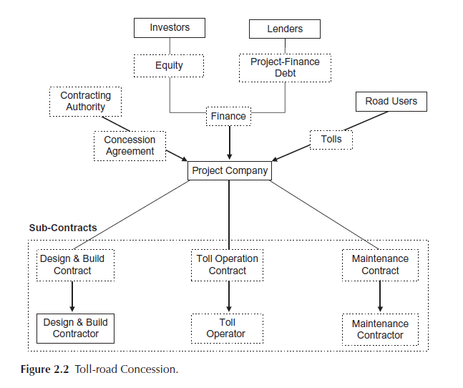
Project Finance Structure – Infrastructure Projects

Slide 55
EPC Contract and Construction Risks
A major risk for capital intensive projects is the potential for cost over-runs and the project not being up to standard from a technical perspective (Nuclear plants, Airbus 380, Eurotunnel, Eurodisney)
  Engineers and businessmen have dreams of building wonderful projects and want to see things work
A Construction Agreement is often made with a contractor who will be responsible for designing and building the project.
The contract can be structured on a lump sum or turnkey basis where the contractor has an agreed price for project construction with any cost overruns and late completion the responsibility of the contractor who will have to bear any extra costs.
The contractor may be a shareholder in the SPV and may either retain his share after construction or sell his stake to fellow shareholders or an external source.
Big preference for conventional technology rather than innovative technology
The key issue is how much more would you pay for an EPC contract than a cost plus contract to mitigate the risks.

Slide 56
Interests of Contractors, Bankers and Sponsors
Sponsor has an incentive to check that everything had been built properly, and that everything will be operated well, so there actually was little conflict of interest between him and banks
The sponsor is closer to the assets than banks are and can sometimes be satisfied with less stringent criteria than we do, and the fight is to get formalized things that would likely be done
Sometimes, the fight is with the constructor (who wants to limit its obligations and liabilities), and the sponsor is stuck in the middle between the bank requirements and what the constructor is willing to give him.
Lenders will generally have an influence on the drafting of all of the agreements.

Slide 57
Assessment of Contracts
The ultimate effectiveness of such risk allocation rests on the legal system which must be proven and reliable to ensure enforceability of various contracts and agreements.
The credit quality of project finance depends on the ability of parties to uphold contracts:
  Examples of problems with project contracts – Dabhol, AES Drax, PT Pation, many others.
  Examples of problems with construction contracts – Stone and Webster
  Change of Law and Political Risk – Robbins waste to energy plant in US
  In one day, Indonesia cancelled 25 PPA contracts because of a World Bank report

Slide 58
Off-take Contracts – PPA Agreement, Concession Agreement
Central Contract for the Project – Defines the Revenues and the Cash Flows of a Contract
  Commodity project such as oil
    Less need for contract because of world wide market, history of prices and forward markets that can be used to hedge risk
  Infrastructure (Tollways, Airports etc.)
    Part of concession agreement that defines the toll prices, the ability to construct competing roads
  Electricity
    Purchased power agreement (non-merchant plant), includes fixed and variable charges where variable energy charges cover the variable cost of running a plant while fixed charges cover fixed costs, debt servicing costs and equity returns

Slide 59
Off-take Purchase Agreement
The most important issues in the off-take purchase agreement are:
  Pricing
  Buy-out requirements
  Step-in rights
  Termination
Availability versus usage
  Conditions placed on availability payment directly affect the lenders’ ability to obtain debt service financing
Buyout
  If there is a breach of contractor, buyout rights should be at least the value of the remaining debt

Slide 60
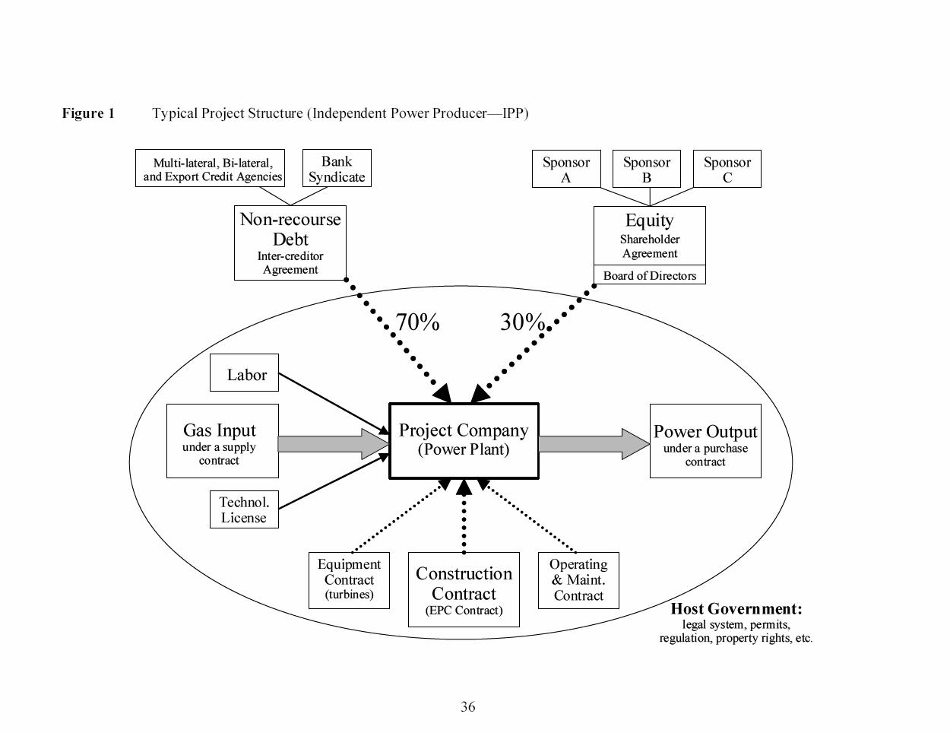
Project Finance Representation with Contracts for Electricity Plant and Ring Fence
Debt is serviced entirely via cash flow through the project and the SPV This structure exposes the lenders to significant risks. If something goes wrong, their recourse against the sponsor, with its typically larger balance sheet, will be limited or none.
The loan is structured so that bankers can step into and take over the project if things were to go wrong, a so-called step-in right. This process is also called ‘ring-fencing.’
Ring-Fence

Slide 61
Non-Recourse and Recourse Debt
Non-Recourse
  The financing of capital assets in which the providers of funds are repaid solely by cash flow generated by those assets
  Security and collateral is focused on the accounts, contracts, and physical assets of the project
Limited Recourse
  Many transactions may have recourse to project sponsors in a variety of ways: contingent equity, marketing, operating, step-in rights, etc.
  Other transactions have corporate guarantees of completion and infusions of equity capital when cost over-runs and delays exist

Slide 62
Deal Diagram – Sithe Cogen
470MW
20 Plants
US/Canada
(+ 3 = 308MW
Constructing)
US$158m Notes 9yrs
US$150m Bonds 14 yrs
US$409m Bonds 20yrs
US$75m Overrun Debt
Subsidiaries/LP
SIFC
92% Debt
3 Pipeline
Contracts
Sithe
Energies GP
Trustee
PPA
40 yrs
740MW
Con Ed
{curtailments}
20-yr Gas
Supply Ag’t
(+damages)
1000MW
Cogen
Enron
balance
20-yr
PPA
Subordinated
Payments
Niagara
Mohawk
(Chap.11)
LDS=40%
Contract
Price
Steam
Tracking a/c
Spot>Contract
>50% Proj. Value
Turnkey
Construction
Contract
44MW
PPA
Alcan
Aluminium
smelter
Ebasco
GE
1st ever
7FA Turbines

Slide 63
Project Finance Funding Sources

Slide 64
Sources of Capital
Corporate Finance
  Equity
    Public (IPO, Secondary Offerings)
    Private
Debt (backed by corporate assets)
  Bonds (Publicly-traded, Private Placement)
  Bank
  Term Loans, Revolvers, etc.
  Parent Company loans
Project Finance Debt (backed by project assets)
  Commercial Bank Loans
  Bonds
    Typically Private Placement
  Agency / Multilateral (Direct Loans or Insurance Coverage)
  Shareholder Loans
  Subordinated Debt

Slide 65
Characteristics of Project Finance and Corporate Debt
Project finance debt Corporate debt
· Limited asset life · Indefinite asset life
· Single asset · Multiple assets
· Non-recourse · Recourse
· Pledge of collateral · Unsecured debt
· High leverage · Moderate Leverage
· Stable cash flows · Unpredictable cash flows
Collateral gets cash Collateral independent from cash
Credit risk from cash Credit risk independent of collateral
No business record to use in underwriting Loan against balance sheet
Generally new project Extrapolate from past record
Cash flow defines the value of the collateral Second way out from re-financing
Ring fenced, legal entity (special purpose vehicle)

Slide 66
Advantages of Project Finance from a Credit Perspective
Control of Collateral Exclusive access in the case of liquidation
Strong Sponsors Deep pockets with vested interest in project
Covenant Triggers Tight covenants to trigger restructure of debt
Restrictions Drawdown and waterfall definition
Transparency Single asset and complicated accounting and corporate structure
Independence Can survive the bankruptcy of sponsor

Slide 67
Permanent Project Finance Debt
Non-recourse financing
  Payback through cash flow
  Secured by project assets, contracts, not corporate assets
Long-term Commitment
  Typically 10-15 years or more
  Longest payback of any other investor
Capital at Risk or Debt Capital
  Typically 50%-90% of project cost
Capped Return on Capital
  Return fixed at the margin over an index rate plus any maintenance fee.
  No upside; substantial downside
Successful projects frequently refinanced
Control over Collateral

Slide 68
Covenants
Positive
  Comply with contract obligations
  Comply with legal obligations
  Refrain from changing from contracts
  Insurances
Negative
  No other debt
  No other contracts
Not so much as a basis for claiming damages, but rather to prevent drawdown, demand repayment, enforce security

Slide 69
Sources of Debt
Mezzanine Debt
Construction Cost Over-run
Bonus to Contractor
Debt
Commercial Banks
Multilaterals
Bilaterals
Export Credit agencies
Agencies
Sovereign Finance
Corporate Finance
Secured Finance
Capital Market Issues
Publicly-traded Bonds
Private Placements
Notes:
No one model, no cookie cutter approach to PF. Properly structured, each deal is likely to be unique.
Evidence indicates that PF can lower not only default rates (emphasis on cash flow) but also loss given default (remedies, recourse to security package, step-in rights).

Slide 70
144A Bonds
70-80% of Project Finance Bonds
Begun in April 1990
Freed up $ 15 Trillion in debt
Rated by Moody’s, S&P and Fitch
Much reduced disclosure by SEC
Single Draw
Fewer Covenants
Include Debt Service Reserve
Often no Political Risk Insurance (Included in Spread)
Included Pre-payment Penalty

Slide 71
Sources of Equity Capital
Lenders look for sponsors with:
  Experience in the industry
  A reasonable amount of equity in the project
  Reasonable return on equity
  Interest in project success
  Financial ability to support the project during construction
Typical companies enter project finance to:
  Increase ROE
  Regulated industries
  Contractors
  Off-takers
Summary: a project that looks viable but does not have credible sponsors will probably not get financed.

Slide 72
Rise in Indian Project Finance
The most conspicuous feature is the almost incredible rise of the Indian project-finance market. Starting from a negligible level in 2000, by 2010 the total volume of project financing in India was almost equal to that in the two next-largest markets (Australia and U.S.A.).
This was based on very high levels of private investment in infrastructure PPPs, power generation and natural resources projects. In 2011–12 the market fell back, primarily because banks could not continue to fund on the scale required.
However the Indian project-finance market is distorted by the debt for Concessions being 100% guaranteed.

Slide 73
Lender Preferences for Sponsors
experience in the industry concerned and, hence, the ability to provide any technical or operating support required by the project;
arm’s-length Sub-Contract arrangements with the Project Company (if a Sponsor is also a Sub-Contractor);
a reasonable amount of equity invested in the project, which gives the Sponsors an incentive to provide support to protect their investment if it gets into difficulty;
a reasonable return on their equity investment: if the return is too low there may be little incentive for the Sponsors to continue their involvement with
the Project Company, and also limited cash-flow cover for the lenders the financial ability (although not the obligation) to support the project if it runs into difficulty.

Slide 74
Different Types of Project Finance Loans
Straight
  Sponsors guarantee completion during construction phase; becomes non-recourse during the operation phase.
  Amortizing principal rather than bullet re-payment
  Principal re-payment corresponds to cash flow
Production loans
  Re-payment is linked directly to output – faster production results in faster debt repayment
Co-financing
  Different funding sources provide project financing under one set of documents; Important when multilateral agencies are involved (e.g. countries do not want to default on ADB loans)
  Preferred creditor status that occurs from providing preference to International financial institutions when resources are limited.
Non-recourse
  No recourse to the project sponsors even during the construction phase (EPC contracts).
Limited-recourse
  Recourse is limited to a dollar amount or is subject to performance criteria.

Slide 75
PF Loans – Cash Flow Lending (Reference)
Cash flow as this is the main source for repaying project debt.
Project Finance is not asset-based financial engineering, such as real estate/property or leveraged buyouts,
  a future refinancing is specifically structured as an exit for the investor and is the intended means of repayment of the debt.
  Re-financing (Bullet maturities)
  Assets Sales (Structured Finance and A/R Sales)
  Cash flow from other Assets (Corporate Lending)

Slide 76
Non-Recourse Debt in Project Finance
If a project fails, the project lenders recourse is to ownership of the actual project and they are unable to pursue the equity investors for debt.
Rarely will the Project Financier allow the option (to non-recourse) to be granted prior to completion of the plant.
To the Project Financier, non-recourse means that repayments originate from the projects cash flows, and not the parent companies.
  The Project Financier does not want the parent or sponsor to withdraw its people or entrepreneurship from the deal and will seek contractual recourse to ensure continuation of that commitment and ownership.
Examples:
  Euro Disney
  Mobil Oil

Slide 77
PF Loans – Debt Service Reserves
Project Finance loans often have associated debt service reserves which involve sponsors keeping funds at the bank for liquidity. Debt service reserves can be used to limit dividend payments and can be used for managing covenants.
Example of Cash Reserves: SmarTone cellular telephone Project Financing in Hong Kong
  Besides the original US$90-million Project Financing -- to roll out the cell stations and market the system -- an additional US$30 million was held as cash collateral
  The cash collateral could be accessed, if needed, for up to 18 months after completion should subscriber cash flows be insufficient.

Slide 78
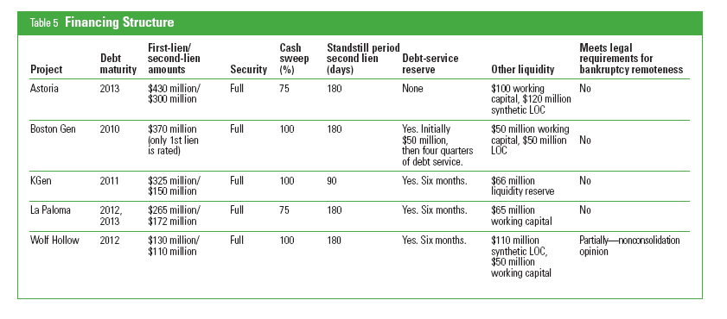
Example of Debt Service Reserves and Other Features in Merchant Plant Transactions (S&P 2007)
Source S&P 2007

Slide 79
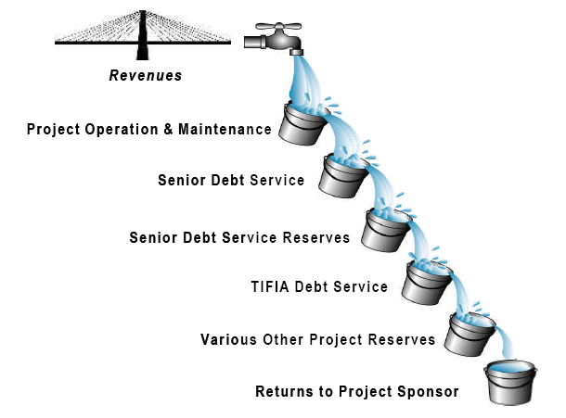
Cash Waterfall Example
If insufficient revenue, (1) use of Demand Note; (2) if Demand Note insufficient, use of Total Debt Service Reserve
Operating Expenses
Capital Expenditure
If insufficient revenue, (1) use of Demand Note; (2) if Demand Note insufficient, use of Total Debt Service Reserve
Agency Fee and TIFIA Service Fee
Senior Debt Interest and Hedging Costs
Deposit to Extraordinary Maintenance and Repair Reserve (requirement of the ARCA)
If insufficient revenue but only after Mandatory Debt Service Commencement Debt, (1) use of Demand Note; (2) if Demand Note insufficient, use of Total Debt Service Reserve
TIFIA Interest Payments
Scheduled Repayment of Bank Loan
TIFIA Scheduled Amortization
Repayment of Bank Loan (through cash sweep)
If insufficient revenue (including before TIFIA Mandatory Debt Service Commencement Debt), use of Unrestricted Sub Account of the Total Debt Service Reserve
Interest Payment on Affiliate Subordinated Note (“ASN”)
Amortization of ASN
Equity Distributions
Note: This cash waterfall has been simplified for clarity. It reflects the relative level of seniority of the different payment obligations of the Borrower should they be coexisting in time.

Slide 80
Cash Flow Waterfall and Project Accounts
Gross Revenues
Proceeds Account
Debt Service Account
O&M and permitted payments
Debt Service Reserve Account
Maintenance Reserve Acct
Distribution Account

Slide 81
Example of Cash Flow Waterfall

Slide 82
Bank Loans and Bonds in Project Finance
Bank Debt
  Most markets
  Ties up lending capacity of sponsors
  Difficult to achieve long tenors
  Draw when needed
  Long-term view
  Terms established early
  Confidential contracts
  Can negotiate revised covenants when in trouble
Bonds
  Limited markets
  Does not take up lending capacity
  Long tenors of bonds compared to banks
  Draw at once
  Short-term reaction
  Terms established late
  Published contracts
  Difficult to negotiate when in trouble
Bonds are tradeable instruments – Used in US, UK, Europe and Asia

Slide 83
Production Payment Loans (Reference)
Production payment financing began in the Texas oilfields in the 1930’s.
A driller would fund the well-drilling costs in exchange for a share in future oil proceeds.
  In West Texas, it was hard to ‘miss’ striking oil every time!
A Dallas bank granted a non-recourse loan to develop an oil and gas property to be repaid from the cash flows from those wells.
Borrowing base concept
  Compute the borrowing base in each year to determine the amount of required repayment.

Slide 84
Agency Financing Sources
Multilateral Agencies
  Long process to arrange financing
  Tenors tend to be longer than commercial bank financing
  Policy/development criteria apply as well as commercial issues
  E.g.: IFC, World Bank (PRG), AFDB, MIGA (PRI only)
Export Credit Agencies (ECAs)
  Finance provided based on export value of home country
  OECD ECA terms governed by common conditions (limitations on weighted average payback period)
  Exposure fee payable upfront, risk-adjusts the interest rate
  E.g.: U.S. Ex-Im Bank, ECGD, EDC, SACE, COFACE, HERMES, JBIC
Bilateral Agencies
  Provide limited recourse financing and guarantee programs
  E.g.: OPIC

Slide 85
Political Risk Gurarantees
Standard Political Risk
  War and civil disturbance
  Expropriation and nationalization
  Foreign currency availability and convertability
Contractual and Regulatory Risk
  Failure to meet contractual payment obligations
  Non-payment of termination amount
  Non-payment of arbitration amount
  Changes in law
Benefits in terms of credit spread

Slide 86
Advantages and Disadvantages of Project Finance

Slide 87
Cost of Project Finance and Problem of Complex Contracts, Subcontracts, Guarantees, Insurances
The downside is that it is costly to set up and they have to deal with very assertive banks that in a very real sense own the asset until the debt is paid off.
Complexity of multi-party negotiations and documentation lead to high costs for lawyers, financial advisors, and expert consultants
Financing process can take from 3-12 months or longer
Constraints on Business Activities
Loan documentation will provide lenders with intrusive rights over how business is run: Approvals required for annual budgets; changes to contractual structures; additional indebtedness, etc.
Administrative Cost of Loan compliance

Slide 88
Time Requirements in Project Finance
Estimated time to complete project finance loans
  Bank : 3-6 months
  Private Placement: 2-4 months
  Bonds: 3-4 months
Transaction costs limits the economic size of projects
  Not generally worthwhile to do a project financing below $50-100 million, if the project includes Export Credit Agencies, Political Risk Insurance and Development Agencies.
  If the project does not have Export Credit Agencies and is financed by local banks, the smallest size of a project may be $5-10 million.
  Median size of PF loan is $50 million, average size is $100 million.

Slide 89
Representative Financing Costs in Project Financing (Pre Financial Crisis)
Up-Front Fees: .25-1.5%
Commitment Fee: .25-.5%
Credit Spread: 1-2%
Agent Fee: $20,000-$100,000
Independent Reports: $50,000-$500,000
Independent Engineer: $20,000-$400,000
Legal Documentation: 1-2%, Floor of $500,000
Voluntary Pre-Payment: 1-3%
Default Interest: 3-5%
Development Cost 2-5%

Slide 90
Reasons for Using Project Finance
High Leverage
  Often 80% compared with 40% for corporate finance
Tax Benefits
  Interest shield on taxes
Off-balance Sheet Finance
  If joint venture with less than 50% ownership
Risk Measurement and Risk Allocation
  Parties who can control risk take the risk
Transparency

Slide 91
Project Finance Success and Failure Examples

Slide 92
Ras Laffan
Qatar situation:
  Small country on Arabian peninsula
  Had not raised significant money in international markets
  Running huge budget deficits to finance the national oil company’s investments in energy and petrochemical projects.
  Looking to finance gas-based manufacturing projects.

Slide 93
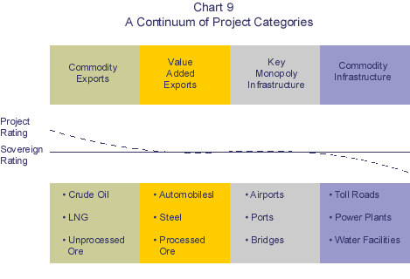
Types of Projects and Sovereign Risk

Slide 94
Example: Ras Laffan Liquified Gas Company (Ras Gas)
Summary of Original Transaction
  Project: 2 LNG Trains and cost of developing natural gas reserves
    Cost $3.4 billion
    5.2 millions of tons per annum
  Equity Sponsors
    70% State of Quatar
    30% Mobil Oil
  EPC Construction Contracts
    JCG/MW Kellogg for LNG Trains and on-shore facilities
    McDermott-EPTM/Chiyoda for off-shore platforms
    Saipan for off-shore pipeline connection

Slide 95
Ras Laffan Liquified Gas Company
Revenue Contracts
  25 year contract with Korea Gas Corporation for output of one train
  Korean Gas Corporation built receiving facilities and purchased ships ($3.1 billion)

Slide 96
Ras Laffan Liquified Gas Company
Financing of $3.4 Billion
  $850 million in Equity
  $465 million supported by US EXIM
  $250 million supported by UK ECGD
  $185 million supported by Italy’s SACE
  $450 million uninsured loan from commercial banks
  $1,200 million from bond markets
    10 and 17 year maturity
    Rated BBB+ by S&P
    Rated A3 by Moody’s

Slide 97
Ras Laffan Liquified Gas Company
Reasons for Bond Financing
  Bank market tapped out for Qatar – given the size of the project, there was not enough financing from banks
  Bond investors understood commodity price risks; Issue over-subscribed
  Long maturity
  BBB rating allowed many investors to come in.
  Attraction (pre-Asian crisis):
    Pure Commodity
    Link to East Asian Economies

Slide 98
Ras Laffan III
Raised $4.6 billion in debt
Bonds rated A+
Elimination of sales volume risk through long-term contracts
Few technological issues based on the construction of initial phase
Sponsor support from ExxonMobil
Virtually no supply risk from sourcing of natural gas
Competitive cost position due to economies of scale and low feedstock prices
Elimination of construction risk through EPC contracts
DSCR’s above 2x in stress scenarios; break even oil price of $11/BBL and $2/MMBTU

Slide 99
Ras Laffan III Weaknesses
Linkages of prices to oil price and natural gas prices in Europe
High counterparty risk – 74% of sales volumes to off-takers with BBB or below
Counterparty risk from the necessity of third parties to complete infrastructure projects such as port facilities, terminal facilities, and ships
Exposure to indemnity payments
Absence of business interruption insurance

Slide 100
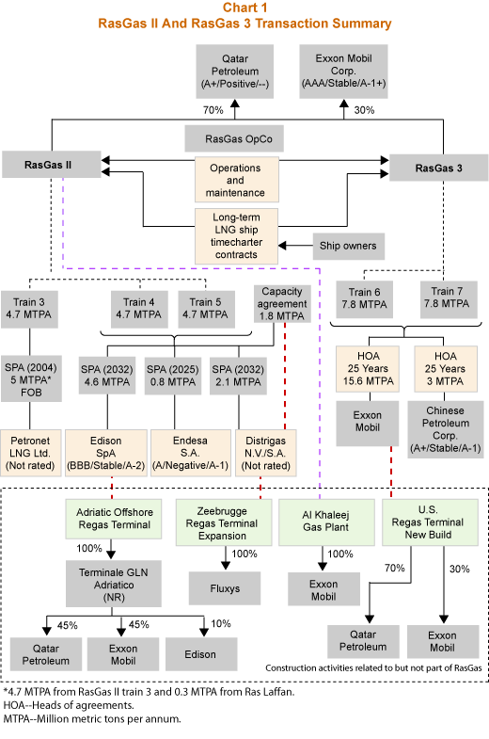
Ras Laffan III Off-takers

Slide 101
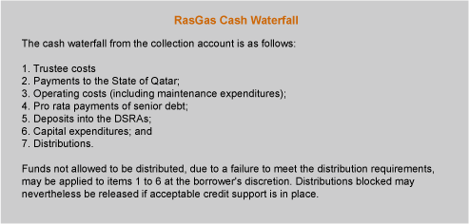
Ras Laffan 3 Cash Flow Waterfall
The diagram illustrates how the ordering of cash flow works in a cash flow waterfall

Slide 102
Ras Laffan 3 Sources and Uses of Funds
Sources and Uses of Funds are a good way to get a handle on the structure of the project

Slide 103
Financing Terms and Risks
Phase 1 Financial Structuring
  Cash flows from Trains 3-4 to support Phase 1 debt
  Essentially a financing of Trains 3-4 to fund expansion
Phase 1 Financing Key Risks
  Train 3-4 Operations
  Shipping and Access to Markets
  Revenue Risk (Price x Volume)
Terms
  Series A Bonds (15-yr): LIBOR + 97 bp
  Series B Bonds (22-yr): LIBOR + 130 bp
  International Banks: LIBOR + 45-65 bp
    Up-front Fee (Arranger Fee) = 60 bp
    Commitment Fee = 20 bp p.a.
Phase 2 Scope: Completion of Train 6 and Fund Construction of Train 7
  Estimated Debt: US$5.4 billion (Will likely require completion guarantees)
Track record
Shipping contracted
Sale & Purchase Agreements in place with creditworthy counterparties (Petronet, Edison, Endesa)

Slide 104
Ras Laffan 3 Debt Amortization Schedule
This chart illustrates the sculpting of debt amortization according to the cash flow of the project.

Slide 105
Formula for Sculpting Debt
DSCR = Cash Flow/Debt Service
DSCR = Cash Flow/(Interest Expense + Principal Repayment)
(Interest Expense + Principal Repayment) x DSCR = Cash Flow
(Interest Expense + Principal Repayment) = Cash Flow/DSCR
Principal Repayment = Cash Flow/DSCR – Interest Expense
Principal Repayment = Cash Flow/Target DSCR – Interest Expense

Slide 106
Project Finance Success: Gaza Power Plant
Simple cycle plant constructed by CCC
100 MW more than serves Gaza population
Financed by Arab Bank (60-70 percent debt)
Unable to acquire economic political risk insurance
Surplus electricity sold in Israel
PPA contract that protects equity returns
Not harmed in any way in the past few years

Slide 107
Project Finance Risks
Over the last few years episodes of:
  financial turmoil in emerging markets,
  the difficulties encountered by telecommunications sectors
  financial failures of high profile projects (Channel Tunnel, Eurodisney, Dabhol) have led many to rethink the risks involved in project financing.

Slide 108
Concession Alphabet
BOO, BOOM
BOT, BOOT, BOOST, COT, DBOOT, FBOOT
DBFO, DBOM, DCMF, DBFM, GOCO
  (Franchising)
RM, DBM, RLM
  Equipment (Rolling Stock)
BLT, RLT,BOLT
  Asset Manager
BTO
  Contract Operator

Slide 109
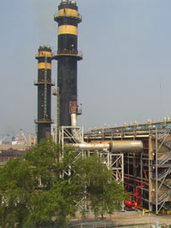

Slide 110
Philippine Power Market - Background
Frequent brown outs ranging from 2 to 12 hrs daily in early 1991.
Cancelled Batam Nuclear plant when it was almost complete.
Projected growth in electricity demand requires commissioning of new plants and rehabilitation of old plants.
State-owned Generating Company was NAPCOR; Approx. 72% of NAPCOR’s capacity is in Luzon.
Frequent closure of existing plants due to deterioration of oil based plants.
Failure to undertake regular maintenance of certain plants
Postponed maintenance due to insufficient power reserve
The S&P bond rating for the Philippines was BB

Slide 111
Background on Existing State-Owned Utility Company
Approx. 72% of NAPOCOR’s capacity is in Luzon.
Existing plant capacity exceeds peak demand (est. at 3,473 MW).
NAPOCOR unable to operate its plants at full capacity, only 2,333 MW (50%) of 4,639 MW total Luzon capacity.
Frequent closure of existing plants due to deterioration of oil based plants.
Failure to undertake regular maintenance of certain plants
Postponed maintenance due to insufficient power reserve
Fidel Ramos

Slide 112
Problems with Power in Philippines
Electric power prices facing Philippine industrial customers were the second highest in Asia after Japan.
Power supply was also unreliable. The World Bank estimated that power outages in 1990 reduced economic output in Metro Manila alone by $2.4 billion.
Generation capacity remained outdated and precarious, with 40% of the power plants in the Philippines scheduled to be shut down within 10 years.
Severe power shortages were first felt in hydroelectric-dependent Mindanao in 1991. Later, Luzon began to experience brownouts of 2 hours or more increasing to 10 hours daily in the summer of 1993.
Economic activity was severely hampered, and companies were forced to install generators and lay off thousands of workers. Traffic on the already clogged streets of Manila became impossible as signal lights failed. The festivity — and spending — that characterized Christmas in the Philippines was marred by a full system shutdown three days before Christmas 1994.

Slide 113
Attempts to Solve Power Problem
In 1993, Congress granted Ramos broad emergency powers to combat the electricity problem through the passage of the Electricity Crisis Act.
He appointed Delfin Lazaro, an HBS graduate, as the Secretary of Energy and Chairman of NAPOCOR.
Lazaro’s main goal was to “solve” the immediate power crisis while preparing the industry for increased private sector participation.

Slide 114
Context of Power Crisis in Early 1990’s
To understand the rush to welcome private investment in the early 1990s, it helps to also see the cost of the chronic blackouts of that time.
At the peak of the shortage, the blackouts averaged 12-14 hours per day, 300 days per year.
A World Bank report in 1994 estimated that gross economic cost of the outages was US$0.50/kWh.
Thus, even though IPP-generated electricity (average cost US$0.0652/kWh) at the time was more expensive that NPC-generated electricity (US$0.0637/kWh), the inability of the government to finance rapid expansion of the power sector made private investment extremely attractive.

Slide 115
Legislation and the Power Shortage
The Philippines entered the IPP market early, with a 1988 presidential decree authorizing private investment in the generation sector. Major investment in IPPs occurred in response to a 1991-93 electricity crisis.
The Electric Power Crisis Act passed in 1993 authorized negotiating IPP contracts on a fast track basis.
In terms of addressing the power shortage, this law was a success—several thousand megawatts of generating capacity was installed in the country in the first 18 months.
Most of the generating capacity built during this time was based on combustion turbines or diesel systems—the only generation plants that could be brought to operation within a year—which are characterized by low initial capital costs, but high operating costs.
The fast track authority under this law expired in April 1994.

Slide 116
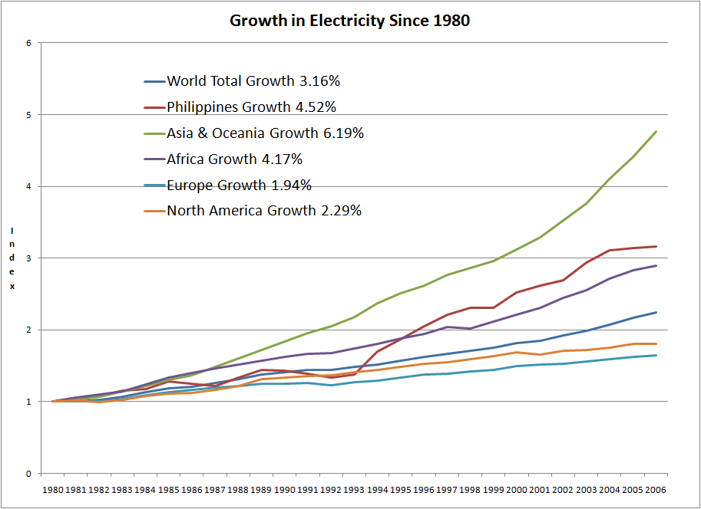
Growth in Electricity Generation from EIA
Prediction was for about 9% Growth

Slide 117
Fast Track Contracting
Because of the power crisis, the government had no significant leverage in the negotiations. The unstable political condition created a situation where “economy risks” required a premium placed on project returns.
The entry of some IPPs had to be on a “fast-track” basis and some were contracted through negotiations rather than competitive bidding.
In contrast, Thailand bided out its first batch of IPP capacity during the time when its economic performance was the envy of all ASEAN. As a result, the offers were very competitive (some offers took on the FOREX risk) and represented about ten times more capacity than what EGAT had asked for.

Slide 118
Three Rounds of Development
The IPP sector in the Philippines developed in three main rounds.
  First, the plants contracted in the early 1990s to address the power crisis were largely oil-fired plants with 5-12 year PPAs. These tended to be expensive because: (1) the rapid capital recovery period under short PPAs, (2) the extreme pressure on government negotiators stemming from the grave electricity crisis, and (3) the high fuel cost oil plants were dispatched as baseload facilities during the crisis.
  Second, a wave of large baseload coal plants – most importantly Pagbilao (700MW), Sual (1200MW), and Quezon (originally 440MW, now rated at 460MW). These reached operation between 1996 and 2000 and had longer PPAs (up to 25 years).
  Third, a round of big hydro/irrigation projects and natural gas plants that reached operation from 1998 to 2002, including Casecnan hydro (140MW), San Roque hydro (345MW), CBK hydro (640MW), Ilijan natural gas (1200MW), Santa Rita natural gas (1000MW) and San Lorenzo natural gas (500MW).

Slide 119
Philippines Contracts

Slide 120
Allocation of Risks
Given investor concerns about the stability of the Philippine environment, the government encouraged private sector participation by assuming many risks. For example,
  NAPOCOR reduced IPPs foreign exchange rate risk by specifying payments for capacity and power in foreign currency and by providing the fuel requirements of the IPPs.
  NAPOCOR also assumed responsibility in case of any change in law or government related acts of force majeure that changed the terms of the contract.
  Most importantly, all of NAPOCOR’s obligations under the contract were backed by a formal government undertaking “carrying the full faith and credit of the Republic of the Philippines.”
The main risks the IPPs bore were risks associated with lining up financing, costs of construction and some costs of operating plants.

Slide 121
Initial Contracts
The country had its first Build-Operate-Transfer contract in 1987, with Hopewell Holdings Ltd. of Hong Kong tycoon Gordon Wu as the proponent. Hopewell constructed two 100-megawatt gas turbine plants in Luzon.
The venture was deemed so successful that the government was encouraged to enter into more BOT power contracts and even enact the BOT law (Republic Act 7718) that would allow Napocor to tap the private sector more effectively. Past and present government officials agree that the early Hopewell contracts provided the model for all future power deals with the private sector.
But Napocor soon found itself with more IPP contracts, and more power, than it could handle, and what was once thought of as a brilliant solution to the country's power needs have now become problems themselves. At the time it was accumulating IPP contracts, the government had also let the private Manila Electric Co. (Meralco) to build its own power plants, which later exacerbated an energy oversupply.

Slide 122
Summary of Capacity and Costs
By 1998, foreign owned IPPs accounted for US$6 billion of investment and 4800 MW of generating capacity. Over 90% of new capacity installed during the 1990s came from foreign owned IPPs.
Average capital cost of $1,250 per kW.
IPP capacity with PPAs is now 55% of the total capacity.
The first contract was signed in 1988 and more than forty projects have been built in total. IPPs in the Philippines have exhibited a wide variety of characteristics from fuel choice to the composition of project sponsors and the identity of the offtaker. IPPs in the Philippines have largely earned healthy returns, even in the wake of economic crises and a highly visible renegotiation of most of the PPAs in the sector. From the country perspective, returns have been mixed. Political instability and poor sector planning have led to expensive electricity.

Slide 123
Concession Alphabet
B Build
O Own or Operate
    GOCO = Government-Own; Contract Out
T Transfer
D Design
S Subsidise
M Maintain
C Construct (or Contract)
F Finance
L Lease (sometimes as R=Rent)
R Rehabilitate
G Government

Slide 124
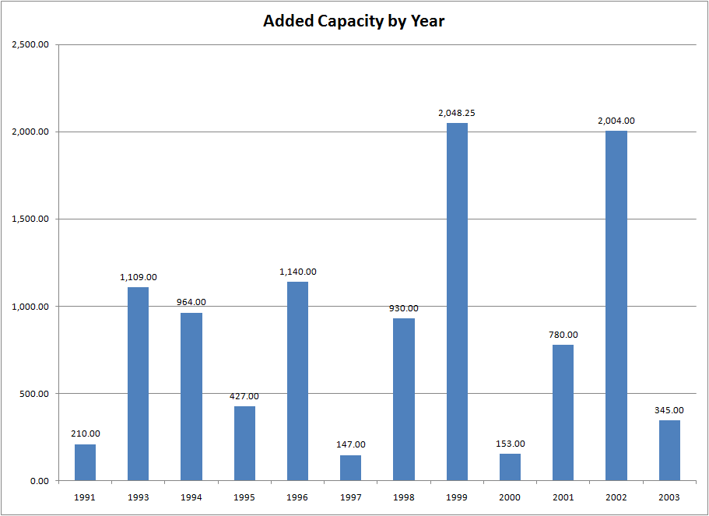
Capacity was Added over Many Years

Slide 125
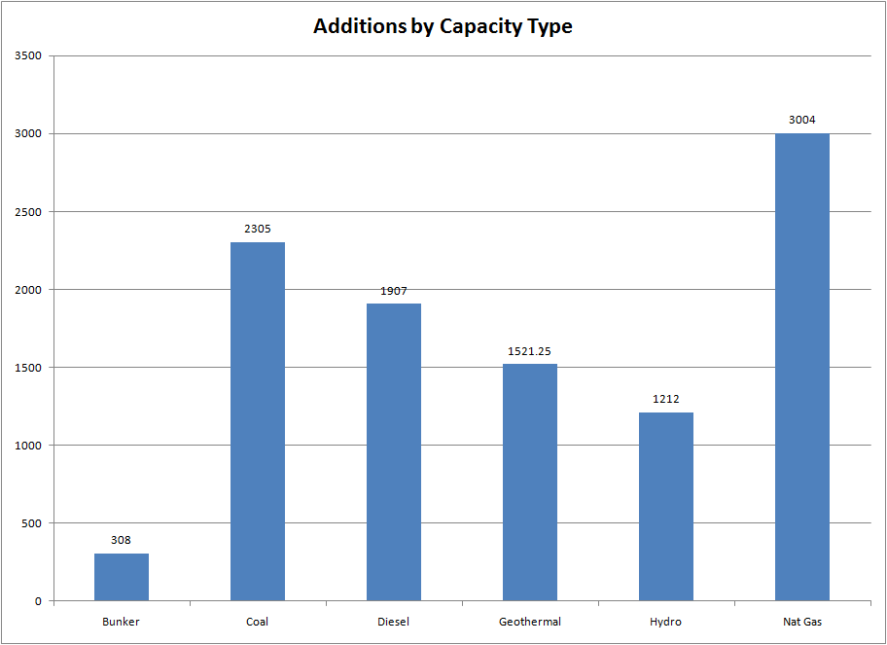
Additions of Capacity by Type

Slide 126
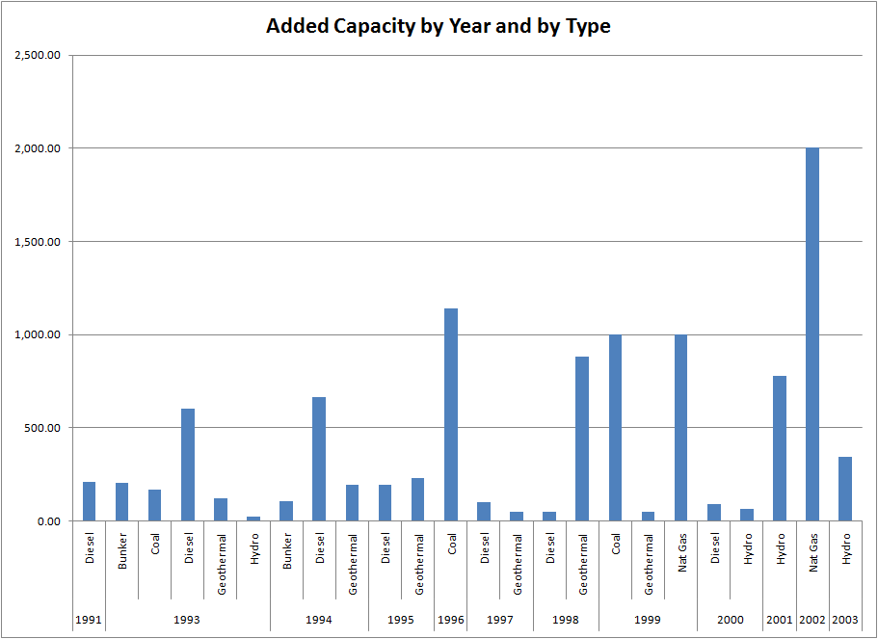
Diesel Added Early/Gas and Hydro Added Later

Slide 127
Praise for Philippines Program
Measured by their ability to reduce power outages, the BOT programs were undoubtedly a success.
Notably, this increased provision of power came without increased government debt as most projects were financed on global capital markets. The BOT and related programs also significantly increased the scope of private sector involvement.
At the beginning of 1996, 21% of the country’s installed capacity for power generation was contracted with the IPPs. Because the IPP schemes also encouraged private sector operation of government-owned plants, fully 42% of Philippine generation capacity was operated by the private sector.
The World Bank praised the BOT programs, calling them a potential model for other developing economies.

Slide 128
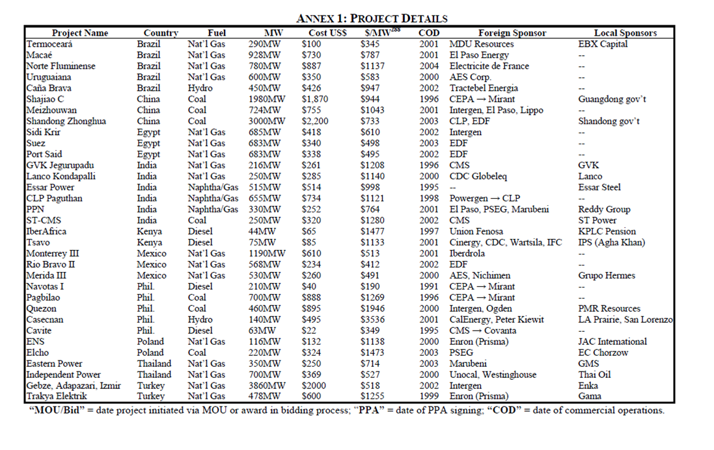
Comparative Plant Costs

Slide 129
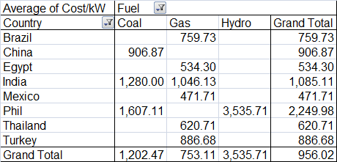
Cost of Plants per kW

Slide 130
Philippines PPA Features
Capacity-based formula with take or pay and capacity nominated by the IPP.
Energy-based formula, a percentage is applied on a contracted or guaranteed annual energy.
Availability fee formula carries both the capacity recovery and the fixed O&M fees. These fees are payable as long as the facility is available even if not dispatched.
NPC is responsible for the supply of fuel, with delivery at site. Storage, usage and management of the fuel are within the control of the IPP. This was because NPC has tax-exempt privileges with respect to fuel oil purchases and government-to-government arrangements for coal; making fuel pass through charges to consumers cheaper.
Fee payments by NPC to the IPPs have large dollar denominated components. NPC thus bears the currency risk to the extent of the dollar payments.

Slide 131
Philippines PPA Provisions Continued
Payments in IPP contracts have both Capacities cost recovery and O&M component. In turn, the O&M portion is subject to escalation. In some of the geothermal contracts, fees are bundled into a single energy charge and escalation is pegged thereon to as high as 75%.
Escalation is based on varying factors depending on the project such as salary adjustment of personnel, movement of local and foreign consumer price indices, and the peso-dollar exchange rate.
A number of NPC’s obligations are fully backed up by a government guarantee or performance undertaking. Very few contracts have only partial government performance undertaking depending on stipulations regarding payments of fees, privatization, and foreign exchange convertibility.

Slide 132
PPA Provisions
The take-or-pay provisions ensure that the IPP proponents are paid up to the level of the minimum energy off-take (MEOT) whether the government utility was able to sell the power or not.
IPP liabilities estimates up to the remaining terms of the contracts is in-between $6 - $ 8B in net present value. The buy-out figure of $11.8 B is gross since the Government can turn around and sell the capacity to another party.
In 1992, the GDP was US$52 billion. PPA buyout in total would be 21% of GDP.

Slide 133
BOT and Sovereign Guarantee
Ownership structure for IPPs in the Philippines is dominated by the BOT form. The prevalence of BOT contracts as opposed to other forms results from the fact that the “transfer” element of the project makes the project eligible for a sovereign guarantee. Formally, only solicited projects are eligible for this guarantee – a rule that invited substantial controversy in the case of the CBK hydro project, which although unsolicited, received a performance undertaking from the Department of Finance.

Slide 134
List of Projects and
PPA Terms

Slide 135
Case 1: Enron Subic
Summary
  Financial Close: 1993 (First Round)
  Commercial Operation: 1994
  PPA Agreement: 15 Years; Guarantee by Government
  Bonds: $105 Million
    Maturity 15 Years
    Repayment Level
    Interest Rate 9.5% (3.68% spread to Treasury)
    Minimum DSCR 1.37
  Completion Guarantee/Liquidated Damages
  Capacity Charge $21.6/kW/Month

Slide 136
DSCR Criteria

Slide 137
BOT/PPA Contract
15 year BOT and toll process
NAPOCOR (government owned generation company) to supply fuel & take electricity - no fuel availability risk
Capacity fee $21.6/kW/month on available capacity
Capacity fee is dollar denominated – no direct foreign exchange risk, overseas a/c
O&M fixed fee and energy fee is in Peso - $4.56/kW/Month
heat rate penalty & bonuses
buy out rights @ NPV capacity fees- late payment, change of BOT law, war, etc

Slide 138
Case Study - Funding
Enron - Subic Bay, Philippines
Philippines
Government
Equip’t Cos.
Warranties
Enron Power
Operating Co.
Completion
Guarantee
Fluor Daniel
EPC
Enron Power
Phils. Op’g Co.
Enron
Corp.
15-year
BOT
Concession
Turnkey
Construction
Contract
Performance
Undertaking
O&M
Agreement
Enron Subic
Power Corp
Napocor
Supply
Fuel Free
113MW
Subic
Power
Corp.
Ground
Lease
65%
Enron Power
Philippines Corp
Buyout
Rights
35%
Philippine
Investors
Capacity Charge
O&M Charge
Energy Charge
PPA
Insurances
US$105 million, 15-year Notes

Slide 139
113 MW Diesel Generator Power Station
Subic Bay, Philippines
Sources of Funds:
Notes $ 105 M
Subordinated Note 7
Contr. Of Shareholders 28
Working Capital 2
TOTAL $ 142
Uses of Funds:
Turnkey Contractor $ 112 M
Bonus to Turnkey Contractor 7
Development and other related costs and Fees 14
Pre operating, Start-up and Commissioning Costs 3
IDC 4
Working Capital 2
TOTAL $ 142

Slide 140
Subic Covenants
Financial Covenants
  Debt Service Cover Ratio 1.10
  Debt Service Reserve Account: 6mos debt service deposit
  Debt Payment Account: monthly retention
  Restrictions on
    additional indebtedness other than
        financing acquisition of Additional Facilities @ max 75%
        financing scheduled payments to EPOC
        subordinated debt < US$ 25mln
        working capital loan
    shareholder payments / repayments
    payments of sub-debt
    investments other than permitted investments

Slide 141
Conclusion from Investor Perspective
In Conclusion:
  Attractive Return
  Well Structured Deal
  Solid Sponsors (Enron, NAPOCOR and the Philippine Government)
  Manageable Risks
  Minimum Take: US$ 20 Million

Slide 142
Bond issue under rule 144 A
BORROWER - Subic Power Corporation
Amount - USD 105 million
Maturity - 15 years
Payments of Principal & Interest are fully guaranteed by Enron Corporation until the Facility Completion Date.
Repayment - equal semi-annual Jun 28/Dec 28.
Interest is accrued - 9 1/2 % p.a payable semi annual.
Interest base and Margin - US Treasuries 15 Y + 385 bp fixed rate

Slide 143
Key Defaults
Failure to pay principal/ interest within 15 days after due dates
Fails to perform following covenants
  maintain DSRA, DPA & Revenue account & payments therein
  amendment of project contracts or merge/ sell assets outside indenture
  default on other indebtedness over $1 mn. - right of acceleration not waived
  Ceasure of BOT/ Performance undertaking and/ or reduction under BOT by over 2% and modification of Performance u’tkg. for the same
  Enron’s completion guarantee held invalid/ unenforceable
  NAPOCOR’s bankruptcy and Govt.’s non-confirmation of performance u’tkg.

Slide 144
Completion Guarantee
Completion Guarantee
All principal and interest payments on the Notes are guaranteed fully by Enron Corporation, and severally, in proportion to their ownership interest in the Company, by House of Investment (HI) and Rizal Commercial Banking Corporation (RCBC).
Security:
  Mortgage on all real property and security interest on all substantial tangible property.
  Security interest in Company’s cash and investment.
  Collateral assignment of:
    BOT Agreement
    Turnkey Construction contract
    Performance Undertaking
    Other project contracts

Slide 145
EPC Contract
EPOC wrap- Fluor Daniels assistance & local contracts
$112m fixed price
LDs $6m capacity, $10m heat rate
$2m scope discrepancy
bonus payments for $3.6m capacity and $3m heat rate
12-19 month warranty with liquidated damages per day

Slide 146
Sensitivity Cases

Slide 147
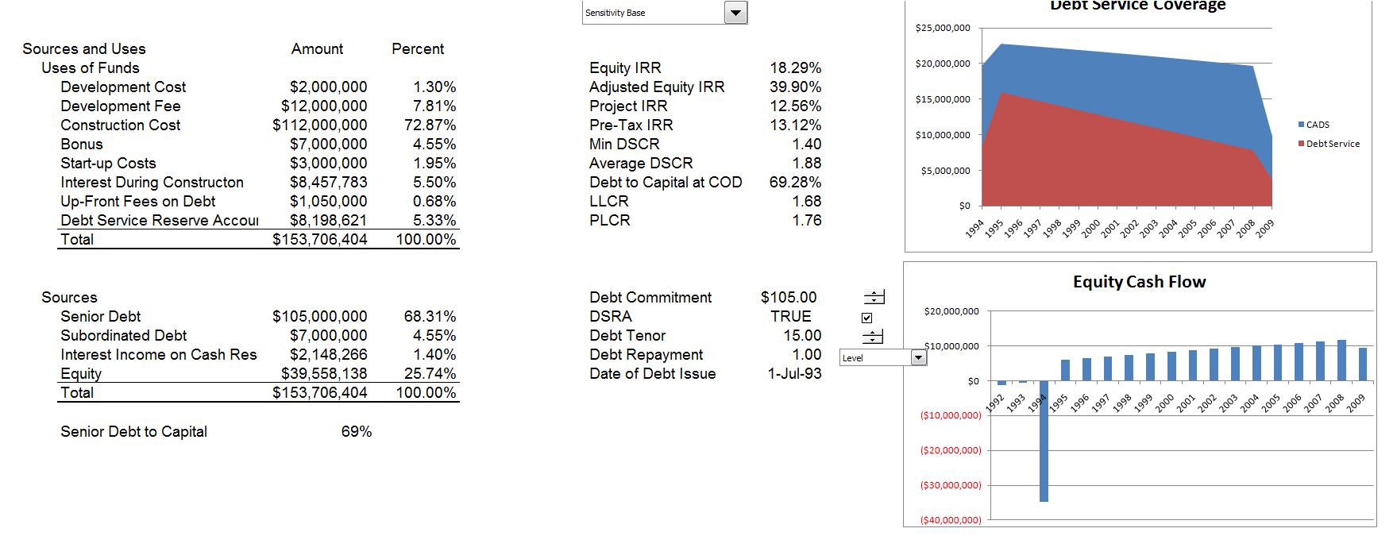
Adjusted Results

Slide 148
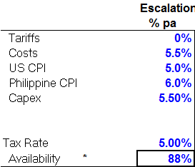
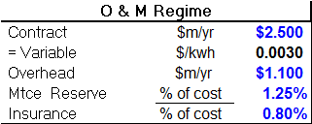
Other Assumptions

Slide 149
Case 2: Quezon Case

Slide 150
Quezon Sources and Uses

Slide 151
Quezon Contractual Structure
The EPC contractor for the project was Bechtel Overseas Corporation. The project was constructed under a lump sum turnkey Engineering, Procurement and Construction Management contract (“EPCM”) to facilitate financing with non-recourse debt.
Equipment sourcing was concentrated with US vendors (GE, Foster Wheeler) in order to maximize the use of export credit finance from US Exim.
The O&M contractor for the project is Covanta. Operations and maintenance is performed on a cost plus basis pursuant to a 25-year agreement providing a monthly fee of $160,000 as of the commercial operations date.
The project is managed by Intergen under a 25-year management services agreement providing an annual fee of approximately $400,000 as ofthe commercial operations date.

Slide 152
Quezon Costs
Capacity and O&M Charges
  Capacity Charge: $18.8/kW/Mo Fixed
  Fixed O&M Charge; $8.63/kW/Mo Escalating
  Transmission Charge: $1.3/kW/Mo
Energy Charges
  Fuel Charge/MWH
  Variable O&M Charge/MWH
Total Cost of Power at 70% Capacity Factor
  Approximately 10 Cents/kWh

Slide 153
Financial Results
Original models by Intergen called for a 23% IRR for equity in the project.
Intergen itself realized some profit in the 1997 sale of a 26% interest to Global Power Investments, which generated a 12% profit.
The project has endured periods of technical default under the loan documents, due to non-payment by Meralco. However, the debt service has been uninterrupted.
The PPA has been renegotiated at various times. Bilateral renegotiations between Meralco and Quezon served to clarify items that were important to both sides.

Slide 154
Philippines Case - Results

Slide 155
Capacity and Demand
By 1998, peak capacity was 11,988 MW while peak demand was 6,421 MW. Demand projections in the early- and mid-1990s forecast demand growth ranging from 9.5-12% per year.
A 1994 report by the World Bank already warned implicitly against the risk of over-commitment through the uncoordinated signing of PPAs, which essentially passed demand risk to the consumer through take-or-pay provisions.
The costs of IPPs were often high because the new capacity was not consistent with the least-cost expansion path and the private sector required high rates of return.
The focus on production rather than efficient distribution put the public sector in the position of retaining that activity in which it was least effective and restricting the private sector from performing the customer focused activities (distribution and supply) where it had real expertise. At the same time, it isolated the private sector from the market through a combination of regulated pricing and guarantees against commercial risks.

Slide 156
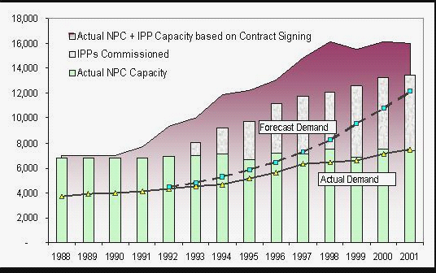
Philippines IPP Contracts
Reserve Margin is about 155%
Estimated Growth – 9.2%
Actual Growth – 3%

Slide 157
Effects of PPA Program
The effects of the PPA capacity charges were exacerbated by the structure and implementation of the IPP program. The rapid build-out of IPPs during the 1990s meant that with the impact of the Asian financial crisis in 1998, the cost of electricity began to explode dramatically due to a combination of:
  the high fixed cost of the IPPs (capacity payments or minimum offtake) and
  the escalating foreign exchange liability stemming from deep reliance on foreign capital.
The controversial “PPA” pass-through mechanism began climbing rapidly with the crisis, eventually becoming larger than the base rate itself.

Slide 158
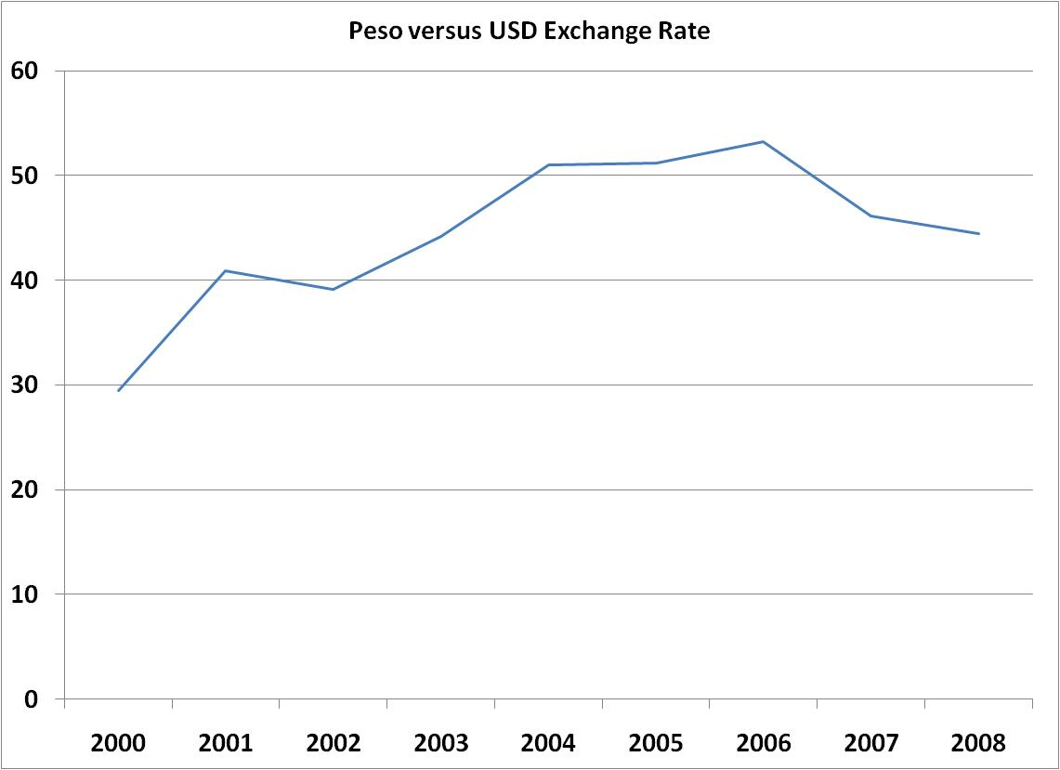
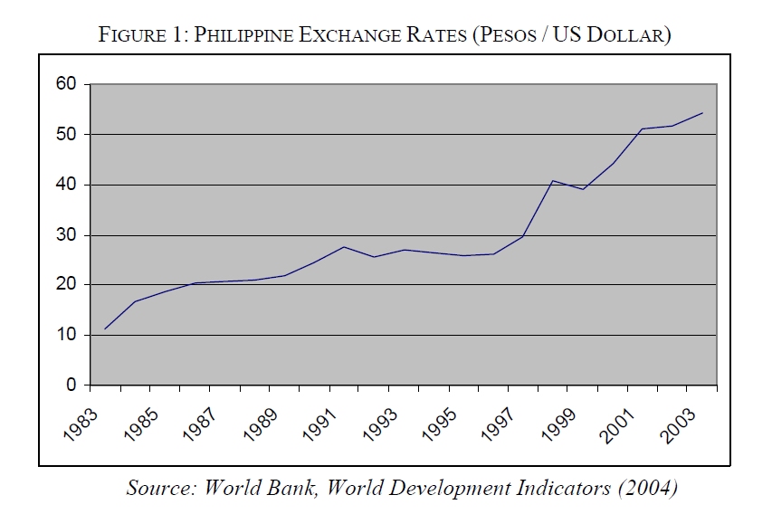
Exchange Rates
Depreciation in exchange rates of about 70% caused increases in capacity charges

Slide 159
Risk Mitigation and Purchasing Power Parity
Purchasing Power Parity
  Change in exchange rate (versus USD)
    Current exchange rate x (1+local inflation)/(1+US$ inflation)
  How purchasing power parity mitigates risk
    In theory people in the country are willing to pay higher nominal prices because of inflation and the net cash flow for the project should be the same
    For example, if the inflation rate increases to 20%, the exchange rate should reflect depreciation in the currency of 20%.
  Problems with purchasing power parity assumption
    Large devaluations can occur without inflation rate changes
    For example, the East Asian Crisis of 1997

Slide 160
Example of Purchasing Power Parity and Inflation

Slide 161
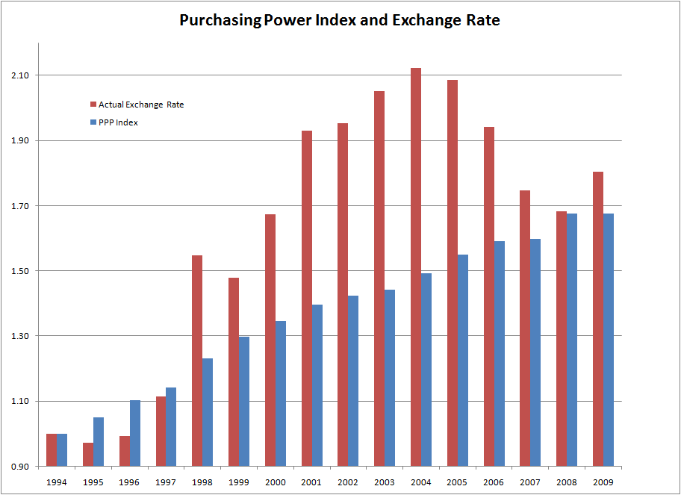
Index of Exchange Rate and Purchasing Power

Slide 162
Result – High Power Rates
Exceptionally high power rates were cited as one reason why Intel Philippines, one of the country's biggest foreign investors and largest employers, with over 5,000 workers, plans to close down its Philippine operations and divert the company's investments to lower-cost Vietnam and Malaysia. A recent government survey showed that the high cost of electricity is one of the main reasons why foreign investors are reluctant to locate their businesses in the Philippines.
According to the Heads of ASEAN Power Utilities/Authorities, a consultative group attached to the 10-member Association of Southeast Asian Nations, the average cost of electricity in the Philippines last year was 17.5 US cents per kilowatt-hour (kWh). That is more than three times the 5.38 per kWh cost in Vietnam, and is markedly higher then the 6.77 per kWh cost in Indonesia, 7.67 per kWh in Malaysia and 8.50 per kWh in Thailand. Even high-cost Singapore recorded cheaper power rates at 13.07 per kWh.

Slide 163
High Power Rates (Excluding Europe)

Slide 164
Philippines – Contract Review
The process began with a 2001 electricity sector reform law (“EPIRA”) that required the appointment of an inter-agency commission (“IAC”) to review the IPP contracts, which by 2001 had become politically and economically vulnerable.
The law also mandated the unbundling of electricity rates in consumer bills. This seemingly innocuous measure allowed Filipino citizens to see for the first time the precise origins of the costs that created some of the highest electricity rates in Asia.
  What they saw was that the power purchase adjustment that financed the state utility’s IPP obligations was almost equal to the cost of the actual electricity consumed.

Slide 165
Philippines – Review of Contracts
The IAC Review covered a total of 35 projects—all of Napocor’s operating contracts with IPPs. Of these, six were cleared, and the other 29 contracts were found to have issues of various kinds and were targeted for renegotiation.
Upon completing the review, the IAC handed responsibility for implementing its findings to the Power Sector Assets and Liabilities Management Corporation (“PSALM”).
  First, IPPs would bear cost or fee reductions that were not contrary to the terms of the original contract—most commonly the project companies made a collateral agreement not to nominate the full 105% or 110% that the contract allowed, or clarified ambiguous terms in a manner advantageous to the government.
  Second, PSALM also considered a negotiated buy-out when the sponsor firms were interested in exiting the project.

Slide 166
Payouts for Political Risk Insurance
Since the 1970s
  402 Claims
  US$1.9 billion
    14% Transfer
    37% Expropriation (1970s?)
    49% War and Civil Disturbance
  Recent Events
    Indonesia
      Cancelled 27 PPAs
      Russia Default/Moratorium

Slide 167
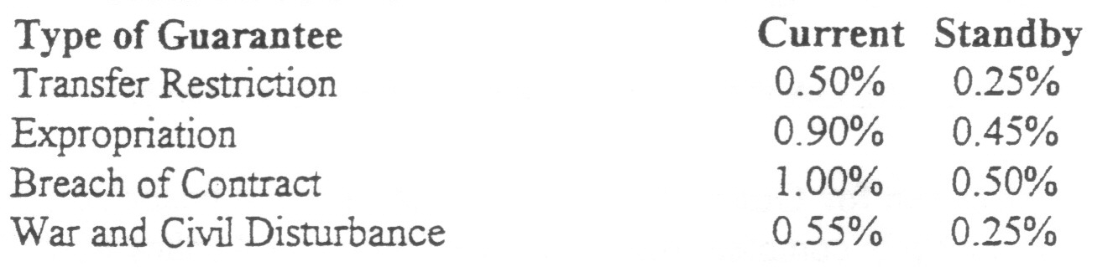
MEGA Insurance Rates
Annual Base Rates – Natural Resources

Slide 168
Project Finance and Theory

Slide 169
General Finance Issues and Project Finance
In project finance modelling, a number of fundamental financial issues that arise in finance must be addressed. These questions are more important than excel techniques:
  What is the appropriate minimum return to equity holders.
    What is the method to compute returns, what are the returns that should be computed for different projects, should equity or project returns should be the criteria used
  What is the appropriate minimum return to the project
    What is the definition of free cash flow, what is the minimum level project return, how should the project return be used.
  What is the debt capacity of a project
    What is the definition of debt capacity, can debt capacity be used in assessing the risk of a project, what criteria should be used in measuring debt capacity.

Slide 170
General Finance Issues and Project Finance (Continued)
  What is the appropriate credit spread for senior and subordinated debt
    How the credit spread analyzed, what spread should be used for senior and subordinated debt, how should the credit spread change with different debt structures
  What are the economics associated with debt structuring issues
    What is the risk and return tradeoffs associated with covenants, debt service reserves, cash flow sweeps and alternative debt amoritsation schedules
  How should the risk and return tradeoffs be assessed
    How should the risk benefits of liquidated damages, fixed price contracts, fixed price O&M be assessed.

Slide 171
Methods of Analysing the Fundamental Issues
Three general approaches can be used for evaluating these issues
  Finance Theory
  Market Data
  Mathematical Analysis
In assessing minimum required returns
  Finance Theory: Use the CAPM and the WACC from market weights. (e.g. Market risk premium is 5%.)
  Market Data: Evaluate the required returns that comparable projects require from general knowledge of the industry (e.g. typical projects fetch returns of about 10%.)
  Mathematical Analysis: Construct a distribution of IRR’s and then compute the value at risk and other statistics (e.g. worst case probability of 10% is 8% IRR in one project and -20% in another project).

Slide 172
Methods of Analysis -- Continued
In assessing Project Returns
  Finance Theory: Use the Adjusted present value and un-geared Beta
  Market Data: Evaluate the project return against the cost of debt to see if structuring can work (e.g. if project return is 4% and after tax debt cost is 5.5%, the project will not work).
  Mathematical Analysis: Construct a volatility statistics for used in assessing options (e.g. the volatility of free cash flow is 8% for one project and 20% for another)
In assessing Debt Capacity
  Finance Theory: Use the probability of default and loss given default
  Market Data: Evaluate other projects with similar contract structures and use debt service coverage statistics (e.g. the required DSCR is 1.4 for a project with a BBB rating)
  Mathematical Analysis: Use option theory and the value of the debt outstanding at the end of the project (e.g. compute the credit spread and back into the debt leverage)

Slide 173
Methods of Analysis -- Continued
In assessing Credit Spreads
  Finance Theory: Use option pricing theory and the probability of default and loss given default
  Market Data: Evaluate spreads for different types of debt (e.g. spreads for BBB debt are about 1.5% and sub debt range from 4%-7%)
  Mathematical Analysis: Use Monte Carlo simulation to directly evaluate the IRR to debt holders (e.g. the debt IRR is 12% and falls when the price declines by 20%)
In assessing Project Risks
  Finance Theory: Use the risk neutral theory to directly assess risk
  Market Data: Evaluate the typical premiums for project contracts (e.g. 20% premium is required for EPC contract with LD.)
  Mathematical Analysis: Directly compute the risk and return associated with contract provisions

Slide 174
Methods of Analysis -- Continued
In assessing Structural Enhancements
  Finance Theory: Use the option pricing theory to change the cash flows
  Market Data: Evaluate the typical covenants for similar projects and see how the covenants and debt service reserves affect the equity IRR and the risk of the project (e.g. evaluate how a dividend restriction of 1.5 affects the Equity IRR)
  Mathematical Analysis: Directly compute the distribution of IRR to equity and the value of debt with alternative structural enhancements

Slide 175
Case Exercise
Evaluate two projects without any financing
  How would you evaluate the two projects – one with merchant risk and the other with contract financing of the plant
    Which has a better risk and return tradeoff
  Now add debt financing of the plant
    Assume that the merchant project can obtain 40% debt financing
    Assume that the contract project can obtain 80% debt financing
  Which is the best investment using project finance to evaluate the investment

Slide 176
Project Finance Process

Slide 177
Project Finance Process and Documentation from Alternative Perspectives
Sponsors and Developers
  Information Memorandum
  Road Show
Financial Institutions
  Credit Classification
  Risk Monitoring

Slide 178
Project Finance Process
Say a Project has a Construction Cost of $100 Million
  You would like to raise as much debt as possible. Reasonable debt percentages are 60-80% depending on risk, PPA terms, and host countries.
    You must generally have a PPA contract signed to start the process
    The credit quality of the project will depend on the strength of the contract and the strength of the party that signs the contract.
  You will try to secure a construction loan which allows you to borrow money from the bank as you spend money for construction.
    The interest you pay for the construction loan is capitalized (interest during construction).
    The sequencing of expenditures from debt and equity funds must be negotiated
  The most important date in the project is the commercial operation date.
    After the operation date, the plant earns revenues.
    At the commercial operation date construction loan can be converted.

Slide 179
Traditional Finance
Pretend you are evaluating an investment, in theory you would:
  Compute the overall rate of return
    Your would first compute the cash flow generated from the project
    This includes the capital expenditures during construction and then the net revenues received after construction
    The cash flow is after tax, but before financing
  Evaluate whether the rate of return compensates for risks
    The risks are incorporated in the weighted average cost of capital number which includes the return that equity holders need
    The rate of return on equity in theory can be computed from financial market data
  If the return is higher than the cost of capital, you should invest
Classic Finance
  Compute the rate of return on the project
    Cash flow forecast internal and not subject to review by external institution
    Growth rates in cash flow cannot be predicted with accuracy
  Evaluate risks in the weighted average cost of capital
    Theory of beta of project
    Subject to judgment
    Debates on theory and the risk premium
Example
  Contract versus Merchant financing
  Run scenarios with model

Slide 180
Reference Slides:
Use of Project Finance in Various Industries

Slide 181
Agent Bank (Reference)
Role of agent bank:
  Collects funds from the syndicate and passes funds to project company
  Holds the project security
  Calculates interest and principal
  Receives payment from project company and passes to individual syndicate banks
  Distributes information materials
  Takes enforcement after default

Slide 182
Project Finance Definition is Not Static
Project finance has continuously evolved and shifted in response to the needs of project sponsors and their lenders.
  The school of thought that once required a long-term, fixed-price contract as an essential feature of a project is distinctly a minority view.
  Now projects can have multiple assets (telecom) and merchant price risk if the product is a commodity for which there is a wide market but not necessarily an Off-take contract.
  A toll road has a Concession contract but no off-take contract.
  A project that does not use fuel or a similar raw material and does not require an Inputs Supply Contract.
  Government support in developing countries.

Slide 183
Definition of Project Finance (Reference)
Project Finance is a specialised form of finance, based on:
  “Stand-alone” project
  Special purpose Project Company as the borrower
  High ratio of debt to equity (“gearing” or “leverage”)
  Lending based on project-specific cash flow, not corporate balance sheet or past profit record
  Lenders rely on project contracts not physical assets as security – “contract-based financial engineering”
  Non-recourse (i.e. no claim on investors)
  Finite project life, so debt must be fully repaid (cf. corporate loan, where debt may be rolled over indefinitely)

Slide 184
Project Finance - Banks
Source: Project Finance International

Slide 185
Project Finance - Bonds
Source: Project Finance International

Slide 186
Primary Applications of Project Finance
Natural Resources
  Oil
  Gas
  Mining
Infrastructure Projects
  Power plants
  Bridges
  Port facilities
Processing Industries
  Petrochemicals
  Refineries
  Manufacturing

Slide 187
Industries that Use Project Finance
Merchant power plants, mining projects, and oil and gas projects that produce and sell volatile commodities have raised billions of dollars of non-recourse rated project finance debt without the benefit of traditionally structured off take contracts.
Still other project-financed transactions have dashed the assumption that project-financed transactions must have construction risk in order to be classified as projects. As the restructurings of the U.S., Australian and U.K. electric utility industries, among other national industries, have demonstrated, project finance techniques have been used to finance spin-offs of operating power plants into standalone projects.

Slide 188
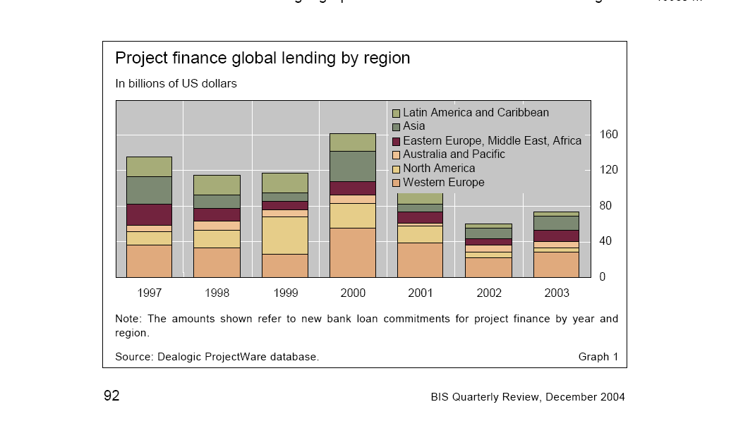
Project Finance Volume by Year and by Area
Note the worldwide diversification

Slide 189
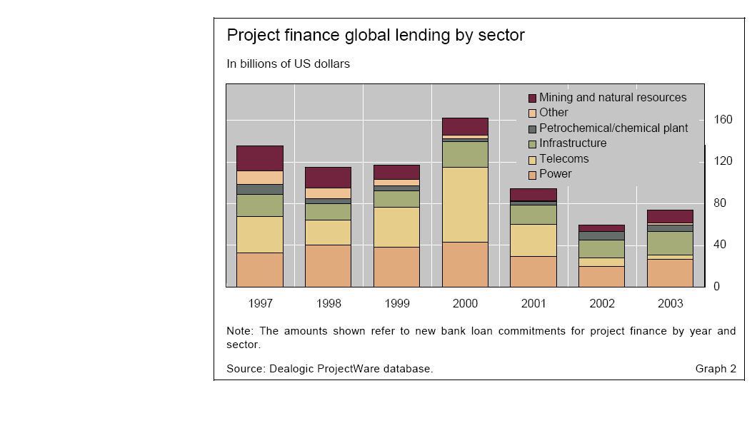
Project Finance by Sector by Year
Power and Infrastructure are large portions

Slide 190
Project Finance by Sector

Slide 191
Oil and Gas
Oil and Gas - from the financing of oil and gas rigs to oil refineries and pipelines, oil & gas companies are increasingly using project financing as a method of reducing corporate debt by taking heavy capital investment off balance sheet.
Examples
  Petrozuarta in Venezuela – “pierced sovereign ceiling” and achieved investment grade rating
  Star Refinery in Thailand – 70% financing, 10 year debt, debt service coverage ratio of 1.58x
  Ras Gas in Qatar – 75% debt financing with maturity of 10 to 17 years
  Production Payment Loans – Debt re-payment depends on the production of oil

Slide 192
Mining
Mining - In Latin America and parts of Africa, mining companies are using project financing techniques to fund their mining development and reduce company debt and shareholder exposure.
Examples
  Freeport
  Newmont

Slide 193
Electricity Generation
Examples
  Dabhol (India)
  PT Punjak Power (Indonesia) – Contract could not be supported because of exchange rate problems
  Hummer (United Kingdom) - Dividend suspension if DSCR is below 1.20
  US (Purpa, Contract, Merchant and Mixed)
Issues
  Contracts, Electricity Price, Supply, Efficiency, Capital Cost, Technical Breakdown

Slide 194
Toll ways, Pipelines and Airports
Roads and Highways - National road networks are under the strain of increased user demand and falling government budgets for maintenance and future expansion. Private sector companies are now encouraged to build, fund and operate new and existing roads on either a real or shadow toll basis using public authority concessions.
Examples
  Euro Tunnel: Restructured with extended maturity
  M1/M15 Toll way in Hungary
  China Tollroad – problems with contract concessions
Issues
Construction cost, traffic studies, concessions, maintenance, exchange rate risk

Slide 195
Other
Examples
  Universal Studios
  Euro Disney
  Columbia Telecommunications Funding Corporation
  Desalination plants
  Cheese Processing

Slide 196
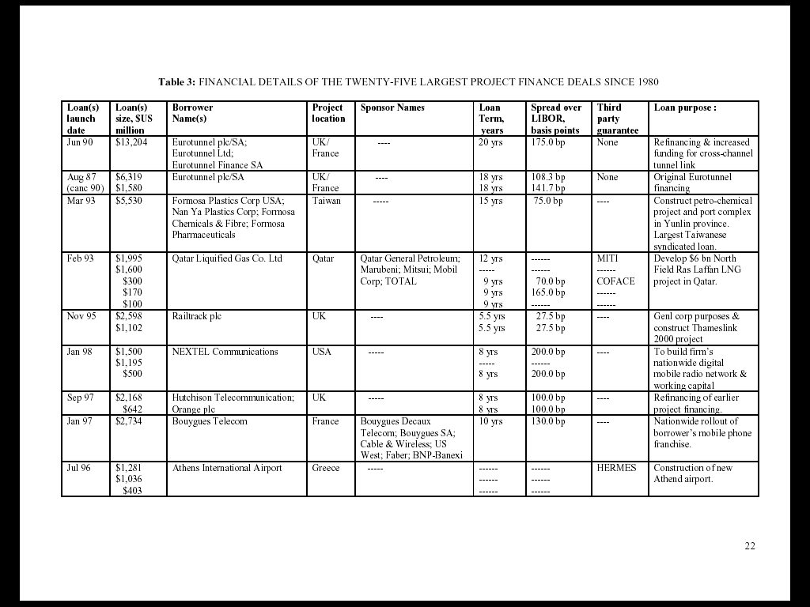
Project Financings

Slide 197

Project Financings

Slide 198
Project Finance Statistics
14% of Project Finance Loans US Based
34% of Project Finance Loans have guarantees
Project Finance Loans have lower covenants than other loans
Project Finance is popular in less developed countries
Project Financing 2001
  Citibank, US
  West LB Germany
  PNB Parabis, Franc
  Societe General, France
  CS First Boston, Switzerland
  JP Morgan, US

Slide 199
Funding Sources for Project Finance
Debt
  Banks
    Construction and permanent debt
    Information
  Bond Issues
    Negative Arbitrage
    Bond Ratings
  Mezzanine and Subordinated Debt
  Lease Finance
  Vendor Finance
Equity
  Sponsors
  Joint Venture

Slide 200
Export Credit Agencies
Export Credit Agencies
  Canada
    Export Development Canada
  France
    Compagnie Française d'Assurance pour le Commerce Extérieur
  Germany
    Euler Hermes Kreditversicherungs-AG
    Kreditanstalt für Wiederaufbau
  Italy
    Istituto per i Servizi Assicurativi e il Credito all’Esportazione
    Società Italiana per le Imprese all’Estero (Simest)

Slide 201
Multilateral Agencies
Japan
  Nippon Export and Investment Insurance (NEXI)
  Japan Bank for International Cooperation (JBIC)
United Kingdom
  Export Credits Guarantee Department (ECGD)
United States
  Export-Import Bank of the United States (US ExIm)
  Overseas Private Investment Corporation (OPIC)t Finance

Slide 202
Azito IPP Project
Azito is the second IPP in Cote d' lvoire following CIPREL, which was developed in 1994
The project was designed as a competitively tendered concession by the Ivorian government.
In 1996, six consortia were pre-selected. Four submitted bids - AES, Enron, Tractebel and ABB
In June 1997, the project was awarded to ABB, for being the lowest bidder
ABB-EV, Electricite de France (EdF), and IPS (Industrial promotion services)
ABB Energy Venture (ABB-EV), a subsidiary of Asea Brown Boveri has 37.74% holdings of the company
Electricite de France (EdF), the French national utility holds 36.26%
Industrial Promotion Services (IPS), a unit of the Aga Khan Fund for Economic Development holds 26%

Slide 203
Project Finance History (Reference)
Waves of project finance:
  1930’s oil resources and later the 1980’s oil production in the North Sea.
  1980’s private electricity plants in the US and private electricity plants in the UK is 1990’s.
  Private Finance Initiative (PFI) in the UK for roads, and public buildings, becoming public private partnerships (PPP).
  Finance for growth in mobile telephone networks.
In the fifth century B.C.E., the commercial code of Athens acknowledged a form of project financing used to finance shipping ventures. Lenders agreed to look only to the future sales of the cargo and the ship, if necessary, for repayment. If the ship was lost at sea, therefore, the debt was, in effect, discharged without any liability to the vessel- or cargo-owners.
In the Eighteenth and Nineteenth centuries, large pubic works and infrastructure projects, such as roads, canals, electricity, and coal gas, were often financed through private sector funding sources

Slide 204
Project Finance History (Reference)
Modern Project Financing is often thought to have originated with production payment financing in the Texas oilfields in the 1930’s.
A driller would fund the well-drilling costs in exchange for a share in future oil proceeds. In West Texas, it was hard to ‘miss’ striking oil every time!
At that time, a Dallas bank granted a non-recourse loan to develop an oil & gas property to be repaid from the cash flows from those wells.
Resources transactions, especially mining and oil & gas, led the way in the 1960’s mainly driven by US banks. Their techniques were ‘imported’ into Europe in the late 1970’s for a string of large Project Financings for North Sea offshore oil.

Slide 205
Recent Project Finance History (Reference)
Much of the development of the U.K.'s offshore petroleum reserves in the 1970’s relied on project finance.
In the 1980s, the independent power projects (IPPs) that sprung up in the U.S. and which were fostered by the Public Utilities Regulatory Policy Act of 1978. This financed an explosion of over 55,000 MW of new generation projects.
The oil and gas, refining, petrochemicals, other process industries, mining, telecommunications, entertainment, and transportation have all used project finance to raise capital.

Slide 206
Loy Yang Financing
Cost Structure
  Low cost coal
  Market Power (40% of capacity of the state)
Financing
  62% senior bank debt
    Maturities of 6 and 9 year bullets
    15 year amortizing tranche
    Pricing: 120 to 170 basis points
  7% senior inflation adjusted
    30 year tenor
    Back-loaded re-payments
  6% Junior Subordinated
    14 year debt
    7 years interest only
  25 % Equity

Slide 207
Loy Yang Covenants
The covenants restricted dividends on the basis of the DSCR (debt service coverage ratio) and the LLCR (loan life coverage ratio)
  Different levels for contract and merchant period
  Defaults defined by LLCR and DSCR tests
  Covenants trap cash flow so it is available to lenders and does not leak out to equity holders
  Covenants reduce risk to lenders and reduce returns to equity holders: the cost benefit analysis is a risk versus return evaluation
Debt Service Reserve Account
  3 Months during contract period
  6 Months during merchant period

Slide 208
Illustration of Development Stage for Wind Farms

Slide 209
Capital and Project Stages

Slide 210
Project Timing and Tasks During the Development Phase (Before the Completion Date)
Projects usually undergo two main phases (construction and operation) characterized by quite different risks and cash flow patterns.
Construction primarily involves technological and environmental risks, whereas operation is exposed to market risk (fluctuations in prices of inputs and outputs) and political risk. Most of the capital expenditures are concentrated in the initial construction phases, with revenues starting to accrue only after the project has begun.

Slide 211
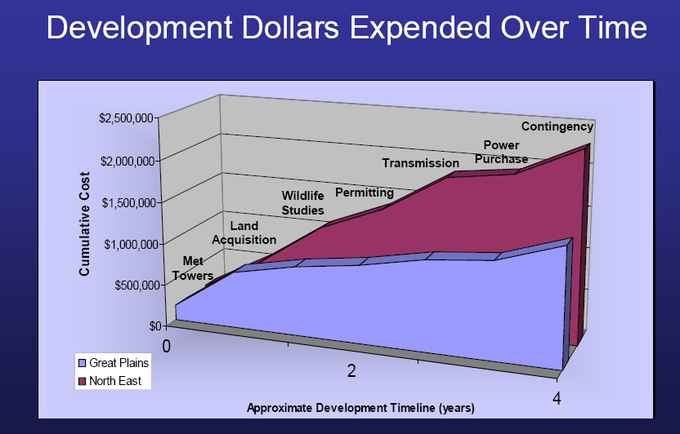
Example of Development Cost in Different Wind Projects

Slide 212
Exercise: Compute the Development Cost Percent

Slide 213
Project Finance Risk Analysis

Slide 214
Risk Analysis
Project financing is a financing of a particular economic unit where a lender is initially satisfied to look to the cash flow as the source of repayment of the loan and the assets as the collateral of the loan.
The analytic task begins with identifying a broad spectrum of risks to which lenders might be exposed. Can create a risk matrix that lists the risks.
Determine which risks the project can avoid through allocation of those risks elsewhere and the cost of mitigating the risk.
Those risks that remain unallocated, unmitigated or minimal in consequence, determine the risk of default and must be covered in the margin over which the DSCR is above 1.0.

Slide 215
Project Finance and Risk Management
One of the principal advantages of project finance often cited is that a project finance structure allocates risk to parties willing to accept and manage the risk.
This notion is not that risk transfer can some how reduce risk by itself. Rather, if risks are transferred to parties who can control risk then operating efficiency will be improved.
  For example, if revenue, cost and debt contracts are associated with an investment, risks of construction cost over-runs can be transferred to developers, operation and maintenance risks are transferred to contractors, price risk is transferred to an electric utility company and interest rate risk can be transferred to a bank.
  The transfer of risk is beneficial to the extent that it improves incentives related to the basic economic drivers of plants - reduced capital expenditures, a better cost structure, more plant output, fewer maintenance outages and so forth.

Slide 216
Project Finance and Allocation of Risk
Often, the risks associated with a project are so great that it would not be prudent for a single party to bear them alone. Project financing permits the sharing of operating and financing risks ...in a more flexible manner than general credit…
Because of the contractual arrangements that provide credit support for borrowing, the project company may be able to achieve significantly higher financial leverage than the sponsor ... if it financed the project entirely on its own balance sheet.
Other advantages include achieving economies of scale, reduced cost of capital, reduced cost of resolving financial distress and keeping a project off of a sponsor's balance sheet.

Slide 217
Importance of Proven Technology
Even a proven technology may have above average operating risks when it is employed on a much larger scale. Scale-up risk can cause lower credit ratings during the first few years of a project's operations until sufficient observable operating history demonstrates that these risks are manageable for the project. Likewise, a proven technology that is unusual in its engineering design (i.e., an atypical configuration of power turbines and generators) could pose risks that suggest more conservative maintenance budgeting or higher operating reserves to offset these technical uncertainties.

Slide 218
Analysis of Major Risks According to Phases of Project Finance
Risks During the Construction Phase
  Cost over-runs and delay in completion
  Performance of technology
  Environmental and political risks
  Credit quality and experience of contractor
  Legal and other costs
  Mitigation
    Use of fixed price, date certain turn-key contracts
    Sponsor support and limited recourse
Risks After Completion
  Price and contract sustainability
  Volume and traffic
  Operating cost, technology performance and other costs

Slide 219
Technical Failure – New Combined Cycle Electricity Plants
An example of technical failure is the ABB combined cycle plants that were used in the merchant industry. These plants had excessive vibration and did not meet heat rate performance estimates.
Demonstrates preference for conventional technology (even though there have been remarkable improvements in heat rates and efficiency)
Standard and Poor’s comments
  As equipment suppliers modify proven designs to expand the performance envelope to give greater output and improved efficiencies, the resulting higher operating temperatures and pressures can result in increased wear and maintenance.
  This has been a potential problem with gas-fired power generation technology recently, despite manufacturer expertise. These design modifications can adversely affect reliable performance and O&M budget requirements over time. Some scaled-up gas turbine generator designs, for instance, have met initial test parameters, but have seen problems during operations, such as premature failure or excessive vibration, which have required design modifications.

Slide 220
Project Risks and Causes of Project Failure – S&P Risk Categories
Delay in completion (increase in IDC)
Capital cost over-run
Technical Failure
Revenue Contract Default
Increased Price of Raw Materials
Loss of Competitive Position
Commodity Price Risk
Volume Risk
Overoptimistic Reserve Projections
Exchange rate
Technical Obsolescence of Plant
Financial Failure of Contractor
Contract Mismatch
Uninsured Casualty Losses
Aribus
Eurotunnel
Alstrom Combined Cycle
Dabhol; AES Drax
California Wood Plants
Natural gas plants
Argentina Merchants
Euro Disney; Tollways; Subways
Briax Gold Project
Jawa Power in Indonesia
Iridium
Stone and Webster
MCV

Slide 221
Strong and Weak Technology/Construction Risk
Strong
  Fixed-price, date-certain turnkey contract;
  one-year-plus guarantees;
  superior liquidated performance/delay damages;
  highly rated EPC contractor,
  credible sponsor completion guarantee or LOC-backed construction;
  installed costs at/below market;
  contracts executed.
  IE oversight through completion, including completion certificate.
  Commercially proven, currently used technology.
  Rated O&M contract with performance damages.
  Budget and schedule credible, not aggressive.
  Thorough and credible IE report.

Slide 222
Strong and Weak Technology/Construction Risk
Weak
  Cost-plus contracts,
    no cap;
    weak guarantees, if any; minor liquidated performance/delay damages;
    questionable EPC contractor.
  Costly project budget.
  Permits lacking and siting issues.
  Possible local political/regulatory problems.
  No Independent Engineering oversight.
  Technology issues exist.
  Budget and schedule aggressive.
  No Independent Engineering report.

Slide 223
Reasons for Use of Project Finance Debt
The appropriate use of non-recourse financing should broadly result in a lower all-in financing cost and a return that corporate financing could not achieve.
In the starkest cases, project finance can make a project feasible because the sponsor could not raise the funds on its own balance sheet.
Project structure does not create cash flows that would not otherwise exist. Rather, structure serves as a tool to help manage an investment's risk profile in order to achieve other objectives, such as maximizing leverage or increasing return on equity.

Slide 224
Why Use Project Finance
Project structure does not create cash flows that would not otherwise exist. Rather, structure serves as a tool to help manage an investment's risk profile in order to achieve other objectives, such as maximizing leverage or increasing return on equity.
Project financing can lower financing cost.
  One reason for using project finance is that the project developer or sponsor has a low credit rating. If a project has a contractual offtaker with a higher credit rating, the project will likely achieve cheaper financing, all else being equal, than the sponsor could achieve by itself. Such a project's borrowing costs may be lower than the sponsor's total cost of capital, including equity, if the project's unique characteristics indicate a reliable cash flow potential. For example, certain natural resource extraction projects have very low production costs or locations so strategically advantageous that they can earn an economic rent—an excess rate of return compared to the industry. In either case, the ability to cover debt service is reasonably certain.

Slide 225
Why Use Project Finance
Projects usually have a simple capital structure with only a limited number of claimants (i.e., a single debt class and suppliers to the project), in contrast to the numerous claimants that corporations accumulate. Thus, the limited number of sophisticated Rule 144A institutional investors in a project generally have commonly aligned interests that will expedite a workout.
That managing project risk is generally easier than managing corporate risk offers another explanation as to why a good project finance structure can potentially lower financing costs. Perhaps the most obvious risk control results from projects having contractually allocated specific risks to parties best able and willing to assume the risks, such as construction, fuel supply, and marketing.

Slide 226
Why Use Project Finance (Continued)
Project finance can potentially reduce corporate taxes. The most visible way is the tax shield effect. A project with good security and contractual arrangements and solid prospects for generating cash may well support more leverage than its corporate sponsors. Hence, the project-financed investment may be able to shield more income from taxes than the on-balance-sheet investment.
Where two or more sponsors with similar investment needs or goals exist, project-financed joint ventures can help achieve economies of scale. A refinery project with two sponsors who each take a proportionate share of the output illustrates such a case. Building one large refinery that has access to feedstock and distribution channels is economically more efficient than building two separate facilities in separate locations. Both sponsors can share the benefits of scale.

Slide 227
Costs of Project Finance – Transaction Costs
Despite the potential advantages that project finance may offer the transaction parties, project-financed transactions are expensive and time consuming to arrange.
The effort may be so great or costly that some sponsors may find the transaction costs not worth the benefits. Discussions among the many parties and government bodies may take years to reach acceptable conclusions. The highly negotiated operational and financing covenants, restrictive structural arrangements, and loss of control over project assets, all of which are characteristic of project finance may in the end be unacceptable, despite the financial incentives.
Sometimes sponsors will incur significant real costs for years, not knowing for certain whether they will actually be successful in raising the funds required for the enterprise. In addition, because of the extensive project and financing documentation, legal costs can grow to considerable sums. Finally, the disclosure that lenders and rating services, such as Standard & Poor's, require may so contradict a company's culture that it may abandon the effort altogether.

Slide 228
Resources and Contacts
My contacts
  Ed Bodmer
  Phone: +001-630-886-2754
  E-mail: edbodmer@aol.com
Other Sources
  Financial Library on disk – articles and books
  www.standardandpoors.com; www.moodys.com – credit rating and other information
  www.bondsonline.com – credit spreads
  Project finance portal.

