Slide 1
Terminal Value in Project Finance

Slide 2
Issues
Should we account for terminal value when we make a bid?
01
Is the terminal value a big deal or is terminal value just lost in the rounding?
02
What assumption should we make about terminal value
03
Under a contract extension
Under volatile spot prices

Slide 3
Key Themes
If over-state the required IRR or use a target IRR that is higher than you bid, the terminal value will be understated – it will look to low relative to its true value.
Terminal value is very speculative and may be negative, but that does not mean we should use an arbitrary value or “be conservative”
Real Options should be reflected in terminal value as constraints of contract no longer apply.

Slide 4
Subjects Covered in Terminal Value Modelling Exercise
Terminal Value and Required IRR in Simple Case
Terminal Value and Required Equity IRR with Financing and Re-financing
Estimating Terminal Value – Contract Extension
Terminal Value with Spot Price and Real Options
Terminal Value and Risk Premium

Slide 5
Part 1: Terminal Value and Required IRR without Debt Financing

Slide 6
Basic Math of IRR and Long-term Value
If you are assuming a high required IRR then the value of cash flows in periods far out in the future seem to have no value at all.
Example: If the IRR is 20% and the terminal value is 100% of the initial capital expenditure then the terminal value has just about no effect on the IRR.
On the other hand if the IRR is 5%, then the terminal value has a larger effect.

Slide 7
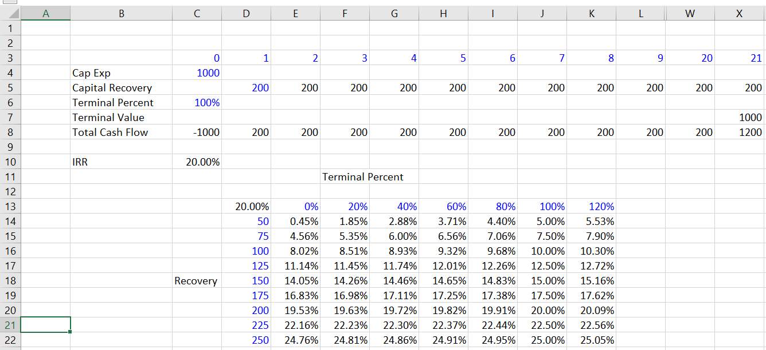
Illustration of Simple Mathematics – IRR with Different Terminal Value
Standard data table. One series with the terminal value and another without the terminal value.

Slide 8
Graph Showing Effect of High and Low IRR on Value of Terminal
When IRR is low, the effect of the terminal value is more
Much of the discussion is about nothing more than the mathematics of IRR. As IRR and NPV are essentially the same, a high IRR has a high discount rate and values future cash flows less.

Slide 9
Implication for Africa
When private equity wants a return of above 20%, terminal value does not seem to matter.
This is because the equity IRR is so high and not because the terminal value is not important
The bias created by high IRR also affects things like the value of extending the life of contracts.

Slide 10
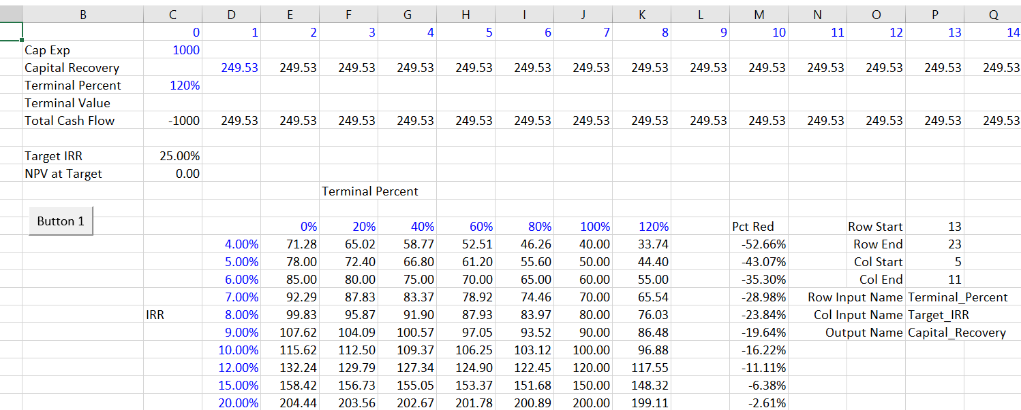
Simple Mathematics – Bid Prices are more affected by terminal value with low IRR’s
Macro data table with goal seek. Use goal seek with different terminal values and different IRR requirements.
Enormous reduction in bid when the IRR is low

Slide 11
Theme So Far: You will lose bids with high IRR requirement
Interest rates are at very low levels
People are desperate to find any investments that are relatively safe with IRR’s above the interest rate
If you bid at high target IRR’s you will lose for two reasons
  You will lose because of the IRR
  You will lose because of understatement of the terminal value

Slide 12
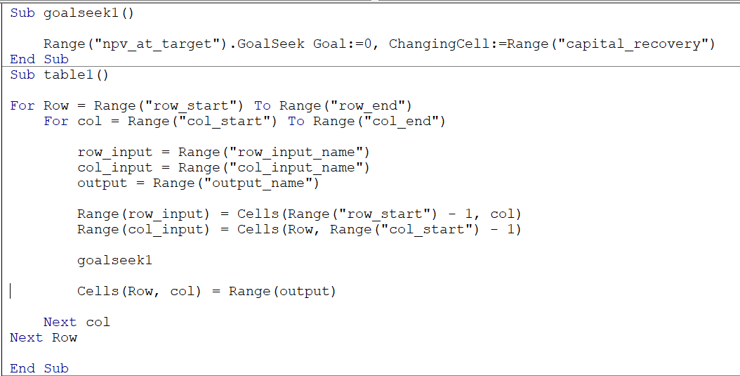
Technical Note: VBA code for Data Table with Goal Seek

Slide 13
Part 2: Effects of Terminal Value with Financing and Re-financing

Slide 14
How Terminal Value is Lowered because of Lower Project IRR’s with Financing
With financing, the project IRR is a bit lower for a given equity IRR (taxes magnify this but for simplicity do not assume taxes now)
The question then is, if the overall project IRR is lowered with financing, does this increase the effect of the terminal value
A second question is how re-financing affects the bid price from the terminal value. I have heard that some banks will be crazy enough to directly or indirectly finance cash flow from the terminal value.

Slide 15
Without Re-financing, the Bid Price is More Sensitive
Re-financing assumes that there will be a new financing that will be long enough to even account for the terminal value.
Sculpting is used to size the re-financed debt meaning that with terminal value, the size of the re-financed debt is increased.
This contrasts with the prior case without re-financing where the size of the debt is independent of the re-financing.

Slide 16
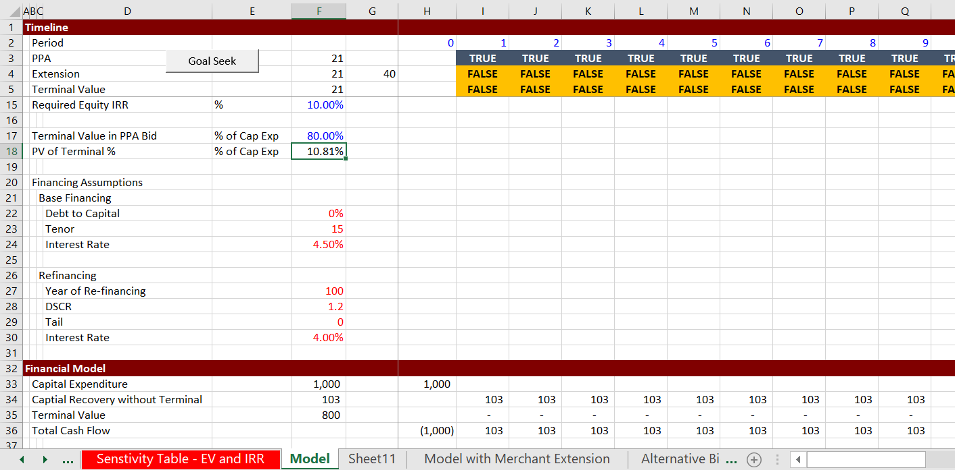
Project Finance Model with Terminal Value and Financing
Standard simple project finance model, except include terminal value

Slide 17
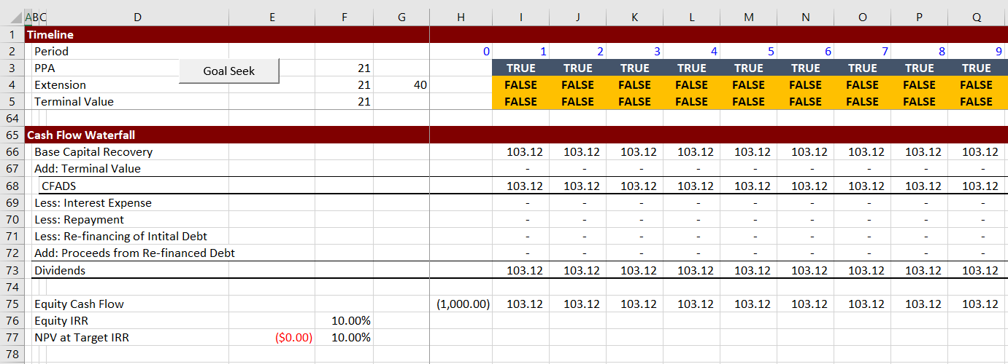
Project Finance Model with Terminal Value and Financing
Standard simple project finance model, except include terminal value

Slide 18
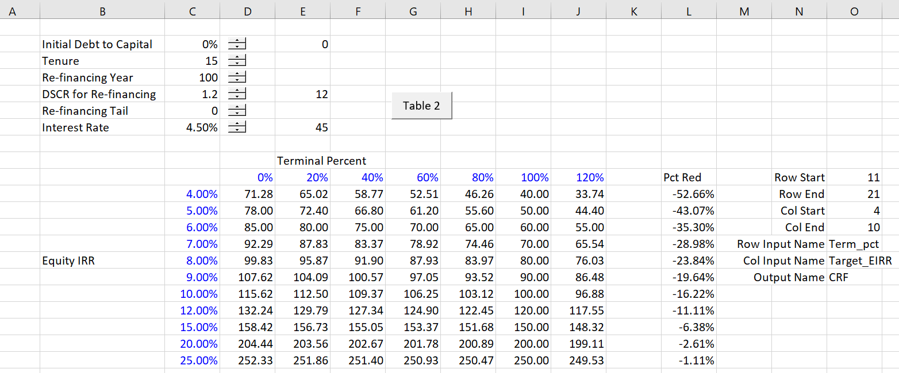
Table without any Financing
Table without any finance that is the same as the table in the last table

Slide 19
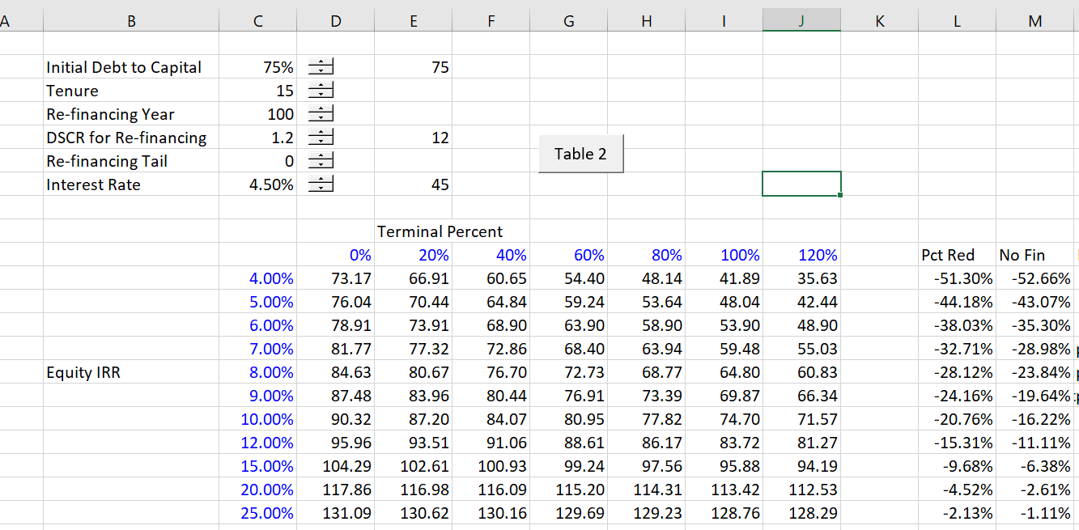
Table with Financing and No Re-financing
Note that if the financing does not cover the terminal period, the effect is similar to the no financing case. At 8% IRR the effect is quite large.
Table with debt finance that is similar to the last table

Slide 20
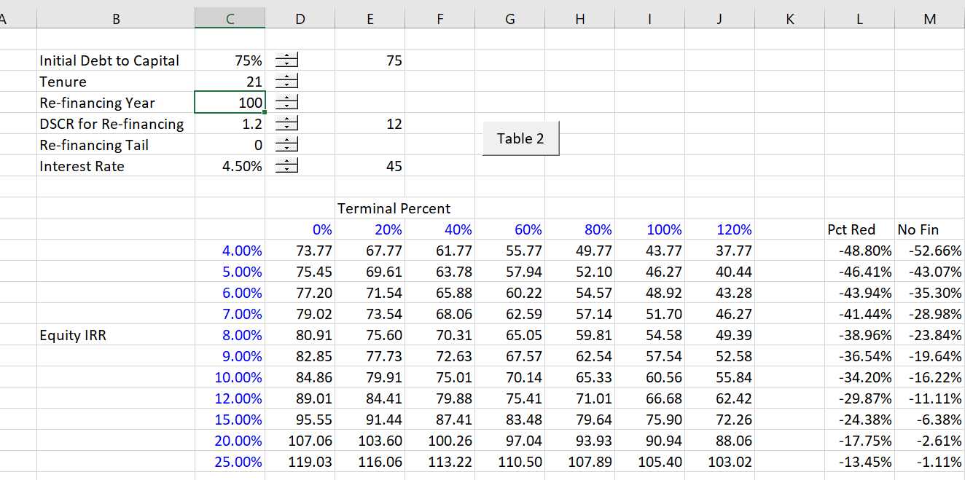
Table with Financing and No Re-financing, but Financing is Long and Covers Terminal Period
If the financing covers the terminal period, the effect is larger when the IRR is high. At 8% Equity IRR the effect moves from 28% to 38%.
Table with debt finance now has a bigger effect when the terminal value is high

Slide 21
Re-financing size and Terminal Value
In the re-financing, the size of the debt is the NPV of debt service as usual.
The debt service in turn is the cash flow divided by the DSCR.
If the cash flow includes the terminal value, then the re-financing will be higher because of the terminal value.
With the higher amount of low cost debt, the bid price is reduced.

Slide 22
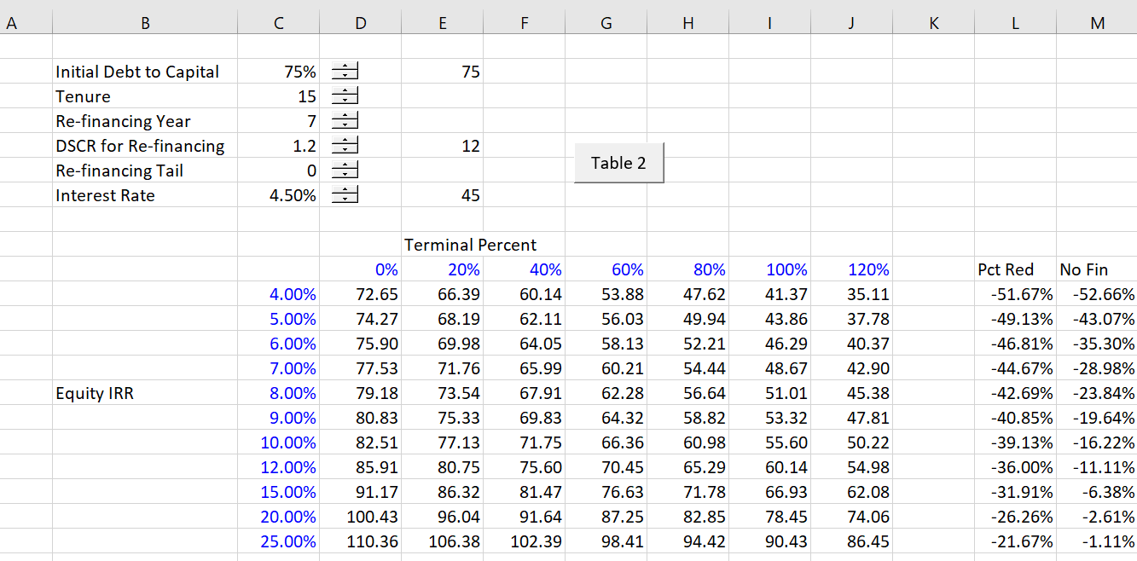
Table with Re-financing
With re-financing, the effect is even larger when the IRR is high. At 8% Equity IRR the effect moves from 28% to 42%.
Table with debt finance now has a bigger effect when the terminal value is high

Slide 23
Part 3: Estimating Terminal Value – Contract Extension

Slide 24
Measuring Terminal Value
Earlier section (hopefully) demonstrated that you cannot ignore terminal value in bidding even if you have a high IRR requirement.
This section begins to address the question of how much should the terminal value be.
I begin with the case of contract extensions and tricky issues of contracting
The idea is that the plant has some economic value after the PPA period, but that economic value will not necessarily be present in the contract extension.

Slide 25
Consider Negotiation with the Regulator
Regulator Position
We already paid for the plant in the first PPA, why should we pay for it twice with a contract extension. Therefore, you deserve no terminal value
SPV Position
If you do not provide me any profit for a contract extension, I will not run the plant and you will have to go and find power from a really expensive new plant.

Slide 26
More Nuanced Position
SPV Position
We lowered the initial bid by assuming that you will be rational and give us a contract extension. Therefore, the initial bid did not really pay for the plant. You are wrong.
We took the risk of how much the plant would be worth at the end of the PPA and you must recognize this.
Besides, you have no choice. If you don’t give us any money we will shut down the plant.
Regulator Position
I will give you just enough money to keep the plant running and so you do not sell the site. This could have nothing to do with the value of the plant as the SPV is stuck.

Slide 27
Problem in Negotiation
Range in Value from providing capital recovery somewhat above zero to the economic value of the remaining plant
Range in value between net value of site and economic value of plant

Slide 28
Simple Ways of Measuring the Value of Contract Extension
If we agree that the plant has value after the PPA (something that is obvious), then one way to do the analysis is the following:
  Estimate the value of a new plant (maybe you could inflate the capital expenditures)
  Given that the plant will be less efficient and more expensive to maintain and also have a shorter remaining life, estimate the value as percent of new plant).
  Example: New plant value is 1,500. Value of plant in 20 years falls by 70%. Value of capacity payments should be 30% of new plant value.

Slide 29
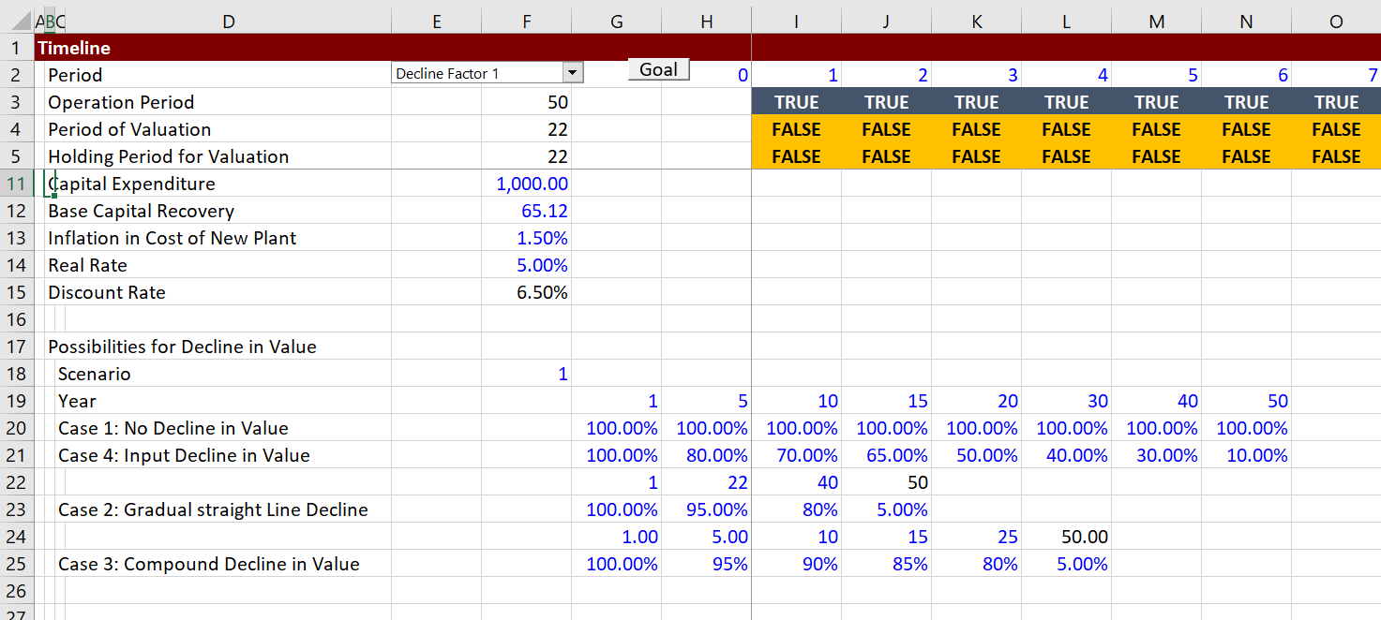
Analytical Exercise
A model with declines in the efficiency of a plant along with the inflation in new plants and a discount rate.

Slide 30
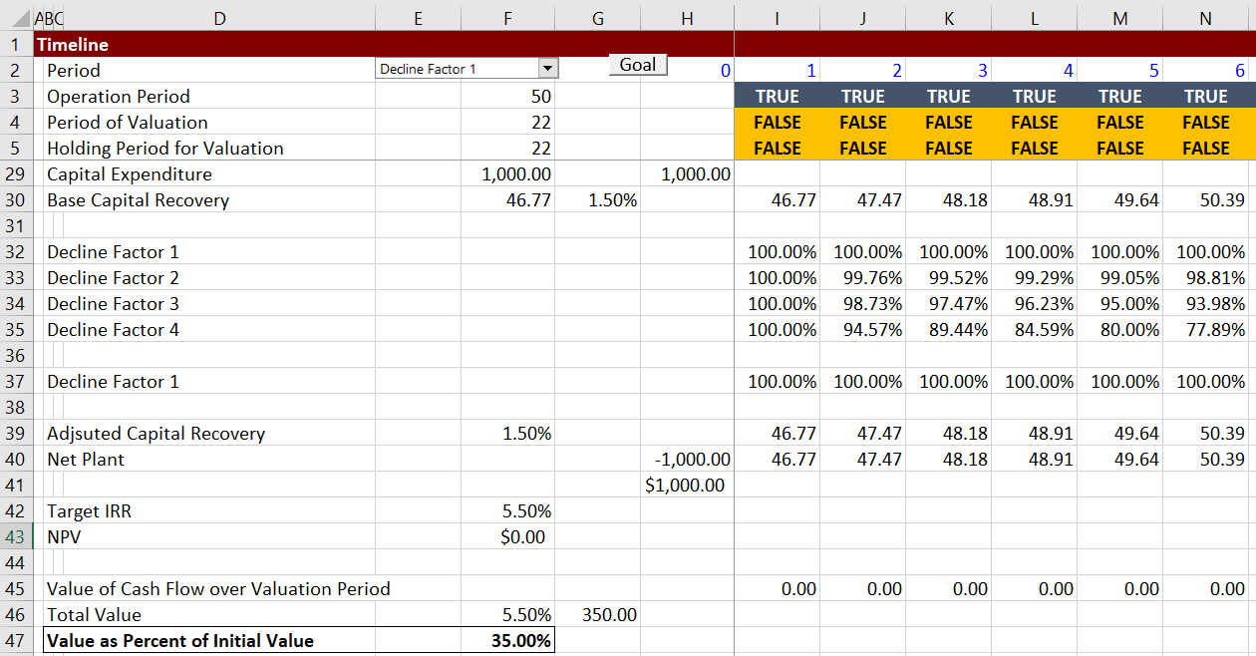
Valuation with Different Decline Rates
The valuation result is measured as the value during the post PPA period divided by the value of the plant as shown below.

Slide 31
Making a New Data Table with a Macro Should Take about as Much Time as Making a Data Table
Step 1: Copy the last data table macro
Step 2: Link the new row and column numbers
Step 3: Make the range names with SHIFT, CNTL, F3
Step 4: Modify the macro with the new goal seek and attach the button to the new macro.
Note that a macro is needed because the decline rate affects the value of the plant and hence the required carrying charge factor.

Slide 32
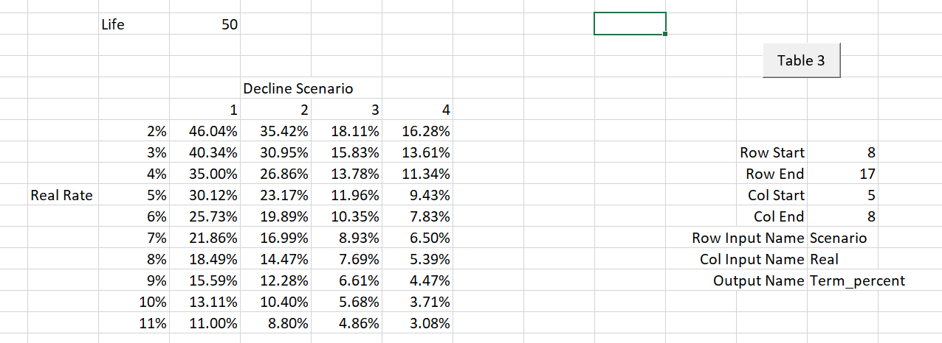
Summary of Valuation of Plant After Contract Period
You can copy the data table and then evaluate the terminal value with the different discount rates.

Slide 33
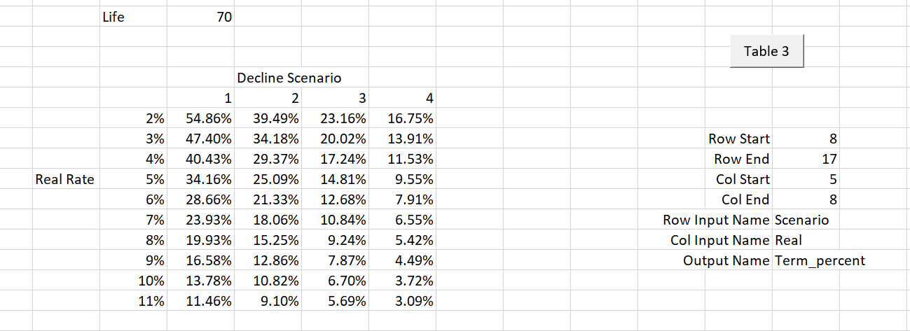
Alternative Scenario with Longer Life
You can copy the data table and then evaluate the terminal value with the different discount rates.

Slide 34
Part 4: Terminal Value and Real Options with Spot Pricing

Slide 35
Terminal Value and Spot Prices
We need to admit that we have absolutely no idea what the value of the plant will be. It is possible that spot prices will be in place rather than contracts.
If a spot price (merchant market) replaces contract prices, then we have absolutely no idea about what merchant prices will be.
With uncertain spot prices we may be able to choose different strategies depending on the level of spot prices.

Slide 36
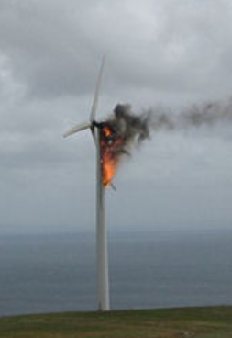
Options for Terminal Value
Maybe this will happen if you don’t change the oil
Unlike operations under a PPA contract, you can apply different strategies when the contract has expired.
  You can abandon the plant and pay decommissioning costs
  You can spend a lot of money and re-furbish the plant so it is almost like new
  You can reduce maintenance on the plant and let it deteriorate (often the best option)

Slide 37
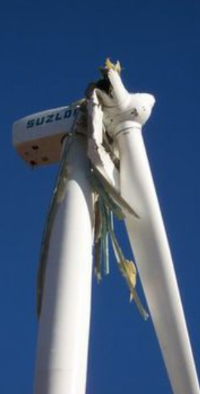
Example of Wind Turbine
Consider a wind turbine that used to be under a feed-in tariff. Assume also that merchant prices are low.
You could chose to stop maintenance if the merchant price is low. With lower prices the economics of spending a lot on maintenance do not make sense.
Instead, you could let the turbines decline (engineers will yell at you). This may be better than either retiring the turbines or spending more on maintenance than the net cash flow that is generated.
When prices are high, you should pay for insurance

Slide 38
An Option Normally Means you Can Get Out of Doing Something. A Commitment is Different
When you have a commitment, your strategy is fixed. After the contract there are different strategies that can be employed.
There is a lot of uncertainty around the terminal value and we have no idea about the level of prices.
With low prices we will care less about maintenance and making capital expenditures to make our plant look like new.

Slide 39
Options and Uncertainty
The final model will demonstrate how to model different strategies in the face of uncertainty.
As with any option in your personal life or in business, the value is more if the uncertainty is more.
To demonstrate the value of options, you must have uncertainty in prices and EBITDA as well as alternative management strategies when the prices are different.
You can do all of this with the index function (Monte Carlo simulation will not add much to this analysis).

Slide 40
Merchant Plant Analysis and Market Heat Rates
If you are evaluating an NGCC under merchant prices, you should probably use market implied heat rates.
For a natural gas plant such as an NGCC plant, the relationship between electricity prices (USD/MWH) and gas prices (USD/MMBTU) drives profit. Therefore, after each electricity market price review, the relationship between electricity prices and natural gas prices will be evaluated through the market heat rate:
  Market Heat Rate = Electricity Price (USD/MWH)/Gas Price (USD/MMBTU)
  Market Heat Rate = USD/MWH Divided by USD/MMBTU
  Market Heat Rate = USD/MWH x MMBTU/USD
  Market Heat Rate = MMBTU/MWH

Slide 41
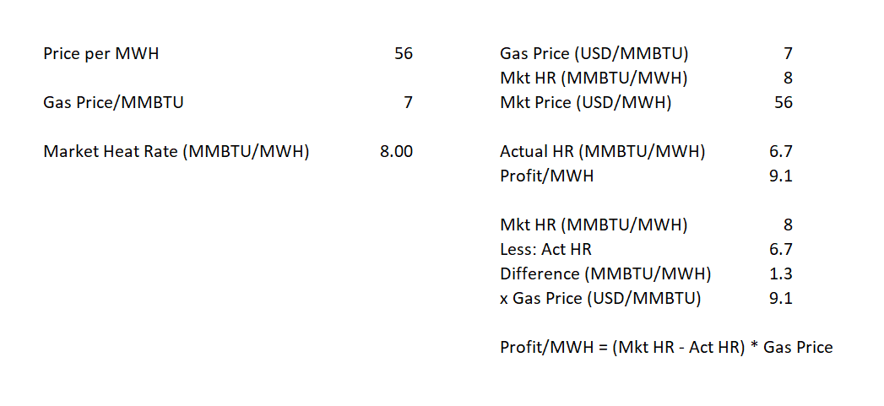
Market Heat Rate and Modelling
You can use the market rate to project merchant cash flow as illustrated below:

Slide 42
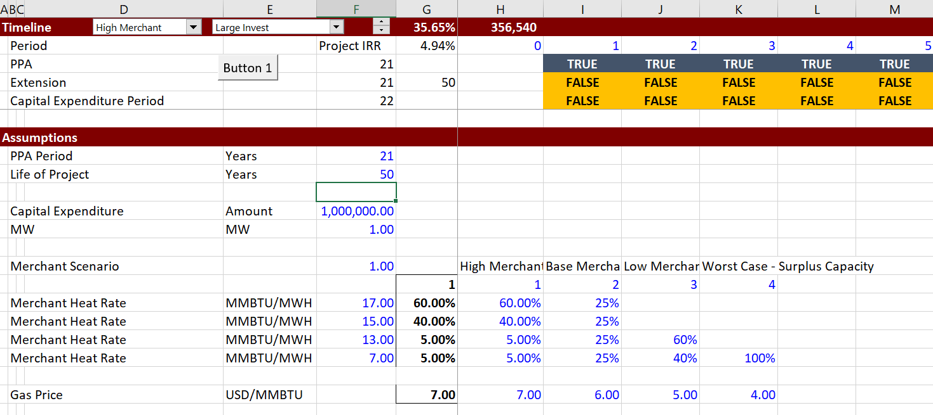
Alternative Assumptions About the Market Heat Rates
Different market heat rate assumptions are made with various probabilities. See the appendix on market heat rates. The larger the variation in heat rates the larger the value of real options.

Slide 43
Modelling of Alternative Strategies with Different Fixed and Variable Cost
The different market price scenarios are combined with different management strategies to illustrate the value of the option to do different things after the PPA expires. Real options can be simulated with the INDEX function.

Slide 44
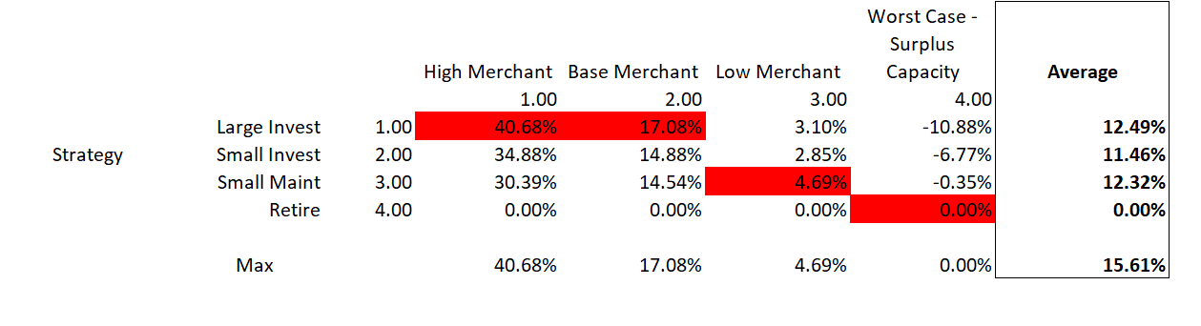
Value with Rigid Strategy and Uncertain Prices
The terminal value with rigid and flexible strategies is illustrated below. Note that with the high merchant prices, the strategy with high fixed cost and low variable cost is used. With low merchant prices, the strategy with high variable costs and low variable costs is optimal.

Slide 45
Long-run Merchant Analysis
All over the world, merchant markets have been built where there is surplus capacity and in most markets there has been an overbuild that has lasted for many years.
However, in the long-run merchant prices (and implied heat rates) must be high enough to justify building a new plant. If the merchant heat rates are too low, no capacity will ever come into the market.

Slide 46
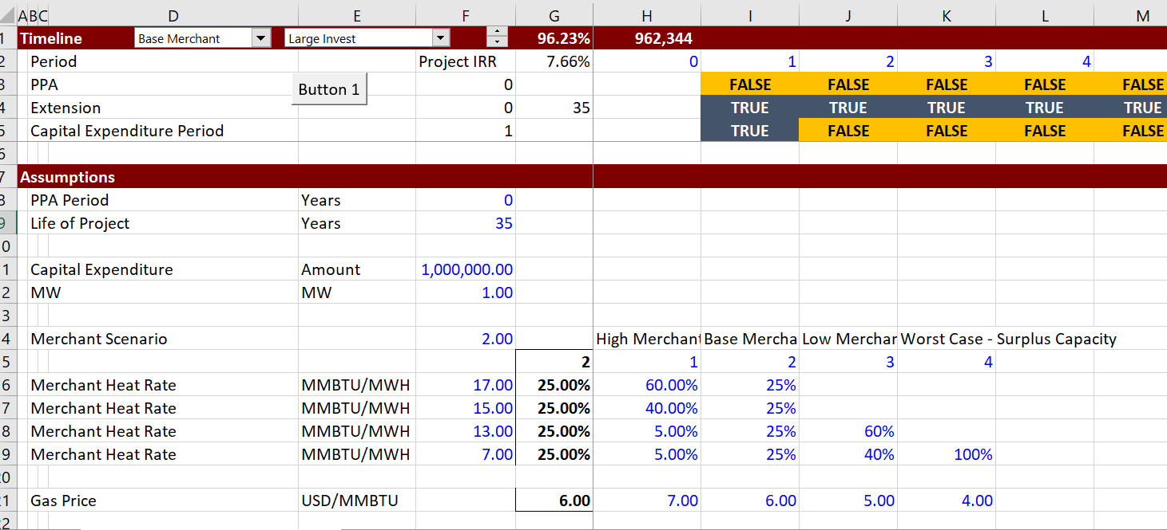
Verification of Long-Run Merchant Prices
If there are no additional capacity payments from a capacity market (for example, in Australia) then market heat rates should be high enough to justify the expenditure – this is a way you can test if your assumptions are reasonable.
Note that if the Model is re-set to be completely merchant, the IRR is reasonable

Slide 47
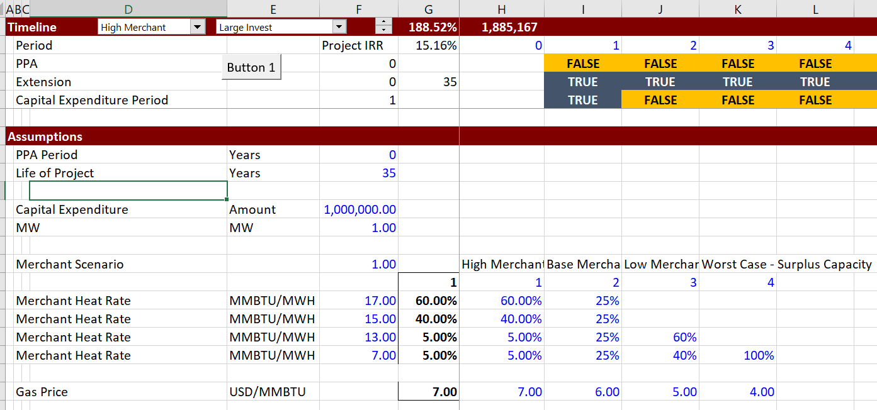
Verification of Long-Run Merchant Prices – High Case
Again, if there are no additional capacity payments then market heat rates should be high enough to justify the initial capital expenditure – in the high case the IRR is high but not extreme.
Note that if the Model is re-set to be completely merchant, the IRR is reasonable

Slide 48
Appendix on Merchant Prices and Market Heat Rates

Slide 49
A Little Review of Merchant Prices
The next few slides are intended to be a very quick review of what level prices could reach under a merchant system. Prices in merchant markets are reviewed in USD/MWH. These prices are the driver of terminal value and strategic options. Prices are reviewed in:
  US regional markets
  Philippines
  Europe
  Australia
  Turkey
  Scandinavia
  United Kingdom

Slide 50
Part 1: Philosophy of Merchant and Contract Systems

Slide 51
Arguments for and Against Merchant Systems
Few issues get economists more excited than arguments for and against real competition in electricity markets.
According to the Wall Street Journal:
  “It was one of the great fantasies of American Business: a deregulated market that would send cheaper and more reliable supplies of electricity coursing into homes and offices across the nation…

Slide 52
Positions on Merchant Markets
I do not take any position at all about the efficacy of merchant versus PPA (single buyer) systems or even government ownership.

Slide 53
Basis for Arguments
In arguing for one system or another, general statements about incentives, market failures (like California) and economic efficiency are used.
I will try to take a very big step backwards and think about what things could make a merchant system good or bad for a country.
Instead of starting with electricity, you can think about merchant markets and alternative systems for hospitals and prisons, where pricing systems have different risks and incentives.

Slide 54
Argument for Merchant Systems
Investors rather than consumers take risk of mistakes in supply and demand in PPA Single Buyer Market.

Slide 55
Start with Hospitals
Imagine Hospital or Prison – Three possible schemes
  Option 1: Price increase with demand and profits depend on the demand and supply. Demand (number of patients or prisoners) affects prices as well as the capacity. This is like a merchant market.
  Option 2: Price is fixed, but demand varies with the volume – the more patients or prisoners, the higher the revenue. This is like a one part, output-based, feed-in tariff.
  Option 3: Price is fixed and independent of demand. Variable costs covered by separate tariffs. This is like PPA scheme.

Slide 56
Merchant System for Prisons and Hospitals
Of course the owners of prisons and hospitals want more prisoners and patients.
When there are more sick people or there is more crime, the prices go up.
This encourages more capacity because profit is higher.
Owners of prisons and hospitals do not control crime or sick people, meaning that at least part of the profits are not in the control of companies.

Slide 57
Is Risk Just Transferred in the Different Systems, or is Risk Changed
Consider increase in crime or increase in patients.
Merchant markets have price increases when crime and/or sickness increases.
One can say that if the price does not increase when demand increases meaning investors take the risk, then consumers take the risk.
The idea is that risk cannot reduced, it can just be transferred.
Consider hospitals, if there is a shortage of

Slide 58
Implied Heat Rates and Merchant Prices
The price review will demonstrate that electricity prices are correlated with natural gas prices in virtually every market. For a natural gas plant such as an NGCC plant, the relationship between electricity prices (USD/MWH) and gas prices (USD/MMBTU) drives profit. Therefore, after each electricity market price review, the relationship between electricity prices and natural gas prices will be evaluated through the market heat rate:
  Market Heat Rate = Electricity Price (USD/MWH)/Gas Price (USD/MMBTU)
  Market Heat Rate = USD/MWH Divided by USD/MMBTU
  Market Heat Rate = USD/MWH x MMBTU/USD
  Market Heat Rate = MMBTU/MWH

Slide 59
Is it Really Efficient to Have Fluctuating Prices Like This
In merchant markets, prices fluctuate with the gas price as shown below for the Northeast U.S. market. This does reflect the marginal cost, but are the added risks from price fluctuations really efficient.

Slide 60
Could go to the gas well

Slide 61
Efficiency Depends on Price Elasticiy

Slide 62
Do You Really Need Extreme Price Spikes to Promote New Capacity
Now with the power industry hovering uneasily between regulation and deregulation, it faces the prospect of a market that combines the worst features of both: a return to government restrictions, mixed with volatility and price spikes as companies struggle to meet the nation’s energy needs.

Slide 63
Notes on Google Maps and Graphing

Slide 64
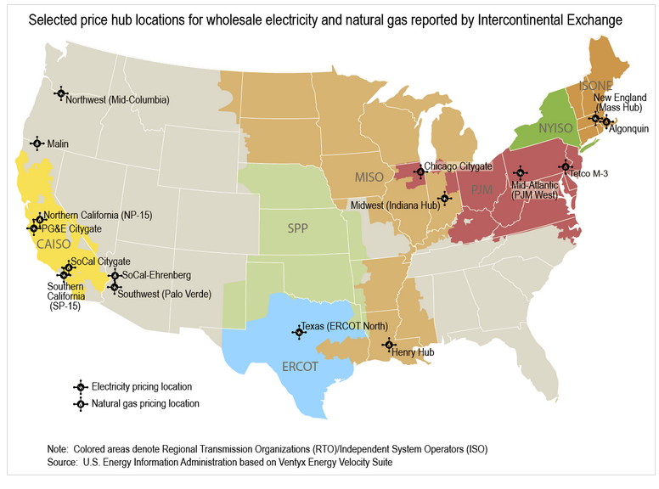
U.S. Regional Hubs
For the U.S., the EIA database is used that contains historic data (albeit in different formats) as well as Natural Gas basis differentials.

Slide 65
US Regional Markets - PJM
Prices are about USD 30/MWH (on-peak) and gas prices are about USD 3/MMBTU
Prices are reported publicly for on-peak periods. Prices are around USD 30/MWH in various markets and correlated to gas prices to different degrees. The first market reviewed is PJM.

Slide 66
Market Heat Rate US Regional Markets - PJM
The market prices relative to gas prices resulted in the following market heat rates – not the heat rates increased to 15 MMBTU/MWH. The heat rate remained below 10 for many years. Note that this market includes capacity prices.

Slide 67
Prices in 2006-2009
Note follows gas price but not precisely

Slide 68
Implied Heat Rates 2006-2009
Even though the prices were much higher, the market heat rates were lower and quite stable.

Slide 69
Monthly Average Gas and Electricity Prices in PJM from
When compute monthly averages, the correlation appears stronger.

Slide 70
Comparison of Monthly Implied Heat Rates
The heat rates have been stable.

Slide 71
Case: German Electricity Prices, Demand Growth and Renewables

Slide 72
German Gas and Electricity Prices and the Effect of Renewable
Note the relationship between the red line and the blue line.

Slide 73
Implied Heat Rate from German Baseload Prices
The all-hours price produces a low average heat rate.
The average heat rate was around 4 and utilities were having serious financial problems.

Slide 74
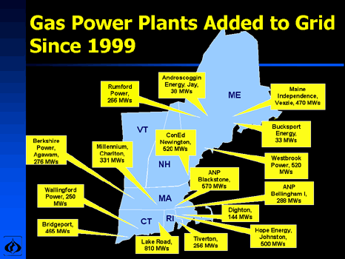
Case 1: New England Merchant Market Overbuild

Slide 75
Other Overbuild

Slide 76
US Regional Markets – NE ISO
In New England, if you can forecast the natural gas price, you can also forecast the electricity price.
Prices are about USD 40/MWH (on-peak) and gas prices are about USD 3/MMBTU

Slide 77
New England Over-build
Note the decline in the market heat rate from the start of the market – the big overbuild was finished in 2001 and heat rates tumbled. The increase has been very slow and capacity charges are needed to promote new plant development.

Slide 78
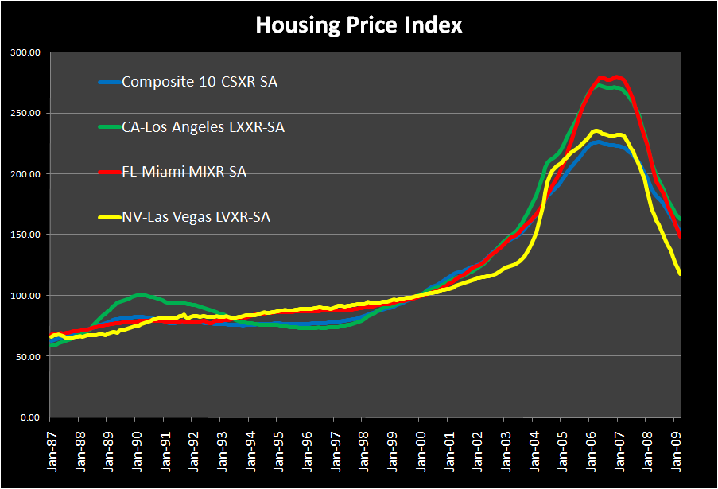
Bubble and Bust from Earning High IRR and Then Over-Supply
The notion of high prices when supply is constrained followed by crashing prices is not unique to electricity.

Slide 79
Midwest Peak Prices and Payback from Peaking Plants
This graph from 1996 to 2001 illustrated the dramatic price spikes that shocked the industry. Price spikes very high and then never again.

Slide 80
Summer of 1998
How many price spikes to build plant

Slide 81
Peaking Plant Economics
1 day of 2000 USD = 24 hrs x 2000/MWH
Provides 48,000/MWH
This is 48 per kW-year
If 3 days, then 48 x 3 = 144 USD/kW-yr
Peaking Plant costs about 400 USD/kW
Paid off 30% of plant cost

Slide 82
Midwest Overbuild – Annual Market Heat Rates
Midwest had very high price spikes that had never been seen before.

Slide 83
California – After Crisis
The gas and electricity is still correlated.

Slide 84
California Recent Prices
Recent prices have been down to USD 20/MWH. This is updated regularly.

Slide 85
Hydro Generation in the California Crisis

Slide 86
Gas and Electric Prices for California Crisis
Shows the dramatic prices. Was manipulation or capacity shortage. Never fully resolved.

Slide 87
California Implied Heat Rates
The Annual Heat Rates Demonstrate the crisis years. Extreme profits for gas plants.

Slide 88
California – Economics of Gas Plant
Note high gas and electricity prices in 2000 and 2001.
30 MMBTU/MWH x 5 USD/MMBTU gas price
If actual heat rate is 10 (old gas steam plant) implies profits of
(30-10) or 20 MMBTU/MWH x 5 USD/MMBTU = 100/MWH.
At 50% CF or about 5,000 hrs:
100 x 5,000 hrs = 500,000/MW-yr or 500 per kW-yr.
A new gas plant costs around 600 per kW.
Recovered about the full cost in one year

Slide 89
Daily On-Peak Heat Rates
Daily implied heat rates for NE-ISO and PJM on-peak prices.

Slide 90
Texas and Bankruptcy
Largest bankruptcy - TXU

Slide 91
Texas Prices from 2002-2009
Prices before the decline in gas prices were high enough to justify the price paid for nuclear plant

Slide 92
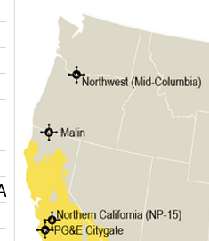
Wind Production and Transmission Differentials
Mid Con and Wind

Slide 93
Wind Production and Transmission Differentials
Mid Con and Wind – Show wind patterns in northeast.

Slide 94
Wind Production and Transmission Differentials
Mid Con and Wind: 2014 – 2017 on-peak prices. Merchant wind having a difficult time.

Slide 95
Price Differentials were Lower in Earlier Years
Price Differentials 2002-2007

Slide 96
A Little Review of Merchant Prices
The next few slides are intended to be a very quick review of what level prices could reach under a merchant system. Prices in merchant markets are reviewed in USD/MWH. These prices are the driver of terminal value and strategic options. Prices are reviewed in:
  US regional markets
  Philippines
  Europe
  Australia
  Turkey
  Scandinavia
  United Kingdom

Slide 97
A Little Review of Merchant Prices
The next few slides are intended to be a very quick review of what level prices could reach under a merchant system. Prices in merchant markets are reviewed in USD/MWH. These prices are the driver of terminal value and strategic options. Prices are reviewed in:
  US regional markets
  Philippines
  Europe
  Australia
  Turkey
  Scandinavia
  United Kingdom

Slide 98
A Little Review of Merchant Prices
The next few slides are intended to be a very quick review of what level prices could reach under a merchant system. Prices in merchant markets are reviewed in USD/MWH. These prices are the driver of terminal value and strategic options. Prices are reviewed in:
  US regional markets
  Philippines
  Europe
  Australia
  Turkey
  Scandinavia
  United Kingdom

Slide 99
A Little Review of Merchant Prices
The next few slides are intended to be a very quick review of what level prices could reach under a merchant system. Prices in merchant markets are reviewed in USD/MWH. These prices are the driver of terminal value and strategic options. Prices are reviewed in:
  US regional markets
  Philippines
  Europe
  Australia
  Turkey
  Scandinavia
  United Kingdom

Slide 100
A Little Review of Merchant Prices
The next few slides are intended to be a very quick review of what level prices could reach under a merchant system. Prices in merchant markets are reviewed in USD/MWH. These prices are the driver of terminal value and strategic options. Prices are reviewed in:
  US regional markets
  Philippines
  Europe
  Australia
  Turkey
  Scandinavia
  United Kingdom

Slide 101
A Little Review of Merchant Prices
The next few slides are intended to be a very quick review of what level prices could reach under a merchant system. Prices in merchant markets are reviewed in USD/MWH. These prices are the driver of terminal value and strategic options. Prices are reviewed in:
  US regional markets
  Philippines
  Europe
  Australia
  Turkey
  Scandinavia
  United Kingdom

Slide 102
A Little Review of Merchant Prices
The next few slides are intended to be a very quick review of what level prices could reach under a merchant system. Prices in merchant markets are reviewed in USD/MWH. These prices are the driver of terminal value and strategic options. Prices are reviewed in:
  US regional markets
  Philippines
  Europe
  Australia
  Turkey
  Scandinavia
  United Kingdom

Slide 103
A Little Review of Merchant Prices
The next few slides are intended to be a very quick review of what level prices could reach under a merchant system. Prices in merchant markets are reviewed in USD/MWH. These prices are the driver of terminal value and strategic options. Prices are reviewed in:
  US regional markets
  Philippines
  Europe
  Australia
  Turkey
  Scandinavia
  United Kingdom

Slide 104
A Little Review of Merchant Prices
The next few slides are intended to be a very quick review of what level prices could reach under a merchant system. Prices in merchant markets are reviewed in USD/MWH. These prices are the driver of terminal value and strategic options. Prices are reviewed in:
  US regional markets
  Philippines
  Europe
  Australia
  Turkey
  Scandinavia
  United Kingdom

Slide 105
A Little Review of Merchant Prices
The next few slides are intended to be a very quick review of what level prices could reach under a merchant system. Prices in merchant markets are reviewed in USD/MWH. These prices are the driver of terminal value and strategic options. Prices are reviewed in:
  US regional markets
  Philippines
  Europe
  Australia
  Turkey
  Scandinavia
  United Kingdom

