Slide 1
Major Subjects
Introduction and Alternative Valuation Techniques
Corporate Modelling for DCF and Credit Analysis
Valuation from Multiples and Financial Mathematics
Valuation with DCF Analysis
M&A Analysis from Corporate Model
Risk and Scenario Analysis
Corporate Credit Analysis
Cost of Capital Analysis

Slide 2
Introduction
Introduction and Alternative Valuation Techniques
  Innovations in Modelling, Theory and Data Analysis
  Football Field Diagram and Variation in Valuation
  Economic Theory of M&A and Synergies
  Alternative Valuation Techniques and Ranges
  LBO Analysis
  Accretion and Dilution
  Stock Market Review for Valuation Analysis

Slide 3
Corporate Modelling
Corporate Modelling for DCF and Credit Analysis
  Objectives of Corporate Modelling
  Excel Functions and Techniques for Modelling including Interpolate Function
  Structure of Corporate Models
  Acquiring Data from Internet and From PDF files and Presentation of History
  Evaluating Fundamental Risks of Operating Cash Flow
  Objectives and Mechanics of ROIC using Direct and Indirect method
  Problems with Depreciation in Corporate Models

Slide 4
Valuation Mathematics and Multiples
Valuation from Multiples
  PE Ratio Analysis
  EV/EBITDA Analysis
  Fundamental Financial Mathematics
  Value Driver Formula and Problems
  Stable Relationships for Evaluating Capital Investments and Other Items

Slide 5
Valuation from DCF Analysis
Valuation with DCF Analysis
  Careful Definition of Cash Flow (Deferred taxes, warranty costs, employee reserves)
  Flexible timing in DCF
  ½ Year Adjustment in DCF
  Terminal Value with Timing in Models
  Alternative Terminal Methods
  Adjustment to Terminal Value for EBITDA, Working Capital, Capital Expenditures, Deferred Tax and Other Items
  Evaluating the Bridge Between Enterprise Value and Equity Value

Slide 6
M&A Analysis from Private Equity and LBO
M&A Analysis from Private Equity and LBO
  Acquisition Model Mechanics
  Acquisition Transaction Costs
  Merger Models and LBO Models
  Debt Provisions and Analysis in Acquisition Models
  Tax Provisions and Analysis in Acquisition Models

Slide 7
Corporate Credit Analysis
  Project and Corporate Finance Credit Analysis
  Use of Ratios in Evaluating Credit Risk
  Credit Scoring with Financial Ratios and Models
  Risk Analysis for Credit Analysis and Modelling
  Default Risk Statistics and Analysis
  Creating Short-term Model and Working Capital Loans
  Theory of Credit Risk and Merton Model

Slide 8
Cost of Capital
Cost of Capital Analysis
  Can you Avoid Cost of Capital in Valuation
  Traditional Measurement with Beta
  Simple DCF Model
  Implied Cost of Capital from P/E and EV/EBITDA Ratio
  Cost of Capital from Market to Book Ratio
  Weighted Average Cost of Capital
    Theory of constant weighted cost of capital
    Debt beta, credit spreads and debt cost of capital
    Tax shields and weighted average cost of capital

Slide 9
Risk and Scenario Analysis
Risk and Scenario Analysis
  Where to Put Scenarios
  Scenario Analysis with INDEX Function
  Scenario Reporter
  Presentation of Scenario Analysis
  Circular Reference Problems with Corporate Models

Slide 10
Introduction: Football Field Diagram and Alternative Valuation Approaches with Different Ranges in Value for M&A Evaluation

Slide 11
Introduction
Introduction and Alternative Valuation Techniques
  Innovations in Modelling, Theory and Data Analysis
  Football Field Diagram and Variation in Valuation
  Economic Theory of M&A and Synergies
  Multiples
  DCF Valuation
  Premiums Paid
  LBO Analysis
  Accretion and Dilution
  Stock Market Review for Valuation Analysis

Slide 12
Innovations in Finance Theory, Modelling and Data Analysis

Slide 13

Corporate Finance, Risk Assessment and Magic Potion
Calculation of Cost of Capital with CAPM and Expected Market Risk Premium
Use of Valuation Formula: Value = Income x (1-g/ROIC)/(WACC-g)
Assumption that a Company will suddenly become a stable company in equilibrium
Myriad of adjustments for political risk, liquidity, beta mean reversion, small company risk …
Methods to Normalise Cash Flow in Terminal Period

Slide 14
Innovations in Corporate Finance Theory
Solution to IRR problem of re-investment and ranking with Weighted Average IRR
Computing Cost of Capital with Market to Book Regression Rather than CAPM
Demonstration of Flaws in Value Driver Formula: V=Income x (1-g/ROI)/(COC-g)
Correct Evaluation of WACC using Tax Shield from Interest Expense
Use of Credit Spread to Derive Debt Beta and More Properly Derive Unlevered Beta
Evaluation of Terminal Value Adjustments for Capital Expenditures, Working Capital and Deferred Tax that Depend on Growth
Adjustments to Free Cash Flow and EV to Enterprise Value Bridge for Deferred Tax, Warranty Cost and Other Items
Development of Terminal Valuation Techniques for Financial Institutions that Use Market to Book Ratio and ROE from Financial Models
Evaluation of Political Risk Premia from Computing Implied Probability of Default

Slide 15
Innovations in Corporate Modelling
Use of Historic Switch to Make Incorporation of New Financial Statements
Evaluation of ROIC and Invested Capital Using Switches and SUMPRODUCT
Development of INTERPOLATE Function to Evaluate Assumptions
Automation of Scenario Analysis with Scenario Reporter
Effective Automation of Historic Data Graphs with Flexible Spinner Box
Resolution of Circular References Related to Interest Expense and Taxes
Deprecation Techniques that Account for Changing Growth and Implied Retirements
Development of Techniques to Automate Constant Capital Structure in Financial Models
Dynamic Goal Seek Functions for Evaluation of Cost of Capital Using P/E Ratios
User Defined Functions for Computing Stable Capital Expenditures to Depreciation and Other Items

Slide 16
Innovations in Corporate Finance Data Analysis
Creation of techniques to download stock price data, financial statement data and economic data
Stock price database that allows you to evaluate IRR’s, volatility and beta for stocks, stock price indices, economic series and commodity prices.
Financial Database that allows you to extract and evaluate financial data, financial ratios, and cost of capital across companies.
Extraction of Data that Enables you to have Historic Basis for Creating Financial Models.
Interest Rate, Exchange Rate and Commodity Price Databases that Include Historic Evaluation of Term Structures, Volatility and Other Statistics.
Comprehensive Country by Country Database to Evaluate Growth and Risks Across the World.

Slide 17
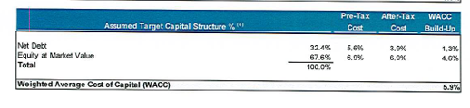
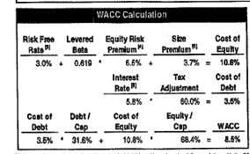
Cost of Capital in Same Transaction
Top is buy side (if negotiating would want high cost of capital). Bottom is sell side.

Slide 18
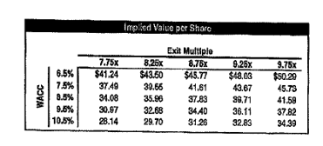
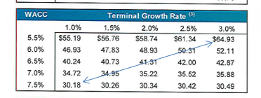
Effect of WACC on DCF
Variation in value from the cost of capital with the two cases. Note how much more the variation is than is reported on the Football field diagram.

Slide 19
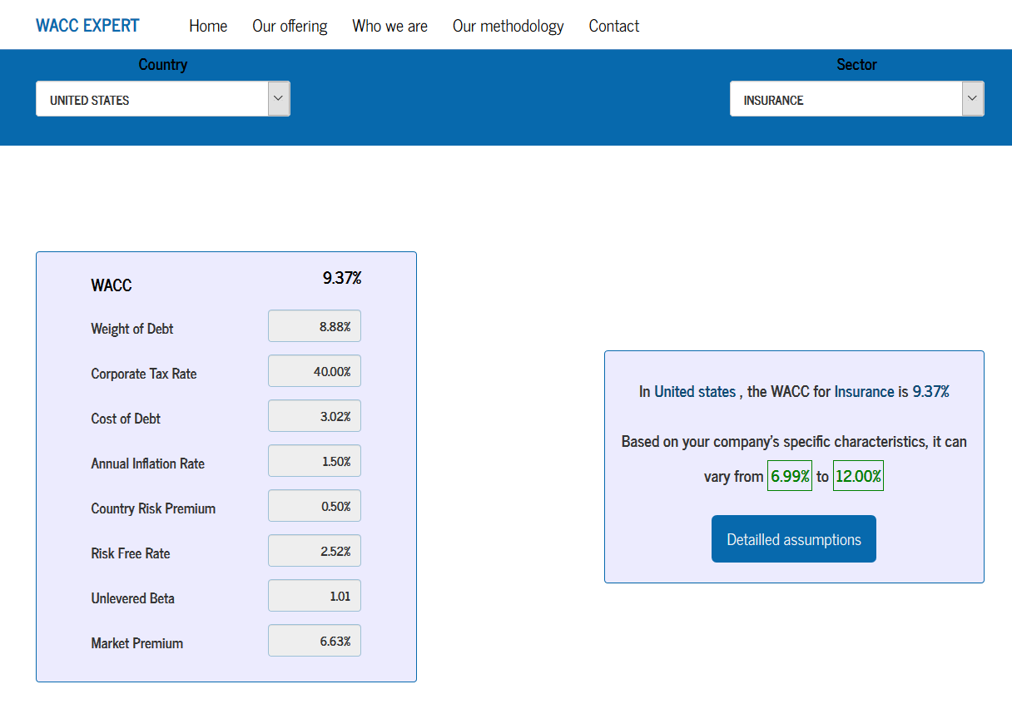
WACC Craziness – Website with WACC for Insurance
http://www.waccexpert.com/

Slide 20
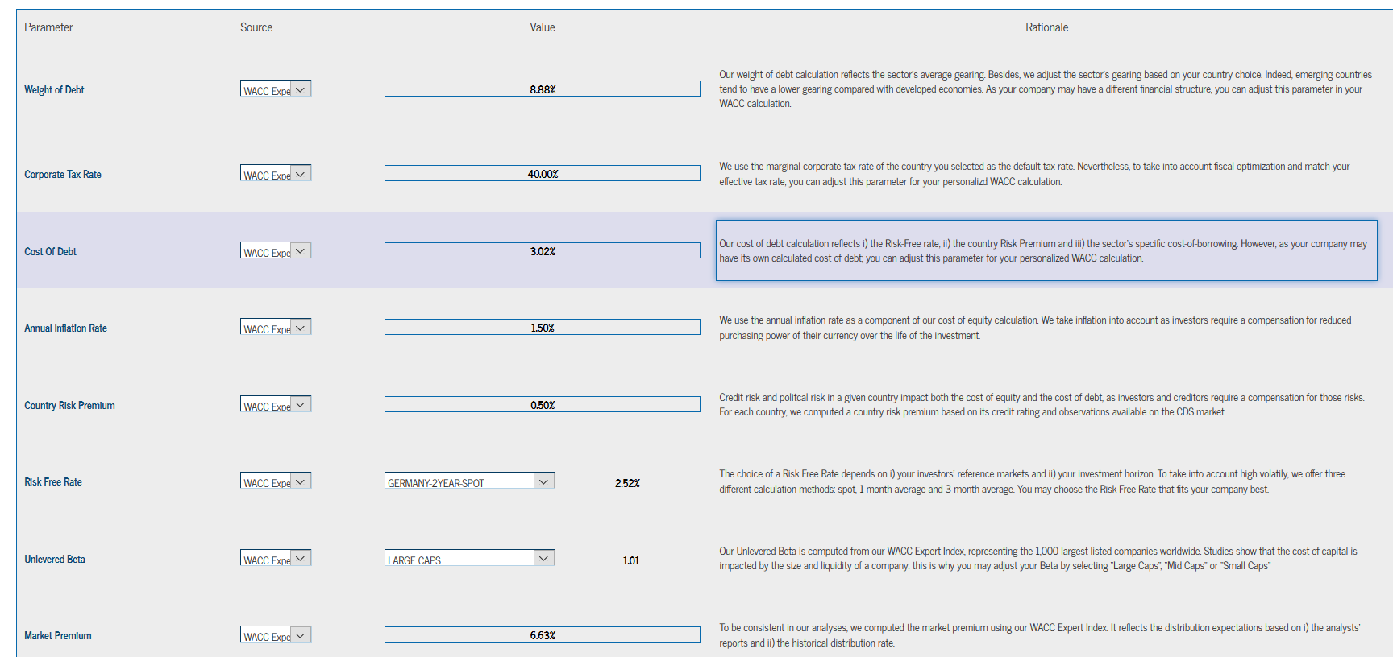
Cost of Capital for Insurance Companies

Slide 21
Football Field Diagrams and Ranges in Value from Different Techniques

Slide 22
Themes of Part 1
Theory
  Divergence in values from football field diagram
  Fundamental valuation issues and the present value of synergies
  Computation of accretion and dilution as well as break-even synergies from exchange analysis and importance of P/E ratio
  Difficulty in defining discount rate
Excel Analysis
  Creating football field and labels
  Using correct functions and interpolate in excel
  Creating effective presentation of accretion and dilution

Slide 23
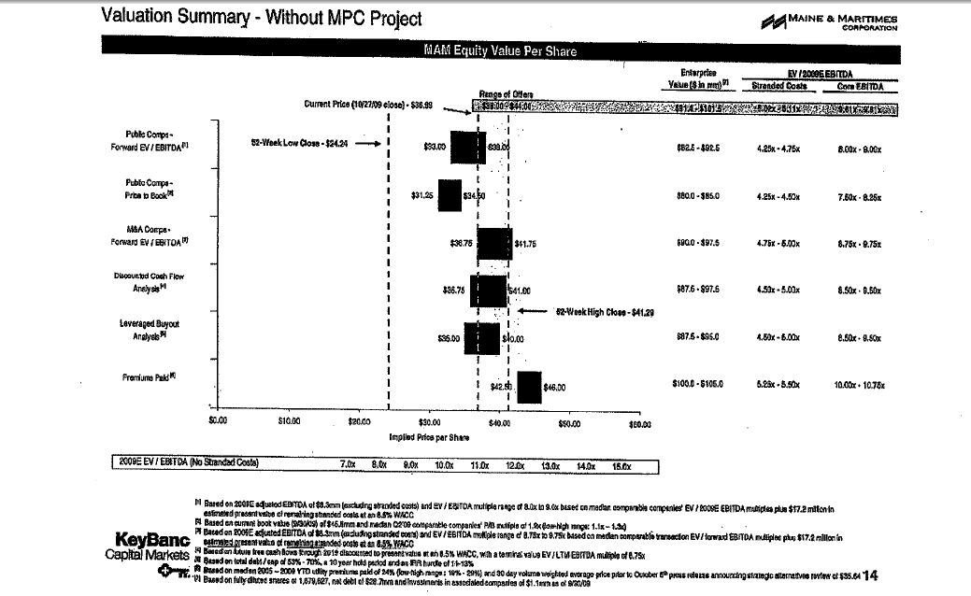
Football Field Diagram – Seller
Show the price per share and the Enterprise Value

Slide 24
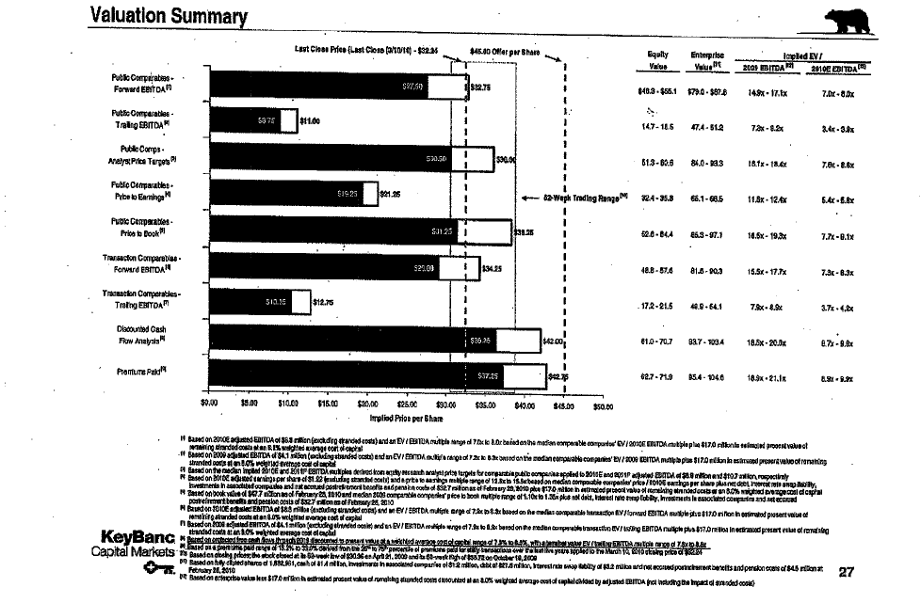
Football Field Diagram – Sell Side
Includes purchase price
Notes on forward EBITDA from Earnings Projection

Slide 25
Football Field Data Example
Look at Different Methods of Valuation
  Recognize that there is not a precise number
  Recognize that there is not a single method, but many

Slide 26
Football Field Diagram in Exercise File
Example – tricky technical part is to create space for labels and put in the labels – you can see this in the exercise file.

Slide 27
Issues with Each Method M&A Valuation Method
Problems with use of multiples – finding the right multiple when multiples change within an industry and over time – see the data
Use of transaction multiples – why is there a wide range for different transactions.
When is it better to use the DCF model and how should the DCF model be applied in different industries.
Is the accretion and dilution method really as bad as you learn in business school.
Can you effectively compute the rate of return earned on an acquisition (the LBO method in the football field diagram)

Slide 28
Economic Theory of M&A and Accretion/Dilution

Slide 29
Danger of Thinking You Are Too Smart and Making Things Un-necessarily Complex
In Finance
  M&A is some kind of magic and requires highly technical and advanced knowledge:
Sun Edison Quote:
    SunEdison will transfer to Seller Note LLC, and Seller Note LLC will pledge, on a first priority basis, additional shares of the Class B Securities in connection with any adjustment to the exchange rate, so that, at all times, the Class B Securities equal to the full number of shares of TerraForm Power Class A Common Stock issuable upon exchange of the Exchangeable Notes shall be held by Seller Note LLC and subject to such first priority lien.
    …repurchase date is after a regular record date and on or prior to the interest payment date to which it relates, Seller Note LLC will instead pay interest accrued to the interest payment date to the holder of record of the Exchangeable Note as of the close of business on the regular record date, and the Fundamental Change purchase price shall then be equal to 100% of the principal amount of the note subject to purchase and will not include any accrued and unpaid interest. In addition, following certain events that constitute “Make-Whole Fundamental Changes” (as defined in the Exchangeable Notes Indenture), Seller Note LLC will increase the exchange rate for holders who elect to exchange Exchangeable Notes in connection with such events in certain circumstances.
Sun Edison Shortly Went Bankrupt

Slide 30
Don’t be Intimidated by Fancy Terms – M&A is a Valuation Problem with Some Wrinkles
There are a few things we should agreed on. One is that valuation comes from two things – estimates of future cash flow and risk of that cash flow.
  The cash flow could be equity cash flow – dividends; debt cash flow – debt service; free cash flow etc.
  Adjusting the cash flow for risk requires discounting at a cost of capital that is adjusted for risk.
An acquisition produces cash flow and that cash flow can have different levels of risk. As such, an acquisition can be viewed as a standard valuation problem with a few exceptions.
Valuation ➔ (1) Future Cash Flow and (2) Risk

Slide 31
M&A Language Does Not Mean You Need Different Analysis Techniques
M&A transactions can involve partial share exchange and partial cash payments; different forms of debt can be used as to fund the acquisition. A merger can involve a series of options including earn out provisions.
Terms of transaction may lead to accretion or dilution in earnings per share or other measures.
Private equity transactions can involve complex debt terms.
Do not assume that these things make M&A analysis fundamentally different than other valuation analyses.

Slide 32

Differences in Valuation for M&A and Other Typical Valuations
The most basic economic idea of an acquisition involves why anybody would pay a premium above the market price for anything. (It is as if you go to get your can of beer and pay more than the price listed (or you pay me for stuff on my website).
If you think a listed company is undervalued, you can just ask your shareholders to buy some shares or even by the shares yourself.
But if you can get control of the company, you can fire people and do other things to realize synergies. If the value of taking control and realizing synergies is more than the value of the premium, then the acquisition has positive value.
Economics: PV of After-tax Synergies > Premium

Slide 33
Valuing Synergies is Not Like Valuing Other Cash Flows and Should Not Apply the Same Discount Rate
There are a few points about valuing synergies that you should consider and are not necessarily evaluated when thinking about M&A economics:
  First, the risk of a change in management strategy is not the same as the overall risk of the company.
  Second, the revenue and expense synergies should be after tax.
  Third, you can never really assess whether synergies have been obtained, because you do not know what would have happened without the acquisition.

Slide 34
Basic Merger and Acquisition Background
A few terms that will be used throughout the course.
Mergers and Acquisitions are valuation and capital budgeting problems, but:
  The value of synergies and management strategy in M&A are difficult to quantify with financial models
  Costs and benefits of a merger can be measured in various different ways (DCF Valuation, Equity IRR, EPS changes, credit quality, NPV)
  Accounting, tax, and regulatory issues can be complex in modeling (goodwill, tax step-ups, re-financing)
Methods of quantifying the costs and benefits of M&A with financial model
  Merger or consolidation; performance of combined company in terms of EPS and credit quality (as well as DCF of target company)
  Acquisition; model the rate of return earned assuming that the company will be re-sold after a holding period and evaluate EPS effects (as well as DCF of target company)

Slide 35
Synergy and Premium Example and Valuation of Target
Go back to the beer example. You are not buying beer for yourself, but you are buying it for everybody in the room (your shareholders). You are just a buyer for other people and it is not your money.
You believe that one of the beers has a lower price than its true inherent value.
Of course the undervaluation does not mean that you should pay more for the beer.
This implies that under-valuation does not mean that you should pay a premium.

Slide 36

Simplistic Analysis of Acquisitions
Let’s say the acquisition is in your industry (it is really stupid to think you can get synergies from operating in other industries).
You would rather buy a company that is earning a low return than a high return because there is room for improvement.
This idea does not work if returns are a function of sunk cost investments like policies in the insurance industry.
Simple Rule:
  Same industry
  Target has low return on investment

Slide 37
Premium and Synergy Example
Estimated Premium and Synergy Example

Slide 38
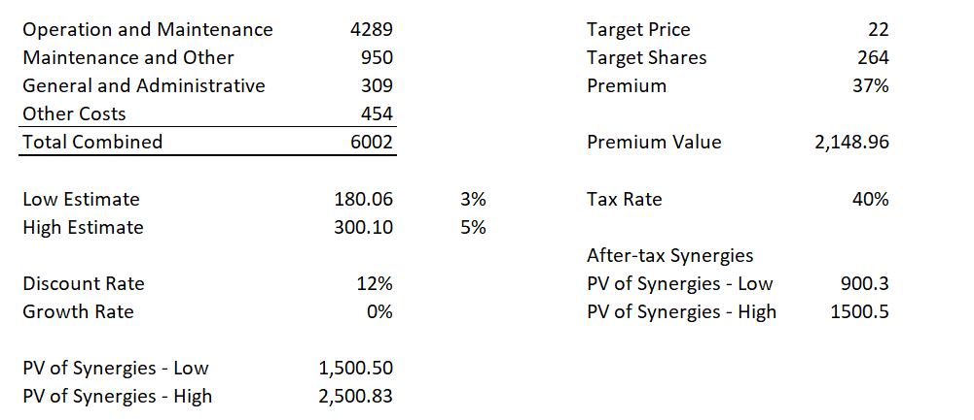
Economic Analysis of Merger with NPV of After Tax Synergies versus Premium
Note how depends on discount rate and tax rate. Some also use P/E to after-tax synergies or EV/EBITDA to pre-tax synergies.
Can compute the economic IRR on a transaction.

Slide 39

Accretion and Dilution Example
Protective life purchased at 34% premium. No change in management by Dai-ichi.
Dai-ichi said the favorable foreign exchange rate Dai-ichi secured in the acquisition of Protective largely offset the premium it paid. The yen has weakened 14% against the dollar since the purchase agreement.
Dai-ichi plans to set up a holding-company structure in October 2016 under which Tokyo headquarters will delegate more power to North American and Asian regional heads. Understand that management not changed – implies no synergies.

Slide 40
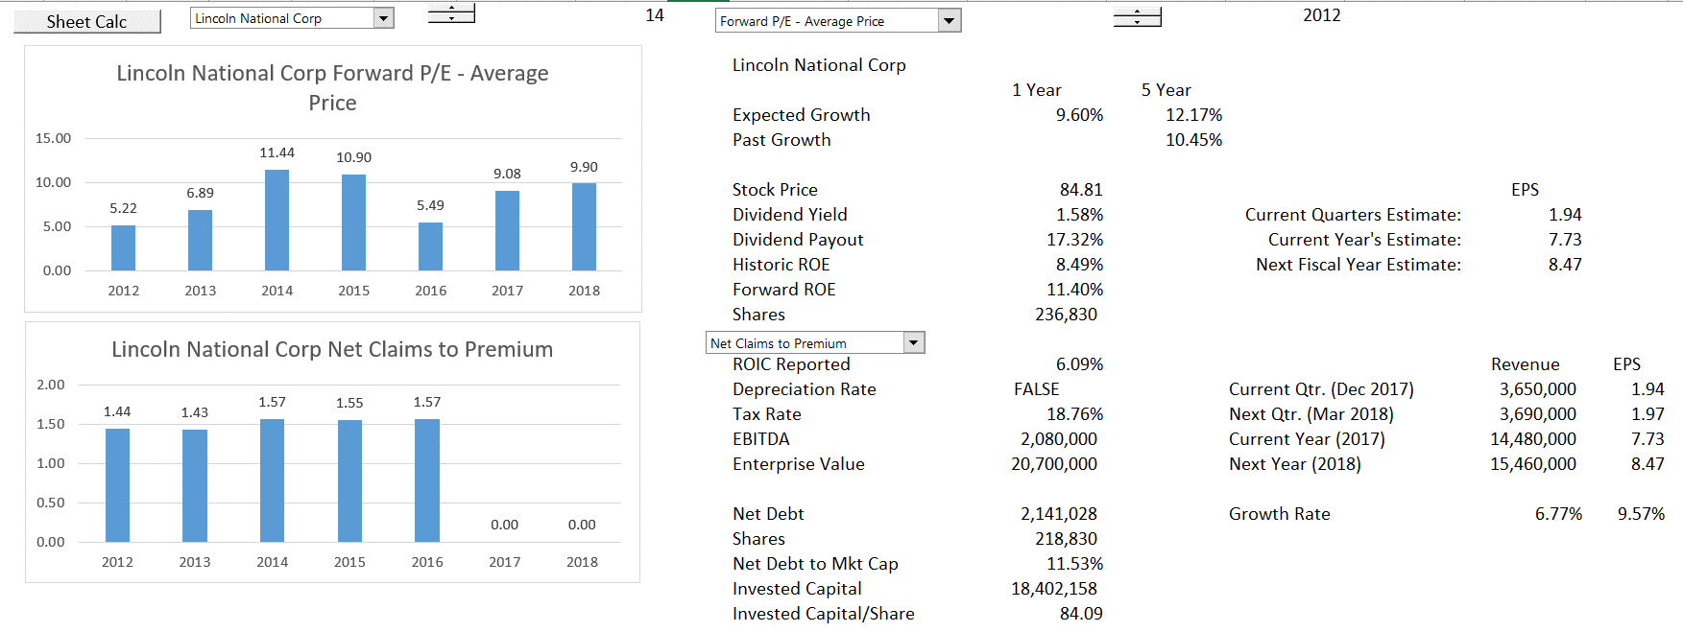
Accretion and Dilution Analysis: Target – Low P/E Ratio
Use Lincoln National as the target because of low P/E – note expected growth in EPS

Slide 41
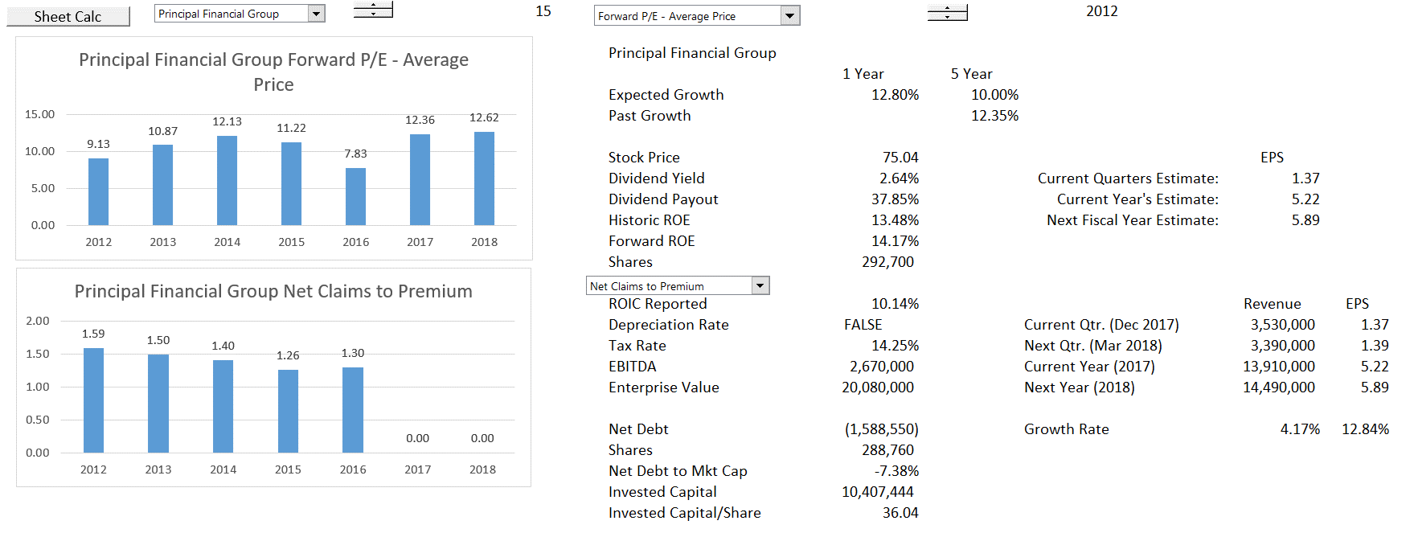
Accretion and Dilution Analysis: Acquiring Company
Use Principal Financial Group as assumed acquiring company

Slide 42
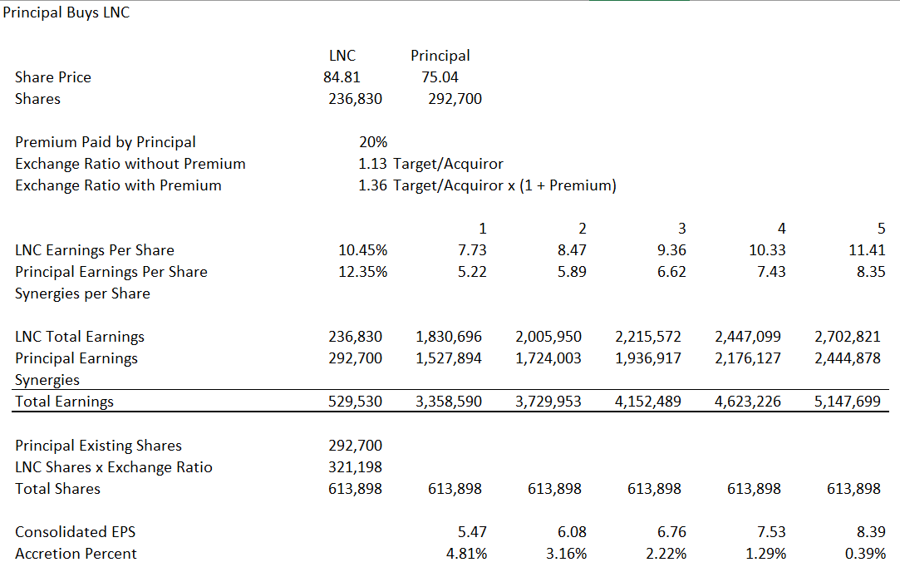
Demonstration of Accretion without Synergies
This is like USD/Euro – You get higher exchange rate.

Slide 43
Standard Valuation Problems

Slide 44
Standard Problems in Valuation
Some general valuation problems related to the notion that any valuation problem involves: (1) forecasting cash flow, and (2) quantifying and assessing risk:
Forecasting Cash Flow
  Earning returns higher than history without special competitive advantages.
  Cash flow in the long-run that is not consistent with investments required to earn the cash flow.
  Not considering fundamental risk factors of surplus capacity, technical obsoleteness, growth and product maturity in key assumptions.
Risk of Cash Flow
  Use of magic potion models to come up with minimum required returns.
  Absurd risk premiums for country risk, small companies, private companies.
  Adjustments to WACC for debt beta and taxes that make no sense.

Slide 45
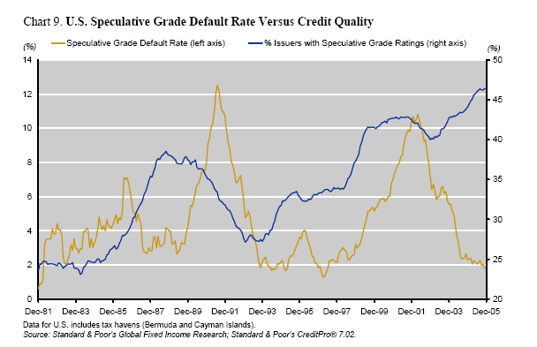
Problems with Valuation – Estimates of Cash Flow
Financial projections that underpinned several high-profile LBO bankruptcies in the late 1980s. Many of these transactions were based on assumptions that the companies could achieve levels of performance, revenue growth, operating margins, and capital utilization never before achieved in their industry.
The buyers of these companies typically had no concrete plans for executing the financial performance necessary to meet their obligations. In many such transactions, the buyers simply assumed that they could resell pieces of the acquired companies for a higher price to someone else.

Slide 46
Why Start with Introduction to Stock Prices
Demonstrates reasonable return expectations over the long term from M&A.
Stock prices are the subject of Football Field diagrams and valuation.
Compare stock returns with growth in corporate profits to introduce multiples.
Evaluate traditional measures of risk for different industries.
Note: There are no real answers here – it is mainly background

Slide 47
How Do You Know When To Start
A long time ago there was a study of by Ibbetson who tried to come up with the equity risk premium.
To evaluate what is really required by investors, the general idea is that you had to go back a long way – then you can remove ups and downs and assume the requirements equal the expectations (I am not saying this is in any way a reasonable idea).
But it can be interesting to look a long way back.
Various conclusions are affected by the start and end dates of the analysis.

Slide 48
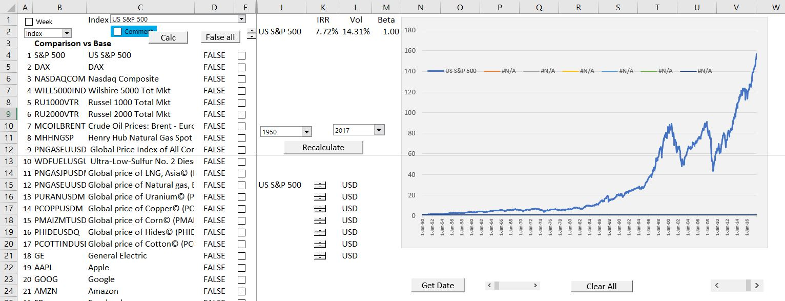
Example of Indices
S&P Index since 1950 is base.
IRR is final value (149.5) divided by initial value (1.0), raised to years – 1 (67.8 years).
Returns and volatility is affected by the time period.

Slide 49
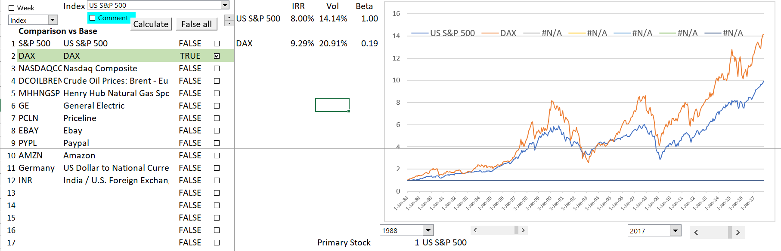
S&P 500 and DAX
This illustrates how you can compare different indices and adjust for exchange rates.
Note the volatility and the Beta versus the IRR

Slide 50
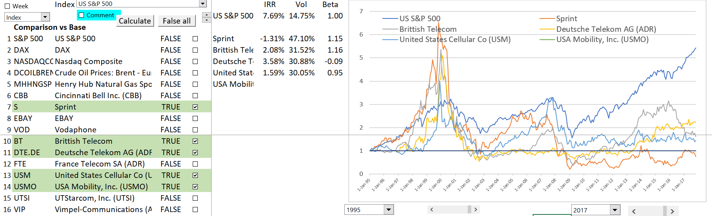
Telecom’s and the Dot.com Bubble
As shown in the graph, the stocks of the telecoms were more variable.

Slide 51
Fundamental Economic Question of Economic Growth and Stock Value Growth
Can stocks out-grow the overall economy in the long-run.
  Eventually, stocks should reflect corporate profits.
  Corporate profits should reflect overall economic growth, otherwise there will be nothing but corporate profits – nothing for anybody who does not own corporations
What has been the return on stocks (with dividend re-investment) relative overall economic growth.
If stocks do not grow faster than the economy, then investors are not compensated for taking risk.

Slide 52
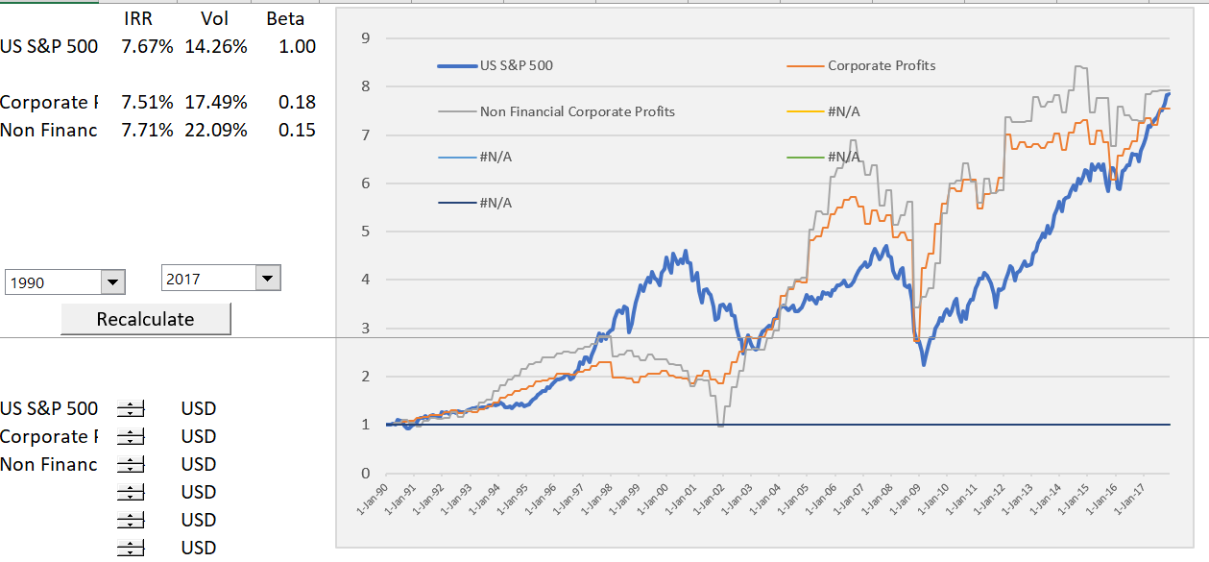
Long-term Review of Corporate Profits and Stock Prices
Note the volatility in corporate profits and the increase after the financial crisis. This has implications for the P/E ratio.
Profits are a quarterly series

Slide 53
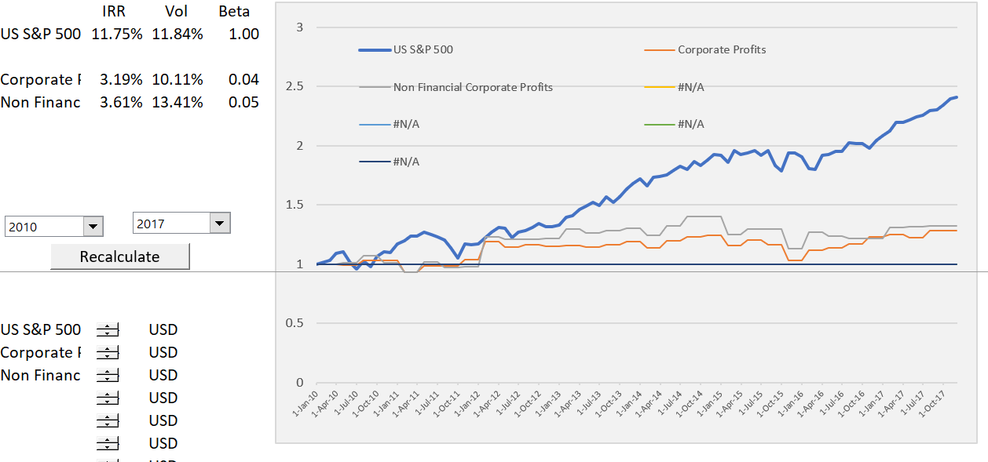
Again, this Type of Analysis Depends on the Start Point for the Analysis
If you start from 2010, it looks like there is a big increase stock prices relative to corporate profits.

Slide 54
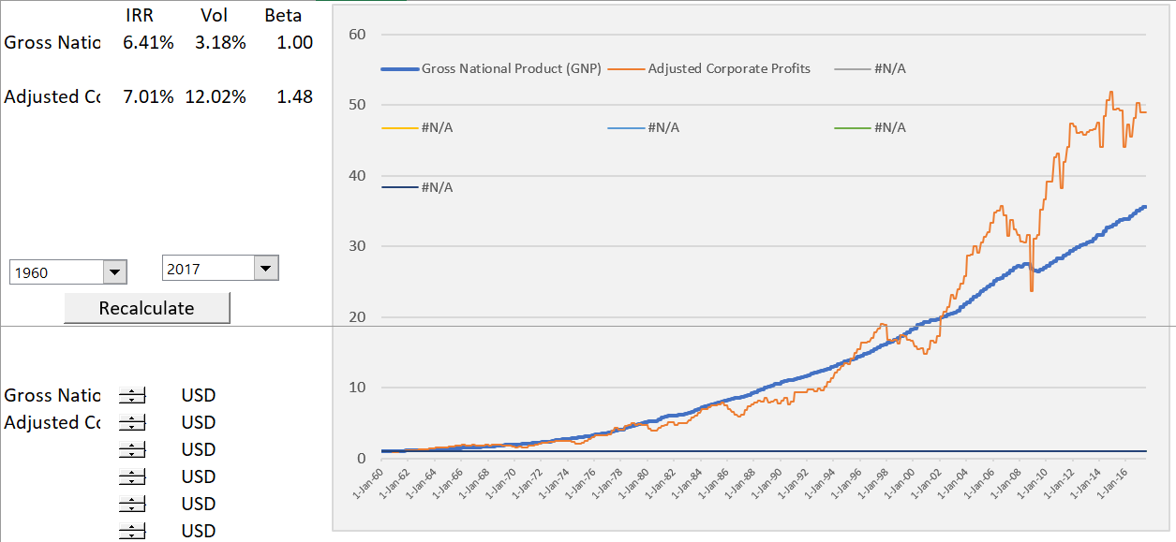
Compare the Corporate Profits with GDP
Raises questions of whether the level of corporate profits can continue to grow faster than GDP. This has implications about long-term growth.

Slide 55
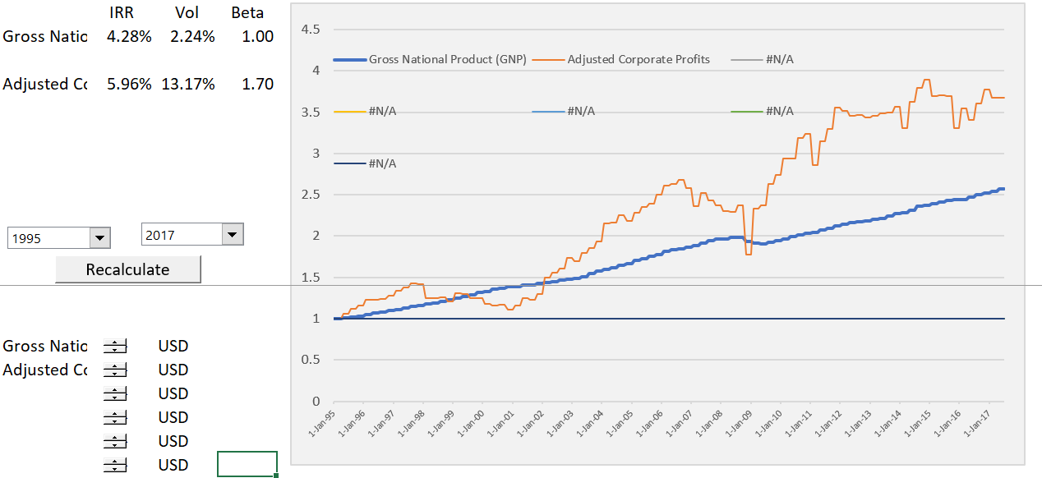
Again, Look at More Recent Trends
Recently, the corporate profits have not grown faster than GDP.

Slide 56
More Comparison of Stock Prices and Economic Indicies – GNP and Median Income
Note the recent increase in stock prices relative to national income and even corporate profits. Different starting points.

Slide 57
Creating a Model for Financial and Non-Financial Companies

Slide 58
Corporate Modelling
Corporate Modelling for DCF and Credit Analysis
  Objectives of Corporate Modelling
  Excel Functions and Techniques for Modelling including Interpolate Function
  Structure of Corporate Models
  Acquiring Data from Internet and From PDF files and Presentation of History
  Evaluating Fundamental Risks of Operating Cash Flow
  Objectives and Mechanics of ROIC using Direct and Indirect method
  Problems with Depreciation in Corporate Models

Slide 59
Introduction and Objectives

Slide 60
Corporate Modelling
  General Ideas and Objectives of Corporate Modelling
  Excel Functions and Techniques for Modelling including Interpolate Function
  Structure of Corporate Models and Simple Exercise
  Acquiring Data from Internet and From PDF files and Presentation of History and ROIC Analysis
  Evaluating Fundamental Risks of Operating Cash Flow
  Problems with Depreciation in Corporate Models
  Circular Reference Issues in Corporate Models

Slide 61
Corporate Finance Ideas for Simple Company
Lets say you can find the following:
  A company with some fluctuations in return, but not too much.
  A company that grows at about the same rate in real terms as the population (e.g. a food company).
  An industry where P/E multiples and EV/EBITDA multiples are stable across companies and stable over time.
  An industry where there is quite a lot of competition and assets are not very capital intensive.

Slide 62
Companies Used in McKinsey Book and Typical Examples
This kind of relatively stable company is used in the McKinsey Book. You can use ideas of ROIC and WACC along with a financial model to make a DCF analysis as well as a credit analysis. Companies in the McKinsey Book include:
  Fed Ex
  UPS
  Heiniken
  Disney
  Walgreens
  General Mills

Slide 63
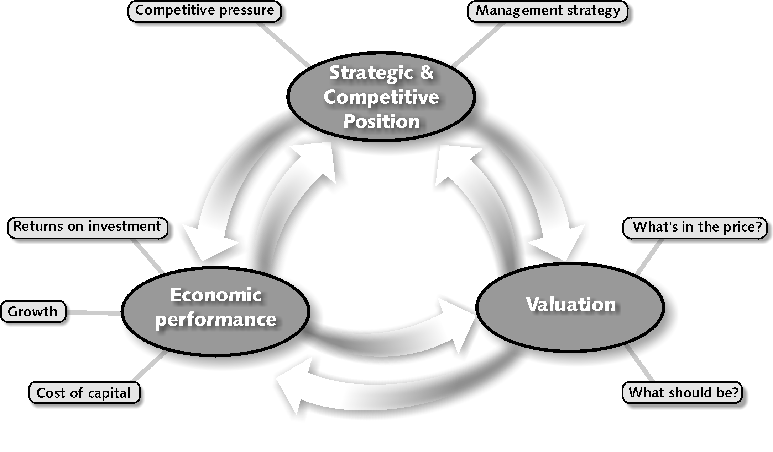
Analytical framework for Valuation – Combine Forecasts of Economic Performance with Cost of Capital
Competitive position such as pricing power and cost structure affects ROIC
In financial terms, value comes from ROIC and growth versus cost of capital
P/E ratio and other valuation come from ROIC and Growth

Slide 64
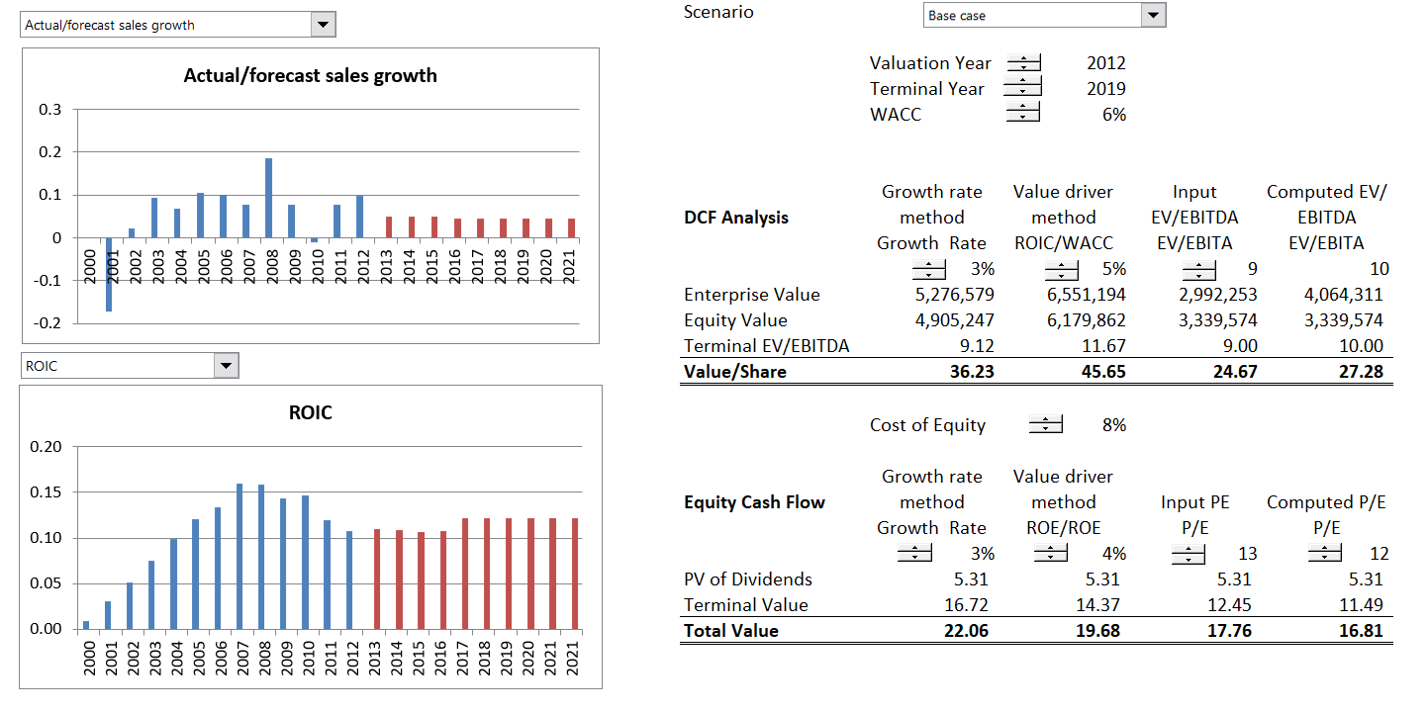
Example of Classic Company – Food Business and Use of ROIC for Benchmarking
In this case, keep ROIC in sight when make a valuation.

Slide 65
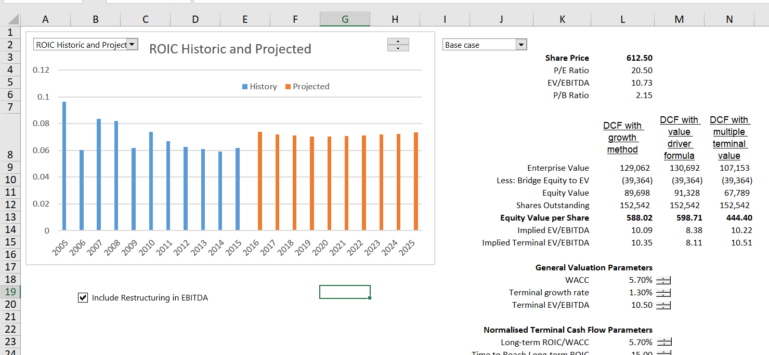
Carlsberg Analysis – Forecasting Management Ability to Affect Return
Change the scenarios and evaluate value at the same time you are gauging value

Slide 66
Use of Corporate Models in Credit Analysis
Using corporate models in credit analysis is more tricky than credit analysis with project finance models.
This is because you are really forecasting the ability to re-finance debt rather than pure cash flow. To forecast re-financing you need to evaluate and forecast financial ratios. Then, you have to evaluate whether the company can be re-financed.

Slide 67
Contrast Two Companies in Evaluation of Corporate Finance
Classic Company
Mature Company with capital expenditures used to make investment.
No large write-offs, re-structuring's or asset sales.
Multiples are similar across companies in the industry and over time.
Value to Investment (price to book) ratios are stable and can be used to evaluate company management and cost of capital.
Return earned on assets invested in the past is similar to return on investment on new assets.
Tricky Situations
Investment in the form of research, operating losses and software.
Balance sheet affected by gains on asset sales, write-offs, re-structuring charges.
Multiples change a lot over time for individual companies and across a cross-section of companies.
Value to investment have little meaning as historic investment was very small compared to new investment.
Return on historic investments change as plants age and conditions change in an industry.

Slide 68
But, What happens if …
Rate of return (it could be ROIC, ROCE, ROE or any other measure), is not very relevant because:
  Returns are distorted (i.e. very high) because of large writeoffs that the company took a couple of years ago
  Invested Capital is high because of because of asset sales that resulted in gains and a higher equity.
  Businesses like construction and contracting carry risks and therefore earn returns, but little or no capital is invested, so how can you compute ROIC, ROE etc.
  Investment is in the form of research and development or operating expense to keep quasi monopoly going (e.g. Apple, Google etc.)
  Return on new investments very different from return on historic investments (e.g. Amazon investment in food delivery versus investment in websites).

Slide 69
Also, What Happens if …
A company has been growing fast and it cannot keep growing forever, but you don’t really know how long the growth will last.
  If a company grows fast and its return is greater than its cost of capital, the P/E ratio and the EV/EBITDA ratio can be very high. Do you really think you can predict the length of time the company will continue to grow.
  If you claim that you know how fast the company can keep growing you are a fraud.
  A company has been experiencing high return on invested capital because of low capital spending, but it will eventually have to replace its capital.

Slide 70
Were the “New Economy” Ideas Not So Stupid
The new economy concepts were that real options could be created if a company gains scale. These ideas were laughed at. But after 20 years, maybe some of the ideas were not so silly.
For example, “the extraordinarily high anticipated profits represented by stock prices during the Internet bubble never materialized, because there was no ‘new economy.’”
Get data from the comprehensive stock price file.
The real thing that happened during the dot.com bubble was with telecom companies
Use Amazon, Priceline, Pay Pal, EBAY

Slide 71
Stock Prices of New Economy Stocks versus Old Economy Stocks
During the Internet bubble, managers and investors lost sight of what drove return on invested capital (ROIC); indeed, many forgot the importance of this ratio entirely. Many executives and investors either forgot or threw out fundamental rules of economics in the rarefied air of the Internet revolution.
The notion of “winner take all” led companies and investors to believe naively that all that mattered was getting big fast, and that they could worry about creating an effective business model later. Increasing-returns logic was also mistakenly applied to online pet supplies and grocery delivery services, even though these firms had to invest (unsustainably, eventually) in more drivers, trucks, warehouses, and inventory when their customer base grew. When the laws of economics prevailed, as they always do, it was clear that many Internet businesses did not have the unassailable competitive advantages required to earn even modest returns on invested capital.
unassailable competitive advantages = addiction to products or creating a monopoly

Slide 72
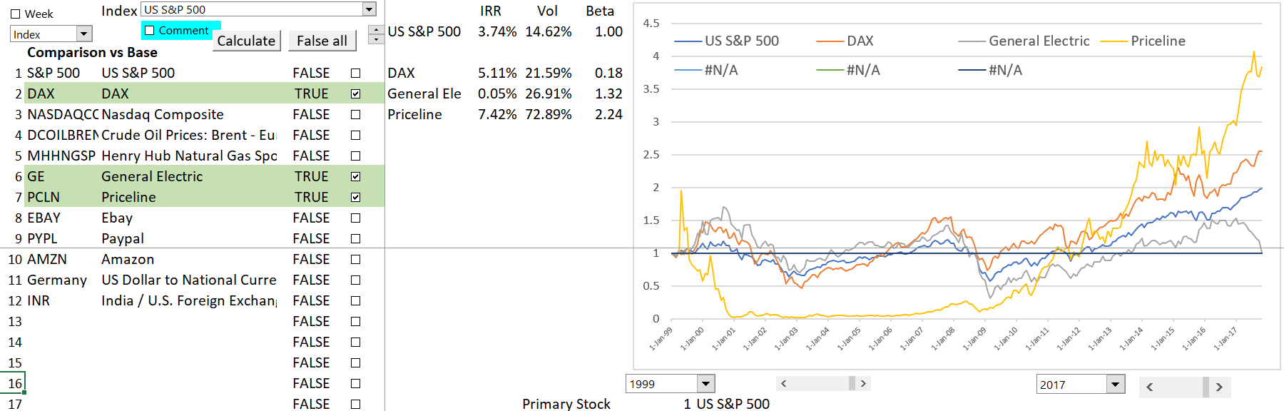
Comparison of Priceline to Old Economy Stocks
Now, begin to look at what were called “New Economy Stocks”. Begin with Priceline. It had no “unassailable” competitive advantage.

Slide 73
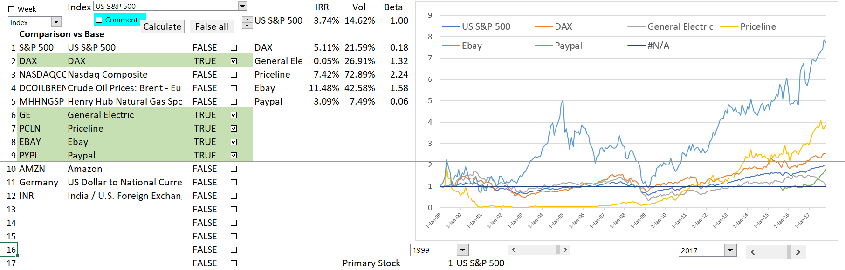
Now Add eBay
The case of eBay is more extreme.

Slide 74
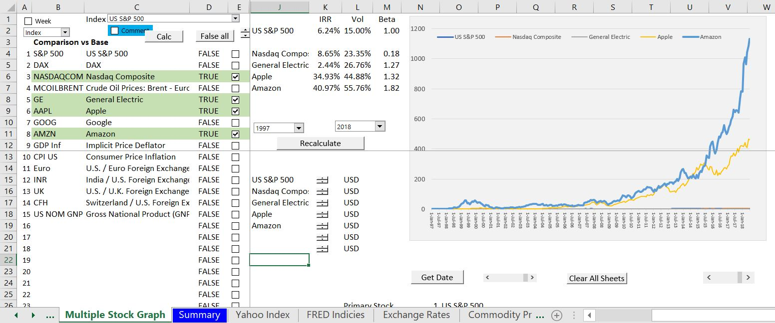
Explosion in Amazon Share Price – Can it be Explained with a Financial Model

Slide 75
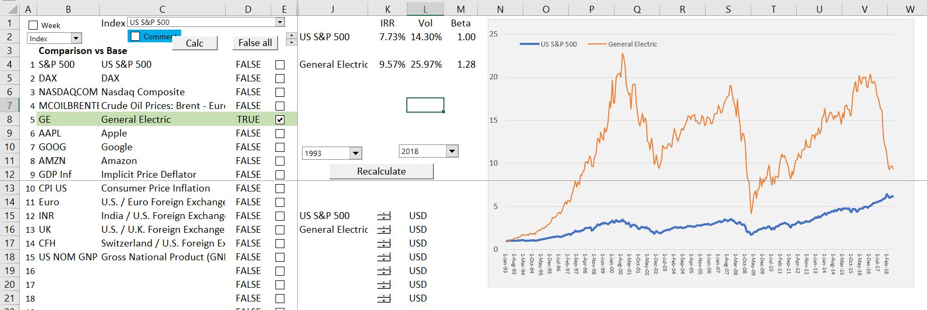
Crash in Share Price of GE – A Company that Makes Investments in Factories

Slide 76
Modelling Philosophy and Excel Functions

Slide 77
Modelling Discussion and Exercises
Review the general finance theory and concepts first.
  Do this very quickly with power point slides as many of the concepts have been discussed
  Do this because modelling is not useful unless understand the project finance concept
  After discussing the modelling concept, add issues into a simple model.
Many issues are much better analysed with a simple demonstration in excel rather than a big model with 30 sheets.

Slide 78

Financial Modelling Religion and FAST
Various organisations have rules for modelling.
One good technique for modelling (and maybe for your life) is FAST. (General conflict between Structure and Flexible)
F
  Flexible: Different timing, scenarios, financing techniques.
A
  Accurate or appropriate. The balance sheet must balance
S
  Structured.
  Separate financing from operations.
T
  Transparent – short equations.

Slide 79
What does Flexibility Mean in Corporate Model
Add new history without re-doing the model
Alternative terminal value timing
Addition of different scenario analysis
Alternative valuation techniques
Different types of assumptions (e.g. A/R to sales as last year or historic average)

Slide 80
Accurate/Appropriate
Accurate and Appropriate
  Level of detail in model
  Balance sheet
  Make Sure History is Accurate
  Evaluate ROIC

Slide 81

My Rule: Laziness Principle
There are many ways in excel to do things. Find the fastest and easiest way to do it.
  Often use short cut like Alt,E, IS
  Sometimes use the mouse
  Use entire row or column when you can
  Use TRUE/FALSE instead of IF: =1=1 is TRUE
    True is 1
    False is 0
Find the Laziest Way

Slide 82
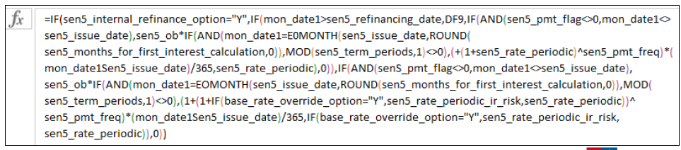
Transparency
Keep the formulas simple
No excuse at all for long formulas because it makes the concepts difficult to explain to somebody not familiar with the model.
Long formulas come about because you do not exactly understand what you are doing.

Slide 83

Excel Functions
We will use short-cuts, excel enhancements, TRUE/FALSE switches and only four functions.
The functions should be used in a way that you are probably not used to.
INDEX
LOOKUP (not VLOOKUP or HLOOKUP)
SUMIF (or AVERAGEIF or COUNTIF)
EDATE
MAX and MIN for Waterfalls (not IF)

Slide 84
Files to Use and Open
Generic Macros
Shift, CNTL, R to copy to the RIGHT
CNTL, ALT, C to colour and format
Must Enable Macros
Should say CNTL,ALT,C on the bottom of excel
Read PDF to Excel
Should say SHIFT, CNTL, A on the bottom
Enable Macros
Use Acrobat
Use Google Chrome

Slide 85
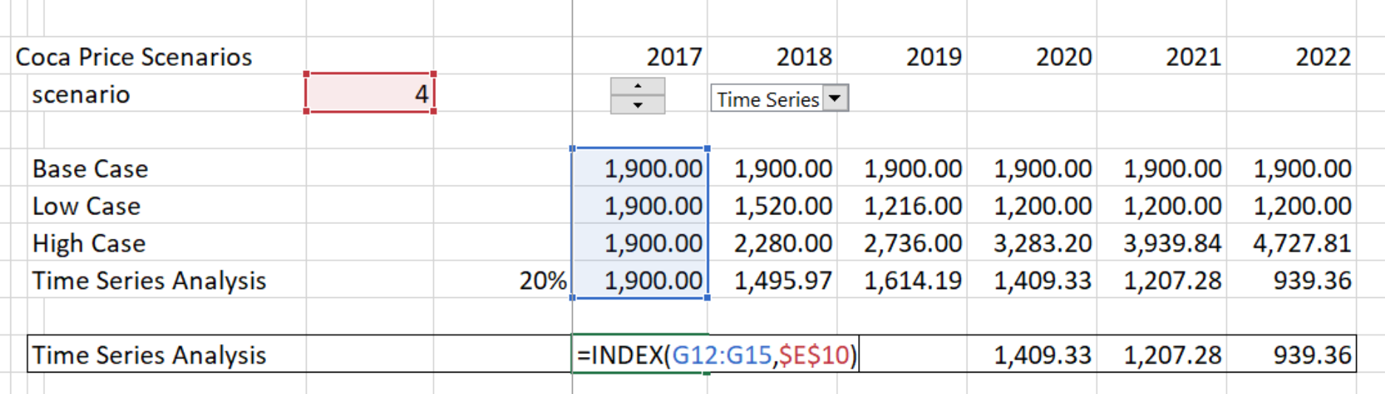
Example of INDEX Function
We will make scenarios for things like:
  Variation in traffic for infrastructure projects
  Variation in price for commodity projects
  Difference in availability for availability projects
Example of Index Function

Slide 86
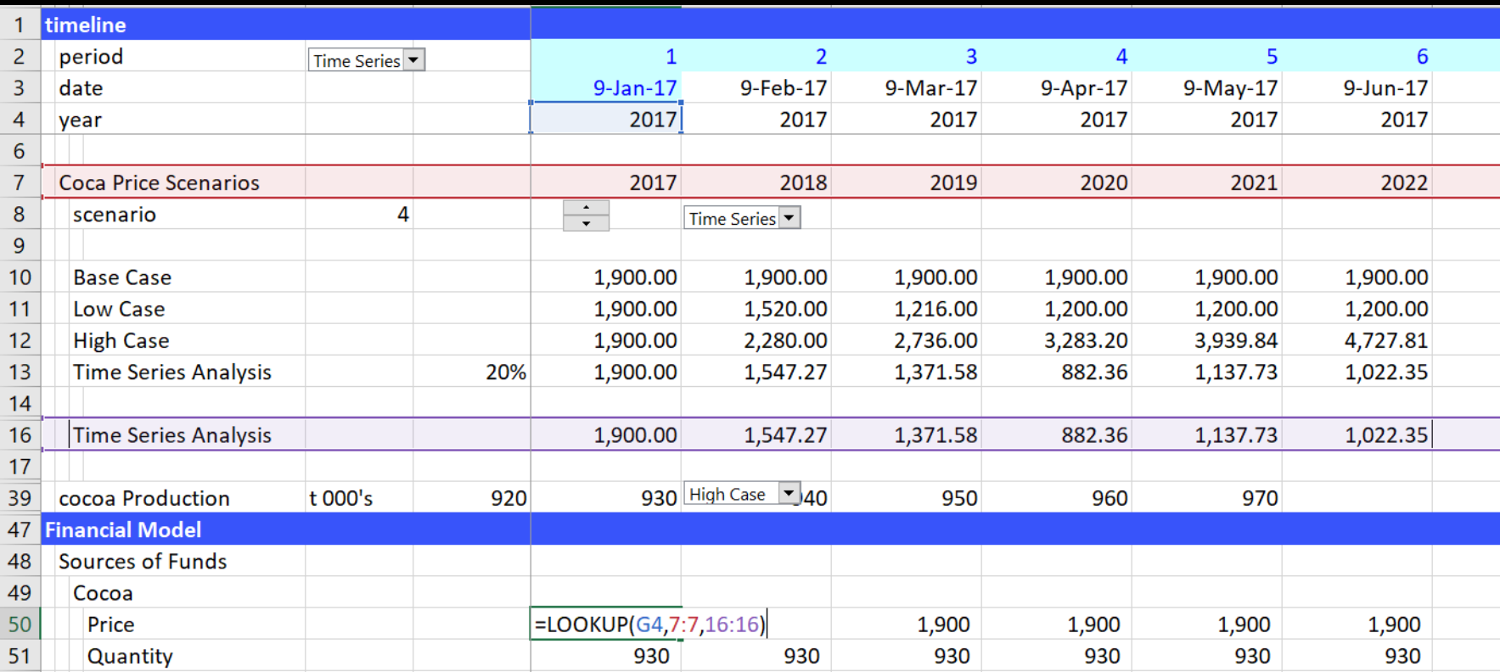
Use of LOOKUP Function
Don’t use VLOOKUP, HLOOKUP or INDEX/MATCH with models that have a time line. Instead, use the LOOKUP function with an entire row as illustrated below:

Slide 87
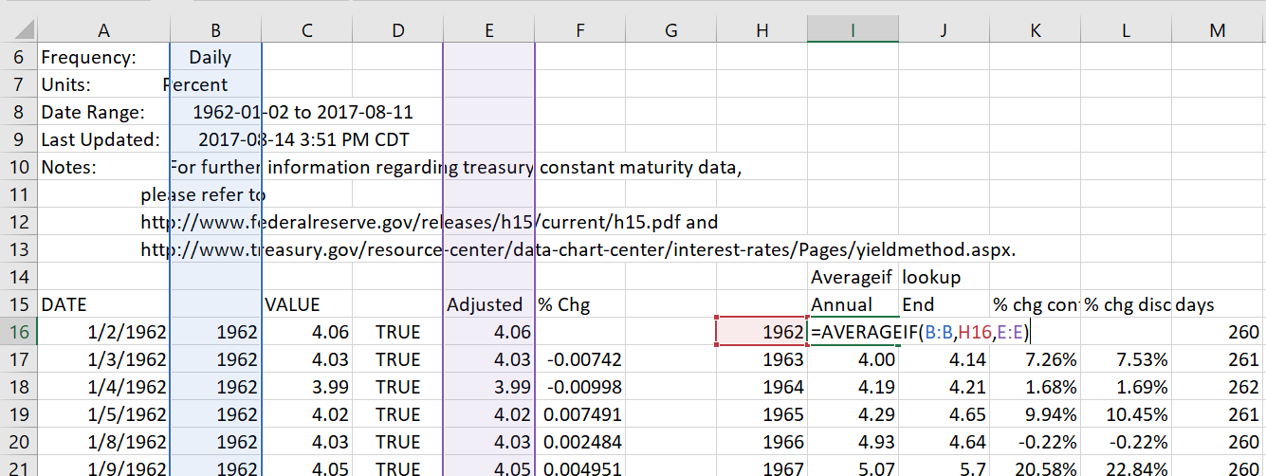
Use of AVERAGEIF, SUMIF, COUNTIF
These functions are useful in project finance model for:
  Converting periodic data by month to sum for a year
  Checking errors
  Counting TRUE’s or FALSE’s

Slide 88
Structure of Standard Corporate Models

Slide 89
For This Simple Company you Can Make an Elegant Financial Analysis
Start
First, start reading a lot of historic financial data from financial statements with read pdf or with workbooks.open or with sec read.
Project
Next, project variables from actual data – you can even use the historic revenue growth.
Create
After that, create nice pictures of the historic and future return on invested capital.
Apply
Finally, apply multiples or a fancy formula like (1-g/ROIC)/(WACC-g) to evaluate the terminal value. It doesn’t matter very much because you get the same answer

Slide 90
Historic Switch
Define the Last Historic Year
Alternative Time Lines
Formula with 1=1, 2<1 to Find TRUE or FALSE
Conditional Formatting
Use of Generic Macros

Slide 91
Contrast Models and Simple Financial Statements for Alternative Types of Companies
Model Structure Exercise – Demonstrate Fundamental Structuring Issues with Simple Case
  Historical Financials
  Set-up of Assumptions
  Connection of Financial Statements
  Free Cash Flow and Equity Cash Flow
  ROE and ROIC to Benchmark Model

Slide 92
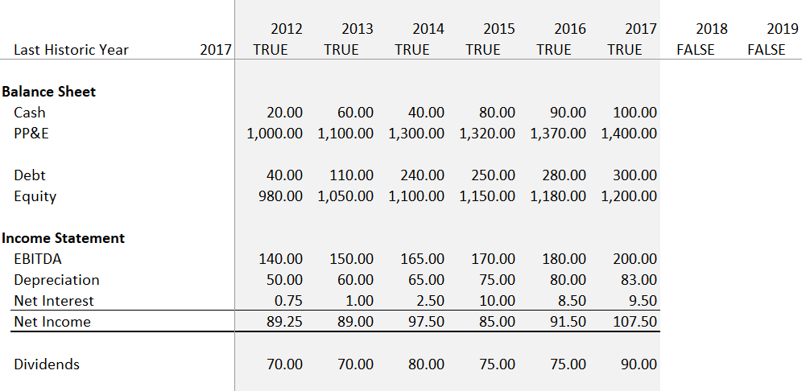
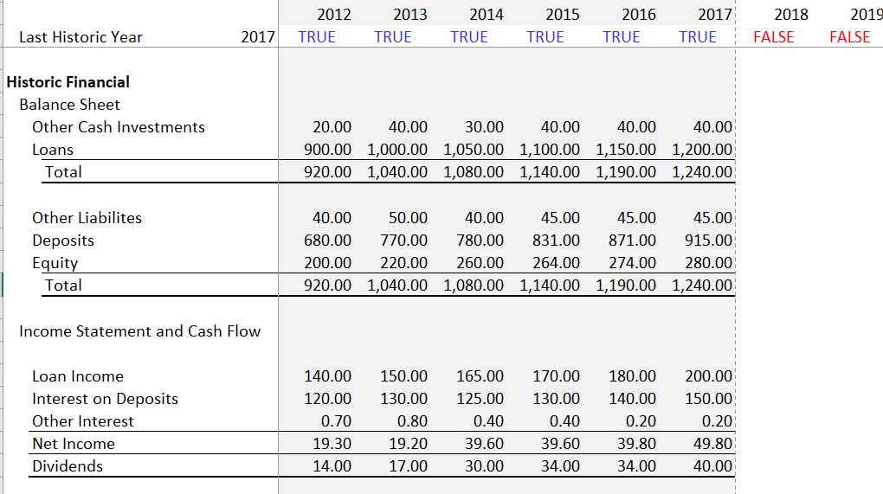
Start with Financials: Simple Example of Bank Versus Industrial
PP&E versus Loans
Interest Income versus EBITDA
Include Deposits to Finance Loans
Depreciation in Industrial

Slide 93
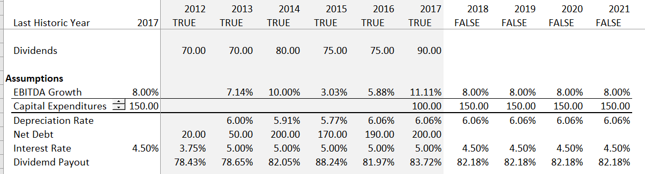
Assumptions in Simple Industrial
For simple case, create assumptions from the history. Of course, the real world involves careful assessment of risks.

Slide 94
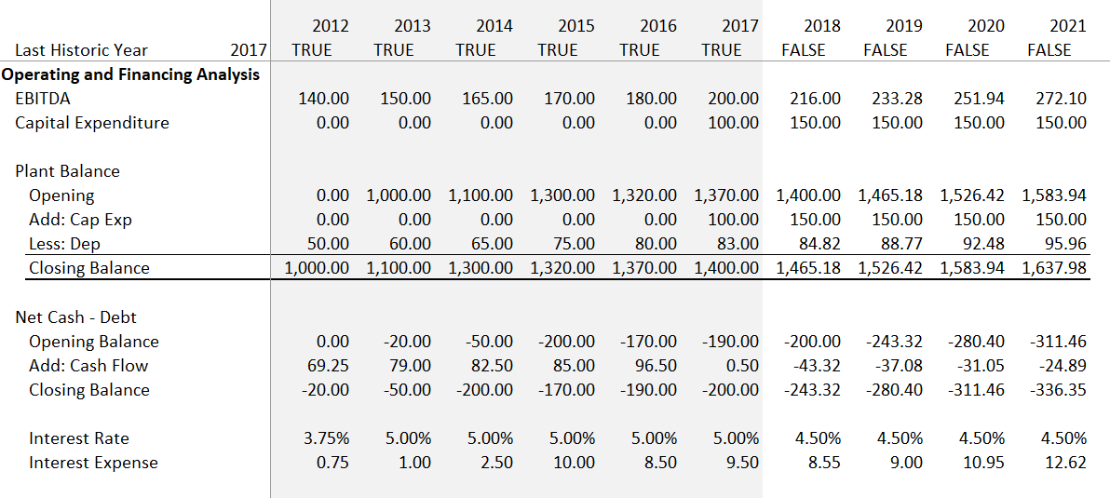
Operating Analysis in Industrial Case – Set-up Plant Balance and Net Debt Balance
To reconcile cash flow with balance sheet and income statement, set up an account the is incremented by net cash flow and goes on the balance sheet.
Historic closing balances come from balance sheet

Slide 95
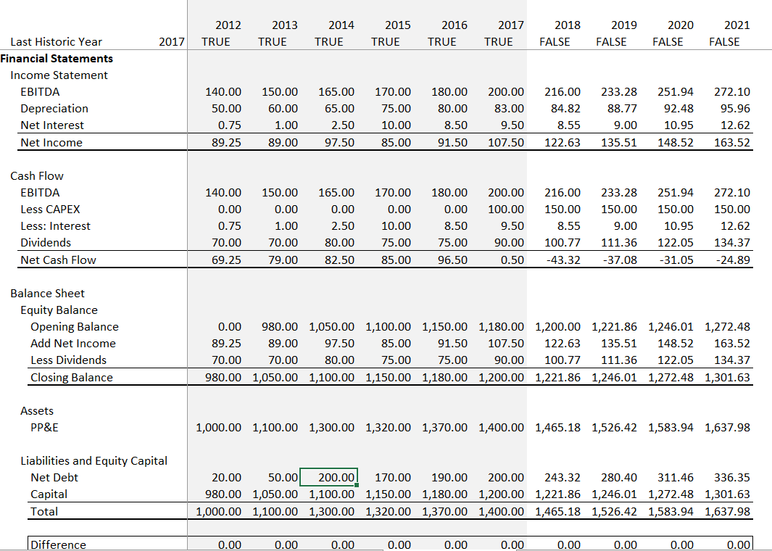
Financial Statement for Industrial Company – Net Cash Flow Goes onto Balance Sheet as Cash
Set-up the equity account from income on P&L and dividends on cash flow.
Connect net cash flow to the net debt account.
If the cash is positive, allow cash to be built-up. If the cash is negative start borrowing.

Slide 96
Acquisition and Analysis of History

Slide 97
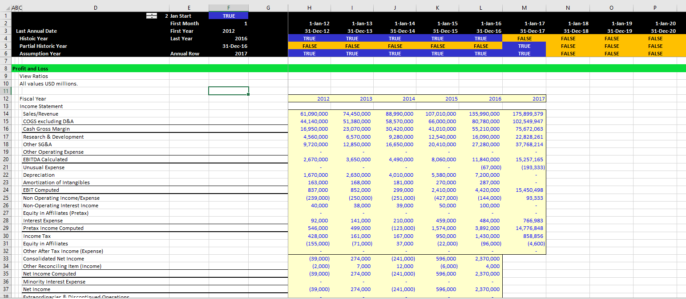
Example of Acquiring Data from Internet – Profit and Loss for Amazon

Slide 98
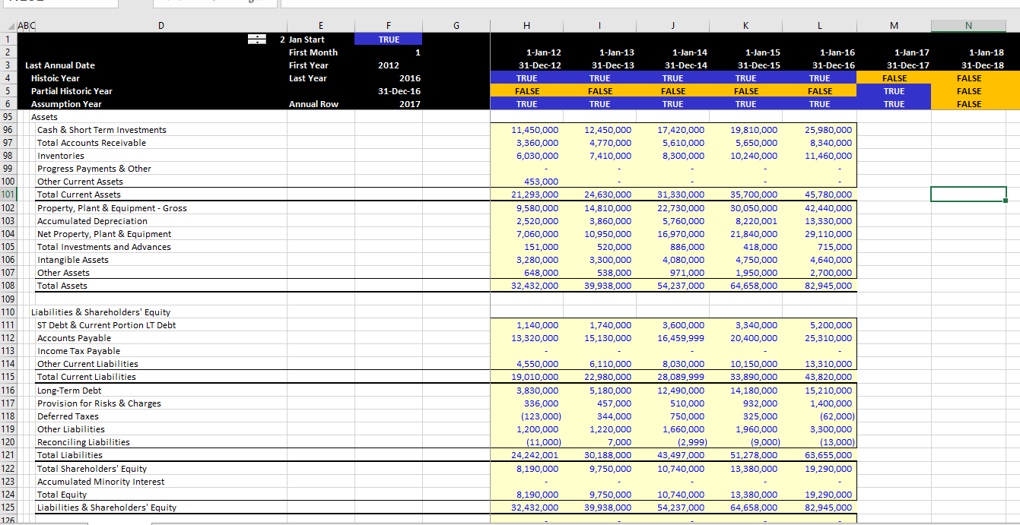
Example of Reading from the Internet – Balance Sheet for Amazon

Slide 99
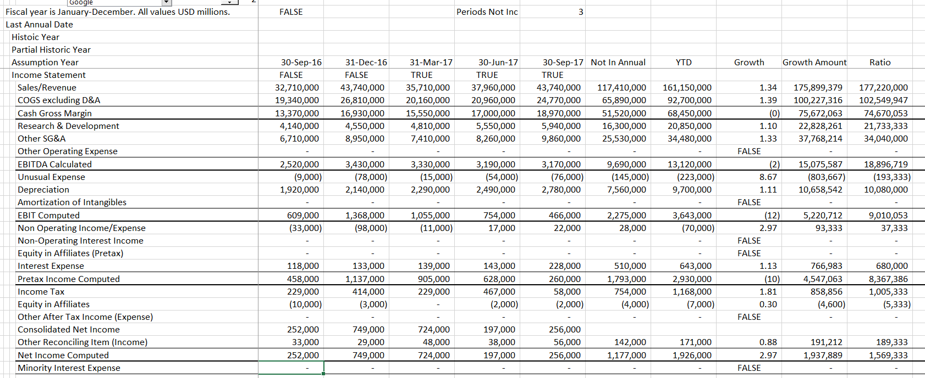
Quarterly Historic Data from the Internet

Slide 100

You Need to Understand and Not Bias Historical Analysis as the First Step in a Forecast
Forecasts from History
  The most effective way to destroy people is to deny and obliterate their own understanding of their history.”
Forecasts from History and Manipulating History in Financial Models
  “Day by day and almost minute by minute the past was brought up to date. In this way every prediction made by the Party could be shown by documentary evidence to have been correct; nor was any item of news, or any expression of opinion, which conflicted with the needs of the moment, ever allowed to remain on record. All history was a palimpsest, scraped clean and reinscribed exactly as often as was necessary.”

Slide 101
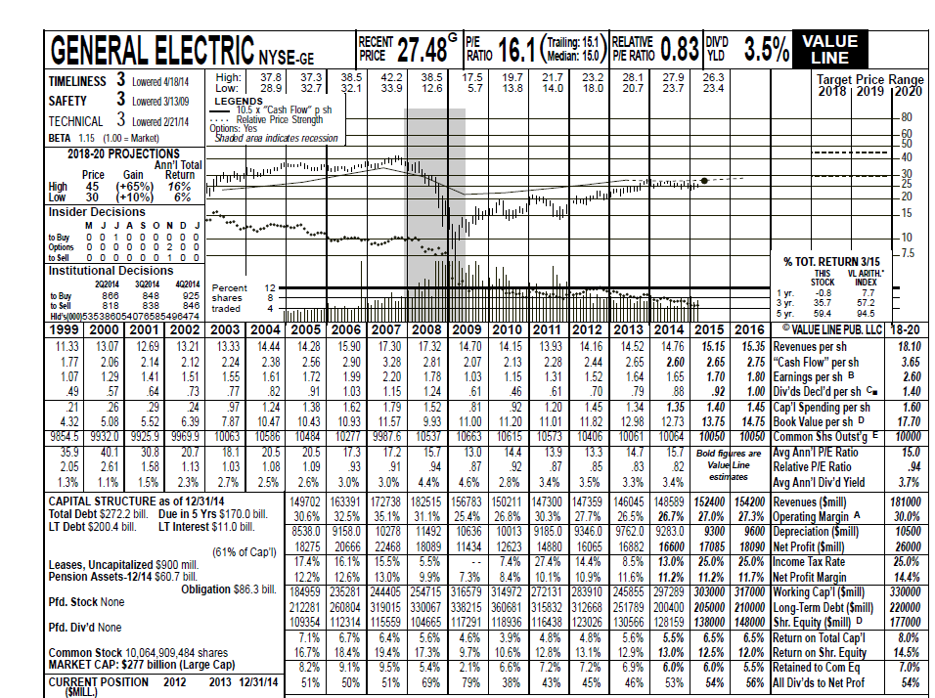
Illustration of History and Forecast – Old Fashion Value Line
Note all of the history and financial ratios in the reports – can assess forecasts with ROE and value from P/E Ratios.
Note all of the history and that the target price is the forecast P/E x EPS

Slide 102
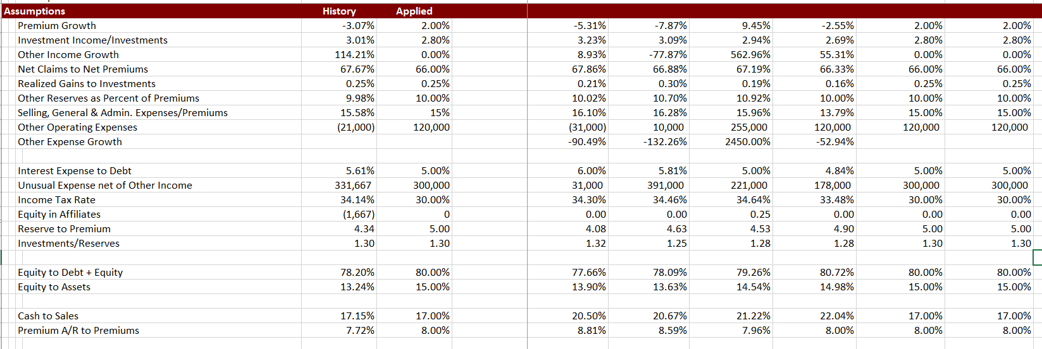
Assumptions Step 1: Work Through Each Item and Compare Items to Historic Average
Note the average at the left and then the input number. Use Averageif

Slide 103
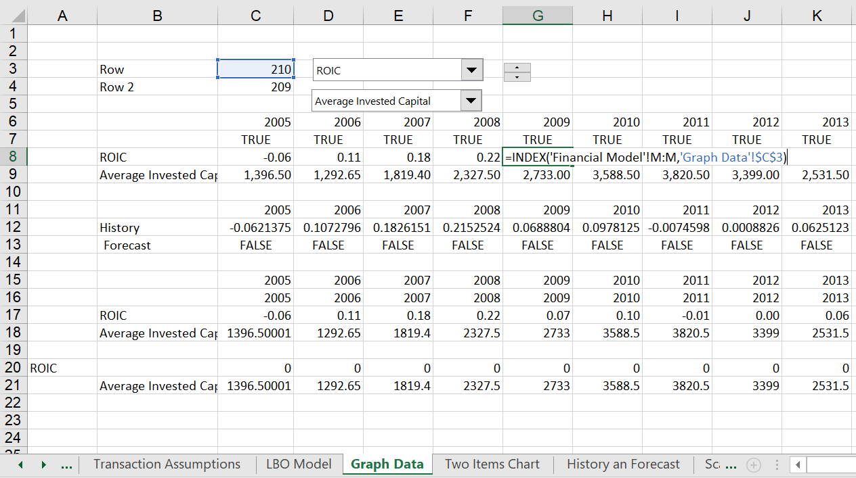
Graphing Historic Data
Use the INDEX function and Spinner Boxes to quickly make a graph of historic data

Slide 104
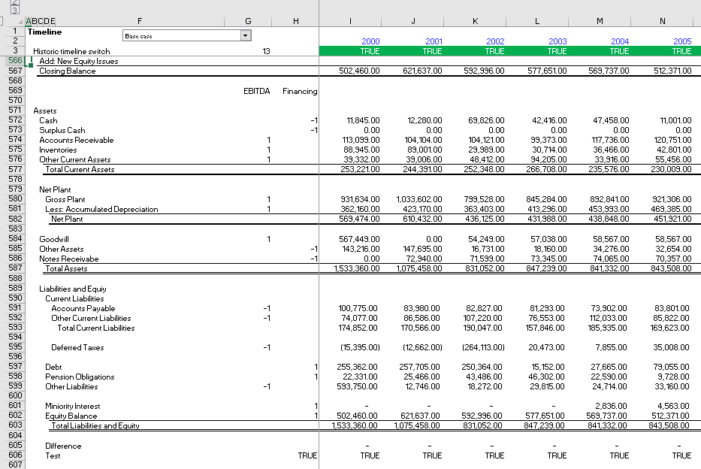
Allocate Assets and Liabilities with -1 and 1 to Compute Invested Capital

Slide 105
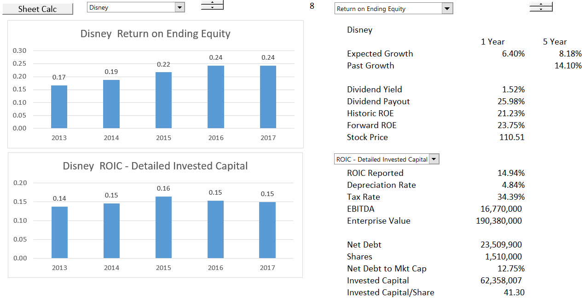
ROE and ROIC Comparison
Use ROE for exercise

Slide 106
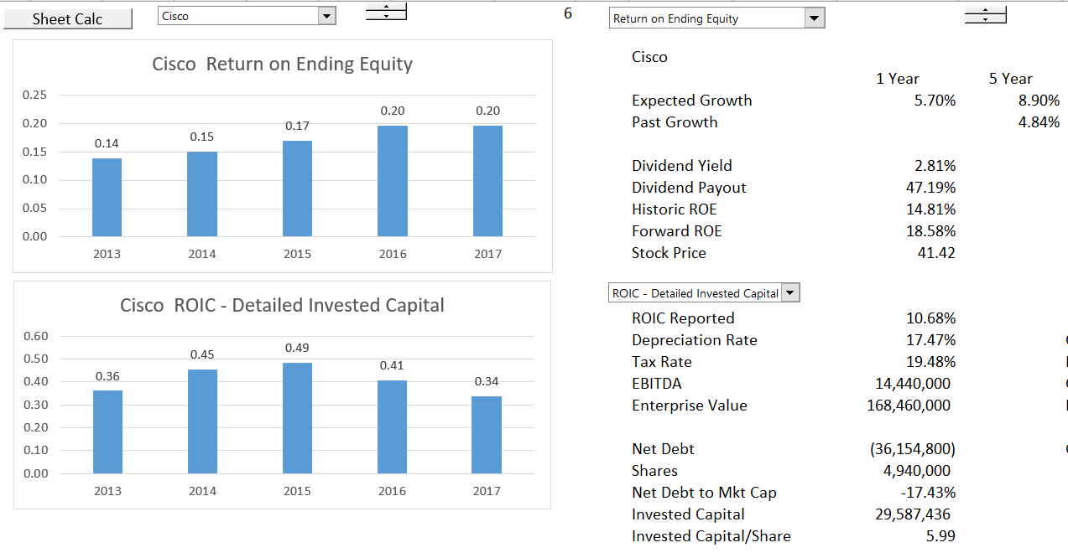
Careful Calculation of ROIC
Long-term investments should be accounted for.

Slide 107
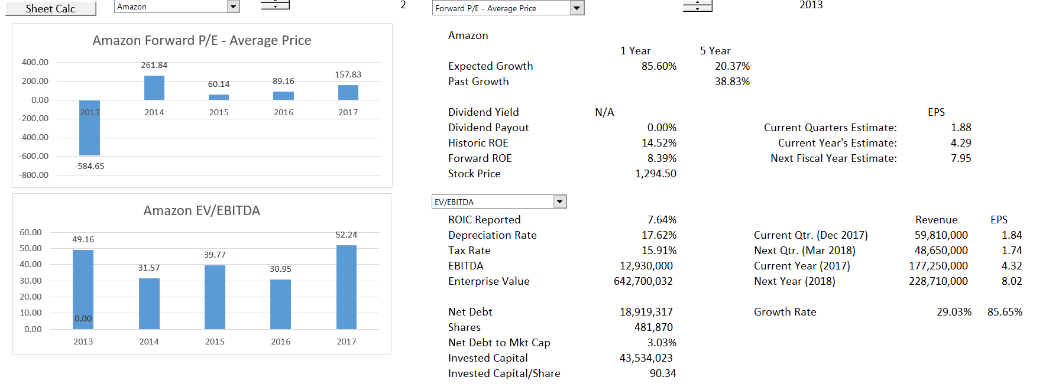
Historic Analysis from MarketWatch, PDF Conversion
Note all of the history and financial ratios in the reports – can assess forecasts with ROE and value from P/E Ratios.

Slide 108
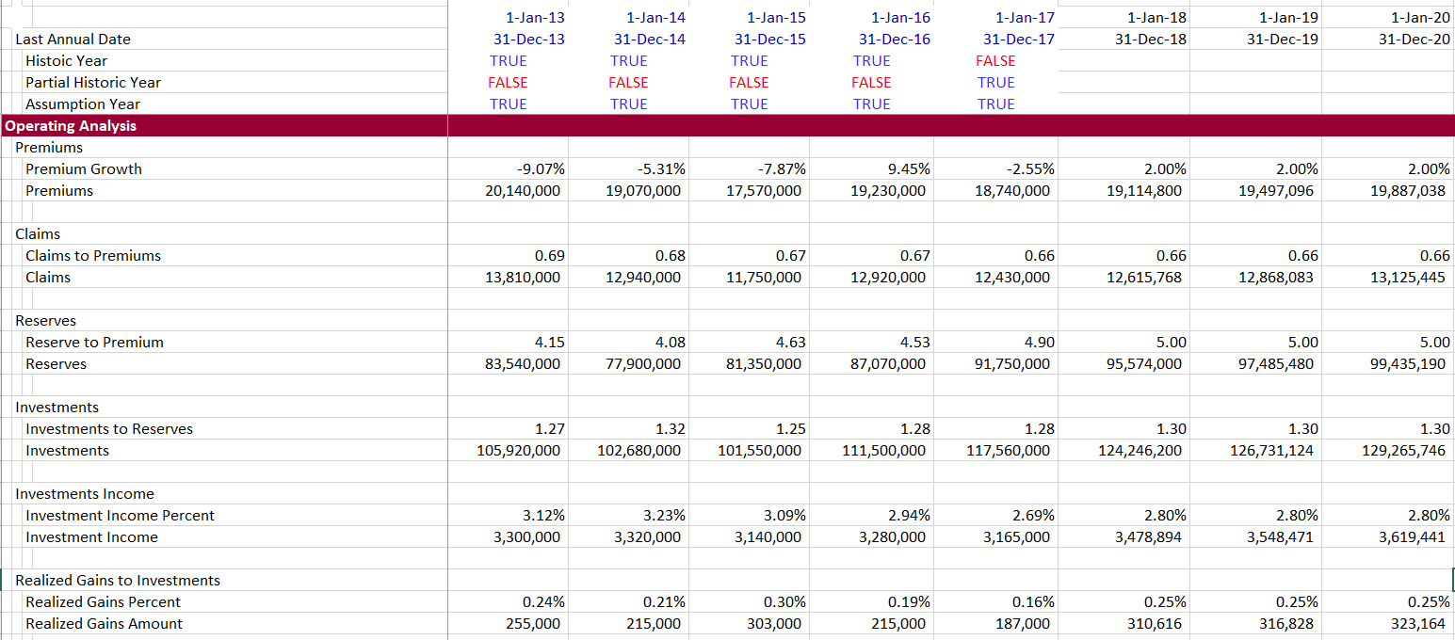
Insurance Model – Step Two, Tedious Work Through of Accounts
This is tedious, but go through each assumption.

Slide 109
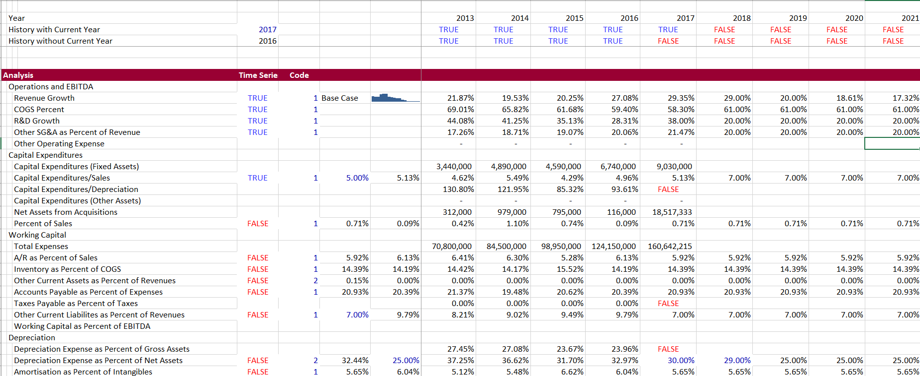
Using Historic Data to Develop Assumptions
Work through the income statement and balance sheet to develop ratios used for assumptions.

Slide 110
Risk Analysis in Corporate Finance Models

Slide 111
Difficulty in Classifying Assumptions and Risks
Surplus Capacity (worse with Capital Intensive Investments)
Fashion Going Out of Style and/or Technical Obsolescence
Cost Structure Changes from International Competition
Price Bubbles from Speculation
Forecast May be Really About Projecting Continuing Ability to Earn Economic Rents

Slide 112
Consultant Slide on Value Creation
Can Replace the ROIC with ROE and WACC with Cost of Equity

Slide 113
The Value Matrix - Stock Categorization
What is the economic reason for getting here and how long can the performance be maintained
Throwing good money after bad
Give the money to investors
Try to get out of the business

Slide 114
Need to Answer Fundamental Questions about Demand Growth, Prices and Cost Structure
Demand Growth
  Volatility of demand growth
  Implications of demand volatility and capital intensity
  Implications of demand volatility and fixed operating cost
  Example: Airlines versus Retail
Price Levels and Return
  How can sustain prices that lead to high return
  Types of products (solar panels and cell phones)
  First mover and scale (Disney and merchant electric plants)
  Creating Loyalty (Coke and Fiber Optic Cable)

Slide 115
Need to Answer Fundamental Questions about Demand Growth, Prices and Cost Structure
Cost Structure
  Fixed and Variable Costs
  Comparison of Costs with Competitors
  Sustainability of Cost Advantage
  Example: Shale Gas and High Cost of Replacement
Problems with Analysis
  Very difficult to measure – some companies have sustained high ROIC
  Product life cycle shortening – how long can maintain returns from innovation
  Problems of obsolescence, changes in taste, fashion etc.

Slide 116
Still Volume and Price, But …
Have volume history from financial data, but need long-term data that covers business cycles.
Surplus capacity analysis may require knowledge of competitor capacity additions – there is no historic financial data that can be used for this.
Demand volatility is aggravated by operating leverage. It is difficult from financial statements to separate fixed and variable cost. Example of airlines and auto companies after 2000 and 2008.

Slide 117
No History and Problems with Volume Forecasts
Without volume history from financial statements, predicting revenues is extremely speculative.
In this case, that occurred around the dot com bubble, a venture financed by Motorola had a dramatic crash. The interesting thing was that how the investment bankers bought the marketing projections hook line and sinker.

Slide 118
Obsolesce, Fashion, Uber
Very difficult to predict sudden changes in cost structure and/or price in an industry driven by new technology. Stock price of company that finances medallions in New York.

Slide 119
The Saudi Market – A Classic Bubble
Teachers, cab drivers etc. stopped working and purchased shares. There were wonderful excuses as to why the Saudi market is different.

Slide 120
Industry versus Firm Analysis
Industry Analysis
  Drivers of price and volume volatility
  Cost Structure of Industry, fixed and variable cost
  Capitals expenditures required to sustain EBITDA
  Product life cycle
Company Analysis
  Drivers of market share
  Customer tastes
  Relative cost structure
Examples of Industry and Company Failures

Slide 121
Cyclical Industries
Companies where earnings show cycles of major rises and declines
Characteristics:
  Cyclical downturn in recession
  Producers over-invest at peak
  Supply rises
  Prices fall sharply when demand declines because of surplus capacity
Cash available for investment at peak
Rational behavior to not invest is limited by desire to maintain market share
Example: Rates to move a 20 foot container from Hong Kong to Northern Europe have fallen from about $12,0000 to roughly $220, creating the deepest ever crisis in the industry. (FT 08).
Examples:
Retail, property, paper, cars, chemicals, airlines, steel, primary metals, house-building, building materials, advertising, capital goods, shipping.

Slide 122
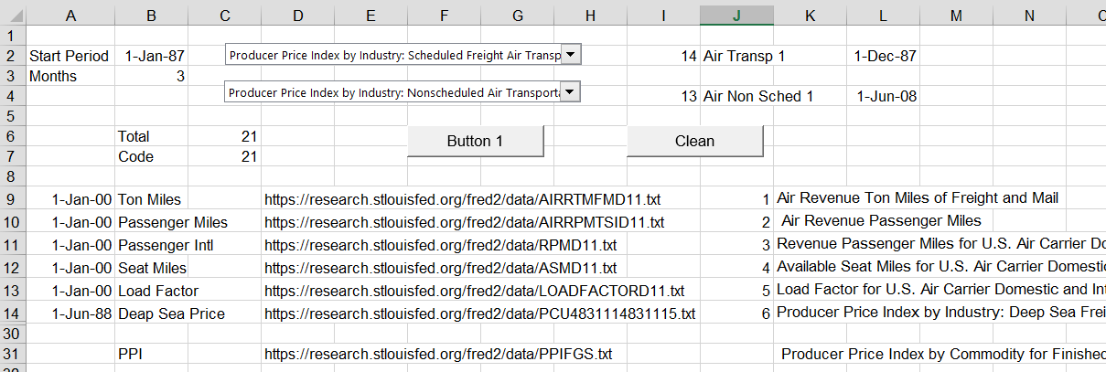
Exercise on Cyclical Industry: Rates for Shipping
Go to St. Louis FRED data
Find the relevant URL’s
Copy the data to Excel Sheet
Create Macro to Download the Data
Key is to use the WORKBOOKS.OPEN statement in a macro together with the INDEX Function

Slide 123
Macro-economic Factors and Cyclicality
Macro Economic Policy | Result
Excessive Liquidity and Low Interest Rates Leads to Over-lending | U.S. Subprime Crisis, Spain Construction
Higher Interest Rates to Slow Down the Economy | U.S. Commercial Real Estate in 1980’s
Unemployment Increase Slows Down Demand | U.S. Recession of 2008 and Bankruptcy of GM Suppliers

Slide 124
Economics of Price Volatility in Industry Analysis
Demand Volatility
  Technical Definition of Volatility
  Different Distributions
  Income Elasticity
Capital Expenditure Changes
Difference between Long-Run Marginal Cost and Short-Run Marginal Cost
Capital Intensity of Assets
  Lifetime of Assets
  Revenues versus Operating Costs
Operating Leverage

Slide 125
Operating Leverage
Definition: Fixed Expenses that do not vary with sales
Definition of Fixed and Variable Costs
  Not in Financial Statements
  COGS generally includes depreciation which is fixed
  Administrative expenses are related to sales when many are fixed
  Semi-fixed expenses that change after passage of time
  Pension obligations and costs of employee reductions
Analysis of Fixed and Variable Expenses
  Open a Financial Statement File
  Use F11 to make graph of revenues and operating expenses
  Remove title and create scatter plot

Slide 126
Investment to Maintain Cash Flow and Profits
To generate profits or cash flow, just about everything requires some level of investment:
  Personal: Invest in education
  High Tech: Invest in research and investment
  Start-up: Invest in marketing and service or product
  Telecom: Invest in acquisitions and licenses
  Retailing or Trading: Invest in Inventories
  Banking: Invest in Loans
  Manufacturing: Invest in Capital Expenditures
If a company stops investing or makes bad investment decisions, or pays too much for investments, it will have problems in the future

Slide 127
Benchmarking And Evaluation of Model with Graphs and ROIC

Slide 128
Evaluate a Forecast with ROE or ROIC
Fundamental economic notion that it is very difficult to charge high prices/premiums and also grow.
Basic check of forecasts is to consider the return on investment and make sure it is consistent with economic conditions and the industry.
For industrial company, use ROIC which is not distorted by changes in the capital structure.
For financial companies, use ROE as long as capital structure is stable.

Slide 129
Statement about U.S. and Asian Companies by McKinsey
The median large U.S. company earned a 19 percent ROIC in 2013, while the median large Asian company earned 8 percent.
But for the most part, Asian companies historically have focused more on growth than profitability or ROIC, which explains the large difference between their average valuation and that of U.S. companies.
Comment: Everybody of course wants a high monopoly profit. Very smart people are hired to create monopoly profits through marketing strategies (or making children and adults addicted to a product). The focus must be on making positive NPV investments, value should increase.

Slide 130
Use of Return on Invested Capital to Assess Model
The big question is what really goes into calculation of the invested capital.
The most obvious point is that surplus cash should not be in invested capital because the income associated with surplus cash is not in NOPAT.
For Amazon, the issue of R&D cost is a big issue. If R&D was capitalised, the observed return would be a lot higher.

Slide 131
Depreciation Issue in Corporate Models

Slide 132
Depreciation Process
You can separate existing depreciation from new depreciation. Then, you can evaluate the retirements on existing depreciation using the process below.
The best way I have found to do this is to first find the historic growth rate in capital expenditures as well as a starting point for the retirements.
Use the Solver to Find the Base Level of Retirements and the Historic Growth Rate
To do this:
Step 1: Derive the plant life for one category of assets or the assets in aggregate.
Step 2: Set-up a schedule with gross plant that has balance from the balance sheet. Include retirements as part of the schedule.
Step 3: Set-up a schedule with the accumulated depreciation that also includes retirements.
Step 4: Put an equation with a base level of retirements and a growth rate to compute the amount of period by period retirements.
Step 5: Use the Solver feature to derive the base level of retirements and the growth rate by setting the closing balance to zero.

Slide 133
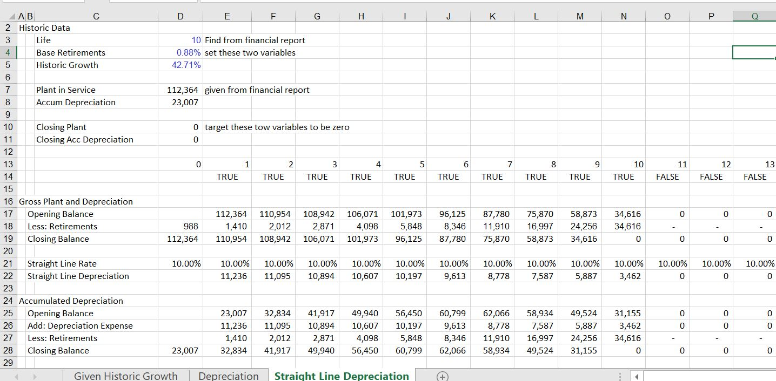
Schedule of Existing Assets with Closing Balance of Zero at End of Life

Slide 134

Use of Solver to Find Values

Slide 135

Setting-up Depreciation Schedule

Slide 136

Depreciation Expense from Financial Statements

Slide 137
What do Multiples Really Mean and Evaluation of History of Multiples

Slide 138
Valuation Mathematics and Multiples
Valuation from Multiples
  Fundamental Financial Mathematics
  Value Driver Formula
  Value Driver Problems
  PE Ratio Analysis
  EV/EBITDA Analysis
  Stable Relationships for Evaluating Capital Investments and Other Items

Slide 139
Application of Multiples in Valuation – Top Part of Football Field
Nothing Fancy
  Expected Earnings x P/E Multiple = Market Value
  If you are evaluating an industrial company
    Expected EBITDA x EV/EBITDA = EV
    EV – Net Debt = Market Value
    Market Value/Current Shares = Share Value
  Standard Method of Target Price:
    Earnings in 3-5 years x P/E Ratio
    P/E ratio comes from Witches Brew

Slide 140

Example of Application of Multiples – First Item in Football Field
Forecasted Price of more than 400.

Slide 141

Current First Solar
Note the actual earnings and return on capital: Demonstrates that both growth and return matter.

Slide 142

Public Comparables – Buy Side
Even in very boring industry there is wide variation in P/E ratios – we need to understand why.
In the football field diagram, the range was 8-9
EV/EBITDA 8.4; P/E 14.5

Slide 143

Basic Idea – Are Multiples Stable Across Companies in an Industry and Across Time
Example of boring companies in the utility industry. If have an earnings estimate than can make a stock price forecast. Change a lot over time and some outliers across the industry.

Slide 144

EV/EBITDA versus P/E
Is there more stability when using a proxy for cash flow and enterprise value.

Slide 145
Reported Multiples of S&P 500
Current levels are high, but you don’t know how the numbers are developed in computing the numbers.
http://www.wsj.com/mdc/public/page/2_3021-peyield.html?mod=topnav_2_3002
https://ycharts.com/indicators/sp_500_pe_ratio
https://ycharts.com/indicators/pe10
http://www.multpl.com/shiller-pe/table

Slide 146
Effect of Taxes on P/E
Assume that P/E is trailing and earnings do not reflect the change in the tax law.
Assume that companies are monopolies and they can retain savings from the tax reductions.
What is the equity cash flow increase from a tax reduction from 35% to 21%:
Pre-tax 100 100
Tax 35 21
After Tax 65 79
Percent increase in value: 79/65-1 = 21.5%

Slide 147

Example of P/E Ratios for Dow Companies – Generally from 20-25 (At the top of the market)
Note changes in P/E ratio over time and across companies

Slide 148
Why is the P/E Ratio Higher for One Company than Another Company
Reasons for Differences in P/E
  Cost of equity capital and risk is higher for Apple than for Google
  Future growth in earnings per share and ROE is lower for Apple than for Google
  ROE for Apple with fall and ROE for Google will increase
  Potential for long-term growth and return

Slide 149

Look at Elon Musk’s PayPal
Note the expected increase in ROE and the very high EV/EBITDA

Slide 150
Return to Two Companies – Why does Lincoln have a Lower PE in the same industry
Use Lincoln National as the target because of low P/E – note expected growth in EPS

Slide 151
This is the company with a higher P/E – Higher ROE and Higher Growth
Use Principal Financial Group as assumed acquiring company

Slide 152
Begin with One Industry
We will see the P/E and EV/EBITDA are driven by returns, growth and risk.
Therefore review P/E ratio in the context of things that can be measured:
First, Growth
Second, Returns
Start with Multiples for the Beer and Beverage Industry
Try to find stable ratios if risks, growth and returns are stable.
Try to explain high and low multiples
Look at P/E, EV/EBITDA and EV/EBIT

Slide 153
Are Multiples the Same Across Over Time
Depends on whether the following changed:
  ROE prospects
  Growth prospects
  Cost of Capital – Should be real cost of capital and not a function of nominal interest rates that are related to inflation.
Inter-relationship between growth and return.
  If no growth, the P/E = 1/k, no matter what the level of return
  If return=k then P/E = 1/k no matter what the growth
  It is the relationship between return and growth that can result in extreme P/E ratios

Slide 154

Examine Growth and then Multiples
Example with one company – little growth and boring.

Slide 155

Increasing Multiples and Flat Income
Raises the issue of why multiples would increase if earnings and cash flow are stable.

Slide 156

P/E Ratios for Selected Companies – More Extreme P/E Ratios for Amazon etc.
Why are some ratios so high; why are they so different

Slide 157

EV to EBITDA for Selected Stocks

Slide 158
Differences between EV/EBITDA and P/E
EBITDA is different from Earnings because of:
  Depreciation and Amortisation
  Taxes
  Interest Expense and Interest Income
This means can differ between companies because of:
  Capital Expenditures
  Tax Rates
  Financing

Slide 159

Does EPS or EBTIDA give a Better Picture of Growth and Profit
Illustration of growth in EPS and EBITDA for Apple

Slide 160
Why is the EV/EBITDA different for Different Companies
EV/EBITDA will be lower for companies that need to replace assets more quickly. If the net investment is the same and the EBITDA is the same, the company with shorter lived assets will have to replace assets more quickly and have more capital expenditures for the same EBITDA. This means EV/EBITDA will be lower for companies with higher depreciation rates.
This means you cannot theoretically compare the EV/EBTIDA across different industries with different types of assets (and also within the industry)

Slide 161
Simple Illustration of EV/EBITDA with Different Asset Lives
Assume the same ROIC, growth and WACC.
One company has 5 year assets and another company has 30 year assets.
EV/NOPAT is the same, but EV/EBITDA is different.

Slide 162
What About EV/EBIT
This can fix the capital expenditure problem, but:
  Affected by depreciation policies
  If one company has a higher tax rate, the EV/EBIT for that company will be lower (EV is affected by taxes, but EBIT is not).
This means you have to be careful in evaluating across time when the tax rate changes and
This means you have to be careful in evaluating across countries with different tax rates (note not the same as with the P/E ratio)

Slide 163
Mathematics of Multiples and Valuation

Slide 164
Two Basic Equations
Equation 1: Just Integrate from 0 to ∞
  Value = CF(1)/k (No Growth)
  Value = CF(1)/(k-g) (Growth)
  This is just math (integral from 0 to ∞)
Equation 2: Sustainable Growth
  Growth = ROE * Retention Rate
  Growth = ROE * (1-Payout)
  Payout = 1 – G/ROE

Slide 165
For Equity, All you Have to Do is Substitute
Start with Basics
  Value = D1/(k-g) Simple calculus
  DPO = (1-g/ROE) Fundamental growth
  D1 = E1 * DPO Earnings
  Value = E1 * (1-g/ROE)/(k-g)
For P/E Ratio
  Value/E1 = (1-g/ROE)/(k-g)
For P/B Ratio
  E1=Book Value * ROE1
  Value = Book Value * ROE * (1-g/ROE)/(k-g)
  Value/Book Value = (ROE-g)/(k-g)

Slide 166
Fundamental Valuation Ideas and P/E, EV/EBITDA, P/B Multiples
Objective is to get monopoly profit and then to grow these profits (not making judgment about capitalism here). Value depends on the return from your investment.
  Rate of Return on Investment
  Growth
  Cost of Capital Adjusted for Risk
There is no question about theses basic ideas and one can think of valuation as forecasting movements in these three variables.
The most difficult thing to think about is what will happen to the rate of return.
If you do not make an investment, use of ROIC does not work anymore.

Slide 167
Fundamental Idea about Investment Necessary to Generate Return
If you don’t make an investment, you cannot improve your life.
If you don’t make capital expenditures, you cannot get EBITDA.
If you don’t sell policies and put investments on the balance sheet, you can not earn a return.
If you don’t pay for a stock, you cannot get dividends.
Even when you gamble, you must put some money down on the table.
But, what about:
  Uber: drivers make investment and all Uber has is a bit of software
  Services: You make money from your reputation (Deloitte, Cap Gemini, GE, Siemens, Law Firms, etc.)
  Construction contracts: You make money by constructing a plant and the investment in tractors etc. is very minor.

Slide 168
Simple Case: Valuation with Constant ROE
Very simple case of valuation:
  Return on equity and growth constant
  No adjustment for inflation (assume no inflation)
In this case, you can use the valuation formula:
Value = Earnings x (1-g/ROE)/(k-g)
You can also use the formula to evaluate implied cost of capital from P/E ratio, growth and assumed return on equity.
Silly to worry about ROE versus ROIC at this point. For now, can assume an all equity company with no net debt.

Slide 169
Problems with These Formulas
McKinsey Discussion of the Formula:
  This formula underpins the discounted-cash-flow (DCF) approach to valuation, and a variant of the equation lies behind the economic-profit approach (i.e. monopoly profit)….You might go so far as to say that this formula represents all there is to valuation. Everything else is mere detail.”
However, the formula is really not very good:
  Only works when ROE and g and k are constant.
  It does not work with inflation, because the value of the investment increases over time due to inflation.
  It does not work if the return on new investments is different from the return on existing investments in cases such as high technology.

Slide 170
Quote from McKinsey Valuation Book
We (McKinsey) explain the two core principles of value creation:
  (1) the idea that return on invested capital and growth drive cash flow, which in turn drives value, and
  (2) the conservation of value principle, which says that anything that doesn’t increase cash flow doesn’t create value (unless it reduces risk).
Led to ideas about measuring all performance with return versus cost of capital and books on (ROIC-WACC) * Capital Charge

Slide 171
Another Silly McKinsey Comment
We will show that high-ROIC companies typically create more value by focusing on growth, while lower-ROIC companies create more value by increasing ROIC.
Comment: Everybody of course wants high ROIC, which is just another word for monopoly profit and which is the driver of capitalist economies. If you are valuing a company you must assess the ability of a company to maintain or grow its monopoly position. That is the hard part.

Slide 172
Of Course You Should Invest when Return Exceeds Cost of Capital – This is NPV Rule
The interaction between growth and ROI is a key factor to consider when assessing the likely impact of a particular investment on a company’s overall ROI. For example, we’ve found that some very successful, high-ROI companies in the United States are reluctant to invest in growth if it will reduce their ROIs.
One technology company had a 30 percent operating margin and ROIC of more than 50 percent, so it didn’t want to invest in projects that might earn only 25 percent returns, fearing this would dilute its average returns.
But as the first principle of value creation would lead you to expect, even an opportunity with a 25 percent return would still create value as long as the cost of capital was lower, despite the resulting decline in average ROIC.

Slide 173




Lets Review How this Works Mathematically (From Exercise File)
When the Growth Rate is Zero, the P/E ratio is 1/k

Slide 174


What Happens when the ROI = Cost of Capital
When the ROI is the same as the cost of capital, the growth does not matter.
Think about a company that buys treasury bonds and distributes debt service as dividends.
For once, you know cost of capital and the cost of capital is the same as the return (unless you waste money)

Slide 175


If you make Negative NPV Investments, Growth Hurts
Notice that when the growth is negative and the return is less than the cost of capital, then the P/E goes up.
This makes sense (think about the case when you waste money in the treasury bond case)

Slide 176

Valuation Sensitivity in Simple Case
Keep discount rate constant at 6% (the discount rate or the expected IRR is the biggest variable)
A graph of the data table demonstrates that the combination of variables makes the valuation change dramatically.

Slide 177
Sensitivity Graph – Difficulty with Interaction of Growth and Return
Demonstrates that the value has higher variability with respect to ROE with higher growth rate. There is a strong inter-relationship.

Slide 178
Simulation of Value from Growth and Return
Illustration of combined effect of growth and return.

Slide 179

Interaction between Growth and Return
If the growth is zero, the level of the return does not matter in the valuation formulas
This is not really true when growth rate changes. A change in return makes a big difference in any case.
Long-term growth is the central issue and growth rates projected by analysts are not very reliable.

Slide 180
With Inflation, the Sensitivity is more extreme
This graph shows the data table with and without inflation. Need to have growth more than inflation to create value. Difficult to evaluate interactions non-linear interactions of variables.

Slide 181
Changing ROE, Changing Growth and Changing Inflation
Cannot grow in long-term much faster than the economy.
Demonstrates the that the real issue is whether ROIC above the cost of capital can continue.
When ROIC expectations decline, then the P/E ratio falls.
To make this analysis, you cannot use the simple formula. Instead,
  In the terminal period, use the version of the formula that starts from the book value of the investment.
  Use the formulas for dividend payout as a function of growth.
  Use the INTERPOLATE LOOKUP function to gradually change Return.

Slide 182


Changing ROI and Growth
Notice how the change in ROI makes so more of a difference when the growth rate is high

Slide 183
Reasonable Estimates of Growth – Is this Graph Reasonable
The short term
Based on best estimate of likely outcome
The medium term transition to tranquillity
Assessment of industry outlook and company position
ROIC fades towards the
cost of capital
Growth fades towards GDP
The long run – tranquillity and equilibrium
Long run assumptions:
ROIC = Cost of capital
Real growth = 0%
Much of valuation involves implicitly or explicitly making growth estimates – High P/E comes from high growth
Reference: Level and persistence of growth rates

Slide 184
Crazy Idea that ROIC = WACC in Long Run
According the McKinsey: Many forecasters assume that the rate of return on new invested capital equals the cost of capital in the continuing value period, but that the company will earn returns exceeding the cost of capital during the explicit forecast period.

Slide 185



Now Look at Growth a Little More
First, Nominal or Real Growth – Inflation Rates over time.

Slide 186


Now Move to Population – Some Industries Grow by Inflation and Population Like Beer
You can compute population growth for the US and the World

Slide 187




Think About the Long-term Growth Prospects of Amazon – Look at GDP and Consumption
The graphs show real and nominal GNP, GDP and Consumption for the U.S.

Slide 188


Consumption and S&P 500 in Real and Nominal Terms
Conclusion depends on starting point assumption.

Slide 189

Now Return to Amazon – Returns and Growth
Can the growth continue after you get very big

Slide 190

Amazon Revenues in 5 Years Assuming EPS Growth = Revenue Growth
Note just how much money high growth represents – USD 1 Trillion

Slide 191

Compare Assumption to Wallmart
Somebody has to lose if Amazon gets the gain, will they compete effectively?

Slide 192
ROIC instead of ROE and EV/EBITDA
First, assume invested capital is only plant and equipment
Second, assume that invested capital includes working capital changes
Key variable is deriving the net plant depreciation rate from the growth rate and formula:
Cap Exp/Depreciation = g/Net Plant Depreciation rate + 1

Slide 193




EV/EBITDA Analysis
First, the EV/EBITDA analysis – very big effect of growth and WACC

Slide 194
Now Evaluate Effect of Asset Life
Compare buying a house that lasts for 100 years with buying a Tesla that lasts for 10 years.
How much money do you have to earn to support these investments (how much EBITDA do you need).
Assume no inflation and no return. Then you could spread your money over 100 years for the house but only over 10 years for the car.
You need 10 times as much money to cover the value of the car than the house.
If you earn the same amount, then your are covering much less value in the case of the car and the value to EBITDA is less.

Slide 195




EV/EBITDA in Simple Case with No Taxes, No Working Capital, No Discount Rate, No Growth
Note that the EV/EBITDA changes dramatically when the lifetime of the asset changes – 46 to 75 to 104 to 160.

Slide 196


Now Evaluate Changes in Tax Rates on EV/EBITDA
Companies with different tax rates should have different EV/EBITDA ratios because EV is after tax but EBITDA is pre-tax. The example below shows the effect of changing the tax rate from 35% to 21%. Note the big change in EV/EBITDA.

Slide 197

No Compare the EV/EBITDA for Different Asset Lives
Demonstrates that you should show the depreciation rates and asset lives when presenting the EV/EBITDA ratio.

Slide 198

Evaluation of Net Plant Depreciation Rate and Capital Expenditures to Depreciation
The example below demonstrates how the plant ratios stabalises after a plant cycle.

Slide 199

Ratios of Net Plant to Depreciation and Capital Expenditure to Depreciation with Longer Life
Note how the Cap Exp to Depreciation is defined as g/Net Plant Depr + 1

Slide 200

Demonstration of (1-g/ROIC)/(WACC-g) Formula
The formula can be demonstrated by using working capital ratio and net plant depreciation.

Slide 201

Apply Ratios to Demonstrate Model
Note how valuation result is the same as the formula (1-g/ROIC)/(WACC-g)

Slide 202
Reasons for More Complex Formulas with Cap Exp to Depreciation, Working Capital etc.
Demonstration of EV/EBITDA ratio with different asset lives, tax rates and working capital ratios
Demonstration of how the value changes when growth and ROIC changes. When ROIC changes, the net cash flow changes and different amounts of money must be plowed back into the company.

Slide 203
Return on New Capital and Return on Existing Capital
Technically, we should use the return on new, or incremental, capital, but for simplicity here, we assume that the ROIC and incremental ROIC are equal.
Technically, this formula should use the return on new invested capital (RONIC), not the company’s return on all invested capital (ROIC).
What crap: when oil prices go down, you cannot say that existing projects still maintain their existing ROIC. When Uber destroys the taxi industry, you cannot say that only new taxies earn a lower return. When the internet kills advertising for newspaper companies, one cannot say that it is only new investments that suffer.

Slide 204
Transaction Multiples – Next Item in the Football Field

Slide 205
Issues with Transaction Multiples
How to derive transaction multiples from public data
How to use transaction multiples in estimating value of M&A
Adjustments to transaction multiples for tax treatment of transaction
Computing the derived synergies from transaction multiples versus public multiples

Slide 206
Transaction versus Public Multiples in Football Field Diagram
In the initial football field
  Market Multiples (EV/EBITDA) 8.0 – 9.0
  Transaction Multiples (EV/EBITDA) 8.7 – 9.7
  PV of synergies are .7/8.5 or 8.2% of the value of the transaction, or a premium of only 8.2% on Enterprise Value. With 50% debt, this would be a 16% premium on Market Capitalisation.
  The EV/EBITDA premium can imply more than 16% premium if the companies have more than 50% debt in the capital structure.

Slide 207

Precedent Transactions – By Industry, Buy Side
PE ratio of 16.0 and EV/EBITDA of 7.9x

Slide 208
Tax Treatment and Multiples
Assume two transactions, one taxable and one non-taxable
Simplistic discussion of taxable versus non-taxable transaction
Focus on the largest asset of insurance is investments – think about alternative tax treatment of investments with potential for capital gains

