Slide 1
Applied Valuation and Financial Modelling Excellence Financial Modelling for Acquisitions in Excel
2-day workshop
April 22-23, Mumbai Bengaluru, India
Apr 25-26, Mumbai, India
“Practical techniques to develop better valuation analysis with more flexible, accurate and structured models”

Slide 2
Why the Session can be Valuable to You
Teaching experience; theory and practice
Taking a step back and thinking carefully about what valuation methods without academic theories that do not work
Make things interesting with unique ways to look at financial theory
Make things practical with new ways to program models
Obsessed about participants retaining knowledge with continuing learning resources

Slide 3
Teaching Style
I will use excel to demonstrate various practical aspects of modelling and theoretical points.
But, I will make an effort not to waste you time by typing in titles, repeating accounts or making you complete and A-Z model (if you want to complete and exercise you can go to my website).

Slide 4
Re-thinking Financial Theory from Financial Modelling Analysis and Proofs - 1
Evaluation of Terminal Value Adjustments for Capital Expenditures, Working Capital and Deferred Tax that Depend on Growth
Adjustments to Free Cash Flow and EV to Enterprise Value Bridge for Deferred Tax, Warranty Cost and Other Items
Demonstration of Flaws in Value Driver Formula: Value = Income x (1-g/ROI)/(COC-g) with Changes in Growth and Inflation
Correct Evaluation of WACC using Tax Shield from Interest Expense by Using Net of Tax Debt in Capital Structure and Gross of Tax Interest Expense
Reconciliation of IRR and ROIC with Solution to IRR Problem of Re-investment and Ranking with Weighted Average IRR

Slide 5
Re-thinking Financial Theory from Financial Modelling Analysis and Proofs - 2
Macroeconomics and the Ability to Earn High Premiums over the Long-term and Philosophy of Modelling as Assessment of Potential for Maintaining Real Economic Rents
Computing Cost of Capital with Market to Book Regression Rather than CAPM or using P/E Ratios
Evaluating Depreciation Expense and Net Depreciation Rates in the Context of Changing Growth
Different Drivers of P/E Ratio and EV/EBITDA Ratio and Dependence of EV/EBITDA Ratio on Asset Life

Slide 6
Re-thinking Financial Theory from Financial Modelling Analysis and Proofs - 3
Use of Credit Spread to Derive Debt Beta and More Properly Derive Unlevered Beta
Development of Terminal Valuation Techniques for Financial Institutions that Use Market to Book Ratio and ROE from Financial Models
Evaluation of Political Risk Premiums from Computing Implied Probability of Default
Simulating Credit Ratings in M&A using Financial Ratios and Business Risk

Slide 7
Innovations in Corporate Modelling
Use of Historic Switch to Make Incorporation of New Financial Statements
Evaluation of ROIC and Invested Capital Using Switches and SUMPRODUCT
Development of INTERPOLATE Function to Evaluate Assumptions
Automation of Scenario Analysis with Scenario Reporter
Effective Automation of Historic Data Graphs with Flexible Spinner Box
Resolution of Circular References Related to Interest Expense and Taxes
Deprecation Techniques that Account for Changing Growth and Implied Retirements
Unique Tools for Presentation and Creating Efficient Short-Cuts
Development of Techniques to Automate Constant Capital Structure in Financial Models
Dynamic Goal Seek Functions for Evaluation of Cost of Capital Using P/E Ratios
User Defined Functions for Computing Stable Capital Expenditures to Depreciation and Other Items

Slide 8
Innovations in Corporate Data Analysis
Creation of techniques to download stock price data, financial statement data and economic data
Development of read pdf to excel sheet for financial data
Stock price database that allows you to evaluate IRR’s, volatility and beta for stocks, stock price indices, economic series and commodity prices.
Financial Database that allows you to extract and evaluate financial data, financial ratios, and cost of capital across companies.
Extraction of Data that Enables you to have Historic Basis for Creating Financial Models.
Interest Rate, Exchange Rate and Commodity Price Databases that Include Historic Evaluation of Term Structures, Volatility and Other Statistics.
Comprehensive Country by Country Database to Evaluate Growth and Risks Across the World.

Slide 9
Outline – Step by Step Analysis
Introduction – Stock prices and economic growth; IRR and volatility
Acquiring Data and ROIC – Drivers of value and problems with McKinsey formula; IRR reconciliation
Creating Assumptions and Reasons for Changes in Performance – Economic Theory and Risk; Presenting Assumptions; Working through growth, margins, costs and capital expenditures
Model Structure – Layout of model with free cash flow and financing; depreciation complications; connecting cash flow to balances
Free Cash Flow – Cash flow Theory; Philosophy of Growth and ROIC; WACC and Tax Shield
Terminal Valuation – Alternative Methods; Stable Terminal Cash Flow; Using Multiples; Applying Value Driver Formula
Acquisition Model – Theory of Acquisitions; Presentation of Costs and Benefits; Mechanics of Acquisition Modelling
Scenario and Sensitivity Analysis – Scenario Page; Scenario Reporter; Tornado Diagrams
Cost of Capital Analysis – Problems with CAPM; Multiples to Derive Cost of Capital; Regression Analysis of P/B and ROE

Slide 10
Corporate Modelling
Corporate Modelling for DCF and Credit Analysis
  Objectives of Corporate Modelling
  Excel Functions and Techniques for Modelling including Interpolate Function
  Structure of Corporate Models
  Acquiring Data from Internet and From PDF files and Presentation of History
  Evaluating Fundamental Risks of Operating Cash Flow
  Objectives and Mechanics of ROIC using Direct and Indirect method
  Problems with Depreciation in Corporate Models

Slide 11
Valuation from DCF Analysis
Valuation with DCF Analysis
  Careful Definition of Cash Flow (Deferred taxes, warranty costs, employee reserves)
  Flexible timing in DCF
  ½ Year Adjustment in DCF
  Terminal Value with Timing in Models
  Alternative Terminal Methods
  Adjustment to Terminal Value for EBITDA, Working Capital, Capital Expenditures, Deferred Tax and Other Items
  Evaluating the Bridge Between Enterprise Value and Equity Value

Slide 12
Valuation Mathematics and Multiples
Valuation from Multiples
  PE Ratio Analysis
  EV/EBITDA Analysis
  Fundamental Financial Mathematics
  Value Driver Formula and Problems
  Stable Relationships for Evaluating Capital Investments and Other Items

Slide 13
M&A Analysis from Private Equity and LBO
M&A Analysis from Private Equity and LBO
  Acquisition Model Mechanics
  Acquisition Transaction Costs
  Merger Models and LBO Models
  Debt Provisions and Analysis in Acquisition Models
  Tax Provisions and Analysis in Acquisition Models

Slide 14
Corporate Credit Analysis
  Project and Corporate Finance Credit Analysis
  Use of Ratios in Evaluating Credit Risk
  Credit Scoring with Financial Ratios and Models
  Risk Analysis for Credit Analysis and Modelling
  Default Risk Statistics and Analysis
  Creating Short-term Model and Working Capital Loans
  Theory of Credit Risk and Merton Model

Slide 15
Cost of Capital
Cost of Capital Analysis
  Can you Avoid Cost of Capital in Valuation
  Traditional Measurement with Beta
  Simple DCF Model
  Implied Cost of Capital from P/E and EV/EBITDA Ratio
  Cost of Capital from Market to Book Ratio
  Weighted Average Cost of Capital
    Theory of constant weighted cost of capital
    Debt beta, credit spreads and debt cost of capital
    Tax shields and weighted average cost of capital

Slide 16
Risk and Scenario Analysis
Risk and Scenario Analysis
  Where to Put Scenarios
  Scenario Analysis with INDEX Function
  Scenario Reporter
  Presentation of Scenario Analysis
  Circular Reference Problems with Corporate Models

Slide 17
Section 1:
Corporate Value, Stock Price and Economic Analysis

Slide 18
Section 1a:
Value of Corporations, Macro-economic Data and the Real Meaning of IRR

Slide 19
Why Start with Introduction to Stock Prices
Compare stock returns with growth in corporate profits and GDP growth to understand realistic returns.
Small differences in returns over long periods have dramatic impacts on value.
Is risk measured by beta or by volatility
Note: There are no real answers here – it is mainly background

Slide 20
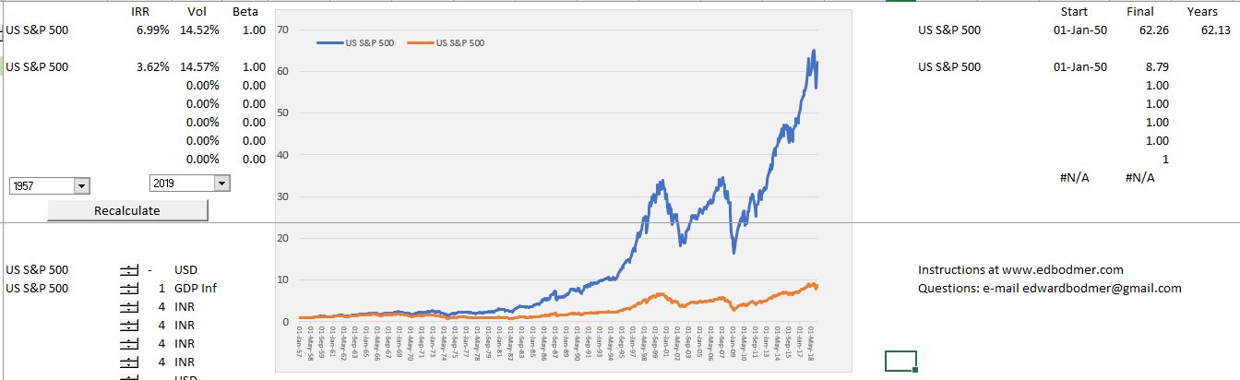
Returns to Investors Come from Company Rate of Return and Growth
This illustrates how you can compare different indices and adjust for exchange rates. Notice the difference between a return of 7% and 3.6%

Slide 21
Fundamental Economic Question of Economic Growth and Stock Value Growth
Can stocks out-grow the overall economy in the long-run.
  Eventually, stocks should reflect corporate profits.
  Corporate profits should reflect overall economic growth, otherwise there will be nothing but corporate profits – nothing for anybody who does not own corporations
What has been the return on stocks (with dividend re-investment) relative overall economic growth.
If stocks do not grow faster than the economy, then investors are not compensated for taking risk.

Slide 22
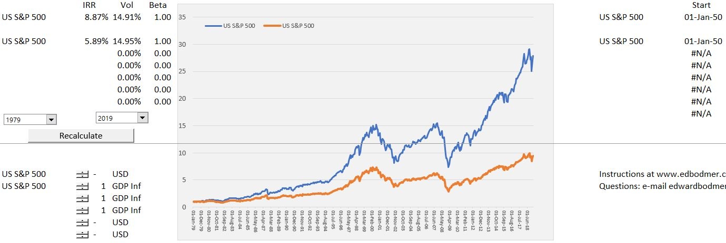
Stocks and Inflation
In evaluating any financial model, you must be careful with inflation. Note the rate of return with and without inflation.

Slide 23
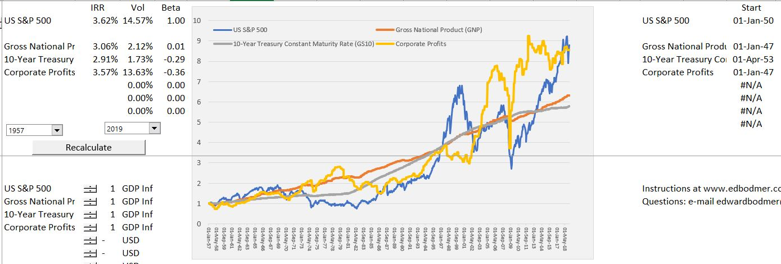
Returns to Investors Come from Company Rate of Return and Growth
Increase in stock price in past years has been dramatic; difference between bonds and stocks – equity risk premium – has been nowhere near CAPM estimates. EMRP = 3.62%-2.91%.

Slide 24
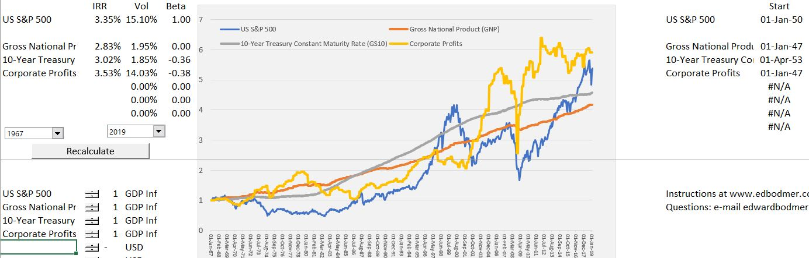
Stock Prices, Bonds and Equity Market Premium
Evidence of an equity market risk premium is difficult to find until the very recent increase in stock prices. Here the EMRP = 3.35%- 3.02%.

Slide 25
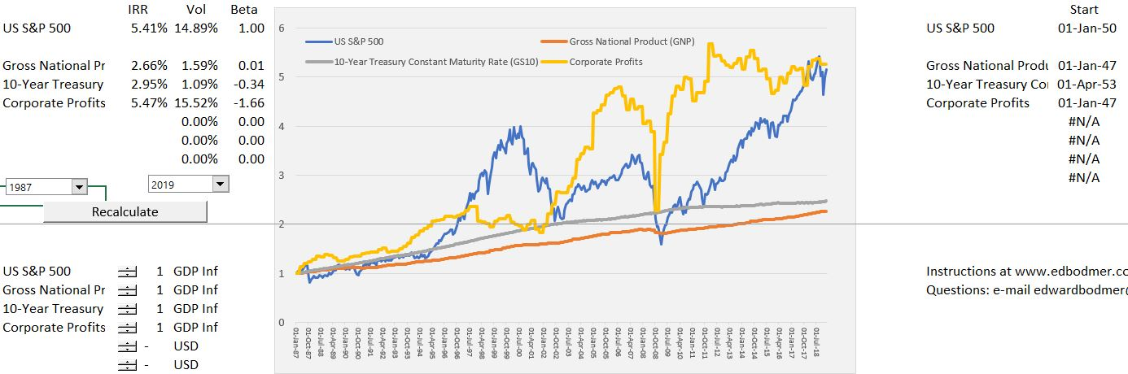
Stock Prices, Bonds and Equity Market Premium
Recent increase in stock values has effects on the distribution of income as profits are higher than economic growth. Note the increase in P/E ratio.

Slide 26
Section 1b:
Analysis of Individual Stocks

Slide 27
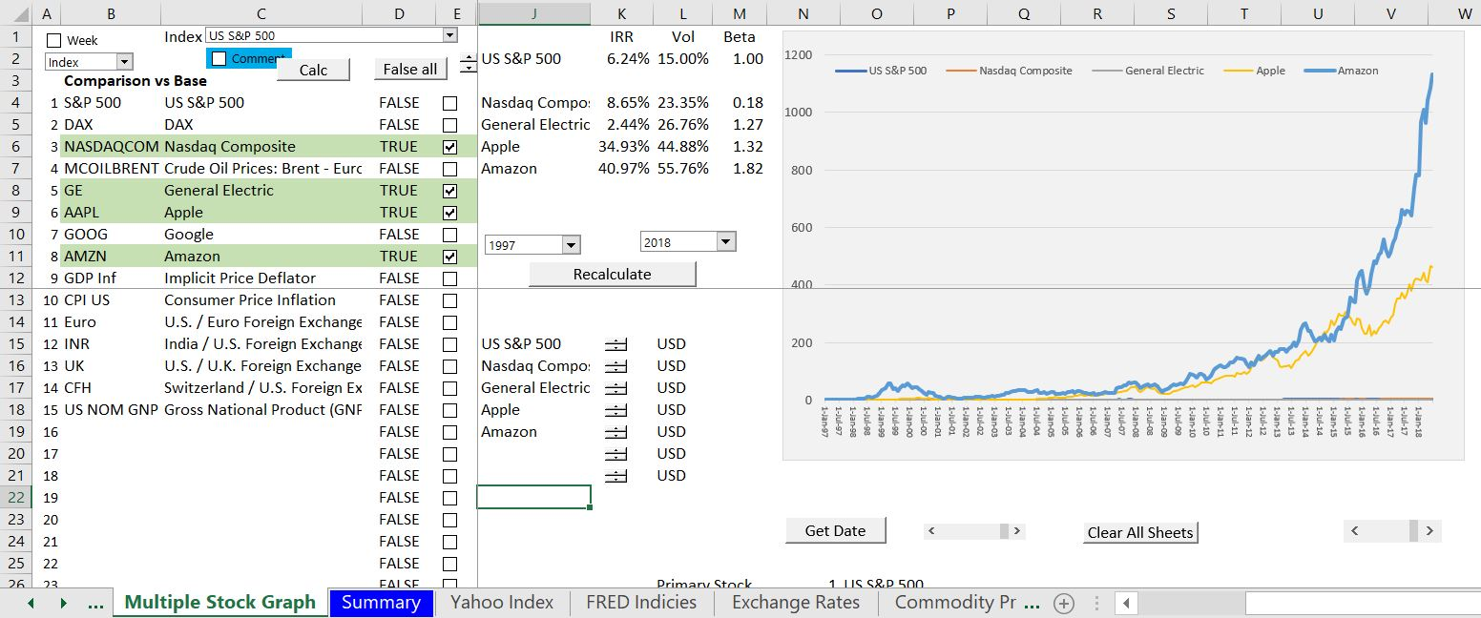
Explosion in Amazon Share Price – Can it be Explained with a Financial Model
Understand the dramatic effect of different rates of return. What is really possible

Slide 28
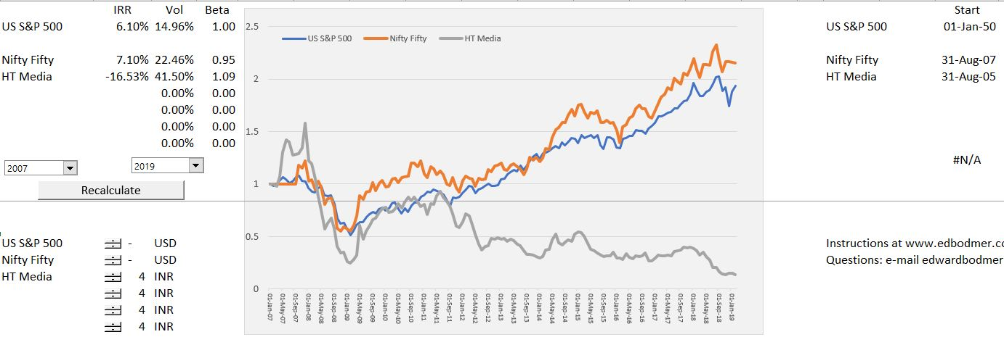
Stock Prices Before Adjustments for Currencies
Comparison of Indian market with S&P 500 and HT Media before adjustments.

Slide 29
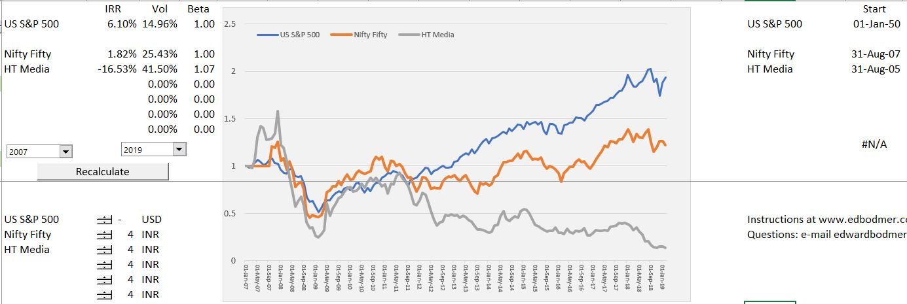
Stock Prices After Adjustments for Currencies
Comparison of Indian market with S&P 500 and HT Media after exchange rate adjustments.

Slide 30
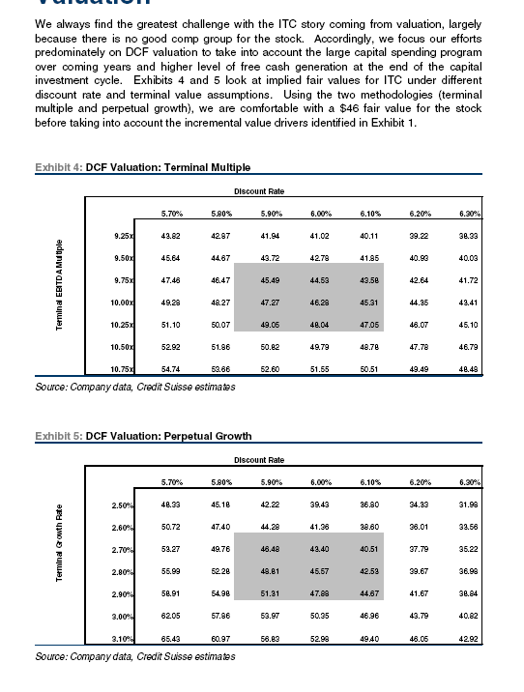
Inverse of IRR impacts is the Dramatic Changes in Value from WACC
Note the range in values in the analyst report
The range is less when a terminal value multiple is used, but the range is still very high
The high range exists even though there is a tight range in discount rates

Slide 31
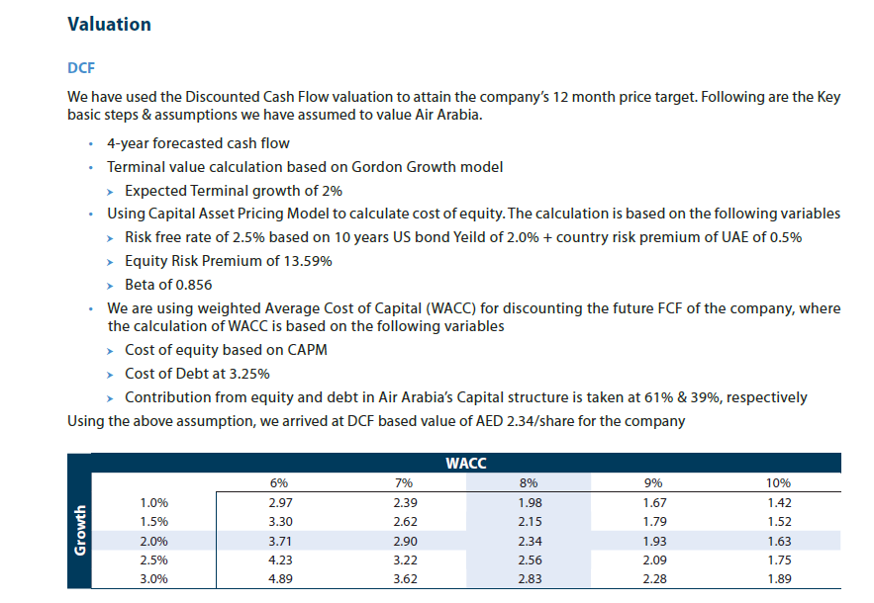
Another Example of High Variation in Valuation from DCF Problems

Slide 32
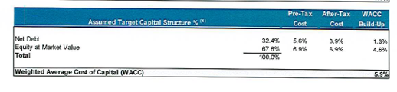
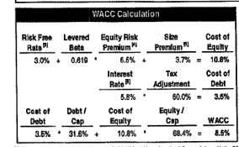
Cost of Capital in Same Transaction
Top is buy side (if negotiating would want high cost of capital). Bottom is sell side.

Slide 33
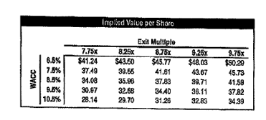
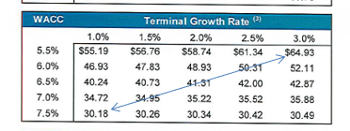
Effect of WACC on DCF
Variation in value from the cost of capital with the two cases. Note how much more the variation is than is reported on the Football field diagram.

Slide 34
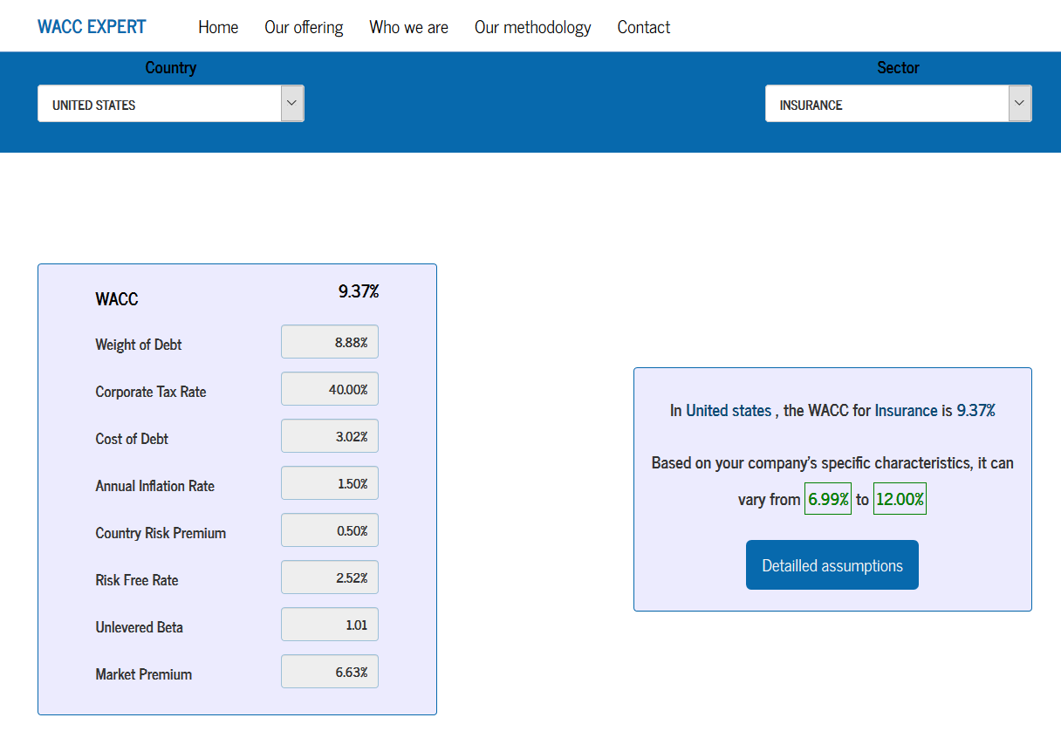
WACC Craziness – Website with WACC for Insurance
http://www.waccexpert.com/

Slide 35
Section 1c:
Working with Stock Price Data; LOOKUP, AVERAGEIF, Generic Macro Introduction

Slide 36
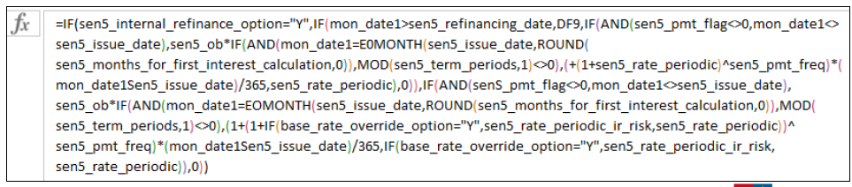
Transparency
Keep the formulas simple
No excuse at all for long formulas because it makes the concepts difficult to explain to somebody not familiar with the model.
Long formulas come about because you do not exactly understand what you are doing.

Slide 37

Excel Functions
We will use short-cuts, excel enhancements, TRUE/FALSE switches and only four functions.
The functions should be used in a way that you are probably not used to.
INDEX
LOOKUP (not VLOOKUP or HLOOKUP)
SUMIF (or AVERAGEIF or COUNTIF)
EDATE
MAX and MIN for Waterfalls (not IF)

Slide 38
Files to Use and Open
Generic Macros
Shift, CNTL, R to copy to the RIGHT
CNTL, ALT, C to colour and format
Must Enable Macros
Should say CNTL,ALT,C on the bottom of excel
Read PDF to Excel
Should say SHIFT, CNTL, A on the bottom
Enable Macros
Use Acrobat
Use Google Chrome

Slide 39
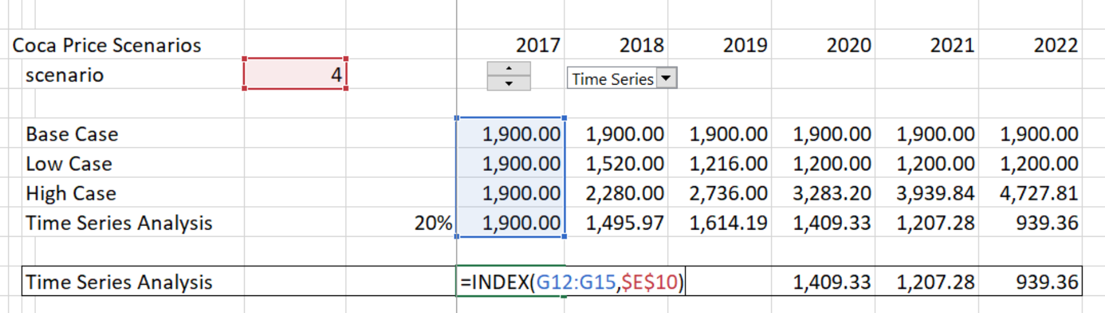
Example of INDEX Function
We will make scenarios for things like:
  Variation in traffic for infrastructure projects
  Variation in price for commodity projects
  Difference in availability for availability projects
Example of Index Function

Slide 40
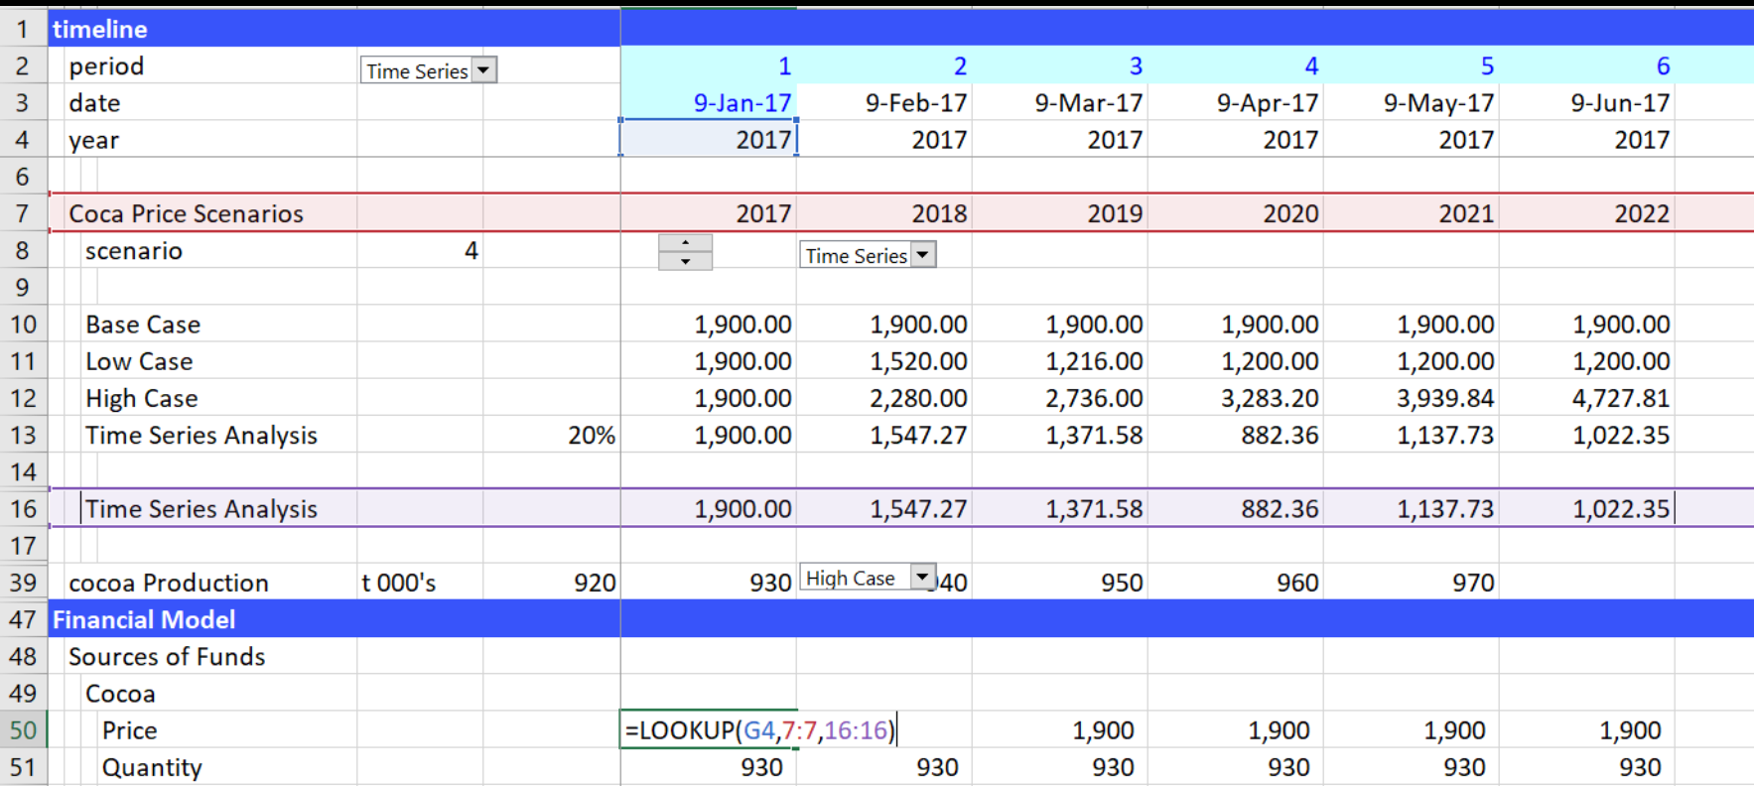
Use of LOOKUP Function
Don’t use VLOOKUP, HLOOKUP or INDEX/MATCH with models that have a time line. Instead, use the LOOKUP function with an entire row as illustrated below:

Slide 41
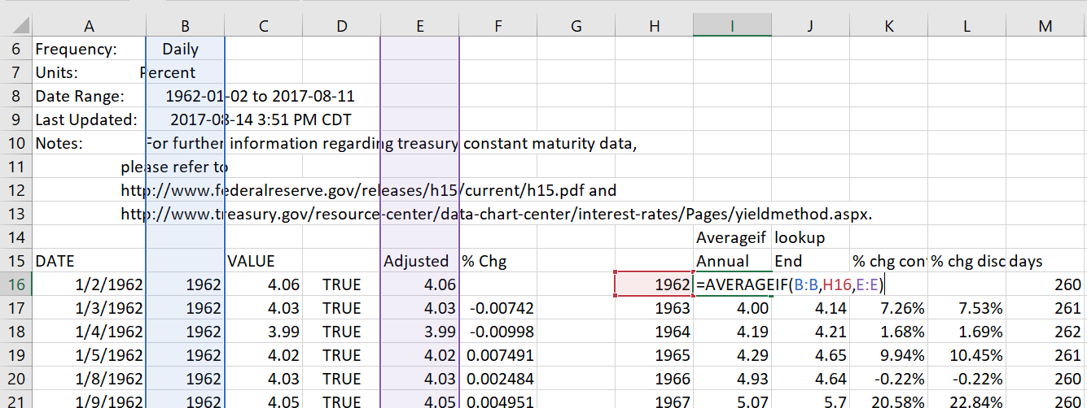
Use of AVERAGEIF, SUMIF, COUNTIF
These functions are useful in project finance model for:
  Converting periodic data by month to sum for a year
  Checking errors
  Counting TRUE’s or FALSE’s

Slide 42
Section 2:
Reading Data, ROIC, Growth and Valuation

Slide 43
Section 2a:
Valuation Theory – ROIC, growth and cost of capital

Slide 44
Valuation, Forecasting and Risk
Every decision for a company is in one way or another derived from how much the outcome of the decision is worth. Valuation is the single financial analytical skill that managers must master.
Valuation analysis of debt or equity involves assessing
  Future cash flow levels, (cash flow is reality) and
  Risks in valuing those cash flows, whether it be the cash flow from assets, debt or equity
Measurement value – forecasting and risk assessment -- is a very complex and difficult problem.
Coming up with a measurement of risk is extremely difficult and things like beta, value at risk and credit scoring have not worked very well.

Slide 45
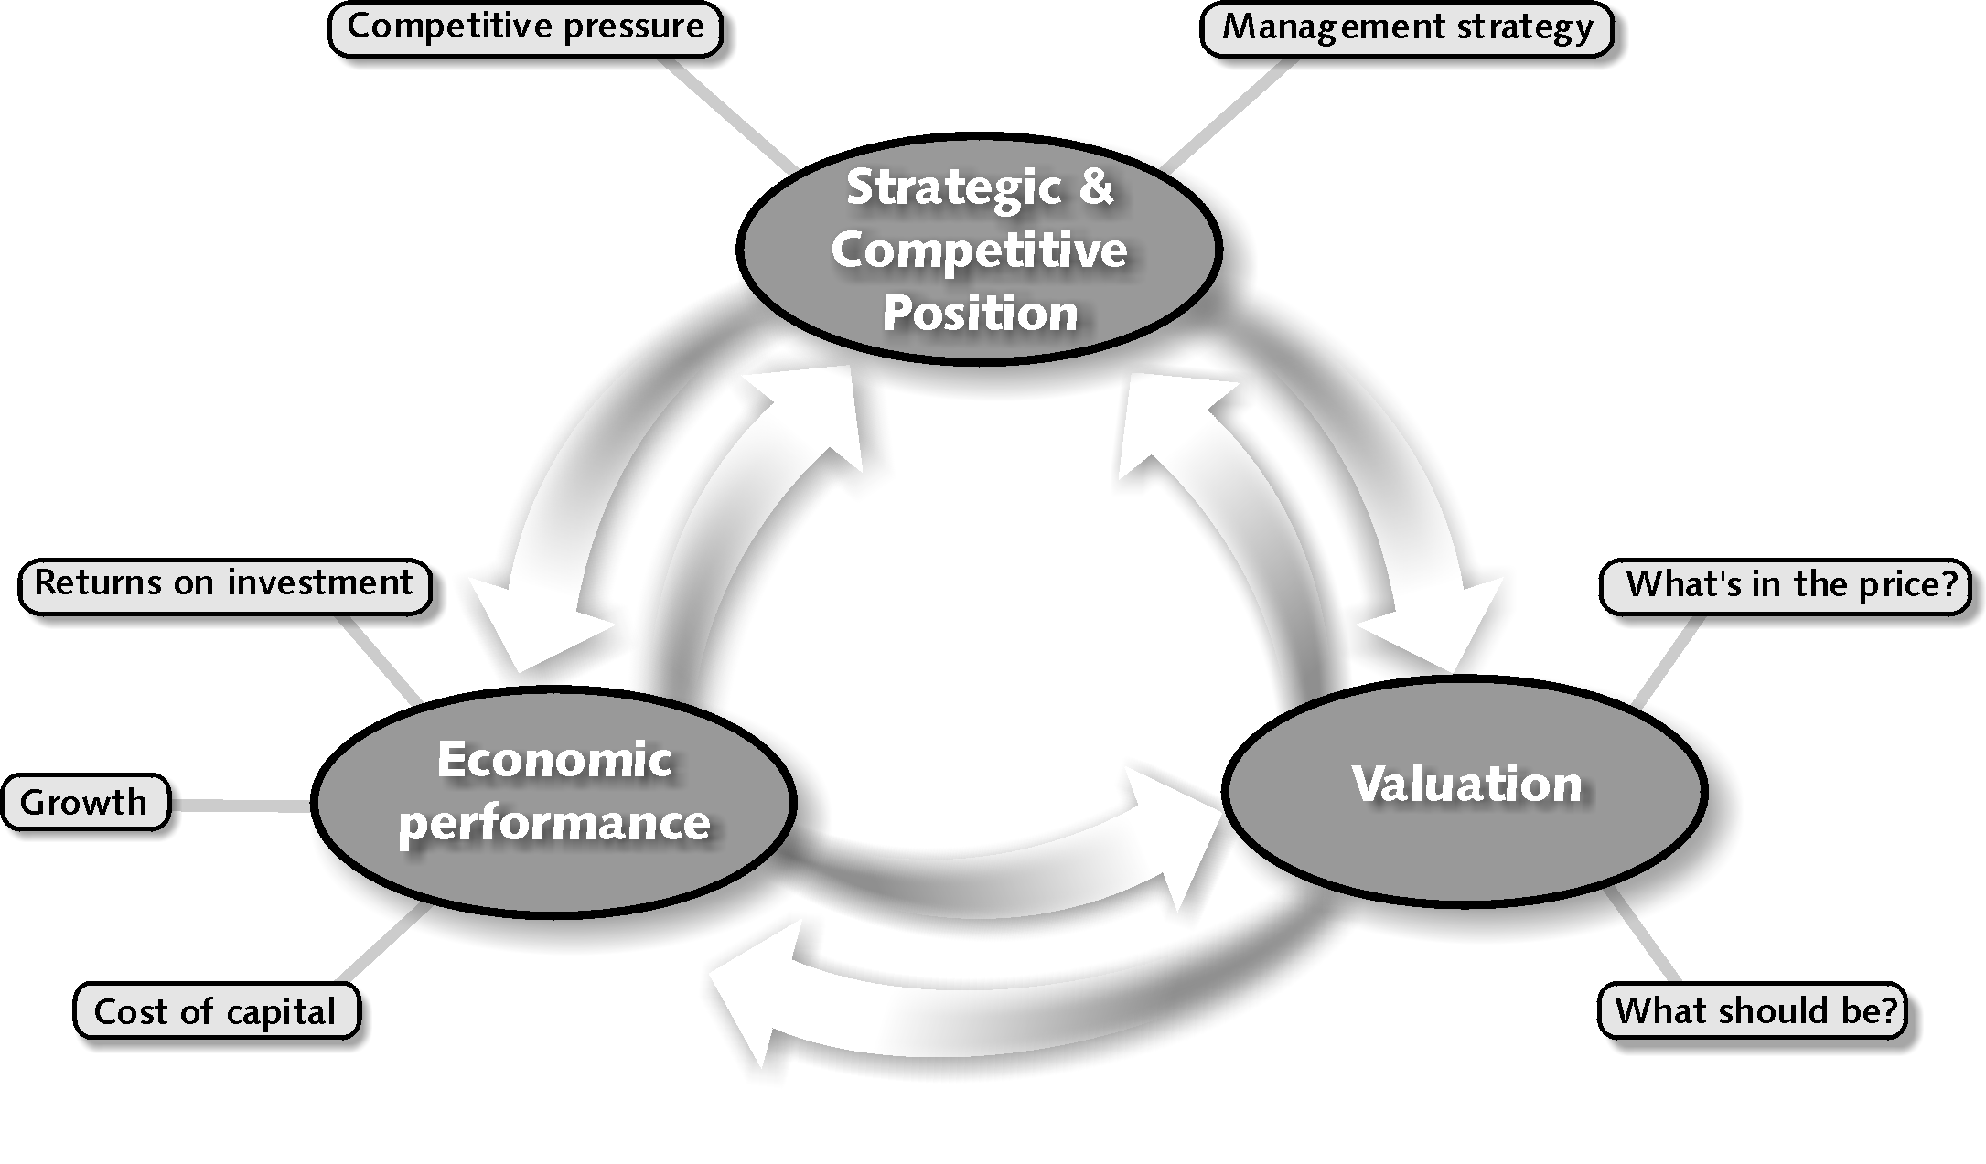
Analytical framework for Valuation – Combine Forecasts of Economic Performance with Cost of Capital
Competitive position such as pricing power and cost structure affects ROIC
In financial terms, value comes from ROIC and growth versus cost of capital
P/E ratio and other valuation come from ROIC and Growth

Slide 46
Quote from McKinsey Valuation Book
We (McKinsey) explain the two core principles of value creation:
  (1) the idea that return on invested capital and growth drive cash flow, which in turn drives value, and
  (2) the conservation of value principle, which says that anything that doesn’t increase cash flow doesn’t create value (unless it reduces risk).
Led to ideas about measuring all performance with return versus cost of capital and books on (ROIC-WACC) * Capital Charge

Slide 47
Investment to Maintain Cash Flow and Profits
To generate profits or cash flow, just about everything requires some level of investment:
  Personal: Invest in education
  High Tech: Invest in research and investment
  Start-up: Invest in marketing and service or product
  Telecom: Invest in acquisitions and licenses
  Retailing or Trading: Invest in Inventories
  Banking: Invest in Loans
  Manufacturing: Invest in Capital Expenditures
If a company stops investing or makes bad investment decisions, or pays too much for investments, it will have problems in the future

Slide 48
Drivers of Value and Growth
Can Replace the ROIC with ROE and WACC with Cost of Equity

Slide 49
The Value Matrix – Company Categories and Strategy
What is the economic reason for getting here and how long can the performance be maintained
Throwing good money after bad
Give the money to investors
Try to get out of the business

Slide 50
Return and Cost of Capital
Rule 1: Interest rate must be higher than the rate of inflation
Rule 2: Return must be higher than the interest rate because there is more risk
Rule 3: The overall return on capital should be higher than the weighted average cost of capital. But the weighted average cost of capital is tricky to compute.

Slide 51
Exercise on ROIC, Growth and Value
Long-term and EIS
SHIFT, CNTL, R from generic macros
Use Interpolate and LOOKUP
Developer Tools
Macro instead of data table

Slide 52
Fundamental Valuation Ideas and Value Drivers
The objective of any corporation is get high returns and then to grow these profits. The value of cash flow from these profits depends on the risk associated with the cash flow or the cost of capital. That means three things drive value:
  Rate of Return on Investment
  Growth
  Cost of Capital Adjusted for Risk
There is no question about these basic ideas and one can think of valuation as forecasting movements in these three variables.

Slide 53
Two Basic Equations in Financial Mathematics
Equation 1: Just Integrate from 0 to ∞
  Value = CF(1)/k (No Growth)
  Value = CF(1)/(k-g) (Growth)
  This is just math (integral from 0 to ∞)
Equation 2: Sustainable Growth
  Growth = ROE * Retention Rate
  Growth = ROE * (1-Payout)
  Payout = 1 – G/ROE

Slide 54
For Equity Case, All you Have to Do is Substitute
Start with Basics
  Value = D1/(k-g) Simple calculus
  DPO = (1-g/ROE) Fundamental growth
  D1 = E1 * DPO Earnings
  Value = E1 * (1-g/ROE)/(k-g)
For P/E Ratio
  Value/E1 = (1-g/ROE)/(k-g)
For P/B Ratio
  E1=Book Value * ROE1
  Value = Book Value * ROE * (1-g/ROE)/(k-g)
  Value/Book Value = (ROE-g)/(k-g)

Slide 55
Fundamental Idea about Investment Necessary to Generate Return
If you don’t make an investment, you cannot improve your life.
If you don’t make capital expenditures, you cannot get EBITDA.
If you don’t sell policies and put investments on the balance sheet, you can not earn a return.
If you don’t pay for a stock, you cannot get dividends.
Even when you gamble, you must put some money down on the table.
But, what about:
  Uber: drivers make investment and all Uber has is a bit of software
  Services: You make money from your reputation (Deloitte, Cap Gemini, GE, Siemens, Law Firms, etc.)
  Construction contracts: You make money by constructing a plant and the investment in tractors etc. is very minor.

Slide 56
The Value Driver Formula
The formula for value from the three value drivers can be stated in general as:
Value =
  Earning x (1-growth/return)/
  (Cost of capital –growth)
  The formula can also be used to compute valuation ratios (the P/E ratio of the EV/NOPAT ratio) as follows:
Multiple or Value/Earnings =
  (1-growth/return)/(Cost of capital –growth)

Slide 57
The Value Driver Formula for Equity Value
The formula for equity value uses the growth rate in equity (g), the return on equity (ROE) and the cost of equity capital (k):
Equity Value per Share =
  Earning x (1-g/ROE)/(k –g)
  The formula can also be used to compute the P/E ratios as follows:
P/E = (1-g/ROE)/(k –g)

Slide 58
The Value Driver Formula for Enterprise Value
The formula for enterprise value from the three value drivers uses NOPAT or net operating income after tax or EBIT x (1-t) as earnings. The return is expressed as ROIC and the growth is the growth rate in invested capital. The cost of capital is WACC:
Enterprise Value = NOPAT x (1-growth/ROIC)/
  (WACC –growth)
  The formula can also be used to compute valuation ratios (the EV/NOPAT ratio) as follows:
EV/NOPAT = (1-g/ROIC)/(WACC – g)

Slide 59
Problems with These Value Driver Formulas – They Only Work when All Items are Constant
McKinsey Discussion of the Formula:
  This formula underpins the discounted-cash-flow (DCF) approach to valuation, and a variant of the equation lies behind the economic-profit approach (i.e. monopoly profit)….You might go so far as to say that this formula represents all there is to valuation. Everything else is mere detail.”
However, the formula is really not very good:
  Only works when ROE and g and k are constant.
  It does not work with inflation, because the value of the investment increases over time due to inflation.
  It does not work if the return on new investments is different from the return on existing investments in cases such as high technology.

Slide 60
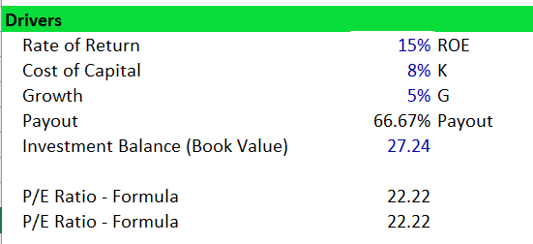
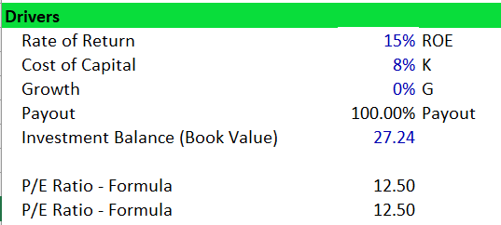
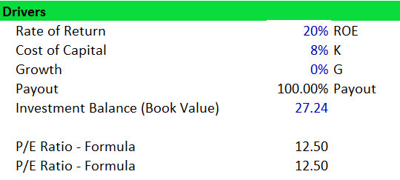
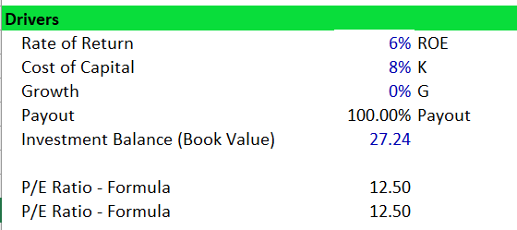
Lets Review How this Works Mathematically – Start with the No Growth Case
When the Growth Rate is Zero, the P/E ratio is 1/k. In this case the rate of return does not matter to the P/E ratio because E is there.

Slide 61
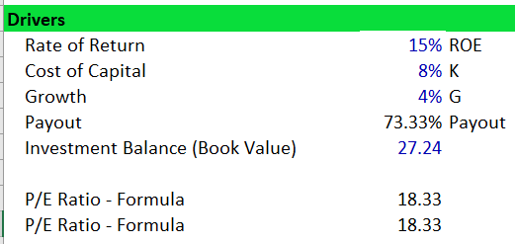
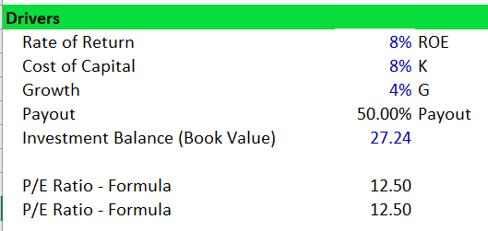
What Happens when the ROI = Cost of Capital
When the ROI is the same as the cost of capital, the growth does not matter.
Think about a company that buys treasury bonds and distributes debt service as dividends.
For once, you know cost of capital and the cost of capital is the same as the return (unless you waste money)

Slide 62
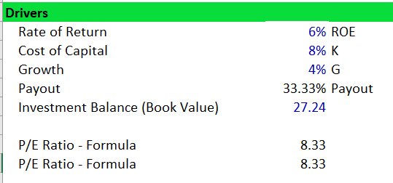
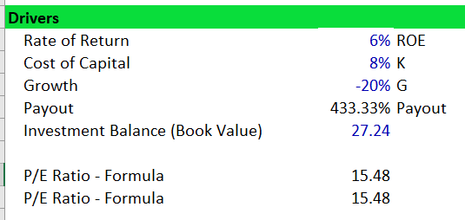
If you make Negative NPV Investments, Growth Hurts
Notice that when the growth is negative and the return is less than the cost of capital, then the P/E goes up.
This makes sense (think about the case when you waste money in the treasury bond case)

Slide 63
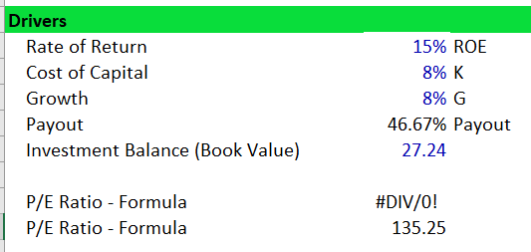
Interaction between Growth and Return
If the growth is zero, the level of the return does not matter in the valuation formulas
This is not really true when growth rate changes. A change in return makes a big difference in any case.
Long-term growth is the central issue and growth rates projected by analysts are not very reliable.

Slide 64
Changing ROE, Changing Growth and Changing Inflation
Cannot grow in long-term much faster than the economy.
Demonstrates the that the real issue is whether ROIC above the cost of capital can continue.
When ROIC expectations decline, then the P/E ratio falls.
To make this analysis, you cannot use the simple formula. Instead,
  In the terminal period, use the version of the formula that starts from the book value of the investment.
  Use the formulas for dividend payout as a function of growth.
  Use the INTERPOLATE LOOKUP function to gradually change Return.

Slide 65
ROIC instead of ROE and EV/EBITDA
First, assume invested capital is only plant and equipment
Second, assume that invested capital includes working capital changes
Key variable is deriving the net plant depreciation rate from the growth rate and formula:
Cap Exp/Depreciation = g/Net Plant Depreciation rate + 1

Slide 66
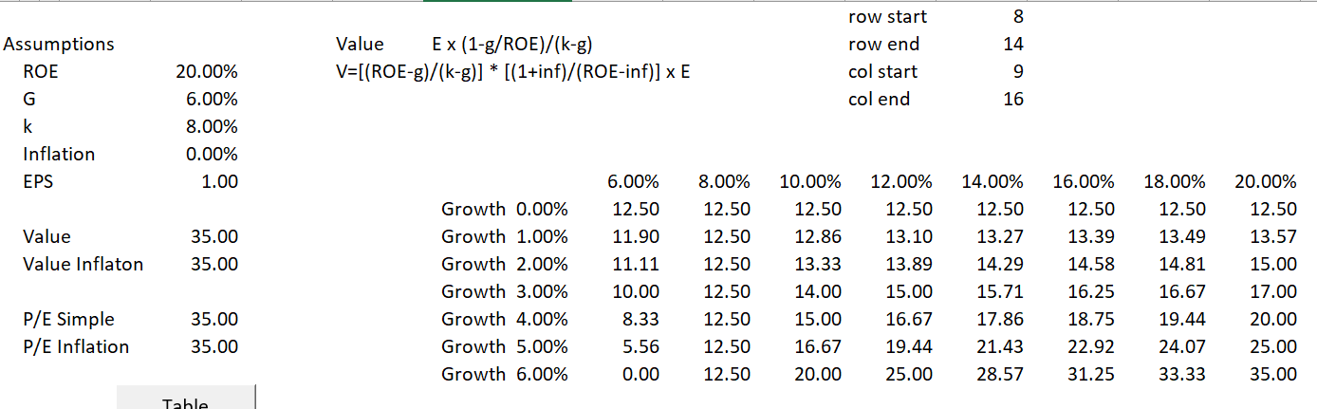
Valuation Sensitivity in Simple Case
Keep discount rate constant at 6% (the discount rate or the expected IRR is the biggest variable)
A graph of the data table demonstrates that the combination of variables makes the valuation change dramatically.

Slide 67
Value Does not Change on a Linear Basis With the Variables – Instead there is an Interaction
Demonstrates that the value has higher variability with respect to ROE with higher growth rate. There is a strong inter-relationship.

Slide 68
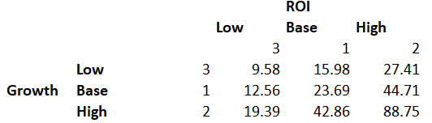
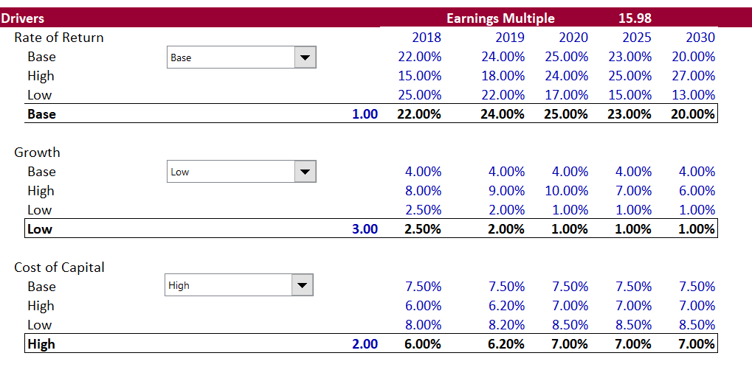
Changing ROI and Growth
Notice how the change in ROI makes so more of a difference when the growth rate is high

Slide 69
The Interaction between Growth and Return with a Simulation
Illustration of combined effect of growth and return. The circles with blanks are negative and the blue dots are positive. This demonstrates the worst place to be in terms of value is the high growth and low return square.

Slide 70
Why ROIC and Not ROE
Biggest reason is the ROIC measures the returns from the core value of the business and does not include things like cash on the balance sheet, returns from debt, changes in the value of financial derivatives, changes in gearing.
  All of these things do not reflect what is really going on in the factories, in the marketing efforts, in the pricing of products and so forth.

Slide 71
ROE versus ROIC and Exxon Mobil Return on Average Capital Employed
Return on average capital employed (ROCE) is a performance measure ratio. From the perspective of the business segments, ROCE is annual business segment earnings divided by average business segment capital employed (average of beginning and end-of-year amounts).
These segment earnings include ExxonMobil’s share of segment earnings of equity companies, consistent with our capital employed definition, and exclude the cost of financing.
The corporation’s total ROCE is net income excluding the after-tax cost of financing, divided by total corporate average capital employed. The corporation has consistently applied its ROCE definition for many years and views it as the best measure of historical capital productivity in our capital intensive long-term industry, both to evaluate management’s performance and to demonstrate to shareholders that capital has been used wisely over the long term. Additional measures, which tend to be more cash flow based, are used for future investment decisions.

Slide 72
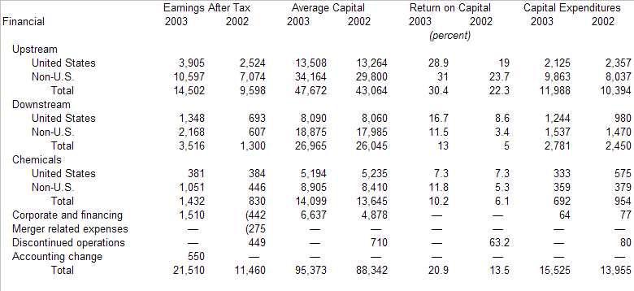
Exxon Mobil Return on Capital Employed – Where are they making expenditures

Slide 73
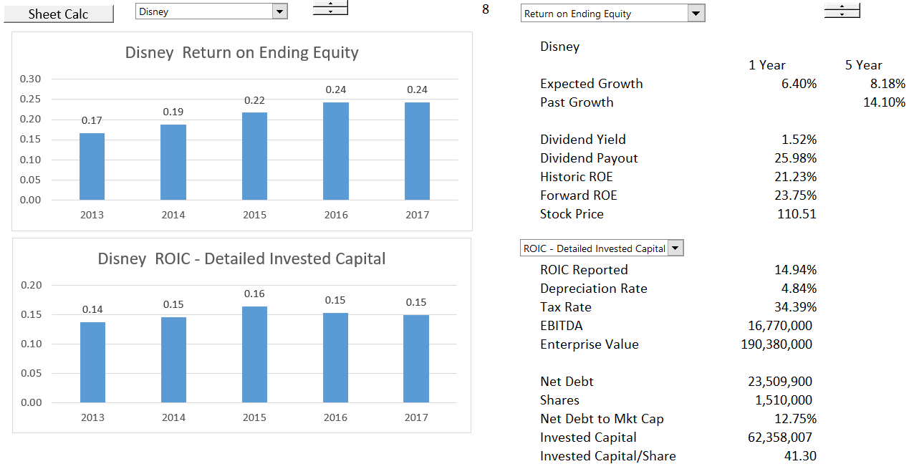
ROE and ROIC Comparison
Use ROE for exercise

Slide 74
Returns versus Growth – Which would you Rather Have
McKinsey: We will show that high-ROIC companies typically create more value by focusing on growth, while lower-ROIC companies create more value by increasing ROIC.
Comment: Everybody of course wants high ROIC, which is just another word for monopoly profit and which is the driver of capitalist economies. If you are valuing a company you must assess the ability of a company to maintain or grow its monopoly position. That is the hard part.

Slide 75
Statement about U.S. and Asian Companies by McKinsey
The median large U.S. company earned a 19 percent ROIC in 2013, while the median large Asian company earned 8 percent.
But for the most part, Asian companies historically have focused more on growth than profitability or ROIC, which explains the large difference between their average valuation and that of U.S. companies.
Comment: Everybody of course wants a high monopoly profit. Very smart people are hired to create monopoly profits through marketing strategies (or making children and adults addicted to a product). The focus must be on making positive NPV investments, value should increase.

Slide 76
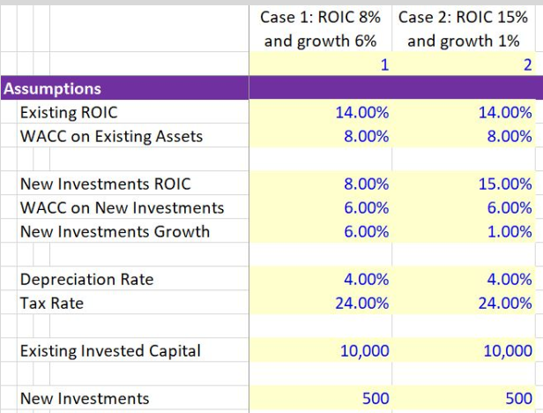
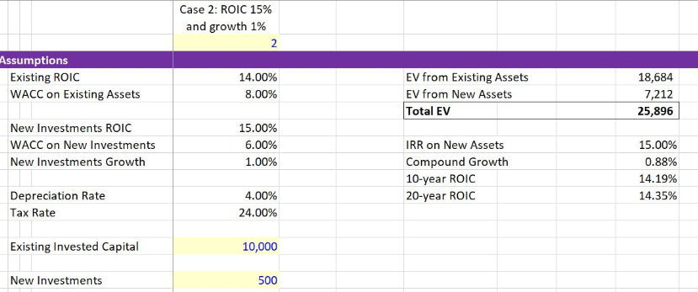
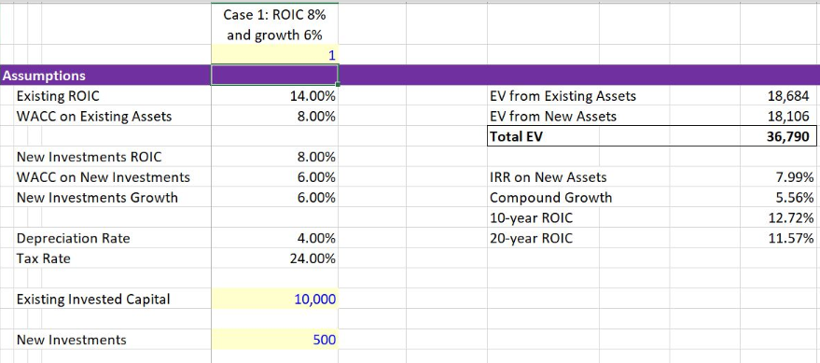
Demonstration that Growth Can be More Important Than Return

Slide 77
Of Course You Should Invest when Return Exceeds Cost of Capital – This is NPV Rule
The interaction between growth and ROI is a key factor to consider when assessing the likely impact of a particular investment on a company’s overall ROI. For example, we’ve found that some very successful, high-ROI companies in the United States are reluctant to invest in growth if it will reduce their ROIs.
One technology company had a 30 percent operating margin and ROIC of more than 50 percent, so it didn’t want to invest in projects that might earn only 25 percent returns, fearing this would dilute its average returns.
But as the first principle of value creation would lead you to expect, even an opportunity with a 25 percent return would still create value as long as the cost of capital was lower, despite the resulting decline in average ROIC.

Slide 78
Section 2b – Acquiring Data and Computing ROIC

Slide 79
HD Media and Moneycontrol
Using Read PDF
  Open File from Internet (Chrome)
  Copy to Excel
  Convert to Readable Format
Reading from Internet
  Split-up URLs
  Create Macro with Workbooks.open
  Collect Sheets
  Use INDIRECT to summarise

Slide 80
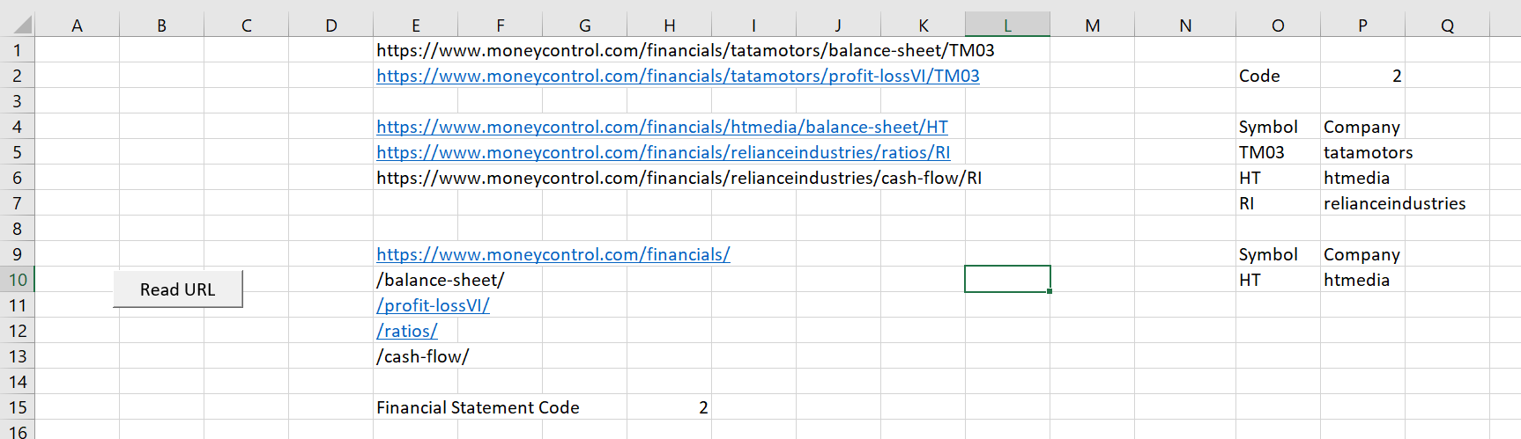
Moneycontrol Website
You can automatically read and update financial from the moneycontrol website. Then, you can automatically update your model. You need to know the workbooks.open method and split the url.

Slide 81
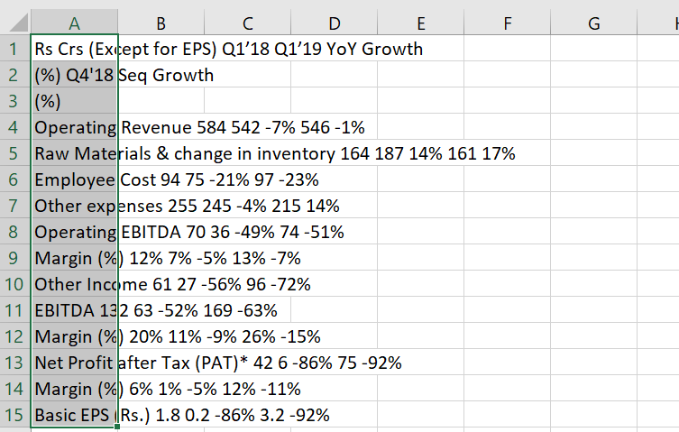
Reading PDF Format
You can also get the annual report in PDF format. Then, from google chrome or in adobe, copy and paste special as unicode text.

Slide 82
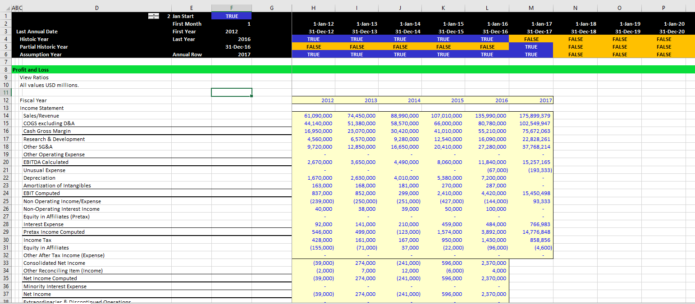
Example of Acquiring Data from Internet – Profit and Loss for Amazon

Slide 83
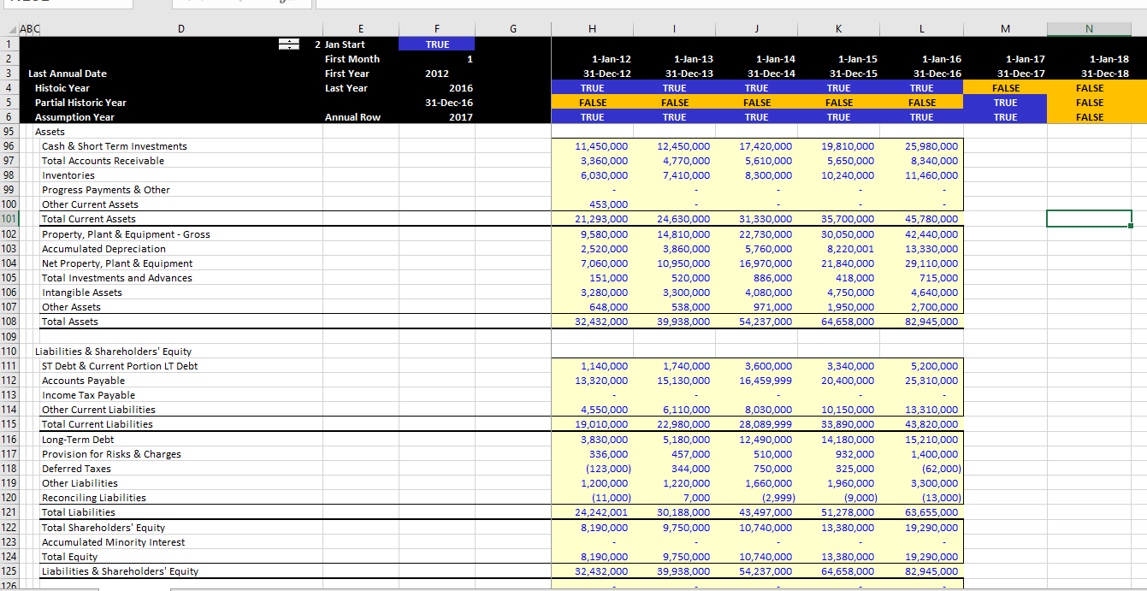
Example of Reading from the Internet – Balance Sheet for Amazon

Slide 84
Computing ROIC with Historic Data
Classify balance sheet accounts
Direct Method
  Assets and liabilities related to core operations (i.e. producing EBITDA) in invested capital. Assets and liabilities not in core operations (e.g. surplus cash or other investments) not included
Financing Method
  Liabilities and capital that finance assets (e.g. equity and debt) included and net assets that are not part of core operations are excluded. Idea that some of the financing is for things like cash and other investments and this part of financing should be removed.
Use 1’s and -1’s to classify the balance sheet; all assets and liabilities should be classified.
Use SUMPRODUCT with 1’s and -1’s to compute invested capital
NOPAT is EBIT x (1-tax rate); issue is what tax rate to use – statutory tax rate or actual tax rate.

Slide 85
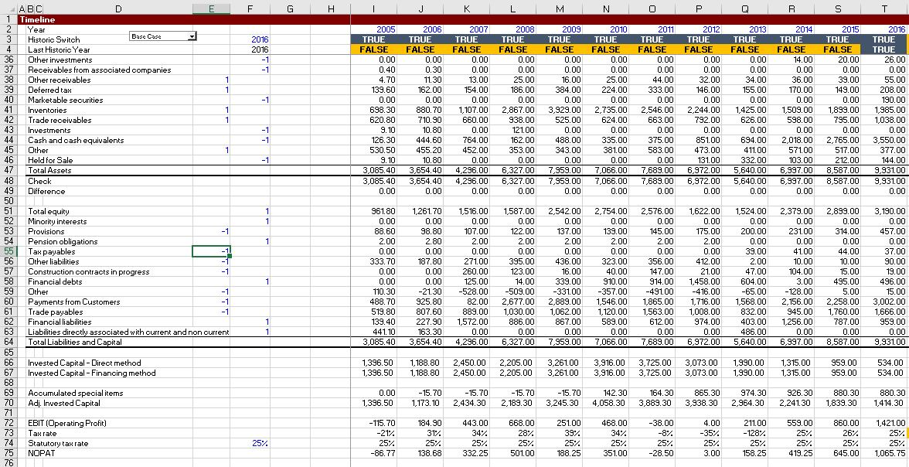
Computing ROIC Using SUMPRODUCT
Example of segregating the balance sheet and computing ROIC

Slide 86
Return on Invested Capital Analysis
ROIC is not distorted by the leverage of the company
ROIC can be used to gauge economic profit and whether the company should grow operations
ROIC can be used to assess the reasonableness of projections
  For example, if ROIC is very high and the company is in a competitive business with few barriers to entry, the forecast is probably not realistic.
ROIC can be computed on a division basis EBIT and allocation of capital to divisions from net assets to gauge the profit of parts of the company
ROIC comes from sustainable competitive advantage and high market share

Slide 87
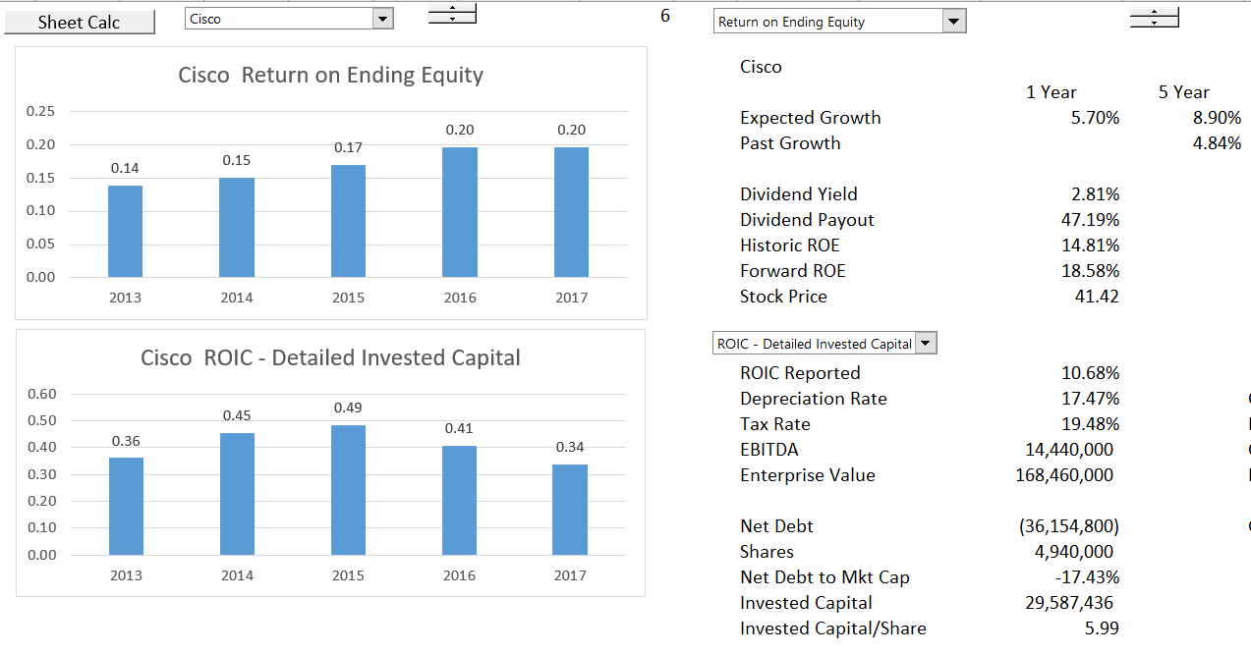
Careful Calculation of ROIC
Long-term investments should be accounted for.

Slide 88
ROE and ROIC Comparison
Use ROE for exercise

Slide 89
Section 2c
Value Analysis from ROIC and Growth from Financial Database – Amazon Case Study

Slide 90
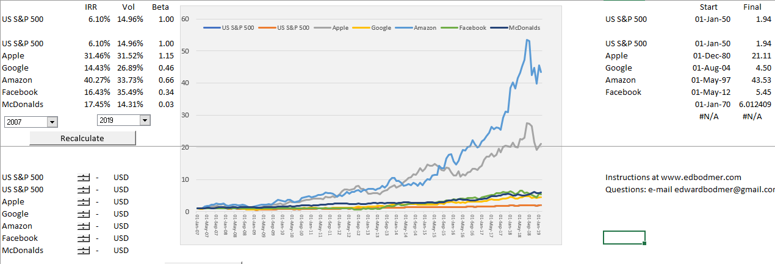
Amazon Stock Price
Growth since 1997

Slide 91
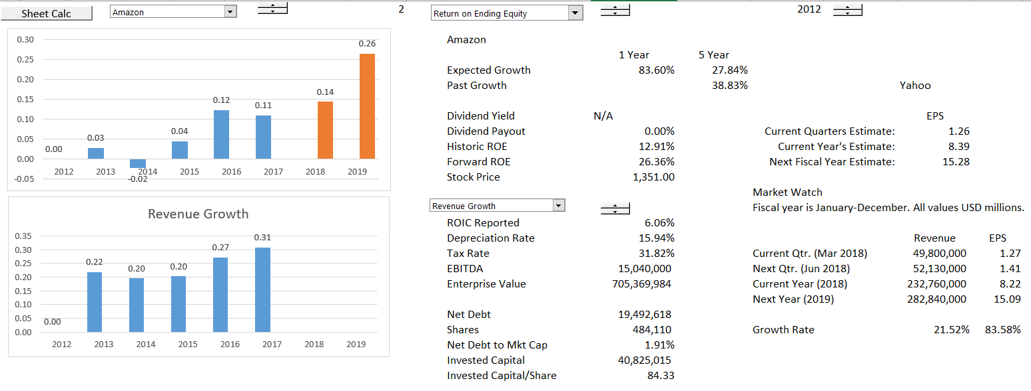
Amazon – Returns and Growth
Can the growth continue after you get very big

Slide 92
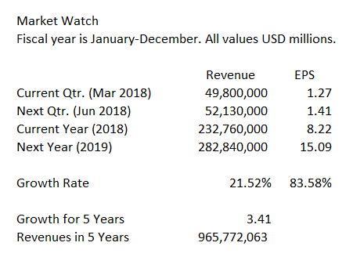
Amazon Revenues in 5 Years Assuming EPS Growth = Revenue Growth
Note just how much money high growth represents – USD 1 Trillion

Slide 93
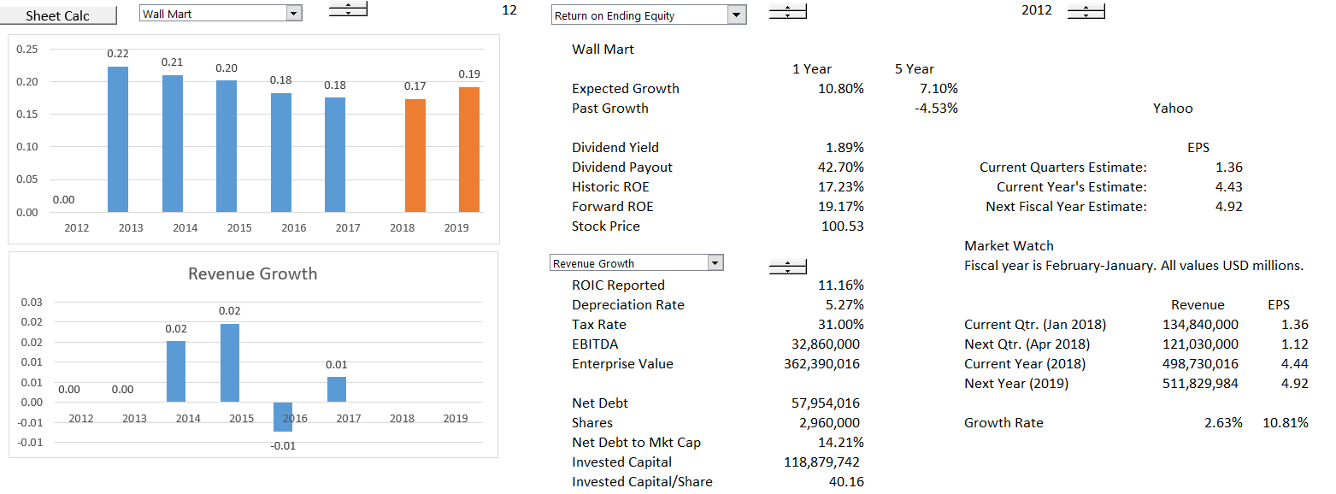
Compare Assumption to Walmart
Somebody has to lose if Amazon gets the gain, will they compete effectively?

Slide 94
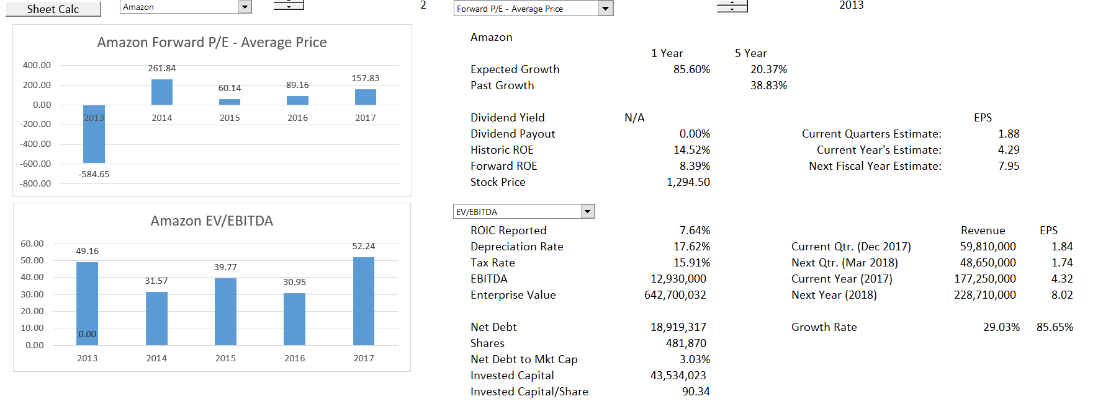
Historic Analysis from MarketWatch, PDF Conversion
Note all of the history and financial ratios in the reports – can assess forecasts with ROE and value from P/E Ratios.

Slide 95
Mini Case Study of Amazon
How do you explain the P/E and EV/EBITDA ratios with ROIC and Growth

Slide 96
Section 3:
Deriving Assumptions in Corporate Model

Slide 97
Section 3a:
Theoretical Discussion of Assumptions and Risks

Slide 98
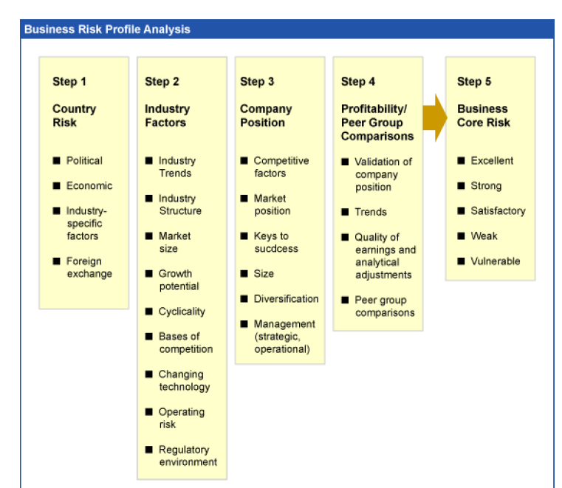
Why S&P Credit Criteria – More Rubbish

Slide 99
Why S&P Credit Criteria is Rubbish
Note the lack of diversity in the categories – when there is no diversity the ratings are useless

Slide 100
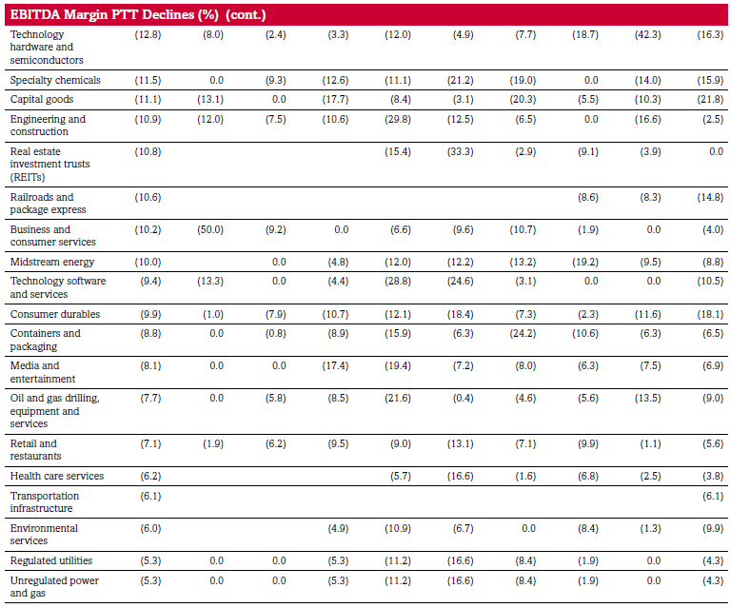
EBITDA Volatility – Peak to Trough Percent (PTT) – Rubbish

Slide 101
Difficulty in Classifying Assumptions and Risks
Surplus Capacity (worse with Capital Intensive Investments)
Fashion Going Out of Style and/or Technical Obsolescence
Cost Structure Changes from International Competition
Price Bubbles from Speculation
Forecast May be Really About Projecting Continuing Ability to Earn Economic Rents

Slide 102
Economic Risks in Models
Surplus capacity from demand reduction combined with capital intensity and large difference between short-run marginal cost and long-run marginal cost.
  Examples: telecom fiber optic cable, U.S. housing in 2008, shale gas, bulk ships, electricity
All sorts of obsolescence, fashion changes, innovation that cause margins to suddenly change and that are very difficult to forecast.
  Examples: Blackberry, Nokia, Victoria Secret, Sears, Kodak, Blockbuster
Changing cost structure
  Examples: solar power, airlines; clothes; furniture

Slide 103
Other Risks in Models
Reliance on uneconomic contracts
Pure fraud
Inventory obsolescence
Reliance on idiotic consultant forecasts
Believing in operating leverage
Are you in a price bubble

Slide 104
Drivers of Value and Growth
End up here
Want to be here – results in over capacity
Can Replace the ROIC with ROE and WACC with Cost of Equity

Slide 105
Still Volume and Price, But …
Have volume history from financial data, but need long-term data that covers business cycles.
Surplus capacity analysis may require knowledge of competitor capacity additions – there is no historic financial data that can be used for this.
Demand volatility is aggravated by operating leverage. It is difficult from financial statements to separate fixed and variable cost. Example of airlines and auto companies after 2000 and 2008.

Slide 106
Industry versus Firm Analysis
Industry Analysis
  Drivers of price and volume volatility
  Cost Structure of Industry, fixed and variable cost
  Capitals expenditures required to sustain EBITDA
  Product life cycle
Company Analysis
  Drivers of market share
  Customer tastes
  Relative cost structure
Examples of Industry and Company Failures

Slide 107

Telecom’s and the Dot.com Bubble
As shown in the graph, the stocks of the telecoms were more variable.

Slide 108
No History and Problems with Volume Forecasts
Without volume history from financial statements, predicting revenues is extremely speculative.
In this case, that occurred around the dot com bubble, a venture financed by Motorola had a dramatic crash. The interesting thing was that how the investment bankers bought the marketing projections hook line and sinker.

Slide 109
The Saudi Market – A Classic Bubble
Teachers, cab drivers etc. stopped working and purchased shares. There were wonderful excuses as to why the Saudi market is different.

Slide 110
Section 3b:
Historic Switch and Presenting Assumptions in a Financial Model

Slide 111

You Need to Understand and Not Bias Historical Analysis as the First Step in a Forecast
Forecasts from History
  The most effective way to destroy people is to deny and obliterate their own understanding of their history.”
Forecasts from History and Manipulating History in Financial Models
  “Day by day and almost minute by minute the past was brought up to date. In this way every prediction made by the Party could be shown by documentary evidence to have been correct; nor was any item of news, or any expression of opinion, which conflicted with the needs of the moment, ever allowed to remain on record. All history was a palimpsest, scraped clean and reinscribed exactly as often as was necessary.”

Slide 112

Old Fashioned Models with History and Forecast
Examine the ROE and Return on capital to judge the forecast

Slide 113
Historic Switch
Define the Last Historic Year
Alternative Time Lines
Formula with 1=1, 2<1 to Find TRUE or FALSE
Conditional Formatting
Use of Generic Macros

Slide 114


Start with Financials: Simple Example of Bank Versus Industrial
PP&E versus Loans
Interest Income versus EBITDA
Include Deposits to Finance Loans
Depreciation in Industrial

Slide 115

Assumptions in Simple Industrial
For simple case, create assumptions from the history. Of course, the real world involves careful assessment of risks.

Slide 116

Example of Classic Company – Food Business and Use of ROIC for Benchmarking
In this case, keep ROIC in sight when make a valuation.

Slide 117
Section 3c:
Growth, Margin, Operating Cost and Capital Expenditure Assumptions

Slide 118
Need to Answer Fundamental Questions about Demand Growth, Prices and Cost Structure
Demand Growth
  Volatility of demand growth
  Implications of demand volatility and capital intensity
  Implications of demand volatility and fixed operating cost
  Example: Airlines versus Retail
Price Levels and Return
  How can sustain prices that lead to high return
  Types of products (solar panels and cell phones)
  First mover and scale (Disney and merchant electric plants)
  Creating Loyalty (Coke and Fiber Optic Cable)

Slide 119
Need to Answer Fundamental Questions about Demand Growth, Prices and Cost Structure
Cost Structure
  Fixed and Variable Costs
  Comparison of Costs with Competitors
  Sustainability of Cost Advantage
  Example: Shale Gas and High Cost of Replacement
Problems with Analysis
  Very difficult to measure – some companies have sustained high ROIC
  Product life cycle shortening – how long can maintain returns from innovation
  Problems of obsolescence, changes in taste, fashion etc.

Slide 120

Example of Fibrex – Can It Get Back Up to Powerhouse Square
Danger of obsolescence and competition when returns are high

Slide 121


Price and Volumes in Fibrex

Slide 122
Still Volume and Price, But …
Have volume history from financial data, but need long-term data that covers business cycles.
Surplus capacity analysis may require knowledge of competitor capacity additions – there is no historic financial data that can be used for this.
Demand volatility is aggravated by operating leverage. It is difficult from financial statements to separate fixed and variable cost. Example of airlines and auto companies after 2000 and 2008.

Slide 123

Crash in Share Price of GE – A Company that Makes Investments in Factories

Slide 124
Use of Return on Invested Capital to Assess Model
The big question is what really goes into calculation of the invested capital.
The most obvious point is that surplus cash should not be in invested capital because the income associated with surplus cash is not in NOPAT.
For Amazon, the issue of R&D cost is a big issue. If R&D was capitalised, the observed return would be a lot higher.

Slide 125

Carlsberg Analysis – Forecasting Management Ability to Affect Return
Change the scenarios and evaluate value at the same time you are gauging value

Slide 126
Mini Case of First Solar

Slide 127

Case Study of Not Being Able to Sustain ROIC, ROE and Growth
Forecasted Price of more than 400.

Slide 128

Current First Solar
Note the actual earnings and return on capital: Demonstrates that both growth and return matter.

Slide 129
Section 4:
Creating Structured and Transparent Model Given the Assumptions

Slide 130
Section 4a:
Good and Bad Structures of Corporate Models

Slide 131

Operating Analysis in Industrial Case – Set-up Plant Balance and Net Debt Balance
To reconcile cash flow with balance sheet and income statement, set up an account the is incremented by net cash flow and goes on the balance sheet.
Historic closing balances come from balance sheet

Slide 132

Financial Statement for Industrial Company – Net Cash Flow Goes onto Balance Sheet as Cash
Set-up the equity account from income on P&L and dividends on cash flow.
Connect net cash flow to the net debt account.
If the cash is positive, allow cash to be built-up. If the cash is negative start borrowing.

Slide 133
Criminal Practices
Hard-coded numbers after inputs
Forecasted Profit and Loss and Balance Sheet at the beginning of the model
No explicit section that connects the financing with the balance sheet
No historic switch and method to flexibly move from history to forecast
Formulas not consistent across columns
Depreciation methods that do not recognize change in net deprecation rate with change in growth rates

Slide 134

Example of Poor Structure
In this example, the financial statement with historic and projected is at the top; there are hard coded numbers; there is no historic switch; formulas are not consistent

Slide 135
Section 4b:
Depreciation Issue in Corporate Models

Slide 136
Depreciation Process
You can separate existing depreciation from new depreciation. Then, you can evaluate the retirements on existing depreciation using the process below.
The best way I have found to do this is to first find the historic growth rate in capital expenditures as well as a starting point for the retirements.
Use the Solver to Find the Base Level of Retirements and the Historic Growth Rate
To do this:
Step 1: Derive the plant life for one category of assets or the assets in aggregate.
Step 2: Set-up a schedule with gross plant that has balance from the balance sheet. Include retirements as part of the schedule.
Step 3: Set-up a schedule with the accumulated depreciation that also includes retirements.
Step 4: Put an equation with a base level of retirements and a growth rate to compute the amount of period by period retirements.
Step 5: Use the Solver feature to derive the base level of retirements and the growth rate by setting the closing balance to zero.

Slide 137

Schedule of Existing Assets with Closing Balance of Zero at End of Life
Separate existing and new assets because of retirements and changing growth.

Slide 138

Use of Solver to Find Values
You need to find the historic growth rate and the historic basis for the retirements. You can create a little schedule and use the solver for this.

Slide 139

Setting-up Depreciation Schedule
If you are using gross depreciation rate, set up the retirements and use the offset function for new capital expenditures.

Slide 140
Section 4c:
Connecting Cash Flow and Balance Sheet with Cash Balance and Debt Section

Slide 141
Short-term Cash Flow Analysis and Liquidity
Seasonality versus trends in cash flows relative to current assets and current liabilities
Fixed and Variable Costs: how changes in revenues impact profit
Cash Flows and revolving credit facilities
  Managing the working capital cycle Business cycles and businesses
    Stocking
    Selling
    Destocking
Applying and evaluating the main ratios to understand and analyse
  the Cash Conversion Cycle
  the cash position of the business
the credit-worth of the business

Slide 142
Evaluate a Forecast with ROE or ROIC
Fundamental economic notion that it is very difficult to charge high prices/premiums and also grow.
Basic check of forecasts is to consider the return on investment and make sure it is consistent with economic conditions and the industry.
For industrial company, use ROIC which is not distorted by changes in the capital structure.
For financial companies, use ROE as long as capital structure is stable.

Slide 143
Section 5:
Computation of Explicit Cash Flow Over Holding Period EV to Equity Value Bridge

Slide 144
Section 5a: Definition of Free Cash Flow

Slide 145
Valuation from DCF Analysis
Valuation with DCF Analysis
  Careful Definition of Cash Flow (Deferred taxes, warranty costs, employee reserves)
  Flexible timing in DCF
  ½ Year Adjustment in DCF
  Terminal Value with Timing in Models
  Alternative Terminal Methods
  Adjustment to Terminal Value for EBITDA, Working Capital, Capital Expenditures, Deferred Tax and Other Items
  Evaluating the Bridge Between Enterprise Value and Equity Value

Slide 146
Free Cash Flow
Free cash flow or unleveraged cash flow:
Do not include any effects of interest expense or other income in cash flow
Free Cash Flow
  EBITDA
  Less: Capital Expenditures
  Less: Adjustment to EBITDA for changes in working capital
  Add: Other adjustments for warranty provisions
  Add: Changes in deferred taxes
  Less: Operating Taxes without interest – EBIT x Tax
    FREE CASH FLOW

Slide 147
Equity Cash Flow
Equity cash flow;
Depends on constant or near constant capital structure
Equity Cash Flow
  Dividend Inflows
  Less: New Equity Issues
    EQUITY CASH FLOW
New equity issues dilute shareholdings and/or could be funded by lower dividends.

Slide 148
Valuation Diagram – DCF from Cash Flow
Valuation using discounted cash flows requires forecasted cash flows, application of a discount rate and measurement of continuing value (also referred to as horizon value or terminal value)
Continuing Value
Cash Flow
Cash Flow
Cash Flow
Cash Flow
Discount Rate is WACC
Enterprise Value
Net Debt
Reference: Private Valuation; Valuation Mistakes
Equity Value

Slide 149
Equity Cash Flow, Debt Cash Flow, Free Cash Flow and
Cost of Equity, Cost of Debt and WACC
Equity Cash Flow and Value of Equity :
Dividends less Equity Issued
Value of Equity
PV of Cash Flows at
Cost of Equity
+
+
Debt Cash Flow and Market Value of Debt :
Net Interest plus Net Debt Payments
Value of Debt
PV of Cash Flows at
Incremental Cost of Debt
=
=
Free Cash Flow:
EBITDA – Op Taxes – Cap Exp – WC Chg
Value of Enterprise
PV of Cash Flows
At WACC

Slide 150
Terminal Value in Corporate Model
Year after explicit period to establish stable cash flows
Gordon’s
CFt x (1+g)/
(WACC-g)
History
Explicit Forecast Period
Terminal Value
EV/EBITDA that Reflects
Long-term Growth Rate and ROIC
PV of Cash
Year t
Infinity
Step 2: PV from Year t to current year
Step 1: PV to year t – End of period t, so Gordon’s method must use t+1 cash flows
Market to Book Ratio that Reflects Long-term ROE
Make sure Cash Flow in period t reflects realistic ROIC, Working Capital that reflects long-term growth and realistic capital expenditures
Valuation Date

Slide 151
Section 5b:
Cash Flow Complications EV to Equity Value Bridge

Slide 152
Deferred Tax Example
Deferred Tax from NOL or from depreciation or from fair valuation of derivatives
Answer
  Deferred tax from depreciation (changes) should be in cash flow and not as a liability in the net debt calculation
  Deferred tax from NOL should be in cash flow as long as NOL turns in the explicit period
  Deferred tax from derivative valuation should not be in cash flow or net debt

Slide 153
Enterprise Value to Equity Analysis- 1
Proof 1: Accounts Payable: Demonstrates the A/P should not be in bridge because included in FCF; Also demonstrates process of making proof
Proof 2: Provisions Related to Warranty Expenses; Demonstrates that should include in EV, NOT in bridge and that changes in provisions should be in Free Cash Flow
Proof 3: Provisions Related to Dismantling/Decommissioning: When cash flow is after explicit period INCLUDE in BRIDGE
Proof 4: Provisions Related to Dismantling/Decommissioning with taxes: Taxes follow the BRIDGE treatment and should include at net of tax
Proof 5: Provisions Related to Warranty Expenses with taxes; Demonstrates that should include in EV, NOT in bridge and that changes in provisions should be in Free Cash Flow and Deferred Taxes should be in free cash flow
Proof 6: Debt with alternative provisions; Demonstrates Clear Point that Should Include in Bridge at Market Value
Proof 7: Debt with Constant Capital Structure; Demonstrates Clear Point that Should Include Debt in Bridge at Market Value and Can Be Used for WACC Analysis with Taxes

Slide 154
Enterprise Value to Equity Analysis - 2
Proof 8: Taxes Payable and Interest; Alternatively include the interest paid to the Government in EBITDA
Proof 9: Derivatives from Interest Rate Swaps; Shows that Debt should be at book value and the value of Swap should be added
Proof 10: Derivatives from Interest Rate Swaps with Tax; Shows that tax effect should follow the valuation and be included in bridge
Proof 11: Income and Assets from Associates; If not in EBITDA then compute PV of After Tax Income and put in Bridge and Account for Differences in Discount Rate
Proof 12: Futures Contract Associated with Operations; take the derivative gains and losses out of EBITDA
Proof 13: Deferred Taxes from Capital Expenditures and other Operating Items; Include in Free Cash Flow and do not include in Bridge
Proof 14: Deferred Taxes from NOL; Treatment Depends on the length of the holding period

Slide 155
Section 6:
Terminal Value, Normalised Cash Flow and Multiples

Slide 156
Section 6a:
Terminal Value and Philosophy

Slide 157
Importance of Terminal Value and Normalised Cash Flow
Normalising cash flow is very important because the normalised cash flow will be the basis of terminal value.
If terminal value is too high or low because of unreasonable assumptions about return, working capital changes or capital expenditures, the valuation will be biased.
Deriving terminal value from normalised cash flow is like buying a stock and receiving dividends. What matters most is the value of the stock in the next few years and not the small amounts of dividends received. This value comes in large part from earnings assumption in the last year.

Slide 158
Reasonable Estimates of Growth – Is this Graph Reasonable
The short term
Based on best estimate of likely outcome
The medium term transition to tranquillity
Assessment of industry outlook and company position
ROIC fades towards the
cost of capital
Growth fades towards GDP
The long run – tranquillity and equilibrium
Long run assumptions:
ROIC = Cost of capital
Real growth = 0%
Much of valuation involves implicitly or explicitly making growth estimates – High P/E comes from high growth
Reference: Level and persistence of growth rates

Slide 159
Crazy Idea that ROIC = WACC in Long Run
According the McKinsey: Many forecasters assume that the rate of return on new invested capital equals the cost of capital in the continuing value period, but that the company will earn returns exceeding the cost of capital during the explicit forecast period.

Slide 160



Now Look at Growth a Little More
First, Nominal or Real Growth – Inflation Rates over time.

Slide 161


Now Move to Population – Some Industries Grow by Inflation and Population Like Beer
You can compute population growth for the US and the World

Slide 162




Think About the Long-term Growth Prospects of Amazon – Look at GDP and Consumption
The graphs show real and nominal GNP, GDP and Consumption for the U.S.

Slide 163


Consumption and S&P 500 in Real and Nominal Terms
Conclusion depends on starting point assumption.

Slide 164
Evaluating ROIC in the Terminal Period
In evaluating the terminal value and the model itself, the ROIC in the terminal year should be evaluated compared to reasonable assumptions and history.
If a high level of ROIC or a low level of ROIC is assumed, this assumption has a very large effect on the valuation as it is assumed to remain indefinitely.
The next slide illustrates a case where the ROIC jumped in the terminal year rendering the whole valuation all but useless.

Slide 165

Example of Danger – Terminal Value Assumptions

Slide 166
Section 6b:
Alternative Terminal Value Methods

Slide 167
Three Terminal Value Methods
In the next few slides three different terminal value assumptions will be discussed. These include:
The growth rate method;
Use of multiples like the EV/EBITDA multiples ;and,
The Value Driver Method, which can be further separated into starting with NOPAT or Starting with Invested Capital x ROIC

Slide 168
Alternative Terminal Values for Industrial Company and Financial Firm
Industrial Company
  Constant growth (1+g)/(WACC-g)
  Terminal EV/EBITDA
  Use of Value Driver (1-g/ROIC)/(WACC-g)
Financial/Insurance Company
  Constant growth (1+g)/(k-g)
  Use Terminal P/E Ratio with Net Income
  Apply Value Driver (1-g/ROE)/(k-g)
  Use regression: P/B = A + B x ROE

Slide 169
In DCF, Terminal Cash Flow is the Key
The DCF makes a forecast that in theory is supposed to reach some kind of stable cash flow (as if there is any day in your life that your life is stable and will stay like that).
Most of the value should come from the terminal period – this is like buying a stock, holding it for dividends and then selling it. Your final result will be driven by the capital gain.
Methods for computing terminal value and deriving stable long-term cash flows are the real issue in applying the DCF, whether for a financial company or for an industrial company.

Slide 170
Using the Terminal Growth Rate and its Problems
The growth rate method uses the formula FCF x (1+g)/(WACC-g).
  You should always use the next year cash flow when dividing by WACC-g, because of the mathematics of valuation.
The biggest problem with this method is that is the very wide range in valuations that occur with different growth rates and WACC.

Slide 171
Pros and Cons of Using Terminal Value Multiples
If you use multiples, like multiplying the terminal EBITDA by an assumed EV/EBITDA ratio:
There is less sensitivity in value to growth and WACC because there is no WACC or g in the terminal value formula. (the value is just the assumed multiple multiplied by the EBITDA.)
Problems with this method include the theoretical problem that changes in future growth and risk affect the multiple. This probably does not reflect the current multiple or the industry multiple.

Slide 172
Value Driver Method in the Terminal Value
You can use the value driver formula to compute terminal value.
  To apply this method, first the NOPAT in the terminal period.
  Next, multiply the terminal NOPAT by (1-g/ROIC)/(WACC-g).
  Alternatively, you can multiply the terminal invested capital by ROIC x (1-g/ROIC)/(WACC-g).
This method has the advantage of including all three different value driver factors.
But the formula does not work properly when the assumed stable ROIC is different from the current ROIC.

Slide 173
Presentation of the Implied EV/EBITDA Multiple or Implied P/E Ratio
Whatever of the three different methods are used, the implied multiple terminal multiple should be presented.
This means that if, for example, the growth rate method is used (FCF x (1+g)/(WACC-g), the terminal value computed by the formula should be divided by the EBITDA in the terminal year. This EV/EBITDA value should be presented to verify that the model is producing reasonable results.

Slide 174

Terminal Value for Industrial Company
Summarize after you compute stable cash flow.

Slide 175

Terminal Value Method 3 – Use of Value Driver Formula
Supposed to reflect a stable return and gradual movement to stable return (the mechanics do not really work).

Slide 176


Terminal Value Assumptions – Industrial with Free Cash Flow and Insurance with Equity Cash Flow
Insurance company is based on cost of equity, terminal growth and terminal P/E. Industrial company uses WACC, EV/EBITDA etc. Insurance on the right, industrial on the left

Slide 177

Terminal Value Method 4: Use the P/B Regression
Go to the last year and apply the formula. If the book value has increased from growth, this method will properly account for the increase in book value.

Slide 178
Return on New Capital and Return on Existing Capital
Technically, we should use the return on new, or incremental, capital, but for simplicity here, we assume that the ROIC and incremental ROIC are equal.
Technically, this formula should use the return on new invested capital (RONIC), not the company’s return on all invested capital (ROIC).
What crap: when oil prices go down, you cannot say that existing projects still maintain their existing ROIC. When Uber destroys the taxi industry, you cannot say that only new taxies earn a lower return. When the internet kills advertising for newspaper companies, one cannot say that it is only new investments that suffer.

Slide 179
Section 6b:
Computing Normalised Cash Flow

Slide 180
Reasons for More Complex Formulas with Cap Exp to Depreciation, Working Capital etc.
Demonstration of EV/EBITDA ratio with different asset lives, tax rates and working capital ratios
Demonstration of how the value changes when growth and ROIC changes. When ROIC changes, the net cash flow changes and different amounts of money must be plowed back into the company.

Slide 181

Stable Capital Expenditures
The stable capital expenditures to depreciation is a function of asset life, growth rate. When computing normalised cash flow in the terminal year, the depreciation in the terminal period can be multiplied by a ratio of capital expenditures to depreciation. This ratio will only be 1.0 when there is no growth, or the asset life is one year. The ratio is higher when the asset life is longer and/or when the growth rate is above zero.

Slide 182

Stable Working Capital
Stable WC Change =
  [EBITDA x WC/EBITDA * Growth]/[1+Growth]
  A stable value of working capital can also be computed. If the terminal growth is less than the historic growth rate, the working capital in terminal value should be lower. You can use the formula for working capital changes = WC/EBITDA x EBITDA x g/(1+g).

Slide 183

Holding Period and Stable Cash Flow for Industrial Company
Note the stable cash flow to capital expenditures, stable working capital and stable ROIC in the industrial case.

Slide 184
Illustration of Terminal Value Issues for Insurance Company
For the entire industry, think about scenario where people want similar levels of insurance.
Real Growth is population growth
Nominal growth is population growth plus inflation
The problem occurs when you are changing growth rates:
  You have to decide whether return on equity in the terminal period is sustainable indefinitely
  The ratio investments to reserves changes when growth rate changes – you should work out the stable level of investments to reserves and then use this in the normalized cash flow
  Similar issues occur with other ratios like the ratio of increases in reserves to increases in premiums.

Slide 185
Stable Capital Expenditures to Depreciation
If you are assuming a higher rate of growth in EBITDA, you must assume a higher level of stable capital expenditures. This should be obvious.
You also need to replace existing assets at some time if the EBITDA is to continue.
The growth includes growth from inflation as well as real growth.
You can make a little growth and depreciation analysis to evaluate how what happens to the stable ratio of capital expenditures to depreciation, where the depreciation reflects the status of existing assets.

Slide 186

Evaluation of Net Plant Depreciation Rate and Capital Expenditures to Depreciation
The example below demonstrates how the plant ratios stabalises after a plant cycle.

Slide 187

Stable Capital Expenditures to Depreciation
Capital expenditure to depreciation ratio depends on the growth rate and the depreciation life.

Slide 188

Ratios of Net Plant to Depreciation and Capital Expenditure to Depreciation with Longer Life
Note how the Cap Exp to Depreciation is defined as g/Net Plant Depr + 1

Slide 189
Section 6d:
Multiples in Terminal Value

Slide 190
Relationship Between Multiples and DCF
A leading sell-side analyst recently told us that he uses discounted cash flow to analyze and value companies but typically communicates his findings in terms of implied multiples. For example, an analyst might say Company X deserves a higher multiple than Company Y because it is expected to grow faster, earn higher margins, or generate more cash flow. Earnings multiples are also a useful sanity check for your valuation.
In practice, we always compare a company’s implied multiple based on our valuation with those of its peers to see if we can explain why its multiple is higher or lower in terms of its ROIC or growth rates.

Slide 191
Why is the EV/EBITDA different for Different Companies
EV/EBITDA will be lower for companies that need to replace assets more quickly. If the net investment is the same and the EBITDA is the same, the company with shorter lived assets will have to replace assets more quickly and have more capital expenditures for the same EBITDA. This means EV/EBITDA will be lower for companies with higher depreciation rates.
This means you cannot theoretically compare the EV/EBTIDA across different industries with different types of assets (and also within the industry)

Slide 192
Reported Multiples of S&P 500
Current levels are high, but you don’t know how the numbers are developed in computing the numbers.
http://www.wsj.com/mdc/public/page/2_3021-peyield.html?mod=topnav_2_3002
https://ycharts.com/indicators/sp_500_pe_ratio
https://ycharts.com/indicators/pe10
http://www.multpl.com/shiller-pe/table

Slide 193

Example of P/E Ratios for Dow Companies – Generally from 20-25 (At the top of the market)
Note changes in P/E ratio over time and across companies

Slide 194
Are Multiples the Same Across Over Time
Depends on whether the following changed:
  ROE prospects
  Growth prospects
  Cost of Capital – Should be real cost of capital and not a function of nominal interest rates that are related to inflation.
Inter-relationship between growth and return.
  If no growth, the P/E = 1/k, no matter what the level of return
  If return=k then P/E = 1/k no matter what the growth
  It is the relationship between return and growth that can result in extreme P/E ratios

Slide 195

Examine Growth and then Multiples
Example with one company – little growth and boring.

Slide 196

Increasing Multiples and Flat Income
Raises the issue of why multiples would increase if earnings and cash flow are stable.

Slide 197

P/E Ratios for Selected Companies – More Extreme P/E Ratios for Amazon etc.
Why are some ratios so high; why are they so different

Slide 198

EV to EBITDA for Selected Stocks

Slide 199

Does EPS or EBTIDA give a Better Picture of Growth and Profit
Illustration of growth in EPS and EBITDA for Apple

Slide 200
Simple Illustration of EV/EBITDA with Different Asset Lives
Assume the same ROIC, growth and WACC.
One company has 5 year assets and another company has 30 year assets.
EV/NOPAT is the same, but EV/EBITDA is different.

Slide 201
What About EV/EBIT
This can fix the capital expenditure problem, but:
  Affected by depreciation policies
  If one company has a higher tax rate, the EV/EBIT for that company will be lower (EV is affected by taxes, but EBIT is not).
This means you have to be careful in evaluating across time when the tax rate changes and
This means you have to be careful in evaluating across countries with different tax rates (note not the same as with the P/E ratio)

Slide 202
Why P/E and EV/EBITDA Multiples are So Important
The P/E and EV/EBITDA multiples are very often used in valuation and M&A. Examples of where the multiples are used include:
  Making Valuations
  Assessing Terminal Value
  Computing Terminal Value
  Computing Synergies
Two primary multiples used:
  P/E or Market Capitalization/Earnings
  EV/EBITDA or Enterprise Value/EBITDA

Slide 203
Contrast Between P/E and EV/EBITDA Only Case where P/E and EV/EBITDA are the Same
Define EV as Market Capital + Net Debt
Define EBITDA as Earnings + Interest + Taxes and Depreciation
For a street vendor, with no capital investment other than working capital, no debt or cash, and no taxes. Here:
  EV would be the same as the market capital because of no debt;
  The Earnings equal the EBITDA because of no taxes or depreciation or interest

Slide 204
Differences between EV/EBITDA and P/E
EBITDA is different from Earnings because of:
  Depreciation and Amortisation
  Taxes
  Interest Expense and Interest Income
This means can differ between companies because of:
  Capital Expenditures
  Tax Rates
  Financing

Slide 205

EV/EBITDA versus P/E
Is there more stability when using a proxy for cash flow and enterprise value.

Slide 206
Why is the P/E Ratio Higher for One Company than Another Company
Reasons for Differences in P/E
  Cost of equity capital and risk is higher for Apple than for Google
  Future growth in earnings per share and ROE is lower for Apple than for Google
  ROE for Apple with fall and ROE for Google will increase
  Potential for long-term growth and return

Slide 207
Pros and Cons of P/E and EV/EBITDA
P/E Discussion
The pros of using P/E include:
  This is the most common ratio used by analysts
  The market value comes from dividends and earnings, not some other measure of cash flow.
  Earnings incorporate all of the costs of a corporation that include taxes, allocation of the costs of capital expenditures and interest
Cons of using the P/E multiple include:
  Earnings can be distorted and even manipulated by leverage, share re-purchases and cash that does not affect the real value of a company
  Earnings can be distorted by different depreciation, amortisation and other accounting policies.

Slide 208
Pros and Cons of P/E and EV/EBITDA
EV/EBITDA Discussion
Pros of Using EV/EBITDA
  The EBITDA represents cash flow that is clear to measure and difficult to distort with accounting policy
  The EV and EBITDA are consistent with DCF and finance theory that suggests you should focus on overall value and not risk and return trade-offs that are affected by leverage and cash
Cons of Using the EV/EBITDA
  Items like taxes, capital expenditures and working capital that do affect value are not included in the EBITDA
  By excluding depreciation, EBITDA does not account for the effect on value of having to replace assets

Slide 209
Effect of Taxes on P/E
A tax law change should not affect the P/E ratio, but should make the EV/EBITDA ratio greater
Assume that P/E is trailing and earnings do not reflect the change in the tax law.
Assume that companies are monopolies and they can retain savings from the tax reductions.
What is the equity cash flow increase from a tax reduction from 35% to 21%:
Pre-tax 100 100
Tax 35 21
After Tax 65 79
Percent increase in value: 79/65-1 = 21.5%

Slide 210
Big Problem with EV/EBITDA – No Accounting for Asset Replacement
To illustrate the big problem with EV/EBITDA and comparing the ratio across companies that have different asset lives assume you are assessing how much income you need to buy a car and a house that have the same value.
You need a lot more earnings (EBITDA) to buy the car than the house because the car will have to be replaced many times over the lifetime of the house.
In the above example, the depreciation on the car would be much more than the depreciation on a house.
By ignoring deprecation and thus cash flow required to replace assets the EV/EBITDA is overstated for companies with shorter asset lives and understated for companies with long life assets.

Slide 211
Debt to EBITDA ratio has the Same Problems as EV/EBITDA in Terms of Asset Replacement
The Debt to EBITDA ratio is often used in credit analysis and has the same problems as the EV/EBITDA ratio.
If you have more expenditures to replace assets that have a shorter life, there will be less cash flow to pay debt
Similarly, if you have to pay higher taxes and a higher interest rate, the amount left over to pay debt will be less.

Slide 212




EV/EBITDA Analysis
First, the EV/EBITDA analysis – very big effect of growth and WACC

Slide 213
Now Evaluate Effect of Asset Life
Compare buying a house that lasts for 100 years with buying a Tesla that lasts for 10 years.
How much money do you have to earn to support these investments (how much EBITDA do you need).
Assume no inflation and no return. Then you could spread your money over 100 years for the house but only over 10 years for the car.
You need 10 times as much money to cover the value of the car than the house.
If you earn the same amount, then your are covering much less value in the case of the car and the value to EBITDA is less.

Slide 214




EV/EBITDA in Simple Case with No Taxes, No Working Capital, No Discount Rate, No Growth
Note that the EV/EBITDA changes dramatically when the lifetime of the asset changes – 46 to 75 to 104 to 160.

Slide 215


Now Evaluate Changes in Tax Rates on EV/EBITDA
Companies with different tax rates should have different EV/EBITDA ratios because EV is after tax but EBITDA is pre-tax. The example below shows the effect of changing the tax rate from 35% to 21%. Note the big change in EV/EBITDA.

Slide 216

No Compare the EV/EBITDA for Different Asset Lives
Demonstrates that you should show the depreciation rates and asset lives when presenting the EV/EBITDA ratio.

Slide 217
Section 7:
Converting Corporate Model into Acquisition Model

Slide 218
Section 7a:
M&A Economics and Measuring Costs and Benefits

Slide 219
Danger of Thinking You Are Too Smart and Making Things Un-necessarily Complex
In Finance
  M&A is some kind of magic and requires highly technical and advanced knowledge:
Sun Edison Quote:
    SunEdison will transfer to Seller Note LLC, and Seller Note LLC will pledge, on a first priority basis, additional shares of the Class B Securities in connection with any adjustment to the exchange rate, so that, at all times, the Class B Securities equal to the full number of shares of TerraForm Power Class A Common Stock issuable upon exchange of the Exchangeable Notes shall be held by Seller Note LLC and subject to such first priority lien.
    …repurchase date is after a regular record date and on or prior to the interest payment date to which it relates, Seller Note LLC will instead pay interest accrued to the interest payment date to the holder of record of the Exchangeable Note as of the close of business on the regular record date, and the Fundamental Change purchase price shall then be equal to 100% of the principal amount of the note subject to purchase and will not include any accrued and unpaid interest. In addition, following certain events that constitute “Make-Whole Fundamental Changes” (as defined in the Exchangeable Notes Indenture), Seller Note LLC will increase the exchange rate for holders who elect to exchange Exchangeable Notes in connection with such events in certain circumstances.
Sun Edison Shortly Went Bankrupt

Slide 220
Don’t be Intimidated by Fancy Terms – M&A is a Valuation Problem with Some Wrinkles
There are a few things we should agreed on. One is that valuation comes from two things – estimates of future cash flow and risk of that cash flow.
  The cash flow could be equity cash flow – dividends; debt cash flow – debt service; free cash flow etc.
  Adjusting the cash flow for risk requires discounting at a cost of capital that is adjusted for risk.
An acquisition produces cash flow and that cash flow can have different levels of risk. As such, an acquisition can be viewed as a standard valuation problem with a few exceptions.
Valuation ➔ (1) Future Cash Flow and (2) Risk

Slide 221
M&A Language Does Not Mean You Need Different Analysis Techniques
M&A transactions can involve partial share exchange and partial cash payments; different forms of debt can be used as to fund the acquisition. A merger can involve a series of options including earn out provisions.
Terms of transaction may lead to accretion or dilution in earnings per share or other measures.
Private equity transactions can involve complex debt terms.
Do not assume that these things make M&A analysis fundamentally different than other valuation analyses.

Slide 222

Differences in Valuation for M&A and Other Typical Valuations
The most basic economic idea of an acquisition involves why anybody would pay a premium above the market price for anything. (It is as if you go to get your can of beer and pay more than the price listed (or you pay me for stuff on my website).
If you think a listed company is undervalued, you can just ask your shareholders to buy some shares or even by the shares yourself.
But if you can get control of the company, you can fire people and do other things to realize synergies. If the value of taking control and realizing synergies is more than the value of the premium, then the acquisition has positive value.
Economics: PV of After-tax Synergies > Premium

Slide 223
Valuing Synergies is Not Like Valuing Other Cash Flows and Should Not Apply the Same Discount Rate
There are a few points about valuing synergies that you should consider and are not necessarily evaluated when thinking about M&A economics:
  First, the risk of a change in management strategy is not the same as the overall risk of the company.
  Second, the revenue and expense synergies should be after tax.
  Third, you can never really assess whether synergies have been obtained, because you do not know what would have happened without the acquisition.

Slide 224
Basic Merger and Acquisition Background
A few terms that will be used throughout the course.
Mergers and Acquisitions are valuation and capital budgeting problems, but:
  The value of synergies and management strategy in M&A are difficult to quantify with financial models
  Costs and benefits of a merger can be measured in various different ways (DCF Valuation, Equity IRR, EPS changes, credit quality, NPV)
  Accounting, tax, and regulatory issues can be complex in modeling (goodwill, tax step-ups, re-financing)
Methods of quantifying the costs and benefits of M&A with financial model
  Merger or consolidation; performance of combined company in terms of EPS and credit quality (as well as DCF of target company)
  Acquisition; model the rate of return earned assuming that the company will be re-sold after a holding period and evaluate EPS effects (as well as DCF of target company)

Slide 225
Synergy and Premium Example and Valuation of Target
Go back to the beer example. You are not buying beer for yourself, but you are buying it for everybody in the room (your shareholders). You are just a buyer for other people and it is not your money.
You believe that one of the beers has a lower price than its true inherent value.
Of course the undervaluation does not mean that you should pay more for the beer.
This implies that under-valuation does not mean that you should pay a premium.

Slide 226

Simplistic Analysis of Acquisitions
Let’s say the acquisition is in your industry (it is really stupid to think you can get synergies from operating in other industries).
You would rather buy a company that is earning a low return than a high return because there is room for improvement.
This idea does not work if returns are a function of sunk cost investments like policies in the insurance industry.
Simple Rule:
  Same industry
  Target has low return on investment

Slide 227
Premium and Synergy Example
Estimated Premium and Synergy Example

Slide 228

Economic Analysis of Merger with NPV of After Tax Synergies versus Premium
Note how depends on discount rate and tax rate. Some also use P/E to after-tax synergies or EV/EBITDA to pre-tax synergies.
Can compute the economic IRR on a transaction.

Slide 229

Accretion and Dilution Example
Protective life purchased at 34% premium. No change in management by Dai-ichi.
Dai-ichi said the favorable foreign exchange rate Dai-ichi secured in the acquisition of Protective largely offset the premium it paid. The yen has weakened 14% against the dollar since the purchase agreement.
Dai-ichi plans to set up a holding-company structure in October 2016 under which Tokyo headquarters will delegate more power to North American and Asian regional heads. Understand that management not changed – implies no synergies.

Slide 230

Accretion and Dilution Analysis: Target – Low P/E Ratio
Use Lincoln National as the target because of low P/E – note expected growth in EPS

Slide 231

Accretion and Dilution Analysis: Acquiring Company
Use Principal Financial Group as assumed acquiring company

Slide 232

Demonstration of Accretion without Synergies
This is like USD/Euro – You get higher exchange rate.

Slide 233
Section 7b:
Alternative Measures of Cost and Benefit of Acquisitions

Slide 234

Football Field Diagram – Seller
Show the price per share and the Enterprise Value

Slide 235

Football Field Diagram – Sell Side
Includes purchase price
Notes on forward EBITDA from Earnings Projection

Slide 236
Football Field Data Example
Look at Different Methods of Valuation
  Recognize that there is not a precise number
  Recognize that there is not a single method, but many

Slide 237
Football Field Diagram in Exercise File
Example – tricky technical part is to create space for labels and put in the labels – you can see this in the exercise file.

Slide 238
Graphs and Labels
Football Field Diagrams
  Add label space before and after the data ranges
  Remove the fill in the labels and other bars
  Use the = sign technique and make one by one (this is a pain)
Synergies and Premiums
  Use lookup and interpolate
  Introduce to generic macros
  Understand discounting and economic IRR on transaction

Slide 239
Issues with Each Method M&A Valuation Method
Problems with use of multiples – finding the right multiple when multiples change within an industry and over time – see the data
Use of transaction multiples – why is there a wide range for different transactions.
When is it better to use the DCF model and how should the DCF model be applied in different industries.
Is the accretion and dilution method really as bad as you learn in business school.
Can you effectively compute the rate of return earned on an acquisition (the LBO method in the football field diagram)

Slide 240
Application of Multiples in Valuation – Top Part of Football Field
Nothing Fancy
  Expected Earnings x P/E Multiple = Market Value
  If you are evaluating an industrial company
    Expected EBITDA x EV/EBITDA = EV
    EV – Net Debt = Market Value
    Market Value/Current Shares = Share Value
  Standard Method of Target Price:
    Earnings in 3-5 years x P/E Ratio
    P/E ratio comes from Witches Brew

Slide 241
Drivers of P/E and EV/EBITDA and Comparisons Over Time and Across Companies
Both the P/E Ratio and the EV/EBITDA ratio are driven by profitable growth and risk.
The ratios are also affected by risk perceptions as measured by the real cost of capital.
The lower the risk and the higher the growth, both the P/E ratio and the EV/EBITDA ratio will be higher.
If risks are stable and growth rate is stable for a company, the multiples should be stable across time.
If risks are stable and growth is stable across an industry, the multiples should be stable across the industry.

Slide 242

Basic Idea – Are Multiples Stable Across Companies in an Industry and Across Time
Example of boring companies in the utility industry. If have an earnings estimate than can make a stock price forecast. Change a lot over time and some outliers across the industry.

Slide 243
Section 7c:
Transaction Multiples

Slide 244
Issues with Transaction Multiples
How to derive transaction multiples from public data
How to use transaction multiples in estimating value of M&A
Adjustments to transaction multiples for tax treatment of transaction
Computing the derived synergies from transaction multiples versus public multiples

Slide 245
Transaction versus Public Multiples in Football Field Diagram
In the initial football field
  Market Multiples (EV/EBITDA) 8.0 – 9.0
  Transaction Multiples (EV/EBITDA) 8.7 – 9.7
  PV of synergies are .7/8.5 or 8.2% of the value of the transaction, or a premium of only 8.2% on Enterprise Value. With 50% debt, this would be a 16% premium on Market Capitalisation.
  The EV/EBITDA premium can imply more than 16% premium if the companies have more than 50% debt in the capital structure.

Slide 246

Precedent Transactions – By Industry, Buy Side
PE ratio of 16.0 and EV/EBITDA of 7.9x

Slide 247
Tax Treatment and Multiples
Assume two transactions, one taxable and one non-taxable
Simplistic discussion of taxable versus non-taxable transaction
Focus on the largest asset of insurance is investments – think about alternative tax treatment of investments with potential for capital gains

Slide 248
Themes of Part 1
Theory
  Divergence in values from football field diagram
  Fundamental valuation issues and the present value of synergies
  Computation of accretion and dilution as well as break-even synergies from exchange analysis and importance of P/E ratio
  Difficulty in defining discount rate
Excel Analysis
  Creating football field and labels
  Using correct functions and interpolate in excel
  Creating effective presentation of accretion and dilution

Slide 249

Public Comparables – Buy Side
Even in very boring industry there is wide variation in P/E ratios – we need to understand why.
In the football field diagram, the range was 8-9
EV/EBITDA 8.4; P/E 14.5

Slide 250
Section 8:
Risk Analysis with Alternative Scenario, Sensitivity, Spider and Waterfall Diagrams

Slide 251


Valuation Model and Sensitivity
The valuation model is structured with switches and a sensitivity analysis is set-up.

Slide 252
Sensitivity Analysis – Use Tornado Diagram
Tornado Diagram with Alternative Cost of Capital and Terminal Value. Low cost of capital increases importance of growth. Longer terminal value means slower change in ROE.

Slide 253
Section 9:
Cost of Capital Analysis

Slide 254
What is the Cost of Capital
Formal Definition: The MINIMUM required return (i.e. the IRR) for an investment with the same risk.
  If a Treasury Bond is assumed to have no risk, then the cost of capital for a risk free investment is the required IRR or the yield on a bond.
You can also call the cost of capital the target IRR on an investment (that should be affected by the risk of the investment).

Slide 255
Section 9a:
Problems with CAPM

Slide 256
CAPM Problems
Biggest problem – you do not know the EMRP (equity market risk premium) and a number around 5% is not plausible.
Other Problems:
  Beta is not stable
  Beta is different when you use different periods
  Beta adjustments are arbitrary
  Small company adjustments
  Country risk premium adjustments
  What really is a risk free rate (not a 10 year treasury bond with fixed interest rates which exposes you to inflation)

Slide 257
Cost of Equity Capital Methods
Do not waste hardly any of your time on CAPM and Dividend Discount Model
Implied Cost of Capital from P/E or EV/EBITDA
Implied Cost of Capital from Market to Book Ratio
Cost of capital and different currencies

Slide 258

Computation of WACC – Buy Side of Analysis
Note the Cost of Equity and EMRP

Slide 259

Traditional Cost of Equity Capital for Insurance Companies
CAPM depends on beta, risk premium and nominal risk free rate.

Slide 260

Attempts to Compute Cost of Capital
Problems with risk premium, with the risk free rate, with the beta.

Slide 261


Standard CAPM – Equity Risk Premium
Note the subjective elements

Slide 262
Section 9b:
Implied Cost of Capital from P/E Ratio or Dividend Yiels

Slide 263
Dividend Discount Method
The dividend discount model is an old approach from times when corporations were stable and paid a lot of dividends:
Stock Price = D1/(k-g)
or
Stock Price = D0 x (1+g)/(k-g)
or
Stock Price/D0 = (1+g)/(k-g)
(k-g) x Stock Price/D0 = (1+g)
(k-g) = D0/Stock Price * (1+g)
k = D0/Stock Price * (1+g) + g

Slide 264

The Problem with This Method is Estimated Growth
Note that expected growth in EPS is high.

Slide 265

Dividend Discount Does Not Result in Reasonable Estimates Because of Growth
Note the high cost of capital from the dividend discount method.

Slide 266

Cost of Capital for Utility Companies
Use standard dividend growth model – depends on long-term growth

Slide 267
Observed and Computed P/E
Let’s say you observe a P/E ratio for a particular company or for the entire market or for a particular industry. This P/E ratio will be distorted by inflation.
When you put in your ROE, growth and cost of capital, you will come up with this distorted P/E ratio.
You could adjust the ROE, the growth rate and the cost of capital to real values and then you would come up with a higher P/E ratio that is correct.
Or, you could adjust the P/E ratio for inflation and re-derive the cost of capital.

Slide 268

Cost of Capital from P/E Formula and Correction for Inflation
Use the Real ROE, Real k and Real g. But also adjust the P/E Ratio for Inflation:
P/E = (1-g/ROE)/(k-g)
    or
P/E x (k-g) = (1-g/ROE)
k-g = (1-g/ROE) / P/E
k = (1-g/ROE) / P/E
But this has the inflation bias

Slide 269

Cost of Capital from P/E Formula
Note differences in cost of capital and dependence on the expected growth rate

Slide 270
Simple Proof that P/E should Reflect Values Adjusted for Inflation – Real Values
Say you have a company operating in a high inflation country and you measure returns, dividends and value.
Then, you simply re-state the earnings, cash flow and dividends into a hypothetical country where there is no inflation.
The re-stated dividends and the cost of capital for the no-inflation country provide the true P/E ratio.
You can compute all of your returns, dividends and book value for the inflated currency, but after you translate back with a Purchasing Power Parity exchange rate, the value of the dividends should be the same.

Slide 271
Inflation Can Be Tricky
The value driver does not work if there is inflation – even a little inflation.
Steps
  Adjust the earnings for loss in investment value
  Adjust the earnings for inflation
  Use nominal ROE and Cost of Capital
Example:
  P/E for S&P 500 is 25
  Inflation is 2%
  Book Value per Share is 12.5
  EPS is 2
  ROE is 16%
  Then the adjusted P/E for the analysis is:
    First, adjust for loss in investment value 12.5 * .02
    Second, adjust for earnings in real terms
  When you are finished, the corrected P/E

Slide 272
Including ROE with Inflation in Value Driver Formula
Theory of inflation: if no growth except for inflation and constant nominal return that includes inflation, then income includes the rate of return with inflation as well as
P/E = [(ROE-g)/(k-g)] * [(1+inf)/(ROE-inf)]
This formula gives you the real P/E ratio from nominal inputs.
Observe P/E ratios that are understated in places with high inflation, because:
  The E and the P are not measured at the same date – the E is a forward number and the P is today’s price. When the E is reduced, the true P/E is higher.
  The E does not measure the loss in value from assets that are measured at book value and must be replaced at market value. When the E is adjusted to reflect the increase in value, the observed P/E is less than the corrected P/E.

Slide 273
With Inflation, the Sensitivity is more extreme
There is more sensitivity to ROE in the inflation case and the case with zero growth results in value that declines.

Slide 274

Estimate of Cost of Equity from P/E Ratio
The cost of equity depends a lot on the future growth estimates and when the growth will become stable.

Slide 275
Section 9c:
Cost of Capital from Regression of Market to Book Value and Forward ROE

Slide 276
P/B and ROE Regression
The final method uses the formula:
P/B = (ROE-g)/(k-g)
When the P/B = 1, then the ROE = k
1 = (ROE-g)/(k-g)
k-g = ROE –g
k= ROE
A regression equation of P/B = ROE can be created
P/B = A + B x ROE
When P/B = 1, then 1=A + B x ROE
or
ROE = (1-A)/B, which is an estimate of k

Slide 277

Insurance Companies: Note the Relation Between ROE and P/B
The P/B ratio is not much above 1 for insurance companies which suggests that cost of capital is not much lower than ROE.

Slide 278

Cost of Capital for Insurance Companies Using P/B and ROE Regression
Note two things. First, the cost of capital is higher for insurance companies than for many other companies.

Slide 279

Using Idea that when M/B = 1, ROE = Cost of Equity
This sort of analysis requires similar companies – you cannot do this for Dow 30 for example.
Formula is M/B = (ROE-g)/(k-g)
When the M/B = 1, then the ROE = k no matter what the g. For utilities cost is 5.1% to 4.88% depending on regression assumption.

Slide 280

Effect of Growth on the Equity to Assets Ratio
Use a target capital structure ratio. In this case the equity cash flow is understated because of allowing the capital structure to change.

Slide 281

Using Algebra to Compute Required Equity Contributions
As with the bank case, you can compute the new equity issues as illustrated below.

