Slide 1
Project Finance Lecture

Slide 2
History versus Contracts and Consultant Reports: Project Finance versus Corporate Finance
Corporate Finance
Project Finance
Analysis is founded on history and evaluation of how companies will evolve relative to the past.
Financing is important but not necessarily the primary part of the valuation.
Successful companies expected to continue growing and refinance.
Focus on earnings, P/E ratios, EV/EBITDA ratios and Debt/EBITDA.
Since there is no history a series of consulting and engineering studies must be evaluated.
The bank assesses whether the project works (engineering report). Without financing, no project.
Successful projects will pay of all debt from cash flow and end.
Focus on cash flow. Equity IRR and DSCR.

Slide 3
Start with Revenues – General Categories
Different types of revenues in project finance
  Price Risk and Volume Risk from Demand
    Real Estate
    Telecommunication
  Price Risk but Limited Demand Risk
    Commodity Price – Oil and Gas
    Refinery and Mining
  Volume Risk but Limited Price Risk
    Infrastructure – Toll roads and bridges
    Infrastructure – Airports
    Renewable Energy with Resource Risk
  Availability Risk – No Price or Volume Risk
    Dispatchable Power Plants
    Hospitals, Schools, Prisons
    Availability Bases Toll Roads

Slide 4
Three Case Studies
Solar Project in Norther Nigeria
  Resource Risk
  PPA Off-taker Risk and Inflation Risk
  Different DSCR’s
  Debt Sizing and Financing Costs
Nigerian Thermal Project
  Availability Payment
  Risks and Penalties and Political Risk
  Repayment, Mini-Perm, Balloon and Credit Spreads
  Inflation and Exchange Rate Risk
  Equity IRR, EBL IRR, Debt IRR, Project IRR and Financing
Lekki Expressway
  Traffic Risk Analysis
  Construction Cost and Delays
  Initial Financing and Refinancing
  LLCR and PLCR
  Equity IRR and Financing Cost

Slide 5
Some Themes
Project Finance in Western Countries may not be effective or efficient for development in Africa
When evaluating financing in project finance, things come down to the equity IRR and the DSCR – understand these ratios at a very deep level
Cannot make an investment decision without fully understanding the economics of the project (a high IRR without a lot of risk suggests something is too good to be true)
Need to decipher financial models and to translate project documents – this can be torture but you should know what to look for

Slide 6
Too Many Slides – Structure of Course
Many of the slides are for reference and can be skipped. I would rather provide a comprehensive reference with different case studies.
Financial issues separated in the various case studies, rather than discussing the financing issues.
  Debt Commitment and Sizing (Solar Case)
  Debt Funding (Commodity Price Case)
  Debt Repayment (Thermal Plant Case)
  Interest Rate (Thermal Plant Case)
  Covenants, Reserves, Sweeps (Infrastructure Case)

Slide 7
Definition of Project Finance, PPP, Availability, Project Phases etc. – Everybody Starts with This

Slide 8
Project Finance and Non-Recourse Debt
Language from Term Sheet:
Notwithstanding any other provision of the Financing Documents, there shall be no recourse against the stockholders of the SPV … for any liability to the Lenders in connection with any breach or default under this Agreement
Notwithstanding the foregoing, nothing contained in this Article
  (i) shareholders of the SPV shall remain fully liable to the extent that be liable for its own actions with respect to, any fraud, willful misconduct or gross negligence,
  (ii) limit in any respect the enforceability against an Acceptable O&M Reserve Letter of Credit, an Acceptable Major Maintenance Reserve Letter of Credit, an Acceptable DSR Letter of Credit
  (iii) release any legal consultant in its capacity as such from liability on account of any legal opinion rendered in connection with the transactions contemplated hereby.

Slide 9
Classic Project Finance Diagram – Is it Really Good for Africa
Off-taker: Want strong off-taker with inactive to honor contract
Each contract can have many nuances with penalties, bonuses, default clauses, termination.
EPC Contractor: Want Strong Record and Finances
Price Risk or Volume Risk or Both or None (Availability)
EPC: Fixed Price Contract with LD
Supplier: Need to Understand Economics and Supply Curve
Special Purpose Vehicle: Bond Rating of BBB-
O&M Contractor
Supply Agreement
O&M Agreement
Loan Agreement – Draws Green; Debt Service Red
Banks Like Strong Sponsors. Sponsors want EIRR
Shareholder Agreement
Lenders:
Lenders want DSCR (LLCR, PLCR)
Invest with paid in cap; payback dividends
Invest with draws; payback debt service

Slide 10
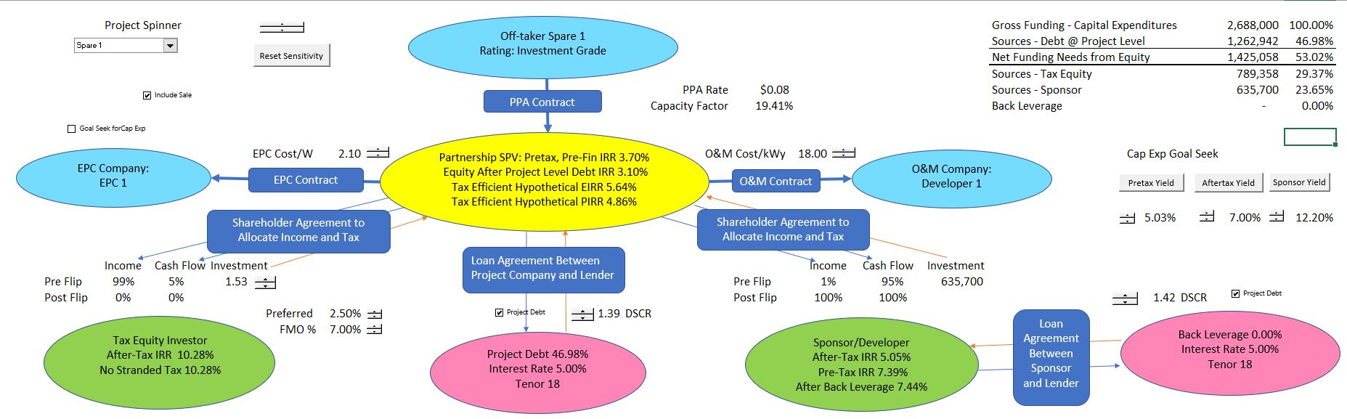
Diagram of Project Finance
Volume or price or availability risk in model, and then, the IRR’s of each party and the DSCR’s of the lenders. Include cost to off-taker for the project economics.

Slide 11
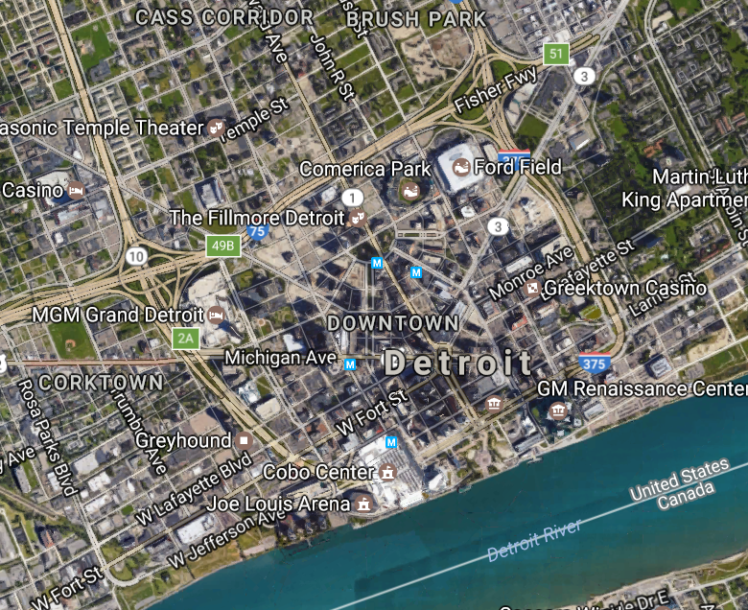
City is Like a Corporation/Project is Business
Individual Business or Family is like project Finance

Slide 12
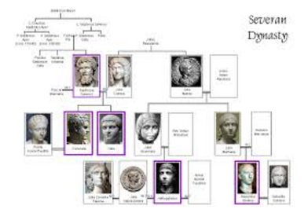
Family is Like Corporation, Person is Like Project Finance
Person is the project
Entire Family is the Corporation

Slide 13
Project Phases – Pre-COD and Post-COD
On the Term Conversion Date, Borrower may convert a portion of the Construction Loans, as set forth below, into Term Loans
Availability. Each Lender agrees to advance to Borrower from time to time during the applicable Construction Loan Availability Period, but no more frequently than once per month, a “Construction Loan”
Availability from Financial Close, to COD (Pre-COD)
Operations from COD to End of Project (Post COD)

Slide 14




Project Finance Model Structure Changes at COD
Before COD, cash flow is presented in the sources and uses statement
After COD, cash flow is presented in the cash flow waterfall and the last line is dividends
Father of the bride makes commitment to pay for wedding
Commitment Fee
Development is Dating period. Probability of failure is high
Pay for Wedding with Other peoples money
Pay your Bills and re-structure your life. Stuck with PPA type contract. May default.
FC is just after engagement date
COD is Wedding Date
Decommissioning Date

Slide 15
Time-Line is Crucial in Project Finance
A crucial Feature of Project finance is CHANGING -- DECLINING RISK
RISK
Financial Close
Completion Test

Slide 16
Project Finance and WACC
In the last diagram it would be crazy to assume the risks associated with a relationship are the same over the course of the relationship.
Similarly, assuming that the risk of a project is the same over the life of a project makes no sense at all.
Additionally, the equity to capital ratio on a book or an economic basis is not the same over the life of a project.
This is unlike project finance, a corporation with portfolios of projects may have a reasonably constant WACC

Slide 17
IRR in Project Finance – Is there any better performance ratio for investors

Slide 18
Project IRR or DSCR
Importance of Project IRR. Objective in a sense is to maximize the equity IRR given a level of project IRR. IRR is the measure most commonly used to assess value for an investor.
Danger of high project IRR from banking perspective. In commodity price analysis means that others will come into the market and the margin will be reduced. Must have demonstrated cost advantage.
Danger of high project IRR and political risk. Eventually the government will understand if the project price is uneconomic

Slide 19
IRR versus Return on Investment
Project finance uses IRR instead of return on equity or return on invested capital
In project finance, the investment on the balance sheet (net plant) declines investment over the life of the project.
If you compute the ROE or the ROIC, the number starts very small and becomes very large.
Unless you develop a weighted average that accounts for the cost of capital and the level of investment on the balance sheet, it is very difficult to find a good ROE or ROIC statistic to summarise the project.

Slide 20
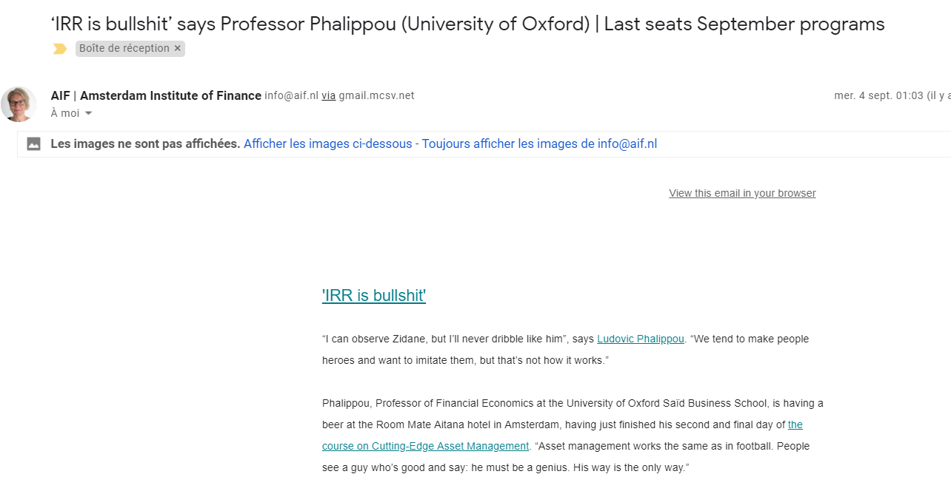
E-mail from Amsterdam Institute of Finance
Arrogant Business School Professors in Amsterdam

Slide 21
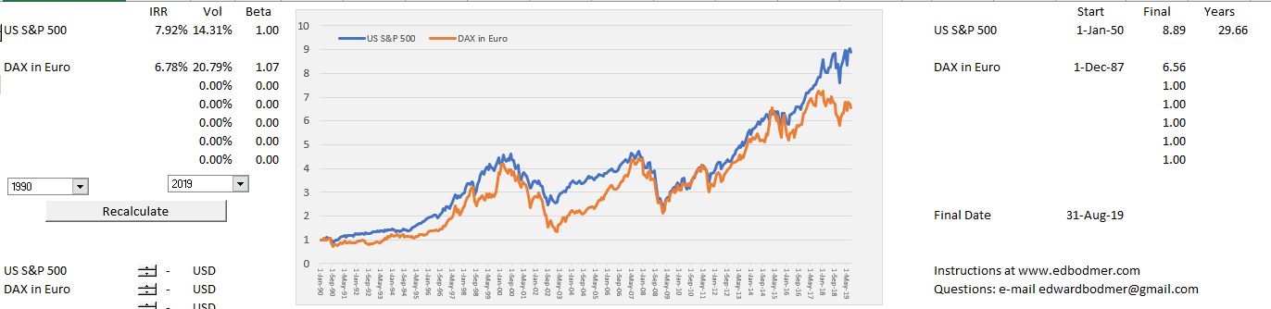
Thanks to Finance.Yahoo for Adjusted Stock Price
IRR on a stock with re-investment of dividends is the ultimate way to measure performance. It is the growth rate in your money. It is all you care about if you are obsessed with consuming expensive things.

Slide 22
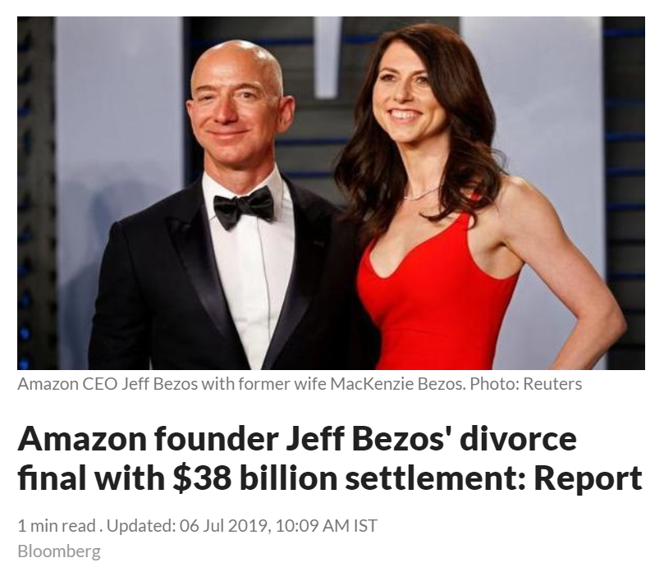
For Bad or Good, Growth is All that Matters, ask Jeff Bezos

Slide 23
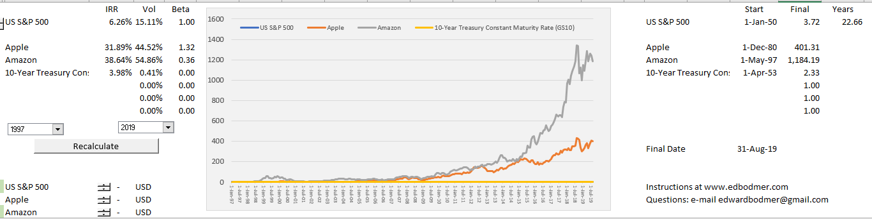
Should Jeff Bezos’ Payment to his soon to be ex-wife be adjusted because the WACC for Amazon was high
The measurement of Amazon performance can be made with the IRR and not other statistics.

Slide 24
IRR and Growth Rate in Cash Flow
The equity IRR or Project IRR can be thought of as a growth rate in cash flow. If there is no intermediate cash flow, the CAGR and the IRR are the same.
The problem with the IRR is that cash flow that occurs before the end of the project (i.e. intermediate cash) is assumed to be re-invested at the IRR itself. If the IRR is really high, you may not be able to find another investment with the same IRR. Further, the MIRR provides no help to this.
The IRR can be compared to stock market total returns.

Slide 25
Negative Cash Flow and Different IRR’s
For the IRR, there should be negative cash flows at the beginning reflecting the investment followed by positive cash flows.
In project finance you can compute the project IRR without tax, the project IRR after tax, the equity IRR and the debt IRR.
The project IRR reflects the overall return on the project and is relatively simple to calculate.
The after-tax project IRR is the same as the equity IRR if there would be no debt financing.

Slide 26
Project IRR, Debt IRR and Equity IRR Interpretation
The debt IRR can be computed from the perspective of debt holders. The debt drawdowns are the negative cash flow while the debt service including interest and principal are positive cash flows. The fees should be included as cash flow. The debt IRR can be called the effective interest rate or the all-in rate.
The project IRR is an effective statistic for evaluating the overall competitiveness of a project. If the project IRR is very high, you should ask questions about why others cannot create similar projects and charge a lower price. If the project IRR is below the cost of debt, you should ask why the project is occurring.
The equity IRR is the focus of investors because it reflects money taken out of their pocket relative to dividends received. In structuring debt terms such as a cash sweep or the debt to capital, the equity IRR can be used to understand the perspective of the sponsor.

Slide 27
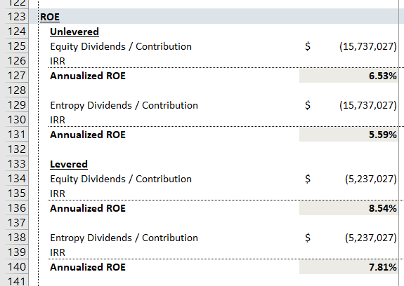
IRR in Solar Case
IRR Statistics from original model

Slide 28
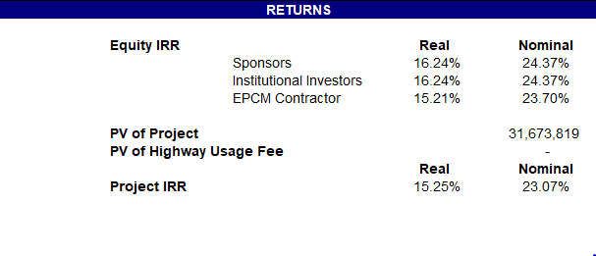
What Returns are Reasonable
Note the real returns; if you can really get this, you will become very rich

Slide 29
Why Ratios are Different in Project Finance and Corporate Finance
Continuing Large Capital Expenditures in Corporate Finance
Large Bullet Repayments in Corporate Finance that Do Not Correspond to Cash Flow
No Customizing Repayments to Cash Flow
In Corporate Finance, Source of Repayment in Re-Financing

Slide 30
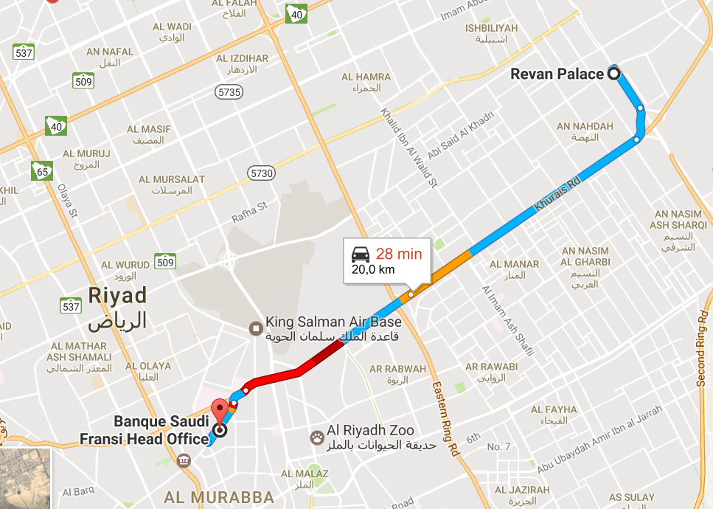
Example of DSCR and Why DSCR is Better Measure of Risk than Beta, VAR, Implied Vol, Duration, EMRP
You need to be at a meeting at 9:00 AM
  Elvis Presley is staying at a hotel next door and can walk a few steps
  Michael Jackson is staying across town and must take a taxi. Traffic can be good or bad. Google Maps said it takes 15 Minutes.
Elvis will leave at 8:58 AM and have no problem in arriving on time – this is a very low DSCR
Michael will leave 30 minutes early at 8:30 AM to make sure he will make be on time – this is a DSCR of 2.0 that is higher because of higher operating risk. The google map is like a financial model – it could be wrong and you must estimate a downside case.

Slide 31
Difference Between Ratios for Project Finance and Corporate Finance
Corporate Finance
Project Finance
Interest Coverage Buffer
  EBITDA/Interest
  EBIT/Interest
  FFO/Interest
Time To Repay Debt
  Debt/EBITDA
  Debt/FFO or FFO/Debt
Value of Company to Debt
  Debt to Equity
  Debt to Capital
Debt Service Buffer
  DSCR
  LLCR
  PLCR
Skin in the Game
  Debt to Capital
  Debt to Equity

Slide 32
Valuation Metrics in Project Finance and Corporate Finance
Project Finance Investment
  Equity IRR
  Project IRR
  Equity NPV
  Project NPV
Project Finance Debt
  DSCR
  LLCR
  PLCR
Liquidity
  Debt Service Reserve
Corporate Finance Valuation
  P/E Ratio
  EV/EBITDA
  Projected Dividend and Earnings
  Free Cash Flow
Corporate Finance Debt
  Times Interest Earned
  Debt to EBITDA
  Debt to Capital
Corporate Finance Liquidity
  Current Ratio; Quick Ratio

Slide 33
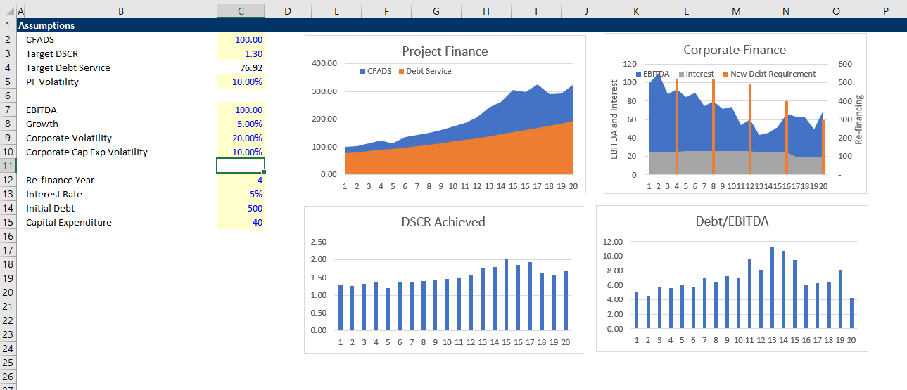
Simple Example of Credit Analysis in Corporate Finance and Project Finance
Illustration of re-financing risk in corporate loans versus DSCR in project finance.

Slide 34
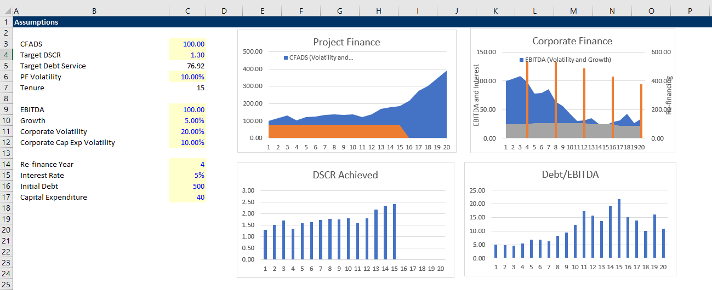
Simple Example of Credit Analysis in Corporate Finance and Project Finance
Find the file named project and corporate credit example.

Slide 35
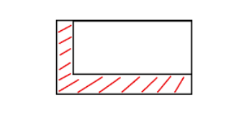


Risk Analysis – Skin in Game versus Safety Buffer
Equity Skin in Game
Buffer to Make Sure No Problems

Slide 36
Pre-and Post COD Analysis
Pre-Cod
Post-Cod

Slide 37
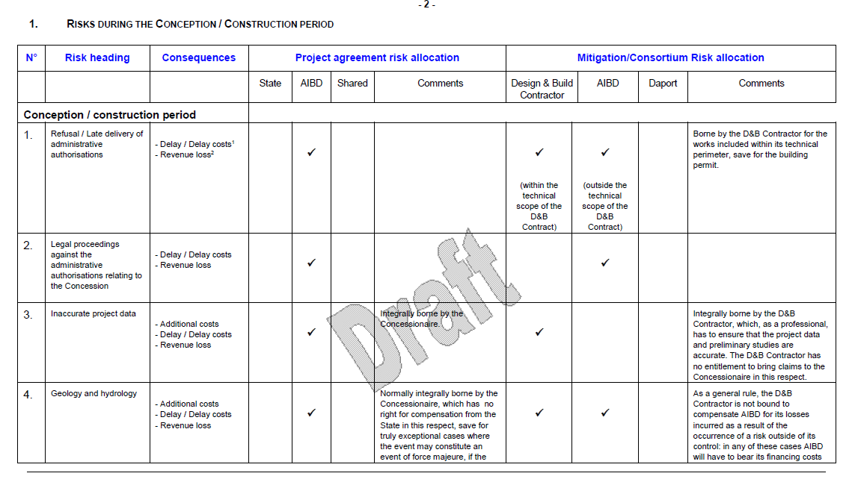
Risk Allocation Matrix

Slide 38
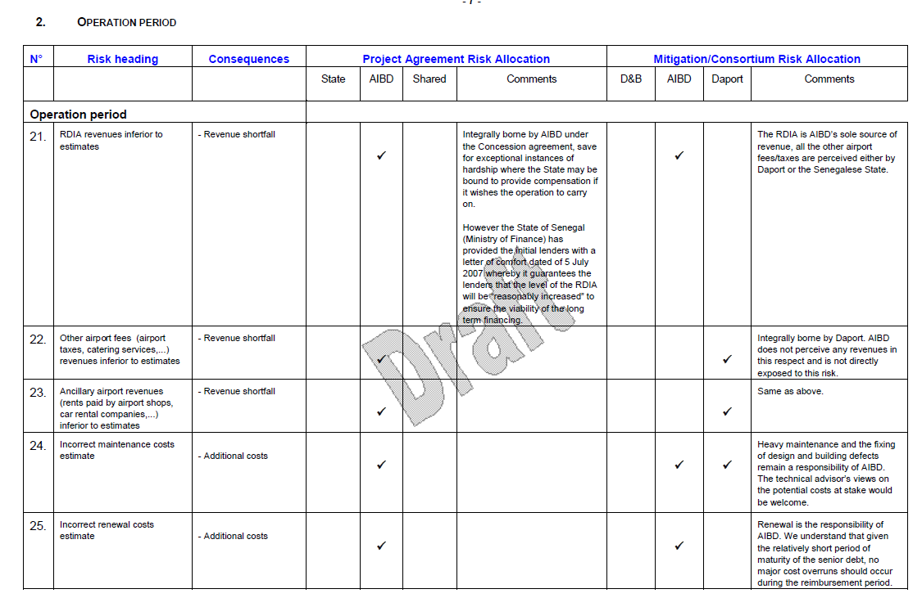
Risk Allocation Matrix

Slide 39
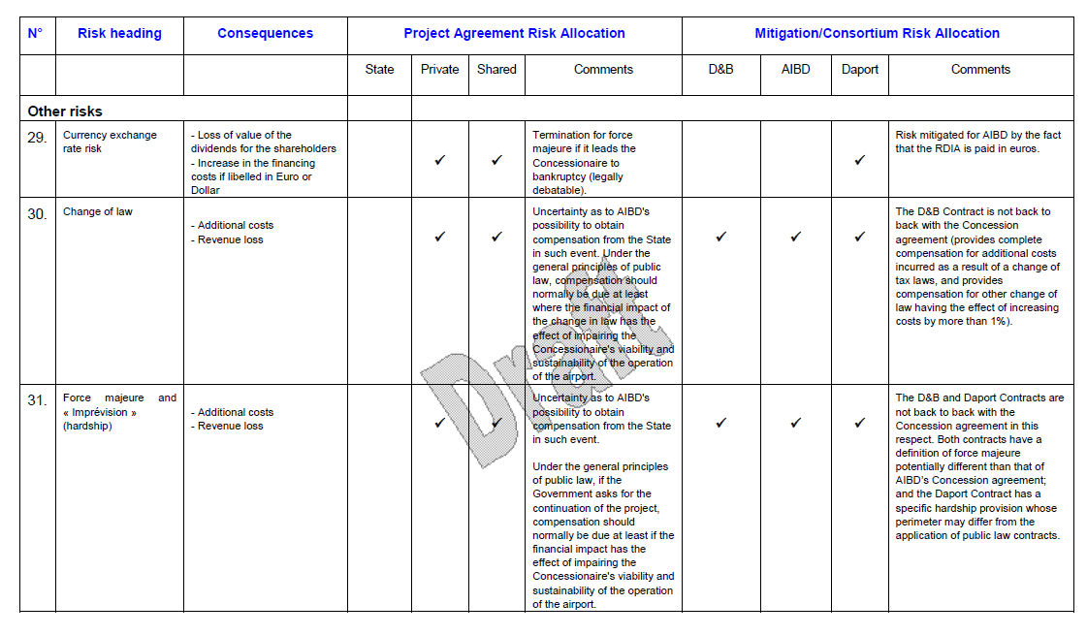
Risk Matrix – Other Risks

Slide 40
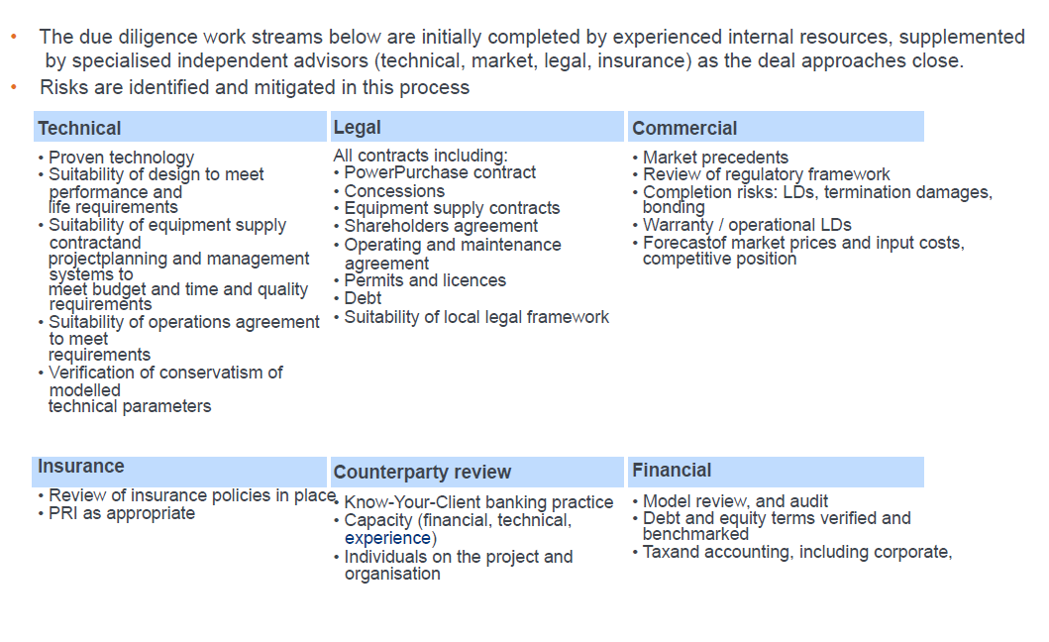
Contract Risks

Slide 41
Illustration of Skin in the Game from Sources and Uses versus Buffer from DSCR

Slide 42
DSCR as a Buffer to Break Even
The key point about the DSCR is that it is a measure of break-even from a forecasted cash flow. For example if the cash flow is 150 and the debt service is 100, the DSCR is 1.5. In this case the cash flow can go down by 50 before a default occurs. So in percentage terms this means that a reduction of 50/150 or 33%.
In terms of a formula, the percent reduction before default can be expressed using the formula:
Percent reduction = (DSCR-1)/DSCR

Slide 43
DSCR Key Points
The DSCR is computed from prospective cash flow like other ratios in project finance including the project IRR, equity IRR and other ratios.
There could be many definitions of the DSCR, but the general definition is CFADS/DS where:
  CFADS is cash flow available for debt service
  DS includes interest expense, debt repayment and fees
The DSCR can be explained with the graph of CFADS and Debt Service

Slide 44
Buffer for Coverage of Debt Service in Project Finance (DSCR)
Alternative Debt Service Coverage Ratios for Different Types of Projects
  Electric Power with Fixed Contract: 1.3-1.4
  Resources with volatile prices: 1.5-2.0
  Telecoms with volume risk: 1.5-2.0
  Infrastructure availability payment or traffic: 1.2-1.6
At a minimum, investment-grade merchant projects probably will have to exceed a 2.0x annual DSCR through debt maturity, but also show steadily increasing ratios. Even with 2.0x coverage levels, Standard & Poor's will need to be satisfied that the scenarios behind such forecasts are defensible. Hence, Standard & Poor's may rely on more conservative scenarios when determining its rating levels.
For more traditional contract revenue driven projects, minimum base case coverage levels should exceed 1.3x to 1.5x levels for investment-grade.

Slide 45
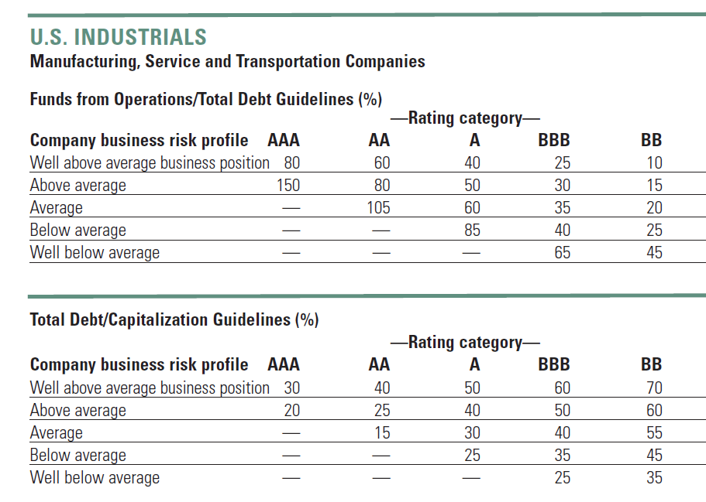
Financial Ratios that Depend on Business Risk is Standard in Credit Rating

Slide 46
Measurement of Credit Risk with Rating Systems – How Do you Come Up with Good Rating
Map of Internal Ratings to Public Rating Agencies
Investment Grade
Junk

Slide 47
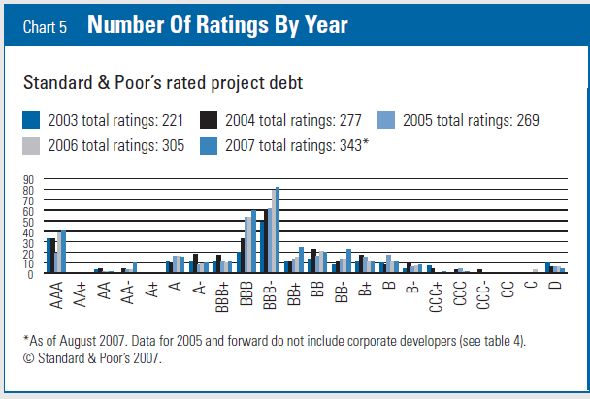
Project Finance ties to BBB- (Baa3)
Investment Grade
Junk

Slide 48
Credit Spreads in Project Finance
African credit spreads are much higher

Slide 49
Case Study Number 1:
Solar Case Study (Northern Nigeria)

Slide 50
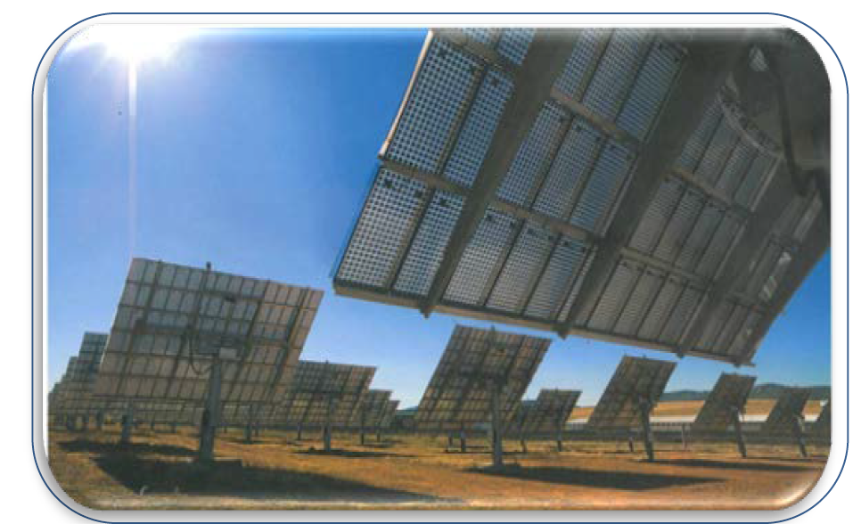
Case Study Overview
Make Use of Solar Resource in Northern Nigeria
Apply NBET Contract with Revised Fixed Price
Use Chinese Panels with Low Cost
Resource Study, O&M Contract and EPC Contract
Possible Concession Financing

Slide 51
Northern Nigeria Solar Case - Contents
Overview and Contract Structure
Benchmarking Capital Cost and Yield
Resource Analysis
NBET PPA Contract
EPC Contract and Benchmarking
Resource Risk (P90) and DSCR
Debt Sizing from DSCR
  Operation and Maintenance Contract
  Transmission Risk

Slide 52
Solar Can be Defined by a Few Parameters
Operating
  Capital Expenditure/kW – as low as USD 500/kW
  O&M Cost – Pure O&M as low as USD 4/kWyear
  Capacity Factor – Good sunlight, as high as 28% with tracking
Financing
  Required Equity IRR – Can be 5-6% in Europe
  Debt Parameters
    Debt Size from DSCR
    Credit Spread
    Required Hedging
    Tenure of Debt and Re-financing

Slide 53
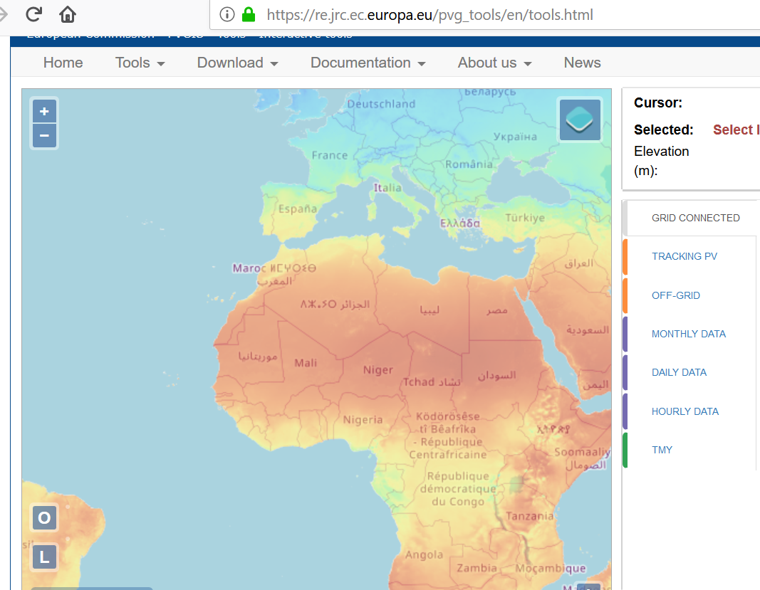
Solar Resource in Nigeria Compared to Scotland
There is a fantastic website from the EU where you can get amazing data for solar power: https://re.jrc.ec.europa.eu/pvg_tools/en/tools.html

Slide 54
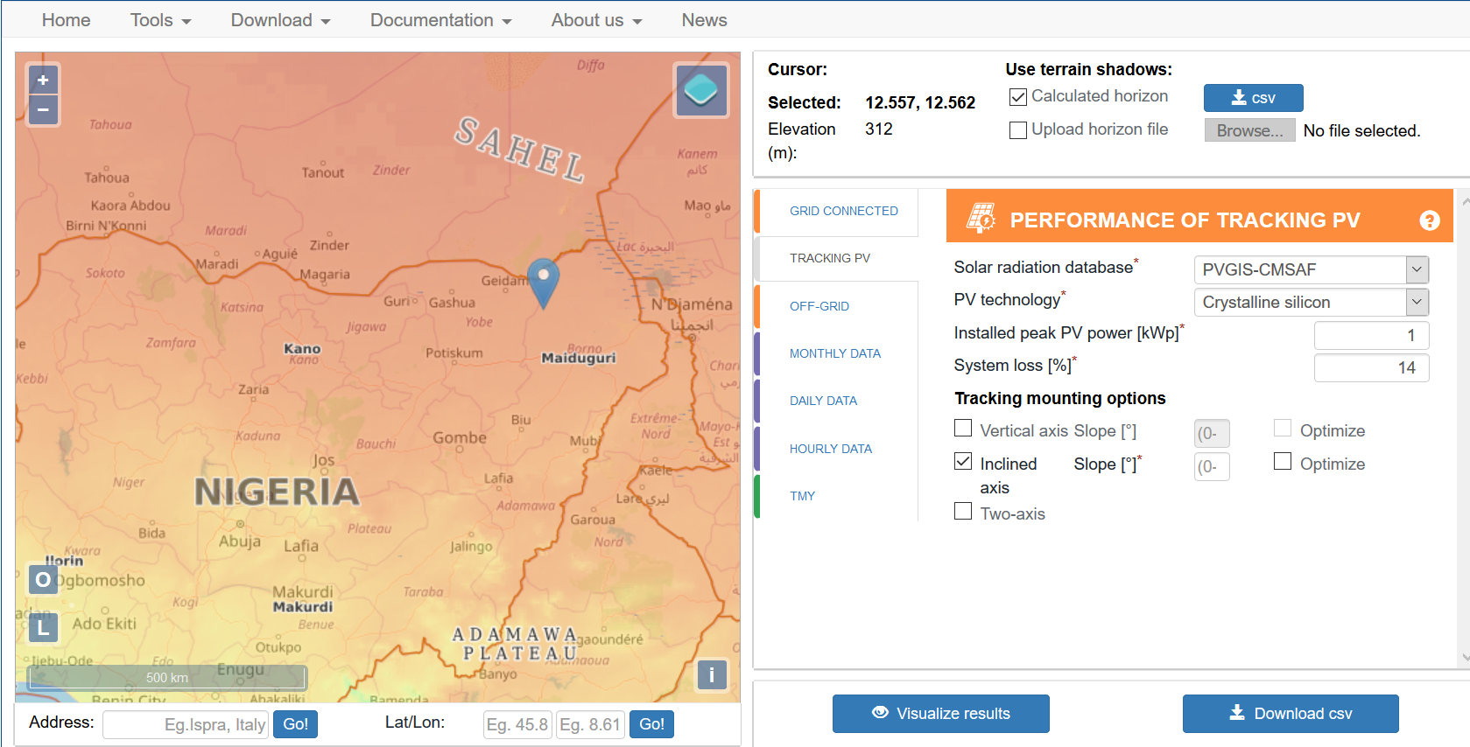
Find a Good Place in the North
Lagos would be not be nearly as good

Slide 55
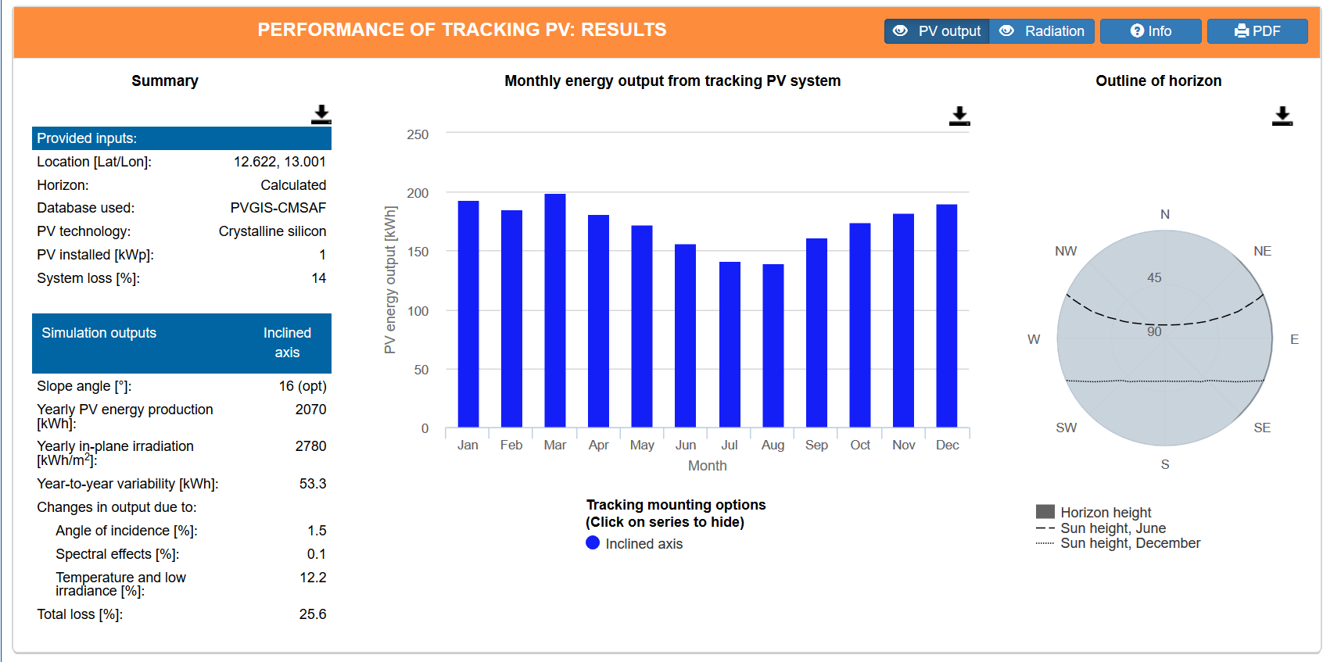
Focus on In-Plane Yield for Capacity Factor
Concentrate on the in-plane radiation that hits the panels. Yield in kWh/m2 divided by 8760 gives you the capacity factor: 2780/8760 is 31.7%. You won’t find much better places than this.

Slide 56
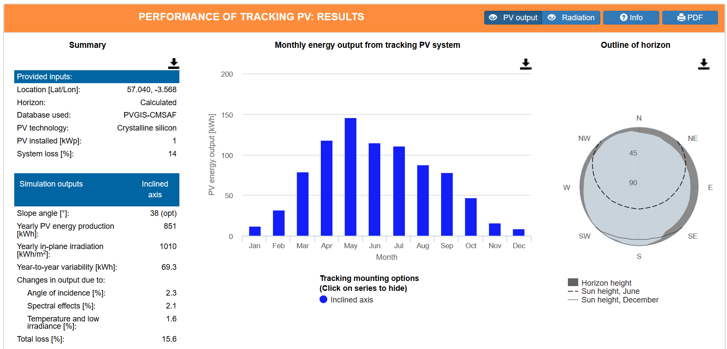
For Comparison, Try Scotland
Now, with tracking, the yield per kWh on the plane of the solar panel is only 1,010 kWh/m2. This produces a capacity factor of 11.52% (1010/8760).

Slide 57
Final Output and Performance Ratio
In-plane radiation
  From the sun and nothing to do with type of solar panels, sand on panels, size of inverters, losses from trees and shading, line losses. Only depends on the day and night and clouds
Final output
  Depends on panel temperature coefficient, how size the inverters, line losses, losses due to crap on the panels etc.
Performance Ratio
  Converts in-plane radiation to final output
  In-plane capacity factor x PR = Final capacity factor
Example
  In-Plane (31%) x PR (80%) = 24.8%

Slide 58
Coverage of Fixed Costs
In solar, all costs including financing costs and operation costs are fixed. If you have twice as much output the cost is halved.
Imagine two factories with the same fixed cost and no variable cost. One factory produces half as much as the other. The factory with lower production must receive twice the price.

Slide 59
Solar Patterns in Northern Nigeria

Slide 60
Weekly Solar Irradiation - Europe

Slide 61

Wind versus Solar Wind Atlas

Slide 62
Drivers and Contracts – Solar and Renewable
IPP Risks
Cost of Project, Time Delay and Technology Parameters
Demand and Technology Change
O&M Risk
Interest Rate Fluctuation
Output or Resource Risk
Risk Mitigation
EPC Contract with Fixed Price and LD (LSTK)
PPA with Fixed Price and No Inflation
O&M Contract
Interest Rate Contract (Fix Rates)
NONE !!!

Slide 63
Diagram for Solar Case
PPA Contract Price
Volumes from Solar Resource Analysis
O&M Contract (see next slide)
EPC Contractor
Loan Agreement
DSRA
Equity Contribution
“EPC Contractor” means Entropy Solar Integrators, LLC, a North Carolina limited liability company.
“Sponsors” means each of (i) York Credit Opportunities Fund, L.P. and (ii) York Credit Opportunities Investments Master Fund, L.P., acting by its general partner York Credit Opportunities Domestic Holdings, LLC.

Slide 64

Classic Project Finance Diagram – Is it Really Good for Africa
Privatised Electricity Distribution
Nigeria Bulk Electricity Trader
Ability of NBET to Pay ???
Price Risk or Mitigated by NBET Contract
Volume Risk from Solar Resource
EPC Contractor: Want Strong Record and Finances
EPC: Fixed Price Contract with LD
Special Purpose Vehicle: Bond Rating of BBB-
O&M Contractor, also often investor
O&M Agreement
Loan Agreement – Draws Green; Debt Service Red
Banks Like Strong Sponsors. Sponsors want EIRR
Shareholder Agreement
Lenders:
Lenders want DSCR (LLCR, PLCR)
Invest with paid in cap; payback dividends
Invest with draws; payback debt service

Slide 65
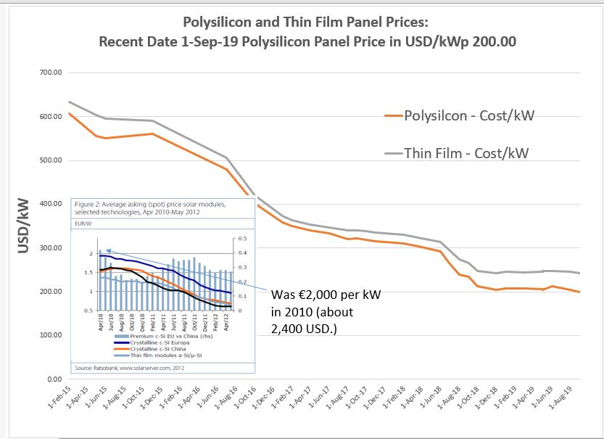
Revolution in Solar Power
Dramatic cost reduction in panel prices – source is pvinsight.com
No Africa excuse (transport, duties, bribes …)

Slide 66
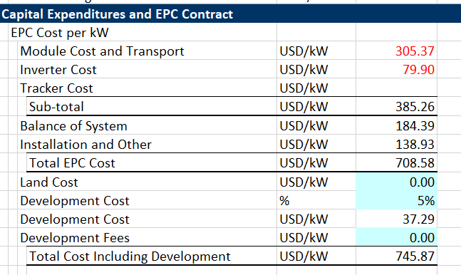
Some Estimates of Total Cost
Mexico

Slide 67
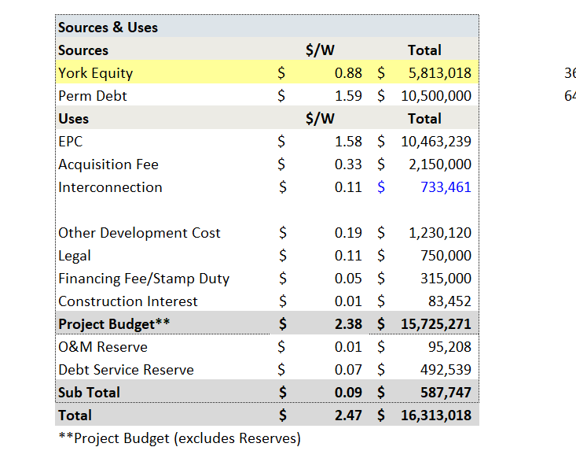
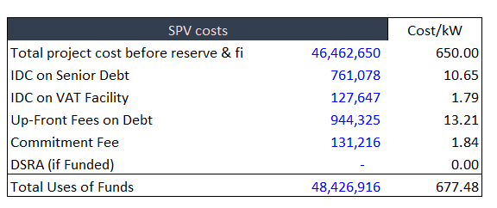
Benchmarking Capital Cost – Solar Case
Compare with Mexico case

Slide 68
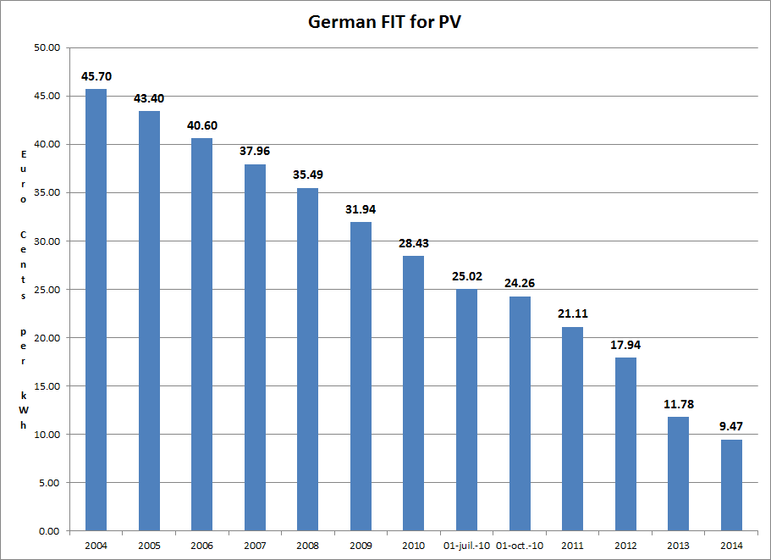
Thank you Germany for Developing the Market with Simple and Highly Subsidised Tariff
Promoted market development.

Slide 69
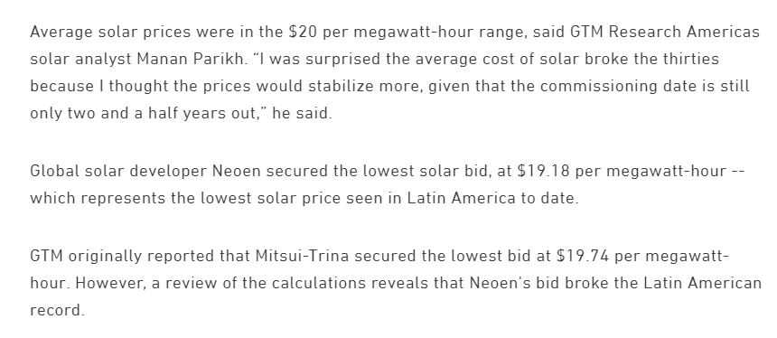
Some Famous Low-Price Solar Projects
Mexico
Compare to the cost of running a combined cycle plant: fuel cost is Heat Rate x Cost/MMBTU (the cost must be marginal economic cost). Say the heat rate is 8 and the cost is 6, then the running cost is USD 54/MWH. Notice I do not use the regulated price of natural gas.

Slide 70
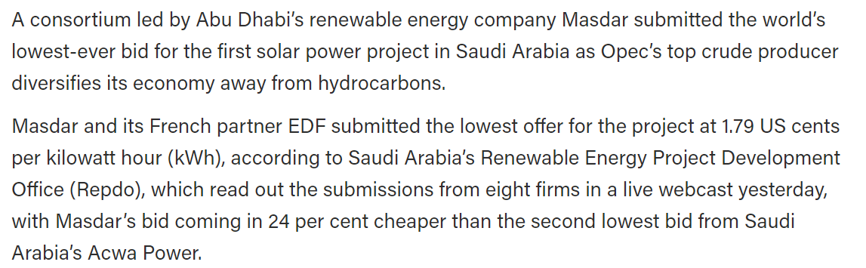
Low Price Solar Continued
Saudi Arabia

Slide 71
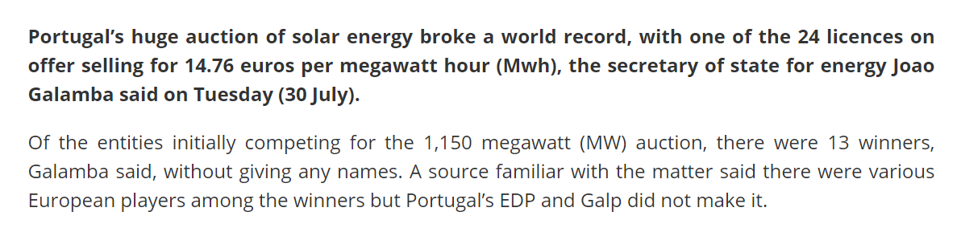
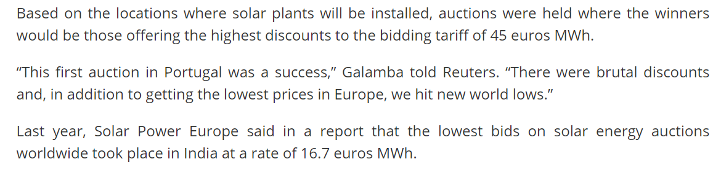
Some Famous Low-Price Solar Projects
Portugal

Slide 72

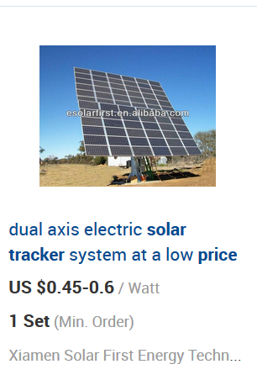
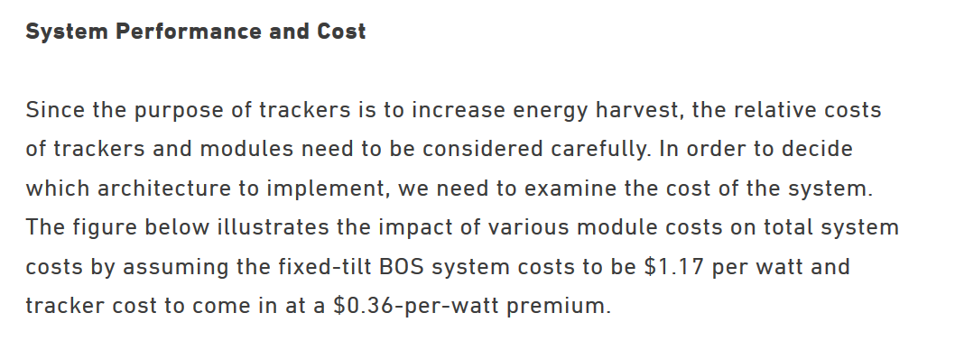
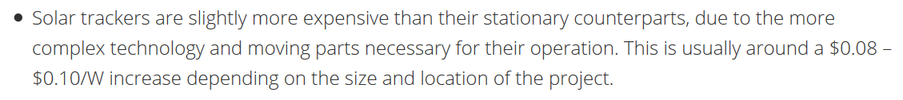
Cost of Tracking

Slide 73
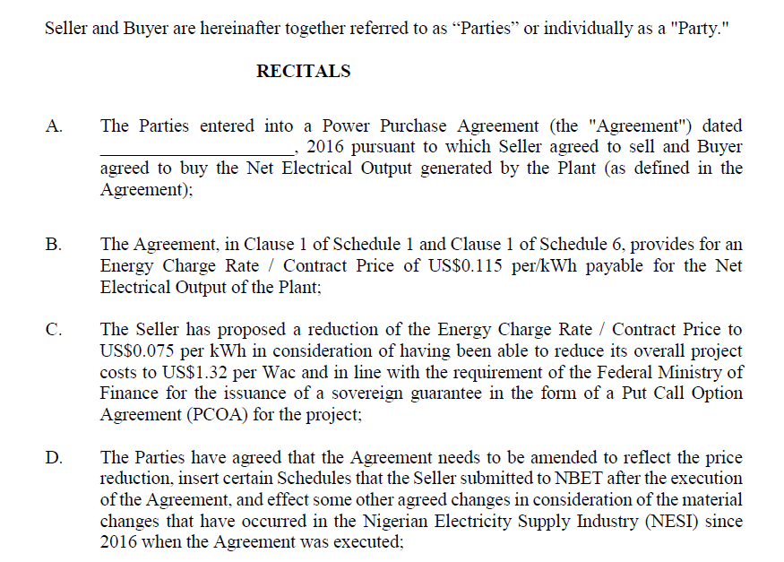
NBET Revised Tariffs and Low Solar Costs
NBET Changed things in the Autumn of 2018

Slide 74
PPA Contracts

Slide 75
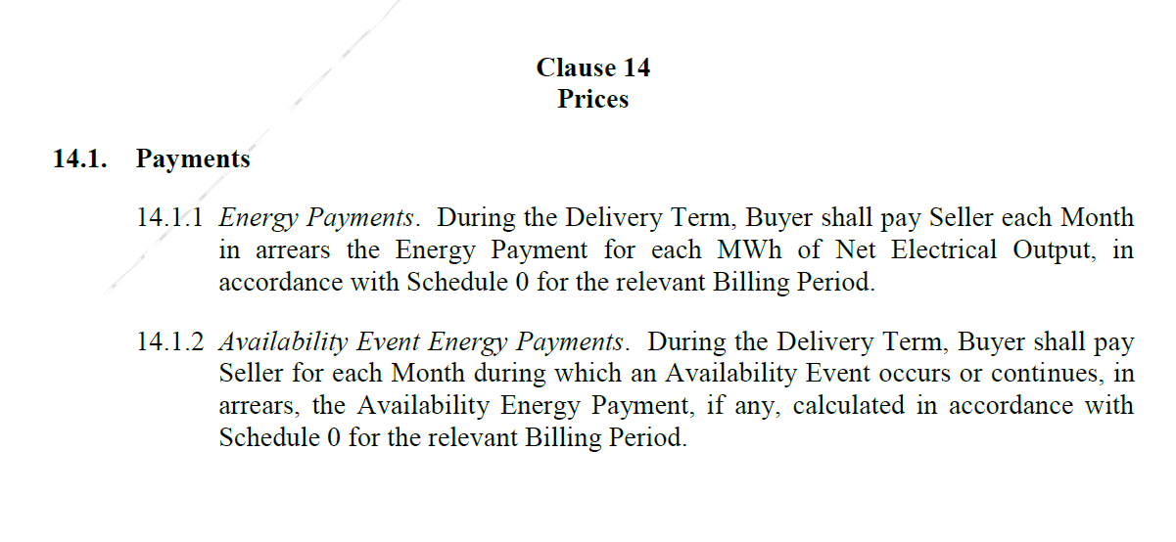
Pricing in NBET Solar PPA

Slide 76
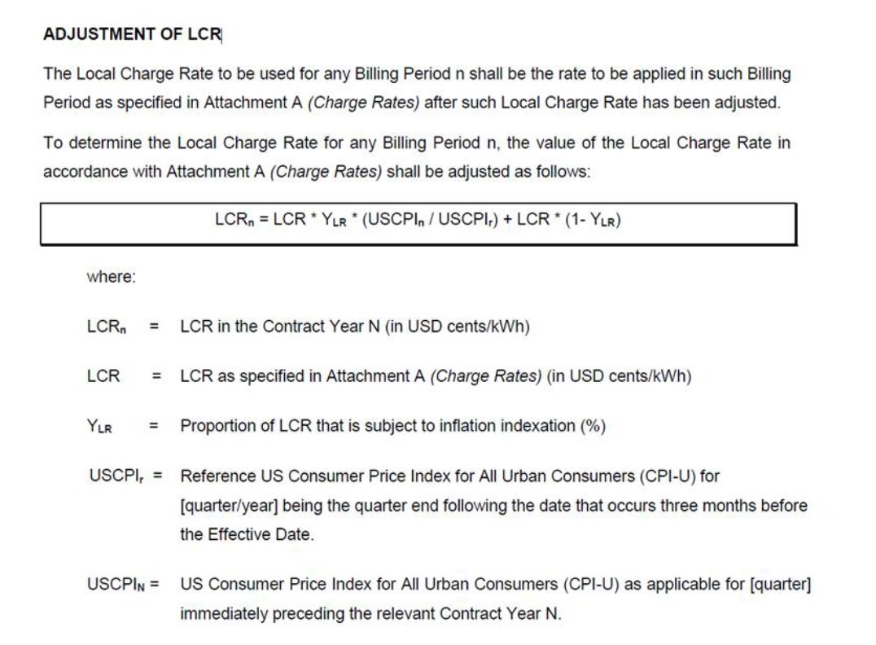
Single Price PPA with Inflation

Slide 77
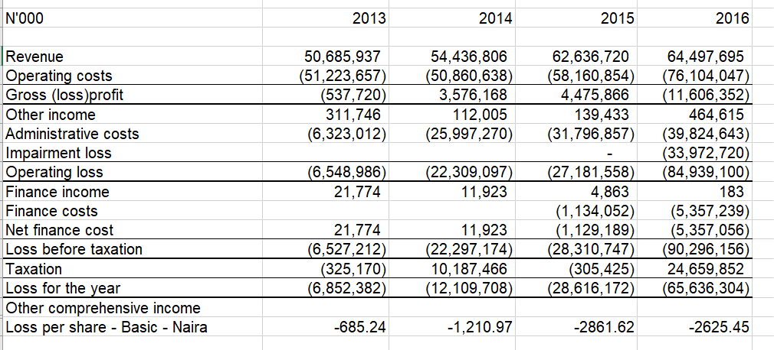
Rates do Not Allow for Profitable Investment
This is the financial state of distribution companies, who ultimately pay the PPA. Compute the required increase in price.

Slide 78
Multi-Year Tariff Order – Is This a Fantasy
The Multi-Year Tariff Order (MYTO) is a tariff model for incentive-based regulation that seeks to reward performance above certain benchmarks, reduces technical and non-technical/commercial losses and leads to cost recovery and improved performance standards from all industry operators in the Nigerian Electricity Supply Industry.
It is used to set wholesale and retail prices for electricity in the industry by employing a unified way to determine total industry revenue requirement that is tied to measurable performance improvements and standards.

Slide 79
Distorted O&M and Reliability Incentives from Single Price in PPA
We saw in the prior section that the off-taker marginal cost is important both in establishing penalties and in establishing targets. To illustrate an extreme example, consider a solar project that had a feed-in tariff of 450 Euro/MWH signed in 2004 in Germany versus the Abu Dubai project with a PPA price of 24.2 USD/MWH.
For the first case, the off-taker should go crazy trying to get every kWh by improving cleaning of the panels, optimising the operation and other things.
In the second case with 24.2 USD/MWH, the incentives are much less. But from the off-taker perspective the incentives are the opposite. The German off-taker does not want the IPP to do any maintenance because of it costs so much to buy the power. The only answer to all of this is to have a structure where the cost to the off-taker is the same amount that the IPP is benefited or penalised.

Slide 80
EPC Contract Issues in Solar Projects

Slide 81
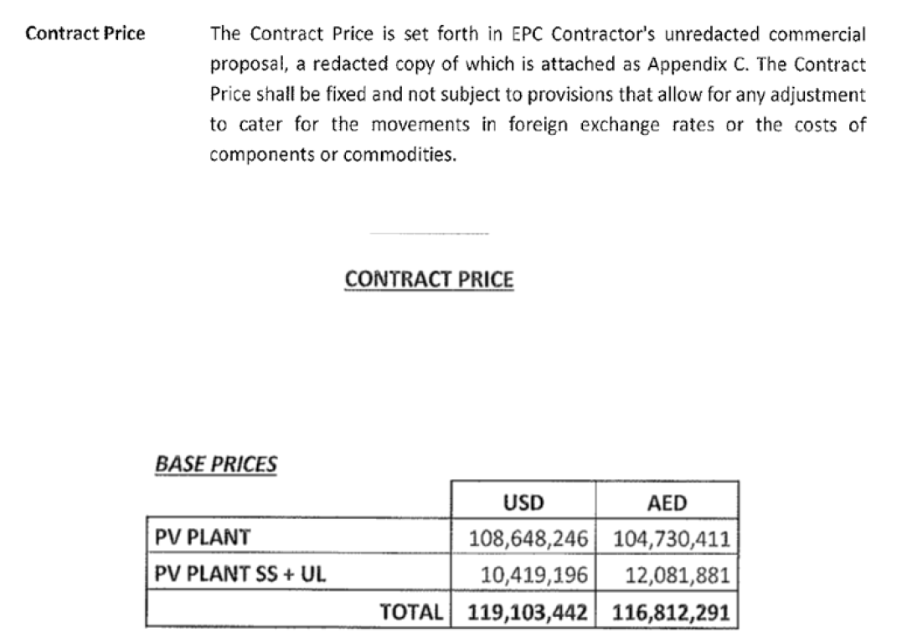
Fixed Contract Price in EPC Contract

Slide 82
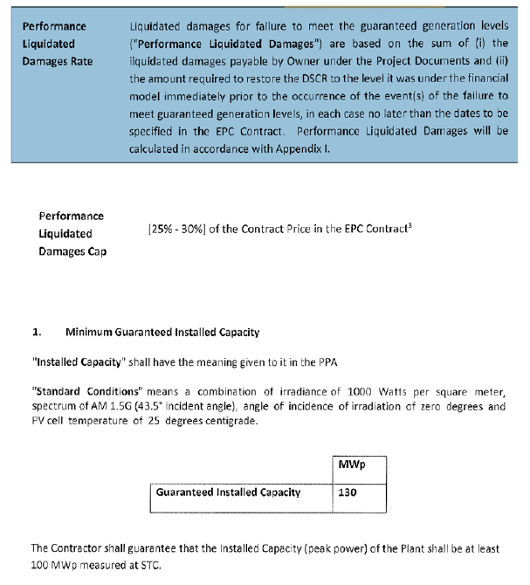
EPC Provisions – Guaranteed Capacity and Performance for Solar Plant

Slide 83
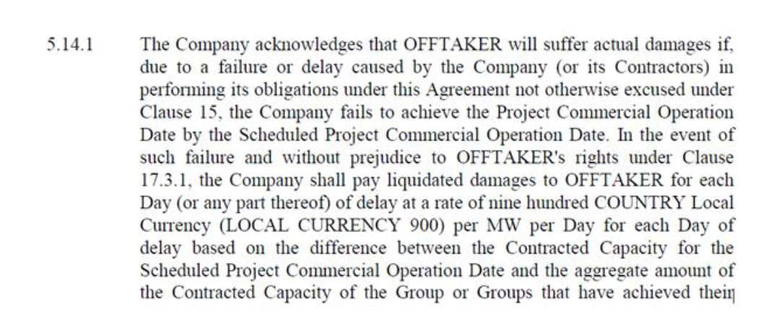
Example of Delay Penalty in PPA Contract

Slide 84
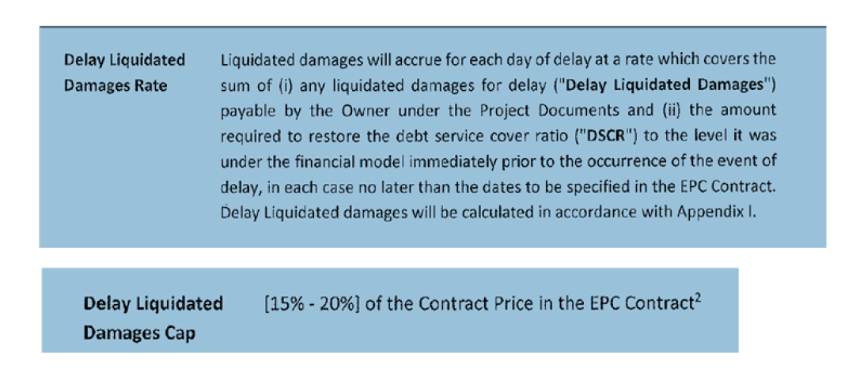
Example of Delay LD in EPC Contract

Slide 85
Theory of Risk and Return in Project Finance
Different parties in project finance including EPC contractors, O&M contractors, insurance companies, financial institutions and sponsors are paid for taking risk.
The general idea that if parties are paid too much or too little for accepting risk, the off-taker will pay too much for the service and/or sponsors will not receive an adequate return will be demonstrated.
Off-taker economics as well as the technical aspects of the facility must be fully understood to effectively negotiate project finance terms.
The theory and practice of computing delay liquidated damages, availability penalties, target heat rates and other items through the central idea of minimizing the sum of off-taker costs and IPP costs.

Slide 86
Change Orders in LSTK Contract
The SPV may at any time prior to PCOD direct Changes.
The Contractor may request a Design Change, which request shall be granted or denied by the SPV.
The price of any work required, modified or deleted by a change shall be on a “cost plus” basis to be mutually agreed by the parties.
If disagreements occur, on the necessary adjustments to the contract, the contractor shall proceed if requested by the SPV.

Slide 87
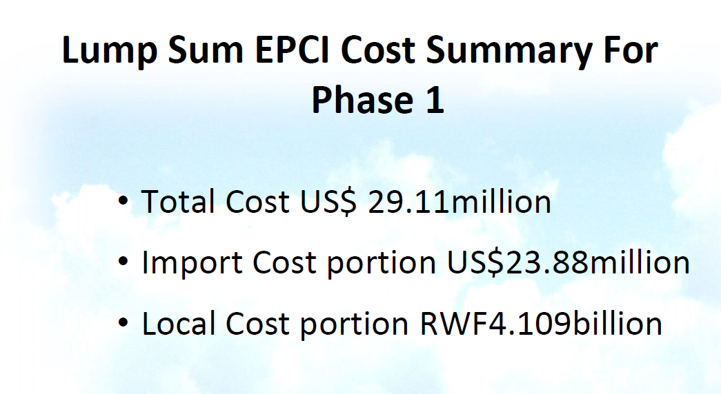
EPC Contractor Proposal
Is the Premium to the EPC contractor worth the risk

Slide 88
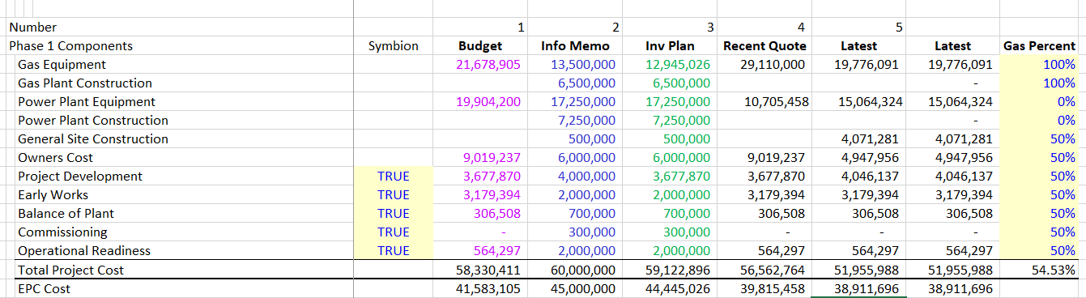
Is the Risk Reduction Value worth the Fixed Cost
Exchange Rate about 900
Notice the enormous premium

Slide 89
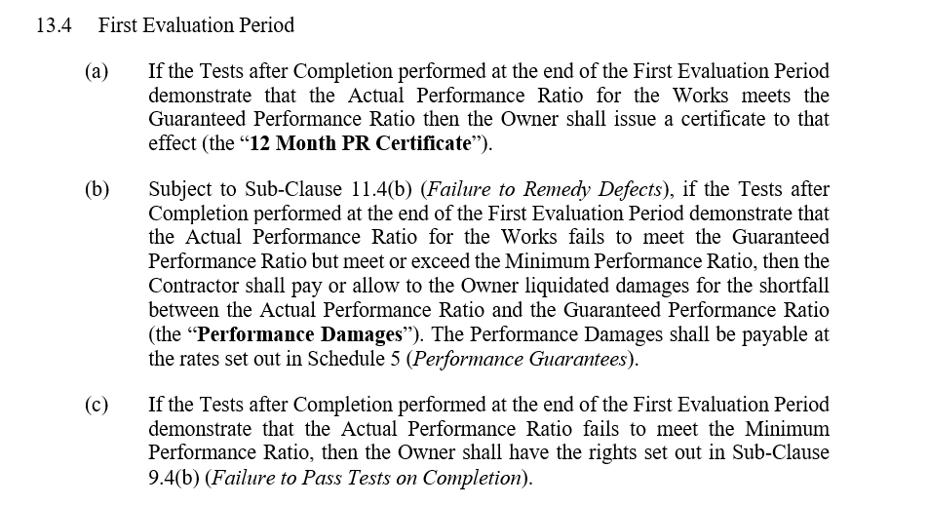
Liquidated Damages for Performance Ratio

Slide 90
O&M Contracts

Slide 91
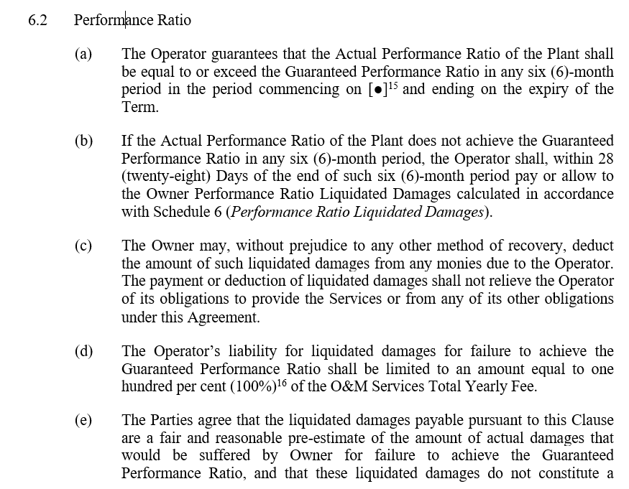
Example of PR Clause

Slide 92
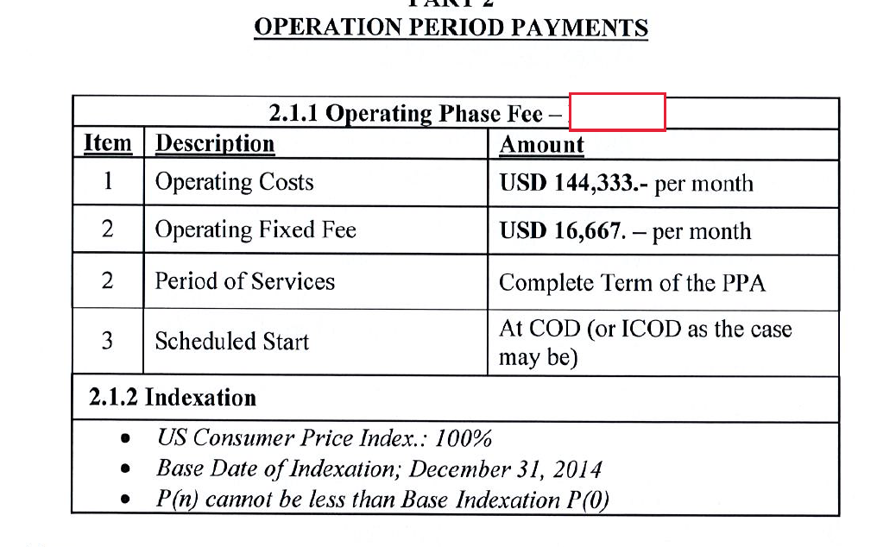
Payment in O&M Contract

Slide 93
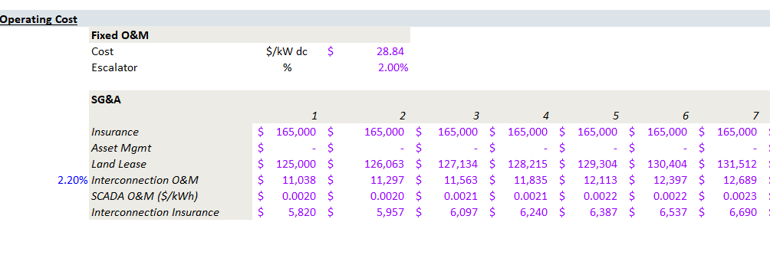

O&M Cost Benchmarking
Compare O&M Cost

Slide 94


More O&M Cost Benchmarking
The table below is a low-cost example – total cost is USD 6/kWyear

Slide 95
Renewable (mainly solar) Resource Uncertainty

Slide 96

Where Uncertainty Comes From
First, there may be different solar resource estimates

Slide 97

Explanation of P50, P90 etc.

Slide 98

P50 and P99 in Solar Case
Evaluate the P50 and P99 using the DSCR criteria.

Slide 99
P50 and P90 in Solar Case
“P50 Production Level” means the aggregate annual energy production level of the Project that has a probability of exceedance of 50% over a one-year period of time, according to the Independent Engineer’s solar production forecasts included in the report delivered to Administrative Agent.
“P99 Production Level” means the aggregate annual energy production level of the Project that has a probability of exceedance of 99% over a one-year period of time, according to the Independent Engineer’s solar production forecasts included in the report delivered to Administrative Agent.

Slide 100
Nightmare Graph and Missing the P90 – Fitch Report

Slide 101

P50, P90, P99 in Term Sheets
Note the use of 1-year and 10-year P50 and P99
Calculation involves understanding permanent changes versus mean-reverting flows.

Slide 102

P90, P99 etc. for Sizing Debt
Note the small actual variation in solar production – the problem is the starting point and risk goes down after COD.

Slide 103

P90 and P50 DSCR with Actual Case
Actual case where P50 and P90 were estimated.

Slide 104
DSCR in Solar Project Finance

Slide 105
Term Coverage Ratio in Solar Case
“Minimum Term Conversion Date Debt Service Coverage Ratio” means,
  a minimum Average Annual Projected Debt Service Coverage Ratio for the twelve (12) month period of:
  1.35 to 1 on a P50 Production Level during years 1 through 9, and
  1.00 to 1 under a P99 Production Level during years 1 through 9 of the amortization schedule.

Slide 106
Definition of CFADS in Solar Case
Operating Cash Available for Debt Service for any period, the sum of
  (a) Net Income, plus
    (i) amortization,
    (ii) income tax expense,
    (iii) the aggregate interest expense
    (iv) depreciation of assets and
    (v) any other expense that does not constitute an outlay of cash
  minus (c) any income that does not constitute cash received
    Operating Cash Available for Debt Service shall exclude any deposits of the Major Maintenance Reserve Funding into the Major Maintenance Reserve Account during such period.
Should also include working capital changes and future capital expenditures and be computed from EBITDA

Slide 107
DSCR in Solar Case
“Debt Service” - all obligations for principal and interest payments due in respect of all Debt payable by Borrower in such period. (Question: Do you think the DSCR should also include fees for L/C’s and/or other fees paid to Administrative Agent).
“Average Annual Debt Service Coverage Ratio” means, as of any Repayment Date, the ratio of
  (a) Operating Cash Available for Debt Service to
  (b) Debt Service, for the previous four (4) consecutive fiscal quarters ending
  the Average Annual Debt Service Coverage Ratio for the 3 Repayment Dates after the Term Conversion Date shall be calculated with actual figures which shall be pro rated on an annualized basis.

Slide 108


DSCR for Solar PV from Fitch

Slide 109
DSCR for Target Debt Size and Covenants
The DSCR has at least two different uses in project finance.
  One use is for determining the size of the debt. This means that if the projected DSCR is below a certain level, the loan should not be made. For example, if the DSCR is below 1.35, then the amount of debt must be reduced.
  A second is for dividend covenants (a lower level, say 1.1). This means if the DSCR falls below a certain level, then dividends are not allowed to be paid. If dividends are not allow (a dividend trap), then the cash that could have been paid in dividends is put in a reserve account.

Slide 110
DSCR is Minimum over Debt Tenure
DSCR is a measure of the chance of default. When the DSCR is 1.0 or below, there is not enough cash to pay the debt service.
This means the probability of the DSCR falling to 1.0 is similar to the probability of default.
If the DSCR falls to 1.0 or below in any single period, a default has occurred in the period. This is why the minimum DSCR rather than the average DSCR is used in discussing transactions.

Slide 111
Why DSCR is Used in Project Finance and Less in Corporate Finance
DSCR is used in project finance because the debt service and in particular the repayments are structured according to expected cash flow.
In corporate finance on the other hand, there may be bonds with bullet repayments where the ability to re-finance defines the credit risk. With bullet repayments, the DSCR would fluctuate.
You can explain this with a diagram.

Slide 112
Three DSCR’s in Solar Case
Distributions
  Make any distribution unless such distribution is made from Distributable Cash and on a Distribution Date; if the Average Annual DSCR calculated as of the Repayment Date immediately preceding such Distribution Date is less than 1.20 to 1.00, or
  the Average Annual Projected DSCR (based upon the Term Conversion Date Base Case Projections but updated for actual operating performance of the Project through the applicable Repayment Date) calculated as of the Repayment Date immediately preceding such Distribution Date, is less than 1.20 to 1.00;
Financial Covenants (Default)
  Permit the Average Annual DSCR as of the last day of any Quarterly Date commencing from the first Repayment Date to be less than 1.10 to 1.00 or
  Permit the Average Annual Projected DSCR (based upon the Term Conversion Date Base Case Projections but updated for actual operating performance of the Project through the applicable Repayment Date) calculated as of the Repayment Date immediately preceding such Distribution Date, as of the last day of any Quarterly Date commencing from the first Repayment Date to be less than 1.10 to 1.00;
Minimum Term Conversion Date Debt Service Coverage Ratio
  a minimum Average Annual Projected Debt Service Coverage Ratio for the twelve (12) month period of 1.35 to 1 on a P50 Production Level during years 1 through 9, and,
  1.00 to 1 under a P99 Production Level during years 1 through 9 of the amortization schedule.

Slide 113
You Can Go the Other Way to Find the DSCR
Formulas for Break-Even: Say that you want to know how big the DSCR should be to cover for an availability payment that could be reduced by 20%.
The formulas below are for DSCR; you could also use LLCR and PLCR
  Break-even cash flow = (DSCR-1)/DSCR
  BE = (DSCR-1)/DSCR
  BE x DSCR = DSCR – 1
  DSCR – BE x DSCR = 1
  DSCR * (1-BE) = 1
  DSCR = 1/(1-BE) or 1/.8 or 1.25
Note: Be careful with fixed costs. If an oil project has fixed costs you have to make a more complex formula

Slide 114

Risk Analysis in Solar Projects

Slide 115
Nuances of Debt to Capital Constraint and DSCR Constraint in Different Circumstances

Slide 116
Effects of Financing on Bid Price – Capital Intensive

Slide 117
Effects of Debt Provisions on Fuel Intensive Diesel Technology

Slide 118

With Good Financing Structure can Achieve Low Costs

Slide 119
Debt Sizing - Introduction
Detailed analysis of the term sheet and loan agreements begins with debt sizing.
Difference in sizing debt on the basis of:
  maximum debt-to-capital ratio: from cost and sources and uses
  minimum DSCR: from financial model
Notion of negotiated base case and downside for evaluating DSCR.
Limit the debt to assure equity is in project and the value of the project is above the debt

Slide 120


Debt Size From Debt to Capital and DSCR

Slide 121

Debt Size in Solar Case
Solar Case Debt Size
Term Loans. The aggregate principal amount of all Term Loans made by the Lenders outstanding at any time shall not exceed Ten Million Five Hundred Thousand Dollars ($10,500,000) (the “Total Term Loan Commitment”).
$6,471,614, the “Minimum Equity Contribution” or the funding of any remaining unfunded portion, including by delivery of a letter of credit, and verification by the Independent Engineer.
What is the debt to capital ratio
.

Slide 122

Debt Sizing – Key Philosophical Question
Debt to Capital Ratio – Trust sponsor to be smart enough to not invest in a bad project. Make sure the sponsor is taking downside risk. With no cash invested in the project, there is only upside potential and the sponsor will not care about downside evaluation. The test is historic investment and do not have to look forward.
The notion of DSCR implies that you are smart enough to make a forecast. If you really believe your forecast and even variation around your forecast, you can back into the debt from the DSCR. This is the notion of negotiated base case and downside for evaluating DSCR.
Limit the debt to assure equity is in project and the value of the project is above the debt

Slide 123
Illustration of DSCR and Debt to Capital Constraint
Lower DSCR results in too high debt to capital ratio. Need to constrain the debt.
Discounted Red Area (using the interest rate) is the Value of the Debt.
DSCR sizing means you believe your forecast.

Slide 124
Which Constraint is in Place
Items have an effect on whether the debt to capital constraint or the debt to capital constraint applies:
Need to Understand that NPV of Debt Service is Loan Value
  High Project IRR → More Likely Debt to Constraint;
  Long Tenor → More Likely Debt to Capital Constraint;
  Sculpting → More Likely Debt to Capital Constraint;
  Low Interest Rate → Morel Likely Debt to Capital Constraint.
  Low Project IRR → More Likely DSCR Constraint;
  Short Tenor → More Likely DSCR Constraint;
  Level Payment → More Likely DSCR Constraint;
  High Interest Rate → More Likely DSCR Constraint

Slide 125
DSCR Case Study and Exercise
Wind Study with different probability levels (the FPL Case)
Solar case with probability levels
No dividends allowed if the Average Annual Debt Service Coverage Ratio calculated as of the Repayment Date immediately preceding such Distribution Date is less than 1.20 to 1.00
Permit the Average Annual Debt Service Coverage Ratio as of the last day of any Quarterly Date commencing from the first Repayment Date to be less than 1.10 to 1.00 or

Slide 126

Development Fee Theory
Development fees can be a percent of project cost or a multiple of the amount spent on development.
This yields big profits to developers when the notice to proceed occurs and can be a cash outflow for the sponsor. The big profit accounts for the low probability of success during development.
If the developer and the sponsor are the same, this profit is not a cash outflow from the perspective of the project.
Better to put development fees into cost with debt to capital constraint

Slide 127
Development Cost Documentation
Equity Contribution.
(i) evidence (including copies of invoices and other documentation, as reviewed and confirmed by the Independent Engineer) of the payment of Project Costs in connection with the development and construction of the Project on or prior to the Closing Date

Slide 128
BOT/PPA Contract
15 year BOT and toll process
NAPOCOR (government owned generation company) to supply fuel & take electricity - no fuel availability risk
Capacity fee $21.6/kW/month on available capacity
Capacity fee is dollar denominated – no direct foreign exchange risk, overseas a/c
O&M fixed fee and energy fee is in Peso - $4.56/kW/Month
heat rate penalty & bonuses
buy out rights @ NPV capacity fees- late payment, change of BOT law, war, etc.

Slide 129
Case Study - Funding
Enron - Subic Bay, Philippines
Philippines
Government
Equip’t Cos.
Warranties
Enron Power
Operating Co.
Completion
Guarantee
Fluor Daniel
EPC
Enron Power
Phils. Op’g Co.
Enron
Corp.
15-year
BOT
Concession
Turnkey
Construction
Contract
Performance
Undertaking
O&M
Agreement
Enron Subic
Power Corp
Napocor
Supply
Fuel Free
113MW
Subic
Power
Corp.
Ground
Lease
65%
Enron Power
Philippines Corp
Buyout
Rights
35%
Philippine
Investors
Capacity Charge
O&M Charge
Energy Charge
PPA
Insurances
US$105 million, 15-year Notes

Slide 130
113 MW Diesel Generator Power Station
Subic Bay, Philippines
Sources of Funds:
Notes $ 105 M
Subordinated Note 7
Equity of Sponsor 28
Working Capital 2
TOTAL $ 142
Uses of Funds:
Turnkey Contractor $ 112 M
Bonus to Turnkey Contractor 7
Development and other related costs and Fees 14
Pre operating, Start-up and Commissioning Costs 3
IDC 4
Working Capital Loan 2
TOTAL $ 142

Slide 131
Reconciling Debt to Capital with DSCR
Cash Flow results in too high DSCR meaning that you have debt to cap constraint
Increase the project cost WITHOUT spending money on things like land value
Yes
After you are finished with the term sheet it looks like the DSCR constraint and the debt to capital constraint give you the same answer. This could be because of the process.
No
Try to increase tenor to reduce increase the DSCR

Slide 132
Effects of Non-Cash Increases in Project Cost
When does asset increase matter and when does it not
Importance of paying cash or not paying cash
Examples of non-cash increases in project cost
  Development fees
  Owner costs
  Some development costs
  Contingencies
  Value of Land allocated to project
  EPC profit if EPC is sponsor
  Games with EPC profit
Items that can increase the cost of a project affect returns primarily when the debt to capital constraint applies and have less or no importance when the DSCR drives debt capacity.

Slide 133
Debt Sizing: Including Items in Project Cost that do not Involve Cash Outflow
Accounting allocations to the project can have large effects on the equity IRR through debt sizing derived from the debt to capital ratio.
If the DSCR drives debt sizing, the accounting allocations, fee allocations and other adjustments have no effect on the equity IRR.
Accounting allocations and non-cash contributions can change the structure of returns when multiple investors are involved in the project. If one party is allowed to include non-cash allocations as the basis for his investment, his return is much higher.
Depending on the manner in which project costs are accounted for, multiple investors pay debt service and receive dividends, but the investor who did not invest as much cash effectively borrows less relative to the cash investment.

Slide 134
Debt Sizing: Profits from EPC Contractors or O&M Contractor when Investor is also Contractor
If the EPC profits do not affect the debt size and there is only one investor, placing profits at the EPC contractor level or the investor level does not influence overall returns (i.e. if DSCR drives debt size).
Depending on whether the debt to capital constraint applies or there are multiple investors, EPC profits can increase equity IRR (by increasing the debt size).
Cash Flow Waterfall and issues associated with including profits in O&M contract rather than in SPV cash flow. Profits on the O&M contract versus including O&M costs at the SPV level can affect the distribution of dividends as the O&M fee is paid before debt service.

Slide 135
O&M Contractor is Sponsor
Off-taker: Korea and Japan Utility Companies: Want strong off-taker with inactive to honor contract
Profits to O&M Reduce the SPV Cash Flow. O&M paid before debt service
Off-take Contract with minimum supply but no fixed price
Special Purpose Vehicle: Bond Rating of A-
O&M Contractor
O&M Agreement
Sponsors: Want strong sponsor:
Mobil
State
Loan Agreement
Lenders:
Issued bonds and debt with long tenor and low rates

Slide 136
Adjustments for Development Fee
Add Development Fee to Sources and Uses
Adjust the Equity IRR for Development Fees Received
Adjust Model to have Debt to Capital Constraint
Use Goal Seek to Compute Development Fees

Slide 137

Solar Development Fees
How much is the padding; What is debt to capital without the added costs

Slide 138

Project IRR with Development Costs

Slide 139
Solar Case Accounts
Accounts. On or prior to the Closing Date, Borrower and Administrative Agent shall establish at the Depositary accounts entitled
“Solar Construction Account” (the “Construction Account”),
“Solar Operating Account” (the “Operating Account”),
“Solar Distribution Account” (the “Distribution Account”),
“Solar O&M Reserve Account” (the “O&M Reserve Account”),
“Solar Debt Service Reserve Account” (the “Debt Service Reserve Account”),
“Solar Distribution Reserve Account (the “Distribution Reserve Account”),
“Solar Completion Reserve Account” (the “Completion Reserve Account”),
“Solar Interest Reserve Account” (the “Interest Reserve Account”)
“Solar Loss Proceeds Account” (the “Loss Proceeds Account”),
“Solar Delay Proceeds Account” (the “Delay Proceeds Account”)
“Solar Major Maintenance Reserve Account” (the “Major Maintenance Reserve Account”).
Any deposits, transfer or application of funds in the Accounts shall be in accordance with the Depositary Agreement.

Slide 140
Case Number 2:
Availability and Capacity Based Projects

Slide 141

Overview of Cost
Combustion turbine power plant case study

Slide 142
Issues Covered in Thermal Case
Notion of availability payment that applies to PPP structures
Rational for payment structure
Review of PPA, EPC, O&M and Fuel Supply Contracts
Financing Issues Covered – Repayment and Credit Spread

Slide 143
Definition of Output and Availability Projects
Understanding the definition of output and availability-based projects.
Output-based Projects: The cash flows are sensitive to volumes or demand (Solar or Traffic).
Availability-based projects: the cash flow is sensitive to whether the projects are available to deliver their service but not the actual services produced.
  This means output-based projects are sensitive to demand and availability-based projects are not.

Slide 144
Reason Why Some Projects are Availability Structured Projects
Consider a hospital – one could imagine an output project with a single price where the revenues depend on the number of patients who are in the hospital.
The hospital would hope for sick people and disease. This has little to do with the way the hospital is being managed.
If the government decides how many hospitals to build and where to build them, an availability structure could be developed where the hospital receives revenues on a fixed basis, adjusted for items such as the availability and efficiency of equipment that is under control of the management.
If an availability contract is established, the contract is more complex.

Slide 145
Risk Allocation and Drivers in PPA Agreement
Plant Cost and Construction Delay
Efficiency (Heat Rate)
Fuel Price
Capacity Factor and Availability Factor from Forced and Unforced
Variable O&M Expense
Fixed O&M Expense
Carrying Charge Rate
IPP Controls and Takes Risk
IPP Control and Risk
Off-taker Risk
Off-taker Controls Dispatch, IPP controls Availability
IPP Control and Takes Risk
IPP Control and Risk
Off-taker

Slide 146
Structure of Contracts for Availability Projects and Output Projects
Output based projects and availability projects have different structure of contracts.
The availability projects generally are more complex because incentives must be structured in the contracts.
  A toll way example could be used. If a toll way is structured as an output-based project, the revenues just depend on traffic.
  If the toll way is output based, the revenues are not dependent on traffic, but incentives must be structured for making sure the road is in good condition and re-surfacing is completed in an efficient and timely basis.

Slide 147
Risks for Availability and Output Projects
Risks of output-based projects primarily involve making incorrect estimates of the output such as traffic. This can be very difficult because there is often no historical basis for the forecasts.
Risks of availability projects often involve assessing whether the counterparty to the contract will live up to the contract terms. When the counterparty is a government agency this becomes political risk.

Slide 148
Central Philosophical Point
Make the Parties -- Equity, Debt, EPC Contractor, O&M Contractor, Fuel Supplier – responsible for risks that they can control
  If you make the parties responsible for risks outside of their control, like natural gas prices or exchange rate variation or dispatch from the off-taker, they will:
  Increase the required IRR which will increase the price to the consumers
  Increase the required DSCR which will increase funding costs and increase price to consumers
  Increase EPC and O&M contract which will increase cost to consumers

Slide 149
Problem of Allocating Uncontrollable Risks
The general idea that risks which can be accepted at a reasonable cost should be allocated to IPP versus the off-taker. The allocation process is demonstrated with databases that show the volatility of commodities and interest rates. For example, fuel price is allocated to the off-taker because of variation on natural gas, coal and oil prices.
But variation in iron prices that cause construction costs to change are allocated to the IPP. The class discussion involves nuances of whether risks should be allocated.
Non-dispatchable plants have a one-part tariff while dispatchable plants have a multi-part tariff. Discussion of resources that discuss risk allocation are shown below. The left-hand figure demonstrates where to find the resource and the right hand figure shows an example of the analysis. The first figure illustrates summary slides and the second slide demonstrates a database of commodity prices.

Slide 150
Allocation of Risks that Are Out of IPP Control
Start with capacity factor risk
  What would the IPP want in order to take the output risk
  If there is surplus capacity, consumers still pay fixed cost of the plant
  What do you conclude about taking capacity factor or output risk
Fuel price risk
  Are the issues with fuel price risk the same as output risk
  What about negotiating fuel prices

Slide 151

Changes in Availability in Nigeria

Slide 152


Egbin Plant in Nigeria after Privatisation

Slide 153
Egbin Capacity and Generation – Arguments for Incentives in Project Finance

Slide 154
Drivers and Contracts - Dispatchable
IPP Risks
Cost of Project, Time Delay and Technology Parameters
Availability Penalty
Heat Rate Risk (Adjusted)
O&M Risk
Interest Rate Fluctuation
Contract Mitigation
EPC Contract with Fixed Price and LD (LSTK)
O&M Contract
O&M Contract with LD Provision
O&M Contract
Interest Rate Contract (Fix Rates)

Slide 155
Drivers and Profit and Loss Statement - Dispatchable
Cost Driver
Cost x Carrying Charge + Fuel Cost + Variable O&M + Fixed O&M
Fuel Cost – HR x Gen x Fuel Pr
Variable and Fixed O&M
Capacity Charge Revenue (€/kW-year x kW)
Portion of Capacity Charge
Portion of Capacity Charge
Portion of Capacity Charge
Portion of Capacity Charge
Profit and Loss Account
Total Revenue from Four Part Tariff
Fuel Expense
Fixed and Variable O&M Expense
EBITDA (Operating Margin)
Depreciation
Taxes
Interest
Net Income

Slide 156
Tricky Allocation Issues
Who should take
  Temperature risk when the plant (thermal or solar) operates less efficiently at higher temperatures
  Fuel transport risk such as insufficient gas supply
  Transmission risk if the power cannot be delivered to the distribution system. Consider both renewable and thermal.
  Distribution risk if the distribution system cannot accept the load

Slide 157
General Notion of Back to Back Contacts
Begins with Project Contract (Concession Contract, PPA Contract, Availability Contract).
Back to back contracts follow the Project Contract
Fixed Price EPC Contract from Fixed Availability Payment
Transfer Delay Risk with Liquidated Damage
Transfer O&M Risks with Incentives and Penalties

Slide 158
Economic Efficiency of Contracts in Project Finance
Notion of allocating risks to IPP that can be controlled
Incorporation of different risks in multipart tariffs
The general idea that risks which can be accepted at a reasonable cost should be allocated to IPP versus the off-taker.
Nuances of whether risks should be allocated.
Notion that penalties and bonuses should reflect off-taker costs combined with SPV costs
Use of marginal cost analysis in measuring availability benefits and costs in different periods
Calculation levelized prices in PPA contracts

Slide 159
Back to Back Contracts with Availability
Off-taker
EPC Contractor
PPA Contract
Four Part Tariff
Fixed Capacity Charge at Fin Close
LD Penalty for Delay Risk
Contract O&M Charge
Contract Heat Rate
Availability Penalty
Fixed Price Contract with LD
Fuel Supply
Fuel Index
Fuel Supply Contract with Index Corresponding to PPA
Special Purpose Vehicle
Contract with Guaranteed Heat Rate and Availability Penalty
and Fixed Fee
O&M Contractor
Shareholder Agreement
Loan Agreement
Sponsors
Lenders
Letter of Credit for Equity Cash

Slide 160

Alternative Way to Look at PF Structure – Key is are Paying too Much for Risk

Slide 161
Making Money in Different Places by Receiving Money from PPA Contracts
Off-taker pays money for PPA
EPC Contractor: ENRON
EPC Profit
PPA – Four Part Tariff
LD for Delay Risk
Fixed Capacity Charge at FC
Contract O&M Charge
Contract Heat Rate
Capacity Charge with Index
Availability Penalty
Fixed Price Contract with LD
Special Purpose Corporation (IRR)
Fuel Supply Contract
ENRON – Fuel Mgmt. Fee
Contract with Guaranteed Heat Rate and Availability Penalty
and Fixed Fee
Loan Agreement
Shareholder Agreement
ENRON O&M Profit
Lenders
ENRON IRR on SPV

Slide 162


Dabhol Case Study

Slide 163

Case Study of Risk and Return and Danger of Un-economic Projects

Slide 164
Very High Cost of USD 1,400 per kW
Off-taker Needs Rate Increase of 27%-39% to Pay PPA
State of Maharashtra
Bechtel Construction
Off-taker – Maharashtra State Electricity Company
EPC Management by Enron
Guarantee
Federal Government of India
Letter
GE Equipment
PPA Contract
EPC Contract
Dabhol SPV
Fuel Supply
ENRON – Fuel Mgmt.
O&M Contract
Shareholders Agreement
Loan Agreement
LNG from Qatar
O&M Contractor - Enron
Lenders
Sponsors – Enron, GE and Bechtel IRR on SPV
PRI/PRG
PRI/PRG
OPIC

Slide 165


Issues in Dabhol Case
Economics of the plant
Careful Benchmarking of Costs
Ability of off-taker to pay
Trust in contracts that are not economic
Compute Project IRR

Slide 166

Energy Charge in Lagos Barge
Favourable Energy Charge Provision

Slide 167
PPA Contracts for Multi-part Tariffs

Slide 168
General Purchased Power Agreement Pricing
Components
  A – Capacity Payment
    Covers debt service, taxes and equity return from project budget
    Deductions for unavailability of plant
    Currency adjustments and currency split
  B – Fixed O&M Charge
    Escalates with general inflation
    Could have currency adjustment
  C – Fuel Energy Charge
    Use the target heat rate
    HR x Fuel Price = Energy Charge
  D – Variable O&M Charge
    Definition of fixed and variable costs
    Start-up costs

Slide 169
Four Part Tariff in Availability-based Dispatchable Plants
If the revenues and profits depend on the availability and not output but some costs depend on the output of the project then the pricing structure must be designed to compensate to cover variable as well as fixed costs. Some costs of producing electricity are fixed and some are variable, including fuel costs. Therefore, a variable price must be implemented to cover variable costs and a fixed charge must be included to cover fixed charges:
Availability Charge: €/kW-month x Available MW
Fuel Charge: €/MWh x Energy Production in MWH
  (MWh = MW x hours of production or MW x capacity factor x hours in period)
Variable O&M Charge: €/MWh x Energy Production in MWH
Fixed O&M Charge: €/kW-month x Available MW

Slide 170

Four Part Tariff Example

Slide 171

Excerpts from NBET PPA

Slide 172

More Excerpts from NBET PPA

Slide 173
Capacity Payment
Commencing on the Commercial Operation Date and for the remainder of the Term, the off-taker shall pay the Capacity Payment, on a monthly basis in arrears, regardless of whether the off-taker requests that the Seller deliver Energy from the Facility.
Such Capacity Payment shall be a monthly charge established as of the Department Commitment Time for each calendar year based on a formula and allocated among months (shaped) on a $ per MW-mo basis and include a separate component that covers debt service, equity returns and taxes and a component that covers fixed operation and maintenance expenses

Slide 174


Example of Indexing

Slide 175

Total Payment and Capacity Payment for NBET PPA

Slide 176

Indexing Capacity Charge for Inflation – Protection for Devaluation During Construction Period

Slide 177

Liquidated Damages in Nigeria Contract

Slide 178

Liquidated Damage for Delay

Slide 179

Capacity Charge

Slide 180


Delay Bonus in Lagos Barge

Slide 181

NBET Payment Components – What to Look For

Slide 182

Example of Capacity Charge

Slide 183
Currency Risk - Introduction
Currency Risk and Interest Rate Risk in IPP’s
  Theory of purchasing power parity and indexing capacity payments
    Does the Indexing result in constant real prices
    Implications for fixing interest rates
  Problems with indexing capacity charges from off-taker perspective
  Alternatives for allocating exchange rate risk
    Price in local currency
    Requires Inflation Indexation

Slide 184
Currency Risk
One of the difficult risks to evaluate is the currency risk. If the exchange is driven by inflation, then the indexing of capacity charges results in the same real, inflation-adjusted prices to consumers. For example, if the local inflation rate is 10% and the reference inflation rate (e.g. USD) then a devaluation of about 9% will occur.
If the capacity charge is indexed to the USD, then the rate will increase by 9% in local currency, keeping the rate the same in USD. However, if exchange rates change for reasons other than inflation, there can be large changes in rates to local consumers.
Indexing rates to the USD in this case also assures there will be no currency mismatch between operating cash flow and debt cash flow.

Slide 185
Significant Emerging Country Defaults (S&P 2007) – Off-taker Risk

Slide 186
Other Problem Loans (S&P 2007) – Off-taker Risk

Slide 187
Issue In Africa – Given Problems with Off-taker is the PPA Model Valid
PPA Payment problems
  Ghana – big delays
  South Africa – Bankruptcy of ESCOM
  Nigeria – Nonpayment because of NBET cannot collect form distribution companies
Southern Africa Power Pool
  Traded price
  Transparent price
  Back-up to PPA ???

Slide 188

Project Finance Defaults
A lot of merchant plants in US. Note the initial rating of BBB-

Slide 189

S&P Recovery Rates
LGD for Defaults – Not much data

Slide 190

Project Finance is Unfair to Africa
Credit spreads are much higher in Africa, but compute the ratio of defaults to loans.
For U.S. the ratio is 32/21 or 1.53.
For Africa the ratio is 3/8 = .375.

Slide 191

Useless but Interesting Chart on PD

Slide 192
PPA and Off-taker Risk

Slide 193
PPA Pricing and Energy Conversion Agreement Example
For each month of the term after the commercial operation date, off-taker must pay the SPV for the facility’s net capacity, successful start-ups and associated shutdowns, other services and fuel conversion services at the applicable rates described in the PPA.
Each monthly payment will consist of
  a total fixed payment,
  a fuel conversion payment and,
  a start-up payment.
The total fixed payment, which is payable regardless of facility dispatch but is subject to adjustment based on facility availability, is calculated by multiplying a fixed capacity rate for each contract year by the facility’s net capacity in the billing month and is anticipated to be sufficient to cover the SPV’s debt service and fixed operating and maintenance costs and to provide the Company a return on equity.
The fuel conversion payment is intended to cover the SPV’s variable operating and maintenance costs and escalates annually based on an escalation index described in the PPA. The start-up payment is intended to cover the SPV’s non-fuel variable costs when the plant is starting up to meet a dispatch request. In addition, the SPV may receive heat rate bonuses or be required to pay heat rate penalties.

Slide 194
PPA Examples for Fuel Component
The power purchase agreements for our facilities typically include a fixed capacity payment, an escalating operations and maintenance payment tied to an inflation index and a fuel expense component tied to the utility's weighted average cost of gas ("WACOG") or another measure. The fuel components of the Camden and Bayonne power purchase agreements historically have been well correlated to our actual fuel costs. The fuel component in one of the Bayonne agreements is based on the utility's prior year's WACOG resulting in a lag between reimbursement of fuel costs and actual costs.
The fuel component in the Linden power purchase agreement is based on a cap indexed to the purchaser's, Con Ed's, weighted average cost of gas. Con Ed reimburses the project for its actual fuel costs throughout the year. At the end of the contract year, actual costs are compared to the cap. If Linden Venture's fuel costs exceed the cap, Linden Venture reimburses Con Ed for the excess over the next 12 months. If fuel costs are below the cap, Linden Venture and Con Ed split the difference on a 50/50 basis and Con Ed reimburses Linden Venture for its share of the savings over the next 12 months. Linden Venture‘s fuel costs have exceeded the cap established by Con Ed's WACOG in four of the past six years. Con Ed purchases gas both for distribution to its local gas customers and as fuel for its gas-fired generating plants. Linden Venture's results were adversely affected by a nuclear plant outage which increased Con Ed's gas purchases to run gas-fired power plants and therefore lowered Con Ed's WACOG. Distributions to us from Linden Venture will continue to be impacted by our ability to manage our fuel costs against Con Ed's WACOG.

Slide 195

Escalation Rates and LCOE

Slide 196

Calculation of Fuel Price with Index

Slide 197

Target Availability by Year

Slide 198


Calculation of Availability Target
Test

Slide 199




Availability Deductions from Capacity Payment

Slide 200


Availability Deductions Continued

Slide 201


Summer and Winter Penalties

Slide 202

Risks and Bank Data
Bank can collect data on actual versus target levels

Slide 203

Risks for Coal and Gas Plant - Availability

Slide 204
EPC Contract Issues in Thermal Plant

Slide 205

Comparative Plant Costs for Natural Gas and Benchmarking – High EPC “Risk Premiums”

Slide 206
Real World Problems with EPC Contracts – Case 1, Samsung
Samsung Constructed a Combined Cycle Plant
Aggressive Bid on Contract Heat Rate
Allowed Band in EPC Contract of up to 1% Increase in Heat Rate
Met the Heat Rate in the Test. Turning knobs issue
Actual Heat Rate is 1.5% above Contract Heat Rate
Causes at Dramatic Reduction in the Financial Performance because Gas Price is about USD 5/MMBTU and fuel cost is much higher than the capacity charge.
Looking at spending about USD 80 million for compressor to improve the heat rate.

Slide 207
Real World Case 2, Sino Hydro
Sino Hydro was late in constructing a combined cycle plant by 5 months. The liquidated damage per day was about USD 200 per MW-day resulting in cost of about USD 15 million.
Sino Hydro claimed the delay was caused by weather and refused to pay the liquidated damage (bonding, total cost of project was about 265 million)
Now in arbitration. Sino Hydro and IPP appoint one arbiter. The two pick a third.
Also heat rate problem with 1% band and actual is worse, particularly at low loading levels.
Solutions. Put in solar panels – reduce fuel cost and keep the capacity the same. Alternatively get higher pressure gas from pipeline.

Slide 208
EPC Contract Provisions
EPC contract where the Contractor has single point, full responsibility for engineering, procuring and constructing a Plant and Electrical Special Facilities in accordance with the ‘Sponsors Functional Requirements’ (“SFR”). Also in accordance with the relevant requirements of the Project Agreements to the extent applicable to the engineering, procurement and construction of the Project.
The EPC contract includes full design, construction and testing of the Plant.
The Contractor takes all design risk and the Owner makes no warranty as to the accuracy, completeness or correctness of any documentation given by it to the Contractor.
Includes approvals, design, subcontracting, price and payment, site conditions and soil/ground risk, performance security and retention, performance guarantees and minimum performance criteria, warranty periods, local content requirements, spare parts and special tools, testing, utilities, fuel, consumables and start up power; payment and certification, changes, transfer of title and risk of loss; force majeure, suspension and termination.

Slide 209
LD on Heat Rate in EPC Contract
Determining any liquidated damages related to Commercial Net Heat Rate, Commercial Net Heat Rate shall be averaged (with separate averages for natural gas and fuel oil) for the six Units (based upon the final Performance Tests for each Unit) as adjusted for transformer losses, auxiliary loads and balance of plant restrictions determined during the tests for Plant Commercial Operation, and liquidated damages, if any, shall be computed based upon the per Unit average Commercial Net Heat Rate for natural gas and fuel oil.
Prior to the computation of liquidated damages for net heat rate of the entire Plant, Contractor shall, at such times as are provided in this Agreement, pay to Owner liquidated damages of
  FIVE THOUSAND EIGHT HUNDRED SIXTY DOLLARS ($5,860) per BTU/KW-HR for each BTU/KW-HR that the net heat rate of a Unit exceeds Ten Thousand Six Hundred Eighty Three (10,683) BTU/KW-HR (HHV) when operated on natural gas,
  plus NINE HUNDRED FIFTY DOLLARS ($950) per BTU/KW-HR for each BTU/KW-HR that the net heat rate of a Unit exceeds Ten Thousand Eight Hundred Twenty One (10,821) BTU/KW-HR (HHV) when operated on fuel oil, as measured in the most recent Performance Tests for such Unit.
Contractor shall have the right to retest. Contractor's total aggregate liability for liquidated damages shall not exceed twenty two and one half percent (22 1/2%) of the Guaranteed Lump Sum Price.

Slide 210
O&M Contracts and Fuel Supply Contracts

Slide 211

Example of Terms of O&M Contract

Slide 212

O&M Contract Penalties and Incentives

Slide 213

Liquidated Damages in O&M Contract

Slide 214
O&M Contract Timing
Term of the O&M Agreement begins on the date of execution of the O&M Agreement and terminates on the earlier of (i) termination of the PPA; and (ii) the 20th anniversary of PCOD.
The Term is divided into periods:
  Mobilization Period: Period from the Mobilization Date through the Day before the Commercial Operation Date.
  Early Operating Period: From COD through PCOD.
  Project Operating Period: Period from the PCOD through and the last end of the term.

Slide 215
Incentives in O&M Contract
Fuel Incentive – If the actual consumption of natural gas is lower than estimated in the fuel model, the SPV shall pay the O&M contractor a fuel Incentive payment equal to some percent of energy charge in the PPA . This will be subject to an annual cap.
If gas consumption is higher than estimated, the O&M contractor will pay to the SPV an amount equal to 25% of the energy charge component, subject to an annual cap.
If the actual capacity payments of the SPV exceed the projected capacity payments revenues, the SPV will pay the Operator an Energy Availability Incentive Payment equivalent to 20% of the additional revenue. There is a similar mechanism if the capacity payments are below the project payments

Slide 216
Fuel Supply Agreements

Slide 217
Efficiency in Fuel Contracting
Negotiating Fuel Prices in Long-term Contracts
Predicting Long-term Prices
Contracting Fuel Transport Prices
Hedging Strategy of Fuel Prices
Appropriate Risk Allocation
  Not as simple as fuel price allocation to off-taker

Slide 218

Pass-Through Fuel Payments

Slide 219

Example of Terms of Fuel Supply Agreement

Slide 220

Coal Price Tied to Index

Slide 221

Tata Mudra
Test

Slide 222
Energy Payment and Contract Heat Rate – Nuances of Heat Rate Curve, Degradation

Slide 223
Plant Efficiency
Power
Plant
Energy
Electricity
Measure of Input
BTU
kJ
Kcal
Sunlight – kWh
Wind – m/sec
Water – m3/sec
kWh
Measure of Efficiency
Heat Rate – Thermal
Efficiency – Solar, Hydro
Power Curve – Wind
Measure of Output
kWh
MWh
Wh

Slide 224
Heat Rate Terms
Heat Rates
  Billing Heat Rate
  Tested Heat Rate
  Average Heat Rate
  Incremental Heat Rate
  Guaranteed Heat Rate
  Effective Heat Rate
  Low Heating Value Heat Rate
  High Heating Value Heat Rate
Differences in fuel quality can affect the heat rate
Fuel can have different heating value
Fuel quality should be defined in the fuel supply agreement

Slide 225
Target Heat Rate Formula
Advantages
  Enables compensation for different levels of dispatch which would be distorted from a constant heat rate.
  With a constant heat rate there is an incentive to dispatch too much when the marginal heat rate is low and too little when the marginal heat rate is high.
  Avoids the necessity of fuel price risk where fuel is supplied by government
Disadvantages
  Creates potential for economic inefficiency if the actual heat rate curve differs from the marginal heat rate curve.
  Creates potential for economic inefficiency if the actual level of the heat rate is different from the target level.
  Requires fuel price to determine penalties when the actual heat rate does not equal the target heat rate.
  Complex formulas.

Slide 226
Target Heat Rate Mechanics
Projected Fuel Demand in MMBTU =
  Sum over hours (Energy in MWH x Energy x Contract Heat Rate (BTU/kWh) * Correction Factor ) / 1,000,000
Correction Factor of Specific Net Heat Rate, applicable for each respective hour depends on operating conditions, and level of the plant that is dispatched
Correction factor depends on:
  Temperature and other weather conditions
    Requires a table with different correction factors
  Capacity dispatched
    Requires a heat rate table or heat rate curve
  Fuel quality
    Requires adjustment factors

Slide 227

Risks and Importance of Heat Rate for Coal and Gas Plant

Slide 228

No Contract Heat Rate in Lagos Barge Case

Slide 229

Heat Rate Conversions

Slide 230


Efficiency and Heat Rate

Slide 231

Efficiency of Plant
Efficiency is kWh Output/kWh Input
HR is kWh Input/kWh Output
HR = 1/Efficiency
Conversion: 3412 BTU/kWh
HR x Conversion = Heat Rate in BTU/kWh

Slide 232

Calculation of Fuel Payment from Heat Rate and Fuel Price

Slide 233


Example of Heat Rate Curve with Different Heat Rates for Different Load Levels

Slide 234


Gas Heat Rate Curve and Degradation

Slide 235


Heat Rate Penalty when Fuel Provided by Off-taker or Government

Slide 236

Heat Rate Curve for Contract Heat Rate

Slide 237

Example of Heat Rate Curves
If the plant is dispatched at different levels, the target heat rate should change

Slide 238
Compensation from Marginal and Average Heat Rate
Efficient dispatch should reflect the marginal heat rate:
  Measures the additional fuel used when additional energy is produced
  Plants should be dispatched on a portfolio basis after they are committed
  Plant with lowest marginal heat rate should be dispatched first
Compensation should be on the basis of average heat rates
  The average heat rate measures the total fuel used relative to the total energy produced
  If compensation is based on the marginal heat rate, added revenues should be collected through the capacity payment

Slide 239
Computation of Incremental and Average Heat Rate

Slide 240


Example of Heat Rate Degradation

Slide 241
Problem with Contract Heat Rates
Potential problem is out of order dispatch
Out of order dispatch is complete economic waste
Example: MCV gas plant with coal based energy charges
Example with contract heat rates
  Plant 1: Heat rate below actual to win bid (higher capacity charge)
  Plant 2: Heat rate above actual for buffer and safety protection (lower capacity charge)
  Dispatch Plant 1 first although may be economic to dispatch plant 2

Slide 242
Repayment Analysis in Availability Payment Case

Slide 243
Debt Tenure and Return
It seems that the debt tenure is more important than the interest rate (depending on the relationship between the project return and the interest rate).
You can try some different debt amounts and interest rates and see how the length of the debt is an crucial element (two way data tables).
The problem with this is that it does not account for re-financing.

Slide 244
Debt Repayment - General
The structure of debt (the draw down and term to maturity) can seem to have more important impacts on the value of a project than the size of the debt and certainly more than the interest rate on the debt.
Average life is the general way in project finance to measure the length of the debt although duration is a is better way in theory to measure the effective term of the debt.
The debt structure should depend on the economic characteristics of a project such as the revenue and expense contracts. But it may be able to re-finance debt.

Slide 245
Debt Repayment Structure and Risk
A project's debt amortization schedule often influences the rating, more so than the degree of leverage.
Front-loaded principal amortization schedules that capitalize on the more predictable project cash flows in the near term may be less risky that those with whose delayed amortizations seek to take advantage of long-term inflation effects.
Flexible re-payment structures can be developed where the project has irregular cash flows.

Slide 246
Statistics on Project Finance Debt Tenor
Commercial Bank Market
  Up to 15 years
Private Placement Market
  Up to 20 years
Rule 144A
  Up to 30 Years
  Requires investment grade rating
Project Finance average maturity 8.6 years

Slide 247


Fundamental Effect of Debt Tenure with Debt to Capital Constraint

Slide 248


Sculpting versus Equal Installment with Debt to Capital Constraint

Slide 249
Sculpting Equations - Basic
One of the main ideas about the repayment process in project finance is that the modelling is much more effective when you combine formulas with other excel techniques. If you try and solve these things with a brute force method that uses a copy and paste method or goal seek things will get very messy. Formulas used for repayment and debt sizing are listed below: The fundamental two sculpting formulas are:
(1) Target Debt Service Per Period = CFADS/DSCR
(2) Debt Amount at COD = PV(Interest Rate, Target Debt Service)
Non-Constant Interest Rates
However this is by no means the only formula you should use when working on repayment. In cases when the interest rate changes, a simple present value formula cannot be used. Instead, an interest rate index can be created that accounts for prior interest rate changes as follows:
(3) Int Rate Index(t) = Int Rate Indext-1 x (1+Interest Rate(t))
(4) Debt Amount at COD = ∑ Debt Service(t)/Interest Rate Index(t)

Slide 250
Sculpting Equations with Debt to Capital Constraint
Use of LLCR when there is a Target Debt to Capital constraint that drives the amount of the debt. If the debt is being sized by the debt to capital ratio, a higher DSCR must be used.
This raises the issue of how to compute sculpted debt repayments when debt is sized with the debt to capital ratio and the DSCR is not from the DSCR constraint.
When the Debt is Sized by Debt to Capital the LLCR can be used to size the debt, because with sculpting, the DSCR = LLCR. Formulas in this case include:
(5) Target Debt Service(t) = CF(t)/LLCR
(6) LLCR = NPV(Interest Rate, CFADS)/Max Debt from Debt to Capital
(7) DSCR Applied = MAX(Target DSCR,LLCR with Max Debt)

Slide 251
Sculpting Equations with LC Fees
Adjusting Sculpting Equations for Debt Fees: Debt fees such as the fee on a letter of credit is part of debt service. To include the fees in the sculpting equations, you should subtract the fees when you compute the net present value of debt, as the fees reduce the amount of debt service that can be supported by cash flow. To make the sculpting work you should also make the repayment lower by the fees as shown below:
(14) Repayment = CFADS/DSCR - Interest - Fees
(15) Debt = NPV(Interest Rate, Debt Service-fees)
Debt = NPV(rate, Debt Service) - NPV(rate, Fees)
Note Debt Service in the above equation means debt service without fees and debt is reduced by PV of fees
Adjusting LLCR for Debt Fees: The sculpting analyses include calculation of the LLCR to evaluate whether the debt to capital constraint is driving the constraint. In this case the PV of CFADS is not the correct numerator for the analysis. Instead, the PV of the LC fees should be added to the denominator of the LLCR as follows:
(16) LLCR = PV(CFADS)/(Debt + PV of LC Fees), where
(17) Debt = Project Cost x Debt to Capital

Slide 252
Sculpting with DSRA as Final Payment
Sculpting and Changes in the DSRA balance including Final Repayment
After working through letters of credit for the DSRA, taxes, interest income and other factors that cause difficult circular references, the final subject addressed is using the DSRA to repay debt.
A similar result occurs when changes in the DSRA are included in CFADS. Incorporating these changes in a financial model without massive circularity disruptions can be tricky, but it can be solved by separately computing the present value of changes in the DSRA.
Changes in the DSRA can be modelled using the following equations:
(18) Debt Adjustment = PV(Interest Rate, Change in DSRA/DSCR)
(19) Repayment = Repayment from Normal Sculpting + Change in DSRA/DSCR

Slide 253
Evaluation with Geometry and NPV Formula

Slide 254
Multiple Capacity Charges and Optimisation of Debt Repayment
For some countries and financial institutions, DSCR constraints and debt repayment patterns are given.
In these cases, synthetic sculpting can be developed with alternative tariff structures that have a step down element (Malaysia, Pakistan).
In other cases a flexible maintenance contract can be used to create synthetic sculpting (Brazil).
Incentive issues associated with step-down tariffs where sponsors can have an incentive to walk away from the project and techniques to measure the cost and benefits of alternative maintenance structures will be addressed as part of the session.

Slide 255

Example of Repayment (Bullet Not Shown)
Loan tenor is explained by the repayment period is still within the PPA terms (i.e. 20 years from PCOD), giving a one year tail, and the project is a Build, Own and Operate (BOO) and a BOOT.

Slide 256


Sculpting versus Equal Installment with DSCR Constraint
Note the big increase in IRR with the DSCR constraint – because of the larger debt size. Recall that can effectively make the DSCR constraint be in place

Slide 257
Sculpting Equations - Basic
One of the main ideas about the repayment process in project finance is that the modelling is much more effective when you combine formulas with other excel techniques. If you try and solve these things with a brute force method that uses a copy and paste method or goal seek things will get very messy. Formulas used for repayment and debt sizing are listed below: The fundamental two sculpting formulas are:
(1) Target Debt Service Per Period = CFADS/DSCR
(2) Debt Amount at COD = PV(Interest Rate, Target Debt Service)
Non-Constant Interest Rates
However this is by no means the only formula you should use when working on repayment. In cases when the interest rate changes, a simple present value formula cannot be used. Instead, an interest rate index can be created that accounts for prior interest rate changes as follows:
(3) Int Rate Index(t) = Int Rate Indext-1 x (1+Interest Rate(t))
(4) Debt Amount at COD = ∑ Debt Service(t)/Interest Rate Index(t)

Slide 258
Sculpting Equations with Debt to Capital Constraint
Use of LLCR when there is a Target Debt to Capital constraint that drives the amount of the debt. If the debt is being sized by the debt to capital ratio, a higher DSCR must be used.
This raises the issue of how to compute sculpted debt repayments when debt is sized with the debt to capital ratio and the DSCR is not from the DSCR constraint.
When the Debt is Sized by Debt to Capital the LLCR can be used to size the debt, because with sculpting, the DSCR = LLCR. Formulas in this case include:
(5) Target Debt Service(t) = CF(t)/LLCR
(6) LLCR = NPV(Interest Rate, CFADS)/Max Debt from Debt to Capital
(7) DSCR Applied = MAX(Target DSCR,LLCR with Max Debt)

Slide 259
Sculpting Equations with LC Fees
Adjusting Sculpting Equations for Debt Fees: Debt fees such as the fee on a letter of credit is part of debt service. To include the fees in the sculpting equations, you should subtract the fees when you compute the net present value of debt, as the fees reduce the amount of debt service that can be supported by cash flow. To make the sculpting work you should also make the repayment lower by the fees as shown below:
(14) Repayment = CFADS/DSCR - Interest - Fees
(15) Debt = NPV(Interest Rate, Debt Service-fees)
Debt = NPV(rate, Debt Service) - NPV(rate, Fees)
Note Debt Service in the above equation means debt service without fees and debt is reduced by PV of fees
Adjusting LLCR for Debt Fees: The sculpting analyses include calculation of the LLCR to evaluate whether the debt to capital constraint is driving the constraint. In this case the PV of CFADS is not the correct numerator for the analysis. Instead, the PV of the LC fees should be added to the denominator of the LLCR as follows:
(16) LLCR = PV(CFADS)/(Debt + PV of LC Fees), where
(17) Debt = Project Cost x Debt to Capital

Slide 260
Sculpting with DSRA as Final Payment
Sculpting and Changes in the DSRA balance including Final Repayment
After working through letters of credit for the DSRA, taxes, interest income and other factors that cause difficult circular references, the final subject addressed is using the DSRA to repay debt.
A similar result occurs when changes in the DSRA are included in CFADS. Incorporating these changes in a financial model without massive circularity disruptions can be tricky, but it can be solved by separately computing the present value of changes in the DSRA.
Changes in the DSRA can be modelled using the following equations:
(18) Debt Adjustment = PV(Interest Rate, Change in DSRA/DSCR)
(19) Repayment = Repayment from Normal Sculpting + Change in DSRA/DSCR

Slide 261
Alternative Repayment Patterns
Given a DSCR constraint and the formula that the present value of debt service equals the amount of debt at COD, use geometry to maximize debt.
The general idea of maintaining a constant DSCR over the life of a project in sculpting when the risks can increase over time.
Contrasts to the requirement that banks must increase capital with longer terms and that an implicit assumption of constant credit spreads is increasing risk over time.
Sculpting versus alternative methods in the context of different revenue patterns (indexation, flat fee-in tariffs, tax depreciation, etc.)

Slide 262
Complex Sculpting Issues
Complex sculpting issues can involve:
  Letter of credit fees
  Balloon payments as a percent of the loan amount
  Interest income on sweeps for balloon payment
  Taxes and net operating losses
  DSRA as final debt payment
To resolve these issues use equations and some fancy excel. Do not try to use brute force.

Slide 263
Example of Synthetic Sculpting with O&M Payments

Slide 264
Interest Rates in Thermal Plant with Availability Charge Example

Slide 265
Total Rate assuming BBB Spread with 10 year Swap Rate
Note the low credit spread before the financial crisis

Slide 266
Floating versus Fixed Rate Debt
Premium for fixing rates is very expensive because of expected inflation.

Slide 267

Interest Rates in Latin America
  .

Slide 268
Interest Rate Swaps and Hedging
Interest Rate Agreements. On or prior to the Term Conversion Date, Borrower shall have entered into and shall thereafter maintain through the Term Loan Maturity Date, one or more Hedge Transactions, with the Swap Counterparty, which include
  (i) an interest rate swap, to obtain a net fixed rate,
  (ii) an interest rate cap, to obtain a cap on three month LIBOR or
  (iii) a customized, structured solution for agreed tenors on terms and conditions,
Hedge Transactions shall
  (i) be based upon the Amortization Schedule in effect as of the Closing Date,
  (ii) have a termination date no earlier than the Scheduled Term Loan Maturity Date,
  (iii) have an aggregate notional amount subject to the Hedge Transactions equal to at least seventy-five percent (75%) and no more than one hundred percent (100%) of the projected outstanding Term Loan Facility balance and
  (iv) be for a minimum term of three (3) years except, in the case of any such Hedge Transactions entered into less than three (3) years prior to the Scheduled Term Loan Maturity Date, such lesser term equal to the then remaining period until the Term Loan Maturity Date.

Slide 269
Use of Floating Rate Debt
Project Financings are generally funded on a floating-rate basis due to the necessity for:
  Flexibility in the timing of draw downs
  Flexibility in early repayment.
Floating rates computed as the LIBOR average for the prior six months.
86% of Project Finance Loans are floating rate.
But the floating rate loans can be fixed with interest rate swaps.
Because of flexibility in take downs and repayments, there would be significant interest rate risk with fixed rate transactions.
  Extension risk
  Contraction risk

Slide 270
Swap Settlements
Bank financing in project finance generally uses floating interest rates rather than fixed rates (e.g. LIBOR plus 150-200 basis points).
Because floating rate financing can create risks particularly in projects with tight debt service cover such as PFI, projects often use interest rate swaps to convert floating rates to fixed rates.
Swaps that convert floating rate to fixed rate debt involve:
  Establishing a notional amount that corresponds to the face amount of the loan;
  Paying interest on the floating rate loans;
  Receiving settlements on the swap if the floating interest rate rises so that the effective interest rate is fixed;
  Paying settlements on the swap if the floating interest rate declines so that the effective interest rate is fixed.
  The net value of the swap is generally zero when the swap is established.

Slide 271
Default Interest Rate
In the event that an Event of Default shall have occurred and be continuing, the Default Rate shall apply to all then outstanding Term Loans from and after the date of the occurrence of such Event of Default.
Interest on an overdue amount is payable at a rate calculated by the Facility Agent to be 2 per cent. per annum if such overdue amount is principal of or interest on the Tranche B Loans, the Tranche B Interest Rate or (ii) if such overdue amount is any other amount, the Tranche A Interest Rate.

Slide 272
Discussion of Interest and Fees
Consistent with the discussion of debt as having five components, interest and fees between the time debt draws occur and debt is fully repaid is the next topic.
Interest rates consist of credit spread and base rate.
Debt IRR is the money the lenders receive including fees, relative to the amount funded by lenders
Credit spreads can include step-ups – why they are present in many transactions and what they mean in terms of re-financing.
Loan agreements often require hedging and interest rate swaps.

Slide 273
Commitment Fee, Up-Front Fee and Debt IRR
Commitment Fee
(a) The Borrower will: (i) commencing on the date of the first Utilisation Date until (and including) the last day of the Availability Period for the borrowing under the Tranche A Facility, pay for a commitment fee computed at a rate of four per cent. (4%) per annum on the undrawn and uncancelled portion of the Tranche A Commitments allocated to the Second Tranche A Loans;
Commencing on the date of the first Utilisation Date until (and including) the last day of the Availability Period for the borrowing of the Second Tranche B Loan under the Tranche B Facility, pay the Facility Agent for each Lender a commitment fee computed at a rate of five per cent. (5%) per annum on the undrawn and uncancelled portion of the
Tranche B Commitments allocated to the Second Tranche B Loan; and

Slide 274
Importance of Credit Spreads
In the cases without re-financing it seemed that the credit spread did not make that big a difference to the equity IRR.
But when re-financing was included the credit spread made a big difference as should be expected – the credit spread is a big driver from the difference between project IRR and equity IRR.
The credit spread is driven by the probability of default and loss, given default in theory. The problem is that these statistics are not observable.

Slide 275

Example of Interest Rates
NRG Yield presented a table with the margin earned on interest rates. Most of the project finance transactions had margins between 2% and 2.5%. The longest tenor in the table is the year 2038 implying a remaining term of 23 years.

Slide 276

Example of Pricing and Changing Credit Spreads
Step-up credit spreads encourage re-financing. To not assume re-financing in a base case or upside case in inconsistent with the whole idea of increasing rates.

Slide 277

Interest Rate Margin with Step-up
Should the step-up margin be assumed in the base case

Slide 278

Interest Rate Hedging in Different Transactions

Slide 279
Fees Up-Front or Part of Credit Spread
Compute Debt IRR with fees
Does it matter if fees are paid up-front or part of credit spread
ECA Example with High Premium Up-front

Slide 280
Infrastructure Case Study –
Lekki to EPE Expressway

Slide 281
Case Study Subjects
Introduction and Structure of Toll-Road Projects
Project Risks – Traffic and Tolling
Currency and Political Issues
LLCR and PLCR
Financing Structures
Returns and Credit Statistics

Slide 282

Case Number 3: Toll road and Lekki Expressway

Slide 283

Lekki Expressway
Plans for the Lekki Expressway – widen existing road

Slide 284

Lekki Toll Road - Introduction

Slide 285

Lagos Growth

Slide 286


Other Cases – Traffic Problems with Alternative
May 8, 2007

Slide 287

.
Note the Revenues from Wilton Farm Traffic versus the basic traffic

Slide 288

Case Study of Toll-Road in Un-congested Area
  January 25, 2005, Henrico County adopted HH Hunt Corp.’s plan to build an urban mixed-use development
  3,209 planned housing units on 1,185 acre site
  31 acres to be used for commercial space
  WF Developer will finance and build the access roads / ramps
  Developments other than Wilton Farm are occurring in the area.
WF
Note the lack of development around the parkway and the potential for future development.

Slide 289
Introduction to Toll Roads and Traffic Studies
Standard and Poors:
Unlike other infrastructure projects where provision of services is monopolistic in nature of demand risks are mitigated by contracts by a know, credit-worthy off-taker, toll roads and their operators increasingly will be exposed to users that are sensitive to time-value tradeoffs and underlying economic variables.
Translation
How much market share can a toll-road take from other roads because one can travel faster. This market share analysis must consider the increased cost of the travel on toll-roads versus free roads.

Slide 290
Volume Risk in Tollways – Traffic Studies
Independent studies are used to measure expected and minimum throughput for tollway, port, railway, or other land transportation project.
Issues to be evaluated include:
  The monopoly position
  competing roads, railways etc.
Projects holding concessions for the provision of basic services such as water, toll roads, airports and other transport services will have to provide services at fees competitive to other alternatives.
That expensive tolls for bridges and roads have the effect of diverting traffic to more time-consuming, but cheaper alternative routes, illustrates this risk.

Slide 291
Volume and Interest Rate Risk -- Mexico Tollways
Project Cost: $2.4 billion; Sponsor: Government of Mexico
An unsuccessful toll road program, with government having to bail out the concessionaires and in effect re-nationalize the roads.
Between 1989 and 1994 the government awarded 52 concessions to build 5,500 km of private toll roads at combined cost of $13 billion, or roughly 5% of GDP. But the ambitious program was soon shown to be a failure. The private sponsors had little choice but to finance them with expensive short-term floating-rate debt that led to some of the world's highest tolls. The Mexico City-Acapulco road, for example, cost the peso equivalent of 30 cents a mile, or more than ten times the cost of the New Jersey Turnpike in the U.S.
The high prices left traffic volumes far short of projections, especially since Mexican law required free alternative roads be available next to each new toll road. With low revenues and 26% cost overruns, the three main operators soon ran into trouble meeting their debt obligations, then saw the situation grow worse with the December 1994 peso crisis that caused local interest rates to rise to more than 100% a year. The August 1997 restructuring program bailed out the 23 most troubled concessions, with the government agreeing to take over operations, reduce tolls by 15% for cars and 30% for trucks, and issue new bonds to cover the operators' remaining debt obligations.

Slide 292
S&P Start Up Tollroads Study
32 Tollroads Surveyed
Year 1 Traffic Volumes = 73% Forecast*
* 2003 S&P Study Update results for 68 Tollroads was 74%
 | Scope by: Banks | Scope by: Others | JPMorgan (1996)
Minimum | 45% | 31% | 18%
Average | 82% | 66% | 58%
Maximum | 108% | 119% | 117%

Slide 293

Relying on Complicated Models without Doing a Back of the Envelope Check
Many models are highly complex these days. One example is traffic studies that measure the number of trips on every single road in an area and then attempt to project the number of people who will use a toll road. Another example is electricity market studies that project the hourly production of every plant in a country for twenty or thirty years. These forecasts should be checked as illustrated by the errors made in traffic forecasts:
Simple Checks:
What is the total revenues people are supposed to pay for the toll road – in one study, people were expected to pay $7,000 per year.
What is the market share of the toll road. In one study, a road that was unrealistically expected to capture 60% of airport traffic.
What is the price elasticity of toll road users. In one study, traffic growth was projected even though real toll rates double.

Slide 294
Key Drivers of Forecast Errors In S&P Report
2002 Study
High toll tariffs and a miscalculation of users’ willingness-to-pay
  (especially commuters)
Recession
  Economic Slowdown
Future land-use scenarios that never transpired
Lower time savings
Improvements to competing (toll-free) routes
Much lower truck usage
Lower off-peak/weekend usage
2003 Update
Additional Drivers:
Complexity of transaction
Underestimation of ramp-up severity
Underestimation of Value-of-Time (“VoT”)
Single average VoT rather than distribution of VoTs
Sensitivity of long-term forecasts to GNP growth.
Source: S&P 2003 Update

Slide 295

Transurban versus Original Forecast – Average Annual Traffic
This slide shows the traffic volume expressed as average annual daily transactions in the Halcrow report versus the original WSA study. (The original study made two projections – one assuming a $1.50 toll and another assuming a $2.50 toll).

Slide 296

Example of Simple Checks from Traffic Studies
While the development prospects of Wilton Farm are positive, the trip generation and revenue generation from the housing development is more questionable.
The adjacent table shows that the number of trips and the amount of revenue that households are assumed to generate -- $5,000 per year is high and will be difficult to realize.

Slide 297

Eurotunnel – Contract Structure, Ownership and Timing

Slide 298
Eurotunnel Part 1 – Development Stage
Off-taker: Railways signed contracts using estimate price. Signed before FC
EPC Contractor: Combination of French and English. Not Conventional Technology
Development Cost for RFP Paid for by TML – Seven Months
Accepted Traffic Risk from Study with no History
EPC: Fixed Price Contract with LD
Special Purpose Eurotunnel. Manager Assigned by Government
Sponsors: 60% owned by TML; other Owners were Banks and Institutions
Shareholder Agreement with investment and dividends
Loan Agreement with draws and repayments
Lenders: Made Commitment and required equity capital

Slide 299
Eurotunnel Part 2 – Construction Stage
SIMPLISTINC TRAFFIC STUDY Off-taker: Railways signed contracts using estimate price. Signed before FC
BAD EPC CONTRACT: Combination of French and English. Not Conventional Technology
Accepted Traffic Risk from Study with no History. Big over-supply risk
EPC: Change Orders all favour EOC
Special Purpose Eurotunnel. Manager Assigned by Government
Loan Agreement Increased
LENDERS RELY ON DEBT TO CAPITAL NOT REAL: Lenders: Stuck with project and increased investment
TML owns small amount
IPO
NO STRONG SPONSOR: Individual Shareholders who could not stand up to EPC

Slide 300
EPC Contracts – Eurotunnel Example

Slide 301

Excerpt from Prospectus for IPO Describing Construction Contract

Slide 302

EPC Contract part 1 – Note the Not a Fixed Price Contract for Tunnels and Underground Structures

Slide 303

EPC Contract Part 2 – Procurement of Locomotives and Other Items

Slide 304


EPC Contract Part 3 – Liquidated Damages for Delay
Test

Slide 305

Performance Bonds and Guarantee

Slide 306


Sources and Uses for Estimated and Actual
.

Slide 307
Cost Over-Run Summary
Scope Changes from Government – Safety standards of navettes and other risks
Definition of who bears responsibility and risk allocation
A form of political risk; politically sensitive deadlines; managers with political experience rather than technical experience
The rolling stock for the shuttle trains was let on a procurement basis. TML would manage their acquisition on behalf of Eurotunnel, and be paid a percentage fee for this service.

Slide 308


Eurotunnel Debt/EBITDA
The debt to capital ratio for Eurotunnel at financial close of 76% was in line with other projects, but it was irrelevant

Slide 309
Traffic Analysis for Lekki Expressway

Slide 310

Items included in Traffic Studies

Slide 311

Alternative Routes

Slide 312

Traffic Studies - Surveys

Slide 313

Multiple Traffic Studies

Slide 314

Uncertainty in Traffic Studies
Note the dramatic difference in numbers from different studies even without a forecast

Slide 315

Traffic Forecasts
Forecast Traffic Flow

Slide 316

Difference Between Traffic Studies
See the base volume and growth forecasts from the surveys and then the off-set from the tolls

Slide 317

Traffic Surveys

Slide 318

Traffic Counts of Prior Route

Slide 319

Collection of Tolls

Slide 320

Strategy for Toll Collection

Slide 321


Forecasts and Time Savings

Slide 322

Tolls

Slide 323

Lekki Expressway Revenues in Real Terms
The amount that comes out of people’s pockets

Slide 324

Eurotunnel Projected Traffic Revenues

Slide 325
Actual and Projected Revenues
Wrong by a factor of 2 at start of project

Slide 326
Project Funding

Slide 327

How to Evaluate Funding

Slide 328

Currency Risk
Collections in NGN and some Debt in USD

Slide 329

Cash Flow and Operating Cost in NGN
Test

Slide 330

Dividends and Debt Service in Toll road Case
Test

Slide 331

Cash Flow with Maintenance Reserve Accounts
Note the provisions

Slide 332

Repayment Schedule

Slide 333
PLCR and LLCR versus DSCR in Infrastructure Projects

Slide 334

Use of Ratios Different Ratios in Different Industries: DSCR and Credit Ratings in Project Finance
Target rating of BBB-
Target DSCR or LLCR
Example of Toll-roads

Slide 335
Toll Road
Graph of Cash Flow and Debt Service

Slide 336

Simple Example of DSCR, LLCR and PLCR
Assume zero interest rate
Assume 4-year case
Evaluate alternative scenarios with different DSCR, PLCR and LLCR relationships
Understand break-even points in cash flow

Slide 337

Covenants on DSCR, LLCR, and PLCR
Minimum DSCR is below 1.0 – There should be some kind of reserve account. This is not uncommon.

Slide 338
When Would You Use PLCR and LLCR Rather than Only DSCR
If you have a project with a contract like a PPA contract or an availability contract, the cash flows should be stable from year to year. In this case you would generally focus on the DSCR.
In output based projects or commodity based projects, the cash flow may vary more on a year to year basis. For these projects you would more often see the LLCR and PLCR used.

Slide 339
Why Discounting is at the Interest Rate (or the Debt IRR in the Case of Changing Interest Rate)
The reason that CFADS is discounted at the interest rate is that if there is a default, it is assumed that the defaulted amount must be re-structured and re-paid later on.
The amount of default is assumed to re-paid with interest at the same interest of the loan.
This means that you can compare CFADS over different time periods

Slide 340
DSCR, PLCR and Value of Tail
The tail is the difference between the loan life and the project life.
To see what the PLCR measures you can consider two loans with the same cash flow. One loan has the same DSCR and PLCR because the loan has no tail.
The second loan has a shorter tenor and a tail. In this case the DSCR will be lower than the PLCR.

Slide 341



DSCR versus LLCR versus PLCR and Sculpting
Level Payment and Tail
Min DSCR < LLCR < PLCR
Sculpting and Tail
DSCR = LLCR < PLCR
Sculpting and No Tail
DSCR = LLCR = PLCR

Slide 342
Idea of Risk Allocation Matrix and Use of DSCR, PLCR and LLCR to Measure Break-Even
Risk allocation matrices will be used to demonstrate how the DSCR and LLCR can be used to determine acceptable unmitigated risks:
  The formula:
  break-even cash flow reduction = (DSCR-1)/DSCR.
  Also break-even cash flow over life of loan
  BE reduction = (LLCR-1)/LLCR
  BE reduction for Project Life = (PLCR-1)/PLCR
Different project finance structures that involve:
  availability payments versus output-based revenues;
  commodity price (merchant) risk;
  traffic or volume risk (pipelines), and
  resource risk (wind, solar and run of river hydro) will be derived.
For each of the project finance types, an illustrative risk allocation matrix and project diagram will be developed.

Slide 343

Equity Returns for Tollroads
The following slide shows equity returns over time and how they have come down

Slide 344
What Returns are Reasonable
Note the real returns

Slide 345
Credit Spread Theory

Slide 346

Weighted Average Cost of Debt
Cost of debt in different currencies

Slide 347
Expected Loss Can Be Broken Down Into Three Components
Credit Spread must cover the expected loss and is driven by probability of default x loss given default
Borrower Risk
Facility Risk Related
EXPECTED LOSS
$$
Probability of Default
(PD)
%
Loss Severity
Given Default
(Severity)
%
Loan Equivalent
Exposure
(Exposure)
$$
=
x
x
What is the probability of the counterparty defaulting?
If default occurs, how much of this do we expect to lose?
If default occurs, how much exposure do we expect to have?
The focus of grading tools is on modeling PD

Slide 348
Comparison of PD x LGD with Precise Formula
-- LGD and Multiple Years
Formula demonstrating that Credit spread is function of PD and LGD and the risk free rate.
If you are lazy, just use a goal seek

Slide 349


Implied PD from Credit Spread
Use example of 6% and understand compounding of the credit spread
For one year if LGD is 50%, then implied PD is about 11.32% as shown below for a zero coupon bond example.

Slide 350



Implied PD Explodes with Longer Term Debt
Like any other interest rate, the credit spread is an IRR and it compounds dramatically over time. Scenarios with 6% credit spread and 5, 10 and 15 years are shown below.

Slide 351


S&P Study of PD and LGD for Project Finance
There is not much data, but the data shows that the LGD is very high for project finance. This is logical given the long-term nature of the assets.

Slide 352
Target Rating and Credit Spreads – Why the target is BBB- in Project Finance
BBB and other spreads were very low prior to 2008 Crisis
Note the spread for BBB- should be representative of Project Finance

Slide 353
Probability of Default for BBB and Other Ratings
BBB-

Slide 354

Credit Spreads, PD, LGD and RORAC
You can use the credit spreads along with the PD tables from S&P to evaluate the IRR earned on different ratings. There are two scenarios: one where there is no default and another where the default history by tenure are attributed a loss given default. The first scenario assumes equal debt service.
After adjusting for risk, IRR is much higher for B Spread

Slide 355

Credit Spreads with AA Rated Bonds
In this case, the AA rated spreads from the database are combined with the default probabilities to evaluate the risk adjusted IRR from the lower credit spreads. The risk adjusted IRR now is much smaller than the higher credit spreads.

Slide 356

Credit Spreads with BBB Rated Bonds which are Proxy for Project Finance
In this case, the BBB rated spreads from the interest rate database are combined with the S&P default probabilities to evaluate the lender risk adjusted IRR from the lower credit spreads. The risk adjusted IRR now is much smaller than the higher credit spreads.

Slide 357
Pre-payments Maturity Extensions from Fixed Rate Debt
Pre-payments
  If fixed interest rates are in the transaction and rates are high, the borrower wants pre-payment option and the lender does not. There can be a set of defined pre-payment penalties.
  Pre-payments can come from a “divorce” clause were the borrower pays back the loan instead of taking some action.
Maturity Extensions
  If cannot meet the required maturity payments from cash flow, the loan agreement allow the maturity payments to be extended

Slide 358
Contraction Risk from Fixed Interest Rates (Declining Interest Rates)
Borrower Perspective
  When interest rates decrease, if the loan is at a fixed rate, the borrower will want to re-finance but the lender will not want this. Prepayments accelerate (people re-finance).
Lender Perspective
  From the lenders perspective, the high interest rates are lost and the lender must issue loans at lower rates. Form the borrowers perspective, the proceeds will be re-invested at a lower rate and that bonds will be more expensive.
The results are like selling a call option for debt holders -- the upside is limited but the downside is not limited.

Slide 359
Credit Enhancement: DSRA, MRA, Cash Flow Sweeps and Covenants

Slide 360
Credit Enhancements - Introduction
Various added provisions that are included in loan agreements to provide additional protection to lenders.
These provisions that can include:
  DSRA’s
  MRA’s
  Cash sweeps
  Dividend lock-up covenants
While the credit enhancements can be the subject of intense negotiation, they cannot change a failed project into a good project from a lender perspective.
Instead, they can only either limit dividends or reduce the amount of effective net debt associated with a project.

Slide 361

Covenants and Cash Flow Waterfall
A cash flow waterfall defines the priority of uses of cash flow that is received for a project.
The important part of a cash flow waterfall is what happens if there is not enough cash flow to pay all expenses, debt service and debt service reserve requirements. It is the area after senior debt payments and before dividends
If sufficient cash is available to pay dividends, the cash flow priority defines how and when a distribution can be made.

Slide 362
Default Events and Project Finance Philosophy
What can you really do if:
  A company does not pay debt service
  A company has a big cost over-run
  There is a big delay in construction
Answer
  Waiver
Events of Default
  Failure to Make Payments
  Judgments
  Misstatements
  Cross Default
  Breach of Project Documents
  Breach of Terms of Agreement
  Default in Construction; Schedule (Covenants)
  Loss of Applicable Permits

Slide 363
Remedies for Default: Step-in Rights
Definition of Step-in Rights
  Possession of Project. Enter into possession of the Project and perform any and all work and labor necessary:
    to complete the Project substantially according to the EPC Agreement and,
    the Plans and Specifications or to operate and maintain the Project, and
    all sums expended by Administrative Agent in so doing, together with interest on such total amount at the Default Rate, shall be repaid upon demand

Slide 364
Financial Enhancements – Alternative Definition
Cash flow capture (dividend lock-up, cash trap) covenants
  Cause debt to be re-paid early or debt service reserves to be built-up if debt service coverage ratios are low. Bad time covenant.
Cash flow sweep covenants
  Cause debt to be re-paid early or debt service reserves to be built-up if cash flow is high (or low). Good-time covenant.
Debt service reserves
  Assure debt service can be paid if market prices or other risks cause cash flow to be low for an extended period of time.
Subordinated debt and mezzanine finance
  Protects the cash flow coverage of senior debt instruments.
Contingent equity or sponsor guarantees
  Provide for additional equity funding in downside cases.

Slide 365
Example of Covenants
DSCR Target
  Minimum Senior DSCR of 1.20x in Base Case
Lock-up Covenant
  Minimum Senior DSCR for the previous 12 months to be greater than 1.10x for distribution
Event of Default
  Minimum Senior DSCR of 1.05x
Standard Covenant
  Senior Debt not to exceed 80% of the total project costs

Slide 366
Dividend Distributions
“Distribution Date” means 30 days after each Repayment Date; provided, however, that no Distribution Date shall occur prior to the fourth (4th) Repayment Date.
Implications and grace period

Slide 367
What Covenants Cannot and Can Do
Covenants cannot increase the operating cash flow of a project
Covenants cannot make a project that does not have enough cash flow to avoid default
Covenants cannot make a bad project into a good project
Covenants can change the timing of dividends
Covenants and DSCR can force liquidity into a project

Slide 368
Investors Need Some Dividends Before All Debt is Paid Off
The timing of debt service (i.e. loan interest payments and principal repayments) is one of the biggest factors that drives the rate of return for equity holders in a project. If the debt service is structured to allow no dividends until all debt is paid, return will be lower. This will generally be unacceptable to sponsors.
  The faster investors in a project are paid dividends, the better their rate of return.
  Investors therefore do not wish cash flow from operations of the project to be devoted to lenders at the expense of these dividends.
  Lenders, on the other hand, generally wish to be repaid as rapidly as possible. Striking a reasonable balance between these conflicting demands is an important part of loan negotiations.

Slide 369
Covenants and Structural Enhancements Cannot Make a Bad Project into a Good Project
The most important aspect of the underwriting process is determining whether the plant is economically sound. This means that the cost structure and the technology of the plant must be viable.
However, once a plant is determined to be economically viable, the credit quality of a transaction can be enhanced by various structural features – covenants, debt service reserves, liquidation damages, subordinated debt, contingent equity etc. The potential for structural enhancements to improve the credit quality of a transaction is described in the statement by Standard and Poor’s below:
  Project structure does not mitigate risk that a marginally economic project presents to lenders; structure in and of itself cannot elevate the debt rating of a fundamentally weak project to investment-grade levels. On the other hand, more creditworthy projects will feature covenants designed to identify changing market conditions and trigger cash trapping features to project lenders during occasional stress periods.

Slide 370
Modelling of Cash Flow Waterfall
Set-up Cash Flow Working from EBITDA to CFADS
Take away senior debt service assuming that debt service is paid
Use a lot of sub-totals for cash flow after debt service, cash flow before default, cash flow before use of DSRA etc.
Use MAX(number,0) or Max(-number,0) to test for what to do when sub-total is positive or negative
Use MIN(subtotal, opening balance) to limit the amount of sweep, DSRA use, repayment of default etc.

Slide 371
Cash Flow Waterfall in Airport Case – Subordinate Tranche
If and only if the Tranche A Loan and all Obligations have been repaid and paid, the Borrower must pay the Tranche B Loan the amount under the heading “Payment Amount”
  a portion of which will be applied to pay accrued and unpaid interest, and
  the portion will be applied to repay the principal of the Tranche B Loan payment in full of the Tranche B Loan

Slide 372
Example of Cash Flow Priority
All revenues accrued on and after the Commercial Operation Date will be deposited with the Trustee into the Operating Revenue Account. The Trustee will withdraw amounts on a monthly basis and make deposits in the following priority, but only to the extent funds are then available in the Operating Revenue Account:
  (1) the operations and maintenance expenses for the Project for such month, subject to certain limitations;
  (2) the Tax Equalization Account
  (3) (A) an amount that will not be less than the amount of interest on the Bonds to become due on such Interest Payment Date, and (B) an amount that will not be less than the amount of principal or sinking fund payment to become due on such principal or sinking fund payment date;
  (4) an amount, if any, sufficient to cause the amount on deposit in the Debt Service Reserve Account to equal the Debt Service Reserve Account Requirement;
  (5) an amount, if any, sufficient to pay amounts due pursuant to the Working Capital Facility;
  (6) an amount equal to the balance of the Operating Revenue Account shall be deposited into the Surplus Account and will be transferred monthly to the Operating Revenue Account.

Slide 373
Example of Lock-up and Cash Flow
Amounts in the Surplus Account will be annually transferred on the first business day of January to the Distribution Account and distributed to the Partnership within 90 days thereafter if:
  the Debt Service Coverage Ratio for the Project is equal to or exceeds 1.20 to 1.00 for the calendar year preceding the distribution date and is projected to be equal to or exceed 1.20 to 1.00 for the current calendar year;
  the Partnership does not have knowledge, or could not reasonably be expected to have knowledge, of the occurrence and continuance of an event of default …;
  Working Capital Facility and the Waste Supply Support Facility have been fully restored.
If not so distributed, amounts in the Distribution Account shall revert to the Surplus Account.

Slide 374
Theory of Lock-up and Cash Flow Sweep
Cash Lock-up (dividend lock-up, cash trap) is a “bad time” covenant. It stops dividends when there is not much cash left anyway.
Cash lock-up – if things are getting bad, do not allow dividends and try to get a little more protection for things getting even worse.
Program lock-ups from historic DSCR with a switch variable. Prospective lock-ups cause a circular reference that is probably not worth solving.
Cash sweeps can be though of as a “good time” covenant. They can limit dividends when there is a lot of cash available and protect the lender for later periods when there is less cash.
Cash sweeps are programmed with MAX/MIN functions and sub-totals
  MAX so the sweep occurs only when cash flow is positive
  MIN to make sure you do not sweep too much cash flow
It would not make sense to have some formula for a cash sweep that prepays debt when some low level of DSCR occurs – this is redundant with the lock-up. Ratios like Debt/EBITDA make work better.

Slide 375
Volatility and Risk Reduction from Cash Flow Sweeps
A cash sweep covenant only makes sense in situations where the cash flow is volatile and/or there are potential downward trends in prices.
  Think about a sudden 2008 type decline in cash flow. Lenders do not like to have paid dividends only to later have a default
  If cash flow is always low there is no cash flow to sweep anyway. Here the sweep will not help.
  If cash flow is always high, there is no need for the cash sweep.
To assess the effectiveness of the covenant, cases that incorporate realistic price volatility and potential price trends must be run in the model.

Slide 376
Example of Risk and Return Analysis for Cash Flow Sweep
Sweeps really help when there is a sudden decline in cash flow – when you would have paid dividends otherwise. A sweep would have reduced the default in the example below.
Dividends
Default
Default
Repayment of default

Slide 377
Economic and Financial Analysis of Cash Sweeps, Reserve Accounts and Covenants
Cash sweeps, reserve accounts and covenants can have negative effects on the equity IRR of a project.
Methods to consider the risk benefits to the bank versus the costs to sponsors are addressed.
Mechanics of cash sweep with different triggers and theory of what kinds of transactions would be relevant for cash sweep (e.g. hydro but not solar because of volatility) are addressed.
The theory of what kind of triggers make sense (Debt/EBITDA but not DSCR and operational triggers).
Contrast between cash sweeps and cash trap covenants. As with other issues, the effects of cash sweeps on equity returns should be addressed with and without re-financing assumptions.

Slide 378
Importance of Re-financing Analysis with Cash Sweep
Cash Sweeps seem to dramatically reduce the cash flow
But after the prepayments from the sweep (or even before), the project can be re-financed
You can even lock-in interest rates if you are worried about interest rate risk.
Again, re-financing changes everything – you can get you super dividends when you re-finance.

Slide 379
Prepayment in Airport Case
The Borrower may, prepay any Tranche B Loan at any time in whole or in part, which
(i) after the Tranche A Loans and all Obligations in relation thereto have been unconditionally and irrevocably repaid and paid in full,
and (ii) prior thereto will be applied
  (A) first, to pay any accrued but unpaid interest that has not yet been paid in kind and
  (B) second, to repay such portion of the principal amount outstanding of the Tranche B Loans, if any, that is equal to the remaining portion of the prepayment amount on the date of prepayment.

Slide 380
Debt Service Reserve Accounts

Slide 381
Theory of DSRA
Cost of Debt Service Reserve Account compared to benefits
Who funds the debt service reserve account, debt or equity or debt and equity
Mechanics and theory of using and L/C for the debt service reserve account and support of parent
Measuring the benefits of using an L/C account compared to a funded DSRA with different scenarios
Effect of L/C fees in O&M expense versus L/C fees as part of debt service

Slide 382
DSRA and Liquidity
DSRA is built to get liquidity into the project because holding cash is very expensive – often 6 months of debt service which is arbitrary
  Return on cash is about zero and opportunity cost of funds is equity or debt IRR
You can sometimes use a letter of credit instead of cash.
  Letter of credit should have a parent guarantee
  Paying an LC fee costs much less than the opportunity cost of funds
If debt size is driven by the DSCR and not the debt to capital, then the DSRA is funded by equity and not debt. This is because the level of debt is given.
If the debt to capital is high and the equity contribution is low, the DSRA can be very costly to the equity IRR because of high debt service and low equity.

Slide 383
Using the DSRA as the Final Repayment in Sculpting
Bankers should not care if the DSRA is funded by debt or equity – the idea is just to have liquidity when temporary bad things happen or to have time to restructure.
You can make the last repayment the DSRA. In this case, with sculpting, the amount of the cash flow increases and the debt also increases. This has a small positive effect on the equity IRR as shown in the next slide.

Slide 384


Example Using the DSRA as the Final Repayment in Sculpting
The example below shows the effect of using the DSRA in sculpting debt. The left hand side includes DSRA and the right hand side does not. Without DSRA the IRR is 12.65%.

Slide 385


Use of LC Instead of the DSRA
The example below shows that with a high debt to capital ratio driven by sculpting and a high IRR, the DSRA in LC can make a big difference to the equity IRR – 11.96% to 14.92% as shown below.

Slide 386
DSRA as LC in Solar Case
“Acceptable DSR Letter of Credit”
issued by a financial institution whose long-term senior unsecured debt is rated at least “A-” by S&P and “A3” by Moody’s,
naming Administrative Agent on behalf of the Lenders as the beneficiary, and
including provisions that
  (i) such letter of credit shall automatically renew upon the expiration
  (ii) if no agreement for a renewal or replacement of the letter of credit has been made after the long-term senior unsecured debt rating of the financial institution that provides the letter of credit is downgraded below “A-” by S&P or “A3” by Moody’s, the stated amount of the letter of credit shall be automatically drawn and the proceeds automatically deposited in the Debt Service Reserve Account.
Letter of credit
  (A) shall have an initial expiration date of at least one year after issuance,
  (B) shall not impose on Borrower any obligation to reimburse drawing payments, and
  (C) shall be issued in a face amount equal to amounts required to be retained in the Debt Service Reserve Account.

Slide 387
Debt Service Reserve Language
On the Closing Date, an amount equal to 10% of the original principal amount of the Bonds will be deposited in the Debt Service Reserve Account of the Debt Service Reserve Fund from the proceeds of the Bonds.
The amounts in the Debt Service Reserve Account will be used only for the purpose of making payments into the related Interest Subaccounts, the Principal Subaccounts and Sinking Fund Installment Subaccounts for the Bonds
If a disbursement is made under a Debt Service Reserve Account Facility, the Trustee shall apply amounts transferred from the Operating Revenue Account to the applicable Debt Service Reserve Account to either cause the reinstatement of the maximum limits of such Debt Service Reserve Account Facility. The Trustee will apply moneys on deposit in a Debt Service Reserve Account prior to any drawing on any Debt Service Reserve Account Facility.
In the event that any amount shall be withdrawn from a Debt Service Reserve Account for payments into an Interest Subaccount, Principal Subaccount or Sinking Fund Installment Subaccount or there exists a deficiency in a Debt Service Reserve Account which is to be reinstated, such withdrawals shall be subsequently restored from Revenues available on a pro rata basis after all required payments have been made into such Interest Subaccount.

Slide 388
Re-financing and effects of Debt Tenure (as well as other debt terms)

Slide 389
Re-financing, Corporate Finance and Project Finance
Now move to the length of the debt or the debt tenure
In corporate finance, debt is re-financed continually and the debt to capital is developed on a market value basis.
In project finance, the initial assumption is that debt to capital reduces and for a portion of the project life the total financing can come from equity.
In reality, if a project is performing well, it will be sold and/or re-financed. Continual re-financing can result in a similar outcome a very long-term debt.

Slide 390
Re-financing Changes Everything
There is a fundamental philosophical and strategic issue about re-financing in project finance.
The above charts are distorted because of the assumption that there is no re-financing.
With re-financing, the effect of the debt tenure is much less if not reduced to almost nothing.
Assuming no re-financing is a very negative assumption (like and oil price of zero because we cannot predict everything).

Slide 391

Debt Length and the Interest Rate Assuming Size Driven by Debt/Capital Ratio
The table below illustrates the relationship between the length of the debt and the interest rate in terms of equity IRR.
Note that the length makes more difference than the interest rate (with no re-financing)

Slide 392

Debt Length and the Debt to Capital Ratio
The table below illustrates the relationship between the length of the debt and the debt to capital ratio in terms of equity IRR.
Note that the inter-relationship between the length of the debt and the leverage.
But the length of the debt still has a big effect (again without re-financing).

Slide 393
Philosophy and Re-financing
An argument against the dramatic effects of re-financing is that the length of the debt is a very strong signal – like a stamp of approval – that the project has reasonable risk.
  If one project obtains an advantageous financing at the financial close, why would the project not also receive better terms in re-financing.
If the short tenure is just a reflection of market conditions in a country or the necessity to establish historic results.
There are many possibilities about how re-financing could occur and sensitivity analysis can be performed.

Slide 394
Re-financing Introduction
Every project has the possibility to increase equity returns through re-financing
Re-financing is a real option without a cost if there is no pre-payment penalty (except for fees on new debt)
As with any option, the value of the option is driven by uncertainty – there is uncertainty with respect to when the re-financing occurs, the parameters of the re-financing, the credit spreads and the amount of the re-financing
The re-financing option has much much more value when the initial tenor is short.

Slide 395


Assumptions and Mechanics of Re-financing
The excerpts below show the assumptions and the mechanics behind re-financing

Slide 396

Re-financing Scenarios
The table below illustrates alternative re-financing scenarios using the assumption of DSCR driving the debt size in re-financing. Results of these sensitivities are presented in subsequent slides. This kind of table should be in every model

Slide 397


Re-financing Case 1 – Multiple Re-financings
If there are multiple re-financings, the effect of the tenure on the IRR is dramatically reduced as shown in the two tables below.

Slide 398


Re-financing Case 2 – Later Refinancing
This scenario shows that if the re-financing occurs later there is a smaller effect because higher dividends occur in early years. The table shows Equity IRR

Slide 399

Re-financing Case 3 – Shorter Tail in Re-financing
This scenario demonstrates that if the re-financing occurs later but there is a longer tenure for the re-financing then the effect is increased.

Slide 400

Re-financing Case 4 – Reduced DSCR and Interest Rate on Re-financing
The scenario with reduced interest and reduced DSCR demonstrates higher returns in all scenarios.

Slide 401


Re-financing Case 5 – Effect of Interest Rates when Re-financing Included
When re-financing is included interest rate changes make a big difference and loan tenor is much less important. If you believe that you can re-finance, it is more important to negotiate a low interest rate.

Slide 402


Re-financing Case 6 – Effect of Changing Interest Rates and DSCR for Sizing Re-financing
When re-financing is included and the interest rate is reduced on future financing and the DSCR is reduced, the re-financing effects are more dramatic. The gearing makes more difference and the initial tenor has a smaller effect.

Slide 403
Mini-perms
Matching the tenor of repayment to the life of the project and even considering terminal value in the repayment in the context of both achieving a higher DSCR and an improved equity IRR.
Problems with multi-lateral agencies that allow long-term maturity can be contrasted with commercial banks and bond financing that may be more flexible and sometimes could have lower costs.
Specifically, the effects of hard and soft mini-perms on the profitability of a project along with the difficult problem of required re-financing assumptions.
How the DSRA could be used to re-finance debt at end of loan life and how potential terminal value can be used to justify partial bullet repayment at end of loan.

Slide 404
Re-financing Conclusions
Not being “allowed” to consider re-financing is silly.
Consider a variety of re-financing possibilities with scenario analysis
Re-financing can dramatically change the implications of interest rates and tenures.
Re-financing a particularly important issue for cases where the loan tenure is a lot shorter than the project life.

Slide 405
A Little Theory about Valuation and Risk of Projects
Valuation theory with respect to projects generally involves risk reduction as a project progresses through phases.
In Europe, there are many stories (but not much data) about how insurance companies purchase existing projects with operating history and are willing to accept equity IRR’s as low as 5-6%.
The idea behind a low cost of capital for mature projects is the following:
  During the development stage, expenditures occur with large risks associated with permitting, problematic wind studies, construction cost over-runs, ability to secure tariffs etc. The required equity IRR during the development stage can be 15% to account for the project not being successfully methods.
  Once the development is finished or in late stages, the risk is reduced by a large margin. However there are still risks associated with successfully completing construction at budget and on time. The reduced risk during the construction phase may reduce the required equity IRR to something like 12%
  After construction, the remaining risk for a project with a fixed price contract is that the estimated wind production will not be met. Given this risk, the discount risk is still above the cost of capital for bonds and may be in the range of 8-10%.
  Once operating history is available, the risk is not much higher than the debt cost or the interest rate on long-term bonds. With bonds yielding below 3%, a return of 6% provides a good premium for risk.

Slide 406
Re-financing and Early Project Sale
Timing strategies and sales value. How different types of projects have differences in risk reduction over time, and why wind projects probably have more of a risk reduction than other electricity projects. Show how the effects of changing risk and selling to a Yieldco can be demonstrated with measuring IRR over time with changing buyer IRRs. Demonstrate how optimal holding periods can be computed with various IRR hurdle rate assumptions.

Slide 407

Verification of Cost of Capital from Published Data in Yieldco Reports
As part of this task we have reviewed detailed financial data of Yieldco’s including prospectuses and annual financial reports. One of the last companies that we investigated was Brookfield Renewable Energy Partners (BEP). In its notes to financial statements, discount rates that are applied to both contractual cash flows and non-contracted cash flows in asset valuation are presented. It is assumed that the cost of capital represents after tax cost of capital although this is not specified in the report.

Slide 408
Equity Returns and Re-Financing

Slide 409

Transaction Multiples from Yieldco IPO’s
For valuation of assets the most relevant multiple is the EV/EBITDA ratio. This is because the EBITDA is not affected by financing and because the EV/EBITDA ratio can be computed from IPO’s of Yieldco’s. For Yieldco projects that have minimal capital expenditures and small or no growth in cash flow, the EV/EBITDA can be used to derive an implied pre-tax IRR and an overall cost of capital (this is further explained in the appendix). The IRR’s from this analysis are lower than the low case pre-tax cost of capital assumption.

Slide 410
Equity IRR without Balloon
Data table with structuring – need to use macro instead of basic data table

Slide 411
Equity IRR with Balloon
This case assumes large balloon payment at the end of the life – 20%. Note how the equity IRR increases.

Slide 412
Capital Requirements and Mini-Perms
Capital Requirements.
If any Lender determines
  (i) any Change of Law affects the amount of capital required or expected to be maintained
  and (ii) the amount of capital maintained by such Lender must be increased as a result of such Capital Adequacy Requirement (taking into account such Lender’s policies with respect to capital adequacy)
Borrower shall pay such amounts as such Lender shall reasonably determine are necessary to compensate such Lender for such reasonably increased costs to such Lender of such increased capital.

Slide 413
Re-financing and the Importance of Debt Tenure
Assume that the debt is sized from debt to capital ratio for the next set of slides (this assumption will be changed later on)
Assume that the debt can be re-financed on the basis of DSCR (this assumption will also be changed in later slides).
Various assumptions will be made about re-financing
The slides will demonstrate that with these assumptions, re-financing makes the length of the debt much less important.

Slide 414

Mini-Perm
Start with Amortisation Profile – this is what drives the debt size.
Compute debt size form Amortisation period

Slide 415
Mini-Perm Example
Term Loan Principal Scheduled Payments. Borrower shall repay to Administrative Agent, for the account of each Lender, the aggregate unpaid principal amount of the Term Loans made by such Lender in installments payable on each Repayment Date in accordance with the Amortization Schedule set forth below, together with any remaining unpaid principal, interest, fees and costs due and payable on the Term Loan Maturity Date. The Parties hereto acknowledge and agree that the Amortization Schedule set forth below shows the amount of each installment payment of the Term Loans to be made on each Repayment Date:
Amortization Schedule
Quarterly Payments | Amount
1-4 | $102,600
5-8 | $111,400
9-12 | $118,500
13-16 | $128,000
17-20 | $136,000
21-24 | $146,250
25-28 | $157,000
29-32 | $168,250
33-36 | $180,000
Term Loan Maturity Date | $5,508,000

Slide 416

Mini-Perm Assumptions in Solar Case
Some kind of re-financing assumption must be made.

Slide 417
Mini-Perm and Re-financing Assumption

Slide 418

Credit Analysis of Mini-Perm
To evaluate the effects of being unable to re-finance a cash sweep assumption can be used.
You can then see how low a variable can go before the loan will not be re-paid.

Slide 419
Mini-Perm Extension
Term Loan Maturity Date Extension.
The Borrower may:
  not sooner than twelve (12) months and,
  not later than six (6) months prior to the then-current Term Loan Maturity Date
Request that the Term Loan Maturity Date be extended for an additional period selected by Borrower of up to an additional five (5) years (an “Extension Request”).

Slide 420
Mini-Perm Extension - Continued
Borrower and the Lenders mutually agree to alternate terms and conditions not later than four (4) months prior to the then-current Term Loan Maturity Date
No Lender shall have any obligation to agree to have any of its Term Loans extended pursuant to any Extension Request.
To the extent that not all Lenders approve an Extension Request, the Borrower shall have the right to replace each Lender that voted not to approve such Extension Request, and add as “Lenders”
On the then-current Term Loan Maturity Date, the Borrower shall repay each non-consenting Lender its Proportionate Share of the Term Loans.

Slide 421

Sharing Re-Financing Benefits in NBET PPA

Slide 422
Airport Case Study

Slide 423
Structure of Discussion
Introduction and Structure of Airport-Road Projects
Project Risks – Traffic, Other Revenues, Construction Costs
History and Forecasts
Financing Structures
Returns and Credit Statistics

Slide 424

Airport Debt Size

Slide 425


Airport Capital Expenditures Compared to Debt
Compute the Debt to Capital

Slide 426
Example of Waiver – Airport Case
The Borrower must not (and the Guarantor must use its best efforts to ensure that the Borrower does not) give IATA instructions to remit the Charges (as defined in the IATA Agreement) or the Passenger Facility Charge to any account other than the Collection Account.
What happens if the Airport needs money to pay workers or fix the runway or pay fuel etc.

Slide 427
Debt Service Reserve Account in Airport Case
The Borrower must ensure that, on the first Utilisation Date, the balance of the Debt Service Reserve Account is US$5,000,000. On each Monthly Transfer Date thereafter, the Borrower must ensure that the balance in the Debt Service Reserve Account is an amount equal to US$5,000,000
  or, if a Funds Insufficiency has occurred and the Borrower or the Facility Agent has applied monies from the Debt Service Reserve Account to cover such Funds Insufficiency, an amount equal to: (i) if the balance in the Debt Service Reserve Account is less than US$3,000,000, the amount equal to the difference between US$3,000,000 and the amount then on deposit in the Debt Service Reserve Account the sum of (x) three million US Dollars (US$3,000,000), plus (y) the aggregate amount of transfers made from the Collection Account to the Debt Service Reserve Account, which transfers the Borrower must ensure, in accordance with agree to or propose any major adjustment or increment request on design standard and/or structure or otherwise or any material change on bills of quantities, contract value or construction period, or otherwise vary, modify, supplement or amend or agree to the variation, modification, supplementation or amendment in any way of any material provision of either China Civil Engineering Construction Contract of the performance of any material obligation by any other Person under such China Civil Engineering Construction Contract, in each case by entry into a supplementary agreement or otherwise; provided that the Facility Agent will not unreasonably withhold its consent to any of the foregoing if such consent is requested by the Borrower;

Slide 428
Collections Coverage Ratio in Airport Case
Is the collection coverage ratio relevant
Consolidated Leverage Ratio means, for the last day of any fiscal quarter, the ratio of: (a) total debt of the Borrower as of such day to (b) Consolidated EBITDA for the most recent four consecutive fiscal quarters ending on such date.
The Borrower must ensure (and the Guarantor must use its best efforts to ensure that) on each Interest Payment Date that the Collection Account Coverage Ratio for the Interest Period ending on such Interest Payment Date is 1.4:1 and, commencing with the Determination Date ending 30 June, 2013, the Consolidated Leverage Ratio:

Slide 429
O&M Contract Language from Loan Agreement
“O&M Contractor” means ReNew Solar Delaware Limited shall be approved by the Required Lenders to manage the Project in accordance with the Credit Agreement.
“O&M Costs” means
  all actual cash maintenance and operation costs incurred and paid
  state and local Taxes, insurance, consumables, payments under any lease, payments pursuant to the agreements for the management, operation and maintenance, reasonable legal fees, costs and
  expenses paid by Borrower in connection with the management, maintenance or operation of the Project, costs and
  expenses paid by Borrower in connection with obtaining, transferring, maintaining or amending any Applicable Permits and
  reasonable general and administrative expenses.
If the O&M Contractor is not providing services to the Project in accordance in with the provisions of the O&M Agreement, the contractor may be replaced.
Note: where are the L/C fees paid to the bank

Slide 430
Diagram in Airport Case
Revenues Sources
Government Guarantee
Operation and maintenance
Construction Contract means the AG Construction Contract, the Runway Damages Repair Contract or either China Civil Engineering Construction Contract.
First China Civil Engineering Construction Contract means the Design and Construction Contract on The Expansion Project of V.C. Bird International Airport New Terminal of Antigua & Barbuda between the Borrower as employer and China Civil Engineering Construction Corporation as contractor.
AG Construction Contract The AG Construction Contract is in full force and effect and all conditions to its effectiveness have been satisfied.

Slide 431
Operating Budget – In Airport Case
Operating Budget will be prepared and will specify, for each month during the calendar year
  (i) the Revenues of the Borrower anticipated to be received and
  (ii) the anticipated Operating Costs, together with a comparative presentation of Revenues of the Borrower and Operating Costs in the prior calendar year, and will describe in reasonable detail
    (A) the anticipated maintenance and overhaul schedule (including any major maintenance or overhauls which are projected for the next succeeding calendar year),
    anticipated staffing plans, mobilization schedules, capital expenditure requirements, equipment acquisitions and spare parts and consumable inventories (including a breakdown of capital items and expense items), and administrative activities,
    (B) a high-level summary of reasonably anticipated major maintenance or overhaul activities and capital expenditure projects for the next succeeding two (2) calendar years and (C) any other material underlying assumptions in connection with such Operating Budget.

Slide 432
Operating Budget Control
Operating Budget; provided that the Facility Agent’s approval will be automatically given if
(i) the proposed Operating Budget provides for (x) an increase in aggregate Operating Costs budgeted of not more than 110% of the aggregate Operating Costs budgeted then in effect,
(y) Operating Costs constituting no more than forty-five per cent. (45%) of actual Revenues of the Borrower for the calendar year then-ending and
(z) capital expenditures of no more than US$750,000 for such calendar year or
(ii) (x) the Revenues of the Borrower for the calendar year then-ending are more than 110% of the Revenues of the Borrower for the prior calendar year and
(y) the proposed Operating Budget provides for an increase in aggregate Operating Costs of not more than 45% of actual Revenues of the Borrower for the calendar year then-ending.

Slide 433
Payment in Kind Interest – Airport Case
PIK Interest
If the Tranche B Payment Conditions have not occurred, interest on the outstanding principal amount of the Tranche B Loans accrued during each Quarterly Period will be payable in kind by increasing on such date the outstanding principal amount of the Tranche B Loan by the amount of such interest accrued during such Quarterly Period (the PIK Interest).
The PIK Interest will itself bear interest, from and after such day when it became due, at the rate of interest from time to time in effect with respect to the Tranche B Loans. The outstanding principal amount of the Tranche B Loans will include any interest that has theretofore been paid in kind and added to the outstanding principal amount of the Tranche B Loans.

Slide 434

Airport Case
Project Finance Definition and Historic Revenues

Slide 435

Revenue Collections Coverage

Slide 436
Case Flow Waterfall
Accounts
Airport Case
Revenue Account means the bank account no. 4603 held in the name of the Borrower into which all Revenues of the Borrower, other than those deposited into the Collection Account are deposited.

Slide 437


Limited Use of Liquidity Ratios: General S&P Benchmarks
Note that liquidity ratios are not mentioned in the table
For BBB companies the debt to EBITDA ratio is 2.2 time implying that if there was no interest expense and no taxes, it would take 2.2 years to repay debt. In terms of the debt to FFO, you can compute the ratio through dividing 1 by 35.9%. This number is 2.78 years or .58 years more than the debt to EBITDA.

Slide 438

Benchmark Standards for Airport Debt to EBITDA

Slide 439

Cash Flow Terms for Ratios

Slide 440
Reconciliation of FFO and EBITDA
Funds form Operations (FFO) =
  Net Income + Depreciation and Amortization + Deferred Tax + Other Non-Cash Items
EBITDA =
  Net Income + Depreciation + Current Tax + Deferred Tax + Interest + Other Adjustments
Reconciliation of FFO and EBITDA
  EBITDA is NI + depreciation + interest + taxes
  FFO is NI + depreciation
  Difference between FFO and EBITDA is interest and taxes
  FFO = EBITDA – Interest – Current Taxes

Slide 441
FFO and Free Operating Cash Flow
Funds form Operations (FFO) =
  Net Income from Continuing Operations + Depreciation and Amortization + Deferred Tax + Other Non-Cash Items
Free Operating Cash Flow =
  FFO + (-) Increase in Working Capital excluding changes in cash – Capital Expenditures
Reconciliation of FFO and Free Operating Cash Flow
  Difference is Working Capital and Capital Expenditures

Slide 442
Financial Ratios: Time to Repay and Debt/EBITDA
If there is no interest, taxes or capital expenditures, then the Debt/EBITDA measures the time to repay the loan.
Eurotunnel 2003:
  Debt 6,365,028
  EBITDA 298,619
  Debt to EBITDA 23.10
  Interest 340,386
  Capital Expenditures 41,118
  Working Capital Change 2,360
  Taxes 0
  Free Operating Cash Flow to Debt (61,850)
  Debt to Free Operating Cash Flow Infinity
  Implication: Debt to EBITDA does not really measure how long it takes to repay debt

Slide 443

Why Do Not Debt to EBITDA in Project Finance
Simple Example – note that the Debt to EBITDA must decline over time while the DSCR stays constant

Slide 444
CFADS in Project Finance vs EBITDA in Corporate Finance
EBITDA
  Less Working Capital Changes
  Less Capital Expenditures
  Less Taxes
  Plus Interest Income
Equals CFADS
Demonstrates problems with EBITDA as measure of cash flow

Slide 445
Key Point about Credit Ratios like DSCR and Debt/EBITDA
You should understand why the ratio is computed
You cannot apply same ratio to companies with different business risk
This means what you really need to do is to understand business risk
Business risk cannot be boiled down to a simple formula
The place to start evaluating business risk is fundamental economics
Evaluating business risk is why you make financial models

Slide 446


Problems with Debt to EBITDA – Compare FFO to Debt and Debt to EBITA
Compute the length of time to repay debt with Debt to FFO rather than Debt to EBITDA
Assume that Maintenance Cap Exp is 10% of EBITDA and compute length of time to repay debt.

Slide 447
Compute the CFADS to Debt and Debt to FFO in the Airport Case
Start with EBITDA
Difference between FFO and CFADS
Subtract Interest Expense to Compute FFO
Should you subtract maintenance capital expenditures
Compare FFO to Debt with EBITDA to Debt
Compare Debt to FFO with BBB companies

Slide 448
Credit Ratings, Business Risk and Financial Risk

Slide 449
S&P Risk Rating Example
Assume:
  FFO to Debt is 40%
  Debt to Capital is 50%
  Debt to EBITDA is 1.5
  Business Risk is Modest
Find the Rating

Slide 450
Use of Financial Ratios in Corporate Analysis - Credit Rating Standards and Business Risk

Slide 451


Detail Benchmarks

Slide 452

Detailed Benchmarks Continued
Start with the business risk and then find the row with the index function
Use the Interpolate Function to Find the Rating

Slide 453

Use of Different Ratios in Different Industries: Example of Using Ratios to Gauge Credit Rating
The credit ratios are shown next to the achieved ratios. Concentrate on Funds from operations ratios.
Note that based on business profile scores published by S&P

Slide 454

Credit Formula Definitions

Slide 455

Formulas for Ratios - Continued

Slide 456

Formulas for Ratios - Continued

Slide 457
Airport Financial Ratios - Fitch
Senior-/Subordinate-Lien DSCR: Total operating revenues minus total operating expenses net of depreciation, divided by senior-/subordinate-lien debt service. Available revenues may include non-operating revenues such as passenger facility charges, funds available to provide extra coverage and certain offsets to debt service permitted under the bond/loan documents.
Synthetic Annuity DSCR Approach: Typically calculated up to a 25-year period. CFADS for concession airports will also incorporates major maintenance and renewal costs. Debt service is calculated with the debt outstanding for the specific year and the average cost of debt over the same tenor.
LLCR: Ratio of the present value of net cash flows to outstanding net debt.
Interest Coverage Ratio (ICR): Cash flow available for debt service divided by the cost of interest.

Slide 458
Risk of Operating Cash Flow in Project Finance and Related Transactions

Slide 459
Why S&P Credit Criteria is Rubbish
Note the lack of diversity in the categories – when there is no diversity the ratings are useless

Slide 460

Why S&P Credit Criteria – More Rubbish

Slide 461

EBITDA Volatility – Peak to Trough Percent (PTT) – Even More Rubbish

Slide 462
More Rubbish - 5 Cs of Credit
Character
Cash Flow/Condition
Capital
Capacity
Collateral

Slide 463
Airport Risks, Fitch
There are several reasons why most airports globally remain financially solid and have ratings in the ‘A’ and ‘BBB’ categories, despite these risks.
  Competition is more limited as the capital-intensive nature of airports, combined with the regulatory hurdles of a public utility-like industry, creates strong barriers to entry.
  These barriers include the cost of land acquisition and air space requirements, significant environmental hurdles and opposition from the population affected by land acquisition and noise.
  Airports generally operate under a cost-recovery model that can help keep cash flows relatively stable.
  While the airline industry continues to go through its profitable and unprofitable cycles, airports do have a strong debt repayment history and Fitch expects this to continue.

Slide 464



Airport Exercise – Make Classification

Slide 465
Volume Risk for Airports
Strong
  Large and robust metropolitan/regional air service area, in a region with a mature economy, with an O&D enplanement base of 5 million or more
  Lower traffic volatility with historical and prospective peak-to-trough decline of around 5%
  Connecting traffic of up to 20% for domestic airports and higher for international gateways
  Single carrier concentration of 30% or less with extensive nonstop and international service offerings
  Relatively equal mix of business and leisure traffic
  Minimal competition from other airports/modes of transport
Moderate
  Midsize air service area with solid economic underpinnings and an O&D enplanement base of 2 million−5 million, or an airport in a region with a developing-stage economy
  Moderate traffic volatility with historical and prospective peak-to-trough decline of around 10%–15%
  Connecting traffic of 20%−60% or supporting a primary connecting operation, or a major carrier base of operations
  Single carrier concentration of 30%−60% with broad service offerings
  Leisure traffic exceeds business traffic
  Some competition from larger airports with more extensive service, or other modes of transport
Weak
  Small air service area with an O&D enplanement base of 2 million or less
  Elevated traffic volatility with historical and prospective peak-to-trough decline of over 20%
  Connecting traffic of 60% or more.
  Single carrier concentration of more than 60% or limited service offerings
  Meaningful competition from other airports/modes of transport

Slide 466

Limited Historic Data on Volatility
How would you evaluate volatility

Slide 467
Price Risk for Airports
Strong
  High flexibility on charge-setting authority
  Ability to annually cover all necessary costs related to airport’s debt, capital investments and operational costs from aeronautical revenues (primary basis) or other commercial revenues independent of (or compensating) underlying traffic performance (e.g. take-or-pay agreements)
  None or very minimal tariff or pricing caps
Moderate
  Adequate charge-setting authority to cover all necessary costs related to airport debt, capital investments and operational costs from aeronautical revenues (primary basis) or other commercial revenues
  Limited use of balance sheet (e.g. airport funds) to subsidize rate setting
  Price caps offering some ability to index charges on the capex, but limiting flexibility within the control period
Weak
  Limited flexibility and charge-setting authority (e.g. non-indexed price caps)
  Elevated dependence on non-aeronautical revenues or airport funds to meet all required costs
  Tariffs cannot be increased to compensate for traffic declines

Slide 468
Price Risk Discussion in Loan Agreement
Evidence of the enactment of legislation allowing the Borrower to charge and collect each arriving passenger US$37.50 and each departing passenger US$37.50, subject to exceptions for certain exempt passengers.
(b) Evidence of the exemption of the Borrower from tax under the Income Tax Act of Antigua and Barbuda for the transactions.
(c) Evidence of the approval by the Cabinet of Antigua and Barbuda of the waiver of the payment by the Borrower and any other Person of any withholding tax and any stamp tax relating to the transactions.
(d) Evidence of the authority of IATA to collect the Airport Administration Charge and the Passenger Facility Charge on behalf of the Borrower and directly deposit the funds into the Collection Account.
(e) Evidence of the repeal of the Passenger Facility Charge Act.
(f) Evidence of the repeal of the Embarkation Tax Act, 2002.
(g) Evidence of the agreement of the Social Security Administration and the Medical Benefits Scheme of Antigua and Barbuda of the deferral of payment by the Borrower to it of outstanding statutory arrears

Slide 469
Risk for Airports - Operations
Strong
  Modern and very well-maintained airport
  Strong access to excess cash flow or external funding for critical or committed capex
  Short-term and long-term maintenance needs are well defined with solid funding plans identified
  Concession framework provides for full recovery of expenditure via adjustment in rates (if applicable)
Moderate
  Well maintained airport
  Moderate access to excess cash flow or external funding for critical or committed capex
  Short-term and long-term maintenance needs are generally defined with some uncertainty regarding timing and funding
  Concession framework provides for adequate recovery of expenditure via adjustment in rates (if applicable)
Weak
  Issues with the maintenance of the airport
  Limited access to excess cash flow or external funding for critical or committed capex
  Short-term and long-term maintenance needs are not well defined; timing and funding are unclear
  Concession framework does not provide for significant recovery of expenditure via adjustment in rates (if applicable)

Slide 470
Operating Cost Risk for Airports
Strong
  Senior debt
  No material exposure to refinance risk (i.e. fully amortizing debt)
  No material exposure to variable interest rates
  No imbalance from swaps/derivatives
  Strong structural features (e.g. 12-month DSRA, robust lock-up requirements)
  Progressive deleveraging, with sweep of significant portion of excess cash flow to repay debt
Moderate
  Junior debt with limited subordination
  Limited exposure to refinance risk (i.e. moderate use of bullet maturities, some back-loading of debt)
  Limited exposure to floating-interest rates
  Some imbalance from swaps/derivatives
  Adequate structural features and reserves (e.g. six-month DSRA)
  Stable leverage or moderate deleveraging
Weak
  Deeply subordinated debt exposed to, or negatively affected by protective features of the senior debt
  Material refinance risk exists (i.e. significant use of bullet or back-loaded maturity structure)
  Significant exposure to floating-interest rates
  Use of derivatives resulting in imbalanced exposure
  Loose structural features (limited ABT protection precluding excessive additional leverage) and reserves (e.g. less than six-month DSRA)
  Increasing leverage

Slide 471

Using the Subjective Assessment and Debt to EBITDA
Evaluate what you think the airport rating should be

Slide 472
Real Measures of Industry Operating Risk – Demand and Price
Demand Volatility with Mean Reversion
Demand Volatility from Fashion Changes and/or Technology Changes – No Mean Reversion
Difference Between Short-run Marginal Cost and Long Run Marginal Cost – Exposure to Price Change
Demand Growth to Alleviate Surplus Capacity
Surplus Capacity with Capital Intensity and without Capital Intensity
Shape of Supply Curve in the Industry
Rate of Return in Industry

Slide 473
Real Measures of Industry Operating Risk – Operating Cost and Capital Expenditures
Fixed and Variable Cost – Percent of Revenues
Fixed and Variable Cost – Per Unit
Exposure to Volatile Prices
Exposure to Increasing Competitiveness in Industry Structure
Potential for Obsolescence in Capital Expenditure
Potential for Changes in Capital Expenditure Value
Changes in Value for Inventory from Commodity Price Spike

Slide 474
Real Measures of Company Position in Industry
Cost position relative to competitors
  Cost per unit of fixed and variable
  Rate of return position and potential to fall to industry norm
Price relative to competitors and relative to companies in other countries
Ability of company to maintain product differentiation

Slide 475
Contract Problems and Character
You may say that anytime somebody breaks a contract that they have bad character – they are not willing to pay.
You may say that you cannot predict bad character
You may even attribute bad character to an entire country and call it political risk.
Alternatively, you can look through the contracts and understand if the contracts are economic in the first place.
When contracts are not economic, it would be just plain stupid to assume that they will remain in place.

Slide 476
Risks and Hotel Case Study
Apply statistics from Dubai downside analysis to Hotel case.
No excel work, just change assumptions and create a downside case.
Evaluate DSCR, LLCR, PLCR and Loan to Value in the case
Use read pdf file to extract data from Dubai case

Slide 477
Dispute Resolution in Airport Case
The English courts and the Cayman Islands courts have exclusive jurisdiction to settle any dispute arising out of or in connection with any Finance Document, including any dispute relating to any non-contractual obligation arising out of or in connection with any Finance Document (a Dispute).

Slide 478
Commodity Price Risk Case Study

Slide 479

Ras Laffan in Qatar

Slide 480


Qatar Background

Slide 481
Project Finance Diagram – Ras Laffan
Off-taker: Korea and Japan Utility Companies: Want strong off-taker with inactive to honor contract
EPC Contractor: Kellogg with Strong Record and Finances
EPC Contractor: Kellogg with Strong Record and Finances
Price of Gas Linked to Oil Price
Off-take Contract with minimum supply
EPC: Fixed Price Contract with LD
Special Purpose Vehicle: Bond Rating of A-
O&M Contractor
Supplier: Need to Understand Economics and Supply Curve
O&M Contractor
Supply Agreement
O&M Agreement
Loan Agreement – Draws Green; Debt Service Red
Sponsors: Want strong sponsor:
Mobil
State
Shareholder Agreement
Lenders:
Issued bonds and debt with long tenor and low rates
Lenders:
Issued bonds and debt with long tenor and low rates

Slide 482

Price Risk in Projects
Loans were granted on the presumption that housing prices would follow historic trends and continue to increase. The most fundamental of economic principles dictate that prices eventually move to long-run marginal cost, or the cost of building a new home. As a corollary, economics suggests that prices can move to short-run marginal when surplus capacity exists. The graph of median housing prices in the U.S. shown below illustrates how the basic economic principles were ignored.
.
.
AES Drax and UK Merchants
Declines in prices were not predicted in merchant electricity markets after increases in supply. Losses were estimated to be $100 billion. In the U.K. changes in the market structure and increased supply pushed prices to marginal cost.

Slide 483
Example: Ras Laffan Liquified Gas Company (Ras Gas)
Summary of Original Transaction
  Project: 2 LNG Trains and cost of developing natural gas reserves
    Cost $3.4 billion
    5.2 millions of tons per annum
  Equity Sponsors
    70% State of Qatar
    30% Mobil Oil
  EPC Construction Contracts
    JCG/MW Kellogg for LNG Trains and on-shore facilities
    McDermott-EPTM/Chiyoda for off-shore platforms
    Saipan for off-shore pipeline connection

Slide 484

Project Finance Representation with Contracts for Ring Fencing Risks – This is the Idea of contracts
Debt is serviced entirely via cash flow through the project and the SPV This structure exposes the lenders to significant risks. If something goes wrong, their recourse against the sponsor, with its typically larger balance sheet, will be limited or none.
The loan is structured so that bankers can step into and take over the project if things were to go wrong, a so-called step-in right. This process is also called ‘ring-fencing.’
Ring-Fence

Slide 485

Bad Diagram of Project Financing for Discussion

Slide 486


Explaining Project Finance with Diagrams: Bad Examples

Slide 487
Explaining Project Finance with Diagrams
SPV is a separate corporation in the middle
SPV signs a lot of contracts that should be illustrate with solid lines
The contracts should be labeled (e.g. concession contract, EPC contract, PPA contract, O&M contract, Loan Agreement, Shareholders agreement)
Contracts should be consistent with each other
Diagram should show direction of money and start with revenues (no revenues, no project)
Quality of off-takers should be shown on the diagram in the circles
Insurances and guarantees should can be demonstrated

Slide 488
Ras Laffan Liquified Gas Company
Financing of $3.4 Billion
  $850 million in Equity
  $465 million supported by US EXIM
  $250 million supported by UK ECGD
  $185 million supported by Italy’s SACE
  $450 million uninsured loan from commercial banks
  $1,200 million from bond markets
    10 and 17 year maturity
    Rated BBB+ by S&P
    Rated A3 by Moody’s
Revenue Contracts
  25 year contract with Korea Gas Corporation for output of one train
  Korean Gas Corporation built receiving facilities and purchased ships ($3.1 billion)

Slide 489
Ras Laffan III
Raised $4.6 billion in debt
Bonds rated A+
Elimination of sales volume risk through long-term contracts
Few technological issues based on the construction of initial phase
Sponsor support from ExxonMobil
Virtually no supply risk from sourcing of natural gas
Competitive cost position due to economies of scale and low feedstock prices
Elimination of construction risk through EPC contracts
DSCR’s above 2x in stress scenarios; break even oil price of $11/BBL and $2/MMBTU

Slide 490
Ras Laffan III Weaknesses
Linkages of prices to oil price and natural gas prices in Europe
High counterparty risk – 74% of sales volumes to off-takers with BBB or below
Counterparty risk from the necessity of third parties to complete infrastructure projects such as port facilities, terminal facilities, and ships
Exposure to indemnity payments
Absence of business interruption insurance

Slide 491

Ras Laffan III Off-takers

Slide 492

Ras Laffan 3 Cash Flow Waterfall
The diagram illustrates how the ordering of cash flow works in a cash flow waterfall

Slide 493
Risks of Commodity Prices versus Traffic
Determine the break-even price relative to historic prices: Do with DSCR, LLCR or PLCR

Slide 494


Petrozuata – Deal of the Decade

Slide 495

Broke Just About Every Record for Financing in Latin America

Slide 496

Structure of Petrozuata Ownership – Value of Construction Guarantee from Parent

Slide 497

Contract Issues in Petrozuata
Was the type of purchase good for the project or would the project have been better with a production sharing agreement.
Royalty rate was 0.5%
Conoco owned 51%
Negotiations were like Columbus and Indians

Slide 498


Structure was very Different From Production Sharing Contract
Example of rate of return limit in some production sharing contracts

Slide 499

Summary of Project from Sources and Uses
Picture of project pre-COD from Uses and sources: Operating Cash Flow as equity

Slide 500


Post COD Picture – DSCR. PLCR and LLCR
Enormous buffer – even using a 15 USD Oil Price

Slide 501


Outcome of Petrozuata

Slide 502



Time Line and Nationalisation

Slide 503

Example of Arbitration Language

Slide 504

Disputed findings

Slide 505
Debt Funding: Nuanced Issues with Pre-Commercial Cash Flow and Equity Bridge Loans

Slide 506

Up-Font Equity in Solar Case

Slide 507
Issues with Funding
In general, debt funding is difficult without some kind of support from outside of the project.
If the project return is above the interest rate, equity return increases when the equity is contributed later and debt earlier.
From bank perspective, the equity should be put in first and the loan in last.
Specific Issues:
  Funding of equity first or pro-rata
  Capitalisation of interest
  Pre-operating cash flow
  Interest on sub-debt or shareholder loan
  Equity bridge loan

Slide 508
Draw Request and Funding - Introduction
When a borrower uses cash during construction, the funding request includes:
  Notice of Borrowing
  Payment and draw details
  Construction certificate
  Schedule of construction costs and cumulative amounts
  Insurance certificates
  Financial reports and other documents

Slide 509
Project Finance Loans – Drawdown during Construction (Reference)
Prior to satisfying the options conditions, it is the usual practice for the financiers to:
  be able to rely on other contractual or financial resources (recourse or some kind of support from sponsors) to repay that funding [if the project fails to be completed];
  If equity is not up-front may require letter of credit, sponsor guarantee or really strong EPC contract; and,
  to roll up the capitalized interest-during-construction (“IDC”) into the financing (i.e. capitalizing interest).
During the construction phase, equity and debt funds are used to finance the project construction with funds generated from the project cash flow covering the operation period.

Slide 510
Capitalised Interest and Interest Capitalised During Construction for Accounting (IDC)
Interest (and fees) can be paid during construction or capitalized to the debt balance (not paid now, but paid later).
If interest is capitalized and the debt is the same percent of the project cost, the capitalizing of interest does not make any difference.
Whether the interest is paid or capitalized, it is recorded as part of the project cost as interest during construction (IDC).
Note there is no capitalization of the equity cost of capital in a manner similar to debt.

Slide 511
Nuanced Issues with Pre-Commercial Cash Flow
The effects of accounting for pre-commercial cash flows as either equity or reduction in project cost.
In terms of accounting, pre-commercial cash flow is income and should be part of equity.
Alternatively, one could call the pre-commercial cash flow a reduction in the cost of the asset.
Related issues include the issue of government grants and early production.
With an extreme case the labelling the pre-commercial cash flow as equity results in improved returns but from banker’s perspective is not “skin in the game.”

Slide 512

Illustration of Accounting for Pre-commercial Cash Flow
Note the operating cash flow is included as equity. More than the Paid in equity.

Slide 513
Equity Bridge Loans and Recourse Debt
In some projects, equity holders provide loans to the project from their balance sheet instead of equity.
Example
  A project finance transaction is structured with equity first financing (i.e. equity put in to finance construction before debt).
  The sponsor secures a separate loan to finance its equity requirements, meaning it does not put any equity when you count the corporate side.
  The loan will be re-paid in a bullet (with interest capitalised) at the end of the construction period or maybe even later.
  When the loan is re-paid, the sponsor provides equity to finance the loan.
  The equity bridge loan must have a parent guarantee.

Slide 514
Nuanced Issues with Equity Bridge Loans
In pure project finance, equity should be contributed before debt during the construction period to assure that equity does not walk away from the project during construction.
Pro-rata debt and equity contributions or equity bridge loans require some kind of sponsor support and can in theory distort the equity cash flow.
An equity bridge loan requires parent support, the cost of which is not included in the equity IRR. The effects of IDC on equity bridge loan on project taxes and the effects of equity bridge loans in different interest rate environments and on different types of projects will be discussed.
Issue
  Should the equity bridge loan be included in computing Equity IRR.
  The loan uses resources of the parent and must be guaranteed by the parent

Slide 515
Issues with EBL
If there are multiple sponsors, one of which provides a guarantee, how should the benefits of the EBL be allocated
The IDC increases the cost of the project and increases other debt capacity if there is a debt capacity constraint

Slide 516
Nuanced Issues with IDC on Shareholder Loans
Shareholder loans seem to have no effect on senior debt. All of the covenants and waterfall issues occur after the senior debt is paid.
If senior debt limits the dividends to shareholders, it will also limit the shareholder loan payments
Equity IRR should consider the shareholder loan and any other equity as combined cash flows
The shareholder loan may affect taxes which will increase the cash flow (and cause a circular reference problem).

Slide 517
Standby Loans for Construction Cost Over-run and the Issue of Cost Under-run
With a cost over-run facility, the commitment fee can increase the cost of the project.
If the debt is subordinated to senior debt the over-run facility is similar to shareholder loans.
If there is a cost under-run and the debt has been committed with and EBL or pro-rata, a question arises as to whether the debt should be reduced or whether the proceeds should accrue to shareholders.

Slide 518

Evaluation of Delays in Construction
In evaluating delays in construction, it is generally better not to change the S-curve but rather to assume there is dead time.
After accounting for the reductions in PPA revenues, the liquidated damage can accrue to reduction of debt to maintain the DSCR.

Slide 519
Complex IDC Calculations with Portfolios
The IDC calculations can be complex if some parts of the project are completed while others are continuing to be constructed.
This is a typical problem in real estate and solar roof-top
To resolve the problem:
  Keep track of plant in service and construction work in progress in separate accounts
  Allocate interest from the ratio of CWIP to (CWIP + Plant in Service)
  IDC itself will also be in CWIP and Plant in Service

Slide 520
Draw-downs and Management of Disbursement of Funds
The strict control of fund disbursements can provide a mechanism to maintain leverage over contractors and thus help to minimize construction risk in the better rated projects.
Loan documents typically give lenders the right to closely monitor construction progress and release funds only for work that the lender's engineering and construction expert has approved as being complete.
Third-party trustees, acting in a fiduciary capacity, will generally manage disbursement of funds to protect debtholders' interest in the project. (Multiple Investors)

Slide 521
Draw-downs and Retention of Funds
Retention of all debt-financed funds in a segregated account by a trustee experienced in management of power project construction, preferably an experienced bank or other lender for these projects;
  Payment structures that retain a small portion of each amount payable, about 5%, until the project reaches commercial completion;
  Disbursements made only for work certified as complete by an independent project engineer retained by the construction trustee solely for approving disbursements;
  Right to suspend or halt disbursements when the trustee concludes that construction progress is materially at risk (reversals or revocations of necessary regulatory approvals or changes in law or cost outside the levels anticipated by the budget and schedule)
Authority to approve all change orders or authority to limit change orders to a pre-determined amount (example MCV)

Slide 522
Telecom Project Finance Case

Slide 523

Structuring and Strong Sponsors -- Iridium
International Coverage
  66-LEO Satellites
    Launched 72; got 67; 5-year life each
  12 Ground Stations
Handset Cost = US$3,000
Call Cost = US$3.00-US$7.50 per min.
US$800 million PF
  LIBOR + 4%; 2-year Bullet

Slide 524
Sources and Uses of Funds

Slide 525
Iridium Sources and Uses

Slide 526
Violation of Rule that Trusts Strong Sponsors (Motorola) - Iridium
According to one story an investor called the rating agency Standard & Poor’s and asked what would happen to default rates if real estate prices fell.
“The man at S&P couldn’t say; its model for home prices had no ability to accept a negative number. ‘They were just assuming home prices would keep going up…’”

