Slide 1
Introduction

Slide 2

Separate Sessions of Approximately Three Hours with Optional Extension for Questions
Separate Sessions to Avoid Torture

Slide 3

Interactive Sessions with Participants Sharing Screen and Questions Encouraged at Any time
No Muting and Interruption Encouraged

Slide 4

Interactive Sessions with Participants Sharing Screen and Questions Encouraged at Any time
No Muting and Interruption Encouraged

Slide 5
Major Theme of Course:
Do Not Teach Bureaucratic Rules that are BS, But How to be Creative in Financial Analysis and Modelling

Slide 6
Major Subjects Covered in M&A
Alternative Valuation Techniques and Alternative Ways to Evaluate M&A
  Synergies with probably analysis and different discount rates
  Consideration and accretion/dilution analysis
  Implied LBO
Corporate Modelling for DCF and Use of Corrected Terminal Value for M&A Analysis
Valuation from EV/EBITDA and P/E Multiples and Financial Mathematics
Evaluating Reasonable Cost of Capital in Models and Problems with Un-Lever and Re-Lever of Beta and Equity Market Risk Premium
Avoidance of Idiotic Adjustments for Country Risk and for Private/Public Analysis

Slide 7
Introduction – Different Valuation Techniques
Introduction and Alternative Valuation Techniques
  Valuation Techniques
    Economics; Change in Strategy; Synergies and Premium
    Accretion and Dilution with Private and Public Company
    LBO Analysis with EV/EBITDA and Financing
    DCF with Synergy Added and Appropriate Terminal Value
    Use of Multiples in M&A
  Football Field Diagram and Variation in Valuation
    Concept
    Mechanics
  Stock Market Review for Valuation Analysis

Slide 8
Introduction - Corporate Modelling and Appropriate DCF Analysis
Corporate Modelling for DCF and Credit Analysis
  Objectives of Corporate Modelling
  Evaluate the Return on Invested Capital (ROIC)
  Excel Functions and Techniques for Modelling including Interpolate Function
  Flexible Structure of Corporate Models
  Acquiring Data from Internet and From PDF files and Presentation of History
  Evaluating Fundamental Risks of Operating Cash Flow with Scenarios
  Objectives and Mechanics of ROIC using Direct and Indirect method
  Problems with Depreciation in Corporate Models

Slide 9
Introduction – Understand Valuation Mathematics Before Applying Simple Multiples
Valuation from Multiples
  PE Ratio Analysis and Fundamental Value Drivers
  EV/EBITDA Analysis and Understanding the Importance of Asset Life, Taxes and Changes in Return
  Derivation of Simple Value Driver Formula (1-g/ROIC)/(WACC-g) with fundamental Financial Mathematics
  Understanding Problems with the Value Driver Formula
  Stable Relationships for Evaluating Capital Investments and Other Items

Slide 10
Issues with Each Method M&A Valuation Method
Problems with use of multiples – finding the right multiple when multiples change within an industry and over time – see the data
Use of transaction multiples – why is there a wide range for different transactions.
When is it better to use the DCF model and how should the DCF model be applied in different industries.
Is the accretion and dilution method really as bad as you learn in business school.
Can you effectively compute the rate of return earned on an acquisition (the LBO method in the football field diagram)

Slide 11
Nuanced and Corrected Valuation from DCF Analysis
Valuation with DCF Analysis
  Careful Definition of Cash Flow (Deferred taxes, warranty costs, employee reserves)
  Flexible timing in DCF and Length of Explicit Period
  ½ Year Adjustment in DCF
  Alternative and Best Terminal Value Methods – Adjusted Value Driver Method with Interpolate
  Adjustment to Terminal Cash Flow and Value for EBITDA, Working Capital, Capital Expenditures, Deferred Tax and Other Items
  Evaluating the Bridge Between Enterprise Value and Equity Value

Slide 12
Cost of Capital
Cost of Capital Analysis
  Can you Avoid Cost of Capital in Valuation
  The most common problem – overstate the cost of capital and then make optimistic assumptions in forecast
  Obsolescence of CAPM and measurement of EMRP and Beta
  Distortions in Un-lever and Re-levering the Beta
  Implied Cost of Capital from P/E and EV/EBITDA Ratio
  Impossible Country Adjustments
  Cost of Capital from Market to Book Ratio
  Weighted Average Cost of Capital
    Theory of constant weighted cost of capital
    Debt beta, credit spreads and debt cost of capital
    Tax shields and weighted average cost of capital

Slide 13
Risk and Scenario Analysis
Risk and Scenario Analysis
  Where to Put Scenarios
  Scenario Analysis with INDEX Function
  Scenario Reporter
  Presentation of Scenario Analysis
  Circular Reference Problems with Corporate Models

Slide 14
Introduction: Football Field Diagram and Alternative Valuation Approaches with Different Ranges in Value for M&A Evaluation

Slide 15
General Valuation Ideas
M&A Analysis is at its heart a valuation and investment problem
  Synergy valuation may be like developing a start-up or investing in a mature business
Do not get confused by crazy language and overly complex structures that hide the basic valuation issues
Understand where value comes from and how you can earn a return on invested capital

Slide 16
Different Methods to Measure Cost and Benefits of M&A – All Founded on Related Valuation Methods
Summary of Alternative Valuation Techniques and Background on Valuation
  Football Field Diagram and Variation in Valuation
  Economic Theory of M&A and Synergies and Premium Analysis
  LBO Analysis
  Accretion and Dilution
  Multiples with EV/EBITDA
  DCF Valuation

Slide 17
Don’t be Intimidated by Fancy Terms – M&A is a Valuation Problem with Some Wrinkles
There are a few things we should agreed on. One is that valuation comes from two things – estimates of future cash flow and risk of that cash flow.
  The cash flow could be equity cash flow – dividends; debt cash flow – debt service; free cash flow etc.
  Adjusting the cash flow for risk requires discounting at a cost of capital that is adjusted for risk.
An acquisition produces cash flow and that cash flow can have different levels of risk. As such, an acquisition can be viewed as a standard valuation problem with a few exceptions.
Valuation ➔ (1) Future Cash Flow and (2) Risk

Slide 18

Corporate Finance, Risk Assessment and Magic Potion
Calculation of Cost of Capital with CAPM and Expected Market Risk Premium
Use of Valuation Formula: Value = Income x (1-g/ROIC)/(WACC-g)
Assumption that a Company will suddenly become a stable company in equilibrium
Myriad of adjustments for political risk, liquidity, beta mean reversion, small company risk …
Methods to Normalise Cash Flow in Terminal Period

Slide 19
Football Field Diagram with Range of Values and Different Valuation Methods in M&A
Theory
  Divergence in values from football field diagram
  Fundamental valuation issues and the present value of synergies
  Computation of accretion and dilution as well as break-even synergies from exchange analysis and importance of P/E ratio
  Difficulty in defining discount rate
Excel Analysis
  Creating football field and labels
  Using correct functions and interpolate in excel
  Creating effective presentation of accretion and dilution

Slide 20
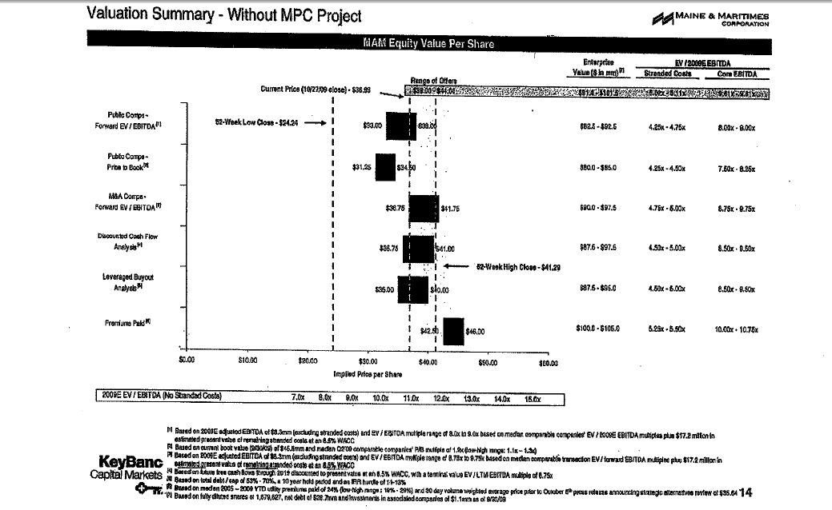
Football Field Diagram – Seller
Show the price per share and the Enterprise Value

Slide 21
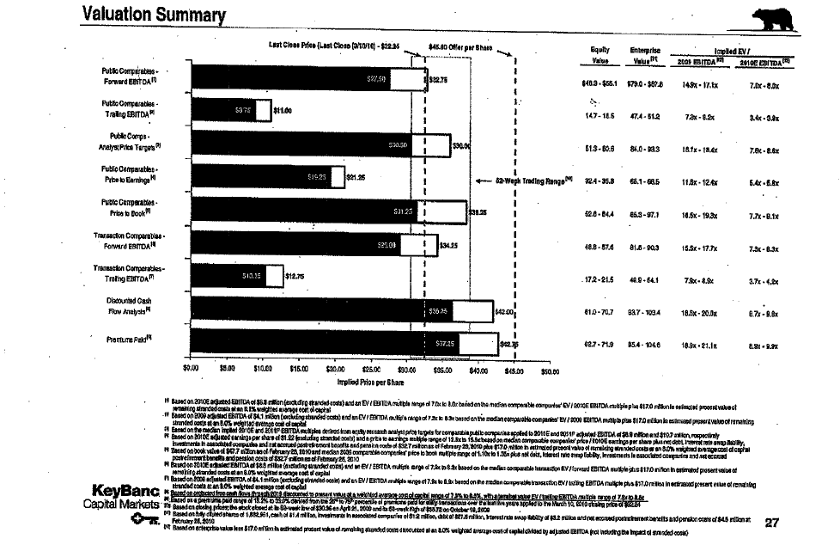
Football Field Diagram – Sell Side
Includes purchase price
Notes on forward EBITDA from Earnings Projection

Slide 22
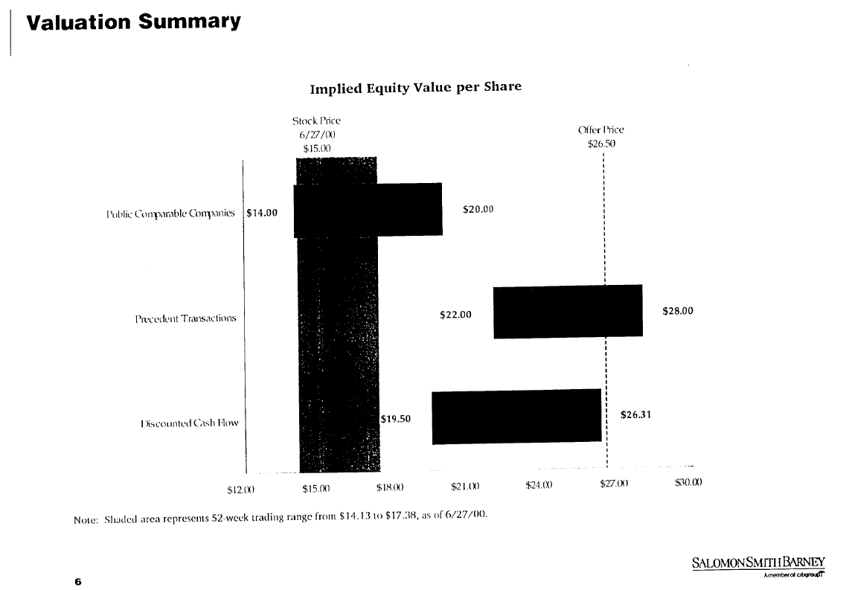
Another Football Field

Slide 23
Football Field Data Example
Look at Different Methods of Valuation
  Recognize that there is not a precise number
  Recognize that there is not a single method, but many

Slide 24
Football Field Diagram in Exercise File
Example – tricky technical part is to create space for labels and put in the labels – you can see this in the exercise file.

Slide 25
Danger of Thinking You Are Too Smart and Making Things Un-necessarily Complex
In Finance
  M&A is some kind of magic and requires highly technical and advanced knowledge:
Sun Edison Quote:
    SunEdison will transfer to Seller Note LLC, and Seller Note LLC will pledge, on a first priority basis, additional shares of the Class B Securities in connection with any adjustment to the exchange rate, so that, at all times, the Class B Securities equal to the full number of shares of TerraForm Power Class A Common Stock issuable upon exchange of the Exchangeable Notes shall be held by Seller Note LLC and subject to such first priority lien.
    …repurchase date is after a regular record date and on or prior to the interest payment date to which it relates, Seller Note LLC will instead pay interest accrued to the interest payment date to the holder of record of the Exchangeable Note as of the close of business on the regular record date, and the Fundamental Change purchase price shall then be equal to 100% of the principal amount of the note subject to purchase and will not include any accrued and unpaid interest. In addition, following certain events that constitute “Make-Whole Fundamental Changes” (as defined in the Exchangeable Notes Indenture), Seller Note LLC will increase the exchange rate for holders who elect to exchange Exchangeable Notes in connection with such events in certain circumstances.
Sun Edison Shortly Went Bankrupt

Slide 26
M&A Language Does Not Mean You Need Different Analysis Techniques
M&A transactions can involve partial share exchange and partial cash payments; different forms of debt can be used as to fund the acquisition. A merger can involve a series of options including earn out provisions.
Terms of transaction may lead to accretion or dilution in earnings per share or other measures.
Private equity transactions can involve complex debt terms.
Do not assume that these things make M&A analysis fundamentally different than other valuation analyses.

Slide 27
Standard Problems in Valuation
Some general valuation problems related to the notion that any valuation problem involves: (1) forecasting cash flow, and (2) quantifying and assessing risk:
Forecasting Cash Flow
  Earning returns higher than history without special competitive advantages.
  Cash flow in the long-run that is not consistent with investments required to earn the cash flow.
  Not considering fundamental risk factors of surplus capacity, technical obsoleteness, growth and product maturity in key assumptions.
Risk of Cash Flow
  Use of magic potion models to come up with minimum required returns.
  Absurd risk premiums for country risk, small companies, private companies.
  Adjustments to WACC for debt beta and taxes that make no sense.

Slide 28
Companies Used in McKinsey Book and Typical Examples
This kind of relatively stable company is used in the McKinsey Book. You can use ideas of ROIC and WACC along with a financial model to make a DCF analysis as well as a credit analysis. Companies in the McKinsey Book include:
  Fed Ex
  UPS
  Heiniken
  Disney
  Walgreens
  General Mills

Slide 29

Biggest Problems
Applying bureaucratic techniques without thinking
  Using 5 years for explicit period
  Using growth model without normalizing
  Using EV/EBITDA ratios from comparable companies without adjusting for ROIC, depreciation, taxes and growth
  Not considering strategic implications of synergies and discount rates
  Adjusting Beta
  Cost of Capital potion

Slide 30
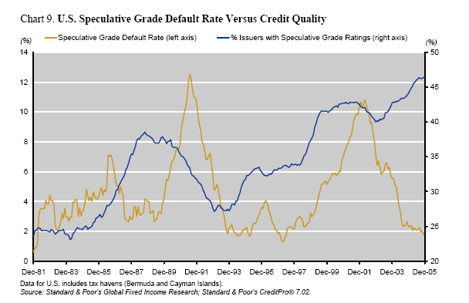
Problems with Valuation – Estimates of Cash Flow
Financial projections that underpinned several high-profile LBO bankruptcies in the late 1980s. Many of these transactions were based on assumptions that the companies could achieve levels of performance, revenue growth, operating margins, and capital utilization never before achieved in their industry.
The buyers of these companies typically had no concrete plans for executing the financial performance necessary to meet their obligations. In many such transactions, the buyers simply assumed that they could resell pieces of the acquired companies for a higher price to someone else.

Slide 31
Contrast Two Companies in Evaluation of Corporate Finance
Boring Company
Mature Company with capital expenditures used to make investment.
No large write-offs, re-structuring's or asset sales.
Multiples are similar across companies in the industry and over time.
Value to Investment (price to book) ratios are stable and can be used to evaluate company management and cost of capital.
Return earned on assets invested in the past is similar to return on investment on new assets.
Tricky Situations
Investment in the form of research, operating losses and software.
Balance sheet affected by gains on asset sales, write-offs, re-structuring charges.
Multiples change a lot over time for individual companies and across a cross-section of companies.
Value to investment have little meaning as historic investment was very small compared to new investment.
Return on historic investments change as plants age and conditions change in an industry.

Slide 32
But, What happens if …
Rate of return (it could be ROIC, ROCE, ROE or any other measure), is not very relevant because:
  Returns are distorted (i.e. very high) because of large writeoffs that the company took a couple of years ago
  Invested Capital is high because of because of asset sales that resulted in gains and a higher equity.
  Businesses like construction and contracting carry risks and therefore earn returns, but little or no capital is invested, so how can you compute ROIC, ROE etc.
  Investment is in the form of research and development or operating expense to keep quasi monopoly going (e.g. Apple, Google etc.)
  Return on new investments very different from return on historic investments (e.g. Amazon investment in food delivery versus investment in websites).

Slide 33
Also, What Happens if …
A company has been growing fast and it cannot keep growing forever, but you don’t really know how long the growth will last.
  If a company grows fast and its return is greater than its cost of capital, the P/E ratio and the EV/EBITDA ratio can be very high. Do you really think you can predict the length of time the company will continue to grow.
  If you claim that you know how fast the company can keep growing you are a fraud.
  A company has been experiencing high return on invested capital because of low capital spending, but it will eventually have to replace its capital.

Slide 34
Were the “New Economy” Ideas Not So Stupid
The new economy concepts were that real options could be created if a company gains scale. These ideas were laughed at. But after 20 years, maybe some of the ideas were not so silly.
For example, “the extraordinarily high anticipated profits represented by stock prices during the Internet bubble never materialized, because there was no ‘new economy.’”
Get data from the comprehensive stock price file.
The real thing that happened during the dot.com bubble was with telecom companies
Use Amazon, Priceline, Pay Pal, EBAY

Slide 35
M&A Valuation and Rate of Return on Invested Capital

Slide 36
Fundamental Valuation Ideas and Value Drivers
The objective of any corporation is get high returns and then to grow these profits. The value of cash flow from these profits depends on the risk associated with the cash flow or the cost of capital. That means three things drive value:
  Rate of Return on Investment
  Growth
  Cost of Capital Adjusted for Risk
There is no question about theses basic ideas and one can think of valuation as forecasting movements in these three variables.

Slide 37
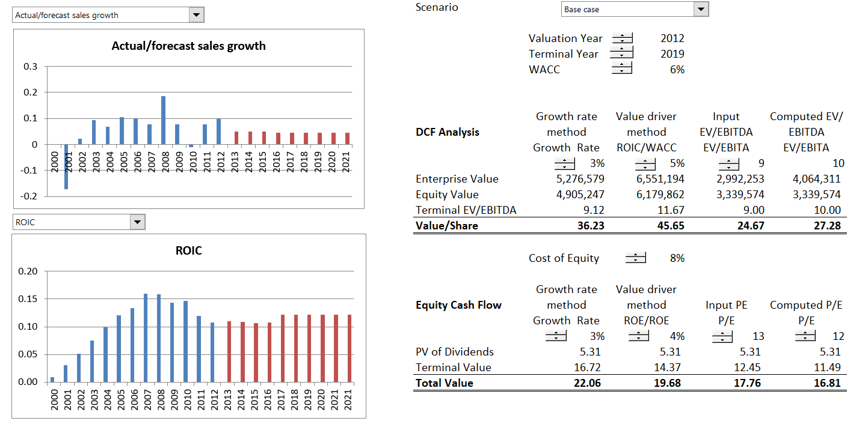
Example of Classic Company – Food Business and Use of ROIC for Benchmarking
In this case, keep ROIC in sight when make a valuation.

Slide 38
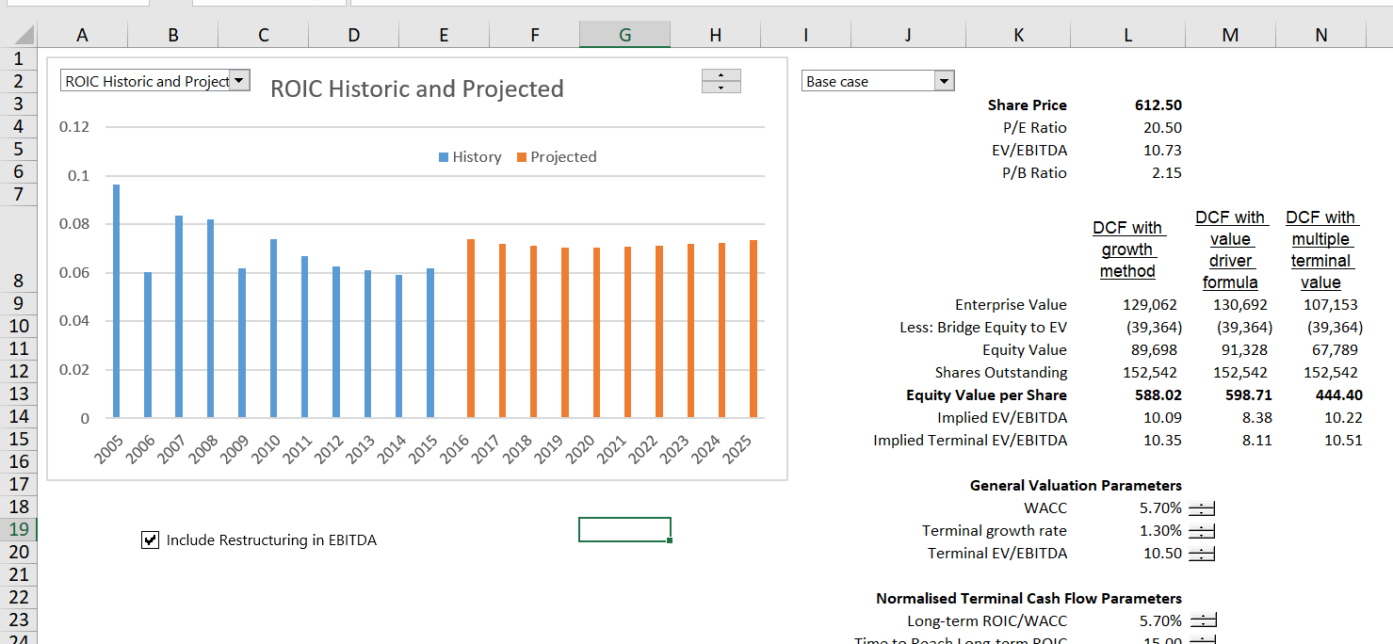
Carlsberg Analysis – Forecasting Management Ability to Affect Return
Change the scenarios and evaluate value at the same time you are gauging value

Slide 39
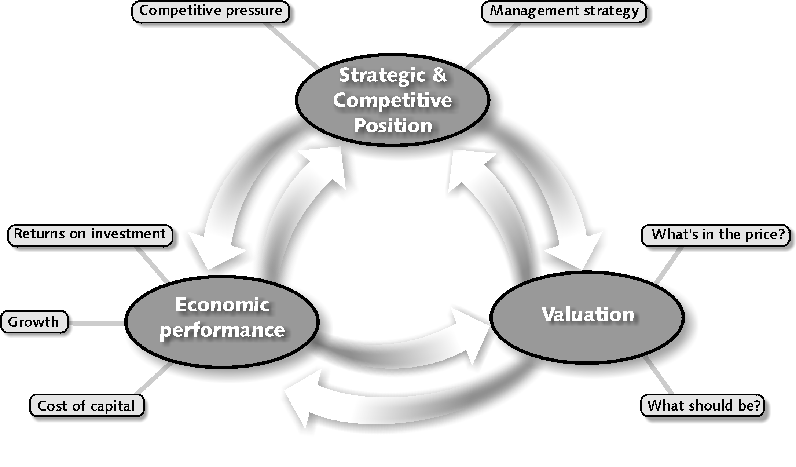
Analytical framework for Valuation – Combine Forecasts of Economic Performance with Cost of Capital
Competitive position such as pricing power and cost structure affects ROIC
In financial terms, value comes from ROIC and growth versus cost of capital
P/E ratio and other valuation come from ROIC and Growth

Slide 40
The Value Matrix - Stock Categorization
What is the economic reason for getting here and how long can the performance be maintained
Throwing good money after bad
Give the money to investors
Try to get out of the business

Slide 41
Consultant Slide on Value Creation
Can Replace the ROIC with ROE and WACC with Cost of Equity

Slide 42

Simplistic Analysis of Acquisitions
Let’s say the acquisition is in your industry (it is really stupid to think you can get synergies from operating in other industries).
You would rather buy a company that is earning a low return than a high return because there is room for improvement.
This idea does not work if returns are a function of sunk cost investments like policies in the insurance industry.
Simple Rule:
  Same industry
  Target has low return on investment
  Target has good ROIC but low growth

Slide 43
The Interaction between Growth and Return with a Simulation
Illustration of combined effect of growth and return. The circles with blanks are negative and the blue dots are positive. This demonstrates the worst place to be in terms of value is the high growth and low return square.

Slide 44
Valuation and Return
In project finance, you could not discuss the assessment of a project without considering the IRR or the growth rate that you realize on your investment.
How could you consider any of the valuation issues without assessing the return you are generating
  If you are assuming a really high return in a competitive business I think you are crazy
  If you are assuming that you can buy a company that is already earning the highest return in the industry, you are naïve

Slide 45
Statement about U.S. and Asian Companies by McKinsey
The median large U.S. company earned a 19 percent ROIC in 2013, while the median large Asian company earned 8 percent.
But for the most part, Asian companies historically have focused more on growth than profitability or ROIC, which explains the large difference between their average valuation and that of U.S. companies.
Comment: Everybody of course wants a high monopoly profit. Very smart people are hired to create monopoly profits through marketing strategies (or making children and adults addicted to a product). The focus must be on making positive NPV investments, value should increase.

Slide 46
Use of Return on Invested Capital to Assess Model
The big question is what really goes into calculation of the invested capital.
The most obvious point is that surplus cash should not be in invested capital because the income associated with surplus cash is not in NOPAT.
For Amazon, the issue of R&D cost is a big issue. If R&D was capitalised, the observed return would be a lot higher.

Slide 47
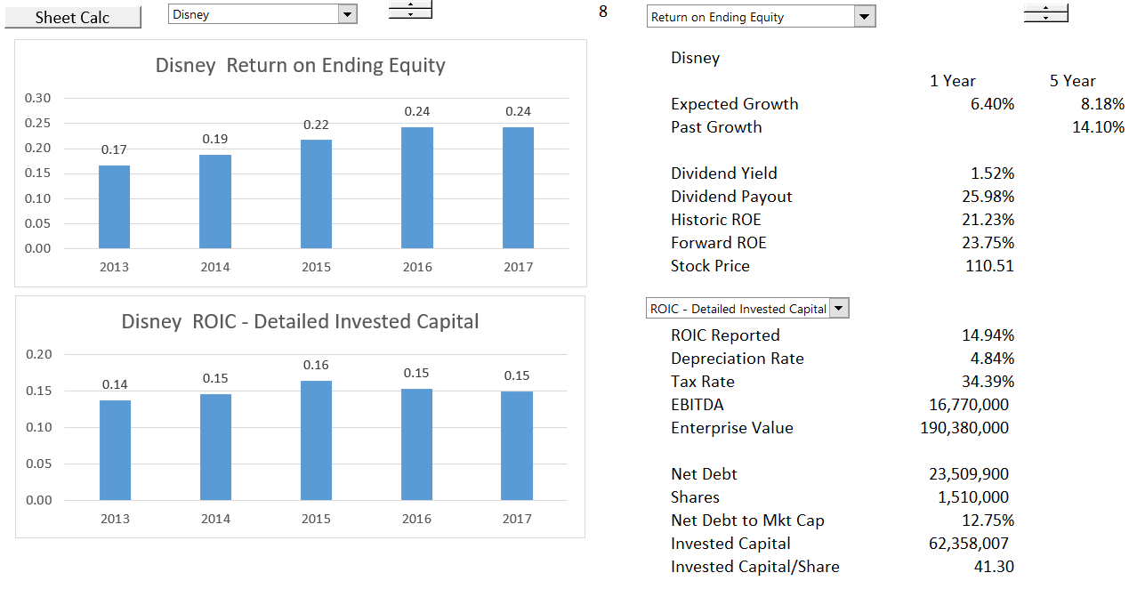
ROE and ROIC Comparison
Use ROE for exercise

Slide 48
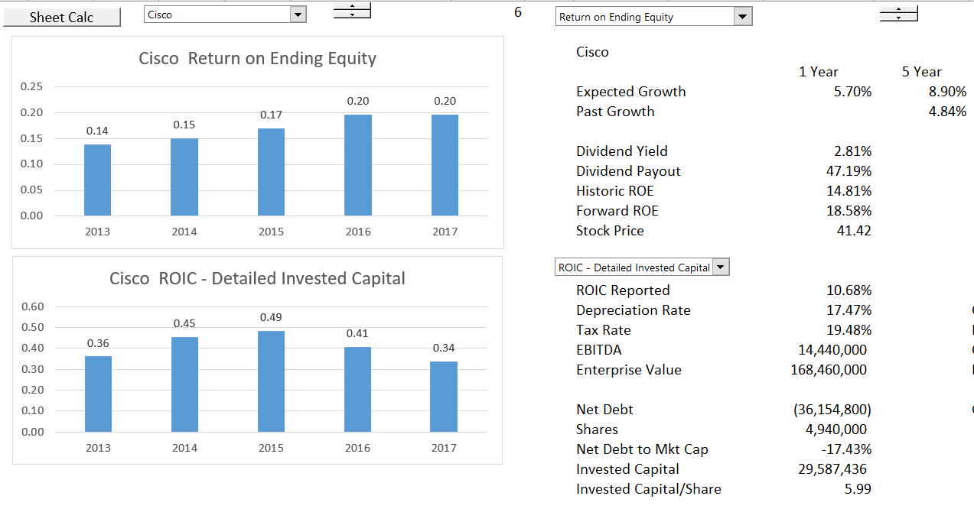
Careful Calculation of ROIC
Long-term investments should be accounted for.

Slide 49
Investment to Maintain Cash Flow and Profits
To generate profits or cash flow, just about everything requires some level of investment:
  Personal: Invest in education
  High Tech: Invest in research and investment
  Start-up: Invest in marketing and service or product
  Telecom: Invest in acquisitions and licenses
  Retailing or Trading: Invest in Inventories
  Banking: Invest in Loans
  Manufacturing: Invest in Capital Expenditures
If a company stops investing or makes bad investment decisions, or pays too much for investments, it will have problems in the future

Slide 50
Evaluate a Forecast with ROE or ROIC
Fundamental economic notion that it is very difficult to charge high prices/premiums and also grow.
Basic check of forecasts is to consider the return on investment and make sure it is consistent with economic conditions and the industry.
For industrial company, use ROIC which is not distorted by changes in the capital structure.
For financial companies, use ROE as long as capital structure is stable.

Slide 51
Method 1:
Evaluation of Premiums and Synergies and Understanding Valuation

Slide 52

Differences in Valuation for M&A and Other Typical Valuations
The most basic economic idea of an acquisition involves why anybody would pay a premium above the market price for anything. (It is as if you go to get your can of beer and pay more than the price listed (or you pay me for stuff on my website).
If you think a listed company is undervalued, you can just ask your shareholders to buy some shares or even by the shares yourself.
But if you can get control of the company, you can fire people and do other things to realize synergies. If the value of taking control and realizing synergies is more than the value of the premium, then the acquisition has positive value.
Economics: PV of After-tax Synergies > Premium

Slide 53
Basic Merger and Acquisition Background
A few terms that will be used throughout the course.
Mergers and Acquisitions are valuation and capital budgeting problems, but:
  The value of synergies and management strategy in M&A are difficult to quantify with financial models
  Costs and benefits of a merger can be measured in various different ways (DCF Valuation, Equity IRR, EPS changes, credit quality, NPV)
  Accounting, tax, and regulatory issues can be complex in modeling (goodwill, tax step-ups, re-financing)
Methods of quantifying the costs and benefits of M&A with financial model
  Merger or consolidation; performance of combined company in terms of EPS and credit quality (as well as DCF of target company)
  Acquisition; model the rate of return earned assuming that the company will be re-sold after a holding period and evaluate EPS effects (as well as DCF of target company)

Slide 54
Valuing Synergies is Not Like Valuing Other Cash Flows and Should Not Apply the Same Discount Rate
There are a few points about valuing synergies that you should consider and are not necessarily evaluated when thinking about M&A economics:
  First, the risk of a change in management strategy is not the same as the overall risk of the company.
  Second, the revenue and expense synergies should be after tax.
  Third, you can never really assess whether synergies have been obtained, because you do not know what would have happened without the acquisition.

Slide 55
Synergy and Premium Example and Valuation of Target
Go back to the beer example. You are not buying beer for yourself, but you are buying it for everybody in the room (your shareholders). You are just a buyer for other people and it is not your money.
You believe that one of the beers has a lower price than its true inherent value.
Of course the undervaluation does not mean that you should pay more for the beer.
This implies that under-valuation does not mean that you should pay a premium.

Slide 56
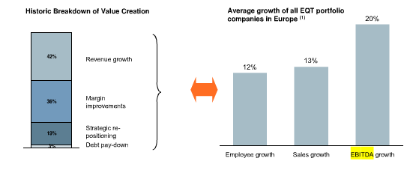
Illustrative Margin Growth

Slide 57
Premium and Synergy Example
Estimated Premium and Synergy Example

Slide 58
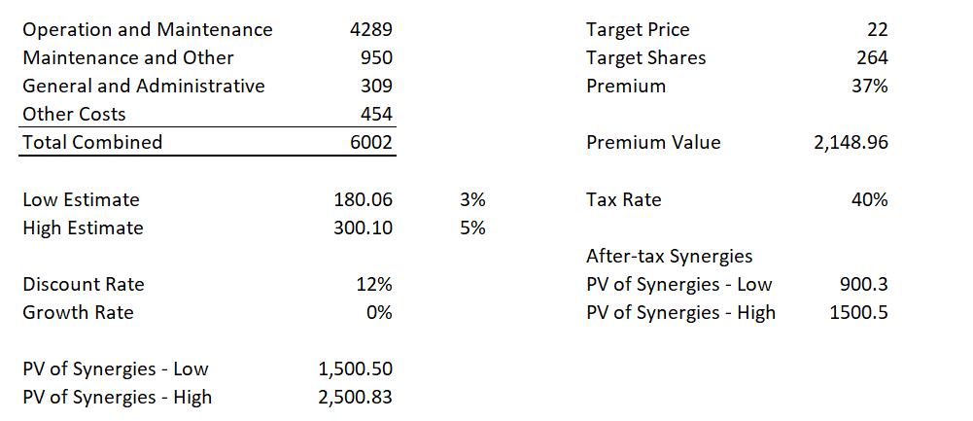
Economic Analysis of Merger with NPV of After-Tax Synergies versus Premium
Note how depends on discount rate and tax rate. Some also use P/E to after-tax synergies or EV/EBITDA to pre-tax synergies.
Can compute the economic IRR on a transaction.

Slide 59
Different Types of Synergies and Strategies
Some synergies are almost risk free:
  Reduction in overhead costs
  Savings from capacity (e.g. trucks are not at capacity)
Other Synergies may be pretty sure
  Increase growth with more capital expenditures
  Incorporate target company in your company
Synergies that are risk
  Revenue increase from new strategy
  Increase price with competition
Cannot Apply the Same Discount Rate to Different Strategies

Slide 60
M&A Method 2:
Accretion and Dilution

Slide 61

Accretion and Dilution Example
Protective life purchased at 34% premium. No change in management by Dai-ichi.
Dai-ichi said the favorable foreign exchange rate Dai-ichi secured in the acquisition of Protective largely offset the premium it paid. The yen has weakened 14% against the dollar since the purchase agreement.
Dai-ichi plans to set up a holding-company structure in October 2016 under which Tokyo headquarters will delegate more power to North American and Asian regional heads. Understand that management not changed – implies no synergies.

Slide 62
Step by Step Process in Acquisition Model
Begin with Standalone Model
1
Add New Page for Acquisition Assumptions
2
Create Sources and Uses and Pro-Forma
3
Include New Page for Acquisition Model
4
Add Provision for Exit and Switch
5
Present Results of Acquisition Model
6

Slide 63
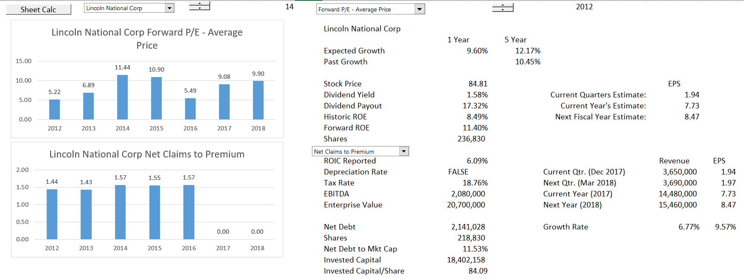
Accretion and Dilution Analysis: Target – Low P/E Ratio
Use Lincoln National as the target because of low P/E – note expected growth in EPS

Slide 64
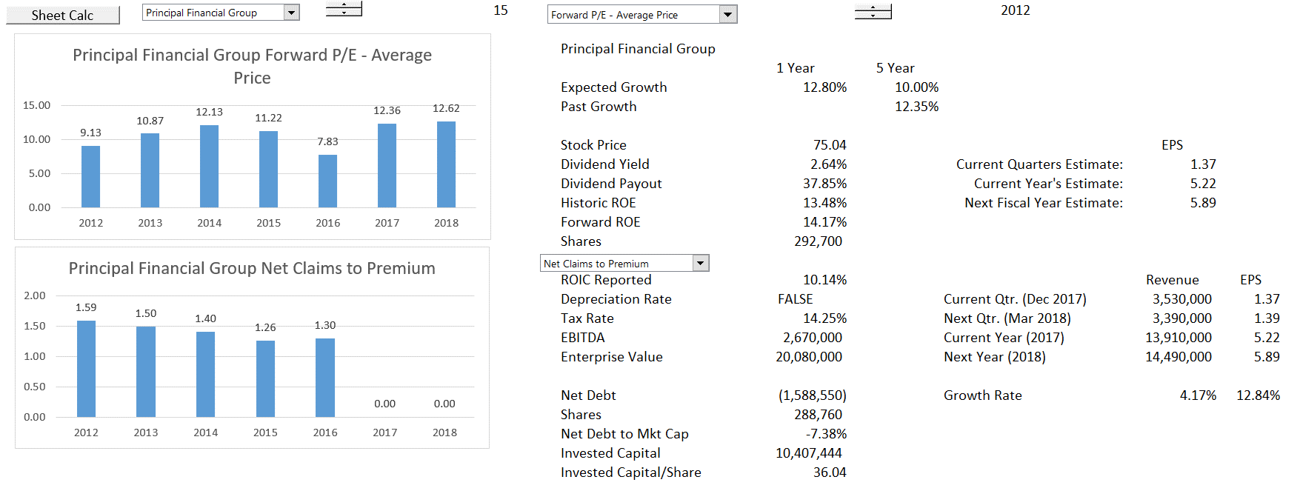
Accretion and Dilution Analysis: Acquiring Company
Use Principal Financial Group as assumed acquiring company

Slide 65
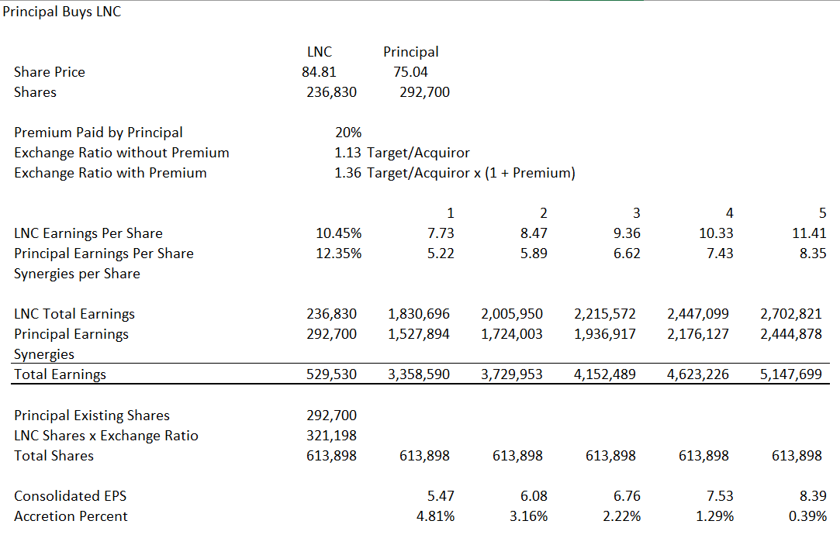
Demonstration of Accretion without Synergies
This is like USD/Euro – You get higher exchange rate.

Slide 66
Conversion of Standalone Model
Need Fundamental Operating Analysis
  Revenues, Operating Expenses and Capital Expenditures
  Depreciation Expense and Working Capital
Set-up Flexible Data Depending on Starting Point of Acquisition
Use Lookup Function to Bring Data from Standalone to Acquisition Model on a Flexible Basis
Add Switch to Model for Holding Period and Terminal Period

Slide 67
Add Acquisition Assumptions
Transaction Price Assumptions
  Alternative Approaches to Acquisition Price
  Premium on Stock Price
  EV/EBITDA
Financing Assumptions
  New Debt
  Retired Debt
  Debt Terms
  Disposition of Cash Balance
Terminal Value Assumptions
  Holding Period and Exit
  Exit Multiple
Accounting and Tax Assumptions

Slide 68
Sources and Uses and Pro-Forma
Begin with Goodwill Analysis
  Consideration – Existing Equity as Start
  Take away increases in asset value
  Adjustment for deferred taxes
  Adjustment for fees
Sources and Uses
  All Items from Goodwill or Assumptions
  Begin with Consideration and Fees
  Adjustments for Debt Retired
  End with Equity Contributed
Pro-Forma
  Use Lookup as Standalone Starting Point
  Put in Accounting Adjustments and Items from Sources and Uses
  Adjust for Fees
  Adjust for Cash

Slide 69
Financing of Acquisition
Set-up Debt Balance Between Operations and Financing
  Put in Balances
  Connect to Cash Flow
  Compute Interest
  Put in Cash Flow Titles
  Put in Exit Value

Slide 70
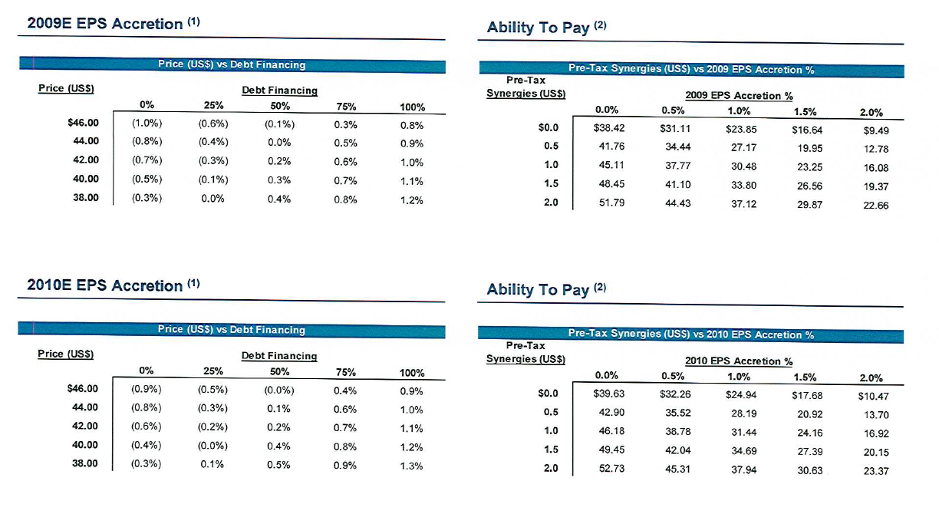
Example of Accretion and Dilution from Financial Model

Slide 71
M&A Valuation Method 3:
Implied Valuation from LBO and EV/EBITDA Ratio

Slide 72
Introduction – Structure of LBO and Valuation
An LBO is when a company purchases a company with a lot of debt, holds the company for a period while debt is being repaid and re-sells the company at an assumed EV/EBITDA.
An LBO valuation analysis can be structured by starting with the entry EV/EBITDA financed by debt defined with Debt/EBITDA.
After a holding period there is an exit defined by the terminal EV/EBITDA.
The entry and exit EV/EBITDA and leverage define the equity IRR.

Slide 73
Leveraged Finance - Introduction
Leveraged Finance simply means funding a company or business unit with more debt than would be considered normal for that company or industry.
Higher-than-normal debt implies that the funding may be riskier, and therefore more costly, than normal borrowing -- higher credit spreads and fees. It is often also more complex with covenants and waterfalls.
Hence leveraged finance is commonly employed to achieve a specific, often temporary, objective: to make an acquisition, to effect a buy-out, to repurchase shares or fund a one-time dividend, or to invest in a self sustaining, cash-generating asset.

Slide 74
Leveraged Buyout Process
A group takes over control of a company (sometimes with hostile takeovers).
Use high level of leverage and multiple debt layers to take control
Once in control, improve operations – increase EBITDA, divest unrelated businesses to generate cash for transaction, re-sell the new company for a profit.
High amortization assures self-restraint on behalf of the borrower.
In a typical LBO, capital expenditures do not exceed depreciation by much.
By changing the relative participation of debt and equity in the capital structure, an LBO redistributes returns and risks among providers of capital.

Slide 75
Method for Deriving Entry EV/EBITDA with LBO Analysis
The entry EV/EBITDA can be derived if the following is given:
The target IRR;
The exit EV/EBITDA;
The Debt/EBITDA and the Interest Rate;
The projected cash flow including synergies.
Note that the higher the debt leverage, the higher the EV/EBITDA and valuation can be.

Slide 76
Similarities Between LBO Method and DCF
Both the DCF and the LBO model project cash flows, the most important of which is the final period cash flow.
Both the DCF and the LBO methods have a period of cash flows and an ending value period. For the DCF this is the explicit cash flow period (e.g. 5 years). For the LBO the period is the holding period.
The final value is called the terminal value in DCF and the exit value in the case of the LBO.
The DCF method can apply the EV/EBITDA in computing the terminal value which is the same assumption used in the LBO method.

Slide 77
Difference between LBO Valuation Method and DCF Method
A key difference between the methods is that the DCF method uses free cash flow and WACC while the LBO method uses equity cash flow after debt and applies a target equity IRR from real transactions.
A key assumption in the LBO method is that amount of debt the cash flow will support. If there is more debt, the implied entry EV/EBITDA is larger.
Further, the LBO method always applies a multiple in the analysis while the DCF method can apply alternative terminal value approaches.

Slide 78
Theory of LBO and WACC
The theory of using the LBO should be implicitly suggests that risk is lower if a company can support more debt. If a company can support more debt, this implies that there is higher value and a lower WACC.
If there is a higher amount of debt, the same equity IRR can be obtained with a higher entry EV/EBITDA. This means that instead of estimating WACC you must estimate the amount of debt that a company can support and then use a given equity IRR such as 25%.
The mechanics of the approach involve setting up the cash flow, the entry EV/EBITDA and exit EV/EBITDA as well as the debt. Then you get an IRR adjust the entry EV/EBITDA with the goal seek function.

Slide 79
Debt Capacity

Slide 80
Computation of Debt Capacity
Computation of debt capacity cannot be reduced to a simple formula:
  Re-calculate the debt capacity under many scenarios.
  Stress tests should include price and volume pressure resulting from unfavorable competitive or macro-economic pressures.
  Need assurance on cash flows in the first couple of years.
The debt is an important signal along with the equity investment of managers.
LBO financing is expressed in terms of debt to EBITDA
  Secured financing
    3 x EBITDA
  High yield
    2.5 to 3.5 x EBITDA Incremental
  Equity
    1.5 to 2 x EBITDA
  Total Transaction Value
    7 to 8 x EBITDA

Slide 81
Debt Capacity Method
Balance sheet approach
  Market value of debt as percentage of market value of the firm
  Compare with industry average
Free cash flow approach
  Is there enough cash flow to pay more interest comfortably?
  How much more interest?
  How much more debt?
  Debt/EDITDA, EBIT/Interest, other measures

Slide 82
Deal Sources
Some of the Targets for Private Equity and LBO’s Include:
  Family Businesses (Seeking Partnerships)
  Divisions of Large Corporations (Non-Core)
  Privatizations
  Forced Divestitures
  Other Private Equity Firms

Slide 83
Leveraged Buyout and Adjusted EBITDA
Modeling and key covenant drivers are based on “Adjusted” EBITDA
In a leveraged acquisition context, focus on non-recurring “add-backs” that determine Adjusted EBITDA, including
  Transaction fees and expenses
  “Public company” costs if acquiring a public company in a going private deal
  Non-cash write-offs (e.g., goodwill adjustments) that arise under FASB rules
  Non-cash compensation expenses relating to options, etc.
  Retention bonuses for Target employees
  Set up favorable TTM parameters going-in
Why covenant drivers use adjusted EBITDA?
EBITDA is a measure commonly used by the capital markets to value enterprises. Interest, taxes, depreciation and amortization can vary significantly between companies due in part to differences in accounting policies, tax strategies, levels of indebtedness and interest rates.
Excluding these items provides insight into the underlying results of operations and facilitates comparisons between Global and other companies. EBITDA is also a useful measure of the company’s ability to service debt and is one of the measures used for determining debt covenant compliance. EBITDA and adjusted EBITDA information is useful to investors for these reasons.

Slide 84
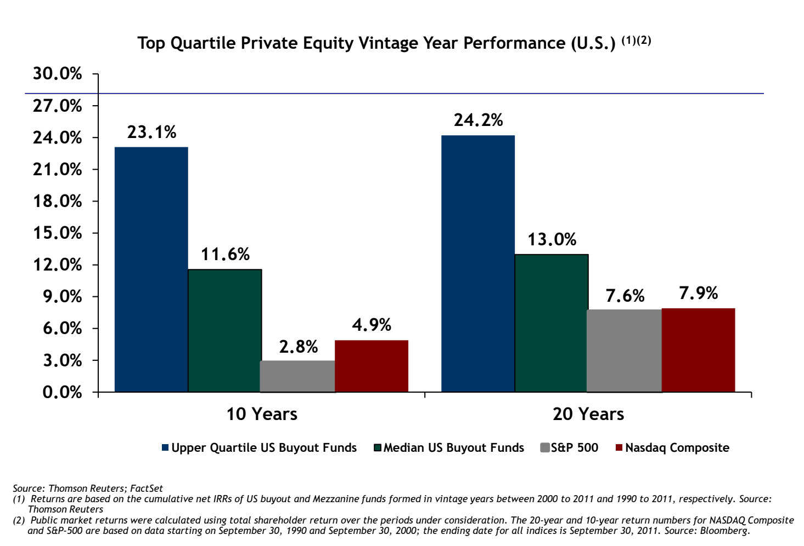
IRR Targets and Returns in Private Equity and Target Returns

Slide 85
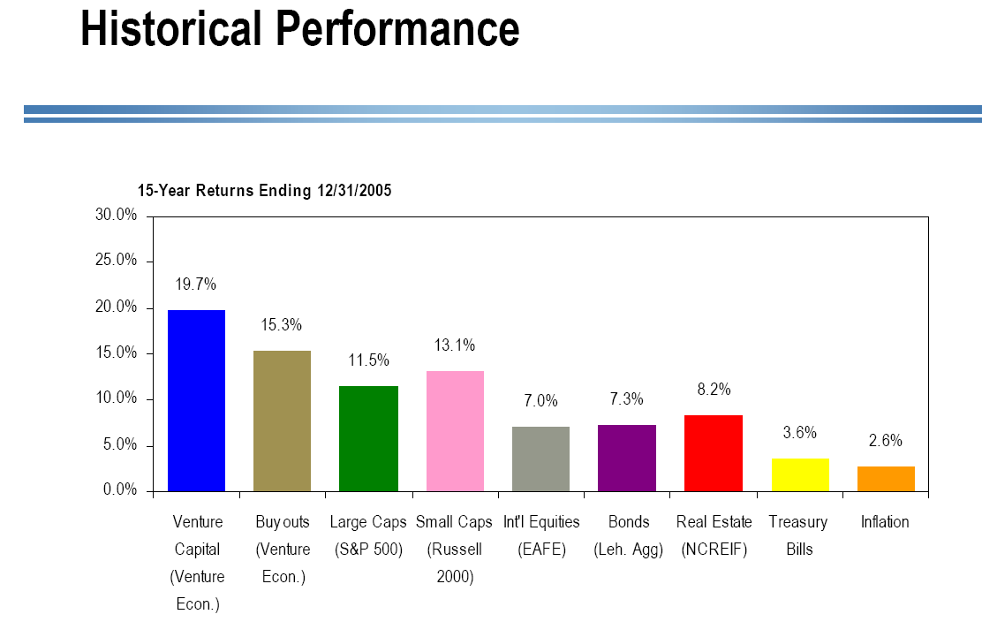
Target IRR and Return on Alternative Investments

Slide 86
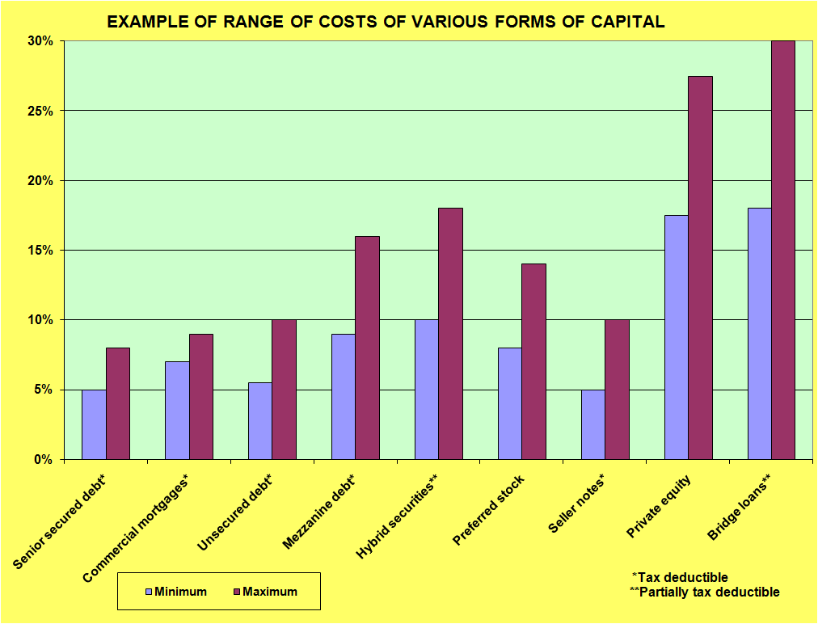
Leveraged Buyout Modeling
86

Slide 87
M&A Analysis from Private Equity and LBO
M&A Analysis from Private Equity and LBO
  Acquisition Model Mechanics
  Acquisition Transaction Costs
  Merger Models and LBO Models
  Debt Provisions and Analysis in Acquisition Models
  Tax Provisions and Analysis in Acquisition Models

Slide 88
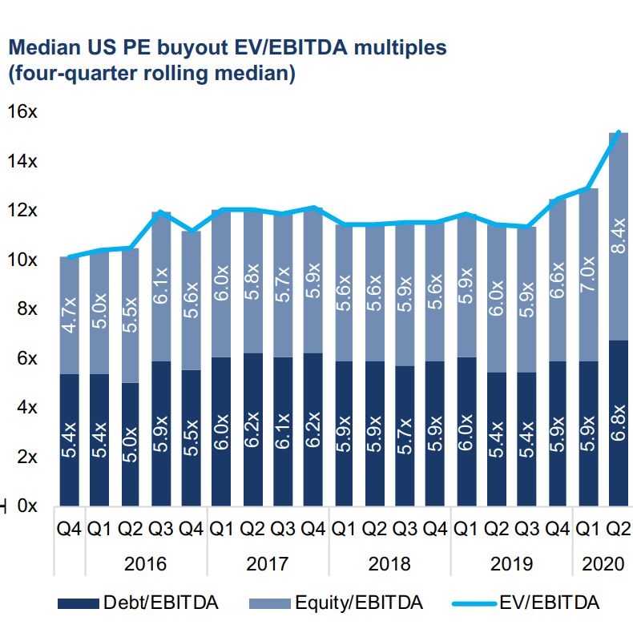
EV/EBITDA Entry and Exit Drives the Valuations in LBO

Slide 89
Effect of Taxes on P/E
A tax law change should not affect the P/E ratio, but should make the EV/EBITDA ratio greater
Assume that P/E is trailing and earnings do not reflect the change in the tax law.
Assume that companies are monopolies and they can retain savings from the tax reductions.
What is the equity cash flow increase from a tax reduction from 35% to 21%:
Pre-tax 100 100
Tax 35 21
After Tax 65 79
Percent increase in value: 79/65-1 = 21.5%

Slide 90
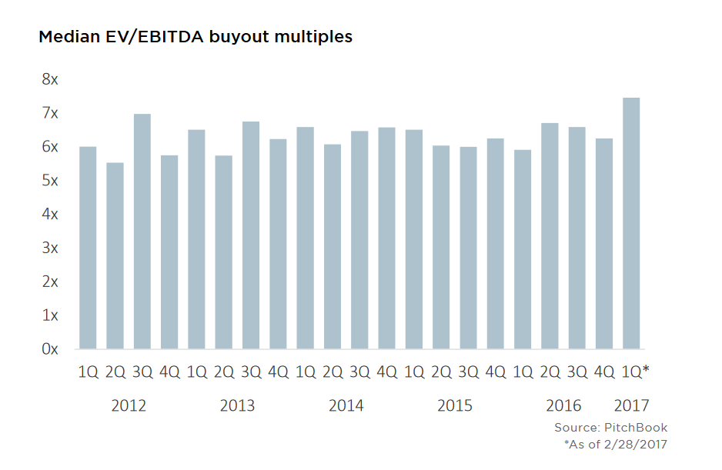
Overall Median EV/EBITDA Multiples

Slide 91
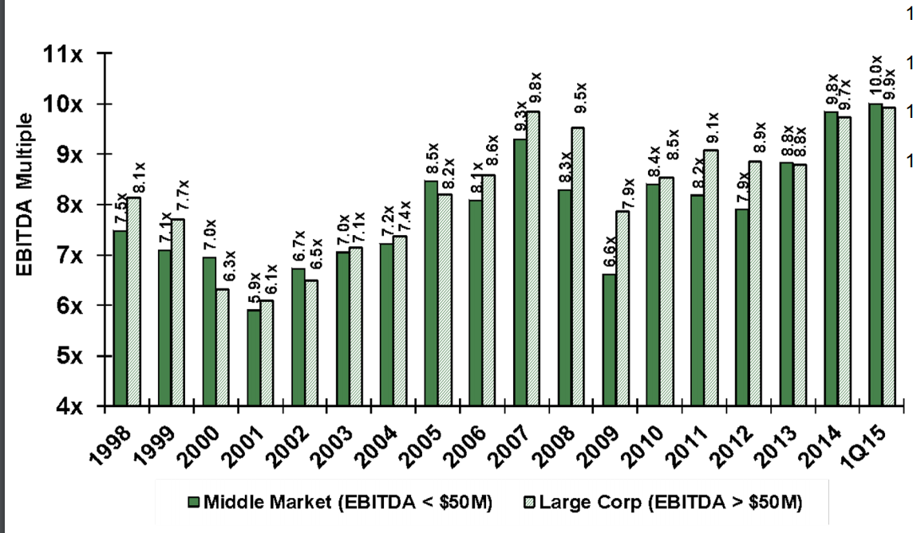
So Much for Small Company Premium

Slide 92
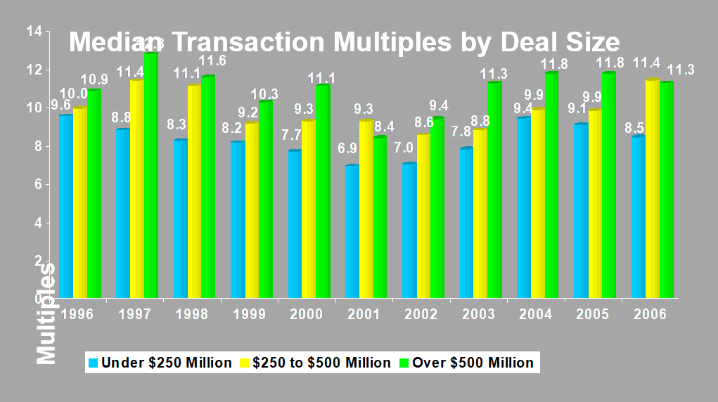
Liquidity Determines Valuation Premium
Median Transaction Multiples by Deal Size
Multiples
Source: Merger stat (U.S. Only)
Disclaimer: Data is continually updated and is subject to change

Slide 93
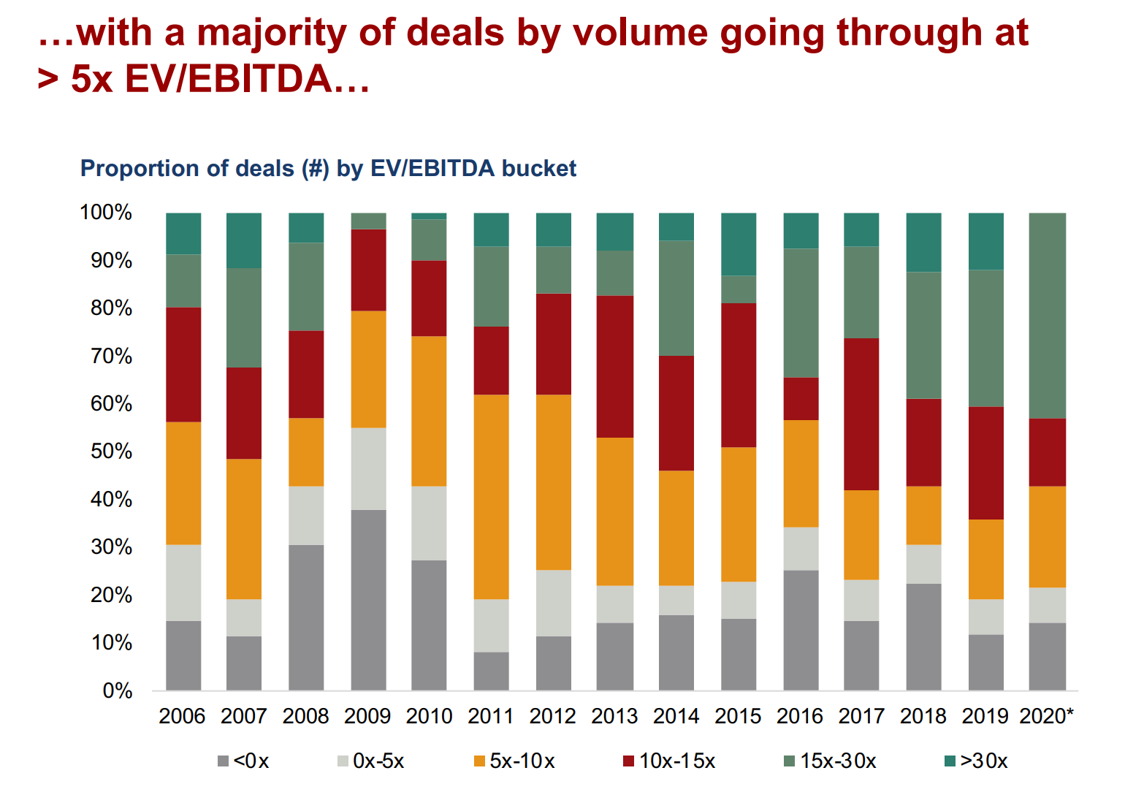
More Transactions with Really High EV/EBITDA

Slide 94
Now Evaluate Effect of Asset Life
Compare buying a house that lasts for 100 years with buying a Tesla that lasts for 10 years.
How much money do you have to earn to support these investments (how much EBITDA do you need).
Assume no inflation and no return. Then you could spread your money over 100 years for the house but only over 10 years for the car.
You need 10 times as much money to cover the value of the car than the house.
If you earn the same amount, then your are covering much less value in the case of the car and the value to EBITDA is less.

Slide 95
Leveraged Buyout
Asset-Based Versus Cash Flow Loans
An asset-based loan is a loan, often for a short term, secured by a company‘s assets.
  Real estate, A/R, inventory, and equipment are typical backing assets
A cash flow loan is a loan in which a bank lends funds against cash flows that a borrowing company generates.
  To secure repayment, the bank installs covenants on levels and ratios such as EBITDA, total debt/EBITDA, etc.
  Layering: Understand The Terms
  Revolver: A credit line that a firm can use as needed
  Term Loans
    Term “A”: “Amortizing Term Loans” that typically require substantial principal repayment throughout the life of the loan •
    Term “B”: “Institutional Term Loans” that are non-amortizing loans with longer maturities and higher coupons (more prevalent than Term A loans in LBO financings)

Slide 96
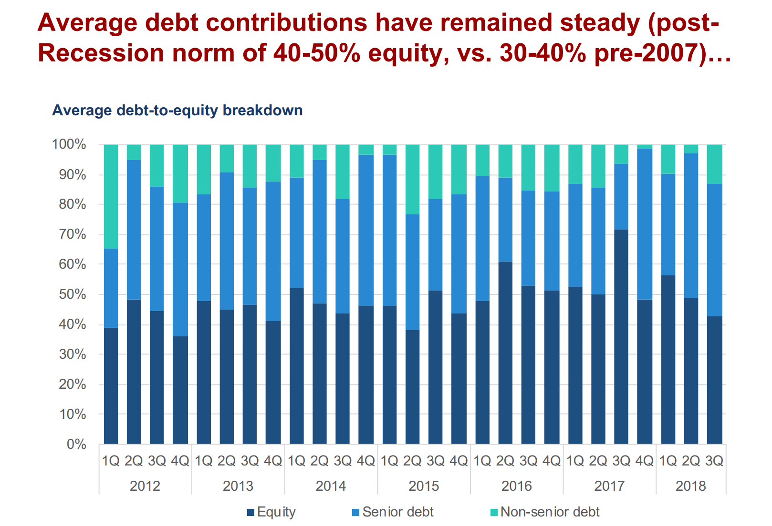
Debt in Leveraged Buyouts

Slide 97
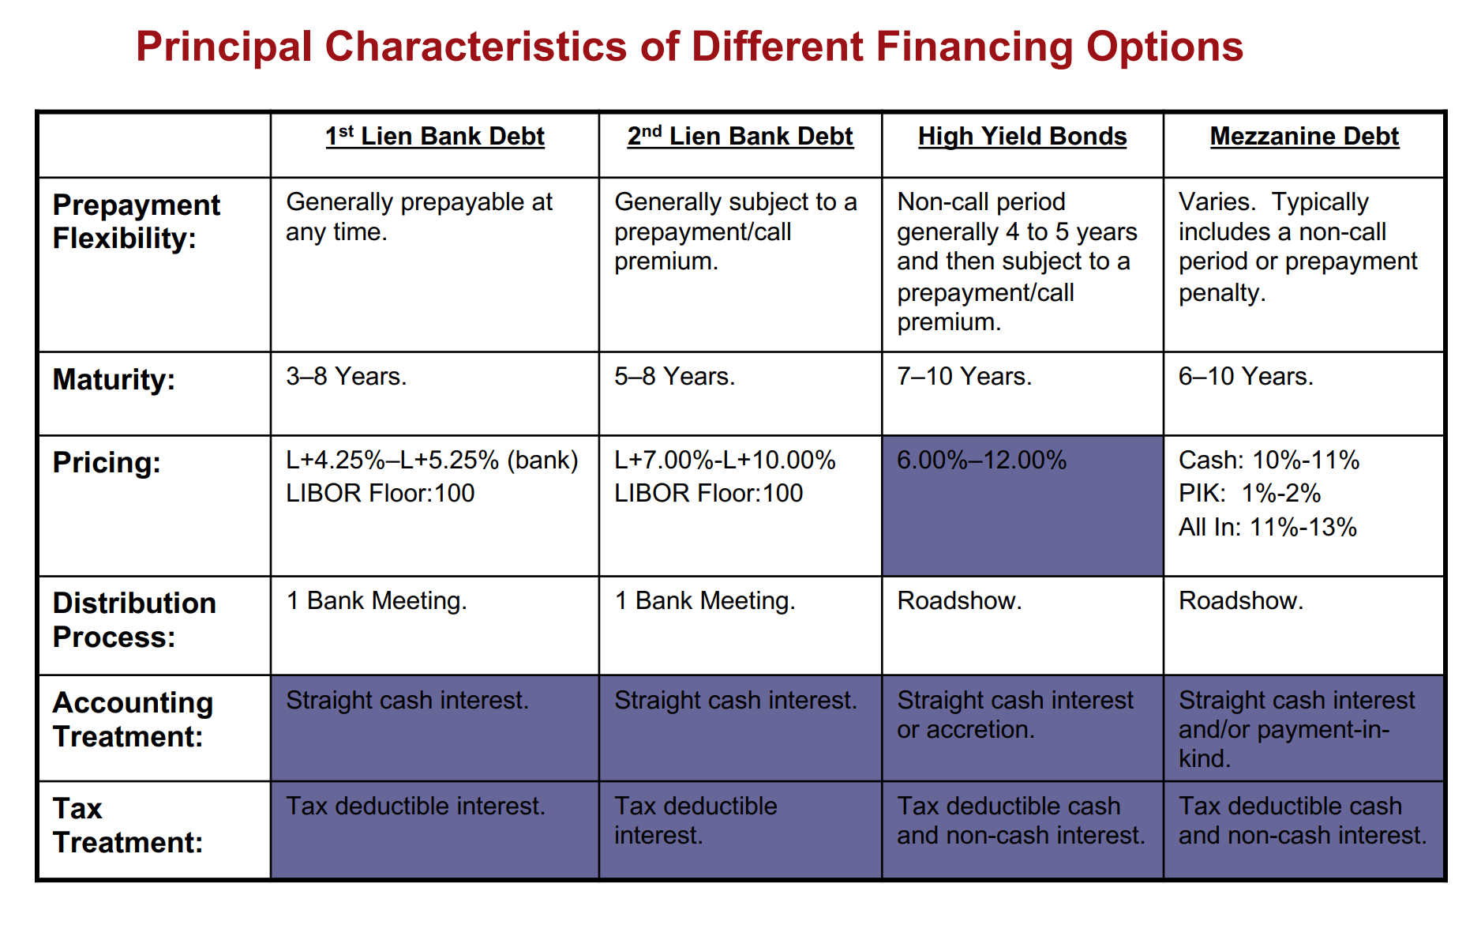
Interest Rates and Maturity

Slide 98
LBO and Private Equity Terms
Strategic Acquisition
  Same industry, synergies
Financial Acquisition
  Purely an investment without links to other businesses (e.g. private equity)
Trading Comparables and Public Comparables

Slide 99
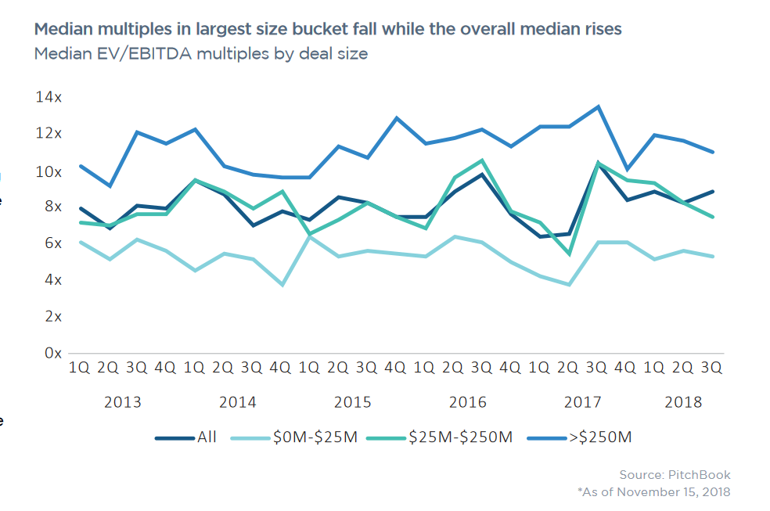
Starting Point – Entry EV/EBITDA Multiples
EBITDA must be normalised

Slide 100
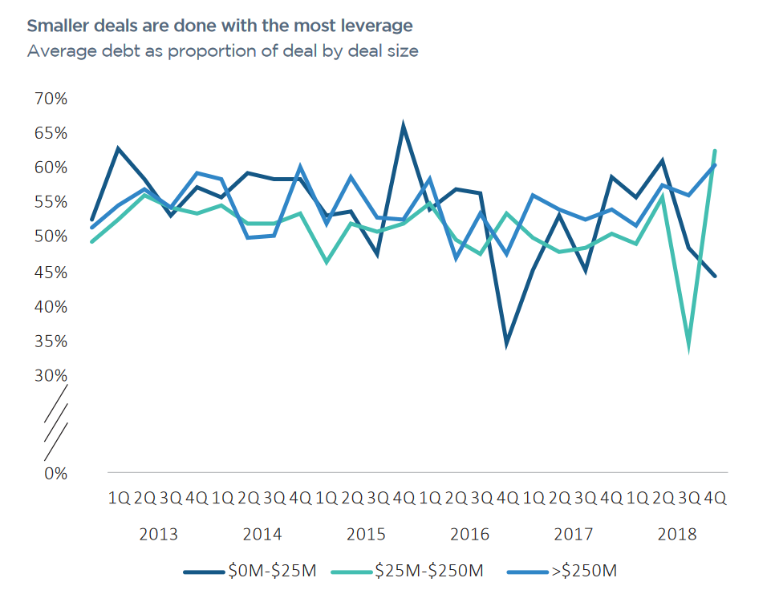
Gearing in Private Equity
Debt to Capital is about 55%

Slide 101
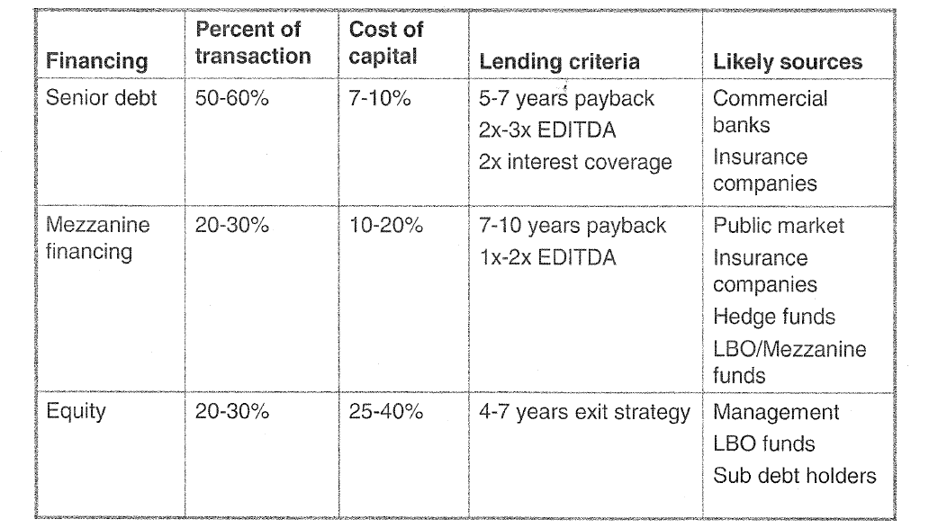
Typical LBO Structure – Earlier Data
Divide by EBITDA in Computing EV/EBITDA and Debt/EBITDA
4-6
Incremental Debt to EBITDA ratio
This totals 7-8 x EBITDA

Slide 102
PRINCIPAL LBO FINANCING TIERS
Type | Comments
Commercial mortgage | 1st lien against real estate 70 – 90% of property value
Revolving line of credit | Interest-only loan secured primarily by accounts receivable and inventory (prime collateral)
Mezzanine debt | “Cash-flow” loans, with possible deferrals in early years Zero-coupon bonds May include “equity kickers”
Seller note | Unsecured interest-bearing note typically repaid within 3 – 7 years
Contingent payments | Additional payments due only if revenues or earnings milestones are met
Senior equity | Special class of common or preferred stock issued to LBO sponsor with liquidation preference and possible preferred return
Common stock | Typically issued to management and possible minority interest retained by seller Purchase of management equity may be financed, in part, by nonrecourse note
Bridge loan | Temporary loan to be repaid within 6 – 12 months from permanent financing
102

Slide 103
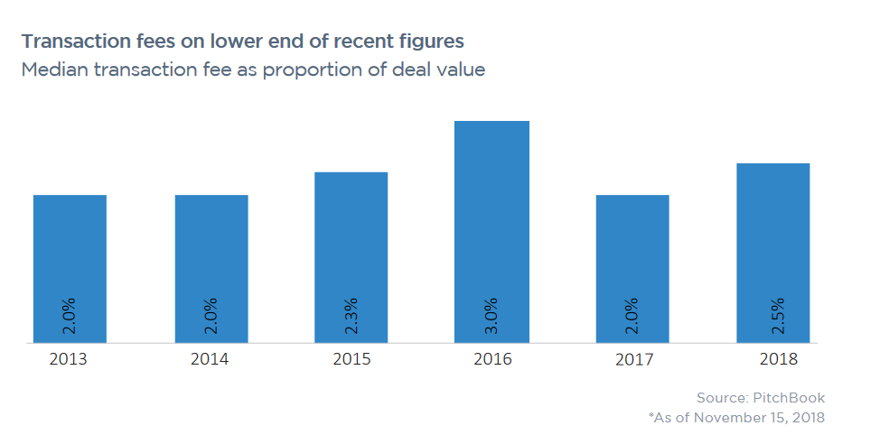
Transaction Fees
Fees include debt fees

Slide 104
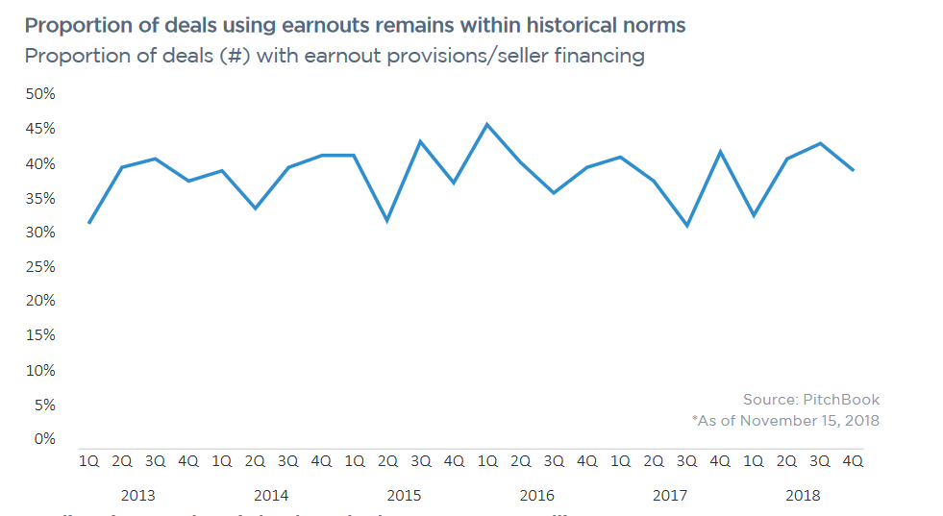
Earn Outs

Slide 105
Use of Mezzanine Debt to Meet Objectives and Restrictions of Equity and Senior Debt LBO General Points
An LBO is a transaction in which an investor group acquires a company by taking on an extraordinary amount of debt, with plans to repay the debt with funds generated from the company or with revenue earned by selling off the newly acquired company's assets
  Leveraged buy-out seeks to force realization of the firm’s potential value by taking control (also done by proxy fights)
  Leveraging-up the purchase of the company is a "temporary“ structure pending realization of the value
  Leveraging method of financing the purchase permits "democracy“ in purchase of ownership and control--you don't have to be a billionaire to do it; management can buy their company.
Raise money to pay for buyout premium
  Get as much as possible from the senior lenders
  Get as little as possible from the equity investors
  Tailor the terms of the mezzanine to be serviced from the expected cash flow.

Slide 106
Leveraged Buyout General Characteristics
Leverage ranges from 6:1 to 12:1. Debt to EBITDA ranges from 3.5 times to 6 times or even more.
Investors seek equity returns of 20 percent or more – focus is on equity IRR rather than free cash flow.
Average life of 6.7 years, after which investors take the firm public. Bank amortizes senior debt over 3-7 years.
Characteristics
  Strong and stable cash flows
  Low level of capital expenditures
  Strong market position
  Low rate of technological change
  Relatively low market valuation

Slide 107
J-Curve or Hockey Stick and LBO’s
The return depends on the holding period:
  If the LBO would be sold early on, the LBO would have a low rate of return because of the premium used in the acquisition and the fact that EBITDA has not increased
  Eventually, the return increases as the EBITDA grows and cash flow is used to pay of debt
  Evaluate the optimal holding period for the LBO with alternative possible EBITDA scenarios.

Slide 108
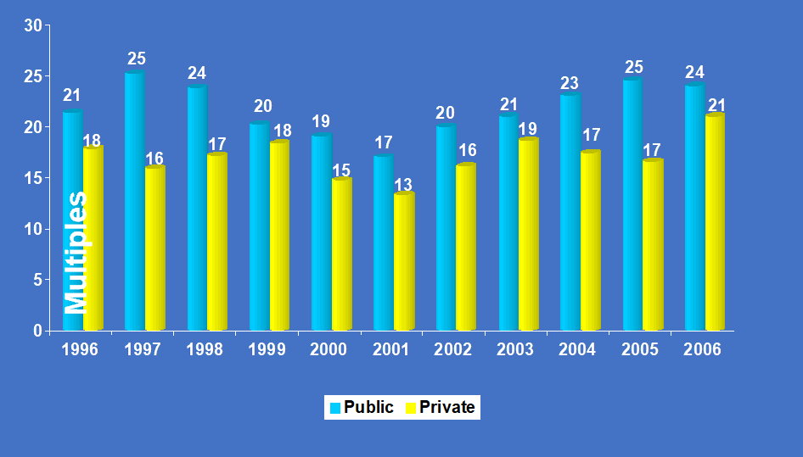
Private Companies Sell At A Small Discount
Median P/E Multiples: Public vs. Private Deals
Multiples
Source: Merger stat (U.S. Only)
Disclaimer: Data is continually updated and is subject to change

Slide 109
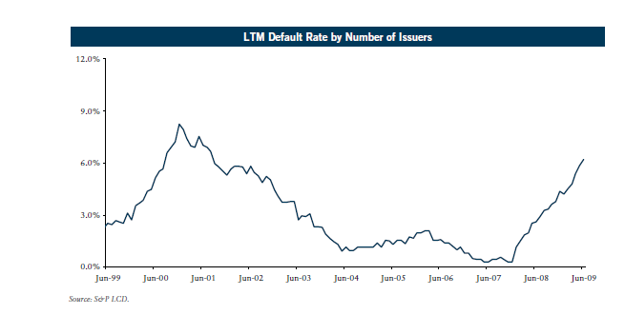
Default Rate for LBO’s

Slide 110
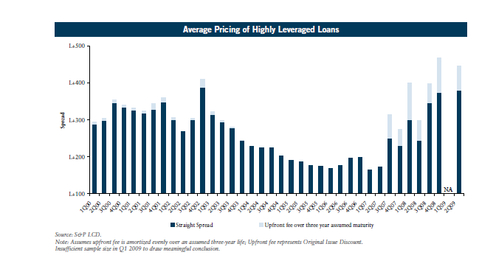
Loan Pricing

Slide 111
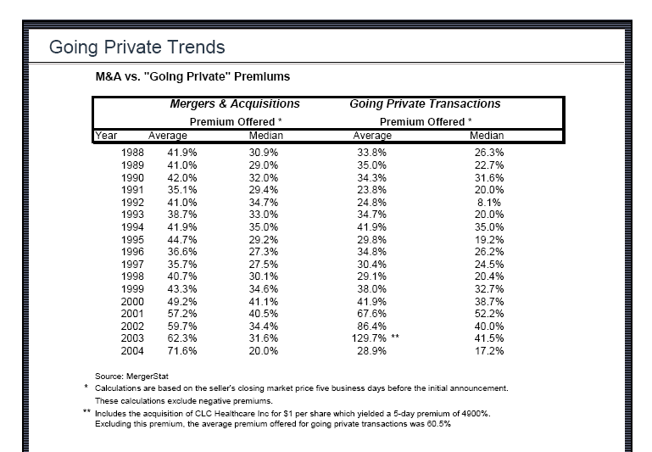
Premiums in Private Equity versus M&A

Slide 112
Private Equity Market
global fundraising from since 1998 estimated at more than $1,000 billion
US represents about two-thirds
Europe represents about one-quarter; not much left for the rest of the world, but some signs that the focus is spreading East
about two-thirds of the equity raised for private equity is devoted to buy-outs (in both Europe and US)
but these are highly leveraged – often with only 30% equity in capital structure; so the value of transactions is much larger than the equity figures suggest
money is pouring into buy-out funds: $96 billion was committed to US funds alone in the first half of 2006
funds are getting bigger: Blackstone recently raised a $15.6 billion fund; TPG raised $15 billion; Permira raised €11 billion …
secondary deals are on the rise: in 2005, 28% of all buy-out deals were between PE houses, amounting to over $100 billion (Dialogic)

Slide 113
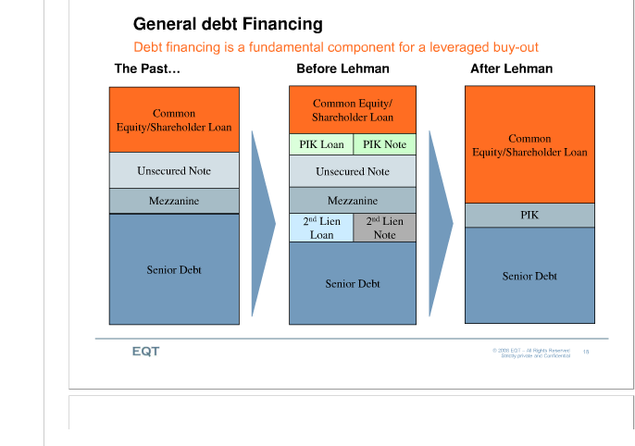
Pre and Post Crisis Financing

Slide 114
Average Sources of Proceeds for Leveraged Buyouts by Company EBITDA of More Than $50M
2Q07
Debt Level Depends on Cash Flow and Lenders Risk Evaluation

Slide 115
Discussion of LBO Exit
Once increase the EBITDA through increasing efficiency, exit through selling the company
J-curve or hockey stick – pay a premium and the return goes down before EBITDA increases
Exit often measured with EV/EBITDA multiples
  If increased EBITDA, the multiple should be lower than the acquisition multiple in theory
  Increased stability may imply higher multiples
Mezzanine debt equity kickers come when the company is sold

Slide 116
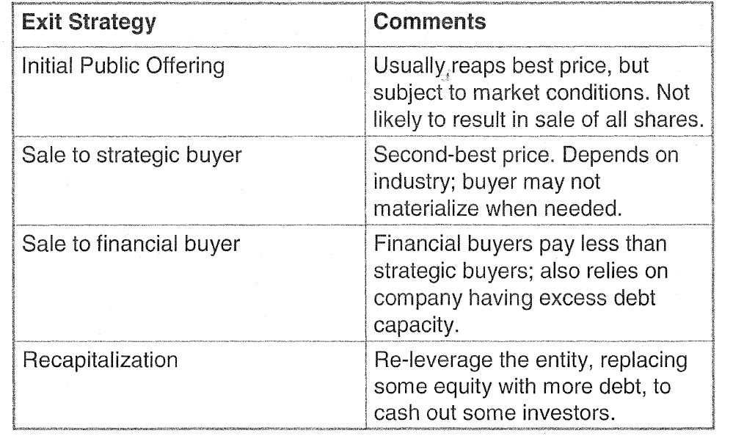
LBO Exit Possibilities

Slide 117
Splitting Terminal Value
Provide Incentives to management
Hurdle rate of return
Sharing of Excess Return
  Use future value factors
  Complex when multiple cash inflows rather than a single cash inflow

Slide 118
Acquisition Financing

Slide 119
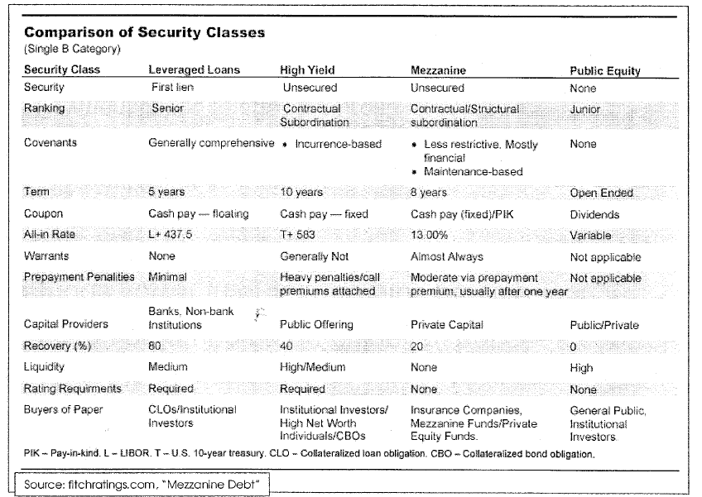
Alternative Types of Financing for LBO’s

Slide 120
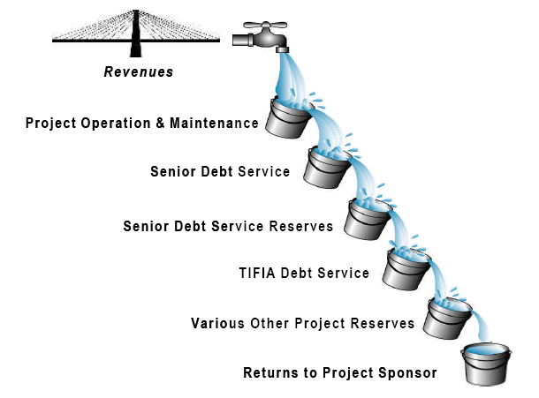
Waterfall Example
Operating Expenses
Capital Expenditure
Agency Fee and TIFIA Service Fee
Senior Debt Interest and Hedging Costs
Deposit to Extraordinary Maintenance and Repair Reserve (requirement of the ARCA)
TIFIA Interest Payments
Scheduled Repayment of Bank Loan
TIFIA Scheduled Amortization
Repayment of Bank Loan (through cash sweep)
Interest Payment on Affiliate Subordinated Note (“ASN”)
Amortization of ASN
Equity Distributions

Slide 121
Payment in Kind Notes
PIK notes are fixed-income securities that pay interest in the form of additional bonds rather than cash. Like zero-coupon bonds, they give a company breathing room before having to make cash outlays, offering in return rich yields.
Example: In 2005, Woznick Co., a Cincinnati supplier of packaged meals controlled by Veritas Capital Fund, raised $26 million in 13.875% senior PIK notes through CIBC World Markets. Some deals are floaters: Innophos's 10-year, noncaii-2 notes were priced to yield 800 bp over LIBOR.
Some PIKs have the added risk of being issued at the holding company level, meaning they are subordinated and rely on a stream of cash from the operating company to pay them down.
PIK notes tend to receive ratings at the lower tier of the junk spectrum. Examples: the Norcross deal was rated Caal/B-; Warner Music and K&F were rated Caa2/B-; and Innophos came at B3/B-.

Slide 122
Mezzanine Debt
Mezzanine debt is issued with a cash pay interest rate of 12 to 12 1/2 percent and a maturity ranging from five to seven years.
The remainder of the required 18 to 20 percent all-in-return consists of warrants to buy common stock, which the investor values based on the outlook of the company, or incremental interest paid on a "pay-in-kind" or PIK basis.
The fee for raising the money runs between two and three percent of the transaction.
Deal sizes typically range from three million to $25 million but can go as high as $150 million.
Source: Bank of America

Slide 123
Mezzanine Debt
High-yield or “junk” bonds
5- to 15-year maturity (although may be a demand loan)
Prepayment
May be prohibited during lockout period
May require a penalty during years immediately following lockout period
Interest
Generally fixed at a substantial premium over Treasuries, although may be floating rate
Payment-in-kind (PIK) provision allows issuer to pay interest to bondholders by issuing more bonds
Zero-coupon bonds don’t pay a cash coupon, but are issued at discount and accrete to par value at maturity

Slide 124
Issuers of High Yield Bonds
"Fallen angels" are the classic issuer of junk bonds. These are former investment-grade companies that are experiencing hard times, which cause their credit to drop from investment-grade to lower ratings.
"Rising stars" are emerging companies that have not yet achieved the operational history, the size or the capital strength required to receive an investment-grade rating. These companies may turn to the bond market to obtain seed capital. A start-up company that qualifies for a single-B rating should have about the same risk level as a going concern with the same rating.
High-debt companies (which may be blue chip in size and revenues) leveraged with above-average debt loads that may cause concern among rating agencies. Leveraged buyouts (LB0s) create a special type of company that typically uses high-yield bonds to buy a public corporation from its shareholders.
Capital-intensive companies turn to the high-yield market when they are not able to finance all their capital needs through earnings or bank borrowings. For example, cable TV companies require large amounts of capital to acquire, expand or upgrade their systems.
Foreign governments and foreign corporations, often less familiar to domestic investors, may rely on high-yield bonds to attract capital.

Slide 125
Covenants and Events of Default for High Yield Debt
High yield bonds have a "standard" covenant package intended to maintain the credit quality of the issuer and its group and the unencumbered movement of cash up the issuer's group and ensure that the issuer deals on an arm's length basis with its group companies. The covenants will include limitations on the ability of the issuer and other group companies from
  incurring further indebtedness,
  making certain "restricted payments" (such as dividends and other distributions to shareholders, intra-group loan repayments and investments)
  asset transfers
  granting liens over its property and assets
  entering into non-arm's length transactions with group companies.
"Events of default" include any default in the payment of principal or interest (usually following a specified grace period), any breach of covenant and the instigation of insolvency or other related proceedings against the issuer or the group.

Slide 126
LBO Modelling Issues
Perspective of Alternative Parties
Cash Flow Waterfall
  Model the default points on alternative instruments
  Model the IRR on cash flows received by different instruments
Complex Interest Structures with Payment in Kind and multiple interest rates
Sources and Uses of Funds
Pro-Forma Analysis
IRR on Alternative Financial Instruments

Slide 127
Leveraged Buyout Case Study
Original Buyout Structure
The total purchase price of $61.6 million represented a 5.5 multiple of cash flow.
XYZ advised the mgmt team on the structure and financing of the acquisition.
The following table contains sources and uses:

Slide 128
M&A Valuation
Method 4:
Comparable Companies and Multiples

Slide 129
Multiples in the Survey
The most popular multiple is EV/EBITDA (enterprise value to EBITDA). Eighty-four percent of respondents answer that they use this multiple always or almost always (conditional on using multiples). For consultants and private equity professionals it is higher.
Investment bankers are heavy users of P/E. This may reflect that investment bankers and asset managers are more focused on listed firms. Industry specific multiples are more popular among consultants than among other valuation professionals. EV/EBITDA is also the most popular choice across all education levels and both experience levels, with P/E being the second highest choice.
The comparables set is crucial with respect to the performance of a multiples valuation. Valuation professionals do not tend to simply pick the Bloomberg comparables; while 60% use it some of the time, only 16% use this set almost always or always. Rivals and firms in the same industry which 91% and 89%, respectively, of respondents use almost always or always.

Slide 130
Survey of Practices of Using Multiples
There is an often-heard claim among practitioners that multiples are better, more market oriented, and a less tedious method of valuation than DCF.
One often hears that people use multiples first and then back up the results with DCF. This is supported by the survey finding that about half of the respondents use both methods, but favor multiples.
There is an often-heard claim among practitioners that multiples are better, more market oriented, and a less tedious method of valuation than DCF.
One often hears that people use multiples first and then back up the results with DCF.
This is supported by the survey finding that about half of the respondents use both methods, but favor multiples. In this section, we study the usage of multiples in more detail by reporting on which multiples survey respondents favor and how they use them.

Slide 131
Application of Multiples in Valuation
Nothing Fancy
  Expected Earnings x P/E Multiple = Market Value
  If you are evaluating an industrial company
    Expected EBITDA x EV/EBITDA = EV
    Then, EV – Net Debt = Market Value
    Market Value/Current Shares = Share Value
  Standard Method of Target Price:
    Earnings in 3-5 years x P/E Ratio
    P/E ratio comes from Witches Brew

Slide 132
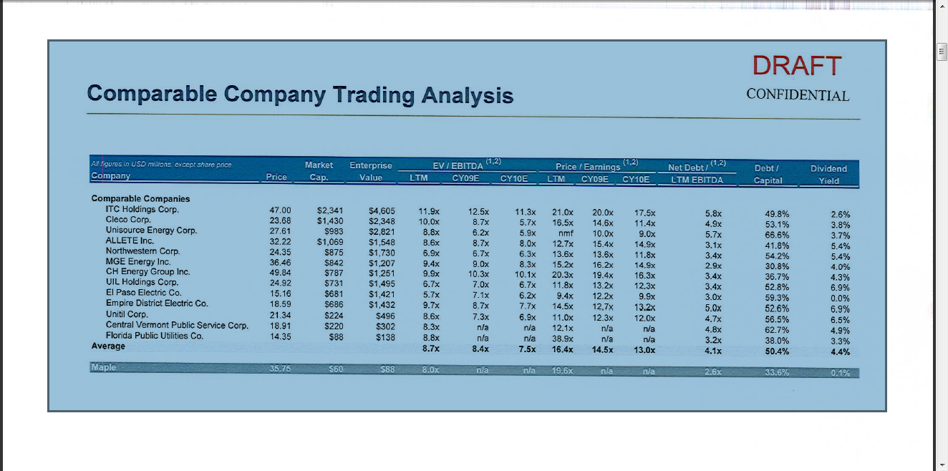
Public Comparables – Buy Side
Even in very boring industry there is wide variation in P/E ratios – we need to understand why.
In the football field diagram, the range was 8-9
EV/EBITDA 8.4; P/E 14.5

Slide 133
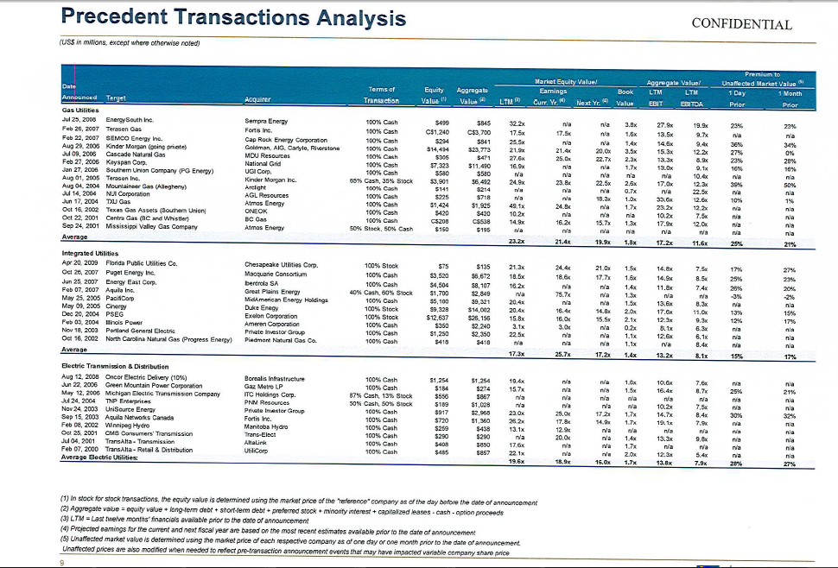
Precedent Transactions – Buy Side
PE ratio of 16.0 and EV/EBITDA of 7.9x

Slide 134
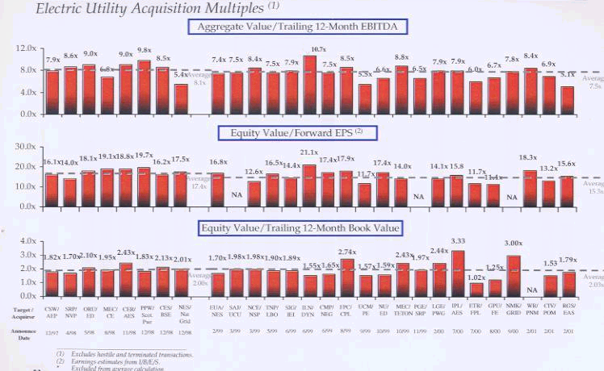
Investment Banker Analysis of Multiples

Slide 135
Transaction versus Public Multiples in Football Field Diagram
In the initial football field
  Market Multiples (EV/EBITDA) 8.0 – 9.0
  Transaction Multiples (EV/EBITDA) 8.7 – 9.7
  PV of synergies are .7/8.5 or 8.2% of the value of the transaction, or a premium of only 8.2% on Enterprise Value. With 50% debt, this would be a 16% premium on Market Capitalisation.
  The EV/EBITDA premium can imply more than 16% premium if the companies have more than 50% debt in the capital structure.

Slide 136
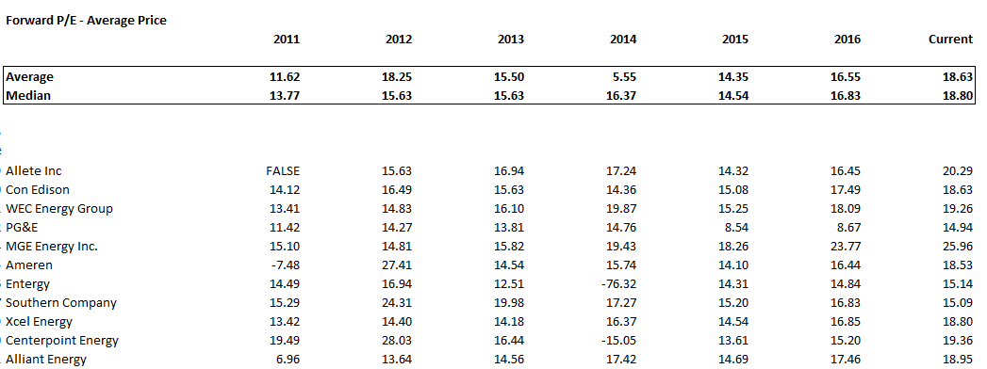
Basic Idea – Are Multiples Stable Across Companies in an Industry and Across Time
Example of boring companies in the utility industry. If have an earnings estimate than can make a stock price forecast. Change a lot over time and some outliers across the industry.

Slide 137
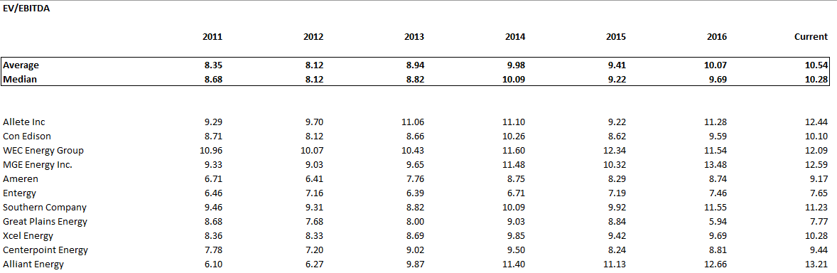
EV/EBITDA versus P/E
Is there more stability when using a proxy for cash flow and enterprise value.

Slide 138
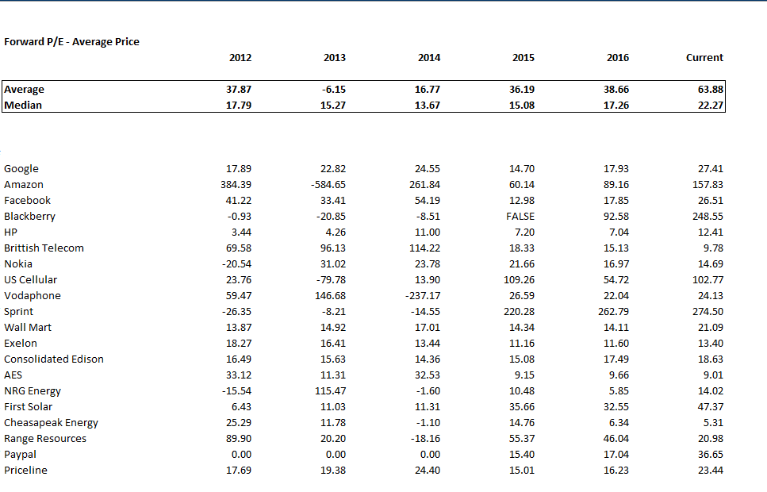
P/E Ratios for Selected Companies – More Extreme P/E Ratios for Amazon etc.

Slide 139
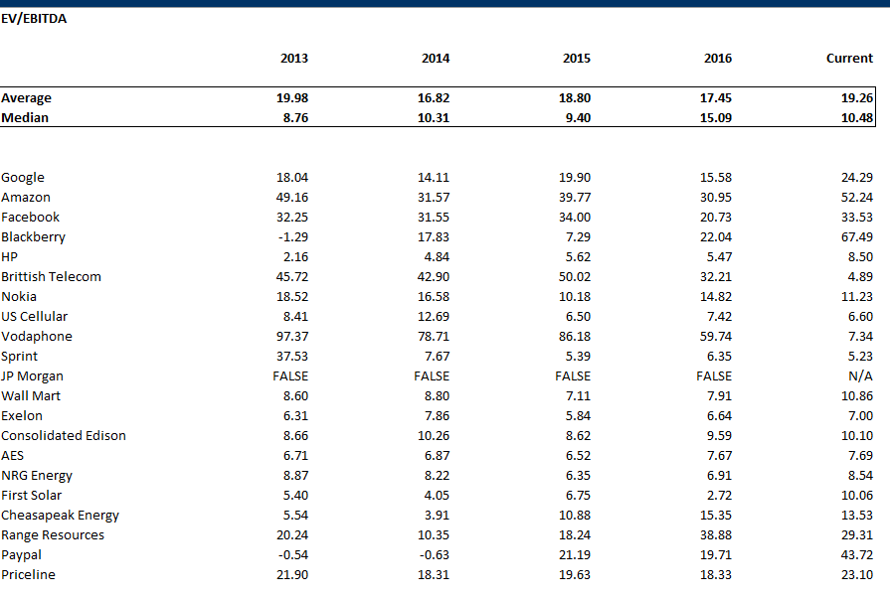
EV to EBITDA for Selected Stocks

Slide 140
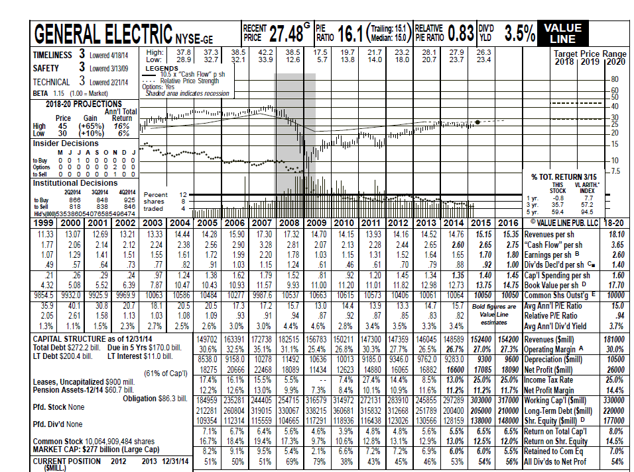
Illustration of History and Forecast – Old Fashion Value Line
Note all of the history and financial ratios in the reports – can assess forecasts with ROE and value from P/E Ratios.
Note all of the history and that the target price is the forecast P/E x EPS

Slide 141
Why P/E and EV/EBITDA Multiples are So Important
The P/E and EV/EBITDA multiples are very often used in valuation and M&A. Examples of where the multiples are used include:
  Making Valuations
  Assessing Terminal Value
  Computing Terminal Value
  Computing Synergies
Two primary multiples used:
  P/E or Market Capitalization/Earnings
  EV/EBITDA or Enterprise Value/EBITDA

Slide 142
Contrast Between P/E and EV/EBITDA Only Case where P/E and EV/EBITDA are the Same
Define EV as Market Capital + Net Debt
Define EBITDA as Earnings + Interest + Taxes and Depreciation
For a street vendor, with no capital investment other than working capital, no debt or cash, and no taxes. Here:
  EV would be the same as the market capital because of no debt;
  The Earnings equal the EBITDA because of no taxes or depreciation or interest

Slide 143
Differences between EV/EBITDA and P/E
No Taxes, No Interest, No Depreciation then
  EV/EBITDA = P/E Ratio
EBITDA is different from Earnings because of:
  Depreciation and Amortisation
  Taxes
  Interest Expense and Interest Income
This means can differ between companies because of:
  Capital Expenditures
  Tax Rates
  Financing

Slide 144
Pros and Cons of P/E and EV/EBITDA
P/E Discussion
The pros of using P/E include:
  This is the most common ratio used by analysts
  The market value comes from dividends and earnings, not some other measure of cash flow.
  Earnings incorporate all of the costs of a corporation that include taxes, allocation of the costs of capital expenditures and interest
Cons of using the P/E multiple include:
  Earnings can be distorted and even manipulated by leverage, share re-purchases and cash that does not affect the real value of a company
  Earnings can be distorted by different depreciation, amortisation and other accounting policies.

Slide 145
Pros and Cons of P/E and EV/EBITDA
EV/EBITDA Discussion
Pros of Using EV/EBITDA
  The EBITDA represents cash flow that is clear to measure and difficult to distort with accounting policy
  The EV and EBITDA are consistent with DCF and finance theory that suggests you should focus on overall value and not risk and return trade-offs that are affected by leverage and cash
Cons of Using the EV/EBITDA
  Items like taxes, capital expenditures and working capital that do affect value are not included in the EBITDA
  By excluding depreciation, EBITDA does not account for the effect on value of having to replace assets

Slide 146
Big Problem with EV/EBITDA – No Accounting for Asset Replacement
To illustrate the big problem with EV/EBITDA and comparing the ratio across companies that have different asset lives assume you are assessing how much income you need to buy a car and a house that have the same value.
You need a lot more earnings (EBITDA) to buy the car than the house because the car will have to be replaced many times over the lifetime of the house.
In the above example, the depreciation on the car would be much more than the depreciation on a house.
By ignoring deprecation and thus cash flow required to replace assets the EV/EBITDA is overstated for companies with shorter asset lives and understated for companies with long life assets.

Slide 147
Why is the P/E Ratio Higher for One Company than Another Company
Reasons for Differences in P/E
  Cost of equity capital and risk is higher for Apple than for Google
  Future growth in earnings per share and ROE is lower for Apple than for Google
  ROE for Apple with fall and ROE for Google will increase
  Potential for long-term growth and return

Slide 148
Why is the EV/EBITDA different for Different Companies
EV/EBITDA will be lower for companies that need to replace assets more quickly. If the net investment is the same and the EBITDA is the same, the company with shorter lived assets will have to replace assets more quickly and have more capital expenditures for the same EBITDA. This means EV/EBITDA will be lower for companies with higher depreciation rates.
This means you cannot theoretically compare the EV/EBTIDA across different industries with different types of assets (and also within the industry)

Slide 149
Begin with One Industry
We will see the P/E and EV/EBITDA are driven by returns, growth and risk.
Therefore review P/E ratio in the context of things that can be measured:
First, Growth
Second, Returns
Start with Multiples for the Beer and Beverage Industry
Try to find stable ratios if risks, growth and returns are stable.
Try to explain high and low multiples
Look at P/E, EV/EBITDA and EV/EBIT

Slide 150
Drivers of P/E and EV/EBITDA and Comparisons Over Time and Across Companies
Both the P/E Ratio and the EV/EBITDA ratio are driven by profitable growth and risk.
The ratios are also affected by risk perceptions as measured by the real cost of capital.
The lower the risk and the higher the growth, both the P/E ratio and the EV/EBITDA ratio will be higher.
If risks are stable and growth rate is stable for a company, the multiples should be stable across time.
If risks are stable and growth is stable across an industry, the multiples should be stable across the industry.

Slide 151
Return to Two Companies – Why does Lincoln have a Lower PE in the same industry
Use Lincoln National as the target because of low P/E – note expected growth in EPS

Slide 152
Are Multiples the Same Across Over Time
Depends on whether the following changed:
  ROE prospects
  Growth prospects
  Cost of Capital – Should be real cost of capital and not a function of nominal interest rates that are related to inflation.
Inter-relationship between growth and return.
  If no growth, the P/E = 1/k, no matter what the level of return
  If return=k then P/E = 1/k no matter what the growth
  It is the relationship between return and growth that can result in extreme P/E ratios

Slide 153
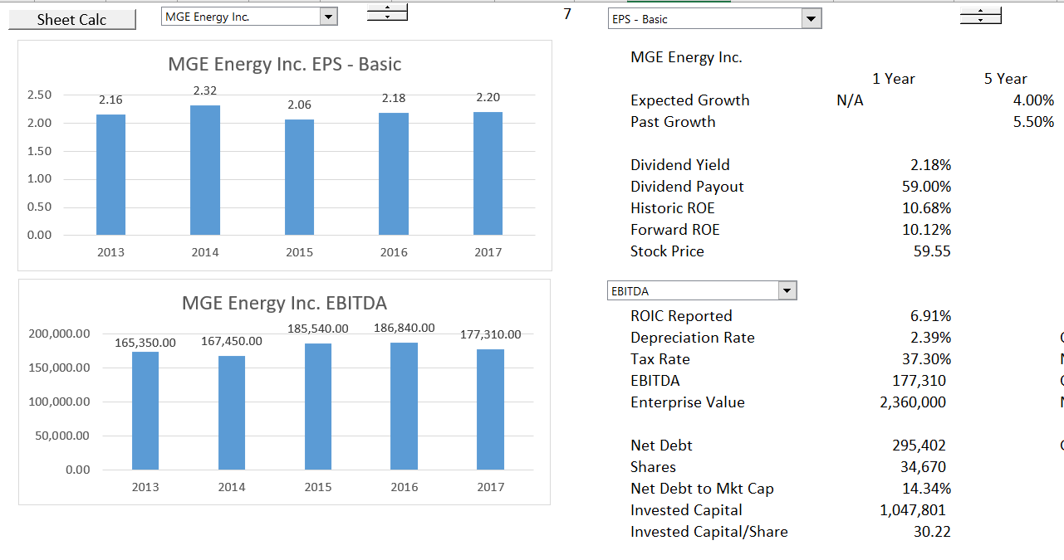
Examine Growth and then Multiples
Example with one company – little growth and boring.

Slide 154
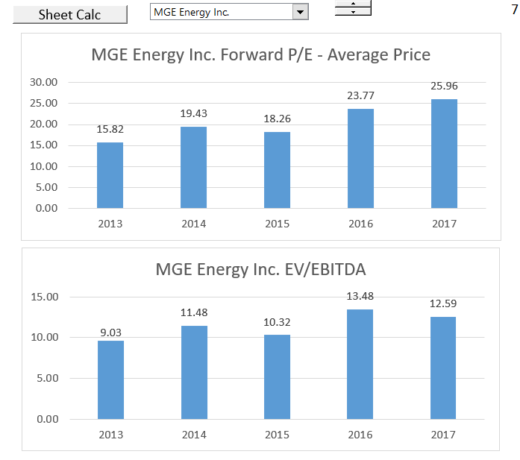
Increasing Multiples and Flat Income
Raises the issue of why multiples would increase if earnings and cash flow are stable. Can only explain this with lower cost of capital

Slide 155
Tax Treatment and Multiples
Assume two transactions, one taxable and one non-taxable
Simplistic discussion of taxable versus non-taxable transaction
Focus on the largest asset of insurance is investments – think about alternative tax treatment of investments with potential for capital gains

Slide 156
M&A Valuation Method 5:
Discounted Cash Flow

Slide 157
Valuation Survey
The most popular multiperiod model is DCF.
Respondents typically discount expected cash flows at the WACC, with the cost of debt being estimated by the risk-free rate plus a spread and the cost of equity being estimated by the CAPM.
The risk-free rate is most commonly taken to be the yield on a long-term Treasury security.
Cash flows are typically projected for only five years.
Terminal values are calculated using the Gordon growth model, with the most popular choices of growth rates being 2% and the expected GDP growth.

Slide 158
DCF Concepts From Survey
With these choices and with realistic assumptions on the discount rate and forecasting horizon growth rates, we show by way of examples that the fraction of the total gross value of a project that can be attributed to the terminal value is around 70%.
This underscores the practical significance of the forecasting horizon and the terminal value. It also implies that the way the technique of DCF is implemented in practice means that it collapses to being almost just another multiples exercise, with the majority of the estimated value being attributable to the forecasted cash flow in the first year after the forecasting horizon multiplied by one over the discount rate less the growth rate.

Slide 159
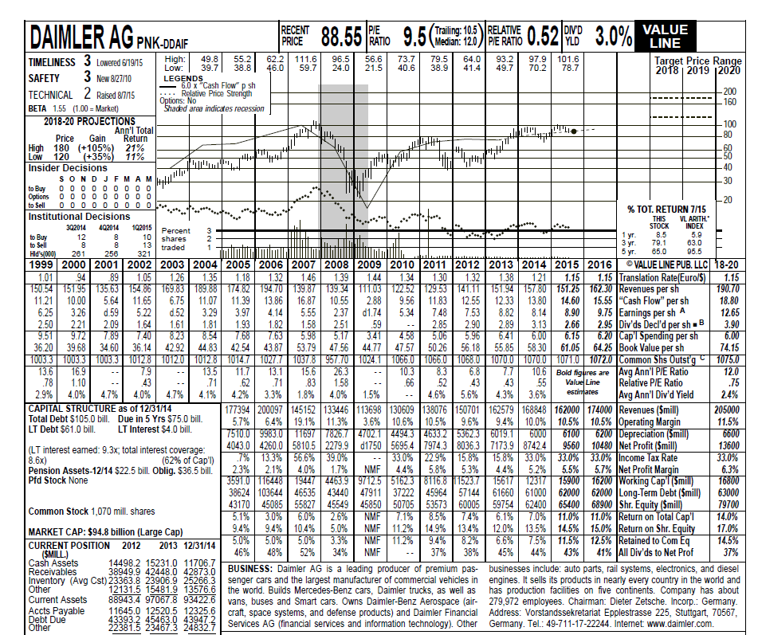
Old Fashioned Models with History and Forecast
Examine the ROE and Return on capital to judge the forecast

Slide 160
Valuation from DCF Analysis
Valuation with DCF Analysis
  Careful Definition of Cash Flow (Deferred taxes, warranty costs, employee reserves)
  Flexible timing in DCF
  ½ Year Adjustment in DCF
  Terminal Value with Timing in Models
  Alternative Terminal Methods
  Adjustment to Terminal Value for EBITDA, Working Capital, Capital Expenditures, Deferred Tax and Other Items
  Evaluating the Bridge Between Enterprise Value and Equity Value

Slide 161
Free Cash Flow
Free cash flow or unleveraged cash flow:
Do not include any effects of interest expense or other income in cash flow
Free Cash Flow
  EBITDA
  Less: Capital Expenditures
  Less: Adjustment to EBITDA for changes in working capital
  Add: Other adjustments for warranty provisions
  Add: Changes in deferred taxes
  Less: Operating Taxes without interest – EBIT x Tax
    FREE CASH FLOW

Slide 162
Equity Cash Flow
Equity cash flow;
Depends on constant or near constant capital structure
Equity Cash Flow
  Dividend Inflows
  Less: New Equity Issues
    EQUITY CASH FLOW
New equity issues dilute shareholdings and/or could be funded by lower dividends.

Slide 163
Valuation Diagram – DCF from Cash Flow
Valuation using discounted cash flows requires forecasted cash flows, application of a discount rate and measurement of continuing value (also referred to as horizon value or terminal value)
Continuing Value
Cash Flow
Cash Flow
Cash Flow
Cash Flow
Discount Rate is WACC
Enterprise Value
Net Debt
Reference: Private Valuation; Valuation Mistakes
Equity Value

Slide 164
Equity Cash Flow, Debt Cash Flow, Free Cash Flow and
Cost of Equity, Cost of Debt and WACC
Equity Cash Flow and Value of Equity :
Dividends less Equity Issued
Value of Equity
PV of Cash Flows at
Cost of Equity
+
+
Debt Cash Flow and Market Value of Debt :
Net Interest plus Net Debt Payments
Value of Debt
PV of Cash Flows at
Incremental Cost of Debt
=
=
Free Cash Flow:
EBITDA – Op Taxes – Cap Exp – WC Chg
Value of Enterprise
PV of Cash Flows
At WACC

Slide 165
Terminal Value in Corporate Model
Year after explicit period to establish stable cash flows
Gordon’s
CFt x (1+g)/
(WACC-g)
History
Explicit Forecast Period
Terminal Value
EV/EBITDA that Reflects
Long-term Growth Rate and ROIC
PV of Cash
Year t
Infinity
Step 2: PV from Year t to current year
Step 1: PV to year t – End of period t, so Gordon’s method must use t+1 cash flows
Market to Book Ratio that Reflects Long-term ROE
Make sure Cash Flow in period t reflects realistic ROIC, Working Capital that reflects long-term growth and realistic capital expenditures
Valuation Date

Slide 166
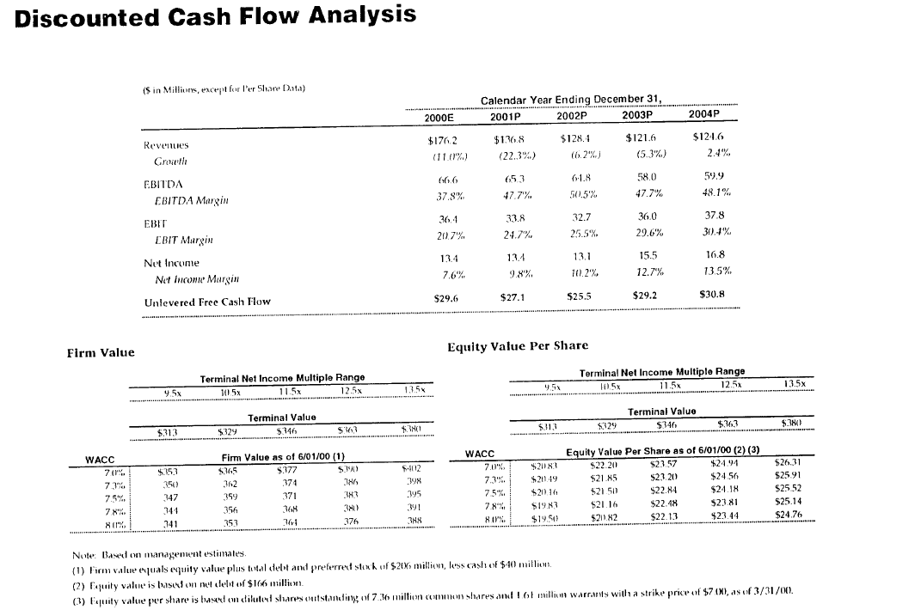
Presentation of DCF

Slide 167
Terminal Value Methods

Slide 168
Five Terminal Value Methods
Demonstrate five different terminal value approaches that inclue:
The growth rate method;
Use of multiples like the EV/EBITDA multiples ;and,
The Value Driver Method starting with NOPAT
  TV = NOPAT x (1-g/ROIC)/(WACC-g)
The Value Driver Method Starting with Invested Capital x ROIC
  TV = New ROIC x Invested Capital x (1-g/ROIC)/(WACC-g)
The Value Driver Method with Interpolation for growth and ROIC using the ROIC x Invested Capital Method Above

Slide 169
In DCF, Terminal Cash Flow is the Key
The DCF makes a forecast that in theory is supposed to reach some kind of stable cash flow (as if there is any day in your life that your life is stable and will stay like that).
Most of the value should come from the terminal period – this is like buying a stock, holding it for dividends and then selling it. Your final result will be driven by the capital gain.
Methods for computing terminal value and deriving stable long-term cash flows are the real issue in applying the DCF, whether for a financial company or for an industrial company.

Slide 170
Method 1: Using the Terminal Growth Rate and its Problems
The growth rate method uses the formula FCF x (1+g)/(WACC-g).
  You should always use the next year cash flow when dividing by WACC-g, because of the mathematics of valuation.
The biggest problem with this method is that is the very wide range in valuations that occur with different growth rates and WACC.

Slide 171

The Big Problem with The DCF
Return to the Football Field diagram. The range from the DCF approach was from 36.75 to 41.00.
When looking at the DCF model, the true variation was gigantic and the variation is driven by two of the most difficult variables to assess – the terminal growth and the cost of capital.

Slide 172

Problems with DCF –
Range in Values
Note the range in values in the analyst report
The range is less when a terminal value multiple is used, but the range is still very high
The high range exists even though there is a tight range in discount rates

Slide 173

Another Example of High Variation in Valuation from DCF Problems

Slide 174
Method 2: Pros and Cons of Using EV/EBITDA Multiples for Terminal Value
If you use multiples, like multiplying the terminal EBITDA by an assumed EV/EBITDA ratio:
There is less sensitivity in value to growth and WACC because there is no WACC or g in the terminal value formula. (the value is just the assumed multiple multiplied by the EBITDA.)
Problems with this method include the theoretical problem that changes in future growth and risk affect the multiple. This probably does not reflect the current multiple or the industry multiple.

Slide 175
Relationship Between Multiples and DCF
A leading sell-side analyst recently told us that he uses discounted cash flow to analyze and value companies but typically communicates his findings in terms of implied multiples. For example, an analyst might say Company X deserves a higher multiple than Company Y because it is expected to grow faster, earn higher margins, or generate more cash flow. Earnings multiples are also a useful sanity check for your valuation.
In practice, we always compare a company’s implied multiple based on our valuation with those of its peers to see if we can explain why its multiple is higher or lower in terms of its ROIC or growth rates.

Slide 176
Method 3: Value Driver Method in the Terminal Value Starting with NOPAT
You can use the value driver formula to compute terminal value.
  To apply this method, first the NOPAT in the terminal period.
  Next, multiply the terminal NOPAT by (1-g/ROIC)/(WACC-g).
This method has the advantage of including all three different value driver factors.
But the formula does not work properly when the assumed stable ROIC is different from the current ROIC.
There is little or no convergence to ROIC

Slide 177
Method 4: Value Driver Method with ROIC as the Base in the Terminal Value
You can use the value driver formula to compute terminal value using the simple adjustment that NOPAT = Invested Capital x ROIC.
To apply this method, first the Invested Capital in the terminal period.
  Then you can multiply the terminal invested capital by ROIC x (1-g/ROIC)/(WACC-g).
This method has the advantage of including all three different value driver factors.
The formula assumes there is an immediate transition to the new ROIC and not a gradual transition.

Slide 178
Presentation of the Implied EV/EBITDA Multiple or Implied P/E Ratio
Whatever of the three different methods are used, the implied multiple terminal multiple should be presented.
This means that if, for example, the growth rate method is used (FCF x (1+g)/(WACC-g), the terminal value computed by the formula should be divided by the EBITDA in the terminal year. This EV/EBITDA value should be presented to verify that the model is producing reasonable results.

Slide 179

Terminal Value Method 3 – Use of Value Driver Formula
Supposed to reflect a stable return and gradual movement to stable return (the mechanics do not really work).

Slide 180
Normalising Cash Flow in Terminal Period

Slide 181
Importance of Terminal Value and Normalised Cash Flow
Normalising cash flow is very important because the normalised cash flow will be the basis of terminal value.
If terminal value cash flow is too high or low because of unreasonable assumptions about return, working capital changes or capital expenditures, the valuation using the growth model will be biased.
Deriving terminal value from normalised cash flow is like buying a stock and receiving dividends. What matters most is the value of the stock in the next few years and not the small amounts of dividends received. This value comes in large part from earnings assumption in the last year.

Slide 182
Reasonable Estimates of Growth – Is this Graph Reasonable
The short term
Based on best estimate of likely outcome
The medium term transition to tranquillity
Assessment of industry outlook and company position
ROIC fades towards the
cost of capital
Growth fades towards GDP
The long run – tranquillity and equilibrium
Long run assumptions:
ROIC = Cost of capital
Real growth = 0%
Much of valuation involves implicitly or explicitly making growth estimates – High P/E comes from high growth
Reference: Level and persistence of growth rates

Slide 183
Normalised Cash Flow in Above Chart
You can adjust cash flows in the terminal period with respect to capital expenditures and working capital changes as discussed above.
You can adjust the graph to suddenly go down to the ROIC you expect in the long-run when you normalize cash flow.
You could also adjust the graph so that the ROIC gradually goes down.
This kind of adjustment to normalize cash flow is very rare.
If you normalize with an ROIC, you can use the NOPAT and you don’t have to worry about the adjustments to capital expenditures or to the working capital.

Slide 184
Evaluating ROIC in the Terminal Period
In evaluating the terminal value and the model itself, the ROIC in the terminal year should be evaluated compared to reasonable assumptions and history.
If a high level of ROIC or a low level of ROIC is assumed, this assumption has a very large effect on the valuation as it is assumed to remain indefinitely.
The next slide illustrates a case where the ROIC jumped in the terminal year rendering the whole valuation all but useless.

Slide 185

Example of Danger – Terminal Value Assumptions

Slide 186

Stable Capital Expenditures
The stable capital expenditures to depreciation is a function of asset life, growth rate. When computing normalised cash flow in the terminal year, the depreciation in the terminal period can be multiplied by a ratio of capital expenditures to depreciation. This ratio will only be 1.0 when there is no growth, or the asset life is one year. The ratio is higher when the asset life is longer and/or when the growth rate is above zero.

Slide 187

Stable Working Capital
Stable WC Change =
  [EBITDA x WC/EBITDA * Growth]/[1+Growth]
  A stable value of working capital can also be computed. If the terminal growth is less than the historic growth rate, the working capital in terminal value should be lower. You can use the formula for working capital changes = WC/EBITDA x EBITDA x g/(1+g).

Slide 188

Holding Period and Stable Cash Flow for Industrial Company
Note the stable cash flow to capital expenditures, stable working capital and stable ROIC in the industrial case.

Slide 189

Terminal Value Progression
Case 1: No Change in Growth
No Need for Stable Ratios, all methods produce the same value. The key is the long-term value that does not have a terminal value.

Slide 190

Case 2: Change in Growth but No Change in Return with No Stable Adjustment
No stable adjustment means that the reduced investment associated with the reduced growth is not included in the terminal period. Note that the growth rate produces the wrong value.

Slide 191

Normalised Cash Flow Part 1
When you change the growth, investment changes (capital expenditure and working capital change)

Slide 192

Normalised Cash Flow by Adjusting Investment Growth in Terminal Period
Note that change in investment moved to the terminal period – change in balance of the investment. Adjustment to Payout is from next period growth.

Slide 193

Case 3: Terminal Value with Stable Cash Flow Adjustments in terminal period
The corrected terminal value adjustments produce the correct cash flow and all valuation methods again produce the same value.

Slide 194

Case 4: Change in Return but Not Change in Growth with Stable Value Adjustment for Return
In this case, the growth method and the value driver method that does not adjust returns in the NOPAT calculation produces incorrect value. This is again because the terminal value cash flow is not adjusted for the return

Slide 195

Case 5: Change in Return and Growth with Interpolation
The final case shows the case where there is not a sudden change, but a gradual change. This is higher than the sudden change.

Slide 196


Terminal Value Assumptions – Industrial with Free Cash Flow and Insurance with Equity Cash Flow
Insurance company is based on cost of equity, terminal growth and terminal P/E. Industrial company uses WACC, EV/EBITDA etc. Insurance on the right, industrial on the left

Slide 197

Terminal Value Method 4: Use the P/B Regression
Go to the last year and apply the formula. If the book value has increased from growth, this method will properly account for the increase in book value.

Slide 198
Cost of Capital and M&A

Slide 199
Innovations in Corporate Finance Theory
Solution to IRR problem of re-investment and ranking with Weighted Average IRR
Computing Cost of Capital with Market to Book Regression Rather than CAPM
Demonstration of Flaws in Value Driver Formula: V=Income x (1-g/ROI)/(COC-g)
Correct Evaluation of WACC using Tax Shield from Interest Expense
Use of Credit Spread to Derive Debt Beta and More Properly Derive Unlevered Beta
Evaluation of Terminal Value Adjustments for Capital Expenditures, Working Capital and Deferred Tax that Depend on Growth
Adjustments to Free Cash Flow and EV to Enterprise Value Bridge for Deferred Tax, Warranty Cost and Other Items
Development of Terminal Valuation Techniques for Financial Institutions that Use Market to Book Ratio and ROE from Financial Models
Evaluation of Political Risk Premia from Computing Implied Probability of Default

Slide 200

Cost of Capital Relevance

Slide 201


Original McKinsey Book

Slide 202


Cost of Capital in Same Transaction
Top is buy side (if negotiating would want high cost of capital). Bottom is sell side.

Slide 203


Effect of WACC on DCF
Variation in value from the cost of capital with the two cases. Note how much more the variation is than is reported on the Football field diagram.

Slide 204

WACC Craziness – Website with WACC for Insurance
http://www.waccexpert.com/

Slide 205

Cost of Capital for Insurance Companies

Slide 206
Ideas in Cost of Capital Not Previously Addressed
Compare variation in beta across companies in an industry
Evaluate expected inflation with Inflation Indexed Bond versus Standard Bond
Work with different transition periods using the P/E Ratio method
Demonstrate sensitivity of Market to Book to regression selection
Changes in cost of capital from changes in the rate of inflation

Slide 207
What is the Cost of Capital
Formal Definition: The MINIMUM required return (i.e. the IRR) for an investment with the same risk.
  If a Treasury Bond is assumed to have no risk, then the cost of capital for a risk free investment is the required IRR or the yield on a bond.
You can also call the cost of capital the target IRR on an investment (that should be affected by the risk of the investment).

Slide 208
Cost of Equity Capital Methods
Do not waste hardly any of your time on CAPM and Dividend Discount Model
Implied Cost of Capital from P/E or EV/EBITDA
Implied Cost of Capital from Market to Book Ratio
Cost of capital and different currencies

Slide 209

Computation of WACC – Buy Side of Analysis
Note the Cost of Equity and EMRP

Slide 210


Asset Beta and Equity Beta

Slide 211
Formulas
Formula for with tax:
Ba = Be x E%/[%E + %D * (1-t)]
+ Bd % D * (1-t)/[%D * (1-t) + %E]
Ba = Be x Equity Percent/[%E + %D * (1-t)] +Bd x Debt Percent * (1-t)/[%D * (1-t) + %E]

Slide 212

Formulas
Be = Bu * (1+D/E) * (1-t)
Bu = Be/[1+D/E)*(1-t)]

Slide 213

Traditional Cost of Equity Capital for Insurance Companies
CAPM depends on beta, risk premium and nominal risk-free rate.

Slide 214

Unlevered Beta without Debt Beta

Slide 215

Unlevered Beta and Debt Beta

Slide 216

Attempts to Compute Cost of Capital
Problems with risk premium, with the risk free rate, with the beta.

Slide 217


Standard CAPM – Equity Risk Premium
Note the subjective elements

Slide 218
Dividend Discount Method
The dividend discount model is an old approach from times when corporations were stable and paid a lot of dividends:
Stock Price = D1/(k-g)
or
Stock Price = D0 x (1+g)/(k-g)
or
Stock Price/D0 = (1+g)/(k-g)
(k-g) x Stock Price/D0 = (1+g)
(k-g) = D0/Stock Price * (1+g)
k = D0/Stock Price * (1+g) + g

Slide 219

The Problem with This Method is Estimated Growth
Note that expected growth in EPS is high.

Slide 220

Dividend Discount Does Not Result in Reasonable Estimates Because of Growth
Note the high cost of capital from the dividend discount method.

Slide 221

Cost of Capital for Utility Companies
Use standard dividend growth model – depends on long-term growth

Slide 222
Observed and Computed P/E
Let’s say you observe a P/E ratio for a particular company or for the entire market or for a particular industry. This P/E ratio will be distorted by inflation.
When you put in your ROE, growth and cost of capital, you will come up with this distorted P/E ratio.
You could adjust the ROE, the growth rate and the cost of capital to real values and then you would come up with a higher P/E ratio that is correct.
Or, you could adjust the P/E ratio for inflation and re-derive the cost of capital.

Slide 223

Cost of Capital from P/E Formula and Correction for Inflation
Use the Real ROE, Real k and Real g. But also adjust the P/E Ratio for Inflation:
P/E = (1-g/ROE)/(k-g)
    or
P/E x (k-g) = (1-g/ROE)
k-g = (1-g/ROE) / P/E
k = (1-g/ROE) / P/E
But this has the inflation bias

Slide 224

Cost of Capital from P/E Formula
Note differences in cost of capital and dependence on the expected growth rate

Slide 225
Simple Proof that P/E should Reflect Values Adjusted for Inflation – Real Values
Say you have a company operating in a high inflation country and you measure returns, dividends and value.
Then, you simply re-state the earnings, cash flow and dividends into a hypothetical country where there is no inflation.
The re-stated dividends and the cost of capital for the no-inflation country provide the true P/E ratio.
You can compute all of your returns, dividends and book value for the inflated currency, but after you translate back with a Purchasing Power Parity exchange rate, the value of the dividends should be the same.

Slide 226
Including ROE with Inflation
Theory of inflation: if no growth except for inflation and constant nominal return that includes inflation, then income includes the rate of return with inflation as well as
P/E = [(ROE-g)/(k-g)] * [(1+inf)/(ROE-inf)]
This formula gives you the real P/E ratio from nominal inputs.
Observe P/E ratios that are understated in places with high inflation, because:
  The E and the P are not measured at the same date – the E is a forward number and the P is today’s price. When the E is reduced, the true P/E is higher.
  The E does not measure the loss in value from assets that are measured at book value and must be replaced at market value. When the E is adjusted to reflect the increase in value, the observed P/E is less than the corrected P/E.

Slide 227

Beta with Tax Adjustment

Slide 228
Inflation Can Be Tricky
The value driver does not work if there is inflation – even a little inflation.
Steps
  Adjust the earnings for loss in investment value
  Adjust the earnings for inflation
  Use nominal ROE and Cost of Capital
Example:
  P/E for S&P 500 is 25
  Inflation is 2%
  Book Value per Share is 12.5
  EPS is 2
  ROE is 16%
  Then the adjusted P/E for the analysis is:
    First, adjust for loss in investment value 12.5 * .02
    Second, adjust for earnings in real terms
  When you are finished, the corrected P/E

Slide 229
With Inflation, the Sensitivity is more extreme
There is more sensitivity to ROE in the inflation case and the case with zero growth results in value that declines.

Slide 230

Estimate of Cost of Equity from P/E Ratio
The cost of equity depends a lot on the future growth estimates and when the growth will become stable.

Slide 231
P/B and ROE Regression
The final method uses the formula:
P/B = (ROE-g)/(k-g)
When the P/B = 1, then the ROE = k
1 = (ROE-g)/(k-g)
k-g = ROE –g
k= ROE
A regression equation of P/B = ROE can be created
P/B = A + B x ROE
When P/B = 1, then 1=A + B x ROE
or
ROE = (1-A)/B, which is an estimate of k

Slide 232

Insurance Companies: Note the Relation Between ROE and P/B
The P/B ratio is not much above 1 for insurance companies which suggests that cost of capital is not much lower than ROE.

Slide 233

Cost of Capital for Insurance Companies Using P/B and ROE Regression
Note two things. First, the cost of capital is higher for insurance companies than for many other companies.

Slide 234

Using Idea that when M/B = 1, ROE = Cost of Equity
This sort of analysis requires similar companies – you cannot do this for Dow 30 for example.
Formula is M/B = (ROE-g)/(k-g)
When the M/B = 1, then the ROE = k no matter what the g. For utilities cost is 5.1% to 4.88% depending on regression assumption.
Re-arrange k = (ROE-g)/M/B + g

Slide 235
Cost of Capital in Survey
76% of respondents use the CAPM almost always or always. No other method comes close. Notably, only 4% of respondents use the Fama and French (1993) three-factor model that is so popular in academic research.
The cost of equity is typically viewed as being represented by a risk-free rate plus a risk premium (as in the CAPM).
Valuation professionals typically use longer term treasury securities as their risk-free rate. Only asset managers differ in this respect, having a preference for using swap rates.

Slide 236
Equity Market Risk Premium Used
The survey also asked about what market risk premium respondents typically use. The average is 5.4%, with little variation across subpopulations with different regional foci. There is some variation among the professions. The highest average is among private equity professionals (5.7%), while the lowest is among asset managers (4.6%).

Slide 237
Innovations in Corporate Modelling
Use of Historic Switch to Make Incorporation of New Financial Statements
Evaluation of ROIC and Invested Capital Using Switches and SUMPRODUCT
Development of INTERPOLATE Function to Evaluate Assumptions
Automation of Scenario Analysis with Scenario Reporter
Effective Automation of Historic Data Graphs with Flexible Spinner Box
Resolution of Circular References Related to Interest Expense and Taxes
Deprecation Techniques that Account for Changing Growth and Implied Retirements
Development of Techniques to Automate Constant Capital Structure in Financial Models
Dynamic Goal Seek Functions for Evaluation of Cost of Capital Using P/E Ratios
User Defined Functions for Computing Stable Capital Expenditures to Depreciation and Other Items

Slide 238
Innovations in Corporate Finance Data Analysis
Creation of techniques to download stock price data, financial statement data and economic data
Stock price database that allows you to evaluate IRR’s, volatility and beta for stocks, stock price indices, economic series and commodity prices.
Financial Database that allows you to extract and evaluate financial data, financial ratios, and cost of capital across companies.
Extraction of Data that Enables you to have Historic Basis for Creating Financial Models.
Interest Rate, Exchange Rate and Commodity Price Databases that Include Historic Evaluation of Term Structures, Volatility and Other Statistics.
Comprehensive Country by Country Database to Evaluate Growth and Risks Across the World.

Slide 239
Tax Shields
While APV is not commonly used among the survey respondents, how they deal with tax shields when they use the two-step APV procedure. The key issue that is being explored is whether respondents understand that the appropriate discount rate for the interest tax savings depends on debt policy. Under a constant debt to value ratio, the appropriate discount rate for future tax shields is the all equity opportunity cost of capital, Ru. Under a deterministic debt schedule, it is appropriate to discount tax shields at the debt’s yield. However, what is well communicated in textbooks is that when a project supports a constant amount of debt, D, interest tax savings should be discounted at the cost of debt, leaving the standard formula, PV(TS) = DTc (assuming corporate taxes only).
Ask whether respondents typically discount interest tax savings at Ru, Rd (cost of debt), or take into account debt policy in their choice of discount rate. We also ask whether respondents take into account the stability of the cash flows that will be used to service the debt. Highly variable cash flows may make the tax savings more risky.

Slide 240
Corporate Credit Analysis
  Project and Corporate Finance Credit Analysis
  Use of Ratios in Evaluating Credit Risk
  Credit Scoring with Financial Ratios and Models
  Risk Analysis for Credit Analysis and Modelling
  Default Risk Statistics and Analysis
  Creating Short-term Model and Working Capital Loans
  Theory of Credit Risk and Merton Model

Slide 241
Appendix:
Mathematics of Multiples, Valuation and the Value Driver Formula

Slide 242
The Value Driver Formula
The formula for value from the three value drivers can be stated in general as:
Value =
  Earning x (1-growth/return)/
  (Cost of capital –growth)
  The formula can also be used to compute valuation ratios (the P/E ratio of the EV/NOPAT ratio) as follows:
Multiple or Value/Earnings =
  (1-growth/return)/(Cost of capital –growth)

Slide 243
The Value Driver Formula for Equity Value
The formula for equity value uses the growth rate in equity (g), the return on equity (ROE) and the cost of equity capital (k):
Equity Value per Share =
  Earning x (1-g/ROE)/(k –g)
  The formula can also be used to compute the P/E ratios as follows:
P/E = (1-g/ROE)/(k –g)

Slide 244
The Value Driver Formula for Enterprise Value
The formula for enterprise value from the three value drivers uses NOPAT or net operating income after tax or EBIT x (1-t) as earnings. The return is expressed as ROIC and the growth is the growth rate in invested capital. The cost of capital is WACC:
Enterprise Value = NOPAT x (1-growth/ROIC)/
  (WACC –growth)
  The formula can also be used to compute valuation ratios (the EV/NOPAT ratio) as follows:
EV/NOPAT = (1-g/ROIC)/(WACC – g)

Slide 245
Problems with These Value Driver Formulas – They Only Work when All Items are Constant
McKinsey Discussion of the Formula:
  This formula underpins the discounted-cash-flow (DCF) approach to valuation, and a variant of the equation lies behind the economic-profit approach (i.e. monopoly profit)….You might go so far as to say that this formula represents all there is to valuation. Everything else is mere detail.”
However, the formula is really not very good:
  Only works when ROE and g and k are constant.
  It does not work with inflation, because the value of the investment increases over time due to inflation.
  It does not work if the return on new investments is different from the return on existing investments in cases such as high technology.

Slide 246




Lets Review How this Works Mathematically – Start with the No Growth Case
When the Growth Rate is Zero, the P/E ratio is 1/k. In this case the rate of return does not matter to the P/E ratio because E is there.

Slide 247


What Happens when the ROI = Cost of Capital
When the ROI is the same as the cost of capital, the growth does not matter.
Think about a company that buys treasury bonds and distributes debt service as dividends.
For once, you know cost of capital and the cost of capital is the same as the return (unless you waste money)

Slide 248


If you make Negative NPV Investments, Growth Hurts
Notice that when the growth is negative and the return is less than the cost of capital, then the P/E goes up.
This makes sense (think about the case when you waste money in the treasury bond case)

Slide 249

Interaction between Growth and Return
If the growth is zero, the level of the return does not matter in the valuation formulas
This is not really true when growth rate changes. A change in return makes a big difference in any case.
Long-term growth is the central issue and growth rates projected by analysts are not very reliable.

Slide 250

Valuation Sensitivity in Simple Case
Keep discount rate constant at 6% (the discount rate or the expected IRR is the biggest variable)
A graph of the data table demonstrates that the combination of variables makes the valuation change dramatically.

Slide 251
Value Does not Change on a Linear Basis With the Variables – Instead there is an Interaction
Demonstrates that the value has higher variability with respect to ROE with higher growth rate. There is a strong inter-relationship.

Slide 252
With Inflation, the Sensitivity is more extreme
This graph shows the data table with and without inflation. Need to have growth more than inflation to create value. Difficult to evaluate interactions non-linear interactions of variables.

Slide 253
Two Basic Equations
Equation 1: Just Integrate from 0 to ∞
  Value = CF(1)/k (No Growth)
  Value = CF(1)/(k-g) (Growth)
  This is just math (integral from 0 to ∞)
Equation 2: Sustainable Growth
  Growth = ROE * Retention Rate
  Growth = ROE * (1-Payout)
  Payout = 1 – G/ROE

Slide 254
For Equity, All you Have to Do is Substitute
Start with Basics
  Value = D1/(k-g) Simple calculus
  DPO = (1-g/ROE) Fundamental growth
  D1 = E1 * DPO Earnings
  Value = E1 * (1-g/ROE)/(k-g)
For P/E Ratio
  Value/E1 = (1-g/ROE)/(k-g)
For P/B Ratio
  E1=Book Value * ROE1
  Value = Book Value * ROE * (1-g/ROE)/(k-g)
  Value/Book Value = (ROE-g)/(k-g)

Slide 255
Fundamental Idea about Investment Necessary to Generate Return
If you don’t make an investment, you cannot improve your life.
If you don’t make capital expenditures, you cannot get EBITDA.
If you don’t sell policies and put investments on the balance sheet, you can not earn a return.
If you don’t pay for a stock, you cannot get dividends.
Even when you gamble, you must put some money down on the table.
But, what about:
  Uber: drivers make investment and all Uber has is a bit of software
  Services: You make money from your reputation (Deloitte, Cap Gemini, GE, Siemens, Law Firms, etc.)
  Construction contracts: You make money by constructing a plant and the investment in tractors etc. is very minor.

Slide 256
Simple Case: Valuation with Constant ROE
Very simple case of valuation:
  Return on equity and growth constant
  No adjustment for inflation (assume no inflation)
In this case, you can use the valuation formula:
Value = Earnings x (1-g/ROE)/(k-g)
You can also use the formula to evaluate implied cost of capital from P/E ratio, growth and assumed return on equity.
Silly to worry about ROE versus ROIC at this point. For now, can assume an all equity company with no net debt.

Slide 257
Quote from McKinsey Valuation Book
We (McKinsey) explain the two core principles of value creation:
  (1) the idea that return on invested capital and growth drive cash flow, which in turn drives value, and
  (2) the conservation of value principle, which says that anything that doesn’t increase cash flow doesn’t create value (unless it reduces risk).
Led to ideas about measuring all performance with return versus cost of capital and books on (ROIC-WACC) * Capital Charge

Slide 258
Another Silly McKinsey Comment
We will show that high-ROIC companies typically create more value by focusing on growth, while lower-ROIC companies create more value by increasing ROIC.
Comment: Everybody of course wants high ROIC, which is just another word for monopoly profit and which is the driver of capitalist economies. If you are valuing a company you must assess the ability of a company to maintain or grow its monopoly position. That is the hard part.

Slide 259
Of Course You Should Invest when Return Exceeds Cost of Capital – This is NPV Rule
The interaction between growth and ROI is a key factor to consider when assessing the likely impact of a particular investment on a company’s overall ROI. For example, we’ve found that some very successful, high-ROI companies in the United States are reluctant to invest in growth if it will reduce their ROIs.
One technology company had a 30 percent operating margin and ROIC of more than 50 percent, so it didn’t want to invest in projects that might earn only 25 percent returns, fearing this would dilute its average returns.
But as the first principle of value creation would lead you to expect, even an opportunity with a 25 percent return would still create value as long as the cost of capital was lower, despite the resulting decline in average ROIC.

Slide 260
Changing ROE, Changing Growth and Changing Inflation
Cannot grow in long-term much faster than the economy.
Demonstrates the that the real issue is whether ROIC above the cost of capital can continue.
When ROIC expectations decline, then the P/E ratio falls.
To make this analysis, you cannot use the simple formula. Instead,
  In the terminal period, use the version of the formula that starts from the book value of the investment.
  Use the formulas for dividend payout as a function of growth.
  Use the INTERPOLATE LOOKUP function to gradually change Return.

Slide 261


Changing ROI and Growth
Notice how the change in ROI makes so more of a difference when the growth rate is high

Slide 262
ROIC instead of ROE and EV/EBITDA
First, assume invested capital is only plant and equipment
Second, assume that invested capital includes working capital changes
Key variable is deriving the net plant depreciation rate from the growth rate and formula:
Cap Exp/Depreciation = g/Net Plant Depreciation rate + 1

Slide 263




EV/EBITDA Analysis
First, the EV/EBITDA analysis – very big effect of growth and WACC

Slide 264




EV/EBITDA in Simple Case with No Taxes, No Working Capital, No Discount Rate, No Growth
Note that the EV/EBITDA changes dramatically when the lifetime of the asset changes – 46 to 75 to 104 to 160.

Slide 265


Now Evaluate Changes in Tax Rates on EV/EBITDA
Companies with different tax rates should have different EV/EBITDA ratios because EV is after tax but EBITDA is pre-tax. The example below shows the effect of changing the tax rate from 35% to 21%. Note the big change in EV/EBITDA.

Slide 266

No Compare the EV/EBITDA for Different Asset Lives
Demonstrates that you should show the depreciation rates and asset lives when presenting the EV/EBITDA ratio.

Slide 267

Evaluation of Net Plant Depreciation Rate and Capital Expenditures to Depreciation
The example below demonstrates how the plant ratios stabalises after a plant cycle.

Slide 268

Ratios of Net Plant to Depreciation and Capital Expenditure to Depreciation with Longer Life
Note how the Cap Exp to Depreciation is defined as g/Net Plant Depr + 1

Slide 269
Reasons for More Complex Formulas with Cap Exp to Depreciation, Working Capital etc.
Demonstration of EV/EBITDA ratio with different asset lives, tax rates and working capital ratios
Demonstration of how the value changes when growth and ROIC changes. When ROIC changes, the net cash flow changes and different amounts of money must be plowed back into the company.

Slide 270
Return on New Capital and Return on Existing Capital
Technically, we should use the return on new, or incremental, capital, but for simplicity here, we assume that the ROIC and incremental ROIC are equal.
Technically, this formula should use the return on new invested capital (RONIC), not the company’s return on all invested capital (ROIC).
What crap: when oil prices go down, you cannot say that existing projects still maintain their existing ROIC. When Uber destroys the taxi industry, you cannot say that only new taxies earn a lower return. When the internet kills advertising for newspaper companies, one cannot say that it is only new investments that suffer.

Slide 271
Appendix:
Corporate Model

Slide 272
Corporate Modelling
Corporate Modelling for DCF and Credit Analysis
  Objectives of Corporate Modelling
  Excel Functions and Techniques for Modelling including Interpolate Function
  Structure of Corporate Models
  Acquiring Data from Internet and From PDF files and Presentation of History
  Evaluating Fundamental Risks of Operating Cash Flow
  Objectives and Mechanics of ROIC using Direct and Indirect method
  Problems with Depreciation in Corporate Models

Slide 273
Corporate Modelling
  General Ideas and Objectives of Corporate Modelling
  Excel Functions and Techniques for Modelling including Interpolate Function
  Structure of Corporate Models and Simple Exercise
  Acquiring Data from Internet and From PDF files and Presentation of History and ROIC Analysis
  Evaluating Fundamental Risks of Operating Cash Flow
  Problems with Depreciation in Corporate Models
  Circular Reference Issues in Corporate Models

Slide 274
Corporate Finance Ideas for Simple Company
Lets say you can find the following:
  A company with some fluctuations in return, but not too much.
  A company that grows at about the same rate in real terms as the population (e.g. a food company).
  An industry where P/E multiples and EV/EBITDA multiples are stable across companies and stable over time.
  An industry where there is quite a lot of competition and assets are not very capital intensive.

Slide 275
For This Simple Company you Can Make an Elegant Financial Analysis
Start
First, start reading a lot of historic financial data from financial statements with read pdf or with workbooks.open or with sec read.
Project
Next, project variables from actual data – you can even use the historic revenue growth.
Create
After that, create nice pictures of the historic and future return on invested capital.
Apply
Finally, apply multiples or a fancy formula like (1-g/ROIC)/(WACC-g) to evaluate the terminal value. It doesn’t matter very much because you get the same answer

Slide 276
Historic Switch
Define the Last Historic Year
Alternative Time Lines
Formula with 1=1, 2<1 to Find TRUE or FALSE
Conditional Formatting
Use of Generic Macros

Slide 277
Contrast Models and Simple Financial Statements for Alternative Types of Companies
Model Structure Exercise – Demonstrate Fundamental Structuring Issues with Simple Case
  Historical Financials
  Set-up of Assumptions
  Connection of Financial Statements
  Free Cash Flow and Equity Cash Flow
  ROE and ROIC to Benchmark Model

Slide 278


Start with Financials: Simple Example of Bank Versus Industrial
PP&E versus Loans
Interest Income versus EBITDA
Include Deposits to Finance Loans
Depreciation in Industrial

Slide 279

Assumptions in Simple Industrial
For simple case, create assumptions from the history. Of course, the real world involves careful assessment of risks.

Slide 280

Operating Analysis in Industrial Case – Set-up Plant Balance and Net Debt Balance
To reconcile cash flow with balance sheet and income statement, set up an account the is incremented by net cash flow and goes on the balance sheet.
Historic closing balances come from balance sheet

Slide 281

Financial Statement for Industrial Company – Net Cash Flow Goes onto Balance Sheet as Cash
Set-up the equity account from income on P&L and dividends on cash flow.
Connect net cash flow to the net debt account.
If the cash is positive, allow cash to be built-up. If the cash is negative start borrowing.

Slide 282
Acquisition and Analysis of History

Slide 283

Example of Acquiring Data from Internet – Profit and Loss for Amazon

Slide 284

Example of Reading from the Internet – Balance Sheet for Amazon

Slide 285

Quarterly Historic Data from the Internet

Slide 286

You Need to Understand and Not Bias Historical Analysis as the First Step in a Forecast
Forecasts from History
  The most effective way to destroy people is to deny and obliterate their own understanding of their history.”
Forecasts from History and Manipulating History in Financial Models
  “Day by day and almost minute by minute the past was brought up to date. In this way every prediction made by the Party could be shown by documentary evidence to have been correct; nor was any item of news, or any expression of opinion, which conflicted with the needs of the moment, ever allowed to remain on record. All history was a palimpsest, scraped clean and reinscribed exactly as often as was necessary.”

Slide 287
Modelling Philosophy and Excel Functions

Slide 288
Modelling Discussion and Exercises
Review the general finance theory and concepts first.
  Do this very quickly with power point slides as many of the concepts have been discussed
  Do this because modelling is not useful unless understand the project finance concept
  After discussing the modelling concept, add issues into a simple model.
Many issues are much better analysed with a simple demonstration in excel rather than a big model with 30 sheets.

Slide 289

Financial Modelling Religion and FAST
Various organisations have rules for modelling.
One good technique for modelling (and maybe for your life) is FAST. (General conflict between Structure and Flexible)
F
  Flexible: Different timing, scenarios, financing techniques.
A
  Accurate or appropriate. The balance sheet must balance
S
  Structured.
  Separate financing from operations.
T
  Transparent – short equations.

Slide 290
What does Flexibility Mean in Corporate Model
Add new history without re-doing the model
Alternative terminal value timing
Addition of different scenario analysis
Alternative valuation techniques
Different types of assumptions (e.g. A/R to sales as last year or historic average)

Slide 291
Accurate/Appropriate
Accurate and Appropriate
  Level of detail in model
  Balance sheet
  Make Sure History is Accurate
  Evaluate ROIC

Slide 292

My Rule: Laziness Principle
There are many ways in excel to do things. Find the fastest and easiest way to do it.
  Often use short cut like Alt,E, IS
  Sometimes use the mouse
  Use entire row or column when you can
  Use TRUE/FALSE instead of IF: =1=1 is TRUE
    True is 1
    False is 0
Find the Laziest Way

Slide 293

Transparency
Keep the formulas simple
No excuse at all for long formulas because it makes the concepts difficult to explain to somebody not familiar with the model.
Long formulas come about because you do not exactly understand what you are doing.

Slide 294

Excel Functions
We will use short-cuts, excel enhancements, TRUE/FALSE switches and only four functions.
The functions should be used in a way that you are probably not used to.
INDEX
LOOKUP (not VLOOKUP or HLOOKUP)
SUMIF (or AVERAGEIF or COUNTIF)
EDATE
MAX and MIN for Waterfalls (not IF)

Slide 295
Files to Use and Open
Generic Macros
Shift, CNTL, R to copy to the RIGHT
CNTL, ALT, C to colour and format
Must Enable Macros
Should say CNTL,ALT,C on the bottom of excel
Read PDF to Excel
Should say SHIFT, CNTL, A on the bottom
Enable Macros
Use Acrobat
Use Google Chrome

Slide 296

Example of INDEX Function
We will make scenarios for things like:
  Variation in traffic for infrastructure projects
  Variation in price for commodity projects
  Difference in availability for availability projects
Example of Index Function

Slide 297

Use of LOOKUP Function
Don’t use VLOOKUP, HLOOKUP or INDEX/MATCH with models that have a time line. Instead, use the LOOKUP function with an entire row as illustrated below:

Slide 298

Assumptions Step 1: Work Through Each Item and Compare Items to Historic Average
Note the average at the left and then the input number. Use Averageif

Slide 299

Graphing Historic Data
Use the INDEX function and Spinner Boxes to quickly make a graph of historic data

Slide 300

Allocate Assets and Liabilities with -1 and 1 to Compute Invested Capital

Slide 301

Use of AVERAGEIF, SUMIF, COUNTIF
These functions are useful in project finance model for:
  Converting periodic data by month to sum for a year
  Checking errors
  Counting TRUE’s or FALSE’s

Slide 302

Insurance Model – Step Two, Tedious Work Through of Accounts
This is tedious, but you should go through each assumption.

Slide 303

Using Historic Data to Develop Assumptions
Work through the income statement and balance sheet to develop ratios used for assumptions.

Slide 304
Graphs and Labels
Football Field Diagrams
  Add label space before and after the data ranges
  Remove the fill in the labels and other bars
  Use the = sign technique and make one by one (this is a pain)
Synergies and Premiums
  Use lookup and interpolate
  Introduce to generic macros
  Understand discounting and economic IRR on transaction

Slide 305


Valuation Model and Sensitivity
The valuation model is structured with switches and a sensitivity analysis is set-up.

Slide 306
Sensitivity Analysis – Use Tornado Diagram
Tornado Diagram with Alternative Cost of Capital and Terminal Value. Low cost of capital increases importance of growth. Longer terminal value means slower change in ROE.

Slide 307

Effect of Growth on the Equity to Assets Ratio
Use a target capital structure ratio. In this case the equity cash flow is understated because of allowing the capital structure to change.

Slide 308

Using Algebra to Compute Required Equity Contributions
As with the bank case, you can compute the new equity issues as illustrated below.

Slide 309
Tax Shields and WACC
While respondents discount cash flows at the WACC, it is clear from their answers to other questions that confusion reigns with respect to the well known result, articulated in most textbooks, that the WACC is sensitive to leverage because of interest tax shields.
On the whole, respondents do not exhibit a deep understanding of how to deal with tax shields in a DCF analysis. Incorrectly implemented valuation methodologies by valuation professionals are important to the extent that the valuations they come up with affect the allocation of resources in the economy. The valuation professionals’ confusion therefore points to a challenge for finance academics to improve the effectiveness of their teaching.

Slide 310
DCF Explicit Period in Survey
We see in Panel A that the most common choice of forecasting horizon is five years, with 122 of 222 respondents naming this as their favored option. Only investment bankers favor a longer horizon, namely ten years.
With respect to calculating VT , Panel B reveals that the overwhelmingly most popular method for estimating VT is the Gordon growth model. Seventy-eight percent of respondents use this method almost always or always, with the average strength of response on our 0–4 point scale being 2.99. This is the favoredchoice among all professions (except private equity) and educational levels. Private equity professionals prefer using multiples.

Slide 311
Need to Answer Fundamental Questions about Demand Growth, Prices and Cost Structure
Demand Growth
  Volatility of demand growth
  Implications of demand volatility and capital intensity
  Implications of demand volatility and fixed operating cost
  Example: Airlines versus Retail
Price Levels and Return
  How can sustain prices that lead to high return
  Types of products (solar panels and cell phones)
  First mover and scale (Disney and merchant electric plants)
  Creating Loyalty (Coke and Fiber Optic Cable)

Slide 312
Need to Answer Fundamental Questions about Demand Growth, Prices and Cost Structure
Cost Structure
  Fixed and Variable Costs
  Comparison of Costs with Competitors
  Sustainability of Cost Advantage
  Example: Shale Gas and High Cost of Replacement
Problems with Analysis
  Very difficult to measure – some companies have sustained high ROIC
  Product life cycle shortening – how long can maintain returns from innovation
  Problems of obsolescence, changes in taste, fashion etc.

Slide 313
Still Volume and Price, But …
Have volume history from financial data, but need long-term data that covers business cycles.
Surplus capacity analysis may require knowledge of competitor capacity additions – there is no historic financial data that can be used for this.
Demand volatility is aggravated by operating leverage. It is difficult from financial statements to separate fixed and variable cost. Example of airlines and auto companies after 2000 and 2008.

Slide 314
No History and Problems with Volume Forecasts
Without volume history from financial statements, predicting revenues is extremely speculative.
In this case, that occurred around the dot com bubble, a venture financed by Motorola had a dramatic crash. The interesting thing was that how the investment bankers bought the marketing projections hook line and sinker.

Slide 315
Obsolesce, Fashion, Uber
Very difficult to predict sudden changes in cost structure and/or price in an industry driven by new technology. Stock price of company that finances medallions in New York.

Slide 316
The Saudi Market – A Classic Bubble
Teachers, cab drivers etc. stopped working and purchased shares. There were wonderful excuses as to why the Saudi market is different.

Slide 317
Industry versus Firm Analysis
Industry Analysis
  Drivers of price and volume volatility
  Cost Structure of Industry, fixed and variable cost
  Capitals expenditures required to sustain EBITDA
  Product life cycle
Company Analysis
  Drivers of market share
  Customer tastes
  Relative cost structure
Examples of Industry and Company Failures

Slide 318
Cyclical Industries
Companies where earnings show cycles of major rises and declines
Characteristics:
  Cyclical downturn in recession
  Producers over-invest at peak
  Supply rises
  Prices fall sharply when demand declines because of surplus capacity
Cash available for investment at peak
Rational behavior to not invest is limited by desire to maintain market share
Example: Rates to move a 20 foot container from Hong Kong to Northern Europe have fallen from about $12,0000 to roughly $220, creating the deepest ever crisis in the industry. (FT 08).
Examples:
Retail, property, paper, cars, chemicals, airlines, steel, primary metals, house-building, building materials, advertising, capital goods, shipping.

Slide 319

Exercise on Cyclical Industry: Rates for Shipping
Go to St. Louis FRED data
Find the relevant URL’s
Copy the data to Excel Sheet
Create Macro to Download the Data
Key is to use the WORKBOOKS.OPEN statement in a macro together with the INDEX Function

Slide 320
Macro-economic Factors and Cyclicality
Macro Economic Policy | Result
Excessive Liquidity and Low Interest Rates Leads to Over-lending | U.S. Subprime Crisis, Spain Construction
Higher Interest Rates to Slow Down the Economy | U.S. Commercial Real Estate in 1980’s
Unemployment Increase Slows Down Demand | U.S. Recession of 2008 and Bankruptcy of GM Suppliers

Slide 321
Economics of Price Volatility in Industry Analysis
Demand Volatility
  Technical Definition of Volatility
  Different Distributions
  Income Elasticity
Capital Expenditure Changes
Difference between Long-Run Marginal Cost and Short-Run Marginal Cost
Capital Intensity of Assets
  Lifetime of Assets
  Revenues versus Operating Costs
Operating Leverage

Slide 322
Stock Prices of New Economy Stocks versus Old Economy Stocks
During the Internet bubble, managers and investors lost sight of what drove return on invested capital (ROIC); indeed, many forgot the importance of this ratio entirely. Many executives and investors either forgot or threw out fundamental rules of economics in the rarefied air of the Internet revolution.
The notion of “winner take all” led companies and investors to believe naively that all that mattered was getting big fast, and that they could worry about creating an effective business model later. Increasing-returns logic was also mistakenly applied to online pet supplies and grocery delivery services, even though these firms had to invest (unsustainably, eventually) in more drivers, trucks, warehouses, and inventory when their customer base grew. When the laws of economics prevailed, as they always do, it was clear that many Internet businesses did not have the unassailable competitive advantages required to earn even modest returns on invested capital.
unassailable competitive advantages = addiction to products or creating a monopoly

Slide 323

Example of Application of Multiples – First Item in Football Field
Forecasted Price of more than 400.

Slide 324

Current First Solar
Note the actual earnings and return on capital: Demonstrates that both growth and return matter.

Slide 325
Reported Multiples of S&P 500
Current levels are high, but you don’t know how the numbers are developed in computing the numbers.
http://www.wsj.com/mdc/public/page/2_3021-peyield.html?mod=topnav_2_3002
https://ycharts.com/indicators/sp_500_pe_ratio
https://ycharts.com/indicators/pe10
http://www.multpl.com/shiller-pe/table

Slide 326

Example of P/E Ratios for Dow Companies – Generally from 20-25 (At the top of the market)
Note changes in P/E ratio over time and across companies

Slide 327
Depreciation Issue in Corporate Models

Slide 328
Depreciation Process
You can separate existing depreciation from new depreciation. Then, you can evaluate the retirements on existing depreciation using the process below.
The best way I have found to do this is to first find the historic growth rate in capital expenditures as well as a starting point for the retirements.
Use the Solver to Find the Base Level of Retirements and the Historic Growth Rate
To do this:
Step 1: Derive the plant life for one category of assets or the assets in aggregate.
Step 2: Set-up a schedule with gross plant that has balance from the balance sheet. Include retirements as part of the schedule.
Step 3: Set-up a schedule with the accumulated depreciation that also includes retirements.
Step 4: Put an equation with a base level of retirements and a growth rate to compute the amount of period by period retirements.
Step 5: Use the Solver feature to derive the base level of retirements and the growth rate by setting the closing balance to zero.

Slide 329

Schedule of Existing Assets with Closing Balance of Zero at End of Life

Slide 330

Use of Solver to Find Values

Slide 331

Setting-up Depreciation Schedule

Slide 332

Depreciation Expense from Financial Statements

Slide 333
Difficulty in Classifying Assumptions and Risks
Surplus Capacity (worse with Capital Intensive Investments)
Fashion Going Out of Style and/or Technical Obsolescence
Cost Structure Changes from International Competition
Price Bubbles from Speculation
Forecast May be Really About Projecting Continuing Ability to Earn Economic Rents

Slide 334
Crazy Idea that ROIC = WACC in Long Run
According the McKinsey: Many forecasters assume that the rate of return on new invested capital equals the cost of capital in the continuing value period, but that the company will earn returns exceeding the cost of capital during the explicit forecast period.

Slide 335



Now Look at Growth a Little More
First, Nominal or Real Growth – Inflation Rates over time.

Slide 336


Now Move to Population – Some Industries Grow by Inflation and Population Like Beer
You can compute population growth for the US and the World

Slide 337




Think About the Long-term Growth Prospects of Amazon – Look at GDP and Consumption
The graphs show real and nominal GNP, GDP and Consumption for the U.S.

Slide 338


Consumption and S&P 500 in Real and Nominal Terms
Conclusion depends on starting point assumption.

Slide 339

Now Return to Amazon – Returns and Growth
Can the growth continue after you get very big

Slide 340

Amazon Revenues in 5 Years Assuming EPS Growth = Revenue Growth
Note just how much money high growth represents – USD 1 Trillion

Slide 341

Compare Assumption to Walmart
Somebody has to lose if Amazon gets the gain, will they compete effectively?

Slide 342
Appendix
LBO Examples

Slide 343
Buyouts and Real Estate
CI Buyout shops like The Blackstone Group, Permira, Apollo and CVC Capital Partners have long coveted real estate because they can use the buildings as guarantees against hefty bank loans.
Rich property assets were one of the main drivers behind the leveraged acquisition of U.S.-based toy retailer Toys R Us Valuable real estate has also driven most of Europe's big retail deals in the past two years, with department stores Selfridges, Debenhams, Harvey Nichols, Bhs and Arcadia all taken private.
Another factor luring private financiers to property is the expected introduction of real estate investment trusts, or REITs. REITs are listed property funds which can carry out their investment activities tax free provided they pay out a high proportion of their profits in the form of taxable dividends.

Slide 344
LBO Example – Michaels Stores
It was a buyout deal that tested the outer limits of leverage. In June of 2006, Bain Capital LLC and Blackstone Group LP acquired arts and crafts retailer Michaels Stores Inc., known for its knitting, beading and framing supplies, for $6.3 billion. The sponsors put in $2.18 billion in equity, paying a rich multiple of 11.7 times Ebitda for the chain.
In making their pitch to finance providers, Michaels' sponsors lobbied for flexibility, portraying the largest crafts supply chain in the U.S. as a category killer, with few competitors that could match its scale. Michaels operates about 900 stores in North America, plus other art and design outlets. The debt markets eventually agreed to a "covenant lite" structure. Financing came at a steep 9.3 times debt-to-Ebitda ratio that levels off to 7.5 times before expenses and other charges.
The leverage, however, leaves Michaels with little room for error to meet interest payments. Coming out of the deal, Michaels' interest coverage ratio -- its Ebitda relative to interest expenses -- is only 1.3 times, where a ratio below 1 means negative cash flow. While the company purports to have strong free cash flow projections without relying on huge capital expenditures, its coverage ratio would be considered tight by historical standards.

Slide 345
LBO Example – RJR Nabisco
the $31.3 billion LBO of RJR Nabisco by Kohlberg Kravis Roberts & Co. The RJR deal carried such a large debt load that the interest expense and capital expenditures actually topped RJR's cash flow.
Many other LBO'd companies back then were smaller, marginal businesses that took on too much debt and then collapsed as soon as the economy slowed.
http://www.youtube.com/watch?v=GNEQyKvbsX4

Slide 346
LBO example – Toys R Us
Toys "R" Us is among those deals with exceptionally high debt multiples, close to 8 times debt to Ebitda, and a significant proportion of bridge debt is in its capital structure. Toys was purchased in June 2005 for about $8 billion in a buyout by KKR, Bain Capital LLC and the country's largest real estate investment trust, Vornado Realty Trust. The toy retailer got a B- rating from S&P because it is in an intensely competitive industry and its total debt -- about $8 billion -- is high. Sales in the U.S. have been soft, and its business is extremely seasonal, analysts say. Cash flow comes pretty much from the fourth-­quarter holiday season, although its less seasonal Babies "R" Us unit has become a bigger part of the business. As of its fiscal year ended Jan. 28, its $777 million Ebitda barely covers interest expenses and capex of about $718 million. That equates to roughly a 1.1 ratio.

Slide 347

LBO Example – MediMedia – 1980’s
Revolver and senior debt
  Amount $32 million
  Term 7 years
  Rate LIBOR + 2.25%
Mezzanine Debt
  Amount $15 million
  Term 8 years
  Rate LIBOR + 3.25%
Vendor Note
  Amount $11 Million
Equity
  Amount $11 Million

Slide 348
LBO Example – Revco Late 1986
Sources
  Bank Term Loans 455,000
  Senior Subordinated 400,000
  Subordinated 210,000
  Junior Subordinated 91,145
  Common Stock 93,750
  Exchangable Preferred 130,200
  Convertible Preferred 85,000
  Junior Preferred 30,098
  Investor Common 34,276
  Cash of Revco 10,655
    Total Sources 1,448,799
Uses
  Purchase of Common Stock 1,253,315
  Repayment of Debt 117,484
  Fees and Expenses 78,000
    Total Uses 1,448,799
Common equity to total financing – 2.41%
Cash Flow/Cash Interest 87%
Required Asset Sales $255 million
First three years of principal payments -- $305 million

Slide 349
LBO Example – Revco Drug Stores
Poor stock performance before the LBO
Taken private at $1.4 billion in 1986 – one of the largest LBO’s
Premium of 48% compared to year earlier stock price
Complex capital structure with 9 layers of debt and preferred stock
Collapsed 19 months after going private
Maintained capital expenditures

Slide 350
LBO of Ashell
Tranche 1: US$288.478 Term Loan A
  05 Oct 2005-04 Oct I 2012 AIS: 225 bps/NA
Tranche 2: US$180.299m Term Loan B
  05 Oct 2005-04 Oct 2013 AIS: 275 bps/NA
Tranche 3: US$180.299m Term Loan C
  05 Oct 2005-04 Oct 2014 AIS: 325 bps/NA
Tranche 4: US$64.392m Revolver/Late >= 1 Yr.
  05 Oct 2005¬04 Oct 2012 AIS: 225 bps/NA
Tranche 5: US$193.177m
  Revolver/Line >= 1 Yr. 05 Oct 2005-04 Oct 2012 AIS: 225 bps/NA
Tranche 6: US$80.49m Term Loan
  05 Oct 2005 AIS:500 bps/NA
Tranche 7: US$159.693m
  Other Loan 05 Oct 2005 HIS:1025 bps/NA

Slide 351
TRW Payment in Kind Note Example
In March 2003, Blackstone Group acquired TRW Automotive from Northrop Grumman for $4.7 billion.
Part of the debt financing was a 600 million, 8% pay-in-kind note payable to a subsidiary of Northrop Grumman Corporation
  Valued at $348 million on a 15-year life using a 12% discount rate
As of September, 2004, the accreted book value totaled $417 million, and accreted face-value was $678 million
That month TRW Automotive repurchased the Seller Note and settled various contractual issues stemming from the acquisition, for a net amount of $493.5 million.

Slide 352
Woodstream
Brockway Moran & Partners purchased Woodstream Corp., a maker of wild animal cage traps, rodent control devices and pesticides, from Friend Skoler Co. LLC.
The $100 million purchase price is equivalent to between 6.5 and 7x EBITDA.
Of the equity, Brockway contributed 85% of the total, with management chipping in 10%. Lenders Antares Capital Corp. and Allied Capital Corp. fill in the remaining 5%. Total equity represents approximately 40% of the purchase price.
On the debt side, Antares led a $58 million senior facility, along with Merrill Lynch and GE Capital Corp. The senior debt component also contains a revolver to be used in the future as working capital (and not included in the $100 million purchase price).
CIT Private Equity and Denali Advisors LLC provided a subordinated note in the amount of $17 million.

Slide 353
Woodstream Debt
Senior debt: Libor + 3.50%, 4 year amortization
Subordinated notes:
  7% cash interest
  7% pay-in-kind interest
  Warrants to purchase 5% of the company's equity at $0.05 per share
  Repayment after 5 years or at exit event
  Fees 1.5%
Equity
  27% required return

Slide 354
Finance Theory and LBO’s
Desirable to adopt high leverage during a transition period
  Leveraged buyouts – acquisitions financed mainly by borrowing
  Leveraged recapitalizations – companies borrow to retire most of their equity
  Workouts – companies with excessive debt that have to be recapitalized in order to meet debt capacity.
Jensen’s free cash-flow hypothesis.
  Managers spend excess cash at their discretion rather than in the interest of the firm.
  Debt reduces the agency cost and restores the valuation to the enterprise value
  Sponsor’s incentive from the equity investment that does not get paid until the debt is repaid.

Slide 355
General Concept
New Owners
  Improve Operations
  Divest Unrelated Business
  Re-sell the Newly Made Company at a Profit
Early Successes with High Yield Bonds
  1981 – 99 LBO’s
  1988 – 381 LBO’s
Discipline declined with increased deals
Made assumptions that growth and margins could reach levels never before achieved

Slide 356
LBO Bubble
In 1981, 99 LBO deals took place in the US; by 1988, the number was 381.Early on, LBO players grounded their deal activity in solid analysis and realistic economics.
Yet as the number of participants in the hot market increased, discipline declined. The swelling ranks of LBO firms bid up prices for takeover prospects encouraged by investment bankers, who stood to reap large advisory fees, as well as with the help of commercial bankers, who were willing to support aggressive financing plans.

Slide 357
LBO Bubble - Continued
We have reviewed some financial projections that underpinned several high-profile LBO bankruptcies in the late 1980s. Many of these transactions were based on assumptions that the companies could achieve levels of performance, revenue growth, operating margins, and capital utilization never before achieved in their industry. The buyers of these companies typically had no concrete plans for executing the financial performance necessary to meet their obligations. In many such transactions, the buyers simply assumed that they could resell pieces of the acquired companies for a higher price to someone else.
Why wouldn't investors see through such shoddy analyses?
In many of these transactions, bankers and loan committees felt great pressure to keep up with their peers and generate high up-front fees, so they approved highly questionable loans. In other cases, each participant assumed someone else had carefully done the homework.
  Buyers assumed that if they could get financing, the deal must be good.
  High-yield bond investors figured that the commercial bankers providing the senior debt must surely have worked their numbers properly. After all, the bankers selling the bonds had their reputations at stake, and the buyers had some capital in the game as well.
Whatever the assumption, however, the immutable laws of economics and value creation prevailed. Many deals went under.

Slide 358
LBO’s in the U.S.
In the early 1980s inflation became under control. Investors rediscovered the confidence to innovate.
A market for corporate control emerged, in which companies and private investors (corporate raiders) demonstrated their ability to successfully complete hostile takeovers of poorly performing companies.
Once in control, the new owners often improve operations, divest unrelated businesses, and then resell the newly made-over company for a substantial profit.
The emergence of high-yield bond financing opened the door for smaller investors, known as leveraged-buyout (LBO) firms, to take a leading role in the hostile-takeover game.

Slide 359
LBO Statistics
3% to 6% of M&A activity in number of transactions
Peak in 1980’s
Significant increases in efficiency
Late 1980’s, 27 percent of LBO’s defaulted
Opportunities to transfer wealth between groups

Slide 360
Parked
Mechanics of Acquisition Modelling

Slide 361
Corporate Credit Analysis

Slide 362
Corporate Credit Analysis
  Project and Corporate Finance Credit Analysis
  Use of Ratios in Evaluating Credit Risk
  Credit Scoring with Financial Ratios and Models
  Risk Analysis for Credit Analysis and Modelling
  Default Risk Statistics and Analysis
  Creating Short-term Model and Working Capital Loans
  Theory of Credit Risk and Merton Model

Slide 363
Corporate Versus Project Analysis

Slide 364
Difference Between Ratios for Project Finance and Corporate Finance
Corporate Finance
Project Finance
Interest Coverage Buffer
  EBITDA/Interest
  EBIT/Interest
  FFO/Interest
Time To Repay Debt
  Debt/EBITDA
  Debt/FFO or FFO/Debt
Value of Company to Debt
  Debt to Equity
  Debt to Capital
Debt Service Buffer
  DSCR
  LLCR
  PLCR
Skin in the Game
  Debt to Capital
  Debt to Equity

Slide 365
Why Ratios are Different in Project Finance and Corporate Finance
Continuing Large Capital Expenditures in Corporate Finance
Large Bullet Repayments in Corporate Finance that Do Not Correspond to Cash Flow
No Customizing Repayments and Debt Service to Cash Flow
In Corporate Finance, Source of Repayment in Re-Financing.

Slide 366
Cash Flow and Credit Analysis: Primary Source of Repayment for Credit Analysis
Project finance source of repayment is cash flow
  Cash flow after taxes and maintenance capital expenditures
  Examples
Corporate finance
  When a company grows, it would be bad to repay all debt
  Source of repayment is strong enough financial ratios to re-finance
  When markets loose confidence, companies go bankrupt
    Examples: Enron, Constellation Energy, Lehman Brothers
    How can you assess when re-financing becomes not possible

Slide 367
CFADS in Project Finance vs EBITDA in Corporate Finance
EBITDA
  Less Working Capital Changes
  Less Capital Expenditures
  Less Taxes
  Plus Interest Income
Equals CFADS
Demonstrates problems with EBITDA as measure of cash flow

Slide 368

Corporate and Project Finance Ratios and Cash Flow

Slide 369

Illustration of Project Finance vs Corporate Finance with Volatility
Corporate Finance is about re-financing and ratios that allow re-financing

Slide 370
Small Business Loans and Movements in Cash Account
Notion that if you have to wait for financial statements, this is too late
Notion that Ratios are not very helpful
Predict problems better with movements in cash account. When the cash account falls, there will be problems
As soon as cash account goes down, visit customer
Problem if the client has multiple cash accounts

Slide 371
Financial Ratios for Credit

Slide 372
Key Point about Credit Ratios like DSCR and Debt/EBITDA
You should understand why the ratio is computed
You cannot apply same ratio to companies with different business risk
This means what you really need to do is to understand business risk
Business risk cannot be boiled down to a simple formula
The place to start evaluating business risk is fundamental economics
Evaluating business risk is why you make financial models

Slide 373
Five Classes of Financial Ratios
Coverage buffer for debt service (AES Drax)
Time to Repay Debt from Stable Cash Flow
  Coverage of Collateral and Skin in Game
Liquidity ratios
Excessive or Deficient Return (Discussed in next session)

Slide 374

Credit Formula Definitions

Slide 375

Formulas for Ratios - Continued

Slide 376

Formulas for Ratios - Continued

Slide 377
Buffer and Breakeven
Percent reduction in cash flow: (DSCR-1)/DSCR
    Max Reduction = (DSCR-1)/DSCR
    DSCR = 1/(1-Max Reduction)
    DSCR * Max Reduction = DSCR – 1
    DSCR - DSCR * Max Reduction = 1
    DSCR * (1- Max Reduction) = 1
    DSCR = 1/(1-Max Reduction)
    Max Reduction over life of project = (PLCR-1)/PLCR
    Max Reduction over life of loan = (LLCR-1)/LLCR

Slide 378
Solvency Ratios in Credit Analysis
Ratios are the center of traditional credit analysis that assesses whether a company can re-pay loans. These ratios should be compared to benchmarks.
Debt Payback Ratios (Time to Repay)
  Funds from Operations to Total Debt
  Debt to EBITDA
Leverage Ratios (Skin in the Game)
  Debt to Capital (Include Short-term Debt)
  Market Debt to Market Capital
Payment Ratios (Buffer for Downside Repayment)
  Interest Coverage
  Debt Service Coverage [Cash Flow/(Interest + Principal)]

Slide 379
Liquidity Ratios in Credit Analysis
Current Ratio
  Current Assets to Current Liabilities
  Current Assets less Inventory to Current Liabilities
Model Working Capital
  Current Assets less Cash and Temporary Securities minus Current liabilities less Short-term Debt
Liquidity Assessment
  Debt Profile (Maturities)
  Bank Lines (Availability, amount, maturity, covenants, triggers)
  Alternative Sources of Liquidity (Asset sales, dividend flexibility, capital spending flexibility)

Slide 380
Buffer for Coverage of Debt Service
Alternative Ratios
  Debt Service Coverage
  EBITDA Interest Coverage
  EBIT Interest Coverage
  FFO to Interest Coverage
Formula for potential change in EBITDA or Cash Flow
Change in Cash = (1-Ratio)/Ratio

Slide 381
Philosophy Behind Debt to EBITDA and FFO to Debt
General philosophy is to compute the amount of time that it takes to repay debt.
Debt to EBITDA does not really measure to years of EBITDA to repay debt
  Must account for interest
  Must account for replacement capital expenditures
  Must account for maintenance capital expenditures
  Does not account for asset life
FFO to Debt
  Accounts for interest
  Does not account for other flaws

Slide 382
Coverage of Collateral and Skin in Game
  Debt to Equity
  Debt to Capital
  Loan to Value
  Project Life Coverage Ratio

Slide 383
Debt to Capital in Project Finance and Corporate Finance
Project Finance
  Equity invested is skin in the game. Without equity, sponsor does not care about downside (they still like upside)
  Definition of equity can be tricky because of development cost, contributed assets, earnings during construction
Corporate Finance
  Debt to Capital measures the decline in book value before company value is less than debt (e.g. loan to value)
  Debt to capital can be distorted by accounting policy (e.g. goodwill on the balance sheet)

Slide 384
Coverage of Collateral and Debt to Capital Ratio
The debt to capital ratio has two general ideas
  The amount of investment made by equity holders – they would not be stupid enough to put skin in the game if they did not expect to be paid
  The amount by which the net assets of the company can fall before which the value of the debt will be below the collateral value
Problems with debt ratio is that it depends on the valuation of assets on the balance sheet
  Example of goodwill and mergers
  Example of stock price assumptions in mergers

Slide 385
EBITDA has a problem that it does not really account for project life of assets because it does not include depreciation
In simple terms, if two companies have the same EBITDA but one company has assets of 2 years and another has assets of 20 years, the relationship between EBITDA and capital expenditures.
If Project Life is 2 years, and Investment is 1000 and debt is 700.
  If Debt to EBITDA is 4, then EBITDA is 700/4 = 175. This 175 EBITDA is not enough to repay the debt because by the time 175 is paid for 2 years, the company has to raise more debt. 175 x 2 = 350
If Project Life is 20 years, and Investment is 1000 and debt is 700.
  If the Debt to EBITDA is 4 and EBITDA is 175. The 175 is easily enough to repay the debt over 20 years. 20 x 175 = 3,500.

Slide 386
Balance Sheet and Cash Flow and Ratios
The ratios are all taken from some combination of the cash flow statement and the balance sheet
EBITDA/Interest or DSCR
  Numerator and denominator come from cash flow
  Measures buffer before cannot make payments
Debt/EBITDA or Debt/FFO
  Numerator from the balance sheet and denominator from cash flow
  Measures the time it takes to repay debt in crude ways
Debt to Capital or Debt to Equity
  Both Numbers come from the balance sheet
  Measures skin in the game or potential decline in value

Slide 387
Reconciliation of FFO and EBITDA
Funds form Operations (FFO) =
  Net Income + Depreciation and Amortization + Deferred Tax + Other Non-Cash Items
EBITDA =
  Net Income + Depreciation + Current Tax + Deferred Tax + Interest + Other Adjustments
Reconciliation of FFO and EBITDA
  EBITDA is NI + depreciation + interest + taxes
  FFO is NI + depreciation
  Difference between FFO and EBITDA is interest and taxes
  FFO = EBITDA – Interest – Current Taxes

Slide 388
Key Point about Credit Ratios like DSCR and Debt/EBITDA
You should understand why the ratio is computed
You cannot apply same ratio to companies with different business risk
This means what you really need to do is to understand business risk
Business risk cannot be boiled down to a simple formula
The place to start evaluating business risk is fundamental economics
Evaluating business risk is why you make financial models

Slide 389
Multicollinearity and Corporate Ratios
All of the ratios should be highly related to each other in corporate finance.
Business risk cannot be boiled down to a simple formula
The place to start evaluating business risk is fundamental economics
Evaluating business risk is why you make financial models

Slide 390
Credit Scoring and Financial Ratio Benchmarks

Slide 391

Credit Ratings and Financial Ratio Statistics
Credit rating agencies must compute the risk associated with cash flow. That is a lot more difficult to evaluate than computing a financial ratio.

Slide 392
Measurement of Credit Risk with Rating Systems – How Do you Come Up with Good Rating
Map of Internal Ratings to Public Rating Agencies
Investment Grade
Junk

Slide 393


Limited Use of Liquidity Ratios: General S&P Benchmarks
Note that liquidity ratios are not mentioned in the table
For BBB companies the debt to EBITDA ratio is 2.2 time implying that if there was no interest expense and no taxes, it would take 2.2 years to repay debt. In terms of the debt to FFO, you can compute the ratio through dividing 1 by 35.9%. This number is 2.78 years or .58 years more than the debt to EBITDA.

Slide 394


Problems with Debt to EBITDA – Compare FFO to Debt and Debt to EBITA
Compute the length of time to repay debt with Debt to FFO rather than Debt to EBITDA
Assume that Maintenance Cap Exp is 10% of EBITDA and compute length of time to repay debt.

Slide 395
Consider Rating the Default Risk on a Marriage
Default risk is the probability of default
Some say you would be a fool to predict the default risk for very long-term loans
You could just use averages without adjusting for risk – that is like the first table.
You could adjust the rating on the marriage for factors such as age, income, family history etc. This is what the business classification is supposed to do.
It is not a good idea to discuss the risk rating before you get married.

Slide 396

Use of Ratios Different Ratios in Different Industries: DSCR and Credit Ratings in Project Finance
Target rating of BBB-
Target DSCR or LLCR
Example of Toll-roads

Slide 397

Complexities in Corporate Finance - Alternate S&P Guidelines Depending on Business Risk Profile

Slide 398

Use of Different Ratios in Different Industries: Example of Using Ratios to Gauge Credit Rating
The credit ratios are shown next to the achieved ratios. Concentrate on Funds from operations ratios.
Note that based on business profile scores published by S&P

Slide 399
Use of Financial Ratios in Corporate Analysis - Credit Rating Standards and Business Risk

Slide 400
Credit Ratings, Business Risk and Financial Risk

Slide 401
Use of Financial Ratios in Corporate Analysis - Credit Rating Standards and Business Risk

Slide 402


Detail Benchmarks

Slide 403

Detailed Benchmarks Continued
Start with the business risk and then find the row with the index function
Use the Interpolate Function to Find the Rating

Slide 404
S&P Risk Rating Example
Assume:
  FFO to Debt is 40%
  Debt to Capital is 50%
  Debt to EBITDA is 1.5
  Business Risk is Modest
Find the Rating Use Interpolate Lookup Function

Slide 405
Assessment of Credit Risk and
Modelling

Slide 406
More Rubbish - 5 Cs of Credit
Character
Cash Flow/Condition
Capital
Capacity
Collateral

Slide 407

EBITDA Volatility – Peak to Trough Percent (PTT) – Even More Rubbish

Slide 408
Why S&P Credit Criteria is Rubbish
Note the lack of diversity in the categories – when there is no diversity the ratings are useless

Slide 409

Why S&P Credit Criteria – More Rubbish

Slide 410
Real Measures of Industry Operating Risk – Demand and Price
Demand Volatility with Mean Reversion
Demand Volatility from Fashion Changes and/or Technology Changes – No Mean Reversion
Difference Between Short-run Marginal Cost and Long Run Marginal Cost – Exposure to Price Change
Demand Growth to Alleviate Surplus Capacity
Surplus Capacity with Capital Intensity and without Capital Intensity
Shape of Supply Curve in the Industry
Rate of Return in Industry

Slide 411
Real Measures of Industry Operating Risk – Operating Cost and Capital Expenditures
Fixed and Variable Cost – Percent of Revenues
Fixed and Variable Cost – Per Unit
Exposure to Volatile Prices
Exposure to Increasing Competitiveness in Industry Structure
Potential for Obsolescence in Capital Expenditure
Potential for Changes in Capital Expenditure Value
Changes in Value for Inventory from Commodity Price Spike

Slide 412
Real Measures of Company Position in Industry
Cost position relative to competitors
  Cost per unit of fixed and variable
  Rate of return position and potential to fall to industry norm
Price relative to competitors and relative to companies in other countries
Ability of company to maintain product differentiation

Slide 413
Contract Problems and Character
You may say that anytime somebody breaks a contract that they have bad character – they are not willing to pay.
You may say that you cannot predict bad character
You may even attribute bad character to an entire country and call it political risk.
Alternatively, you can look through the contracts and understand if the contracts are economic in the first place.
When contracts are not economic, it would be just plain stupid to assume that they will remain in place.

Slide 414

Industry Data 2015: Industry Default History

Slide 415


Industry Data 2001 and 2014: Industry Default History

Slide 416

Industry Data 2003: Industry Default History

Slide 417


Largest Defaults by Year

Slide 418



Selected Defaults including Lehman Brothers in 2008
Lehman is about ½ of total defaults

Slide 419

Project Finance Defaults

Slide 420
Demand Volatility with Mean Reversion
Demand Volatility with Mean Reversion – In almost all of the bankruptcy cases the demand is below the expected demand. You can sometimes look at history and gauge potential reduction in demand just from cycles in the industry. Other times you may need to use some judgment to assess whether demand will fall. For example, construction activity has more volatility than food and leisure activity may be more volatile than health care.
  Lehman Brothers and Real Estate
  Shale Gas
  Calpine

Slide 421
Credit Spreads, Defaults and Loss Given Default

Slide 422
Credit Spreads on Bonds

Slide 423
Recent Credit Spreads

Slide 424

Project Finance Defaults

Slide 425

Corporate Defaults

Slide 426

Default Rates and Bond Ratings

Slide 427

Loss, Given Default

Slide 428

Recovery of Project Finance Loans

Slide 429
Risks and Causes of Project Failure
Delay in completion (increase in IDC)
Capital cost over-run
Technical Failure
Revenue Contract Default
Increased Price of Raw Materials
Loss of Competitive Position
Commodity Price Risk
Volume Risk
Overoptimistic Reserve Projections
Exchange rate
Technical Obsolescence of Plant
Financial Failure of Contractor
Uninsured Casualty Losses
US Nuclear Plants
Eurotunnel / Samsung Heavy Industries
Alstrom Combined Cycle
Dabhol; AES Drax
Austrian/California Wood Plants
Natural gas plants
Argentina Merchants
Pocantas Toll way; Subways
Philippines Project
PT Pation in Indonesia
Iridium
Hima Power Plant in India

Slide 430
Evaluating Cash Flow and EBITDA

Slide 431
Evaluating Cash Flow and EBITDA

Slide 432
EBITDA as Starting Point – General Discussion
First big point about EBITDA – EBITDA cannot be found on the income statement and there is no absolute rule for computing EBITDA
  Attempt to evaluate on-going operations in a consistent manner
  Definition as revenues related to basic operations coming in versus cash expenses going out. Do not include gains on sales of assets
Computation of EBITDA and Measurement Issues
Understanding and Dissecting Trends in EBITDA
Acquiring Long-term data on EBITDA (read PDF)
Adjusting EBITDA for Exploration Expenses, Rental Expenses and Other Factors

Slide 433
Review of Chesapeake Case – Why Make Adjustments to Accounting Data in Finance
Why do we make adjustments to accounting data and use EBITDA
  Separate financing analysis from operating analysis
    EBITDA should focus on core operations (Apple example)
    EBITDA takes interest away
    EBITDA can be compared to capital expenditures (takes depreciation away)
    FFO and EBITDA used to evaluate debt repayments
  Starting point of DCF valuation is EBITDA:
    A simple definition of free cash flow for a company with no taxes and cash accounting:
      Free Cash Flow = EBITDA – Capital Expenditures
    Full Definition:
      Free Cash Flow = EBITDA – WC Changes – Capital Expenditures – Operating Taxes + Deferred Taxes + Other Items

Slide 434
EBITDA has a Problem that it does not really account for project life of assets because it does not include depreciation
In simple terms, if two companies have the same EBITDA but one company has assets of 2 years and another has assets of 20 years, the relationship between EBITDA and capital expenditures.
If Project Life is 2 years, and Investment is 1000 and debt is 700.
  If Debt to EBITDA is 4, then EBITDA is 700/4 = 175. This 175 EBITDA is not enough to repay the debt because by the time 175 is paid for 2 years, the company has to raise more debt. 175 x 2 = 350
If Project Life is 20 years, and Investment is 1000 and debt is 700.
  If the Debt to EBITDA is 4 and EBITDA is 175. The 175 is easily enough to repay the debt over 20 years. 20 x 175 = 3,500.

Slide 435
Evaluation of EBITDA in Credit Analysis
  Assessment of EBITDA in Different Analyses
    Sufficient to Repay all Debt in Project Finance Analysis
    Sufficient to Generate Financial Ratios for Refinance in Corporate Analysis
    Sufficient to Limit Draws from Revolver in Acquisition Analysis
  EBITDA Break-even
    Potential Reductions in EBITDA
    Probability of Default
    Loss on Debt

Slide 436
Summary of why EBITDA is Used in Credit Analysis and Valuation
  EBITDA is useful because one way to think about the fundamental operations of a company is that it makes capital expenditures to generate EBITDA. EBITDA is before depreciation and before taxes and interest while capital expenditures is before financing from debt and equity. Therefore the EBITDA that is computed before depreciation, financing and taxes can be compared to capital expenditures so as to assess whether the strategy is working.
  EBITDA is good for assessing the ability to repay debt and interest expense because EBITDA is representative of cash flow before interest meaning EBITDA can be used to assess whether debt service (interest expense and debt repayments) can be repaid.

Slide 437
Short-term And Working Capital
Credit Analysis

Slide 438
Short-term Cash Flow Analysis and Liquidity
Seasonality versus trends in cash flows relative to current assets and current liabilities
Fixed and Variable Costs: how changes in revenues impact profit
Cash Flows and revolving credit facilities
  Managing the working capital cycle Business cycles and businesses
    Stocking
    Selling
    Destocking
Applying and evaluating the main ratios to understand and analyse
  the Cash Conversion Cycle
  the cash position of the business
the credit-worth of the business

Slide 439

Example of Indices
S&P Index since 1950 is base.
IRR is final value (149.5) divided by initial value (1.0), raised to years – 1 (67.8 years).
Returns and volatility is affected by the time period.

Slide 440

S&P 500 and DAX
This illustrates how you can compare different indices and adjust for exchange rates.
Note the volatility and the Beta versus the IRR

Slide 441

Telecom’s and the Dot.com Bubble
As shown in the graph, the stocks of the telecoms were more variable.

Slide 442
Fundamental Economic Question of Economic Growth and Stock Value Growth
Can stocks out-grow the overall economy in the long-run.
  Eventually, stocks should reflect corporate profits.
  Corporate profits should reflect overall economic growth, otherwise there will be nothing but corporate profits – nothing for anybody who does not own corporations
What has been the return on stocks (with dividend re-investment) relative overall economic growth.
If stocks do not grow faster than the economy, then investors are not compensated for taking risk.

Slide 443
Why Start with Introduction to Stock Prices
Demonstrates reasonable return expectations over the long term from M&A.
Stock prices are the subject of Football Field diagrams and valuation.
Compare stock returns with growth in corporate profits to introduce multiples.
Evaluate traditional measures of risk for different industries.
Note: There are no real answers here – it is mainly background

Slide 444

Long-term Review of Corporate Profits and Stock Prices
Note the volatility in corporate profits and the increase after the financial crisis. This has implications for the P/E ratio.
Profits are a quarterly series

Slide 445

Again, this Type of Analysis Depends on the Start Point for the Analysis
If you start from 2010, it looks like there is a big increase stock prices relative to corporate profits.

Slide 446

Compare the Corporate Profits with GDP
Raises questions of whether the level of corporate profits can continue to grow faster than GDP. This has implications about long-term growth.

Slide 447

Again, Look at More Recent Trends
Recently, the corporate profits have not grown faster than GDP.

Slide 448
More Comparison of Stock Prices and Economic Indicies – GNP and Median Income
Note the recent increase in stock prices relative to national income and even corporate profits. Different starting points.

Slide 449

Comparison of Priceline to Old Economy Stocks
Now, begin to look at what were called “New Economy Stocks”. Begin with Priceline. It had no “unassailable” competitive advantage.

Slide 450

Now Add eBay
The case of eBay is more extreme.

Slide 451

Explosion in Amazon Share Price – Can it be Explained with a Financial Model

Slide 452

Crash in Share Price of GE – A Company that Makes Investments in Factories

