Slide 1
Outline for Day 2
Short Review
Evaluation of One-Year and 10-Year P50/P90 in the Context of Solar as Introduction to Wind Later
Economic Analysis with LCOE Compared to Non-Renewable – Pure Economics
Carrying Charge on Batteries with Different Life, Degradation
Simulating Battery Capacity and Storage in Alternative Cases

Slide 2
Contents
Solar Power History
Solar Power Yield
Temperature Coefficient and Performance Ratio
Solar Power Financial Model
Solar Power Carrying Charge Analysis

Slide 3
General Objectives
Objective 1: Develop a reasonable method where you can use the temperature reported in the EU website and derive a reasonable production estimate.
01
Objective 2: Demonstrate a Financial Model with Costs and Ability to Update Circular References
02
Objective 3: Illustrate how to use Carrying Charge Analysis as a Proxy for Project Finance Model to Evaluate Tracking Cost and Benefit
03

Slide 4
Summary of Tools
Read PVINSIGHT
Read PDF to Excel for EU Website
MSE and Excel Tools for Evaluating P90, P95 etc.
Database of Actual Solar Production
Solver Analysis for Performance Ratio and Waterfall Charts
Solar Project Finance Models with Circular Reference Resolution and Re-financing
Cost of Debt and Equity Capital and Implied Inflation from Databases
Carrying Charge Analysis
LCOE Spreadsheet and Analysis

Slide 5
Solar Power History and Parameters

Slide 6
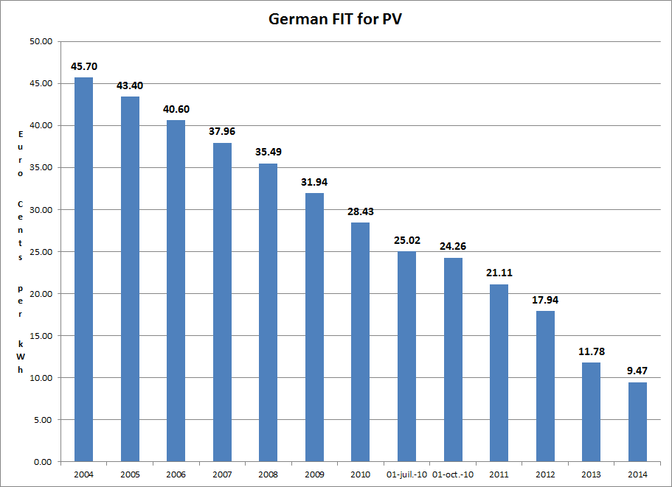
German Feed-In Tariffs

Slide 7
Merchant Prices in Germany
The feed-in tariffs were dramatically higher than wholesale prices of generation as shown in the graph.
The 45.70 (or Euro 450.7/MWH) is way off the chart.
The 9.47 or Euro 94.7/MWH is also off the scale.

Slide 8
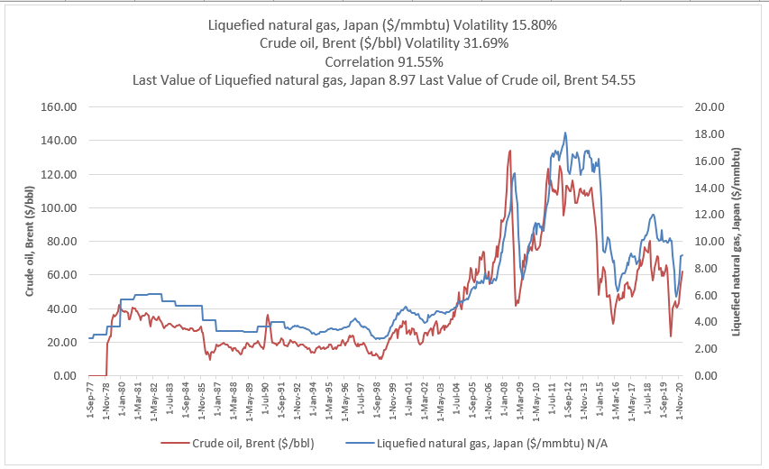
Natural Gas as Benchmark
Gas to Electricity
  New Natural Gas – 6.5 MMBTU/MWH
  New Turbine – 10 MMBTU/MWH

Slide 9
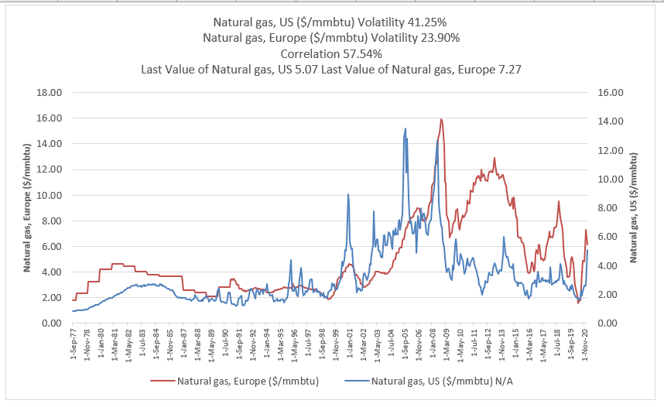
Europe and US Natural Gas Price

Slide 10
Spanish Case and Political Risk
Higher or similar feed-in tariffs to Germany and much higher capacity factors.
Germany had limit on capacity, Spain did not.
Total Cost of 26.4 Billion Euros

Slide 11
Illustration of STC
If produced at full capacity factor (kWp) during the day and nothing at night, the capacity factor would be 50% and the yield would be 8760/2 = 4380. Just need solar patterns over the day. Don’t need anything else.

Slide 12
STC and Capacity Factor
Given that the STC at 1000 w/m2 defines the capacity, if you can find the average w/m2 for a year you can compute the capacity factor before the performance ratio:
  If you have annual data on the kWh that hits a plane (a horizontal plane or an inclined plane), then the average per hour is the total divided by 8760.
  If you have average daily data you can divide the number by 24

Slide 13
Where to Find Tools – PV Insight Read

Slide 14
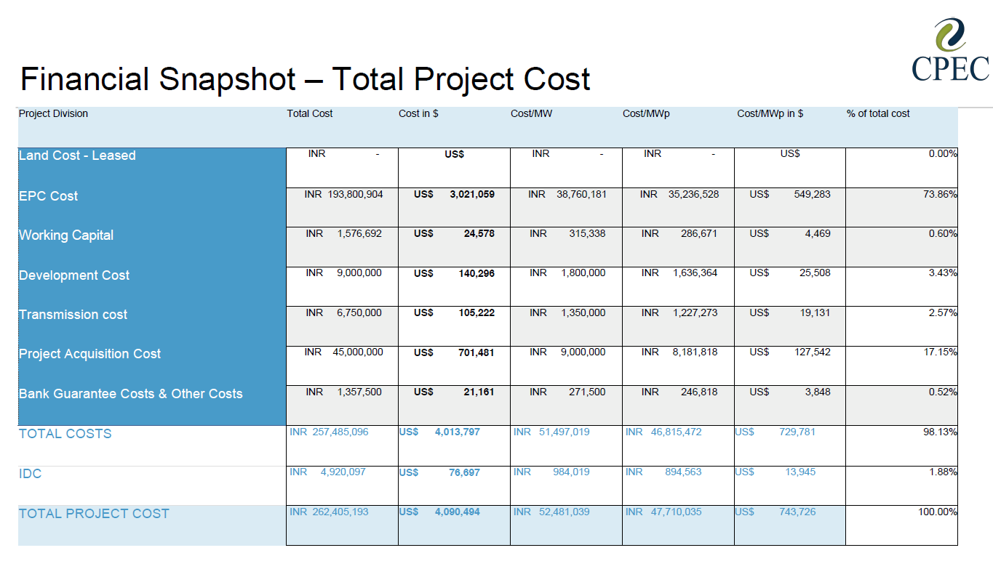
Recent EPC Cost of Solar in India

Slide 15
LCOE of Solar Power

Slide 16
LCOE Points
Understanding how to compute levelised cost per MWH from fixed and variable costs using the capacity factor
Use of a carrying charge rate to summarise financial ratios and project finance parameters
Effect of different drivers for different power plants
Importance of carrying charge rates for capital intensive plants

Slide 17
LCOE Discussion
As the off-taker evaluates alternative PPA bids with levelized cost of electricity (LCOE), understanding details of the LCOE calculation is important. Basic calculation of the LCOE can be derived from factors that include the capital cost per kW, the capacity factor, the O&M costs, the fuel costs and the carrying charge rate.
The carrying charge can be computed as the EBITDA divided by the capital cost of the plant or it can be computed from the project IRR of the project with the PMT function. The carrying charge is driven by the required equity IRR, the debt cost, the debt tenor, the debt level and the tax rate.
The panel below shows where to find an example of using the different cost drivers to compute the LCOE and the right panel illustrates the effect of financial parameters on the LCOE. The first diagram illustrates short-run marginal cost with a supply curve and the second diagram shows an example of computing long-run marginal cost.

Slide 18
Introduction to LCOE
Eight Factors that drive LCOE of electric generating facilities ranging from solar projects to NGCC projects
Understanding how to compute levelised cost per MWH from fixed and variable costs using the capacity factor
Use of a carrying charge rate to summarise financial ratios and project finance parameters
Effect of different drivers for different power plants
Importance of carrying charge rates for capital intensive plants

Slide 19
Basic Equations for Revenue Build Up
Electricity plants have capacity which is the ability to produce at an instant
  kW, mW, W
For producing revenue, there must be some kind of time dimension attached to the capacity
  Hours, months, years
  kW x h, kW x month, kW x year
  kWh, kW-month, kW-year
There is a basic distinction in project finance for availability and output based projects. Output base projects earn revenues on production, availability based projects earn revenue as long as the plant is available to produce even if it does not produce.
  Output based projects (renewable): revenue = price x kWh
  Availability based projects (dispatchable): revenue = price x kW-month

Slide 20
Step 1 of LCOE: Annual Carrying Charge per kW
Convert the Cost per kW which is the crucial driver of power costs for many technologies by the carrying charge rate. This gives the cost per kW-year. The carrying charge can be thought of as the amount of annual EBITDA required for an amount of up-front cost. It can also be thought of as the return on and the return of capital to carry the investment. It can also be thought of like the loan payment on a house divided by the price of the house.
Annual Carrying Charges = Cost/kW x Carrying Charge Rate

Slide 21
Step 2: Total Fixed Cost per kW-year
Add the fixed O&M costs expressed in Amount (e.g. USD) per kW-year to the annual carrying charges to derive the total annual cost per kW-year.
Total Annual Fixed Cost/kW-year = Annual Carrying Charges + Fixed O&M Cost

Slide 22
Step 3: Compute the Fixed Cost to Turn on the Lights
Compute the total fixed cost based on energy rather than capacity. To do this, you need the capacity factor (for renewable) or the availability factor for base load (assuming the plant will run whenever it is available). The hours that must be covered by the fixed cost are 8766 x capacity factor. The total annual fixed cost per MWH as the annual cost x 1000 divided by 8766 x capacity factor.
Total Annual Fixed Cost/MWH = Total Fixed Cost/kW-year x 1000/ (8766 x CF)

Slide 23
LCOE Calculation – Calculation of Cost per MWH
Compute the total fixed cost based on energy rather than capacity. To do this, you need the capacity factor (for renewable) or the availability factor for base load (assuming the plant will run whenever it is available). The hours that must be covered by the fixed cost are 8766 x capacity factor. The total annual fixed cost per MWH as the annual cost x 1000 divided by 8766 x capacity factor.
Total Annual Fixed Cost/MWH = Total Fixed Cost/kW-year x 1000/ (8766 x CF)
Compute the fuel cost as the heat rate expressed in MMBTU/MWH with the Cost (e.g. USD/MMBTU) to derive the fuel cost per MWH.
Fuel Cost (USD/MWH) = Heat Rate (MMBTU/MWH) x Fuel Price (USD/MMBTU)
Add the variable O&M per MWH to the fuel cost to derive the total variable cost per MWH.
Variable Cost (USD/MWH) = Fuel Cost + Variable O&M
Add the total fixed cost to the variable cost to derive the levelized cost per MWH.
Levelised Cost/MWH = Total Fixed Cost/MWH + Total Variable Cost/MWH

Slide 24
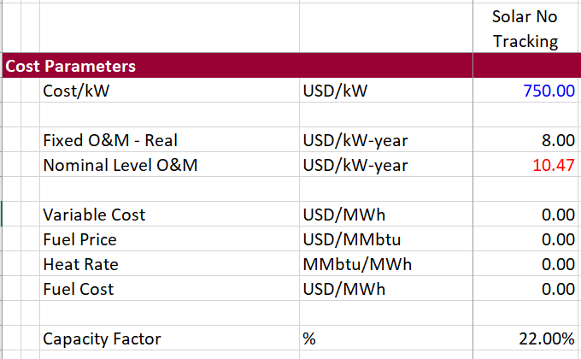

LCOE Basic Illustration
First Need the Operating Parameters for Solar or for Diesel. Need the variable and fuel costs for diesel.

Slide 25
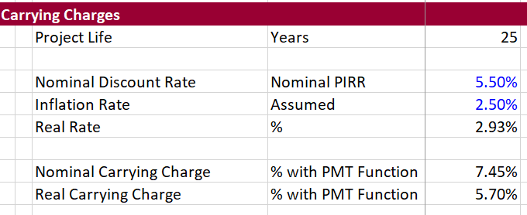
Now Move to Carrying Charges
Carrying Charges can be computed with the PMT function. You can reconcile this to a simple financial model. Can compute on a nominal or real basis.

Slide 26
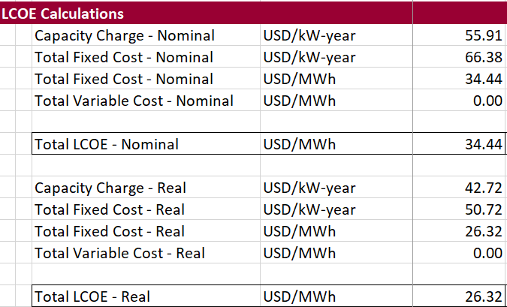
LCOE on Nominal or Real Basis
Compute on both a nominal and real basis using alternative carrying charge rates.

Slide 27
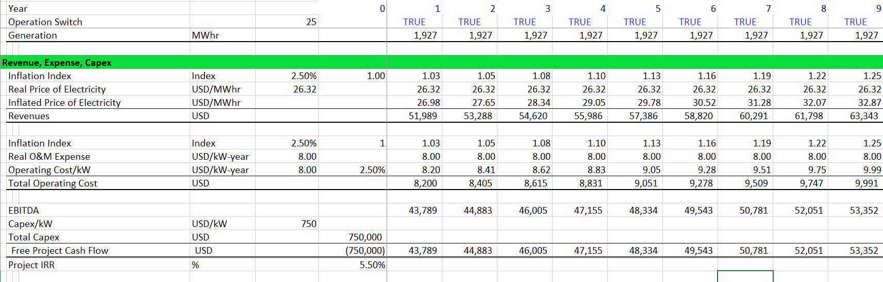
Reconciliation of LCOE and Project Finance Model
Proof: Put in real rate with inflation. Then put in the inflation rate for revenues and operating costs.
Demonstrate that the project IRR is achieved.

Slide 28
LCOE for Base Load and Intermittent Plant
Treat the levelized cost analysis differently for a base load plant and an intermittent low capacity factor renewable energy plant.
For the base load plant measure the avoided cost of unavailable time.
For the intermittent plant with low capacity factor (e.g. solar and low capacity factor wind), measure the levelized cost relative to short-run avoided cost (should include the cost of ancillary services).
For the intermittent plant with a high capacity factor (e.g. off-shore wind and geothermal), could perform a loss of load probability analysis that credits the intermittent plant with some capacity value.
Note that the carrying charge formula is consistent with the formula:
LCOE = NPV(Revenues)/NPV(MWH) when degradation is accounted for in the carrying charges and the carrying charge formula includes inflation. This implies that the carrying charges are computed on a real and not nominal basis if all the fuel and O&M components are inflated on the same basis.

Slide 29
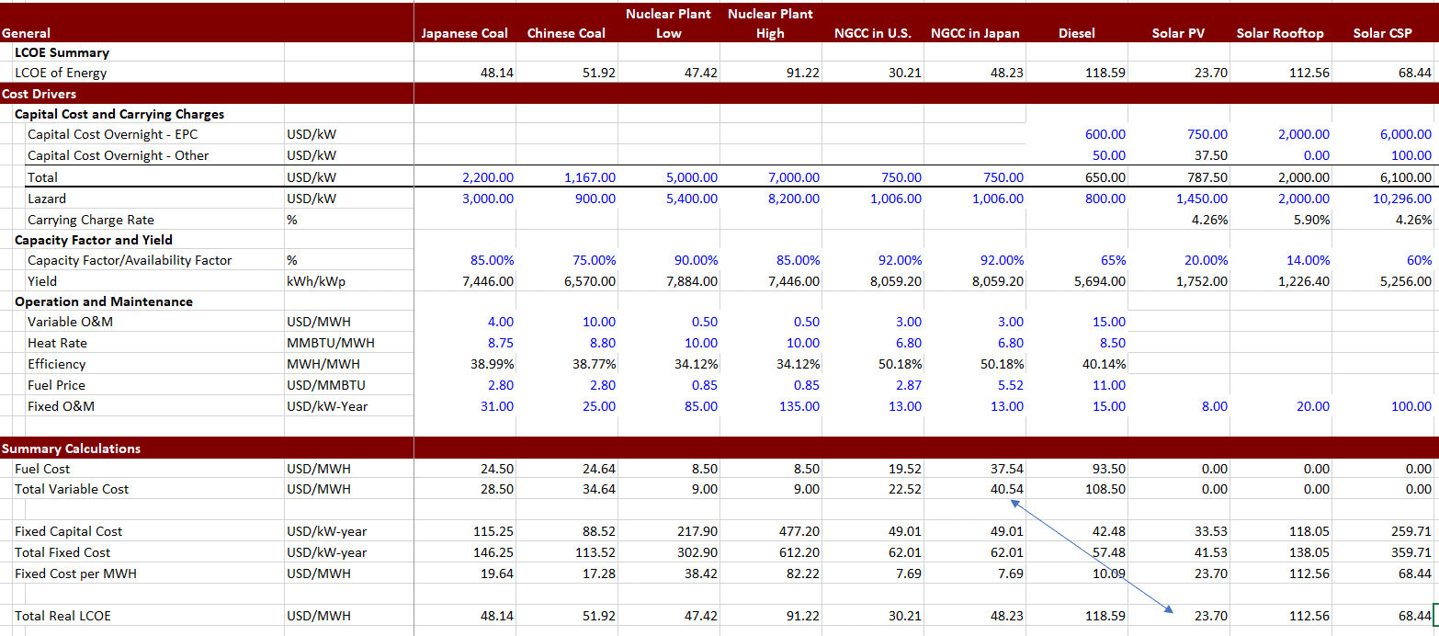
Use of LCOE for Comparison with Dispatchable Technologies
Compare Real LCOE (not nominal) to Current Variable Costs including Fuel and Variable O&M. Can make adjustment for spinning reserve also.

Slide 30
Revenue Build-up and LCOE
LCOE is the levelized or weighted average price of electricity over the lifetime of a project
Cost of electricity is Revenue/MWH
LCOE is weighted Revenue/MWH over the lifetime of a plant
Weighting
  Cost of capital so future revenues have lower weight than current revenues
  Amount of generation so periods with more generation have more weight
Instead of detailed weighted average could use NPV formula where
LCOE = NPV of Revenues/NPV of Generation

Slide 31
Risk Allocation and Drivers in PPA Agreement
IPP Controls and Takes Risk
IPP Control and Risk
Off-taker Risk
Off-taker Controls Dispatch, IPP controls Availability
IPP Control and Takes Risk
IPP Control and Risk
Off-taker
Plant Cost and Construction Delay
Efficiency (Heat Rate)
Fuel Price
Capacity Factor and Availability Factor from Forced and Unforced
Variable O&M Expense
Fixed O&M Expense
Carrying Charge Rate

Slide 32
Drivers and Contracts - Renewable
IPP Risks
Cost of Project, Time Delay and Technology Parameters
Capacity Factor Risk
O&M Risk
Interest Rate Fluctuation
Risk Mitigation
EPC Contract with Fixed Price and LD (LSTK)
NONE !!!
O&M Contract
Interest Rate Contract (Fix Rates)

Slide 33
Example of LCOE
Prices
  Price in Year 1 is 100
  Price in Year 2 is 200
Generation
  Generation is 500 in year 1
  Generation is 1000 in year 2
Discount Rate is 10%
  PV Factor is 1/1.1 = .909 in year 1
  PV Factor is 1/1.21 = .826 in year 2
Average price is 150
Weighted average price for Generation is: 33 x 100 + .67 x 200 = 33 + 134 = 167. This can be computed as (100 x 500+200 x 100)/1,500 or 167. This is sum of revenue/sum of generation
Weighted average price for discounting is .909 x 100 + .826 x 200 divided by (.909 + .826)
LCOE Combines weightings

Slide 34
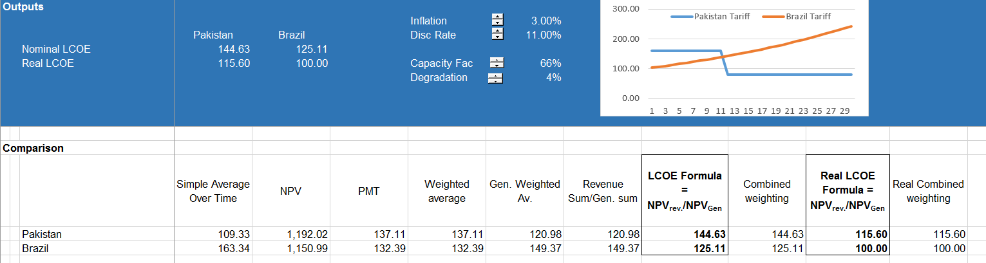
LCOE Illustration
LCOE formula:
LCOE = NPV Revenues/NPV Units

Slide 35
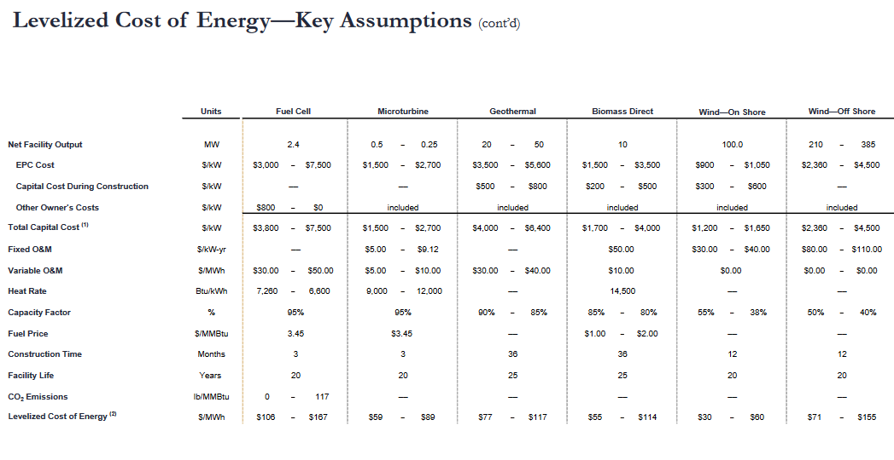
LCOE Benchmarking
Ask Questions about cost, O&M, heat rate etc. in Biomass

Slide 36
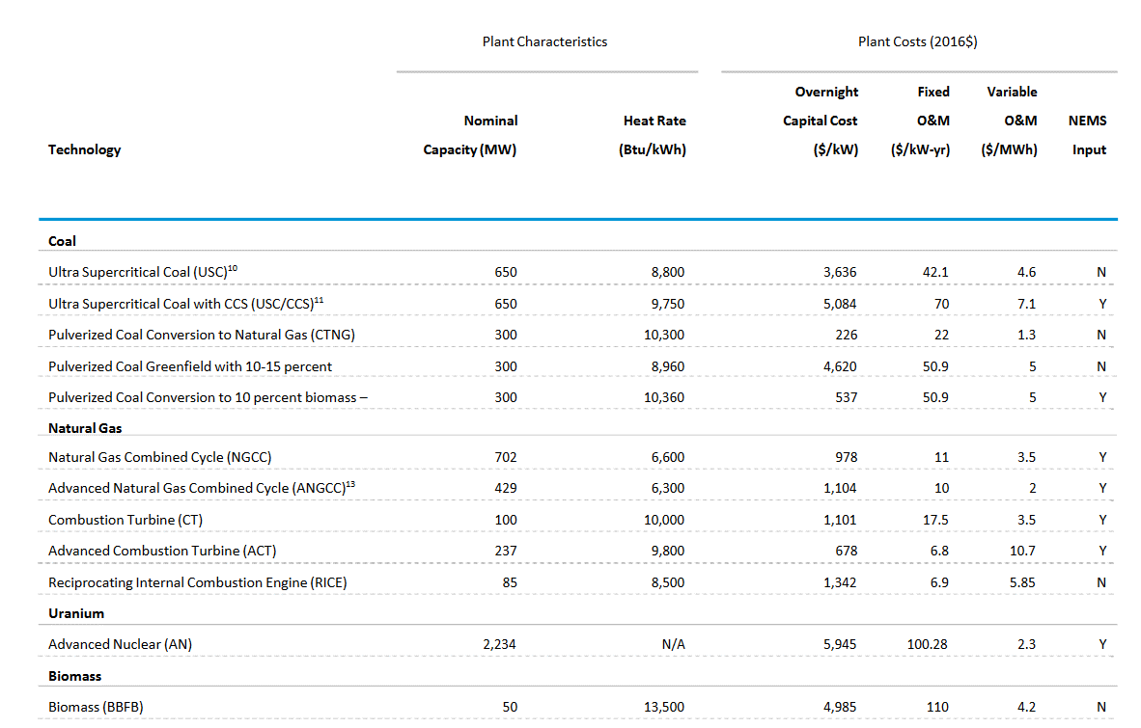
LCOE Benchmarking 2

Slide 37
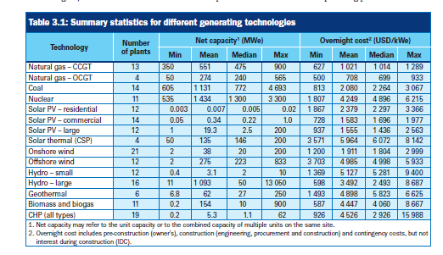
LCOE Benchmarking 3
Which one should you believe – look at the Capital Cost of biomass

Slide 38
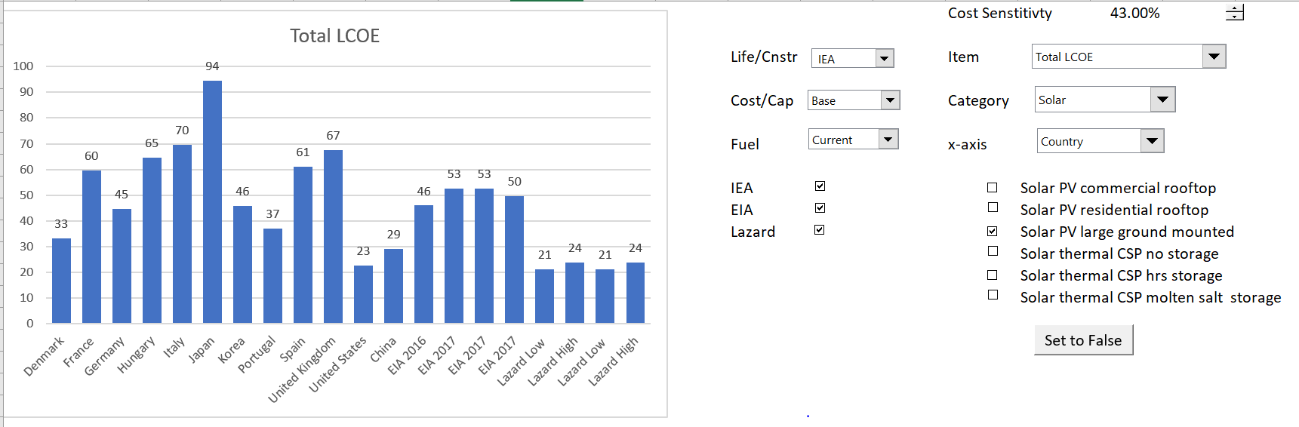
Base Case LCOE from Database
Solar LCOE with Different Carrying Charge Rates from Database

Slide 39
LCOE Best Case
Low real returns, high debt, low credit spreads

Slide 40
LCOE Worst Case
High real returns, low debt, high credit spread. Note how costs are double.

Slide 41
Solar Power Yield and Capacity Factor

Slide 42
Solar Yield Files – Read PDF and EU Site
There are two outputs whether for PVSyst or for the EU site or for the PVWATT
Hm: Average monthly sum of global irradiation per square meter received by the modules of the given system [kWh/m²]. This could be called POA – point of access or it could be called Effective irradiance on collectors.
Em: Average monthly electricity production from the given system [kWh]. In PVSyst this is Earray or Energy Injected into the grid

Slide 43
Solar Power Yield Files
Case study on comparison of yield from alternative sources.
Problem is that there is more variation from different sources than comes from the year by year variation.
Location of files on edbodmer.com

Slide 44
Spinning Reserve and Batteries
Solar Variation in Different Hours for a single day. You can use this to apply against an amount of capacity.
Need to Ramp up the Diesel Plant when the clouds come

Slide 45
Weekly Solar Irradiation

Slide 46
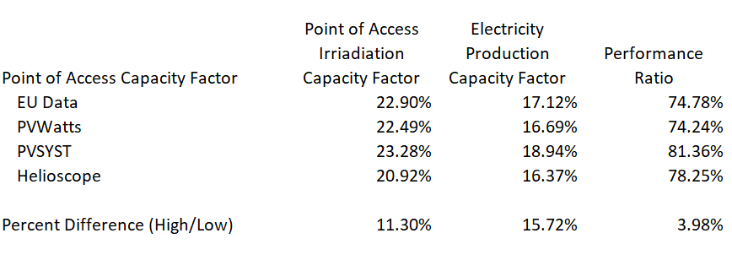
Output from EU file on Point of Access and Output to Grid
The yield analysis demonstrates that different sources can give you different results and this comes from either the point of access energy or the performance ratio.

Slide 47
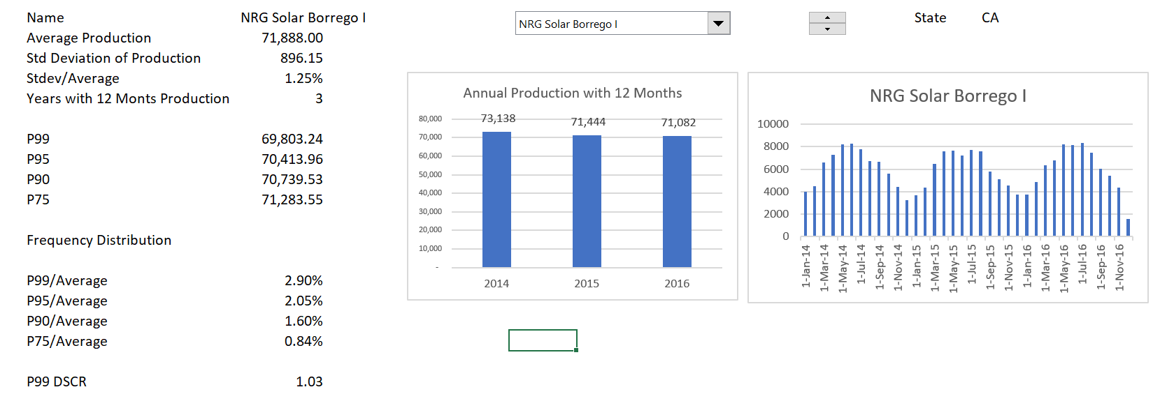
Solar Power Yield – Database of Actual Production
Note the small actual variation in solar production – the problem is the starting point and risk goes down after COD.

Slide 48
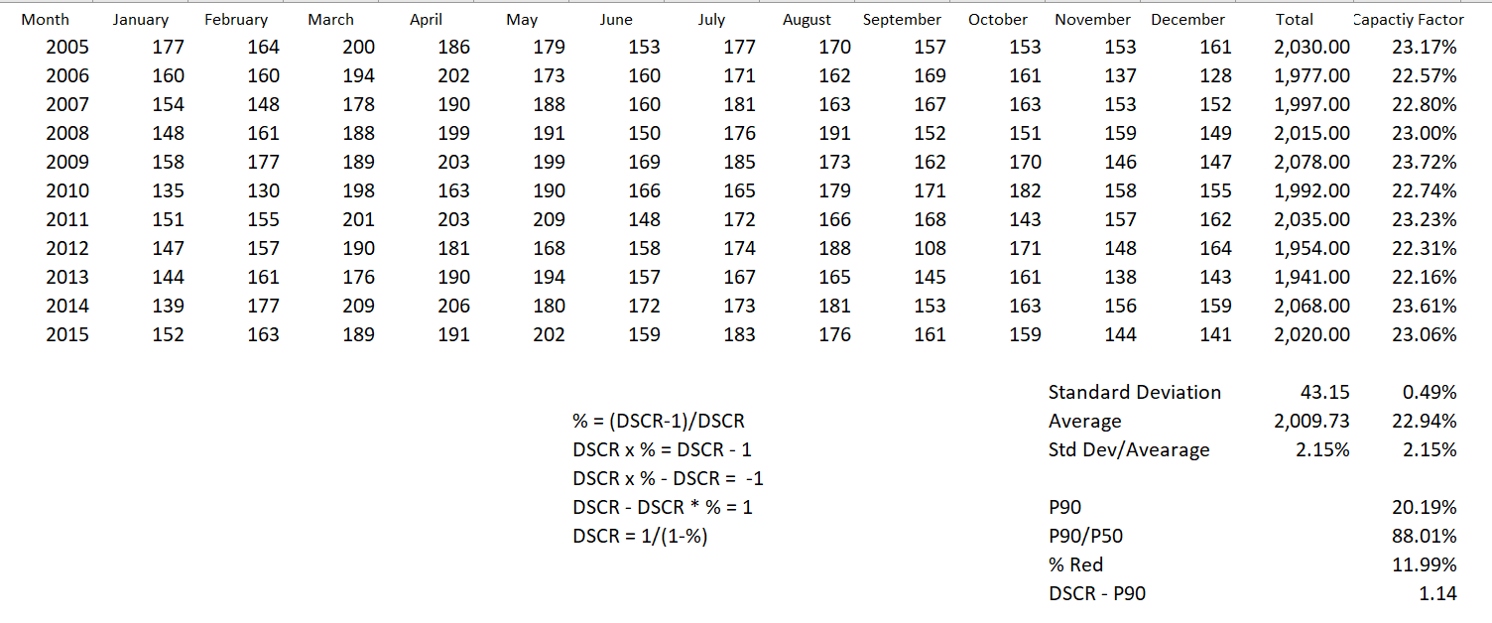
Year by Year Variation
Compute the P90 level from standard deviation and average using NORMINV

Slide 49
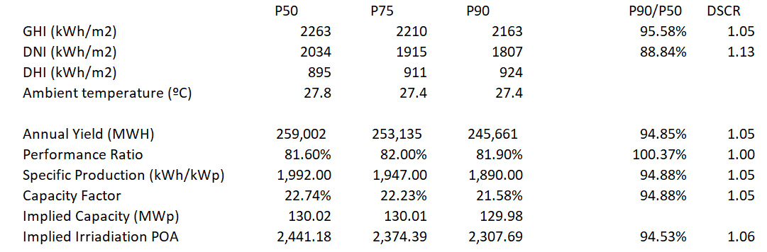
P90 and P50 DSCR with Actual Case
Actual case where P50 and P90 were estimated.

Slide 50
Performance Ratio

Slide 51
Use of Regression to Find the Implied Temperature on the Panels
Objective: Come up with a reasonable method where you can use the temperature reported in the EU website and derive a reasonable production estimate.
At the end of the section you can do the following with the EU data:
Compute the Panel Temperature from the Ambient Temperature
  For example, Panel = 20 + 1.2 * Ambient
  Apply the temperature coefficient to the panel temperature
  Use a typical loss factor for other items
  Therefore, derive a performance ratio that is a function of the temperature

Slide 52
First, Some Terms
Horizontal global irradiation
This is only useful when there is no tilt. The only case where it is optimal to have no tilt is when you are on the equator
Effective irradiance on collectors
This accounts for tilt and tracking. The capacity factor at this point is the basis for computing the performance ratio. Also called Point of Access Irradiation
Corrections for reflection (IAM) and soiling
The IAM depends on tilt and soiling is estimated. These are part of the performance ratio.
Energy injected to grid at AC
This is the final number of use in computing the performance ratio and in the final yield and capacity factor.

Slide 53
Formulas
The energy from a solar project can expressed as capacity factor or yield. The energy hitting the solar plane (point of access) can be expressed as a capacity factor – watt hour on average over the year divided by 1000.
The energy produced can also be expressed as a capacity factor:
Capacity Factor = (Energy/8760)/Capacity

Slide 54
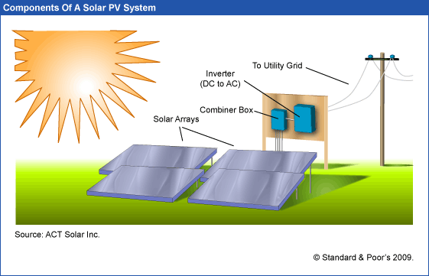
Case 1: Pretend for One Hour the Sunlight Irradiation is 1000 Watts per M
If the performance ratio is 100% (Don’t lose from dirt, sizing, temperature etc., the capacity factor is 100%
Capacity Factor of Generation to Grid relative to kWp
Capacity Factor of Sunlight – Average Sunlight Divided by Capacity of Sunlight Defined as 1000 w
Performance Ratio is the Capacity Factor of the Final Divided by the Capacity Factor of Amounts that Hit the Array

Slide 55
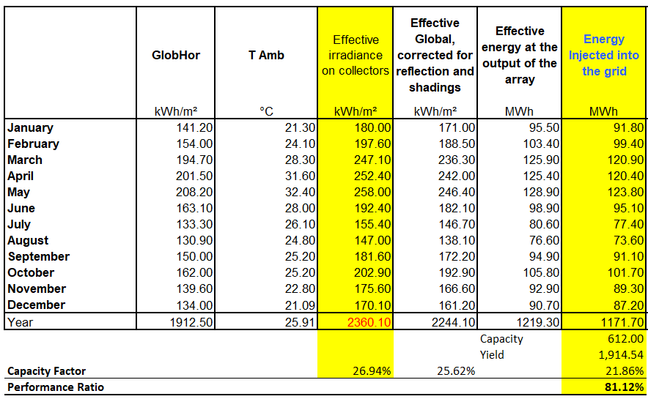
Work Through PVSyst
Can divide the energy injected to grid divided by radiation on collectors
Don’t need anything other than the column of Effective Irradiance on Collectors as well as Energy Injected into the Grid. Convert both of these to capacity factors and then divide the energy into grid by the irradiation on collectors.

Slide 56
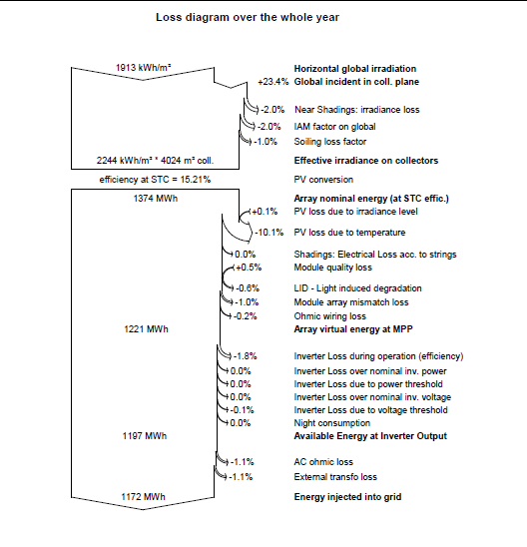
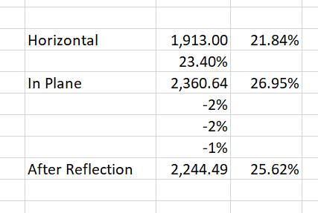
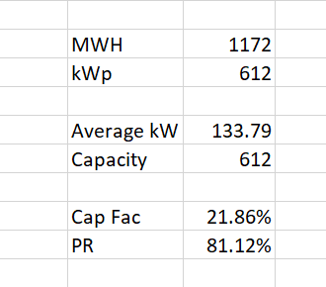
Loss Diagram Illustration
Convert loss diagram into capacity factor and compare different cases.
Difficult to compute performance ratio from these diagrams.
Generally, the loss due to temperature is the largest loss factor.

Slide 57
PVSyst and Waterfall Chart for Capacity Factor
You can use the waterfall macro to make this chart. Note the temperature coefficient is the largest negative bar.
The performance ratio is computed from dividing the final bar by the second blue bar.
PR is 22.34/26.94 or 81.12%

Slide 58
Loss Diagram for Australia
Loss diagram from using waterfall diagram macro in terms of capacity factor. Again the temperature is the biggest factor.
PR = 22.32/27.47 or 81.31%

Slide 59
Mexico Loss Factor
Again, the largest loss factor is the temperature effect.

Slide 60
Decomposing the Performance Ratio
The final capacity factor can be expressed using the formula:
Final CF = CF at POA x (1-loss1) x (1-loss2) x (1-loss3) x (1-loss4) ….
This can also be expressed as:
Final CF = CF at POA x (1-Temprature) x (1-other losses)
Since PR = Final CF/CF at POA, then
PR = (1-Temprature) x (1-other losses)

Slide 61
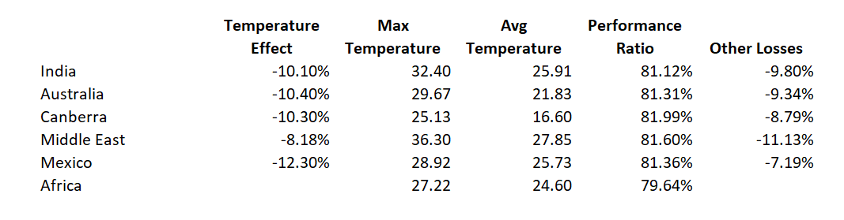
Looking for Correlation between Temperature Loss and Temperature Levels
The table below shows that expected correlations between temperature coefficient and temperature loss is not consistent.
This should be the basis for questions rather than going through the detail.

Slide 62
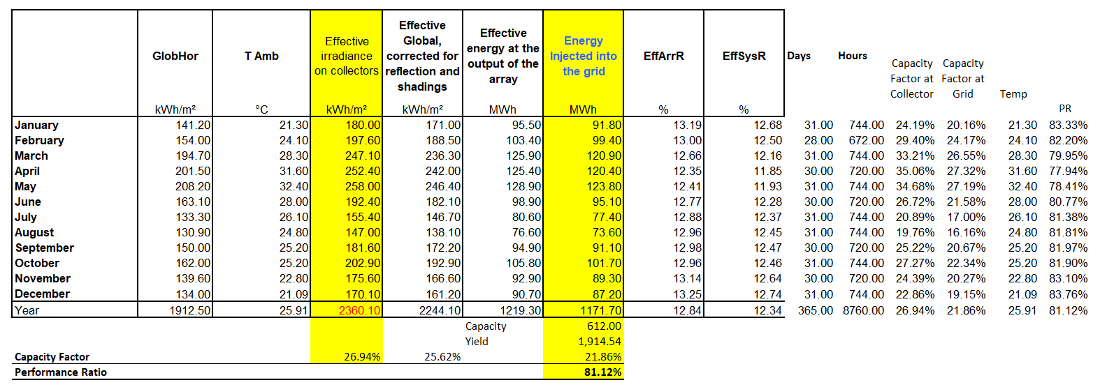
Performance Ratio within Year
The performance ratio can be computed on a month by month, recognizing that:
  PR = Final CF/CF at POA.

Slide 63
Scatter Plots of PR and Temperature
You can create scatter plots within a year and there should be a strong negative relationship. Note the temperature coefficient is about -.4 % change to C.

Slide 64
Performance Ratio and Temperature in Other Cases

Slide 65
Temperature Coefficient
The temperature coefficient is the value of the slope for the percent change in output versus the change in temperature.
  For example, the temperature coefficient of a Sharp Solar Panel NU-U230F3 is -.485% per 1 degree Celsius.
  So, for every degree above 25°C, the maximum power of the Sharp solar panel falls by .485%, for every degree below, it increases by .485%.
The problem is that the temperature is not the Ambient Temperature but the temperature of the panels.

Slide 66
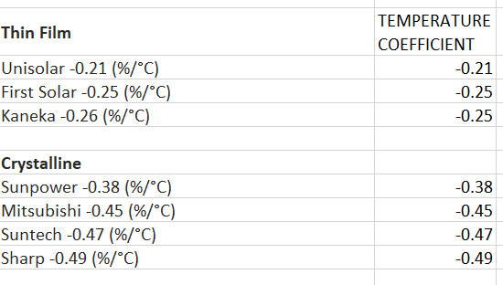
Example of Temperature Coefficient
You can find temperature coefficients – some examples are listed below.

Slide 67
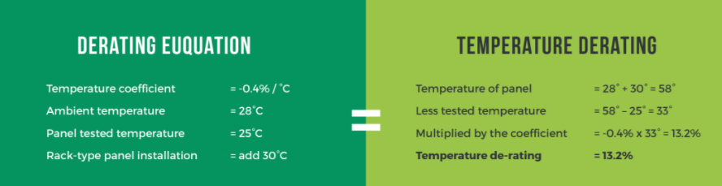
Problems with Measuring Temperature on Panels versus Ambient Temperature
Note how the example adds 30 degrees to the panel.

Slide 68
Derive Implied Panel Temperature
Percent Loss * 100 = (Panel Temp - 25) x Temperature Coefficient
Input Temperature Coefficient
Compute Loss from PR and Other Losses
Derive Panel Temperature from Equation Below
Percent Loss * 100/Temp Coefficient = (Panel -25)
Panel = Percent Loss * 100/Temp Coefficient + 25
Panel Temp = Amb Temp * Mult Factor + Constant Factor

Slide 69
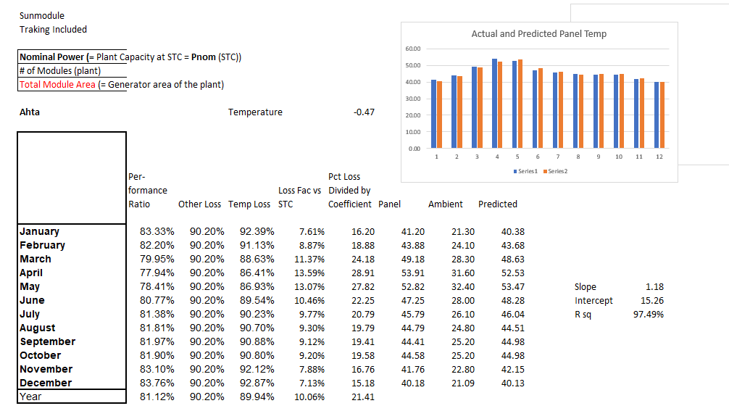
Example of Finding Implied Panel Temperature
This example works through the equations and comes up with a slope and intercept.
In this case Panel = 15.26 + Amb * 1.18

Slide 70
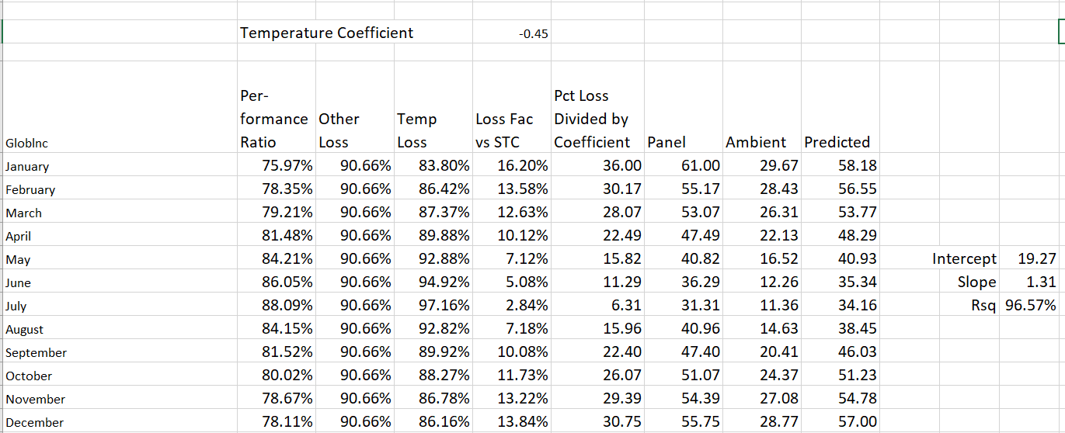
Second Example of Finding Panel Temperature
The implied panel temperature depends on input for the temperature coefficient and the performance ratio.

Slide 71
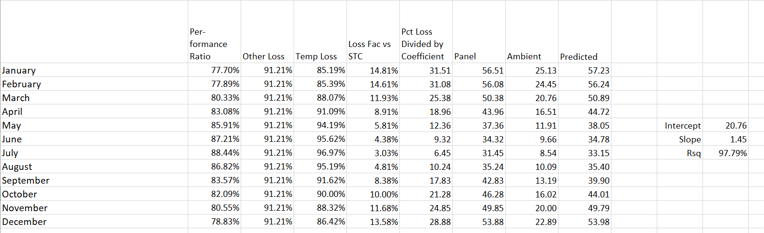
Inconsistent Results
If the results would be consistent in terms of the slope and the intercept, then an independent equation with the temperature coefficient could be applied.

Slide 72
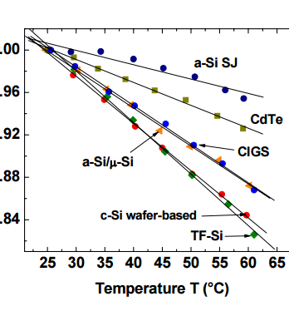
Temperature and Power Reduction
Definition – Percent Change in Production Divided by Change in Temperature

Slide 73
Capital Cost per kW

Slide 74
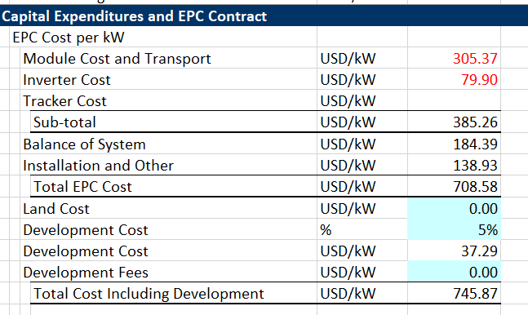
Example of Aggressive Cost Estimate
Cancun Estimate

Slide 75
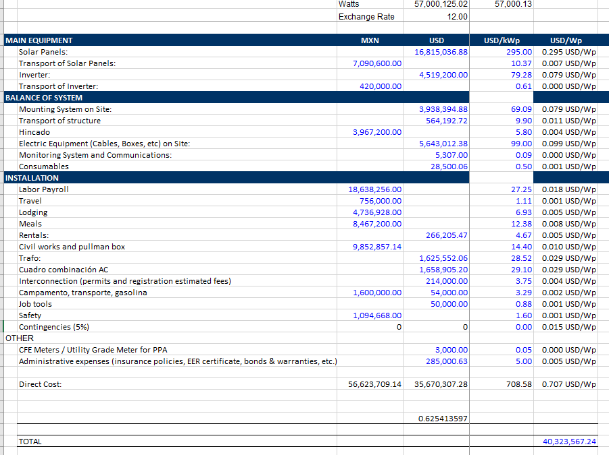
Cost of Items other than Modules

Slide 76
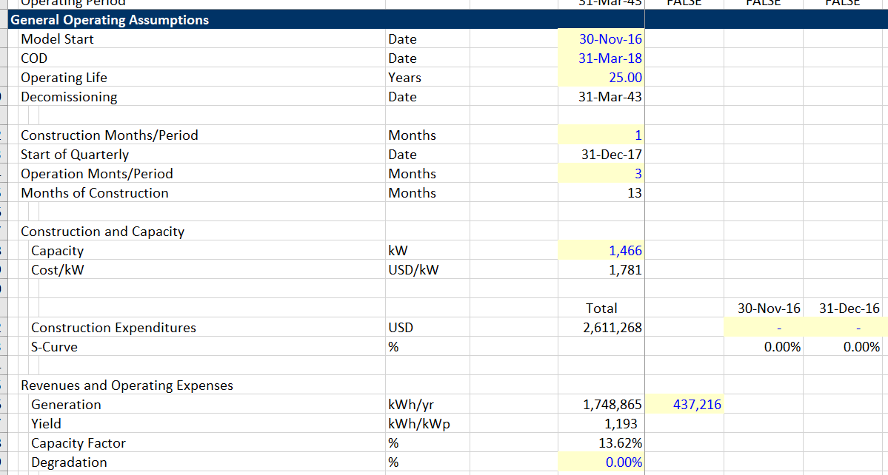
Example of High Cost – NY Project
Note cost/kW

Slide 77
Surprising Range in Capital Cost from Published Databases – A little Out of Date
From Lazard, IEA, EIA

Slide 78
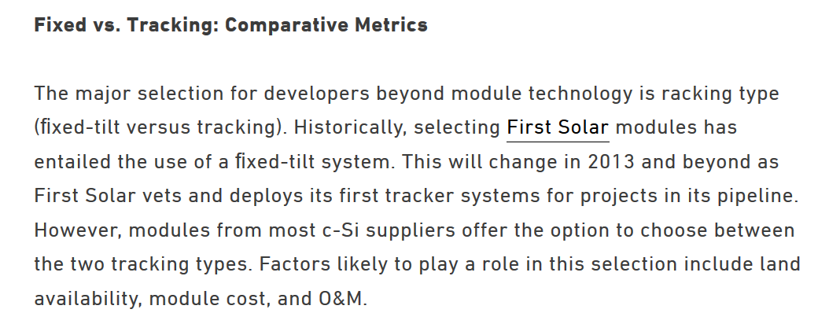
Tracking Notes

Slide 79
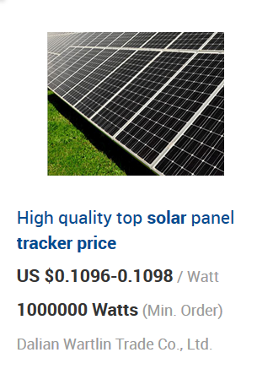
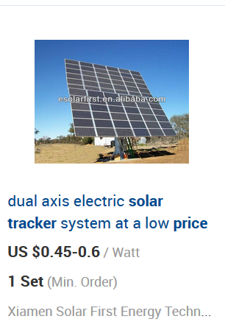
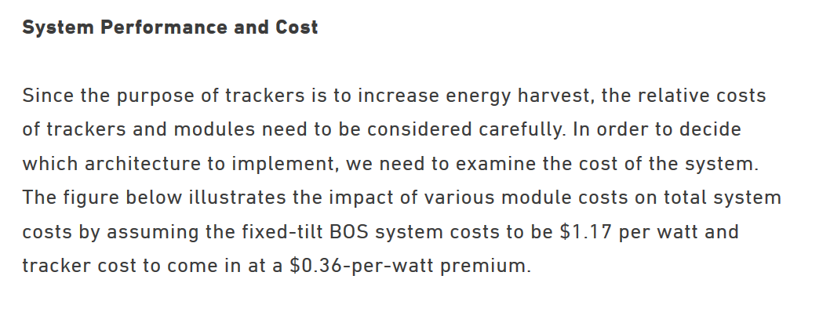
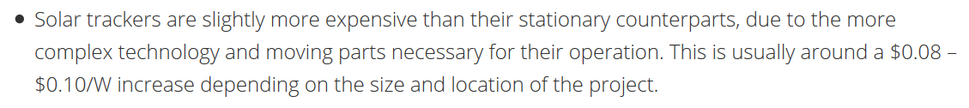
Cost of Tracking

Slide 80
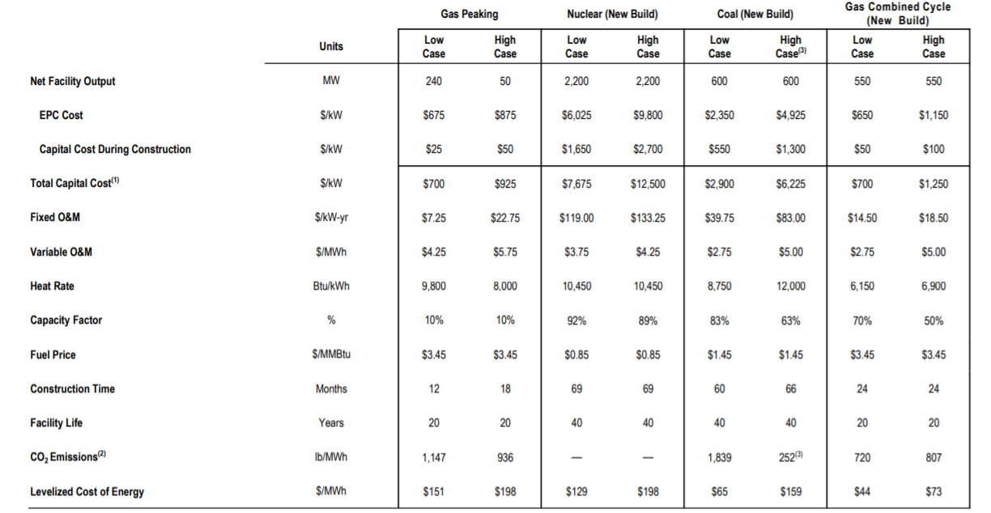
Capital Cost, Operating Cost and Efficiency
Natural Gas and Coal

Slide 81
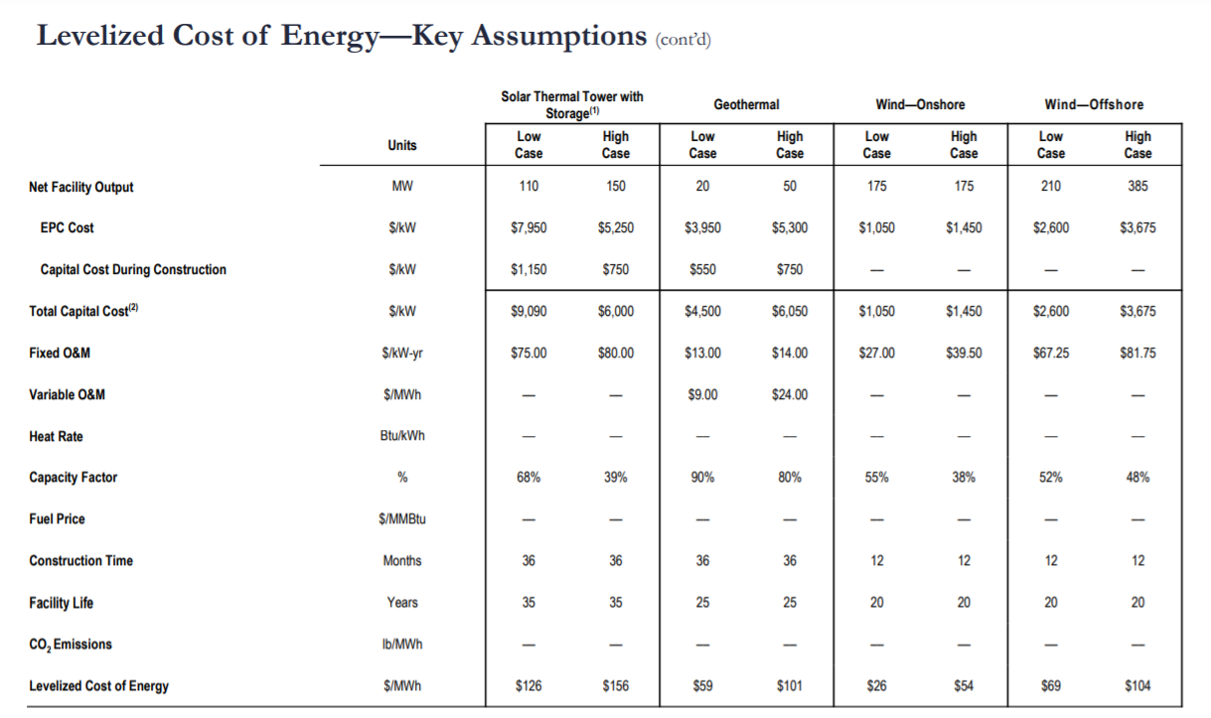
Wind and Geothermal

Slide 82
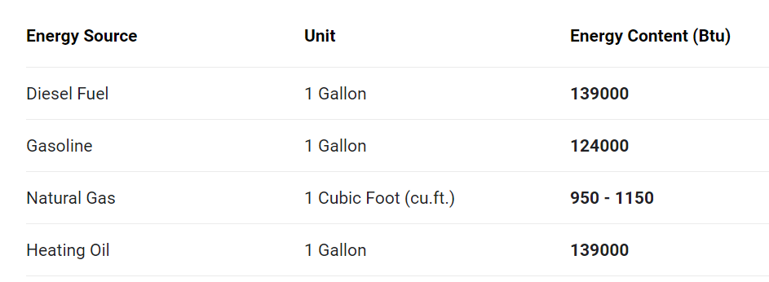
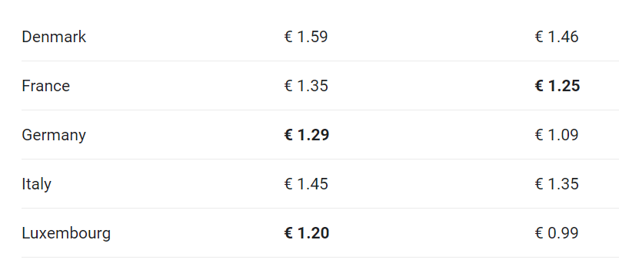
Converting Diesel Price
Price per Litre
BTU/Litre = 139,000 MMBTU/Litre = .139
Euro/Litre = 1.25/.139 = 8.99 Euro/Litre

Slide 83
Reconciliation of Carrying Charge Rates and Project Finance

Slide 84
Solar Operating and Maintenance Expenses

Slide 85
Solar O&M Cost per kW-year from LCOE Databases
Quite a large range in cost – what exactly is in O&M cost is an issue.

Slide 86
Operating and Maintenance Cost for Commercial
There is a big variation in Fixed O&M cost expressed in USD/kwyr

Slide 87
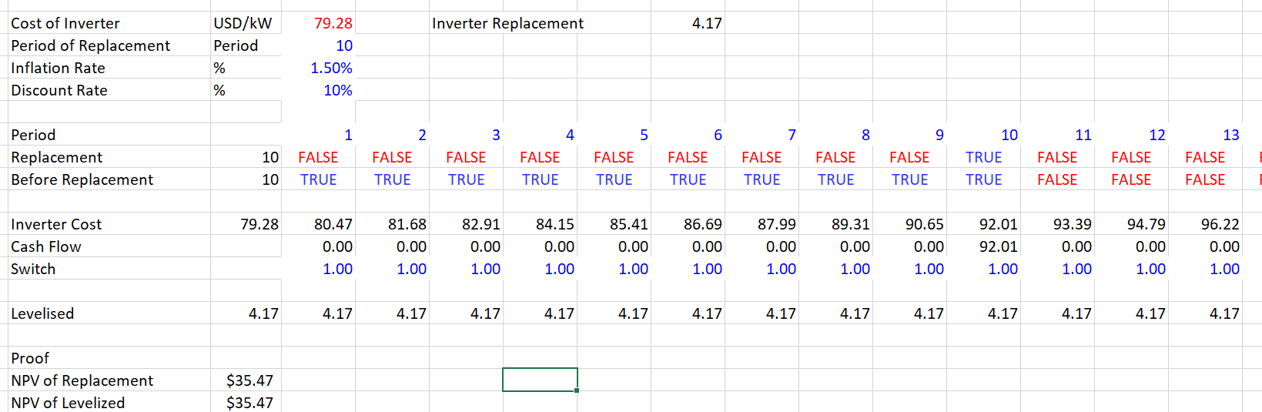
Analysis of Inverter Replacement
Levelized cost of inverter replacement should be in O&M. Sometimes called life cycle costs.

Slide 88
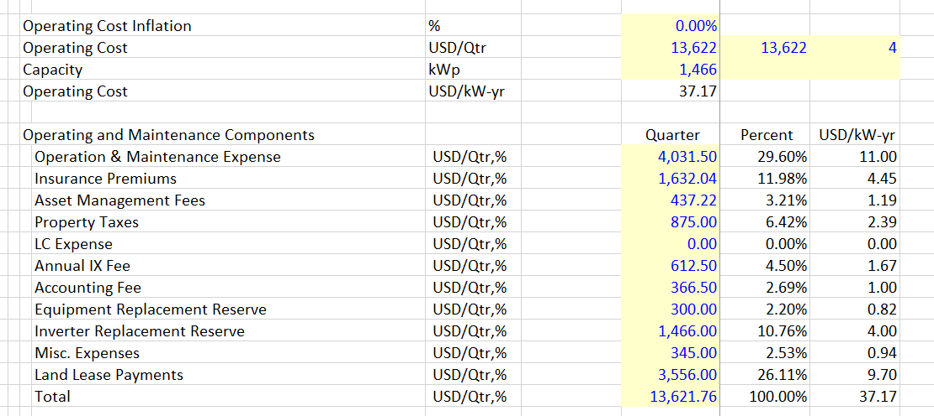
All of the Costs on Top of Pure O&M
Example from New York

Slide 89
Reconciling Project Finance Model and Carrying Charge Rates

Slide 90
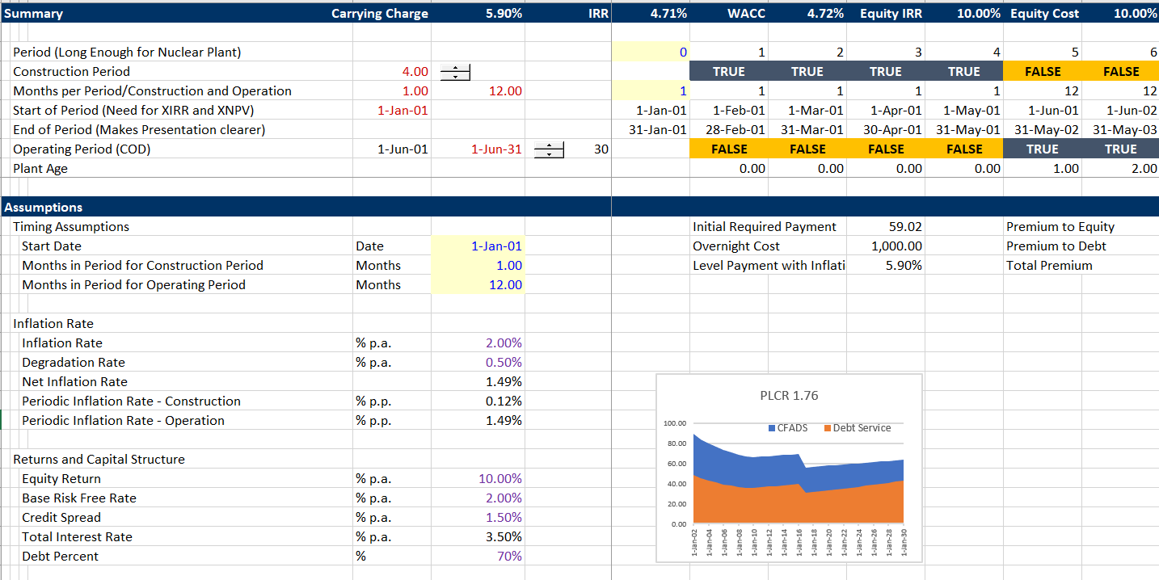
Carrying Charge File
Compute the carrying charge from cost of capital, plant life, tax, debt etc.

Slide 91
Case 1: Starting Point
No Debt
No Inflation
Constant Cost of Capital
No Taxes
No Construction Period
PMT function and Project Finance Model with Equity IRR and Goal Seek Produce the Same Result
Demonstrate that you can just use the capital cost and a carrying charge rate with inflation or a project finance model
  Required EBITDA = Capital Cost x Carrying Charge Rate
  Required Revenue = EBITDA + Operating Expenses
  Level Price = Required Revenue/Generation

Slide 92
Case 2: Understanding of Real vs Nominal LCOE
Allow Price to Inflate in the simple project finance model
Think about an alternative project with only fuel cost and where fuel cost increases with inflation
Financial Model – Inflation and Goal Seek to get target IRR
PMT function – Use Real Rate and then Inflate the PMT
  Real rate is (1+target IRR)/(1+ Inflation)-1
  Now the EBITDA is the first year EBITDA
  Now the LCOE is the Real LCOE

Slide 93
Case 3: Degradation
In project finance model put in reduction in output – if panels lose 15% of output in 25 years, then the annual degradation is:
  Annual = (1+15%)^(1/25)-1
Include a reduction in generation in the project finance model and re-do the target IRR.
When using the PMT function, treat like negative inflation
Point about the generation changing too and the reason for LCOE formula where:
  Real LCOE = NPV(Nominal Rate, Revenues)/NPV(Real Rate, Generation)

Slide 94
Case 4: Taxes and No Debt
Note how leave debt to the end.
In project finance model include depreciation and then multiply EBITDA by taxes. Then use Target IRR.
In case with PMT, need to first compute depreciation from capital cost.
Then use algebra:
  Revenues = Equity Return + Taxes
  Taxes = (Revenues – Depreciation) x Tax Rate
  Revenues = Equity Return + (Revenues – Depreciation) x Tax Rate
  Revenues – Revenues x Tax Rate = Equity Return – Depreciation x Tax Rate
  Revenues = (Equity Return – Depreciation x Tax)/(1-Tax Rate)
  Revenues = (PMT with Inflation – Deprecation x Tax)/(1-Tax)

Slide 95
Case 5: Construction Period but Still No Debt
Run project finance model and add a construction period
Use PMT function with FV instead of simple plant cost
When using FV use the real required equity IRR
Note that everything depends on the IRR premium above the rate of inflation

Slide 96
Case 6: Debt
Alternative debt assumptions
  Sculpting
  Re-financing
  Tail by the end of re-financing
Key is the interest rate relative to inflation
With re-financing, the amount of debt and the credit spread really matter and not the tenor of the debt

Slide 97
Interest Rates and Inflation
Interest Rates Related to Inflation – US. Negative Real Rate

Slide 98
Interest Rates and Inflation
Interest Rates Related to Inflation - US

Slide 99
Inflation Expectations in Cost of Capital
Expected inflation from Index bond less nominal interest rate

Slide 100
Inflation and Interest Rates in India
Real Rate is the key to LCOE

Slide 101
Credit Spreads
BBB Spreads for Project Finance

Slide 102
Credit Spreads – More Detailed Graph
Spreads between 1.3% and 2.2%

Slide 103
Key Points About Batteries
Understanding the difference between kWh and kW in measuring capital and operating costs
What characteristics of batteries make most sense in terms of duration
Importance of battery life, degradation, replacement and cost of capital
True value of ancillary services

Slide 104
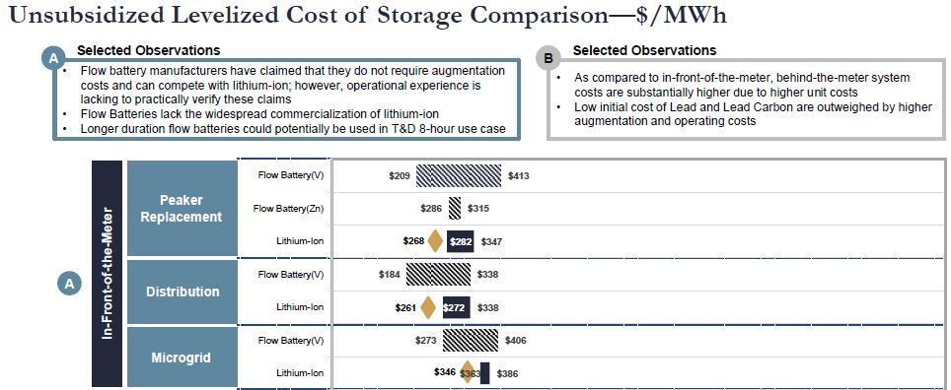
LCOS in Lazard Study
Does this USD/MWH mean anything at all for you.
The cost is far higher than the cost of solar.
The cost of lithium seems to be lower than flow batteries

Slide 105
Does the Charge (kW) or the Discharge (kWh) drive the Cost

Slide 106
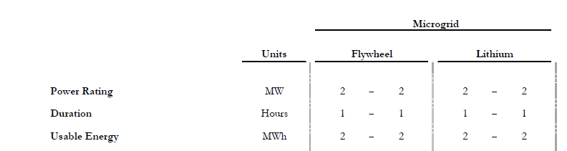
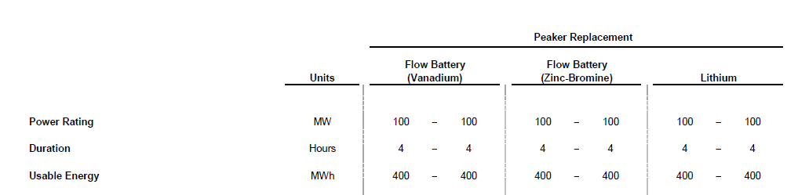
Do you Care about the Duration

Slide 107
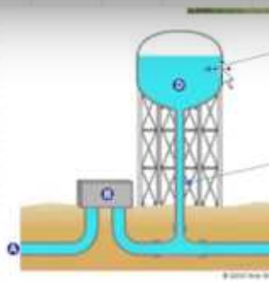
Think of a Batter Like a Water Tower
The storage tank is the number of hours that be stored and then delivered. It is measured in kWh. If the capacity is 100 kW and the storage is 4 hours, then the kWh is 400 kWh.
The pipe is the capacity at any instant. If this pipe capacity is 100 kW, then in one hour, the maximum that can be charged or delivered is 100 kWh

Slide 108




Case 1
1 Hour of Sunlight and 1 Hour of Required Discharge for Lighting
1 MW
Charge
Discharge
In this case, it does not help to have a duration of 4 hours. You pay for a kW of charge and the same 1 hour of discharge. Extra payment for long discharge is a waste

Slide 109


Which would you Rather Have in terms of Cost
1,540 to 1,956 per kw versus 883 to 1,176 per kw

Slide 110
Case 2
1 Hour of Sunlight and 4 Hours of Required Discharge for Lighting
4 MW
Charge
1 MW
1 MW
1 MW
1 MW
Discharge 4 batteries with 1 MW
In this case again, it does not help to have a duration of 4 hours or 2 hours on the battery. If you had more duration you could not get any benefits because you can only get amount of the charge out of the battery

Slide 111
Case 3
4 Hours of Sunlight and 1 Hour of Required Discharge for Lighting – Try More Storage
250 kW
Energy 1 MWH
Capacity 250 kW
Cannot Discharge more than 250 MW of capacity in one hour
1 MW
In this case it still does not help to have storage of 4 hours on the battery. You are limited by the rate of discharge in kW.

Slide 112
Case 4
4 Hours of Sunlight and 4 Hours of Required Discharge for Lighting – Try More Storage
250 kW
Energy 1 MWH
Capacity 250 kW
250 kW
250 kW
250 kW
250 kW
250 kW
250 kW
250 kW
Finally, there is a case where the amount of the storage makes a difference. Here, you are storing the solar in a big tank and pumping up the storage until you reach the capacity of the tank. Then you are releasing the energy from the tank. Here the cost per kWh matters and not the cost per kW.

Slide 113
Which would you Rather Have in terms of Cost
Now it is the cost per kWh that matters – get enough batteries to meet the discharge requirements.

Slide 114
Case 6
4 Hours of Sunlight and 2 Hours of Required Discharge for Lighting – Limited More Storage
250 kW
Energy 1 MWH
Capacity 500 kW
500 kW
500 kW
Here, there is a case where the amount of the storage makes a difference, but you only need two hours of storage. You are storing the solar in a medium big tank and pumping up the storage until you reach the capacity of the tank. You need capacity of 500 kW and a duration of 2 hours

Slide 115
Case 2
2 Hours of Sunlight and 4 Hours of Required Discharge for Lighting – Limited Storage
500 kW
Energy 1 MWH
Capacity 500 kW
250 kW
250 kW
250 kW
250 kW
Here, there is a case where the amount of the storage makes a difference, but you only need two hours of storage. You are storing the solar in a medium big tank and pumping up the storage until you reach the capacity of the tank. You need capacity of 500 kW and a duration of 2 hours

Slide 116
Conclusion
Start with the amount of discharge per hour.
Make sure the capacity is high enough to meet the load required.
Make sure you have enough added solar capacity to meet the capacity requirement of the battery (including losses as explained below).

Slide 117
Spinning Reserve and Batteries
Solar Variation in Different Hours
Need to Ramp up the Diesel Plant when the clouds come

Slide 118
Weekly Solar Irradiation

Slide 119
Reduction in Solar with Spinning Reserve
Assume load of 100 MW during the sunlight hours.
If require the diesel for spinning reserve, must run the plant at minimum level (e.g. 25%)
In this case, should only install 75 MW instead of 100 MW
If you have a battery that can deliver 100MW and is charged, this could replace the minimum usage of the diesel plant

Slide 120
Battery Balance Calculation

Slide 121
Setting-up Battery Balance
Set up account to track storage and make sure that you cannot store added amounts when the storage capacity is exceeded.
Include losses for efficiency.
Cannot store more than battery capacity or the maximum amount of storage
Cannot discharge more than the amount of the opening balance or the amount of the capacity

Slide 122

Set-up of Battery Balance
To understand how batteries work you can set a balance of the amount stored in batteries.

Slide 123
Simple Battery Analysis with Merchant and without Ancillary Services

Slide 124

First, Compute the Total Battery Cost per Day
Begin with capital and operating costs. You need the carrying charge for the analysis.

Slide 125

Compute the Net Revenues per Day
You can use the merchant price database to find the difference between on-peak and off-peak prices.

Slide 126

Micro-Grid Analysis Part 1: Define Parameters
The first part of the micro-grid analysis involves defining parameters similar to those used in evaluating the LCOE.

Slide 127

Put in Capacity and Load Parameters for Different Scenarios
Make the model flexible so can increase the amount of solar and battery capacity.

Slide 128

Compute the Total Cost by Adding the Fixed Costs of Solar and Battery to Diesel Cost
Use an approach similar to the LCOE to evaluate the total costs including fixed and variable cost.

Slide 129

Presentation of Results
Solar and Battery Results – Demonstrate the effect of the load shape and the battery. Solar not coincident with load.

Slide 130

Scenario with Solar Only and Non-coincident Load – Use Much Less Solar
Note the should adjust the amount of solar with the spinner box.

Slide 131

Diesel Only Has Higher Cost
The case with only diesel has a higher cost.

Slide 132
Ancillary Service and Micro-Grid
Think of person running diesel plant.
If some clouds come, you cannot suddenly turn on the diesel.
If the diesel is running on partial load, the operator can look in the sky and see clouds coming and ramp-up the solar plant
If the diesel always has to run at minimum load, less solar should be installed.
A battery would solve all of these problems.

