Slide 1
Economics and Financial Analysis of Solar Power
Solar Power Revolution
After the dramatic changes in the cost of renewable energy, It is hard to overstate the dramatic change in the cost and economics of solar power over the past decade and where this will lead in the future.

Slide 2
Why Study the Economics and Financing of Solar Power in a Structured Manner
Maybe you are starting a career in the energy business,
or you have been around a long-time but not had time to work through all the aspects of how solar power works,
or you are an engineer and a bit intimated by financial language
Remove any reluctance to do analysis yourself and evaluate the economics and financing of solar from A-Z

Slide 3
My Background and How I can Help You
A lot of experience
Modelling
Mistakes in the past
Understanding how to share knowledge
Practical tools for you

Slide 4
Keys to Understanding Solar Power Economics and Making an Effective Analysis
Finding data and benchmarking costs

Slide 5
Keys to Understanding Solar Power Economics and Making an Effective Analysis
Computing the cost of solar power compared to other energy alternatives

Slide 6
Keys to Understanding Solar Power Economics and Making an Effective Analysis
Understanding what how solar resource analysis works

Slide 7
Keys to Understanding Solar Power Economics and Making an Effective Analysis
Evaluating the risks of solar power including resource risks and power pricing risks

Slide 8
Understanding Financial Issues Related to Solar Power
Working through financial strategies related to the changing risk of solar power projects

Slide 9
Understanding Financial Issues Related to Solar Power
Understanding how different financial instruments and techniques work

Slide 10
Understanding Financial Issues Related to Solar Power
Demonstrating how the low cost of solar power can be used in the context of energy storage and hydrogen

Slide 11
Course Introduction

Slide 12
General Course Overview – Economic and Financial Analysis
        Very High-Level Introduction to Technical Aspects
        Economic History of Solar Power Revolution
        Computing the Cost of Solar Power and Explaining the Key Drivers Leading to the Revolution
        Capital Cost of Solar Power and Database of Module Costs
        Evaluating Operation and Maintenance Costs and Adjustments for Inflation and Degradation
        Resource Analysis with Case Study – Understanding of Performance Ratio Benchmarks and Solar Irriadiation that Hits the Collector
        Two Ways of Computing Cost of Capital for LCOE with Project Finance and Constant Capital Structure and Reconciliation of LCOE with a Financial Model

Slide 13
General Course Overview – Economic and Financial Analysis
        After-tax Carrying Charges for Solar Power and Putting things Together to Evaluate LCOE
        Evaluation of Solar Power Economics with Short-run and Long-run Marginal Cost
        General Risk Analysis of Solar Power and Example of Credit Evaluation (Degradation, O&M cost, Inverter Cost, Merchant Pricing, Resource Analysis)
        Risk Analysis of Resource and P50, P90, P95 etc.
        Project Finance of Solar Power and Changing Risk over the Lifetime of a Solar Power Investment
        Debt Sizing and Risk Analysis using Different DSCR’s and Different Probability Levels
        Economic Analysis During the Development Phase and Development Premiums and Fees
        Project Finance Issues from Re-financing, Asset Sales, Equity Bridge Loans, Mini-Perms and IRR Measurement
        Evaluation Implications of Low-cost Solar for Other Issues Like Hydrogen, Storage, Electric Vehicles, Duck Curve

Slide 14
Summary of Tools Provided in the Course
Read PVINSIGHT to Track Module Cost
Read PDF to Excel for EU Website
MSE and Excel Tools for Evaluating P90, P95 etc.
Database of Actual Solar Production
Solver Analysis for Performance Ratio and Waterfall Charts
Solar Project Finance Models with Circular Reference Resolution and Re-financing
Cost of Debt and Equity Capital and Implied Inflation from Databases
Carrying Charge Analysis
LCOE Calculation Tool with Taxes Analysis

Slide 15
Session 1

Slide 16
General Overview of Solar Power
        Physical Properties Photoelectric Effect at a Very High Level
        Characteristics of Different Solar Modules
        German European Feed-in Tariffs to Current Mideast Bids
        Solar Power Drivers Including Capital Expenditure Cost, Resource, Operating Costs and Financing Cost
        Detailed Discussion of Capital Cost of Solar Modules and Data Retrieval
        Other Capital Expenditure Items Including Inverters, Racking, Trackers, Bi-facial Panels, Wiring and Labour

Slide 17
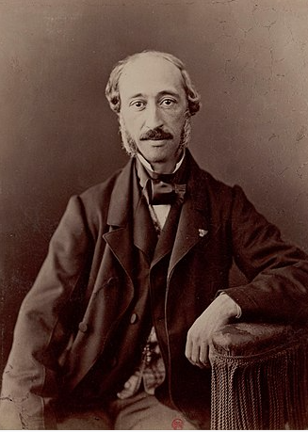
Photoelectric Effect – 1839 French Physicist Edmond Becquerel
PV cells convert sunlight directly into electricity by taking advantage of the photoelectric effect.
PV cells are constructed from conductive materials coated with light-absorbing materials on the top and on the bottom.
When photons in sunlight strike the top layer of a PV cell, they provide sufficient energy to excite electrons and knock them through the semiconductor to a bottom layer, causing a separation of electric charges on the top and bottom of the solar cell.
Connecting the bottom layer to the top with a conductor makes an electrical circuit and allows the electrons to flow back to the top, creating an electric current. The cycle repeats with more sunlight.

Slide 18
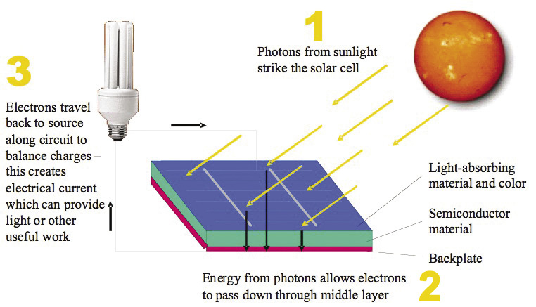
Illustration of the Photoelectric Effect

Slide 19
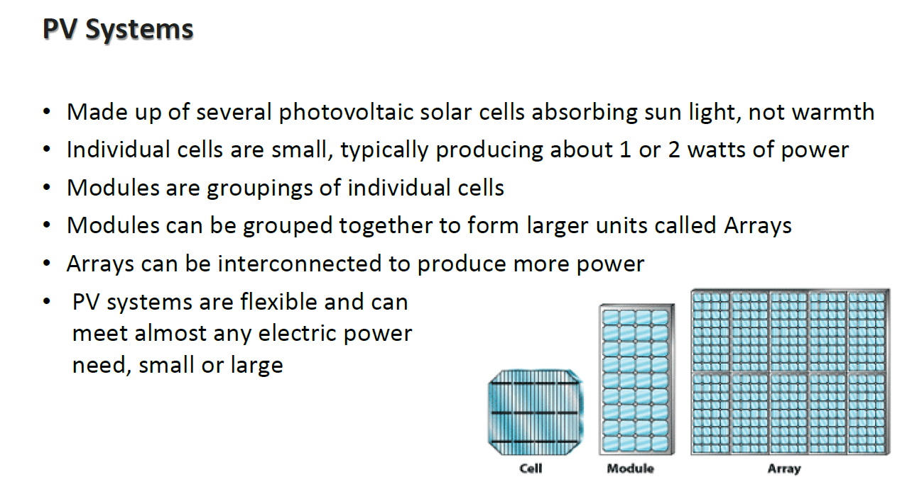
Depending on the Cost of racking, inverters, labour, tracking, cells could account for 30 to 45 percent of the manufacturing cost of a solar panel.

Slide 20
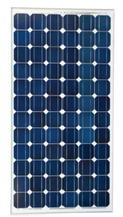
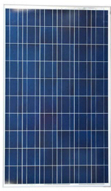

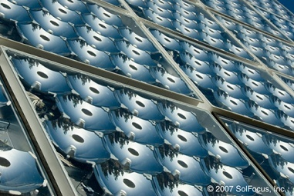
Main Difference Between Poly Silicon and Thin Film
Four main module types:
  Mono crystalline silicon PV (mono c-Si)
  Cut from a single source of silicon –
  More efficient
  Poly or multi crystalline silicon PV (multi c-Si)
  Cut from multiple sources of silicon
  Thin film PV: a-Si, CdTe, CIGS/CIS
  Concentrating PV (CPV)
Currently: over 5,252 modules from 204 module makers

Slide 21
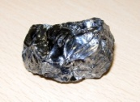
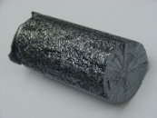



How Polysilicon Panels are Made
Crystal growing and casting (refining that takes time)
Relatively energy-intensive metallurgical processes
Ingot is sawed into bars…
…and then wafers
The wafer is taken through a high technology semiconductor processing sequence to create working solar cells
Cells are soldered together to produce a string of cells, and then laminating it between toughened glass on top and a polymeric backing sheet on bottom.
Silicon
Ingot
Wafer
Cell
Module
Notes:
Cell
In c-Si, wafers typically undergo a process sequence of etching, diffusion, and screen-printing steps before they are tested and graded for incorporation into modules.
Module
Frames are usually created to allow for mounting in the field. The laminates may also be separately integrated into a mounting system for a specific application, such as building integration.
Module vs cell: less IP, more easy process

Slide 22
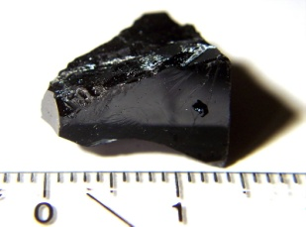

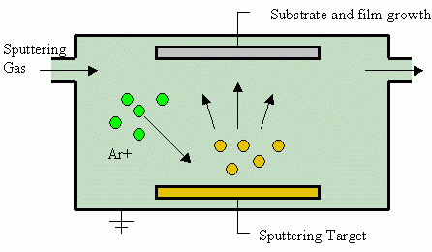
Thin Film value chain (First Solar)
Thin layers of photo-active material are deposited (like being painted) on a (flexible) surface rather than cutting wafers from ingots of silicon (do not need to wait for material to form or have a refining process)
Glass or stainless-steel substrates (at the bottom of the panel) are processed through steps of:
  transparent conducting oxide deposition
  semiconductor layer growth
  laser scribing
  metallization
Once the deposition of the semi-conductor material is completed, the module is basically finished, except for soldering the connections and laminating the module.
Semi conductor material
Substrate
Depositing of material
Module

Slide 23
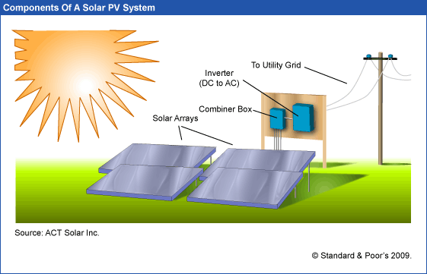
What you Can and Cannot Control
Sunlight, clouds, earth position – things that come from above. In-plane irradiation (effective irradiance on collectors)
Capacity Factor of Generation to Grid relative to kWp
Performance Ratio is final output including controllable and non-controllable divided by the non-controllable from above
Controllable – type of panels, cleaning, wiring, inverter size, tracking …

Slide 24
Polysilicon versus Thin Film
Polysilicon
  Proven technology: in the market for decennia
  Large share -- about 80% of all globally installed PV capacity
  Chinese players dominate the market - (previously Germany and the US)
  Performance more affected in diffuse light (clouds) than thin film PV
  Higher efficiency than thin film (affects area required for producing kW’s)
Thin Film
  Less semi-conductor material use than c-Si
  Continuous process without waiting for silicon to form
  Better diffuse light performance than c-Si
  Better high ambient temperature performance than c-Si
  Higher total construction and installation expenses (when installing the same capacity as c-Si)

Slide 25
Solar Power Economic History

Slide 26
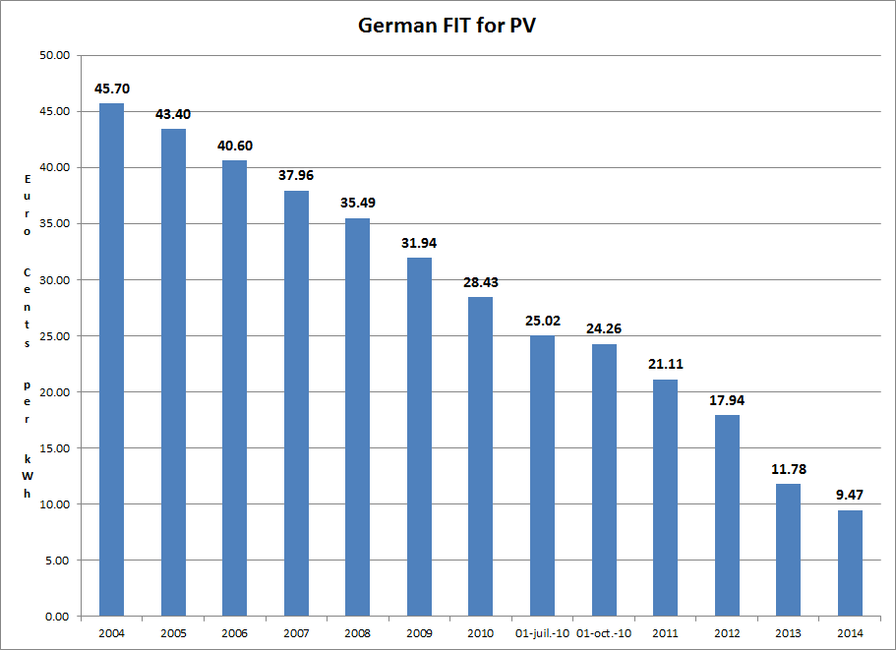
German Feed-In Tariffs
Example of government policy that worked. Idea to make very simple tariff to finance projects and then achieve scale.

Slide 27
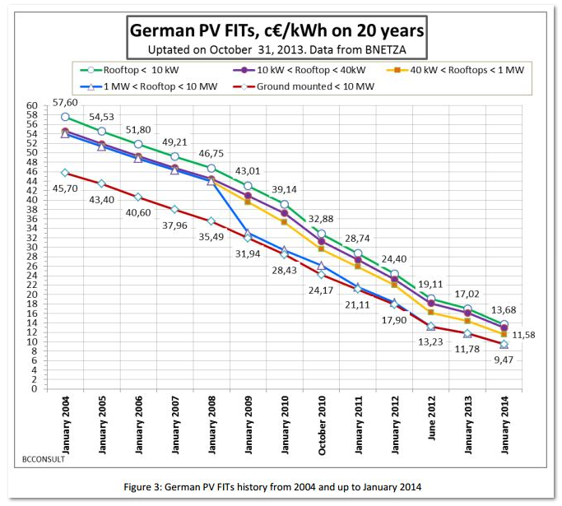
German Tariffs for Alternative Sizes of PV

Slide 28
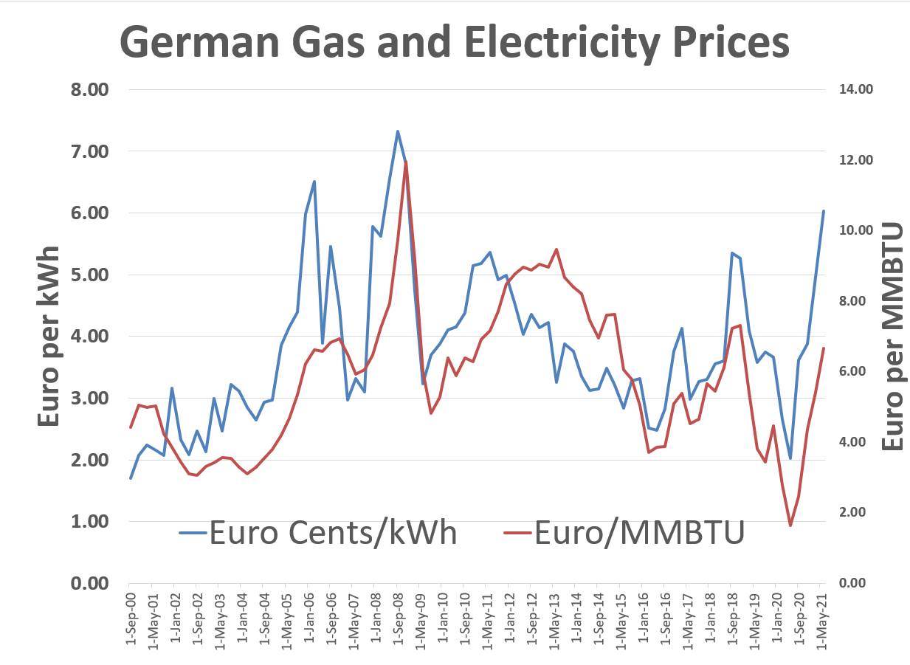
Context of Subsided Prices – Compare 45 Euro/kWh with Merchant Prices of about 3 Euro Cents
Demonstrates that the economics of solar power can be driven by natural gas prices

Slide 29
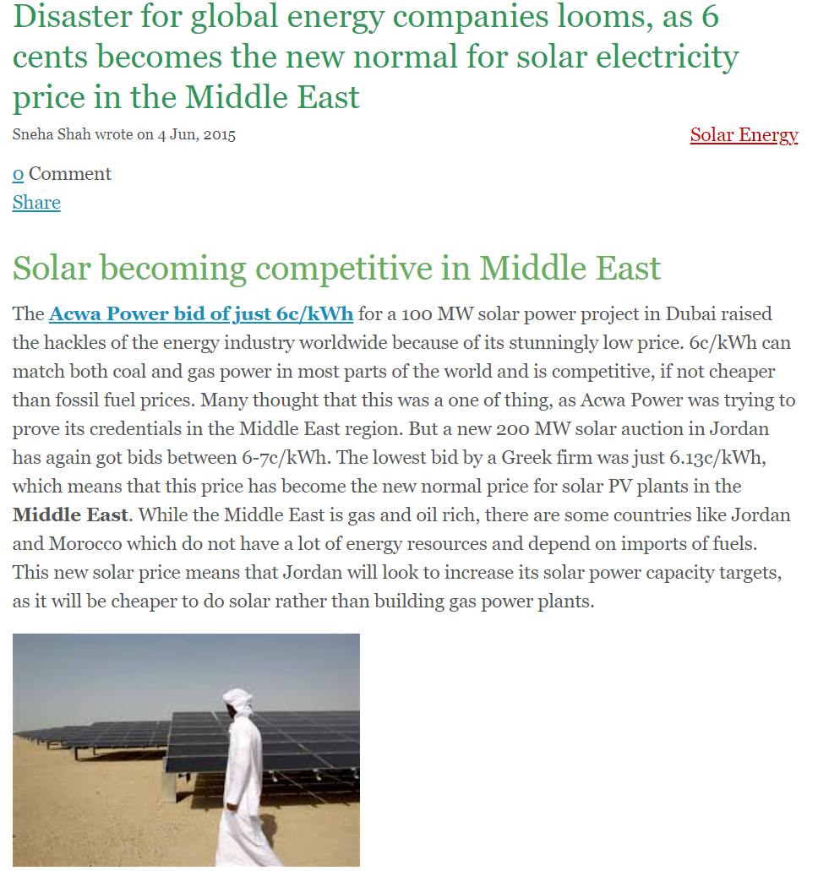
Dubai 6 Cents per kWh in 2015

Slide 30
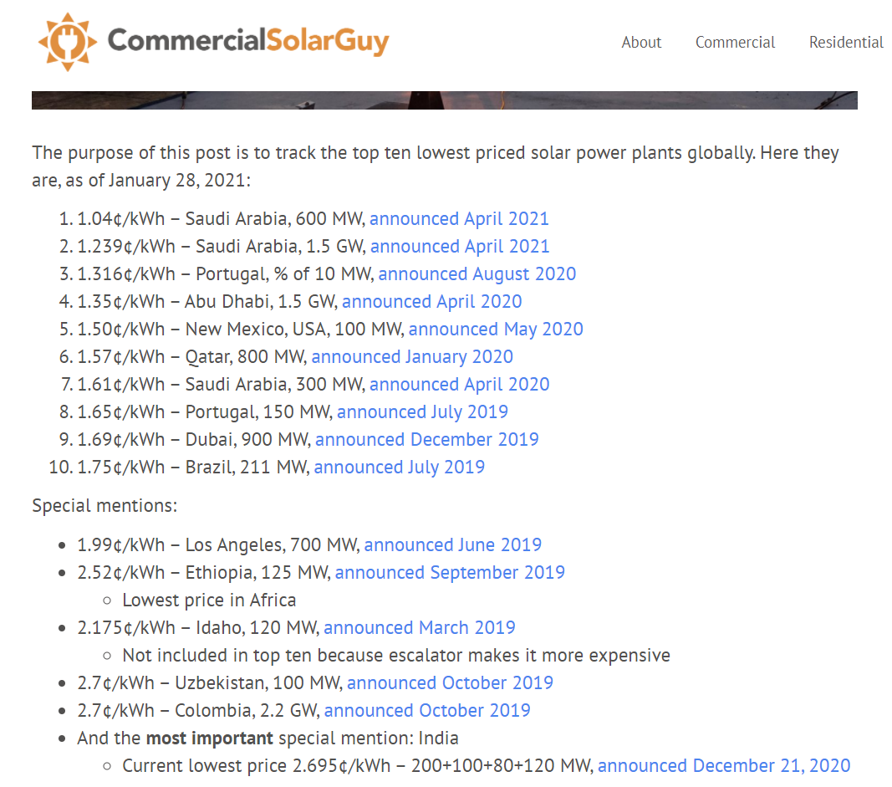
Examples of Very Low Solar Prices
To see how far things have come, there are many projects now that are lower than 2 USD cents per kWh.

Slide 31
Drivers of Dramatic Declines in Solar Prices
Declines in the Capital Costs
  Modules
  Other Equipment
  Labour
Resources
  Data availability
  Tracking
  Bi-facial
Operating Costs
  O&M costs
  Insurance
  Other Taxes
Financing Costs
  Debt Amount and Cost
  Equity Requirement
  Income Taxes
In a financial model, you should clearly show all of these key drivers. To understand solar power, you should understand all of the items.

Slide 32

Use of Levelised Cost to Assess Drivers and Economic Viability
  Importance of understanding levelised cost to evaluate business cases and what strategy makes sense
  Level is flat; you are trying to compute flat costs over the life of a project
  Mechanics of computing levelised cost for solar power given carrying charge rates
  More complex items: Real levelised cost, financing factors, degradation and using levelised cost calculator
    Intuition of LCOE
      Comparing LCOE of solar to electricity bills and to the level cost of other technologies that include fuel and environmental cost
      Cost per unit calculations in other industries like oil
      Operating inputs to any LCOE calculation – capital cost, operation cost, and output
      LCOE with and without inflation

Slide 33
The Levelised Cost of Anything to Assess Economic Costs and Benefits
Example of a horse, Beethoven’s horse, a car, a plane, an oil field
You must measure levelised cost relative to something – e.g., cost/km, cost/kg (hydrogen), cost per MWh.
The capital cost of the investment must be divided into periods over the life of the investment. This is the tricky part.

Slide 34
Computing the Cost of Producing Something per Unit (the LCOE)
You need:
  Up-front Capital Cost Amount
  Operation and Maintenance Costs
  Production Quantity
The rest is the cost of capital and carrying charge
  Asset life
  Cost of debt and equity capital
  Taxes and tax depreciation
  Degradation

Slide 35
LCOE Mechanics for Solar
Use numbers 1,000 and 8760 (8766)
Find the Annual Cost that you express in terms of USD/kw-year that includes recovery of capital costs
Take the USD/kw-year and convert it to hours – USD/kWh
  Divided by 8766 x capacity factor
  or, Yield expressed as kWh/kWp
Multiply by 1,000 to express as USD per MWH
Divide by 10 to express as cents per kWh
For producing revenue, there must be some kind of time dimension attached to the capacity
  Hours, months, years
  kW x h, kW x month, kW x year
  kWh, kW-month, kW-year

Slide 36
Explain Price Changes with LCOE Calculation and Drivers
Start with Total Cost per kWp Capital Cost)
  Multiply by Carrying Charge (CCR %)
  Capital Cost x CCR = Carrying Charge per kWy
Add Total Operating Cost per kWy
Total Annual Cost per kWy = Capital Cost + Operating Cost
Convert to kWh with Yield – kWh/kWp, this is hours
LCOE per MWh = Cost per kWy/hours x 1000

Slide 37
LCOE Complications and Adjustments
You can use the PMT function for computing level costs, but there are complications:
  Using a real discount rate and adjusting the LCOE for general inflation
  Adjusting the LCOE for degradation
  Adjusting the LCOE for taxes and tax depreciation shield
  Deriving the after-tax project IRR from project finance analysis or from a constant capital structure.
  Interpretation of LCOE with Long-run and Short-run marginal cost
As we move through the cost, production and financing issues I will explain how to deal with these complications.

Slide 38
Session 2:
Solar Power Up-Front Capital Expenditures – Modules and Other Equipment

Slide 39
Capital Cost and Operating Cost of Solar Power
        Detailed Discussion of Capital Cost of Solar Modules and Data Retrieval
        Other Capital Expenditure Items Including Inverters, Racking, Trackers, Bi-facial Panels, Wiring and Labour
        Cost Differences for Different Regions
        Real and Nominal Capital Cost Recovery in Solar LCOE Analysis
        Operation and Maintenance – Base and Other
        Adjustments to Compute Nominal and Real LCOE

Slide 40
Solar Manufacturing History
European and U.S. Manufacturers and Power-House or Under-Achiever
Competition and Chinese Entry to the Market
Module Prices Becoming a Commodity

Slide 41

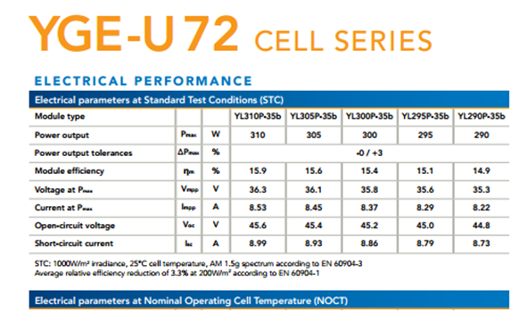
Up-front Capital Cost and kWp Benchmark
In most projects, you have some kind of benchmark to measure capital costs
For example, in real estate, the cost per square meter
In solar the amount you produce depends on sunlight and how you configure the solar project.
Standard Testing Condition (STC) is used with a flash test to create a benchmark test for a panel (kWp or kWdc).

Slide 42
Weekly Solar Irradiation

Slide 43
Solar Patterns in Northern Nigeria

Slide 44
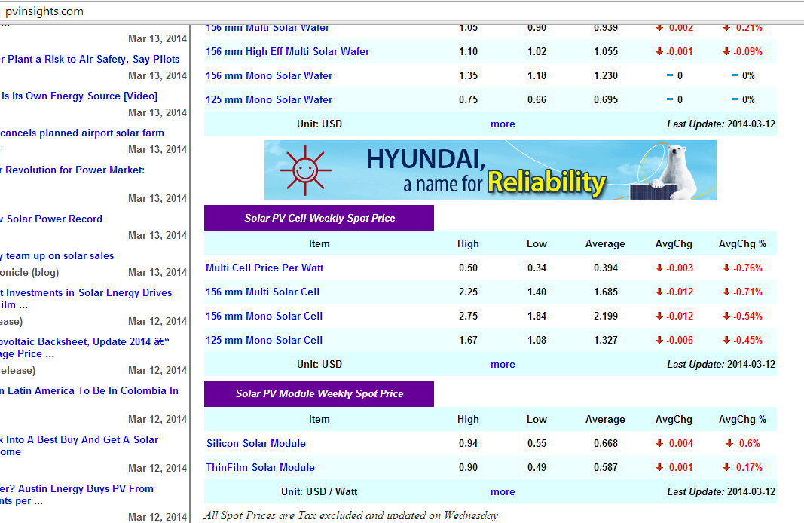
Pvinsights.com - Find Current Price of Modules per kWp

Slide 45
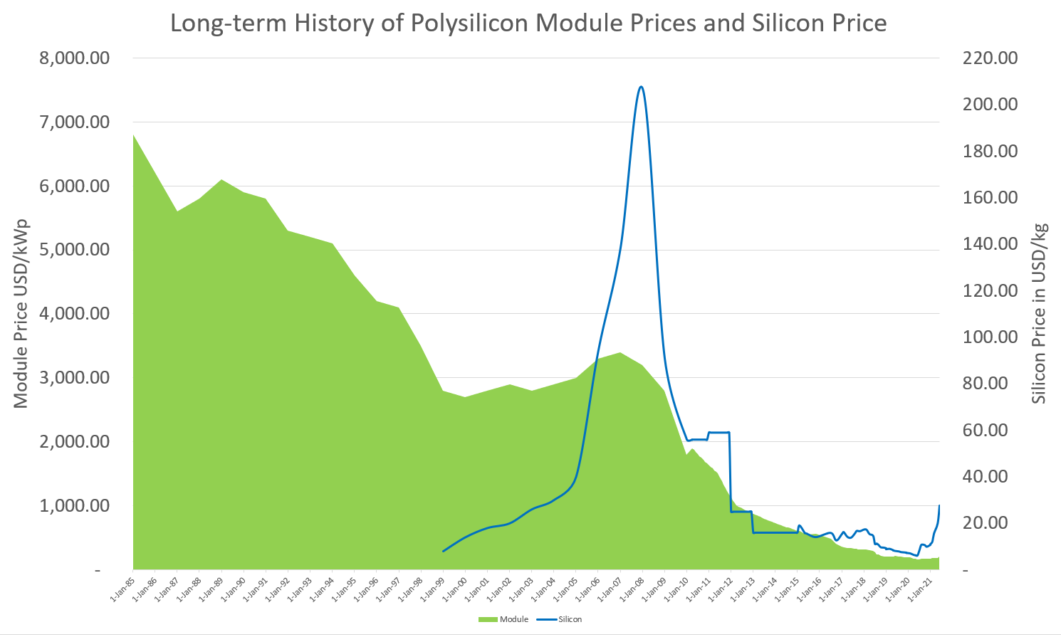
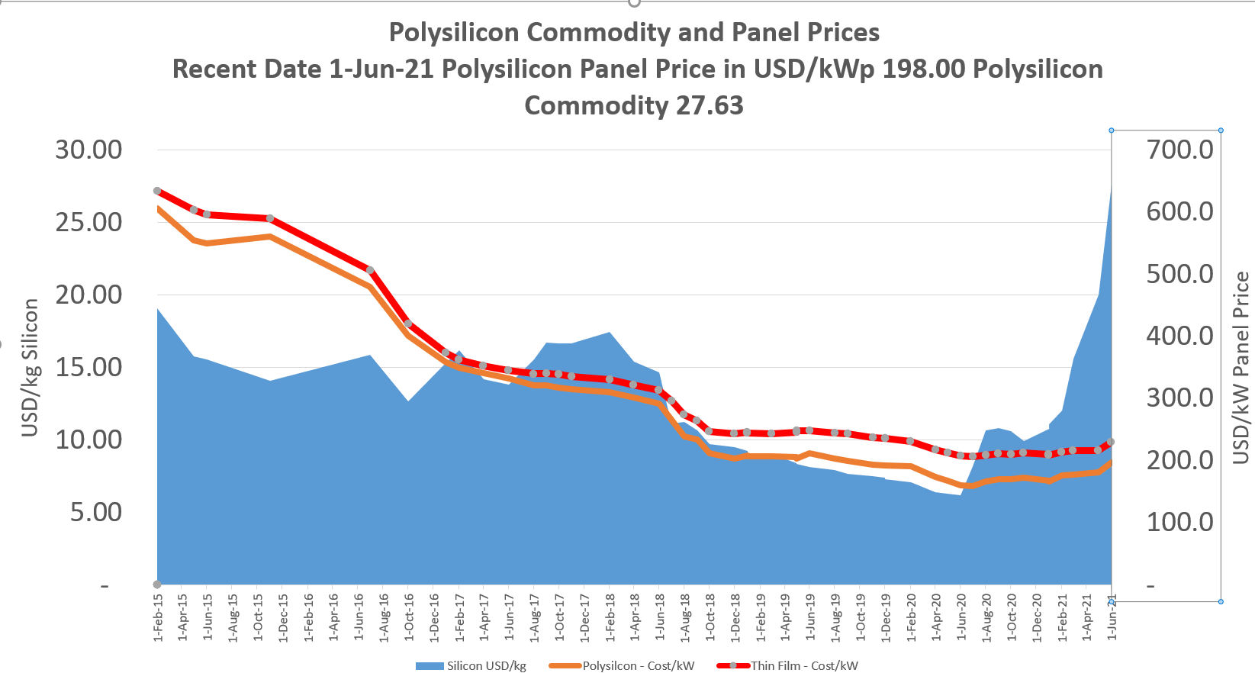
Dramatic History of Module Prices from USD 7,000 per kWp to below 200 per kWp

Slide 46
Balance of System Components
“Balance of System” (“BOS”) components consist of the battery, inverter, control unit, cabling/wiring, and the mechanical support structure for the modules.
  Batteries are used to account for the intermittency of solar power generation and to match the system’s output to the load on a continuous basis.
  The inverter converts the DC current produced by the cells into AC current used by the world’s transmission and distribution infrastructure.
  The control unit contains the circuitry to ensure proper load matching.
  Cabling and wiring are used to connect all of the modules together and to the control circuitry.
  Mechanical support structures serve as physical mounts for the modules themselves.
These components, in addition to the labor to install the system, comprise the BOS and account for nearly 50 percent of overall system costs.

Slide 47

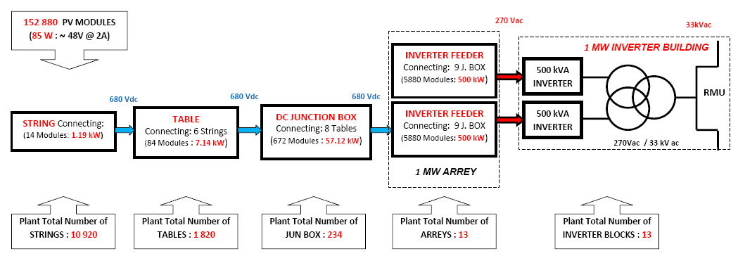
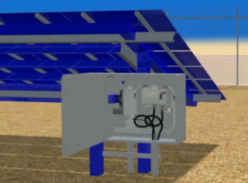
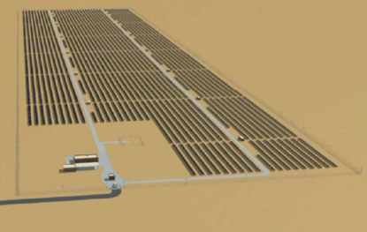
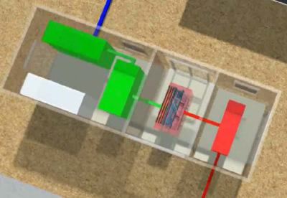
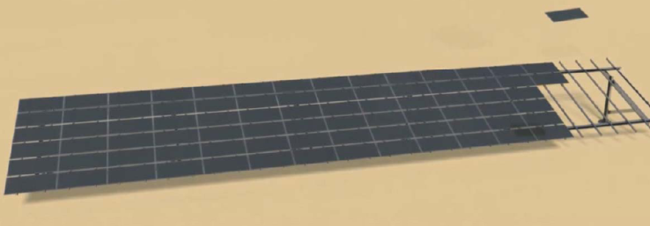
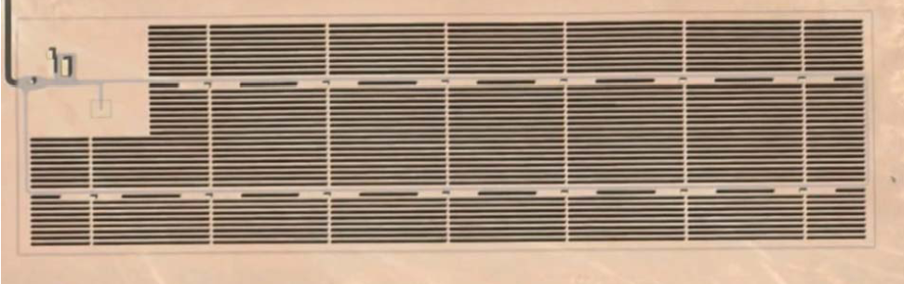
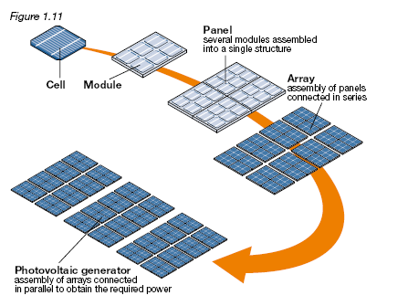
Construction Components

Slide 48
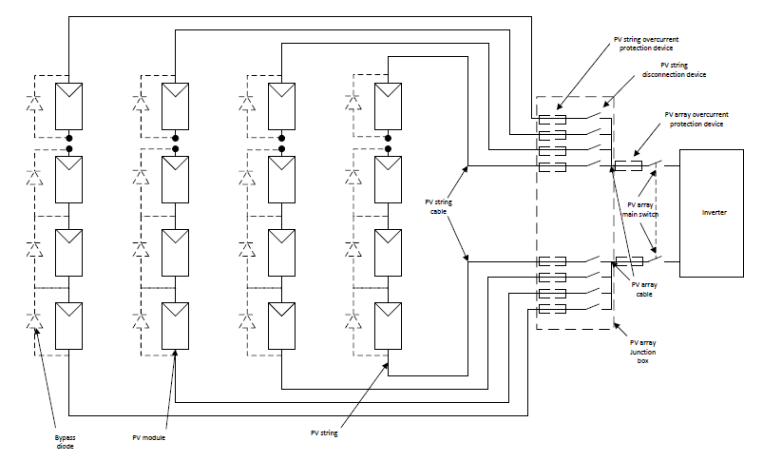
Solar Diagram with Balance of System

Slide 49
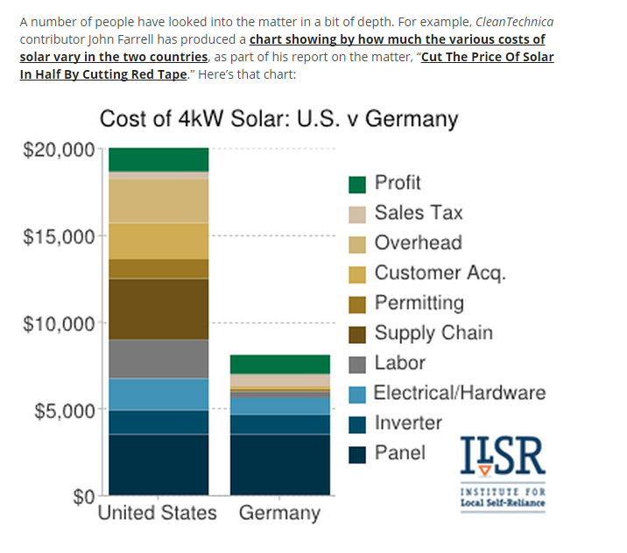
Balance of System for Roof Top Power

Slide 50
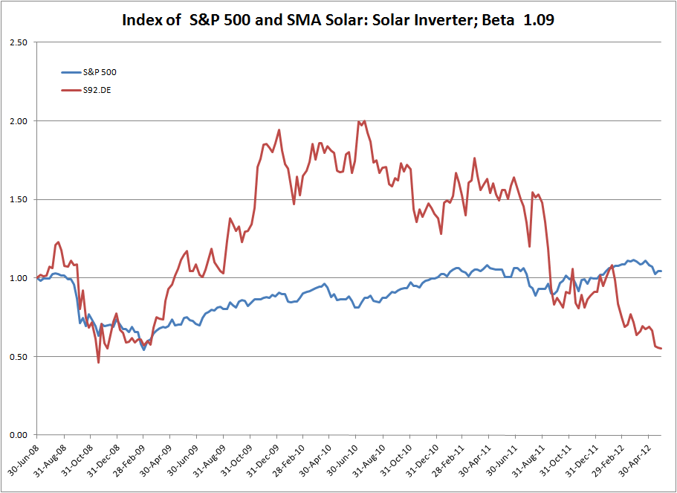
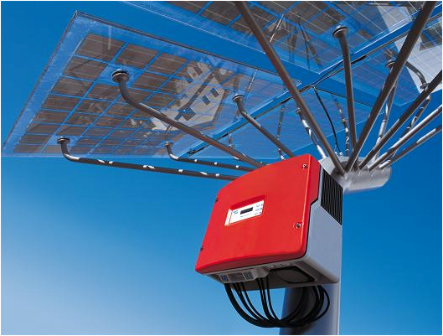
Inverter Cost
Current Costs USD/kWp of 40 to 80 or .4 per W from financial models
Companies: SMA, US-based Power-One, Denmark’s Danfoss and Austria’s Fronius.
SMA claims it commanded a 35% share of the global market for PV inverters.

Slide 51
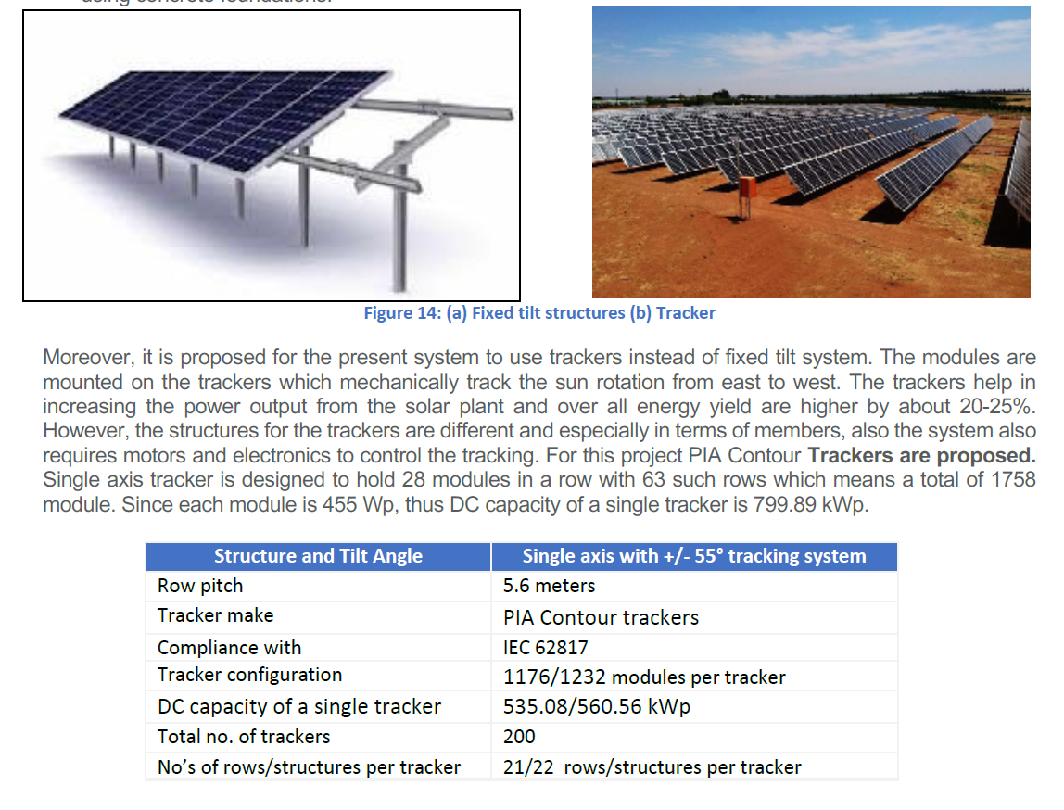
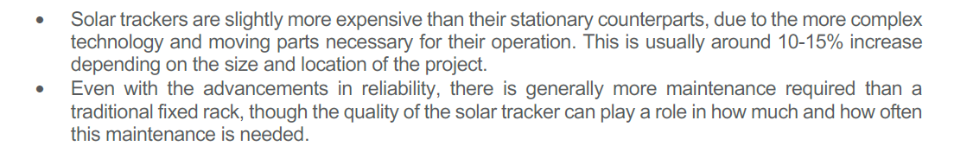
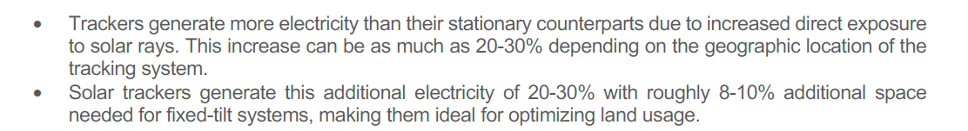
Tracking and Cost – 10%-15% Increase

Slide 52
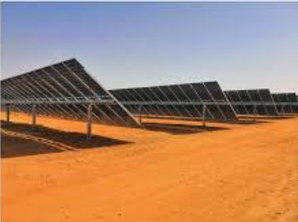
Bi-Facial Costs
Can generate from both sides of the module
Can produce 5-20% more output
Production Costs are not much higher for bi-facial
Wood McKinsey estimates that the increase in cost at only USD 5/kWp (relative to the panel cost of approximately USD 200/kWp.
Module producers offer bi-facial products
Tracking companies making adjustments

Slide 53
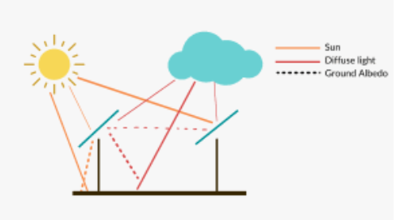
Bi-Facial and Albedo
  Ground Albedo (the amount of whiteness for reflection)
  Best Reflection is snow or sand
  Could increase output by as much as 20%, but typical surfaces like grass are much less
  Depends also on the shadow caused by tilt and inverter placement

Slide 54
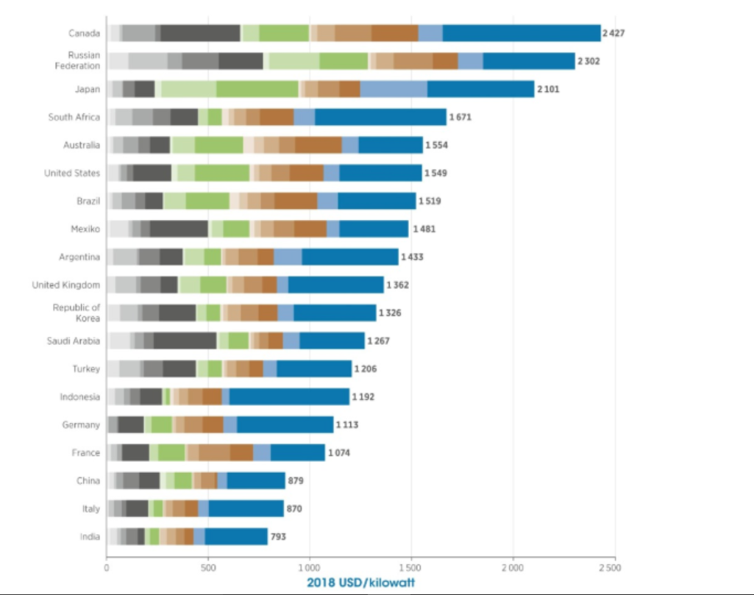
Variation of Total Cost per kWp in Different Countries

Slide 55
Surprising Range in Capital Cost from Published Databases – A little Out of Date
From Lazard, IEA, EIA

Slide 56
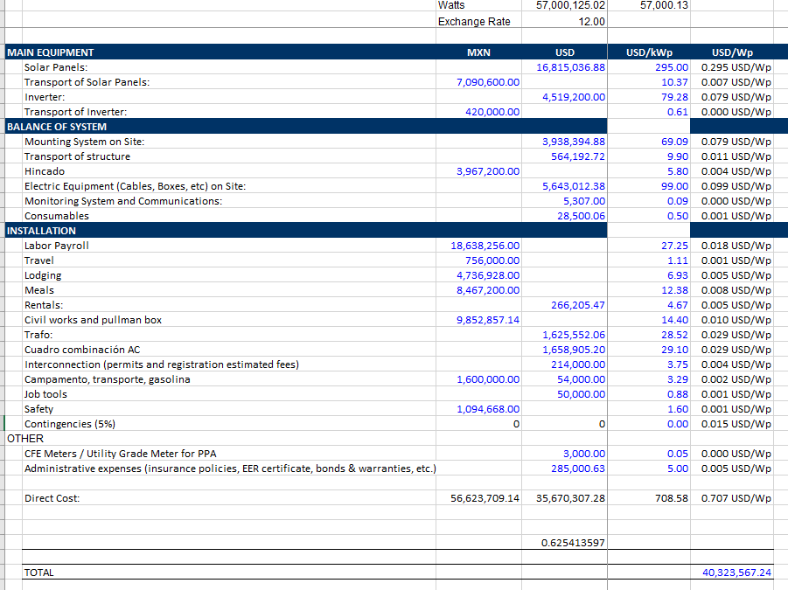
Achieving USD 700 per kW with USD 295/kW Module Cost

Slide 57
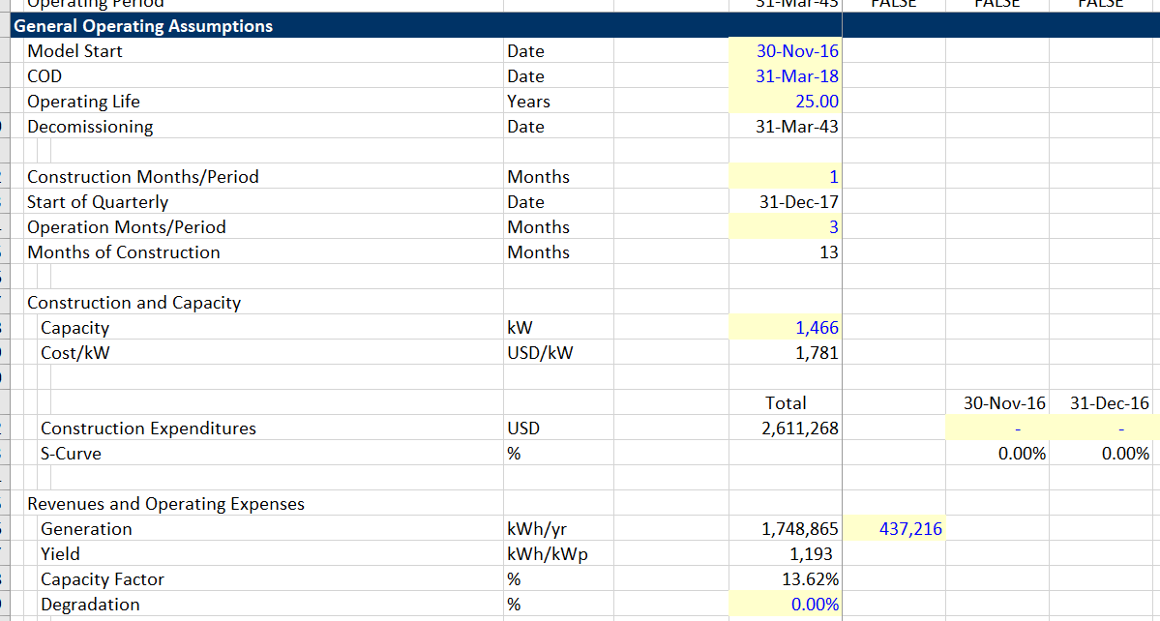
Example of High Cost – NY Project
Note cost/kWp in the Assumptions

Slide 58
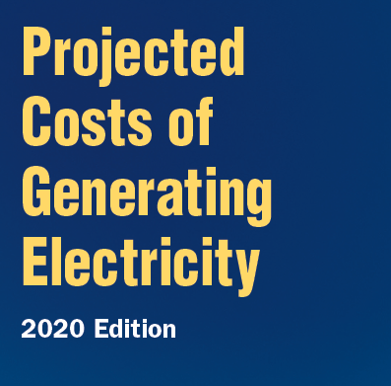
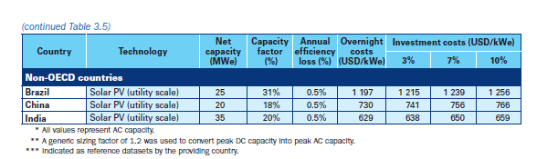
Total Up-front Cost from IEA – India Cost is USD 531/kWp
India Cost in USD per kWp is USD 531/kWp – or 629/1.2
For Brazil in USD/kWp the cost is USD 997.5/kWp or 1197/1.2
We will use these two examples as we proceed

Slide 59
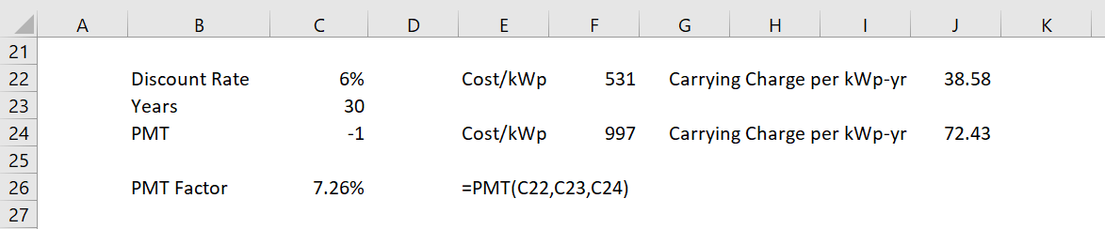
Converting One-time Capital Cost to Capital Cost over the Lifetime of a Project
You can use the level payment function in excel (PMT) and the present value function of a level payment (PV) to make just about all of the calculations.
We can spread out the capital costs using a real or nominal discount rate
Assuming a 30-year life and a discount rate of 6% the factor to spread out costs is shown below:

Slide 60
Real and Nominal Levelised Cost with Capital Costs
Nominal Levelised Cost
  Cost per unit does not change over the lifetime of the project. For example, say the levelised cost is USD 35/MWH. In this case, with 2% inflation, the real cost falls to USD 28.71 per MWH by year 10.
  You will ultimately compare the levelised cost to something – say natural gas prices or electric bills
  It is not reasonable to assume that comparative prices do not change
  Some technologies are more capital intensive, and some are more fuel intensive. If the fuel is in current or real terms, but the capital cost is in nominal terms, then the comparison will not be appropriate
Real Levelised Cost
  Cost per unit increases with inflation and stays level in real terms.
  For example, if the levelised cost is 35/MWH and the inflation rate is 2% and the life is 10 years, then the real cost is USD 31.34/MWH.

Slide 61
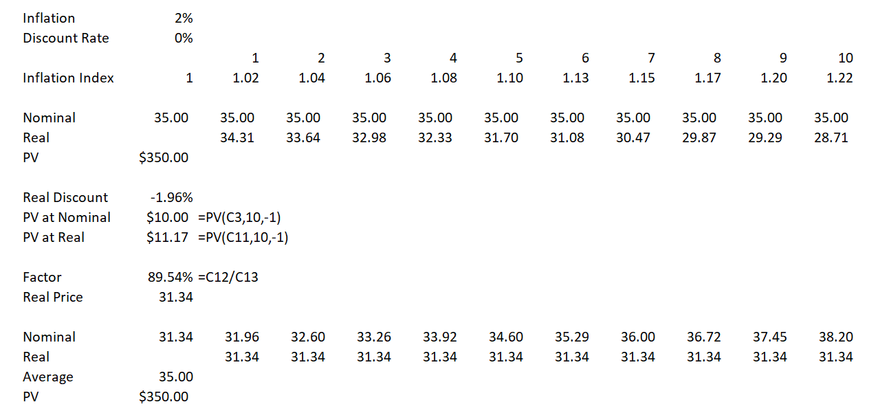
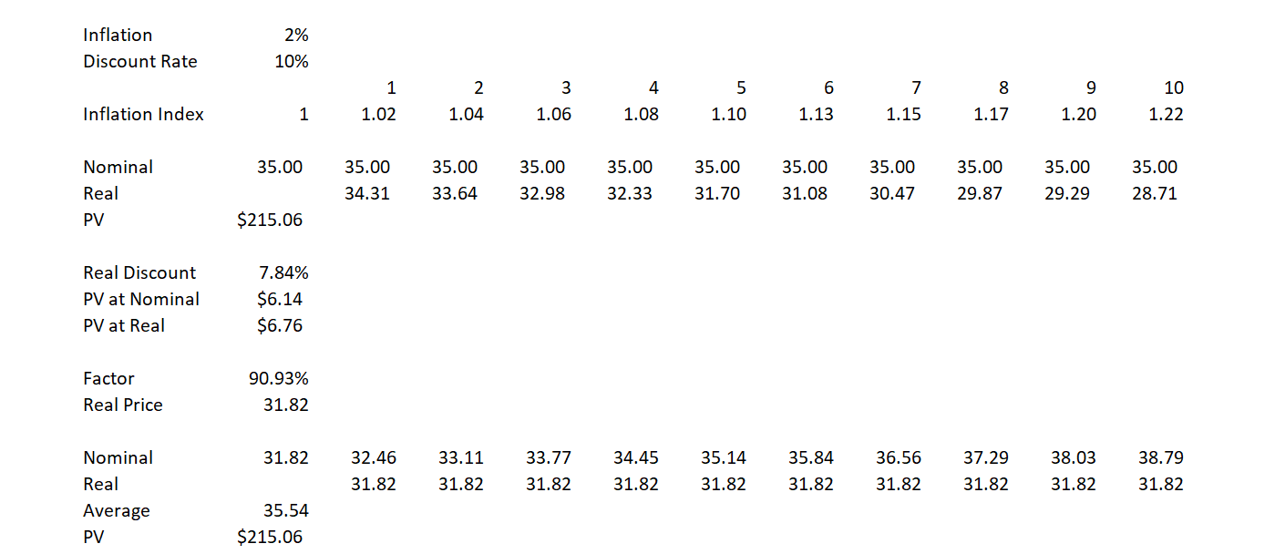
Example of Real and Nominal Levelised Cost for O&M Evaluation
The adjustment depends on the discount rate
Use the PV of 1 with the nominal and real discount rate.
Divide the PV of Real by Nominal
Real Rate is (1+Nom Rate)/(1+Inf)-1

Slide 62
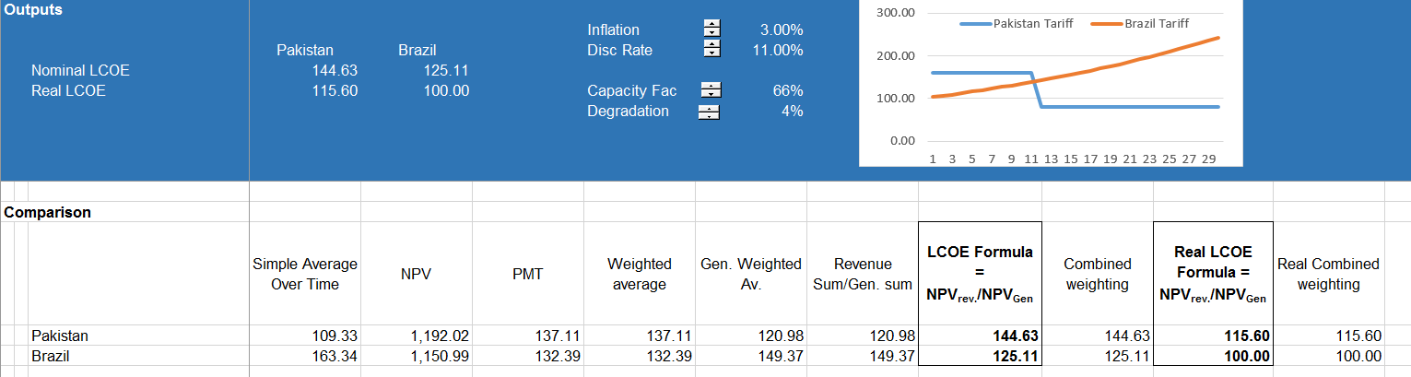
LCOE Illustration
LCOE formula:
LCOE = NPV Revenues/NPV Units

Slide 63
Solar Operating and Maintenance Expenses

Slide 64
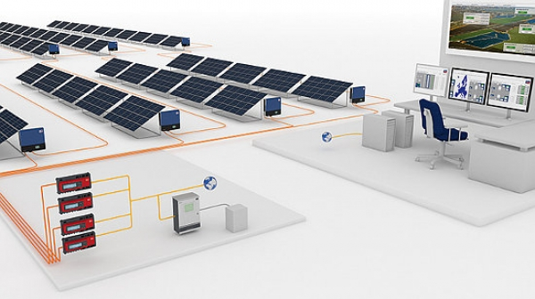
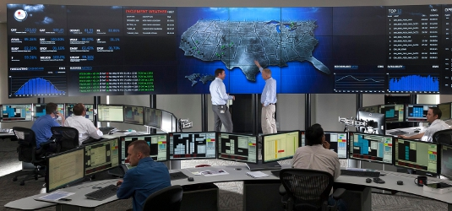

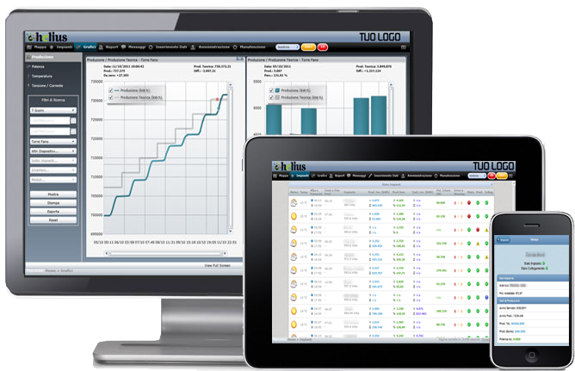
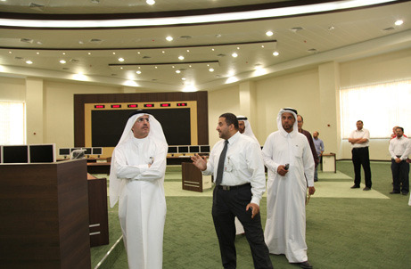
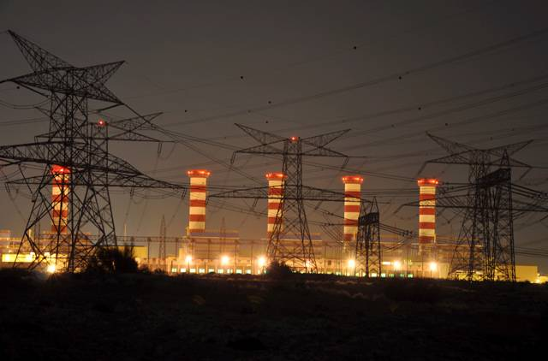
OPERATION & MONITORING OF PV PLANT
RE-ORGANIZE “BUSINESS AS USUAL”
LOCAL – PLANT
OPERATION MONITORING
By Plant Operator
REMOTE – (USA) CENTER
PERFORMANCE MONITORING
By OEM : M/S. FIRST SOLAR
ENSURE:
AVAILABILITY
PERFORMANCE
SAFETY
QUALITY
SMART - WEB
PRODUCTION MONITORING
PERFORMANCE CHECK
& INVOICING FOR O&M
REMOTE – GRID
PROTECTIVE MONITORING
By DEWA (DCC- WARSAN)

Slide 65









MAINTENANCE OF PV PLANTS – FOCUS TOWARDS CLEANING
WASHED DAILY
NOT WASHED
Metro Station
Performance Ratio on each Reporting period is adjusted allowing :
degradation (0.7% per year),
measured ambient temperature,
changes to the irradiance spectrum caused by humidity,
1% allowance for Availability,
2% allowance for soiling (dirt collection)

Slide 66
Solar Operating Expense
Not Only O&M Expense, but includes
  lease expense for land,
  insurance,
  inverter reserve,
  property taxes and,
  asset management.
Examples of Additions to Base O&M Cost
  Recent examples:
    O&M is about USD 7.0/kWy to USD 9.0/kWy.
    Total expenses – USD 19.96/kWy to 22.76/kWy

Slide 67

All of the Costs on Top of Pure O&M
Example from New York – Pure O&M is only 30%

Slide 68
Total Cost/kWy from IEA and Formulas
    USD/MWH Cap Fac Hours
Brazil 6.52 31% 8760 * 31%
China 8.02 18% 8760 * 18%
India 3.69 20% 8760 * 20%
  Hours Total Cost
  USD/kWy
Brazil 2,714 17.29
China 1,576 14.02
India 1,752 6.46
Cost/kWy – Cost per MWH x hours/1000

Slide 69

Example of Benchmark Costs

Slide 70
Operating and Maintenance Cost for Commercial
There is a big variation in Fixed O&M cost expressed in USD/kWyr

Slide 71
Adjustment for Inflation and Degradation when Computing Nominal LCOE
O&M is computed in terms of current currency.
  But LCOE could be computed in nominal, or flat terms over the life of the project
  To adjust for inflation and compute levelised cost of O&M, use the formulas, for now assume that the discount rate is the required project IRR or the WACC:
    Real Discount Rate = (1+Nominal Rate)/(1+Inflation)-1
    Inflation Factor = PV(Real Rate,life,-1)/PV(Nominal Rate,life,-1)
    Nominal O&M = Real O&M x Factor
  To adjust for degradation:
    Adjusted Discount Rate = (1+Discount Rate)/(1-Degradaton Rate) – 1
    Degradation Factor = PV(Adjusted Rate,life,-1)/PV(Nominal Rate,life,-1)
    Nominal O&M = Real O&M x Inflation Factor x Degradation Factor

Slide 72
Adjustment for Degradation when Computing Real LCOE
O&M is normally expressed in terms of current currency (i.e., in real terms)
  To adjust for degradation:
    Adjusted Discount Rate = (1+Discount Rate)/(1-Degradaton Rate) – 1
    Degradation Factor = PV(Adjusted Rate,life,-1)/PV(Nominal Rate,life,-1)
    Nominal O&M = Real O&M x Inflation Factor x Degradation Factor

Slide 73
Total Cost including Capital Cost and Operating Cost
Once you compute the real or nominal cost per kW-year, you can add it to the capital cost to evaluate the total cost that needs to be recovered:
  In real terms using the real discount rate
    With adjustment for degradation in the capital recovery and in the operating and maintenance
  In nominal terms using the nominal discount rate
    With adjustment in the operating cost for both inflation and for degradation
Note that the adjustment for taxes and alternative financing will be discussed in subsequent sections.

Slide 74

Analysis of Inverter Replacement
Levelized cost of inverter replacement should be in O&M. Sometimes called life cycle costs.

Slide 75
Session 3:
Resource Analysis

Slide 76

Solar LCOE with Different Resources

Slide 77
Issues in Resource Analysis
General Objective and Measuring Yields in LCOE Analysis
Alternative Measures of In-plane (Irradiation on collectors) from different sources with and without tracking
Performance Ratio Benchmarks and Calculations with and without Bi-facial Adjustments
Hourly Allocations of Energy for Merchant Price Analysis
Reasonable Benchmarking of Performance Ratio

Slide 78
Yield and Capacity Factor
Yield expressed in terms of kWh/kWp or kWh/kWac has the same information as capacity factor.
Capacity factor is always:
  Average per hour/Maximum
Yield is:
Total across hours/Maximum
For either measure, capacity factor or yield, you need a benchmark for the maximum capacity. For kWp, the capacity is measured by testing the modules at the STC.
The relationship between capacity factor and yield is:
  Capacity factor x 8760 = yield
  Yield/8760 = capacity factor
  Yield is hours at full capacity

Slide 79
Compute the LCOE without Taxes from Resource Analysis
Compute the total fixed cost based on energy (USD/MWH) rather than capacity (USD/kW-yr).
To do this, you need the capacity factor or the yield.
Using the yield is easier since it is expressed in hours, and you want to convert USD/kW-yr into hours USD/kWh or USD/MWH.
  Total Fixed Cost/kW-yr = Capacity Cost/kW-yr + Fixed O&M/kw-yr
  LCOE/MWH = Total Fixed Cost/kW-year / Hours x 1000
  Hours are either
    Yield
    Capacity Factor x 8760

Slide 80
Basic Equations Driven by What you Can and Cannot Control - Start with What You Cannot Control
In-Plane Yield (or Irradiance on Collectors) is controlled by the sun and the earth and the weather and not you.
  The In-plane yield can be measure in annual kWh/m².
  Since at the capacity is measured at 1,000 w/ m², the 1000 accumulated over a year produces 8,760,000 watts or 8760 kWh.
  The in-plane capacity factor could be defined as the annual w/m² /8760 and the in-plane yield is simply the annual w/m²

Slide 81
The Total Capacity Factor or Yield
The final capacity factor or yield is determined by a lot of things you may do with the modules including:
  using modules that are less sensitive to temperature;
  adjusting the size of the inverter that converts to AC power to optimize the amount cost and the usage of the inverters
  adjusting the cleaning strategy of the solar modules
  doing things to change the losses in various different parts of the project
  using bi-facial panels to increase the yield

Slide 82
Final Yield or Capacity Factor After Adjusting for Things You Control
Capacity Factor is again:
  Average Output for an Hour/Maximum Capacity
Yield is
  Total Output for Year/Maximum Capacity
You could measure capacity in terms of kWp (the dc power of the modules from STC) or kWac (the maximum power possible from the inverters)
Performance Ratio = Final/Non-controllable

Slide 83
Pretend for One Hour the Sunlight Irradiation is 1000 Watts per M
If the performance ratio is 100% (Don’t lose from dirt, sizing, temperature etc., the capacity factor is 100%
Capacity Factor of Generation to Grid relative to kWp
Capacity Factor of Sunlight – Average Sunlight Divided by Capacity of Sunlight Defined as 1000 w
Performance Ratio is the Capacity Factor of the Final Divided by the Capacity Factor of Amounts that Hit the Array

Slide 84
First, Some Terms
Horizontal global irradiation
This is only useful when there is no tilt. The only case where it is optimal to have no tilt is when you are on the equator. It can be useful for benchmarking
Effective irradiance on collectors
This accounts for tilt and tracking. The capacity factor at this point is the basis for computing the performance ratio. Also called Point of Access Irradiation
Corrections for reflection (IAM) and soiling
The IAM depends on tilt and soiling is estimated. These are part of the performance ratio.
Energy injected to grid at AC
This is the final number of use in computing the performance ratio and in the final yield and capacity factor.

Slide 85

Differences in Data Sources

Slide 86
Formulas for Yield and Capacity Factor
The energy from a solar project can expressed as capacity factor or yield. Capacity Factor is always average over the period divided by maximum for the period
The energy hitting the solar plane (point of access) can be expressed as a capacity factor. As the maximum capacity is defined by the 1000 watts per meter squared, the average for the period per hour divided by1000 gives you the capacity factor.
The energy produced can also be expressed as a yield or kWh/kW. As the yield is expressed in hours, there is a direct relationship between capacity factor and yield:
Capacity Factor = (Yield/8760)

Slide 87
Solar Resource Assessment
The solar resource assessment depends on the latitude of the location on the earth as well as the cloudiness or clearness. It also depends on the temperature.
The step-by-step process used by various satellite models include:
  Compute the declination angle that depends on the day of the year
  Compute the sunset angle and the hours of sunlight that depend on the latitude of the location.
  Compute the sunlight radiation from the clearness index

Slide 88
Three Solar Resource Orientations
Direct normal insolation (DNI) is most relevant to concentrating solar plants.
  Cloud cover reduces the direct insolation.
When discussing the solar resource, it is common to consider three orientations:
  Horizontal
    Horizontal insolation is that received by any flat, horizontal surface, such as a lake, hay field, swimming pool or warehouse roof.
  Global tilt
    Global tilt insolation is that received by any flat surface tilted to the south at a tilt angle approximately equal to a site’s latitude, like a sloped residential rooftop.
  Normal
    Normal insolation is that received by a tracking surface that always faces the sun, such as a solar collector which tracks the sun’s movement through the sky.

Slide 89

Direct Normal Irradiance

Slide 90

Adjustments for Tilt and for Tracking

Slide 91

Cloud Cover and PV Generation

Slide 92
Weekly Solar Irradiation – Note it is sometimes above the 1,000 STC

Slide 93

Illustration of STC

Slide 94
Solar Power Yield and Capacity Factor

Slide 95

Case Study of Different Estimates from Different Models

Slide 96

Helioscope
Implied In-plane irradiation:
1,713.5/83.9% = 2042.31 kWh/m2
Capacity Factor 1713/8760 = 19.55%

Slide 97

PV Syst 1 - General
344 kWp and 294 kWac

Slide 98

PV Syst 2
Global Incident Irradiation on collector 2497.2 = 28.39%
Final Production - yield 2189 = 24.98%
Performance ratio computed 2497/2189 = 87.65%

Slide 99

EU PV GIS

Slide 100

Horizontal – 1869.58 kWh/m2

Slide 101

PV GIS with Tracking

Slide 102

PV Watts
5.53 x 365 =

Slide 103

From World Bank

Slide 104

Different Models of Solar Resource
First, there may be different solar resource estimates
2210/2110 == 5% Difference

Slide 105

Comparison of Estimates

Slide 106
Performance Ratio

Slide 107
Case 1: Pretend for One Hour the Sunlight Irradiation is 1000 Watts per M
If the performance ratio is 100% (Don’t lose from dirt, sizing, temperature etc., the capacity factor is 100%
Capacity Factor of Generation to Grid relative to kWp
Capacity Factor of Sunlight – Average Sunlight Divided by Capacity of Sunlight Defined as 1000 w
Performance Ratio is the Capacity Factor of the Final Divided by the Capacity Factor of Amounts that Hit the Array

Slide 108
Performance Ratio
The performance ratio is a measure of the quality of a PV plant that is independent of location and it therefore often described as a quality factor. The performance ratio (PR) is stated as percent and describes the relationship between the actual and theoretical energy outputs of the PV plant. It thus shows the proportion of the energy that is actually available for export to the grid after deduction of energy loss (e.g., due to thermal losses and conduction losses ) and of energy consumption for operation.
The closer the PR value determined for a PV plant approaches 100 %, the more efficiently the respective PV plant is operating. In real life, a value of 100 % cannot be achieved, as unavoidable losses always arise with the operation of the PV plant (e.g. thermal loss due to heating of the PV modules). High-performance PV plants can however reach a performance ratio of up to 80 %. The performance ratio informs you as to how energy efficient and reliable your PV plant is. With the performance ratio you can compare the energy output of your PV plant with that of other PV plants or monitor the status of your PV plant over a prolonged period.
The determination of the performance ratio at fixed regular intervals does not provide an absolute comparison. Instead, it provides the operator with the option of checking performance and output: if it is assumed that the PV plant is running optimally on being commissioned, and hence that the initial value for the performance ratio is 100%, then taking of further PR values over time enables the identification of deviations, meaning that appropriate countermeasures can be promptly initiated. Deviations in the PR value in the form of values below the normal range therefore indicate a possible fault in your PV plant at an early stage.
Formula for manual calculation of the performance ratio
PR = Actual reading of plant output in kWh p.a. / Calculated, nominal plant output in kWh p.a

Slide 109
Example of Computing Solar Output
Measured average solar irradiation intensity in 1 year: 120 kWh/m2
Efficiency factor of the PV modules: 15 % [ “Assume typical” The energy conversion level of the solar cell or solar module.] Electrical energy actually exported by plant to grid: 110 kWh
The irradiation values measured on location yields an average solar irradiation for the entire analysis period of 120 kWh/m2 This irradiation value is extrapolated to the modular area of the PV plant as follows:
Irradiation value in kWh/m2 x plant area in m2= 120 kWh/m2 x 10 m2= 1,200 kWh
In order to subsequently calculate the nominal plant output, the irradiation value for the PV plant is multiplied by the modular efficiency: 1,200 kWh x 15 % = 1,200 kWh x 0.15 = 180 kWh. This anticipated nominal plant output corresponds to a performance ratio of 100 %.
However, the actual value for electrical energy exported by the PV plant to the grid is only 110 kWh. If this value and the calculated nominal plant output are fed into the formula for calculating the performance ratio, the following result is obtained:
The PR value is approx. 61 %. This means that approx. 39 % of the incident solar energy in the analysis period is not converted into usable energy due to circumstances such as conduction loss, thermal loss or, for example, defects in components. Here the performance ratio acts as an indicator and can prompt more detailed inspection of the PV plant so that, for example, soiling of the PV modules is removed or defective components can be repaired or replaced.

Slide 110

Differences in Output Due to Factors Other Than Solar Radiation – Explained by Performance Ratio

Slide 111
Balance of System and Inverter
Inverters convert the direct current (DC) that is generated by the PV modules into alternating current (AC)
Required for grid-connected systems, the grid only accepts AC power.
The inverter plays a crucial role in a PV system, as the inverter defines a large part the
(1) efficiency
(2) reliability
(3) yield of a PV system
Micro Inverters avoid the Christmas Tree effect

Slide 112

Work Through PVSyst
Can divide the energy injected to grid divided by radiation on collectors
Don’t need anything other than the column of Effective Irradiance on Collectors as well as Energy Injected into the Grid. Convert both of these to capacity factors and then divide the energy into grid by the irradiation on collectors.

Slide 113



Loss Diagram Illustration
Convert loss diagram into capacity factor and compare different cases.
Difficult to compute performance ratio from these diagrams.
Generally, the loss due to temperature is the largest loss factor.

Slide 114
PVSyst and Waterfall Chart for Capacity Factor
You can use the waterfall macro to make this chart. Note the temperature coefficient is the largest negative bar.
The performance ratio is computed from dividing the final bar by the second blue bar.
PR is 22.34/26.94 or 81.12%

Slide 115
Loss Diagram for Australia
Loss diagram from using waterfall diagram macro in terms of capacity factor. Again the temperature is the biggest factor.
PR = 22.32/27.47 or 81.31%

Slide 116
Mexico Loss Factor
Again, the largest loss factor is the temperature effect.

Slide 117
Decomposing the Performance Ratio – POA is point of Access
The final capacity factor can be expressed using the formula:
Final CF = CF at POA x (1-loss1) x (1-loss2) x (1-loss3) x (1-loss4) ….
This can also be expressed as:
Final CF = CF at POA x (1-Temprature) x (1-other losses)
Since PR = Final CF/CF at POA, then
PR = (1-Temprature) x (1-other losses)

Slide 118

Looking for Correlation between Temperature Loss and Temperature Levels
The table below shows that expected correlations between temperature coefficient and temperature loss is not consistent.
This should be the basis for questions rather than going through the detail.

Slide 119

Performance Ratio within Year
The performance ratio can be computed on a month by month, recognizing that:
  PR = Final CF/CF at POA.

Slide 120

Loss Diagram

Slide 121
Use of Regression to Find the Implied Temperature on the Panels
Objective: Come up with a reasonable method where you can use the temperature reported in the EU website and derive a reasonable production estimate.
At the end of the section you can do the following with the EU data:
Compute the Panel Temperature from the Ambient Temperature
  For example, Panel = 20 + 1.2 * Ambient
  Apply the temperature coefficient to the panel temperature
  Use a typical loss factor for other items
  Therefore, derive a performance ratio that is a function of the temperature

Slide 122
Scatter Plots of PR and Temperature
You can create scatter plots within a year and there should be a strong negative relationship. Note the temperature coefficient is about -.4 % change to C.

Slide 123
Performance Ratio and Temperature in Other Cases

Slide 124







CHRISTALINE
TECHNOLOGY
THIN FILM TECHNOLOGY
Monocrystalline silicon
Policrystalline silicon
Amorphous silicon
Cadmium telluride
Copper indium selenium (CIS)
The module efficiency
is described by the formula:
The modules are thermally sensitive
HIGHER the ambient temperature- LOWER the output
Voltage at maximum power point
Current at maximum power point
Global horizontal irradiance
 | Type of cell | Crystalline |  | Thin film
Number | Types of material | Monocrystalline | Polycrystalline | Amorphous silicon tandem | Micromorphous silicon | CIS | Cadmium telluride CdTe
1 | Efficiency* | 16% - 20% | 14% - 17% | 4% - 7% | 7% - 10% | 10% - 14% | 9% - 12%
2 | Temperature influence | High | High | Low | Low | Low | Low
3 | Frame material | aluminium | aluminium | frameless | frameless | frameless or aluminium | frameless
4 | Backside cover | Plastic | Plastic | Glass | Glass | Glass or plastic | Glass
5 | Max. operating temperature | 85°C | 80 – 125°C | 85°C | 85 – 90°C | 85°C | 85°C
6 | Long time experience | Approx. 20-30 years | Approx. 20-30 years | Approx. 5-10 years | Approx. 5-10 years | Approx. 5-10 years | Approx. 5-10 years

Slide 125







CHRYSTALLINE
7000 AED / kW
13 MW PV Plant 15 days
Performance Ratio:
1,079,617 (kWh)
96.5 (kWh/m²) x 110,073 (m²) x 0.119
= 85.5%
Yearly Degradation expected
~1% or 25% in 25 years
Thin Film – 9 m² / kW
7000 AED / kW
THIN FILM
Crystalline (Si) – 6,5 m² / kW
LAND MOUNTING
THIN
FILM
ROOF MOUNTING
Poli & Mono
Crystalline

Slide 126
Temperature Coefficient
The temperature coefficient is the value of the slope for the percent change in output versus the change in temperature.
  For example, the temperature coefficient of a Sharp Solar Panel NU-U230F3 is -.485% per 1 degree Celsius.
  So, for every degree above 25°C, the maximum power of the Sharp solar panel falls by .485%, for every degree below, it increases by .485%.
The problem is that the temperature is not the Ambient Temperature but the temperature of the panels.

Slide 127

Example of Temperature Coefficient
You can find temperature coefficients – some examples are listed below.

Slide 128

Problems with Measuring Temperature on Panels versus Ambient Temperature
Note how the example adds 30 degrees to the panel.

Slide 129
Derive Implied Panel Temperature
Percent Loss * 100 = (Panel Temp - 25) x Temperature Coefficient
Input Temperature Coefficient
Compute Loss from PR and Other Losses
Derive Panel Temperature from Equation Below
Percent Loss * 100/Temp Coefficient = (Panel -25)
Panel = Percent Loss * 100/Temp Coefficient + 25
Panel Temp = Amb Temp * Mult Factor + Constant Factor

Slide 130

Example of Finding Implied Panel Temperature
This example works through the equations and comes up with a slope and intercept.
In this case Panel = 15.26 + Amb * 1.18

Slide 131

Second Example of Finding Panel Temperature
The implied panel temperature depends on input for the temperature coefficient and the performance ratio.

Slide 132

Inconsistent Results
If the results would be consistent in terms of the slope and the intercept, then an independent equation with the temperature coefficient could be applied.

Slide 133

Temperature and Power Reduction
Definition – Percent Change in Production Divided by Change in Temperature

Slide 134

Linear Effect of Temperature on Output

Slide 135

Exercise of Matching PV Array to Inverter

Slide 136
Degradation

Slide 137
Degradation in PV system performance
PV module is not the main cause of performance degradation.
Latest trends indicate that R&D and innovation is shifting from efficiency improvements at cell level to system level improvements including inverter
Balance of System, O&M and project management improvements and the enhancing the efficiency of existing installations at the module level.

Slide 138
PV warranties
  Bankability of PV modules has (partly) to do with the warranty…
    … but the first questions to answer are: (1) are certifications in place, (2) is there a track record and (3) to whom did the company sell its modules
  Almost all module manufacturers offer the same warranties
  90% output in 10 years and 80% output after 20 years.
  Nobody really knows if panels can stand the test of time.
  Corrosion, yellowing plastics, dopants that move or electro migration can always happen!
Warranties only make sense if the company offering such warranties has a strong enough balance sheet and a prosperous future.

Slide 139
Land Use and Solar Power
Solar radiation has a low energy density relative to other conventional energy sources, and for all but the smallest power applications, therefore, requires a relatively large area to collect an appreciable amount of energy.
  Typical solar power plant designs, require about 5 acres per megawatt of generating capacity. For example, a 200 MW thermal trough plant would require about 1,000 acres of land. Likewise, a 30 MW thin-film PV array in central Texas would require about 168 acres.4
While the construction of large solar power plants is technologically feasible, their size requires that land use issues be considered.
  These concerns may be mitigated to some extent since large solar power plants tend to be located in remote, unpopulated areas, and since small, distributed solar facilities are typically located on rooftops of existing buildings.

Slide 140
Evaluation of LCOE

Slide 141
Economics, Marginal Cost and Levelised Cost
A central question in evaluating the economics of solar or just about anything is whether the ultimate long-run production cost -- the levelised cost -- LCOE, or LCOH for hydrogen, or LCOS for storage -- is less than then alternatives measured at their short-term or long-term marginal cost. For example, is the cost of solar less than the operating cost of natural gas or the variable charge on your electric bill.
One way to use the LCOE, LCOH, LCOS or the levelised cost per unit of just about anything is to make an initial evaluation of the business case for different strategies.
LCOE depends on the cost of capital, taxes, inflation, the life of the asset and the degradation rate in the productivity of an asset.
This section works through how to compute the carrying charge components of the LCOE. With the carrying charge rate, you can put your own capital cost per kW, operating cost, capacity factor and derive the total LCOE. Then you can evaluate the marginal cost of energy, then consumer bills will be reduced from using more solar power.

Slide 142

Example of LCOE versus Electric Bill
Focus on variable charges

Slide 143
LCOE for Base Load and Intermittent Plant
Treat the levelized cost analysis differently for a base load plant and an intermittent low-capacity factor renewable energy plant.
For the base load plant measure the avoided cost of unavailable time.
For the intermittent plant with low-capacity factor (e.g., solar and low-capacity factor wind), measure the levelized cost relative to short-run avoided cost (should include the cost of ancillary services).
For the intermittent plant with a high-capacity factor (e.g., off-shore wind and geothermal), could perform a loss of load probability analysis that credits the intermittent plant with some capacity value.
Note that the carrying charge formula is consistent with the formula:
LCOE = NPV(Revenues)/NPV(MWH) when degradation is accounted for in the carrying charges and the carrying charge formula includes inflation. This implies that the carrying charges are computed on a real and not nominal basis if all the fuel and O&M components are inflated on the same basis.

Slide 144
Carrying Charges, Cost of Capital and Financial Modelling versus LCOE

Slide 145
Objectives of Session
    General objectives an importance of financial model.
    Key outputs of financial model and meaning of IRR
    Structure of financial model using LCOE as price of power

Slide 146

Use of LCOE for Comparison with Dispatchable Technologies
Compare Real LCOE (not nominal) to Current Variable Costs including Fuel and Variable O&M. Can make adjustment for spinning reserve also.

Slide 147
Revenue Build-up and LCOE
LCOE is the levelized or weighted average price of electricity over the lifetime of a project
Cost of electricity is Revenue/MWH
LCOE is weighted Revenue/MWH over the lifetime of a plant
Weighting
  Cost of capital so future revenues have lower weight than current revenues
  Amount of generation so periods with more generation have more weight
Instead of detailed weighted average could use NPV formula where
LCOE = NPV of Revenues/NPV of Generation

Slide 148
Example of LCOE
Prices
  Price in Year 1 is 100
  Price in Year 2 is 200
Generation
  Generation is 500 in year 1
  Generation is 1000 in year 2
Discount Rate is 10%
  PV Factor is 1/1.1 = .909 in year 1
  PV Factor is 1/1.21 = .826 in year 2
Average price is 150
Weighted average price for Generation is: 33 x 100 + .67 x 200 = 33 + 134 = 167. This can be computed as (100 x 500+200 x 100)/1,500 or 167. This is sum of revenue/sum of generation
Weighted average price for discounting is .909 x 100 + .826 x 200 divided by (.909 + .826)
LCOE Combines weightings

Slide 149

Computing the Carrying Charge to Switch Capital Investment into a Annual Fixed Cost
This chart illustrates the large effects of taxes and inflation on the measurement of carrying charges.

Slide 150
Reconciling Project Finance Model and Carrying Charge Rates

Slide 151
Financial Model and LCOE are the Same Thing
In this section I work through a financial model and demonstrate the LCOE and the results of a financial model are the same thing, just presented in a different way.
The LCOE starts with the required IRR and financing assumptions and derives prices
A financial model starts with the price (from LCOE analysis) and derives the IRR

Slide 152
Financial Model Objectives
    General Objectives of Financial Model
        Database of relevant information for debt and equity investors
        Financial model the same as LCOE in another format
        Key outputs of financial model – IRR and DSCR
        Presentation of key drivers in financial model – cost/kWp, O&M cost/kW-year, capacity factor and financing
        Price of power in real or nominal terms in model
      Review of selected actual models

Slide 153
Fundamental of Creating Any Financial Model
Making a well structured, flexible, accurate and transparent model (the FAST letters).
Do not worry about silly rules, just keep these ideas in the back of your head somewhere.
  Flexibility is illustrated by learning how to make timelines in seconds with a differentiation between the pre-COD and post-COD periods.
  Accuracy is covered by using TRUE/FALSE switches that assure that the balance sheet balances among others.
  Structured means that you should first compute the project IRR pre-tax; then add taxes; and put the financing in only after the after-tax project IRR is computed.
  Transparency means that you can see everything with simple formulas using F2 and that you can find the source of the inputs in driver columns to the left and then use the CNTL [.

Slide 154
Principles of Creating a Financial Model
Creating a financial model from the LCOE makes you think about some of the fundamental principles of making a financial model.
This is to make a well structured, flexible, accurate and transparent model (the FAST letters). Do not worry about silly rules, just keep these ideas in the back of your head somewhere.
Flexibility is illustrated by learning how to make timelines in seconds with a differentiation between the pre-COD and post-COD periods.
Accuracy is covered by using TRUE/FALSE switches that assure that the balance sheet balances among others.
Structured means that you should first compute the project IRR pre-tax; then add taxes; and put the financing in only after the after-tax project IRR is computed.
Finally, transparency means that you can see everything with simple formulas using F2 and that you can find the source of the inputs in driver columns to the left and then use the CNTL [.

Slide 155




Project Finance Model Structure Changes at COD
Before COD, cash flow is presented in the sources and uses statement
After COD, cash flow is presented in the cash flow waterfall and the last line is dividends
Father of the bride makes commitment to pay for wedding
Commitment Fee
Development is Dating period. Probability of failure is high
Pay for Wedding with Other peoples money
Pay your Bills and re-structure your life. Stuck with PPA type contract. May default.
FC is just after engagement date
COD is Wedding Date
Decommissioning Date

Slide 156
Project Finance and WACC
In the last diagram it would be crazy to assume the risks associated with a relationship are the same over the course of the relationship.
Similarly, assuming that the risk of a project is the same over the life of a project makes no sense at all.
Additionally, the equity to capital ratio on a book or an economic basis is not the same over the life of a project.
This is unlike project finance, a corporation with portfolios of projects may have a reasonably constant WACC

Slide 157
Spanish Case and Political Risk with PIRR Assessment
Higher or similar feed-in tariffs to Germany and much higher capacity factors.
Germany had limit on capacity, Spain did not.
Total Cost of 26.4 Billion Euros

Slide 158
Time-Line and Changing Risk are Crucial in Project Finance
RISK
A crucial Feature of Project finance is CHANGING -- DECLINING RISK
Financial Close
Completion Test

Slide 159
Some General Ideas
Project Finance in Western Countries may not be effective or efficient for development in Africa
When evaluating financing in project finance, things come down to the equity IRR and the DSCR – understand these ratios at a very deep level
Cannot make an investment decision without fully understanding the economics of the project (a high IRR without a lot of risk suggests something is too good to be true)
Need to decipher financial models and to translate project documents – this can be torture, but you should know what to look for

Slide 160
Classic Project Finance Diagram – Is it Really Good for Africa – Follow the Money and Start with Revenues
Off-taker: Want strong off-taker with inactive to honor contract
Each contract can have many nuances with penalties, bonuses, default clauses, termination.
EPC Contractor: Want Strong Record and Finances
Price Risk or Volume Risk or Both or None (Availability)
EPC: Fixed Price Contract with LD
Supplier: Need to Understand Economics and Supply Curve
Special Purpose Vehicle: Bond Rating of BBB-
O&M Contractor
Supply Agreement
O&M Agreement
Loan Agreement – Draws Green; Debt Service Red
Banks Like Strong Sponsors. Sponsors want EIRR
Shareholder Agreement
Lenders:
Lenders want DSCR (LLCR, PLCR)
Invest with paid in cap; payback dividends
Invest with draws; payback debt service

Slide 161

Diagram of Project Finance
Volume or price or availability risk in model, and then, the IRR’s of each party and the DSCR’s of the lenders. Include cost to off-taker for the project economics.

Slide 162

Example of Timelines and Project IRR
The screenshot below illustrates the first part of a financial model with concepts of a flexible timeline; transparent input presentation at the left and structuring with a project IRR. Note the price comes from the real LCOE.
.

Slide 163

Financing and Debt Schedule
After establishing the pre-tax and post-tax project IRR, you are ready to work on the financing part of a model. The big issue in modelling is often deriving the method of debt repayment. In this example, I use the economic depreciation to compute the capital associated with the project. This economic capital is used to divide the capital between debt and equity. Once you have the debt balance, you can derive the debt repayment. Then, in any model there should always be a debt balance and an interest computation. Note in this case that the after-tax interest rate is below the after-tax project IRR.

Slide 164

Equity Cash Flow, IRR and DSCR
The final part of the model includes a cash flow waterfall and calculation of equity cash flow that includes the initial sources and uses of cash. You can then also derive the DSCR implied by the debt to capital ratio.

Slide 165
Interpretation of IRR
      Interest rate as IRR
      IRR as growth rate with re-investment
      Total cash collected with different IRR’s
      Project IRR compared to debt interest rate – pre-tax
      Goldie Locks principle and IRR – Case of Spain and Africa
      Equity IRR and levels of debt
      Target IRR as cost of equity capital
      Target IRR’s and compression for existing solar projects
      Computing price from Target IRR
      Verification of LCOE with financial model

Slide 166

Nominal Cash Flow
In IRR, you compute can compute the cash flows generated from re-investing. The example below over 60 years illustrates that a small difference in cash flow results in a big difference in accumulated cash.

Slide 167
Case 1: Starting Point
No Debt
No Inflation
Constant Cost of Capital
No Taxes
No Construction Period
PMT function and Project Finance Model with Equity IRR and Goal Seek Produce the Same Result
Demonstrate that you can just use the capital cost and a carrying charge rate with inflation or a project finance model
  Required EBITDA = Capital Cost x Carrying Charge Rate
  Required Revenue = EBITDA + Operating Expenses
  Level Price = Required Revenue/Generation

Slide 168
Case 2: Understanding of Real vs Nominal LCOE
Allow Price to Inflate in the simple project finance model
Think about an alternative project with only fuel cost and where fuel cost increases with inflation
Financial Model – Inflation and Goal Seek to get target IRR
PMT function – Use Real Rate and then Inflate the PMT
  Real rate is (1+target IRR)/(1+ Inflation)-1
  Now the EBITDA is the first year EBITDA
  Now the LCOE is the Real LCOE

Slide 169
Case 3: Degradation
In project finance model put in reduction in output – if panels lose 15% of output in 25 years, then the annual degradation is:
  Annual = (1+15%)^(1/25)-1
Include a reduction in generation in the project finance model and re-do the target IRR.
When using the PMT function, treat like negative inflation
Point about the generation changing too and the reason for LCOE formula where:
  Real LCOE = NPV(Nominal Rate, Revenues)/NPV(Real Rate, Generation)

Slide 170
Case 4: Taxes and No Debt
Note how leave debt to the end.
In project finance model include depreciation and then multiply EBITDA by taxes. Then use Target IRR.
In case with PMT, need to first compute depreciation from capital cost.
Then use algebra:
  Revenues = Equity Return + Taxes
  Taxes = (Revenues – Depreciation) x Tax Rate
  Revenues = Equity Return + (Revenues – Depreciation) x Tax Rate
  Revenues – Revenues x Tax Rate = Equity Return – Depreciation x Tax Rate
  Revenues = (Equity Return – Depreciation x Tax)/(1-Tax Rate)
  Revenues = (PMT with Inflation – Deprecation x Tax)/(1-Tax)

Slide 171
Case 5: Construction Period but Still No Debt
Run project finance model and add a construction period
Use PMT function with FV instead of simple plant cost
When using FV use the real required equity IRR
Note that everything depends on the IRR premium above the rate of inflation

Slide 172
Case 6: Debt
Alternative debt assumptions
  Sculpting
  Re-financing
  Tail by the end of re-financing
Key is the interest rate relative to inflation
With re-financing, the amount of debt and the credit spread really matter and not the tenor of the debt

Slide 173
Day 2, Session 2: Project Financing of Solar Power

Slide 174
Interest Rates and Inflation
Interest Rates Related to Inflation – US. Negative Real Rate

Slide 175
Interest Rates and Inflation
Interest Rates Related to Inflation - US

Slide 176
Inflation Expectations in Cost of Capital
Expected inflation from Index bond less nominal interest rate

Slide 177
Inflation and Interest Rates in India
Real Rate is the key to LCOE

Slide 178
Credit Spreads
BBB Spreads for Project Finance

Slide 179
Credit Spreads – More Detailed Graph
Spreads between 1.3% and 2.2%

Slide 180
Day 2, Session 2:
Risk Analysis of Resource and P90/P95/P99

Slide 181
Resource Analysis
    Review and understand solar resource studies and importance of solar resource analysis in risk analysis
    Analyse In-plain resource and yield
    Performance ratio and understanding PVSYST
      Reason for studying uncertainty – output-based project
      Resource uncertainty and DSCR analysis – Percent Acceptable = (DSCR-1)/DSCR
      Intuition behind P90/P95/P99
      Normal distribution and estimation of probability levels
      Risks that are mean reverting and risks that are non-mean reverting
      Sources of mean reverting and non-mean reverting uncertainty

Slide 182
Weekly Solar Irradiation

Slide 183
Sources of Uncertainty
    Uncertainty and P90/P95/P99 from Radiation Uncertainty
        Computation of standard deviation of monthly and annual resource
        Comparison of standard deviation for different regions and for tracking/non-tracking
        Calculation of P90/P95/P99 from standard deviation
        DSCR from in-plane resource variation
        Interpretation of DSCR in terms of probability of default
    Uncertainty from Modelling/Data/Configuration Errors
        Example of errors from data sources
        Errors in modelling soiling/losses/inverter performance
        Errors in modelling temperature coefficient
        Combining uncertainty with mean squared error
        Calculation of one-year P90/P95/P99 from combined standard deviation
        Calculation of 10-year P90/P95/P99 from non-mean reverting standard deviation
        Judgement in computing standard deviation from modelling errors

Slide 184
Solar Data Reliability
There are various data sets for both DNI and global. Generally, ground measurement for DNI and global is more accurate than satellite data. The most accurate ground measurement is about 3% for DNI and about 5% for global.
In conjunction with the independent solar resource consultant's assessment, we will factor in the knowledge of institutions such as the U.S. National Renewal Energy Laboratory (NREL) to reach a conclusion on the likely accuracy of the resource data.
  For example, according to NREL, the National Solar Radiation Database (a composite model) data accuracy has a range of 9%-15% uncertainty with DNI being closer to 15% and global 9%.
  NREL indicates that accuracy could improve with the use of ground-based measurements at the project site; and, based on discussions with many industry participants, we believe several project developers will likely make ground-based measurements of the resource at the project sites to gain accuracy and increase confidence in the solar data.

Slide 185
Differences in Data Sources

Slide 186

On-Site and Simulated Solar Power
Compute P50 for P90 for wind versus solar

Slide 187
Where Uncertainty Comes From
First, there may be different solar resource estimates

Slide 188
Variation in Solar Radiation
Solar radiation varies according to a combination of predictable annual and daily cycles, and irregular (though not entirely unpredictable) changes in weather.
The annual and daily average variation is predictable within certain bounds;
  hourly variation over the course of a day is more difficult to predict.
  Certain events such as major forest fires and, even more significantly volcanic eruptions, can produce unexpected declines in solar irradiance for extended periods of time.

Slide 189

Variation in Solar Resource
In general, most sources indicate that the solar resource is fairly stable from year to year.
  For instance, there is a low annual standard deviation (3% to 5%) of global solar insolation for select cities in the U.S. as a percentage of the mean based on the National Solar Resource Database's 45 years of measured and modeled data (see table 1).
This suggests that annual generation levels based on insolation should be stable.

Slide 190

Variation in Solar Irradiation
Compute P50 and P90 and compare to wind distribution and hydro distribution

Slide 191

Output from EU file on Point of Access and Output to Grid
The yield analysis demonstrates that different sources can give you different results and this comes from either the point of access energy or the performance ratio.

Slide 192

Solar Power Yield – Database of Actual Production
Note the small actual variation in solar production – the problem is the starting point and risk goes down after COD.

Slide 193

Year by Year Variation
Compute the P90 level from standard deviation and average using NORMINV

Slide 194

P90 and P50 DSCR with Actual Case
Actual case where P50 and P90 were estimated.

Slide 195

Explanation of P50, P90 etc.

Slide 196

P50 and P99 in Solar Case
Evaluate the P50 and P99 using the DSCR criteria.

Slide 197
P50 and P90 in Solar Case
“P50 Production Level” means the aggregate annual energy production level of the Project that has a probability of exceedance of 50% over a one-year period of time, according to the Independent Engineer’s solar production forecasts included in the report delivered to Administrative Agent.
“P99 Production Level” means the aggregate annual energy production level of the Project that has a probability of exceedance of 99% over a one-year period of time, according to the Independent Engineer’s solar production forecasts included in the report delivered to Administrative Agent.

Slide 198
Nightmare Graph and Missing the P90 – Fitch Report

Slide 199
Day 2, Session 3: Debt Capacity and Debt Sculpting

Slide 200
Debt Repayment - General
The structure of debt (the draw down and term to maturity) can seem to have more important impacts on the value of a project than the size of the debt and certainly more than the interest rate on the debt.
Average life is the general way in project finance to measure the length of the debt although duration is a is better way in theory to measure the effective term of the debt.
The debt structure should depend on the economic characteristics of a project such as the revenue and expense contracts. But it may be able to re-finance debt.

Slide 201
Debt Repayment Structure and Risk
A project's debt amortization schedule often influences the rating, more so than the degree of leverage.
Front-loaded principal amortization schedules that capitalize on the more predictable project cash flows in the near term may be less risky that those with whose delayed amortizations seek to take advantage of long-term inflation effects.
Flexible re-payment structures can be developed where the project has irregular cash flows.

Slide 202
Debt Tenure and Return
It seems that the debt tenure is more important than the interest rate (depending on the relationship between the project return and the interest rate).
You can try some different debt amounts and interest rates and see how the length of the debt is a crucial element (two-way data tables).
The problem with this is that it does not account for re-financing.

Slide 203


Sculpting versus Equal Installment with Debt to Capital Constraint

Slide 204


Fundamental Effect of Debt Tenure with Debt to Capital Constraint

Slide 205
Sculpting Equations - Basic
One of the main ideas about the repayment process in project finance is that the modelling is much more effective when you combine formulas with other excel techniques. If you try and solve these things with a brute force method that uses a copy and paste method or goal seek things will get very messy. Formulas used for repayment and debt sizing are listed below: The fundamental two sculpting formulas are:
(1) Target Debt Service Per Period = CFADS/DSCR
(2) Debt Amount at COD = PV(Interest Rate, Target Debt Service)
Non-Constant Interest Rates
However this is by no means the only formula you should use when working on repayment. In cases when the interest rate changes, a simple present value formula cannot be used. Instead, an interest rate index can be created that accounts for prior interest rate changes as follows:
(3) Int Rate Index(t) = Int Rate Indext-1 x (1+Interest Rate(t))
(4) Debt Amount at COD = ∑ Debt Service(t)/Interest Rate Index(t)

Slide 206
Sculpting Equations with Debt to Capital Constraint
Use of LLCR when there is a Target Debt to Capital constraint that drives the amount of the debt. If the debt is being sized by the debt to capital ratio, a higher DSCR must be used.
This raises the issue of how to compute sculpted debt repayments when debt is sized with the debt to capital ratio and the DSCR is not from the DSCR constraint.
When the Debt is Sized by Debt to Capital the LLCR can be used to size the debt, because with sculpting, the DSCR = LLCR. Formulas in this case include:
(5) Target Debt Service(t) = CF(t)/LLCR
(6) LLCR = NPV(Interest Rate, CFADS)/Max Debt from Debt to Capital
(7) DSCR Applied = MAX(Target DSCR,LLCR with Max Debt)

Slide 207
Sculpting Equations with LC Fees
Adjusting Sculpting Equations for Debt Fees: Debt fees such as the fee on a letter of credit is part of debt service. To include the fees in the sculpting equations, you should subtract the fees when you compute the net present value of debt, as the fees reduce the amount of debt service that can be supported by cash flow. To make the sculpting work you should also make the repayment lower by the fees as shown below:
(14) Repayment = CFADS/DSCR - Interest - Fees
(15) Debt = NPV(Interest Rate, Debt Service-fees)
Debt = NPV(rate, Debt Service) - NPV(rate, Fees)
Note Debt Service in the above equation means debt service without fees and debt is reduced by PV of fees
Adjusting LLCR for Debt Fees: The sculpting analyses include calculation of the LLCR to evaluate whether the debt to capital constraint is driving the constraint. In this case the PV of CFADS is not the correct numerator for the analysis. Instead, the PV of the LC fees should be added to the denominator of the LLCR as follows:
(16) LLCR = PV(CFADS)/(Debt + PV of LC Fees), where
(17) Debt = Project Cost x Debt to Capital

Slide 208
Sculpting with DSRA as Final Payment
Sculpting and Changes in the DSRA balance including Final Repayment
After working through letters of credit for the DSRA, taxes, interest income and other factors that cause difficult circular references, the final subject addressed is using the DSRA to repay debt.
A similar result occurs when changes in the DSRA are included in CFADS. Incorporating these changes in a financial model without massive circularity disruptions can be tricky, but it can be solved by separately computing the present value of changes in the DSRA.
Changes in the DSRA can be modelled using the following equations:
(18) Debt Adjustment = PV(Interest Rate, Change in DSRA/DSCR)
(19) Repayment = Repayment from Normal Sculpting + Change in DSRA/DSCR

Slide 209
Evaluation with Geometry and NPV Formula

Slide 210
Multiple Capacity Charges and Optimisation of Debt Repayment
For some countries and financial institutions, DSCR constraints and debt repayment patterns are given.
In these cases, synthetic sculpting can be developed with alternative tariff structures that have a step down element (Malaysia, Pakistan).
In other cases a flexible maintenance contract can be used to create synthetic sculpting (Brazil).
Incentive issues associated with step-down tariffs where sponsors can have an incentive to walk away from the project and techniques to measure the cost and benefits of alternative maintenance structures will be addressed as part of the session.

Slide 211

Example of Repayment (Bullet Not Shown)
Loan tenor is explained by the repayment period is still within the PPA terms (i.e. 20 years from PCOD), giving a one year tail, and the project is a Build, Own and Operate (BOO) and a BOOT.

Slide 212


Sculpting versus Equal Installment with DSCR Constraint
Note the big increase in IRR with the DSCR constraint – because of the larger debt size. Recall that can effectively make the DSCR constraint be in place

Slide 213
Sculpting Equations - Basic
One of the main ideas about the repayment process in project finance is that the modelling is much more effective when you combine formulas with other excel techniques. If you try and solve these things with a brute force method that uses a copy and paste method or goal seek things will get very messy. Formulas used for repayment and debt sizing are listed below: The fundamental two sculpting formulas are:
(1) Target Debt Service Per Period = CFADS/DSCR
(2) Debt Amount at COD = PV(Interest Rate, Target Debt Service)
Non-Constant Interest Rates
However this is by no means the only formula you should use when working on repayment. In cases when the interest rate changes, a simple present value formula cannot be used. Instead, an interest rate index can be created that accounts for prior interest rate changes as follows:
(3) Int Rate Index(t) = Int Rate Indext-1 x (1+Interest Rate(t))
(4) Debt Amount at COD = ∑ Debt Service(t)/Interest Rate Index(t)

Slide 214
Sculpting Equations with Debt to Capital Constraint
Use of LLCR when there is a Target Debt to Capital constraint that drives the amount of the debt. If the debt is being sized by the debt to capital ratio, a higher DSCR must be used.
This raises the issue of how to compute sculpted debt repayments when debt is sized with the debt to capital ratio and the DSCR is not from the DSCR constraint.
When the Debt is Sized by Debt to Capital the LLCR can be used to size the debt, because with sculpting, the DSCR = LLCR. Formulas in this case include:
(5) Target Debt Service(t) = CF(t)/LLCR
(6) LLCR = NPV(Interest Rate, CFADS)/Max Debt from Debt to Capital
(7) DSCR Applied = MAX(Target DSCR,LLCR with Max Debt)

Slide 215
Sculpting Equations with LC Fees
Adjusting Sculpting Equations for Debt Fees: Debt fees such as the fee on a letter of credit is part of debt service. To include the fees in the sculpting equations, you should subtract the fees when you compute the net present value of debt, as the fees reduce the amount of debt service that can be supported by cash flow. To make the sculpting work you should also make the repayment lower by the fees as shown below:
(14) Repayment = CFADS/DSCR - Interest - Fees
(15) Debt = NPV(Interest Rate, Debt Service-fees)
Debt = NPV(rate, Debt Service) - NPV(rate, Fees)
Note Debt Service in the above equation means debt service without fees and debt is reduced by PV of fees
Adjusting LLCR for Debt Fees: The sculpting analyses include calculation of the LLCR to evaluate whether the debt to capital constraint is driving the constraint. In this case the PV of CFADS is not the correct numerator for the analysis. Instead, the PV of the LC fees should be added to the denominator of the LLCR as follows:
(16) LLCR = PV(CFADS)/(Debt + PV of LC Fees), where
(17) Debt = Project Cost x Debt to Capital

Slide 216
Sculpting with DSRA as Final Payment
Sculpting and Changes in the DSRA balance including Final Repayment
After working through letters of credit for the DSRA, taxes, interest income and other factors that cause difficult circular references, the final subject addressed is using the DSRA to repay debt.
A similar result occurs when changes in the DSRA are included in CFADS. Incorporating these changes in a financial model without massive circularity disruptions can be tricky, but it can be solved by separately computing the present value of changes in the DSRA.
Changes in the DSRA can be modelled using the following equations:
(18) Debt Adjustment = PV(Interest Rate, Change in DSRA/DSCR)
(19) Repayment = Repayment from Normal Sculpting + Change in DSRA/DSCR

Slide 217
Alternative Repayment Patterns
Given a DSCR constraint and the formula that the present value of debt service equals the amount of debt at COD, use geometry to maximize debt.
The general idea of maintaining a constant DSCR over the life of a project in sculpting when the risks can increase over time.
Contrasts to the requirement that banks must increase capital with longer terms and that an implicit assumption of constant credit spreads is increasing risk over time.
Sculpting versus alternative methods in the context of different revenue patterns (indexation, flat fee-in tariffs, tax depreciation, etc.)

Slide 218
Complex Sculpting Issues
Complex sculpting issues can involve:
  Letter of credit fees
  Balloon payments as a percent of the loan amount
  Interest income on sweeps for balloon payment
  Taxes and net operating losses
  DSRA as final debt payment
To resolve these issues use equations and some fancy excel. Do not try to use brute force.

Slide 219
Day 2, Session 4:
Development Costs, Development Fees and Risk Changes

Slide 220
Objectives of Session
    Understand Solar Risks of Failure During Development
    Quantifying Solar Risks from Probability of Success
    Compensation for Development Risk from Development Fee
    Risks of failure during development
      Probability of success when bidding on projects
      Costs of development relative to construction costs
      Costs of feasibility, permits, contracts
      Compensation for unsuccessful projects from successful projects
      Examples of development costs and project failures

Slide 221




Efficiently Executed Project
Planned
Consultant Selection
22 Feb 2012
Module Selection
30 Mar 2012
EPC Tender Floating
26 Jun 2012
LOA
10 Oct 2012
Construction Start
08 Dec 2012
Commiss. Start
15 Jun 2013
Plant Energization
07 Oct 2013
Warranty End
07 Oct 2015
Launch of the Project
Jan 2012
Consultant Selected
22 Feb 2012
Module Selection
30 Mar 2012
EPC Tender Float
26 Jun 2012
LOA
08 Oct 2012
Construction Started
06 Feb 2013
Commissi. Started
29 Aug 2013
Plant Energized
26.09.2013
DLC
(Defect Liability Certificate)
OCT 2015
Actual

Slide 222

Elements of Renewable Development

Slide 223
Stages of Development – If do not pass, the project can be cancelled at any stage

Slide 224

Development Cost Study
Using total project cost of about USD 2,000 per kW and exchange rate of 1.6, the development cost is
78.6 x 1.6 = 125
125/2000 = 6.5%

Slide 225

Steps in Development Phase

Slide 226
Valuation of Development Expenditures and Probability of Proceeding
Simple approach
  If 10% chance of proceeding, development expenditure is worth 10 times as much as other construction expenditure.
  Example: 2% of development cost really has a cost of 20% of the project
Progress of probability after success at various stages
  If probability of cancelling during the first stage is 90% and it is 50% at the second stage, then the costs of the first stage have 10 times the value and expenditures at the second stage have 2 times the value

Slide 227

Uncertainty of Costs and Time to Development

Slide 228
Project Finance Timing and Finance
Finance is critical path.
  After the Commercial Operation Date, the Permanent Loan is Repaid.
    The slower the loan is repaid, the better the financial results of the project.
    Bankers are reluctant to make loans with tenors that extend for the life of the project.
  After the Commercial Operation Date, the Project can Begin to Pay Dividends
    Dividends or Distributions Define the Equity Cash Flow of the Project.
    Dividend Payments can be Limited by Covenants and Cash Flow Sweeps.
  Financial Metrics in Project Finance
    Equity IRR – The amount of money you invest relative to the amount you get back.
    Debt Service Coverage – The cash flow of the project on a year to year basis relative to the amount of money (interest and principal) you have to repay.

Slide 229
Timeline Before Commercial Operation
2-3 YRS.
1 YR
Project
Identification
Development Stage
C
L
O
S
E
Negotiations
Financing Negotiations
“Go-Ahead”
Approval
Feasibility
Study
Site
Project Contracts
Form
Project Co.
Partner
(JVA or JDA)
Site & Gov’t Approval
O
&
M
Further Engineering
Offtake Contract
Fuel Supply
EPC
O&M
Other
Finalizing EPC and Commercial Contracts
Design, Engineering & Procurement
“Pre-Development” Costs
Phase I Development Costs & Expenses
Phase II Development Costs & Expenses

Slide 230
Illustration of Development Stage for Wind Farms

Slide 231
Project Timing and Tasks During the Development Phase (Before the Completion Date)
Projects usually undergo two main phases (construction and operation) characterized by quite different risks and cash flow patterns.
Construction primarily involves technological and environmental risks, whereas operation is exposed to market risk (fluctuations in prices of inputs and outputs) and political risk. Most of the capital expenditures are concentrated in the initial construction phases, with revenues starting to accrue only after the project has begun.

Slide 232

Example of Development Cost in Different Wind Projects

Slide 233

Example of Development in Solar

Slide 234
Development Cost Documentation
Equity Contribution.
(i) evidence (including copies of invoices and other documentation, as reviewed and confirmed by the Independent Engineer) of the payment of Project Costs in connection with the development and construction of the Project on or prior to the Closing Date

Slide 235
Example of Development Cost – Environmental Permits
Northwest wind plans dropped in face of strict regulations
Developers attempting to claim new territory for wind development in the US Pacific Northwest have dropped plans for three projects in the face of strict regulatory conditions and business concerns.
Radar Ridge, one of the first large-scale wind projects to be proposed in the forested, coastal hills on the west side of Washington state has been scrapped, because regulatory mandates to protect a threatened seabird were “untenable”, according to Jack Baker, vice president of Energy Northwest, which was developing the 82MW project with a coalition of four public utilities.
The group invested $4m and four years of effort into development before being told by the US Fish and Wildlife Service (USFWS) that the project would have to shut down for more than half the year to avoid harming the marbled murrelet, which nests in the region, though Energy Northwest maintains that “extensive, independent, scientific studies found that no murrelets nest atop the Radar Ridge site and few fly through the area”.
4 million/82 MW is USD 48/MW or about 2.5% of total cost.
Note economies of scale in development cost.
Meanwhile, in empty southeast Oregon, another part of the region that has seen no wind built, and which also features a winter-peaking wind regime, Columbia Energy Partners scrapped its plans for the East and West Ridge projects.
The two projects, on private land, would have had a combined capacity of about 200MW. The developer faced opposition from conservation groups and residents on the grounds that they would spoil a dramatic, empty landscape. The company told The Oregonian newspaper that “business, regulatory and environmental” concerns prompted the decision.

Slide 236
Development Problems – Local Opposition
Meridian scraps plans for 633MW New Zealand wind farm
New Zealand’s Meridian Energy has scrapped plans for a 633MW wind farm after a five-year planning battle.
Meridian says it is withdrawing consent applications for the proposed NZ$2bn ($1.6bn) wind farm, known as Project Hayes, following a review of its renewable development portfolio.
The development in the Central Otago region of New Zealand's South Island would have been the nation’s biggest wind farm.
But the 176-turbine project encountered determined opposition because of its location in an area of natural beauty.
Meridian launched the project in 2006 and won local planning consents the following year. But appeals forced the project back to New Zealand’s Environmental Court and it has remained in a legal quagmire ever since.
Meridian chief executive Mark Binns says: “Our portfolio has developed considerably and our review showed us that other projects now are a higher commercial priority than Project Hayes.
"Withdrawing the consent applications is not only the most prudent commercial decision for Meridian, but also avoids prolonging uncertainty about this project for the community and the project’s supporters”
“One of the disappointing things about this whole project was that the area it was to be built in had not been declared an outstanding landscape. "The local councils had done a fairly comprehensive land assessment not long before Project Hayes proposal was made, and so you have to ask questions about the veracity of the landscape planning process in New Zealand,” Pyle says.
“We are very keen to see...landscapes more clearly identified to give the industry more certainty.”
“I don’t think we’re through the process yet of really exploring New Zealand and really understanding the sites. That will take us a few years to do.” The whole exercise cost Meridian, which is state-owned but slated for privatisation, NZ$8.9m, a company spokeswoman confirms.
Cost of about 14/kW or about 1% of total cost

Slide 237
Local Opposition and Compromise
Scotland says yes to 371MW Viking wind farm on Shetland
The Scottish government has given a green light to Viking Energy’s huge wind farm on the Shetland Islands, drawing a line under an acrimonious planning debate that has raged since the application was submitted nearly three years ago.
As part of its approval, the government has forced the project to downsize from 127 Siemens 3.6MW turbines to 103 – thereby dropping the total capacity from 457MW to 371MW – due to radar concerns at the nearby Scatsta Airport.
The wind farm was originally slated to use 150 turbines, although the developers reduced the proposed count to 127 in late October 2010 to allay environmental concerns. The approval nevertheless represents a major victory both for Viking Energy – owned by Scottish utility SSE (50%), the Shetland Charitable Trust (45%) and a local wind developer (5%) – and for the Scottish government, which has become increasingly forceful in consenting projects in the face of noisy local resistance.
The Edinburgh government says it received 2,772 public objections to the Viking project and just 1,115 responses in support.
In addition to being a major project in its own right – Viking will be the third-largest in Scotland upon its completion – the wind farm will also open the Shetlands to further renewables development by making it economical to build an interconnector to the mainland for the first time.
Shetland’s first connection to the National Grid will make it an attractive candidate for marine renewable projects in future, as well as other community wind farms, according to Scottish energy minister Fergus Ewing.
The wind farm itself will take five years to build, although it could be held up by installation of the interconnector.
The Viking project will produce 16 times more electricity than is consumed in the Shetlands, an archipelago lying more than 100 miles off the northern tip of mainland Scotland, with a population of about 22,000.
Due to the reduction in turbines, the total price of the project has dropped to £566m ($899m), with 140 jobs to be created during construction – and 34 to stay on permanently.
The wind farm has proven one of the most controversial issues the Shetlands have faced in recent memory.
The developers argue that it will bring unprecedented economic opportunity, with some £30m a year to be generated for the local community, £20m of which will be funnelled through the Shetland Charitable Trust.
Many locals, however, have opposed the project vociferously, claiming it will spoil the natural beauty of the archipelago and dent the tourism industry.

Slide 238
Quantifying Development Risks
      Compensation for probability with single stage (bidding)
      Compensation for probability of failure with multiple stages
      Use of decision tree to evaluate the risk of development
      Translation of probability into required IRR

Slide 239

Illustration of bidder risk

Slide 240

Case with probabilities and stages

Slide 241
    Compensation for Development Risk from Development Fee
      Measurement of IRR with and without Development Fee as Cost
      Development fee impacts on debt financing and equity IRR
      Development fee impacts on IRR to partners in joint venture financing
      Measuring Costs in Real and Nominal Terms

Slide 242

Example of development fee structure

Slide 243
BOT/PPA Contract
15 year BOT and toll process
NAPOCOR (government owned generation company) to supply fuel & take electricity - no fuel availability risk
Capacity fee $21.6/kW/month on available capacity
Capacity fee is dollar denominated – no direct foreign exchange risk, overseas a/c
O&M fixed fee and energy fee is in Peso - $4.56/kW/Month
heat rate penalty & bonuses
buy out rights @ NPV capacity fees- late payment, change of BOT law, war, etc.

Slide 244
Case Study - Funding
Enron - Subic Bay, Philippines
Philippines
Government
Equip’t Cos.
Warranties
Enron Power
Operating Co.
Completion
Guarantee
Fluor Daniel
EPC
Enron Power
Phils. Op’g Co.
Enron
Corp.
15-year
BOT
Concession
Turnkey
Construction
Contract
Performance
Undertaking
O&M
Agreement
Enron Subic
Power Corp
Napocor
Supply
Fuel Free
113MW
Subic
Power
Corp.
Ground
Lease
65%
Enron Power
Philippines Corp
Buyout
Rights
35%
Philippine
Investors
Capacity Charge
O&M Charge
Energy Charge
PPA
Insurances
US$105 million, 15-year Notes

Slide 245
113 MW Diesel Generator Power Station
Subic Bay, Philippines
Sources of Funds:
Notes $ 105 M
Subordinated Note 7
Equity of Sponsor 28
Working Capital 2
TOTAL $ 142
Uses of Funds:
Turnkey Contractor $ 112 M
Bonus to Turnkey Contractor 7
Development and other related costs and Fees 14
Pre operating, Start-up and Commissioning Costs 3
IDC 4
Working Capital Loan 2
TOTAL $ 142

Slide 246
Reconciling Debt to Capital with DSCR
Cash Flow results in too high DSCR meaning that you have debt to cap constraint
Increase the project cost WITHOUT spending money on things like land value
Yes
After you are finished with the term sheet it looks like the DSCR constraint and the debt to capital constraint give you the same answer. This could be because of the process.
No
Try to increase tenor to reduce increase the DSCR

Slide 247
Effects of Non-Cash Increases in Project Cost
When does asset increase matter and when does it not
Importance of paying cash or not paying cash
Examples of non-cash increases in project cost
  Development fees
  Owner costs
  Some development costs
  Contingencies
  Value of Land allocated to project
  EPC profit if EPC is sponsor
  Games with EPC profit
Items that can increase the cost of a project affect returns primarily when the debt to capital constraint applies and have less or no importance when the DSCR drives debt capacity.

Slide 248
Debt Sizing: Including Items in Project Cost that do not Involve Cash Outflow
Accounting allocations to the project can have large effects on the equity IRR through debt sizing derived from the debt to capital ratio.
If the DSCR drives debt sizing, the accounting allocations, fee allocations and other adjustments have no effect on the equity IRR.
Accounting allocations and non-cash contributions can change the structure of returns when multiple investors are involved in the project. If one party is allowed to include non-cash allocations as the basis for his investment, his return is much higher.
Depending on the manner in which project costs are accounted for, multiple investors pay debt service and receive dividends, but the investor who did not invest as much cash effectively borrows less relative to the cash investment.

Slide 249
Debt Sizing: Profits from EPC Contractors or O&M Contractor when Investor is also Contractor
If the EPC profits do not affect the debt size and there is only one investor, placing profits at the EPC contractor level or the investor level does not influence overall returns (i.e. if DSCR drives debt size).
Depending on whether the debt to capital constraint applies or there are multiple investors, EPC profits can increase equity IRR (by increasing the debt size).
Cash Flow Waterfall and issues associated with including profits in O&M contract rather than in SPV cash flow. Profits on the O&M contract versus including O&M costs at the SPV level can affect the distribution of dividends as the O&M fee is paid before debt service.

Slide 250
O&M Contractor is Sponsor
Off-taker: Korea and Japan Utility Companies: Want strong off-taker with inactive to honor contract
Profits to O&M Reduce the SPV Cash Flow. O&M paid before debt service
Off-take Contract with minimum supply but no fixed price
Special Purpose Vehicle: Bond Rating of A-
O&M Contractor
O&M Agreement
Sponsors: Want strong sponsor:
Mobil
State
Loan Agreement
Lenders:
Issued bonds and debt with long tenor and low rates

Slide 251
Adjustments for Development Fee
Add Development Fee to Sources and Uses
Adjust the Equity IRR for Development Fees Received
Adjust Model to have Debt to Capital Constraint
Use Goal Seek to Compute Development Fees

Slide 252

Solar Development Fees
How much is the padding; What is debt to capital without the added costs

Slide 253

Project IRR with Development Costs

Slide 254
Solar Case Accounts
Accounts. On or prior to the Closing Date, Borrower and Administrative Agent shall establish at the Depositary accounts entitled
“Solar Construction Account” (the “Construction Account”),
“Solar Operating Account” (the “Operating Account”),
“Solar Distribution Account” (the “Distribution Account”),
“Solar O&M Reserve Account” (the “O&M Reserve Account”),
“Solar Debt Service Reserve Account” (the “Debt Service Reserve Account”),
“Solar Distribution Reserve Account (the “Distribution Reserve Account”),
“Solar Completion Reserve Account” (the “Completion Reserve Account”),
“Solar Interest Reserve Account” (the “Interest Reserve Account”)
“Solar Loss Proceeds Account” (the “Loss Proceeds Account”),
“Solar Delay Proceeds Account” (the “Delay Proceeds Account”)
“Solar Major Maintenance Reserve Account” (the “Major Maintenance Reserve Account”).
Any deposits, transfer or application of funds in the Accounts shall be in accordance with the Depositary Agreement.

Slide 255
Day 2, Session 5: Upside Analysis for Solar Power – Refinancing, Asset Sales and Real Options

Slide 256
Re-financing, Corporate Finance and Project Finance
Now move to the length of the debt or the debt tenure
In corporate finance, debt is re-financed continually and the debt to capital is developed on a market value basis.
In project finance, the initial assumption is that debt to capital reduces and for a portion of the project life the total financing can come from equity.
In reality, if a project is performing well, it will be sold and/or re-financed. Continual re-financing can result in a similar outcome a very long-term debt.

Slide 257
Re-financing Changes Everything
There is a fundamental philosophical and strategic issue about re-financing in project finance.
The above charts are distorted because of the assumption that there is no re-financing.
With re-financing, the effect of the debt tenure is much less if not reduced to almost nothing.
Assuming no re-financing is a very negative assumption (like and oil price of zero because we cannot predict everything).

Slide 258

Debt Length and the Interest Rate Assuming Size Driven by Debt/Capital Ratio
The table below illustrates the relationship between the length of the debt and the interest rate in terms of equity IRR.
Note that the length makes more difference than the interest rate (with no re-financing)

Slide 259

Debt Length and the Debt to Capital Ratio
The table below illustrates the relationship between the length of the debt and the debt to capital ratio in terms of equity IRR.
Note that the inter-relationship between the length of the debt and the leverage.
But the length of the debt still has a big effect (again without re-financing).

Slide 260
Philosophy and Re-financing
An argument against the dramatic effects of re-financing is that the length of the debt is a very strong signal – like a stamp of approval – that the project has reasonable risk.
  If one project obtains an advantageous financing at the financial close, why would the project not also receive better terms in re-financing.
If the short tenure is just a reflection of market conditions in a country or the necessity to establish historic results.
There are many possibilities about how re-financing could occur and sensitivity analysis can be performed.

Slide 261
Re-financing Introduction
Every project has the possibility to increase equity returns through re-financing
Re-financing is a real option without a cost if there is no pre-payment penalty (except for fees on new debt)
As with any option, the value of the option is driven by uncertainty – there is uncertainty with respect to when the re-financing occurs, the parameters of the re-financing, the credit spreads and the amount of the re-financing
The re-financing option has much much more value when the initial tenor is short.

Slide 262


Assumptions and Mechanics of Re-financing
The excerpts below show the assumptions and the mechanics behind re-financing

Slide 263

Re-financing Scenarios
The table below illustrates alternative re-financing scenarios using the assumption of DSCR driving the debt size in re-financing. Results of these sensitivities are presented in subsequent slides. This kind of table should be in every model

Slide 264


Re-financing Case 1 – Multiple Re-financings
If there are multiple re-financings, the effect of the tenure on the IRR is dramatically reduced as shown in the two tables below.

Slide 265


Re-financing Case 2 – Later Refinancing
This scenario shows that if the re-financing occurs later there is a smaller effect because higher dividends occur in early years. The table shows Equity IRR

Slide 266

Re-financing Case 3 – Shorter Tail in Re-financing
This scenario demonstrates that if the re-financing occurs later but there is a longer tenure for the re-financing then the effect is increased.

Slide 267

Re-financing Case 4 – Reduced DSCR and Interest Rate on Re-financing
The scenario with reduced interest and reduced DSCR demonstrates higher returns in all scenarios.

Slide 268


Re-financing Case 5 – Effect of Interest Rates when Re-financing Included
When re-financing is included interest rate changes make a big difference and loan tenor is much less important. If you believe that you can re-finance, it is more important to negotiate a low interest rate.

Slide 269


Re-financing Case 6 – Effect of Changing Interest Rates and DSCR for Sizing Re-financing
When re-financing is included and the interest rate is reduced on future financing and the DSCR is reduced, the re-financing effects are more dramatic. The gearing makes more difference and the initial tenor has a smaller effect.

Slide 270
Mini-perms
Matching the tenor of repayment to the life of the project and even considering terminal value in the repayment in the context of both achieving a higher DSCR and an improved equity IRR.
Problems with multi-lateral agencies that allow long-term maturity can be contrasted with commercial banks and bond financing that may be more flexible and sometimes could have lower costs.
Specifically, the effects of hard and soft mini-perms on the profitability of a project along with the difficult problem of required re-financing assumptions.
How the DSRA could be used to re-finance debt at end of loan life and how potential terminal value can be used to justify partial bullet repayment at end of loan.

Slide 271
Re-financing Conclusions
Not being “allowed” to consider re-financing is silly.
Consider a variety of re-financing possibilities with scenario analysis
Re-financing can dramatically change the implications of interest rates and tenures.
Re-financing a particularly important issue for cases where the loan tenure is a lot shorter than the project life.

Slide 272
A Little Theory about Valuation and Risk of Projects
Valuation theory with respect to projects generally involves risk reduction as a project progresses through phases.
In Europe, there are many stories (but not much data) about how insurance companies purchase existing projects with operating history and are willing to accept equity IRR’s as low as 5-6%.
The idea behind a low cost of capital for mature projects is the following:
  During the development stage, expenditures occur with large risks associated with permitting, problematic wind studies, construction cost over-runs, ability to secure tariffs etc. The required equity IRR during the development stage can be 15% to account for the project not being successfully methods.
  Once the development is finished or in late stages, the risk is reduced by a large margin. However there are still risks associated with successfully completing construction at budget and on time. The reduced risk during the construction phase may reduce the required equity IRR to something like 12%
  After construction, the remaining risk for a project with a fixed price contract is that the estimated wind production will not be met. Given this risk, the discount risk is still above the cost of capital for bonds and may be in the range of 8-10%.
  Once operating history is available, the risk is not much higher than the debt cost or the interest rate on long-term bonds. With bonds yielding below 3%, a return of 6% provides a good premium for risk.

Slide 273
Re-financing and Early Project Sale
Timing strategies and sales value. How different types of projects have differences in risk reduction over time, and why wind projects probably have more of a risk reduction than other electricity projects. Show how the effects of changing risk and selling to a Yieldco can be demonstrated with measuring IRR over time with changing buyer IRRs. Demonstrate how optimal holding periods can be computed with various IRR hurdle rate assumptions.

Slide 274

Verification of Cost of Capital from Published Data in Yieldco Reports
As part of this task we have reviewed detailed financial data of Yieldco’s including prospectuses and annual financial reports. One of the last companies that we investigated was Brookfield Renewable Energy Partners (BEP). In its notes to financial statements, discount rates that are applied to both contractual cash flows and non-contracted cash flows in asset valuation are presented. It is assumed that the cost of capital represents after tax cost of capital although this is not specified in the report.

Slide 275
Equity Returns and Re-Financing

Slide 276

Transaction Multiples from Yieldco IPO’s
For valuation of assets the most relevant multiple is the EV/EBITDA ratio. This is because the EBITDA is not affected by financing and because the EV/EBITDA ratio can be computed from IPO’s of Yieldco’s. For Yieldco projects that have minimal capital expenditures and small or no growth in cash flow, the EV/EBITDA can be used to derive an implied pre-tax IRR and an overall cost of capital (this is further explained in the appendix). The IRR’s from this analysis are lower than the low case pre-tax cost of capital assumption.

Slide 277
Equity IRR without Balloon
Data table with structuring – need to use macro instead of basic data table

Slide 278
Equity IRR with Balloon
This case assumes large balloon payment at the end of the life – 20%. Note how the equity IRR increases.

Slide 279
Capital Requirements and Mini-Perms
Capital Requirements.
If any Lender determines
  (i) any Change of Law affects the amount of capital required or expected to be maintained
  and (ii) the amount of capital maintained by such Lender must be increased as a result of such Capital Adequacy Requirement (taking into account such Lender’s policies with respect to capital adequacy)
Borrower shall pay such amounts as such Lender shall reasonably determine are necessary to compensate such Lender for such reasonably increased costs to such Lender of such increased capital.

Slide 280
Re-financing and the Importance of Debt Tenure
Assume that the debt is sized from debt to capital ratio for the next set of slides (this assumption will be changed later on)
Assume that the debt can be re-financed on the basis of DSCR (this assumption will also be changed in later slides).
Various assumptions will be made about re-financing
The slides will demonstrate that with these assumptions, re-financing makes the length of the debt much less important.

Slide 281

Mini-Perm
Start with Amortisation Profile – this is what drives the debt size.
Compute debt size form Amortisation period

Slide 282
Mini-Perm Example
Term Loan Principal Scheduled Payments. Borrower shall repay to Administrative Agent, for the account of each Lender, the aggregate unpaid principal amount of the Term Loans made by such Lender in installments payable on each Repayment Date in accordance with the Amortization Schedule set forth below, together with any remaining unpaid principal, interest, fees and costs due and payable on the Term Loan Maturity Date. The Parties hereto acknowledge and agree that the Amortization Schedule set forth below shows the amount of each installment payment of the Term Loans to be made on each Repayment Date:
Amortization Schedule
Quarterly Payments | Amount
1-4 | $102,600
5-8 | $111,400
9-12 | $118,500
13-16 | $128,000
17-20 | $136,000
21-24 | $146,250
25-28 | $157,000
29-32 | $168,250
33-36 | $180,000
Term Loan Maturity Date | $5,508,000

Slide 283

Mini-Perm Assumptions in Solar Case
Some kind of re-financing assumption must be made.

Slide 284
Mini-Perm and Re-financing Assumption

Slide 285

Credit Analysis of Mini-Perm
To evaluate the effects of being unable to re-finance a cash sweep assumption can be used.
You can then see how low a variable can go before the loan will not be re-paid.

Slide 286
Mini-Perm Extension
Term Loan Maturity Date Extension.
The Borrower may:
  not sooner than twelve (12) months and,
  not later than six (6) months prior to the then-current Term Loan Maturity Date
Request that the Term Loan Maturity Date be extended for an additional period selected by Borrower of up to an additional five (5) years (an “Extension Request”).

Slide 287
Mini-Perm Extension - Continued
Borrower and the Lenders mutually agree to alternate terms and conditions not later than four (4) months prior to the then-current Term Loan Maturity Date
No Lender shall have any obligation to agree to have any of its Term Loans extended pursuant to any Extension Request.
To the extent that not all Lenders approve an Extension Request, the Borrower shall have the right to replace each Lender that voted not to approve such Extension Request, and add as “Lenders”
On the then-current Term Loan Maturity Date, the Borrower shall repay each non-consenting Lender its Proportionate Share of the Term Loans.

Slide 288
Parked

Slide 289

General Discussion on How Solar PV Works
Semi-conductor material
Equilibrium situation: hole-electron diffusion balanced in electrical field
Semi conductor material

Slide 290

General Discussion on How Solar PV Works
Photovoltaic effect in the pn-junction: free electrons start flowing due to electric field caused by photons from sunlight

Slide 291
Session 1
    Reasons it is essential to fully understand economics of solar power.
    A little solar history; German Feed-in Tariffs; Chinese Panels; Dubai Bids; Technology Adoption of Tracking and Bifacial.
    Drivers of Solar Value – price per kWh, MWH; Yield or capacity factor; Cost Measurement
    Simple Economic Analysis -- Solar versus Gas and Solar versus Merchant Prices

Slide 292
Components of Array Assembly
Depending on the Cost of racking, inverters, labour, tracking, cells could account for 30 to 45 percent of the manufacturing cost of a solar panel.

Slide 293
Silicon used in the Process

Slide 294

Solar Value Chain
PV cells and modules take advantage of different materials and manufacturing processes. The most common technology in commercial production historically and today uses highly-refined crystalline silicon for its semiconductor layer. While crystalline solar cells have decades of solid field performance history, they involve high energy and labor inputs.
Alternative is depositing non-crystalline (or “amorphous”) semiconductor materials, onto low cost substrates. Examples of these “thin film” technology types include cadmium telluride (CdTe), copper indium gallium selenide (CIGS), and amorphous silicon.

Slide 295

Long-term Drop in Solar Modules

Slide 296


First Solar and Suntech Price and Cost of PV Modules

Slide 297

Prices of Solar Modules 2010-2012
Cost of Chinese modules fell to about 600 Euro per kW. Using 700 USD per kW.
Premium of EU vs Chinese is 25%.
Big difference between financing a solar module and a wind turbine

Slide 298

2011-2013 Trends in Total Cost

Slide 299

Solar Power in Germany and Summer Loads – Implication for Net Metering and Distribution

Slide 300

Construction Costs array layout
Electrical & Control Building
Entrance and security
1
2
3
4
5
6
10
12
Metrological Station
7
8
9
11
13

Slide 301
Database of Old Solar PV Projects

Slide 302


Other Examples of Cost Breakdown

Slide 303

Recent EPC Cost of Solar in India

Slide 304


Example of Cost Breakdown

Slide 305

Example of Aggressive Cost Estimate
Cancun Estimate

Slide 306
What is kWp -Illustration of STC
If produced at full capacity factor (kWp) during the day and nothing at night, the capacity factor would be 50% and the yield would be 8760/2 = 4380. Just need solar patterns over the day. Don’t need anything else.

Slide 307
Fundamentals of Computing Levelised Cost
Three Inputs:
  What is the output of the investment -- km, kWh, kg, bbls, MMBTU etc.
  Compute the capital cost of getting this output by making an investment
  Compute the fixed and variable costs
Calculations:
Once you have these numbers, you must spread the cost over the life of the investment
You can then divide the total costs by the production.
You should be careful with real and nominal costs for the operating costs.
I hope this makes you can compute the levelised cost of just about anything. I suggest when making an evaluation of something like a solar project or hydrogen, you should begin with levelised cost analysis.

Slide 308
Factors the Drive Capital Expenditures, Production and O&M
Eight Factors that drive LCOE of electric generating facilities ranging from solar projects to NGCC projects
Understanding how to compute levelised cost per MWH from fixed and variable costs using the capacity factor
Use of a carrying charge rate to summarise financial ratios and project finance parameters
Effect of different drivers for different power plants
Importance of carrying charge rates for capital intensive plants

Slide 309
LCOE Points
Understanding how to compute levelised cost per MWH from fixed and variable costs using the capacity factor
Use of a carrying charge rate to summarise financial ratios and project finance parameters
Effect of different drivers for different power plants
Importance of carrying charge rates for capital intensive plants

Slide 310
Step 1 of LCOE: Annual Carrying Charge per kW
Convert the Cost per kW which is the crucial driver of power costs for many technologies by the carrying charge rate. This gives the cost per kW-year. The carrying charge can be thought of as the amount of annual EBITDA required for an amount of up-front cost. It can also be thought of as the return on and the return of capital to carry the investment. It can also be thought of like the loan payment on a house divided by the price of the house.
Annual Carrying Charges = Cost/kW x Carrying Charge Rate

Slide 311
Step 2: Total Fixed Cost per kW-year
Add the fixed O&M costs expressed in Amount (e.g. USD) per kW-year to the annual carrying charges to derive the total annual cost per kW-year.
Total Annual Fixed Cost/kW-year = Annual Carrying Charges + Fixed O&M Cost

Slide 312
LCOE Discussion
As the off-taker evaluates alternative PPA bids with levelized cost of electricity (LCOE), understanding details of the LCOE calculation is important. Basic calculation of the LCOE can be derived from factors that include the capital cost per kW, the capacity factor, the O&M costs, the fuel costs and the carrying charge rate.
The carrying charge can be computed as the EBITDA divided by the capital cost of the plant or it can be computed from the project IRR of the project with the PMT function. The carrying charge is driven by the required equity IRR, the debt cost, the debt tenor, the debt level and the tax rate.
The panel below shows where to find an example of using the different cost drivers to compute the LCOE and the right panel illustrates the effect of financial parameters on the LCOE. The first diagram illustrates short-run marginal cost with a supply curve and the second diagram shows an example of computing long-run marginal cost.

Slide 313
Basic Equations for Investment, Operation and Production
Electricity plants have capacity which is the ability to produce at an instant
  kW, mW, W
For producing revenue, there must be some kind of time dimension attached to the capacity
  Hours, months, years
  kW x h, kW x month, kW x year
  kWh, kW-month, kW-year
There is a basic distinction in project finance for availability and output-based projects. Output base projects earn revenues on production, availability-based projects earn revenue as long as the plant is available to produce even if it does not produce.
  Output based projects (renewable): revenue = price x kWh
  Availability based projects (dispatchable): revenue = price x kW-month

Slide 314
Illustration of STC
If produced at full capacity factor (kWp) during the day and nothing at night, the capacity factor would be 50% and the yield would be 8760/2 = 4380. Just need solar patterns over the day. Don’t need anything else.

Slide 315

LCOE and Cost Benchmarking
A big part of computing LCOE is benchmarking costs.
Which one should you believe – look at the Capital Cost of biomass

Slide 316
LCOE Best Case
Low real returns, high debt, low credit spreads

Slide 317

Capital Cost, Operating Cost and Efficiency
Natural Gas and Coal

Slide 318


Converting Diesel Price
Price per Litre
BTU/Litre = 139,000 MMBTU/Litre = .139
Euro/Litre = 1.25/.139 = 8.99 Euro/Litre

Slide 319
Hydrogen
5% of cap exp, 8,500
3% op exp

