Slide 1
Introduction
So many presentations with hope that battery storage will solve the world’s problems
Just because you want it to work does not mean the economics work (it did with solar)
Go to the bottom of things source and find how to do things yourself
If you cannot quantify something in terms of numbers, you don’t have much
The unit cost can be flexible enough to handle many different problems and it can be used to quantify different uses

Slide 2
Analysis of Batteries and Storage - Introduction

Slide 3
Outline
Electricity Economics and the Value of Storage Related to Ancillary Services
Electricity Economics and Value of Storage Related to Bulk Power
Storage Terminology and Key Analysis Variables
Alternative Battery Technology and Other Types of Competing Storage
Comprehensive Analysis of Battery in Retail Rate Case Study
Comprehensive Analysis of Battery in Microgrid Case Study

Slide 4
Different Services of Batteries (World Bank)
Peak load shifting - storing electricity at times when it has lower value and discharging when it has higher economic value. This can be at grid, transmission, distribution or consumer levels, with typical time frames of several hours or more each day. It is increasingly deployed at VRE projects, where it may also serve to reduce curtailment, and offer firmer energy contracts. In the typical application, there is often one charging and one discharging cycle per day.
Peaking or firm capacity - where a BESS is installed expressly for the purpose of avoiding conventional thermal peaking capacity that is used only for a few hours of system peak every day. More broadly BESS may provide significant capacity when used for peak load shifting on a stand-alone basis or as part of a PV + BESS project, though it depends on duration and the rest of the system

Slide 5
Battery Services (World Bank)
Congestion management and deferral of network investments: Batteries located near VRE resources can be useful in managing the loading of transmission lines by storing energy including surplus renewable energy, that cannot be otherwise transferred due to inadequate transfer capability and releasing them at a later period when the line is not fully loaded. Alternatively, batteries located near load centers may reduce the peak demand on transmission or distribution lines and may be useful in deferring network upgrades including both transformer and line upgrades that would otherwise be needed.
Provision of ancillary services, which include frequency control, and the provision of operating reserves (spinning and non-spinning). Note: some newer service like ramping discussed above may be classified as ancillary services.
Smoothing and ramping – both use the same principle as load shifting, but for smoothing is at much shorter time intervals (typically seconds to minutes) due variations in output of wind (due wind speed variations on these timescales) or PV (e.g. due to cloud cover or rain). For this application BESS may undergo perhaps hundreds of partial cycles a day – and consequently may requires different battery performance (or possibly technology).

Slide 6
My Cases
Case 1: Ancillary Service – Measure effects of characteristics like firehouse
Case 2: Peaker – Measure the effects of operating battery and back into the required price
Case 3: Load Shifting -- Measure the Value of Solar Plus Battery with Different Load Shapes and Solar Patterns
Case 4: Retail Use – Measure the value of purchasing at off-peak and selling at on-peak

Slide 7
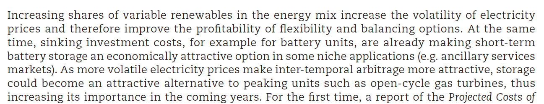
IEA Comments on Battery Storage
Ancillary Services and Peaking

Slide 8
Spinning Reserve and Batteries
Solar Variation in Different Hours
Need to Ramp up the Diesel Plant when the clouds come

Slide 9
Weekly Solar Irradiation

Slide 10
Solar Patterns in Northern Nigeria

Slide 11


Can you Add Revenue Streams
Capacity Price and Artificial Markets
  When capacity is available, you can receive revenues no matter whether you use the capacity for revenues, this can be added
  Some ancillary services may be like capacity where if you have the service available, you can earn money whether you use the capacity to produce energy
Think of Firemen (Firehouse Effect)
  You pay them and need them to be ready
  But if they are putting out a fire, they cannot be used for another fire
  They receive capacity payments and must be available
  You cannot really pay them on the volume of fires the

Slide 12
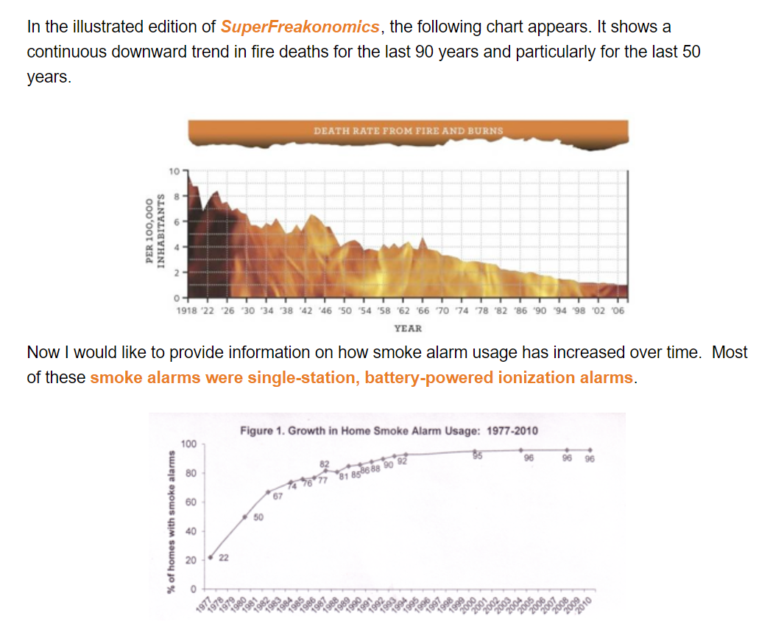
Illustration of Reduction in Fires
Is it worth it to put in smoke detectors
According to estimates by the National Fire Protection Association and the U.S. Fire Administration, U.S. home usage of smoke alarms rose from less than 10% in 1975 to at least 95% in 2000, while the number of home fire deaths was cut nearly in half. Thus the home smoke alarm is credited as the greatest success story in fire safety in the last part of the 20th century, because it alone represented a highly effective fire safety technology with leverage on most of the fire death problem that went from only token usage to nearly universal usage in a remarkably short time.

Slide 13
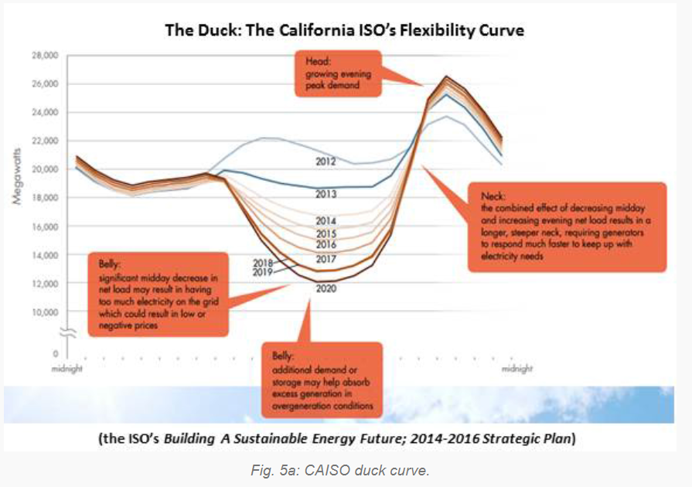
California Duck Diagram and More Extreme Need for Ramping and Spinning Reserve

Slide 14
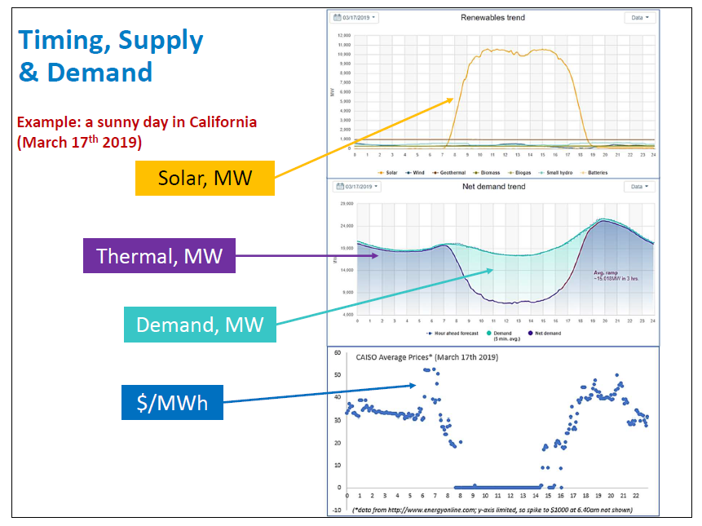
Duck Curve and Prices – Peaker Application

Slide 15
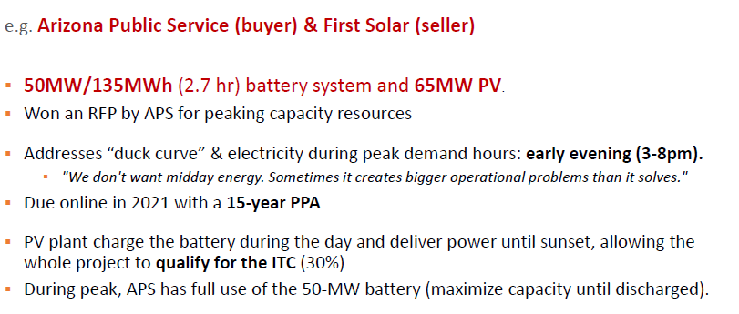
Example of Economics – 2.7 Hour Battery to Address the Duck Curve
Alternative is to have gas capacity available and running the whole time

Slide 16
Implications of Duck Graph
Day Ahead Scheduling
Filling in the Graph with Different Economic Units
Load Factor and Capacity Factor
Uncertainty from Sunlight Variation
Think of Extreme Case
  All Renewable Except for Night-Time
  Still Need Back-up Gas Plants that can be available to run quickly

Slide 17
Estimates of the Cost of Ancillary Services
Survey of Costs
Example from Lazard Study
Short-term Marginal Cost of Ancillary Services versus Long-term Cost
Sources of for Market Price of Ancillary Services

Slide 18
Rewards and Risks from Battery Business Opportunities
Problems addressed by batteries and storage
Essential grounding in the core cost issues for storage analysis (cost/kWh, life, degradation, losses, depth of discharge, cycles).
Competing storage technologies and alternatives to batteries including hydrogen
Growth in storage and drivers of growth
Impacts of storage on electricity players with different deployment timescales

Slide 19
Essential Grounding in Core Issues
On the internet you can find massive amounts of information on batteries relating to how they work, beautiful diagrams and even cost data.
What is more difficult to find is a clear step by step analysis of the cost and benefits of storage strategies compared to conventional electricity production.

Slide 20
Comment on Storage
Everyone asks for storage
~1% actually go ahead, though some specialize
At least there can be some profit in it
Tesla has got everyone even more excited …

Slide 21
Diagram of Battery Capacity, Storage and Energy
The diagram below of a water tower illustrates the issue of capacity storage and energy. In determining how much storage or ancillary service you need, should you use:
  The maximum amount of electricity that can be sent to the battery or drawn from the battery at any instant, measured in kW.
  The maximum amount of energy that you can take from the battery – the discharge -- over a cycle (e.g., a day) measured in kW x time of discharge or kWh
  The maximum amount of energy that you can send to the battery over a cycle – the charge – measured again in kWh.

Slide 22
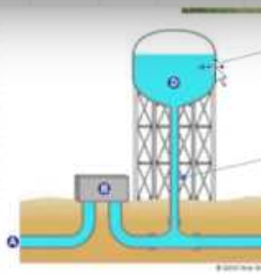
Battery Capacity and a Water Tower
The issue of capacity is illustrated by picture of a water tower below. The capacity to charge or discharge in an instant is illustrated by the pipe leading up to the storage tank.
The amount of energy from one charge is illustrated by the size of the tank.
Think of the pipe as how long it takes to discharge

Slide 23

Capacity and Storage of Batteries - Think of a Battery Like a Water Tower or a Warehouse
The pipe is the capacity at any instant. If this pipe capacity is 100 kW, then in one hour, the maximum that can be charged or delivered in one single hour is 100 kWh
The storage tank is the number of hours that be stored and then delivered. It is measured in kWh. If the capacity is 100 kW and the storage is 4 hours, then the kWh is 400 kWh.
In the warehouse, the movement in and out is the capacity (kW) – how many boxes in and out. The time in storage is kWh – you need the space for the boxes.

Slide 24
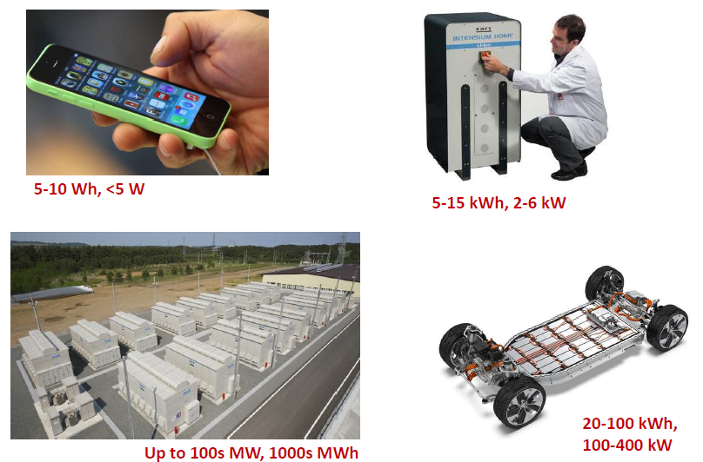
Different Capacity and Energy of Different Batteries
Hours of storage is kWh/kW
Compute the kW/kWh
Need to Charge Fast
Length of Storage more Important

Slide 25
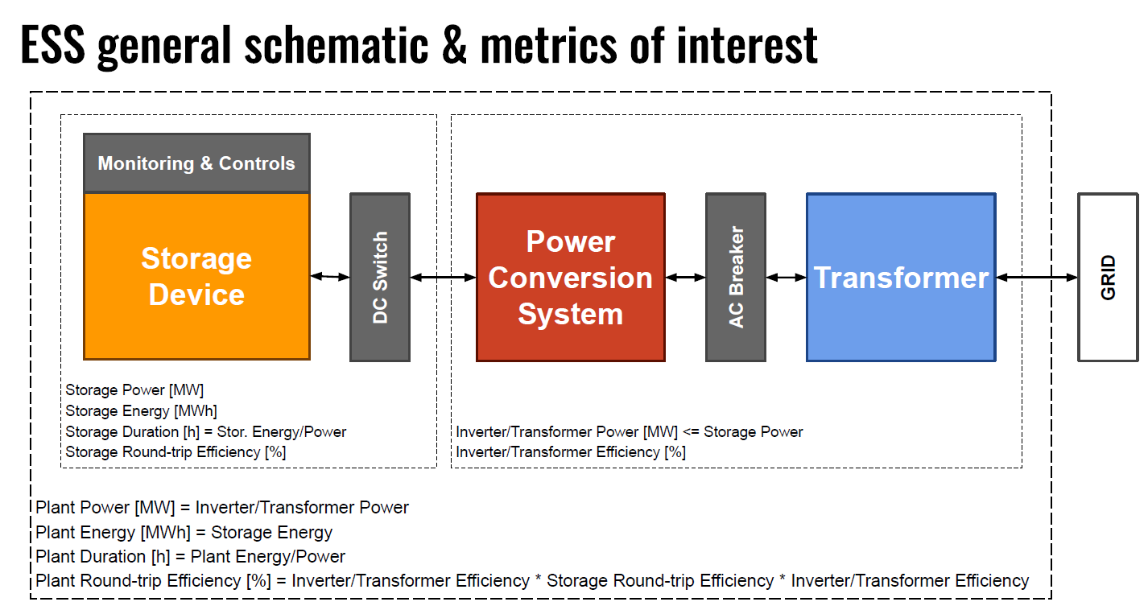
Equipment for Storage

Slide 26
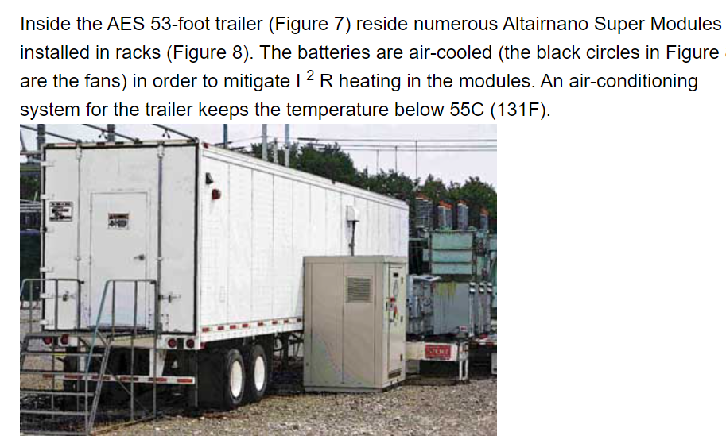
Battery Size for Ancillary Service
With AES developed a 2-MW, 500-kWh system with the capability of producing 1,000 amps at 1,000 volts that was designed and built to fit inside two 53-foot trailers for ancillary services
.5 MWH/2 MW = 15 minutes of storage

Slide 27
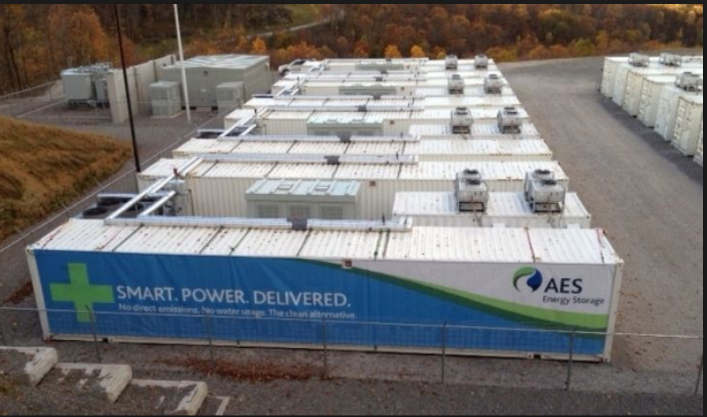
Picture of Large Lithium Facility in U.S.

Slide 28
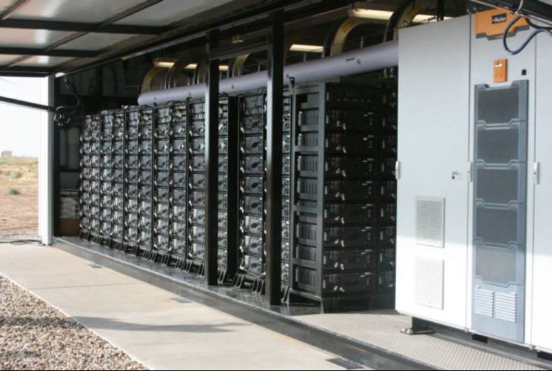
Picture of Lithium Battery for Storage

Slide 29
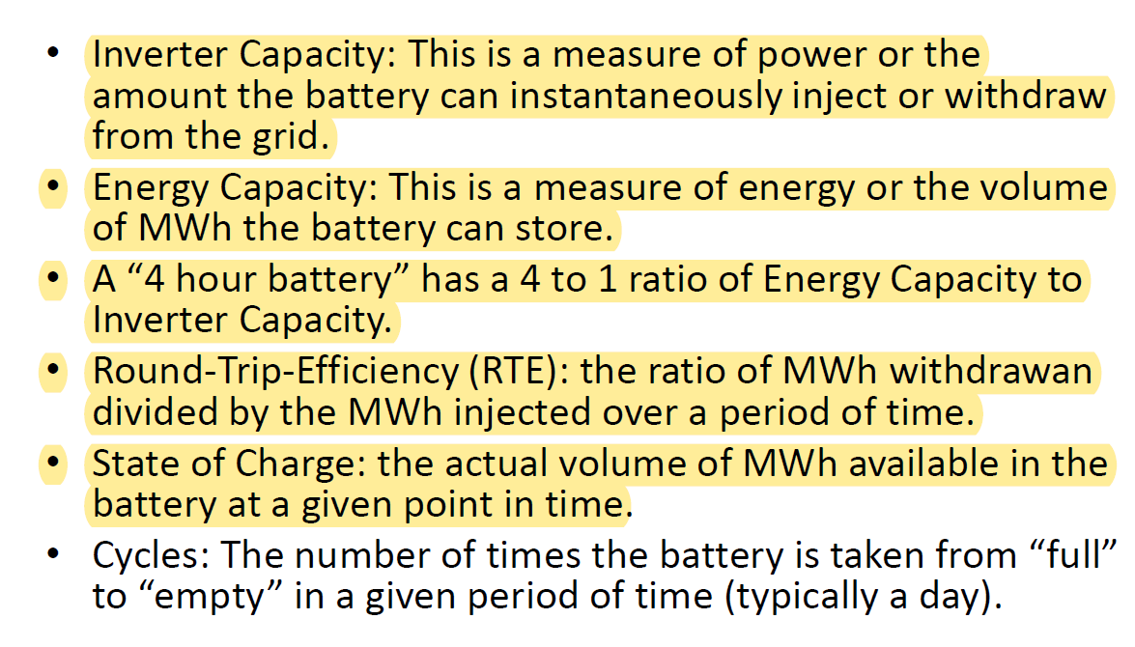
Battery Characteristics

Slide 30

Elephant in the Room
In can be cloudy for many days or it can be dark in the winter for weeks. You would need much more than a few hours of storage.

Slide 31
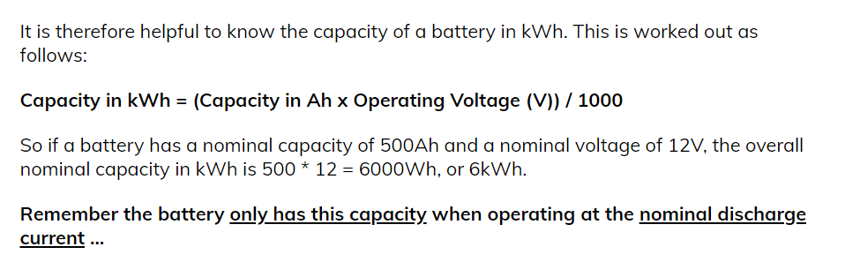
Capacity in kWh
You can multiply the voltage by the hertz

Slide 32
Characteristic Number 1
Historic and Projected Capital Cost Trends for Storage

Slide 33
Cost per kWh of Batteries
Benchmark is cost per level of storage rather than the cost per level of capacity as with other technologies.
For the same level of storage, if you have relatively more capacity, the cost should be higher because of fixed costs.
Costs of retail storage at households per kWh are more than large storage systems for lithium batteries

Slide 34
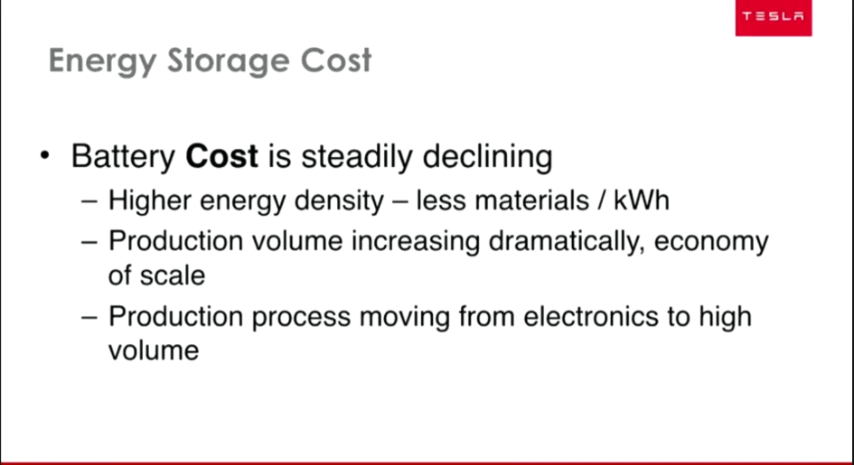
Tesla Comments on Battery Cost

Slide 35
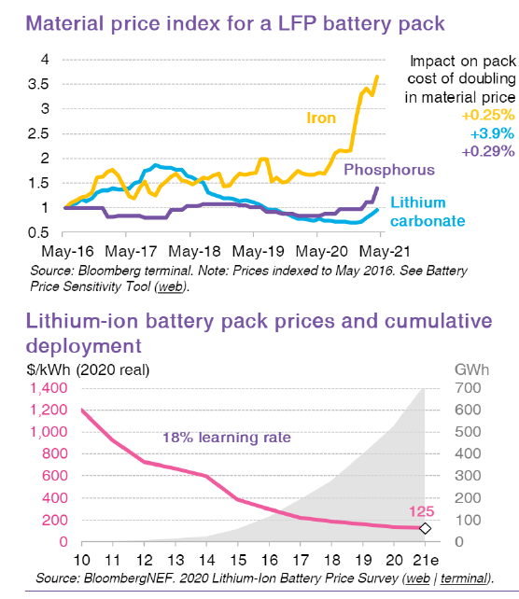
Recent Bloomberg Battery Prices

Slide 36
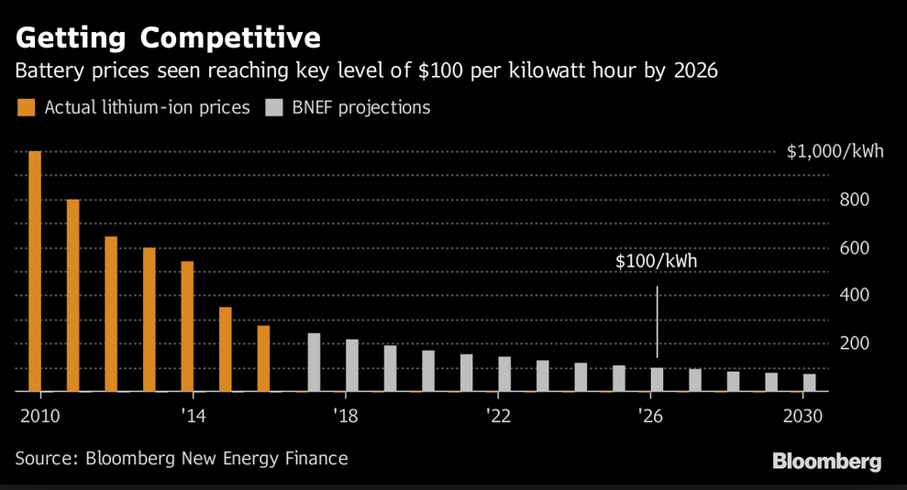
Historic and Projected Price of Lithium

Slide 37
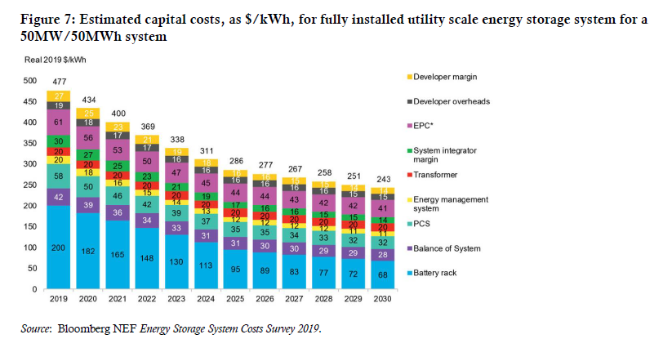
Components of Battery Cost
Note in this slide that the duration is one hour

Slide 38
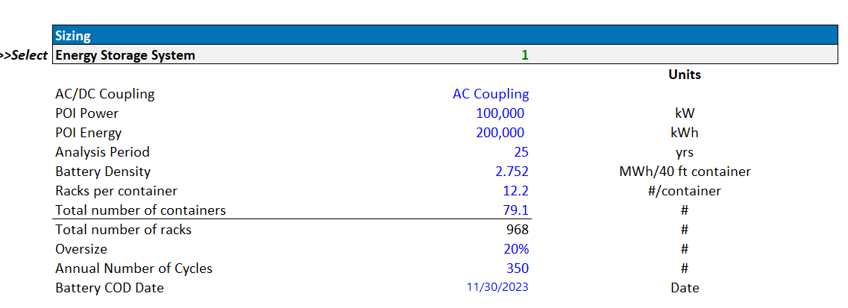
Example of Battery Cost – Part 1
Note the lifetime and the battery duration
Also note the oversize

Slide 39
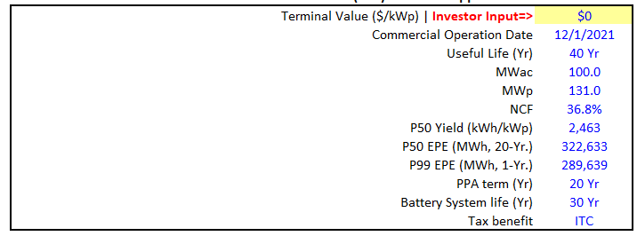
Assumption of Long Battery Life

Slide 40
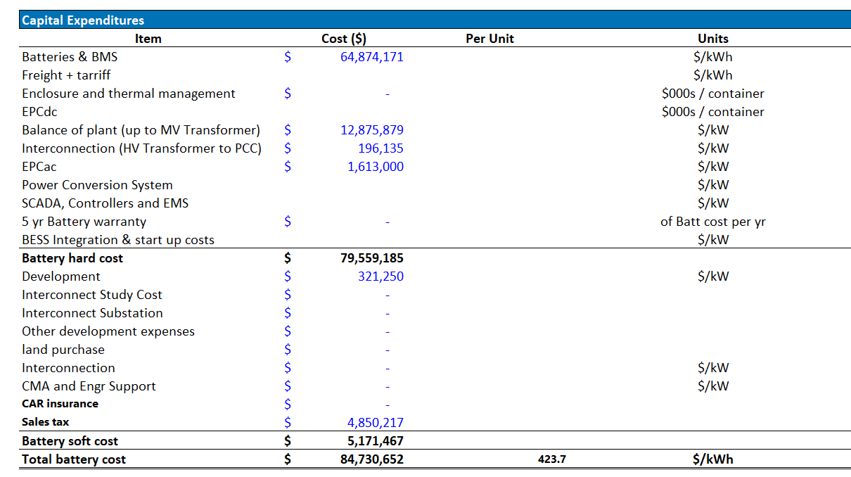
Example of Battery Cost – Part 2
Most of the cost is the battery management cost

Slide 41
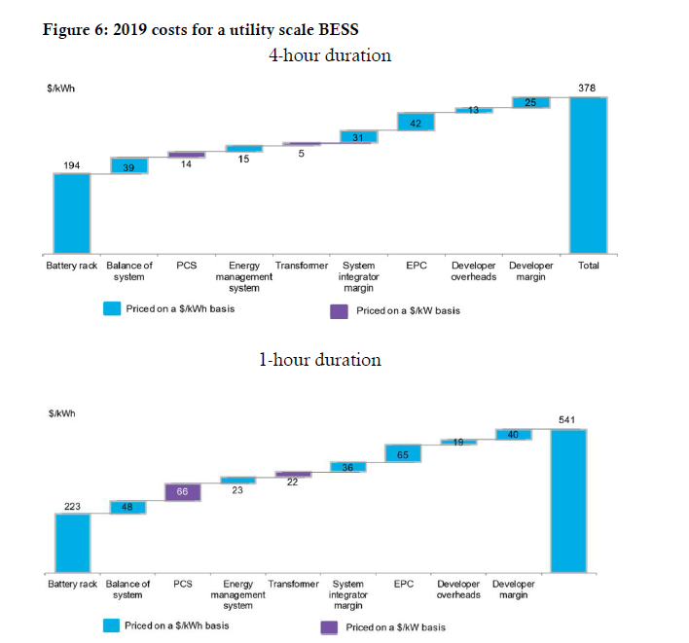
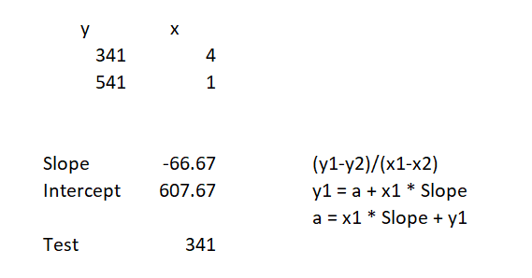
2019 Estimated Costs
378 for 4 hour and 541 for one hour.
Slope and Intercept

Slide 42
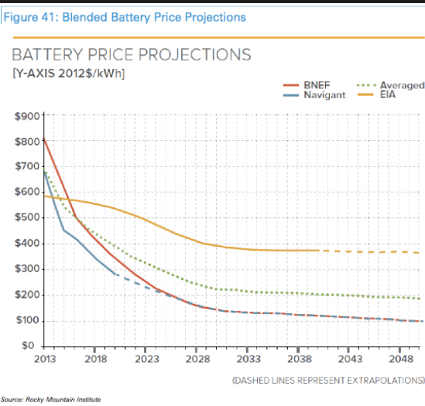
Alternative Forecasts

Slide 43
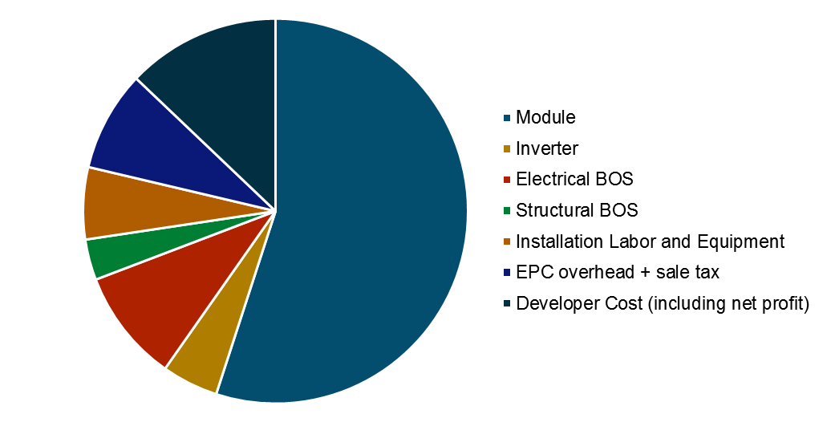
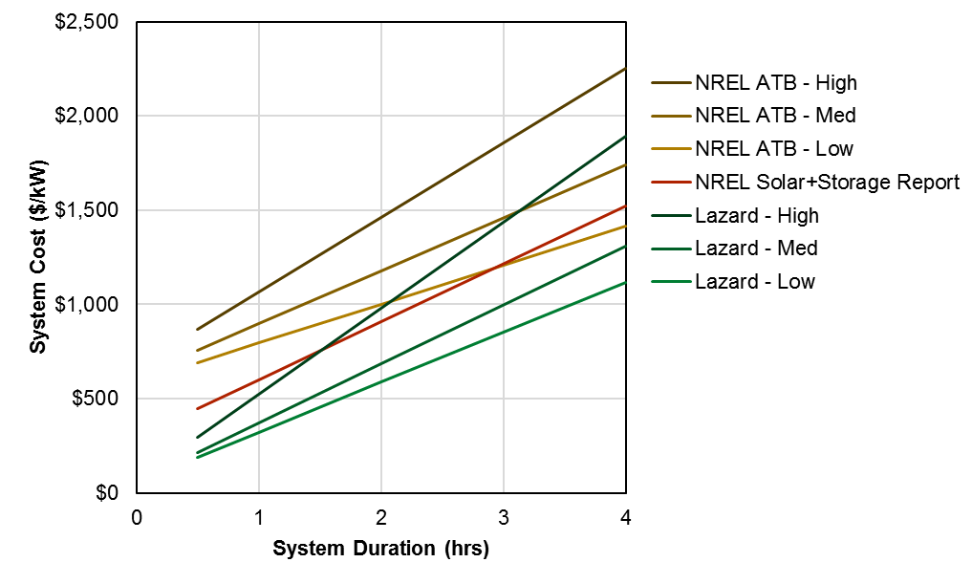
Battery Costs and Duration
Battery costs vary significantly by system specifications
For modeling purposes, costs are commonly broken into two categories
  Costs that scale with power (“capacity”), quoted in $/kW
  Costs that scale with energy (“duration”), quoted in $/kWh
Battery modules are the largest and best understood component of system cost and the one that scales most linearly with duration
  Each kWh of duration adds around $300 today, but is declining rapidly
Fixed capacity cost including inverter and interconnection varies significantly by report
  For storage paired with solar, these costs may be minimal
Utility-scale 4-hr Battery Cost by Component
Utility-scale Battery Cost by Duration

Slide 44
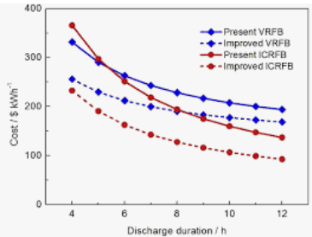
Cost per kWh is not Constant
The chart below implies that there is value for capacity and for storage. If the lines were flat there would be no premium for capacity relative to storage.

Slide 45
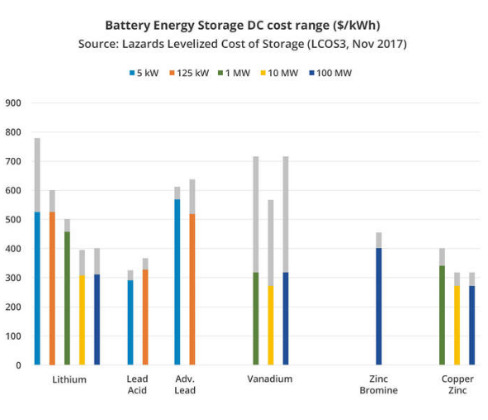
Battery Size and Cost/kWh – Economies of Scale

Slide 46
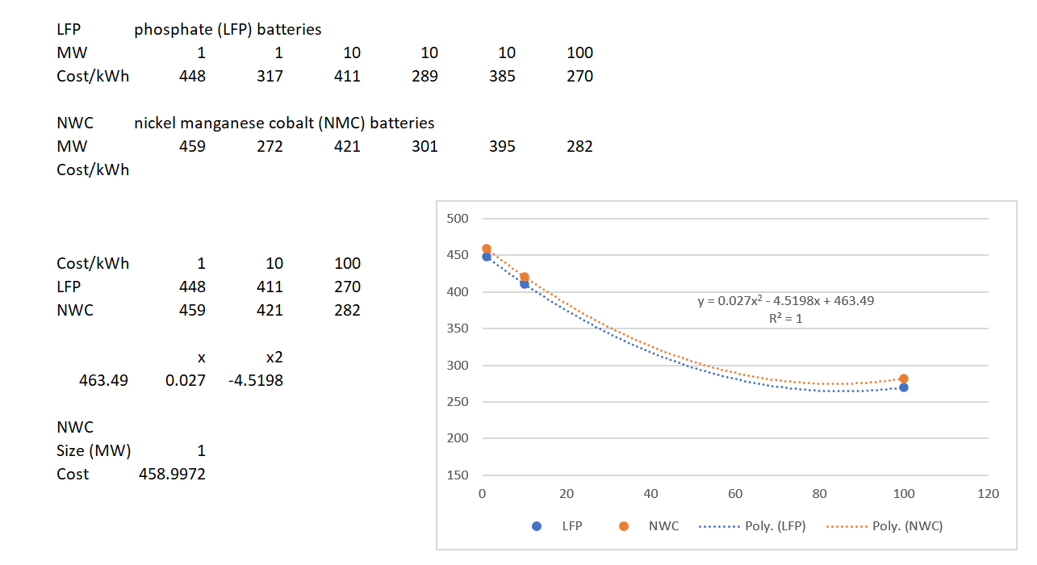
Economies of Scale for Batteries (DOE Study)
You can plug in the MW and derive the cost per kWh the Graph is for 2020 estimates

Slide 47
Cost of Cobalt and Lithium Batteries
This is the metal driving li-ion's high cost far more than lithium itself.
Cobalt acts as the negative cathode of a lithium battery and makes up a much larger portion of the battery by volume.
Cobalt is a lot harder to get than lithium.
This is because the metal is largely mined as a byproduct of other metal mining operations. Because of this, there are a limited number of mines that safely and reliably produce the metal.
That puts the world's supplies in a pretty risky position...
The vast majority of the world's cobalt supply comes from the Democratic Republic of Congo. Last year, the region produced 66,000 tons of cobalt. The next-largest producer, China, followed with just 7,700 tons for the year.

Slide 48
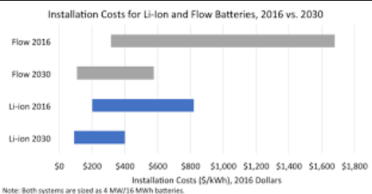
Cost Trends
Expect larger change in Flow Batteries than in Lithium. Note that in this slide the assumption is 4 MW and 16 MWH or 4 hours of storage.

Slide 49
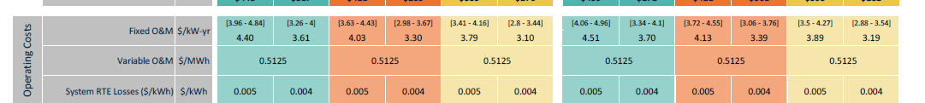
O&M Costs
O&M Costs from DOE. With cost per kW can compare to the solar O&M. Careful with the variable cost per O&M – the cost of one cycle or the cost across the year.

Slide 50
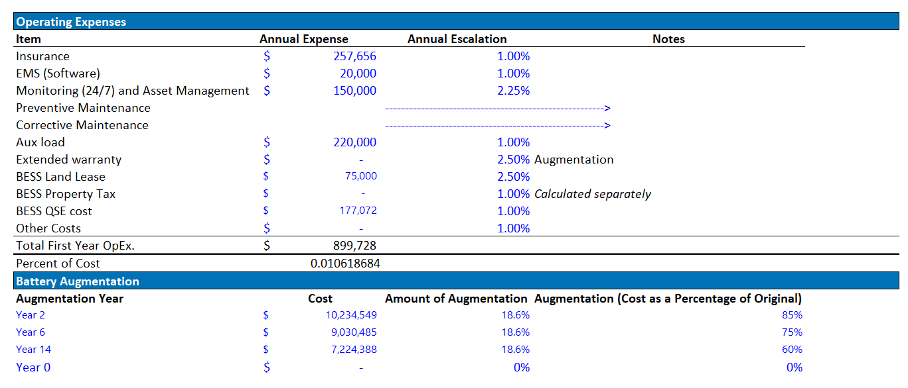
O&M Cost
O&M cost 1.06% of total capital expenditure

Slide 51
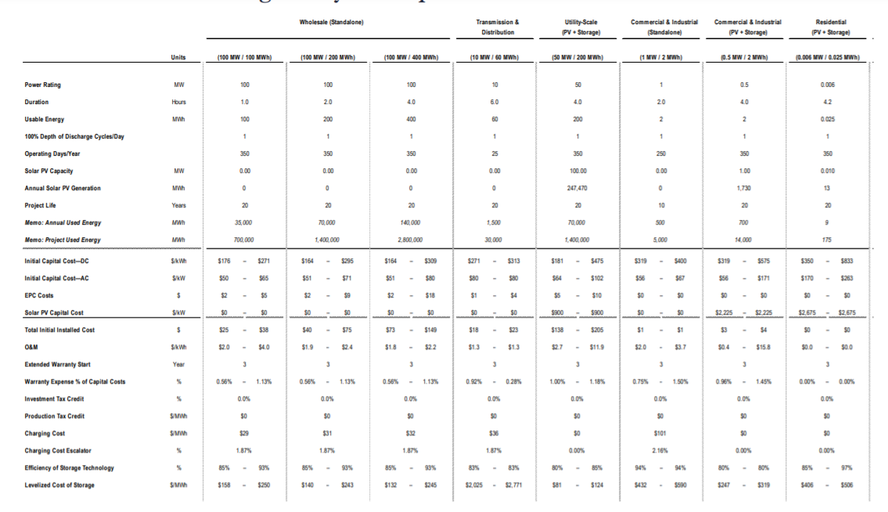
Cost from Lazard
Somewhere around 1.3%

Slide 52
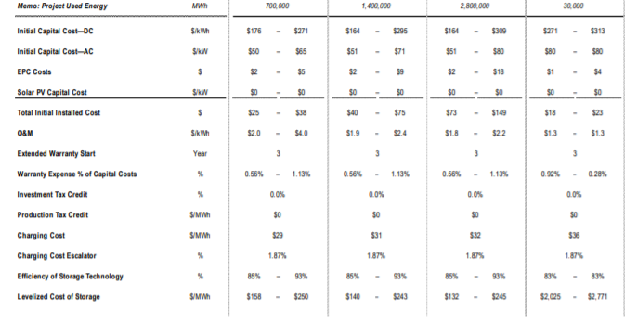
O&M Cost Continued

Slide 53
Cost Targets for Flow Batteries
Capital costs for Flow Batteries are expected to be broadly similar to lithium-ion costs over the long term and at similar scale.
Most flow battery companies have $100 / kwh capital cost as a target in their minds or one that they’ve publicly talked about. (ARPA-E has used $100 / kwh as a target.)
Because a flow battery or compressed air system lasts for so many more cycles, the overall cost of electricity is likely to be many times lower.

Slide 54
Characteristic Number 2
Operating Life

Slide 55
Life and Discharges
The lithium-ion battery works on ion movement between the positive and negative electrodes.
In theory such a mechanism should work forever.
Cycling, elevated temperature and aging decrease the performance over time.

Slide 56
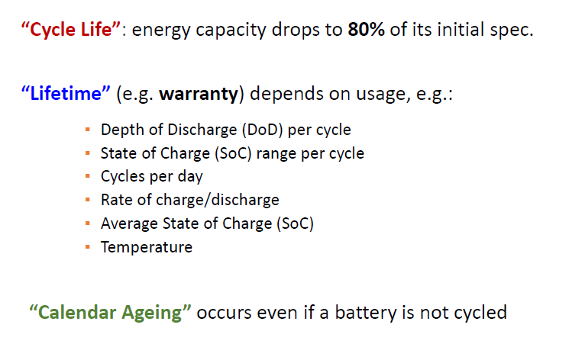
Battery Life and Lifetime Warranty

Slide 57
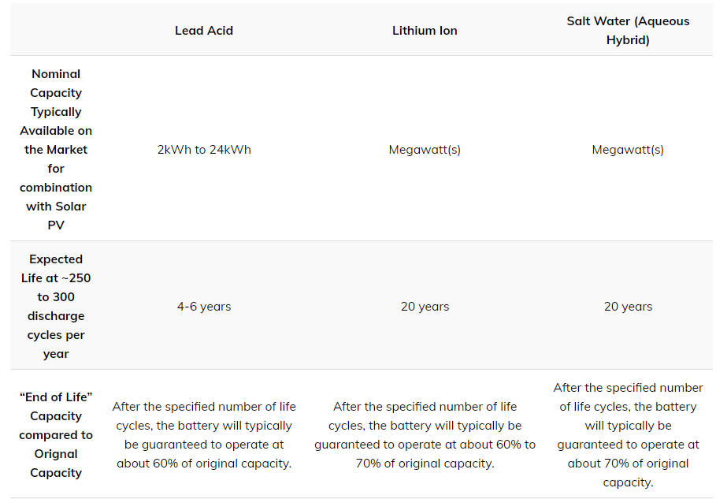
Degradation and Life
Can compute that annual degradation from this table.

Slide 58
Battery Life of Laptop
The battery doesn’t hold a charge
On average, a laptop battery has a lifespan of between two and four years (around 1,000 full charges). Total lifespan depends on the battery type, how you treat the computer, and how often you use your laptop. Additionally, using demanding software programs, your computer reaching high temperatures, or long periods of non-use can cause the battery to lose capacity more quickly.
Batteries slowly degrade over time and with each charge-recharge cycle. To combat this, HP laptops are designed to discharge a small amount of power after fully charging. The battery starts to charge again when the charge drops to 95%.
Also, factors like display brightness, backlit keyboard, processing speed, and using external storage can have an impact on how long your charge lasts in the long term. Some users will even find that after a few years, their laptops no longer hold a charge at all.
You do have the option of buying a new battery for your laptop as well. However, if your laptop is older, chances are it has issues that go beyond battery life, so it may make more sense to buy a new laptop.

Slide 59
Battery Life
Battery life is influenced by many factors, so there is no straightforward answer to this question. However, on average, a cell phone battery loses 20% of its capacity after 500 charge cycles and usually becomes unusable after about 2500 charge cycles.
According to Apple, the iPhone batteries are expected to last at least 500 full recharging cycles before the capacity drops under 80%. This means that you will see a noticeable drop in battery performance after:
8 months if you charge your phone twice a day
16 months if you charge your phone once a day
32 months if you charge up once every two days
Of course, these numbers are just an estimation and should not be taken as such. Asking “how long does a cell phone battery last?” is similar to asking “how many miles you can drive a car?“. To which the only possible answer is “it depends“.

Slide 60
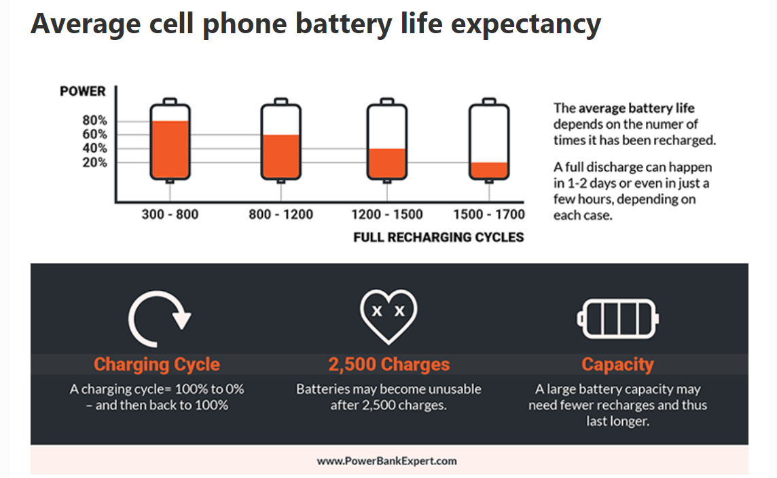
Life of Cell Phones and Cycles

Slide 61
Battery and Cycle Life for Storage Applications
Home solar battery units last anywhere between 5 and 15 years.
Under NREL's scenarios, an energy storage system is expected to last between seven and 10 years. "Without active thermal management, 7 years lifetime is possible provided the battery is cycled within a restricted 47% DOD operating range. With active thermal management, 10 years lifetime is possible provided the battery is cycled within a restricted 54% operating range,"
This means that if you decide to install a solar battery today, it’s almost certain you’ll need a replacement in the future to match the 20- to 30-year lifespan of your solar power system.
The life expectancy of a solar battery is mostly determined by its usage cycles. Most solar batteries are generally deep-cycle batteries, which allows them to discharge up to 80% of their stored energy before recharging.

Slide 62
Battery Life for Different Types of Batteries
For larger off-grid systems lead-acid batteries are still one of the most trusted options as they are a well proven technology with a correctly designed system typically lasting 10-15 years.
Lithium-ion batteries on the other hand have cycles of between 1,000 and 4,000 cycles.
4,000 cycles/365 days = 10.9 years

Slide 63
Battery Life, Discharge and Depth of Discharge
Anyone who checks the analysis in greater detail recognizes that the price advantage of the lithium product is primarily due to the high number of cycles of 6,000 specified cycles (at 365 days, about 16 years).
These cycles are not guaranteed in the warranty terms. So, the question arises, what are 6,000 cycles good for if the manufacturer does not guarantee for them?
An analysis rates the lithium product at 3,650 cycles.

Slide 64
Life Comments from DOE Report
A range of cycle estimates was provided throughout the literature for lithium-ion of up to nearly 6,000 cycles with lower DOD (DiOrio et al., 2015; Greenspon, 2017). (6000/365=16 years).
  The analysis conducted here estimates that lithium-ion LFP can typically provide 2,000 cycles at 80% DOD, while NMC systems provide 1,200 cycles for the same DOD, due to positive electrode dissolution and associated increased capacity loss at the negative electrode. In the next phase, more detailed cycle life data for LFP and NMC chemistries will be obtained. For example, based on 70% capacity at end of life, lithium-ion batteries have demonstrated a cycle life of approximately 8,000 cycles at 80% DOD (R. B. Wright & Motloch, 2001).
The calendar life of lithium-ion batteries ranges with some stating > 5 years or as high as 20 years (R. B. Wright & Motloch, 2001) and others in the range of 5-15 years (Dubarry, Qin, & Brooker, 2018).
This report estimates a 10-year calendar life at 80% DOD, also assuming 5% of that time will also be allocated to downtime. A cycle life of 2,000 cycles for LFP and 1,200 for NMC is assumed with a 5% increase in total cycles each by 2030.

Slide 65
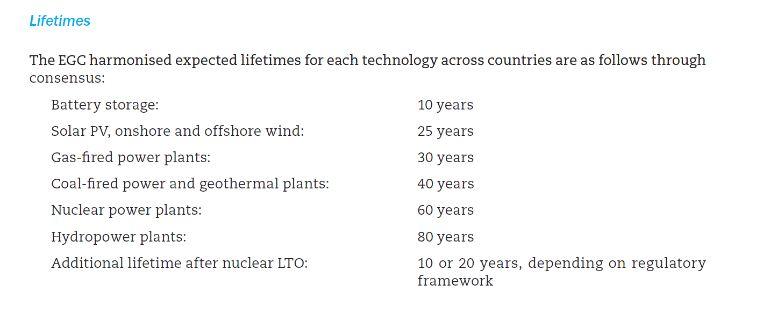
IEA Assumptions
Note the shorter life for batteries assumed by IEA

Slide 66
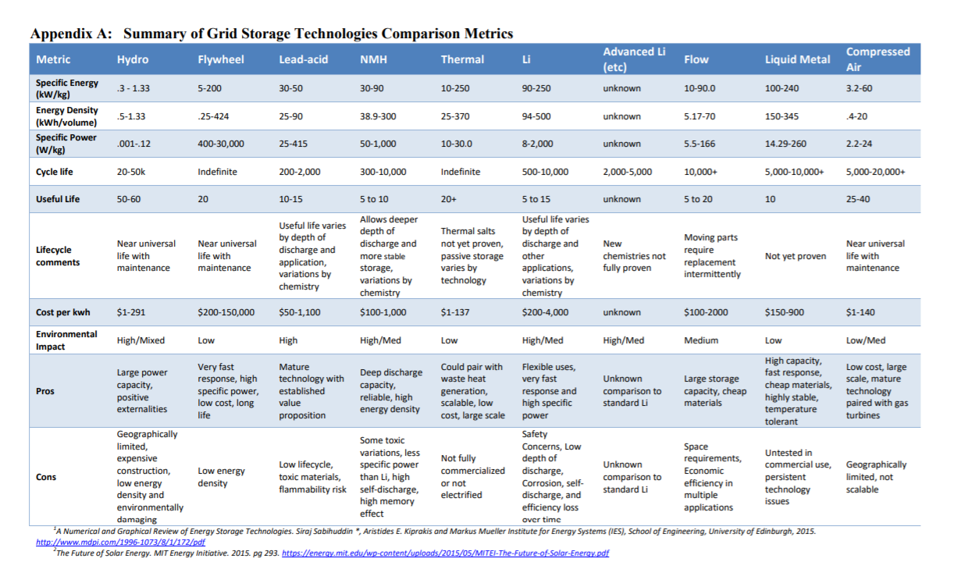
Comparison with Useful Life - MIT

Slide 67
Lithium-ion Batteries and Charges
Each battery is basically a crystalline structure.
  Each time you charge the battery, you add an electron or remove one from this structure.
  The fact that you modify the structure time and time again means you weaken it.
  You could compare it with bending a metal plate over and over again. At a given point, the plate will tear”

Slide 68
Batteries and Temperature
Temperature is a very important factor in the performance of batteries or power storage.
Narrow temperature windows for lead batteries +15 ° to + 25 ° Celsius or + 10 ° to + 30 ° Celsius limit the performance. As the temperatures get cooler, the capacity of the power storage decreases.
A study shows that lead-acid battery life is reduced by 50% when the temperature is 8.3 ° C above the specification level. There are serious increases in costs if the battery is working in high temperature ranges.

Slide 69
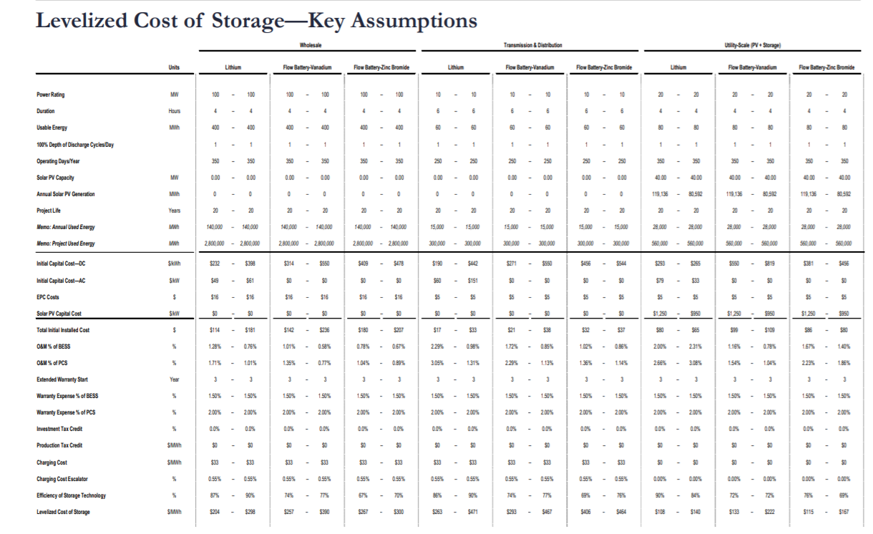
Life in Lazard Analysis

Slide 70
Operating Characteristic Number 3
Degradation

Slide 71
Degradation, Depth of Discharge and Usable Capacity
How many kWh per cycle can be used by the battery?
Meaning how many kWh can be discharged from the storage.
The usable capacity of the battery storage degrades (decreases) the more frequently the battery is used. Depending on the number of cycles, degradation is between 2% and 4% per year.
The usable capacity differs from the nominal capacity or gross capacity because depth of discharge (DoD) limits the nominal capacity.
You can calculate the usable capacity by multiplying the nominal capacity and discharging depth (in%).

Slide 72
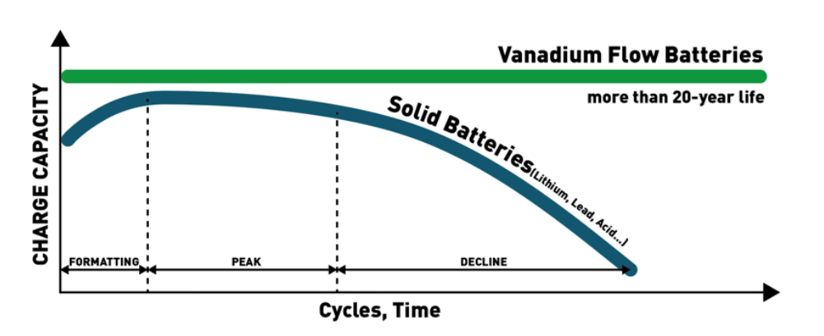
Degradation
Different batteries have different degradation.

Slide 73
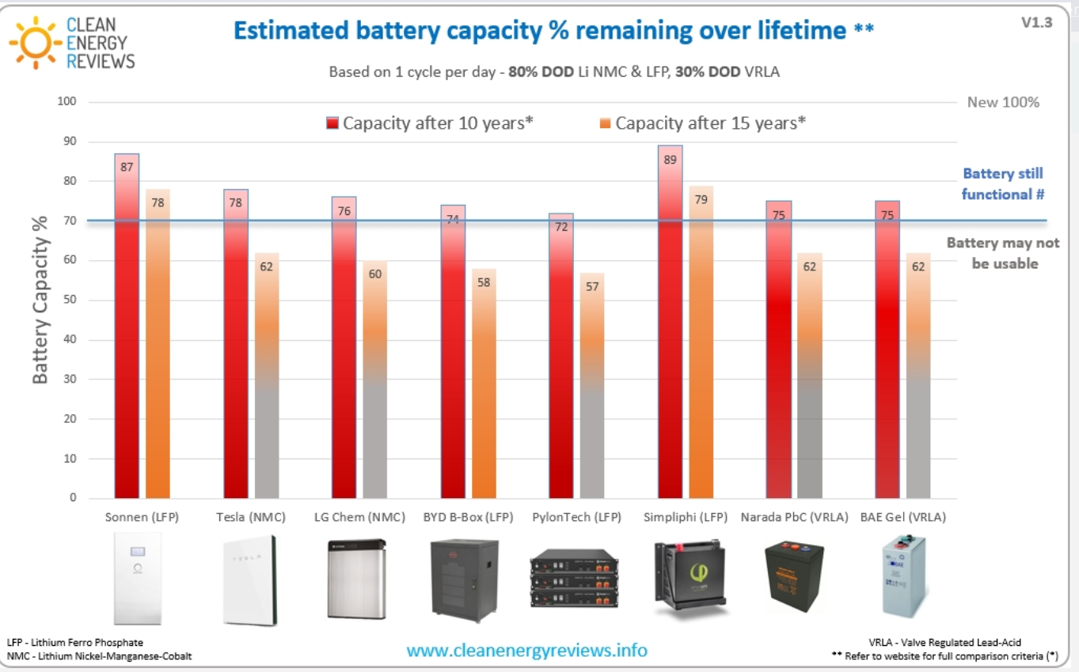
Degradation and Age
Compute the implied annual degradation

Slide 74
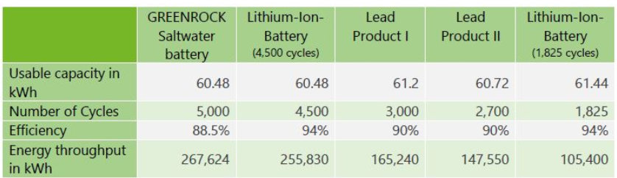
Questions Regarding Degradation
Traditional lithium ion-batteries begin to degrade after a few hundred cycles of fully charging and fully discharging, or 1,000 cycles at most.

Slide 75
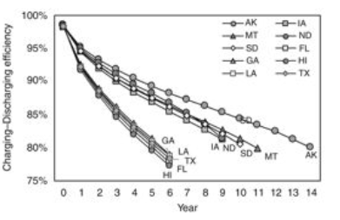
Degradation from Age and Cycling
For the annual battery degradation, the calendar capacity loss contributes more to the total capacity loss than the cycling capacity loss. The battery degradation can largely increase the energy consumption and GHG emissions of EV per km driven.

Slide 76
Operating Characteristic 5
Round Trip Efficiency

Slide 77
Roundtrip Efficiency
Efficiency is the charging and discharging efficiency or losses during cycle use. The kWh capacity is measured at the discharge.
The transfer of energy from one form to another (in the case of batteries from electrical to chemical energy) will always result in some losses.
Generally, charge/discharge losses from a lead-acid based battery is close to 20%
Most new lithium-based batteries can be as low as 2% but generally in the 5-8% range.

Slide 78
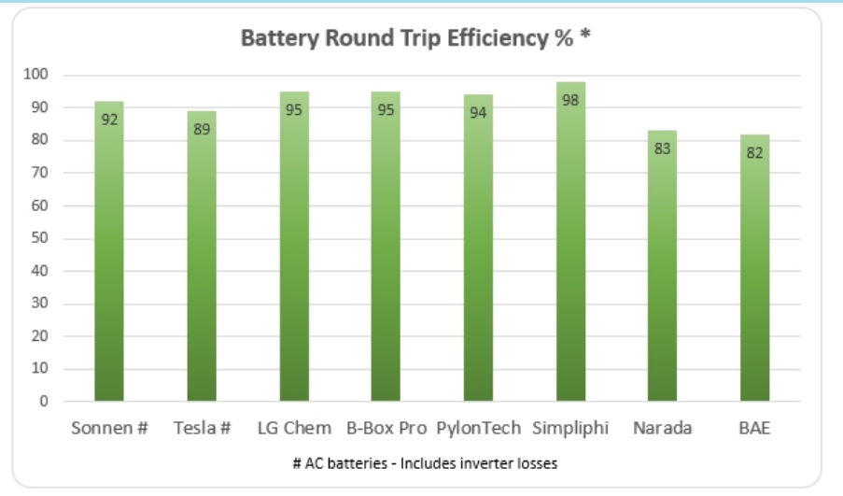
Differences in Battery

Slide 79
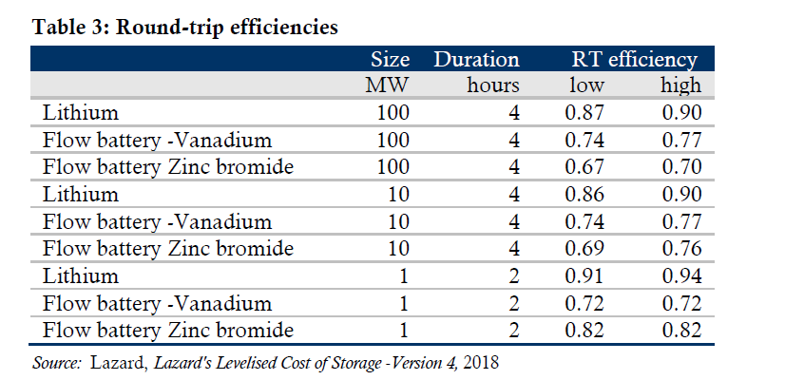
Round Trip Efficiency

Slide 80
Round Trip Efficiency in DOE Report
With respect to RTE (round trip efficiency), the literature typically provided estimates between 77-98% (Aquino et al., 2017; DiOrio et al., 2015; EASE, 2016; Greenspon, 2017).
PNNL (U.S. DOE) testing of grid-scale batteries in the past yielded an AC-AC RTE of:
  83–87% over 1.5 years of testing,
  RTE for a battery > 5 years old was only 81%.
A system RTE of 86% was used in this work.

Slide 81
Characteristic 5
Depth of Discharge

Slide 82
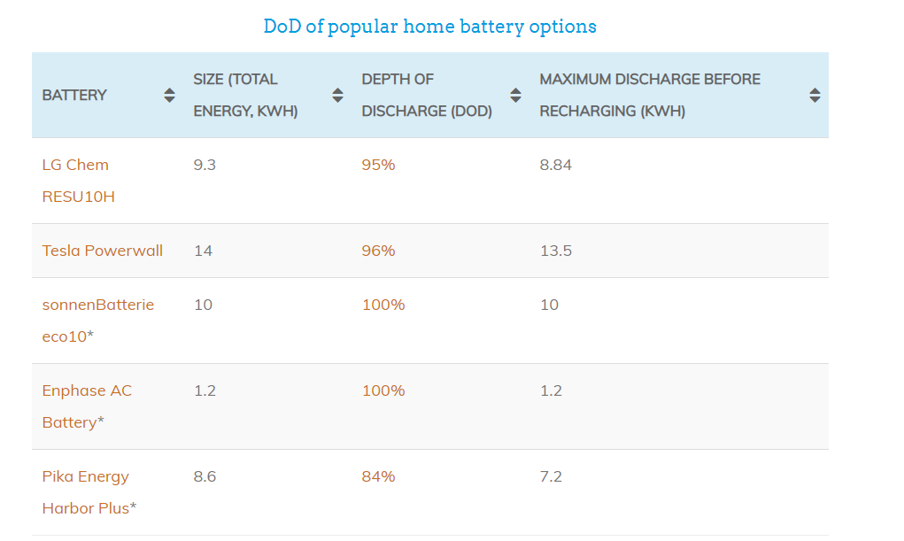
Depth of Discharge
Depth of discharge affects the economics of a battery if the capacity stated in gross input kWh does not reflect the limitation.

Slide 83
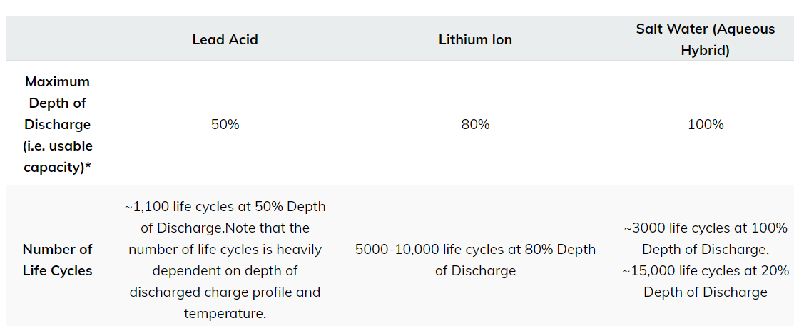
Depth of Discharge and Lifetime in Cycles
Divide the cycles by 365
10,000/365=27 years

Slide 84
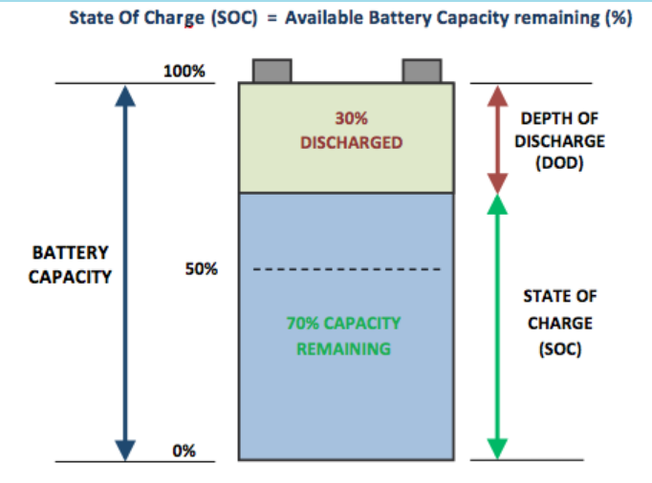
Depth of Discharge Limit
Should be included in excel table

Slide 85
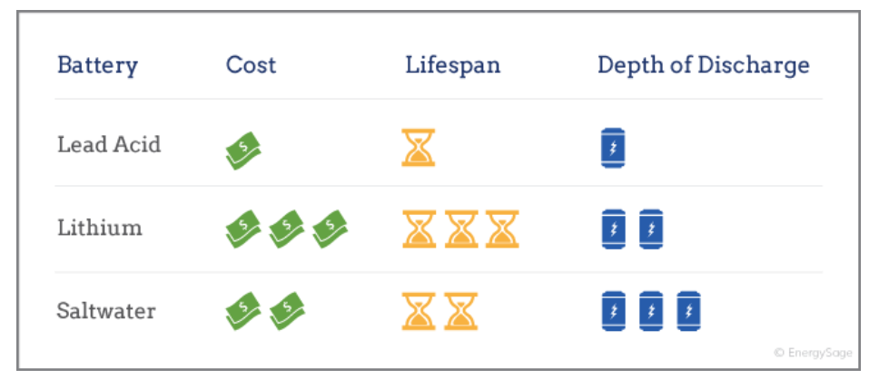
Tradeoffs between Cost, Life and Depth of Discharge

Slide 86
Characteristic 5
Learning Rate

Slide 87
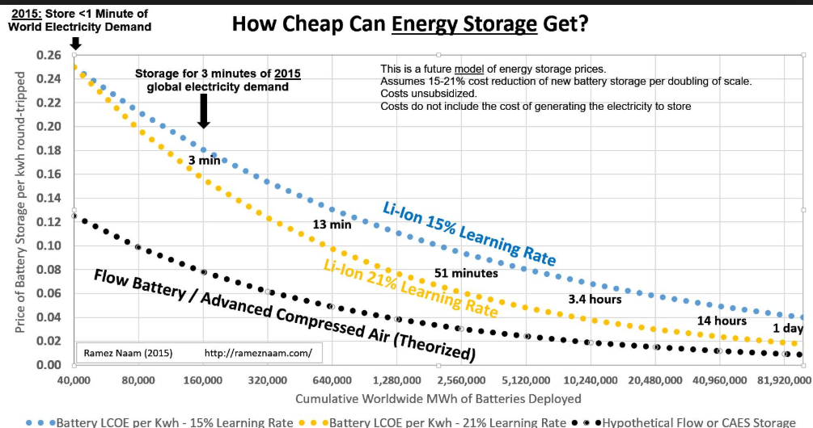
Economies of Scale and Projected Cost
Cost Trends

Slide 88
Incorporation of Learning Rate in LCOS
Compute the LCOS without learning
  Use the estimated life
  Make other computations
Compute LCOS with Learning
  Make alternative estimates using real costs
  Understand that when you combine costs, the later costs should have less weight
Compute weighted average
  Costs of initial battery at current cost
  Cost of new battery at lower cost
  Multiply the lower cost by the PV at the year of installation
  Add the initial battery and the PV of the battery with learning

Slide 89

How Much Can you Add Services

Slide 90

Declining capital costs low storage bid prices when paired with solar
NextEra claims storage adds a premium of $15/MWh for solar projects completed in 2017-2018
  Approximate capacity price of $160-$175/kW-yr for storage assuming typical sizing and solar capacity factor
  Typically 4-hr storage at 25% of solar capacity (e.g. 100 MW solar plant, 25 MW / 100 MWh storage)
In recent RFPs, this premium has fallen to $6-$7/MWh for projects with COD in 2021-22
  Capacity price of $73 to $94/kW-yr for hybrid projects with unbundled storage prices (NV Energy)
NextEra projects storage premium will fall to $5/MWh by mid-2020s, or under $60/kW-yr with typical sizing ratio
Levelized cost of storage when paired with solar – E3 vs NextEra
Gross CONE in 2018 $/kW-yr
Current hybrid storage bids reflect aggressive price decline assumptions, capture of the ITC, and other cost savings from pairing with solar such as reduced interconnection costs
Result? Discount of 25% to 40% versus standalone storage levelized costs
Recent NV Energy RFP winners
NextEra forecast

Slide 91
Quantification of Costs

Slide 92
Start with Simple Cast
Hours of Solar
Hours of Battery Discharge
Solar Required for Charging Batteries
No Loss from Round Trip Efficiency
Level Amount of Load in Each Period

Slide 93

Simulation with Simple Loads
.

Slide 94

Include Carrying Charges

Slide 95

Battery Analysis
Sensitivity to Drivers

Slide 96

Waterfall Chart
.

Slide 97

Alternative U.S. Value of Frequency Regulation – Ancillary Services

Slide 98

Lazard Value of Storage Depending on Ancillary Services Prices

Slide 99
Analysis in the Context of Ancillary Service

Slide 100


Characteristics of Wind and Solar

Slide 101

What Really are Ancillary Services
Which are affected by wind and solar

Slide 102

Ancillary Service Example

Slide 103

Ancillary Service Example

Slide 104
Value of Ancillary Service – Measure in Amount per kW-year and not per kWh
For a battery entering service in 2021 in the California ISO, PA Consulting projects a decline in ancillary service revenues:
  Over $70/kW-year in 2021,
  Just over $10/kW-year by 2027
  as California’s regulation and spinning reserve markets become increasingly saturated with new battery storage.

Slide 105

Assumptions for Demand Response and Regulation Payment

Slide 106

Saturation Risk and Frequency

Slide 107
General Discussion of Ancillary Reserves
Ancillary services are generators or other service providers that are synchronized to the grid and are able to rapidly increase output in three major categories: contingency, regulation, and flexibility reserves.
The contingency reserve requirement is assumed to be constant for all hours of the year and corresponds to a spinning reserve equal to about 3% of peak load and about 4.5% of the average load.
Another way to think of “spinning reserves” are the backup or redundancy built into the grid. Basically, we slightly overbuild the total generation needed so the grid can be provided with ancillary services making good quality power possible.

Slide 108
Wind Variability
Graphs of hourly data show some relationship between wind speed and prices

Slide 109
Wind Variability

Slide 110
Wind and Electricity Price – One Day
One Day Patterns

Slide 111
Wind Speed and Electricity Price
The scatter chart shows some relationship but not strong

Slide 112



Example of Load Data - Predictable

Slide 113

Malaysia Hourly Load

Slide 114
Load Variation

Slide 115
Load Variation – Peak Day

Slide 116
Load Variation - Week

Slide 117
Electricity Storage Analysis and Electricity Economics
Instantaneous Matching of Supply and Demand and Ancillary Services Provided by Storage Technology: What is the true value
  Spinning Reserve
  Black Start
  Frequency Regulation
  Value of Storage for Ancillary Services
Conversely, the size of the additional costs will also depend on the particular electricity system. Systems with smaller shares of VRE, greater shares of flexible resources, and more interconnections are able to incorporate additional VRE very inexpensively whereas those with high shares and limited or no interconnection will find incremental system costs to be higher. The key point is that the system costs depend on the existing system, and not just the plant-level technology.

Slide 118
What Really Are Ancillary Services and What Should be Their Cost
Every engineer in electricity will tell you that the demand and supply of electricity must match at every instant. If they don’t the frequency of electricity will be off and if it is really bad, two things can happen. First, your appliances will not work properly. Second, you can have outages.
Thermal electricity plants like coal plants and gas plants cannot be turned on in an instant and sometimes they cannot adjust their output really quickly. If plants are operating at their maximum output, then they cannot adjust their output to increase.
A generator is like a motor can be like a motor if it is reversed. At a hydro plant, a generator can be in a spinning mode and suddenly turn around and start to generate.

Slide 119

Illustration of Load and PV

Slide 120


Case of Micro Grid and Diesel – Spinning Reserve
Ancillary Services as Running Diesel at Minimum Levels

Slide 121
Reduction in the Value of Solar Because of Spinning Reserve
Assume load of 100 MW during the sunlight hours.
If require the diesel for spinning reserve, must run the plant at minimum level (e.g. 25%)
In this case, should only install 75 MW instead of 100 MW
If you have a battery that can deliver 100MW and is charged, this could replace the minimum usage of the diesel plant

Slide 122
Example of Balancing
System has hydro with a reservoir. When the generators are not running they can be operating like a motor – spinning.
The system also has a large thermal plant that can have a sudden outage – say the plant is 1000 MW.
If the hydro has more capacity to react quickly than the large plant, no more reserve is necessary and there is no cost to the reserve.
In this case since the reserve is available anyway, the reserve has no cost.
In scheduling units on a day ahead basis, there should enough capacity to meet load in the next day plus some reserve. When scheduling plants, there will be some plants that are not running at full capacity. This is operating reserve.

Slide 123
Illustration of Flexibility to Adjust Quickly with a Hydro Plant
Assume you have a system like Hydro Quebec or in Brazil where most of your power comes from hydro with large reservoirs that can handle many months of power. The generators can be run in spinning or generation mode and the cost of ancillary services is very small.

Slide 124
Illustration of Ancillary Services with Coal Plants and Sudden Change in Demand
Assume you have very flat loads during the day (example of Korea is presented below for a year).
Assume schedule coal plants to operate near full capacity.
If the there is a sudden change in demand or supply (e.g. one of the coal plants goes down), then you have to find a way to get the demand and supply balance back.) This could be expensive. For example, you may have to have a gas plant running at a minimum level.

Slide 125
Plants with Surplus Spinning Reserve
Load following power plants can be hydroelectric power plants, diesel and gas engine power plants, combined cycle gas turbine power plants and steam turbine power plants that run on natural gas or heavy fuel oil, although heavy fuel oil plants make up a very small portion of the energy mix.
A relatively efficient model of gas turbine that runs on natural gas can also make a decent load following plant.

Slide 126
Cost of Ancillary Services and Value from Providing Ancillary Services
I hope with these simple examples you can start to think about the cost of ancillary services that all involve responses to sudden changes in demand or supply.
  The cost can be very low and ancillary services can be a by-product of the existing system
  The cost can be high if there are old thermal plants on the system
  With small amount of renewables, the ancillary services will not be a big deal. With a whole lot of renewables, ancillary services can be a big concern.

Slide 127
Implications of Renewables on Ancillary Services
Furthermore, system operators are forced to increase (by “buying off”) the amount energy from plants being run part-loaded and therefore less efficiently. The situation may also lead to increases in the load factors of peaking plants due to response constraints.
Today it is almost impossible to exactly forecast wind speed a day in advance. This implies that wind generations will not be known, or at least very imperfectly known in the day-ahead market. But forecasts improve as one moves forward in time and can become quite accurate a few hours before real time.

Slide 128
Reserves and Dispatch
“Balancing Reserves” – (BR – Capacity in MW) are services procured in advance of real-time as “Security insurance” and mainly deployed for capacity purposes and usually delivering only a marginal amount of energy in real time. Technically reserves can be either automatically or manually operated.
“Balancing Energy” – (BE – MWh): energy activated by the TSO to maintain the balance of the system in real time.

Slide 129

Ramp Requirement and Increased Renewables

Slide 130

Variance in Estimated Cost of Ancillary Services

Slide 131
Balancing Cost
Accurately defining and estimating the balancing cost of a single power generation technology, like wind power, is not a straightforward exercise.
  International comparisons of wind integration studies suggest that in the EU, increases in balancing costs due to wind variability and uncertainty amounts to approximately 1–4.5 €/MWh for wind energy penetrations of up to 20% of energy demand.
  This is generally a marginal fraction of the wholesale value of wind energy (about 10% or less).
  Ranges of incurred balancing costs for wind power generators are 2-3 €/MWh on average. Wind power generators already bear the extra balancing costs they cause. In certain cases, this responsibility even exceeds the costs.
  There are some notable exceptions. In Bulgaria, the range is between 10 and 24€/MWh and in Romania, if not part of a large aggregator, wind power generators pay on average 8-10€/MWh.

Slide 132
Wind and Balancing
The wind itself cannot be controlled.
Since the Dutch grid has nearly no storage capacity (e.g. pumped storage hydro), the balance between the active generators and consumers must be managed from units that are dispatchable.
When the wind fluctuates, a sudden decline could be like a generator suddenly going out of service. When the wind suddenly stops, generators elsewhere in the grid must increase or decrease their output to compensate.
Gas-fired generators ramp up and down faster and more efficiently than coal generators.

Slide 133
Use of Batteries for Peaking and Price Arbitrage

Slide 134
Peaker and Merchant Batteries
Marginal Cost of Electricity by Time Period: Storage Allows Movement of Electricity from One Time Period to Another
  Merchant Prices by Time Period
  Marginal Cost Theory and Supply Curve
  Value of Storage in Different Markets

Slide 135
General Discussion of Bulk Power and Storage
Review of Merchant Power Prices in Different Markets
Variation in Hourly Prices and Value of Price Variation
Reasons for Price Variation with Supply and Demand Curve

Slide 136
Peaking Plants
Modern Peaking Plants with Rapid Reaction to Changes
Contrast Batteries and Peaking Plants
Batteries must be charged and cannot operate over many days

Slide 137

Comparison with Conventional Peaking Plants

Slide 138

Meet High Sudden Prices – Must Be Charged

Slide 139

Reasons for Storage – More Volatility in Prices

Slide 140

Merchant Prices in Nordpool – Cannot Build new Wind Farm Against Prices

Slide 141
Electricity and Gas – Correlation Between Electricity and Gas with German Example

Slide 142

WESM Price Variation 2008 (Prices Converted to USD per MWH)

Slide 143

Philippines Price Variation 2015 – High Variation in Day

Slide 144
Denmark Examples

Slide 145

Lower Variation 2016

Slide 146

Low Price and Negative Price Example

Slide 147

Little Variation During Day and Some Variation over the Month

Slide 148
Why is there Variation in Price over Day and Month
Differences in the value of bulk power can be represented by supply and demand curve and the amount of surplus power
Shape of supply curve – steeper the supply curve more variation. Example, coal during night and diesel during high load hours
More variation in demand more variation in the price over the course of a day

Slide 149

Supply and Demand with More Renewable
The graph below illustrates a case where capacity is increased and the same shapes are applied. In this case the marginal declines as the net demand pushes down.

Slide 150
Mico Grid with Solar Can be Considered Like the Bulk Power Variation
Consider a case with solar power and diesel power at night.
This is like having very low market prices when the sun shines and very high prices when the diesel plant operates.

Slide 151
Battery Analysis in For Moving Load

Slide 152
Battery Analysis in Microgrid Case – Solar and Battery versus Diesel
A battery storage analysis in a microgrid case is presented in this section.
The value of battery storage for electricity using lithium and flow batteries is presented with different load shapes and solar yields for a single representative day.
The model designed to illustrate modelling principles that include maintaining the balance of energy in the battery, evaluating the effect of the energy storage relative to the capacity of the battery, incorporating capital costs of the battery and solar in the analysis and many other issues.
The value of installing batteries depends on the cost of the battery, the efficiency of the battery, carrying charges as well as the price of diesel fuel and the economics of solar power.

Slide 153
Analysis of Moving Load with Battery Storage
Understand the cost of solar so you can produce extra solar and then move that solar power to different periods. See the UAE how this is possible with LCOE

Slide 154
Object and Issues
Objective – compare the cost of solar and natural gas with nuclear cost over the life of the assets
Issues
  Different lives of assets and adjustments for inflation
  Solar intermittency and adding storage to solar
  Natural gas capacity through Dolphin pipeline and carbon emissions from natural gas

Slide 155
Nuclear Cost
Use real and not nominal costs.
Confirm LCOE with two formulas
  Classic LCOE
    PV of Revenues/PV of Generation
    PV of Generation at Real Discount Rate
  Cost per kW and Carrying Charge and O&M Costs
    Compute Real Carrying Charge
    Capital Cost/kW x Real CCR + Real O&M all divided by Generation
  Produce Virtually the Same Result

Slide 156
Importance of Using Real and Not Nominal Costs
When LEC is computed for purposes of the PPA, nominal prices are used.
When the IEA computes LCOE, it uses discounts

Slide 157

Natural Gas CC Cost Assumptions
Cost is approximately USD 1,000 per kW

Slide 158

Capital Cost of Technologies from 2020 Report
General Capital Costs – PV Costs on the Low End Used

Slide 159

Levelised Cost of Solar and Nuclear

Slide 160

Replicate the LCOE of Solar
Hourly loads and other parameters that replicate the UAE bid

Slide 161

Examine Load Patterns
Look at the load patterns to see how the load patterns compare to the solar patterns. Demonstrates that the Middle East loads are quite flat (these are not loads from UAE).

Slide 162

Example of Dispatch

Slide 163

Example of the Cost of Moving Power

Slide 164

Point 2: Batteries Are Only Needed if There is Load that is Non-Coincident with Solar
Example of loads

Slide 165

Analysis of One Day Demand and Supply
Summary – Positive Battery Case

Slide 166

One Day Worst Case for Battery Characteristics
Battery Worst Case

Slide 167

One Day Mid Case for Battery Characteristics
Mid Case

Slide 168
Scenarios and Drivers of Battery Analysis
I present three cases with:
(1) no solar or battery;
(2) solar but no battery;
and (3) solar and battery.
In this hypothetical example, the case with solar and a battery produces the lowest costs. But the results depend on many variables such as (1) the solar power pattern; (2) the load pattern; (3) the cost of solar power; (4) the carrying cost for batteries; (5) the cost of batteries; (6) the carrying cost of solar power; (7) the price of diesel fuel; (8) the capacity of the solar power; (9) the capacity of the batteries; (10) the efficiency losses of the batteries; (11) the battery storage duration; (12) the solar O&M cost; (13) the battery O&M cost; (14) the diesel variable O&M; (15) required spinning reserve for the diesel; (16) changes in load from day to day; (17) changes in solar power from day to day;
That is a lot of variables and demonstrates the required complexity of the analysis.

Slide 169

Case of No Solar or Battery in Microgrid
The screenshots of the summary pages shown below demonstrate how you may present the results of your analysis. The general idea is that load after solar production must be derived from somewhere. In the microgrid case, the load could be met by paying for diesel power, producing solar power, or using of batteries (that really moves the loads around). The costs of meeting load from diesel power; from solar power; or from batteries is shown on the summary page. In the first example, there is only load with a picture of the load on the bottom left of the summary page. Note that the total annual cost of this alternative is 745,600 per year for energy of 3,402 MWH. There is no cost for the battery or for the solar panels. Importantly, the load is mainly during the night.

Slide 170

Case with Only Solar Power
The second case is a case where solar power is added to the microgrid. Solar power is very advantageous, but the problem is that the solar power is not used when most of the electricity is needed. The advantage of solar power can be evaluated by comparing the real LCOE of solar power with the energy cost of the diesel power. It may be beneficial to put more solar capacity into the system than the peak load depending on the cost of solar power and the pattern of the sunlight. You can press the button to optimize the amount of the solar power. In the case below, the optimal solar power is 400.

Slide 171

Microgrid Case with Solar and Battery
The case with non-coincident load (i.e. load that has a different pattern to the solar pattern) along with batteries and with solar capacity is shown below. In this case the surplus solar power can be moved to the night time hours. In this case the optimize saving for the diesel versus the surplus solar power must be high enough to cover the cost of the battery. As with other cases you can optimize the size of the solar capacity, the size of the battery and the operation of the battery.

Slide 172
Optimisation with Higher Carrying Charge Rate
Financing cost and financing analysis is crucial in battery and solar analysis.
Both batteries and solar power are highly capital intensive with low operating costs relative to up-front capital costs. This means the cost of capital is a major driver for the analysis.
Many factors including the construction period, the credit spread, the equity return, the debt to capital percent, the tax rate, the decommissioning and inflation rates can be expressed in a single number that I label the carrying charge rate.
There is really an entire project finance model underneath the carrying charge rate.

Slide 173

Low Carrying Charges and Solar Power
To introduce the importance of the carrying charge, I have used the microgrid analysis with different carrying charge rates. In subsequent sections of this page I explain how to compute the carrying charge in a step by step manner. First take the case with only solar in no batteries in the case where the electricity usage over a day is similar to pattern of solar power. This is what I have labeled the coincident case. In the first case I use a carrying charge rate of 6% and in the second case I use a carrying charge of 11%. In the first case, using solar is economic as shown in the screenshot below. In the case with a 6% carrying charge, the savings from paying fixed costs offset the cost of paying diesel fuel.

Slide 174

Solar with Higher Carrying Charge Rate
In the case with a higher carrying charge, the solar is not economic as demonstrated in the screenshot below. Here the costs that are spread into a single year of any solar power are more than the savings that can be achieved by using less diesel fuel.

Slide 175
Battery Analysis in Retail Rate Context

Slide 176
Introduction to Retail Rate Analysis
Retail electricity bills can depend on a demand charge and the general idea is to examine whether peak load and therefore demand charges can be reduced by using batteries to reduce load during peak periods.
If demand is reduced during peak periods it is offset by increasing load during off-peak periods.
In the next slides, battery analysis is added to the retail rate analysis where the case without batteries is presented and compared to cases with batteries and no solar; to cases with batteries and solar; and to a case with only solar.

Slide 177

Setting-up Retail Rate Analysis
In making retail rate analysis the first step is understanding how demand charges and off-peak as well as on-peak energy charges.

Slide 178

Mexico Example
High Peak Demand Charge and Small Window for Computing the Peak Demand

Slide 179

Retail Electricity Bills and Demand Charges
The screenshot below demonstrates how results of the retail rate analysis are presented. The general idea is that retail electricity use per hour (load) after solar production must be derived from somewhere. It can be met by paying retail rates, production of solar power, or use of batteries (that really moves the loads around). The costs of meeting load from retail rates; from solar power; or from batteries is shown on the summary page. In the first example, there is only retail load with a picture of the load on the bottom left of the summary page. Note that the total annual cost of this alternative is 991,145 per year for a demand of 1,200 kW and energy of 7,198 MWH. The cost of electricity is a function of the peak load with drives the demand charge and the energy which drives the energy charge. In this case the demand charge is USD 9.74 per month and the energy charge is a very high level of more than 11 US cents per kWh. Computation of the retail rate for the year (with the absurd assumption that the load is the same every day) is shown in the right column. There is no cost for the battery or for the solar panels.

Slide 180

Case with Batteries and Retail Rates
In the second case, batteries are added to the retail analysis without solar power. When adding batteries to the retail rate analysis, the size of the battery must be selected as well as how the battery will be operated. The operation of the battery is simulated with a set point where that determines how the load is flattened. This is makes the analysis more complex and is illustrated on the graph on the right. The battery analysis allows the blue load line to be flattened. The off-peak loads increase and the on-peak loads are reduced. The technical problem is finding the flat level of loads that produces the lowest cost or peak demand. The manner in which batteries are charged and discharged is shown on the middle graph. This graph demonstrates that more load is used for charging than for discharging because of the efficiency assumptions.

Slide 181
Cost and Benefit Analysis of Batteries
The electric rates are reduced in the scenario with batteries from 991,145 per year to 981, 548 per year because of the reduction in demand.
But this reduction in demand is offset by the fact that you must pay for the battery.
The cost of batteries is evaluated with a carrying charge rate where up-front cost is allocated across years of the battery life to derive an annualized cost of the battery. There is a whole financial model underneath the carrying charge rate that includes assumptions about interest rates, equity returns, decommissioning costs, degradation, capital structure and tax depreciation.
In the case shown with the screenshot above the battery cost is 192.88 per kW per year which is higher than the demand charge. This means that more must be paid to reduce the demand than to increase demand.

Slide 182

Operation of Batteries and Set-point
The method of using a set-point and accumulating the battery storage is illustrated in the screenshot below. When the electricity load is less than the set-point, the battery is charged. When the load is greater than the set point, the battery is discharged. The battery cannot be charged by more than its capacity. The battery cannot be charged by more than the storage capacity of the battery. The charging formula is illustrated in the screenshot below.

Slide 183

Formulas for Discharging Batteries
The set-point is computed using a function to minimize cost or minimize peak load. The above screenshot demonstrates that how the set point is used with the MIN function to compute the charging. For the discharge calculation, the MIN function is also used. The discharge cannot be more than the capacity of the battery. The discharge cannot be more than the amount of energy in storage. The discharge should not be more than the amount computed from the set point. This MIN function is demonstrated in the screenshot below.

Slide 184

Case with Retail Rates and Solar
The third case demonstrates the case with solar power and no battery. You can change the amount of solar power and determine how much to install to minimize electricity rates. There may be some hours when the amount of solar capacity exceeds the electricity load. Note that could compute the optimal amount of solar. When you put in different amounts of solar with the spinner box, you can look at the total cost. You could make a data table or write a macro like the one below to evaluate the optimal amount of solar capacity. The optimal amount may result in more solar power than can be used as illustrated in the screenshot below.
In this case a battery may be beneficial because the solar power can be used and then transferred to different time periods. Note that because of the energy price of USD 118 per MWH and the low cost of solar with a levelised cost of USD 32.99/MWH that the solar power reduces rates. This occurs even though solar is wasted and a demand charge must still be paid.

Slide 185

Case with Retail Rates, Solar and Batteries
The final case includes both solar and the battery in the retail rate analysis. In this case when the load after solar is less than zero, this load can be used to charge the battery. The case with both battery and solar shown in the screenshot below. You can try different battery sizes and then press the button to optimize the set-point.

Slide 186
Case with Batteries and Solar in Microgrid
The case with non-coincident load (i.e. load that has a different pattern to the solar pattern) along with batteries and with solar capacity is shown below. In this case the surplus solar power can be moved to the night time hours. In this case the optimize saving for the diesel versus the surplus solar power must be high enough to cover the cost of the battery. As with other cases you can optimize the size of the solar capacity, the size of the battery and the operation of the battery.

Slide 187
Simple Formulas for Correction Factor Adjusted for Balance Cost
In very simple terms, without balancing, the correction amount is the following. Note that the subsidy is larger because there is a larger market price subtraction.
  Subsidy = Base Cost (LCOE) – Market Price
  Subsidy with Balancing Cost =
  Base Cost (LCOE) – Market Price - Balance Costs
Alternatively, the market price can be adjusted as in Rutger’s question:
Market Price = APX * (1-WDFOP).
  This WDFOP takes into account the Profile and Imbalance Factor (PIF).

Slide 188

Example of Using Batteries for Retail Rates

Slide 189

University of Washington Building

Slide 190

Data Centre

Slide 191
Terminology and General Concepts for Analysis of Storage Technologies

Slide 192
Analysis Variables
Variables for Solar Power with PPA
  PPA Price
  Capacity Factor
  Up-Front Cost of Solar
  Operation Cost of Solar
  Cost of Capital and Life
  Cost of Alternative Energy
Variables for Solar Power with Storage
  Everything Above (Capital Cost, Operating Cost, Financing Cost)
  Cost of Battery per kWh and per kW
  Life of Battery and number of cycles
  Degradation of Battery
  Efficiency of Battery
  Replacement Cost of Battery
  Value of Ancillary Services
  Value of Alternative Energy in Different Periods

Slide 193

kW Capacity versus kWh Storage Energy and Set-up of Energy Balance
Set-up storage account in excel and make sure that the amount of storage capacity is not exceeded, the amount of capacity is not exceeded, the depth of discharge is not violated.

Slide 194


Do you Care about the Duration

Slide 195




Case 1
1 Hour of Sunlight and 1 Hour of Required Discharge for Lighting – Cost per kW
1 MW
Charge
Discharge
In this case, it does not help to have a duration of 4 hours. You pay for a kW of charge and the same 1 hour of discharge. Extra payment for long discharge is a waste

Slide 196


Which would you Rather Have in terms of Cost
1,540 to 1,956 per kw versus 883 to 1,176 per kw

Slide 197
Case 2
1 Hour of Sunlight and 4 Hours of Required Discharge for Lighting
4 MW
Charge
1 MW
1 MW
1 MW
1 MW
Discharge 4 batteries with 1 MW
In this case again, it does not help to have a duration of 4 hours or 2 hours on the battery. If you had more duration you could not get any benefits because you can only get amount of the charge out of the battery

Slide 198
Case 3
4 Hours of Sunlight and 1 Hour of Required Discharge for Lighting – Try More Storage
250 kW
Energy 1 MWH
Capacity 250 kW
Cannot Discharge more than 250 MW of capacity in one hour
1 MW
In this case it still does not help to have storage of 4 hours on the battery. You are limited by the rate of discharge in kW.

Slide 199
4 Hours of Sunlight and 4 Hours of Required Discharge for Lighting – Try More Storage – Cost per kWh
250 kW
Energy 1 MWH
Capacity 250 kW
250 kW
250 kW
250 kW
250 kW
250 kW
250 kW
250 kW
Finally, there is a case where the amount of the storage makes a difference. Here, you are storing the solar in a big tank and pumping up the storage until you reach the capacity of the tank. Then you are releasing the energy from the tank. Here the cost per kWh matters and not the cost per kW.

Slide 200
Which would you Rather Have in terms of Cost
Now it is the cost per kWh that matters – get enough batteries to meet the discharge requirements.

Slide 201
4 Hours of Sunlight and 2 Hours of Required Discharge for Lighting – Limited More Storage
250 kW
Energy 1 MWH
Capacity 500 kW
500 kW
500 kW
Here, there is a case where the amount of the storage makes a difference, but you only need two hours of storage. You are storing the solar in a medium big tank and pumping up the storage until you reach the capacity of the tank. You need capacity of 500 kW and a duration of 2 hours

Slide 202
Case 2
2 Hours of Sunlight and 4 Hours of Required Discharge for Lighting – Limited Storage
500 kW
Energy 1 MWH
Capacity 500 kW
250 kW
250 kW
250 kW
250 kW
Here, there is a case where the amount of the storage makes a difference, but you only need two hours of storage. You are storing the solar in a medium big tank and pumping up the storage until you reach the capacity of the tank. You need capacity of 500 kW and a duration of 2 hours

Slide 203
Battery Performance Characteristics

Slide 204

Examples of Technology Solutions
Micro Grid
Replacement of Chillers
Working with Retail Rates
Domestic DC Appliances
Ancillary Services
Substitution for Lamps

Slide 205

Home Battery Systems
Manufacturers from different places in the world

Slide 206
UPS Battery Systems
Batteries for energy storage in buildings have been around for a long time
Stand-alone (off-grid)
Commercial back-up (UPS) power systems.
SonnenBatterie - Lithium LFP - Germany
Tesla Powerwall 2 – Lithium NMC - USA
LG Chem RESU – Lithium NMC - Sth Korea
BYD B-box Pro - Lithium LFP - China
PylonTech US2000B – Lithium LFP - China
Simpliphi PHI - Lithium LFP - USA
Narada – Lead-Carbon - China
BAE – Gel Lead-Acid - Germany

Slide 207
Market Examples
Classic Battery Storage as back-up
Pumped Storage Hydro and Nuclear Power
Mexico Rate Structure Example
  Very short on-peak window
Malaysia Micro Grid
Off-Grid in Peru
Household Use in Rwanda

Slide 208
Common Aspects of Storage Analysis No Matter What the Technology or Application
No matter whether an acid battery is used with a solar panel replace kerosene lamps or part of a large project in a merchant market, the analysis concepts are similar:
  Understand capital costs and carrying charges of storage including replacement costs
  Understand the value of batteries from avoiding other costs

Slide 209

Diagram of Flow Battery
As replace liquid, the lifetime is longer

Slide 210
Flow Batteries Advantage
Recent in market.
Can theoretically operate for 5,000 charge cycles or more. In some cases they can operate for 10,000 cycles or more.
The electrolyte in a flow battery is a liquid that can be replaced, refurbishing the battery at a fraction of the cost of installing a new one.

Slide 211

Diagram of Lithium Battery

Slide 212

Picture of Flow Battery

Slide 213

Picture of Lead Acid versus Lithium Battery
Lead Acid in Counter

Slide 214

Picture of DC Air Conditioner

Slide 215
Lead Acid Batteries
Lead-acid batteries have been used to provide backup power for since at least the 1970s. While they're similar to conventional car batteries, the batteries used for home energy storage are called deep-cycle batteries since they can be discharged and recharged to greater levels than the batteries in most cars and trucks.
Lead acid batteries require high levels of maintenance and any cost savings can be outweighed by regular maintenance work required throughout the life of the battery.
For larger off-grid systems lead-acid batteries are still one of the most trusted options as they are a well proven technology with a correctly designed system typically lasting 10-15 years.

Slide 216

Comparison

Slide 217

Current and Planned Battery Cell Production

Slide 218
LCOE for Storage

Slide 219
Computing Required Price to Recover Return on Battery Investment
The prices we’ve just been talking about are capital costs. Those are the costs of the equipment.
But how does that translate into the cost of electricity?
What really matters when we talk about energy storage for electricity that can be used in homes and buildings is the impact on Levelized Cost of Electricity (LCOE) that the battery imposes. In other words, if I put a kwh of electricity into the battery, and then pull a kwh of electricity out, over the lifetime of the battery (and including maintenance costs, installation costs, and all the rest), what did that cost me?

Slide 220
Difficulty in Computing LCOE for Storage where the Net Output is Negative
For normal technologies, the LCOE can be computed as the capital cost spread out over time plus the operating cost divided by the net energy output
For storage, more energy is input than is output, so the concept of LCOE loses meaning.
One could compute the cost divided by the discharge and ignore the charging cost, but this would not be relevant.
For example, assume that battery uses 100 MWH and it produces 90 MWH. You could make an assumption about the cost of purchasing the power and then divide the 90MWH by the total cost. I don’t think this would be very meaningful.

Slide 221
Complexity of Computing Required Prices for Systems with and without Storage
Storage and battery analysis adds complexity to electricity analysis because:
  The value of discharging batteries less the cost of charging batteries must be considered over time.
  Battery analysis should consider the value of servicing sudden and foreseen changes in demand (balancing costs and ancillary services).
  The potentially high degradation rates of batteries and the relatively short life of batteries must be considered in evaluating the fixed cost of batteries.
  The values created by storage depend on the manner in which demand occurs over time and optimal capacity and storage of batteries should be considered in an analysis.

Slide 222

Example of Inputs for LCOE Analysis

Slide 223

Illustration of Lazard LOS Mechanics

Slide 224

Example of Cost – What does the cost of USD 346 per MWH (34.6 cents per kWh) mean – Do you add this to the cost of solar

Slide 225

Lazard Study and USD/kW-yr
Another football field presents results in terms of the cost per kW-year. For a few people who have spent a lot of time in the electricity industry this may seem more interesting. But as a rule of thumb, the cost of a peaker at something like USD 600 per kW with a carrying cost of 7% should have a cost around USD 54/kw-year. Costs in the range of USD 1000 per kW-year cannot mean anything at all.

Slide 226
Analysis Case: Micro Grid

Slide 227
Step-by-Step Analysis
The Lazard study which has now been published in a few versions derives something that the bank calls the levelised cost of storage.
The concept of LCOS is meaningless.
The Lazard study presents a number of fancy football field graphs and then provides data on the capital cost per kWh, efficiency and operation cost per kWh of different types of storage options.
What I think is necessary is a step-by-step analysis that demonstrates the costs and benefits of battery operations.

Slide 228
Batteries and Peaking Plants
A dispatchable plant (e.g. a peaking plant) has some measure of capacity that measures the output of the plant in any instant. The input to the plant in any instant (measured in MMBTU or Kcal or Giga Joules or even kWh) is also delivered at a single point in time.
There are generally no constraints on the storage of inputs that limit a dispatchable plant from operating. For a battery, the output can only be delivered if that the battery has storage. This issue of storage makes batteries not comparable to dispatchable plants such as peaking plants. For example, if the battery has a capacity output that can produce 1 kW, that 1 kW may be produced for 8 hours producing an output of 8 kWh. Alternatively, it may have less storage and produce power only for one hour producing 1 kWh.
The amount of output from the battery contrasts with the amount of electricity that is used to “push power” into storage. This amount of power at any instant is like the amount of energy that is delivered to an electricity plant and can be measured with standard units of capacity such as kW.

Slide 229
Measuring the Basis for the Cost of a Battery
One would not express the cost per capacity of a peaking plant as the cost per delivering five hours of electricity. One expresses the number as the Euro or USD relative to the amount of capacity — in kW — that can be delivered at an instant.
For batteries, the standard is to measure the cost of the battery relative to the kWh discharge. If we are on an island and we need power at night, we can pay for it with a diesel plant that is benchmarked on a per kW basis. If we want to use a battery instead (which is very difficult) we would have to pay for many batteries with no storage or a lot more for a battery with storage.
Without arguing about whether this idea of using kWh instead of kW is a good or a bad benchmark, we should understand that the benchmark is different for a battery than for a standard plant. Further, the output may be able to be produced very quickly for frequency regulation, spinning reserve or voltage regulation (discussed below).

Slide 230
Alternatives to storage and barriers to its market growth

Slide 231

Pumped Storage Hydro versus Batteries

Slide 232
Current and emerging market opportunities for electricity storage
Form Energy, which recently secured funding from Bill Gates’s Breakthrough Energy Ventures, is trying to develop aqueous sulfur flow batteries with far longer duration, at a fifth the cost where lithium-ion batteries are likely to land.

Slide 233
Drivers of Growth in Energy Storage - Why and where storage markets are growing

Slide 234

Forecast Battery Capacity

Slide 235

Increase in Battery Capacity – Still very Small

Slide 236

Meeting 75% Capacity Factor
Step 1:
Find the hourly solar

Slide 237


Tracking Yield

Slide 238


Tilted Yield

Slide 239


Malaysia

Slide 240


Malaysia No Tracking

Slide 241


Malaysia with Tracking

