Slide 1
Contents
LCOE to Overview
Capacity Factor
  Wind Speed
  Power Curve
  Net Production
Wind Resources Risk Analysis
  P90 etc
  One year versus Long-term
  Accuracy of Risk Analysis
Capital Cost, O&M Cost and Life
  Capital Cost
  O&M Cost
  Off-shore and On-shore Operating Life

Slide 2
Contents - Continued
Financing Analysis
  Debt Sizing with DSCR and Debt to Capital
  Debt Funding
  Debt Repayment
  Interest Costs and Fees
Wind Contract Structure to Mitigate Risks
  Power Curve Guarantee
  O&M Contracts with Incentives
  EPC and Other Contracts
Off-Shore Analysis
  Wind Turbines
  Mono-piles and Balance of System
  Transmission Cost

Slide 3
LCOE of Wind and Introduction

Slide 4
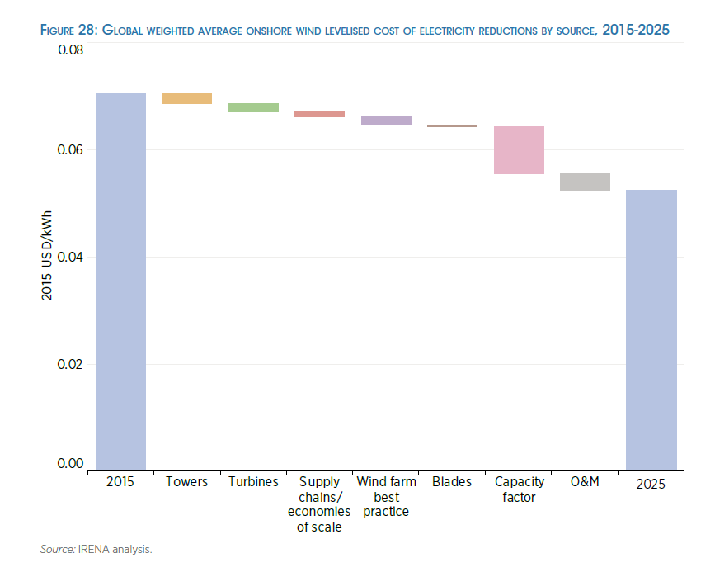
Capacity Factor and Power Curve Drive Trends in Costs

Slide 5
Basic Equations for Revenue Build Up
Electricity plants have capacity which is the ability to produce at an instant
  kW, mW, W
For producing revenue, there must be some kind of time dimension attached to the capacity
  Hours, months, years
  kW x h, kW x month, kW x year
  kWh, kW-month, kW-year
There is a basic distinction in project finance for availability and output based projects. Output base projects earn revenues on production, availability based projects earn revenue as long as the plant is available to produce even if it does not produce.
  Output based projects (renewable): revenue = price x kWh
  Availability based projects (dispatchable): revenue = price x kW-month

Slide 6
Step 1 of LCOE: Annual Carrying Charge per kW
Convert the Cost per kW which is the crucial driver of power costs for many technologies by the carrying charge rate.
This gives the cost per kW-year.
The carrying charge can be thought of as the amount of annual EBITDA required for an amount of up-front cost. It can also be thought of as the return on and the return of capital to carry the investment.
It can also be thought of like the loan payment on a house divided by the price of the house.
Annual Carrying Charges = Cost/kW x Carrying Charge Rate

Slide 7
Step 2: Total Fixed Cost per kW-year
Add the fixed O&M costs expressed in Amount (e.g. USD) per kW-year to the annual carrying charges to derive the total annual cost per kW-year.
Total Annual Fixed Cost/kW-year = Annual Carrying Charges + Fixed O&M Cost

Slide 8
Step 3: Compute the Fixed Cost to Turn on the Lights
Compute the total fixed cost based on energy rather than capacity.
To do this, you need the capacity factor (for renewable) or the availability factor for base load (assuming the plant will run whenever it is available).
The hours that must be covered by the fixed cost are 8766 x capacity factor. The total annual fixed cost per MWH as the annual cost x 1000 divided by 8766 x capacity factor.
Total Annual Fixed Cost/MWH = Total Fixed Cost/kW-year x 1000/ (8766 x CF)

Slide 9
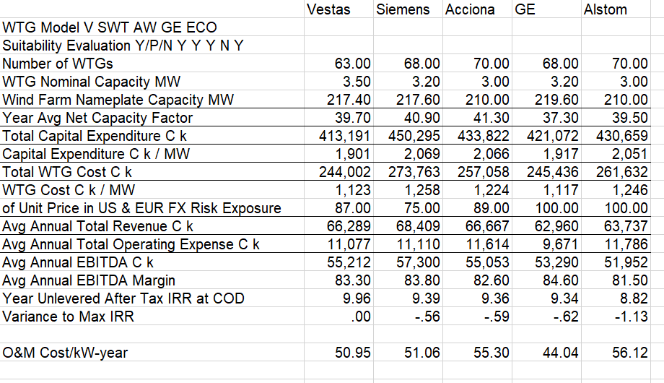
Parameters for LCOE Exercise
Work through the LCOE for wind fames using data in the table below. Need a carrying charge rate.

Slide 10
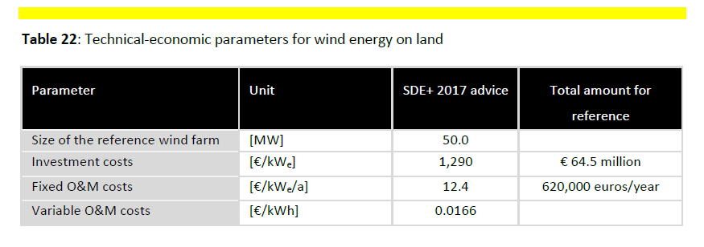
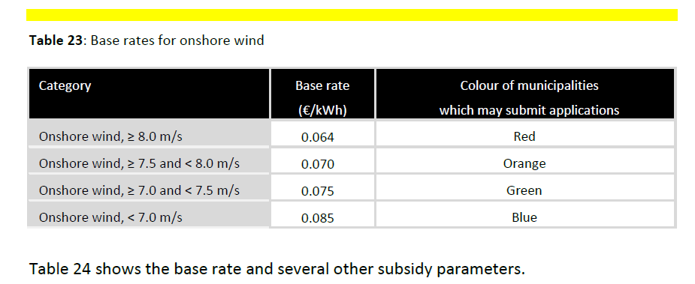
Example of LCOE Base Rates in NL Tariff

Slide 11
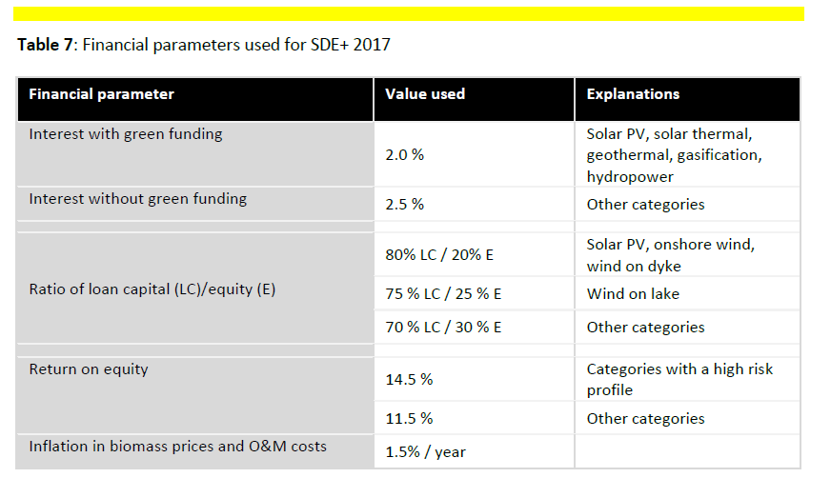
Financial Assumptions Used in Computing Base Rates
Factors other than tax rate

Slide 12
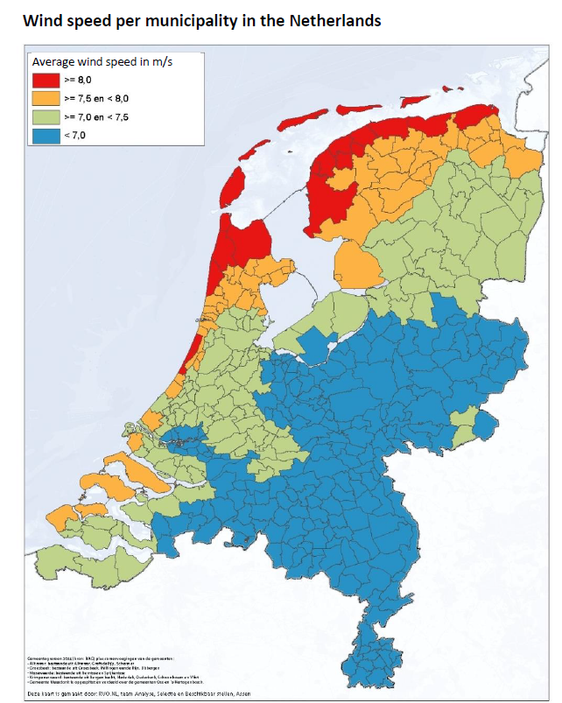
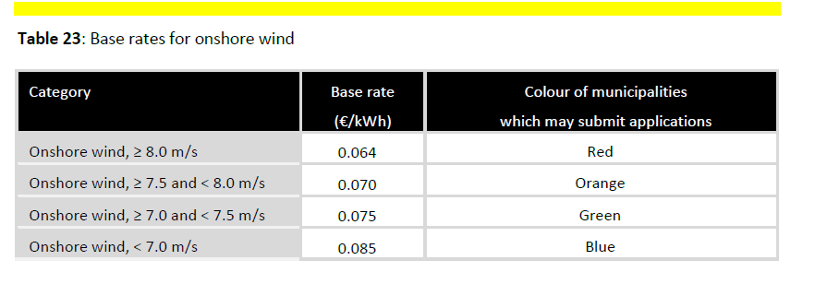
Wind Atlas from ECN

Slide 13
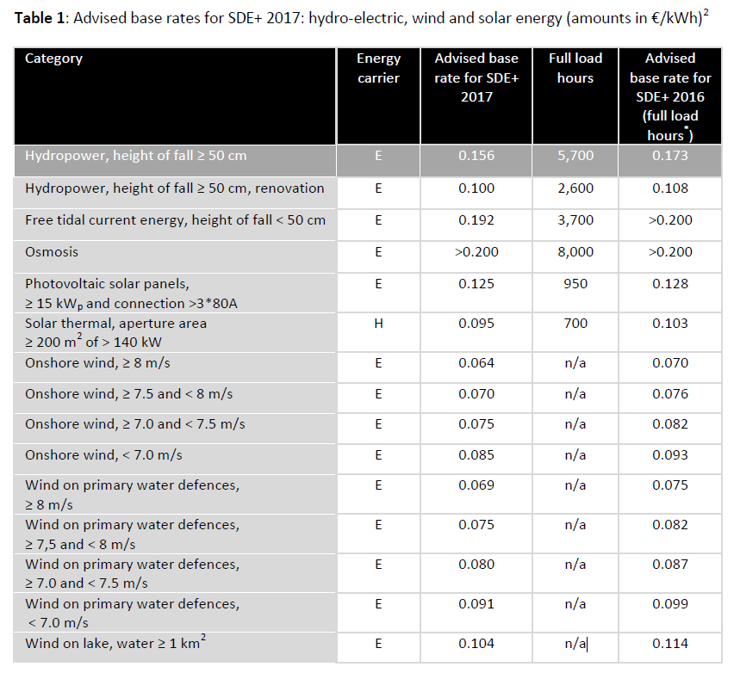
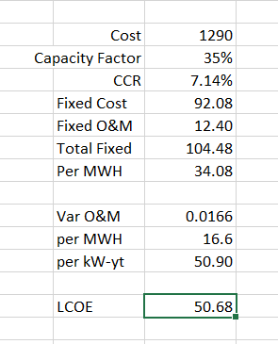
Base Tariffs for Renewable – Essentially the LCOE

Slide 14
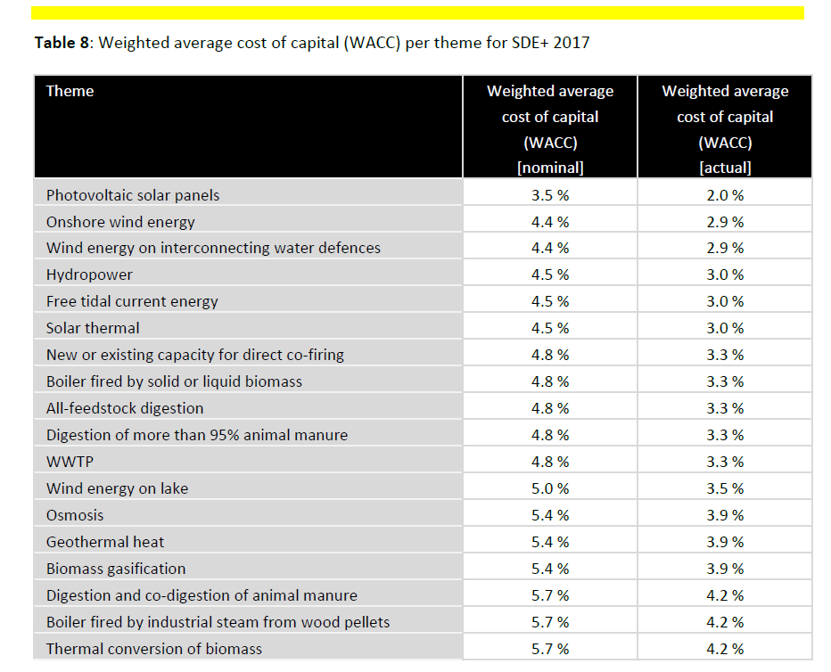
Cost of Capital in LCOE Study

Slide 15
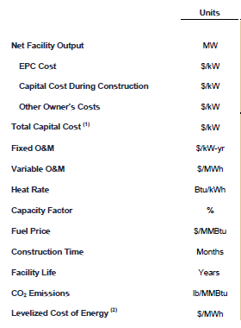
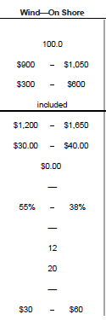
LCOE and Benchmarking and Lazard Study
Real versus Nominal

Slide 16
Bid Examples and LCOE

Slide 17
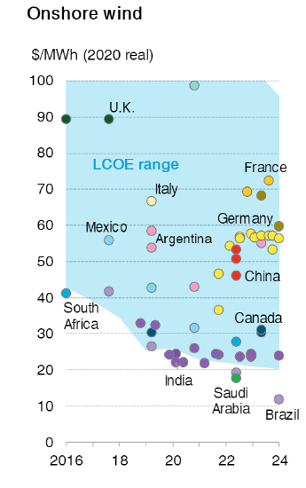
Dramatic Bids for On-Shore Wind (Bloomberg 2021)
There are dramatic low-cost projects
Depends a lot on the capacity factor
Low Costs Drive by Capacity Factor Differences
Estimating Capacity More Difficult

Slide 18
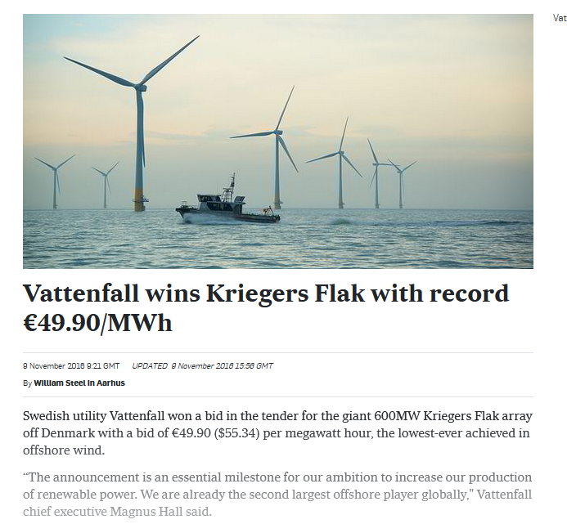
Denmark Off-Shore Bid

Slide 19
UK Off-Shore Bids
A UK government auction has secured a record 11 gigawatts (GW) of new renewable energy capacity that will generate electricity four times more cheaply than current gas prices.
The projects are all due to start operating within the next five years up to 2026/27 and have agreed to generate electricity for an average price of £48 MWh in today’s money. This is four times cheaper than the £196/MWh current cost of running gas-fired power stations.
Most of the new capacity – some 7GW – will be offshore wind. Notably, for the first time, these projects were cheaper than the 1.5GW of onshore wind or 2.2GW of solar.

Slide 20
US Off-Shore Bid
The levelized procurement price of U.S. offshore wind energy projects ranges between $96/MWh (Vineyard Wind 1) and $71/MWh (Mayflower Wind) for projects commencing commercial operations between 2022 and 2025.
These prices from power purchase agreements and offshore renewable energy certificates are based on a total of 5.5 GW of signed agreements.

Slide 21
LCOE Driver 1 – Capacity Factor Overview

Slide 22
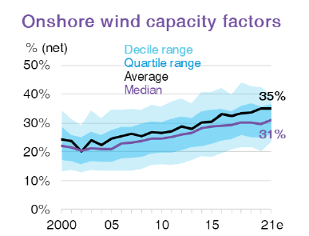
Bloomberg Capacity Factor Data
Driven in large part by improvements in Power Curve
Cannot Look Similar Data Nearby

Slide 23
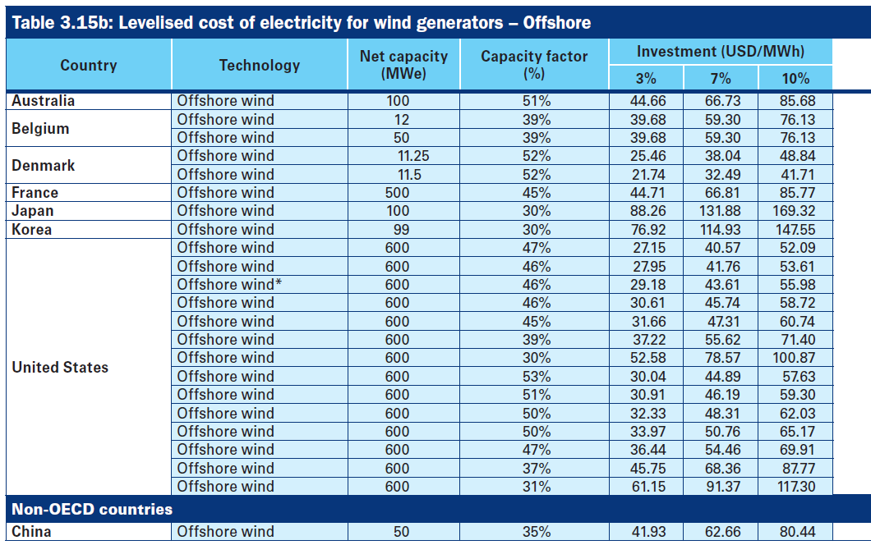
Capacity Factor of Off-Shore from IEA
2020

Slide 24
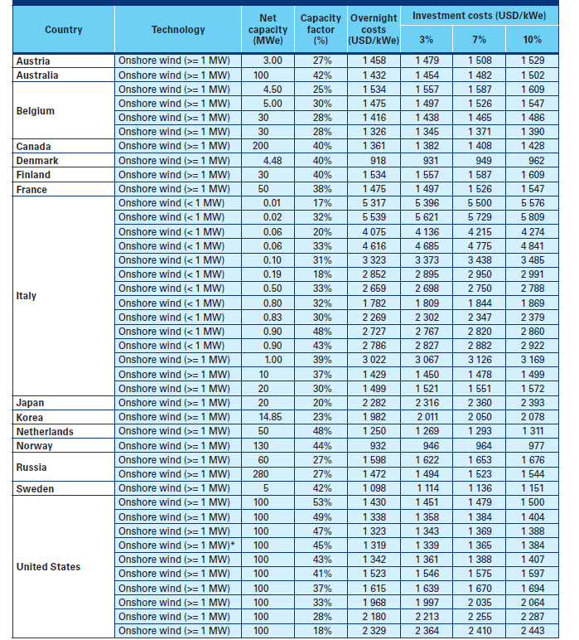
On-Shore Wind

Slide 25
LCOE Driver 2 – Up-Front Capital Expenditure

Slide 26
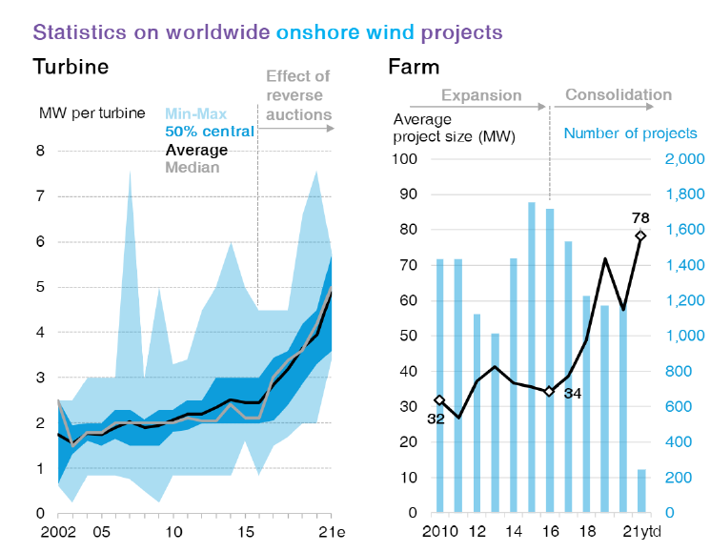
Changes in the Size of Windfarms (Bloomberg 2021)
Big Change – Increase in Size of Turbines.

Slide 27
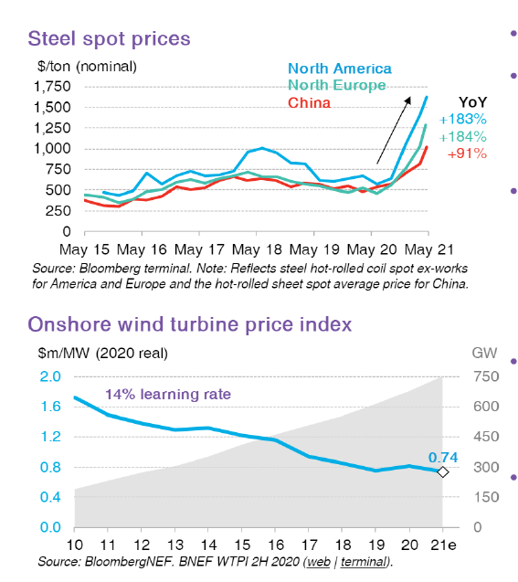
2021 Wind Prices from Bloomberg

Slide 28
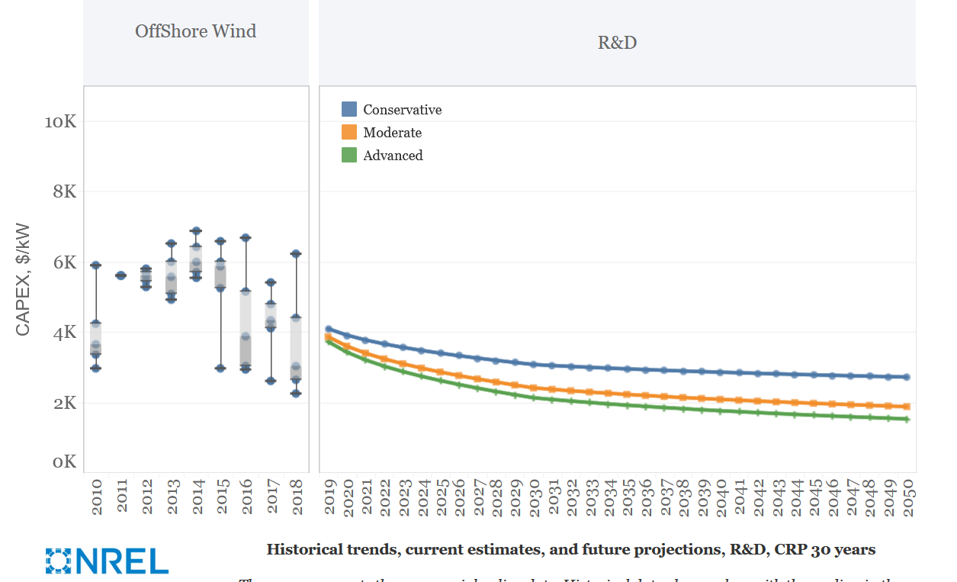
Wide Cost Range for Off-Shore Wind Capital Expenditure

Slide 29
Capital Cost per kW
Wind energy capital costs have declined steadily. A typical cost for a typical onshore wind farms has reached around $1,000/kW of installed rated capacity, and for offshore wind farms about $ 1,600/kW.
The corresponding electricity costs vary due to wind speed variations, locations and different institutional frameworks in different countries.

Slide 30
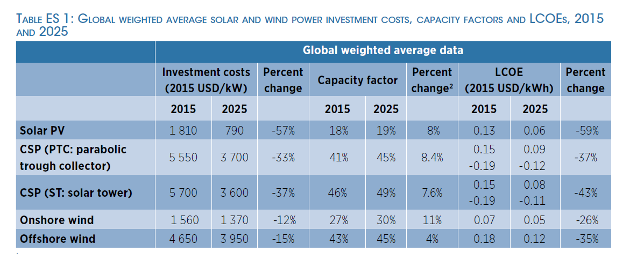
IRENA Estimated Capital Costs
Older Study with estimated changes in cost and capacity factor
Cost versus capacity factor

Slide 31
LCOE Driver 3 – O&M Cost

Slide 32
O&M Comments and Maintenance Contracts
The variable costs (except land costs), which include guarantee and maintenance contracts, have also decreased this year.
The variable costs are approximately 0.0095 €/kWh.
It is becoming more common for turbine manufacturers to offer a choice of maintenance contracts at a fixed price per turbine. On average, these prices lie within the range of 20-30 €/kW.
The fixed annual costs are those of public liability insurance, machinery breakdown insurance, standstill insurance, network maintenance, energy use, property tax, and management and maintenance of land and roads.
ECN and DNV GL have assumed 12.4 €/kWy.

Slide 33
Renewable versus Electricity Price
Short-term Analysis
  Don’t have to be too Fancy
  Imagine you are putting in a wind turbine in your business
  Must cover all of fixed costs including levelised capital costs
  Costs must be covered by savings over the time that wind turbine operates
  Example: Runs for ½ of year and costs 1000, then cover costs through dividing by hours
  Compare total cost of wind or solar with variable cost of natural gas
  Fuel cost of natural gas: Cost of Gas/MMBTU x MMBTU/MWH = Cost/MWH
  Add Variable Cost/MWH: Much lower
  Illustrates Fuel Intensive versus Capital Intensive

Slide 34
Fixed and Variable O&M Cost
General Magnitude of Costs and Importance of O&M in LCOE
Variable Cost Range USD/kWh - .0166
Multiply by 1000 to get Usual USD/MWH, 1.66
Use capacity factor of 25% with 8760 hours per year to get 2190 full load hours
Convert to USD/kW-yr (divide by 1000):
  16.6 x 2190/1000 = 36.35 USD/kw-year
Include Fixed Cost of 12.4
Total O&M Cost of 48.74/kW-year
USD to Compare 56.69/kW-year
Lazard High Range – 40/kW-year

Slide 35
Evaluation with LCOE

Slide 36
Simple Equation for Evaluation
Use Real LCOE
Compare to Variable Cost
Cost and Benefit of Renewable
Cost → Real LCOE/MWH including All Capital Costs
Benefit → Todays or Real Variable Cost of Alternative in Real Terms
If Variable Cost/MWH > Total Cost/MWH then Benefit
Variable Cost could be:
  Cost of buying power from the grid
  Cost of Operating Gas Plant
  Energy Cost in Electricity Bill

Slide 37
Long-term Analysis
Need to Incorporate Storage in LCOE Analysis
Include Total Cost in Alternative Analysis
Total Cost in Alternative Analysis
  Capacity Factor and Load Factor
  Total Cost of Natural Gas or Alternative
  Demand Charge and Energy Charge in Bill Comparison
  Total Cost of Diesel
Storage Cost in LCOE analysis
  Include Capital Cost of Storage
  Reflect Life of Storage, Degradation, Round trip Efficiency
  Reflect Cost of Renewable into Storage
  Sizing of Battery Storage
Cost and Benefit is Total Cost of Natural Gas versus Total Cost of Renewable Including Storage

Slide 38
Capacity Factor Detail

Slide 39
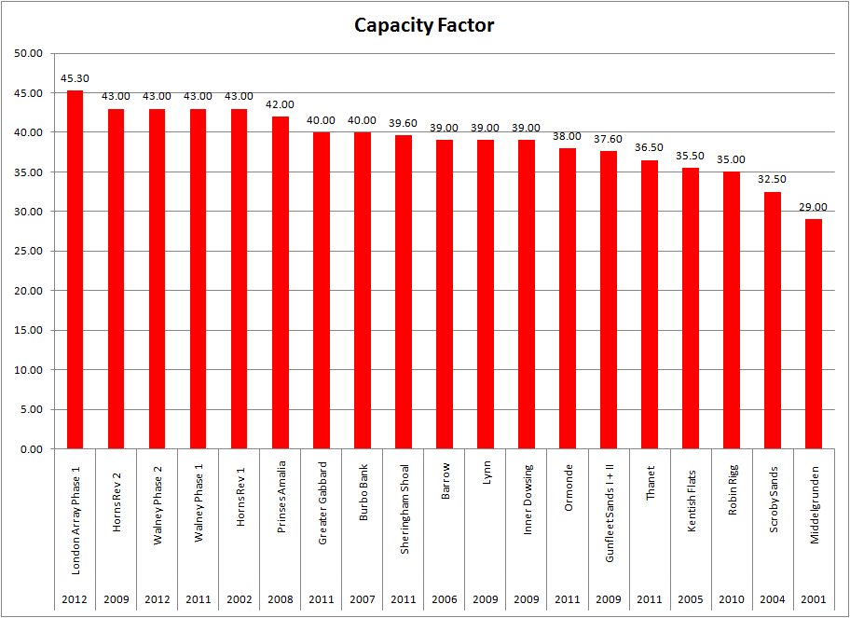
Expected Capacity Factor

Slide 40
Capacity Factor Variation for Single Farm
Source: Data Base on Off-Shore Wind Farms

Slide 41
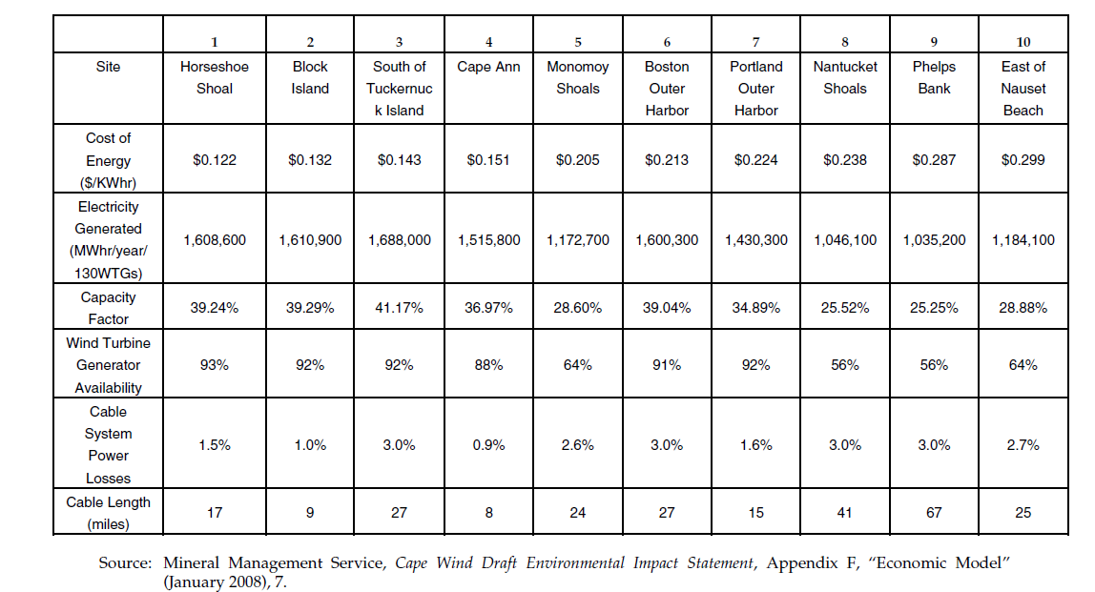
Capacity Factor of Off-Shore Wind
Note the difference in availability

Slide 42
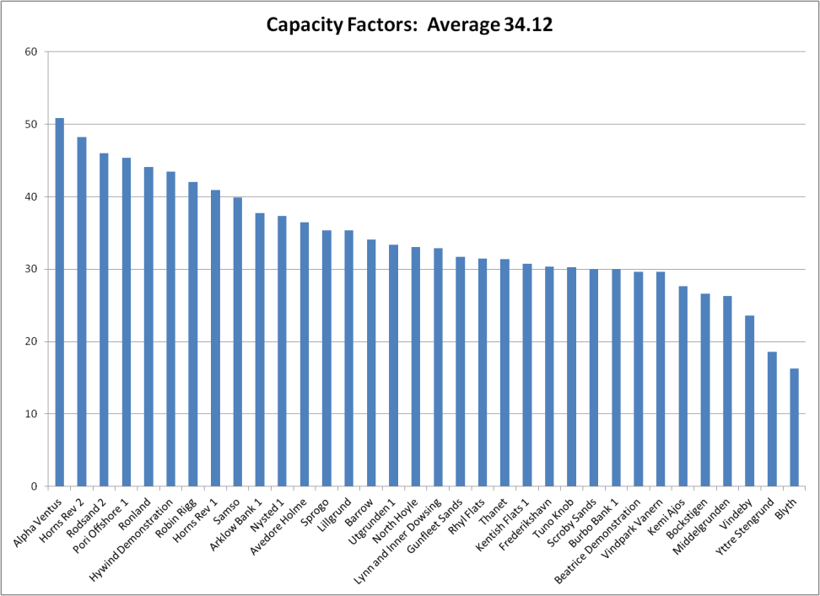
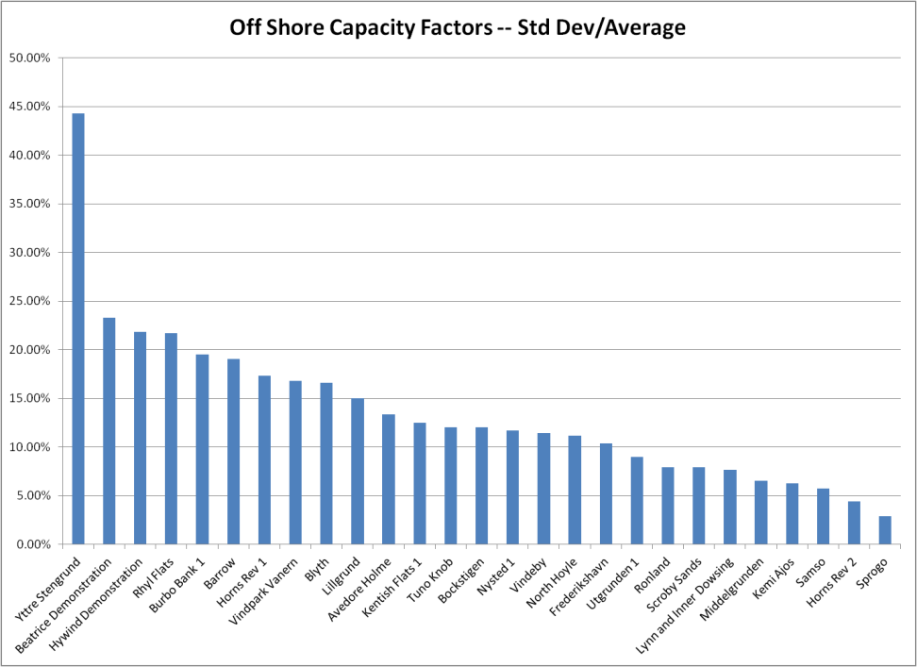
Average and Variation in Capacity Factors

Slide 43
Wind Speeds

Slide 44
Wind Studies
The first step for the project lenders is to conduct an in-depth analysis of the owner feasibility study and possibly even hire a consultant to conduct an independent feasibility study. Such studies will analyze the wind resource data and should demonstrate the financial viability of the project. These studies will detail technical, financial and other aspects of the project and are crucial to the lender in its risk assessment of the proposed project.
Independent Engineers compute the probability of different wind availability. However, these studies are based on the wind measurements for previous years and for a particular site, and while the studies accommodate the fact that the year in which the measurements were taken may have been a particular good or bad year, there is no guarantee that there will not be substantially less wind in the future.

Slide 45
Trying to Find Wind Speeds
Very Difficult
https://www.yumpu.com/en/document/view/4469663/wind-resources-at-horns-rev

Slide 46
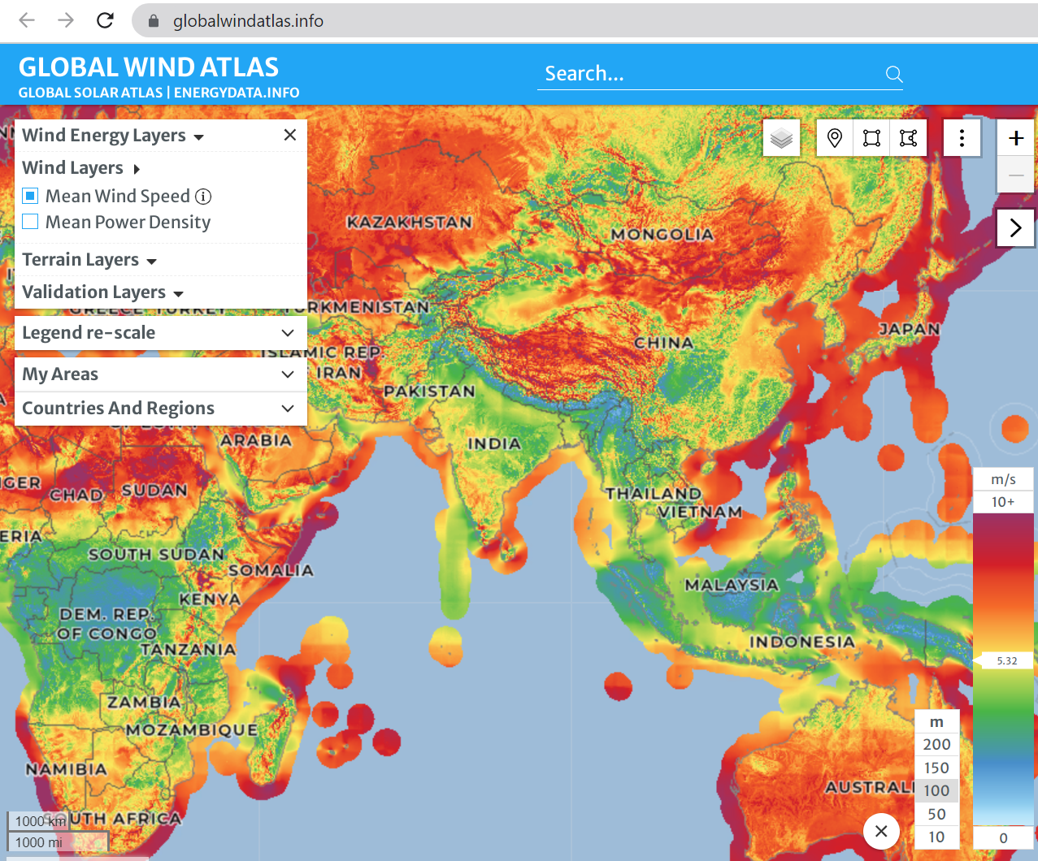
Global Wind Atlas

Slide 47
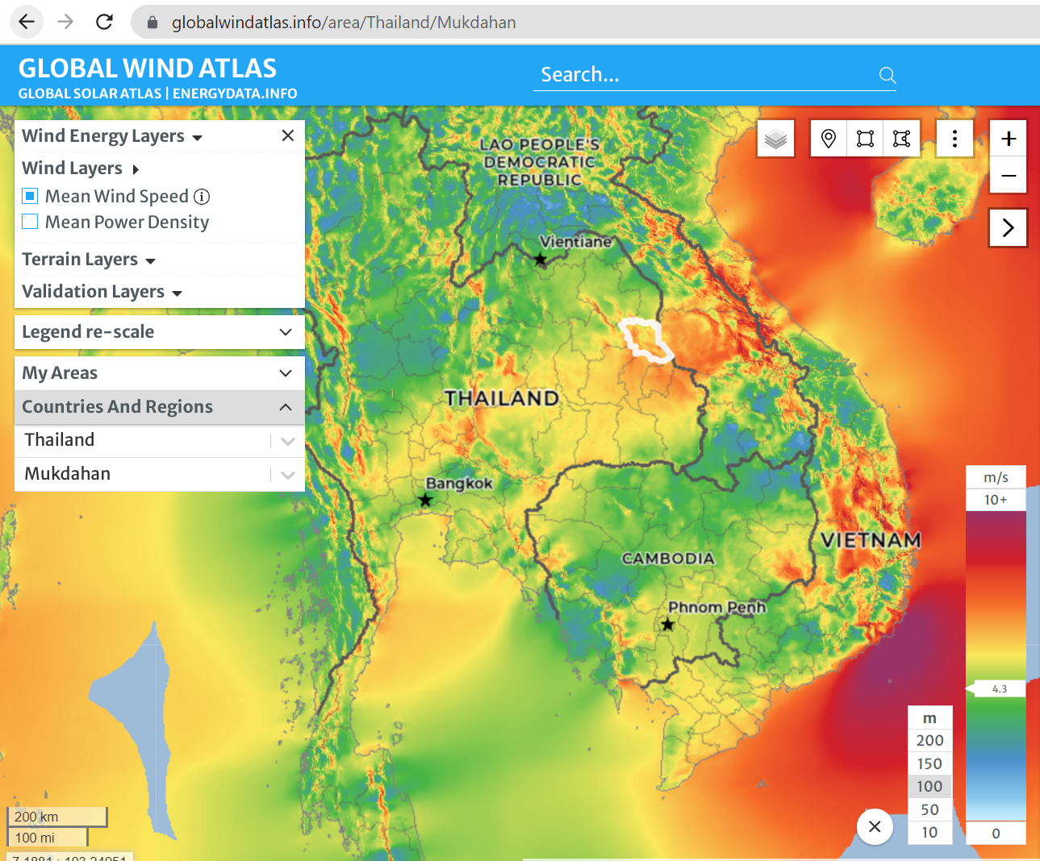
Height and Wind Shear

Slide 48
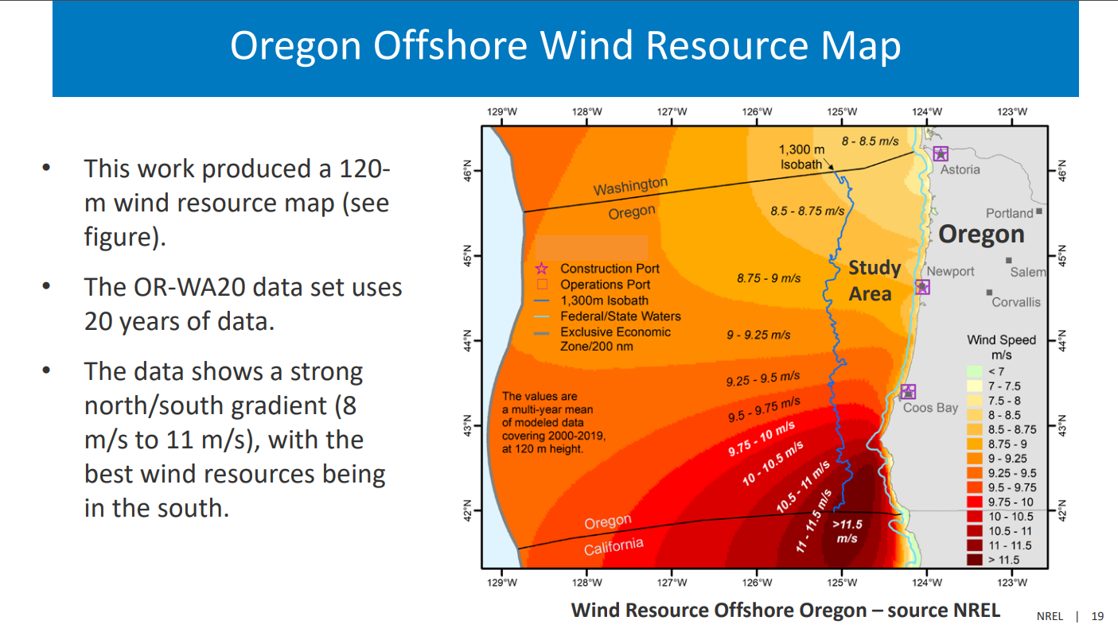
Offshore Wind in Pacific

Slide 49
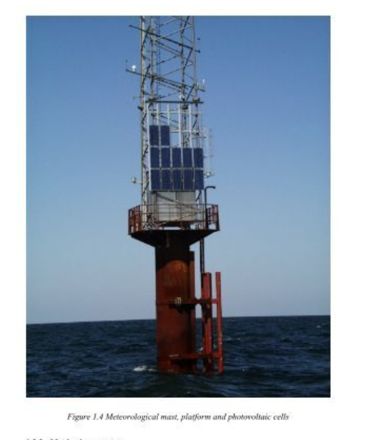
Met Mast off-shore

Slide 50
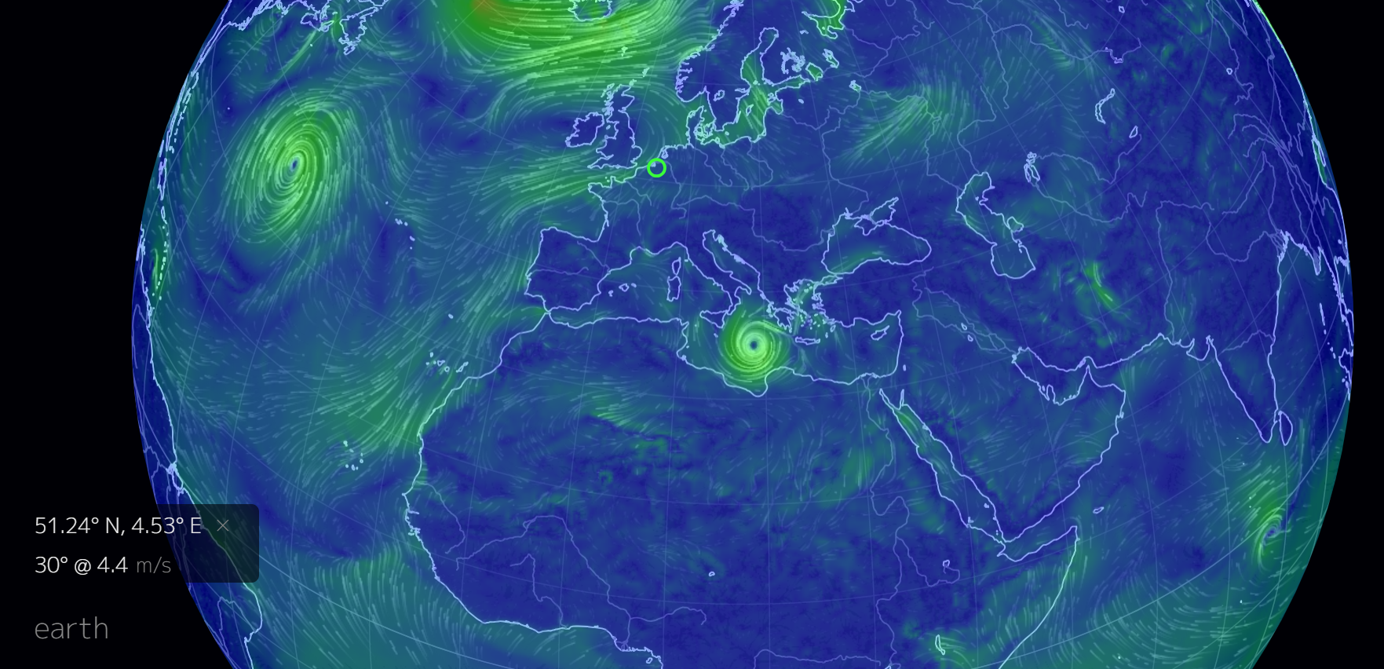
From World Wind Map

Slide 51
Lidar
LiDAR (light detection and ranging) or Soda (sound detection and ranging) are remote-sensing methods that use either light in the form of a pulsed laser or sound to measure ranges.
Ground based, remote-sensing technology often supplements anemometers because remote-sensing technology can measure winds at much greater heights.
The measurements are needed because the industry is building ever-taller turbines (80 to 100 m) to capture the stronger winds higher up.
“Is this device as accurate as my met tower?” The short answer is “yes.” Remote sensors are often more accurate than met towers. A number of validation and correlation studies have proven this.

Slide 52
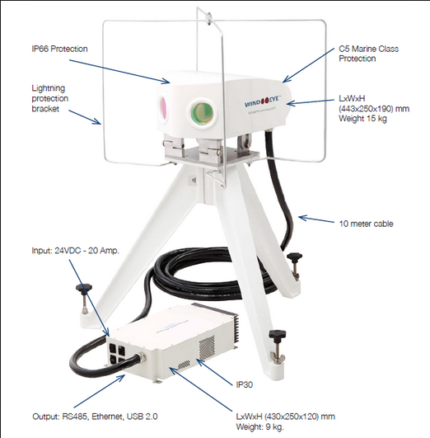
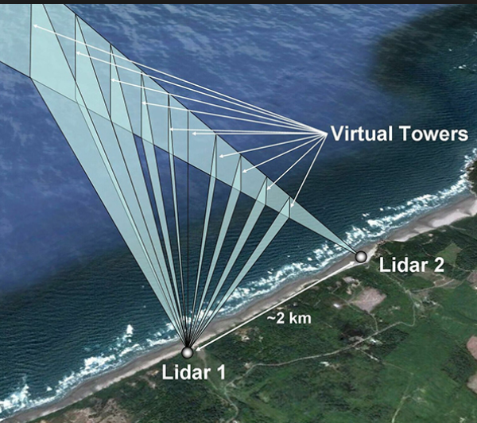
Collecting Data - Lidar
Lidar and ability to collect data at different heights. Also, reliability and location issues.

Slide 53
Data Collection
Which method provides more accurate long term production estimate, using on-site data measured with lidar or using synthetic data supplied by vendor like 3tier.
If the on-site measurement is at least 1 year long, and then correlated to long term data set from a near by weather station, then it is more accurate then synthetic data. That is especially true if the site has a lot of terrain variation.
The problem with measurement with lidar is that often times the lidar measurement was too short (<1 yr), the equipment is not maintained, the data is not monitored and QCed on a regular basis, and data was not processed by someone who is competent for that type of analysis.

Slide 54
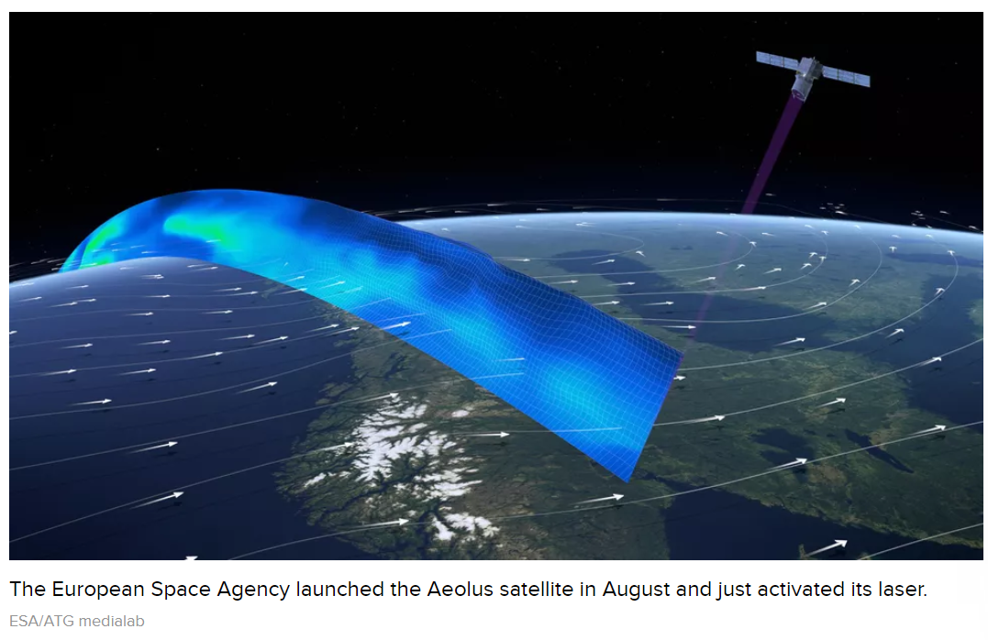
Lidar and Laser Compared to Solar
For Solar, the use of satellite data has become standard.

Slide 55
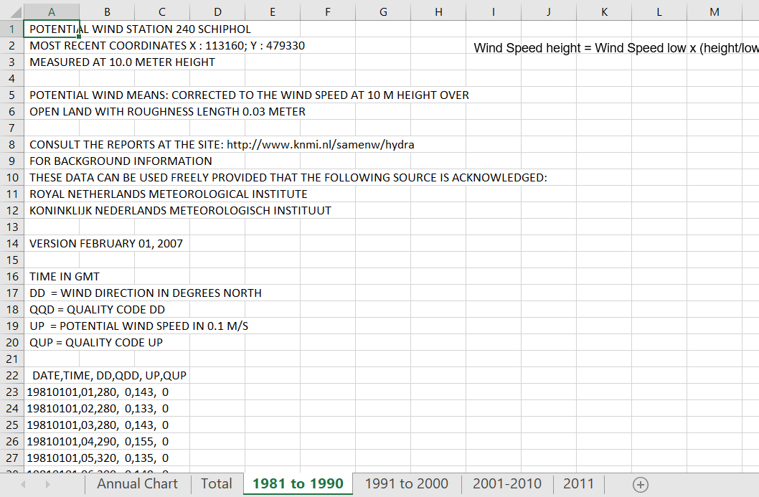
Data Example for NL
Data for many years on an hour by hour basis

Slide 56
Weibull Distribution

Slide 57
Example of Fitting the Weibull Distribution

Slide 58
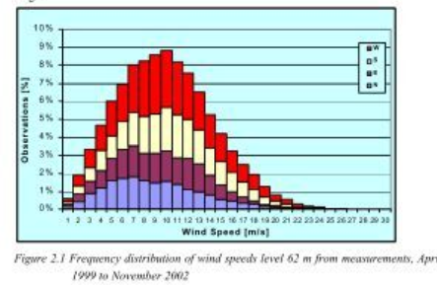
Skewed Distribution in Year – No Negative Wind

Slide 59
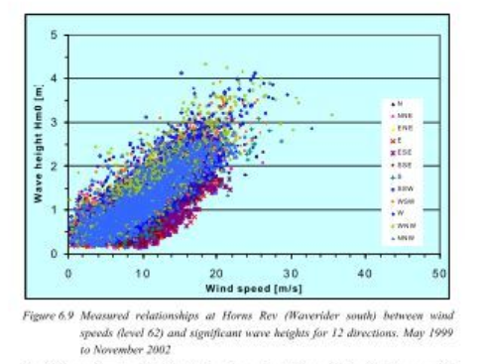
Wind Speed and Wave Height

Slide 60
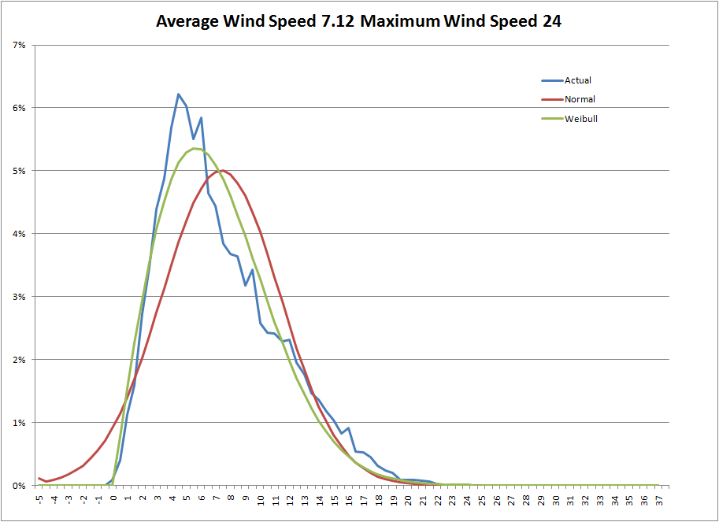
Weibull versus Actual Versus Normal from Creating Annual Wind Distribution – Alpha 2.0; Gamma .89
Note that normal distribution produces negative values

Slide 61
Wind Shear

Slide 62
Calculation of Wind Shear Exponent
Calculation of Wind Shear Factor Using Logs – the difference in wind speed on the top in the numerator and the height in the denominator.
.
v2 is wind speed at high height
Begin with 1/7 power law – alpha = .142; but not good enough for site specific applications

Slide 63
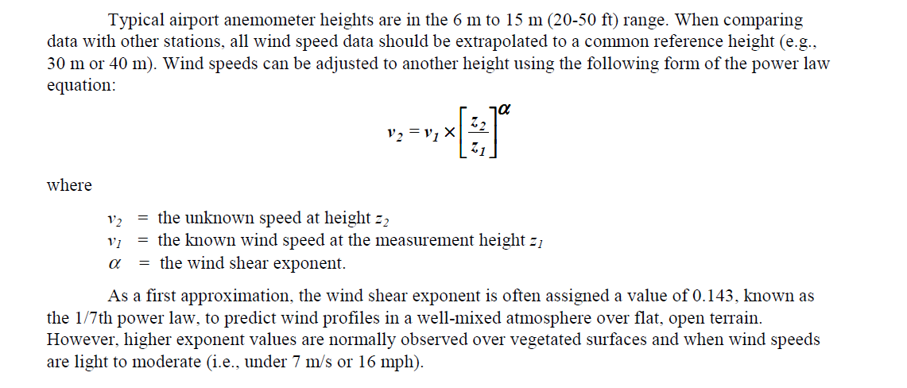
Wind Shear Adjustment
Height in meters versus wind speed in meters/second
Wind Speed high height = Wind Speed low x (height/low) ^ Alpha

Slide 64
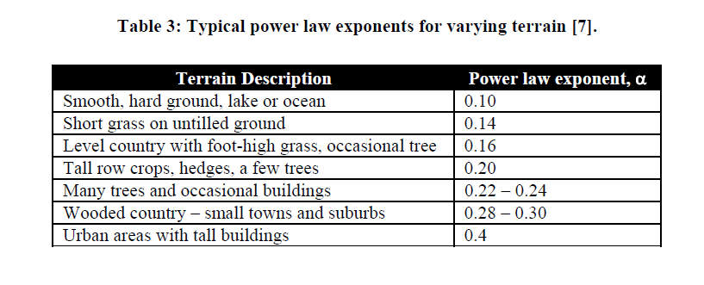
Errors in Wind Shear
Wind shear is the variation of wind speed with elevation. It is important to understand because it directly impacts the power available at different wind turbine hub heights.
For the site with the most complex terrain, the average annual wind shear varied up to 7% between different years.
For fairly flat terrain, many investigators have used the one-seventh power law, where α = 1/7 = .143

Slide 65
Application of Wind Shear
Step 1: Tower Height/Anemometer Height
  Eg Anom. Height 40 meters
  Tower Height 60 meters
Step 2: Wind Speed at Anom. Height
  6 Meters/Second
Step 3: Adjusted Wind Speed from Shear Exponent
  Assume Shear Exponent is .15
  (60/40)^.15 = 1.5^.15 = 1.06
  Adjusted Wind Speed: 6 x 1.06 = 6.84 Meters/Second

Slide 66
Power Curves

Slide 67
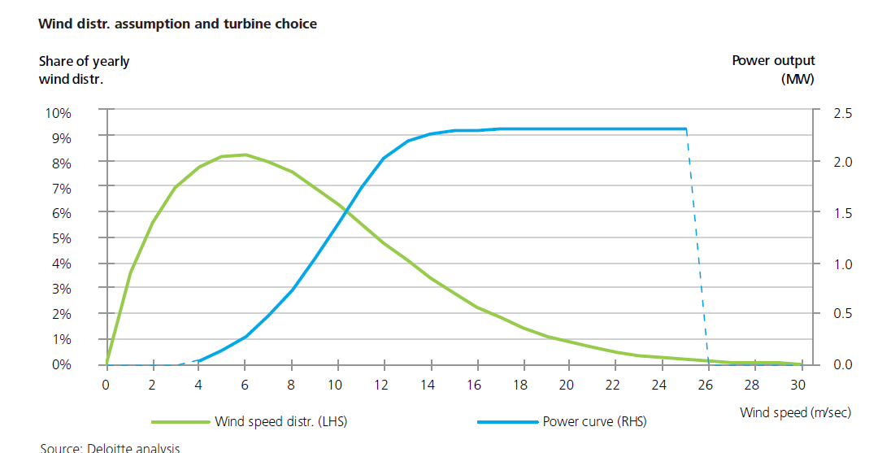
Power Curve and Wind Distribution
To predict the wind production, you need the distribution and not a single point.

Slide 68
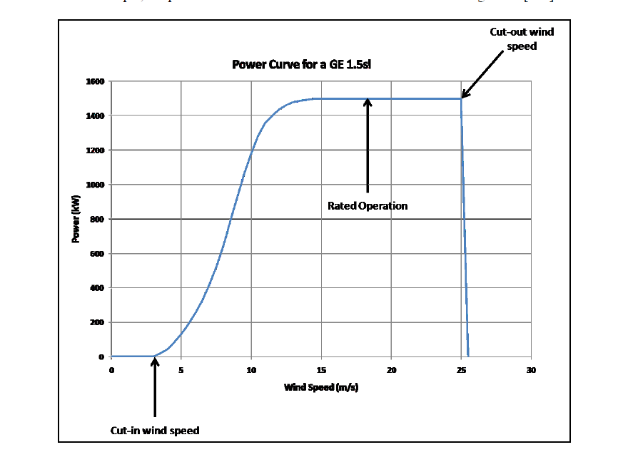
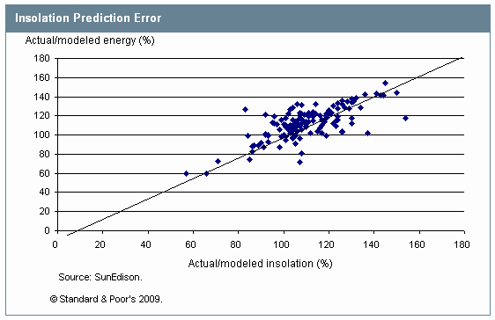
Relationship between Resource (Wind or Solar) and Energy Output
Solar is Linear and Wind has Curve – Power Curve

Slide 69
Increases in Turbine Size
Wind Energy the Facts
Source: Wind Energy the Facts

Slide 70
Ability to Produce at Relatively Low Wind Speed
Spanish turbine maker Gamesa has unveiled plans for a 2MW giant-rotor model to be used on sites with lower wind speeds.
It will have a 114-metre rotor diameter with a swept area of 10,207 square metres, compared with 7,390 square metres for its G97 turbine. “We know our customers need to take more energy from 6.5-7.5 metre-per-second and even six metre-per-second sites, and they need a turbine that can get maximum energy with a low investment cost.”
It aims to install a prototype by the third quarter of 2013, with some units going to customers the same year, before moving to serial production in 2014. Expect the turbine to have a “very relevant impact” in India and China.
“We expect the turbine to do very well in all the provinces around Beijing and Shanghai where the government is pushing development, because of the problems in connecting areas with higher wind resources further away to the grid” Gamesa also expects the turbine to sell well in Brazil, in sites that are class 2 (medium speed) but have low levels of turbulence and it hopes to sell the model in Europe and the US if markets recover from 2014. The new model is a big part in meeting its aim — set in 2011 — to reduce its turbines’ average cost of energy by 30% by 2015.
Source: Current Topics

Slide 71
Power Curve Normalisation

Slide 72
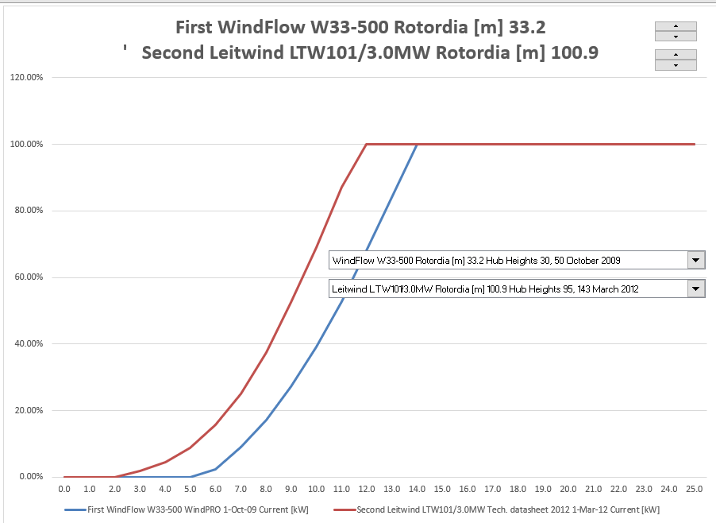
Power Curve Comparison

Slide 73
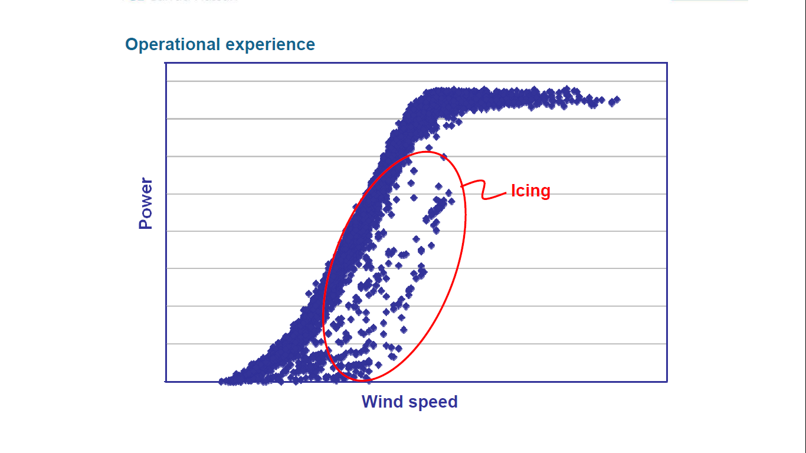
Effect of Icing on Power Curve

Slide 74
Net Versus Gross Generation

Slide 75
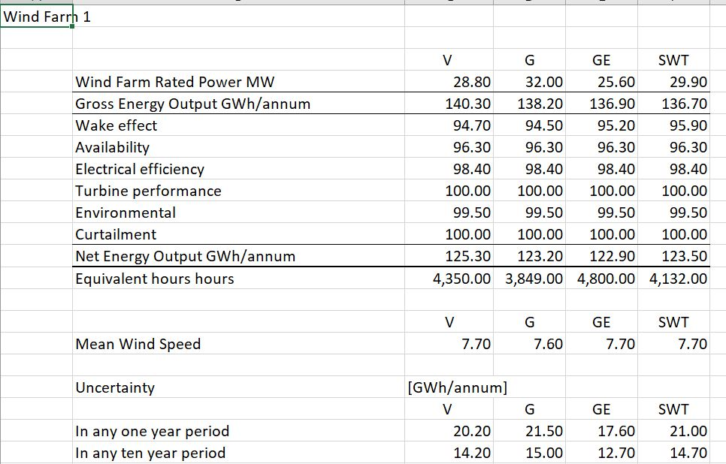
Example of Wind Study – Components of Estimation Like Performance Ratio

Slide 76
Wake Effect
The installation of turbines in wind farms will, due to mutual wake effects, alter the local wind conditions. Hence, erecting wind turbines close to each other will reduce the internal wind farm wind speed and thus in turn the efficiency of the total power production.
On the other hand, if the wind turbines are too far from each other, the full potential of the wind resources on the ocean will not be achieved, and the financial expenses related to the internal grid will increase significantly. An important parameter in this context is the average distance between the wind turbines, measured in rotor diameters, which is a reference length for wind farms. Today, in a typical wind farm, such as the Danish Rødsand or Horns Rev wind farms, the wind turbines are located about seven diameters from each other in order to diminish the wake effects.

Slide 77
For Risks Other than Resource Risk, Back-to-Back Contracts Can Be Used
General discussion about wind and power risk after the plant is in service.
  Wind fluctuation is a risk that contractors cannot and probably should not take.
    They would make very negative assumptions about wind and charge very high prices
    Factors such as environmental risk that can affect output and cannot be controlled also cannot be accepted
  But other factors that affect electricity production may be mitigated:
    The power curve that converts different levels of wind to electricity
    The availability of the turbines
    The degradation of blades and turbines
Systematic Losses
Wake Effect |  |  |  | 95.3%
Electric Efficiency |  |  |  | 97.0%
Blade Performance Degradation |  |  |  | 99.5%
WSM Curtailment |  |  |  | 97.0%
Turbine Performance |  |  |  | 99.8%
Availability |  |  |  | 96.8%
 |  |  |  | 86.19%
Net Turbine Capacity Factor |  |  |  | 51.71%

Slide 78
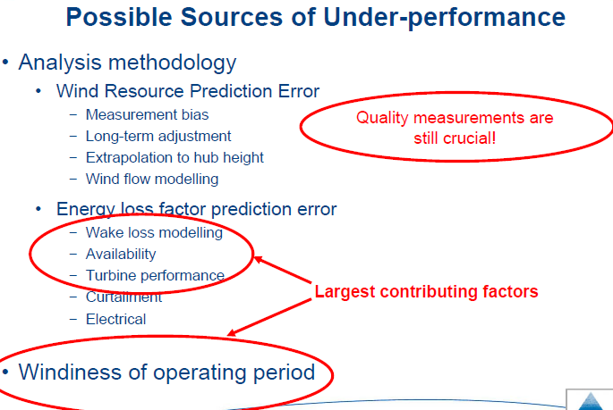
Biggest Problem Areas According to GH

Slide 79
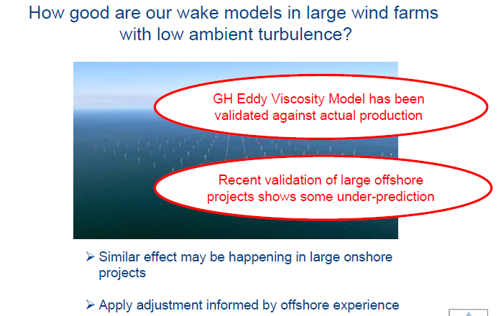
Errors in Estimation from Wake Effects

Slide 80
Wind Capital Cost Detail

Slide 81
Balance of Plant Cost for Off-Shore versus On-Shore
Source: Wind Energy the Facts
Turbine Cost is About the Same

Slide 82
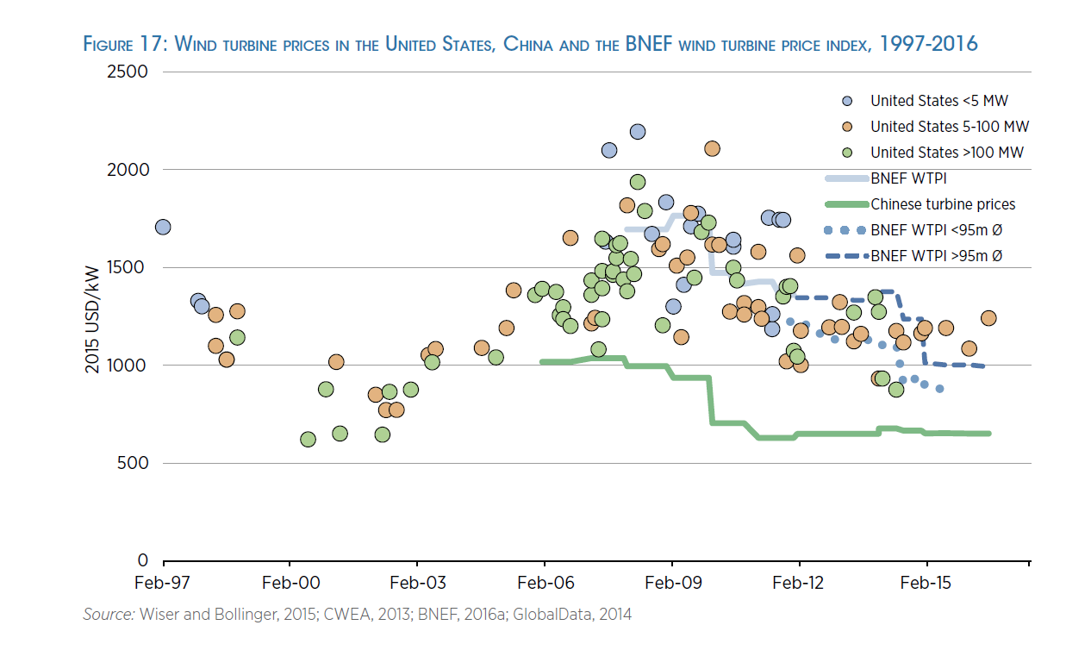
Wind Turbine – China and Other

Slide 83
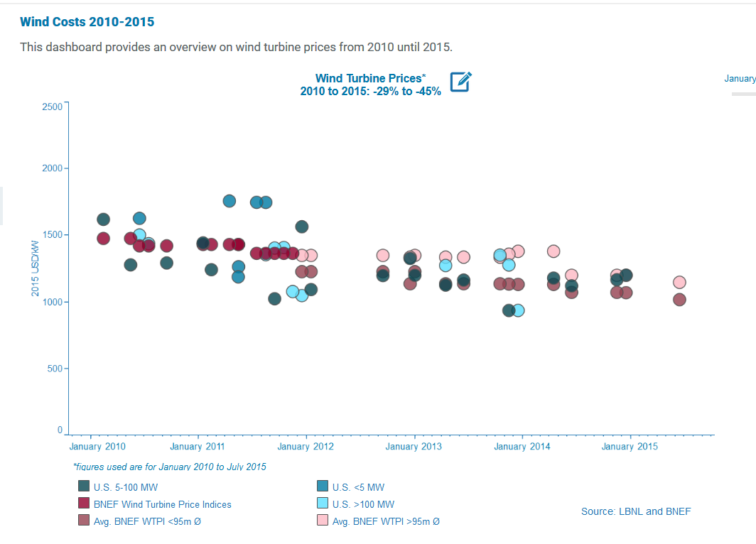
Cost of Wind Turbines

Slide 84
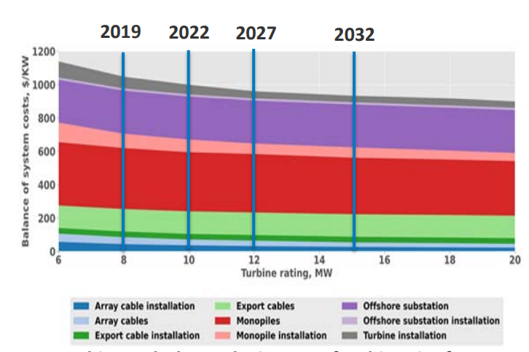
Balance of Plant Cost – Off-shore

Slide 85



Trends in Total Project Cost including Balance of System
Cost of 1,400 Euro x 1.4 = USD 1,960/kW
Source: Case Studies On Shore

Slide 86
Costs of Grid Connection for On-Shore and Off-Shore
Difficulties in connecting wind turbines to the grid can contribute significantly to the risks and costs of a project. While the costs and risks of grid connection for onshore projects are mainly concerned with distance and the possible crossing or tunneling of rivers, roads or tracks, the situation is completely different for offshore projects.
Depending on the location of the project, cable must be laid over many kilometers of hostile and inaccessible environment and, usually, ploughed into the sea bed. As a result, costs for grid connection can constitute a very large share of the total investment in an offshore project, easily 40%. This contrasts sharply with onshore where, for most projects, costs for grid connection account for around 10% of total project cost.

Slide 87
Operation and Maintenance Cost

Slide 88

O&M Costs from IRENA – Note the Dramatic Variation in Costs

Slide 89
Off-Shore O&M and Other Issues
O&M for off-shore
  Hotels
  Rule of thumb 10% of revenues
Decommissioning cost of off-shore
  Problem of replacing turbines
  Setting-up funds
Merchant risk in Feed-in tariffs
Balancing cost when selling in markets

Slide 90


Selected Examples of O&M Cost
O&M Estimates

Slide 91




Example of O&M from Turbine O&M and Other O&M

Slide 92
Operation and Maintenance Cost Issues
Bankable O&M Contract
Suppliers like GE make more money on O&M contracts than on selling equipment
How much of O&M cost is fixed and how much is variable:
  Developers often use fixed and express in Amount/kW/Year
  Other sources use Amount/MWH
  Example from Ireland Below:

Slide 93


O&M Costs

Slide 94

O&M Costs per MWH
.O&M Database from U.S. -- Appears that O&M increases with age of project.

Slide 95

Operating Expense Analysis
The operating cost of a project can be measured on an absolute basis, on the basis of the kW capacity or on the basis of the MWH produced. The range in operating costs for a few projects is shown in the accompanying table.
.
.

Slide 96

Operating Cost Breakdown
.

Slide 97
Overview of Risk Issues Particular to Wind Projects

Slide 98
Nightmare Graph and Missing the P90 – Fitch Report

Slide 99

Noise from Turbines
The amount of noise from turbines can be measured and guaranteed, unlike the flicker example

Slide 100

Risks from Avian Issues
Problems of birds can reduce the output of turbines.
  Example in France when must stop turbines during bird migration
  Example in Canada with reduction in generation and also costs for scientists

Slide 101
Additional Risks: Transmission Capacity
Best Wind Sites not Located in Load Centres
  Wind Producer may be responsible for transmission
  Examples of curtailment
    Lake Turkana
    Oklahoma
  Low Merchant Prices in Transmission Constrained Areas
    Example: Montana and Off-peak Prices
NL has priority dispatch for RES. In addition, in case of curtailment compensation is paid. So far, curtailment is seemingly not an issue in NL.

Slide 102
Additional Risk: Partial Exposure to Merchant Power Price
History of Merchant Power and Merchant Power Problems at the Turn of the Century
Debt Structuring with Merchant Power Risk
Examples of Merchant Power Risk in PPA Contracts

Slide 103
Additional Risks: Shadow Flicker
What is shadow flicker in wind and is it a big deal
Shadow flicker is the intermittent shadow casted by the moving wind blades of a wind turbine. The extent of its impact depends on the latitude of the project, time of the day, time of the year, turbine height, blade length, distance between the impacted dwelling and the turbine, the window placement of the dwelling etc.
Depends on the project and buildings in the vicinity and the rules & regulations. Some projects need to stop turbines for specific times for shadow flicker reasons.
Certain governing bodies have clear regulations on shadow flicker, e.g. max number of shadow hours casted at a dwelling. Even if there is no clear written regulations, residence (participating or not participating in the project) can express concerns during public comment period of a permitting process if there is one. Shadow flicker can be modeled using commercially available software like wind pro.

Slide 104
Counter Party Risk and O&M Contracts
Replacement of the EPC/maintenance contractor --Consider a case where the turbine manufacturer/supplier will build the wind farm (EPC contract, full scope) and will also maintain it (the turbines, maintenance agreement).
  Is the turbine manufacturer/supplier easy to replace (for example in case of bankruptcy)?
  Can a replacement turbine manufacturer/supplier maintain the current installed turbines and replace its parts?
  Or, are parts and turbines very (brand) specific and do they need to install their own turbines (or even windmills)?
  Do these turbine manufacturers/suppliers use parts from subcontractors or is everything designed and built in-house and very specific?

Slide 105
Uncertainty and P90 vs P50 etc.

Slide 106

Explanation of P50, P90 etc.

Slide 107

Use of Resource Analysis to Compute Probability Distributions for Project Finance

Slide 108

1-year and 10-year P90, P50 etc.

Slide 109

Compare the P50 versus P99 to DSCR from Wind Study
The difference between P50 and P99

Slide 110
Example of Sources of Uncertainty

Slide 111
Errors in Estimation due to Variable Winds
Most, if not all, small wind turbines have controls that put the system into standby or monitoring mode when turbine output falls below a certain level.
If the wind at a site is particularly gusty, a turbine can go through repeated on/off cycles. In these situations, the system may shut down as the wind speed decreases but, depending on its factory‐set response time, the inverter may remain in standby mode through one or more subsequent gusts.
To quantify the amount of energy lost due to standby timing, it is necessary to track wind speed and power output concurrently, keeping track of high wind speeds coinciding with standby power draw. Without measured data, there is no way to accurately estimate the magnitude of this loss.
Highly variable or turbulent winds can rapidly change not only speed but also direction. When wind direction changes, the turbine generally responds by trying to turn into the wind. Rapidly changing wind speed and direction can cause excessive “tracking” as the turbine yaws and tries to turn into the wind. During these times, the turbine rotor is not perpendicular to the wind flow and power output decreases. The magnitude of the energy loss due to this effect is difficult to estimate without detailed system monitoring, and it is not surprising that none of the commonly available estimating tools attempt to include losses for turbine tracking.

Slide 112


More Analysis of Actual Wind Variation from Database

Slide 113
Resource Analysis for Wind and General Discussion of P90, P99, Power Curves and Wind Variation

Slide 114
Wind Speed Risk
A potential and significant risk for any energy project is the underlying resource for its generation – in this case wind. Identifying the availability of wind is paramount. This has two aspects.
  The first is the question of whether a particular site has sufficient wind speeds. This issue is addressed by the lending banks insisting on long-term – usually at least 12 months – wind measurements, which are then used as the basis for a number of wind studies. Banks usually insist on at least two of those coming from reputable wind experts. These wind studies give an estimate of the annual electricity output of a project, based on a probability curve, usually 75% or 90%, that the project will generate x number of full load hours. Depending on the wind turbine used, there is therefore a 75% or 90% respectively, probability that the turbine will generate y kW/h per year when in service.

Slide 115
Annual Variation in Wind Speed
Due to the natural variability of wind, the annual energy yield of a given wind farm may change drastically from year to year depending on the wind regime of the area. A study undertaken has estimated that annual mean wind speeds over the long term may be assumed to be normally distributed with a standard deviation of 6%.
Implies that deviation of 14% in one of every 100 years.
Wind speed should be within one standard deviation for 6.8 years out of 10.

Slide 116




Netherlands Wind Speeds – Historical Variation by Year

Slide 117


More NL Wind Speeds with Variation and Percent Variation

Slide 118
Variability in Annual Wind Speed

Slide 119

Wind Speed by Hour of Day and Month of Year

Slide 120


Variability in Wind → UK Wind Index in 2010 – 10% below Average
Statistical Analysis and Standard Deviation

Slide 121

Variation in Average Wind Speeds

Slide 122



Example of Variation in Wind Speed for Italian Wind Projects

Slide 123




More Examples of Wind and Wind Compared to Hydro

Slide 124
Example of the Effect of Swept Area in DK
From January 2014, the total support duration is determined in a different way, now roughly depending only 30% on capacity (full load hours) and 70% on swept area.
More precisely, the support comprises a fixed amount of 6.600 Full Load Hours but additionally 5.6 MWh are supported for every m2 of the swept area.
This support policy benefits larger blades as the support increases with the size of the swept area.

Slide 125

Siemens Wind Turbine SWT-2.3-101

Slide 126
Assessment of Risk Analysis

Slide 127
Optimistic Estimates in Wind Studies
Comment from a few years ago: An industry-wide tendency was recognized for pre-construction P50 performance estimates to be higher than actual performance;
  over-projection of turbine availability was identified as a significant contributor to this error.
Johnson C, Tindal A, LeBlanc M, Graves A & Harman K, Validation of GH North American
Energy Predictions by Comparison to Actual Production, 2008 AWEA WINDPOWER Conference, June 2008.

Slide 128
Factors that Affect Wind Production and Estimates
Incorrect Wind Speed Estimates
Incorrect Power Curves
Incorrect Site Condition Estimates
  roughness classes, described as smooth, moderate, rough, and very rough.
  These terrain classes affect the estimated wind shear exponent and effective ground level.
Weibull shape factor
Other loss factors
  (e.g., voltage drop, blade weathering).

Slide 129
Relative Production
Relative Production: Relative production (RP) is used to describe the actual performance of a small wind system compared to its predicted energy output. This metric demonstrates how well a small wind system future energy output can be predicted based on available estimating techniques, micro siting, wind speeds, and turbine information. Relative production is calculated as follows:
RP = AEPpredicted/RP = AEPactual
RP is calculated by dividing observed annual energy production by the predicted annual energy production. For example, if a system was predicted to produce 10,000 kWh per year and onsite meter readings indicated an AEP of 5,000 kWh, the relative production for that system would be 50 percent.
The benefit of using RP as a metric is that, by using estimated output as a basis, it implicitly includes some normalization for wind speed, turbine efficiency, and terrain conditions.

Slide 130
S&P Comments on Actual and Projected Wind Speeds
Assumptions may be wrong in any project financing, but for wind projects that only receive payments if there is wind, the wind forecast provides a principal uncertainty.
In many cases there is insufficient historical wind data to support an extrapolation of wind production for the next 20 years. Unfortunately, there is no public database available that compares actual wind outturn with the initial forecasts for individual projects. Research conducted in the industry provided general statements that few, if any, wind projects have defaulted. This apparently reassuring conclusion may, however, not be based on Standard & Poor definition of default, which includes any missed or deferred payment of interest and principal, restructuring, or restatement of the terms and conditions of the debt that would lead to an economic loss.

Slide 131


Actual versus Expected in NaturEner

Slide 132

GH Study of Actual and Predicted
16 observations had 80% of P50. Only 7 Observations had more than 100% of P50.

Slide 133

Actual Versus Predicted Wind
In each case the production was less than realized; often as much as 40%.

Slide 134

Actual and Predicted Output
In studying larger projects, the difference is not as great, but for one of the three the production was 34% less.
.

Slide 135

NextEra Forecasts and Actual

Slide 136


Example of Actual and Estimated Production in Wind Energy Book

Slide 137


Actual Wind Production Variation

Slide 138
Contract Structure and Mitigation of Risks

Slide 139
Begin with Fundamental Question of Risk Allocation Between Off-taker and PPA
Risk to IPP
Construction Over-run
Construction Delay
Availability
Efficiency
O&M Cost Over-runs
Capacity Amount

Slide 140

Risks and Project Development

Slide 141

General Comparison of Wind and Solar

Slide 142
General Idea of Availability versus Output Projects
Consider a hospital – one could imagine an output project with a single price where the revenues depend on the number of patients who are in the hospital.
The hospital would hope for sick people and disease. This has little to do with the way the hospital is being managed.
If the government decides how many hospitals to build and where to build them, an availability structure could be developed where the hospital receives revenues on a fixed basis, adjusted for items such as the availability and efficiency of equipment that is under control of the management.
If an availability contract is established, the contract is more complex.

Slide 143
Risk Allocation and Drivers in PPA Agreement
Risk in Electricity Production
Plant Cost and Construction Delay
Efficiency (Heat Rate)
Fuel Price
Capacity Factor and Availability Factor from Forced and Unforced
Variable O&M Expense
Fixed O&M Expense
Carrying Charge Rate
Allocation of Risk Off-taker and IPP
IPP Controls and Takes Risk
IPP Control and Risk
Off-taker Risk
Off-taker Controls Dispatch, IPP controls Availability
IPP Control and Takes Risk
IPP Control and Risk
Off-taker

Slide 144
Drivers and Contracts - Renewable
IPP Risks
Cost of Project, Time Delay and Technology Parameters
Capacity Factor Risk
O&M Risk
Interest Rate Fluctuation
Risk Mitigation
EPC Contract with Fixed Price and LD (LSTK)
NONE !!!
O&M Contract
Interest Rate Contract (Fix Rates)

Slide 145
Mitigation of Resource and Production Risk
Given there is no contract to mitigate wind risk, how can we handle the risk:
  The fundamental method is to require multiple wind studies from different consultants.
  The wind studies a lot of statistical analysis and report probabilities of different electricity volumes from wind
  The wind speed must be evaluated as well as how the wind is converted to electricity.
    For measuring wind, new methods of using a laser versus anemometer versus satellite for wind and solar
    Components of converting wind to power that can be addressed with O&M contracts
  Address with one-year and long-term P90, P95, P99
    Wake effect, turbulence, wind shear, availability, correlation, losses
    Analogy to a toll road

Slide 146
Project Agreements and Mitigation of Non-Resource Related Risk: Questions
Project management agreements
  Development phase
    lease agreements for land
    development costs that are reasonable
    development fees
  Construction contracts (EPC)
    EPC contractors and bankruptcy
    Change orders and cost over-runs
    Liquidated damage for delay and performance
  Maintenance contracts
    Availability guarantee
    Power curve guarantee
  Asset management contracts,
  Power Purchase Agreements
    Term of contracts and term of debt
    Merchant risk in PPA
    Merchant risk in Tail

Slide 147

Availability in EPC Contract
Example of Availability Language

Slide 148

EPC Question
EPC Performance – Siemens Example
Items in the contract for power curve and availability

Slide 149


Availability Guarantee in Service Contract
Test

Slide 150

EPC Contact and Changes in Scope
Standard EPC Terms Like other Contracts

Slide 151

Example of Payment for Turbine Maintenance
Payment in turbine maintenance contract for warranty

Slide 152

Liquidated Damages of Power Curve
Liquidated damages

Slide 153
Off-taker Risk

Slide 154

O&M Contract and Bankruptcy of O&M Contractor
Provision in Vestas Contract
  If Vestas would default, how would you measure the cost to the turbine owner
  Example in Solar Industry, Insurance for capacity and degradation. Swiss Re Insurance policies that guarantee capacity.

Slide 155
Replacement of Turbine Manufacturer for O&M
Replacing the turbine manufacturer is easy enough in terms of O&M, there are sufficient 3rd party O&M providers in most countries. Spare parts and blades are also not an issue for the leading manufacturers.
Note that manufacturers probably make more on the O&M than on selling turbines and as shown in subsequent sections, the high O&M costs of wind can be a big issue in economics.
I understand that a reason for the increased competitive position of off-shore wind is reduction in O&M expense.

Slide 156

Example of Vestas Financial Problems

Slide 157

Vestas Stock Price
Illustration of the possibility of bankruptcy of suppliers

Slide 158
Protection from Bankruptcy O&M Guarantees and Parts
Continued discussion of bankruptcy of O&M Provider:
The turbine providers should guaranty the availability of the turbine backed up by LDs or LCs.
  How exactly would the LD work – if there was a bankruptcy of Vestas and Vestas could not guarantee availability, what would be the size of the damage and how would it be calculated as part of the LD.
  Recall solar industry where bankruptcy of panel manufacturers was a big issue – seems to be much less of an issue now.
There also be an escrow in case a bank or project owner sees bankruptcy of the turbine manufacturer then they can insist on a technical escrow meaning all drawings and spare parts overview will be hold by a notary.

Slide 159
Replacement of Spare Parts
Can a replacement turbine manufacturer/supplier maintain the current installed turbines and replace its parts?
Some project owners want to do their own O&M and only will choose a turbine manufacturer that agrees to allow third party O&M.
Not all suppliers will accept an O&M contractor different than the supplier -- Vestas and Siemens for sure insist on a 10 year O&M agreement performed by themselves. Returning revenues of course.
I think Nordex accepts 3rd party from the beginning, they won a project with this in the Netherlands.

Slide 160

Differences in Turbines and Spare Parts
Are the O&M and replacement parts very (brand) specific and do they need to install their own turbines (or even windmills)?
Depends on the manufacturer, Enercon makes most parts themselves, others source externally, also for blades, some have their own blade factory, others use contractors
Do turbine manufacturers/suppliers use parts from subcontractors or is everything designed and built in-house and very specific?
Same as above depends on the manufacturer

Slide 161
Power Curve Guarantee

Slide 162

Example of Power Curve Test in EPC Contract
Example from EPC Contract – Note the Proxy Units

Slide 163

Power Curve Introduction -- Turbine Performance and Maintenance
Cannot guarantee power curve without making sure the maintenance is performed

Slide 164

Power Curve Accuracy
This example does not look very good. There is variation around the power curve.

Slide 165

Problems in Measurement and Verification of Power Curve
Need Good Wind Measurement. Does not work from gauge on turbine.

Slide 166
PPA Contract Issues
During the operational phase, the purchase price equals the yearly average APX price minus the Wind Discount Factor Operation Phase (WDFOP), where:
Adjusted Market Price = APX * (1-WDFOP).
  This WDFOP takes into account the Profile and Imbalance Factor (PIF).
  The PIF is published by the Dutch Government and corrected by an improvement factor.
The formula takes into account the Dutch subsidy regime (SDE+) correctly and conforms with market.
WDFOP = SDE Profile & Imbalance Factor (SDE PIF) + Improvement Factor.
The estimation market price SDE + calculation is: average annual APX price level (multiplied by correction factors for imbalance and profile costs).
Please explain, if possible, the profile factor/costs and the improvement factor;

Slide 167
Discussion of PPA Details
In addressing question, I will discuss the following:
What do all of these horrible terms mean and why is there not a simple fixed price.
Is there merchant price exposure in the NL Tariff System
Can the formulas for the price be explained in a simple way.
Do the terms mean that there is some merchant price risk during the PPA period.
What are general issues associated with wind and other renewables related to energy balances.

Slide 168

Example of Single Price Contract for Wind Power that is Contrasted with Multi-part Pricing for Availability Payment Transactions

Slide 169


Short-fall and Excess Energy in Renewable PPA

Slide 170

LD for Capacity in NBET Solar PPA

Slide 171
Financing Terms for Wind

Slide 172
Examples of Gearing and Debt to Capital
Discuss Maximum Debt to Capital, Debt often Driven by the DSCR in European Wind
Debt to Capital in Term Sheet Case Example: 80%
Debt to Capital in Recent Canadian Bids: 75% to 85%
Debt to Capital often an Output of:
DSCR in P50 Case
DSCR in P90 or P99 Case

Slide 173


Debt Size From Debt to Capital and DSCR

Slide 174

Maturity Terms

Slide 175


Cash Sweep

Slide 176

Debt Terms for Wind Farms 1

Slide 177

Debt Terms for Wind Farms 1

Slide 178

Debt Terms for Wind Farms 1

Slide 179

Debt Terms for Wind Farms 2

Slide 180

Debt Terms for Wind Farms 2

Slide 181

Debt Terms for Wind 2

Slide 182
DSCR and % P50 vs P90
Percent Decline to Break Even: (DSCR-1)/DSCR
Example: P50: 1.4; P99 1.0 → 28%
Required DSCR for Reduction: 1/(1-% Reduction)
Example: 25% Reduction → 1.33

Slide 183
Merchant Power Price Risk and Wind Projects

Slide 184

Data on Merchant Market from Nordpool
Nordpool Database

Slide 185
Merchant Risks in Wind Power Under NL Tariff
If the market price is very low, the subsidy declines
FiT tenure is less than the life of project.
  If the debt tenure is more than the Fit life there is merchant risk
  The value of the tail depends on merchant prices
The market price is adjusted for the profile of market prices during times of wind production. If the profile used in the correction factor is different from the actual profile, the subsidy will not compensate to the target level (this is a relatively minor issue).
If the market price that is used to sell power is different than the APX price used there could be a difference.
If the production exceeds the P50, the project is not compensated with the subsidy and receives only the market price for the production (excluding the banking stuff).

Slide 186
Comments that NL Feed-in Tariff Does not Fully Remove Merchant Risk
The SDE+ scheme removes the price risk of fluctuating electricity prices
But it does so only to a lower limit.
  If electricity prices are very low, the SDE+ scheme will no longer compensate the full financial gap.
  Accordingly, the risk of very low energy prices lies with the projects themselves.
  The price of this risk, or the costs of insuring this risk within private energy sale contracts, is referred to in this report as the base price premium.

Slide 187


Reason for Merchant Price Risk when Prices are Low
The examples below illustrate the exposure to market prices in a low price environment

Slide 188

Merchant Power in Wind Projects
Merchant Power Tail
Merchant Power and PPA Mixed
Floor of Tariff and Merchant Power Upside

Slide 189
Problem with Merchant Price Assumptions
Merchant Prices Vary by Hour
In the future, merchant prices will be lower when there is more wind (should also be happening today)
If a model assumes that merchant prices are higher than the real LCOE of a new plant, this is an inconsistent assumption.

Slide 190

Natural Gas Prices in Europe

Slide 191
Implied Heat Rate (Electricity Price Divided by Gas Price)
Low price of electricity does not justify building new gas capacity

Slide 192
Hourly Prices for a Month
To examine wind effects, look at hourly prices

Slide 193

Merchant Prices in Nord pool – Cannot Build new Wind Farm Against Prices

Slide 194
Electricity and Gas – Correlation Between Electricity and Gas with German Example

Slide 195
Denmark West
Denmark West – Area with a Lot of Wind Parks

Slide 196
Relationship Between Wind and Power Price - Hourly

Slide 197
More Examples of Price and Wind

Slide 198
Different Months of Price and Wind

Slide 199
More Examples

Slide 200
Wind and Electricity Price – One Day
One Day Patterns

Slide 201
Wind Speed and Electricity Price
The scatter chart shows some relationship but not strong

Slide 202
Lower Limit on Market Prices
The base energy price is the lower limit for the correction amount. The correction amount cannot be lower than this. If the correction amount is equal to the base energy price, the maximum subsidy is reached.
The ultimate subsidy payments are calculated per year based on the amount of energy produced and the actual energy price. You will receive a subsidy up to a maximum number of full load hours per year. Subsidies are also subject to a maximum term, depending on the technology used.

Slide 203
Negative Prices
No SDE+ subsidy is given for feeding renewable electricity into the grid if the price of electricity is negative for an uninterrupted period of six hours or more. Small projects (with a nominal power of less than 500 kW per connection) or projects where the subsidy was applied for, before 1 December 2015 are exempt from this ruling. The limit for wind energy projects is 3 MW per connection to the electricity grid.
The maximum number of production hours at full load (nominal capacity) per year for which the subsidy is paid.

Slide 204
Balancing Requirements and Wind

Slide 205
Simple Formulas for Correction Factor Adjusted for Balance Cost
In very simple terms, without balancing, the correction amount is the following. Note that the subsidy is larger because there is a larger market price subtraction.
  Subsidy = Base Cost (LCOE) – Market Price
  Subsidy with Balancing Cost =
  Base Cost (LCOE) – Market Price - Balance Costs
Alternatively, the market price can be adjusted as in question:
Market Price = APX * (1-WDFOP).
  This WDFOP takes into account the Profile and Imbalance Factor (PIF).

Slide 206
Example of Balancing
System has hydro with a reservoir. When the generations are not running they can be operating like a motor – spinning.
The system also has a large thermal plant that can have a sudden outage – say the plant is 1000 MW.
If the hydro has more than the large plant, no more reserve is necessary and there is no cost to the reserve.
In this case since the reserve is available anyway, the reserve has no cost.
In scheduling units on a day ahead basis, there should enough capacity to meet load in the next day plus some reserve. When scheduling plants, there will be some plants that are not running at full capacity.

Slide 207
Plants with Surplus Spinning Reserve
Load following power plants can be hydroelectric power plants, diesel and gas engine power plants, combined cycle gas turbine power plants and steam turbine power plants that run on natural gas or heavy fuel oil, although heavy fuel oil plants make up a very small portion of the energy mix. A relatively efficient model of gas turbine that runs on natural gas can also make a decent load following plant.

Slide 208
Balancing Cost
Accurately defining and estimating the balancing cost of a single power generation technology, like wind power, is not a straightforward exercise.
  International comparisons of wind integration studies suggest that in the EU, increases in balancing costs due to wind variability and uncertainty amounts to approximately 1–4.5 €/MWh for wind energy penetrations of up to 20% of energy demand.
  This is generally a marginal fraction of the wholesale value of wind energy (about 10% or less).
  Ranges of incurred balancing costs for wind power generators are 2-3 €/MWh on average. Wind power generators already bear the extra balancing costs they cause. In certain cases, this responsibility even exceeds the costs.
  There are some notable exceptions. In Bulgaria, the range is between 10 and 24€/MWh and in Romania, if not part of a large aggregator, wind power generators pay on average 8-10€/MWh.

Slide 209
Wind and Balancing
The wind itself cannot be controlled.
Since the Dutch grid has nearly no storage capacity (e.g. pumped storage hydro), the balance between the active generators and consumers must be managed from units that are dispatchable.
When the wind fluctuates, a sudden decline could be like a generator suddenly going out of service. When the wind suddenly stops, generators elsewhere in the grid must increase or decrease their output to compensate.
Gas-fired generators ramp up and down faster and more efficiently than coal generators.

Slide 210
Hourly Electricity Price and Wind Speed
More graphs of Wind Speed and Price

Slide 211
Wind and Electricity Price
Graphs of hourly data show some relationship between wind speed and prices

Slide 212
Balance Responsibility in NL Feed-in Tariff
In NL the Electricity Act stipulates that all connected parties must arrange their own Balance Responsibility.
The System Code states that connected parties can assign this responsibility to a legal entity who is recognised by TenneT (the transmission company) as a Balance Responsible party.
There is a cost of balancing. The cost balancing is included into the calculation of the “correction amount” (again, this is the market price), meaning the correction decreases because of the balancing cost.

Slide 213

Much Easier to Predict Wind In the Short-term Suggesting Lower Required Reserves

Slide 214
Reserves from Combined Heat and Power Capacity not Used
Small scale generators like the many CHP installations in The Netherlands also help to maintain the balance, as does time-shifting part of the power demand. The Dutch transmission systems operator TenneT contracts in advance with industrial consumers for some of its power reserve.

Slide 215
Imbalance
In DK RES-E producers are also balancing responsible (and the cost of 0.25 ct/kWh for this is added to the tariff).
The only way that potentially differing balancing responsibilities should be taken into account is in terms of differing costs which have to be included into the tariff calculation.

Slide 216

Variance in Estimated Costs

Slide 217
Off-Shore Data

Slide 218

Off-Shore Database
Source: Database of Comparative Costs

Slide 219

MW Capacity by year in Database

Slide 220

Cost per kW of Individual Plants (USD/kW)

Slide 221

Costs of Off-Shore Wind by Project

Slide 222

Average Cost per kW of Off-Shore (USD/kW)

Slide 223

Old Cost of Off-Shore Wind Estimates – Depend on Distance Off-shore

Slide 224

Distance from Shore by Year

Slide 225

Distance from Shore and Cost/kW (Excluding Early Plants)

Slide 226

Maximum Depth and Cost/kW by Year

Slide 227

Cost/kW and Depth in Meters (Excluding Early Plants)

Slide 228

Hub Height by Year

Slide 229

Turbine Size by Year

Slide 230

Off Shore Wind and Depth

Slide 231

Parameters for Off-Shore Wind

Slide 232

Off Shore Statistics

Slide 233
Off-shore -- Introduction
The potential for offshore wind is enormous, but the technical challenges are also great. The capital costs are higher than onshore, the risks are greater, the project sizes are greater and the costs of mistakes are greater.
Methods of installation and operation are already very different from onshore wind generation, with great attention being given to reliability and access.
Off-shore can have high construction risks, revenuer risks (from partial merchant), scheduling risks, wind risks (from wake effect estimation) and O&M risks (need for helicopters and ship hotels).
Cabling from Off-shore may be subject to regulated risks

Slide 234
Availability and O&M Risk of Off Shore
If you are comfortable with assessing a 95% or 97% availability rate for a turbine in an onshore context, does that availability rate need to be discounted in your model in an offshore context?
And how much support for that assumption are you going to get in terms of contracted remedies from the O&M contractor? That is a key debate in the offshore market at the moment.
There is likely to be more downtime of machines offshore, primarily due to difficult access to the turbines. If a turbine has shut down and needs maintenance work, access to it may be delayed until there is a suitable window in the weather conditions.

Slide 235
Problems with Estimating Off-Shore Costs
Horns Rev I
  Fixed cost from Vestas
  Replacement of Equipment
  True Cost Much Higher
Costs Depend on Depth of Sea
Movement of Cranes to Construct
Swedish utility Vattenfall has confirmed that repairs will be needed at all the foundations at its Horns Rev 1 and Kentish Flats offshore wind projects, in Danish and UK waters respectively.
Denmark Horns Rev 1 wind farm rendered inoperative by fault: Denmark trouble-prone Horns Rev 1 offshore wind farm has been rendered inoperative by a faulty transformer station, with the necessary parts to fix it unlikely to arrive for several weeks.

Slide 236


Slide 237
Components of Wind Turbine that Drive Costs
Gearbox
Turbine
Cooling
Source: Wind Energy the Facts

Slide 238


Slide 239
Denmark Case Study

Slide 240

Denmark Study

Slide 241

Denmark Capacity

Slide 242
Off-shore versus On-Shore Wind Speeds
Denmark has relatively modest average wind speeds in the range of 4.9–5.6 m/s measured at 10 m height.
The country has very large offshore wind resources, and large areas of sea territory with a shallow water depth of 5–15 m, where siting is most feasible.
These sites offer higher wind speeds, in the range of roughly 8.5–9.0 m/s at 50 m height

Slide 243
Floating
Global Floating Offshore Wind Energy Market
The global pipeline for floating offshore wind energy more than tripled in 2020. Overall, the 2020 global floating offshore wind pipeline grew from 7,663 MW to 26,529 MW, representing
18,866 MW of growth since the “2019 Offshore Wind Technologies Data Update.” This growth
is attributed to several projects beginning their planning phase during 2020, especially in Asian markets.
Offshore Wind Market Report: 2021 Edition
No additions are made to the installed capacity for floating wind in 2020. Despite a surge of floating wind energy projects entering the early planning stages of the pipeline, the global market did not expand its installed capacity in 2020.

