Slide 1
Project Finance Documents and Analysis

Slide 2
Section 1:
The Essence of Project Finance

Slide 3
Why Begin with the Essence of Project Finance
Project Finance in University
This is a bit philosophical
Introduce Monte Carlo which is not used in the real world
What I hope this background makes you think about
  How can you make the project able to acquire financing
  How can you use project finance to value and investment
  How should the debt be structured
  How is the DSCR determined in theory
  How do you measure costs and benefits of investment
  How should you think about equity IRR requirements for Sponsors

Slide 4
Alternative Project Finance Definitions
Investopedia
… Project financing is a loan structure that relies primarily on the project's cash flow for repayment, with the project's assets, rights, and interests held as secondary collateral.
Nevitt and Fabozzi:
… financing of a particular economic unit in which a lender is satisfied to look initially to the cash flow and earnings of that project economic unit as the source of funds from which a loan will be repaid and to the assets of the economic unit as collateral for the loan.
Project finance involves the creation of a legally independent project company financed with nonrecourse debt (and equity from one or more corporate entities known as sponsoring firms) for the purpose of financing investment in a single purpose capital asset, usually with a limited life.

Slide 5

Project Finance Definition in HBS Cases
Finnerty
… the raising of funds on a limited or nonrecourse basis to finance and economically separable capital investment in which the providers of the funds look primarily to the cash flow from the project as the source of funds to service their loans and provide the return of and return on their equity invested in the project.
Terms in definition
  Limited or nonrecourse
  SPV – economically separable investment
  DSCR – key measure of risk of default
  IRR - Return on and of equity

Slide 6
Problems with Defining Project Finance as Just a Form of Debt
Misses the Essence of Project Finance
  Economic Unit – understand the definition of investment with a defined life and changing risk
  The definition implies that Project Finance is a matter of debt – it is much more and directly associated with making efficient investments decisions
  When treating project finance as a type of debt, you will end up over-estimating the cost of capital
  Collateral in project finance is driven by cash flow and not very important
  Earnings includes depreciation, cash flow does not

Slide 7
Things that Should Be in Project Finance Definition
How Project Finance establishes objective economic viability of a project
How Project Finance quantifies value of an investment
How Project Finance assures risk of the investment is reasonable over the long-term
How Project Finance debt is structured to reflect the unique risk and cash flow timing characteristics of an investment
How Project Finance generally does not have the same risk and cost of capital over the life of the project
How Project Finance can achieve low cost of capital for projects

Slide 8
Can You Think of a Better Definition of Project Finance

Slide 9



Why Debt is So Important
Somebody from outside of the company
  Puts money into the company
  Makes sure the money will be paid back
  Crucial stamp of approval

Slide 10

Non-Recourse and Parent Support
No parent guarantees where your children can send and email and receive your financial support
Philosophical question – is a child with a lot of parent support able to perform better than one with none.
If you know there is a rich parent behind you, can you use this even if there is no direct promise.

Slide 11
Special Purpose Vehicle and the Economics of
Any Investment
Revenues Realized
Start
Capital Investments
Operating Expenses
Special Purpose Vehicle:
No parent guarantees where your children can send and email and receive your financial support
Philosophical question – is a child with a lot of parent support able to perform better than one with none.
If you know there is a rich parent behind you, can you use this even if there is no direct promise.
Project Finance in a sense in going around the bend from revenues to operating expenditures to capital expenditures and getting to the loan agreement.
End
Lenders Receive Debt Service and Invest Debt
Equity Sponsors Receive Dividends and Invest Equity

Slide 12

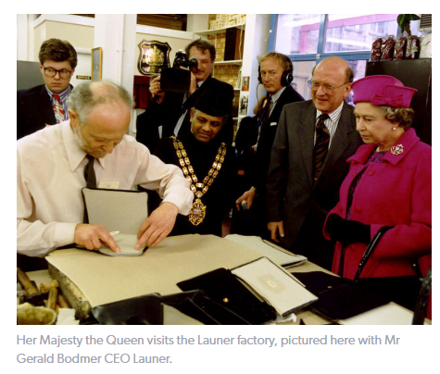
The Queen, Paddington and Gerald – What can be Project Financed
Boring Investment otherwise known as proven technology
Things that cannot be funded with project finance
Could Launer qualify for project financing for establishing a set of retail outlets after the increase in demand
Could a coca farm in Ghana be Project Financed
Can a hotel be project financed
https://www.youtube.com/watch?v=7UfiCa244XE&t=9s

Slide 13
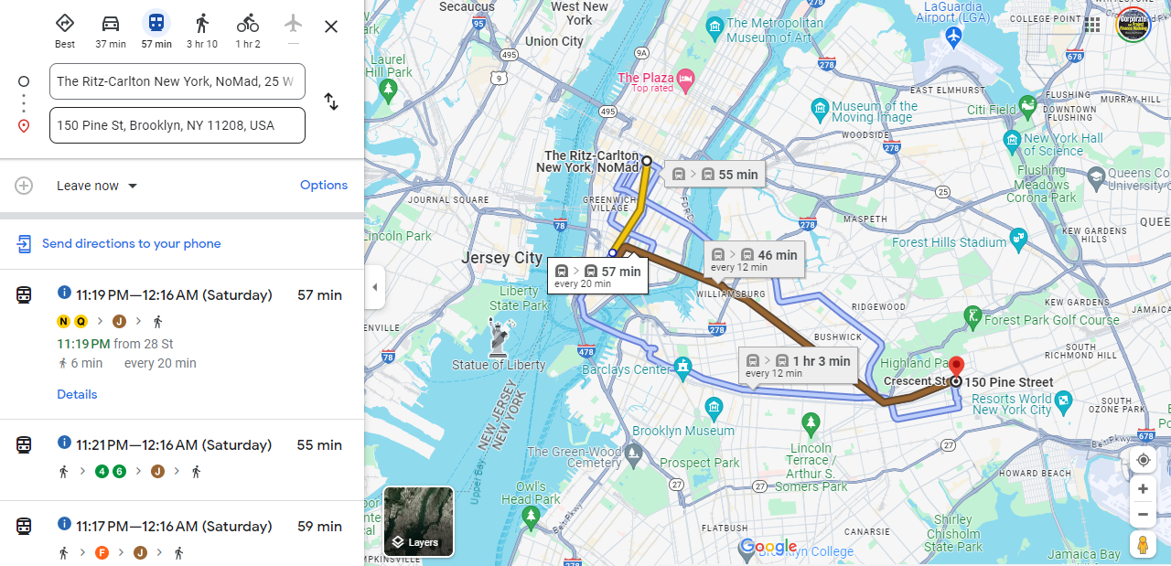
New York Meeting, Google Maps and Risk of Being Late

Slide 14
DSCR, LLCR, PLCR and Downside Cases
DSCR = CFADS/Debt Service
Percent Cash Flow Reduction Before Not Paying Debt = (DSCR – 1)/DSCR
Debt Outstanding at COD = PV of Debt Service at Interest Rate
PLCR = Present Value of CFADS over Life at Interest Rate/Present Value of Debt Service
PLCR = Present Value of CFADS over Life at Interest Rate/Debt Outstanding at COD
LLCR = Present Value of CFADS over Debt Life at Interest Rate/PV of Debt Service
LLCR = Present Value of CFADS over Debt Life at Interest Rate/Debt Outstanding at COD

Slide 15
You Can Go the Other Way to Find the DSCR
Formulas for Break-Even: Say that you want to know how big the DSCR should be to cover for an availability payment that could be reduced by 20%.
The formulas below are for DSCR; you could also use LLCR and PLCR
  Break-even cash flow = (DSCR-1)/DSCR
  BE = (DSCR-1)/DSCR
  BE x DSCR = DSCR – 1
  DSCR – BE x DSCR = 1
  DSCR * (1-BE) = 1
  DSCR = 1/(1-BE) or 1/.8 or 1.25
Note: Be careful with fixed costs. If a project has fixed costs you have to make a more complex formula

Slide 16
Examples of Things that are Mean Reverting and Not Mean Reverting
Mean Reverting
Solar and Wind Variation
Commodity Prices moving to marginal cost of production
Movement in Traffic from year to year after initial traffic has been established
Maintenance cost variation from year to year
Refinery Margins
Electricity Merchant Prices in Markets with Little Renewable Capacity
Non-Mean Reverting
Stock Prices
Items that go out of fashion such as handbags
Items that become obsolete like Kodak Cameras and Blackberry
Sudden Political Decisions to Nationalize Industries
Errors in Modelling Solar, Wind or Toll Road Traffic

Slide 17
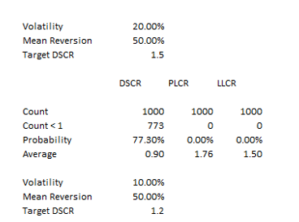
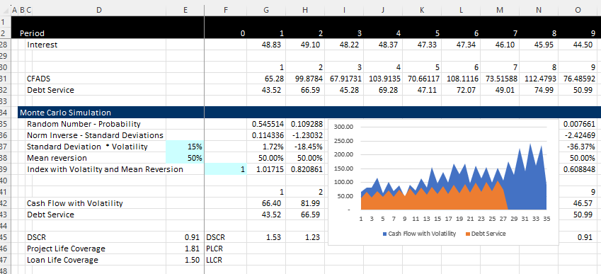
Monte Carlo Simulation as Illustration of Project Finance
Structure the Debt
Simulation with Volatility
Volatility and Mean Reversion Equations
  CF1 = Cf0 + CF0 * Rand x Volatility
  CF1 = Cf0 + CFO * Normal Inverse (Rand()) * Volatility
  With Mean Reversion
  CF1 = CF0 + (Mean – CF0) * Mean Reversion Factor + Volatility from Above
Results

Slide 18
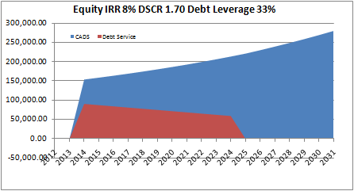
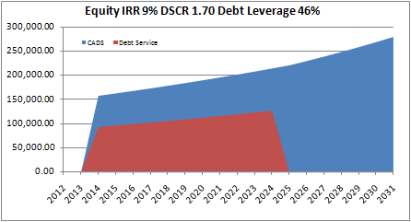
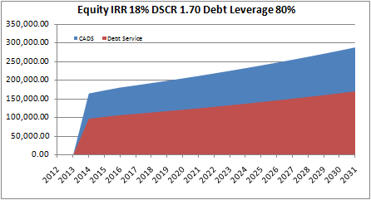
DSCR versus LLCR versus PLCR and Sculpting
Level Payment and Tail
Min DSCR < LLCR < PLCR
Sculpting and Tail
DSCR = LLCR < PLCR
Sculpting and No Tail
DSCR = LLCR = PLCR

Slide 19
Exercise – Groups Compute Required DSCR with Different Volatility and Mean Reversion

Slide 20
What is this Business with IRR Anyway

Slide 21
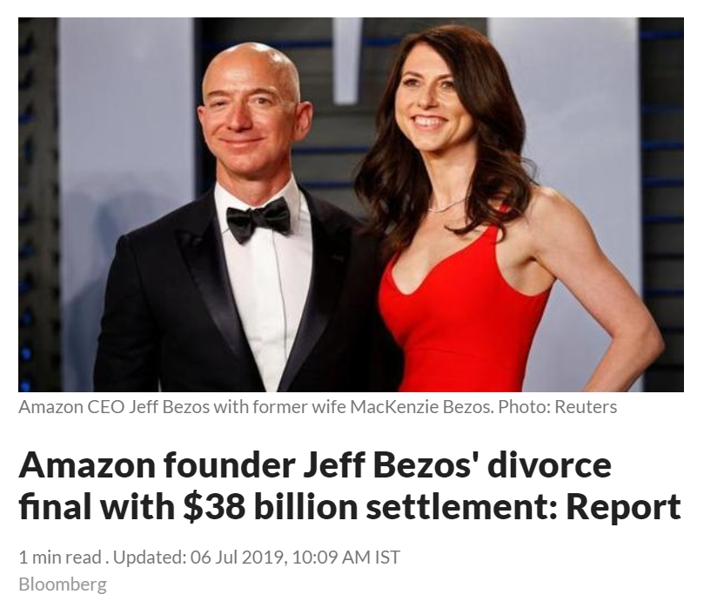
For Bad or Good, Growth is What People Want, ask Jeff Bezos
IRR is the Growth Rate in your Money
20 Year Investment
Money Grows
Re-invest Money
Exercise with Stock Price plus Dividends
  ACWA Power
  Amazon
  Aramco
  Project Financed Transaction
Why are IRRs not typically used in valuing stocks

Slide 22
Project Finance versus Corporate Finance

Slide 23
Project Finance as the Foundation for Corporate Finance
A corporation is a portfolio of individual projects
To really value a corporation:
  You would like to find the value the individual projects
  You would like to understand prospects for earning and IRR
  You would like to measure potential risks
  You would like to add the value from existing projects to the value from potential new projects – this is terminal value and the impossible task of corporate finance
  You would like to understand the risks and cost of capital for individual projects (beta and the CAPM do not work)
Corporate finance cannot do any of these things – if you could imagine a case where you knew about the IRR and the debt capacity of all exiting projects and you could measure the potential economic value from new investments, project finance would give you the answer.

Slide 24
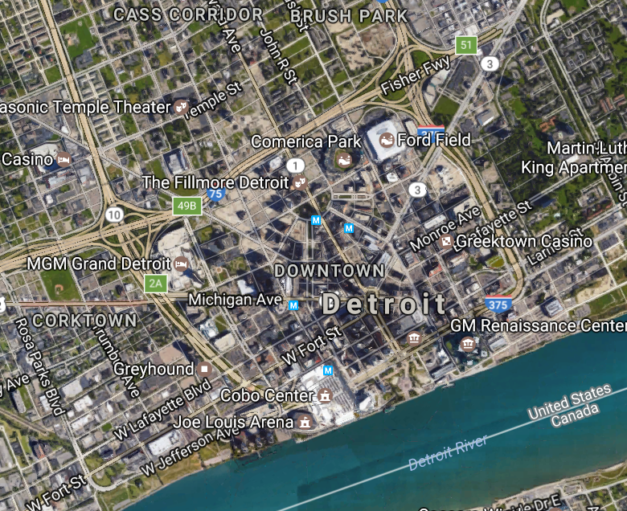
City is Like a Corporation/Project is Business
.
Individual Business or Family is like project Finance
Financial health of a city depends on the financial health of individuals and businesses in the city

Slide 25
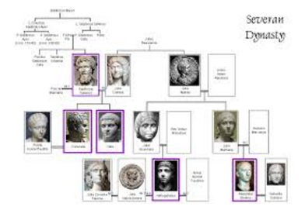
Family is Like Corporation, Person is Like Project Finance
Person is the project
Entire Family is the Corporation
Success of a family depends on the success of individuals in the family

Slide 26
History versus Contracts and Consultant Reports: Project Finance versus Corporate Finance
Corporate Finance
Project Finance
Analysis is founded on historic financial statements and companies will evolve relative to the past.
Financing is important but not necessarily the primary part of the valuation.
Successful companies expected to continue growing and refinance. Terminal value is a big factor.
Focus on earnings, ROIC, P/E ratios, EV/EBITDA ratios and Debt/EBITDA.
Since there is no history a series of consulting and engineering studies must be evaluated.
The bank assesses whether the project works (engineering report). Without debt financing, the project is not viable.
Successful projects will pay of all debt from cash flow and end their life.
Focus on cash flow rather than earnings. Equity IRR and DSCR.

Slide 27
Corporate Finance and Project Finance
Corporate Finance is a lot like magic potion, not close to being a science
Corporate finance is a portfolio of investments
You need to make some kind of investment to get a return unless you inherit money, or it comes from the sky
The fundamental question in finance is what kind of return can you earn on your money and how can you find people to invest in your project if you don’t have your own money

Slide 28
How Project Finance Derives Better Valuation than Corporate Finance
Corporate Finance
Estimate free cash flow over explicit period – ROIC does not provide basis
Make some kind of forecast of capital expenditures
Terminal value should be the biggest driver of value as the corporation has an indefinite life
Subtract market value of debt from enterprise value
Final value is very dependent on the WACC and terminal value
Project Finance
Value of existing assets and existing equity is the present value of cash flows at objective discount rates
Make some kind of forecast of capital expenditures
Terminal value should be the biggest driver of value as the corporation has an indefinite life
Subtract market value of debt from enterprise value
Final value is very dependent on the WACC and terminal value

Slide 29
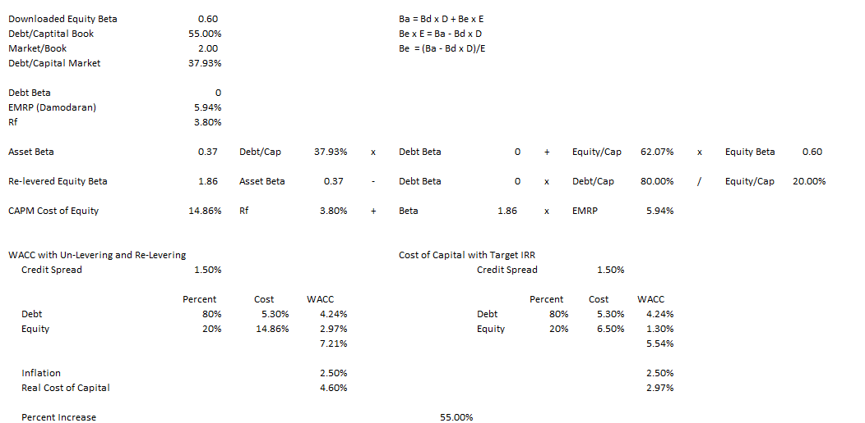
Better Ways of Cost of Capital Measurement in Project Finance
55% increase in the real cost of capital. That is a big deal for capital intensive assets
Problems with un-levering and re-levering beta

Slide 30
Time-Line and Changing Risk are Crucial in Project Finance
RISK
Financial Close
Completion Test
A crucial Feature of Project finance is CHANGING -- DECLINING RISK

Slide 31




Project Finance and Changing Risk
Before COD, cash flow is presented in the sources and uses statement
After COD, cash flow is presented in the cash flow waterfall and the last line is dividends
Father of the bride makes commitment to pay for wedding
Commitment Fee
Date at which you realize that the wedding is working or is a complete disaster
Development is Dating period. Probability of failure is high
Pay for Wedding with Other peoples’ money
Pay your Bills and re-structure your life. Stuck with PPA type contract. May default.
FC is making promises (that you may not keep)
COD is Wedding Date
Decommissioning Date

Slide 32
Project Finance and WACC
In the last diagram it would be crazy to assume the risks associated with a relationship are the same over the course of the relationship.
Similarly, assuming that the risk of a project is the same over the life of a project makes no sense at all.
Additionally, the equity to capital ratio on a book or an economic basis is not the same over the life of a project.
This is unlike project finance, a corporation with portfolios of projects may have a reasonably constant WACC

Slide 33
Simple IRR Calculation with Risk Reduction
Step 1: Compute the Equity IRR from the Project
Step 2: Compute the Value of the Project Assuming a Buyer has the same discount rate as the earned IRR
Step 3: Compute the IRR with Changing Risk
Step 4: Compute the IRR with Value increase from risk reduction

Slide 34
Re-Write of Project Finance Definition and the Essence of Project Finance
Alternative Definition
… finding money from a bank (not associated with your company) and/or an investor for a capital investment where you can prove (through nonrecourse loans and equity cash flow evaluation) that the project is economic on a stand-alone basis and has acceptable risks where debt and equity is structured corresponding to the risks, the timing and the pattern of cash flows from the project. Long-term financing is achieved through demonstrating mean reversion in cash flow and/or use of long-term contracts can meet debt service and provide a reasonable growth rate in cash flow to investors.

Slide 35
Introduction to Project Finance Diagrams Illustrate Risks

Slide 36
Explaining Project Finance with Diagrams
You would like the diagram to give you a picture of the risk of the project and highlight issues with contracts
  SPV is a separate corporation in the middle
  SPV signs a lot of contracts that should be illustrate with solid lines
  The contracts should be labeled (e.g. concession contract, EPC contract, PPA contract, O&M contract, Loan Agreement, Shareholders agreement)
  Different levels of support from parent (non-recourse is no support)
  Contracts should be consistent with each other
  Diagram should show direction of money and start with revenues (no revenues, no project)
  Quality of off-takers should be shown on the diagram in the circles
  Insurances and guarantees should can be demonstrated

Slide 37
Start with Revenues and Risks from Revenues – General Categories from Revenue Generation
Different types of revenues in project finance
  Price Risk and Volume Risk from Demand
    Real Estate
    Technology
    Rehabilitation and some health care
  Price Risk but Limited Demand Risk
    Commodity Price – Oil and Gas
    Refinery and Mining
  Volume Risk but Limited Price Risk
    Infrastructure – Toll roads and bridges
    Infrastructure – Airports
    Renewable Energy with Resource Risk
  Availability Risk – No Price or Volume Risk
    Dispatchable Power Plants – IPP, BOT, BOOT
    Hospitals, Schools, Prisons – PPP, Availability Payment
    Availability Bases Toll Roads – Availability Projects

Slide 38
Not Just a Diagram – Illustrate Risks
Each contract can have many nuances with penalties, bonuses, default clauses, termination.
Off-taker: Want strong off-taker with inactive to honor contract
Write down notes associated with each contract and if a contract does not exist, how the cash flow volatility can be addressed.
EPC Contractor: Want Strong Record and Finances
Price Risk or Volume Risk or Both or None (Availability)
EPC: Fixed Price Contract with LD
Supplier: Need to Understand Economics and Supply Curve
Special Purpose Vehicle: Bond Rating of BBB-
O&M Contractor
Supply Agreement
O&M Agreement
Loan Agreement – Draws Green; Debt Service Red
Banks Like Strong Sponsors. Sponsors want EIRR
Shareholder Agreement
Lenders:
Lenders want DSCR (LLCR, PLCR)
Invest with paid in cap; payback dividends
Invest with draws; payback debt service

Slide 39
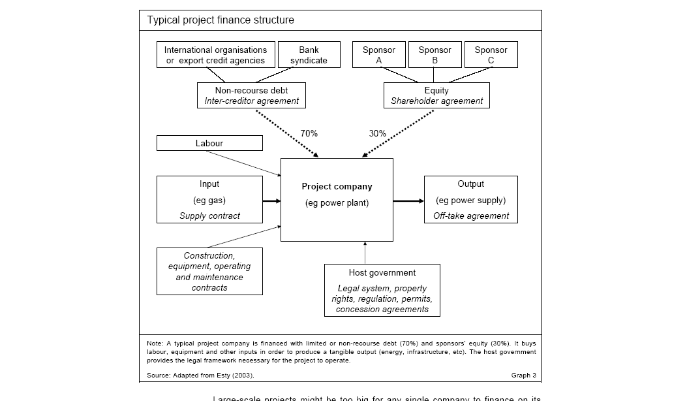
What are Problems with this Diagram from HBS

Slide 40
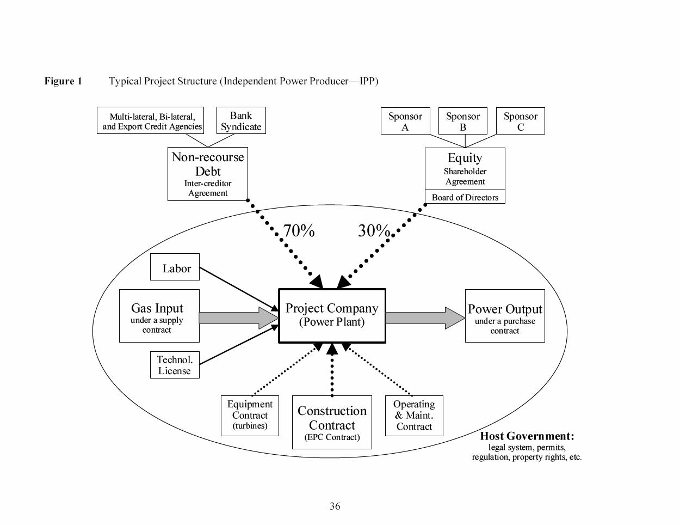
What is Good and Bad about this Diagram
Debt is serviced entirely via cash flow through the project and the SPV This structure exposes the lenders to significant risks. If something goes wrong, their recourse against the sponsor, with its typically larger balance sheet, will be limited or none.
The loan is structured so that bankers can step into and take over the project if things were to go wrong, a so-called step-in right. This process is also called ‘ring-fencing.’
Ring-Fence

Slide 41
Nuances and Creative Structures
Please don’t think there is some kind of rule and you can always use “boiler plate” methods and contracts for transactions
When you try something different (different countries, different technologies, different pricing structures, different incentives in contracts) you can work things out with some theoretical background.

Slide 42
Section 2:
Mini Case Studies – History Through the Present

Slide 43
Mini Cases
Mini Cases Discussed
  Ras Laffan in Qatar (Break-even risks, sponsors and contract structure)
  Dabhol in India (Contract Structure, Availability and Economics)
Idea is to Quickly Discuss Cases and Highlight Major Issues
Some history is good in just about anything

Slide 44
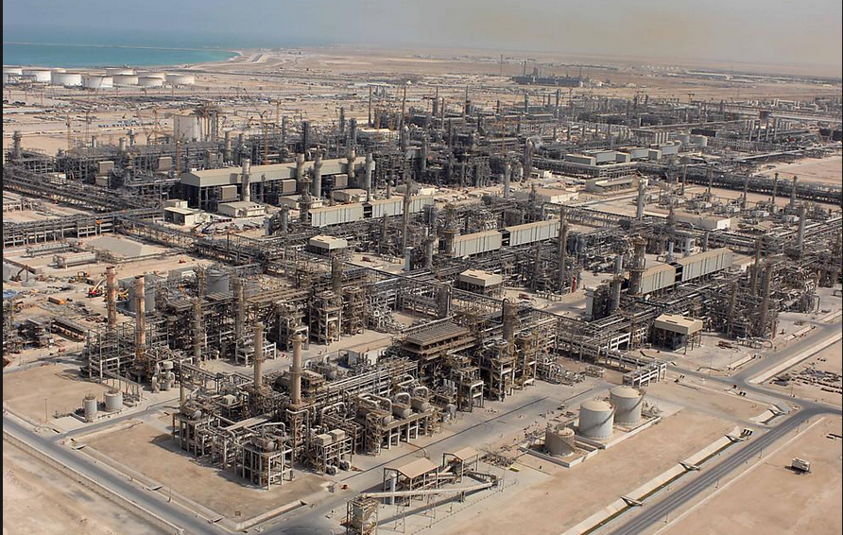
Ras Laffan in Qatar - 1996 COD

Slide 45
Issues to Discuss – Ras Laffan
Read the Pre-Sale Report – The Strengths
  Could Qatar have hosted the world cup without project finance
  Simulate the importance of Exxon
  List the risks and mitigations
  Could there have been more problems if the State of Qatar was not the biggest sponsor
Open the Model
  Why do the fundamental economics of the project work or do not work
  What notes would you put in the diagram
  How do you think the break-even gas price was computed – DSCR, LLCR or PLCR

Slide 46
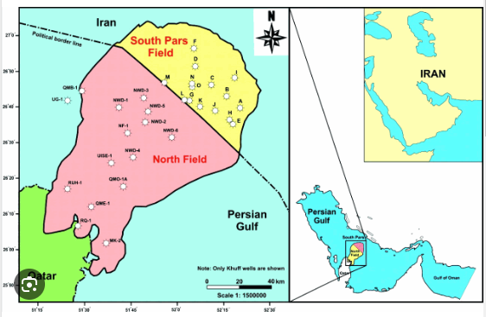
Illustration of Gas Lake Under the Gulf
Cost of production of natural gas is low

Slide 47
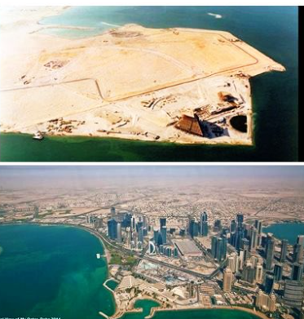
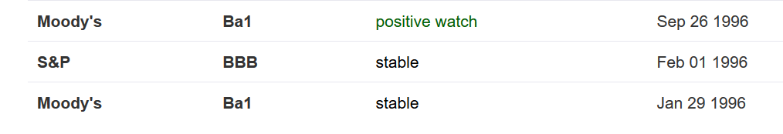
Country of Qatar Background before and After Project

Slide 48
Example: Ras Laffan Liquified Gas Company (Ras Gas)
Summary of Original Transaction
  Project: Two LNG Trains and cost of developing natural gas reserves
    Cost $3.4 billion
    5.2 millions of tons per annum
Equity Sponsors
    70% State of Qatar
    30% Mobil Oil
EPC Construction Contracts
  JCG/MW Kellogg for LNG Trains and on-shore facilities
  McDermott-EPTM/Chiyoda for off-shore platforms
  Saipan for off-shore pipeline connection

Slide 49
Ras Laffan Liquified Gas Company
Financing of $3.4 Billion
  $850 million in Equity
  $465 million supported by US EXIM
  $250 million supported by UK ECGD
  $185 million supported by Italy’s SACE
  $450 million uninsured loan from commercial banks
  $1,200 million from bond markets
    10 and 17 year maturity
    Rated BBB+ by S&P
    Rated A3 by Moody’s
Revenue Contracts
  25 year contract with Korea Gas Corporation for output of one train
  Korean Gas Corporation built receiving facilities and purchased ships ($3.1 billion)
Relatively unconventional technology, no projects in the country and can achieve bond rating better than country rating

Slide 50
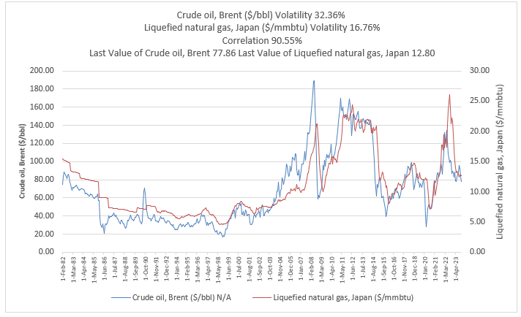
Commodity Price 1
Commodity Prices are Volatile
But;
  Mean Reversion
  Can Hedge
  Importance of Natural Gas

Slide 51
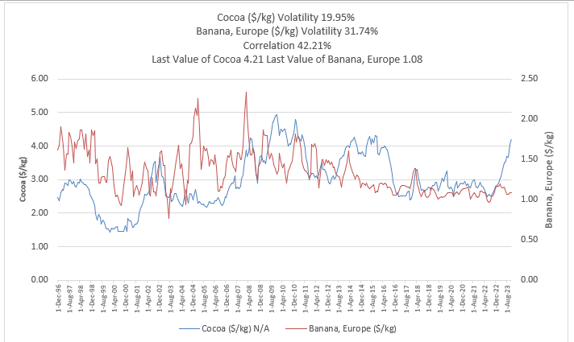
Commodity Price 2
Commodity Price Issues
https://edbodmer.com/databases-and-graphs/databases-from-internet/commodity-price-database/

Slide 52
Use Snipping Tool to Fill in Items from Pre-Sale Report
Conventional (boring) technology
Construction Cost Over-Run Risk
Supply Risk
Volume Risk
Price Risk

Slide 53
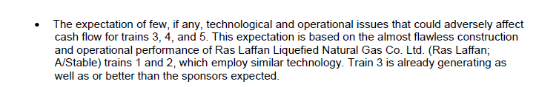
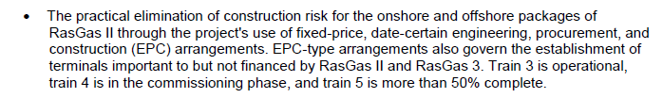



Use Snipping Tool to Fill in Items from Pre-Sale Report
Conventional (boring) technology
Construction Cost Over-Run Risk
Supply Risk
Volume Risk
Price Risk

Slide 54
Open the Financial Model
Use the financial model to quantify risks
  Present and discuss the cost structure
  Break-even Oil Price
Volume Risk
Price Risk

Slide 55
Revenue Risks
Generally one or two big sources of risk
Can be
  Commodity Price
  Volume – Traffic
  Volume – Solar or Wind Resource
  Incentives in Contracts – Availability, Efficiency, Performance
  Off-taker Risk
  Price and Volume Risk (e.g. high tech, hotel, private health facility)
For each type of risk, discuss implications to Africa – for example would you rather off-taker be a mining company or the government of Nigeria

Slide 56
Ras Laffan Diagram
Off-taker: Korea and Japan Utility Companies: Want strong off-taker with inactive to honor contract
EPC Contractor: Kellogg with Strong Record and Finances
Price of Gas Linked to Oil Price
Off-take Contract with minimum supply
EPC: Fixed Price Contract with LD
Special Purpose Vehicle: Bond Rating of A-
O&M Contractor
Supplier: Need to Understand Economics and Supply Curve
O&M Contractor
Supply Agreement
O&M Agreement
Loan Agreement – Draws Green; Debt Service Red
Sponsors: Want strong sponsor:
Mobil
State
Shareholder Agreement
Lenders:
Issued bonds and debt with long tenor and low rates
Lenders:
Issued bonds and debt with long tenor and low rates

Slide 57
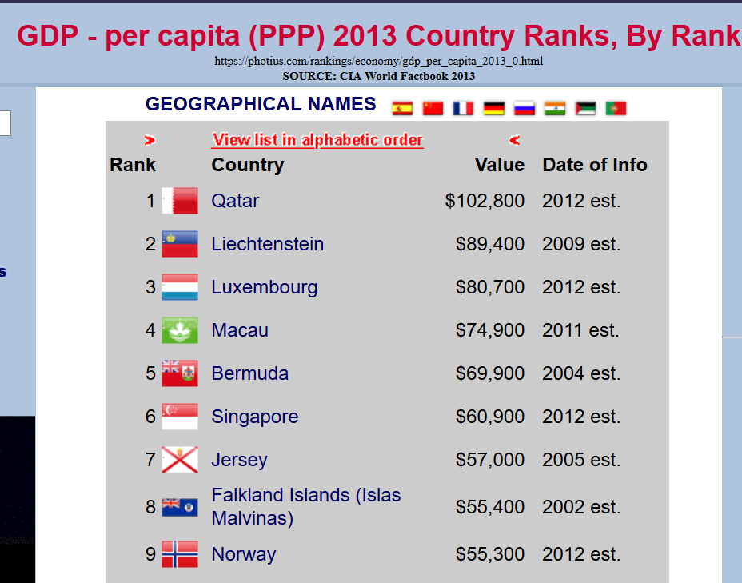

Ras Laffan Postscript

Slide 58
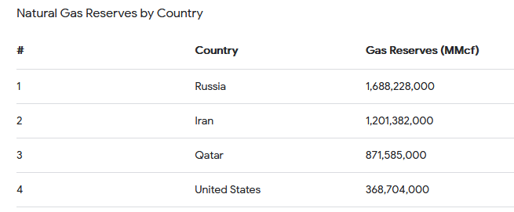
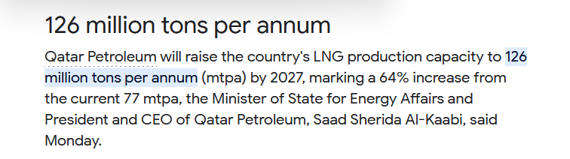


How Much Money from All Projects before Additions
29.7 Tons in Project

Slide 59
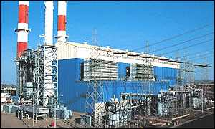
Case 2: Dabhol Electricity Plant and Capacity Payment

Slide 60
Case Questions: Dabhol
Do you think GE, Bechtel and Enron were good missionaries
Do you think a high project IRR reduces risk
What was the key statistic to demonstrate risk
Do you think there was political risk and if so, how could it be mitigated
Why did they wanted a high fixed capacity factor rather than an energy charge and a capacity charge independent of production and did this make sense

Slide 61

Background on Risk Allocation Two Step Process
Step 1 – Off-taker versus Investor
Risks controlled by off-taker
Risks of general economic conditions
Risks in the way the machine operates
Step 2 – Allocate to Contractors
Allocate risks in contracts to parties that can control the risk
Back-to-back contracts
Does it make sense for the rental car company to take the risk of how much a driver drives the car per year when it does not have any control of how much people will drive the car.

Slide 62
Risk Allocation Part 1: Allocation between IPP Investor and the Off-taker
Risk
Generation Level from Changes in Demand
Generation Level from Changes in Plant Availability
Cost Over-Run
Construction Delay
Plant Efficiency (Heat Rate)
Change in Fuel Price
Change in Real O&M Cost
Change in Inflation Rate
Change in Interest Rates and Cost of Capital
Investor or Off-taker Risk
.
.
.
.
.
.
.
.
.

Slide 63
Risk Allocation Part 2: Investor Risks to Different Contracts for the SPV
IPP Risks
Cost of Project, Time Delay and Technology Parameters
Availability Penalty in PPA
Efficiency or Heat Rate Risk
O&M cost Risk – Real
Independence of Generation Risk
Interest Rate Fluctuation
Contract Mitigation
EPC Contract with Fixed Price and LD (LSTK)
O&M and EPC Contract
O&M Contract and EPC LD Provision
O&M Contract
Capacity Charge/Month; 4 Part PPA Contract
Swap Contract (Fix Rates)

Slide 64
Central Philosophical Point
Make the Parties -- Equity, Debt, EPC Contractor, O&M Contractor, Fuel Supplier – responsible for risks that they can control
It sounds too simple, but the little things and the nuances can be very important
  If you make the parties responsible for risks outside of their control, like natural gas prices or exchange rate variation or dispatch from the off-taker, they will:
  Increase the required IRR which will increase the price to the consumers
  Increase the required DSCR which will increase funding costs and increase price to consumers
  Increase EPC and O&M contract which will increase cost to consumers

Slide 65
Dahbol Background
Investment in a $3 billion, 10-year liquefied natural gas power plant development project, was the largest development project and the single largest direct foreign investment in India’s history.
Begun in 1992, the Dabhol power plant near India’s financial capital of Bombay in Maharashtra state was to have gone online by 1997. It was supposed to supply energy-hungry India with more than 2,000 megawatts of electricity, about one-fifth the new energy needed by India each year.
In a joint venture with U.S. companies General Electric and Bechtel, Enron created an Indian subsidiary, Dabhol Power Co. DPC, which was 65 percent owned by Enron, was to build the power plant. Enron was to develop and operate the plant. Bechtel was to design and construct it, with GE supplying the equipment.
Enron brokered a deal with Qatar/Oman to provide the Dabhol plant 2.5 million tons of liquefied natural gas per year for 25 years, starting in 1997.

Slide 66
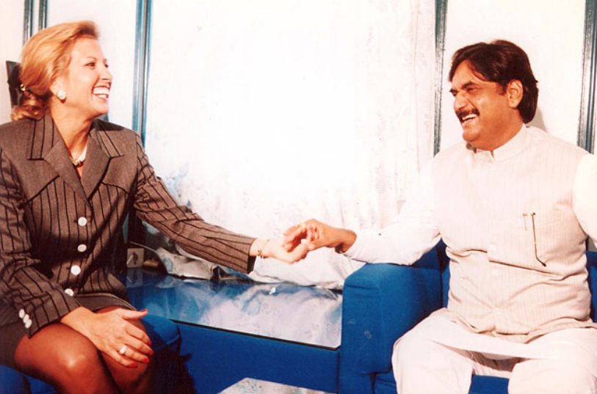
Where did Rebecca Mark Get her MBA
As they inched along the traffic jam of Bombay taxi cabs on Marine Drive, Rebecca Mark and Joe Sutton reflected upon the intense negotiation efforts of the past year and what had been accomplished. Their company, Enron Development Corporation, EDC, the development arm of the Enron Corporation, had been attempting entry into the potentially huge Indian market. EDC was headed by Rebecca Mark, its youthful, energetic president and CEO. She summed up her philosophy and mission:
We are a very eclectic bunch with some ex-military people and some ex-entrepreneurs. We are brought together with a certain amount of missionary zeal which I think you have to have in this business. It demands so much of you all the time that you really have to believe in what you are doing. I think for us that missionary zeal has three parts – first, that these projects are good for the country. They get the economy moving by bringing in power and they bring in investment. Second, these plants are environmentally safe and without equal when you consider other options of coal or nuclear power. Third, we are brining a market mentality and spreading the privatization gospel in countries that desperately need this kind of thinking. We are in the business of doing deals. This deal mentality is central to what we do. It’s never a question of finding deals but of finding the kind of deals we like to do. We like to be pioneers.

Slide 67
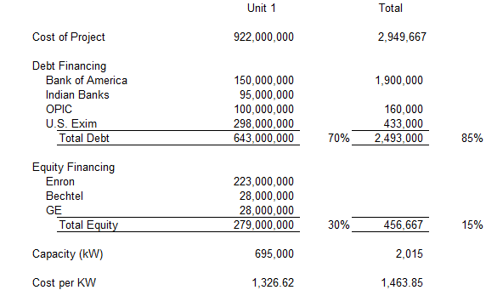
Dahbol Costs
Project Included:
  Largest Independent Power Producer – 695 MW + 1,320 MW or 2,015 MW. 22.4% of Capacity of Maharashtra
  LNG Re-gasification Plant
  LNG Tanker to access supplies in Qatar
  85% Debt and 15% Equity
  Equity
    Enron 65%
    Bechtel
    GE
  Enron Net Income $465 Million
  Enron Assets (1993): $12 Billion
  Enron Equity (1993): $3.5 Billion

Slide 68
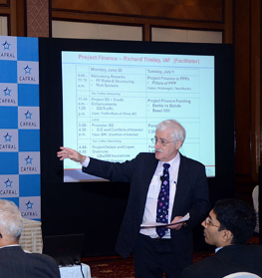
Dabhol Structure – Richard Tinsley
Reserve
Bank of
India
Government
of Maharashtra
Domestic
(Indian)
Financial
Institutions
(Banks)
Government
of India
Full
Guarantee
Ministry
of Power
Maharashtra
State
Electricity
Board
Limited
guarantee
State
Support
Agreement
US Exim
Comfort
Letter
Political Risk
Guarantee
PPA
Lending Banks
FX Availability
Dabhol
Power
Corp
Loan
Agreement

Slide 69
General Notion of Back-to-Back Contacts
Begins with Project Contract (Concession Contract, PPA Contract, Availability Contract).
Back-to-back contracts follow the Project Contract
Fixed Price EPC Contract from Fixed Availability Payment
Transfer Delay Risk with Liquidated Damage
Transfer O&M Risks with Incentives and Penalties

Slide 70
Back to Back Contracts with Availability Contracts
Off-taker
EPC Contractor
PPA Contract
Four Part Tariff
Fixed Capacity Charge at Fin Close
LD Penalty for Delay Risk
Contract O&M Charge
Contract Heat Rate
Availability Penalty
Fixed Price Contract with LD
Fuel Supply
Fuel Index
Fuel Supply Contract with Index Corresponding to PPA
Special Purpose Vehicle
Contract with Guaranteed Heat Rate and Availability Penalty
and Fixed Fee
O&M Contractor
Shareholder Agreement
Loan Agreement
Sponsors
Lenders
Letter of Credit for Equity Cash

Slide 71
Don’t Be Afraid to Try and Make a Diagram. You Don’t have to be a fancy investment banker
Very High Cost of USD 1,400 per kW
Off-taker Needs Rate Increase of 27%-39% to Pay PPA
State of Maharashtra
Bechtel Construction
Off-taker – Maharashtra State Electricity Company
EPC Management by Enron
Guarantee
Federal Government of India
Letter
GE Equipment
PPA Contract
EPC Contract
Dabhol SPV
Fuel Supply
ENRON – Fuel Mgmt.
O&M Contract
Shareholders Agreement
Loan Agreement
LNG from Qatar
O&M Contractor - Enron
Lenders
Sponsors – Enron, GE and Bechtel IRR on SPV
PRI/PRG
PRI/PRG
OPIC

Slide 72
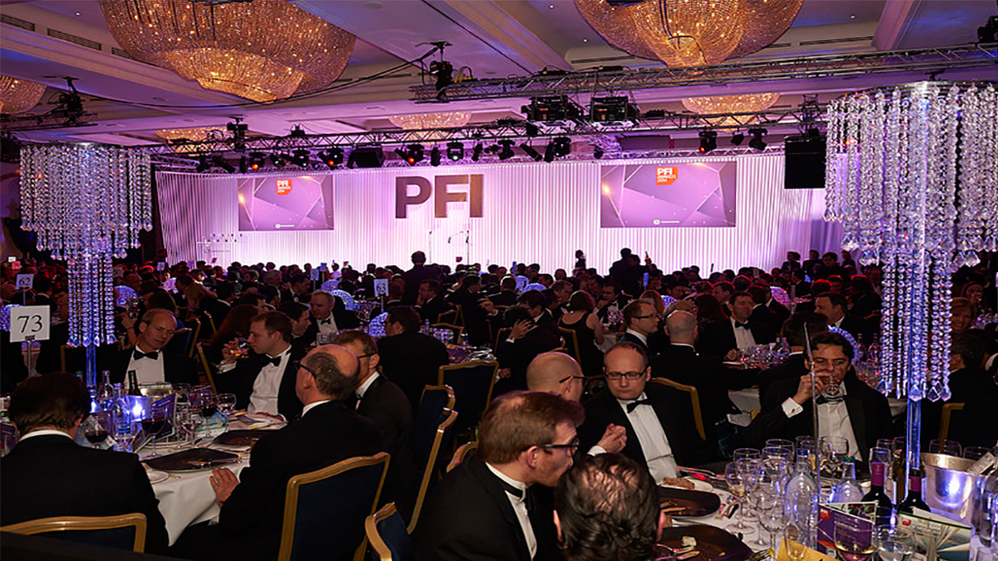
Awards for Dabhol Contract Structure

Slide 73
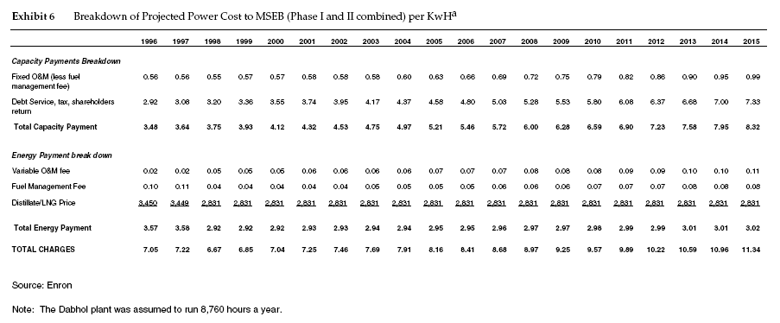
Structure of Dabhol PPA Contract
PPA Contracts can transfer all demand and fuel cost risk. The Dabhol PPA contract is illustrated below

Slide 74
IRR Exercise
If you had data from the case, what would you compute.

Slide 75
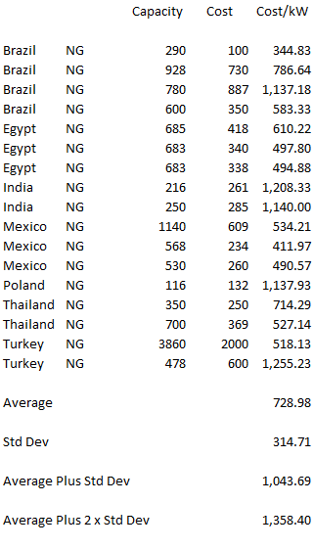
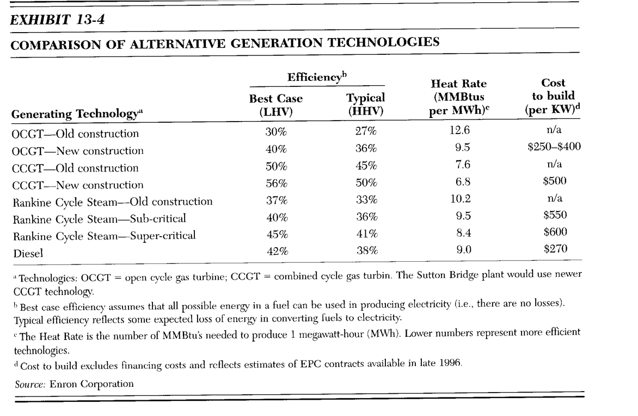
Benchmarking Cost of Other Plants

Slide 76
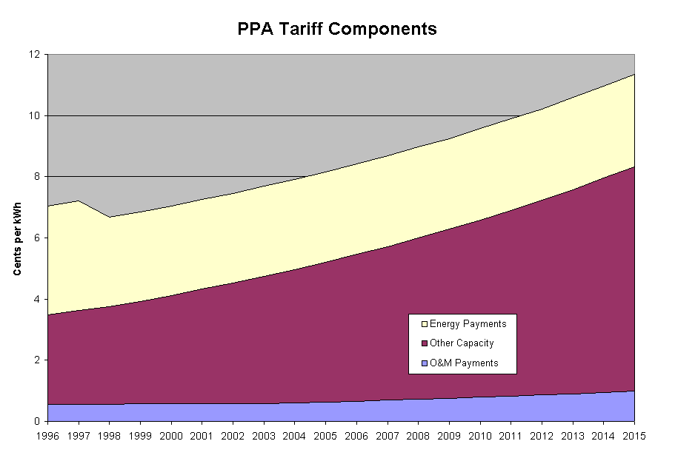
Dahbol PPA Tariffs
The Tariffs were about 7 U.S. cents per kWh increasing to 11 cents over 20 years.
Comparable plants in the US were selling power at 3-4 cents per kWh.
Initially IRR was 26.52%
Officially the ROE allowed was up to 16%
The contract was indexed to USD

Slide 77
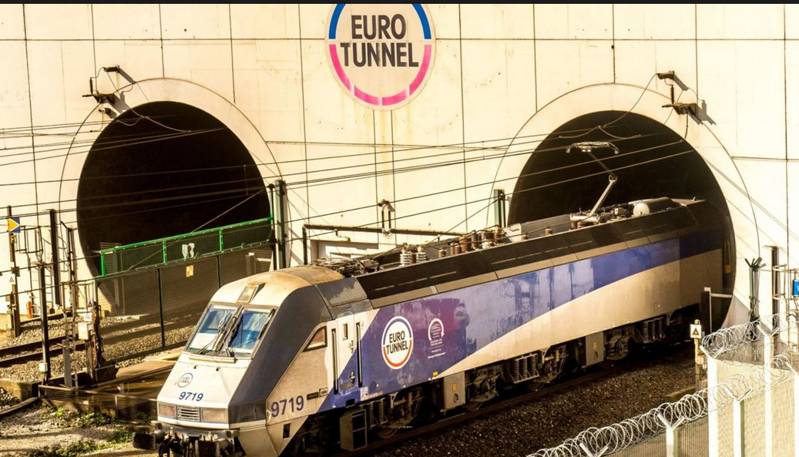
Case 3: Eurotunnel – Contract Structure, Ownership and Timing

Slide 78
Risks for Availability and Output Projects
Risks of output-based projects primarily involve making incorrect estimates of the output such as traffic. This can be very difficult because there is often no historical basis for the forecasts.
Risks of availability projects often involve assessing whether the counterparty to the contract will live up to the contract terms. When the counterparty is a government agency this becomes political risk.

Slide 79
Eurotunnel Background
August 1994, the British Isles and continental Europe were linked together for the first time in 8,000 years. The Channel tunnel, or Chunnel as it is better known, is Europe's biggest infrastructure project financed wholly by private capital. The desire to link Britain and France dates back more than 200 years.
  A French farmer named Nicolas Desmaret argued in 1751 in "A Dissertation on the Ancient Link Between England and France" that the two countries should once again be linked, "... either by bridge, tunnel or causeway."(1) Fifty-one years later Napoleon approved a plan drafted by Albert Mathieu, a French mining engineer, for twin tunnels with surface-reaching chimneys for ventilation. However, England and France went to war a year later and the plan died. Similar afflictions tainted the link devised by Thome de Gamond in the 1830s. The first serious construction attempt took place in the early 1880s. Tunneling had actually begun from both the British and the French coasts, but after a mere 2,000 yards the British became uneasy with the potential success of the project and called it off.(2)
  Over the next 100 years, studies were taken, proposals were written and various holes were drilled. Harold Wilson's Labor Party government forfeited tunnel construction in 1975, opting to pursue the Anglo-French Concorde project instead.
It wasn't until late in 1984 that the British and French governments reached an agreement to build the tunnel. The project became official with the signing of the Paris Agreement on March 14,1986.(3) This triggered the largest binational joint venture ever, as well as unprecedented cooperation between the two nations. As Dr. Brian Mawhinney, secretary of state for transportation, said: the tunnel "... is perhaps the greatest example of international collaboration in transport.".

Slide 80
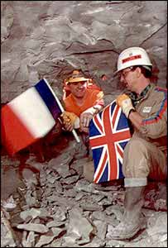
Eurotunnel
31 Mile (50 km) tunnel between England and France
Similar project in Japan had 100% cost over-run, no other comparative projects
Financed by 225 banks
Construction expected to be completed in May 1993; actual was in December 1994
Original construction budget was £4.9 billion
Most Equity Funded by IPO
Multiple EPC Contractors

Slide 81
The lead banks were also the IPO Advisors
The 10 original construction corporations were the majority shareholders in Eurotunnel.
225 Banks for £5 Billion

Slide 82
Eurotunnel Part 1 – Development Stage
Off-taker: Railways signed contracts using estimate price. Signed before FC
EPC Contractor: Combination of French and English. Not Conventional Technology
Development Cost for RFP Paid for by TML – Seven Months
Accepted Traffic Risk from Study with no History
EPC: Fixed Price Contract with LD
Special Purpose Eurotunnel. Manager Assigned by Government
Sponsors: 60% owned by TML; other Owners were Banks and Institutions
Shareholder Agreement with investment and dividends
Loan Agreement with draws and repayments
Lenders: Made Commitment and required equity capital

Slide 83
Eurotunnel Part 2 – Construction Stage
SIMPLISTINC TRAFFIC STUDY Off-taker: Railways signed contracts using estimate price. Signed before FC
EPC CONTRACT: Combination of French and English. Not Conventional Technology
Accepted Traffic Risk from Study with no History. Big over-supply risk
EPC: Change Orders all favour EOC
Special Purpose Eurotunnel. Manager Assigned by Government
Loan Agreement Increased
LENDERS RELY ON DEBT TO CAPITAL NOT REAL: Lenders: Stuck with project and increased investment
TML owns small amount
IPO
NO STRONG SPONSOR: Individual Shareholders who could not stand up to EPC

Slide 84
Excerpts from the IPO Offering Memorandum
Construction Contract
Eurotunnel has entered into a construction contract with a joint venture of ten major companies providing for a fully-operational System to be delivered by May 1993. The construction of the tunnels will employ conventional but modern technology and well proven techniques. The geology of the proposed route for the tunnels is well understood and generally provides an excellent medium for tunneling.
The order to start design and construction work was given in May 1986. Work to date has been concentrated on design and development studies, geological surveys and the detailed design of the tunnels. In addition, the UK tunnel linings plant is now in operation. A similar facility in France and the access shaft for tunnelling at Sangatte in France are nearing completion. The erection on site in the UK of a tunnel boring machine for the service tunnel will soon be completed. Orders and sub-contracts have been placed with a value of over GBP 200 million and more than 1,800 people are currently engaged on the project.

Slide 85
EPC Contract part 1 – Note the Not a Fixed Price Contract for Tunnels and Underground Structures
Target Works
The tunnels and other underground structures, accounting for approximately 50 per cent of the value of the construction contract, a being constructed on a target cost basis with the Contractor being reimbursed for actual costs incurred plus a fixed fee of 12.36 per cent of the target cost. If the actual cost a completion is less than the target cost, the Contractor will receive a bonus equal to 50 percent of the saving. If the actual cost is more than the target cost, the contractor will meet 30 percent of the excess up to a point where the Contractor has borne an excess equal to six per cent of the target cost.
Lump Sum Works
The buildings and all related infrastructure for the terminal, the fixed equipment and the mechanical and electrical elements of the System, representing approximately 40 per cent of the value of the construction contract, will be constructed on a lump sum basis. The lump sum provided in the contract will be paid to the Contractor irrespective of the actual cost of the specified items. Any overruns will therefore be borne by the Contractor except to the extent that they relate to variations or additions to the contract required by Eurotunnel or are caused by inflation.

Slide 86
EPC Contract Part 2 – Procurement of Locomotives and Other Items
Procurement Items
Subject to the approval of Eurotunnel and following a procedure defined in the construction contract, the Contractor will conclude sub-contracts for the supply and installation of procurements items, principally the locomotives and shuttles. The amount provided in the construction (the Contractor’s fee included) represents approximately 10 percent of the value of the contract. The Contractor, which will be responsible for the preparation, management a supervision of the sub-contracts in order to ensure the adequacy and fitness of the procurement items, will be reimbursed for its cost and will be paid a fee of 11.5 per cent of the cost of the procurement items purchased.
Adjustment to contract price
The target cost and lump sum are subject to price adjustments to reflect, inter alia, additional costs incurred by reason of unforeseeable ground conditions, variations to contract specifications requested by the inter-Governmental Commission (except were reasonably foreseeable), and changes requested by Eurotunnel. The lump sum and the fee for the target works are subject to adjustment for inflation, and similar adjustments will be made in respect of the target costs.

Slide 87
EPC Contract Part 3 – Liquidated Damages for Delay
Contractor’s obligations and incentives
The Contractor is under a general obligation to design, construct, test and commission a fully operational system for delivery by 15th May 1993. The System will be required to meet specified performance criteria.
In addition to the incentives and penalties described above in relation to costs, milestone dates have been established by which certain events or project stages are to have been completed. If these milestone dates are not met, payments to the Contractor will be reduced be reduced by the application of advance liquidated damages. One half of such advance liquidated damages will be repaid if the delay is recovered, and the completion date is met. The Contractor will suffer financial penalties at an initial rate of GBP 354,000 per day to be increased after six months to GBP 536,000 per day up to a maximum of GBP 165 million (all in September 1985 prices subject to adjustment for inflation), if the completion date is delayed for reasons in respect of which the Contractor is not entitled to an extension of time.

Slide 88
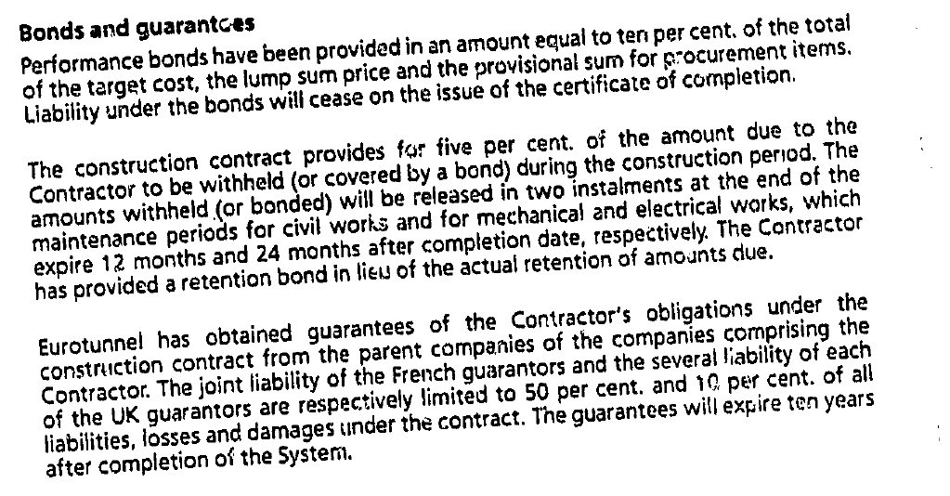
Performance Bonds and Guarantee

Slide 89
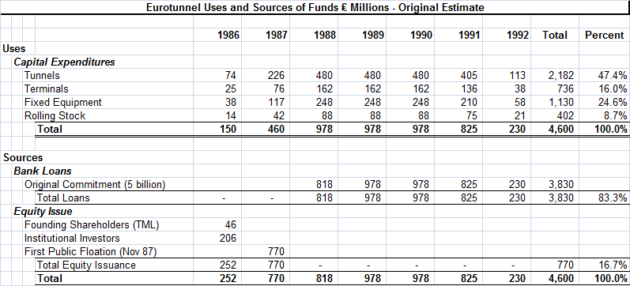
Estimated Uses and Sources
.

Slide 90
Revenue Forecast from Traffic
Traffic study was performed by Wilbur Smith – well known forecasting company for traffic studies.
  Studied traffic across the tunnel from 1964-1985
  Interviewed Ferry companies and asked “complex questions that we did not understand.”
  Did not forecast bloody price war.
S. G. Warburg Securities, one of Eurotunnel's investment banks, said in a report issued several months ago that it expected the number of cars crossing the channel to increase to 12.9 million in 2003 from 5.3 million in 1993, when they were all carried by ferry, with 7 million of the increased numbers representing travel via the tunnel.
Similarly, Warburg said it expected the number of passengers crossing the channel to jump to 125 million in 2003 from 76.5 million last year. The tunnel would provide almost all the growth.
The Railway Usage Contract
  Railways are entitled to up to 50% of the capacity of the system per hour.
  Railways are obliged to pay usage charges for the system by through trains.
  Usage charges include a fixed annual amount (25 million GBP per year and a variable element; 12.4 per passenger.)

Slide 91
Eurotunnel Case Questions
Who do you think paid for change orders in EPC contract
Do you think it is bad to have the EPC Contractor as an Investor
Do you think risks associated with the traffic volumes conform to the idea of what is necessary for project finance
Do you think the debt to capital was a good way to evaluate the credit risk
Think about supply and demand. What happened to the supply of ways to get across the channel with the project
What do you think was the reaction of Ferries and Airlines

Slide 92
Cost Over-Run Summary
The rolling stock for the shuttle trains was let on a procurement basis. TML would manage their acquisition on behalf of Eurotunnel and be paid a percentage fee for this service.
Scope Changes from Government – Safety standards of navettes and other risks
Definition of who bears responsibility and risk allocation
A form of political risk; politically sensitive deadlines; managers with political experience rather than technical experience

Slide 93
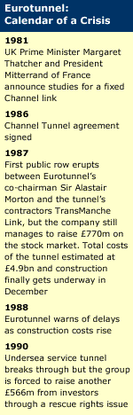
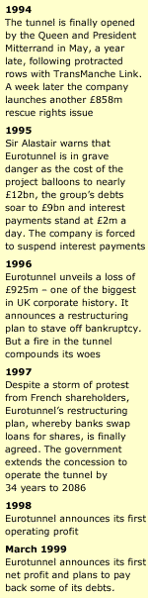
Eurotunnel Time-Line
The tunnelling works were let on a target cost basis. TML would work on a cost‑plus basis and be paid a fee of 12.36% of the target cost including adjustments for variations and inflation. Any cost overruns would be paid for on a 70:30 Eurotunnel:TML basis, up to a cap of 6% of the target cost adjusted for inflation and variations. Eurotunnel would pay 100% of any cost overruns over this cap.
Initial Cost Estimate to be 4.9 billion GBP

Slide 94
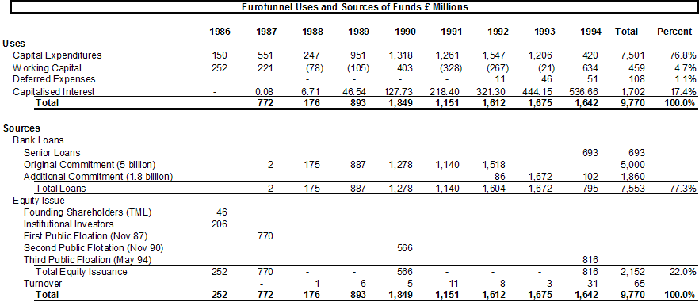
Uses and Sources of Funds
The Equity Issuances were to the public rather than to a company with expertise

Slide 95
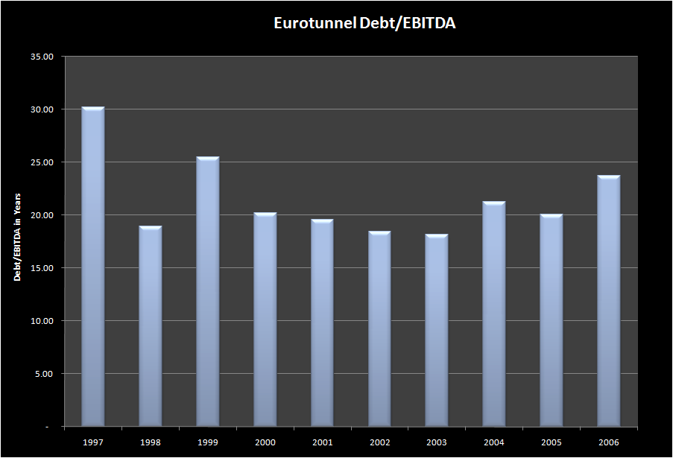
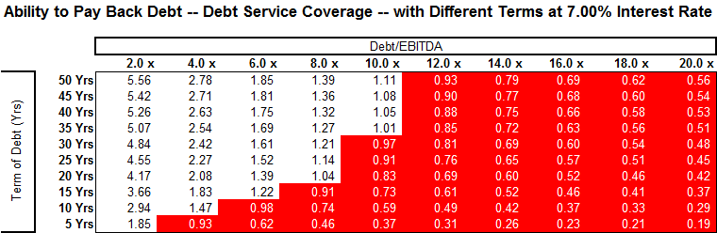
Eurotunnel Debt/EBITDA
The debt to capital ratio for Eurotunnel at financial close of 76% was in line with other projects, but it was irrelevant

Slide 96
Problems with Construction costs and Shuttles
25% Buffer in original bank agreement
Some changes in terminal and fixed equipment work
Major problem was with the shuttles
  More complex than originally estimated
  Market tight
  Bids higher than expected
Additional GPB 2 billion debt financing dependent on new equity issue and support by EIB, May 1990.
TML claimed added costs of 1.2 billion in 1992. Funded with debt and final equity issuance.
!994 added senior debt to cover interest payments that could not be serviced through cash flow
Suspended interest on debt in 1995

Slide 97
Eurotunnel Traffic Forecast
Eurotunnel comments
  "We were predicting that on Eurostar there would be 21 million passengers (annually)," admits David Freud of Warburg, the investment house which sold Eurotunnel shares to the public.
  The actual figure was less than a third of that.
"So the traffic forecasts were not just out by a little bit. They were completely potty; they were nowhere."
Those who drafted Eurotunnel's prospectus failed completely to foresee a robust response from the ferries.
There was a marketing war that broke out between the ferries and Eurotunnel in the summer of 1995 which further damaged revenues.
“The forecasts were comically optimistic”, The Financial Times

Slide 98
Projected and Forecast Traffic and Revenues

Slide 99
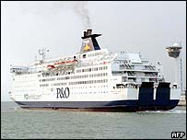
Eurotunnel – Price and Traffic Estimates
Not only did P&O not fade away, as Eurotunnel had thought likely, it fought back with better ships and lower prices, retaining the loyalty of passengers who had been forecast to switch to the tunnel.
Another blow to Eurotunnel was the unexpected emergence of no-frills airlines, offering rock-bottom prices on short-haul trips to a wide range of European destinations.

Slide 100
Effect of Traffic Study Errors on the Financial Results of Eurotunnel
.

Slide 101
Valuation Problems with Eurotunnel
The Eurotunnel project includes many classic valuation issues in addition to the focus of applying optimistic assumptions from consultant studies related to construction costs and traffic projections. These problems included distorted incentives because of the corporate structure, limited experience and reputation of equity investors, conflicts with the government and use of unconventional equipment:
  First, a consortium of ten construction companies named TML that owned the majority of the shell company that was created for bidding on the concession. This shell company signed construction contracts even though TML eventually only owned a tiny fraction of investment, presenting a dramatic conflict of interest. Problems with the construction contracts led to many construction over-runs and delays.
  Second, the equity providers (mainly small French investors) did not have the wherewithal to evaluate the project economics provide assurance that somebody who gets paid after lenders could check the key valuation assumptions. With hindsight, partially because of weak sponsors, the managers of Eurotunnel neither negotiated effectively with bankers nor with TML nor did they seem to have the best interests of shareholders in mind.
  Third, relationships between Eurotunnel and the governments of Britain and France were not aligned properly. Even though the project was directly related to the government activities – government owned railways operated the trains, the 55-year concession period was defined by the government, the project was awarded by the government, and the government defined the safety requirements, there was no direct or indirect financial support from the French or British governments.
  Fourth, the complexity of the ventilation systems, the shuttles, the toll plazas, the electricity requirements and other items introduced risk that could not be gauged by evaluating the cost and performance of other projects.

Slide 102
Construction Cost Over-Runs and Contractual Problems
Eurotunnel’s difficulties were in part due to the wrong contractual structure set up at the origin of the project.
  The main contracts were signed at a time where Eurotunnel had virtually no existence.
  Eurotunnel lacked powerful sponsors to defend its interests against opportunistic contractors (especially, the construction companies).
    As a consequence, these co-contractors imposed long-term contractual features extremely unfavorable to Eurotunnel.
    These conflicts were not anticipated at the very beginning of the project since the construction companies initially held a part of Eurotunnel’s shares.
  The other important contractor, the bank syndicate, was unable to stem the opportunistic behavior of the construction companies due to its lack of expertise on technical features.
In July 1989 there was an enormous conflict with construction companies.
The 1987 Offer for Sale:
  “The construction contract provides financial incentives for the contractor TML to complete the tunnels under budget and financial penalties if they are completed over budget or late…This arrangement is designed to encourage the cost-effective completion of the System on time.”
  TML’s contribution to the cost over-runs was limited to 6%
  Revised agreement re-apportion cost over-runs
    70% Eurotunnel
    30% TML

Slide 103
Cost Over-Runs and Contract Problems Continued
This series of disputes was partly due to the incentives / penalties scheme of the construction contract. In reality, the construction contract signed in 1987 charged almost all the construction risk to Eurotunnel.
  For tunneling costs (representing roughly 50% of overall costs), TML was only responsible for 30% of cost overruns with TML’s contribution being capped at a maximum of 6% of the target cost. Eurotunnel would pay 100% of any cost overruns over this cap. Even when the contract seemed to be favorable to Eurotunnel (TML was assumed to support 100% of cost overruns on the terminals and the fixed equipment in the tunnel), some covenants gave TML the possibility to transfer cost overruns to Eurotunnel. Indeed, the construction contract explicitly made provisions allowing TML to ask for price adjustments in case of unpredictable ground conditions, changes imposed by the IGC or asked by Eurotunnel. Hence, it is not surprising to notice that the resolution of the disputes was largely in favor of TML. Despite an agreement was found just before the rights issue of 1994, Eurotunnel had to pay for the main part of cost overruns.
  In 1993, a few months before the opening of the Tunnel, a dispute emerged between Eurotunnel and the Railways. Eurotunnel concerning for example the starting date of Eurostar or the delay in the construction of high speed rail link between London and the tunnel and claimed £2 billion. The claim was finally rejected.

Slide 104
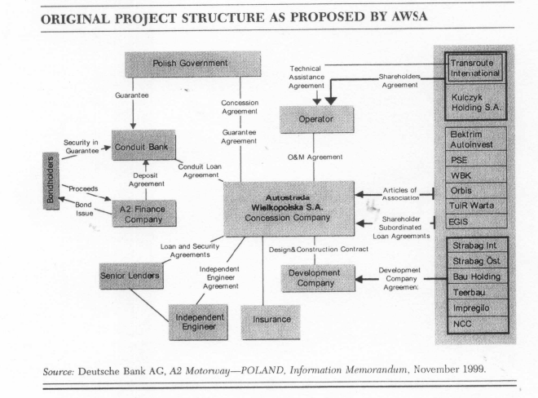
Contrast of Eurotunnel to Public Private Partnership
Under the BOT model, the government retained ownership of the motorway while the private companies that financed construction, known as concessionaires, had the right to operate the motorway and receive profits for a defined period of time. When a concession ended, the concessionaire would transfer operations and control back to the government. The Toll Motorways Act of 1994 provided the legal framework for the program. It authorized the government to grant concessions on a competitive tender basis for the construction and operation of tolled motorways.
In addition, the Act authorized the government to guarantee financing of up to 50% of the total cost of construction, create a new government agency to oversee the program, and take land for the motorways by eminent domain.

Slide 105
Cash 3: Solar Case Study –

Slide 106
Case Question
How would you design a performance test as part of the EPC contract
How would you design the performance part of the O&M contract

Slide 107

Two Projects that Changed the World

Slide 108

ACWA Power Dubai 6 Cents per kWh in 2015

Slide 109
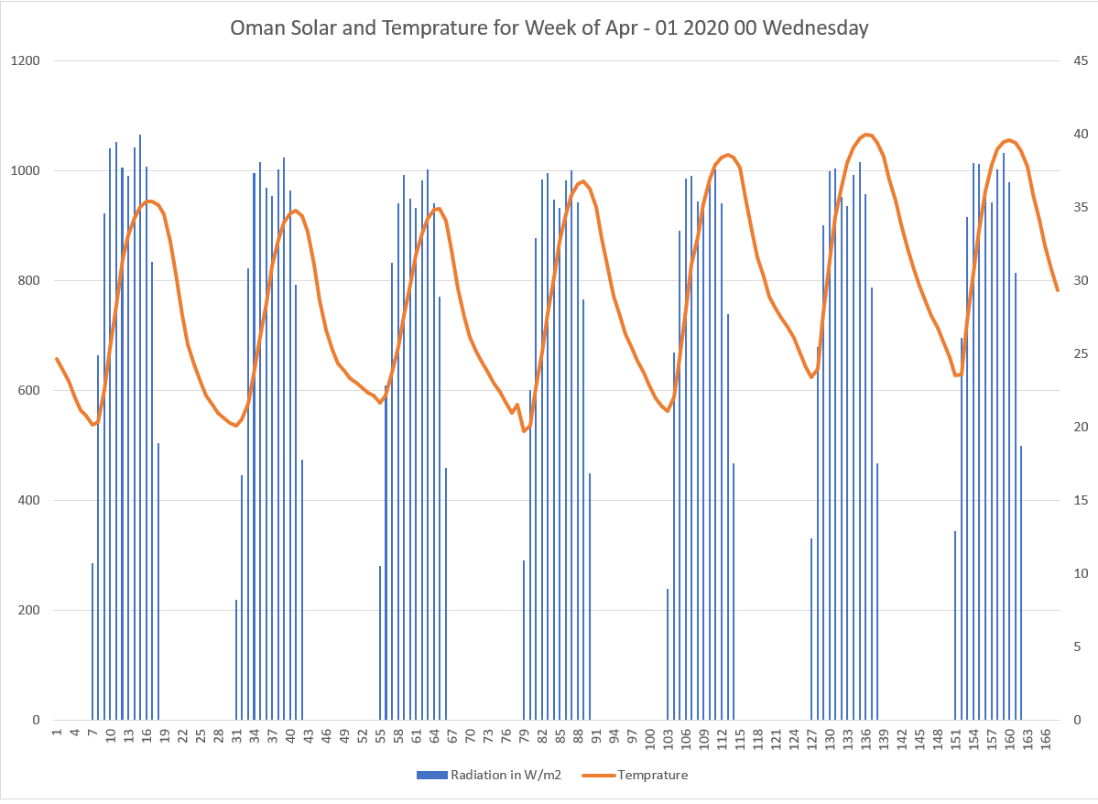
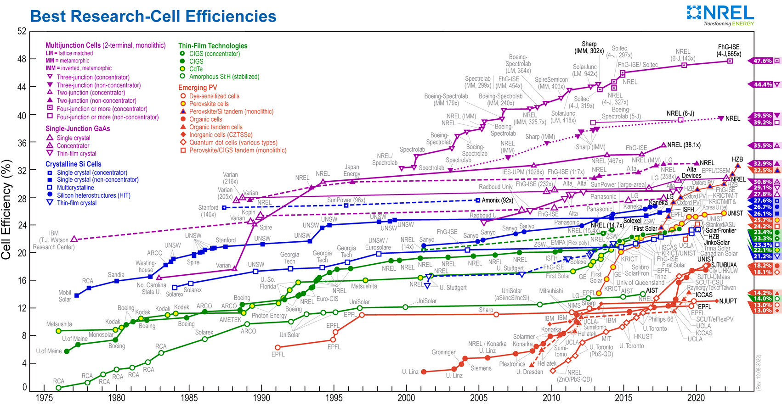
Efficiency and Capacity Factor
Question: What is the difference between efficiency and capacity factor
Banks and Investors: Concern with the overall cost

Slide 110
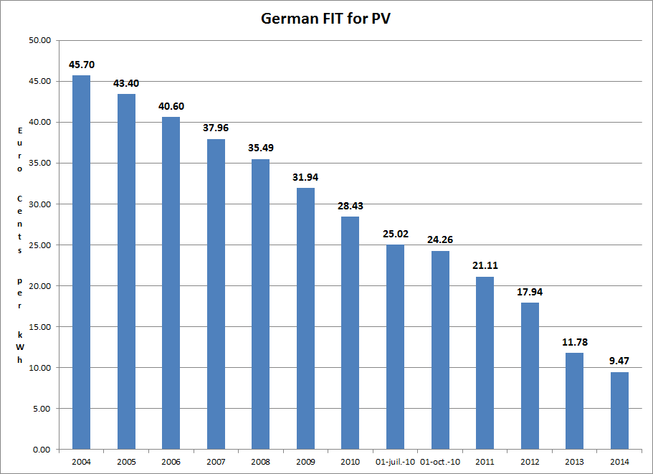
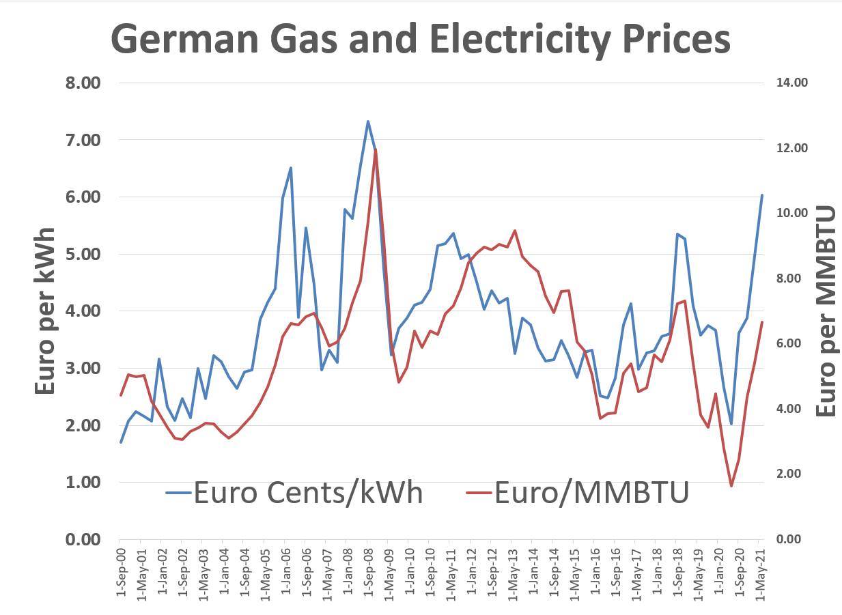
Why Are We Even Discussing Green Hydrogen 1 - German Solar Feed-In Tariffs and Managing Risk
Example of government policy that worked. Idea to make very simple tariff to finance projects and then achieve scale.

Slide 111
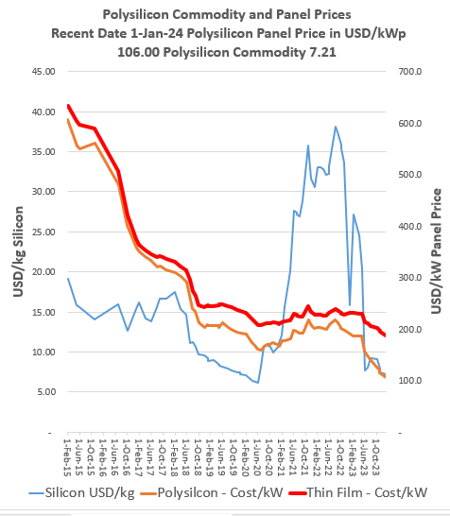
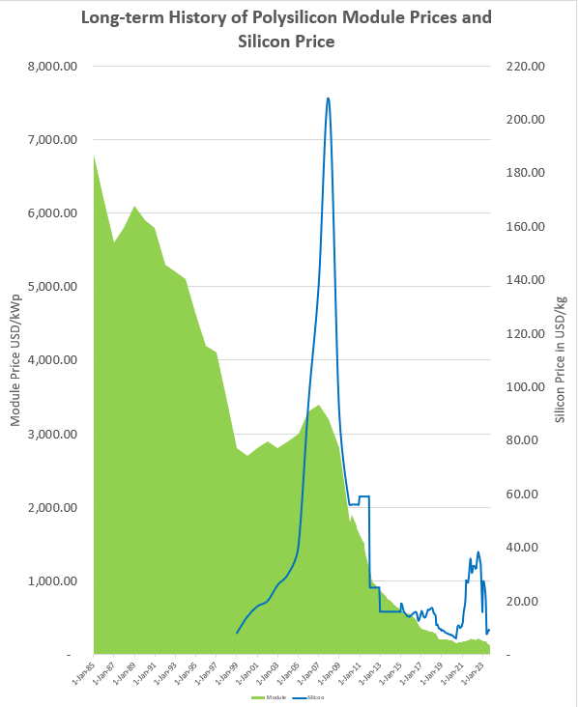
Why Are We Even Discussing Hydrogen 2 - Module Prices and Polysilicon

Slide 112
Solar Can be Defined by a Few Parameters
Operating
  Capital Expenditure/kW – as low as USD 500/kW
  O&M Cost – Pure O&M as low as USD 4/kWyear
  Capacity Factor – Good sunlight, as high as 28% with tracking
Financing
  Required Equity IRR – Can be 5-6% in Europe
  Debt Parameters
    Debt Size from DSCR
    Credit Spread
    Required Hedging
    Tenure of Debt and Re-financing
    Required Political Risk Insurance

Slide 113




Cost of Tracking and Bifacial

Slide 114

Bi-Facial Costs
Can generate from both sides of the module
Can produce 5-20% more output
Production Costs are not much higher for bi-facial
Wood McKinsey estimates that the increase in cost at only USD 5/kWp (relative to the panel cost of approximately USD 200/kWp.
Module producers offer bi-facial products
Tracking companies making adjustments

Slide 115


Examples of Very Low Solar Prices
To see how far things have come, there are many projects now that are lower than 2 USD cents per kWh.

Slide 116

Solar PV – Inverter and Solar Arrays
Final Yield and generation Capacity Factor of Generation to Grid relative to kWp.
Yield and capacity factor measure the same thing
In-Plane Irradiation
Capacity Factor of Sunlight – Average Sunlight Divided by Capacity of Sunlight Defined as 1000 w
Performance Ratio is the Capacity Factor of the Final Divided by the Capacity Factor of Amounts that Hit the Array

Slide 117
Risk Allocation for Renewable Energy
IPP Risks
Cost of Project, Time Delay and Technology Parameters
Demand and Technology Change
Performance Ratio Risk
Interest Rate Fluctuation
Generation that Cannot be Controlled
Contract Mitigation
EPC Contract with Fixed Price and LD (LSTK)
PPA with Fixed Price and No Inflation
O&M Contract
Interest Rate Swap
NONE !!!
Explain why Single Part Tariff is Used and why risk of generation is taken by the investor

Slide 118

Diagram of Solar Project Finance
Volume or price or availability risk in model, and then, the IRR’s of each party and the DSCR’s of the lenders. Include cost to off-taker for the project economics.

Slide 119
Renewable (mainly solar) Resource Uncertainty

Slide 120

Where Uncertainty Comes From
First, there may be different solar resource estimates

Slide 121

Understand the Concept of STC
1,000 Watts/m2 = 1kW/m2
Measure Electricity Generated Relative to 1,000 watts
Temperature at 25 degrees

Slide 122

Explanation of P50, P90 etc.

Slide 123

P50 and P99 in Solar Case
Evaluate the P50 and P99 using the DSCR criteria.

Slide 124

Risk Analysis in Solar Projects

Slide 125
Nightmare Graph and Missing the P90 – Fitch Report

Slide 126

Estimation of Yield or Capacity Factor
Base Estimate
Performance Estimate
Variation from Changes in Annual or Semi-Annual Irradiation
Variation from Different Starting Points
Variation from Modelling Errors
Variation from Performance Ratio
Use of Mean Square Error to Add up the Components of Standard Deviation
Use of NORMINV to Compute P90, P99 etc.

Slide 127
Exercise – See How Things Work from the Bottom Up

Slide 128

Focus on In-Plane Yield for Capacity Factor
Concentrate on the in-plane radiation that hits the panels. Yield in kWh/m2 divided by 8760 gives you the capacity factor: 2780/8760 is 31.7%. You won’t find much better places than this.

Slide 129
Solar Patterns in Desert – Note the Stability

Slide 130
Weekly Solar Irradiation - Europe

Slide 131
Final Output and Performance Ratio
In-plane radiation
  From the sun and nothing to do with type of solar panels, sand on panels, size of inverters, losses from trees and shading, line losses. Only depends on the day and night and clouds
Final output
  Depends on panel temperature coefficient, how size the inverters, line losses, losses due to crap on the panels etc.
Performance Ratio
  Converts in-plane radiation to final output
  In-plane capacity factor x PR = Final capacity factor
Example
  In-Plane (31%) x PR (80%) = 24.8%

Slide 132

Work Through PVSyst
Can divide the energy injected to grid divided by radiation on collectors
Don’t need anything other than the column of Effective Irradiance on Collectors as well as Energy Injected into the Grid. Convert both of these to capacity factors and then divide the energy into grid by the irradiation on collectors.

Slide 133



Loss Diagram Illustration
Convert loss diagram into capacity factor and compare different cases.
Difficult to compute performance ratio from these diagrams.
Generally, the loss due to temperature is the largest loss factor.

Slide 134

Example of Temperature Coefficient
You can find temperature coefficients – some examples are listed below.
The Nominal Operating Cell Temperature (NOCT) is defined as the temperature reached by open circuited cells in a module.

Slide 135
Solar Case Issues to Think About
Starting Point versus variation
Degradation and guarantees
If you have other projects in similar areas
Comparison with other P90 and standard deviation

Slide 136
Section 3:
Loan Agreement Contract in Project Finance

Slide 137

Five Parts of Debt
Any debt has the following parts in deriving the structure
Debt Size
Funding Pre-COD
Repayment Post-COD
Interest and Fees Paid
Other Features to Improve Ability to Repay including covenants, DSRA and cash sweep

Slide 138
Pre-and Post COD Analysis
Post-Cod
Pre-Cod

Slide 139
Part 1: Debt Size – Nuanced Issues with DSCR and Debt to Capital Ratio

Slide 140


Debt Size From Debt to Capital and DSCR

Slide 141



Risk Analysis – Skin in Game versus Safety Buffer
Equity Skin in Game
Buffer to Make Sure No Problems

Slide 142


DSCR, Alarm Clock
DSCR = Cash Received/Cash Paid to Bank
DSCR = CFADS/Debt Service
How much buffer do you need to make sure you will not have a risk event
Time to catch plane
How much time would you leave
  First time took the plane
  Very important flight that you cannot miss

Slide 143
Debt Sizing – Key Philosophical Question
Debt to Capital Ratio – Trust sponsor to be smart enough to not invest in a bad project. Make sure the sponsor is taking downside risk. With no cash invested in the project, there is only upside potential, and the sponsor will not care about downside evaluation. The test is historic investment and do not have to look forward.
The notion of DSCR implies that you are smart enough to make a forecast. If you really believe your forecast and even variation around your forecast, you can back into the debt from the DSCR. This is the notion of negotiated base case and downside for evaluating DSCR.
Limit the debt to assure equity is in project and the value of the project is above the debt

Slide 144
Reconciling Debt to Capital with DSCR
Cash Flow results in too high DSCR meaning that you have debt to cap constraint
Increase the project cost WITHOUT spending money on things like land value
Yes
After you are finished with the term sheet it looks like the DSCR constraint and the debt to capital constraint give you the same answer. This could be because of the process.
No
Try to increase tenor to reduce increase the DSCR

Slide 145
Effects of Non-Cash Increases in Project Cost
When does asset increase matter and when does it not
Importance of paying cash or not paying cash
Examples of non-cash increases in project cost
  Development fees
  Owner costs
  Some development costs
  Contingencies
  Value of Land allocated to project
  EPC profit if EPC is sponsor
  Games with EPC profit
Items that can increase the cost of a project affect returns primarily when the debt to capital constraint applies and have less or no importance when the DSCR drives debt capacity.

Slide 146
Debt Sizing: Including Items in Project Cost that do not Involve Cash Outflow
Accounting allocations to the project can have large effects on the equity IRR through debt sizing derived from the debt to capital ratio.
If the DSCR drives debt sizing, the accounting allocations, fee allocations and other adjustments have no effect on the equity IRR.
Accounting allocations and non-cash contributions can change the structure of returns when multiple investors are involved in the project. If one party is allowed to include non-cash allocations as the basis for his investment, his return is much higher.
Depending on the manner in which project costs are accounted for, multiple investors pay debt service and receive dividends, but the investor who did not invest as much cash effectively borrows less relative to the cash investment.

Slide 147
Debt Sizing: Profits from EPC Contractors or O&M Contractor when Investor is also Contractor
If the EPC profits do not affect the debt size and there is only one investor, placing profits at the EPC contractor level or the investor level does not influence overall returns (i.e. if DSCR drives debt size).
Depending on whether the debt to capital constraint applies or there are multiple investors, EPC profits can increase equity IRR (by increasing the debt size).
Cash Flow Waterfall and issues associated with including profits in O&M contract rather than in SPV cash flow. Profits on the O&M contract versus including O&M costs at the SPV level can affect the distribution of dividends as the O&M fee is paid before debt service.

Slide 148
Illustration of DSCR and Debt to Capital Constraint
Lower DSCR results in too high debt to capital ratio. Need to constrain the debt.
Discounted Red Area (using the interest rate) is the Value of the Debt.
DSCR sizing means you believe your forecast.

Slide 149
Which Constraint is in Place
Items have an effect on whether the debt to capital constraint or the debt to capital constraint applies:
Need to Understand that NPV of Debt Service is Loan Value
  High Project IRR → More Likely Debt to Constraint;
  Long Tenor → More Likely Debt to Capital Constraint;
  Sculpting → More Likely Debt to Capital Constraint;
  Low Interest Rate → Morel Likely Debt to Capital Constraint.
  Low Project IRR → More Likely DSCR Constraint;
  Short Tenor → More Likely DSCR Constraint;
  Level Payment → More Likely DSCR Constraint;
  High Interest Rate → More Likely DSCR Constraint
Fundamental Math:
PV of Debt Service at Interest Rate = Debt at COD
Debt/Capital = Debt/Cap Exp
Debt/Cap Exp = PV of DS/Cap Exp
DS = EBITDA/DSCR

Slide 150
Why Skin in the Game
The DSCR defines the amount debt from cash flow
  Say the cash flow is 150 and the DSCR is 1.5
  Then, the debt service is 100 = 150/1.5
  If the interest rate is zero, the DS = Interest + Repayment = Repayment
  If the debt term is 10, then the Repayment = 100
  In this case the total repayment = 100 x 10 = 1000
  Total repayment = Total Debt
But now say the total project cost = 800
If you lend 1000, then the company gets 200 immediately
If the SPV does well, everybody is happy
If the SPV does badly, the company put 200 in its pocket and lost nothing
They have no skin in the game

Slide 151


DSCR for Solar PV from Fitch

Slide 152

Project Finance ties to BBB- (Baa3)
Investment Grade
Junk

Slide 153
Part 2 of Loan Contract - Funding

Slide 154
Issues with Funding
In general, debt funding is difficult without some kind of support from outside of the project.
If the project return is above the interest rate, equity return increases when the equity is contributed later and debt earlier.
From bank perspective, the equity should be put in first and the loan in last.
Specific Issues:
  Funding of equity first or pro-rata
  Capitalisation of interest
  Pre-operating cash flow
  Interest on sub-debt or shareholder loan
  Equity bridge loan

Slide 155
Draw Request and Funding - Introduction
When a borrower uses cash during construction, the funding request includes:
  Notice of Borrowing
  Payment and draw details
  Construction certificate
  Schedule of construction costs and cumulative amounts
  Insurance certificates
  Financial reports and other documents

Slide 156
Project Finance Loans – Drawdown during Construction
Prior to satisfying the options conditions, it is the usual practice for the financiers to:
  be able to rely on other contractual or financial resources (recourse or some kind of support from sponsors) to repay that funding [if the project fails to be completed];
  If equity is not up-front may require letter of credit, sponsor guarantee or really strong EPC contract; and,
  to roll up the capitalized interest-during-construction (“IDC”) into the financing (i.e. capitalizing interest).
During the construction phase, equity and debt funds are used to finance the project construction with funds generated from the project cash flow covering the operation period.

Slide 157
Capitalised Interest and Interest Capitalised During Construction for Accounting (IDC)
Interest (and fees) can be paid during construction or capitalized to the debt balance (not paid now, but paid later).
If interest is capitalized and the debt is the same percent of the project cost, the capitalizing of interest does not make any difference.
Whether the interest is paid or capitalized, it is recorded as part of the project cost as interest during construction (IDC).
Note there is no capitalization of the equity cost of capital in a manner similar to debt.

Slide 158
Pre-Commercial Cash Flow – Reduction in Asset Cost or Equity Increase – It can make a big difference
The effects of accounting for pre-commercial cash flows as either equity or reduction in project cost.
In terms of accounting, pre-commercial cash flow is income and should be part of equity.
Alternatively, one could call the pre-commercial cash flow a reduction in the cost of the asset.
Related issues include the issue of government grants and early production.
With an extreme case the labelling the pre-commercial cash flow as equity results in improved returns but from banker’s perspective is not “skin in the game.”

Slide 159
Equity Bridge Loans and Recourse Debt
In some projects, equity holders provide loans to the project from their balance sheet instead of equity.
Example
  A project finance transaction is structured with equity first financing (i.e. equity put in to finance construction before debt).
  The sponsor secures a separate loan to finance its equity requirements, meaning it does not put any equity when you count the corporate side.
  The loan will be re-paid in a bullet (with interest capitalised) at the end of the construction period or maybe even later.
  When the loan is re-paid, the sponsor provides equity to finance the loan.
  The equity bridge loan must have a parent guarantee.

Slide 160
Issues with Equity Bridge Loans
In pure project finance, equity should be contributed before debt during the construction period to assure that equity does not walk away from the project during construction.
Pro-rata debt and equity contributions or equity bridge loans require some kind of sponsor support and can in theory distort the equity cash flow.
An equity bridge loan requires parent support, the cost of which is not included in the equity IRR. The effects of IDC on equity bridge loan on project taxes and the effects of equity bridge loans in different interest rate environments and on different types of projects will be discussed.
Issue
  Should the equity bridge loan be included in computing Equity IRR.
  The loan uses resources of the parent and must be guaranteed by the parent

Slide 161
Issues with EBL
If there are multiple sponsors, one of which provides a guarantee, how should the benefits of the EBL be allocated
The IDC increases the cost of the project and increases other debt capacity if there is a debt capacity constraint

Slide 162
Nuanced Issues with IDC on Shareholder Loans
Shareholder loans seem to have no effect on senior debt. All of the covenants and waterfall issues occur after the senior debt is paid.
If senior debt limits the dividends to shareholders, it will also limit the shareholder loan payments
Equity IRR should consider the shareholder loan and any other equity as combined cash flows
The shareholder loan may affect taxes which will increase the cash flow (and cause a circular reference problem).

Slide 163
Standby Loans for Construction Cost Over-run and the Issue of Cost Under-run
With a cost over-run facility, the commitment fee can increase the cost of the project.
If the debt is subordinated to senior debt the over-run facility is similar to shareholder loans.
If there is a cost under-run and the debt has been committed with and EBL or pro-rata, a question arises as to whether the debt should be reduced or whether the proceeds should accrue to shareholders.

Slide 164

Evaluation of Delays in Construction
In evaluating delays in construction, it is generally better not to change the S-curve but rather to assume there is dead time.
After accounting for the reductions in PPA revenues, the liquidated damage can accrue to reduction of debt to maintain the DSCR.

Slide 165
Complex IDC Calculations with Portfolios
The IDC calculations can be complex if some parts of the project are completed while others are continuing to be constructed.
This is a typical problem in real estate and solar roof-top
To resolve the problem:
  Keep track of plant in service and construction work in progress in separate accounts
  Allocate interest from the ratio of CWIP to (CWIP + Plant in Service)
  IDC itself will also be in CWIP and Plant in Service

Slide 166
Draw-downs and Management of Disbursement of Funds
The strict control of fund disbursements can provide a mechanism to maintain leverage over contractors and thus help to minimize construction risk in the better rated projects.
Loan documents typically give lenders the right to closely monitor construction progress and release funds only for work that the lender's engineering and construction expert has approved as being complete.
Third-party trustees, acting in a fiduciary capacity, will generally manage disbursement of funds to protect debtholders' interest in the project. (Multiple Investors)

Slide 167
Draw-downs and Retention of Funds
Retention of all debt-financed funds in a segregated account by a trustee experienced in management of power project construction, preferably an experienced bank or other lender for these projects;
  Payment structures that retain a small portion of each amount payable, about 5%, until the project reaches commercial completion;
  Disbursements made only for work certified as complete by an independent project engineer retained by the construction trustee solely for approving disbursements;
  Right to suspend or halt disbursements when the trustee concludes that construction progress is materially at risk (reversals or revocations of necessary regulatory approvals or changes in law or cost outside the levels anticipated by the budget and schedule)
Authority to approve all change orders or authority to limit change orders to a pre-determined amount (example MCV)

Slide 168
Part 3: Debt Repayment

Slide 169
Alternative Repayment Patterns
Given a DSCR constraint and the formula that the present value of debt service equals the amount of debt at COD, use geometry to maximize debt.
The general idea of maintaining a constant DSCR over the life of a project in sculpting when the risks can increase over time.
Contrasts to the requirement that banks must increase capital with longer terms and that an implicit assumption of constant credit spreads is increasing risk over time.
Sculpting versus alternative methods in the context of different revenue patterns (indexation, flat fee-in tariffs, tax depreciation, etc.)

Slide 170


Fundamental Effect of Debt Tenure with Debt to Capital Constraint
Same debt, but longer tenor gives earlier dividends

Slide 171


Sculpting versus Equal Installment with Debt to Capital Constraint
More dividends earlier with sculpting

Slide 172
Sculpting Equations - Basic
One of the main ideas about the repayment process in project finance is that the modelling is much more effective when you combine formulas with other excel techniques. If you try and solve these things with a brute force method that uses a copy and paste method or goal seek things will get very messy. Formulas used for repayment and debt sizing are listed below: The fundamental two sculpting formulas are:
(1) Target Debt Service Per Period = CFADS/DSCR
(2) Debt Amount at COD = PV(Interest Rate, Target Debt Service)
Non-Constant Interest Rates
However this is by no means the only formula you should use when working on repayment. In cases when the interest rate changes, a simple present value formula cannot be used. Instead, an interest rate index can be created that accounts for prior interest rate changes as follows:
(3) Int Rate Index(t) = Int Rate Indext-1 x (1+Interest Rate(t))
(4) Debt Amount at COD = ∑ Debt Service(t)/Interest Rate Index(t)

Slide 173
Sculpting Equations with Debt to Capital Constraint
Use of LLCR when there is a Target Debt to Capital constraint that drives the amount of the debt. If the debt is being sized by the debt to capital ratio, a higher DSCR must be used.
This raises the issue of how to compute sculpted debt repayments when debt is sized with the debt to capital ratio and the DSCR is not from the DSCR constraint.
When the Debt is Sized by Debt to Capital the LLCR can be used to size the debt, because with sculpting, the DSCR = LLCR. Formulas in this case include:
(5) Target Debt Service(t) = CF(t)/LLCR
(6) LLCR = NPV(Interest Rate, CFADS)/Max Debt from Debt to Capital
(7) DSCR Applied = MAX(Target DSCR,LLCR with Max Debt)

Slide 174
Sculpting Equations with LC Fees
Adjusting Sculpting Equations for Debt Fees: Debt fees such as the fee on a letter of credit is part of debt service. To include the fees in the sculpting equations, you should subtract the fees when you compute the net present value of debt, as the fees reduce the amount of debt service that can be supported by cash flow. To make the sculpting work you should also make the repayment lower by the fees as shown below:
(14) Repayment = CFADS/DSCR - Interest - Fees
(15) Debt = NPV(Interest Rate, Debt Service-fees)
Debt = NPV(rate, Debt Service) - NPV(rate, Fees)
Note Debt Service in the above equation means debt service without fees and debt is reduced by PV of fees
Adjusting LLCR for Debt Fees: The sculpting analyses include calculation of the LLCR to evaluate whether the debt to capital constraint is driving the constraint. In this case the PV of CFADS is not the correct numerator for the analysis. Instead, the PV of the LC fees should be added to the denominator of the LLCR as follows:
(16) LLCR = PV(CFADS)/(Debt + PV of LC Fees), where
(17) Debt = Project Cost x Debt to Capital

Slide 175
Sculpting with DSRA as Final Payment
Sculpting and Changes in the DSRA balance including Final Repayment
After working through letters of credit for the DSRA, taxes, interest income and other factors that cause difficult circular references, the final subject addressed is using the DSRA to repay debt.
A similar result occurs when changes in the DSRA are included in CFADS. Incorporating these changes in a financial model without massive circularity disruptions can be tricky, but it can be solved by separately computing the present value of changes in the DSRA.
Changes in the DSRA can be modelled using the following equations:
(18) Debt Adjustment = PV(Interest Rate, Change in DSRA/DSCR)
(19) Repayment = Repayment from Normal Sculpting + Change in DSRA/DSCR

Slide 176


Sculpting versus Equal Installment with DSCR Constraint
Note the big increase in IRR with the DSCR constraint – because of the larger debt size. Recall that can effectively make the DSCR constraint be in place

Slide 177
Sculpting Equations - Basic
One of the main ideas about the repayment process in project finance is that the modelling is much more effective when you combine formulas with other excel techniques. If you try and solve these things with a brute force method that uses a copy and paste method or goal seek things will get very messy. Formulas used for repayment and debt sizing are listed below: The fundamental two sculpting formulas are:
(1) Target Debt Service Per Period = CFADS/DSCR
(2) Debt Amount at COD = PV(Interest Rate, Target Debt Service)
Non-Constant Interest Rates
However this is by no means the only formula you should use when working on repayment. In cases when the interest rate changes, a simple present value formula cannot be used. Instead, an interest rate index can be created that accounts for prior interest rate changes as follows:
(3) Int Rate Index(t) = Int Rate Indext-1 x (1+Interest Rate(t))
(4) Debt Amount at COD = ∑ Debt Service(t)/Interest Rate Index(t)

Slide 178
Sculpting Equations with Debt to Capital Constraint
Use of LLCR when there is a Target Debt to Capital constraint that drives the amount of the debt. If the debt is being sized by the debt to capital ratio, a higher DSCR must be used.
This raises the issue of how to compute sculpted debt repayments when debt is sized with the debt to capital ratio and the DSCR is not from the DSCR constraint.
When the Debt is Sized by Debt to Capital the LLCR can be used to size the debt, because with sculpting, the DSCR = LLCR. Formulas in this case include:
(5) Target Debt Service(t) = CF(t)/LLCR
(6) LLCR = NPV(Interest Rate, CFADS)/Max Debt from Debt to Capital
(7) DSCR Applied = MAX(Target DSCR,LLCR with Max Debt)

Slide 179
Sculpting Equations with LC Fees
Adjusting Sculpting Equations for Debt Fees: Debt fees such as the fee on a letter of credit is part of debt service. To include the fees in the sculpting equations, you should subtract the fees when you compute the net present value of debt, as the fees reduce the amount of debt service that can be supported by cash flow. To make the sculpting work you should also make the repayment lower by the fees as shown below:
(14) Repayment = CFADS/DSCR - Interest - Fees
(15) Debt = NPV(Interest Rate, Debt Service-fees)
Debt = NPV(rate, Debt Service) - NPV(rate, Fees)
Note Debt Service in the above equation means debt service without fees and debt is reduced by PV of fees
Adjusting LLCR for Debt Fees: The sculpting analyses include calculation of the LLCR to evaluate whether the debt to capital constraint is driving the constraint. In this case the PV of CFADS is not the correct numerator for the analysis. Instead, the PV of the LC fees should be added to the denominator of the LLCR as follows:
(16) LLCR = PV(CFADS)/(Debt + PV of LC Fees), where
(17) Debt = Project Cost x Debt to Capital

Slide 180
Sculpting with DSRA as Final Payment
Sculpting and Changes in the DSRA balance including Final Repayment
After working through letters of credit for the DSRA, taxes, interest income and other factors that cause difficult circular references, the final subject addressed is using the DSRA to repay debt.
A similar result occurs when changes in the DSRA are included in CFADS. Incorporating these changes in a financial model without massive circularity disruptions can be tricky, but it can be solved by separately computing the present value of changes in the DSRA.
Changes in the DSRA can be modelled using the following equations:
(18) Debt Adjustment = PV(Interest Rate, Change in DSRA/DSCR)
(19) Repayment = Repayment from Normal Sculpting + Change in DSRA/DSCR

Slide 181
Part 4: Interest Rates and Credit Spreads

Slide 182
Fees Up-Front or Part of Credit Spread
Compute Debt IRR with fees
Does it matter if fees are paid up-front or part of credit spread
ECA Example with High Premium Up-front

Slide 183
Commitment Fee, Up-Front Fee and Debt IRR
Commitment Fee
(a) The Borrower will: (i) commencing on the date of the first Utilisation Date until (and including) the last day of the Availability Period for the borrowing under the Tranche A Facility, pay for a commitment fee computed at a rate of four per cent. (4%) per annum on the undrawn and uncancelled portion of the Tranche A Commitments allocated to the Second Tranche A Loans;
Commencing on the date of the first Utilisation Date until (and including) the last day of the Availability Period for the borrowing of the Second Tranche B Loan under the Tranche B Facility, pay the Facility Agent for each Lender a commitment fee computed at a rate of five per cent. (5%) per annum on the undrawn and uncancelled portion of the
Tranche B Commitments allocated to the Second Tranche B Loan; and

Slide 184
Importance of Credit Spreads
In the cases without re-financing, it seemed that the credit spread did not make that big a difference to the equity IRR.
But when re-financing was included the credit spread made a big difference as should be expected – the credit spread is a big driver from the difference between project IRR and equity IRR.
The credit spread is driven by the probability of default and loss, given default in theory. The problem is that these statistics are not observable.

Slide 185


Example of Pricing and Changing Credit Spreads
Step-up credit spreads encourage re-financing. To not assume re-financing in a base case or upside case in inconsistent with the whole idea of increasing rates.

Slide 186
Idea of Risk Allocation Matrix and Use of DSCR, PLCR and LLCR to Measure Break-Even
Risk allocation matrices will be used to demonstrate how the DSCR and LLCR can be used to determine acceptable unmitigated risks:
  The formula:
  break-even cash flow reduction = (DSCR-1)/DSCR.
  Also break-even cash flow over life of loan
  BE reduction = (LLCR-1)/LLCR
  BE reduction for Project Life = (PLCR-1)/PLCR
Different project finance structures that involve:
  availability payments versus output-based revenues;
  commodity price (merchant) risk;
  traffic or volume risk (pipelines), and
  resource risk (wind, solar and run of river hydro) will be derived.
For each of the project finance types, an illustrative risk allocation matrix and project diagram will be developed.

Slide 187
Find BBB and BB Spread with 10-year Swap Rate

Slide 188

Interest Rate Hedging in Different Transactions

Slide 189
Expected Loss Can Be Broken Down Into Three Components
Borrower Risk
Facility Risk Related
EXPECTED LOSS
$$
Probability of Default
(PD)
%
Loss Severity
Given Default
(Severity)
%
Loan Equivalent
Exposure
(Exposure)
$$
=
x
x
What is the probability of the counterparty defaulting?
If default occurs, how much of this do we expect to lose?
If default occurs, how much exposure do we expect to have?
The focus of grading tools is on modeling PD
Credit Spread must cover the expected loss and is driven by probability of default x loss given default

Slide 190
Comparison of PD x LGD with Precise Formula
-- LGD and Multiple Years
Formula demonstrating that Credit spread is function of PD and LGD and the risk-free rate.
If you are lazy, just use a goal seek

Slide 191


Implied PD from Credit Spread
Use example of 6% and understand compounding of the credit spread
For one year if LGD is 50%, then implied PD is about 11.32% as shown below for a zero coupon bond example.

Slide 192



Implied PD Explodes with Longer Term Debt
Like any other interest rate, the credit spread is an IRR and it compounds dramatically over time. Scenarios with 6% credit spread and 5, 10 and 15 years are shown below.

Slide 193


S&P Study of PD and LGD for Project Finance
There is not much data, but the data shows that the LGD is very high for project finance. This is logical given the long-term nature of the assets.

Slide 194
Target Rating and Credit Spreads – Why the target is BBB- in Project Finance
BBB and other spreads were very low prior to 2008 Crisis
Note the spread for BBB- should be representative of Project Finance

Slide 195
Probability of Default for BBB and Other Ratings
BBB-

Slide 196

Project Finance Defaults
A lot of merchant plants in US. Note the initial rating of BBB-

Slide 197

S&P Recovery Rates
LGD for Defaults – Not much data

Slide 198

Project Finance is Unfair to Africa
Credit spreads are much higher in Africa, but compute the ratio of defaults to loans.
For U.S. the ratio is 32/21 or 1.53.
For Africa the ratio is 3/8 = .375.

Slide 199

Useless but Interesting Chart on PD

Slide 200
Part 5: Credit Enhancement: DSRA, MRA, Cash Flow Sweeps and Covenants

Slide 201
Covenants and Structural Enhancements Cannot Make a Bad Project into a Good Project
The most important aspect of the underwriting process is determining whether the plant is economically sound. This means that the cost structure and the technology of the plant must be viable.
However, once a plant is determined to be economically viable, the credit quality of a transaction can be enhanced by various structural features – covenants, debt service reserves, liquidation damages, subordinated debt, contingent equity etc. The potential for structural enhancements to improve the credit quality of a transaction is described in the statement by Standard and Poor’s below:
  Project structure does not mitigate risk that a marginally economic project presents to lenders; structure in and of itself cannot elevate the debt rating of a fundamentally weak project to investment-grade levels. On the other hand, more creditworthy projects will feature covenants designed to identify changing market conditions and trigger cash trapping features to project lenders during occasional stress periods.

Slide 202
Financial Enhancements – Alternative Definition
Cash flow capture (dividend lock-up, cash trap) covenants
  Cause debt to be re-paid early or debt service reserves to be built-up if debt service coverage ratios are low. Bad time covenant.
Cash flow sweep covenants
  Cause debt to be re-paid early or debt service reserves to be built-up if cash flow is high (or low). Good-time covenant.
Debt service reserves
  Assure debt service can be paid if market prices or other risks cause cash flow to be low for an extended period of time.
Subordinated debt and mezzanine finance
  Protects the cash flow coverage of senior debt instruments.
Contingent equity or sponsor guarantees
  Provide for additional equity funding in downside cases.

Slide 203
Default Events and Project Finance Philosophy
What can you really do if:
  A company does not pay debt service
  A company has a big cost over-run
  There is a big delay in construction
Answer
  Waiver
Events of Default
  Failure to Make Payments
  Judgments
  Misstatements
  Cross Default
  Breach of Project Documents
  Breach of Terms of Agreement
  Default in Construction; Schedule (Covenants)
  Loss of Applicable Permits

Slide 204
Remedies for Default: Step-in Rights
Definition of Step-in Rights
  Possession of Project. Enter into possession of the Project and perform any and all work and labor necessary:
    to complete the Project substantially according to the EPC Agreement and,
    the Plans and Specifications or to operate and maintain the Project, and
    all sums expended by Administrative Agent in so doing, together with interest on such total amount at the Default Rate, shall be repaid upon demand

Slide 205
Solar Case Accounts
Accounts. On or prior to the Closing Date, Borrower and Administrative Agent shall establish at the Depositary accounts entitled
“Solar Construction Account” (the “Construction Account”),
“Solar Operating Account” (the “Operating Account”),
“Solar Distribution Account” (the “Distribution Account”),
“Solar O&M Reserve Account” (the “O&M Reserve Account”),
“Solar Debt Service Reserve Account” (the “Debt Service Reserve Account”),
“Solar Distribution Reserve Account (the “Distribution Reserve Account”),
“Solar Completion Reserve Account” (the “Completion Reserve Account”),
“Solar Interest Reserve Account” (the “Interest Reserve Account”)
“Solar Loss Proceeds Account” (the “Loss Proceeds Account”),
“Solar Delay Proceeds Account” (the “Delay Proceeds Account”)
“Solar Major Maintenance Reserve Account” (the “Major Maintenance Reserve Account”).
Any deposits, transfer or application of funds in the Accounts shall be in accordance with the Depositary Agreement.

Slide 206
What Covenants Cannot and Can Do
Covenants cannot increase the operating cash flow of a project
Covenants cannot make a project that does not have enough cash flow to avoid default
Covenants cannot make a bad project into a good project
Covenants can change the timing of dividends
Covenants and DSCR can force liquidity into a project

Slide 207
Example of Covenants
DSCR Target
  Minimum Senior DSCR of 1.20x in Base Case
Lock-up Covenant
  Minimum Senior DSCR for the previous 12 months to be greater than 1.10x for distribution
Event of Default
  Minimum Senior DSCR of 1.05x
Standard Covenant
  Senior Debt not to exceed 80% of the total project costs
The DSCR has at least two different uses in project finance.
  One use is for determining the size of the debt. This means that if the projected DSCR is below a certain level, the loan should not be made. For example, if the DSCR is below 1.35, then the amount of debt must be reduced.
  A second is for dividend covenants (a lower level, say 1.1). This means if the DSCR falls below a certain level, then dividends are not allowed to be paid. If dividends are not allow (a dividend trap), then the cash that could have been paid in dividends is put in a reserve account.

Slide 208
Investors Need Some Dividends Before All Debt is Paid Off
The timing of debt service (i.e. loan interest payments and principal repayments) is one of the biggest factors that drives the rate of return for equity holders in a project. If the debt service is structured to allow no dividends until all debt is paid, return will be lower. This will generally be unacceptable to sponsors.
  The faster investors in a project are paid dividends, the better their rate of return.
  Investors therefore do not wish cash flow from operations of the project to be devoted to lenders at the expense of these dividends.
  Lenders, on the other hand, generally wish to be repaid as rapidly as possible. Striking a reasonable balance between these conflicting demands is an important part of loan negotiations.

Slide 209
Example of Cash Flow Priority
All revenues accrued on and after the Commercial Operation Date will be deposited with the Trustee into the Operating Revenue Account. The Trustee will withdraw amounts on a monthly basis and make deposits in the following priority, but only to the extent funds are then available in the Operating Revenue Account:
  (1) the operations and maintenance expenses for the Project for such month, subject to certain limitations;
  (2) the Tax Equalization Account
  (3) (A) an amount that will not be less than the amount of interest on the Bonds to become due on such Interest Payment Date, and (B) an amount that will not be less than the amount of principal or sinking fund payment to become due on such principal or sinking fund payment date;
  (4) an amount, if any, sufficient to cause the amount on deposit in the Debt Service Reserve Account to equal the Debt Service Reserve Account Requirement;
  (5) an amount, if any, sufficient to pay amounts due pursuant to the Working Capital Facility;
  (6) an amount equal to the balance of the Operating Revenue Account shall be deposited into the Surplus Account and will be transferred monthly to the Operating Revenue Account.

Slide 210
Example of Lock-up and Cash Flow
Amounts in the Surplus Account will be annually transferred on the first business day of January to the Distribution Account and distributed to the Partnership within 90 days thereafter if:
  the Debt Service Coverage Ratio for the Project is equal to or exceeds 1.20 to 1.00 for the calendar year preceding the distribution date and is projected to be equal to or exceed 1.20 to 1.00 for the current calendar year;
  the Partnership does not have knowledge, or could not reasonably be expected to have knowledge, of the occurrence and continuance of an event of default …;
  Working Capital Facility and the Waste Supply Support Facility have been fully restored.
If not so distributed, amounts in the Distribution Account shall revert to the Surplus Account.

Slide 211
Theory of Lock-up and Cash Flow Sweep
Cash Lock-up (dividend lock-up, cash trap) is a “bad time” covenant. It stops dividends when there is not much cash left anyway.
Cash lock-up – if things are getting bad, do not allow dividends and try to get a little more protection for things getting even worse.
Program lock-ups from historic DSCR with a switch variable. Prospective lock-ups cause a circular reference that is probably not worth solving.
Cash sweeps can be though of as a “good time” covenant. They can limit dividends when there is a lot of cash available and protect the lender for later periods when there is less cash.
Cash sweeps are programmed with MAX/MIN functions and sub-totals
  MAX so the sweep occurs only when cash flow is positive
  MIN to make sure you do not sweep too much cash flow
It would not make sense to have some formula for a cash sweep that prepays debt when some low level of DSCR occurs – this is redundant with the lock-up. Ratios like Debt/EBITDA make work better.

Slide 212
Cash Flow Sweeps

Slide 213
Volatility and Risk Reduction from Cash Flow Sweeps
A cash sweep covenant only makes sense in situations where the cash flow is volatile and/or there are potential downward trends in prices.
  Think about a sudden 2008 type decline in cash flow. Lenders do not like to have paid dividends only to later have a default
  If cash flow is always low, there is no cash flow to sweep anyway. Here the sweep will not help.
  If cash flow is always high, there is no need for the cash sweep.
To assess the effectiveness of the covenant, cases that incorporate realistic price volatility and potential price trends must be run in the model.

Slide 214
Example of Risk and Return Analysis for Cash Flow Sweep
Sweeps really help when there is a sudden decline in cash flow – when you would have paid dividends otherwise. A sweep would have reduced the default in the example below.
Dividends
Default
Default
Repayment of default

Slide 215
Analysis of Cash Sweeps, Reserve Accounts and Covenants
Cash sweeps, reserve accounts and covenants can have negative effects on the equity IRR of a project.
Methods to consider the risk benefits to the bank versus the costs to sponsors are addressed.
Mechanics of cash sweep with different triggers and theory of what kinds of transactions would be relevant for cash sweep (e.g. hydro but not solar because of volatility) are addressed.
The theory of what kind of triggers make sense (Debt/EBITDA but not DSCR and operational triggers).
Contrast between cash sweeps and cash trap covenants. As with other issues, the effects of cash sweeps on equity returns should be addressed with and without re-financing assumptions.

Slide 216
Debt Service Reserve Accounts

Slide 217
DSRA and Liquidity
DSRA is built to get liquidity into the project because holding cash is very expensive – often 6 months of debt service which is arbitrary
  Return on cash is about zero and opportunity cost of funds is equity or debt IRR
You can sometimes use a letter of credit instead of cash.
  Letter of credit should have a parent guarantee
  Paying an LC fee costs much less than the opportunity cost of funds
If debt size is driven by the DSCR and not the debt to capital, then the DSRA is funded by equity and not debt. This is because the level of debt is given.
If the debt to capital is high and the equity contribution is low, the DSRA can be very costly to the equity IRR because of high debt service and low equity.

Slide 218
DSRA as LC in Solar Case
“Acceptable DSR Letter of Credit”
issued by a financial institution whose long-term senior unsecured debt is rated at least “A-” by S&P and “A3” by Moody’s,
naming Administrative Agent on behalf of the Lenders as the beneficiary, and
including provisions that
  (i) such letter of credit shall automatically renew upon the expiration
  (ii) if no agreement for a renewal or replacement of the letter of credit has been made after the long-term senior unsecured debt rating of the financial institution that provides the letter of credit is downgraded below “A-” by S&P or “A3” by Moody’s, the stated amount of the letter of credit shall be automatically drawn and the proceeds automatically deposited in the Debt Service Reserve Account.
Letter of credit
  (A) shall have an initial expiration date of at least one year after issuance,
  (B) shall not impose on Borrower any obligation to reimburse drawing payments, and
  (C) shall be issued in a face amount equal to amounts required to be retained in the Debt Service Reserve Account.

Slide 219
Debt Service Reserve Language
On the Closing Date, an amount equal to 10% of the original principal amount of the Bonds will be deposited in the Debt Service Reserve Account of the Debt Service Reserve Fund from the proceeds of the Bonds.
The amounts in the Debt Service Reserve Account will be used only for the purpose of making payments into the related Interest Subaccounts, the Principal Subaccounts and Sinking Fund Installment Subaccounts for the Bonds
If a disbursement is made under a Debt Service Reserve Account Facility, the Trustee shall apply amounts transferred from the Operating Revenue Account to the applicable Debt Service Reserve Account to either cause the reinstatement of the maximum limits of such Debt Service Reserve Account Facility. The Trustee will apply moneys on deposit in a Debt Service Reserve Account prior to any drawing on any Debt Service Reserve Account Facility.
In the event that any amount shall be withdrawn from a Debt Service Reserve Account for payments into an Interest Subaccount, Principal Subaccount or Sinking Fund Installment Subaccount or there exists a deficiency in a Debt Service Reserve Account which is to be reinstated, such withdrawals shall be subsequently restored from Revenues available on a pro rata basis after all required payments have been made into such Interest Subaccount.

Slide 220


Example Using the DSRA as the Final Repayment in Sculpting
The example below shows the effect of using the DSRA in sculpting debt. The left-hand side includes DSRA, and the right-hand side does not. Without DSRA the IRR is 12.65%.

Slide 221


Use of LC Instead of the DSRA
The example below shows that with a high debt to capital ratio driven by sculpting and a high IRR, the DSRA in LC can make a big difference to the equity IRR – 11.96% to 14.92% as shown below.

Slide 222
Section 4: EPC, O&M and PPA Contracts

Slide 223
Economic Theory of Contracts
Alternative to Contract – not fixing risks, spot pricing
Generally, but not always, with hindsight, one party will be better off and the other will be worse off by locking things in
Contracts should encourage parties to behave well, in economic terms they should manage things efficiently and not waste money
Liquidated damages – should reflect costs and not just be penalties

Slide 224
Illustration of Off-taker Costs and Penalties
Example of lighting
  No penalty – would not replace lights
  Very high penalty – would have staff devoted to changing lights and a whole lot of inventory of lights
Alternative penalties
  With low penalty – bids would be lower
  With high penalty – bids would be higher
How do decide on the penalty
  Make some kind of assessment of how much it costs the off-taker when the lights go out
  Examples
    In a surgery center the cost of not having good lighting may be very high and the penalties should be higher
    In a store room, the costs of a light going out should be less

Slide 225


Example of Cleaning Panels
Contracts should give correct incentive to clean panels
Depends on the merchant price or avoided cost

Slide 226
Distorted O&M and Reliability Incentives from Single Price in PPA
The off-taker marginal cost is important both in establishing penalties and in establishing targets. To illustrate an extreme example, consider a solar project that had a feed-in tariff of 450 Euro/MWH signed in 2004 in Germany versus the Abu Dubai project with a PPA price of 13.2 USD/MWH.
For the first case, the off-taker should go crazy trying to get every kWh by improving cleaning of the panels, optimising the operation and other things.
In the second case with 13.2 USD/MWH, the incentives are much less. But from the off-taker perspective the incentives are the opposite. The German off-taker does not want the IPP to do any maintenance because of it costs so much to buy the power. The only answer to all of this is to have a structure where the cost to the off-taker is the same amount that the IPP is benefited or penalised.

Slide 227

Tradeoff Between Cost and Availablitity

Slide 228


Optimisation and Minimum Cost
In Theory, Minimum is where replacement cost change = maintenance cost change
The red line of 45 degrees is the cost of replacing output lost due to availability problems. The green line adds the two lines together and derives the minimum overall cost

Slide 229
Theory of Availability Deductions
Deductions should come from the cost to the off-taker
  Say the deductions are very low
    The company will not spend enough on maintenance
    Say and outage costs xxx/MW-hour to consumers because electricity must be purchased from a more expensive plant or maybe there will not be enough capacity
    If the deductions for being unavailable are less than xxx/MW-hour then the company will not worry about maintaining the plant to achieve the availability
  Say the deductions for availability are very high
    If the deductions are more than the costs of xxx/MW-hour
    The company will spend too much on availability
    When the company spends more for maintenance it will increase its bid
  To summarise
    Off-taker needs to understand the cost of a plant being unavailable
    Can vary by season and/or by year
    Similar issues for hospitals, airports etc.

Slide 230
Theory of Cost Minimisation
IPP should not have incentive to do too much or too little maintenance
If penalty is higher than the cost, then will do too much maintenance
If penalty is lower than the replacement cost than will do too little maintenance

Slide 231
Theoretical Formula for Penalty
Penalty for replacement power should be:
  Penalty/MWH = (Replacement – Fuel)
  Penalty/kW-year =
    Penalty/MWH x 8760/1000

Slide 232

Example of Replacement Cost and Capacity Penalty

Slide 233
Economic Efficiency of Contracts in Project Finance
Notion of allocating risks to IPP that can be controlled
Incorporation of different risks in multipart tariffs
The general idea that risks which can be accepted at a reasonable cost should be allocated to IPP versus the off-taker.
Notion that penalties and bonuses should reflect off-taker costs combined with SPV cost curves
Use of marginal cost analysis in measuring availability benefits and costs in different periods

Slide 234
Example of Availability Penalty and Chemical Plant versus a Plant In Nigeria
Assume an electricity plant which is right next door to a chemical plant
  Assume the electricity plant is in the middle of nowhere and not connected to other plants
  If the electricity plant has an outage, the chemical plant cannot operate.
  The lost production from the chemical plant is very expensive
  When writing a contract, the penalty will be very high
  You will then spend a lot on maintenance and probably build multiple small plants instead of one large plant which may be a lot more expensive
Assume a new plant in Nigeria
  People still have generators and can use them if the plant has an outage
  It may not be possible to get power to the plant because of distribution limitations
  You want the plant to be maintained but you do not want the IPP to spend a whole lot on maintenance
The availability penalty should come from the off-taker cost

Slide 235
Illustration of Off-taker Costs and Penalties
Example of lighting
  No penalty – would not replace lights
  Very high penalty – would have staff devoted to changing lights and a whole lot of inventory of lights
Alternative penalties
  With low penalty – bids would be lower
  With high penalty – bids would be higher
How do decide on the penalty
  Make some kind of assessment of how much it costs the off-taker when the lights go out
  Examples
    In a surgery center the cost of not having good lighting may be very high and the penalties should be higher
    In a store room, the costs of a light going out should be less

Slide 236
Mechanics of How Risks are Allocated: Definition of Output and Availability Projects
Understanding the definition of output and availability-based projects.
Output-based Projects: The cash flows are sensitive to volumes or demand (Solar or Traffic).
Availability-based projects: the cash flow is sensitive to whether the projects are available to deliver their service but not the actual services produced.
  This means output-based projects are sensitive to demand and availability-based projects are not.

Slide 237

Contract Risks

Slide 238
Liquidated Damages in PPA, EPC and O&M Contract and Connections

Slide 239

Example of Liquidated Damages in PPA
Liquidated damages should reflect the cost to the off-taker and should not be arbitrary penalties
Provide a theoretical reason for limits on liquidated damage

Slide 240

Example of Delay Penalty in PPA Contract
Evaluate the cost compared to marginal cost of electricity.
Convert to MWH
Consider capacity savings

Slide 241
PPA and Revenue Contracts

Slide 242
General Purchased Power Agreement Pricing
Components
  A – Capacity Payment
    Does not vary with output
    Covers debt service, taxes and equity return from project budget
    Deductions for unavailability of plant
    Currency adjustments and currency split
  B – Fixed O&M Charge
    Does not vary with output
    Escalates with general inflation
    Could have currency adjustment
  C – Fuel Energy Charge
    Varies with energy produced
    Use the target heat rate (Target HR)
    Target HR x Fuel Price = Energy Charge
  D – Variable O&M Charge
    Definition of fixed and variable costs
    Start-up costs

Slide 243

Four Part Tariff Example

Slide 244
Allocation of Construction Risk to Investor and Capacity Charge
Contracts Signed at FC and not COD
  Expressed in Price/kW-mo not Price/kWh
  Like promises before marriage date (at engagement)
Pricing of Capacity Fixed (exchange rates)
  Also Exceptions for Inflation during Construction
  Price does not vary with production
  Price does not increase with over-run
Liquidated Damages so cannot get lower costs with delay
Liquidated Damages so cannot get lower costs with poor performance
  Liquidated damages should also compensate for interest
  Liquidated damages cannot be arbitrary

Slide 245


Lagos Barge and Columbus
My friend told me that the initial PPA contracts were like Columbus taking gold from the native peoples – they had no idea what they were negotiating and what they were giving up. The YTL case in Malaysia and the Philippines cases illustrate the same point. The question is where are we today.

Slide 246




Stanford AES Nigeria Case
The plant was not new. It was purchased used from the Philippines. At that time the cost of a new CCGT was about USD 250-400/kW.

Slide 247


Excerpts from NBET PPA

Slide 248


Delay Bonus in Lagos Barge

Slide 249
PPA: Target Availability and Capacity Price Deductions

Slide 250


Reductions in Capacity Charge Because of Availability Target

Slide 251


Summer and Winter Penalties
Summer Penalties are Higher than Winter Penalties. Illustrates that the penalties should correspond to the cost of the off-taker in PPP Contracts

Slide 252
PPA: Energy Charges and Efficiency Targets

Slide 253
Energy Charges and Energy Payments
If the revenues and profits depend on the availability and not output but some costs depend on the output of the project, then the pricing structure must be designed to compensate to cover variable as well as fixed costs. Some costs of producing electricity are fixed and some are variable, including fuel costs. Therefore, a variable price must be implemented to cover variable costs and a fixed charge must be included to cover fixed charges:
Availability Charge: €/kW-month x Available MW
Fuel Charge: €/kJ x target kJ/MWH x Actual MWH
  (MWh = MW x hours of production or MW x capacity factor x hours in period)
Variable O&M Charge: €/MWh x Energy Production in MWH
Fixed O&M Charge: €/kW-month x Available MW
General Idea:
Energy Charge per Unit = Fuel Cost (Outside Control) x Target Efficiency (Investor Control)
Multiply Energy Charge per Unit by the Actual Units

Slide 254

Plant Efficiency Discussion for Heat Rate Target
Power
Plant
Energy
Electricity
Measure of Input
BTU
kJ
Kcal
Sunlight – kWh
Wind – m/sec
Water – m3/sec
kWh
Measure of Efficiency
Heat Rate – Thermal
Efficiency – Solar, Hydro
Power Curve – Wind
Measure of Output
kWh
MWh
Wh

Slide 255


Example of Heat Rate Degradation

Slide 256

Risks for Coal and Gas Plant - Availability
The manner in which different penalties for the PPA contract work for gas plant and coal plant. In this case the actual availability is below the target availability
Note that the penalty is much more for the coal plant with the higher capacity factor

Slide 257
Target Heat Rate Mechanics
Projected Fuel Demand in MMBTU =
  Sum over hours
  (Energy in MWH x Energy x Contract Heat Rate (BTU/kWh) * Correction Factor ) / 1,000,000
Correction Factor of Specific Net Heat Rate, applicable for each respective hour depends on operating conditions, and level of the plant that is dispatched
Correction factor depends on:
  Temperature and other weather conditions
    Requires a table with different correction factors
  Capacity dispatched
    Requires a heat rate table or heat rate curve
  Fuel quality
    Requires adjustment factors

Slide 258

Efficiency in Fuel Contracting
Negotiating Fuel Prices in Long-term Contracts
Predicting Long-term Prices
Contracting Fuel Transport Prices
Hedging Strategy of Fuel Prices
Appropriate Risk Allocation
  Not as simple as fuel price allocation to off-taker

Slide 259
Heat Rate Terminology
Heat Rates
  Billing Heat Rate
  Tested Heat Rate
  Average Heat Rate
  Incremental Heat Rate
  Guaranteed Heat Rate
  Effective Heat Rate
  Low Heating Value Heat Rate
  High Heating Value Heat Rate
Differences in fuel quality can affect the heat rate
Fuel can have different heating value
Fuel quality should be defined in the fuel supply agreement

Slide 260


Gas Heat Rate Curve and Degradation

Slide 261


Heat Rate Penalty when Fuel Provided by Off-taker or Government

Slide 262


No Contract Heat Rate in Lagos Barge Case
Paid a fixed capacity charge of 19.37 USD/kW per month. If there is less spending on maintenance and the heat rate is worse, then the average cost per kWh will increase

Slide 263

More Excerpts from NBET PPA
Don’t Be Intimidated by the terminology. Understand the principles and then you can understand why these things exist

Slide 264
Inflation in Contracts

Slide 265

Single Price PPA with Inflation

Slide 266

Indexing Capacity Charge for Inflation – Protection for Devaluation During Construction Period
When Index, pick a starting point EXRr and Compare the current value EXRm
Final payment is in USD

Slide 267

Total Payment and Capacity Payment for NBET PPA
Don’t be afraid of formulas like this.
Try to substitute with examples

Slide 268

Escalation Rates for different Components
Assumptions that the off-taker will use in assessing the bid

Slide 269
Inflation Questions in PPA
Assuming the same NPV, do you think the off-taker would rather have a contract that inflates or that remains flat in nominal terms
Assuming the same NPV, do you think the lender would rather have a contract that inflates or that remains flat in nominal terms
Assuming the same NPV, do you think the investor would rather have a contract that inflates or that remains flat in nominal terms

Slide 270
EPC Contract

Slide 271
Change Orders in LSTK Contract
The SPV may at any time prior to PCOD direct Changes.
The Contractor may request a Design Change, which request shall be granted or denied by the SPV.
The price of any work required, modified or deleted by a change shall be on a “cost plus” basis to be mutually agreed by the parties.
If disagreements occur, on the necessary adjustments to the contract, the contractor shall proceed if requested by the SPV.

Slide 272


Is the Risk Reduction Value worth the Fixed Cost
What is the premium to the EPC contractor
Should there be and Africa Risk Premium

Slide 273

Example of Delay LD in EPC Contract

Slide 274

Completion Test and Liquidated Damages for Performance Ratio
How should the test be adjusted for the temperature as the temperature is part of the PR and cannot be controlled

Slide 275
Real World Problems with EPC Contracts – Case 1, Samsung
Samsung Constructed a Combined Cycle Plant
Aggressive Bid on Contract Heat Rate
Allowed Band in EPC Contract of up to 1% Increase in Heat Rate
Met the Heat Rate in the Test. Turning knobs issue
Actual Heat Rate is 1.5% above Contract Heat Rate
Causes at Dramatic Reduction in the Financial Performance because Gas Price is about USD 5/MMBTU and fuel cost is much higher than the capacity charge.
Looking at spending about USD 80 million for compressor to improve the heat rate.

Slide 276
Real World Case 2, Sino Hydro
Sino Hydro was late in constructing a combined cycle plant by 5 months. The liquidated damage per day was about USD 200 per MW-day resulting in cost of about USD 15 million.
Sino Hydro claimed the delay was caused by weather and refused to pay the liquidated damage (bonding, total cost of project was about 265 million)
Now in arbitration. Sino Hydro and IPP appoint one arbiter. The two pick a third.
Also heat rate problem with 1% band and actual is worse, particularly at low loading levels.
Solutions. Put in solar panels – reduce fuel cost and keep the capacity the same. Alternatively get higher pressure gas from pipeline.

Slide 277
LD on Heat Rate in EPC Contract
Determining any liquidated damages related to Commercial Net Heat Rate, Commercial Net Heat Rate shall be averaged (with separate averages for natural gas and fuel oil) for the six Units (based upon the final Performance Tests for each Unit) as adjusted for transformer losses, auxiliary loads and balance of plant restrictions determined during the tests for Plant Commercial Operation, and liquidated damages, if any, shall be computed based upon the per Unit average Commercial Net Heat Rate for natural gas and fuel oil.
Prior to the computation of liquidated damages for net heat rate of the entire Plant, Contractor shall, at such times as are provided in this Agreement, pay to Owner liquidated damages of
  FIVE THOUSAND EIGHT HUNDRED SIXTY DOLLARS ($5,860) per BTU/KW-HR for each BTU/KW-HR that the net heat rate of a Unit exceeds Ten Thousand Six Hundred Eighty Three (10,683) BTU/KW-HR (HHV) when operated on natural gas,
  plus NINE HUNDRED FIFTY DOLLARS ($950) per BTU/KW-HR for each BTU/KW-HR that the net heat rate of a Unit exceeds Ten Thousand Eight Hundred Twenty One (10,821) BTU/KW-HR (HHV) when operated on fuel oil, as measured in the most recent Performance Tests for such Unit.
Contractor shall have the right to retest. Contractor's total aggregate liability for liquidated damages shall not exceed twenty two and one half percent (22 1/2%) of the Guaranteed Lump Sum Price.

Slide 278
O&M Contracts

Slide 279

Example of Terms of O&M Contract
Should profit relative to PPA

Slide 280

Liquidated Damages in O&M Contract – Not Arbitrary Penalties

Slide 281

O&M Contract Penalties and Incentives

Slide 282
Incentives in O&M Contract
Maintenance of Plant to Achieve Heat Rate – Better than Expected
  Fuel Incentive – If the actual consumption of natural gas is lower than estimated in the fuel model, the SPV shall pay the O&M contractor a fuel Incentive payment equal to some percent of energy charge in the PPA . This will be subject to an annual cap.
  If gas consumption is higher than estimated, the O&M contractor will pay to the SPV an amount equal to 25% of the energy charge component, subject to an annual cap.
Availability Incentive in O&M Contract
  If the actual capacity payments of the SPV exceed the projected capacity payments revenues, the SPV will pay the Operator an Energy Availability Incentive Payment equivalent to 20% of the additional revenue. There is a similar mechanism if the capacity payments are below the project payments

Slide 283

Example of PR Clause
Adjustments for temperature
Adjustments for completion test

Slide 284
O&M Contract Questions
If the O&M contract includes a guaranteed heat rate, then
  Would it be easier to have the EPC contractor or the equipment supplier be the O&M contractor
  Do you think the equipment supplier will have a high price for the heat rate guarantee
If renewable energy comes into a market and the off-taker uses the plant less, do you think the heat rate guarantee is more or less important
What kind of presentation could you make to the off-taker to negotiate less restrictive terms for the heat rate guarantee

Slide 285
Section 5: Upsides, Development Fees, Re-financing and Selling Project

Slide 286
Development Fees and Shareholder Agreements

Slide 287

Development Fee Theory
Development fees can be a percent of project cost or a multiple of the amount spent on development.
This yields big profits to developers when the notice to proceed occurs and can be a cash outflow for the sponsor. The big profit accounts for the low probability of success during development.
If the developer and the sponsor are the same, this profit is not a cash outflow from the perspective of the project.
Better to put development fees into cost with debt to capital constraint

Slide 288
Development Fee Theory and Partners after COD
How to quantify risk with probability before financial close
Example of bidding for solar project in UAE with 5 bidders
  Probability of winning one in five
  Probability of losing four in five
  Cost of lost projects to collect when win
  Collect costs of four losing projects in the development fee
Example with 1,000 cost of development per project, whether win or lose
  Spend 5,000 to win one project
  1,000 is included in development cost and allowed
  4,000 included in the development fee – 1000 * losses
A partner who comes in after the financial close should pay for the development fee that is computed from probability

Slide 289

Stages of Probability and Development Fee
Case with probabilities and stages

Slide 290

Solar Development Fees
How much is the padding; What is debt to capital without the added costs

Slide 291

Project IRR with Development Costs
Should the project IRR be computed with deducting development fees

Slide 292
Development Cost Documentation
Equity Contribution.
(i) evidence (including copies of invoices and other documentation, as reviewed and confirmed by the Independent Engineer) of the payment of Project Costs in connection with the development and construction of the Project on or prior to the Closing Date

Slide 293
BOT/PPA Contract
15-year BOT and toll process
NAPOCOR (government owned generation company) to supply fuel & take electricity - no fuel availability risk
Capacity fee $21.6/kW/month on available capacity
Capacity fee is dollar denominated – no direct foreign exchange risk, overseas a/c
O&M fixed fee and energy fee is in Peso - $4.56/kW/Month
heat rate penalty & bonuses
buy out rights @ NPV capacity fees- late payment, change of BOT law, war, etc.

Slide 294
113 MW Diesel Generator Power Station
Subic Bay, Philippines
Sources of Funds:
Notes $ 105 M
Subordinated Note 7
Equity of Sponsor 28
Working Capital 2
TOTAL $ 142
Uses of Funds:
Turnkey Contractor $ 112 M
Bonus to Turnkey Contractor 7
Development and other related costs and Fees 14
Pre operating, Start-up and Commissioning Costs 3
IDC 4
Working Capital Loan 2
TOTAL $ 142

Slide 295
Case Study - Funding
Enron - Subic Bay, Philippines
Philippines
Government
Equip’t Cos.
Warranties
Enron Power
Operating Co.
Completion
Guarantee
Fluor Daniel
EPC
Enron Power
Phils. Op’g Co.
Enron
Corp.
15-year
BOT
Concession
Turnkey
Construction
Contract
Performance
Undertaking
O&M
Agreement
Enron Subic
Power Corp
Napocor
Supply
Fuel Free
113MW
Subic
Power
Corp.
Ground
Lease
65%
Enron Power
Philippines Corp
Buyout
Rights
35%
Philippine
Investors
Capacity Charge
O&M Charge
Energy Charge
PPA
Insurances
US$105 million, 15-year Notes

Slide 296
Compute Partner IRRs with Development Fee

Slide 297
Re-Financing

Slide 298
Re-financing Introduction
Every project has the possibility to increase equity returns through re-financing
Re-financing is a real option without a cost if there is no pre-payment penalty (except for fees on new debt)
As with any option, the value of the option is driven by uncertainty – there is uncertainty with respect to when the re-financing occurs, the parameters of the re-financing, the credit spreads and the amount of the re-financing
The re-financing option has much much more value when the initial tenor is short.

Slide 299
A Little Theory about Valuation and Risk of Projects
Valuation theory with respect to projects generally involves risk reduction as a project progresses through phases.
In Europe, there are many stories (but not much data) about how insurance companies purchase existing projects with operating history and are willing to accept equity IRR’s as low as 5-6%.
The idea behind a low cost of capital for mature projects is the following:
  During the development stage, expenditures occur with large risks associated with permitting, problematic wind studies, construction cost over-runs, ability to secure tariffs etc. The required equity IRR during the development stage can be 15% to account for the project not being successfully methods.
  Once the development is finished or in late stages, the risk is reduced by a large margin. However there are still risks associated with successfully completing construction at budget and on time. The reduced risk during the construction phase may reduce the required equity IRR to something like 12%
  After construction, the remaining risk for a project with a fixed price contract is that the estimated wind production will not be met. Given this risk, the discount risk is still above the cost of capital for bonds and may be in the range of 8-10%.
  Once operating history is available, the risk is not much higher than the debt cost or the interest rate on long-term bonds. With bonds yielding below 3%, a return of 6% provides a good premium for risk.

Slide 300

Debt Length and the Interest Rate Assuming Size Driven by Debt/Capital Ratio
The table below illustrates the relationship between the length of the debt and the interest rate in terms of equity IRR.
Note that the length makes more difference than the interest rate (with no re-financing)

Slide 301

Debt Length and the Debt to Capital Ratio
The table below illustrates the relationship between the length of the debt and the debt to capital ratio in terms of equity IRR.
Note that the inter-relationship between the length of the debt and the leverage.
But the length of the debt still has a big effect (again without re-financing).

Slide 302
Philosophy and Re-financing
An argument against the dramatic effects of re-financing is that the length of the debt is a very strong signal – like a stamp of approval – that the project has reasonable risk.
  If one project obtains an advantageous financing at the financial close, why would the project not also receive better terms in re-financing.
If the short tenure is just a reflection of market conditions in a country or the necessity to establish historic results.
There are many possibilities about how re-financing could occur and sensitivity analysis can be performed.
  Not being “allowed” to consider re-financing is silly.
  Consider a variety of re-financing possibilities with scenario analysis
  Re-financing can dramatically change the implications of interest rates and tenures.
  Re-financing a particularly important issue for cases where the loan tenure is a lot shorter than the project life.

Slide 303
Importance of Re-financing Analysis with Cash Sweep
Cash Sweeps seem to dramatically reduce the cash flow
But after the prepayments from the sweep (or even before), the project can be re-financed
You can even lock-in interest rates if you are worried about interest rate risk.
Again, re-financing changes everything – you can get you super dividends when you re-finance.

Slide 304


Assumptions and Mechanics of Re-financing
The excerpts below show the assumptions and the mechanics behind re-financing

Slide 305
Credit Enhancements - Introduction
Various added provisions that are included in loan agreements to provide additional protection to lenders.
These provisions that can include:
  DSRA’s
  MRA’s
  Cash sweeps
  Dividend lock-up covenants
While the credit enhancements can be the subject of intense negotiation, they cannot change a failed project into a good project from a lender perspective.
Instead, they can only either limit dividends or reduce the amount of effective net debt associated with a project.

Slide 306
Equity Returns and Re-Financing

Slide 307

Mini-Perms

Slide 308


Basel and Capital Requirements and Mini-Perms
Capital Requirements.
If any Lender determines
  (i) any Change of Law affects the amount of capital required or expected to be maintained
  and (ii) the amount of capital maintained by such Lender must be increased as a result of such Capital Adequacy Requirement (taking into account such Lender’s policies with respect to capital adequacy)
Borrower shall pay such amounts as such Lender shall reasonably determine are necessary to compensate such Lender for such reasonably increased costs to such Lender of such increased capital.

Slide 309
Mini-perms
Matching the tenor of repayment to the life of the project and even considering terminal value in the repayment in the context of both achieving a higher DSCR and an improved equity IRR.
Problems with multi-lateral agencies that allow long-term maturity can be contrasted with commercial banks and bond financing that may be more flexible and sometimes could have lower costs.
The effects of hard and soft mini-perms on the profitability of a project along with the difficult problem of required re-financing assumptions.
A mini-perm is like a forced re-financing. It is a bit worse than the re-financing which is flexible and purely an option.

Slide 310

Mini-Perm
Start with Amortisation Profile – this is what drives the debt size.
Compute debt size form Amortisation period

Slide 311
Mini-Perm Example
Term Loan Principal Scheduled Payments. Borrower shall repay to Administrative Agent, for the account of each Lender, the aggregate unpaid principal amount of the Term Loans made by such Lender in installments payable on each Repayment Date in accordance with the Amortization Schedule set forth below, together with any remaining unpaid principal, interest, fees and costs due and payable on the Term Loan Maturity Date. The Parties hereto acknowledge and agree that the Amortization Schedule set forth below shows the amount of each installment payment of the Term Loans to be made on each Repayment Date:
Amortization Schedule
Quarterly Payments | Amount
1-4 | $102,600
5-8 | $111,400
9-12 | $118,500
13-16 | $128,000
17-20 | $136,000
21-24 | $146,250
25-28 | $157,000
29-32 | $168,250
33-36 | $180,000
Term Loan Maturity Date | $5,508,000

Slide 312
Mini-Perm and Re-financing Assumption

Slide 313
Mini-Perm Extension
Term Loan Maturity Date Extension.
The Borrower may:
  not sooner than twelve (12) months and,
  not later than six (6) months prior to the then-current Term Loan Maturity Date
Request that the Term Loan Maturity Date be extended for an additional period selected by Borrower of up to an additional five (5) years (an “Extension Request”).
Borrower and the Lenders mutually agree to alternate terms and conditions not later than four (4) months prior to the then-current Term Loan Maturity Date
No Lender shall have any obligation to agree to have any of its Term Loans extended pursuant to any Extension Request.
To the extent that not all Lenders approve an Extension Request, the Borrower shall have the right to replace each Lender that voted not to approve such Extension Request, and add as “Lenders”
On the then-current Term Loan Maturity Date, the Borrower shall repay each non-consenting Lender its Proportionate Share of the Term Loans.

Slide 314
YieldCo’s and Balloon Payments

Slide 315

Transaction Multiples from Yieldco IPO’s
For valuation of assets the most relevant multiple is the EV/EBITDA ratio. This is because the EBITDA is not affected by financing and because the EV/EBITDA ratio can be computed from IPO’s of Yieldco’s. For Yieldco projects that have minimal capital expenditures and small or no growth in cash flow, the EV/EBITDA can be used to derive an implied pre-tax IRR and an overall cost of capital (this is further explained in the appendix). The IRRs from this analysis are lower than the low case pre-tax cost of capital assumption.

Slide 316

Verification of Cost of Capital from Published Data in Yieldco Reports
Detailed financial data of Yieldco’s including prospectuses and annual financial reports. One of the last companies that we investigated was Brookfield Renewable Energy Partners (BEP). In its notes to financial statements, discount rates that are applied to both contractual cash flows and non-contracted cash flows in asset valuation are presented. It is assumed that the cost of capital represents after tax cost of capital although this is not specified in the report.

Slide 317
Equity IRR without Balloon

Slide 318
Equity IRR with Balloon
This case assumes large balloon payment at the end of the life – 20%. Note how the equity IRR increases.

Slide 319
Section 7:
Case Study

Slide 320
Introduction
You have developed a bid complete with a model, project contracts and with resource studies.
You need to lower the price to become competitive with other suppliers.
You will make a presentation to the boss to understand things you can do to make your bid more competitive.
Base Model
  Conservative P90
  High Liquidated Damages
  No Re-financing
  No Partner Assumed
  No Development Fee

Slide 321
Investor Team
Meet with other teams (we do this together)
Put together negotiation and compute the pricing offer.
Put the model together with different P90, debt terms, re-financing assumptions.
Recommend a target IRR with and without re-financing.

Slide 322
PPA Team
Compute the effect of inflating the PPA
Compute the effect of reducing liquidated damages
Adjust the performance ratio

Slide 323
Resource Team
Compute P50 with alternative assumptions for temperature coefficient and temperature adjustment
Compute alternative standard deviation
Present revised P50 and P90 cases
Make a recommendation.

Slide 324
Debt Team
Compute the debt size with alternative assumptions for sizing, sculpting and credit spreads.
Change the development fee to affect the debt size.
Re-sculpt the debt with the assumption that revenues increase with inflation.
Reduce the tenor; reduce the credit spread and assume re-financing.

Slide 325
EPC and O&M Team
Compute the change in EPC cost if liquidated damages are changed.
Evaluate the IRR if the EPC contractor is an investor.
Assume different prices for the O&M contract with different performance ratio incentives.

Slide 326
Project Finance, Climate Change and Cost of Capital

Slide 327


Capital Intensity – Refinery versus Roof-top Solar

Slide 328


Capital Intensity – Hydro versus Natural Gas

Slide 329

Capital Intensity – Energy Efficient House

Slide 330


Which is more Capital Intensive Electric or Internal Combustion

Slide 331
Careful Definition of Capital Intensity
Any project has three things that drive value:
  Capital Expenditures
  Operating Expenditures
  Revenues
Capital Intensity
  More Capital Expenditures Relative to Revenues
  Less Operating Expenses Relative to Revenues
Calculation
  NPV of Revenues Divided by NPV of Capital Expenditures
  Can use Project IRR as the discount rate

