Slide 1
Key Parameters for Credit Appraisal
Appropriate DSCR
Use of P90 or other Probability Level for Debt Sizing
Establishment of Downside Case
Cash Sweeps for Commodity Prices
Contract Off-taker and Diagram
Tenure and Maintenance Reserves

Slide 2
Presentation on Green and Blue Hydrogen

Slide 3
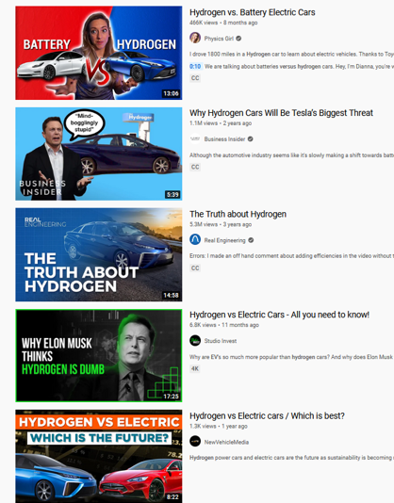

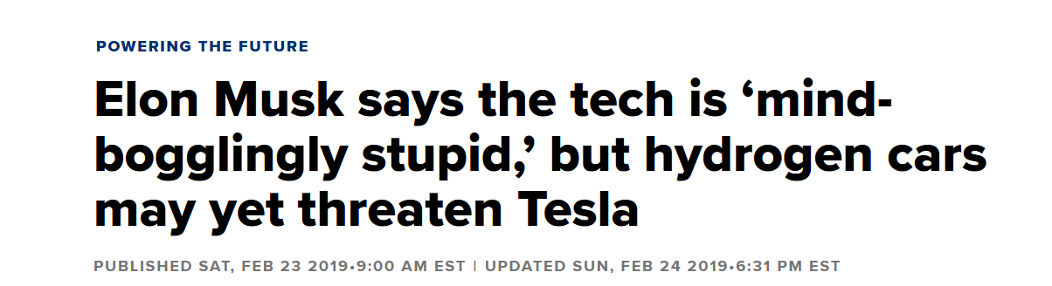

Reprehensible Hydrogen Skeptics

Slide 4
Subjects Addressed
Overview of Green and Blue Hydrogen
Locational factors requirements
Demand for Green/Blue Hydrogen & their feasibility
Life Span and Ongoing Capex Requirements
Due Diligence Requirements for Lending
Key Parameters for Credit Appraisal

Slide 5
Overview of Green and Blue Hydrogen
Chemistry and Uses of Hydrogen
Cost Structure and Efficiency (China versus Siemens)
Emissions of Blue Hydrogen versus Grey Hydrogen
Challenges of Green Hydrogen

Slide 6
Part 1: Overview of Green and Blue Hydrogen – Chemistry and Uses

Slide 7

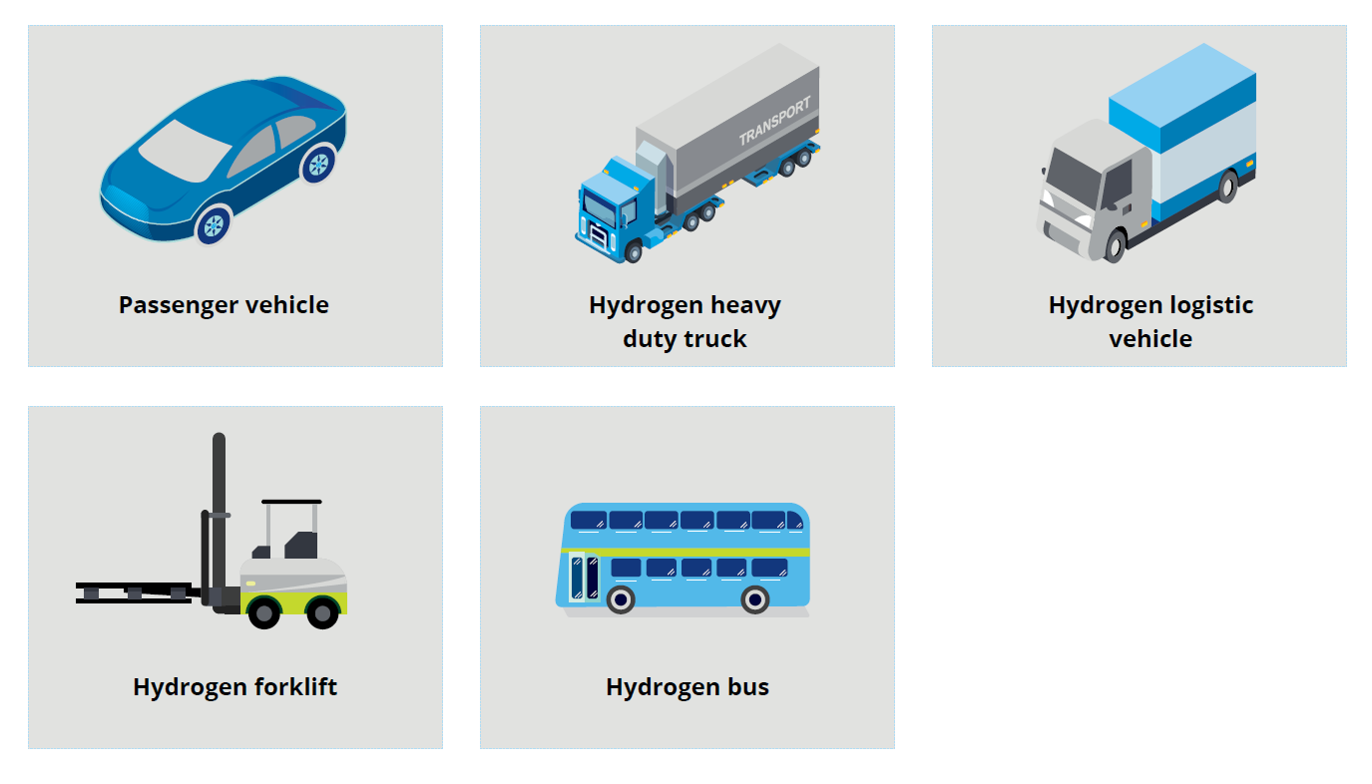

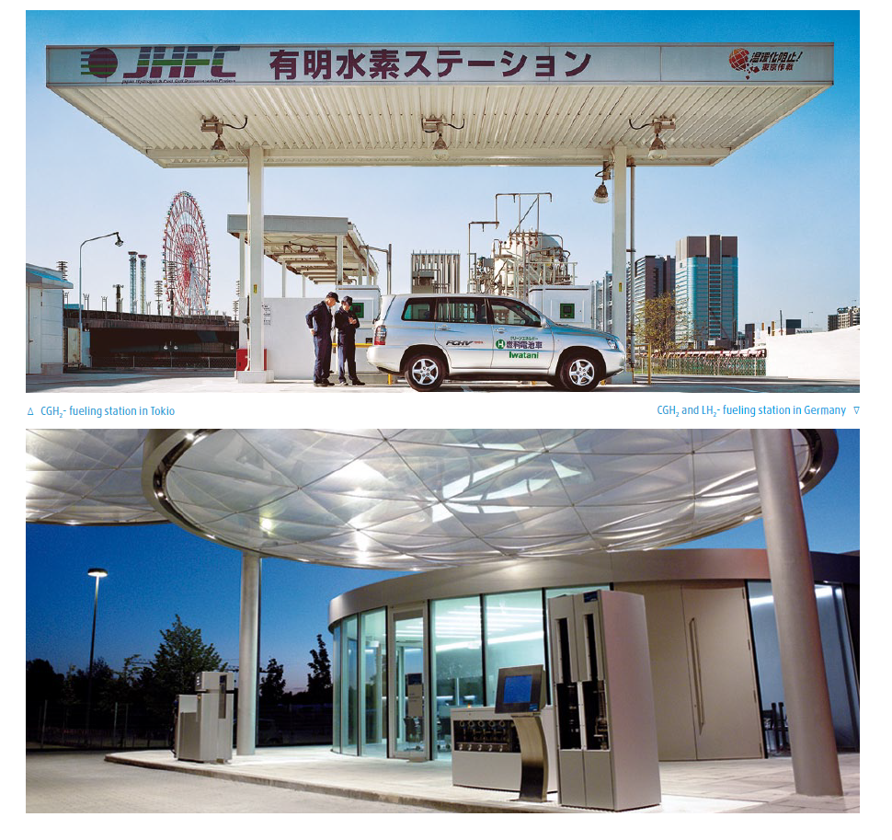
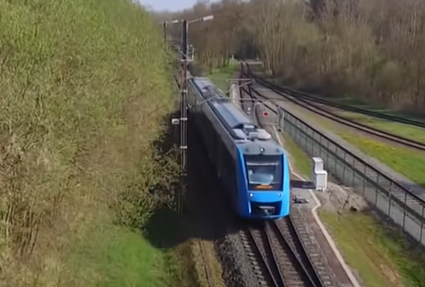
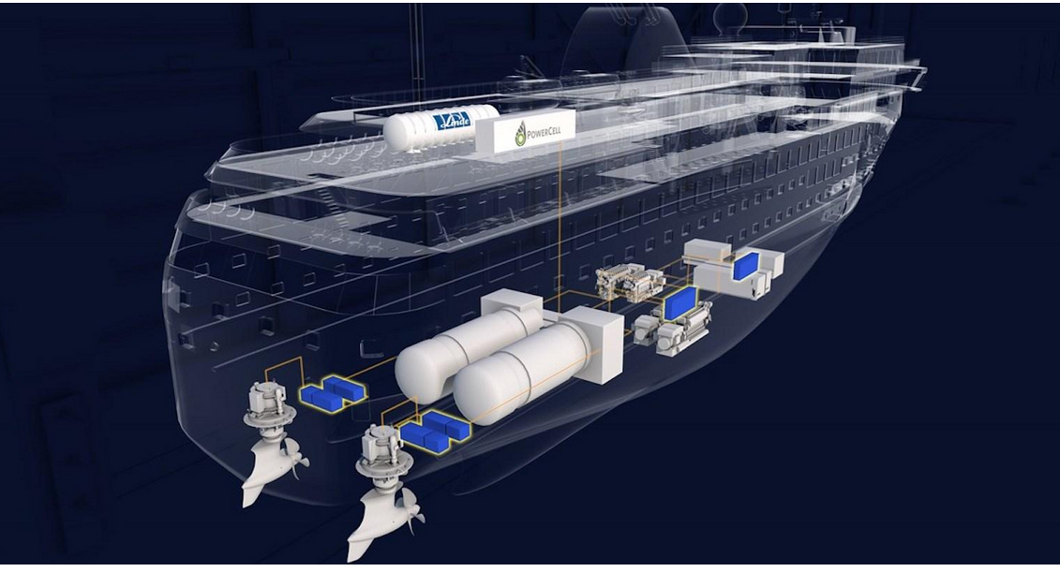
Potential and Current Hydrogen Uses

Slide 8
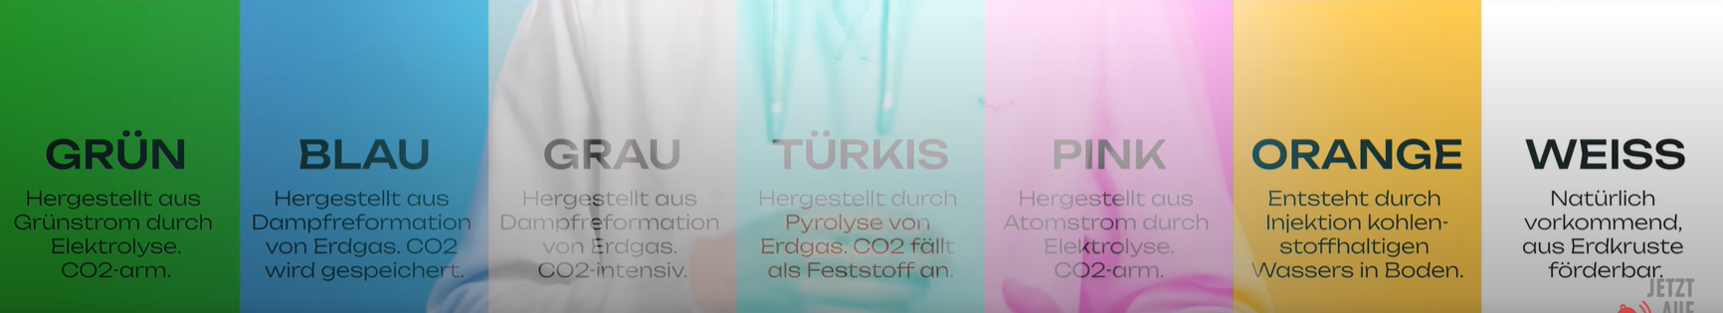
Hydrogen Colours

Slide 9

Hydrogen Chemistry
The most common method of making hydrogen today is steam methane reformation (SMR). The process combines methane (from natural gas) and water at very high temperatures (about 900°C) to produce a mix of carbon monoxide, carbon dioxide (CO2) and hydrogen.
For SMR grey, the reaction is represented by this equilibrium:
        CH4 + H2O ⇌ CO + 3 H2.
Electrolysis is the green alternative:
Alkaline electrolysis and Proton Exchange Membrane are established technologies.
Fuel Cells for Transport and Electricity Storage
Fuel Cells Use Hydrogen as an input and produce
Fuel cell and electrolysis is not a new topic. Invented by William Grove in 1839
2014 Commercialized fuel cell vehicle by Toyota

Slide 10
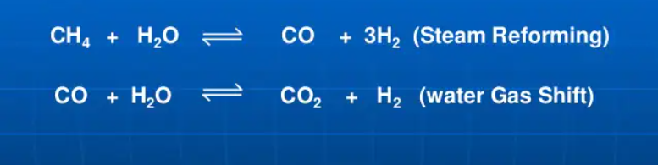
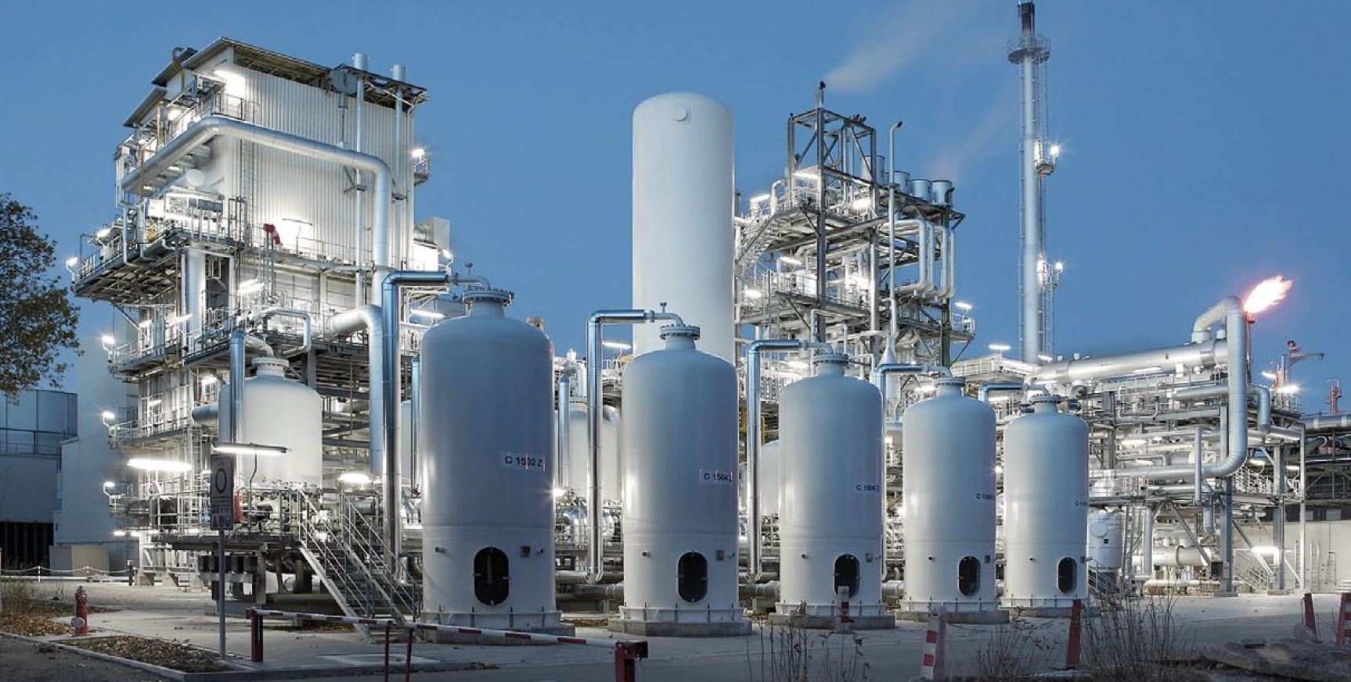
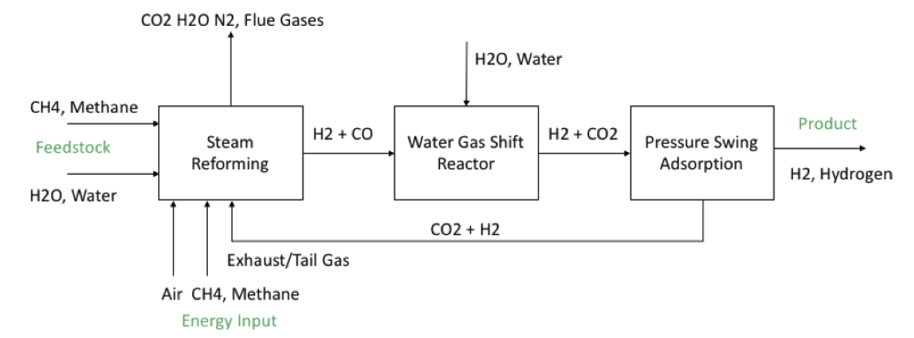
Steam Methane Reforming – Grey (Bad) Hydrogen
Use Natural Gas
CO2 Must be Produced
In Refinery or Steel Plant
Less Downstream

Slide 11
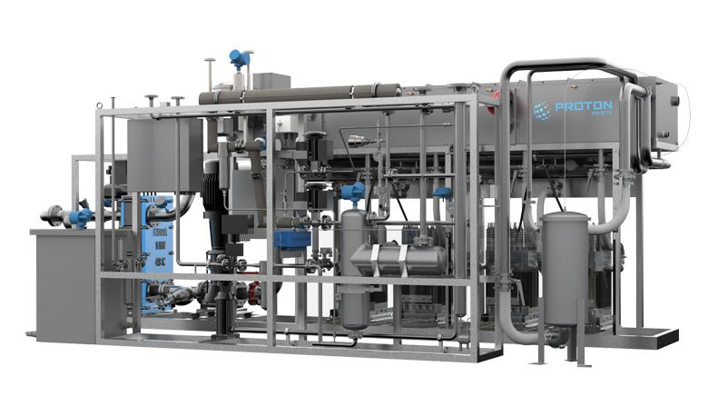
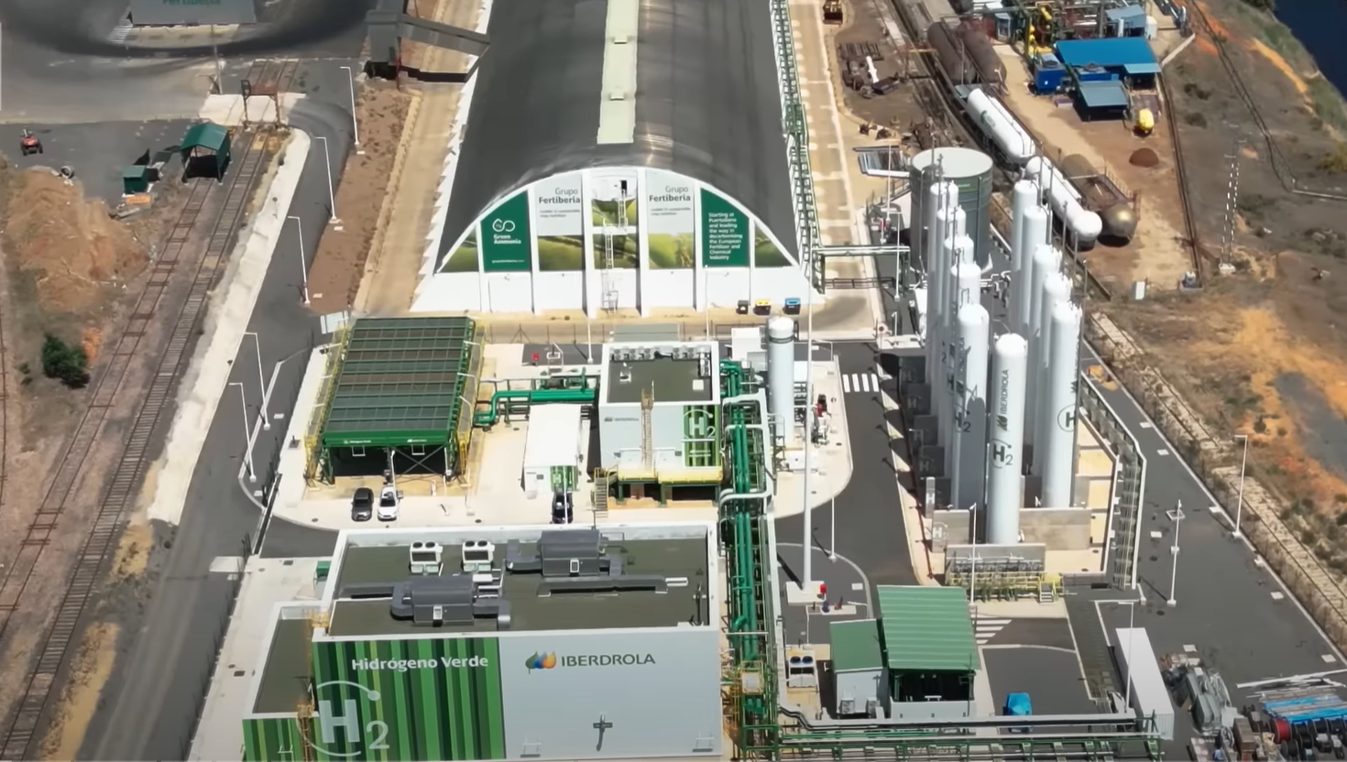
Green Hydrogen from Electrolysis
Converting water into hydrogen has been around for a long time
Need stack which is coated with platinum and depends on the platinum price
Until recently, smallest SMR is bigger than largest electrolyzer
You can make the electrolyzes modular
Question about economies of scale
Efficiency is 60% for both electrolysis and for the fuel cell.
Efficiency = output/Input
Output is 33.33 kWh/kg
60% = 55.55 kWh/kg

Slide 12
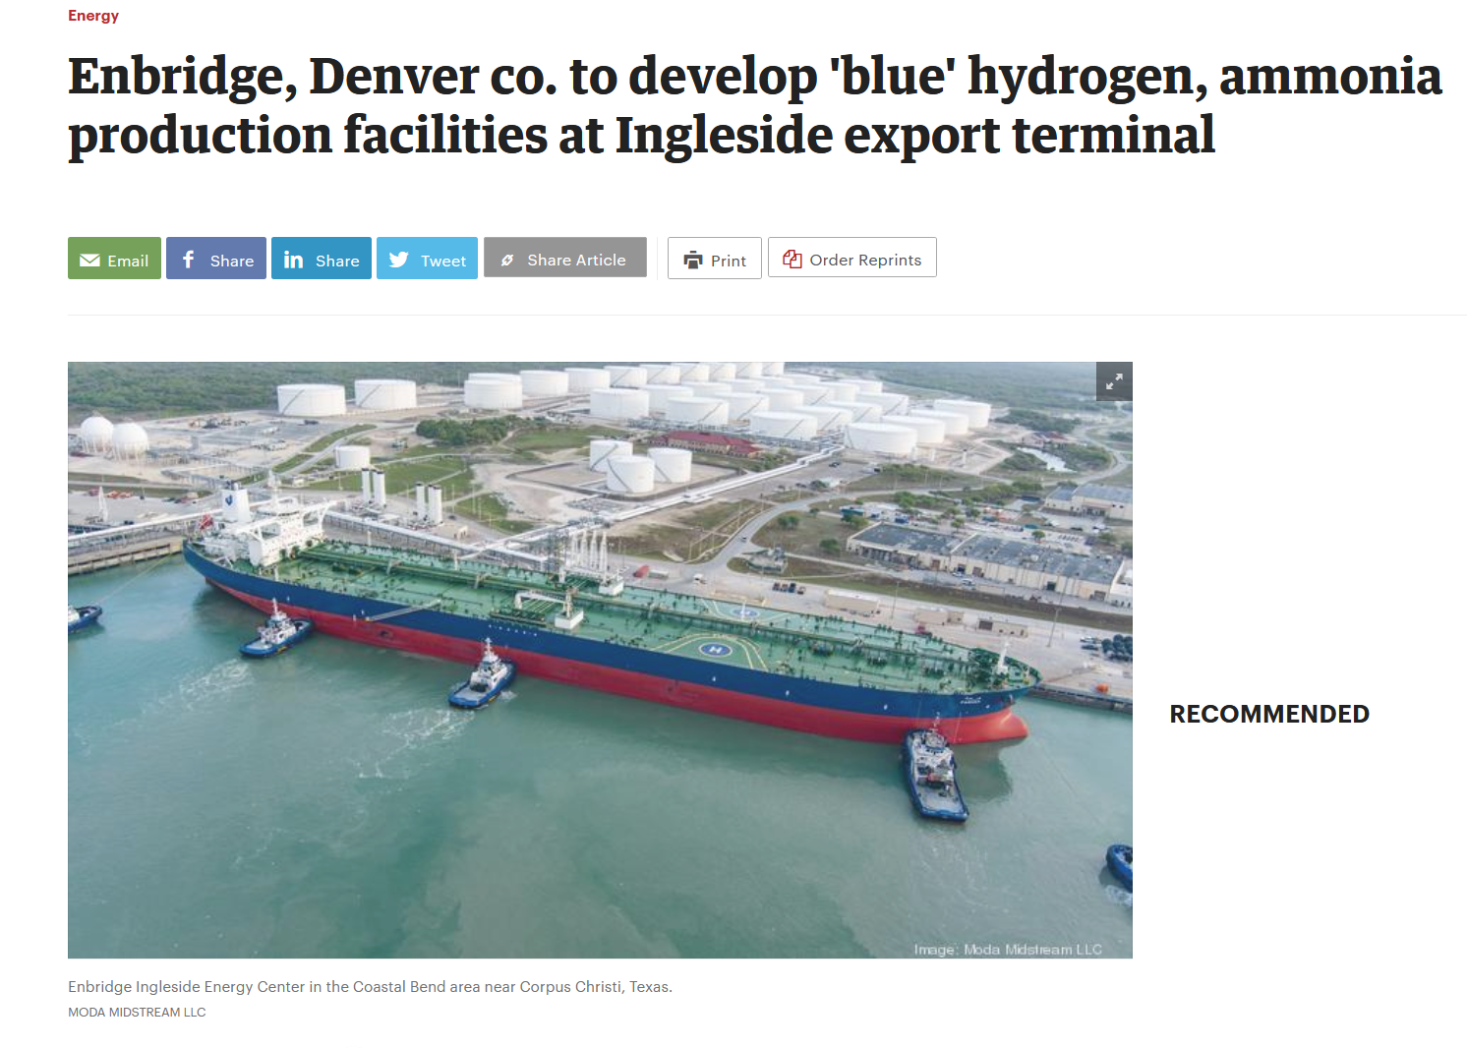
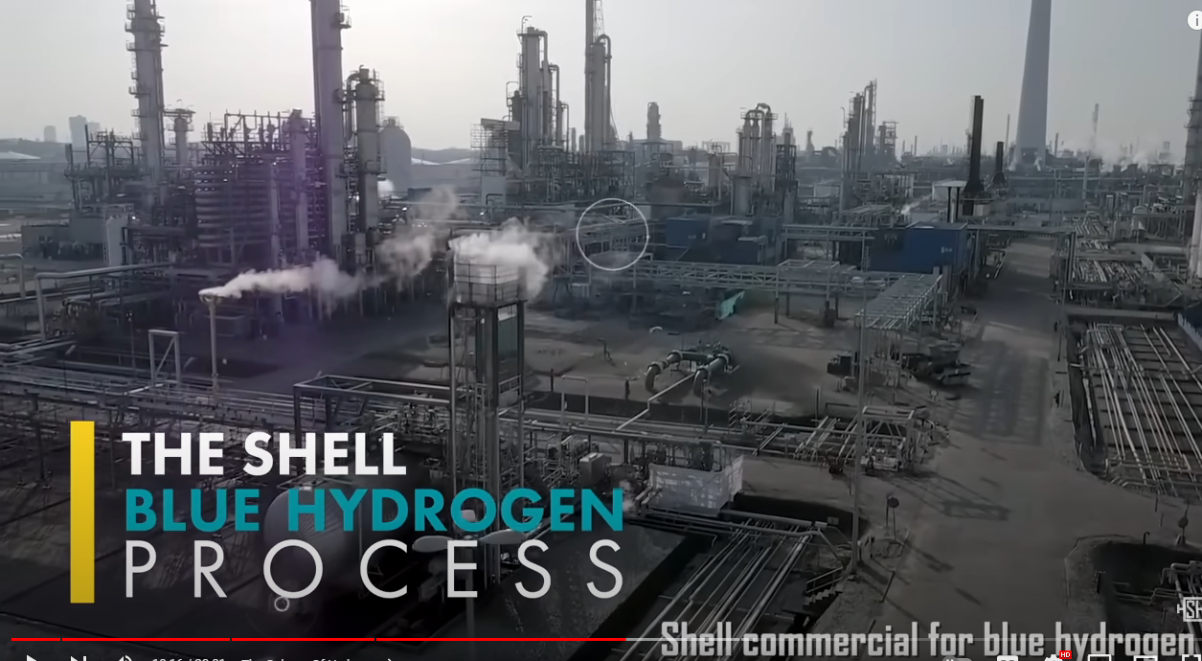
Illustration of Ingleside Proposed Blue Hydrogen/Ammonia
Choose the picture according to your opinions about CCS

Slide 13
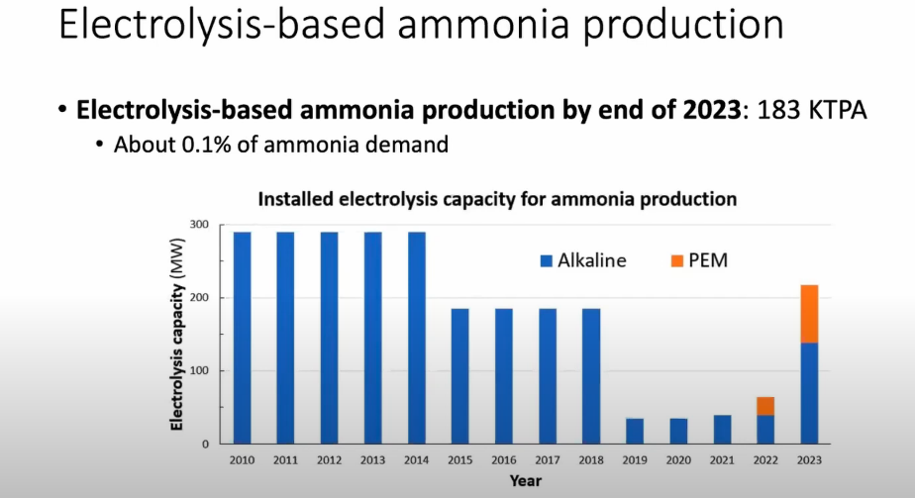
Very Little Green versus Grey Hydrogen - .1% of Ammonia

Slide 14
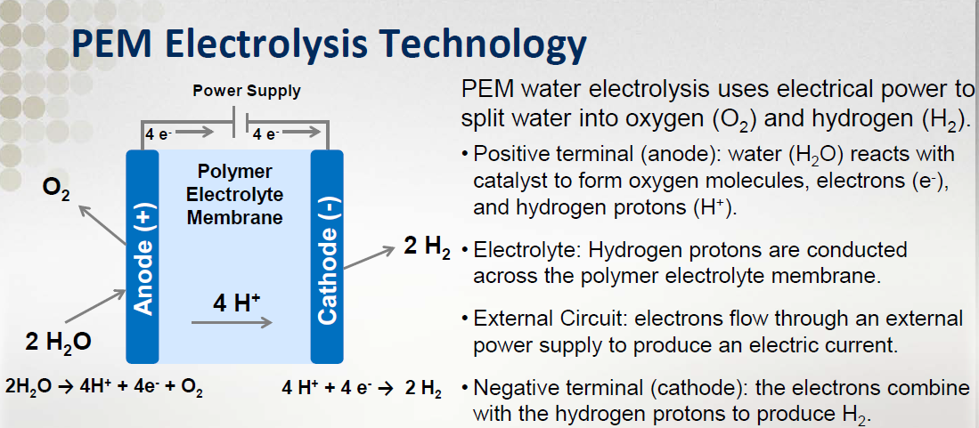
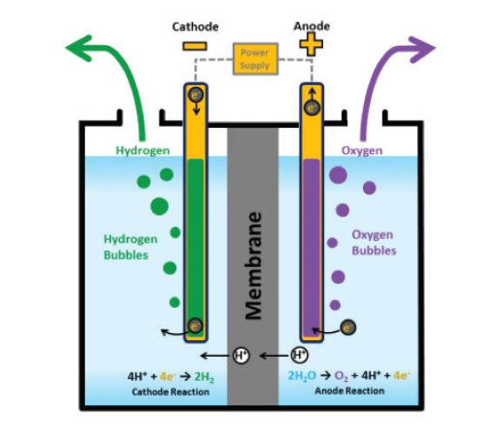
Green Hydrogen - Electrolysis from Proton Membrane
Illustration of Electrolysis
Platinum
Key Modelling and Economic Issue – Stack has a life that is different than the other equipment
Stack

Slide 15
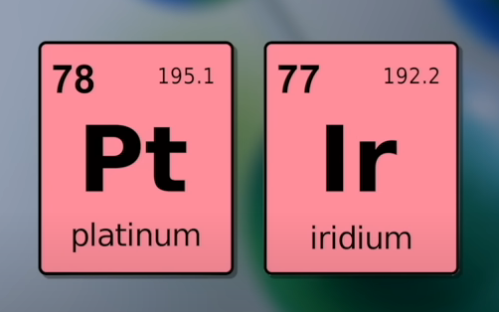
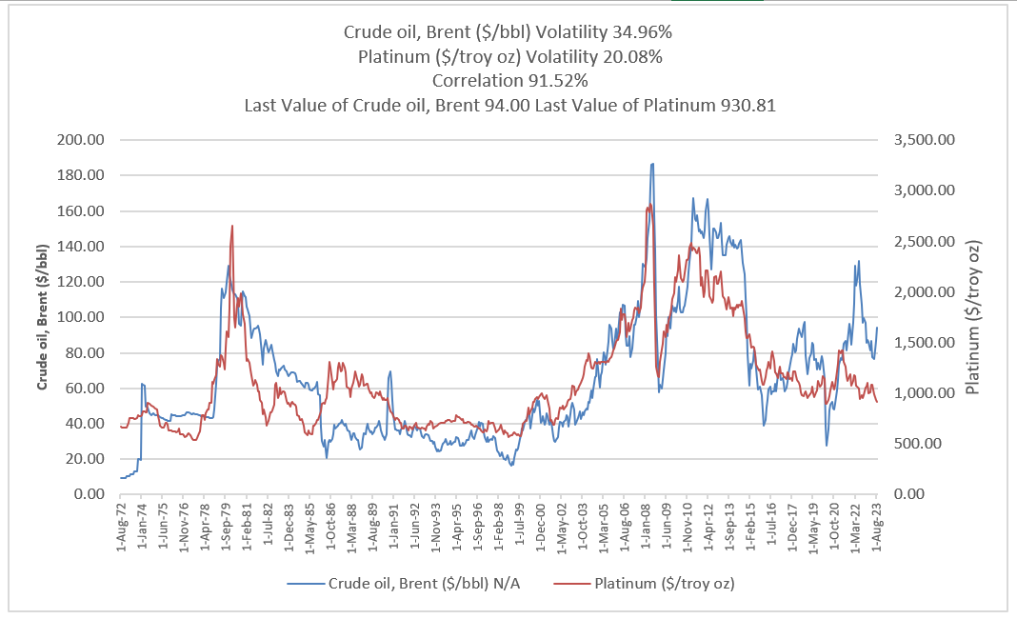
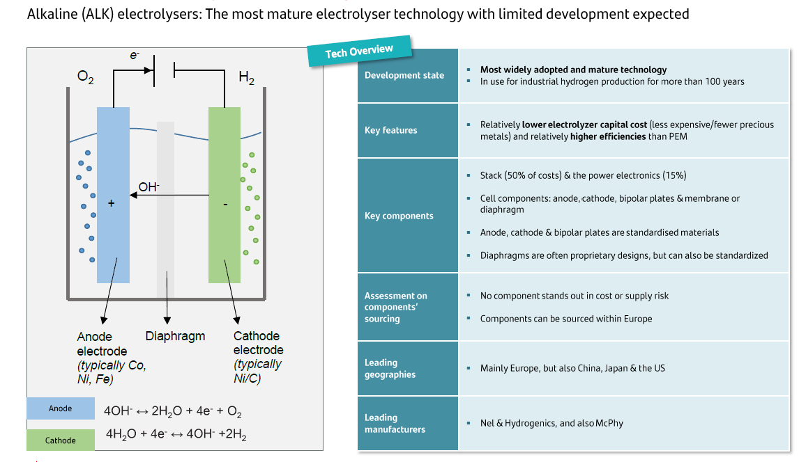
Alkaline and Proton Membrane

Slide 16
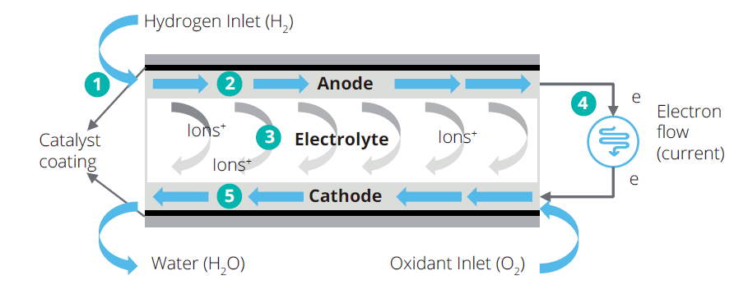
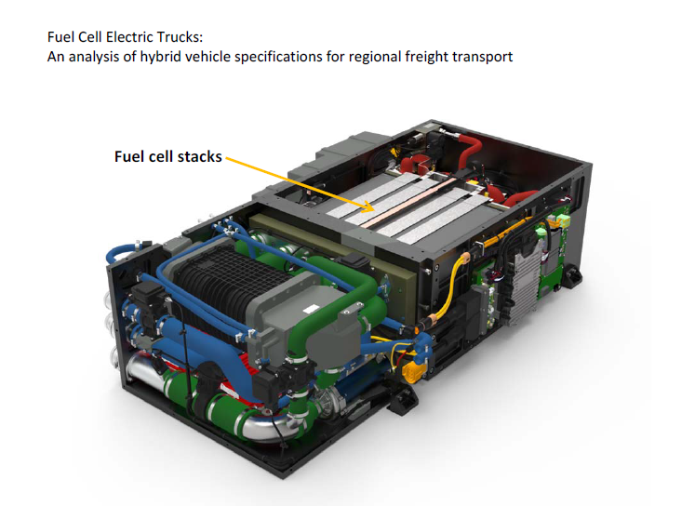
Operation of Fuel Cell – Reverse of Electrolysis
Hydrogen is input and produces electric current. No Carbon Produced
Same as issue with the life of the stack – like the life of a battery that depends on the number of cycles

Slide 17
Part 1b: Overview of Green and Blue Hydrogen – Cost Structure and Efficiency

Slide 18
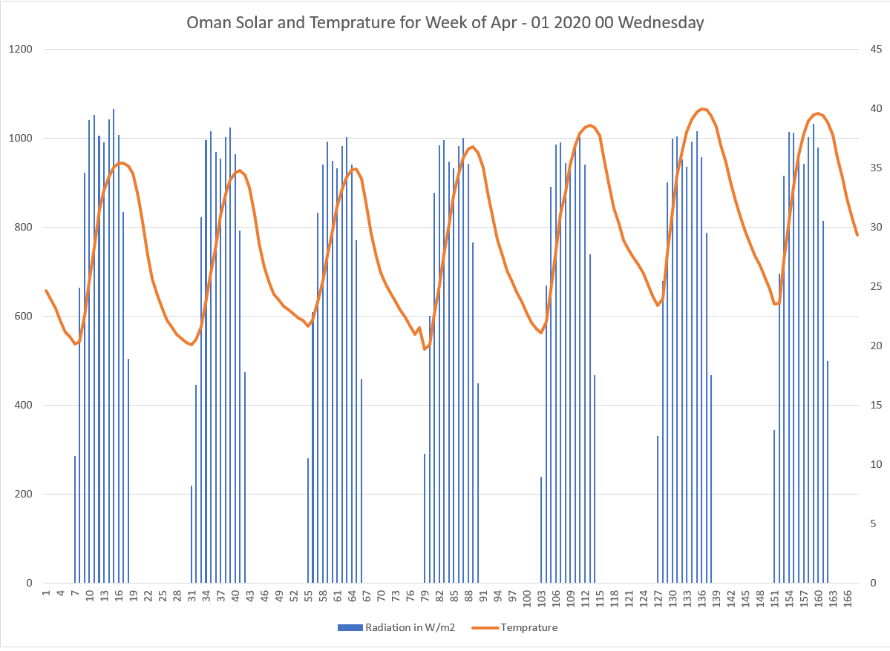
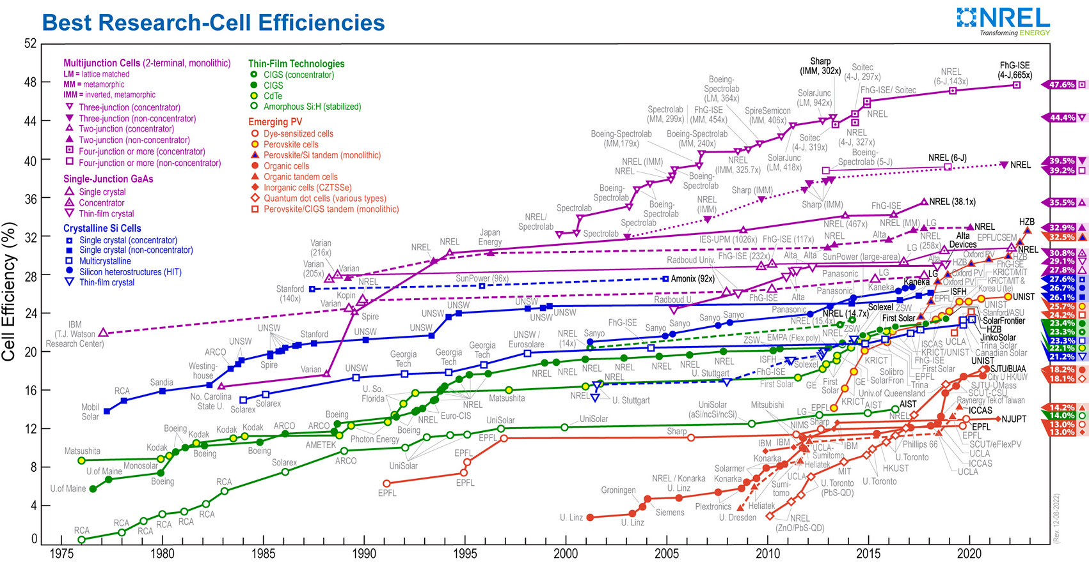
Efficiency and Capacity Factor
Question: What is the difference between efficiency and capacity factor
Banks and Investors: Concern with the overall cost

Slide 19
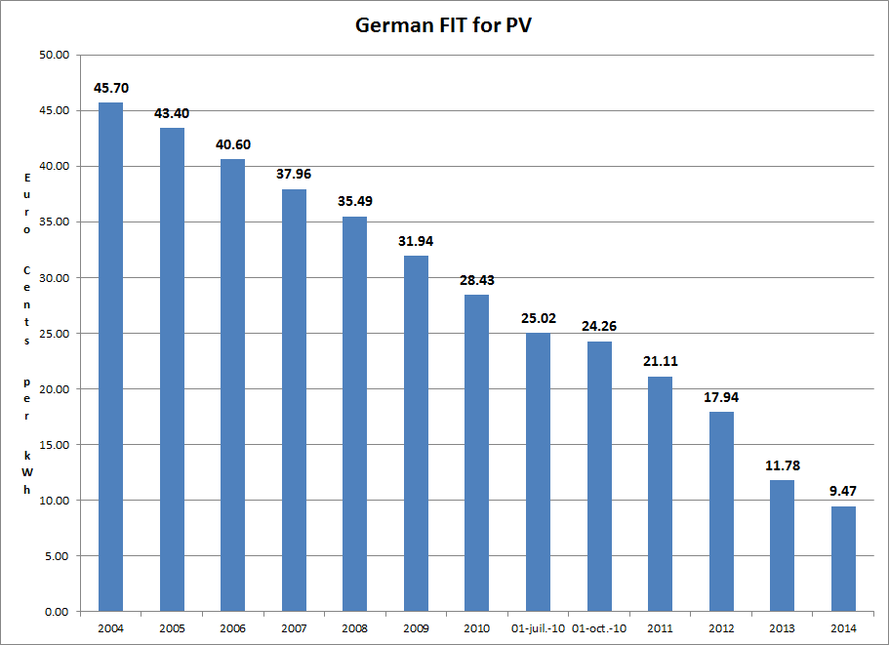
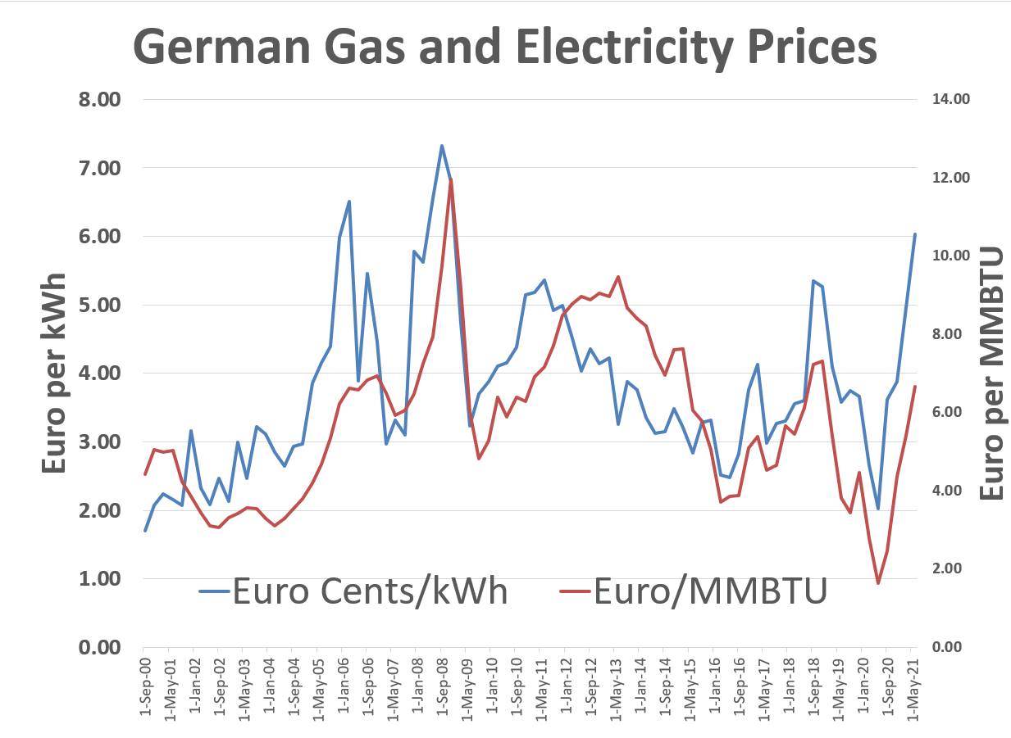
Why Are We Even Discussing Green Hydrogen 1 - German Solar Feed-In Tariffs and Managing Risk
Example of government policy that worked. Idea to make very simple tariff to finance projects and then achieve scale.

Slide 20
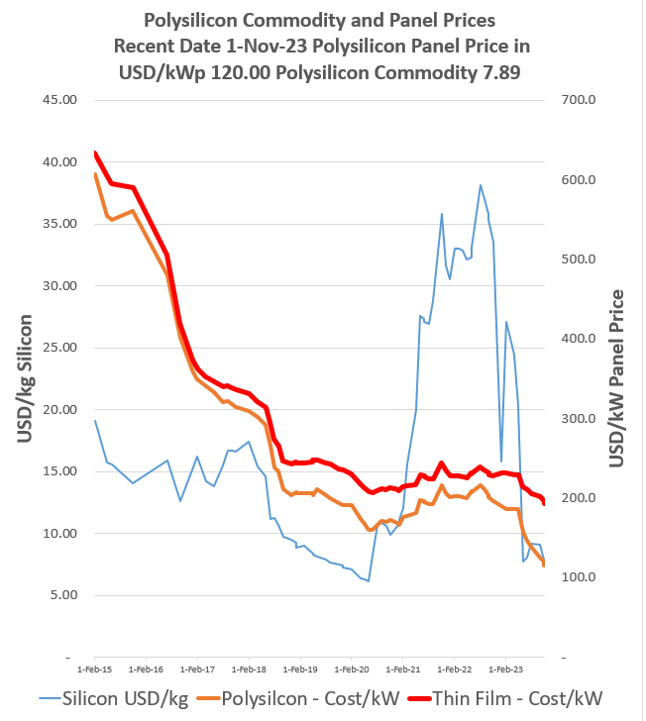
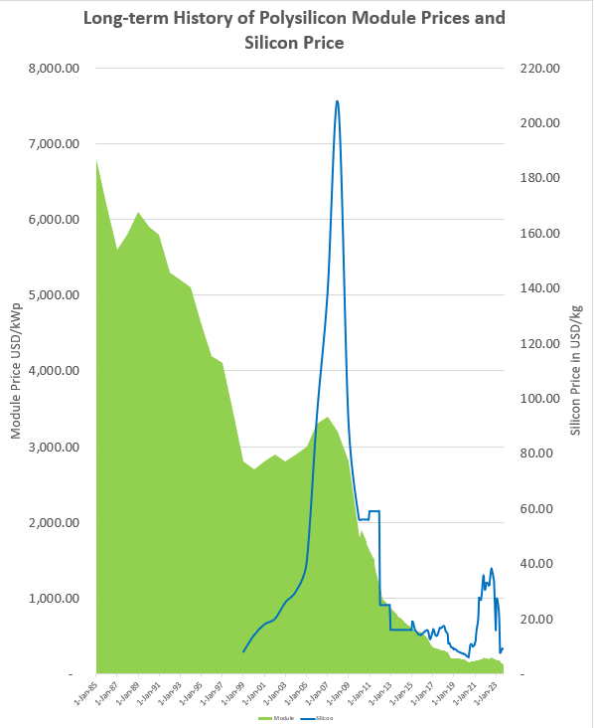
Why Are We Even Discussing Hydrogen 2 - Module Prices and Polysilicon

Slide 21
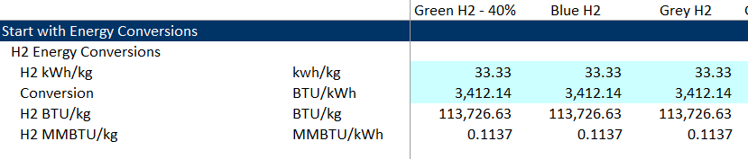
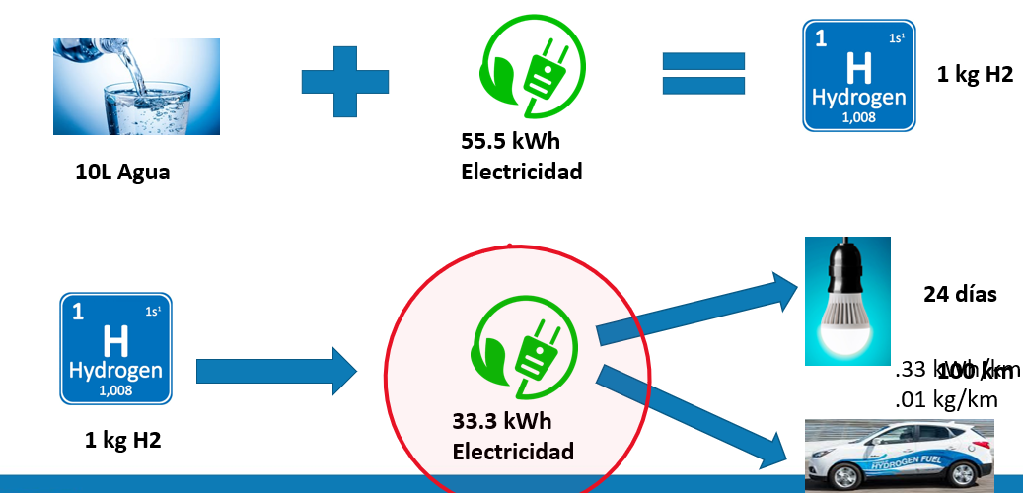
Important to Understand Basic Energy Conversions – kWh/kg = 33.33 as Hydrogen Output

Slide 22
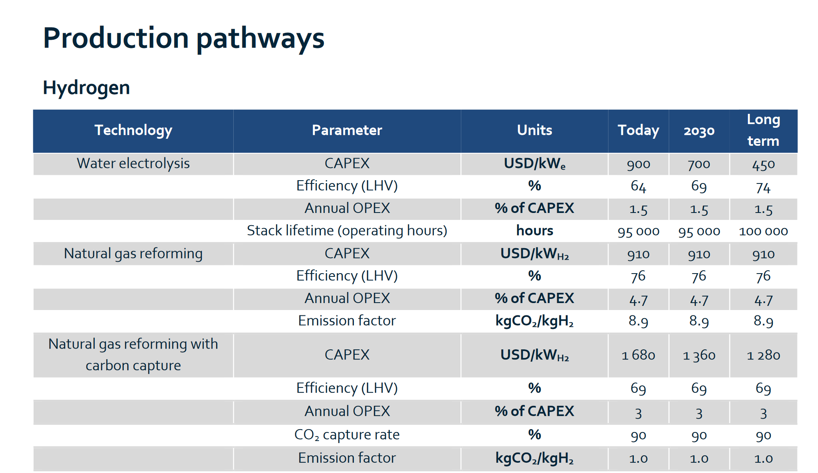

IEA, Benchmarks and Economics
Convert kWe to kWh2 using 33.33 kWh/kg energy conversion
Electrolyzer based on kWe using efficiency reduction
Blue and grey hydrogen based on kWh2
Largest uncertainty on cost is from Electrolyzer

Slide 23
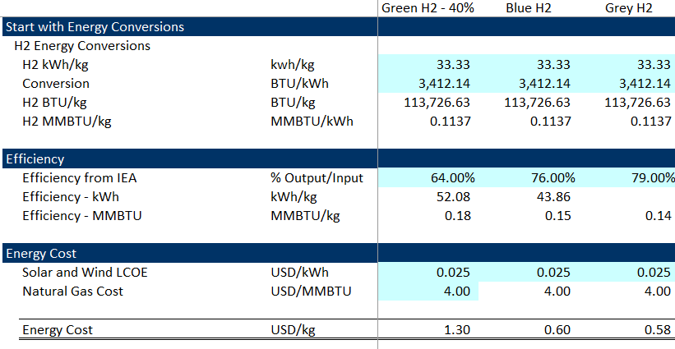
Some Basics of Efficiency Conversions
Multiply kWh/kg by USD/kWh or MMBTU/kg by USD/MMBTU
Energy Content of H2 in kWh 33.33 kWh/kg
Conversion from kwh to BTU 3,412 BTU/kWh
Energy Content of H2 in BTU 113,721 BTU/kg
IEA Data
  Electrolyzer Efficiency – 64%
  SMR Grey Efficiency per IEA – 76%
  SMR Blue Efficiency per IEA – 69%
Need Ratios to Output – kWh/kg or MMBTU/kg
Need these because fuel is USD/kWh or USD/MMBTU
Electrolyzer → 33.33/.64 = 52.07 kWh/kg
SMR Grey → .113721/.76 = .1496 MMBTU/kg
SMR Blue → .113721/.69 = .1648 MMBTU/kg

Slide 24
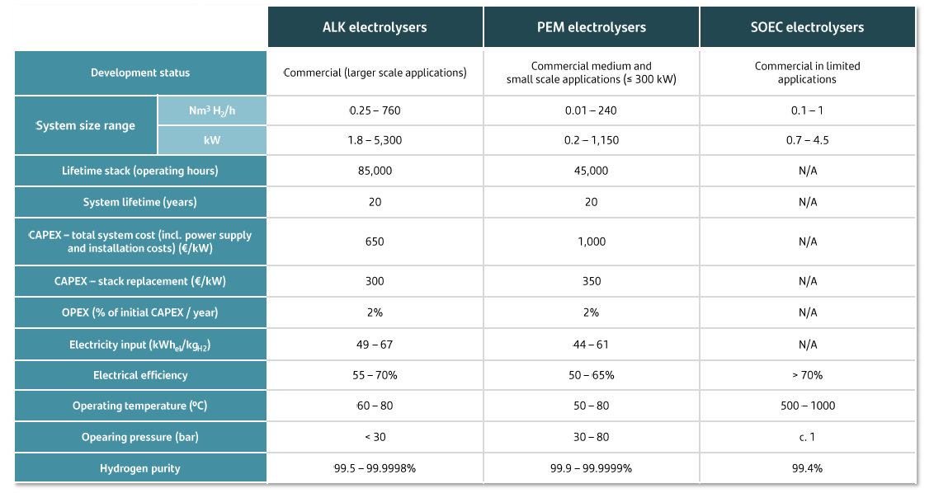
Estimate of Capital Expenditures – No Economies of Scale
SOEC is Solid Oxide
Note the cost of USD 650/kW with a very wide range in the efficiency
Note also that ALK dominates in terms of cost and efficiency

Slide 25
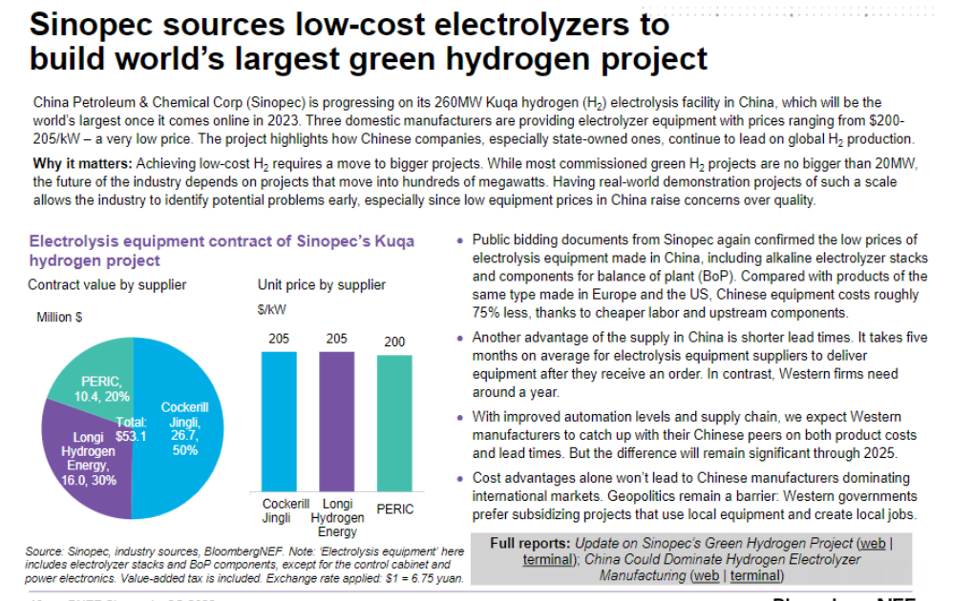
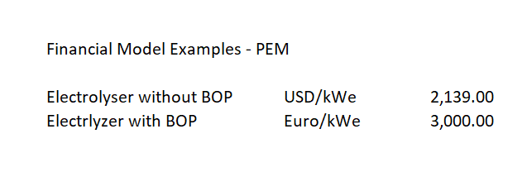

Chinese Electrolyzer Cost Dramatic Cost Reduction – Price of USD 200/kW to USD 205/kW

Slide 26
PEM versus Alkaline – Can you Turn off Alkaline at Night when the Sun is Not Shining and there is No Wind
It is often noted that PEM electrolysis has a fast response ramp-up and ramp-down capability, as well as a wide dynamic operating range of 0-100% – making it ideal for generating hydrogen using excess renewable energy.
One of the advantages of [atmospheric] alkaline is that it’s a proven technology, it’s been around... for 100 years or so. It’s a technology that is well known. It is probably around half the price of PEM [to buy],”
In any given 24-hour period, there will often be one or two hours where the electrolyser has to be turned off, and on a windless night it could be up to 12 hours. “And that’s a challenge for alkaline of particular importance is the ability to start things up from a cold start very quickly.”
Alkaline electrolyzers can take up to 50 minutes to get up to full operating speed, compared to less than five minutes for PEM.

Slide 27
Part 1c: Overview of Green and Blue Hydrogen – Emissions from Green, Blue and Grey versus Battery and Petrol

Slide 28
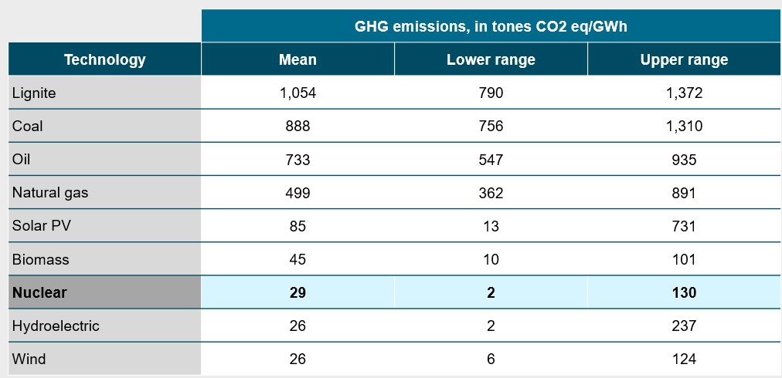
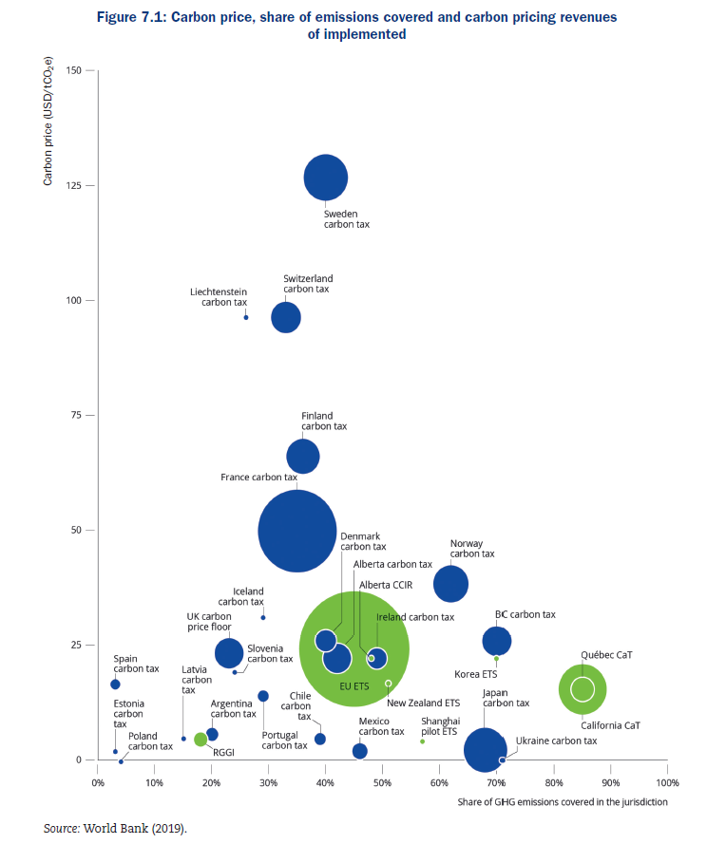
Emissions of Electricity Generation (IEA)
Include in the operating cost
Use a cost of USD/Tonne that can range
The IEA uses USD 30/Tonne
In Europe the cost is higher
Convert GWH to Tonnes using some table

Slide 29

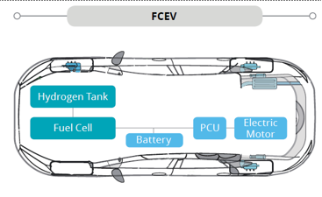
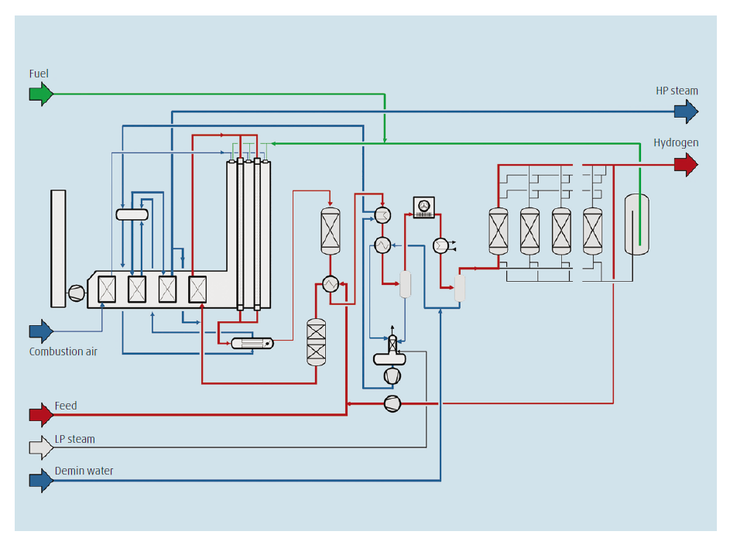
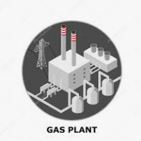
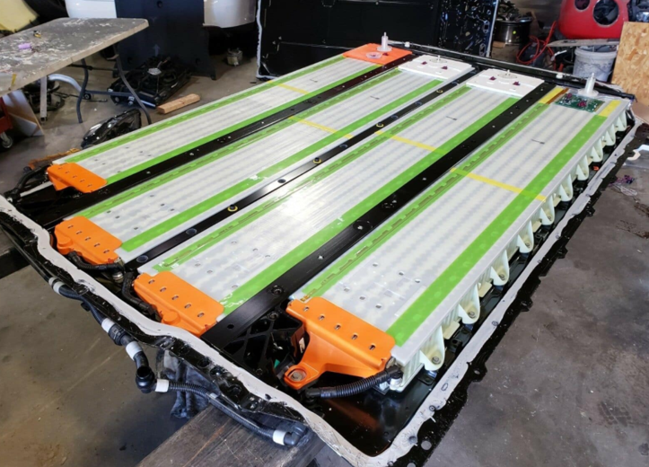
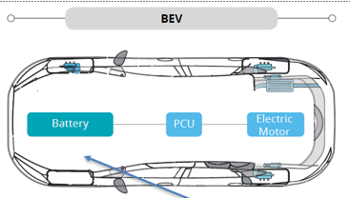
How Much Natural Gas and Emissions to a km using SMR – Grey or Blue
More natural gas used for electric car.
If avoid 90% of emissions from natural gas are reduced, the emissions are much less.
Natural gas use is 12,800 per BTU versus
13,160
Get from efficiency of electrolyzer, efficiency of car, efficiency of electricity and efficiency of battery
.16 MMBTU/kg .008 kg/1 km .00128 MMBTU/km
Heat Rate 7,000 BTU/kWh .188 kWh/km 80% Efficiency .001316 MMBTU/km

Slide 30
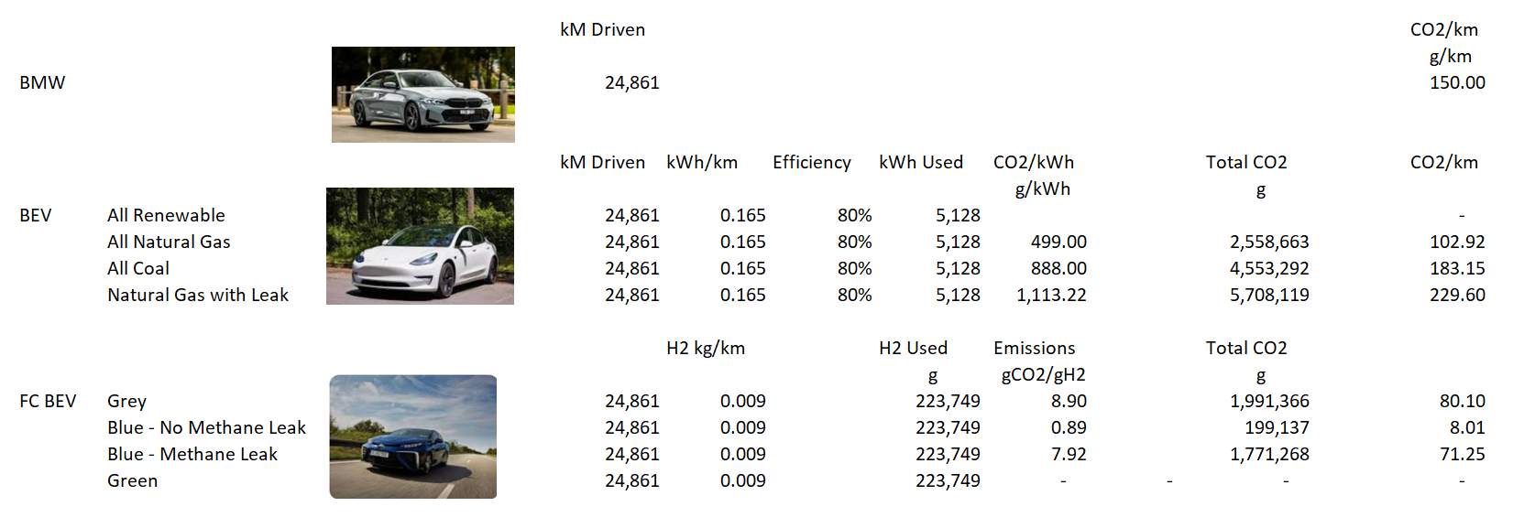
Computed Emissions from Hydrogen (FC BEV) and Battery Cars (BEV)
Note the dramatic effect of Methane Leaks

Slide 31
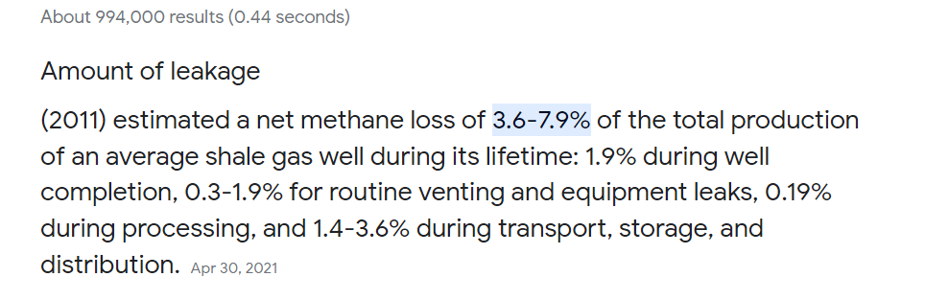
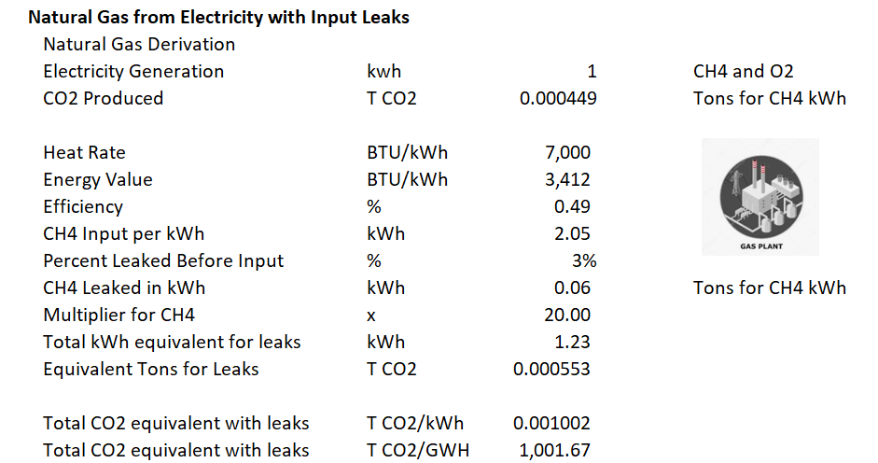
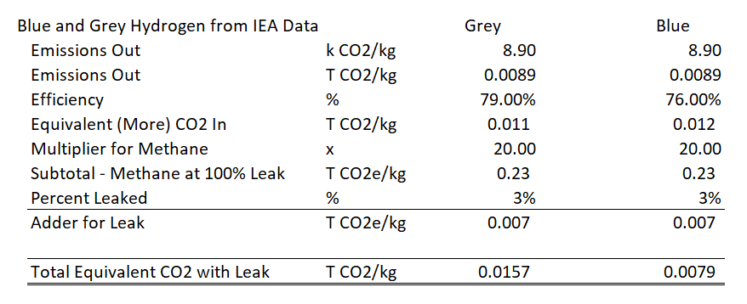
Emissions from Natural Gas Leaks

Slide 32
Part 1d: Overview of Green and Blue Hydrogen – Hydrogen Challenges

Slide 33

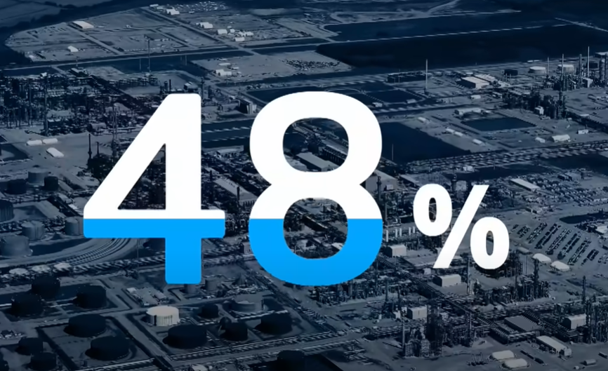
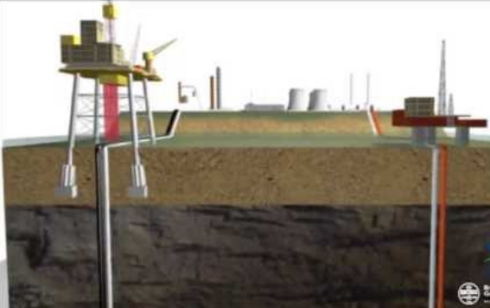
Hydrogen CCS Adding Cost of Leakage of Natural Gas
The IEA estimates the cost of abating 70% methane leaks would range from $6/MMBTU to $30/MMBTU.
The authors then moved their attention to CCS and instead of finding 90% capture, they calculated an overall capture rate of 52%.
Shell says 90%

Slide 34
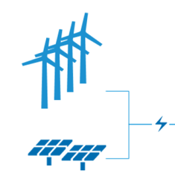
Green Hydrogen Efficiency Problem - Electricity to a KM Using Electrolysis and Battery
50 kWh/kg .8 kg/100 km 40 kWh/100 km; .40 kWh/km
Efficiency 80% .15 kWh/km .188 kWh/km

Slide 35
Problem of Green Hydrogen – Proven Technology
Parameters that cannot now be guaranteed with a contract
  Efficiency
  Degradation
  Cost of Replacing the Stack
  Time period for Replacing the Stack
Other Problems
  As a very small molecule, Hydrogen can easily escape
  Hydrogen is so light and need to store a lot to get energy
  Hydrogen filling and delivery
  Hydrogen infrastructure for transport
  Escaped Hydrogen can aggravate greenhouse gas when combines with other gasses

Slide 36
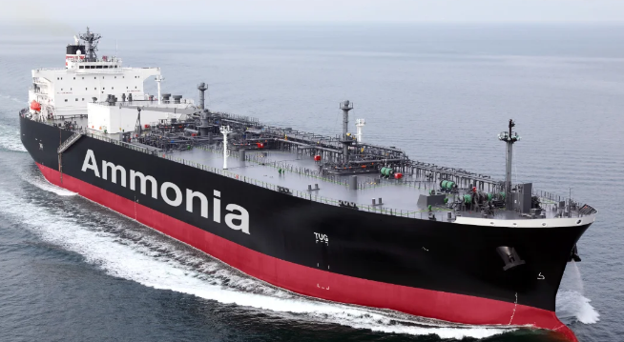
Part 2: Location of Green and Blue Hydrogen

Slide 37
Location of Green and Blue Hydrogen
Need for Wind and Solar Combined
Irradiation Levels and Levelised Cost of Electricity for Green Energy
Selected Other Locations and Characteristics
Yield and Price of Electricity
Importance of Capacity Factor of Green Hydrogen
Sea Ports and Proximity to Markets
Conversion to Ammonia and Current Transport
Markets for Green Ammonia
Correlation with Natural Gas

Slide 38




The Dream – Future – No Electricity or Hydrogen Distribution or Downstream
Electricity and Hydrogen Production
No Distribution Cost
No T&D cost for electricity
Limited Storage Needs
Spread out dispensing

Slide 39



Alternative Renewable
Blue Hydrogen depends on natural gas that is not already exported with LNG
Immediately divide 5,800/8760 to get 66%

Slide 40


Bloomberg Forecast of Green Hydrogen Price/kg

Slide 41

Solar - 1
Nothing that special, but good

Slide 42

Solar - 2
Maybe 31% with tracking and bi-facial

Slide 43


Wind

Slide 44

Required
Price
Note the change in the required price with the capacity factor.
This is dramatically aggravated with higher capital costs.

Slide 45


Illustration of Economics and Planned Projects

Slide 46



H2 Transport and Location

Slide 47


Location and Blue Hydrogen
Depends on Natural Gas Reserves and Finding a place to store the CO2

Slide 48
Part 3: Demand for Green/Blue Hydrogen and Feasibility

Slide 49
Demand for Green/Blue Hydrogen and Feasibility
Alternative Uses of Hydrogen
Derivation of Demand from Emission Prices in Europe and U.S.
Levelised Cost and Drivers of Green versus Blue Hydrogen
Storage of Hydrogen versus Storage of Electricity

Slide 50

Hydrogen Demand – Ammonia and Refining
IEA

Slide 51




Ammonia
A big use of Hydrogen is Making Ammonia for Fertilizer

Slide 52

Levelized Cost of Green Ammonia

Slide 53
Storage Case 1 – Does Not Make Sense

Slide 54

Storage Case 2: Need Hydrogen and Better to Store Hydrogen in Cask than Electricity in Lithium

Slide 55
Part 4: Life Span and Capital Expenditure Requirements

Slide 56
Life Span and Capital Expenditure Requirements
Stack Life and Hours of Use
Degradation in Electricity Supply and Projected Balance of System
Prediction of Future Capital Expenditures and Price of Platinum
Guarantees from EPC or Suppliers
Operating Expense of Green versus Grey and Blue
Sources of Real Information and Financial Models

Slide 57
Credit Issues with Blue Hydrogen
Can we find places to store the hydrogen
Does the equipment really capture 90% of the hydrogen
What is the true efficiency of the CCS equipment
The technology is certainly non-proven

Slide 58

Example of Replacement and Degradation

Slide 59

Example of Degradation

Slide 60

Stack Life in Hours
Total Hours from 60,000 to 100,000
If the capacity factor is 25% and there are 100,000 hours, the life is 100,000/(8760*25%)

Slide 61


Measuring Risk with Project Finance and DSCR

Slide 62


Debt Terms Example

Slide 63
Response to Hydrogen Skeptics

Slide 64

Levelised Cost of Energy with Battery
Measure Capital Cost with Storage
Add Costs with different lives
Create simple example

Slide 65

Duck Curve, Camel Curve and Malaysia Flat Loads

Slide 66


Wind Variation and Zero Prices

