Slide 1
Mini-grid Corporate Model

Slide 2
Introduction
Mini-grid is a corporate model
  Carefully modelling a mini-grid provides the basis for other issues
  Think about EDF providing power to the city of Paris or the country of France
  Think about a data centre powered with solar and battery or nuclear
  Think about powering an electrolyzer with alternative strategies
Why a mini-grid model is corporate model and not a project finance model
  The model must consider both supply and demand, project finance is only supply
  Portfolio of assets with different lives, not one asset with a limited life
  The mini-grid does not end; there will be come kind of terminal value or liability
  Capital expenditures to replace and augment

Slide 3
History of Model Development
Reviewed models for other countries
Created model framework using PVGIS hourly data
Constructed model framework for different clients
Observed models that are project finance based and too simplistic
Reviewed and evaluated quality data from Mozambique

Slide 4
Other Models Reviewed
Model from Nigeria
Model from Tunesia
Other Financial Models (World Bank)
Earlier Models Created
Use of other mini-grid model as a starting point
  Nigeria case
  Uses InputC and InputS with financial model
  No supply and demand
  No degradation or augmentation
  No terminal value
Problems with other mini-grid models
  The big variable is how much diesel must be used – no ability to measure this
  No ability to evaluate the cost of mini-grid with different load profiles
  Cannot measure the effect of unserved energy
  Does not measure the effect of incorrectly sizing solar and battery for the system

Slide 5
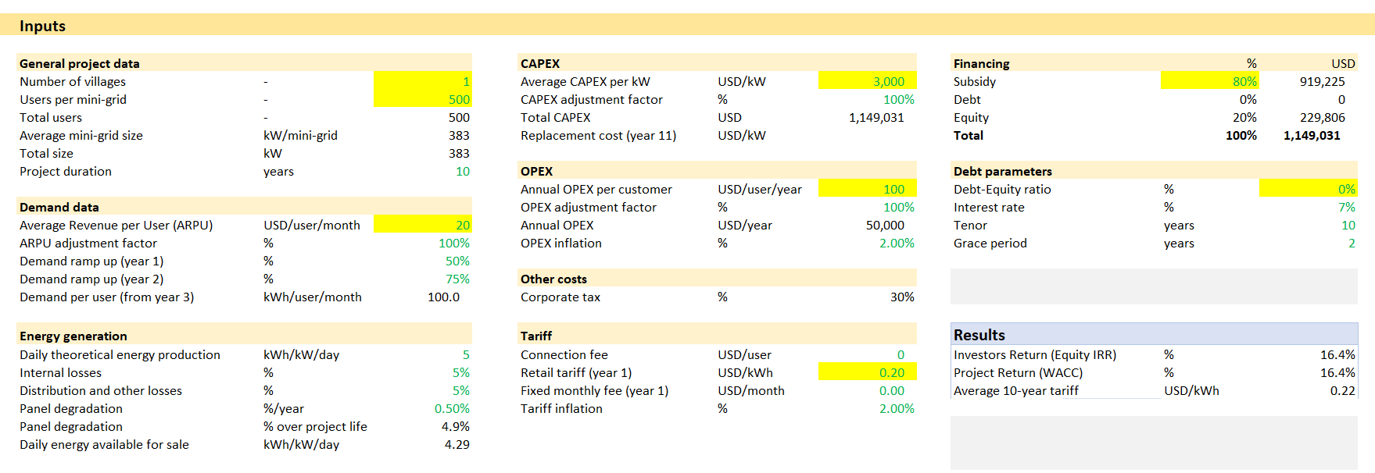
Examples of Other Models – Too Simple to Model the Essence of Case Studies
What is not in the inputs
  Nothing about load shapes
  Degradation is not used
  No capital cost of solar and batteries
  Nothing about solar production for batteries, state of charge, round trip efficiency
  Nothing about diesel requirement, diesel price, diesel heat rate
  Nothing about capital cost of replacement

Slide 6
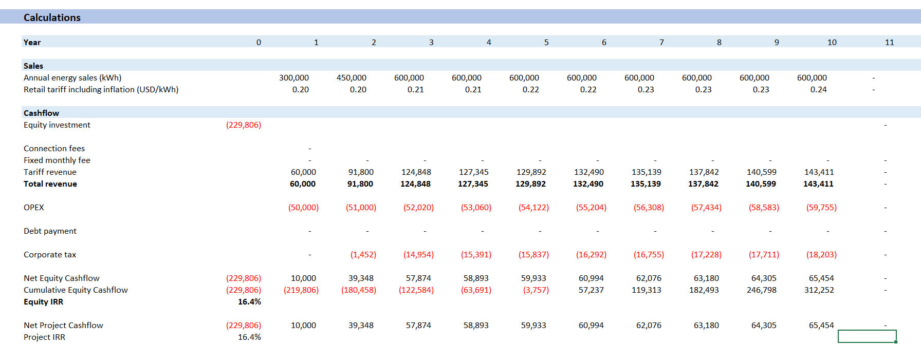
Simple Model Output
No replacement capital expenditures
No evaluation of diesel cost from load shape
No quantification of over-size or under-size the mini-grid
No augmentation for the growth
No detail of distribution and generation costs

Slide 7
Data Sources and Model Data

Slide 8
Sources of Data
Actual Systems
  High quality data for operations
  Data on growth in demand
Cost Data from
Data from Tariff Setting
Current Data on Solar Costs and Battery Systems from China

Slide 9
Method for Evaluating GCF Funding
Use actual case studies with load shapes, load growth, tariffs, minimum state of charge, diesel prices, distribution costs.
Framework for evaluating added funding requirement
Create downside and upside cases
  Alternative growth scenarios
  Alternative losses
  Alternative replacement cost equations and assumptions
  Alternative solar production from drivers of performance ratio
  Alternative battery characteristics (round trip efficiency, degradation, minimum state of charge)

Slide 10
Case Studies

Slide 11
Use of Case Studies for Analysis
Case Studies of existing projects implemented by that contain high quality data for:
  Load growth
  Operation of solar relative to irradiation allowing analysis of performance ratio
  Operation of battery including state of charge, round trip efficiency and degradation
  Distribution characteristics allowing cost analysis
Case studies have different characteristics that can be used to evaluate required funding from the GFC including.
  Different Load Shapes
  Different Size and ramp-up rates
  Different Load Growth
  Different Solar Irradiation
  Different Capacity Structure (Solar relative to Battery and Diesel)
Different case studies with alternative load, size, distribution allow for analysis of characteristics and the effect on required support

Slide 12
Operational Inputs for Case 1 - Nagonha Mini Grid

Slide 13
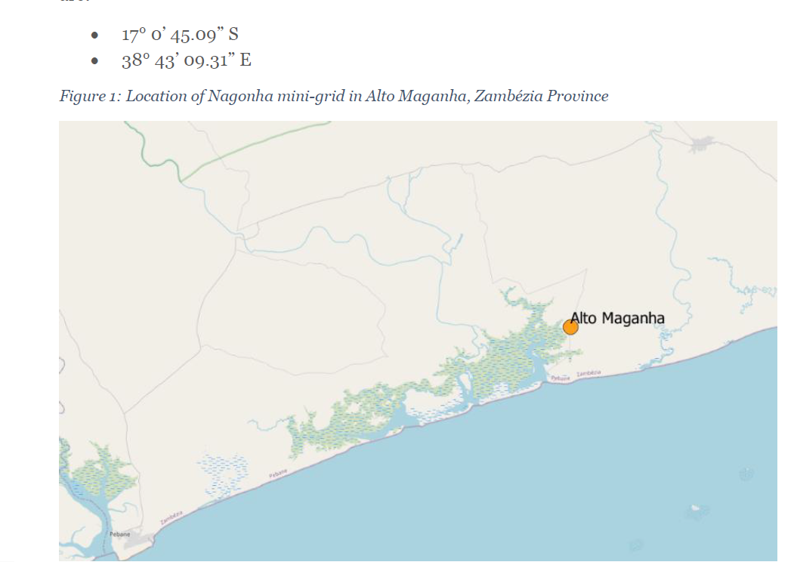
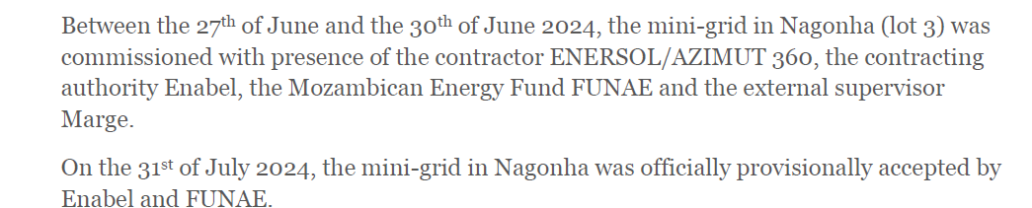
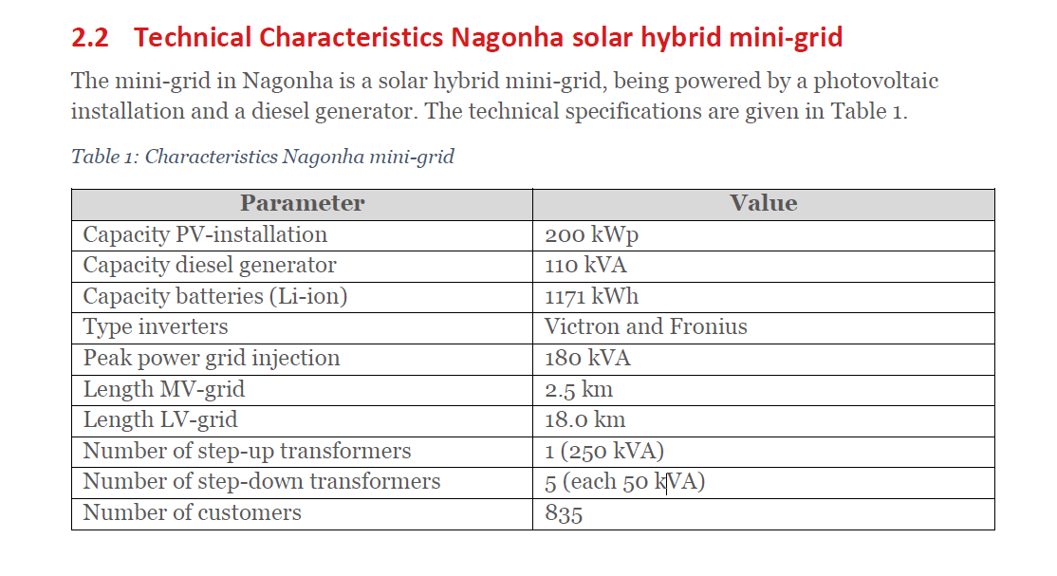
Case 1 Mini Grid

Slide 14
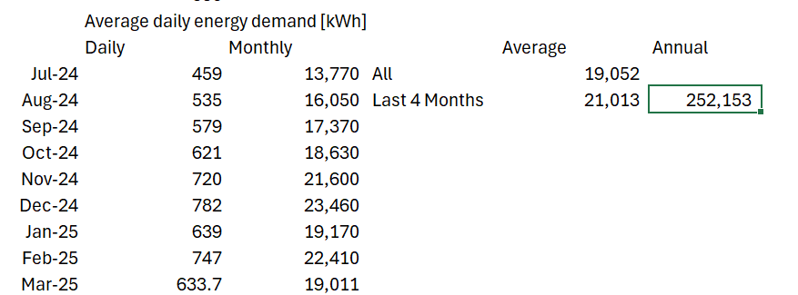
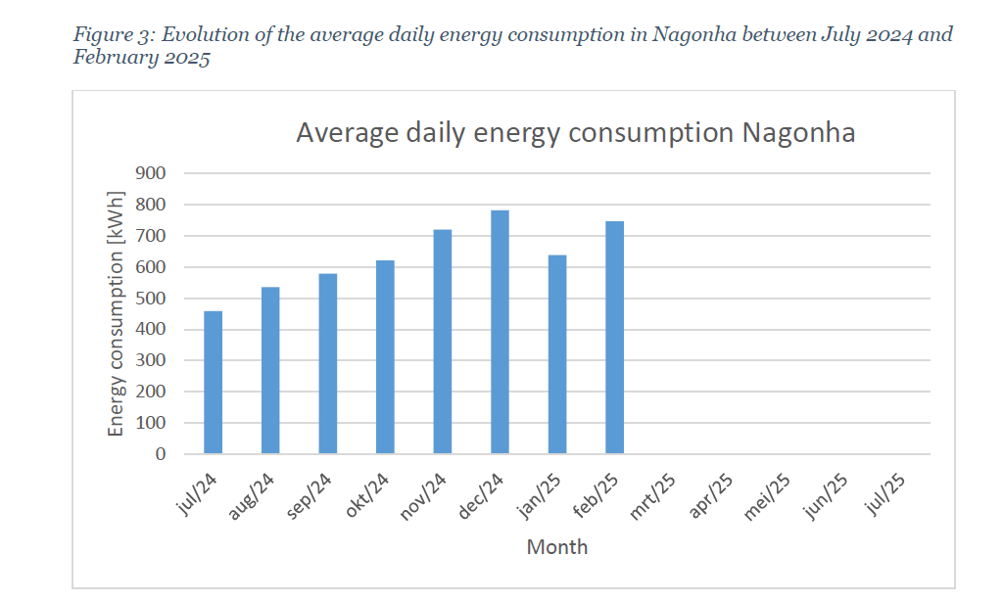
Energy Consumption
Use this to establish the base case annual demand. We make alternative load growth assumptions going forward. Annualizing the last four months produces a base value of 252,153 kWh per year.

Slide 15
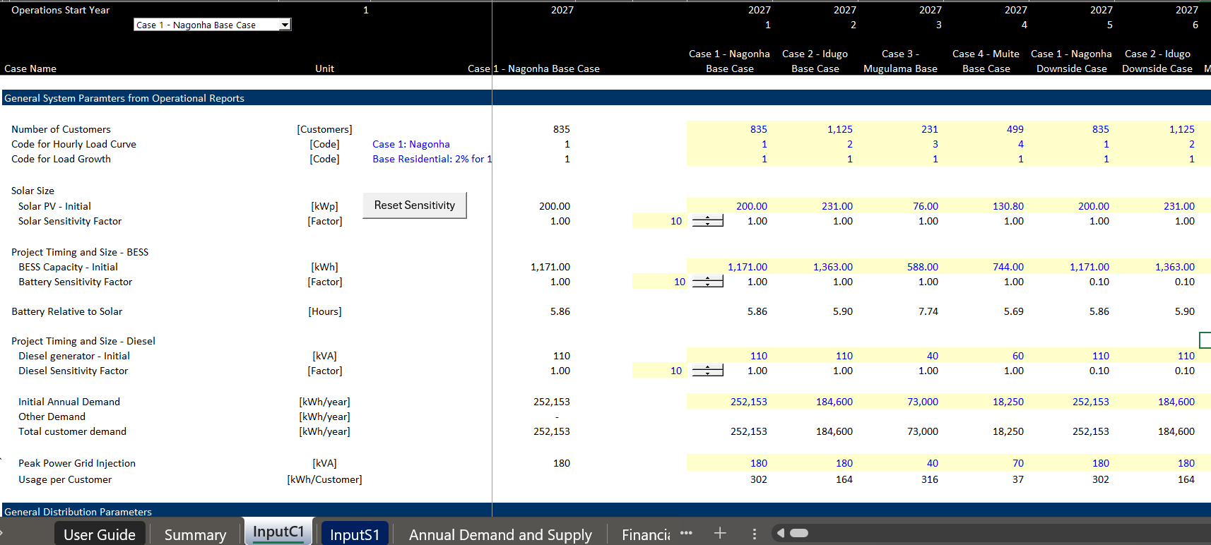
Illustration of Inputs for Capacity and Deman Growth
First part of inputs has sizing of capacity and annual demand.
Use the notion of constant inputs and time series that is now common in models.
Use the drop-down box to simulate different cases.

Slide 16
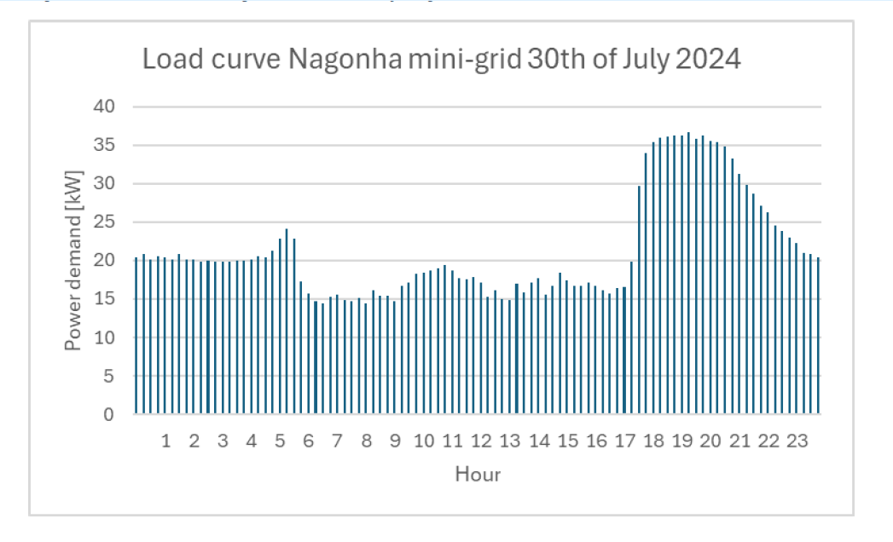
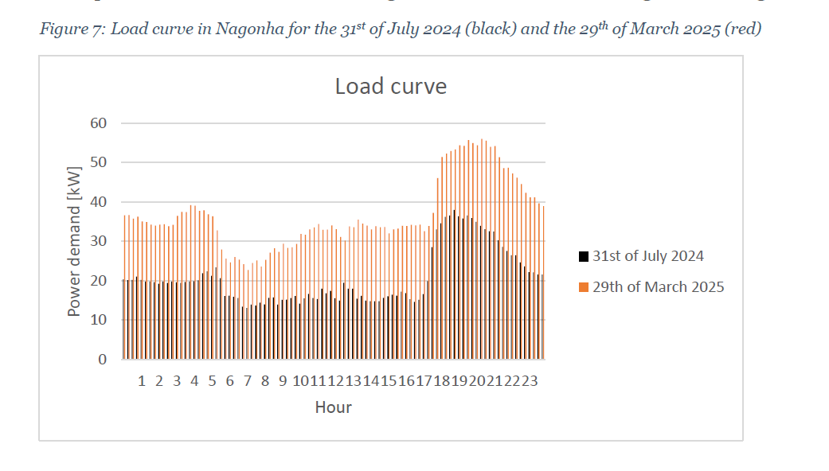
Case 1 – Mini Grid Load Curves
The fact that hourly loads are provided allows dispatch analysis in the financial model when combined with solar and battery. For this system, note that the load increases after sundown. Similar usage pattern in 2025; but increase from load growth. The load from 2025 is used as a baseline.
Note in the right-hand graph that the increase in load happens slightly later because of the timing of the sundown.

Slide 17
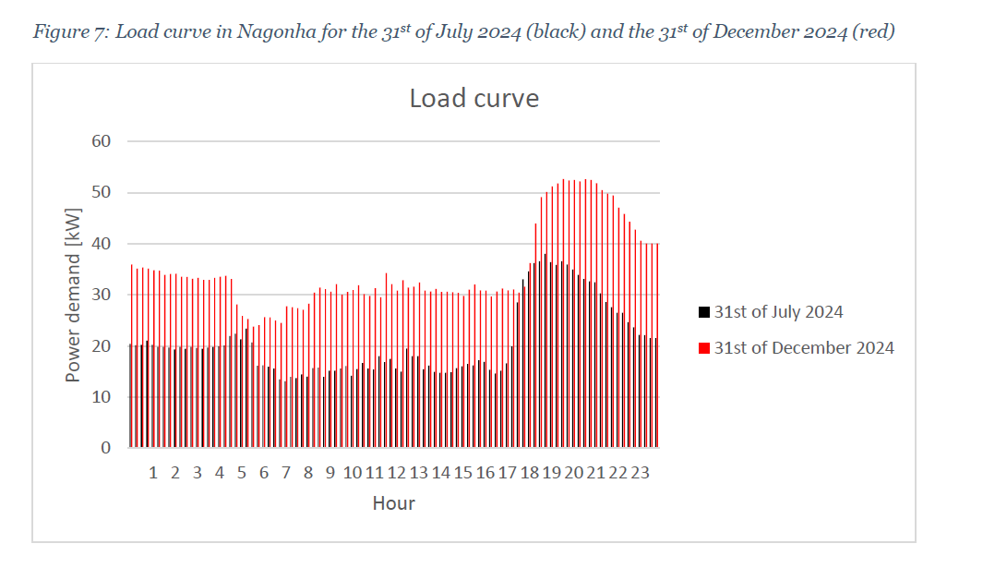
More Load Curves
.

Slide 18
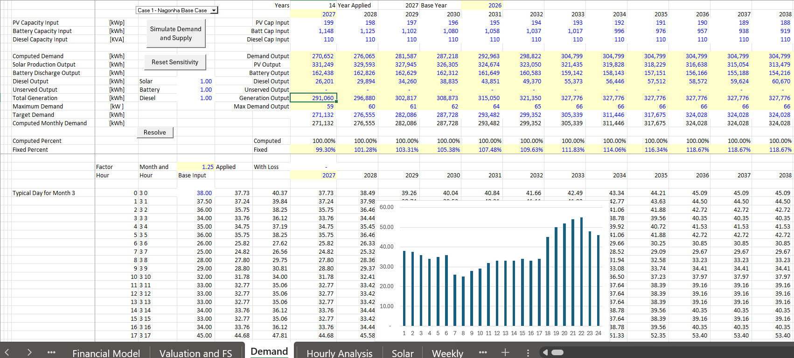
Hourly Demand Patterns per Month
Different hourly demands are entered by month in the model
Hourly demands are resolved to annual demands using the resolve button
Simulation of hourly solar, battery charge and discharge and remaining diesel using the Simulate Demand and Supply button

Slide 19
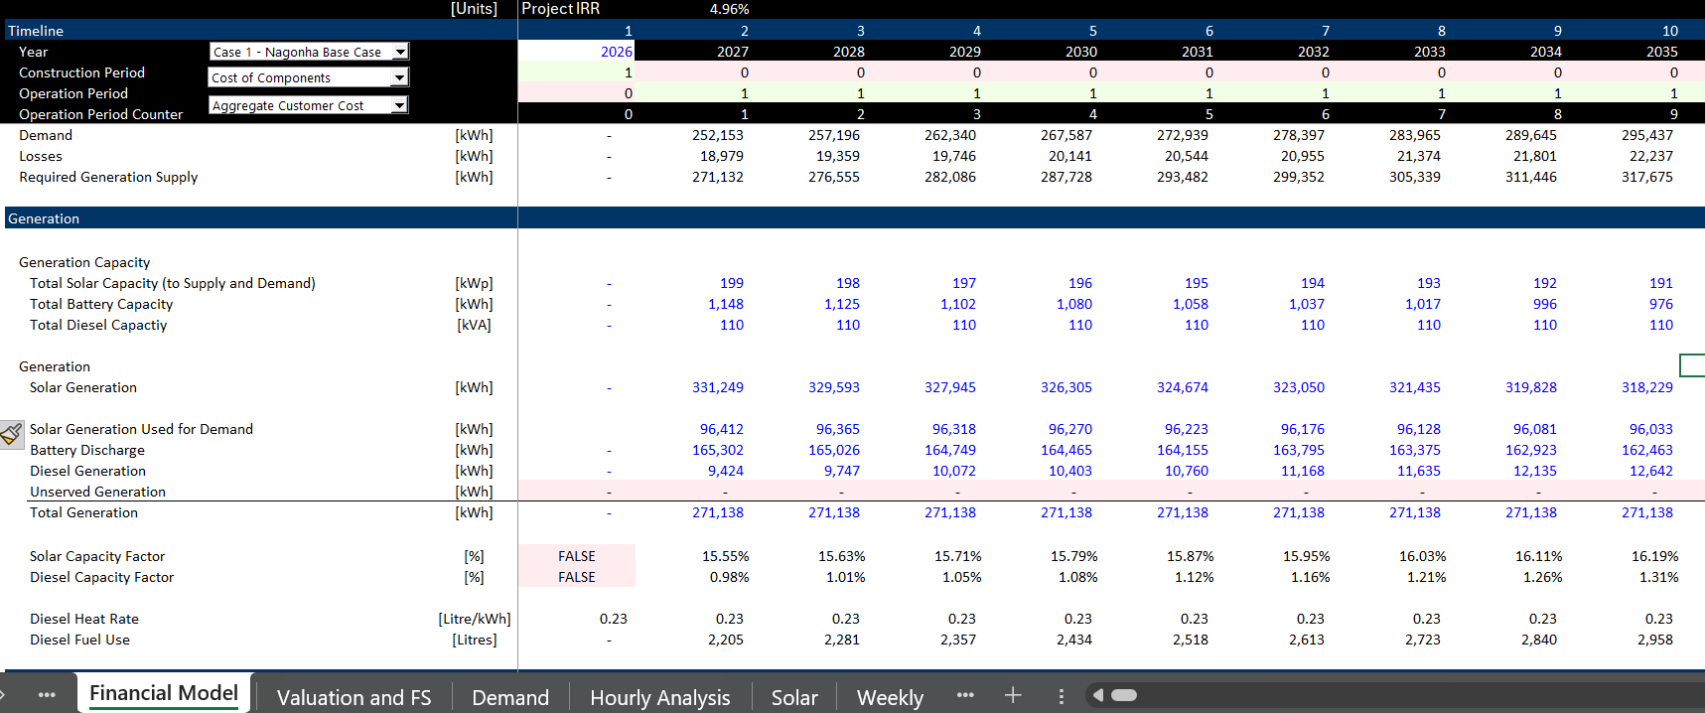
Demand and Supply in Financial Model
Illustration of demand and supply

Slide 20
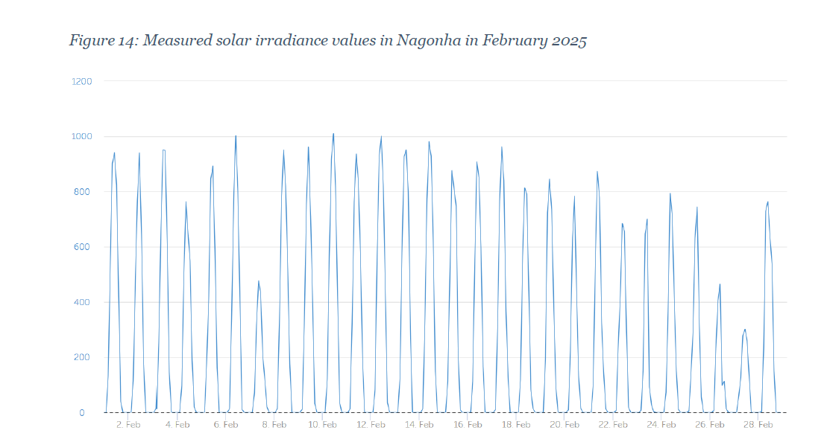
Solar Irradiation - Actual
Solar irradiation is provided for Nagonha. We have used the latitude and longitude to evaluate the hourly irradiation from the EU website that provides hourly irradiation.

Slide 21
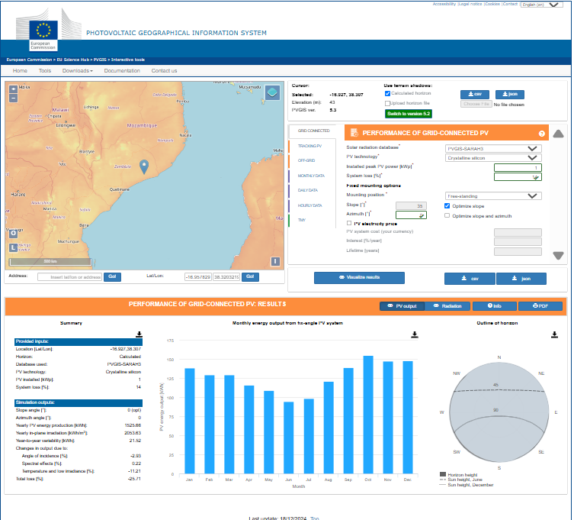
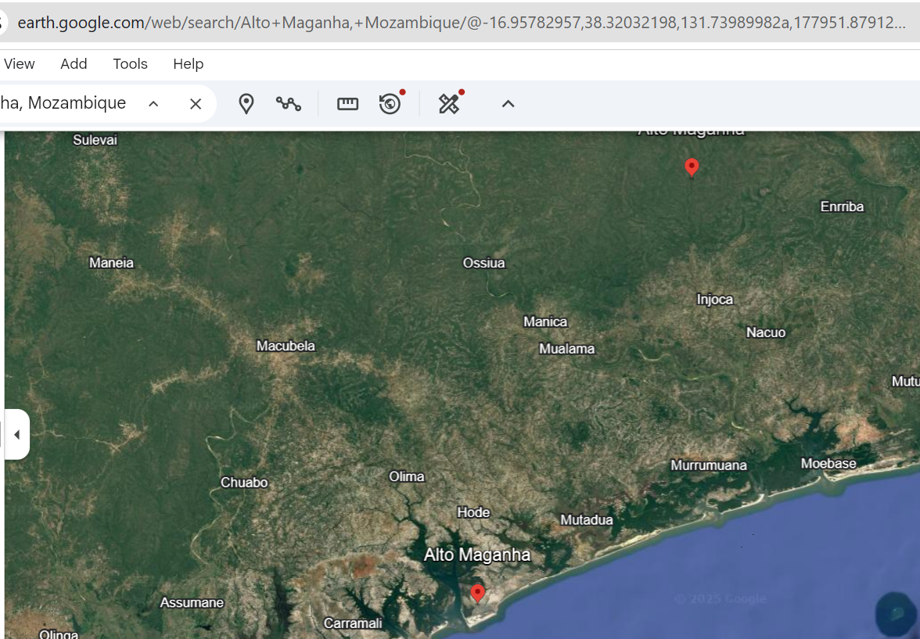
Comparison of Hourly Irradiation with PVGIS Hourly Irradiation
The hourly irradiation produced by PVGIS produces values from 2005 to 2023 which does not cover the actual period. But comparison can be used to evaluate the general levels of solar and the patterns. The google earth shows the latitude and longitude. The

Slide 22
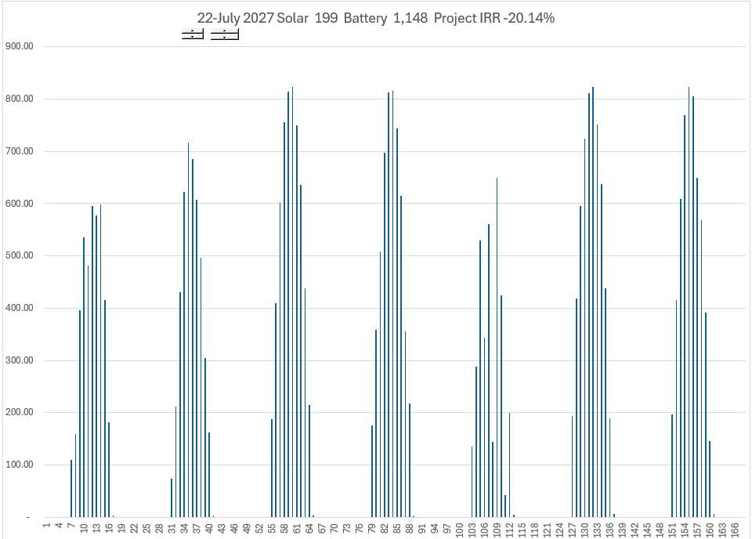
Simulated Solar Irradiation from PVGIS
Download the hourly solar irradiation for each system.
Use fixed tilt system
Observe the different patterns in different seasons

Slide 23
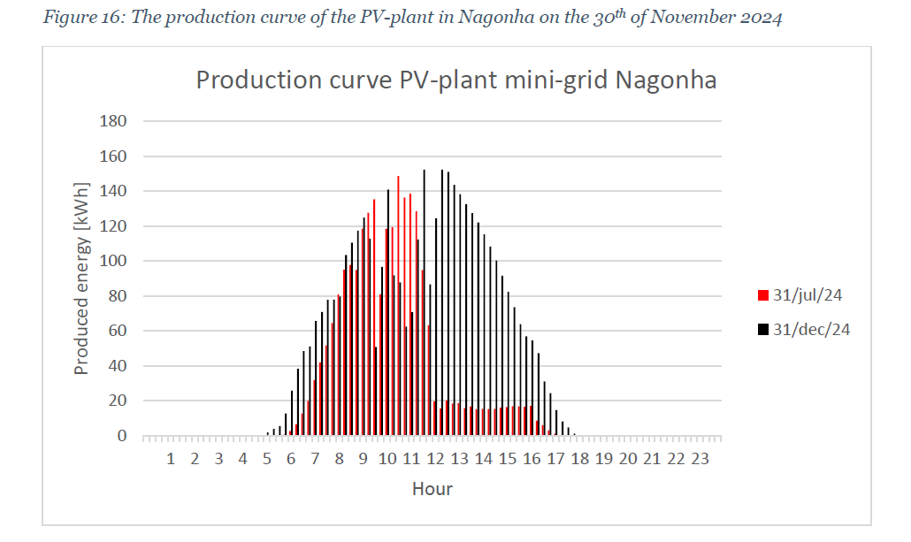
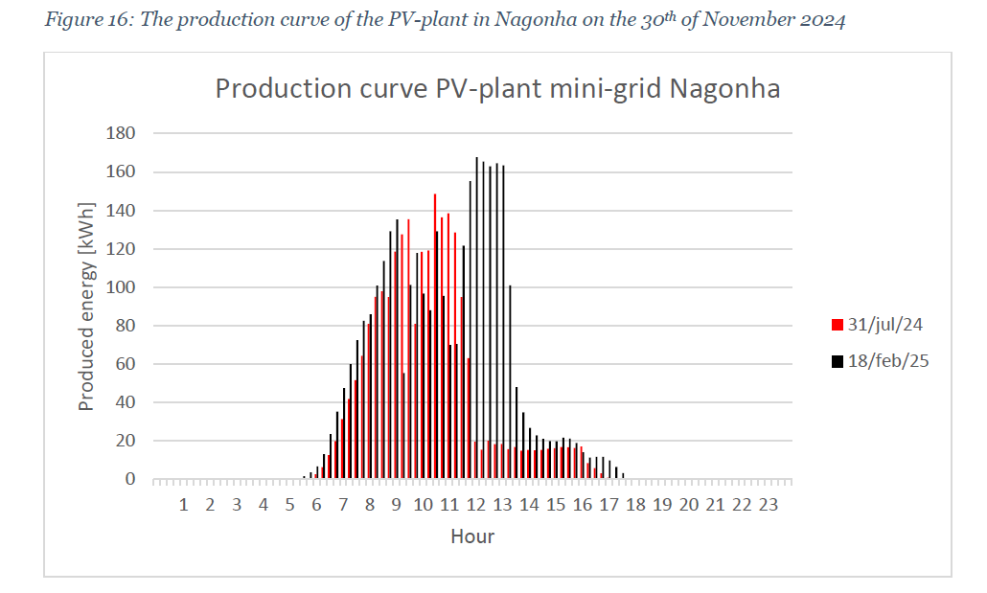
Hourly Solar Production and Performance Ratio
Will correlate this with PVGIS to derive the performance ratio. Note that there was too much solar in the early period relative to the battery, but this was resolved with the increase in load. Note that in July 2024, there is too much solar relative to the battery but in December, all of the solar is used to charge the battery.
The level of solar production in February 2025 can be used to gauge an approximate performance ratio during the peak hours. Production is about 165 kW, and the capacity of the solar project is 200 kWp. This implies a performance ratio of 82.5% during the peak hours.

Slide 24
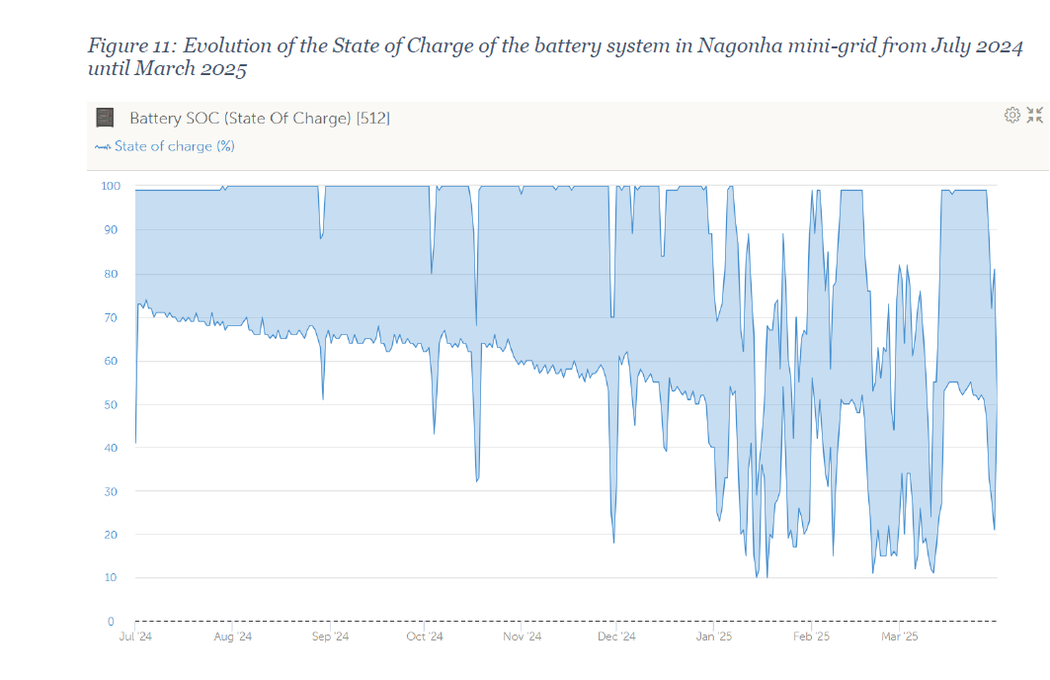
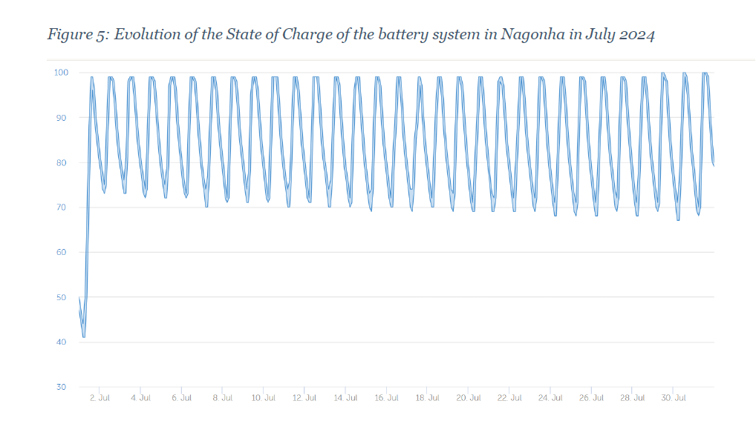
Battery Usage
Note the change in the battery usage over time. As load grows the battery state of charge declines and becomes near 15%. We assume a minimum state of charge of 15% as described in the next slide.

Slide 25
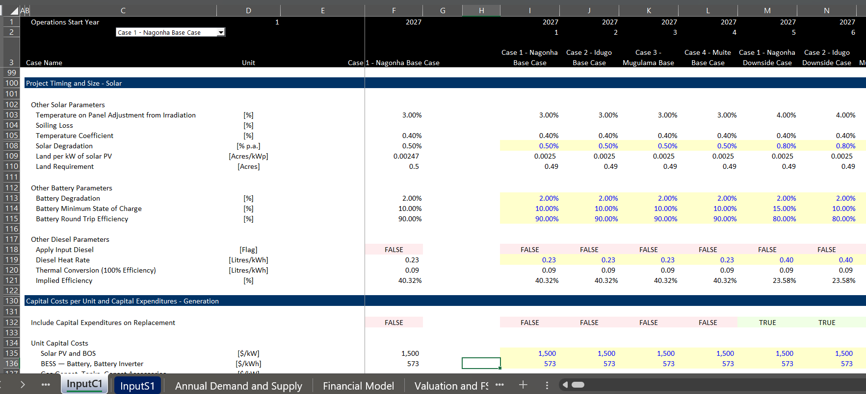
Inputs for Battery, Solar and Diesel Characteristics
Can change the assumptions and evaluate the effect on diesel production.

Slide 26
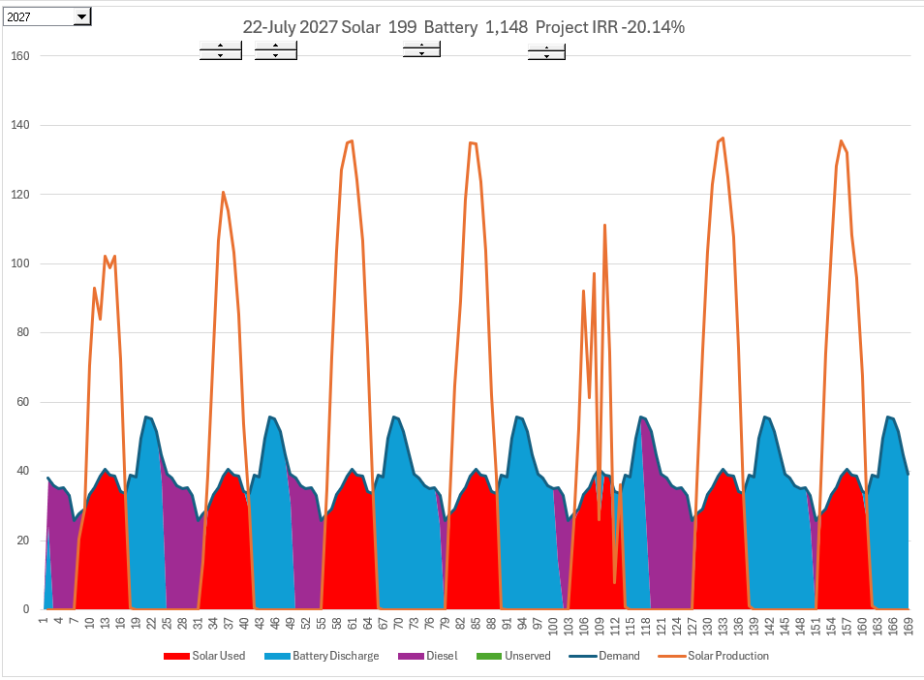
Simulation of Solar, Battery and Diesel – One Week Example
Simulation for one week
Note that when the solar is less, the diesel is more.
Driven by battery capacity, round trip efficiency and state of charge.

Slide 27
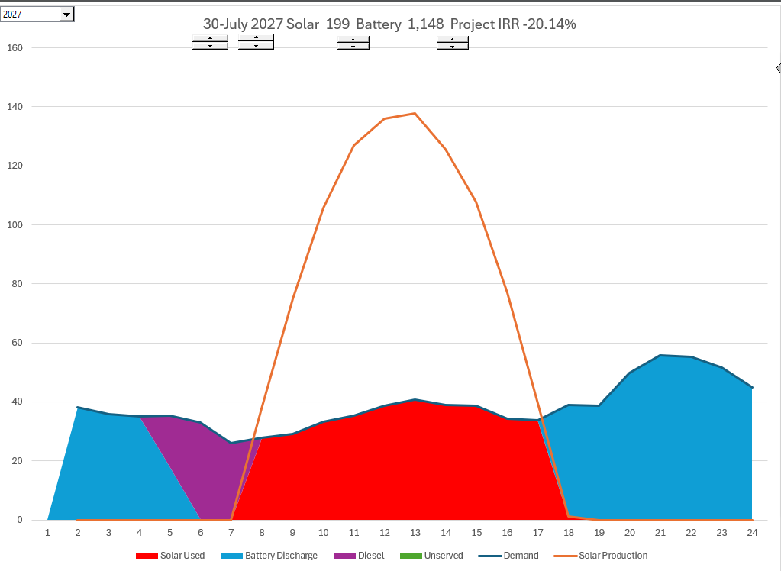
Simulation of Battery and Diesel for One Day
Note that not enough batter plus solar to meet the demand

Slide 28
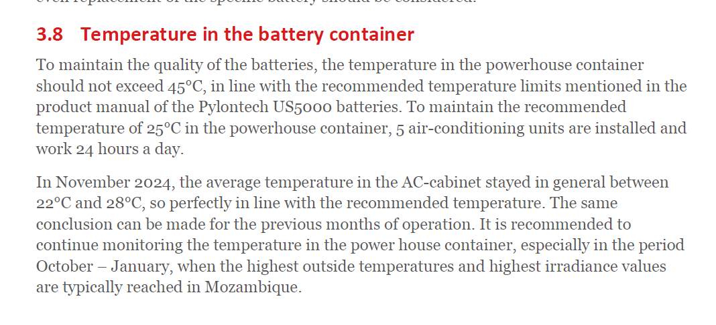
Temperature and Electricity Usage for Battery
.

Slide 29
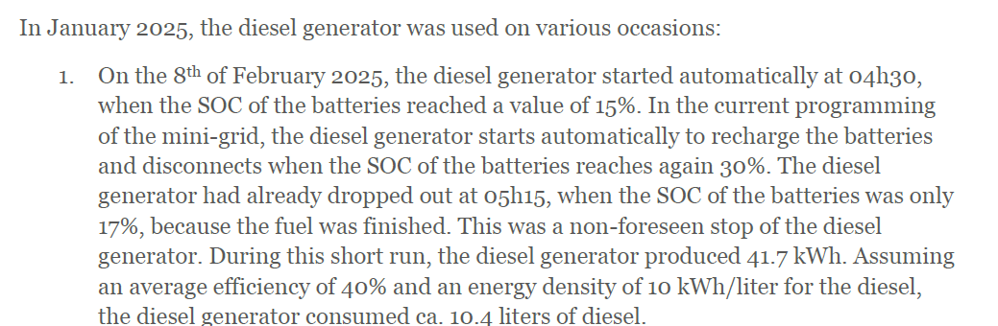
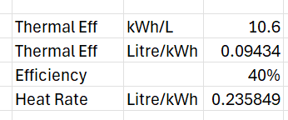
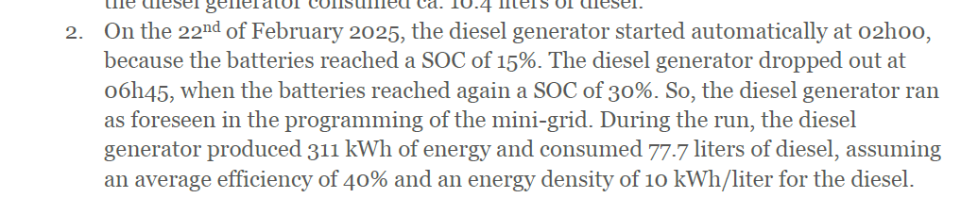
Battery State of Charge of 15% and Start of Diesel
.
Note the diesel efficiency of 40% above. Below 77.7 Liters/311 kWh implies a heat rate of .25 which is extremely good. The heat rate is an input to the model.

Slide 30
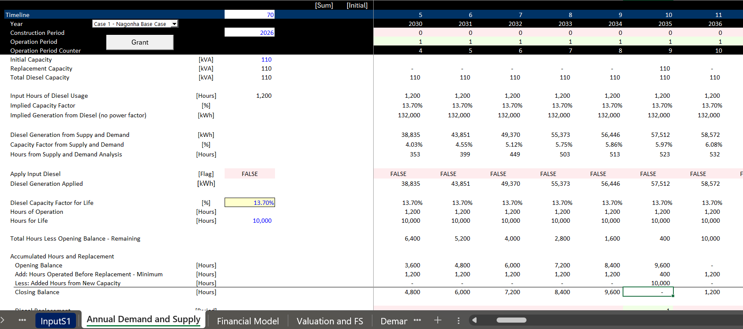
Simulation of Diesel Replacement from Hours Run
.

Slide 31
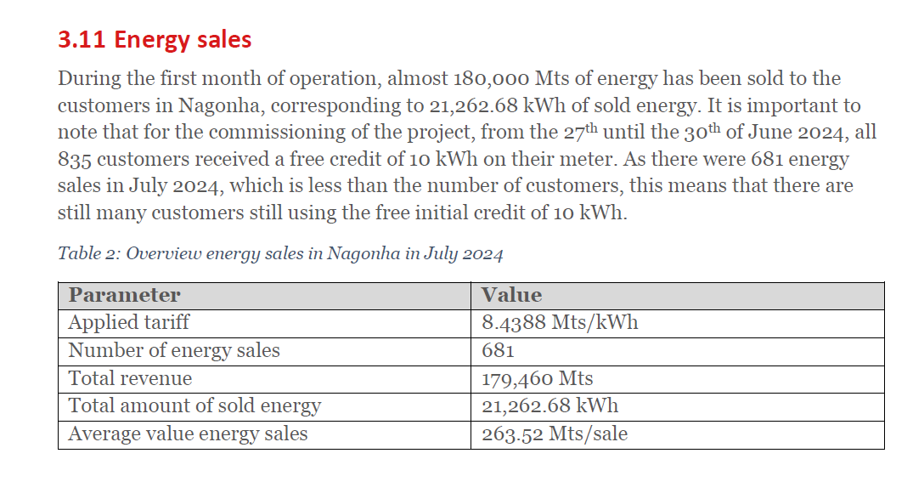
Revenue Summary
The revenue summary is presented. Not the average price of 8.44 which converts to .
Note the comment about the initial sales which is why the energy sales are high at the beginning of the mini-grid and then go down.

Slide 32
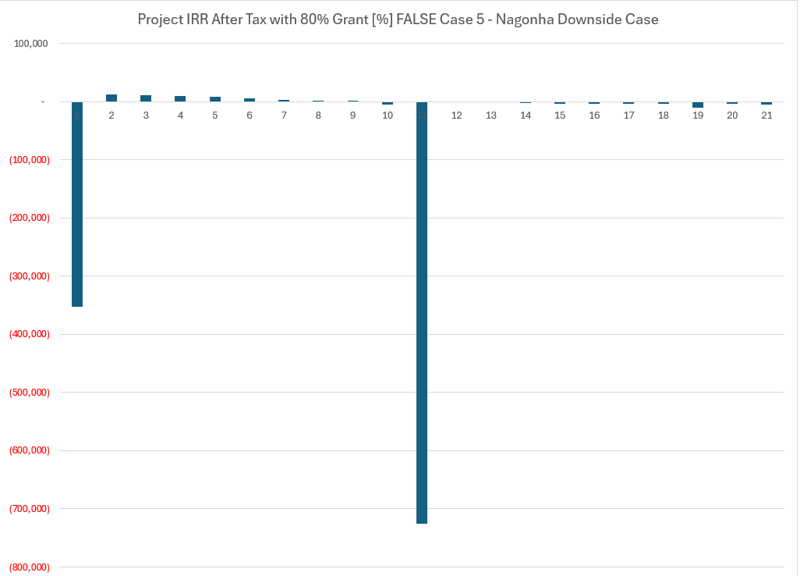
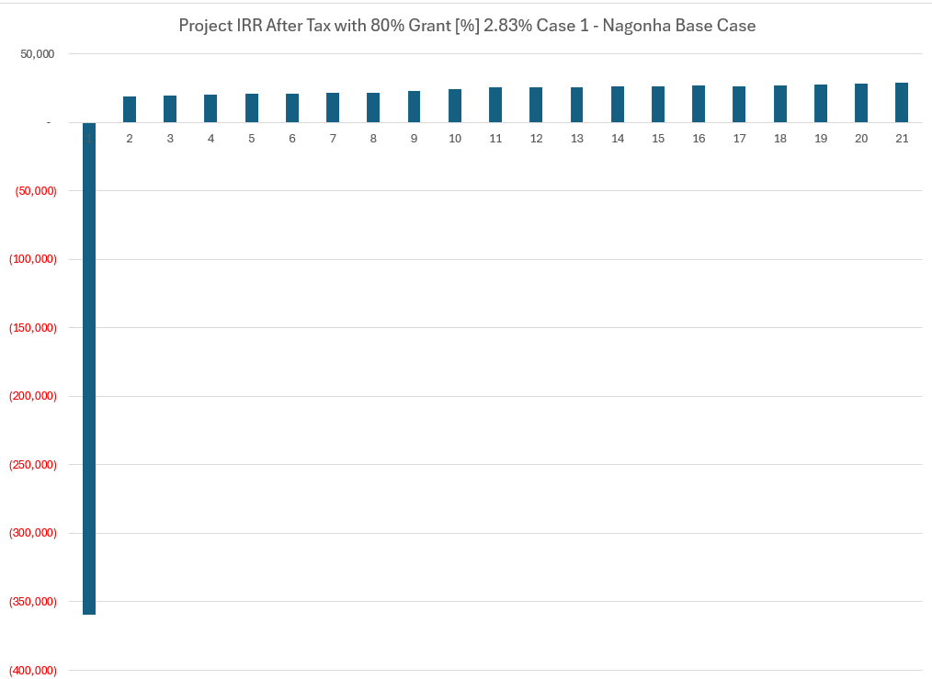
Results of Base Cases
Base Case and Downside Case

Slide 33
Case 2

Slide 34
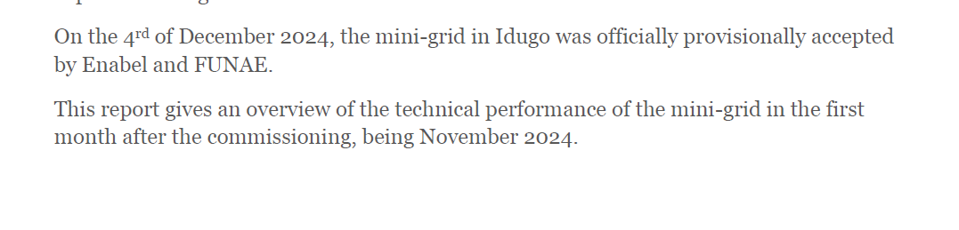
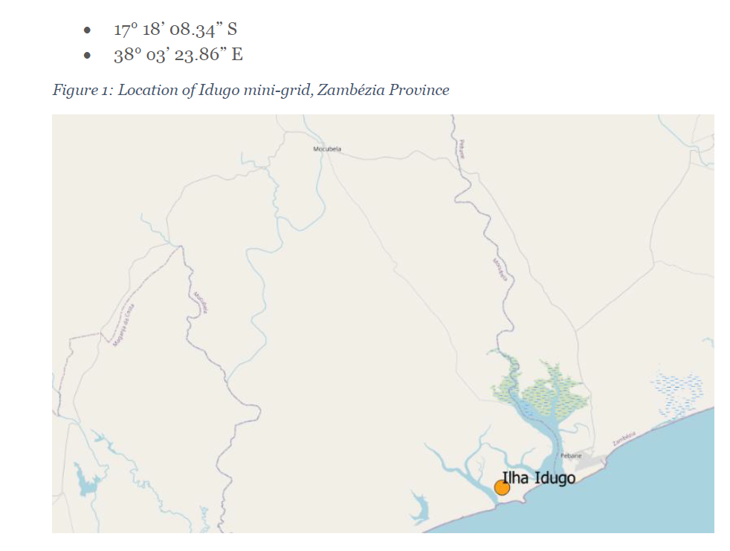
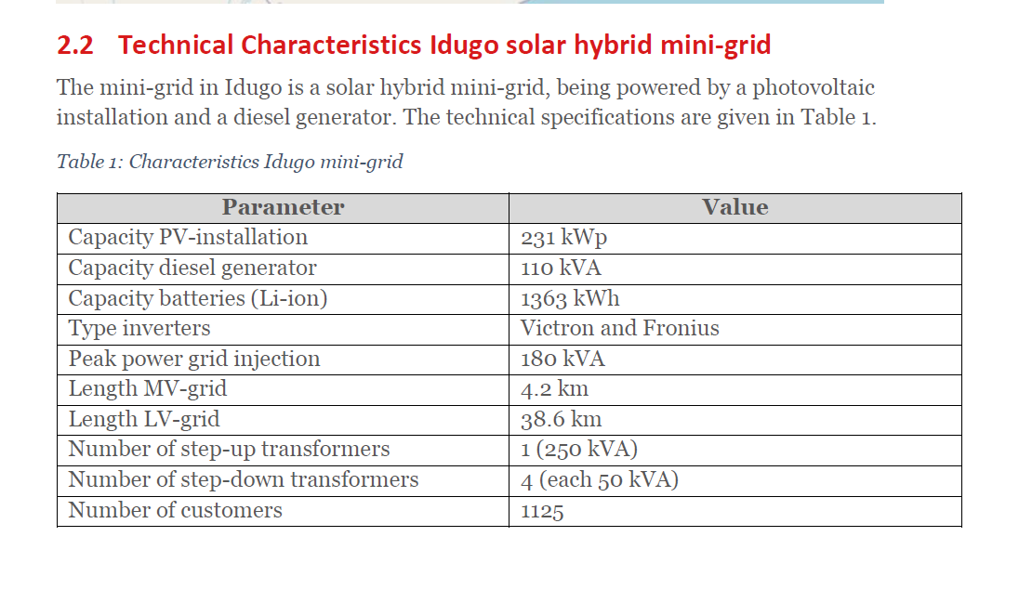
Mini-grid Capacity and Customers
This is the largest system in terms of number of customers

Slide 35
Issues
Why does the performance ratio seem to be so low
Effect of the load curve that has much less usage during sunlight hours
Larger system with less penetration

Slide 36
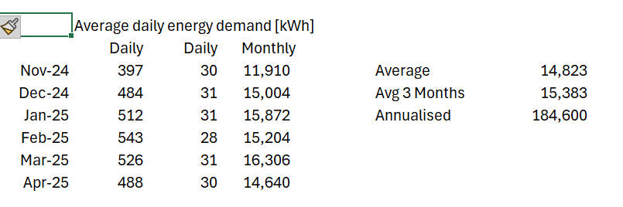
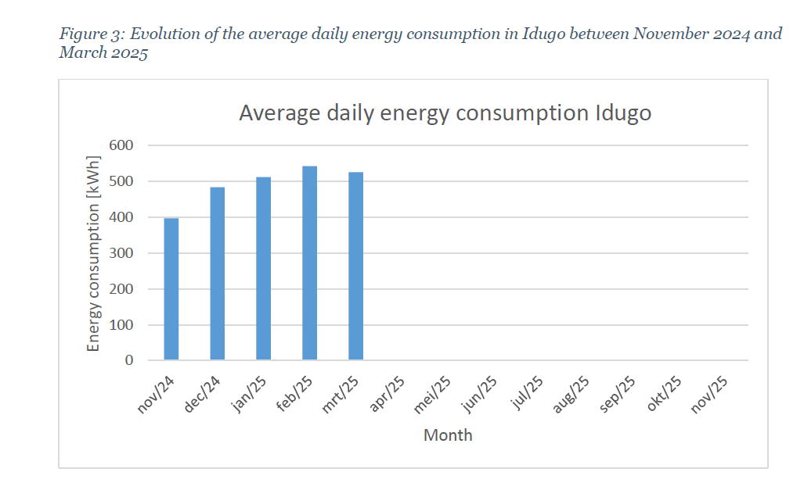
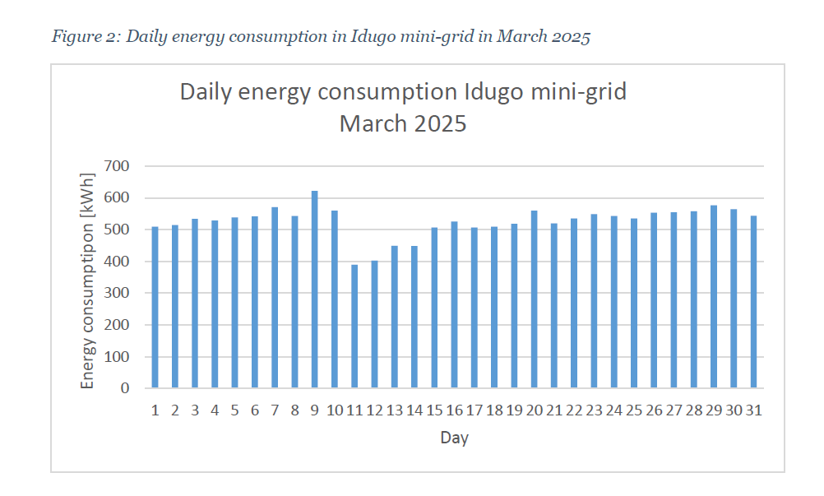
Daily Consumption and Annual Demand

Slide 37
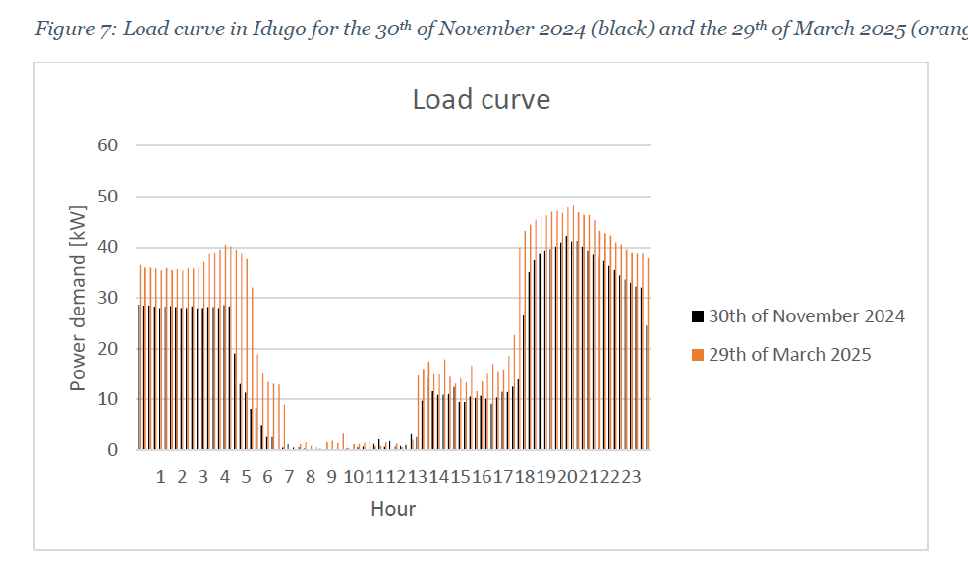
Cost Structure and Loads in Case 1 vs Case 2
Evaluate the dramatic difference in loads

Slide 38
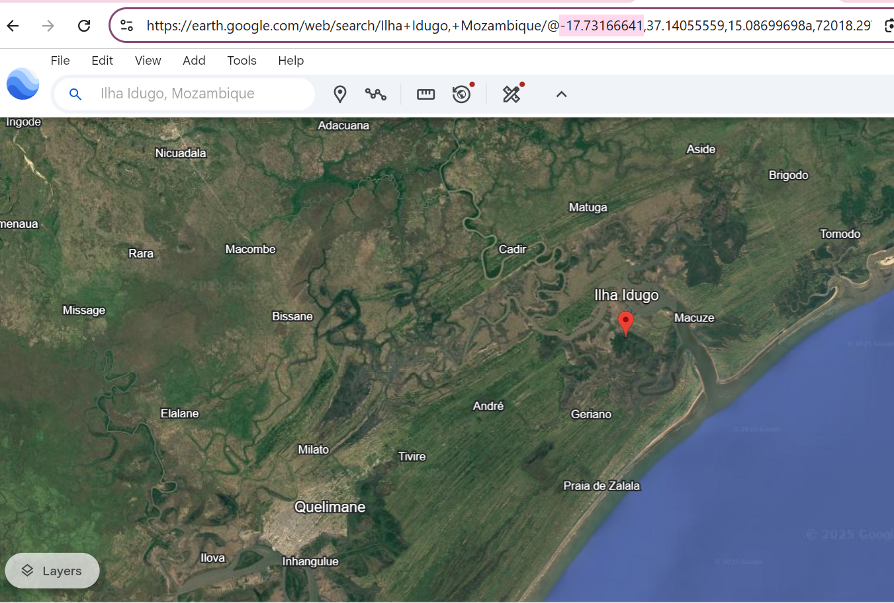
Location of Mini-Grid for PVGIS
.

Slide 39
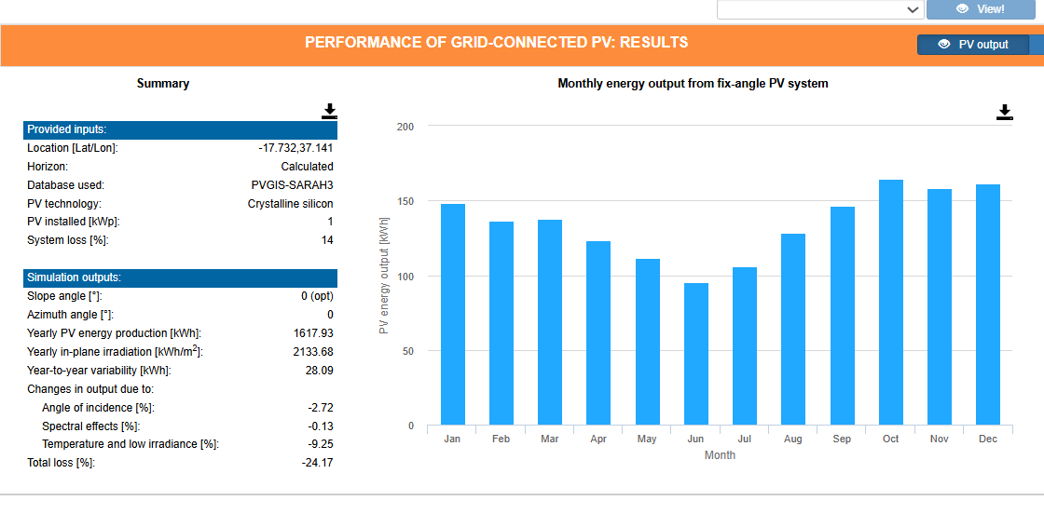
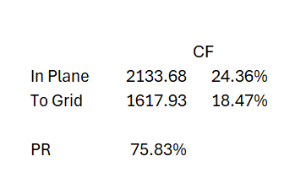
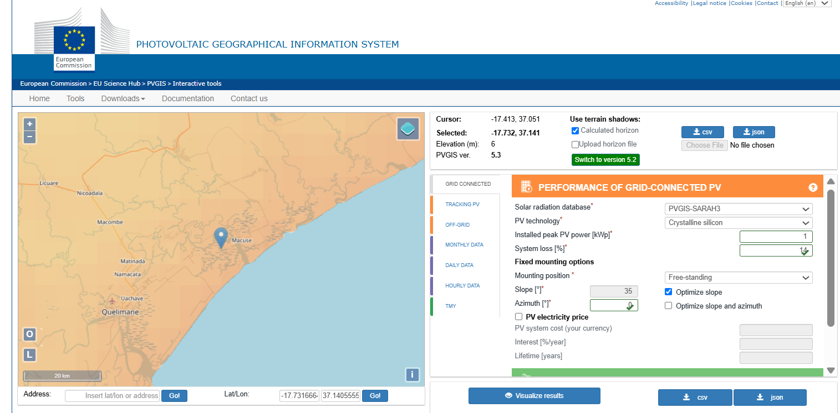
PVGIS for Mini-Grid
.

Slide 40
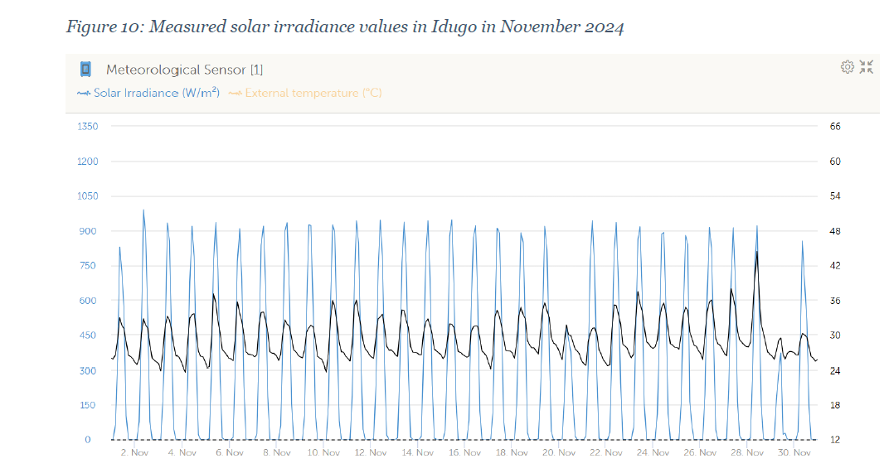
Idugo Solar Irradiation – November 2024
.

Slide 41
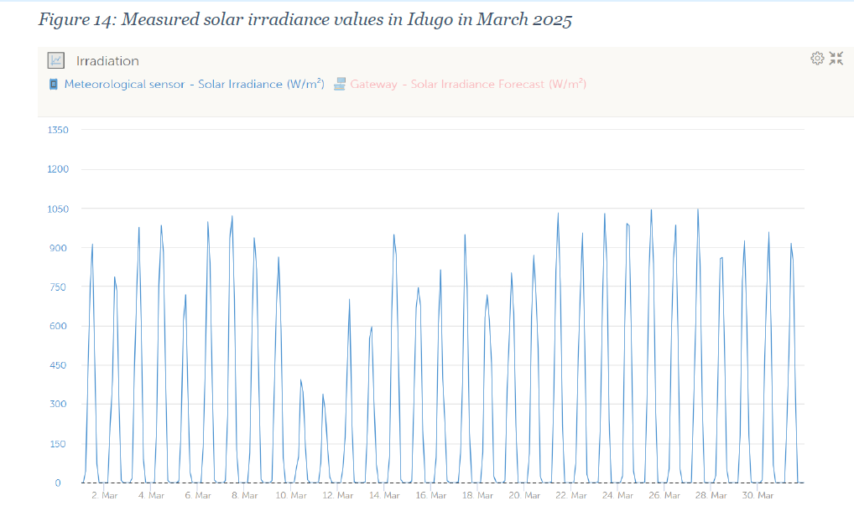
Idugo Irradiation – March 2025
.

Slide 42
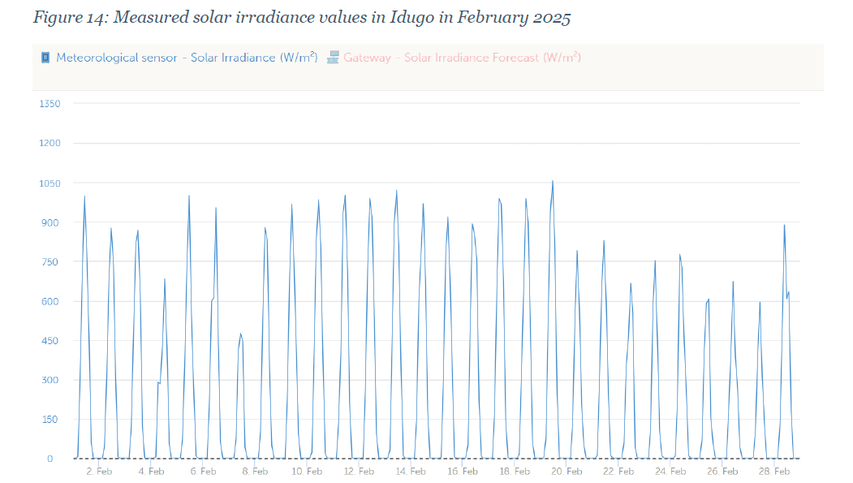
Idugo Irradiation February 2025

Slide 43
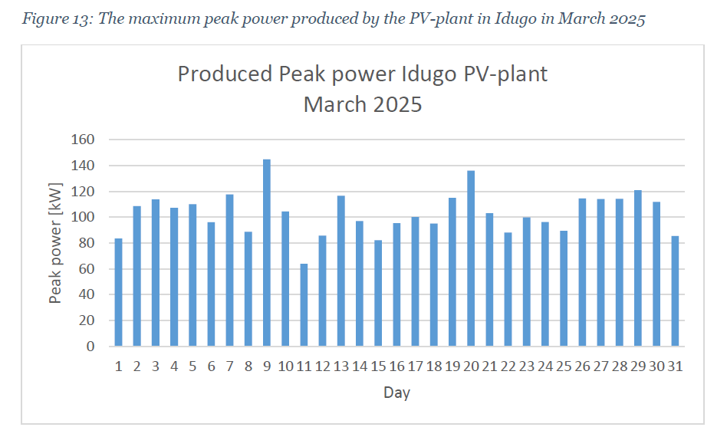
Peak Solar Production and Implied PR
The peak production should occur when the solar irradiation is about 1,000 kWh/m2. The level of 140 kW relative to the size of the plant at 231 kWp implies a performance ratio for the peak hour of only 60%. This is much lower than the 75% shown in the earlier slide.

Slide 44
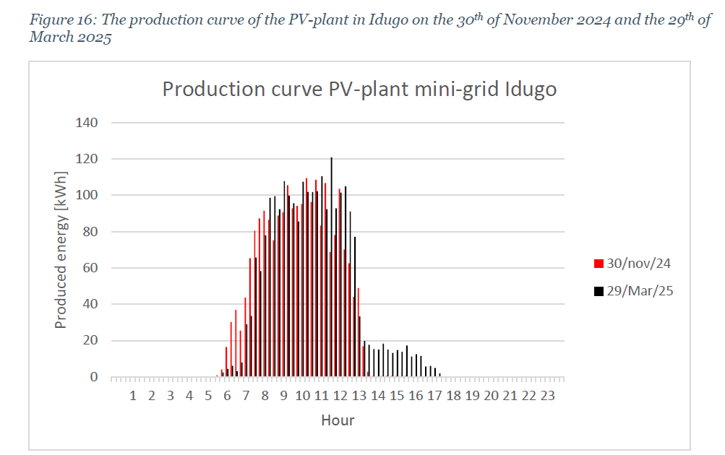
Hourly Solar Production and Battery Constraint
The hourly solar production demonstrates that solar may be wasted.

Slide 45
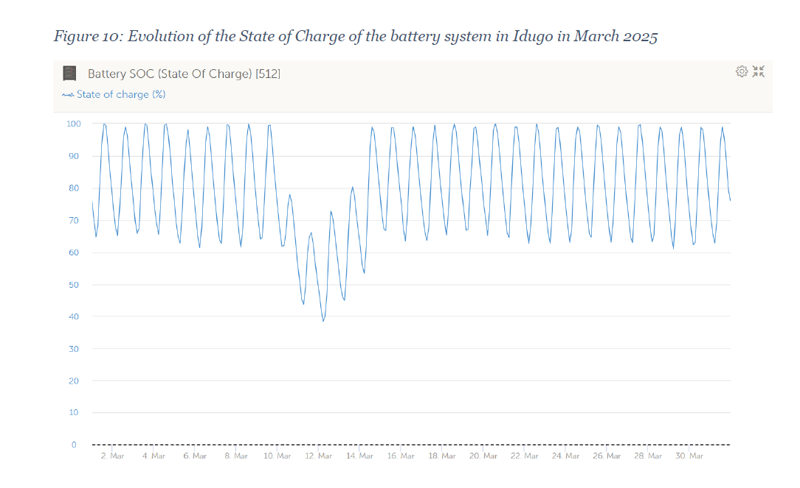
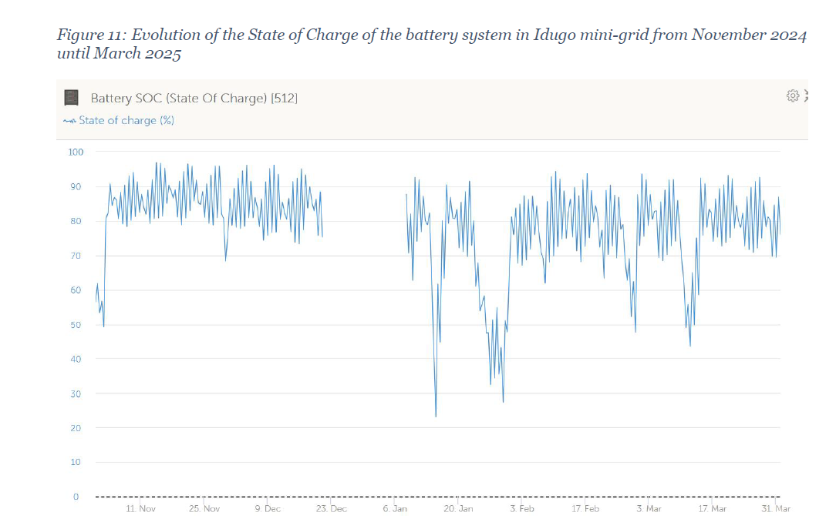
Battery is Over-sized for Current Demand
Note how the state of charge does not reach the minimum state of charge except on a few occasions.

Slide 46

Depth of Discharge and Battery Discussion for Idugo
.

Slide 47

Idugo Battery Temperature
They even present the battery temperature

Slide 48

Idugo Tariff
Note that the rate is the same for each system. An issue for modelling is the assumption of rate increases over time.

Slide 49

Base Case with 80% Grant
.

Slide 50
Case 3

Slide 51


Smaller System with Less Load Relative to Supply

Slide 52

Issues Raised in Mugulama Case
Change in Load Profile
Data on the Temperature on the Panel
Very small system, but more load than Muite

Slide 53

Mugulama - Electricity Demand
The average daily demand is around 200 kWh per day. 200 kWh x 365 = 73,000 kWh per year.

Slide 54

Case 3 Load Curve
.

Slide 55



Case 3 Annual and Daily Demand
Title of graph is wrong. Assume 14 kWh per day.
,

Slide 56

Irradiation Benchmark and Panel Temperature
Note how the temperature on the PV panel reaches a lot more than 60 degrees. This is discussed in the Appendix.

Slide 57

Location of Mini-Grid for PVGIS
Location and Longitude and Latitude

Slide 58



Solar Irradiation from PVGIS
PVGIS

Slide 59

Hourly Production
Solar Production of about 55 kW relative to the capacity of 76 kWp. Implies a performance ratio of 72%.

Slide 60

Peak Power Production – 76 kWp
.

Slide 61

Base Case
.

Slide 62
Case 4 – Mini-grid

Slide 63



Muite Mini-grid

Slide 64
Issues
The usage for this system is very low
Small system with little penetration
Oversized system – battery usage

Slide 65


Load Curve for Mini-Grid
The Load curve shows that there is potentially high variability in this system that was not apparent in the other systems.
Note how the load decreased for the recent period relative to the initial period.

Slide 66


Estimated Energy Consumption
Energy consumption is less for the Muite. Note the decline after the initial free electricity. The base is about 50kWh/day. 50 kWh/day. Per month this is 1,500 kWh (about the size of a suburban home in the US). Per year the demand is 18,250 kWh.

Slide 67



Muite PVGIS
.

Slide 68

Solar Peak Production and Performance Ratio
Less Date for this system. If produce 70 when the irradiation is 1,000 watts/m2 then as the capacity is 130.8, the implied performance ratio is only 53%.

Slide 69

Hourly Solar Production
Produced 80 kW of solar with capacity of 130.8. Implies a performance ratio of 61%. The shape implies that there is wasted solar and the maximum may be constrained by the battery capacity and the load.

Slide 70

Temperature on Panels and Simulation
.

Slide 71

Problem of Oversizing and Surplus Capacity
.

Slide 72

Muite Tariff
.

Slide 73

Cash Flow with Over-sizing
.

Slide 74
Cost Estimates

Slide 75
Objectives
Should reflect reasonable estimates of costs for new system
Incorporate different methods for computing distribution costs
Begin with assumptions used for existing systems
Must be able to evaluate rapidly changing solar and battery costs
Must be able to simulate diesel costs with different fuel prices

Slide 76

Nigeria Model
.

Slide 77
Source 4: Current Estimates from Asia
Cost of Solar
  USD 63/kW for panels
  USD 360/kW for system including inverter
Cost of Battery
  USD 130/kWh including inverter

Slide 78

Generation Costs in UIPCE Report
Data provided by private sector and programmes. Regional benchmarks for “best in class” systems
Minimum connections: 150
Production costs:
Solar system: $1,500/kW
Battery: $530/kWh
Inverter: $304/kW
Diesel generator set: $371/kVA
Wind turbine: $2,500/kW
Hydro: $14,588/kW

Slide 79

Generation Costs in Regulatory Report
.

Slide 80

Inputs for Generation Costs
.

Slide 81


Distribution Costs
"Forced" grid length: 30km & < 2,000 $/connection
Maximum grid branch: 150km
Central grid CAPEX: 2500 $/kW
Distribution costs:
Medium Voltage: 26,000 $/km
Low Voltage: 18,900 $/km
Transformers: 29,200 $/160 kVA
Grid losses: 15%
Disc rate: 8%

Slide 82

Distribution Capital Costs and Connection Cost from Regulatory Report
Distribution
Cost
1 phase 6,000 MZN
3 phases (industrial customers only) 12,000 MZN
Cost per connection 8,000 MZN

Slide 83

Generic Mini-Grid From Regulatory
Electricity produced per year Unit
One village 50,000 kWh
Portfolio size 30 mini-grids
Entire portfolio 1,500,000 kWh
Equity Expected ROI before taxes (%) 18%
Debt interest rate 14%
Loan term (years) 10
FOREX MZN-USD 62
Cost of diesel (MZN/Unit) 71.71 MZN

Slide 84

Operating and Maintenance Cost from Regulatory Report
Total cost including cost of solar and insurance.

Slide 85

Inputs for Distribution Capital Expenditures
.

Slide 86
Tariffs and Grant

Slide 87

Tariffs

Slide 88

Tariffs for Households

Slide 89

Other Tariffs
.

Slide 90

Other Tariffs Continued
.

Slide 91
Project Fact Sheet
Project start year 2024
Own funds on total investment at project start 5%
CAPEX subsidy 80%
Own funds at component replacement 70%
Equity Expected ROI before taxes (%) 18%
Debt interest rate 14%
Loan term (years) 10
FOREX MZN-USD 62

Slide 92

Need for GCF – Private Operators do Not Make a Profit

Slide 93

Potential for GCF
.

Slide 94
Alternative (Negative) Case

Slide 95

Location of Mini-grid
.

Slide 96

Demand and Supply Reduction – What is the Cause
.

Slide 97

Is the Decline in Solar Production for Consumption Due to Decline in Demand or Problems with Solar Farm
.

Slide 98

Alto Changane – Demand Reduction or Battery Degradation
.

Slide 99

Round Trip Efficiency Percent
.

Slide 100

Loss Percent
.

Slide 101

Subsidy and Model Development
Evaluate existing subsidies and cash flow from the model
25 MZM/kWh = 40 US Cents/kWh

Slide 102
Appendix – Computation of Solar Output and Battery Discharge

Slide 103

Inputs from PVSYST Example
.
5,120 MWac
6,784 MWp
75% Ratio
33,008 meters for 6.784 MWp or 33,008/6.784; 4,865 m2 per MWp; Football field assumptions – 50 x 150 meters = 7,500 m2. 1 MW is 4865/7,500 = .64% of a football field. Or, 7,500/4865 = 1.54 means a football field gives you 1.54 MWp.

Slide 104

Loss Factors in PVSYST
To understand solar I think you should replicate PVSYST by yourself.
You need data on the various loss factors, the temperature coefficient and the AC/DC Ratio

Slide 105

Performance Ratio by Month
Capacity for Radiation on Plane – 2,458 kWh per m2. With STC of 1,000 the capacity factor is 28.06%
Final Capacity factor. Generation kWh is 13,064. Capacity in MWP is 6,784, Average Production is 1,491 kWh. Capacity Factor is 21.97%.
Performance Ratio is Final Capacity Factor Divided by Gross or
21.97% divided by 28.06% or 78.3%
.

Slide 106

Capacity Factor for Solar with Performance Ratio and Temperature - Equations

Slide 107

Idea that cannot use Ambient Temperature
.

Slide 108

Solar, Temperature and Performance Ratio
Temperature coefficient
Note that 20 to 30 degrees above the ambient temperature

Slide 109

Detailed Weather Measurement

Slide 110

Detailed Solar Analysis with Temperature Adjustment
.
Find the file named hourly equations

Slide 111


Providing PVSYST Report in PPA
.

Slide 112
Detailed Formulas for Solar with Performance Ratio
Soiling Losses = Soiling Percent x In Plane Radiation
Net In Plance radiation = Gross In-plane Radiation – Soiling Losses
Pantel Temperatre Adjustment = 3% x Gross In Plane Radiation
Temperature on Pantel = Temperature + Panel Adjustment Temperature
Temperature versus STC Temperature = Temperature – Temperature on Panel
Efficiency Effect of Temp = Temperature Coefficient x Temperature Difference
Temperature Effect = Efficiency Adjustment * In Plane Radiation
Subtotal = Irritation – Losses – Temperature Effect
Other Losses = Other Loss Percent x Other Loss Percent
Subtotal = subtotal – Other Losses
Irradiation STC = 1000
AC/DC ratio = AC percent x ADC
Output before Loss = Minimum (AC Output, subtotal)
Inverter Loss = Output before loss x Inverter Loss Percent
Compute financial capacity factor as percent of STC

Slide 113
Incorporate Detail of Solar
Add 15 columns
Soiling Loss Assumption: 2.8%
Factor for Increase in Temperature on Panel (% of irradiation) – 3%
Temperature Coefficient Percent Efficiency/(Panel Temp-25): -.41%
Other Wiring Losses: 2.9%
AC to DC ratio: 80%
Inverter Losses: 3%

Slide 114

Cell Panel Temperature from Ambient Temperature
Note that results in 20 to 30 degree adjustments.
Use Homer Method with 3%

Slide 115

Temperature Adjustment with Temperature Coefficient
Use PV adjustment of -.4%
Note that never come close to 1,000 STC; this is reason for the AC/DC ratio

Slide 116

AC to DC Ratio and Performance Ratio
Can compute the remaining output subject to the maximum output from the size of the inverter

Slide 117


Size of System
.

Slide 118

Capital Expenditure Discussion
.

Slide 119
One of the pending points are the mini-grid construction milestones that would result in the disbursement of a percentage of the CAPEX support funds to the SPVs.
One variant could be to define in advance very strict milestone moments that will be applied for all SPVs or as the other variant, the definition of these milestones could be kept very open and be the result of negotiations with the SPVs during the concession awarding.
Of course, the final decision is with Enabel, but based on your experience with GCF, would both variants be acceptable for GCF?
In which sense does the decision on the construction milestones influence the financial model of annex 3?

