Slide 1
Session 1:
Timelines
Simple Scenarios
IRRs

Slide 2
Agenda
Introduction
  Questioning Finance Theory
  Practical Financial Modelling
Downloads
  Generic Macros
  Stock and Economic Analysis
Overview of IRR, Growth and Value
  Working with File
  Importance of Timing
Work through Model from Scratch
  InputC
  Flexible Timelines
  Cap Exp and EBITDA
  Long-term and Short-term project
  IRR with Sensitivity and the problem with IRR
  Solution to IRR with Premium versus Risk Free Rate Earned
Discussion after finished with the model

Slide 3
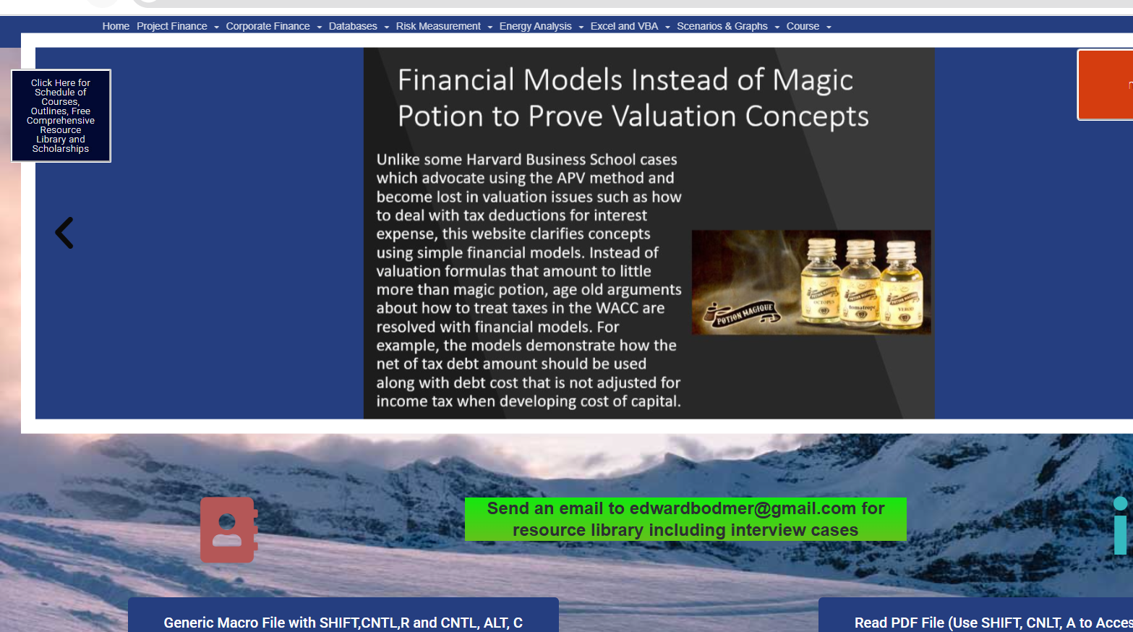
Downloading Generic Macros
Download
Unblock
Test

Slide 4
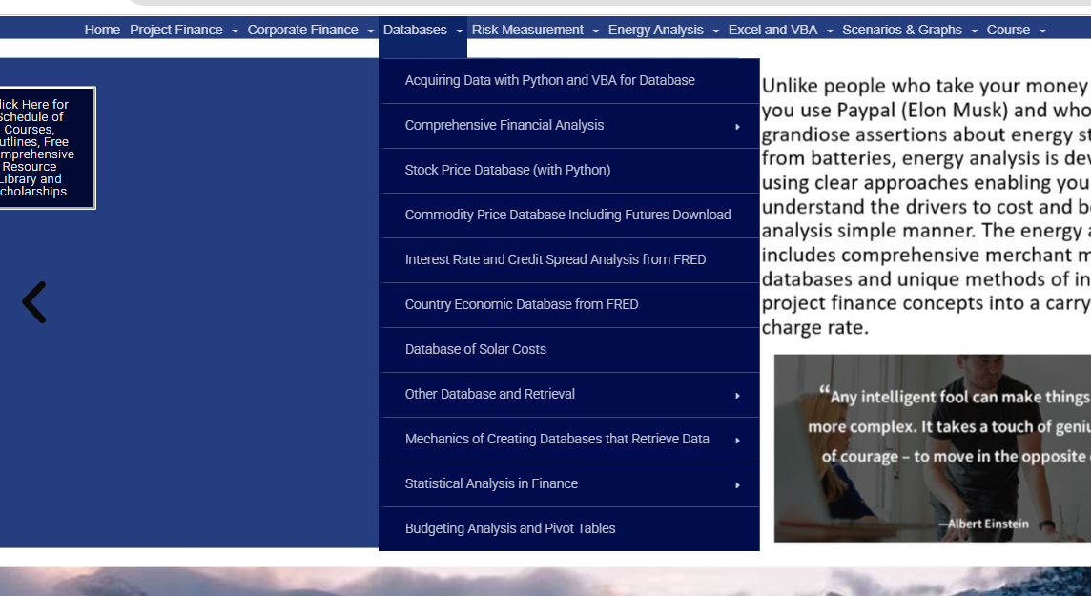
Downloading Stock and Economic IRR
.

Slide 5
Yahoo Finance Adjusted Stock Price
IRR is growth rate in cash flow from stocks
Need an investment period
Need a final period
Compute growth rate including dividends that are re-invested in the same stock
The biggest question in finance is what is the minimum return that people really need

Slide 6
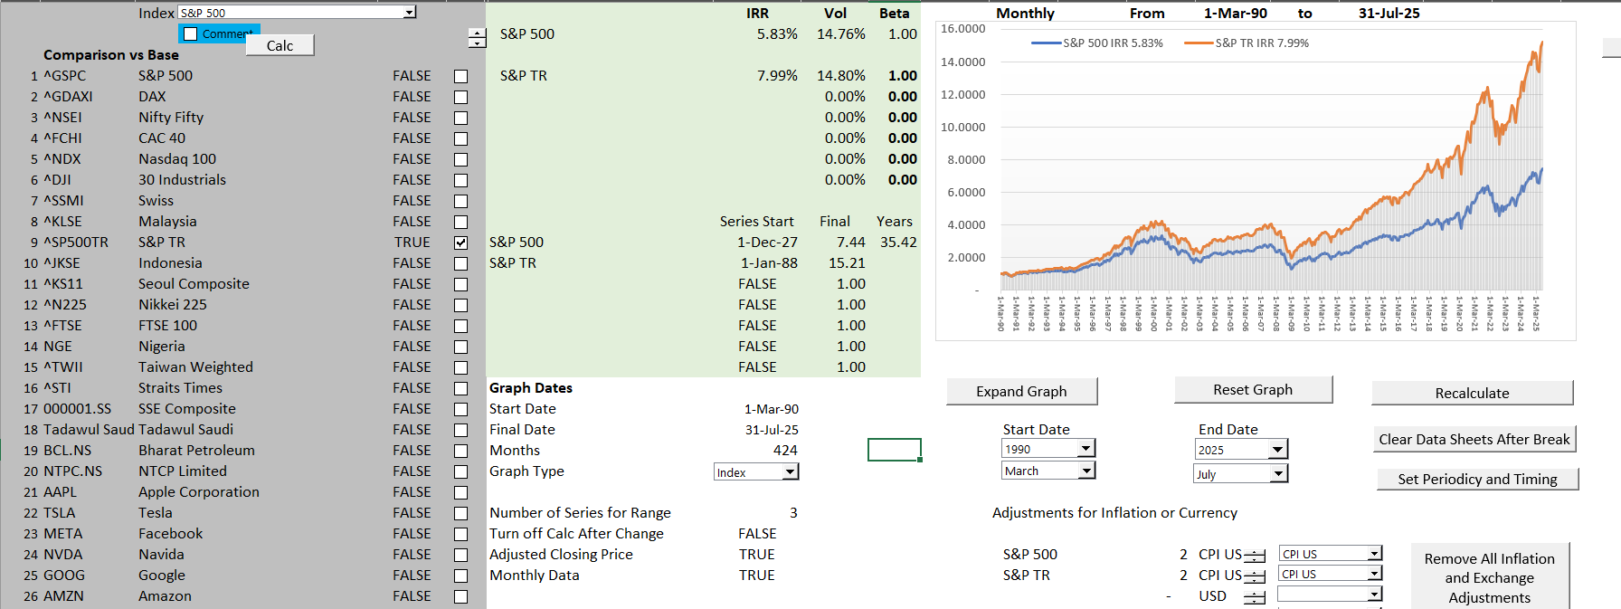
Demonstration of IRR for Stocks
IRR on Stocks using S&P 500

Slide 7
Session 2

Slide 8
Subjects
Location of Files and Videos
Last session implication
  When somebody tells you that your model is wrong because you increased the length of the PPA and nothing happened to the IRR you can explain it.
  Why a bit of delay in the project up-front has a bigger impact than a lot of money in the future
  Why you want to structure the debt to get dividends as soon as possible
  Why MIRR is crap
  In terms of excel, be very careful and try to get flexible timelines
Show you where we are going
  Debt in the model
  Difficult timelines and summing the debt
  How is the DSCR defined and defining risk with Monte Carlo simulation (not very useful in the real world)
  Pain point of circular references
  Corporate finance and project finance
My original idea of this session was absurd

Slide 9
Outline
Theme: Stop the Bureaucracy; Keep to FAST philosophy; Understand alternative ways to model; Stop showing off with fast talking, excel equations that can be done in a simpler way; using language that is confusing …; Think Differently and Incorporate Theory and Have an Open Mind
Review of implications from day 1
  Flexible timelines and consistent timelines essential in any model (in corporate model, actual period versus forecast period versus terminal period)
  Pre-cod when need cash from funding versus post COD where you have surplus cash flow
  Indulge me with generic macros
  Importance and distortions with IRR
Continue with Basic Model and Include Basic Debt
  Make Sure Everybody Can Get the Model Correct
  Good for Experienced People to Have and Open Mind and Realize that Their Methods are Crap
Start with Simple Debt Structure
  Some Don’t Understand the Key Behind Debt Structure versus Risk Analysis Anymore
  Understand the Essence and Importance of LLCR and PLCR versus DSCR
  Create Cash Flow Waterfall with Defaults and Repayments of Default
More complex model and incorporation of flexible debt timing

Slide 10
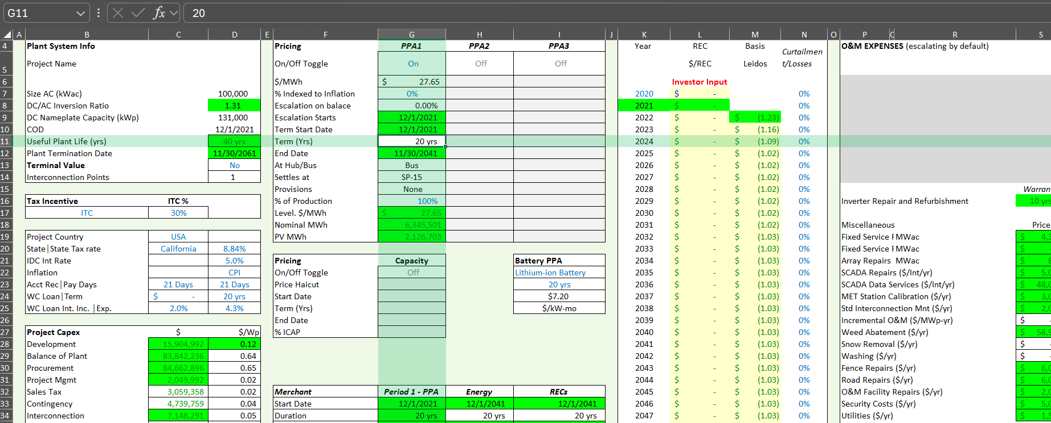
Example of a Mess – Inputs not in InputC
.

Slide 11
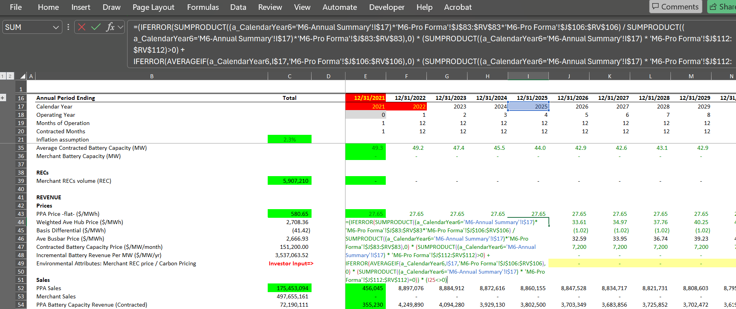
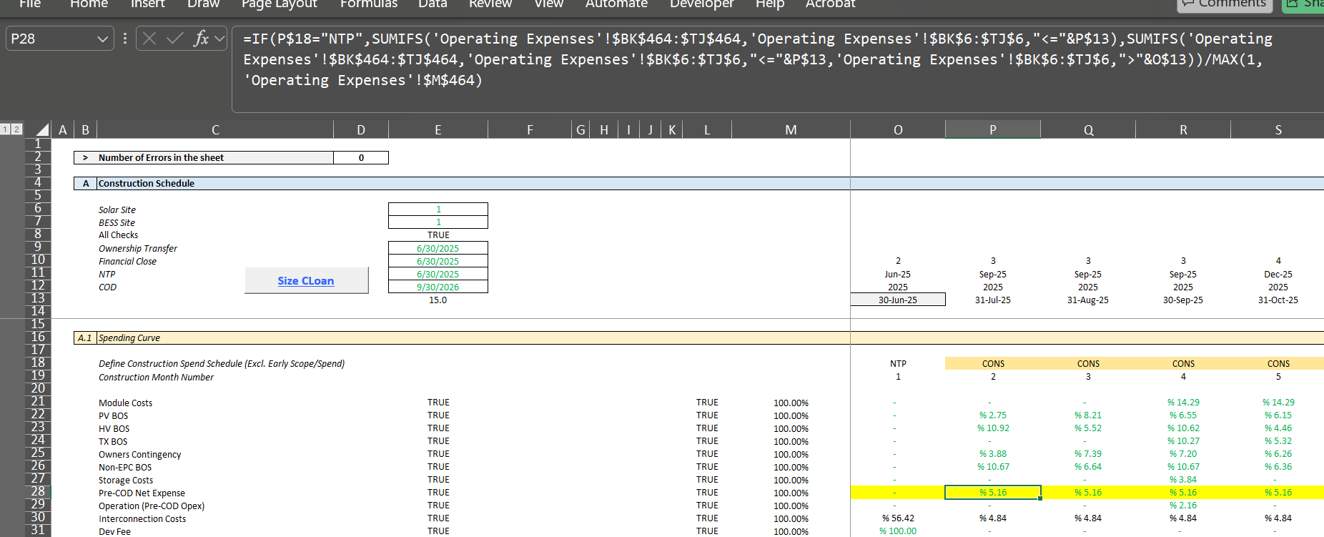
Example of Illegal Formulas
.

Slide 12
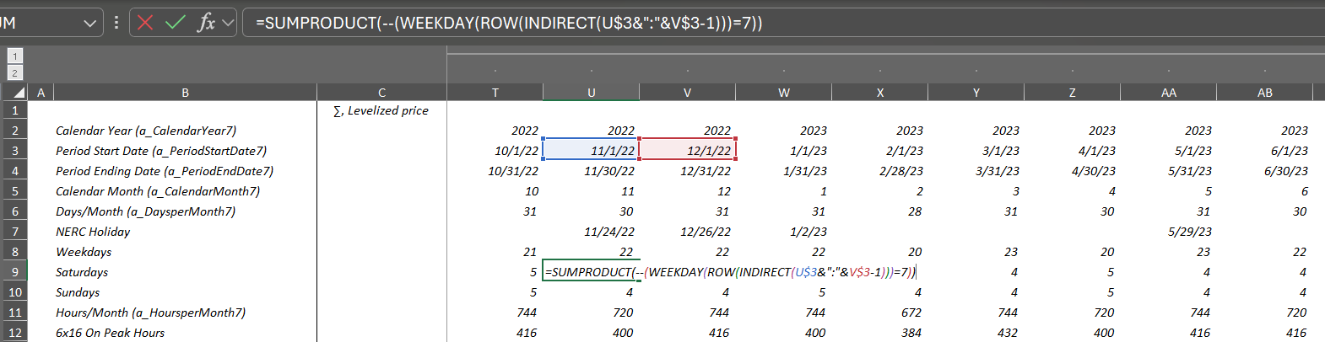
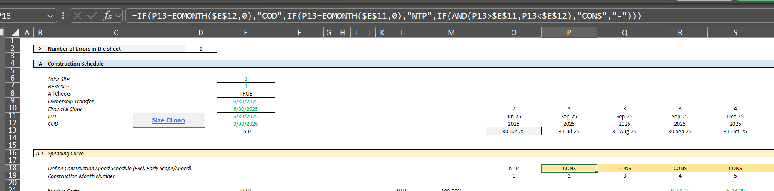
Example of Timeline formula
Could have used day() function and then a simple flag

Slide 13
Questions from Last Session
I find it easy/fast to select the entire row in Lookup Function but how do I prevent it from slowing the workbook. Is there any work around to prevent this slow down?
So the difference btwn IRR and XIRR is the difference btwn 360 and 365 days p.a? And not a case of beginning of period vs end of period. And IRR is preferrable than XIRR?
The button labelled, "Copy Functions to your Workbook -- Click on this button and then copy code with CNTL A and CNTL C (close the box). Then go to your book (any sheet), ALT F8 and paste to new module" in the generic macros doesn’t seem to be working.
Can you consider energy projects for the next modelling sessions? Will be fantastic to grasp financial concepts related to my working experience as energy consultant.
Open new version of Generic-Macros

Slide 14
Understanding of DSCR, LLCR and PLCR
All ratios are measures of buffer and driven by possibility of decline in cash flow
  Example
    DSCR = CFADS/DS
    CFADS 150
    Debt Service 100
    DSCR 1.5
  How much can cash go down before cannot meet debt service: 150-100 = 50
  How much can cash go down in percent : 50/150 = 33.33%
  Formula for minimum break-even: (1.5-1)/1.5 = 33.33%
LLCR measures break-even over the entire debt life (it is possible that DSCR is below 1)
  LLCR = NPV (CFADS ll)/NPV of DS (NPV of DS = Loan at COD)
  How much can cash flow go down before cannot pay off loan at end of the loan life
    LLCR = 1.6
    Break-even over loan life (1.6-1)/1.2 = 37.5%
PLCR measures the break-even over the entire life and give the value of the tail
  PLCR = NPV (CFADS pl)/NPV of DS (NPV of DS = Loan at COD)
  How much can cash flow go down before cannot pay off loan at end of the loan life
    PCR = 2.0
    Break-even over loan life (2-1)/2 = 50%

Slide 15
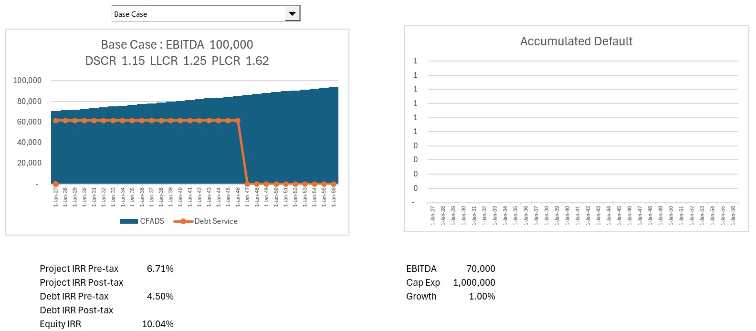
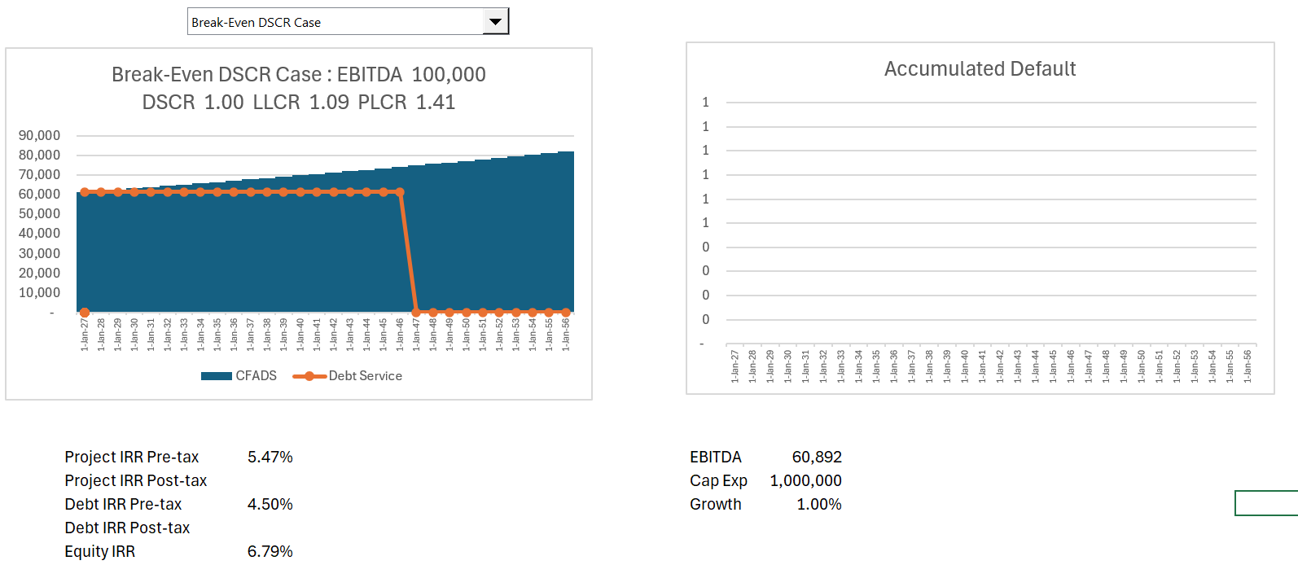
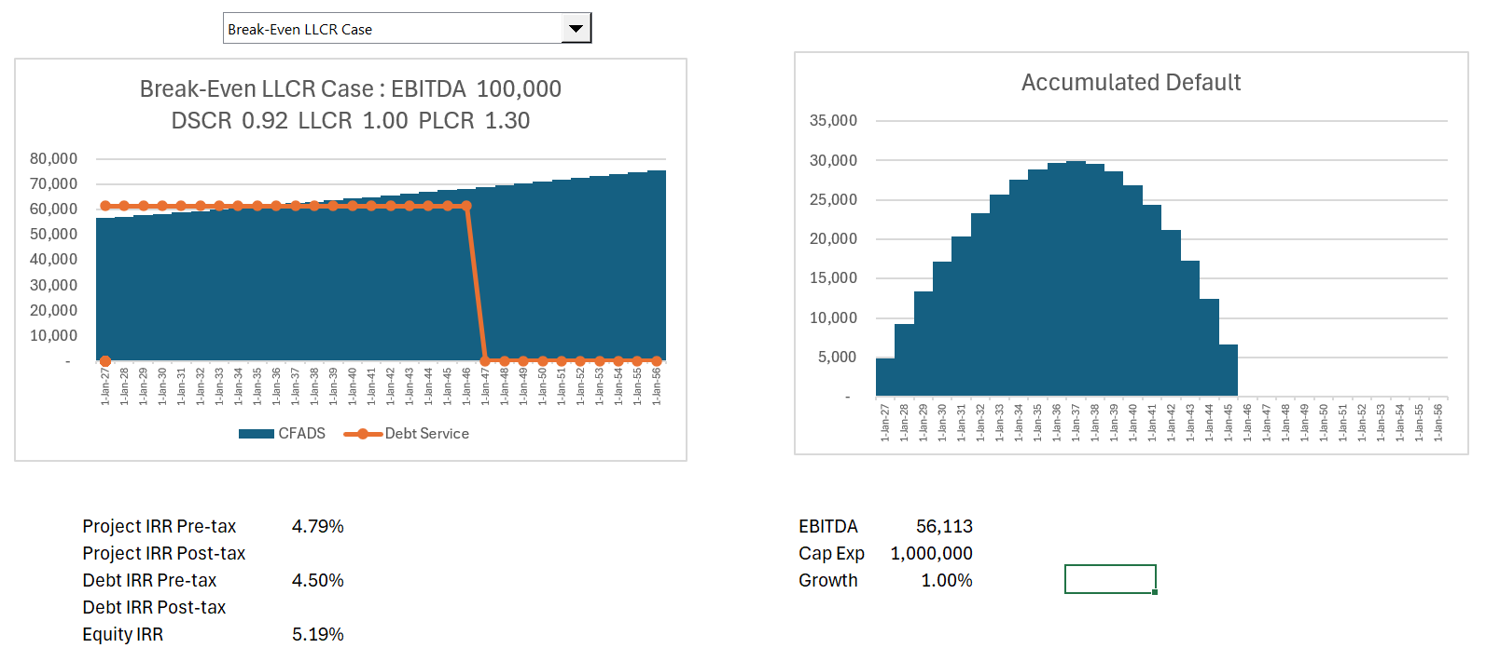
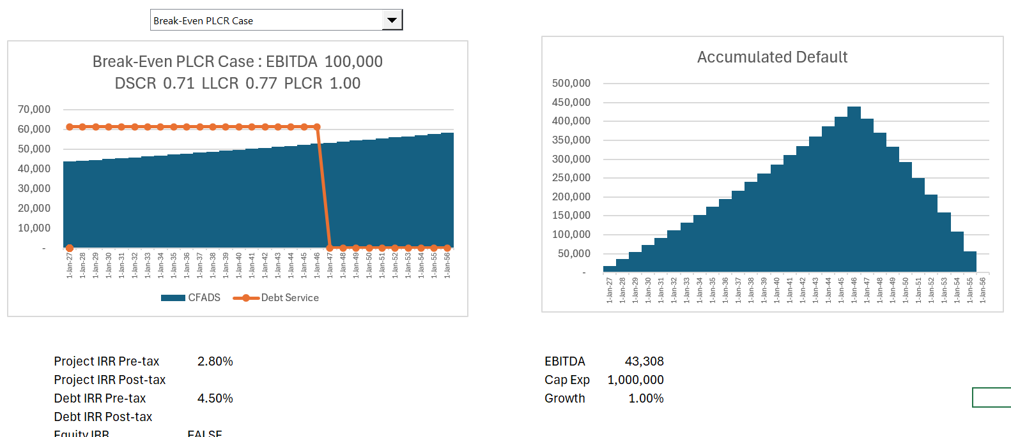
Illustration of Cases
Break Even % = (LLCR-1)/LLCR, (DSCR-1)/DSCR etc.

Slide 16
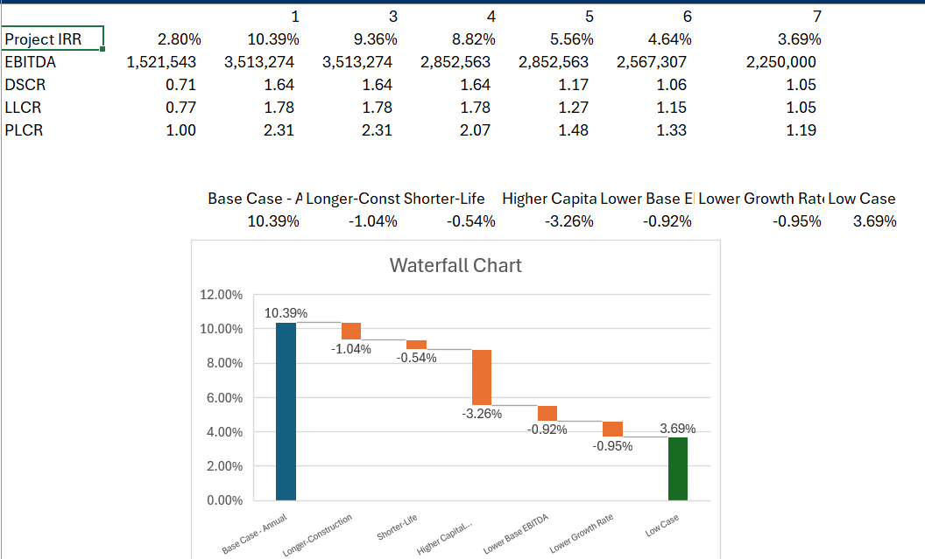
Scenarios and Waterfall Graph
.

Slide 17
DSCR, LLCR and PLCR and Credit Analysis
Probability of Default = Probability of DSCR < 1 = Probability of cash below Break even
Probability of Loss = Probability of Default x Loss Given Default
Probability of Loss over Loan Life = Probability of LLCR < 1 = Probability of cash below LLCR Break even
Probability of Loss over Project Life = Probability of PLCR < 1 = Probability of cash below PLCR Break even

Slide 18
Mean Reverting and Non-Mean Reverting Cash Flow and Risk
Importance of mean reversion in financing long-term asset
Non-mean reverting, volatility increases with time (technically, the square root of time period)
  Volatility for a year – standard deviation of return annually
  Volatility for a month – standard deviation of return for month
  Volatility for a year = volatility for month x square root of 12
  Volatility for five years = volatility for one year x square root of 5
  Price t = Price t-1 + Price t-1 * volatility
  Price t = Price t-1 + Price t-1 * Norminv(Rand()) * Volatility
  Price t = Price t-1 x (1 + Norminv(Rand()) * Volatility)
Mean reverting – follows cyclical pattern
  Volatility increases less than by square root of time
  Mean Reversion Factor ➔ % by which move to mean in one period
  Example: Mean Reversion = (Price t = Mean Price – Price t-1) * Mean Reversion Factor
  Start with Mean price and subtract last period price
  If last period price above mean, then price should come down, so mean reversion is negative
  If last period price below mean, then price should go up, so mean reversion is positive
  Mean reversion factor is difficult to measure
  If Mean reversion factor is 100%, then the volatility does not increase with period

Slide 19
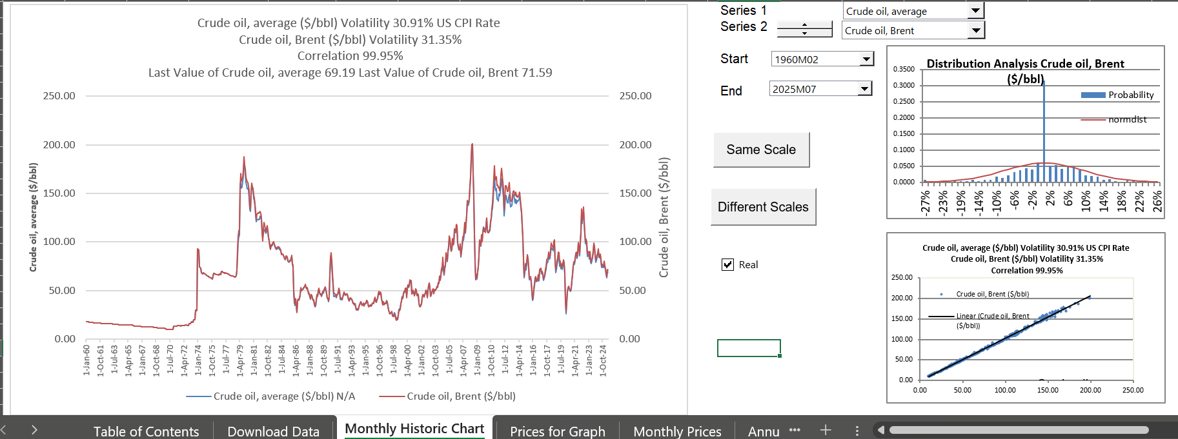
Oil Price from Database File
.

Slide 20
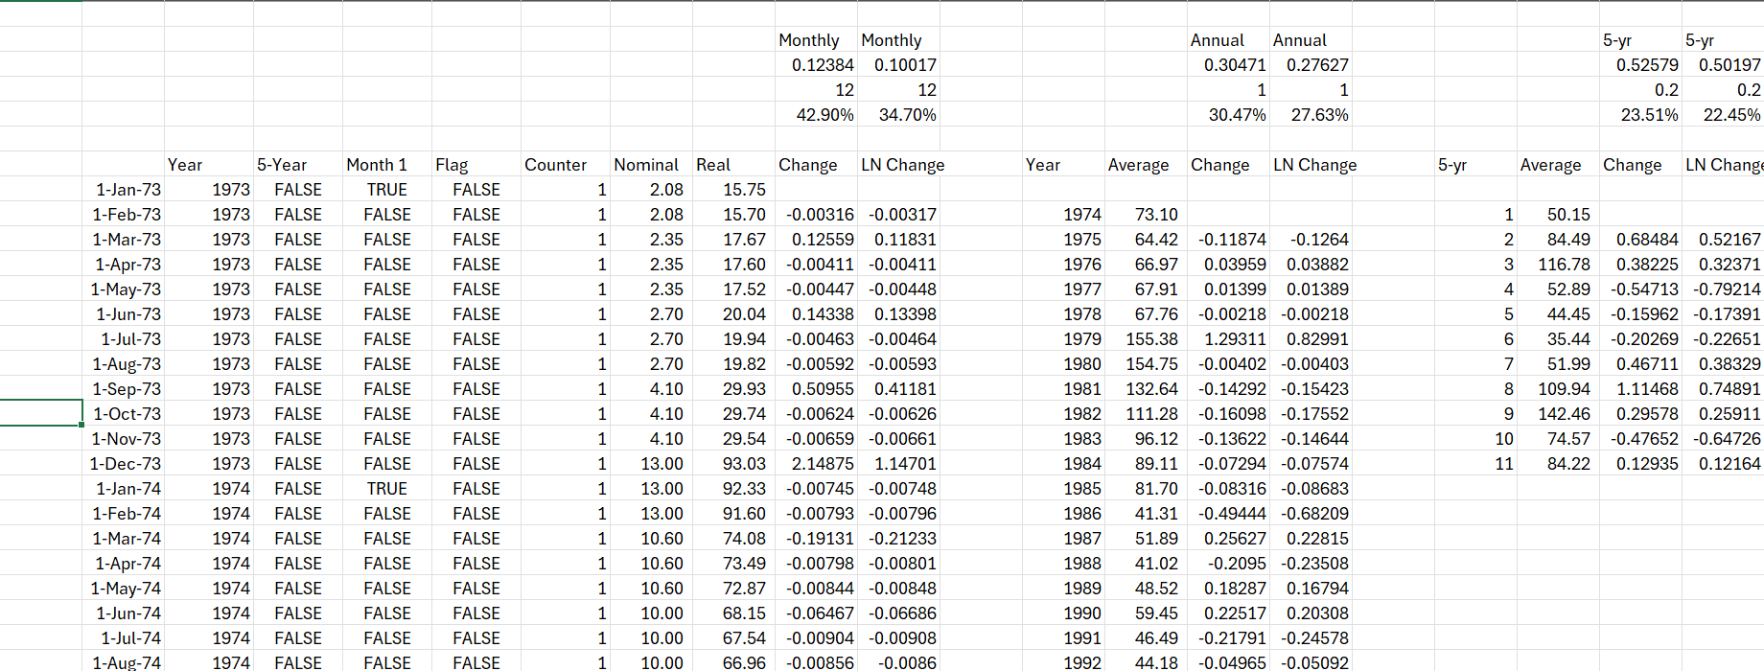
Illustration of Mean Reverting Cash Flows – Commodity Prices Except Change in Oil Prices in 1973
Volatility of prices for 1-year, 5-years, 10-years

Slide 21
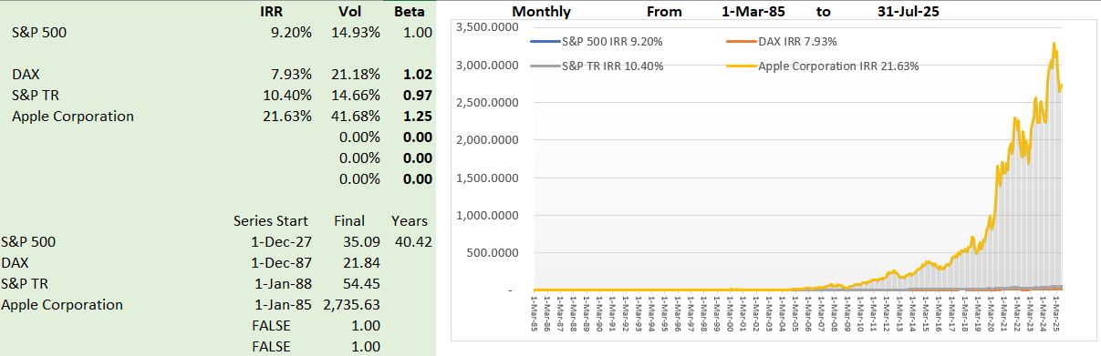
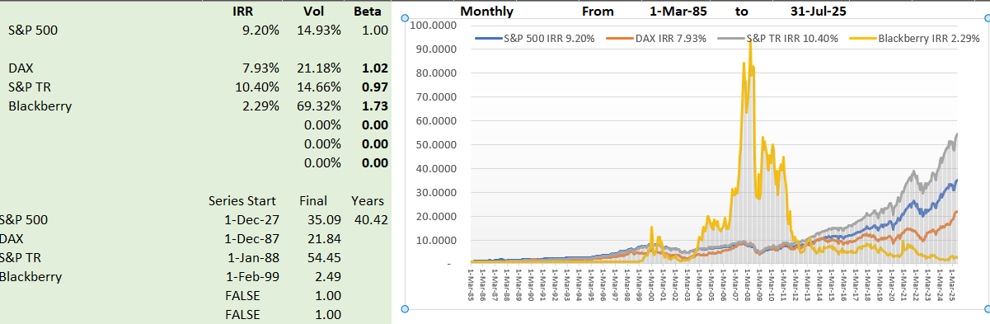
Illustration of Non-Mean Reverting
Blackberry Price and Apple Price
Volatility driven by fashion, changes in technology, one-time non-recurring events.
Volatility of one year, three-year, five-year

Slide 22
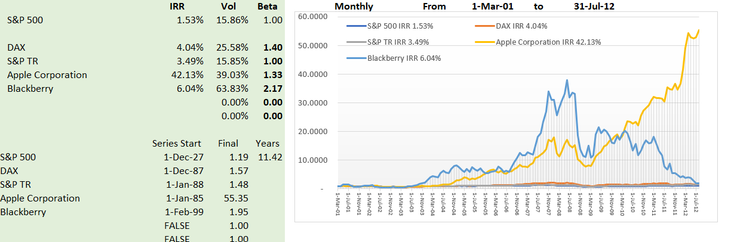
Blackberry and Apple
.

Slide 23
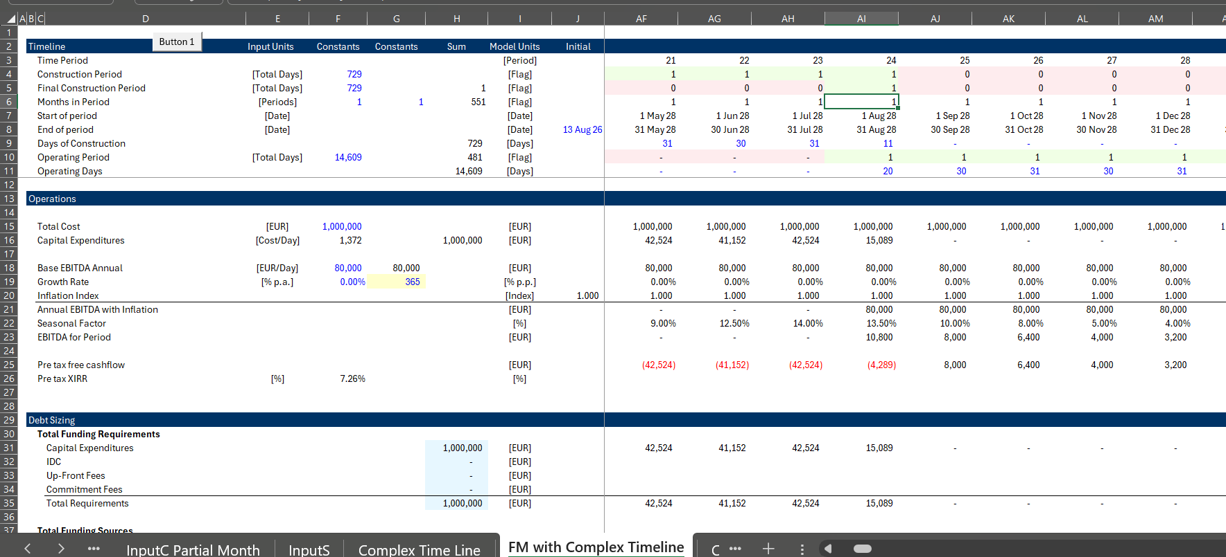
Complex Timelines
.

Slide 24
Session 3 – Default and Implementation of Monte Carlo Simulation

Slide 25
Default Studies
Probability of Loss = Probability of Default x Loss Given Default
Measure with Default at Loan Life or LLCR or PLCR
For project finance, loss given default is relatively low

Slide 26
Expected Loss Can Be Broken Down Into Three Components
Credit Spread must cover the expected loss and is driven by probability of default x loss given default
Borrower Risk
Facility Risk Related
EXPECTED LOSS
$$
Probability of Default
(PD)
%
Loss Severity
Given Default
(Severity)
%
Loan Equivalent
Exposure
(Exposure)
$$
=
x
x
What is the probability of the counterparty defaulting?
If default occurs, how much of this do we expect to lose?
If default occurs, how much exposure do we expect to have?
The focus of grading tools is on modeling PD

Slide 27
Measurement of Credit Risk with Rating Systems – How Do you Come Up with Good Rating
Map of Internal Ratings to Public Rating Agencies
Investment Grade
Junk

Slide 28
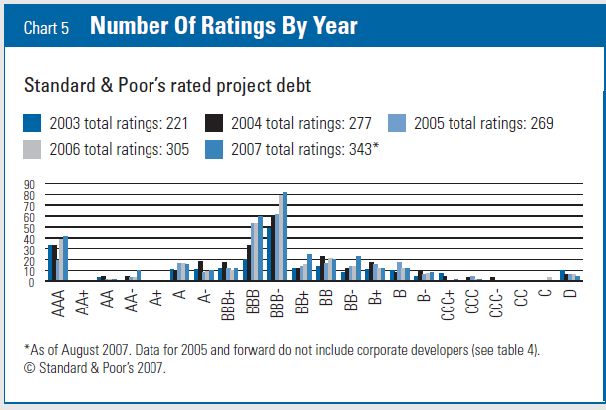
Project Finance ties to BBB- (Baa3)
Investment Grade
Junk

Slide 29
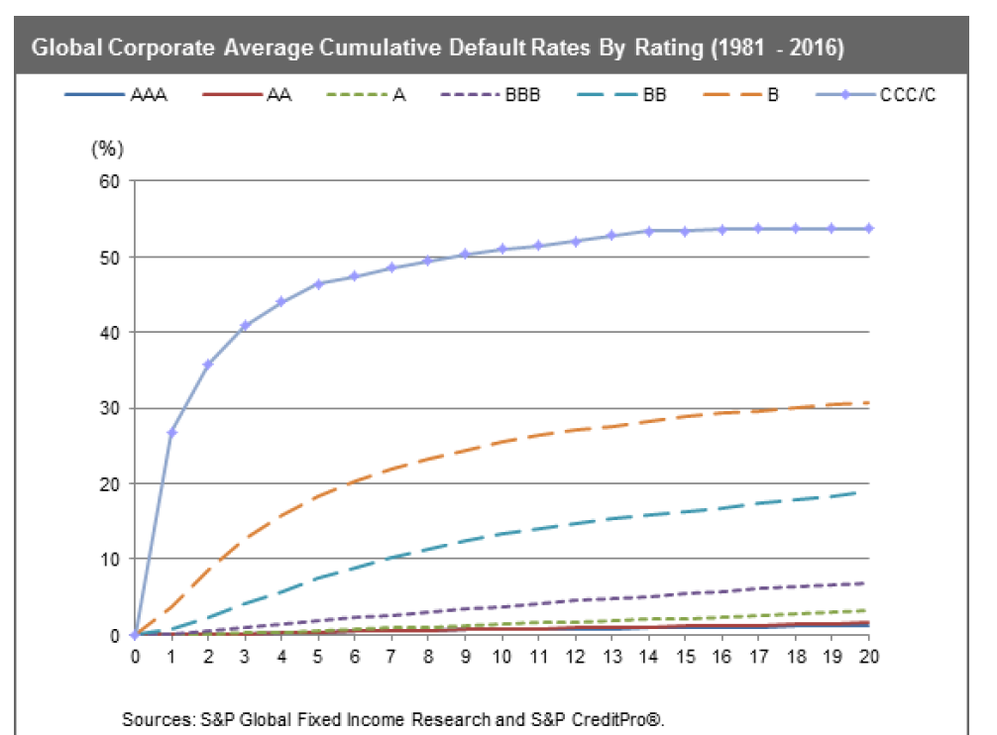
Default Studies – Probability of DSCR Below 1
.

Slide 30
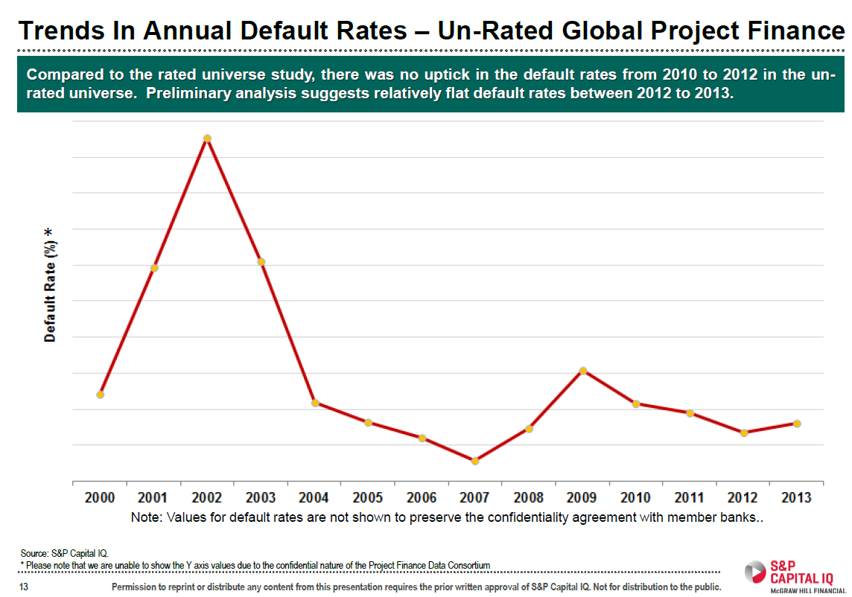
Useless but Interesting Chart on PD

Slide 31
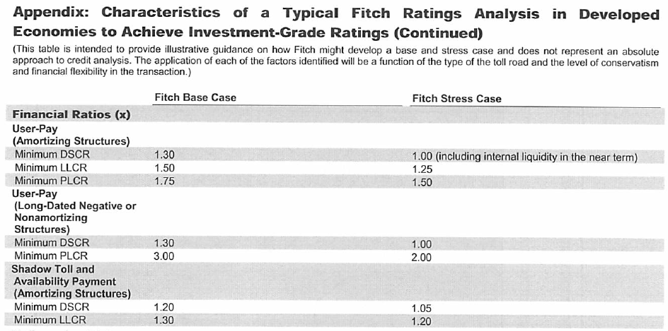
Use of Ratios Different Ratios in Different Industries: DSCR and Credit Ratings in Project Finance
Target rating of BBB-
Target DSCR or LLCR
Example of Toll-roads

Slide 32
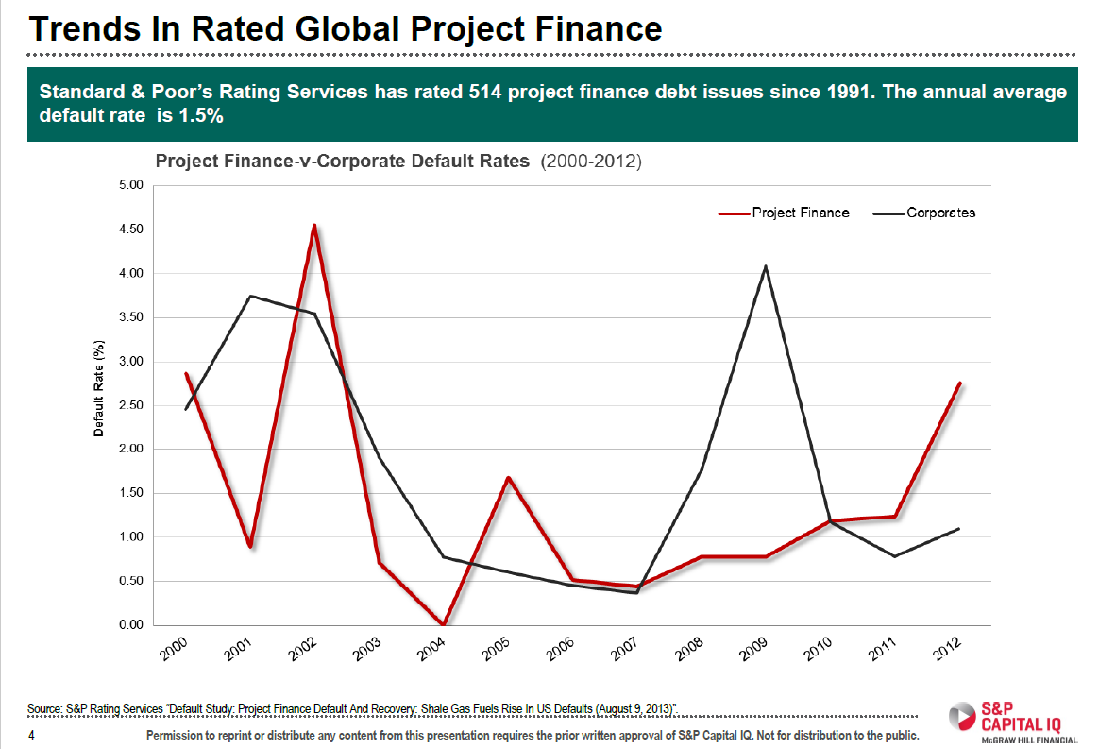
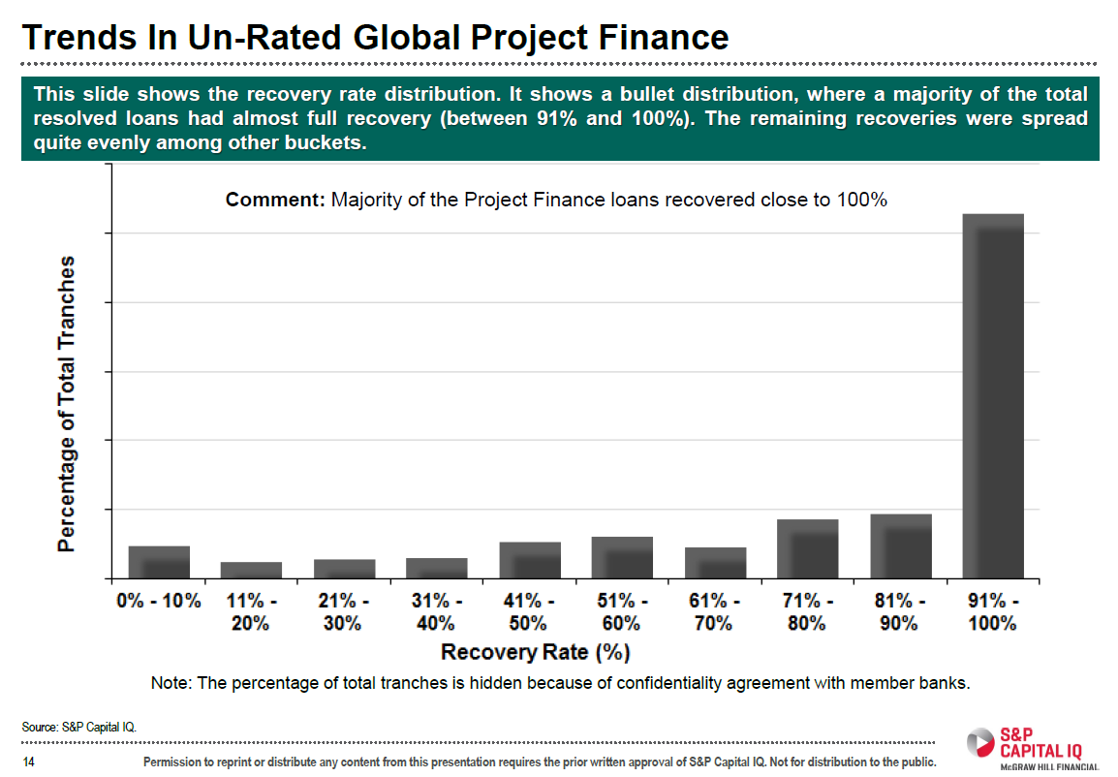
S&P Study of PD and LGD for Project Finance
There is not much data, but the data shows that the LGD is very high for project finance. This is logical given the long-term nature of the assets.

Slide 33
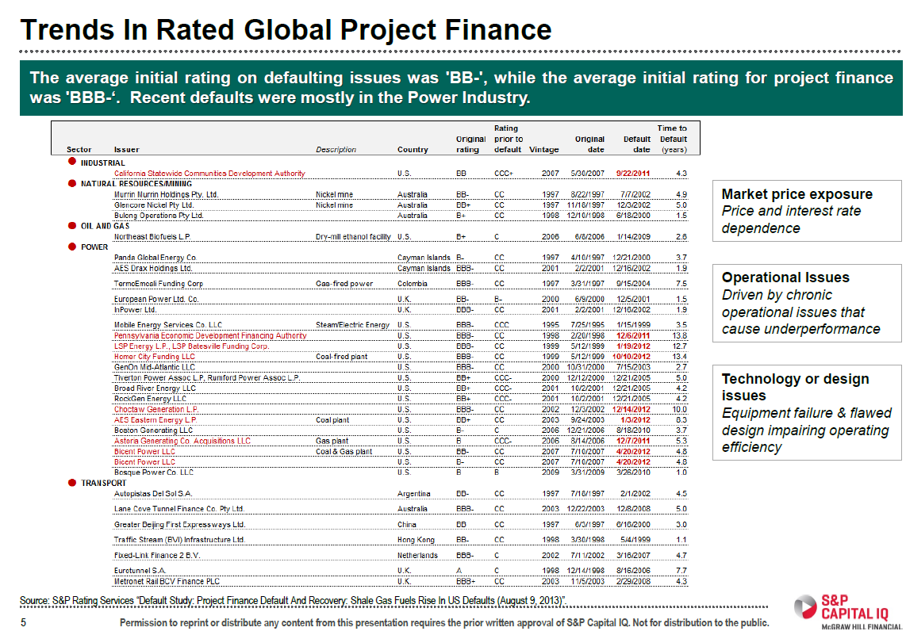
Project Finance Defaults
A lot of merchant plants in US. Note the initial rating of BBB-

Slide 34
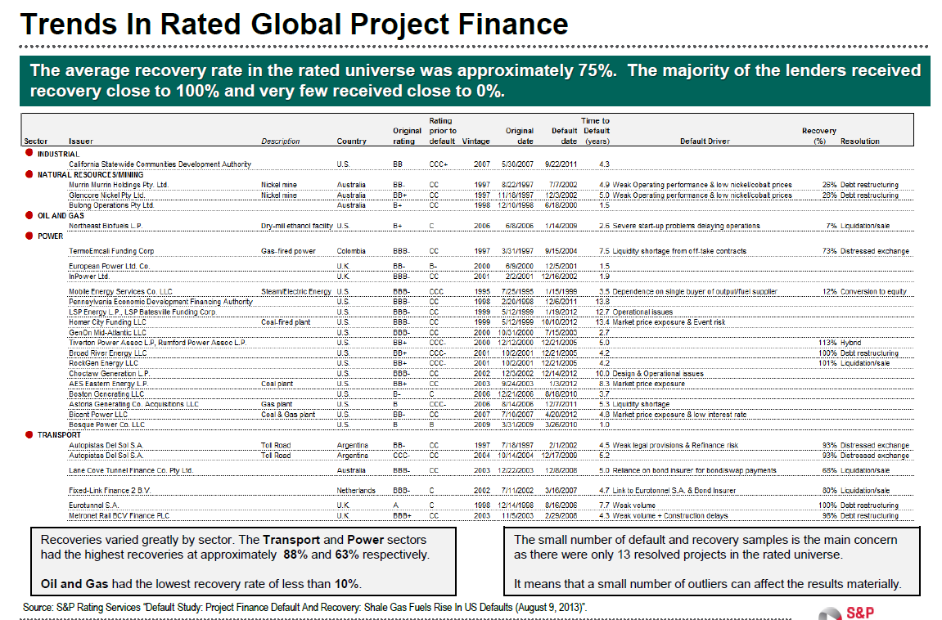
S&P Recovery Rates
LGD for Defaults – Not much data

Slide 35
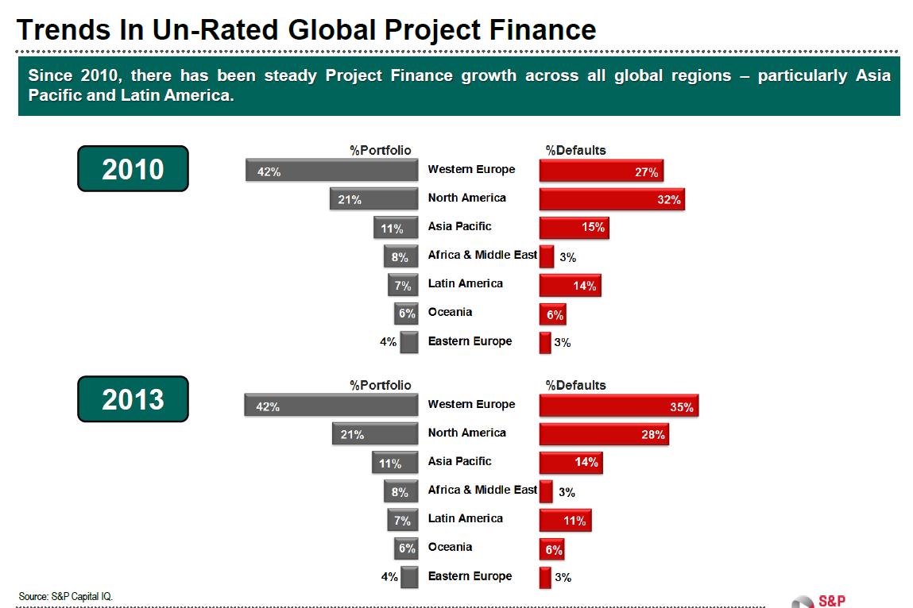
Project Finance is Unfair to Africa
Credit spreads are much higher in Africa, but compute the ratio of defaults to loans.
For U.S. the ratio is 32/21 or 1.53.
For Africa the ratio is 3/8 = .375.

Slide 36
Session 4: Valuation

Slide 37
Assignment
Valuation should be done using DDM methodology (equity value and enterprise value), alongside relevant returns and key sensitivities that a prospective buyer might look at
  Use your discretion on which sensitivities to highlight
  For pricing the asset, you are expected to triangulate between precedent transactions and the bottom-up rate derived using CAPM methodology (for the CAPM buildup specifically, you’re allowed to do desktop research and are encouraged to make sensible assumptions as needed), and include relevant build-ups in the files
  For the returns analysis, assume a 7-year hold period with a prudent yield compression between entry and exit discount rates
Illustrative precedent transactions
  No. Size (MW) Technology Year
  Implied exit discount rate (USD)
    1 350 Solar 2023 9.0%
    2 150 Wind 2022 11.0%
    3 180 Solar & Wind 2022 9.0%
    4 225 Wind 2022 10.0%
    5 200 Solar 2021 8.0%

Slide 38
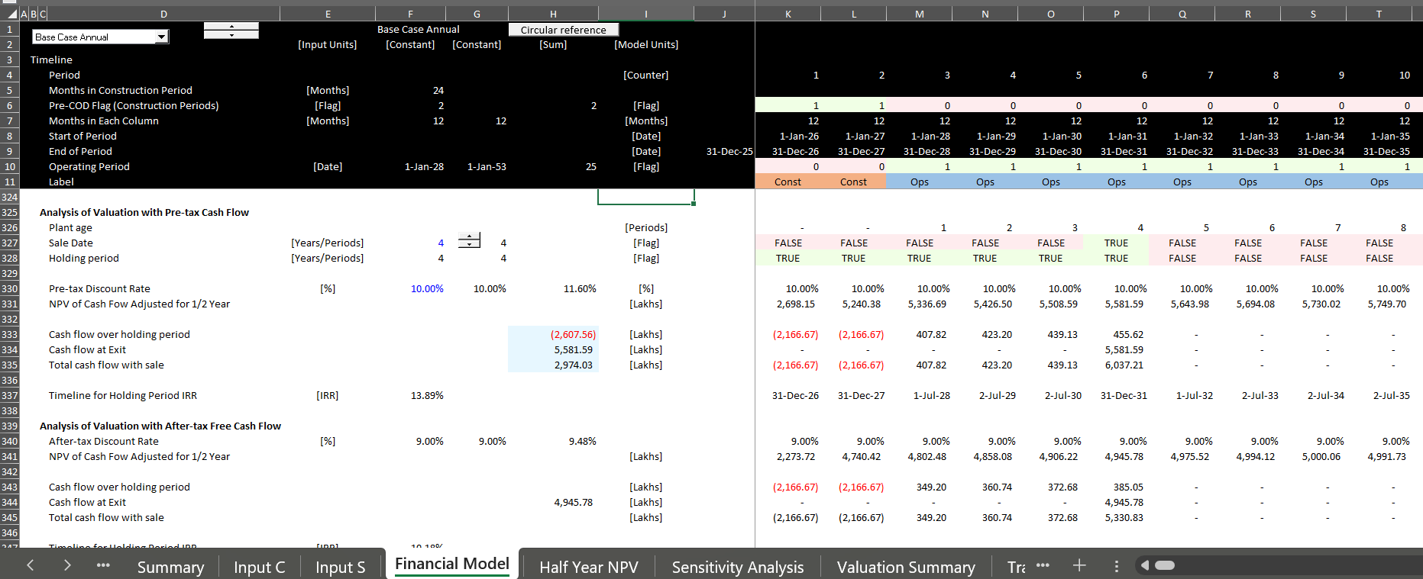
Start with Basic Valuation
Timeline and Discounting
In project finance no need for the big problem of terminal value

Slide 39




Project Finance and Changing Risk
Before COD, cash flow is presented in the sources and uses statement
After COD, cash flow is presented in the cash flow waterfall and the last line is dividends
Father of the bride makes commitment to pay for wedding
Commitment Fee
Date at which you realize that the wedding is working or is a complete disaster
Development is Dating period. Probability of failure is high
Pay for Wedding with Other peoples’ money
Pay your Bills and re-structure your life. Stuck with PPA type contract. May default.
FC is making promises (that you may not keep)
COD is Wedding Date
Decommissioning Date

Slide 40
Reasons for Risk Reduction After a Couple Years of Operation
Examples of Risk Resolution After A Couple of Years of Operation
  Finished with Development Risk – Big Probability of Failure
  Finished with Financing – Things May Not Work Out
  Finished with Construction – Many Things Can Go Wrong
  Establish Historic Volumes – Test Whether Base Estimates are Wrong
  Establish Ability to Collect Revenues – Political Risk Resolved
  Establish O&M Expenses from History – E.g. Evaluate Insurance Expenses
How much more of a return do you need for taking these risks. Anybody who says that you can find this from

Slide 41
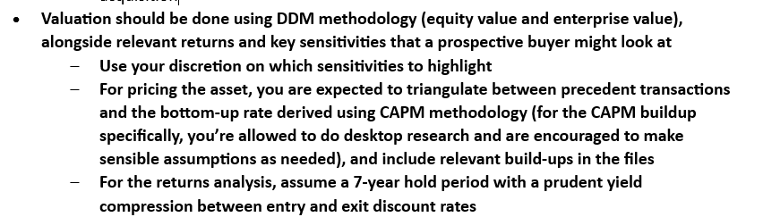
Back to Assignment - Triangulation
Comments in Assignment
What does DDM methodology
More sensible process
  Start at end with stable cash flows
  Select reasonable holding period as short as possible
  Make reasonable assessment of required yield
  Use goal seek to find the price with IRR that includes sale

Slide 42
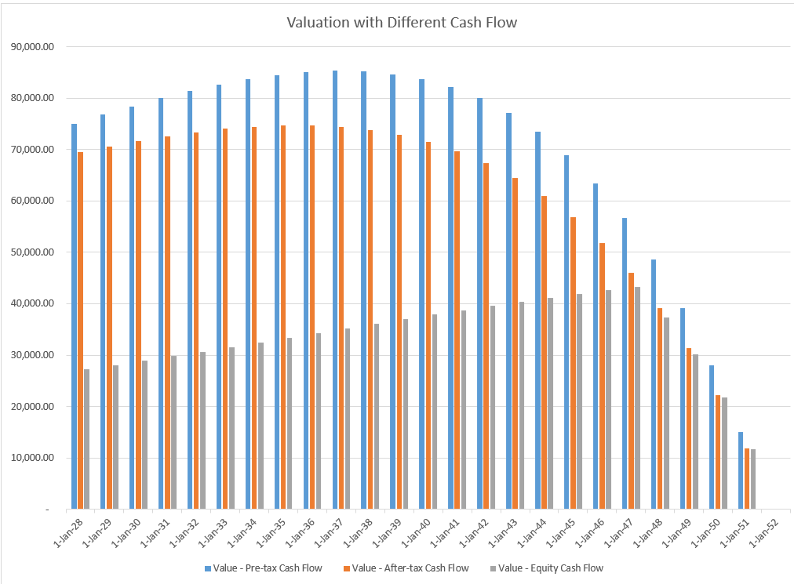
Process of Adjusted for Risk Changes
Start at the End with Target Equity IRR for Stable IRR
Set PPA with Higher IRR
Use Flags to Test Exit and Holding Period
Compute Exit and Holding Company Valuation with Discount Rate
Why Cannot Compute Terminal Value because of Distortions from EV/EBITDA or P/E Ratio
Evaluate the IRR with Compression between Initial Discount and Exit Discount Rate

Slide 43
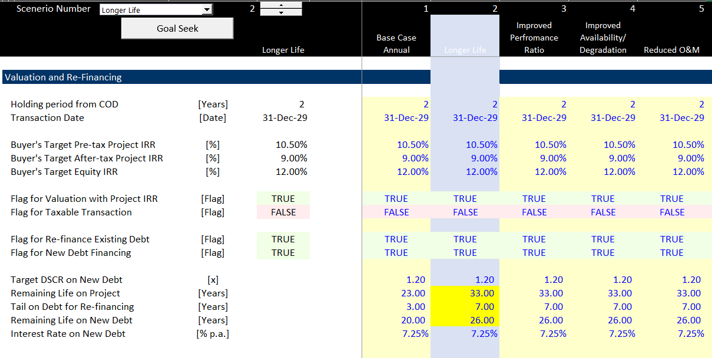
Assumptions for Transaction
In InputC, put in some synergies (not very credible for projects)
Allow Valuation from Pre-tax project cash flow, After-tax project cash flow, Equity cash flow with different discount rates.
If purchasing projects from Orsted and companies without project finance, use project cash flow and assume financing
Incorporate re-financing where debt size comes from the present value of debt service and debt sculpting.

Slide 44
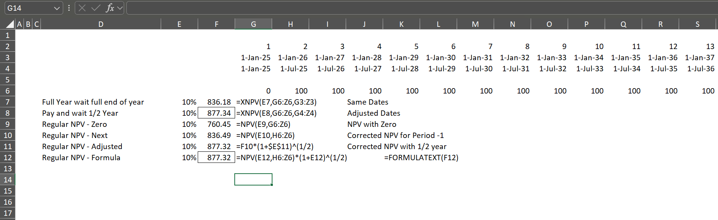
Timing Problem with Valuation
Nice thing about valuation – no terminal value
Nice thing about valuation – objective discount rates

Slide 45
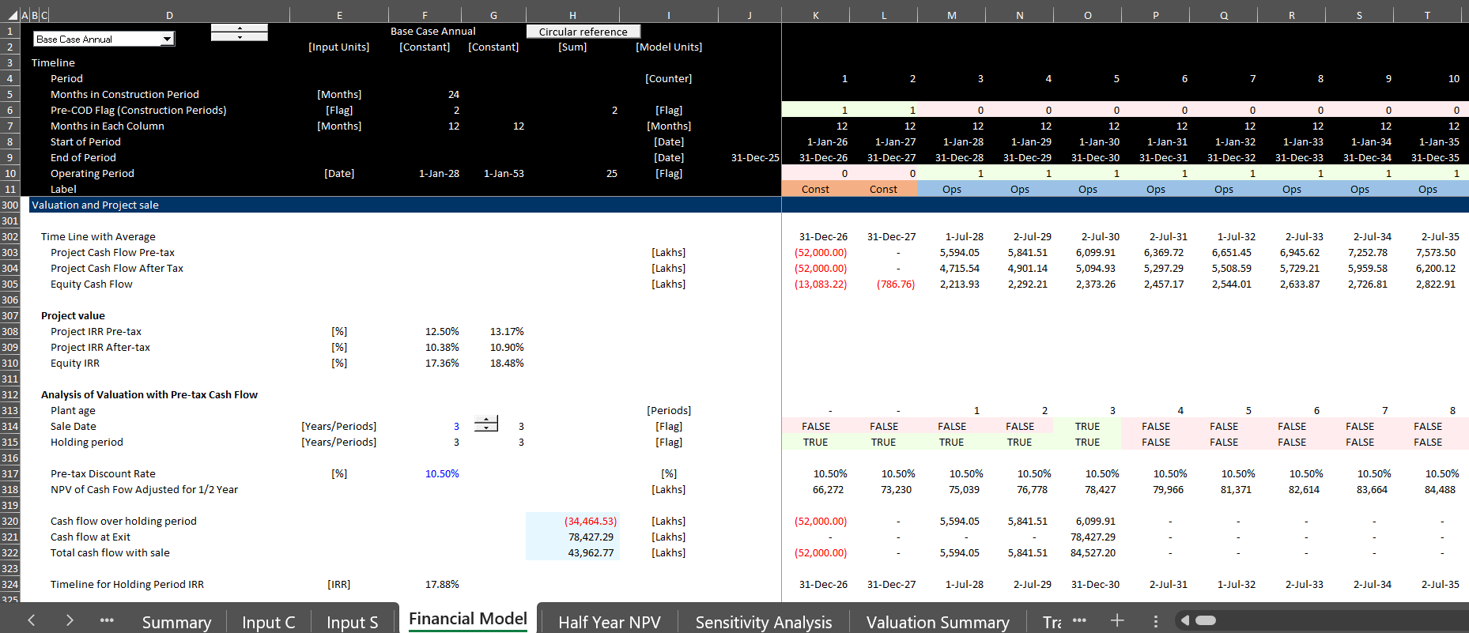
Understanding Patterns of Cash Flow that Influence Value and Timing
Simple Alternative Patterns of EBITDA
Case with Flat Nominal EBITDA
Case with EBITDA increasing with Inflation
Equity Cash Flow Increases After Debt Repayment

Slide 46
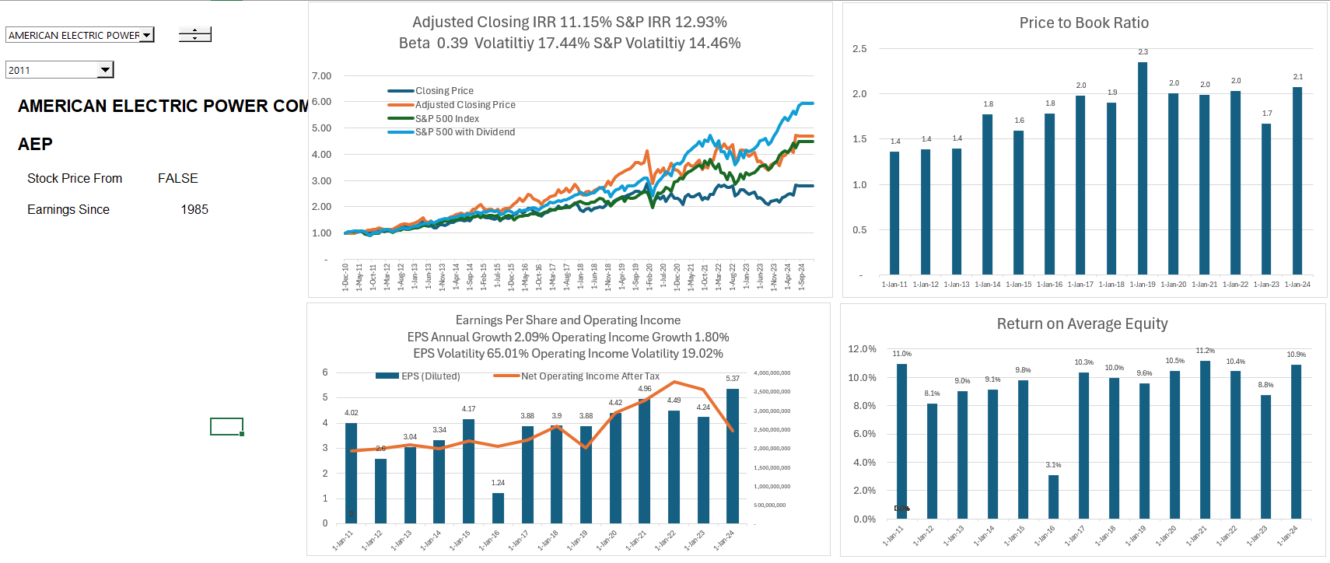
Financial Ratios for Stable Corporation
.

Slide 47
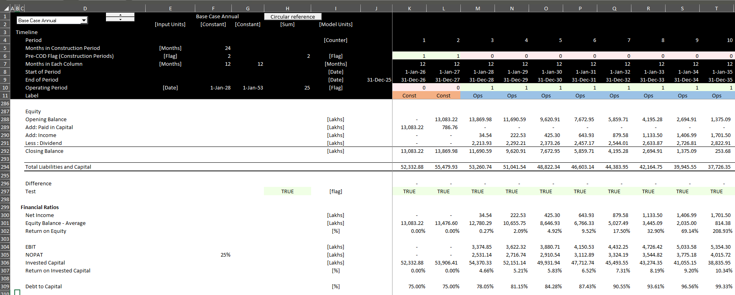
Problem with Financial Ratios in Project Finance
Because of depreciation and debt repayment, financial ratios do not give an indication of the performance of a project

Slide 48
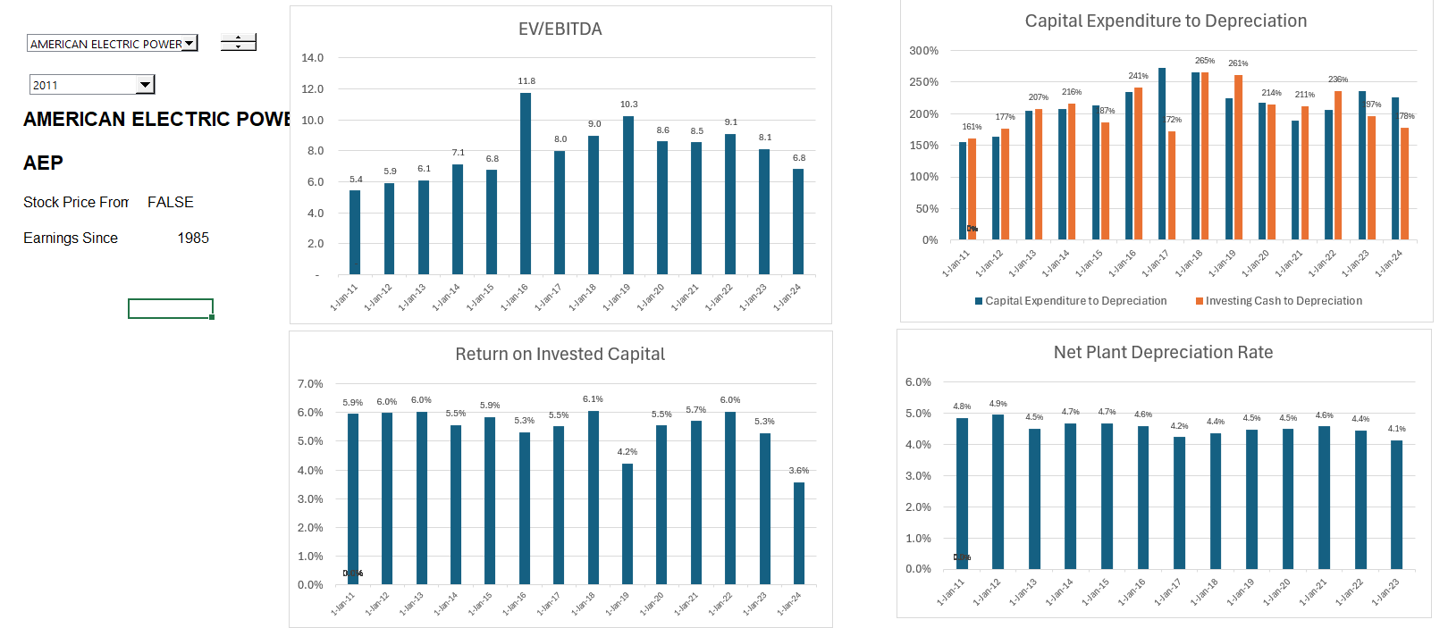
Stable Company EV/EBITDA, ROIC and Project IRR
.

Slide 49
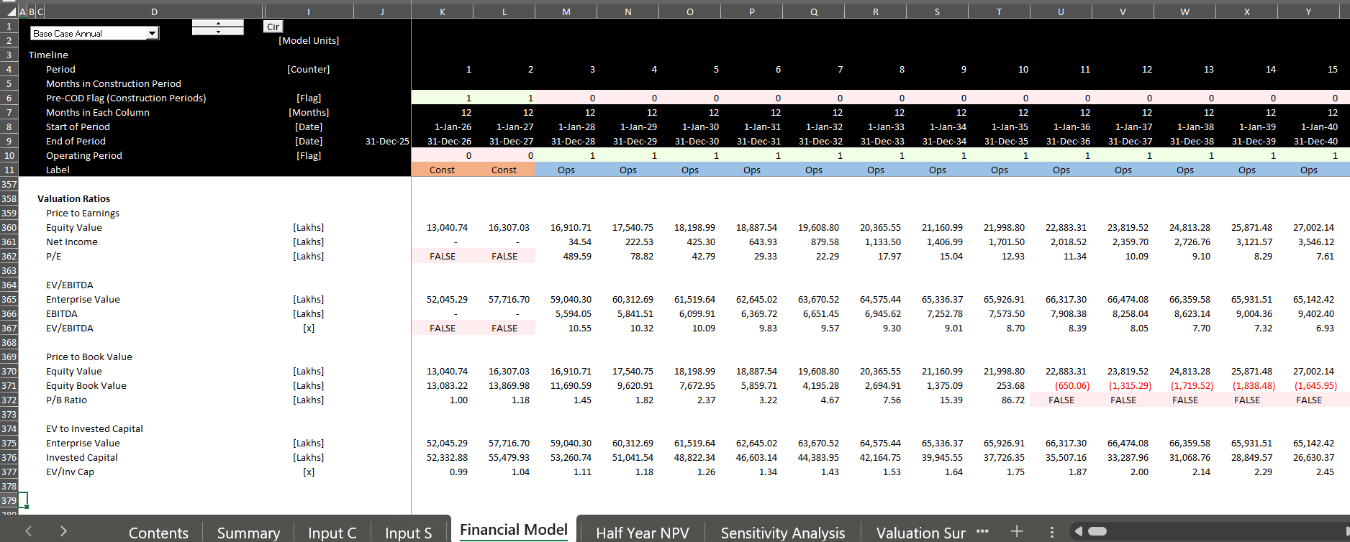
Valuation Ratios Not Constant
Valuation Ratios with IRR = Discount Rate
Price to Book Should be 1.0
Implication – Just Use the Discount Rate

Slide 50
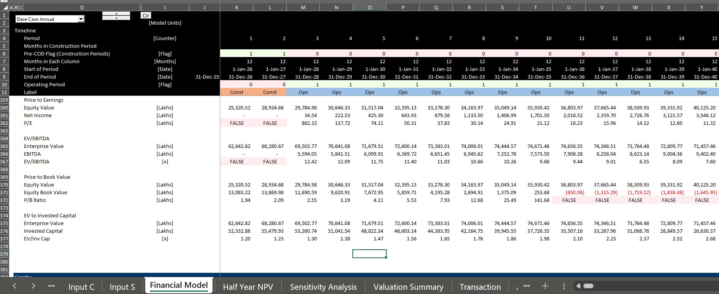
Valuation Ratios with Declining Cost of Capital
Alternative Discount Rate
Everything is About the Discount Rate

Slide 51
Transaction Assumptions, Re-financing and Financial Statements
Get Valuation
Compute Sources and Uses with Consideration, Assumption of Debt, New Debt and Equity Issue
Compute Possible Goodwill from Asset Write-up and Existing Book Value
Use Transaction Data to Develop Model with Three Statements
Demonstrate Problem of Earnings and Depreciation
Put in Assumed Stock Price and Accretion or Dilution

Slide 52
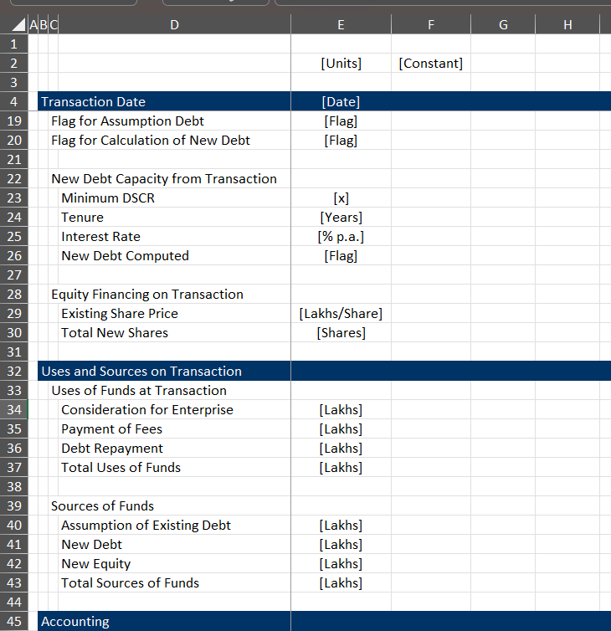
Transaction Set-up
.

Slide 53
Exercises
Valuation with Alternative Cash Flow (Use Solar Model)
Timelines and Holding Period
Holding Period Returns
Compute Uses and Sources for M&A Transaction
Compute Fair Value and Goodwill for M&A Transaction
Take out taxes for Model Example because of circular references
Compute Financial Model for New Company from Base Financial Model

Slide 54
Process for Evaluating Cost of Capital and Required Price
Step 1: Start at end after stable period with required return for buyer
  Can get data from transactions
  If not can add a little bit to the interest rate
Step 2: Decide on a reasonable holding period
  Should have some history
  The shorter the period the higher the returns
Step 3: Make an estimate of how much higher an IRR you need for taking resolved risks
  Risks are development risks, construction over-run and delay, volume estimation, operating and maintenance levels etc.
  To think you can somehow quantify these risks with the Capital Asset Pricing Model and Beta is ridiculous
  For example, add 4% for initial risk to get the target equity IRR
Step 4: Run goal seek for price with target IRR
  Go to the portion of the model with the IRR after the plant sale and the holding period
  Compute the NPV of the holding period cash flow using the target IRR from Step 3
  Use goal seek to find price to meet the target return that covers these risks

Slide 55
Session 5: Debt Structuring and Re-financing

Slide 56
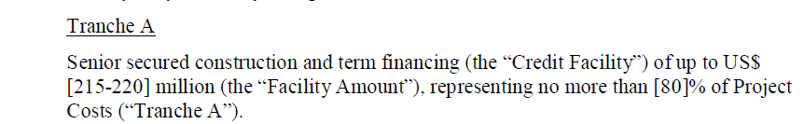
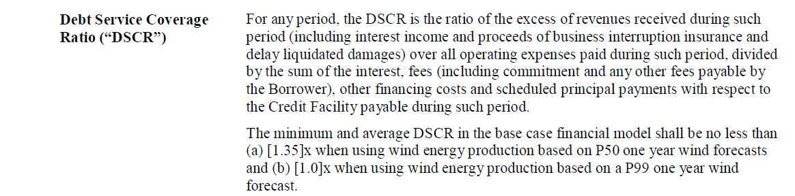
Excerpts from Term Sheet
Maximum Debt to Capital Constraint
Minimum DSCR Constraint

Slide 57
Review of Credit and Debt Sizing
In project finance, cash flow is the driver, not accounting asset valuation
Primary analysis by lenders should be DSCR which provides a buffer – for example, a DSCR of 1.20 means there is a buffer of .2/1.2 = 16.67% before a default occurs (in solar this buffer is against the downside case which inappropriately is assumed to be based on objective statistical analysis).
Contracts and mean reversion to allow stable cash flow is necessary for project finance and should be a general driver of risk for any investment
Debt size from cash flow analysis is always PV of debt service or PV of CFADS/DS (next slide)
The constraint on debt size from PV of debt service is the second step
This constraint can be manipulated by increasing the project cost with items that do not take money out of your pocket
You must come up with some kind of repayment method that is not based on CFADS/DSCR - Interest
Alternatives include repayment early, higher DSCR and shaped or curved DSCR

Slide 58
Formulas for Sculpting
Basic Formulas
  DSCR = CFADS/Debt Service
  Debt Service Target = CFADS/DSCR
  PV of Debt Service over Repayment Period = Initial Debt Balance
  Debt Service = Interest + Repayment
  Repayment = Debt Service – Interest
  If you have annual or semi-annual cash flow and constant interest rate you can use the NPV formula
More Advanced Formulas
  DSCR = CFADS/Debt Service Including Fees
  Debt Service Including Fees = CFADS/DSCR
  Repayment + Interest + Fees = CFADS/DSCR
  PV of Repayment + Interest = Debt
  Debt Balance = PV of CFADS/DSCR – PV of Fees
  If interest rates not constant, use an interest rate index (monthly or semi-annual)
  Multiple Issues: DSCR = CFADS/(DS1 + DS2 + DS3)
  DS1 = CFADS/DSCR – DS2 – DS3
  If DS2 and DS3 Given, PV of CFADS/DSCR - DS2 – DS3 = Debt Balance

Slide 59
Income Taxes, Circular Reference
Sculpting Problem
  CFADS = EBITDA – Taxes – Other
  Taxes = (EBITDA – Depreciation – Interest) x Tax Rate
  CFADS drives the amount of debt
  Debt Drives Taxes and CFADS
  Circular Reference Results
Interest During Construction Problem with Debt to Capital
  Project Cost = Capital Expenditure + Fees + IDC
  Debt = Project Cost x Debt to Capital
  Debt Drives IDC and Fees
  Circular Reference Results

Slide 60
Taxes and NOL
Please, never ever and IF statement in any kind of cash waterfall
MAX for positive or Negative
MIN on opening balance for constraint
EBT Before NOL
Starting NOL Balance = Prior NOL Balance
Carried Forward = MAX(-EBT,0)
Used = MIN(MAX(EBT,0)
Closing = Opening + Carried Forward – Used
EBT After NOL = EBT Before NOL + Carried Forward – Used
Taxes = EBT After NOL x Tax Rate

Slide 61
Session 6: Debt Sculpting Complications, Re-Financing, Circular References

Slide 62
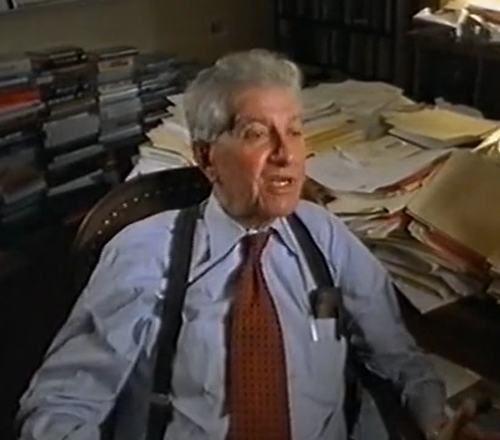
As Usual, Start with Theory
Miller and Modigliani and APV
Debt Level and Risk in Project Finance
Un-gear and Re-gear Beta is ridiculous in project finance (and maybe in any finance). This is because the debt level defines the level of risk and not the other way around
Why Equity IRR rather than Project IRR is used in project finance. For example, a risky project has less debt that would imply a lower equity IRR if the project IRR was the same. But the project IRR should be higher because of the higher risk, and the lower debt offsets this risk leading to a similar equity IRR
Problem with cash on the balance sheet
Much bigger problem if cash is invested at the beginning because of IRR mathematics – if the cash must be financed by equity and not a mixture of debt and equity.
This is one of the issues that arise with putting a cash reserve on the balance sheet to resolve the interest expense versus debt service problem

Slide 63
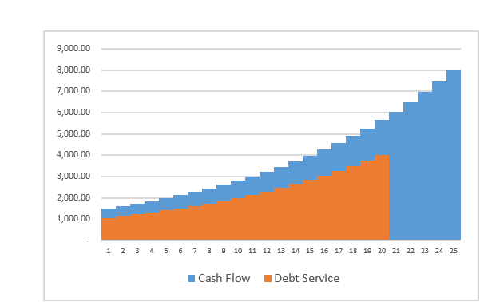
Project Finance and Dividends
Dividends (without cash sweep or cash trap) serve two purposes. One is to get the IRR; the second is to provide a buffer to lenders
Should dividends occur if interest is above debt service
Without dividends the IRR will be low (remember the IRR mathematics)
Dividends are needed for CFADS buffer
If extra cash is put in a reserve account and it just meets the debt service, there will be no buffer.
The formula: Debt Service = CFADS/DSCR
  can be reversed to Debt Service * DSCR = CFADS
  If the repayment is zero, you can use the formula to derive how much of a cash reserve is necessary

Slide 64
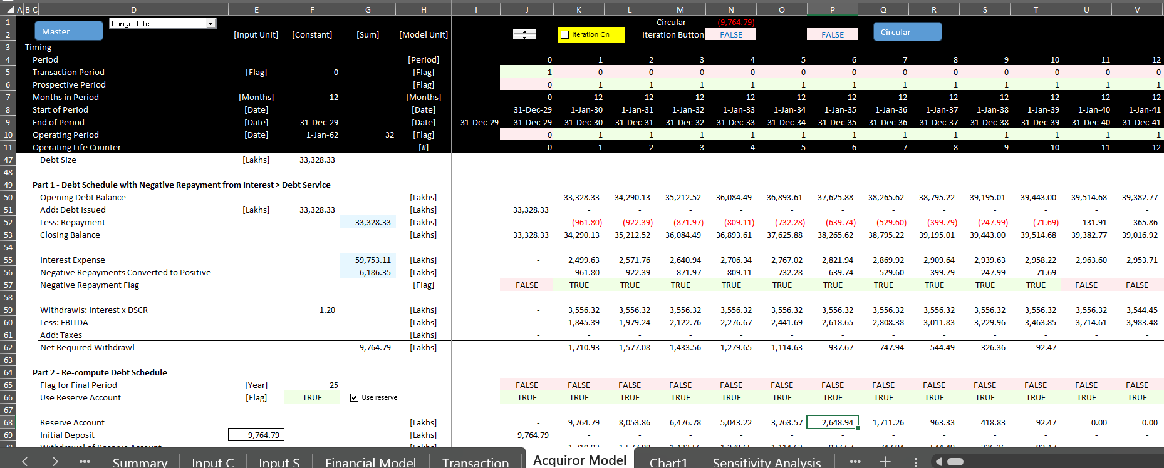
Option for Payment in Kind Interest
Issue
  How much should the payment in kind interest be
  How should you structure the model to add payment in kind interest
  What is the equity IRR with payment in kind interest versus a cash reserve
  Just replace the negative repayment with PIK interest when the repayment is negative

Slide 65
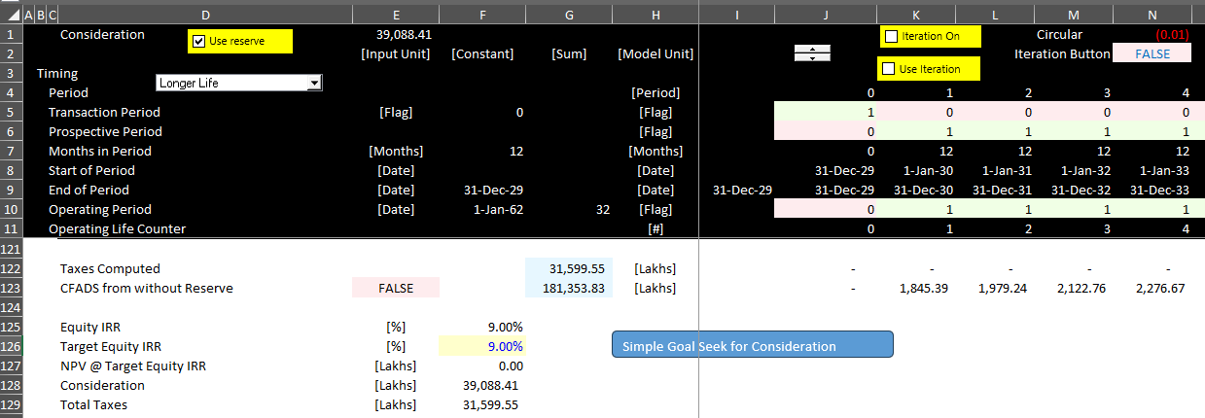
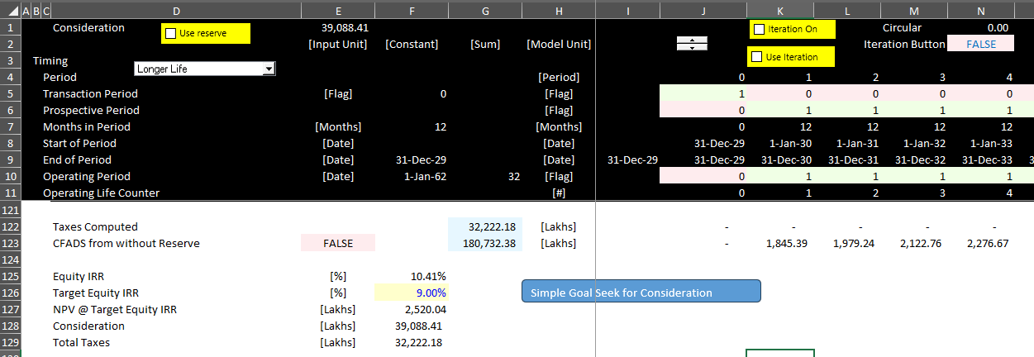
Understanding Equity Impact of Reserves
Cash reserves increase equity funding
Remember anything at the beginning has biggest impacts on IRR

Slide 66
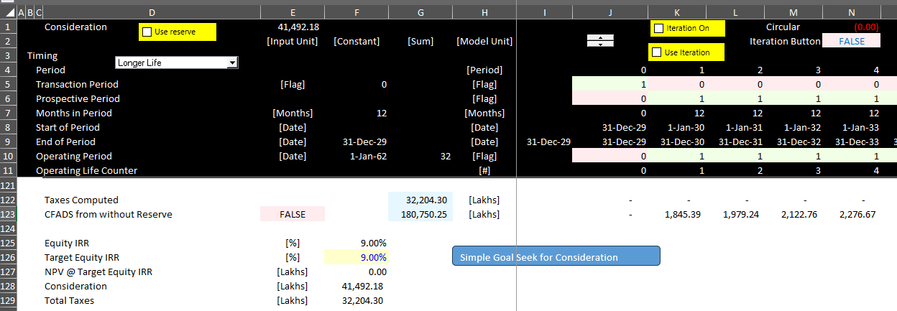
Consideration Impact of Reserves
Note the Increase in Consideration if you have PIK Interest

Slide 67
Debt Sculpting, DSCR Formula and Negative Repayment
Start with the basic formula:
  DSCR = CFADS/DS
  DS = CFADS/DSCR
  DS = Interest + Repayment
It is possible that in this formula the repayment will be negative when interest is greater than debt service
In this case there are a couple things you can do.
  You can set up a cash reserve account to cover the interest
  You can use the cash reserve withdraws to cover the repayment
  In this case there is higher repayment (non-negative) and the tenure of the debt declines
  If the CFADS includes only the cash for repayment, the DSCR is below the target
Solution
  Amount withdrawn from the reserve account uses the formula
  CFADS = EBITDA – Taxes + Amount Withdrawn from Reserve
  Target CFADS = Debt Service x DSCR
  Debt Service = Interest Expense
  (EBITDA – Taxes + Amount Withdrawn) = Interest * DSCR
  Amount of Reserve Withdrawn = Interest * DSCR – EBITDA + Taxes
  Note the extra amount results in dividends like the normal situation

Slide 68
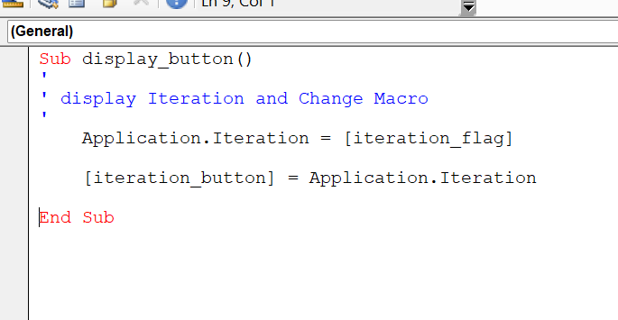
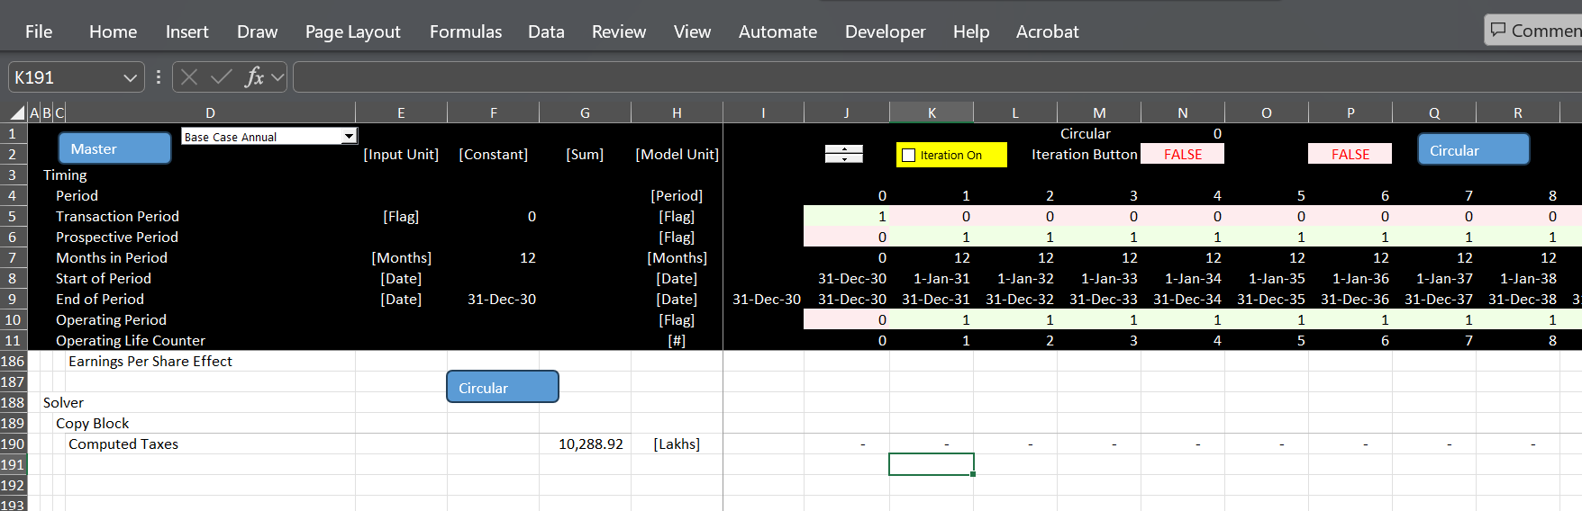
Review of Ugly problem of Circular References
Issue
  Does the Iteration Button cause problems with a goal seek
  Allow circular with with if statement (not multiplication) with switch and check box
  Illustration of Turning on and off Iteration Button
Issue
  Macro with goal seek – use range names
  Test copy and paste with goal seek together
  Use NPV for target IRR

Slide 69

When Does Problem of Interest > Debt Service Occur
High growth and or inflation rate
Big difference between seasonal cash flow
Battery augmentation
Inverter Replacement Financed
Major Overhauls without MRA

Slide 70

Three Steps to Demonstrate Problems
Step 1:
  Set-up account that allows repayment to be Debt Service – Interest
  Set-up the amount of negative repayment (named positive payments below)

Slide 71

Try 1: Simple Account Approach
Set up cash reserve account
Sum of balances is the amount in the account
Illustrated below
Problems
  Shortens Debt Tenure
  Reduced IRR from Cash in Sources and Uses
  Circular Reference

Slide 72
Resolution of Shorter-tenure
If you are using DSCR to size debt, then the maximum debt to capital should be less than the required amount
You should have room to increase the debt
You can increase the debt and extend the maturity with a goal seek
You are essentially funding some of the cash reserve with increased debt
Use the goal seek function to size the debt
High Interest Rate

Slide 73




Summary of Results
Case with allowing negative repayment

Slide 74
Session 7:
Consolidation of Projects

Slide 75
A Corporation’s Value and the Value of a Family
To begin the discussion, I note that any corporation is a portfolio of different investments.
The investments could be factories, advertising, an internet website, investments in R&D, training of employees and many other things.
The way I think about this portfolio of investments is a family tree where the family has a history and may last for many generations into the future.
If we for some reason want to value the family, we would need to not only value the current generation, but also future generations that will be there long after we are gone.

Slide 76

Family is Like a Corporation; Person is Like Project Finance – How would Value the Family
Potential for Next Generation as a Guide for the Performance History of Prior Generation
Person is the project
Entire Family is the Corporation
Success of a family depends on the success of individuals in the family
Terminal Value of Future Generations Difficult to Compute – Comes from Potential from Future Generations

Slide 77
Biggest Problems in Corporate Finance
The biggest item of value in a corporate DCF analysis is the terminal value as a corporation is assumed to last indefinitely (forever).
  In the long-term future, all of the management will be replaced
  In the long-term future, all of the current products will be obsolete
  In the long-term, all existing assets (except land) will be retired
  Value in the long-term comes from the ability of management to earn returns above the cost of capital; why should we assume management can continually earn high returns on new projects
A really big problem in corporation is what WACC to use in valuation
  Assuming a constant WACC is crazy
  Everybody has different opinions about what the equity risk premium and the beta are, leading to dramatic differences in WACC
  There continue to be problems with valuing the tax shield from interest in WACC and debates about un-levering and re-levering Beta and adjusted net present value
Another big problem in corporate finance is interpreting EPS, ROE and ROIC along with P/E, EV/EBITDA and Price to Book Ratio
  When companies are growing fast, the ROE and ROIC will be lower than the equity or project IRR while when companies are not investing the reverse will be true
  The value impacts of this can be resolved with project finance analysis.

Slide 78
These Problems Do Not Exist in Project Finance
Value a project over its life and don’t need terminal value
Discount rate changes, but stable discount rate for a mature project can be established from transactions (when your children become mature, you know their value)
Most of the cost of capital comes from debt and the mature equity cost of capital is a bit above (or even below) the interest rate
Problems: Irrelevant to use ROIC, ROE, EV/EBITDA, P/E – this makes these ratios irrelevant in fast growing or fast declining corporations. It may be depressing, but this can make just about all financial statement analysis irrelevant for corporate valuation.
Market to Book Value can be assessed by the ability to earn returns above the cost of capital.
  Book Value (without write-offs) is the equity value on the balance sheet
  Cash Flow from Book Value at Cost of Capital can be computed with PMT
  Cash Flow from Premium Above Book Value can be computed with PMT and Higher Interest Rate
  Theoretical Price to Book Ratio can be computed from PV

Slide 79

Returns and Market to Book Ratio
Orsted is case study

Slide 80
Financial Ratios for Stable Corporation
.

Slide 81
Stable Company EV/EBITDA, ROIC and Project IRR
.

Slide 82

Return and Price to Book Ratio for Oil Companies
Look at Equity IRR -- Seems to require about 15% to 18% to generate value of 2.0 to 2.5x value relative to the investment. Note that the beta is .9

Slide 83

Reconciliation of IRR and ROE – Large Renewable Developer
About 7% to 12% return leads to much higher value relative to the invested capital – the market value to paid in capital plus income retained is 3.5x. The beta is similar at .85.

Slide 84

Total Energy – More Stable Returns but Low Value Relative to Investment
Note the high return of 18% with the relatively low price to book ratio.

Slide 85

Shell Oil and Exit from Renewable Investments
Return of about 10-11% and market value relative to investment is a bit more than 1.0x. Again the beta is similar at .93.

Slide 86

Portugal Renewables and Low Returns when Growing
Company with much lower returns has higher price to book ratio than Shell. Low returns driven by rapid expansion. Again beta is the same.

Slide 87

EDP with Returns and Growth
When grow quickly, the returns are low because the returns are low when companies grow fast as the ROE is lower than the IRR. For renewable energy companies the emphasis is on IRR and not accounting returns.

Slide 88
Model Analysis with FAST Principles
Modelling of energy projects sometimes uses something called FAST principles. I really do not like these silly acronyms, but it can be a way to discuss the models.
F – Flexible; the model should be flexible so that you can change scenarios, look at different valuation techniques; change the timelines for individual projects and so forth.
A – Accurate; The model should contain audit tests and an audit page that verifies the mechanics of the model are accurate.
S – Structured; The model should be structured in a logical way beginning with how the project works and moving to project cash flows. Debt and equity cash flow should be computed after the project cash flow is established.
T – Transparent; The model equations should be short and simple and easy to understand. Somebody picking up the model should be able to understand the model in short order.
I believe the model developed by the PE firm violated these principles.

Slide 89

Flexibility – Adding New Projects
Perhaps I am obsessed with the idea of presenting projects in a separate sheet and then having the option to consolidate the projects.
Assume a new project is added to the portfolio. Using the method in the PE model and illustrated above, you would have to go into the consolidation file and copy each of the formulas (e.g., revenues, operating expenses). You would have to add rows evaluate whether the prior row is appropriate for the new project.
If you used the method for making a new sheet for each project the process would be much more flexible.

Slide 90

Flexibility – Equations Across the Sheet
Note in the timelines that there are blanks at in some of the columns implying that the formulas are not consistent. This is of course a horrible practice.
Long formulas are perhaps the worst crime both in terms of transparency and in terms of making the model flexible. This crime is in the flags which are crucial to a model.

Slide 91


Model Accuracy
The model as provided did not have accuracy tests. Perhaps just as bad, it did not have sum columns to the left of the equations.
In the example below the loan interest is computed from a different sheet where the debt is shown in vertical columns. A much better and obvious way to evaluate the debt is to show the opening and closing balance and to assure that the debt drawdowns equal the debt repayments.

Slide 92

Model Structure
The model provided did not include a sources and uses display during construction and a cash flow waterfall after construction. Whether or not you apply project finance, a cash flow analysis of what happens before and after the operation period is essential.
The screenshot below illustrates an extract from the model with the cash flow analysis.

Slide 93

Model Transparency
There are many examples of very long formulas in the model which is the biggest problem. These formulas do not cause problems in the base case, but they could result in difficult issues when things change.
It is poor practice to refer to different sheets in the model

Slide 94
Consolidation of Projects with Simple Case
Compute Common Timeline
  Monthly Timeline
  Creates Large Model
Make InputC type Sheet with Projects
  Inputs can be flexible
  Must be in consistent format across projects
Use Model as Template
Create a Loop that changes the code number and copies template file to new sheet
  Start at End
  Create a Blank Start and End Sheet
  Start at the End of the Loop
  Demonstrate that you can change the template file
Create a macro to delete sheets between start and end sheet
  Again, start at the end

Slide 95
Cash Sweep

Slide 96
General Cash Sweep Comments
First, somebody once told me that cash sweeps are like false advertising where the bank tells you the tenure is 20 years, but because of early repayment from a cash sweep, the actual maturity is 15 years.
Secondly, if you are going to structure debt with a tenure of 15 years, why wouldn't you just structure the debt with 15 years instead of 20 years.
Third, ages ago somebody from ENRON called a cash sweep as a positive covenant where the debt is repaid early if the cash flow is volatile and high. You can think about oil prices where the cash sweep limits dividends when the oil price is very high, then lowers the debt when the oil price goes down.
Fourth, to model cash sweeps, you should understand the fundamental idea that distinguishes debt structuring and risk analysis. In debt structuring the cash sweep should not generally be modelled because it is designed to account for things like volatility.
I have recently come across cash sweeps that are designed to change the structure of debt after the actual cash flow is established. For toll roads, after actual traffic is established the debt structure can be readjusted. This can be accomplished with a cash sweep. To model this, you can set up a debt structuring part of the model with an aggressive debt structure (e.g. one year tail). Then after traffic is established a cash sweep is used with the actual cash flow to design a debt structure with something like a three-year tail. This can be accomplished by making a second risk analysis section with a cash sweep added. The cash sweep is 100% until the 3-year tail is established.

Slide 97
General Points

Slide 98
IRR and Funding
Financial Modelling in Africa
What is the target IRR for your projects
What is the definition of the IRR
How does the IRR and the cost of debt relate
Do you need grants or concessional debt

