Slide 1
Two Case Studies M&A Modelling for Electricity Production from Renewable Energy

Slide 2
Two Case Studies
I use the Orsted case to demonstrate various project finance and Renewable Energy issues
The company had the highest market capital in Scandinavia with ideas of constructing half of off-shore wind worldwide; it had the highest value to investment (price to book) in the energy industry.
Problems with development of specific projects have led to a decline of price to book ratio from 5.5 to 1.8. Understanding what happened and how the company is structured closely conforms to general objectives (project finance versus corporate finance, renewable energy valuation, energy pricing, contracts, non-project financed assets, resource uncertainty, etc.)
Because of the dramatic fall in Orsted, the company became far more transparent and provided data on individual projects.
The case poses project-by-project issues associated with valuation of projects – irrelevance or ROIC or ROCE; inability to apply terminal value from EV/EBITDA or NOPAT x (1-g/ROIC)/(WACC-g); dramatic changes in risk and cost of capital over the life of projects; debt financing as driver of investment; and risks of mean-reverting and non-stationary cash flow.

Slide 3
General Objectives
As a general comment, the use of concrete [renewable energy] cases in the training is good and will make it more relevant for the participants. [not gas and coal plants; not transmission and distribution of electricity].
Some background on the industry and the theory [of regulation, pricing, financing] behind would be good. To the extent possible, please try to link this to the practical applications for the participants in their work, e.g. regulatory regimes, different types of subsidy regimes, the impact of inflation, energy pricing, hedging considerations, etc.

Slide 4
Summary of Theoretical Distortions when Valuing Capital Intensive Electricity Assets
Renewable energy companies are portfolios of separate project whether project financed or not. Value depends on cash flow and risk (discount rate) applied to sum of individual assets (terminal value depends on asset life, and asset portfolio).
ROI, ROIC, ROCE are not meaningful – when single assets age, investment on the balance sheet goes to zero and returns become infinite. This means applying a valuation formula or variant: Income x (1-g/ROI)/(WACC-g) is not relevant.
There is no such thing as applying WACC to cash flow because of risk changes over the life or assets. The risk of a development project is completely different than a mature project with history.
It is futile to find standards for EV/EBITDA and P/E because of the ratios are affected by the age of assets. Value depends on remaining EBITDA and decreases as projects age.
You cannot derive cost of equity from CAPM because financing is gauged to risk (equity premium to debt for mature assets, debt cannot be measured, un-levering and re-levering debt irrelevant as debt is gauged to risk)
Three statement models not useful or interesting for valuation. Instead, need to model projects separately and efficiently consolidate projects with different ages and risks (it is not that difficult)
There is a premium for renewable assets relative to fossil assets as evidenced by P/B versus ROE and EV/EBITDA adjusted for growth and return.
When preparing risk analysis, understanding risks that are driven by mean-reverting cash flows (variations in annual wind speeds or weather) versus non-mean reverting risks such as making errors in the initial assessment of resource levels and costs.
Orsted case and discipline of project finance (cannot sign PPA agreements without non-recourse debt financing).

Slide 5
Background on Orsted

Slide 6
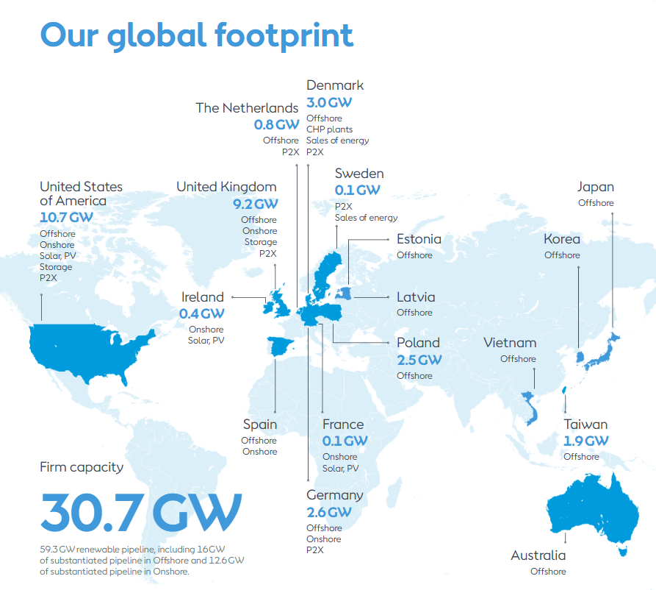
Orsted Story – Desire to Have 50% of Off-Shore Development
One of the few companies in renewable energy that does not finance on a project finance basis (mainly wind but also some solar)
Was an incredibly valuable company with among the highest price to book ratios in the industry
Had a disastrous experience with projects in the U.S. that illustrates risks and value drivers in the industry.
Comments from investors demonstrate how valuations are made in practice
Even though not project financed, financing driven by debt financing at BBB level
Includes data on wind resource risk and data subsidy schemes
Because of impairment write-off, you can get insights to valuation
Current Operating Generation Capacity is 12.7 GW of which 5.2 GW is off-shore
Orsted’s stock price fell by 79% from 1243 Dkk to 263 Dkk

Slide 7
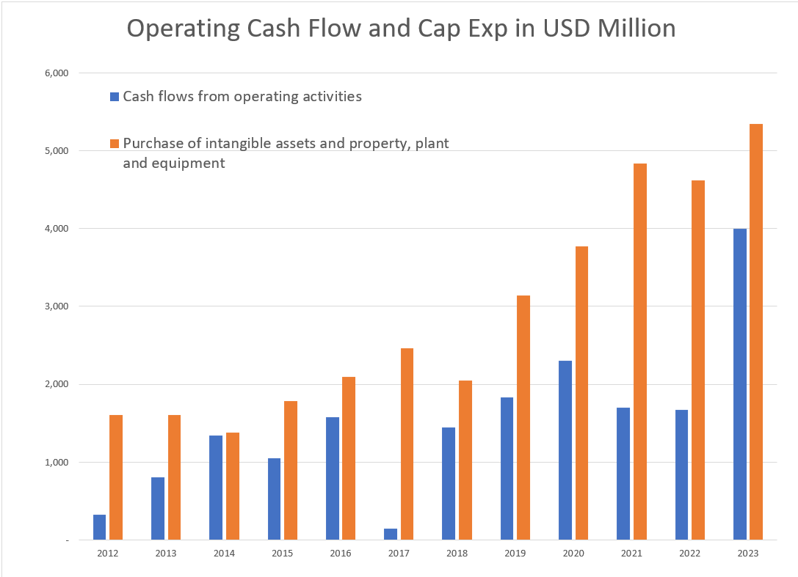
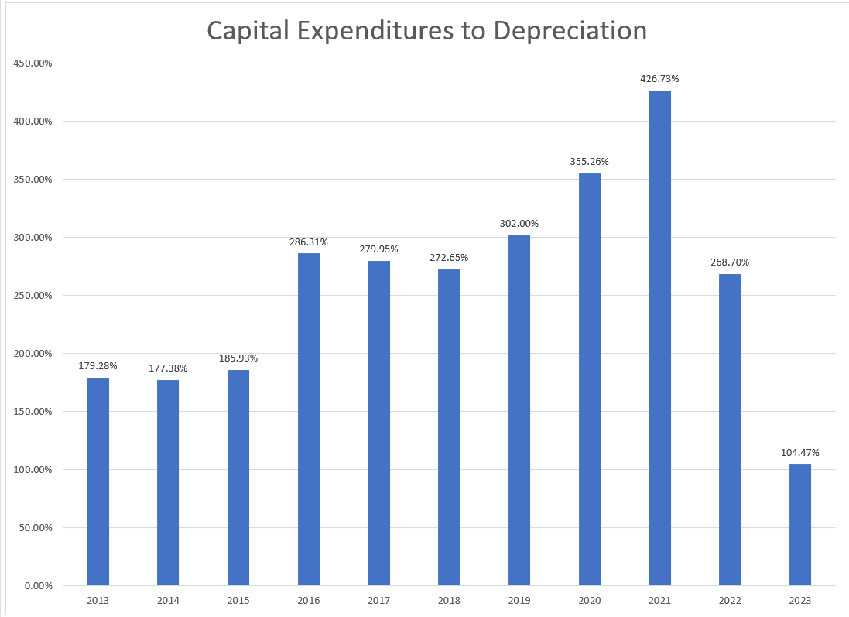
Orsted Capital Expenditure Program
Over the past two decades, we have transformed ourselves from a fossil fuel-based company (DONG Energy) into a global leader within the renewable sector. We realized this transformation due to our strong and innovative capabilities within project development, construction, and operations. And we continue to see increased and exciting opportunities across our business segments, exemplified by increasing targets and support by governments for the buildout of renewables. At the same time, we are encouraged by the political support towards our industry, such as the Inflation Reduction Act in the US and the proposed Net Zero Industry Act in Europe, which would expand the addressable market and represent an important support for the entire industry. We will continue working towards our vision of a world that runs entirely on green energy.

Slide 8
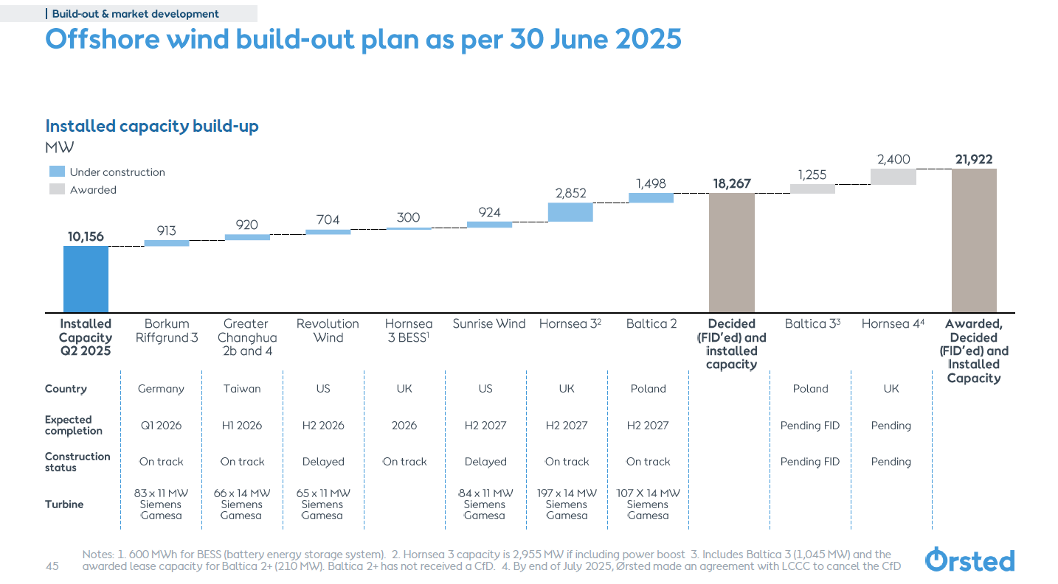
Capital Expenditures in DKK
Financing the large capital expenditures
Primarily use corporate finance
WACC and project IRR versus equity IRR
Transparency of project versus corporate finance
External approvals in project finance

Slide 9
Orsted Case Issues
Do you think that Orsted’s business model using corporate finance without fixed price construction or operation expense and contracts and bidding low prices is effective or do you agree with the Governor of the US state of New Jersey who called Orsted management “outrageous” and questioned ”Ørsted’s credibility and competence”.
Orsted buys turbines from Vestas, Siemens etc.; it contracts with a company to construct the monopiles; it hires vessel companies to deliver the turbines and put them into the monopiles. If Orsted is the best in the world at this, why did problems at one project eliminate almost 40% of its balance sheet equity capital.
The Orsted case addresses all of the issues in the objectives including regulatory regimes, different types of subsidy regimes, the impact of inflation, energy pricing, hedging considerations and other issues including the crucial question of resource analysis.
The Orsted case demonstrates the fundamental issue of risk and return and the fact that a constant cost of capital must not be used in assessing renewable energy.
The case demonstrates other issues including changes in wind speeds, management of cost over-runs, different contract structures for power …

Slide 10
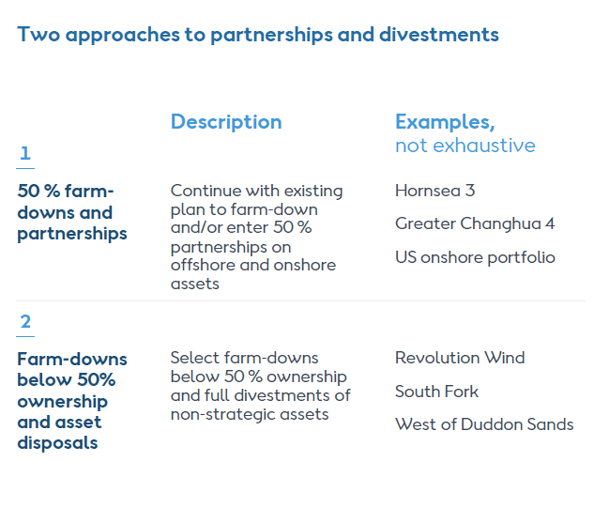
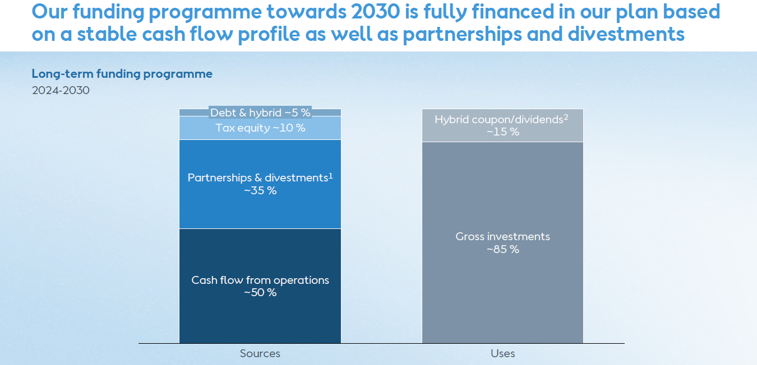
Orsted Divestments Illustrate the Kind of M&A Analysis Required
As shown in the inserts Orsted plans to raise a lot of money by selling down its assets (up to 50%).
Valuing the assets does not involve fancy or complex finance, you need to make assessments of future cash flow and apply a discount rate to that cash flow.
Nuances of cash flow forecast from information on regulatory regimes, subsidy regimes, resource variation, hedging, power pricing.
The case does demonstrate that there is a lot of M&A work in the industry from farm downs of individual assets.

Slide 11
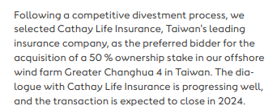
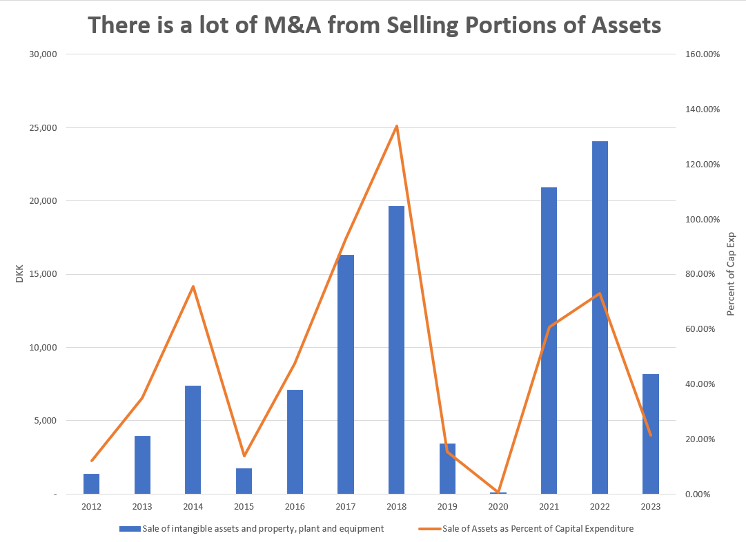
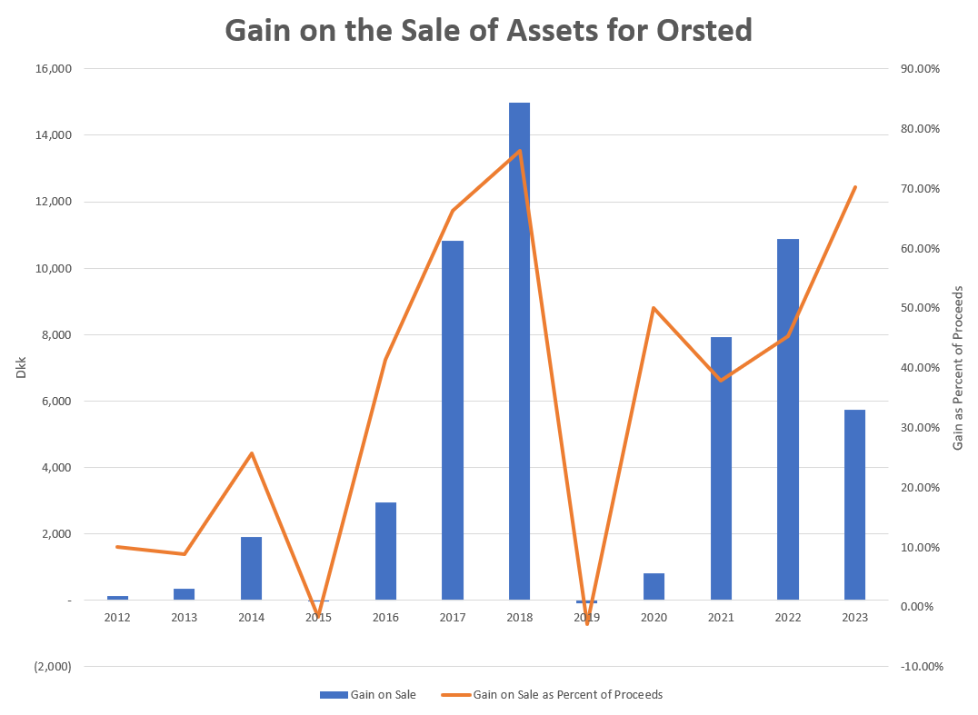
M&A Activity from Selling Interest in Projects
Valuation depends on the characteristics of individual assets and their risks. M&A analysis depends on understanding these things and then translating that to value. Clearly requires evaluation of individual projects.

Slide 12
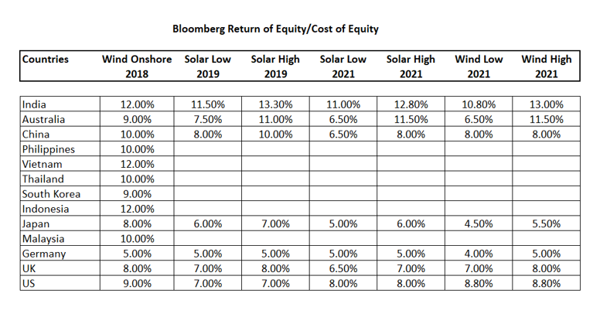
Real World Minimum Acceptable Target IRR
In practice there is no CAPM and certainly no un-levering and re-levering of Beta (see the discussion at the end).
In practice, equity IRR is used rather than project IRR as a target (this makes sense in theory as project finance implicitly adjusts for risk
In practice, and there are general standards for target IRR on buying and selling of projects. These standards have change over time. Pre-Covid for projects in Europe with a few years of history, equity IRR targets were as low as 4%.
I have been told stories of insurance company executives and pension plan managers going around Europe holding suitcases of cash to buy solar and wind projects with operating history.

Slide 13
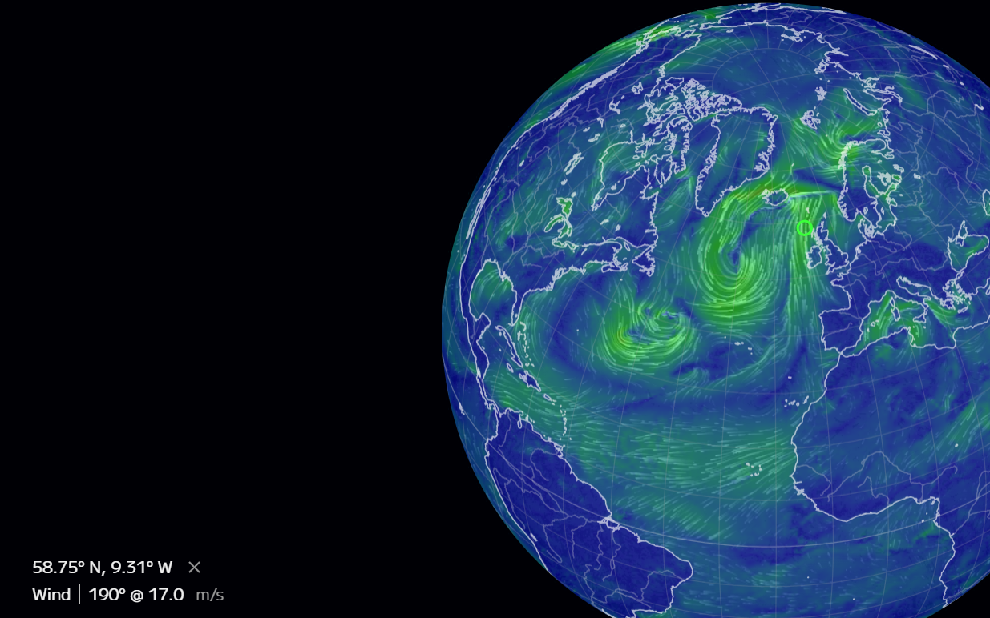
M&A Analysis for Companies Like Orsted
The valuation analysis for renewable companies, projects or assets could involve
  Valuing a portfolio of existing assets that are at different stages of development, construction and operation
  Valuing single assets
  Valuing the entire corporation including potential for continued growth
In each of the valuation tasks, you would need to make an assessment of the cash flow over the remaining life of assets and understand:
  How the assets earn revenues (what is the subsidy scheme and what happens after the subsidy scheme expires when prices can become variable or merchant)
  What is the quantity of electricity produced and how can this vary over time
  What are the development costs and capital costs and what is the exposure to changes in the costs

Slide 14
Orsted, Dong and History of Electricity Finance and Risks
Some background on the industry and the theory [of regulation, pricing, financing] behind would be good. To the extent possible, please try to link this to the practical applications for the participants in their work, e.g. regulatory regimes, different types of subsidy regimes, the impact of inflation, energy pricing, hedging considerations, etc.

Slide 15
Some Historic Perspective would be good
Part 1: 1945 to 1973
Les Trente Gloriouses or MAGA
Regulatory Scheme – Cost Plus Regulation with WACC

Slide 16
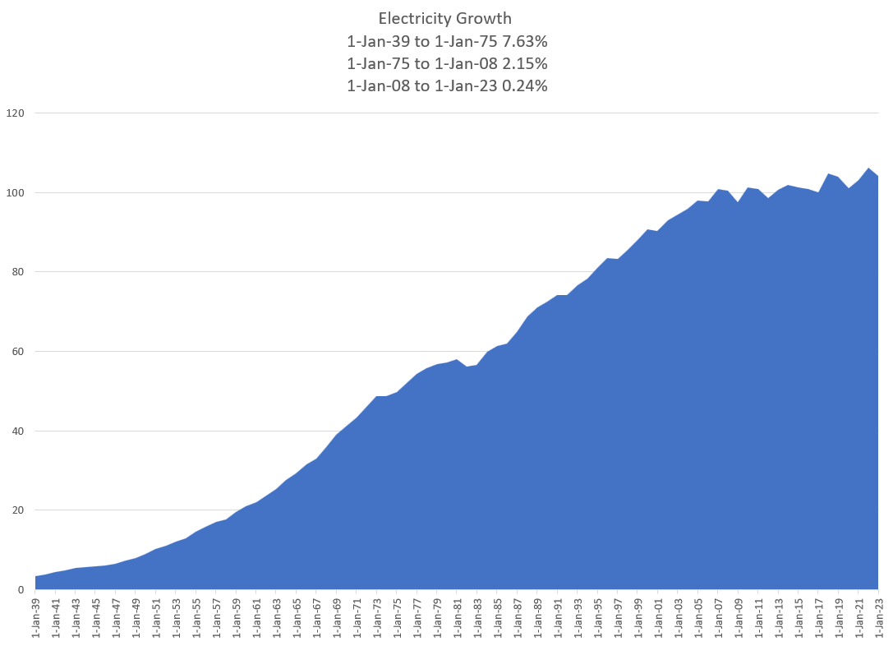

Les Trente Glorieouses and MAGA or MUBA – 1945 to 1973
Appliances and Bigger Houses
  Washing Machine
  Dryer
  Electric Stove
  More Lights
  Air Conditioning
Why is this introduction relevant for M&A Analysis. Demonstrates classic corporate finance. Companies want to get back to the low risk from cost plus model with WACC.
You will see that this analysis cannot be applied to companies like Orsted that are not stable.

Slide 17
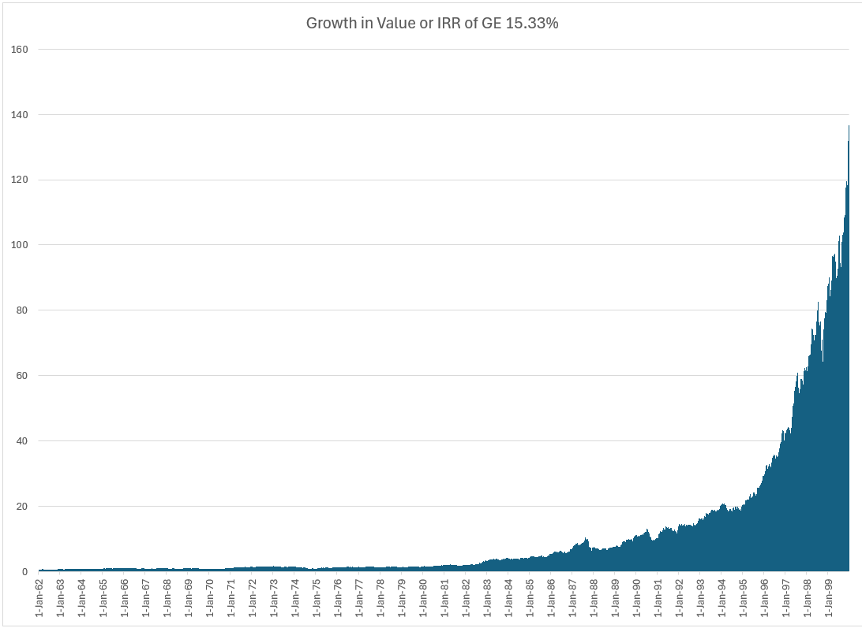
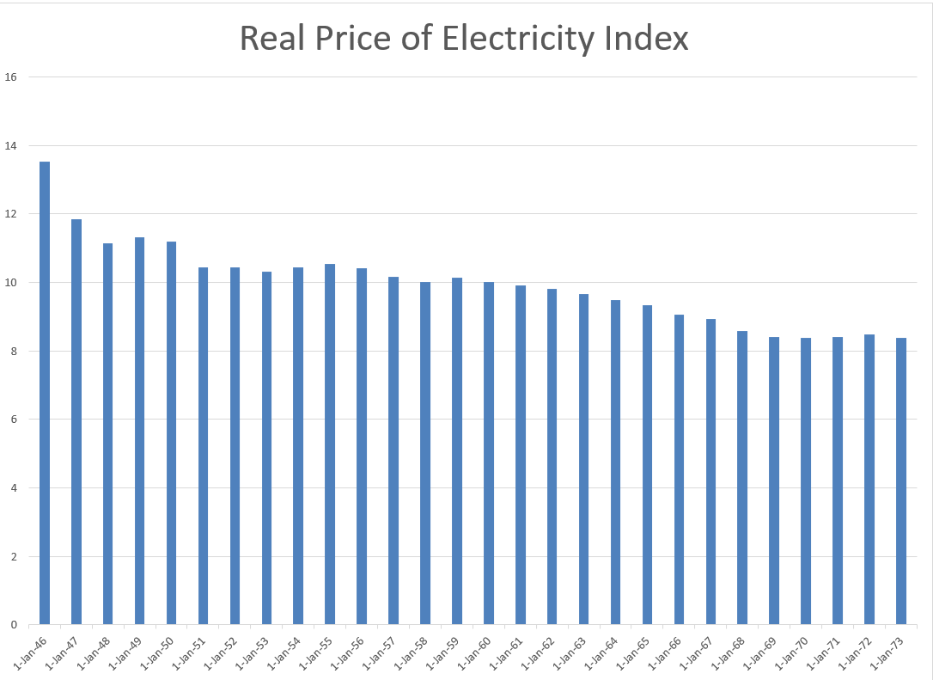
GE and Electricity
GE is most valuable company in the world – Note what a 15% growth rate means from compounding over a long period of time,
High Growth and economies of scale allowed declining real cost. Larger networks and larger coal plants.
Natural monopoly and cost-plus regulation or government ownership – No incentives for cost control of capital expenditures or operating costs.

Slide 18
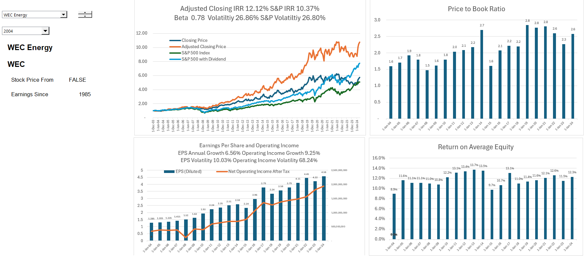
Originally the Class was Named Utility M&A – A Boring Utility Company and MUBA – Not Orsted
After US experience maybe Orsted is longing for the good old days of DONG Energy
12% return on equity produces market values relative to investment of well more than 2 suggesting that the cost of capital is far below 12%.

Slide 19
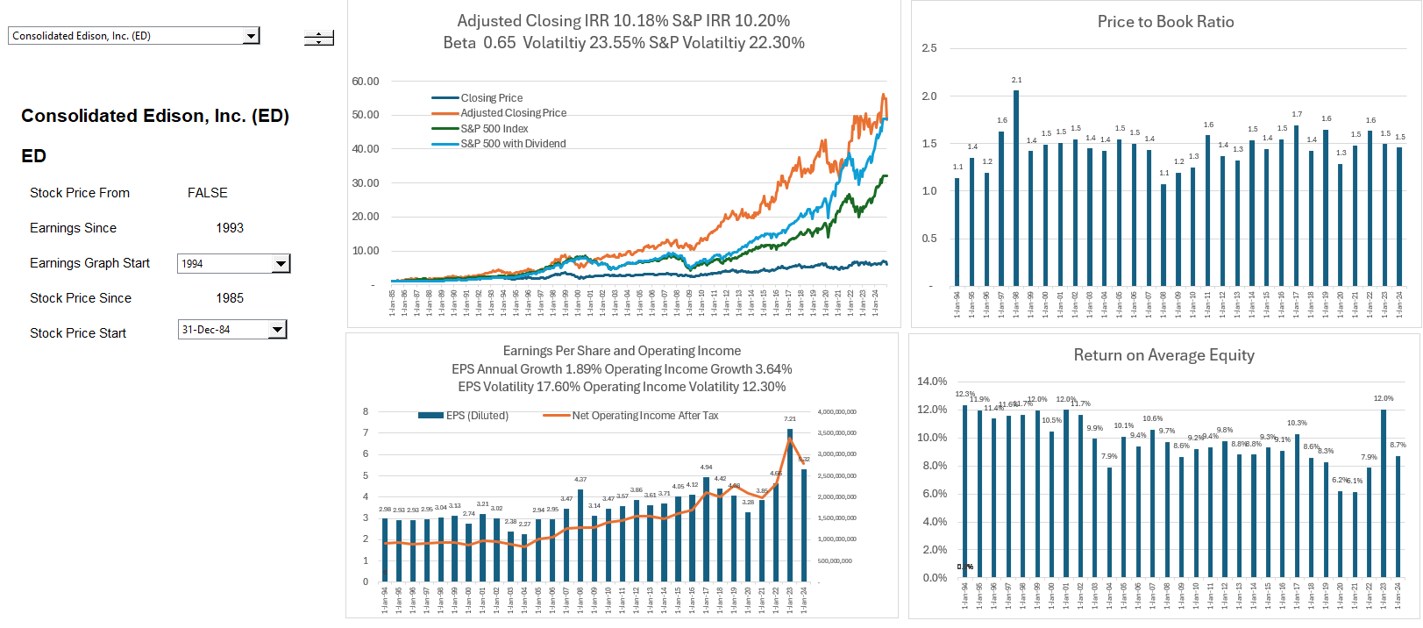
Another Boring Company ConEd of New York, Again Not Orsted
Returns relatively flat and returns of about 8% produce price to book value of 1.5. Growth about 2%

Slide 20
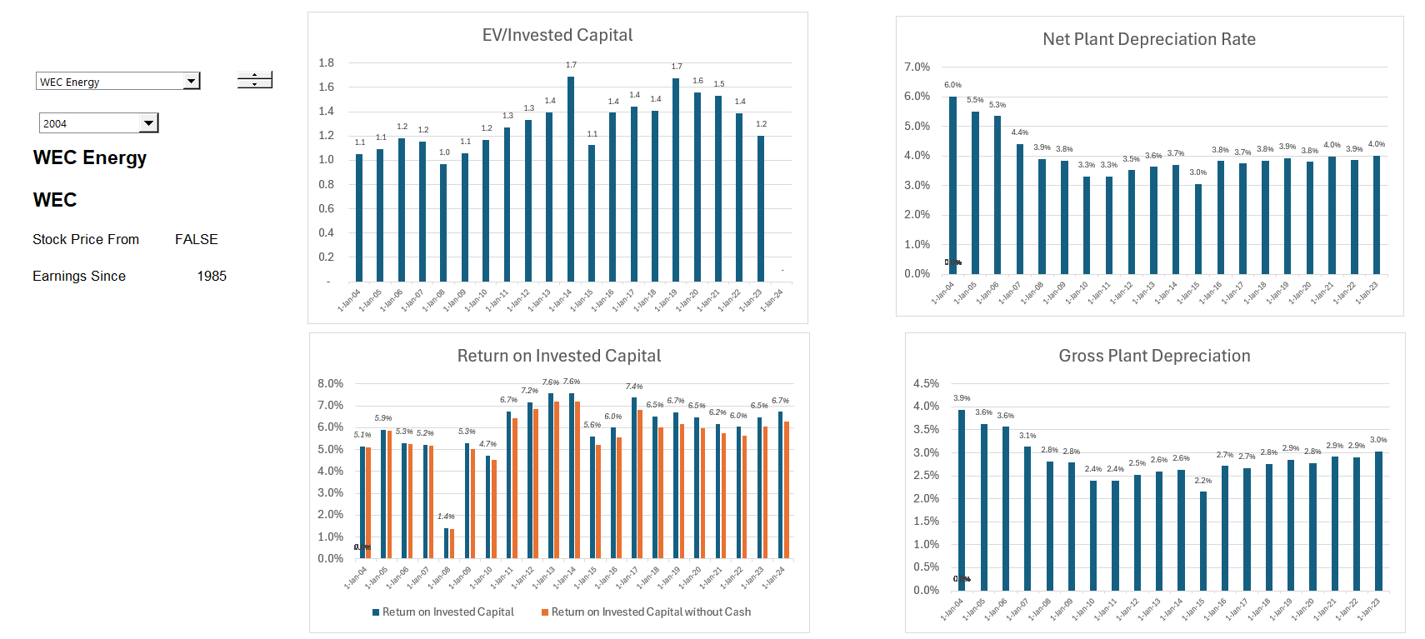
Boring Utility Company Earning Much Lower Returns – ROIC Perspective
Valuation can be made from stable multiples, DCF and maybe CAPM. Could apply valuation formulas P/B = (ROE-g)/(k-g). Cost plus regulation. But cannot apply to renewable companies like Orsted

Slide 21
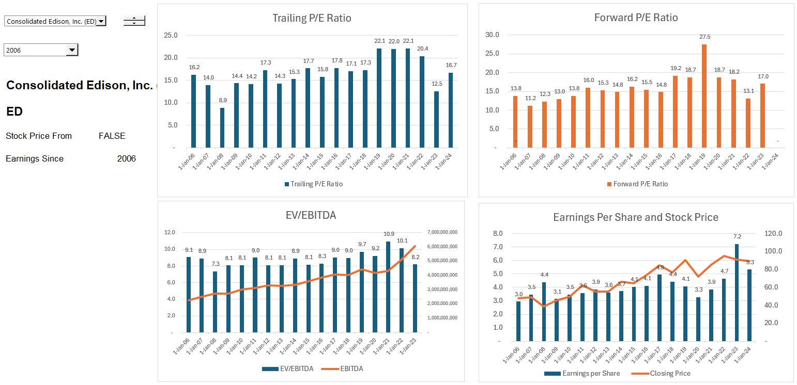
Relatively Stable Multiples of Earnings and EBITDA for Boring Utility Companies

Slide 22




Project Finance and Changing Risk
Before COD, cash flow is presented in the sources and uses statement
After COD, cash flow is presented in the cash flow waterfall and the last line is dividends
Father of the bride makes commitment to pay for wedding
Commitment Fee
Date at which you realize that the wedding is working or is a complete disaster
Development is Dating period. Probability of failure is high
Pay for Wedding with Other peoples’ money
Pay your Bills and re-structure your life. Stuck with PPA type contract. May default.
FC is making promises (that you may not keep)
COD is Wedding Date
Decommissioning Date

Slide 23
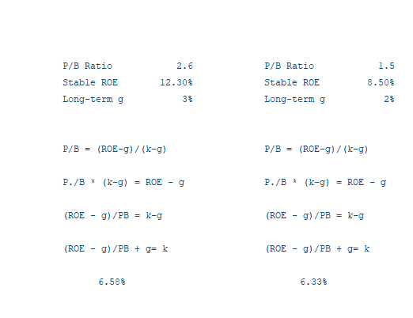
Implied Cost of Capital or Value for Companies with Stable Return
The most fundamental principle of old-fashion regulatory regimes is that in return for cost plus low risk regulation, returns should be set at the WACC.
Value = Dividend1/(k-g)
Growth = ROE x (1-Payout)
Payout = (1-g/ROE)
Value = Earnings x (1-g/ROE)/(k-g)
P/E = (1-g/ROE)/(k-g)
P = ROE x BV * (1-g/ROE)/(k-g)
P/BV = ROE * (1-g/ROE)/(k-g)
P/BV = (ROE-g)/(k-g)
k= (ROE-g)/(P/BV) + g
If returns are stable, you can use a formula like (1-g/ROIC)/(WACC-g) for the terminal value

Slide 24
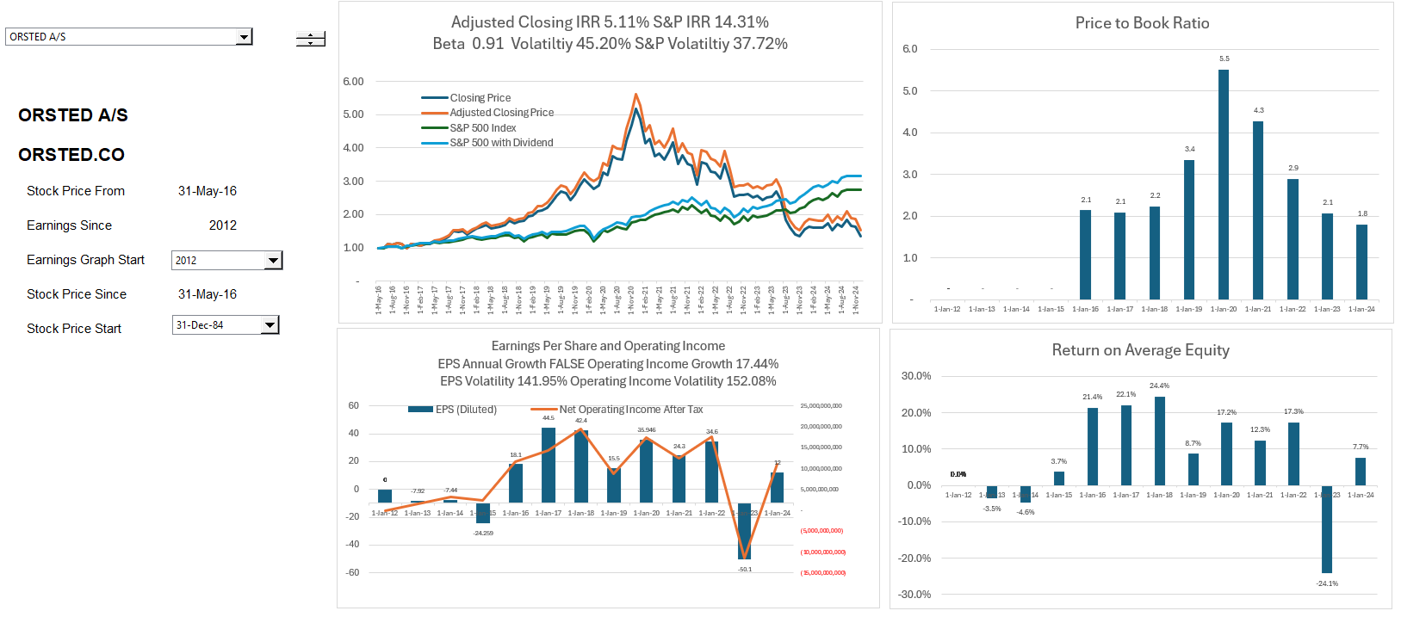
Orsted Has a Completely Different Profile
Orsted was once a boring utility company, but it looks a lot different now. The 5.5x price to boom ration is incredible for an asset heavy company. The equity you invested for a wind turbine (and monopile etc.) becomes 5.5x of what you invested.
Orsted’s stock price fell by 75% from 1,243 Dkk to 263 Dkk

Slide 25
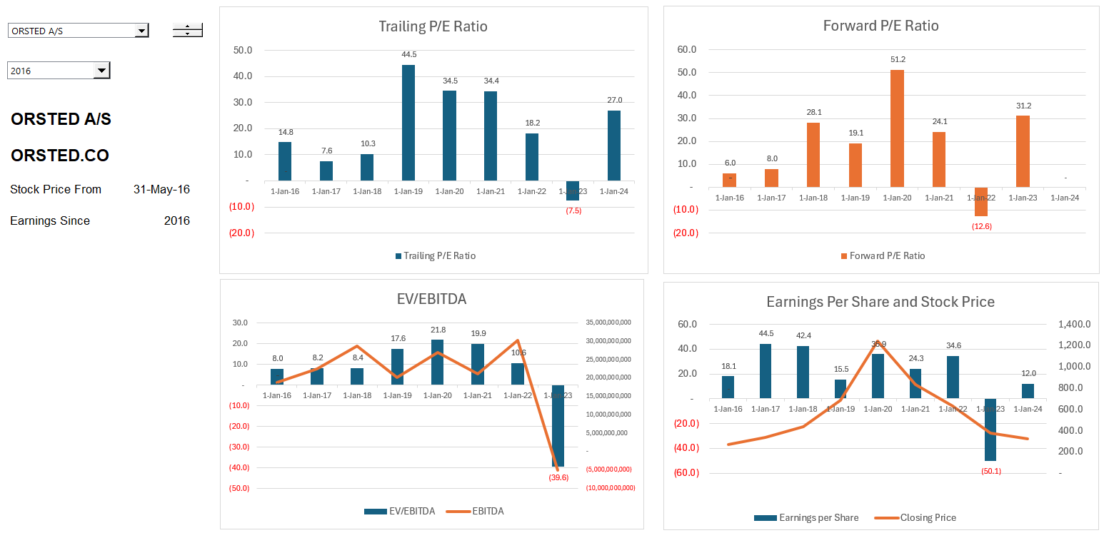
Orsted Multiples
Implication. Dangerous to attempt to apply multiples in terminal value; you need to unlearn the standard valuation techniques.

Slide 26
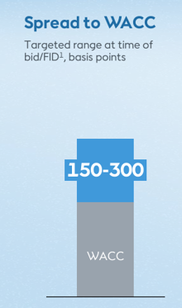
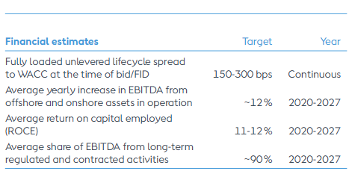
Orsted Obsession with 150-300 Basis Points Over WACC as the Target IRR; Why should you give a crap
Statements by Orsted about the WACC premium:
“All of this leads to, and you will hear us say that again, the updated guidance is an unchanged 150 to 300 basis points spread to WACC. This is industry-leading, as I’m sure you’re aware, and fully loaded so that it is fully cost-loaded with our fixed cost as well.”
“The portfolio of Asia Pacific and Europe projects are within the guided range of 150 to 300 basis points spread to WACC, a key piece of information despite the turbulence that we have seen and despite the additional cost for the mitigating actions that we have taken.”
What does “industry leading” mean – it seems to imply that Orsted is so efficient in construction and operation that it can bid the same price and earn a higher return than other companies (or maybe it takes more risk)

Slide 27
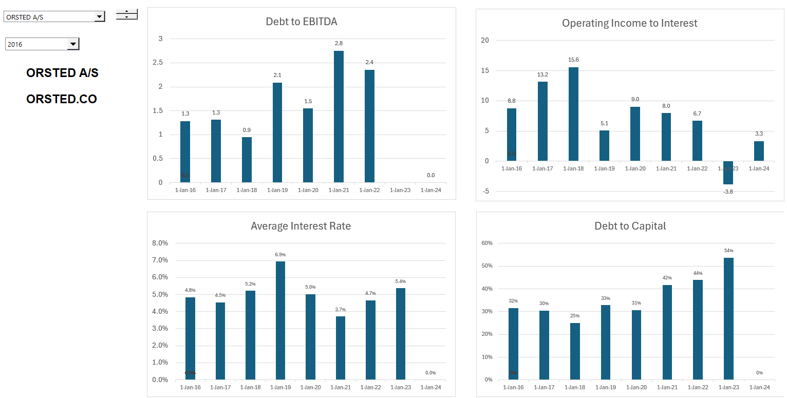
WACC Part 1 – Debt Cost and Percent
Orsted discusses the return and investment criteria in every presentation, but the company does not present the WACC anywhere, even in the impairment notes.

Slide 28
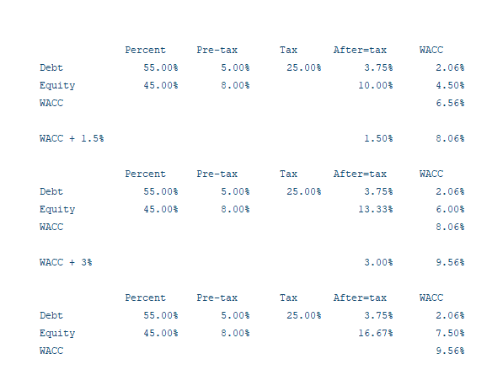
WACC Part 2 – Illustrative Estimation and Premium
I have estimated WACC and WACC plus the premia below. I use these estimates to illustrate conceptual issues associated valuation analysis of Orsted.
In this example, adding 3.5% to the WACC increases the ROE from 10% to 16.7%

Slide 29
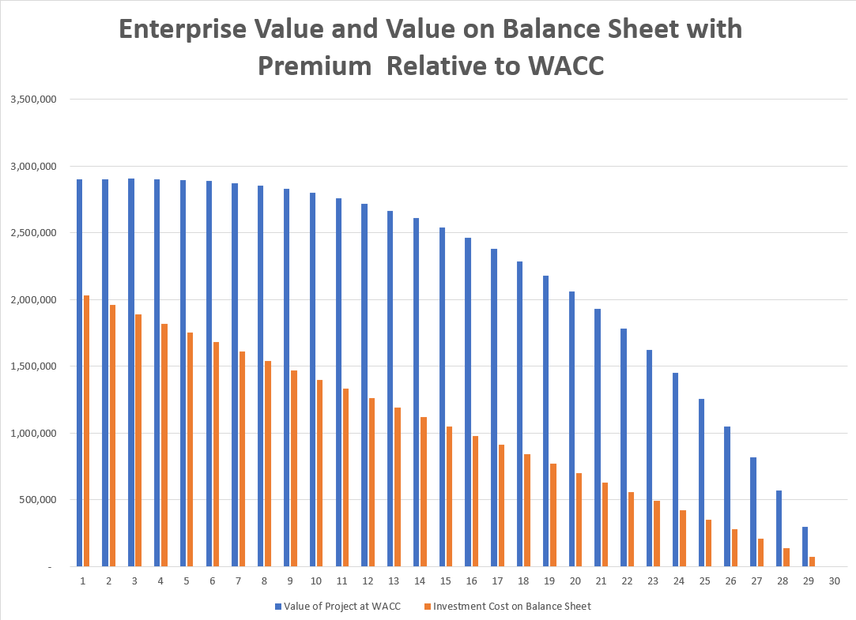
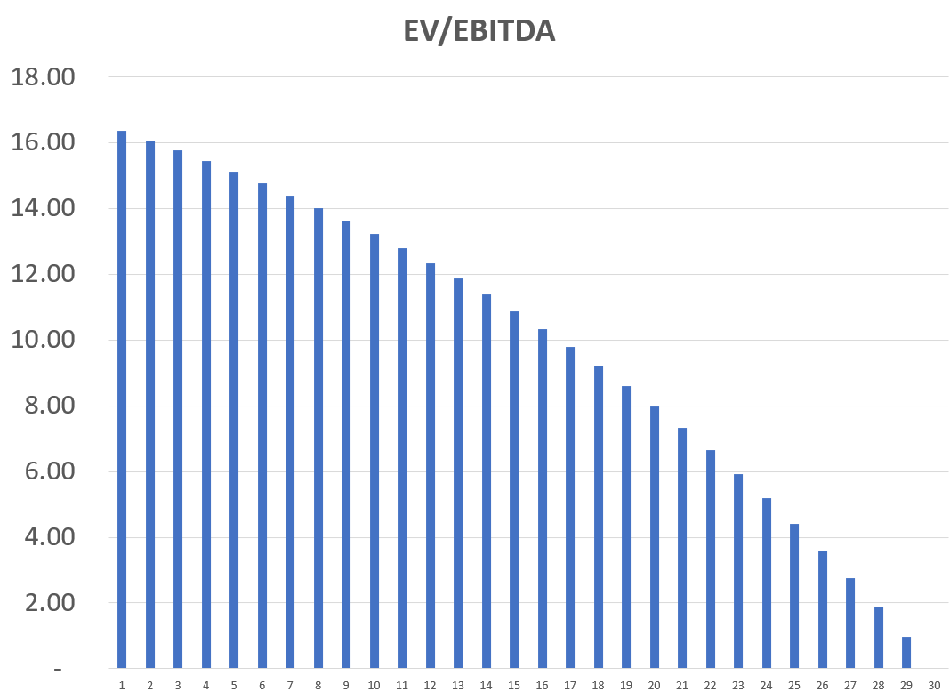
EV to EBITDA is not Constant over Life for Single Asset
The value of a single asset naturally declines as the asset has less remaining cash flow. The same happens to the EV/EBITDA ratio and implies that the EV/EBITDA ratio depends on the age of assets in the portfolio. It also depends on the premium to WACC.

Slide 30
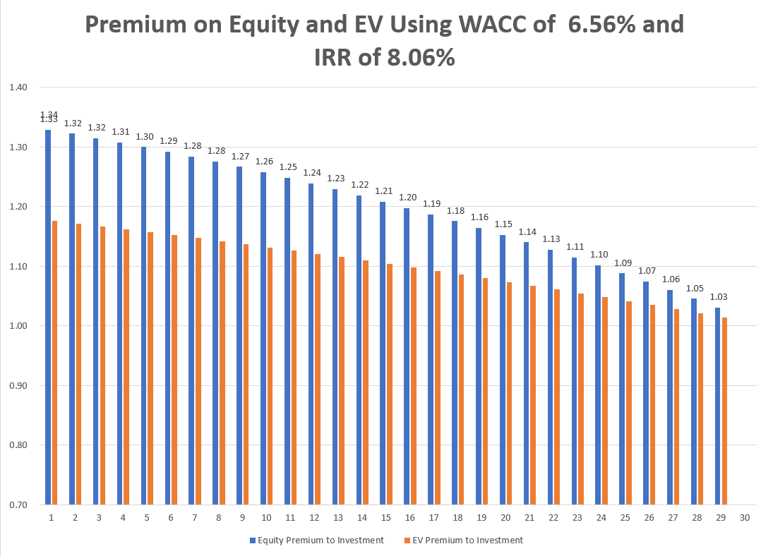
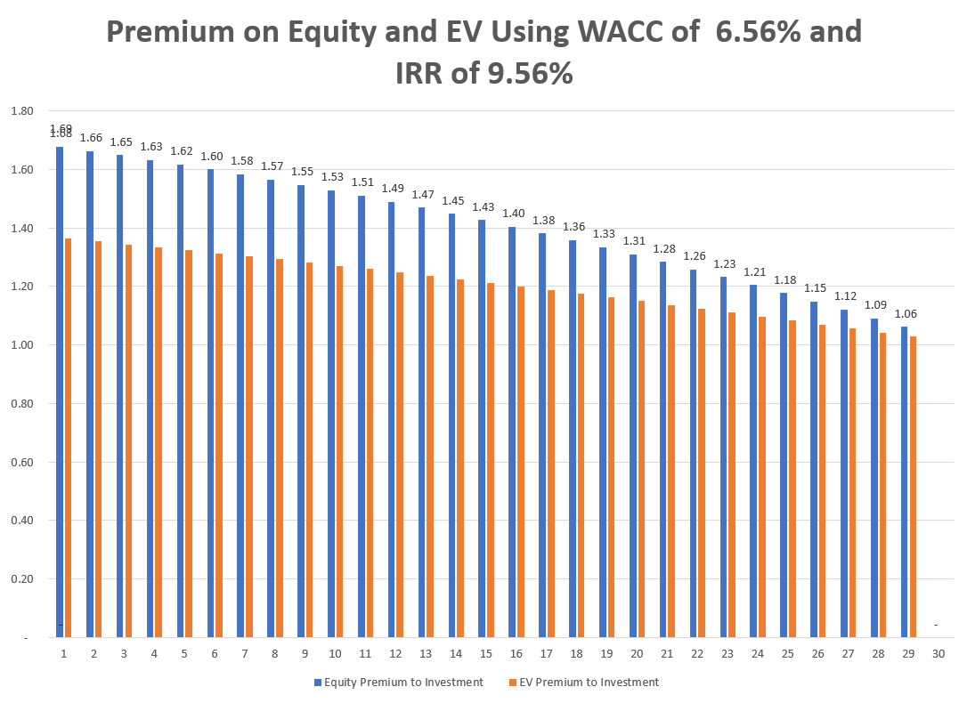
Premium to Value at WACC for Single Project or Asset
Value at WACC is the investment cost – the premium above WACC can be measured with premium to equity (price to book) or the premium above investment cost (EV/Investment Cost). With 150 bps, the equity premium is 1.32 and with 300 bps, the premium is 1.69.

Slide 31
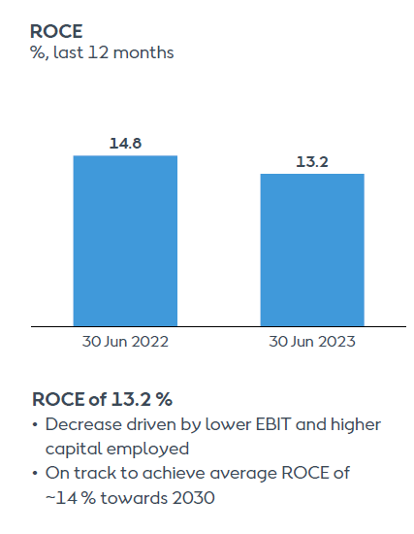
Rate of Return Presented by Orsted
Orsted lists the ROCE as one of its primary performance measures (in listening to many earnings calls and capital markets day sessions not one analyst asked about ROCE). The company seems to want to compare the ROCE with the WACC and suggest that it is achieving its objectives of earning more than the WACC. The comparison is completely irrelevant.
Problems with ROCE presented by Orsted
  ROCE is naturally much lower for a growth business than a business in decline. This is simply due to the decline in investment over time.
  The ROCE computed by Orsted includes construction work in progress in the denominator even though it is not producing any income during the development and construction period.
  The ROCE is distorted by impairment write-offs. After an impairment write-off the denominator is reduced, and the numerator of the ratio is increased from the reduction in depreciation.

Slide 32
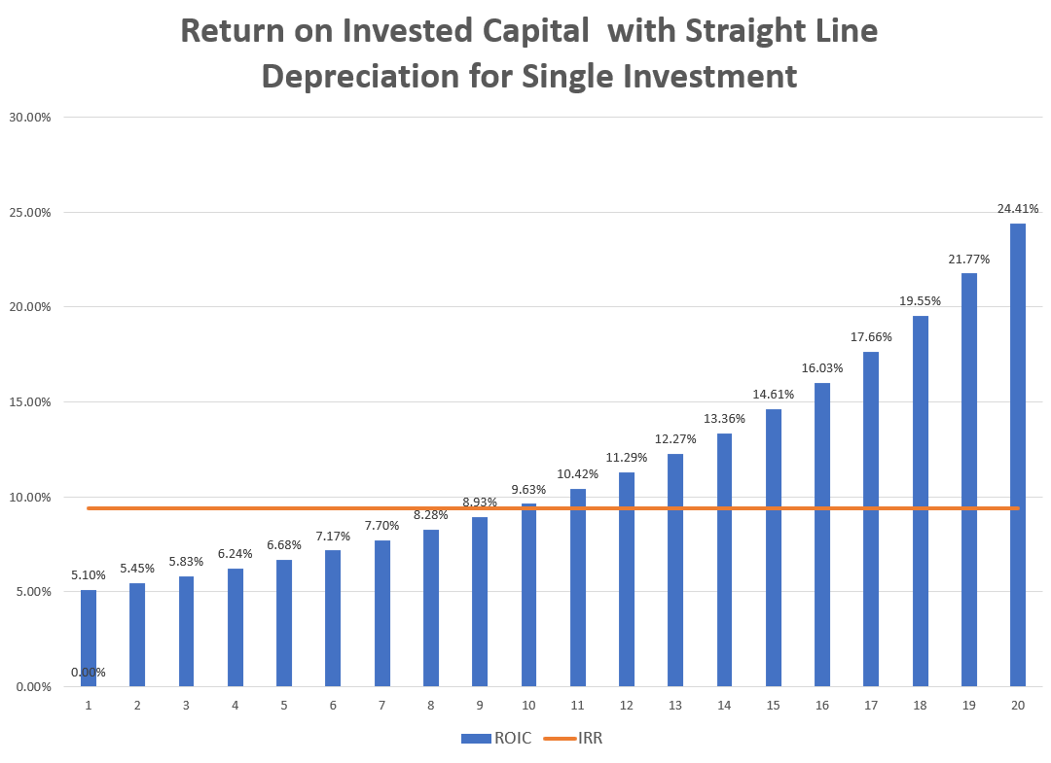
Project IRR and ROIC for Single Asset
And summing up, this all leads to these updated guidance targets, which I already mentioned in the beginning, but let me reiterate them. An unchanged industry-leading, value-creating target of 150 to 300 basis-point spread to WACC, average 14 % return on capital employed.
Late years with less PV and lower investment, ROIC is higher than the ROE
Initial Years – the ROIC is below the IRR

Slide 33
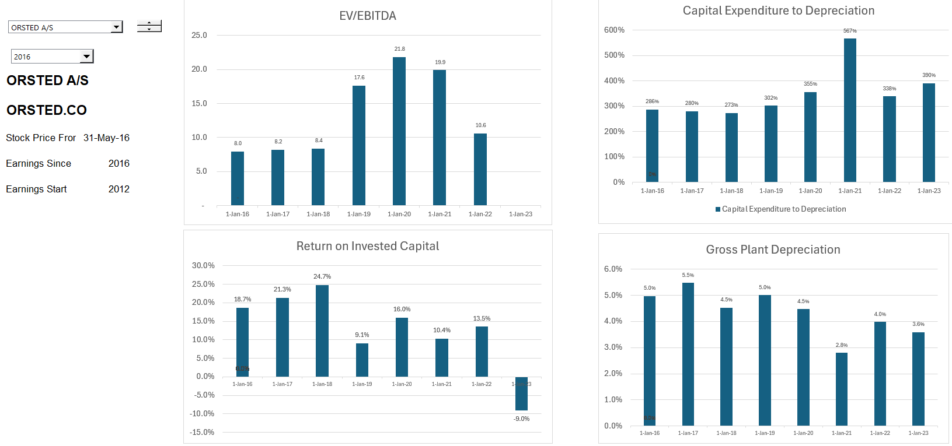
What you Really Want to See – The Earned Project IRR on Each Project
If you compute the IRR from the original anticipated cashflow you can compute the value over time and the economic depreciation as the change in this value.
If the cash flows turn out to be equal the expected cash flow, then the ROIC for each year is the same as the project IRR.
If the cash flow are lower because of lower electricity production or higher costs, then the ROIC with economic depreciation will capture.

Slide 34
Method for Modelling Individual Projects and Consolidating the Projects
In valuing projects whether project financed or not, you will most probably end up modelling the projects over their remaining life and computing the value of the projects with different scenario from the cash flow over the life of the projects. In other words, no terminal value, no valuation multiples, no computation of accounting returns.
If you are working on multiple assets as a package which is often the case, you can put the individual projects in different sheets (don’t worry I will not open excel). Once the projects are in different sheets you can consolidate the cash flows into another sheet that adds the projects together. To do this effectively you should be very careful with timelines and drive the analysis with some kind control sheet.
To illustrate how the consolidation of projects, I assume one project per year is added for many years. After the first project reaches the end of its life, the company stabilizes, and you can see the effect of different WACC premia and growth rates. This is of course illustrative, but it demonstrates the general patters and magnitude of multiples.
We can use Orsted’s WACC premium, its current balance of equity capital and invested capital to illustrate

Slide 35
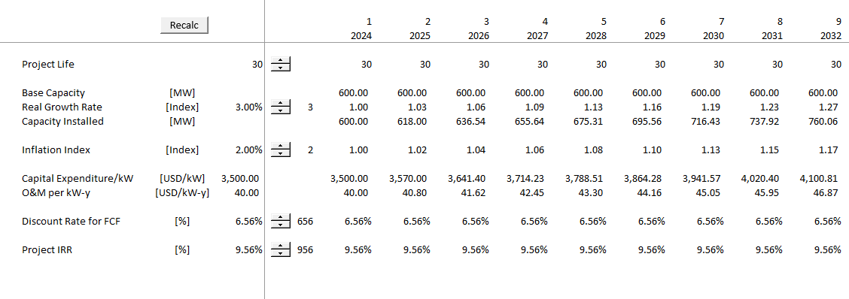
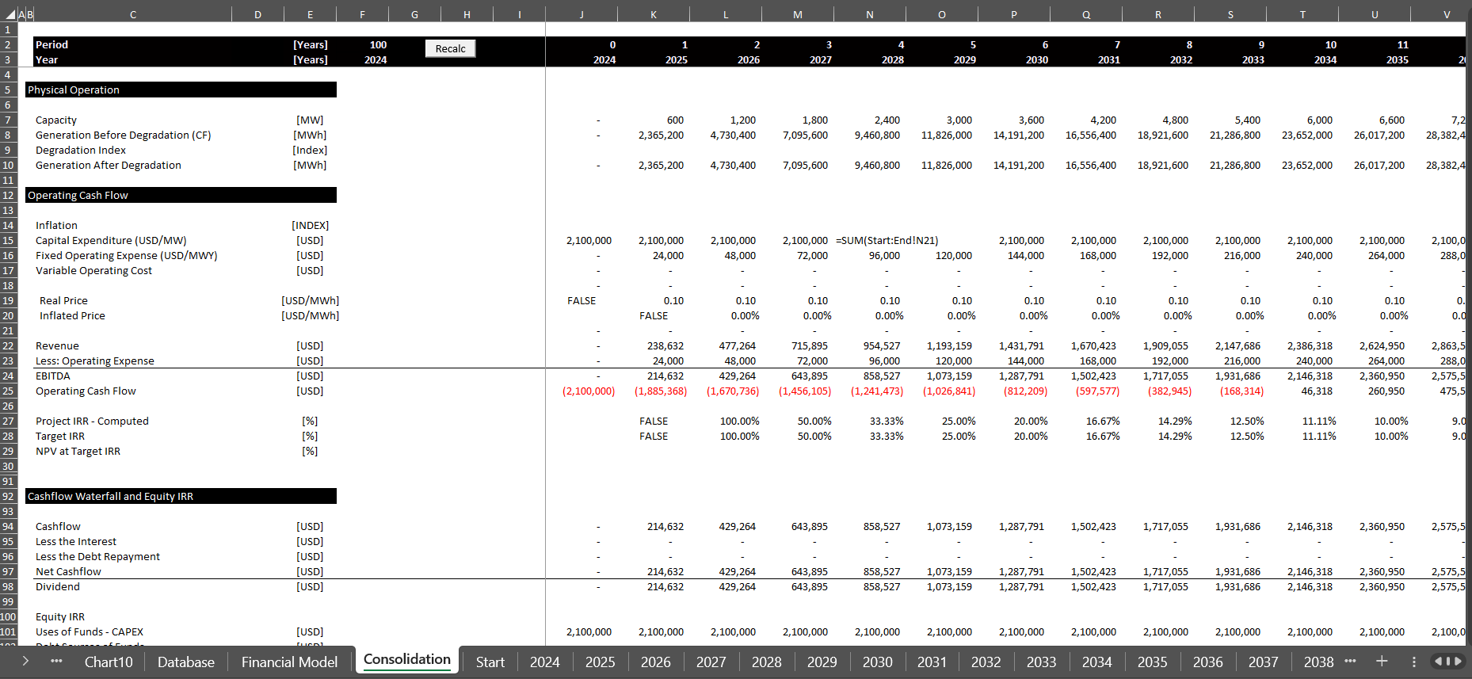
Consolidation of Projects with Orsted WACC premium and Alternative Growth Rates
After making separate simulations of additions year by year, you can consolidate into a file and see how the corporation develops.

Slide 36
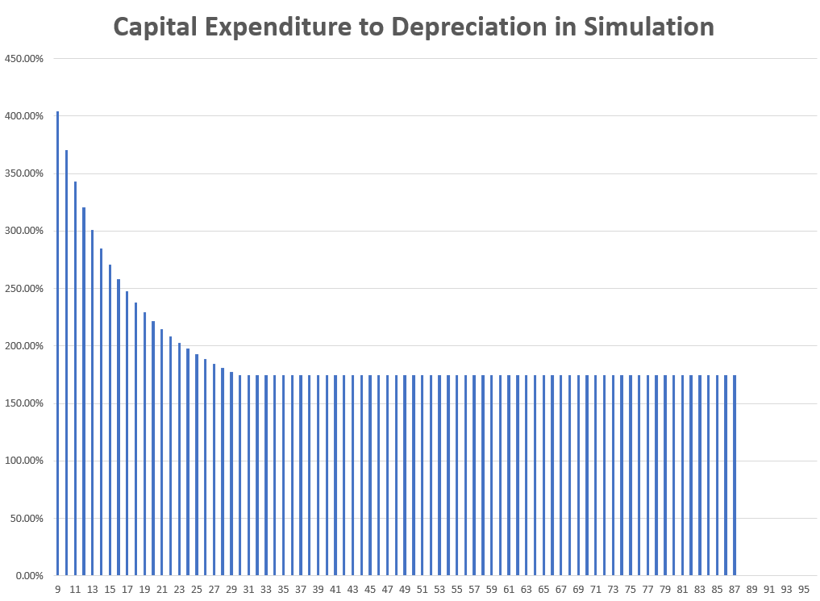
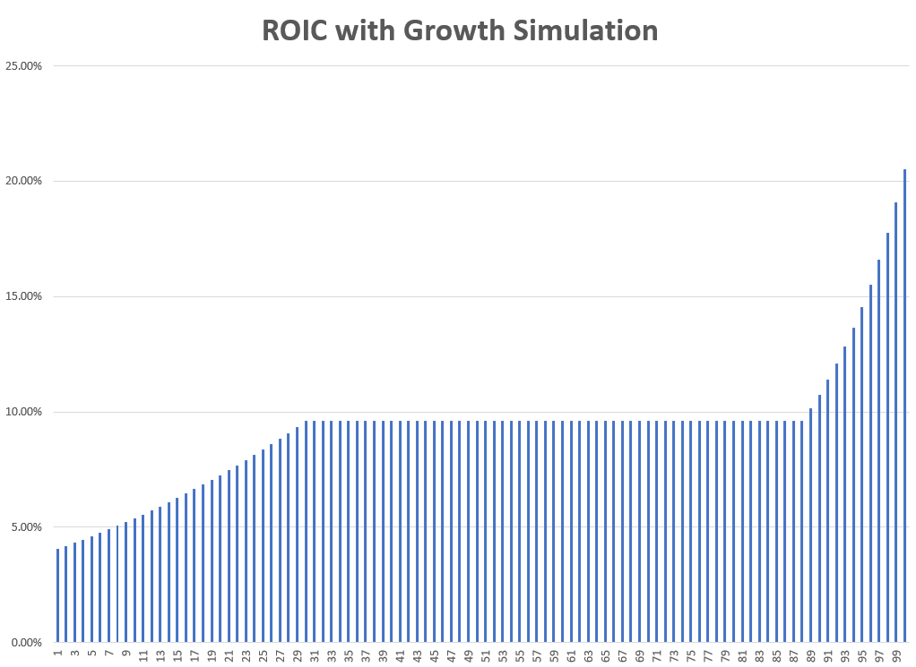
Illustration of How Ratios Stabilize But are Change in Growth Stage
To introduce the simulation, I show the consolidated analysis with constant growth and with inflation. In this scenario the premium earned relative to WACC is 200 basis points. The cap exp to depreciation stabilizes at 170% when the old assets are retired and replaced with inflated assets. The ROIC stabilizes when the assets are being replaced.
Stable Period after asset life is achieved and replace existing assets. With growth not 100%
ROIC eventually stabilizes when assets are replaced

Slide 37
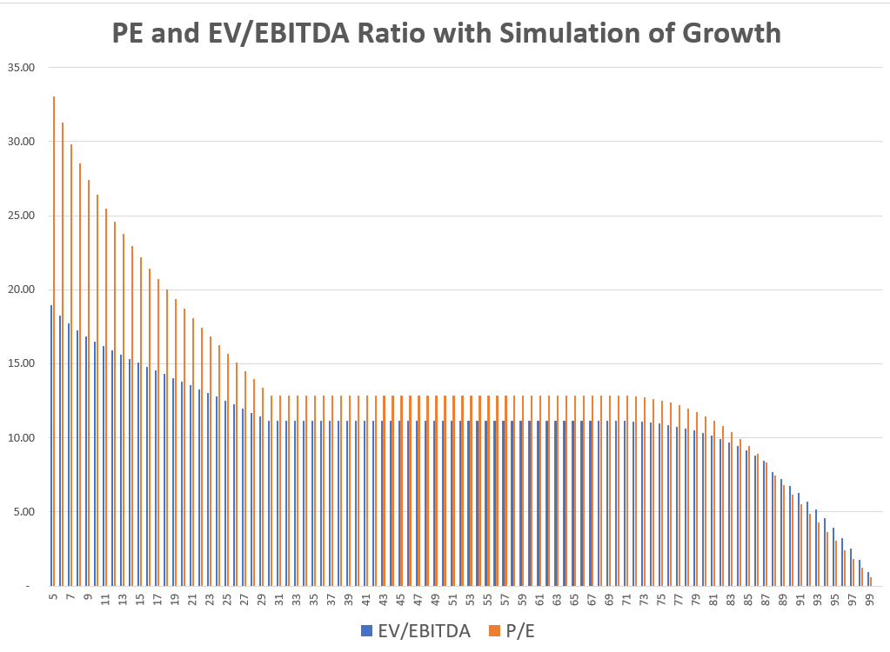
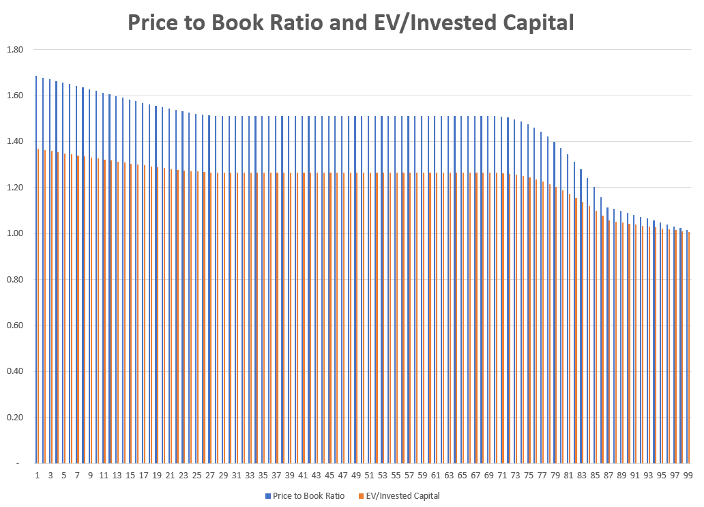
Simulation of Multiples with Growth
The simulation illustrates that with 2% real growth, 2% inflation and earning 200 basis points relative to the WACC that the EV/EBITDA ratio and the P/E ratio are not constant values until the company is in the period of stabilization. The idea of the graph is to demonstrate that you cannot use a simple EV/EBITDA, P/E or price to book multiple when evaluating companies that are in a growth or in a decline stage.

Slide 38
Part 2: Capital Expenditure Over-runs; Low Efficiency, Independent Power Producers and PPA Agreements
Introduction to PPA Regulatory Scheme
Different Structures of PPA

Slide 39
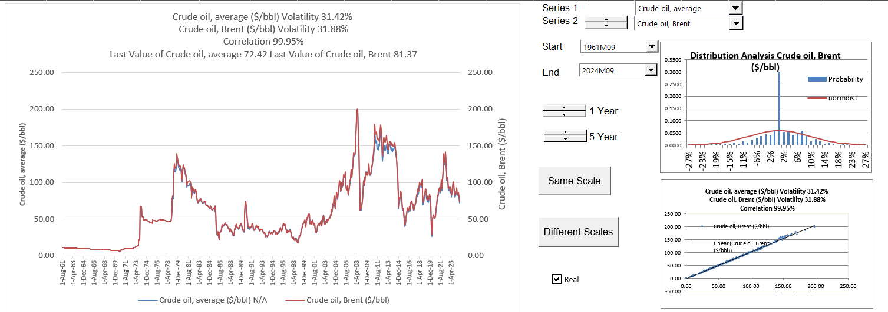
Part 2: 1973 Energy Crisis and End of Declining Real Prices
Dramatic Oil Shock of 1973 ended the Trente Gloriouses. Led to more nuclear power and first thinking about renewable energy.

Slide 40
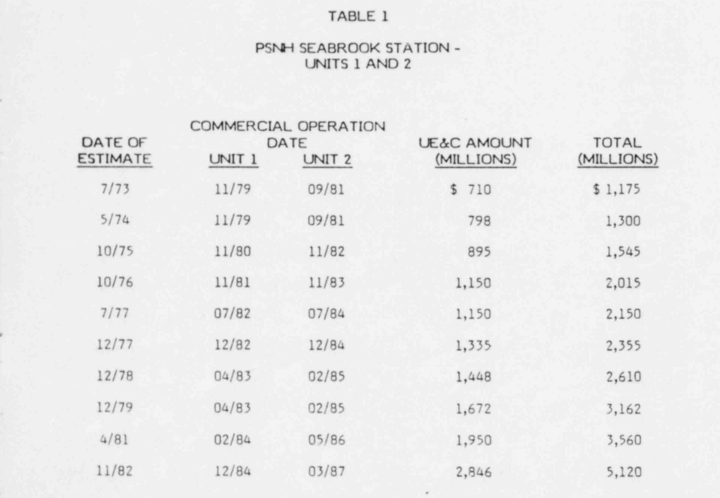
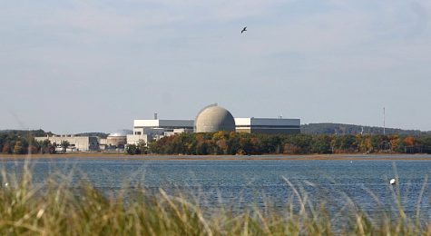
Part 2: 1980’s and Cost Increases and Cost Over-runs
Seabrook nuclear plant in US. (I understand that Denmark was considering nuclear power as well).
Enough of the cost-plus regulatory scheme. Let companies bid and hold them to their cost estimates – if costs increase, you cannot increase prices, and multiple companies can build assets.

Slide 41
Special Purpose Vehicle and Project Finance versus Orsted Model
No parent guarantees where your children can send and email and receive your financial support
Philosophical question – is a child with a lot of parent support able to perform better than one with none.
If you know there is a rich parent behind you, can you use this even if there is no direct promise.
Project Finance in a sense in going around the bend from revenues to operating expenditures to capital expenditures and getting to the loan agreement.
Revenues Realized
Start
Capital Investments
Operating Expenses
Special Purpose Vehicle:
End
Lenders Receive Debt Service and Invest Debt
Equity Sponsors Receive Dividends and Invest Equity

Slide 42
Independent Power and Targeted Risk Allocation with Contracts Signed at Financial Close
Orsted did not have the discipline imposed by project finance. But there are costs of risk allocation. Which model is better.
Each contract can have many nuances with penalties, bonuses, default clauses, termination.
Off-taker: Want strong off-taker with inactive to honor contract
EPC Contractor: Want Strong Record and Finances
Price Risk from Plant Performance and Efficiency targets
EPC: Fixed Price Contract with LD
Supplier: Need to Understand Economics and Supply Curve
Special Purpose Vehicle: Bond Rating of BBB-
O&M Contractor
Supply Agreement
O&M Agreement
Loan Agreement – Draws Green; Debt Service Red
Banks Like Strong Sponsors. Sponsors want EIRR
Shareholder Agreement
Lenders:
Lenders want DSCR (LLCR, PLCR)
Invest with paid in cap; payback dividends
Invest with draws; payback debt service

Slide 43
Notion of Independent Power Projects, Risk Allocation and PPA
With nuclear cost increases and price of oil increases, cost plus and WACC model considered a poor approach.
Bidding systems where companies competed to provide generating capacity (no longer belief in economies of scale for generation). Idea that companies bid down to their cost of capital.
Bid on long-term fixed price contracts (same as today) – purchased power agreements (PPA’s) were designed to allocate risks under control of investor (construction cost, construction timing, fixed operating cost, plant efficiency, plant availability). Costs that could not be controlled – fuel cost and amount of generation required were allocated to investors.
Once investor takes risk, the risk can be allocated to a company that takes construction risk, a company that guarantees plant efficiency, a company that provides operation and maintenance.
The risk allocation to third parties (off-takers) led to project finance where lenders verified fixed construction costs, operation costs and technical aspects of plant efficiency and availability.
Risks remaining with purchaser – fuel price, generation (maybe inflation)
Risks taken by investor and allocated – construction cost, construction timing, efficiency, availability, operating cost except fuel
Risks allocated from investor to contractors who provide fixed prices and absorb penalties for efficiency and availability

Slide 44
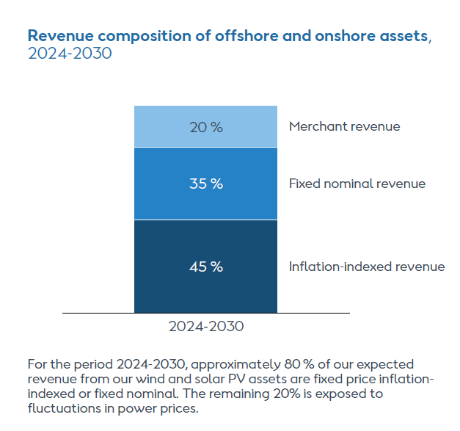
Example of Nuanced Risk Allocation in IPP Regulatory Regime – Inflation Risk
For IPP projects, some risk allocation is obvious. For example, owners of the plant take risks of construction over-run, construction delay, plant efficiency, plant availability and operating cost increases.
These risks are in control of the investor (again, the risks can be allocated to other parties through contracts as in the EPC contract). The idea was the if risks that cannot be controlled are allocated to the investor, the investor’s cost of capital will increase which will increase prices as investors bid.
Inflation risk is an example of a risk that may or may not be allocated. If prices change with the overall rate of inflation (i.e., prices are indexed), then the inflation risk is not allocated to the investor, and the investor receives a protected real return. If prices are fixed and the inflation rate is high, then nominal returns are protected but real returns vary.
All of our early-stage US projects, have been materially hit over a longer period of time by the generally adverse industry conditions. But because these projects were without any kind of inflation indexing, increasing interest rates and significantly increasing CAPEX inflation, which was three to four times as high as consumer price inflation, it was already a project whose returns were under pressure and who had also lost most of the float in the schedule.
Especially after a period in a very volatile environment, we have also clearly prioritized that we will get only inflation-indexed contracts, especially in markets like the US, where there’s a long time from award to actual FID. In a market like the UK, where, by the way, there is inflation protection, there’s a much, much shorter timeline between award and FID, so lower risks there.

Slide 45
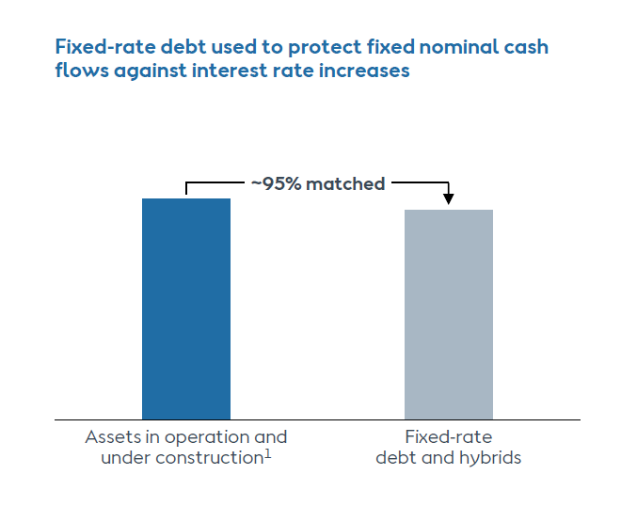
Allocation of Inflation Risk and Relevance to Current M&A Analysis and Orsted
PPA regulatory regimes from 1980’s is still directly used in battery analysis with bidding, fixed price to cover capital costs and issues of inflation treatment.
For project finance, lenders charge nominal interest and prefer fixed nominal price.
Equity holders who want to protect real returns (not nominal returns) prefer inflation indexed prices where prices increase with inflation rather than being flat.
Valuation based on earned IRR over life of project without terminal value.
IRRs computed for project - project IRR (analogous to ROIC or ROCE) and equity IRR (analogous to ROE)
ROIC and ROE not relevant because of declining investment for a single asset
Target IRR for valuation changes over time as project milestones are met.
Orsted and Inflation Index
What is the effect on the required IRR (cost of capital) from inflation protection.

Slide 46
Definition of FID versus Financial Close
I'm sure you've done the calculation, so are you telling us that maybe walking away, stopping Sunrise, would have been more expensive than doing what you're doing today, which is literally raising half of your market cap?
And with respect to the Sunrise Wind, the decision not to walk away from the project, with a project that is so far progressed, 35% constructed, it is by far the most value-accretive option to move forward with the project.
When you execute an offshore wind project, the vast majority of the of the construction costs to your suppliers are committed at the point of FID, so where you lock in pricing of equipment and so on. So, therefore, in that sense, you are obviously very much locked in at FID. And then also, remember that construction of the project is going well, that we are looking at a lifecycle IRR of mid-single digit, and that the forward-looking IRRs are very attractive.

Slide 47
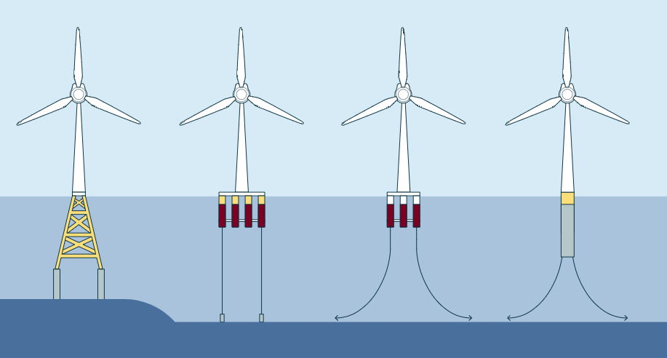
Time to Discuss the Abandonment of Ocean Wind Project and Valuation Implications
In developing off-shore projects, Orsted
  Signs contracts to buy turbines from Vestas, Siemens etc.;
  Signs Contracts with a company to construct the monopiles;
  Hires vessel companies to deliver the turbines
  Employs labor and materials to put turbines into monopiles.
Efficiently constructing turbines is supposedly Orsted’s strength. If this is the case, why did problems at one project before the FID eliminate almost 40% of its balance sheet equity capital.
Confusion with FID
  In project finance the term Financial Close FC is used. The FC is the date contracts are signed, and construction can begin. The contracts include the PPA contract (revenue contract), the EPC contract that has a fixed price, the loan agreement and the operating and maintenance contract.
  The FID is a term used by Orsted that stands for Final Investment Decision. The FID date is after the bid for the PPA has been submitted.
  One would think that there is not much construction before the FID, but this is apparently not the case and raises the question of why even define this date.

Slide 48
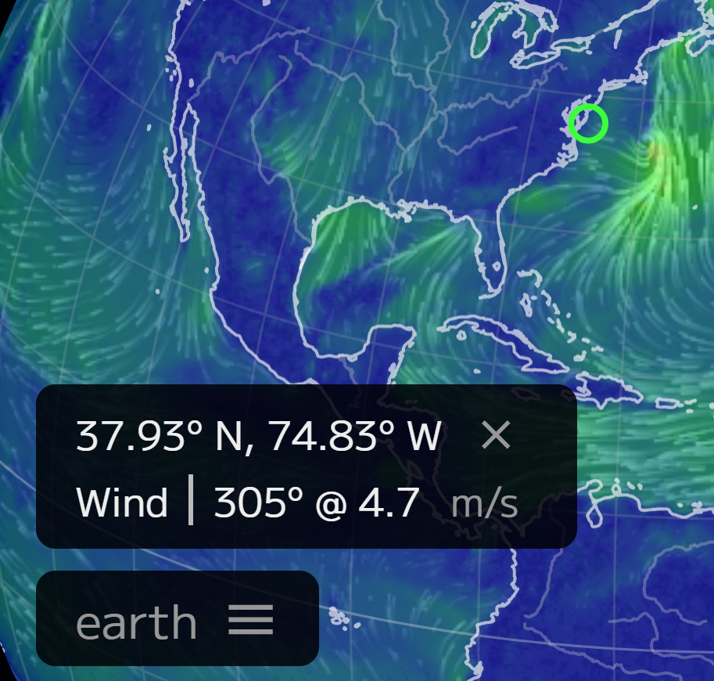
Background on the Ocean Wind Project
The New Jersey Board of Public Utilities awarded Ocean Wind 2 a 20-year OREC (Offshore Renewable Energy Certificate) for its offshore wind farm with a capacity of 1,148 MW. With today’s award, the Ocean Wind lease will be utilized to its maximum capacity of 2.3 GW. The 2029 OREC price is USD 84.03 per MWh with a 2% annual escalator. Note that the OREC is a premium on market prices, but because of low gas prices in the base electricity price is low (maybe USD 30 per MWH).
Ørsted had provided a USD 100 million guarantee to complete one of them, Ocean Wind 1, by the end of 2025. Additionally, the company was obligated to contribute USD 200 million toward developing the offshore wind industry in New Jersey. According to the Orsted, supply chain disruptions, rising interest rates, and inflation were some of the causes of the discontinuation of the Ocean Wind 1 and Ocean Wind 2 offshore.
Located about 24 kilometers southeast of Atlantic City, the 1.1 GW Ocean Wind 1 was planned to feature 98 Haliade-X 12 MW (GE) wind turbines and up to three offshore substations within its lease area.
Orsted’s statement in earnings call for the quarter before the cancellation: “On the strategic side, let me start with our portfolio of awarded projects in the US. We received the federal record of decision for New Jersey's first offshore wind farm, Ocean Wind 1. With this milestone, Ocean Wind 1 remains on track to begin offshore construction in 2024.”

Slide 49
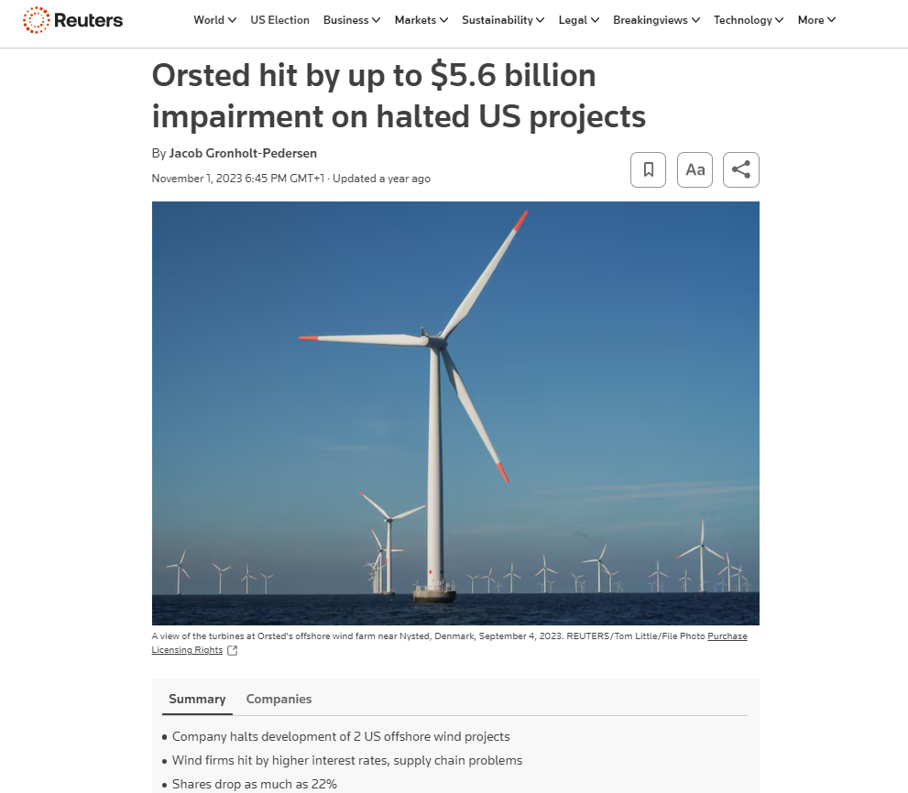
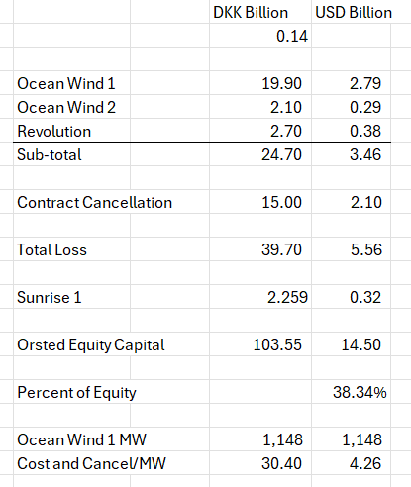
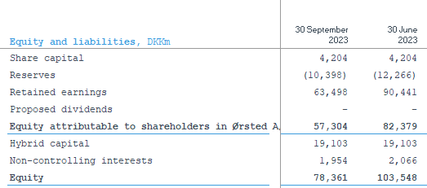
Orsted’s Cancellation and Write-off
The table below shows parts of the loss for abandoning the Ocean Wind project and other U.S. projects. The loss includes amounts spent on the project and liabilities for cash cancellation fees.
Why didn’t Orsted pull the plug much earlier

Slide 50
Basic Question about Orsted Write-off for New Jersey Project
How could you spend USD 3.5 billion and then take another hit of USD 2.1 billion in cancellation fees on a project where the total cost was about 6.8 billion.
Possible theories
  Orsted explanation – big difficulty securing vessels on time along large inflation in capital expenditures and difficulty in securing labor. Problem – this is supposed to be what Orsted is really good at – it is supposed to have subcontracts and understand the risks of delays.
  Orsted is running out of financing capacity to fund projects and is over-stretched from a capital raising perspective
  Orsted has been over-aggressive in bidding for projects that do not generate a return and/or revised estimation of the capacity factor and generation (never mentioned by Orsted management)
Question from Morgan Stanley
You seemed to have two very late-notice disappointments from suppliers on foundations and vessels during 2023, which, of course, was very surprising for a developer with such a strong track record such as yourselves.
Orsted Response
We got information, that first 20 monopiles and then a significant additional delay on a vessel, this was something which was new information to us. And that is where we’re saying the monopile facility was new, but during the conversations we’ve had with the supplier, we were not led to believe that this was an impact that was likely to happen to this scale.

Slide 51
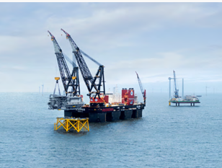
More Specific Explanation of Ocean Wind
So, what has happened, especially in Ocean Wind 1, which also under supply chain changes have been by far the bulk of these. Is that we have seen with centered, unfortunately around the vessels again, further significant delays on vessel availability, which in a project that was without any further float, meant that the delay of the overall project due to lacking backup vessel availability in the entire market, has now meant that it would implicate a multi-year delay of the entire project. What that would mean is that due to this significant additional delay caused by these supply chain delays, we would be in a situation where we would need to go out and recontract all or very large scopes of the project at expectedly higher prices. It meant massive impacts because of the uncertainty of needing to go out and recontract many of the scopes in Ocean Wind 1. That is why it is such a massive impact.
On the Ocean Wind 1 project, we had a book value of 13 billion DKK at the end of Q3 (about 2 billion USD). So, that's roughly what we've spent on that project. We are having a large cancellation fee from, from walking away from this project. But at the same time, we are also not having to spend the large Capex on this project, which should give a relief on the on the capital structure in the shorter term.
Now remember it differs a lot depending on what region you are in, what project it is that you are looking into, what scope it is. So, there's a lot of different metrics here. But I think if we talk the remaining larger US projects, I think the indications that we've been giving before is the roughly 6 million USD per megawatt.

Slide 52
Comment by Investor on Orsted and Any Corporation as Sum of Projects
The following is a statement from and investor about the value of existing assets versus the speculative value of development assets in an earnings conference call.
Analysts on this call probably get the same question I get every day. That question is what is the the valuation of Orsted’s existing assets? And I'm sure you get similar questions, but the question tells you something. It tells you that investors do understand that you have a portfolio of operating assets that are valuable.
But what investors are not buying is the conditional stuff (related to the development of new assets). Investors do not like to hear we (Orsted) hope to build this if type thing, if we get the tax credit, if we get a bump in the tax credit, if we can negotiate better terms, etcetera. So, I feel like if you guys in your strategy update can come with a base plan that is really dependable and is as reliable as people think the existing constructed assets are, and I think you'll get credit for that. And what I hope you'll be able to do is, is take away any pieces of it where there's still an uncertainty or something that people have to buy into a belief. Because it seems to me that the share price at the moment is telling us that nobody wants to believe in any of those kind of development uncertainties anymore.
Translation:
It is absurd when making a valuation of a portfolio of assets to assume a constant cost of capital.
Any corporation is a portfolio of assets

Slide 53
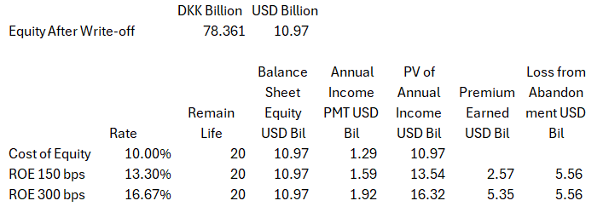
Back of Envelope Value Calculations for Abandonment
How would you make an analysis of the value lost from abandonment of the project relative to the amount earned above the cost of capital on the equity invested in all of the other projects. My calculation shows that the loss on the abandonment and cancellation fees exceeds the amount Orsted could earn on all of its other projects. It is more difficult to make simple calculations using PMT, PV and WACC concepts.
Steps to compute
  Levelised income on the equity balance from WACC calculations
  PV of income at the cost of equity allows premium calculation
Political risk in USA wiped out all of the economic profit on Orsted’s other projects.

Slide 54
A Better Description of Orsted and Idiocy of WACC Premium
In managing venture capital, does Orsted exit the investments at the appropriate time, does the company assess probability of failure well, does the company manage the timing of expenditures well.
A Venture Capital Firm
  Goes Around the World
  Invests in very early-stage projects
  Invests in projects with low probability of success
A Quasi EPC Company
  Signs Contracts
  Procures Equipment
  Secures Vessels and Labor
  Installs Facilities
A Holder of Boring Assets
  Manages O&M
  Measures the Wind
Big Question: Is Orsted Managing These Aspects of Business Well
Are the risks of these different activities incorporated in the famous WACC plus premium (of course not)
In managing construction, does Orsted limit risk of over-runs well; does it sign effective contracts with suppliers; does the company have an appropriate labor force.
In managing its portfolio of boring assets, does it present the cash flow stability well; does it show cash flow and debt service; does it allow investors to compute the value of assets that have been constructed.

Slide 55

Sunrise Wind in US
Corporate Financing versus Project Finance

Slide 56

Finance Theory
Miller and Modigliani and APV
Debt Level and Risk in Project Finance
Un-gear and Re-gear Beta is ridiculous in project finance (and maybe in any finance).
Why Equity IRR rather than Project IRR is used in project finance
Problem with cash on the balance sheet
Much bigger problem because of IRR mathematics – if the cash must be financed by equity and not a mixture of debt and equity.
This is one of the issues that arise with putting a cash reserve on the balance sheet to resolve the interest expense versus debt service problem

Slide 57

Problems with Un-levering and Re-levering Beta
This example (which I have seen), illustrates the manner in which it is inappropriate to un-lever and then re-lever betas. The big problem is that the debt itself defines the risk and the lower risk that allows higher leverage is not reflected in the process.
Low Risk Project
  Debt to Capital – 85%
  Tenor – 30 Years
  Equity IRR – 7.5%
High Risk Project
  Debt to Capital – 60%
  Tenor – 15 Years
  Equity IRR – 7.5%
Find Unlevered Beta with Utility Companies

Slide 58

Value Progression
Value with Discount Rate Changing
If the IRR is increased because of gains on sale, we can return to the simulation of putting together a portfolio and examine the financial ratios as well as the stable ROIC that should conform to the IRR with the gains.

Slide 59
Assignment
Valuation should be done using DDM methodology (equity value and enterprise value), alongside relevant returns and key sensitivities that a prospective buyer might look at
  Use your discretion on which sensitivities to highlight
  For pricing the asset, you are expected to triangulate between precedent transactions and the bottom-up rate derived using CAPM methodology (for the CAPM buildup specifically, you’re allowed to do desktop research and are encouraged to make sensible assumptions as needed), and include relevant build-ups in the files
  For the returns analysis, assume a 7-year hold period with a prudent yield compression between entry and exit discount rates
Illustrative precedent transactions
  No. Size (MW) Technology Year
  Implied exit discount rate (USD)
    1 350 Solar 2023 9.0%
    2 150 Wind 2022 11.0%
    3 180 Solar & Wind 2022 9.0%
    4 225 Wind 2022 10.0%
    5 200 Solar 2021 8.0%

Slide 60
Selling Share in Sunrise Wind
Ørsted has now completed the acquisition of Eversource’s 50% share of Sunrise Wind, a 924 MW offshore wind farm located off the coast of New York. The purchase price at closing to acquire Eversource’s share of Sunrise Wind is USD 152 million..
Ørsted has assumed full ownership of the project, which has all federal permits in place and recently signed an OREC (Offshore Wind Renewable Energy Certificates) contract with New York’s energy agency, NYSERDA at USD 146 per MWh for 25 years. The final investment decision for the project was taken in March this year.
“Sunrise Wind has been significantly de-risked and achieved important milestones since we agreed with Eversource to buy their share. The transaction is a value-accretive opportunity for Ørsted as we continue to develop the project.”

Slide 61
Return on Sunrise
Discontinued the development of Hornsea 4 in its current form. While we are currently reconfiguring the project on a different timeline, we continue to view the long-term fundamentals for offshore wind in the UK as strong, and we see an attractive potential for the future deployment of Hornsea 4 as we continue to hold the seabed rights, the grid connection, as well as the development consent order for the project.
The combined effect of these developments has led to an incremental funding requirement of around 40 billion across the period 2025 to 2027. Despite these developments around the funding of Sunrise Wind, the project is moving forward well, with an absolute return level on a lifecycle basis that remains at the mid-single-digit level we have communicated before.
Fundamental rule of project finance. Compare return to interest rate.

Slide 62
Orsted and Attempts to Change Prices After Bids
As shown in later slides, some of the most significant projects of Orsted include winning a competitive bid based on price. The most prominent of this is the Hornsea project, the largest off-shore wind farm in the world. Others include the Poland projects and the large US projects. In these projects bids were made for fixed future prices (some with inflation indexing).
The whole idea of winning a bid is that you will stick to the bid price; asking for increases or adjustments to the bid price obviously invalidates the competitive bidding process.
But Orsted does not seem to apply this basic idea of sticking to bides. For example, Ørsted said this year that its Hornsea 3 offshore wind project, which won a contract for £37.35/MWh, was at risk unless the UK government agreed to increase the UK’s support for the project. The company plans to make a final investment decision before the end of the year.
We are about to discuss the project that devastated Orsted in New Jersey. I can imagine Orsted going to the Governor of New Jersey and telling him, please increase our prices by 100% because we did not realize that we could not get the boats to install the turbines, and we need to meet our 150 basis points above WACC.

Slide 63
Orsted EPC Cost and EPC Wrap
Orsted’s construction contracts are ambiguous. There seems to be no locked in price when the contacts are bid, but Orsted does discuss wrapped EPC contacts.
One of the key aspects of the IPP/PPA model was an EPC contract with a separate company that takes construction risks. The EPC (engineering done by a separate company; procurement done by the separate company and construction done by the company). The EPC company guarantees the efficiency of the project (see the discussion of power curves below); the timing of the project (there are penalties called liquidated damages for delay); and finally the total cost of the project.
Orsted discussed EPC contracts in the context of farm-downs. If part of project is sold (e.g., 50%) then Orsted explains there are two options.
  First, Orsted can use a method called “shared risk” or “the traditional way”. Here if there are cost over-runs or other problems with performance, the partner shares in the risks.
  The other method is what Orsted calls an EPC wrap around FID. This implies that Orsted agrees to a fixed price and a fixed data and fixed performance. If there are problems with construction, the partner is protected and Orsted takes all of the risk.

Slide 64


Projects without Revenue Risk and Notion of Reserve Capacity for Being Ready to Deliver
Capacity Price and Artificial Markets
  When capacity is available, you can receive revenues no matter whether you use the capacity for revenues, this can be added
  Some ancillary services may be like capacity where if you have the service available, you can earn money whether you use the capacity to produce energy
Think of Firemen (Firehouse Effect)
  You pay them and need them to be ready
  But if they are putting out a fire, they cannot be used for another fire
  They receive capacity payments and must be available
  You cannot really pay them on the volume of fires the

Slide 65
2000’s, Renewable Energy and Feed-in Tariffs

Slide 66

Difference Between Contract Prices for Renewable Energy and Dispatchable Plants
In a dispatchable coal plant, gas plant, nuclear plant the operator controls the amount of electricity that is produced by the plant.
In a renewable project, the amount of output comes from upstairs – wind for wind projects, solar radiation for solar projects and rainfall for hydro projects.
For a dispatchable plant (except for merchant plants discussed below), the amount of production is controlled by the buyer and not the seller for the plant
If you are stupid enough to build your wind farm next to a tree, then you should realize a lower return than somebody who does not do something so stupid. This demonstrates that investors in renewable energy must take generation risk to encourage efficient development of projects. Taking resource risks makes renewable energy projects inherently more risky than dispatchable projects in a PPA context

Slide 67


2000’s and Feed-in Tariffs - German Solar Feed-In Tariffs and Managing Risk
The left-hand scale represents feed-in tariffs meaning that if you put a meter next to your solar project and record the MWH generation, you get paid for that generation. The right-hand graph shows market prices (with correlation to gas prices). The y-scale is the same for both graphs. Comparing the blue bars on the left to the blue line on the right illustrates the magnitude of the subsidy in the feed-in tariff.
The feed-in tariffs were very simple contracts enabling companies to secure financing. The feed-in tariffs were supposed to encourage cost declines from scale, and they worked very well. There have been solar projects with contracts of around 1 Euro cent per kWh

Slide 68


Revolution in Solar Module Prices and the Price of Polysilicon

Slide 69

Renewable Project Finance Diagram
Subsidy paid by ratepayers
Government or Utility Company Off-taker
Contract with subsidy scheme and merchant
Volume Risk from Variable Wind Resource
EPC Contractor: Want Strong Record and Finances
EPC: Fixed Price Contract with LD
Special Purpose Vehicle: Bond Rating of BBB-
O&M Contractor, also often investor
O&M Agreement
Loan Agreement – Draws Green; Debt Service Red
Banks Like Strong Sponsors. Sponsors want EIRR
Shareholder Agreement
Lenders:
Lenders want DSCR (LLCR, PLCR)
Invest with paid in cap; payback dividends
Invest with draws; payback debt service

Slide 70
Orsted Subsidy Regimes and Pricing
Orsted presents the different pricing and subsidy regimes for its projects. In general, the pricing regimes can have the following characteristics.
Prices per MWH can come from Government Established Prices or from a Bidding Process
Prices per MWH can be fixed or have some merchant price portion (with a merchant price portion and a fixed adder per MWH)
Prices per MWH can extend for different lengths of time, after which merchant prices are applied
Price per MWH can be paid by a corporation instead of the government (a corporate PPA)
In the U.S. there are subsidies from large breaks. The subsidies are an Investment Tax Credit that can directly reduce taxes by 30% to 40% of the project cost. An alternative is the production tax credit, where taxes are reduced by a credit per MWH produced. The tax subsidy scheme in the US is so aggressive that partnerships are formed with companies that have a high tax liability.

Slide 71




Example of Feed-in Tariff Calculation
Note the return on equity target of 11.5%

Slide 72

Pricing Regimes for Orsted’s Non-UK Offshore Wind Projects
After disaster with the Ocean Wind Project, Orsted just began publishing prices for different projects. Most of the projects have feed-in tariffs. Note that the highest prices are in Taiwan and in US (in Taiwan the capacity factor is low). The lowest prices are the recent fixed price contracts in Poland. Most contracts have some merchant price exposure.

Slide 73

UK Renewable Obligation Certificates (ROC) and CFD
The UK attempted to base subsidies from a market basis where suppliers are given targets and the subsidy required to meet the target is applied to different renewable energy projects. As different renewable energy technologies have different costs, the amount of ROC’s depends on the type of technology. The table shows the renewable energy subsidy (which is above the market price) for different periods.
The UK has moved to a bidding system where total prices are fixed (with inflation indexes). The fixed prices are like forward prices and termed contracts for differences discussed below.

Slide 74
Risks of Transmission Constraints with UK CfD Pricing
The following discussion illustrates that unlike feed-in tariffs, where payment is made at the meter in the project, the CfD transactions are paid at the meter where the power is delivered. This means that if there is a transmission constraint, Orsted will not get paid for the power that is not able to be delivered.
  Investor: Can I ask about these Hornsea 1 and 2 curtailments that you mentioned. So, how much of an earnings impact did those have, or how much of an earnings improvement can we get, when they're fixed later in the year? How much is it going to cost to fix them? And how sure are you that they will be fully fixed?
  Orsted: We are not going to give you the specific number, but it is one that, as you can see, does not move the fact that we have delivered a quarter as expected and with higher offshore earnings, and one that does not, in any way, impact the full year guidance.
  Orsted: We are going into a low wind quarter now, and given that, as mentioned, this is a transmission issue that only has an impact at the highest loads, then this is something where we expect that the additional impact will be minimal, and we have a high confidence that we will be able to fix it. The costs are not high. It is expected to be a relatively simple fix, but we will continue to monitor the development, to ensure that it is fixed, and we will do that during Q2.

Slide 75

Renewable Energy Certificate Prices and Contracts for Difference
Renewable energy certificate prices in the UK as a function of the required amount of renewable energy (shown in the third column) and the supply of renewable energy.
Note that the certificate prices are in addition to the market prices meaning the there is some merchant risk (discussed below).
In the UK, we were awarded a contract for difference (CfD) for building Hornsea 3, the world’s single biggest offshore wind farm, and we commissioned Hornsea 2, the world’s largest operating wind farm.

Slide 76
Orsted Corporate PPA And No Subsidy
We reached a major milestone for the German program as the first foundation for Gode Wind 3 was installed.
Gode Wind 3 is being constructed in tandem with our Borkum Riffgrund 3 Offshore Wind Farm, and combined they will have a capacity of around 1.1 GW.
The German projects are a clear example of Ørsted's continued leadership in offshore wind. Gode Wind 3 will pioneer Siemens Gamesa's 11 MW turbine
Borkum Riffgrund 3 is the world's first zero subsidy offshore wind farm that has been enabled by corporate PPAs with key corporate partners. We are progressing according to plan and expect commissioning in 2024 and 2025, respectively.

Slide 77
Merchant Phase and Notion that Investors Should Take Risks of Surplus Supply and Wrong Type of Investment
Many Areas of the World Remained with Single Buyer and PPA

Slide 78


Merchant Prices and Correlation between Gas Price and Electric Price
The idea that independent power plants should not have PPA contracts but instead earn their revenue from merchant prices was began in the 1990’s. The general theory was that the investor should take the risk in the economics of what type of plant is most economic (with a tradeoff between capital and fuel costs). The idea the merchant plants should bid into the market implied that plants would make economically efficient decisions to improve efficiency and schedule maintenance.
To introduce merchant risks, hedging and policy issues I begin by presenting some data on merchant prices. One feature is almost universal (maybe not in Norway) and that is the high correlation between natural gas and electricity prices.

Slide 79


Relationship Between Electricity and Gas Prices with Different Time Frames
In the short-term on an hourly basis there are prices that are not correlated with natural gas as shown in the left-hand side graph. When averaged over longer periods, as in the right-hand side graph with average prices over a month in Denmark, the correlation is very strong.

Slide 80


Wind Production and Merchant Prices in Denmark
One of the issues that will become more pronounced in the future is the relationship between renewable energy production and electricity merchant prices. The two graphs below show that in periods where there is a lot of wind production the prices tend to be low and vice versa when wind production is high. This can make hedging difficult. The graph on the right shows that the effect of wind is much more pronounced in Denmark than in France with prices that go to zero when there is a lot of wind.

Slide 81

Why Merchant Exposure is so Scary to ti Lenders and Investors
A lot of merchant plants in US. Note the initial rating of BBB-
This table demonstrates that the largest category of project finance defaults is merchant plants and explains why lenders are very sensitive to merchant exposure.

Slide 82

Merchant Prices and E.ON Financials

Slide 83
2020’s – Corporate PPA’s, Price Hedging, Merchant Tails in Renewable Projects

Slide 84


Orsted Merchant Exposure and Hedging
I was asked to discuss hedging of merchant prices. The Orsted case illustrates difficulties in hedging merchant prices with power generation that does not produce power at predictable times. The excerpts from Orsted’s financial statements have some background on Orsted’s hedging and merchant exposure. The right-hand slide shows that the merchant exposure is about 20% of generation. The left-hand slide shows historic and forward prices. Note that at the beginning of the chart prices for the U.S. and Europe were similar and that they have dramatically diverged after Russia’s invasion of Ukraine. Subsequent slides discuss the mechanics of hedging and how Orsted to a loss from over-hedging.

Slide 85
Difference between a Standard Forward Swap and Contract for Difference
We discussed Contracts for Differences above in the context of UK and Polish projects. In these forward contracts the settlement is made based on production which can vary. The price is assured no matter what is the production. Classic forward contracts like interest rate swaps are different because they have fixed notional volumes which allows the counter party to evaluate prices without the price variation. Orsted’s hedging uses forward or swap contracts where notional volume is fixed.
Forward Contract (Swap)
Contract for Difference
Contract settles on the difference between a fixed forward price and the merchant price
Contract has defined term
Contract based on a notional amount like and interest rate swap or a forward exchange rate contract
Contract settles on the difference between a fixed forward price and the merchant price
Contract has defined term
Contract based on production at a power project where the amount of output is not fixed

Slide 86


Forward Merchant Prices, Natural Gas Prices and Market Heat Rates
The graphs below are intended to illustrate how a trader could evaluate future electricity prices. As electricity is driven by natural gas and as natural gas can be stored, the forward prices for natural gas are stable as shown on the left-hand side graph.
Electricity prices can be evaluated relative to natural gas prices using the formula: Heat Rate = Electric Price/Natural Gas Price. The right-hand side graph shows that the implied heat rate in France and Denmark. For France it is quite stable. The forward price could then be evaluated as: Forward Price = HR x Gas Price. For Denmark the heat rate is much more variable and more difficult for the trader to evaluate.

Slide 87


Counter Parties, Swap Contract and Exposure
The example below shows the danger of hedging without production. There is no notional amount.
Fixed price is 40
Merchant Price is 5
Production is Notional amount of 100
Sell at Merchant price and receive 500
Receive Settlement of 35 x 100 or 3,500
Receive Total of 40,000
Fixed price is 40
Merchant Price is 200
Production is 0
Pay Settlement of 160 x 100 or 160,000
No offset from selling notional amount of power because none is produced

Slide 88


Orsted Exposure to Fixed Volume Swaps and CfD with Flexible Volumes
The chart below shows how the exposure to merchant prices is hedged. The chart shows the percent of exposure to merchant prices that is hedged. This is further split between the percent that is hedged with swap contracts with fixed notional amounts and the amount that is hedged with CfD’s which can also be termed a PPA with a fixed price (I don’t think this is really hedging merchant price risk). Note that corporate PPA’s can use a third party to hedge the risk with a CfD in the on-shore category.

Slide 89

Orsted Losses from Over-Hedging
Orsted Comment:
Also, we saw negative effects from volume-related over-hedging. When we hedge our future power generation, we try to take into account the difference between the price we will receive from our power generation and the price our hedges will be settled at, i.e. what we describe as intermittency. In addition to cater for intermittency, when we enter into hedges years in advance, we have entered into trades to mitigate the more near-term risk of even higher price differences between peak and off-peak periods over the '22-'23 winter period.
Over-hedging Defined by Orsted
Misalignment between volume of actual production versus volume that was hedged. Potential causes include delayed ramp-up and low wind
Presumably, Orsted is producing when the prices are zero and collects a settlement to receive a fixed price. But if there is no production when the prices are high, the settlement must be paid. If the production were constant, the hedge would work.

Slide 90
Resource Risk with Data from Orsted

Slide 91

Offshore – wind speed and load factor reduction

Slide 92

Onshore – wind speed and capacity factor reduction

Slide 93


Data in 2024 versus Earlier Years
Because revenues are based on volumes produced multiplied by a price per MWH, the risk of changes in production must be assessed (the tree).
After the failure of Ocean Wind Orsted began to publish statistics on its wind production over time. This illustrates analysis of resource risk.

Slide 94


Estimation of Production with Resource Study
For any renewable energy project, a resource analysis is made. For wind projects this is based on an assessment of local wind speed and the wind power curve.
The output from a resource study can be expressed as a capacity factor (average/maximum). In the example, 340.3 x 1000/8760 is the average and this average divided by the 94 capacity gives the capacity factor.
The resource study also gives probabilities of downside cases which is essential for banks. The P99 one year capacity factor is 31.1%

Slide 95

Aggregate Capacity Factor for Denmark
From Nordpool you can obtain hour by hour wind since 2013. The graph below shows the variation over time with some assumptions. From the standard deviation you can compute different downside probabilities. By aggregating across plants (as Orsted does in its presentation, you can miss potentially miss important trends).

Slide 96
Nightmare Graph and Missing the P90 – Fitch Report
This is one of my favorite graphs showing the P50, P90 and the actual data.
In theory the P90 should be below the P50 level only for one year out of 10.
In the graph it is below the P50 in just about every month and by a large margin.
This shows that estimation of the P90 was completely flawed

Slide 97

First Step on Resource Study – Match the Wind Speed and the Power Curve
The capacity factor can be computed by matching the wind speed with the power curve for each hour of the period used. The x-axis in both graphs is the wind speed in meter per second. When the wind speed is in the steep portion of the power curve, small changes in wind speed can result in large changes in capacity factor. Innovation that produces different power curves can have a big effect on capacity factor.
Note that normal distribution produces negative values

Slide 98

Selected Graphs of Historic Capacity Factors for Orsted Projects – Mean Reverting Case
I have used the data provided by Orsted to compute and present capacity factors for different cases. This data highlights financial risks that investors are concerned about. The first case for an off-shore plant in the UK with a lot of history demonstrates a situation that should not be of concern. There is variation in the capacity factor, but this variation does not have a trend, and it is mean reverting. For valuation you should be much less concerned about mean reverting cash flow.

Slide 99

Drop Off in Capacity Factor for German Project
The second example I use is a case of a German project. If you were making a valuation of the project, would you use the average or the recent data (I would use the recent data). There has been discussion of global warming having an important effect on wind speeds in different locations.
Note that the lower capacity factor in the initial year is expected.
This worrisome trend appears in other German projects as well.
The lower capacity factor could also be the result of transmission constraints.

Slide 100


Denmark Off-shore Projects
The adjacent graphs show capacity factors for two projects in Denmark. These projects also demonstrate a downward trend for the past three or four years.
The kind of drop off in production could lead to the exposure that Orsted had for overproduction in the hedge contracts.
Needless to say, when making forecasts for M&A analysis you should ask detailed questions about the historic achieved capacity factors and whether factors other than wind speeds are driving the trends.

Slide 101


Aggregate Data Masks Worrisome Trends
Orsted’s largest projects are in the UK which do not show the drop-off in capacity factors and these projects result in the load factor below that shows reasonably constant capacity factors.
Orsted management refers to the aggregate data when asked about lower wind speeds.

Slide 102


Capacity Factor of On-Shore Wind Farms
The on-shore for US projects shown above demonstrate a drop-off in 2023. This could be one bad year or due to transmission constraints. This data was not available to investors until recently and Orsted has not addressed the issue.

Slide 103
Another Comment from Earnings Call Transcripts
If you'd like a bit more about kind of what's happened this year and where we go next with your strategy update or the review that you've talked about. And I think my kind of opening comment is if we reflect on the various announcements this year.
Since you've started really dealing with and communicating about these legacy issues, starting with the first impairment at the beginning of the year, the full year results for Q1 and Q2, the CMD, the August profit warning, and then the release we're talking about today. And it does seem clear that each time you've had an update, the situation has been kind of worse than you thought it was at the time before. And the numbers have got bigger, not smaller. And I guess that's what drives the kind of questions that we receive from your shareholders and investors.
And what people constantly ask us is when do we think you can draw a line underneath all these problems and kind of move forward in a way that leaves the uncertainties behind? And I'm sure that you're asking the same question. I don't mean to be flippant about it. But just to kind of turn this into a question you can answer. I mean, when you set out this strategy update that you've talked about, is it your intention that update will then give us a new base plan. Like financial targets and financing equation, that only then relies on projects where you've taken FID. You've got contracts 100% locked.
You have good status of project execution. Suppliers are delivering comfortably against what you're expecting and so on. So, is there anything else that you might be hoping for, like projects that could go ahead if they get a bump in the tax credit or get a bit more support or anything else, would all be an upside to the plan.

Slide 104
Target Credit Rating
Yeah. So, our perspective on this is that of course we want to create stability around our credit profile. And we believe that the BBB+ level is also a level that makes us competitive when we are bidding with the right level of funding costs compared to the capacity, we have within the key credit metrics.
On top of that, we also rely on, for example, a lot of counterparts for doing trading and also to deliver on our farm down model. We are also relying on being a credit worthy counterpart towards the investors. Those are some of the key drivers for us wanting to retain a BBB+ rating. But we are not targeting a lower credit rating. So, that is our target and that is what we will protect with our capital structure.

Slide 105



Is Political Risk Higher in US or Nigeria
Danger of investing in the US

Slide 106
In Defense of Project Finance
When Orsted had a price to book value of 5.5, one may have thought that it certainly had a better business model than companies such as EDF, EDPR, NextEra, ACWA Power and other companies who spend a lot of time and pay a lot of fees for project finance.
The Orsted case now demonstrates the value of an outside institution verifying contractual, technical, cash flow and other items.
  Without signed construction contracts, Orsted could have not received debt financing at financial close (remember FID is meaningless).
  Without cash flow analysis verified by financial institutions, Orsted could not have received debt financing if the OREC (PPA price) did not justify the capital expenditures
  Without technical engineering verification, Orsted could not have justified the resource analysis

Slide 107
M&A Model for Renewable Electricity – Case 2

Slide 108
Background on the M&A Modelling Case
This case involves modelling a portfolio of renewable energy assets (run of river hydro). Issues in the case are very similar to the issues discussed in the context of wind projects in the Orsted case, but this case discusses specific modelling issues.
There are 12 different projects representing in total 168 MW.
Three of the projects are already operating 24.8 MW are already operating prompting you to think about risks and returns of projects that do not have any construction or development risk.
Two of the projects representing 22 MW are under construction with contracted tariffs. These projects could have varying degrees of construction risk that depends on the type of EPC contract in place. The value of these projects is reduced for the remaining capital expenditures that must be incurred.
The remaining seven projects representing 117 MW have not been developed and do not have contracted tariffs. Paying for these projects implies that you pay for the right to work with a developer on potential projects. If they are developed, you will pay for the development expenditures, the construction expenditures and then receive the cash flow. If the projects are not developed you will not receive anything.

Slide 109
Part 1 and Part 2 of M&A Model Analysis
I believe the case is effective because it includes both modelling issues (you are to comment on the model created by the PE company) and it also includes valuation issues that often arise in electricity energy transactions. I have provided two financial models. The first is the original model provided by the PE firm and the second model is a revised model we have created.
Part 1: Comment on the model provided by the PE firm
  Use the FAST framework to comment on the model (Flexible, Accurate, Structured, Transparent)
  Comment on the flexibility of the model and the ability to change in-service dates, remove projects from the analysis, evaluate key assumptions, present alternative valuations, change financing assumptions and present the effect on the valuation.
  Comment on methods you would use to verify the accuracy of the model
  Comment on the structure of the model and whether you would change anything in presenting the valuation
  Comment on the model transparency
Part 2: Use the revised model to evaluate valuation issues
  Describe key risks associated with cash flow
  Discuss how you would differentiate valuation of the projects in different stages
  What information would you ask from the company
  How would you model the earn-out and the financing requirements

Slide 110
A Bit of Background on Run of River Hydro

Slide 111


Why you can Think of Run of River Hydro as Solar or Wind
A hydro plant requires a river with a head which is the difference between the height where a river is diverted and where the turbine is located. Whereas wind depends on the wind speed and solar power depends on the amount of rainfall which drives the flow rate of the water. With this exception, the modelling issues for hydro are very similar to the modelling issues for wind projects.

Slide 112


Diversion of River Called the Weir for Run-of-River Hydro
The pictures below show examples of diverting the river. I understand the construction of the Weir is not that big a deal

Slide 113


Pictures of Run of River Hydro
The pictures give a sense of what has to be the construction expenditures. The construction will be site specific and depend on the length of the pipe and the terrain etc.

Slide 114

Hydro Production
The key to resource estimation is the power equation
  In this equation the head is given by geography
  The efficiency is standard
  The gravity is a constant
  The only variable that is uncertain is the flow rate
  Gravity constant is 9.8 m/second squared (Newton and Einstien)
Power = Flow Rate x Head x Gravity Constant x Efficiency
KW = m3/sec x m x m/sec2 x %
All factors are constant or simple to estimate except flow rate
Flow rate depends on the amount of rainfall

Slide 115

Flow Rate over a Period of Time (a Year)
In the graphs below the Q on the y-scale represents the flow rate. As illustrated, the flow rate can change dramatically after a big rain or a flood. This flow rate is sorted from highest to lowest on the middle graph and then expressed as a probability. You could make a turbine large enough to accept the very high level of river flow, but it would be operating below capacity for most of the year.

Slide 116
Review of Modelling Renewable Electricity Assets with FiT or PPA Agreements
Hydro assets in the transaction include purchased power agreements that have a fixed price but accept the risk of how much power will be produced.
The amount of power that can be produced can be computed using the equation below that depends on the capacity factor:
Annual Production of Electricity = Maximum Capacity x Hours in a Year x Capacity Factor
Analysts in electricity generally know the number 8,760.
For Hydro power plants, the amount of generation depends on the volume of the water flow which in turn depends on the amount of rainfall that can vary from year to year.
Given the rainfall risk that can be termed the resource risk, a resource study is made which evaluates historic volumes of water flow.

Slide 117
Model Review Part 1 – Summary of Suggested Valuation Approach

Slide 118
Introduction to the M&A Valuation Model
Case of Multiple Hydro Projects
  The issues would be exactly the same if they were wind or solar projects
  Production depends on the amount of water flow (for solar projects would be the sunlight and for wind would be the speed of the wind)
  The hydro projects are in different stages of development (a few are operating, some have revenue (PPA) contracts, and some are at a development stage without contracts)
  The selling company needs funds to continue construction and development
  Projects do not have complex project financing
The selling company hired an investment adviser (a PE company) and developed a financial model that is sent to potential buyers
  You are provided the original financial model
  In addition to working on the valuation issues and the structuring issues, I comment on the structure and equations used in the model
  I make a list of things you would do differently in terms of the equations and the layout of the sheets
The model includes a summary of the estimated cash flow of the project and the buyer is supposed to fill in the valuation
  Do you agree with the layout of the transaction in the model
  How would you differentiate value of projects with some history and projects that do not yet have a contract structure
  How would you evaluate the earn out in the existing model

Slide 119

Summary of Valuation as Presented
When you open the spreadsheet created by the PE firm, you see a list of the projects that are categorized by different stages of development – operating, under construction or future development. The presentation is for the equity cash flow after debt financing (FCFE). The number in yellow of 72 million and the number of 22 million are inputs which produce the equity IRRs shown and supposedly represent the equity consideration you would pay for the portfolio of assets. There is also consideration for an earn out provision, the PV of which should be added to the 22 million.

Slide 120

Summary of Valuation with Additional Statistics
I have added a few statistics to the summary to illustrate some general notions of the transaction. You can see the valuation of the project relative to the amount of equity investment and you can see the positive NPV of development projects that is assumed. The payment for exiting projects which have a total value of 72.5 million is relative to book value of equity of 44.3 or a premium of 64% (implying that the original IRR was much more than 10.3%). The positive NPV for projects that have not been developed of 27.77 million implies that investors will pay for the general idea of the projects and things that have been secured so that they can begin development.

Slide 121
Valuation Concepts and Triggering of the Earn Out
There are essentially three different valuation concepts in the transaction.
Valuation of Operating Assets: for these assets you are buying the right for the cash flow produced by the assets. Presumably the cash that is generated to the seller can be used to fund construction of future assets. The premium relative to the invested capital of the assets implies that the original IRR on the projects (generated by a feed-in tariff) was higher than the discount rate used in the valuation
Valuation of Assets Under Construction: These assets have completed contracts that generate the economic value of the projects – the feed-in tariff is established; the construction contracts are signed; the resource estimates are made. There is value to the seller of the assets from these contracts implying that the buyer would accept a lower discount rate than the original IRR for the seller. The value is derived from this IRR difference.
Valuation of Development Projects: It is more difficult to find value in the assets that have no contracts and are based on assumed contracts, and it is not certain whether there is any kind of exclusive right for the seller to develop these assets. These development projects are analogous to venture capital where the value depends on (1) the probability that the project will be developed and (2) the value (the IRR above the cost of capital) if it is developed. The earn out provisions should be tied to these two things.

Slide 122

Computation of Equity Cash Flow by Project
The excerpt below shows how the equity cash flow depends on the financing and the repayment of debt in the future. One can argue about whether equity or operating cash flows can be used in valuation, but the model makes speculative assumptions about new debt that will be issued, and it also includes speculative assumptions about re-financing of debt. I suggest that at minimum the enterprise value and project IRR should be presented (remember that unless you use economic depreciation the ROIC will not be useful.

Slide 123
Risks and Discount Rates
I think you can use many concepts from Orsted case study in thinking about risk and value
Risk Associated with Operating Projects and Projects Under Construction
  Tariff
  EPC Wrap
  Resource Variation
  Operating Expenses
  Insurance Expenses
  Inflation
Information you would like
  Full Year Production
  Full Year Operating Expenses
  Evaluation of EPC progress and EPC Contracts
For projects under construction, you may have varying degrees of construction risk (cost over-run, delay, technical performance). You also do not have any history to verify the assumptions. The discount rate should be higher.
For an operating project, the tariff is fixed in nominal terms, there is no more construction risk. One of the biggest risks will be assessment of the capacity factor as was the case for Orsted.
You would want to see the resource study and trends in the flow rate over time. You would want to carefully evaluate potential effects of climate change and be able to make sensitivity analysis

Slide 124

Terminal Value, BOT and BOO
As stated in the Orsted case, calculation of terminal value is not useful. In this case, with one exception the cash flow ends at the end of the tariff date. This is because the projects are BOT which stands for build own transfer. There is one project that is BOO which does not have a defined end date. For this project you could make a longer operating period or as hydro projects have such a long life, you could use the simple perpetuity formula: CF/(WACC)

Slide 125

Modelling Presentation and Issues
The model puts all of the projects together in a single sheet. This results in complex and in my opinion unacceptable formulas. The format also makes it difficult to understand the risks of individual projects.
If anybody is proud of a formula like this, they should not be allowed to touch a spreadsheet

Slide 126
Separate Project by Project Analysis and Alternative Valuation

Slide 127

Alternative Presentation Project by Project – Timelines and Energy Production
I suggest making an alternative presentation where you can look at individual projects beginning with how much production is obtained. You can present all drivers on a transparent basis moving to revenues, operating expenses, capital expenditures after which you can compute pre-tax project IRR. Then you can compute taxes without financing and compute project IRR. An important part of this presentation is the actual capacity factor for the first year of operation.
The model was provided at the end of 2024. You should demand capacity factor data for 2024

Slide 128

Alternative Presentation by Project – Revenues and Expenses with Actuals
The subsequent part of the model for a single project that is repeated for each project is shown below. This section illustrates questions that should be asked about historic operating cost relative to actual cost. As with energy production, you should demand the operating costs for the year 2024. I understand that increasing insurance expenses has become more of and issue.
Note the high level or operating expense relative to projected expense

Slide 129

Presentation of Free Cash Flow, Project IRR, Enterprise Value and EV/EBITDA
Once the projects are shown in separate sheets, you can compute project IRR and enterprise value as illustrated below. Note that if you are careful with the timelines that you can make the valuations flexible and include the capital expenditures as a deduction from free cash flow. As explained in the Orsted case, the EV/EBITDA declines as projects age and it increases as new projects are added to the portfolio.

Slide 130


Cash Flow Patterns of Projects
With evaluation of IRRs cash flows, you can see the patterns of cash flow over time. When IRRs are this high, my question is generally if it sounds too good to be true it probably is. Recall the way feed-in tariffs were computed in Netherlands with a target IRR of 11%. If it is clear the tariffs produce very high IRR’s one would think the government is not so stupid to not figure this out. The two charts compare a project with a step-down feed-in tariff and a tariff that is fixed in nominal terms.

Slide 131
Summary, Valuation Issues and Further Modelling

Slide 132


Template Project Model that Extracts from Database
The technical process for evaluating different projects in different sheets involves creating a template model that extracts data from the project database depending on a project code number. In the example below, the template sheet is extracting data from the database using the XLOOKUP function (note the name Project 3 at the top).
Note how the XLOOKUP refers to column D and K in the database.

Slide 133


Creation of Multiple Project Sheets with Macro
In terms of programming, the key skill in modelling a portfolio of projects is certainly not making a three-statement model. A much more useful concept is the ability to start from the template model and create multiple sheets from that model where each sheet has the project name as shown below. Once you have created separate sheets, you can consolidate the sheets using the sum function that works across sheets or the INDIRECT function. To start with the template model and create multiple sheets, you can make a loop that goes around projects in the database and then changes the name at the top of the template sheet and creates a new sheet for each iteration of the loop.
The macro is shown below. There is a range name for the scenario and when this range name is change, the name of the project changes. The new project is put into the template and then the template is copied. Finally, the sheet name is of the new template is replaced with the project name.

Slide 134
Summary of Enterprise and Equity Value
I suggest getting too worked up about enterprise or equity value is a waste of time. For projects that apply project finance it is typical to use equity value as the amount of project finance debt is an equalizer of risk (if a project is riskier, the debt will be less, and the project IRR must be higher to achieve the same equity IRR). For speculative development projects without financing the enterprise value with probabilities is a better option.
From a modelling perspective, I suggest that you should be able to model either equity cash flow or project cash flow.
Whether the transaction is based on project finance or not, the valuation will be entirely driven by cash flow and there is no use for being proud of creating a three-statement financial model. None of the key outputs or ratios require a balance sheet or income statement.
I suggest that the valuation analysis must take account of both the different risks of projects varying from safe projects with a good historical record evidence of mean reverting cash flow to projects with construction risk and no historical record. To claim that you can somehow scientifically derive the discount rates would be, simply stated, fraud.
Finally, as I stated earlier, valuation of the development projects is analogous to valuing venture capital projects where a key to valuation is assessing the probability that the projects will reach various milestones and proofs of concept. This is of course subjective but necessary.

Slide 135

Enterprise Value with Different Discount Rates and Probabilities
The example below illustrates the kind of thinking and analysis that are involved in valuing different projects. Note that I have used a 7% discount for operating projects. This would obviously be discussed with the client.
For projects being constructed with no history and potential construction risk, I used a higher discount rate. This of course depends on the EPC contract and trust in the resource study.
The discount rate for the development projects have more risk without a defined revenue contract or locked-in construction. For these projects I believe you should add a probability.
Note the lower valuation and the overwhelming value that comes from the three existing projects were there in no capital expenditure

Slide 136

Sensitivity to Capacity Factor
In an earlier slide I demonstrated that the actual capacity factor was lower than the projected capacity factor. The excerpt below demonstrates how sensitive the valuation is to the capacity factor. In the sensitivity all is the same as the prior case except the capacity factor is reduced to 65%. The decline in the capacity factor reduces the value of the portfolio to 30 million (it was 56 million). Because the project IRR is less than the discount rate, many of the projects do not generate any value at all. This demonstrates that intense study of the resource is essential.

Slide 137
Consolidation Model if Advising Seller
If you are advising the seller on how it can use proceeds from the transaction and how it can structure an earn-out, you could prepare a consolidated model.
Preparing a consolidated model would involve adding a consolidation sheet (this was done for the example used in the Orsted case). The consolidated sheet would begin with the same structure as the template model that includes a cash flow funding section and a cash flow waterfall. Cash flows from the projects could be summed and the model could evaluate real world issues about financing the future projects.
One could evaluate how much of the equity consideration from the transaction could fund the equity requirements for the projects that are under construction.
One could evaluation how much the dividends from the current and future operating projects can fund the development projects or whether further sales of the operating projects are required to raise more equity.

Slide 138
Comments on the Modelling Practices of PE Firm

Slide 139
Model Analysis with FAST Principles
Modelling of energy projects sometimes uses something called FAST principles. I really do not like these silly acronyms, but it can be a way to discuss the models.
F – Flexible; the model should be flexible so that you can change scenarios, look at different valuation techniques; change the timelines for individual projects and so forth.
A – Accurate; The model should contain audit tests and an audit page that verifies the mechanics of the model are accurate.
S – Structured; The model should be structured in a logical way beginning with how the project works and moving to project cash flows. Debt and equity cash flow should be computed after the project cash flow is established.
T – Transparent; The model equations should be short and simple and easy to understand. Somebody picking up the model should be able to understand the model in short order.
I believe the model developed by the PE firm violated these principles.

Slide 140

Flexibility – Adding New Projects
Perhaps I am obsessed with the idea of presenting projects in a separate sheet and then having the option to consolidate the projects.
Assume a new project is added to the portfolio. Using the method in the PE model and illustrated above, you would have to go into the consolidation file and copy each of the formulas (e.g., revenues, operating expenses). You would have to add rows evaluate whether the prior row is appropriate for the new project.
If you used the method for making a new sheet for each project the process would be much more flexible.

Slide 141

Flexibility – Equations Across the Sheet
Note in the timelines that there are blanks at in some of the columns implying that the formulas are not consistent. This is of course a horrible practice.
Long formulas are perhaps the worst crime both in terms of transparency and in terms of making the model flexible. This crime is in the flags which are crucial to a model.

Slide 142


Model Accuracy
The model as provided did not have accuracy tests. Perhaps just as bad, it did not have sum columns to the left of the equations.
In the example below the loan interest is computed from a different sheet where the debt is shown in vertical columns. A much better and obvious way to evaluate the debt is to show the opening and closing balance and to assure that the debt drawdowns equal the debt repayments.

Slide 143

Model Structure
The model provided did not include a sources and uses display during construction and a cash flow waterfall after construction. Whether or not you apply project finance, a cash flow analysis of what happens before and after the operation period is essential.
The screenshot below illustrates an extract from the model with the cash flow analysis.

Slide 144

Model Transparency
There are many examples of very long formulas in the model which is the biggest problem. These formulas do not cause problems in the base case, but they could result in difficult issues when things change.
It is poor practice to refer to different sheets in the model

Slide 145
Other More Advanced Financial Topics

Slide 146


IRR and Assumption of Re-investment of Cash Flow at IRR Itself
Classic Complaint about IRR and Africa Hydro Problem with High IRR and Long Life
  No Credit for Long-life
  MIRR gives you input WACC
  Rp Method Does Provide Credit for Long-Life

Slide 147


IRR and Assumption of Re-investment of Cash Flow at IRR Itself
Less of Effect when the IRR is lower
  More Credit for Long-life
  MIRR gives you input WACC again
  Rp Method Does Provide Credit

Slide 148
Alternatives to IRR that Do Not Work
IRR does give compound growth in cash flow without intervening dividends (LBO example)
Multiple of Invested Capital or Payback (the same thing)
Modified IRR
IRR over Different Periods
Risk Premium is computed in three steps
  Compute PV of cash flows after construction at the risk-free rate
  Divide PV by capital expenditures (FV at COD) to compute total risk premium
  Spread the risk premium over the project life with Rf discount rate

Slide 149


IRR with Changing WACC
Wind Example Using Orsted Approximate Data
  WACC 6%
  WACC + Premium at Development 9%
  IRR Target at Start of Construction 8%
  IRR Target at End of Construction 7%
  IRR Target after Two Years 6%

Slide 150
Upside from Re-financing and Equity versus Free Cash Flow
Argue that financed project has cash flow patterns like a convertible bond with an upside
Consider P50 and P90
  Financing based on downside case
  Single principle of financing that is essential is that PV of debt service = Debt Commitment
  When you use P90, you get less debt
  If you achieve P50, the debt capacity is increased
  With increased debt capacity, you can pay yourself a super dividend and achieve a higher IRR – an upside option that you do not have to exercise if you stay at P90.

Slide 151
Potential for Re-financing
When valuing a project with equity IRR, you can see the potential for re-financing by observing the graphs below. Note that there is a lot of blue area that enables re-financing. You could argue that if equity IRR is being examined, it is not appropriate to ignore the re-financing and it would be better to just assume a constant capital structure or a constant DSCR.

Slide 152
Value Drivers for Renewable Energy
Solar
  Resource (Capacity Factor or Yield)
    Solar Irradiation
    Performance Ratio
    Temperature Coefficient
    Degradation
  Project Life
  Up-Front Cost (Capital Expenditure per kW)
    Module Cost
    Inverter Cost
    Other Costs
  Operating Cost
    O&M Cost per kW-year
    Insurance Costs
    Other Costs
LCOE (Feed-in Tariff, CfD, PPA)
  Step 1: Convert Capital Expenditure into Capital Expenditure per kW-Year
    PMT(Target IRR, Life, Cap Exp/kW)
  Step 2: Add O&M Cost/kW-yr
    Fixed Cost = PMT + O&M/kW-yr
  Step 3: Convert to per MWH
    Fixed Cost/kW * kW/kWh
    KW/kWh = 1/yield
    Capacity Factor = kWh/kW / 8760

Slide 153
Weekly Solar Irradiation

Slide 154
Spinning Reserve and Batteries
Solar Variation in Different Hours
Need to Ramp up the Diesel Plant when the clouds come

Slide 155
Weekly Solar Irradiation

Slide 156
Solar Patterns in Northern Nigeria

Slide 157


Case 1: Pretend for One Hour the Sunlight Irradiation is 1000 Watts per M
If the performance ratio is 100% (Don’t lose from dirt, sizing, temperature etc., the capacity factor is 100%
Capacity Factor of Generation to Grid relative to kWp
Capacity Factor of Sunlight – Average Sunlight Divided by Capacity of Sunlight Defined as 1000 w
Performance Ratio is the Capacity Factor of the Final Divided by the Capacity Factor of Amounts that Hit the Array

Slide 158

New Equity
.

Slide 159
Sunrise Wind Project Finance in US Cancelled
Replace non-recourse debt with new equity issue (new rights issue)
Announced
While we do not take this decision lightly, it is based on a comprehensive assessment of our options, and we have no doubt that this is the right decision for Ørsted and our shareholders, and puts us on the path to maximise shareholder value going forward. We are very pleased with the support from our majority shareholder.

Slide 160

Focus on EBITDA – How much Capital Expenditures are Supporting the EBITDA
Concern about wind speeds.
First, we are pleased with the operational performance for the first half of the year, where our EBITDA, excluding new partnerships and cancellation fees, amounts to 13.9 billion. We remain on track to deliver our full year EBITDA guidance of 25 billion to 28 billion, despite the lower wind speeds in the first half of the year.

Slide 161
Political Risk, Project Finance and Required Return
Comments
This extraordinary and unprecedented development, which arose unexpectedly and was outside of our control, impacted our dialogues during recent months, where investors involved in the equity process substantially increased their required risk protections and return requirements, and the banks involved on project financing ultimately were not able to continue the process under current market conditions, without material risk protection, including recourse from Ørsted’s parent company.
Explain this

Slide 162
Did Project Finance on Greater Changhua 2 (Taiwan)
The first priority is to strengthen our capital structure. While the rights issue, obviously, will be an essential component of this, we have also taken several measures through lowering our build-out ambitions and reducing our investment programme. During the first half of 2025, we progressed these measures as we closed divestments related to stakes in a US onshore portfolio and our West of Duddon Sands project, and also closed the project financing package for Greater Changhua 2.

Slide 163
What does this mean
We will continue to be very financially disciplined in the way we decide to allocate capital. We will uphold our return requirement of 150 to 300 basis points, which is based on a fully cost-loaded lifecycle perspective, including all development, overhead and decommissioning costs, while not taking into account potential benefits from farm-down gains or leverage.

Slide 164

Why Do Not Use FFO to Debt in Project Finance
.

Slide 165

More Information after Problems
.

Slide 166
US Problems
At the same time, I want to reiterate that despite the recent and highly disappointing challenges related to our US offshore wind projects under construction and the adverse impact it has had on our capital structure, we remain fully committed to our target of having a solid investment grade credit rating.

Slide 167
FID and Risk Changes
First, we have commissioned around 2.4 GW of total renewable capacity across offshore and onshore assets, representing a significant contribution to the buildout of our operational fleet of assets. In addition, we very recently took the final investment decision on our Baltica 2 project in Poland. All major component and vessel contracts for the projects have been signed, locking in the majority of the project's Capex, which significantly de-risk the projects. We are satisfied with the value creation of the project, which has an attractive risk reward profile. This FID highlights that solid investment opportunities continue to exist, despite the challenging industry backdrop, and I am proud of the team getting the project to this important milestone.
For Sunrise Wind, we continue to progress the construction. As we shared a few weeks ago, the project has seen adverse developments in terms of higher costs and schedule delays, which have been factored into the business case now. While we work extremely dedicated to deliver on the updated schedule and timeline, we have seen good progress in terms of onshore construction work, as well as fabrication of the offshore components, such as monopiles, turbines and export cables.

Slide 168
Inflation and Risk
Lastly, we have taken the final investment decision on our Baltica 2 project. The project holds a 25-year inflation-indexed CFD contract, and has secured all major components and vessel contracts for the project, locking in the majority of the Capex. We are satisfied with the value creation of the project, which has an attractive risk reward profile, and we expect to comm
We also expect earnings increase from inflation-linked ROCEs and Cfd farms, partly offset by lower offtake price assumptions for our merchant assets, as well as lower earnings at Anholt and the older German assets, as they respectively see a phase-out and a step down in the subsidy level.

Slide 169
Farm Down and Changing Risk
Hi, thank you for taking my question. You talk a lot about cost pressures that have caused your credit metrics to deteriorate. Obviously, we're aware of the 4 billion cost overrun at Sunrise Wind. But the Capex inflation that you presented today is actually 30 billion, approximately, versus the 270 billion Capex plan that you've had until now. Just trying to square where the other 25 billion has come from and why that wasn't disclosed before today, because your Q3 slides still show that 270 billion.
As we've been talking and talking about before, we are not saying anything about specific farm downs or specific assets that we have in the market, and we are working on. But our modus operandi and our business plan is, of course, the ordinary one, to own 50% of our assets. And that, of course, is going to include the 100% ownership we have on the projects that we are running.
As I said, we are firmly committed to moving forward Revolution Wind and Sunrise, but everything on the other side of that, we will carefully consider. And over time, if that trend continues, that could have an implication on the supply chain in the US. But I think it is too soon to have a firm view about that.

