Slide 1
Foundations of Project Finance

Slide 2
Context: Different Projects and Different Structures
Modifications to better reflect the evolving nature and scope of the types of projects that EIB sees.
Traditional Sectors and the Core
Renewable energy
Rail
PPP’s Schools, Hospital PPPs
Project Finance used in new areas with ever complex structures.
New sectors
Greater use of natural resources,
Developments in Green Hydrogen
Green steel
Battery giga factories
Much of the fundamental principles of project finance remain
More complex, multi-faceted partnerships, particularly those that rely on significant government support
Innovative financing structures, technology collaboration, and robust risk management.
For such projects to succeed, public and private entities face greater challenges than in the past and work together across a wider range of issue; everything from infrastructure and supply chain development to community engagement and environmental compliance. By aligning financial, technological and regulatory incentives, and using the decades of experience from projects in other sectors,
PPPs in these new areas can drive sustainable growth in these emerging high-potential industries, helping countries achieve their environmental and economic goals. All these issues have been reflected

Slide 3
Learning Objectives – All Courses
Critical learnings will be:
Understand the foundations of the Project Finance industry, recent developments and trends
Identify the key parties in a transaction and their respective optimal outcomes including all the different project finance indirect exposure roles/entities participating in a typical PF structure
Define the stages in the structuring and negotiation of key commercial and financial terms particularly as they relate to issues involving blended financing and Government Support
Offtake Agreements and Revenue Guarantees when dealing with traditional and non-traditional projects
Identify the key risks in a project and how to handle and structure them including the use of risk sharing contracts
Examine different types of funding sources including blended finance and government/public support mechanisms
Define the essential parameters and logic flow for a robust Project Finance model, for example: Role in assessing the overall financial feasibility of a project even
Implications when dealing with projects such as green hydrogen or battery
Technology, extraction and other related uncertainties
Use of Price Floors and Caps particularly relevant for hydrogen, battery, green steel, or similar projects where raw materials like lithium can be volatile
Hedging Strategies where a project has a significant exposure to commodity price

Slide 4
Other Subjects
Use a model: How to stress test project variables and judge the appropriateness of a project’s financing structure
Perform simple audit checks on financial models prepared by third parties
Improve the due diligence process of Project Finance transactions to ultimately structure more robust transactions including issues related to technology and operational risk management, use of piloting and optimal scaling etc.
Financial strategies and implications: Understand covenants and other features designed to protect investors interests in Project
Use of Carbon Credits and Green Subsidies
Finance with particular emphasis to green projects involving natural resources
Understand the regulatory aspects and insurance programmes in Project Finance
Understand EIB Group financial legal structuring document requirements
Post signature events: Be aware of most recurrent project finance post-signature events
Key PF monitoring aspects
Regular Financial model updates and approvals
Dividend distributions – checks and due diligence

Slide 5
Foundations Phase of Learning
This module is mainly aimed at those with little or no previous background in using project finance and need a broad understanding of this subject or to progress to the further modules.
By attending this module, participants will be able to:
State the main uses of project finance and how it differs from other forms of finance;
Be aware of how a project finance structure moves through its many stages;
Identify the key parties to a project finance;
State the key stages of a project finance and its associated risks;
Articulate the principle(s) by which risks are allocated;
Understand critical policy and regulatory issues and their impact on infrastructure project finance and bankability; and
Differentiate between sector specific and project finance risks.

Slide 6
Practical Activities
Two day in a classroom setting, with a number of sessions which present core concepts and principles of finance and financing:
Four brief case studies are envisaged: the first one to assess the different types of project finance structures and in day two a brief case study will be used to demonstrate the different themes that will be presented throughout the day
I will use a bit of excel to illustrate ideas, but you won’t have to type many formulas
During the course we will also use interactive poling and other participatory techniques. The different types of questions that can be asked are: Yes/No and True/False questions where users can choose one option; Multiple Choice questions where participants can choose the best and most relevant options from the options provided; as well as hotspot questions that will be followed up by discussions
I will try to provoke you to make you think.
In this class we will take some steps backward and discuss theory and maybe some philosophy of risk and economic efficiency. Maybe you will not use some of these ideas in your current work or even in a year. But I hope it is useful. I hope

Slide 7
We will discuss:
What is the real essence of project finance and how does it differ from corporate finance (is it better or worse)?
Why Understanding of Project Finance is the Best Way to Understand Corporate Finance and Why Corporate Finance Theory is so Messed Up
Why Non-Recourse is so Important in Establishing Value and why Non-Recourse is not Just a Feature of Loans?
What Factors Allow you to Make Long-term Loans to Single Assets with No Parent Support?
How do Risk Changes Affect Valuation Analysis and Financing and How Projects Move from Venture Capital to Boring Debt Like Instrument?
How Project Finance makes Corporate Finance Seem Like Magic Potion.

Slide 8
Session 1: The foundations of project finance

Slide 9
Definition of Project Finance and Concepts
Definition of project finance and how it differs from corporate, asset and object finance;
How is this different from other lending, what does non-recourse or limited recourse actually mean and who guarantees;
Use of special purpose vehicle structures, how this looks in a project structure and why are they needed;
When project finance can be an effective solution;
Timelines, i.e. what happens and when;
Overall contractual architecture in structured non-recourse transactions (for example renewable energy projects) and how does this differ from traditional Public Private Partnerships (PPPs);
Recent trends on the use of project finance and the links with PPPs.

Slide 10
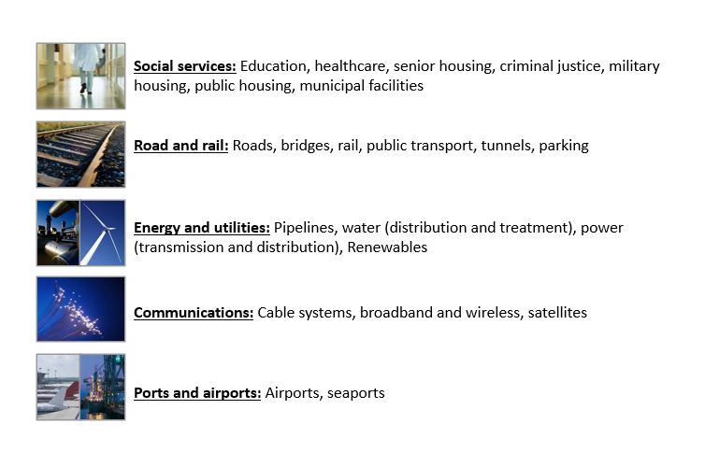
Not as Sexy as a New Version of TikTok, but Very Important to Society
Remember that the ultimate objective of finance is to provide the basis for assessing whether investments make sense for a company and/or a society
Maybe not “criminal justice” which encourages new jails

Slide 11
What is Project Finance?
Project finance refers to how an infrastructure project is structured where:
Future project revenues pay back the initial money invested, and
Investors are subject to limitations on losses in the event of project non-performance.
Nothing about cash flow; Nothing about single asset
Technical Definition:
Project finance is used to refer to a non-recourse or limited recourse debt financing structure in which debt, equity and credit enhancement are combined for the construction and operation or the refinancing of a particular facility in a capital-intensive industry.

Slide 12

Project Finance Definition in HBS Cases
Finnerty
… the raising of funds on a limited or nonrecourse basis to finance and economically separable capital investment in which the providers of the funds look primarily to the cash flow from the project as the source of funds to service their loans and provide the return of and return on their equity invested in the project.
Terms in definition
Limited or nonrecourse
SPV – economically separable investment
DSCR – key measure of risk of default
IRR - Return on and of equity

Slide 13
More Definitions
Project financing is a loan structure that relies primarily on the project's cash flow for repayment, with the project's assets, rights, and interests held as secondary collateral.
… financing of a particular economic unit in which a lender is satisfied to look initially to the cash flow and earnings of that project economic unit as the source of funds from which a loan will be repaid and to the assets of the economic unit as collateral for the loan.
Project finance involves the creation of a legally independent project company financed with nonrecourse debt (and equity from one or more corporate entities known as sponsoring firms) for the purpose of financing investment in a single purpose capital asset, usually with a limited life.
Investopedia, definition of project finance
Nevitt, P.K. and Fabozzi F, Euromoney, Project Financing, 7th Edition, London

Slide 14



Which is a Better Way to Assess the Value of an Investment – Two Presentations to the Board
Value and Risk Verified by Investors Outside of the Company
Bank Puts money into the company
Makes sure the money will be paid back
Crucial stamp of approval

Slide 15
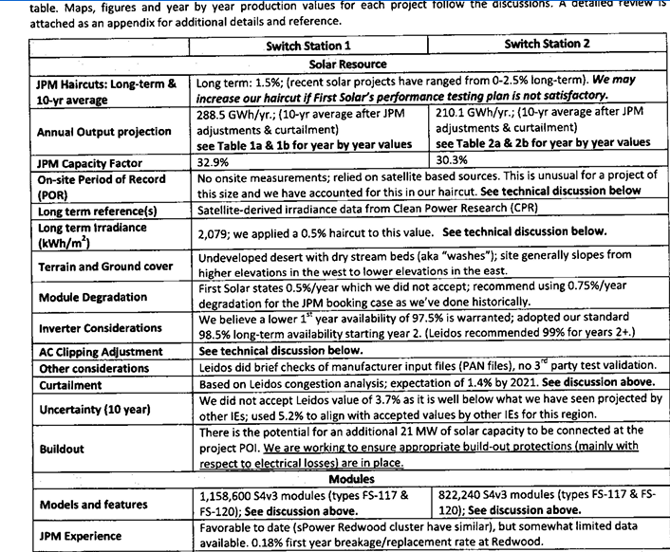
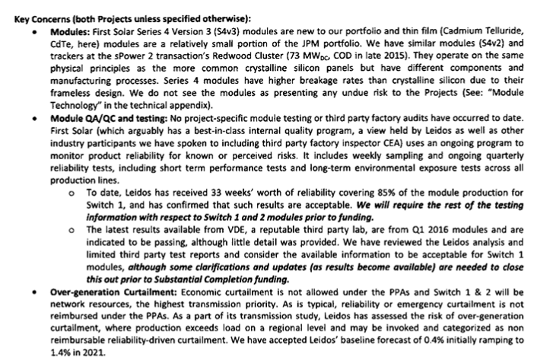
Example of Lender Analysis which Uses Data not Available to Equity Investor
Key Credit Concerns and Verification with Independent Engineer
Use of Alternative Parameters from Experience

Slide 16
Technical Definition of Recourse and Non-Recourse Financing
Corporate Finance
Project Finance
Company
Debt and Equity Financing
NO RECOURSE
to Company
NO RECOURSE
to equity holders
Company
(Borrower)
Bank
(Lender)
Equity Investors
VS
RECOURSE
Dividends
Equity Investment
SPV
(Borrower)
Debt Financing
Bank
(Lender)
Debt Service
(Principal and Interest)
Debt Service
(Principal and Interest)
On balance sheet
Lender CAN take assets in the event of default (“debt recourse to company”)
Off balance sheet financing
Borrower is a special purpose vehicle (SPV)
Lender CANNOT take Company assets in the event of a default (“no debt recourse to company”); only from the SPV

Slide 17

Why is Non-Recourse and No Parent Support so Important In Essence of Project Finance
No parent guarantees (your children cannot send and email and receive your financial support like my daughter).
From a valuation and from a loan perspective a project must be economically viable and evaluated on a standalone basis. In corporate finance and regular old capital budgeting there is no such test.
Philosophical question – is a child with a lot of parent support able to perform better than one with none.
If you know there is a rich parent behind you, can you use this even if there is no direct promise.

Slide 18
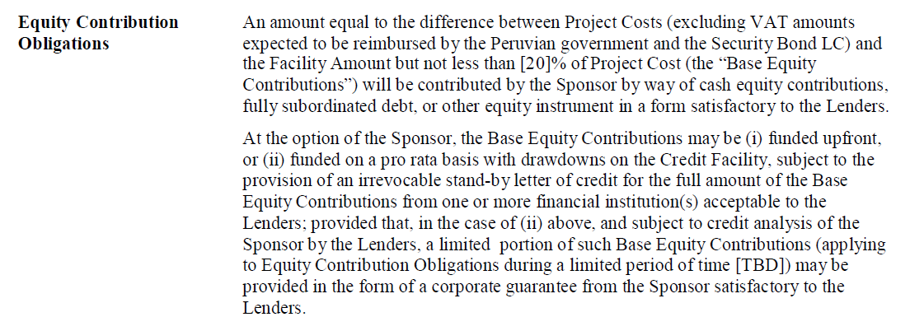
Language of Term Sheet Illustrating Parent Support
Why do they write sentences like this.
How would you read and interpret this if you were trying to understand the term for the first time.
What does it have to do with non-recourse financing.

Slide 19
What is an Investment
The important thing about finance is that it guides you to make the right kind of investments that will ultimately make a society better off.
But what is an investment
It is something where you have to incur a cost and then wait for benefits.
It is all about time and not even necessarily about money
Whenever you have to wait, there is uncertainty
Examples of investment
Capital Expenditure for a project
Spending money for sports betting
Creating a new website for your company
Hiring employees to study AI
Government investing in basic research on the origins of life
Writing a book
Having a child
Question:
Despite what you may hear on a YouTube advertisement, can you think of and investment gaining future benefits (happiness) without making an investment.

Slide 20
What is Return on an Investment
Making the correct investment that is best for you and for society is measured by the return on investment. Any return is a measure of the future benefits received compared to the investment made.
Assessment of the rate of return boils down to a cost and benefit analysis.
The cost is the investment made
The benefit is the future benefits received
The ratio of benefits to costs measure the efficacy of an investment.
The return to society can be different than the return to investors
In project finance an economic return can be computed that accounts for things like carbon emissions, land use, increased employment, personal productivity and other factors.

Slide 21
Any Investment has at Minimum Three Things and a Rate of Return
Revenues Realized
Capital Investments
Return on Investment from Cash Flow versus Capital Expenditure
Operating Expenses
Project IRR, Unlevered Pre-tax IRR, Ungeared IRR, Pre-tax Project IRR

Slide 22
Question and Activity
What do you think about a project that has a 20% high return:
In a market like merchant electricity markets
In a resource market like lithium mining
In a PPP project that is supported by government contracts
In Africa where returns are higher because of so-called political risk
Activity
Use project finance model and compute project IRR with different pricing, operating expense and capital expenditure assumptions
If you are working on contracts, this is could be the PPA contract, the O&M contract and the EPC contract

Slide 23
Special Purpose Vehicle and the Economics of Any Investment
Revenues Realized
Go Around the Bend and Assure that Risks are Mitigated or Reasonable.
If all of the risks are acceptable and produce reasonable cash flow relative to the amount paid on debt, the lenders will put a lot of money into the project.
Reputation of the equity sponsors is important even if the loan is non-recourse.
Note the IRR and the DSCR from cash flow as the performance metrics for the project.
Start
Capital Investments
Operating Expenses
Special Purpose Vehicle:
Project IRR
End
Lenders Receive Debt Service and Invest Debt
DSCR
Equity Sponsors Receive Dividends and Invest Equity – Equity IRR

Slide 24
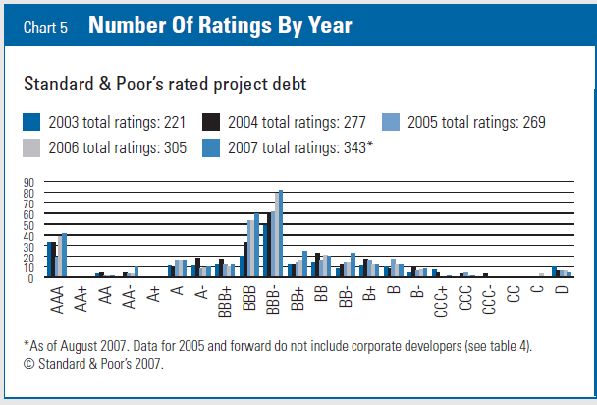
In Project Finance, Risk is Managed to Achieve BBB- (Baa3)
Example, the DSCR of 1.20 x for a solar project should have and footnote to be on a BBB equivalent.
Why BBB- and not AA
Why BBB- and not BB-

Slide 25
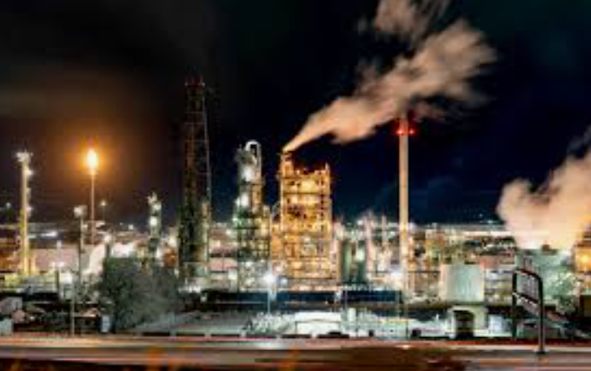
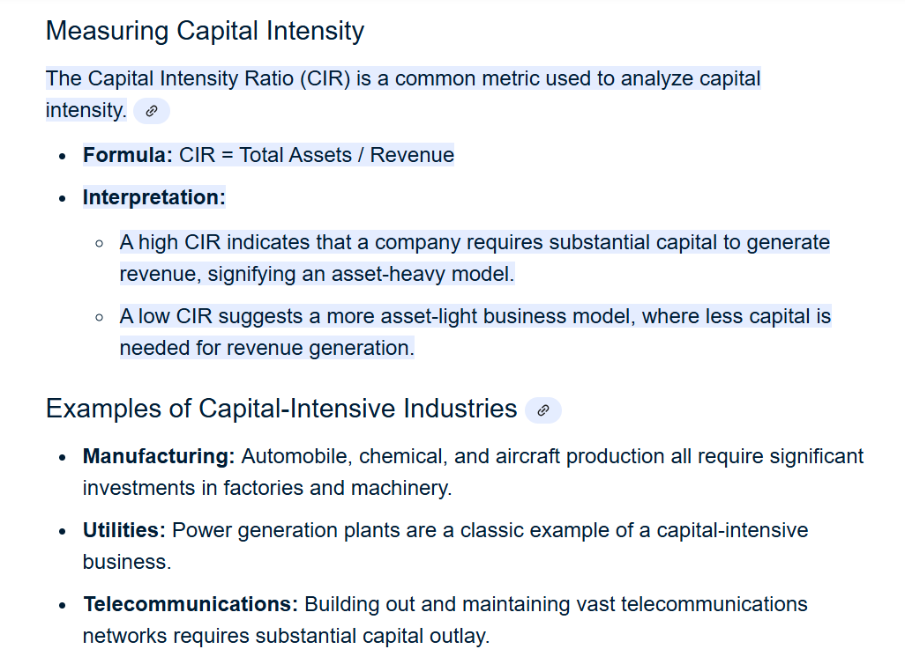
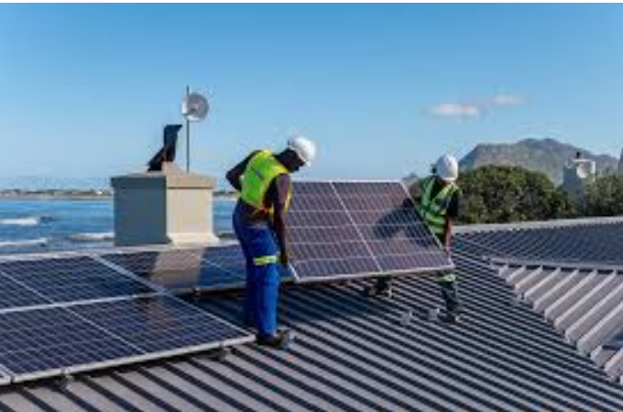
Capital Intensity – Refinery versus Roof-top Solar and Importance of Financing

Slide 26
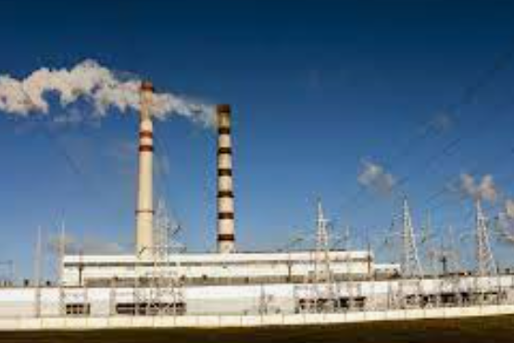

Capital Intensity – Hydro versus Natural Gas

Slide 27

Capital Intensity – Energy Efficient House
.

Slide 28
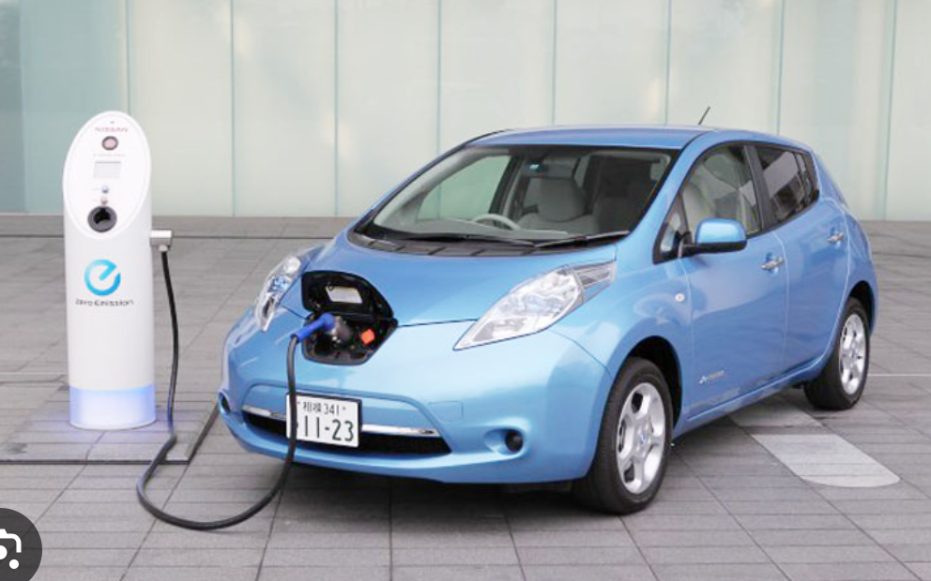

Which is more Capital-Intensive Electric or Internal Combustion

Slide 29
Activity – Compute the Capital Intensity Ratio for Different Projects with Excel Model

Slide 30
Corporate Finance versus Project Finance: A Good Way to Think About Project Finance is What it is Not
How is this different from structured lending, what does non-recourse or limited recourse actually mean and who guarantees;
What are activities in corporate finance
How are corporations valued
How are loans made to corporations
What makes corporations successful
What makes corporations fail

Slide 31
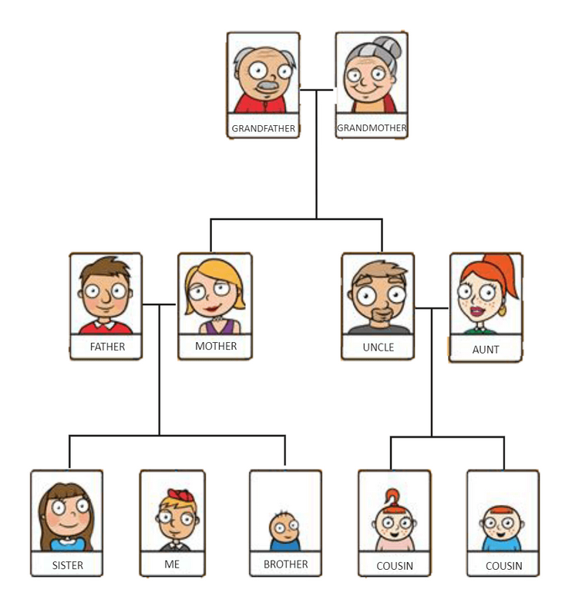
Family is Like a Corporation; Person is Like Project Finance – How would Value the Family
Success of a family depends on the success of individuals in the family
Person is the project going through different phases
Potential for Next Generation as a Guide for the Performance History of Prior Generation
Entire Family is the Corporation
Terminal Value of Future Generations Difficult to Compute – Comes from Potential from Future Generations

Slide 32

Problems that Make Corporate Finance into Magic Portion and a Bad wat to Evaluate Investments
The biggest item of value in a corporate DCF analysis is the terminal value as a corporation is assumed to last indefinitely (forever).
In the long-term future, all of the management will be replaced
In the long-term future, all of the current products will be obsolete
In the long-term, all existing assets (except land) will be retired
Value in the long-term comes from the ability of management to earn returns above the cost of capital; why should we assume management can continually earn high returns on new projects
A really big problem in corporation is what WACC to use in valuation
Assuming a constant WACC or that all risk can be stuffed into one beta statistic is absurd
Everybody has different opinions about what the equity risk premium and the beta are, leading to dramatic differences in WACC
There continue to be problems with valuing the tax shield from interest in WACC and debates about un-levering and re-levering Beta and adjusted net present value
Another big problem in corporate finance is interpreting EPS, ROE and ROIC along with P/E, EV/EBITDA and Price to Book Ratio
When companies are growing fast, the ROE and ROIC will be lower than the equity or project IRR while when companies are not investing the reverse will be true
With straight line depreciation, earnings are distorted, and income is too low when companies grow and then too high when companies contract.

Slide 33
Three Big Problems in Corporate Finance that are Resolved with Project Finance
Corporate Finance Magic Potion
The biggest item of value in a corporate DCF analysis is the terminal value which is modelled using a simplistic formula when the problem is philosophy.
Risk and Cost of Capital Analysis in DCF or Alternative is Stuffed into Beta, an unproven theory with many ambiguities
Financial Ratios Underlying Value Including EPS, ROE and ROIC along with P/E, EV/EBITDA are Distorted by Asset Age, Write-offs, Accounting Conventions
Why Project Finance is Better
You don’t compute terminal value; as you are measuring risk and cash flow for a single asset, you just need the discount rate.
You do not waste time with beta, CAPM or WACC; instead, you look to implied minimum target IRRs in purchases and sales of other projects, and you realize that the cost of capital is mainly debt.
You do not worry about ratios that come from financial statements, but instead, you focus on cash flow which drives the IRR and the DSCR

Slide 34
Radical Idea: The Best Way to Evaluate Corporate Value is to Understand Individual Investments in the Portfolio using Project Finance Analysis
To begin the discussion, I note that any corporation is a portfolio of different investments.
An investment is anything that costs you something and you have to wait to receive benefits – you may only have to wait one day, but the benefits are uncertain relative to the cost.
The investments could be factories, advertising, an internet website, investments in R&D, training of employees and many other things and you want to test whether the benefits of each investment exceed the cost of the investment.
The way I think about this portfolio of investments is a family tree where the family has a history and may last for many generations into the future.
If we for some reason want to value the family, we would need to not only value the current generation, but also future generations that will be there long after we are gone.

Slide 35

Theoretical, Mythical Valuation of a Corporation using Project Finance Concepts
Existing Investments
Compute the remaining cash flow of each investment made by a corporation.
Value the cash flow of each investment using objective data on target IRR’s of sellers in competitive bidding transactions and account for the stage of development of the investment (e.g. development of new investment is valued like venture capital).
The value of each investment is derived from the IRR relative to the minimum target IRR in transactions which is the cost of capital
Prospective Investments
Somehow know the project IRR on new investments relative to the cost of capital.
The ability to earn a return above the cost of capital depends on some kind of unique management ability to differentiate products or other monopoly power.
Somehow know the potential for growth in new investments that earn returns above the cost of capital
In a mythical perfect world, a bank would establish the viability of each investment and valuation would be made from equity cash flows.
In this perfect mythical world, you could make a reasonable assessment about the IRR versus the growth rate of new investments where the only factor that really drives value is the skills of management

Slide 36
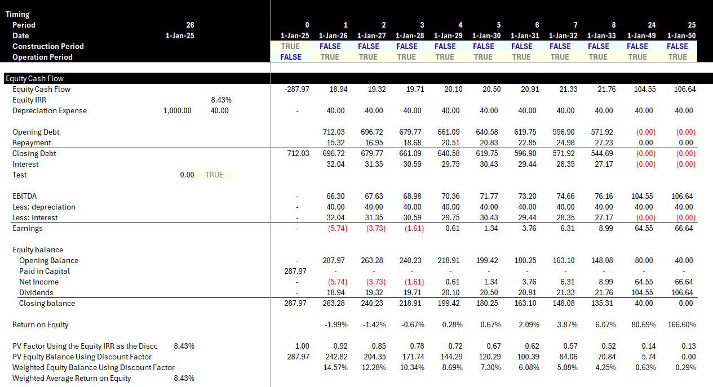
Reconciliation of IRR and ROE
IRR and ROE are the same over the long-run.
ROE you can compute.
IRR is known only after the entire project is finished.

Slide 37
These Problems Do Not Exist in Project Finance
Value a project over its life and don’t need terminal value
Discount rate changes, but stable discount rate for a mature project can be established from transactions (when your children become mature, you know their value)
Most of the cost of capital comes from debt and the mature equity cost of capital is a bit above (or even below) the interest rate
Problems: Irrelevant to use ROIC, ROE, EV/EBITDA, P/E – this makes these ratios irrelevant in fast growing or fast declining corporations. It may be depressing, but this can make just about all financial statement analysis irrelevant for corporate valuation.
Market to Book Value can be assessed by the ability to earn returns above the cost of capital.
Book Value (without write-offs) is the equity value on the balance sheet
Cash Flow from Book Value at Cost of Capital can be computed with PMT
Cash Flow from Premium Above Book Value can be computed with PMT and Higher Interest Rate
Theoretical Price to Book Ratio can be computed from PV

Slide 38
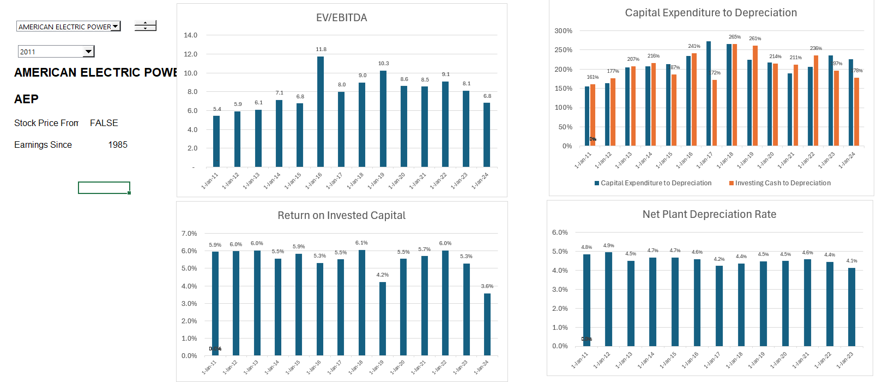
Stable Company EV/EBITDA, ROIC and Project IRR
.

Slide 39
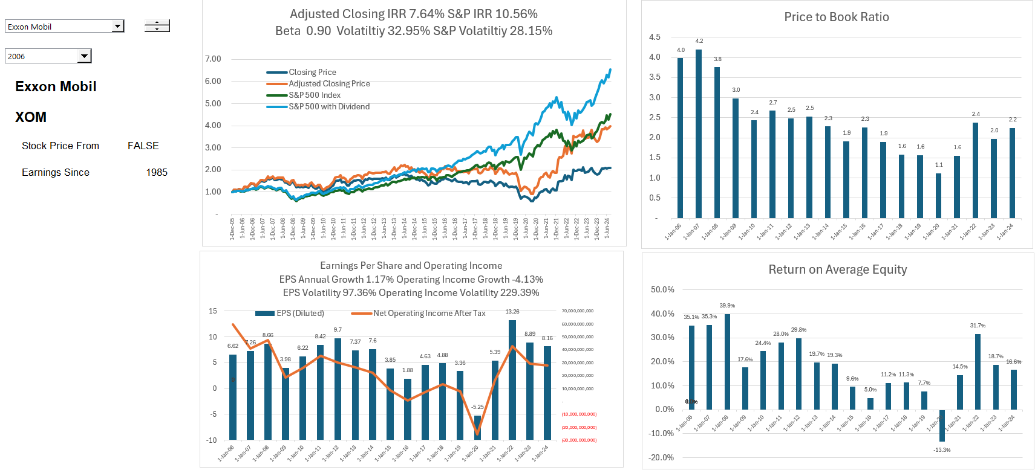
Return and Price to Book Ratio for Oil Companies
Look at Equity IRR -- Seems to require about 15% to 18% to generate value of 2.0 to 2.5x value relative to the investment. Note that the beta is .9

Slide 40
Session 2: The key parties in a project finance including the lender and two key project finance ratios

Slide 41
Subjects for Key Parties, Contracts, Lenders and Equity Investors
Project company/borrower (IRR);
Industrial Sponsors and Financial Sponsors: key differences and how do they interact, e.g. shareholders agreement etc;
Construction contractors (EPC and margins);
Operator;
Suppliers; purchasers/off-takers;
Government role, government as a counterparty, government as a host etc
Risk-return and what it means (Required Equity IRR);
Third party equity investors (IRR for Mature Project);
Lenders banks and other sources (DSCR, LLCR, PLCR);
Multilateral banks and export credit agencies;
Different teams: legal team; finance team; financial adviser; model auditor; insurers; tax and accounting advisers; environmental consultant.

Slide 42
Economic Theory of Contracts
Take a step back and think about what contracts really do:
Contracts change the risk structure between the parities. If you have no contract, you may have more variation in your cash flows or something else
Things that vary for which you can have hedging contracts
Commodity and electricity prices
Real Estate prices
Interest Rates
Inflation Rates
Generally, but not always, with hindsight, one party will be better off, and the other will be worse off by locking prices or other things in.
If you sign a contract for a loan on your house with a fixed interest rate, you may be happy if the interest rate rises but sad if it declines
If you sign a contract for life insurance and you die later, you lose on the contract, and the insurance company wins
If you sign a contract for buying solar power, you may be sad if the price of solar power goes down but happy if the solar price goes up.
Contracts should encourage parties to behave well, and in economic terms they should manage things efficiently and not waste money
Liquidated damages like warranties when you buy something – you will pay extra for the warranty on your phone from the likelihood of you damaging the phone and what is covered. The economics of a warranty depend on the buyer value,

Slide 43
Explaining Project Finance with Diagrams
You would like the diagram to give you a picture of the risk of the project and highlight issues with contracts
SPV is a separate corporation in the middle
SPV signs a lot of contracts that should be illustrate with solid lines
The contracts should be labeled (e.g. concession contract, EPC contract, PPA contract, O&M contract, Loan Agreement, Shareholders agreement)
Different levels of support from parent (non-recourse is no support)
Contracts should be consistent with each other
Diagram should show direction of money and start with revenues (no revenues, no project)
Quality of off-takers should be shown on the diagram in the circles
Insurances and guarantees should can be demonstrated

Slide 44
Start with Revenues and Risks from Revenues – General Categories from Revenue Generation
Different types of revenues in project finance
Price Risk and Volume Risk from Demand
Real Estate
Technology
Rehabilitation and some health care
Price Risk but Limited Demand Risk
Commodity Price – Oil and Gas
Refinery and Mining
Volume Risk but Limited Price Risk
Infrastructure – Toll roads and bridges
Infrastructure – Airports
Renewable Energy with Resource Risk
Availability Risk – No Price or Volume Risk
Dispatchable Power Plants – IPP, BOT, BOOT
Hospitals, Schools, Prisons – PPP, Availability Payment
Availability Bases Toll Roads – Availability Projects

Slide 45
Not Just a Diagram – Illustrate Risks
Each contract can have many nuances with penalties, bonuses, default clauses, termination.
Off-taker: Want strong off-taker with inactive to honor contract
Write down notes associated with each contract and if a contract does not exist, how the cash flow volatility can be addressed.
EPC Contractor: Want Strong Record and Finances
Price Risk or Volume Risk or Both or None (Availability)
EPC: Fixed Price Contract with LD
Supplier: Need to Understand Economics and Supply Curve
Special Purpose Vehicle: Bond Rating of BBB-
O&M Contractor
Supply Agreement
O&M Agreement
Loan Agreement – Draws Green; Debt Service Red
Banks Like Strong Sponsors. Sponsors want EIRR
Shareholder Agreement
Lenders:
Lenders want DSCR (LLCR, PLCR)
Invest with paid in cap; payback dividends
Invest with draws; payback debt service

Slide 46
Project Participant Overview – Means Nothing
Public Authority (CDOT)
Debt Investors
Special Purpose Vehicle
(SPV)
Design-Build Contractor
Equity Investors
Operations & Maintenance Contractor
Toll Road Users

Slide 47
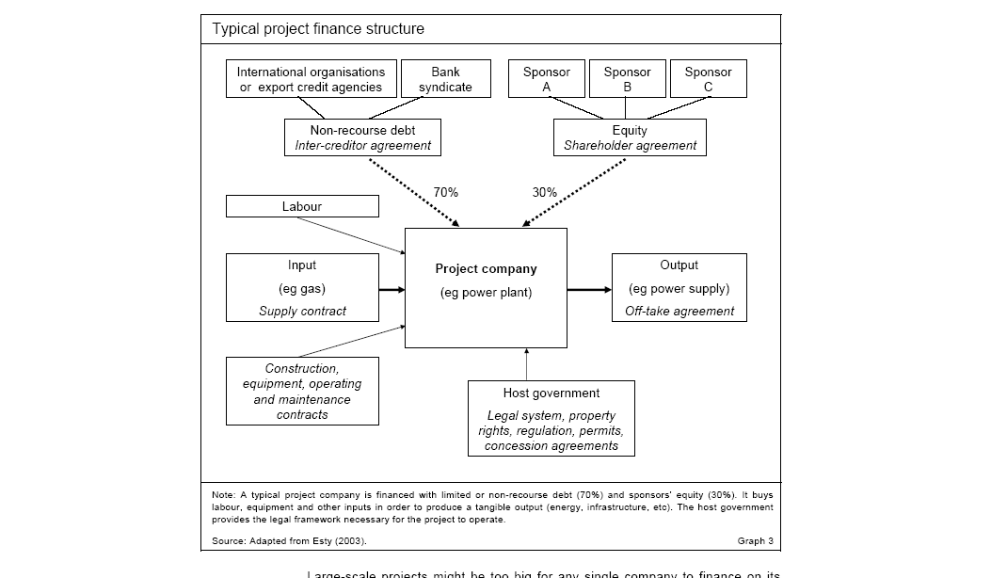
What are Problems with this Diagram from HBS

Slide 48
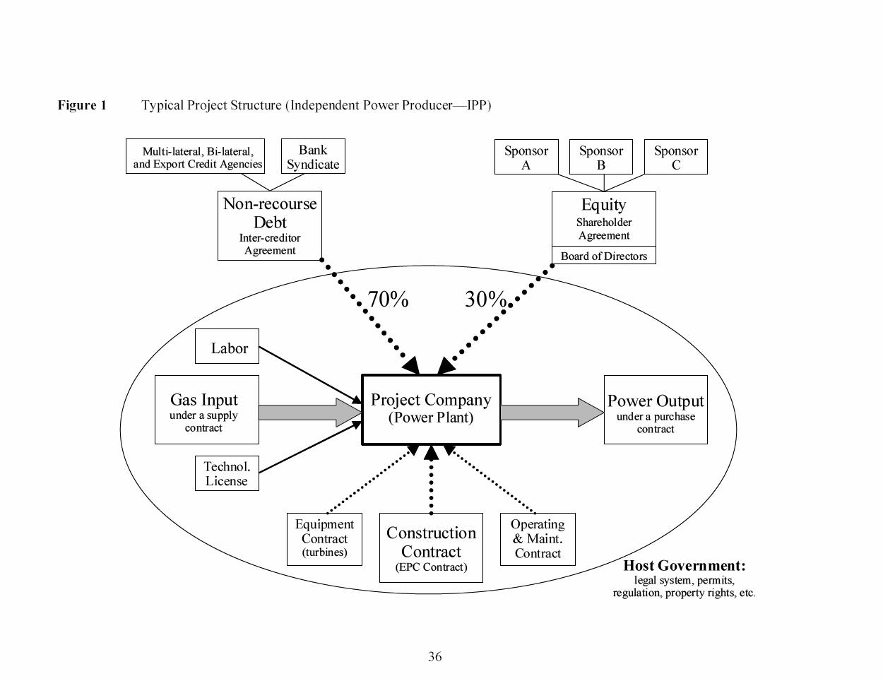
What is Good and Bad about this Diagram
Debt is serviced entirely via cash flow through the project and the SPV This structure exposes the lenders to significant risks. If something goes wrong, their recourse against the sponsor, with its typically larger balance sheet, will be limited or none.
The loan is structured so that bankers can step into and take over the project if things were to go wrong, a so-called step-in right. This process is also called ‘ring-fencing.’
Ring-Fence

Slide 49
Activity Ras Laffan Case Study Part 1 – Project Finance versus Government

Slide 50
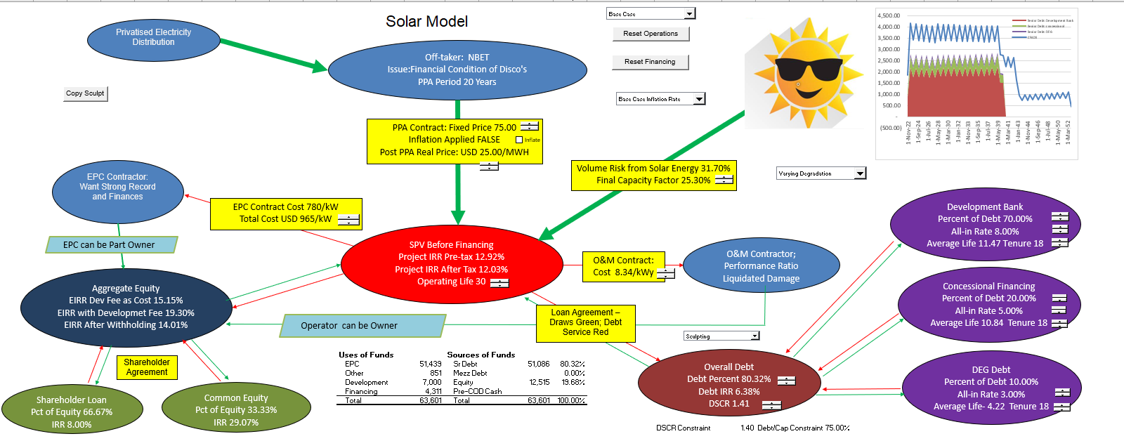
Diagram of Solar Project Finance
Volume or price or availability risk in model, and then, the IRR’s of each party and the DSCR’s of the lenders. Include cost to off-taker for the project economics.

Slide 51
Two Statistics in Project Finance: IRR and DSCR IRR: Happiness; What is this Business with IRR Anyway and how can you measure Risk DSCR: Anxiety; Measuring Risk with Safety Buffers

Slide 52
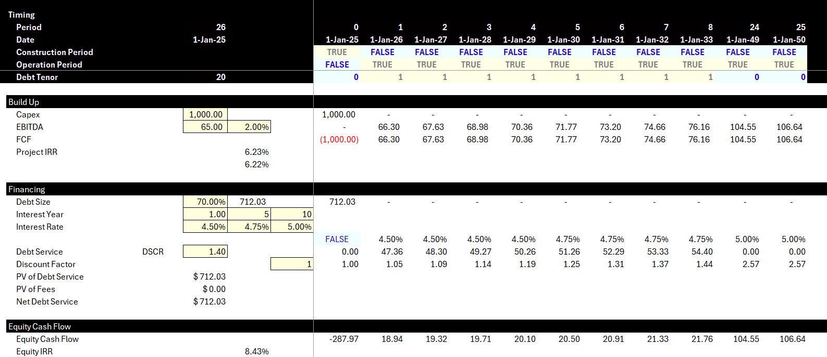
Project Finance Model
Basic Model Operating Cash Flow, Debt Service and Equity IRR

Slide 53
Equity Valuation in Project Finance – The IRR

Slide 54

Valuation of Projects and IRR
Project is typically valued with IRR
Different IRRs
Project IRR pre-tax
Project IRR after-tax
Debt IRR pre-tax
Equity IRR – Overall
EBL or Shareholder Debt IRR
Pure Equity IRR
IRR with and without Development Fee
Holding Company IRR
IRR has taken over the world
Need to Understand the Nuances of the IRR

Slide 55
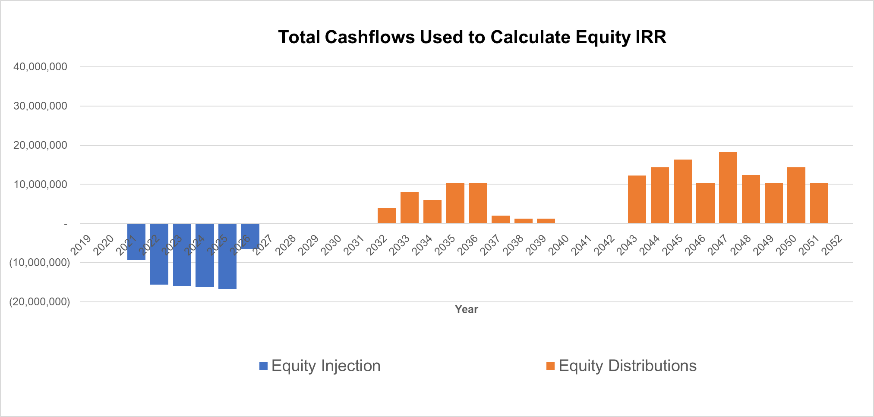
What is this All of This Business with the IRR Anyway
Reflect the timing and required amount of equity investments and distributions
Distributions made after all mandatory project costs and debt service are paid
Equity IRR is the "rate of return" that makes the NPV of all equity cash flows (both positive and negative) from an equity investment equal to zero.
Requirement of Equity IRR depends on the riskiness of revenue stream (e.g., 11% for projects with unpredictable revenues, 8% for projects with predictable revenues)
When the Chairman of Apple makes an investment, is he asking about the discount rate for the NPV formula

Slide 56
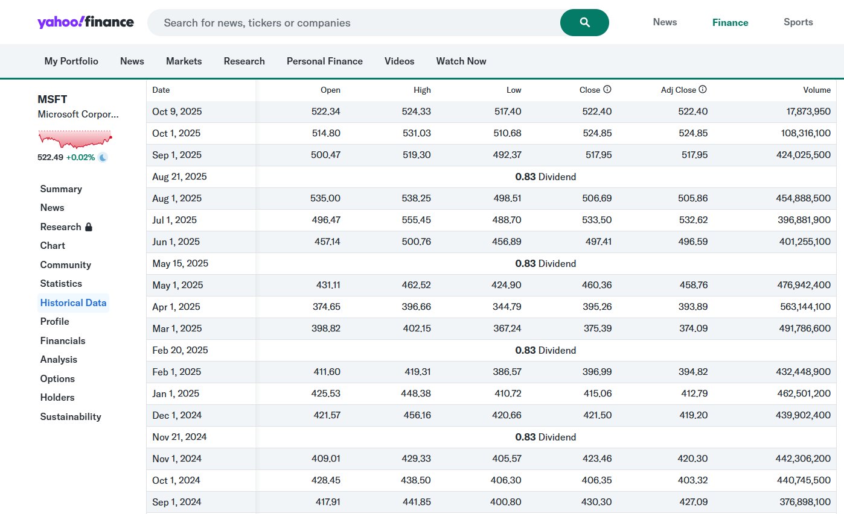
IRR from Investing in a Stock and Yahoo Finance Adjusted Stock Price
People who want to get rich, care about one thing. That is, how fast will your money grow and can it keep growing over a long period

Slide 57
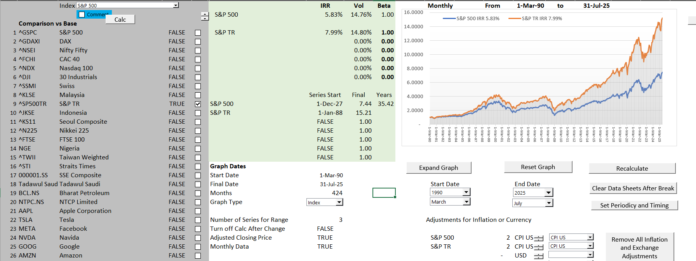
Compute IRR for Stocks and Prove the IRR is the Growth Rate
Understand why investors care so much about IRR
IRR on Stocks using S&P 500

Slide 58
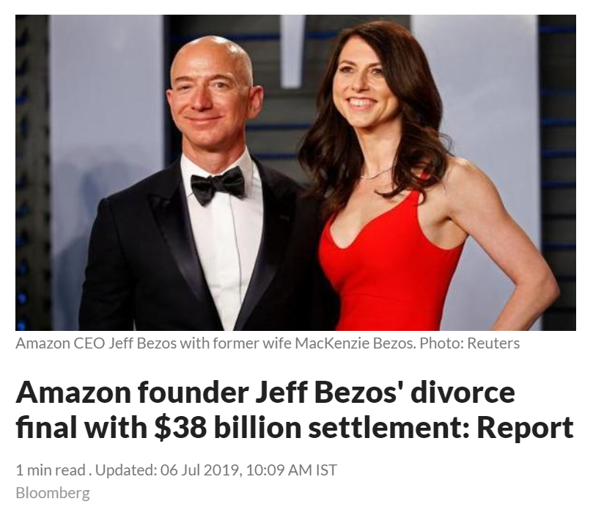
Exercise: Computing the IRR and Growth for Amazon; Understanding the Effect of Small IRR Differences over Long Periods of Time
Open File on Stock Prices and Economic Indicators from the Drop Box
Compute the IRR with dates using XIRR and assuming dividends are re-invested
Compute the daily compound growth rate as g = (End/Start)^(1/Days) – 1 and then annualize using (1+Daily Growth)^365-1
This demonstrates that XIRR is based on a daily rate

Slide 59
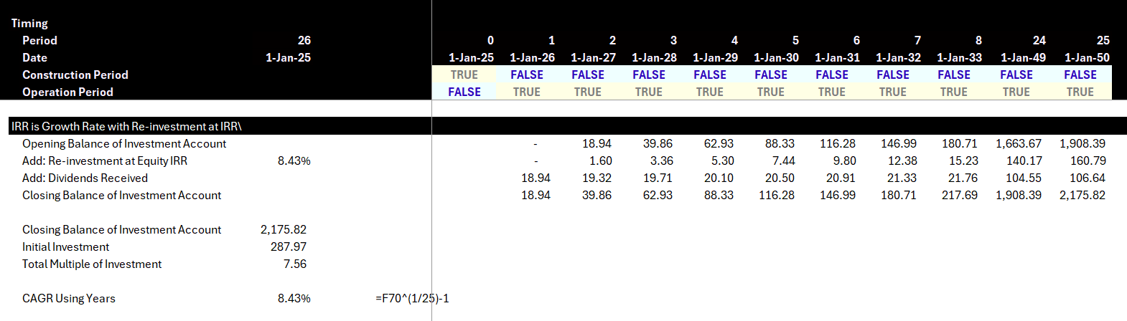
IRR as Growth Rate in Cash Flow in a Project Finance Model
Hypothetical Investment Account

Slide 60
Reconciliation of IRR and ROE
IRR and ROE are the same over the long-run.
ROE you can compute.
IRR is known only after the entire project is finished.

Slide 61
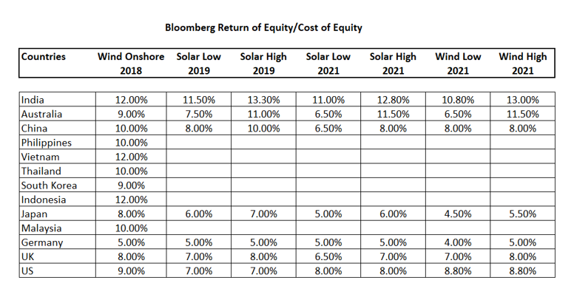
Real World Minimum Acceptable Target IRR
In practice there is no CAPM and certainly no un-levering and re-levering of Beta (see the discussion at the end).
In practice, equity IRR is used rather than project IRR as a target (this makes sense in theory as project finance implicitly adjusts for risk
In practice, and there are general standards for target IRR on buying and selling of projects. These standards have change over time. Pre-Covid for projects in Europe with a few years of history, equity IRR targets were as low as 4%.
I have been told stories of insurance company executives and pension plan managers going around Europe holding suitcases of cash to buy solar and wind projects with operating history.

Slide 62

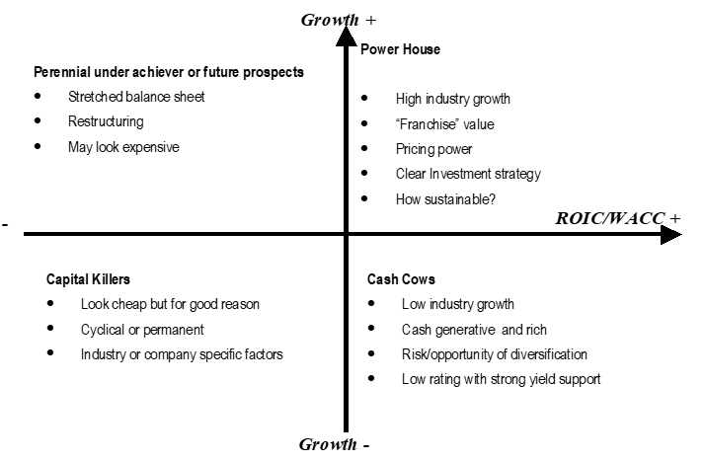
Simplistic Valuation Concepts in McKinsey Book and Project Finance
In project finance you would use IRR and in particular equity IRR instead of ROIC.
In project finance the cost of capital is the target IRR for buyers in a competitive bidding situation.
Value = D₁/(k-g)
Growth (g) = ROE x (1-DPO)
DPO = 1 – g/ROE
Value = (E₁ x DPO)/(k-g)
Value = E₁ x (1-g/ROE)/(k-g)
The P/E ratio: [P/EPS₁= (1-g/ROE)/(k-g)]
[k=E₁ /P x (1-g/ROE) – g]
[EV = NOPAT₁ x (1-g/ROIC)/(WACC-g)]
E = ROE x Book Value of Investment
BV = E/ROE
[P/B = (ROE-g)/(k-g)]

Slide 63
IRR Problems and Implications
The IRR is the growth rate in cash flows with a big caveat. That caveat is the assumption that cash flow is re-invested with the same return as the IRR itself. As everybody uses the IRR, arguing against the IRR is not silly. But understanding IRR distortions and IRR alternatives is useful:
IRR Distortions
Extreme effects of near-term cash flows and almost no effect of long-term cash flows
Cannot reflect the change in risk of a project
IRR Alternatives
MIRR does not work (maybe use in part for EBL)
Risk Premium Method
Compute the Value at the risk-free rate including initial investment
Compute the premium as a percent of the initial investment
Spread the Risk Premium percent over the life of the investment using PMT

Slide 64
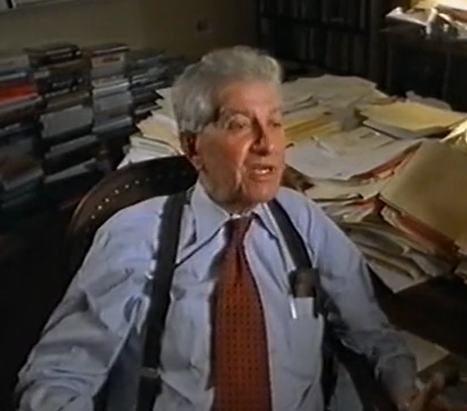
Equity IRR, Debt Financing Theory and Project Finance
Miller and Modigliani and APV
Debt Level and Risk in Project Finance
Un-gear and Re-gear Beta is ridiculous in project finance (and maybe in any finance). This is because the debt level defines the level of risk and not the other way around
Why Equity IRR rather than Project IRR is used in project finance. For example, a risky project has less debt that would imply a lower equity IRR if the project IRR was the same. But the project IRR should be higher because of the higher risk, and the lower debt offsets this risk leading to a similar equity IRR
Problem with cash on the balance sheet
Much bigger problem if cash is invested at the beginning because of IRR mathematics – if the cash must be financed by equity and not a mixture of debt and equity.
This is one of the issues that arise with putting a cash reserve on the balance sheet to resolve the interest expense versus debt service problem

Slide 65
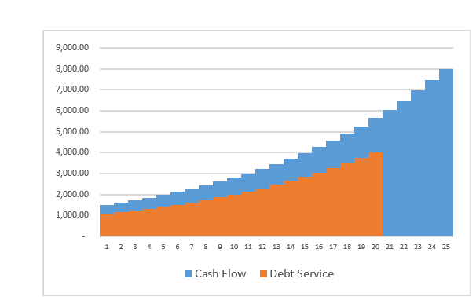
Project Finance, Dividends and the Key Graph for Debt Structure
Dividends (without cash sweep or cash trap) serve two purposes. One is to get the IRR; the second is to provide a buffer to lenders
Should dividends occur if interest is above debt service
Without dividends the IRR will be low (remember the IRR mathematics)
Dividends are needed for CFADS buffer
If extra cash is put in a reserve account and it just meets the debt service, there will be no buffer.
The formula: Debt Service = CFADS/DSCR
can be reversed to Debt Service * DSCR = CFADS
If the repayment is zero, you can use the formula to derive how much of a cash reserve is necessary

Slide 66
Lender in Project Finance and Assessment of Risk – The DSCR

Slide 67
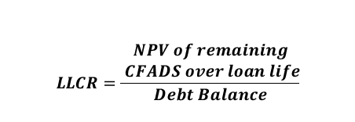

Technical DSCR Definitions
Debt Service
Coverage Ratio (DSCR)
Loan Life
Coverage Ratio (LLCR)
$$LLCR=\frac{\begin{aligned}NPV of remaining \\ CFADS over loan life\end{aligned}}{Debt Balance}$$
Debt Balance is PV of Debt Service, so LLCR is DSCR in terms of PV.
Use PV of Debt Service because current cash flow is better than future cash flow
$$DSCR=\frac{CFADS}{Debt Service}$$
Where:
Debt Service = principal repayments + interest
Where:
Discount rate for NPV= cost of debt
Debt Service Coverage Ratio (DSCR) determines debt borrowing capacity
Remainder of CFADS after debt service is the amount available for equity distributions
DSCR = 1.0x means there is exactly enough cash available to repay project debt
Loan Life Coverage Ratio (LLCR) measures the number of times available future cash can repay the outstanding debt balance
LLCR = 1.0x means there is exactly enough future cash available to pay off the debt balance

Slide 68
Start with Risk Question
A couple of weeks ago, a very nice man asked me the following question. Which is riskier:
A solar project
A wind project
A battery project
My normal response would have been a bunch of gobbledegook about the variability of wind compared to solar, whether batteries are proven technology over their lifetime; uncertainty in battery parameters of degradation, round-trip efficiency and state of charge …
Somebody who just completed an MBA program would try to find companies that only develop solar projects; companies that only own wind projects and companies that are only involved in the ownership of batteries. Then I suppose you could try to find betas for these companies. All of this would not be possible. But then you would have to un-lever the beta and re-lever the beta after you could get into arguments about whether the beta should be computed from daily, weekly or monthly stock price data and whether the beta should be mean reverted with the arbitrary two-third and one-third adjustment made in an academic article by Professor Bloom in the 1970’s.
How utterly ridiculous. Can you think of anything better.

Slide 69
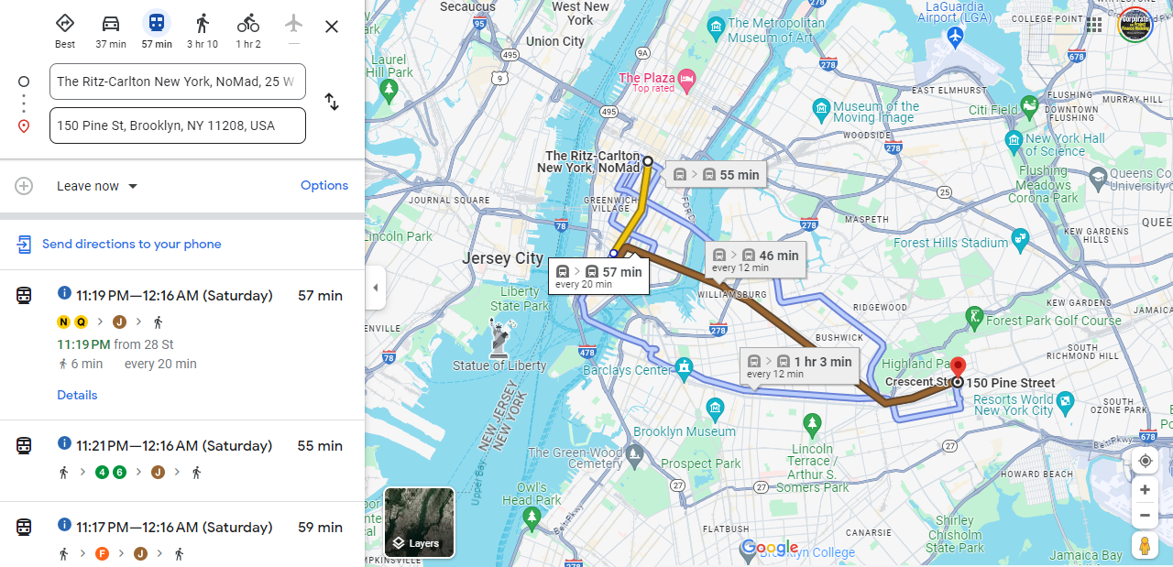
New York Meeting, Google Maps and Assessing the Risk of Being Late

Slide 70
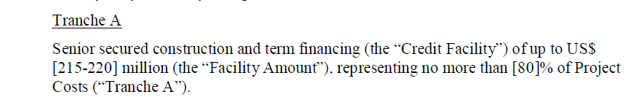
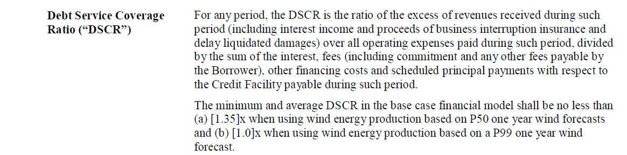
Which is More Important – DSCR or Debt to Capital
Maximum Debt to Capital Constraint
Minimum DSCR Constraint

Slide 71
Cash Flow Available for Debt Service (CFADS); It is what the Definition Says it is
Toll Road Mini Case
$$CFADS =Revenue−Operating Costs±Working Capital Adj$$
What is missing from the formula
What about changes in DSRA
CFADS represents periodic net revenue available to repay initial financing of capital expenditures from the construction period
Once operating costs are accounted for, remaining money must be used to repay debt, followed by equity distributions
CFADS is the single-most important metric for evaluating the likelihood of senior debt repayment

Slide 72
You Can Go the Other Way to Find the DSCR
Formulas for Break-Even: Say that you want to know how big the DSCR should be to cover for an availability payment that could be reduced by 20%.
The formulas below are for DSCR; you could also use LLCR and PLCR
Break-even cash flow = (DSCR-1)/DSCR
BE = (DSCR-1)/DSCR
BE x DSCR = DSCR – 1
DSCR – BE x DSCR = 1
DSCR * (1-BE) = 1
DSCR = 1/(1-BE) or 1/.8 or 1.25
Note: Be careful with fixed costs. If a project has fixed costs you have to make a more complex formula

Slide 73
DSCR, LLCR, PLCR and Downside Cases
DSCR = CFADS/Debt Service
Percent Cash Flow Reduction Before Not Paying Debt = (DSCR – 1)/DSCR
Debt Outstanding at COD = PV of Debt Service at Interest Rate
PLCR = Present Value of CFADS over Life at Interest Rate/Present Value of Debt Service
PLCR = Present Value of CFADS over Life at Interest Rate/Debt Outstanding at COD
LLCR = Present Value of CFADS over Debt Life at Interest Rate/PV of Debt Service
LLCR = Present Value of CFADS over Debt Life at Interest Rate/Debt Outstanding at COD

Slide 74
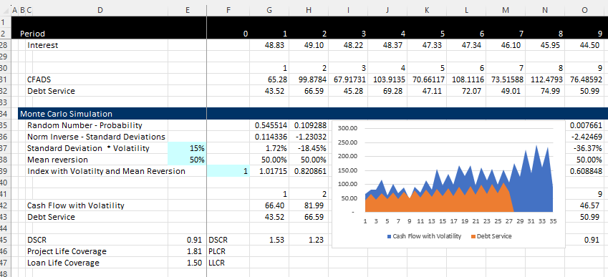
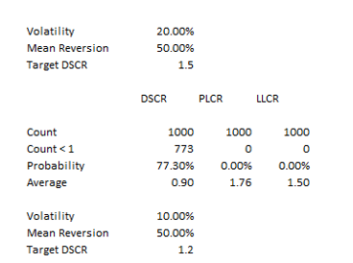
Monte Carlo Simulation as Illustration of Project Finance
Structure the Debt
Simulation with Volatility
Volatility and Mean Reversion Equations
CF1 = Cf0 + CF0 * Rand x Volatility
CF1 = Cf0 + CFO * Normal Inverse (Rand()) * Volatility
With Mean Reversion
CF1 = CF0 + (Mean – CF0) * Mean Reversion Factor + Volatility from Above
Results

Slide 75
Understanding of DSCR, LLCR and PLCR (DSCR-1)/DSCR = Break Even Cash Flow
All ratios are measures of buffer and driven by possibility of decline in cash flow
Example
DSCR = CFADS/DS
CFADS 150
Debt Service 100
DSCR 1.5
How much can cash go down before cannot meet debt service: 150-100 = 50
How much can cash go down in percent : 50/150 = 33.33%
Formula for minimum break-even: (1.5-1)/1.5 = 33.33%
LLCR measures break-even over the entire debt life (it is possible that DSCR is below 1)
LLCR = NPV (CFADS ll)/NPV of DS (NPV of DS = Loan at COD)
How much can cash flow go down before cannot pay off loan at end of the loan life
LLCR = 1.6
Break-even over loan life (1.6-1)/1.2 = 37.5%
PLCR measures the break-even over the entire life and give the value of the tail
PLCR = NPV (CFADS pl)/NPV of DS (NPV of DS = Loan at COD)
How much can cash flow go down before cannot pay off loan at end of the loan life
PCR = 2.0
Break-even over loan life (2-1)/2 = 50%
Formulas work if there is a 100% cash flow sweep

Slide 76
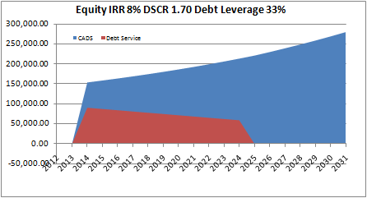
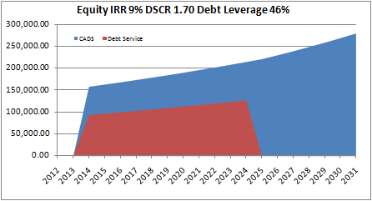
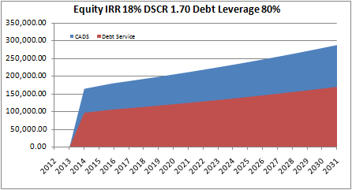
DSCR versus LLCR versus PLCR and Sculpting
Level Payment and Tail
Min DSCR < LLCR < PLCR
Sculpting and Tail
DSCR = LLCR < PLCR
Sculpting and No Tail
DSCR = LLCR = PLCR

Slide 77
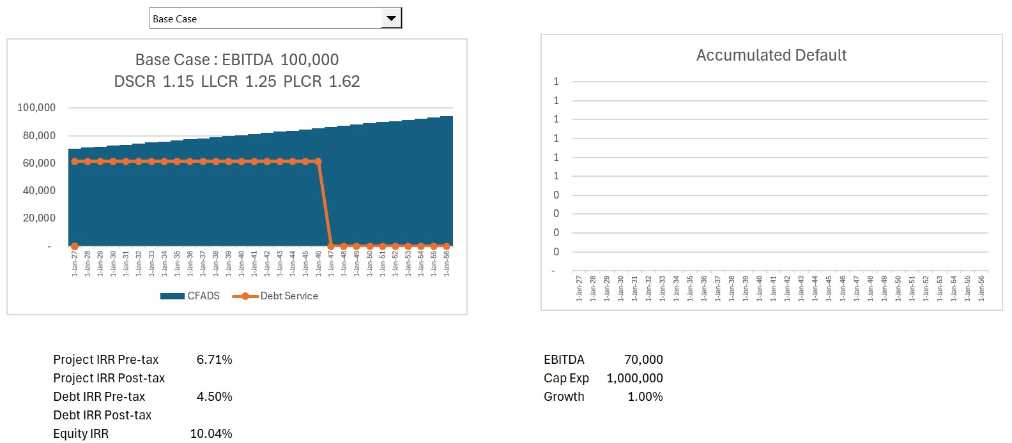
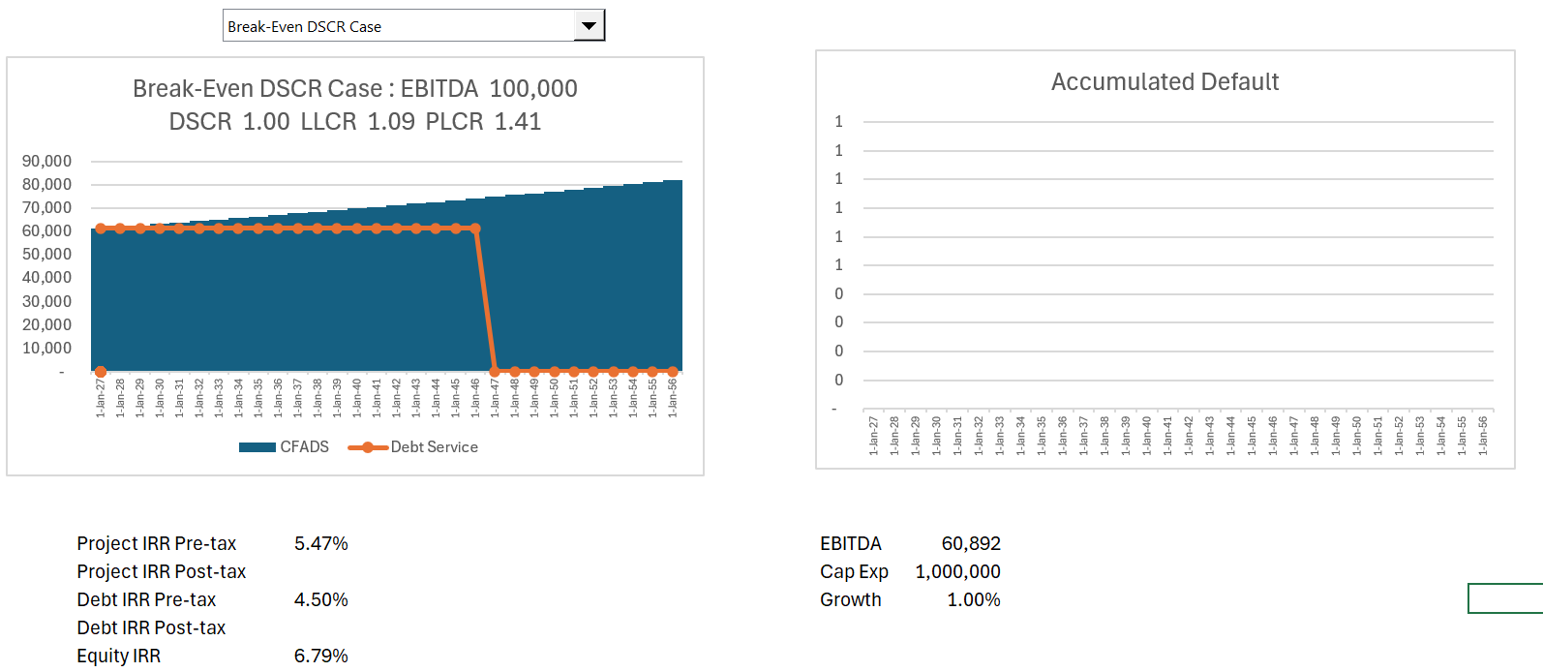
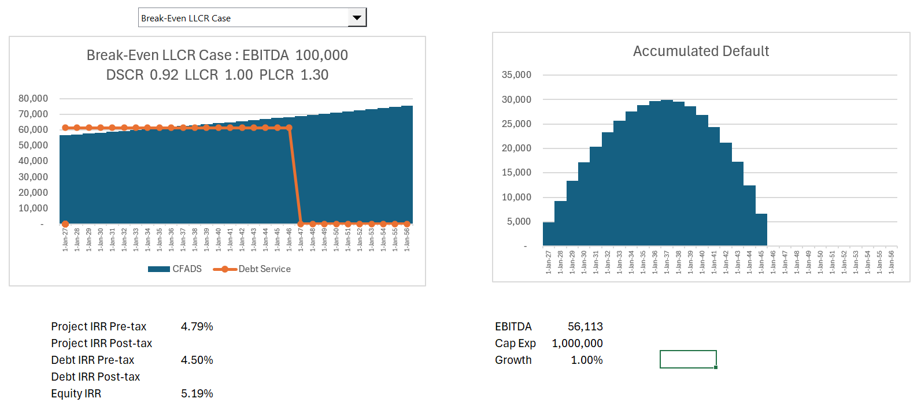
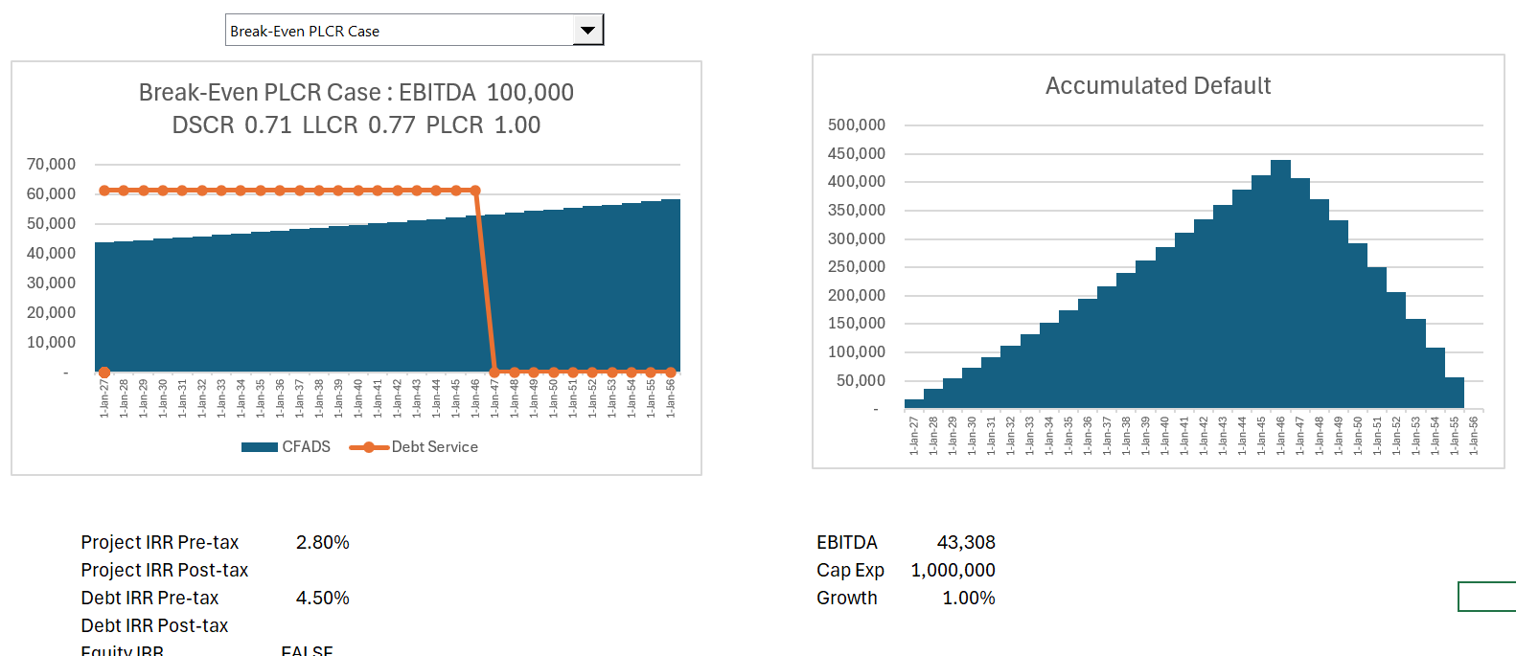
Illustration of Cases
Break Even % = (LLCR-1)/LLCR, (DSCR-1)/DSCR etc.

Slide 78
What Makes it Possible to Lend Long-term to Single Assets
Discussed the importance of debt financing in raising money for project financed assets.
To achieve low cost of capital, the debt tenure of must be long (otherwise the DSCR will be too low).
Cannot have debt that has a bullet repayment that is supported by a portfolio of assets owned by a corporation.
Projects must have contacts and/or mean reverting cash flow to support long-term debt.
Use the formula: PV of Debt Service at Interest Rate = Debt

Slide 79

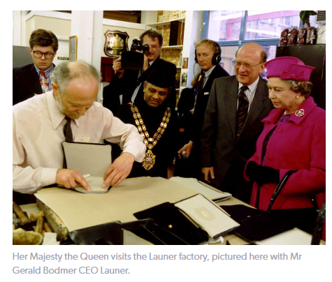
The Queen, Paddington and Gerald – What can be Project Financed
Boring Investment otherwise known as proven technology
Things that cannot be funded with project finance
Could Launer qualify for project financing for establishing a set of retail outlets after the increase in demand
Could a coca farm in Ghana be Project Financed
Can a hotel be project financed
https://www.youtube.com/watch?v=7UfiCa244XE&t=9s

Slide 80
Risk Allocation Part 2: Investor Risks to Different Contracts for the SPV
Contract Mitigation
EPC Contract with Fixed Price and LD (LSTK)
O&M and EPC Contract
O&M Contract and EPC LD Provision
O&M Contract
Capacity Charge/Month; 4 Part PPA Contract
Swap Contract (Fix Rates)
IPP Risks
Cost of Project, Time Delay and Technology Parameters
Availability Penalty in PPA
Efficiency or Heat Rate Risk
O&M cost Risk – Real
Independence of Generation Risk
Interest Rate Fluctuation

Slide 81
Examples of Things that are Mean Reverting and Not Mean Reverting
Mean Reverting
Solar and Wind Variation
Commodity Prices moving to marginal cost of production
Movement in Traffic from year to year after initial traffic has been established
Maintenance cost variation from year to year
Refinery Margins
Electricity Merchant Prices in Markets with Little Renewable Capacity
Non-Mean Reverting
Stock Prices
Items that go out of fashion such as handbags
Items that become obsolete like Kodak Cameras and Blackberry
Sudden Political Decisions to Nationalize Industries or to Change Rules on Off-Shore Wind
Errors in Modelling Solar, Wind or Toll Road Traffic

Slide 82
Mean Reverting and Non-Mean Reverting Cash Flow and Risk
Importance of mean reversion in financing long-term asset
Non-mean reverting, volatility increases with time (technically, the square root of time period)
Volatility for a year – standard deviation of return annually
Volatility for a month – standard deviation of return for month
Volatility for a year = volatility for month x square root of 12
Volatility for five years = volatility for one year x square root of 5
Price t = Price t-1 + Price t-1 * volatility
Price t = Price t-1 + Price t-1 * Norminv(Rand()) * Volatility
Price t = Price t-1 x (1 + Norminv(Rand()) * Volatility)
Mean reverting – follows cyclical pattern
Volatility increases less than by square root of time
Mean Reversion Factor ➔ % by which move to mean in one period
Example: Mean Reversion = (Price t = Mean Price – Price t-1) * Mean Reversion Factor
Start with Mean price and subtract last period price
If last period price above mean, then price should come down, so mean reversion is negative
If last period price below mean, then price should go up, so mean reversion is positive
Mean reversion factor is difficult to measure
If Mean reversion factor is 100%, then the volatility does not increase with period

Slide 83
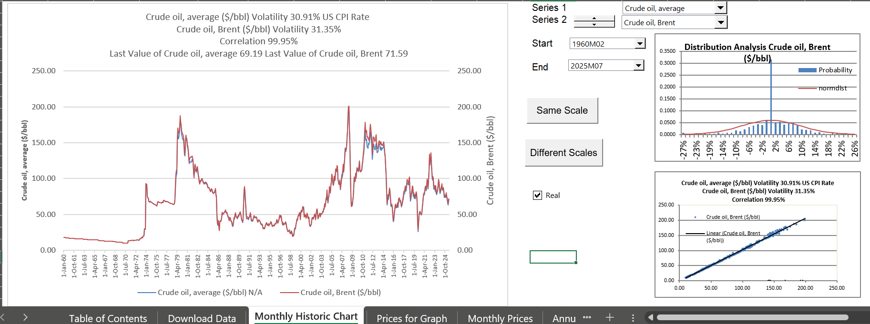
Oil Price from Database File
.

Slide 84
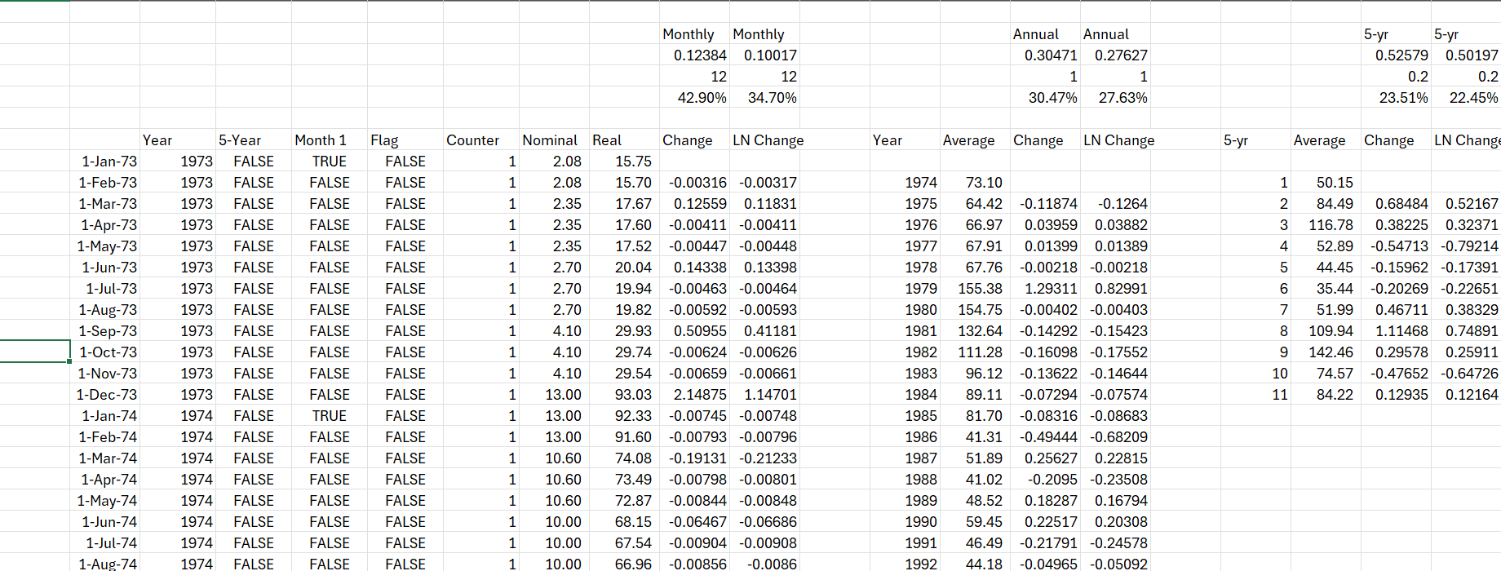
Illustration of Mean Reverting Cash Flows – Commodity Prices Except Change in Oil Prices in 1973
Volatility of prices for 1-year, 5-years, 10-years

Slide 85
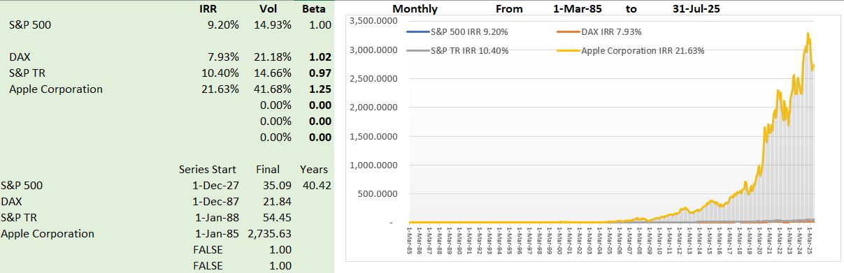
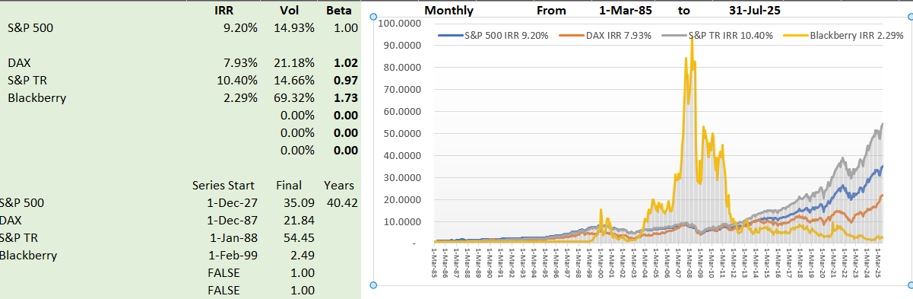
Illustration of Non-Mean Reverting
Blackberry Price and Apple Price
Volatility driven by fashion, changes in technology, one-time non-recurring events.
Volatility of one year, three-year, five-year

Slide 86
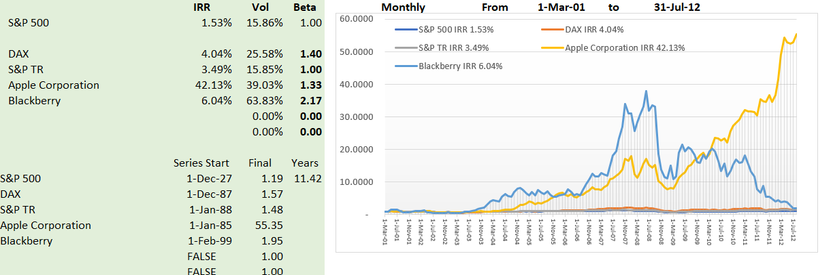
Non-Mean Reverting Series - Blackberry and Apple
Blackberry Price and Apple Price
Volatility driven by fashion, changes in technology, one-time non-recurring events.
Volatility of one year, three-year, five-year does not diminish

Slide 87
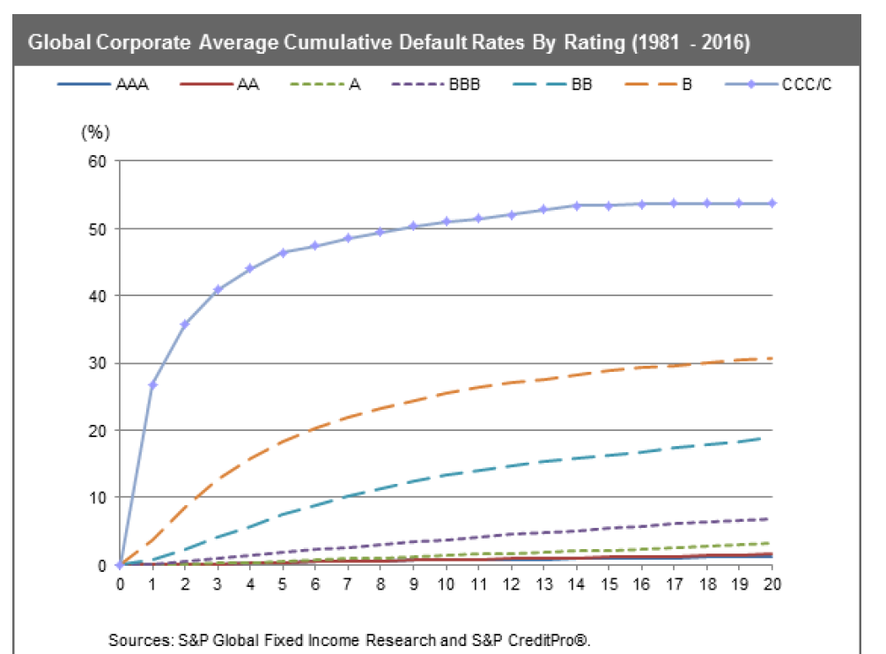
Default Studies – Probability of DSCR Below 1
.

Slide 88
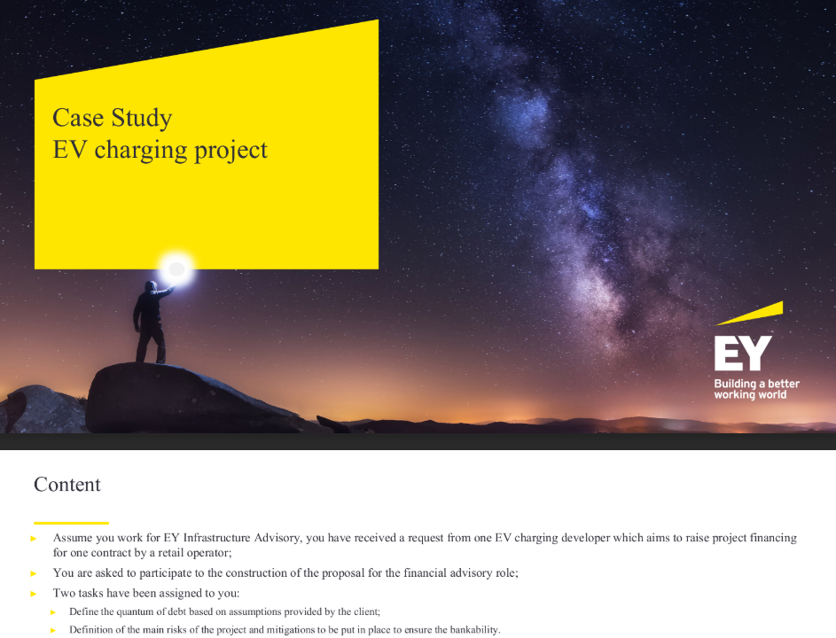
Financing Charging Stations
Question: Do you think EV charging stations are a good candidate for project finance.

Slide 89
Session 3: Different contracts structures and implications of revenue risk

Slide 90
Project Participants, Risks and Contracts
Importance of Project Economics
Need Risk to Provide Economic Incentives
Different contractual relationships and how this gets reflected in a contract ;
Critical differences of contractual structures (Output versus Availability)
Does the sector mean you have a specific contractual structure?
Public private partnerships (PPPs) and Project Finance. Are they the same?
Risk transfer and the modality of contract used
Can contracts migrate from one for to another?
Avoiding renegotiations

Slide 91
If the Project Does not Make Economic Sense, Should you Lend or Invest Completion of Dabhol Case

Slide 92
Activity – Contractual Structure in Dahbol Case Study
Activity:
Review the contractual structure of Dabhol -- sponsors, lenders or the contracting authority (in the case of PPPs) and contracting entity for other types of contracts. Participants will have to:
Identify parties involved, mentioning their name and function
Contracts signed between the parties
Cash flows (in- and – out flows)
Differences in risk perception on whether you represent sponsors, lenders or counterparties
Identification of counterparty risks
A moderated discussion will be done highlighting the core project finance principles that have been addressed under each of the contractual structures.

Slide 93
Some Historic Perspective would be good Part 1: 1945 to 1973 Les Trente Gloriouses or MAGA Regulatory Scheme – Cost Plus Regulation with WACC

Slide 94
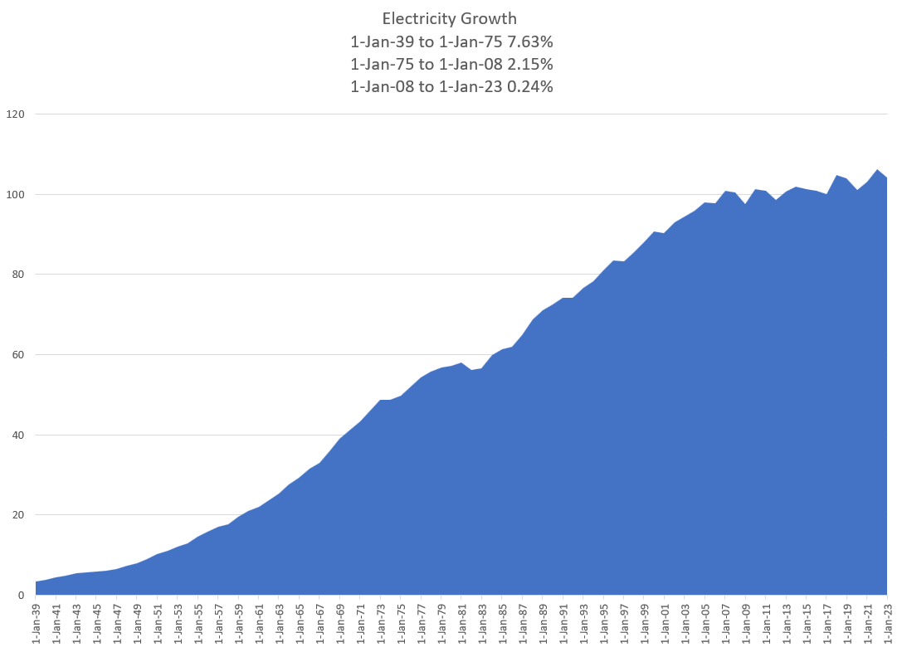

Les Trente Glorieouses and MAGA or MUBA – 1945 to 1973
Why is this introduction relevant for Project Finance Analysis. Demonstrates classic corporate finance. Companies want to get back to the low risk from cost plus model with WACC.
You will see that this analysis cannot be applied to companies like Orsted that are not stable.
Appliances and Bigger Houses
Washing Machine
Dryer
Electric Stove
More Lights
Air Conditioning

Slide 95
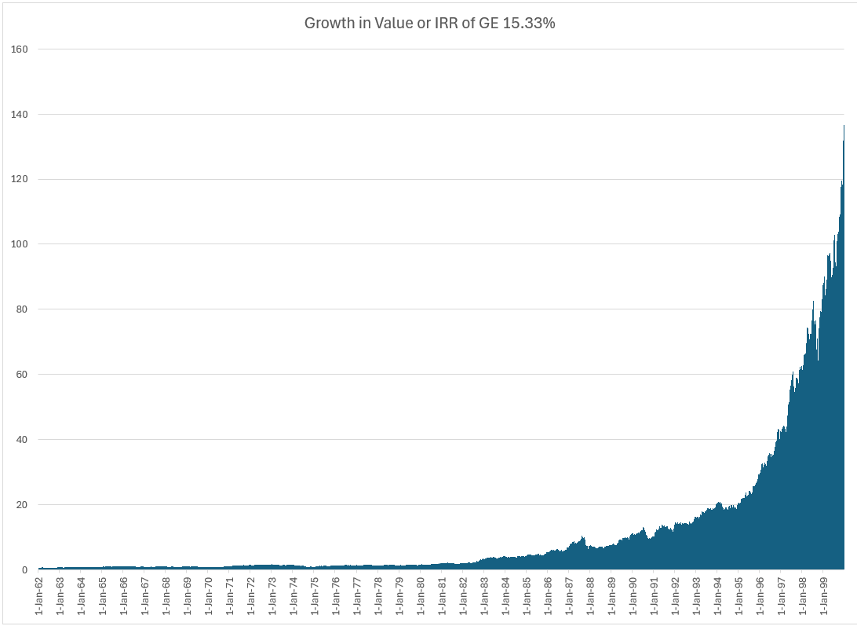


GE and Electricity
GE is most valuable company in the world – Note what a 15% growth rate means from compounding over a long period of time,
High Growth and economies of scale allowed declining real cost. Larger networks and larger coal plants.
Natural monopoly and cost-plus regulation or government ownership – No incentives for cost control of capital expenditures or operating costs.
Financed from with Corporate Guarantees
Long-term Financing from Regulatory Assurances

Slide 96

A Boring Utility Company and MUBA
Ability to finance long-term assets from guaranteed cost recovery and from allowed monopoly position.
12% return on equity produces market values relative to investment of well more than 2 suggesting that the cost of capital is far below 12%.

Slide 97

Boring Utility Company Earning Much Lower Returns – ROIC Perspective
Valuation can be made from stable multiples, DCF and maybe CAPM. Could apply valuation formulas P/B = (ROE-g)/(k-g). Cost plus regulation. But cannot apply to renewable companies like Orsted

Slide 98

Relatively Stable Multiples of Earnings and EBITDA for Boring Utility Companies

Slide 99
Part 2: 1980’s Capital Expenditure Over-runs; Low Efficiency, Independent Power Producers and PPA Agreements Introduction to PPA Regulatory Scheme Introduction to Output versus Availability Inefficient to Impose Risks on Investor (including contractor) that cannot be controlled Example of Toll Traffic

Slide 100

Part 2: 1973 Energy Crisis and End of Declining Real Prices
Dramatic Oil Shock of 1973 ended the Trente Gloriouses. Led to more nuclear power and first thinking about renewable energy.

Slide 101


Part 2: 1980’s and Cost Increases and Cost Over-runs
Seabrook nuclear plant in US. (I understand that Denmark was considering nuclear power as well).
Enough of the cost-plus regulatory scheme. Let companies bid and hold them to their cost estimates – if costs increase, you cannot increase prices, and multiple companies can build assets.

Slide 102
You Need to Impose Risk for People to be Efficient But Imposing Uncontrollable Risks Increases Prices Without Getting You Anything

Slide 103
Notion of Independent Power Projects, Risk Allocation and PPA
With nuclear cost increases and price of oil increases, cost plus and WACC model considered a poor approach.
Bidding systems where companies competed to provide generating capacity (no longer belief in economies of scale for generation). Idea that companies bid down to their cost of capital.
Bid on long-term fixed price contracts (same as today) – purchased power agreements (PPA’s) were designed to allocate risks under control of investor (construction cost, construction timing, fixed operating cost, plant efficiency, plant availability). Costs that could not be controlled – fuel cost and amount of generation required were allocated to investors.
Once investor takes risk, the risk can be allocated to a company that takes construction risk, a company that guarantees plant efficiency, a company that provides operation and maintenance.
The risk allocation to third parties (off-takers) led to project finance where lenders verified fixed construction costs, operation costs and technical aspects of plant efficiency and availability.
Risks remaining with purchaser – fuel price, generation (maybe inflation)
Risks taken by investor and allocated – construction cost, construction timing, efficiency, availability, operating cost except fuel
Risks allocated from investor to contractors who provide fixed prices and absorb penalties for efficiency and availability

Slide 104
Risk Allocation Part 1: Allocation between IPP Investor and the Off-taker
Investor or Off-taker Risk
.
.
.
.
.
.
.
.
.
Risk to Be Allocated
Generation Level from Changes in Demand
Generation Level from Changes in Plant Availability
Cost Over-Run
Construction Delay
Plant Efficiency (Heat Rate)
Change in Fuel Price
Change in Real O&M Cost
Change in Inflation Rate
Change in Interest Rates and Cost of Capital

Slide 105

Background on Risk Allocation Two Step Process
Step 1 – Off-taker versus Investor
Risks controlled by off-taker
Risks of general economic conditions
Risks in the way the machine operates
Step 2 – Allocate to Contractors
Allocate risks in contracts to parties that can control the risk
Back-to-back contracts
If the rental car charged a fixed price for the period, then you would have an incentive to drive a lot because you do not have to pay for fuel.
If the rental car has only a variable cost with mileage and no fixed charge, could rent just for a very short trip and pay almost nothing.
Rental car company cannot control how much you drive

Slide 106


Availability versus Utilization
Availability
Utilization

Slide 107


Availability Projects without Output Risk and Notion of Not No Control of Output – Would you pay firemen only when they put out fires
Capacity Price and Artificial Markets
When capacity is available, you can receive revenues no matter whether you use the capacity for revenues, this can be added
Some ancillary services may be like capacity where if you have the service available, you can earn money whether you use the capacity to produce energy
Think of Firemen (Firehouse Effect)
You pay them and need them to be ready
But if they are putting out a fire, they cannot be used for another fire
They receive capacity payments and must be available
You cannot really pay them on the volume of fires the

Slide 108

Back-to-Back Contracts in Availability Projects
PPA Contract designed to allocate controllable risks to give incentives for efficiency.

Slide 109


1980’s Independent Power and Incentives (Plant Availability)
Plant Availability has dramatically improved from about 60% in 1993-1994 to 75-80%.
Leads to independent power producers and contracts that provided rewards and penalties for particular risks – capital expenditure cost over-runs and power plant availability
Project finance and back-to-back contracts to limit risk to banks and allow low cost of capital
No output risk (cash flow is independent of amount produced with is given by off-taker) designed with a capacity charge

Slide 110

Problems with Capacity Contracts - Philippines IPP Contracts
Reserve Margin is about 155%
Estimated Growth – 9.2%
Actual Growth – 3%

Slide 111
Case Study on Availability Payment versus Output – Eurotunel and A2 in Poland
Back-to-Back Contracts
Low Risk and Low DSCR
Small Risks Become Large
Goal Seek for Price
Increase the Interest Rate in InputS

Slide 112
Part 3: 2000’s, Renewable Energy and Feed-in Tariffs All Output Purchased and Control of Output is Investor (and upstairs) and not Off-taker

Slide 113


Difference Between Contract Prices for Renewable Energy and Dispatchable Plants
In a dispatchable coal plant, gas plant, nuclear plant the operator controls the amount of electricity that is produced by the plant.
In a renewable project, the amount of output comes from upstairs – wind for wind projects, solar radiation for solar projects and rainfall for hydro projects.
For a dispatchable plant (except for merchant plants discussed below), the amount of production is controlled by the buyer and not the seller for the plant
If you are stupid enough to build your wind farm next to a tree, then you should realize a lower return than somebody who does not do something so stupid. This demonstrates that investors in renewable energy must take generation risk to encourage efficient development of projects. Taking resource risks makes renewable energy projects inherently more risky than dispatchable projects in a PPA context

Slide 114


Revolution in Solar Module Prices and the Price of Polysilicon

Slide 115

Renewable Project Finance Diagram
Big Difference is output risk where there is uncertainty for volumes sold.

Slide 116
Model Exercise on Output Project
Back-to-Back Contracts
Low Risk and Low DSCR
Small Risks Become Large
Goal Seek for Price
Increase the Interest Rate in InputS

Slide 117
Merchant Phase and Notion that Investors Should Take Risks of Surplus Supply and Wrong Type of Investment Many Areas of the World Remained with Single Buyer and PPA

Slide 118


Merchant Prices and Correlation between Gas Price and Electric Price
The idea that independent power plants should not have PPA contracts but instead earn their revenue from merchant prices was began in the 1990’s. The general theory was that the investor should take the risk in the economics of what type of plant is most economic (with a tradeoff between capital and fuel costs). The idea the merchant plants should bid into the market implied that plants would make economically efficient decisions to improve efficiency and schedule maintenance.
To introduce merchant risks, hedging and policy issues I begin by presenting some data on merchant prices. One feature is almost universal (maybe not in Norway) and that is the high correlation between natural gas and electricity prices.

Slide 119


Relationship Between Electricity and Gas Prices with Different Time Frames
In the short-term on an hourly basis there are prices that are not correlated with natural gas as shown in the left-hand side graph. When averaged over longer periods, as in the right-hand side graph with average prices over a month in Denmark, the correlation is very strong.

Slide 120


Wind Production and Merchant Prices in Denmark
One of the issues that will become more pronounced in the future is the relationship between renewable energy production and electricity merchant prices. The two graphs below show that in periods where there is a lot of wind production the prices tend to be low and vice versa when wind production is high. This can make hedging difficult. The graph on the right shows that the effect of wind is much more pronounced in Denmark than in France with prices that go to zero when there is a lot of wind.

Slide 121

1990’s and Crash of Merchant Power

Slide 122

AES TimeLine
“The initial assumptions on which the AES Drax companies relied when making the original investment assumed that it would have the protection of its long-term Hedging Contract with TXU Europe and that electricity prices would remain at a certain level. Since we acquired the Drax Power Station electricity prices have declined on average by approximately 40% and in November 2002 our Hedging Contract with TXU Europe was terminated and the TXU group entered into administration.” Drax Annual Report

Slide 123

Why Merchant Exposure is so Scary to Lenders and Investors
A lot of merchant plants in US. Note the initial rating of BBB-
This table demonstrates that the largest category of project finance defaults is merchant plants and explains why lenders are very sensitive to merchant exposure.

Slide 124
2020’s – Corporate PPA’s, Price Hedging, Merchant Tails in Renewable Projects

Slide 125
Difference between a Standard Forward Swap and Contract for Difference
In forward contracts the settlement is made based on production which can vary. The price is assured no matter what is the production. Classic forward contracts like interest rate swaps are different because they have fixed notional volumes which allows the counter party to evaluate prices without the price variation.
Forward Contract (Swap)
Contract for Difference
Contract settles on the difference between a fixed forward price and the merchant price
Contract has defined term
Contract based on a notional amount like and interest rate swap or a forward exchange rate contract
Contract settles on the difference between a fixed forward price and the merchant price
Contract has defined term
Contract based on production at a power project where the amount of output is not fixed

Slide 126


Forward Merchant Prices, Natural Gas Prices and Market Heat Rates
The graphs below are intended to illustrate how a trader could evaluate future electricity prices. As electricity is driven by natural gas and as natural gas can be stored, the forward prices for natural gas are stable as shown on the left-hand side graph.
Electricity prices can be evaluated relative to natural gas prices using the formula: Heat Rate = Electric Price/Natural Gas Price. The right-hand side graph shows that the implied heat rate in France and Denmark. For France it is quite stable. The forward price could then be evaluated as: Forward Price = HR x Gas Price. For Denmark the heat rate is much more variable and more difficult for the trader to evaluate.

Slide 127

Value of Merchant Tail – Denmark (Non- Copenhagen)
The value per MW can be divided by 1,00 to get the value per kW per year. This can then be compared to the up-front cost Euro/kW or the carrying cost – Euro/kW-year

Slide 128



Is Political Risk Higher in US or Nigeria
Danger of investing in the US

Slide 129
Session 4: Stages of Project Finance

Slide 130
Timeline Subjects
Project identification;
Project definition & feasibility study;
Competition;
Contract negotiation;
Financial competition/commitments;
Financial due diligence;
Contractual structure of a Request for Proposals (RfP) and implications to achieve financial close
Linkages between these different stages and how they all fit together.

Slide 131
Activity
Understanding the progression of activities in a project finance
 Interactive polling
 Various examples on how different projects have dealt with the different stages of project finance and in particular drawing out differences between public procurement vs private processes
 Using a case study that involve natural resource project, issues related to the debt financing package required for expansion will be used. Issues to review under this activity include:
how debt can be used for expansion,
how loan covenants needs to be strengthened to provide comfort to lenders,
if a project is of national importance, when and how government support may be required, and what are the implications of government support
what does it mean to develop a “hybrid” financing structure
other contractual and bankability implications

Slide 132
Illustrate Theory Issues with Model – Step 1 Project Timing Assumptions:
Determined that construction of the windfarm will take 2 years.
Useful life of the windfarm will be 32 years.
Create Flexible timeline as its periodicity (months per period; 1 month means there will be 12 periods to make year)
Anticipated Model Timeline
Construction Period
24 Months (2 Years)
Operations Period
23 Years
Jan 1, 2019
Apr 1, 2019
Apr 1, 2021
Mar 31, 2044
Dec 31, 2044

Slide 133
Typical Project Timeline
Project Development Phase (2 years)
Construction Phase
(3 years)
Operations Phase
(30 years)
Project Milestones
Initial Evaluation
Bid Submission
Financial Close
Start of Operations
End of project term

Slide 134

Start with Basic Valuation
Timeline and Discounting
In project finance no need for the big problem of terminal value

Slide 135
Key of Starting with Flag for Pre-COD and Two Cash Flow Statements
Two Ratios that Define Project Finance
IRR – the Growth Rate in Cash Flow
Cash Outflow pre-COD
Cash Inflow post-COD
DSCR – Buffer in Cash flow Before Default
From Cash Flow Waterfall Post-COD
Project Finance Model Has Two Cash Flow Statements
Sources and Uses when Need Cash
Cash Waterfall when Return Cash

Slide 136
We Need a Flexible Timeline for Illustrating Ideas
Why would a model have 1 month per period in construction and 6 months per period after COD
Allow different months per period in the model for pre-COD and post-COD period.
Use a trick with EDATE or EOMONTH and Months in Period
Example:
1 Month per period pre-COD
6 Months per period post-COD
Because of accurately modelling interest expense
Input Months in Model (1/6) and Periods to Make Year (12/2)
Need a pre-COD flag or switch to start – put it in the Input File
Construction Periods = Construction Months * (12/Months per period)
Use Construction Periods as first flag

Slide 137
Reasons for Risk Reduction After a Couple Years of Operation
Examples of Risk Resolution After A Couple of Years of Operation
Finished with Development Risk – Big Probability of Failure
Finished with Financing – Things May Not Work Out
Finished with Construction – Many Things Can Go Wrong
Establish Historic Volumes – Test Whether Base Estimates are Wrong
Establish Ability to Collect Revenues – Political Risk Resolved
Establish O&M Expenses from History – E.g. Evaluate Insurance Expenses
How much more of a return do you need for taking these risks. Anybody who says that you can find this from

Slide 138




Project Finance and Changing Risk
Before COD, cash flow is presented in the sources and uses statement
After COD, cash flow is presented in the cash flow waterfall and the last line is dividends
Father of the bride makes commitment to pay for wedding
Commitment Fee
Date at which you realize that the wedding is working or is a complete disaster
Development is Dating period. Probability of failure is high
Pay for Wedding with Other peoples’ money
Pay your Bills and re-structure your life. Stuck with PPA type contract. May default.
FC is making promises (that you may not keep)
COD is Wedding Date
Decommissioning Date

Slide 139

Back to Assignment - Triangulation
Comments in Assignment
What does DDM methodology
More sensible process
Start at end with stable cash flows
Select reasonable holding period as short as possible
Make reasonable assessment of required yield
Use goal seek to find the price with IRR that includes sale

Slide 140
Time-Line and Changing Risk are Crucial in Project Finance
RISK
Financial Close
Completion Test
A crucial Feature of Project finance is CHANGING -- DECLINING RISK

Slide 141
Development Phase, Probability and Venture Capital
How to quantify risk with probability before financial close
Example of bidding for solar project in UAE with 5 bidders
Probability of winning one in five
Probability of losing four in five
Cost of lost projects to collect when win
Collect costs of four losing projects in the development fee
Example with 1,000 cost of development per project, whether win or lose
Spend 5,000 to win one project
1,000 is included in development cost and allowed
4,000 included in the development fee – 1000 * number of losses
If you only earned the post-FC and lower risk IRR your business would be a losing proposition.

Slide 142

Process of Adjusted for Risk Changes
Start at the End with Target Equity IRR for Stable IRR
Set PPA with Higher IRR
Use Flags to Test Exit and Holding Period
Compute Exit and Holding Company Valuation with Discount Rate
Why Cannot Compute Terminal Value because of Distortions from EV/EBITDA or P/E Ratio
Evaluate the IRR with Compression between Initial Discount and Exit Discount Rate

Slide 143

Better Ways of Cost of Capital Measurement in Project Finance
Problems with un-levering and re-levering beta
55% increase in the real cost of capital. That is a big deal for capital intensive assets

Slide 144
History versus Contracts and Consultant Reports: Project Finance versus Corporate Finance
Corporate Finance
Project Finance
Analysis is founded on historic financial statements and companies will evolve relative to the past.
Financing is important but not necessarily the primary part of the valuation.
Successful companies expected to continue growing and refinance. Terminal value is a big factor.
Focus on earnings, ROIC, P/E ratios, EV/EBITDA ratios and Debt/EBITDA.
Since there is no history a series of consulting and engineering studies must be evaluated.
The bank assesses whether the project works (engineering report). Without debt financing, the project is not viable.
Successful projects will pay of all debt from cash flow and end their life.
Focus on cash flow rather than earnings. Equity IRR and DSCR.

Slide 145
Many Proofs that IRR and Return on Investment are the Same Thing over the Long Run
Return on Capital is Income Divided by Capital Investment and is affected by depreciation
You can compute return on capital (ROIC or ROE) from actual financial data.
You cannot compute actual IRR until the project is finished
Project IRR and Return on Invested Capital (ROCI) are the Same
Investment Bankers, Analysts and Consultants are Obsessed with ROIC (for good reason)
Standard Idea in Finance – Invest when ROIC > WACC
ROIC and Project IRR are the same in the over the life of the project, but not in the short term
Many proofs
Project IRR is weighted ROIC where weight is NPV of Investment
Project IRR equals ROIC when Economic Depreciation is Used
Equity IRR and ROE are also the same thing
Equity IRR is weighted ROE when Weighting is by NPV of Equity Capital
Equity IRR equals ROE when Capital Structure is constant and when Economic Depreciation is used
In the graphs below, consider ROE to be Equity IRR

Slide 146
Price to Book and Example of a Bond
To understand the price to book ratio and the relationship with the cost of capital, think of the value of a bond. The nice thing about a bond – whether a risky bond or a government bond is that you can observe the cost of capital.
Say that you purchased a bond for 1,000 with and interest rate of 5%. You can compute the value of that bond relative to the amount you paid for the bond and call this the price to book ratio.
If the interest rate on the bond does not change and the bond pays back the 1,000 with a bullet payment, then the value of the bond will stay at 1,000 over the life of the bond.
At the very last day of the bond’s life when you get the bullet payment, the value of the bond is the 1,000 bullet payment.
If the interest rate changes – the interest rate you can read in the paper or on-line, then the value of the bond changes. The current interest rate is the cost of capital.
If the interest rate or cost of capital increases, the value of the bond declines and the price to book ratio is below 1.0. The exact nature of the decline depends on the cash flow structure of the bond.
By looking at the price to book ratio you can see the relationship between the current cost of capital (the current interest rate) and the rate of return or IRR on the bond – the earned return.

Slide 147


Example of Investment versus Value
Price to Book Ratio measures the cost of inputs – the investment – relative to the value of that investment today. Think of the cost of materials for a statue versus the current value of a statue.
If the value of the statue is more than the cost including the opportunity cost of capital than the value divided by the investment is more than 1.0. If the value to the investment is more than 1.0, than your return is above the opportunity cost of capital.

Slide 148

Problem in Project Finance of Project IRR and ROIC and Resolution
By computing a weighting with discount factors and the level of invested capital as well as economic depreciation, the relationship between the ROIC and project IRR can be evaluated. This is illustrated in the excerpt below.

Slide 149


Resolving Problem with ROIC and Declining Capital in Project Finance

Slide 150


EV to EBITDA is not Constant over Life for Single Asset
The value of a single asset naturally declines as the asset has less remaining cash flow. The same happens to the EV/EBITDA ratio and implies that the EV/EBITDA ratio depends on the age of assets in the portfolio. It also depends on the premium to WACC.

Slide 151


Premium to Value at WACC for Single Project or Asset
Value at WACC is the investment cost – the premium above WACC can be measured with premium to equity (price to book) or the premium above investment cost (EV/Investment Cost). With 150 bps, the equity premium is 1.32 and with 300 bps, the premium is 1.69.

Slide 152
Example of Valuation with Implied Exit Discount Rates
Valuation should be done using DDM methodology (equity value and enterprise value), alongside relevant returns and key sensitivities that a prospective buyer might look at
For pricing the asset, you are expected to triangulate between precedent transactions and the bottom-up rate derived using CAPM methodology (for the CAPM buildup specifically, you’re allowed to do desktop research and are encouraged to make sensible assumptions as needed), and include relevant build-ups in the files
For the returns analysis, assume a 7-year hold period with a prudent yield compression between entry and exit discount rates
Illustrative precedent transactions
No. Size (MW) Technology Year
Implied exit discount rate (USD)
1 350 Solar 2023 9.0%
2 150 Wind 2022 11.0%
3 180 Solar & Wind 2022 9.0%
4 225 Wind 2022 10.0%
5 200 Solar 2021 8.0%

Slide 153
Process for Evaluating Cost of Capital and Required Price
Step 1: Start at end after stable period with required return for buyer
Can get data from transactions
If not can add a little bit to the interest rate
Step 2: Decide on a reasonable holding period
Should have some history
The shorter the period the higher the returns
Step 3: Make an estimate of how much higher an IRR you need for taking resolved risks
Risks are development risks, construction over-run and delay, volume estimation, operating and maintenance levels etc.
To think you can somehow quantify these risks with the Capital Asset Pricing Model and Beta is ridiculous
For example, add 4% for initial risk to get the target equity IRR
Step 4: Run goal seek for price with target IRR
Go to the portion of the model with the IRR after the plant sale and the holding period
Compute the NPV of the holding period cash flow using the target IRR from Step 3
Use goal seek to find price to meet the target return that covers these risks

Slide 154
Debt Sculpting, DSCR Formula and Negative Repayment
Start with the basic formula:
DSCR = CFADS/DS
DS = CFADS/DSCR
DS = Interest + Repayment
It is possible that in this formula the repayment will be negative when interest is greater than debt service
In this case there are a couple things you can do.
You can set up a cash reserve account to cover the interest
You can use the cash reserve withdraws to cover the repayment
In this case there is higher repayment (non-negative) and the tenure of the debt declines
If the CFADS includes only the cash for repayment, the DSCR is below the target
Solution
Amount withdrawn from the reserve account uses the formula
CFADS = EBITDA – Taxes + Amount Withdrawn from Reserve
Target CFADS = Debt Service x DSCR
Debt Service = Interest Expense
(EBITDA – Taxes + Amount Withdrawn) = Interest * DSCR
Amount of Reserve Withdrawn = Interest * DSCR – EBITDA + Taxes
Note the extra amount results in dividends like the normal situation

Slide 155




Summary of Results
Case with allowing negative repayment

Slide 156

Reconciliation of IRR and ROE – Large Renewable Developer
About 7% to 12% return leads to much higher value relative to the invested capital – the market value to paid in capital plus income retained is 3.5x. The beta is similar at .85.

Slide 157

Total Energy – More Stable Returns but Low Value Relative to Investment
Note the high return of 18% with the relatively low price to book ratio.

Slide 158

Shell Oil and Exit from Renewable Investments
Return of about 10-11% and market value relative to investment is a bit more than 1.0x. Again the beta is similar at .93.

Slide 159

Portugal Renewables and Low Returns when Growing
Company with much lower returns has higher price to book ratio than Shell. Low returns driven by rapid expansion. Again beta is the same.

Slide 160

EDP with Returns and Growth
When grow quickly, the returns are low because the returns are low when companies grow fast as the ROE is lower than the IRR. For renewable energy companies the emphasis is on IRR and not accounting returns.

Slide 161
Section 8 Corporate Finance and Return Analysis

Slide 162
Subjects
Index function and Indirect function
Discussion of corporate finance and McKinsey
Exercise on Value from Growth, Return and Cost of Capital
Review of Consolidated Model and Economic Depreciation
Complexity in Project Finance Model – Semi-annual Debt Repayments in Monthly Model
Complexity in Project Finance Model – Consolidation Macro
Complexity in Project Finance Model – IDC and Fees Circular Reference

Slide 163
IRR and ROIC
IRR, Economic Depreciation and Financial Statements
Requirement that Value for Economic Depreciation is computed with IRR
With IRR, NPV of Project = Initial Investment
NPV declines and goes to zero by the end of the project
The change in the NPV will add up to the initial NPV
With the Revised Depreciation, the IRR and the ROIC are the same
You can then use the ROIC as a benchmark representing the rate of return earned by the portfolio of assets

Slide 164

Corporate Finance Example – Value if Income Produces Cash from ROIC
Corporate Model Example with continuing growth
Does not work if Dividends that Produce Cash are Distorted from Deprecaiation

Slide 165
In Project Finance we Do Not Need Terminal Value Formula; Only the Cost of Capital
Value a project over its life and don’t need terminal value
Discount rate changes, but stable discount rate for a mature project can be established from transactions (when your children become mature, you know their value)
Most of the cost of capital comes from debt and the mature equity cost of capital is a bit above (or even below) the interest rate
Problems: Irrelevant to use ROIC, ROE, EV/EBITDA, P/E – this makes these ratios irrelevant in fast growing or fast declining corporations. It may be depressing, but this can make just about all financial statement analysis irrelevant for corporate valuation.
Market to Book Value can be assessed by the ability to earn returns above the cost of capital.
Book Value (without write-offs) is the equity value on the balance sheet
Cash Flow from Book Value at Cost of Capital can be computed with PMT
Cash Flow from Premium Above Book Value can be computed with PMT and Higher Interest Rate
Theoretical Price to Book Ratio can be computed from PV

