Slide 1
Historic Case Studies

Slide 2
Mini Cases
Mini Cases Discussed
  Ras Laffan in Qatar (Break-even risks, sponsors and contract structure)
  Dabhol in India (Contract Structure, Availability and Economics)
Idea is to Quickly Discuss Cases and Highlight Major Issues
Some history is good in just about anything

Slide 3
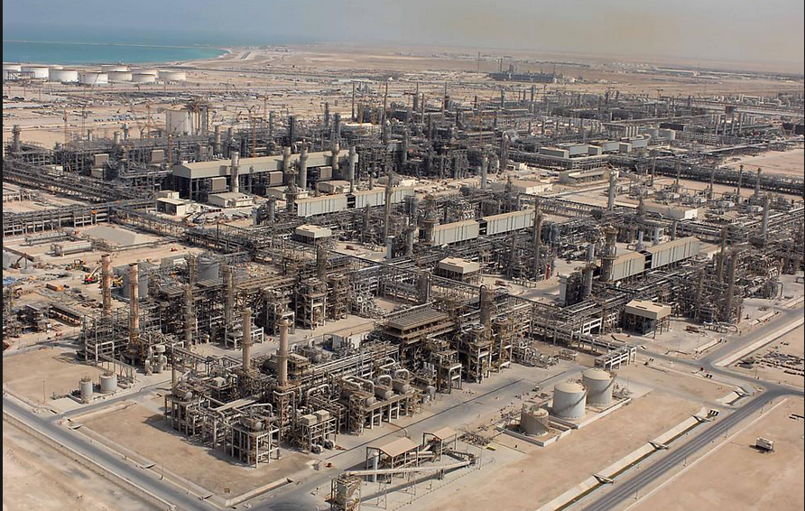
Ras Laffan in Qatar - 1996 COD

Slide 4
Issues to Discuss – Ras Laffan
Read the Pre-Sale Report – The Strengths
  Could Qatar have hosted the world cup without project finance
  Simulate the importance of Exxon
  List the risks and mitigations
  Could there have been more problems if the State of Qatar was not the biggest sponsor
Open the Model
  Why do the fundamental economics of the project work or do not work
  What notes would you put in the diagram
  How do you think the break-even gas price was computed – DSCR, LLCR or PLCR

Slide 5
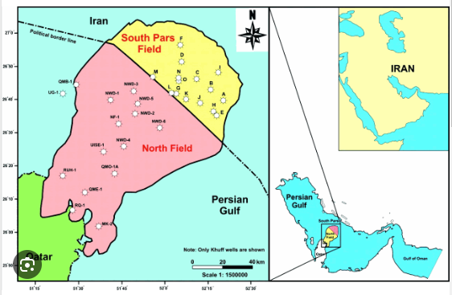
Illustration of Gas Lake Under the Gulf
Cost of production of natural gas is low

Slide 6
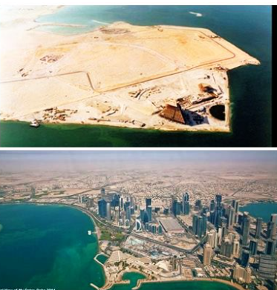
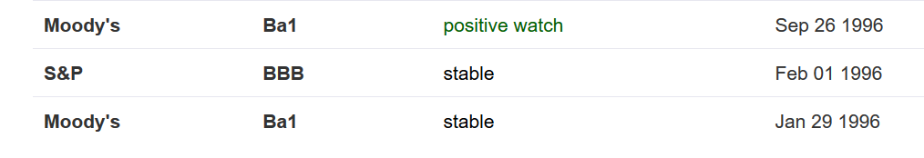
Country of Qatar Background before and After Project

Slide 7
Example: Ras Laffan Liquified Gas Company (Ras Gas)
Summary of Original Transaction
  Project: Two LNG Trains and cost of developing natural gas reserves
    Cost $3.4 billion
    5.2 millions of tons per annum
Equity Sponsors
    70% State of Qatar
    30% Mobil Oil
EPC Construction Contracts
  JCG/MW Kellogg for LNG Trains and on-shore facilities
  McDermott-EPTM/Chiyoda for off-shore platforms
  Saipan for off-shore pipeline connection

Slide 8
Ras Laffan Liquified Gas Company
Financing of $3.4 Billion
  $850 million in Equity
  $465 million supported by US EXIM
  $250 million supported by UK ECGD
  $185 million supported by Italy’s SACE
  $450 million uninsured loan from commercial banks
  $1,200 million from bond markets
    10 and 17 year maturity
    Rated BBB+ by S&P
    Rated A3 by Moody’s
Revenue Contracts
  25 year contract with Korea Gas Corporation for output of one train
  Korean Gas Corporation built receiving facilities and purchased ships ($3.1 billion)
Relatively unconventional technology, no projects in the country and can achieve bond rating better than country rating

Slide 9
Ras Laffan Diagram
Off-taker: Korea and Japan Utility Companies: Want strong off-taker with inactive to honor contract
EPC Contractor: Kellogg with Strong Record and Finances
Price of Gas Linked to Oil Price
Off-take Contract with minimum supply
EPC: Fixed Price Contract with LD
Special Purpose Vehicle: Bond Rating of A-
O&M Contractor
Supplier: Need to Understand Economics and Supply Curve
O&M Contractor
Supply Agreement
O&M Agreement
Loan Agreement – Draws Green; Debt Service Red
Sponsors: Want strong sponsor:
Mobil
State
Shareholder Agreement
Lenders:
Issued bonds and debt with long tenor and low rates
Lenders:
Issued bonds and debt with long tenor and low rates

Slide 10
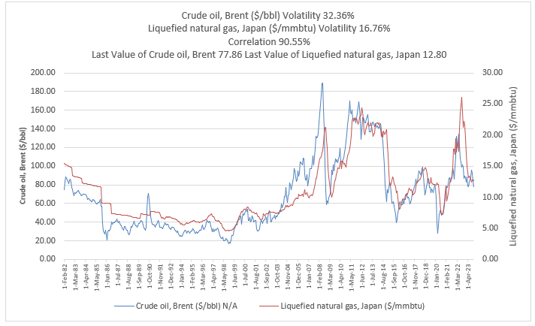
Commodity Price 1
Commodity Prices are Volatile
But;
  Mean Reversion
  Can Hedge
  Importance of Natural Gas

Slide 11
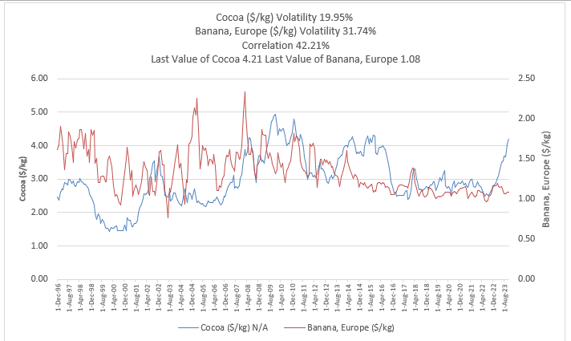
Commodity Price 2
Commodity Price Issues
https://edbodmer.com/databases-and-graphs/databases-from-internet/commodity-price-database/

Slide 12
Use Snipping Tool to Fill in Items from Pre-Sale Report
Conventional (boring) technology
Construction Cost Over-Run Risk
Supply Risk
Volume Risk
Price Risk

Slide 13
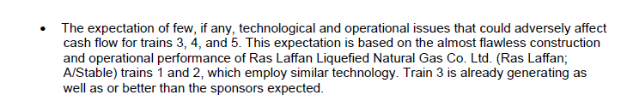
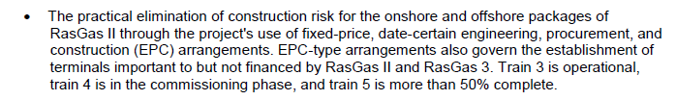



Use Snipping Tool to Fill in Items from Pre-Sale Report
Conventional (boring) technology
Construction Cost Over-Run Risk
Supply Risk
Volume Risk
Price Risk

Slide 14
Open the Financial Model
Use the financial model to quantify risks
  Present and discuss the cost structure
  Break-even Oil Price
Volume Risk
Price Risk

Slide 15
Revenue Risks
Generally one or two big sources of risk
Can be
  Commodity Price
  Volume – Traffic
  Volume – Solar or Wind Resource
  Incentives in Contracts – Availability, Efficiency, Performance
  Off-taker Risk
  Price and Volume Risk (e.g. high tech, hotel, private health facility)
For each type of risk, discuss implications to Africa – for example would you rather off-taker be a mining company or the government of Nigeria

Slide 16
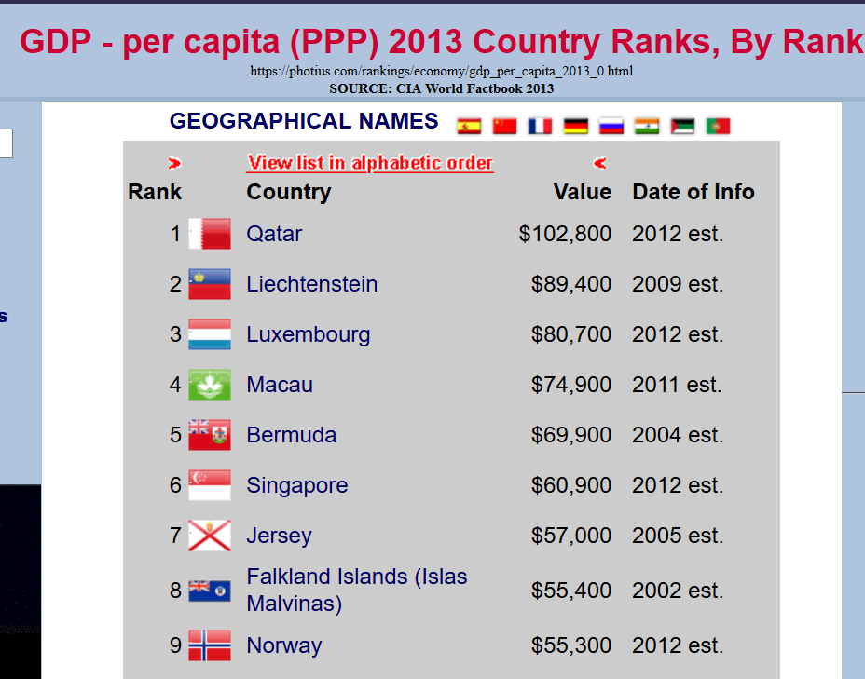

Ras Laffan Postscript

Slide 17
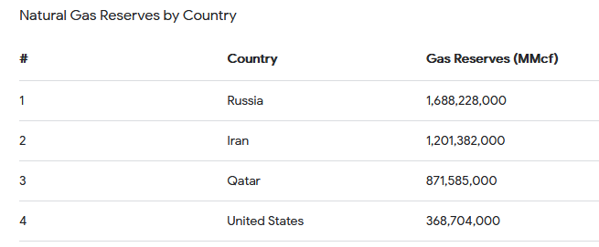
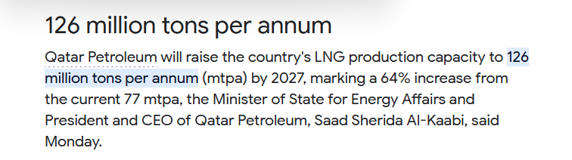

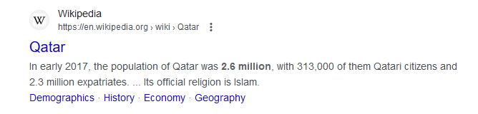
How Much Money from All Projects before Additions
29.7 Tons in Project

Slide 18
Other Questions
Can the approach be replicated
How much was luck
How much money was really made
Should the loans have been production payment loans

Slide 19
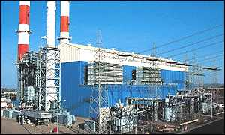
Appendix Case 2: Dabhol Electricity Plant and Capacity Payment

Slide 20
Case Questions: Dabhol
Do you think GE, Bechtel and Enron were good missionaries
Do you think a high project IRR reduces risk
What was the key statistic to demonstrate risk
Do you think there was political risk and if so, how could it be mitigated
Why did they wanted a high fixed capacity factor rather than an energy charge and a capacity charge independent of production and did this make sense

Slide 21
Central Philosophical Point
Make the Parties -- Equity, Debt, EPC Contractor, O&M Contractor, Fuel Supplier – responsible for risks that they can control
It sounds too simple, but the little things and the nuances can be very important
  If you make the parties responsible for risks outside of their control, like natural gas prices or exchange rate variation or dispatch from the off-taker, they will:
  Increase the required IRR which will increase the price to the consumers
  Increase the required DSCR which will increase funding costs and increase price to consumers
  Increase EPC and O&M contract which will increase cost to consumers

Slide 22
Dahbol Background
Investment in a $3 billion, 10-year liquefied natural gas power plant development project, was the largest development project and the single largest direct foreign investment in India’s history.
Begun in 1992, the Dabhol power plant near India’s financial capital of Bombay in Maharashtra state was to have gone online by 1997. It was supposed to supply energy-hungry India with more than 2,000 megawatts of electricity, about one-fifth the new energy needed by India each year.
In a joint venture with U.S. companies General Electric and Bechtel, Enron created an Indian subsidiary, Dabhol Power Co. DPC, which was 65 percent owned by Enron, was to build the power plant. Enron was to develop and operate the plant. Bechtel was to design and construct it, with GE supplying the equipment.
Enron brokered a deal with Qatar/Oman to provide the Dabhol plant 2.5 million tons of liquefied natural gas per year for 25 years, starting in 1997.

Slide 23
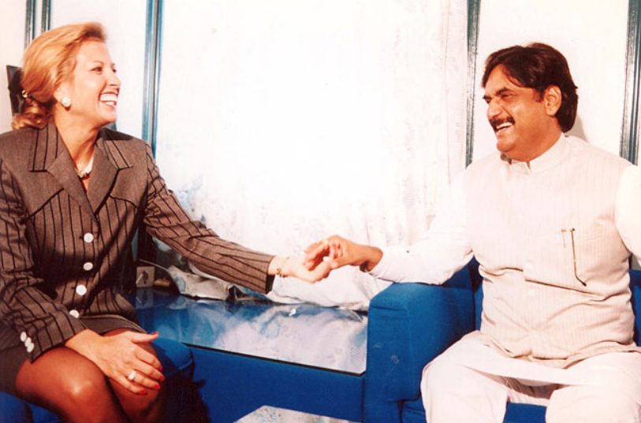
Where did Rebecca Mark Get her MBA
As they inched along the traffic jam of Bombay taxi cabs on Marine Drive, Rebecca Mark and Joe Sutton reflected upon the intense negotiation efforts of the past year and what had been accomplished. Their company, Enron Development Corporation, EDC, the development arm of the Enron Corporation, had been attempting entry into the potentially huge Indian market. EDC was headed by Rebecca Mark, its youthful, energetic president and CEO. She summed up her philosophy and mission:
We are a very eclectic bunch with some ex-military people and some ex-entrepreneurs. We are brought together with a certain amount of missionary zeal which I think you have to have in this business. It demands so much of you all the time that you really have to believe in what you are doing. I think for us that missionary zeal has three parts – first, that these projects are good for the country. They get the economy moving by bringing in power and they bring in investment. Second, these plants are environmentally safe and without equal when you consider other options of coal or nuclear power. Third, we are brining a market mentality and spreading the privatization gospel in countries that desperately need this kind of thinking. We are in the business of doing deals. This deal mentality is central to what we do. It’s never a question of finding deals but of finding the kind of deals we like to do. We like to be pioneers.

Slide 24
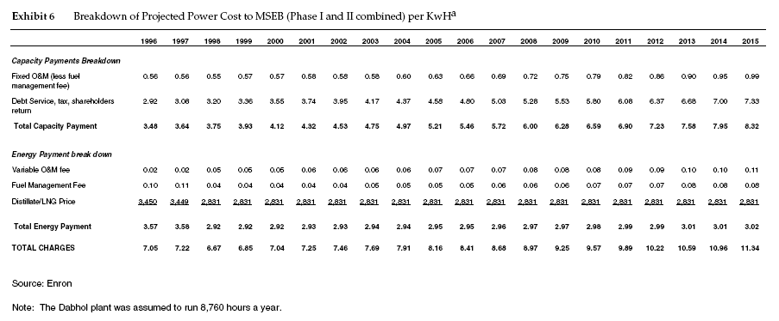
Structure of Dabhol PPA Contract
PPA Contracts can transfer all demand and fuel cost risk. The Dabhol PPA contract is illustrated below

Slide 25
IRR Exercise
If you had data from the case, what would you compute.

Slide 26
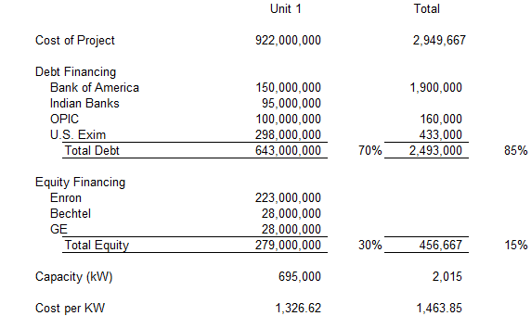
Dahbol Costs
Project Included:
  Largest Independent Power Producer – 695 MW + 1,320 MW or 2,015 MW. 22.4% of Capacity of Maharashtra
  LNG Re-gasification Plant
  LNG Tanker to access supplies in Qatar
  85% Debt and 15% Equity
  Equity
    Enron 65%
    Bechtel
    GE
  Enron Net Income $465 Million
  Enron Assets (1993): $12 Billion
  Enron Equity (1993): $3.5 Billion

Slide 27
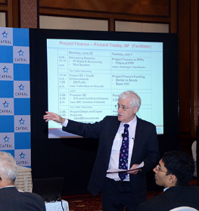
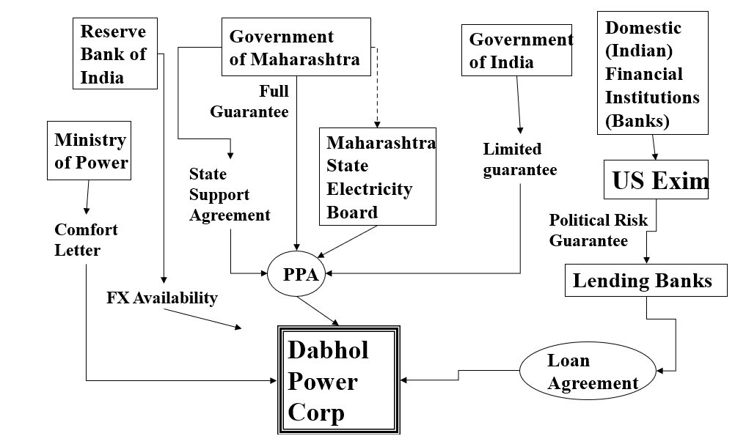
Dabhol Structure – Richard Tinsley

Slide 28
Don’t Be Afraid to Try and Make a Diagram. You Don’t have to be a fancy investment banker
Very High Cost of USD 1,400 per kW
Off-taker Needs Rate Increase of 27%-39% to Pay PPA
State of Maharashtra
Bechtel Construction
Off-taker – Maharashtra State Electricity Company
EPC Management by Enron
Guarantee
Federal Government of India
Letter
GE Equipment
PPA Contract
EPC Contract
Dabhol SPV
Fuel Supply
ENRON – Fuel Mgmt.
O&M Contract
Shareholders Agreement
Loan Agreement
LNG from Qatar
O&M Contractor - Enron
Lenders
Sponsors – Enron, GE and Bechtel IRR on SPV
PRI/PRG
PRI/PRG
OPIC

Slide 29
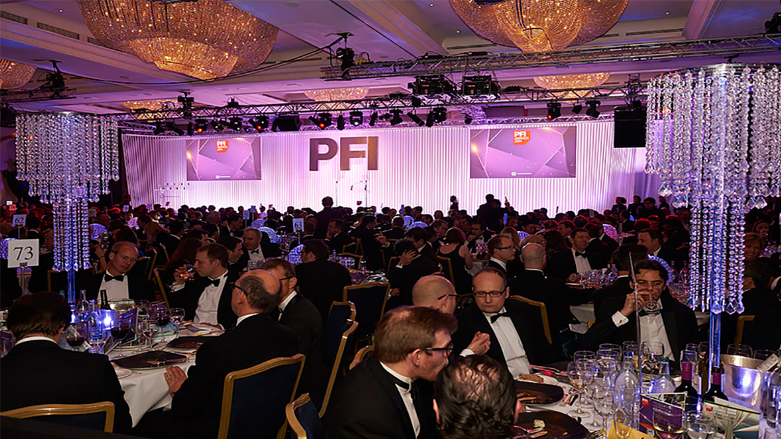
Awards for Dabhol Contract Structure

Slide 30
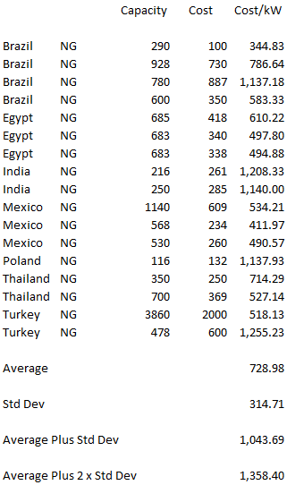
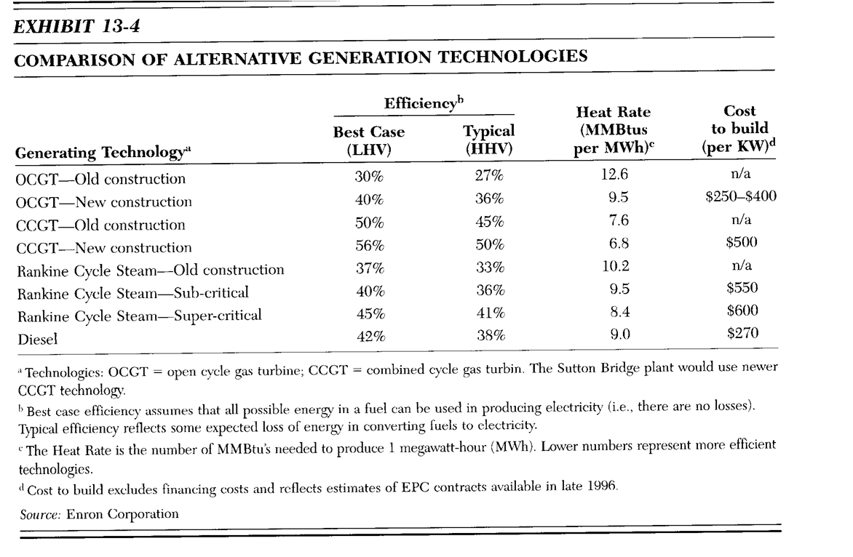
Benchmarking Cost of Other Plants

Slide 31
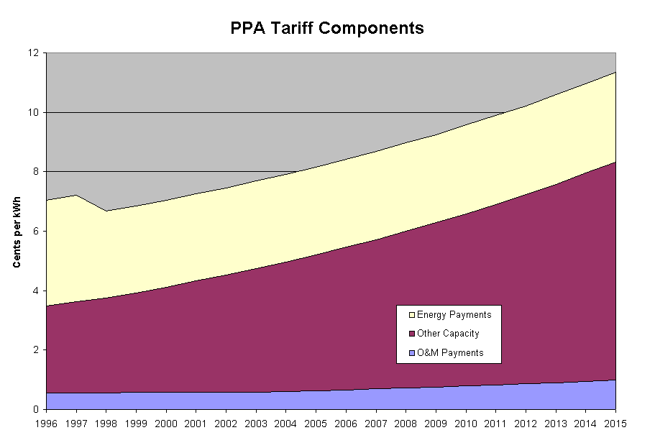
Dahbol PPA Tariffs
The Tariffs were about 7 U.S. cents per kWh increasing to 11 cents over 20 years.
Comparable plants in the US were selling power at 3-4 cents per kWh.
Initially IRR was 26.52%
Officially the ROE allowed was up to 16%
The contract was indexed to USD

Slide 32
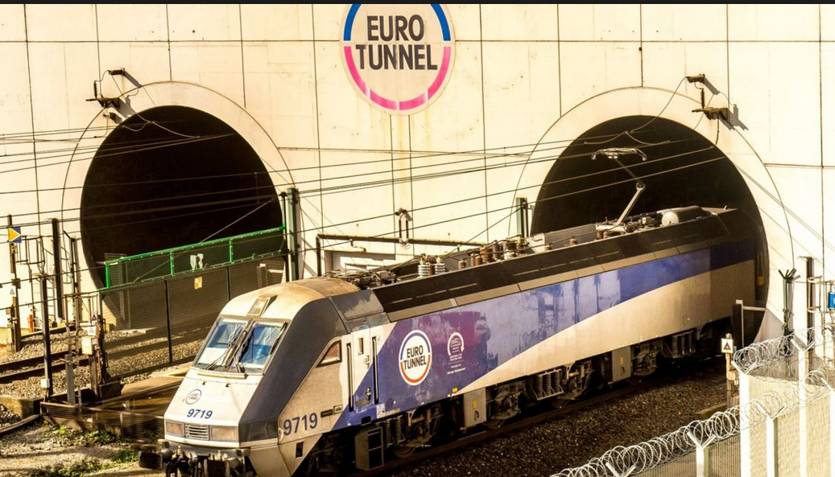
Case 3: Eurotunnel – Contract Structure, Ownership and Timing

Slide 33
Risks for Availability and Output Projects
Risks of output-based projects primarily involve making incorrect estimates of the output such as traffic. This can be very difficult because there is often no historical basis for the forecasts.
Risks of availability projects often involve assessing whether the counterparty to the contract will live up to the contract terms. When the counterparty is a government agency this becomes political risk.

Slide 34
Eurotunnel Background
August 1994, the British Isles and continental Europe were linked together for the first time in 8,000 years. The Channel tunnel, or Chunnel as it is better known, is Europe's biggest infrastructure project financed wholly by private capital. The desire to link Britain and France dates back more than 200 years.
  A French farmer named Nicolas Desmaret argued in 1751 in "A Dissertation on the Ancient Link Between England and France" that the two countries should once again be linked, "... either by bridge, tunnel or causeway."(1) Fifty-one years later Napoleon approved a plan drafted by Albert Mathieu, a French mining engineer, for twin tunnels with surface-reaching chimneys for ventilation. However, England and France went to war a year later and the plan died. Similar afflictions tainted the link devised by Thome de Gamond in the 1830s. The first serious construction attempt took place in the early 1880s. Tunneling had actually begun from both the British and the French coasts, but after a mere 2,000 yards the British became uneasy with the potential success of the project and called it off.(2)
  Over the next 100 years, studies were taken, proposals were written and various holes were drilled. Harold Wilson's Labor Party government forfeited tunnel construction in 1975, opting to pursue the Anglo-French Concorde project instead.
It wasn't until late in 1984 that the British and French governments reached an agreement to build the tunnel. The project became official with the signing of the Paris Agreement on March 14,1986.(3) This triggered the largest binational joint venture ever, as well as unprecedented cooperation between the two nations. As Dr. Brian Mawhinney, secretary of state for transportation, said: the tunnel "... is perhaps the greatest example of international collaboration in transport.".

Slide 35
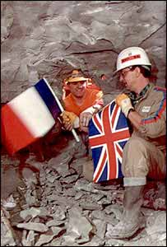
Eurotunnel
31 Mile (50 km) tunnel between England and France
Similar project in Japan had 100% cost over-run, no other comparative projects
Financed by 225 banks
Construction expected to be completed in May 1993; actual was in December 1994
Original construction budget was £4.9 billion
Most Equity Funded by IPO
Multiple EPC Contractors

Slide 36
Simple Eurotunnel Diagram
The lead banks were also the IPO Advisors
The 10 original construction corporations were the majority shareholders in Eurotunnel.
225 Banks for £5 Billion

Slide 37
Eurotunnel Part 1 – Development Stage
Off-taker: Railways signed contracts using estimate price. Signed before FC
EPC Contractor: Combination of French and English. Not Conventional Technology
Development Cost for RFP Paid for by TML – Seven Months
Accepted Traffic Risk from Study with no History
EPC: Fixed Price Contract with LD
Special Purpose Eurotunnel. Manager Assigned by Government
Sponsors: 60% owned by TML; other Owners were Banks and Institutions
Shareholder Agreement with investment and dividends
Loan Agreement with draws and repayments
Lenders: Made Commitment and required equity capital

Slide 38
Eurotunnel Part 2 – Construction Stage
SIMPLISTINC TRAFFIC STUDY Off-taker: Railways signed contracts using estimate price. Signed before FC
EPC CONTRACT: Combination of French and English. Not Conventional Technology
Accepted Traffic Risk from Study with no History. Big over-supply risk
EPC: Change Orders all favour EOC
Special Purpose Eurotunnel. Manager Assigned by Government
Loan Agreement Increased
LENDERS RELY ON DEBT TO CAPITAL NOT REAL: Lenders: Stuck with project and increased investment
TML owns small amount
IPO
NO STRONG SPONSOR: Individual Shareholders who could not stand up to EPC

Slide 39
Excerpts from the IPO Offering Memorandum
Construction Contract
Eurotunnel has entered into a construction contract with a joint venture of ten major companies providing for a fully-operational System to be delivered by May 1993. The construction of the tunnels will employ conventional but modern technology and well proven techniques. The geology of the proposed route for the tunnels is well understood and generally provides an excellent medium for tunneling.
The order to start design and construction work was given in May 1986. Work to date has been concentrated on design and development studies, geological surveys and the detailed design of the tunnels. In addition, the UK tunnel linings plant is now in operation. A similar facility in France and the access shaft for tunnelling at Sangatte in France are nearing completion. The erection on site in the UK of a tunnel boring machine for the service tunnel will soon be completed. Orders and sub-contracts have been placed with a value of over GBP 200 million and more than 1,800 people are currently engaged on the project.

Slide 40
EPC Contract part 1 – Note the Not a Fixed Price Contract for Tunnels and Underground Structures
Target Works
The tunnels and other underground structures, accounting for approximately 50 per cent of the value of the construction contract, a being constructed on a target cost basis with the Contractor being reimbursed for actual costs incurred plus a fixed fee of 12.36 per cent of the target cost. If the actual cost a completion is less than the target cost, the Contractor will receive a bonus equal to 50 percent of the saving. If the actual cost is more than the target cost, the contractor will meet 30 percent of the excess up to a point where the Contractor has borne an excess equal to six per cent of the target cost.
Lump Sum Works
The buildings and all related infrastructure for the terminal, the fixed equipment and the mechanical and electrical elements of the System, representing approximately 40 per cent of the value of the construction contract, will be constructed on a lump sum basis. The lump sum provided in the contract will be paid to the Contractor irrespective of the actual cost of the specified items. Any overruns will therefore be borne by the Contractor except to the extent that they relate to variations or additions to the contract required by Eurotunnel or are caused by inflation.

Slide 41
EPC Contract Part 2 – Procurement of Locomotives and Other Items
Procurement Items
Subject to the approval of Eurotunnel and following a procedure defined in the construction contract, the Contractor will conclude sub-contracts for the supply and installation of procurements items, principally the locomotives and shuttles. The amount provided in the construction (the Contractor’s fee included) represents approximately 10 percent of the value of the contract. The Contractor, which will be responsible for the preparation, management a supervision of the sub-contracts in order to ensure the adequacy and fitness of the procurement items, will be reimbursed for its cost and will be paid a fee of 11.5 per cent of the cost of the procurement items purchased.
Adjustment to contract price
The target cost and lump sum are subject to price adjustments to reflect, inter alia, additional costs incurred by reason of unforeseeable ground conditions, variations to contract specifications requested by the inter-Governmental Commission (except were reasonably foreseeable), and changes requested by Eurotunnel. The lump sum and the fee for the target works are subject to adjustment for inflation, and similar adjustments will be made in respect of the target costs.

Slide 42
EPC Contract Part 3 – Liquidated Damages for Delay
Contractor’s obligations and incentives
The Contractor is under a general obligation to design, construct, test and commission a fully operational system for delivery by 15th May 1993. The System will be required to meet specified performance criteria.
In addition to the incentives and penalties described above in relation to costs, milestone dates have been established by which certain events or project stages are to have been completed. If these milestone dates are not met, payments to the Contractor will be reduced be reduced by the application of advance liquidated damages. One half of such advance liquidated damages will be repaid if the delay is recovered, and the completion date is met. The Contractor will suffer financial penalties at an initial rate of GBP 354,000 per day to be increased after six months to GBP 536,000 per day up to a maximum of GBP 165 million (all in September 1985 prices subject to adjustment for inflation), if the completion date is delayed for reasons in respect of which the Contractor is not entitled to an extension of time.

Slide 43
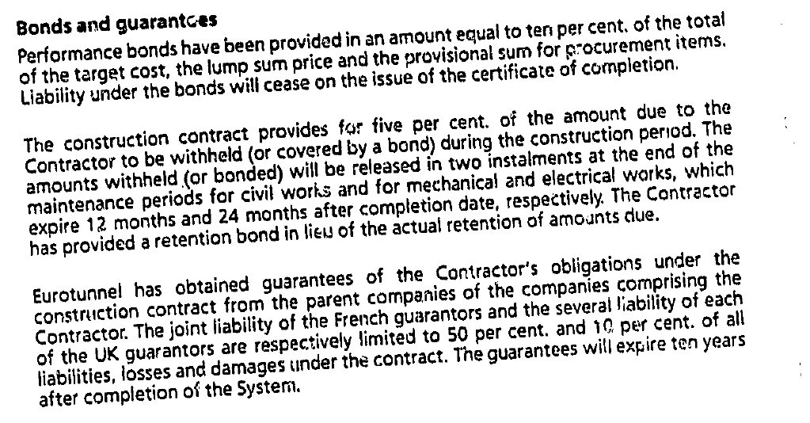
Performance Bonds and Guarantee

Slide 44
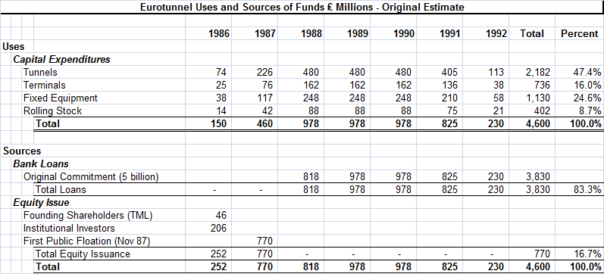
Estimated Uses and Sources
.

Slide 45
Revenue Forecast from Traffic
Traffic study was performed by Wilbur Smith – well known forecasting company for traffic studies.
  Studied traffic across the tunnel from 1964-1985
  Interviewed Ferry companies and asked “complex questions that we did not understand.”
  Did not forecast bloody price war.
S. G. Warburg Securities, one of Eurotunnel's investment banks, said in a report issued several months ago that it expected the number of cars crossing the channel to increase to 12.9 million in 2003 from 5.3 million in 1993, when they were all carried by ferry, with 7 million of the increased numbers representing travel via the tunnel.
Similarly, Warburg said it expected the number of passengers crossing the channel to jump to 125 million in 2003 from 76.5 million last year. The tunnel would provide almost all the growth.
The Railway Usage Contract
  Railways are entitled to up to 50% of the capacity of the system per hour.
  Railways are obliged to pay usage charges for the system by through trains.
  Usage charges include a fixed annual amount (25 million GBP per year and a variable element; 12.4 per passenger.)

Slide 46
Eurotunnel Case Questions
Who do you think paid for change orders in EPC contract
Do you think it is bad to have the EPC Contractor as an Investor
Do you think risks associated with the traffic volumes conform to the idea of what is necessary for project finance
Do you think the debt to capital was a good way to evaluate the credit risk
Think about supply and demand. What happened to the supply of ways to get across the channel with the project
What do you think was the reaction of Ferries and Airlines

Slide 47
Cost Over-Run Summary
The rolling stock for the shuttle trains was let on a procurement basis. TML would manage their acquisition on behalf of Eurotunnel and be paid a percentage fee for this service.
Scope Changes from Government – Safety standards of navettes and other risks
Definition of who bears responsibility and risk allocation
A form of political risk; politically sensitive deadlines; managers with political experience rather than technical experience

Slide 48
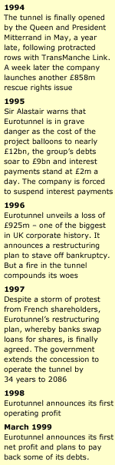
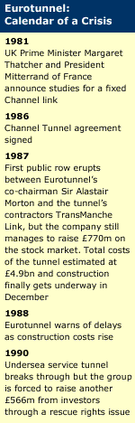
Eurotunnel Time-Line
The tunnelling works were let on a target cost basis. TML would work on a cost‑plus basis and be paid a fee of 12.36% of the target cost including adjustments for variations and inflation. Any cost overruns would be paid for on a 70:30 Eurotunnel:TML basis, up to a cap of 6% of the target cost adjusted for inflation and variations. Eurotunnel would pay 100% of any cost overruns over this cap.
Initial Cost Estimate to be 4.9 billion GBP

Slide 49
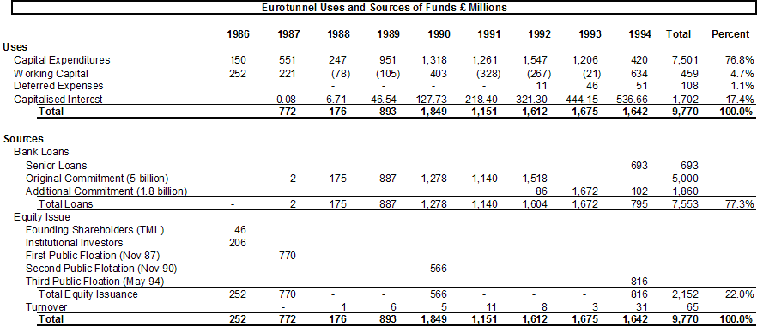
Uses and Sources of Funds
The Equity Issuances were to the public rather than to a company with expertise

Slide 50
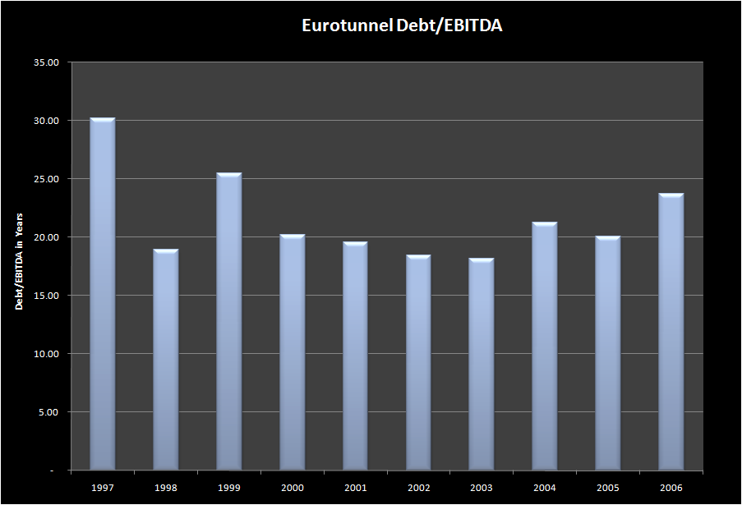
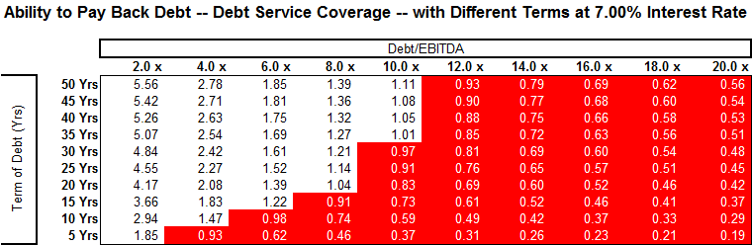
Eurotunnel Debt/EBITDA
The debt to capital ratio for Eurotunnel at financial close of 76% was in line with other projects, but it was irrelevant

Slide 51
Problems with Construction costs and Shuttles
25% Buffer in original bank agreement
Some changes in terminal and fixed equipment work
Major problem was with the shuttles
  More complex than originally estimated
  Market tight
  Bids higher than expected
Additional GPB 2 billion debt financing dependent on new equity issue and support by EIB, May 1990.
TML claimed added costs of 1.2 billion in 1992. Funded with debt and final equity issuance.
!994 added senior debt to cover interest payments that could not be serviced through cash flow
Suspended interest on debt in 1995

Slide 52
Eurotunnel Traffic Forecast
Eurotunnel comments
  "We were predicting that on Eurostar there would be 21 million passengers (annually)," admits David Freud of Warburg, the investment house which sold Eurotunnel shares to the public.
  The actual figure was less than a third of that.
"So the traffic forecasts were not just out by a little bit. They were completely potty; they were nowhere."
Those who drafted Eurotunnel's prospectus failed completely to foresee a robust response from the ferries.
There was a marketing war that broke out between the ferries and Eurotunnel in the summer of 1995 which further damaged revenues.
“The forecasts were comically optimistic”, The Financial Times

Slide 53
Projected and Forecast Traffic and Revenues

Slide 54
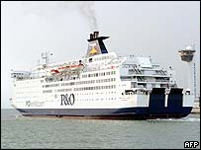
Eurotunnel – Price and Traffic Estimates
Not only did P&O not fade away, as Eurotunnel had thought likely, it fought back with better ships and lower prices, retaining the loyalty of passengers who had been forecast to switch to the tunnel.
Another blow to Eurotunnel was the unexpected emergence of no-frills airlines, offering rock-bottom prices on short-haul trips to a wide range of European destinations.

Slide 55
Effect of Traffic Study Errors on the Financial Results of Eurotunnel
.

Slide 56
Valuation Problems with Eurotunnel
The Eurotunnel project includes many classic valuation issues in addition to the focus of applying optimistic assumptions from consultant studies related to construction costs and traffic projections. These problems included distorted incentives because of the corporate structure, limited experience and reputation of equity investors, conflicts with the government and use of unconventional equipment:
  First, a consortium of ten construction companies named TML that owned the majority of the shell company that was created for bidding on the concession. This shell company signed construction contracts even though TML eventually only owned a tiny fraction of investment, presenting a dramatic conflict of interest. Problems with the construction contracts led to many construction over-runs and delays.
  Second, the equity providers (mainly small French investors) did not have the wherewithal to evaluate the project economics provide assurance that somebody who gets paid after lenders could check the key valuation assumptions. With hindsight, partially because of weak sponsors, the managers of Eurotunnel neither negotiated effectively with bankers nor with TML nor did they seem to have the best interests of shareholders in mind.
  Third, relationships between Eurotunnel and the governments of Britain and France were not aligned properly. Even though the project was directly related to the government activities – government owned railways operated the trains, the 55-year concession period was defined by the government, the project was awarded by the government, and the government defined the safety requirements, there was no direct or indirect financial support from the French or British governments.
  Fourth, the complexity of the ventilation systems, the shuttles, the toll plazas, the electricity requirements and other items introduced risk that could not be gauged by evaluating the cost and performance of other projects.

Slide 57
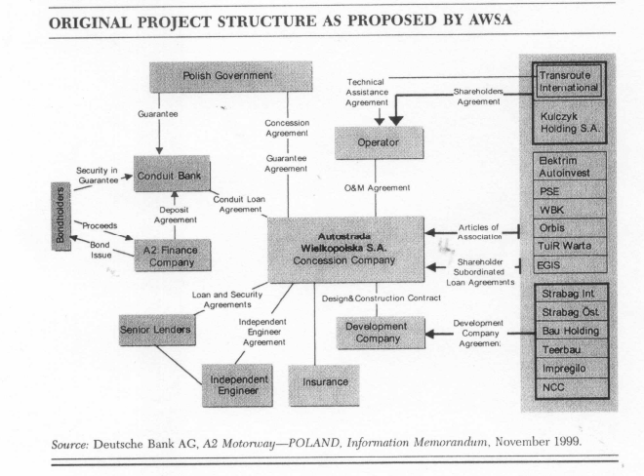
Contrast of Eurotunnel to Public Private Partnership
Under the BOT model, the government retained ownership of the motorway while the private companies that financed construction, known as concessionaires, had the right to operate the motorway and receive profits for a defined period of time. When a concession ended, the concessionaire would transfer operations and control back to the government. The Toll Motorways Act of 1994 provided the legal framework for the program. It authorized the government to grant concessions on a competitive tender basis for the construction and operation of tolled motorways.
In addition, the Act authorized the government to guarantee financing of up to 50% of the total cost of construction, create a new government agency to oversee the program, and take land for the motorways by eminent domain.

Slide 58
Appendix Case 4:
Solar Case Study –

Slide 59
Case Question
How would you design a performance test as part of the EPC contract
How would you design the performance part of the O&M contract

Slide 60
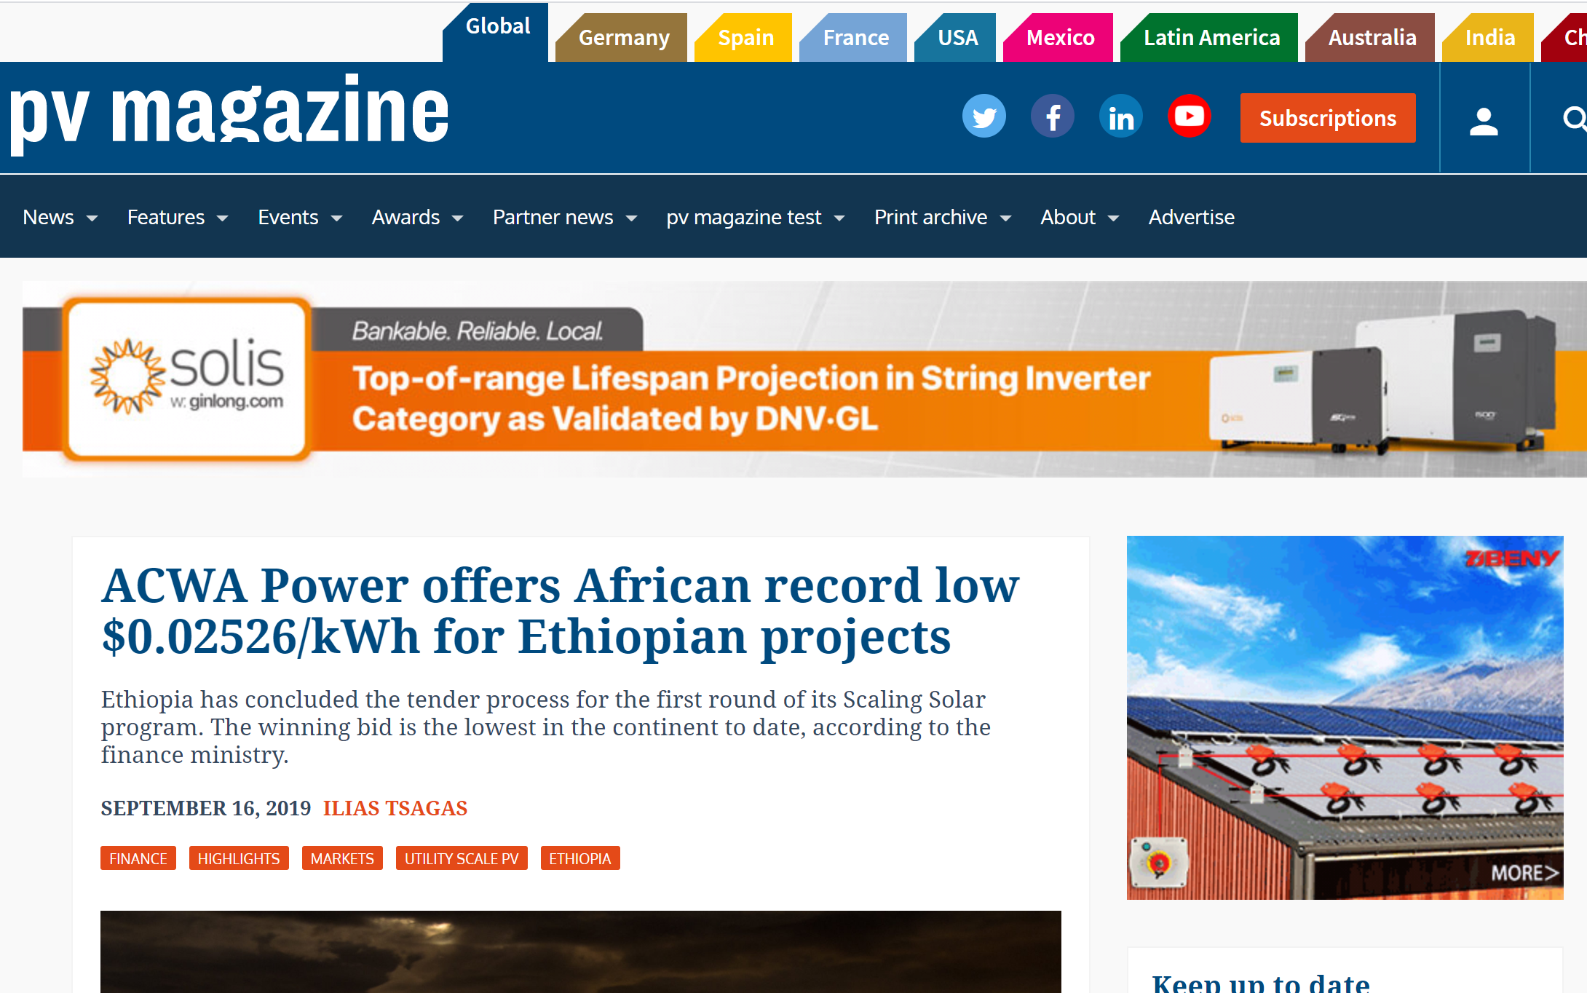
Two Projects that Changed the World

Slide 61
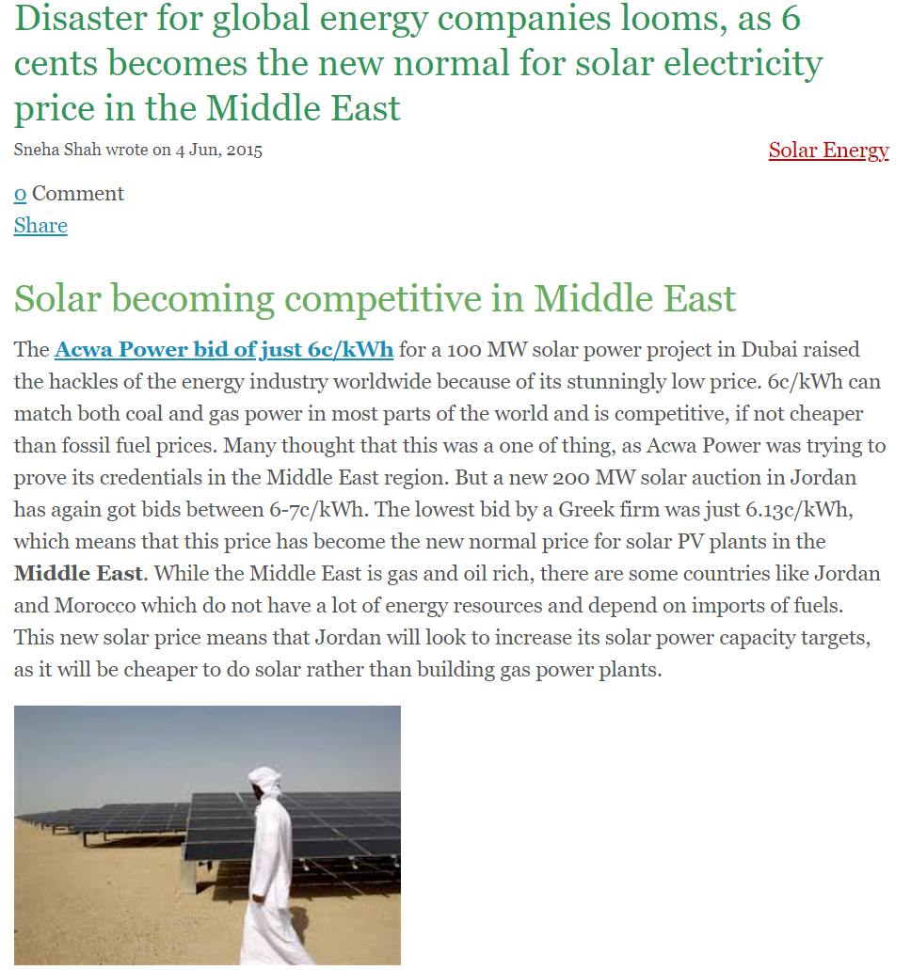
ACWA Power Dubai 6 Cents per kWh in 2015

Slide 62
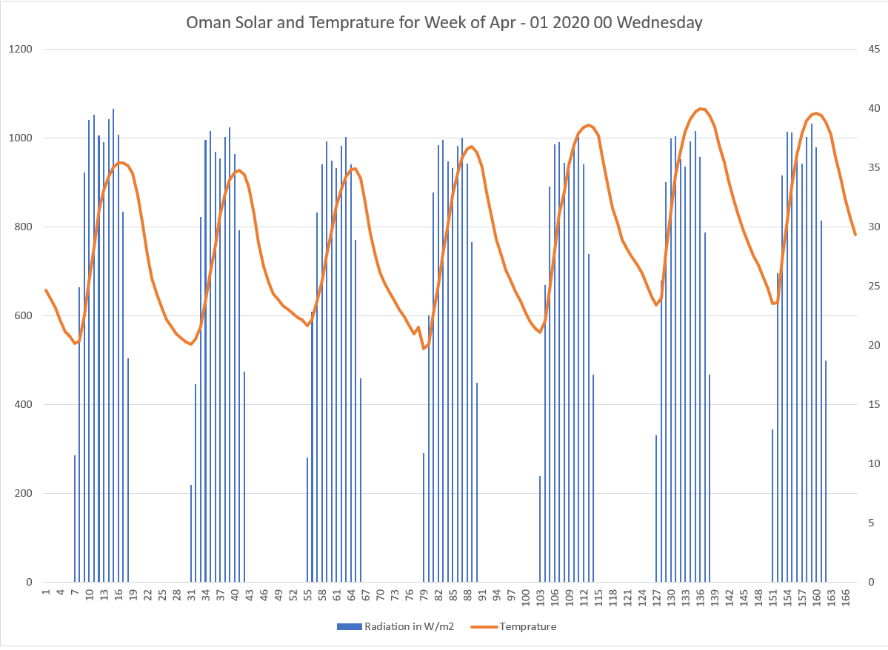
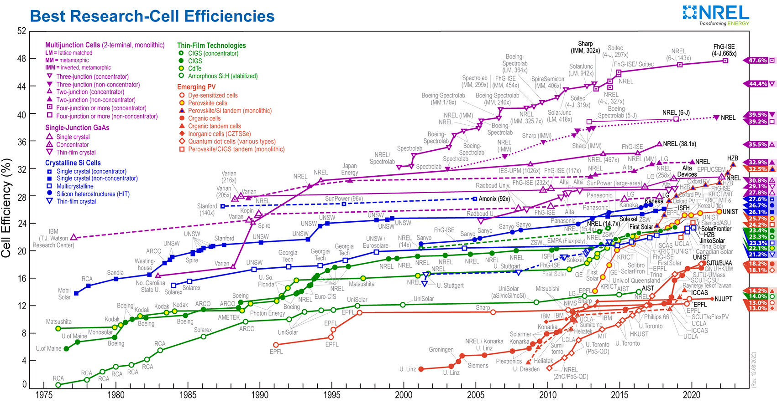
Efficiency and Capacity Factor
Question: What is the difference between efficiency and capacity factor
Banks and Investors: Concern with the overall cost

Slide 63
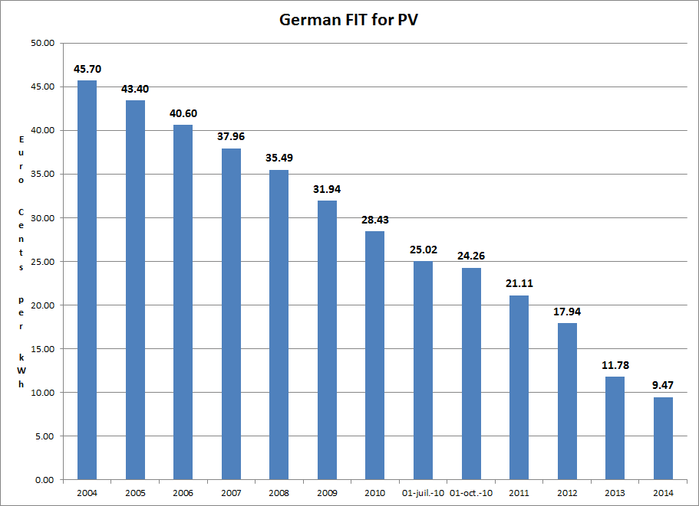
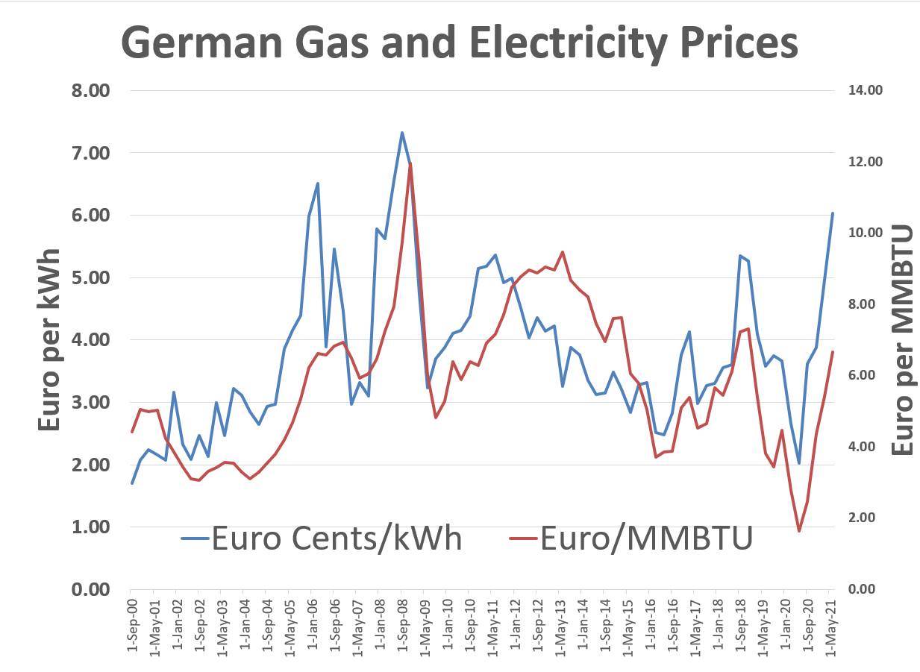
Why Are We Even Discussing Green Hydrogen 1 - German Solar Feed-In Tariffs and Managing Risk
Example of government policy that worked. Idea to make very simple tariff to finance projects and then achieve scale.

Slide 64
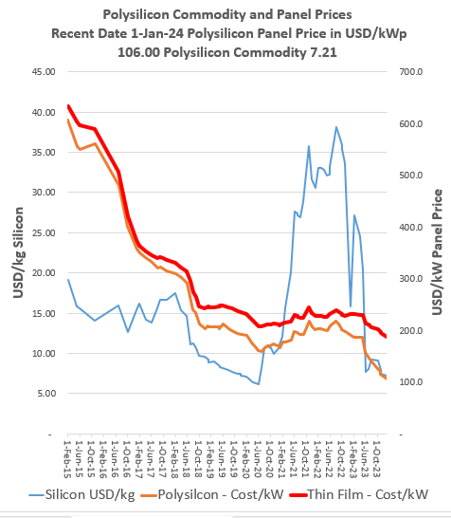
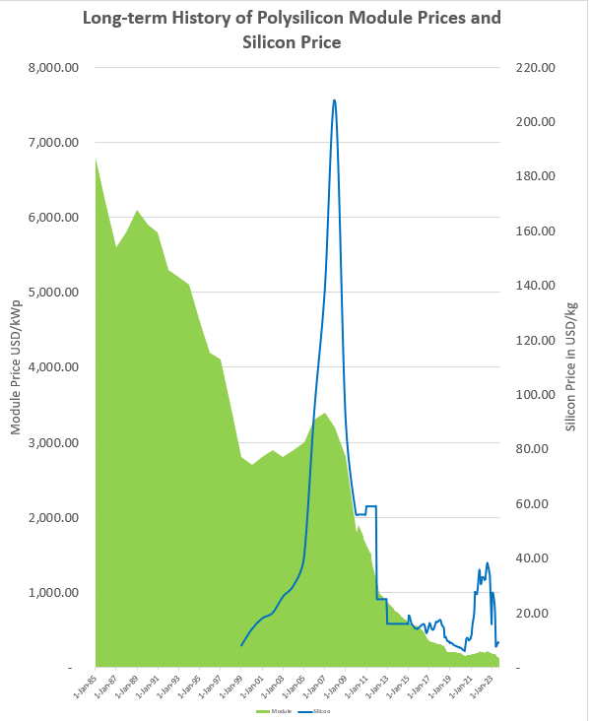
Why Are We Even Discussing Hydrogen 2 - Module Prices and Polysilicon

Slide 65
Solar Can be Defined by a Few Parameters
Operating
  Capital Expenditure/kW – as low as USD 500/kW
  O&M Cost – Pure O&M as low as USD 4/kWyear
  Capacity Factor – Good sunlight, as high as 28% with tracking
Financing
  Required Equity IRR – Can be 5-6% in Europe
  Debt Parameters
    Debt Size from DSCR
    Credit Spread
    Required Hedging
    Tenure of Debt and Re-financing
    Required Political Risk Insurance

Slide 66
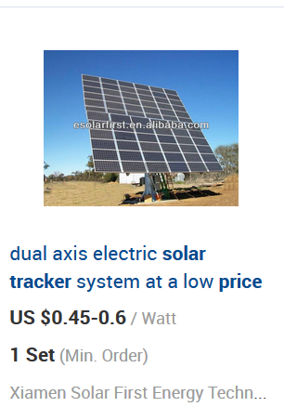
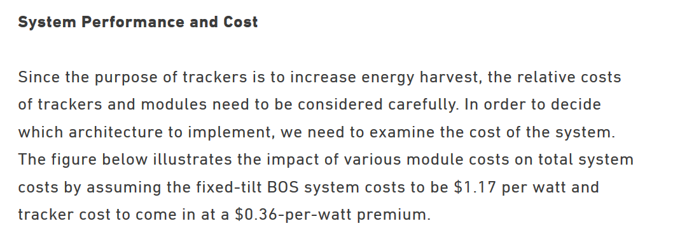
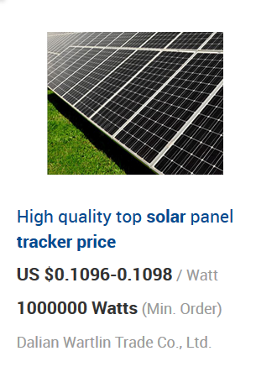
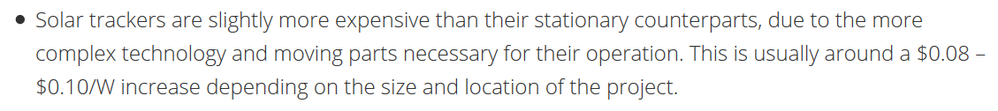
Cost of Tracking and Bifacial

Slide 67
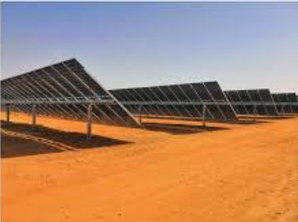
Bi-Facial Costs
Can generate from both sides of the module
Can produce 5-20% more output
Production Costs are not much higher for bi-facial
Wood McKinsey estimates that the increase in cost at only USD 5/kWp (relative to the panel cost of approximately USD 200/kWp.
Module producers offer bi-facial products
Tracking companies making adjustments

Slide 68
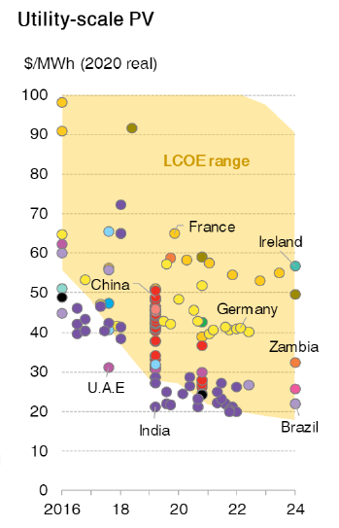
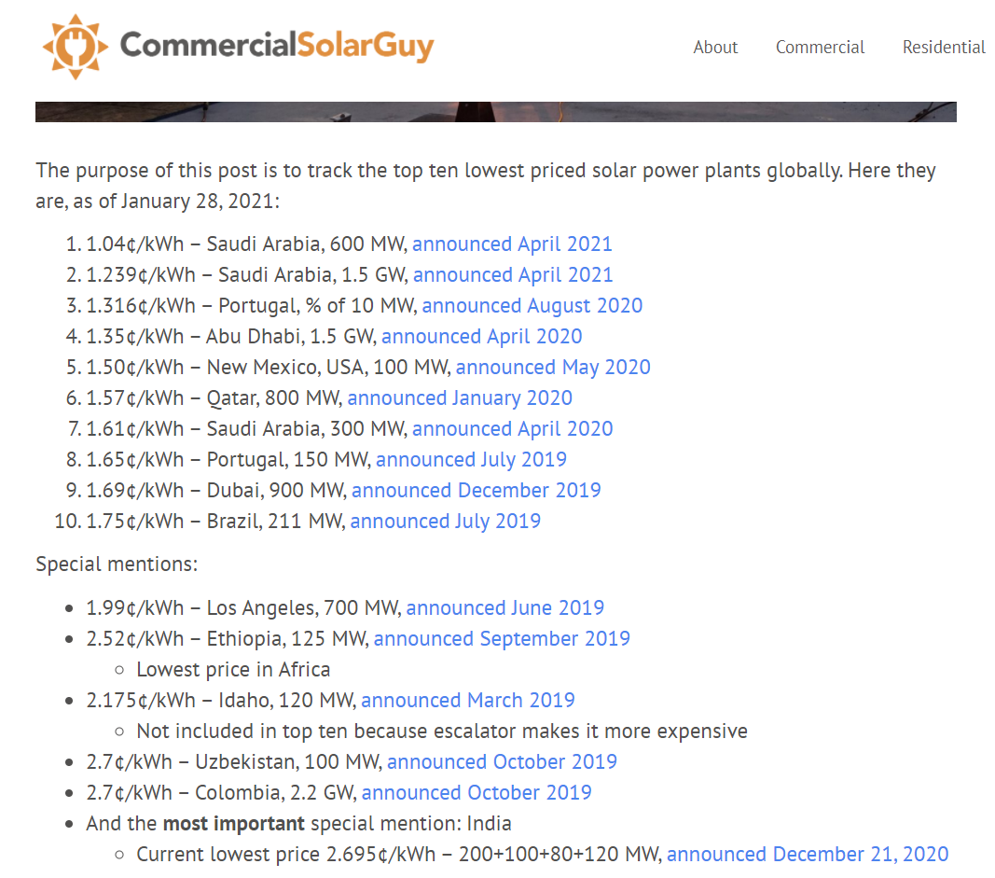
Examples of Very Low Solar Prices
To see how far things have come, there are many projects now that are lower than 2 USD cents per kWh.

Slide 69
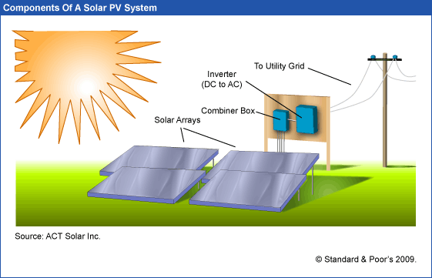
Solar PV – Inverter and Solar Arrays
Final Yield and generation Capacity Factor of Generation to Grid relative to kWp.
Yield and capacity factor measure the same thing
In-Plane Irradiation
Capacity Factor of Sunlight – Average Sunlight Divided by Capacity of Sunlight Defined as 1000 w
Performance Ratio is the Capacity Factor of the Final Divided by the Capacity Factor of Amounts that Hit the Array

Slide 70
Risk Allocation for Renewable Energy
IPP Risks
Cost of Project, Time Delay and Technology Parameters
Demand and Technology Change
Performance Ratio Risk
Interest Rate Fluctuation
Generation that Cannot be Controlled
Contract Mitigation
EPC Contract with Fixed Price and LD (LSTK)
PPA with Fixed Price and No Inflation
O&M Contract
Interest Rate Swap
NONE !!!
Explain why Single Part Tariff is Used and why risk of generation is taken by the investor

Slide 71
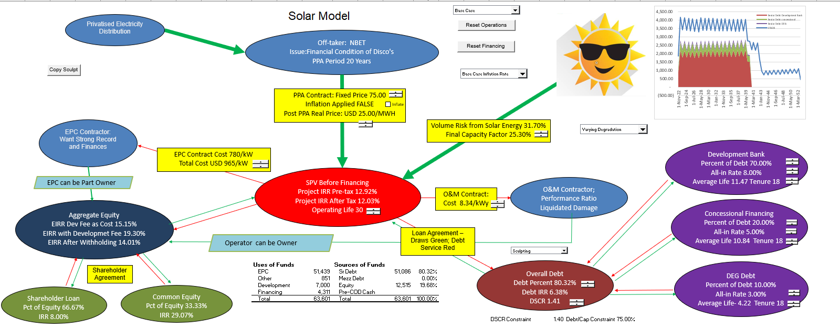
Diagram of Solar Project Finance
Volume or price or availability risk in model, and then, the IRR’s of each party and the DSCR’s of the lenders. Include cost to off-taker for the project economics.

Slide 72
Renewable (mainly solar) Resource Uncertainty

Slide 73

Where Uncertainty Comes From
First, there may be different solar resource estimates

Slide 74

Understand the Concept of STC
1,000 Watts/m2 = 1kW/m2
Measure Electricity Generated Relative to 1,000 watts
Temperature at 25 degrees

Slide 75

Explanation of P50, P90 etc.

Slide 76

P50 and P99 in Solar Case
Evaluate the P50 and P99 using the DSCR criteria.

Slide 77

Risk Analysis in Solar Projects

Slide 78
Nightmare Graph and Missing the P90 – Fitch Report

Slide 79

Estimation of Yield or Capacity Factor
Base Estimate
Performance Estimate
Variation from Changes in Annual or Semi-Annual Irradiation
Variation from Different Starting Points
Variation from Modelling Errors
Variation from Performance Ratio
Use of Mean Square Error to Add up the Components of Standard Deviation
Use of NORMINV to Compute P90, P99 etc.

Slide 80

Focus on In-Plane Yield for Capacity Factor
Concentrate on the in-plane radiation that hits the panels. Yield in kWh/m2 divided by 8760 gives you the capacity factor: 2780/8760 is 31.7%. You won’t find much better places than this.

Slide 81
Solar Patterns in Desert – Note the Stability

Slide 82
Weekly Solar Irradiation - Europe

Slide 83
Final Output and Performance Ratio
In-plane radiation
  From the sun and nothing to do with type of solar panels, sand on panels, size of inverters, losses from trees and shading, line losses. Only depends on the day and night and clouds
Final output
  Depends on panel temperature coefficient, how size the inverters, line losses, losses due to crap on the panels etc.
Performance Ratio
  Converts in-plane radiation to final output
  In-plane capacity factor x PR = Final capacity factor
Example
  In-Plane (31%) x PR (80%) = 24.8%

Slide 84

Work Through PVSyst
Can divide the energy injected to grid divided by radiation on collectors
Don’t need anything other than the column of Effective Irradiance on Collectors as well as Energy Injected into the Grid. Convert both of these to capacity factors and then divide the energy into grid by the irradiation on collectors.

Slide 85



Loss Diagram Illustration
Convert loss diagram into capacity factor and compare different cases.
Difficult to compute performance ratio from these diagrams.
Generally, the loss due to temperature is the largest loss factor.

Slide 86

Example of Temperature Coefficient
You can find temperature coefficients – some examples are listed below.
The Nominal Operating Cell Temperature (NOCT) is defined as the temperature reached by open circuited cells in a module.

Slide 87
Solar Case Issues to Think About
Starting Point versus variation
Degradation and guarantees
If you have other projects in similar areas
Comparison with other P90 and standard deviation

Slide 88
Section 3:
Loan Agreement Contract in Project Finance

Slide 89

Five Parts of Debt
Any debt has the following parts in deriving the structure
Debt Size
Funding Pre-COD
Repayment Post-COD
Interest and Fees Paid
Other Features to Improve Ability to Repay including covenants, DSRA and cash sweep

Slide 90
Pre-and Post COD Analysis
Pre-Cod
Post-Cod

Slide 91
Part 1: Debt Size – Nuanced Issues with DSCR and Debt to Capital Ratio

Slide 92


Debt Size From Debt to Capital and DSCR

Slide 93



Risk Analysis – Skin in Game versus Safety Buffer
Equity Skin in Game
Buffer to Make Sure No Problems

Slide 94


DSCR, Alarm Clock
How much buffer do you need to make sure you will not have a risk event
Time to catch plane
How much time would you leave
  First time took the plane
  Very important flight that you cannot miss
DSCR = Cash Received/Cash Paid to Bank
DSCR = CFADS/Debt Service

Slide 95
Debt Sizing – Key Philosophical Question
Debt to Capital Ratio – Trust sponsor to be smart enough to not invest in a bad project. Make sure the sponsor is taking downside risk. With no cash invested in the project, there is only upside potential, and the sponsor will not care about downside evaluation. The test is historic investment and do not have to look forward.
The notion of DSCR implies that you are smart enough to make a forecast. If you really believe your forecast and even variation around your forecast, you can back into the debt from the DSCR. This is the notion of negotiated base case and downside for evaluating DSCR.
Limit the debt to assure equity is in project and the value of the project is above the debt

Slide 96
Reconciling Debt to Capital with DSCR
Cash Flow results in too high DSCR meaning that you have debt to cap constraint
Increase the project cost WITHOUT spending money on things like land value
Yes
After you are finished with the term sheet it looks like the DSCR constraint and the debt to capital constraint give you the same answer. This could be because of the process.
No
Try to increase tenor to reduce increase the DSCR

Slide 97
Effects of Non-Cash Increases in Project Cost
When does asset increase matter and when does it not
Importance of paying cash or not paying cash
Examples of non-cash increases in project cost
  Development fees
  Owner costs
  Some development costs
  Contingencies
  Value of Land allocated to project
  EPC profit if EPC is sponsor
  Games with EPC profit
Items that can increase the cost of a project affect returns primarily when the debt to capital constraint applies and have less or no importance when the DSCR drives debt capacity.

Slide 98
Debt Sizing: Including Items in Project Cost that do not Involve Cash Outflow
Accounting allocations to the project can have large effects on the equity IRR through debt sizing derived from the debt to capital ratio.
If the DSCR drives debt sizing, the accounting allocations, fee allocations and other adjustments have no effect on the equity IRR.
Accounting allocations and non-cash contributions can change the structure of returns when multiple investors are involved in the project. If one party is allowed to include non-cash allocations as the basis for his investment, his return is much higher.
Depending on the manner in which project costs are accounted for, multiple investors pay debt service and receive dividends, but the investor who did not invest as much cash effectively borrows less relative to the cash investment.

Slide 99
Debt Sizing: Profits from EPC Contractors or O&M Contractor when Investor is also Contractor
If the EPC profits do not affect the debt size and there is only one investor, placing profits at the EPC contractor level or the investor level does not influence overall returns (i.e. if DSCR drives debt size).
Depending on whether the debt to capital constraint applies or there are multiple investors, EPC profits can increase equity IRR (by increasing the debt size).
Cash Flow Waterfall and issues associated with including profits in O&M contract rather than in SPV cash flow. Profits on the O&M contract versus including O&M costs at the SPV level can affect the distribution of dividends as the O&M fee is paid before debt service.

Slide 100
Illustration of DSCR and Debt to Capital Constraint
Lower DSCR results in too high debt to capital ratio. Need to constrain the debt.
Discounted Red Area (using the interest rate) is the Value of the Debt.
DSCR sizing means you believe your forecast.

Slide 101
Which Constraint is in Place
Items have an effect on whether the debt to capital constraint or the debt to capital constraint applies:
Need to Understand that NPV of Debt Service is Loan Value
  High Project IRR → More Likely Debt to Constraint;
  Long Tenor → More Likely Debt to Capital Constraint;
  Sculpting → More Likely Debt to Capital Constraint;
  Low Interest Rate → Morel Likely Debt to Capital Constraint.
  Low Project IRR → More Likely DSCR Constraint;
  Short Tenor → More Likely DSCR Constraint;
  Level Payment → More Likely DSCR Constraint;
  High Interest Rate → More Likely DSCR Constraint
Fundamental Math:
PV of Debt Service at Interest Rate = Debt at COD
Debt/Capital = Debt/Cap Exp
Debt/Cap Exp = PV of DS/Cap Exp
DS = EBITDA/DSCR

Slide 102
Why Skin in the Game
The DSCR defines the amount debt from cash flow
  Say the cash flow is 150 and the DSCR is 1.5
  Then, the debt service is 100 = 150/1.5
  If the interest rate is zero, the DS = Interest + Repayment = Repayment
  If the debt term is 10, then the Repayment = 100
  In this case the total repayment = 100 x 10 = 1000
  Total repayment = Total Debt
But now say the total project cost = 800
If you lend 1000, then the company gets 200 immediately
If the SPV does well, everybody is happy
If the SPV does badly, the company put 200 in its pocket and lost nothing
They have no skin in the game

Slide 103


DSCR for Solar PV from Fitch

Slide 104
Appendix Case 5:
Africa Case Study

Slide 105


Lagos Barge and Columbus
My friend told me that the initial PPA contracts were like Columbus taking gold from the native peoples – they had no idea what they were negotiating and what they were giving up. The YTL case in Malaysia and the Philippines cases illustrate the same point. The question is where are we today.

Slide 106




Stanford AES Nigeria Case
The plant was not new. It was purchased used from the Philippines. At that time the cost of a new CCGT was about USD 250-400/kW.

Slide 107


Excerpts from NBET PPA

Slide 108


Delay Bonus in Lagos Barge

Slide 109

More Excerpts from NBET PPA
Don’t Be Intimidated by the terminology. Understand the principles and then you can understand why these things exist

Slide 110

Development Fee Theory
Development fees can be a percent of project cost or a multiple of the amount spent on development.
This yields big profits to developers when the notice to proceed occurs and can be a cash outflow for the sponsor. The big profit accounts for the low probability of success during development.
If the developer and the sponsor are the same, this profit is not a cash outflow from the perspective of the project.
Better to put development fees into cost with debt to capital constraint

Slide 111
Development Fee Diagram and Round Trip
Sometimes Call this Round Trip
Special Purpose Vehicle Corporation
Other Investor Contributes Capital as Percent of Total Including Development Fee
Investor Contributes to SPV as Paid In Capital
SPV pays the fee to Main Investor and Records Asset
Main Investor who Incurs Development Risk
Partner who Invests After Financial Close
Development Fee increases the cost of the project

Slide 112

Stages of Probability and Development Fee
Case with probabilities and stages

Slide 113

Solar Development Fees
How much is the padding; What is debt to capital without the added costs

Slide 114
Development Cost Documentation
Equity Contribution.
(i) evidence (including copies of invoices and other documentation, as reviewed and confirmed by the Independent Engineer) of the payment of Project Costs in connection with the development and construction of the Project on or prior to the Closing Date

Slide 115
BOT/PPA Contract
15-year BOT and toll process
NAPOCOR (government owned generation company) to supply fuel & take electricity - no fuel availability risk
Capacity fee $21.6/kW/month on available capacity
Capacity fee is dollar denominated – no direct foreign exchange risk, overseas a/c
O&M fixed fee and energy fee is in Peso - $4.56/kW/Month
heat rate penalty & bonuses
buy out rights @ NPV capacity fees- late payment, change of BOT law, war, etc.

Slide 116

Case Study - Funding
Enron - Subic Bay, Philippines

Slide 117
113 MW Diesel Generator Power Station Subic Bay, Philippines and Richard Tinsley
Sources of Funds:
Notes $ 105 M
Subordinated Note 7
Equity of Sponsor 28
Working Capital 2
TOTAL $ 142
Uses of Funds:
Turnkey Contractor $ 112 M
Bonus to Turnkey Contractor 7
Development and other related costs and Fees 14
Pre operating, Start-up and Commissioning Costs 3
IDC 4
Working Capital Loan 2
TOTAL $ 142
What is the equity contribution

Slide 118
Importance of Strong Sponsor - Ras Laffan Diagram
Off-taker: Korea and Japan Utility Companies: Want strong off-taker with inactive to honor contract
EPC Contractor: Kellogg with Strong Record and Finances
Price of Gas Linked to Oil Price
Off-take Contract with minimum supply
EPC: Fixed Price Contract with LD
Special Purpose Vehicle: Bond Rating of A-
O&M Contractor
Supplier: Need to Understand Economics and Supply Curve
O&M Contractor
Supply Agreement
O&M Agreement
Loan Agreement – Draws Green; Debt Service Red
Sponsors: Want strong sponsor:
Mobil
State
Shareholder Agreement
Lenders:
Issued bonds and debt with long tenor and low rates
Lenders:
Issued bonds and debt with long tenor and low rates

