Slide 1
Project Finance for European Investment Bank – Lot 1

Slide 2
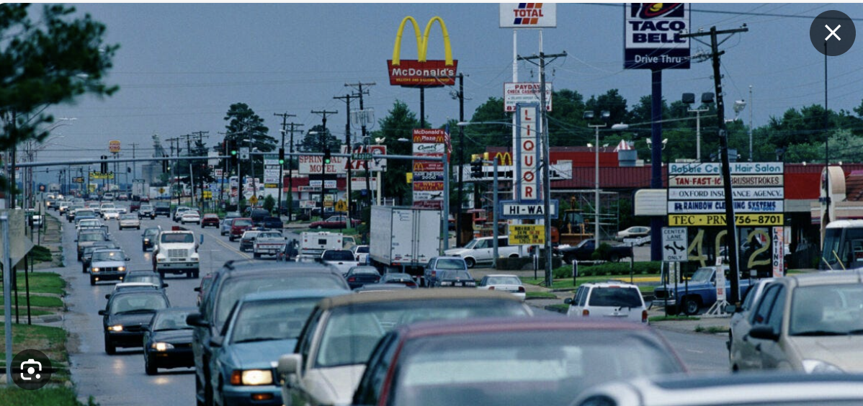
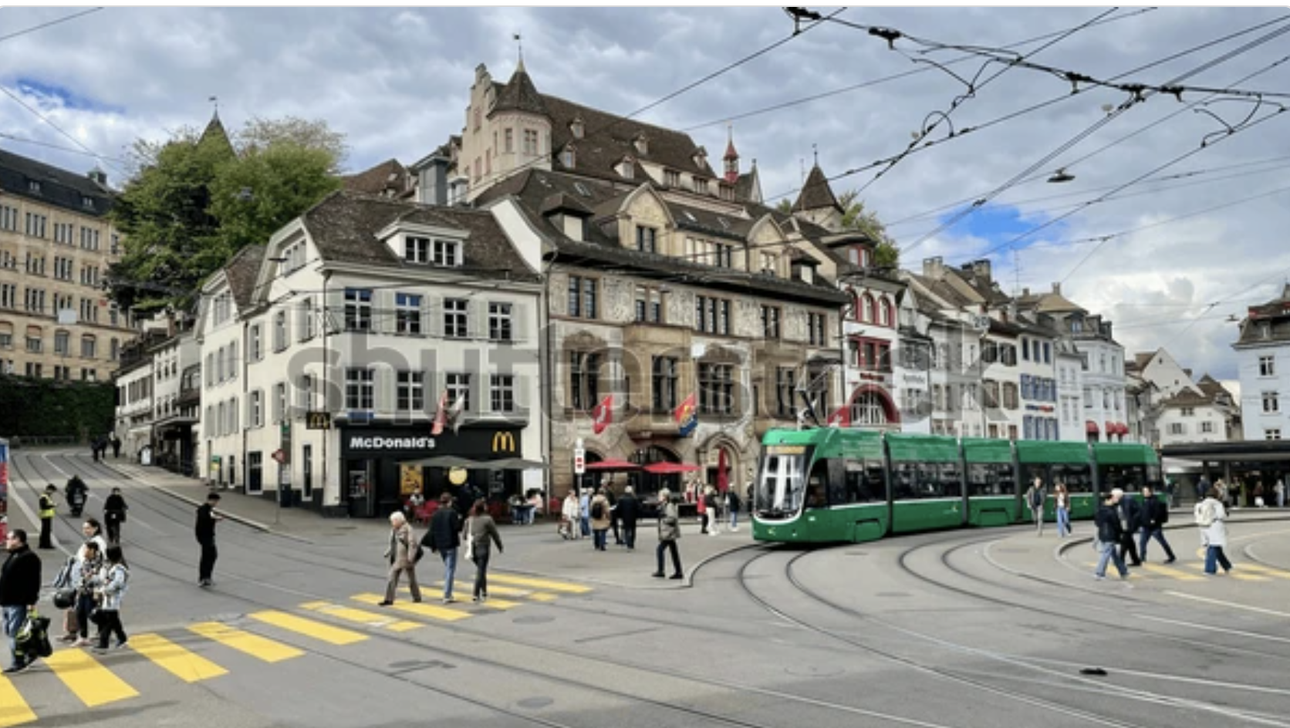
Introduction
Europe
What is an Investment
What is Finance
Importance to Society of Investment Decisions
Definition and Essence of Finance
Understanding the Importance of IRR and DSCR

Slide 3
Objectives of Lot 1
The course is not necessarily meant to be immediately practical to your daily job. The more important idea is to understand the basis for various ideas in project finance.
Underlying ideas behind ideas when working on transactions rather than details
  What is the most fundamental goal of EIB
  What is the essence of project finance
  How does project finance relate to fundamental economic and societal questions
  How can long-term assets be financed and also provide incentives for efficient operation
  How should government policy issues associated with project finance investments be evaluated
Analysis of project finance
  Why is everybody so obsessed with IRR
  What is the meaning of DSCR and why are people so obsessed with the ratio
  How can the ideas be converted into structuring of loans
  How can we define major risks of a project and address those risks in contracts and debt structure
  What if anything can we do to manage risk after the project documents are signed
  How can be understand, use and not be intimidated by project finance models
  How do risks change as a project moves from through different phases
  Who are parties to project finance and

Slide 4
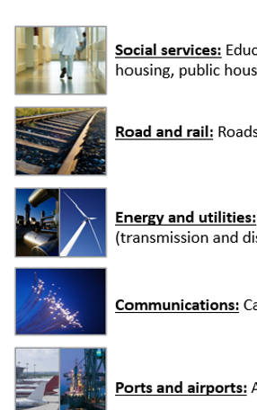
General Instructions from EIB
Modifications to better reflect the evolving nature and scope of the types of projects that EIB sees.
Traditional Sectors and the Core
  Renewable energy
  Rail
  PPP’s Schools, Hospital PPPs
Project Finance used in new areas with ever complex structures.
  Greater use of Natural Resources (Lithium)
  Developments in Green Hydrogen and Green steel
  Battery Analysis
Much of the fundamental principles of project finance remain
  More complex, multi-faceted partnerships, particularly those that rely on significant government support
  Innovative financing structures, technology collaboration, and robust risk management.
  PPPs in these new areas can drive sustainable growth (for example, electric busses, railways) in these emerging high-potential industries, helping countries achieve their environmental and economic goals.

Slide 5
Learning Objectives - 1
Critical learnings:
    Identify the key risks in a project and how to handle and structure them including the use of risk sharing contracts.
    Define the essential parameters and logic flow for a robust project finance model. For example: financial model role of a model in assessing the overall financial feasibility of a project.
    Implications when dealing with projects such as green hydrogen or battery, technology, extraction and other related uncertainties
    Understand the foundations of the Project Finance industry, recent developments and trends
    Define the stages in the structuring and negotiation of key commercial and financial terms particularly as they relate to issues involving blended financing and Government Support

Slide 6
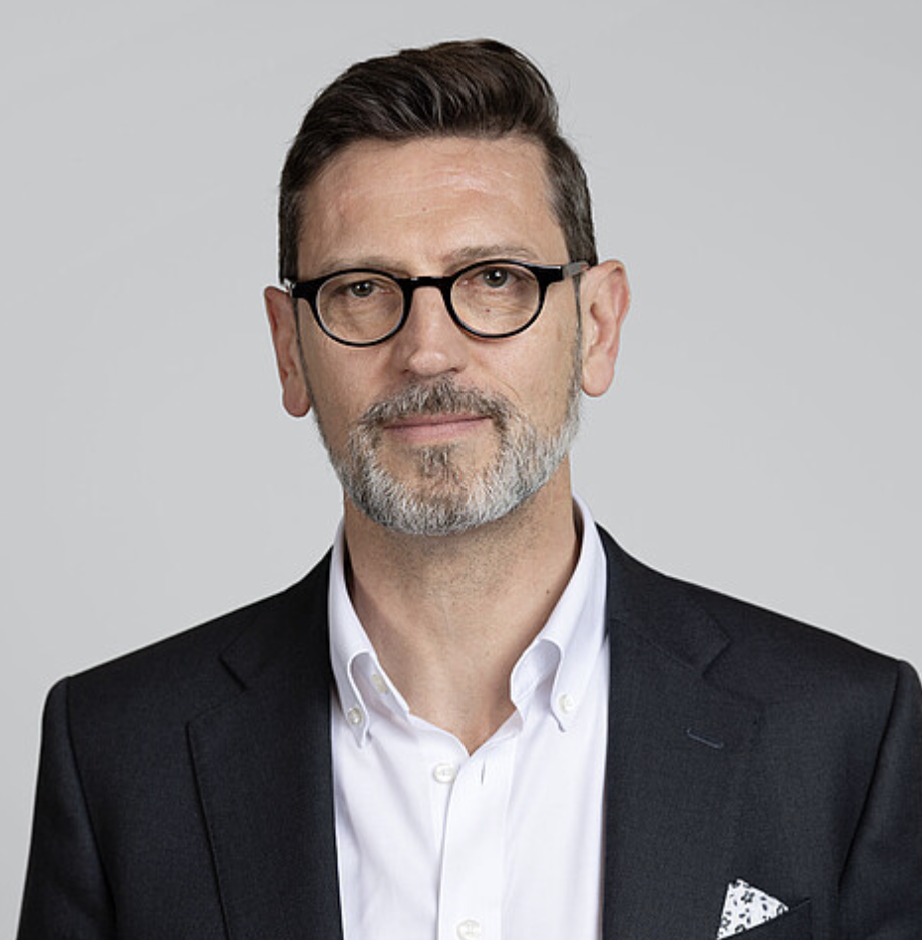
Suggestions from Dr. Dr Cledan Mandri-Perrott and Adjustments to Course
Working with Cledan in the past
Suggestions made by Cledan
Introductions
  Your Objectives
  Your Experience
  Your Desired Course Style (How much excel)
  I need to Listen Carefully
  You are not in Prison
Flexibility with Case Studies
Financial Models
Comments from First Course
  Avoid too many advanced subjects in introductory course
  Make sure all participants understand the key concepts – not just a few
  Stick to structured subjects

Slide 7
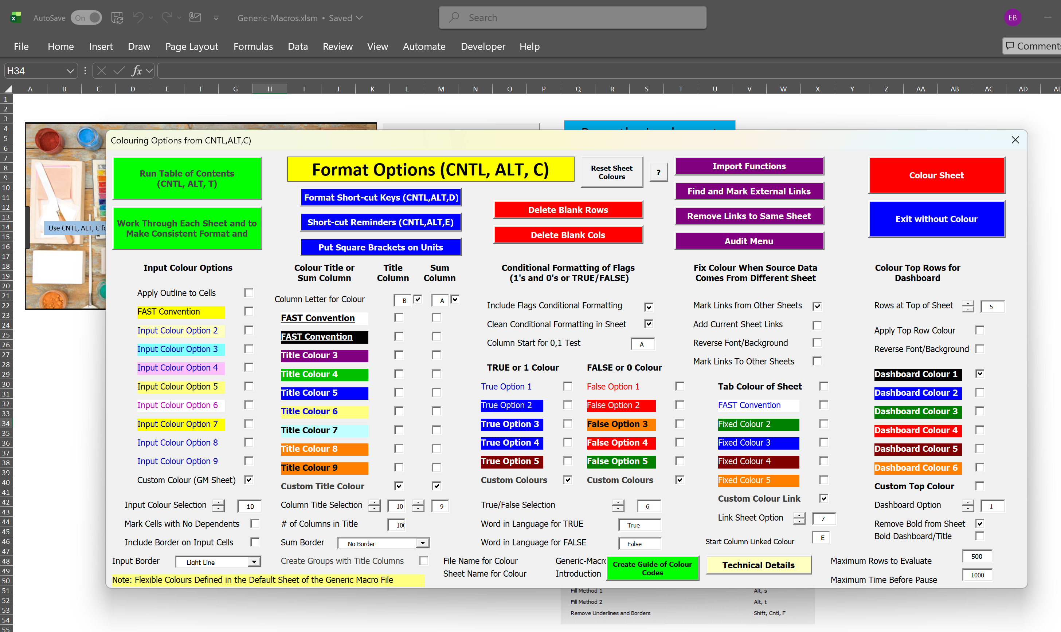
Case Studies
Four brief case studies are envisaged: the first one to assess the different types of project finance structures and in day two a brief case study will be used to demonstrate the different themes that will be presented throughout the day.
I try to pick interesting cases and cases that demonstrate how societal issues interact with project finance.
I will use a bit of excel to illustrate ideas, but you won’t have to type many formulas.
I will try to provoke you to make you think.
In this class we will take some steps backward and discuss theory and maybe some philosophy of risk and economic efficiency. Maybe you will not use some of these ideas in your current work or even in a year. But I hope it is useful.
Cases that had selected subjects
  Dechipher Risks
  Understand Some Contract Issues Given Risks
  Understand Debt Structure in the Context of Risks
  Consider the Pricing and the Benefits to Overall Society

Slide 8
Notes on Financial Model
Financial Model in Transaction
  Tests whether all of the contracts including the loan agreement work in terms of financial ratios
  Used for risk analysis to test downside cases and assure the lenders get paid
  Puts all of the technical data together with the financing data to assess the economics of a project
  Is a database of the meaningful data for the project
Financial Model as a Teaching Tool
  Demonstrates the how project finance concepts work (e.g. DSCR and Volatility)
  Isolate on issue to understand impacts on investors, lenders and society
  Used to present nuanced issues
  Demonstrates issues in case studies

Slide 9
Practical Activities
Two day in a classroom setting, with a number of sessions which present core concepts and principles of finance and financing:
Four brief case studies are envisaged: the first one to assess the different types of project finance structures and in day two a brief case study will be used to demonstrate the different themes that will be presented throughout the day
I will use a bit of excel to illustrate ideas, but you won’t have to type many formulas
During the course we will also use interactive poling and other participatory techniques. The different types of questions that can be asked are: Yes/No and True/False questions where users can choose one option; Multiple Choice questions where participants can choose the best and most relevant options from the options provided; as well as hotspot questions that will be followed up by discussions
I will try to provoke you to make you think.
In this class we will take some steps backward and discuss theory and maybe some philosophy of risk and economic efficiency. Maybe you will not use some of these ideas in your current work or even in a year. But I hope it is useful. I hope

Slide 10
Outline
Project Finance Overview
  What is Finance, Investment, Rate of Return
  What is the Definition and the Essence of Project Finance
  Model Introduction and Capital Intensity
IRR and DSCR to Define Rate of Return and Risk in Project Finance
  Petrozuata and Ras Laffan Case Study
  Project Diagram and Risks
  Exercise on Computing IRR and DSCR
History of Project Finance and Risk Allocation
  Financing Long-term Capital-Intensive Assets – Sam Insull
  Providing Incentives in Financing – Availability Model
  Resource and Output Risk – Renewable and Traffic
  Merchant Risk – Incentives to Optimize Capacity Building
Current Project Finance and Renewable Energy
  Overview of Renewable Energy
  Risks and Contracts in Renewable Energy
  Debt Structuring and Term Sheet
Infrastructure and PPP

Slide 11
Value of Your Time
Stress and Time
Extra Slides
Flexibility and Cases
Depends on your requests
Excel Efficiency and Learning
Attempt to Prioritize Important Subjects

Slide 12
Session 1: What is Finance and What is an Investment

Slide 13
What is an Investment
The important thing about finance is that it guides you to make the right kind of investments that will ultimately make a society better off.
But what is an investment
  It is something where you have to incur a cost and then wait for benefits.
  It is all about time and not even necessarily about money
  Whenever you have to wait, there is uncertainty
Examples of investment
  Capital Expenditure for a project
  Spending money for sports betting
  Creating a new website for your company
  Hiring employees to study AI
  Government investing in basic research on the origins of life
  Writing a book
  Having a child
Question:
  Despite what you may hear on a YouTube advertisement, can you think of and investment gaining future benefits (happiness) without making an investment.

Slide 14
What is Return on an Investment
Making the correct investment that is best for you and for society is measured by the return on investment. Any return is a measure of the future benefits received compared to the investment made.
Assessment of the rate of return boils down to a cost and benefit analysis.
  The cost is the investment made
  The benefit is the future benefits received
  The ratio of benefits to costs measure the efficacy of an investment.
  The return to society can be different than the return to investors
  In project finance an economic return can be computed that accounts for things like carbon emissions, land use, increased employment, personal productivity and other factors.

Slide 15
Any Investment has at Minimum Three Things and a Rate of Return
Revenues Realized
Capital Investments
Return on Investment from Cash Flow versus Capital Expenditure
Operating Expenses
Project IRR, Unlevered Pre-tax IRR, Ungeared IRR, Pre-tax Project IRR

Slide 16
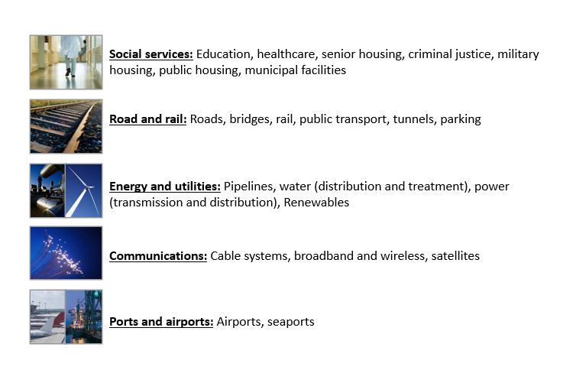
Not as Sexy as a New Version of TikTok, but Very Important to Society
Remember that the ultimate objective of finance is to provide the basis for assessing whether investments make sense for a company and/or a society
Maybe not “criminal justice” which encourages new jails

Slide 17
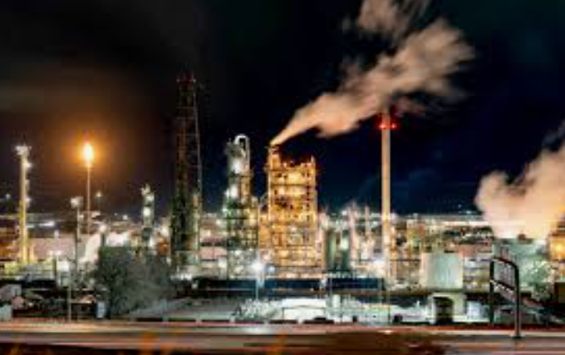
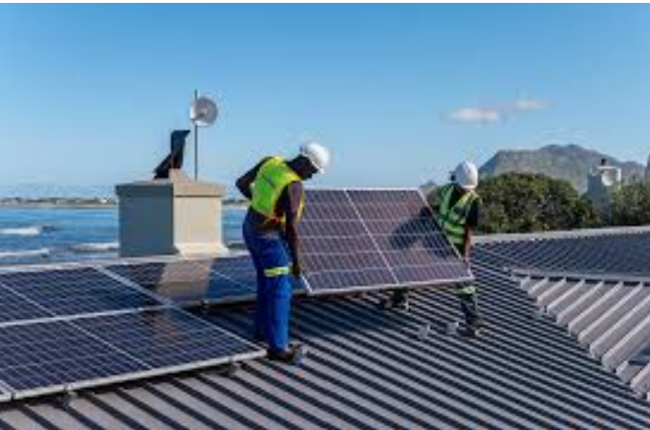
Capital Intensity – Refinery versus Roof-top Solar and Importance of Financing

Slide 18
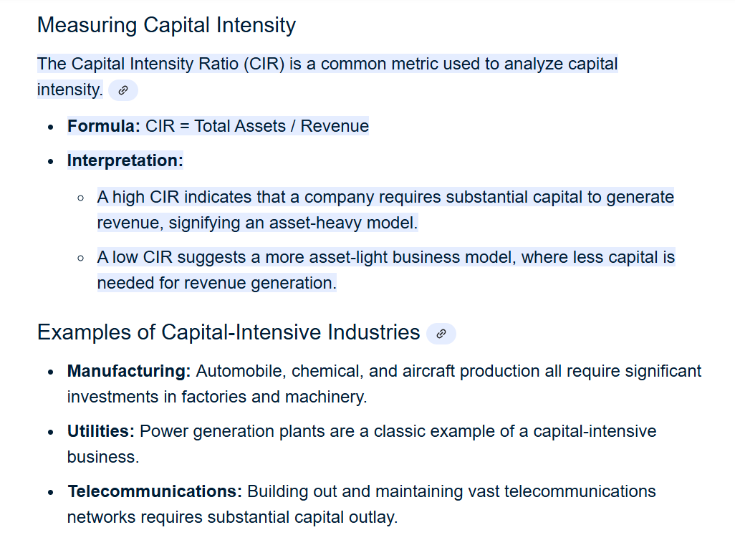
Definition and Importance of Capital-Intensive Investment
Any investment and operating costs, investment and life
Street Vendor
  Asset is truck and inventory
  High operating expense
  Most revenue covers costs of sales and labor
  Most revenues for operating expense and not truck
  Truck has relatively short life
  Assets to Revenues a little more than 1.0
Railway
  Assets high relative to the operating expense
  Assets last a long time
  Revenues spread over long period
  Assets many times the value of revenues

Slide 19
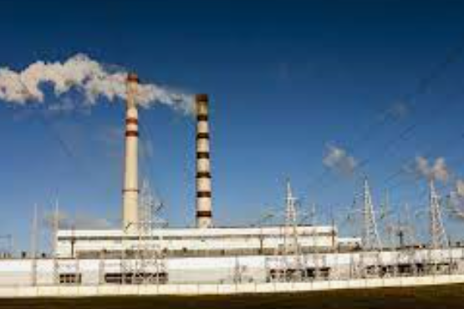

Capital Intensity – Hydro versus Natural Gas

Slide 20


Capital Intensity – Energy Efficient House and Food Store
.

Slide 21
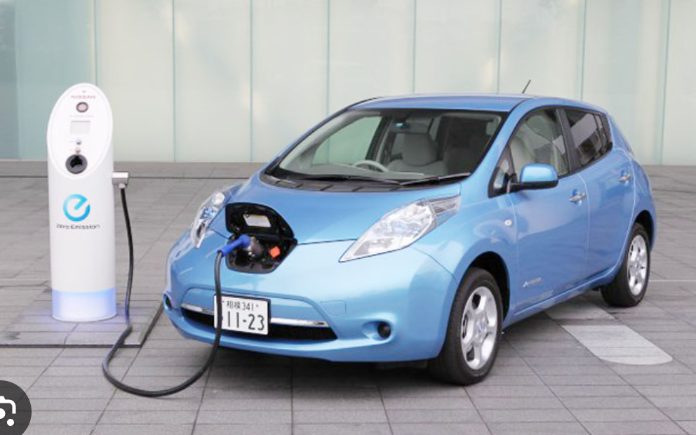

Which is more Capital-Intensive Electric or Internal Combustion

Slide 22
Why is Capital Intensity Important for Our Course
Basic Equations
  Assets x Return on Investment = Operating Income
  Operating Income = Revenues – Operating Expenses
  Revenues = Operating Income + Operating Expense
  Price = Revenues/Quantity
Non-Capital Intensive
  Most of Revenue is Operating Expense
  Assets Small for Relative to Operating Expense
  Price not very sensitive to Return on Investment
Capital Intensive
  Most of Revenue is Asset Return
  Long-life Means Assets not Repaced
  Assets High for Relative to Operating Expense
  Price sensitive to Return on Investment
For Public Investment
  Important to Obtain Low Return driven by low cost of capital
  Important to Build High Quality Assets with Reasonable Cost

Slide 23
Activity – Compute the Capital Intensity Ratio for Different Projects with Excel Model

Slide 24
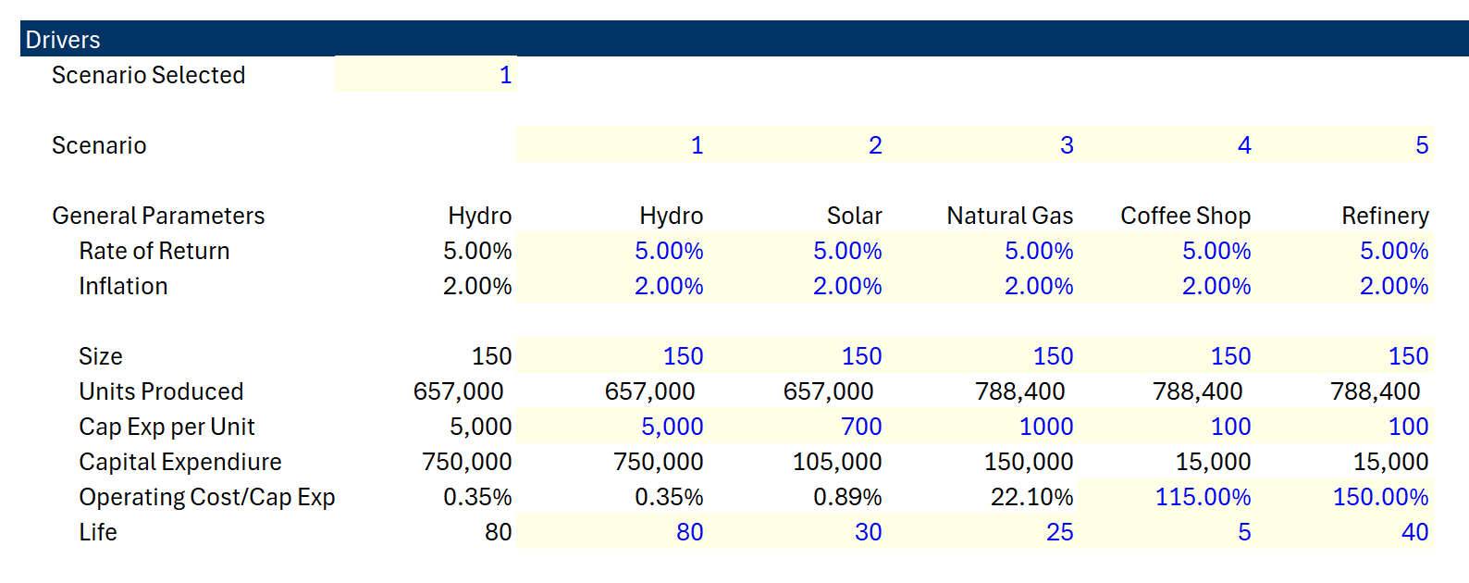
Capital Intensity Definitions and Returns
Capital Intensity Depends
  Operating Expenses to Capital Expenditures
  Asset Life
  Rate of Return

Slide 25
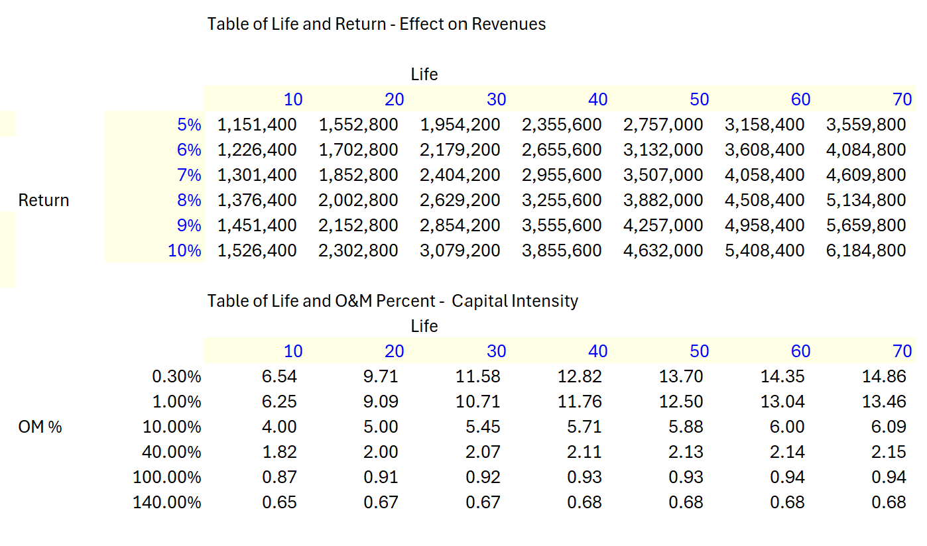
Capital Intensity and Life and Operating Expense
Data Tables Demonstrating Capital Intensity

Slide 26
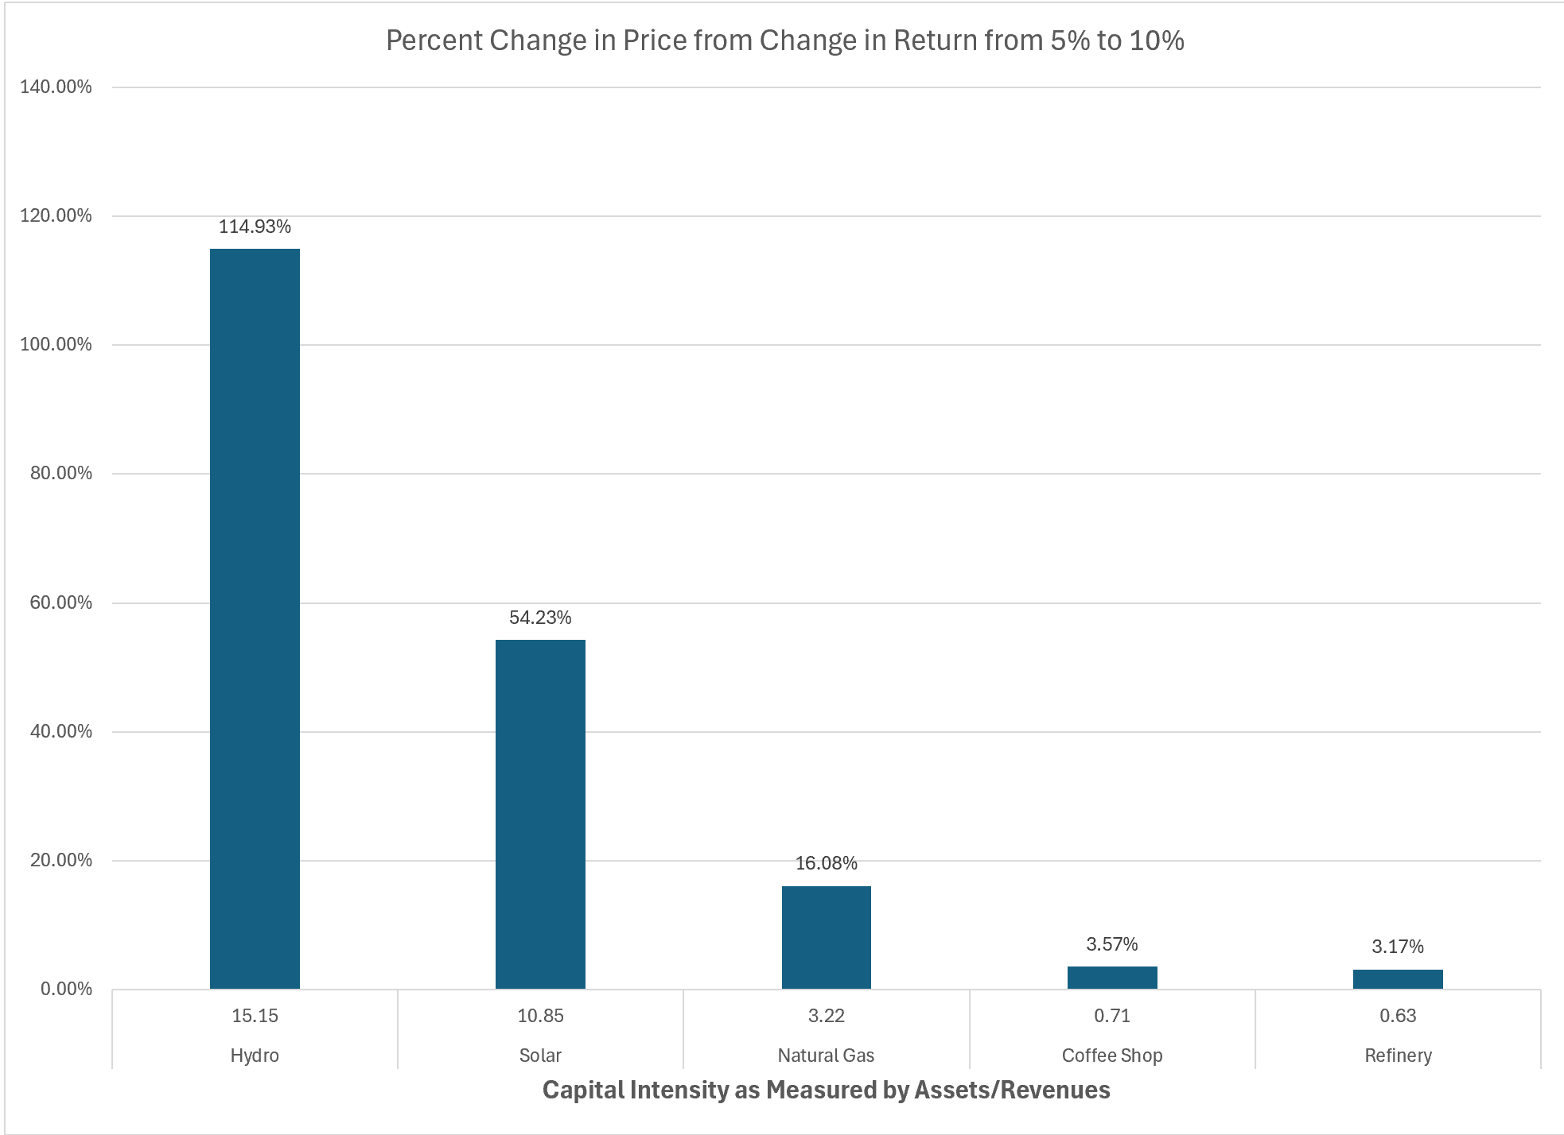
Capital Intensity Graph
If you can keep returns lower for capital intensive assets, the effect on prices or costs to the government is dramatic.

Slide 27
Effects of Financing on Bid Price – Capital Intensive

Slide 28
Definition of Project Finance and Concepts
Definition of project finance and how it differs from corporate, asset and object finance;
  How is this different from other lending, what does non-recourse or limited recourse actually mean and who guarantees;
  Use of special purpose vehicle structures, how this looks in a project structure and why are they needed;
  When project finance can be an effective solution;
  Timelines, i.e. what happens and when;
  Overall contractual architecture in structured non-recourse transactions (for example renewable energy projects) and how does this differ from traditional Public Private Partnerships (PPPs);
  Recent trends on the use of project finance and the links with PPPs.

Slide 29
Section 1a. Definition of Project Finance

Slide 30

Project Finance Definition in HBS Cases
Finnerty
… the raising of funds on a limited or nonrecourse basis to finance and economically separable capital investment in which the providers of the funds look primarily to the cash flow from the project as the source of funds to service their loans and provide the return of and return on their equity invested in the project.
Terms in definition
  Limited or nonrecourse
  SPV – economically separable investment
  DSCR – key measure of risk of default
  IRR - Return on and of equity

Slide 31
More Definitions
Project financing is a loan structure that relies primarily on the project's cash flow for repayment, with the project's assets, rights, and interests held as secondary collateral.
… financing of a particular economic unit in which a lender is satisfied to look initially to the cash flow and earnings of that project economic unit as the source of funds from which a loan will be repaid and to the assets of the economic unit as collateral for the loan.
Project finance involves the creation of a legally independent project company financed with nonrecourse debt (and equity from one or more corporate entities known as sponsoring firms) for the purpose of financing investment in a single purpose capital asset, usually with a limited life.
Investopedia, definition of project finance
Nevitt, P.K. and Fabozzi F, Euromoney, Project Financing, 7th Edition, London

Slide 32
What is Project Finance?
Project finance refers to how an infrastructure project is structured where:
  Future project revenues pay back the initial money invested, and
  Investors are subject to limitations on losses in the event of project non-performance.
Nothing about cash flow; Nothing about single asset
  Technical Definition:
  Project finance is used to refer to a non-recourse or limited recourse debt financing structure in which debt, equity and credit enhancement are combined for the construction and operation or the refinancing of a particular facility in a capital-intensive industry.

Slide 33



Which is a Better Way to Assess the Value of an Investment – Two Presentations to the Board
Value and Risk Verified by Investors Outside of the Company
  Bank Puts money into the company
  Makes sure the money will be paid back
  Crucial stamp of approval

Slide 34
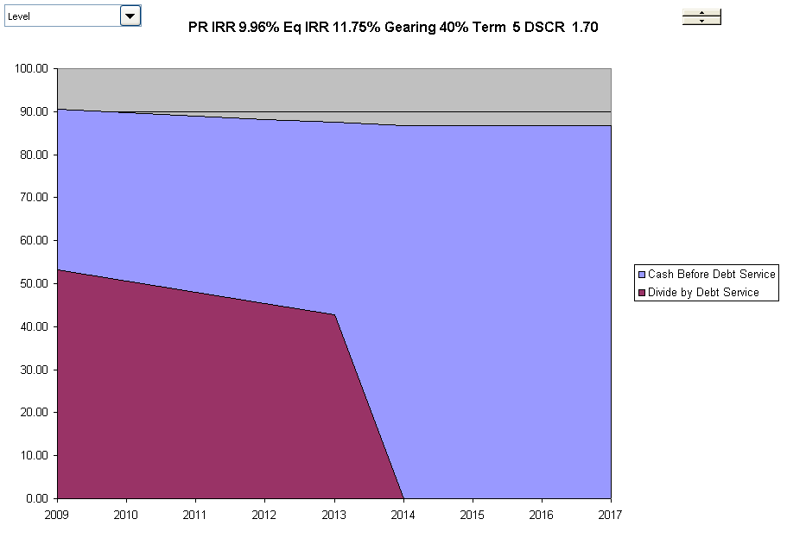
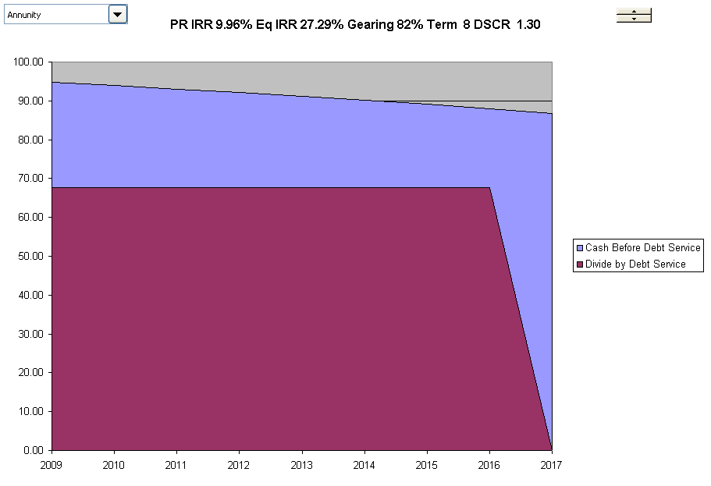
Risk Measured by Bank from Cash Flow Forecast DSCR with High and Low Risk
High Risk Cash Flows
Low Risk Cash Flows
High Risk Project has higher margin, shorter-term and declining debt service. Low risk has flat debt service, and longer-term and higher IRR on Equity

Slide 35

Why is Non-Recourse and No Parent Support so Important In Essence of Project Finance
No parent guarantees (your children cannot send and email and receive your financial support like my daughter).
From a valuation and from a loan perspective a project must be economically viable and evaluated on a standalone basis. In corporate finance and regular old capital budgeting there is no such test.
Philosophical question – is a child with a lot of parent support able to perform better than one with none.
If you know there is a rich parent behind you, can you use this even if there is no direct promise.

Slide 36
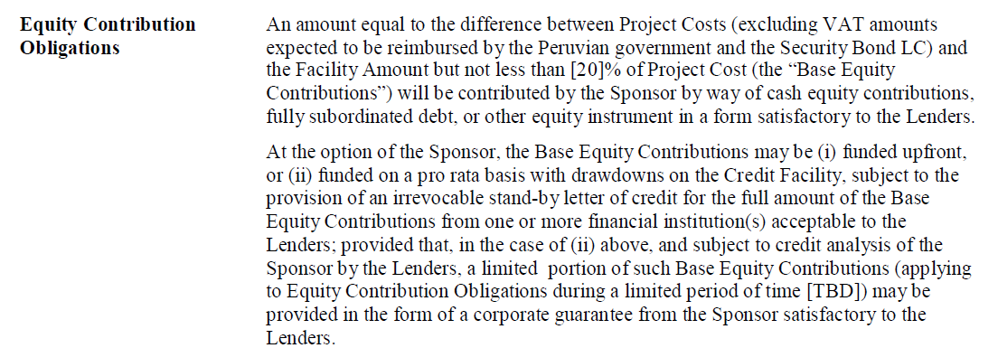
Language of Term Sheet Illustrating Parent Support
Why do they write sentences like this.
How would you read and interpret this if you were trying to understand the term for the first time.
What does it have to do with non-recourse financing.

Slide 37
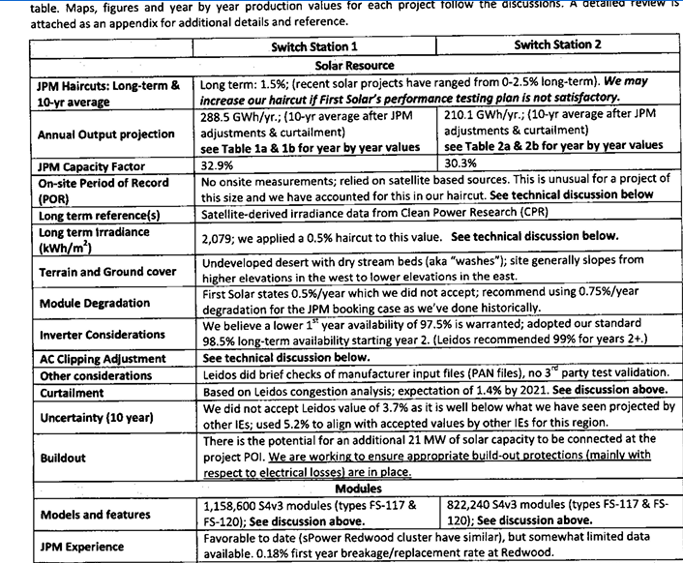
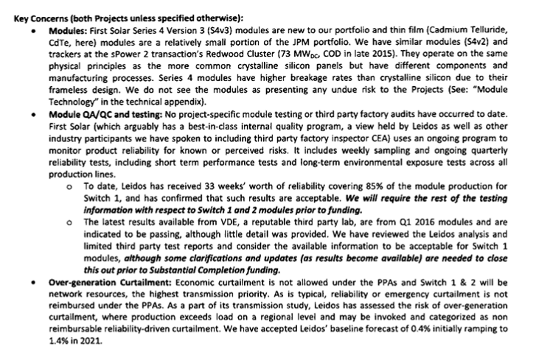
Example of Lender Analysis which Uses Data not Available to Equity Investor
Key Credit Concerns and Verification with Independent Engineer
Use of Alternative Parameters from Experience

Slide 38
The Essence of Project Finance
Revenues Realized
Go Around the Bend and Assure that Risks are Mitigated or Reasonable.
If all of the risks are acceptable and produce reasonable cash flow relative to the amount paid on debt, the lenders will put a lot of money into the project.
Reputation of the equity sponsors is important even if the loan is non-recourse.
Note the IRR and the DSCR from cash flow as the performance metrics for the project.
Start
Capital Investments
Operating Expenses
Special Purpose Vehicle:
Project IRR
End
Lenders Receive Debt Service and Invest Debt
DSCR
Equity Sponsors Receive Dividends and Invest Equity – Equity IRR
Project Finance is a method of financing where the costs and benefits of long-term capital-intensive assets can be assessed from the structuring of debt by lenders. Structuring of debt considers the cash flow derived directly from the asset (non-recourse). Project finance typically involves management of risks through a series of contracts where risks are designed to provide incentives for project parties to efficiently manage construction and operation of a project. Project finance can low cost of capital with transparent and manageable risks and demonstration of support from lenders.

Slide 39
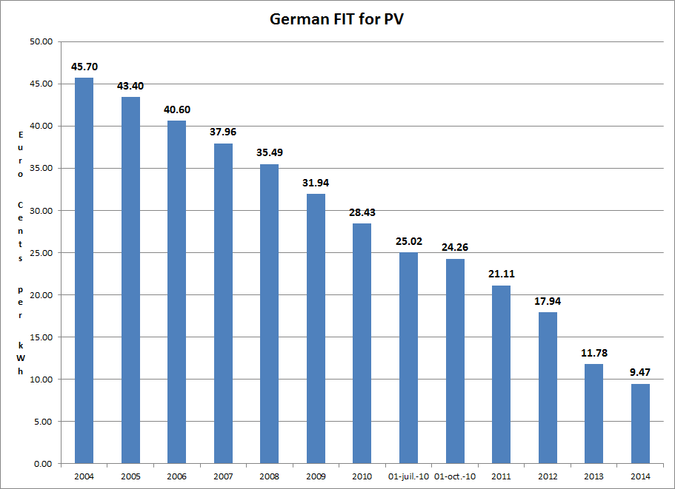
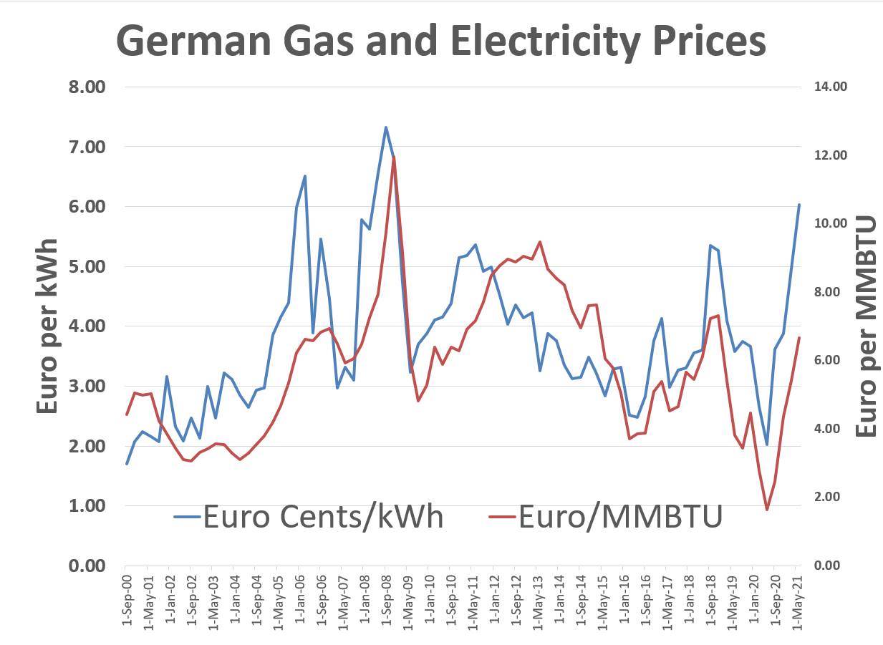
Solar History: 2000’s and Feed-in Tariffs - German Solar Feed-In Tariffs and Managing Risk
The left-hand scale represents feed-in tariffs meaning that if you put a meter next to your solar project and record the MWH generation, you get paid for that generation. The right-hand graph shows market prices (with correlation to gas prices). The y-scale is the same for both graphs. Comparing the blue bars on the left to the blue line on the right illustrates the magnitude of the subsidy in the feed-in tariff.
The feed-in tariffs were very simple contracts enabling companies to secure financing. The feed-in tariffs were supposed to encourage cost declines from scale, and they worked very well. There have been solar projects with contracts of around 1 Euro cent per kWh

Slide 40
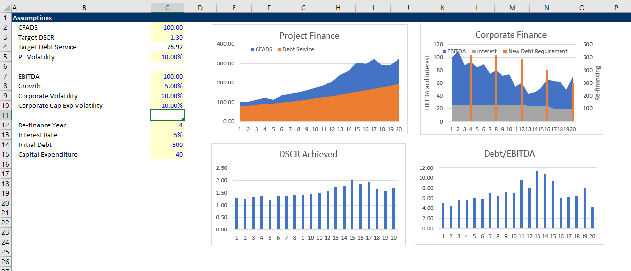
Simple Example of Credit Analysis in Corporate Finance and Project Finance
Illustration of re-financing risk in corporate loans versus DSCR in project finance.

Slide 41
Risk Analysis in Project Finance Models
Project finance analysis to a large degree involves identifying, allocating and mitigating risk. One must therefore be able first to identify risks and then to measure how effective the contracts and other mitigating factors (covenant, debt service reserve, liquidated damage) are in managing risk.
Project Finance Adage:
  At the beginning of the project
    Lender has the money
    Developer has the experience
  At the end of the project
    Developer has the money
    Lender has the experience

Slide 42
The key parties in a project finance including the lender and two key project finance ratios

Slide 43
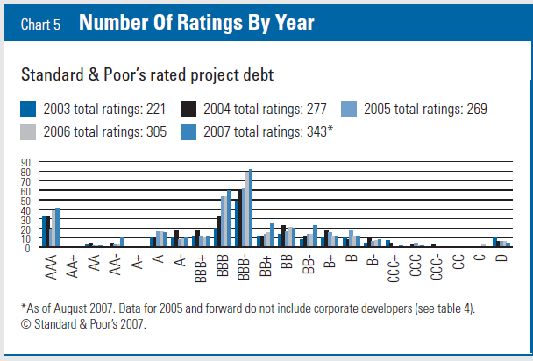
In Project Finance, Risk is Managed to Achieve BBB- (Baa3)
Example, the DSCR of 1.20 x for a solar project should have and footnote to be on a BBB equivalent.
Why BBB- and not AA
Why BBB- and not BB-

Slide 44
Subjects for Key Parties, Contracts, Lenders and Equity Investors
Project company/borrower (IRR);
  Industrial Sponsors and Financial Sponsors: key differences and how do they interact, e.g. shareholders agreement etc;
  Construction contractors (EPC and margins);
  Operator;
  Suppliers; purchasers/off-takers;
  Government role, government as a counterparty, government as a host etc
Risk-return and what it means (Required Equity IRR);
  Third party equity investors (IRR for Mature Project);
  Lenders banks and other sources (DSCR, LLCR, PLCR);
  Multilateral banks and export credit agencies;
Different teams: legal team; finance team; financial adviser; model auditor; insurers; tax and accounting advisers; environmental consultant.

Slide 45
Economic Theory of Contracts
Take a step back and think about what contracts really do:
  Contracts manage the risk structure between the parities to provide incentives to operate efficiently. If you have no contract, you may have more variation in your cash flows or something else
    Things that vary for which you can have hedging contracts
      Commodity and electricity prices
      Real Estate prices
      Interest Rates
      Inflation Rates
  Generally, but not always, with hindsight, one party will be better off, and the other will be worse off by locking prices or other things in.
    If you sign a contract for a loan on your house with a fixed interest rate, you may be happy if the interest rate rises but sad if it declines
    If you sign a contract for life insurance and you die later, you lose on the contract, and the insurance company wins
    If you sign a contract for buying solar power, you may be sad if the price of solar power goes down but happy if the solar price goes up.
  Contracts should encourage parties to behave well, and in economic terms they should manage things efficiently and not waste money
  Liquidated damages like warranties when you buy something – you will pay extra for the warranty on your phone from the likelihood of you damaging the phone and what is covered. The economics of a warranty depend on the buyer value,

Slide 46
Explaining Project Finance with Diagrams
You would like the diagram to give you a picture of the risk of the project and highlight issues with contracts
  SPV is a separate corporation in the middle
  SPV signs a lot of contracts that should be illustrate with solid lines
  The contracts should be labeled (e.g. concession contract, EPC contract, PPA contract, O&M contract, Loan Agreement, Shareholders agreement)
  Different levels of support from parent (non-recourse is no support)
  Contracts should be consistent with each other
  Diagram should show direction of money and start with revenues (no revenues, no project)
  Quality of off-takers should be shown on the diagram in the circles
  Insurances and guarantees should can be demonstrated

Slide 47
Start with Revenues and Risks from Revenues – General Categories from Revenue Generation
Different types of revenues in project finance
  Price Risk and Volume Risk from Demand
    Real Estate
    Technology
    Rehabilitation and some health care
  Price Risk but Limited Demand Risk
    Commodity Price – Oil and Gas
    Refinery and Mining
  Volume Risk but Limited Price Risk
    Infrastructure – Toll roads and bridges
    Infrastructure – Airports
    Renewable Energy with Resource Risk
  Availability Risk – No Price or Volume Risk
    Dispatchable Power Plants – IPP, BOT, BOOT
    Hospitals, Schools, Prisons – PPP, Availability Payment
    Availability Bases Toll Roads – Availability Projects

Slide 48
Not Just a Diagram – Illustrate Risks
Each contract can have many nuances with penalties, bonuses, default clauses, termination.
Off-taker: Want strong off-taker with inactive to honor contract
Write down notes associated with each contract and if a contract does not exist, how the cash flow volatility can be addressed.
EPC Contractor: Want Strong Record and Finances
Price Risk or Volume Risk or Both or None (Availability)
EPC: Fixed Price Contract with LD
Supplier: Need to Understand Economics and Supply Curve
Special Purpose Vehicle: Bond Rating of BBB-
O&M Contractor
Supply Agreement
O&M Agreement
Loan Agreement – Draws Green; Debt Service Red
Banks Like Strong Sponsors. Sponsors want EIRR
Shareholder Agreement
Lenders:
Lenders want DSCR (LLCR, PLCR)
Invest with paid in cap; payback dividends
Invest with draws; payback debt service

Slide 49
Project Participant Overview – Means Nothing
Public Authority (CDOT)
Debt
Investors
Special Purpose Vehicle
(SPV)
Design-Build Contractor
Equity Investors
Operations & Maintenance Contractor
Toll Road Users

Slide 50
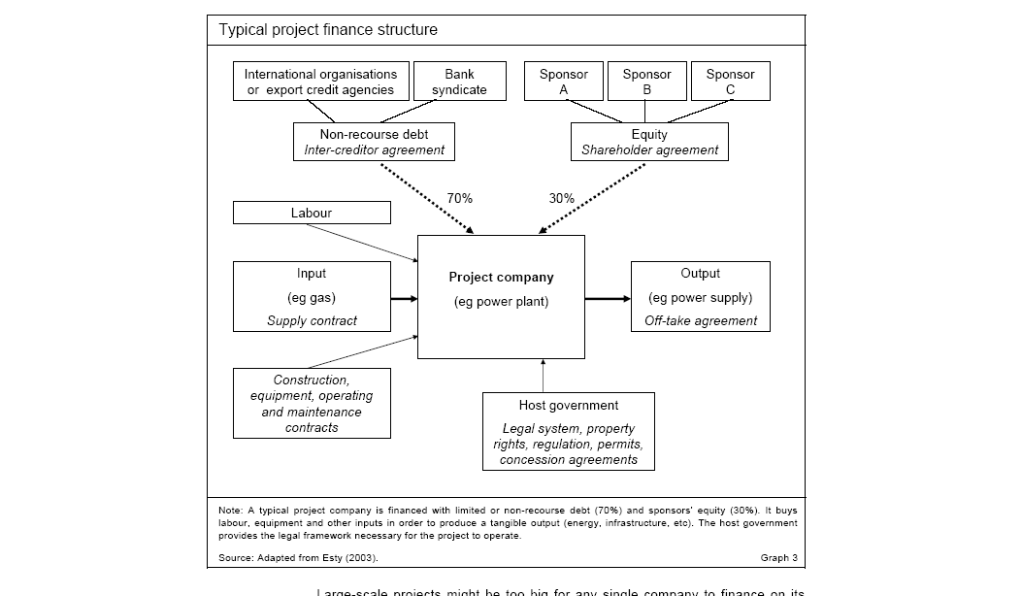
What are Problems with this Diagram from HBS

Slide 51
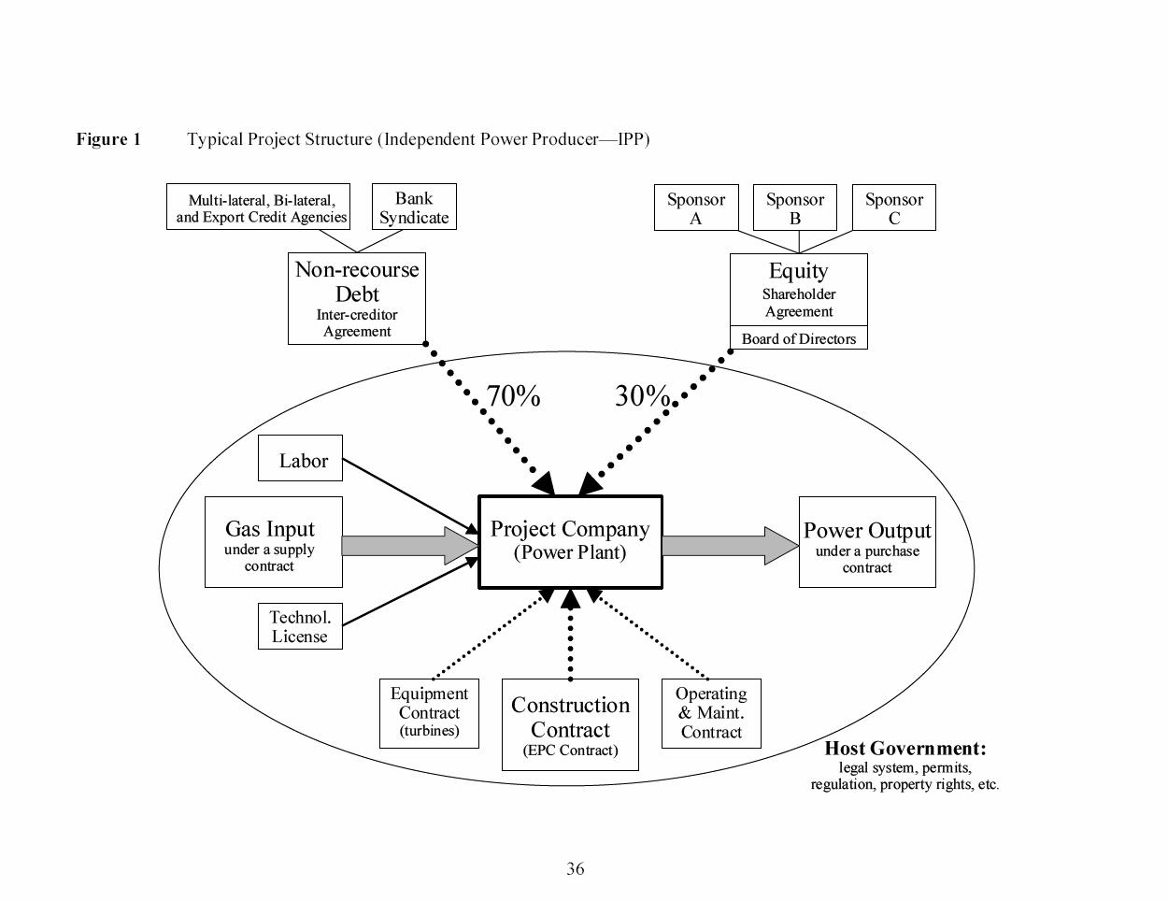
What is Good and Bad about this Diagram
Debt is serviced entirely via cash flow through the project and the SPV This structure exposes the lenders to significant risks. If something goes wrong, their recourse against the sponsor, with its typically larger balance sheet, will be limited or none.
The loan is structured so that bankers can step into and take over the project if things were to go wrong, a so-called step-in right. This process is also called ‘ring-fencing.’
Ring-Fence

Slide 52
Activity Ras Laffan Case Study Part 1 – Petrozuata

Slide 53
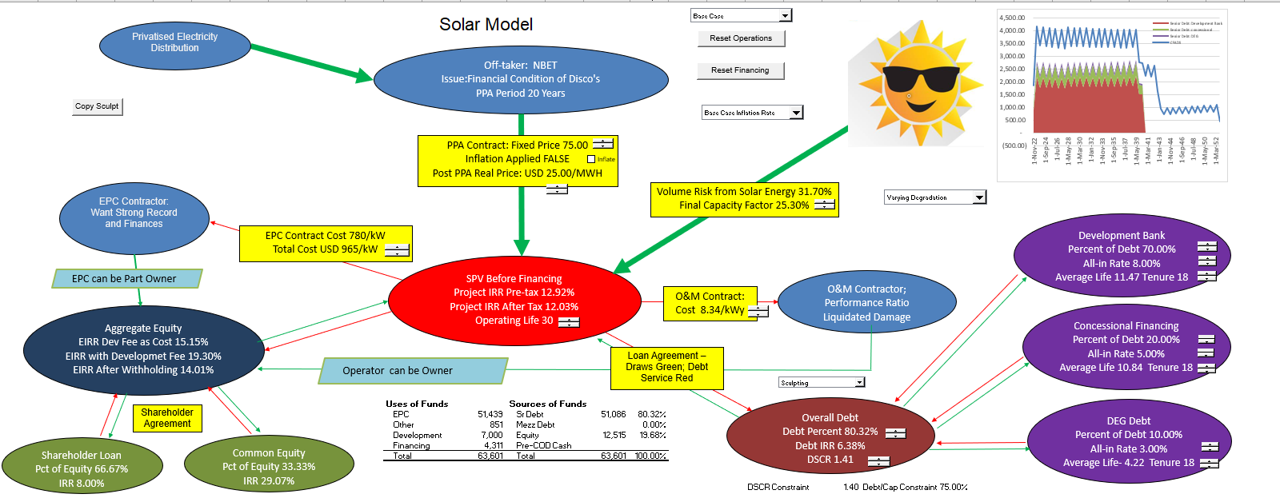
Diagram of Solar Project Finance
Volume or price or availability risk in model, and then, the IRR’s of each party and the DSCR’s of the lenders. Include cost to off-taker for the project economics.

Slide 54
Section 2:
Two Statistics in Project Finance:
IRR and DSCR

Slide 55
Equity Valuation in Project Finance –
The IRR

Slide 56
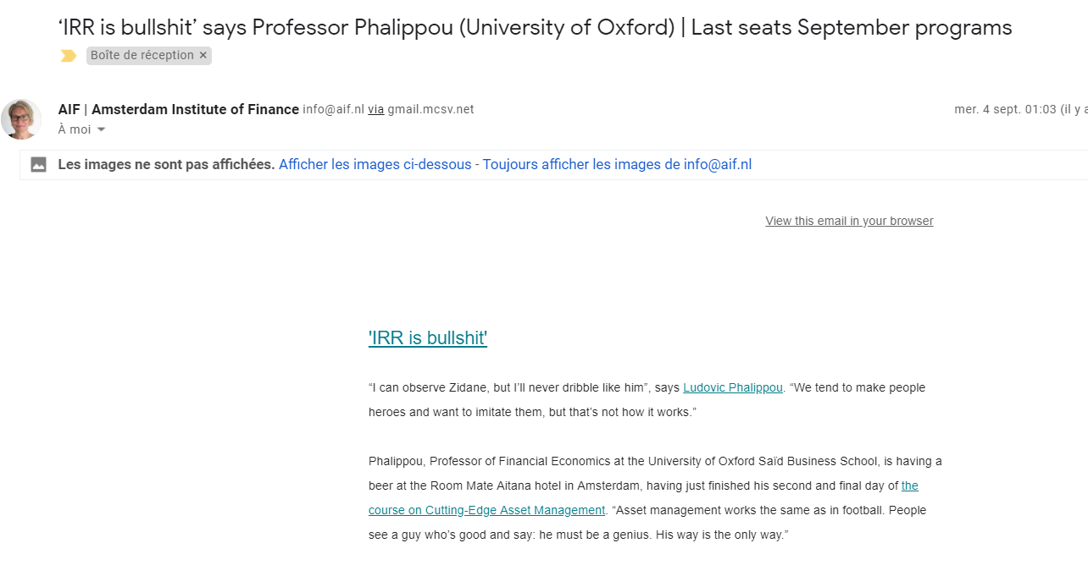
Valuation of Projects and IRR
Project is typically valued with IRR
Different IRRs
  Project IRR pre-tax
  Project IRR after-tax
  Debt IRR pre-tax
  Equity IRR – Overall
  EBL or Shareholder Debt IRR
  Pure Equity IRR
  IRR with and without Development Fee
  Holding Company IRR
IRR has taken over the world
Need to Understand the Nuances of the IRR

Slide 57
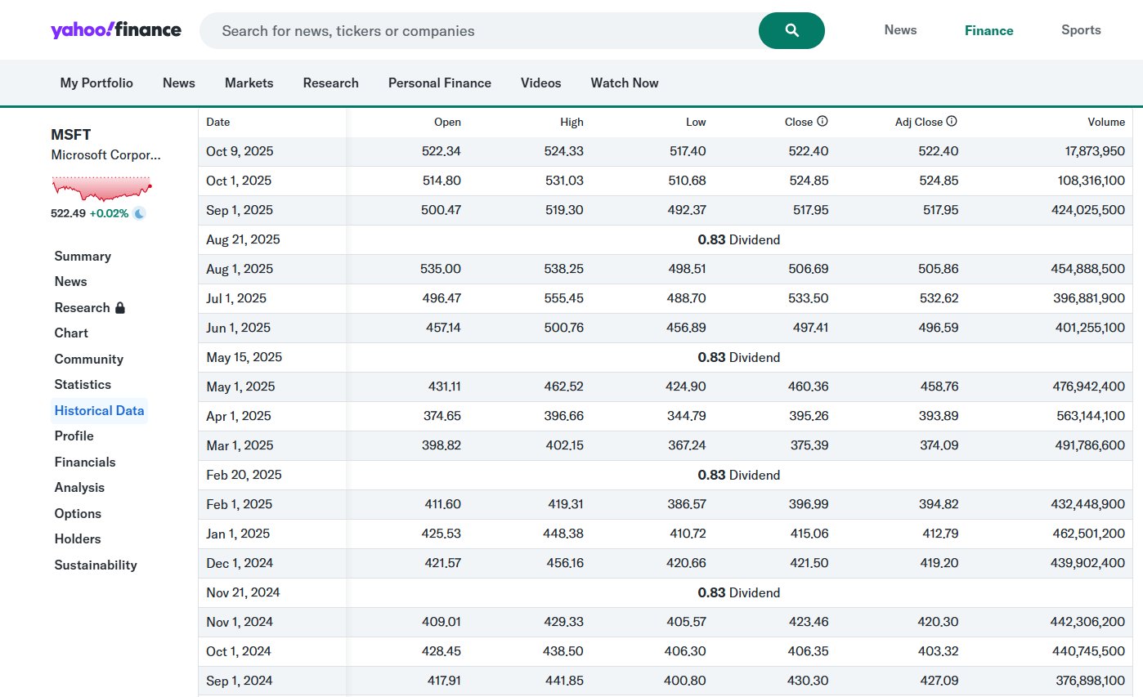
IRR from Investing in a Stock and Yahoo Finance Adjusted Stock Price
People who want to get rich, care about one thing. That is, how fast will your money grow and can it keep growing over a long period

Slide 58
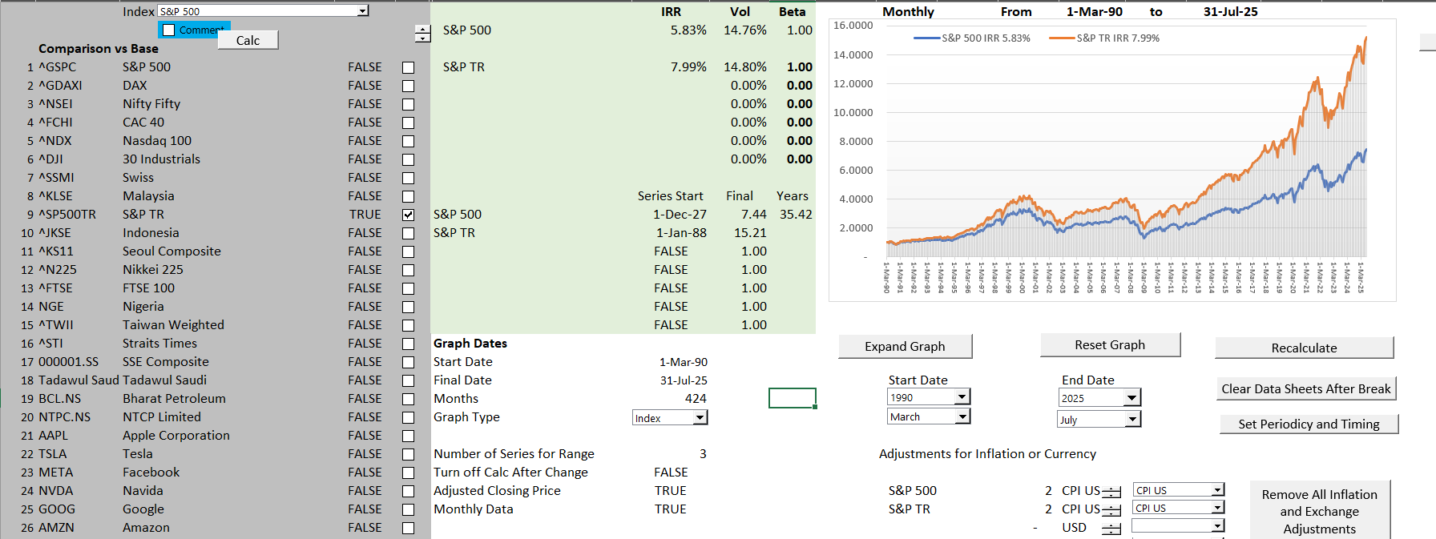
Compute IRR for Stocks and Prove the IRR is the Growth Rate
Understand why investors care so much about IRR
IRR on Stocks using S&P 500

Slide 59
Project IRR, Debt IRR and Equity IRR Interpretation
The debt IRR can be computed from the perspective of debt holders. The debt drawdowns are the negative cash flow while the debt service including interest and principal are positive cash flows. The fees should be included as cash flow. The debt IRR can be called the effective interest rate or the all-in rate.
The project IRR is an effective statistic for evaluating the overall competitiveness of a project. If the project IRR is very high, you should ask questions about why others cannot create similar projects and charge a lower price. If the project IRR is below the cost of debt, you should ask why the project is occurring.
The equity IRR is the focus of investors because it reflects money taken out of their pocket relative to dividends received. In structuring debt terms such as a cash sweep or the debt to capital, the equity IRR can be used to understand the perspective of the sponsor.

Slide 60
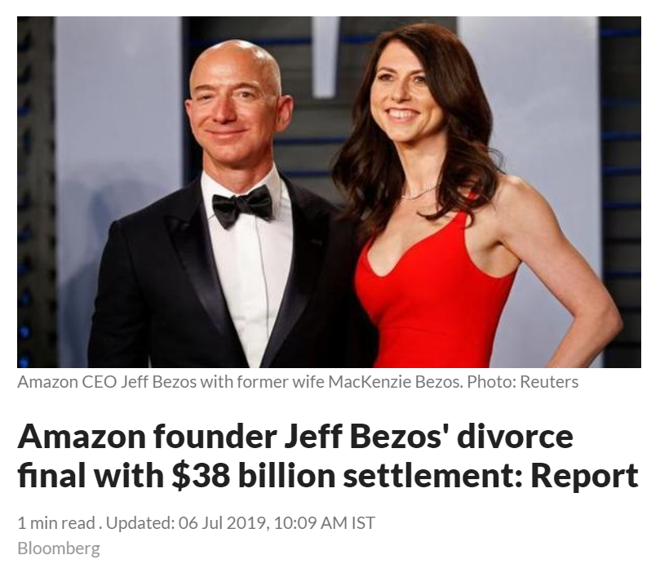
Exercise: Computing the IRR and Growth for Amazon; Understanding the Effect of Small IRR Differences over Long Periods of Time
Open File on Stock Prices and Economic Indicators from the Drop Box
Compute the IRR with dates using XIRR and assuming dividends are re-invested
Compute the daily compound growth rate as g = (End/Start)^(1/Days) – 1 and then annualize using (1+Daily Growth)^365-1
This demonstrates that XIRR is based on a daily rate

Slide 61
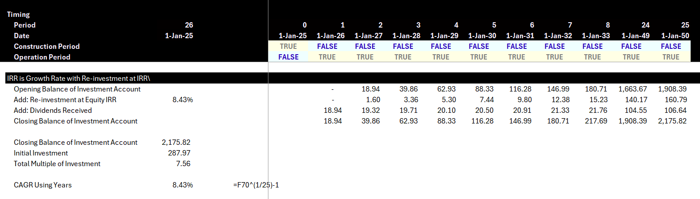
IRR as Growth Rate in Cash Flow in a Project Finance Model
Hypothetical Investment Account

Slide 62
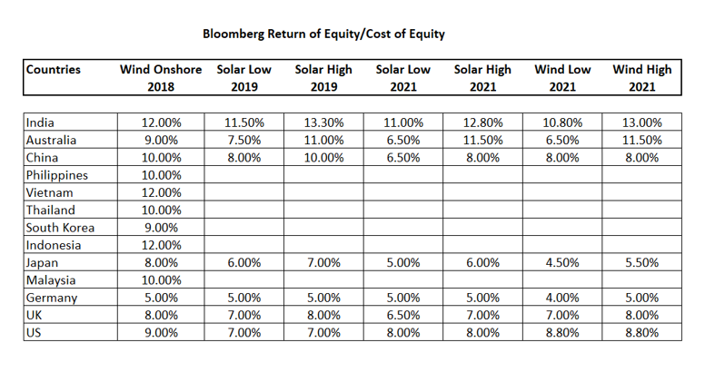
Real World Minimum Acceptable Target IRR
In practice there is no CAPM and certainly no un-levering and re-levering of Beta (see the discussion at the end).
In practice, equity IRR is used rather than project IRR as a target (this makes sense in theory as project finance implicitly adjusts for risk
In practice, and there are general standards for target IRR on buying and selling of projects. These standards have change over time. Pre-Covid for projects in Europe with a few years of history, equity IRR targets were as low as 4%.
I have been told stories of insurance company executives and pension plan managers going around Europe holding suitcases of cash to buy solar and wind projects with operating history.

Slide 63
Lender in Project Finance and Assessment of Risk – The DSCR

Slide 64
What Makes it Possible to Lend Long-term to Single Assets
Discussed the importance of debt financing in raising money for project financed assets.
To achieve low cost of capital, the debt tenure of must be long (otherwise the DSCR will be too low).
Cannot have debt that has a bullet repayment that is supported by a portfolio of assets owned by a corporation.
Projects must have contacts and/or mean reverting cash flow to support long-term debt.
Use the formula: PV of Debt Service at Interest Rate = Debt

Slide 65
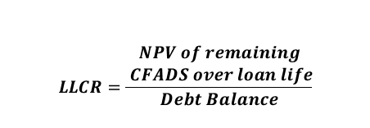

Technical DSCR Definitions
Debt Service
Coverage Ratio (DSCR)
Loan Life
Coverage Ratio (LLCR)
  $$LLCR=\frac{\begin{aligned}NPV of remaining \\ CFADS over loan life\end{aligned}}{Debt Balance}$$
Debt Balance is PV of Debt Service, so LLCR is DSCR in terms of PV.
Use PV of Debt Service because current cash flow is better than future cash flow
  $$DSCR=\frac{CFADS}{Debt Service}$$
          Where:
          Debt Service = principal repayments + interest
          Where:
          Discount rate for NPV= cost of debt
Debt Service Coverage Ratio (DSCR) determines debt borrowing capacity
Remainder of CFADS after debt service is the amount available for equity distributions
DSCR = 1.0x means there is exactly enough cash available to repay project debt
Loan Life Coverage Ratio (LLCR) measures the number of times available future cash can repay the outstanding debt balance
LLCR = 1.0x means there is exactly enough future cash available to pay off the debt balance

Slide 66
Start with Risk Question
A couple of weeks ago, a very nice man asked me the following question. Which is riskier:
  A solar project
  A wind project
  A battery project
My normal response would have been a bunch of gobbledegook about the variability of wind compared to solar, whether batteries are proven technology over their lifetime; uncertainty in battery parameters of degradation, round-trip efficiency and state of charge …
Somebody who just completed an MBA program would try to find companies that only develop solar projects; companies that only own wind projects and companies that are only involved in the ownership of batteries. Then I suppose you could try to find betas for these companies. All of this would not be possible. But then you would have to un-lever the beta and re-lever the beta after you could get into arguments about whether the beta should be computed from daily, weekly or monthly stock price data and whether the beta should be mean reverted with the arbitrary two-third and one-third adjustment made in an academic article by Professor Bloom in the 1970’s.
How utterly ridiculous. Can you think of anything better.

Slide 67
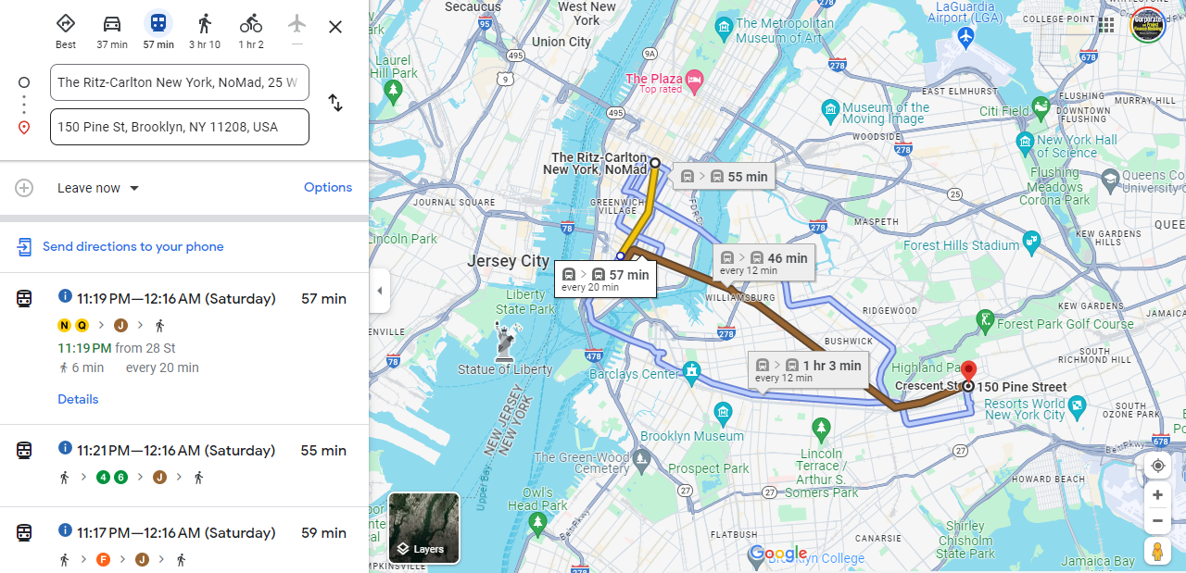
New York Meeting, Google Maps and Assessing the Risk of Being Late

Slide 68
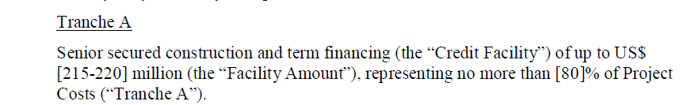
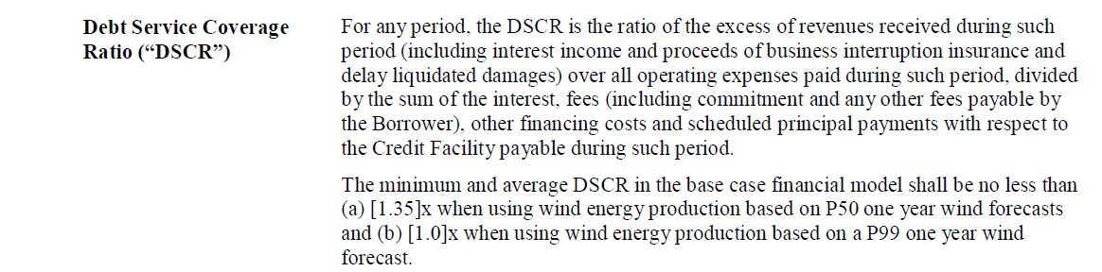
Which is More Important – DSCR or Debt to Capital
Maximum Debt to Capital Constraint
Minimum DSCR Constraint

Slide 69
Cash Flow Available for Debt Service (CFADS); It is what the Definition Says it is
Toll Road Mini Case
          $$CFADS =Revenue−Operating Costs±Working Capital Adj$$
What is missing from the formula
What about changes in DSRA
CFADS represents periodic net revenue available to repay initial financing of capital expenditures from the construction period
Once operating costs are accounted for, remaining money must be used to repay debt, followed by equity distributions
CFADS is the single-most important metric for evaluating the likelihood of senior debt repayment

Slide 70
You Can Go the Other Way to Find the DSCR
Formulas for Break-Even: Say that you want to know how big the DSCR should be to cover for an availability payment that could be reduced by 20%.
The formulas below are for DSCR; you could also use LLCR and PLCR
  DSCR = Cash Flow/Debt Service
  Example: DSCR = 1.5 = 150/100
  This means the cash flow break even is 50/150 = 1/3 = 33%
  Break-even cash flow = (DSCR-1)/DSCR
  BE = (DSCR-1)/DSCR
  BE x DSCR = DSCR – 1
  DSCR – BE x DSCR = 1
  DSCR * (1-BE) = 1
  DSCR = 1/(1-BE) or 1/.667 or 1.50
Note: Be careful with fixed costs. If a project has fixed costs you have to make a more complex formula

Slide 71
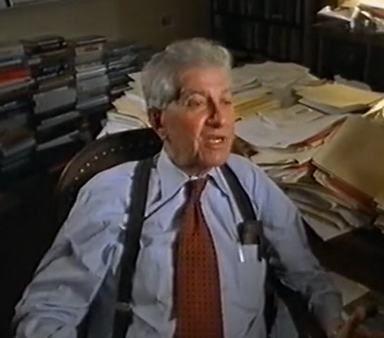
Equity IRR, Debt Financing Theory and Project Finance
Miller and Modigliani and APV
Debt Level and Risk in Project Finance
Un-gear and Re-gear Beta is ridiculous in project finance (and maybe in any finance). This is because the debt level defines the level of risk and not the other way around
Why Equity IRR rather than Project IRR is used in project finance. For example, a risky project has less debt that would imply a lower equity IRR if the project IRR was the same. But the project IRR should be higher because of the higher risk, and the lower debt offsets this risk leading to a similar equity IRR
Problem with cash on the balance sheet
Much bigger problem if cash is invested at the beginning because of IRR mathematics – if the cash must be financed by equity and not a mixture of debt and equity.
This is one of the issues that arise with putting a cash reserve on the balance sheet to resolve the interest expense versus debt service problem

Slide 72
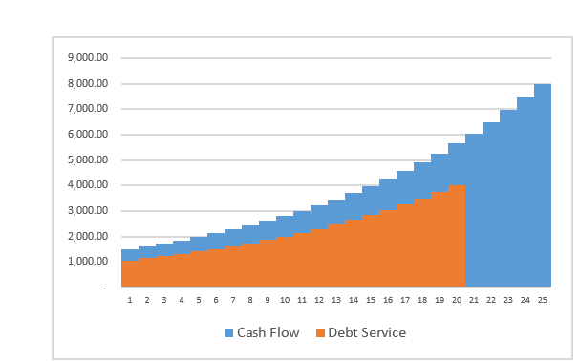
Project Finance, Dividends and the Key Graph for Debt Structure
Dividends (without cash sweep or cash trap) serve two purposes. One is to get the IRR; the second is to provide a buffer to lenders
Should dividends occur if interest is above debt service
Without dividends the IRR will be low (remember the IRR mathematics)
Dividends are needed for CFADS buffer
If extra cash is put in a reserve account and it just meets the debt service, there will be no buffer.
The formula: Debt Service = CFADS/DSCR
  can be reversed to Debt Service * DSCR = CFADS
  If the repayment is zero, you can use the formula to derive how much of a cash reserve is necessary

Slide 73
Risk Allocation Part 2: Investor Risks to Different Contracts for the SPV
Contract Mitigation
EPC Contract with Fixed Price and LD (LSTK)
O&M and EPC Contract
O&M Contract and EPC LD Provision
O&M Contract
Capacity Charge/Month; 4 Part PPA Contract
Swap Contract (Fix Rates)
IPP Risks
Cost of Project, Time Delay and Technology Parameters
Availability Penalty in PPA
Efficiency or Heat Rate Risk
O&M cost Risk – Real
Independence of Generation Risk
Interest Rate Fluctuation

Slide 74
Ras Laffan and Petrozuata
Structure, IRR, DSCR

Slide 75
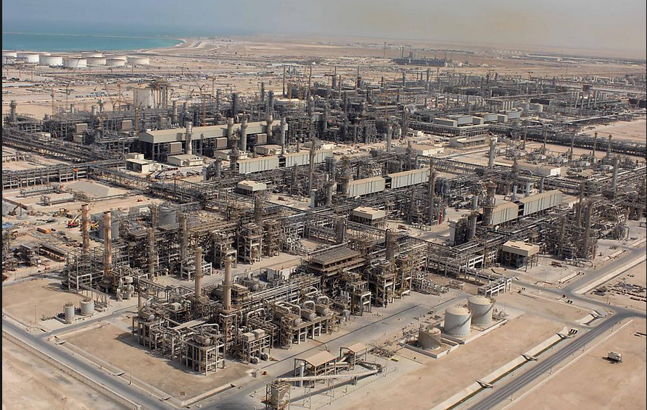
Ras Laffan in Qatar - 1996 COD

Slide 76
Issues to Discuss – Ras Laffan
Read the Pre-Sale Report – The Strengths
  Could Qatar have hosted the world cup without project finance
  Simulate the importance of Exxon
  List the risks and mitigations
  Could there have been more problems if the State of Qatar was not the biggest sponsor
Open the Model
  Why do the fundamental economics of the project work or do not work
  What notes would you put in the diagram
  How do you think the break-even gas price was computed – DSCR, LLCR or PLCR

Slide 77
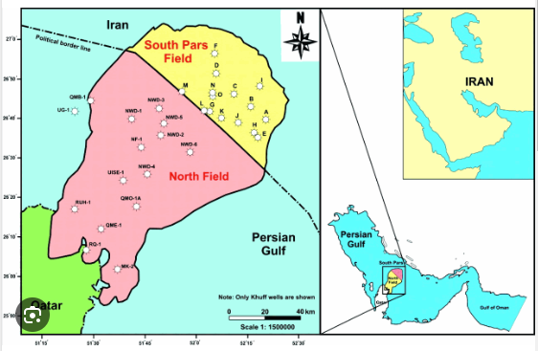
Illustration of Gas Lake Under the Gulf
Cost of production of natural gas is low

Slide 78
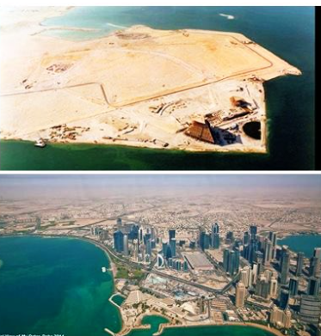
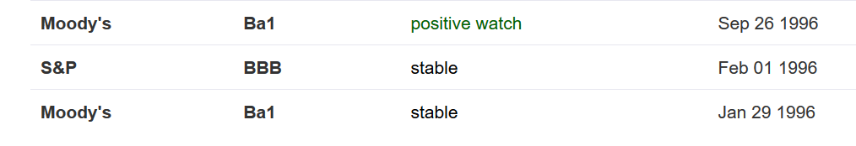
Country of Qatar Background before and After Project

Slide 79
Example: Ras Laffan Liquified Gas Company (Ras Gas)
Summary of Original Transaction
  Project: Two LNG Trains and cost of developing natural gas reserves
    Cost $3.4 billion
    5.2 millions of tons per annum
Equity Sponsors
    70% State of Qatar
    30% Mobil Oil
EPC Construction Contracts
  JCG/MW Kellogg for LNG Trains and on-shore facilities
  McDermott-EPTM/Chiyoda for off-shore platforms
  Saipan for off-shore pipeline connection

Slide 80
Ras Laffan Liquified Gas Company
Financing of $3.4 Billion
  $850 million in Equity
  $465 million supported by US EXIM
  $250 million supported by UK ECGD
  $185 million supported by Italy’s SACE
  $450 million uninsured loan from commercial banks
  $1,200 million from bond markets
    10 and 17 year maturity
    Rated BBB+ by S&P
    Rated A3 by Moody’s
Revenue Contracts
  25 year contract with Korea Gas Corporation for output of one train
  Korean Gas Corporation built receiving facilities and purchased ships ($3.1 billion)
Relatively unconventional technology, no projects in the country and can achieve bond rating better than country rating

Slide 81
Ras Laffan Diagram
Off-taker: Korea and Japan Utility Companies: Want strong off-taker with inactive to honor contract
EPC Contractor: Kellogg with Strong Record and Finances
Price of Gas Linked to Oil Price
Off-take Contract with minimum supply
EPC: Fixed Price Contract with LD
Special Purpose Vehicle: Bond Rating of A-
O&M Contractor
Supplier: Need to Understand Economics and Supply Curve
O&M Contractor
Supply Agreement
O&M Agreement
Loan Agreement – Draws Green; Debt Service Red
Sponsors: Want strong sponsor:
Mobil
State
Shareholder Agreement
Lenders:
Issued bonds and debt with long tenor and low rates
Lenders:
Issued bonds and debt with long tenor and low rates

Slide 82
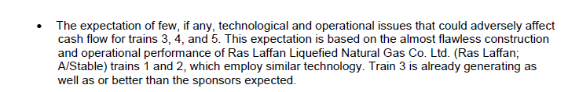
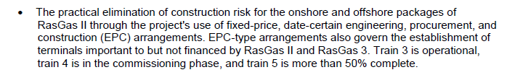



Use Snipping Tool to Fill in Items from Pre-Sale Report
Proven (boring) technology
Construction Cost Over-Run Risk
Supply Risk
Volume Risk
Price Risk

Slide 83
Financing Terms and Risks
Phase 1 Financial Structuring
  Cash flows from Trains 3-4 to support Phase 1 debt
  Essentially a financing of Trains 3-4 to fund expansion
Phase 1 Financing Key Risks
  Train 3-4 Operations
  Shipping and Access to Markets
  Revenue Risk (Price x Volume)
Terms
  Series A Bonds (15-yr): LIBOR + 97 bp
  Series B Bonds (22-yr): LIBOR + 130 bp
  International Banks: LIBOR + 45-65 bp
    Up-front Fee (Arranger Fee) = 60 bp
    Commitment Fee = 20 bp p.a.
Phase 2 Scope: Completion of Train 6 and Fund Construction of Train 7
  Estimated Debt: US$5.4 billion (Will likely require completion guarantees)
Track record
Shipping contracted
Sale & Purchase Agreements in place with creditworthy counterparties (Petronet, Edison, Endesa)

Slide 84
Open the Financial Model
Use the financial model to quantify risks
  Present and discuss the cost structure
  Break-even Oil Price
Volume Risk
Price Risk

Slide 85
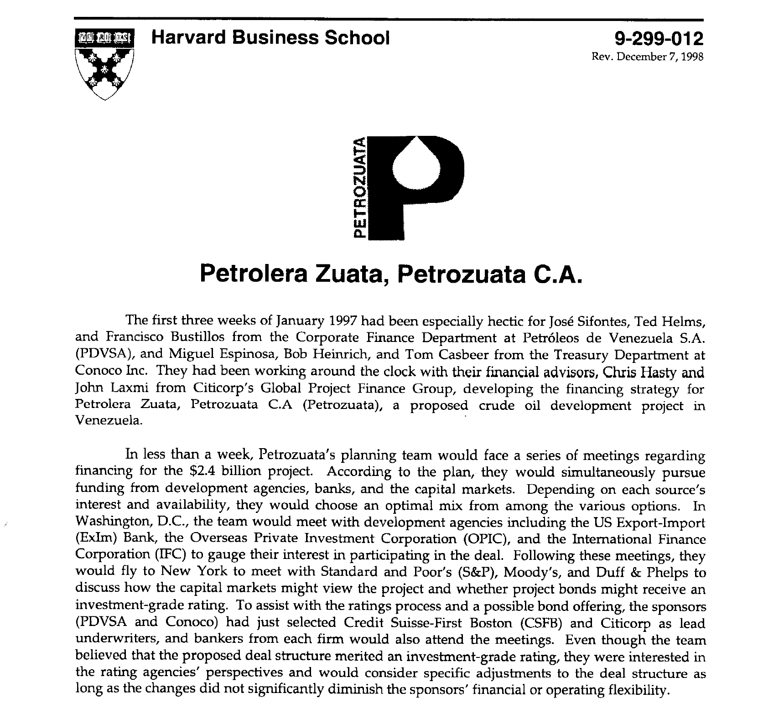
HBS Case Study
Read through case study – what would you look for

Slide 86
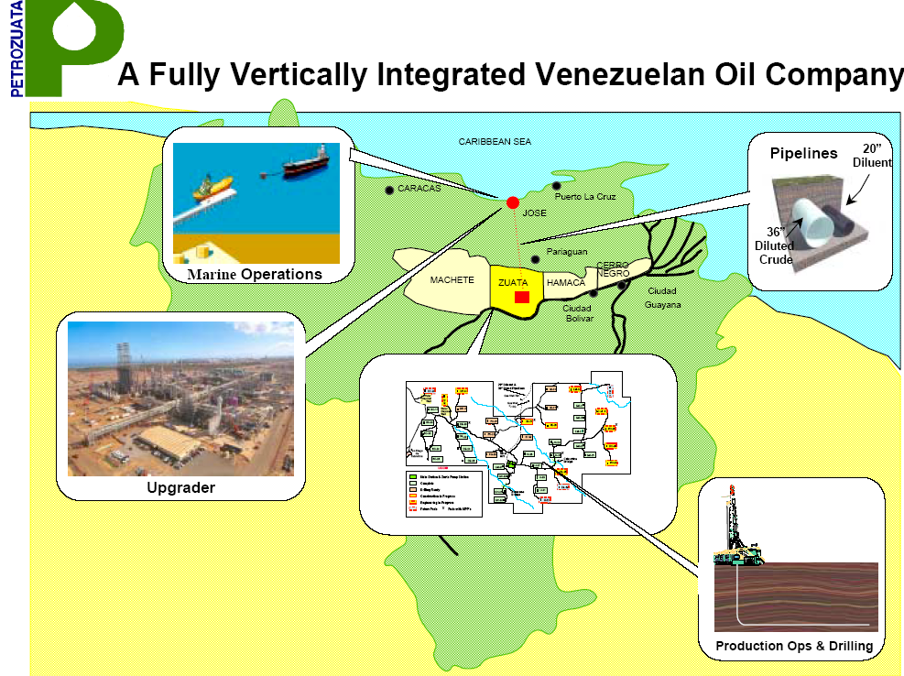
Diagram of Facilities
This shows the location of facilities
Heavy oil is analogous to mining
The upgrader is similar to a refiner

Slide 87
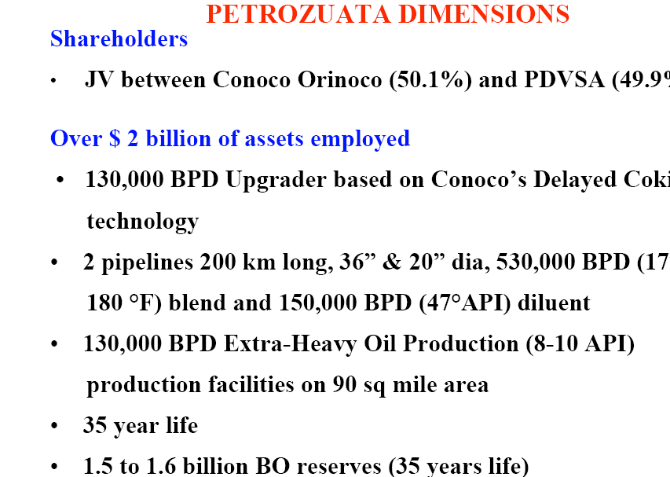
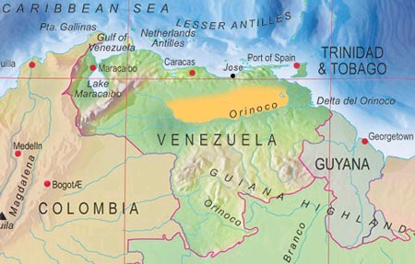
Petroleos de Venezuela (PDVsa) Perspective

Slide 88
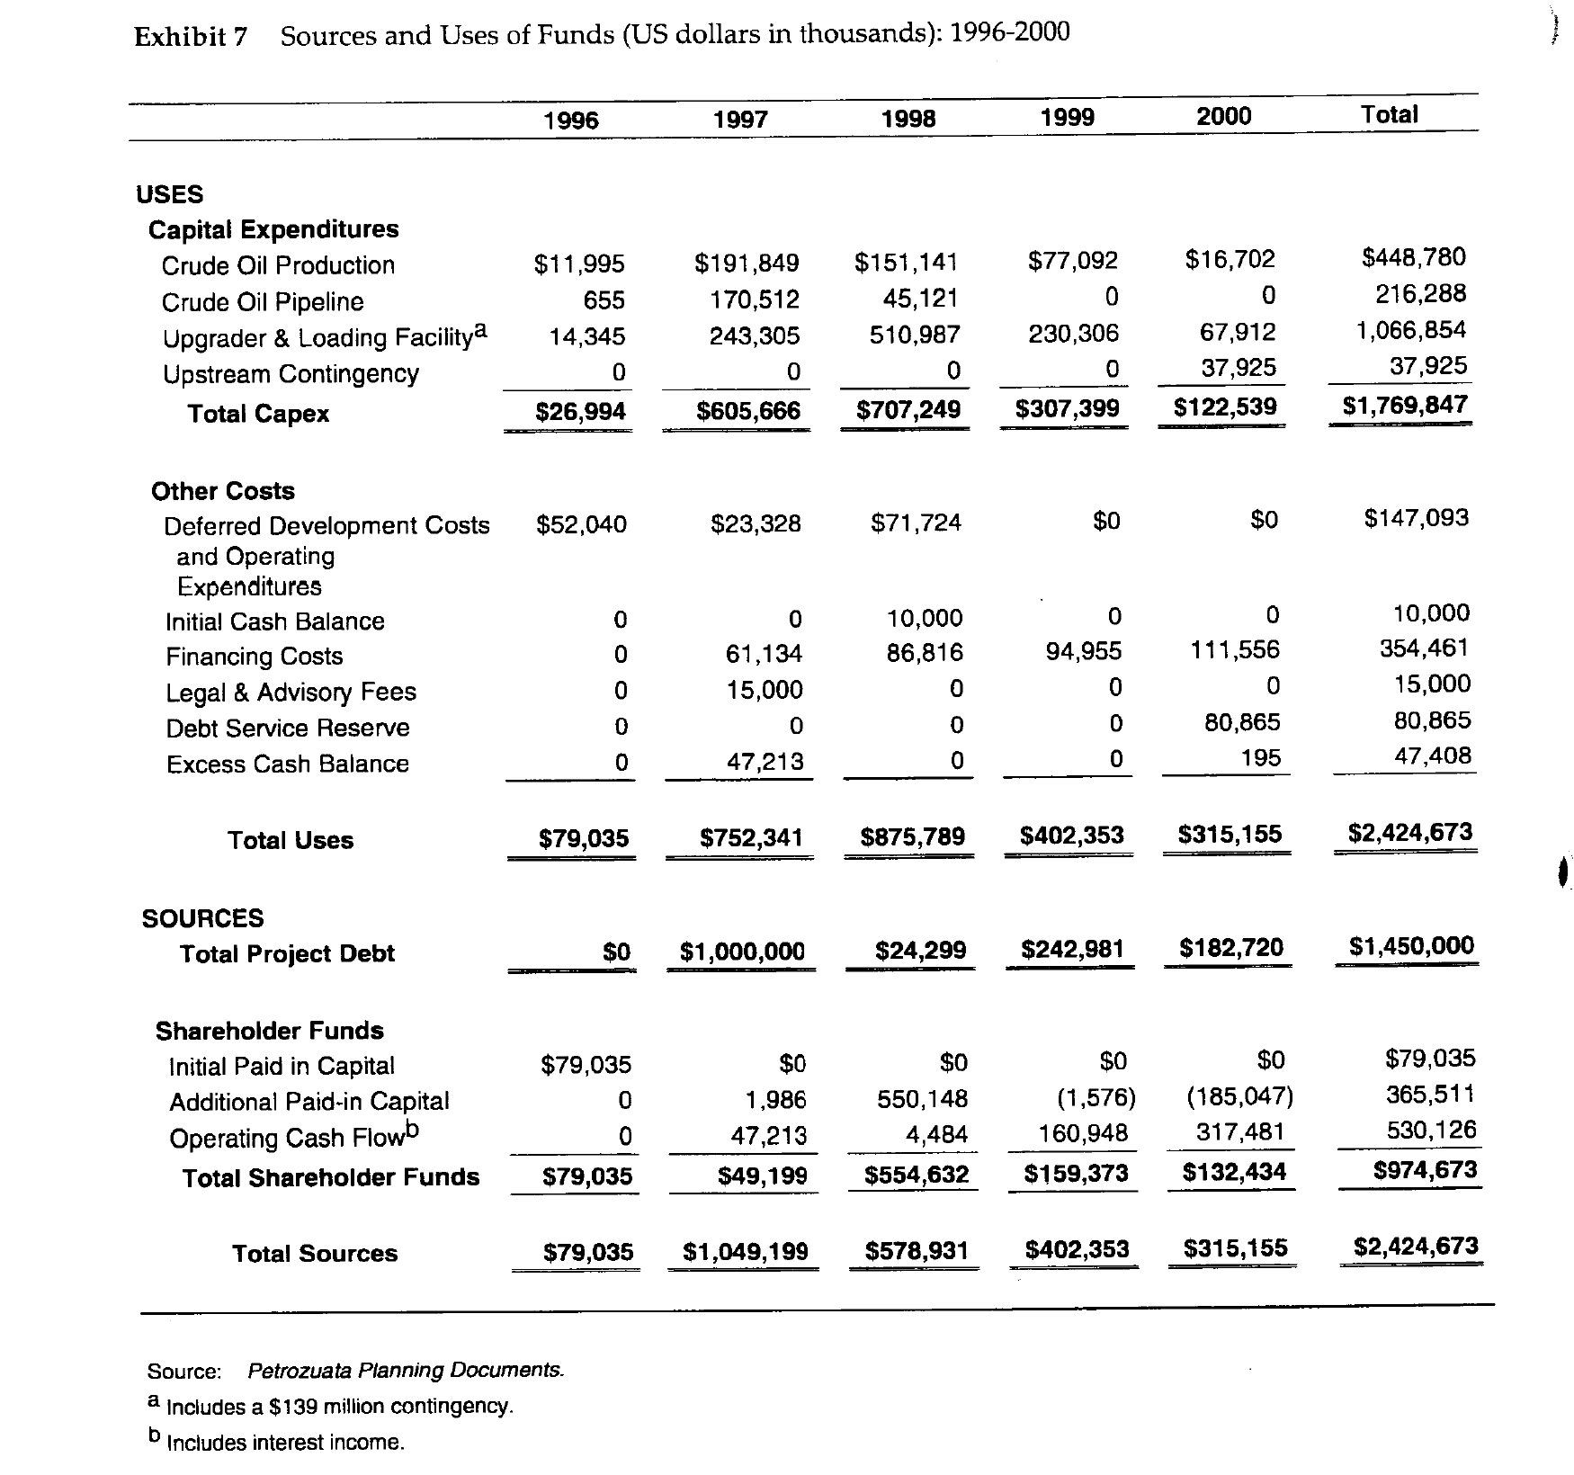
Key Exhibits to in Case Study
Understand construction period

Slide 89
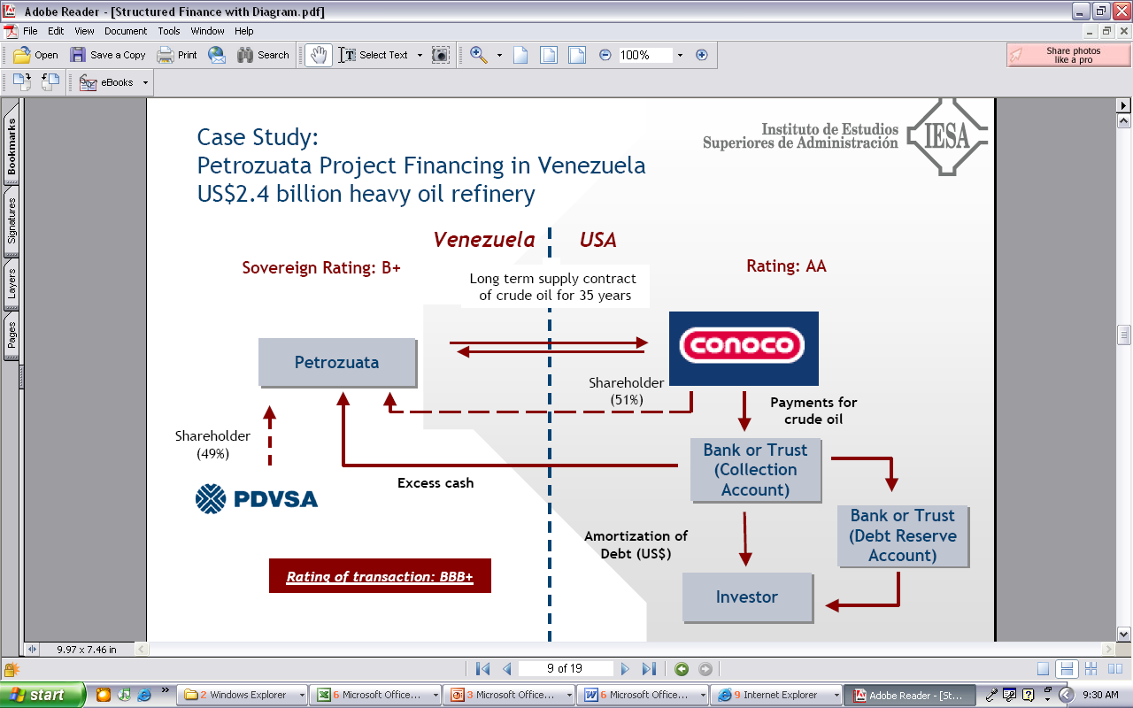
Cash Collection in Petrozuata

Slide 90
Petrozuata Revised Diagram
Conoco US Refinery
PDVSA
Refinery
Conoco
Venezuela Govt - Royalty
Conoco
Purchase Agreement
Oil Price
Opening of Orinoco Belt Agreement
Royalty 1%; Tax 34%
EPC Contracts
Venezuela Govt - Tax
SPV – Petrozuata
BBB+
Exploration
O&M
Conoco, PDVSA
Loan Agreement, Inter Creditor
Shareholder Agreement
Bonds
Conoco 51%
Bank Debt
PDVSA 49%

Slide 91

Post Construction – What to Compute
Convert to financial model
Historic oil price comparison

Slide 92
Financing Process
Banks responded with $5 billion in bids
With bank debt, could do “road show” for the public debt
Because of favorable response in bond market, raised more than expected from banks and used $450 million in bank debt.
Tranches of public debt
  $300 million 12-year maturity at 130 over treasuries (7.63%)
  $625 million 20-year maturity at 145 over treasuries (8.22%)
  $75 million 25-year bullet bonds at 160 over treasuries (8.73%)
Tranches of bank debt
  $200 million 14-year maturity at 220 basis points
  $250 million 12-year maturity at 208 basis points.
Bonds purchased by investment advisors, insurance companies, mutual funds, pension funds and individuals.

Slide 93

Cost of Capital
Evaluation of cost of capital and bias in financial evaluation

Slide 94

Financing
1997 Americas Project Finance Deal of the Year (IFLR)
1997 Project Finance Deals of the Year (Institutional Investor)
1997 Americas Oil & Gas/Petrochemicals Deal of the Year (PFI)
The project is a stunning achievement for the sponsors and for Venezuela” (Oil and Gas Journal)
“The deal attracted rave reviews across the project finance industry. Scores of bankers not even involved in the deal refer to it as the best ever done in project finance” (Euro week)
“Petrozuata’s feat in raising funds is nothing short of amazing. In terms of the amounts taken from both the bank and bond markets, the tenors achieved, pricing and the structure of the project itself, the package has no parallel (IFR)
“Petrozuata Finance … bulldozed over previous boundaries for bond maturities and deal size in the Rule 144A market, showcasing the growing ability of stronger-rated credits to borrow without political risk insurance.

Slide 95

Article on Project
.

Slide 96

Teaching Note
.

Slide 97
Real World Minimum Acceptable Target IRR
In practice there is no CAPM and certainly no un-levering and re-levering of Beta (see the discussion at the end).
In practice, equity IRR is used rather than project IRR as a target (this makes sense in theory as project finance implicitly adjusts for risk
In practice, and there are general standards for target IRR on buying and selling of projects. These standards have change over time. Pre-Covid for projects in Europe with a few years of history, equity IRR targets were as low as 4%.
I have been told stories of insurance company executives and pension plan managers going around Europe holding suitcases of cash to buy solar and wind projects with operating history.

Slide 98
Fitch Downgrade in 2006
NEW YORK--(BUSINESS WIRE)--May 11, 2006--Fitch has downgraded to 'B+' from 'BB' the ratings that apply to four Venezuelan heavy oil strategic associations: Petrozuata, Cerro Negro, Sincor, and Hamaca. The ratings are placed on Rating Watch Negative.
The National Assembly amended the organic hydrocarbons law to impose a new oil extraction tax of 33.33%. The tax is calculated on the same basis as the oil royalty, and the royalty of 16.66% that applies to the strategic associations is deducted from the tax. Effectively, remittances payable to the government on the value of crude at the well head are doubled. Royalties were previously raised ahead of expectations in 2004 from a preferential rate of 1% to 16.66% in 2004. The agreed 1% rate was adopted in the 1990s to incentivize private development of the Orinoco Basin reserves at a time of prolonged weakness in oil prices and in recognition of Venezuela's need to improve its oil producing infrastructure.
The government has also announced its intention of increasing from 34% to 50% the corporate income tax applicable to the strategic associations. Fitch anticipates that the much heavier royalty and tax burdens combined with the deleterious effect of persistent double-digit inflation in Venezuela will substantially diminish cash flows available for debt service. In its oil price deck, Fitch expects a gradual return to the long-term historical average in the mid-US$20s per barrel for West Texas Intermediate by 2009. Despite the operational success of the projects and the benefit of unexpectedly high oil prices, royalty and tax remittances reduced project revenue in 2005 by an average of 40% from 2004.

Slide 99
Early History of
Project Finance
Contracts and Dabhol Case

Slide 100
Project Participants, Risks and Contracts
Importance of Project Economics
Need Risk to Provide Economic Incentives
Different contractual relationships and how this gets reflected in a contract ;
Critical differences of contractual structures (Output versus Availability)
Does the sector mean you have a specific contractual structure?
Public private partnerships (PPPs) and Project Finance. Are they the same?
Risk transfer and the modality of contract used
Can contracts migrate from one for to another?
Avoiding renegotiations

Slide 101
If the Project Does not Make Economic Sense, Should you Lend or Invest
Completion of Dabhol Case

Slide 102
Activity – Contractual Structure in Dahbol Case Study
Activity:
Review the contractual structure of Dabhol -- sponsors, lenders or the contracting authority (in the case of PPPs) and contracting entity for other types of contracts. Participants will have to:
Identify parties involved, mentioning their name and function
Contracts signed between the parties
Cash flows (in- and – out flows)
Differences in risk perception on whether you represent sponsors, lenders or counterparties
Identification of counterparty risks
A moderated discussion will be done highlighting the core project finance principles that have been addressed under each of the contractual structures.

Slide 103
Some Historic Perspective would be good
Part 1: 1945 to 1973
Les Trente Gloriouses or MAGA
Regulatory Scheme – Cost Plus Regulation with WACC

Slide 104


Les Trente Glorieouses and MAGA or MUBA – 1945 to 1973
Why is this introduction relevant for Project Finance Analysis. Demonstrates classic corporate finance. Companies want to get back to the low risk from cost plus model with WACC.
You will see that this analysis cannot be applied to companies like Orsted that are not stable.
Appliances and Bigger Houses
  Washing Machine
  Dryer
  Electric Stove
  More Lights
  Air Conditioning

Slide 105




GE and Electricity
GE is most valuable company in the world – Note what a 15% growth rate means from compounding over a long period of time,
High Growth and economies of scale allowed declining real cost. Larger networks and larger coal plants.
Natural monopoly and cost-plus regulation or government ownership – No incentives for cost control of capital expenditures or operating costs.
Financed from with Corporate Guarantees
Long-term Financing from Regulatory Assurances

Slide 106


A Boring Utility Company and MUBA
Ability to finance long-term assets from guaranteed cost recovery and from allowed monopoly position.
12% return on equity produces market values relative to investment of well more than 2 suggesting that the cost of capital is far below 12%.

Slide 107

Boring Utility Company Earning Much Lower Returns – ROIC Perspective
Valuation can be made from stable multiples, DCF and maybe CAPM. Could apply valuation formulas P/B = (ROE-g)/(k-g). Cost plus regulation. But cannot apply to renewable companies like Orsted

Slide 108

Relatively Stable Multiples of Earnings and EBITDA for Boring Utility Companies

Slide 109

Return of Rate Base Regulation – British Nuclear
Sizewell Nuclear Plant

Slide 110
Part 2: 1980’s
Capital Expenditure Over-runs; Low Efficiency, Independent Power Producers and PPA Agreements
Introduction to PPA Regulatory Scheme
Introduction to Output versus Availability
Inefficient to Impose Risks on Investor (including contractor) that cannot be controlled
Example of Toll Traffic

Slide 111

Part 2: 1973 Energy Crisis and End of Declining Real Prices
Dramatic Oil Shock of 1973 ended the Trente Gloriouses. Led to more nuclear power and first thinking about renewable energy.

Slide 112


Part 2: 1980’s and Cost Increases and Cost Over-runs
Seabrook nuclear plant in US. (I understand that Denmark was considering nuclear power as well).
Enough of the cost-plus regulatory scheme. Let companies bid and hold them to their cost estimates – if costs increase, you cannot increase prices, and multiple companies can build assets.

Slide 113
Concept that You Need to Impose Risk for People to be Efficient
But Imposing Uncontrollable Risks Increases Prices Without Getting You Anything

Slide 114
Notion of Independent Power Projects, Risk Allocation and PPA
With nuclear cost increases and price of oil increases, cost plus and WACC model considered a poor approach.
Bidding systems where companies competed to provide generating capacity (no longer belief in economies of scale for generation). Idea that companies bid down to their cost of capital.
Bid on long-term fixed price contracts (same as today) – purchased power agreements (PPA’s) were designed to allocate risks under control of investor (construction cost, construction timing, fixed operating cost, plant efficiency, plant availability). Costs that could not be controlled – fuel cost and amount of generation required were allocated to investors.
Once investor takes risk, the risk can be allocated to a company that takes construction risk, a company that guarantees plant efficiency, a company that provides operation and maintenance.
The risk allocation to third parties (off-takers) led to project finance where lenders verified fixed construction costs, operation costs and technical aspects of plant efficiency and availability.
Risks remaining with purchaser – fuel price, generation (maybe inflation)
Risks taken by investor and allocated – construction cost, construction timing, efficiency, availability, operating cost except fuel
Risks allocated from investor to contractors who provide fixed prices and absorb penalties for efficiency and availability

Slide 115

Detailed Project Contracts
Diagram from Law Firm

Slide 116
Risk Allocation Part 1: Allocation between IPP Investor and the Off-taker
Investor or Off-taker Risk
.
.
.
.
.
.
.
.
.
Risk to Be Allocated
Generation Level from Changes in Demand
Generation Level from Changes in Plant Availability
Cost Over-Run
Construction Delay
Plant Efficiency (Heat Rate)
Change in Fuel Price
Change in Real O&M Cost
Change in Inflation Rate
Change in Interest Rates and Cost of Capital

Slide 117


Availability versus Utilization
Availability
Utilization

Slide 118

Background on Risk Allocation Two Step Process
Step 1 – Off-taker versus Investor
Risks controlled by off-taker
Risks of general economic conditions
Risks in the way the machine operates
Step 2 – Allocate to Contractors
Allocate risks in contracts to parties that can control the risk
Back-to-back contracts
If the rental car charged a fixed price for the period, then you would have an incentive to drive a lot because you do not have to pay for fuel.
If the rental car has only a variable cost with mileage and no fixed charge, could rent just for a very short trip and pay almost nothing.
Rental car company cannot control how much you drive

Slide 119
Risk Allocation in Rental Car Agreements
Risk Allocated to Off-takers – You as Renters
  Fuel Price Risk – Return the Car Full
  Risk of Scratches on the Car
  Risk of Usage per Rental – Capacity Payment
Risk Taken to Sponsors – Rental Car Company
  Operation and Maintenance
  Utilization Risk
  Availability Risk (Car Must Work)

Slide 120


Availability Projects without Output Risk and Notion of Not No Control of Output – Would you pay firemen only when they put out fires
Capacity Price and Artificial Markets
  When capacity is available, you can receive revenues no matter whether you use the capacity for revenues, this can be added
  Some ancillary services may be like capacity where if you have the service available, you can earn money whether you use the capacity to produce energy
Think of Firemen (Firehouse Effect)
  You pay them and need them to be ready
  But if they are putting out a fire, they cannot be used for another fire
  They receive capacity payments and must be available
  You cannot really pay them on the volume of fires the

Slide 121
Back to Back Contracts with Availability
Off-taker
EPC Contractor
PPA Contract
Four Part Tariff
Fixed Capacity Charge at Fin Close
LD Penalty for Delay Risk
Contract O&M Charge
Contract Heat Rate
Availability Penalty
Fixed Price Contract with LD
Fuel Supply
Fuel Index
Fuel Supply Contract with Index Corresponding to PPA
Special Purpose Vehicle
Contract with Guaranteed Heat Rate and Availability Penalty
and Fixed Fee
O&M Contractor
Shareholder Agreement
Loan Agreement
Sponsors
Lenders
Letter of Credit for Equity Cash

Slide 122
Dahbol Case Study

Slide 123


Dabhol Case Study

Slide 124
Contract Risk and Dahbol
Investment in a $3 billion, 10-year liquefied natural gas power plant development project, was the largest development project and the single largest direct foreign investment in India’s history.
Begun in 1992, the Dabhol power plant near India’s financial capital of Bombay in Maharashtra state was to have gone online by 1997. It was supposed to supply energy-hungry India with more than 2,000 megawatts of electricity, about one-fifth the new energy needed by India each year.
In a joint venture with U.S. companies General Electric and Bechtel, Enron created an Indian subsidiary, Dabhol Power Co. DPC, which was 65 percent owned by Enron, was to build the power plant. Enron was to develop and operate the plant. Bechtel was to design and construct it, with GE supplying the equipment.
Enron brokered a deal with Qatar to provide the Dabhol plant 2.5 million tons of liquefied natural gas per year for 25 years, starting in 1997.

Slide 125
Comments from Harvard Case Study
This project is new-it's definitely a pioneer and as a result the policies and approvals are still evolving. But precisely because of its pioneer status and government interest at the top, many in India feel that this project has moved quite rapidly.
Judging from our Philippines experience, the first project through certainly paves the way. The first one is like a "baptism" for the country-after that you can use boilerplate documents; people are educated about the process .... The fact is that we've already invested $13.2 million with Bechtel and GE on this project, so we're very committed .... If we didn't believe in this project and the importance of it to India, we wouldn't be doing it. We believe in the goal of cheap power in abundance for India ....
The stakes are high for India too. By having three large American companies involved, issues of national pride and the sincerity of economic reform naturally arise .... This project is really important for India. It symbolizes that real change has occurred, that they can get it done. Foreign investment will follow as will greater economic growth. This is a bellwether project. Other projects are being held up to see what happens here. If it can't happen here-with the most respectable sponsors, with independent fuel supply, and the most financially stable state-can it happen anywhere in India?

Slide 126

Enron - Subic Bay, Philippines
Philippines
Government
Equip’t Cos.
Warranties
Enron Power
Operating Co.
Completion
Guarantee
Fluor Daniel
EPC
Enron Power
Phils. Op’g Co.
Enron
Corp.
15-year
BOT
Concession
Turnkey
Construction
Contract
Performance
Undertaking
O&M
Agreement
Enron Subic
Power Corp
Napocor
Supply
Fuel Free
113MW
Subic
Power
Corp.
Ground
Lease
65%
Enron Power
Philippines Corp
Buyout
Rights
35%
Philippine
Investors
Capacity Charge
O&M Charge
Energy Charge
PPA
Insurances
US$105 million, 15-year Notes

Slide 127
BOT/PPA Contract
15-year BOT and toll process
NAPOCOR (government owned generation company) to supply fuel & take electricity - no fuel availability risk
Capacity fee $21.6/kW/month on available capacity
Capacity fee is dollar denominated – no direct foreign exchange risk, overseas a/c
O&M fixed fee and energy fee is in Peso - $4.56/kW/Month
heat rate penalty & bonuses
buy out rights @ NPV capacity fees- late payment, change of BOT law, war, etc.

Slide 128
113 MW Diesel Generator Power Station Subic Bay, Philippines and Richard Tinsley
Sources of Funds:
Notes $ 105 M
Subordinated Note 7
Equity of Sponsor 28
Working Capital 2
TOTAL $ 142
Uses of Funds:
Turnkey Contractor $ 112 M
Bonus to Turnkey Contractor 7
Development and other related costs and Fees 14
Pre operating, Start-up and Commissioning Costs 3
IDC 4
Working Capital Loan 2
TOTAL $ 142
What is the equity contribution

Slide 129
Where did Rebecca Mark Get her MBA
As they inched along the traffic jam of Bombay taxi cabs on Marine Drive, Rebecca Mark and Joe Sutton reflected upon the intense negotiation efforts of the past year and what had been accomplished. Their company, Enron Development Corporation, EDC, the development arm of the Enron Corporation, had been attempting entry into the potentially huge Indian market. EDC was headed by Rebecca Mark, its youthful, energetic president and CEO. She summed up her philosophy and mission:
We are a very eclectic bunch with some ex-military people and some ex-entrepreneurs. We are brought together with a certain amount of missionary zeal which I think you have to have in this business. It demands so much of you all the time that you really have to believe in what you are doing. I think for us that missionary zeal has three parts – first, that these projects are good for the country. They get the economy moving by bringing in power and they bring in investment. Second, these plants are environmentally safe and without equal when you consider other options of coal or nuclear power. Third, we are brining a market mentality and spreading the privatization gospel in countries that desperately need this kind of thinking. We are in the business of doing deals. This deal mentality is central to what we do. It’s never a question of finding deals but of finding the kind of deals we like to do. We like to be pioneers.

Slide 130

Structure of Dabhol PPA Contract
PPA Contracts can transfer all demand and fuel cost risk. The Dabhol PPA contract is illustrated below

Slide 131

Dabhol Plant
Project Included
  Largest Independent Power Producer – 695 MW + 1,320 MW or 2,015 MW. 22.4% of Capacity of Maharashtra
  LNG Re-gasification Plant
  LNG Tanker to access supplies in Qatar
  85% Debt and 15% Equity
  Equity
    Enron 65%
    Bechtel
    GE
  Enron Net Income $465 Million
  Enron Assets (1993): $12 Billion
  Enron Equity (1993): $3.5 Billion

Slide 132
Dabhol Structure
Reserve
Bank of
India
Government
of Maharashtra
Domestic
(Indian)
Financial
Institutions
(Banks)
Government
of India
Full
Guarantee
Ministry
of Power
Maharashtra
State
Electricity
Board
Limited
guarantee
State
Support
Agreement
US Exim
Comfort
Letter
Political Risk
Guarantee
PPA
Lending Banks
FX Availability
Dabhol
Power
Corp
Loan
Agreement

Slide 133
Making Money in Different Places by Receiving Money from PPA Contracts
Off-taker pays money for PPA
EPC Contractor: ENRON
EPC Profit
PPA – Four Part Tariff
LD for Delay Risk
Fixed Capacity Charge at FC
Contract O&M Charge
Contract Heat Rate
Capacity Charge with Index
Availability Penalty
Fixed Price Contract with LD
Special Purpose Corporation (IRR)
Fuel Supply Contract
ENRON – Fuel Mgmt. Fee
Contract with Guaranteed Heat Rate and Availability Penalty
and Fixed Fee
Loan Agreement
Shareholder Agreement
ENRON O&M Profit
Lenders
ENRON IRR on SPV

Slide 134
Very High Cost of USD 1,400 per kW
Off-taker Needs Rate Increase of 27%-39% to Pay PPA
State of Maharashtra
Bechtel Construction
Off-taker – Maharashtra State Electricity Company
EPC Management by Enron
Guarantee
Federal Government of India
Letter
GE Equipment
PPA Contract
EPC Contract
Dabhol SPV
Fuel Supply
ENRON – Fuel Mgmt.
O&M Contract
Shareholders Agreement
Loan Agreement
LNG from Qatar
O&M Contractor - Enron
Lenders
Sponsors – Enron, GE and Bechtel IRR on SPV
PRI/PRG
PRI/PRG
OPIC

Slide 135
Dabhol Timeline
May-June, 1992: India invites Enron Corp to explore the possibility of building a large power plant in Maharashtra.
June 20, 1992: Initial memorandum of understanding signed between Enron and Maharashtra government for a plant with capacity of 2000-2,400 MW. The Maharashtra State Electricity Board is expected to pick up a 10 per cent stake.
Jan 2, 1993: The Foreign Investment Promotion Board clears proposal for a 1,920 MW plant, expandable to 2,550 MW.
Dec 8, 1993: The power purchase agreement signed between Dabhol Power Company and MSEB for a 2,015 MW project to be implemented in two phases.
March-June, 1995: Following state elections, a new Maharashtra government, headed by the Shiv Sena, scraps the project, alleging corruption and high costs.
Nov 1995: Project re-negotiated with a final capacity of 2,184 MW. MSEB's stake is upped to 30 per cent -- 15 per cent in the first phase, and a further 15 per cent upon completion of the project.
May, 1996: India extends counter-guarantee to the project, under which the federal government promises to cover any defaults by the state utility.
May, 1999: Phase one of the project with a capacity of 740 MW begins operating.
June-Oct 2000: Maharashtra government allies demand scrapping theproject because of the cost of the power it produces.
Oct, 2000: MSEB defaults on its October payment to DPC.
Dec, 2000: Maharashtra state announces plan to review the project, stating that the tariff is too high.
Feb, 2001: The Credit Rating Information Services of India Ltd cuts ratings on bonds issued by Maharashtra government due to defaults on payments owed to Dabhol. Enron invokes the Union government guarantee.
April, 2001: Enron issues a notice of arbitration to the Indian government to collect on the December bill of Rs 1.02 billion.
April, 2001: Enron invokes the political force majeure clause in its contract with MSEB, stating that unfavourable political conditions have prevented it from fulfilling contractual obligations.
April 23, 2001: DPC and its lenders meet in London to discuss the payments issue. Enron seeks lenders' permission to issue a notice of termination.
April 25 2001: The board of Dabhol Power Company authorises management to terminate the contract any time it chooses.

Slide 136
Dabhol Plant Cost
First phase
695 MW plant
Cost of $920 M
Construction began 1995, project to come on-line in 1997
Cost $1323/kW
Second phase
1,320 MW capacity
LNG re-gasification plant, storage, and harbor facilities to be built.
Construction to begin after phase 1 completed
Cost of $1.88 B
Cost per $1,466/kW

Slide 137


Importance of Benchmarking Cost of Other Plants

Slide 138
Contract Off-taker Risk and Dahbol
Endless disputes over prices and terms of the deal turned the venture into a symbol of what can go wrong in large-scale development projects when cultures collide.
In April 1993, a World Bank analysis questioned the project's economic viability, citing the high cost of importing and using liquefied natural gas relative to other domestic sources of fuels. Because of those findings, the World Bank refused to provide funds for the project.
"Price is becoming a sticky issue," the Financial Times reported. "Indian officials see the price as very high compared to domestic gas and imported and indigenous alternative fuels."
Protesters took to the streets to support demands for changes in the plant's design and -- more broadly -- to oppose the Indian government’s economic liberalization policies. Social activists, lawyers, villagers and farmers banded together in groups opposed to the Enron project.
The devaluation meant that Dabhol's energy prices would soar to between two and five times the average price in the area.

Slide 139
Enron’s Economic Rational Underlying the Transaction

Slide 140
Transparency

Slide 141

Vemagiri Power Project
Capacity of 388.5 MW
  15 year PPA for 370 MW
Natural gas fired (1x1) GE 9FA CCGT
  1.64 mmscmd of gas allocated on firm basis
Project cost US$ 238 mn, project cost is the lowest for any gas based plant constructed in India
Estimated first year tariff of Rs. 1.94/ kWh (approx 4 cents)
  Fixed Charge - Rs. 1.01/kWh
  Variable Charge - Rs. 0.93/kWh
VPGL - Vemagiri

Slide 142
Dabhol Postscript
The power plant Phase I which was re-named Ratnagiri Gas and Power Pvt Ltd (RGPL) started operation in May 2006, after a hiatus of over 5 years.
The plant runs on naphtha supply and LNG.
GE and Bechtel were fully compensated for their investment
Reduced Enron interest.

Slide 143
Part 3:
2000’s, Renewable Energy and Feed-in Tariffs
All Output Purchased and Control of Output is Investor (and upstairs) and not Off-taker

Slide 144


Difference Between Contract Prices for Renewable Energy and Dispatchable Plants
In a dispatchable coal plant, gas plant, nuclear plant the operator controls the amount of electricity that is produced by the plant.
In a renewable project, the amount of output comes from upstairs – wind for wind projects, solar radiation for solar projects and rainfall for hydro projects.
For a dispatchable plant (except for merchant plants discussed below), the amount of production is controlled by the buyer and not the seller for the plant
If you are stupid enough to build your wind farm next to a tree, then you should realize a lower return than somebody who does not do something so stupid. This demonstrates that investors in renewable energy must take generation risk to encourage efficient development of projects. Taking resource risks makes renewable energy projects inherently more risky than dispatchable projects in a PPA context

Slide 145


Revolution in Solar Module Prices and the Price of Polysilicon
.

Slide 146

Renewable Project Finance Diagram
Big Difference is output risk where there is uncertainty for volumes sold.

Slide 147

Single Price PPA with Inflation

Slide 148

Fixed Contract Price in EPC Contract

Slide 149

EPC Provisions – Guaranteed Capacity and Performance for Solar Plant

Slide 150

Example of Delay Penalty in PPA Contract

Slide 151

Example of Delay LD in EPC Contract

Slide 152


Summer and Winter Penalties
Summer Penalties are Higher than Winter Penalties. Illustrates that the penalties should correspond to the cost of the off-taker in PPP Contracts

Slide 153

Five Parts of Debt
Any debt has the following parts in deriving the structure
Debt Size
Funding Pre-COD
Repayment Post-COD
Interest and Fees Paid
Other Features to Improve Ability to Repay including covenants, DSRA and cash sweep

Slide 154



Risk Analysis – Skin in Game versus Safety Buffer
Equity Skin in Game
Buffer to Make Sure No Problems

Slide 155
Pre-and Post COD Analysis
Pre-Cod
Post-Cod

Slide 156
Model Exercise on Output Project
Back-to-Back Contracts
Low Risk and Low DSCR
Small Risks Become Large
Goal Seek for Price
Increase the Interest Rate in InputS

Slide 157
Infrastructure with and without Traffic Risk
Stages of Project Finance

Slide 158
Timeline Subjects
Project identification;
Project definition & feasibility study;
Competition;
Contract negotiation;
Financial competition/commitments;
Financial due diligence;
Contractual structure of a Request for Proposals (RfP) and implications to achieve financial close
Linkages between these different stages and how they all fit together.

Slide 159
Case Study on Availability Payment versus Output – Eurotunel and A2 in Poland
Back-to-Back Contracts
Low Risk and Low DSCR
Small Risks Become Large
Goal Seek for Price
Increase the Interest Rate in InputS

Slide 160

Eurotunnel – Contract Structure, Ownership and Timing

Slide 161

Euro tunnel
31 Mile tunnel between England and France
Similar project in Japan had 100% cost over-run, no other comparative projects
Financed by 225 banks
Construction expected to be completed in May 1993; actual was in December 1994
Original construction budget was £4.9 billion; actual £9.5 -12 billion
Bankers egos and ties got in the way
Problems with rail links (delay in Eurostar)
Serious aspect of risk misjudged
  Construction Cost and Contracts
  Traffic Studies
  Political Risk (Governments did not step in to help)

Slide 162
Eurotunnel Background - Continued
Eurotunnel is the British company serving as the operators, and its partner is Trans-Manche Link, a French construction company. Cooperation also has been extraordinary between European Passenger Services and the French and Belgian rail companies, SNCF and SNCB, which run the Eurostar services among London, Paris and Brussels.
The architectural result is a 50-kilometer (31-mile) tunnel connecting Folkestone, England and Calais, France. It consists of two parallel tunnels, allowing for traffic in both directions, and is linked by a third which provides air conditioning and technical services. Passengers are able to exit the highway on either side of the Channel, pick up a ticket at a tollbooth and drive onto Le Shuttle. Crossing the Channel via the tunnel takes a mere 35 minutes compared with 75 minutes by ferry.
There also are through trains carrying passenger and freight services. These include an hourly service between London and Paris, taking three hours, and between London and Brussels, taking 2 hours, 45 minutes. Sleeper services are available from London to cities in Germany, Switzerland and other connections, between Scotland, Wales and cities throughout Europe.(5)
The tunnel is a small, yet expensive, piece of a much larger puzzle. It is the missing link in a plan which includes building a high-speed rail system across England and expanding France's Train de Grande Vitesse (TGV) system.

Slide 163
Eurotunnel Background
August 1994, the British Isles and continental Europe were linked together for the first time in 8,000 years. The Channel tunnel, or Chunnel as it is better known, is Europe's biggest infrastructure project financed wholly by private capital. The desire to link Britain and France dates back more than 200 years.
  A French farmer named Nicolas Desmaret argued in 1751 in "A Dissertation on the Ancient Link Between England and France" that the two countries should once again be linked, "... either by bridge, tunnel or causeway."(1) Fifty-one years later Napoleon approved a plan drafted by Albert Mathieu, a French mining engineer, for twin tunnels with surface-reaching chimneys for ventilation. However, England and France went to war a year later and the plan died. Similar afflictions tainted the link devised by Thome de Gamond in the 1830s. The first serious construction attempt took place in the early 1880s. Tunneling had actually begun from both the British and the French coasts, but after a mere 2,000 yards the British became uneasy with the potential success of the project and called it off.(2)
  Over the next 100 years, studies were taken, proposals were written and various holes were drilled. Harold Wilson's Labor Party government forfeited tunnel construction in 1975, opting to pursue the Anglo-French Concorde project instead.
It wasn't until late in 1984 that the British and French governments reached an agreement to build the tunnel. The project became official with the signing of the Paris Agreement on March 14,1986.(3) This triggered the largest binational joint venture ever, as well as unprecedented cooperation between the two nations. As Dr. Brian Mawhinney, secretary of state for transportation, said: the tunnel "... is perhaps the greatest example of international collaboration in transport.".

Slide 164
Contracts and Traffic Forecast

Slide 165
Revenue Forecast from Traffic
Traffic study was performed by Wilbur Smith – well known forecasting company for traffic studies.
  Studied traffic across the tunnel from 1964-1985
  Interviewed Ferry companies and asked “complex questions that we did not understand.”
  Did not forecast bloody price war.
S. G. Warburg Securities, one of Eurotunnel's investment banks, said in a report issued several months ago that it expected the number of cars crossing the channel to increase to 12.9 million in 2003 from 5.3 million in 1993, when they were all carried by ferry, with 7 million of the increased numbers representing travel via the tunnel.
Similarly, Warburg said it expected the number of passengers crossing the channel to jump to 125 million in 2003 from 76.5 million last year. The tunnel would provide almost all the growth.
The Railway Usage Contract
  Railways are entitled to up to 50% of the capacity of the system per hour.
  Railways are obliged to pay usage charges for the system by through trains.
  Usage charges include a fixed annual amount (25 million GBP per year and a variable element; 12.4 per passenger.)

Slide 166
Forecast of Traffic Volumes
Traffic study was performed by Wilbur Smith – well known forecasting company for traffic studies.
  Studied traffic across the tunnel from 1964-1985
  Interviewed Ferry companies and asked “complex questions that we did not understand.”
  Overall prediction of traffic was reasonable, but did not forecast bloody price war.
Similarly, Warburg said it expected the number of passengers crossing the channel to jump to 125 million in 2003 from 76.5 million last year. The tunnel would provide almost all the growth.
S. G. Warburg Securities, one of Eurotunnel's investment banks, said in a report issued several months ago that it expected the number of cars crossing the channel to increase to 12.9 million in 2003 from 5.3 million in 1993, when they were all carried by ferry, with 7 million of the increased numbers representing travel via the tunnel.

Slide 167
Excerpts from the IPO Offering Memorandum
Construction Contract
Eurotunnel has entered into a construction contract with a joint venture of ten major companies providing for a fully-operational System to be delivered by May 1993. The construction of the tunnels will employ conventional but modern technology and well proven techniques. The geology of the proposed route for the tunnels is well understood and generally provides an excellent medium for tunneling.
The order to start design and construction work was given in May 1986. Work to date has been concentrated on design and development studies, geological surveys and the detailed design of the tunnels. In addition, the UK tunnel linings plant is now in operation. A similar facility in France and the access shaft for tunnelling at Sangatte in France are nearing completion. The erection on site in the UK of a tunnel boring machine for the service tunnel will soon be completed. Orders and sub-contracts have been placed with a value of over GBP 200 million and more than 1,800 people are currently engaged on the project.

Slide 168
EPC Contract part 1 – Note the Not a Fixed Price Contract for Tunnels and Underground Structure
Target Works
The tunnels and other underground structures, accounting for approximately 50 per cent of the value of the construction contract, a being constructed on a target cost basis with the Contractor being reimbursed for actual costs incurred plus a fixed fee of 12.36 per cent of the target cost. If the actual cost a completion is less than the target cost, the Contractor will receive a bonus equal to 50 percent of the saving. If the actual cost is more than the target cost, the contractor will meet 30 percent of the excess up to a point where the Contractor has borne an excess equal to six per cent of the target cost.
Lump Sum Works
The buildings and all related infrastructure for the terminal, the fixed equipment and the mechanical and electrical elements of the System, representing approximately 40 per cent of the value of the construction contract, will be constructed on a lump sum basis. The lump sum provided in the contract will be paid to the Contractor irrespective of the actual cost of the specified items. Any overruns will therefore be borne by the Contractor except to the extent that they relate to variations or additions to the contract required by Eurotunnel or are caused by inflation.

Slide 169
EPC Contract Part 2 – Procurement of Locomotives and Other Items
Procurement Items
Subject to the approval of Eurotunnel and following a procedure defined in the construction contract, the Contractor will conclude sub-contracts for the supply and installation of procurements items, principally the locomotives and shuttles. The amount provided in the construction (the Contractor’s fee included) represents approximately 10 percent of the value of the contract. The Contractor, which will be responsible for the preparation, management a supervision of the sub-contracts in order to ensure the adequacy and fitness of the procurement items, will be reimbursed for its cost and will be paid a fee of 11.5 per cent of the cost of the procurement items purchased.
Adjustment to contract price
The target cost and lump sum are subject to price adjustments to reflect, inter alia, additional costs incurred by reason of unforeseeable ground conditions, variations to contract specifications requested by the inter-Governmental Commission (except were reasonably foreseeable), and changes requested by Eurotunnel. The lump sum and the fee for the target works are subject to adjustment for inflation, and similar adjustments will be made in respect of the target costs.

Slide 170
EPC Contract Part 3 – Liquidated Damages for Delay
Contractor’s obligations and incentives
The Contractor is under a general obligation to design, construct, test and commission a fully operational system for delivery by 15th May 1993. The System will be required to meet specified performance criteria.
In addition to the incentives and penalties described above in relation to costs, milestone dates have been established by which certain events or project stages are to have been completed. If these milestone dates are not met, payments to the Contractor will be reduced be reduced by the application of advance liquidated damages. One half of such advance liquidated damages will be repaid if the delay is recovered, and the completion date is met. The Contractor will suffer financial penalties at an initial rate of GBP 354,000 per day to be increased after six months to GBP 536,000 per day up to a maximum of GBP 165 million (all in September 1985 prices subject to adjustment for inflation), if the completion date is delayed for reasons in respect of which the Contractor is not entitled to an extension of time.

Slide 171

Performance Bonds and Guarantee

Slide 172
Initial Structure of Eurotunnel Before the Public Offerings
the lead banks were also the promoters
the 10 original construction corporations were the majority shareholders in Eurotunnel.
225 Banks for £5 Billion
"Le premier problème est qu'il n'existait pas de maître d'ouvrage, c'est-à-dire de client, face au constructeurs" André Bénard, co-Président, Eurotunnel

Slide 173
Eurotunnel Part 1 – Development Stage
Off-taker: Railways signed contracts using estimate price. Signed before FC
EPC Contractor: Combination of French and English. Not Conventional Technology
Development Cost for RFP Paid for by TML – Seven Months
Accepted Traffic Risk from Study with no History
EPC: Fixed Price Contract with LD
Special Purpose Eurotunnel. Manager Assigned by Government
Sponsors: 60% owned by TML; other Owners were Banks and Institutions
Shareholder Agreement with investment and dividends
Loan Agreement with draws and repayments
Lenders: Made Commitment and required equity capital

Slide 174
Eurotunnel Part 2 – Construction Stage
SIMPLISTINC TRAFFIC STUDY Off-taker: Railways signed contracts using estimate price. Signed before FC
BAD EPC CONTRACT: Combination of French and English. Not Conventional Technology
Accepted Traffic Risk from Study with no History. Big over-supply risk
EPC: Change Orders all favour EOC
Special Purpose Eurotunnel. Manager Assigned by Government
Loan Agreement Increased
LENDERS RELY ON DEBT TO CAPITAL NOT REAL: Lenders: Stuck with project and increased investment
TML owns small amount
IPO
NO STRONG SPONSOR: Individual Shareholders who could not stand up to EPC

Slide 175
Results - Construction

Slide 176
Cost Over-Runs
This cost escalation was at the origin of a major conflict between Eurotunnel and the construction companies (The TML consortium). This conflict appeared from the very beginning of the construction schedule as the construction companies were faced with technical problems caused by poorer than expected ground conditions under the English coast. These first difficulties led to tunneling delays and cost overruns.
In the following years, the main conflict concerned the cost of the rolling stock. The TML consortium argued that the Intergovernmental Commission (IGC) imposed major safety changes that led to considerably more sophisticated shuttles than expected.
Jack Lemley (former Chief Executive of TML) asserted in this spirit that IGC had “free rein to change physical criteria without providing the money to do so” (Lemley 1995). TML run many disputes against Eurotunnel in order to obtain compensation for cost overruns.

Slide 177
Disputes During Construction
This series of disputes was partly due to the incentives/penalties scheme of the construction contract. In reality, the construction contract signed in 1987 charge almost all of the risk to Eurotunnel. For tunneling costs (representing roughly 50% of overall costs) TML was only responsible for 30% of the cost over-runs with TML’s contribution being capped at a maximum of 6% of the target cost. Eurotunnel would pay 100% of any cost overruns over this cap.
Even when the contract seemed to be favorable to Eurotunnel (TML was assumed to support 100% of cost overruns on the terminals and the fixed equipment in the tunnel), some covenants gave TML the possibility to transfer cost overruns to Eurotunnel.
It is not surprising that resolution of the disputes was largely in favor of TML.

Slide 178
Cost Over-Runs and Contract Problems Continued
This series of disputes was partly due to the incentives / penalties scheme of the construction contract. In reality, the construction contract signed in 1987 charged almost all the construction risk to Eurotunnel.
  For tunneling costs (representing roughly 50% of overall costs), TML was only responsible for 30% of cost overruns with TML’s contribution being capped at a maximum of 6% of the target cost. Eurotunnel would pay 100% of any cost overruns over this cap. Even when the contract seemed to be favorable to Eurotunnel (TML was assumed to support 100% of cost overruns on the terminals and the fixed equipment in the tunnel), some covenants gave TML the possibility to transfer cost overruns to Eurotunnel. Indeed, the construction contract explicitly made provisions allowing TML to ask for price adjustments in case of unpredictable ground conditions, changes imposed by the IGC or asked by Eurotunnel. Hence, it is not surprising to notice that the resolution of the disputes was largely in favor of TML. Despite an agreement was found just before the rights issue of 1994, Eurotunnel had to pay for the main part of cost overruns.
  In 1993, a few months before the opening of the Tunnel, a dispute emerged between Eurotunnel and the Railways. Eurotunnel concerning for example the starting date of Eurostar or the delay in the construction of high speed rail link between London and the tunnel and claimed £2 billion. The claim was finally rejected.

Slide 179
Construction Cost Over-Runs and Contractual Problems
Eurotunnel’s difficulties were in part due to the wrong contractual structure set up at the origin of the project.
  The main contracts were signed at a time where Eurotunnel had virtually no existence.
  Eurotunnel lacked powerful sponsors to defend its interests against opportunistic contractors (especially, the construction companies).
    As a consequence, these co-contractors imposed long-term contractual features extremely unfavorable to Eurotunnel.
    These conflicts were not anticipated at the very beginning of the project since the construction companies initially held a part of Eurotunnel’s shares.
  The other important contractor, the bank syndicate, was unable to stem the opportunistic behavior of the construction companies due to its lack of expertise on technical features.
Warren Buffett: "if you overpay for an asset, there ain't no cure", he might have had Eurotunnel in mind.

Slide 180
Problems with Construction costs and Shuttles
25% Buffer in original bank agreement
Some changes in terminal and fixed equipment work
Major problem was with the shuttles
  More complex than originally estimated
  Market tight
  Bids higher than expected
Additional GPB 2 billion debt financing dependent on new equity issue and support by EIB, May 1990.
TML claimed added costs of 1.2 billion in 1992. Funded with debt and final equity issuance.
!994 added senior debt to cover interest payments that could not be serviced through cash flow
Suspended interest on debt in 1995

Slide 181
Cost Over-Run Summary
Scope Changes from Government – Safety standards of navettes and other risks
Definition of who bears responsibility and risk allocation
A form of political risk; politically sensitive deadlines; managers with political experience rather than technical experience
The rolling stock for the shuttle trains was let on a procurement basis. TML would manage their acquisition on behalf of Eurotunnel and be paid a percentage fee for this service.

Slide 182



Sources and Uses for Estimated and Actual
.

Slide 183
Over-riding Problem with Construction and Revenue Estimates – Hiding Behind Experts
Les dirigeants d’Eurotunnel ont toujours eu l’habitude de se retrancher derrière les cabinets de consultants et les experts pour ne pas endosser eux-mêmes la responsabilité de leurs affirmations”
  meaning that the leaders of Eurotunnel always had the habit of hiding behind the consultants so that they did not have to take responsibility.
Cette histoire montre a quel point il est dangereux de confire son destin a des model mathématiques.
  This story shows at what point it is dangerous to put your destiny in the hands of mathematical models.
The question of whether cost over-runs were the fault of government requirements or were the fault of consultants coming up with solutions that were too complex.

Slide 184
Financial Performance from Construction Problems
Eurotunnel would have still performed reasonably well as long as the traffic projections could be met. The IRR of 12% was still above many other project financings.

Slide 185
Results - Traffic

Slide 186
Eurotunnel Traffic Forecast
Eurotunnel comments
  "We were predicting that on Eurostar there would be 21 million passengers (annually)," admits David Freud of Warburg, the investment house which sold Eurotunnel shares to the public.
  The actual figure was less than a third of that.
"So the traffic forecasts were not just out by a little bit. They were completely potty; they were nowhere."
Those who drafted Eurotunnel's prospectus failed completely to foresee a robust response from the ferries.
There was a marketing war that broke out between the ferries and Eurotunnel in the summer of 1995 which further damaged revenues.
“The forecasts were comically optimistic”, The Financial Times

Slide 187


Eurotunnel – Price and Traffic Estimates
Not only did P&O not fade away, as Eurotunnel had thought likely, it fought back with better ships and lower prices, retaining the loyalty of passengers who had been forecast to switch to the tunnel.
Another blow to Eurotunnel was the unexpected emergence of no-frills airlines, offering rock-bottom prices on short-haul trips to a wide range of European destinations.

Slide 188
Projected and Forecast Traffic and Revenues

Slide 189
Results - Financial

Slide 190


Eurotunnel Time-Line
The tunnelling works were let on a target cost basis. TML would work on a cost‑plus basis and be paid a fee of 12.36% of the target cost including adjustments for variations and inflation. Any cost overruns would be paid for on a 70:30 Eurotunnel:TML basis, up to a cap of 6% of the target cost adjusted for inflation and variations. Eurotunnel would pay 100% of any cost overruns over this cap.
Initial Cost Estimate to be 4.9 billion GBP

Slide 191

Projected Traffic Revenues

Slide 192


Eurotunnel Debt/EBITDA
The debt to capital ratio for Eurotunnel at financial close of 76% was in line with other projects, but it was irrelevant

Slide 193
Effect of Traffic Study Errors on the Financial Results of Eurotunnel
.

Slide 194

Contrast of Eurotunnel to Public Private Partnership
Under the BOT model, the government retained ownership of the motorway while the private companies that financed construction, known as concessionaires, had the right to operate the motorway and receive profits for a defined period of time. When a concession ended, the concessionaire would transfer operations and control back to the government. The Toll Motorways Act of 1994 provided the legal framework for the program. It authorized the government to grant concessions on a competitive tender basis for the construction and operation of tolled motorways.
In addition, the Act authorized the government to guarantee financing of up to 50% of the total cost of construction, create a new government agency to oversee the program, and take land for the motorways by eminent domain.

Slide 195

Traffic Studies
Many infrastructure projects depend on highly complex models that measure the number of trips on every single road in an area and then attempt to project the number of people who will use a toll road. These forecasts have turned out to widely off in many cases where the road is supposed to create economic activity.

Slide 196


Illustration of Government Comparator versus PPP procurement

