Slide 1
Introduction

Slide 2
Teaching Style
Participants will work through analysis of different renewable technologies
  Resource analysis
  LCOE and Pricing
  Financing
  Construct renewable analysis with financial models
    Three Associated Workbooks on the Website
    Long-term Resource Analysis, One-year Resource Analysis and LCOE/Financial Model
  Evaluate comprehensive project finance models
  Put emphasis on practical techniques with current data from MENA.

Slide 3
I Want to Know Your Priorities
Very Brief Overview of Outline
Introductions
  Objectives
  Experience
  Desired Course Style (hands on)
  I need to Listen Carefully
  You are not in Prison
Flexibility with Case Studies
Financial Models – getting your hands dirty to understand concepts

Slide 4
Notes on Financial Model
Financial Model in Transaction
    Tests whether all of the contracts including the loan agreement work in terms of financial ratios
    Used for risk analysis to test downside cases and assure the lenders get paid
    Puts all of the technical data together with the financing data to assess the economics of a project
    Is a database of the meaningful data for the project
Financial Model as a Teaching Tool
    Demonstrates the how project finance concepts work (e.g. DSCR and Volatility)
    Isolate on issue to understand impacts on investors, lenders and society
    Used to present nuanced issues
    Demonstrates issues in case studies

Slide 5
Course Structure
Part 1: As Bankers, know how renewable energy and battery storage works
  Take intimidation about terminology away so you can question projects
  Understand key risks from understanding technical aspects away
  Get your hands dirty with data from Oman and the Middle East
  Understand essential drivers with LCOE calculations
  Compute LCOE to demonstrate drivers
  Reconcile Operating Section of Model with LCOE
Part 2: Measuring Downside cases with P90, P99 etc.
  Essential Mathematics for the formulas
  Difficulties in estimating standard deviations
  Use of P90 downside case in structuring debt
  Implications of probability analysis for debt structuring
Part 3:
  Debt Structuring with P90 and P50
  Sculpting in Renewable Energy
  Use of Debt Structuring and Debt Sizing Formulas

Slide 6
Course Structure - Continued
Part 4: Integration of Renewable with Demand
  Ancillary services problem from renewable energy
  Bulk power movement to high load hours
  Duck Curve
  Battery use cases
  Simulation of Surplus Solar for Battery Discharge – Abu Dhabi Case Study
Part 5: Characteristics of Batteries and Financing with Battery PPA
  Battery Characteristics and Operation Parameters
  Battery PPA versus Solar PPA
  Battery PPA provisions and Risk Analysis for Credit
Part 6: Review of Financial Models
  Understand Model Structure and Get Rid of Intimidation
  Using Models for Debt Structuring
  Using Models for Risk Analysis
  Working through Selected Equations in Models

Slide 7
Project Finance for Renewable Energy

Slide 8
Objectives
Incorporate storage and battery analysis in analysis of renewable energy from an energy storage perspective and from an ancillary service point of view
Learn practical tools to analyse renewable energy including efficient tools to work with wind, hydro and solar data:
  Creating flexible scenario and sensitivity analysis to evaluate resource risk, construction risk, O&M risk and debt structuring
  Developing techniques to resolve circular references related to funding debt and sculpting debt without copy and paste macros
Identify the implications of project finance features in the context of renewable energy (sculpting, debt funding, debt size, DSCR, DSRA, debt tenor, re-financing) on costs and equity returns from renewable energy
Develop efficient ways to quickly compute the levelised electricity cost of different technologies using carrying charge factors and alternative financial models
Work through resource assessments and compute probability of achieving different levels of production (P90, P75 etc.) using hands-on exercises for different types of projects in order to effectively review consulting studies
Create flexible and transparent financial models of renewable energy from A-Z that incorporate resource risk, financing structure, tax treatments, alternative pricing policies and other factors.
Evaluate the economics of renewable energy (including ancillary services) in the context of merchant markets and review the structure of corporate PPA contracts

Slide 9
Some Provocative Comments
As Bankers you have better information than developers themselves
Do not get fooled by P90 which is just and old-fashioned downside case
Understand models and don’t go crazy with complex models
Work through technical data so that you can understand the risks and the terminology
The best place to get real data on costs is from inputs to financial models
The US has more political risk than Middle Eastern Countries
You cannot understand storage costs and strategies without getting you hands dirty with hourly data on solar, loads and exiting plants
To get a PPA right and understand how it affects risks, do not copy language from other PPA’s but instead understand costs and incentives in the context of MENA

Slide 10
Some Provocative Comments (Continued)
Don’t make things seem complex by using big words – the issue with ancillary services is show fast can thermal plants react to sudden changes in wind or solar output that do not have the inertia of thermal plants.
Don’t use general statements about how wind and solar together can diversify and lessen the need for ancillary services. Instead, get you hands dirty with PVGIS where you can do the analysis by yourself.
A banker or a lawyer is so much better if he or she understands the underlying economics and technical aspects of what is in the contracts (i.e. batteries, solar or wind)
With renewable and battery, you cannot do analysis using the old methods
Simple is difficult and more important

Slide 11
Concentrate on Numbers
There are many biases in analysis of renewable energy and storage
Some want the answer and make general statements
Some make aggressive assumptions to support a case
The objective here is simple
  Find real data on costs, production and other parameters
  Develop unbiased analysis of alternatives
  Keep the analysis as simple as possible
  Focus on drivers of cost and output
Not somebody who tells you that batteries are going to solve problems in the world without telling you how much they cost and how much they degrade
How you present the data is a big deal

Slide 12
Course Outline and Teaching Style – Be Mean Now and Not After the Course
This is not a university course – keep guiding me as to what you want
It is important to not be overly structured and focus on what you want (e.g. how much hands-on financial modelling)
Please comment on the course before it is too late.
Please interrupt with any question or comment.
You need breaks to avoid torture.
Follow-up research and practice

Slide 13
Independent Power and Targeted Risk Allocation with Contracts Signed at Financial Close
Orsted did not have the discipline imposed by project finance. But there are costs of risk allocation. Which model is better.
Each contract can have many nuances with penalties, bonuses, default clauses, termination.
Off-taker: Want strong off-taker with inactive to honor contract
EPC Contractor: Want Strong Record and Finances
Price Risk from Plant Performance and Efficiency targets
EPC: Fixed Price Contract with LD
Supplier: Need to Understand Economics and Supply Curve
aa
Special Purpose Vehicle: Bond Rating of BBB-
O&M Contractor
Supply Agreement
O&M Agreement
Shareholder Agreement
Loan Agreement – Draws Green; Debt Service Red
Banks Like Strong Sponsors. Sponsors want EIRR
Lenders:
Lenders want DSCR (LLCR, PLCR)
Invest with paid in cap; payback dividends
Invest with draws; payback debt service

Slide 14

Renewable Project Finance Diagram
The big risk that cannot be mitigated with a contract is the resource risk from uncertainty associated with solar or wind power
Subsidy paid by ratepayers
Government or Utility Company Off-taker
Contract with subsidy scheme and merchant
Volume Risk from Variable Wind Resource
Note that this is a project with no merchant risk
EPC Contractor: Want Strong Record and Finances
EPC: Fixed Price Contract with LD
Special Purpose Vehicle: Bond Rating of BBB-
O&M Contractor, also often investor
O&M Agreement
Shareholder Agreement
Loan Agreement – Draws Green; Debt Service Red
Banks Like Strong Sponsors. Sponsors want EIRR
Lenders:
Lenders want DSCR (LLCR, PLCR)
Invest with paid in cap; payback dividends
Invest with draws; payback debt service

Slide 15
Part 1: Renewable Economics and Value Drivers

Slide 16
Overview of Section
Background for Financing
  Understand how Solar, Wind and Batteries work
    You should understand some of the technical details to assess the risk
    You should understand some of the technical details so you are not intimidated by discussions
  Understand the Cost Drivers and Trend
    What makes renewable energy competitive
    When should you beware of cost assumptions
  Understand Resource
    This is the risk that is not mitigated with a contract
  Understand Structure of PPA’s
    What is the theory behind which provisions are in PPA’s
    How should the numbers in PPA’s be derived

Slide 17
Websites to Review
PVGIS (fantastic hourly data)
  Find the best and worst place in Jamica
  Download hourly data
World Wind Map
  What is windspeed in locations in meters per second
  Global Wind Atlas
PV Insight
  What is current price of panels
Lazard LCOE (this is no good)
  Find the cost assumptions
Solar Project Finance Model

Slide 18
Review of Solar and Wind as the Basis for Evaluation of Storage
The detail is not so hard
Enough to ask questions

Slide 19
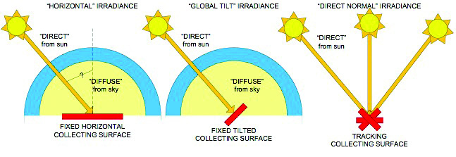
Direct Normal Irradiance

Slide 20
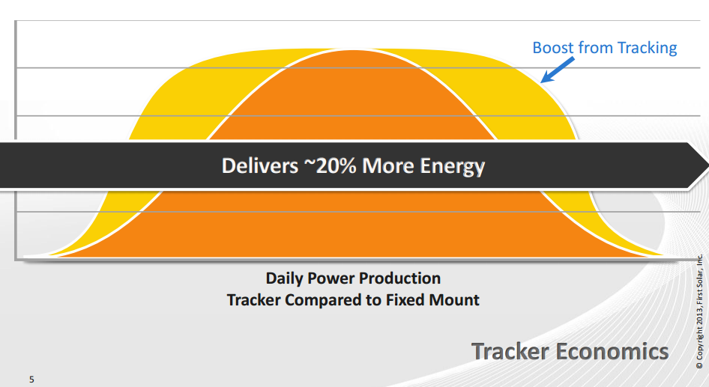
Adjustments for Tilt and for Tracking
Do you think that tracking makes a bigger difference in South Africa or Peru

Slide 21
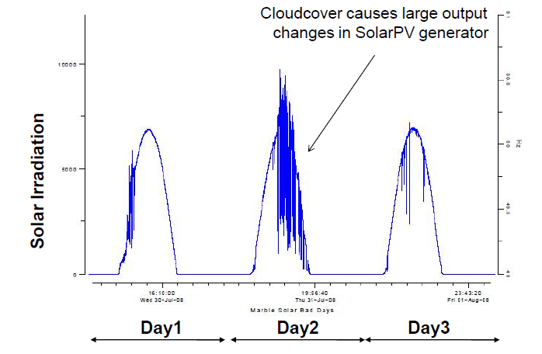
Cloud Cover and PV Generation
You can understand issues with batteries and solar by examining hourly or more detailed data.

Slide 22

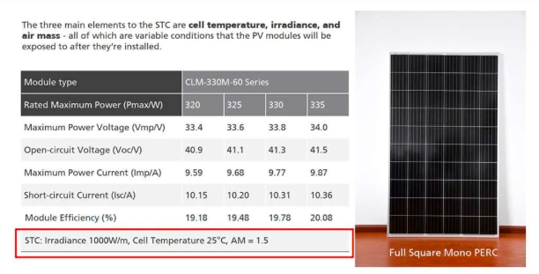
kWp Benchmark from STC – 1000 Watts/m2 and 25°
In most projects, you have some kind of benchmark to measure capital costs
For example, in real estate, the cost per square meter
In solar the amount you produce depends on sunlight and how you configure the solar project.
Standard Testing Condition (STC) is used with a flash test to create a benchmark test for a panel (kWp or kWdc).

Slide 23
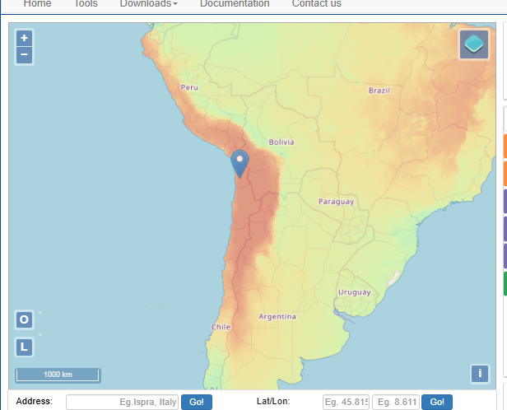
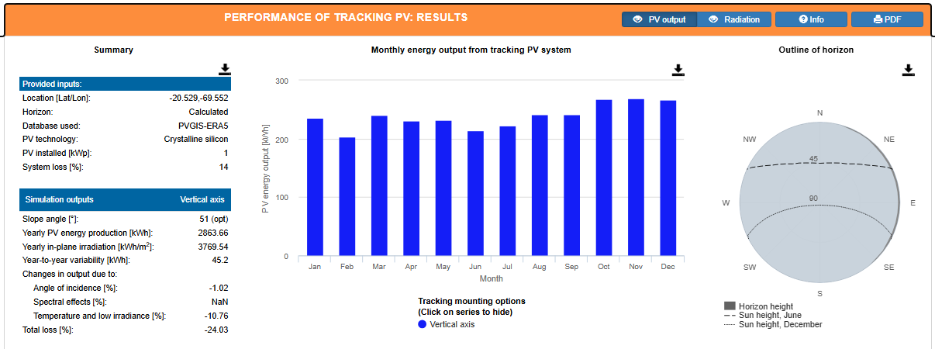
Start with Data – Best Solar Places - PVGIS
Chile; What is yield and what is capacity factor
Irradiation is measured with watts/m2
If you had 1,000 watts in every hour (including night time) and you could use all of the sunlight, there would be 365 x 24 = 8760 x 1,000 STC = 8760,000 watt hours
In plane radiation of 3,769 for a capacity factor of 43%

Slide 24
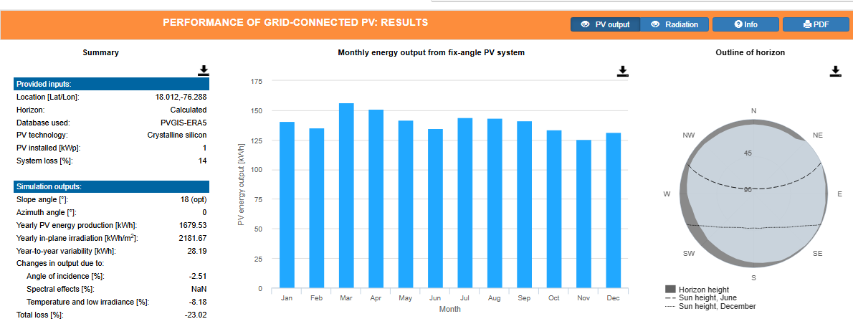
In-Plane Radiation without Tracking
kWh/kWp gives hours annual hours. Hours divided by 8760 gives capacity factor
In plane radiation is 2181 kWh/m2 per year. 2,181 kwh is 2,181,000 watts per m2. Dividing by 8,760 gives you 249 watts per hour on average. As the standard definition o of maximum capacity is 1,000 watts/m2, this gives you a capacity factor of 2,181/8760 = 24.89%

Slide 25
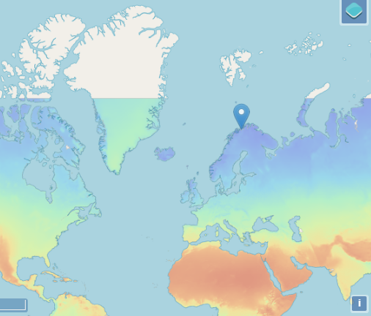
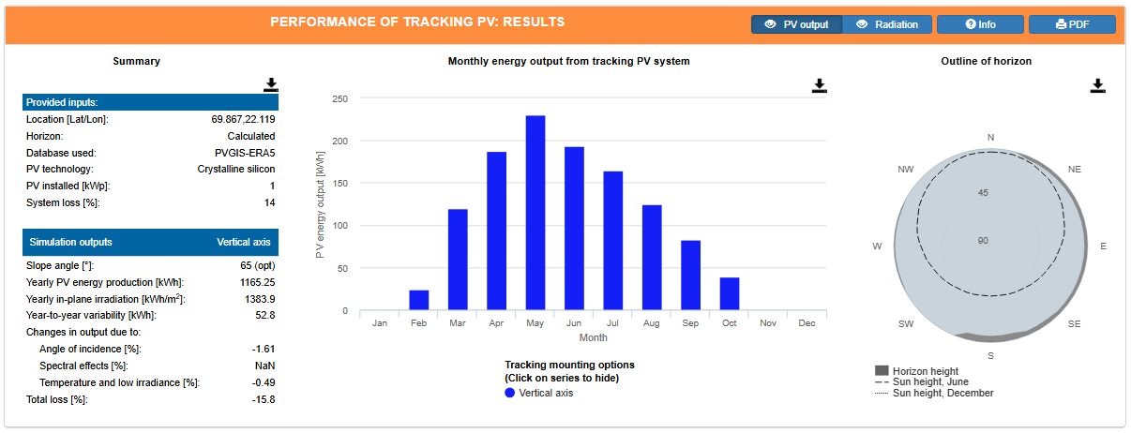
Contrast with
Norway with Tracking
The capacity factor is 15.8%
Compute the performance ratio
Compute

Slide 26
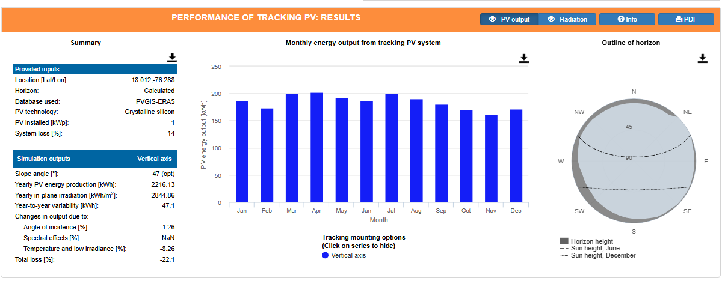
Tracking Increase Relative to Fixed with Tilt
.
In Plane Radiation 2,845 per year in kWh per m2. Capacity Factor of 32.47% from 2845/8760. This is a 30% increase in the amount of sunlight that hits the panel

Slide 27
Quiz for Thinking About Issues
If the kWh per m2 is 2,000 in a year and the Performance Ratio is 100%
    What would be the production if the temperature for every hour on the panels was 25 degrees
    Under the conditions above, what would be the production for a 100 MWp farm
    Is it realistically possible to achieve this level of production if you assume the performance ratio is 25 degrees
    What is the biggest factor that makes it not possible to achieve this level of production
    If the performance ratio is 85%, what would be the production for the 100 MWp farm

Slide 28
Definition of Capacity - Solar, STC and Capacity Factor
Understand that with non-controllable quantity, you cannot define capacity in the same way as with something you can control like the speed of a car
  Creates confusion with kWp and kWac
  Work through efficiency and capacity factor
  Begin with the irradiation in watts/m2 which does not have adjustments for losses and temperature
  With real data need to work with dates
  Understand capacity factor and yield as average divided by maximum. You can compute the capacity factor before adjustments for performance ratio.

Slide 29


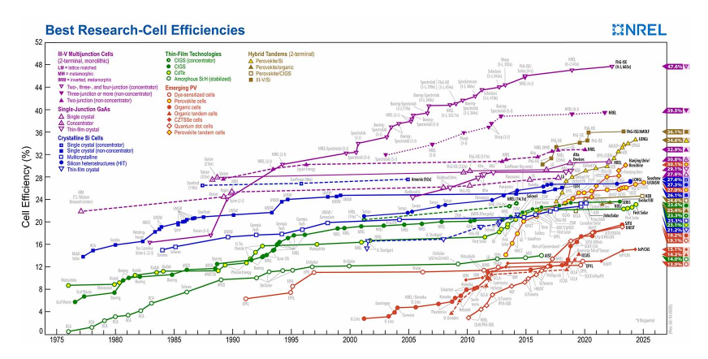
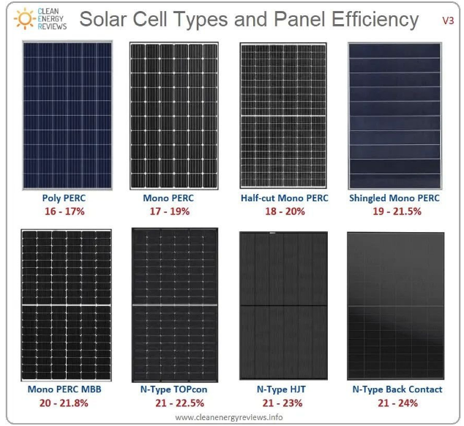
Confusion with Importance of Efficiency of Solar Panels
Consider a building. Pretend you can build a building with 10 floors or 20 floors
You could call the building with 20 floors more efficient from the standpoint of the land below the building.
But if you have to pay twice as much for the 20 floors as the 10 floors, the efficiency does not make the building more economic because you have to pay for the floors.
This is the same general idea with solar power.

Slide 30
STC as Capacity – Demonstrate that when you pay for output and not input, the economics not affected
Low Efficiency
STC 1000 Watt/m2
Efficiency 16%
Production at 1000 W – 160 W
Cost per kW - $100
Total Cost for 1 kW= 160,000
Purchase 1000 watts = 1kW
Production at STC Hour = 160 watts
Cost of 160 watts = 160,000
High Efficiency
STC 1000 Watt/m2
Efficiency 24%
Production at 1000 W – 240 W
Cost per kW - $100
Total Cost for 1 kW = 240,000
Purchase 1,000 watts = 1 kW
Production at STC Hour = 240 watts
Cost of 240 watts = 240,000
Capacity factor and yield can be based on the kWp after efficiency which would be the same as if you used irradiation. For example, if the irradiation for four days is 0, 500, 1000 and 500. The average is 2000/4 or 500 or a capacity factor of 50%. If all of the numbers are multiplied by the efficiency, the capacity factor is the same.

Slide 31
File with Long-term
Hourly Data and
File with One-year

Slide 32
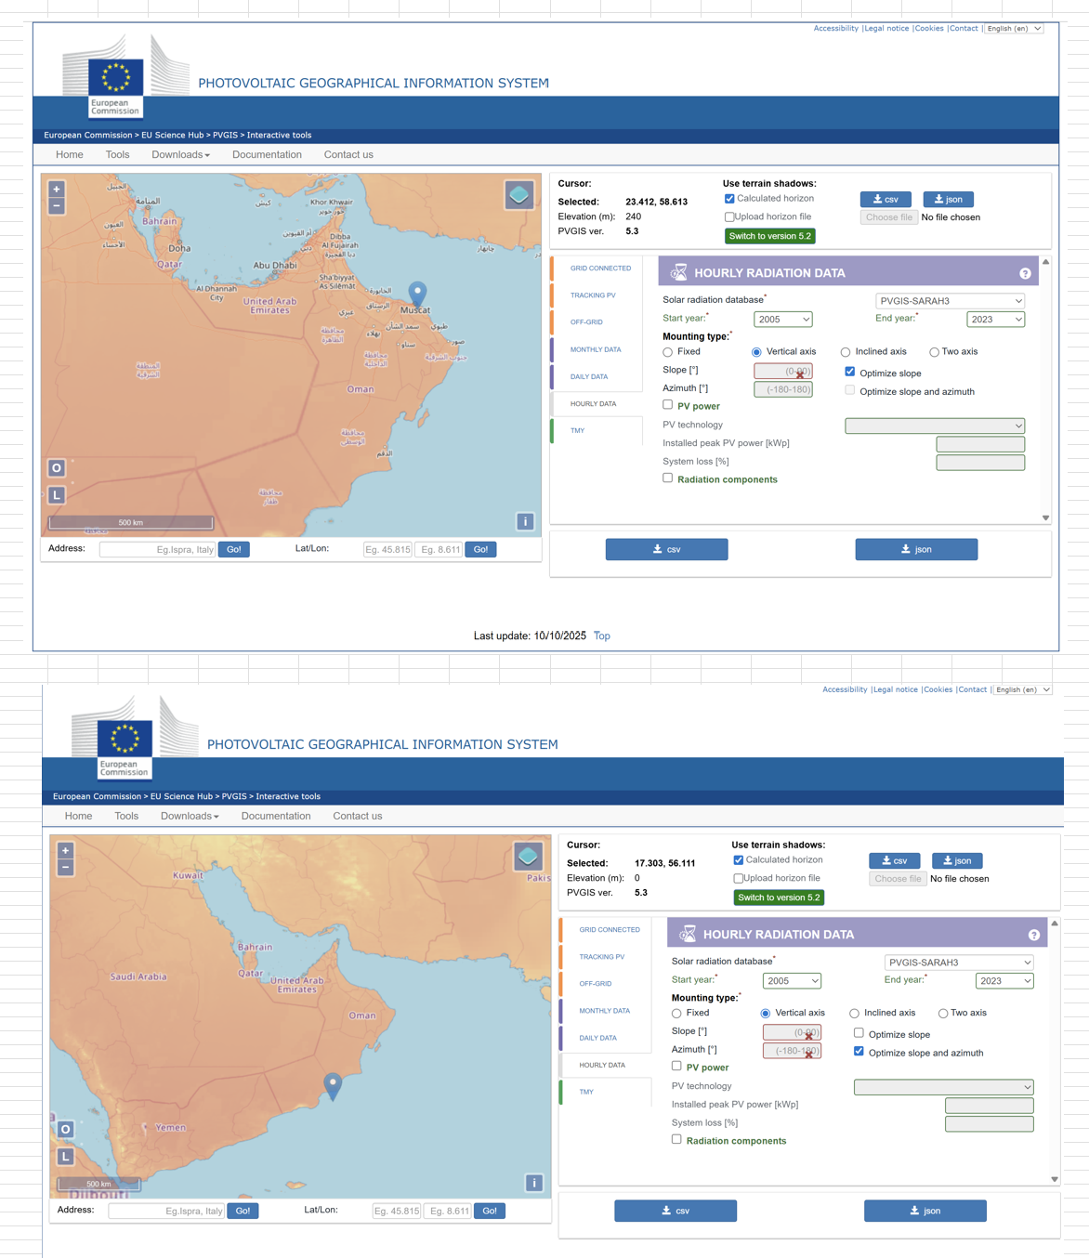
Example Sites in Oman
Open PVGIS and go to the hourly data section
The files that I have downloaded are on the website
The big deal is to adjust the date

Slide 33
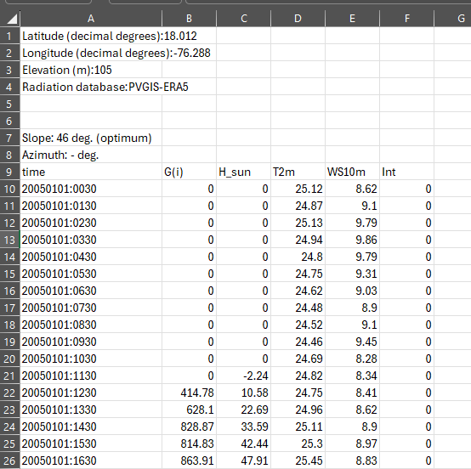
Quick Demonstration of Understanding Solar Power with Hourly Solar Date (Irradiation per m2)
Raw data
G(i) is radiation
H_Sun is height of sun
T2m is ambient temperature
WS10 m is wind speed
Could evaluate solar and impact of temperature
Could compare wind to solar by hour
Coud evaluate variation in solar by hour
Could evaluate variation by year

Slide 34
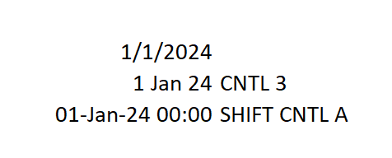
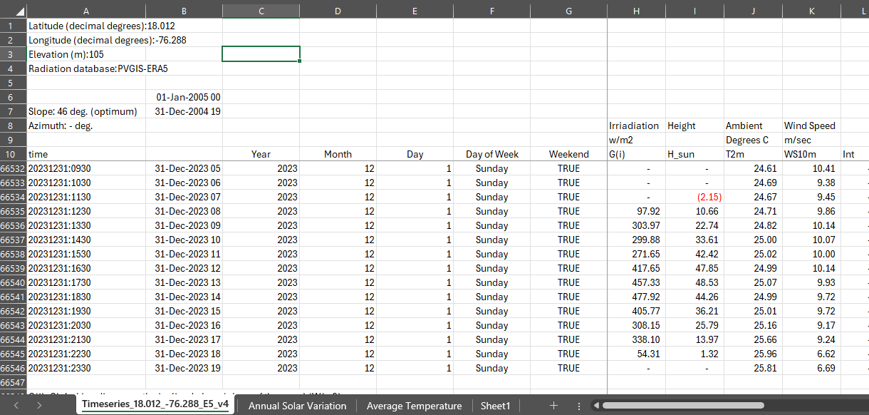
Even as a Banker, the First thing I do is look at hourly solar data and get dates
Once you get the dates right you can do a lot.
Use Generic Macro for Date Format and 1/24 for increment
Use Lookup function to compare dates and understand variability

Slide 35
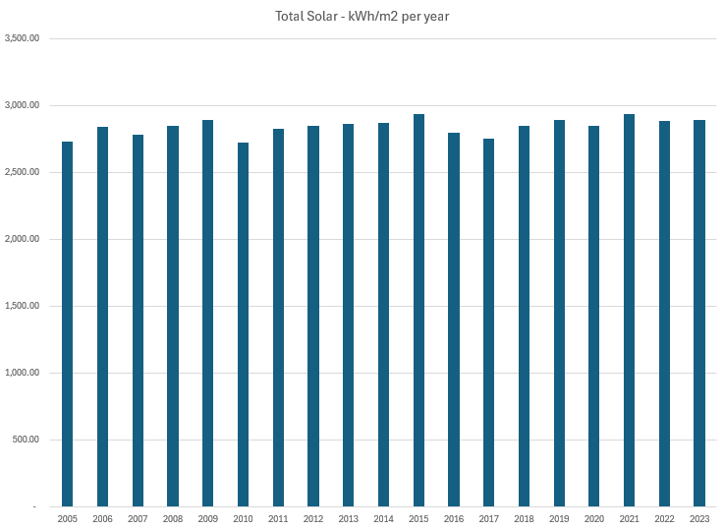
Average Solar by Year – Little Variation
You can see the lack of variation in solar from year to year.
Standard deviation allows you to compute P90 with NORMSIM.
This is not meant to be too technical
This risk is easy, and it is mean reverting.
The technical risks discussed next are much more important

Slide 36
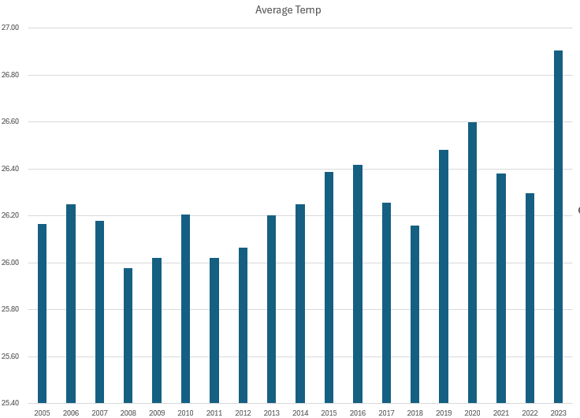
Average Temperature by Year
Get the temperature data from PVGIS and use AverageIF
You cannot control the temperature, but you can control the temperature coefficient by using different types of panels.

Slide 37
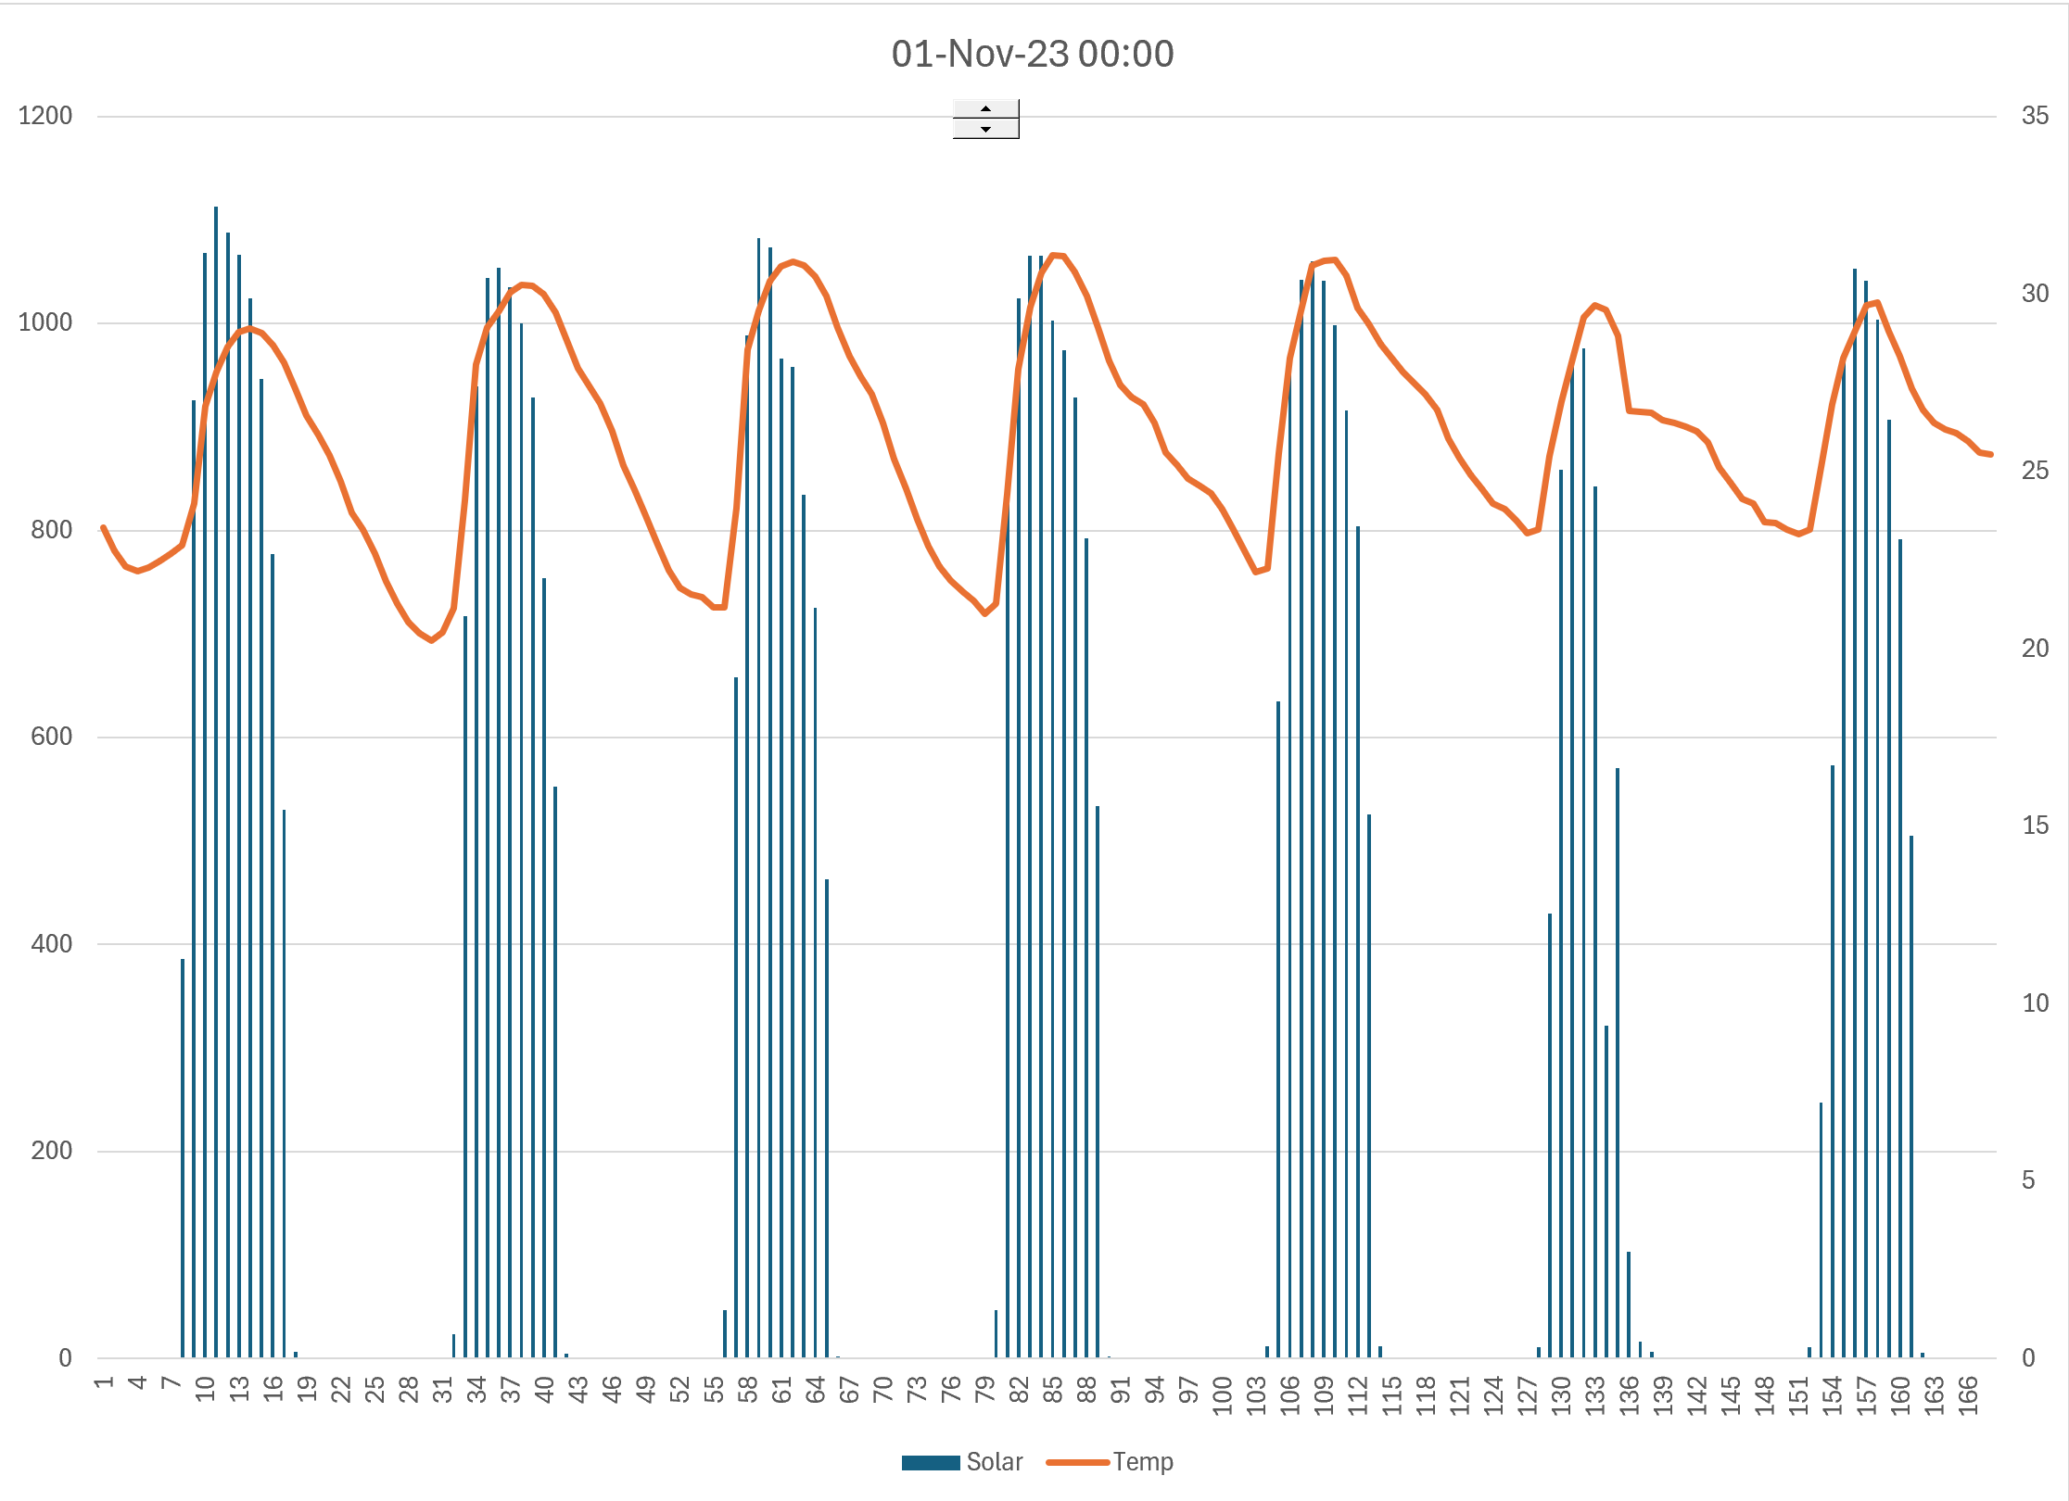
Solar Patterns in Oman
Note the stability in the resource in the desert. Note also that each hour the irradiation is near 1,000.
This does not mean the solar is at capacity because it is a lot hotter than 25 degrees.
The capacity of the solar panels measured at STC (kWp) is never obtained.

Slide 38
Solar Performance Ratio
Think about questions to ask
Don’t be afraid of sounding stupid

Slide 39
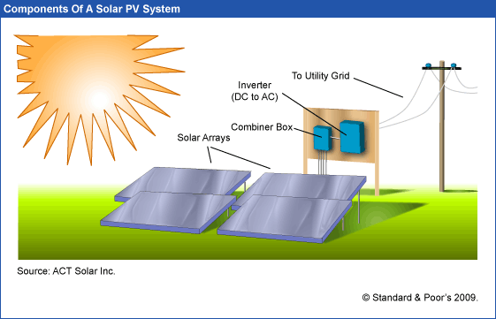
What you Can and Cannot Control
Sunlight, clouds, earth position – things that come from above. In-plane irradiation (effective irradiance on collectors)
Capacity Factor of Generation to Grid relative to kWp
Performance Ratio is final output including controllable and non-controllable divided by the non-controllable from above
Controllable – type of panels, cleaning, wiring, inverter size, tracking …

Slide 40
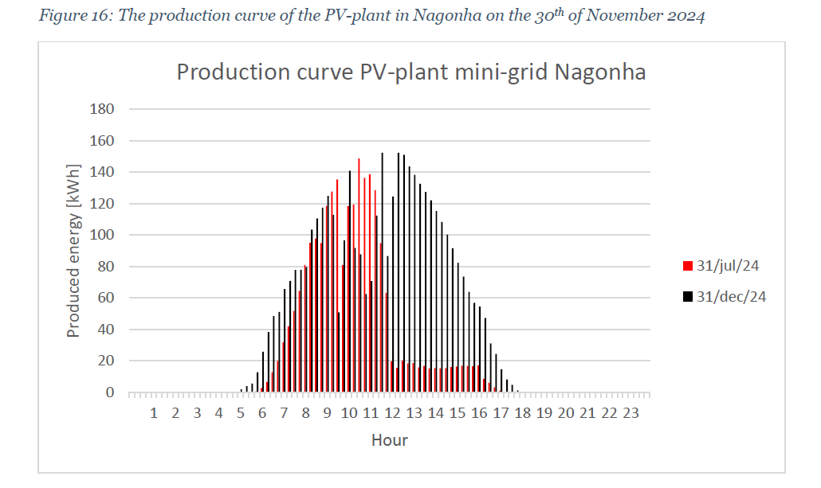
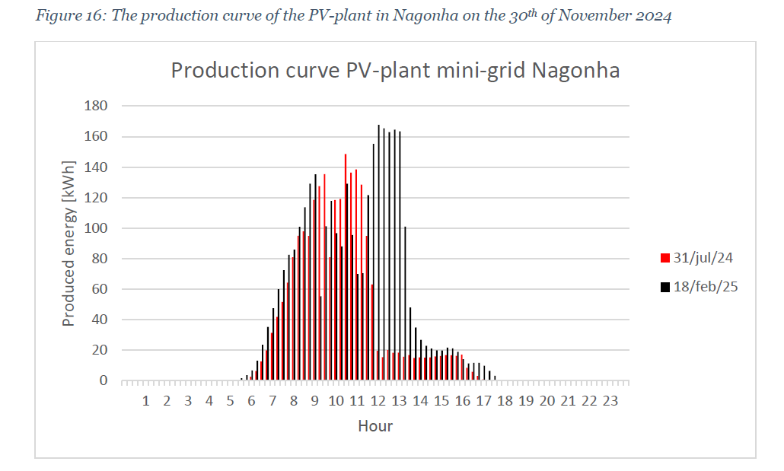
Hourly Solar Production in Nagonha and Performance Ratio
Will correlate this with PVGIS to derive the performance ratio. Note that there was too much solar in the early period relative to the battery, but this was resolved with the increase in load. Note also that in July 2024, there is too much solar relative to the battery but in December, all of the solar is used to charge the battery.
The level of solar production in February 2025 can be used to gauge an approximate performance ratio during the peak hours. Production is about 165 kW, and the capacity of the solar project is 200 kWp. This implies a performance ratio of 82.5% during the peak hours.

Slide 41
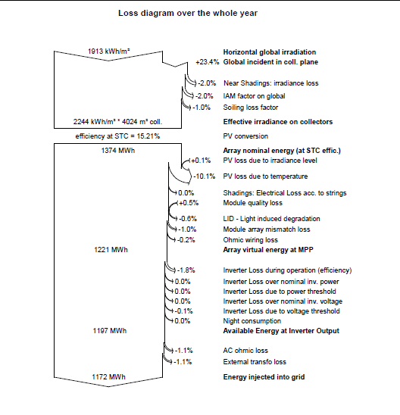
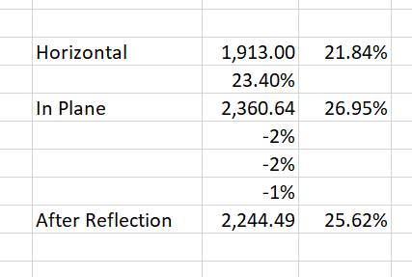
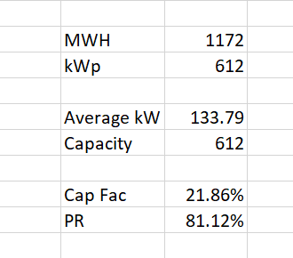
Loss Diagram Illustration – See that there is a lot of uncertainty in estimating the performance ratio
Convert loss diagram into capacity factor and compare different cases.
Difficult to compute performance ratio from these diagrams.
Generally, the loss due to temperature is the largest loss factor.

Slide 42
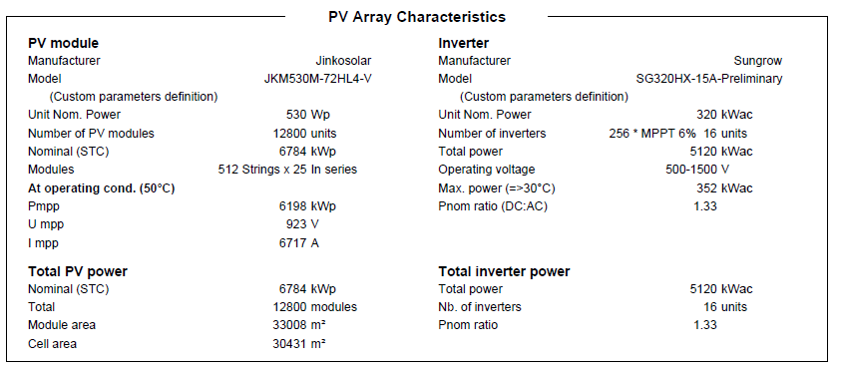
Inputs from PVSYST Example and Football Field
5,120 MWac
6,784 MWp
75% Ratio of AC to DC
Could make this to be 100%
Why not
Don’t get intimidated by PVSYST, can ask questions
33,008 meters for 6.784 MWp or 33,008/6.784; 4,865 m2 per MWp; Football field assumptions – 50 x 150 meters = 7,500 m2.
1 MW is 4865/7,500 = .64% of a football field. Or, 7,500/4865 = 1.54 means a football field gives you 1.54 MWp.
6,000 kWh per house per year. 1.5 MW x 20% x 8760 is the MWh production from a football field – 2,628 MWh. This gives you 438 homes from a football field

Slide 43
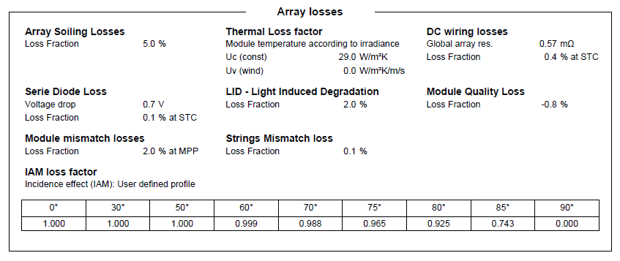
Loss Factors in PVSYST for the Performance Ratio
To understand solar, I think you should replicate PVSYST by yourself.
You need data on the various loss factors, the temperature coefficient and the AC/DC Ratio
Note the soiling loss – depends on how you clean the panels

Slide 44
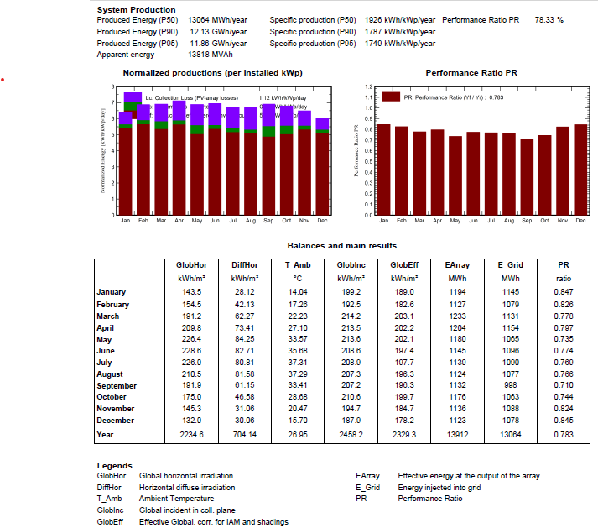
Performance Ratio by Month
Capacity for Radiation on Plane – 2,458 kWh per m2. With STC of 1,000 the capacity factor is 28.06%
Final Capacity factor. Generation kWh is 13,064. Capacity in MWP is 6,784, Average Production is 1,491 kWh. Capacity Factor is 21.97%.
Performance Ratio is Final Capacity Factor Divided by Gross or
21.97% divided by 28.06% or 78.3%
.

Slide 45
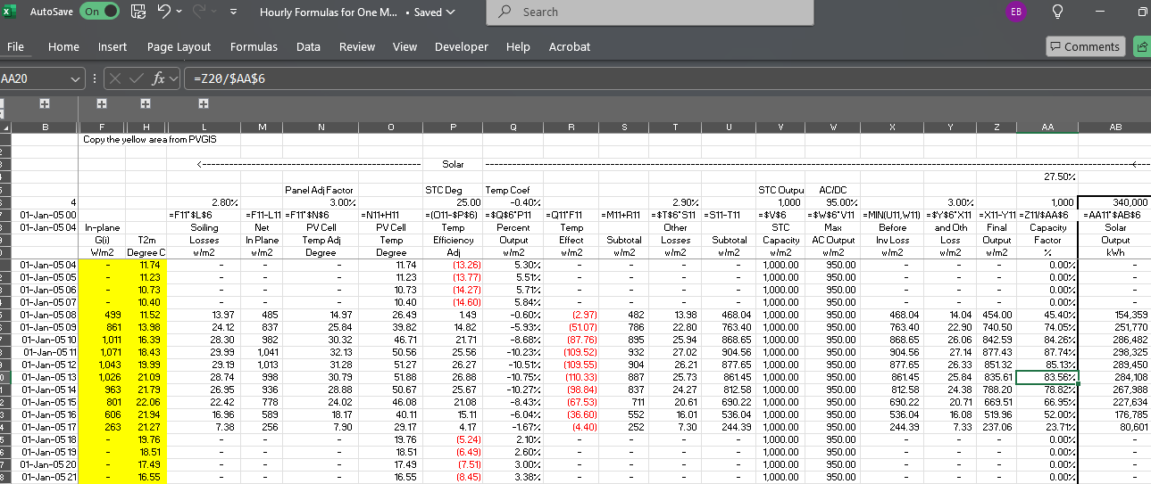
Capacity Factor for Solar with Performance Ratio and Temperature - Equations
Homer uses 3% of Irradiation in w/m2 as temperature adjustment

Slide 46
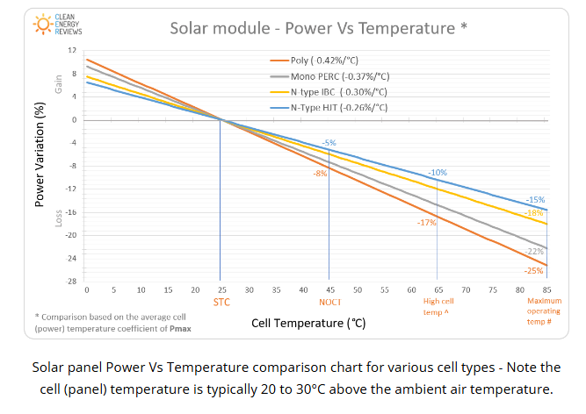
Solar, Temperature and Performance Ratio
Temperature coefficient. Understand that % change for temperature change versus 25 degrees
Example – Poly; if one degree higher, lose .42% of output
Note that 20 to 30 degrees above the ambient temperature

Slide 47
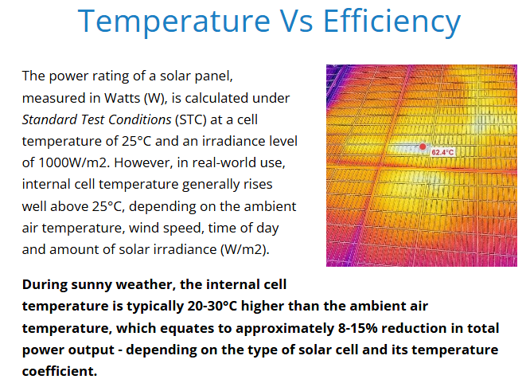
Idea that cannot use Ambient Temperature
.
Homer uses 3% of Irradiation in w/m2 as temperature adjustment

Slide 48
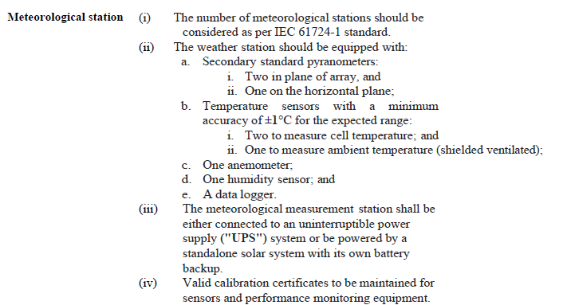
Detailed Weather Measurement in PPA – You can monitor the Temperature on the Panel
This technical detail is part of a PPA. Note the temperature of the Cell and the ambient temperature.

Slide 49
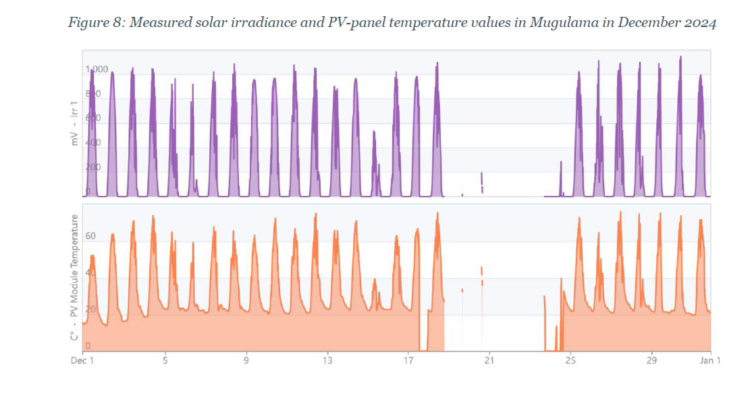
Irradiation Benchmark
Note how the temperature on the PV panel reaches a lot more than 60 degrees. This is discussed in the Appendix.

Slide 50
Homer Equation
To compute the increase in temperature on the panels
  Multiply the Irradiation that hits the panels by 3%
  Do not multiply the ambient temperature by a factor
  This gives the increase in temperature
Key question
  Do you think this is always accurate
  Do you think other programs have better methods
  How could you do this with actual data

Slide 51
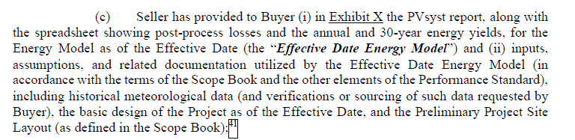
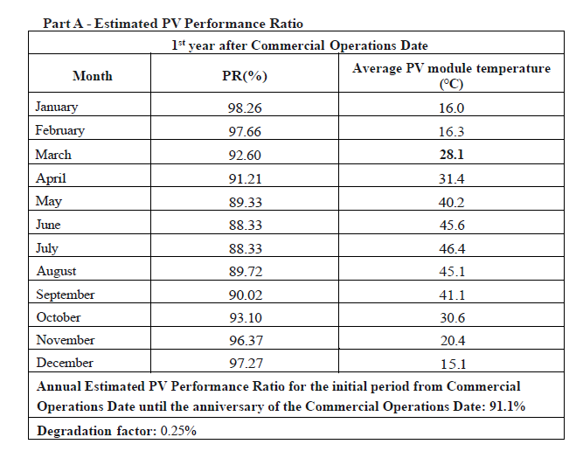
Providing PVSYST Report in PPA
.
As a banker, you could ask why the performance ratio is so high. You do not have to be a super technical expert to ask the question.

Slide 52
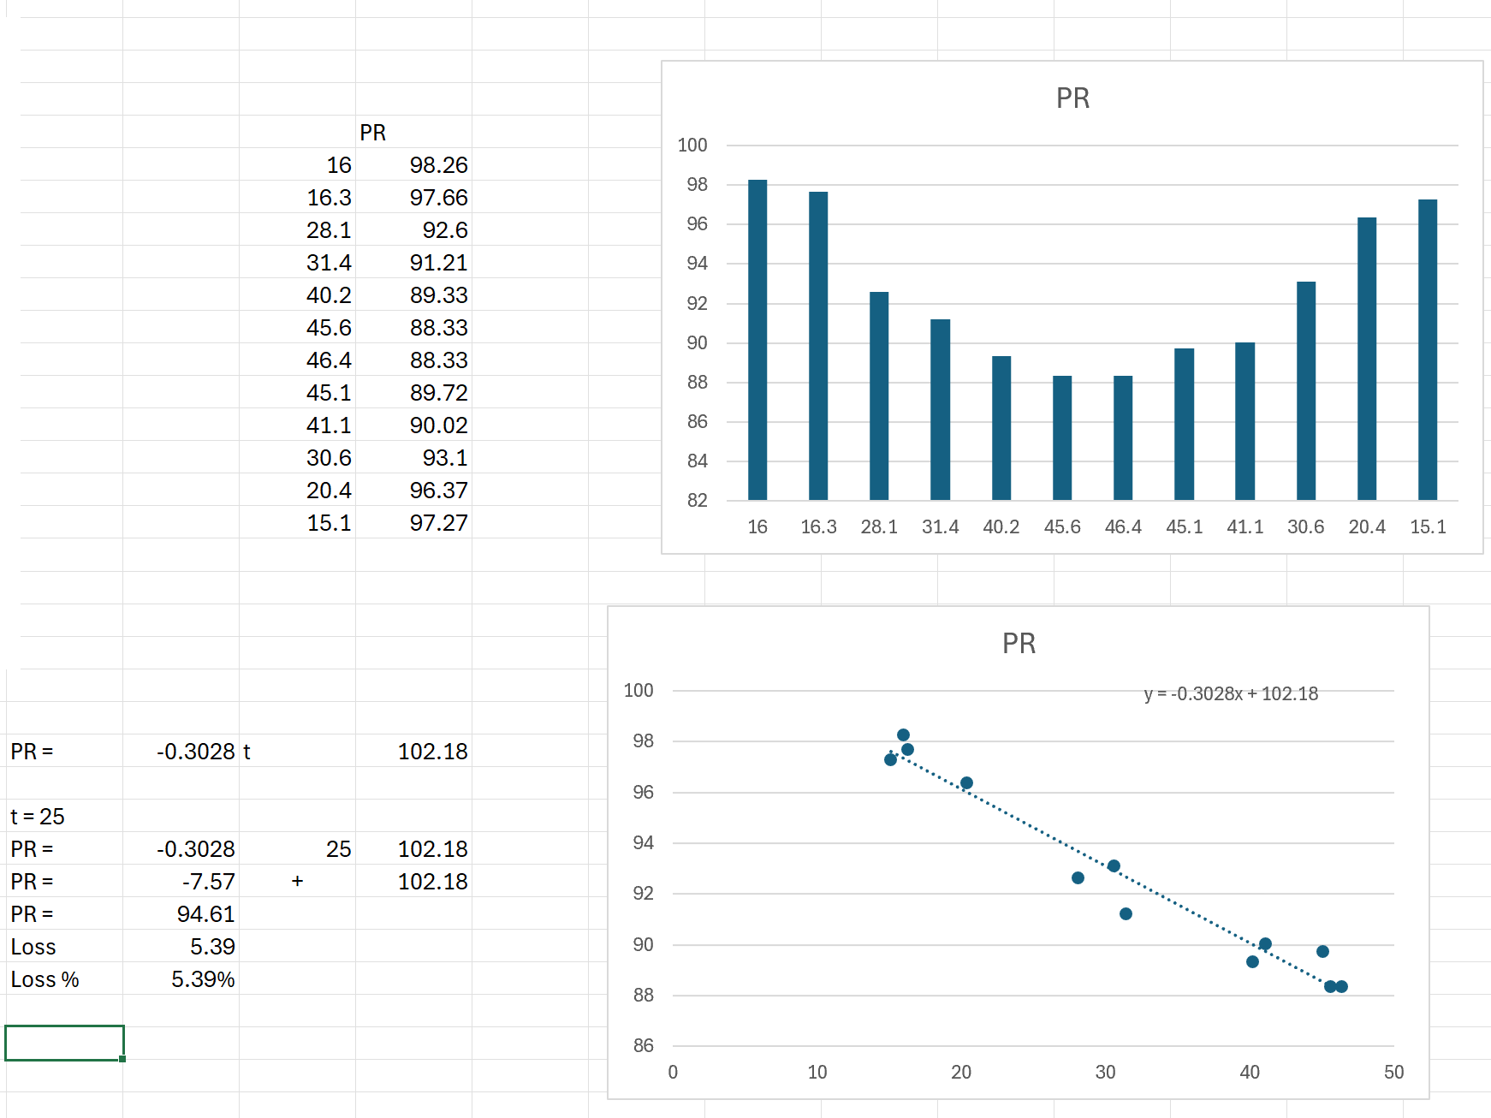
Analysis of PR and Temperature
Use x-y graph and equation to derive losses. Then you as bankers can ask questions and benchmark the data.
What questions would you ask
Derive the performance ratio at 25 degrees and then compute losses.
With temperature coefficient, you can see why AC capacity is less than DC capacity because 1,000 w/m2 and 25 degrees is a fiction

Slide 53
Detailed Formulas for Solar with Performance Ratio
Soiling Losses = Soiling Percent x In Plane Radiation
Net In Plance radiation = Gross In-plane Radiation – Soiling Losses
Pantel Temperatre Adjustment = 3% x Gross In Plane Radiation
Temperature on Pantel = Temperature + Panel Adjustment Temperature
Temperature versus STC Temperature = Temperature – Temperature on Panel
Efficiency Effect of Temp = Temperature Coefficient x Temperature Difference
Temperature Effect = Efficiency Adjustment * In Plane Radiation
Subtotal = Irritation – Losses – Temperature Effect
Other Losses = Other Loss Percent x Other Loss Percent
Subtotal = subtotal – Other Losses
Irradiation STC = 1000
AC/DC ratio = AC percent x ADC
Output before Loss = Minimum (AC Output, subtotal)
Inverter Loss = Output before loss x Inverter Loss Percent
Compute financial capacity factor as percent of STC

Slide 54
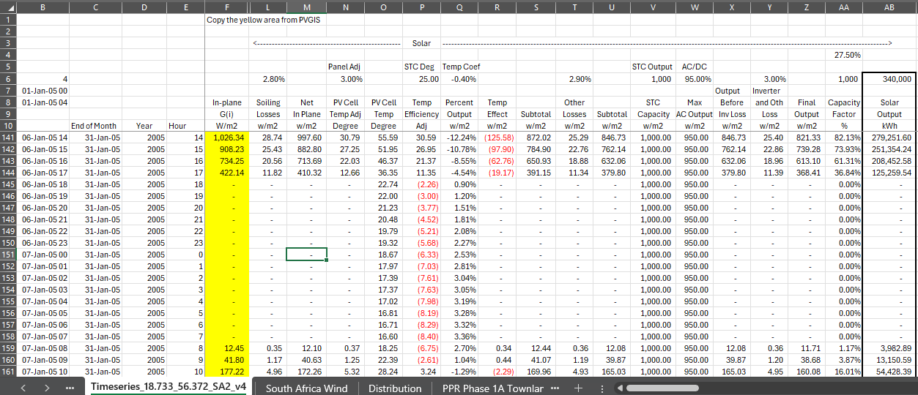
Detailed Solar Analysis with Temperature Adjustment
Illustration of doing the solar analysis by yourself to understand the details
Find the file named hourly equations

Slide 55
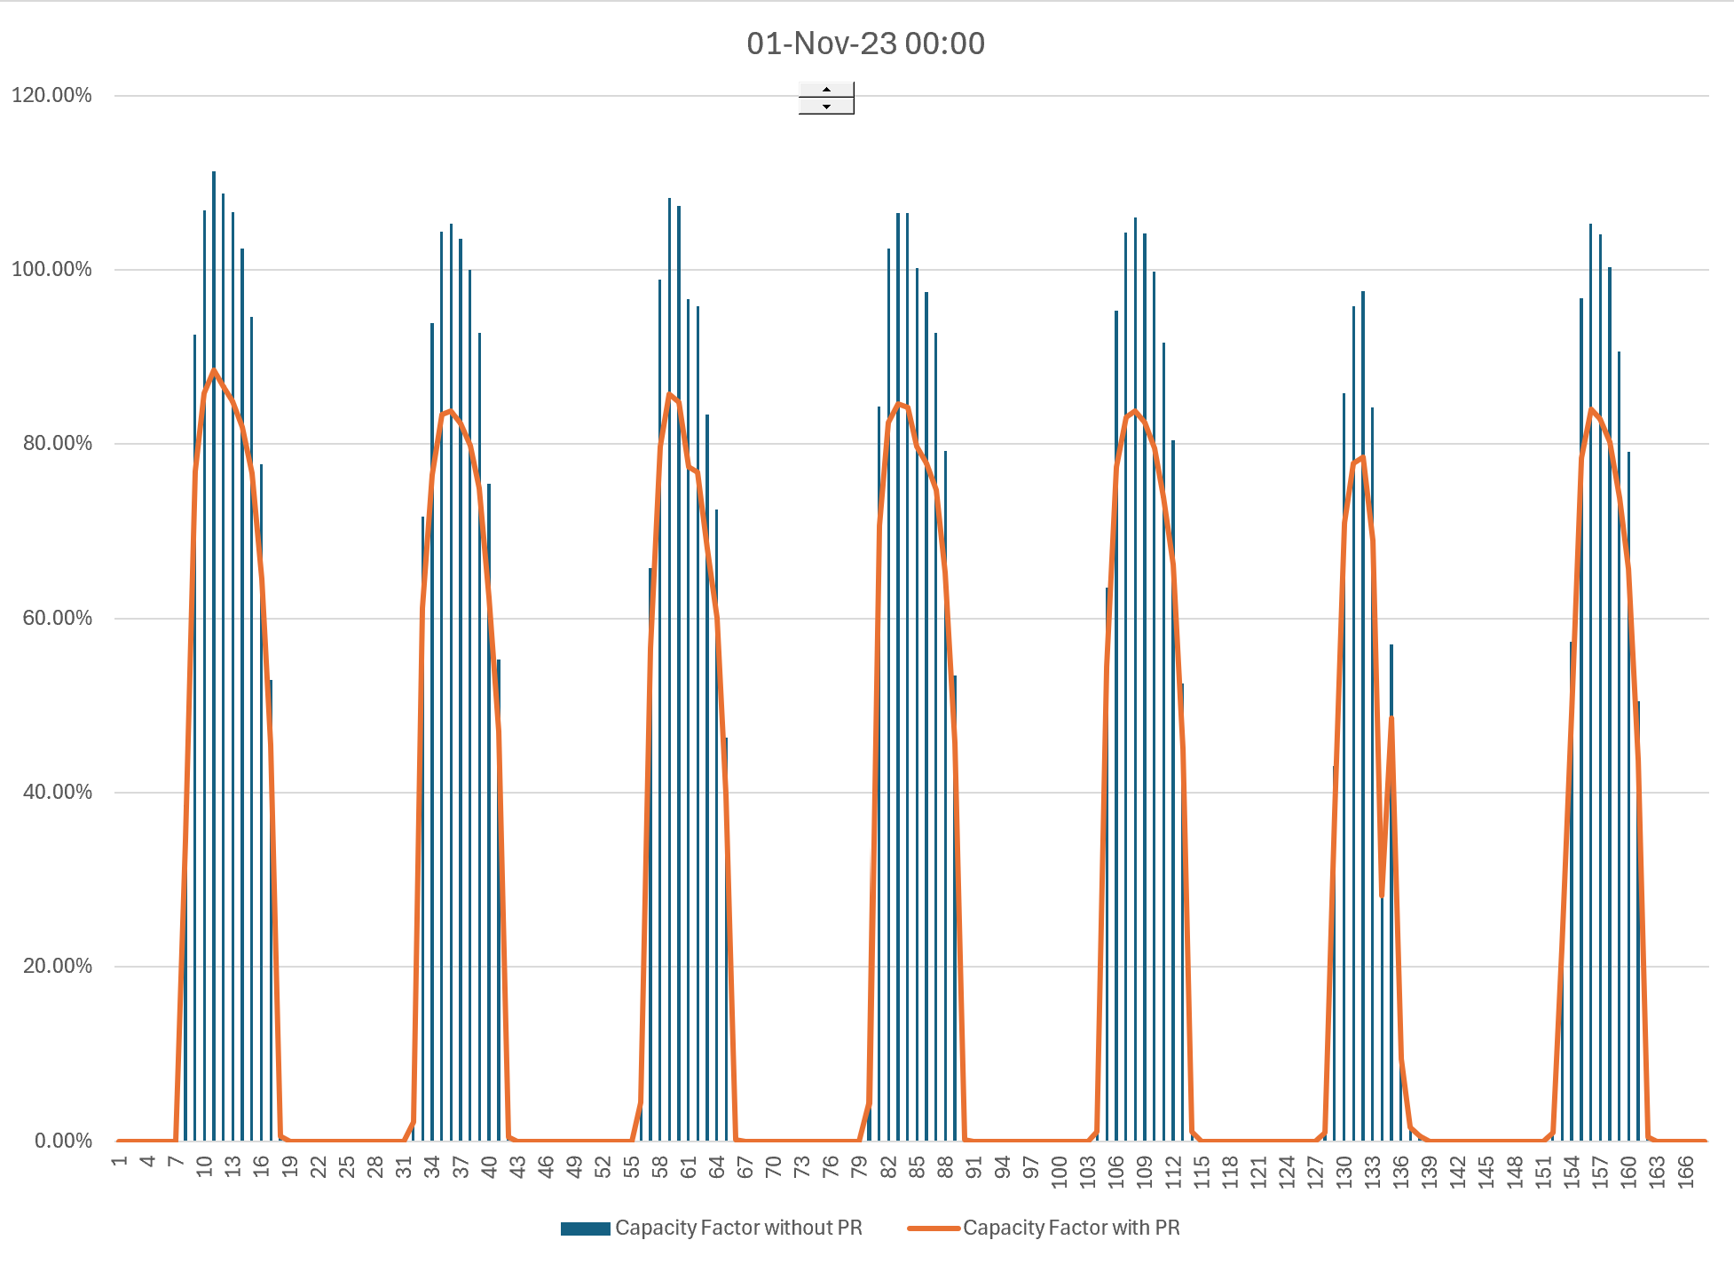
Capacity Factor with and without PR
.
With temperature coefficient, you can see why AC capacity is less than DC capacity because 1,000 w/m2 and 25 degrees is a fiction

Slide 56
Incorporate Detail of Solar
Add 15 columns
Soiling Loss Assumption: 2.8%
Factor for Increase in Temperature on Panel (% of irradiation) – 3%
Temperature Coefficient Percent Efficiency/(Panel Temp-25): -.41%
Other Wiring Losses: 2.9%
AC to DC ratio: 80%
Inverter Losses: 3%
Exercise – play around with 3% temperature adjustment, loss ratio and the temperature coefficient and be able to question the PR of the developer.

Slide 57
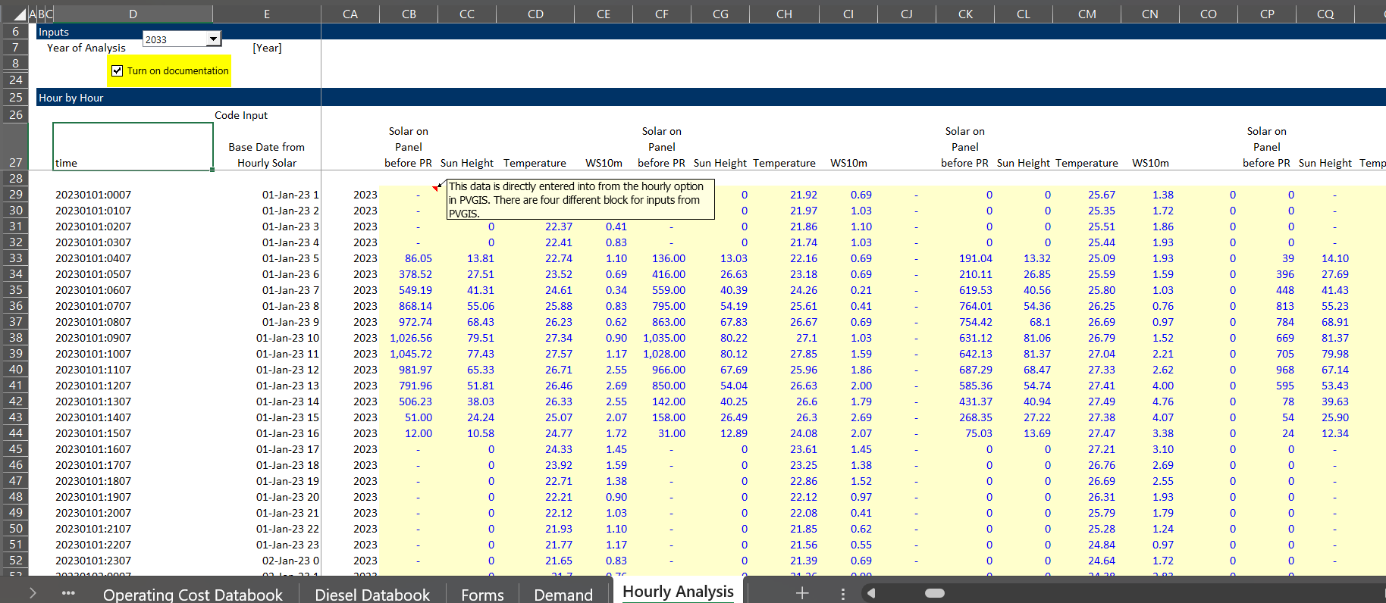
Data on Hourly Irradiation
The data input locations in the model were somewhat clear in the prior analysis. The screenshot below shows the hourly irradiation data from PVGIS for different locations is used. We have used the latest year from the PVGIS data.

Slide 58
Quiz for Bankers
List difficulties in making a resource estimate for solar
List specific parameters that are difficult to assess and rank them according to what you think are the most difficult items to assess
  .
  .
  .
  .
Would you be more concerned with fluctuation in the solar energy resource from year to year or adjustments to compute the temperature on the panels

Slide 59
Renewable Energy from Wind

Slide 60
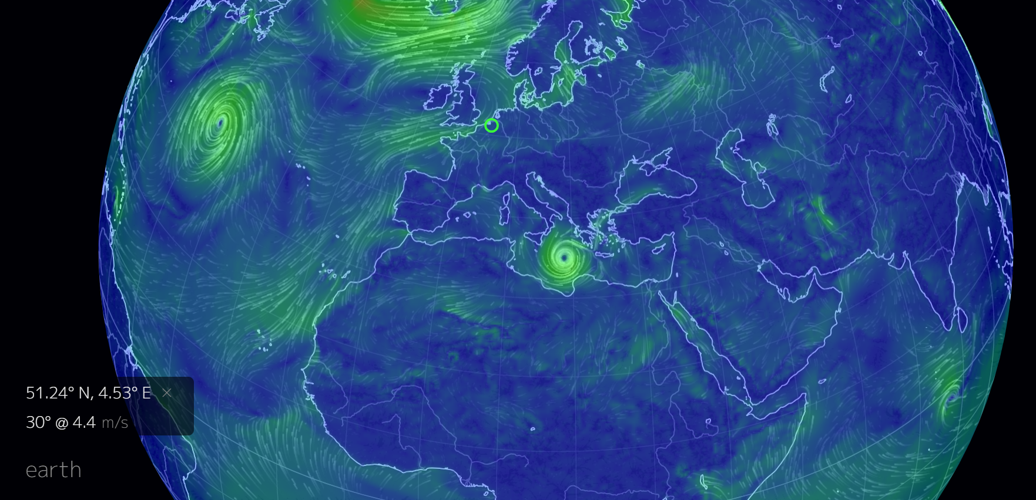
General From World Wind Map
Google world wind map
Change to meters per second

Slide 61
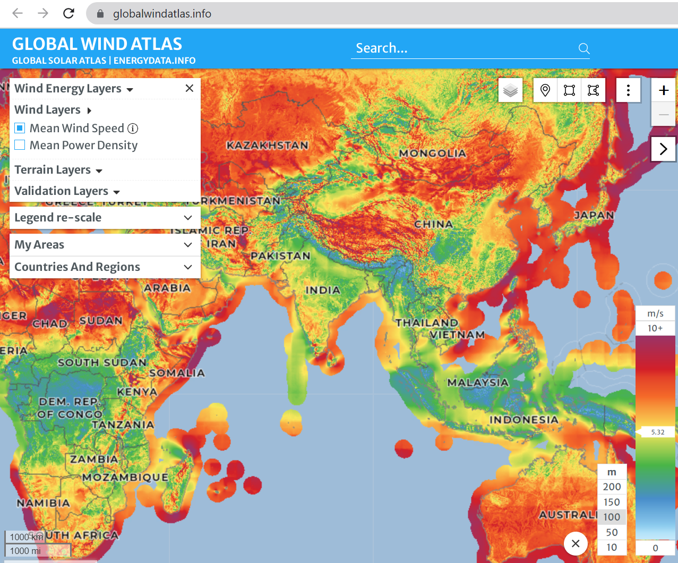
Global Wind Atlas
Difficult to work with and controversial.

Slide 62
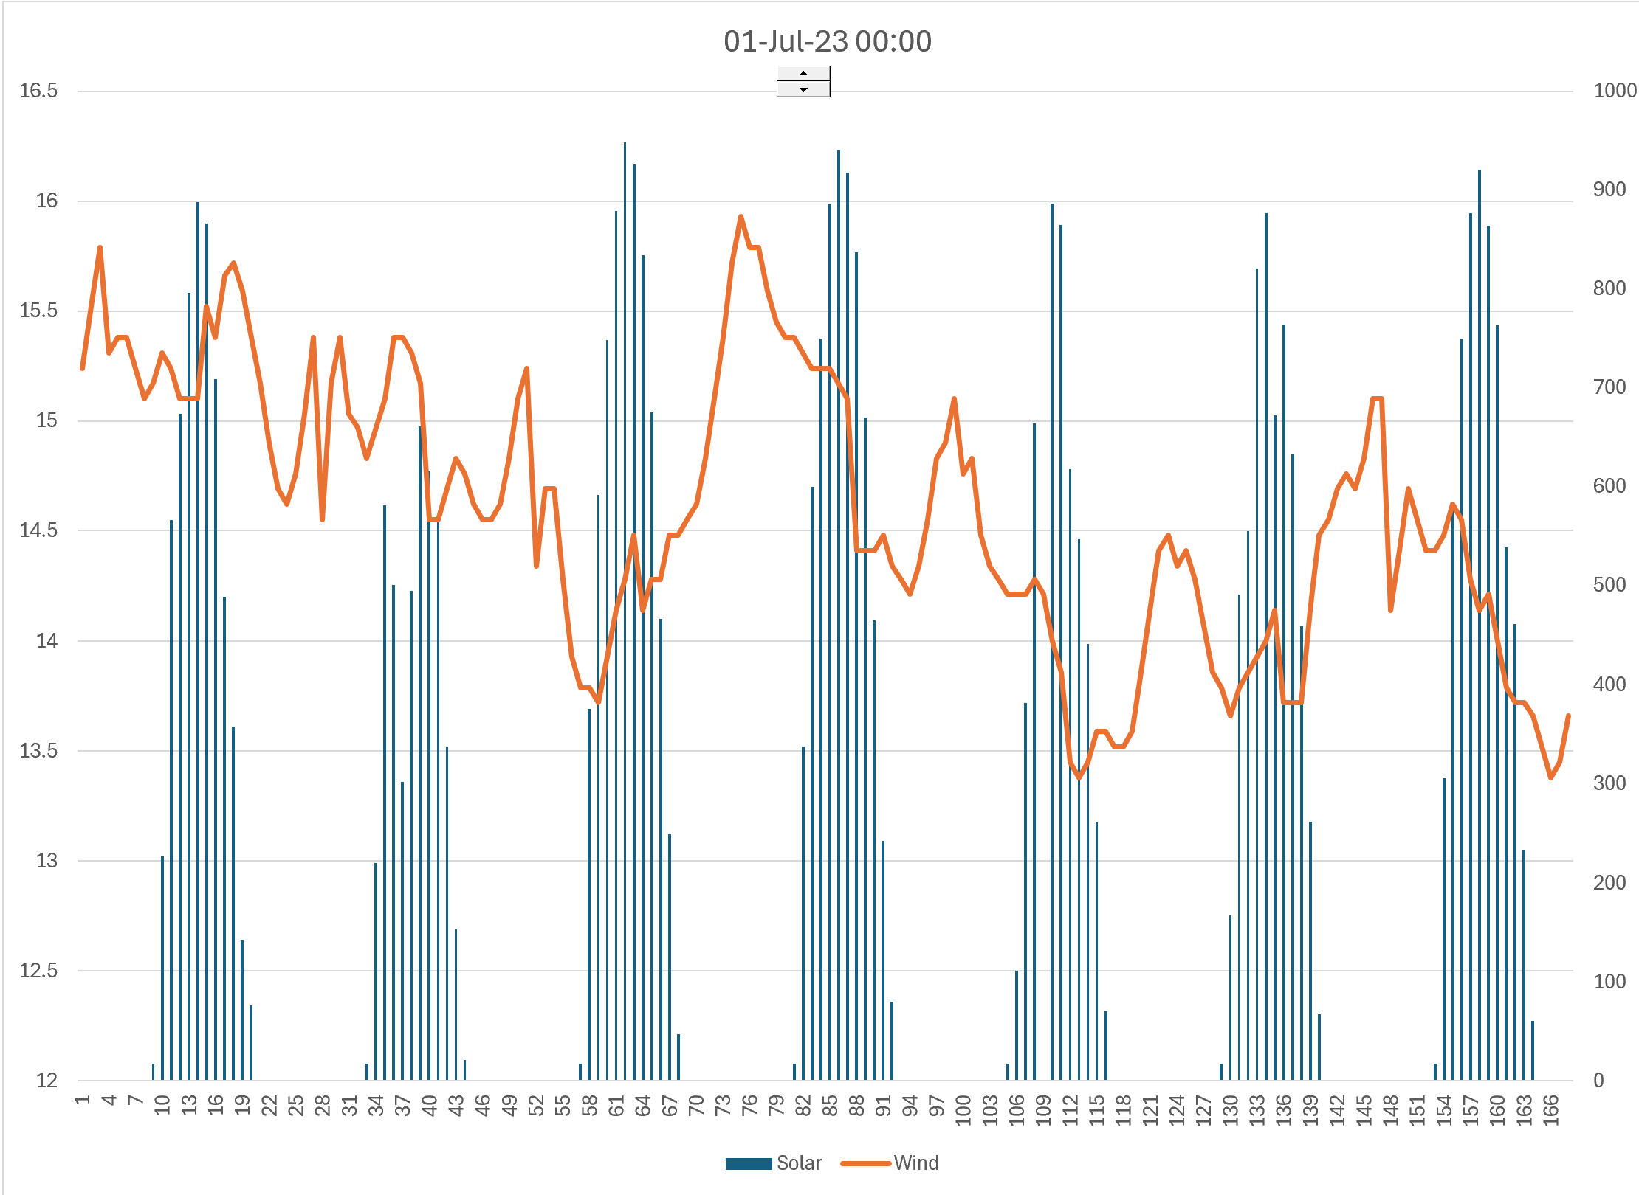
Solar and Wind in Oman (Wind is Offshore)
More changes without constant pattern for wind
Go to the single year file to work with the data.

Slide 63
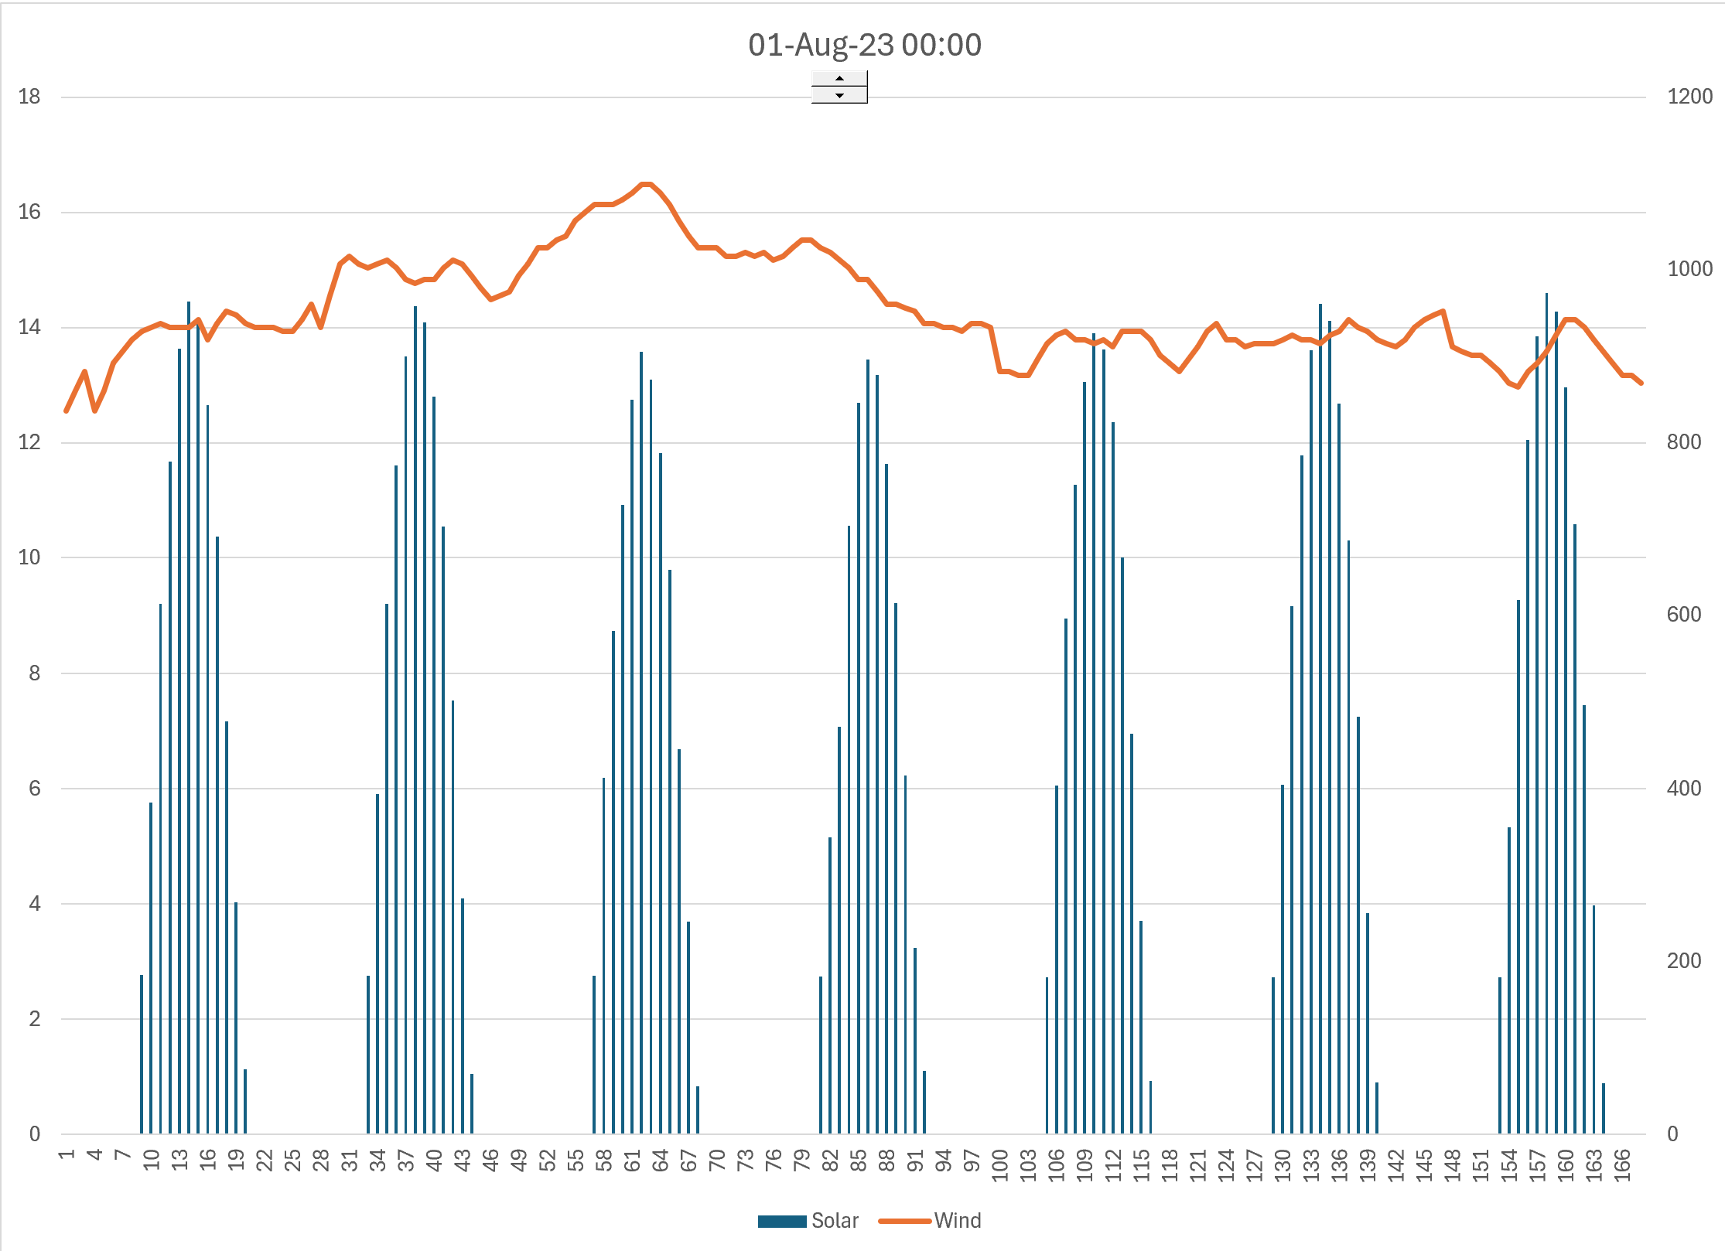
Solar and Wind in Oman
Stable wind month

Slide 64
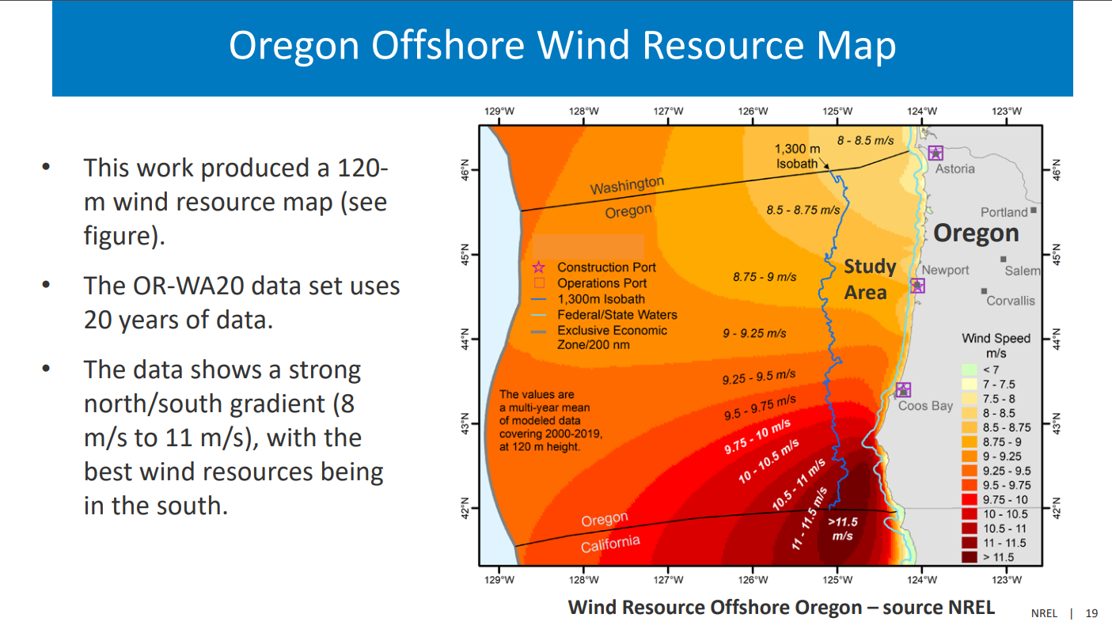
Offshore Wind in Pacific
Off-shore depth

Slide 65
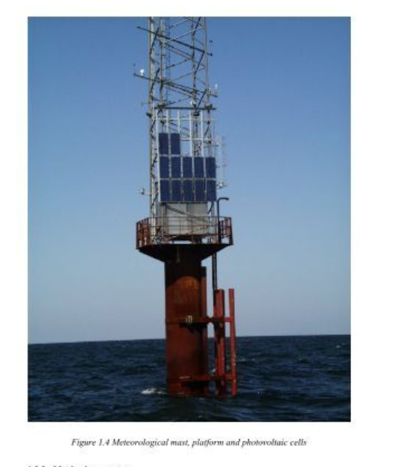
Met Mast off-shore
Need to acquire local wind speeds
Cannot do this for multiple years

Slide 66
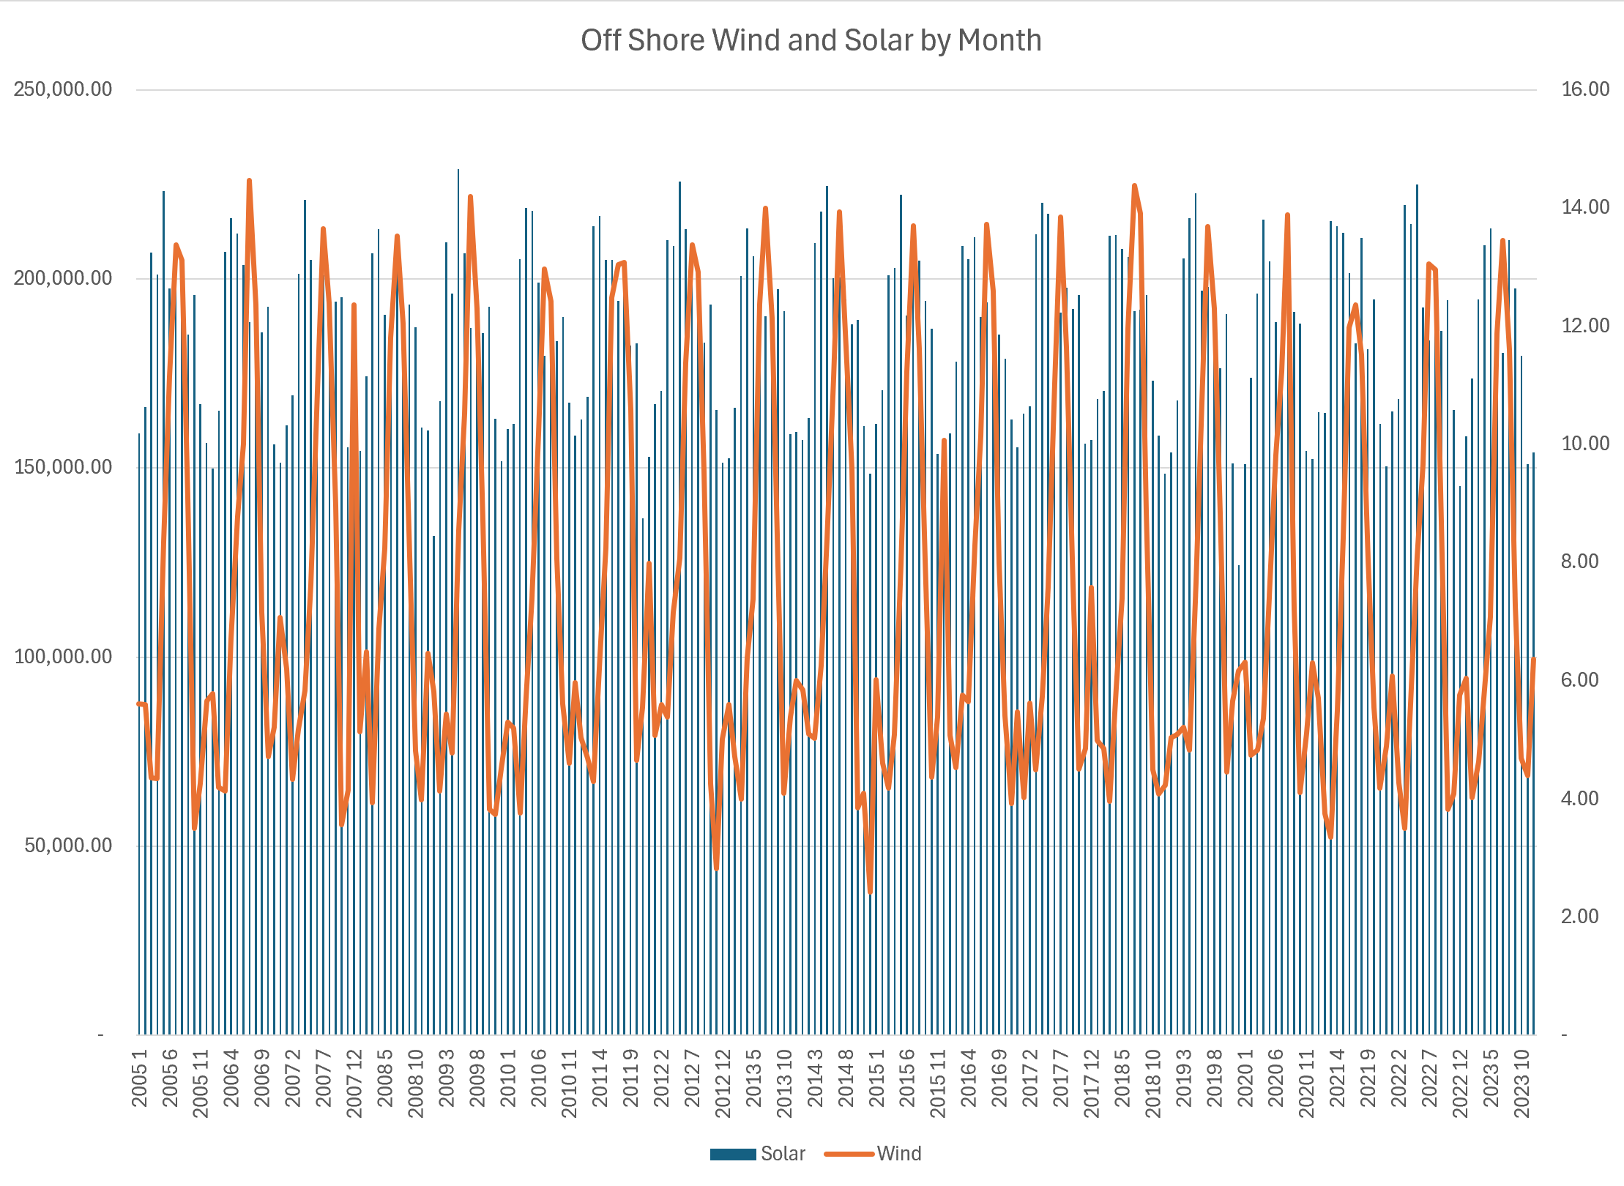
Offshore Wind and Solar per Month
.

Slide 67
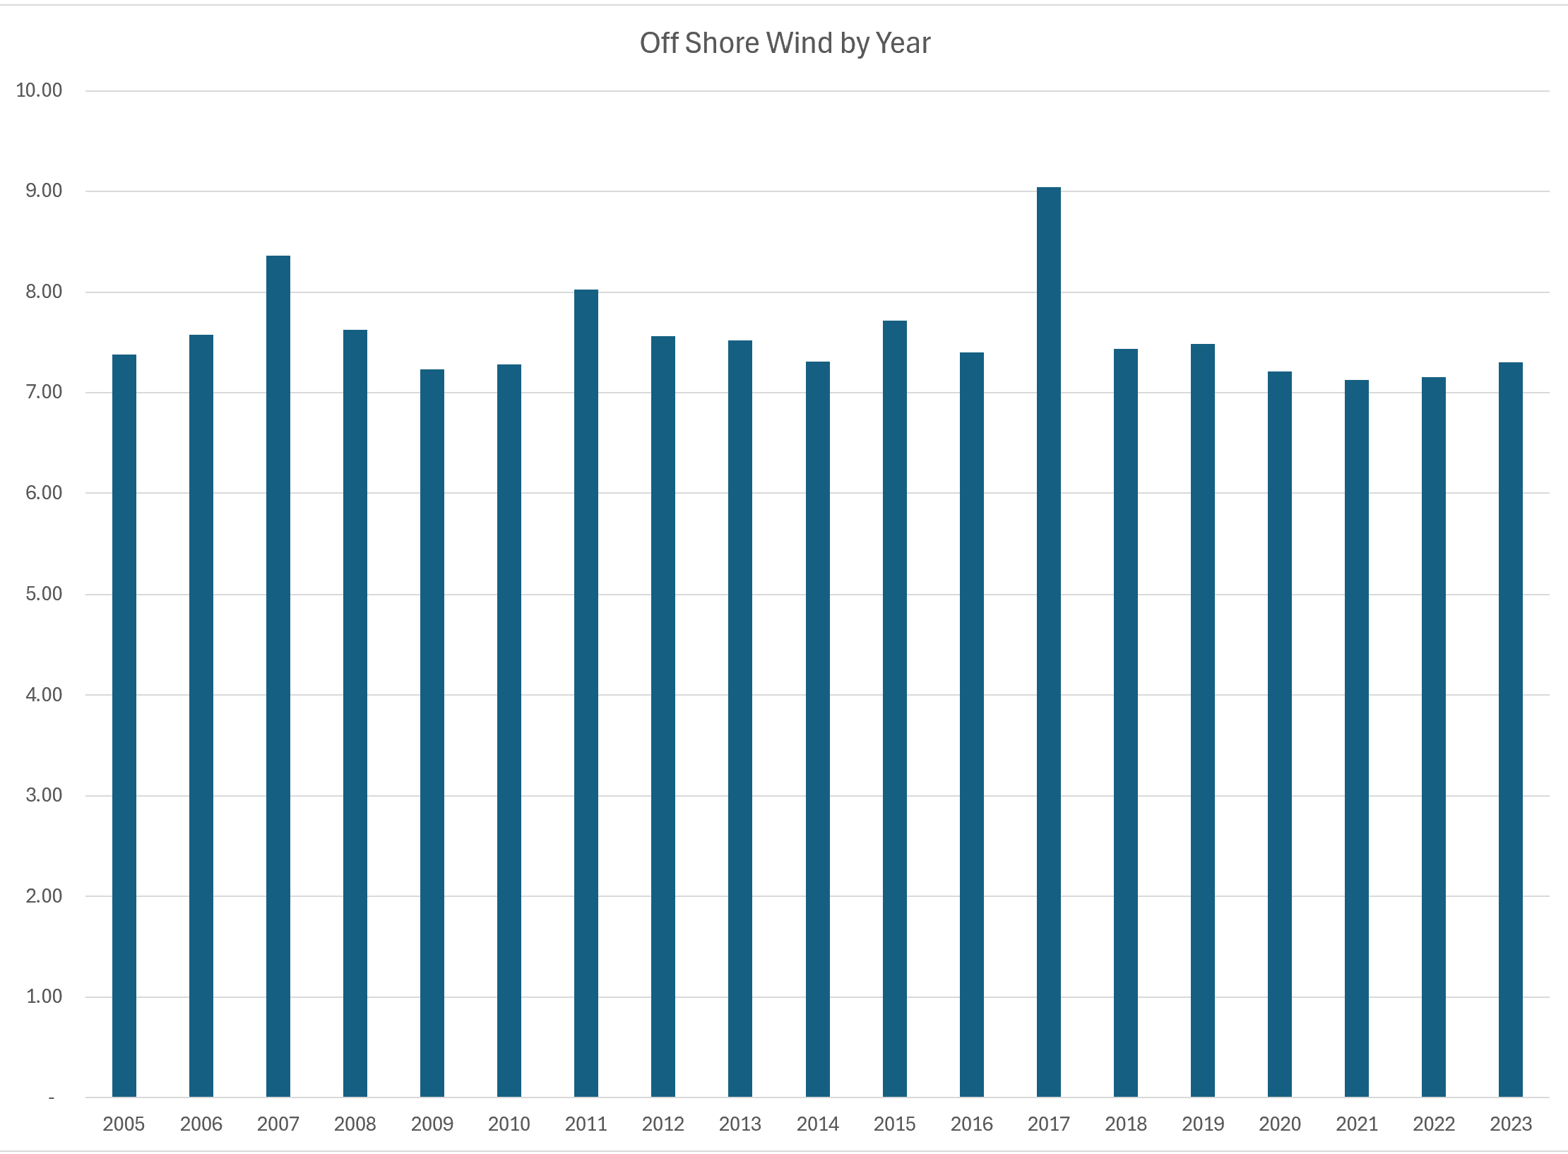
Offshore Wind by Year in Oman
.

Slide 68
Wind Capacity Factor and Production
Compute wind at higher heights using wind shear
Combine the wind after wind shear with the power curve for capacity factor
Multiply the capacity factor by the assumed capacity to calculate generation
Adjust the generation for losses from wake effect etc.

Slide 69
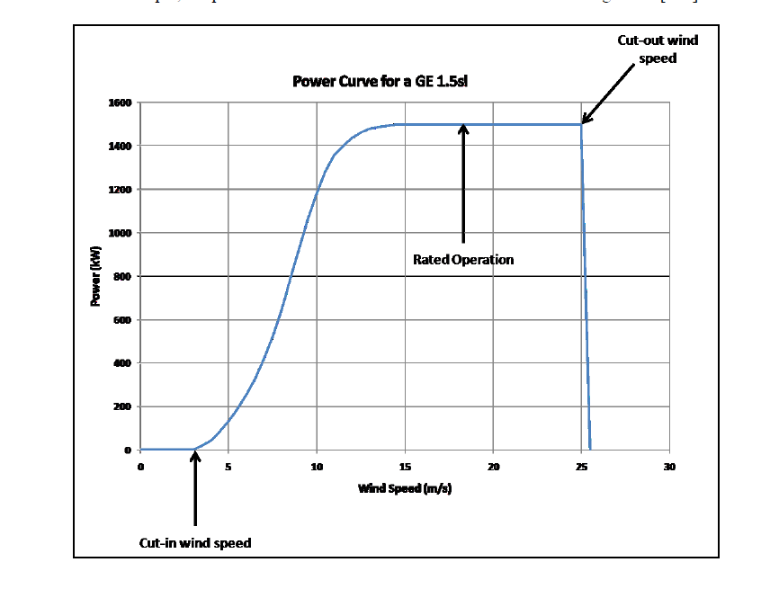
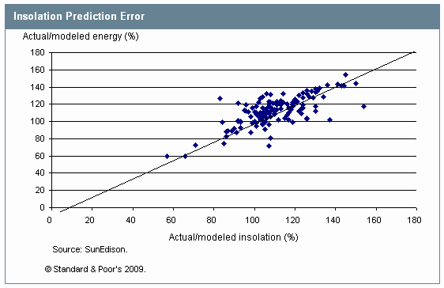
Relationship between Resource (Wind or Solar) and Energy Output – Understand Power Curve
Solar is Linear and Wind has Curve – Power Curve. The non-linear aspect of power curve is key to wind. Small differences in power curve can have big effects on wind production.

Slide 70
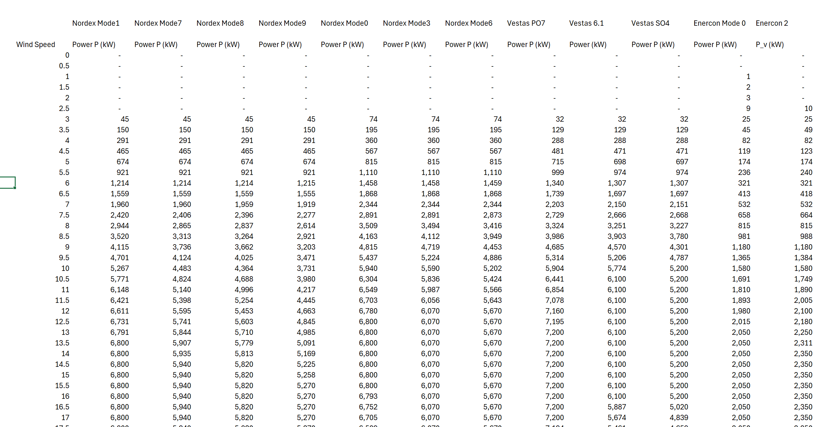
Example of Different Power Curves
Wind Speed and Capacity

Slide 71

Power Curves Expressed as Percent of Capacity
Different Power Curves have different cut-out speeds
Express as a percent of capacity because cost is expressed in USD per kW of capacity
Should pay more per kW of capacity if the power curve is higher

Slide 72

Selected Power Curves
Can be a large difference in power curves – best depends on wind speed

Slide 73

Power Curve Normalisation
http://www.thewindpower.net
Power curve can be expressed as a percent of the maximum capacity.

Slide 74

Wind Shear Adjustment
Height in meters versus wind speed in meters/second
Z2 and z1 are the height in meters
Speed = (100/10)^.143 x 10 Meter Speed
Wind Speed high height = Wind Speed low x (height/low) ^ Alpha

Slide 75
Calculation of Wind Shear Exponent
.
Calculation of Wind Shear Factor Using Logs – the difference in wind speed on the top in the numerator and the height in the denominator.
Alpha is the log of wind ratio divided by the log of height ratio
v2 is wind speed at high height
Z2 and z1 are the height in meters
10 meter 5.13
100 meter 8.21
Begin with 1/7 power law – alpha = .142; but not good enough for site specific applications

Slide 76

Example of Wind Study and Height
Uncertainty in measuring
Test the alpha at different heights. First compute the alpha as log of wind ratio divided by log of height ratio.
Then test whether the ratio of height raised to the power

Slide 77

Changing Alpha from Wind Study
Check of mathematics

Slide 78



Get the 10 meter and different heights
Latitude 18.7333729
Longitude 56.372223

Slide 79




300 Meter Wind Turbines
.

Slide 80

Wind Shear Estimates
Alpha = .17
v2 =8
v1 = 6
z2 = 100
z1 = 50
Derive the alpha from the chart below

Slide 81

Errors in Wind Shear
Wind shear is the variation of wind speed with elevation. It is important to understand because it directly impacts the power available at different wind turbine hub heights.
For the site with the most complex terrain, the average annual wind shear varied up to 7% between different years.
For fairly flat terrain, many investigators have used the one-seventh power law, where α = 1/7 = .143

Slide 82

Estimation of Production after Losses with Resource Study
For any renewable energy project, a resource analysis is made. For wind projects this is based on an assessment of local wind speed and the wind power curve.
The output from a resource study can be expressed as a capacity factor (average/maximum). In the example, 340.3 x 1000/8760 is the average and this average divided by the 94 capacity gives the capacity factor.
The resource study also gives probabilities of downside cases which is essential for banks. The P99 one year capacity factor is 31.1%

Slide 83

Estimation of Wind Capacity Factor
From study of wind in Jamica

Slide 84

Calculation of Hourly Wind Production
Note the capacity factor after the wake and other losses.

Slide 85

Selected Graphs of Historic Capacity Factors for Orsted Projects – Mean Reverting Case
I have used the data provided by Orsted to compute and present capacity factors for different cases. This data highlights financial risks that investors are concerned about. The first case for an off-shore plant in the UK with a lot of history demonstrates a situation that should not be of concern. There is variation in the capacity factor, but this variation does not have a trend, and it is mean reverting. For valuation you should be much less concerned about mean reverting cash flow.

Slide 86

Drop Off in Capacity Factor for German Project
The second example I use is a case of a German project. If you were making a valuation of the project, would you use the average or the recent data (I would use the recent data). There has been discussion of global warming having an important effect on wind speeds in different locations.
Note that the lower capacity factor in the initial year is expected.
This worrisome trend appears in other German projects as well.
The lower capacity factor could also be the result of transmission constraints.

Slide 87
Risk Analysis for Wind and Solar for Credit

Slide 88
Objectives of Section
Structuring contracts around risk and project characteristics
Structuring loan agreement around risk
Understanding the P90 or other P and what it measures
What does DSCR on P90 mean
Can risks really be boiled down to probability statistics
Evaluation of technical risks
Wouldn’t it be fantastic if you could just get a downside case from pure objective mathematics

Slide 89
Mathematics of P90
Step 1: Compute Standard Deviation
Step 2: Use NORMINV in excel to compute P90 from standard deviation
Step 3: Use Mean Squared Error to Compute Multiple Standard Deviations
Mathematical Principles
  Everything depends on the standard deviation
  Standard deviation is computed for different components
  Some parts of standard deviation are straightforward
  Some components of standard deviation are more judgmental
  Basic Statistical Idea
    If variation is independent, you cannot add depreciation
    You can use Mean Square Error
    Step 1: Square each standard depreciation
    Step 2: Add the squares of standard deviation
    Step 3: Once, you have the sum, take the square root
    Step 4: The square root is the combined standard deviation
  Once you have the standard deviation, use NORMINV
    NORMINV takes probability, mean and standard deviation
    Mean is the P50
  Philosophic issue
    Can you really boil down risks to a standard deviation

Slide 90
P90 and DSCR
General idea of DSCR
  DSCR = CFADS/Debt Service
  Example 150/100 = 1.5x
  Does not mean that cash flow can decrease by 50% and no default
  Reduction in CFADS to break even – 50
  Cash Flow 150
  Percent reduction 50/150 = 1/3 = 33%
  General Formula: Break Even → 50/150 or (DSCR – 1)/DSCR
  Relation to P90, P90/P50 = X %

Slide 91

Risks Other Than Resource Risk
Availability Risk
Technical Risk
O&M Risk
Transmission Risk
Environmental Risk
Political Risk
Degradation Risk
The resource study also gives probabilities of downside cases which is essential for banks. The P99 one year capacity factor is 31.1%

Slide 92


Example of Lender Analysis which Uses Data not Available to Equity Investor
Key Credit Concerns and Verification with Independent Engineer
Use of Alternative Parameters from Experience

Slide 93

On-Site and Simulated Solar Power
Compute standard deviation
Compute the P50 versus P90
Compute the debt capacity with 20 year debt
Compute P50 for P90 for wind versus solar

Slide 94

Where Uncertainty Comes From – Not Just Variation Year to Year
First, there may be different solar resource estimates from different models
How would you account for this in the P90

Slide 95

Availability Risk of Solar

Slide 96

Mean Square Error – Exercise, Compute it
Exercise
  Compute the square of the component
  Sum the Squares of the components
  Take the Square Root of the Sum

Slide 97

Exercise - Solar
Derive standard deviation
Compute P90

Slide 98

Compute P Levels from Uncertainty
Convert Percent to kWh
Use Norminv
How could you derive the implied standard deviation in this chart

Slide 99

P50 and P99 in Solar Case
Evaluate the P50 and P99 using the DSCR criteria.

Slide 100
Example of Sources of Uncertainty

Slide 101

Noise from Turbines
The amount of noise from turbines can be measured and guaranteed, unlike the flicker example

Slide 102

Risks from Avian Issues
Problems of birds can reduce the output of turbines.
  Example in France when must stop turbines during bird migration
  Example in Canada with reduction in generation and also costs for scientists

Slide 103
Additional Risks: Transmission Capacity
Best Wind Sites not Located in Load Centres
  Wind Producer may be responsible for transmission
  Examples of curtailment
    Lake Turkana
    Oklahoma
  Low Merchant Prices in Transmission Constrained Areas
    Example: Montana and Off-peak Prices
NL has priority dispatch for RES. In addition, in case of curtailment compensation is paid. So far, curtailment is seemingly not an issue in NL.

Slide 104
Additional Risk: Partial Exposure to Merchant Power Price
History of Merchant Power and Merchant Power Problems at the Turn of the Century
Debt Structuring with Merchant Power Risk
Examples of Merchant Power Risk in PPA Contracts

Slide 105
Additional Risks: Shadow Flicker
What is shadow flicker in wind and is it a big deal
Shadow flicker is the intermittent shadow casted by the moving wind blades of a wind turbine. The extent of its impact depends on the latitude of the project, time of the day, time of the year, turbine height, blade length, distance between the impacted dwelling and the turbine, the window placement of the dwelling etc.
Depends on the project and buildings in the vicinity and the rules & regulations. Some projects need to stop turbines for specific times for shadow flicker reasons.
Certain governing bodies have clear regulations on shadow flicker, e.g. max number of shadow hours casted at a dwelling. Even if there is no clear written regulations, residence (participating or not participating in the project) can express concerns during public comment period of a permitting process if there is one. Shadow flicker can be modeled using commercially available software like wind pro.

Slide 106
Counter Party Risk and O&M Contracts
Replacement of the EPC/maintenance contractor --Consider a case where the turbine manufacturer/supplier will build the wind farm (EPC contract, full scope) and will also maintain it (the turbines, maintenance agreement).
  Is the turbine manufacturer/supplier easy to replace (for example in case of bankruptcy)?
  Can a replacement turbine manufacturer/supplier maintain the current installed turbines and replace its parts?
  Or, are parts and turbines very (brand) specific and do they need to install their own turbines (or even windmills)?
  Do these turbine manufacturers/suppliers use parts from subcontractors or is everything designed and built in-house and very specific?

Slide 107
Nightmare Graph and Missing the P90 – Fitch Report

Slide 108

DSCR to Accept 90% or 99% Uncertainty
The total of individual simulations has the MSE when the variables are independent

Slide 109

1-year and 10-year P90, P50 etc.

Slide 110

Compare the P50 versus P99 to DSCR from Wind Study
The difference between P50 and P99

Slide 111
LCOE Mechanics
Understanding the
Competitiveness and
Drivers of Value for Renewable Energy

Slide 112
Overview of Section
Understand Economic Costs and Benefits with Levelised Cost of Electricity (LCOE)
  Taking away mystery of LCOE
  Drivers of LCOE
  Reconciliation of LCOE and Simple Financial Model
  Nuances of LCOE
  Importance of Cost of Capital and Project Financing
  Using LCOE to Evaluate Costs and Benefits of Renewable Energy

Slide 113
Objectives and Issues in this Section
Cost measurement
  Fundamental issue in electricity of which is the best alternative
  Understanding LCOE
  How to Incorporate Battery Storage in LCOE
Drivers
  Capital Cost (USD/kWp)
  O&M Cost (USD/kW-y)
  Capacity Factor
  Degradation
  Required Project IRR
  Inflation

Slide 114

Definition and Importance of Capital-Intensive Investment
Any investment and operating costs, investment and life
Street Vendor
  Asset is truck and inventory
  High operating expense
  Most revenue covers costs of sales and labor
  Most revenues for operating expense and not truck
  Truck has relatively short life
  Assets to Revenues a little more than 1.0
Railway
  Assets high relative to the operating expense
  Assets last a long time
  Revenues spread over long period
  Assets many times the value of revenues

Slide 115


Capital Intensity – Refinery versus Roof-top Solar and Importance of Financing

Slide 116


Capital Intensity – Hydro versus Natural Gas

Slide 117


Capital Intensity – Energy Efficient House and Food Store
.

Slide 118


Which is more Capital-Intensive Electric or Internal Combustion

Slide 119

German Solar Feed-In Tariffs
Example of government policy that worked. Idea to make very simple tariff to finance projects and then achieve scale.

Slide 120

German Tariffs for Alternative Sizes of PV

Slide 121

Context of Subsided Prices – Compare 45 Euro/kWh with Merchant Prices of about 3 Euro Cents
Demonstrates that the economics of solar power can be driven by natural gas prices

Slide 122


Revolution in Solar Module Prices and the Price of Polysilicon
.

Slide 123

Dubai 6 Cents per kWh in 2015

Slide 124


Examples of Very Low Solar Prices
To see how far things have come, there are many projects now that are lower than 2 USD cents per kWh.

Slide 125

Low-Cost Solar Example
Assume that there is inflation in the tariff

Slide 126

LCOE Estimates for Discussed Later
.

Slide 127
Section 3: Computation of Levelised Cost of Electricity with Battery Storage for Different Use Cases
Alternative battery cases including Ancillary Services, Peaker Replacement, Movement of Power to Nighttime Peak and Base Load Case.
Inclusion of batteries in LCOE with different assumptions for battery cost, battery life, battery degradation, battery round trip efficiency and battery dispatch
Case exercise with solar use case and battery implemented for ancillary services
Dispatch of Batteries in Alternative Contexts and Effects on LCOE
Risk Evaluation Using Break-Even and Sensitivity Analysis

Slide 128

Natural Gas Price History
.

Slide 129

Levelised Cost of Dispatchable Plants and Variable Cost
Comparison of real LCOE for Renewable with Fuel Prices/kWh
.

Slide 130

Example of LCOE versus Electric Bill
Focus on variable charges

Slide 131

Actual Case – Financial Model, Should show drivers
.

Slide 132

O&M Costs and Capital Expenditures
.

Slide 133

Real World Minimum Acceptable Target IRR
In practice there is no CAPM and certainly no un-levering and re-levering of Beta (see the discussion at the end).
In practice, equity IRR is used rather than project IRR as a target (this makes sense in theory as project finance implicitly adjusts for risk
In practice, and there are general standards for target IRR on buying and selling of projects. These standards have change over time. Pre-Covid for projects in Europe with a few years of history, equity IRR targets were as low as 4%.
I have been told stories of insurance company executives and pension plan managers going around Europe holding suitcases of cash to buy solar and wind projects with operating history.

Slide 134

Can Get Solar at 2 US Cents per kWh so why can’t Jamica
Uzbekistan proof of solar power cost
Uzbekistan sovereign rating
Uzbekistan solar power resource

Slide 135

Simple LCOE Calculations and Drivers – Solar Cost
.

Slide 136

EPC Contractors to Achieve Low Cost
Contractors for solar and battery listed in PPA.

Slide 137

Pricing Regimes for Orsted’s Non-UK Offshore Wind Projects
After disaster with the Ocean Wind Project, Orsted just began publishing prices for different projects. Most of the projects have feed-in tariffs. Note that the highest prices are in Taiwan and in US (in Taiwan the capacity factor is low). The lowest prices are the recent fixed price contracts in Poland. Most contracts have some merchant price exposure.

Slide 138

UK Renewable Obligation Certificates (ROC) and CFD
The UK attempted to base subsidies from a market basis where suppliers are given targets and the subsidy required to meet the target is applied to different renewable energy projects. As different renewable energy technologies have different costs, the amount of ROC’s depends on the type of technology. The table shows the renewable energy subsidy (which is above the market price) for different periods.
The UK has moved to a bidding system where total prices are fixed (with inflation indexes). The fixed prices are like forward prices and termed contracts for differences discussed below.

Slide 139




Example of Feed-in Tariff Calculation
Note the return on equity target of 11.5%

Slide 140

We will demonstrate how to make a relatively simple analysis of the LCOE – Not much excel
Calculation of the cost of different alternatives with simple LCOE
Open the File named LCOE Analysis

Slide 141

LCOE So Far With More Advanced Equations
.
The more advanced equations include real versus nominal and degradation

Slide 142

Reconcile LCOE with Financial Model - Lazard
.

Slide 143

Financial Model for Storage
.

Slide 144

Financial Model in LCOE Analysis
.

Slide 145
It Should be Obvious that One Should Compare LCOE of Renewable and Thermal Plants
If you build a solar project the LCOE is the effective amount you pay for the solar project is the amount for when you use the solar project.
Assume that you still need the combined cycle or the heavy oil plant to meet load at night and when the sun does not shine.
You could then do economic analysis by comparing only the variable cost of operating the thermal dispatchable plant per kWh with the total cost of the solar project.
You should be very careful with variable O&M costs of thermal as there will be more starts and stops
This kind of analysis works if the thermal plants are running during the time that solar or wind is producing power. It does not work if the plants are turned off and batteries are necessary for allowing the plants to turn on and off.
When there is more renewable energy, you need to understand how the thermal plants will work.

Slide 146
Analysis of Solar and
Wind Debt Structuring with P90 and DSCR Target

Slide 147
Risk Analysis and Financial Models
Evaluation of Financing and Integrated Financial Models of Battery Systems is more around risk analyses and not really around financial analysis and modelling in relation to energy storage as the title implies. Can this section be modified to also include how a utility should go about doing the financial analysis and modelling so that the appropriate cost parameters be included in the PPA.

Slide 148
Financial Models for Batteries and Renewable Energy
Financial Model versus LCOE Driver Analysis
  Should reconcile
  Taxes can be included
  Replacement with different lives is an issue
  Detailed finance costs and cost of capital
  Reconcile different methods to compute LCOE
Presentation of Financial Model
  Show the LCOE and sensitivity
  Evaluate different strategies
  Evaluate risks of different strategies
  Show the prices and financial results
Understand corporate versus project finance model

Slide 149
Three DSCR’s in Solar Case
Distributions
  Make any distribution unless such distribution is made from Distributable Cash and on a Distribution Date; if the Average Annual DSCR calculated as of the Repayment Date immediately preceding such Distribution Date is less than 1.20 to 1.00, or
  the Average Annual Projected DSCR (based upon the Term Conversion Date Base Case Projections but updated for actual operating performance of the Project through the applicable Repayment Date) calculated as of the Repayment Date immediately preceding such Distribution Date, is less than 1.20 to 1.00;
Financial Covenants (Default)
  Permit the Average Annual DSCR as of the last day of any Quarterly Date commencing from the first Repayment Date to be less than 1.10 to 1.00 or
  Permit the Average Annual Projected DSCR (based upon the Term Conversion Date Base Case Projections but updated for actual operating performance of the Project through the applicable Repayment Date) calculated as of the Repayment Date immediately preceding such Distribution Date, as of the last day of any Quarterly Date commencing from the first Repayment Date to be less than 1.10 to 1.00;
Minimum Term Conversion Date Debt Service Coverage Ratio
  a minimum Average Annual Projected Debt Service Coverage Ratio for the twelve (12) month period of 1.35 to 1 on a P50 Production Level during years 1 through 9, and,
  1.00 to 1 under a P99 Production Level during years 1 through 9 of the amortization schedule.

Slide 150


DSCR for Solar PV from Fitch

Slide 151
Pre-and Post COD Analysis
Pre-Cod
Post-Cod

Slide 152

Risk Analysis in Solar Projects

Slide 153

Other Inputs – Price Calculation, Required IRR and Finance Inputs
Focus less on detailed finance than a detailed financial models.
Will compute price from the required IRR as in the LCOE

Slide 154
Term Coverage Ratio in Solar Case
“Minimum Term Conversion Date Debt Service Coverage Ratio” means,
  a minimum Average Annual Projected Debt Service Coverage Ratio for the twelve (12) month period of:
  1.35 to 1 on a P50 Production Level during years 1 through 9, and
  1.00 to 1 under a P99 Production Level during years 1 through 9 of the amortization schedule.

Slide 155


Fundamental Effect of Debt Tenure with Debt to Capital Constraint

Slide 156
Sculpting Equations - Basic
One of the main ideas about the repayment process in project finance is that the modelling is much more effective when you combine formulas with other excel techniques. If you try and solve these things with a brute force method that uses a copy and paste method or goal seek things will get very messy. Formulas used for repayment and debt sizing are listed below: The fundamental two sculpting formulas are:
(1) Target Debt Service Per Period = CFADS/DSCR
(2) Debt Amount at COD = PV(Interest Rate, Target Debt Service)
Non-Constant Interest Rates
However, this is by no means the only formula you should use when working on repayment. In cases when the interest rate changes, a simple present value formula cannot be used. Instead, an interest rate index can be created that accounts for prior interest rate changes as follows:
(3) Int Rate Index(t) = Int Rate Indext-1 x (1+Interest Rate(t))
(4) Debt Amount at COD = ∑ Debt Service(t)/Interest Rate Index(t)

Slide 157
Sculpting Equations with Debt to Capital Constraint
Use of LLCR when there is a Target Debt to Capital constraint that drives the amount of the debt. If the debt is being sized by the debt to capital ratio, a higher DSCR must be used.
This raises the issue of how to compute sculpted debt repayments when debt is sized with the debt to capital ratio and the DSCR is not from the DSCR constraint.
When the Debt is Sized by Debt to Capital the LLCR can be used to size the debt, because with sculpting, the DSCR = LLCR. Formulas in this case include:
(5) Target Debt Service(t) = CF(t)/LLCR
(6) LLCR = NPV(Interest Rate, CFADS)/Max Debt from Debt to Capital
(7) DSCR Applied = MAX(Target DSCR,LLCR with Max Debt)

Slide 158
Sculpting Equations with LC Fees
Adjusting Sculpting Equations for Debt Fees: Debt fees such as the fee on a letter of credit is part of debt service. To include the fees in the sculpting equations, you should subtract the fees when you compute the net present value of debt, as the fees reduce the amount of debt service that can be supported by cash flow. To make the sculpting work you should also make the repayment lower by the fees as shown below:
(14) Repayment = CFADS/DSCR - Interest - Fees
(15) Debt = NPV(Interest Rate, Debt Service-fees)
Debt = NPV(rate, Debt Service) - NPV(rate, Fees)
Note Debt Service in the above equation means debt service without fees and debt is reduced by PV of fees
Adjusting LLCR for Debt Fees: The sculpting analyses include calculation of the LLCR to evaluate whether the debt to capital constraint is driving the constraint. In this case the PV of CFADS is not the correct numerator for the analysis. Instead, the PV of the LC fees should be added to the denominator of the LLCR as follows:
(16) LLCR = PV(CFADS)/(Debt + PV of LC Fees), where
(17) Debt = Project Cost x Debt to Capital

Slide 159
Sculpting with DSRA as Final Payment
Sculpting and Changes in the DSRA balance including Final Repayment
After working through letters of credit for the DSRA, taxes, interest income and other factors that cause difficult circular references, the final subject addressed is using the DSRA to repay debt.
A similar result occurs when changes in the DSRA are included in CFADS. Incorporating these changes in a financial model without massive circularity disruptions can be tricky, but it can be solved by separately computing the present value of changes in the DSRA.
Changes in the DSRA can be modelled using the following equations:
(18) Debt Adjustment = PV(Interest Rate, Change in DSRA/DSCR)
(19) Repayment = Repayment from Normal Sculpting + Change in DSRA/DSCR

Slide 160


Sculpting versus Equal Installment with DSCR Constraint
Note the big increase in IRR with the DSCR constraint – because of the larger debt size. Recall that can effectively make the DSCR constraint be in place

Slide 161
Sculpting Equations - Basic
One of the main ideas about the repayment process in project finance is that the modelling is much more effective when you combine formulas with other excel techniques. If you try and solve these things with a brute force method that uses a copy and paste method or goal seek things will get very messy. Formulas used for repayment and debt sizing are listed below: The fundamental two sculpting formulas are:
(1) Target Debt Service Per Period = CFADS/DSCR
(2) Debt Amount at COD = PV(Interest Rate, Target Debt Service)
Non-Constant Interest Rates
However this is by no means the only formula you should use when working on repayment. In cases when the interest rate changes, a simple present value formula cannot be used. Instead, an interest rate index can be created that accounts for prior interest rate changes as follows:
(3) Int Rate Index(t) = Int Rate Indext-1 x (1+Interest Rate(t))
(4) Debt Amount at COD = ∑ Debt Service(t)/Interest Rate Index(t)

Slide 162
Sculpting Equations with Debt to Capital Constraint
Use of LLCR when there is a Target Debt to Capital constraint that drives the amount of the debt. If the debt is being sized by the debt to capital ratio, a higher DSCR must be used.
This raises the issue of how to compute sculpted debt repayments when debt is sized with the debt to capital ratio and the DSCR is not from the DSCR constraint.
When the Debt is Sized by Debt to Capital the LLCR can be used to size the debt, because with sculpting, the DSCR = LLCR. Formulas in this case include:
(5) Target Debt Service(t) = CF(t)/LLCR
(6) LLCR = NPV(Interest Rate, CFADS)/Max Debt from Debt to Capital
(7) DSCR Applied = MAX(Target DSCR,LLCR with Max Debt)

Slide 163
Sculpting Equations with LC Fees
Adjusting Sculpting Equations for Debt Fees: Debt fees such as the fee on a letter of credit is part of debt service. To include the fees in the sculpting equations, you should subtract the fees when you compute the net present value of debt, as the fees reduce the amount of debt service that can be supported by cash flow. To make the sculpting work you should also make the repayment lower by the fees as shown below:
(14) Repayment = CFADS/DSCR - Interest - Fees
(15) Debt = NPV(Interest Rate, Debt Service-fees)
Debt = NPV(rate, Debt Service) - NPV(rate, Fees)
Note Debt Service in the above equation means debt service without fees and debt is reduced by PV of fees
Adjusting LLCR for Debt Fees: The sculpting analyses include calculation of the LLCR to evaluate whether the debt to capital constraint is driving the constraint. In this case the PV of CFADS is not the correct numerator for the analysis. Instead, the PV of the LC fees should be added to the denominator of the LLCR as follows:
(16) LLCR = PV(CFADS)/(Debt + PV of LC Fees), where
(17) Debt = Project Cost x Debt to Capital

Slide 164
Mini-perms
Matching the tenor of repayment to the life of the project and even considering terminal value in the repayment in the context of both achieving a higher DSCR and an improved equity IRR.
Problems with multi-lateral agencies that allow long-term maturity can be contrasted with commercial banks and bond financing that may be more flexible and sometimes could have lower costs.
Specifically, the effects of hard and soft mini-perms on the profitability of a project along with the difficult problem of required re-financing assumptions.
How the DSRA could be used to re-finance debt at end of loan life and how potential terminal value can be used to justify partial bullet repayment at end of loan.

Slide 165
Re-financing Conclusions
Not being “allowed” to consider re-financing is silly.
Consider a variety of re-financing possibilities with scenario analysis
Re-financing can dramatically change the implications of interest rates and tenures.
Re-financing a particularly important issue for cases where the loan tenure is a lot shorter than the project life.

Slide 166
A Little Theory about Valuation and Risk of Projects
Valuation theory with respect to projects generally involves risk reduction as a project progresses through phases.
In Europe, there are many stories (but not much data) about how insurance companies purchase existing projects with operating history and are willing to accept equity IRR’s as low as 5-6%.
The idea behind a low cost of capital for mature projects is the following:
  During the development stage, expenditures occur with large risks associated with permitting, problematic wind studies, construction cost over-runs, ability to secure tariffs etc. The required equity IRR during the development stage can be 15% to account for the project not being successfully methods.
  Once the development is finished or in late stages, the risk is reduced by a large margin. However there are still risks associated with successfully completing construction at budget and on time. The reduced risk during the construction phase may reduce the required equity IRR to something like 12%
  After construction, the remaining risk for a project with a fixed price contract is that the estimated wind production will not be met. Given this risk, the discount risk is still above the cost of capital for bonds and may be in the range of 8-10%.
  Once operating history is available, the risk is not much higher than the debt cost or the interest rate on long-term bonds. With bonds yielding below 3%, a return of 6% provides a good premium for risk.

Slide 167
Re-financing and Early Project Sale
Timing strategies and sales value. How different types of projects have differences in risk reduction over time, and why wind projects probably have more of a risk reduction than other electricity projects. Show how the effects of changing risk and selling to a Yieldco can be demonstrated with measuring IRR over time with changing buyer IRRs. Demonstrate how optimal holding periods can be computed with various IRR hurdle rate assumptions.

Slide 168

Mini-Perm
Start with Amortisation Profile – this is what drives the debt size.
Compute debt size form Amortisation period

Slide 169
Mini-Perm Example
Term Loan Principal Scheduled Payments. Borrower shall repay to Administrative Agent, for the account of each Lender, the aggregate unpaid principal amount of the Term Loans made by such Lender in installments payable on each Repayment Date in accordance with the Amortization Schedule set forth below, together with any remaining unpaid principal, interest, fees and costs due and payable on the Term Loan Maturity Date. The Parties hereto acknowledge and agree that the Amortization Schedule set forth below shows the amount of each installment payment of the Term Loans to be made on each Repayment Date:
Amortization Schedule
Quarterly Payments | Amount
1-4 | $102,600
5-8 | $111,400
9-12 | $118,500
13-16 | $128,000
17-20 | $136,000
21-24 | $146,250
25-28 | $157,000
29-32 | $168,250
33-36 | $180,000
Term Loan Maturity Date | $5,508,000

Slide 170
Mini-Perm Extension
Term Loan Maturity Date Extension.
The Borrower may:
  not sooner than twelve (12) months and,
  not later than six (6) months prior to the then-current Term Loan Maturity Date
Request that the Term Loan Maturity Date be extended for an additional period selected by Borrower of up to an additional five (5) years (an “Extension Request”).

Slide 171
Mini-Perm Extension - Continued
Borrower and the Lenders mutually agree to alternate terms and conditions not later than four (4) months prior to the then-current Term Loan Maturity Date
No Lender shall have any obligation to agree to have any of its Term Loans extended pursuant to any Extension Request.
To the extent that not all Lenders approve an Extension Request, the Borrower shall have the right to replace each Lender that voted not to approve such Extension Request, and add as “Lenders”
On the then-current Term Loan Maturity Date, the Borrower shall repay each non-consenting Lender its Proportionate Share of the Term Loans.

Slide 172
Section 3: Introduction to Batteries:
Integration of Supply and Demand and Different Use Cases

Slide 173
Other Examples of Use Cases
Take the Example of a Car
  If you only use the car for short distances and only to get to work, you would buy a different car than if you had to travel long distances and bring a few people
Other Examples
For Batteries, you may use the batteries for different functions
Be very careful about assuming that you can use the batteries for multiple functions that depend on:
  Electricity usage over a day
  Electricity usage in very short time periods
  The value of electricity in different periods – merchant
  The sources of supply of electricity (solar, wind, renewable)

Slide 174

Addition of Loads and Capacity to the Analysis
Assume weekday and weekend Loads Continue
Multiply Load Percentages by Total Load
Analysis for One Year
Solar is Capacity Factor x Capacity Factor
Solar is Reduced by Simple Performance Ratio
Wind Uses a Wind Shear Exponent to Get to 100 Meters
Wind Uses a Good Power Curve and 5% Losses
Evaluate Thermal Variation and Requirement

Slide 175

Combine Loads with Solar – Jamica Loads
.
Before renewable energy, this kind of flat pattern would have been considered good – we do not need extra plants for short-term use.
Everything is different with Solar and wind

Slide 176


Chicago versus Jamica Loads – No Longer Better to Have Flat Loads
.

Slide 177


Example of Load Data - Predictable and Different Patterns Around the World

Slide 178


Malaysia Hourly Load versus Chicago

Slide 179

Hourly Soar and Wind in Oman – Note Fluctuation on the second day
.
You need a lot of battery storage to meet the rainy days

Slide 180

Hourly Solar and Wind – Sudden Moves and Low Irradiation
.
Note the sudden change in the solar on the third day – need for ancillary services as no inertia in solar

Slide 181

Hourly Data – Stable Solar near Irradiation STC and Relatively Stable Wind
.

Slide 182

Graph of Dispatch without Renewable – One Week – Demand on Top and Dispatch
.

Slide 183

Illustration of Load, Solar (Yellow) and Dispatchable (Brown) VRE is Renewable Energy

Slide 184
Battery Capacity Measured with Storage and Also Measured with Instant Input and Output for Evaluation of Use Cases

Slide 185
Issues to Consider
How much storage do you need for short-term demand movements
If you need 24 hours of storage for a data centre and the solar load is for 6 hours
Assume the load is 100 MW each hour
  Can you do this with 18 batteries with one hour of storage, each with 100 MW
  Can you do this with one batter with 18 hours of storage (not sure if 18 hour batteries are possible, but assume anyway)
  Can you do this with batteries with 6-hour duration – 3 batteries with 100 MW capacity

Slide 186
Diagram of Battery Capacity, Storage and Energy
The diagram below of a water tower illustrates the issue of capacity storage and energy. In determining how much storage or ancillary service you need, should you use:
  The maximum amount of electricity that can be sent to the battery or drawn from the battery at any instant, measured in kW.
  The maximum amount of energy that you can take from the battery – the discharge -- over a cycle (e.g., a day) measured in kW x time of discharge or kWh
  The maximum amount of energy that you can send to the battery over a cycle – the charge – measured again in kWh.

Slide 187

Battery Characteristics

Slide 188

Battery Capacity and a Water Tower
The issue of capacity is illustrated by picture of a water tower below. The capacity to charge or discharge in an instant is illustrated by the pipe leading up to the storage tank.
The amount of energy from one charge is illustrated by the size of the tank.
Think of the pipe as the instantaneous amount of water that can be discharged or charged

Slide 189


Capacity and Storage of Batteries - Think of a Battery Like a Water Tower or a Warehouse
The pipe is the capacity at any instant. If this pipe capacity is 100 kW, then in one hour, the maximum that can be charged or delivered in one single hour is 100 kWh
kwh
The storage tank is the number of hours that be stored and then delivered. It is measured in kWh. If the capacity is 100 kW and the storage is 4 hours, then the kWh is 400 kWh.
Bigger Spout gives faster water
kw
In the warehouse, the movement in and out is the capacity (kW) – how many boxes in and out. The time in storage is kWh – you need the space for the boxes.

Slide 190

Different Capacity and Energy of Different Batteries
Hours of storage is kWh/kW
Compute the kW/kWh
Need to Charge Fast
Length of Storage more Important

Slide 191

Phone Capacity in kW and Storage in kWh
.

Slide 192

Time and Batteries
.

Slide 193

Capacity in kWh
You can multiply the voltage by the hertz

Slide 194

Battery Size for Ancillary Service
With AES developed a 2-MW, 500-kWh system with the capability of producing 1,000 amps at 1,000 volts that was designed and built to fit inside two 53-foot trailers for ancillary services
Compute the battery duration

Slide 195

Picture of Large Lithium Facility in U.S.

Slide 196

High Battery Cost Jamaica
Cost per kW and per kWh
What is the Cost per kWh
.
.
What is the use case
What is the duration

Slide 197

Equipment for Storage

Slide 198

Battery Components
.

Slide 199

Elephant in the Room
In can be cloudy for many days or it can be dark in the winter for weeks. You would need much more than a few hours of storage.

Slide 200
Battery Use Case
Analysis – Combining Demand with Storage Characteristics

Slide 201
Time and Batteries
.

Slide 202


Section 1, Part 7 – Myth of Using Batteries for Multiple Uses
What if you do not have the battery charged and you suddenly need it for frequency – for example a hospital or a remote petrochemical facility.

Slide 203

Cost and Benefit Analysis – Cannot Combine the Frequency and the Storage Savings
Compare the Cost and the Savings
Frequency Problems at Mine and Lose Power
Value of Frequency versus On and Off Peak

Slide 204
Battery Use Case 1 –
Tariff Arbitrage where you charge when rates are low and discharge when rates are high

Slide 205
General Comments on Arbitrage and Questions to Ponder
If you buy off-peak for a number of hours, how much storage do you need
If you have a battery for arbitrage, can you also use the battery from frequency outages
How would you size the battery in this case

Slide 206



South Africa Tariffs – On-peak vs Off-Peak
The red areas have much higher rates. Can you use a battery to store using the green area and discharge in the red areas
.

Slide 207
South Africa Bill for Different Periods
.

Slide 208

Move Power to Off-Peak
To evaluate just about any battery use case, you need to use hourly data

Slide 209

Need Hourly Data for Battery
Require a battery for the entire period
.

Slide 210

Battery Simulation
Use a formula with opening battery balance, charges and discharges to get closing balance
.

Slide 211
Equations for Battery without State of Charge Limitations
Starting Balance (MWh)
Add: Charging subject to Maximum Capacity (MW)
Less: Losses from Round Trip Efficiency (MW)
Less: Discharge subject to Battery Balance (MW)
Closing Balance (MWh)
Define capacity as MWh
Can make limit on MW charge and discharge
Can use to evaluate best size of battery

Slide 212
Use Case 2:
Batteries for Ancillary Services

Slide 213
General Discussion of Ancillary Reserves
Questions to Ponder
  In the desert would you need different levels of ancillary service
  If a system has surplus storage hydro, would you need different levels of ancillary service
  Do different ancillary services require different levels of storage
  How would you evaluate new gas fired generation with the ability to quickly react to changes in load
Ancillary services are generators or other service providers that are synchronized to the grid and are able to rapidly increase output in three major categories: contingency, regulation, and flexibility reserves.
The contingency reserve requirement is assumed to be constant for all hours of the year and corresponds to a spinning reserve equal to about 3% of peak load and about 4.5% of the average load.
Another way to think of “spinning reserves” are the backup or redundancy built into the grid. Basically, we slightly overbuild the total generation needed so the grid can be provided with ancillary services making good quality power possible.

Slide 214

Case of Short-term Ancillary Services
Recall the firming of solar.
Assume limited storage for short-term fluctuations – 10% of Solar
Use a higher cost to reflect the higher kW relative to kWh – Assume $450/kWh to $550/kWh depending on the hours or minutes of storage.
Assume a lifespan of 10 years (discussion of the number of full cycles).
Use alternative storage amounts ranging from 15 minutes to two hours.
Assume the battery capacity is ½ of the solar project.

Slide 215
Illustration of Ancillary Service Use Case with Hourly Analysis
.

Slide 216

Ancillary Services and Time Requirements for Batteries

Slide 217

How Fast can a Thermal Plat Achieve 100% Capacity
The different stages are shown without the specific time. The time it takes to get to 100% can be filled in by discharge of a battery that does not have these stages.

Slide 218

Time for Ramping Plant and Need of Batteries for Ancillary Service
The table relates to batteries and the amount of storage necessary. For a plant that is already hot, there is still a lot of time until it can reach full production.

Slide 219


Ancillary Services, Duration and Cycles

Slide 220

What Really are Ancillary Services
Which are affected by wind and solar

Slide 221

Ancillary Service Example

Slide 222

Ancillary Service Example

Slide 223
Value of Ancillary Service – Measure in Amount per kW-year and not per kWh
For a battery entering service in 2021 in the California ISO, PA Consulting projects a decline in ancillary service revenues:
  Over $70/kW-year in 2021,
  Just over $10/kW-year by 2027
  as California’s regulation and spinning reserve markets become increasingly saturated with new battery storage.

Slide 224

Ramp Requirement and Increased Renewables

Slide 225

Variance in Estimated Cost of Ancillary Services
Notice the increase in the cost of ancillary services with the amount of renewable energy – this demonstrates how batteries can be used.

Slide 226
Comment – Extended Outages
A case comparison for long duration batteries during extended outages such as 8 hours or more.
Assume that this is like a peaking plant case
Could build a diesel plant or combustion turbine that will operate rarely
Need an assumption about capacity factor of peaking plants because of tradeoff between capital costs and energy costs. We make sensitivity.

Slide 227
Use Case 3:
Load Shifting Use Case

Slide 228

Illustration of Demand and Supply with Limited Solar
.

Slide 229

Illustration of Surplus Solar and Flat Loads
.

Slide 230

Simulation of Load, Battery and Diesel for One Day in Micro Grid
Another graph allows illustration of one day. In this case there was a constraint on either the solar capacity or the battery capacity that does not allow Note that not enough batter plus solar to meet the demand. The model includes sensitivity factors on solar and battery to optimize the surplus solar used to charge the battery to meet the demand.
Surplus solar used to charge the battery

Slide 231


Results of Dispatch for Nagonha
For the Nagonha case, the sizing of the system was relatively small relative to the demand. This is illustrated by the two graphs below where there was not sufficient solar and battery capacity to meet 24-hour demand in periods with relatively low solar. Note that in July there is a lot of purple area represented by required diesel capacity.

Slide 232

Duck Curve and Solar
.

Slide 233

California Duck Diagram and More Extreme Need for Ramping and Spinning Reserve

Slide 234

Duck Curve and Prices – Peaker Application

Slide 235

Example of Economics – 2.7 Hour Battery to Address the Duck Curve
Alternative is to have gas capacity available and running the whole time

Slide 236


Jamica Solar from IRP

Slide 237
Comment on BESS Mimicking Baseload
Cost feasibility of battery storage providing energy for more than 8 hours such that a combination of solar plus BESS can mimic a baseload system.
I love this question
Cost of Batteries with Long-term Storage
  24 Hours in a day
  Hours of Solar: Capacity Factor x 24 hours
  Target Hours of Added Generation
  Battery Hours = Added Generation Hours
  Adjustments for Round Trip Efficiency – More Solar
  Adjustments for State of Charge – More Battery Capacity

Slide 238

Computation of Real LCOE where the LCOE is Comparable to Today’s Electricity Price
.

Slide 239

Simple Case to Meet Flat 24-Hour Load
6.08 hours per day of solar
Means that 24-6.08 = 17.92 hours of added discharge of battery required.
Need to charge battery and account for the round -trip efficiency need more solar = 17.92/(.95)=18.86
Battery Capacity in kWh is 100 solar to charge x 17.92/SOC =
2,108 kWh
.

Slide 240

24 Hour Use Case Total Costs
.

Slide 241

Ultimate Question – Can Solar and Battery Compete with other Technologies
.
We will work through this and understand both the mechanics and the implications

Slide 242
Case 4:
Peaker Use Case

Slide 243

Use Case is Something Like Two Rainy Day Case
.
You need a lot of battery storage to meet the rainy days

Slide 244
Assumptions for Peaker Case
Cost of Batteries with Long-term Storage
  Compute the Levelised Cost of a Peaker with ADO in Three Capacity Factor Cases; 3%, 5%, 10% and 15%
  Compute Required Discharge of a Battery for the Three Cases – Adjust for Round Trip Efficiency and State of Charge
  Battery kWh = Added kWh for Peaker
  Adjustments for Round Trip Efficiency – More Solar
  Adjustments for State of Charge – More Battery Capacity

Slide 245
Peaker Case Demonstrates Back of Envelope Case
A good traditional exercise in comparing fixed and variable costs
Forces you to think about batteries with low number of cycles
To get eight hours of battery you could use two four-hour batteries
For Battery with low cycles
  Long Life (20 years)
  Lower Cost with more storage (USD 300/kWh)
  Round Trip Efficiency does not matter if can charge in a flexible manner before outage
For the Peaker, use the most expensive fuel (ADO) and assume a relatively low capital cost
Do not consider cost analysis with effects of transmission and distribution

Slide 246

Comparison with Conventional Peaking Plants

Slide 247

Meet High Sudden Prices – Must Be Charged

Slide 248
Battery Characteristics
LCOE of Renewable
Plus Battery

Slide 249
Session 2: Battery Characteristics and Economic Analysis
Cost as a Function of both Storage Capacity and Charging/Discharging
Battery Lifespan Driven by the Number of Cycles
Operating and Maintenance Cost of Batteries
Battery Degradation
Round Trip Efficiency
State of Charge
These factors are necessary to carefully compute the LCOE of renewable plus storage in different cases

Slide 250
Characteristic 1:
Battery Cost

Slide 251
Section 2, Part 1 – Battery Cost Trends and Information
Big Theme – Difficulty of Finding Reliable Information on Battery Cost
The relationship between battery prices and costs of materials -- lithimum
Implications of measuring the costs in amounts per kWh and not in amounts per kW – more storage gives you more cost, but more kW of inverter capacity also gives you more cost.
Understanding of the costs of battery including more than just the battery pack and the total cost of a battery.
Contracts for battery capacity with guaranteed life and capacity
Cost of warranties
Adjustments and Distortions from Required Augmentation to Meet Capacity Requirements

Slide 252

Recent Cell Price Price
Note the dramatic decline in 2024 after prices that were pretty constant – where to find data on the cost of batteries that can be used.

Slide 253

Cost of German Battery 2026
The key number is 194/kWh – this is dramatically lower than a couple of years earlier.

Slide 254

Components of Battery Cost
Note in this slide that the duration is one hour

Slide 255
Cost per kWh of Batteries
Benchmark is cost per level of storage rather than the cost per level of capacity as with other technologies.
For the same level of storage, if you have relatively more capacity, the cost should be higher because of fixed costs.
Costs of retail storage at households per kWh are more than large storage systems for lithium batteries

Slide 256

Range in Cost from Lazard
You can go to Lazard and then derive the cost of batteries assumed. Try to make these computations. Make a graph of high and low costs from Lazard. Go to Lazard website and update these numbers.

Slide 257

Historic and Projected Price of Lithium

Slide 258


Bloomberg Battery Prices and Lithium

Slide 259

Lithium and Cobalt Prices

Slide 260

Data on Battery Prices
.

Slide 261

Downloading Battery Data From Shanghai Exchange
.

Slide 262


2019 Estimated Costs for 4 hour and 1 hour Battery
378 for 4 hour and 541 for one hour.
Slope and Intercept

Slide 263


Battery Costs and Duration
Battery costs vary significantly by system specifications
For modeling purposes, costs are commonly broken into two categories
  Costs that scale with power (“capacity”), quoted in $/kW
  Costs that scale with energy (“duration”), quoted in $/kWh
Battery modules are the largest and best understood component of system cost and the one that scales most linearly with duration
  Each kWh of duration adds around $300 today, but is declining rapidly
Fixed capacity cost including inverter and interconnection varies significantly by report
  For storage paired with solar, these costs may be minimal
Utility-scale 4-hr Battery Cost by Component
Utility-scale Battery Cost by Duration

Slide 264
Cost of Cobalt and Lithium Batteries
This is the metal driving li-ion's high cost far more than lithium itself.
Cobalt acts as the negative cathode of a lithium battery and makes up a much larger portion of the battery by volume.
Cobalt is a lot harder to get than lithium.
This is because the metal is largely mined as a byproduct of other metal mining operations. Because of this, there are a limited number of mines that safely and reliably produce the metal.
That puts the world's supplies in a pretty risky position...
The vast majority of the world's cobalt supply comes from the Democratic Republic of Congo. Last year, the region produced 66,000 tons of cobalt. The next-largest producer, China, followed with just 7,700 tons for the year.

Slide 265

Capital Expenditures and Operating Expenditures for Computing LOCE
.

Slide 266
Characteristic Number 2
Operating Life and Cycle

Slide 267
Section 2, Part 2 – Battery Lifespan
Importance of Lifespan Issue in Economic Analysis
Life is estimated from the number of cycles
  This means that you need to defined what is a cycle
  The number of cycles depends of battery life management

Slide 268
Lifespan and Cycles
Lithium batteries generally last longer and perform better than other types of batteries. Like lead-acid batteries, for example.
Lithium-ion batteries are the most commonly used type in modern energy storage systems, with a typical lifespan ranging from 10 to 15 years. They typically undergo between 2,000 and 8,000 charge-discharge cycles. The lifespan of lithium-ion batteries is influenced by factors such as charge-discharge rates and environmental temperature. Compared to traditional lead-acid batteries, lithium-ion batteries offer higher energy density, longer cycle life, and lower maintenance requirements.
Partial cycles refer to draining the battery and then recharging it. If you charge the battery and then discharge it at half its capacity, that would be a half cycle. Let’s consider a side-by-side or boat powered by a lithium battery that’s recharged once a day. This means that the battery should last for more than 3,000 days, which is over eight years. (3,000/365=8.22)
That’s a fantastic lifespan! By doing a few calculations, you can get a better feel for how long lithium batteries can last for you.

Slide 269

What is a Cycle

Slide 270

Definition of Cycle in RFP/PPA
India RFP

Slide 271

Lithium Battery for Storage and Augmentation

Slide 272

Lifespan from RFP and PPA
12 or 10 years

Slide 273

Old Slide on Battery Problems
Some Estimates of Battery Life
.

Slide 274

Life and Number of Discharge Cycles
The lithium-ion battery works on ion movement between the positive and negative electrodes.
In theory such a mechanism should work forever.
Cycling, elevated temperature and aging decrease the performance over time.

Slide 275

Degradation and Life
Can compute that annual degradation from this table.

Slide 276
Battery Life of Laptop
The battery doesn’t hold a charge
On average, a laptop battery has a lifespan of between two and four years (around 1,000 full charges). Total lifespan depends on the battery type, how you treat the computer, and how often you use your laptop. Additionally, using demanding software programs, your computer reaching high temperatures, or long periods of non-use can cause the battery to lose capacity more quickly.
Batteries slowly degrade over time and with each charge-recharge cycle. To combat this, HP laptops are designed to discharge a small amount of power after fully charging. The battery starts to charge again when the charge drops to 95%.
Also, factors like display brightness, backlit keyboard, processing speed, and using external storage can have an impact on how long your charge lasts in the long term. Some users will even find that after a few years, their laptops no longer hold a charge at all.
You do have the option of buying a new battery for your laptop as well. However, if your laptop is older, chances are it has issues that go beyond battery life, so it may make more sense to buy a new laptop.

Slide 277

Life of Cell Phones and Cycles

Slide 278
Battery and Cycle Life for Storage Applications
Home solar battery units last anywhere between 5 and 15 years.
Under NREL's scenarios, an energy storage system is expected to last between seven and 10 years. "Without active thermal management, 7 years lifetime is possible provided the battery is cycled within a restricted 47% DOD operating range. With active thermal management, 10 years lifetime is possible provided the battery is cycled within a restricted 54% operating range,"
This means that if you decide to install a solar battery today, it’s almost certain you’ll need a replacement in the future to match the 20- to 30-year lifespan of your solar power system.
The life expectancy of a solar battery is mostly determined by its usage cycles. Most solar batteries are generally deep-cycle batteries, which allows them to discharge up to 80% of their stored energy before recharging.

Slide 279
Battery Life, Discharge and Depth of Discharge
Anyone who checks the analysis in greater detail recognizes that the price advantage of the lithium product is primarily due to the high number of cycles of 6,000 specified cycles (at 365 days, about 16 years).
These cycles are not guaranteed in the warranty terms. So, the question arises, what are 6,000 cycles good for if the manufacturer does not guarantee for them?
An analysis rates the lithium product at 3,650 cycles.
For larger off-grid systems lead-acid batteries are still one of the most trusted options as they are a well proven technology with a correctly designed system typically lasting 10-15 years.
Lithium-ion batteries on the other hand have cycles of between 1,000 and 4,000 cycles.
4,000 cycles/365 days = 10.9 years

Slide 280
Life Comments from DOE Report
A range of cycle estimates was provided throughout the literature for lithium-ion of up to nearly 6,000 cycles with lower DOD (DiOrio et al., 2015; Greenspon, 2017). (6000/365=16 years).
  The analysis conducted here estimates that lithium-ion LFP can typically provide 2,000 cycles at 80% DOD, while NMC systems provide 1,200 cycles for the same DOD, due to positive electrode dissolution and associated increased capacity loss at the negative electrode. In the next phase, more detailed cycle life data for LFP and NMC chemistries will be obtained. For example, based on 70% capacity at end of life, lithium-ion batteries have demonstrated a cycle life of approximately 8,000 cycles at 80% DOD (R. B. Wright & Motloch, 2001).
The calendar life of lithium-ion batteries ranges with some stating > 5 years or as high as 20 years (R. B. Wright & Motloch, 2001) and others in the range of 5-15 years (Dubarry, Qin, & Brooker, 2018).
This report estimates a 10-year calendar life at 80% DOD, also assuming 5% of that time will also be allocated to downtime. A cycle life of 2,000 cycles for LFP and 1,200 for NMC is assumed with a 5% increase in total cycles each by 2030.

Slide 281

IEA Assumptions
Note the shorter life for batteries assumed by IEA

Slide 282

Comparison with Useful Life - MIT

Slide 283
Battery Life, Temperature and Charges
Temperature is a very important factor in the performance of batteries or power storage.
Narrow temperature windows for lead batteries +15 ° to + 25 ° Celsius or + 10 ° to + 30 ° Celsius limit the performance. As the temperatures get cooler, the capacity of the power storage decreases.
A study shows that lead-acid battery life is reduced by 50% when the temperature is 8.3 ° C above the specification level. There are serious increases in costs if the battery is working in high temperature ranges.
Each battery is basically a crystalline structure.
  Each time you charge the battery; you add an electron or remove one from this structure.
  The fact that you modify the structure time and time again means you weaken it.
  You could compare it with bending a metal plate over and over again. At a given point, the plate will tear”

Slide 284
Battery Characteristic 3:
Operation and Maintenance

Slide 285

Temperature and Electricity Usage for Battery
As further illustration of the data collected by Enabel, the excerpt below shows that the temperature in the battery cabinet was tabulated and managed.

Slide 286
Section 2, Part 3 – Operation and Maintenance Cost
Costs of Batteries in Caribbean versus other Areas of the World
Costs of Cooling
Other Costs
Inclusion of Augmentation in Operating Costs
Sources of Information from Published Sources and Financial Models
Analysis of full O&M costs for battery energy storage systems (i.e. not just auxiliary power for cooling and servicing).
Best way to answer this is to examine financial models

Slide 287


Cost from Lazard
Efficiency 91%
Depth of Discharge 90%
Degradation ?
Fixed Cost/kWh 1.3
Life 20 years
Cycles 350 x 20 = 7,000
Initial Cost USD 292/kWh

Slide 288

Total O&M Costs
O&M Costs from DOE. With cost per kW can compare to the solar O&M. Careful with the variable cost per O&M – the cost of one cycle or the cost across the year. The table below shows the costs in terms of both per kW-year.
Be careful that the variable costs are not the same as the cost per cycle

Slide 289

O&M Components
.

Slide 290

O&M Cost From Lazard

Slide 291
Modelling of Battery and Renewable as Baseload
Very Useful Use Case to think about the world
Question was for Solar without wind
Compute hours of solar per day
Derive remaining hours with battery
Account for RTE and minimum SOC
Evaluate Sensitivity
Note that Ancillary Service Battery is Not Added

Slide 292
Characteristic Number 3
Degradation

Slide 293

Section 2, Part 4 – Battery Degradation
Battery Degradation
Changes in Degradation over Time
Degradation and end of life

Slide 294
Degradation, Depth of Discharge and Usable Capacity
How many kWh per cycle can be used by the battery?
Meaning how many kWh can be discharged from the storage.
The usable capacity of the battery storage degrades (decreases) the more frequently the battery is used. Depending on the number of cycles, degradation is between 2% and 4% per year.
The usable capacity differs from the nominal capacity or gross capacity because depth of discharge (DoD) limits the nominal capacity.
You can calculate the usable capacity by multiplying the nominal capacity and discharging depth (in%).

Slide 295

Degradation
Different batteries have different degradation.

Slide 296

Degradation and Age
Compute the implied annual degradation
DR 1-year = (1-Ten year)^(1/10) – 1
DR15/DR10 = Degradation in 5 years
DR yrs 10-15 = (1-above)^(1/5) - 1
Compute the implied annual degradation

Slide 297

Questions Regarding Degradation
Traditional lithium ion-batteries begin to degrade after a few hundred cycles of fully charging and fully discharging, or 1,000 cycles at most.

Slide 298

Degradation from Age and Cycling
For the annual battery degradation, the calendar capacity loss contributes more to the total capacity loss than the cycling capacity loss. The battery degradation can largely increase the energy consumption and GHG emissions of EV per km driven.

Slide 299

Implied Degradation and Augmentation from India RFP
Compute the annual degradation
Annual degradation
.7 = (1-annual) ^ (12)
.7 ^ (1/12) = 1 – annual
Annual = 1 - .7 ^ (1/12)
Annual =

Slide 300

Degradation, Cycles and Battery Life
.

Slide 301


Degradation in PPA
.

Slide 302
Modelling Degradation in LCOE Calculation
Can model as the inverse of inflation
Adjusted IRR = (1+Base IRR)/(1-Degradation)
Also need an adjustment to O&M cost because the same O&M cost results in less production
Can use the formula
Adjustment Factor = PV(Adjusted IRR, Life, -1)/PV(Base IRR, Life, -1)

Slide 303

Increased Degradation with Worse Solar
The price increases to 19.8 cents per kWh.

Slide 304
Operating Characteristic 5
Round Trip Efficiency

Slide 305
Roundtrip Efficiency
Efficiency is the charging and discharging efficiency or losses during cycle use. The kWh capacity is measured at the discharge.
The transfer of energy from one form to another (in the case of batteries from electrical to chemical energy) will always result in some losses.
Generally, charge/discharge losses from a lead-acid based battery is close to 20%
Most new lithium-based batteries can be as low as 2% but generally in the 5-8% range.

Slide 306
Implications for Round Trip Efficiency and Analysis
If the round-trip efficiency is 90% then to get 100 MWH you need to have 100/.9 0r 111.11 MWH of solar produced
You need also to increase the capacity of the battery to be able to input the energy
The minimum constraint on the kWh capacity should account for the round-trip efficiency

Slide 307

Differences in Battery Efficiency

Slide 308

Round Trip Efficiency

Slide 309
Round Trip Efficiency in DOE Report
With respect to RTE (round trip efficiency), the literature typically provided estimates between 77-98% (Aquino et al., 2017; DiOrio et al., 2015; EASE, 2016; Greenspon, 2017).
PNNL (U.S. DOE) testing of grid-scale batteries in the past yielded an AC-AC RTE of:
  83–87% over 1.5 years of testing,
  RTE for a battery > 5 years old was only 81%.
A system RTE of 86% was used in this work.

Slide 310
Characteristic 5
Depth of Discharge

Slide 311


Results of Simulated State of Charge for the Nagonha Case
For the Nagonha case unlike other cases, the state of charge can decline to the minimum state of charge. We have used the same example months as in the prior dispatch examples. As mentioned elsewhere, the quality of data collected and funded by Enabel can be used to simulate alternative potential operations.

Slide 312

Depth of Discharge
Depth of discharge affects the economics of a battery if the capacity stated in gross input kWh does not reflect the limitation.

Slide 313

Depth of Discharge and Lifetime in Cycles
Divide the cycles by 365
10,000/365=27 years

Slide 314

Depth of Discharge Limit
Should be included in excel table

Slide 315

Tradeoffs between Cost, Life and Depth of Discharge

Slide 316
Modelling Degradation in LCOE Calculation
Can model as the inverse of inflation
Adjusted IRR = (1+Base IRR)/(1-Degradation)
Also need an adjustment to O&M cost because the same O&M cost results in less production
Can use the formula
Adjustment Factor = PV(Adjusted IRR, Life, -1)/PV(Base IRR, Life, -1)

Slide 317
Battery Characteristics from Financial Models

Slide 318

Example of Simple Battery Model
Demonstrates crazy assumptions about batteries

Slide 319


Compute Key Valuation Drivers for Battery
From modelling test

Slide 320

Qcells Case
From Case Exercise
Cap Exp per kWh

Slide 321


US Comprehensive Model in California
.
Assume per year
Cost is very low

Slide 322


US Model for Solar and Battery
.

Slide 323

Total Capital Expenditures
.
Battery Cost – 306,827
MWH – 800
Cost per kWh -- $ 383.5

Slide 324


Mongolia Cost 2020
.

Slide 325

Mongolia Cost Components
.

Slide 326

Example – Start with Solar and Note Assumption of Long Battery Life

Slide 327

Example of Battery Cost – Part 1
Note the lifetime and the battery duration
Also note the oversize

Slide 328

Example of Battery Cost – Part 2
Most of the cost is the battery management cost

Slide 329

O&M Cost
O&M cost 1.06% of total capital expenditure

Slide 330
Cost Targets for Flow Batteries
Capital costs for Flow Batteries are expected to be broadly similar to lithium-ion costs over the long term and at similar scale.
Most flow battery companies have $100 / kwh capital cost as a target in their minds or one that they’ve publicly talked about. (ARPA-E has used $100 / kwh as a target.)
Because a flow battery or compressed air system lasts for so many more cycles, the overall cost of electricity is likely to be many times lower.

Slide 331
PPA Agreements with Renewable and Batteries

Slide 332


Can you Add Revenue Streams
Capacity Price and Artificial Markets
  When capacity is available, you can receive revenues no matter whether you use the capacity for revenues, this can be added
  Some ancillary services may be like capacity where if you have the service available, you can earn money whether you use the capacity to produce energy
Think of Firemen (Firehouse Effect)
  You pay them and need them to be ready
  But if they are putting out a fire, they cannot be used for another fire
  They receive capacity payments and must be available
  You cannot really pay them on the volume of fires the

Slide 333


Availability versus Utilization
Availability
Utilization

Slide 334


Difference Between Contract Prices for Renewable Energy and Dispatchable Plants
In a dispatchable coal plant, gas plant, nuclear plant the operator controls the amount of electricity that is produced by the plant.
In a renewable project, the amount of output comes from upstairs – wind for wind projects, solar radiation for solar projects and rainfall for hydro projects.
For a dispatchable plant (except for merchant plants discussed below), the amount of production is controlled by the buyer and not the seller for the plant
If you are stupid enough to build your wind farm next to a tree, then you should realize a lower return than somebody who does not do something so stupid. This demonstrates that investors in renewable energy must take generation risk to encourage efficient development of projects. Taking resource risks makes renewable energy projects inherently more risky than dispatchable projects in a PPA context

Slide 335
Section 5, Part 1 – History and Objective of PPAs with Single Buyer
Theory of PPA agreements in the context of historic PPA agreements – capacity, availability, efficiency, risk allocation, capacity charges, coverage of variable charges
How to develop Battery Energy Storage Systems to provide ancillary market in PPAs (grid services provided load shifting, frequency and voltage management, spinning reserve management, inertia support, black start).

Slide 336
Notion of Independent Power Projects, Risk Allocation and PPA
With nuclear cost increases and price of oil increases, cost plus and WACC model considered a poor approach.
Bidding systems where companies competed to provide generating capacity (no longer belief in economies of scale for generation). Idea that companies bid down to their cost of capital.
Bid on long-term fixed price contracts (same as today) – purchased power agreements (PPA’s) were designed to allocate risks under control of investor (construction cost, construction timing, fixed operating cost, plant efficiency, plant availability). Costs that could not be controlled – fuel cost and amount of generation required were allocated to investors.
Once investor takes risk, the risk can be allocated to a company that takes construction risk, a company that guarantees plant efficiency, a company that provides operation and maintenance.
The risk allocation to third parties (off-takers) led to project finance where lenders verified fixed construction costs, operation costs and technical aspects of plant efficiency and availability.
Risks remaining with purchaser – fuel price, generation (maybe inflation)
Risks taken by investor and allocated – construction cost, construction timing, efficiency, availability, operating cost except fuel
Risks allocated from investor to contractors who provide fixed prices and absorb penalties for efficiency and availability

Slide 337
Difference Between Contract Prices for Renewable Energy and Dispatchable Plants
In a dispatchable coal plant, gas plant, nuclear plant the operator controls the amount of electricity that is produced by the plant.
In a renewable project, the amount of output comes from upstairs – wind for wind projects, solar radiation for solar projects and rainfall for hydro projects.
For a dispatchable plant (except for merchant plants discussed below), the amount of production is controlled by the buyer and not the seller for the plant
If you are stupid enough to build your wind farm next to a tree, then you should realize a lower return than somebody who does not do something so stupid. This demonstrates that investors in renewable energy must take generation risk to encourage efficient development of projects. Taking resource risks makes renewable energy projects inherently more risky than dispatchable projects in a PPA context

Slide 338
Section 5, Part 2 – Introduction to PPA Structures and Reading PPAs
Ensure that the PPA financial section includes different costs and how they should be calculated for various ancillary service functions that the BESS is capable of providing (for e.g., frequency & voltage management, spinning reserve, load shifting, etc).

Slide 339
General Approach
Use three examples
  Completed PPA with prices, penalties, terms
  RFP with PPA outline
  PPA template without specific prices
In each case the PPA defines battery and not the specific uses
Even though there are clearly costs (lifespan and degradation), the PPAs do not have direct variable cost charge
Define the duration of the storage
Define the maximum cycles per day
These examples are certainly not optimal

Slide 340

PPA Example 1
.

Slide 341

PPA Example 2
.

Slide 342

PPA Example 3
.

Slide 343
PPA Issues from Examples
Risks of construction over-run to investors
Risks of O&M to investors
Risks of initial capacity in performance test
Should capacity be required or should it be allowed to degrade
Should capacity price be based on the kW of capacity or on the kWh of storage
Should risks of round-trip efficiency be allocated to battery investors
Should risks of degradation rate be allocated to investors
Should the risks of lifespan be allocated to investors
If buyer controls the cycles and operation, the degradation is affected
Could address with augmentation
Derivation of optimal LD charges that are not treated like random penalties

Slide 344

Comment About PPAs
Ensure that the PPA financial section includes different costs and how they should be calculated for various ancillary service functions that the BESS is capable of providing (for e.g., frequency & voltage management, spinning reserve, load shifting, etc).
Could define cycles which lowers degradation risk - Entergy

Slide 345

Use of Batteries Discussion in PPA
Kazakhstan Buyer in the PPA can use the battery however it wants to.

Slide 346


Functions Defined in Scope Book
.

Slide 347


Control of Charge and Discharge to Buyer and not the Seller
.
Variable cost of increased cycles issue
Is there a counting of the number of cycles
Is there a limit on cycles to replace variable cost

Slide 348
Output and Available Capacity in PPA (Take or Pay versus Take and Pay)

Slide 349



PPA 1 – Storage Capacity in MW
.
Should this be adjusted for the minimum state of charge

Slide 350



PPA Introduction
.

Slide 351


Capacity Adjusted for Target Degradation – PPA 1
Contracted capacity is reduced by the degradation of 2%.
If the degradation is more than the investor takes the risk.
Understand the difference between actual and target
Degradation is affected by the cycles that are used

Slide 352


Power Rating, RT and Storage in PPA Number 2
.

Slide 353

Quantity of Capacity as the Basis for Capacity Payment – PPA Number 3
India example
Compute the round-trip efficiency
Note the guaranteed round-trip efficiency

Slide 354


Guaranteed Power, RT and Storage Capacity with Liquidated Damages

Slide 355

Performance Tests and Penalties in Entergy PPA – Not Penalty for both kW and kWh
.
Note that there is a penalty for both capacity kW and storage kWh

Slide 356



Performance Test in Entergy Contract
Seller pays for the performance test

Slide 357

Capacity Documentation and Monitoring
Documenting base of capacity

Slide 358
Pricing in Battery PPA

Slide 359
Section 5, Part 4 – Pricing of Batteries in PPA Contracts -- Examples
Capacity Payments
Minimum Cycles
Variable Energy Charges
Example of Language
Research on alternative practices in different countries (dispatch of batteries in PPA agreements, battery requirements in renewable PPAs; structure of tolling contracts; financing of batteries by electricity distribution companies).
Data availability on Battery Storage PPA Agreements
Case Study on PPA Agreements – Entergy Case

Slide 360

Pricing of Energy and Capacity – PPA 1
Energy Charge from metered energy for solar and available storage capacity.

Slide 361

Capacity Payment Formula – PPA 1
Use capacity because of 1 hour duration battery

Slide 362



Pricing in PPA and Back of Envelope
Should there be a variable charge.
Is overhaul that is a function of hours a variable or fixed cost

Slide 363

Pricing in a PPA Contract for Batteries – PPA Number 3
Capacity based – No discussion of a variable energy charge
This is MW of capacity and not MWH

Slide 364

Pricing in PPA Contract with Batteries
.

Slide 365

Documentation of Charging and Discharging
From RFP

Slide 366
Liquidated Damages

Slide 367

Liquidated Damage for Capacity Availability – PPA 1
.

Slide 368

Amount of Liquidated Damage – PPA Number 1
Seems to have a large penalty on degradation more than 2% allowed
$ 44/MW-year or .044 per kW year

Slide 369

Capacity Penalty – PPA Number 3
India RFP
Lose more than the capacity payment

Slide 370

Performance Bond Example
Example from India

Slide 371


Liquidated Damage for Delay in PPA 2
.

Slide 372

Liquidated Damage Amount per Day – PPA 2
.

Slide 373

Liquidated Damage for Delay – PPA 3 (India RFP)
Classic

Slide 374
Section 5, Part 5 – Liquidated Damages, Incentives and Other Charges in PPAs with Batteries
Data measurement of capacity and availability in PPA
Availability KPI’s in PPA agreements and liquidated damages for missing availability targets
Efficiency KPI’s in PPA agreements and liquidated damages for missing targets
Degradation and Augmentation KPI’s and requirements in PPA’s and how to structure capacity requirements in PPA’s
PPA price mechanisms Alterative pricing for batteries – Capacity payment; Pay-as-produced, Limits on Cycles, Correspondence with supply contracts
Batteries in the context of Physical and Virtual PPAs for renewable energy such as corporate PPAs for datacenters and other non-utility consumers.

Slide 375
LCOE of Renewable
Plus Battery

Slide 376

Summary of Financial Model Results
Importance of presentation
Select different supply options to meet demand
See the results in terms of electricity price and explain electricity price with LCOE

Slide 377

Alternative Load Profile
Different load profile with more load after solar
More storage and can see the cost

Slide 378

Case with Increase in Battery Cost to $400/kWh
.The total LCOE Increases 24.36 cents per kWh

Slide 379

Optimistic Case
Cost Decreases all the way down to 6.7 cents per kWh
IRR decreased to 6%
Battery Cost USD 200/kWh
Battery Life 20 years
Degradation 1.8%

Slide 380

Solar Plus Battery – Big Range in LCOE
Once you have the costs you can add in the two components of solar cost and the total amount of energy to derive the cost per kWh. The round-trip efficiency is used to increase the cost of the solar power which comes from the levelised cost of solar power.

Slide 381

Cost for Baseload with 18 Hour Battery
In this scenario, there is enough battery capacity to meet the full load.

Slide 382
Detailed Use Cases
Batteries with Simulation

Slide 383
Different Services of Batteries (World Bank)
Peak load shifting - storing electricity at times when it has lower value and discharging when it has higher economic value. This can be at grid, transmission, distribution or consumer levels, with typical time frames of several hours or more each day. It is increasingly deployed at VRE projects, where it may also serve to reduce curtailment, and offer firmer energy contracts. In the typical application, there is often one charging and one discharging cycle per day.
Peaking or firm capacity - where a BESS is installed expressly for the purpose of avoiding conventional thermal peaking capacity that is used only for a few hours of system peak every day. More broadly BESS may provide significant capacity when used for peak load shifting on a stand-alone basis or as part of a PV + BESS project, though it depends on duration and the rest of the system

Slide 384
Battery Services (World Bank)
Congestion management and deferral of network investments: Batteries located near VRE resources can be useful in managing the loading of transmission lines by storing energy including surplus renewable energy, that cannot be otherwise transferred due to inadequate transfer capability and releasing them at a later period when the line is not fully loaded. Alternatively, batteries located near load centers may reduce the peak demand on transmission or distribution lines and may be useful in deferring network upgrades including both transformer and line upgrades that would otherwise be needed.
Provision of ancillary services, which include frequency control, and the provision of operating reserves (spinning and non-spinning). Note: some newer service like ramping discussed above may be classified as ancillary services.
Smoothing and ramping – both use the same principle as load shifting, but for smoothing is at much shorter time intervals (typically seconds to minutes) due variations in output of wind (due wind speed variations on these timescales) or PV (e.g. due to cloud cover or rain). For this application BESS may undergo perhaps hundreds of partial cycles a day – and consequently may requires different battery performance (or possibly technology).

Slide 385
Formulas for Basic Battery Balance
Surplus Solar = Max(Solar – Load,0)
Deficit Solar = Max(Load – Solar,0)
Define Battery Capacity in MW as Peak Load
Define Battery Capacity in MWh as Capacity in MW x Duration
Maximum Charge in Hour = Capacity MWH – Opening Balance MWH
Maximum Discharge in Hour = Opening Balance MWH
Charge in Hour = Min(Maximum Charge, Surplus Solar)
Discharge in Hour = Min(Maximum Discharge, Deficit Solar)
Solar for Load = Min (Solar, Load)
Wasted Solar = Solar – Solar for Load – Solar for Charge
Unserved = Load – Load for Solar - Discharge

Slide 386

Computation of Battery Balance
.

Slide 387
More Detailed Analysis
Include round trip efficiency and added solar for charging
Include minimum state of charge which reduces the amount of discharge allowed
Include wind to evaluate unserved energy and different duration scenarios
Equations
  Efficiency Loss = charging without efficiency loss from surplus – loss rate x charging
  Minimum Charge = total capacity of battery * minimum charge rate
  Maximum Discharge = Opening balance – minimum charge
  Discharge = Minimum(Maximum Discharge, Deficit Energy)
  Unserved Energy = Load – Solar – Discharge + Solar Loss from RTE
  Wasted Solar = Solar Production – Solar for Load – Solar for Charge – Loss from RTE

Slide 388

Balance of Battery Calculations on Hourly Basis
.

Slide 389

Example of Dispatch

Slide 390
Financial Modelling

Slide 391

One Day Worst Case for Battery Characteristics
Battery Worst Case

Slide 392

Case of No Solar or Battery in Microgrid
The screenshots of the summary pages shown below demonstrate how you may present the results of your analysis. The general idea is that load after solar production must be derived from somewhere. In the microgrid case, the load could be met by paying for diesel power, producing solar power, or using of batteries (that really moves the loads around). The costs of meeting load from diesel power; from solar power; or from batteries is shown on the summary page. In the first example, there is only load with a picture of the load on the bottom left of the summary page. Note that the total annual cost of this alternative is 745,600 per year for energy of 3,402 MWH. There is no cost for the battery or for the solar panels. Importantly, the load is mainly during the night.

Slide 393

Case with Only Solar Power
The second case is a case where solar power is added to the microgrid. Solar power is very advantageous, but the problem is that the solar power is not used when most of the electricity is needed. The advantage of solar power can be evaluated by comparing the real LCOE of solar power with the energy cost of the diesel power. It may be beneficial to put more solar capacity into the system than the peak load depending on the cost of solar power and the pattern of the sunlight. You can press the button to optimize the amount of the solar power. In the case below, the optimal solar power is 400.

Slide 394

Microgrid Case with Solar and Battery
The case with non-coincident load (i.e. load that has a different pattern to the solar pattern) along with batteries and with solar capacity is shown below. In this case the surplus solar power can be moved to the night time hours. In this case the optimize saving for the diesel versus the surplus solar power must be high enough to cover the cost of the battery. As with other cases you can optimize the size of the solar capacity, the size of the battery and the operation of the battery.

Slide 395
Debt and Equity Structuring of Renewable Energy

