Slide 1
Introductory Notes
Some starting point items may seem basic like allocating risks to those who control the risk, but beginning with the key philosophic items will drive much more nuanced issues.
Some of the marginal cost analysis may seem simple and obvious like developing a supply curve and matching that with demand. But the fundamental ideas can be used to evaluate all sorts of issues related to renewable energy, storage and merchant prices.
Some of the merchant price analysis based on historic data may seem to be out of date. But the case studies which are driven by supply and demand reflect analysis that has not changed and studying selected issues using historic price analysis.

Slide 2
Slides
I have included slides that probably can be skipped for reference
This depends on the interests of people in the class

Slide 3
Some General Issues
Locked In Forward Prices and Contract Terms (What is the difference between a Swap and a Contract for Difference)
P99 Hedge and Other PPA’s (Why this is not really a P99 hedge because the standard deviation for a year is not the same as the standard deviation for an hour)
Risks Allocation in Different Type of Contracts (You have to pay for less risk in theory)
Merchant Risk During Contract Period (When sell power it will be cheaper and when you buy power it will be more expensive)
Corporate PPAs in Financial Models (Real examples and what they typically get wrong)
Denmark Case Study (Why Denmark is so much more interesting than ERCOT)

Slide 4
One of the Big Problems – Don’t Get to the Fundamental Concepts
The Market-Averaged P25 Indices (an average of the quarterly changes in each ISO) increased for the third-consecutive quarter
  the Blended (wind and solar) P25 Index rising 5.9% to $36.30 per MWh.
  The Market-Averaged P25 Index for solar PPA offers increased 5.7% to $34.25 per MWh
  The Wind Index increased 6.1% to $38.36 per MWh.
Some vPPA’s that combine batteries bifurcate grid injection from generation and grid injection from batteries (that were charged from pv/wind) and will have different upside sharing ratios.
Regulated Markets
  Only Sleaved or Green tariff PPA’S options for Sellers, other than traditional utility PPAs, or Qualifying Facility avoided cost contract.
  For instance, using same CFD mechanics, but using RECs as contractual PPA item that is being settled, with the RECs value being based on energy prices.

Slide 5
Contents - Detailed
Contracts and Risk Allocation
  General Discussion
  Utility PPA
  Generation Risk Allocation
  Node versus Hub
  Merchant Price
Locked In Forward Prices and Contract Terms
  Forward Gas Price
  Merchant
  Swap
  Contract for Difference
  Brokers

Slide 6
New Sources of Data

Slide 7
Three Sources of Data
Trading Economics EU Natural Gas Prices
https://www.renewables.ninja/#/country
https://ember-energy.org/data/european-wholesale-electricity-price-data/

Slide 8
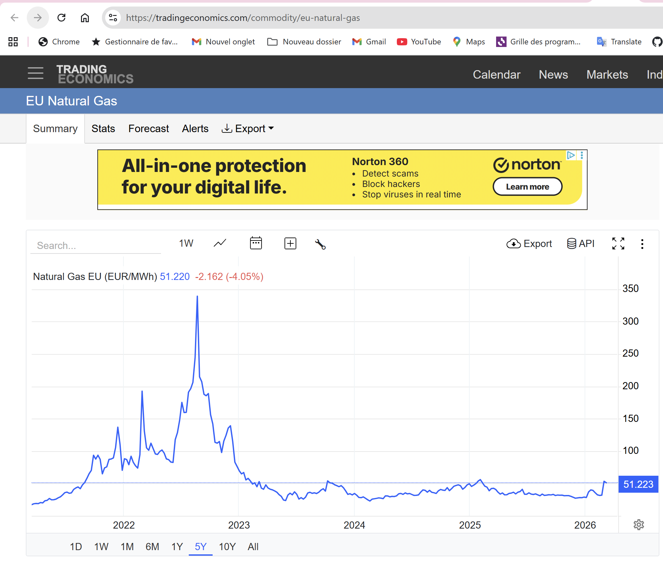
Natural Gas Website
Difficult to find daily gas prices
One of the only ways I use AI to Hack Data

Slide 9
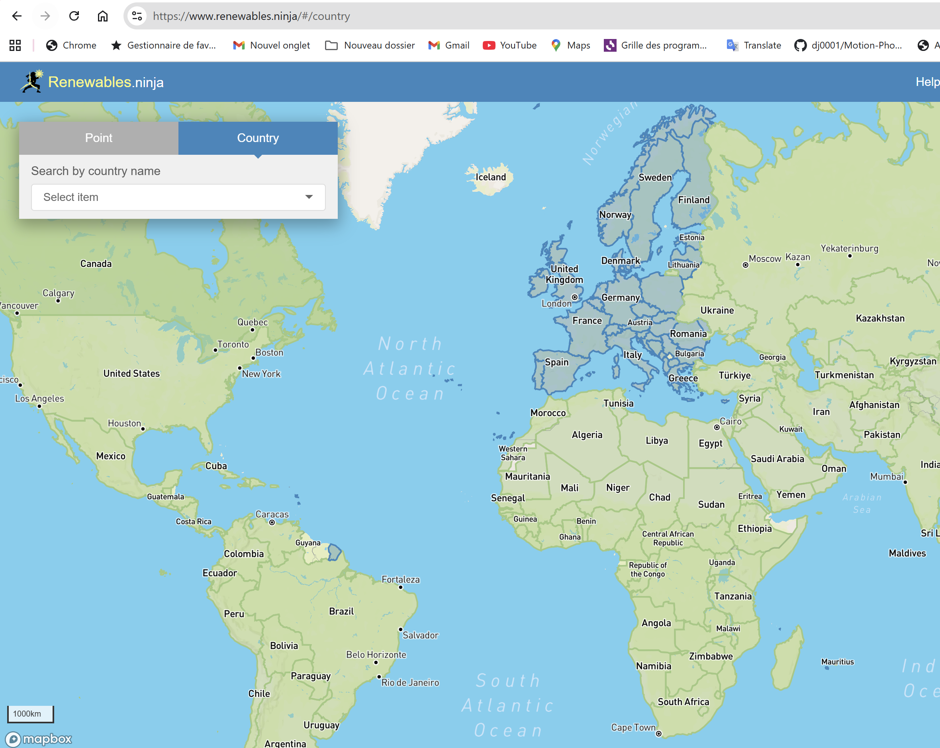
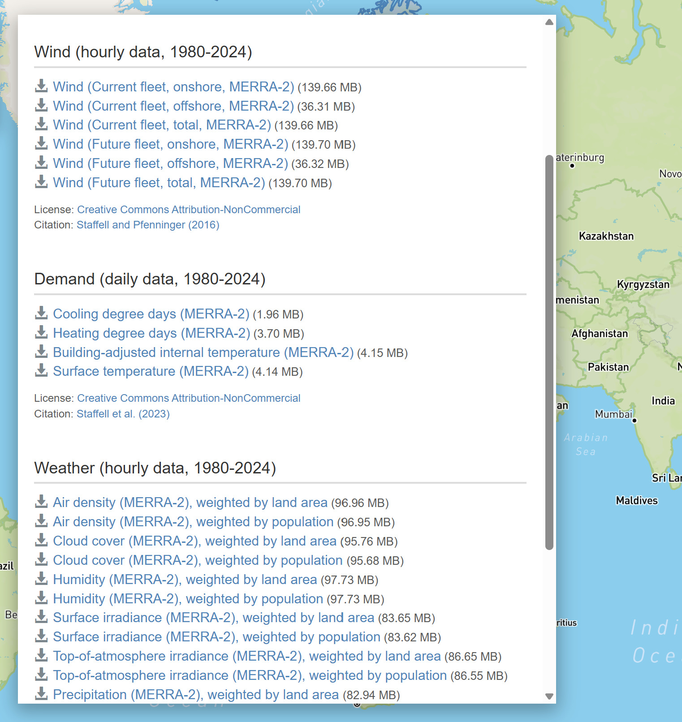
Renewable Production by Country
Renewable.Ninja website

Slide 10
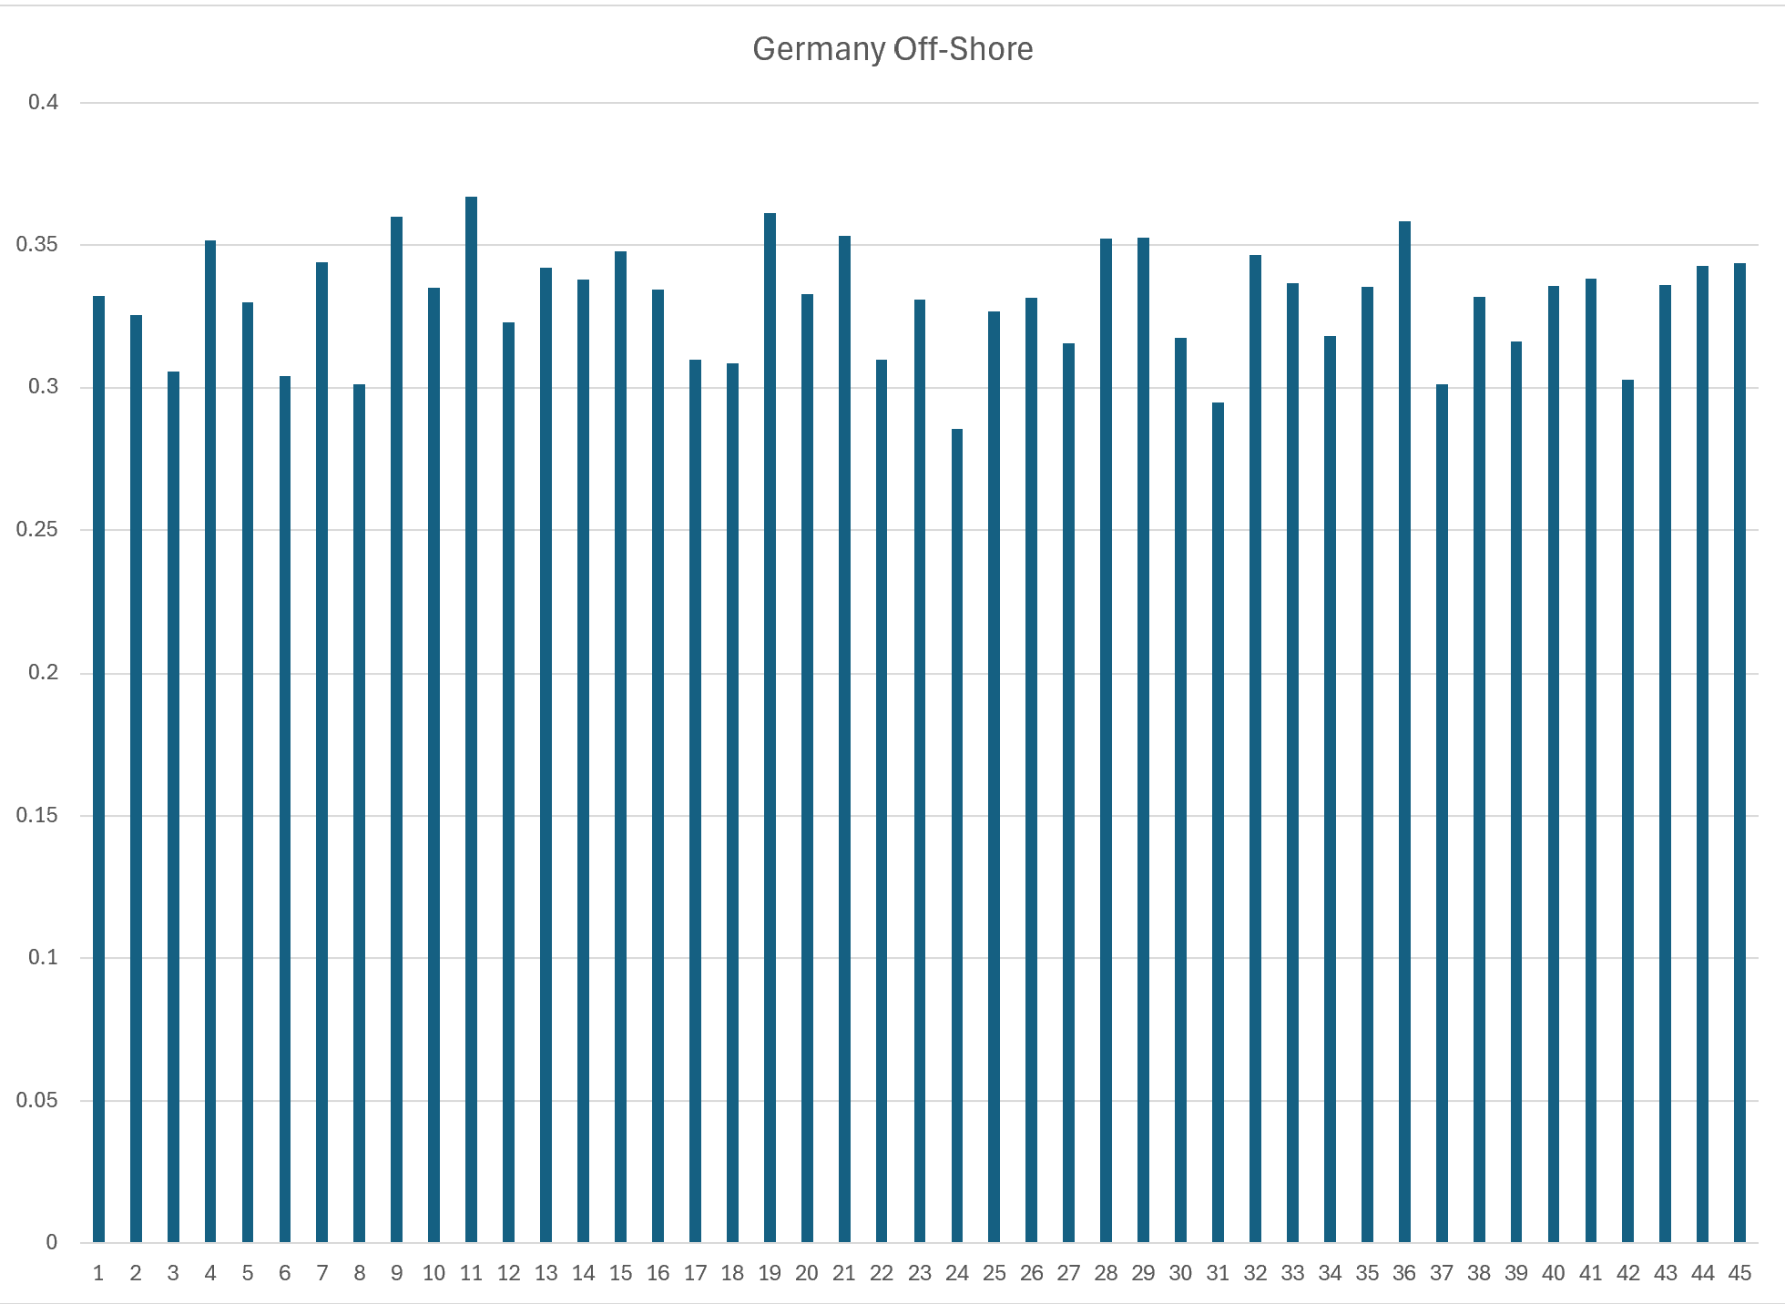
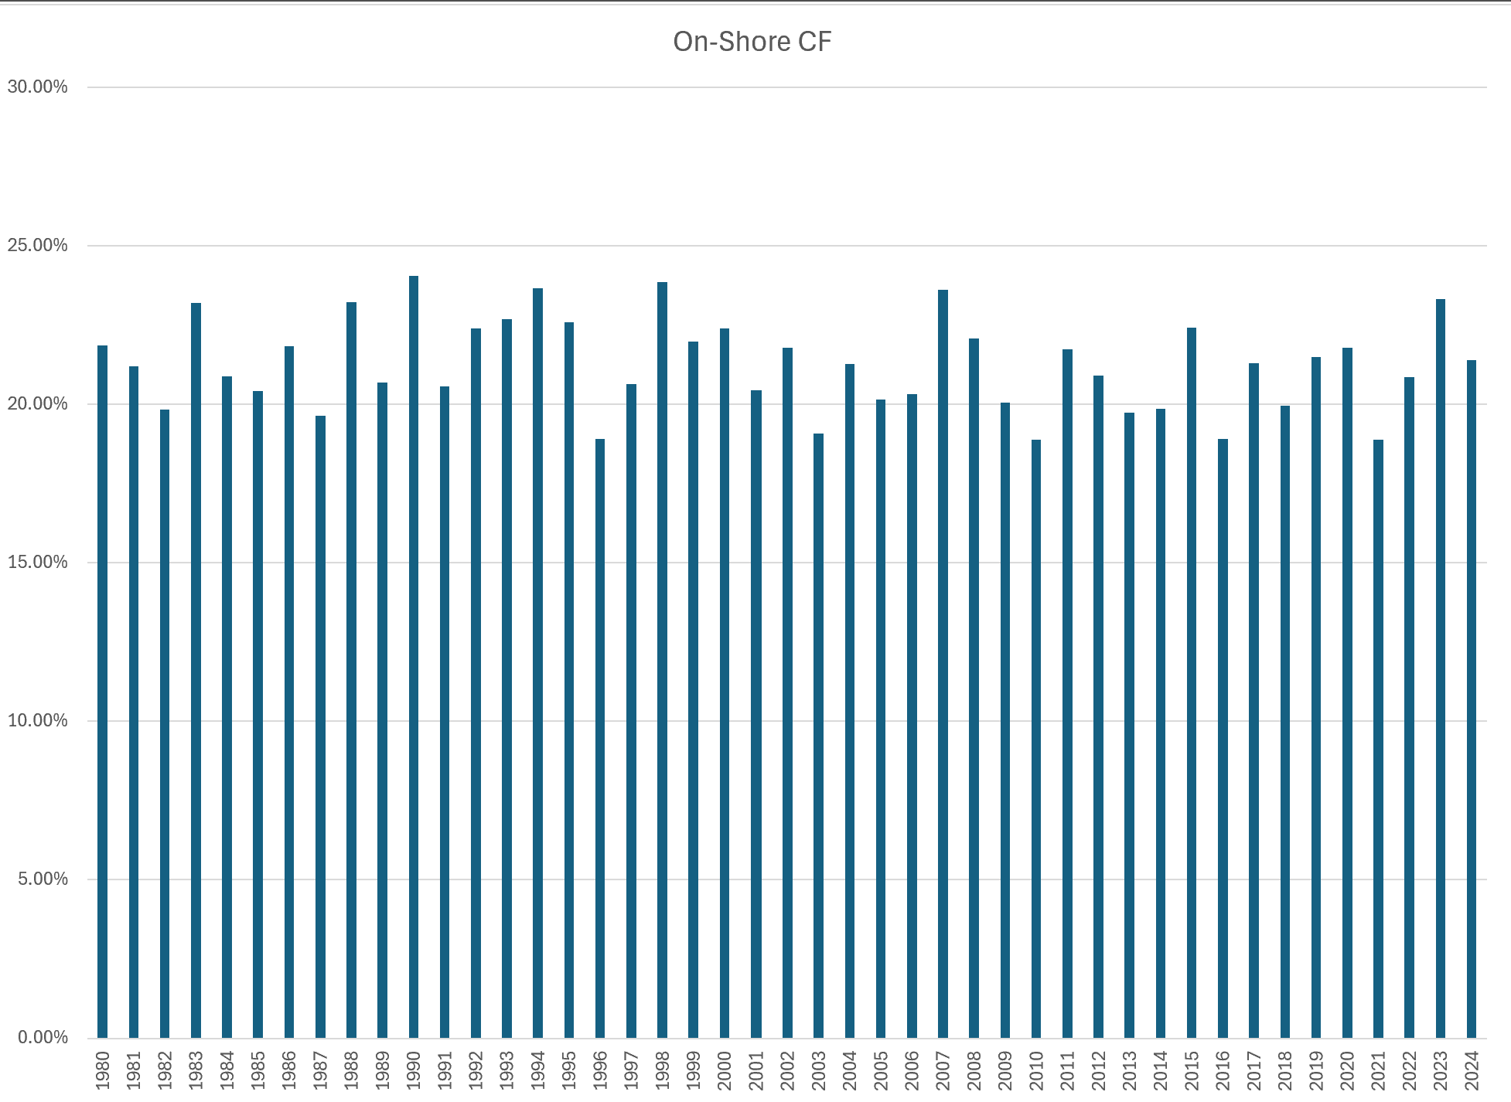
Example of Data
Example of Data Wind Off-shore and On-shore

Slide 11
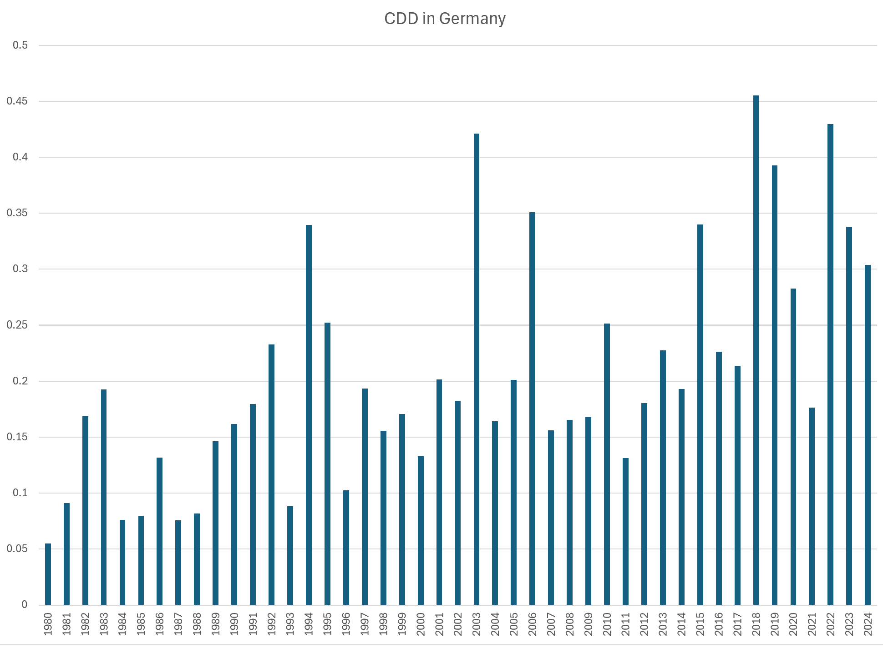
Cooling Degree Days
.

Slide 12
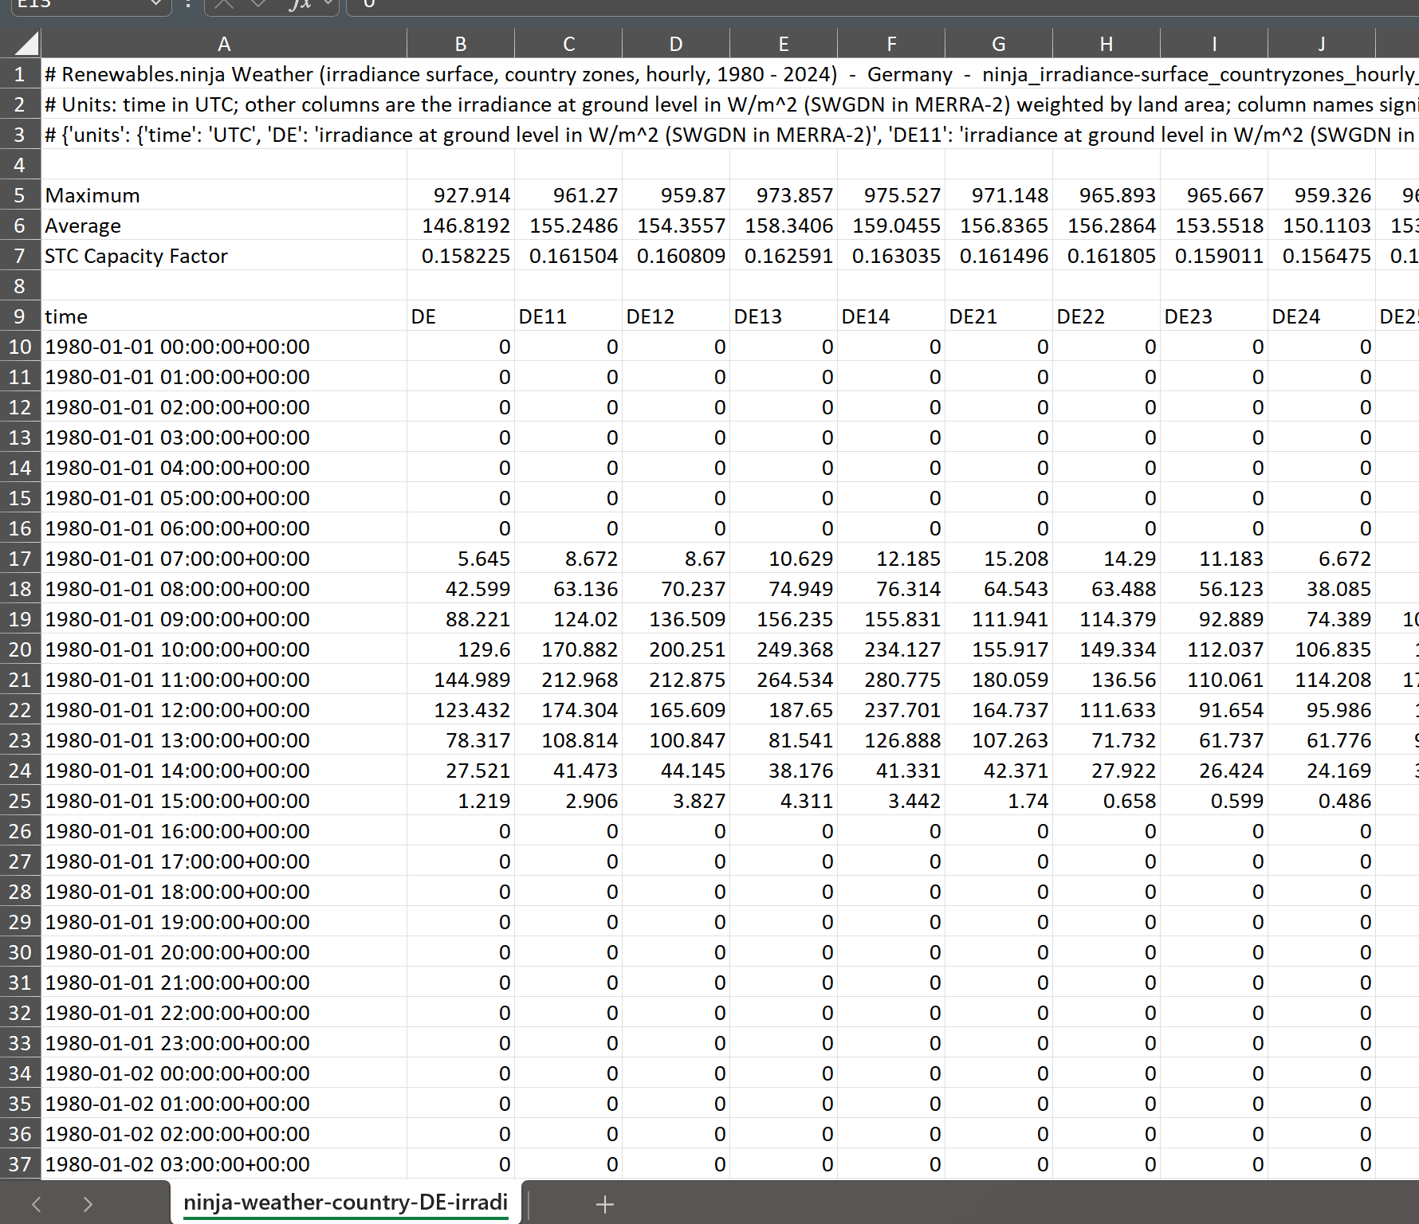
Solar Irradiation
,

Slide 13
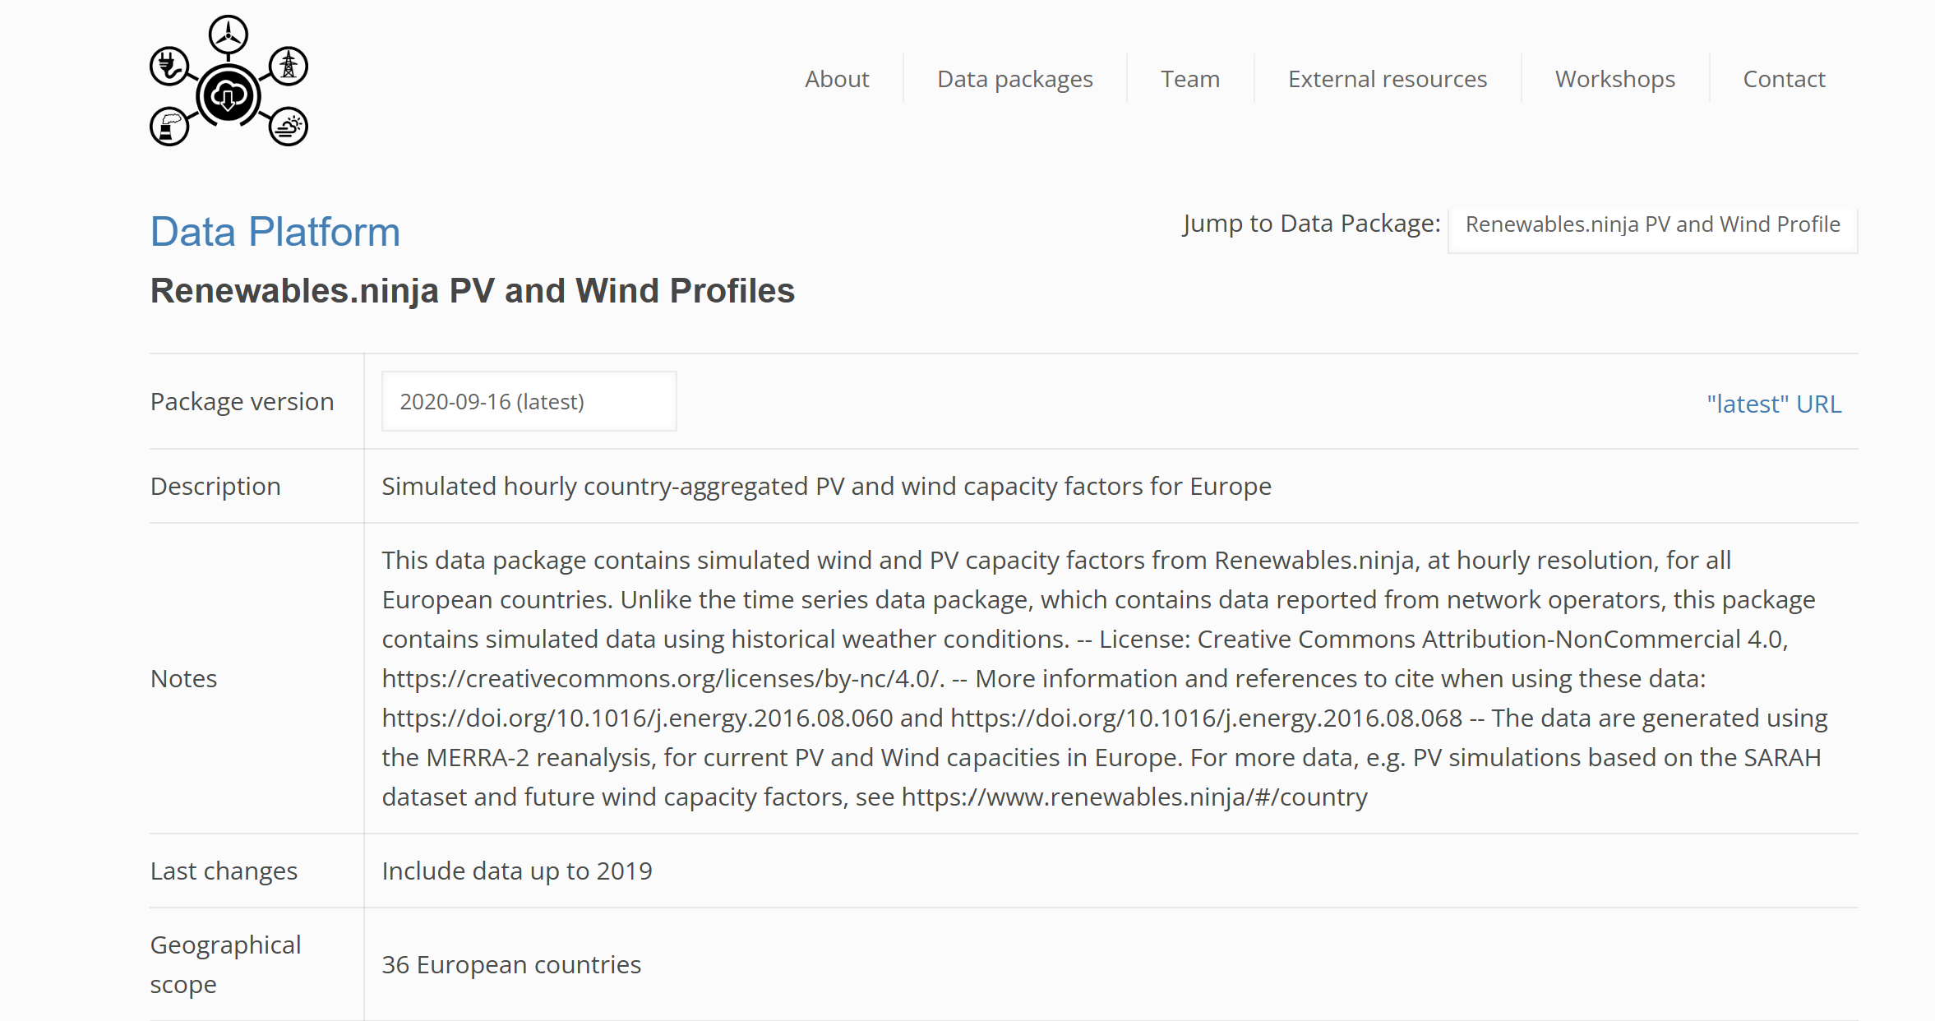
Description of Data

Slide 14
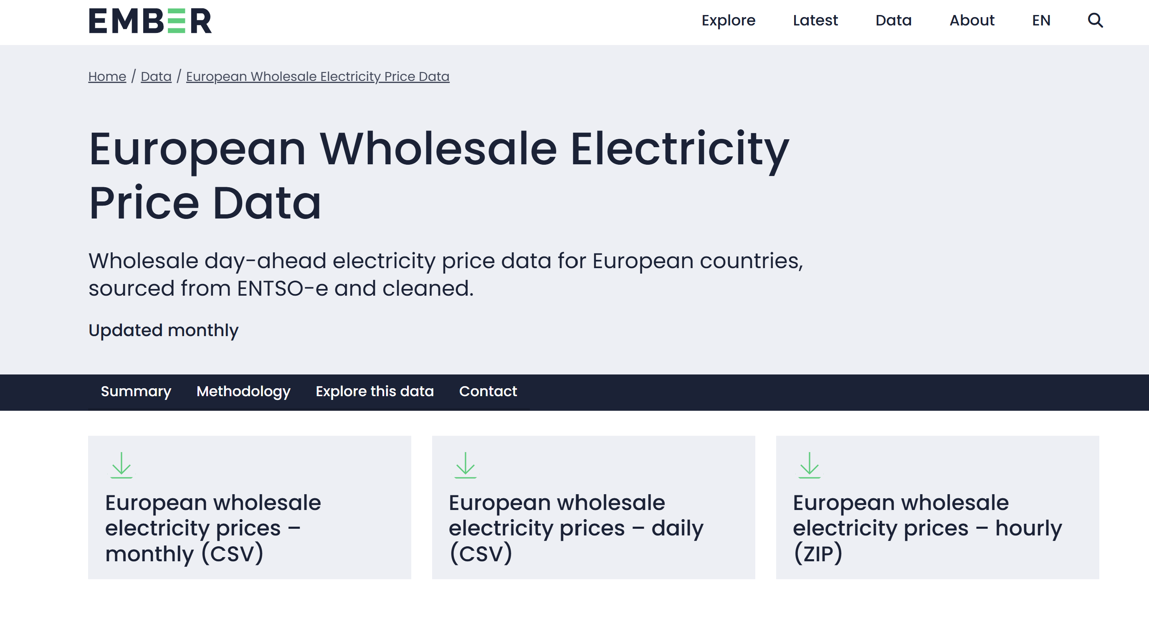
Hourly Merchant Prices
https://ember-energy.org/data/european-wholesale-electricity-price-data/

Slide 15
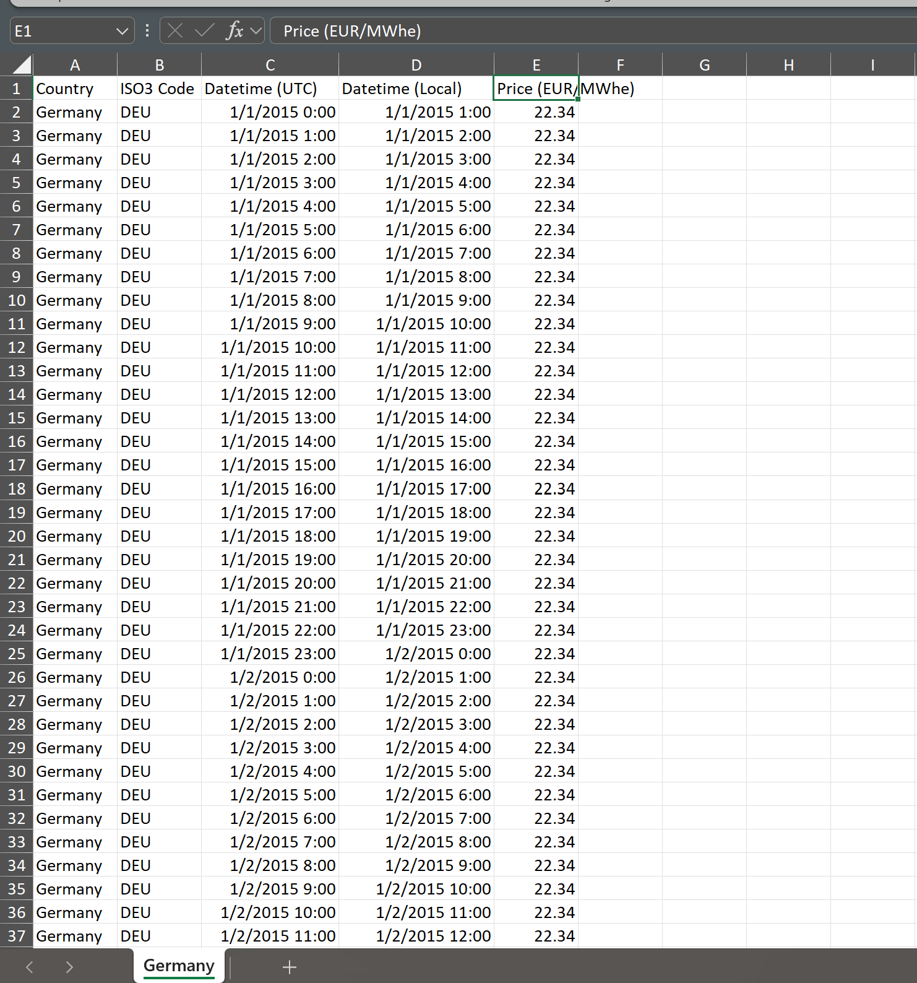
Germany Price Database
.

Slide 16
Price Analysis from Pre-COVID to Current

Slide 17
Analysis of Data
Different time periods for graph – tells a different story
Different situations in Europe (France versus Germany)
Simulation of one-hour and two-hour battery from day ahead prices
Analysis of pre-COVID to post-COVID with flexible graph
Idea is to gain a general understanding of trends and playing with data

Slide 18
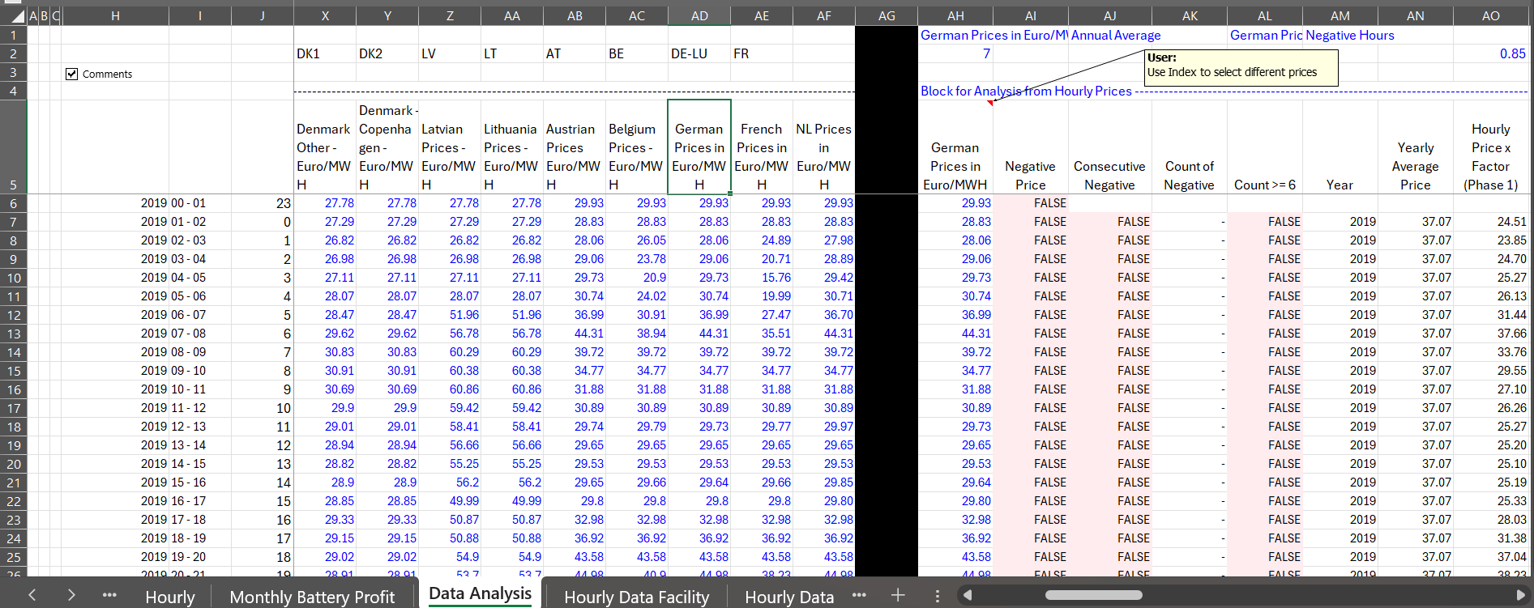
Hourly Price Data
Hourly data from different regions with selection and then analysis

Slide 19
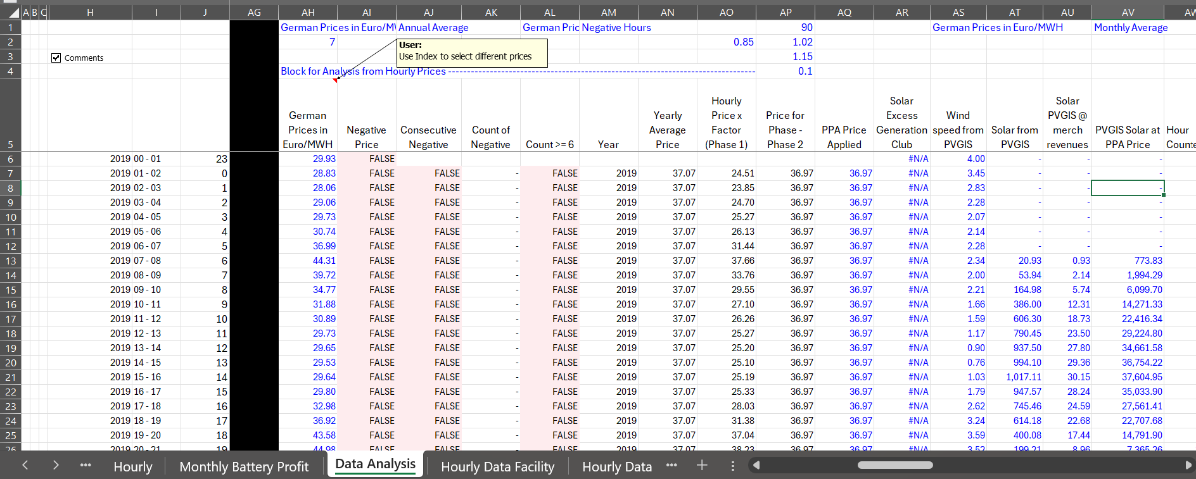
Match Prices with Solar and Win
Count the negative prices
Simulate PPAs

Slide 20
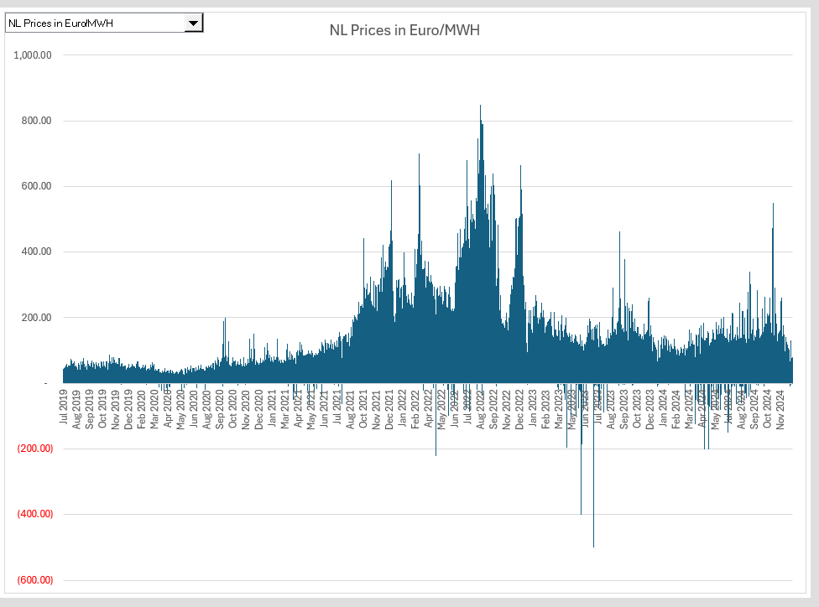
Hourly Price Graph - Netherlands
Cannot see things like value of battery, number of negative prices, gas and electricity prices, etc.

Slide 21
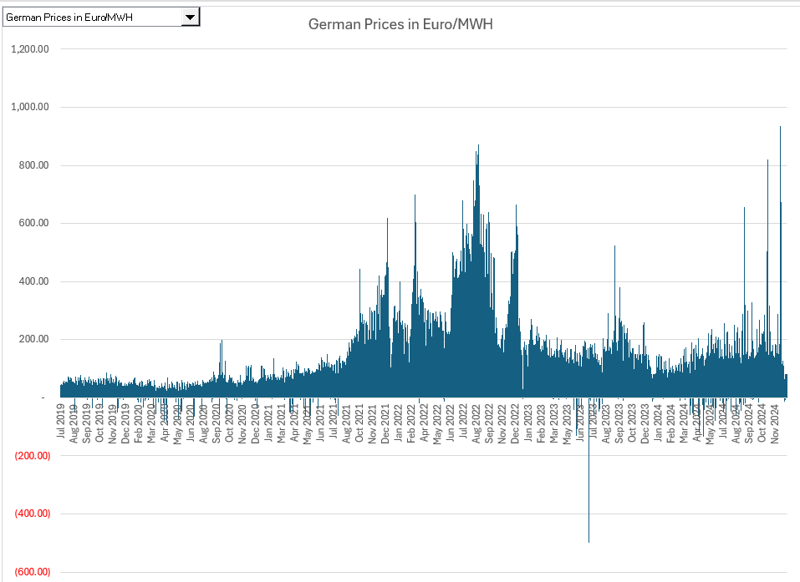
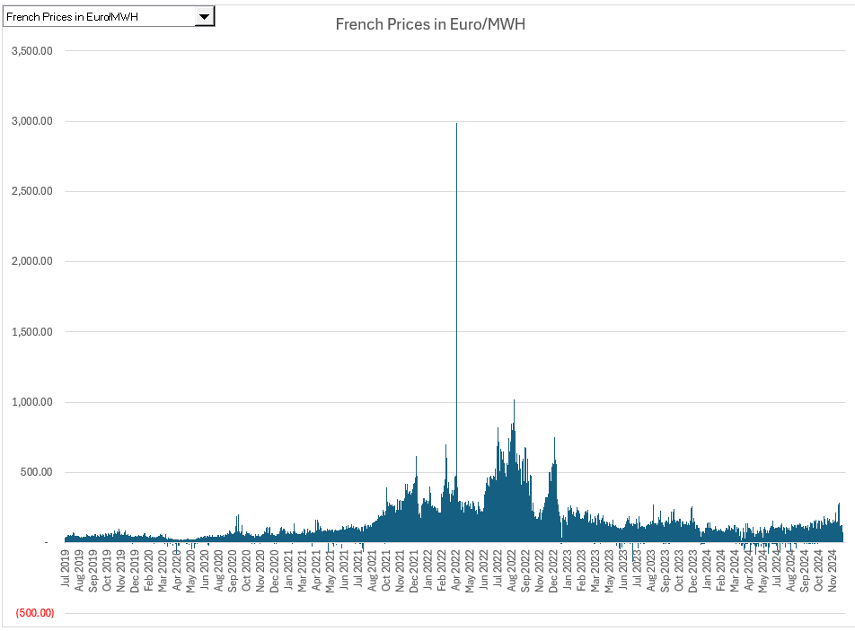
Hourly Price – Germany and France
Get paid if have capacity to charge in Germany (400) and get paid if have battery charged in France (3000) per MWh
Note the volatility in 2024
Famous French Price Spike

Slide 22
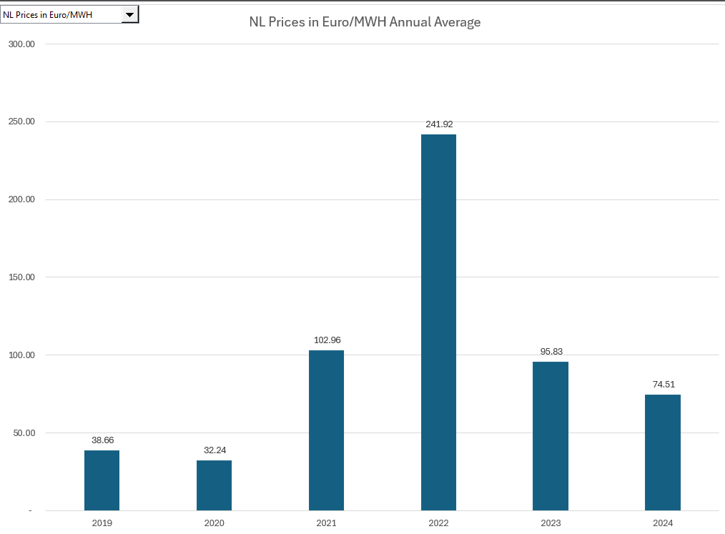
Note how prices have stabilized at higher levels
Pre and post COVID and stable prices at higher levels – after spike from Invasion. Quickly use SUMIF on the hourly prices.

Slide 23
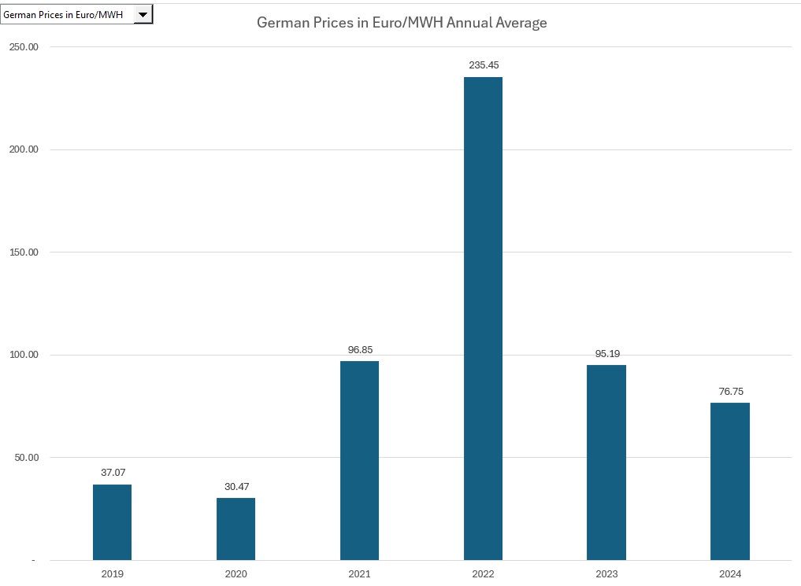
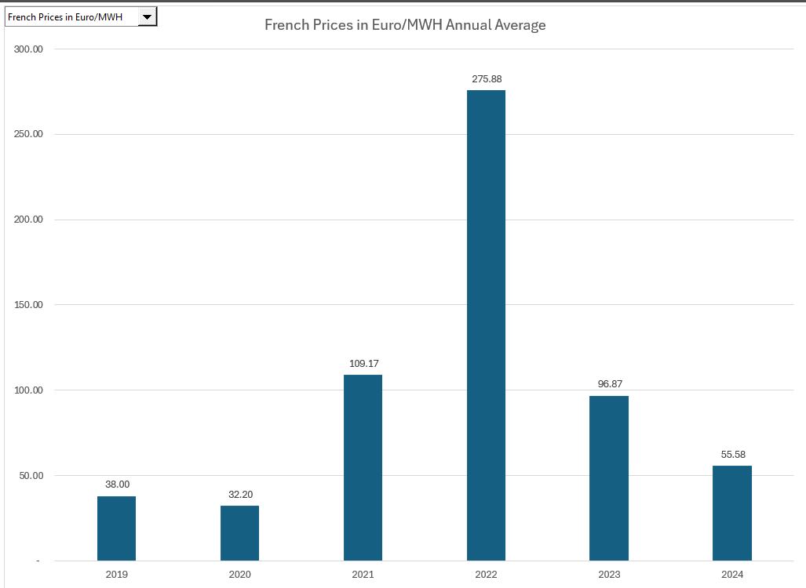
Annual German and French Prices
.

Slide 24
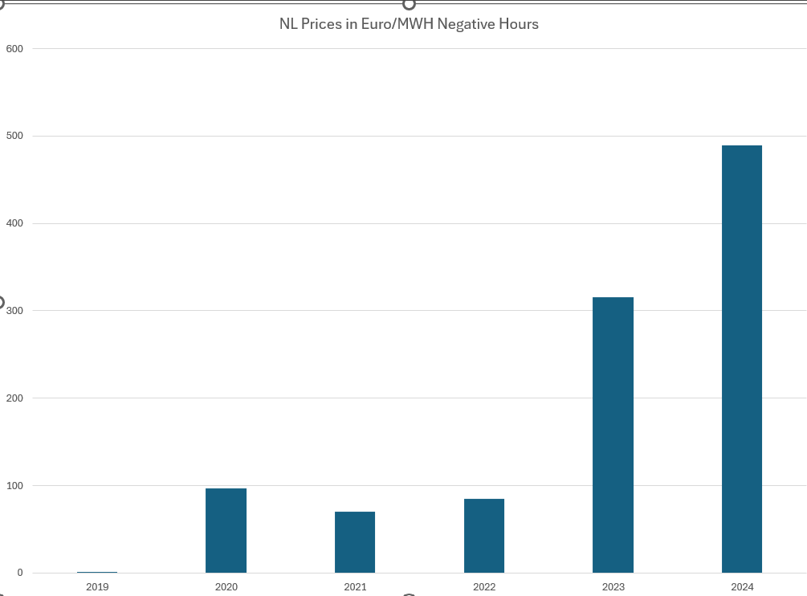
Annual Number of Negative Prices - Netherlands
Use COUNTIF with Flag for Price < 0

Slide 25
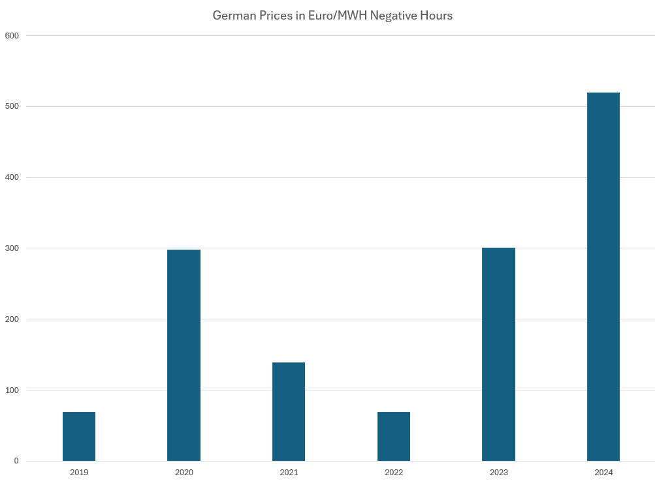
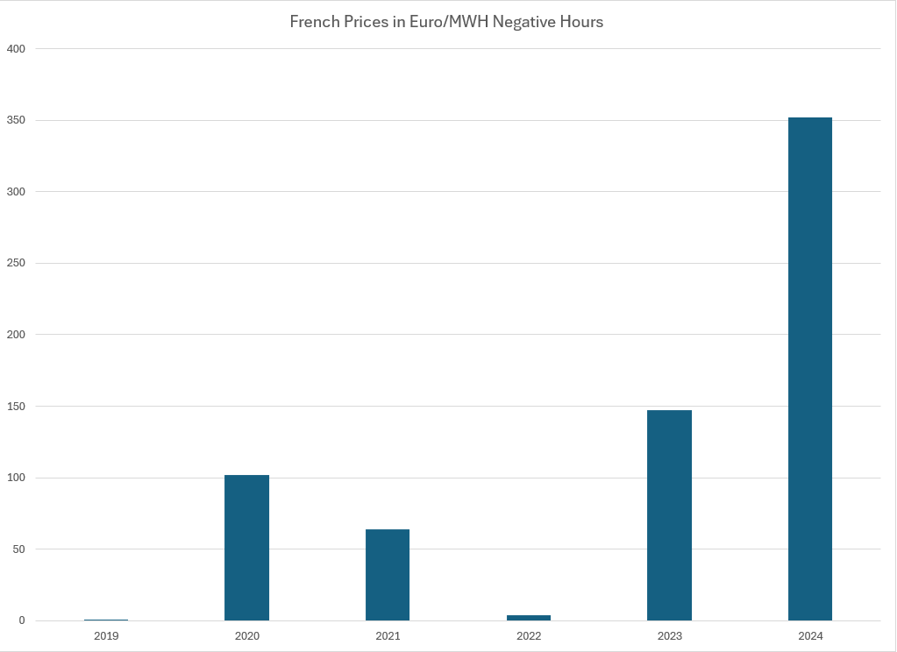
Annual Number of Negative Prices – Germany and France
More negative prices in early years; less in later periods

Slide 26
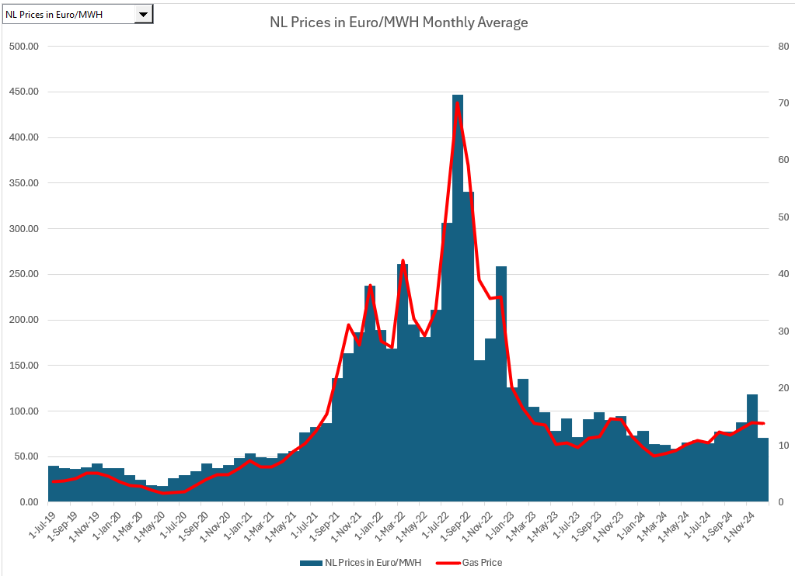
Monthly Prices and Natural Gas Prices
Can see the effect gas prices with monthly data

Slide 27

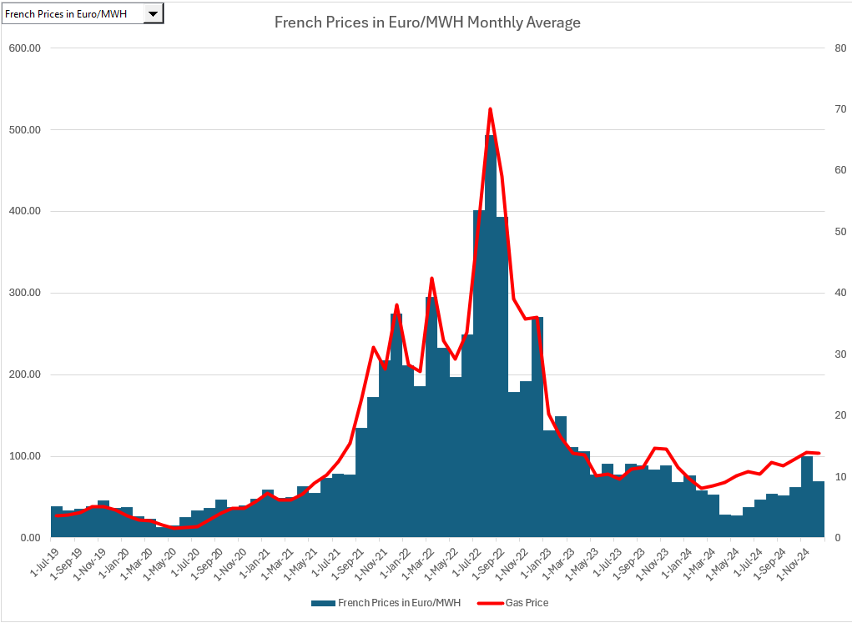
Monthly Prices – Germany and France
Approximate analysis of which plants are on the margin.

Slide 28
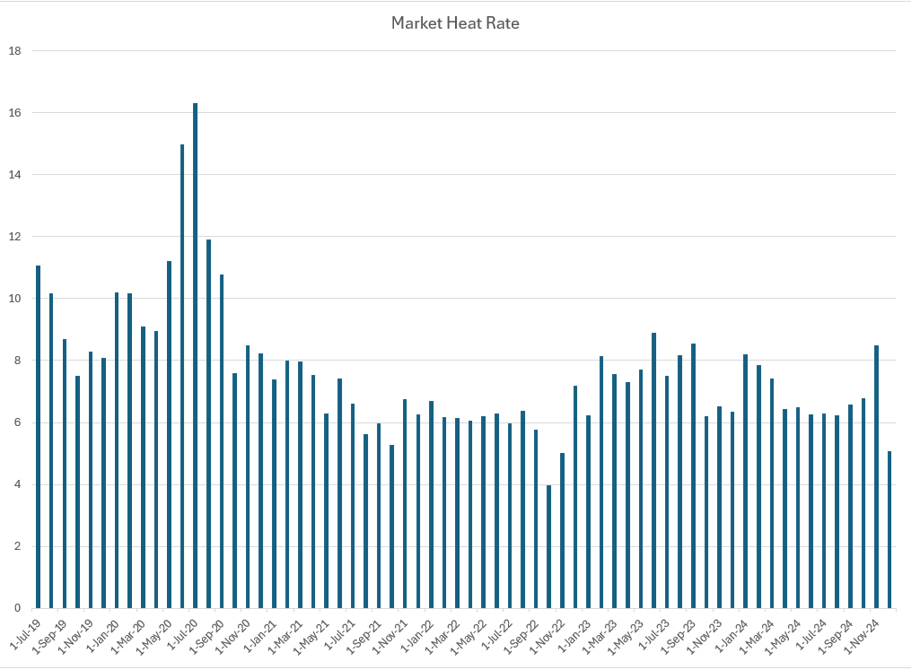
Profitability of Natural Gap Plants and Market Heat Rate Forecasting - NL
Electricity price divided by Gas Price – (Euro/MWH)/(Euro/MMBTU) = MMBTU/MWH

Slide 29
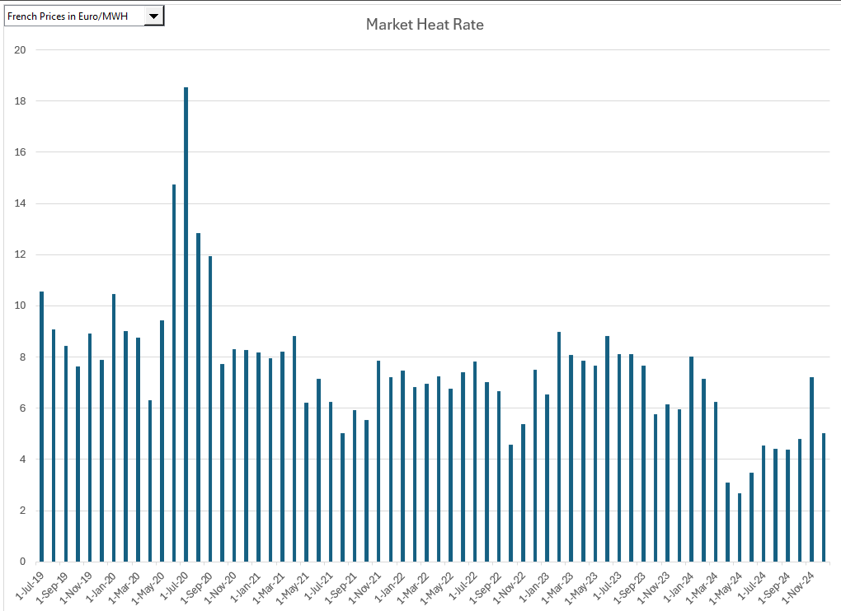
Market Heat Rates in French Merchant Markets
.

Slide 30
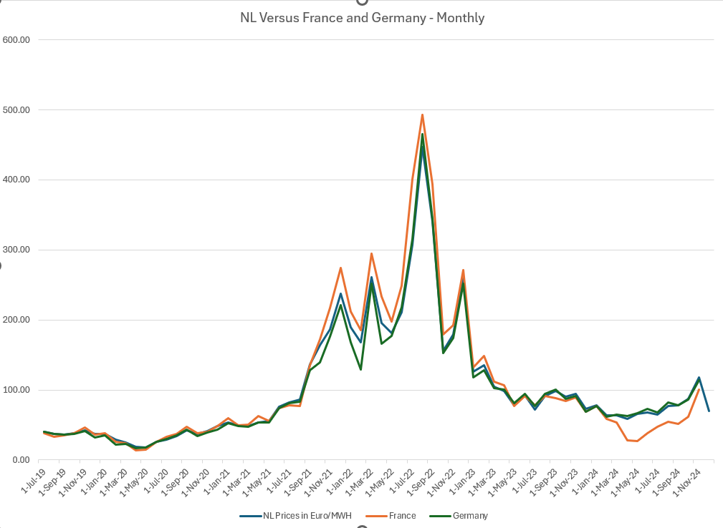
Differences in Regional Prices
Demonstrates that more deviation in prices in 2024 than in prior years.
Implies there are transmission limitations and differences in cost.

Slide 31
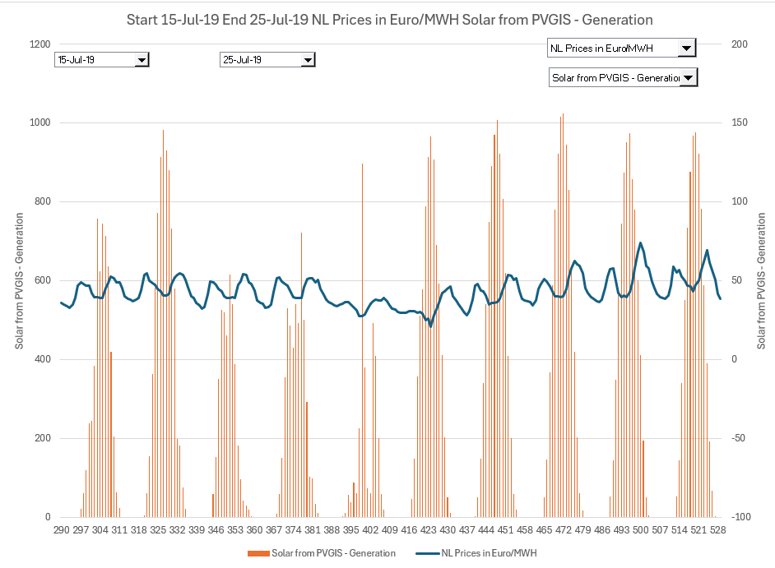
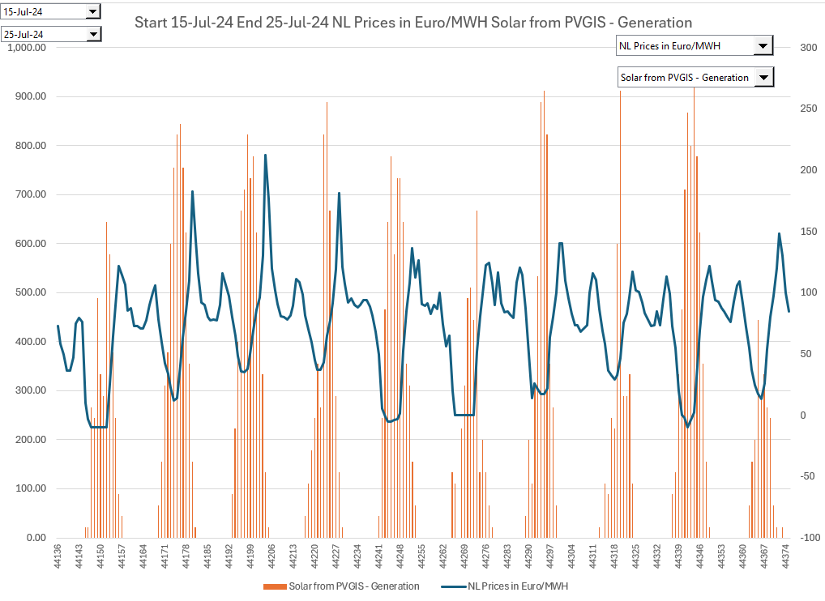
Netherlands
Comparison of 2019 and 2024 - Summer

Slide 32
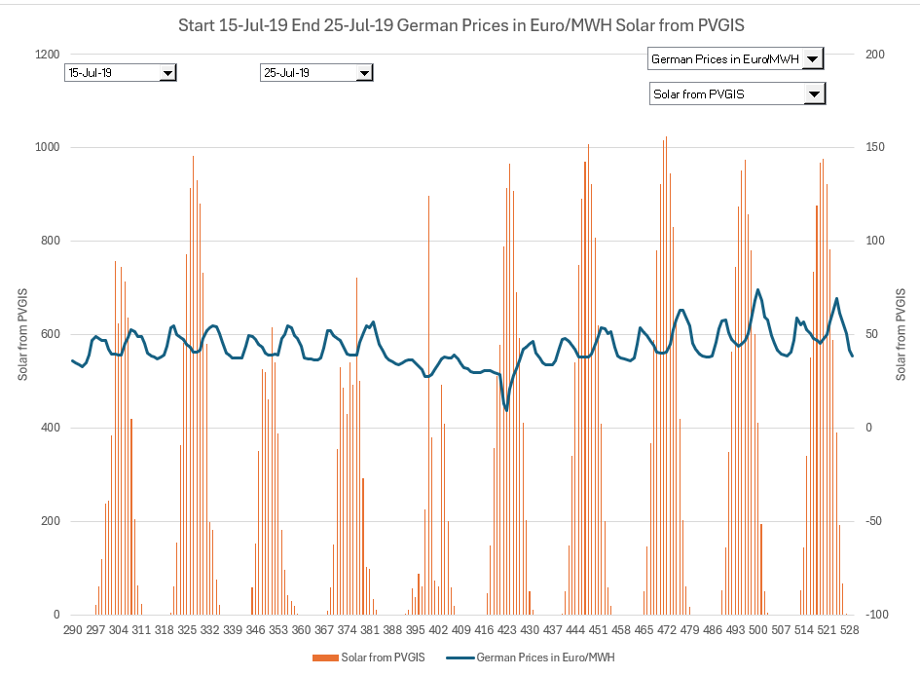
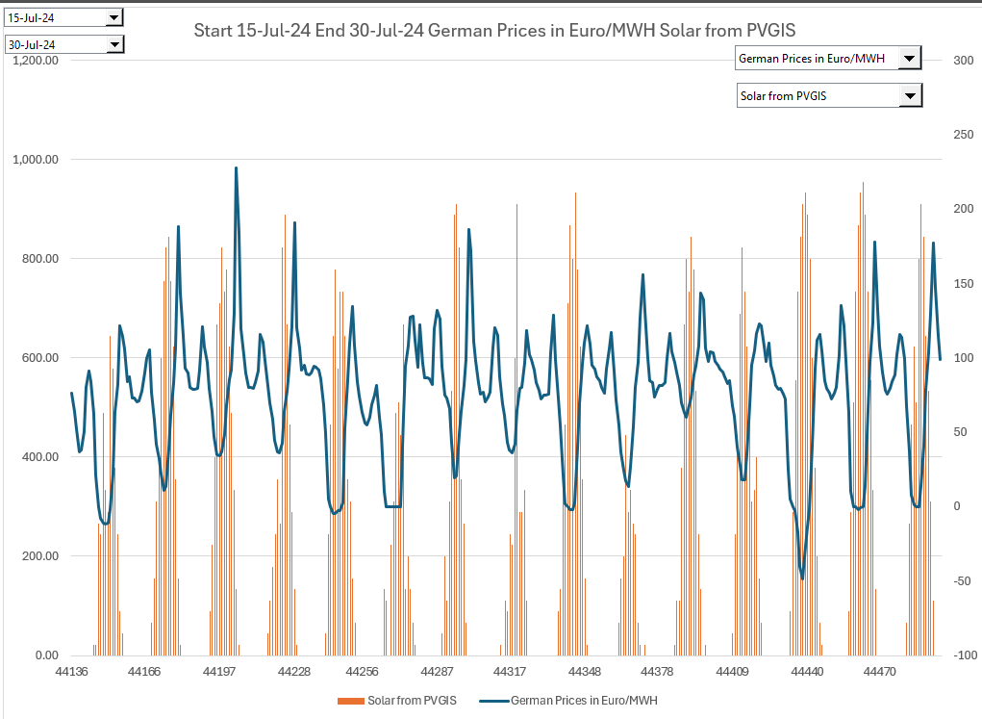
Germany
Summer 2019 and 2024
You can see the increase in volatility by graphing selected prices and clearly see the increase in volatility.
Note that it is important to keep the same scale on prices

Slide 33
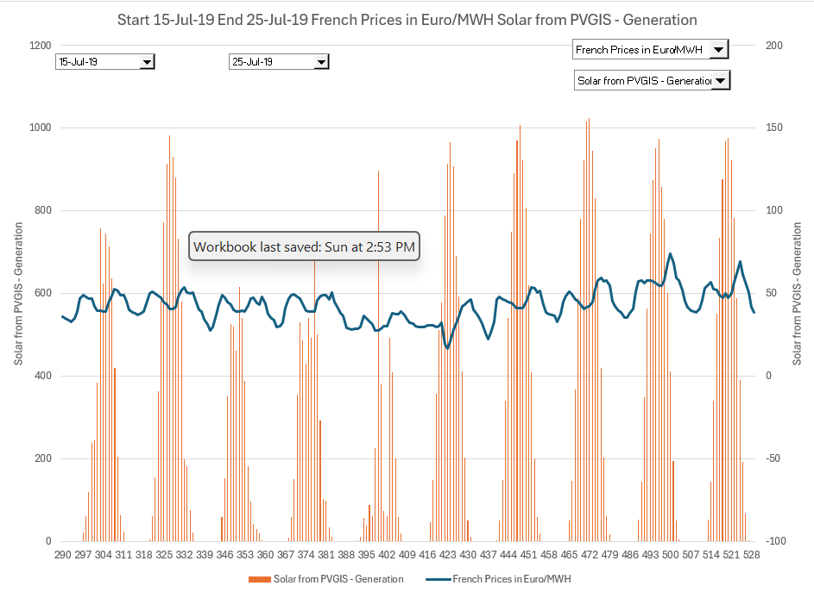
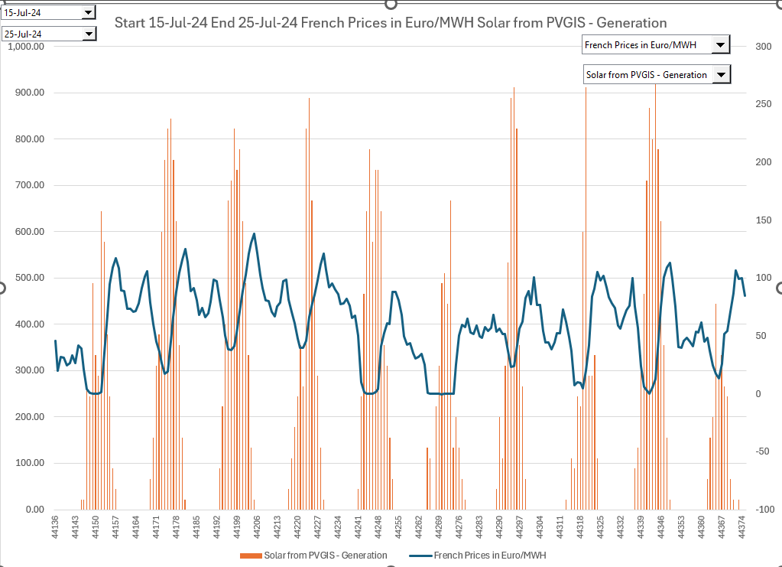
France
Summer 2019 and 2024
.

Slide 34
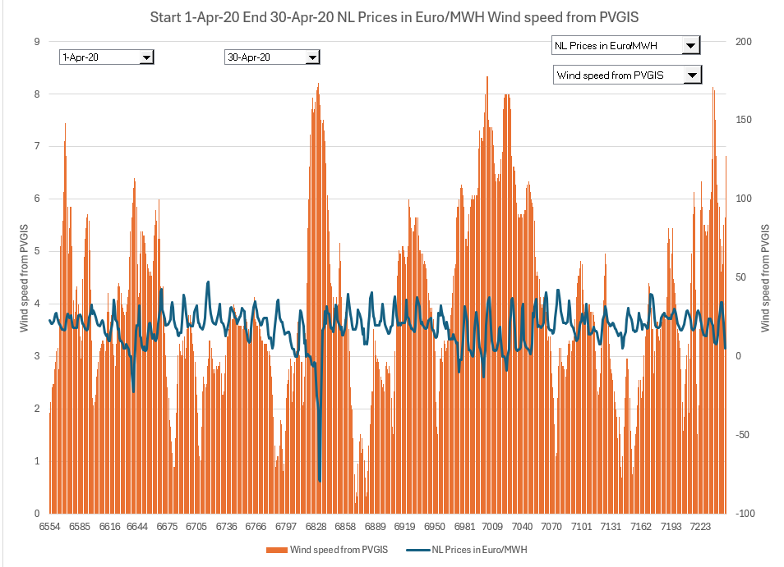
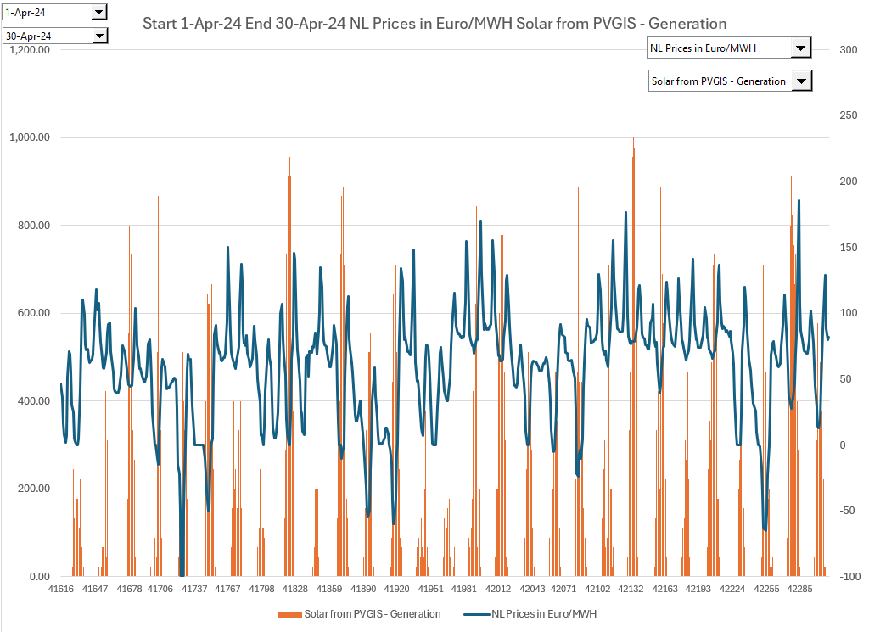
Netherlands Comparison of Month of April 2020 and 2024
Get a different picture for an entire month.
Note the big difference in volatility for the recent period.
Wind data not available for 2024 from PVGIS

Slide 35
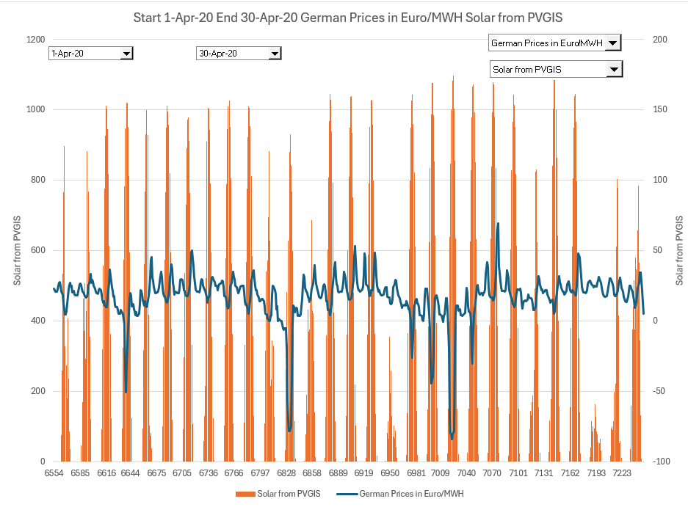
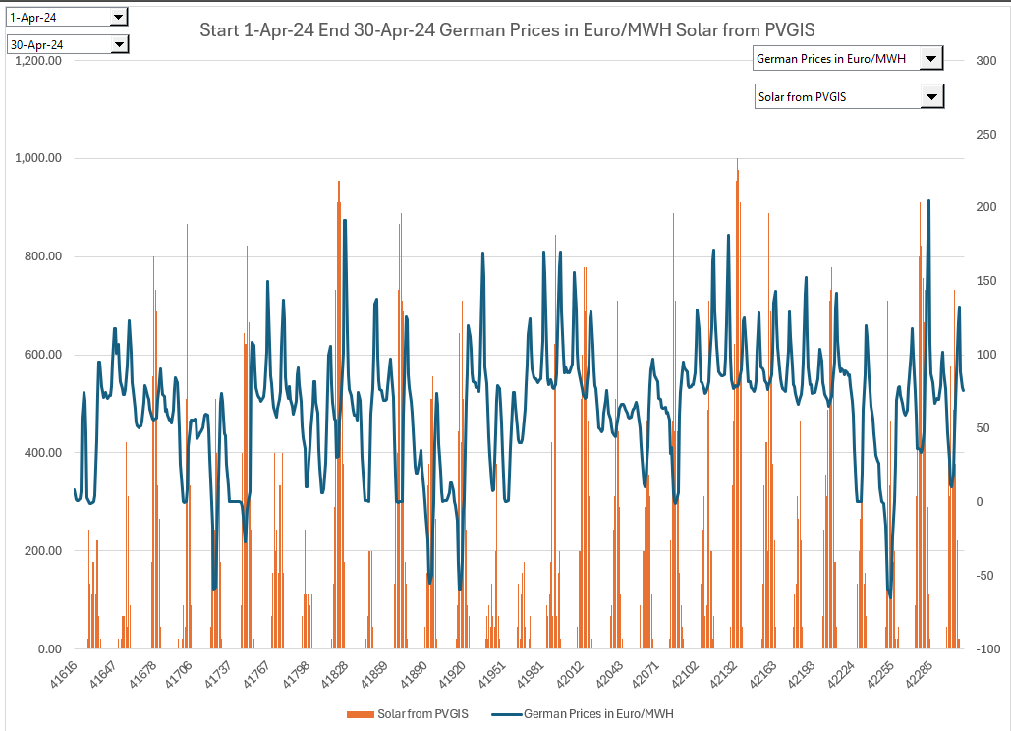
Comparison of German Prices in April 2020 and 2024
Compare to solar. Again, there is more variation in 2024 that appears to be somewhat related to solar.

Slide 36
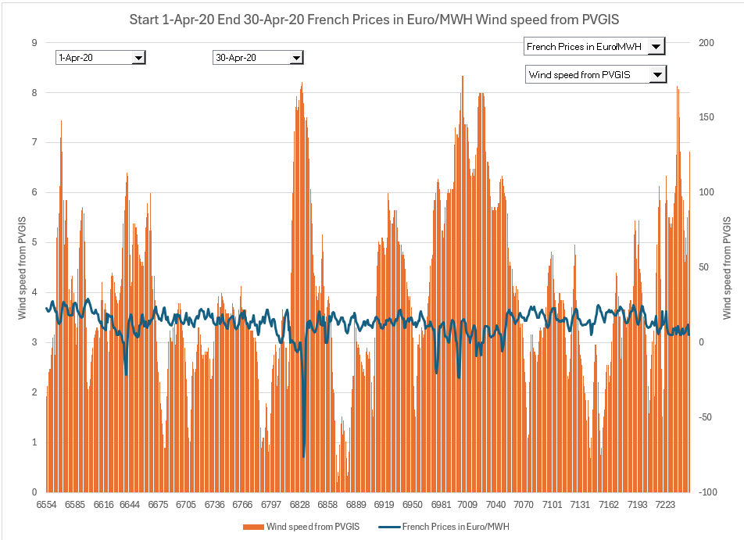
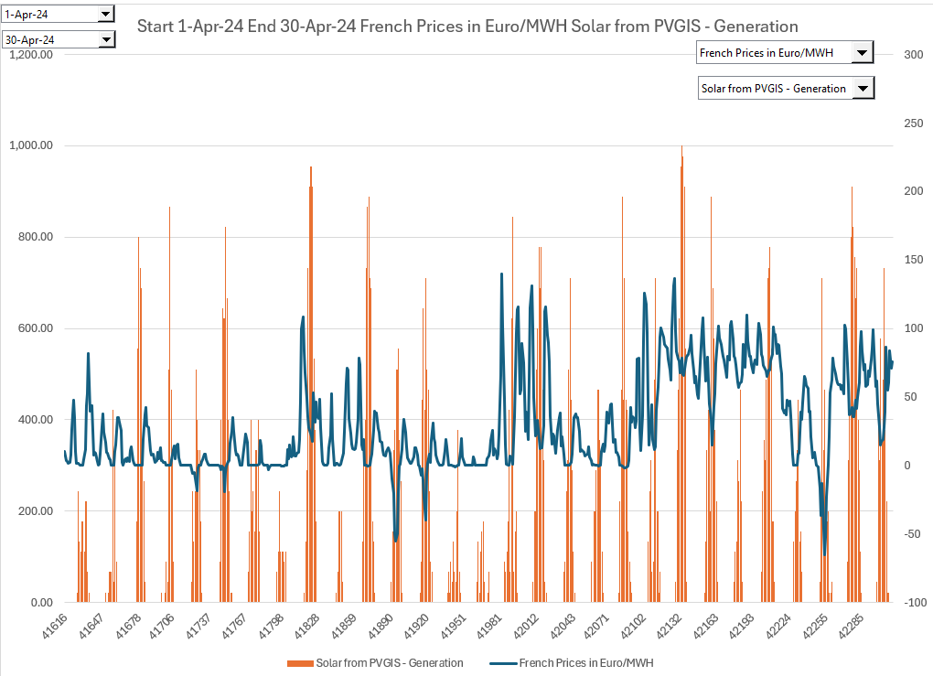
Comparison of Prices – France April 2020 and 2024

Slide 37
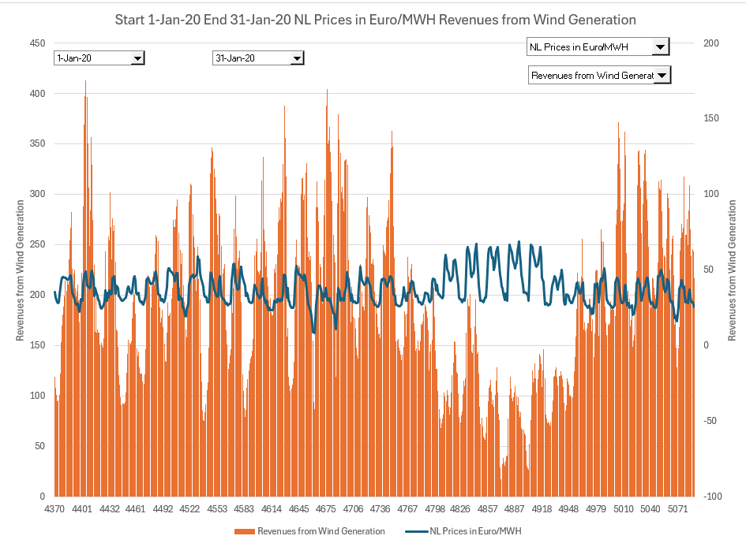
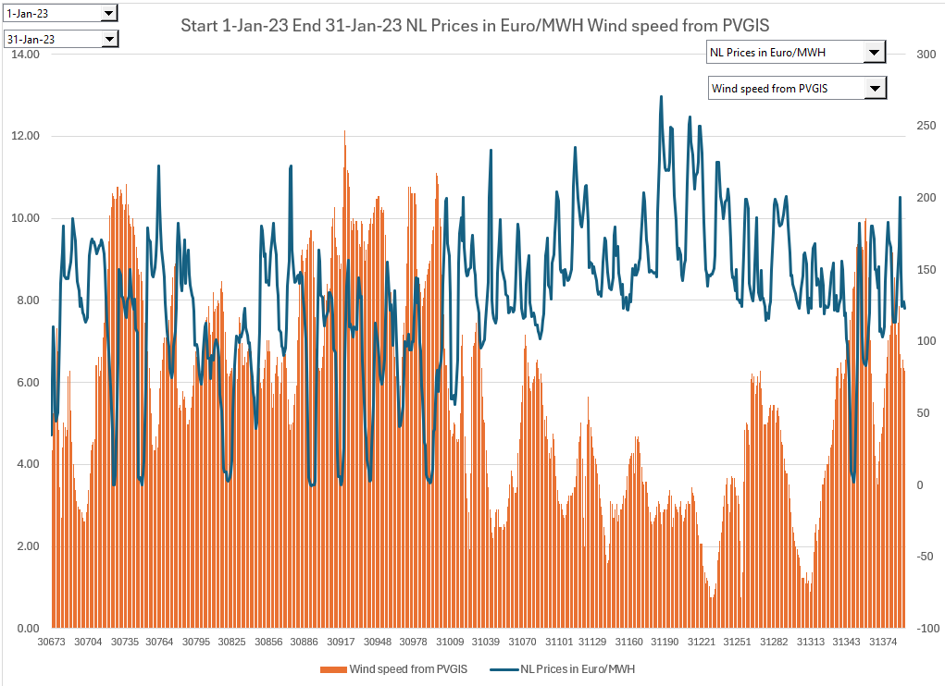
Comparison – Month of January - Netherlands
Difference in volatility in different time periods

Slide 38
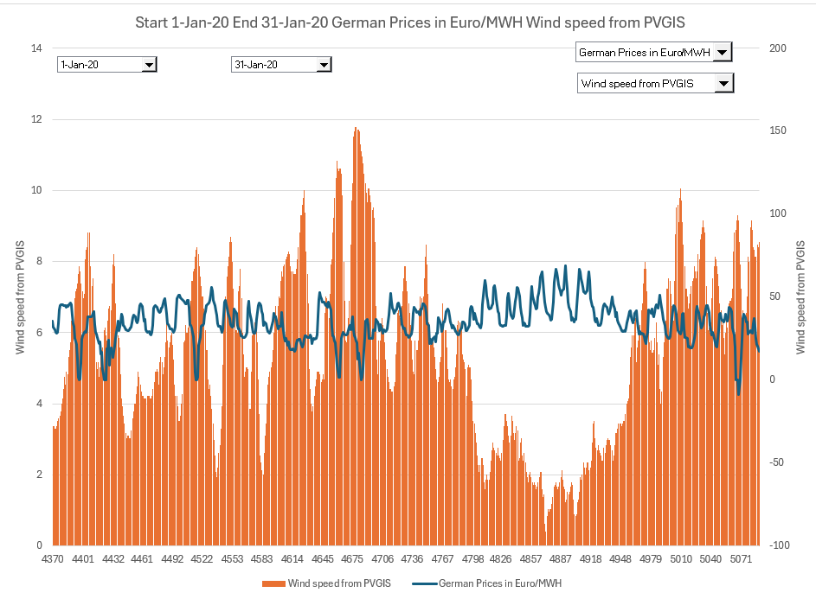
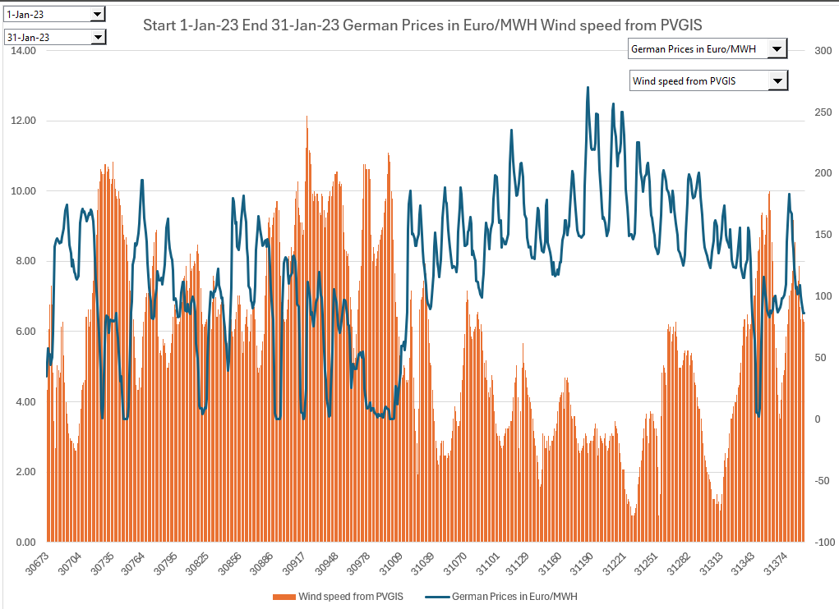
German Prices
January 2020 and January 2023
The prices are affected by wind.
Wind speed from PVGIS only through 2023

Slide 39
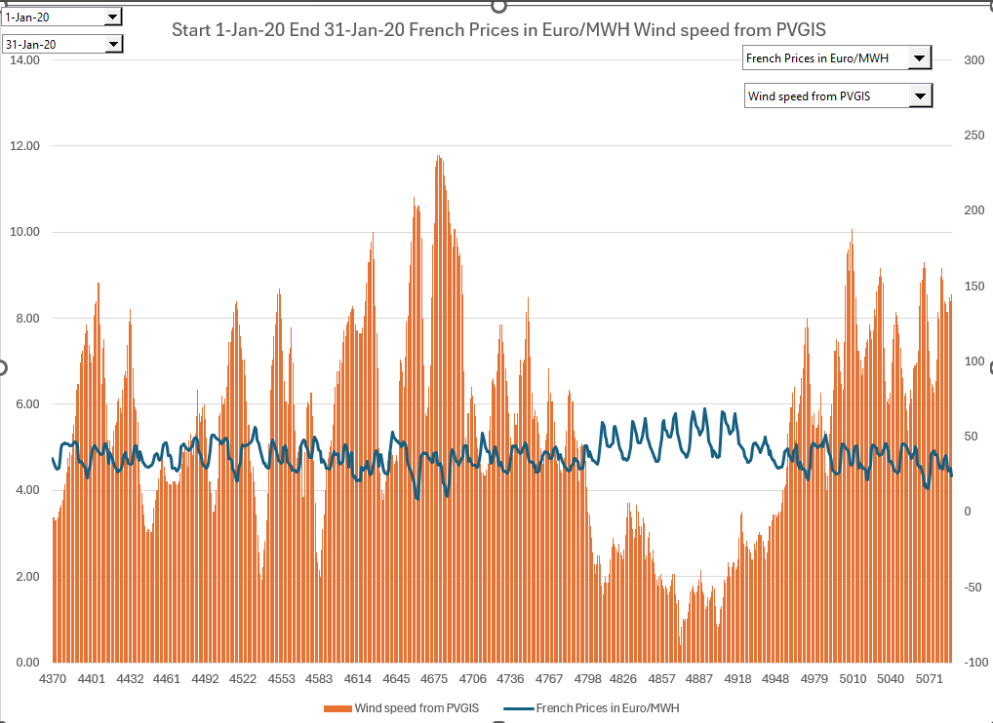
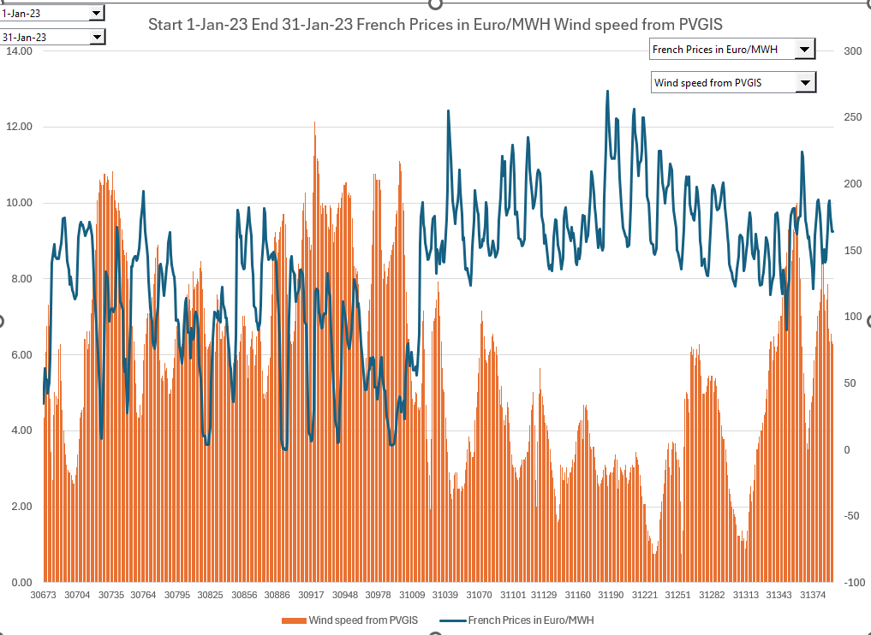
French Prices
January 2020 and January 2023
.

Slide 40
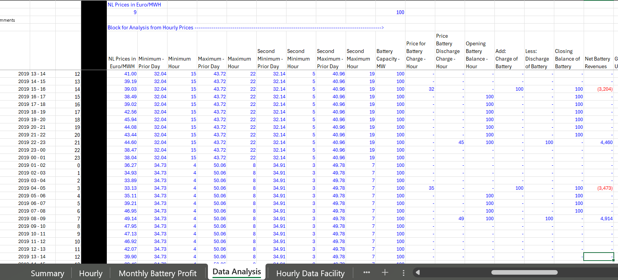
Calculation of Battery Revenues from One Hour and Two Hour Battery
Use the SMALL and LARGE Functions in Excel (these can be slow function)
Use the SMALL and LARGE from the prior 24 hours
Could have assumed perfect foresight
Could have made Day by Day Graph

Slide 41
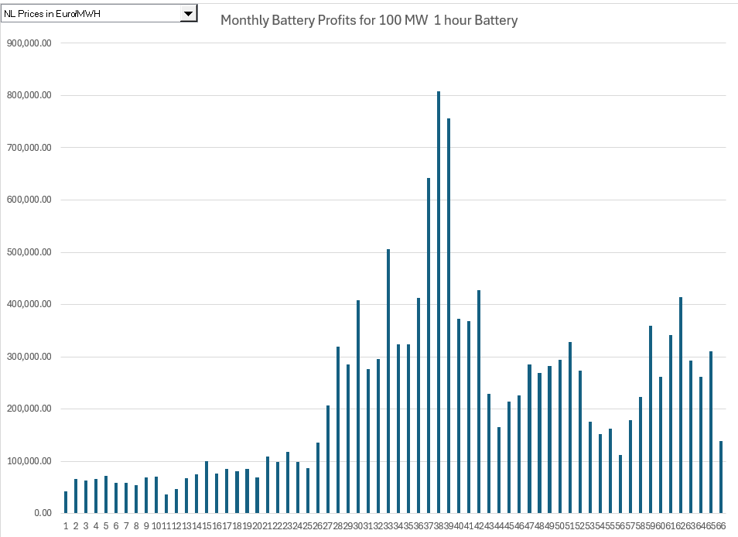
Monthly Battery Profits - Netherlands
Battery profits are compiled using SUMIF and EOMONTH.
Could have used regulation markets instead of day ahead prices

Slide 42
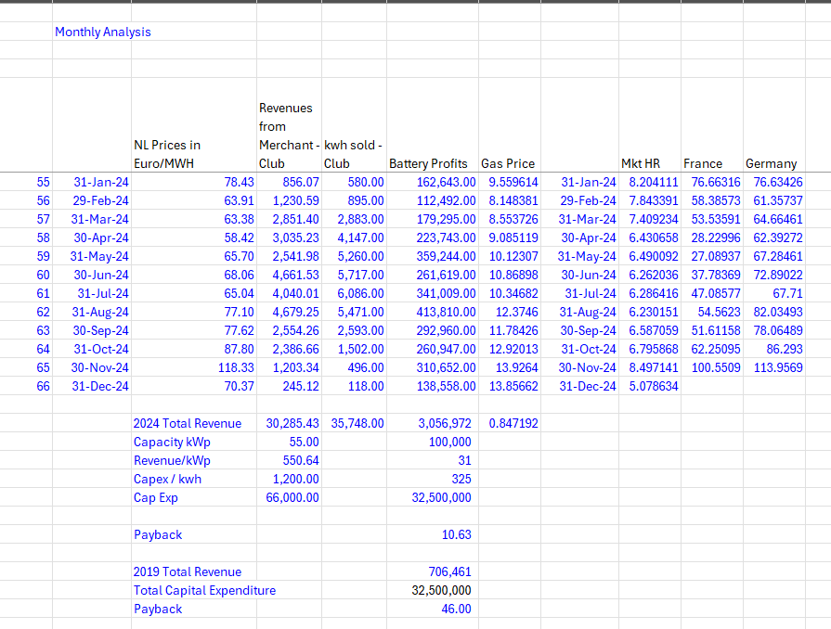
Monthly Analysis and Payback with 325 Euro per kWh Battery Cost - Netherlands
The implication of this chart is that the volatility of prices should diminish in the future
Note that this does not include O&M taxes, financing and other issues.

Slide 43
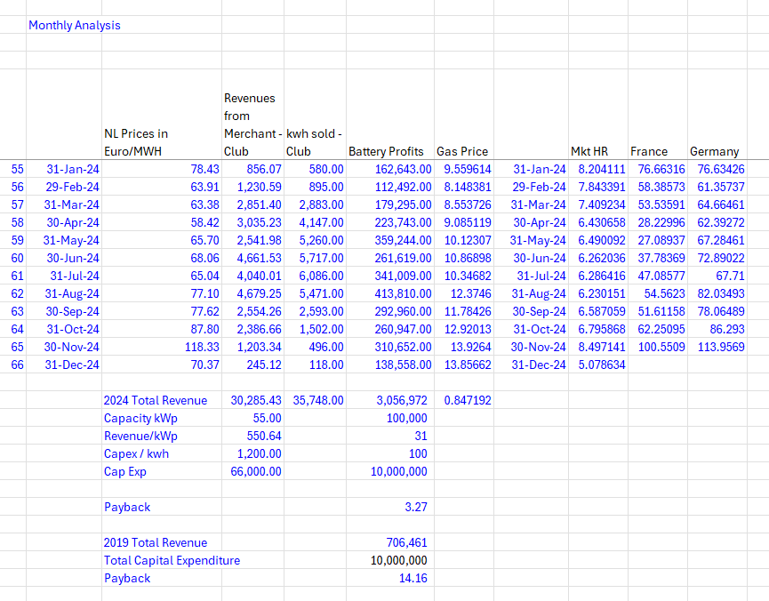
Monthly Analysis with 100 Euro Battery Cost - Netherlands
The summation of profits is for part of 2019 and 2020.

Slide 44
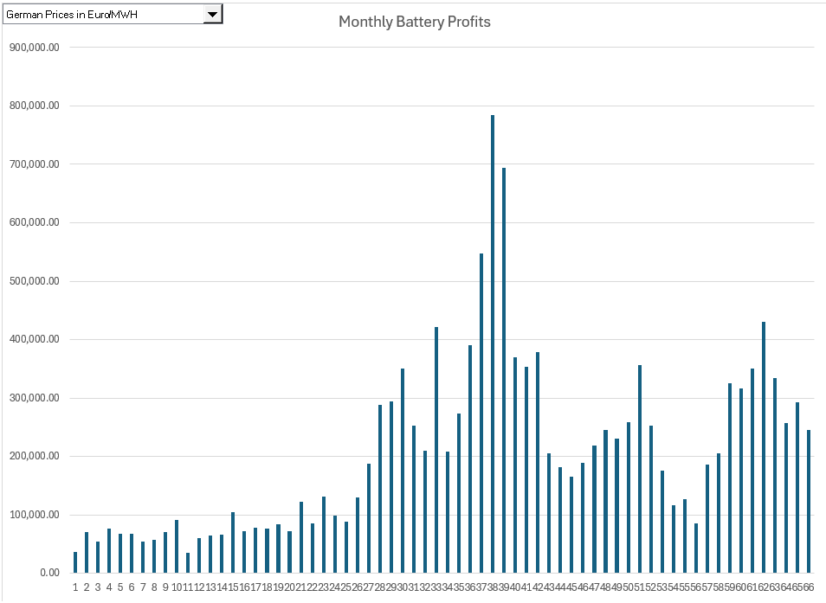
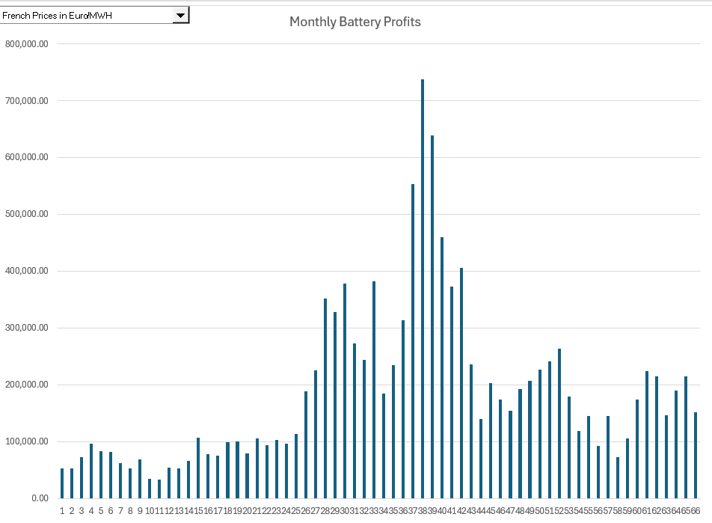
Monthly Battery Profits - Germany
Using SUMIF across months to accumulate daily profits from buying low and selling high.
Note the difference in profits in 2024 between France and Germany

Slide 45


Valuation of Battery – Germany and France with 100 per kWh
Compare to other regions
Compare early years to later years

Slide 46

German and French Monthly Prices Realised for Solar, Wind and All-hours
Prices for solar have become lower with more capacity
Focus on the summer months

Slide 47


German and French Monthly Prices Realised for Solar, Wind and All-hours
Dramatic change in solar value in current period
Depends on incentives in the market

Slide 48
Example of Corporate PPA

Slide 49

First, Standard Terms
Terms in PPA – Liquidated damages for delay and performance.
Target COD
Interpret Numbers
Capitalized Items

Slide 50


Example of Pricing in Corporate PPA
Define the type of contract.
Define issues and risks
Pricing level
Perspective of corporate buyer

Slide 51


Credit Rating of Corporate Off-taker
Importance of Off-taker Credit
Is the amount of 12.5 million reasonable
Perspective of lender

Slide 52

Interpretation and Understanding of More Complex Items
Work through examples and refer to definitions.
Use actual market prices to illustrate the impacts

Slide 53

Contract Term and Merchant Exposure
Need to understand merchant risk.

Slide 54
Forward Prices

Slide 55

Counter Parties

Slide 56
General Issues in Fixing Prices
Can Fix Prices of many things if you know the quantity
  Interest Rate Swap
  Exchange Rate Swap
  Commodity Price Swap
Problem with Renewable Energy
  Volumes not known
  Cannot always deliver on contract
  It is like you hedged interest rates but don’t know how much debt
  Tracking Accounts for Volume Differences

Slide 57

Different Types of Contracts

Slide 58

Swap Contract

Slide 59
Hedge Settlement
Formula:
  Notional Amount of Power Sold
    Fixed – P99 Hedge with SWAP
    Varying – Contract for Difference
  Hedge Price minus Price at the Hub
  Gives the Settlement Received by Project

Slide 60
Swap vs CDF and Importance of Notional Amount
Fixed Quantity Because of Energy Use in Data Center
Developer Fixed Quantity for Debt
Don’t care that much about fancy hedging
Buy non-renewable power from market or from utility company
CFD, a fixed price with a variable contract quantity, is established with LCOE

Slide 61

Virtual Power Purchase Agreement or
Contract for Differences (CFD)
Financially settled
Common, especially with non-utility off takers
Allows for hedging of energy pricing without “hassle” of physical delivery
Parameters include most of what you’d include in a PPA, along with a printed settlement point (hub or node) for settlement purposes
Project pays counterparty if prices are above fixed price
Counterparty pays project if prices are below fixed price
Can be based on notional, fixed-shape
output or based on actual
Notional is like a swap

Slide 62

Most Contracts are Swap Contracts – P99 Hedge

Slide 63
Corporate PPA

Slide 64
Financing and Corporate PPA
Developers
  Need Stable Revenues for Financing
  Tax Equity – 10 Years
  Back Leverage
Corporate
  Corporate customers sign PPAs with a 14-year average
  Contract term, shorter than the traditional 20 year

Slide 65

Revenue Options in Merchant Markets

Slide 66

Different Types of Contracts

Slide 67

Risks and Allocation – Who takes the Risks of Actual versus Expected

Slide 68

Corporate PPA’s

Slide 69
PPA Price Elements
To mitigate initial negative cashflows (relative to depressed wholesale prices) before Pandemic:
  Some corporate buyers are opting for stepped pricing
  Fixed pricing with escalation
  Fixed pricing with indexation as opposed to fixed (no inflation) price arrangements.
  Some discount-to market and hybrid structures
  Some cap-and-floor add-ons.
3 non-standard PPA contract structures that distribute risk between developers and energy buyers were:
  upside sharing above a set price ceiling (61%),
  delayed contract start with project merchant exposure from COD to contract start (56%), and
  market index (41%).

Slide 70
Why not Old Fashioned PPA – Regulated Markets
Some markets do not allow you to find a developer and directly sign a contract
Physical PPA is a supply of electricity that the energy service provider (e.g., local utility) ultimately feeds to the corporate buyer for consumption.
  The PPA price and settlement are typically independent of the wholesale price – CFD structure.
May need to sleeve the power through the energy service provider for the corporate buyer’s consumption (depends on the corporate buyer rate structure and the demand charge, on-peak and off-peak energy charge).

Slide 71

Corporate PPA - Synthetic PPA (Like Contract for Difference)
What kind of contract
  Power sold at Node
  Node versus Hub is Basis Risk
Use Actual Output
  Actual Output means contract for difference
  If P99 Hedge would be Swap Contract where you come up with the notional amount from reducing expected output.
Settle at Hub or Node
  If settle at Hub, then take Basis Risk because power is valued at the node

Slide 72

Corporate PPA – Contract for Difference
RECS or Green-E
(when a Bundled PPA)
If the Contract price is for varying output this is contract for difference
Basis risk from Hub versus node to project

Slide 73
Corporate PPA – Swap and Shape Risk
RECs or Green-E
This is Contract for difference and includes basis risk
Floating Price @ hub x Fixed Notional MWh
Project Company
PPA Buyer
$
Settlement
$
(Fixed) Offtake Price x Fixed Notional MWh
Actual MWh produced
Spot Market Price @ Project Node x Actual MWh Produced
$
Project Node

Slide 74

General Swap without Basis or Volume Issues
Receives Power at Variable Rate and Then Gets the Difference between fixed and variable prices

Slide 75

Price Index – Levelten (Before Run-up)

Slide 76

Example of Swap Contracts with Fixed Price

Slide 77
Sources
https://cebuyers.org/
https://eqrreportviewer.ferc.gov/
https://www.wbcsd.org/contentwbc/download/12227/182946/1

Slide 78
P99 Hedge and Risk

Slide 79

P99 Hedge
A fixed quantity energy price swap is often referred to as a “P99 Hedge” because the total quantity of energy sold at a fixed price is typically equal to the project’s total annual energy generation at the expected P99 level.
The keyword here is the word annual and the key point is that the P99 on an hourly basis is completely different from P99 on an hourly basis.

Slide 80
Protection from P99 Hedge to Developers
Assumes that
1) a wind project’s minimum, or “P99” quantity of energy generation has been hedged, and
(2) any excess generation above P99 provides financial upside through the sale of unhedged energy at the spot market price
projects with a P99 Hedge are constantly buying expensive spot market power during periods of low generation and selling cheap spot market power during periods of high generation…..
Unhedged generation under a P99 Hedge has historically been 38% less valuable than the market price of energy over the same period.

Slide 81
Implied Standard Deviation of P99 with 20% Reduction
Wind farms in Texas generally predict that their minimum quantity of annual energy generation (the “P99 Generation”) is approximately 80% of their expected quantity of energy generation (the “P50 Generation”).
As a result, the “80/20 Method” has emerged as a common tool for estimating the value of project revenues after settlement payments are paid to or from the wind project as a result of the P99 Hedge contract (the “Hedged Revenue”).
The 80/20 Method assumes that 80% of a wind project’s generation has been sold at the fixed price established in the P99 Hedge contract (the “Fixed Price”), with the remaining 20% sold, unhedged, on the spot market.

Slide 82
Understand P50 and P99
Need to understand that statistics of hourly, daily, monthly and annual
Bankers need P90 or P99 on an annual basis
Mean squared error
  Cannot add standard deviation
  Standard deviation of small increments is much more than aggregate standard deviation

Slide 83
Most Basic Idea in Statistics
When you have a series of data
Standard deviation is more when there is less diversification
Means that P99 one hour is dramatically different than P99 one year

Slide 84
How often can hit a fixed shape?
STANTON 49%*
McADOO 52%*
Block volumes offered to Facebook (7x16, 7x8)
1.5% of block volume will be covered 95% of the time
15.2% of block volume will be covered 90% of the time
Hour by hour, we will cover block volume 67% of time

Slide 85

Shape Risk and Statistical Problem

Slide 86

Hedged Quantity can be below P99
Note the hedged quantity

Slide 87
Relation between Low Output and Market Price (Denmark Study)
The negative relationship between the hourly Generated Quantity and the hourly spot market price of energy means that the ~45% of energy generated that is unhedged under a typical P99 Hedge structure is significantly less valuable that the Market Price of energy. REsurety’s review of 234 operational years
in ERCOT showed this discount to be 38% on average.
This significant discount off the Market Price occurs for two reasons. First, the value of the Long Quantity is typically lower than the Market Price as energy prices tend to be low when the quantity of wind farm generation is high. Second, the cost of the Short Quantity is typically higher than the value of the Non-Generated Sale Quantity, as energy prices tend to be high when the quantity of wind farm generation is low. As a result, the low value of the Long Quantity is further degraded by the net cost created by the short position.

Slide 88

Illustration of Buying and Selling at Different Prices (Denmark Study Again)

Slide 89
P99 Hedge and Tracking Accounts

Slide 90
P99 Hedge
General Idea:
(1) a wind project’s minimum, or “P99” quantity of energy generation has been hedged, and
(2) any excess generation above P99 provides financial upside through the sale of unhedged energy at the spot market price.
This interpretation of a P99 Hedge’s performance ignores the reality of hourly settlements, where projects with a P99 Hedge are constantly buying expensive spot market power during periods of low generation and selling cheap spot market power during periods of high generation.

Slide 91

Swap with P99

Slide 92


What do the Items in the Prior Slide Mean

Slide 93

Details of Tracking Account

Slide 94

Tracking Account Example

Slide 95


Example of Contract – P99 Hedge

Slide 96

Example of a Swap Contract with Tracking

Slide 97
Proxy Revenue Swap

Slide 98
Proxy Revenue Swap – Sounds Fancy but Just Fixing Revenues
Takes away output risk
Back to beginning - who controls risk should take the risk

Slide 99

Revenue Swap – Makes No Sense

Slide 100

Revenue Swap

Slide 101
Study of Volatility and Different Types of Contracts

Slide 102

How is this Study of Variation Done

Slide 103
Explanation
Most Helpful to Understand What They Are Doing
  For Merchant and Swap, Use Market Prices
  Download ERCOT Prices from Website
Merchant Prices
  Use Actual Merchant Prices
  Use Actual Production as Reported in EIA 423Merchant
SWAP Contracts
  Find fixed prices
  Just use actual merchant prices without any contract
  Swap

Slide 104

Risks in Different Kinds of Contracts

Slide 105

Volatility Simulation of Different Contract Structures

Slide 106
European Price Analysis

Slide 107
Analysis with Historic Data
Importance of hourly price data for analysis
Before you work with projections see how investments and strategies work with actual data
Actual price data allows you to understand fundamental relationships like electric and natural gas prices, movements in a day, week, month or year
You can simulate things like the value of different storage over time
You can evaluate the effects of renewables in different markets
Ignoring historic data should be criminal
Other issues to discuss
  Merchant prices in the case with only batteries and solar like in African Villages
  Transmission constraints, electricity trade and tariffs
  Do merchant markets really create economic efficiency versus audited variable cost dispatch and least cost planning and PPA contracts

Slide 108
EEX and Nordpool
Nordpool used to be the best
  Free
  Easy to download historic data
  Then Nordpool was purchased by Euronext and started to charge for data
  At first the price was reasonable
  Now they suddenly increased the price
  I have data through the end of 2024.
As I cannot afford to pay the fee, I have developed a method to gather data from EEX
  Cannot easily download spreadsheets
  Can get data for a couple of days into excel
  Cannot get UK or Switzerland
  The next slides explain how to do this

Slide 109
Orsted Case Study

Slide 110
Orsted Subsidy Regimes and Pricing
Orsted presents the different pricing and subsidy regimes for its projects. In general, the pricing regimes can have the following characteristics.
Prices per MWH can come from Government Established Prices or from a Bidding Process
Prices per MWH can be fixed or have some merchant price portion (with a merchant price portion and a fixed adder per MWH)
Prices per MWH can extend for different lengths of time, after which merchant prices are applied
Price per MWH can be paid by a corporation instead of the government (a corporate PPA)
In the U.S. there are subsidies from large breaks. The subsidies are an Investment Tax Credit that can directly reduce taxes by 30% to 40% of the project cost. An alternative is the production tax credit, where taxes are reduced by a credit per MWH produced. The tax subsidy scheme in the US is so aggressive that partnerships are formed with companies that have a high tax liability.

Slide 111

Pricing Regimes for Orsted’s Non-UK Offshore Wind Projects
After disaster with the Ocean Wind Project, Orsted just began publishing prices for different projects. Most of the projects have feed-in tariffs. Note that the highest prices are in Taiwan and in US (in Taiwan the capacity factor is low). The lowest prices are the recent fixed price contracts in Poland. Most contracts have some merchant price exposure.

Slide 112

UK Renewable Obligation Certificates (ROC) and CFD
The UK attempted to base subsidies from a market basis where suppliers are given targets and the subsidy required to meet the target is applied to different renewable energy projects. As different renewable energy technologies have different costs, the amount of ROC’s depends on the type of technology. The table shows the renewable energy subsidy (which is above the market price) for different periods.
The UK has moved to a bidding system where total prices are fixed (with inflation indexes). The fixed prices are like forward prices and termed contracts for differences discussed below.

Slide 113
Risks of Transmission Constraints with UK CfD Pricing
The following discussion illustrates that unlike feed-in tariffs, where payment is made at the meter in the project, the CfD transactions are paid at the meter where the power is delivered. This means that if there is a transmission constraint, Orsted will not get paid for the power that is not able to be delivered.
  Investor: Can I ask about these Hornsea 1 and 2 curtailments that you mentioned. So, how much of an earnings impact did those have, or how much of an earnings improvement can we get, when they're fixed later in the year? How much is it going to cost to fix them? And how sure are you that they will be fully fixed?
  Orsted: We are not going to give you the specific number, but it is one that, as you can see, does not move the fact that we have delivered a quarter as expected and with higher offshore earnings, and one that does not, in any way, impact the full year guidance.
  Orsted: We are going into a low wind quarter now, and given that, as mentioned, this is a transmission issue that only has an impact at the highest loads, then this is something where we expect that the additional impact will be minimal, and we have a high confidence that we will be able to fix it. The costs are not high. It is expected to be a relatively simple fix, but we will continue to monitor the development, to ensure that it is fixed, and we will do that during Q2.

Slide 114

Renewable Energy Certificate Prices and Contracts for Difference
Renewable energy certificate prices in the UK as a function of the required amount of renewable energy (shown in the third column) and the supply of renewable energy.
Note that the certificate prices are in addition to the market prices meaning the there is some merchant risk (discussed below).
In the UK, we were awarded a contract for difference (CfD) for building Hornsea 3, the world’s single biggest offshore wind farm, and we commissioned Hornsea 2, the world’s largest operating wind farm.

Slide 115
Orsted Corporate PPA And No Subsidy
We reached a major milestone for the German program as the first foundation for Gode Wind 3 was installed.
Gode Wind 3 is being constructed in tandem with our Borkum Riffgrund 3 Offshore Wind Farm, and combined they will have a capacity of around 1.1 GW.
The German projects are a clear example of Ørsted's continued leadership in offshore wind. Gode Wind 3 will pioneer Siemens Gamesa's 11 MW turbine
Borkum Riffgrund 3 is the world's first zero subsidy offshore wind farm that has been enabled by corporate PPAs with key corporate partners. We are progressing according to plan and expect commissioning in 2024 and 2025, respectively.

Slide 116


Orsted Merchant Exposure and Hedging
Kasper asked to discuss hedging of merchant prices. The Orsted case illustrates difficulties in hedging merchant prices with power generation that does not produce power at predictable times. The excerpts from Orsted’s financial statements have some background on Orsted’s hedging and merchant exposure. The right-hand slide shows that the merchant exposure is about 20% of generation. The left-hand slide shows historic and forward prices. Note that at the beginning of the chart prices for the U.S. and Europe were similar and that they have dramatically diverged after Russia’s invasion of Ukraine. Subsequent slides discuss the mechanics of hedging and how Orsted to a loss from over-hedging.

Slide 117
Difference between a Standard Forward Swap and Contract for Difference
We discussed Contracts for Differences above in the context of UK and Polish projects. In these forward contracts the settlement is made based on production which can vary. The price is assured no matter what is the production. Classic forward contracts like interest rate swaps are different because they have fixed notional volumes which allows the counter party to evaluate prices without the price variation. Orsted’s hedging uses forward or swap contracts where notional volume is fixed.
Forward Contract (Swap)
Contract for Difference
Contract settles on the difference between a fixed forward price and the merchant price
Contract has defined term
Contract based on a notional amount like and interest rate swap or a forward exchange rate contract
Contract settles on the difference between a fixed forward price and the merchant price
Contract has defined term
Contract based on production at a power project where the amount of output is not fixed

Slide 118


Forward Merchant Prices, Natural Gas Prices and Market Heat Rates
The graphs below are intended to illustrate how a trader could evaluate future electricity prices. As electricity is driven by natural gas and as natural gas can be stored, the forward prices for natural gas are stable as shown on the left-hand side graph.
Electricity prices can be evaluated relative to natural gas prices using the formula: Heat Rate = Electric Price/Natural Gas Price. The right-hand side graph shows that the implied heat rate in France and Denmark. For France it is quite stable. The forward price could then be evaluated as: Forward Price = HR x Gas Price. For Denmark the heat rate is much more variable and more difficult for the trader to evaluate.

Slide 119
Counter Parties, Swap Contract and Exposure
The example below shows the danger of hedging without production. There is no notional amount.
Fixed price is 40
Merchant Price is 5
Production is Notional amount of 100
Sell at Merchant price and receive 500
Receive Settlement of 35 x 100 or 3,500
Receive Total of 40,000
Fixed price is 40
Merchant Price is 200
Production is 0
Pay Settlement of 160 x 100 or 160,000
No offset from selling notional amount of power because none is produced

Slide 120

Orsted Losses from Over-Hedging
Orsted Comment:
Also, we saw negative effects from volume-related over-hedging. When we hedge our future power generation, we try to take into account the difference between the price we will receive from our power generation and the price our hedges will be settled at, i.e. what we describe as intermittency. In addition to cater for intermittency, when we enter into hedges years in advance, we have entered into trades to mitigate the more near-term risk of even higher price differences between peak and off-peak periods over the '22-'23 winter period.
Over-hedging Defined by Orsted
Misalignment between volume of actual production versus volume that was hedged. Potential causes include delayed ramp-up and low wind
Presumably, Orsted is producing when the prices are zero and collects a settlement to receive a fixed price. But if there is no production when the prices are high, the settlement must be paid. If the production were constant, the hedge would work.

Slide 121
Resource Risk with Data from Orsted

Slide 122


Data in 2024 versus Earlier Years
Because revenues are based on volumes produced multiplied by a price per MWH, the risk of changes in production must be assessed (the tree).
After the failure of Ocean Wind Orsted began to publish statistics on its wind production over time. This illustrates analysis of resource risk.

Slide 123


Estimation of Production with Resource Study
For any renewable energy project, a resource analysis is made. For wind projects this is based on an assessment of local wind speed and the wind power curve.
The output from a resource study can be expressed as a capacity factor (average/maximum). In the example, 340.3 x 1000/8760 is the average and this average divided by the 94 capacity gives the capacity factor.
The resource study also gives probabilities of downside cases which is essential for banks. The P99 one year capacity factor is 31.1%

Slide 124

Aggregate Capacity Factor for Denmark
From Nordpool you can obtain hour by hour wind since 2013. The graph below shows the variation over time with some assumptions. From the standard deviation you can compute different downside probabilities. By aggregating across plants (as Orsted does in its presentation, you can miss potentially miss important trends).

Slide 125
Nightmare Graph and Missing the P90 – Fitch Report
This is one of my favorite graphs showing the P50, P90 and the actual data.
In theory the P90 should be below the P50 level only for one year out of 10.
In the graph it is below the P50 in just about every month and by a large margin.
This shows that estimation of the P90 was completely flawed

Slide 126

First Step on Resource Study – Match the Wind Speed and the Power Curve
The capacity factor can be computed by matching the wind speed with the power curve for each hour of the period used. The x-axis in both graphs is the wind speed in meter per second. When the wind speed is in the steep portion of the power curve, small changes in wind speed can result in large changes in capacity factor. Innovation that produces different power curves can have a big effect on capacity factor.
Note that normal distribution produces negative values

Slide 127

Selected Graphs of Historic Capacity Factors for Orsted Projects – Mean Reverting Case
I have used the data provided by Orsted to compute and present capacity factors for different cases. This data highlights financial risks that investors are concerned about. The first case for an off-shore plant in the UK with a lot of history demonstrates a situation that should not be of concern. There is variation in the capacity factor, but this variation does not have a trend, and it is mean reverting. For valuation you should be much less concerned about mean reverting cash flow.

Slide 128

Drop Off in Capacity Factor for German Project
The second example I use is a case of a German project. If you were making a valuation of the project, would you use the average or the recent data (I would use the recent data). There has been discussion of global warming having an important effect on wind speeds in different locations.
Note that the lower capacity factor in the initial year is expected.
This worrisome trend appears in other German projects as well.
The lower capacity factor could also be the result of transmission constraints.

Slide 129


Denmark Off-shore Projects
The adjacent graphs show capacity factors for two projects in Denmark. These projects also demonstrate a downward trend for the past three or four years.
The kind of drop off in production could lead to the exposure that Orsted had for overproduction in the hedge contracts.
Needless to say, when making forecasts for M&A analysis you should ask detailed questions about the historic achieved capacity factors and whether factors other than wind speeds are driving the trends.

Slide 130


Aggregate Data Masks Worrisome Trends
Orsted’s largest projects are in the UK which do not show the drop-off in capacity factors and these projects result in the load factor below that shows reasonably constant capacity factors.
Orsted management refers to the aggregate data when asked about lower wind speeds.

Slide 131


Capacity Factor of On-Shore Wind Farms
The on-shore for US projects shown above demonstrate a drop-off in 2023. This could be one bad year or due to transmission constraints. This data was not available to investors until recently and Orsted has not addressed the issue.

Slide 132
Another Comment from Earnings Call Transcripts
If you'd like a bit more about kind of what's happened this year and where we go next with your strategy update or the review that you've talked about. And I think my kind of opening comment is if we reflect on the various announcements this year.
Since you've started really dealing with and communicating about these legacy issues, starting with the first impairment at the beginning of the year, the full year results for Q1 and Q2, the CMD, the August profit warning, and then the release we're talking about today. And it does seem clear that each time you've had an update, the situation has been kind of worse than you thought it was at the time before. And the numbers have got bigger, not smaller. And I guess that's what drives the kind of questions that we receive from your shareholders and investors.
And what people constantly ask us is when do we think you can draw a line underneath all these problems and kind of move forward in a way that leaves the uncertainties behind? And I'm sure that you're asking the same question. I don't mean to be flippant about it. But just to kind of turn this into a question you can answer. I mean, when you set out this strategy update that you've talked about, is it your intention that update will then give us a new base plan. Like financial targets and financing equation, that only then relies on projects where you've taken FID. You've got contracts 100% locked.
You have good status of project execution. Suppliers are delivering comfortably against what you're expecting and so on. So, is there anything else that you might be hoping for, like projects that could go ahead if they get a bump in the tax credit or get a bit more support or anything else, would all be an upside to the plan.

Slide 133
Target Credit Rating
Yeah. So, our perspective on this is that of course we want to create stability around our credit profile. And we believe that the BBB+ level is also a level that makes us competitive when we are bidding with the right level of funding costs compared to the capacity, we have within the key credit metrics.
On top of that, we also rely on, for example, a lot of counterparts for doing trading and also to deliver on our farm down model. We are also relying on being a credit worthy counterpart towards the investors. Those are some of the key drivers for us wanting to retain a BBB+ rating. But we are not targeting a lower credit rating. So, that is our target and that is what we will protect with our capital structure.

Slide 134
Electricity Pricing History

Slide 135
Some Historic Perspective would be good
Part 1: 1945 to 1973
Les Trente Gloriouses or MAGA
Regulatory Scheme – Cost Plus Regulation with WACC

Slide 136


Les Trente Glorieouses and MAGA or MUBA – 1945 to 1973
Appliances and Bigger Houses
  Washing Machine
  Dryer
  Electric Stove
  More Lights
  Air Conditioning
Why is this introduction relevant for M&A Analysis. Demonstrates classic corporate finance. Companies want to get back to the low risk from cost plus model with WACC.
You will see that this analysis cannot be applied to companies like Orsted that are not stable.

Slide 137


GE and Electricity
Natural monopoly and cost-plus regulation or government ownership – No incentives for cost control of capital expenditures or operating costs.
GE is most valuable company in the world – Note what a 15% growth rate means from compounding over a long period of time,
High Growth and economies of scale allowed declining real cost. Larger networks and larger coal plants.

Slide 138

Originally the Class was Named Utility M&A – A Boring Utility Company and MUBA
After US experience maybe Orsted is longing for the good old days of DONG Energy
12% return on equity produces market values relative to investment of well more than 2 suggesting that the cost of capital is far below 12%.

Slide 139

Another Boring Company ConEd of New York
Returns relatively flat and returns of about 8% produce price to book value of 1.5. Growth about 2%
This company exited a bit of solar power development (it earned a gain).

Slide 140

Boring Utility Company Earning Much Lower Returns – ROIC Perspective
Valuation can be made from stable multiples, DCF and maybe CAPM. Could apply valuation formulas P/B = (ROE-g)/(k-g). Cost plus regulation. But cannot apply to renewable companies like Orsted

Slide 141

Relatively Stable Multiples of Earnings and EBITDA for Boring Utility Companies

Slide 142

Implied Cost of Capital or Value for Companies with Stable Return
Value = Dividend1/(k-g)
Growth = ROE x (1-Payout)
Payout = (1-g/ROE)
Value = Earnings x (1-g/ROE)/(k-g)
P/E = (1-g/ROE)/(k-g)
P = ROE x BV * (1-g/ROE)/(k-g)
P/BV = ROE * (1-g/ROE)/(k-g)
P/BV = (ROE-g)/(k-g)
k= (ROE-g)/(P/BV) + g
The most fundamental principle of old-fashion regulatory regimes is that in return for cost plus low risk regulation, returns should be set at the WACC.
If returns are stable, you can use a formula like (1-g/ROIC)/(WACC-g) for the terminal value

Slide 143


Orsted Obsession with 150-300 Basis Points Over WACC as the Target IRR
Statements by Orsted about the WACC premium:
“All of this leads to, and you will hear us say that again, the updated guidance is an unchanged 150 to 300 basis points spread to WACC. This is industry-leading, as I’m sure you’re aware, and fully loaded so that it is fully cost-loaded with our fixed cost as well.”
“The portfolio of Asia Pacific and Europe projects are within the guided range of 150 to 300 basis points spread to WACC, a key piece of information despite the turbulence that we have seen and despite the additional cost for the mitigating actions that we have taken.”
What does “industry leading” mean – it seems to imply that Orsted is so efficient in construction and operation that it can bid the same price and earn a higher return than other companies (or maybe it takes more risk)

Slide 144

WACC Part 2 – Illustrative Estimation and Premium
I have estimated WACC and WACC plus the premia below. I use these estimates to illustrate conceptual issues associated valuation analysis of Orsted.
In this example, adding 3.5% to the WACC increases the ROE from 10% to 16.7%
I will explain why the business of adding a premium to WACC and not changing the cost of capital over the life of the project from initial development through signing contracts for construction through realizing operating cash flow.

Slide 145

Project IRR and ROIC for Single Asset
And summing up, this all leads to these updated guidance targets, which I already mentioned in the beginning, but let me reiterate them. An unchanged industry-leading, value-creating target of 150 to 300 basis-point spread to WACC, average 14 % return on capital employed.
Late years with less PV and lower investment, ROIC is higher than the ROE
Initial Years – the ROIC is below the IRR

Slide 146

What you Really Want to See – The Earned Project IRR on Each Project
If you compute the IRR from the original anticipated cashflow you can compute the value over time and the economic depreciation as the change in this value.
If the cash flows turn out to be equal the expected cash flow, then the ROIC for each year is the same as the project IRR.
If the cash flow are lower because of lower electricity production or higher costs, then the ROIC with economic depreciation will capture.

Slide 147
Method for Modelling Individual Projects and Consolidating the Projects
In valuing projects whether project financed or not, you will most probably end up modelling the projects over their remaining life and computing the value of the projects with different scenario from the cash flow over the life of the projects. In other words, no terminal value, no valuation multiples, no computation of accounting returns.
If you are working on multiple assets as a package which is often the case, you can put the individual projects in different sheets (don’t worry I will not open excel). Once the projects are in different sheets you can consolidate the cash flows into another sheet that adds the projects together. To do this effectively you should be very careful with timelines and drive the analysis with some kind control sheet.
To illustrate how the consolidation of projects, I assume one project per year is added for many years. After the first project reaches the end of its life, the company stabilizes, and you can see the effect of different WACC premia and growth rates. This is of course illustrative, but it demonstrates the general patters and magnitude of multiples.
We can use Orsted’s WACC premium, its current balance of equity capital and invested capital to illustrate

Slide 148


Illustration of How Ratios Stabilize But are Change in Growth Stage
To introduce the simulation, I show the consolidated analysis with constant growth and with inflation. In this scenario the premium earned relative to WACC is 200 basis points. The cap exp to depreciation stabilizes at 170% when the old assets are retired and replaced with inflated assets. The ROIC stabilizes when the assets are being replaced.
Stable Period after asset life is achieved and replace existing assets. With growth not 100%
ROIC eventually stabilizes when assets are replaced

Slide 149


Simulation of Multiples with Growth
The simulation illustrates that with 2% real growth, 2% inflation and earning 200 basis points relative to the WACC that the EV/EBITDA ratio and the P/E ratio are not constant values until the company is in the period of stabilization. The idea of the graph is to demonstrate that you cannot use a simple EV/EBITDA, P/E or price to book multiple when evaluating companies that are in a growth or in a decline stage.

Slide 150
Part 2: Capital Expenditure Over-runs; Low Efficiency, Independent Power Producers and PPA Agreements
Introduction to PPA Regulatory Scheme
Different Structures of PPA

Slide 151

Part 2: 1973 Energy Crisis and End of Declining Real Prices
Dramatic Oil Shock of 1973 ended the Trente Gloriouses. Led to more nuclear power and first thinking about renewable

Slide 152


Part 2: 1980’s and Cost Increases and Cost Over-runs
Seabrook nuclear plant in US. (I understand that Denmark was considering nuclear power as well).
Enough of the cost-plus regulatory scheme. Let companies bid and hold them to their cost estimates – if costs increase, you cannot increase prices, and multiple companies can build assets.

Slide 153
Notion of Independent Power Projects, Risk Allocation and PPA
With nuclear cost increases and price of oil increases, cost plus and WACC model considered a poor approach.
Bidding systems where companies competed to provide generating capacity (no longer belief in economies of scale for generation). Idea that companies bid down to their cost of capital.
Bid on long-term fixed price contracts (same as today) – purchased power agreements (PPA’s) were designed to allocate risks under control of investor (construction cost, construction timing, fixed operating cost, plant efficiency, plant availability). Costs that could not be controlled – fuel cost and amount of generation required were allocated to investors.
Once investor takes risk, the risk can be allocated to a company that takes construction risk, a company that guarantees plant efficiency, a company that provides operation and maintenance.
The risk allocation to third parties (off-takers) led to project finance where lenders verified fixed construction costs, operation costs and technical aspects of plant efficiency and availability.
Risks remaining with purchaser – fuel price, generation (maybe inflation)
Risks taken by investor and allocated – construction cost, construction timing, efficiency, availability, operating cost except fuel
Risks allocated from investor to contractors who provide fixed prices and absorb penalties for efficiency and availability

Slide 154
Allocation of Risk – What Else Does Contract Do
Agreements
  Define Delivery of Products
  Define Responsibilities
  Define Penalties
  Define Timing
  May Define Prices
Much of the Reason for Contracts Boils Down to Allocation of Risk
  Simple Idea that the party who controls risk should take the risk
  Some risks out of everybody’s control

Slide 155
Risk Allocation Part 1: Allocation between IPP Investor and the Off-taker
Risk
Generation Level from Changes in Demand
Generation Level from Changes in Plant Availability
Cost Over-Run
Construction Delay
Plant Efficiency (Heat Rate)
Change in Fuel Price
Change in Real O&M Cost
Change in Inflation Rate
Change in Interest Rates and Cost of Capital
Investor or Off-taker Risk
.
.
.
.
.
.
.
.
.
Not yet allocated to separate contracts like EPC, O&M, Fuel Supply, Heat Rate Guarantee

Slide 156
Risk Allocation Part 2: Investor Risks to Different Contracts for the SPV
Contract Mitigation
EPC Contract with Fixed Price and LD (LSTK)
O&M and EPC Contract
O&M Contract and EPC LD Provision
O&M Contract
Capacity Charge/Month; 4 Part PPA Contract
Swap Contract (Fix Rates)
IPP Risks
Cost of Project, Time Delay and Technology Parameters
Availability Penalty in PPA
Efficiency or Heat Rate Risk
O&M cost Risk – Real
Independence of Generation Risk
Interest Rate Fluctuation

Slide 157
Special Purpose Vehicle and Project Finance versus Orsted Model
No parent guarantees where your children can send and email and receive your financial support
Project Finance in a sense in going around the bend from revenues to operating expenditures to capital expenditures and getting to the loan agreement.
Of course, the value of any project is derived from revenues, capital expenditures and operating costs.
In project finance, there are contracts for each of these to reduce risk over a long term period
Lenders give you better financing – more risk and longer debt if more risk is mitigated through contracts.
Project is non-recourse – no parent guarantee. With no parent guarantee the analysis is pure and investors know the project can standalone and produce value on a standalone basis.
If you know there is a rich parent behind you, can you use this even if there is no direct promise.
Revenues Realized
Start
Capital Investments
Operating Expenses
Special Purpose Vehicle:
End
Lenders Receive Debt Service and Invest Debt
Equity Sponsors Receive Dividends and Invest Equity
Project Finance provides discipline that risks must be mitigated before the loan contract is signed. With Orsted, investors have no idea whether construction risk exists.

Slide 158
Independent Power and Targeted Risk Allocation with Contracts Signed at Financial Close
Orsted did not have the discipline imposed by project finance. But there are costs of risk allocation. Which model is better.
Each contract can have many nuances with penalties, bonuses, default clauses, termination.
Off-taker: Want strong off-taker with inactive to honor contract
EPC Contractor: Want Strong Record and Finances
All contracts are signed at Financial Close. Orsted’s FiD is much less meaningful.
Price Risk from Plant Performance and Efficiency targets, not volumes
EPC: Fixed Price Contract with LD
Supplier: Need to Understand Economics and Supply Curve
Special Purpose Vehicle: Bond Rating of BBB-
O&M Contractor
Supply Agreement
O&M Agreement
Shareholder Agreement
Loan Agreement – Draws Green; Debt Service Red
Banks Like Strong Sponsors. Sponsors want EIRR
Lenders:
Lenders want DSCR (LLCR, PLCR)
Invest with paid in cap; payback dividends
Invest with draws; payback debt service

Slide 159
Issues In Operating Contracts
A principle idea of a contract, EPC, PPA, Marriage is to transfer risk. The ultimate question for contracts is whether the benefit of risk transfer worth the cost.
Incentives and penalties in contracts involve trade-offs. Is the cost to one party too high relative to the benefit of another party. If the targets, penalties and bonuses are not correct, outcomes will be inefficient.
Is the financing contract imposing constraints on the operation of the plant that results in economic inefficiency.
The contract is only as good as the ability of the counterparty to honour the contract.
How much does the structure of the off-taker versus the SPV and O&M contractor matter.

Slide 160
What are the benefits of a contract
Make a long-term commitment
  Developer needs a long-term contract
  Buyer needs to show they are not green washing
Stability – protect parties against crazy things (volatility)
  Both parties want stable prices
  Buyer wants to assure he/she can get the energy
Out clauses
  Cost of exiting the contract
  Responsibility for causing the exit of the contract
P99, Merchant Risk
  Most of the time you use the counter party
  But sometimes you go to the market

Slide 161
Fundamental Reasons for Contract
Buyer
Wants green energy – net zero
  ESG, Branding, RE100
  Some want to prove additionality
Wants electricity price stability
Wants quantity of energy to meet needs of data center etc.
Assure the contract for fixed prices will remain in place
Supplier (developer)
Wants Fixed Price to attract debt investment
Wants Price Stability for Tax Equity Investor
Wants to sell power when it is produced

Slide 162
Load Factor, Capacity Factor, Availability Factor
Load Factor
  Average Demand/Peak Demand
  Annual Energy/8760/Peak Demand
Capacity Factor for Plant
  Average Generation/Possible Generation
  Annual Generation/8760/Capacity
Availability Factor
  Hours Available/Total Hours

Slide 163
Central Philosophical Point
Make the Parties -- Equity, Debt, EPC Contractor, O&M Contractor, Fuel Supplier – responsible for risks that they can control
  If you make the parties responsible for risks outside of their control, like natural gas prices or exchange rate variation or dispatch from the off-taker, they will:
  Increase the required IRR which will increase the price to the consumers
  Increase the required DSCR which will increase funding costs and increase price to consumers
  Increase EPC and O&M contract which will increase cost to consumers

Slide 164
Problems of Allocating Uncontrollable Risks to Investors
Think of fuel price inflation
Say we try to impose risk to investors, and they cannot mitigate the risk or mitigating is very expensive
Investors will require higher return for taking risk and this will increase the price of the project.
  Demonstrate with very simple example
  Open the spreadsheet and use EIS and goal seek
Consumers get nothing for off-loading this risk because on average they would pay for inflation in any scheme
No increase in economic efficiency from off-loading this risk but you do pay more

Slide 165
Mechanics of How Risks are Allocated: Definition of Output and Availability Projects
Understanding the definition of output and availability-based projects.
Output-based Projects: Volumes determined by somebody stairs. Developer chooses place and technology to optimise volumes
Availability-based projects: Volumes controlled by the off-taker through dispatch. Developer has no control over the volumes except for keeping the plant available

Slide 166
Reason Why Some Projects are Availability Structured Projects
Consider a hospital – one could imagine an output project with a single price where the revenues depend on the number of patients who are in the hospital.
The hospital would hope for sick people and disease. This has little to do with the way the hospital is being managed.
If the government decides how many hospitals to build and where to build them, an availability structure could be developed where the hospital receives revenues on a fixed basis, adjusted for items such as the availability and efficiency of equipment that is under control of the management.
If an availability contract is established, the contract is more complex.

Slide 167


Notion of Reserve Capacity for Being Ready to Deliver for Dispatchable Projects
Capacity Price and Artificial Markets
  When capacity is available, you can receive revenues no matter whether you use the capacity for revenues, this can be added
  Some ancillary services may be like capacity where if you have the service available, you can earn money whether you use the capacity to produce energy
Think of Firemen (Firehouse Effect)
  You pay them and need them to be ready
  But if they are putting out a fire, they cannot be used for another fire
  They receive capacity payments and must be available
  You cannot really pay them on the volume of fires the

Slide 168

For Bad or Good, Growth is What People Want, ask Jeff Bezos
IRR is the Growth Rate in your Money
20 Year Investment
Money Grows
Re-invest Money
Exercise with Stock Price plus Dividends
  ACWA Power
  Amazon
  Aramco
  Project Financed Transaction
Why are IRRs not typically used in valuing stocks

Slide 169

What does IRR of 33% Mean

Slide 170

Solar Development Fees
How much is the padding; What is debt to capital without the added costs

Slide 171



No Contract Heat Rate in Lagos Barge Case
Paid a fixed capacity charge of 19.37 USD/kW per month. If there is less spending on maintenance and the heat rate is worse, then the average cost per kWh will increase

Slide 172
BOT/PPA Contract
15-year BOT and toll process
NAPOCOR (government owned generation company) to supply fuel & take electricity - no fuel availability risk
Capacity fee $21.6/kW/month on available capacity
Capacity fee is dollar denominated – no direct foreign exchange risk, overseas a/c
O&M fixed fee and energy fee is in Peso - $4.56/kW/Month
heat rate penalty & bonuses
buy out rights @ NPV capacity fees- late payment, change of BOT law, war, etc.

Slide 173
Case Study - Funding
Enron - Subic Bay, Philippines
Philippines
Government
Equip’t Cos.
Warranties
Enron Power
Operating Co.
Completion
Guarantee
Fluor Daniel
EPC
Enron Power
Phils. Op’g Co.
Enron
Corp.
15-year
BOT
Concession
Turnkey
Construction
Contract
Performance
Undertaking
O&M
Agreement
Enron Subic
Power Corp
Napocor
Supply
Fuel Free
113MW
Subic
Power
Corp.
Ground
Lease
65%
Enron Power
Philippines Corp
Buyout
Rights
35%
Philippine
Investors
Capacity Charge
O&M Charge
Energy Charge
PPA
Insurances
US$105 million, 15-year Notes

Slide 174

113 MW Diesel Generator Power Station Subic Bay, Philippines and Richard Tinsley
Sources of Funds:
Notes $ 105 M
Subordinated Note 7
Equity of Sponsor 28
Working Capital 2
TOTAL $ 142
Uses of Funds:
Turnkey Contractor $ 112 M
Bonus to Turnkey Contractor 7
Development and other related costs and Fees 14
Pre operating, Start-up and Commissioning Costs 3
IDC 4
Working Capital Loan 2
TOTAL $ 142
What is the equity contribution

Slide 175
Project Finance and WACC
In the risk changing diagram it would be crazy to assume the risks associated with a relationship are the same over the course of the relationship.
Similarly, assuming that the risk of a project is the same over the life of a project makes no sense at all.
Additionally, the equity to capital ratio on a book or an economic basis is not the same over the life of a project.
This is unlike project finance, a corporation with portfolios of projects may have a reasonably constant WACC

Slide 176
Simple IRR Calculation with Risk Reduction
Step 1: Compute the Equity IRR from the Project
Step 2: Compute the Value of the Project Assuming a Buyer has the same discount rate as the earned IRR
Step 3: Compute the IRR with Changing Risk
Step 4: Compute the IRR with Value increase from risk reduction

Slide 177
Single Buyer

Slide 178
History and Definition of Independent Power Production
PURPA Law (1978)
  Avoided Cost
  Bidding
Chile 1982
  Power Prices from Marginal Cost
Asia 1990’s until East Asian Crisis
  Use of IPPs with PPA contracts to Finance Power Expansion
    Philippines
    Indonesia
    Malaysia
Boom period for developing countries 1992-1997

Slide 179
Single Buyer Model with IPPs and PPAs – General Discussion
Governments authorize private investors to build plants (IPPs) to enter into contracts (PPAs) to sell power to a national power company.
  The national generation company is responsible for dispatch and balancing the system which cannot realistically be performed by multiple different companies.
PPA’s protect the investors from market risks using capacity payments and take-or-pay provisions.
Often accompanied by splitting the system into generation, transmission and distribution. Direct contracts with distribution companies often not allowed.
Prevents the state from completely exiting from key generation functions of electricity

Slide 180
Single Buyer PPA Model – Benefits and Problems
Benefits
  Can attract private capital when governments may not have access to capital.
  With contracts, cost of capital is lower than for merchant plants in the fully competitive model.
  Efficiency in construction cost and in operation can be encouraged through using a competitive bidding process.
  Simplifies the regulatory process as wholesale price comes from actual payments to suppliers.
  Process of acquiring supply can be a transparent process using avoided cost.

Slide 181
Single Buyer PPA Model – Benefits and Problems
Problems
  Capacity expansion and capacity mix are determined by buying agency rather than entities that have their own money at risk. This arguably leads to over supply of capacity.
  Can create large contingent liabilities for the government related exchange rate changes and other items.
  Investors spend a lot of time on political issues rather than evaluating the true demand and fuel price risks associated with electric power.
  Can be prone to corruption with the numerous contracts.
  Companies are isolated from consumers and economic conditions.

Slide 182


1980’s Independent Power and Incentives (Plant Availability)
Plant Availability has dramatically improved from about 60% in 1993-1994 to 75-80%.
Leads to independent power producers and contracts that provided rewards and penalties for particular risks – capital expenditure cost over-runs and power plant availability
Project finance and back-to-back contracts to limit risk to banks and allow low cost of capital
No output risk (cash flow is independent of amount produced with is given by off-taker) designed with a capacity charge

Slide 183

Problems with Capacity Contracts - Philippines IPP Contracts
Reserve Margin is about 155%
Estimated Growth – 9.2%
Actual Growth – 3%

Slide 184
2000’s, Renewable Energy and Feed-in Tariffs

Slide 185

Difference Between Contract Prices for Renewable Energy and Dispatchable Plants
In a dispatchable coal plant, gas plant, nuclear plant the operator controls the amount of electricity that is produced by the plant.
In a renewable project, the amount of output comes from upstairs – wind for wind projects, solar radiation for solar projects and rainfall for hydro projects.
For a dispatchable plant (except for merchant plants discussed below), the amount of production is controlled by the buyer and not the seller for the plant
If you are stupid enough to build your wind farm next to a tree, then you should realize a lower return than somebody who does not do something so stupid. This demonstrates that investors in renewable energy must take generation risk to encourage efficient development of projects. Taking resource risks makes renewable energy projects inherently more risky than dispatchable projects in a PPA context

Slide 186


2000’s and Feed-in Tariffs - German Solar Feed-In Tariffs and Managing Risk
The left-hand scale represents feed-in tariffs meaning that if you put a meter next to your solar project and record the MWH generation, you get paid for that generation. The right-hand graph shows market prices (with correlation to gas prices). The y-scale is the same for both graphs. Comparing the blue bars on the left to the blue line on the right illustrates the magnitude of the subsidy in the feed-in tariff.
The feed-in tariffs were very simple contracts enabling companies to secure financing. The feed-in tariffs were supposed to encourage cost declines from scale, and they worked very well. There have been solar projects with contracts of around 1 Euro cent per kWh

Slide 187


Revolution in Solar Module Prices and the Price of Polysilicon

Slide 188

Renewable Project Finance Diagram
Subsidy paid by ratepayers
Government or Utility Company Off-taker
All contracts are signed at Financial Close. Orsted’s FiD is much less meaningful.
Contract with subsidy scheme and merchant
Volume Risk from Variable Wind Resource
EPC Contractor: Want Strong Record and Finances
EPC: Fixed Price Contract with LD
Special Purpose Vehicle: Bond Rating of BBB-
O&M Contractor, also often investor
O&M Agreement
Shareholder Agreement
Loan Agreement – Draws Green; Debt Service Red
Banks Like Strong Sponsors. Sponsors want EIRR
Lenders:
Lenders want DSCR (LLCR, PLCR)
Invest with paid in cap; payback dividends
Invest with draws; payback debt service

Slide 189




Example of Feed-in Tariff Calculation
Note the return on equity target of 11.5%

Slide 190
Merchant Phase and Notion that Investors Should Take Risks of Surplus Supply and Wrong Type of Investment
Many Areas of the World Remained with Single Buyer and PPA

Slide 191


Merchant Prices and Correlation between Gas Price and Electric Price
The idea that independent power plants should not have PPA contracts but instead earn their revenue from merchant prices was began in the 1990’s. The general theory was that the investor should take the risk in the economics of what type of plant is most economic (with a tradeoff between capital and fuel costs). The idea the merchant plants should bid into the market implied that plants would make economically efficient decisions to improve efficiency and schedule maintenance.
To introduce merchant risks, hedging and policy issues I begin by presenting some data on merchant prices. One feature is almost universal (maybe not in Norway) and that is the high correlation between natural gas and electricity prices.

Slide 192


Relationship Between Electricity and Gas Prices with Different Time Frames
In the short-term on an hourly basis there are prices that are not correlated with natural gas as shown in the left-hand side graph. When averaged over longer periods, as in the right-hand side graph with average prices over a month in Denmark, the correlation is very strong.

Slide 193


Wind Production and Merchant Prices in Denmark
One of the issues that will become more pronounced in the future is the relationship between renewable energy production and electricity merchant prices. The two graphs below show that in periods where there is a lot of wind production the prices tend to be low and vice versa when wind production is high. This can make hedging difficult. The graph on the right shows that the effect of wind is much more pronounced in Denmark than in France with prices that go to zero when there is a lot of wind.

Slide 194

Why Merchant Exposure is so Scary to ti Lenders and Investors
A lot of merchant plants in US. Note the initial rating of BBB-
This table demonstrates that the largest category of project finance defaults is merchant plants and explains why lenders are very sensitive to merchant exposure.

Slide 195

Merchant Prices and E.ON Financials

Slide 196
2020’s – Corporate PPA’s, Price Hedging, Merchant Tails in Renewable Projects

Slide 197
Contracts and Allocation of Risks

Slide 198
Structure of Contracts for Availability Projects and Output Projects
Output based projects and availability projects have different structure of contracts.
The availability projects generally are more complex because incentives must be structured in the contracts.
  A toll way example could be used. If a toll way is structured as an output-based project, the revenues just depend on traffic.
  If the toll way is output based, the revenues are not dependent on traffic, but incentives must be structured for making sure the road is in good condition and re-surfacing is completed in an efficient and timely basis.

Slide 199
Spinning Reserve and Batteries
Solar Variation in Different Hours
Need to Ramp up the Diesel Plant when the clouds come

Slide 200
Weekly Solar Irradiation

Slide 201
Solar Patterns in Northern Nigeria

Slide 202

Illustration of Reduction in Fires
Is it worth it to put in smoke detectors
According to estimates by the National Fire Protection Association and the U.S. Fire Administration, U.S. home usage of smoke alarms rose from less than 10% in 1975 to at least 95% in 2000, while the number of home fire deaths was cut nearly in half. Thus the home smoke alarm is credited as the greatest success story in fire safety in the last part of the 20th century, because it alone represented a highly effective fire safety technology with leverage on most of the fire death problem that went from only token usage to nearly universal usage in a remarkably short time.

Slide 203

California Duck Diagram and More Extreme Need for Ramping and Spinning Reserve

Slide 204

Prices Wind and Consumption

Slide 205

Consumption and Prognosis

Slide 206
Tricky Allocation Issues
Who should take specific risks
  Temperature risk when the plant (thermal or solar) operates less efficiently at higher temperatures – should the investor build the plant in more efficient places and take the risk
  Fuel transport risk such as insufficient gas supply – should the investor build a pipeline that is deep underground and cannot be damaged
  Transmission risk if the power cannot be delivered to the distribution system – should the plant be built in a place that minimizes transmission congestion. Consider both renewable and thermal.
  Distribution risk if the distribution system cannot accept the load

Slide 207
Who should take what risks
Incentives and who can manage risk
  Volume risk – buy at P99 annually
  Construction risk – fixed price with CFD
  O&M risk – fixed price
  Inflation risk – during contract can be fixed or variable

Slide 208
Risk Allocation between IPP Investor and the Off-taker
Plant Cost and Construction Delay
Efficiency (Heat Rate)
Fuel Price
Capacity Factor and Availability Factor from Forced and Unforced
Variable O&M Expense
Fixed O&M Expense
Carrying Charge Rate
IPP Controls and Takes Risk
IPP Control and Risk
Off-taker Risk
Off-taker Controls Dispatch, IPP controls Availability. This is the big one – output vs availability
IPP Control and Takes Risk
IPP Control and Risk
Off-taker/Investor – Inflation and Interest Rates

Slide 209
Risk Allocation to Different Contracts for the SPV
IPP Risks
Cost of Project, Time Delay and Technology Parameters
Availability Penalty
Heat Rate Risk (Adjusted)
O&M Risk
Interest Rate Fluctuation
Contract Mitigation
EPC Contract with Fixed Price and LD (LSTK)
O&M Contract
O&M Contract with LD Provision
O&M Contract
Interest Rate Contract (Fix Rates)

Slide 210
Different Revenue Risks – Off-taker Default Risk
Big risk left over is the off-taker risk
The volume and price risk are transferred to political risk
  Ghana example with re-negotiation after surplus capacity
  India example when costs too high
  Solar examples when prices coming down
Implication
  Off-taker with industrial
  Letter of credit to protect from off-taker default
  Smaller projects with commercial customers

Slide 211
Classic Project Finance Diagram Follow the Money and Start with Revenues
Off-taker: Want strong off-taker with inactive to honor contract
Each contract can have many nuances with penalties, bonuses, default clauses, termination.
EPC Contractor: Want Strong Record and Finances
Price Risk or Volume Risk or Both or None (Availability)
EPC: Fixed Price Contract with LD
Supplier: Need to Understand Economics and Supply Curve
Special Purpose Vehicle: Bond Rating of BBB-
O&M Contractor
Supply Agreement
O&M Agreement
Loan Agreement – Draws Green; Debt Service Red
Banks Like Strong Sponsors. Sponsors want EIRR
Shareholder Agreement
Lenders:
Lenders want DSCR (LLCR, PLCR)
Invest with paid in cap; payback dividends
Invest with draws; payback debt service

Slide 212

Project Finance Representation with Contracts for Ring Fencing Risks – This is the Idea of contracts
Debt is serviced entirely via cash flow through the project and the SPV This structure exposes the lenders to significant risks. If something goes wrong, their recourse against the sponsor, with its typically larger balance sheet, will be limited or none.
The loan is structured so that bankers can step into and take over the project if things were to go wrong, a so-called step-in right. This process is also called ‘ring-fencing.’
Ring-Fence

Slide 213

Typical Bad Diagram of Project Financing for Evaluation of Risk

Slide 214


Explaining Project Finance with Diagrams: Bad Examples

Slide 215
General Notion of Back-to-Back Contacts
Begins with Project Contract (Concession Contract, PPA Contract, Availability Contract).
Back-to-back contracts follow the Project Contract
Fixed Price EPC Contract from Fixed Availability Payment
Transfer Delay Risk with Liquidated Damage
Transfer O&M Risks with Incentives and Penalties

Slide 216
Back-to- Back Contracts with Availability Contracts
Off-taker
EPC Contractor
PPA Contract
Four Part Tariff
Fixed Capacity Charge at Fin Close
LD Penalty for Delay Risk
Contract O&M Charge
Contract Heat Rate
Availability Penalty
Fixed Price Contract with LD
Fuel Supply
Fuel Index
Fuel Supply Contract with Index Corresponding to PPA
Special Purpose Vehicle
Contract with Guaranteed Heat Rate and Availability Penalty
and Fixed Fee
O&M Contractor
Shareholder Agreement
Loan Agreement
Sponsors
Lenders
Letter of Credit for Equity Cash

Slide 217

Example of Delay LD in EPC Contract

Slide 218
Change Orders in LSTK Contract
The SPV may at any time prior to PCOD direct Changes.
The Contractor may request a Design Change, which request shall be granted or denied by the SPV.
The price of any work required, modified or deleted by a change shall be on a “cost plus” basis to be mutually agreed by the parties.
If disagreements occur, on the necessary adjustments to the contract, the contractor shall proceed if requested by the SPV.

Slide 219

EPC Contractor Proposal
Is the Premium to the EPC contractor worth the risk

Slide 220

Is the Risk Reduction Value worth the Fixed Cost
Exchange Rate about 900
Notice the enormous premium

Slide 221
Profit from Different Contracts

Slide 222
IRR for Investments versus Profit in EPC and O&M
Alternative Profit Measures
  EPC → Percent above estimated cost
  O&M→ Percent above estimated cost
  SPV Investment → IRR
For the measuring any required profit: Return versus Risk
In the background: What is political risk and how much should you change your bids for political risk
Implications for Elsewedy: How to bid competitively and earn a reasonable return. Don’t believe other companies

Slide 223
Evaluation of IRR for SPV Investment
For project finance investments, understand what IRR really is:
  IRR is a growth rate (special growth rate with re-investment at the same rate)
  We did an excel exercise on this (sorry)
  Relatively small differences in IRR can cause a big difference in money (in our exercise)
Use the IRR to measure the financial performance of long-term investments where you take money out of your pocket and have to wait to get money back into your pocket
IRR does not work well for measuring EPC or O&M profits
Excel Exercise you did on IRR
  Relatively small difference in IRR gives you very big difference in cash at the end
  You proved that IRR is the growth rate on your investment
  You put in -1000 for the investment and something like 150 for the cash flow over 20 years
  For one year if outflow in year 1 is 100 and inflow in year 2 is 110, IRR is 10%

Slide 224
Don’t Be Afraid to Try and Make a Diagram. You Don’t have to be a fancy investment banker
Very High Cost of USD 1,400 per kW
Off-taker Needs Rate Increase of 27%-39% to Pay PPA
State of Maharashtra
Bechtel Construction
Off-taker – Maharashtra State Electricity Company
EPC Management by Enron
Guarantee
Federal Government of India
Letter
GE Equipment
PPA Contract
EPC Contract
Dabhol SPV
Fuel Supply
ENRON – Fuel Mgmt.
O&M Contract
Loan Agreement
LNG from Qatar
Shareholders Agreement
O&M Contractor - Enron
Lenders
Sponsors – Enron, GE and Bechtel IRR on SPV
PRI/PRG
PRI/PRG
OPIC

Slide 225
Making Money in Different Places by Receiving Money from PPA Contracts
Off-taker pays money for PPA
EPC Contractor: ENRON
EPC Profit
PPA – Four Part Tariff
LD for Delay Risk
Fixed Capacity Charge at FC
Contract O&M Charge
Contract Heat Rate
Capacity Charge with Index
Availability Penalty
Fixed Price Contract with LD
Special Purpose Corporation (IRR)
Fuel Supply Contract
ENRON – Fuel Mgmt. Fee
Contract with Guaranteed Heat Rate and Availability Penalty
and Fixed Fee
Loan Agreement
Shareholder Agreement
ENRON O&M Profit
Lenders
ENRON IRR on SPV

Slide 226
How to Set Targets in Contracts

Slide 227
Distorted O&M and Reliability Incentives from Single Price in PPA
The off-taker marginal cost is important both in establishing penalties and in establishing targets. To illustrate an extreme example, consider a solar project that had a feed-in tariff of 450 Euro/MWH signed in 2004 in Germany versus the Abu Dubai project with a PPA price of 24.2 USD/MWH.
For the first case, the off-taker should go crazy trying to get every kWh by improving cleaning of the panels, optimising the operation and other things.
In the second case with 24.2 USD/MWH, the incentives are much less. But from the off-taker perspective the incentives are the opposite. The German off-taker does not want the IPP to do any maintenance because of it costs so much to buy the power. The only answer to all of this is to have a structure where the cost to the off-taker is the same amount that the IPP is benefited or penalised.

Slide 228
Causes of Variation in Availability
Random or Forced Outage
Scheduled Maintenance Outage
  Submit schedule for approval from off-taker
  Coordination with other plants
  Calculation of optimal maintenance period
  Requirements for maintenance outage
  Penalties can be imposed for maintenance during peak periods
Problems with Preventative Maintenance
Poor Operations

Slide 229
Definition of Forced Outage
"Total Forced Outage" - during periods other than Planned Outages or Maintenance Outages, the Facility is unable to engage in Dispatch Operation, or the Facility is declared by Seller to be in a Total Forced Outage for what would otherwise be a Partial Forced Outage.
"Partial Forced Outage" - during periods other than Planned Outages or Maintenance Outages, the Facility is partially able to engage in Dispatch Operation, and has not been declared by Seller to be in a Total Forced Outage

Slide 230
Valuation of Outages
Theory: Marginal Value of Energy and Outage During Hour of Outage
Similar to Problem of Valuing Capacity
  Valuation approaches:
    Peaker Method
    Value of Lost Supply
Depends on Supply Curve
Depends on Season of Year
Depends on Hydro Availability
Depends on amount of Surplus Capacity

Slide 231
Example of Availability Penalty and Chemical Plant versus a Plant In Nigeria
Assume an electricity plant which is right next door to a chemical plant
  Assume the electricity plant is in the middle of nowhere and not connected to other plants
  If the electricity plant has an outage, the chemical plant cannot operate.
  The lost production from the chemical plant is very expensive
  When writing a contract, the penalty will be very high
  You will then spend a lot on maintenance and probably build multiple small plants instead of one large plant which may be a lot more expensive
Assume a new plant in Nigeria
  People still have generators and can use them if the plant has an outage
  It may not be possible to get power to the plant because of distribution limitations
  You want the plant to be maintained but you do not want the IPP to spend a whole lot on maintenance
The availability penalty should come from the off-taker cost

Slide 232
Economic Efficiency of Contracts in Project Finance
Notion of allocating risks to IPP that can be controlled
Incorporation of different risks in multipart tariffs
The general idea that risks which can be accepted at a reasonable cost should be allocated to IPP versus the off-taker.
Nuances of whether certain risks should be allocated to government or investor
Notion that penalties and bonuses should reflect off-taker costs combined with SPV cost curves
Use of marginal cost analysis in measuring availability benefits and costs in different periods
Calculation levelized prices in PPA contracts to evaluate bids

Slide 233
Illustration of Off-taker Costs and Penalties
Example of lighting
  No penalty – would not replace lights
  Very high penalty – would have staff devoted to changing lights and a whole lot of inventory of lights
Alternative penalties
  With low penalty – bids would be lower
  With high penalty – bids would be higher
How do decide on the penalty
  Make some kind of assessment of how much it costs the off-taker when the lights go out
  Examples
    In a surgery center the cost of not having good lighting may be very high and the penalties should be higher
    In a store room, the costs of a light going out should be less

Slide 234


Summer and Winter Penalties
Summer Penalties are Higher than Winter Penalties. Illustrates that the penalties should correspond to the cost of the off-taker in PPP Contracts

Slide 235


Reductions in Capacity Charge Because of Availability Target

Slide 236




Mechanics of Availability Deductions from Capacity Payment

Slide 237

Tradeoff Between Cost and Availablitity

Slide 238


Optimisation and Minimum Cost
In Theory, Minimum is where replacement cost change = maintenance cost change

Slide 239
Theory of Availability Deductions
Deductions should come from the cost to the off-taker
  Say the deductions are very low
    The company will not spend enough on maintenance
    Say and outage costs xxx/MW-hour to consumers because electricity must be purchased from a more expensive plant or maybe there will not be enough capacity
    If the deductions for being unavailable are less than xxx/MW-hour then the company will not worry about maintaining the plant to achieve the availability
  Say the deductions for availability are very high
    If the deductions are more than the costs of xxx/MW-hour
    The company will spend too much on availability
    When the company spends more for maintenance it will increase its bid
  To summarise
    Off-taker needs to understand the cost of a plant being unavailable
    Can vary by season and/or by year
    Similar issues for hospitals, airports etc.

Slide 240
Theory of Cost Minimisation
IPP should not have incentive to do too much or too little maintenance
If penalty is higher than the cost then will do too much maintenance
If penalty is lower than the replacement cost than will do too little maintenance

Slide 241
Theoretical Formula for Penalty
Penalty for replacement power should be:
  Penalty/MWH = (Replacement – Fuel)
  Penalty/kW-year =
    Penalty/MWH x 8760/1000

Slide 242

Example of Replacement Cost and Capacity Penalty

Slide 243
Commodity Prices and Contracts that Fix Prices

Slide 244
Different Revenue Risks – Commodity Price and Hedging with Third Parties
Elsewedy may not invest in many commodity price projects were the projects derive their revenue from commodity prices such as oil, natural gas, copper, gold etc.
Elsewedy may have indirect interest in commodity project where the off-taker depends on mining revenue, such as mining companies in DRC.
It seems that mining and oil would be very risky projects with volatile prices.
But there are positive effects of commodity prices
  Mean reversion
  Historic prices
  Prices driven by Marginal Cost
  Lenders can Compute Break-even prices
  Break-even prices from how low the price can go before cannot repay debt (DSCR = 1)
Consider whether you would rather have Off-taker as government or mining company

Slide 245


Difference between Swap and CdF – Notional Settlement

Slide 246
Example of Swap Contract
Debt has fixed repayment that is known by a contract
The balance of debt is known
A contract can be written from the swap
Can use forward interest rates to fix the swap
Diagrams with paying variable rate and receiving fixed price

Slide 247
Contrast Interest Rate Swap and Contract for Wind Power
Interest Rates:
  Know the notional amount
  Find a counter party or derive forward rates
  Can do all sorts of hedges
Wind Project
  Do not know the hour of the production
  Can find somebody who will hedge prices given the output
  This is where you can use contracts for differences rather than swap

Slide 248

Forward Prices and Natural Gas
Exercise: Find Prices on NYMEX

Slide 249
Forward Prices and Natural Gas
Forward Prices at Different Historic Dates

Slide 250
Renewable and German Merchant Price Example
The effect of renewables is demonstrated on the graph below of German electricity and natural prices. Note the margin between electricity and gas has turned around after renewable capacity has entered the market.

Slide 251
Interpretation of Detailed Data
Get the Hourly Data
Make a forms page
Be able to look at hourly, daily, weekly, monthly
Use forms and create flexible dates
Move the forms to the graph
Use Lookup for different series

Slide 252
Monthly Gas Price and Electric Price

Slide 253

Implied Heat Rate Hourly

Slide 254
Difficulty in Hedging Output – Wind Variation and Zero Prices

Slide 255
Difficulty in Hedging Output – Wind Variation and Zero Prices

Slide 256

Difficulty in Hedging Output – Wind Variation and Zero Prices - Weekly

Slide 257

Difficulty in Hedging Output – Wind Variation and Zero Prices - Monthly

Slide 258

Difficulty in Hedging Output – Wind Variation and Zero Prices - Daily

Slide 259

Hourly Price and Gas Price

Slide 260
Renewable versus Dispatchable Contracts

Slide 261
PPA Pricing and Energy Conversion Agreement Example
PPA signed before the construction starts (at COD)
  For each month of the term after the commercial operation date, off-taker must pay the SPV for the facility’s net capacity, successful start-ups and associated shutdowns, other services and fuel conversion services at the applicable rates described in the PPA.
Each monthly payment will consist of
  a total fixed payment,
  a fuel conversion payment that depends on how much is produced and,
  a start-up payment.
The total fixed payment, which is payable regardless of facility dispatch but is subject to adjustment based on facility availability, is calculated by multiplying a fixed capacity rate for each contract year by the facility’s net capacity in the billing month and is anticipated to be sufficient to cover the SPV’s debt service and fixed operating and maintenance costs and to provide the Company a return on equity.
The fuel conversion payment is intended to cover the SPV’s variable operating and maintenance costs and escalates annually based on an escalation index described in the PPA. The start-up payment is intended to cover the SPV’s non-fuel variable costs when the plant is starting up to meet a dispatch request. In addition, the SPV may receive heat rate bonuses or be required to pay heat rate penalties.

Slide 262
Four Part Tariff in Availability-based Dispatchable Plants
If the revenues and profits depend on the availability and not output but some costs depend on the output of the project, then the pricing structure must be designed to compensate to cover variable as well as fixed costs.
Some costs of producing electricity are fixed and some are variable, including fuel costs. A variable price can be implemented to cover variable costs and a fixed charge must be included to cover fixed charges
Then the project does not take output risk
Availability Charge: €/kW-month x Available MW
Fuel Charge: €/MWh x Energy Production in MWH
  (MWh = MW x hours of production or MW x capacity factor x hours in period)
Variable O&M Charge: €/MWh x Energy Production in MWH
Fixed O&M Charge: €/kW-month x Available MW

Slide 263
General Purchased Power Agreement Pricing
Components
  A – Capacity Payment
    Does not vary with output
    Covers debt service, taxes and equity return from project budget
    Deductions for unavailability of plant
    Currency adjustments and currency split
  B – Fixed O&M Charge
    Does not vary with output
    Escalates with general inflation
    Could have currency adjustment
  C – Fuel Energy Charge
    Varies with energy produced
    Use the target heat rate (Target HR)
    Target HR x Fuel Price = Energy Charge
  D – Variable O&M Charge
    Definition of fixed and variable costs
    Start-up costs

Slide 264
Contrast Projects that Take Quantity Risk and Contract Complexity
Output Projects
  Renewable Energy
  Certain Toll Roads
  Merchant Electricity Plants
  Airports
  Sea Ports
Contract Complexity in Availability Contracts
  Need to measure availability
  Costs and benefits of different availability provisions
  Theory of penalties – cost to the off-taker

Slide 265
Diagram for Solar Case
PPA Contract Price
Volumes from Solar Resource Analysis
O&M Contract (see next slide)
EPC Contractor
Loan Agreement
DSRA
Equity Contribution
“EPC Contractor” means Entropy Solar Integrators, LLC, a North Carolina limited liability company.
“Sponsors” means each of (i) York Credit Opportunities Fund, L.P. and (ii) York Credit Opportunities Investments Master Fund, L.P., acting by its general partner York Credit Opportunities Domestic Holdings, LLC.

Slide 266

Classic Project Finance Diagram
Privatised Electricity Distribution
Nigeria Bulk Electricity Trader
Ability of NBET to Pay ???
Price Risk or Mitigated by NBET Contract
Volume Risk from Solar Resource
EPC Contractor: Want Strong Record and Finances
EPC: Fixed Price Contract with LD
Special Purpose Vehicle: Bond Rating of BBB-
O&M Contractor, also often investor
O&M Agreement
Loan Agreement – Draws Green; Debt Service Red
Banks Like Strong Sponsors. Sponsors want EIRR
Shareholder Agreement
Lenders:
Lenders want DSCR (LLCR, PLCR)
Invest with paid in cap; payback dividends
Invest with draws; payback debt service

Slide 267

Diagram of Project Finance
Volume or price or availability risk in model, and then, the IRR’s of each party and the DSCR’s of the lenders. Include cost to off-taker for the project economics.

Slide 268

Pricing in NBET Solar PPA

Slide 269

Single Price PPA with Inflation

Slide 270

Example of PR Clause

Slide 271

EPC Provisions – Guaranteed Capacity and Performance for Solar Plant

Slide 272

Example of Delay Penalty in PPA Contract

Slide 273
IPP and Single Buyer Contracts

Slide 274

Four Part Tariff Example

Slide 275
Coverage of Different Costs in PPA Agreement
Profit and Loss Account
Total Revenue from Four Part Tariff
Fuel Expense
Fixed and Variable O&M Expense
EBITDA (Operating Margin)
Depreciation
Taxes
Interest
Net Income
Cost Driver
Cost x Carrying Charge + Fuel Cost + Variable O&M + Fixed O&M
Fuel Cost – HR x Gen x Fuel Pr
Variable and Fixed O&M
Capacity Charge Revenue (€/kW-year x kW)
Portion of Capacity Charge
Portion of Capacity Charge
Portion of Capacity Charge
Portion of Capacity Charge

Slide 276
Allocation of Construction Risk to Investor and Capacity Charge
Contracts Signed at FC and not COD
  Expressed in Price/kW-mo not Price/kWh
  Like promises before marriage date (at engagement)
Pricing of Capacity Fixed (exchange rates)
  Also Exceptions for Inflation during Construction
  Price does not vary with production
  Price does not increase with over-run
Liquidated Damages so cannot compensate with delay
Liquidated Damages so cannot compensate with poor performance
  Liquidated damages should also compensate for interest
  Liquidated damages cannot be arbitrary

Slide 277

Comparative Plant Costs for Natural Gas and Benchmarking – High EPC “Risk Premiums”

Slide 278


Excerpts from NBET PPA

Slide 279
Indexing of Prices and Liquidated Damages

Slide 280

Total Payment and Capacity Payment for NBET PPA

Slide 281

Indexing Capacity Charge for Inflation – Protection for Devaluation During Construction Period
When Index, pick a starting point EXRr and Compare the current value EXRm
Final payment is in USD

Slide 282

Escalation Rates for different Components

Slide 283

Liquidated Damages in Nigeria Contract
Liquidated damages should reflect the cost to the off-taker and should not be arbitrary penalties

Slide 284

Liquidated Damage for Delay

Slide 285


Delay Bonus in Lagos Barge

Slide 286


Availability Deductions Continued

Slide 287
Energy Charges and Energy Payments
If the revenues and profits depend on the availability and not output but some costs depend on the output of the project, then the pricing structure must be designed to compensate to cover variable as well as fixed costs. Some costs of producing electricity are fixed and some are variable, including fuel costs. Therefore, a variable price must be implemented to cover variable costs and a fixed charge must be included to cover fixed charges:
Availability Charge: €/kW-month x Available MW
Fuel Charge: €/kJ x target kJ/MWH x Actual MWH
  (MWh = MW x hours of production or MW x capacity factor x hours in period)
Variable O&M Charge: €/MWh x Energy Production in MWH
Fixed O&M Charge: €/kW-month x Available MW
General Idea:
Energy Charge per Unit = Fuel Cost (Outside Control) x Target Efficiency (Investor Control)
Multiply Energy Charge per Unit by the Actual Units

Slide 288

Fuel, Variable and Fixed O&M
Three operating expense parts:
  Fixed O&M
  Variable O&M
  Fuel Charge
Fuel Charge
  Target HR x Energy Price (Energy Price Example in Slides Below)
Fixed O&M
  Like Capacity Charge with Inflation
  Amount/kW-month
  Local and Major Currency Inflation Index
Variable O&M
  Inflated in Price/MWH

Slide 289

Plant Efficiency Discussion for Heat Rate Target
Power
Plant
Energy
Electricity
Measure of Input
BTU
kJ
Kcal
Sunlight – kWh
Wind – m/sec
Water – m3/sec
kWh
Measure of Efficiency
Heat Rate – Thermal
Efficiency – Solar, Hydro
Power Curve – Wind
Measure of Output
kWh
MWh
Wh

Slide 290
Efficiency in Fuel Contracting
Negotiating Fuel Prices in Long-term Contracts
Predicting Long-term Prices
Contracting Fuel Transport Prices
Hedging Strategy of Fuel Prices
Appropriate Risk Allocation
  Not as simple as fuel price allocation to off-taker

Slide 291
Contract Provision Examples

Slide 292

Example of Terms of Fuel Supply Agreement

Slide 293

Coal Price Tied to Index
Notice that the price comes from a published index. The actual contract should then also be from the fuel supply contract

Slide 294

Tata Mudra
Case study of imported coal where the company owned the coal company and then the government in Indonesia increased the taxes on coal companies where the transfer pricing was adjusted.

Slide 295

Risks for Coal and Gas Plant - Availability
The manner in which different penalties for the PPA contract work for gas plant and coal plant. In this case the actual availability is below the target availability
Note that the penalty is much more for the coal plant with the higher capacity factor

Slide 296
Heat Rate Provisions in Contracts

Slide 297

Risks and Importance of Heat Rate for Coal and Gas Plant
Note the difference between the actual heat rate and the target heat rate.
In both cases, the heat rate is increased by 5% in two cases. As much more of the revenue is related to fuel, the impact on the gas case is much more

Slide 298
Heat Rate Terms
Heat Rates
  Billing Heat Rate
  Tested Heat Rate
  Average Heat Rate
  Incremental Heat Rate
  Guaranteed Heat Rate
  Effective Heat Rate
  Low Heating Value Heat Rate
  High Heating Value Heat Rate
Differences in fuel quality can affect the heat rate
Fuel can have different heating value
Fuel quality should be defined in the fuel supply agreement

Slide 299


Example of Heat Rate Degradation

Slide 300

Example of Heat Rate Curves
If the plant is dispatched at different levels, the target heat rate should change

Slide 301
Issues with Using Average Heat Rates in Energy Charges
Advantages
  Enables compensation for different levels of dispatch which would be distorted from a constant heat rate.
  With a constant heat rate there is an incentive to dispatch too much when the marginal heat rate is low and too little when the marginal heat rate is high.
  Avoids the necessity of fuel price risk where fuel is supplied by government
Disadvantages
  Creates potential for economic inefficiency if the actual heat rate curve differs from the marginal heat rate curve.
  Requires fuel price to determine penalties when the actual heat rate does not equal the target heat rate.
  Complex formulas.

Slide 302
Target Heat Rate Mechanics
Projected Fuel Demand in MMBTU =
  Sum over hours
  (Energy in MWH x Energy x Contract Heat Rate (BTU/kWh) * Correction Factor ) / 1,000,000
Correction Factor of Specific Net Heat Rate, applicable for each respective hour depends on operating conditions, and level of the plant that is dispatched
Correction factor depends on:
  Temperature and other weather conditions
    Requires a table with different correction factors
  Capacity dispatched
    Requires a heat rate table or heat rate curve
  Fuel quality
    Requires adjustment factors

Slide 303


Heat Rate Conversions
Efficiency is kWh Output/kWh Input
Heat Rate is kWh Input/kWh Output
HR = 1/Efficiency
Conversion: 3412 BTU/kWh
HR x Conversion = Heat Rate in BTU/kWh

Slide 304

Calculation of Fuel Payment from Heat Rate and Fuel Price

Slide 305


Example of Heat Rate Curve with Different Heat Rates for Different Load Levels

Slide 306


Gas Heat Rate Curve and Degradation

Slide 307


Heat Rate Penalty when Fuel Provided by Off-taker or Government

Slide 308

Heat Rate Curve for Contract Heat Rate

Slide 309

Liquidated Damages for Performance Ratio

Slide 310

Payment in O&M Contract

Slide 311
Alternative Policy – State Ownership and Regulation

Slide 312
Regulatory Policy Frameworks
  Alternative Frameworks for Pricing of Electricity
    Regulated Rates
    Government Ownership
    Competitive Generation
    IPP/PPA and Single Buyer Model
  No System is Perfect
  Costs and Benefits of Each System

Slide 313
Regulated Monopoly Systems
  U.S. Model since 1920’s
  Founded from Natural Monopoly Idea
  Resulted in Gold Plating and Poor Investment Choices as strong incentive to add more investment when returns are greater than the cost of capital
  Current Evidence of High Returns with Market to Book Ratio
  High administrative costs with multiple cases
      Time for rate case is about a year
      Intevenors and Government Agencies
  Alternative regulatory programs

Slide 314
Process in Regulated Utility Model
Step 1: Determine Revenue Requirements from Accounting Data
Step 2: Determination of Rate Classes (e.g. domestic, business and street lights)
Step 3: Compute the Cost of Service for Each Class of Service
Step 4: Compute Individual Rates in the Rate Design Process

Slide 315
Regulated Private Ownership Model
This model is used in the U.S. where monopoly companies are allowed to own generation, but their rates are subject to regulatory authorities.
Benefits
  Private companies may have more incentive to be efficient than state owned systems
  Regulatory authorities can disallow costs that are not prudent
  The process of setting rates and evaluating decisions can be transparent.
  Stability of regulatory system creates relatively low cost of capital
  Incentive regulation can be used to encourage efficient behavior.

Slide 316
Rates in Regulated and De-regulated Markets

Slide 317

U.S. Nuclear Capacity Factor
Find Data on Disk and Upload Data

Slide 318
Problems with Regulated Private Ownership Model
Problems
  There are very high administrative costs of regulation
  Earned returns to private companies are typically higher than the cost of capital leading to inefficiencies and transfers of wealth
  Incentive regulation has involved game playing and large wealth transfers
  Encourages gold-plating and cost inefficiency (Averch and Johnson 1962).
  Cost of bad decisions borne by consumers
  When demand decreases, prices rise as fixed cost of the regulated utility must be covered

Slide 319
State Ownership Model
Benefits
  Some state-owned and -run enterprises have performed well (e.g. EDF).
  Provision of electric power is highly political, and the state must have some involvement.
  Electricity is very capital intensive, and the state should have a relative low cost of capital.
  Other systems have not worked and have sometimes resulted in large investor returns above the cost of capital being transferred to investors from other countries.
  In the U.S., systems owned by the government have lower rates and they were less affected by extreme movements in wholesale power prices.
  State owned systems may have the flexibility to reduce prices in times of economic crisis.

Slide 320
State Ownership Model
  Problems
    Without the forces of competition or incentives of the profit motive to improve performance many systems eventually result in excessive costs, low service quality, power shortages (e.g. Nigeria) and poor investment decisions.
    The price charged by some state systems is below the marginal cost of producing energy which can lead to over-use of electricity and take resources away from other areas of the economy.
    The inability of the state sector to finance needed expenditures on new investment and/or maintenance. Many power utilities are financially distressed because of their poor governance environment comprising endemic corruption, rampant theft of power, political interference and an inability by stakeholders to work towards long term solutions.
    State systems can be prone to corruption, gold plating of assets and prone to inefficient government intervention.

Slide 321
Studies of State Ownership Versus Private Ownership and Merchant Markets

Slide 322

Study of Costs Associated with State Ownership

Slide 323
Plant Availability
Plant Availability has dramatically improved from about 60% in 1993-1994 to 75-80%

Slide 324
Changes in Availability in Nigeria

Slide 325
LCOE is not a Good way to Make Comparison of Intermittent Plants with Dispatchable Plants
The problem with wind is that it is not always windy and the capacity factor is below 100%. In the case of the off-shore platform, you still need electricity for the platform when it is not windy.
This means that you still need a dispatchable plant for when the wind is not blowing and you still have to pay for the fixed costs of the dispatchable plant.
The implication of this is that you should compare the total cost of wind including the capital cost with only the variable cost of thermal (you still need the fixed costs).
This kind of analysis can be extended from the oil platform to other types of systems including large integrated electricity systems

Slide 326

Example of Comparing the cost Wind with only variable cost
You still need the fixed cost of the thermal plant for when the Wind does not blow. But the Wind can be compared to only the variable cost.

Slide 327

Wind Depends a lot on CCR and Capacity Factor
A case with lower capacity factor and high CCR. In the case below the Wind is not economic because LCOE is more than variable cost of oil operation.

Slide 328
Electricity Contracts in Merchant Markets

Slide 329
Some Terms
Node-to-hub basis risk
Energy price Swap
Transmission congestion
Fixed quantity energy price swap, also known as a “P99 Hedge”
Contracts for Differences
Back-testing the Settlement
Tracking Account
Shape Risk
Mark to Market Accounting

Slide 330
Merchant Prices
Countries around the world have used various different approaches that implement a spot market with prices that change on a hourly or half-hourly basis. In these markets, retail consumers generally have a choice as to their suppliers.
Initial markets were developed in Chile, Argentina and the U.K. These used a pool system where electricity is sold into a pool. These markets also had some kind of capacity uplift.
De-regulation is used in Latin America, parts of the U.S. and Canada, much of Europe, Singapore, Philippines and South Korea.
Many economists and politicians believe markets which do not have any monopoly generation components will create large economic benefits.

Slide 331
Merchant Prices Benefits
Benefits of Competitive System
  Private entities incur risks for not building the correct mix and amount of capacity. It is the only model where investors must deal with demand and fuel price risks that are inherent in production of electric power.
  Market prices create a transparent process where investors do not concentrate resources on gaming the system, negotiating uneconomic contracts or bribing officials.
  Prices move according to supply and demand where prices fall when demand falls and they rise when demand rises. All of the other systems have the opposite effect.
  Can attract foreign capital

Slide 332
Full Competition - Problems
Problems
  Exercise of market power allows companies to extract high profits, play games and leads to inefficient outcomes.
  Cost of capital increased in this model, making renewable investments very difficult.
  Very difficult to build long-lead time plants such as nuclear plants.
  Market will not result in optimal investment decisions given the dramatic changes in value of electricity plants.
  Market prices can be very volatile.
  Benefits do not flow to consumers as suppliers lobby for capacity payments and other items that keep prices high in depressed markets
  California

Slide 333

Pricing at Marginal Cost versus Average Cost

Slide 334

Demand Response when Capacity is Near Demand
One of the things that is not done by the supply curve so far is to determine what happens when there is a high level of demand relative to supply. It may be the case that you can reduce demand for a certain price through interruptible rates or demand response mechanisms or with smart meters. The idea of finding more and more load at higher prices is illustrated below.

Slide 335
Advanced Issues – Demand Elasticity
To perform the calculations of demand elasticity you can use the following equations that are based on the elasticity.
Elasticity = Ln(Q/Qo)/Ln(P/Po)
Demand = Base Demand - Elasticity x Qo
Ln(Demand) = Base Demand - Elasticity x Qo
Ln(Demand) = Base Demand + Ln(P/P0) * Elasticity * LN(Base)
Ln(Demand) = Base Demand + Ln(P/P0) * Elasticity * LN(Base)
Demand = EXP((Ln(P/P0) * Elasticity) * Prior Q
Elasticity = Ln(Q/Qo)/Ln(P/Po)
Ln(P/Po) x Elasticity = Ln(Q/Qo)
EXP (Ln(P/Po) x Elasticity) = Q/Qo
EXP (Ln(P/Po) x Elasticity) x Qo = Q

Slide 336
Method of Computing Supply and Demand
Find the bidding data
Separate the supply bids and demand bids
Sort the supply bids and demand bids
Use and X-Y graph to put the supply and demand together

Slide 337

Example of Supply and Demand in Nordpool – 2014 Hour

Slide 338

Example of Supply and Demand in Nordpool – 2020 Hour

Slide 339

Example of Supply and Demand in Nordpool – August 2022 Hour

Slide 340

Example of Supply and Demand in Nordpool – Another August 2022 Hour

Slide 341

Alternative Supply Curves

Slide 342
Merchant Terms
PPA prices that assume financial settlement in the real time wholesale energy market for all ISOs
Day ahead versus real time
What does this mean
  No capacity value
  No operating reserve value
  No spinning reserve value
 | X - Eligible
 | Blank Cell - Ineligible
 |  | PJM Market Compensated |  |  |  |  |  |  |  | PJM Tariff Compensated
 |  | Energy Market |  | Capacity Market (RPM) | Ancillary Services Market |  |  |  |  | Reactive Power | Black Start Capability
 |  |  |  |  | Regulation Market |  | Reserve Markets
 |  | Day-Ahead | Real-Time |  | Reg A | Reg D | Synchronized | Non-Synchronized | Secondary Reserves
System Type | PV Only | X | X | X |  |  |  |  |  | X
 | BESS Only | X | X | X (10-hour duraction requirement) | X | X | Technically eligible, but not Eligible if participate in ESR |  |  | X? | Not yet.

Slide 343

Supply and Demand from Bids Instead of Cost
The simulated supply and demand in the PJM market is illustrated on the graph below. It applies the same principles as the supply curve based on cost.

Slide 344
Excel Sheet for Administrator
Start with the plant costs, the heat rates and other characteristics.
Ask participants to try and make a bid.
Use different supply curve shapes.

Slide 345

Secret Bidding and Bid Supply Curve

Slide 346

Evaluation of Profit from Bidding

Slide 347
Simulation of Merchant Prices with Bidding Game
When a lot of demand, bid at the next highest cost
When the demand is very high, markets can fall apart
Solutions to the problem:
  Cap prices
  Make Capacity Markets
  But Capacity Markets are Artificial
California Crisis Discussion
  Start with low hydro
  Remove capacity with outages
  Limited demand response
  Transmission and game playing
  Market power and manipulation of gas and electricity prices

Slide 348
Denmark Case Study

Slide 349
Use Denmark
Unfortunately, simply looking at aggregated values grossly oversimplifies how a P99 Hedge works. A P99 Hedge is an hourly-settled contract, so the total quantity of energy generated, the total quantity of energy committed under the
P99 Hedge and the average Market Price are irrelevant.
What matters is the interplay between:
1. the hourly quantity of energy generation,
2. the hourly quantity of energy committed under the P99 Hedge, and
3. the hourly price of energy.

Slide 350
Denmark Case
Variation in Wind Production – Standard Deviation
  Over years
  Over months
  Over days
  Over hours
Implied P99 in Different cases

Slide 351

Prices and Consumption

Slide 352

Prices and Consumption

Slide 353
Prices Wind and Consumption

Slide 354
Prices Wind and Consumption

Slide 355
Consumption and Prognosis

Slide 356

Wind Production and Consumption – Many Years

Slide 357

Wind Production and Consumption – One Year

Slide 358

Wind Production and Consumption – One Month

Slide 359

Wind Production and Consumption – One Week

Slide 360

Wind Production – Capacity Factor

Slide 361

Wind Actual and Prognosis

Slide 362

Wind Production

Slide 363

Natural Gas Price

Slide 364

Natural Gas Price – Long-term

Slide 365

Implied Heat Rate

Slide 366

Electricity Price and Wind

Slide 367

Electricity Price and Wind – Find Wind Variability

Slide 368
Electricity Price and Wind – Find Wind Variability - One Week

Slide 369

Implied Heat Rate and Wind

Slide 370

Implied Heat Rate and Wind

Slide 371
Marginal Cost Analysis

Slide 372
Issues that can be addressed with SRMC
This section moves to evaluating electricity costs with marginal cost. The marginal cost analysis is central to evaluating many issues that include, for example:
  What is the value of new NGCC in a system and how does the new NGCC affect costs to consumers
  What is the effect of a low hydro year on the amount of oil generation
  What is the effect or removing a nuclear plant from service and replacing the plant with renewable energy or thermal plants
  What is the effect of new wind or solar generation on the cost of electricity to consumers

Slide 373
Setting-up Marginal Cost Analysis
Required Data
  Hourly Loads
  Plant by Plant Capacity, Heat Rates, Fuel Costs, Variable O&M
  Wind, Hydro and Solar Production by Hour
  Outage Rates
Steps to Computing Hour by Hour Production
  Create Sheet for Single Hour with Ranking of plants
  Accumulate the Capacity
  Relate Net Demand to Accumulated Capacity
  Compute Total Cost

Slide 374

Example of Load Data - Saudi

Slide 375

Example of Load Data Korea

Slide 376

Example of Load Data

Slide 377

Loads - Norway

Slide 378
Step by Step Analysis for Computing Supply Curve
Once you get the data, you can compute a supply curve with the following steps:
  Step 1: Sort the Data by Cost and find a match key
  Step 2: Accumulate the Capacity
  Step 3: Find the marginal unit with the MATCH function
  Step 4: Use the Index Command to Find the Price of the Marginal Unit
  Step 5: Use TRUE and FALSE switch to Find Unit which is Dispatched and Unit on the Margin
  Step 6: Compute the total generation cost using the switches
  Step 7: Construct Counter by 2 to Create Step Graph
  Step 8: Add the Demand to the Graph

Slide 379

Example of Thermal Supply Inputs
The screenshot demonstrates the inputs the you should input to establish the supply curve. You need heat rates, capacity and fuel prices

Slide 380
Basic Steps for Supply Curve
Step by Step Instructions for Basic Supply and Demand
1. Sort the plants according to their cost and accumulate the total capacity
2. Use the small command on the marginal cost of each plant
3. The small command creates a sort key
4. Use the INDEX command with the sort key to compute the sorted capacity
5. Accumulate the sorted capacity

Slide 381
Technical Details of Creating Supply Stack
Match the demand and the supply
1. You can match the input demand with the accumulated capacity to find the marginal price
2. You must adjust this because the match command gives the last plant not the next plant
3. You must also adjust through reducing the demand by an increment so if the demand matches an increment of supply the marginal cost will be the exact number
4. Once you have matched the demand with the supply, use the INDEX command to find the price -- the index command is used with the COST

Slide 382
Illustration of Different Supply Curves – Economics of Strategies are Different with Different Supply Curves
A key idea of this section is that the economics of different strategies depend importantly on the shape of the supply curve.
  For example, the economics of nuclear power is much higher if the gas price is high. Alternative supply curve shapes are illustrated below.
  With the steep supply curve, small changes in capacity and in demand and in other factors have a big effect on the marginal and total cost of electricity.
  In the case with flat supply curves all of these factors have a minor effect.

Slide 383

Calculation of Supply Stack
With the inputs you can compute the supply stack including the fully dispatched plants and the partially dispatched plants.

Slide 384
Pricing at Marginal Cost versus Average Cost
Forecasting oil generation depends on everything else

Slide 385



Illustration of Different Supply Curves
Three different supply curves with different mixes of capacity, different gas prices, different heat rates and other factors are illustrated below.

Slide 386
Technical Details of Computing Supply Stack
Adjustments for plants with the same cost
1. Make an additional column for adjusted costs
2. The adjusted costs are the input costs plus a very small random number (RAND() x .000001)
3. Use the SMALL command with the adjusted costs rather than the input costs

Slide 387
Creating a Step Function on the Graph
Graphing the Supply and Demand
1. To graph the supply curve, set up columns as usual with the x-axis (the accumulated capacity) in the first column and the y-axis (the sorted cost) in the second column
2. Put a title on the y-axis so that when excel uses the F11 key, it will know what to do.
3. Press the F11 key and then modify the chart type to and X/Y chart
4. To add the demand to the chart, make a column for the demand that has a constant number
5. Modify the chart and use the demand as the x-axis and the sorted cost as the y-axis

Slide 388
Advanced Issues – Incorporating Heat Rate Curve
To incorporate marginal heat rates you can divide plants into separate parts or blocks.
The cost of running a plant is less at full load because the plant is more efficient.
The real marginal cost depends on which block of the plant is running.
You can make a bigger portfolio of plants where you still sort plants, but you sort the plants on a block by block basis.

Slide 389
Compensation from Marginal and Average Heat Rate Instead of Average Heat Rate
Efficient dispatch should reflect the marginal heat rate:
  Measures the additional fuel used when additional energy is produced
  Plants should be dispatched on a portfolio basis after they are committed
  Plant with lowest marginal heat rate should be dispatched first
Compensation should be on the basis of average heat rates
  The average heat rate measures the total fuel used relative to the total energy produced
  If compensation is based on the marginal heat rate, added revenues should be collected through the capacity payment

Slide 390

Representing Thermal Plants with a Curve for Average Heat Rates
An equation for the average heat rate at different levels of capacity is demonstrated below. The screenshot demonstrates how an average heat rate can be represented by an equation with a constant, a slope and a square factor.Test

Slide 391
Computation of Incremental and Average Heat Rate

Slide 392
Example of Heat Rate Curves
If the plant is dispatched at different levels, the incremental heat rate should change. To compute the marginal heat rate curve, you can split the plant up and compute the average heat rate that declines. Then, for each block level you can compute the MMBTU input and the MWH output. The incremental heat rate is the change in MMBTU divided by the change in output for different levels of plant operation.

Slide 393

Incorporating Demand Elasticity in the Supply and Demand Analysis
The manner in which demand elasticity can be included in the analysis is demonstrated below.

Slide 394
Demand Analysis and Hour by Hour Forecast
Once you have the supply stack build with the marginal cost and the total cost for a single hour, you can repeat the process for many hours.
To extend the analysis to multiple hours, you can use a data table.
A data table takes a variable output like the total cost for an hour and can repeat the calculation as many times as you want.
In this case, you want to repeat the calculation of marginal cost and total cost many times for different amounts of load.
A data table must be structured in a particular manner where the output such as the total cost or the marginal cost must be put in one place and the load such as on a row. The load then must be in a column.

Slide 395

Demonstration of Technical Aspects of Making a Data Table to Simulate Hour by Hour
The illustration below demonstrates how you can make a datatable that simulates costs on an hour by hour basis using a data table. The number on the top and the right is from the supply curve analysis. The demand is the Column Input in the data table.

Slide 396


More Efficient Hour by Hour Cost with VBA
Data tables have a number of problems for simulation. Instead of using the data tables you create VBA code. The VBA code avoids the necessity to put the data table in a single sheet and it can be used to make the tables more flexible. The code below is an illustration of how to create the VBA.

Slide 397
Adjustments for Solar, Wind and Hydro

Slide 398
Adjusting Demand for Renewable Energy
In working through the details of an hour by hour production simulation, you need the amount of the load and also the hour by hour amount of the load reduction caused by solar, wind and hydro.
For solar, you can get the solar patterns of the day from websites and then adjust for the amount of the capacity
For wind, you can do something similar, but the analysis is more complex because of power curves
For hydro, the analysis depends if the hydro is run of the river or storage hydro. This is explained below.

Slide 399
Evaluating the Costs and Benefits of Renewable Energy
If you want to measure how much solar, wind or hydro power will save for people in the country, you can do the following:
First, allocate the amount of solar, wind or hydro power to each hour using weather data as explained below.
Second, incorporate the renewable energy as a reduction in demand so the thermal will dispatch against the net demand and not the gross demand as illustrated on the charts of supply and demand below.
Third, add up the cost for each hour with and without different renewable strategies. When you add up the cost with a lot of solar, and the cost with not much solar, you can see the effect on costs.
Fourth, compare the cost savings from solar with the fixed cost of solar where the fixed cost of solar includes the capital cost (cost/kW x CCR) and the fixed O&M cost – Cost/kW-year.

Slide 400

Computing Net Demand with Renewables
The screenshot below illustrates how you can incorporate renewables into the hour by hour cost analysis. You need the pattern of solar, wind or hydro power. You can start with the general patter in different hours and different seasons and then convert the data to percentages. The percentages can then be multiplied by the renewable capacity.

Slide 401

Production and Price depend on the shape of the supply curve and the level of demand net of wind, solar and hydro
You can illustrate production issues in a single hour with a supply and demand graph. In this case there is a relatively small amount of renewable energy.

Slide 402

Supply and Demand with More Renewable
The graph below illustrates a case where capacity is increased and the same shapes are applied. In this case the marginal declines as the net demand pushes down.

Slide 403

Mechanics of Net Demand
When working through demand, the hour by hour solar, wind and hydro should be subtracted from the load to see how much is left for the thermal load.

Slide 404

Solar Power Patterns
Solar power patterns are predictable and stable. The month by month solar for a project is illustrated below.

Slide 405

Year by Year Variation in Solar with EU website
Compute the P90 level from standard deviation and average using NORMINV

Slide 406
Solar Capacity for a Day from EU Website
Solar Variation in Different Hours
Need to Ramp up the Diesel Plant when the clouds come

Slide 407
Weekly Solar Irradiation

Slide 408
Wind Speed and Electricity Price
The scatter chart shows some relationship but not strong

Slide 409
Hydro Resource Assessment
The amount of power depends on flow and head as shown on the adjacent diagram:
Power (kW)=
Flow Rate (m/s)
x Head (m)
x Gravitational Constant (9.8 m/sec^2)
x Efficiency

Slide 410

Residual Flow
9 September 2011
www.edbodmer.com
410

Slide 411

Example of Variation in Hydro Capacity Factor – Applies to Wind, Solar and Tidal
Finding Data on DVD and downloading directly to excel using
WORKBOOKS.OPEN

Slide 412

Variability in Hydro and Thermal Generation – Georgia Example

Slide 413

Hydro Reservoir
The graph shows how you can use a peak shaving method to compute the amount of hydro. This demonstrates that the peaking capacity is allocated to peak hours and the remaining peak is flatter.

Slide 414

Using Set-Point to Compute Peak Shaving
The screenshot below illustrates how you can use the MIN and MAX and a set point to compute the total energy when you are peak shaving.

Slide 415
Long-term Marginal Cost

Slide 416
Peaker Method
Assume that peaker cost should be allocated on the basis of demand, then compute the surplus cost over and above a peaking plant for each type of plant.
The peaking cost is allocated on the basis of demand
The surplus cost above the cost of a peaking plant is allocated on the basis of energy
Difficult to find the cost of peaking plants for older plants
Related Method: On-peak and off-Peak Method for allocating energy costs

Slide 417
Project Finance Analysis and Screening Curves

Slide 418
Peaker Method
Assume that peaker cost should be allocated on the basis of demand, then compute the surplus cost over and above a peaking plant for each type of plant.
The peaking cost is allocated on the basis of demand
The surplus cost above the cost of a peaking plant is allocated on the basis of energy
Difficult to find the cost of peaking plants for older plants
Related Method: On-peak and off-Peak Method for allocating energy costs

Slide 419
Step by Step Method for Evaluating Optimal Capacity and Long-run Marginal Cost
Step 1: Create a load duration curve where you sort from the lowest value to the highest value (note that this is the opposite of a typical load duration curve).
Step 2: Compute the overall capacity factor as the percent of time for each hour. This is a simple calculation where you count the hours and divide by 8760. For example, the second hour when you sort from low to high is 8759/8760 or more than 99%. A plant operating in this increment of load would have a capacity factor of more than 99%.
Step 3: Once you have the capacity factor for each increment, use the lookup function to find the plant number that matches the capacity factor from the screening analysis. The screening analysis is discussed below and produces a list of plants that are optimal to run for different capacity factors.
Step 4: Transpose the plants from the screening analysis to the load duration curve and put the code number for each plant at the top. Then make a switch for whether the plant is the incremental plant running. This switch is used by comparing the code number from step 3 above to the code number at the top of the page.
Step 5: For each load value (e.g. 8760), compute the increment of the load and the accumulated percent of time at the particular load. For the minimum load or the first load value, the increment is the load itself. For subsequent higher loads, the incremental load is the load of the row you are on minus the previous load.
Step 6: Compute the accumulated generation for each plant type. When the switch is true the generation is accumulated. When the switch is not true the accumulation stops.
Step 7: Compute the marginal cost per hour. To do this you can use the lookup function again, but this time lookup against the variable cost from the screening analysis.

Slide 420

Backwards Load Duration and Optimal Capacity
The graph can also be used to evaluate the short-run and long-run marginal cost. The short term marginal cost is the running cost of each of the plant types for the different loads. The long-run marginal cost is the weighted average cost of the different types of units where the capacity cost is weighted by the amount of capacity and the energy cost is weighted average cost of running capacity for the amount of time it is running. Note that this is a somewhat simplistic analysis because reserve margins and cost of outages should be included in the analysis.

Slide 421
Illustration of Variation in Generation Cost versus Variation in Market Prices
Market Prices are Driven by the Marginal Energy Cost of the Plant
Total Generation Costs Driven by All Plants Operating on the System
  Market Prices have more Sensitivity
  Market Prices Closer Relation with Natural Gas Price
  Incentives to Build New Plants Driven by Market Prices

Slide 422


EEX data
You can find prices at EEX

Slide 423

EEX Hourly Data
Illustration of data that is available for a few days
You can get the data directly into excel

Slide 424

Putting the URL Together
You can put the URL together and then access the data with workbooks.open

Slide 425

Re-structuring EEX Data
You can see how the data from the EEX is converted into screens like the one below.

Slide 426

Simple File to Test
I created a simple file with a timer and a macro

Slide 427

First, Make the VBS Script
Note the name and the .VBS extension
I saved to the desktop

Slide 428


Test to Make Sure the VBS Script Works
Click on RunTest.vbs
Try to click only once
Copy the path and test whether it runs

Slide 429


Create a Bat File
Open note file.
Use a text editor
I saved to the desktop
Make sure and Save as ANSI

Slide 430

Task Scheduler
Use the task scheduler and then test with the Run command.
Right click and go to the edit the time and make sure you have the .bat

