Slide 1
Lot 2, Module 1: Foundations of
Project Finance

Slide 2
Preliminary Questions
Question 1
Can you tell me about your project finance experience (for example, if you have worked on project finance transactions, if you have taken the project finance course, if you have a general familiarity with the subject or if you are brand new to the subject of project finance.)

Slide 3
Preliminary Questions
Question 2:
First, from the list below (the agreement with have with EIB) can you tell me if any of the subjects are particularly interesting to you and which subjects have little interest. You can also tell me that you have no idea what some of the terms in the above list mean.
  Foundations, Objectives and Pillars of Project Finance – What are the key difference between project finance and alternatives (government ownership, highly regulated prices, corporate finance)
  Key Parties in Project Finance and Metrics Used by Parties in Assessing Rate of Return – the IRR and Risk – the DSCR (maybe with financial model)
  Contracts to Allocate Risk and Assure Revenue Stability - History of Project Finance and Risk Allocation – How should contracts be structured to provide the best outcomes for efficiency and low cost of capital
  Stages of Project Finance from Feasibility to Boring Project – Working through debt term sheet and case study of development stage

Slide 4
Preliminary Question
Question 3: Excel
  3. Third, can you tell me about your preference for the level of detail and use of excel. Using excel can be a good way to learn but it can also take extra time from discussion of formulas. Can you tell me if you want to some excel as part of:
    Using excel to better understand nuances of IRR and DSCR
    Using excel to construct a simple model
    Using excel in case studies

Slide 5
Preliminary Question
Question 4:
Fourth, could you tell me any expectations you have for our session and a little bit about yourself

Slide 6
Outline
Foundations, Objectives and Pillars of Project Finance
  Overview of project finance objectives and what makes project finance different from corporate finance
  Cost of Capital and Financing Long-term Assets
  Lending in Project Finance and Project Financing Terms (what does nonrecourse mean)
  Contracts in Project Finance and the SPV
  Benefits of Project Finance to Society and Effectiveness of Project Finance
Key Parties in Project Finance and Metrics Used by Parties in Assessing Rate of Return and Risk
  Project Diagram with SPV, Sponsor, Lender, EPC, Operator and Illustration of Risks
  Sponsors Assessing Risk/Return with IRR
  Lenders Assessing Risk with DSCR and Variants
  Petrozuata and Ras Laffan Case Study
Contracts to Allocate Risk and Assure Revenue Stability - History of Project Finance and Risk Allocation
  History of Financing Long-term Capital-Intensive Assets and Development of Project Finance with Risk Allocation
  Differences in Contract Structures; Sectoral Contracts, Availability/Output Contracts and PPP’s
  Contract renegotiation and Migration
  Case Study – Dabhol in India
Stages of Project Finance from Feasibility to Boring Project
  Risk Diagram and Risk Reduction from Development to Maturity for Different Projects
  Financial Close after Development Stage and Term Sheet
  Risks and Contracts in Renewable Energy
  Case Study - Eurotunnel

Slide 7
Learning Objectives - 1
    Identify the key risks in a project and how to handle and structure them including the use of risk sharing contracts.
    Implications when dealing with projects such as green hydrogen or battery, technology, extraction and other related uncertainties
    Understand the foundations of the Project Finance industry, recent developments and trends
    Define the stages in the structuring and negotiation of key commercial and financial terms particularly as they relate to issues involving blended financing and Government Support
    Define the essential parameters and logic flow for a robust project finance model. For example: financial model role of a model in assessing the overall financial feasibility of a project.

Slide 8
Practical Activities
Two day in a classroom setting, with a number of sessions which present core concepts and principles of finance and financing:
Four brief case studies are envisaged: the first one to assess the different types of project finance structures and in day two a brief case study will be used to demonstrate the different themes that will be presented throughout the day
I will use a bit of excel to illustrate ideas, but you won’t have to type many formulas
During the course we will also use interactive poling and other participatory techniques. The different types of questions that can be asked are: Yes/No and True/False questions where users can choose one option; Multiple Choice questions where participants can choose the best and most relevant options from the options provided; as well as hotspot questions that will be followed up by discussions
I will try to provoke you to make you think.
In this class we will take some steps backward and discuss theory and maybe some philosophy of risk and economic efficiency. Maybe you will not use some of these ideas in your current work or even in a year. But I hope it is useful. I hope

Slide 9
Value of Your Time
Stress and Time
Extra Slides
Flexibility and Cases
Depends on your requests
Excel Efficiency and Learning
Attempt to Prioritize Important Subjects

Slide 10
Part 1: The Foundations, Objectives and Pillars of Project Finance

Slide 11

We Will Keep Coming Back to Some Key Objectives of Project Finance
Four Pillars of Project Finance
Minimizing cost of capital for capital intensive long-term investments through use of competitive bidding resulting low prices for in transport, water, electricity and other services.
Financing the project primarily with lenders (organizations with no direct stake in the ownership and development of the project) who will carefully and objectively evaluate risks and assure the project and will assure the project makes sense from a technical and economic perspective.
Using of price, construction and operation contracts that are structured with private entities to provide incentives for efficient construction and operations while not imposing uncontrollable risks on the private companies that increase cost of capital.
Structuring bids, limiting technologies, defining project parameters -- to encourage development of investments that incorporate positive externalities and betterment of society.

Slide 12
Project Finance Importance in Economy and Society
Why Project Finance is so Unique Compared to Government Ownership, Cost Plus Regulation or Corporate Finance
“…the manner in which contracts designed by governments purposely impose risks on private companies to encourage efficient investments; the manner by which bidding programs in project finance are used to discover the cost of capital; the manner by which bankers and other lenders verify the viability of projects; and the way governments can study the impacts externalities related to projects provides a unique and effective way to make crucial investments in an economy.”
This contract and financing structure can be better than alternatives without private investment i.e., government ownership or companies with cost plus regulation. It is also a better way to structure long-term investments that have no government involvement which will likely have a higher cost of crucial services to consumers.

Slide 13
Project Finance versus Government Ownership or Versus Corporate Finance
Difficulty in Financing Assets which can last for 50 years
Government Financing
One alternative to financing long-term assets to project finance is government ownership or strict cost-plus regulation where there is arguably less incentive for efficient operation and less lender verification of the risks of the project.
Corporate Financing
A second alternative for financing long-term investments is purely private investment without contracts and/or government involvement. In this case the cost of capital and resulting prices will most probably be higher to justify and investment and there will be no or less evaluation of whether the project makes sense for society when externalities are considered.

Slide 14
Project Finance Analysis Other than Four Pillars
The fundamental problem resolved by project finance is raising money for an asset that will last a very long time.
The pillars above cover key objectives to enable long-term financing, but not all aspects of project finance.
Aspects of project not in the pillars are the use of IRR and DSCR to evaluate return and risk, changes in the value of a project over its life; upsides in project finance; the manner in which cash flows require mean reversion and/or contracts.

Slide 15
Part 1: What is Finance and
What is an Investment

Slide 16
What is an Investment
The important thing about finance is that it guides you to make the right kind of investments that will ultimately make a society better off.
But what is an investment
  It is something where you have to incur a cost and then wait for benefits.
  It is all about time and not even necessarily about money
  Whenever you have to wait, there is uncertainty
Examples of investment
  Capital Expenditure for a project
  Spending money for sports betting
  Creating a new website for your company
  Hiring employees to study AI
  Government investing in basic research on the origins of life
  Writing a book
  Having a child
Question:
  Despite what you may hear on a YouTube advertisement, can you think of and investment gaining future benefits (happiness) without making an investment.

Slide 17
What is Return on an Investment and What is Cost of Capital
Making the correct investment that is best for you and for society is measured by the return on investment. Any return is a measure of the future benefits received compared to the investment made.
Assessment of the rate of return boils down to a cost and benefit analysis.
  The cost is the investment made
  The benefit is the future benefits received
  The ratio of benefits to costs measure the efficacy of an investment.
  The return to society can be different than the return to investors
  In project finance an economic return can be computed that accounts for things like carbon emissions, land use, increased employment, personal productivity and other factors.

Slide 18
Any Investment has at Minimum Three Things and a Rate of Return
Revenues Realized
Capital Investments
Return on Investment from Cash Flow versus Capital Expenditure
Operating Expenses
Project IRR, Unlevered Pre-tax IRR, Ungeared IRR, Pre-tax Project IRR

Slide 19
What is not and Investment with a Return to Evaluate Costs and Benefits
A company spending money on advertising
Gambling on a football match
Going for a jog in the morning
Inheriting Money
Buying a Stock
Decision by Napoleon to Invade Russia
Buying a coffee
A company making a decision to merge with another company
A private equity company selling off a company
A country finding an off-shore oil and gas field
Receiving a dividend
A city deciding to abandon trams in favor of car traffic
An industrial policy to develop green hydrogen

Slide 20
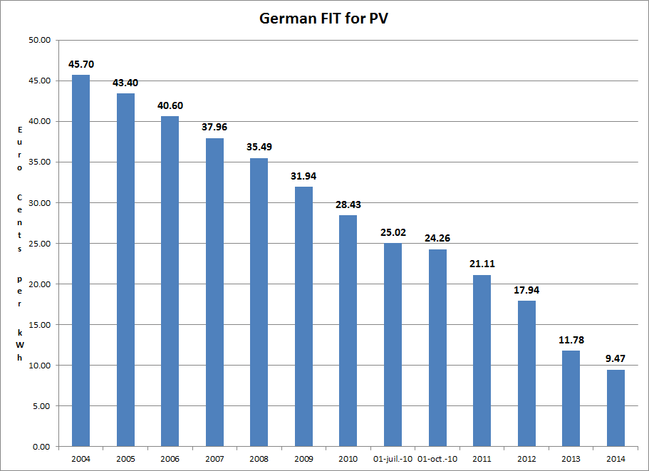
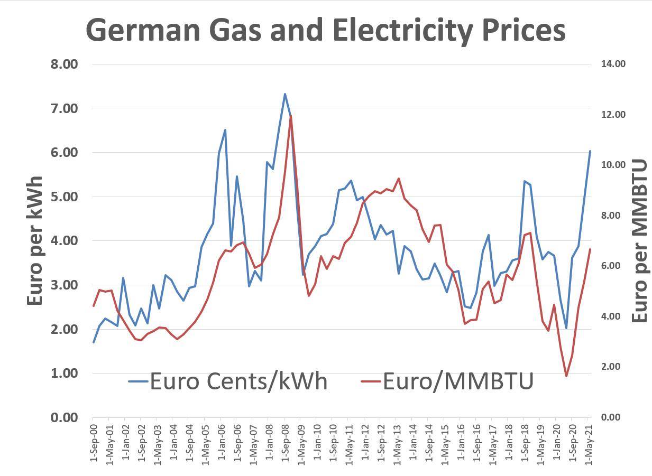
Solar History: 2000’s and Feed-in Tariffs - German Solar Feed-In Tariffs and Managing Risk
The left-hand scale represents feed-in tariffs meaning that if you put a meter next to your solar project and record the MWH generation, you get paid for that generation. The right-hand graph shows market prices (with correlation to gas prices). The y-scale is the same for both graphs. Comparing the blue bars on the left to the blue line on the right illustrates the magnitude of the subsidy in the feed-in tariff.
The feed-in tariffs were very simple contracts enabling companies to secure financing. The feed-in tariffs were supposed to encourage cost declines from scale, and they worked very well. There have been solar projects with contracts of around 1 Euro cent per kWh

Slide 21
Pillar 1 of Project Finance Capital
Intensity and Importance of Cost of Capital being Close to Rate of
Return

Slide 22
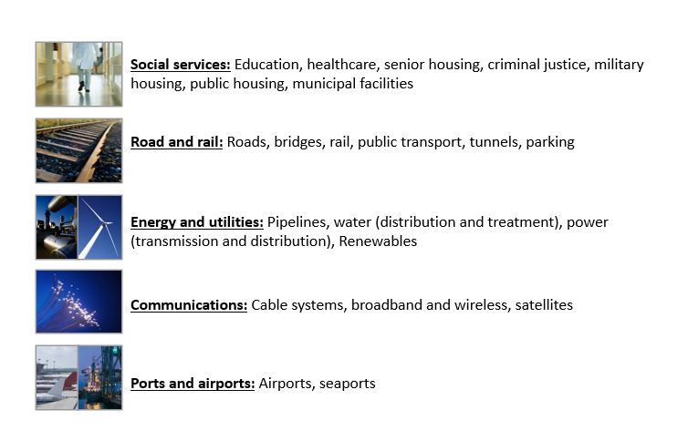
Not as Sexy as a New Version of TikTok, but Very Important to Society
Remember that the ultimate objective of finance is to provide the basis for assessing whether investments make sense for a company and/or a society
Maybe not “criminal justice” which encourages new jails
What is the difference between these business activities and activities like a local restaurant, a software venture, a bakery, hair-dresser, clothes designer

Slide 23
Effect of Capital Intensity and Cost of Capital on Prices People Pay for Essential Services
Something that is pretty obvious → if you have a bigger capital investment, the cost of capital and the return on capital matter more.
Total Revenue (price to consumers) = Capital Recovery + Operating Expense Recovery
Capital x Cost of Capital = Capital Recovery Component of Price
Operating Expense = Operating Expense Recovery
If the Cost of Capital is Higher, what happens to Price
If one project has higher capital than another project (but lower expenses), what is the effect on consumer prices

Slide 24

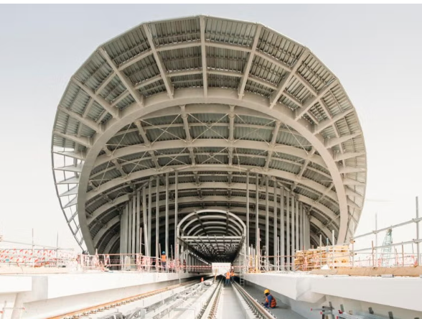
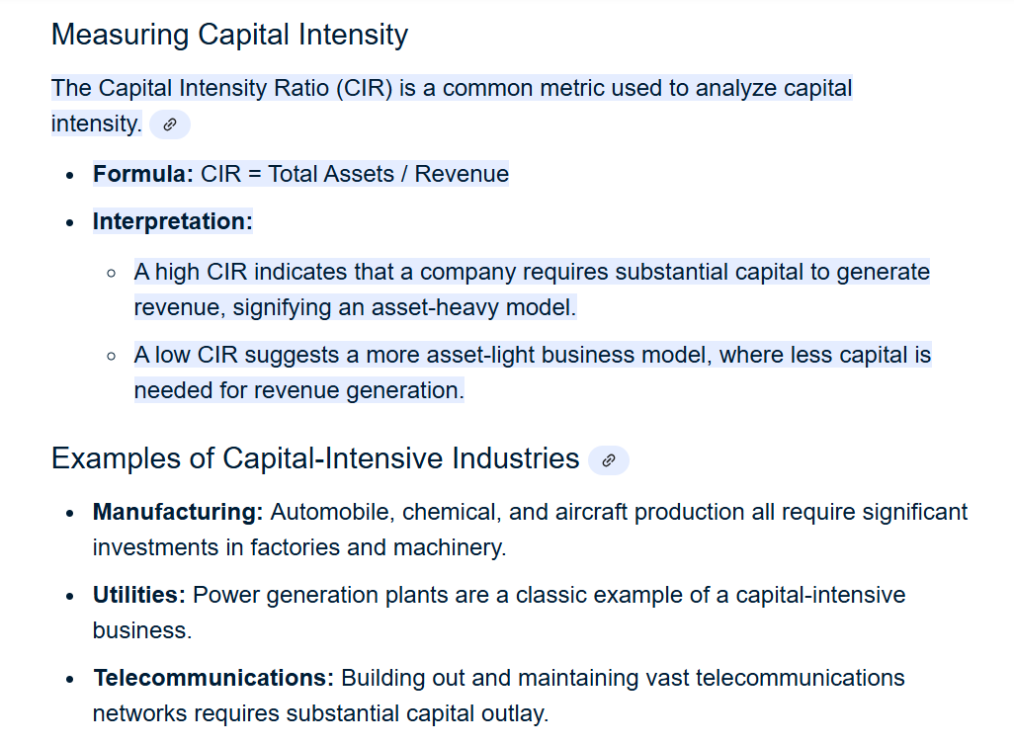
Definition and Importance of Capital-Intensive Investment
Any investment and operating costs, investment and life
Street Vendor
  Asset is truck and inventory
  High operating expense
  Most revenue covers costs of sales and labor
  Most revenues for operating expense and not the truck
  Truck has relatively short life
  Assets to Revenues a little more than 1.0
Railway
  Assets high relative to the operating expense
  Assets last a long time
  Revenues spread over long period
  Assets many times the value of revenues

Slide 25
Why is Capital Intensity an Important Concept for Our Project Finance Course
Basic Equations
  Asset Cost x Return on Investment = Operating Income
  Operating Income = Revenues – Operating Expenses
  Revenues = Operating Income + Operating Expense
  Price = Revenues/Quantity
Non-Capital Intensive
  Most of Revenue is Operating Expense
  Assets Small for Relative to Operating Expense
  Price not very sensitive to Return on Investment
Capital Intensive
  Most of Revenue is Asset Return
  Long-life Means Assets Have Lower Depreciation and Revenues are Low Relative to Assets
  Asset Cost (Capital Expenditure) High for Relative to Operating Expense
  Price sensitive to Return on Investment
For Public Investment
  Important to Obtain Low Return driven by low cost of capital
  Important to Build High Quality Assets with Reasonable Cost

Slide 26
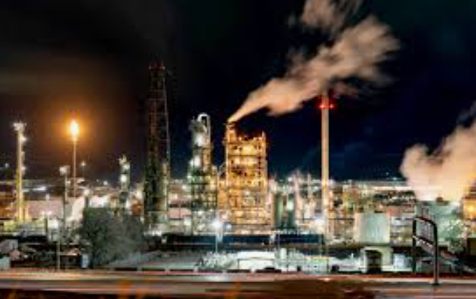
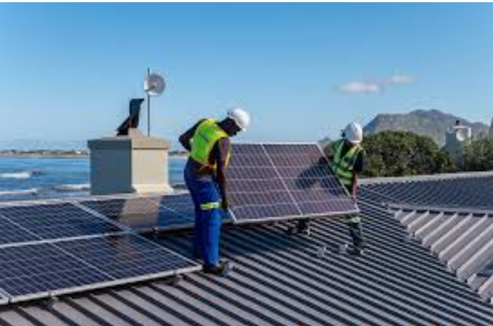
Capital Intensity – Refinery versus Roof-top Solar and Importance of Financing
Which is more capital-intensive and which is more sensitive to the cost of capital

Slide 27
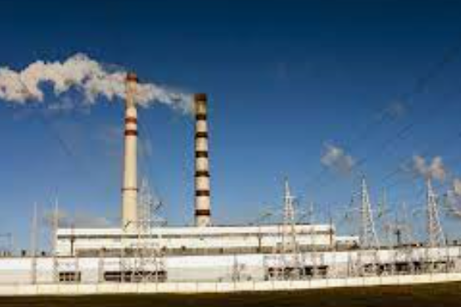

Capital Intensity – Hydro versus Natural Gas
Which is more capital-intensive and which is more sensitive to the cost of capital

Slide 28


Capital Intensity – Energy Efficient House and Food Store
Which is more capital-intensive and which is more sensitive to the cost of capital

Slide 29
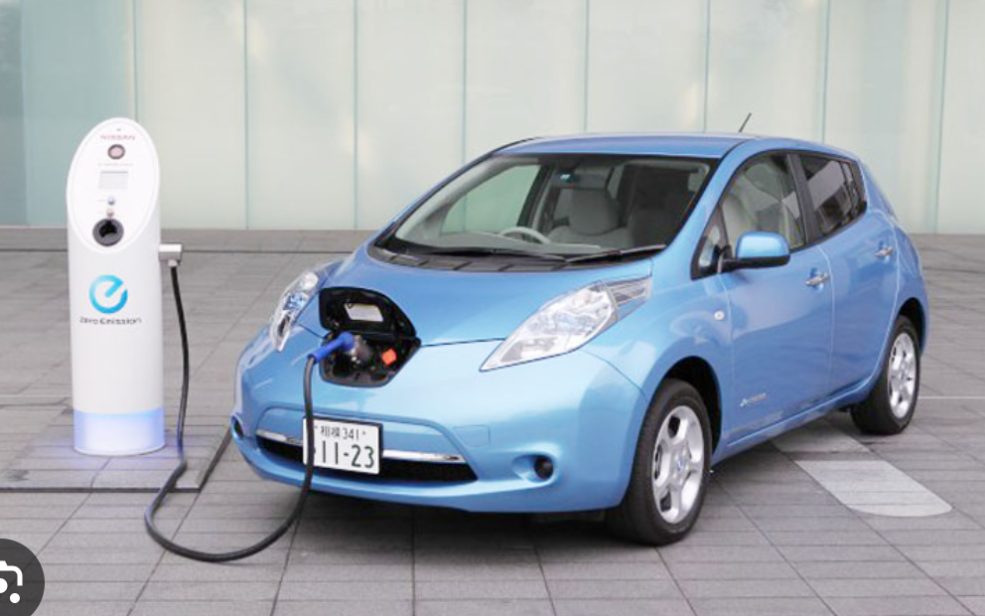

Which is more Capital-Intensive Electric or Internal Combustion
Which is more capital-intensive and which is more sensitive to the cost of capital

Slide 30
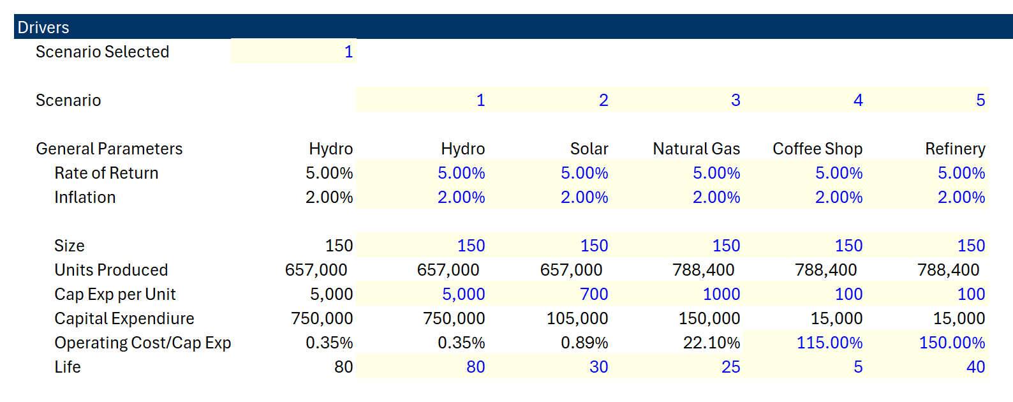
Capital Intensity Definitions and Returns
Which asset has the highest capital intensity, and which has lowest capital intensity
Capital Intensity Depends
  Operating Expenses to Capital Expenditures
  Asset Life
  Rate of Return

Slide 31
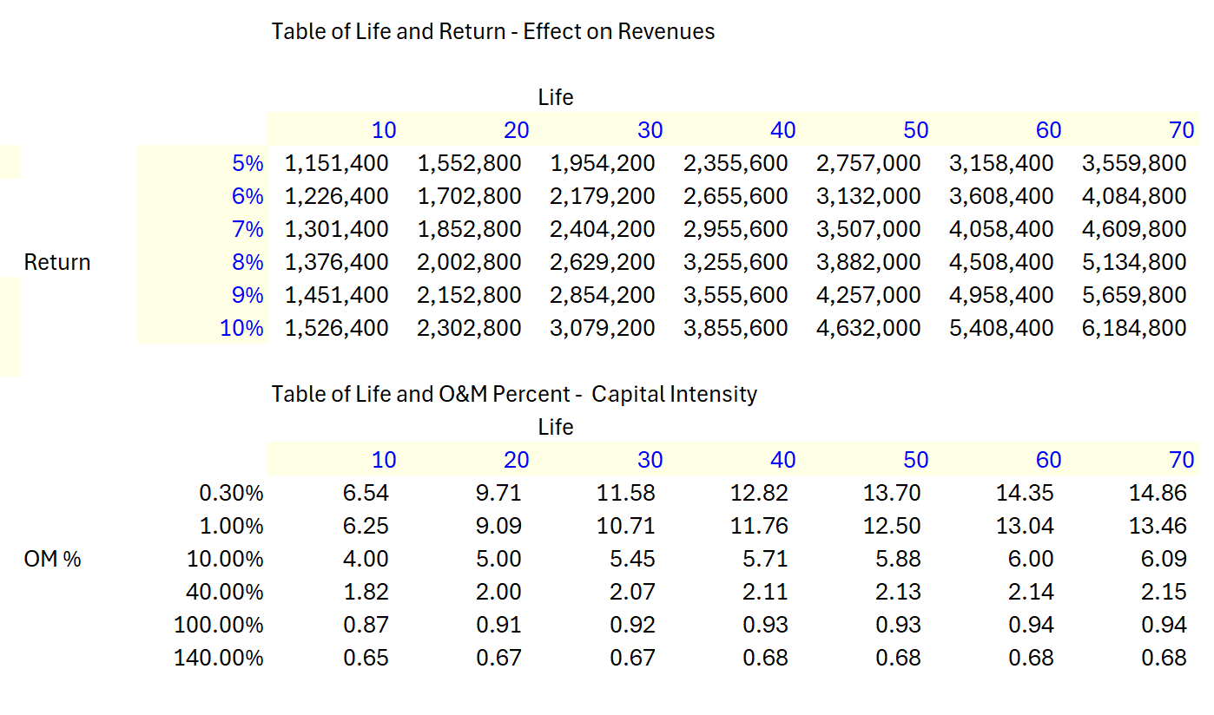
Capital Intensity and Life and Operating Expense
Data Tables Demonstrating Capital Intensity
With 70-year life, the revenues doubles; with the 10-year life the increase in revenues is much less.
Capital Intensity as Assets Divided by Revenues

Slide 32
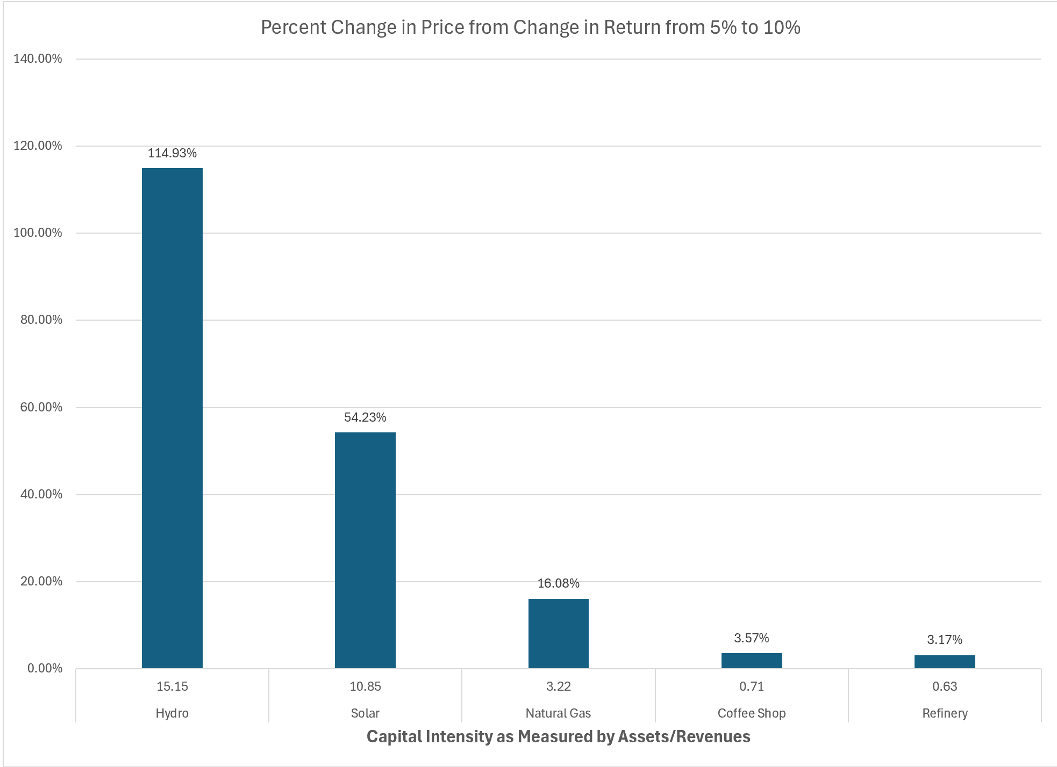
Capital Intensity Graph and Effect of Changes in Overall Return
If you can keep returns lower for capital intensive assets, the effect on prices or costs to the government is dramatic.

Slide 33
Effects of Financing on Bid Price – Capital Intensive
Pillar 1: Effects of Lower Cost of Capital on the Cost Consumers Pay – Levelized Cost of Electricity

Slide 34
The Night Before and Pillar 1
In modern project finance revenues and prices are generally structured with a competitive bid process (it is of course possible to have competitive bidding without project finance).
The implied objective of competitive bidding is that the price to consumers and cost of capital will be as low as possible – meaning the investor return is something close to its cost of capital.
I ask about the “night before.” This is when people who have been working on developing projects for many months and have discussions with the chief financial officer about the acceptable IRR just before making the bid. I imagine (I think correctly) a phone call between the developers and the CFO where the developer tells the CFO that unless you lower the IRR requirement, we will lose the bid.
What this night before is doing is establishing the lowest acceptable rate of return in the context of the risk of the project which is the definition of cost of capital.

Slide 35
Pillar 2:
Classic Definition of Project
Finance as Debt, Project Finance
Terms and Risk Verification

Slide 36
Definition of Project Finance and Concepts
In this section I focus on lender analysis in project finance and how it differs from corporate, asset and object finance;
  How is this different from other lending, what does non-recourse or limited recourse actually mean and who guarantees;
  Use of special purpose vehicle structures, how this looks in a project structure and why are they needed;
  When project finance can be an effective solution;
  Timelines, i.e. what happens and when;
  Overall contractual architecture in structured non-recourse transactions (for example renewable energy projects) and how does this differ from traditional Public Private Partnerships (PPPs);
  Recent trends on the use of project finance and the links with PPPs.

Slide 37

Project Finance Definition in HBS Cases
J.D. Finnerty
… the raising of funds on a limited or nonrecourse basis to finance an economically separable capital investment in which the providers of the funds look primarily to the cash flow from the project as the source of funds to service their loans and provide the return of and return on their equity invested in the project.
Terms in definition
  Limited or nonrecourse
  SPV – economically separable investment
  DSCR – key measure of risk of default
  IRR - Return on and of equity

Slide 38
Terms in Finnerty Definition
The first term is nonrecourse debt.
  I define the notion of nonrecourse as analogous to the lack of ability achieve guarantees from your parents where you cannot send an email to them and ask for money. Getting money from your parents is a parent guarantee is recourse, which is the opposite of nonrecourse.
The second is separable capital investment.
  The idea of a separable investment means that an asset can have different investors, and its cash flow can be measured on distinct financial statements. The separable investment can be called a special purpose vehicle, which is simply a corporation set-up to own the asset. This allows bank financing specifically associated with the project cash flow.
The third term are the two words, cash flow.
  By including the notion of cash flow in the project finance definition (contrasted to earnings per share that are affected by depreciation, impairment charges other accounting adjustments), Finnerty’s definition emphasizes the way cash flow can directly be used in project finance.
The fourth item involves the ability to service loans.
  Servicing debt introduces the notion that in project finance, the debt service – the interest and repayment on debt – is directly related to cash flow.

Slide 39
More Definitions
Definition Two: Project financing is a loan structure that relies primarily on the project's cash flow for repayment, with the project's assets, rights, and interests held as secondary collateral.
Definition Three: Financing of a particular economic unit in which a lender is satisfied to look initially to the cash flow and earnings of that project economic unit as the source of funds from which a loan will be repaid and to the assets of the economic unit as collateral for the loan.
Definition Four: Project finance involves the creation of a legally independent project company financed with nonrecourse debt (and equity from one or more corporate entities known as sponsoring firms) for the purpose of financing investment in a single purpose capital asset, usually with a limited life.
Definition Five: Project finance is used to refer to a non-recourse or limited recourse debt financing structure in which debt, equity and credit enhancements are combined for the construction and operation or refinancing of a particular facility in a capital-intensive industry.
Investopedia, definition of project finance
Nevitt, P.K. and Fabozzi F, Euromoney, Project Financing, 7th Edition, London

Slide 40
More Terms from the Project Finance Definitions
The term “loan structure that relies on cash flow” implies a loan structure where the debt service mimics projected cash flow and implies something named debt sculpting where the repayment of debt goes up and down with the expected cash flow patterns of the project.
The term “secondary collateral” is the value of a project that can potentially be realized through sale of the asset. This concept is not important in project finance because the value of a project comes from cash flow.
The term “sources of funds” points to the idea of cash flow and that the essence of evaluating project finance are two cash flow statements. The first is the sources of cash flow that are paid for constructing the assets while the second is the cash flow returned to investors after operation starts.
The term “legally independent project company” emphasizes the notion that the special purpose company can have different investors is the company that repays debt.

Slide 41
More Terms from the Project Finance Definitions
The term “sponsoring firms” simply refers to the investors in a project. Investors in a public corporation may add up to millions. In project finance there are just a couple of partners.
The term “limited life” in project finance means what is says, but it is important because cash flow analysis can be made over the entire life of a project. The amount of time between the end of the limited life and the end of debt term is called the tail.
The term “credit enhancements” refer to mechanisms that protect debt through limiting dividends. These credit enhancements include covenants that do not allow dividends when ratios fall below a certain level; covenants to repay debt early instead of paying dividends (cash flow sweeps); and cash held on the balance sheet to provide cash in emergency situations.
The term “refinancing” refers to re-paying exiting debt (generally before the end of the term of the debt) and replacing the existing debt with new debt that has better terms.

Slide 42
Problems with the Project Finance Definition: Aspects of Project Finance Other than Debt Ignored
All the definitions miss the pillars of project finance related to:
  encouraging efficient construction and operation using contracts;
  the essential point of achieving low prices for consumers and low returns relative to cost of capital through bidding;
  Explicitly managing externalities through disqualifying certain projects and encouraging others.

Slide 43



Which is a Better Way to Assess the Value of an Investment – Two Presentations to the Board
Value and Risk Verified by Investors Outside of the Company
  Bank Puts money into the company
  Makes sure the money will be paid back
  Crucial stamp of approval

Slide 44
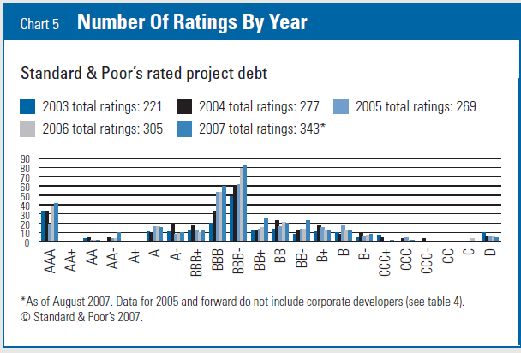
In Project Finance, Risk is Managed to Achieve BBB- (Baa3)
Example, the DSCR of 1.20 x for a solar project should have and footnote to be on a BBB equivalent.
Why BBB- and not AA
Why BBB- and not BB-
Understand the key difference between corporate finance where risk is given and the amount of debt increases or decreases risk versus project finance where you start with risk and back into the amount of debt to give a similar risk profile.

Slide 45
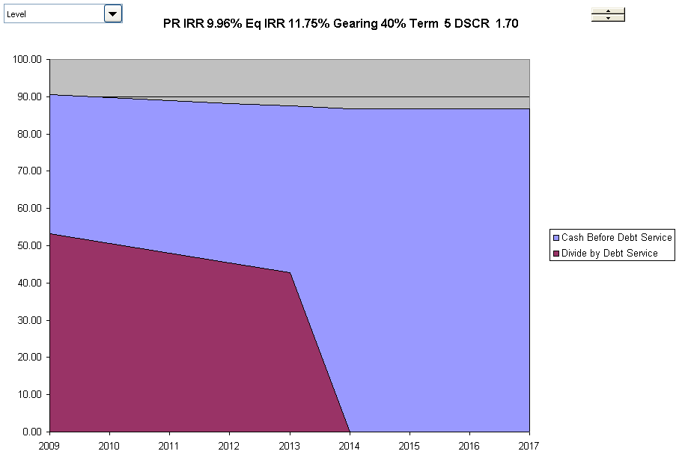
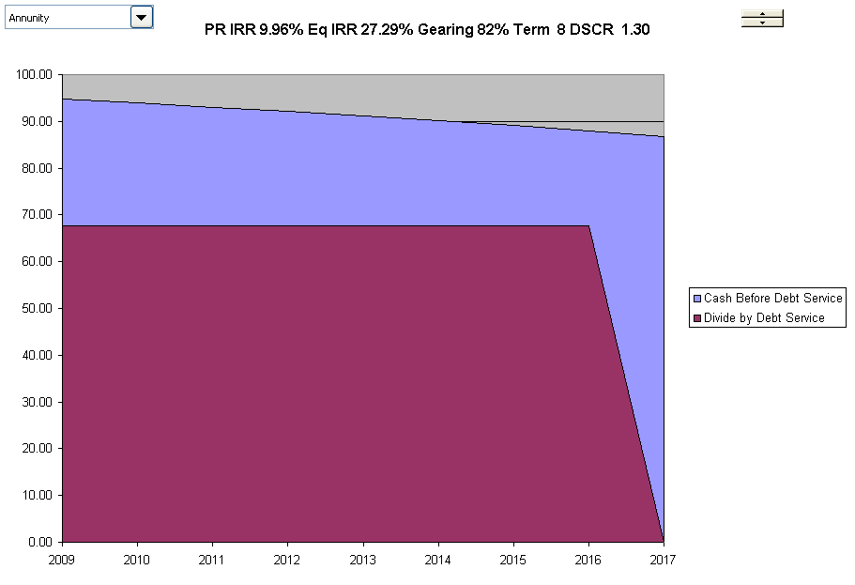
Risk Measured by Bank from Cash Flow Forecast DSCR with High and Low Risk
High Risk Cash Flows
Low Risk Cash Flows
High Risk Project has higher margin, shorter-term and declining debt service. Low risk has flat debt service, and longer-term and higher IRR on Equity

Slide 46

Why is Non-Recourse and No Parent Support so Important In Essence of Project Finance
No parent guarantees (your children cannot send and email and receive your financial support like my daughter).
From a valuation and from a loan perspective a project must be economically viable and evaluated on a standalone basis. In corporate finance and regular old capital budgeting there is no such test.
Philosophical question – is a child with a lot of parent support able to perform better than one with none.
If you know there is a rich parent behind you, can you use this even if there is no direct promise.

Slide 47
The Real Import of Nonrecourse
The example of parental support (a term used in project finance) makes you understand that the real import of nonrecourse financing is that a project must be able to be viable on a standalone basis.
Now think about nonrecourse and investment assessment. Not only do you have a third party assessing the viability of a long-term investment; this assessment of is made on a pure basis where the risks and the economic viability are directly evaluated.
Question: Without nonrecourse provisions in project finance debt, would the example of the two people making presentations be relevant

Slide 48
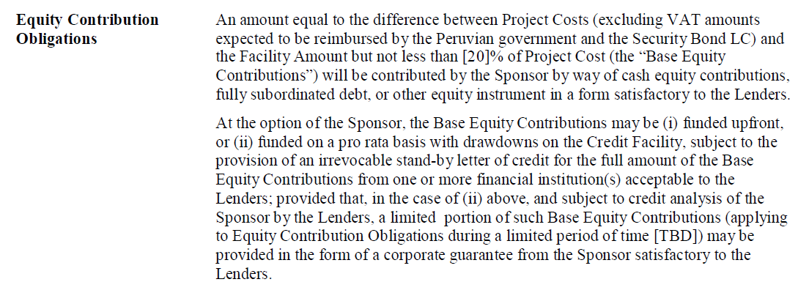
Language of Term Sheet Illustrating Parent Support
Why do they write sentences like this.
How would you read and interpret this if you were trying to understand the term for the first time.
Under which scenario is the loan partial recourse and under which scenario is it full recourse.

Slide 49
The Essence of the Verification Pillar of Project Finance
Revenues Realized
Go Around the Bend and Assure that Risks are Mitigated or Reasonable.
If all of the risks are acceptable and produce reasonable cash flow relative to the amount paid on debt, the lenders will put a lot of money into the project.
Reputation of the equity sponsors is important even if the loan is non-recourse.
Note the IRR and the DSCR from cash flow as the performance metrics for the project.
Start
Capital Investments
Operating Expenses
Special Purpose Vehicle:
Project IRR
End
Lenders Receive Debt Service and Invest Debt
DSCR
Equity Sponsors Receive Dividends and Invest Equity – Equity IRR
Project Finance is a method of financing where the costs and benefits of long-term capital-intensive assets can be assessed from the structuring of debt by lenders. Structuring of debt considers the cash flow derived directly from the asset (non-recourse). Project finance typically involves management of risks through a series of contracts where risks are designed to provide incentives for project parties to efficiently manage construction and operation of a project. Project finance can low cost of capital with transparent and manageable risks and demonstration of support from lenders.

Slide 50
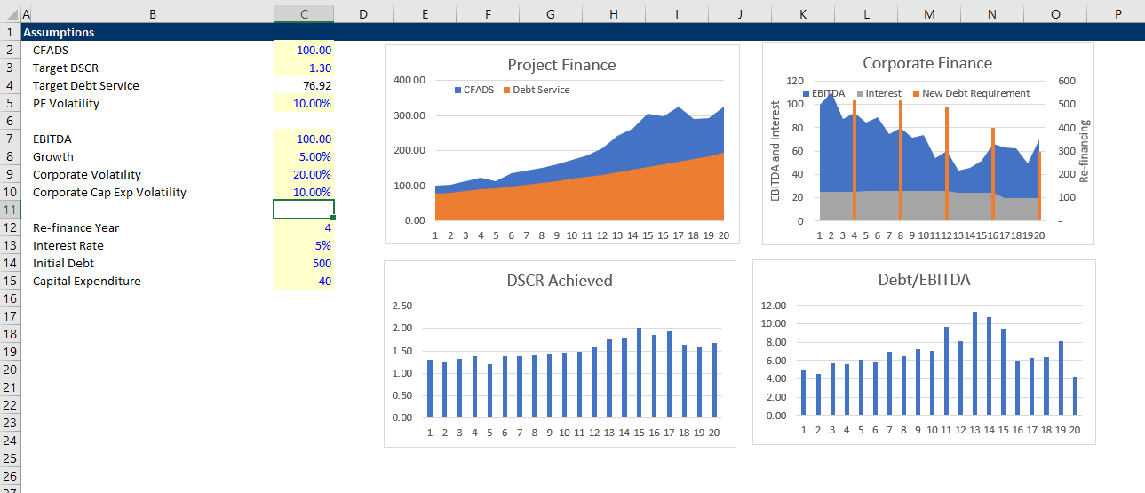
Simple Example of Credit Analysis in Corporate Finance and Project Finance
Illustration of re-financing risk in corporate loans versus DSCR in project finance.

Slide 51
Risk Analysis in Project Finance Models
Project finance analysis to a large degree involves identifying, allocating and mitigating risk. One must therefore be able first to identify risks and then to measure how effective the contracts and other mitigating factors (covenant, debt service reserve, liquidated damage) are in managing risk.
Project Finance Adage:
  At the beginning of the project
    Lender has the money
    Developer has the experience
  At the end of the project
    Developer has the money
    Lender has the experience

Slide 52
Pillar 3:
Contract Structures to Encourage Efficiency and Key Parties in a
Project Finance

Slide 53
Contract Pillar
Some kind of contract structure is almost universal in project finance, although project finance such as merchant electric power and resource project finance has been applied without revenue contracts (which were supported by assumed mean reversion in commodity prices).
Contracts between the SPV and government agencies or other private companies create stable cash flow, mitigating the risk of technological obsolescence.
It is possible to structure an investment with a lot of contracts that impose targeted risks on investor without project finance debt, meaning that some kinds of contracts are necessary for project finance, but contracts do not mean investments will be project financed. Just as important as providing stable cash flow that is necessary for financing long-term investments, contracts can be used to explicitly impose targeted risks to provide private companies with an incentive to construct and operate projects in efficient manner.

Slide 54
Pillar 3 of Project Finance – Private Companies with Contracts to Encourage Efficiency
Pillar number 3 is using of price, construction and operation contracts that are structured with private entities to provide incentives for efficient construction and operations while not imposing uncontrollable risks on the private companies that increase cost of capital.
It is possible to structure an investment with a lot of contracts that impose targeted risks on investor without project finance debt. This is similar to pillar number one that involves achieving a low cost of capital through competitive bidding which does not necessitate a particular financing structure.
Putting all of the pillars together – bidding, financing and contract structuring -- is what makes project finance a unique and potentially effective tool of economic policy.

Slide 55
Contracts with Incentives and the History of Project Finance
The history of project finance was in large part due to coming up with a way to incentivize private investors to accept construction cost risk, construction delay risk, plant performance risk, operating cost and other risks that could be accepted by investors.
In order to be able to provide these incentives, and also encourage competitive bidding, there should in theory be projects that were created from relatively small companies and with different kind of partnerships.
These companies needed to be separable companies (SPV’s) with the ability to sign different contracts to further impose risks on parties that are qualified to take the risks such as Engineering, Procurement and Construction (EPC) companies.
This separability the investment could in turn lead to financing of the projects.

Slide 56
Subjects for Key Parties, Contracts, Lenders and Equity Investors
Project company/borrower (IRR);
  Industrial Sponsors and Financial Sponsors: key differences and how do they interact, e.g. shareholders agreement etc.;
  Construction contractors (EPC and margins);
  Operator;
  Suppliers; purchasers/off-takers;
  Government role, government as a counterparty, government as a host etc
Risk-return and what it means (Required Equity IRR);
  Third party equity investors (IRR for Mature Project);
  Lenders banks and other sources (DSCR, LLCR, PLCR);
  Multilateral banks and export credit agencies;
Different teams: legal team; finance team; financial adviser; model auditor; insurers; tax and accounting advisers; environmental consultant.

Slide 57
Economic Theory of Contracts
Take a step back and think about what contracts really do:
  Contracts manage the risk structure between the parities to provide incentives to operate efficiently. If you have no contract, you may have more variation in your cash flows or something else
    Things that vary for which you can have hedging contracts
      Commodity and electricity prices
      Interest Rates
      Inflation Rates
  Generally, but not always, with hindsight, one party will be better off, and the other will be worse off by locking prices or other things in.
    If you sign a contract for a loan on your house with a fixed interest rate, you may be happy if the interest rate rises but sad if it declines
    If you sign a contract for life insurance and you die later, you lose on the contract, and the insurance company wins
    If you sign a contract for buying solar power, you may be sad if the price of solar power goes down but happy if the solar price goes up.
  Contracts should encourage parties to behave well, and in economic terms they should manage things efficiently and not waste money
  Liquidated damages like warranties when you buy something – you will pay extra for the warranty on your phone from the likelihood of you damaging the phone and what is covered. The economics of a warranty depend on the buyer value,

Slide 58
Explaining Project Finance with Diagrams to Demonstrate Contracts and Risks
You would like the diagram to give you a picture of the risk of the project and highlight issues with contracts
  SPV is a separate corporation in the middle
  SPV signs a lot of contracts that should be illustrate with solid lines
  The contracts should be labeled (e.g. concession contract, EPC contract, PPA contract, O&M contract, Loan Agreement, Shareholders agreement)
  Different levels of support from parent (non-recourse is no support)
  Contracts should be consistent with each other
  Diagram should show direction of money and start with revenues (no revenues, no project)
  Quality of off-takers should be shown on the diagram in the circles
  Insurances and guarantees should can be demonstrated

Slide 59
Start with Revenues and Risks from Revenues – General Categories from Revenue Generation
Different types of revenues in project finance
  Price Risk and Volume Risk from Demand
    Real Estate
    Technology
    Rehabilitation and some health care
  Price Risk but Limited Demand Risk
    Commodity Price – Oil and Gas
    Refinery and Mining
  Volume Risk but Limited Price Risk
    Infrastructure – Toll roads and bridges
    Infrastructure – Airports
    Renewable Energy with Resource Risk
  Availability Risk – No Price or Volume Risk
    Dispatchable Power Plants – IPP, BOT, BOOT
    Hospitals, Schools, Prisons – PPP, Availability Payment
    Availability Bases Toll Roads – Availability Projects

Slide 60
Philosophy of Pillar 3 - Imposing Controllable Risks in Contracts
As with other subjects, when you work on a project finance transaction you can get lost in the language and the details of the contracts.
  Maybe you can work carefully on a formula in the contracts
  Maybe you assure that the language of the contracts addresses details that could potentially become an issue.
General theory of contracts
  Provide incentives to private companies to be efficient.
  Contracts should not be structured where risks that cannot be controlled by the private companies as allocation of such risks does nothing other than increase the cost of capital without encouraging efficient behavior.
  Examples of such contract provisions are imposing the risk of oil price changes; inflation rate variation; uncontrollable output such as traffic; and exchange rate fluctuations on the private investor.

Slide 61
Not Just a Diagram – Illustrate Risks
Each contract can have many nuances with penalties, bonuses, default clauses, termination.
Off-taker: Want strong off-taker with inactive to honor contract
Write down notes associated with each contract and if a contract does not exist, how the cash flow volatility can be addressed.
EPC Contractor: Want Strong Record and Finances
Price Risk or Volume Risk or Both or None (Availability)
EPC: Fixed Price Contract with LD
Supplier: Need to Understand Economics and Supply Curve
Special Purpose Vehicle: Bond Rating of BBB-
O&M Contractor
Supply Agreement
O&M Agreement
Loan Agreement – Draws Green; Debt Service Red
Banks Like Strong Sponsors. Sponsors want EIRR
Shareholder Agreement
Lenders:
Lenders want DSCR (LLCR, PLCR)
Invest with paid in cap; payback dividends
Invest with draws; payback debt service

Slide 62
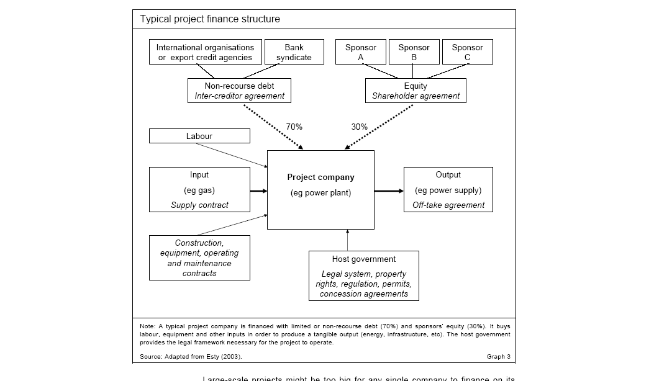
What are Problems with this Diagram from HBS

Slide 63
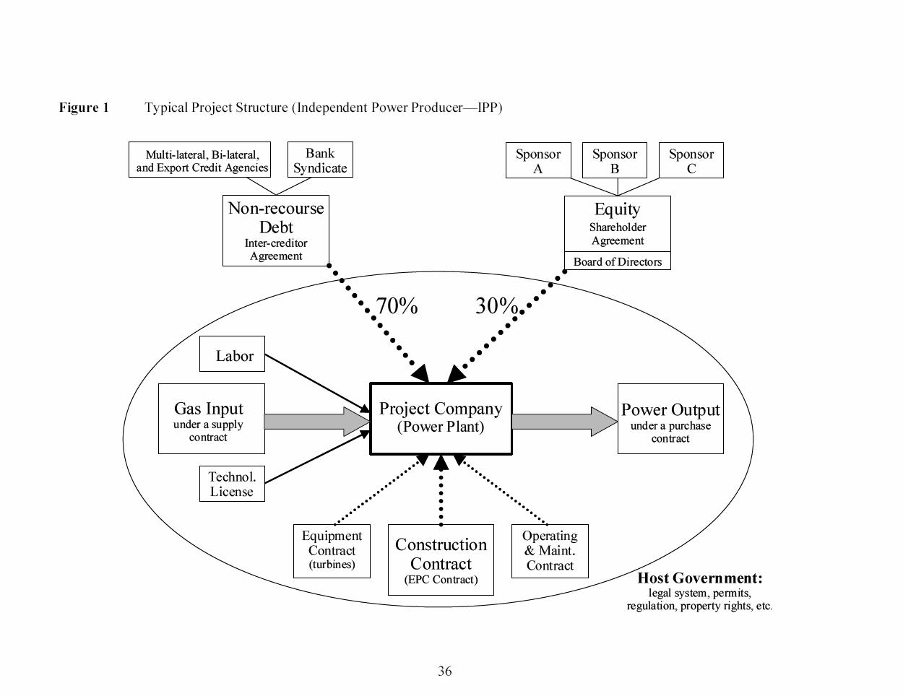
What is Good and Bad about this Diagram
Debt is serviced entirely via cash flow through the project and the SPV This structure exposes the lenders to significant risks. If something goes wrong, their recourse against the sponsor, with its typically larger balance sheet, will be limited or none.
The loan is structured so that bankers can step into and take over the project if things were to go wrong, a so-called step-in right. This process is also called ‘ring-fencing.’
Ring-Fence

Slide 64
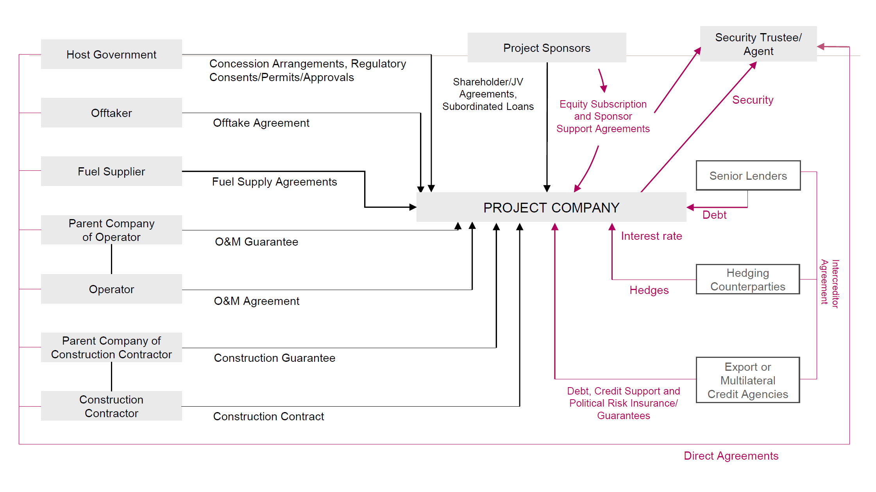
Detailed Project Contracts
Diagram from Law Firm

Slide 65
Project Participant Overview – Fix this Diagram and Use Diagram to Demonstrate Risks
Exercise:
Revise the diagram assuming that there is a minimum traffic guarantee; that toll rates are established with the CDOT with inflation adjustments; that the O&M contracts have incentives to re-surface the road every seven years; that the loan is 70% of the project with a DSCR of 1.4x; and finally, that the project has subordinated debt from the government and there are two different sponsors.
Public Authority (CDOT)
Debt
Investors
Special Purpose Vehicle
(SPV)
Design-Build Contractor
Equity Investors
Operations & Maintenance Contractor
Toll Road Users

Slide 66
More Comprehensive Diagram of Project Finance and Parties
The diagram on the next slide is illustration of a transaction that is part of a project finance model.
The diagram shows the flow of cash (the green arrows) where the quantity produced comes from the sun with not contract.
The price has a contract with a government agency (the yellow box) in Nigeria that in turn receives revenues from electricity distribution companies that have poor financial conditions. The EPC and O&M contracts and off-takers are illustrated in a similar way.
Risks associated with these projects that ultimately affect the cash flow of the SPV could be listed. The SPV oval is shown with the project IRR. This can be used to evaluate the reasonableness of the price contract.
Finally, the funding from debt and equity is illustrated with the key financial ratios – the equity IRR and the DSCR. The diagram also shows the expected cash flow relative to the debt service. This means the diagram should demonstrate the ability of the contractor to meet the terms of the contract. In the diagram below, the important contracts; how the contracts interact, what are the risks, who takes the risks.

Slide 67
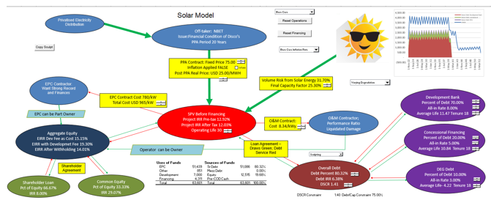
Diagram from Financial Model
Comprehensive diagram illustrating off-takers, contracts, returns, cash flow

Slide 68
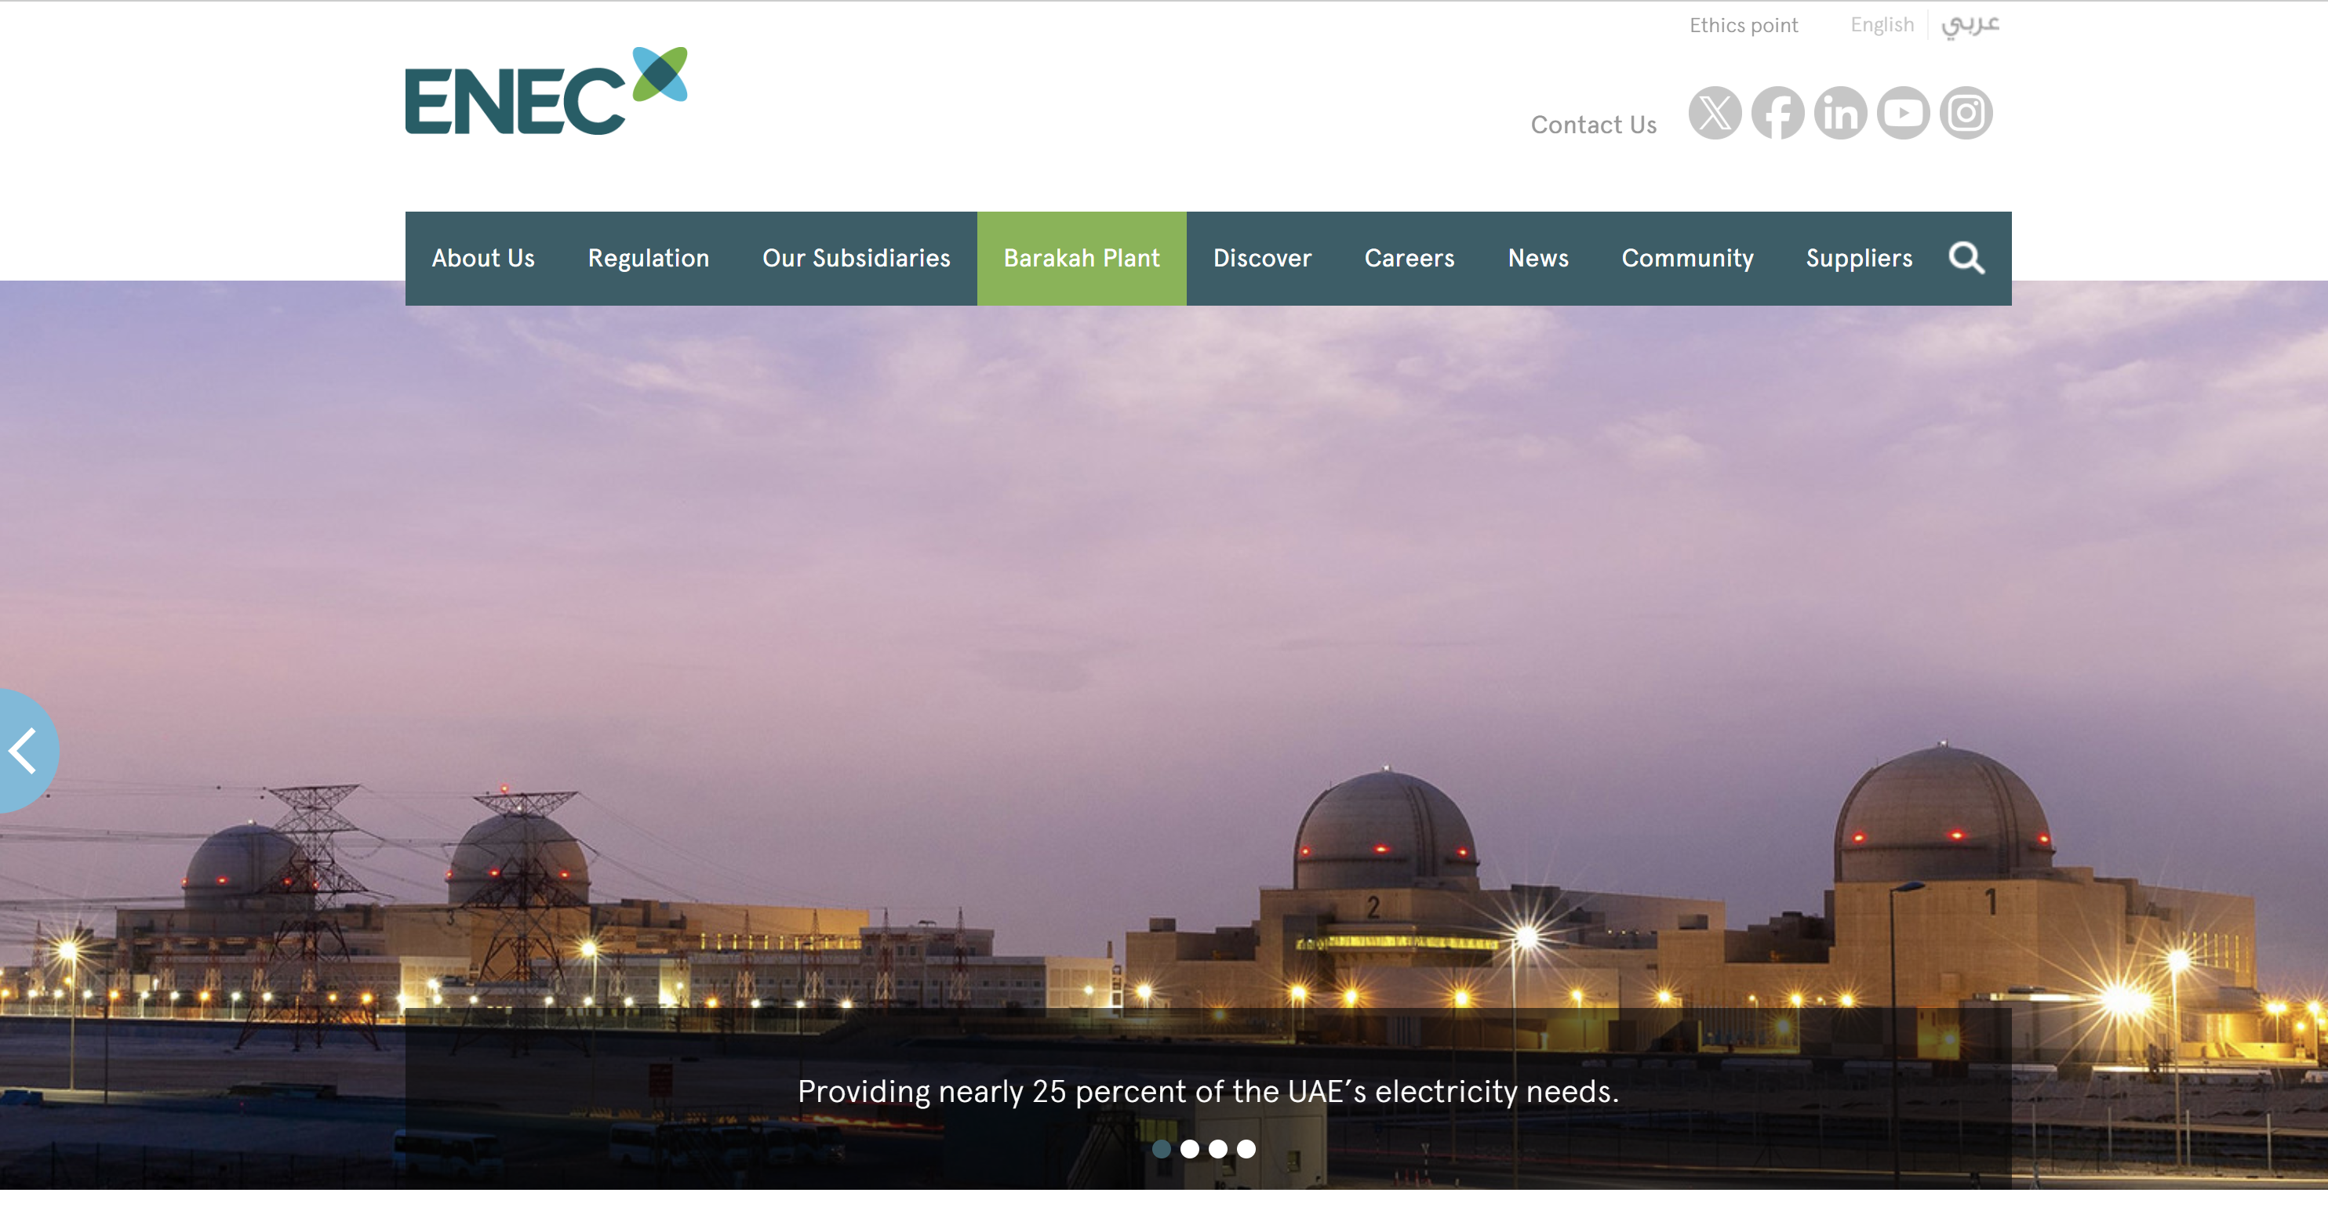
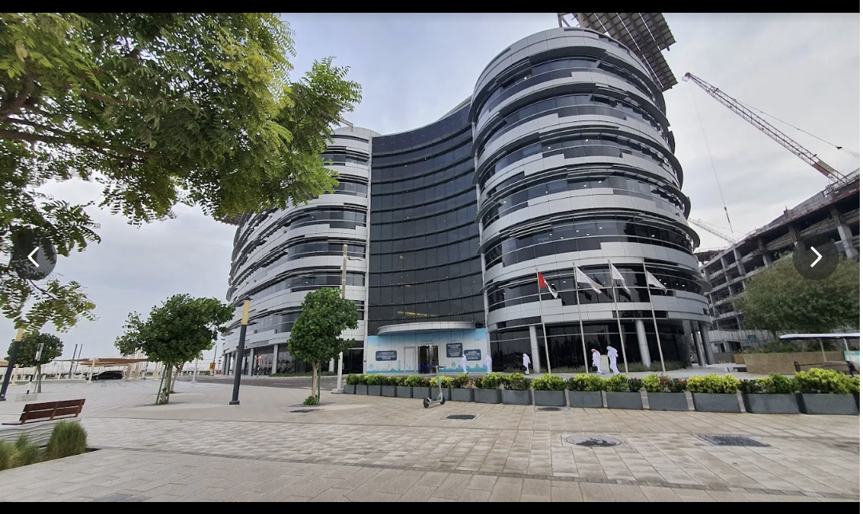
PPP Project Example – Versus Corporate Finance or Government Ownership
Draw diagram of PPP project in nuclear power
.
18%/82% Private/Public
ECP Contract – Private
O&M Public
Debt 20% EXIM/80% Govt
.
.
.
.

Slide 69
Pillar 4: Consideration of Items in
Project that Are Not Measured by
Private Investor Return or Risk Assessment by Lender

Slide 70
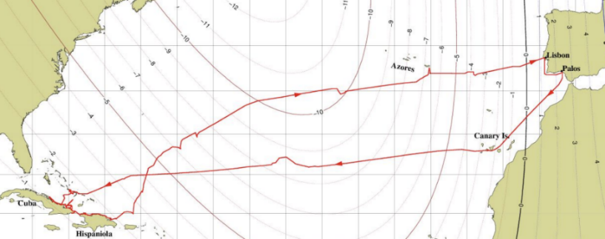
Example of Investments – Christopher Columbus
Cost of Investment
  Three Ships for about USD 3 Million
Financing of Investment
  Public Private Partnership
Forecast of Investment
  Distance from Portugal to India from estimates of the diameter of the earth
Risks of Investment
  Shipwreck, Mutiny, Voyage will take too long
You could think about computing the economic IRR of Columbus’ voyage, but I think it would be almost impossible to get your head around the societal costs and benefits and even make a vague estimate. Benefits could include starting the "Age of Discovery," providing massive wealth and new commodities for Europe; introducing crops like the potato and maize to the old world; allowing Spain to become a global superpower. On the other hand, the societal costs were devastating – genocide of indigenous peoples killing many millions; initiation of the transatlantic slave trade; the brutality and extreme violence of the conquistadors; the ecological impact of invasive species and livestock that permanently altered the American ecosystem.

Slide 71

Example of Investment - NVIDA
Cost of Investment
  Acquisitions and Internal Development in beginning In 2006
Financing of Investment
  Public offering and cash from gaming chips
Forecast of Investment
  Finding an application for the faster calculation chips
Risks of Investment
  Faster calculation chips not needed for most applications
Externalities of Investment

Slide 72

Example of Investment Externalities – Leaf Blower
Cost of Investment
Financing of Investment
Forecast of Investment
Risks of Investment
Externalities of Investment – Positive
Externalities of Investment - Negative

Slide 73
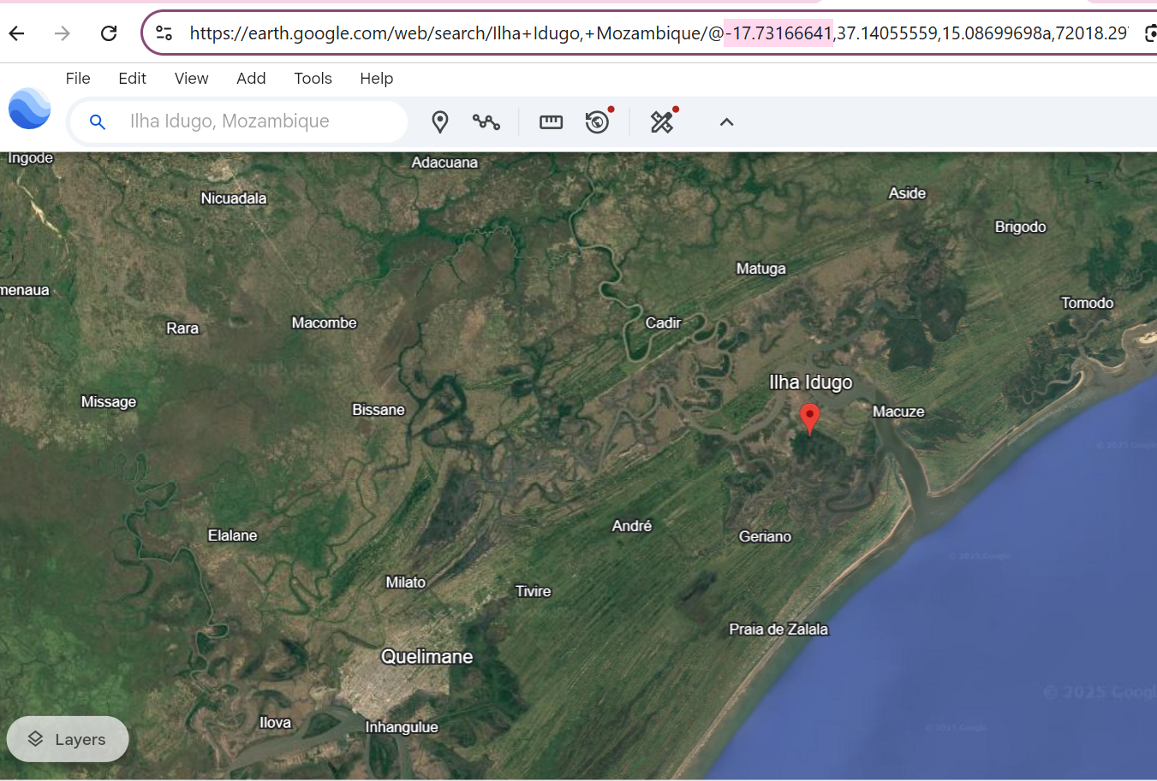
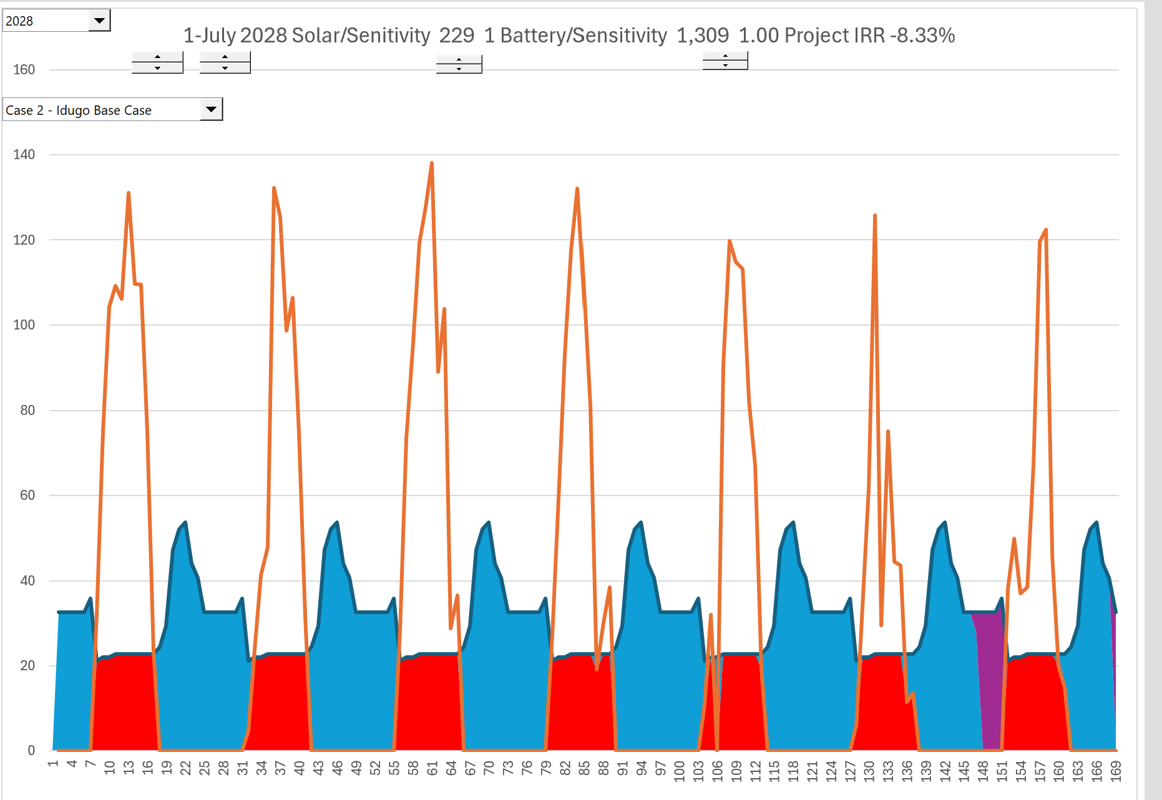
Calculation of EIRR
Actual case
Project to bring electricity to villages in Mozambique through the use of solar power plus batteries. To quantify the environmental effects of the renewable energy, we quantified the value of the reduced emissions in the EIRR and put a price on them. To measure the effects of having electricity to promote irrigation and other uses, we evaluated the price that people and businesses are willing to pay for electricity when the electricity is not available, called the shadow price. This price that people are willing to pay could be derived from the amount people in Nigeria pay for electricity outages by having a back-up generator and the associated fuel.

Slide 74
Part 2: The Key Parties in Project Finance and Financial Ratios

Slide 75
Outline
Foundations, Objectives and Pillars of Project Finance
  Overview of project finance objectives and what makes project finance different from corporate finance
  Cost of Capital and Financing Long-term Assets
  Lending in Project Finance and Project Financing Terms (what does nonrecourse mean)
  Contracts in Project Finance and the SPV
  Benefits of Project Finance to Society and Effectiveness of Project Finance
Key Parties in Project Finance and Metrics Used by Parties in Assessing Rate of Return and Risk
  Project Diagram with SPV, Sponsor, Lender, EPC, Operator and Illustration of Risks
  Sponsors Assessing Risk/Return with IRR
  Lenders Assessing Risk with DSCR and Variants
  Petrozuata and Ras Laffan Case Study
Contracts to Allocate Risk and Assure Revenue Stability - History of Project Finance and Risk Allocation
  History of Financing Long-term Capital-Intensive Assets and Development of Project Finance with Risk Allocation
  Differences in Contract Structures; Sectoral Contracts, Availability/Output Contracts and PPP’s
  Contract renegotiation and Migration
  Case Study – Dabhol in India
Stages of Project Finance from Feasibility to Boring Project
  Risk Diagram and Risk Reduction from Development to Maturity for Different Projects
  Financial Close after Development Stage and Term Sheet
  Risks and Contracts in Renewable Energy
  Case Study - Eurotunnel

Slide 76
Ras Laffan and Petrozuata
Structure, IRR, DSCR

Slide 77
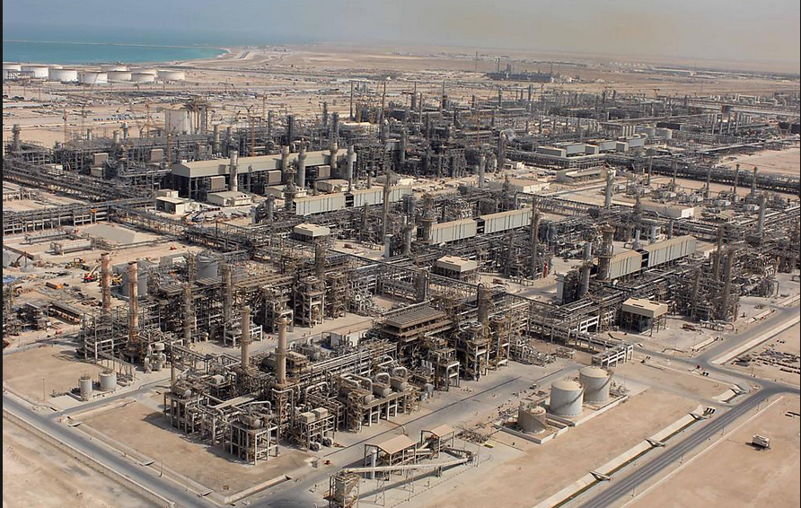
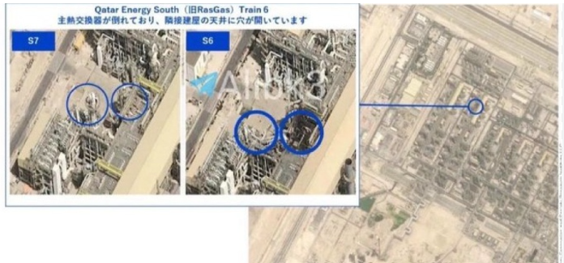
Ras Laffan in Qatar - 1996 COD

Slide 78
Issues to Discuss – Ras Laffan
Read the Pre-Sale Report – The Strengths
  Could Qatar have hosted the world cup without project finance
  Simulate the importance of Exxon
  List the risks and mitigations
  Could there have been more problems if the State of Qatar was not the biggest sponsor
  Contrast project finance with State Ownership
Open the Model
  Why do the fundamental economics of the project work or do not work
  What notes would you put in the diagram
  How do you think the break-even gas price was computed – DSCR, LLCR or PLCR

Slide 79
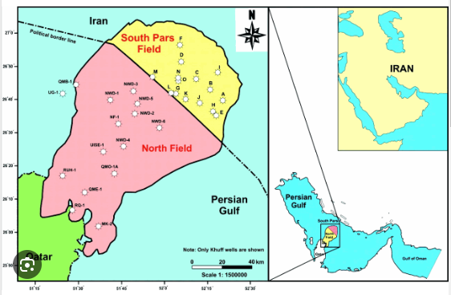
Illustration of Gas Lake Under the Gulf
Cost of production of natural gas is low
The entire ​gas field contains an estimated 1,800 trillion cubic feet of usable gas — enough to ​supply the world’s needs for 13 years.
What is the South Pars gas field?
South Pars is part of the world’s largest natural gas reserves, located offshore in the Persian Gulf. It is shared between Iran and Qatar, which calls its part of it the North Dome.

Slide 80
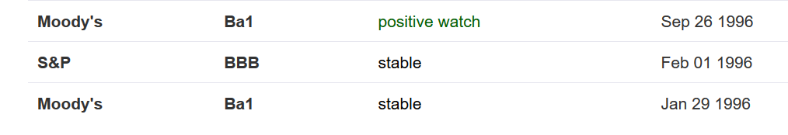
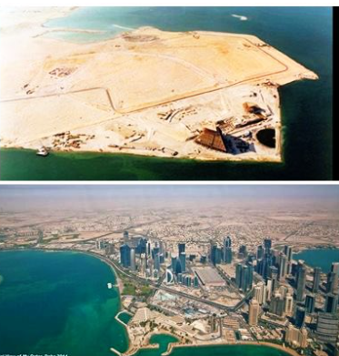
Country of Qatar Background before and After Project
Imagine you were from the government of Qatar, and you asked to for billions of dollars in loans to build LNG facilities.

Slide 81
Example: Ras Laffan Liquified Gas Company (Ras Gas) – Two Trains
Summary of Original Transaction
  Project: Two LNG Trains and cost of developing natural gas reserves
    Cost $3.4 billion
    5.2 millions of tons per annum
Equity Sponsors
    70% State of Qatar
    30% Mobil Oil
EPC Construction Contracts
  JCG/MW Kellogg for LNG Trains and on-shore facilities
  McDermott-EPTM/Chiyoda for off-shore platforms
  Saipan for off-shore pipeline connection
Now there are 14 trains

Slide 82
Ras Laffan Liquified Gas Company
Financing of $3.4 Billion
  $850 million in Equity
  $465 million supported by US EXIM
  $250 million supported by UK ECGD
  $185 million supported by Italy’s SACE
  $450 million uninsured loan from commercial banks
  $1,200 million from bond markets
    10-year and 17-year maturity
    Rated BBB+ by S&P
    Rated A3 by Moody’s
Revenue Contracts
  25-year contract with Korea Gas Corporation for output of one train
  Korean Gas Corporation built receiving facilities and purchased ships ($3.1 billion)
Relatively unconventional technology, no projects in the country and can achieve bond rating better than country rating

Slide 83
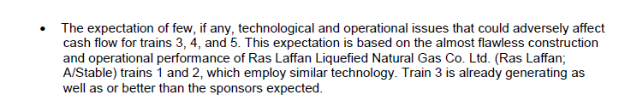
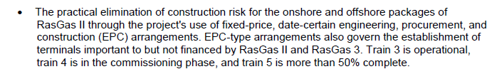



Use Snipping Tool to Fill in Items from Pre-Sale Report
Proven (boring) technology
Construction Cost Over-Run Risk
Supply Risk
Volume Risk
Price Risk

Slide 84
Financing Terms and Risks
Phase 1 Financial Structuring
  Cash flows from Trains 3-4 to support Phase 1 debt
  Essentially a financing of Trains 3-4 to fund expansion
Phase 1 Financing Key Risks
  Train 3-4 Operations
  Shipping and Access to Markets
  Revenue Risk (Price x Volume)
Terms
  Series A Bonds (15-yr): LIBOR + 97 bp
  Series B Bonds (22-yr): LIBOR + 130 bp
  International Banks: LIBOR + 45-65 bp
    Up-front Fee (Arranger Fee) = 60 bp
    Commitment Fee = 20 bp p.a.
Phase 2 Scope: Completion of Train 6 and Fund Construction of Train 7
  Estimated Debt: US$5.4 billion (Will likely require completion guarantees)
Track record
Shipping contracted
Sale & Purchase Agreements in place with creditworthy counterparties (Petronet, Edison, Endesa)

Slide 85
Exercise: Draw a Diagram of the Ras Laffan Project
.
Ras Laffan
Special Purpose Vehicle: Bond Rating of A-

Slide 86
Ras Laffan Diagram
Off-taker: Korea and Japan Utility Companies: Want strong off-taker with inactive to honor contract
EPC Contractor: Kellogg with Strong Record and Finances
Price of Gas Linked to Oil Price
Off-take Contract with minimum supply
EPC: Fixed Price Contract with LD
Special Purpose Vehicle: Bond Rating of A-
O&M Contractor
Supplier: Need to Understand Economics and Supply Curve
O&M Contractor
Supply Agreement
O&M Agreement
Loan Agreement – Draws Green; Debt Service Red
Sponsors: Want strong sponsor:
Mobil
State
Shareholder Agreement
Lenders:
Issued bonds and debt with long tenor and low rates
Lenders:
Issued bonds and debt with long tenor and low rates

Slide 87
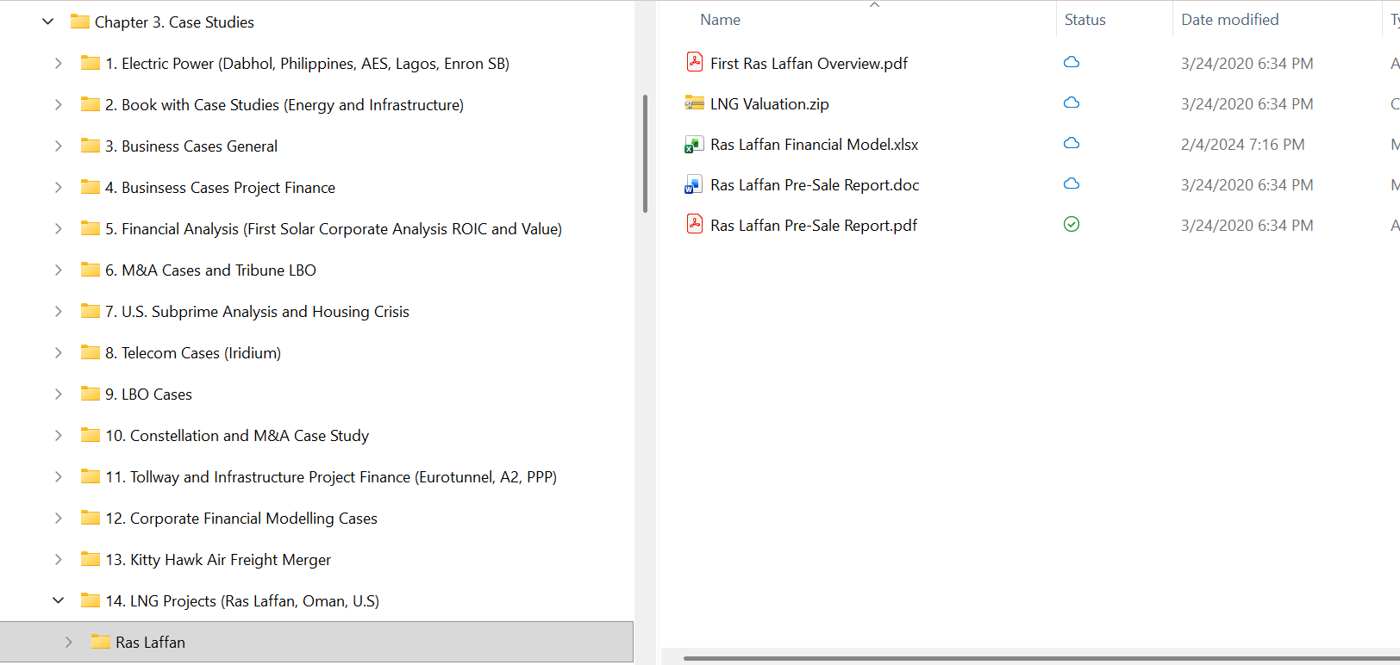
Open the Financial Model
Use the financial model to quantify risks
  Present and discuss the cost structure
  Break-even Oil Price
Volume Risk
Price Risk

Slide 88
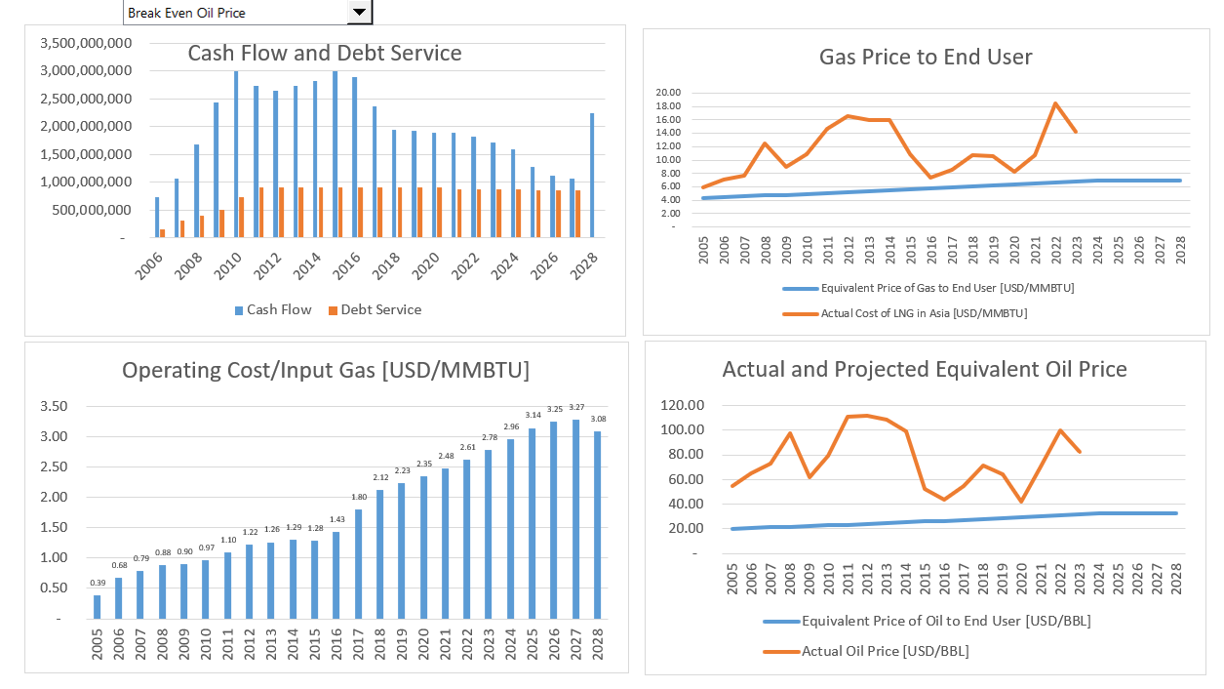
Financial Model – Assumptions from Financing Documents

Slide 89
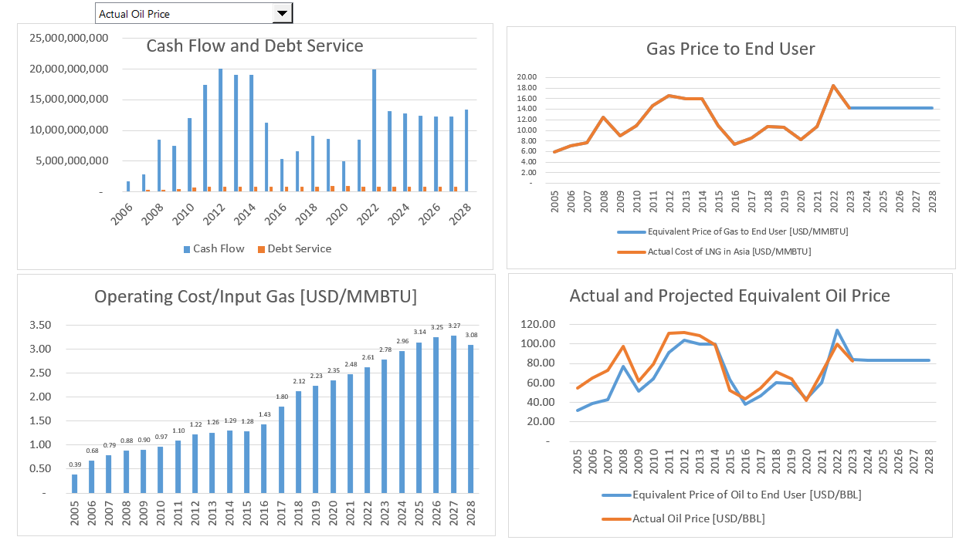
Financial Model with Actual Gas/Oil Price
How much Cash Flow Relative to Investment

Slide 90
Parties to Transaction and Two Statistics in Project Finance:
IRR and DSCR

Slide 91
Equity Valuation in Project for Investors
Finance – The IRR

Slide 92
Project IRR, Debt IRR and Equity IRR Interpretation
The debt IRR can be computed from the perspective of debt holders. The debt drawdowns are the negative cash flow while the debt service including interest and principal are positive cash flows. The fees should be included as cash flow. The debt IRR can be called the effective interest rate or the all-in rate.
The project IRR is an effective statistic for evaluating the overall competitiveness of a project. If the project IRR is very high, you should ask questions about why others cannot create similar projects and charge a lower price. If the project IRR is below the cost of debt, you should ask why the project is occurring.
The equity IRR is the focus of investors because it reflects money taken out of their pocket relative to dividends received. In structuring debt terms such as a cash sweep or the debt to capital, the equity IRR can be used to understand the perspective of the sponsor.

Slide 93
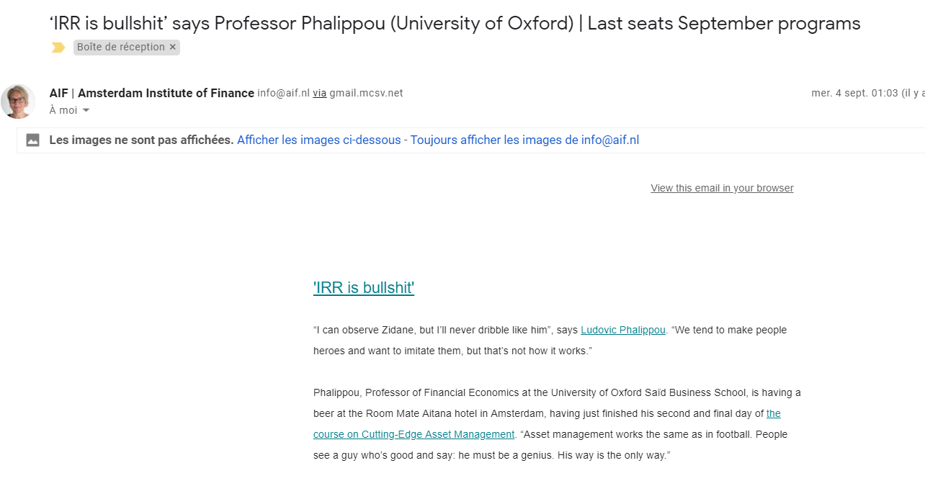
IRR had Taken over the World – Calling it BS is Absurd
Project is typically valued with IRR
Different IRRs
  Project IRR pre-tax
  Project IRR after-tax
  Debt IRR pre-tax
  Equity IRR – Overall
  EBL or Shareholder Debt IRR
  Pure Equity IRR
  IRR with and without Development Fee
  Holding Company IRR

Slide 94
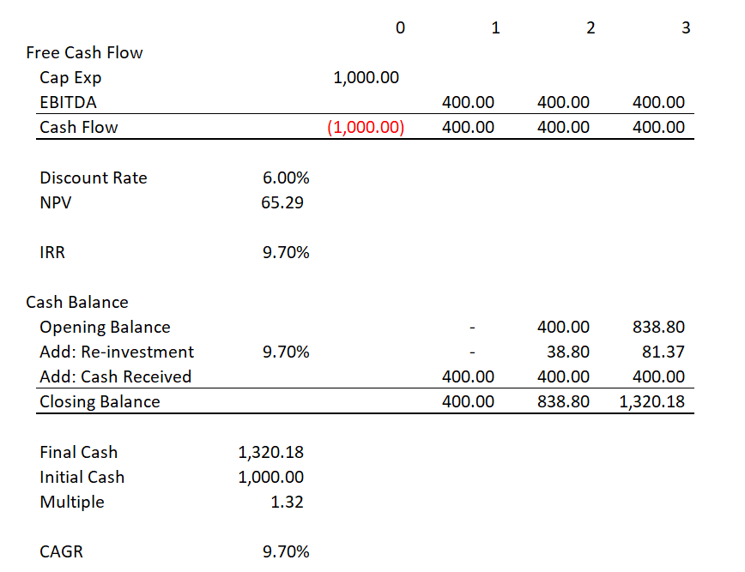
Calculating the IRR by Hand
Compute IRR by Hand without Excel
Compute IRR for one year – I will check your result with excel
Compute IRR for construction and three year with your phone – I will check your result with excel

Slide 95
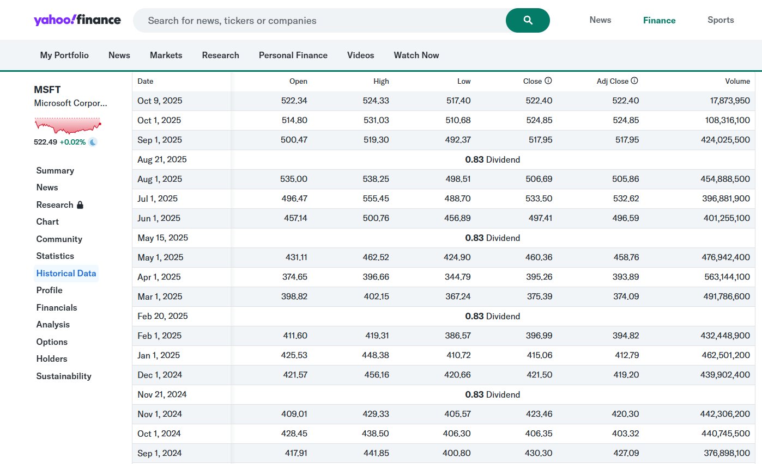
IRR from Investing in a Stock and Yahoo Finance Adjusted Stock Price
People who want to get rich, care about one thing. That is, how fast will your money grow and can it keep growing over a long period

Slide 96
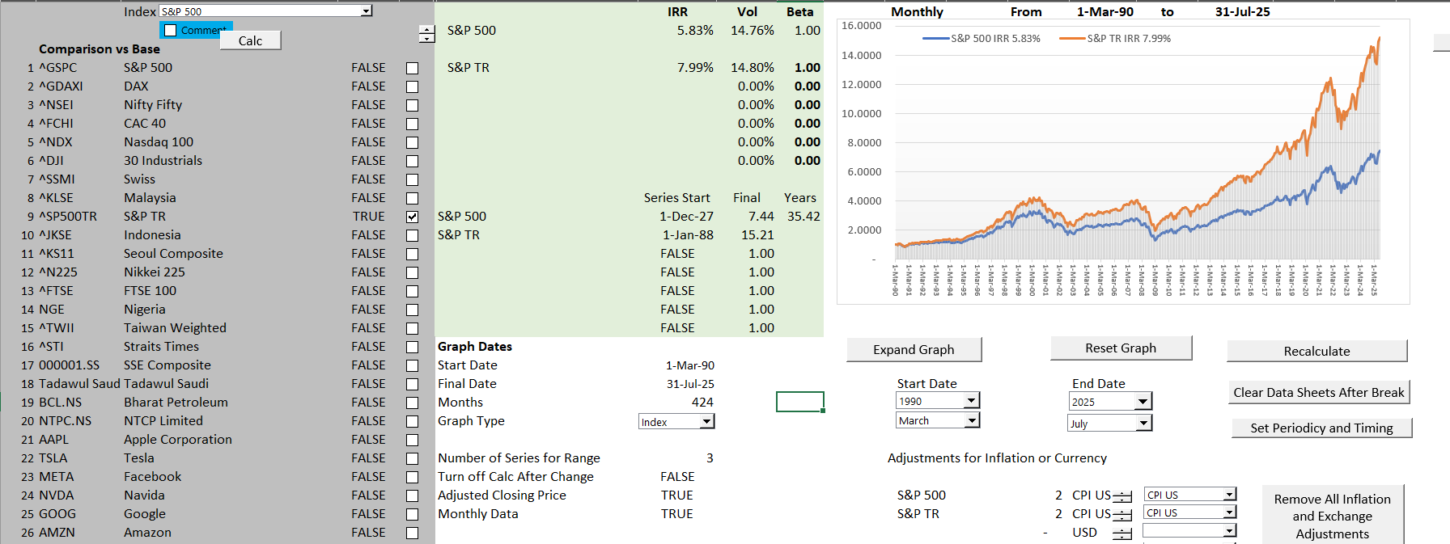
Compute IRR for Stocks and Prove the IRR is the Growth Rate
Understand why investors care so much about IRR
IRR on Stocks using S&P 500

Slide 97
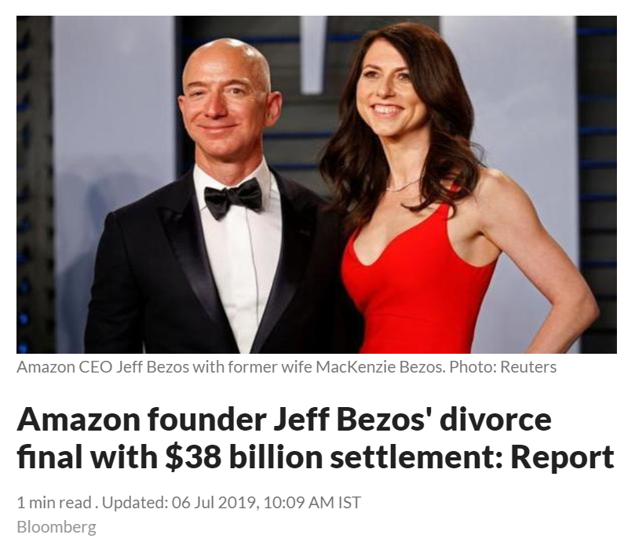
Exercise: Computing the IRR and Growth for Amazon; Understanding the Effect of Small IRR Differences over Long Periods of Time
Open File on Stock Prices and Economic Indicators from the Drop Box
Compute the IRR with dates using XIRR and assuming dividends are re-invested
Compute the daily compound growth rate as g = (End/Start)^(1/Days) – 1 and then annualize using (1+Daily Growth)^365-1
This demonstrates that XIRR is based on a daily rate

Slide 98
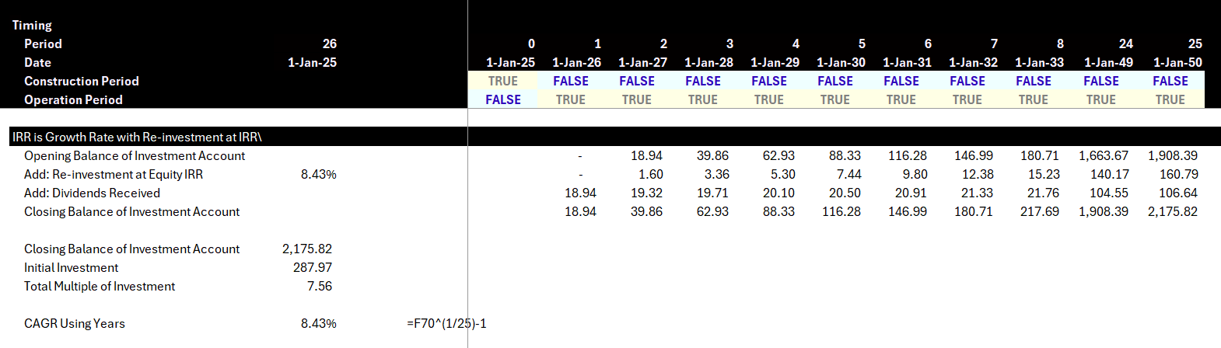
IRR as Growth Rate in Cash Flow in a Project Finance Model
Hypothetical Investment Account

Slide 99
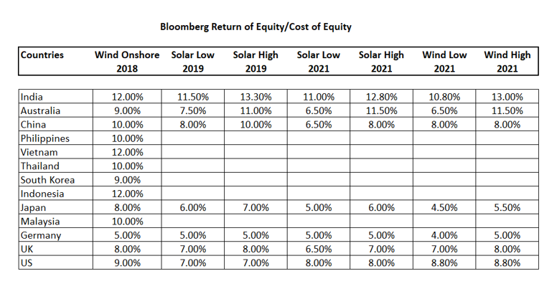
Real World Minimum Acceptable Target IRR
In practice there is no CAPM and certainly no un-levering and re-levering of Beta (see the discussion at the end).
In practice, equity IRR is used rather than project IRR as a target (this makes sense in theory as project finance implicitly adjusts for risk
In practice, and there are general standards for target IRR on buying and selling of projects. These standards have change over time. Pre-Covid for projects in Europe with a few years of history, equity IRR targets were as low as 4%.
I have been told stories of insurance company executives and pension plan managers going around Europe holding suitcases of cash to buy solar and wind projects with operating history.

Slide 100
Lender in Project Finance and
Assessment of Risk – The DSCR

Slide 101
What Makes it Possible to Lend Long-term to Single Assets
Discussed the importance of debt financing in raising money for project financed assets.
To achieve low cost of capital, the debt tenure of must be long (otherwise the DSCR will be too low).
Cannot have debt that has a bullet repayment that is supported by a portfolio of assets owned by a corporation.
Projects must have contacts and/or mean reverting cash flow to support long-term debt.
Use the formula: PV of Debt Service at Interest Rate = Debt

Slide 102
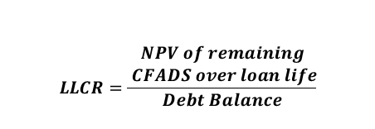

Technical DSCR Definitions
Debt Service
Coverage Ratio (DSCR)
Loan Life
Coverage Ratio (LLCR)
  $$LLCR=\frac{\begin{aligned}NPV of remaining \\ CFADS over loan life\end{aligned}}{Debt Balance}$$
Debt Balance is PV of Debt Service, so LLCR is DSCR in terms of PV.
Use PV of Debt Service because current cash flow is better than future cash flow
  $$DSCR=\frac{CFADS}{Debt Service}$$
          Where:
          Debt Service = principal repayments + interest
          Where:
          Discount rate for NPV= cost of debt
Debt Service Coverage Ratio (DSCR) determines debt borrowing capacity
Remainder of CFADS after debt service is the amount available for equity distributions
DSCR = 1.0x means there is exactly enough cash available to repay project debt
Loan Life Coverage Ratio (LLCR) measures the number of times available future cash can repay the outstanding debt balance
LLCR = 1.0x means there is exactly enough future cash available to pay off the debt balance

Slide 103
Start with Risk Question
A couple of weeks ago, a very nice man asked me the following question. Which is riskier:
  A solar project
  A wind project
  A battery project
My normal response would have been a bunch of gobbledegook about the variability of wind compared to solar, whether batteries are proven technology over their lifetime; uncertainty in battery parameters of degradation, round-trip efficiency and state of charge …
Somebody who just completed an MBA program would try to find companies that only develop solar projects; companies that only own wind projects and companies that are only involved in the ownership of batteries. Then I suppose you could try to find betas for these companies. All of this would not be possible. But then you would have to un-lever the beta and re-lever the beta after you could get into arguments about whether the beta should be computed from daily, weekly or monthly stock price data and whether the beta should be mean reverted with the arbitrary two-third and one-third adjustment made in an academic article by Professor Bloom in the 1970’s.
How utterly ridiculous. Can you think of anything better.

Slide 104
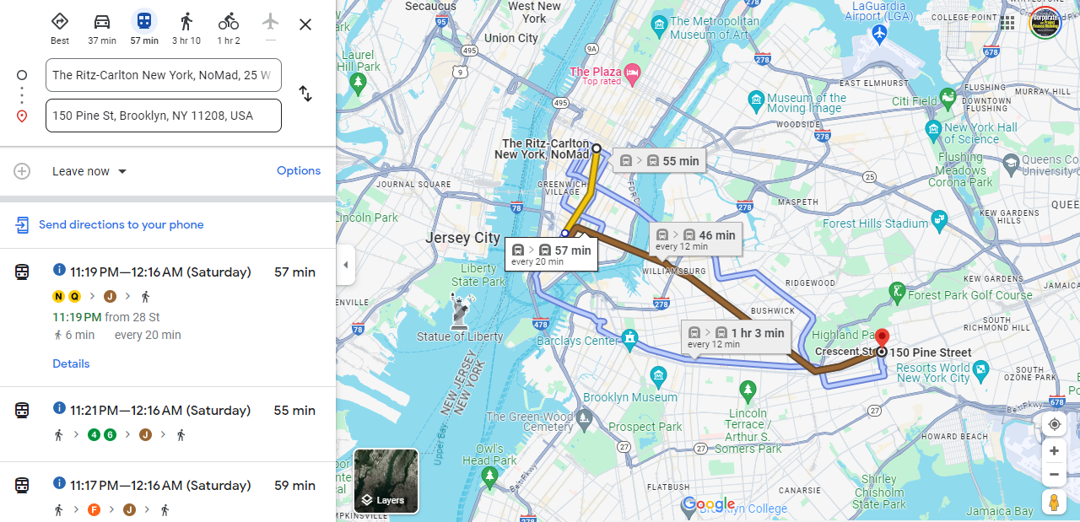
New York Meeting, Google Maps and Assessing the Risk of Being Late
How much extra time would you leave for an important meeting

Slide 105
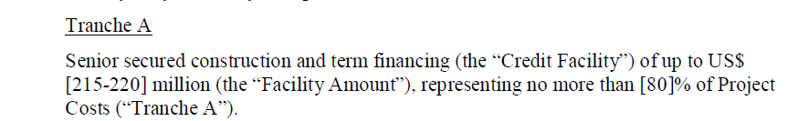
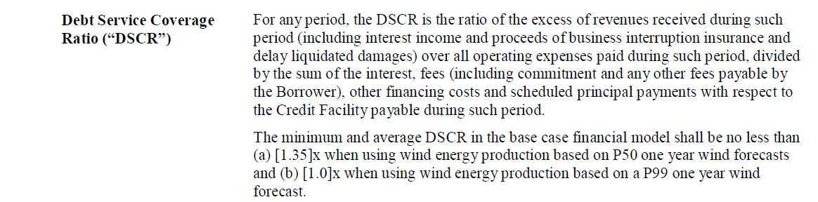
Which is More Important – DSCR or Debt to Capital
Maximum Debt to Capital Constraint
Minimum DSCR Constraint

Slide 106
Cash Flow Available for Debt Service (CFADS); It is what the Definition Says it is
Toll Road Mini Case
          $$CFADS =Revenue−Operating Costs±Working Capital Adj$$
What is missing from the formula
What about changes in DSRA
CFADS represents periodic net revenue available to repay initial financing of capital expenditures from the construction period
Once operating costs are accounted for, remaining money must be used to repay debt, followed by equity distributions
CFADS is the single-most important metric for evaluating the likelihood of senior debt repayment

Slide 107
You Can Go the Other Way to Find the DSCR
Formulas for Break-Even: Say that you want to know how big the DSCR should be to cover for an availability payment that could be reduced by 20%.
The formulas below are for DSCR; you could also use LLCR and PLCR
  DSCR = Cash Flow/Debt Service
  Example: DSCR = 1.5 = 150/100
  This means the cash flow break even is 50/150 = 1/3 = 33%
  Break-even cash flow = (DSCR-1)/DSCR
  BE = (DSCR-1)/DSCR
  BE x DSCR = DSCR – 1
  DSCR – BE x DSCR = 1
  DSCR * (1-BE) = 1
  DSCR = 1/(1-BE) or 1/.667 or 1.50
Note: Be careful with fixed costs. If a project has fixed costs you have to make a more complex formula

Slide 108
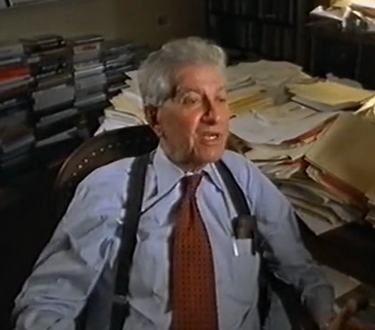
Equity IRR, Debt Financing Theory and Project Finance
Miller and Modigliani and APV
Debt Level and Risk in Project Finance
Un-gear and Re-gear Beta is ridiculous in project finance (and maybe in any finance). This is because the debt level defines the level of risk and not the other way around
Why Equity IRR rather than Project IRR is used in project finance. For example, a risky project has less debt that would imply a lower equity IRR if the project IRR was the same. But the project IRR should be higher because of the higher risk, and the lower debt offsets this risk leading to a similar equity IRR
Problem with cash on the balance sheet
Much bigger problem if cash is invested at the beginning because of IRR mathematics – if the cash must be financed by equity and not a mixture of debt and equity.
This is one of the issues that arise with putting a cash reserve on the balance sheet to resolve the interest expense versus debt service problem

Slide 109
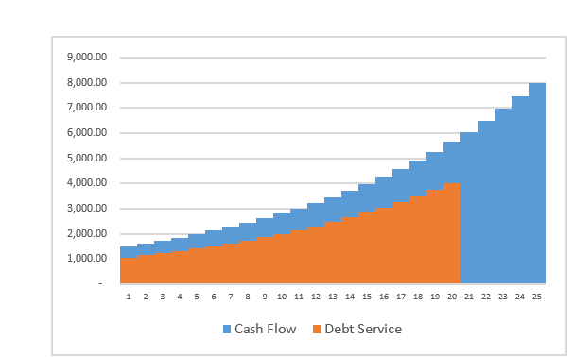
Project Finance, Dividends and the Key Graph for Debt Structure
Dividends (without cash sweep or cash trap) serve two purposes. One is to get the IRR; the second is to provide a buffer to lenders
Should dividends occur if interest is above debt service
Without dividends the IRR will be low (remember the IRR mathematics)
Dividends are needed for CFADS buffer
If extra cash is put in a reserve account and it just meets the debt service, there will be no buffer.
The formula: Debt Service = CFADS/DSCR
  can be reversed to Debt Service * DSCR = CFADS
  If the repayment is zero, you can use the formula to derive how much of a cash reserve is necessary

Slide 110
Review
Finance is about cost and uncertain future benefits for investment decisions
  Investment in this course – uncertain benefits
  Measurement of risk in finance
  IRR is growth but distorted.
    As Lenders do you need to even look at IRR
    Small Differences in IRR for Long-term Projects
    Can you use the IRR to evaluate risks of project
    What is project IRR, debt IRR and equity IRR
  DSCR as measure of risk
    Definition of DSCR
    Structuring and Risk Analysis in Project Finance
    Debt Structuring Around Expected Cash Flow
    Formula for how low measures break-even depending on volatility of cash flow
    Downside Analysis and DSCR

Slide 111
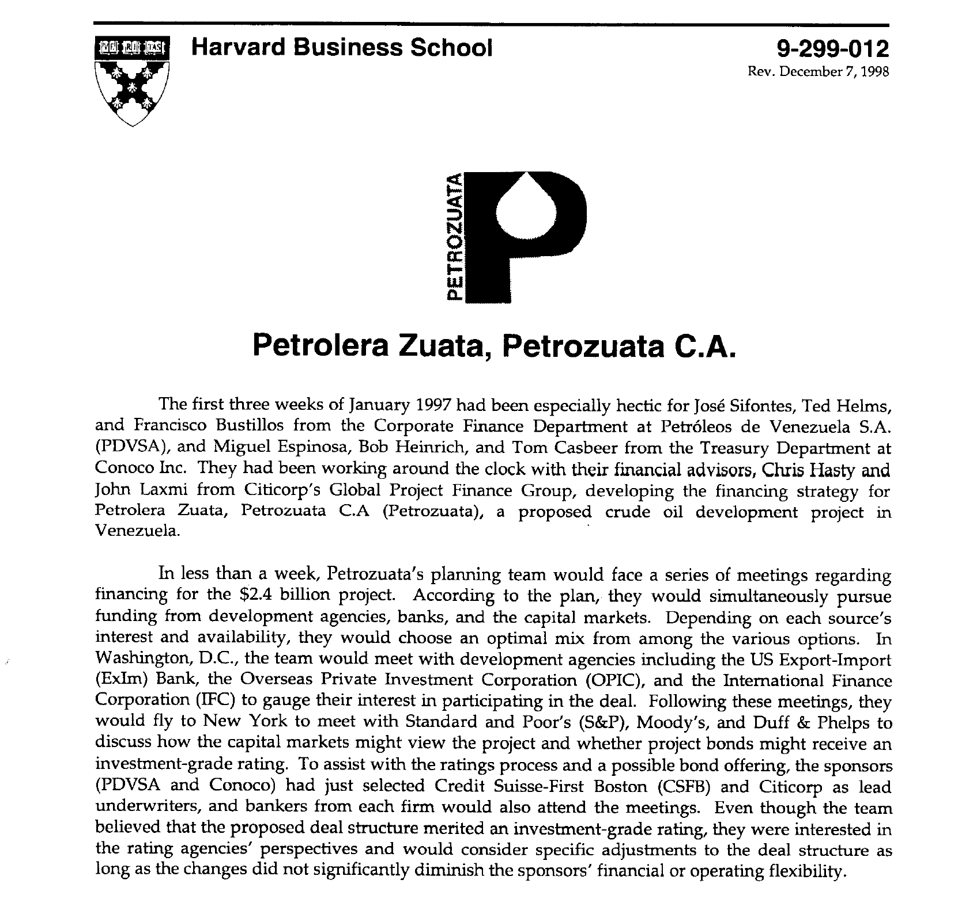
HBS Case Study
Read through case study – what would you look for

Slide 112

Diagram of Facilities
This shows the location of facilities
Heavy oil is analogous to mining
The upgrader is similar to a refiner

Slide 113


Petroleos de Venezuela (PDVsa) Perspective

Slide 114

Key Exhibits to in Case Study
Understand construction period
Compute the Debt to Capital Ratios
How did the paid in capital affect the IRR

Slide 115

Cash Collection in Petrozuata

Slide 116
Petrozuata Revised Diagram
Conoco US Refinery
PDVSA
Refinery
Conoco
Venezuela Govt - Royalty
Conoco
Purchase Agreement
Oil Price
Opening of Orinoco Belt Agreement
Royalty 1%; Tax 34%
EPC Contracts
Venezuela Govt - Tax
SPV – Petrozuata
BBB+
Exploration
O&M
Conoco, PDVSA
Loan Agreement, Inter Creditor
Shareholder Agreement
Bonds
Conoco 51%
Bank Debt
PDVSA 49%

Slide 117

Cost of Capital
Evaluation of cost of capital and bias in financial evaluation
What does 20.97% mean if it is compounded over 35 years.

Slide 118
Financing Process – A big success
Banks responded with $5 billion in bids
With bank debt, could do “road show” for the public debt
Because of favorable response in bond market, raised more than expected from banks and used $450 million in bank debt.
Tranches of public debt
  $300 million 12-year maturity at 130 over treasuries (7.63%)
  $625 million 20-year maturity at 145 over treasuries (8.22%)
  $75 million 25-year bullet bonds at 160 over treasuries (8.73%)
Tranches of bank debt
  $200 million 14-year maturity at 220 basis points
  $250 million 12-year maturity at 208 basis points.
Bonds purchased by investment advisors, insurance companies, mutual funds, pension funds and individuals.
Questions: What made the debt successful. Was project finance necessary; could the project work without project finance.

Slide 119

Post Construction – What to Compute
Convert to financial model
Historic oil price comparison

Slide 120

Petrozuata Won the Academy Award of Project Finance
1997 Americas Project Finance Deal of the Year (IFLR)
1997 Project Finance Deals of the Year (Institutional Investor)
1997 Americas Oil & Gas/Petrochemicals Deal of the Year (PFI)
The project is a stunning achievement for the sponsors and for Venezuela” (Oil and Gas Journal)
“The deal attracted rave reviews across the project finance industry. Scores of bankers not even involved in the deal refer to it as the best ever done in project finance” (Euro week)
“Petrozuata’s feat in raising funds is nothing short of amazing. In terms of the amounts taken from both the bank and bond markets, the tenors achieved, pricing and the structure of the project itself, the package has no parallel (IFR)
“Petrozuata Finance … bulldozed over previous boundaries for bond maturities and deal size in the Rule 144A market, showcasing the growing ability of stronger-rated credits to borrow without political risk insurance.

Slide 121

Article on Project

Slide 122

Teaching Note

Slide 123
Real World Minimum Acceptable Target IRR
In practice there is no CAPM and certainly no un-levering and re-levering of Beta (see the discussion at the end).
In practice, equity IRR is used rather than project IRR as a target (this makes sense in theory as project finance implicitly adjusts for risk
In practice, and there are general standards for target IRR on buying and selling of projects. These standards have change over time. Pre-Covid for projects in Europe with a few years of history, equity IRR targets were as low as 4%.
I have been told stories of insurance company executives and pension plan managers going around Europe holding suitcases of cash to buy solar and wind projects with operating history.

Slide 124
Fitch Downgrade in 2006
NEW YORK--(BUSINESS WIRE)--May 11, 2006--Fitch has downgraded to 'B+' from 'BB' the ratings that apply to four Venezuelan heavy oil strategic associations: Petrozuata, Cerro Negro, Sincor, and Hamaca. The ratings are placed on Rating Watch Negative.
The National Assembly amended the organic hydrocarbons law to impose a new oil extraction tax of 33.33%. The tax is calculated on the same basis as the oil royalty, and the royalty of 16.66% that applies to the strategic associations is deducted from the tax. Effectively, remittances payable to the government on the value of crude at the well head are doubled. Royalties were previously raised ahead of expectations in 2004 from a preferential rate of 1% to 16.66% in 2004. The agreed 1% rate was adopted in the 1990s to incentivize private development of the Orinoco Basin reserves at a time of prolonged weakness in oil prices and in recognition of Venezuela's need to improve its oil producing infrastructure.
The government has also announced its intention of increasing from 34% to 50% the corporate income tax applicable to the strategic associations. Fitch anticipates that the much heavier royalty and tax burdens combined with the deleterious effect of persistent double-digit inflation in Venezuela will substantially diminish cash flows available for debt service. In its oil price deck, Fitch expects a gradual return to the long-term historical average in the mid-US$20s per barrel for West Texas Intermediate by 2009. Despite the operational success of the projects and the benefit of unexpectedly high oil prices, royalty and tax remittances reduced project revenue in 2005 by an average of 40% from 2004.

Slide 125
Why did the project fail
You decide
  Chavez and the communists
  An unreasonable allocation of equity cash flows
  Contracts that did not account for changes in oil prices

Slide 126
Project Participants, Risks and Contracts
Importance of Project Economics
Need Risk to Provide Economic Incentives
Different contractual relationships and how this gets reflected in a contract ;
Critical differences of contractual structures (Output versus Availability)
Does the sector mean you have a specific contractual structure?
Public private partnerships (PPPs) and Project Finance. Are they the same?
Risk transfer and the modality of contract used
Can contracts migrate from one for to another?
Avoiding renegotiations

Slide 127
Activity – Contractual Structure in Dahbol Case Study
Activity:
Review the contractual structure of Dabhol -- sponsors, lenders or the contracting authority (in the case of PPPs) and contracting entity for other types of contracts. Participants will have to:
Identify parties involved, mentioning their name and function
Contracts signed between the parties
Cash flows (in- and – out flows)
Differences in risk perception on whether you represent sponsors, lenders or counterparties
Identification of counterparty risks
A moderated discussion will be done highlighting the core project finance principles that have been addressed under each of the contractual structures.

Slide 128
Part 3: Different Contract Structures and Revenue Risk

Slide 129
Outline
Foundations, Objectives and Pillars of Project Finance
  Overview of project finance objectives and what makes project finance different from corporate finance
  Cost of Capital and Financing Long-term Assets
  Lending in Project Finance and Project Financing Terms (what does nonrecourse mean)
  Contracts in Project Finance and the SPV
  Benefits of Project Finance to Society and Effectiveness of Project Finance
Key Parties in Project Finance and Metrics Used by Parties in Assessing Rate of Return and Risk
  Project Diagram with SPV, Sponsor, Lender, EPC, Operator and Illustration of Risks
  Sponsors Assessing Risk/Return with IRR
  Lenders Assessing Risk with DSCR and Variants
  Petrozuata and Ras Laffan Case Study
Contracts to Allocate Risk and Assure Revenue Stability - History of Project Finance and Risk Allocation
  History of Financing Long-term Capital-Intensive Assets and Development of Project Finance with Risk Allocation
  Differences in Contract Structures; Sectoral Contracts, Availability/Output Contracts and PPP’s
  Contract renegotiation and Migration
  Case Study – Dabhol in India
Stages of Project Finance from Feasibility to Boring Project
  Risk Diagram and Risk Reduction from Development to Maturity for Different Projects
  Financial Close after Development Stage and Term Sheet
  Risks and Contracts in Renewable Energy
  Case Study - Eurotunnel

Slide 130
Project Finance History
Some Historic Perspective would be good
Part 1: 1945 to 1973
Les Trente Gloriouses or MAGA
Regulatory Scheme – Cost Plus Regulation with WACC

Slide 131


Les Trente Glorieouses and MAGA or MUBA – 1945 to 1973
Appliances and Bigger Houses
  Washing Machine
  Dryer
  Electric Stove
  More Lights
  Air Conditioning
Why is this introduction relevant for Project Finance Analysis. Demonstrates classic corporate finance. Companies want to get back to the low risk from cost plus model with WACC.
You will see that this analysis cannot be applied to companies like Orsted that are not stable.

Slide 132




GE and Electricity
GE is most valuable company in the world – Note what a 15% growth rate means from compounding over a long period of time,
High Growth and economies of scale allowed declining real cost. Larger networks and larger coal plants.
Natural monopoly and cost-plus regulation or government ownership – No incentives for cost control of capital expenditures or operating costs.
Financed from with Corporate Guarantees
Long-term Financing from Regulatory Assurances

Slide 133


A Boring Utility Company and MUBA
Ability to finance long-term assets from guaranteed cost recovery and from allowed monopoly position.
12% return on equity produces market values relative to investment of well more than 2 suggesting that the cost of capital is far below 12%.

Slide 134

Boring Utility Company Earning Much Lower Returns – ROIC Perspective
Valuation can be made from stable multiples, DCF and maybe CAPM. Could apply valuation formulas P/B = (ROE-g)/(k-g). Cost plus regulation. But cannot apply to renewable companies like Orsted

Slide 135

Relatively Stable Multiples of Earnings and EBITDA for Boring Utility Companies

Slide 136

Return of Rate Base Regulation – British Nuclear
Sizewell Nuclear Plant

Slide 137
Part 2: 1980’s
Capital Expenditure Over-runs; Low Efficiency, Independent Power Producers and PPA Agreements
Introduction to PPA Regulatory Scheme
Introduction to Output versus Availability
Inefficient to Impose Risks on Investor (including contractor) that cannot be controlled
Example of Toll Traffic

Slide 138


Part 2: 1973 Energy Crisis and End of Declining Real Prices
Dramatic Oil Shock of 1973 ended the Trente Gloriouses. Led to more nuclear power and first thinking about renewable energy.

Slide 139


Part 2: 1980’s and Cost Increases and Cost Over-runs
Seabrook nuclear plant in US. (I understand that Denmark was considering nuclear power as well).
Enough of the cost-plus regulatory scheme. Let companies bid and hold them to their cost estimates – if costs increase, you cannot increase prices, and multiple companies can build assets.

Slide 140
Concept that You Need to Impose
Risk for People to be Efficient
But Imposing Uncontrollable Risks Increases
Prices Without Getting You Anything

Slide 141
Notion of Independent Power Projects, Risk Allocation and PPA
With nuclear cost increases and price of oil increases, cost plus and WACC model considered a poor approach.
Bidding systems where companies competed to provide generating capacity (no longer belief in economies of scale for generation). Idea that companies bid down to their cost of capital.
Bid on long-term fixed price contracts (same as today) – purchased power agreements (PPA’s) were designed to allocate risks under control of investor (construction cost, construction timing, fixed operating cost, plant efficiency, plant availability). Costs that could not be controlled – fuel cost and amount of generation required were allocated to investors.
Once investor takes risk, the risk can be allocated to a company that takes construction risk, a company that guarantees plant efficiency, a company that provides operation and maintenance.
The risk allocation to third parties (off-takers) led to project finance where lenders verified fixed construction costs, operation costs and technical aspects of plant efficiency and availability.
Risks remaining with purchaser – fuel price, generation (maybe inflation)
Risks taken by investor and allocated – construction cost, construction timing, efficiency, availability, operating cost except fuel
Risks allocated from investor to contractors who provide fixed prices and absorb penalties for efficiency and availability

Slide 142
Risk Allocation Part 1: Allocation between IPP Investor and the Off-taker
Risk to Be Allocated
Generation Level from Changes in Demand
Generation Level from Changes in Plant Availability
Cost Over-Run
Construction Delay
Plant Efficiency (Heat Rate)
Change in Fuel Price
Change in Real O&M Cost
Change in Inflation Rate
Change in Interest Rates and Cost of Capital
Investor or Off-taker Risk
.
.
.
.
.
.
.
.
.

Slide 143
Risk Allocation Part 2: Investor Risks to Different Contracts for the SPV
Contract Mitigation
EPC Contract with Fixed Price and LD (LSTK)
O&M and EPC Contract
O&M Contract and EPC LD Provision
O&M Contract
Capacity Charge/Month; 4 Part PPA Contract
Swap Contract (Fix Rates)
IPP Risks
Cost of Project, Time Delay and Technology Parameters
Availability Penalty in PPA
Efficiency or Heat Rate Risk
O&M cost Risk – Real
Independence of Generation Risk
Interest Rate Fluctuation

Slide 144

Single Price PPA with Inflation

Slide 145

Fixed Contract Price in EPC Contract

Slide 146

EPC Provisions – Guaranteed Capacity and Performance for Solar Plant

Slide 147

Example of Delay Penalty in PPA Contract

Slide 148

Example of Delay LD in EPC Contract

Slide 149


Summer and Winter Penalties
Summer Penalties are Higher than Winter Penalties. Illustrates that the penalties should correspond to the cost of the off-taker in PPP Contracts

Slide 150


Availability versus Utilization
Availability
Utilization
Which has take or pay contract and which has take and pay

Slide 151

Background on Risk Allocation Two Step Process
Step 1 – Off-taker versus Investor
Risks controlled by off-taker
Risks of general economic conditions
Risks in the way the machine operates
Step 2 – Allocate to Contractors
Allocate risks in contracts to parties that can control the risk
Back-to-back contracts
If the rental car charged a fixed price for the period, then you would have an incentive to drive a lot because you do not have to pay for fuel.
If the rental car has only a variable cost with mileage and no fixed charge, could rent just for a very short trip and pay almost nothing.
Rental car company cannot control how much you drive

Slide 152

Risk Allocation in Rental Car Agreements
Risk Allocated to Off-takers – You as Renters
  Fuel Price Risk – Return the Car Full
  Risk of Scratches on the Car
  Risk of Usage per Rental – Capacity Payment
Risk Taken to Sponsors – Rental Car Company
  Operation and Maintenance
  Utilization Risk
  Availability Risk (Car Must Work)
When you go to a rental car company and sign a contract.
Is this a take or pay or take and pay contract
Does the contract have a capacity payment
Does the contract have a multi-part price
Does the contract make sense

Slide 153


Availability Projects without Output Risk and Notion of Not No Control of Output – Would you pay firemen only when they put out fires
Capacity Price and Artificial Markets
  When capacity is available, you can receive revenues no matter whether you use the capacity for revenues, this can be added
  Some ancillary services may be like capacity where if you have the service available, you can earn money whether you use the capacity to produce energy
Think of Firemen (Firehouse Effect)
  You pay them and need them to be ready
  But if they are putting out a fire, they cannot be used for another fire
  They receive capacity payments and must be available
  You cannot really pay them on the volume of fires the

Slide 154
Back-to-Back Contracts with Availability
Off-taker
EPC Contractor
PPA Contract
Four Part Tariff
Fixed Capacity Charge at Fin Close
LD Penalty for Delay Risk
Contract O&M Charge
Contract Heat Rate
Availability Penalty
Fixed Price Contract with LD
Fuel Supply
Fuel Index
Fuel Supply Contract with Index Corresponding to PPA
Special Purpose Vehicle
Contract with Guaranteed Heat Rate and Availability Penalty
and Fixed Fee
O&M Contractor
Shareholder Agreement
Loan Agreement
Sponsors
Lenders
Letter of Credit for Equity Cash

Slide 155


1980’s Independent Power and Incentives (Plant Availability)
Plant Availability has dramatically improved from about 60% in 1993-1994 to 75-80%.
Leads to independent power producers and contracts that provided rewards and penalties for particular risks – capital expenditure cost over-runs and power plant availability
Project finance and back-to-back contracts to limit risk to banks and allow low cost of capital
No output risk (cash flow is independent of amount produced with is given by off-taker) designed with a capacity charge

Slide 156

Computation of Unitary Payment Compared to Capacity Charge
Note the Deductions for TUD – Total Unavailability Deductions; SPD – Performance Deductions; RD – Reporting Deductions.

Slide 157


Indexing of the Unitary Charge

Slide 158
2000’s, Renewable Energy and
Feed-in Tariffs
All Output Purchased and Control of
Output is Investor (and upstairs) and not Off-taker

Slide 159




Projects Depend on Who Controls the Output
What is the contract structure for each
Solar or Wind
Battery

Slide 160
Not Just a Diagram – Illustrate Risks
Each contract can have many nuances with penalties, bonuses, default clauses, termination.
Off-taker: Want strong off-taker with inactive to honor contract
Write down notes associated with each contract and if a contract does not exist, how the cash flow volatility can be addressed.
EPC Contractor: Want Strong Record and Finances
Price Risk or Volume Risk or Both or None (Availability)
EPC: Fixed Price Contract with LD
Supplier: Need to Understand Economics and Supply Curve
Special Purpose Vehicle: Bond Rating of BBB-
O&M Contractor
Supply Agreement
O&M Agreement
Loan Agreement – Draws Green; Debt Service Red
Banks Like Strong Sponsors. Sponsors want EIRR
Shareholder Agreement
Lenders:
Lenders want DSCR (LLCR, PLCR)
Invest with paid in cap; payback dividends
Invest with draws; payback debt service

Slide 161


Difference Between Contract Prices for Renewable Energy and Dispatchable Plants
In a dispatchable coal plant, gas plant, nuclear plant the operator controls the amount of electricity that is produced by the plant.
In a renewable project, the amount of output comes from upstairs – wind for wind projects, solar radiation for solar projects and rainfall for hydro projects.
For a dispatchable plant (except for merchant plants discussed below), the amount of production is controlled by the buyer and not the seller for the plant
If you are stupid enough to build your wind farm next to a tree, then you should realize a lower return than somebody who does not do something so stupid. This demonstrates that investors in renewable energy must take generation risk to encourage efficient development of projects. Taking resource risks makes renewable energy projects inherently more risky than dispatchable projects in a PPA context

Slide 162


Revolution in Solar Module Prices and the Price of Polysilicon

Slide 163

Renewable Project Finance Diagram
Big Difference is output risk where there is uncertainty for volumes sold.

Slide 164

Average Solar by Year – Little Variation
You can see the lack of variation in solar from year to year.
Standard deviation allows you to compute P90 with NORMSIM.
This is not meant to be too technical
This risk is easy, and it is mean reverting.
The technical risks discussed next are much more important

Slide 165

Offshore Wind by Year in Oman

Slide 166
P90 and DSCR
General idea of DSCR
  DSCR = CFADS/Debt Service
  Example 150/100 = 1.5x
  Does not mean that cash flow can decrease by 50% and no default
  Reduction in CFADS to break even – 50
  Cash Flow 150
  Percent reduction 50/150 = 1/3 = 33%
  General Formula: Break Even → 50/150 or (DSCR – 1)/DSCR
  Relation to P90, P90/P50 = X %

Slide 167

Risks Other Than Resource Risk
Availability Risk
Technical Risk
O&M Risk
Transmission Risk
Environmental Risk
Political Risk
Degradation Risk
The resource study also gives probabilities of downside cases which is essential for banks. The P99 one year capacity factor is 31.1%

Slide 168

Mean Square Error – Exercise, Compute it
Compute the square of the component
Sum the Squares of the components
Take the Square Root of the Sum

Slide 169

Capacity Payment Formula – PPA 1
Use capacity because of 1 hour duration battery

Slide 170



Pricing in PPA and Back of Envelope
Should there be a variable charge.
Is overhaul that is a function of hours a variable or fixed cost

Slide 171

Pricing in a PPA Contract for Batteries – PPA Number 3
Capacity based – No discussion of a variable energy charge
This is MW of capacity and not MWH

Slide 172
If the Project Does not Make
Economic Sense, Should you
Lend or Invest
Completion of Dabhol Case

Slide 173


Dabhol Case Study

Slide 174
Contract Risk and Dahbol
Investment in a $3 billion, 10-year liquefied natural gas power plant development project, was the largest development project and the single largest direct foreign investment in India’s history.
Begun in 1992, the Dabhol power plant near India’s financial capital of Bombay in Maharashtra state was to have gone online by 1997. It was supposed to supply energy-hungry India with more than 2,000 megawatts of electricity, about one-fifth the new energy needed by India each year.
In a joint venture with U.S. companies General Electric and Bechtel, Enron created an Indian subsidiary, Dabhol Power Co. DPC, which was 65 percent owned by Enron, was to build the power plant. Enron was to develop and operate the plant. Bechtel was to design and construct it, with GE supplying the equipment.
Enron brokered a deal with Qatar to provide the Dabhol plant 2.5 million tons of liquefied natural gas per year for 25 years, starting in 1997.

Slide 175
Comments from Harvard Case Study
This project is new-it's definitely a pioneer and as a result the policies and approvals are still evolving. But precisely because of its pioneer status and government interest at the top, many in India feel that this project has moved quite rapidly.
Judging from our Philippines experience, the first project through certainly paves the way. The first one is like a "baptism" for the country-after that you can use boilerplate documents; people are educated about the process .... The fact is that we've already invested $13.2 million with Bechtel and GE on this project, so we're very committed .... If we didn't believe in this project and the importance of it to India, we wouldn't be doing it. We believe in the goal of cheap power in abundance for India ....
The stakes are high for India too. By having three large American companies involved, issues of national pride and the sincerity of economic reform naturally arise .... This project is really important for India. It symbolizes that real change has occurred, that they can get it done. Foreign investment will follow as will greater economic growth. This is a bellwether project. Other projects are being held up to see what happens here. If it can't happen here-with the most respectable sponsors, with independent fuel supply, and the most financially stable state-can it happen anywhere in India?

Slide 176

Enron - Subic Bay, Philippines
Philippines
Government
Equip’t Cos.
Warranties
Enron Power
Operating Co.
Completion
Guarantee
Fluor Daniel
EPC
Enron Power
Phils. Op’g Co.
Enron
Corp.
15-year
BOT
Concession
Turnkey
Construction
Contract
Performance
Undertaking
O&M
Agreement
Enron Subic
Power Corp
Napocor
Supply
Fuel Free
113MW
Subic
Power
Corp.
Ground
Lease
65%
Enron Power
Philippines Corp
Buyout
Rights
35%
Philippine
Investors
Capacity Charge
O&M Charge
Energy Charge
PPA
Insurances
US$105 million, 15-year Notes

Slide 177
113 MW Diesel Generator Power Station Subic Bay, Philippines and Richard Tinsley
Sources of Funds:
Notes $ 105 M
Subordinated Note 7
Equity of Sponsor 28
Working Capital 2
TOTAL $ 142
Uses of Funds:
Turnkey Contractor $ 112 M
Bonus to Turnkey Contractor 7
Development and other related costs and Fees 14
Pre operating, Start-up and Commissioning Costs 3
IDC 4
Working Capital Loan 2
TOTAL $ 142
What is the equity contribution from Enron

Slide 178
BOT/PPA Contract
15-year BOT and toll process
NAPOCOR (government owned generation company) to supply fuel & take electricity - no fuel availability risk
Capacity fee $21.6/kW/month on available capacity
Capacity fee is dollar denominated – no direct foreign exchange risk, overseas a/c
O&M fixed fee and energy fee is in Peso - $4.56/kW/Month
heat rate penalty & bonuses
buy out rights @ NPV capacity fees- late payment, change of BOT law, war, etc.
Exercise – Compute the payback period with the capacity fee
Use the 113 MW from the prior slide
Use the 142 million from the sources and uses slide

Slide 179

Problems with Capacity Contracts - Philippines IPP Contracts
Reserve Margin is about 155%
Estimated Growth – 9.2%
Actual Growth – 3%

Slide 180
Where did Rebecca Mark Get her MBA
As they inched along the traffic jam of Bombay taxi cabs on Marine Drive, Rebecca Mark and Joe Sutton reflected upon the intense negotiation efforts of the past year and what had been accomplished. Their company, Enron Development Corporation, EDC, the development arm of the Enron Corporation, had been attempting entry into the potentially huge Indian market. EDC was headed by Rebecca Mark, its youthful, energetic president and CEO. She summed up her philosophy and mission:
We are a very eclectic bunch with some ex-military people and some ex-entrepreneurs. We are brought together with a certain amount of missionary zeal which I think you have to have in this business. It demands so much of you all the time that you really have to believe in what you are doing. I think for us that missionary zeal has three parts – first, that these projects are good for the country. They get the economy moving by bringing in power and they bring in investment. Second, these plants are environmentally safe and without equal when you consider other options of coal or nuclear power. Third, we are brining a market mentality and spreading the privatization gospel in countries that desperately need this kind of thinking. We are in the business of doing deals. This deal mentality is central to what we do. It’s never a question of finding deals but of finding the kind of deals we like to do. We like to be pioneers.

Slide 181

Structure of Dabhol PPA Contract
PPA Contracts can transfer all demand and fuel cost risk. The Dabhol PPA contract is illustrated below

Slide 182

Dabhol Plant
Project Included
  Largest Independent Power Producer – 695 MW + 1,320 MW or 2,015 MW. 22.4% of Capacity of Maharashtra
  LNG Re-gasification Plant
  LNG Tanker to access supplies in Qatar
  85% Debt and 15% Equity
  Equity
    Enron 65%
    Bechtel
    GE
  Enron Net Income $465 Million
  Enron Assets (1993): $12 Billion
  Enron Equity (1993): $3.5 Billion

Slide 183
Dabhol Structure
Reserve
Bank of
India
Government
of Maharashtra
Domestic
(Indian)
Financial
Institutions
(Banks)
Government
of India
Full
Guarantee
Ministry
of Power
Maharashtra
State
Electricity
Board
Limited
guarantee
State
Support
Agreement
US Exim
Comfort
Letter
Political Risk
Guarantee
PPA
Lending Banks
FX Availability
Dabhol
Power
Corp
Loan
Agreement

Slide 184
Making Money in Different Places by Receiving Money from PPA Contracts
Off-taker pays money for PPA
EPC Contractor: ENRON
EPC Profit
PPA – Four Part Tariff
LD for Delay Risk
Fixed Capacity Charge at FC
Contract O&M Charge
Contract Heat Rate
Capacity Charge with Index
Availability Penalty
Fixed Price Contract with LD
Special Purpose Corporation (IRR)
Fuel Supply Contract
ENRON – Fuel Mgmt. Fee
Contract with Guaranteed Heat Rate and Availability Penalty
and Fixed Fee
Loan Agreement
Shareholder Agreement
ENRON O&M Profit
Lenders
ENRON IRR on SPV

Slide 185
Very High Cost of USD 1,400 per kW
Off-taker Needs Rate Increase of 27%-39% to Pay PPA
State of Maharashtra
Bechtel Construction
Off-taker – Maharashtra State Electricity Company
EPC Management by Enron
Guarantee
Federal Government of India
Letter
GE Equipment
PPA Contract
EPC Contract
Dabhol SPV
Fuel Supply
ENRON – Fuel Mgmt.
O&M Contract
Shareholders Agreement
Loan Agreement
LNG from Qatar
O&M Contractor - Enron
Lenders
Sponsors – Enron, GE and Bechtel IRR on SPV
PRI/PRG
PRI/PRG
OPIC

Slide 186
Dabhol Timeline
June-Oct 2000: Maharashtra government allies demand scrapping theproject because of the cost of the power it produces.
Oct, 2000: MSEB defaults on its October payment to DPC.
Dec, 2000: Maharashtra state announces plan to review the project, stating that the tariff is too high.
Feb, 2001: The Credit Rating Information Services of India Ltd cuts ratings on bonds issued by Maharashtra government due to defaults on payments owed to Dabhol. Enron invokes the Union government guarantee.
April, 2001: Enron issues a notice of arbitration to the Indian government to collect on the December bill of Rs 1.02 billion.
April, 2001: Enron invokes the political force majeure clause in its contract with MSEB, stating that unfavourable political conditions have prevented it from fulfilling contractual obligations.
April 23, 2001: DPC and its lenders meet in London to discuss the payments issue. Enron seeks lenders' permission to issue a notice of termination.
April 25 2001: The board of Dabhol Power Company authorises management to terminate the contract any time it chooses.
May-June, 1992: India invites Enron Corp to explore the possibility of building a large power plant in Maharashtra.
June 20, 1992: Initial memorandum of understanding signed between Enron and Maharashtra government for a plant with capacity of 2000-2,400 MW. The Maharashtra State Electricity Board is expected to pick up a 10 per cent stake.
Jan 2, 1993: The Foreign Investment Promotion Board clears proposal for a 1,920 MW plant, expandable to 2,550 MW.
Dec 8, 1993: The power purchase agreement signed between Dabhol Power Company and MSEB for a 2,015 MW project to be implemented in two phases.
March-June, 1995: Following state elections, a new Maharashtra government, headed by the Shiv Sena, scraps the project, alleging corruption and high costs.
Nov 1995: Project re-negotiated with a final capacity of 2,184 MW. MSEB's stake is upped to 30 per cent -- 15 per cent in the first phase, and a further 15 per cent upon completion of the project.
May, 1996: India extends counter-guarantee to the project, under which the federal government promises to cover any defaults by the state utility.
May, 1999: Phase one of the project with a capacity of 740 MW begins operating.

Slide 187
Dabhol Plant Cost
First phase
695 MW plant
Cost of $920 M
Construction began 1995, project to come on-line in 1997
Cost $1323/kW
Second phase
1,320 MW capacity
LNG re-gasification plant, storage, and harbor facilities to be built.
Construction to begin after phase 1 completed
Cost of $1.88 B
Cost per $1,466/kW

Slide 188


Importance of Benchmarking Cost of Other Plants

Slide 189
Contract Off-taker Risk and Dahbol
Endless disputes over prices and terms of the deal turned the venture into a symbol of what can go wrong in large-scale development projects when cultures collide.
In April 1993, a World Bank analysis questioned the project's economic viability, citing the high cost of importing and using liquefied natural gas relative to other domestic sources of fuels. Because of those findings, the World Bank refused to provide funds for the project.
"Price is becoming a sticky issue," the Financial Times reported. "Indian officials see the price as very high compared to domestic gas and imported and indigenous alternative fuels."
Protesters took to the streets to support demands for changes in the plant's design and -- more broadly -- to oppose the Indian government’s economic liberalization policies. Social activists, lawyers, villagers and farmers banded together in groups opposed to the Enron project.
The devaluation meant that Dabhol's energy prices would soar to between two and five times the average price in the area.

Slide 190
Enron’s Economic Rational Underlying the Transaction

Slide 191
Transparency

Slide 192

Vemagiri Power Project
Capacity of 388.5 MW
  15 year PPA for 370 MW
Natural gas fired (1x1) GE 9FA CCGT
  1.64 mmscmd of gas allocated on firm basis
Project cost US$ 238 mn, project cost is the lowest for any gas-based plant constructed in India
Estimated first year tariff of Rs. 1.94/ kWh (approximately 4 USD cents)
  Fixed Charge - Rs. 1.01/kWh
  Variable Charge - Rs. 0.93/kWh
VPGL - Vemagiri
What is the cost per kW compared to Dabhol; What is the tariff compared to Dabhol

Slide 193
Dabhol Postscript
The power plant Phase I which was re-named Ratnagiri Gas and Power Pvt Ltd (RGPL) started operation in May 2006, after a hiatus of over 5 years.
The plant runs on naphtha supply and LNG.
GE and Bechtel were fully compensated for their investment
Reduced Enron interest.

Slide 194
Part 4: Project Finance Timeline and Risk Changes

Slide 195
Outline
Foundations, Objectives and Pillars of Project Finance
  Overview of project finance objectives and what makes project finance different from corporate finance
  Cost of Capital and Financing Long-term Assets
  Lending in Project Finance and Project Financing Terms (what does nonrecourse mean)
  Contracts in Project Finance and the SPV
  Benefits of Project Finance to Society and Effectiveness of Project Finance
Key Parties in Project Finance and Metrics Used by Parties in Assessing Rate of Return and Risk
  Project Diagram with SPV, Sponsor, Lender, EPC, Operator and Illustration of Risks
  Sponsors Assessing Risk/Return with IRR
  Lenders Assessing Risk with DSCR and Variants
  Petrozuata and Ras Laffan Case Study
Contracts to Allocate Risk and Assure Revenue Stability - History of Project Finance and Risk Allocation
  History of Financing Long-term Capital-Intensive Assets and Development of Project Finance with Risk Allocation
  Differences in Contract Structures; Sectoral Contracts, Availability/Output Contracts and PPP’s
  Contract renegotiation and Migration
  Case Study – Dabhol in India
Stages of Project Finance from Feasibility to Boring Project
  Risk Diagram and Risk Reduction from Development to Maturity for Different Projects
  Financial Close after Development Stage and Term Sheet
  Risks and Contracts in Renewable Energy
  Case Study - Eurotunnel

Slide 196
Timeline Subjects
Project identification;
Project definition & feasibility study;
Competition;
Contract negotiation;
Financial competition/commitments;
Financial due diligence;
Contractual structure of a Request for Proposals (RFP) and implications to achieve financial close
Linkages between these different stages and how they all fit together.

Slide 197




Project Finance and Changing Risk
Before COD, cash flow is presented in the sources and uses statement
After COD, cash flow is presented in the cash flow waterfall and the last line is dividends
Father of the bride makes commitment to pay for wedding
Commitment Fee
Development is Dating period. Probability of failure is high
Pay for Wedding with Other people's money
Pay your Bills and re-structure your life. Stuck with PPA type contract. May default.
FC is just after engagement date
COD is Wedding Date
Decommissioning Date

Slide 198
Work Through Term Sheet

Slide 199

Five Parts of Debt
Any debt has the following parts in deriving the structure
Debt Size
Funding Pre-COD
Repayment Post-COD
Interest and Fees Paid
Other Features to Improve Ability to Repay including covenants, DSRA and cash sweep

Slide 200



Risk Analysis – Skin in Game versus Safety Buffer
Equity Skin in Game
Buffer to Make Sure No Problems

Slide 201
Pre-and Post COD Analysis
Pre-Cod
Post-Cod

Slide 202
Unlevered and Re-leveraged Beta versus BBB Credit Spread
Equity beta from utility companies (.6 is too high)
Utility companies have market debt to capital of about 30%
Assume Debt Beta is zero
  Unlevered Beta = Equity Beta * Equity/Capital + Debt Beta * Debt/Capital
  Unlevered Beta = Equity Beta * Equity/Capital
  Unlevered Beta = .6 x .75 = .42
Re-lever beta with 80% debt
  Re-levered Beta is Equity Beta = Unlevered Beta * Capital/Equity
  Equity Beta = .42 * (1/.2) = 2.1
Misapplication of the CAPM
  4.5% + 2.1 * 5.9% = 16.89%
Project Finance debt is typically structured to be about BBB or BBB- to maximize debt and also remain investment grade. Equity has upside and more downside and maybe inflation protection.

Slide 203
Infrastructure with and without Traffic Risk
Stages of Project Finance

Slide 204
Case Study on Availability Payment versus
Output – Eurotunnel and A2 in Poland
Back-to-Back Contracts
Low Risk and Low DSCR
Small Risks Become Large
Goal Seek for Price
Increase the Interest Rate in InputS

Slide 205

Eurotunnel – Contract Structure, Ownership and Timing

Slide 206

Euro tunnel
31 Mile tunnel between England and France
Similar project in Japan had 100% cost over-run, no other comparative projects
Financed by 225 banks
Construction expected to be completed in May 1993; actual was in December 1994
Original construction budget was £4.9 billion; actual £9.5 -12 billion
Bankers egos and ties got in the way
Problems with rail links (delay in Eurostar)
Serious aspect of risk misjudged
  Construction Cost and Contracts
  Traffic Studies
  Political Risk (Governments did not step in to help)

Slide 207
Eurotunnel Background - Continued
Eurotunnel is the British company serving as the operators, and its partner is Trans-Manche Link, a French construction company. Cooperation also has been extraordinary between European Passenger Services and the French and Belgian rail companies, SNCF and SNCB, which run the Eurostar services among London, Paris and Brussels.
The architectural result is a 50-kilometer (31-mile) tunnel connecting Folkestone, England and Calais, France. It consists of two parallel tunnels, allowing for traffic in both directions, and is linked by a third which provides air conditioning and technical services. Passengers are able to exit the highway on either side of the Channel, pick up a ticket at a tollbooth and drive onto Le Shuttle. Crossing the Channel via the tunnel takes a mere 35 minutes compared with 75 minutes by ferry.
There also are through trains carrying passenger and freight services. These include an hourly service between London and Paris, taking three hours, and between London and Brussels, taking 2 hours, 45 minutes. Sleeper services are available from London to cities in Germany, Switzerland and other connections, between Scotland, Wales and cities throughout Europe.(5)
The tunnel is a small, yet expensive, piece of a much larger puzzle. It is the missing link in a plan which includes building a high-speed rail system across England and expanding France's Train de Grande Vitesse (TGV) system.

Slide 208
Eurotunnel Background
August 1994, the British Isles and continental Europe were linked together for the first time in 8,000 years. The Channel tunnel, or Chunnel as it is better known, is Europe's biggest infrastructure project financed wholly by private capital. The desire to link Britain and France dates back more than 200 years.
  A French farmer named Nicolas Desmaret argued in 1751 in "A Dissertation on the Ancient Link Between England and France" that the two countries should once again be linked, "... either by bridge, tunnel or causeway."(1) Fifty-one years later Napoleon approved a plan drafted by Albert Mathieu, a French mining engineer, for twin tunnels with surface-reaching chimneys for ventilation. However, England and France went to war a year later and the plan died. Similar afflictions tainted the link devised by Thome de Gamond in the 1830s. The first serious construction attempt took place in the early 1880s. Tunneling had actually begun from both the British and the French coasts, but after a mere 2,000 yards the British became uneasy with the potential success of the project and called it off.(2)
  Over the next 100 years, studies were taken, proposals were written and various holes were drilled. Harold Wilson's Labor Party government forfeited tunnel construction in 1975, opting to pursue the Anglo-French Concorde project instead.
It wasn't until late in 1984 that the British and French governments reached an agreement to build the tunnel. The project became official with the signing of the Paris Agreement on March 14,1986.(3) This triggered the largest binational joint venture ever, as well as unprecedented cooperation between the two nations. As Dr. Brian Mawhinney, secretary of state for transportation, said: the tunnel "... is perhaps the greatest example of international collaboration in transport.".

Slide 209
Contracts and Traffic Forecast

Slide 210
Revenue Forecast from Traffic
Traffic study was performed by Wilbur Smith – well known forecasting company for traffic studies.
  Studied traffic across the tunnel from 1964-1985
  Interviewed Ferry companies and asked: “complex questions that we did not understand.”
  Did not forecast bloody price war.
S. G. Warburg Securities, one of Eurotunnel's investment banks, said in a report issued several months ago that it expected the number of cars crossing the channel to increase to 12.9 million in 2003 from 5.3 million in 1993, when they were all carried by ferry, with 7 million of the increased numbers representing travel via the tunnel.
Similarly, Warburg said it expected the number of passengers crossing the channel to jump to 125 million in 2003 from 76.5 million last year. The tunnel would provide almost all the growth.
The Railway Usage Contract
  Railways are entitled to up to 50% of the capacity of the system per hour.
  Railways are obliged to pay usage charges for the system by through trains.
  Usage charges include a fixed annual amount (25 million GBP per year and a variable element; 12.4 per passenger.)

Slide 211
Excerpts from the IPO Offering Memorandum
Construction Contract
Eurotunnel has entered into a construction contract with a joint venture of ten major companies providing for a fully-operational System to be delivered by May 1993. The construction of the tunnels will employ conventional but modern technology and well proven techniques. The geology of the proposed route for the tunnels is well understood and generally provides an excellent medium for tunneling.
The order to start design and construction work was given in May 1986. Work to date has been concentrated on design and development studies, geological surveys and the detailed design of the tunnels. In addition, the UK tunnel linings plant is now in operation. A similar facility in France and the access shaft for tunnelling at Sangatte in France are nearing completion. The erection on site in the UK of a tunnel boring machine for the service tunnel will soon be completed. Orders and sub-contracts have been placed with a value of over GBP 200 million and more than 1,800 people are currently engaged on the project.

Slide 212
EPC Contract part 1 – Note the Not a Fixed Price Contract for Tunnels and Underground Structure
Target Works
The tunnels and other underground structures, accounting for approximately 50 per cent of the value of the construction contract, a being constructed on a target cost basis with the Contractor being reimbursed for actual costs incurred plus a fixed fee of 12.36 per cent of the target cost. If the actual cost a completion is less than the target cost, the Contractor will receive a bonus equal to 50 percent of the saving. If the actual cost is more than the target cost, the contractor will meet 30 percent of the excess up to a point where the Contractor has borne an excess equal to six per cent of the target cost.
Lump Sum Works
The buildings and all related infrastructure for the terminal, the fixed equipment and the mechanical and electrical elements of the System, representing approximately 40 per cent of the value of the construction contract, will be constructed on a lump sum basis. The lump sum provided in the contract will be paid to the Contractor irrespective of the actual cost of the specified items. Any overruns will therefore be borne by the Contractor except to the extent that they relate to variations or additions to the contract required by Eurotunnel or are caused by inflation.

Slide 213
EPC Contract Part 2 – Procurement of Locomotives and Other Items
Procurement Items
Subject to the approval of Eurotunnel and following a procedure defined in the construction contract, the Contractor will conclude sub-contracts for the supply and installation of procurements items, principally the locomotives and shuttles. The amount provided in the construction (the Contractor’s fee included) represents approximately 10 percent of the value of the contract. The Contractor, which will be responsible for the preparation, management a supervision of the sub-contracts in order to ensure the adequacy and fitness of the procurement items, will be reimbursed for its cost and will be paid a fee of 11.5 per cent of the cost of the procurement items purchased.
Adjustment to contract price
The target cost and lump sum are subject to price adjustments to reflect, inter alia, additional costs incurred by reason of unforeseeable ground conditions, variations to contract specifications requested by the inter-Governmental Commission (except were reasonably foreseeable), and changes requested by Eurotunnel. The lump sum and the fee for the target works are subject to adjustment for inflation, and similar adjustments will be made in respect of the target costs.

Slide 214
EPC Contract Part 3 – Liquidated Damages for Delay
Contractor’s obligations and incentives
The Contractor is under a general obligation to design, construct, test and commission a fully operational system for delivery by 15th May 1993. The System will be required to meet specified performance criteria.
In addition to the incentives and penalties described above in relation to costs, milestone dates have been established by which certain events or project stages are to have been completed. If these milestone dates are not met, payments to the Contractor will be reduced be reduced by the application of advance liquidated damages. One half of such advance liquidated damages will be repaid if the delay is recovered, and the completion date is met. The Contractor will suffer financial penalties at an initial rate of GBP 354,000 per day to be increased after six months to GBP 536,000 per day up to a maximum of GBP 165 million (all in September 1985 prices subject to adjustment for inflation), if the completion date is delayed for reasons in respect of which the Contractor is not entitled to an extension of time.

Slide 215

Performance Bonds and Guarantee

Slide 216
Initial Structure of Eurotunnel Before the Public Offerings
the lead banks were also the promoters
the 10 original construction corporations were the majority shareholders in Eurotunnel.
225 Banks for £5 Billion
"Le premier problème est qu'il n'existait pas de maître d'ouvrage, c'est-à-dire de client, face au constructeurs" André Bénard, co-Président, Eurotunnel

Slide 217
Eurotunnel Part 1 – Development Stage
Off-taker: Railways signed contracts using estimate price. Signed before FC
EPC Contractor: Combination of French and English. Not Conventional Technology
Development Cost for RFP Paid for by TML – Seven Months
Accepted Traffic Risk from Study with no History
EPC: Fixed Price Contract with LD
Special Purpose Eurotunnel. Manager Assigned by Government
Sponsors: 60% owned by TML; other Owners were Banks and Institutions
Shareholder Agreement with investment and dividends
Loan Agreement with draws and repayments
Lenders: Made Commitment and required equity capital

Slide 218
Eurotunnel Part 2 – Construction Stage
SIMPLISTINC TRAFFIC STUDY Off-taker: Railways signed contracts using estimate price. Signed before FC
BAD EPC CONTRACT: Combination of French and English. Not Conventional Technology
Accepted Traffic Risk from Study with no History. Big over-supply risk
EPC: Change Orders all favour EOC
Special Purpose Eurotunnel. Manager Assigned by Government
Loan Agreement Increased
LENDERS RELY ON DEBT TO CAPITAL NOT REAL: Lenders: Stuck with project and increased investment
TML owns small amount
IPO
NO STRONG SPONSOR: Individual Shareholders who could not stand up to EPC

Slide 219
Construction Cost Over-Runs and Contractual Problems
Eurotunnel’s difficulties were in part due to the wrong contractual structure set up at the origin of the project.
  The main contracts were signed at a time where Eurotunnel had virtually no existence.
  Eurotunnel lacked powerful sponsors to defend its interests against opportunistic contractors (especially, the construction companies).
    As a consequence, these co-contractors imposed long-term contractual features extremely unfavorable to Eurotunnel.
    These conflicts were not anticipated at the very beginning of the project since the construction companies initially held a part of Eurotunnel’s shares.
  The other important contractor, the bank syndicate, was unable to stem the opportunistic behavior of the construction companies due to its lack of expertise on technical features.
Warren Buffett: "if you overpay for an asset, there ain't no cure", he might have had Eurotunnel in mind.

Slide 220
Results - Construction

Slide 221
Cost Over-Runs
This cost escalation was at the origin of a major conflict between Eurotunnel and the construction companies (The TML consortium). This conflict appeared from the very beginning of the construction schedule as the construction companies were faced with technical problems caused by poorer than expected ground conditions under the English coast. These first difficulties led to tunneling delays and cost overruns.
In the following years, the main conflict concerned the cost of the rolling stock. The TML consortium argued that the Intergovernmental Commission (IGC) imposed major safety changes that led to considerably more sophisticated shuttles than expected.
Jack Lemley (former Chief Executive of TML) asserted in this spirit that IGC had “free rein to change physical criteria without providing the money to do so” (Lemley 1995). TML run many disputes against Eurotunnel in order to obtain compensation for cost overruns.

Slide 222
Disputes During Construction
This series of disputes was partly due to the incentives/penalties scheme of the construction contract. In reality, the construction contract signed in 1987 charge almost all of the risk to Eurotunnel. For tunneling costs (representing roughly 50% of overall costs) TML was only responsible for 30% of the cost over-runs with TML’s contribution being capped at a maximum of 6% of the target cost. Eurotunnel would pay 100% of any cost overruns over this cap.
Even when the contract seemed to be favorable to Eurotunnel (TML was assumed to support 100% of cost overruns on the terminals and the fixed equipment in the tunnel), some covenants gave TML the possibility to transfer cost overruns to Eurotunnel.
It is not surprising that resolution of the disputes was largely in favor of TML.

Slide 223
Cost Over-Runs and Contract Problems Continued
This series of disputes was partly due to the incentives / penalties scheme of the construction contract. In reality, the construction contract signed in 1987 charged almost all the construction risk to Eurotunnel.
  For tunneling costs (representing roughly 50% of overall costs), TML was only responsible for 30% of cost overruns with TML’s contribution being capped at a maximum of 6% of the target cost. Eurotunnel would pay 100% of any cost overruns over this cap. Even when the contract seemed to be favorable to Eurotunnel (TML was assumed to support 100% of cost overruns on the terminals and the fixed equipment in the tunnel), some covenants gave TML the possibility to transfer cost overruns to Eurotunnel. Indeed, the construction contract explicitly made provisions allowing TML to ask for price adjustments in case of unpredictable ground conditions, changes imposed by the IGC or asked by Eurotunnel. Hence, it is not surprising to notice that the resolution of the disputes was largely in favor of TML. Despite an agreement was found just before the rights issue of 1994, Eurotunnel had to pay for the main part of cost overruns.
  In 1993, a few months before the opening of the Tunnel, a dispute emerged between Eurotunnel and the Railways. Eurotunnel concerning for example the starting date of Eurostar or the delay in the construction of high speed rail link between London and the tunnel and claimed £2 billion. The claim was finally rejected.

Slide 224
Problems with Construction costs and Shuttles
25% Buffer in original bank agreement
Some changes in terminal and fixed equipment work
Major problem was with the shuttles
  More complex than originally estimated
  Market tight
  Bids higher than expected
Additional GPB 2 billion debt financing dependent on new equity issue and support by EIB, May 1990.
TML claimed added costs of 1.2 billion in 1992. Funded with debt and final equity issuance.
!994 added senior debt to cover interest payments that could not be serviced through cash flow
Suspended interest on debt in 1995

Slide 225
Cost Over-Run Summary
The rolling stock for the shuttle trains was let on a procurement basis. TML would manage their acquisition on behalf of Eurotunnel and be paid a percentage fee for this service.
Scope Changes from Government – Safety standards of navettes and other risks
Definition of who bears responsibility and risk allocation
A form of political risk; politically sensitive deadlines; managers with political experience rather than technical experience

Slide 226



Sources and Uses for Estimated and Actual
.

Slide 227
Over-riding Problem with Construction and Revenue Estimates – Hiding Behind Experts
Les dirigeants d’Eurotunnel ont toujours eu l’habitude de se retrancher derrière les cabinets de consultants et les experts pour ne pas endosser eux-mêmes la responsabilité de leurs affirmations”
  meaning that the leaders of Eurotunnel always had the habit of hiding behind the consultants so that they did not have to take responsibility.
Cette histoire montre a quel point il est dangereux de confire son destin a des model mathématiques.
  This story shows at what point it is dangerous to put your destiny in the hands of mathematical models.
The question of whether cost over-runs were the fault of government requirements or were the fault of consultants coming up with solutions that were too complex.

Slide 228
Financial Performance from Construction Problems
Eurotunnel would have still performed reasonably well as long as the traffic projections could be met. The IRR of 12% was still above many other project financings.

Slide 229
Results - Traffic

Slide 230
Eurotunnel Traffic Forecast
Eurotunnel comments
  "We were predicting that on Eurostar there would be 21 million passengers (annually)," admits David Freud of Warburg, the investment house which sold Eurotunnel shares to the public.
  The actual figure was less than a third of that.
"So the traffic forecasts were not just out by a little bit. They were completely potty; they were nowhere."
Those who drafted Eurotunnel's prospectus failed completely to foresee a robust response from the ferries.
There was a marketing war that broke out between the ferries and Eurotunnel in the summer of 1995 which further damaged revenues.
“The forecasts were comically optimistic”, The Financial Times

Slide 231


Eurotunnel – Price and Traffic Estimates
Not only did P&O not fade away, as Eurotunnel had thought likely, it fought back with better ships and lower prices, retaining the loyalty of passengers who had been forecast to switch to the tunnel.
Another blow to Eurotunnel was the unexpected emergence of no-frills airlines, offering rock-bottom prices on short-haul trips to a wide range of European destinations.

Slide 232
Projected and Forecast Traffic and Revenues

Slide 233
Results - Financial

Slide 234


Eurotunnel Time-Line
The tunnelling works were let on a target cost basis. TML would work on a cost‑plus basis and be paid a fee of 12.36% of the target cost including adjustments for variations and inflation. Any cost overruns would be paid for on a 70:30 Eurotunnel:TML basis, up to a cap of 6% of the target cost adjusted for inflation and variations. Eurotunnel would pay 100% of any cost overruns over this cap.
Initial Cost Estimate to be 4.9 billion GBP

Slide 235

Projected Traffic Revenues

Slide 236


Eurotunnel Debt/EBITDA
The debt to capital ratio for Eurotunnel at financial close of 76% was in line with other projects, but it was irrelevant

Slide 237
Effect of Traffic Study Errors on the Financial Results of Eurotunnel

Slide 238

Contrast of Eurotunnel to Public Private Partnership
Under the BOT model, the government retained ownership of the motorway while the private companies that financed construction, known as concessionaires, had the right to operate the motorway and receive profits for a defined period of time. When a concession ended, the concessionaire would transfer operations and control back to the government. The Toll Motorways Act of 1994 provided the legal framework for the program. It authorized the government to grant concessions on a competitive tender basis for the construction and operation of tolled motorways.
In addition, the Act authorized the government to guarantee financing of up to 50% of the total cost of construction, create a new government agency to oversee the program, and take land for the motorways by eminent domain.

Slide 239

Traffic Studies
Many infrastructure projects depend on highly complex models that measure the number of trips on every single road in an area and then attempt to project the number of people who will use a toll road. These forecasts have turned out to widely off in many cases where the road is supposed to create economic activity.

Slide 240


Illustration of Government Comparator versus PPP procurement

Slide 241
What Happens when Project Finance is Used but The Pillars are Violated
Cases of where the returns to private investors are much higher than the cost of capital because bidding has not been applied or not been structured well.
  Spanish Feed-in Tariffs, Petrozuata Case, U.S. Renewables, Dahbol Case, African Solar Cases
Cases where contracts were not structured to provide good incentives to operate efficiently.
  Eurotunnel and toll-roads with traffic risk, Dabhol out of order dispatch, battery contracts without adjustments for number of cycles, Philippines and Ghana single buyer, private prisons
Cases where debt verification were not performed well and projects defaulted
  Merchant electricity plant cases, Errors in traffic risk evaluation,
Cases where externalities not considered
  Train traffic versus air traffic, promotion of roads, Electricity Infrastructure in Nigeria, Coal Plants in Malysia and Vietnam

