Slide 1
Subjects
1. Solar and battery case with negative merchant prices
  a. Background on solar power with analysis of detailed resource data
  b. Risks measured with P90 or other P value
  c. PPA Contracts for Battery versus Solar to Understand Output and Availability
  d. Rationale for Taking Merchant Risk and Corporate PPA
2. Financial Structuring of Solar plus Battery
  a. Classic structuring
  b. Dealing with merchant tail and risk
  c. Dealing with negative prices
  d. Multiple Debt Issues
3. Valuation of Projects with Changing Risk
  a. Dealing with negative prices
  b. Multiple Debt Issues
  c. Re-financing of Projects

Slide 2
PPP Case
PPP Project Case (Blackburn Hospital)
  a. Background on PPP, Value of Money, and Objectives.
  b. Understanding Concession periods and issues with measuring IRR
  c. Risk Transfer in PPP contract and O&M contract on back-to-back basis
  d. DSCR in tight projects and lock-up DSCR’s
  e. Theory of setting liquidated damages and penalties from off-taker cost
  f. Monitoring penalties and bonuses
  g. Reserve accounts built up with dividend restrictions
  h. Understanding effect of reserves on equity IRR and allowance of releasing reserves
  i. Review and Understanding of Actual Models

Slide 3
Development Costs, Political Risk, Actual Models
Development (Off-shore wind and geothermal)
  a. Discussion of Orsted Case and Project Finance versus Corporate Finance
  b. Risk Analysis for Investors – Orsted, EDF, Shell, Total, Iberdrola
  c. Methods of Dealing with and Measuring Development Risk
  d. Evaluation Investment of Investment in Projects without Project Financing
  e. Assessment and Compensation for Development Risk
  f. Funding with Government Backed Subordinated Debt

Slide 4
Traffic Risk, Minimum Guarantee and Creative Structuring
Traffic Risk Project (Southern Turkey)
  a. Review of Model and Minimum Traffic Guarantee
  b. Discussion of Rational for Taking Traffic Risk – What does it get you
  c. Structuring the debt with minimum guarantee
  d. DSCR, LLCR and PLCR in Case
  e. DSCR, LLCR and PLCR from Fitch
  f. Allowing re-structure of debt after traffic is established
  g. Modelling the effect of structure and alternative structures on risk and return

Slide 5
Blackburn Hospital PPP
Investment overview, strategic modernization objectives, and concession structure for the single-site acute general hospital.

Slide 6
Issues
Background on Project
Availability versus Performance Deductions
Theory and Analysis of Penalties and Liquidated Damages
Financial Analysis of the Sponsor and reconciliation of IRR and ROIC
Use of Shareholder Debt and Subordinated Debt
Life cycle costs and Reserve Accounts
Public Policy and Value for Money

Slide 7
Terms
FM – Facilities Management
Life cycle costs (LCC)— often referred to as asset renewal, capital replacement, or major maintenance costs—represent the anticipated expenditure required to maintain, repair, and replace major building components and systems over the duration of the contract.
Service Failure Point (SFP)—sometimes called a Performance Point or Service Point—is a standardized, numerical unit of measurement used to quantify breaches in performance by the private contractor.
Indexed Linked Bond Mechanism (also known as an inflation-linked bond or colloquially as "linkers") is a type of fixed-income security where the principal layout and the coupon payments are contractually tied to a specific economic index—almost always a measure of inflation like the Consumer Price Index (CPI) or the Retail Prices Index (RPI)
Unitary Charge and Penalties - When penalties do occur, they are not paid to the hospital as a cash fine. Instead, they are processed as Deductions that are quietly subtracted from the hospital's main monthly bill (the Unitary Charge) before the Trust writes the check.

Slide 8


Project Overview & Scope - EIB
Strategic Mandate
PPP Concession Structure
Deliver a unified, state-of-the-art single site acute general hospital in Blackburn, Lancashire. The project encompasses expanding existing footprints and supplying new modern medical wings to replace highly aged local facilities.
Once construction is completed, the private partner assumes total responsibility for building maintenance, hard facilities management, and specified support operations (such as grounds preservation) for a 30-year lifecycle.

Slide 9

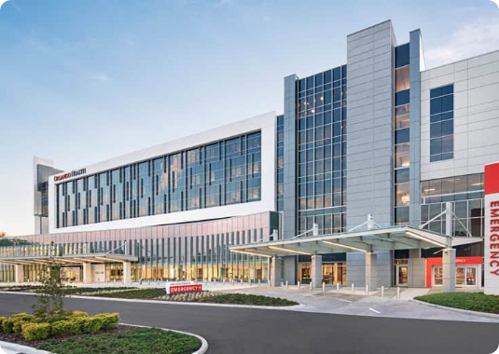
Modernizing Care Infrastructure
Solving Structural Deficits
Prior to the project, health services were fragmented across two distant physical plants. One facility, built over 135 years ago, offered inaccessible and deeply outdated patient accommodation.
Integrated Care: Leverages modern clinical pathways.
Clinical Technology: Integrates modern healthcare systems.
Efficiency: Eliminates inter-site patient transfers.

Slide 10
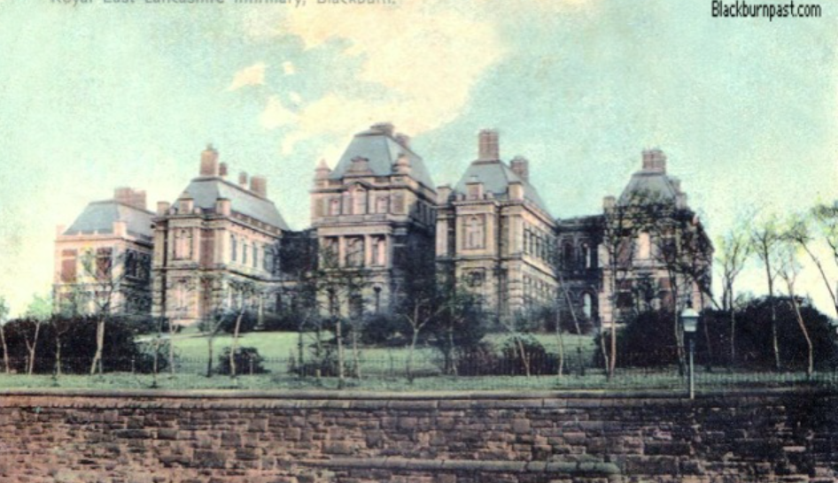
Previous Hospital
Five images of The Royal Infirmary or to give it the name it had when it first opened, The Blackburn and East Lancashire Royal Infirmary. The foundation stone was laid on May 24th, 1858, and it was built on land at Hollin Bank, which was purchased from Joseph Feilden Esq for £3,200 (£1,600 of which he gave back)..

Slide 11

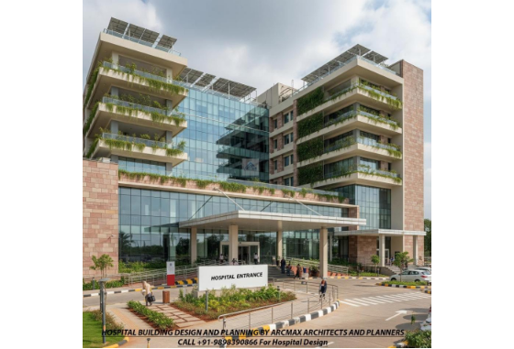
Consolidation of Acute Care
Moving to a Single Site
The Legacy Challenge: Prior to 2003, services were split across two distinct sites. One site, the Blackburn Royal Infirmary, was over 135 years old and offered inappropriate space.
The Strategic Integration: The EIB loan financed the relocation of all acute care services to a unified, modern facility at the Queens Park Hospital site.
Clinical Objective: Integrating clinical specialties onto one site to eliminate risky, expensive inter-site patient transfers and boost local healthcare.

Slide 12






Anticipated PPP Advantages
Lower Investment Costs
Private Efficiencies
Modern Clinical Models
EIB’s highly competitive AAA funding was intended to lower the cost of strategic, long-term capital investments for the public NHS trust.
By delegating construction and facility maintenance to the private sector, the NHS aimed to leverage private sector project management expertise.
Consolidating onto a brand new, purpose-built campus enabled the integration of state-of-the-art medical technology and treatment pathways.

Slide 13
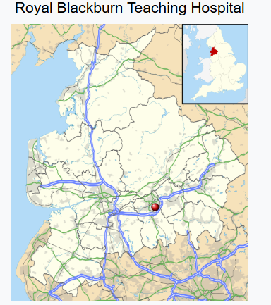
Replacement
The original hospital on the site was established as an infirmary for the local workhouse in February 1864.^{[2]} Additions included a medical wing in 1903, a children's wing in 1925 and a 74-bed annex in 1926.^{[2]} In 1929 it became known as the Queen's Park Institution, a name which evolved to become the Queen's Park Hospital.^{[2]}
A new hospital, to be known as the Royal Blackburn Teaching Hospital, was procured under a Private Finance Initiative contract in 2003 to replace the Queen's Park Hospital and the Blackburn Royal Infirmary.^{[3]} It was built by Balfour Beatty at a cost of £133 million and opened in July 2006.^{[4]}

Slide 14
Cost in 2003
The Royal Blackburn Hospital project achieved financial close in 2003 under the East Lancashire Hospitals NHS Trust. It was structured as a classic New Labour-era PFI project:
The Capital Value: The initial cost to construct the hospital was approximately £133 million.
The Consortium: The private partner responsible for the financing, construction, and ongoing management was Consort Healthcare (a joint venture initially including construction giant Balfour Beatty).
The Deal: In exchange for building the facility, the local NHS Trust committed to paying Consort Healthcare an annual Unitary Charge over a 30-year period to cover the debt, interest, and hard facilities management (FM).

Slide 15


The £50M Funding Framework
EIB Financing Terms
Concession Structure
•
Loan Capital: £50 million (approx. €80.4 million) structured through index-linked bond issues.
•
Consortium Partner: Consort Healthcare (Blackburn) Limited (a special purpose concession company).
•
AAA Advantage: Leveraged EIB's sovereign credit rating to obtain highly competitive, long-maturity funding.
•
Contract Duration: A 38-year concession signed on July 2, 2003, for design, build, and finance.
•
Public Promoter: Blackburn, Hyndburn & Ribble Valley Health Care NHS Trust.
•
Operations Scope: Responsibility for non-clinical facilities maintenance and basic support services.

Slide 16
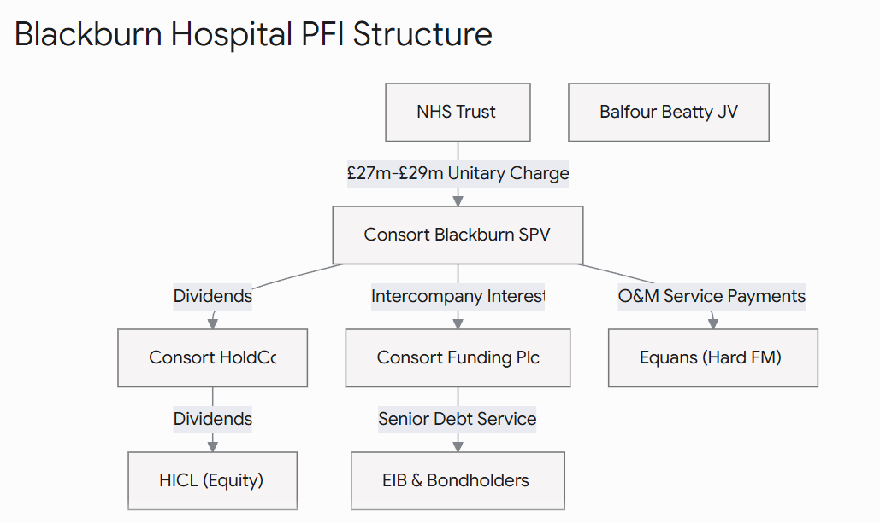
Illustrative Diagram
The private investment fund (the SPV) doesn't absorb this loss. Under the "Pass-Through" architecture of the contract, the SPV instantly forwards the deduction down to the Hard FM Provider (the maintenance sub-contractor on the hook for the repairs, such as Equans or Mitie). The sub-contractor must accept the financial hit on their own balance sheet, insulating the project lenders and equity investors from operational failures.

Slide 17
Parties
The provider responsible for the multi-technical maintenance, planned asset lifecycle renewals, and estates engineering is Equans (operating via the project infrastructure).
The History: This contract was originally awarded at financial close to Haden Building Management (a subsidiary of Balfour Beatty, who built the hospital). Haden was subsequently absorbed into Balfour Beatty Workplace, which was then sold to the French energy giant GDF Suez (Cofely) in 2013. Cofely later rebranded to Engie, and in 2021, Engie spun off its services division into Equans (which is now owned by the Bouygues group).
2. Project Management & SPV Administration
The overarching Special Purpose Vehicle (SPV) management, day-to-day contract variations, and administrative operations are run by Vercity (formerly known as AssetCo / Interserve Investments). Vercity acts as the management partner on behalf of the primary equity fund investor, HICL Infrastructure.
3. Soft FM (Cleaning, Catering, Portering)
While the main infrastructure and building maintenance fall under the hard PFI contract structure, domestic "soft" services like daily hospital cleaning and patient catering are integrated through a combination of sub-contracted partners and internal East Lancashire Hospitals NHS Trust monitoring teams to meet NHS healthcare standards.

Slide 18
EIB Funding & Concession
£50M
Capital Optimization Structure
Supported by a £50 million (approx. €80.4m) European Investment Bank loan, accessed through a highly competitive back-to-back index-linked bond mechanism.
EIB LONG-TERM FINANCE
This allows the project access to highly competitive, ultra-long-term maturity financing. The specialized concession company, Consort Healthcare (Blackburn) Limited, is backed by Balfour Beatty Infrastructure and HSBC Infrastructure Funds.

Slide 19
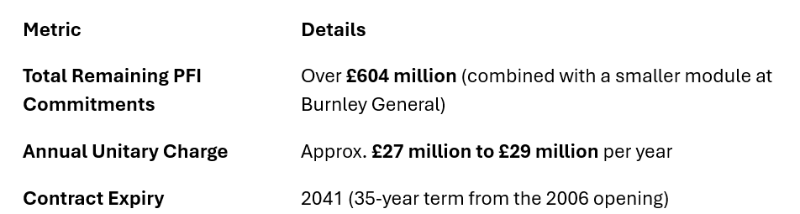
Environment & Procurement
Urban Built Environment
This extension mainly occurs inside an established urban region. The project dramatically upgrades the healthcare workspace for medical staff and clinical surroundings for recuperating patients.
EIA Analysis: Planning permission incorporates robust environmental impact assessments.
Procurement: Initiated via OJEC publication in May 2000.
No Impact Foreseen: Fully structured mitigation measures integrated cleanly.

Slide 20

Blackburn Project Profile
Parameter | Value / Entity | Notes
Public Sector Promoter | Blackburn, Hyndburn & Ribble Valley NHS Trust | Now East Lancashire Hospitals Trust
EIB Loan Status | Signed | 02/07/2003 | EIB Project Reference: 20000444
EIB Loan Amount | £50 Million (~€80.4 Million) | Very long maturity competitive rate
Concessionaire Entity | Consort Healthcare (Blackburn) Ltd | Owned by Balfour Beatty & HSBC Funds
Concession Period | 38-Year Total Concession | Includes 30-year operational phase

Slide 21
Hospital PPP Contracts
A Comprehensive Framework for Strategy, Governance, and Global Risk Allocation in Modern Healthcare Systems.

Slide 22






Structural Frameworks
Infrastructure
Integrated
Specialized
Focused on Design, Build, and Finance. Private partner manages "Hard FM" while clinical care remains strictly public.
Full concession model where the private partner manages both the facility and all clinical operations (Doctors/Nurses).
Co-location of high-tech services (Radiology, Dialysis) within public hospitals to leverage private efficiency.

Slide 23
Integrated Clinical Model
The "Alzira" Evolution
In this model, the private partner takes responsibility for the entire patient journey. It is characterized by capitation-based payments, incentivizing preventative care and operational efficiency.
Impact: Demonstrated reduction in waiting times and increased diagnostic throughput in the Valencia region of Spain.

Slide 24



The PFI Infrastructure Model
Strategic Focus: "Hard FM"
•
Scope: Construction, financing, and lifetime maintenance of the physical estate.
•
Payment: Based on "Availability" of beds and functioning systems.
•
Example: St Bartholomew's Hospital (UK) – A £1.1bn project for state-of-the-art facility management.

Slide 25

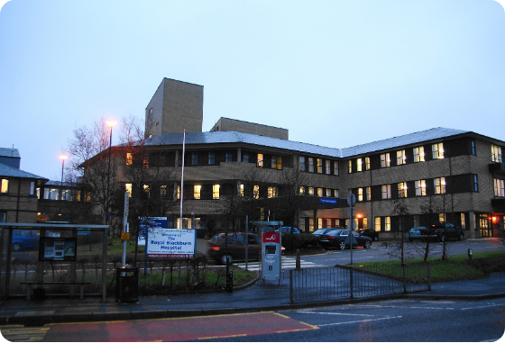
Structural Deficiencies & Limits
Safety Defect Legal Battles
Risk registers have flagged serious physical building flaws, including critical breaches to fire-stopping in compartment walls and fire door surrounds.
Operational Rigidities: Reorganizing ward space for emergency medicine or infection control requires complex renegotiation, delaying urgent healthcare response and drawing extra management fees.
Remediation Disputes: Complex contractual divisions create long, expensive legal battles over whether the Trust or the private partner is financially responsible for resolving safety defects.

Slide 26
Risk Allocation
Optimizing Value for Money through Targeted Risk Transfer

Slide 27
Private Partner Capital Exposure
Why the Private Partner Bears Risk
Key Financial Mechanisms
The concessionaire controls the Engineering, Procurement, and Construction (EPC) pipeline. Consequently, they manage subcontractors, supply chains, site safety, and geological factors better than state agencies.
The payment streams (Availability Payments) only initiate after facility commissioning. Delays lead directly to accrued debt interest, Liquidated Damages (LDs), and lender step-in executions.

Slide 28


Strategic Risk Matrix
Risk Category | Primary Allocation | Mitigation Strategy
Construction Delays | Private Partner | Lump-sum turnkey contracts; performance bonds; step-in rights.
Demand Risk | Shared / Public | Availability payments or Minimum Volume Guarantees (MVGs).
Medical Malpractice | Private (Integrated) | Strict clinical governance; Professional Indemnity Insurance.
Land Acquisition | Public Partner | Public provision of clear site title and access permits.

Slide 29
Infrastructure vs. Integrated
100%
Availability Payments protect Private Capital
In standard PFI models, demand risk remains entirely with the Public Trust. As long as beds and operating rooms are functional, the private partner receives full payments, regardless of whether they sit empty or are fully occupied.
Availability Security

Slide 30
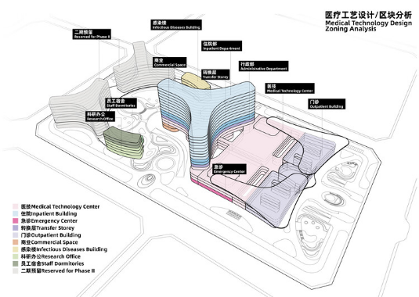
Public Sector Exceptions
Public-Initiated Variations: Scope changes requested by medical directors mid-construction.
Site Access Delays: Failure of the public partner to secure land titles or planning permissions.
Historical Discovery: Archaeological or environmental anomalies discovered on public land.

Slide 31


Managing Construction Risk
Delay & Cost Overruns
Technological Obsolescence
The Private Partner typically bears 100% of the risk for construction timeline slippage. Delays result in "Liquidated Damages" and postponed availability payments, protecting the public purse.
Contracts include "Lifecycle Refresh" clauses, ensuring the private partner upgrades high-value medical tech periodically, preventing the hospital from falling behind clinical standards.

Slide 32
Defining Unavailability
In a PFI arrangement, the hospital doesn't pay a fixed rent; it buys a service. If the building—or a single room within it—fails to meet strict operational conditions, it is legally declared "Unavailable," and the hospital automatically docks the private provider's pay.
Under the contract, the Operating Theatre is legally classified as "Unavailable" because it breaches the mandatory Availability Criteria outlined in the agreement. To be considered available, a room must pass three distinct tests:
Access: Can staff and patients safely get into the room? (No, it's flooded).
Safety: Does it comply with statutory safety laws? (No, standing water with exposed electrical grids).
Environment: Are temperature, lighting, humidity, and medical gases functioning? (No, the power is out).

Slide 33
The Anatomy of an Availability Failure
Imagine a scenario at a typical PFI hospital where a water pipe bursts at 2:00 AM, flooding a core Operating Theatre and knocking out the electricity.
Step 1: The Helpdesk Trigger
  The hospital staff immediately call the PFI Special Purpose Vehicle (SPV)'s centralized 24/7 Helpdesk. The moment the call is logged, two contractual clocks start ticking simultaneously:
  The Response Time Clock: The time the provider has to get an engineer on-site (e.g., must respond within 15 minutes for an emergency).
  The Rectification Time Clock: The total time allowed to fix the issue before financial penalties begin to accrue (e.g., 2 hours for a critical clinical area).
Step 2: Defining "Unavailability"
Under the contract, the Operating Theatre is legally classified as "Unavailable" because it breaches the mandatory Availability Criteria outlined in the agreement. To be considered available, a room must pass three distinct tests:
  Access: Can staff and patients safely get into the room? (No, it's flooded).
  Safety: Does it comply with statutory safety laws? (No, standing water with exposed electrical grids).
  Environment: Are temperature, lighting, humidity, and medical gases functioning? (No, the power is out).
Step 3: Calculating the Deduction Formula
  If the provider fails to dry the room and restore power within the 2-hour rectification window, the PayMech formula triggers. The deduction isn't a random fine; it is an exact mathematical calculation subtracted directly from the hospital's next monthly Unitary Charge invoice:
Deduction = Unit Functional Valuation times Weighting Factor times Duration of Unavailability
Unit Functional Valuation: The baseline "rental" cost of that specific space per hour.
Weighting Factor: A multiplier based on how critical the room is to hospital operations.

Slide 34
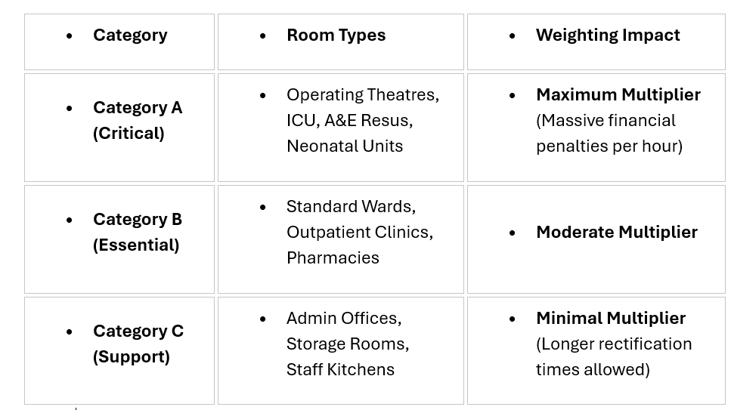
Weighting Example

Slide 35
The "Handback" Clause
PPP contracts feature strict Handback Requirements. In Year 25 or 30, the private partner cannot just hand over a dilapidated building.
The contract stipulates the asset must have a remaining residual life (e.g., "the roof must have at least 10 years of residual life upon handback").
If the SPV skimped on lifecycle spending in Years 15–23 to maximize investor dividends, they face massive financial penalties or must inject huge capital at the eleventh hour to bring the asset up to code.

Slide 36
Benchmarking Costs
Benchmarking and Market Testing: Because PFI deals last for decades, the cost of food, cleaning supplies, and labor changes over time. Most UK PFI contracts contain clauses requiring the Soft FM services to be "benchmarked" or open-market tested every 5 to 7 years to ensure the NHS Trust is still getting value for money, allowing the service fee to adjust to market rates.

Slide 37
Questions
Why have minimum traffic guarantees or any traffic risk
What are variable costs in general
How to deal with variable costs

Slide 38
Setting Penalties and Targets

Slide 39






Three Core Pillars of PPP Risk
Construction Delays
Demand Fluctuations
Clinical Liability
Overruns, site management failures, and design interface risks occurring prior to service launch.
Shifts in clinical volume, occupancy rates, and epidemiological demographics over decades.
Medical malpractice, diagnostic failure, systemic infections, and quality governance outcomes.

Slide 40
Penalties in PPP/PFI
The Blackburn PFI contract utilizes two distinct penalty pathways that reduce the money paid to the private investor:
Availability Deductions: Triggered if a specific area of the hospital (like an operating theatre or a ward) cannot be used due to maintenance issues, structural faults, or structural temperature failures.
Centre for Health and the Public Interest
Performance Deductions: Triggered if the facility management services (such as cleaning, catering, or portering handled by the sub-contractors) fall below the agreed Key Performance Indicators (KPIs).

Slide 41
Time and Weighting in Calculating Deductions
Availability Deductions:
The Breakdown Metric: Calculated using a formula based on Unit Time (how long the space was unusable) multiplied by a Weighting Factor (how critical the room is).
  Critical Categories: A failure in Category A zones (Operating Theatres, Intensive Care, A&E) carries an exponentially higher deduction rate per hour than Category C zones (administrative offices or storage rooms).
  Common Triggers: Heating/ventilation system failures, loss of clinical power sockets, or structure water leaks.
Performance Deductions (The Service Layer)
These penalties target service standard failures. They operate on a Service Failure Points (SFPs) system rather than a direct flat fine.
The Breakdown Metric: Minor infractions generate points. Once a specific threshold of points is crossed within a calendar month, financial deductions kick in.
Common Triggers: Delayed responses to cleaning requests, catering failing food safety temperatures, or portering response times dropping below designated Key Performance Indicators (KPIs).

Slide 42
Setting Targets and Penalties
The "Gold-Plating" vs. Skimping Dilemma
Skimping: Private operators are incentivized to sweat the assets and defer lifecycle replacements to save money, leading to operational friction (e.g., hospital wards closing temporarily due to frequent AC breakdowns).
Gold-Plating: Conversely, because the private partner has to hit strict availability targets to avoid heavy performance penalties, they might over-engineer the lifecycle schedule, replacing perfectly good systems prematurely just to eliminate any risk of operational failure.
In theory this dilemma is resolved with appropriate targets and penalties

Slide 43
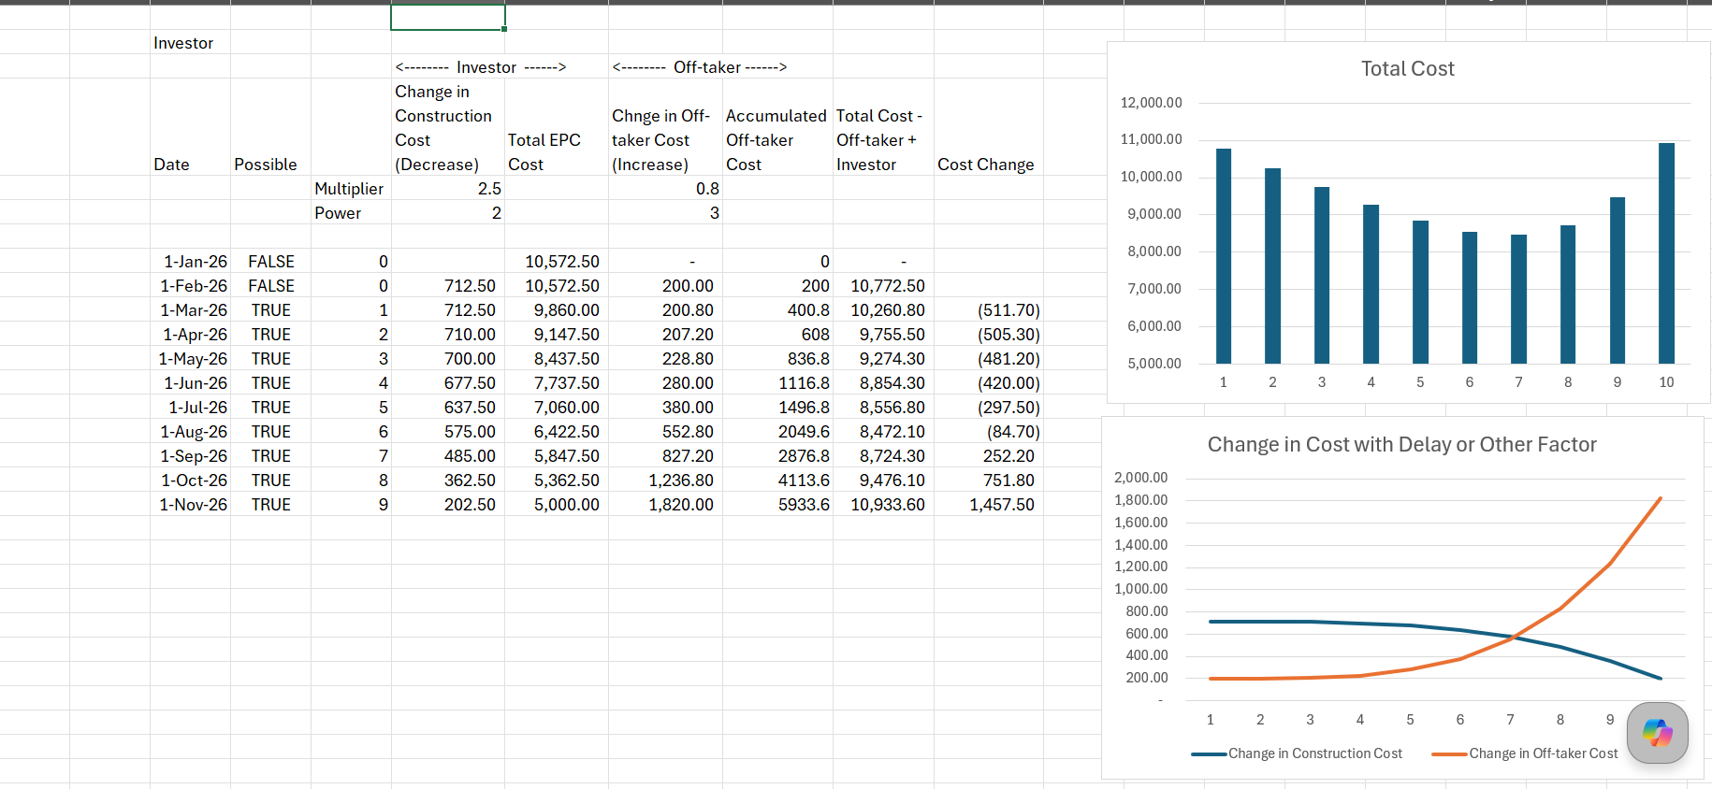
Setting Targets
Theory – Minimize cost for both off-taker and investor
Investor – Cost increases for earlier construction completion
Off-taker – Willing to pay availability charge implies benefits

Slide 44
The Deductions Matrix
Failure Severity | Standard Operational Example | Contractual Consequence
Low (Performance) | A minor delay in non-urgent administrative support requests. | Incurs light Service Failure Points (SFPs).
Medium (Performance) | Substandard catering or food delivered cold to clinical wards. | Slight cash-flow adjustments on month-end invoice.
High (Availability) | Complete failure of primary power or medical gases in a theater. | Immediate full deduction of room-rate charges.
Critical (Default) | Sustained, unresolved fire-stopping defects or structural limits. | Step-in rights or termination for Default.

Slide 45

Navigating Demand Fluctuations
In theory how should you set targets – construction length, availability, KPI targets
Demand Risk Mechanics
95%
In PFI models, demand risk is minimized for the private partner via Availability Payments. The partner is paid if the facility is usable, regardless of patient volume.
AVAILABILITY TARGET
In Integrated models, Capitation shifts demand risk to the private partner. If the population gets sicker, costs rise, incentivizing public health and prevention.

Slide 46
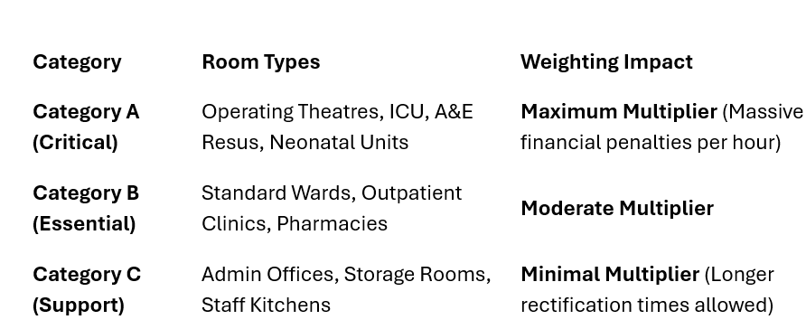
Critical versus Essential versus Support

Slide 47
Output Specification
A PFI agreement contains an incredibly detailed document called the Output Specification. Instead of telling the contractor how to do their job, it specifies the result required. If that result is not met, a service failure occurs.
Failures generally fall into two categories:
Availability Failures: A physical space is completely unusable for its intended purpose (e.g., a hospital operating theatre is too cold to perform surgery, or a school classroom has a leaking roof).
Performance Failures: A service is still operational but falls below the required standard (e.g., the catering team serves school lunch 45 minutes late, or a broken door lock isn't fixed within the 4-hour emergency window).
Each specific failure is assigned a predetermined weight of points based on its severity. For example, a late lunch might equal 5 SFPs, while a critical medical gas failure in an ICU might equal 500 SFPs.

Slide 48
Ratcheting (Repeated Failures)
Many PFI contracts include a ratcheting mechanism. If the contractor fails the same performance metric repeatedly, the SFPs multiply.
Example: If a security gate fails to lock on Monday, it triggers 10 SFPs. If it is still broken on Tuesday, the contract might dictate it triggers 20 SFPs, and 40 SFPs on Wednesday. This stops the contractor from simply accepting a minor flat-rate fine to avoid doing expensive repairs.
To keep the system balanced, availability contracts feature two critical guardrails:
The Ratchet Mechanism: If a room becomes unavailable repeatedly (e.g., the same heating system breaks down three times in a single month), the PayMech includes a "ratchet" that doubles or triples the deduction amount for chronic failures to prevent the provider from treating minor penalties as an acceptable cost of doing business.
The Ratchet Cap: Conversely, to ensure the project remains bankable, the maximum cumulative deductions inside any single month or year are typically capped at 100% of the service fee. This guarantees that a catastrophic failure cannot create an infinite debt spiral that immediately bankrupts the provider, keeping the facility operational while repairs are made.

Slide 49
The Financial and Legal Consequences of SFPs
At the end of each month, the total tally of Service Failure Points is plugged into the project's financial payment mechanism. This triggers a series of escalating contractual remedies:
Level 1: Availability and Performance Deductions
The primary consequence of SFPs is direct financial loss. The total points are converted into a monetary deduction via a formula predefined in the contract. This money is withheld from the government's monthly Unitary Charge payment to the Special Purpose Vehicle (SPV).
Level 2: Increased Monitoring & Warning Notices
If the contractor crosses a certain point threshold within a rolling 3- or 6-month period, they trigger an Increased Monitoring Phase. The private contractor must pay out-of-pocket for independent auditors or public sector staff to closely track their work until performance improves. The public authority will also issue formal Warning Notices.
Level 3: Contractor Replacement (Step-In Rights)
Because the SPV (the corporate shell holding the contract) usually subcontracts the actual work to a Facilities Management (FM) company, crossing a critical SFP threshold allows the SPV investors to fire the FM company. The investors will "step in" and replace the contractor to save the project before the government shuts it down completely.
Level 4: Project Default and Termination
If the total number of SFPs hits an absolute ceiling—representing an existential failure to maintain the public asset—it constitutes a Contractor Default. The public authority has the right to terminate the entire 30-year PFI contract, evict the private consortium, take back the asset, and sue the investors for damages.

Slide 50
Life Cycle Costs

Slide 51
What Lifecycle Costs Include
Lifecycle costs do not cover routine daily maintenance (like cleaning, minor plumbing fixes, or changing lightbulbs)—that falls under Facilities Management (FM) or Operational Maintenance (O&M).
Instead, lifecycle costs cover predictable, large-scale capital replacements (Capital Expenditure replacement), such as:
Mechanical & Electrical (M&E): Replacing entire HVAC units, boilers, lifts, or electrical switchgear.
Fabric & Structure: Replacing roofs, windows, resurfacing car parks, or structural refits.
Fit-Outs: Periodic replacement of carpets, ceiling tiles, and industrial kitchen or hospital equipment.

Slide 52
Lifecycle Cost and Reserve Accounts
In a standard PFI/PPP model, the public sector pays the private consortium (the Special Purpose Vehicle, or SPV) a regular, performance-based payment called the Unitary Charge. A portion of this unitary charge is explicitly earmarked to fund the lifecycle profile.
To manage the uneven spikes in major maintenance, the SPV uses a Lifecycle Sinking Fund or Reserve Account:
[Unitary Charge from Government]
│
▼
[SPV Cash Waterfall] ───► Regular OpEx (Cleaning, Utilities)
│
▼
[Lifecycle Sinking Fund] ───► Sizable cash buffer built up in quiet years
│
▼
[Major CapEx Spend] ───────► Triggered in Year 10, 15, 20 (e.g., Roof/Boiler replacement)
Instead of hit-or-miss budgeting, the SPV models the exact year components are expected to fail. Money is smoothed out and set aside annually into a reserve account so that when a £2 million boiler replacement is due in Year 15, the cash is readily available without impacting the project's debt service or investor returns.

Slide 53
Lifecycle Issues
Risk Passed to the Lifecycle/FM Contractor: In many robust PFI projects, the SPV passes the lifecycle risk down to a heavy-facilities management contractor via a back-to-back contract. The contractor agrees to fixed annual lifecycle payments and takes the hit if real-world costs escalate.
Risk Retained by the SPV: If the SPV cannot pass this risk down affordably, the equity investors bear the risk. If lifecycle costs spike, it eats directly into the equity Internal Rate of Return (IRR).
Risk Shared with the Public Sector: Some contracts include "gain-share/pain-share" mechanisms or benchmarking reviews every 5 to 10 years to adjust the lifecycle budget based on macroeconomic realities (like hyperinflation in construction materials).

Slide 54
Modelling Reserve Accounts
Cash versus letter of credit
Cost of Sleeping Cash
Model Inputs
Risks in Reserve Accounts

Slide 55
Hospital PPP/PFI and Policy

Slide 56
Anatomy of a Failed PPP:
The Blackburn Hospital PFI
A detailed case study exploring cost inefficiencies, structural rigidity, safety concerns, and the ultimate obsolescence of early 2000s Private Finance Initiative models in the NHS.

Slide 57
Problems with PFI and the Lock Scandal

Slide 58

Exorbitant Variation Costs
The "Key and Lock" Scandal
£486
Highlighted directly by the UK National Audit Office (NAO) on PFI efficiency, the private consortium held a strict monopoly over any minor modifications or physical maintenance on-site.
COST TO CHANGE A SINGLE LOCK
Standard replacement keys ranged from £4.26 to £47.48. Because hospital staff lack the commercial or legal right to employ local contractors, the trust was forced to pay massive premium penalties for routine tasks.

Slide 59
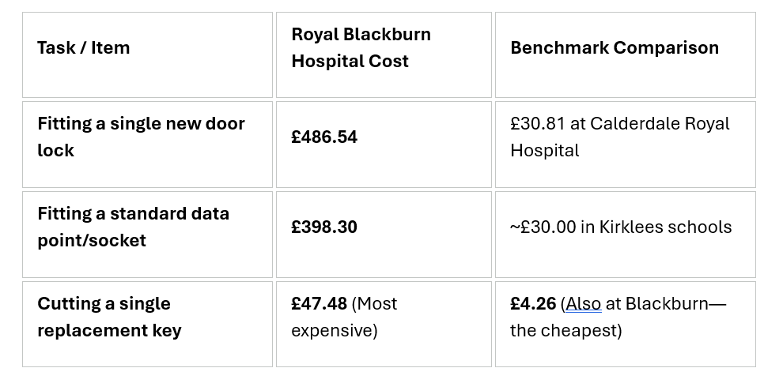
History of Lock Scandal
On January 17, 2008, the National Audit Office (NAO) released a report examining how public bodies negotiated variations or minor works within existing PFI contracts. The watchdog audited around £180 million spent on modifying hospitals, schools, and prisons in 2006.
The report exposed a jaw-dropping disparity in pricing for identical minor maintenance works across different public sectors. The Royal Blackburn Hospital was highlighted as both the absolute best and absolute worst offender in the UK:

Slide 60
Why was the Lock so Expensive (1)
To the public, a £486 lock looked like pure corruption or corporate price-gouging. While excessive private profiting was a factor, the astronomical cost was primarily a structural by-product of how exclusive PFI variations were legally framed.
The mechanism behind the cost explosion relied on several structural layers:
The Exclusive Monopoly Trap
  Under the 30-year PFI contract, Consort Healthcare held an exclusive monopoly over the building's maintenance. The NHS Trust was legally forbidden from hiring an independent, local locksmith to change a door lock for £40. Doing so would violate the contract and void the private consortium's overarching structural warranties.
"Variation" Bureaucracy and Risk Pricing
  Because a lock change was considered a "variation" to the original building blueprint, the request had to pass through an absurdly bureaucratic pipeline. The private consortium had to draw up paperwork, assess whether the new lock impacted fire safety codes, check if it altered the master-key system, and calculate if it added any operational risk to the 30-year lifecycle model. The private partner billed the NHS Trust for every single hour of this legal and administrative processing.

Slide 61
Why was the Lock so Expensive (2)
The "Plus-Plus" Subcontracting Layer
  The SPV (Special Purpose Vehicle) that signed the contract with the NHS did not actually employ locksmiths.
  The NHS Trust requested a lock.
  The SPV passed the request to the prime FM Contractor (e.g., Balfour Beatty/Haden Young), adding a management fee percentage.
  The FM Contractor passed it down to a regional subcontractor, adding their profit margin.
  The subcontractor sent a specialized worker to perform the task.
By the time every corporate tier added its overhead, legal administration, and guaranteed profit margin, a 15-minute job ballooned by 1000%.
The NAO report explicitly noted that public sector contract managers lacked the commercial acumen and bargaining power necessary to challenge these bills. They were essentially "taken for a ride" by highly sophisticated private infrastructure funds.

Slide 62




The Core Contract Failures
Exorbitant Variations
Crippling Deficits
Rigidity & Risks
Extreme monopolies lock the hospital trust into rigid, long-term exclusivity agreements, resulting in astronomical bills for trivial handiwork and minor repairs.
Mandatory unitary charges, highly insulated from NHS spending cuts, aggressively drain core operating budgets and compound trust deficits year-on-year.
Inflexible contractual parameters delay infrastructure adaptation, while legal disputes slow down crucial remedies for core building safety issues.

Slide 63


Legally Binding Deficits
The Unitary Charge Mechanism
(Frontline Impact)
•
The trust must pay a massive, contractually locked annual fee to private partners just to maintain facility "availability".
•
Board papers directly attribute the "premium cost of PFI" as a fundamental structural driver of the trust's financial deficit.
•
These charges are strictly legally insulated from broader NHS spending cuts, indexing directly with inflation.
•
•
Core budgets are forcefully diverted from frontline clinical staff and bed capacity to satisfy debt servicing lines.
Under PFI debt terms, the public sector often ends up paying multiple times the actual capital construction cost.
•
Inflexibility prevents dynamic shifting of services toward community or modern outpatient care settings.

Slide 64
The Wider UK Legacy
"The sheer legacy cost of paying off these contracts—where the public purse pays up to multiple times the actual capital value over 30 years—is why the model has been completely abandoned."
“
”
— HM Treasury Decision to Abolish PFI Contracts

Slide 65
PPP Promises vs. Realities
Strategic Domain | 2003 EIB Announcement Vision | Eventual Real-World Outcomes
Capital Costs | Competitive AAA funding lowers the total cost of capital investment. | Rigid indexation and high interest rates drove multi-fold debt repayments.
Maintenance Costs | Private sector efficiencies reduce long-term operational and support costs. | Exclusivity clauses created strict monopolies and excessive fees (e.g., £486 for a lock).
Facility Agility | Consolidation supports modern, integrated clinical workflows. | 38-year contract created immense rigidities, delaying urgent spatial reconfigurations.

Slide 66
Tameside Hospital Default
The idea of a default or financial restructuring under a "Consort Healthcare" contract comes from a high-profile case of Tameside.
A project entity called Consort Healthcare (Tameside) Plc—which runs the PFI contract for the Tameside and Glossop Integrated Care NHS Foundation Trust—suffered major financial distress. Following severe structural and fire safety defects, that specific NHS Trust successfully hit the Tameside project company with roughly £9 million in performance deductions, pushing it to the brink of cash-flow insolvency. That entity had to launch a pioneering High Court restructuring plan to compromise its liabilities.

Slide 67
Sponsor Analysis

Slide 68
Sponsor Analysis
Balfour Beatty plc is an international infrastructure group based in the United Kingdom with capabilities in construction services, support services and infrastructure investments. A constituent of the FTSE 250 Index, the company is active across the UK, US and Hong Kong.
For a time, Balfour Beatty's activities were dominated by two domestic sectors: power stations and the railways. It also opted to develop its presence as contractor within various power and civil engineering projects. Throughout the 1970s, Balfour Beatty expanded its presence in the road construction sector through schemes such as the M73 motorway and the Glasgow Inner Ring Road. Between 1986 and 1995, Balfour Beatty operated Balfour Beatty Homes; after a collapse of the housing market, Balfour Beatty Homes was renamed Clarke Homes and then sold to Westbury. During the 2000s, the company's business strategy diversified from the construction of infrastructure alone towards the financing, operation, design and management functions. Balfour Beatty also pursued a strategy of growth via acquisition, primarily in the United Kingdom and North America, including Mansell plc, Birse Group, Rok plc, Centex Construction, Parsons Brinckerhoff.

Slide 69


The PFI Return Gap
Target Business Case (12%–15%)
Actual Secondary Returns (15%–30%)
•
Initial Projection: Bids were financial-engineered to show nominal post-tax equity IRRs in the 12% to 15% range.
•
Risk De-escalation: Once construction successfully concluded, physical asset risk effectively dropped to zero.
•
Risk Justification: Proponents argued high returns rewarded sponsors for carrying heavy construction and long-term delivery risks.
•
Equity Flipping: Original sponsors systematically flipped their stakes to specialized secondary infrastructure funds (e.g., HICL).
•
Public Assumption: NHS Trusts signed agreements under the belief that private-sector yields were locked in at these moderate levels.
•
Widespread Excess: Audits mapped actualized operational-phase transaction IRRs averaging an extraordinary **28%**.

Slide 70

Refinancing Windfalls
Leveraging Lower Operational Risks
During a PFI's early bidding stage, sponsors secured senior debt at higher interest rates due to perceived construction risk.
28%
Once the hospital opened, the low-risk nature of state-backed unitary charges allowed consortia to refinance senior debt with commercial banks at much cheaper margins and longer tenors.
AVERAGE ACTUALIZED SECONDARY IRR
The vast cash savings generated by lower debt payments were instantly swept to equity holders via special dividends, hyper-inflating the actualized IRR.

Slide 71
Financial Engineering Levers
Aggressive Subordinated Junior Debt
Sponsors structured the "10% equity slice" as 1% pure equity and 9% shareholder loans. By charging internal interest rates of 12% to 18% on this junior debt, they channeled tax-deductible cash out of the SPV before corporate tax liabilities triggered.
Operational Efficiency Stripping
Special Purpose Vehicles (SPVs) aggressively sub-contracted facilities management services (cleaning, catering, security) at steep discounts, pocketing the vast operational margin between the sub-contracts and the NHS Unitary Charge.
Early Capital Recycling
By selling operational project shares to highly liquid secondary market infrastructure funds, initial construction sponsors successfully unlocked and recycled high-yielding capital early, boosting their portfolio-level IRRs.

Slide 72
Financial Comparison
BYG.F Bouygues SA
MTO.L Mitie Group plc
BBY.L Balfour Beatty plc
KIE.L Kier Group plc
BWY.L Bellway plc
GFRD.L Galliford Try Holdings plc
FGP.L FirstGroup plc
BAB.L Babcock International Group PLC

Slide 73
The PFI Financing Dichotomy
Financial Metric | Bidding Phase Business Case (Vision) | Operational Phase Reality (Outcome)
Equity IRR Target | Locked at a predictable 12% to 15% margin. | Escalated up to 30% through secondary market sales.
Junior Debt Interest | Priced to represent standard risk premiums. | Set at 12%–18% to extract tax-free operational cash.
Senior Debt Structure | Rigid commercial terms designed for construction. | Refinanced to lower rates; gains captured by equity.
Tax Exposure | Forecasted to contribute standard UK corporate tax. | Minimized via high internal interest deductions.

Slide 74
The Wider Policy Legacy
"The high returns to equity holders, which were heavily insulated from risk once the buildings became operational, created a deep misalignment with public interest. This systematic transfer of wealth is what doomed the PFI brand."
“
”
— House of Commons Treasury Committee Report on PFI

Slide 75
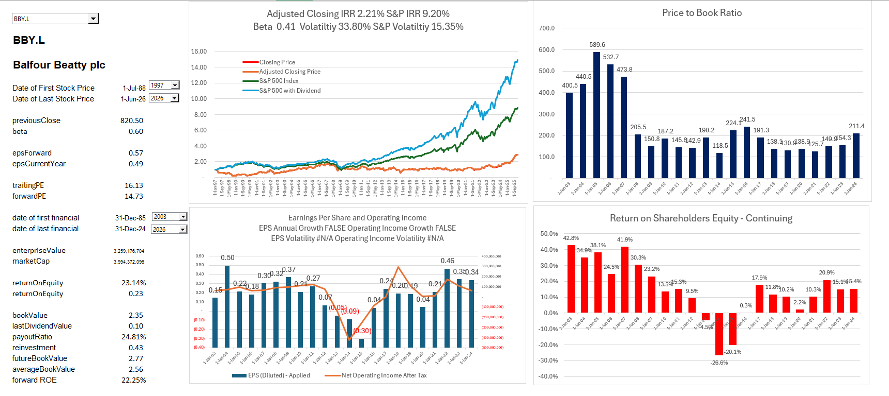
Balfour Beatty ROE and Price to Book
.

Slide 76
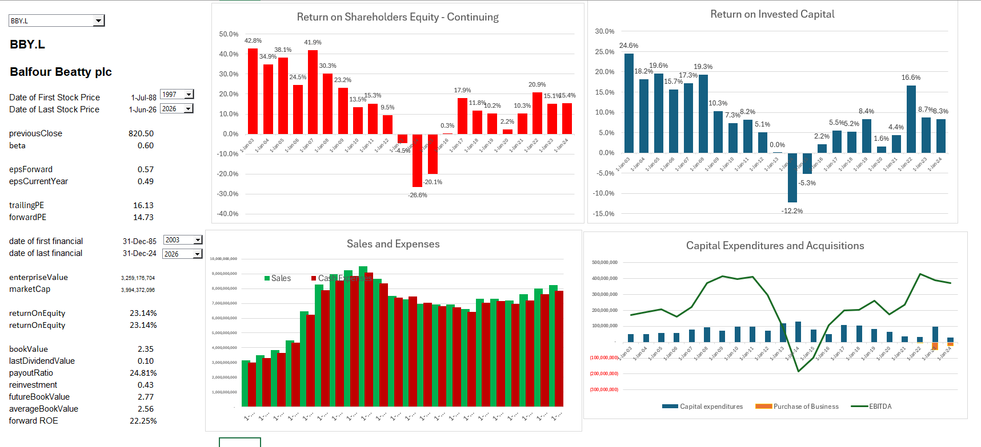
ROE, ROIC and Growth
.

Slide 77
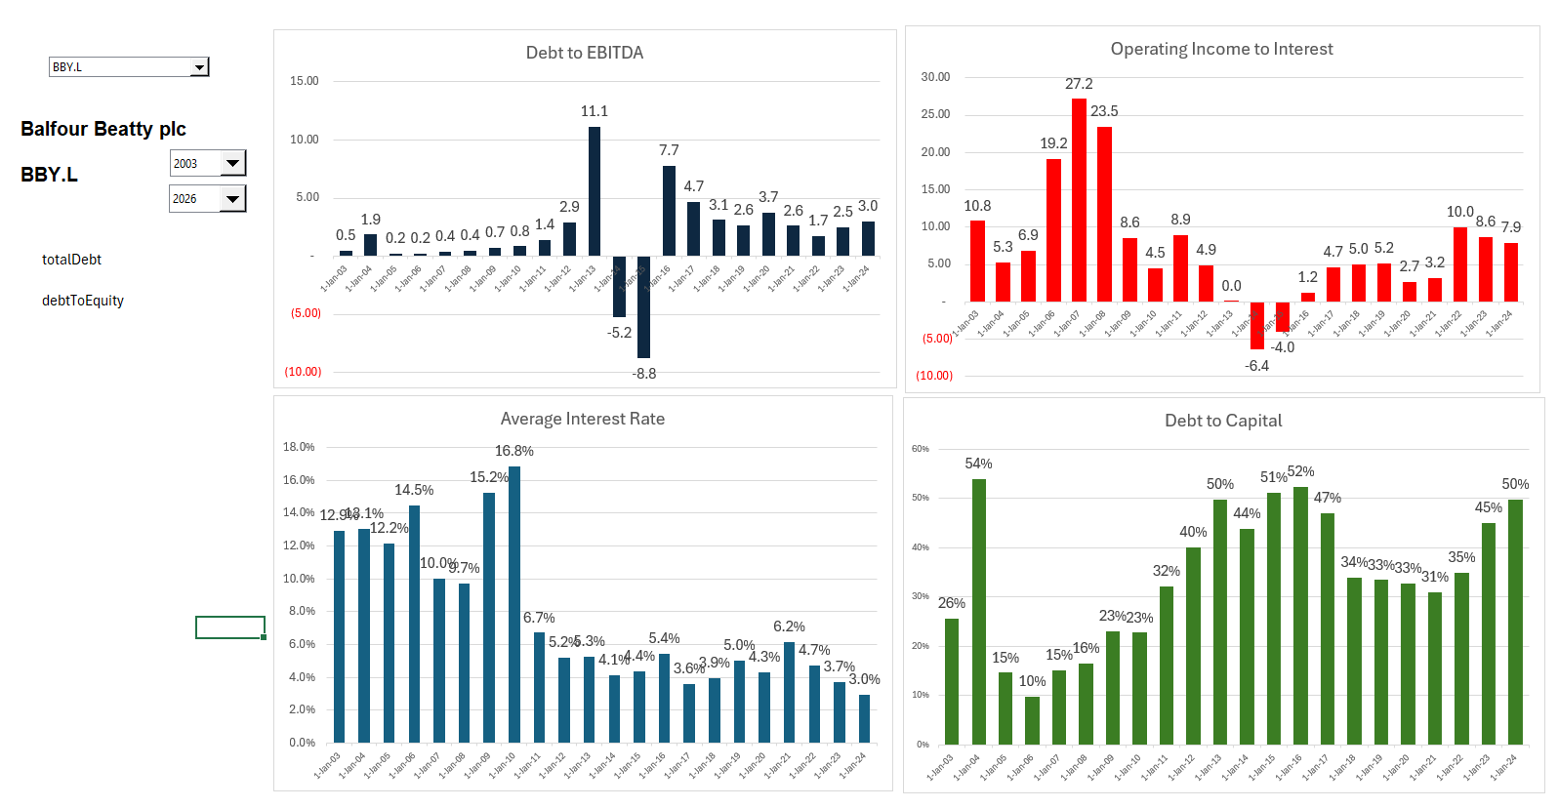
Credit Ratios

Slide 78
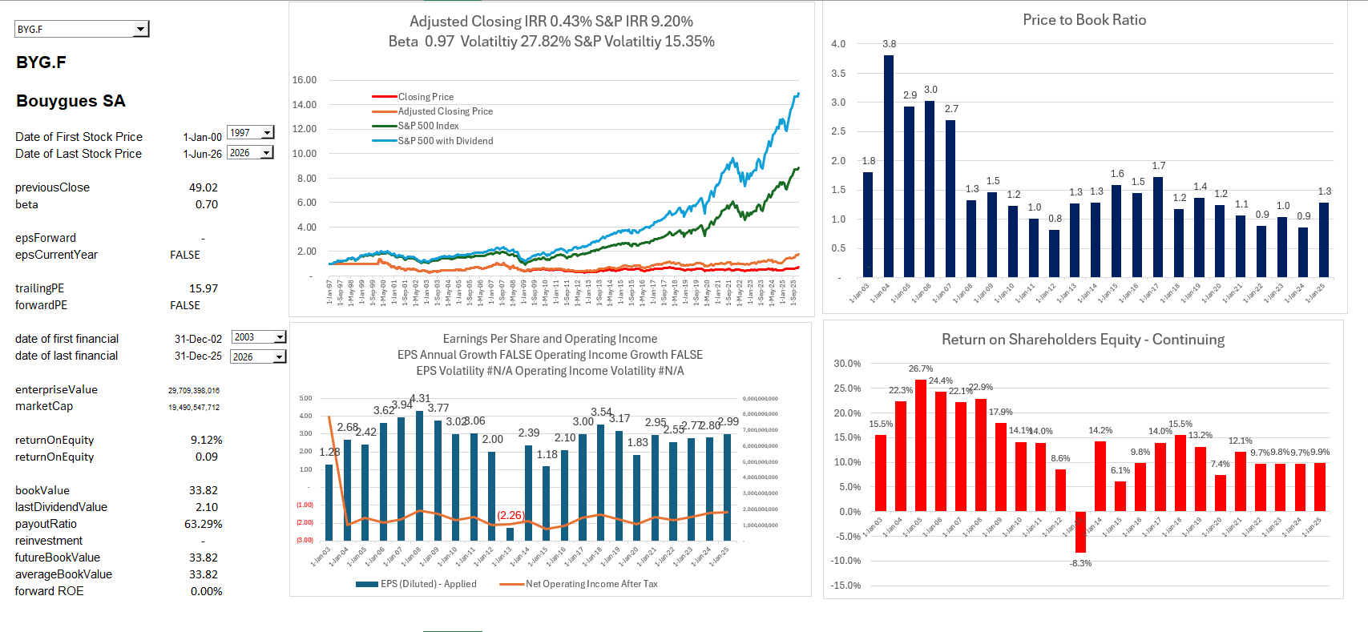
Bouygues Returns and Value
.

Slide 79
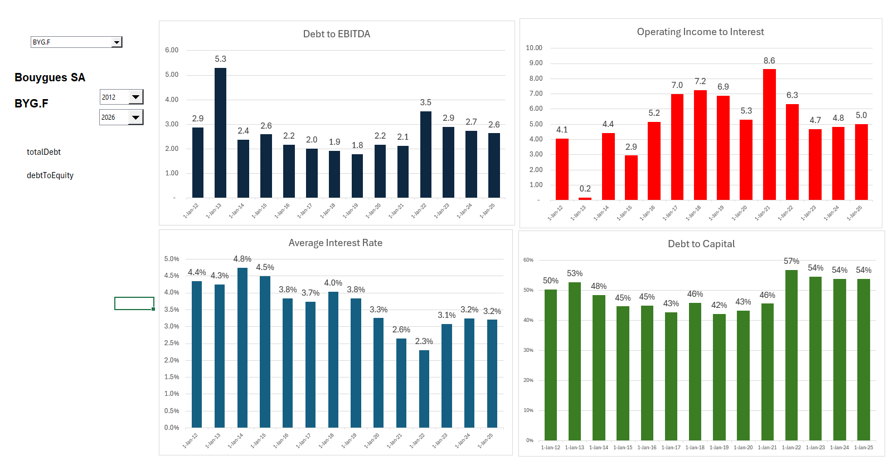
Bouygues Debt Profile
.

Slide 80
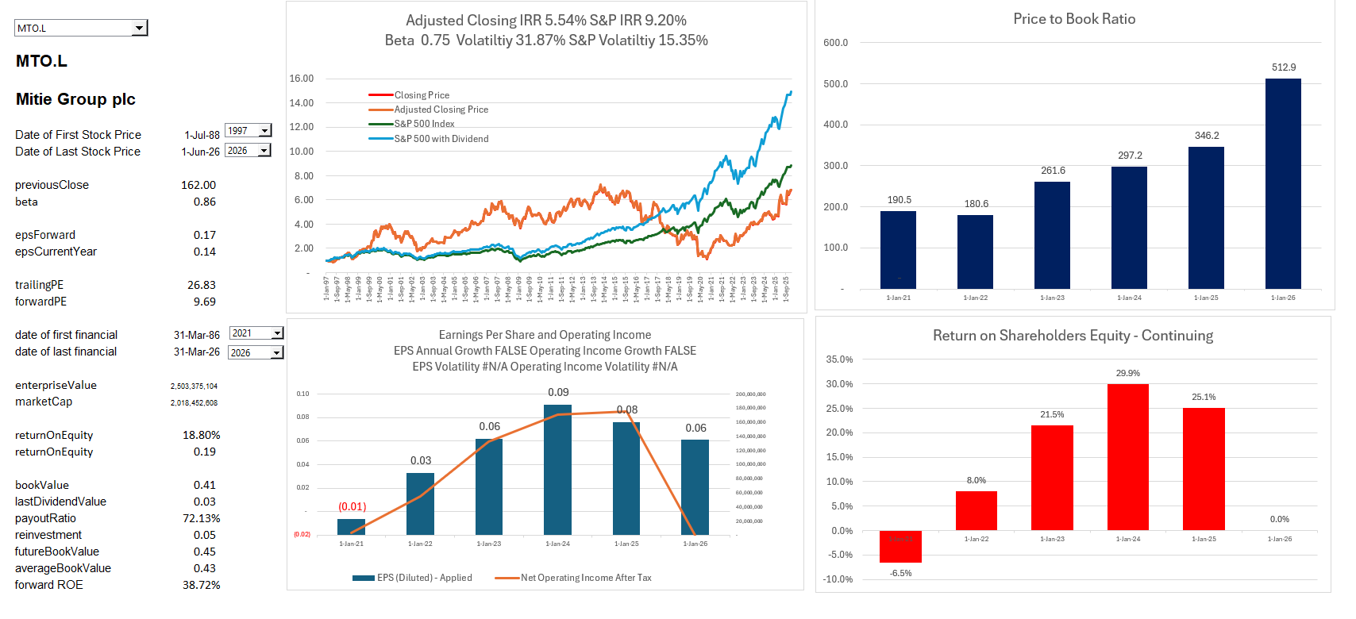
Mitie Group – O&M
.

Slide 81



Availability vs Performance
Availability Deductions
Performance Service Failures
•
Asset Readiness: Triggered when critical areas fail to meet strict physical and operational standards.
•
Service Compliance: Relates directly to the quality of soft and hard facilities management (FM) services.
•
Space Penalties: If clinical rooms are deemed unusable, the monthly Unitary Charge is docked proportionally.
•
Failure Point Matrix: Systematically tracks service failures (e.g., late meals, substandard cleaning).
•
Rectification Windows: Strict timeframes (e.g., minutes to hours) are provided to cure the issue before penalties hit.
•
SFP Accrual: Accumulating Service Failure Points directly converts into cash-flow deductions.

Slide 82






Critical Service Failures
Environmental Control
Infection Control
Clinical Access
Severe deductions occur if operating theaters, wards, or oncology units fall outside of mandatory, safe temperature or humidity limits.
Domestic cleaning failures in high-risk zones that compromise clinical safety and increase bacterial spread carry heavy financial penalties.
Loss of elevator services in multi-story acute clinical blocks instantly triggers massive "unavailability" deductions.

Slide 83

Severe Contract Defaults
Persistent Operational Negligence
Under the standard Payment Mechanism (PayMech), persistent or repeating failures are aggressively escalated.
3x
If the same area suffers from "unavailability" or standard cleaning failures three times within a rolling period, a ratchet multiplier is applied, doubling or tripling the deduction.
RATCHET MULTIPLIER PENALTY
Extreme neglect activates Step-In Rights (allowing the NHS to hire outside help at the SPV's expense) or total contract termination.

