Slide 1
01
Introduction
Welcome to KSPP Financial Modelling

Slide 2
Table Of Contents
01
02
03
Financial Model Ideas
Excel Techniques for Financial Models
Three Excel Functions
FAST Model Philosophy
AI in Models
Fundamental Model
Timelines
Investment Decision
Return Measurement
Risk Measurement
Project Model Structure
IRR and DSCR in Project Model
Timing and Operation Sensitivity
Debt Structuring in Project Finance
04
05
06
Advanced Project Model
Sculpting Formula for Debt Service
Cash Flow Waterfall
Equity IRR and Project Value
Re-financing in Model
Corporate Model
Corporate Model Structure
Corporate Model as Project Portfolio
Historic Analysis in Corporate Model
Corporate Advanced
Cap Exp and Debt from History
Valuation and Terminal Value
Scenario Analysis and Presentation

Slide 3

Financial Modelling
23 June 2026
DAY 1 23 June 2026 | DAY 2 24 June 2026 | DAY 3 25 June 2026 | DAY DATE
9:00AM -12:00PM Key Ideas of Financial Models Excel Techniques for Financial Models Three Excel Functions FAST Model Philosophy | 9:00AM -12:00PM Project Finance Model Structure IRR and DSCR in Project Model Timing and Operation Sensitivity Debt Structuring in Project Finance | 9:00AM -12:00PM Corporate Model Structure Corporate Model as Project Portfolio Historic Analysis in Corporate Model | 00:00AM -00:00PM Project Finance
Lunch break 12:00PM -1:00PM
1:00PM -4:30PM Basic Project Finance Model Essence of Corporate Model Sensitivity Analysis in Models Adjustments Construction Costs | 1:00PM -4:30PM Sculpting Formula for Debt Service Cash Flow Waterfall Equity IRR and Project Value Re-financing in Model | 1:00PM -4:30PM Cap Exp and Debt from History Valuation and Terminal Value Scenario Analysis and Presentation | 00:00AM -00:00PM Corporate Finance

Slide 4



Introduction
About KAPSARC
School

Slide 5




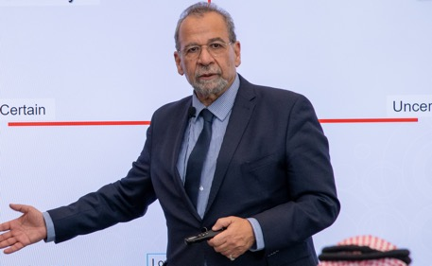


Inspiring,
Effective
and
motivative
KAPSARC
Public
Leadership Program
Cohort

Slide 6


Introduction
About KAPSARC
School
Inspired by His Royal Highness, the Minister of Energy, Prince Abdulaziz bin Salman Al Saud’s passion for education, human capital development and innovation, KAPSARC Academy was launched in 2022 to serve a fundamental role in the education of public policy in the Kingdom of Saudi Arabia.
The academy aims to enable and empower future global public policy leaders and professionals to positively impact society by equipping them with the skills they need to effectively realize the goals of Saudi Vision 2030.
KAPSARC School Of Public Policy

Slide 7

Introduction
Vision
The academy offers a variety of executive education programs in public policy, leadership, and management skills in collaboration with leading local and global educational institutions to professionals in the public and private sectors.
Mission
The academy offers a variety of executive education programs in public policy, leadership, and management skills in collaboration with leading local and global educational institutions to professionals in the public and private sectors.
KAPSARC School Of Public Policy

Slide 8
Jouf
الجوف
Northern Region
الحدود الشمالية
Introduction
Tabuk
تبوك
Location
Hail
حائل
KAPSARC Academy is located at King Abdullah Petroleum Studies and Research Center, in Riyadh.
The academy offers a variety of executive education programs in public policy, leadership, and management skills in collaboration with leading local and global educational institutions to professionals in the public and private sectors.
Qassim
القصيم
Madinah
المدينة المنورة
Riyadh
الرياض
Eastern Region
الشرقية
Makkah
مكة المكرمة
Baha
الباحة
Najran
نجران
Asir
عسير
Jazan
جازان

Slide 9
02
Programs
What We Offer
We are going to cover:
Programs Overview
Programs in Details
Modules

Slide 10
Programs
Programs Overview
01
Program
Energy Economics and Financing
04
Program
The Public Leadership Executive Program
02
Program
Economics of Energy and Environment
05
Program
Business Skills and Communication
03
Program
The Emerging Leaders Executive Program
06
Program
Energy and the Environment

Slide 11
Programs
Programs Overview
07
Program
Energy Security and Energy Diplomacy
9
Program
Renewable and Sustainable Energy Policy
Program
Global Energy Sector
and Business Management
Program
Principles of Microeconomics
and Public Policy
08
10

Slide 12



Programs
Programs Overview
Energy Economics and Financing
Economics of Energy and Environment
The Emerging Leaders Executive Program

Slide 13




Programs
Programs Overview
Energy Security and Energy Diplomacy
Global Energy Sector and Business Management
Renewable and Sustainable Energy Policy
Principles of Microeconomics and Public Policy

Slide 14

244
182
45
15
Nominated
Registered
Accepted
Companies Participated
Introduction
Programs in Details:
Sustainability
Sustainability financing, agreements and treaties
Social and economic aspects of sustainability
Stakeholder and public engagement
The academy offers a variety of executive education programs in public policy, leadership, and management skills in collaboration with leading local and global educational institutions to professionals in the public and private sectors.
Climate change and sustainability
Sustainability governance, ethics and policies

Slide 15
Modelling Equations and Introduction

Slide 16
Only Need A Few Key Functions
In applying functions:
  Use Entire Line
  LOOKUP, XLOOKUP, INDEX, SUMIF is most important
  XIRR, EDATE, EOMONTH
  MIN and MAX

Slide 17
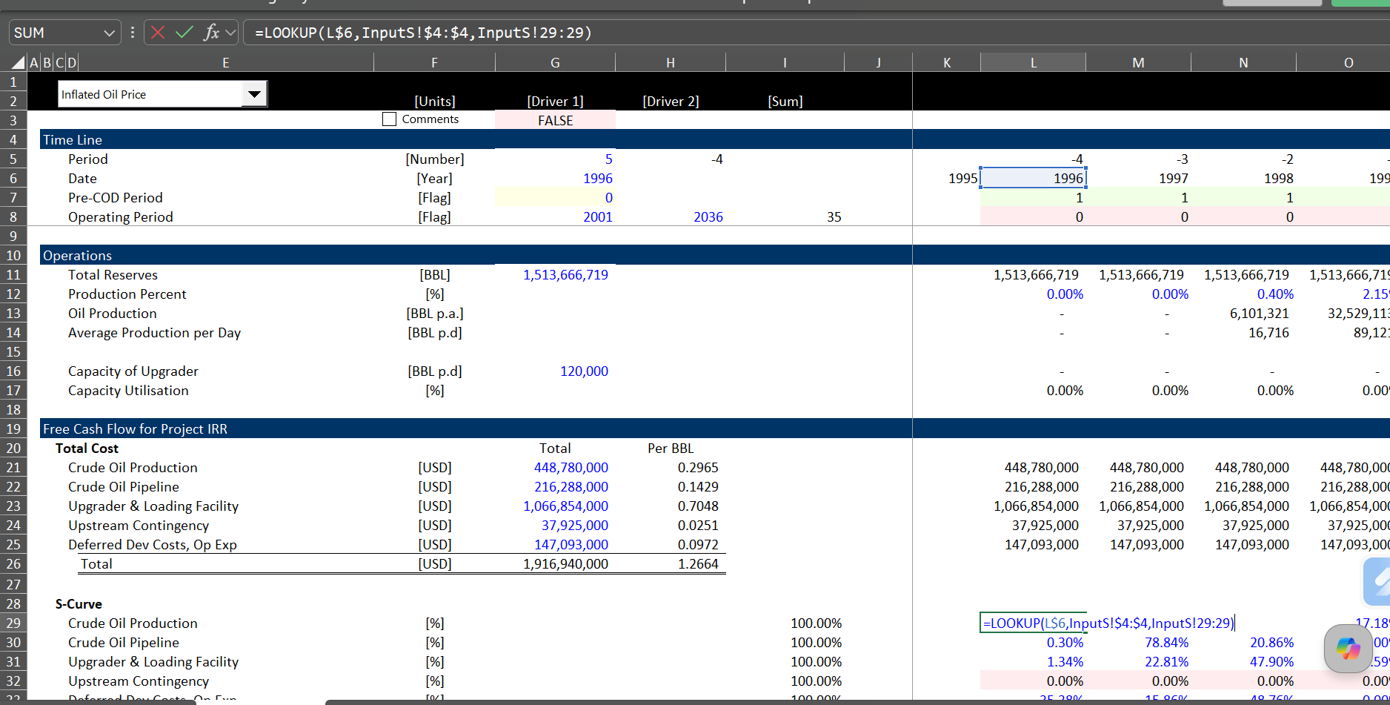
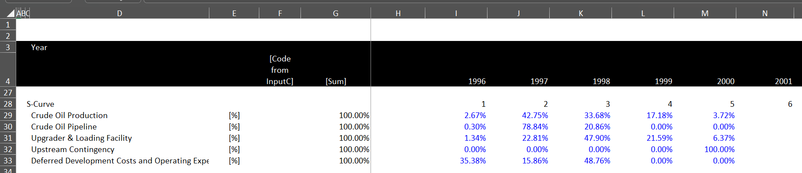
Using Lookup
First find the item being looked-up
Second associate the look-up with a series that is related to the above item
Third point to the result that has the same array format (a whole line)

Slide 18
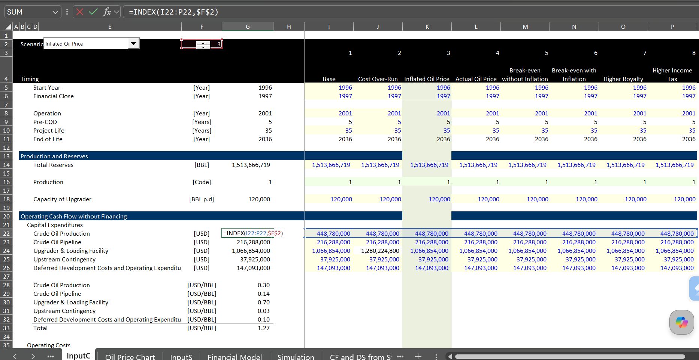
Using Index (In InputC)
With the INDEX, first include an area (often a single row or single column)
Then give the column number (for a single row) or the row number for a single column
In the example below there is a single row and a column number that defines a scenario

Slide 19
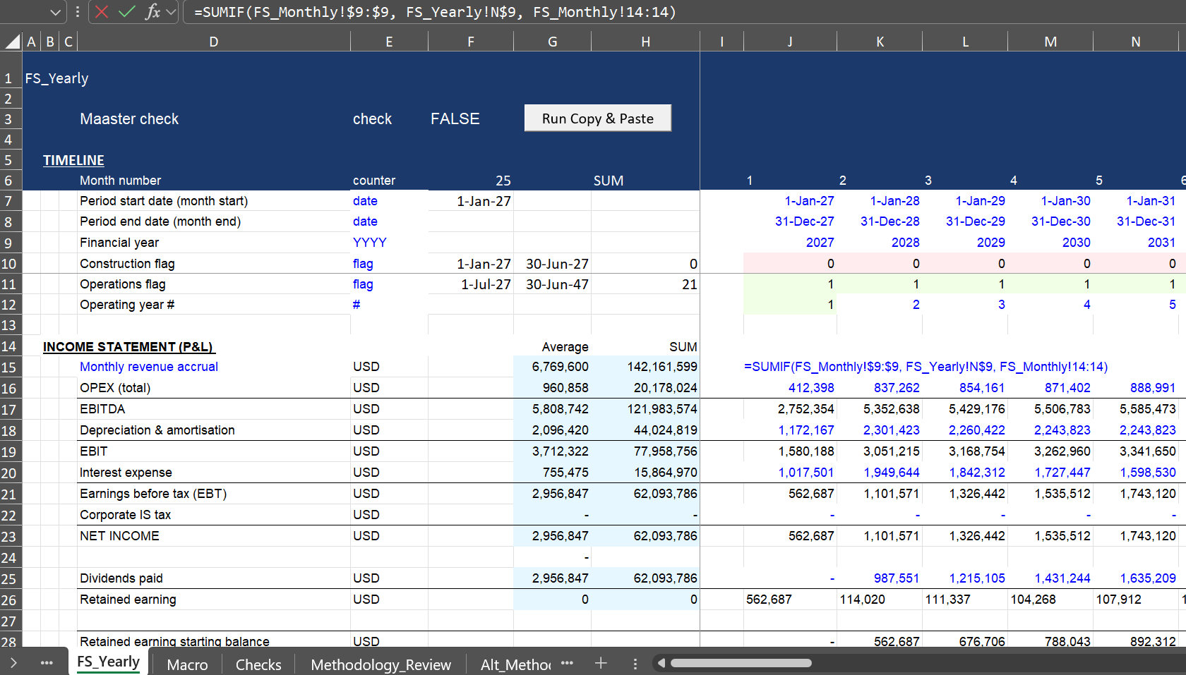
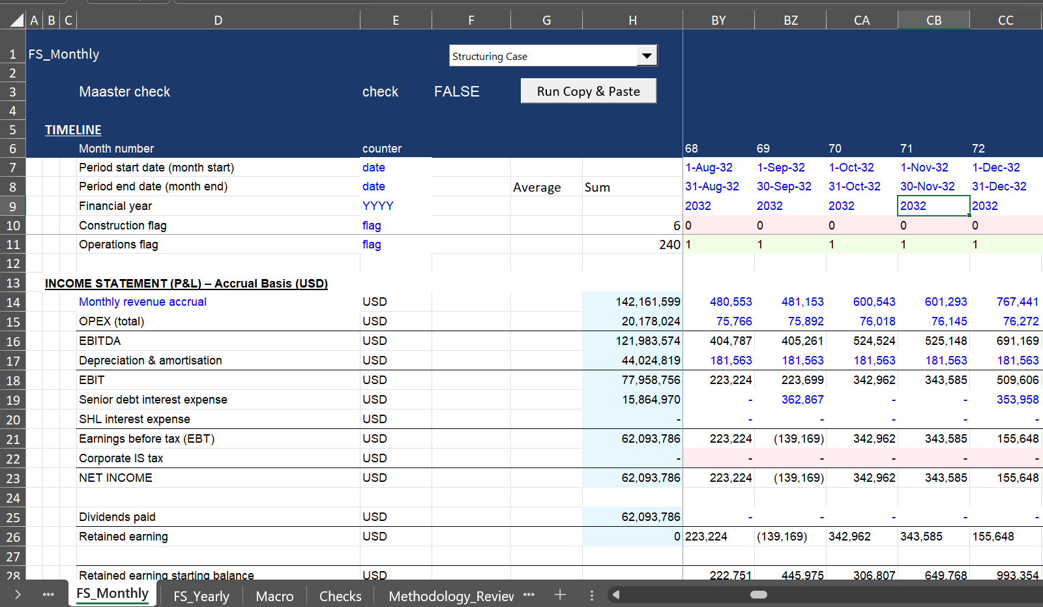
Using SUMIF
The sumif function is surprisingly helpful, It has the form where a range over which to sum is the first part of the formula. Then the criteria which to sum is next and the item to sum is the last part.
The way the SUMIF works is illustrated below. The first screenshot shows the result and the second shows the inputs to the function.

Slide 20
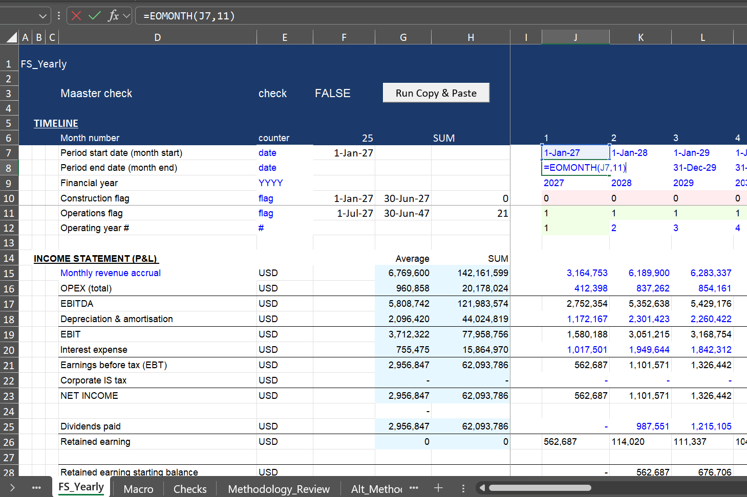
Using EDATE and EOMONTH
Because months do not have 30 or 31 days and years can have 366 days, the EDATE and EOMONTH can be very helpful.
EDATE has the form EDATE(Start Date, Number of Months)
EOMONTH has the form EMONTH(Start Date, Number of Months)

Slide 21
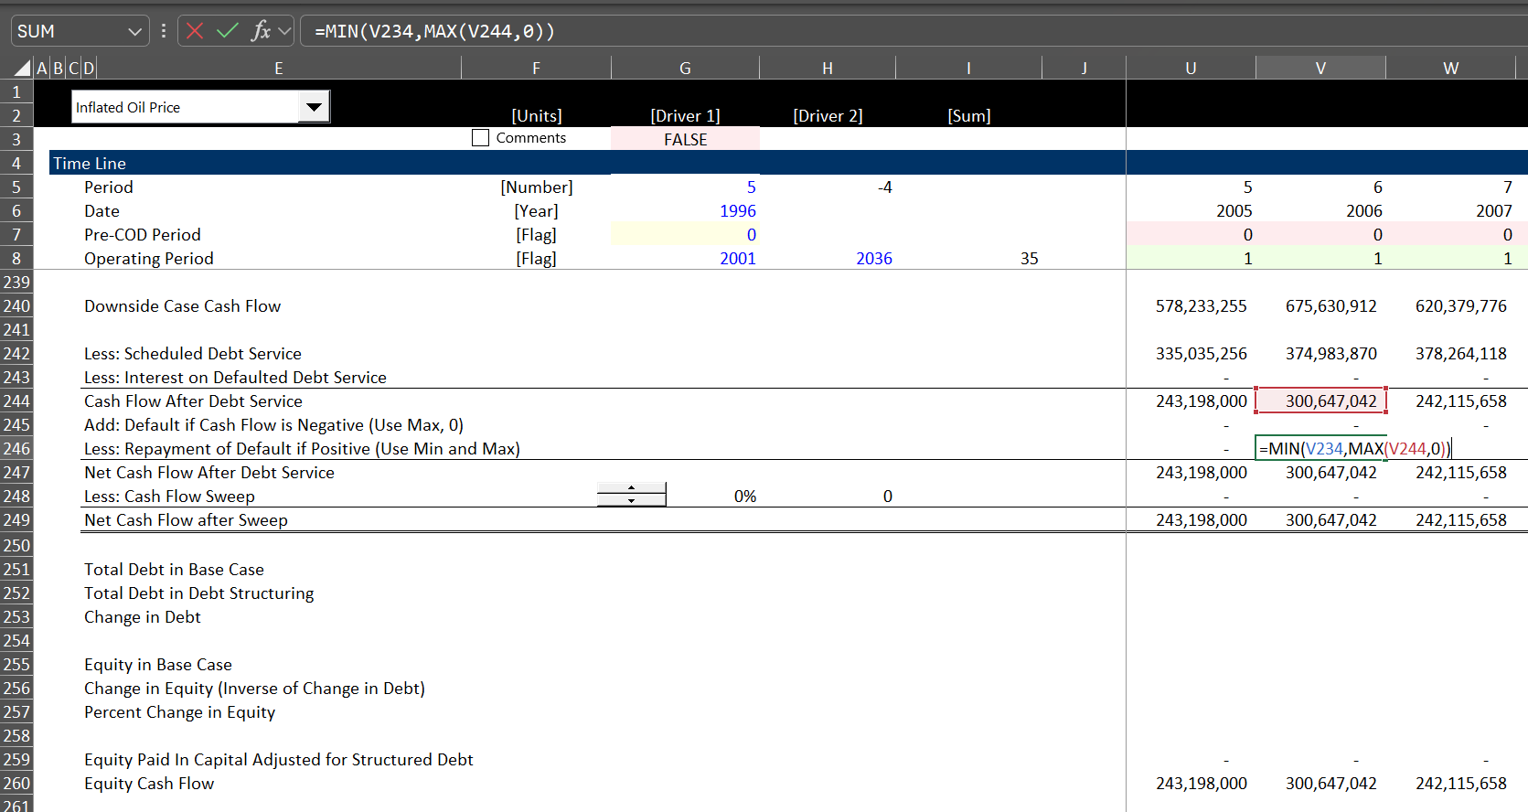
MIN and MAX
The MIN and MAX functions can be very helpful in evaluating cash flow movements. If something only happens when the cash flow is positive, the MAX function can be effective. The following use of max only picks positive numbers:
MAX(Number,0)
The MIN function can be used to test if money is available. For example, the most you can take out of a cash account can be modelled as shown below, where the most that the cash need can be is the opening balance.
MIN(Opening Balance, Cash Need)

Slide 22
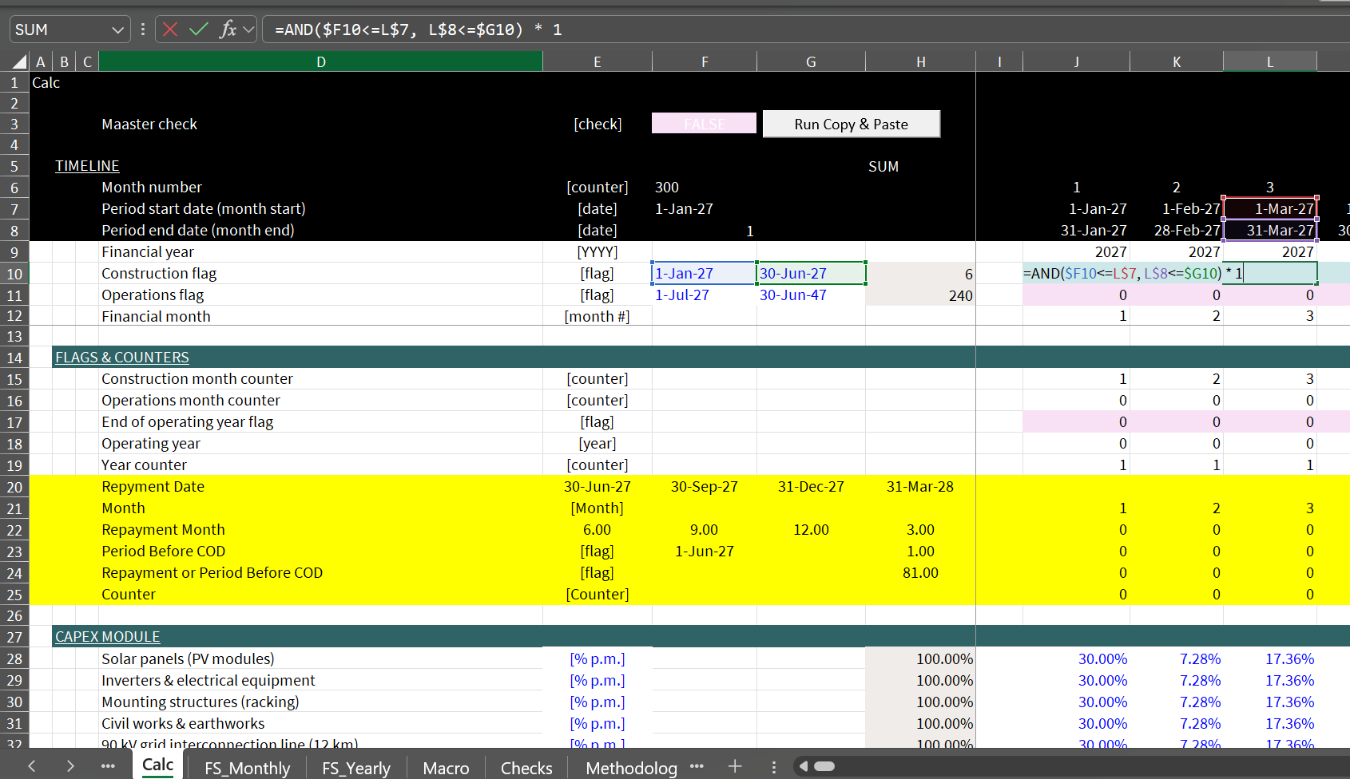
Creating Flags
Use Sequence or ALT, I, S
Flags that are TRUE/FALSE or 1/0 are used a lot in financial models
TRUE is the same as 1 and FALSE is the same as 0
Multiplying by 1 turns the number on and multiplying by 0 turns it off

Slide 23
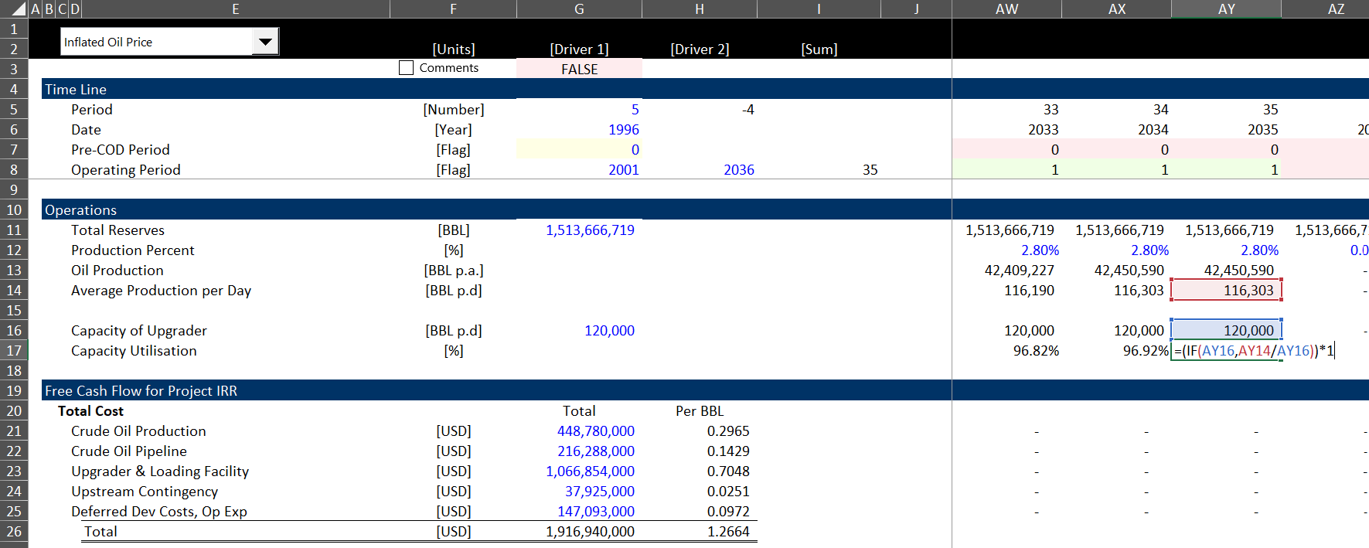
IF and IFS
I suggest not using IF statements too much
There is no excuse for long IF statements that are Nested
There is no reason to use IFS which allows multiple IF’s
Instead to the calculations in order
The form of the IF statement is
IF(TRUE, Do something, Do something else)
You can leave the false condition blank and then the result will be FALSE or zero
The initial IF statement can take a number that is anything other than zero

Slide 24
Using PMT, PV, FV
The PMT function can be effective in financial models for computing level annuities over time and computing simple debt service.
The PMT function has the form PMT(Rate, Periods, Current Amount to Levelise)
The PV function can be used to compute the PV over time with a constant cash flow
The PV function has the form PV(Rate, Periods, Periodic Cash Flow)

Slide 25
Session 1:
Timelines
Simple Scenarios
IRRs

Slide 26
Agenda for Session 1
Introduction
  Questioning Finance Theory
  Practical Financial Modelling
Downloads
  Generic Macros
  Stock and Economic Analysis
Overview of IRR, Growth and Value
  Working with File
  Importance of Timing
Work through Model from Scratch
  InputC
  Flexible Timelines
  Cap Exp and EBITDA
  Long-term and Short-term project
  IRR with Sensitivity and the problem with IRR
  Solution to IRR with Premium versus Risk Free Rate Earned
Discussion after finished with the model

Slide 27
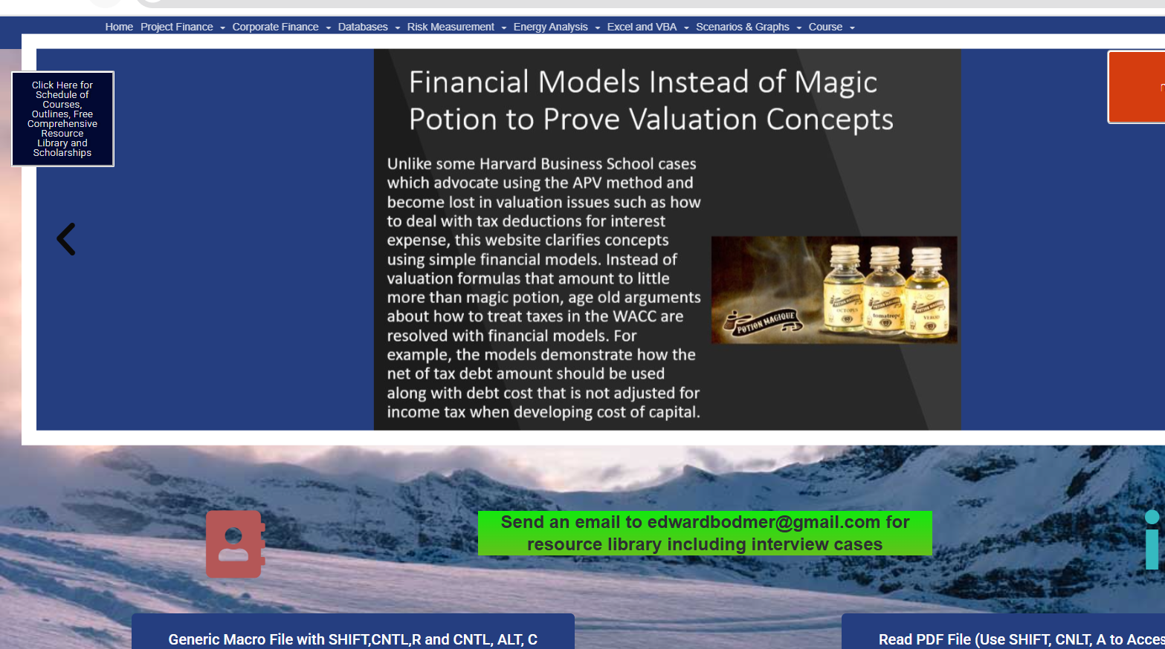
Downloading Generic Macros
Download
Unblock
Test

Slide 28
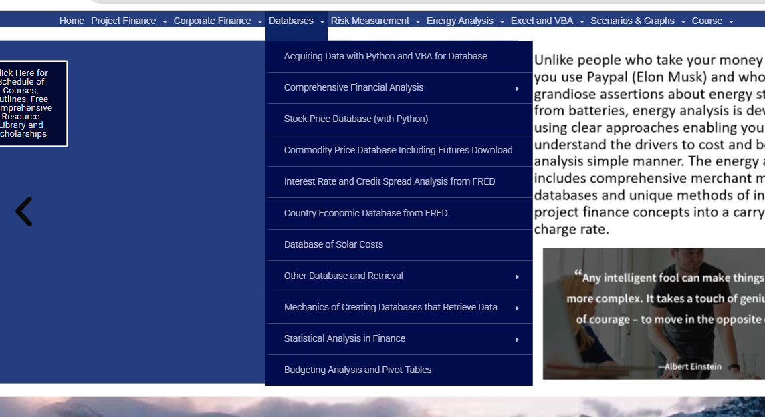
Downloading Stock and Economic IRR
.

Slide 29
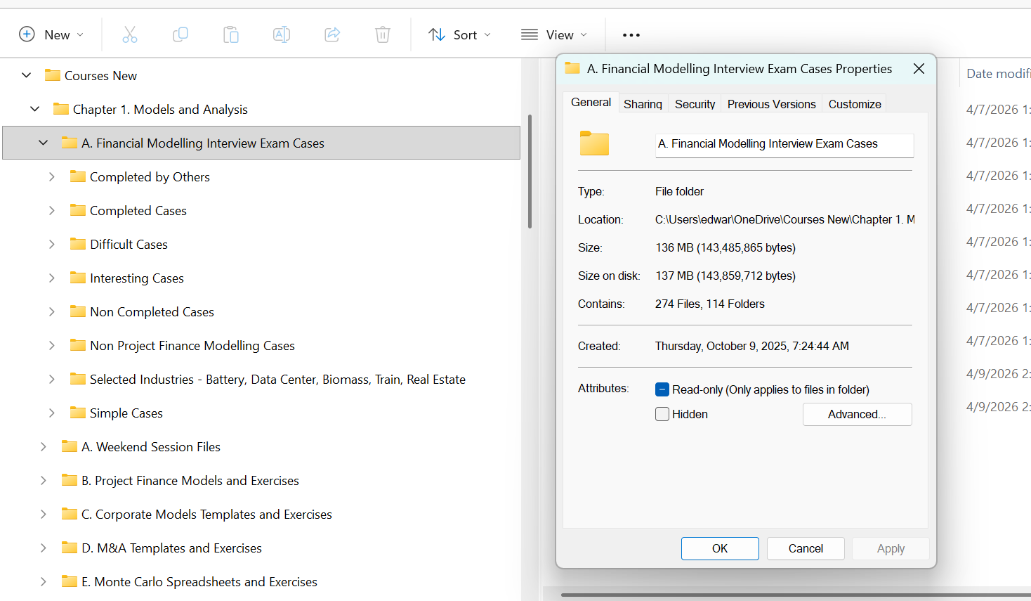
Introduction to Resources
.

Slide 30
Session 2

Slide 31
Agenda for Session 2
Location of Files and Videos
Last session implication
  When somebody tells you that your model is wrong because you increased the length of the PPA and nothing happened to the IRR you can explain it.
  Why a bit of delay in the project up-front has a bigger impact than a lot of money in the future
  Why you want to structure the debt to get dividends as soon as possible
  Why MIRR is crap
  In terms of excel, be very careful and try to get flexible timelines
Show you where we are going
  Debt in the model
  Difficult timelines and summing the debt
  How is the DSCR defined and defining risk with Monte Carlo simulation (not very useful in the real world)
  Pain point of circular references
  Corporate finance and project finance
My original idea of this session was absurd

Slide 32
Outline
Theme: Stop the Bureaucracy; Keep to FAST philosophy; Understand alternative ways to model; Stop showing off with fast talking, excel equations that can be done in a simpler way; using language that is confusing …; Think Differently and Incorporate Theory and Have an Open Mind
Review of implications from day 1
  Flexible timelines and consistent timelines essential in any model (in corporate model, actual period versus forecast period versus terminal period)
  Pre-cod when need cash from funding versus post COD where you have surplus cash flow
  Indulge me with generic macros
  Importance and distortions with IRR
Continue with Basic Model and Include Basic Debt
  Make Sure Everybody Can Get the Model Correct
  Good for Experienced People to Have and Open Mind and Realize that Their Methods are Crap
Start with Simple Debt Structure
  Some Don’t Understand the Key Behind Debt Structure versus Risk Analysis Anymore
  Understand the Essence and Importance of LLCR and PLCR versus DSCR
  Create Cash Flow Waterfall with Defaults and Repayments of Default
More complex model and incorporation of flexible debt timing

Slide 33
Model Analysis with FAST Principles
Modelling of energy projects sometimes uses something called FAST principles. I really do not like these silly acronyms, but it can be a way to discuss the models.
F – Flexible; the model should be flexible so that you can change scenarios, look at different valuation techniques; change the timelines for individual projects and so forth.
A – Accurate; The model should contain audit tests and an audit page that verifies the mechanics of the model are accurate.
S – Structured; The model should be structured in a logical way beginning with how the project works and moving to project cash flows. Debt and equity cash flow should be computed after the project cash flow is established.
T – Transparent; The model equations should be short and simple and easy to understand. Somebody picking up the model should be able to understand the model in short order.
I believe the model developed by the PE firm violated these principles.

Slide 34
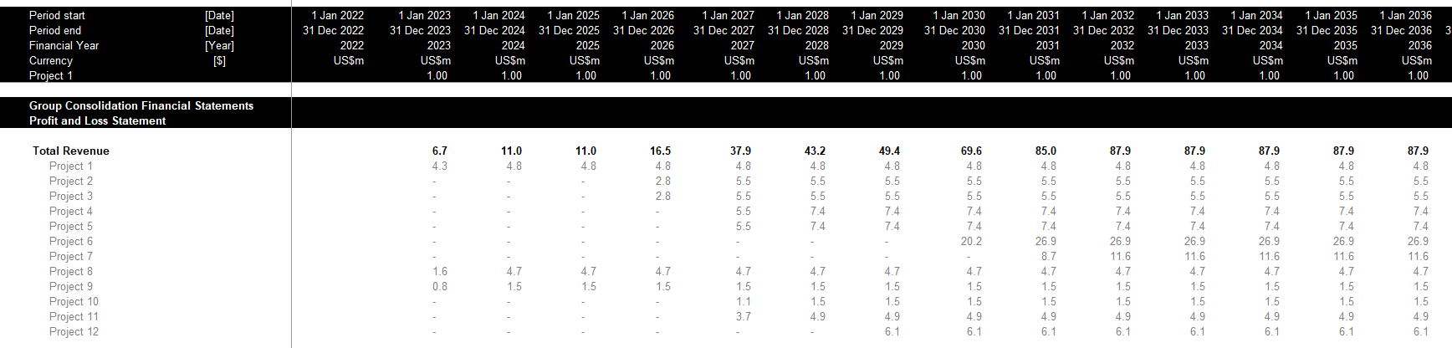
Flexibility – Adding New Projects
Perhaps I am obsessed with the idea of presenting projects in a separate sheet and then having the option to consolidate the projects.
Assume a new project is added to the portfolio. Using the method in the PE model and illustrated above, you would have to go into the consolidation file and copy each of the formulas (e.g., revenues, operating expenses). You would have to add rows evaluate whether the prior row is appropriate for the new project.
If you used the method for making a new sheet for each project the process would be much more flexible.

Slide 35
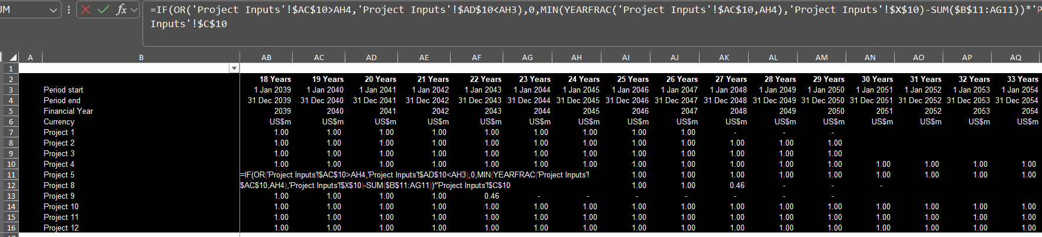
Flexibility – Equations Across the Sheet
Note in the timelines that there are blanks at in some of the columns implying that the formulas are not consistent. This is of course a horrible practice.
Long formulas are perhaps the worst crime both in terms of transparency and in terms of making the model flexible. This crime is in the flags which are crucial to a model.

Slide 36
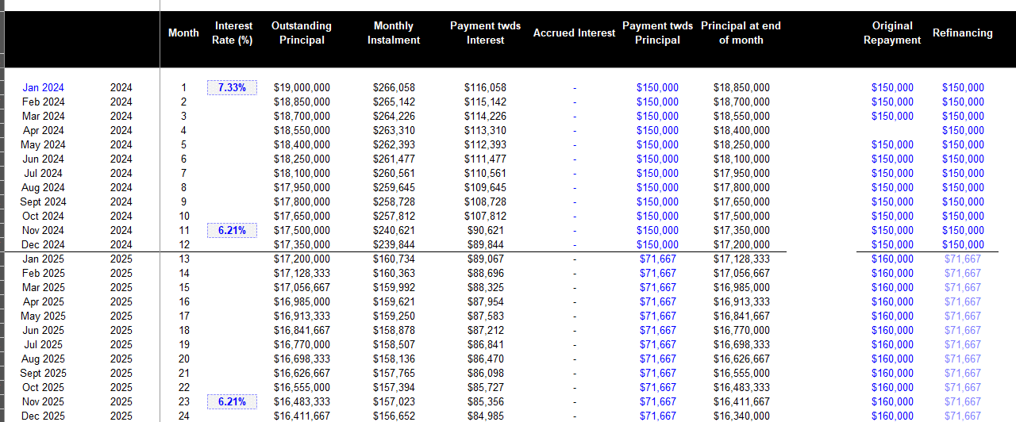
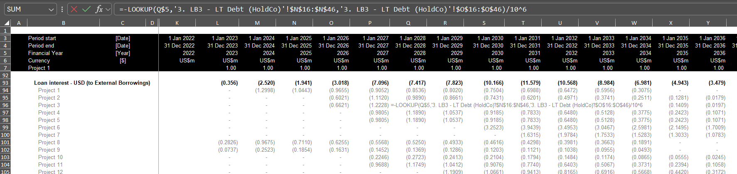
Model Accuracy
The model as provided did not have accuracy tests. Perhaps just as bad, it did not have sum columns to the left of the equations.
In the example below the loan interest is computed from a different sheet where the debt is shown in vertical columns. A much better and obvious way to evaluate the debt is to show the opening and closing balance and to assure that the debt drawdowns equal the debt repayments.

Slide 37
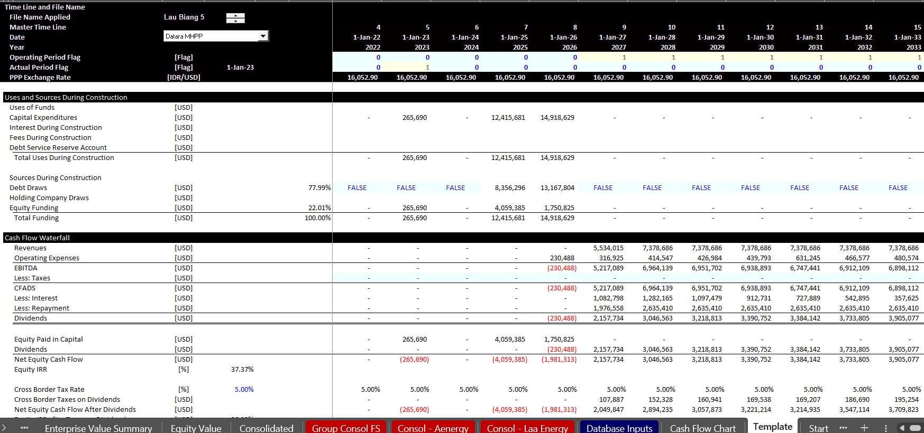
Model Structure
The model provided did not include a sources and uses display during construction and a cash flow waterfall after construction. Whether or not you apply project finance, a cash flow analysis of what happens before and after the operation period is essential.
The screenshot below illustrates an extract from the model with the cash flow analysis.

Slide 38
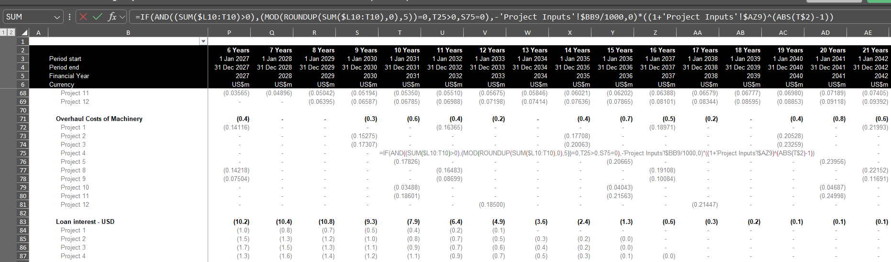
Model Transparency
There are many examples of very long formulas in the model which is the biggest problem. These formulas do not cause problems in the base case, but they could result in difficult issues when things change.
It is poor practice to refer to different sheets in the model

Slide 39
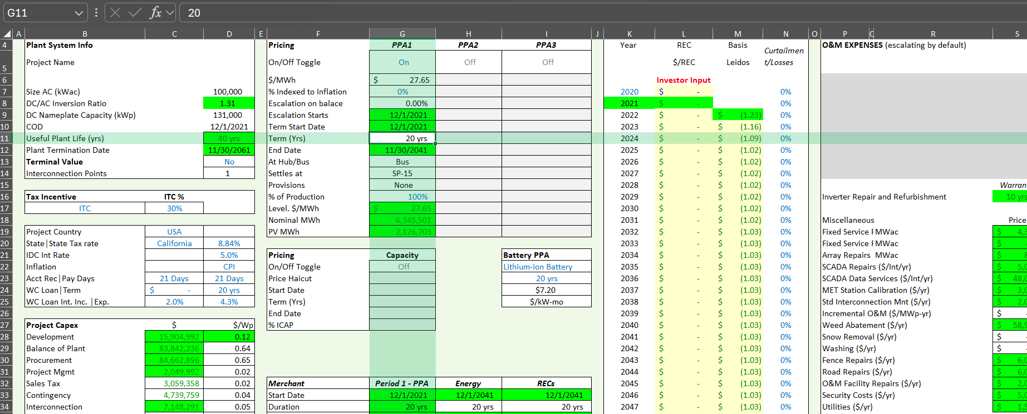
Example of a Mess – Inputs not in InputC
.

Slide 40
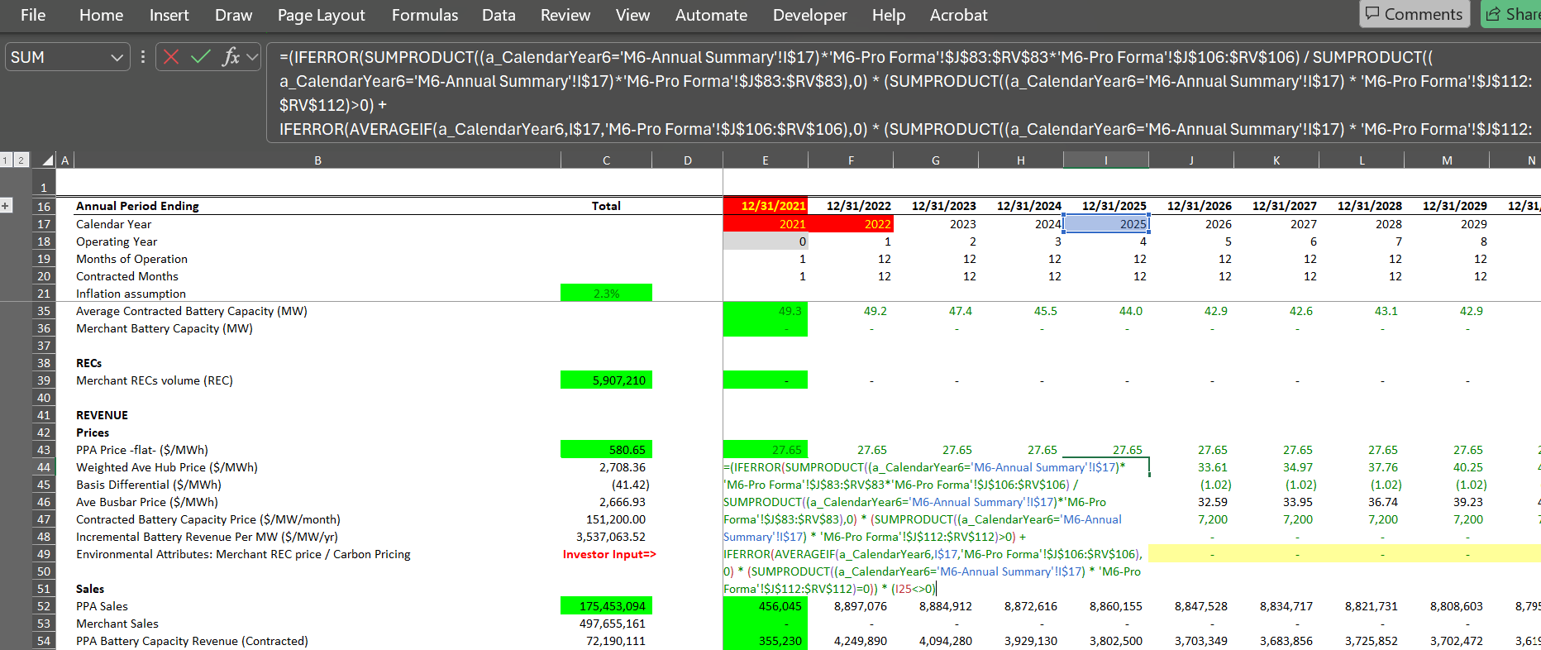
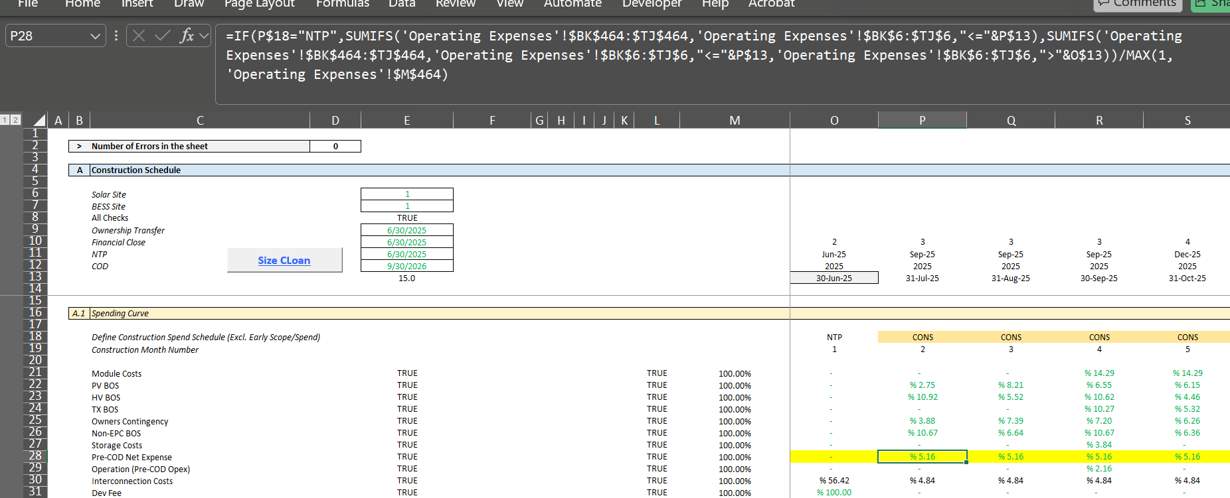
Example of Illegal Formulas
.

Slide 41
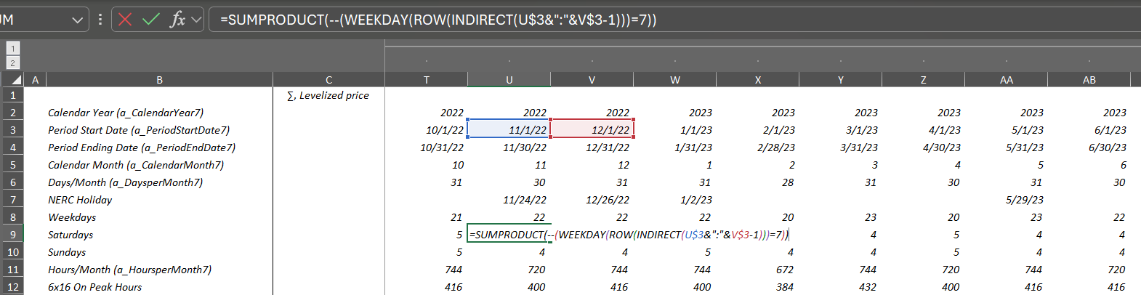
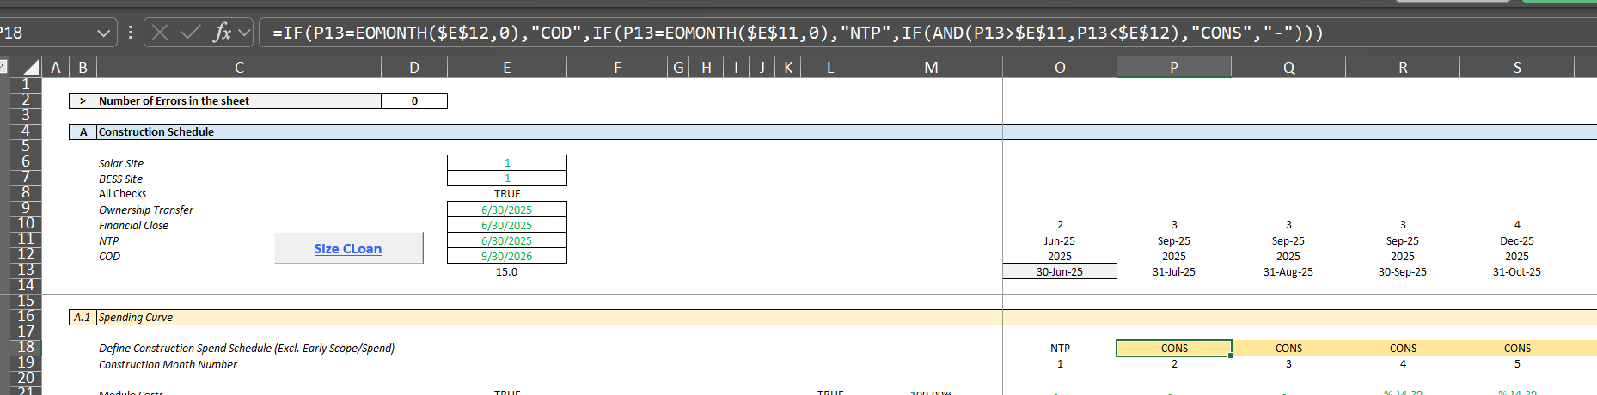
Example of Timeline formula
Could have used day() function and then a simple flag

Slide 42
Understanding of DSCR, LLCR and PLCR
All ratios are measures of buffer and driven by possibility of decline in cash flow
  Example
    DSCR = CFADS/DS
    CFADS 150
    Debt Service 100
    DSCR 1.5
  How much can cash go down before cannot meet debt service: 150-100 = 50
  How much can cash go down in percent : 50/150 = 33.33%
  Formula for minimum break-even: (1.5-1)/1.5 = 33.33%
LLCR measures break-even over the entire debt life (it is possible that DSCR is below 1)
  LLCR = NPV (CFADS ll)/NPV of DS (NPV of DS = Loan at COD)
  How much can cash flow go down before cannot pay off loan at end of the loan life
    LLCR = 1.6
    Break-even over loan life (1.6-1)/1.2 = 37.5%
PLCR measures the break-even over the entire life and give the value of the tail
  PLCR = NPV (CFADS pl)/NPV of DS (NPV of DS = Loan at COD)
  How much can cash flow go down before cannot pay off loan at end of the loan life
    PCR = 2.0
    Break-even over loan life (2-1)/2 = 50%

Slide 43
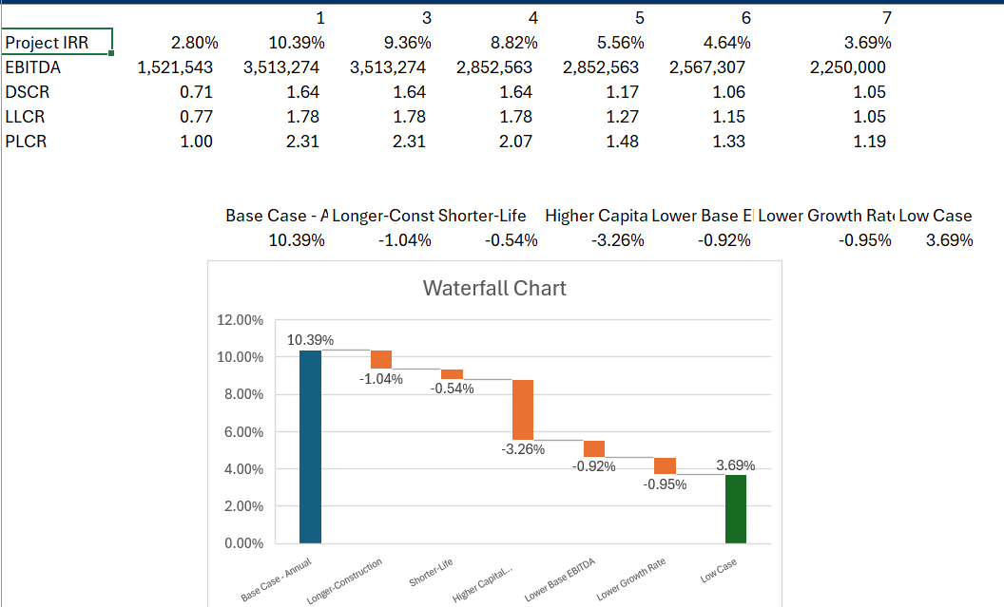
Scenarios and Waterfall Graph
.

Slide 44
DSCR, LLCR and PLCR and Credit Analysis
Probability of Default = Probability of DSCR < 1 = Probability of cash below Break even
Probability of Loss = Probability of Default x Loss Given Default
Probability of Loss over Loan Life = Probability of LLCR < 1 = Probability of cash below LLCR Break even
Probability of Loss over Project Life = Probability of PLCR < 1 = Probability of cash below PLCR Break even

Slide 45
Mean Reverting and Non-Mean Reverting Cash Flow and Risk
Importance of mean reversion in financing long-term asset
Non-mean reverting, volatility increases with time (technically, the square root of time period)
  Volatility for a year – standard deviation of return annually
  Volatility for a month – standard deviation of return for month
  Volatility for a year = volatility for month x square root of 12
  Volatility for five years = volatility for one year x square root of 5
  Price t = Price t-1 + Price t-1 * volatility
  Price t = Price t-1 + Price t-1 * Norminv(Rand()) * Volatility
  Price t = Price t-1 x (1 + Norminv(Rand()) * Volatility)
Mean reverting – follows cyclical pattern
  Volatility increases less than by square root of time
  Mean Reversion Factor ➔ % by which move to mean in one period
  Example: Mean Reversion = (Price t = Mean Price – Price t-1) * Mean Reversion Factor
  Start with Mean price and subtract last period price
  If last period price above mean, then price should come down, so mean reversion is negative
  If last period price below mean, then price should go up, so mean reversion is positive
  Mean reversion factor is difficult to measure
  If Mean reversion factor is 100%, then the volatility does not increase with period

Slide 46
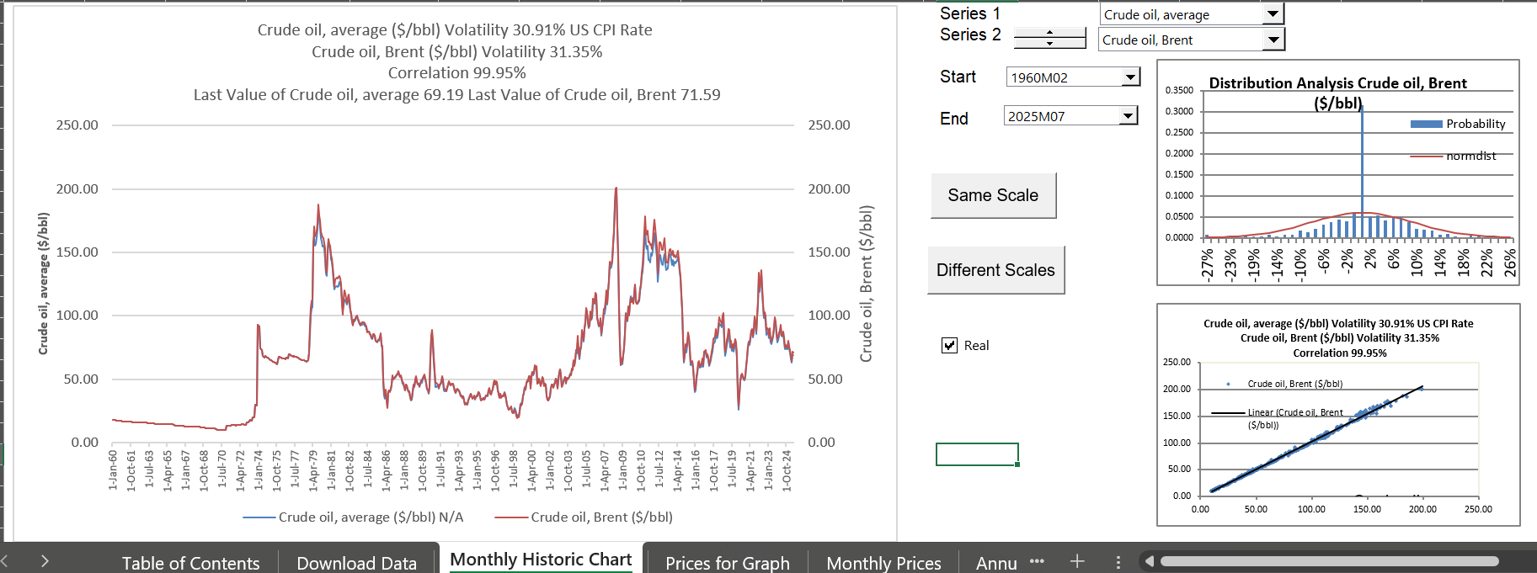
Oil Price from Database File
.

Slide 47
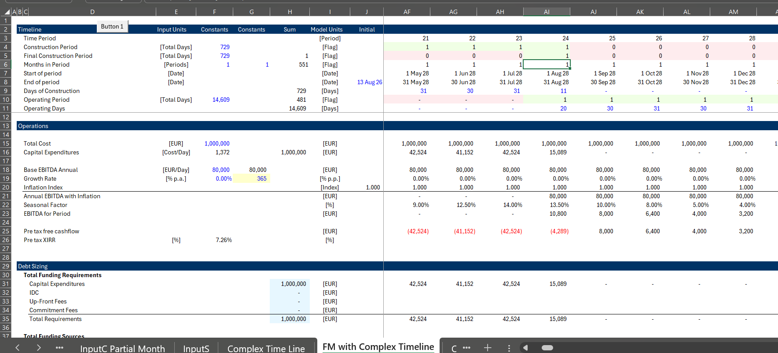
Complex Timelines
.

Slide 48
FAST
Comes down to how many lines
Think you have a good model because you have a standard format
Does it really make models more accurate – you can make tests
"The data concerning prices, OPEX an CAPEX are not accurate. It’s a FM we paid quite expensive and internally we have difficulties to use."

Slide 49
Session 3

Slide 50
Valuation Issues
Instructions versus Reality
  Target IRRs
  Changing Discount Rates with Risk Reduction
  Absurdity of Beta and Un-levering/Re-levering
  Structuring of Model

Slide 51
Modelling Objectives
Any Investment Has:
  Initial Cost
  Uncertain Future Benefits
  Rate of Return Measures Uncertain Returns Relative to Risk
Measure Return on Investment
  Measure Growth Rate in Investment
  Evaluate Return with Sensitivity Analysis
Measure Risks to Different Investors
  Equity Investors with Their Return
  Incorporate Risks with Sensitivity Analysis
  Incorporate Risk with Break Even Analysis
  Measure Risks to Lenders with DSCR to Evaluate Probability of Default

Slide 52
What is Important and Not Important in Modelling
What is not Important
  Typing Fast in Excel
  Making Nice Colours on Spreadsheets
  Using Fancy Excel Formulas
What is Kind of Important
  Structuring Models with Timelines
  Structuring Parts of Models – Operating and Financing
What is Most Important
  Incorporating Risk Analysis
  Presenting Results Effectively
  Understanding Modelling Objectives
  Not Being Intimidated by Models

Slide 53
Project Finance Objectives
Use Bidding or Negotiation with Private Parties to Reduce the Cost of Capital
  What is Capital Intensity
  Importance of Low Cost of Capital to Society
Use Contracts to Create Risk and Provide Incentives
  Risks that can be Controlled
  Allow Banks to Assess Risks

Slide 54
Reading Through a Test
Look what they are asking about timing
See if there is a potential for circular reference
Understand if they are asking for scenarios
Think about valuation issues

Slide 55
A Few Suggestions
Start timeline by distinguishing investment phase (pre-COD) and return phase (post-COD)
  Two cash flow statements in project finance
  Often different timing
  Raise funding and then pay back investors
  Compute without financing (free-cash flow) and with financing (equity cash flow)
  Absolutely need an investment time period (pre-cod flag)

Slide 56

Financial Modelling Background
Differences Between Creative and Open Mindedness in Modelling
and
Modelling Bureaucracy

Slide 57
Don’t Become a Modelling Bureaucrat
Nicholas Taleb:
  In the not-too distant past, say the pre-computer days, projections remained vague and qualitative, one had to make a mental effort to keep track of them, and it was a strain to push scenarios into the future. It took pencils, erasers, reams of paper, and huge wastebaskets to engage in the activity. The activity of projecting, in short, was effortful, undesirable, and marred with self doubt.
  But things changed with the intrusion of the spreadsheet. When you put an Excel spreadsheet into computer literate hands, you get projections effortlessly extending ad infinitum. We have become excessively bureaucratic planners thanks to these potent computer programs given to those who are incapable of handling their knowledge.

Slide 58
Two Situations
Want all modelling to be completely simple
  Believe no circular references in project finance model
  Re-financing and asset sale upside
  Multiple debt issues
Discuss big financial words and don’t bother with models
Think modelling is about excel functions
What is the model really supposed to do

Slide 59
Modelling History
1980’s Either Pencils and Erasers or Fortran Programs with Phone Hookups
1990’s VisiCalc and One Sheet Lotus – Simple Models
2000’s Multiple Sheets – Models were a Mess; Range Names; No Structure
2010’s Larger Models – Big Working Page; Long Formulas; Becoming Difficult to Understand
2020’s Monster Bureaucratic Models – Models with Rules; Creativity Lost; Models for Auditors
Typing fast in excel and copy to the right with left, right, up, Cntl R that is not impressive
Some kind of certificate on bureaucratic modelling rules is not impressive
Copy and paste macros that destroy models are not impressive
Monster models with fees on standby debt and LC fees on equity commitment is not impressive
Creative presentations of sensitivity for different real users (not auditors) is impressive
Use of mathematics to solve problems (e.g. sculpting, leases, residual) is impressive
Not having one single complex formula in a whole model is impressive
Effectively modelling different financing strategies and development fees is impressive

Slide 60
Users Matter and Auditors Do Not
Like Writing a Book or Running a Business – Focus on the Consumer and Not Internal Bureaucratic Rules or Rules for Auditors
Two Things:
F2 to Find Equations without Looking Far
Cntl ] and F5 to Find the source

Slide 61
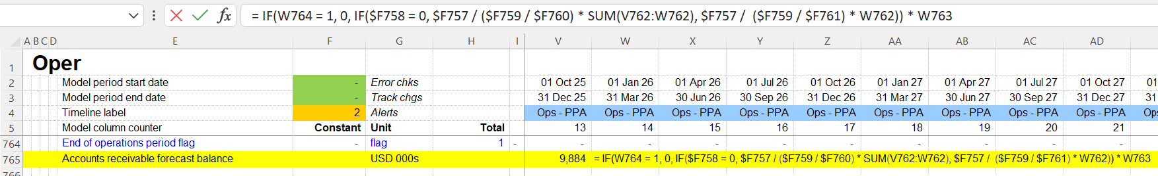
Use Principles and Not Rules
Fast Religion
Flexible – What does it really mean (Really large models with too many rules are not flexible)
Accurate – Not Appropriate. Key checks are essential. Be creative with checks.
Structured – Separation of Cash Flows; Natural Flow of Model for Users.
Transparent – User Focus with Simple Equations and Seeing how the Model Works

Slide 62
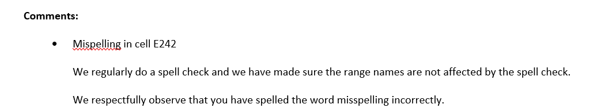
Making Models for Auditors
I have heard that it is good to follow rules like using InputC and putting time switches in a separate page because it will be easier to audit models
You do not make models for auditors; auditors are a painful and often unnecessary part of modelling
Auditors are most concerned with disclaimers
Auditors do not find real errors
Remember who you are making the models for

Slide 63
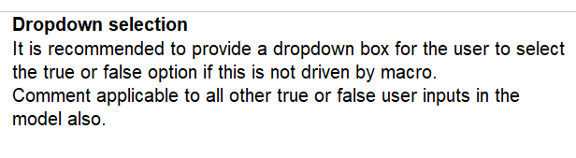
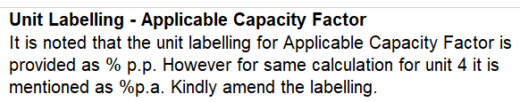
Become a Financial Modelling Rebel
Example

Slide 64

Using Economic Formulas Rather than Forcing things with Macros
For complex items like sculpting of debt, computing of residual value try to find mathematical formulas and do not resort to forcing things with macros and/or goal seek

Slide 65
Economics and Financial Principles
Understanding the Underlying Economics of the Project and the Principles of Financing and Presenting them Well is More Important than Rules
Refineries
Renewable Energy
Downstream
Upstream Oil
Hydrogen
Infrastructure – Toll Roads
Infrastructure -- Airports

Slide 66
Modelling Psychology
How to guide people in reading the models
How difficult is it to wait for models to recompute
How afraid are people of pressing the circular reference button

Slide 67
Productivity, Innovation and Human Progress
Re-do your models
  Simplify equations
  Increase Transparency
  Always doing the same thing is boring and will not make progress in your life

Slide 68
Key Drivers Should be Very Clear
Fancy models and don’t show the USD/kW-year in O&M for Reference
Clearly see the yield and performance ratio
Show the components of Cost per kW
For green hydrogen, efficiency and cost of electricity
For bad hydrogen, efficiency and cost of gas
Show the standard deviation for P90 etc.

Slide 69
Don’t Make your Model for Auditors
Auditors
  First, test the model for accuracy – generally don’t find anything
  Second, test different scenarios – sometimes find very little
  Third, model format – this is where they can find something
Put yourself in position of Auditor
  Want to be useful as in any job
  Frustrating because cannot find anything
  Come down to talking about format
What they should do
  Put themselves in position of bank
  Make flow and presentation understandable
  Comment on the model speed

Slide 70
Time-Lines
Timelines in Separate Pages
Key Timelines at the Top of the Page
Doesn’t matter whether you use TRUE/FALSE or 1 and 0
Don’t waste time with putting drivers in different lines
Don’t go crazy with multiple starts and stops, makes the reader have difficulty
Argument for Consistent Timelines (with monthly and semi-annual flows)
Painful programming of accumulation of sums

Slide 71
Audit Tests
A lot of tests are more important than FAST Style
Balance Sheet, Circularity, Draws = Repayments, Closing Balance
Can incorporate tests of inflation
Interest checks are tricky
More important than style checks, but style is what auditors resort to.

Slide 72
Session 4: Examples of Difficult Issues in Modelling

Slide 73
Not Too Advanced Modelling Issues
Issues that are Not Too Advanced
  Flexible timelines with different periodicity
  Sculpting with changing interest rates and changing DSCR’s
  Modelling DSRA and MRA with balances and flags
  Re-financing with sculpting and no taxes
  Resolution of circular references with copy and paste block
  Waterfalls for cash sweep, DSRA uses and top-ups, Cash Traps, Re-structure using MIN and MAX
  Selling of assets with holding period returns and starting with stable cash flows
  Circularity and NOL from Income Taxes (with sculpting)
  Shareholder Loan with Tax Issues (understand the tax code)
  Equity First versus Pro-Rata financing
  Cash Sweeps and use of MIN after scheduled repayment

Slide 74
Advanced Project Finance Modelling Issues
Structuring a project with evaluation of debt size from either P90, P50, or maximum debt to capital – Requires multiple operating cash flow and Debt Sizing Module from downside case (P90). The base case (P50) can be used with debt from the P90.
Adjusting debt structure when the formula CFADS/DSCR = Debt Service yields a debt service less than the interest expense (would be negative repayments).
Inclusion of DSRA changes in the DSCR for debt sculpting and modelling the DSRA as an LC with LC fees and commitment fees. Should CFADS and/or Debt Service include DSRA changes. For example, CFADS = EBITDA +/ DSRA Changes.
Sculpting with On-going Fees after COD (e.g. agency fees)
Effective control pages where you can evaluate either debt structuring or credit analysis with different structuring and different credit analysis scenarios. Essentially fixing the debt from a structuring scenario and then performing probability with alternative structures.

Slide 75
Advanced Issues - Continued
Debt sculpting of multiple debt issues where cash flow is affected by interest expenses and income taxes. Can use the formula DS1 = CFADS/DSCR – DS2
Computing debt repayment where the debt size is given, and sculpting is used to obtain a minimum DSCR with varying DSCR’s. Flat DSCR is above the Minimum DSCR. It is best for sponsor to have high DSCR at first to allow higher dividends.
Including actual data in models for the construction period and operating period.
Cash Sweeps used after COD to adjust the debt tenure – Design initial debt funding with very long tenure but after establishing traffic, shorten the debt tenure from actual traffic by limiting the dividend.
Developing timelines that can easily convert monthly to semi-annual or quarterly and creating semi-annual sums in monthly models without SUM(OFFSET).

Slide 76
Tricky Modelling Issues - Continued
Incorporating options for DSRA funding with an L/C or with cash funding.
Adding re-financing assumptions to a model where the debt size depends on taxes which are also affected by interest on the re-financing.
Creating scenarios and graphs using VBA to resolve problems with data tables and use data tables with circular references
Modelling the effect of financing in different currencies including translation adjustments on the balance sheet.
Developing alternative ways to model working capital requirements in the initial operating periods of a project.
Modelling mini-perms and different re-financing assumptions (sweep in downside and increased debt in upside).
Modelling equity bridge loans and the associated circular references along with options to include or not include interest during construction in the borrowing base.

Slide 77
Advanced Issues - Continued
Valuation of projects with changing buyer target IRR’s and computation of holding period returns.
Evaluation of NOL time limits on the calculation of income tax.
Accumulation of projects into a portfolio or a fund
Evaluation of risk and return of senior and subordinated debt
Computation of the LLCR with different debt issues using the prospective debt IRR
Evaluating different structures for equity investors including cash flow flips and incentives to developers.
Resolving circular references without copy and paste macros or the iteration button. Copy and Paste and/or Iteration button slow down excel.

Slide 78
Issue 1: Debt size from either P90, P50, or maximum debt to capital
Theory – DSCR on P90 is sizing debt on a downside case which is old-fashioned banking. A DSCR of 1.2 gives you .2/1.2 or 17% buffer on top of the downside case.
Requires multiple operating cash flow and Debt Sizing Module from downside case (P90). The base case (P50) can be used with debt from the P90.
Unlike other scenarios, put the P90 and the P50 directly into the model
Can use NORMINV as input for standard deviation
Debt size section with P90 and include income taxes with the P90
Understand the P90 is just a downside case with a lot of judgement
If P90 is used to size debt and P50 materializes, there is a natural potential for upside with re-financing
If debt to capital is used to size debt and P50 materializes, there is a natural potential for upside with re-financing

Slide 79
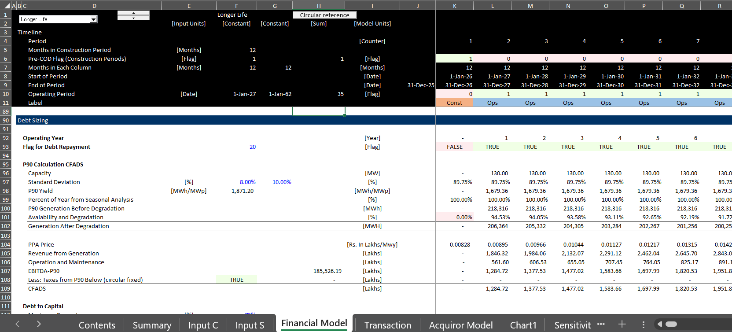
Issue 1: Debt size from P90, P50 Continued
Example of problems with P90 in wind farm

Slide 80
Issue 2: Debt Structure with Negative Repayment
Theory: This problem arises from seasonal cash flow; from battery augmentation; from inflating cash flows; from high interest rates and other factors. If you allowed negative repayment, the size of the debt commitment from the bank can increase. You could solve the problem with payment in kind interest but that may not be acceptable.
Adjusting debt structure when the formula CFADS/DSCR = Debt Service yields a debt service less than the interest expense (would be negative repayments).
You could set-up a cash reserve account where cash taken out of the reserve account is used as an increase in CFADS.
If you only use the CFADS to meet the negative repayment, then the DSCR will be 1.0 and not the target DSCR
If you remove the negative repayment, the debt will be paid off earlier like a cash flow sweep.
If you compute the reserve withdrawal that affects the CFADS, but CFADS drives debt, there will be a circular reference.

Slide 81
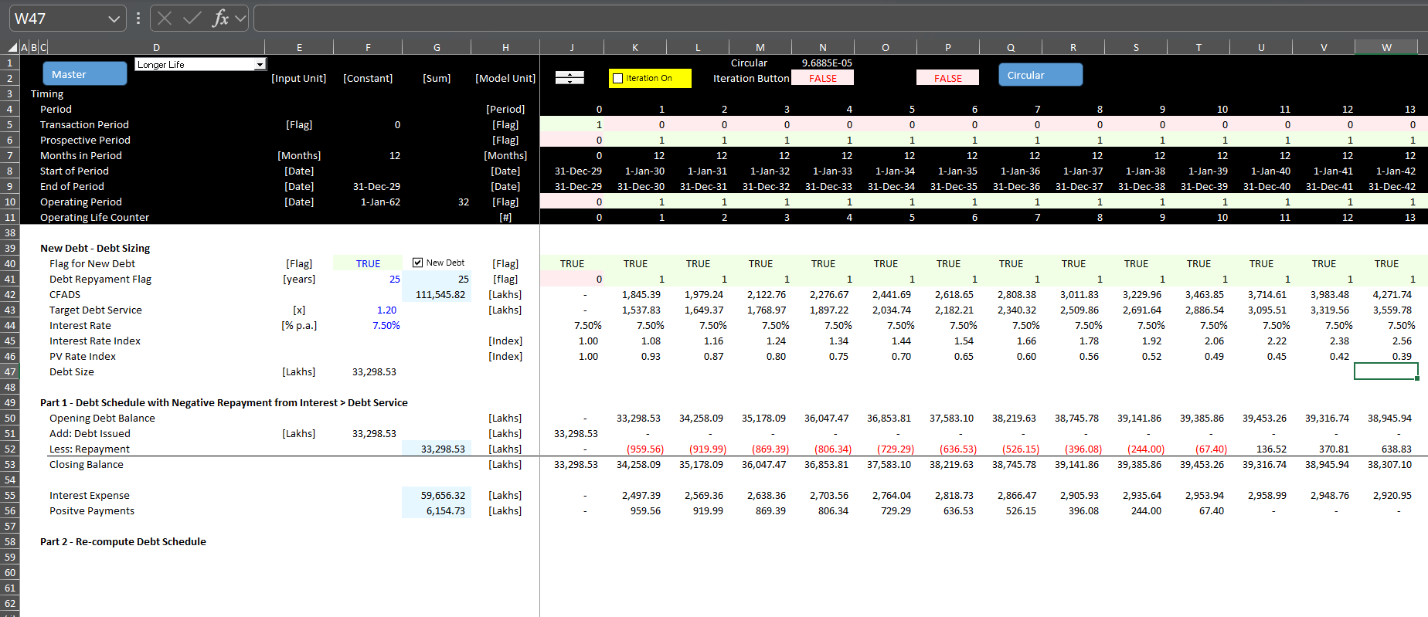
Issue 2: Negative Repayment Continued
Step 1:
  Set-up account that allows repayment to be Debt Service – Interest
  Set-up the amount of negative repayment (named positive payments below)

Slide 82
Issue 3: DSRA Changes in CFADS
Theory: DSRA as cash reserve can be expensive and may or may not come from equity cash flow (if it comes from equity cash flow it is very harmful to the IRR).
In the period when the debt is repaid, the refunding of DSRA provides cash flow. In other periods there can be increases or decreases in cash flow.
Inclusion of DSRA changes in the DSCR for debt sculpting and modelling the DSRA as an LC with LC fees and commitment fees. Should CFADS and/or Debt Service include DSRA changes. For example, CFADS = EBITDA +/ DSRA Changes.
Modelling requires a two-step process.

Slide 83
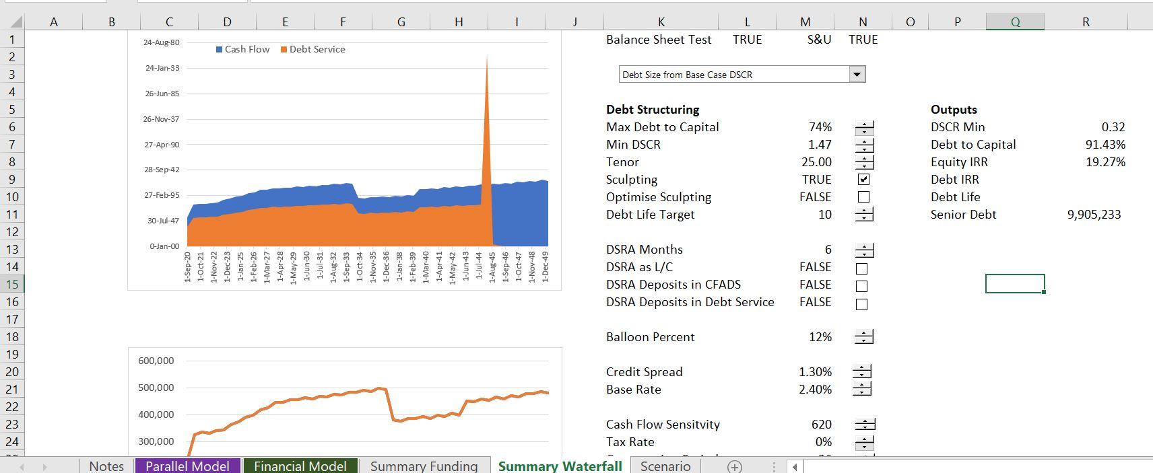
Issue 3: DSRA Changes in CFADS Continued
Delaying the debt service until the DSRA is repaid allows dividends in earlier periods.

Slide 84
Issue 4: Sculpting with Multiple Debt Issues
Theory: In practice, most projects now have multiple senior debt issues with different tenures and different interest rates, but the overall DSCR target is the same. Playing around with different possible structures between the different issues can have significant effects on the equity IRR and should be modelled in a simple way.
Debt sculpting of multiple debt issues where cash flow is affected by interest expenses and income taxes.
Can use the formula DS1 = CFADS/DSCR – DS2
If DS2 is given, then compute the aggregated debt service and then a remainder or a capture debt service issue.
Check each issue with PV of debt service = PV of debt
Can compute the separate issues with LLCR formula using total CFADS and low levels of debt.
Use different interest rates for each issue

Slide 85
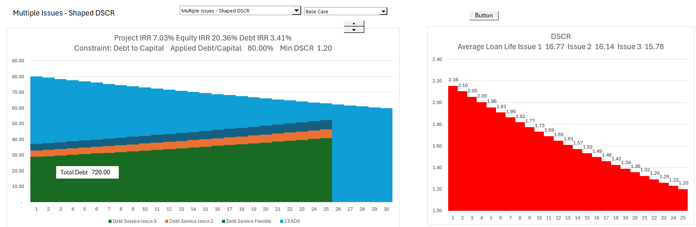
Issue 4: Sculpting with Multiple Debt Issues Continued
Illustration of multiple debt issues and curved sculpting .

Slide 86
Issue 5: Sculpting with On-going Fees after COD (e.g. agency fees)
If fees occur after the COD, the sculpting formula is different.
Without fees:
  DSCR = CFADS/Debt Service
  Debt Service = CFADS/DSCR
  PV of Debt Service = Debt at COD
  Repayment = Debt Service – Interest
  Interest = Opening Debt x Interest Rate
With Fees
  DSCR = CFADS/(Interest + Repayment + Fees)
  Interest + Repayment + Fees = CFADS/DSCR
  PV(Interest + Repayment) + PV(Fees) = CFADS/DSCR
  Debt Size = PV(Interest + Repayment) – PV(Fees)
  Need to compute PV of Fees First
  Circular reference in computing fees
With Given Debt
  LLCR = PV CFADS/(Debt + PV Fees)
  Debt Service = CFADS/LLCR
  Repayment = Debt Service – Interest – Fees

Slide 87
Issue 6: Confusion over Structuring and Credit Analysis
A Model can be used to either evaluate debt structuring or credit analysis. They are related but not the same.
In debt structuring, the size of the debt and other features are modelled with different scenarios.
with different structuring and different credit analysis scenarios. Essentially fixing the debt from a structuring scenario and then performing probability with alternative structures.
Effective control pages where you can evaluate either debt structuring or credit analysis with different structuring and different credit analysis scenarios. Essentially fixing the debt from a structuring scenario and then performing probability with alternative structures.

Slide 88
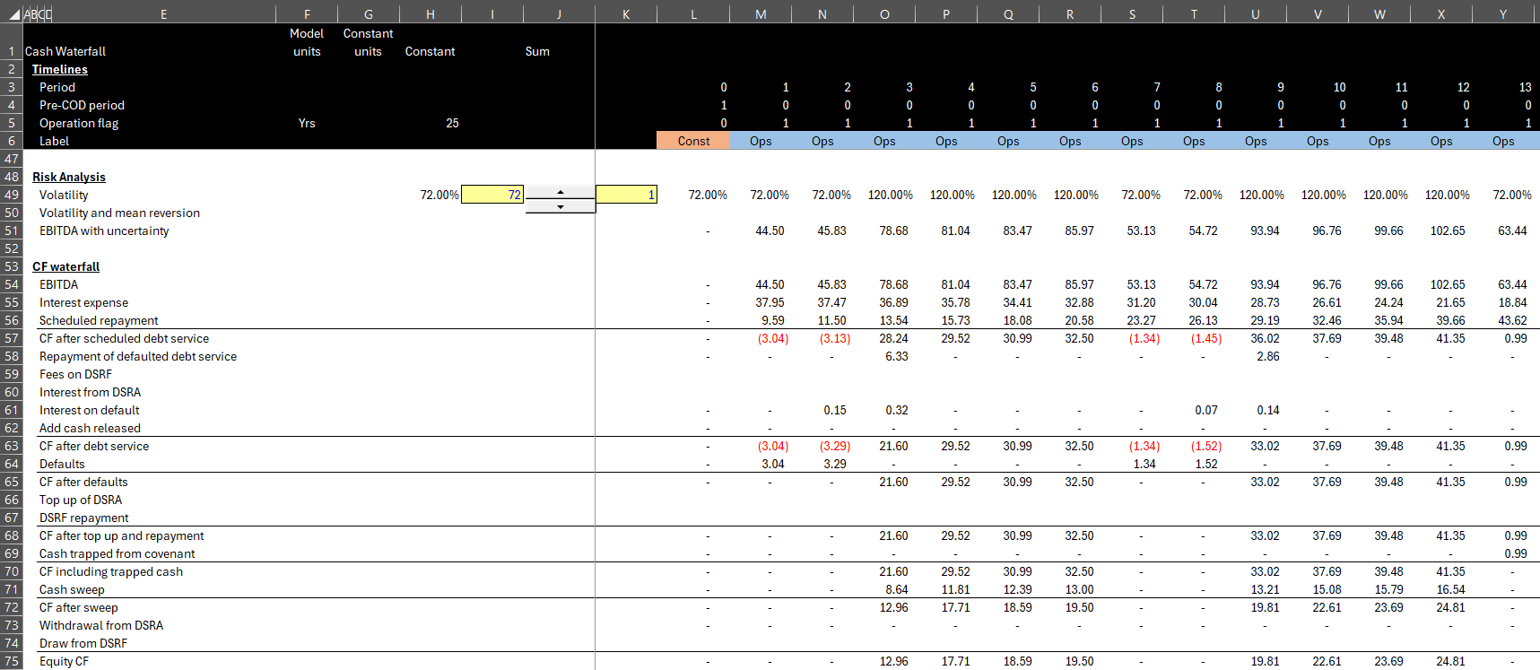
Issue 6: Risk Analysis versus Debt Structuring Continued
In modelling a cash flow waterfall for evaluating risk analysis, you should set up accounts for a second debt schedule, a DSRA account, a reserve account for trapped cash flow, and a default account.
All of the flows into and out of the accounts come from the MIN and MAX in the cash flow statement. Please no IF statements.
Use subtotals as a basis for MIN or MAX

Slide 89
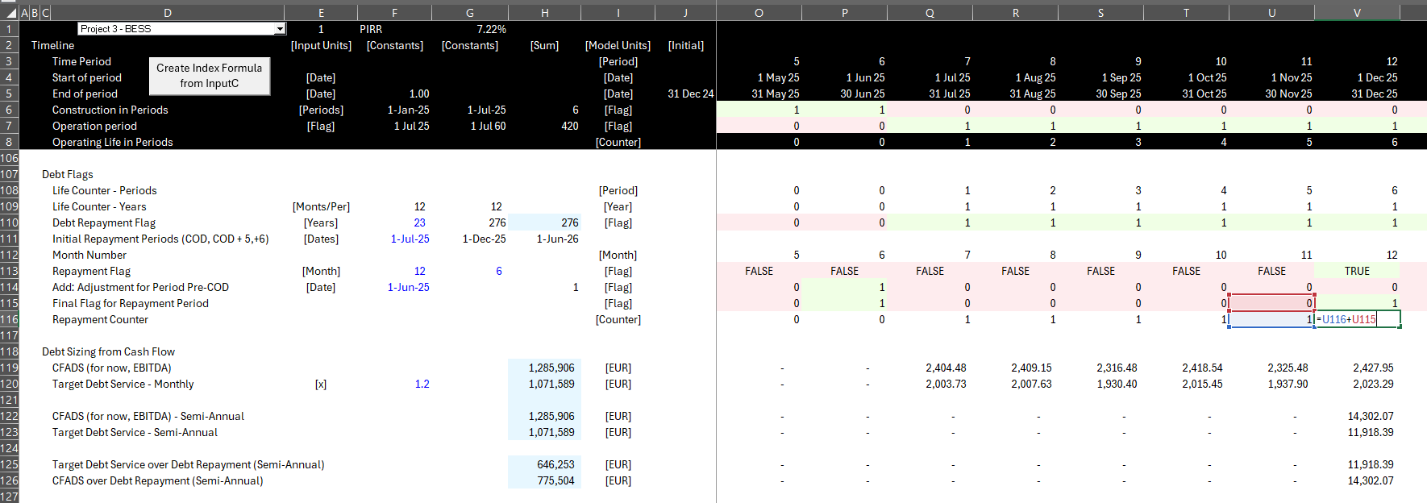
Issue 7: Converting from Monthly to Semi-Annual Financing
Developing timelines that can easily convert monthly to semi-annual or quarterly and creating semi-annual sums in monthly models without SUM(OFFSET).
Step 1: Develop a counter from a flag
  Be very careful with 5 months and the dates
  Add a flag for the last month before COD
  Sum the prior counter and the prior flag

Slide 90
Issue 7: Converting from Monthly to Semi-Annual Financing
Step 2: Use Sumif and not Offset
  Sumif with entire line and the counter
  Multiply the Sumif by the repayment flag
  Make sure the counter changes at the date of the repayment flag
  Make sure there are six months (or 3 months) when adding

Slide 91
Issue 8: Including actual data in models for the construction and operating period
Theory: How to measure the performance of a project. Should you make a new forecast after you receive the actuals; how should you present the project for asset management; what is the benchmark for performance.
A big trick is to use financial statements with and if statement for the closing balance:
  Never over-write the actuals into financial statements
  Keep a separate input sheet with actuals
  If(Historic Switch, Financial Statement Number, Opening Balance +- Stuff)
  For plant balance, accumulated depreciation, debt balance, equity balance and cash
  Derive Items of cash
Including actual data in models for the construction period in project finance.
  You may need a reconciling item for actual debt, capital expenditures and other items as the total amount over the construction period is defined, but the monthly flows can differ
  For example, the total debt commitment is defined, and the reconciliation is entered either in a single end period or a series of periods at the end of the construction
Presenting actual
  Presenting historic with actual and with the original projection is easy
  Could compute economic depreciation in project finance to compare return to the benchmark
  Presenting prospective forecast with bounce back or with continuing trends

Slide 92
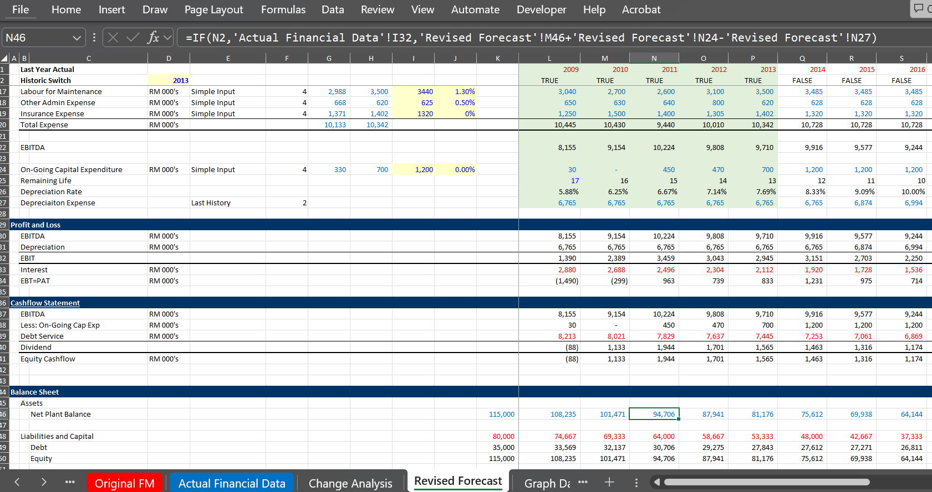
Issue 8: Including actual data in models for the construction and operating period
Illustration of Model with Actuals
Note the balance sheet item with IF statement and the Flags

Slide 93
Issue 9: Adding Re-financing with Taxes
Theory: Re-financing has become standard in analysis and reflects the risk reduction of a project once actual cash flow has been established. The option to re-finance increases equity IRR because of the timing issues in equity IRR. Mathematically, it is better to re-finance earlier.
Mechanics
  Without taxes, re-financing is pretty easy. You add a switch for the re-finance period, you make assumptions about the re-financing (DSCR, tenure, interest rate); you make a new switch for the re-finance repayment; you use the NPV formula to compute debt at the re-finance period; you make a re-finance debt schedule; finally, you repay the existing debt, and you add a few lines to the cash flow waterfall for repayment of initial debt and proceeds from new debt
  As you are using the present value of debt service from CFADS to compute the re-financed debt, the re-financed debt changes the interest expense; the changed interest expense changes the income tax which changes the CFADS
  If you have multiple re-financings, there will be a lot of lines to add to the copy and paste, and the copy and paste could get messy
  Instead, you can create a UDF which you can think of as a sum function with the ability to compute many different re-financings.

Slide 94
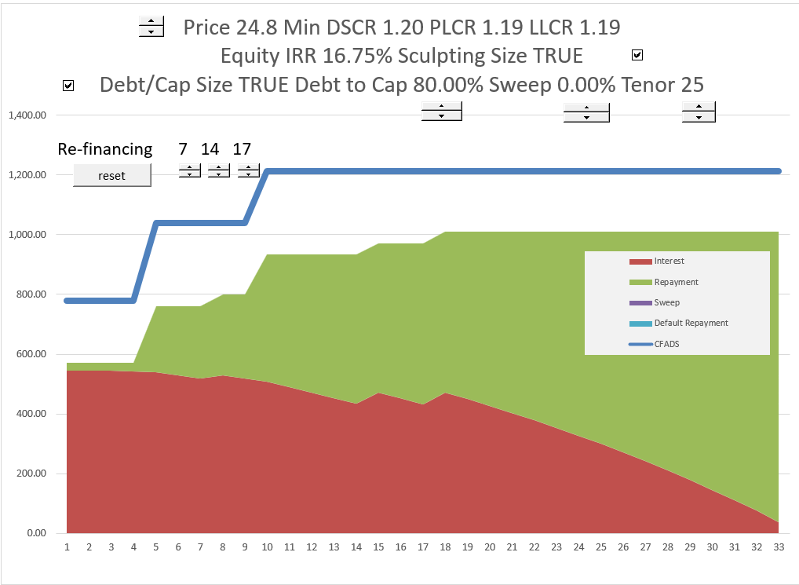
Issue 9: Re-financing Continued
The re-financing can be modelled with a couple of flags and then the PV of debt service formula
Illustration of effects of re-financing with and without cash sweep on the equity IRR

Slide 95
Issue 10: Incorporating options for DSRA funding with an L/C or with cash funding
Theory: It is better to have cash outflow occur later. Because the DSRA can be funded by equity if the debt size is driven by the future cash flow where the debt does not depend on financing, the L/C reduces equity financing.
With L/C DSRA, still need to compute the required amount of the L/C

Slide 96
Issue 11: Debt Size from Debt to Capital with Minimum DSCR
Theory: Preliminary term sheets could have a debt to capital constraint and also a minimum DSCR constraint (the real driver in project finance is DSCR). If the debt to capital is a constraint there are alternative ways to deal with the DSCR and repayments. The optimal method is to gradually decrease the DSCR until the tenure of the debt.
Computing debt repayment where the debt size is given, and sculpting is used to obtain a minimum DSCR with varying DSCR’s. If you use a flat DSCR is above with the constraint, you will pay the debt to early, and this is bad for the DSCR.
Alternatively, you can compute a flat DSCR as the PV of CFADS/ Debt from Debt to capital. In this case, the dividends will be higher in the early years the Minimum DSCR. It is best for sponsor to have high DSCR at first to allow higher dividends.
The best case is to gradually DECREASE the DSCR from a high starting point (allowing high dividends) and then decrease the DSCR until you reach the minimum DSCR. This can be accomplished with a goal seek to derive the debt amount and an interpolate function. The goal seek is used to find the initial DSCR that gradually decreases.

Slide 97
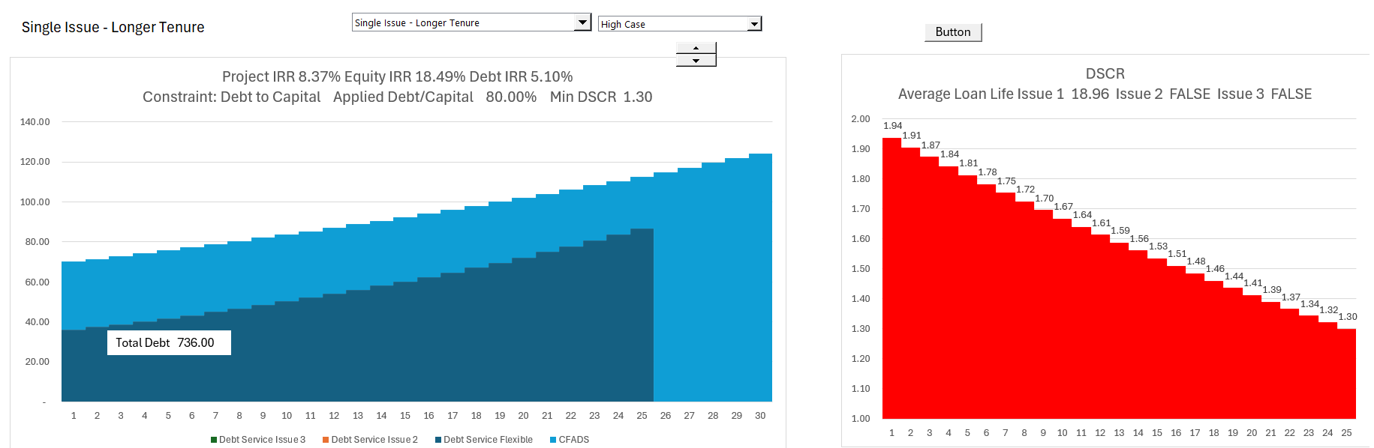
Issue 11: Debt Size from Debt to Capital with Minimum DSCR, Continued
In the graph below, the curved DSCR is used along with the changing DSCR. The graph is for an extreme case.

Slide 98
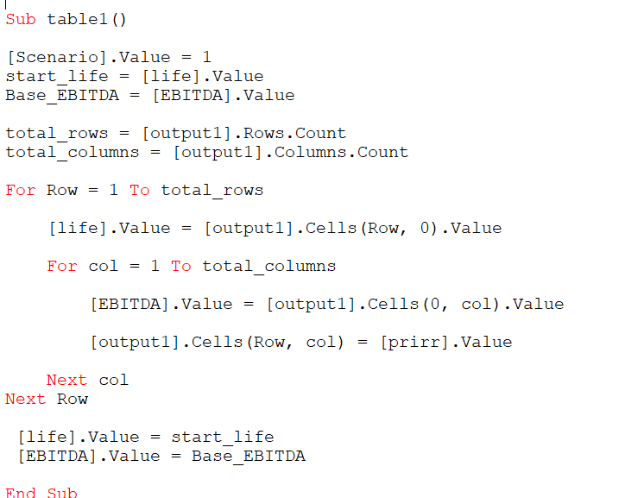
Issue 12: Scenarios and Graphs with VBA
Theory: When making risk analysis, presentation as to which risk is the most important can be the challenge. I suggest a waterfall diagram.
Data tables can be nice, but they can really suck because they make excel slow, but they can only work where the inputs are, and they cannot be used for effective graphs.
With copy and paste or with large models, using a data table is not reasonable because of speed and because of copy and paste macros.
You can use a FOR and NEXT loop to cycle through a range and fix things.
If you set-up the InputC sheet, you can accumulate variables to a high or a low case and then you can make a waterfall graph as shown below.

Slide 99
Issue 12: Scenarios and Graphs with VBA Continued
Scenarios with VBA and accumulating assumptions are illustrated below.

Slide 100
Issue 13: Working Capital and Facilities
Theory: Working capital is sometimes ignored, but it can be a tricky thing to model. You can set-up different working capital loans and allow for periods of cash build-up when the working capital is negative (rather than paying out dividends).
Developing alternative ways to model working capital requirements in the initial operating periods of a project can be surprisingly difficult.
You can use corporate finance ideas with revolving credit agreements
There should generally not be dividends when the cash balance is positive because the cash will later be negative.

Slide 101
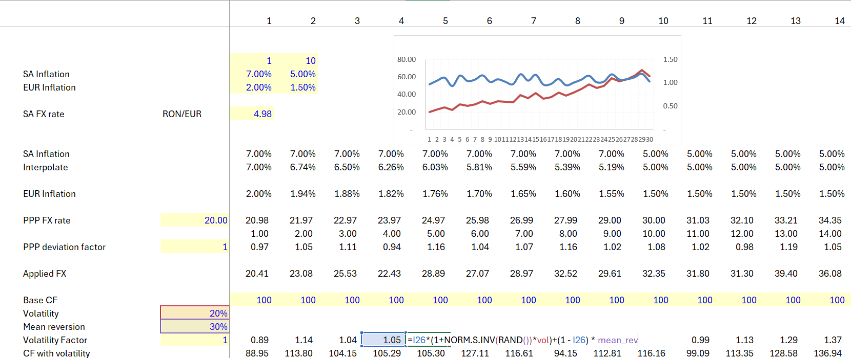
Issue 14: Modelling Different Currencies
Modelling the effect of financing in different currencies including translation adjustments on the balance sheet.

Slide 102
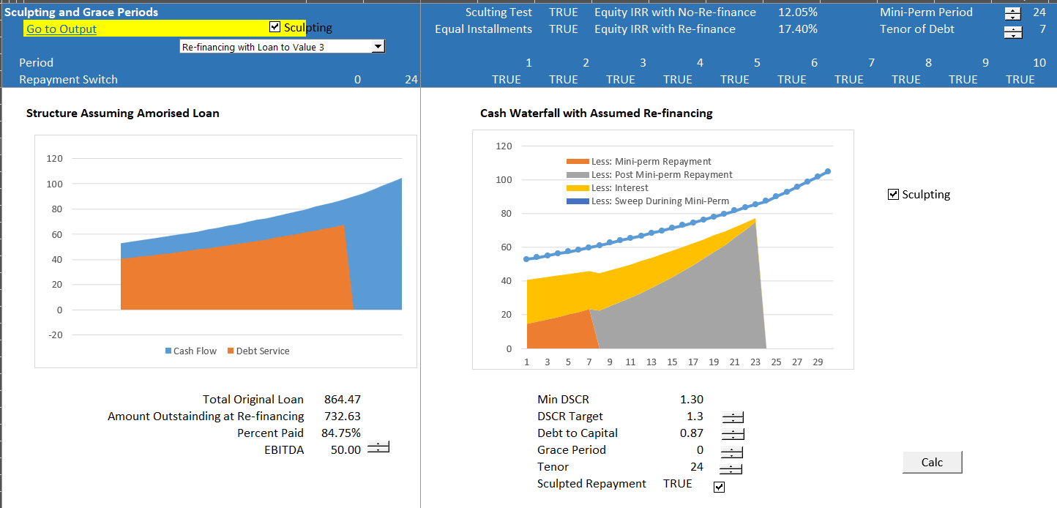
Issue 15: Modelling Mini-Perms
Theory: Modelling Mini-perms comes from banking regulations that make it more expensive for banks to issue debt longer than 7 years. The modelling is generally similar to other re-financing, except that the re-financing is forced rather than an upside option.
Modelling mini-perms and different re-financing assumptions (sweep in downside and increased debt in upside).

Slide 103
Issue 16: Equity Bridge Loans
Theory: Equity bridge loans are loans that are made to the equity investment of a project, meaning that you compute the equity paid in capital and then borrow that amount and eventually pay it off. The biggest question about equity bridge loans is whether the equity IRR should be computed with the bridge loan as the loan depends on
Modelling equity bridge loans and the associated circular references along with options to include or not include interest during construction in the borrowing base.
With an equity bridge loan, it is possible to receive cash flow as dividends before the equity to re-pay the EBL is made.

Slide 104
Issue 18: Project Sale and Holding Period IRR
Step 1: Start at end after stable period with required return for buyer
  Can get data from transactions
  If not can add a little bit to the interest rate
Step 2: Decide on a reasonable holding period
  Should have some history
  The shorter the period the higher the returns
Step 3: Make an estimate of how much higher an IRR you need for taking resolved risks
  Risks are development risks, construction over-run and delay, volume estimation, operating and maintenance levels etc.
  To think you can somehow quantify these risks with the Capital Asset Pricing Model and Beta is ridiculous
  For example, add 4% for initial risk to get the target equity IRR
Step 4: Run goal seek for price with target IRR
  Go to the portion of the model with the IRR after the plant sale and the holding period
  Compute the NPV of the holding period cash flow using the target IRR from Step 3
  Use goal seek to find price to meet the target return that covers these risks

Slide 105
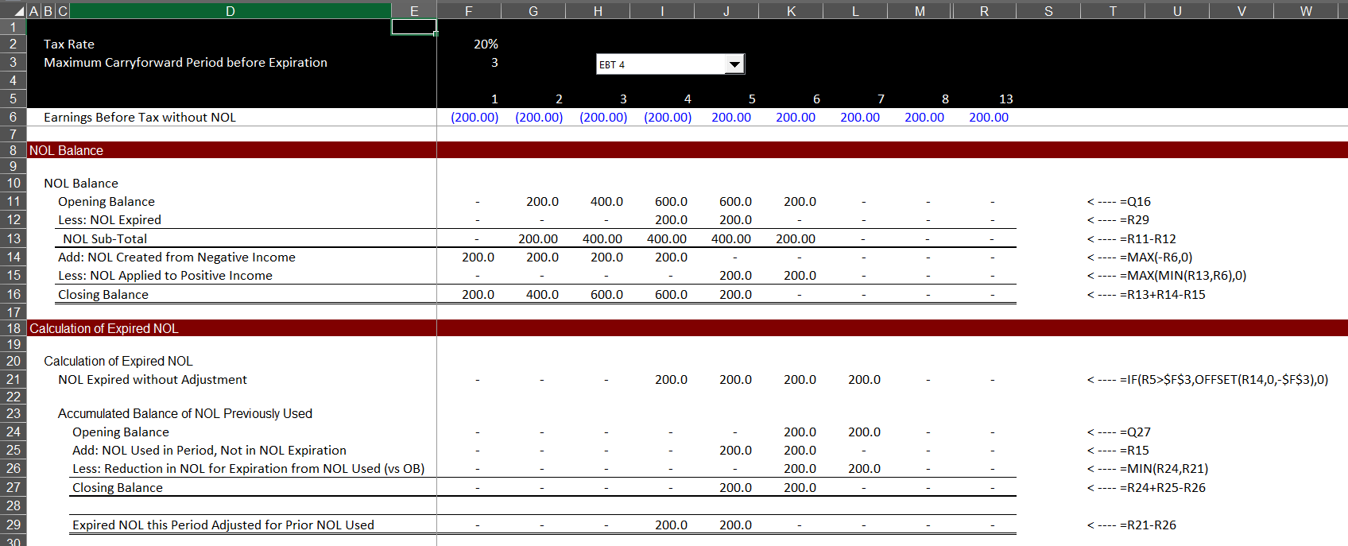
Issue 19: NOL with Expiration
Theory: Without NOL expiration, the adjustment for NOL is easy with MIN and MAX
With the NOL you need to keep track of how much NOL has been used and you can go backward and keep track of previously used NOL.

Slide 106
Issue 20: Creating a Fund of Projects
Compute Common Timeline
  Monthly Timeline
  Creates Large Model
Make InputC type Sheet with Projects
  Inputs can be flexible
  Must be in consistent format across projects
Use Model as Template
Create a Loop that changes the code number and copies template file to new sheet
  Start at End
  Create a Blank Start and End Sheet
  Start at the End of the Loop
  Demonstrate that you can change the template file
Create a macro to delete sheets between start and end sheet
  Again, start at the end

Slide 107
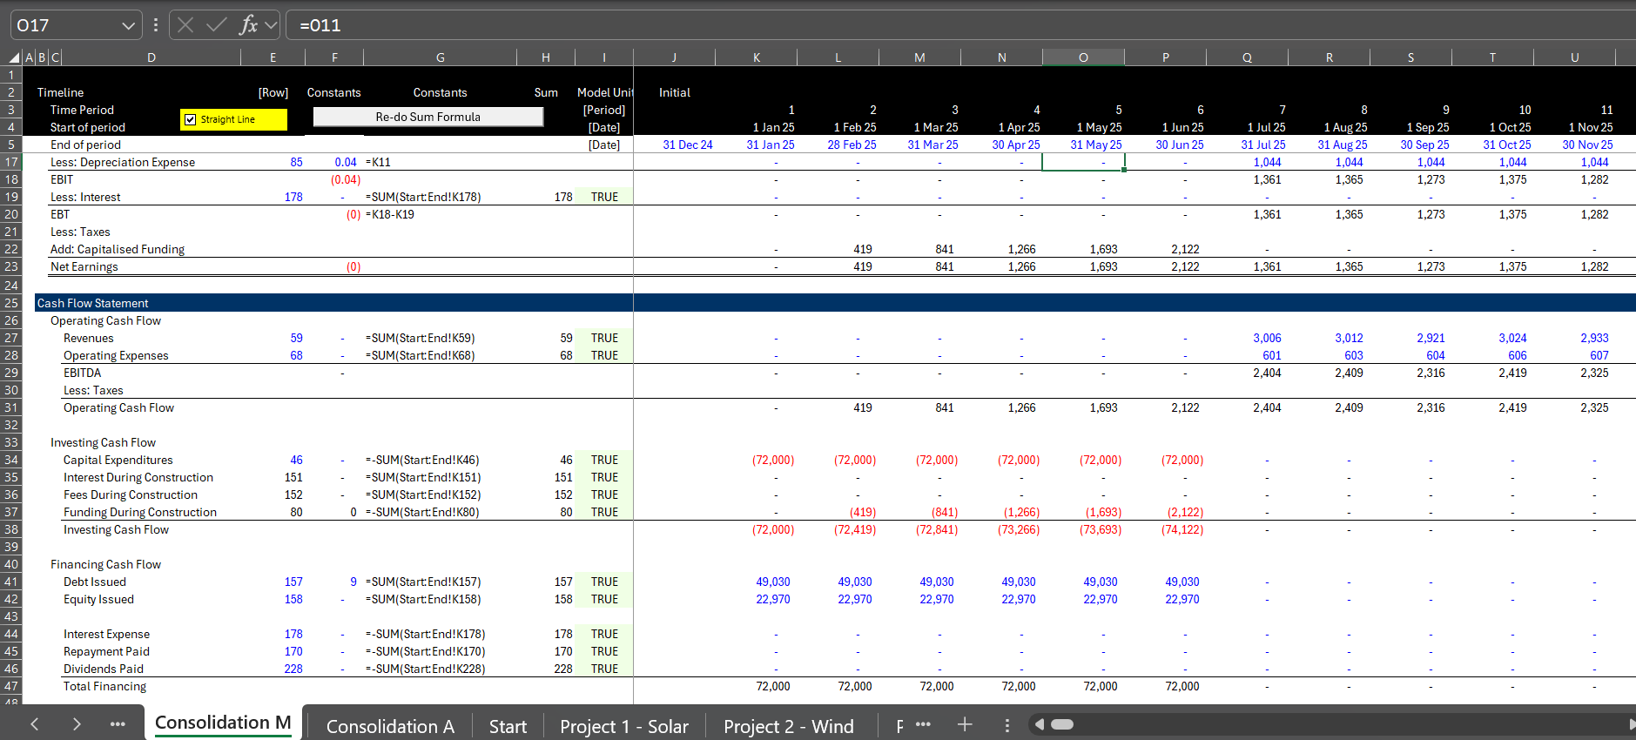
Issue 20: Consolidation Continued
Illustration of consolidation with old-fashioned sum(Start:End!K46)

Slide 108
Issue 21: Evaluation of Risk and Return on Senior and Subordinated Debt
Theory: Subordinated debt carries a higher interest rate than senior debt because of the higher probability of default and loss given default. The question is how can one evaluate the higher return versus the higher risk).
The first step in modelling is evaluating the structure of the subordinated debt and in particular whether the subordinated debt pays interest or capitalizes interest.
The next step is to include provision for default and repayment of default on subordinated debt as well as senior debt.
Once you have modelled the defaults, you can compare the value of the defaults to the amount of the debt issued (in present value at the risk-free rate).

Slide 109
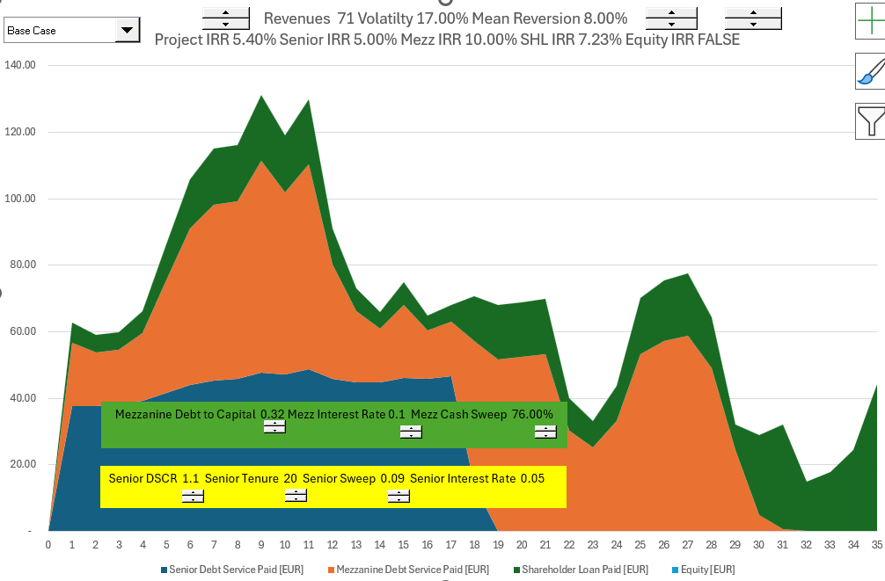
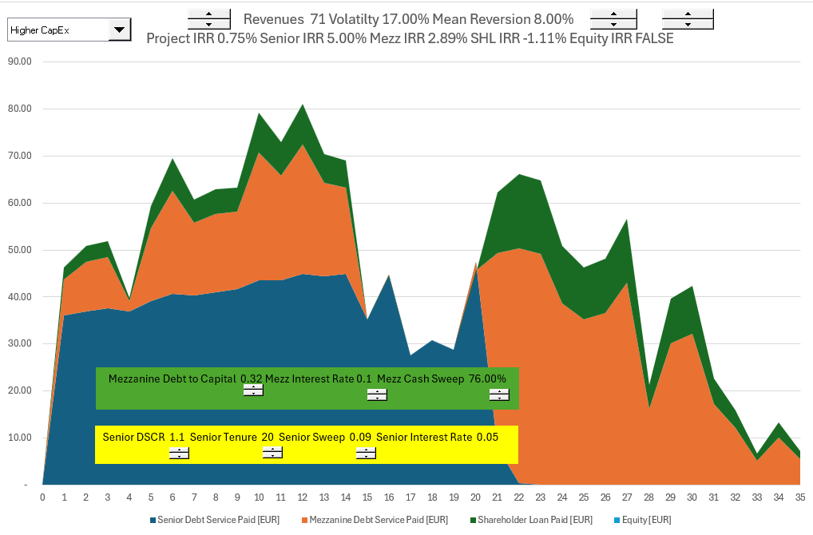
Issue 21: Risk and Return of Senior and Subordinated Debt, Continued
The graphs below demonstrate how the subordinated debt and senior debt could be valued with Monte Carlo simulation.
Left hand graph, fully pays off debt; right hand graph the IRR on Subordinated debt is lower than senior debt

Slide 110
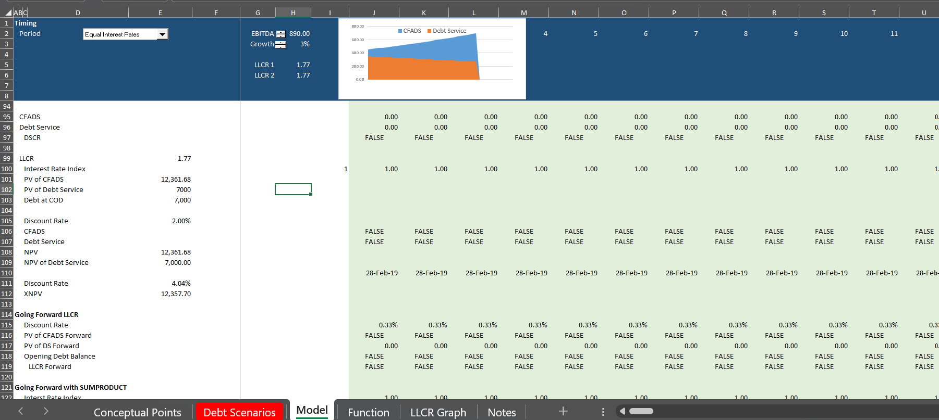
Issue 22: Computation of LLCR with Multiple Issues and Tenures
Theory: The LLCR measures credit quality in terms of the ability to repay debt. with different debt issues using the prospective debt IRR
Use weighted average interest rate
Can also use debt IRR

Slide 111
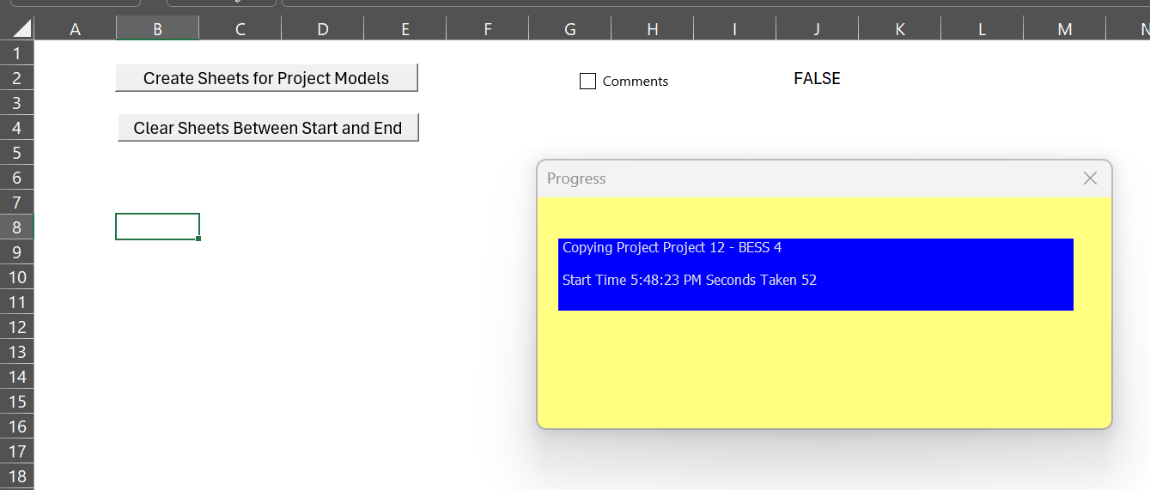
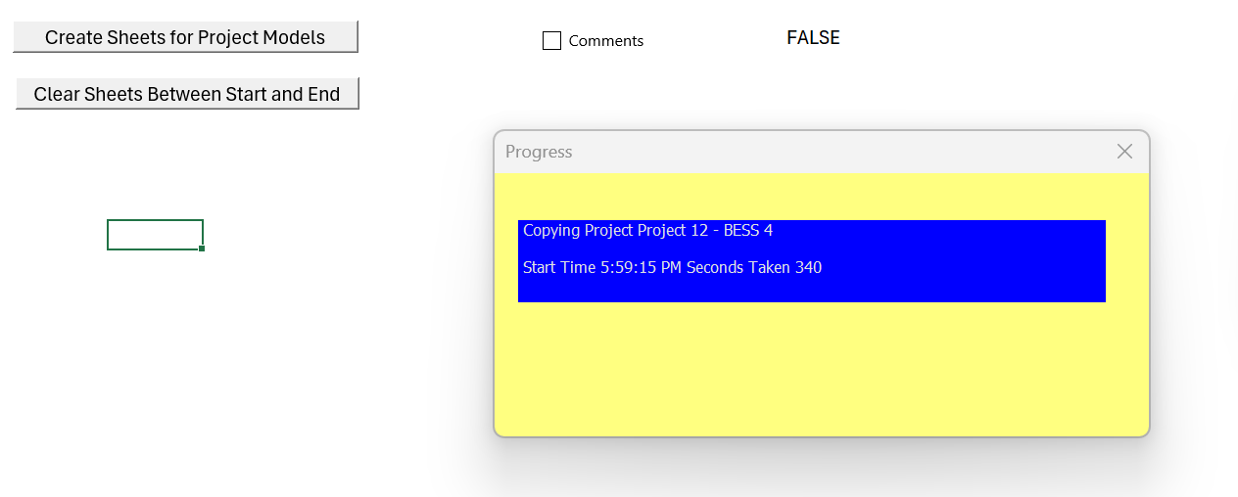

Applying a User Defined Program (UDF) to Resolve Circular References
You can resolve circular references without copy and paste macros and instead programming a UDF (it is like programming a SUM function).

Slide 112

Copy and Paste
Time with copy and paste is more than double

Slide 113

UDF
.

Slide 114
Modelling Objectives Examples
Objective for the course is to build a model from scratch.
Ultimate tasks to be mastered are:
  Building of CFADS
    EBITDA
    Income Taxes
    Working Capital Changes
    Working Capital Facility
    Interest Income
    LC Fees on DSRA
    Changes in Cash DSRA
Use Completed file to work through income tax issues with NOL and limit on carryforward
  Use MAX for positive/negative test
  Use MIN to limit the amount of tax carryforward that can be used
  Copy and paste on the CFADS to resolve interest problem
Use separate exercise for DSRA exercise where DSRA is included in CFADS for sculpting
  Trick of separately computing debt size from EBITDA without the DSRA

Slide 115
Complex Debt Sculpting
Credit policy on sizing debt for power is applying a grid of DSCRs based on different P-curves.
For example, on a solar project, on each quarter we constrain P99 CFADS at a 1.00x and P50 at a 1.35x and take the minimum resulting constrained CFADS.

Slide 116
Income Taxes in CFADS
Net Operating Loss
Limit on Carryforward
Circular Reference with Income Tax
Use the completed model
Fill in the taxes including the adjustment to the carryforward

Slide 117
Cash DSRA Changes and Sculpting
Cannot compute DSRA changes that are a function of the DSRA itself from sculpting.
Use the Following Step by Step Process:
  Compute debt size and sculpting as normal
  Compute the DSRA from the debt size without DSRA itself
  Compute the changes in the DSRA
  Compute the debt service effects of the DSRA through dividing by the DSCR
  Add the Debt Service from the base components and the DSRA
  Compute the PV of the total debt service
  Verify the DSCR and the debt balance

Slide 118
General Objectives
Primary objective is modelling presentations to financiers
Objective for the course is to build a model from scratch.
Ultimate tasks to be mastered are:
  Building of CFADS,
  Setting of debt structure with multiple sources (loan + bonds) on a pari-passu basis,
  Calculating equity returns, and
  Preparing a model for syndication purposes –
  Running sensitivities on a set debt amount (no longer sizing for changes made to CFADS and investors play around with model).

Slide 119
Session 6: Valuation

Slide 120
Assignment
Valuation should be done using DDM methodology (equity value and enterprise value), alongside relevant returns and key sensitivities that a prospective buyer might look at
  Use your discretion on which sensitivities to highlight
  For pricing the asset, you are expected to triangulate between precedent transactions and the bottom-up rate derived using CAPM methodology (for the CAPM buildup specifically, you’re allowed to do desktop research and are encouraged to make sensible assumptions as needed), and include relevant build-ups in the files
  For the returns analysis, assume a 7-year hold period with a prudent yield compression between entry and exit discount rates
Illustrative precedent transactions
  No. Size (MW) Technology Year
  Implied exit discount rate (USD)
    1 350 Solar 2023 9.0%
    2 150 Wind 2022 11.0%
    3 180 Solar & Wind 2022 9.0%
    4 225 Wind 2022 10.0%
    5 200 Solar 2021 8.0%

Slide 121

Start with Basic Valuation
Timeline and Discounting
In project finance no need for the big problem of terminal value

Slide 122




Project Finance and Changing Risk
Before COD, cash flow is presented in the sources and uses statement
After COD, cash flow is presented in the cash flow waterfall and the last line is dividends
Father of the bride makes commitment to pay for wedding
Commitment Fee
Date at which you realize that the wedding is working or is a complete disaster
Development is Dating period. Probability of failure is high
Pay for Wedding with Other peoples’ money
Pay your Bills and re-structure your life. Stuck with PPA type contract. May default.
FC is making promises (that you may not keep)
COD is Wedding Date
Decommissioning Date

Slide 123
Reasons for Risk Reduction After a Couple Years of Operation
Examples of Risk Resolution After A Couple of Years of Operation
  Finished with Development Risk – Big Probability of Failure
  Finished with Financing – Things May Not Work Out
  Finished with Construction – Many Things Can Go Wrong
  Establish Historic Volumes – Test Whether Base Estimates are Wrong
  Establish Ability to Collect Revenues – Political Risk Resolved
  Establish O&M Expenses from History – E.g. Evaluate Insurance Expenses
How much more of a return do you need for taking these risks. Anybody who says that you can find this from

Slide 124

Back to Assignment - Triangulation
Comments in Assignment
What does DDM methodology
More sensible process
  Start at end with stable cash flows
  Select reasonable holding period as short as possible
  Make reasonable assessment of required yield
  Use goal seek to find the price with IRR that includes sale

Slide 125

Process of Adjusted for Risk Changes
Start at the End with Target Equity IRR for Stable IRR
Set PPA with Higher IRR
Use Flags to Test Exit and Holding Period
Compute Exit and Holding Company Valuation with Discount Rate
Why Cannot Compute Terminal Value because of Distortions from EV/EBITDA or P/E Ratio
Evaluate the IRR with Compression between Initial Discount and Exit Discount Rate

Slide 126

Assumptions for Transaction
In InputC, put in some synergies (not very credible for projects)
Allow Valuation from Pre-tax project cash flow, After-tax project cash flow, Equity cash flow with different discount rates.
If purchasing projects from Orsted and companies without project finance, use project cash flow and assume financing
Incorporate re-financing where debt size comes from the present value of debt service and debt sculpting.

Slide 127

Timing Problem with Valuation
Nice thing about valuation – no terminal value
Nice thing about valuation – objective discount rates

Slide 128

Understanding Patterns of Cash Flow that Influence Value and Timing
Simple Alternative Patterns of EBITDA
Case with Flat Nominal EBITDA
Case with EBITDA increasing with Inflation
Equity Cash Flow Increases After Debt Repayment

Slide 129

Financial Ratios for Stable Corporation
.

Slide 130

Problem with Financial Ratios in Project Finance
Because of depreciation and debt repayment, financial ratios do not give an indication of the performance of a project

Slide 131

Stable Company EV/EBITDA, ROIC and Project IRR
.

Slide 132

Valuation Ratios Not Constant
Valuation Ratios with IRR = Discount Rate
Price to Book Should be 1.0
Implication – Just Use the Discount Rate

Slide 133

Valuation Ratios with Declining Cost of Capital
Alternative Discount Rate
Everything is About the Discount Rate

Slide 134
Transaction Assumptions, Re-financing and Financial Statements
Get Valuation
Compute Sources and Uses with Consideration, Assumption of Debt, New Debt and Equity Issue
Compute Possible Goodwill from Asset Write-up and Existing Book Value
Use Transaction Data to Develop Model with Three Statements
Demonstrate Problem of Earnings and Depreciation
Put in Assumed Stock Price and Accretion or Dilution

Slide 135

Transaction Set-up
.

Slide 136
Exercises
Valuation with Alternative Cash Flow (Use Solar Model)
Timelines and Holding Period
Holding Period Returns
Compute Uses and Sources for M&A Transaction
Compute Fair Value and Goodwill for M&A Transaction
Take out taxes for Model Example because of circular references
Compute Financial Model for New Company from Base Financial Model

Slide 137
Process for Evaluating Cost of Capital and Required Price
Step 1: Start at end after stable period with required return for buyer
  Can get data from transactions
  If not can add a little bit to the interest rate
Step 2: Decide on a reasonable holding period
  Should have some history
  The shorter the period the higher the returns
Step 3: Make an estimate of how much higher an IRR you need for taking resolved risks
  Risks are development risks, construction over-run and delay, volume estimation, operating and maintenance levels etc.
  To think you can somehow quantify these risks with the Capital Asset Pricing Model and Beta is ridiculous
  For example, add 4% for initial risk to get the target equity IRR
Step 4: Run goal seek for price with target IRR
  Go to the portion of the model with the IRR after the plant sale and the holding period
  Compute the NPV of the holding period cash flow using the target IRR from Step 3
  Use goal seek to find price to meet the target return that covers these risks

Slide 138
Session 7: Debt Structuring and Re-financing

Slide 139


Excerpts from Term Sheet
Maximum Debt to Capital Constraint
Minimum DSCR Constraint

Slide 140
Review of Credit and Debt Sizing
In project finance, cash flow is the driver, not accounting asset valuation
Primary analysis by lenders should be DSCR which provides a buffer – for example, a DSCR of 1.20 means there is a buffer of .2/1.2 = 16.67% before a default occurs (in solar this buffer is against the downside case which inappropriately is assumed to be based on objective statistical analysis).
Contracts and mean reversion to allow stable cash flow is necessary for project finance and should be a general driver of risk for any investment
Debt size from cash flow analysis is always PV of debt service or PV of CFADS/DS (next slide)
The constraint on debt size from PV of debt service is the second step
This constraint can be manipulated by increasing the project cost with items that do not take money out of your pocket
You must come up with some kind of repayment method that is not based on CFADS/DSCR - Interest
Alternatives include repayment early, higher DSCR and shaped or curved DSCR

Slide 141
Formulas for Sculpting
Basic Formulas
  DSCR = CFADS/Debt Service
  Debt Service Target = CFADS/DSCR
  PV of Debt Service over Repayment Period = Initial Debt Balance
  Debt Service = Interest + Repayment
  Repayment = Debt Service – Interest
  If you have annual or semi-annual cash flow and constant interest rate you can use the NPV formula
More Advanced Formulas
  DSCR = CFADS/Debt Service Including Fees
  Debt Service Including Fees = CFADS/DSCR
  Repayment + Interest + Fees = CFADS/DSCR
  PV of Repayment + Interest = Debt
  Debt Balance = PV of CFADS/DSCR – PV of Fees
  If interest rates not constant, use an interest rate index (monthly or semi-annual)
  Multiple Issues: DSCR = CFADS/(DS1 + DS2 + DS3)
  DS1 = CFADS/DSCR – DS2 – DS3
  If DS2 and DS3 Given, PV of CFADS/DSCR - DS2 – DS3 = Debt Balance

Slide 142
Income Taxes, Circular Reference
Sculpting Problem
  CFADS = EBITDA – Taxes – Other
  Taxes = (EBITDA – Depreciation – Interest) x Tax Rate
  CFADS drives the amount of debt
  Debt Drives Taxes and CFADS
  Circular Reference Results
Interest During Construction Problem with Debt to Capital
  Project Cost = Capital Expenditure + Fees + IDC
  Debt = Project Cost x Debt to Capital
  Debt Drives IDC and Fees
  Circular Reference Results

Slide 143
Taxes and NOL
Please, never ever and IF statement in any kind of cash waterfall
MAX for positive or Negative
MIN on opening balance for constraint
EBT Before NOL
Starting NOL Balance = Prior NOL Balance
Carried Forward = MAX(-EBT,0)
Used = MIN(MAX(EBT,0)
Closing = Opening + Carried Forward – Used
EBT After NOL = EBT Before NOL + Carried Forward – Used
Taxes = EBT After NOL x Tax Rate

Slide 144

As Usual, Start with Theory
Miller and Modigliani and APV
Debt Level and Risk in Project Finance
Un-gear and Re-gear Beta is ridiculous in project finance (and maybe in any finance). This is because the debt level defines the level of risk and not the other way around
Why Equity IRR rather than Project IRR is used in project finance. For example, a risky project has less debt that would imply a lower equity IRR if the project IRR was the same. But the project IRR should be higher because of the higher risk, and the lower debt offsets this risk leading to a similar equity IRR
Problem with cash on the balance sheet
Much bigger problem if cash is invested at the beginning because of IRR mathematics – if the cash must be financed by equity and not a mixture of debt and equity.
This is one of the issues that arise with putting a cash reserve on the balance sheet to resolve the interest expense versus debt service problem

Slide 145

Project Finance and Dividends
Dividends (without cash sweep or cash trap) serve two purposes. One is to get the IRR; the second is to provide a buffer to lenders
Should dividends occur if interest is above debt service
Without dividends the IRR will be low (remember the IRR mathematics)
Dividends are needed for CFADS buffer
If extra cash is put in a reserve account and it just meets the debt service, there will be no buffer.
The formula: Debt Service = CFADS/DSCR
  can be reversed to Debt Service * DSCR = CFADS
  If the repayment is zero, you can use the formula to derive how much of a cash reserve is necessary

Slide 146

Option for Payment in Kind Interest
Issue
  How much should the payment in kind interest be
  How should you structure the model to add payment in kind interest
  What is the equity IRR with payment in kind interest versus a cash reserve
  Just replace the negative repayment with PIK interest when the repayment is negative

Slide 147


Understanding Equity Impact of Reserves
Cash reserves increase equity funding
Remember anything at the beginning has biggest impacts on IRR

Slide 148

Consideration Impact of Reserves
Note the Increase in Consideration if you have PIK Interest

Slide 149
Debt Sculpting, DSCR Formula and Negative Repayment
Start with the basic formula:
  DSCR = CFADS/DS
  DS = CFADS/DSCR
  DS = Interest + Repayment
It is possible that in this formula the repayment will be negative when interest is greater than debt service
In this case there are a couple things you can do.
  You can set up a cash reserve account to cover the interest
  You can use the cash reserve withdraws to cover the repayment
  In this case there is higher repayment (non-negative) and the tenure of the debt declines
  If the CFADS includes only the cash for repayment, the DSCR is below the target
Solution
  Amount withdrawn from the reserve account uses the formula
  CFADS = EBITDA – Taxes + Amount Withdrawn from Reserve
  Target CFADS = Debt Service x DSCR
  Debt Service = Interest Expense
  (EBITDA – Taxes + Amount Withdrawn) = Interest * DSCR
  Amount of Reserve Withdrawn = Interest * DSCR – EBITDA + Taxes
  Note the extra amount results in dividends like the normal situation

Slide 150


Review of Ugly problem of Circular References
Issue
  Does the Iteration Button cause problems with a goal seek
  Allow circular with with if statement (not multiplication) with switch and check box
  Illustration of Turning on and off Iteration Button
Issue
  Macro with goal seek – use range names
  Test copy and paste with goal seek together
  Use NPV for target IRR

Slide 151

When Does Problem of Interest > Debt Service Occur
High growth and or inflation rate
Big difference between seasonal cash flow
Battery augmentation
Inverter Replacement Financed
Major Overhauls without MRA

Slide 152
Three Steps to Demonstrate Problems
Step 1:
  Set-up account that allows repayment to be Debt Service – Interest
  Set-up the amount of negative repayment (named positive payments below)

Slide 153

Try 1: Simple Account Approach
Set up cash reserve account
Sum of balances is the amount in the account
Illustrated below
Problems
  Shortens Debt Tenure
  Reduced IRR from Cash in Sources and Uses
  Circular Reference

Slide 154
Resolution of Shorter-tenure
If you are using DSCR to size debt, then the maximum debt to capital should be less than the required amount
You should have room to increase the debt
You can increase the debt and extend the maturity with a goal seek
You are essentially funding some of the cash reserve with increased debt
Use the goal seek function to size the debt
High Interest Rate

Slide 155




Summary of Results
Case with allowing negative repayment

Slide 156
Session 9:
Consolidation of Projects

Slide 157
A Corporation’s Value and the Value of a Family
To begin the discussion, I note that any corporation is a portfolio of different investments.
The investments could be factories, advertising, an internet website, investments in R&D, training of employees and many other things.
The way I think about this portfolio of investments is a family tree where the family has a history and may last for many generations into the future.
If we for some reason want to value the family, we would need to not only value the current generation, but also future generations that will be there long after we are gone.

Slide 158

Family is Like a Corporation; Person is Like Project Finance – How would Value the Family
Potential for Next Generation as a Guide for the Performance History of Prior Generation
Person is the project
Entire Family is the Corporation
Success of a family depends on the success of individuals in the family
Terminal Value of Future Generations Difficult to Compute – Comes from Potential from Future Generations

Slide 159

Biggest Problems in Corporate Finance
The biggest item of value in a corporate DCF analysis is the terminal value as a corporation is assumed to last indefinitely (forever).
  In the long-term future, all of the management will be replaced
  In the long-term future, all of the current products will be obsolete
  In the long-term, all existing assets (except land) will be retired
  Value in the long-term comes from the ability of management to earn returns above the cost of capital; why should we assume management can continually earn high returns on new projects
A really big problem in corporation is what WACC to use in valuation
  Assuming a constant WACC is crazy
  Everybody has different opinions about what the equity risk premium and the beta are, leading to dramatic differences in WACC
  There continue to be problems with valuing the tax shield from interest in WACC and debates about un-levering and re-levering Beta and adjusted net present value
Another big problem in corporate finance is interpreting EPS, ROE and ROIC along with P/E, EV/EBITDA and Price to Book Ratio
  When companies are growing fast, the ROE and ROIC will be lower than the equity or project IRR while when companies are not investing the reverse will be true
  The value impacts of this can be resolved with project finance analysis.

Slide 160
These Problems Do Not Exist in Project Finance
Value a project over its life and don’t need terminal value
Discount rate changes, but stable discount rate for a mature project can be established from transactions (when your children become mature, you know their value)
Most of the cost of capital comes from debt and the mature equity cost of capital is a bit above (or even below) the interest rate
Problems: Irrelevant to use ROIC, ROE, EV/EBITDA, P/E – this makes these ratios irrelevant in fast growing or fast declining corporations. It may be depressing, but this can make just about all financial statement analysis irrelevant for corporate valuation.
Market to Book Value can be assessed by the ability to earn returns above the cost of capital.
  Book Value (without write-offs) is the equity value on the balance sheet
  Cash Flow from Book Value at Cost of Capital can be computed with PMT
  Cash Flow from Premium Above Book Value can be computed with PMT and Higher Interest Rate
  Theoretical Price to Book Ratio can be computed from PV

Slide 161

Returns and Market to Book Ratio
Orsted is case study

Slide 162
Financial Ratios for Stable Corporation
.

Slide 163
Stable Company EV/EBITDA, ROIC and Project IRR
.

Slide 164

Return and Price to Book Ratio for Oil Companies
Look at Equity IRR -- Seems to require about 15% to 18% to generate value of 2.0 to 2.5x value relative to the investment. Note that the beta is .9

Slide 165

Reconciliation of IRR and ROE – Large Renewable Developer
About 7% to 12% return leads to much higher value relative to the invested capital – the market value to paid in capital plus income retained is 3.5x. The beta is similar at .85.

Slide 166

Total Energy – More Stable Returns but Low Value Relative to Investment
Note the high return of 18% with the relatively low price to book ratio.

Slide 167

Shell Oil and Exit from Renewable Investments
Return of about 10-11% and market value relative to investment is a bit more than 1.0x. Again the beta is similar at .93.

Slide 168

Portugal Renewables and Low Returns when Growing
Company with much lower returns has higher price to book ratio than Shell. Low returns driven by rapid expansion. Again, beta is the same.

Slide 169

EDP with Returns and Growth
When grow quickly, the returns are low because the returns are low when companies grow fast as the ROE is lower than the IRR. For renewable energy companies the emphasis is on IRR and not accounting returns.

Slide 170
Section 11
Corporate Finance and Return Analysis

Slide 171
Subjects
Index function and Indirect function
Discussion of corporate finance and McKinsey
Exercise on Value from Growth, Return and Cost of Capital
Review of Consolidated Model and Economic Depreciation
Complexity in Project Finance Model – Semi-annual Debt Repayments in Monthly Model
Complexity in Project Finance Model – Consolidation Macro
Complexity in Project Finance Model – IDC and Fees Circular Reference

Slide 172

IRR and ROIC
IRR, Economic Depreciation and Financial Statements
Requirement that Value for Economic Depreciation is computed with IRR
  With IRR, NPV of Project = Initial Investment
  NPV declines and goes to zero by the end of the project
  The change in the NPV will add up to the initial NPV
With the Revised Depreciation, the IRR and the ROIC are the same
You can then use the ROIC as a benchmark representing the rate of return earned by the portfolio of assets

Slide 173


Discussion of McKinsey Book
.

Slide 174
Valuation Book, Return, Growth and Cost of Capital
Wealth Growth = Savings Percent x Return on Savings
Wealth Growth = Savings Percent x Return on Investment
Value = D₁/(k-g)
Growth (g) = ROE x (1-DPO)
DPO = 1 – g/ROE
Value = (E₁ x DPO)/(k-g)
Value = E₁ x (1-g/ROE)/(k-g)
The P/E ratio: [P/EPS₁= (1-g/ROE)/(k-g)]
[k=E₁ /P x (1-g/ROE) – g]
[EV = NOPAT₁ x (1-g/ROIC)/(WACC-g)]
E = ROE x Book Value of Investment
BV = E/ROE
[P/B = (ROE-g)/(k-g)]

Slide 175

Corporate Finance Example – Value if Income Produces Cash from ROIC
Corporate Model Example with continuing growth
Does not work if Dividends that Produce Cash are Distorted from Deprecaiation

Slide 176
In Project Finance we Do Not Need Terminal Value Formula; Only the Cost of Capital
Value a project over its life and don’t need terminal value
Discount rate changes, but stable discount rate for a mature project can be established from transactions (when your children become mature, you know their value)
Most of the cost of capital comes from debt and the mature equity cost of capital is a bit above (or even below) the interest rate
Problems: Irrelevant to use ROIC, ROE, EV/EBITDA, P/E – this makes these ratios irrelevant in fast growing or fast declining corporations. It may be depressing, but this can make just about all financial statement analysis irrelevant for corporate valuation.
Market to Book Value can be assessed by the ability to earn returns above the cost of capital.
  Book Value (without write-offs) is the equity value on the balance sheet
  Cash Flow from Book Value at Cost of Capital can be computed with PMT
  Cash Flow from Premium Above Book Value can be computed with PMT and Higher Interest Rate
  Theoretical Price to Book Ratio can be computed from PV

Slide 177
Return to the Biggest Problems in Corporate Finance
The biggest item of value in a corporate DCF analysis is the terminal value as a corporation is assumed to last indefinitely (forever).
  In the long-term future, all of the management will be replaced
  In the long-term future, all of the current products will be obsolete
  In the long-term, all existing assets (except land) will be retired
  Value in the long-term comes from the ability of management to earn returns above the cost of capital; why should we assume management can continually earn high returns on new projects
A really big problem in corporation is what WACC to use in valuation
  Assuming a constant WACC is crazy
  Everybody has different opinions about what the equity risk premium and the beta are, leading to dramatic differences in WACC
  There continue to be problems with valuing the tax shield from interest in WACC and debates about un-levering and re-levering Beta and adjusted net present value
Another big problem in corporate finance is interpreting EPS, ROE and ROIC along with P/E, EV/EBITDA and Price to Book Ratio
  When companies are growing fast, the ROE and ROIC will be lower than the equity or project IRR while when companies are not investing the reverse will be true
  The value impacts of this can be resolved with project finance analysis.

Slide 178

Use of SUMIF and Flags for Semi-Annual
Need to compute PV of Debt Service with a semi-annual interest rate compounding factor.

Slide 179
Cash Sweep

Slide 180
General Cash Sweep Comments
First, somebody once told me that cash sweeps are like false advertising where the bank tells you the tenure is 20 years, but because of early repayment from a cash sweep, the actual maturity is 15 years.
Secondly, if you are going to structure debt with a tenure of 15 years, why wouldn't you just structure the debt with 15 years instead of 20 years.
Third, ages ago somebody from ENRON called a cash sweep as a positive covenant where the debt is repaid early if the cash flow is volatile and high. You can think about oil prices where the cash sweep limits dividends when the oil price is very high, then lowers the debt when the oil price goes down.
Fourth, to model cash sweeps, you should understand the fundamental idea that distinguishes debt structuring and risk analysis. In debt structuring the cash sweep should not generally be modelled because it is designed to account for things like volatility.
I have recently come across cash sweeps that are designed to change the structure of debt after the actual cash flow is established. For toll roads, after actual traffic is established the debt structure can be readjusted. This can be accomplished with a cash sweep. To model this, you can set up a debt structuring part of the model with an aggressive debt structure (e.g. one year tail). Then after traffic is established a cash sweep is used with the actual cash flow to design a debt structure with something like a three-year tail. This can be accomplished by making a second risk analysis section with a cash sweep added. The cash sweep is 100% until the 3-year tail is established.

Slide 181
IRR and Funding
Financial Modelling in Africa
What is the target IRR for your projects
What is the definition of the IRR
How does the IRR and the cost of debt relate
Do you need grants or concessional debt

