Slide 1
Introduction
Welcome to KSPP
Levelised Cost Analysis and Energy Policy

Slide 2
Table Of Contents
01
02
03
LCOE and Policy
LCOE From Sources
Introduction to Use Cases
Basic LCOE and Financial Model
Solar Analysis
LCOE Corrections
Economic Measurement – Real LCOE
Degradation Adjustments
Construction Timing
Taxes
Environmental Cost
Incorporation of Environmental Cost
Appropriate Opportunity Cost
Hydrogen Introduction
04
05
06
Policy & Cost of Capital
Cost of Capital for LCOE
Battery RTE and SOC
Data Centre Case Study of Nuclear versus Solar + Battery
Data Centre Case
Cost of Capital
Battery RTE and SOC
Data Centre Case Study of Nuclear versus Solar + Battery
Hydrogen Policy
Hydrogen Energy Cost
Hydrogen Production
Hydrogen and Ammonia LCOS
Vehicle TCO

Slide 3

Levelised Cost and Energy Policy
23 - 25 June 2026
DAY 1 24 June 2026 | DAY 24 June 2026 | DAY 25 June 2026 | DAY DATE
9:00AM -12:00PM Policy Investment and LCOE LCOE From Sources Introduction to Use Cases Basic LCOE and Financial Model | 9:00AM -12:00PM LCOE and Storage Battery LCOE Drivers Hourly Analysis for Capacity LOCE of Battery Plus Solar | 9:00AM -12:00PM Incorporation of Environmental Cost Appropriate Opportunity Cost Hydrogen Introduction | 00:00AM -00:00PM SESSION TITLE
Lunch break 12:00PM -1:00PM
1:00PM -4:30PM LCOE Policy Corrections Economic Measurement – Real LCOE Degradation Adjustments Construction Costs | 1:00PM -4:30PM Cost of Capital for LCOE Battery RTE and SOC Data Centre Case Study of Nuclear versus Solar + Battery | 1:00PM -4:30PM Hydrogen Energy Cost Hydrogen Production Hydrogen and Ammonia LCOS Vehicle TCO | 00:00AM -00:00PM SESSION TITLE

Slide 4
Improvements
Course duration and content: Building in more breathing room within the 3-day structure.
Theory before Excel Foundational session covering LCOE theory, NPV, WACC, and discount rates before diving into the Excel models. Participants with strong engineering backgrounds but limited finance exposure must understand the underlying concepts.
Course title Energy policy content given the program title and focus on LCOE financial modeling. How LCOE informs energy policy decisions, tariffs, and subsidy design.
Course materials and file access Excel files and slides will be shared.
Structure and flow A clear daily agenda shared at the start of each session so participants can track where they are and what is coming next.
Group work and networking More structured group exercises with mixed teams to maximize cross-sector interaction.

Slide 5
Some Provocative Comments
You can get much more from using PMT formulas than complex models.
If you do not adjust LCOE for inflation your analysis does not make sense.
The LCOE cannot be interpreted for renewable versus dispatchable cannot be interpreted without a use case
You can account for account for battery characteristics including degradation, round trip efficiency and state of charge in battery analysis.
For economic analysis, the LCOE should be computed without tax.
The real required IRR is very low.
The Lazard LCOE is a lot of BS and is heavily biased against nuclear, pumped storage and hydro.
Natural Gas LCOE with environment costs is strongly affected by gas leakage.
Green hydrogen is strongly affected by the capacity factor.

Slide 6
Focus on Numbers
There are many biases in analysis of renewable energy and storage
Some want the answer and make general statements
Some make aggressive assumptions to support a case
The objective here is simple
  Find real data on costs, production and other parameters
  Develop unbiased analysis of alternatives
  Keep the analysis as simple as possible
  Focus on drivers of cost and output
Not somebody who tells you that batteries are going to solve problems in the world without telling you how much they cost and how much they degrade
How you present the data is a big deal

Slide 7
Course Outline and Teaching Style
It is important to not be overly structured and focus on what you want (e.g. how much hands-on financial modelling)
Please comment on the course before it is too late.
Please interrupt with any question or comment.
You need breaks to avoid torture.
Follow-up research and practice

Slide 8
KSPP Executive Education Methodology: Based on ADDIE model
Overview
This methodology adopts a streamlined ADDIE model (Analyze–Design–Develop–Implement–Evaluate) to guide the design and delivery of executive education programs at KSPP. It ensures alignment with institutional priorities, executive-level competencies, and high-quality learning experience.
A core instructional principle across all programs:
sessions follow a structured model: 30 minutes theory + 60 minutes application
This approach ensures a strong balance between conceptual understanding and practical application, aligned with executive learning preferences and applied learning standards.
Purpose
  Identify the program needs, target audience, and strategic alignment.
  Identify capability gaps and training needs
  Define program purpose and objectives
  Analyze target audience (level, background, expectations)
  Ensure alignment with KSPP strategic priorities

Slide 9
Design
Session Design Model
Sessions designs are structured as:
  30 minutes: Theory (concepts, frameworks, models)
  60 minutes: Application (case study, simulation, discussions, group work)
Output
  Program Agenda
  Session Design Plan
  Learning Strategy
Aligned Standards
  Measurable and executive-aligned learning outcomes
  Logical and well-sequenced structure
  Real-world relevant content
  Interactive, participant-centered design

Slide 10


Illustration of How Conceptual Issues are Resolved
The basic problem of any analysis such as this is the relative amount of capital expenditures to operating expenditures
The idea of total cost of operations is to measure the total cost relative to the value of things produced by the investment. For example, you can compute the total cost of operations for a bus as the amount of capital expenditures, fuel cost and operating cost divided by the number of miles or km driven. You could then compare the total cost of an electric bus to a bus that uses gasoline (petrol), to a bus that uses hydrogen and to a bus that uses compressed natural gas. To make a fair comparison, you should compare the total cost of the bus including the annualized cost of the capital expenditures over the lifetime of the bus to the amount of miles or km the bus drives.
In the case of a data center, the amount of electricity drives both the cost of the data center (it must purchase electricity) and it drives the measure of the output of the data center. If the same amount of output (measured with kW or the kWh) can be obtained with less electricity if, for example the liquid cooling produces the same amount of electricity for the IT service that produces value, relative to the amount of electricity that must be purchased. The total cost of operation must divide the total cost by the IT service produced and not the electricity purchased (see next sheet with PUE statistic.

Slide 11
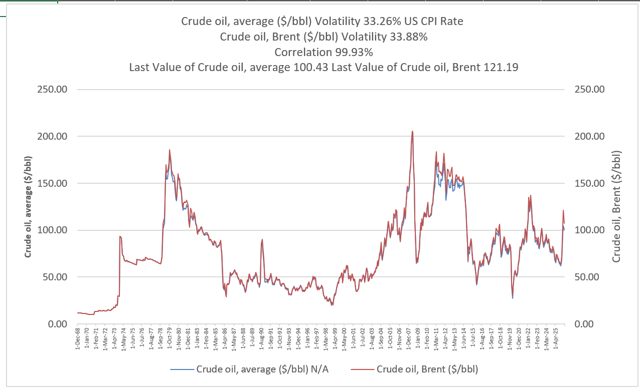
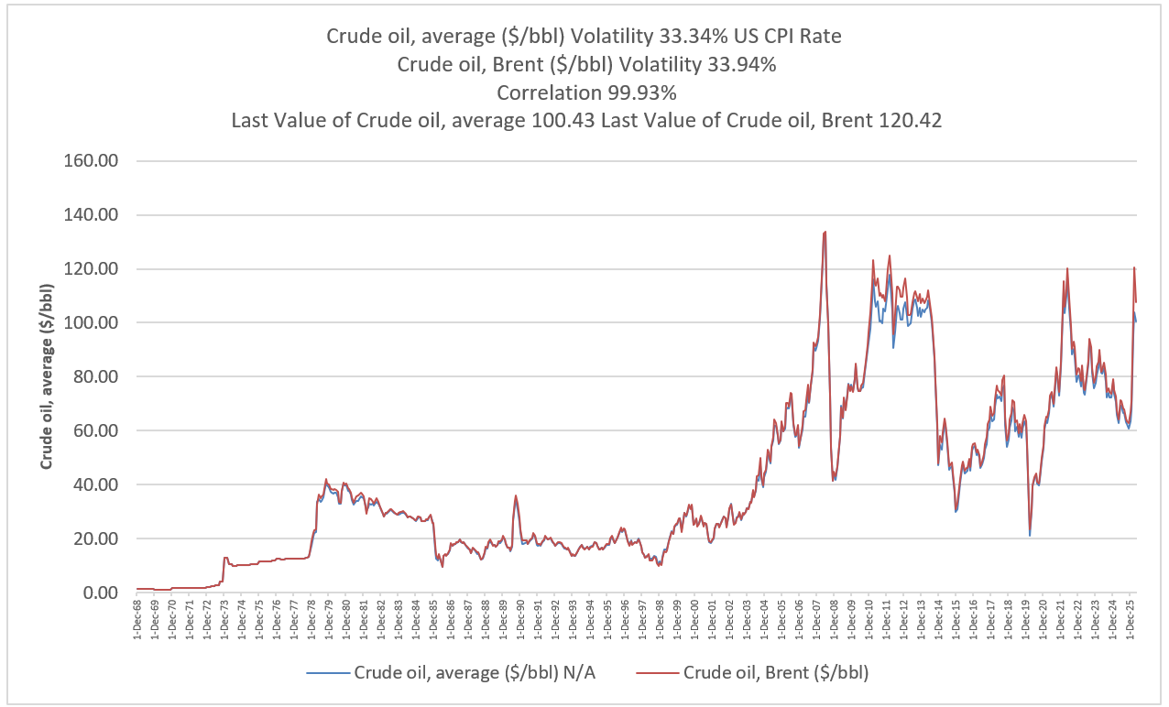
LCOE and Energy Policy
Oil Price History – Real and Nominal

Slide 12
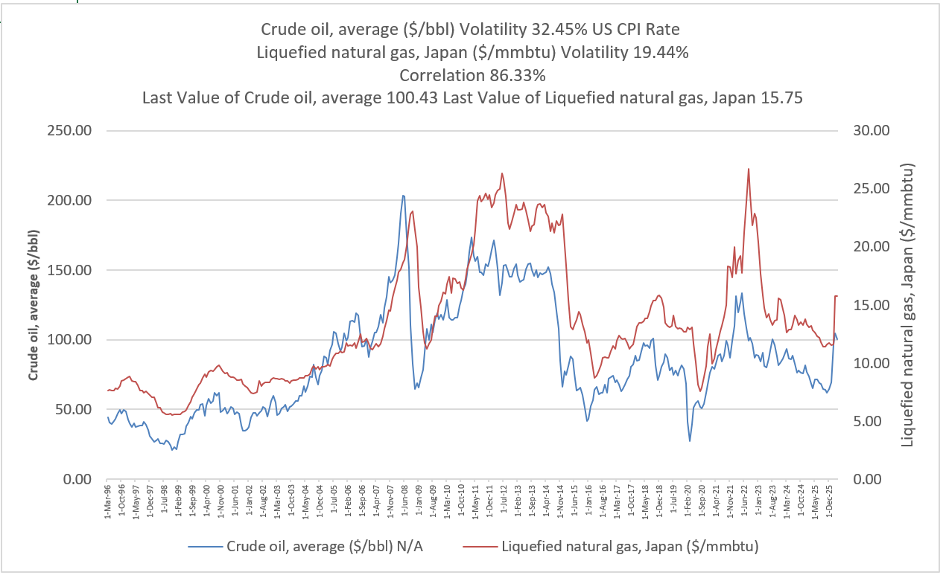
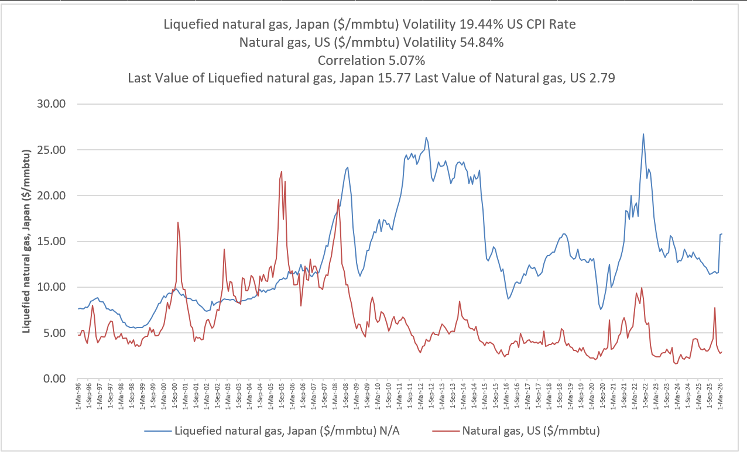
Natural Gas and Oil Price
Asia versus US. Big Question is the ability to keep the NG price low in US or whether reserves will run out.

Slide 13
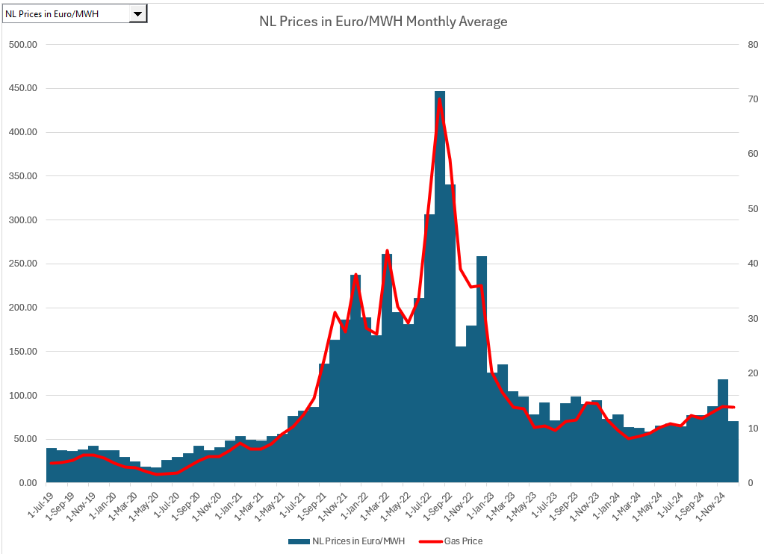
Monthly Electricity Prices and Natural Gas Prices
Can see the effect gas prices with monthly data

Slide 14

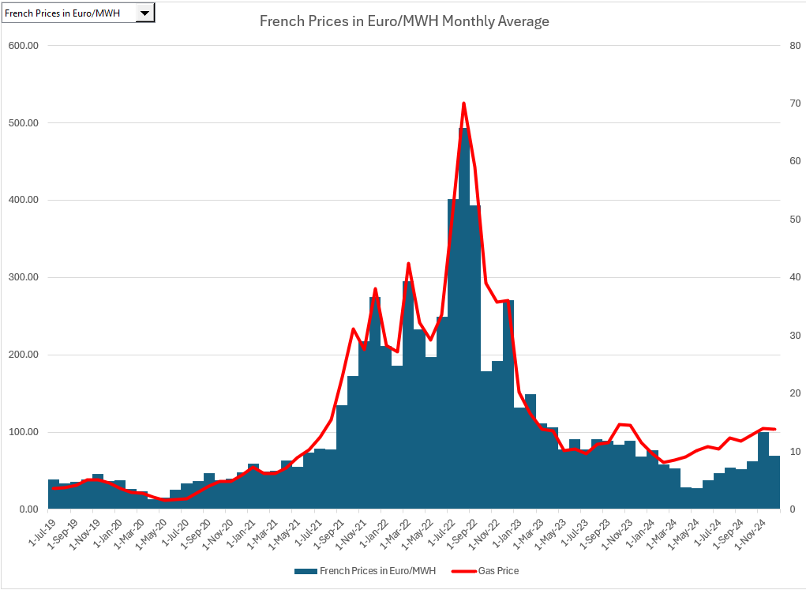
Monthly Electiricy and Natural Gas Prices – Germany and France
Approximate analysis of which plants are on the margin.

Slide 15
Storage Overview

Slide 16
Websites to Review
PVGIS (fantastic hourly data)
  Find the best and worst place in Jamica
  Download hourly data
World Wind Map
  What is windspeed in locations in meters per second
  Global Wind Atlas
PV Insight
  What is current price of panels
Lazard LCOE (this is no good)
  Find the cost assumptions
Solar Project Finance Model

Slide 17
Session 1 Subjects
Renewable Energy Intermittency, Weather Patterns and Unavailability
Problems with Island Systems and Ancillary Service Issues (the duck curve)
Economics - Can Solar/Wind plus Storage Compete with Conventional Dispatchable Technologies on a Cost Basis in Island Systems (LCOE introduction)
Battery Storage Duration and Cycles
Use of Batteries for Different Ancillary Services (spinning reserve, fast start, frequency management, voltage regulation)
Use of Batteries for Bulk Power Storage (shifting power from daytime to nighttime)
Discussion of potential for using batteries for multiple uses – can you reserve battery capacity for frequency regulation and at the same time use the battery for moving power from off-peak to on-peak periods

Slide 18
Review of Solar and Wind as the Basis for Evaluation of Storage

Slide 19
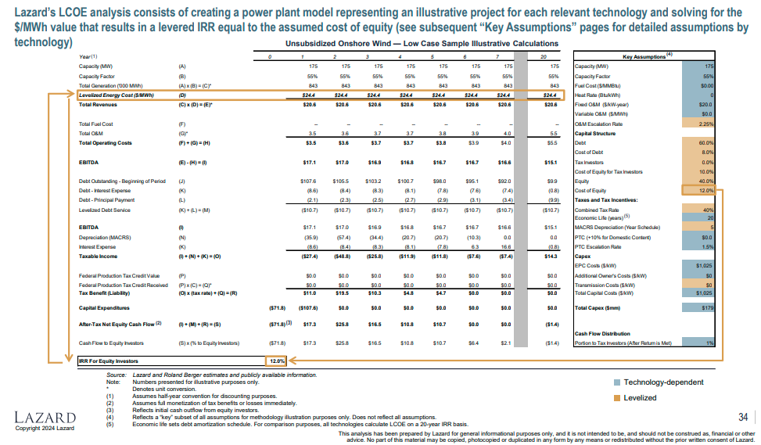
Reconcile LCOE with Financial Model - Lazard
.

Slide 20
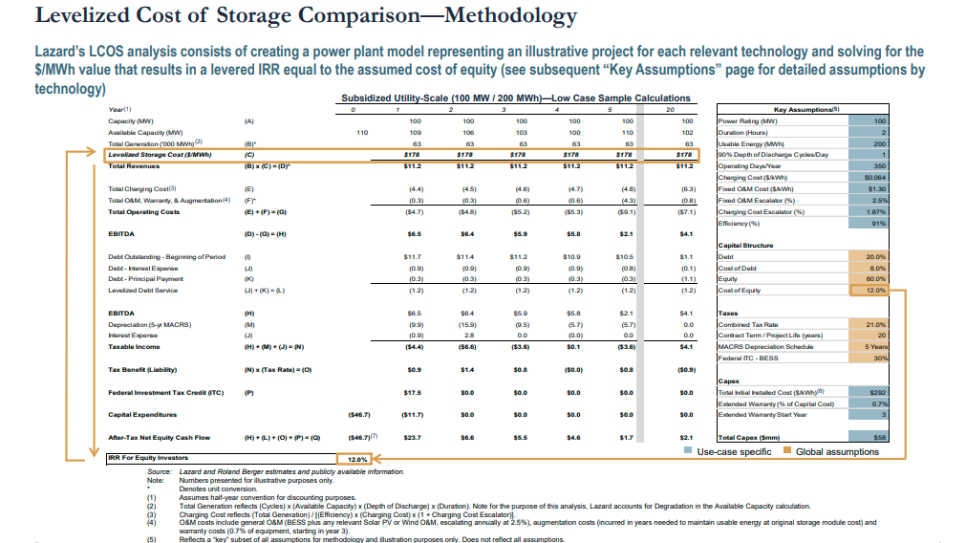
Financial Model for Storage
.

Slide 21
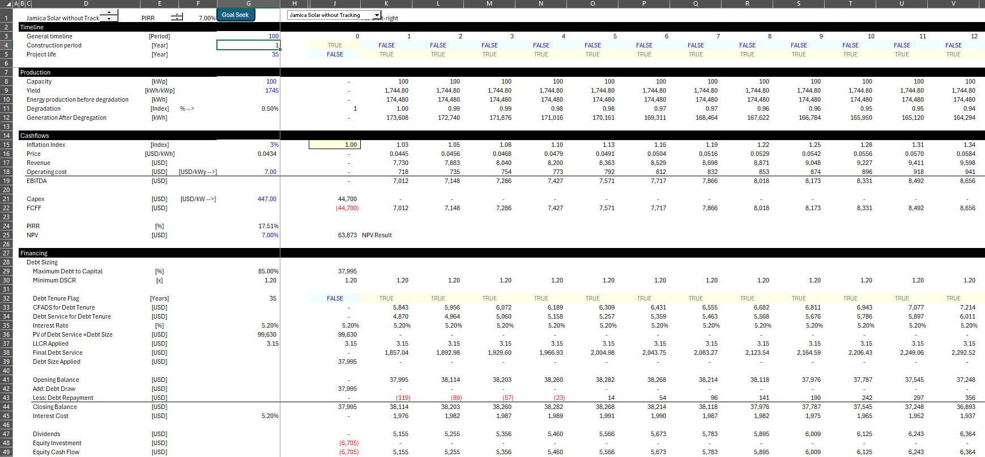
Financial Model in LCOE Analysis
.

Slide 22
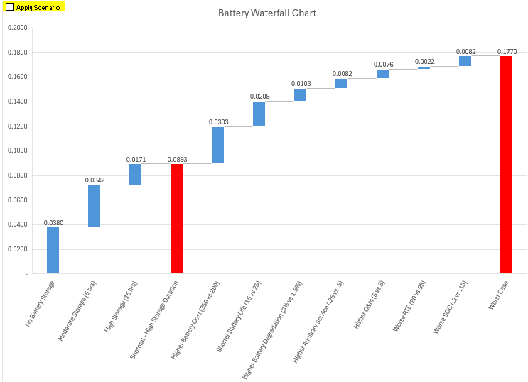
Sensitivity Analysis of Battery LCOE
.
We will work through this and understand both the mechanics and the implications

Slide 23
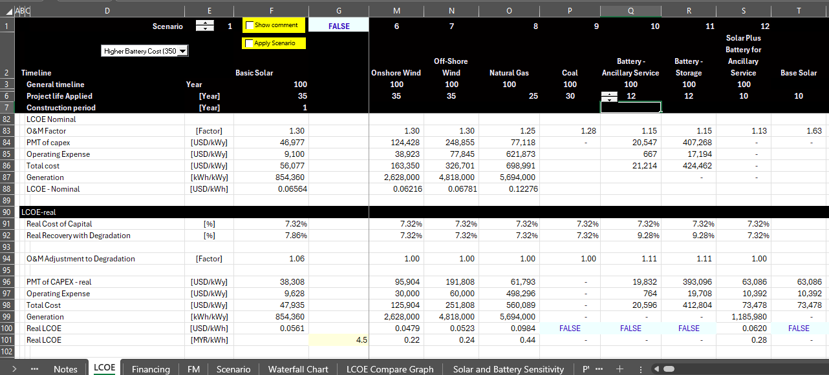
We will demonstrate how to make a relatively simple analysis of the LCOE – Not much excel
What we will do
Open the File named LCOE Analysis

Slide 24
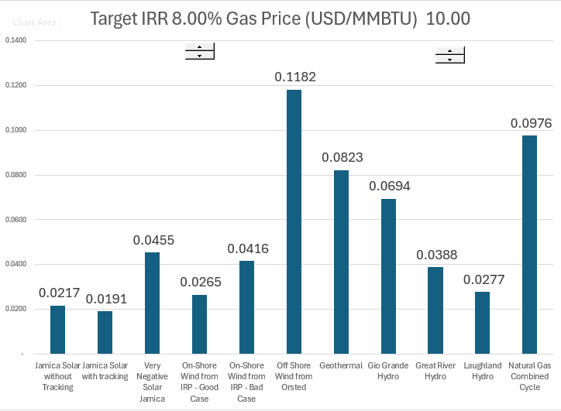
LCOE Estimates for Discussed Later
.

Slide 25
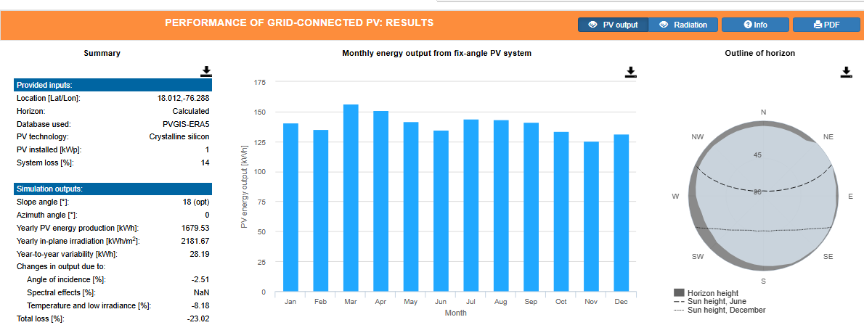
In-Plane Radiation without Tracking
kWh/kWp gives hours annual hours. Hours divided by 8760 gives capacity factor
In plane radiation is 2181 kWh/m2 per year. 2,181 kwh is 2,181,000 watts per m2. Dividing by 8,760 gives you 249 watts per hour on average. As the standard definition o of maximum capacity is 1,000 watts/m2, this gives you a capacity factor of 2,181/8760 = 24.89%

Slide 26
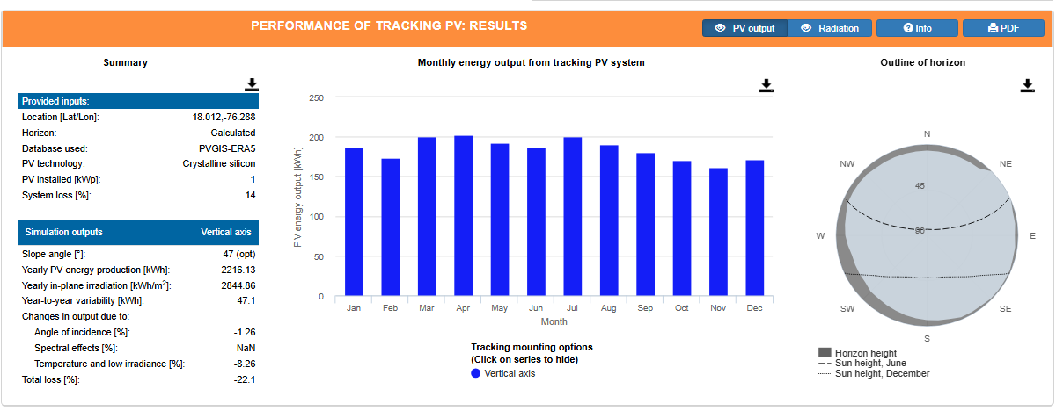
Tracking Increase Relative to Fixed with Tilt
.
In Plane Radiation 2,845 per year in kWh per m2. Capacity Factor of 32.47% from 2845/8760. This is a 30% increase in the amount of sunlight that hits the panel

Slide 27
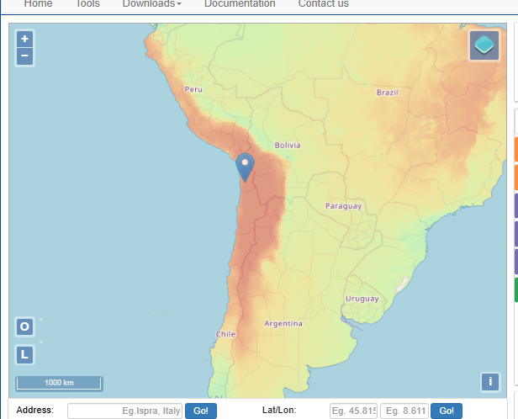
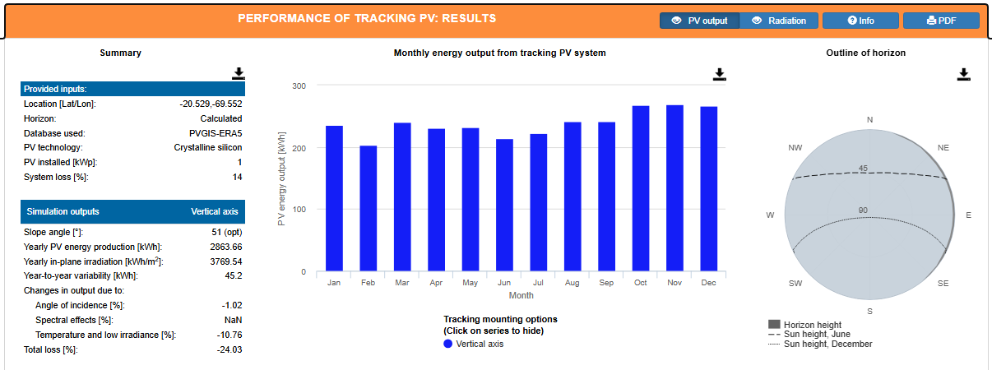
Chile with Tracking
Chile
In plane radiation of 3,769 for a capacity factor of 43%

Slide 28
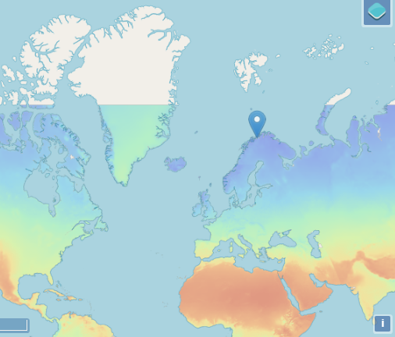
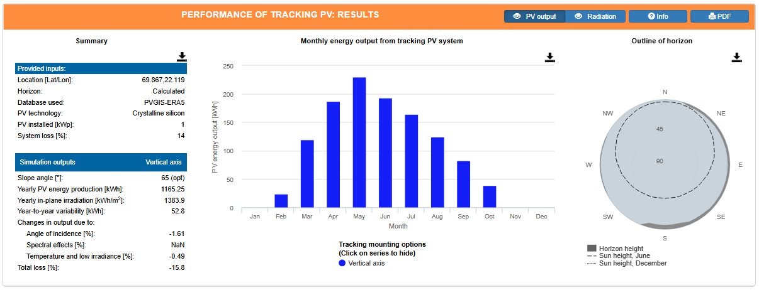
Norway with Tracking
.
The capacity factor is 15.8%

Slide 29
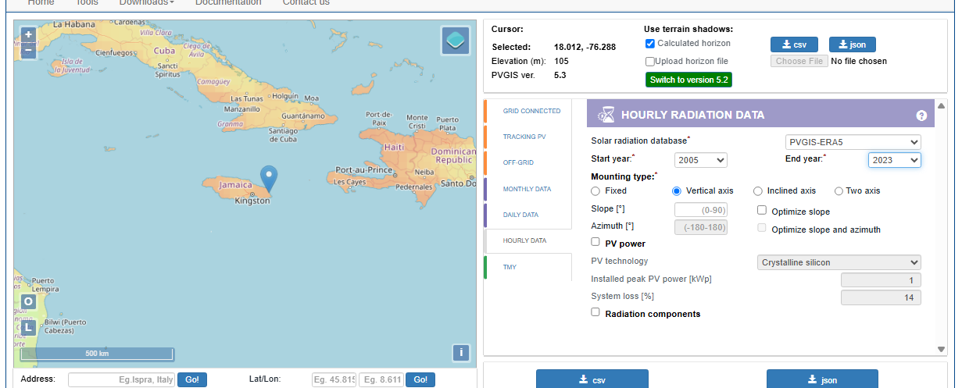
The Real Value of PVGIS is the Hourly Data
Can get multiple years and evaluate changes over time. Then download the CSV file.

Slide 30
Solar, STC and Capacity Factor
Work through efficiency and capacity factor
Begin with the irradiation in watts/m2
Need to work with dates
Can compute the capacity factor before adjustments for performance ratio.

Slide 31

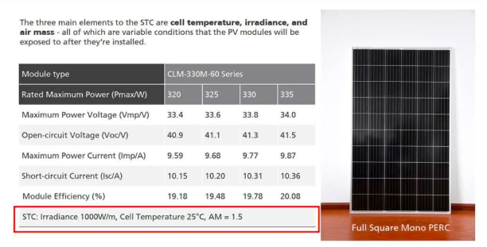
kWp Benchmark from STC – 1000 Watts/m2 and 25°
In most projects, you have some kind of benchmark to measure capital costs
For example, in real estate, the cost per square meter
In solar the amount you produce depends on sunlight and how you configure the solar project.
Standard Testing Condition (STC) is used with a flash test to create a benchmark test for a panel (kWp or kWdc).

Slide 32
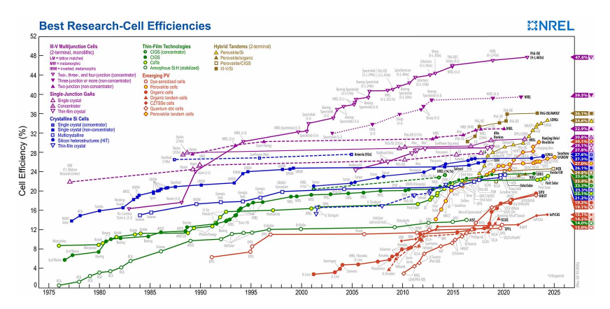
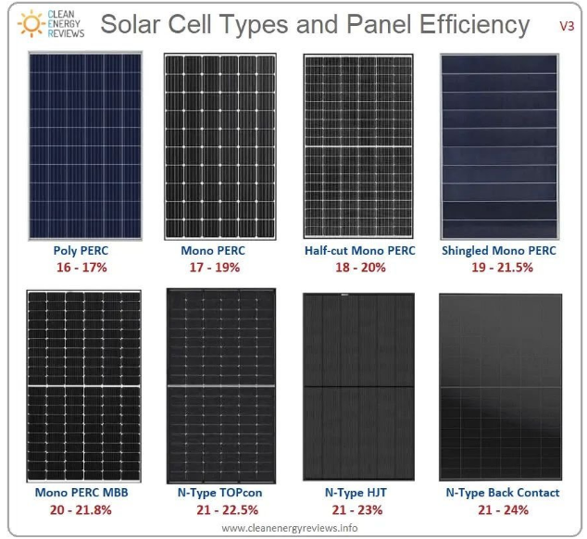
Efficiency of Solar Panels
Confusion of efficiency

Slide 33
STC as Capacity and Efficiency and Cost per Unit of Output not Input
Low Efficiency
STC 1000 Watt/m2
Efficiency 16%
Production at 1000 W – 160 W
Cost per kW - $100
Total Cost for 1 kW= 160,000
Purchase 1000 watts = 1kW
Production at STC Hour = 160 watts
Cost of 160 watts = 160,000
Capacity factor and yield can be based on the kWp after efficiency which would be the same as if you used irradiation. For example, if the irradiation for four days is 0, 500, 1000 and 500. The average is 2000/4 or 500 or a capacity factor of 50%. If all of the numbers are multiplied by the efficiency, the capacity factor is the same.

Slide 34
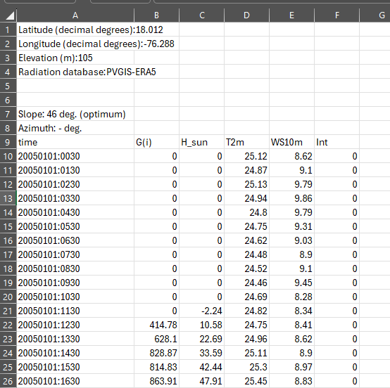
Only Four Pieces of Hourly Data, But Magnificent
Raw data
G(i) is radiation
H_Sun is height of sun
T2m is ambient temperature
WS10 m is wind speed
Could evaluate solar and impact of temperature
Could compare wind to solar by hour
Coud evaluate variation in solar by hour
Could evaluate variation by year

Slide 35
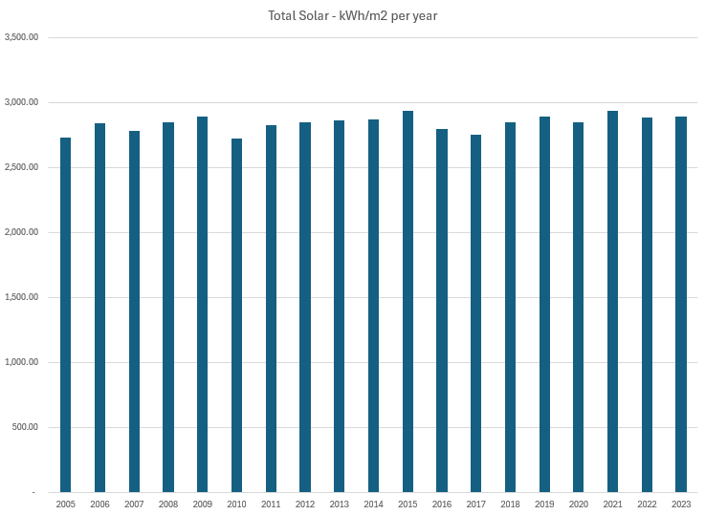
Average Solar by Year – Little Variation
.

Slide 36
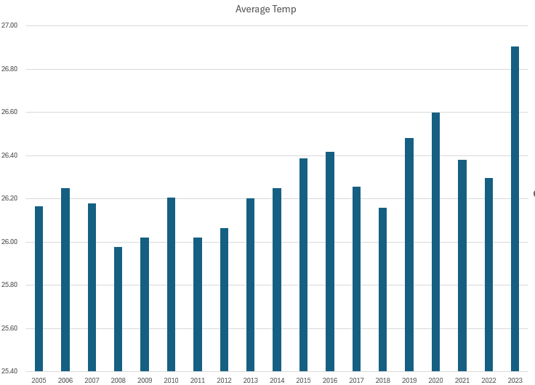
Average Temperature by Year
.

Slide 37
To Model Base Load, Open File to Include Batteries in Hourly Analysis
Use Case with Surplus Renewable Energy
Adjust Solar for more detailed analysis of performance ratio and temperature
Use hourly solar and wind with load curves and test the effectiveness of batteries in alternative cases with rainy days and so forth
Incorporate the battery into the LCOE analysis
Compare overall costs of solar and battery with other alternatives

Slide 38
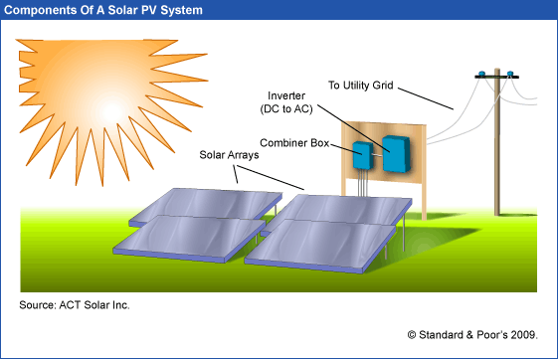
What you Can and Cannot Control
Sunlight, clouds, earth position – things that come from above. In-plane irradiation (effective irradiance on collectors)
Capacity Factor of Generation to Grid relative to kWp
Performance Ratio is final output including controllable and non-controllable divided by the non-controllable from above
Controllable – type of panels, cleaning, wiring, inverter size, tracking …

Slide 39
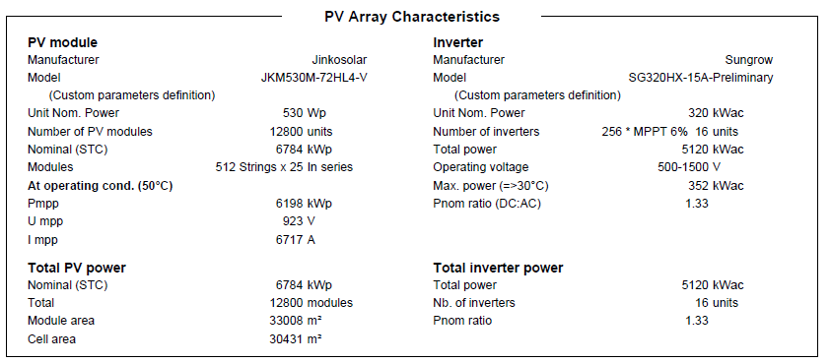
Inputs from PVSYST Example
.
5,120 MWac
6,784 MWp
75% Ratio
33,008 meters for 6.784 MWp or 33,008/6.784; 4,865 m2 per MWp; Football field assumptions – 50 x 150 meters = 7,500 m2. 1 MW is 4865/7,500 = .64% of a football field. Or, 7,500/4865 = 1.54 means a football field gives you 1.54 MWp.

Slide 40
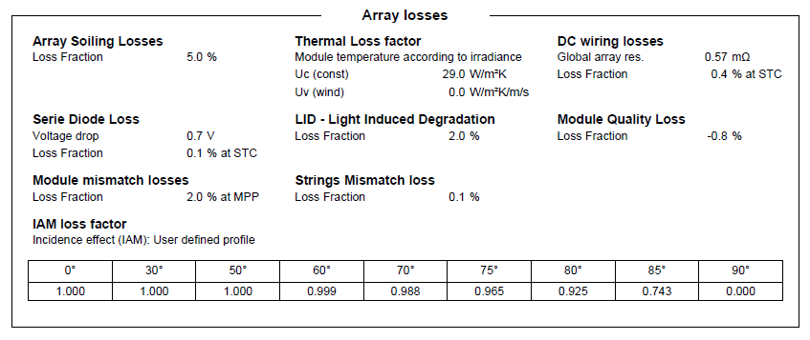
Loss Factors in PVSYST
To understand solar I think you should replicate PVSYST by yourself.
You need data on the various loss factors, the temperature coefficient and the AC/DC Ratio

Slide 41
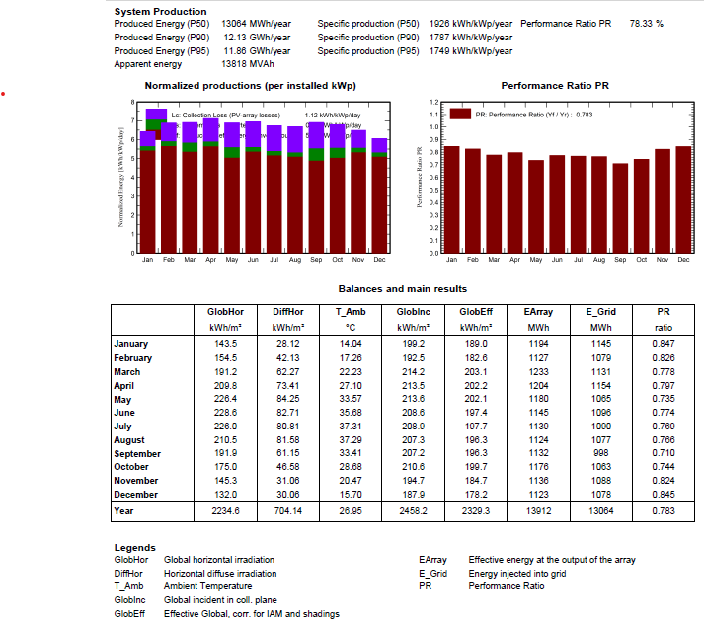
Performance Ratio by Month
Capacity for Radiation on Plane – 2,458 kWh per m2. With STC of 1,000 the capacity factor is 28.06%
Final Capacity factor. Generation kWh is 13,064. Capacity in MWP is 6,784, Average Production is 1,491 kWh. Capacity Factor is 21.97%.
Performance Ratio is Final Capacity Factor Divided by Gross or
21.97% divided by 28.06% or 78.3%
.

Slide 42
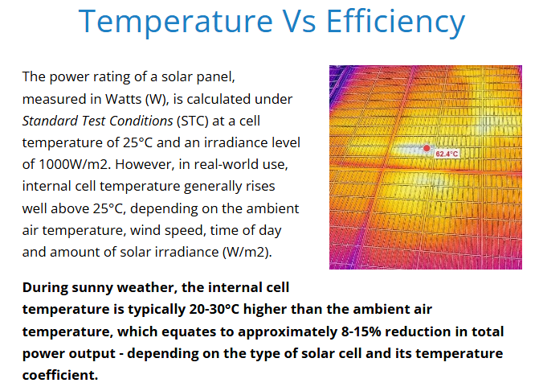
Idea that cannot use Ambient Temperature
.

Slide 43
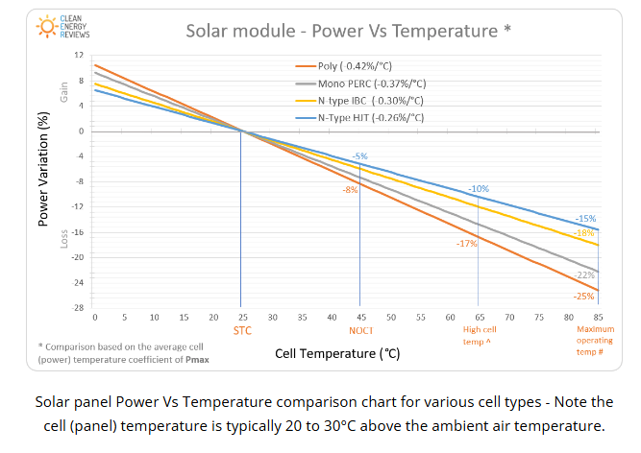
Solar, Temperature and Performance Ratio
Temperature coefficient
Note that 20 to 30 degrees above the ambient temperature

Slide 44
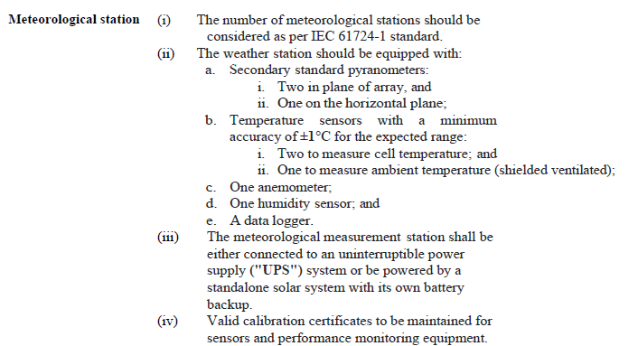
Detailed Weather Measurement

Slide 45
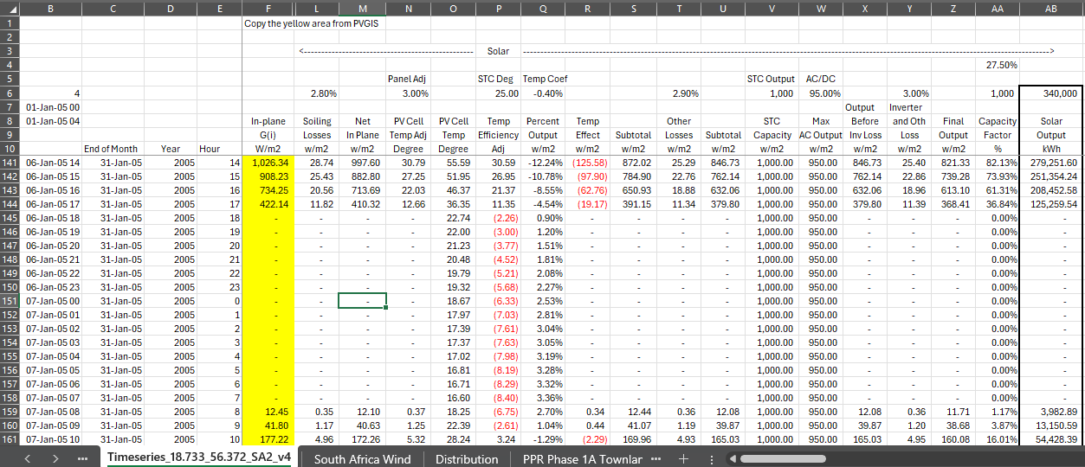
Detailed Solar Analysis with Temperature Adjustment
.
Find the file named hourly equations

Slide 46
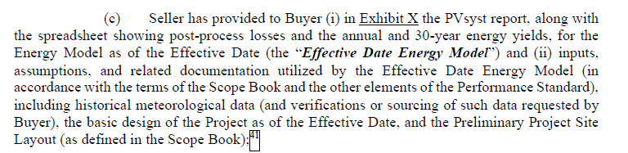
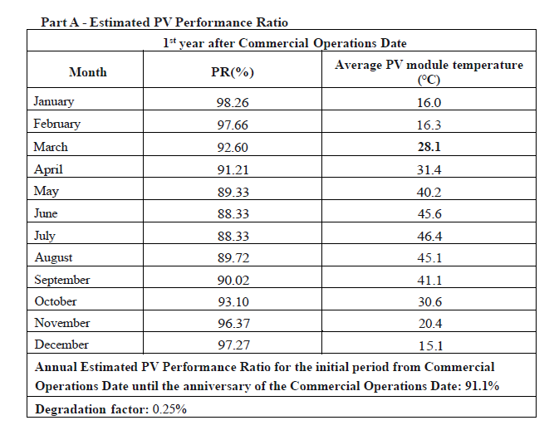
Providing PVSYST Report in PPA
.

Slide 47
Detailed Formulas for Solar with Performance Ratio
Soiling Losses = Soiling Percent x In Plane Radiation
Net In Plance radiation = Gross In-plane Radiation – Soiling Losses
Pantel Temperatre Adjustment = 3% x Gross In Plane Radiation
Temperature on Pantel = Temperature + Panel Adjustment Temperature
Temperature versus STC Temperature = Temperature – Temperature on Panel
Efficiency Effect of Temp = Temperature Coefficient x Temperature Difference
Temperature Effect = Efficiency Adjustment * In Plane Radiation
Subtotal = Irritation – Losses – Temperature Effect
Other Losses = Other Loss Percent x Other Loss Percent
Subtotal = subtotal – Other Losses
Irradiation STC = 1000
AC/DC ratio = AC percent x ADC
Output before Loss = Minimum (AC Output, subtotal)
Inverter Loss = Output before loss x Inverter Loss Percent
Compute financial capacity factor as percent of STC

Slide 48
Incorporate Detail of Solar
Add 15 columns
Soiling Loss Assumption: 2.8%
Factor for Increase in Temperature on Panel (% of irradiation) – 3%
Temperature Coefficient Percent Efficiency/(Panel Temp-25): -.41%
Other Wiring Losses: 2.9%
AC to DC ratio: 80%
Inverter Losses: 3%

Slide 49
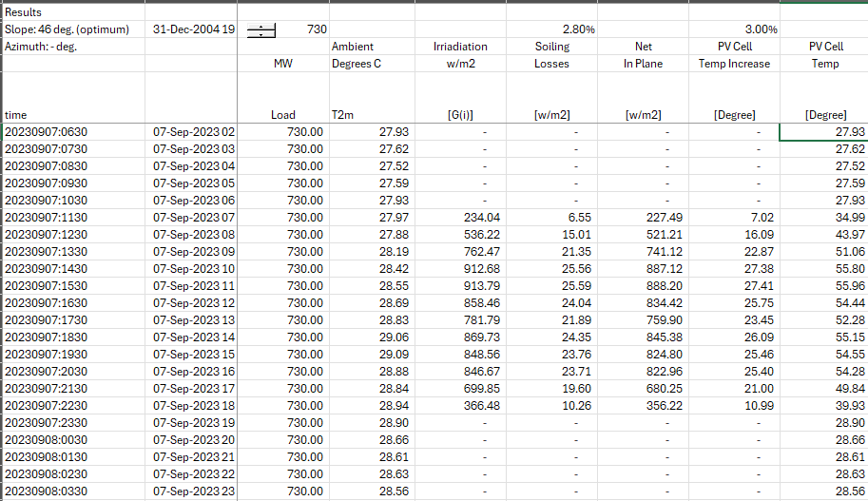
Cell Panel Temperature from Ambient Temperature
Note that results in 20 to 30 degree adjustments.
Use Homer Method with 3%

Slide 50
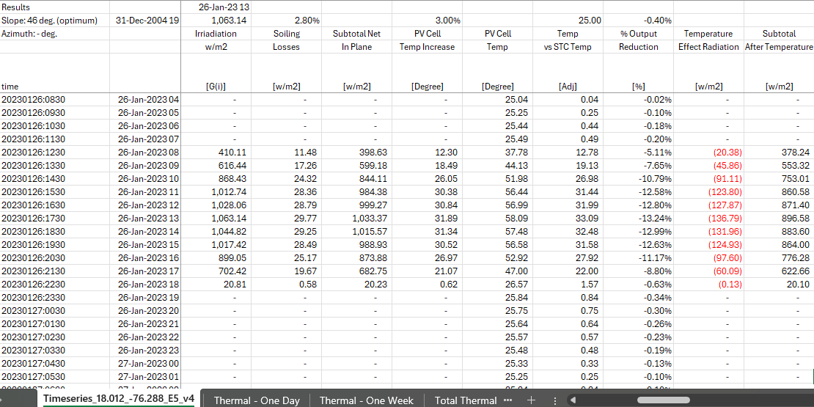
Temperature Adjustment with Temperature Coefficient
Use PV adjustment of -.4%
Note that never come close to 1,000 STC; this is reason for the AC/DC ratio

Slide 51
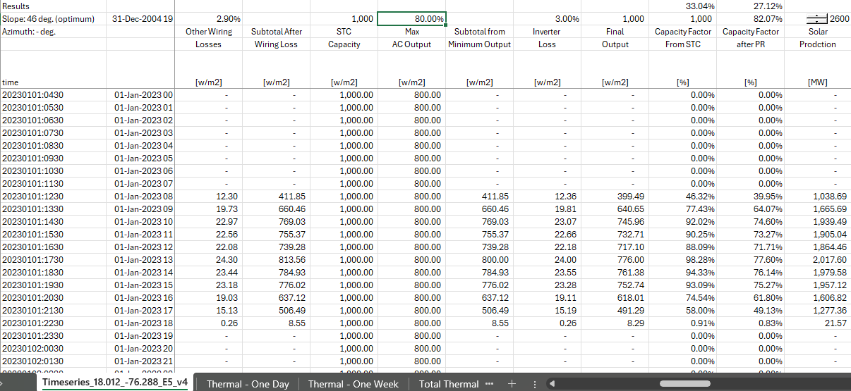
AC to DC Ratio and Performance Ratio
Can compute the remaining output subject to the maximum output from the size of the inverter

Slide 52
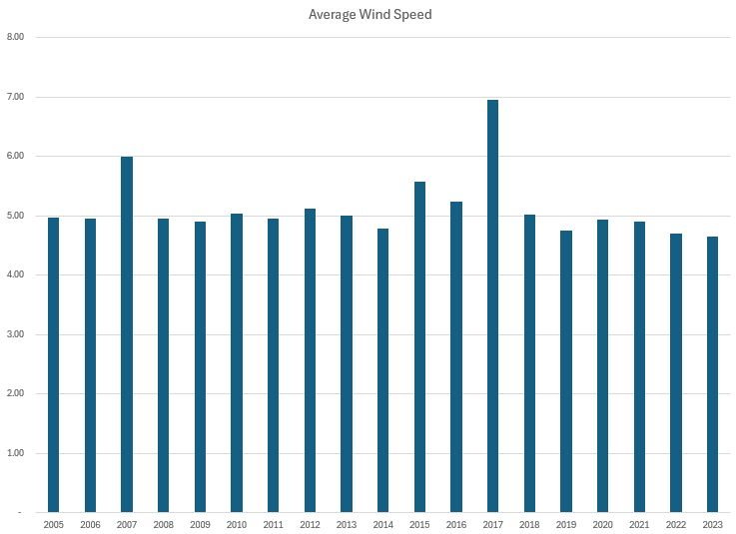
Evaluation of Annual Wind Speeds
.

Slide 53
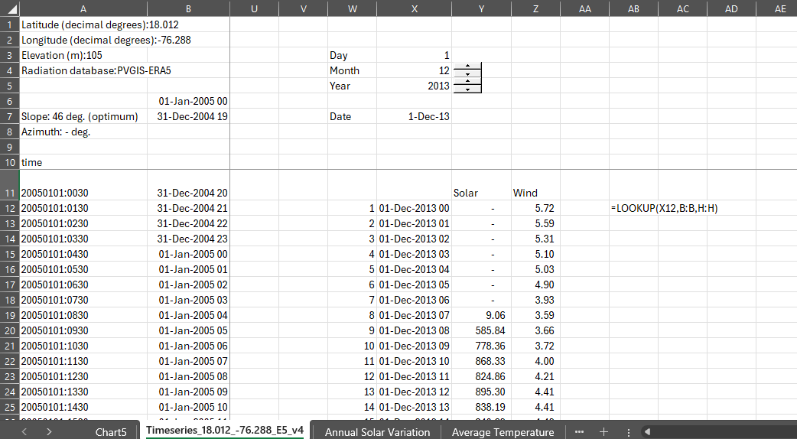
Hourly Analysis with Wind and Solar – More Relevant for Batteries
Mechanics – 1 Week of Data
Use Lookup and 1/24

Slide 54
Solar Patterns in Northern Nigeria

Slide 55
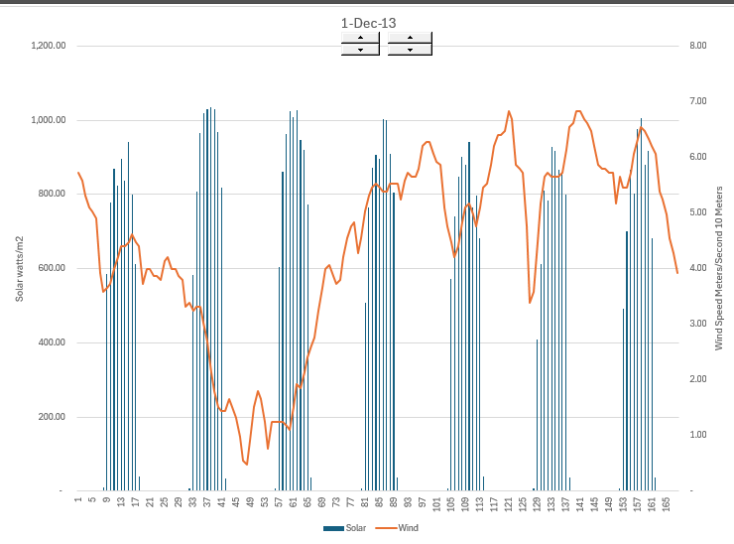
Illustration of Variability and Need for Ancillary Services – Stable Solar Period
.
Batteries needed for sudden changes in wind speed

Slide 56
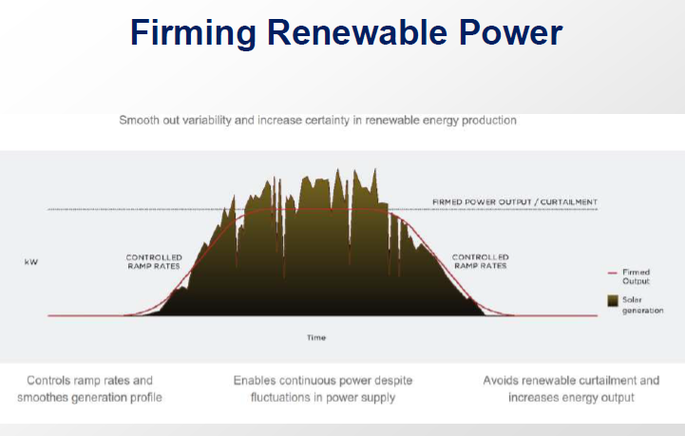
Hourly May Mask Shorter Term Variability
.

Slide 57
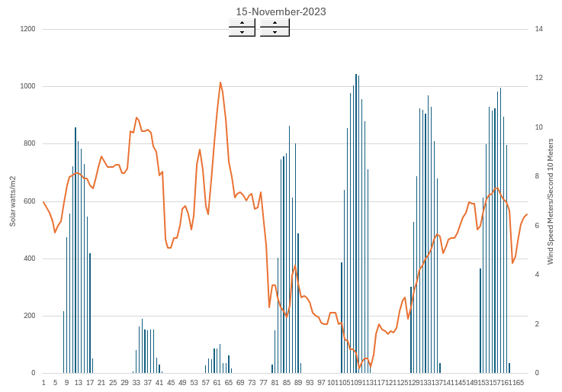
Hourly Soar and wind – A couple of Rainy Days, But Some Diversity
.
You need a lot of battery storage to meet the rainy days

Slide 58
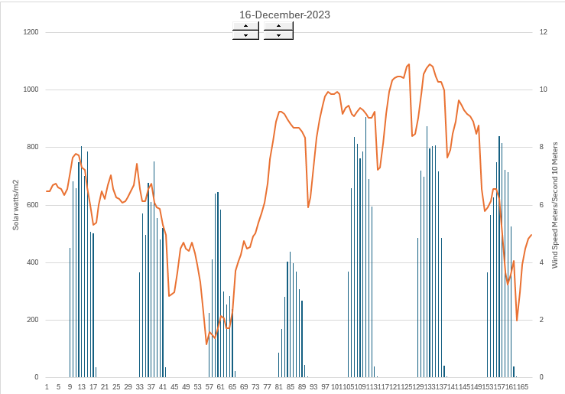
Hourly Solar and Wind – Sudden Moves and Low Irradiation
.
Note the sudden change in the solar on the third day – need for ancillary services as no inertia in solar

Slide 59
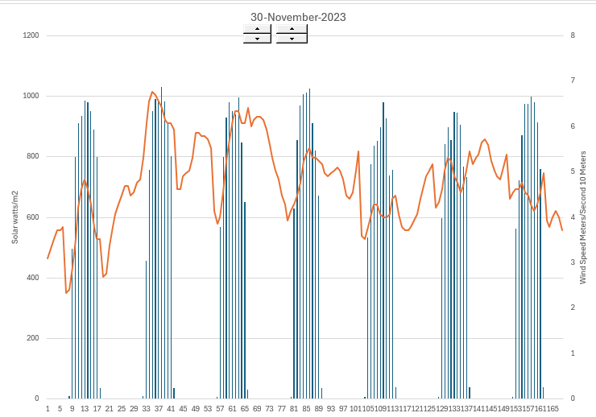
Hourly Data – Stable Solar near Irradiation STC and Relatively Stable Wind
.

Slide 60
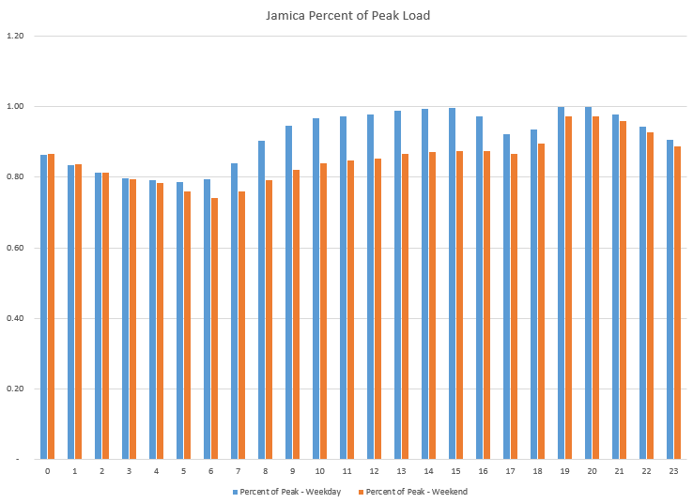
Combine Loads with Solar – Jamica Loads
.

Slide 61
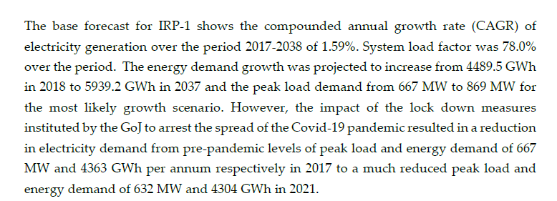
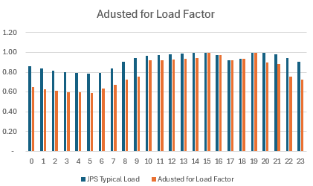
Load and Load Factor
.

Slide 62
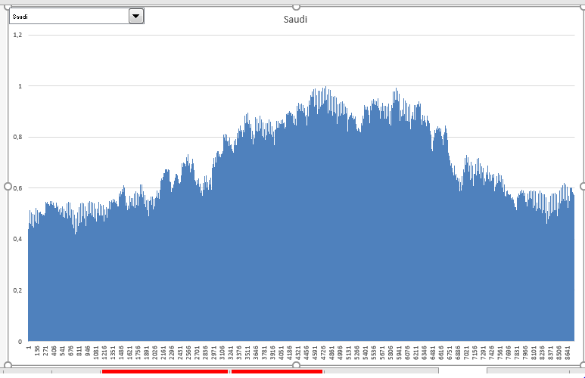
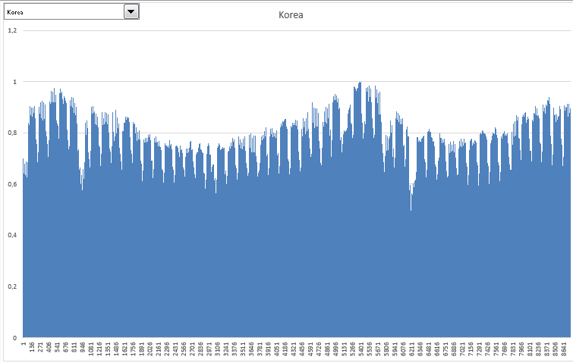

Example of Load Data - Predictable

Slide 63

Creation of Hourly Loads to Compare to Solar, Wind and Operation of Thermal
.

Slide 64

Solar Capacity Factor and Production with Different Solar Capacity

Slide 65
Wind Capacity Factor and Production
Compute wind at higher heights using wind shear
Combine the wind after wind shear with the power curve for capacity factor
Multiply the capacity factor by the assumed capacity to calculate generation
Adjust the generation for losses from wake effect etc.

Slide 66
Calculation of Wind Shear Exponent
.
Calculation of Wind Shear Factor Using Logs – the difference in wind speed on the top in the numerator and the height in the denominator.
v2 is wind speed at high height
Z2 and z1 is the height in meters
10 meter 5.13
100 meter 8.21
Begin with 1/7 power law – alpha = .142; but not good enough for site specific applications

Slide 67

Wind Shear Estimates
Alpha = .17
v2 =8
v1 = 6
z2 = 100
z1 = 50
Derive the alpha from the chart below

Slide 68



Get the 10 meter and different heights
Latitude 18.7333729
Longitude 56.372223

Slide 69

Errors in Wind Shear
Wind shear is the variation of wind speed with elevation. It is important to understand because it directly impacts the power available at different wind turbine hub heights.
For the site with the most complex terrain, the average annual wind shear varied up to 7% between different years.
For fairly flat terrain, many investigators have used the one-seventh power law, where α = 1/7 = .143

Slide 70


Relationship between Resource (Wind or Solar) and Energy Output

Slide 71

Power Curve Normalisation
http://www.thewindpower.net

Slide 72


Estimation of Production after Losses with Resource Study
For any renewable energy project, a resource analysis is made. For wind projects this is based on an assessment of local wind speed and the wind power curve.
The output from a resource study can be expressed as a capacity factor (average/maximum). In the example, 340.3 x 1000/8760 is the average and this average divided by the 94 capacity gives the capacity factor.
The resource study also gives probabilities of downside cases which is essential for banks. The P99 one year capacity factor is 31.1%

Slide 73

Estimation of Wind Capacity Factor
From study of wind in Jamica

Slide 74

Calculation of Hourly Wind Production
.

Slide 75

Graph of Dispatch without Renewable – One Day, Very High Loads for Illustration
.

Slide 76

Thermal with Typical Weekday
.

Slide 77

Graph of Dispatch without Renewable – One Week
.

Slide 78

Duck Curve and Solar
.

Slide 79

California Duck Diagram and More Extreme Need for Ramping and Spinning Reserve

Slide 80

Duck Curve and Prices – Peaker Application

Slide 81

Example of Economics – 2.7 Hour Battery to Address the Duck Curve
Alternative is to have gas capacity available and running the whole time

Slide 82

Illustration of Duck Curve with Solar and No Wind in – One Day with 100 MW
No Big Deal

Slide 83

Illustration for a Week with 100 MW Solar
.

Slide 84

One Day with 500 MW of Solar – Turn Off HFO (Not Really of course)
.

Slide 85

One Day with 1,00 MW of Solar – Turn off and On Thermal
.

Slide 86

Week with Rainy Days

Slide 87

Wind (300 MW) and Solar (500 MW) for One Day
.

Slide 88

Wind (300 MW) and Solar (500 MW) for One Week
.

Slide 89
Section 1, Part 3 – LCOE of Solar/Wind plus Storage

Slide 90


Solar History: 2000’s and Feed-in Tariffs - German Solar Feed-In Tariffs and Managing Risk
The left-hand scale represents feed-in tariffs meaning that if you put a meter next to your solar project and record the MWH generation, you get paid for that generation. The right-hand graph shows market prices (with correlation to gas prices). The y-scale is the same for both graphs. Comparing the blue bars on the left to the blue line on the right illustrates the magnitude of the subsidy in the feed-in tariff.
The feed-in tariffs were very simple contracts enabling companies to secure financing. The feed-in tariffs were supposed to encourage cost declines from scale, and they worked very well. There have been solar projects with contracts of around 1 Euro cent per kWh

Slide 91


Revolution in Solar Module Prices and the Price of Polysilicon

Slide 92


Examples of Low Solar Prices
To see how far things have come, there are many projects now that are lower than 2 USD cents per kWh.

Slide 93

Dramatic Bids for On-Shore Wind (Bloomberg)
There are dramatic low-cost projects
Depends a lot on the capacity factor
Low Costs Drive by Capacity Factor Differences
Estimating Capacity More Difficult

Slide 94


LCOE Comparison
Disagree with IRP Comment about WACC

Slide 95

Example of LCOE Calculation
Very Simple – Please Learn this

Slide 96



Solar LCOE for Comparison
.

Slide 97

Actual Case – Financial Model
.

Slide 98

O&M Costs and Capital Expenditures
.

Slide 99

EPC Contractors to Achieve Low Cost
.

Slide 100

A very Dangerous Idea in the IRP
.
Cost of capital is not very important in thermal because most costs are fuel cost
For renewable energy without fuel cost the cost of capital is very important

Slide 101

Real World Minimum Acceptable Target IRR
In practice there is no CAPM and certainly no un-levering and re-levering of Beta (see the discussion at the end).
In practice, equity IRR is used rather than project IRR as a target (this makes sense in theory as project finance implicitly adjusts for risk
In practice, and there are general standards for target IRR on buying and selling of projects. These standards have change over time. Pre-Covid for projects in Europe with a few years of history, equity IRR targets were as low as 4%.
I have been told stories of insurance company executives and pension plan managers going around Europe holding suitcases of cash to buy solar and wind projects with operating history.

Slide 102

This Caribbean Project is Really Disgusting
How much is the padding; What is debt to capital without the added costs

Slide 103

Simple LCOE Calculations and Drivers – Solar Cost
.

Slide 104

Simple LCOE Calculations – Four Hour Battery
.

Slide 105

Solar Plus Battery – Big Range in LCOE
.

Slide 106

Cost for Baseload with 18 Hour Battery
.

Slide 107

Can Get Solar at 2 US Cents per kWh so why can’t Jamica
Uzbekistan proof of solar power cost
Uzbekistan sovereign rating
Uzbekistan solar power resource

Slide 108

Selected Graphs of Historic Capacity Factors for Orsted Projects – Mean Reverting Case
I have used the data provided by Orsted to compute and present capacity factors for different cases. This data highlights financial risks that investors are concerned about. The first case for an off-shore plant in the UK with a lot of history demonstrates a situation that should not be of concern. There is variation in the capacity factor, but this variation does not have a trend, and it is mean reverting. For valuation you should be much less concerned about mean reverting cash flow.

Slide 109

Drop Off in Capacity Factor for German Project
The second example I use is a case of a German project. If you were making a valuation of the project, would you use the average or the recent data (I would use the recent data). There has been discussion of global warming having an important effect on wind speeds in different locations.
Note that the lower capacity factor in the initial year is expected.
This worrisome trend appears in other German projects as well.
The lower capacity factor could also be the result of transmission constraints.

Slide 110

Pricing Regimes for Orsted’s Non-UK Offshore Wind Projects
After disaster with the Ocean Wind Project, Orsted just began publishing prices for different projects. Most of the projects have feed-in tariffs. Note that the highest prices are in Taiwan and in US (in Taiwan the capacity factor is low). The lowest prices are the recent fixed price contracts in Poland. Most contracts have some merchant price exposure.

Slide 111

UK Renewable Obligation Certificates (ROC) and CFD
The UK attempted to base subsidies from a market basis where suppliers are given targets and the subsidy required to meet the target is applied to different renewable energy projects. As different renewable energy technologies have different costs, the amount of ROC’s depends on the type of technology. The table shows the renewable energy subsidy (which is above the market price) for different periods.
The UK has moved to a bidding system where total prices are fixed (with inflation indexes). The fixed prices are like forward prices and termed contracts for differences discussed below.

Slide 112




Example of Feed-in Tariff Calculation
Note the return on equity target of 11.5%

Slide 113

LCOE So Far With More Advanced Equations
.
The more advanced equations include real versus nominal and degradation

Slide 114
It Should be Obvious that One Should Compare LCOE of Renewable and Thermal Plants
If you build a solar project the LCOE is the effective amount you pay for the solar project is the amount for when you use the solar project.
Assume that you still need the combined cycle or the heavy oil plant to meet load at night and when the sun does not shine.
You could then do economic analysis by comparing only the variable cost of operating the thermal dispatchable plant per kWh with the total cost of the solar project.
You should be very careful with variable O&M costs of thermal as there will be more starts and stops
This kind of analysis works if the thermal plants are running during the time that solar or wind is producing power. It does not work if the plants are turned off and batteries are necessary for allowing the plants to turn on and off.
When there is more renewable energy, you need to understand how the thermal plants will work.

Slide 115


Thermal Fuel Prices in IRP and Annual Report

Slide 116

Natural Gas Price History
.

Slide 117

Levelised Cost of Dispatchable Plants and Variable Cost
Comparison of real LCOE for Renewable with Fuel Prices/kWh
.

Slide 118

Solar and NGCC Fuel Cost
.

Slide 119


Section 1, Part 7 – Myth of Using Batteries for Multiple Uses
South Africa Mine Case

Slide 120



South Africa Tariffs – On-peak vs Off-Peak
.

Slide 121
Bill for Different Periods
.

Slide 122

Move Power to Off-Peak
Load profile to Move

Slide 123

Need Hourly Analysis
Require a battery for the entire period
.

Slide 124

Battery Simulation
.

Slide 125
Equations for Battery without State of Charge Limitations
Starting Balance (MWh)
Add: Charging subject to Maximum Capacity (MW)
Less: Losses from Round Trip Efficiency (MW)
Less: Discharge subject to Battery Balance (MW)
Closing Balance (MWh)
Define capacity as MWh
Can make limit on MW charge and discharge
Can use to evaluate best size of battery

Slide 126

Cost and Benefit Analysis – Cannot Combine the Frequency and the Storage Savings
Compare the Cost and the Savings
Frequency Problems at Mine and Lose Power
Value of Frequency versus On and Off Peak

Slide 127



Point of Case – Cannot Add Applications
.

Slide 128
Section 2: Battery Characteristics and LCOE of Renewable Plus Battery

Slide 129
Session 2: Battery Characteristics and Economic Analysis
Cost as a Function of both Storage Capacity and Charging/Discharging
Battery Lifespan Driven by the Number of Cycles
Operating and Maintenance Cost of Batteries
Battery Degradation
Round Trip Efficiency
State of Charge
These factors are necessary to carefully compute the LCOE of renewable plus storage in different cases

Slide 130
Diagram of Battery Capacity, Storage and Energy
The diagram below of a water tower illustrates the issue of capacity storage and energy. In determining how much storage or ancillary service you need, should you use:
  The maximum amount of electricity that can be sent to the battery or drawn from the battery at any instant, measured in kW.
  The maximum amount of energy that you can take from the battery – the discharge -- over a cycle (e.g., a day) measured in kW x time of discharge or kWh
  The maximum amount of energy that you can send to the battery over a cycle – the charge – measured again in kWh.

Slide 131

Battery Capacity and a Water Tower
The issue of capacity is illustrated by picture of a water tower below. The capacity to charge or discharge in an instant is illustrated by the pipe leading up to the storage tank.
The amount of energy from one charge is illustrated by the size of the tank.
Think of the pipe as how long it takes to discharge

Slide 132


Capacity and Storage of Batteries - Think of a Battery Like a Water Tower or a Warehouse
kwh
The pipe is the capacity at any instant. If this pipe capacity is 100 kW, then in one hour, the maximum that can be charged or delivered in one single hour is 100 kWh
The storage tank is the number of hours that be stored and then delivered. It is measured in kWh. If the capacity is 100 kW and the storage is 4 hours, then the kWh is 400 kWh.
Bigger Spout gives faster water
kw
In the warehouse, the movement in and out is the capacity (kW) – how many boxes in and out. The time in storage is kWh – you need the space for the boxes.

Slide 133

Different Capacity and Energy of Different Batteries
Hours of storage is kWh/kW
Compute the kW/kWh
Need to Charge Fast
Length of Storage more Important

Slide 134

Time and Batteries
.

Slide 135

Capacity in kWh
You can multiply the voltage by the hertz

Slide 136

C-Rate and Capacity
..

Slide 137

Battery Size for Ancillary Service
With AES developed a 2-MW, 500-kWh system with the capability of producing 1,000 amps at 1,000 volts that was designed and built to fit inside two 53-foot trailers for ancillary services

Slide 138

Picture of Large Lithium Facility in U.S.

Slide 139

Cost in Jamica
Cost per kW and per kWh
What is the Cost per kWh
.
.

Slide 140

Battery Components
.

Slide 141

Elephant in the Room
In can be cloudy for many days or it can be dark in the winter for weeks. You would need much more than a few hours of storage.

Slide 142
Characteristic 1: Battery Cost

Slide 143
Section 2, Part 1 – Battery Cost Trends and Information
Big Theme – Difficulty of Finding Reliable Information on Battery Cost
Trends in Capital Costs and Learning
Contracts for battery capacity with guaranteed life and capacity
Cost of warranties
Adjustments and Distortions from Required Augmentation to Meet Capacity Requirements

Slide 144
Cost per kWh of Batteries
Benchmark is cost per level of storage rather than the cost per level of capacity as with other technologies.
For the same level of storage, if you have relatively more capacity, the cost should be higher because of fixed costs.
Costs of retail storage at households per kWh are more than large storage systems for lithium batteries

Slide 145

Range in Cost from Lazard
.

Slide 146

Battery Components Estimate (2024 Presentation)
.

Slide 147

Cost Estimate from IEA
.

Slide 148


Cost from Lazard
Efficiency 91%
Depth of Discharge 90%
Degradation ?
Fixed Cost/kWh 1.3
Life 20 years
Cycles 350 x 20 = 7,000
Initial Cost USD 292/kWh

Slide 149

Recent Cell Price Price

Slide 150

Adders to Battery Cell Price

Slide 151

Components of Battery Cost
Note in this slide that the duration is one hour

Slide 152

Historic and Projected Price of Lithium

Slide 153


Bloomberg Battery Prices and Lithium

Slide 154


Battery Costs and Duration
Battery costs vary significantly by system specifications
For modeling purposes, costs are commonly broken into two categories
  Costs that scale with power (“capacity”), quoted in $/kW
  Costs that scale with energy (“duration”), quoted in $/kWh
Battery modules are the largest and best understood component of system cost and the one that scales most linearly with duration
  Each kWh of duration adds around $300 today, but is declining rapidly
Fixed capacity cost including inverter and interconnection varies significantly by report
  For storage paired with solar, these costs may be minimal
Utility-scale 4-hr Battery Cost by Component
Utility-scale Battery Cost by Duration

Slide 155

Cost per kWh is not Constant
The chart below implies that there is value for capacity and for storage. If the lines were flat there would be no premium for capacity relative to storage.

Slide 156

Economies of Scale for Batteries (DOE Study)
You can plug in the MW and derive the cost per kWh the Graph is for 2020 estimates

Slide 157
Cost of Cobalt and Lithium Batteries
This is the metal driving li-ion's high cost far more than lithium itself.
Cobalt acts as the negative cathode of a lithium battery and makes up a much larger portion of the battery by volume.
Cobalt is a lot harder to get than lithium.
This is because the metal is largely mined as a byproduct of other metal mining operations. Because of this, there are a limited number of mines that safely and reliably produce the metal.
That puts the world's supplies in a pretty risky position...
The vast majority of the world's cobalt supply comes from the Democratic Republic of Congo. Last year, the region produced 66,000 tons of cobalt. The next-largest producer, China, followed with just 7,700 tons for the year.

Slide 158

Cost Trends
Expect larger change in Flow Batteries than in Lithium. Note that in this slide the assumption is 4 MW and 16 MWH or 4 hours of storage.

Slide 159
Characteristic Number 2
Operating Life

Slide 160
Section 2, Part 2 – Battery Lifespan
Importance of Lifespan Issue
Define cycle
Depends on number of cycles
Battery life management

Slide 161
Lifespan and Cycles
Lithium batteries generally last longer and perform better than other types of batteries. Like lead-acid batteries, for example.
Lithium batteries currently have the longest lifespan of all available deep-cycle batteries. Many can last between 3,000 and 5,000 partial cycles. For comparison, lead-acid batteries typically give 500 -1,000 partial cycles.
Partial cycles refer to draining the battery and then recharging it. If you charge the battery and then discharge it at half its capacity, that would be a half cycle. Let’s consider a side-by-side or boat powered by a lithium battery that’s recharged once a day. This means that the battery should last for more than 3,000 days, which is over eight years. (3,000/365=8.22)
That’s a fantastic lifespan! By doing a few calculations, you can get a better feel for how long lithium batteries can last for you.

Slide 162
Battery Life of Laptop
The battery doesn’t hold a charge
On average, a laptop battery has a lifespan of between two and four years (around 1,000 full charges). Total lifespan depends on the battery type, how you treat the computer, and how often you use your laptop. Additionally, using demanding software programs, your computer reaching high temperatures, or long periods of non-use can cause the battery to lose capacity more quickly.
Batteries slowly degrade over time and with each charge-recharge cycle. To combat this, HP laptops are designed to discharge a small amount of power after fully charging. The battery starts to charge again when the charge drops to 95%.
Also, factors like display brightness, backlit keyboard, processing speed, and using external storage can have an impact on how long your charge lasts in the long term. Some users will even find that after a few years, their laptops no longer hold a charge at all.
You do have the option of buying a new battery for your laptop as well. However, if your laptop is older, chances are it has issues that go beyond battery life, so it may make more sense to buy a new laptop.

Slide 163

What is a Cycle

Slide 164

Definition of Cycle in RFP
India RFP

Slide 165

Lithium Battery for Storage and Augmentation

Slide 166

Lifespan from RFP and PPA
12 or 10 years

Slide 167

Some Estimates of Battery Life
.

Slide 168
Life and Discharges
The lithium-ion battery works on ion movement between the positive and negative electrodes.
In theory such a mechanism should work forever.
Cycling, elevated temperature and aging decrease the performance over time.

Slide 169

Battery Life and Lifetime Warranty

Slide 170

Degradation and Life
Can compute that annual degradation from this table.

Slide 171

Life of Cell Phones and Cycles

Slide 172
Battery and Cycle Life for Storage Applications
Home solar battery units last anywhere between 5 and 15 years.
Under NREL's scenarios, an energy storage system is expected to last between seven and 10 years. "Without active thermal management, 7 years lifetime is possible provided the battery is cycled within a restricted 47% DOD operating range. With active thermal management, 10 years lifetime is possible provided the battery is cycled within a restricted 54% operating range,"
This means that if you decide to install a solar battery today, it’s almost certain you’ll need a replacement in the future to match the 20- to 30-year lifespan of your solar power system.
The life expectancy of a solar battery is mostly determined by its usage cycles. Most solar batteries are generally deep-cycle batteries, which allows them to discharge up to 80% of their stored energy before recharging.

Slide 173
Battery Life for Different Types of Batteries
For larger off-grid systems lead-acid batteries are still one of the most trusted options as they are a well proven technology with a correctly designed system typically lasting 10-15 years.
Lithium-ion batteries on the other hand have cycles of between 1,000 and 4,000 cycles.
4,000 cycles/365 days = 10.9 years

Slide 174
Battery Life, Discharge and Depth of Discharge
Anyone who checks the analysis in greater detail recognizes that the price advantage of the lithium product is primarily due to the high number of cycles of 6,000 specified cycles (at 365 days, about 16 years).
These cycles are not guaranteed in the warranty terms. So, the question arises, what are 6,000 cycles good for if the manufacturer does not guarantee for them?
An analysis rates the lithium product at 3,650 cycles.

Slide 175
Life Comments from DOE Report
A range of cycle estimates was provided throughout the literature for lithium-ion of up to nearly 6,000 cycles with lower DOD (DiOrio et al., 2015; Greenspon, 2017). (6000/365=16 years).
  The analysis conducted here estimates that lithium-ion LFP can typically provide 2,000 cycles at 80% DOD, while NMC systems provide 1,200 cycles for the same DOD, due to positive electrode dissolution and associated increased capacity loss at the negative electrode. In the next phase, more detailed cycle life data for LFP and NMC chemistries will be obtained. For example, based on 70% capacity at end of life, lithium-ion batteries have demonstrated a cycle life of approximately 8,000 cycles at 80% DOD (R. B. Wright & Motloch, 2001).
The calendar life of lithium-ion batteries ranges with some stating > 5 years or as high as 20 years (R. B. Wright & Motloch, 2001) and others in the range of 5-15 years (Dubarry, Qin, & Brooker, 2018).
This report estimates a 10-year calendar life at 80% DOD, also assuming 5% of that time will also be allocated to downtime. A cycle life of 2,000 cycles for LFP and 1,200 for NMC is assumed with a 5% increase in total cycles each by 2030.

Slide 176

IEA Assumptions
Note the shorter life for batteries assumed by IEA

Slide 177

Comparison with Useful Life - MIT

Slide 178
Lithium-ion Batteries and Charges
Each battery is basically a crystalline structure.
  Each time you charge the battery; you add an electron or remove one from this structure.
  The fact that you modify the structure time and time again means you weaken it.
  You could compare it with bending a metal plate over and over again. At a given point, the plate will tear”

Slide 179
Batteries and Temperature
Temperature is a very important factor in the performance of batteries or power storage.
Narrow temperature windows for lead batteries +15 ° to + 25 ° Celsius or + 10 ° to + 30 ° Celsius limit the performance. As the temperatures get cooler, the capacity of the power storage decreases.
A study shows that lead-acid battery life is reduced by 50% when the temperature is 8.3 ° C above the specification level. There are serious increases in costs if the battery is working in high temperature ranges.

Slide 180
Battery Characteristic 3:
Operation and Maintenance

Slide 181
Section 2, Part 3 – Operation and Maintenance Cost
Costs of Batteries in Caribbean versus other Areas of the World
Costs of Cooling
Other Costs
Inclusion of Augmentation in Operating Costs
Sources of Information from Published Sources and Financial Models

Slide 182
Question About O&M Cost Components
Analysis of full O&M costs for battery energy storage systems (i.e. not just auxiliary power for cooling and servicing).
Best way to answer this is to examine financial models

Slide 183

O&M Costs
O&M Costs from DOE. With cost per kW can compare to the solar O&M. Careful with the variable cost per O&M – the cost of one cycle or the cost across the year.

Slide 184

O&M Components
.

Slide 185

O&M Cost From Lazard

Slide 186
Operating Characteristic Number 3
Degradation

Slide 187

Section 2, Part 4 – Battery Degradation
Battery Degradation
Changes in Degradation over Time
Degradation and end of life

Slide 188
Degradation, Depth of Discharge and Usable Capacity
How many kWh per cycle can be used by the battery?
Meaning how many kWh can be discharged from the storage.
The usable capacity of the battery storage degrades (decreases) the more frequently the battery is used. Depending on the number of cycles, degradation is between 2% and 4% per year.
The usable capacity differs from the nominal capacity or gross capacity because depth of discharge (DoD) limits the nominal capacity.
You can calculate the usable capacity by multiplying the nominal capacity and discharging depth (in%).

Slide 189

Degradation
Different batteries have different degradation.

Slide 190

Degradation and Age
Compute the implied annual degradation

Slide 191

Questions Regarding Degradation
Traditional lithium ion-batteries begin to degrade after a few hundred cycles of fully charging and fully discharging, or 1,000 cycles at most.

Slide 192

Degradation from Age and Cycling
For the annual battery degradation, the calendar capacity loss contributes more to the total capacity loss than the cycling capacity loss. The battery degradation can largely increase the energy consumption and GHG emissions of EV per km driven.

Slide 193

Implied Degradation and Augmentation from India RFP
Compute the annual degradation
Annual degradation
.7 = (1-annual) ^ (12)
.7 ^ (1/12) = 1 – annual
Annual = 1 - .7 ^ (1/12)
Annual =

Slide 194

Degradation, Cycles and Battery Life
.

Slide 195


Degradation in PPA
.

Slide 196
Operating Characteristic 5
Round Trip Efficiency

Slide 197
Roundtrip Efficiency
Efficiency is the charging and discharging efficiency or losses during cycle use. The kWh capacity is measured at the discharge.
The transfer of energy from one form to another (in the case of batteries from electrical to chemical energy) will always result in some losses.
Generally, charge/discharge losses from a lead-acid based battery is close to 20%
Most new lithium-based batteries can be as low as 2% but generally in the 5-8% range.

Slide 198
Implications for Round Trip Efficiency and Analysis
If the round-trip efficiency is 90% then to get 100 MWH you need to have 100/.9 0r 111.11 MWH of solar produced
You need also to increase the capacity of the battery to be able to input the energy
The minimum constraint on the kWh capacity should account for the round-trip efficiency

Slide 199

Differences in Battery

Slide 200
Round Trip Efficiency in DOE Report
With respect to RTE (round trip efficiency), the literature typically provided estimates between 77-98% (Aquino et al., 2017; DiOrio et al., 2015; EASE, 2016; Greenspon, 2017).
PNNL (U.S. DOE) testing of grid-scale batteries in the past yielded an AC-AC RTE of:
  83–87% over 1.5 years of testing,
  RTE for a battery > 5 years old was only 81%.
A system RTE of 86% was used in this work.

Slide 201
Characteristic 5
Depth of Discharge

Slide 202

Depth of Discharge
Depth of discharge affects the economics of a battery if the capacity stated in gross input kWh does not reflect the limitation.

Slide 203

Depth of Discharge and Lifetime in Cycles
Divide the cycles by 365
10,000/365=27 years

Slide 204

Depth of Discharge Limit
Should be included in excel table

Slide 205

Tradeoffs between Cost, Life and Depth of Discharge

Slide 206
Modelling Degradation in LCOE Calculation
Can model as the inverse of inflation
Adjusted IRR = (1+Base IRR)/(1-Degradation)
Also need an adjustment to O&M cost because the same O&M cost results in less production
Can use the formula
Adjustment Factor = PV(Adjusted IRR, Life, -1)/PV(Base IRR, Life, -1)

Slide 207
Battery Characteristics from Financial Models

Slide 208

Example of Simple Battery Model
Demonstrates crazy assumptions about batteries

Slide 209


Compute Key Valuation Drivers for Battery
From modelling test

Slide 210

Qcells Case
From Case Exercise
Cap Exp per kWh

Slide 211


US Comprehensive Model in California
.
Assume per year
Cost is very low

Slide 212


US Model for Solar and Battery
.

Slide 213

Total Capital Expenditures
.
Battery Cost – 306,827
MWH – 800
Cost per kWh -- $ 383.5

Slide 214


Mongolia Cost 2020
.

Slide 215

Mongolia Cost Components
.

Slide 216

Example of Battery Cost – Part 1
Note the lifetime and the battery duration
Also note the oversize

Slide 217

Example of Battery Cost – Part 2
Most of the cost is the battery management cost

Slide 218

O&M Cost
O&M cost 1.06% of total capital expenditure

Slide 219
Cost Targets for Flow Batteries
Capital costs for Flow Batteries are expected to be broadly similar to lithium-ion costs over the long term and at similar scale.
Most flow battery companies have $100 / kwh capital cost as a target in their minds or one that they’ve publicly talked about. (ARPA-E has used $100 / kwh as a target.)
Because a flow battery or compressed air system lasts for so many more cycles, the overall cost of electricity is likely to be many times lower.

Slide 220
Section 3: Computation of Levelised Cost of Electricity with Battery Storage for Different Use Cases

Slide 221
Section 3: Computation of Levelised Cost of Electricity with Battery Storage for Different Use Cases
Alternative battery cases including Ancillary Services, Peaker Replacement, Movement of Power to Nighttime Peak and Base Load Case.
Inclusion of batteries in LCOE with different assumptions for battery cost, battery life, battery degradation, battery round trip efficiency and battery dispatch
Case exercise with solar use case and battery implemented for ancillary services
Dispatch of Batteries in Alternative Contexts and Effects on LCOE
Risk Evaluation Using Break-Even and Sensitivity Analysis

Slide 222
General Discussion of Ancillary Reserves
Ancillary services are generators or other service providers that are synchronized to the grid and are able to rapidly increase output in three major categories: contingency, regulation, and flexibility reserves.
The contingency reserve requirement is assumed to be constant for all hours of the year and corresponds to a spinning reserve equal to about 3% of peak load and about 4.5% of the average load.
Another way to think of “spinning reserves” are the backup or redundancy built into the grid. Basically, we slightly overbuild the total generation needed so the grid can be provided with ancillary services making good quality power possible.

Slide 223
Case of Short-term Ancillary Services
Recall the firming of solar.
Assume limited storage for short-term fluctuations – 10% of Solar
Use a higher cost to reflect the higher kW relative to kWh – Assume $450/kWh to $550/kWh depending on the hours or minutes of storage.
Assume a lifespan of 10 years (discussion of the number of full cycles).
Use alternative storage amounts ranging from 15 minutes to two hours.
Assume the battery capacity is ½ of the solar project.

Slide 224

Storage Diagram
.

Slide 225

Time for Ramping Plant and Need of Batteries for Ancillary Service
.

Slide 226


Ancillary Services, Duration and Cycles

Slide 227

What Really are Ancillary Services
Which are affected by wind and solar

Slide 228
Value of Ancillary Service – Measure in Amount per kW-year and not per kWh
For a battery entering service in 2021 in the California ISO, PA Consulting projects a decline in ancillary service revenues:
  Over $70/kW-year in 2021,
  Just over $10/kW-year by 2027
  as California’s regulation and spinning reserve markets become increasingly saturated with new battery storage.

Slide 229

Mechanics of Battery and Solar Analysis
.

Slide 230

Capital Expenditures and Operating Expenditures for Computing LOCE
.

Slide 231

Computation of Nominal LCOE from Adding Puzzle Pieces
.

Slide 232

Computation of Real LCOE where the LCOE is Comparable to Today’s Electricity Price
.

Slide 233


Cost of Adding Battery with Short Duration for Ancillary Services
.

Slide 234


Cost of Adding Battery with Short Duration for Ancillary Services
.

Slide 235


Levelized Cost with Two Hour Battery
.
These cases are all less than the fuel cost of the combined cycle plant

Slide 236

Ramp Requirement and Increased Renewables

Slide 237

Variance in Estimated Cost of Ancillary Services

Slide 238
Comment – Extended Outages
A case comparison for long duration batteries during extended outages such as 8 hours or more.
Assume that this is like a peaking plant case
Could build a diesel plant or combustion turbine that will operate rarely
Need an assumption about capacity factor of peaking plants because of tradeoff between capital costs and energy costs. We make sensitivity.

Slide 239
Case Request is Something Like Two Rainy Day Case
.
You need a lot of battery storage to meet the rainy days

Slide 240
Assumptions for Peaker Case
Cost of Batteries with Long-term Storage
  Compute the Levelised Cost of a Peaker with ADO in Three Capacity Factor Cases; 3%, 5%, 10% and 15%
  Compute Required Discharge of a Battery for the Three Cases – Adjust for Round Trip Efficiency and State of Charge
  Battery kWh = Added kWh for Peaker
  Adjustments for Round Trip Efficiency – More Solar
  Adjustments for State of Charge – More Battery Capacity

Slide 241
Time and Batteries
.

Slide 242
Peaker Case Demonstrates Back of Envelope Case
A good traditional exercise in comparing fixed and variable costs
Forces you to think about batteries with low number of cycles
To get eight hours of battery you could use two four-hour batteries
For Battery with low cycles
  Long Life (20 years)
  Lower Cost with more storage (USD 300/kWh)
  Round Trip Efficiency does not matter if can charge in a flexible manner before outage
For the Peaker, use the most expensive fuel (ADO) and assume a relatively low capital cost
Do not consider cost analysis with effects of transmission and distribution

Slide 243

Comparison with Conventional Peaking Plants

Slide 244

Meet High Sudden Prices – Must Be Charged

Slide 245

Capital Expenditure for Peaker and Battery
.
All you really have to do is to look at the capital expenditures.
Even with positive assumptions the difference is dramatic

Slide 246

Energy Cost of Peaker and Battery – Much Higher with Peaker, But Low Capacity Factor
.
Assumes that cost of solar is 4 us cents per kWh

Slide 247

The Levelized Cost of Batteries is Double the Expensive Peaking Plant
.
Best to Look at the real levelized cost case below

Slide 248

Total LCOE at Higher Project IRR of 11%
Difference is more extreme with higher cost of capital

Slide 249


5% and 10% Case

Slide 250
Comment on BESS Mimicking Baseload
Cost feasibility of battery storage providing energy for more than 8 hours such that a combination of solar plus BESS can mimic a baseload system.
I love this question
Cost of Batteries with Long-term Storage
  24 Hours in a day
  Hours of Solar: Capacity Factor x 24 hours
  Target Hours of Added Generation
  Battery Hours = Added Generation Hours
  Adjustments for Round Trip Efficiency – More Solar
  Adjustments for State of Charge – More Battery Capacity

Slide 251

Illustration of Surplus Solar and Flat Loads
.

Slide 252
Modelling of Battery and Renewable as Baseload
Very Useful Use Case to think about the world
Question was for Solar without wind
Compute hours of solar per day
Derive remaining hours with battery
Account for RTE and minimum SOC
Evaluate Sensitivity
Note that Ancillary Service Battery is Not Added

Slide 253

Simple Case to Meet Flat 24 Hour Load
6.08 hours per day of solar
Means that 24-6.08 = 17.92 hours of added discharge of battery required.
Need to charge battery and account for the round -trip efficiency need more solar = 17.92/(.95)=18.86
Battery Capacity in kWh is 100 solar to charge x 17.92/SOC =
2,108 kWh
.

Slide 254

Simple Case Capital Expenditures and Operating Expenses
.
Assume USD 300 per kWh for battery cost because of high storage.
Capital Expenditures for Battery much more than Solar
Assume 2 per kWh for O&M

Slide 255

24 Hour Use Case Total Costs
.

Slide 256

24 Case with Sensitivity – Worse Solar Case
.
When storing more expensive solar, the cost increases to 19 cents

Slide 257

Increased Degradation with Worse Solar
The price increases to 19.8 cents per kWh.

Slide 258

Case with Increase in Battery Cost to $400/kWh
.The total LCOE Increases 24.36 cents per kWh

Slide 259

Optimistic Case
Cost Decreases all the way down to 6.7 cents per kWh
IRR decreased to 6%
Battery Cost USD 200/kWh
Battery Life 20 years
Degradation 1.8%

Slide 260

Case with 10 Hours Rather than 24 Hours
Uses Negative Solar Case. Note there is 5.22 hours of battery capacity.

Slide 261
Session 5: PPA Agreements with Renewable and Batteries

Slide 262
Comment on Integrated Models
Evaluation of Financing and Integrated Financial Models of Battery Systems is more around risk analyses and not really around financial analysis and modelling in relation to energy storage as the title implies. Can this section be modified to also include how a utility should go about doing the financial analysis and modelling so that the appropriate cost parameters be included in the PPA.
My comment
The LCOE analysis is all about

Slide 263


Can you Add Revenue Streams
Capacity Price and Artificial Markets
  When capacity is available, you can receive revenues no matter whether you use the capacity for revenues, this can be added
  Some ancillary services may be like capacity where if you have the service available, you can earn money whether you use the capacity to produce energy
Think of Firemen (Firehouse Effect)
  You pay them and need them to be ready
  But if they are putting out a fire, they cannot be used for another fire
  They receive capacity payments and must be available
  You cannot really pay them on the volume of fires the

Slide 264
Section 5, Part 1 – History and Objective of PPAs with Single Buyer
Theory of PPA agreements in the context of historic PPA agreements – capacity, availability, efficiency, risk allocation, capacity charges, coverage of variable charges
How to develop Battery Energy Storage Systems to provide ancillary market in PPAs (grid services provided load shifting, frequency and voltage management, spinning reserve management, inertia support, black start).

Slide 265
Some Historic Perspective would be good
Part 1: 1945 to 1973
Les Trente Gloriouses or MAGA
Regulatory Scheme – Cost Plus Regulation with WACC

Slide 266


Les Trente Glorieouses and MAGA or MUBA – 1945 to 1973
Appliances and Bigger Houses
  Washing Machine
  Dryer
  Electric Stove
  More Lights
  Air Conditioning
Why is this introduction relevant for M&A Analysis. Demonstrates classic corporate finance. Companies want to get back to the low risk from cost plus model with WACC.
You will see that this analysis cannot be applied to companies like Orsted that are not stable.

Slide 267

Another Boring Company ConEd of New York, Again Not Orsted
Returns relatively flat and returns of about 8% produce price to book value of 1.5. Growth about 2%

Slide 268

Implied Cost of Capital or Value for Companies with Stable Return
Value = Dividend1/(k-g)
Growth = ROE x (1-Payout)
Payout = (1-g/ROE)
Value = Earnings x (1-g/ROE)/(k-g)
P/E = (1-g/ROE)/(k-g)
P = ROE x BV * (1-g/ROE)/(k-g)
P/BV = ROE * (1-g/ROE)/(k-g)
P/BV = (ROE-g)/(k-g)
k= (ROE-g)/(P/BV) + g
The most fundamental principle of old-fashion regulatory regimes is that in return for cost plus low risk regulation, returns should be set at the WACC.
If returns are stable, you can use a formula like (1-g/ROIC)/(WACC-g) for the terminal value

Slide 269
Part 2: Capital Expenditure Over-runs; Low Efficiency, Independent Power Producers and PPA Agreements
Introduction to PPA Regulatory Scheme
Different Structures of PPA

Slide 270

Part 2: 1973 Energy Crisis and End of Declining Real Prices
Dramatic Oil Shock of 1973 ended the Trente Gloriouses. Led to more nuclear power and first thinking about renewable energy.

Slide 271


Part 2: 1980’s and Cost Increases and Cost Over-runs
Seabrook nuclear plant in US. (I understand that Denmark was considering nuclear power as well).
Enough of the cost-plus regulatory scheme. Let companies bid and hold them to their cost estimates – if costs increase, you cannot increase prices, and multiple companies can build assets.

Slide 272
Notion of Independent Power Projects, Risk Allocation and PPA
With nuclear cost increases and price of oil increases, cost plus and WACC model considered a poor approach.
Bidding systems where companies competed to provide generating capacity (no longer belief in economies of scale for generation). Idea that companies bid down to their cost of capital.
Bid on long-term fixed price contracts (same as today) – purchased power agreements (PPA’s) were designed to allocate risks under control of investor (construction cost, construction timing, fixed operating cost, plant efficiency, plant availability). Costs that could not be controlled – fuel cost and amount of generation required were allocated to investors.
Once investor takes risk, the risk can be allocated to a company that takes construction risk, a company that guarantees plant efficiency, a company that provides operation and maintenance.
The risk allocation to third parties (off-takers) led to project finance where lenders verified fixed construction costs, operation costs and technical aspects of plant efficiency and availability.
Risks remaining with purchaser – fuel price, generation (maybe inflation)
Risks taken by investor and allocated – construction cost, construction timing, efficiency, availability, operating cost except fuel
Risks allocated from investor to contractors who provide fixed prices and absorb penalties for efficiency and availability

Slide 273
Independent Power and Targeted Risk Allocation with Contracts Signed at Financial Close
Orsted did not have the discipline imposed by project finance. But there are costs of risk allocation. Which model is better.
Each contract can have many nuances with penalties, bonuses, default clauses, termination.
Off-taker: Want strong off-taker with inactive to honor contract
EPC Contractor: Want Strong Record and Finances
Price Risk from Plant Performance and Efficiency targets
EPC: Fixed Price Contract with LD
Supplier: Need to Understand Economics and Supply Curve
aa
Special Purpose Vehicle: Bond Rating of BBB-
O&M Contractor
Supply Agreement
O&M Agreement
Shareholder Agreement
Loan Agreement – Draws Green; Debt Service Red
Banks Like Strong Sponsors. Sponsors want EIRR
Lenders:
Lenders want DSCR (LLCR, PLCR)
Invest with paid in cap; payback dividends
Invest with draws; payback debt service

Slide 274
2000’s, Renewable Energy and Feed-in Tariffs

Slide 275

Difference Between Contract Prices for Renewable Energy and Dispatchable Plants
In a dispatchable coal plant, gas plant, nuclear plant the operator controls the amount of electricity that is produced by the plant.
In a renewable project, the amount of output comes from upstairs – wind for wind projects, solar radiation for solar projects and rainfall for hydro projects.
For a dispatchable plant (except for merchant plants discussed below), the amount of production is controlled by the buyer and not the seller for the plant
If you are stupid enough to build your wind farm next to a tree, then you should realize a lower return than somebody who does not do something so stupid. This demonstrates that investors in renewable energy must take generation risk to encourage efficient development of projects. Taking resource risks makes renewable energy projects inherently more risky than dispatchable projects in a PPA context

Slide 276

Renewable Project Finance Diagram
Subsidy paid by ratepayers
Government or Utility Company Off-taker
Contract with subsidy scheme and merchant
Volume Risk from Variable Wind Resource
EPC Contractor: Want Strong Record and Finances
EPC: Fixed Price Contract with LD
Special Purpose Vehicle: Bond Rating of BBB-
O&M Contractor, also often investor
O&M Agreement
Shareholder Agreement
Loan Agreement – Draws Green; Debt Service Red
Banks Like Strong Sponsors. Sponsors want EIRR
Lenders:
Lenders want DSCR (LLCR, PLCR)
Invest with paid in cap; payback dividends
Invest with draws; payback debt service

Slide 277
Section 5, Part 2 – Introduction to PPA Structures and Reading PPAs
Ensure that the PPA financial section includes different costs and how they should be calculated for various ancillary service functions that the BESS is capable of providing (for e.g., frequency & voltage management, spinning reserve, load shifting, etc).

Slide 278
General Approach
Use three examples
  Completed PPA with prices, penalties, terms
  RFP with PPA outline
  PPA template without specific prices
In each case the PPA defines battery and not the specific uses
Even though there are clearly costs (lifespan and degradation), the PPAs do not have direct variable cost charge
Define the duration of the storage
Define the maximum cycles per day
These examples are certainly not optimal

Slide 279

PPA Example 1
.

Slide 280

PPA Example 2
.

Slide 281

PPA Example 3
.

Slide 282
PPA Issues from Examples
Risks of construction over-run to investors
Risks of O&M to investors
Risks of initial capacity in performance test
Should capacity be required or should it be allowed to degrade
Should capacity price be based on the kW of capacity or on the kWh of storage
Should risks of round-trip efficiency be allocated to battery investors
Should risks of degradation rate be allocated to investors
Should the risks of lifespan be allocated to investors
If buyer controls the cycles and operation, the degradation is affected
Could address with augmentation
Derivation of optimal LD charges that are not treated like random penalties

Slide 283

Comment About PPAs
Ensure that the PPA financial section includes different costs and how they should be calculated for various ancillary service functions that the BESS is capable of providing (for e.g., frequency & voltage management, spinning reserve, load shifting, etc).
Could define cycles which lowers degradation risk - Entergy

Slide 284

Use of Batteries Discussion in PPA
Kazakhstan Buyer in the PPA can use the battery however it wants to.

Slide 285


Functions Defined in Scope Book
.

Slide 286


Control of Charge and Discharge to Buyer and not the Seller
.
Variable cost of increased cycles issue
Is there a counting of the number of cycles
Is there a limit on cycles to replace variable cost

Slide 287
Section 5, Output and Available Capacity in PPA (Take or Pay versus Take and Pay)

Slide 288



PPA 1 – Storage Capacity in MW
.
Should this be adjusted for the minimum state of charge

Slide 289



PPA Introduction
.

Slide 290


Capacity Adjusted for Target Degradation – PPA 1
Contracted capacity is reduced by the degradation of 2%.
If the degradation is more than the investor takes the risk.
Understand the difference between actual and target
Degradation is affected by the cycles that are used

Slide 291


Power Rating, RT and Storage in PPA Number 2
.

Slide 292

Quantity of Capacity as the Basis for Capacity Payment – PPA Number 3
Compute the round-trip efficiency
Note the guaranteed round-trip efficiency

Slide 293


Guaranteed Power, RT and Storage Capacity with Liquidated Damages

Slide 294

Performance Tests and Penalties in Entergy PPA – Not Penalty for both kW and kWh
.
Note that there is a penalty for both capacity kW and storage kWh

Slide 295



Performance Test in Entergy Contract
Seller pays for the performance test

Slide 296

Capacity Documentation and Monitoring
Documenting base of capacity

Slide 297
Pricing in PPA

Slide 298
Section 5, Part 4 – Pricing of Batteries in PPA Contracts -- Examples
Capacity Payments
Minimum Cycles
Variable Energy Charges
Example of Language
Research on alternative practices in different countries (dispatch of batteries in PPA agreements, battery requirements in renewable PPAs; structure of tolling contracts; financing of batteries by electricity distribution companies).
Data availability on Battery Storage PPA Agreements
Case Study on PPA Agreements – Entergy Case

Slide 299

Pricing of Energy and Capacity – PPA 1

Slide 300

Capacity Payment Formula – PPA 1
Use capacity because of 1 hour duration battery

Slide 301



Pricing in PPA and Back of Envelope
Should there be a variable charge.
Is overhaul that is a function of hours a variable or fixed cost

Slide 302

Pricing in a PPA Contract for Batteries – PPA Number 3
Capacity based – No discussion of a variable energy charge
This is MW of capacity and not MWH

Slide 303

Pricing in PPA Contract with Batteries
.

Slide 304

Documentation of Charging and Discharging
From RFP

Slide 305
Liquidated Damages

Slide 306

Liquidated Damage for Capacity Availability – PPA 1
.

Slide 307

Amount of Liquidated Damage – PPA Number 1
$ 44/MW-year or .044 per kW year

Slide 308

Capacity Penalty – PPA Number 3
Lose more than the capacity payment
India RFP

Slide 309

Performance Bond Example
Example from India

Slide 310


Liquidated Damage for Delay in PPA 2
.

Slide 311

Liquidated Damage Amount per Day – PPA 2
.

Slide 312

Liquidated Damage for Delay – PPA 3 (India RFP)
Classic

Slide 313
Section 5, Part 5 – Liquidated Damages, Incentives and Other Charges in PPAs with Batteries
Data measurement of capacity and availability in PPA
Availability KPI’s in PPA agreements and liquidated damages for missing availability targets
Efficiency KPI’s in PPA agreements and liquidated damages for missing targets
Degradation and Augmentation KPI’s and requirements in PPA’s and how to structure capacity requirements in PPA’s
PPA price mechanisms Alterative pricing for batteries – Capacity payment; Pay-as-produced, Limits on Cycles, Correspondence with supply contracts
Batteries in the context of Physical and Virtual PPAs for renewable energy such as corporate PPAs for datacenters and other non-utility consumers.

Slide 314
Section 5: Evaluation of Financing and Integrated Financial Models of Battery Systems

Slide 315
Risk Analysis and Financial Models
Evaluation of Financing and Integrated Financial Models of Battery Systems is more around risk analyses and not really around financial analysis and modelling in relation to energy storage as the title implies. Can this section be modified to also include how a utility should go about doing the financial analysis and modelling so that the appropriate cost parameters be included in the PPA.

Slide 316
Financial Models for Batteries and Renewable Energy
Use micro grid use case (could be Jamica)
Financial Model versus LCOE Driver Analysis
  Should reconcile
  Taxes can be included
  Replacement with different lives is an issue
  Detailed finance costs and cost of capital
  Reconcile different methods to compute LCOE
Presentation of Financial Model
  Show the LCOE and sensitivity
  Evaluate different strategies
  Evaluate risks of different strategies
  Show the prices and financial results
Understand corporate versus project finance model

Slide 317

Summary of Financial Model Results
Importance of presentation
Select different supply options to meet demand
See the results in terms of electricity price and explain electricity price with LCOE

Slide 318

Alternative Load Profile
Different load profile with more load after solar
More storage and can see the cost

Slide 319

Contents and Structure of Inputs
.

Slide 320

Start of Inputs
Put in load growth and hourly profile
Use drop-down boxes for sensitivity and presentation

Slide 321

Input Drivers of Supply Cost and Options to Change Capacity Strategy
In integrated financial model include replacements with assumed cost declines

Slide 322

Other Inputs – Price Calculation, Required IRR and Finance Inputs
Focus less on detailed finance than a detailed financial models.
Will compute price from the required IRR as in the LCOE

Slide 323

Dispatch and Start of Financial Model with Operations
.

Slide 324

Components of Capital Expenditure
.

Slide 325

Compute Net Capital (Rate Base) and Then Apply Economic Depreciation to Achieve the IRR
.

Slide 326

Replacement Capital Expenditures, Terminal Value and IRR verification
.

Slide 327

Replacement and Terminal Value
.

Slide 328
Different Services of Batteries (World Bank)
Peak load shifting - storing electricity at times when it has lower value and discharging when it has higher economic value. This can be at grid, transmission, distribution or consumer levels, with typical time frames of several hours or more each day. It is increasingly deployed at VRE projects, where it may also serve to reduce curtailment, and offer firmer energy contracts. In the typical application, there is often one charging and one discharging cycle per day.
Peaking or firm capacity - where a BESS is installed expressly for the purpose of avoiding conventional thermal peaking capacity that is used only for a few hours of system peak every day. More broadly BESS may provide significant capacity when used for peak load shifting on a stand-alone basis or as part of a PV + BESS project, though it depends on duration and the rest of the system

Slide 329
Battery Services (World Bank)
Congestion management and deferral of network investments: Batteries located near VRE resources can be useful in managing the loading of transmission lines by storing energy including surplus renewable energy, that cannot be otherwise transferred due to inadequate transfer capability and releasing them at a later period when the line is not fully loaded. Alternatively, batteries located near load centers may reduce the peak demand on transmission or distribution lines and may be useful in deferring network upgrades including both transformer and line upgrades that would otherwise be needed.
Provision of ancillary services, which include frequency control, and the provision of operating reserves (spinning and non-spinning). Note: some newer service like ramping discussed above may be classified as ancillary services.
Smoothing and ramping – both use the same principle as load shifting, but for smoothing is at much shorter time intervals (typically seconds to minutes) due variations in output of wind (due wind speed variations on these timescales) or PV (e.g. due to cloud cover or rain). For this application BESS may undergo perhaps hundreds of partial cycles a day – and consequently may requires different battery performance (or possibly technology).

Slide 330
Estimates of the Cost of Ancillary Services
Survey of Costs
Example from Lazard Study
Short-term Marginal Cost of Ancillary Services versus Long-term Cost
Sources of for Market Price of Ancillary Services

Slide 331
Rewards and Risks from Battery Business Opportunities
Problems addressed by batteries and storage
Essential grounding in the core cost issues for storage analysis (cost/kWh, life, degradation, losses, depth of discharge, cycles).
Competing storage technologies and alternatives to batteries including hydrogen
Growth in storage and drivers of growth
Impacts of storage on electricity players with different deployment timescales

Slide 332
Essential Grounding in Core Issues
On the internet you can find massive amounts of information on batteries relating to how they work, beautiful diagrams and even cost data.
What is more difficult to find is a clear step by step analysis of the cost and benefits of storage strategies compared to conventional electricity production.

Slide 333
Session 4: Detailed Use Cases for Batteries with Simulation

Slide 334
Session 4, Part 1 – Adjusting Loads and Use of Consumer Batteries
Discussion of Alternative Use Cases from Consumer Perspective:
  (e.g. frequency management in the context of individual customers;
  load shifting and management of peak and off-peak rates;
  use of solar in micro grids;
  use of batteries to manage solar power from customer perspective such as batteries for electricity vehicles
  use of batteries from utility dispatch perspective

Slide 335
Session 4, Part 2 – Predictability of Resources and Need for Ancillary Services
Predictability of renewable resources and data
2016 Case Discussion
Seasonality and predictability

Slide 336
Move to Use of Batteries to Meet Load
Begin with Solar Only
Begin without state of charge or round-trip efficiency
Start with surplus and deficit solar relative to demand
Charge when surplus solar exists
Discharge when deficit solar exists
Battery Capacity is the load
Experiment with different battery duration

Slide 337

Example of the Cost of Moving Power

Slide 338
Formulas for Basic Battery Balance
Surplus Solar = Max(Solar – Load,0)
Deficit Solar = Max(Load – Solar,0)
Define Battery Capacity in MW as Peak Load
Define Battery Capacity in MWh as Capacity in MW x Duration
Maximum Charge in Hour = Capacity MWH – Opening Balance MWH
Maximum Discharge in Hour = Opening Balance MWH
Charge in Hour = Min(Maximum Charge, Surplus Solar)
Discharge in Hour = Min(Maximum Discharge, Deficit Solar)
Solar for Load = Min (Solar, Load)
Wasted Solar = Solar – Solar for Load – Solar for Charge
Unserved = Load – Load for Solar - Discharge

Slide 339

Computation of Battery Balance
.

Slide 340

Illustration with Solar Capacity of 2,000 MW and 4 Hour Battery
.

Slide 341

Illustration with Solar Capacity of 2,000 MW and 8 Hour Battery
.

Slide 342

Illustration with Solar Capacity of 2,000 MW and 8 Hour Battery
.

Slide 343

Week without Rainy Day and 2,300 Solar and 15 Hour Battery
.

Slide 344
More Detailed Analysis
Include round trip efficiency and added solar for charging
Include minimum state of charge which reduces the amount of discharge allowed
Include wind to evaluate unserved energy and different duration scenarios
Equations
  Efficiency Loss = charging without efficiency loss from surplus – loss rate x charging
  Minimum Charge = total capacity of battery * minimum charge rate
  Maximum Discharge = Opening balance – minimum charge
  Discharge = Minimum(Maximum Discharge, Deficit Energy)
  Unserved Energy = Load – Solar – Discharge + Solar Loss from RTE
  Wasted Solar = Solar Production – Solar for Load – Solar for Charge – Loss from RTE

Slide 345

Balance of Battery Calculations on Hourly Basis
.

Slide 346


Case with no State of Charge or Efficiency Constraint
Left is no minimum state of charge. Right has minimum state of charge
More wasted solar and less discharge
Minimum State of Charge is like lower battery capacity battery. Pay for 100 capacity but get 80

Slide 347

Case with no Round Trip Efficiency and 15% Loss
Left is no minimum state of charge. Right has 15% Loss from RTE
More required solar and less waste
Less discharge when no wasted solar

Slide 348


Effect of Losses and Minimum State of Charge in Lower Solar Period
Left is no Minimum State of Charge or Loss Right has 20% state of charge and 15% loss
Look carefully and you will see less discharge

Slide 349
Wind Variability
Graphs of hourly data show some relationship between wind speed and prices

Slide 350
Wind Variability

Slide 351


Characteristics of Wind and Solar

Slide 352
Wind and Electricity Price – One Day
One Day Patterns

Slide 353

Include Wind and Use 15% Minimum State of State of Charge and 8% Loss
,

Slide 354

Include Wind and Use 15% Minimum State of State of Charge and 8% Loss
,

Slide 355

Include Wind and Use 15% Minimum State of State of Charge and 8% Loss
,

Slide 356

Include Wind and Use 15% Minimum State of State of Charge and 8% Loss
,

Slide 357

Include Wind and Use 15% Minimum State of State of Charge and 8% Loss
,

Slide 358

Include Wind and Use 15% Minimum State of State of Charge and 8% Loss
,

Slide 359

Include Wind and Use 15% Minimum State of State of Charge and 8% Loss
,

Slide 360

Example of Use Case
Diagram of Case

Slide 361

Project Structure
.

Slide 362

Barbados and Hydrogen for Storage
GCF from Barbados

Slide 363

Water for Hydrogen Electrolyzer
.

Slide 364

Fuel Cell
Fuel Cell for Hydrogen to Electricity

Slide 365

Lifetime of Electrolyzers
Electrolyzers

