Slide 1
Modelling Equations

Slide 2
Only Need A Few Key Functions
In applying functions:
  Use Entire Line
  Sequence
  Formula for TRUE/FALSE or 1,0
  LOOKUP, XLOOKUP, INDEX, SUMIF is most important
  XIRR, EDATE, EOMONTH
  MIN and MAX

Slide 3
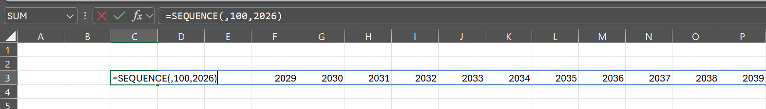
Sequence
Relatively New
Use Sequence and Transpose to work with timelines
Sequence(rows,colums,start)
Rows – down the rows
Columns – across the columns
Sequence for 100 columns → SEQUENCE(,100)
Sequence for 20 columns starting at 2026 → SEQUENCE(,20,2026)

Slide 4
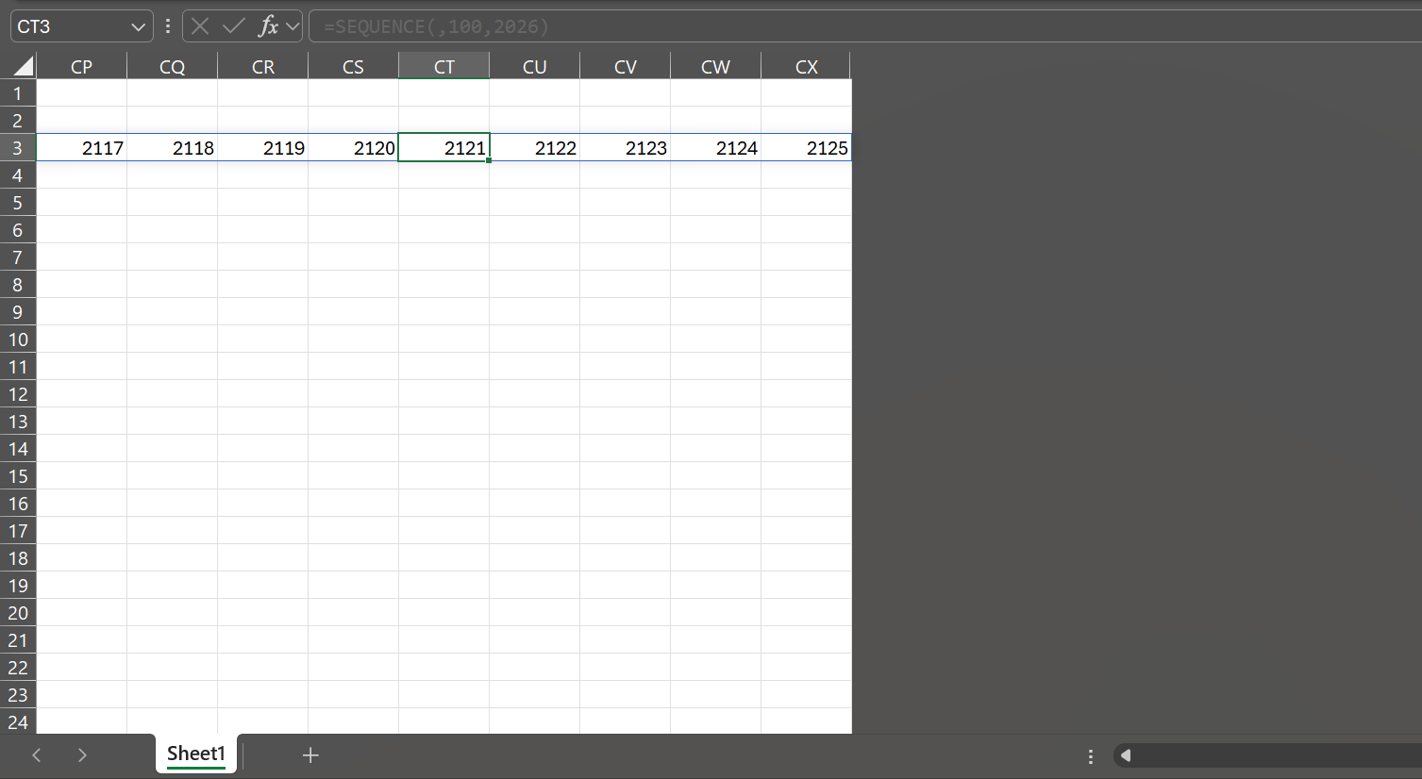
Short-cut for closing end of area
CNTL, → moves to end
Go one cell to the right
SHIFT, CNTL → selects entire area
CNTL, SPACE → selects entire column
SHIFT, CNTL, 0 → Hides selection

Slide 5
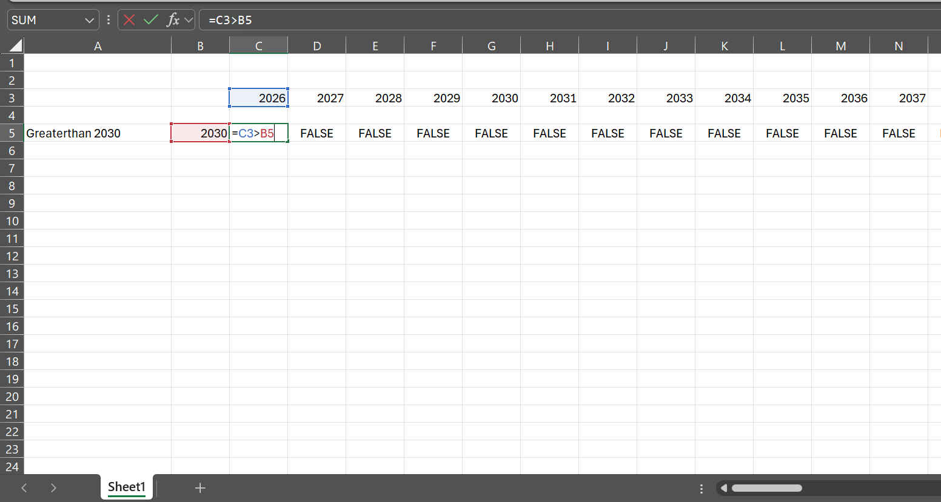
Formula for TRUE/FALSE
In excel, TRUE is normally 1
False is normally 0
Can turn things on an off with TRUE/FALSE
Equations
=1=1 → TRUE
=1=0 → FALSE
=and(TRUE,TRUE), and(1,1) → TRUE
=and(TRUE,FALSE), and(1,0 → FALSE
=or(FALSE,FALSE), or(0,0) → FALSE
=or(TRUE,FALSE), and(1,0 → TRUE

Slide 6
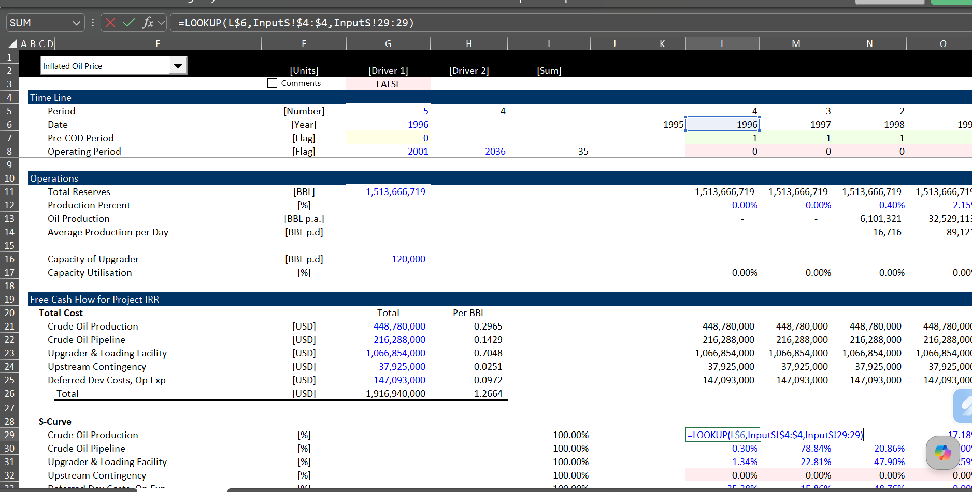
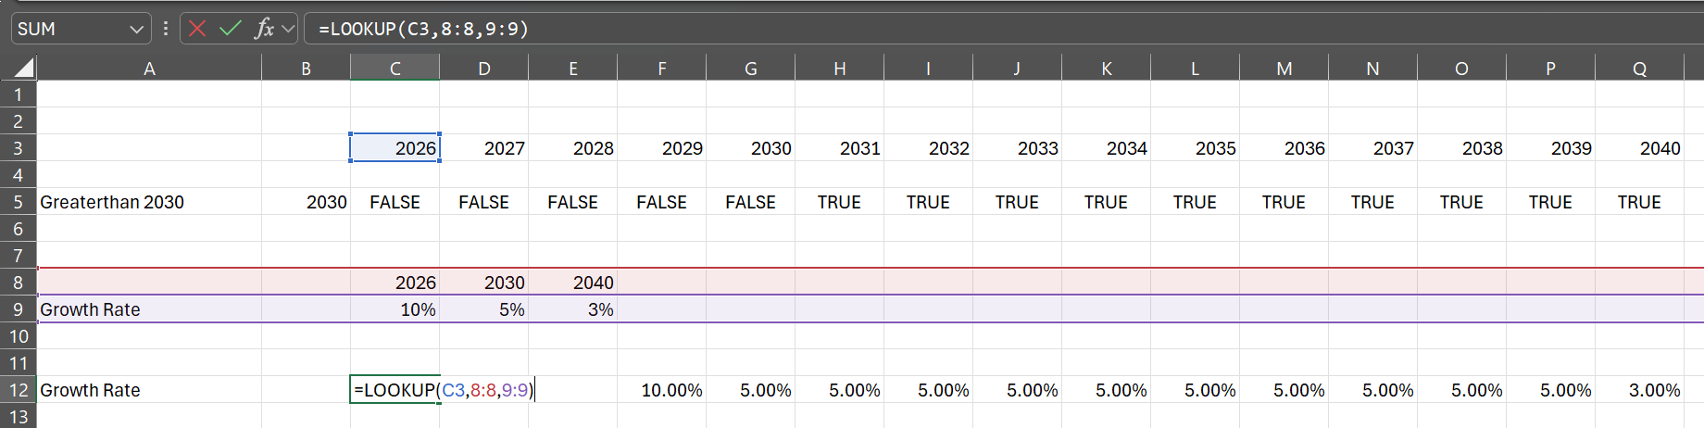
Using Lookup
Never use Hlookup or Vlookup
First find the item being looked-up
Second associate the look-up with a series that is related to the above item
Third point to the result that has the same array format (a whole line)

Slide 7
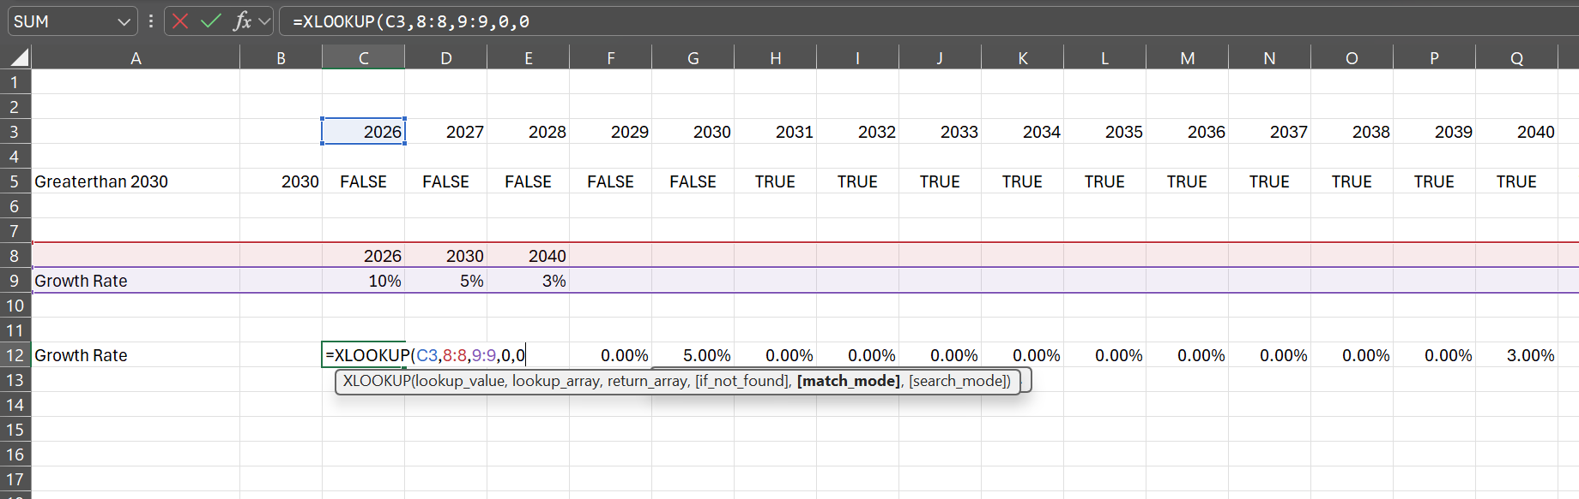
Using XLookup
Never use Hlookup or Vlookup
First find the item being looked-up
Second associate the look-up with a series that is related to the above item
Third point to the result that has the same array format (a whole line)
With XLOOKUP can find exact match
With XLOOKUP can put in values if there is nothing found

Slide 8
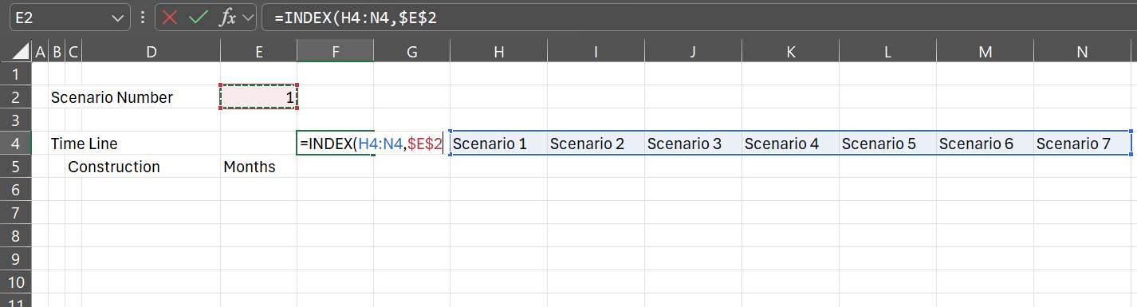
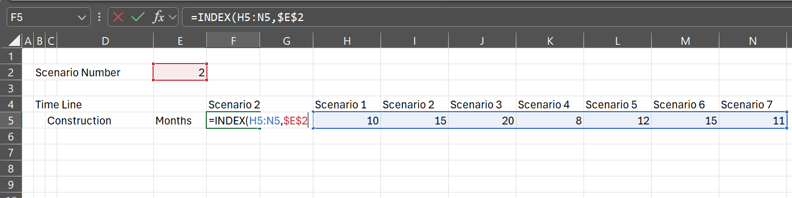
Using Index (In InputC)
With the INDEX, first include an area (often a single row or single column)
Then give the column number (for a single row) or the row number for a single column
In the example below there is a single row and a column number that defines a scenario

Slide 9
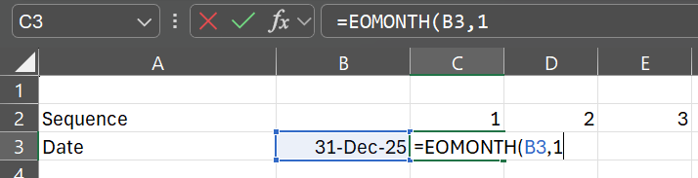
Using EDATE and EOMONTH
Why EDATE and EOMONTH are better than DATE
Because months do not have 30 or 31 days and years can have 366 days, the EDATE and EOMONTH can be very helpful.
EDATE has the form EDATE(Start Date, Number of Months)
EOMONTH has the form EMONTH(Start Date, Number of Months)
SHIFT,CNTL,F3 for Formatting Months

Slide 10
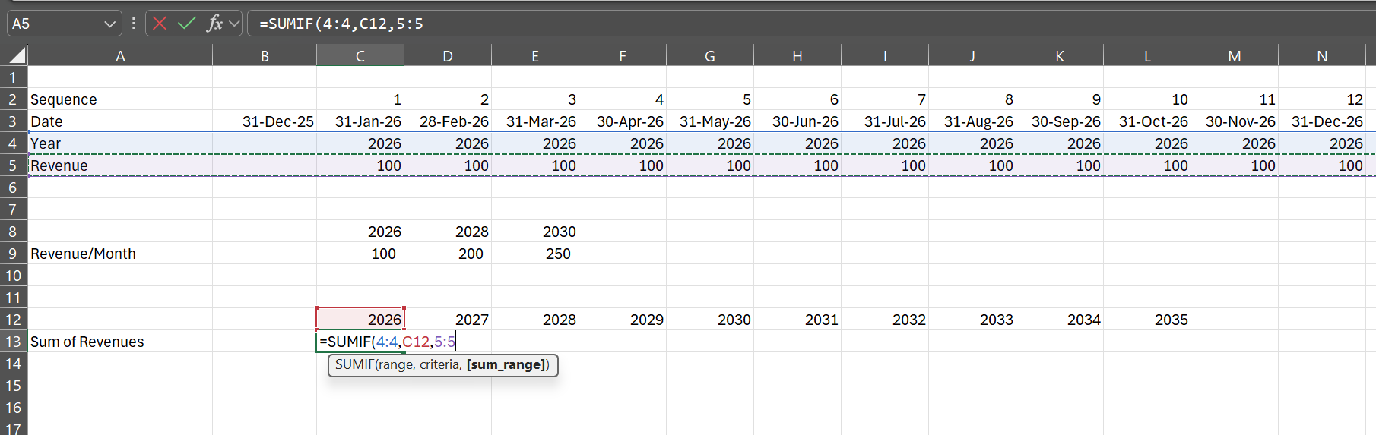
Using SUMIF
The sumif function is surprisingly helpful, It has the form where a range over which to sum is the first part of the formula. Then the criteria which to sum is next and the item to sum is the last part.
The way the SUMIF works is illustrated below. The first screenshot shows the result and the second shows the inputs to the function.

Slide 11
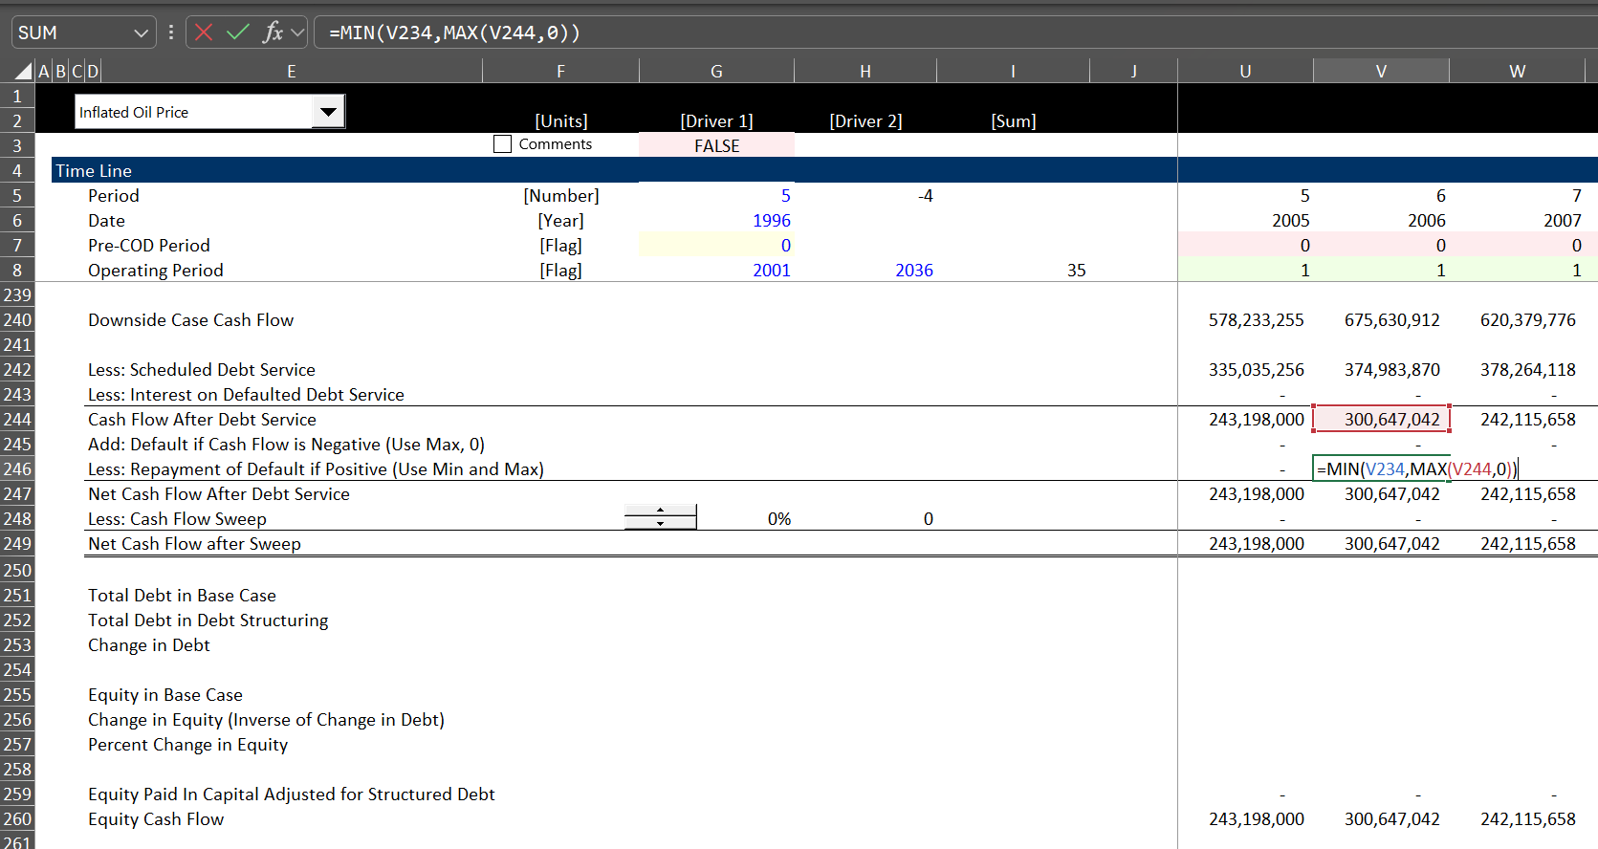
MIN and MAX
The MIN and MAX functions can be very helpful in evaluating cash flow movements. If something only happens when the cash flow is positive, the MAX function can be effective. The following use of max only picks positive numbers:
MAX(Number,0)
The MIN function can be used to test if money is available. For example, the most you can take out of a cash account can be modelled as shown below, where the most that the cash need can be is the opening balance.
MIN(Opening Balance, Cash Need)

Slide 12
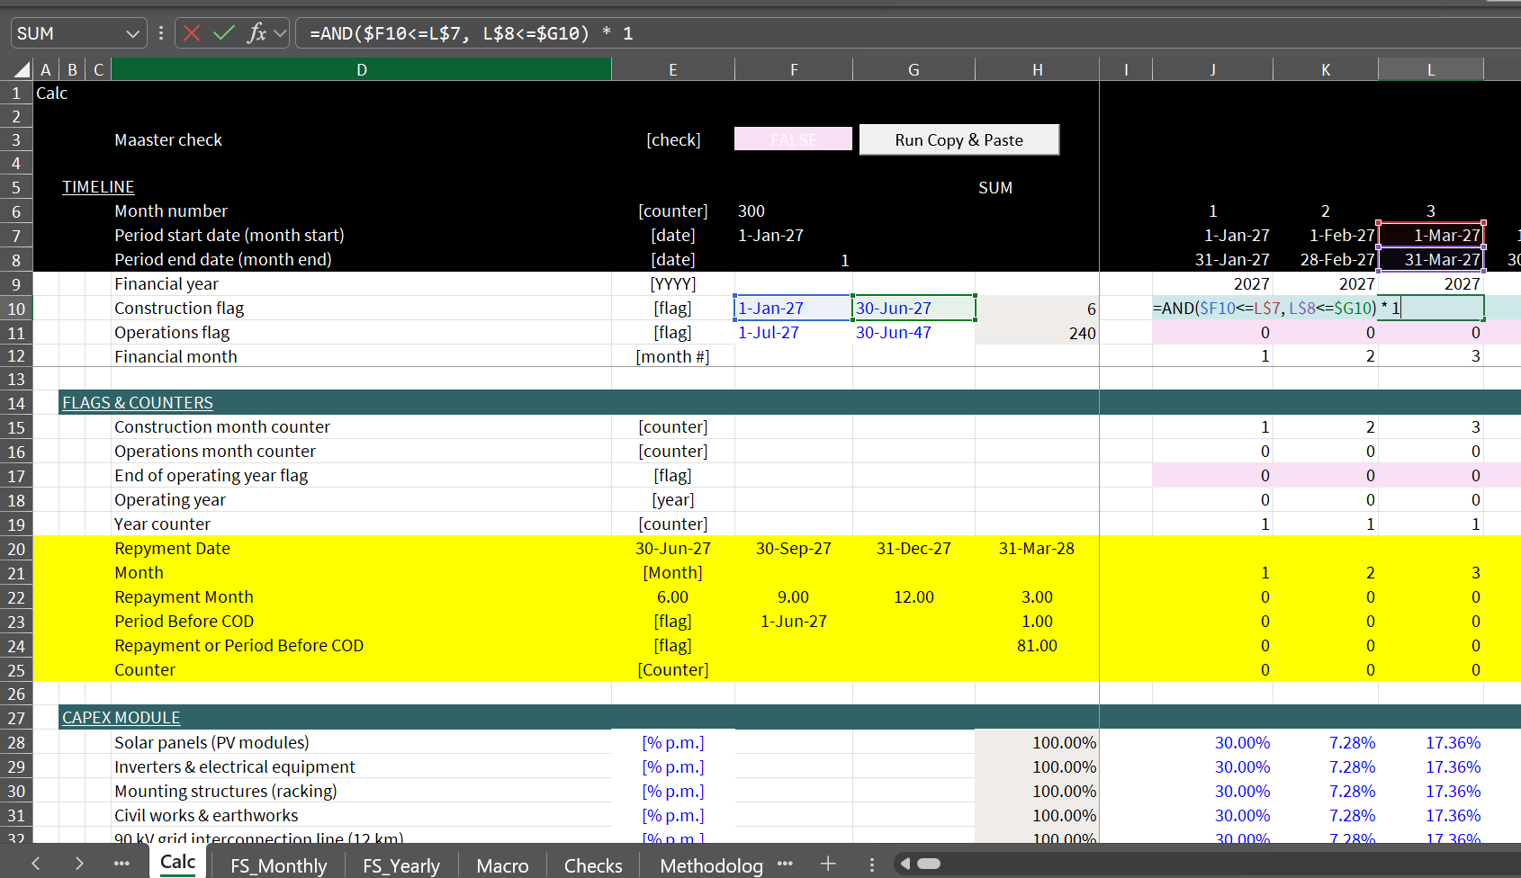
Creating Flags
Use Sequence or ALT, I, S
Flags that are TRUE/FALSE or 1/0 are used a lot in financial models
TRUE is the same as 1 and FALSE is the same as 0
Multiplying by 1 turns the number on and multiplying by 0 turns it off

Slide 13
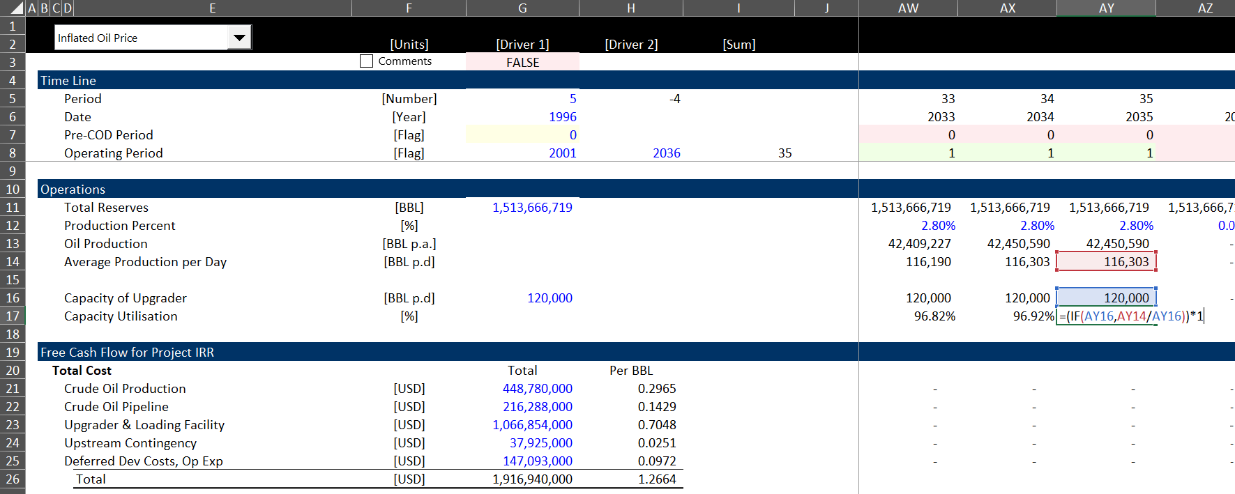
IF and IFS
I suggest not using IF statements too much
There is no excuse for long IF statements that are Nested
There is no reason to use IFS which allows multiple IF’s
Instead to the calculations in order
The form of the IF statement is
IF(TRUE, Do something, Do something else)
You can leave the false condition blank and then the result will be FALSE or zero
The initial IF statement can take a number that is anything other than zero

Slide 14
Using PMT, PV, FV
The PMT function can be effective in financial models for computing level annuities over time and computing simple debt service.
The PMT function has the form PMT(Rate, Periods, Current Amount to Levelise)
The PV function can be used to compute the PV over time with a constant cash flow
The PV function has the form PV(Rate, Periods, Periodic Cash Flow)

