Slide 1
US Offshore Wind Case

Slide 2
Context
Offshore wind in Scottland
Un Speech
Natural Gas Prices in Europe
Complexity in construction
Revenues from OREC
Offshore Commitments in US
Offshore Commitments in Europe
US IRA
Payments for Offshore Leases

Slide 3
General Discussion of Off-Shore Wind in US
The high wind speeds and shallow waters of the Atlantic Ocean make it possible to develop wind power activity in the eastern part of the country. The opposite is true for the west, where the outer continental shelf of the Pacific Ocean sinks rapidly to depths of more than 60 metres, making the ocean unsuitable for traditional fixed-bottom wind turbines.
The administration’s subsequent attacks on the industry, including withdrawing permits and arbitrary stop-work orders, have collapsed a 74GW pipeline to 5.9GW in construction, with consultancies expecting no further development through 2035.

Slide 4
Companies
EDF
Orsted Orsted.co
EDP EDP.LS
NextEra NEE
Ibdrola IBE
RWE RWE.DE
Engie ENGIE.PA
Shell SHEL
Total Energies TTE
Exon
Chevron
BP

Slide 5
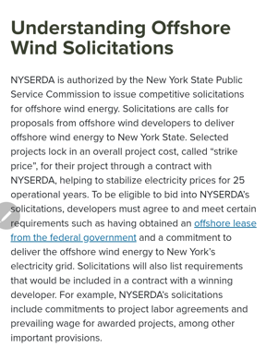
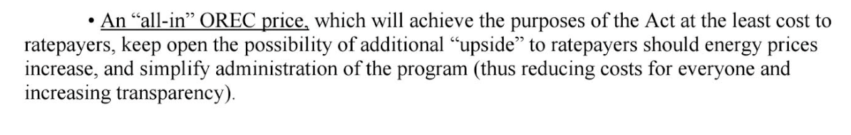
OREC – Offshore Renewable Energy Credit
Offshore Renewable Energy Credit
Renewable Energy Credit – MWH of Energy from renewable energy
Distribution utility companies must purchase renewable energy credits
Can include domestic content rules

Slide 6
OREC Continued
The OREC Funding Mechanism Rules also mandate that the OREC price reflects the total capital and operating costs for an OSW project, offset by any State or Federal tax or production credits, and any other subsidies or grants, as approved by the Board. 28 The OREC Funding Mechanism Rules further provide that once the Board approves a qualified OSW project it shall be funded through an OREC as set forth in the OREC Funding Mechanism Rules, and in accordance with the following principles: 29
1. A Board Order that approves a qualified OSW project shall be binding and enforceable on all parties referenced therein;
2. The total annual OREC allowance for a qualified OSW project, once approved by the Board, shall not be subject to reduction or modification during the term of each OREC order unless otherwise agreed to by both parties;
3. A developer of a qualified OSW project shall be eligible to receive the project's approved OREC rates and payments for 20-years subject to the terms and conditions of the Board Order.
4. Qualified OSW projects shall only be entitled to OREC revenues for MWh actually generated over the 20-year term delineated in the Board Order, and shall have no recourse against the Board, the suppliers, the Electric Distribution Companies (“EDCs”), the OREC Administrator, or the ratepayers for any additional payments;
5. ORECs from a qualified OSW project shall have a qualification life of three years, including the year it was generated and the following two years, thus, allowing ORECs to be banked for future use; and
6. All revenues generated by an OSW project shall be returned to ratepayers

Slide 7
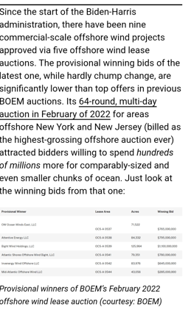
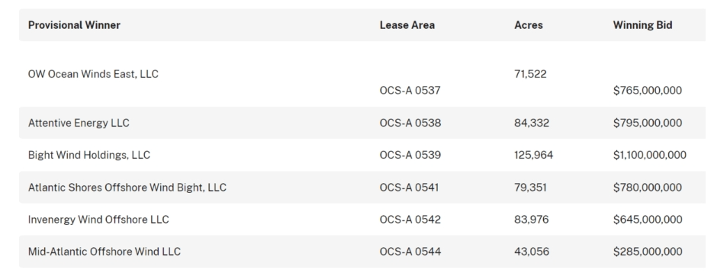
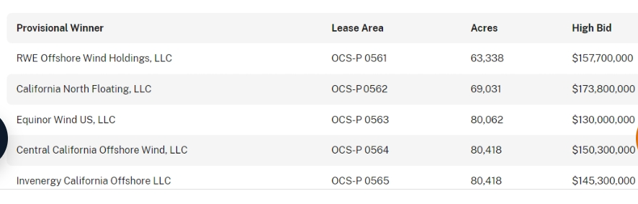
Bidding for Lease Area
Shows payments for leases

Slide 8
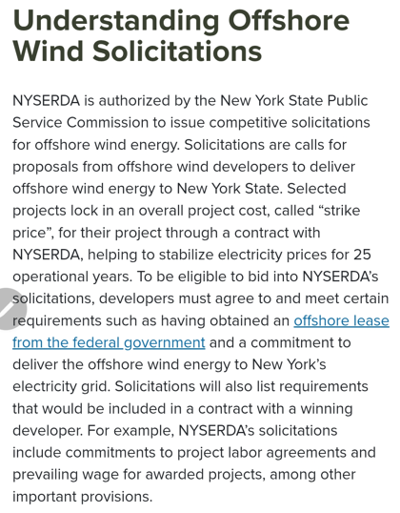
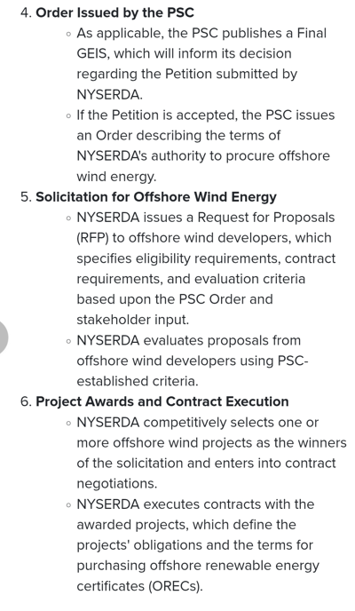
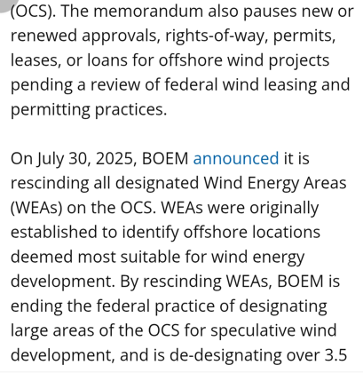
Lease and OREC
.

Slide 9
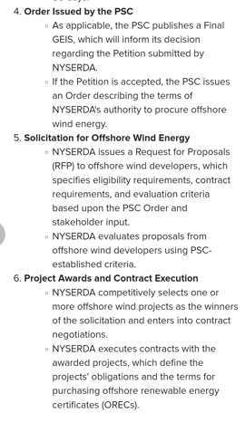
OREC Detail and New York
Eligibility for Award To be eligible to win an award for the sale of ORECs, an Applicant must:33 •
Submit an Application found to be administratively complete;
Submit an OREC Purchase Price offer that meets all requirements of OWEDA and N.J.A.C. 14:8-et seq.;
Have a reasonable ratepayer impact; • Demonstrate that the Project is viable and is likely to begin commercial operation as proposed;
Submit an Application that is consistent with the New Jersey Energy Master Plan, adopted pursuant to section 12 of P.L.1977, c.146 (C.52:27F-14), in effect at the time the Board is considering the Application;
Demonstrate positive economic and environmental net benefits to the State through a benefit-cost analysis;
Demonstrate that the financing mechanism is based upon the actual electrical output of the project, fairly balances the risks and rewards of the project between ratepayers and

Slide 10
OREC Order
The six evaluation criteria are:
• OREC Purchase Price – This includes meeting the requirement for a fixed pay-for performance price, as well as plans for maximizing revenue from the sales of energy, capacity, and ancillary services, which are credited back to ratepayers.
• Economic impact – This includes, among other metrics, the number of jobs created, increase in wages, taxes, receipts, in-state expenditures, and state gross product for each MW of capacity constructed, including development of the New Jersey offshore wind supply chain and utilization of port and existing supply chain facilities.
• Ratepayer impact – This includes the average increase in residential and industrial customer bills, including consideration of the timing of any rate impacts.
• Environmental and fisheries impact – This includes the net reductions of pollutants for each MWh generated, and the feasibility and strength of the Applicant’s plan to avoid, minimize, or mitigate onshore and offshore impacts created by construction and operation. This evaluation criterion also includes consideration of project design elements that will facilitate future expansion of OSW delivery capability and avoid, minimize, or mitigate future incremental environmental and fisheries impacts.

Slide 11
EDF Atlantic Shores Rate Order
In general, DEP found that Atlantic Shores made a good effort in characterizing the existing environment, permit planning, communicating with stakeholders, and collaborating with local and regional experts. There were some concerns about how environmental and fisheries impacts will be assessed, but that is an active area of research, and not the sole responsibility of Atlantic Shores, who demonstrated a commitment to advancing this research.
New Jersey Division of the Rate Counsel Board Staff engaged the New Jersey Division of the Rate Counsel (“Rate Counsel”) to solicit feedback on the potential ratepayer impacts associated with an OREC award(s) consistent with OWEDA and the governing rules at N.J.A.C 14:8-6 et seq. Rate Counsel provided its feedback on May 19, 2021, which was reviewed and considered by Board Staff. Rate Counsel noted that the Projects produced a positive cost-benefit analysis. Rate Counsel expressed concern that if an award was made to the incumbent OSW developer, it would result in market concentration in the New Jersey OSW market that could have potentially negative impacts on future OSW solicitations. Rate Counsel also expressed that concentration of awards with one developer could have negative longer-run supply chain and economic development ramifications for New Jersey.

Slide 12
Different Issues in Offshore Wind
Orsted: Project Financing, EPC Contract and Correspondence with PPA (REC contract)
  Exposure to increased prices from “supply chain.” This means prices not locked in when the contract is signed and increased pressure from higher demand for equipment
  Costs of leases unclear in reports (cancellation penalties)
  Completed projects earning low return
  Information from Annual Reports
Shell
  Abandonment by Shell after pressure from US government
  Increase prices for equipment reducing profit
  Pressure from shareholders on rate of return
  Low natural gas pricing meaning profits from OREC less (off-shore wind renewable energy credit)

Slide 13
Different Issues - Continued
EDF
  Question about ability to continue
  Probably low return without shell and with cost increases not covered by fixed price EPC
  Questions about ability to raise finance
  Cost of lease very high
  Results in Tax Payment to US Government without getting anything
Total Energies
  Paid back the lease payment in return for investing in fossil fuels
  Environmental Policy and Greenwashing
  Is the lease payment tantamount to a tax

Slide 14
Different Issues - Continued
Iberdrola
  Local Content Rules in IRA Law that grants tax incentives
  GE as supplier
  Problems with Blades Falling Off
  Amount of Liquidated Damage in Contract
  Threats when project virtually complete
RWE and EDP
  Similar attempted settlement as Total

Slide 15
Background on Orsted

Slide 16
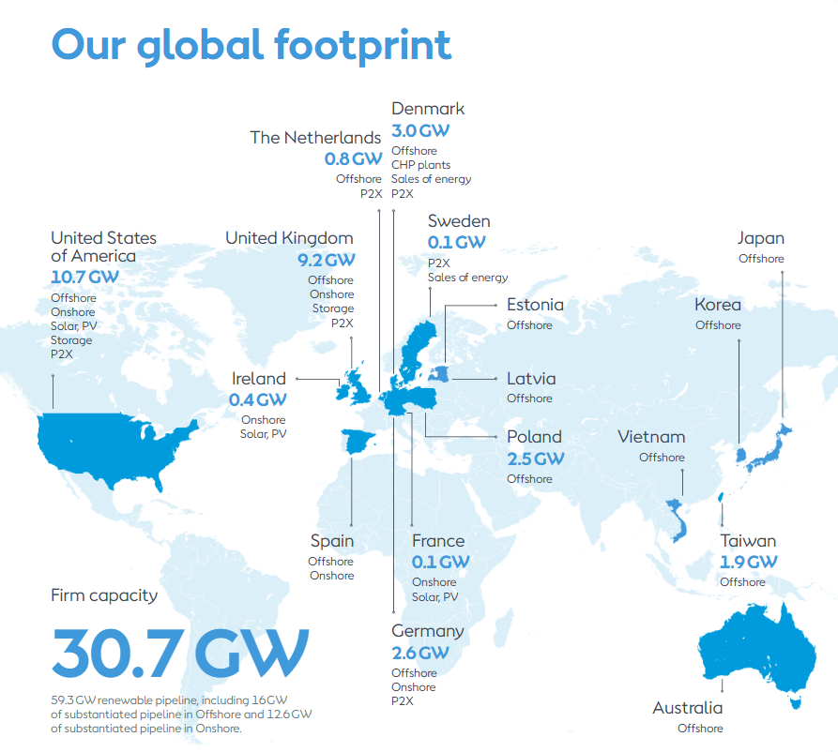
Orsted Story – Desire to Have 50% of Off-Shore Development
One of the few companies in renewable energy that does not finance on a project finance basis (mainly wind but also some solar)
Was an incredibly valuable company with among the highest price to book ratios in the industry
Had a disastrous experience with projects in the U.S. that illustrates risks and value drivers in the industry.
Comments from investors demonstrate how valuations are made in practice
Even though not project financed, financing driven by debt financing at BBB level
Includes data on wind resource risk and data subsidy schemes
Because of impairment write-off, you can get insights to valuation
Current Operating Generation Capacity is 12.7 GW of which 5.2 GW is off-shore
Orsted’s stock price fell by 89% from 1243 Dkk to 133 Dkk

Slide 17
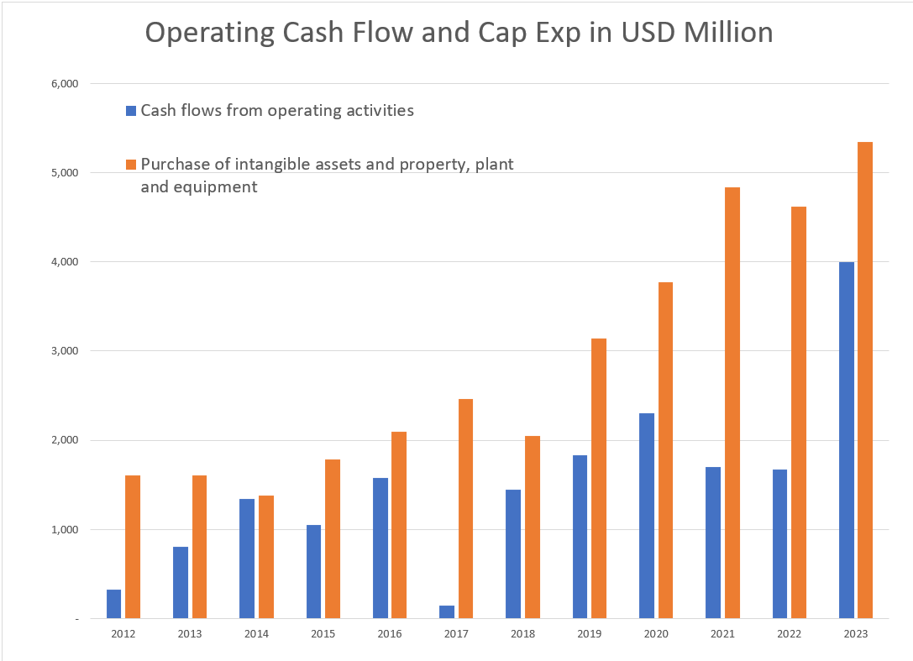
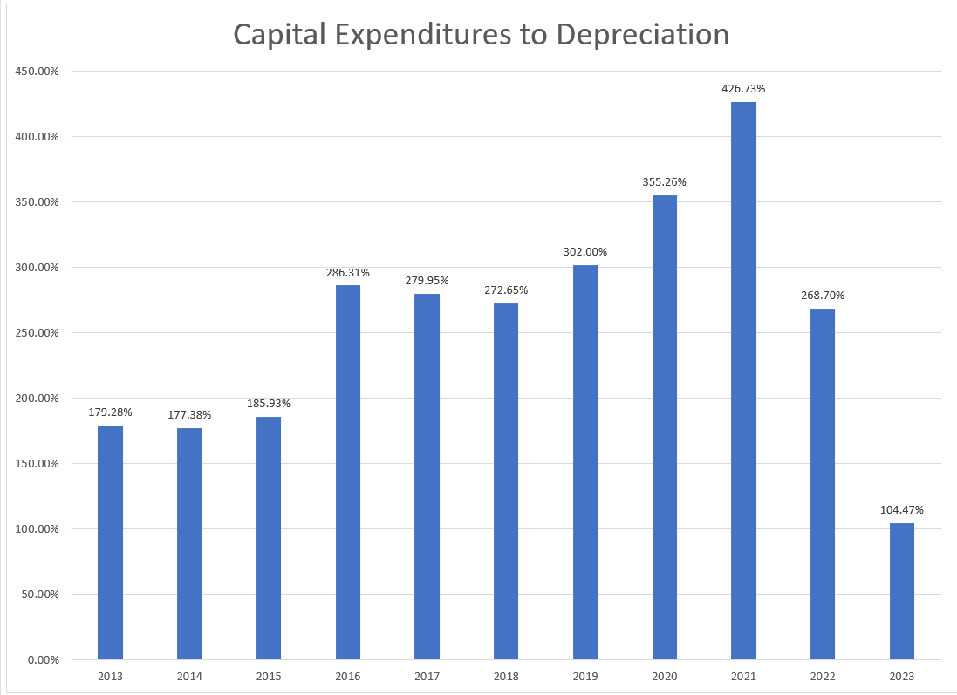
Orsted Capital Expenditure Program
Over the past two decades, we have transformed ourselves from a fossil fuel-based company (DONG Energy) into a global leader within the renewable sector. We realized this transformation due to our strong and innovative capabilities within project development, construction, and operations. And we continue to see increased and exciting opportunities across our business segments, exemplified by increasing targets and support by governments for the buildout of renewables. At the same time, we are encouraged by the political support towards our industry, such as the Inflation Reduction Act in the US and the proposed Net Zero Industry Act in Europe, which would expand the addressable market and represent an important support for the entire industry. We will continue working towards our vision of a world that runs entirely on green energy.

Slide 18
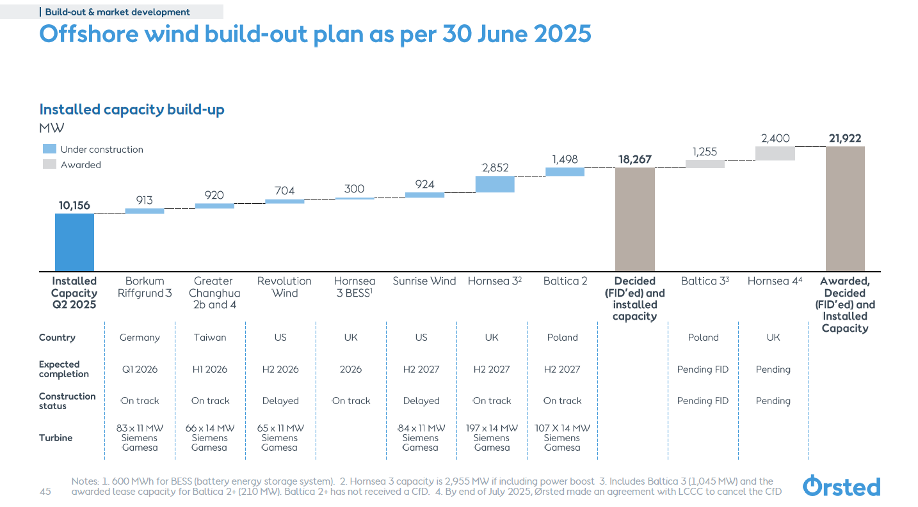
Capital Expenditures in DKK
Financing the large capital expenditures
Primarily use corporate finance
WACC and project IRR versus equity IRR
Transparency of project versus corporate finance
External approvals in project finance

Slide 19
Orsted Case Issues
Do you think that Orsted’s business model using corporate finance without fixed price construction or operation expense and contracts and bidding low prices is effective or do you agree with the Governor of the US state of New Jersey who called Orsted management “outrageous” and questioned ”Ørsted’s credibility and competence”.
Orsted buys turbines from Vestas, Siemens etc.; it contracts with a company to construct the monopiles; it hires vessel companies to deliver the turbines and put them into the monopiles. If Orsted is the best in the world at this, why did problems at one project eliminate almost 40% of its balance sheet equity capital.
The Orsted case addresses all of the issues in the objectives including regulatory regimes, different types of subsidy regimes, the impact of inflation, energy pricing, hedging considerations and other issues including the crucial question of resource analysis.
The Orsted case demonstrates the fundamental issue of risk and return and the fact that a constant cost of capital must not be used in assessing renewable energy.
The case demonstrates other issues including changes in wind speeds, management of cost over-runs, different contract structures for power …

Slide 20
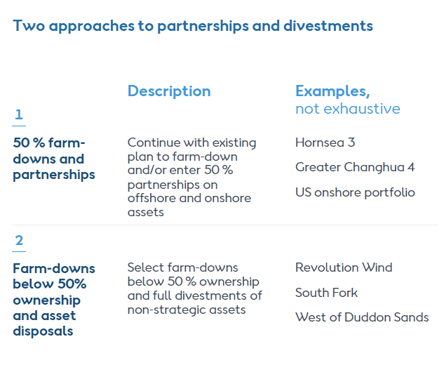
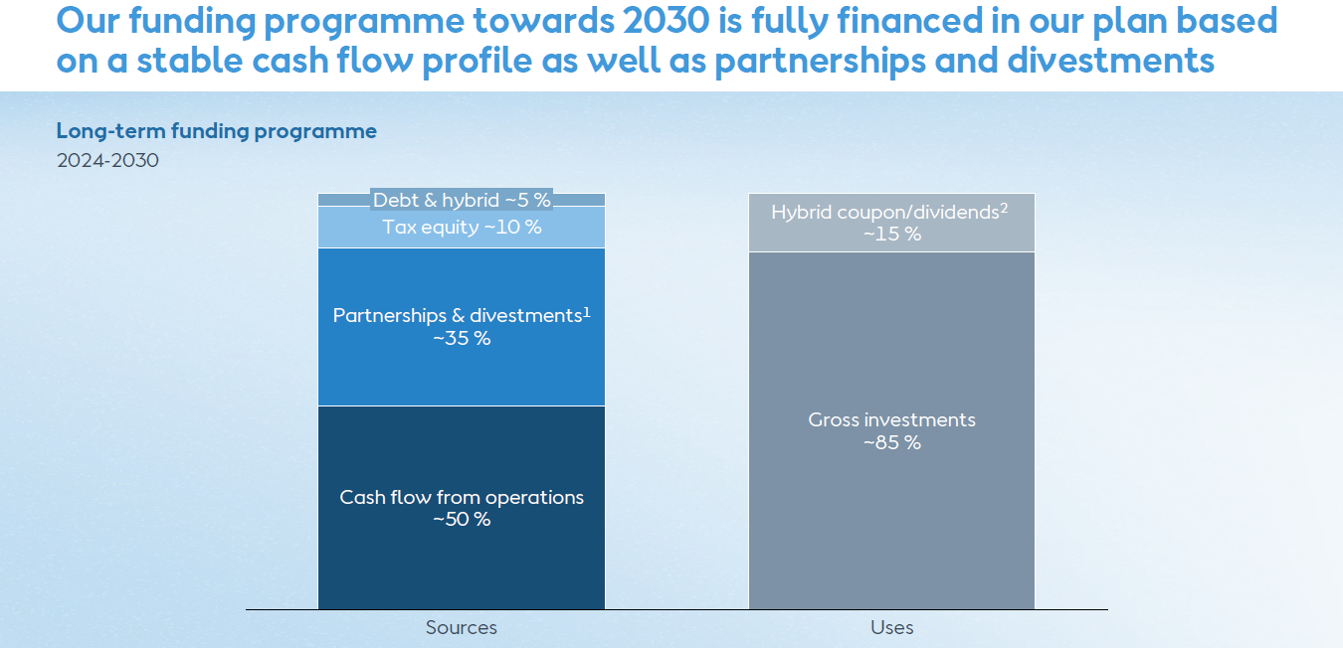
Orsted Divestments Illustrate the Kind of M&A Analysis Required
As shown in the inserts Orsted plans to raise a lot of money by selling down its assets (up to 50%).
Valuing the assets does not involve fancy or complex finance, you need to make assessments of future cash flow and apply a discount rate to that cash flow.
Nuances of cash flow forecast from information on regulatory regimes, subsidy regimes, resource variation, hedging, power pricing.
The case does demonstrate that there is a lot of M&A work in the industry from farm downs of individual assets.

Slide 21
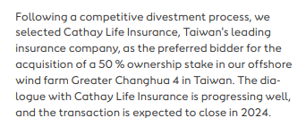
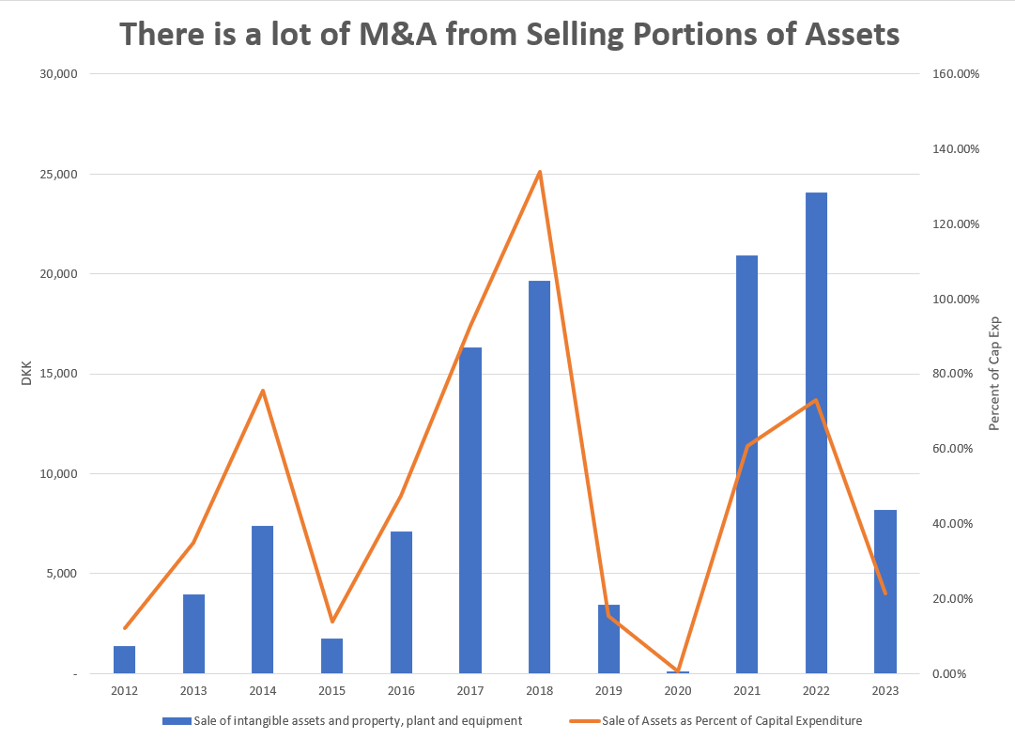
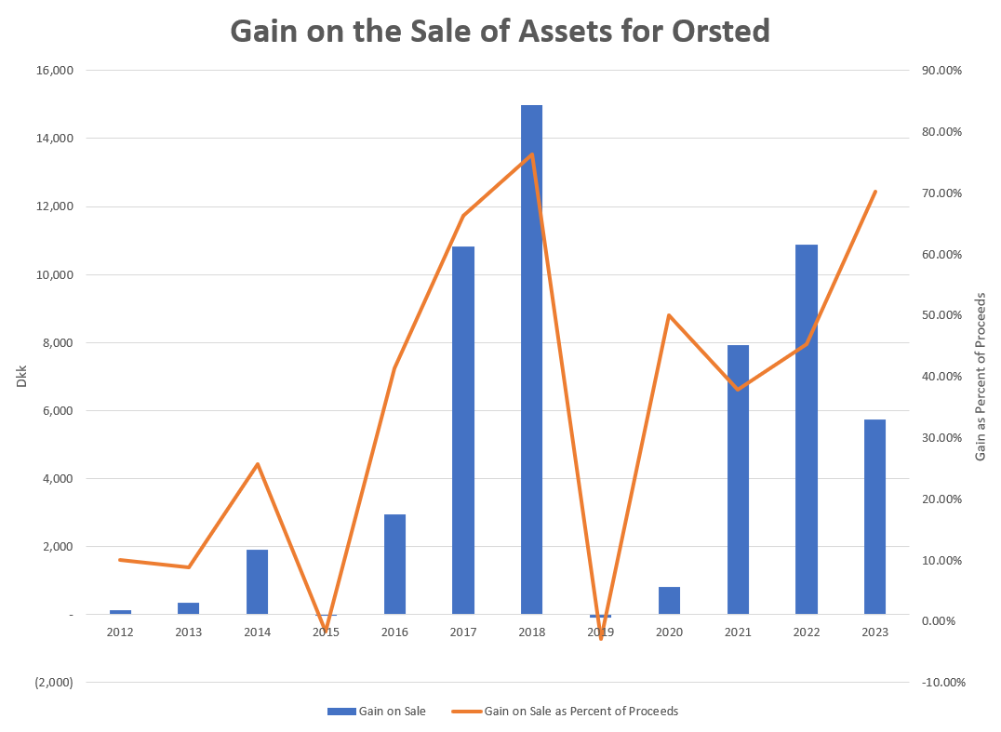
M&A Activity from Selling Interest in Projects
Valuation depends on the characteristics of individual assets and their risks. M&A analysis depends on understanding these things and then translating that to value. Clearly requires evaluation of individual projects.

Slide 22
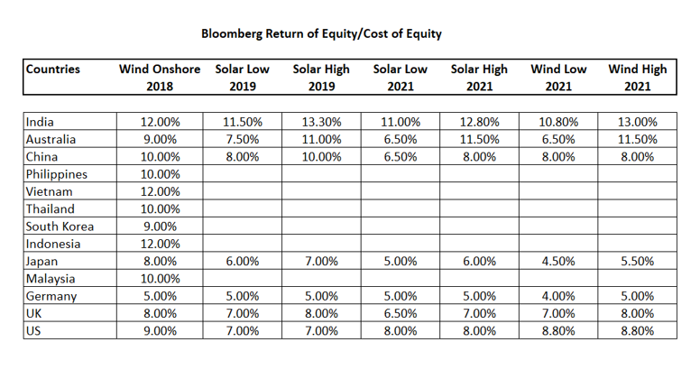
Real World Minimum Acceptable Target IRR
In practice there is no CAPM and certainly no un-levering and re-levering of Beta (see the discussion at the end).
In practice, equity IRR is used rather than project IRR as a target (this makes sense in theory as project finance implicitly adjusts for risk
In practice, and there are general standards for target IRR on buying and selling of projects. These standards have change over time. Pre-Covid for projects in Europe with a few years of history, equity IRR targets were as low as 4%.
I have been told stories of insurance company executives and pension plan managers going around Europe holding suitcases of cash to buy solar and wind projects with operating history.

Slide 23
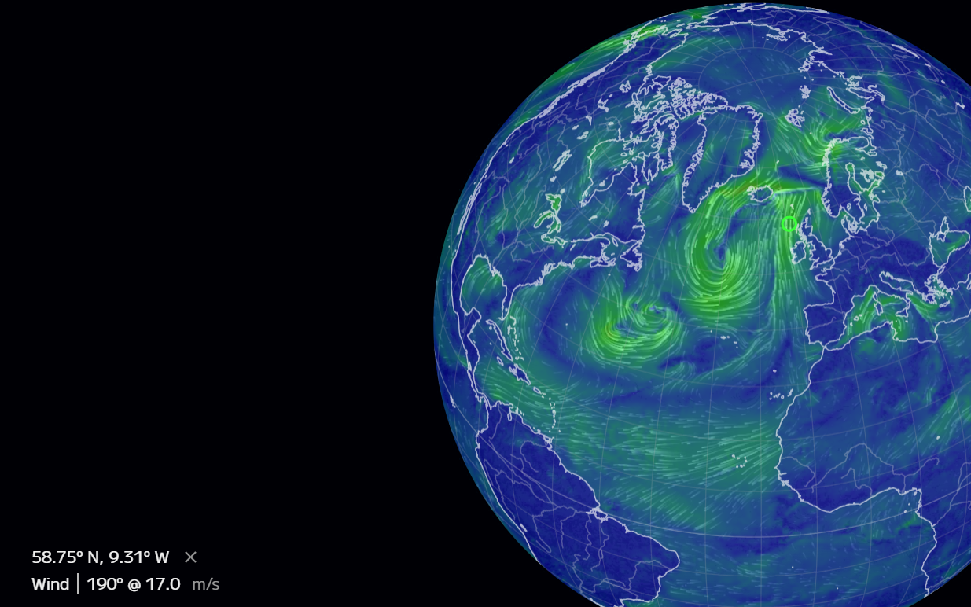
M&A Analysis for Companies Like Orsted
The valuation analysis for renewable companies, projects or assets could involve
  Valuing a portfolio of existing assets that are at different stages of development, construction and operation
  Valuing single assets
  Valuing the entire corporation including potential for continued growth
In each of the valuation tasks, you would need to make an assessment of the cash flow over the remaining life of assets and understand:
  How the assets earn revenues (what is the subsidy scheme and what happens after the subsidy scheme expires when prices can become variable or merchant)
  What is the quantity of electricity produced and how can this vary over time
  What are the development costs and capital costs and what is the exposure to changes in the costs

Slide 24
Orsted, Dong and History of Electricity Finance and Risks
Some background on the industry and the theory [of regulation, pricing, financing] behind would be good. To the extent possible, please try to link this to the practical applications for the participants in their work, e.g. regulatory regimes, different types of subsidy regimes, the impact of inflation, energy pricing, hedging considerations, etc.

Slide 25
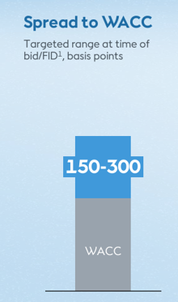
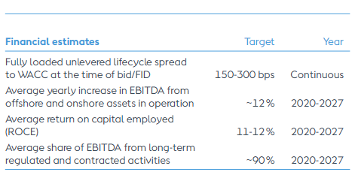
Orsted Obsession with 150-300 Basis Points Over WACC as the Target IRR; Why should you give a crap
Statements by Orsted about the WACC premium:
“All of this leads to, and you will hear us say that again, the updated guidance is an unchanged 150 to 300 basis points spread to WACC. This is industry-leading, as I’m sure you’re aware, and fully loaded so that it is fully cost-loaded with our fixed cost as well.”
“The portfolio of Asia Pacific and Europe projects are within the guided range of 150 to 300 basis points spread to WACC, a key piece of information despite the turbulence that we have seen and despite the additional cost for the mitigating actions that we have taken.”
What does “industry leading” mean – it seems to imply that Orsted is so efficient in construction and operation that it can bid the same price and earn a higher return than other companies (or maybe it takes more risk)

Slide 26
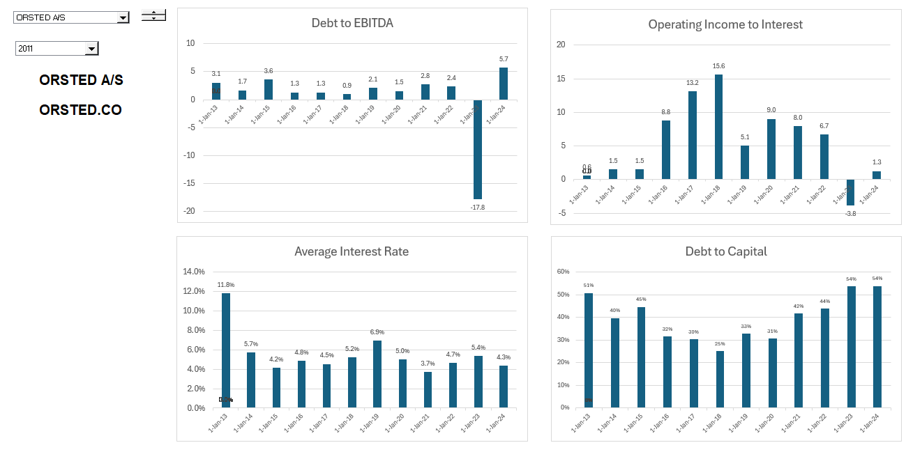
WACC Part 1 – Debt Cost and Percent
Orsted discusses the return and investment criteria in every presentation, but the company does not present the WACC anywhere, even in the impairment notes.

Slide 27
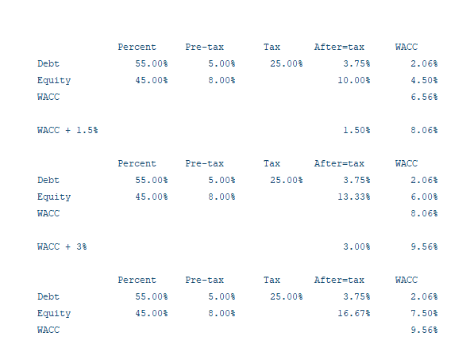
WACC Part 2 – Illustrative Estimation and Premium
I have estimated WACC and WACC plus the premia below. I use these estimates to illustrate conceptual issues associated valuation analysis of Orsted.
In this example, adding 3.5% to the WACC increases the ROE from 10% to 16.7%

Slide 28
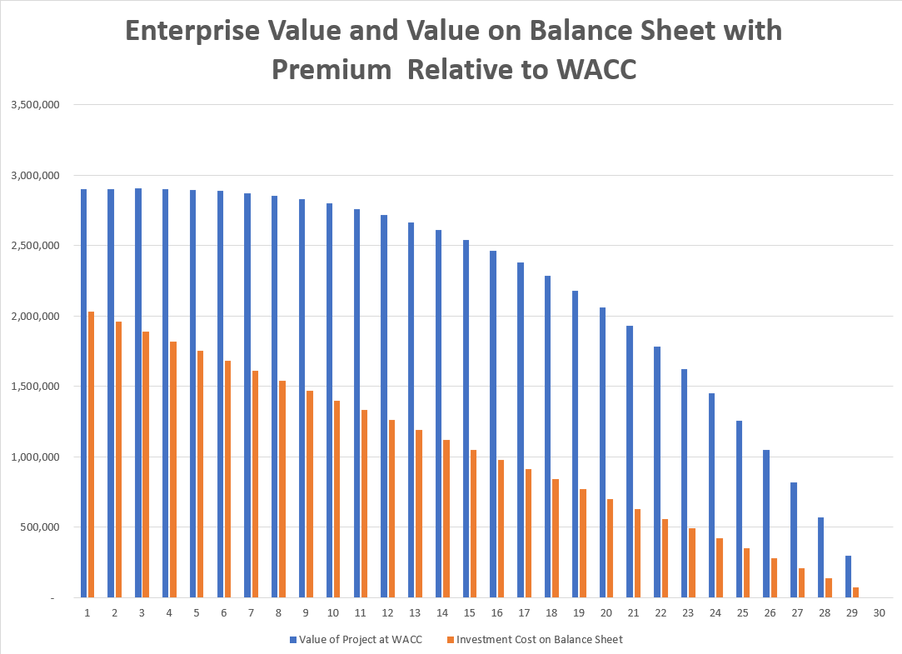
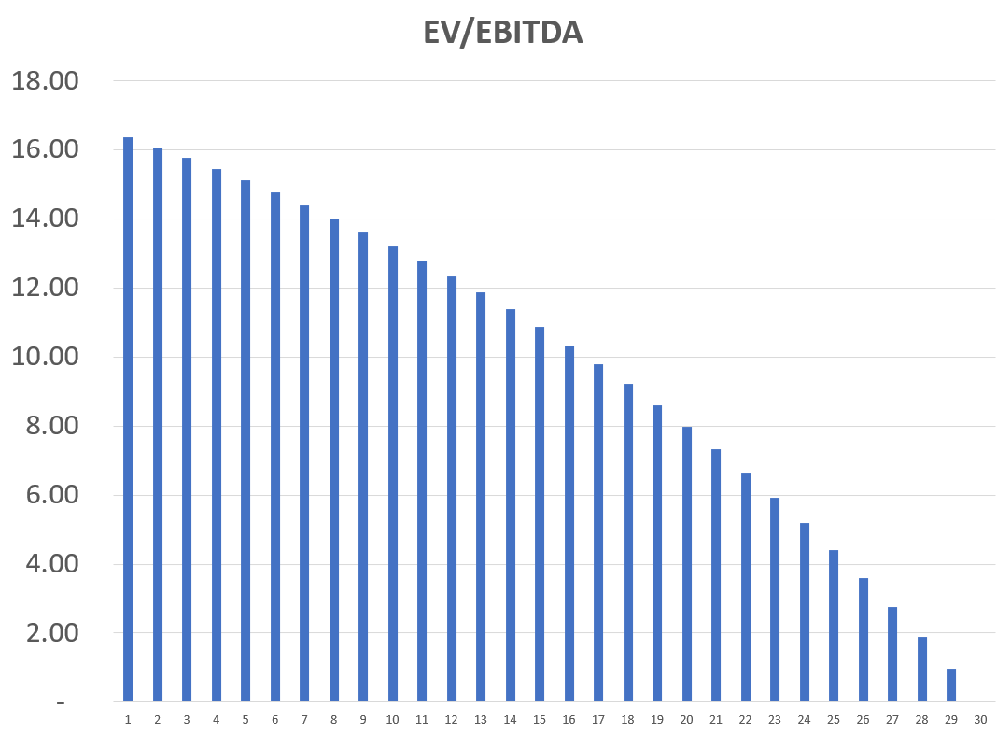
EV to EBITDA is not Constant over Life for Single Asset
The value of a single asset naturally declines as the asset has less remaining cash flow. The same happens to the EV/EBITDA ratio and implies that the EV/EBITDA ratio depends on the age of assets in the portfolio. It also depends on the premium to WACC.

Slide 29
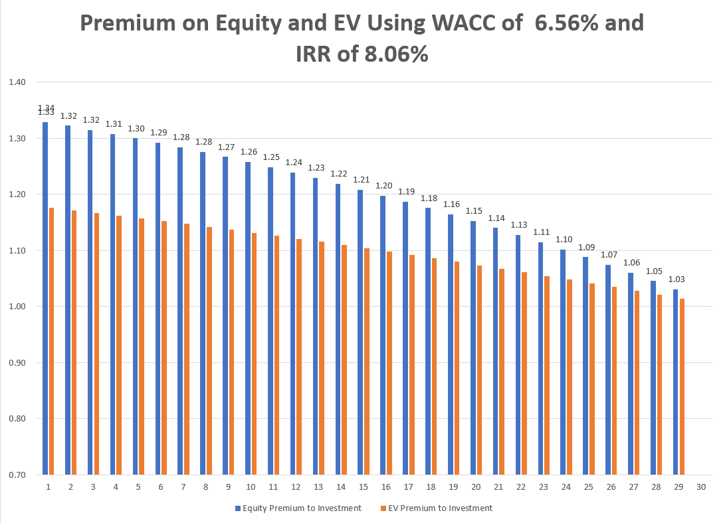
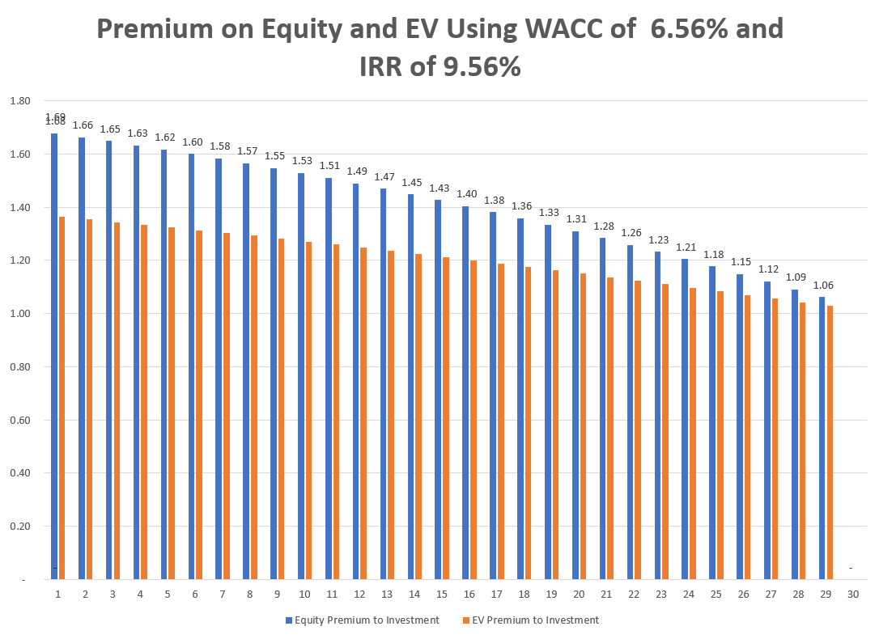
Premium to Value at WACC for Single Project or Asset
Value at WACC is the investment cost – the premium above WACC can be measured with premium to equity (price to book) or the premium above investment cost (EV/Investment Cost). With 150 bps, the equity premium is 1.32 and with 300 bps, the premium is 1.69.

Slide 30
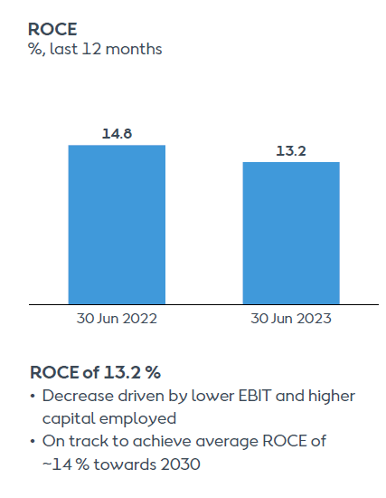
Rate of Return Presented by Orsted
Orsted lists the ROCE as one of its primary performance measures (in listening to many earnings calls and capital markets day sessions not one analyst asked about ROCE). The company seems to want to compare the ROCE with the WACC and suggest that it is achieving its objectives of earning more than the WACC. The comparison is completely irrelevant.
Problems with ROCE presented by Orsted
  ROCE is naturally much lower for a growth business than a business in decline. This is simply due to the decline in investment over time.
  The ROCE computed by Orsted includes construction work in progress in the denominator even though it is not producing any income during the development and construction period.
  The ROCE is distorted by impairment write-offs. After an impairment write-off the denominator is reduced, and the numerator of the ratio is increased from the reduction in depreciation.

Slide 31
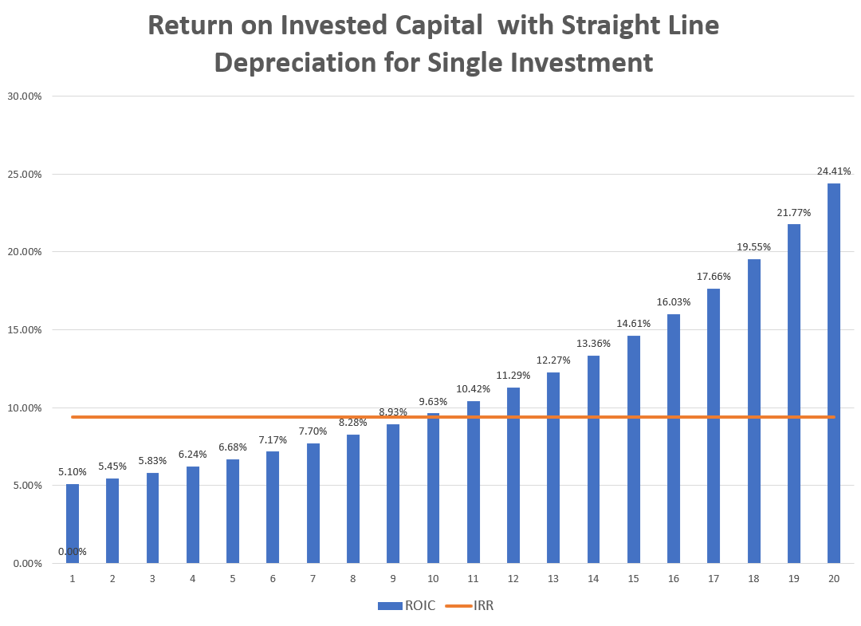
Project IRR and ROIC for Single Asset
And summing up, this all leads to these updated guidance targets, which I already mentioned in the beginning, but let me reiterate them. An unchanged industry-leading, value-creating target of 150 to 300 basis-point spread to WACC, average 14 % return on capital employed.
Late years with less PV and lower investment, ROIC is higher than the ROE
Initial Years – the ROIC is below the IRR

Slide 32
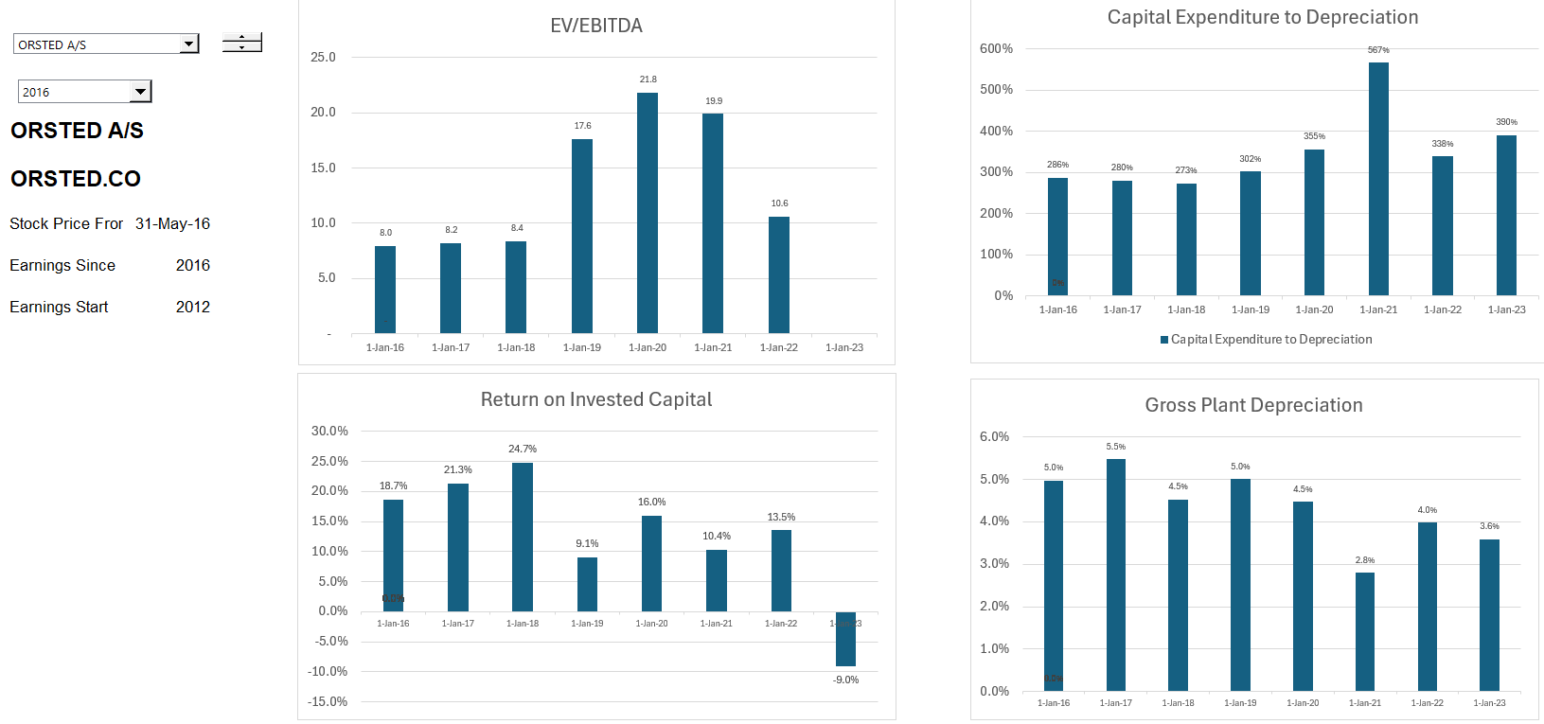
What you Really Want to See – The Earned Project IRR on Each Project
If you compute the IRR from the original anticipated cashflow you can compute the value over time and the economic depreciation as the change in this value.
If the cash flows turn out to be equal the expected cash flow, then the ROIC for each year is the same as the project IRR.
If the cash flow are lower because of lower electricity production or higher costs, then the ROIC with economic depreciation will capture.

Slide 33
Method for Modelling Individual Projects and Consolidating the Projects
In valuing projects whether project financed or not, you will most probably end up modelling the projects over their remaining life and computing the value of the projects with different scenario from the cash flow over the life of the projects. In other words, no terminal value, no valuation multiples, no computation of accounting returns.
If you are working on multiple assets as a package which is often the case, you can put the individual projects in different sheets (don’t worry I will not open excel). Once the projects are in different sheets you can consolidate the cash flows into another sheet that adds the projects together. To do this effectively you should be very careful with timelines and drive the analysis with some kind control sheet.
To illustrate how the consolidation of projects, I assume one project per year is added for many years. After the first project reaches the end of its life, the company stabilizes, and you can see the effect of different WACC premia and growth rates. This is of course illustrative, but it demonstrates the general patters and magnitude of multiples.
We can use Orsted’s WACC premium, its current balance of equity capital and invested capital to illustrate

Slide 34
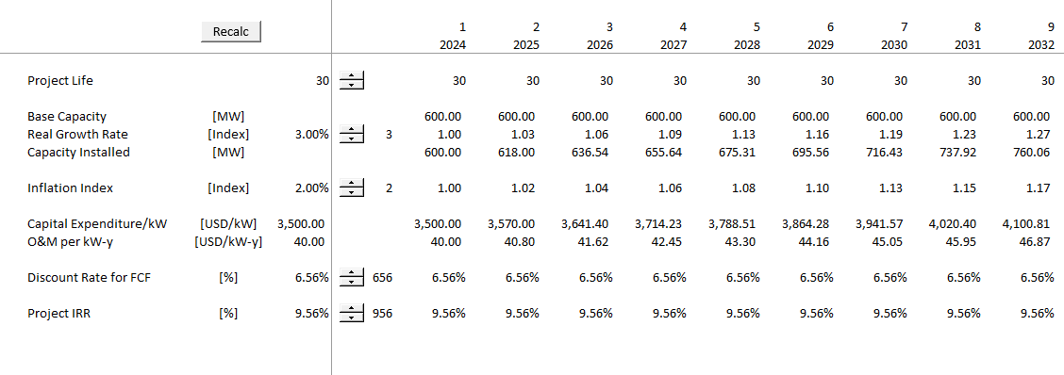
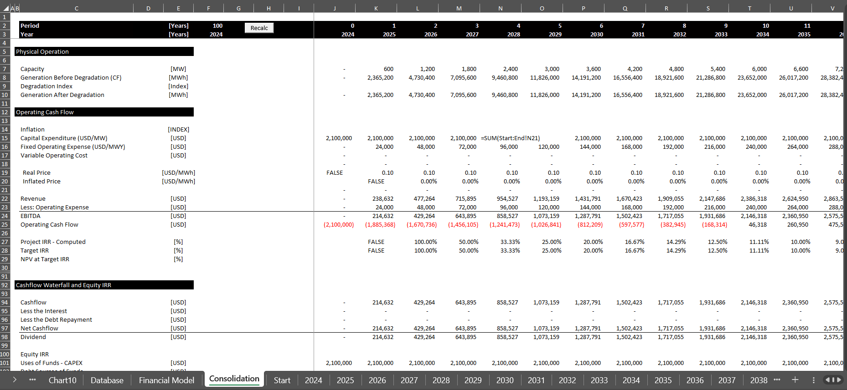
Consolidation of Projects with Orsted WACC premium and Alternative Growth Rates
After making separate simulations of additions year by year, you can consolidate into a file and see how the corporation develops.

Slide 35
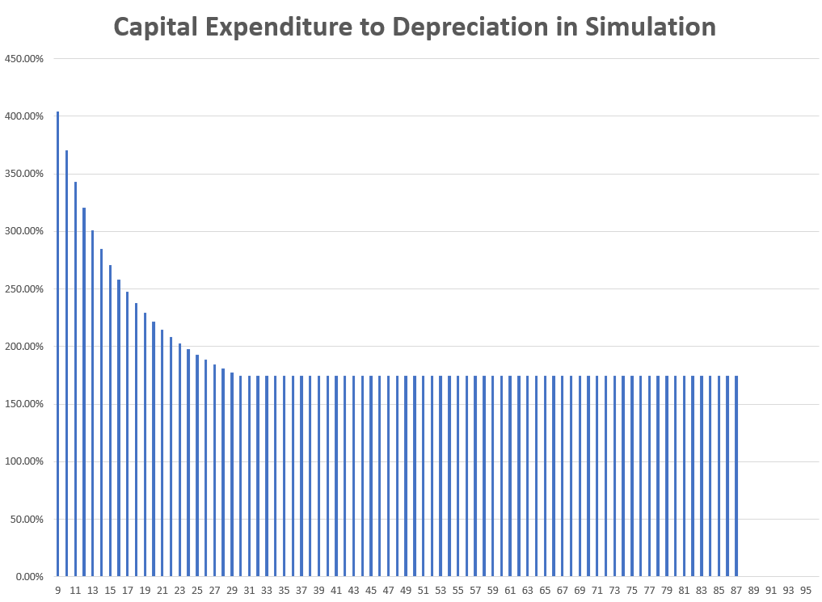
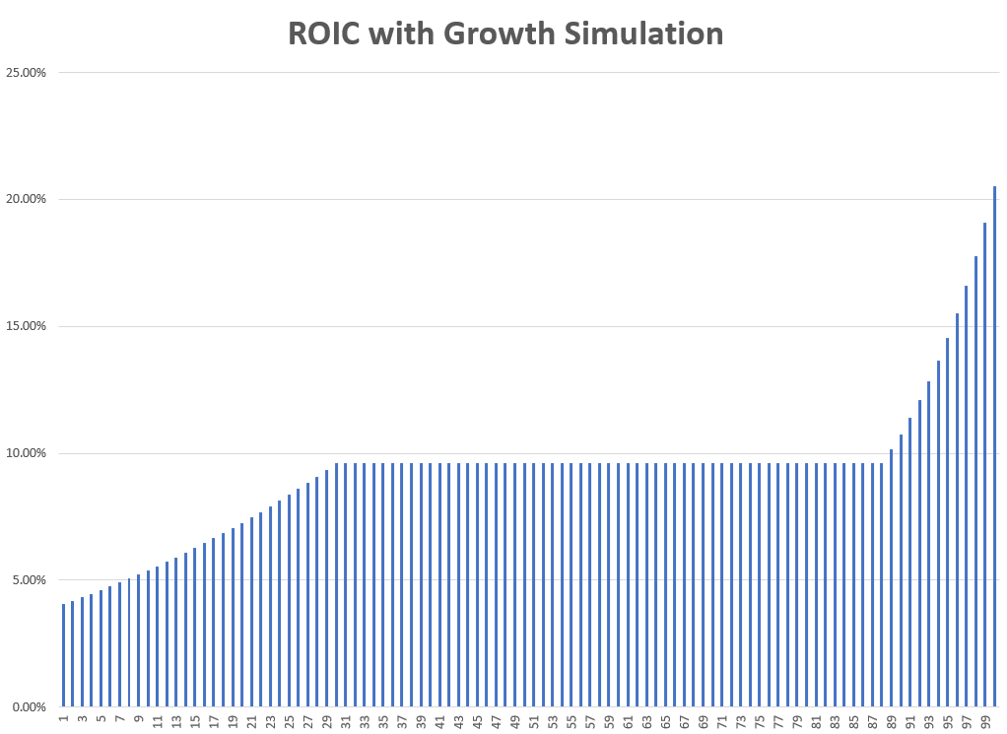
Illustration of How Ratios Stabilize But are Change in Growth Stage
To introduce the simulation, I show the consolidated analysis with constant growth and with inflation. In this scenario the premium earned relative to WACC is 200 basis points. The cap exp to depreciation stabilizes at 170% when the old assets are retired and replaced with inflated assets. The ROIC stabilizes when the assets are being replaced.
Stable Period after asset life is achieved and replace existing assets. With growth not 100%
ROIC eventually stabilizes when assets are replaced

Slide 36
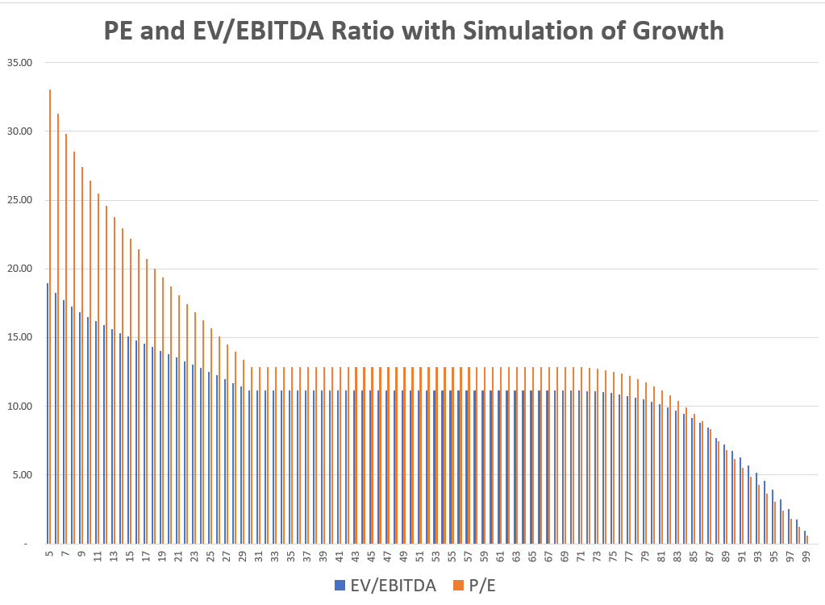
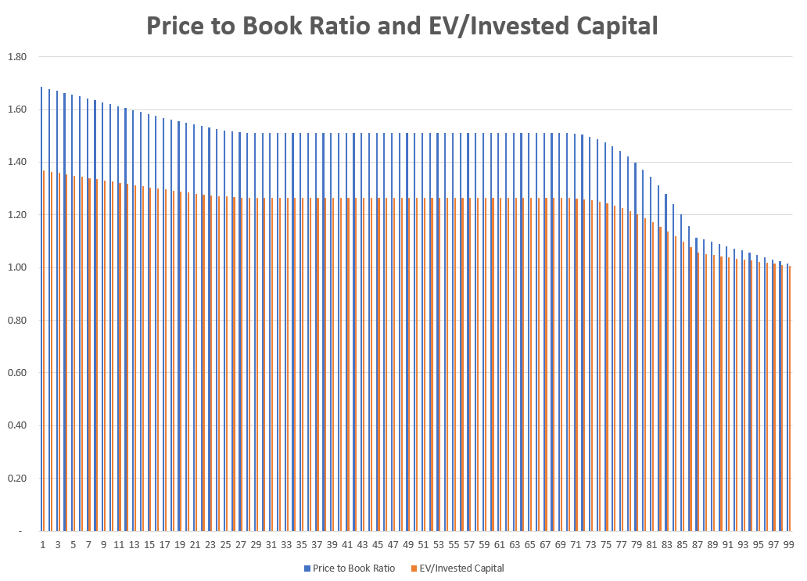
Simulation of Multiples with Growth
The simulation illustrates that with 2% real growth, 2% inflation and earning 200 basis points relative to the WACC that the EV/EBITDA ratio and the P/E ratio are not constant values until the company is in the period of stabilization. The idea of the graph is to demonstrate that you cannot use a simple EV/EBITDA, P/E or price to book multiple when evaluating companies that are in a growth or in a decline stage.

Slide 37
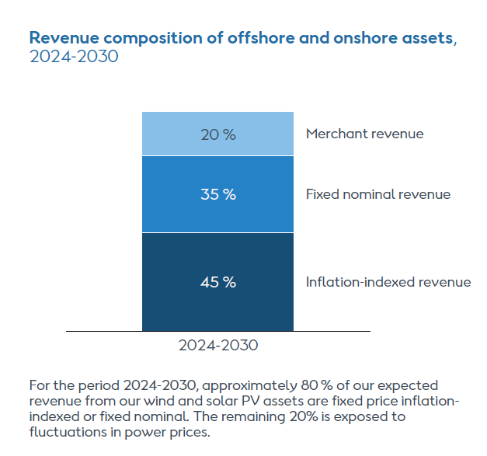
Example of Nuanced Risk Allocation in IPP Regulatory Regime – Inflation Risk
For IPP projects, some risk allocation is obvious. For example, owners of the plant take risks of construction over-run, construction delay, plant efficiency, plant availability and operating cost increases.
These risks are in control of the investor (again, the risks can be allocated to other parties through contracts as in the EPC contract). The idea was the if risks that cannot be controlled are allocated to the investor, the investor’s cost of capital will increase which will increase prices as investors bid.
Inflation risk is an example of a risk that may or may not be allocated. If prices change with the overall rate of inflation (i.e., prices are indexed), then the inflation risk is not allocated to the investor, and the investor receives a protected real return. If prices are fixed and the inflation rate is high, then nominal returns are protected but real returns vary.
All of our early-stage US projects, have been materially hit over a longer period of time by the generally adverse industry conditions. But because these projects were without any kind of inflation indexing, increasing interest rates and significantly increasing CAPEX inflation, which was three to four times as high as consumer price inflation, it was already a project whose returns were under pressure and who had also lost most of the float in the schedule.
Especially after a period in a very volatile environment, we have also clearly prioritized that we will get only inflation-indexed contracts, especially in markets like the US, where there’s a long time from award to actual FID. In a market like the UK, where, by the way, there is inflation protection, there’s a much, much shorter timeline between award and FID, so lower risks there.

Slide 38
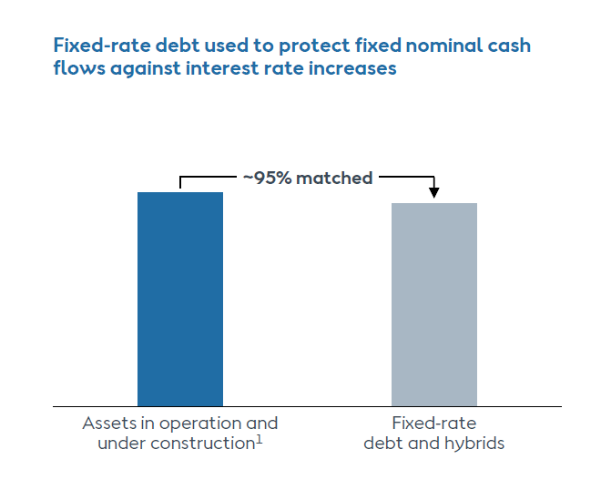
Allocation of Inflation Risk and Relevance to Current M&A Analysis and Orsted
PPA regulatory regimes from 1980’s is still directly used in battery analysis with bidding, fixed price to cover capital costs and issues of inflation treatment.
For project finance, lenders charge nominal interest and prefer fixed nominal price.
Equity holders who want to protect real returns (not nominal returns) prefer inflation indexed prices where prices increase with inflation rather than being flat.
Valuation based on earned IRR over life of project without terminal value.
IRRs computed for project - project IRR (analogous to ROIC or ROCE) and equity IRR (analogous to ROE)
ROIC and ROE not relevant because of declining investment for a single asset
Target IRR for valuation changes over time as project milestones are met.
Orsted and Inflation Index
What is the effect on the required IRR (cost of capital) from inflation protection.

Slide 39
Definition of FID versus Financial Close
I'm sure you've done the calculation, so are you telling us that maybe walking away, stopping Sunrise, would have been more expensive than doing what you're doing today, which is literally raising half of your market cap?
And with respect to the Sunrise Wind, the decision not to walk away from the project, with a project that is so far progressed, 35% constructed, it is by far the most value-accretive option to move forward with the project.
When you execute an offshore wind project, the vast majority of the of the construction costs to your suppliers are committed at the point of FID, so where you lock in pricing of equipment and so on. So, therefore, in that sense, you are obviously very much locked in at FID. And then also, remember that construction of the project is going well, that we are looking at a lifecycle IRR of mid-single digit, and that the forward-looking IRRs are very attractive.

Slide 40
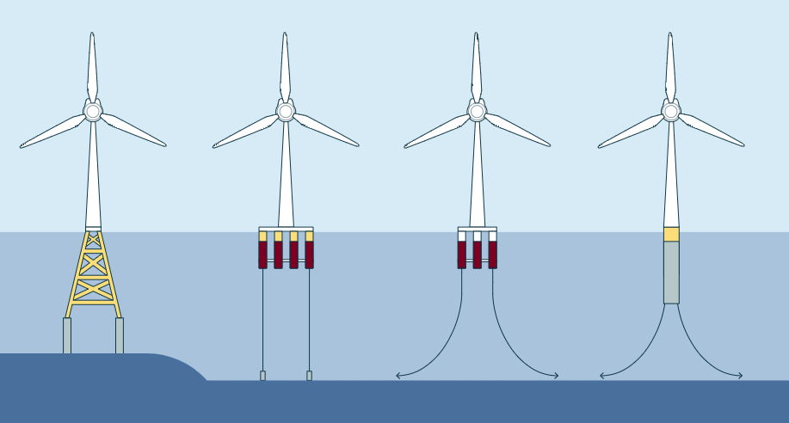
Time to Discuss the Abandonment of Ocean Wind Project and Valuation Implications
In developing off-shore projects, Orsted
  Signs contracts to buy turbines from Vestas, Siemens etc.;
  Signs Contracts with a company to construct the monopiles;
  Hires vessel companies to deliver the turbines
  Employs labor and materials to put turbines into monopiles.
Efficiently constructing turbines is supposedly Orsted’s strength. If this is the case, why did problems at one project before the FID eliminate almost 40% of its balance sheet equity capital.
Confusion with FID
  In project finance the term Financial Close FC is used. The FC is the date contracts are signed, and construction can begin. The contracts include the PPA contract (revenue contract), the EPC contract that has a fixed price, the loan agreement and the operating and maintenance contract.
  The FID is a term used by Orsted that stands for Final Investment Decision. The FID date is after the bid for the PPA has been submitted.
  One would think that there is not much construction before the FID, but this is apparently not the case and raises the question of why even define this date.

Slide 41
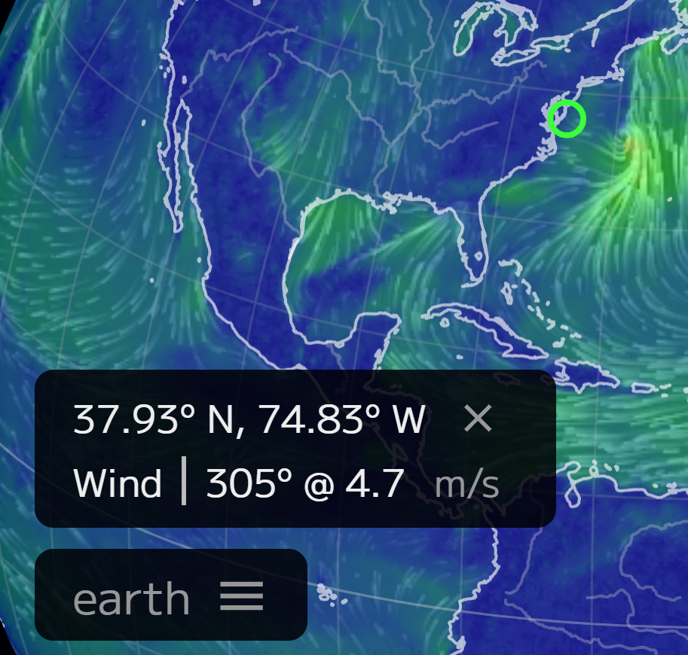
Background on the Ocean Wind Project
The New Jersey Board of Public Utilities awarded Ocean Wind 2 a 20-year OREC (Offshore Renewable Energy Certificate) for its offshore wind farm with a capacity of 1,148 MW. With today’s award, the Ocean Wind lease will be utilized to its maximum capacity of 2.3 GW. The 2029 OREC price is USD 84.03 per MWh with a 2% annual escalator. Note that the OREC is a premium on market prices, but because of low gas prices in the base electricity price is low (maybe USD 30 per MWH).
Ørsted had provided a USD 100 million guarantee to complete one of them, Ocean Wind 1, by the end of 2025. Additionally, the company was obligated to contribute USD 200 million toward developing the offshore wind industry in New Jersey. According to the Orsted, supply chain disruptions, rising interest rates, and inflation were some of the causes of the discontinuation of the Ocean Wind 1 and Ocean Wind 2 offshore.
Located about 24 kilometers southeast of Atlantic City, the 1.1 GW Ocean Wind 1 was planned to feature 98 Haliade-X 12 MW (GE) wind turbines and up to three offshore substations within its lease area.
Orsted’s statement in earnings call for the quarter before the cancellation: “On the strategic side, let me start with our portfolio of awarded projects in the US. We received the federal record of decision for New Jersey's first offshore wind farm, Ocean Wind 1. With this milestone, Ocean Wind 1 remains on track to begin offshore construction in 2024.”

Slide 42
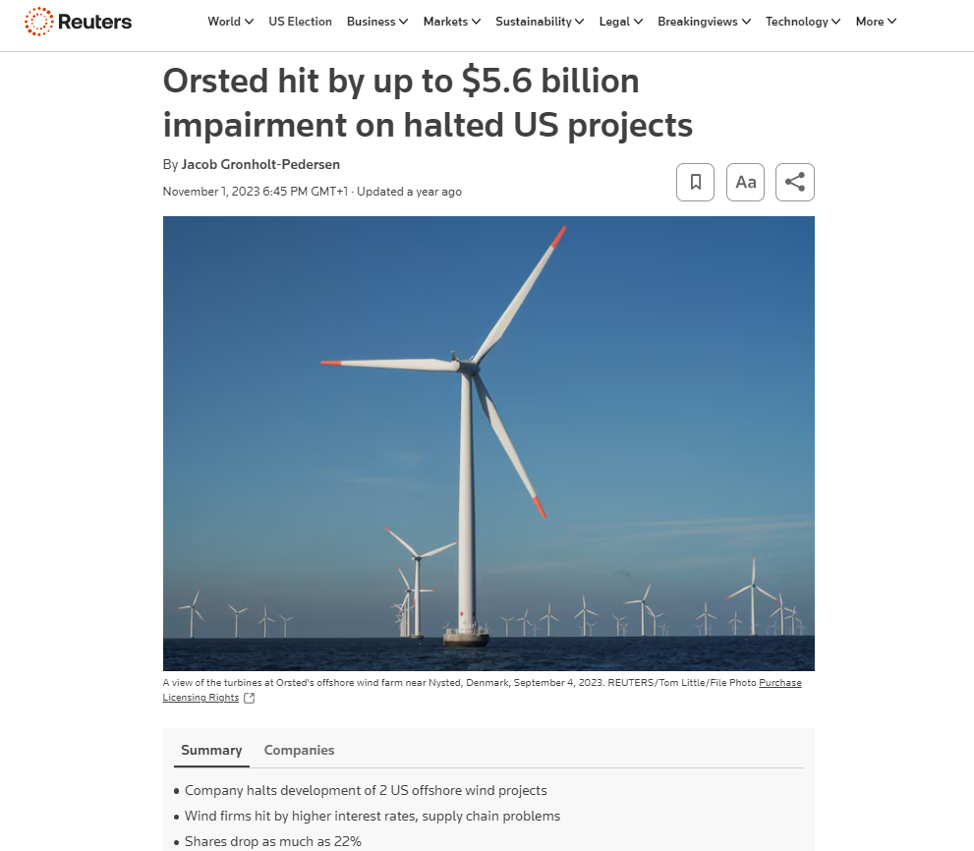
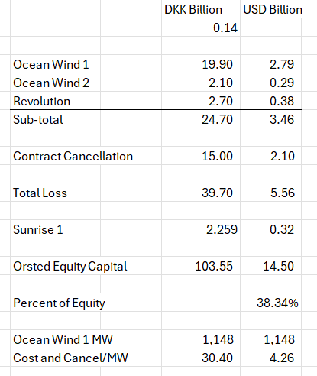
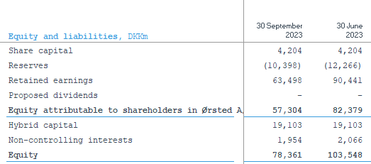
Orsted’s Cancellation and Write-off
The table below shows parts of the loss for abandoning the Ocean Wind project and other U.S. projects. The loss includes amounts spent on the project and liabilities for cash cancellation fees.
Why didn’t Orsted pull the plug much earlier

Slide 43
Basic Question about Orsted Write-off for New Jersey Project
How could you spend USD 3.5 billion and then take another hit of USD 2.1 billion in cancellation fees on a project where the total cost was about 6.8 billion.
Possible theories
  Orsted explanation – big difficulty securing vessels on time along large inflation in capital expenditures and difficulty in securing labor. Problem – this is supposed to be what Orsted is really good at – it is supposed to have subcontracts and understand the risks of delays.
  Orsted is running out of financing capacity to fund projects and is over-stretched from a capital raising perspective
  Orsted has been over-aggressive in bidding for projects that do not generate a return and/or revised estimation of the capacity factor and generation (never mentioned by Orsted management)
Question from Morgan Stanley
You seemed to have two very late-notice disappointments from suppliers on foundations and vessels during 2023, which, of course, was very surprising for a developer with such a strong track record such as yourselves.
Orsted Response
We got information, that first 20 monopiles and then a significant additional delay on a vessel, this was something which was new information to us. And that is where we’re saying the monopile facility was new, but during the conversations we’ve had with the supplier, we were not led to believe that this was an impact that was likely to happen to this scale.

Slide 44
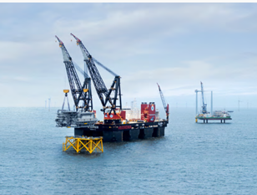
More Specific Explanation of Ocean Wind
So, what has happened, especially in Ocean Wind 1, which also under supply chain changes have been by far the bulk of these. Is that we have seen with centered, unfortunately around the vessels again, further significant delays on vessel availability, which in a project that was without any further float, meant that the delay of the overall project due to lacking backup vessel availability in the entire market, has now meant that it would implicate a multi-year delay of the entire project. What that would mean is that due to this significant additional delay caused by these supply chain delays, we would be in a situation where we would need to go out and recontract all or very large scopes of the project at expectedly higher prices. It meant massive impacts because of the uncertainty of needing to go out and recontract many of the scopes in Ocean Wind 1. That is why it is such a massive impact.
On the Ocean Wind 1 project, we had a book value of 13 billion DKK at the end of Q3 (about 2 billion USD). So, that's roughly what we've spent on that project. We are having a large cancellation fee from, from walking away from this project. But at the same time, we are also not having to spend the large Capex on this project, which should give a relief on the on the capital structure in the shorter term.
Now remember it differs a lot depending on what region you are in, what project it is that you are looking into, what scope it is. So, there's a lot of different metrics here. But I think if we talk the remaining larger US projects, I think the indications that we've been giving before is the roughly 6 million USD per megawatt.

Slide 45
Comment by Investor on Orsted and Any Corporation as Sum of Projects
The following is a statement from and investor about the value of existing assets versus the speculative value of development assets in an earnings conference call.
Analysts on this call probably get the same question I get every day. That question is what is the the valuation of Orsted’s existing assets? And I'm sure you get similar questions, but the question tells you something. It tells you that investors do understand that you have a portfolio of operating assets that are valuable.
But what investors are not buying is the conditional stuff (related to the development of new assets). Investors do not like to hear we (Orsted) hope to build this if type thing, if we get the tax credit, if we get a bump in the tax credit, if we can negotiate better terms, etcetera. So, I feel like if you guys in your strategy update can come with a base plan that is really dependable and is as reliable as people think the existing constructed assets are, and I think you'll get credit for that. And what I hope you'll be able to do is, is take away any pieces of it where there's still an uncertainty or something that people have to buy into a belief. Because it seems to me that the share price at the moment is telling us that nobody wants to believe in any of those kind of development uncertainties anymore.
Translation:
It is absurd when making a valuation of a portfolio of assets to assume a constant cost of capital.
Any corporation is a portfolio of assets

Slide 46
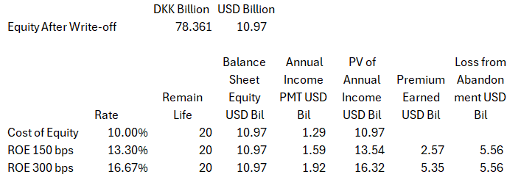
Back of Envelope Value Calculations for Abandonment
How would you make an analysis of the value lost from abandonment of the project relative to the amount earned above the cost of capital on the equity invested in all of the other projects. My calculation shows that the loss on the abandonment and cancellation fees exceeds the amount Orsted could earn on all of its other projects. It is more difficult to make simple calculations using PMT, PV and WACC concepts.
Steps to compute
  Levelised income on the equity balance from WACC calculations
  PV of income at the cost of equity allows premium calculation
Political risk in USA wiped out all of the economic profit on Orsted’s other projects.

Slide 47
A Better Description of Orsted and Idiocy of WACC Premium
In managing venture capital, does Orsted exit the investments at the appropriate time, does the company assess probability of failure well, does the company manage the timing of expenditures well.
A Venture Capital Firm
  Goes Around the World
  Invests in very early-stage projects
  Invests in projects with low probability of success
A Quasi EPC Company
  Signs Contracts
  Procures Equipment
  Secures Vessels and Labor
  Installs Facilities
A Holder of Boring Assets
  Manages O&M
  Measures the Wind
Big Question: Is Orsted Managing These Aspects of Business Well
Are the risks of these different activities incorporated in the famous WACC plus premium (of course not)
In managing construction, does Orsted limit risk of over-runs well; does it sign effective contracts with suppliers; does the company have an appropriate labor force.
In managing its portfolio of boring assets, does it present the cash flow stability well; does it show cash flow and debt service; does it allow investors to compute the value of assets that have been constructed.

Slide 48
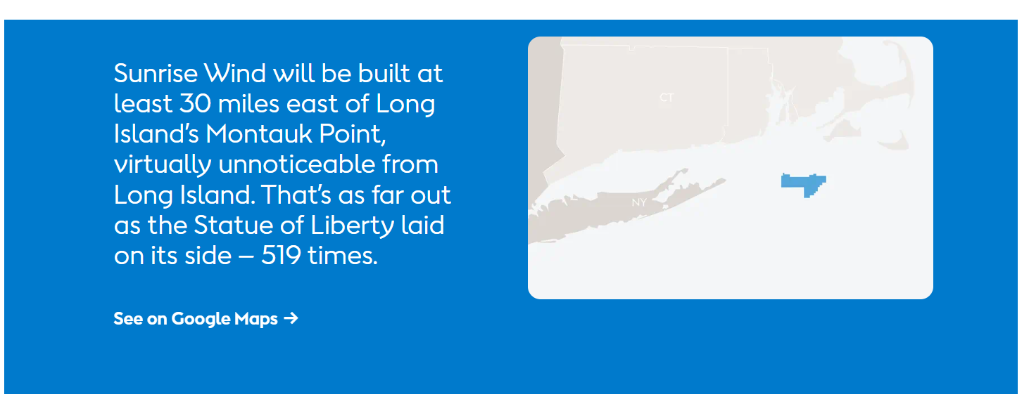
Sunrise Wind in US
Corporate Financing versus Project Finance

Slide 49
Assignment
Valuation should be done using DDM methodology (equity value and enterprise value), alongside relevant returns and key sensitivities that a prospective buyer might look at
  Use your discretion on which sensitivities to highlight
  For pricing the asset, you are expected to triangulate between precedent transactions and the bottom-up rate derived using CAPM methodology (for the CAPM buildup specifically, you’re allowed to do desktop research and are encouraged to make sensible assumptions as needed), and include relevant build-ups in the files
  For the returns analysis, assume a 7-year hold period with a prudent yield compression between entry and exit discount rates
Illustrative precedent transactions
  No. Size (MW) Technology Year
  Implied exit discount rate (USD)
    1 350 Solar 2023 9.0%
    2 150 Wind 2022 11.0%
    3 180 Solar & Wind 2022 9.0%
    4 225 Wind 2022 10.0%
    5 200 Solar 2021 8.0%

Slide 50
Selling Share in Sunrise Wind
Ørsted has now completed the acquisition of Eversource’s 50% share of Sunrise Wind, a 924 MW offshore wind farm located off the coast of New York. The purchase price at closing to acquire Eversource’s share of Sunrise Wind is USD 152 million..
Ørsted has assumed full ownership of the project, which has all federal permits in place and recently signed an OREC (Offshore Wind Renewable Energy Certificates) contract with New York’s energy agency, NYSERDA at USD 146 per MWh for 25 years. The final investment decision for the project was taken in March this year.
“Sunrise Wind has been significantly de-risked and achieved important milestones since we agreed with Eversource to buy their share. The transaction is a value-accretive opportunity for Ørsted as we continue to develop the project.”

Slide 51
Below 5% Return on a Second US Project – Sunrise Wind
Discontinued the development of Hornsea 4 in its current form. While we are currently reconfiguring the project on a different timeline, we continue to view the long-term fundamentals for offshore wind in the UK as strong, and we see an attractive potential for the future deployment of Hornsea 4 as we continue to hold the seabed rights, the grid connection, as well as the development consent order for the project.
The combined effect of these developments has led to an incremental funding requirement of around 40 billion across the period 2025 to 2027. Despite these developments around the funding of Sunrise Wind, the project is moving forward well, with an absolute return level on a lifecycle basis that remains at the mid-single-digit level we have communicated before.
Fundamental rule of project finance. Compare return to interest rate.
This project could not be project financed.

Slide 52
Orsted and Attempts to Change Prices After Bids
As shown in later slides, some of the most significant projects of Orsted include winning a competitive bid based on price. The most prominent of this is the Hornsea project, the largest off-shore wind farm in the world. Others include the Poland projects and the large US projects. In these projects bids were made for fixed future prices (some with inflation indexing).
The whole idea of winning a bid is that you will stick to the bid price; asking for increases or adjustments to the bid price obviously invalidates the competitive bidding process.
But Orsted does not seem to apply this basic idea of sticking to bides. For example, Ørsted said this year that its Hornsea 3 offshore wind project, which won a contract for £37.35/MWh, was at risk unless the UK government agreed to increase the UK’s support for the project. The company plans to make a final investment decision before the end of the year.
We are about to discuss the project that devastated Orsted in New Jersey. I can imagine Orsted going to the Governor of New Jersey and telling him, please increase our prices by 100% because we did not realize that we could not get the boats to install the turbines, and we need to meet our 150 basis points above WACC.

Slide 53
Orsted EPC Cost and EPC Wrap
Orsted’s construction contracts are ambiguous. There seems to be no locked in price when the contacts are bid, but Orsted does discuss wrapped EPC contacts.
One of the key aspects of the IPP/PPA model was an EPC contract with a separate company that takes construction risks. The EPC (engineering done by a separate company; procurement done by the separate company and construction done by the company). The EPC company guarantees the efficiency of the project (see the discussion of power curves below); the timing of the project (there are penalties called liquidated damages for delay); and finally the total cost of the project.
Orsted discussed EPC contracts in the context of farm-downs. If part of project is sold (e.g., 50%) then Orsted explains there are two options.
  First, Orsted can use a method called “shared risk” or “the traditional way”. Here if there are cost over-runs or other problems with performance, the partner shares in the risks.
  The other method is what Orsted calls an EPC wrap around FID. This implies that Orsted agrees to a fixed price and a fixed data and fixed performance. If there are problems with construction, the partner is protected and Orsted takes all of the risk.

Slide 54
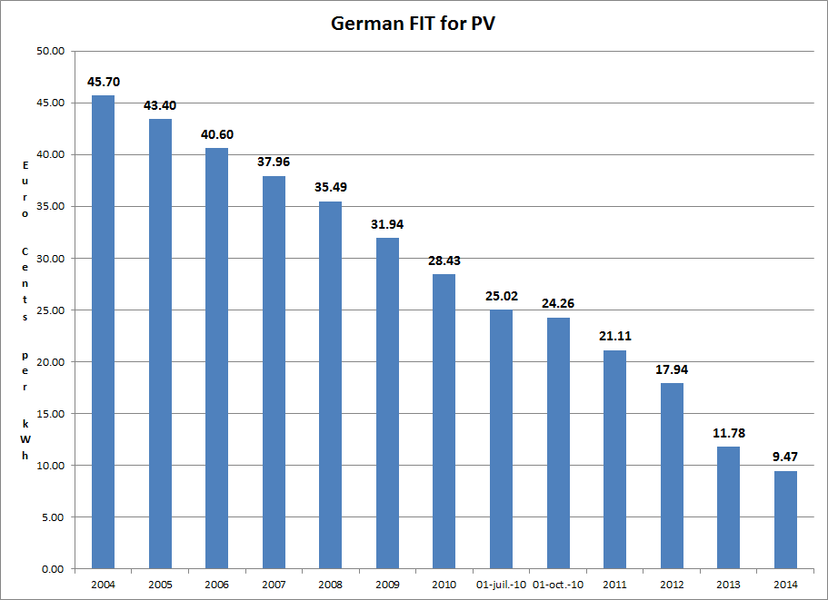
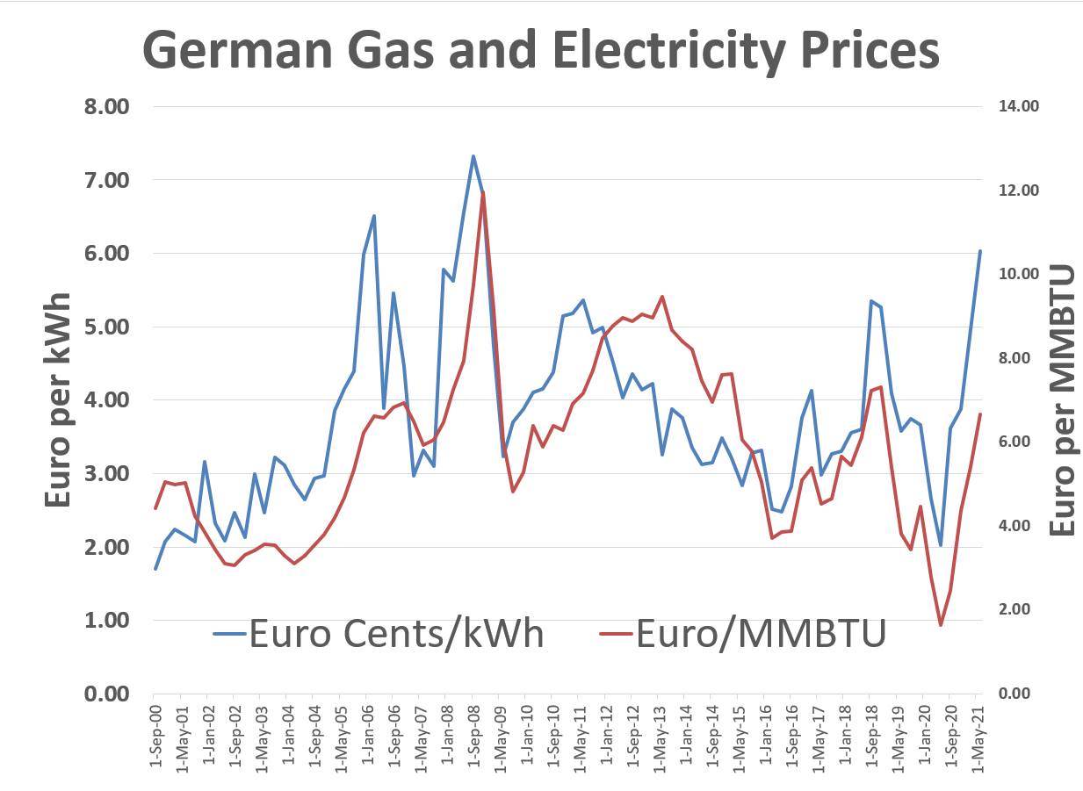
2000’s and Feed-in Tariffs - German Solar Feed-In Tariffs and Managing Risk
The left-hand scale represents feed-in tariffs meaning that if you put a meter next to your solar project and record the MWH generation, you get paid for that generation. The right-hand graph shows market prices (with correlation to gas prices). The y-scale is the same for both graphs. Comparing the blue bars on the left to the blue line on the right illustrates the magnitude of the subsidy in the feed-in tariff.
The feed-in tariffs were very simple contracts enabling companies to secure financing. The feed-in tariffs were supposed to encourage cost declines from scale, and they worked very well. There have been solar projects with contracts of around 1 Euro cent per kWh

Slide 55
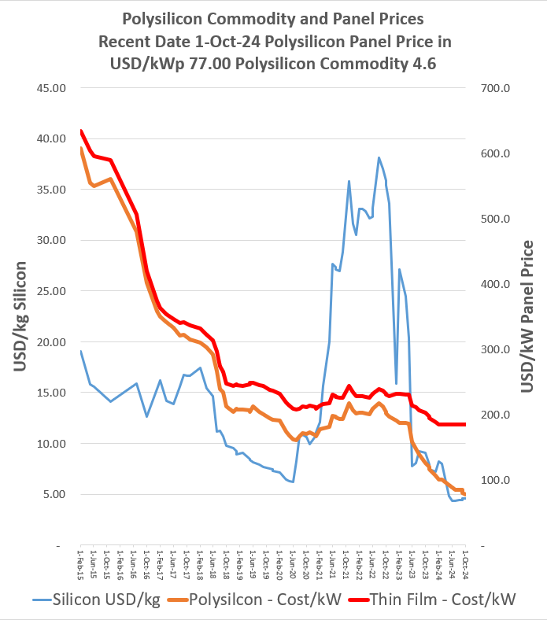

Revolution in Solar Module Prices and the Price of Polysilicon

Slide 56

Renewable Project Finance Diagram
Subsidy paid by ratepayers
Government or Utility Company Off-taker
Contract with subsidy scheme and merchant
Volume Risk from Variable Wind Resource
EPC Contractor: Want Strong Record and Finances
EPC: Fixed Price Contract with LD
Special Purpose Vehicle: Bond Rating of BBB-
O&M Contractor, also often investor
O&M Agreement
Loan Agreement – Draws Green; Debt Service Red
Banks Like Strong Sponsors. Sponsors want EIRR
Shareholder Agreement
Lenders:
Lenders want DSCR (LLCR, PLCR)
Invest with paid in cap; payback dividends
Invest with draws; payback debt service

Slide 57
Orsted Subsidy Regimes and Pricing
Orsted presents the different pricing and subsidy regimes for its projects. In general, the pricing regimes can have the following characteristics.
Prices per MWH can come from Government Established Prices or from a Bidding Process
Prices per MWH can be fixed or have some merchant price portion (with a merchant price portion and a fixed adder per MWH)
Prices per MWH can extend for different lengths of time, after which merchant prices are applied
Price per MWH can be paid by a corporation instead of the government (a corporate PPA)
In the U.S. there are subsidies from large breaks. The subsidies are an Investment Tax Credit that can directly reduce taxes by 30% to 40% of the project cost. An alternative is the production tax credit, where taxes are reduced by a credit per MWH produced. The tax subsidy scheme in the US is so aggressive that partnerships are formed with companies that have a high tax liability.

Slide 58




Example of Feed-in Tariff Calculation
Note the return on equity target of 11.5%

Slide 59

Pricing Regimes for Orsted’s Non-UK Offshore Wind Projects
After disaster with the Ocean Wind Project, Orsted just began publishing prices for different projects. Most of the projects have feed-in tariffs. Note that the highest prices are in Taiwan and in US (in Taiwan the capacity factor is low). The lowest prices are the recent fixed price contracts in Poland. Most contracts have some merchant price exposure.

Slide 60

UK Renewable Obligation Certificates (ROC) and CFD
The UK attempted to base subsidies from a market basis where suppliers are given targets and the subsidy required to meet the target is applied to different renewable energy projects. As different renewable energy technologies have different costs, the amount of ROC’s depends on the type of technology. The table shows the renewable energy subsidy (which is above the market price) for different periods.
The UK has moved to a bidding system where total prices are fixed (with inflation indexes). The fixed prices are like forward prices and termed contracts for differences discussed below.

Slide 61
Risks of Transmission Constraints with UK CfD Pricing
The following discussion illustrates that unlike feed-in tariffs, where payment is made at the meter in the project, the CfD transactions are paid at the meter where the power is delivered. This means that if there is a transmission constraint, Orsted will not get paid for the power that is not able to be delivered.
  Investor: Can I ask about these Hornsea 1 and 2 curtailments that you mentioned. So, how much of an earnings impact did those have, or how much of an earnings improvement can we get, when they're fixed later in the year? How much is it going to cost to fix them? And how sure are you that they will be fully fixed?
  Orsted: We are not going to give you the specific number, but it is one that, as you can see, does not move the fact that we have delivered a quarter as expected and with higher offshore earnings, and one that does not, in any way, impact the full year guidance.
  Orsted: We are going into a low wind quarter now, and given that, as mentioned, this is a transmission issue that only has an impact at the highest loads, then this is something where we expect that the additional impact will be minimal, and we have a high confidence that we will be able to fix it. The costs are not high. It is expected to be a relatively simple fix, but we will continue to monitor the development, to ensure that it is fixed, and we will do that during Q2.

Slide 62

Renewable Energy Certificate Prices and Contracts for Difference
Renewable energy certificate prices in the UK as a function of the required amount of renewable energy (shown in the third column) and the supply of renewable energy.
Note that the certificate prices are in addition to the market prices meaning the there is some merchant risk (discussed below).
In the UK, we were awarded a contract for difference (CfD) for building Hornsea 3, the world’s single biggest offshore wind farm, and we commissioned Hornsea 2, the world’s largest operating wind farm.

Slide 63
Orsted Corporate PPA And No Subsidy
We reached a major milestone for the German program as the first foundation for Gode Wind 3 was installed.
Gode Wind 3 is being constructed in tandem with our Borkum Riffgrund 3 Offshore Wind Farm, and combined they will have a capacity of around 1.1 GW.
The German projects are a clear example of Ørsted's continued leadership in offshore wind. Gode Wind 3 will pioneer Siemens Gamesa's 11 MW turbine
Borkum Riffgrund 3 is the world's first zero subsidy offshore wind farm that has been enabled by corporate PPAs with key corporate partners. We are progressing according to plan and expect commissioning in 2024 and 2025, respectively.

Slide 64


Orsted Merchant Exposure and Hedging
I was asked to discuss hedging of merchant prices. The Orsted case illustrates difficulties in hedging merchant prices with power generation that does not produce power at predictable times. The excerpts from Orsted’s financial statements have some background on Orsted’s hedging and merchant exposure. The right-hand slide shows that the merchant exposure is about 20% of generation. The left-hand slide shows historic and forward prices. Note that at the beginning of the chart prices for the U.S. and Europe were similar and that they have dramatically diverged after Russia’s invasion of Ukraine. Subsequent slides discuss the mechanics of hedging and how Orsted to a loss from over-hedging.

Slide 65
Difference between a Standard Forward Swap and Contract for Difference
We discussed Contracts for Differences above in the context of UK and Polish projects. In these forward contracts the settlement is made based on production which can vary. The price is assured no matter what is the production. Classic forward contracts like interest rate swaps are different because they have fixed notional volumes which allows the counter party to evaluate prices without the price variation. Orsted’s hedging uses forward or swap contracts where notional volume is fixed.
Forward Contract (Swap)
Contract for Difference
Contract settles on the difference between a fixed forward price and the merchant price
Contract has defined term
Contract based on a notional amount like and interest rate swap or a forward exchange rate contract
Contract settles on the difference between a fixed forward price and the merchant price
Contract has defined term
Contract based on production at a power project where the amount of output is not fixed

Slide 66


Counter Parties, Swap Contract and Exposure
The example below shows the danger of hedging without production. There is no notional amount.
Fixed price is 40
Merchant Price is 5
Production is Notional amount of 100
Sell at Merchant price and receive 500
Receive Settlement of 35 x 100 or 3,500
Receive Total of 40,000
Fixed price is 40
Merchant Price is 200
Production is 0
Pay Settlement of 160 x 100 or 160,000
No offset from selling notional amount of power because none is produced

Slide 67


Orsted Exposure to Fixed Volume Swaps and CfD with Flexible Volumes
The chart below shows how the exposure to merchant prices is hedged. The chart shows the percent of exposure to merchant prices that is hedged. This is further split between the percent that is hedged with swap contracts with fixed notional amounts and the amount that is hedged with CfD’s which can also be termed a PPA with a fixed price (I don’t think this is really hedging merchant price risk). Note that corporate PPA’s can use a third party to hedge the risk with a CfD in the on-shore category.

Slide 68

Orsted Losses from Over-Hedging
Orsted Comment:
Also, we saw negative effects from volume-related over-hedging. When we hedge our future power generation, we try to take into account the difference between the price we will receive from our power generation and the price our hedges will be settled at, i.e. what we describe as intermittency. In addition to cater for intermittency, when we enter into hedges years in advance, we have entered into trades to mitigate the more near-term risk of even higher price differences between peak and off-peak periods over the '22-'23 winter period.
Over-hedging Defined by Orsted
Misalignment between volume of actual production versus volume that was hedged. Potential causes include delayed ramp-up and low wind
Presumably, Orsted is producing when the prices are zero and collects a settlement to receive a fixed price. But if there is no production when the prices are high, the settlement must be paid. If the production were constant, the hedge would work.

Slide 69
Resource Risk with Data from Orsted

Slide 70

Offshore – wind speed and load factor reduction

Slide 71

Onshore – wind speed and capacity factor reduction

Slide 72


Data in 2024 versus Earlier Years
Because revenues are based on volumes produced multiplied by a price per MWH, the risk of changes in production must be assessed (the tree).
After the failure of Ocean Wind Orsted began to publish statistics on its wind production over time. This illustrates analysis of resource risk.

Slide 73


Estimation of Production with Resource Study
For any renewable energy project, a resource analysis is made. For wind projects this is based on an assessment of local wind speed and the wind power curve.
The output from a resource study can be expressed as a capacity factor (average/maximum). In the example, 340.3 x 1000/8760 is the average and this average divided by the 94 capacity gives the capacity factor.
The resource study also gives probabilities of downside cases which is essential for banks. The P99 one year capacity factor is 31.1%

Slide 74

Aggregate Capacity Factor for Denmark
From Nordpool you can obtain hour by hour wind since 2013. The graph below shows the variation over time with some assumptions. From the standard deviation you can compute different downside probabilities. By aggregating across plants (as Orsted does in its presentation, you can miss potentially miss important trends).

Slide 75
Nightmare Graph and Missing the P90 – Fitch Report
This is one of my favorite graphs showing the P50, P90 and the actual data.
In theory the P90 should be below the P50 level only for one year out of 10.
In the graph it is below the P50 in just about every month and by a large margin.
This shows that estimation of the P90 was completely flawed

Slide 76

First Step on Resource Study – Match the Wind Speed and the Power Curve
The capacity factor can be computed by matching the wind speed with the power curve for each hour of the period used. The x-axis in both graphs is the wind speed in meter per second. When the wind speed is in the steep portion of the power curve, small changes in wind speed can result in large changes in capacity factor. Innovation that produces different power curves can have a big effect on capacity factor.
Note that normal distribution produces negative values

Slide 77

Selected Graphs of Historic Capacity Factors for Orsted Projects – Mean Reverting Case
I have used the data provided by Orsted to compute and present capacity factors for different cases. This data highlights financial risks that investors are concerned about. The first case for an off-shore plant in the UK with a lot of history demonstrates a situation that should not be of concern. There is variation in the capacity factor, but this variation does not have a trend, and it is mean reverting. For valuation you should be much less concerned about mean reverting cash flow.

Slide 78

Drop Off in Capacity Factor for German Project
The second example I use is a case of a German project. If you were making a valuation of the project, would you use the average or the recent data (I would use the recent data). There has been discussion of global warming having an important effect on wind speeds in different locations.
Note that the lower capacity factor in the initial year is expected.
This worrisome trend appears in other German projects as well.
The lower capacity factor could also be the result of transmission constraints.

Slide 79


Denmark Off-shore Projects
The adjacent graphs show capacity factors for two projects in Denmark. These projects also demonstrate a downward trend for the past three or four years.
The kind of drop off in production could lead to the exposure that Orsted had for overproduction in the hedge contracts.
Needless to say, when making forecasts for M&A analysis you should ask detailed questions about the historic achieved capacity factors and whether factors other than wind speeds are driving the trends.

Slide 80


Aggregate Data Masks Worrisome Trends
Orsted’s largest projects are in the UK which do not show the drop-off in capacity factors and these projects result in the load factor below that shows reasonably constant capacity factors.
Orsted management refers to the aggregate data when asked about lower wind speeds.

Slide 81


Capacity Factor of On-Shore Wind Farms
The on-shore for US projects shown above demonstrate a drop-off in 2023. This could be one bad year or due to transmission constraints. This data was not available to investors until recently and Orsted has not addressed the issue.

Slide 82
Another Comment from Earnings Call Transcripts
If you'd like a bit more about kind of what's happened this year and where we go next with your strategy update or the review that you've talked about. And I think my kind of opening comment is if we reflect on the various announcements this year.
Since you've started really dealing with and communicating about these legacy issues, starting with the first impairment at the beginning of the year, the full year results for Q1 and Q2, the CMD, the August profit warning, and then the release we're talking about today. And it does seem clear that each time you've had an update, the situation has been kind of worse than you thought it was at the time before. And the numbers have got bigger, not smaller. And I guess that's what drives the kind of questions that we receive from your shareholders and investors.
And what people constantly ask us is when do we think you can draw a line underneath all these problems and kind of move forward in a way that leaves the uncertainties behind? And I'm sure that you're asking the same question. I don't mean to be flippant about it. But just to kind of turn this into a question you can answer. I mean, when you set out this strategy update that you've talked about, is it your intention that update will then give us a new base plan. Like financial targets and financing equation, that only then relies on projects where you've taken FID. You've got contracts 100% locked.
You have good status of project execution. Suppliers are delivering comfortably against what you're expecting and so on. So, is there anything else that you might be hoping for, like projects that could go ahead if they get a bump in the tax credit or get a bit more support or anything else, would all be an upside to the plan.

Slide 83
Target Credit Rating
Yeah. So, our perspective on this is that of course we want to create stability around our credit profile. And we believe that the BBB+ level is also a level that makes us competitive when we are bidding with the right level of funding costs compared to the capacity, we have within the key credit metrics.
On top of that, we also rely on, for example, a lot of counterparts for doing trading and also to deliver on our farm down model. We are also relying on being a credit worthy counterpart towards the investors. Those are some of the key drivers for us wanting to retain a BBB+ rating. But we are not targeting a lower credit rating. So, that is our target and that is what we will protect with our capital structure.

Slide 84



Is Political Risk Higher in US or Nigeria
Danger of investing in the US

Slide 85
In Defense of Project Finance
When Orsted had a price to book value of 5.5, one may have thought that it certainly had a better business model than companies such as EDF, EDPR, NextEra, ACWA Power and other companies who spend a lot of time and pay a lot of fees for project finance.
The Orsted case now demonstrates the value of an outside institution verifying contractual, technical, cash flow and other items.
  Without signed construction contracts, Orsted could have not received debt financing at financial close (remember FID is meaningless).
  Without cash flow analysis verified by financial institutions, Orsted could not have received debt financing if the OREC (PPA price) did not justify the capital expenditures
  Without technical engineering verification, Orsted could not have justified the resource analysis

Slide 86
Sunrise Wind Project Finance in US Cancelled
Replace non-recourse debt with new equity issue (new rights issue)
Announced
While we do not take this decision lightly, it is based on a comprehensive assessment of our options, and we have no doubt that this is the right decision for Ørsted and our shareholders, and puts us on the path to maximise shareholder value going forward. We are very pleased with the support from our majority shareholder.

Slide 87

Focus on EBITDA – How much Capital Expenditures are Supporting the EBITDA
Concern about wind speeds.
First, we are pleased with the operational performance for the first half of the year, where our EBITDA, excluding new partnerships and cancellation fees, amounts to 13.9 billion. We remain on track to deliver our full year EBITDA guidance of 25 billion to 28 billion, despite the lower wind speeds in the first half of the year.

Slide 88
Political Risk, Project Finance and Required Return
Comments
This extraordinary and unprecedented development, which arose unexpectedly and was outside of our control, impacted our dialogues during recent months, where investors involved in the equity process substantially increased their required risk protections and return requirements, and the banks involved on project financing ultimately were not able to continue the process under current market conditions, without material risk protection, including recourse from Ørsted’s parent company.
Explain this

Slide 89
Did Project Finance on Greater Changhua 2 (Taiwan)
The first priority is to strengthen our capital structure. While the rights issue, obviously, will be an essential component of this, we have also taken several measures through lowering our build-out ambitions and reducing our investment programme. During the first half of 2025, we progressed these measures as we closed divestments related to stakes in a US onshore portfolio and our West of Duddon Sands project, and also closed the project financing package for Greater Changhua 2.

Slide 90
What does this mean
We will continue to be very financially disciplined in the way we decide to allocate capital. We will uphold our return requirement of 150 to 300 basis points, which is based on a fully cost-loaded lifecycle perspective, including all development, overhead and decommissioning costs, while not taking into account potential benefits from farm-down gains or leverage.

Slide 91

Why Do Not Use FFO to Debt in Project Finance
.

Slide 92

More Information after Problems
.

Slide 93
US Problems
At the same time, I want to reiterate that despite the recent and highly disappointing challenges related to our US offshore wind projects under construction and the adverse impact it has had on our capital structure, we remain fully committed to our target of having a solid investment grade credit rating.

Slide 94
FID and Risk Changes
First, we have commissioned around 2.4 GW of total renewable capacity across offshore and onshore assets, representing a significant contribution to the buildout of our operational fleet of assets. In addition, we very recently took the final investment decision on our Baltica 2 project in Poland. All major component and vessel contracts for the projects have been signed, locking in the majority of the project's Capex, which significantly de-risk the projects. We are satisfied with the value creation of the project, which has an attractive risk reward profile. This FID highlights that solid investment opportunities continue to exist, despite the challenging industry backdrop, and I am proud of the team getting the project to this important milestone.
For Sunrise Wind, we continue to progress the construction. As we shared a few weeks ago, the project has seen adverse developments in terms of higher costs and schedule delays, which have been factored into the business case now. While we work extremely dedicated to deliver on the updated schedule and timeline, we have seen good progress in terms of onshore construction work, as well as fabrication of the offshore components, such as monopiles, turbines and export cables.

Slide 95
Inflation and Risk
Lastly, we have taken the final investment decision on our Baltica 2 project. The project holds a 25-year inflation-indexed CFD contract, and has secured all major components and vessel contracts for the project, locking in the majority of the Capex. We are satisfied with the value creation of the project, which has an attractive risk reward profile, and we expect to comm
We also expect earnings increase from inflation-linked ROCEs and Cfd farms, partly offset by lower offtake price assumptions for our merchant assets, as well as lower earnings at Anholt and the older German assets, as they respectively see a phase-out and a step down in the subsidy level.

Slide 96
Farm Down and Changing Risk
Hi, thank you for taking my question. You talk a lot about cost pressures that have caused your credit metrics to deteriorate. Obviously, we're aware of the 4 billion cost overrun at Sunrise Wind. But the Capex inflation that you presented today is actually 30 billion, approximately, versus the 270 billion Capex plan that you've had until now. Just trying to square where the other 25 billion has come from and why that wasn't disclosed before today, because your Q3 slides still show that 270 billion.
As we've been talking and talking about before, we are not saying anything about specific farm downs or specific assets that we have in the market, and we are working on. But our modus operandi and our business plan is, of course, the ordinary one, to own 50% of our assets. And that, of course, is going to include the 100% ownership we have on the projects that we are running.
As I said, we are firmly committed to moving forward Revolution Wind and Sunrise, but everything on the other side of that, we will carefully consider. And over time, if that trend continues, that could have an implication on the supply chain in the US. But I think it is too soon to have a firm view about that.

Slide 97

Orsted
Ørsted’s Revolution Wind and Dominion Energy’s Coastal Virginia Offshore Wind have started producing power as the projects remain under construction, and Revolution Wind is on track for commissioning in the second half of this year, while Sunrise Wind is expected to be commissioned in the second half of 2027, the firm found. All of those projects survived the Trump administration’s earlier round of stop-work orders.

Slide 98
Ocean Wind Levelised Cost
The Ocean Wind 2 Project offers a first year OREC price of $84.03/MWh42 and LOPP of $98.49/MWh.43 Ocean Wind 2 included a 2.0 percent annual escalator in its OREC Purchase Price schedule. The LNOC is $42.30/MWh. 44 The LNOC adjusts the LOPP by including estimates for the revenue credits to be returned to ratepayers. The LNOC also includes an estimate of the ratepayer share of the PJM transmission system upgrade costs, discussed at the end of this section.45 Ratepayer impacts account for revenue generated by the Project and returned to ratepayers. Ratepayer bill impacts are based on the PVNOC divided by the present value of the MWh load that would absorb those costs. LAI utilized Energy Information Administration (“EIA”) data covering the 2019 calendar year to estimate monthly usages.46 The OW2 Project revenue plan identifies a strategy for producing all revenues over the 20-year OREC term, and OW2 is required to make a good faith effort to maximize all Project revenues.

Slide 99
EDF and Shell Atlantic Shores

Slide 100

EDF Renewables’ 1.5 GW Atlantic Shores Offshore Wind
The future wind farm is located between 10-20 miles off the coast of New Jersey. This offshore wind farm will be one of the most powerful in the United States and will be able to supply enough to power 700,000 homes every year. Construction is scheduled to begin in 2024.
This success confirms the quality and competitiveness of our offer, and I would like to commend the work carried out over the past several months by our teams, in partnership with Shell New Energies. This project is a significant step forward in the Group's CAP 2030 strategy, which aims to double its installed renewable capacity worldwide between 2015 and 2030 to 60 GW net.”

Slide 101

EDF Atlantic Shores
For more info on Atlantic Shores Offshore Wind: www.atlanticshoreswind.com
The 79,351-acre lease area, awarded as part of an outer continental shelf renewable energy auction held by the Bureau of Ocean Energy Management (BOEM), has the potential to support approximately 1.5 gigawatt (GW) of wind generation.
Final capacity 2800 MW with 200 turbines or 14 MW per turbine.
Impairment was 996 for ½ of project mainly for costs of lease or 771 per kW. (Relative to a cost of something like 3,000 per kW).
Shell and EDF Renewables-owned Atlantic Shores Offshore Wind Bight, LLC, won the development area south of the biggest site for USD 780 million, and the area adjacent to Shell and EDF’s was secured by Invenergy Wind Offshore LLC for USD 645 million.

Slide 102
Shell withdrawal from EDF Atlantic Shores
The project was launched as a joint venture between EDF Renewables and Shell. In January, Shell booked a $1 billion impairment associated with the project, which EDF referred to as a “withdrawal” in its annual financial report and which led to NJBPU canceling its fourth offshore wind solicitation. A month later, EDF Renewables booked a $980 million impairment associated with the project.
“A number of reasons led to this decision, notably Shell backing out as an equity partner in the Atlantic Shores project and backing away from the American clean energy market, as well as uncertainty driven by federal actions and permitting,”

Slide 103
Shell Abandonment
The company has assigned its 50 per cent outstanding membership interests to its existing partner, EDF, with an immediate effective date.
Shell said it is driving a strategic shift in its power business, reallocating capital to areas of the value chain where it sees higher returns and where it can leverage its strengths.
Atlantic Shores has four lease areas totaling more than 400 square miles under active development. Two of the lease areas are located approximately 10-20 miles off the Jersey Shore between Atlantic City and Barnegat Light, with a third lease area located off the Atlantic Ocean known as the Bight.
In 2024, the company’s CFO said during a press call that the company would pause its involvement in the Atlantic Shores offshore wind project, which received federal approval in October 2024.
In August 2025, the New Jersey Board of Public Utilities (NJBPU) terminated the offshore renewable energy certificate (OREC) order issued in 2021 for the 1.5 GW Atlantic Shores Project 1.

Slide 104
Shell and Rate of Return
Shell said it is driving a strategic shift in its power business, reallocating capital to areas of the value chain where it sees higher returns and where it can leverage its strengths.
Atlantic Shores has four lease areas totalling more than 400 square miles under active development. Two of the lease areas are located approximately 10-20 miles off the Jersey Shore between Atlantic City and Barnegat Light, with a third lease area located off the Atlantic Ocean known as the Bight.
In 2024, the company’s CFO said during a press call that the company would pause its involvement in the Atlantic Shores offshore wind project, which received federal approval in October 2024.
In August 2025, the New Jersey Board of Public Utilities (NJBPU) terminated the offshore renewable energy certificate (OREC) order issued in 2021 for the 1.5 GW Atlantic Shores Project 1.

Slide 105
EDF and Rebid
The OREC contract was awarded for the first Atlantic Shores offshore wind farm, with the stipulation that the first phase of the offshore wind farm (761.6 MW) would start producing electricity by September 2027 and the remaining 748 MW would reach commercial operation by April 2028.
In 2024, Atlantic Shores rebid the project in New Jersey’s fourth solicitation to secure better terms, but the NJBPU cancelled the solicitation process in February 2025, also amid the uncertainty created in the US offshore wind market following decisions on the federal level.
EDF Renewables, now leading the Atlantic Shores Offshore Wind developments, filed the request to vacate the OREC order in June, saying the project was no longer viable under the terms of the order.

Slide 106
EDF Atlantic Shores – Timing of Cancellation
According to the motion, EDF Renewables had invested hundreds of millions in pre-construction work, including permits, interconnection agreements, supply-chain contracts, community support, and workforce development.
The project’s cancellation follows significant setbacks, including Shell’s withdrawal as a partner in January 2025, resulting in a $996 million impairment, and the cancellation of New Jersey’s fourth offshore wind solicitation in early February 2025.
The project encountered further obstacles when the Environmental Protection Agency suspended permits in March 2025. Before the suspension, the project had received approval for up to 200 wind turbines, said to be capable of generating 2,800 megawatts of power.
In its formal petition to the New Jersey Board of Public Utilities, Atlantic Shores Offshore Wind cited soaring inflation, supply chain disruptions, and—most critically—the federal freeze on offshore wind permitting initiated by the Trump Administration in January (meaning could not re-bid with higher price).
That executive action, followed by the EPA’s revocation of a key air permit in February, effectively halted the project’s progress. Despite investing hundreds of millions into early development, Atlantic Shores states that the regulatory and economic landscape had shifted too drastically to continue under the original terms.

Slide 107
EDF Atlantic Shores Pricing and OREC
The Atlantic Shores Project offers a first year OREC price of $86.62/MWh42
and LOPP of $106.18/MWh.
Atlantic Shores included a 2.5 percent annual escalator in its OREC Purchase Price schedule.
The LNOC is $58.81/MWh. The LNOC adjusts the levelized OREC purchase price by including estimates for the revenue credits to be returned to ratepayers. The LNOC also includes an estimate of the ratepayer share of the transmission system upgrade costs discussed at the end of this section.
Notably, the first year OREC and the levelized OREC price do not include the ratepayers’ share of transmission system upgrade costs. Transmission system upgrade costs are estimates until the upgrades are completed. Upon completion of the upgrades — when the actual upgrade costs are known — the OREC will be trued-up to reflect the actual upgrade costs in accord with the methodology described in Attachment B, using the four-tiered Transmission System Upgrade Cost (“TSUC”) Sharing Parameters (“Upgrade Cost Sharing Formula”) included in ASOW’s application and shown below:

Slide 108
EDF Atlantic Shores – Transmission Adders
Tier 1 and Tier 2: Up to $266M – 100% paid by ASOW
Tier 3: Between $266M and $533M – 30% paid by ASOW, 70% recovered through TSUC price adder
Tier 4: Above $533M – 100% recovered through TSUC price adder.

Slide 109
EDF Atlantic Shores and Air Permit
Despite Atlantic Shores’s substantial efforts and investments to advance the Project and support the development of the OSW industry in New Jersey, external factors ultimately prevent Atlantic Shores from completing the Project at this time.
Global inflation and increased demand for OSW materials have made the Project much more costly than it was when the OREC Order was first approved in 2021.
Additionally, Project construction cannot move forward without the Air Permit, which has been remanded by the [EPA Environmental Appeals Board]. The Wind Memorandum has also introduced significant uncertainty about whether or when the Air Permit may be reinstated and what other actions the federal government may take with respect to the Project”, the New Jersey Board of Public Utilities says in its order vacating the previously issued OREC order.

Slide 110
EDF Explanation of the Atlantic Shores Cancellation
EDF said “unfavourable changes in the political situation in the United States, Shell’s announcement of its withdrawal from the joint venture, and the decision by the State of New Jersey …. to cancel the tender for which ASOW had bid its most advanced project” led the company to make the decision to book an impairment of 934 million euro, or $980 million.
“This is despite Petitioner’s diligent and good faith efforts to advance the Project toward completion as set forth in Section II of this Petition, including submission of a rebid of the Project in the Fourth Solicitation, which was concluded by the BPU without an award,” the petition said.

Slide 111

Letter on National Security

Slide 112
EDF and Atlantic Shores
Political uncertainty surrounding offshore wind in the U.S. and the withdrawal of project partner Shell led EDF Renewables to book a $980 million impairment associated with Atlantic Shores Offshore Wind, the company said in a Friday report.
Atlantic Shores Offshore Wind was a joint venture between Shell and EDF until Shell exited last month and booked a $1 billion impairment associated with the investment. The venture was developing the 2.8-GW Atlantic Shores 1 and 2 projects offshore New Jersey.

Slide 113
Total Energies

Slide 114
Total Energies Settlement
After those efforts failed in court, Interior took a new tack.
The department announced in March that it would pay French company TotalEnergies $928 million to cancel two wind projects off the New York and North Carolina coasts. In exchange, the company agreed to focus its investments on liquefied natural gas in the Gulf Coast. The following month, Interior reached a similar deal with Ocean Winds to refund the company’s $915 million investment for two wind projects off the New York and California coasts. The company also agreed to focus investments on “conventional energy projects.”
The move marked a change in approach from the Trump administration’s first deal with Total, in which the company vowed not to pursue any future wind projects in the United States and instead agreed to bolster existing investments in fossil fuel infrastructure.

Slide 115
Total Energies
Under the deal, TotalEnergies, along with its partners, will relinquish the offshore wind lease areas in Carolina Long Bay and New York Bight, and recover the lease fees from the US government. The company will then invest an equal amount in the construction of the 29 Mt Rio Grande LNG plant and the development of its oil and gas activities in the US, according to TotalEnergies’ press release from 23 March.
According to a press release from the DOI, TotalEnergies has also “pledged not to develop any new offshore wind projects in the United States”.

Slide 116
Total Energies and Ocean Winds
The case is tied to two offshore wind farms that TotalEnergies had planned in the US. The larger one, Attentive Energy, was to be built 54 miles (87km) south of Jones Beach, New York, and would have powered a million homes and businesses in New York and New Jersey. The smaller one, Carolina Long Bay, was meant to start operations in the early 2030s in North Carolina.

Slide 117
Iberdrola and GE Dispute

Slide 118
Iberdrola Vineyard Wind
Vineyard Wind 1
In the case of Iberdrola, the project that was halted and has now been unblocked is Vineyard Wind 1. Located off the coast of Massachusetts, its installed capacity is 806 MW, enough to supply the energy needs of 400,000 homes and businesses in the region.
Iberdrola's US subsidiary, Avangrid Power, has a 50% stake in the project, while the other 50% is held by the Danish company Copenhagen Infrastructure Partners (CIP).
The investment in the project amounts to 2.7 billion euros, guaranteed by contracts with the three main state-owned electricity companies.
Cost per kW: 2,700,000/806,000=3,349/kW

Slide 119
Iberdrola
As a major player in the promotion of renewable energies in the United States, the Iberdrola group is promoting important initiatives in the country, such as the Vineyard Wind 1 project. The complex, which is scheduled to come into operation in 2024, will be the first large offshore wind farm in the US and will generate enough wind energy to cover the demand of more than 400,000 homes and businesses.

Slide 120
Iberdrola
Vineyard Wind, a major offshore wind farm project off the US East Coast owned by Denmark’s Copenhagen Infrastructure Partners (CIP) and Spain’s Iberdrola, secured a key victory on Friday over GE Vernova, the project’s turbine supplier, reports Recharge News.
A court in Boston has ordered the US-based manufacturer to supply wind turbines for the project despite its efforts to withdraw from the contract.
GE Vernova’s subsidiary, GE Renewables (GER), terminated the supply contract in connection with a dispute over payments with Vineyard Wind amounting to USD 1bn.
In his ruling, Judge Peter Krupp “orders and prevents” GE Vernova from “giving any effect” to the termination of the agreement to supply wind turbines for the 800MW project.
GER is thus not permitted to “cease” or “alter the performance of its work,” Recharge News also reports.
The dispute arose back in 2024 when a wind turbine blade collapsed, forcing Vineyard Wind to replace a large number of blades, resulting in delays and additional costs. Consequently, the company withheld payments to GE Vernova totaling USD 360m.
Vineyard also believes that GE Vernova owes USD 850m due to the technical challenges.
After the wind turbine manufacturer terminated the contract, Vineyard Wind decided to sue its supplier because, according to the company, the offshore wind project can only be completed using turbines from GE Vernova.
The total value of the supply agreement is USD 1.2bn.

Slide 121
Iberdrola
In July 2024, a blade from one of GE Vernova’s Haliade-X turbines broke due to a manufacturing deviation, prompting inspections and a programme to remove and replace blades manufactured at the company’s facility in Gaspé, Canada, after additional units were found to have insufficient bonding. The incident led to regulatory scrutiny and the implementation of mitigation measures, including enhanced inspections and monitoring systems for installed blades.
Last week, the federal government lifted the suspension on Vineyard Wind’s installation of the remaining GE Vernova wind turbines.
The new COP details the root cause analysis (RCA) conducted by the wind turbine manufacturer regarding the blade failure that occurred in July 2024.
The RCA found that there was insufficient bonding at certain locations within the blade, which should have been detected at the manufacturing plant through inspection and quality control procedures. After reprocessing of the manufacturing data from the installed blades, additional blades with insufficient bonding were identified.

Slide 122
Iberdrola
Spanish investment analysts are also saying that Iberdrola, the parent company of U.S. renewable energy company Avangrid, which is the developer for several major U.S. offshore wind farms, is also taking steps to protect its investment. It was revealed last week that the Trump administration was planning to challenge approvals for Avangrid’s New England 1 and 2 offshore projects granted in the last days of the Biden administration. Work was expected to begin this year on New England 1, a 791 MW project, and would be followed by the larger 1,080 MW second phase.
The Trump administration’s moves against the offshore wind energy sector are raising broader concerns, with Avangrid potentially one of the most exposed. In addition to the permits for the New England offshore projects, Avangrid is the developer of Vineyard Wind 1, with Iberdrola telling investors in July that the project was already exporting power from 17 out of 62 planned turbines, with 23 turbines installed, and supplying approximately 30 percent (241 MW) of its full capacity of 806 MW.

Slide 123
Dispute Between GE and Iberdrola
The case was brought to court after GE Vernova issued a termination notice to Vineyard Wind under a clause allowing it to terminate the contract with the developer if “amounts due” were not paid within specified conditions, arguing that Vineyard Wind’s withholding of payments triggered that right.
According to the court documents, a project engineer appointed under the contract determined that GE owes Vineyard Wind more than USD 500 million (approximately EUR 425 million) in claims, which then led to Vineyard Wind withholding around USD 308 million (approx. EUR 264 million) in payments to GE based on those determinations.

Slide 124
Iberdrola
The breakage of the blade on one of GE Vernova’s Haliade-X wind turbines at the Vineyard Wind 1 offshore wind farm in the US was caused by a manufacturing deviation, the company’s CEO Scott Strazik revealed during an earnings call on 24 July. Strazik also pointed out that a blade event that happened on a Haliade-X turbine at Dogger Bank A in the UK this May was due to an installation error.

Slide 125
RWE and National Grid

Slide 126
RWE Settlement
RWE is reportedly considering a deal with the Trump administration to surrender US offshore wind leases in exchange for commitments tied to fossil fuel investments, prompting more than 50 US organisations to urge the company to abandon the reported negotiations.
If RWE moves to reach an offshore wind exit agreement with the US government, the company would be the third developer to do so, following TotalEnergies and Ocean Winds, whose deals involve relinquishing their offshore wind lease areas in return for lease payment refunds and committing to invest in fossil fuel projects in the United States.

Slide 127
Lease for RWE
The largest and most expensive site, which could accommodate a minimum of 1,387 MW of installed capacity, was secured for a price of USD 1.1 billion by Bight Wind Holdings, LLC, a joint venture between RWE Renewables and National Grid.

Slide 128
EDP and Engie

Slide 129
Golden State Wind Project
Bluepoint Wind is a partnership between Ocean Winds (a 50/50 joint venture of EDP Renewables and ENGIE) and Global Infrastructure Partners (GIP). The project is a fixed-bottom offshore wind farm off the coast of New York that was planned to have an installed capacity of 2.4 GW.
The Golden State Wind project, a 2 GW floating wind farm proposed to be built in the Morro Bay Wind Energy Area (WEA) off California’s central coast, is a joint venture of Ocean Winds and Reventus Power, with the project managed and led by Ocean Winds.
Separately, Golden State Wind will terminate its lease for the floating wind project off California, for which it will be eligible to recover approximately USD 120 million in lease fees after making an equivalent investment in US oil and gas assets, energy infrastructure, and/or LNG projects along the Gulf Coast.
French utility Engie is in discussions with the Trump administration over a potential refund for its offshore wind project leases in the United States, according to Reuters.

Slide 130


Ocean Winds
.

