Slide 1
Day 2
Contract and Social Impact Pillar

Slide 2
Suggestions from Day 1

Slide 3
Initial Questions for You
Have you ever worked on a contract that establishes prices
Have you ever worked on an engineering, procurement and construction contract (EPC)
Have you ever worked on a loan agreement contract

Slide 4
Simplified Course Outline – Day 2
Day 2, Part 1: Project Finance History and Incentives Efficiency
Day 2, Part 2: Availability Contracts (Blackburn Hospital)
Day 2, Part 3: More Incentives and Higher Cost of Capital (Drax Plant, Eurotunnel)
Day 2, Pay 4: Output Contracts and Merchant Power (Eurotunnel)
Day 2, Part 5: Liquidated Damages, Targets, Change Orders
Day 2, Part 6: Case Study on Structuring Contacts (Battery Storage)

Slide 5
Outline of Issues for Price Contracts
Fundamental Aspects of Contracts
  Allocate Risk Between Parties
  Provide Incentives
Risk and Incentives in Cost Plus Model (Earlier than Project Finance)
Risk and Incentives in Availability/Capacity Payment Model
Risk and Incentives in Merchant Model
Risk and Incentives in Output Model
Liquidated Damages, Performance Penalties and Targets
Incorporating Externalities and Social Impacts

Slide 6
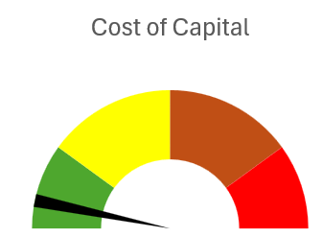
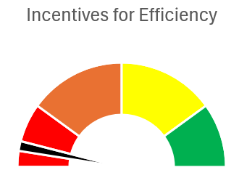
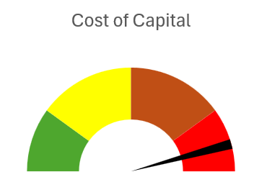
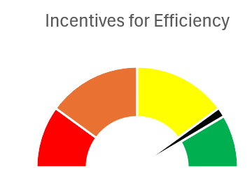
No Easy Way to Measure Value of Incentives vs Increase in Risk
Central Point:
Tradeoff between:
Cost of imposing risk with cost of capital increase
And
Incentives to construct and operate efficiently
Cost Plus Regulation of Private Companies
Merchant – No Revenue Contracts

Slide 7
Terminology and Contract Parties
SPV – Separate Corporation that Signs the Contracts
Off-taker – Utility company, government or corporation (corporate PPA)
Ultimate Consumer – Who ultimately pays electricity prices and has risks
Investor – Sponsor or developer; company that makes equity investment
Lender – Commercial bank, development bank, bond
Supplier – EPC or O&M provider (O&M could be investor)

Slide 8
Diagram of Who Incurs Risk and Contract Structure
Flow of Risk from Contracts
Off-taker Risk – Total Risks Minus Risks Allocated with PPA Contract
Investor Risk – Risk Retained by SPV and Not Transferred to Suppliers
Contractor Risk – Risk Associated with Constructing the Plant and Operating the Plant
Flow of Money with Contracts
Ultimate Consumer (society) Wants low prices
Special Purpose Vehicle (SPV), Shell company that signs contracts
EPC Contractor Wants to profit from efficient construction
O&M Contractor Wants to profit from efficient operation
Off-taker - Pays for Output through PPA Contract
Equity Investor (Sponsor/Developer) Wants High Return Relative to Risk
Debt Investor (Lender) Wants to be paid back

Slide 9
Limited Risk Transferred – More Retained by Off-taker
Flow of Risk from Contracts
Off-taker Risk – Total Risks Minus Risks Allocated with PPA Contract
Limited risk Transferred
Investor Risk – Risk Retained by SPV and Not Transferred to Suppliers
Contractor Risk – Risk Associated with Constructing the Plant and Operating the Plant
Flow of Money with Contracts
Ultimate Consumer (society) Wants low prices
Special Purpose Vehicle (SPV), Shell company that signs contracts
EPC Contractor Wants to profit from efficient construction
O&M Contractor Wants to profit from efficient operation
Off-taker - Pays for Output through PPA Contract
Equity Investor (Sponsor/Developer) Wants High Return Relative to Risk
Debt Investor (Lender) Wants to be paid back

Slide 10
High Risk Transfer with Merchant Prices
Flow of Risk from Contracts
Off-taker Risk – Total Risks Minus Risks Allocated with PPA Contract
Investor Risk – Risk Retained by SPV and Not Transferred to Suppliers
All risk Transferred
Contractor Risk – Risk Associated with Constructing the Plant and Operating the Plant
Flow of Money with Contracts
Special Purpose Vehicle (SPV), Shell company that signs contracts
Ultimate Consumer Pays Merchant Prices
EPC Contractor Wants to profit from efficient construction
Merchant Market Prices
O&M Contractor Wants to profit from efficient operation
Equity Investor (Sponsor/Developer) Wants High Return Relative to Risk
Debt Investor (Lender) Wants to be paid back

Slide 11
Objectives of Pricing Contracts
Analysis of pricing contracts for infrastructure involves questions about:
how to set contract prices in different circumstances;
what kind of risk transfer between the parties is efficient;
whether one party is benefiting at the expense of the other party.
In creating an economically efficient project, the way contracts are developed and negotiated can result in projects that produce results that are good for both the contracting parties and the overall society.
Contracts that are badly structured can have the opposite effect.

Slide 12
Project Finance History
Some Historic Perspective would be good
Part 1: 1945 to 1973
Les Trente Gloriouses or MAGA
Regulatory Scheme – Cost Plus Regulation with WACC

Slide 13
Project Financing History
History highlights the same kind of risk and return trade-offs that are integral to analysis of detailed provisions of contracts.
  For example, an issue may arise regarding whether the investor (and subsequently the EPC contractor) should be insulated from changes in the cement and steel price over a long construction period. The question of whether such a provision should be included boils down to similar questions of risk versus incentives that have driven different government policy.
  The electricity generation industry is used to illustrate issues of risk and cost of capital objectives versus incentives to operate efficiently.
Similar histories could be used for large transport projects that were once entirely government owned and, in some cases went through an availability stage and a stage when investors accepted traffic risk.
The history of the trade-off between achieving low cost financing and incentives to operate efficiently, the history of financing generating assets can be classified into different periods.
  The first period transferring virtually all risk to ultimate consumer.
  The second period transfers selected risks using contracts that allocated selected risks like construction over-runs, delays and efficiency to investors.
  The third period transferred imposed merchant prices by allocating even more risks to investors related to market supply and demand.
  The fourth period using output-based contracts for renewable energy moves back from merchant risks.

Slide 14
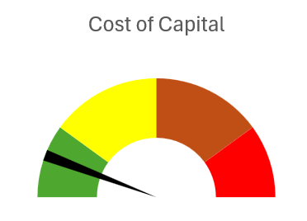
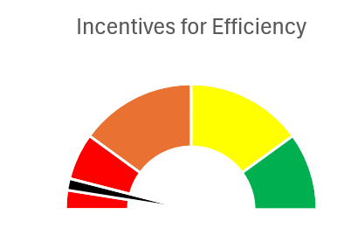
Policy Option 1 – Cost-plus Regulation or State Ownership
Cost of capital versus Incentives
  In contract provisions
  In policy options
Cost plus regulation or government ownership
Illustrate with speedometer of cost of capital and incentives

Slide 15
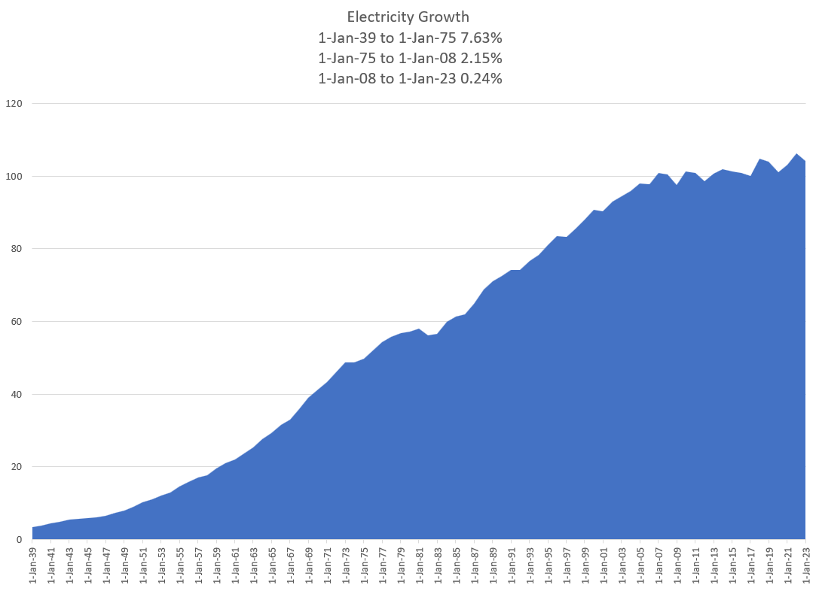

Les Trente Glorieouses and MAGA or MUBA – 1945 to 1973
Appliances and Bigger Houses
  Washing Machine
  Dryer
  Fridge
  Electric Stove
  More Lights
  Air Conditioning
  Radio and Television
  Vacuum Cleaner
Why is this introduction relevant for Project Finance Analysis. Demonstrates classic corporate finance. Companies want to get back to the low risk from cost plus model with WACC.
You will see that this analysis cannot be applied to companies like Orsted that are not stable.

Slide 16
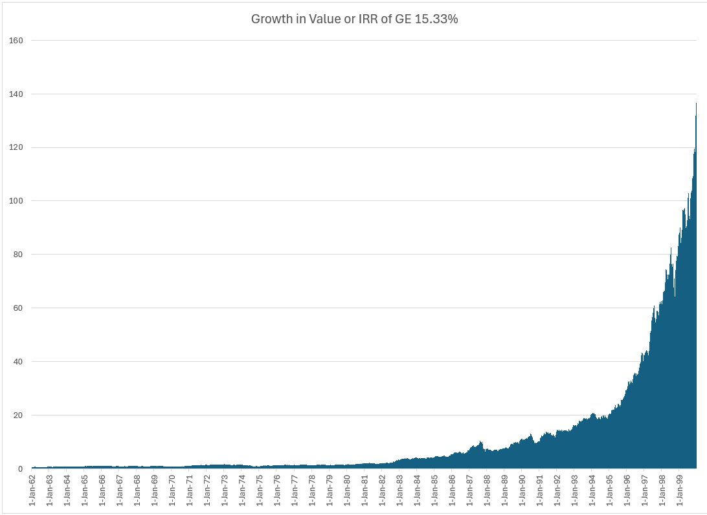
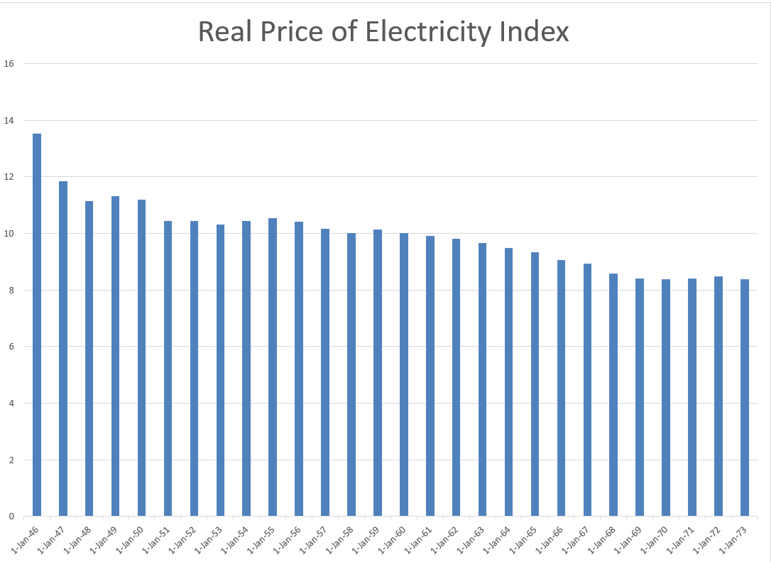
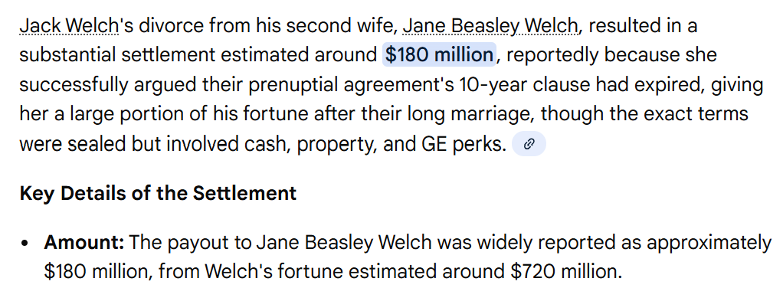

GE and Electricity
GE was the most valuable company in the world – Note what a 15% growth rate means from compounding over a long period of time,
High Growth and economies of scale allowed declining real cost. Larger networks and larger coal plants.
Natural monopoly and cost-plus regulation or government ownership – No incentives for cost control of capital expenditures or operating costs.
Financed from with Corporate Guarantees
Long-term Financing from Regulatory Assurances

Slide 17
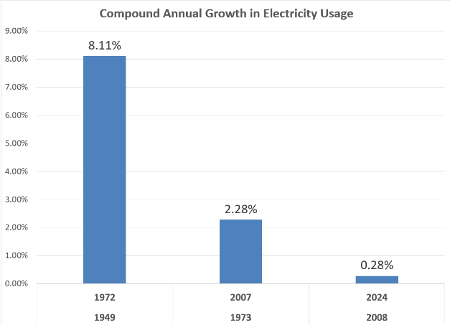
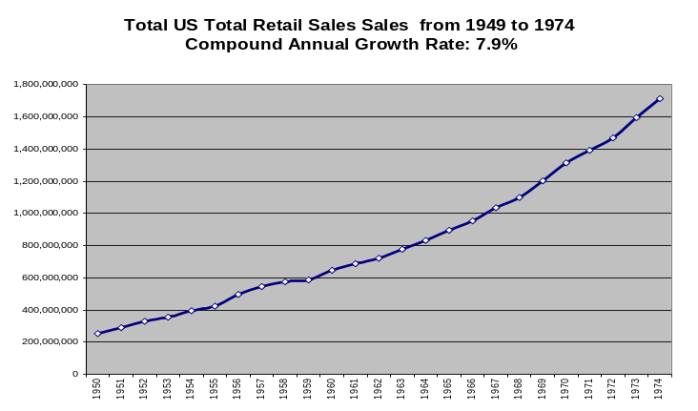
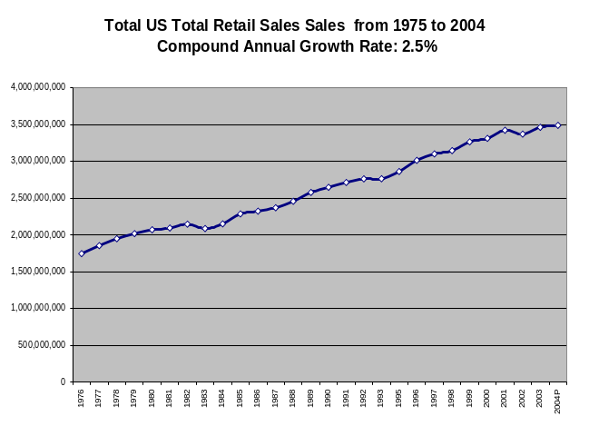
Growth in Electricity Demand
It may be difficult for a young person to think about life before refrigerators, washing machines, television sets, vacuum cleaners, electric/gas stoves, dishwashers and other electric appliances. Use of these appliances grew exponentially after World War II requiring electricity plants that were primarily fuelled by fossil fuels including oil.
Demand growth and economies of scale implied that government ownership or a system of regulated prices which transferred risks to consumers was not controversial as prices of electricity were falling in real terms. GE (prior to Neutron Jack Welch taking control) was the one of the most important industrial companies in the world and private utility companies with stable dividends composed of a large fraction of market capitalization.

Slide 18
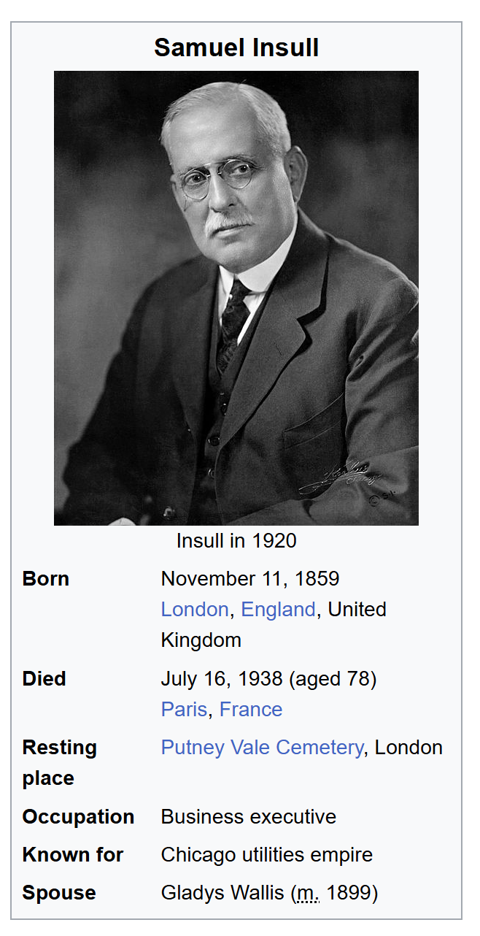
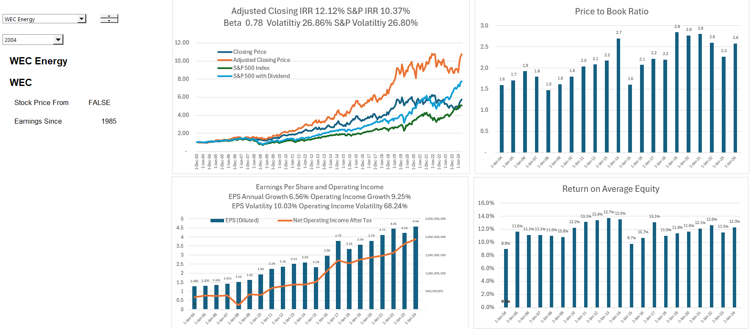
A Boring Utility Company and MUBA (Make Utilities Boring Again) and Cost-Plus Regulation
Ability to finance long-term assets from guaranteed cost recovery and from allowed monopoly position.
12% return on equity produces market values relative to investment of well more than 2 suggesting that the cost of capital is far below 12%.

Slide 19
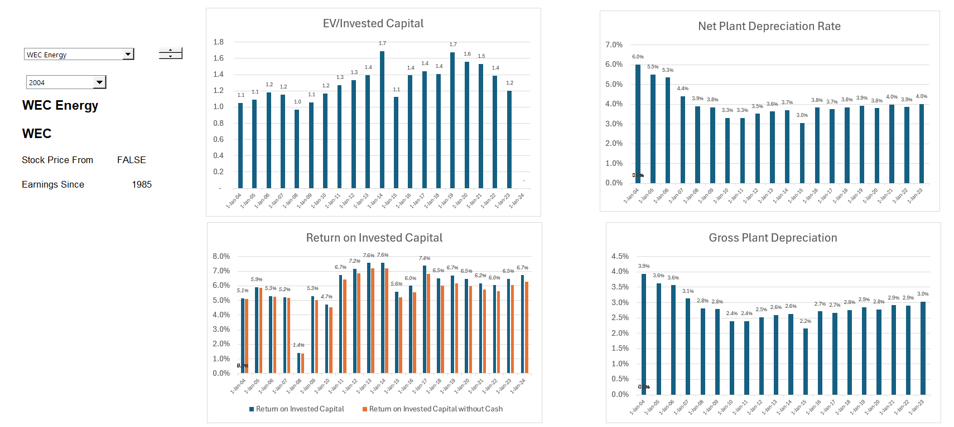
Boring Utility Company Earning Much Lower Returns – ROIC Perspective
Major arguments about what is WACC and what should the rate of return be
Valuation can be made from stable multiples, DCF and maybe CAPM. Could apply valuation formulas P/B = (ROE-g)/(k-g). Cost plus regulation. But cannot apply to renewable companies like Orsted

Slide 20
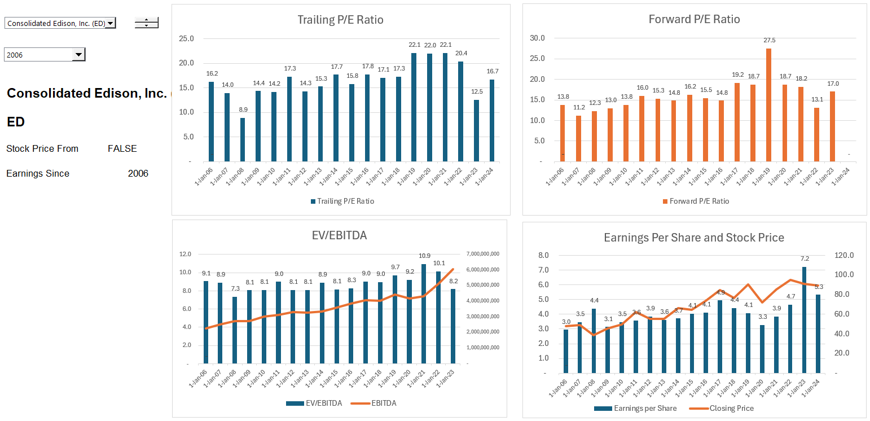
Relatively Stable Multiples of Earnings and EBITDA for Boring Utility Companies

Slide 21
Part 2: 1980’s
Capital Expenditure Over-runs; Low Efficiency, Independent Power Producers and PPA Agreements
Introduction to PPA Regulatory Scheme
Introduction to Output versus Availability
Inefficient to Impose Risks on Investor (including contractor) that cannot be controlled
Example of Toll Traffic

Slide 22
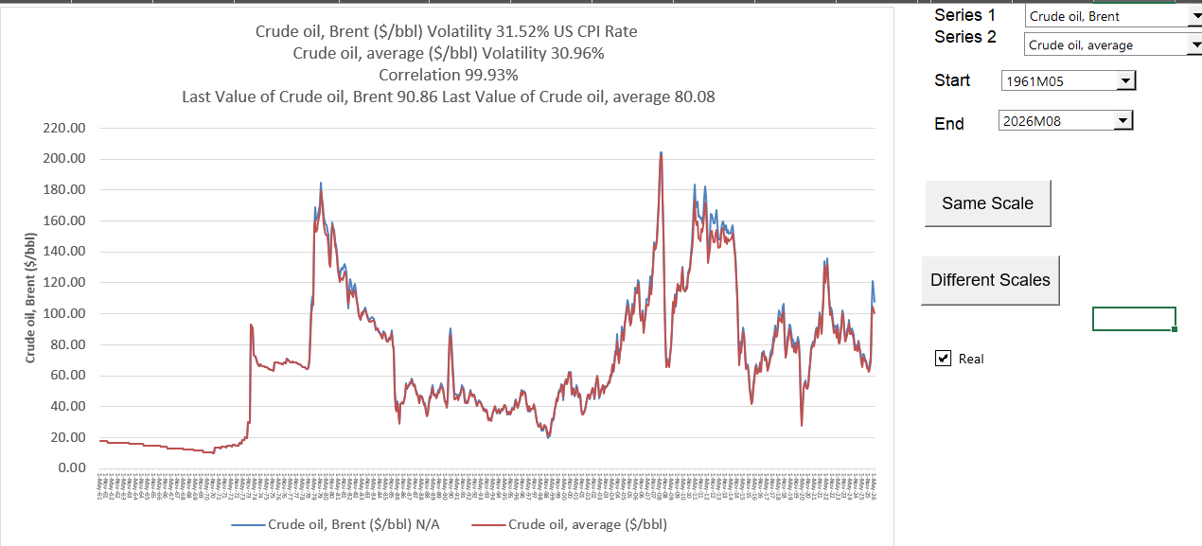
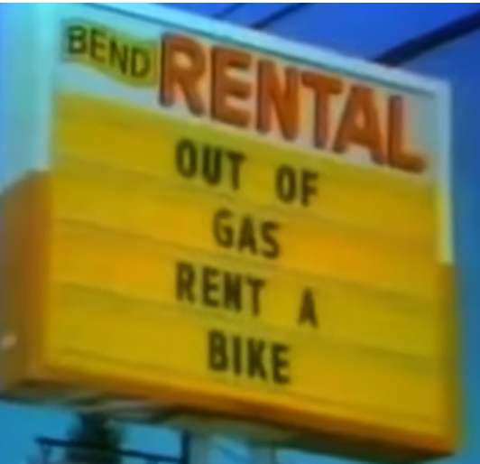
Part 2: 1973 Energy Crisis and End of Declining Real Prices
Dramatic Oil Shock of 1973 ended the Trente Gloriouses. Led to more nuclear power and first thinking about renewable energy.

Slide 23
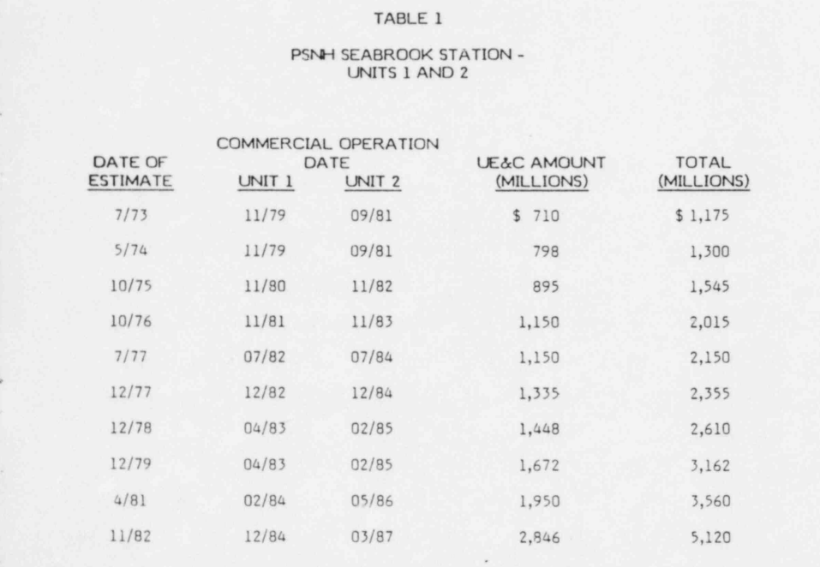
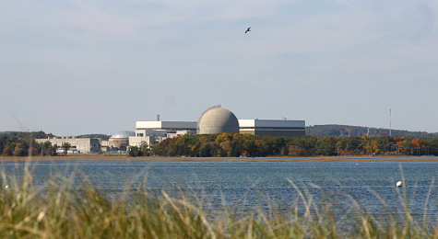
Part 2: 1980’s and Cost Increases and Cost Over-runs
Seabrook nuclear plant in US. (I understand that Denmark was considering nuclear power as well).
Enough of the cost-plus regulatory scheme. Let companies bid and hold them to their cost estimates – if costs increase, you cannot increase prices, and multiple companies can build assets.

Slide 24
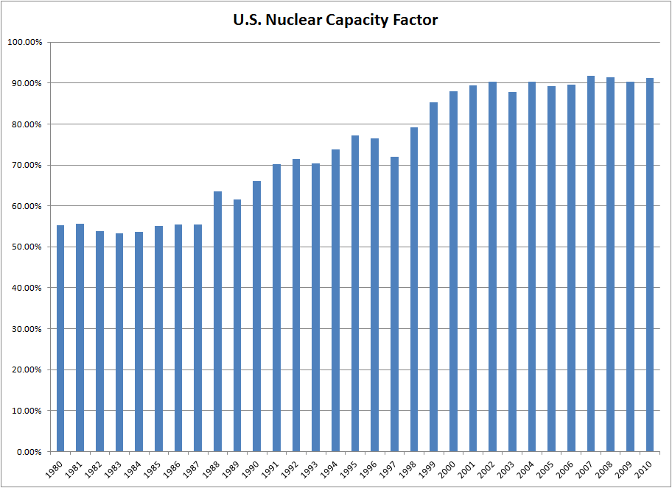
U.S. Nuclear Capacity Factor
Availability problems with nuclear power
Simply demonstrates that there were availability problems with the cost-plus model where there was little incentive to improve reliability
This could be due to new plants coming on-line and simple pressure by regulation

Slide 25

Reaction to Nuclear Plant Cost Increases – Throwing Monopoly Money at Government Regulators
Reasons for Cost Increases
  Demand for Construction Materials
  High Inflation after Oil Shock
  Strict Regulation and Safety Concerns
  Just plain inefficiency and waste
Cost Plus Model
  Front-end loading of price
  No incentives for efficient management
  Little planning with assured prices
  Cost of capital increases
  Declining bond ratings

Slide 26
Availability and Multi-Part
Contracts

Slide 27
Mechanics of Allocating Construction Cost Over-runs and Construction Delay
How is this accomplished relative to cost plus contracts

Slide 28
Define a Take or Pay versus Take and Pay Contract
For the seller, which has less risk, take or pay versus take and pay
Which kind of contract would you call an output-based contract
Which kind of contract would you call an availability-based contract

Slide 29

Question: Is a Rental Car Agreement an Availability or Output Contract
Step 1 – Who is the Off-taker and who is Investor
Who is the off-taker when sign a rental car agreement
Risks controlled by off-taker
Risks of general economic conditions
Risks in the way the machine operates
Step 2 – Allocate to Contractors
Allocate risks in contracts to parties that can control the risk
Back-to-back contracts
If the rental car charged a fixed price for the period, then you would have an incentive to drive a lot because you do not have to pay for fuel.
If the rental car has only a variable cost with mileage and no fixed charge, could rent just for a very short trip and pay almost nothing.
Rental car company cannot control how much you drive

Slide 30

Risk Allocation in Rental Car Agreements
Unlimited miles versus mileage-based contracts
Risk Allocated to Off-takers – You as Renters
  Fuel Price Risk – Return the Car Full
  Risk of Scratches on the Car
  Risk of Usage per Rental – Capacity Payment
Risk Taken to Sponsors – Rental Car Company
  Operation and Maintenance
  Utilization Risk
  Availability Risk (Car Must Work)
When you go to a rental car company and sign a contract.
Is this a take or pay or take and pay contract
Does the contract have a capacity payment
Does the contract have a multi-part price
Does the contract make sense

Slide 31
Rental Car – Who is SPV and Who is Off-taker
.
Who is the Off-taker
Why is the revenue contract structured the way it is
What kind of contract would the SPV prefer
Who is the SPV

Slide 32
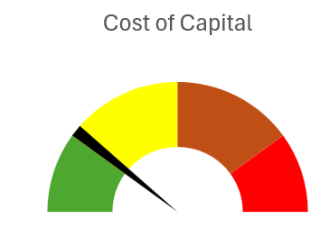
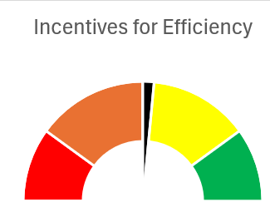
General Allocation in Initial Capacity-based PPA Contracts
Allocate to Investor (Sponsor/Developer and Lender)
Objective
  High Return (IRR)
  Safe Cash Flow
Off-taker (Government, Private Utility Company or Corporation)
Objective
  Low cost
  Strong Incentives

Slide 33
Notion of Independent Dispatchable Power Projects, Risk Allocation and PPA
With nuclear cost increases and price of oil increases, cost plus and WACC model considered a poor approach.
Bidding systems where companies competed to provide generating capacity (no longer belief in economies of scale for generation). Idea that companies bid down to their cost of capital.
Bid on long-term fixed price contracts (same as today) – purchased power agreements (PPA’s) were designed to allocate risks under control of investor (construction cost, construction timing, fixed operating cost, plant efficiency, plant availability). Costs that could not be controlled – fuel cost and amount of generation required were allocated to investors.
Once investor takes risk, the risk can be allocated to a company that takes construction risk, a company that guarantees plant efficiency, a company that provides operation and maintenance.
The risk allocation to third parties (off-takers) led to project finance where lenders verified fixed construction costs, operation costs and technical aspects of plant efficiency and availability.
Risks remaining with purchaser – fuel price, generation (maybe inflation)
Risks taken by investor and allocated – construction cost, construction timing, efficiency, availability, operating cost except fuel
Risks allocated from investor to contractors who provide fixed prices and absorb penalties for efficiency and availability

Slide 34




Projects Depend on Who Controls the Output
What is the contract structure for each
Solar or Wind
Dispatchable Plant or Battery
A single price is where an electric generating plant would be paid a flat price for each unit of electricity that is sold.
This can be referred to as output-based plant.
For an electricity plant whose output is controlled by the off-taker who dispatches all the plants as part of a portfolio, the developer has no control over the actual volume.

Slide 35


Availability Projects without Output Risk and Notion of Not No Control of Output – Would you pay firemen only when they put out fires
Capacity Price and Artificial Markets
  When capacity is available, you can receive revenues no matter whether you use the capacity for revenues, this can be added
  Some ancillary services may be like capacity where if you have the service available, you can earn money whether you use the capacity to produce energy
Think of Firemen (Firehouse Effect)
  You pay them and need them to be ready
  But if they are putting out a fire, they cannot be used for another fire
  They receive capacity payments and must be available
  You cannot really pay them on the volume of fires the
Firehouse Effect from being Available

Slide 36
Risk Allocation Part 1: Allocation between IPP Investor and the Off-taker for Take or Pay Availability Contract
Risk to Be Allocated
Generation Level from Changes in Demand
Generation Level from Changes in Plant Availability
Construction Cost Over-Run
Construction Delay
Plant Efficiency (Heat Rate)
Change in Fuel Price
Change in Real O&M Cost
Change in Inflation Rate
Change in Interest Rates and Cost of Capital
Investor or Off-taker Risk
.
.
.
.
.
.
.
.
.

Slide 37
Risk Allocation Part 2: Investor Risks to Different Contracts for the SPV
Contract Mitigation
EPC Contract with Fixed Price and LD (LSTK)
O&M and EPC Contract
O&M Contract and EPC LD Provision
O&M Contract
Capacity Charge/Month; 4 Part PPA Contract
Swap Contract (Fix Rates)
IPP Risks
Cost of Project, Time Delay and Technology Parameters
Availability Penalty in PPA
Efficiency or Heat Rate Risk
O&M cost Risk – Real
Independence of Generation Risk
Interest Rate Fluctuation

Slide 38
Question:
What Happens to Prices Ultimate Consumers Pay if You Charge Risks that Cannot be Controlled by the SPV to the Investor

Slide 39
The Way You Get to Risk Allocation: Four or More-Part Tariff in Availability
A feature of pricing in availability-based contracts is distinguishing between fixed and variable costs in the pricing structure.
Fundamental idea – fixed and variable cost; some variable cost cannot be controlled; some costs vary with inflation and exchange rate fluctuations.
  One price component is the fixed capacity or availability payment.
  Another component covers fuel expense where the price of fuel varies with some kind of market index.
  A third price component covers fixed costs such as regular maintenance, cost of security and administration.
  The final component is variable operation and maintenance cost which seems to cover things like the cost of chemicals and water for operating a plant and the increased costs of from running the plant.
  A nuance is related to operating cost of starting the plant, which can be an additional price component that is not fixed and not variable.

Slide 40
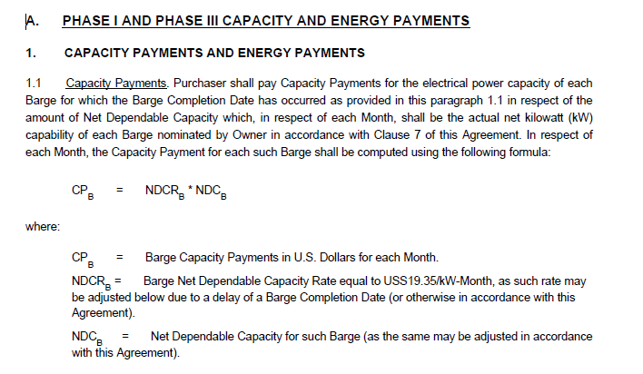
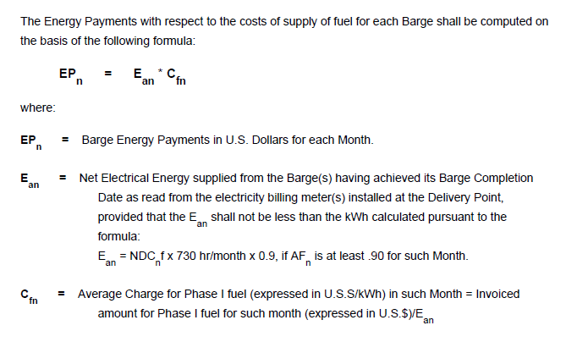
Example of Capacity Charge (A horrible Contract in Lagos)
Fixed Fee that does not vary with production

Slide 41
What is Between E and EBITDA (Include the E)
EBITDA Includes
Interest
Taxes
Depreciation
Earnings

Slide 42
What is Between Revenues and EBITDA
Cash Operating Cost
Variable Cost
Fixed Cost
Fuel Cost

Slide 43
Drivers and Profit and Loss Statement - Dispatchable
Cost Driver
Capital Expenditure x Carrying Charge + Fuel Cost + Variable O&M + Fixed O&M
Fuel Cost: Heat Rate x Generation x Fuel Price (€/kW-hour x kWh)
Variable O&M (€/kW-hour x kWh)
Fixed O&M (€/kW-year x kW)
Capacity Charge Revenue (€/kW-year x kW)
Portion of Capacity Charge for Depreciation
Portion of Capacity Charge for Taxes
Portion of Capacity Charge for Interested
Portion of Capacity Charge Earnings
Profit and Loss Account
Total Revenue from Four-Part Tariff
Fuel Expense
Variable O&M Expense
Fixed O&M Expense
EBITDA (Operating Margin)
Depreciation
Taxes
Interest
Net Income

Slide 44
Availability Case – Blackburn Hospital in the UK

Slide 45
Terms
FM – Facilities Management
Life cycle costs (LCC)— often referred to as asset renewal, capital replacement, or major maintenance costs—represent the anticipated expenditure required to maintain, repair, and replace major building components and systems over the duration of the contract.
Service Failure Point (SFP)—sometimes called a Performance Point or Service Point—is a standardized, numerical unit of measurement used to quantify breaches in performance by the private contractor.
Indexed Linked Bond Mechanism (also known as an inflation-linked bond or colloquially as "linkers") is a type of fixed-income security where the principal layout and the coupon payments are contractually tied to a specific economic index—almost always a measure of inflation like the Consumer Price Index (CPI) or the Retail Prices Index (RPI)
Unitary Charge and Penalties - When penalties do occur, they are not paid to the hospital as a cash fine. Instead, they are processed as Deductions that are quietly subtracted from the hospital's main monthly bill (the Unitary Charge) before the Trust writes the check.

Slide 46



Modernizing Care Infrastructure
Solving Structural Deficits
Prior to the project, health services were fragmented across two distant physical plants.
One facility, built over 135 years ago, offered inaccessible and deeply outdated patient accommodation.
Integrated Care: Leverages modern clinical pathways.
Clinical Technology: Integrates modern healthcare systems.
Efficiency: Eliminates inter-site patient transfers.

Slide 47
Modernizing Care Infrastructure
Availability Payments protect Private Capital
100%
In standard PFI models, demand risk remains entirely with the Public Trust. As long as beds and operating rooms are functional, the private partner receives full payments, regardless of whether they sit empty or are fully occupied.
Availability Security

Slide 48
Defining Unavailability
In a PFI arrangement, the hospital doesn't pay a fixed rent; it buys a service. If the building—or a single room within it—fails to meet strict operational conditions, it is legally declared "Unavailable," and the hospital automatically docks the private provider's pay.
Under the contract, the Operating Theatre is legally classified as "Unavailable" because it breaches the mandatory Availability Criteria outlined in the agreement. To be considered available, a room must pass three distinct tests:
  Access: Can staff and patients safely get into the room? (No, it's flooded).
  Safety: Does it comply with statutory safety laws? (No, standing water with exposed electrical grids).
  Environment: Are temperature, lighting, humidity, and medical gases functioning? (No, the power is out).

Slide 49
Penalties in PPP/PFI
The Blackburn PFI contract utilizes two distinct penalty pathways that reduce the money paid to the private investor:
Availability Deductions: Triggered if a specific area of the hospital (like an operating theatre or a ward) cannot be used due to maintenance issues, structural faults, or structural temperature failures.
Centre for Health and the Public Interest
Performance Deductions: Triggered if the facility management services (such as cleaning, catering, or portering handled by the sub-contractors) fall below the agreed Key Performance Indicators (KPIs).

Slide 50
Managing Construction Risk
Delay & Cost Overruns
Technological Obsolescence
The Private Partner typically bears 100% of the risk for construction timeline slippage. Delays result in "Liquidated Damages" and postponed availability payments, protecting the public purse.
Contracts include "Lifecycle Refresh" clauses, ensuring the private partner upgrades high-value medical tech periodically, preventing the hospital from falling behind clinical standards.

Slide 51


The £50M Funding Framework
EIB Financing Terms
Concession Structure
•
Loan Capital: £50 million (approx. €80.4 million) structured through index-linked bond issues.
•
Consortium Partner: Consort Healthcare (Blackburn) Limited (a special purpose concession company).
•
AAA Advantage: Leveraged EIB's sovereign credit rating to obtain highly competitive, long-maturity funding.
•
Contract Duration: A 38-year concession signed on July 2, 2003, for design, build, and finance.
•
Public Promoter: Blackburn, Hyndburn & Ribble Valley Health Care NHS Trust.
•
Operations Scope: Responsibility for non-clinical facilities maintenance and basic support services.

Slide 52
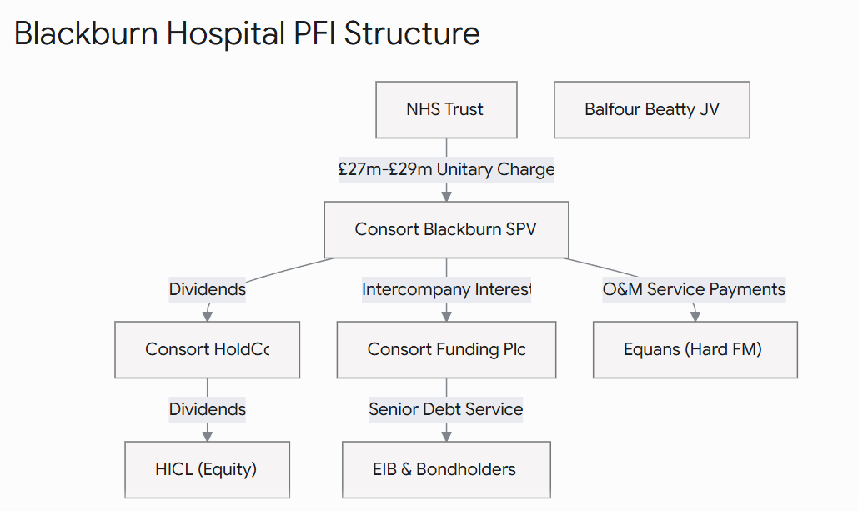
Illustrative Diagram
The private investment fund (the SPV) doesn't absorb this loss. Under the "Pass-Through" architecture of the contract, the SPV instantly forwards the deduction down to the Hard FM Provider (the maintenance sub-contractor on the hook for the repairs, such as Equans or Mitie). The sub-contractor must accept the financial hit on their own balance sheet, insulating the project lenders and equity investors from operational failures.

Slide 53
Nuanced Issue 1: PPA Term

Slide 54
Make and Argument for Long-term or Short-term PPAs
What is the definition of IRR
What is the effect of IRR with longer PPA terms
What is really wrong with the IRR

Slide 55
How Long Should the PPA Life Be to Promote Low Cost
Arguments for Short PPA Term
  Off-taker can revise pricing and terms from current conditions
  Case 1: Do not need plant – will not have to renew
  Case 2: Need plant – can negotiate
  Argument that bidder will be aggressive with assumed renewal
  Can justify the economics of the plant with merchant pricing
Arguments for Long PPA Term
  Investor assigns more risk for things like technology risk
  No incentive advantage from longer-term
  Potential for double recovery

Slide 56
Efficient Length of Contract
Cost and benefit of different contract length
  Seems to show that longer PPA term is not a big deal
  Why is this more important in Africa
For many projects the length of the contract is less than the probable economic life, implying that there is some kind of value to the project after the contract is complete.
For other projects, there may be a designed period after the initial term of the contract when the projects are to incur some kind of spot prices.
In other cases, there may be specific options to extend the contracts with defined pricing terms.
Corporate PPAs have Shorter contracts
  Tax issues
  Credit Quality of Corporate Off-taker

Slide 57
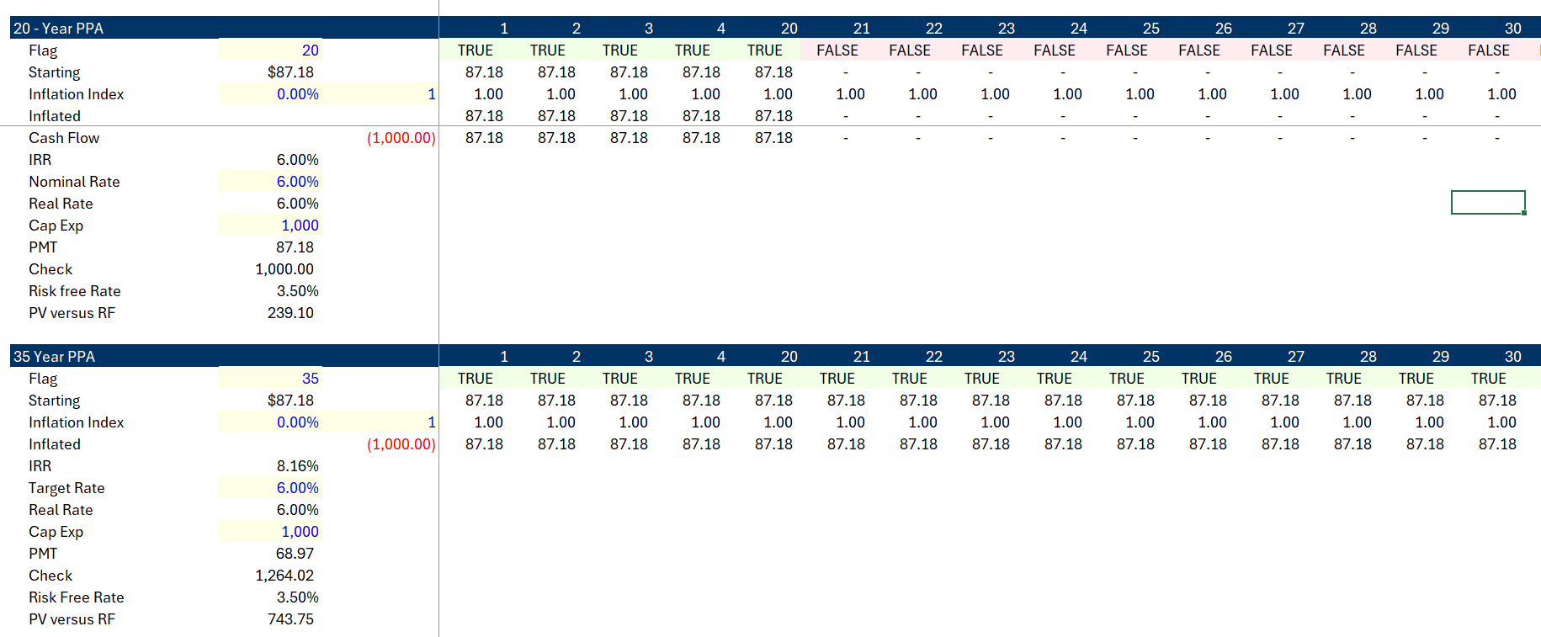
Case 1: Relatively Low IRR; No Terminal Value Assigned
.
Increases the IRR from 6% to 8.16%. Increases premium versus Rf by more

Slide 58
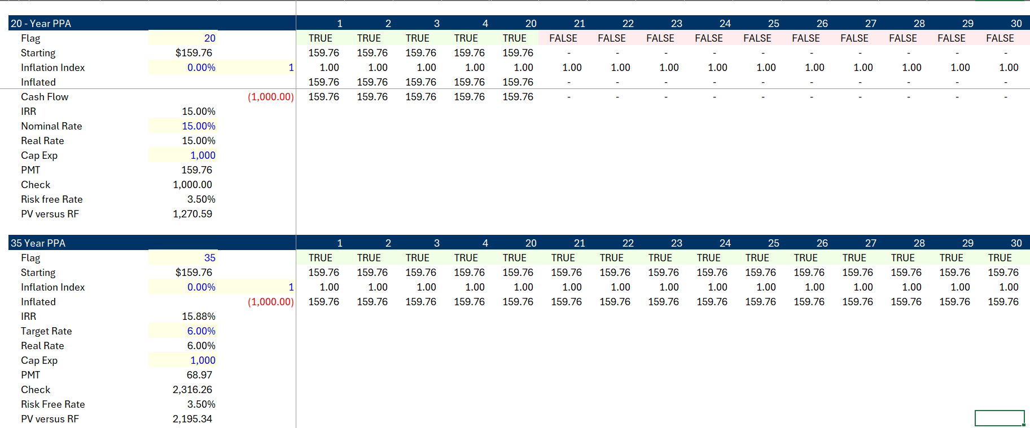
Case 2: High IRR – IRR should not be God
The IRR increases by smaller amount, but the value versus a risk-free security doubles

Slide 59
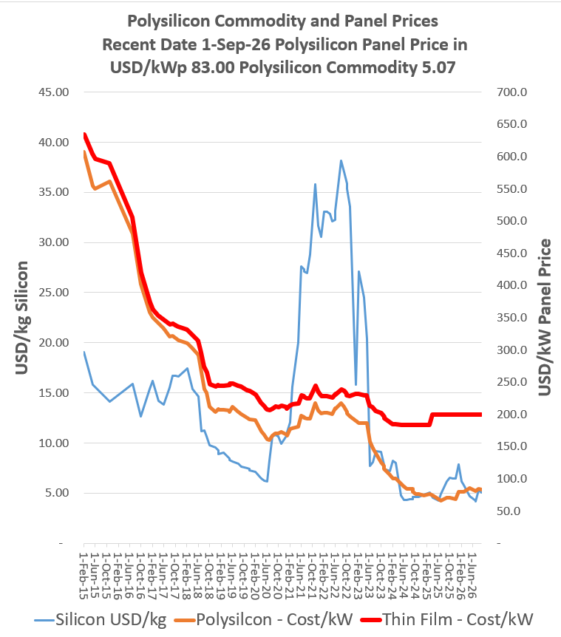
One-year Contract Absurdity
I recall a question from somebody in India about whether contracts could have a one-year term.
When you think about this from the perspective of an investor, making a series of short-term contracts would mean that technological obsolesce risk and the risk of changes in the price of the equipment would be taken by the developer.
Imposing the risk of cost changes and obsolescence risk could be taken by the developer/sponsor, but accepting the risk of changes in the market outside of the control of investors and which cannot be transferred to other contractors such as the EPC contractor or the O&M contractor would have dramatic effects on the price in the contract and the ability of the developer to raise debt.

Slide 60
Economic Life of 40 years versus Contract term of 20 years
When bidding on this contract, the investor would make some kind of terminal value assumption which increases the cash flow.
This assumed terminal value reduces the required cash flow for the initial contract term as part of the IRR is earned from the terminal value.
At the end of the contract term, the project may continue to be necessary for the off-taker, and the off-taker could choose between a new contract for our existing project or pay contract prices associated with a new project.
With inflation in costs, this could mean that the terminal value would be a relatively high portion of the overall project cash flow.
On the other hand, if new projects have lower cost and/or our project is no longer necessary and/or if new projects are more efficient after 20 years, the terminal value could be nothing.
This means that if the contract term is less than the life, the developer/sponsor is forced to take risks of what could happen in twenty years, something it has no control over. If the developer/sponsor were rational, it would place a large risk premium on the terminal value and the reduction in the value of the new contract would not be too much (it is possible that in order to win the bid the contractor would make optimistic forecasts).
If the contract term is longer, it implies that the developer/sponsor would take the risk of forecasting the project life. Further, the longer life limits the ability of the off-taker from taking advantage of more efficient technologies and lower capital expenditures.

Slide 61
PPA Life and What Happens Afterwords
Instead of assuming that a new contract is signed, some projects assume that the project will sell output into some kind of spot market.
This is the case with some wind farms and with corporate PPA’s.
In electricity this structure is known as a merchant tail.
The idea of demonstrating that the project can produce in merchant markets seems to encourage developers with skill in forecasting markets.
As with the shorter contract period, the developer/sponsor will not be able to influence what happens at the end of the contract period.
As with the short contract period, one can assert that this uncertainty will tend to increase the price of the initial contact, impose risks on the developer and will lead to a higher price for the initial contract period.

Slide 62
Nuanced Issue 2:
Fixed and Variable Cost in Biding

Slide 63
Question: Should you Always Bid Actual Fixed and Variable Cost or Should you Play Bidding Games
Related question: What is fixed cost and what is variable cost
Related question: Is there more risk for fixed or variable cost

Slide 64
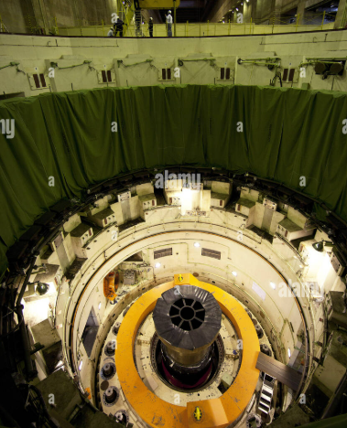
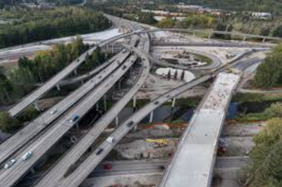
Question: Are These Costs Fixed or Variable
Plant Overhaul Cost Re-surfacing Cost

Slide 65
Risks of Fixed and Variable Cost
In competitive markets, the structure of fixed and variable costs can affect the risk of a company. In general, fixed costs increase risk (operating leverage) profits are more sensitive to changes in sales volumes.
  A company that has more fixed cost relative to variable cost can provide upside for equity upside if volume sales increase. For example, if a company is optimistic about its prospects, it may hire their own employees rather than using consultants.
  On the other hand, lenders may prefer variable costs because the downside is protected (sadly, they like it when employees are variable cost and can be eliminated in economic downturns).
In an availability contract, the risk associated with fixed cost versus variable costs are removed and an incentive is provided for the investor to optimise costs given the expected generation.
  The availability structure removes risk differences between fixed and variable costs as investors are compensated for both costs.
  Assume the off-taker believes a certain level of generation will occur from its analysis of dispatch, demand, new capacity and other factors. This level of generation may be the indicated generation used by the off-taker in assessing the bid,
    The total bid for capacity and fixed operation price are assessed directly
    The fuel expenses and variable operating costs are assessed using assumed generation.

Slide 66
LCOE for Bid in Capacity Payment
Components of LCOE
  Capacity Payment x Capacity from Bidder
  Fixed O&M from Bidder
  Variable O&M from Bidder x Generation from Off-taker
  Fuel Cost from Off-taker x Efficiency from Bidder x Generation from Off-taker
  Add up four costs
  Account for generation changes
  Account for discount rate
  PV of Revenues from adding components/PV of Generation

Slide 67
What Happens if Estimate Fixed and Variable Costs Inconsistent with Actual Cost
Bid fixed cost when true cost is variable
  Under some generation condition
    Fixed cost recovered equals fixed cost incurred
    Variable Cost recovered equals variable cost incurred
  If generation from off-taker is higher
    Collect more fixed than fixed incurred
    Variable cost collected will be less than the actual variable costs incurred
    Cash flow and return will be lower than if costs were calibrated
  If generation from off-taker is higher
    Collect more fixed than fixed costs incurred
    Variable cost collected will be more than fixed costs recovered
    Cash flow and return will be higher
  Risk to investors from cash flow variability increases
  Incentive to bid true fixed and variable cost
Want to:
Win the bid
Make a High Return
Reduce Risk

Slide 68
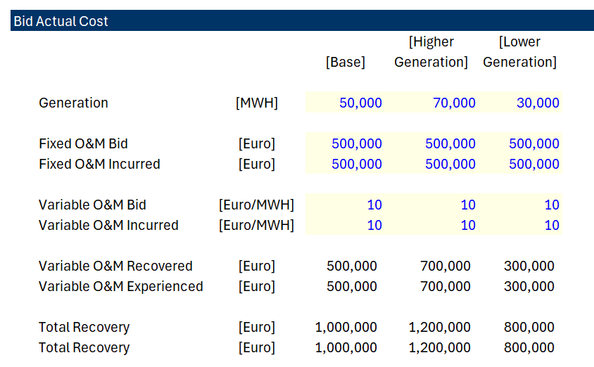
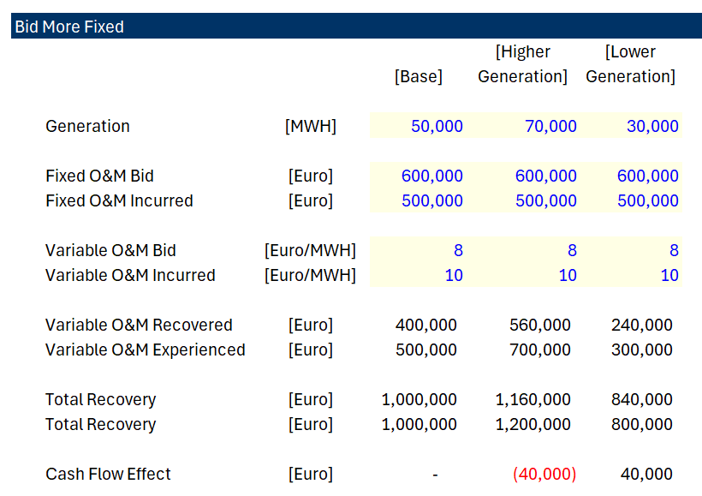
Example of Bidding Differently than Actual Cost – Seems to Increase Risk
.
If investor believes off-taker did not estimate bid correctly, an alternative bidding strategy could be justified. For example, more renewable lowers generation.
Bid Higher Fixed and Lower Variable

Slide 69
Nuance in Bidding when Investor Believes Generation will Change
Fixed cost and variable cost different from actual expected cost
Much of this chapter is about discussing nuances and exceptions.
Pretend that the investor believes the generation expected by the off-taker is overstated as new renewable capacity will enter the market and/or demand will decrease.
If generation is reduced relative to the amount used in the levelised cost bid assessment, then less fixed cost and more variable cost will ultimately be profitable (the third column in the table).
The investor can bid artificial higher fixed cost and lower variable cost relative to what is expected as in the third column and realize the saving.

Slide 70
Life Cycle Costs and Fixed versus Variable

Slide 71
What Lifecycle Costs Include
Lifecycle costs do not cover routine daily maintenance (like cleaning, minor plumbing fixes, or changing lightbulbs)—that falls under Facilities Management (FM) or Operational Maintenance (O&M).
Instead, lifecycle costs cover predictable, large-scale capital replacements (Capital Expenditure replacement), such as:
Mechanical & Electrical (M&E): Replacing entire HVAC units, boilers, lifts, or electrical switchgear.
Fabric & Structure: Replacing roofs, windows, resurfacing car parks, or structural refits.
Fit-Outs: Periodic replacement of carpets, ceiling tiles, and industrial kitchen or hospital equipment.

Slide 72
Lifecycle Cost and Reserve Accounts
In a standard PFI/PPP model, the public sector pays the private consortium (the Special Purpose Vehicle, or SPV) a regular, performance-based payment called the Unitary Charge. A portion of this unitary charge is explicitly earmarked to fund the lifecycle profile.
To manage the uneven spikes in major maintenance, the SPV uses a Lifecycle Sinking Fund or Reserve Account:
[Unitary Charge from Government]
│
▼
[SPV Cash Waterfall] ───► Regular OpEx (Cleaning, Utilities)
│
▼
[Lifecycle Sinking Fund] ───► Sizable cash buffer built up in quiet years
│
▼
[Major CapEx Spend] ───────► Triggered in Year 10, 15, 20 (e.g., Roof/Boiler replacement)
Instead of hit-or-miss budgeting, the SPV models the exact year components are expected to fail. Money is smoothed out and set aside annually into a reserve account so that when a £2 million boiler replacement is due in Year 15, the cash is readily available without impacting the project's debt service or investor returns.

Slide 73
Lifecycle Issues
Risk Passed to the Lifecycle/FM Contractor: In many robust PFI projects, the SPV passes the lifecycle risk down to a heavy-facilities management contractor via a back-to-back contract. The contractor agrees to fixed annual lifecycle payments and takes the hit if real-world costs escalate.
Risk Retained by the SPV: If the SPV cannot pass this risk down affordably, the equity investors bear the risk. If lifecycle costs spike, it eats directly into the equity Internal Rate of Return (IRR).
Risk Shared with the Public Sector: Some contracts include "gain-share/pain-share" mechanisms or benchmarking reviews every 5 to 10 years to adjust the lifecycle budget based on macroeconomic realities (like hyperinflation in construction materials).

Slide 74
Results of PPA (Single Buyer) Model

Slide 75
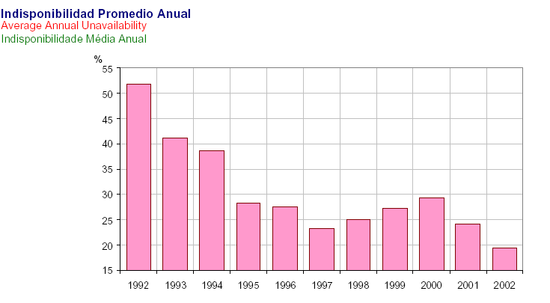
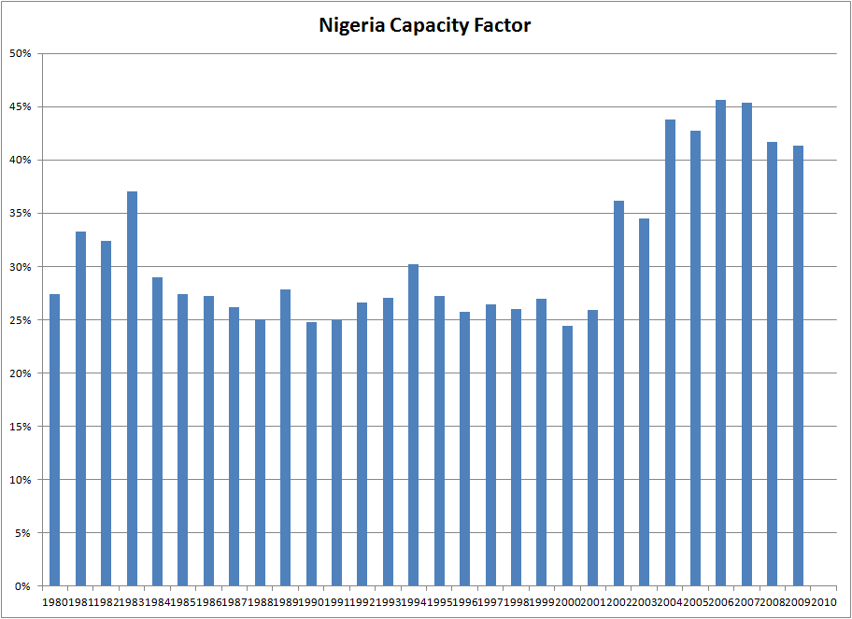
1980’s Independent Power and Incentives (Plant Availability)
Plant Availability has dramatically improved from about 60% in 1993-1994 to 75-80%.
Leads to independent power producers and contracts that provided rewards and penalties for particular risks – capital expenditure cost over-runs and power plant availability
Project finance and back-to-back contracts to limit risk to banks and allow low cost of capital
No output risk (cash flow is independent of amount produced with is given by off-taker) designed with a capacity charge

Slide 76
Mixed Results
Results of the availability contracts have arguably been mixed in terms of both the direct cost of EPC and operating and maintenance contracts as well as in achieving a low cost of capital and corresponding prices to ultimate consumers.
The concept of focused incentives and competitive bids to achieve a low cost of capital has merit.
Enron cases in the Philippines and in India demonstrate potential problems.
  Effective competitive bidding was not applied;
  Equity returns were very high;
  Constraints from lenders limited operating flexibility;
  Prices were not adjusted for inflation;
  Projects such as nuclear plants with long construction periods and long lives were not financed.
  The government and/or off-taker made inefficient decisions that resulted in over-capacity and the wrong type of capacity.
  Profits made by EPC and operation and maintenance companies, particularly for developing companies were very high.

Slide 77
Problems with Availability Structure
Question about true competitive bidding
Question about earned equity returns
Question about constraints from lenders
Question about inflation adjustments
Question about ability to finance projects with long construction periods
Question about government decisions for amount and type of capacity
Question about profits earned by EPC and O&M Providers

Slide 78
Issue of PPA Effectiveness
How would you test the effectiveness of the regulatory model versus PPA contracts
  Whether the right amount of capacity is built by IPPs
  Whether prices decline from levels that existed under government ownership/regulation
  Whether the efficiency gains and the competitive bidding produces lower costs to consumers
  It is impossible to really quantify the benefits of the PPA model relative to the government ownership/cost plus regulation model

Slide 79

Philippines Contracts – Extreme Example
Frequent brown outs ranging from 2 to 12 hour daily in early 1991.
Cancelled 625 MW Batam Nuclear plant when it was almost complete.
Projected growth in electricity demand requires commissioning of new plants and rehabilitation of old plants.
State-owned Generating Company was NAPCOR; Approx. 72% of NAPCOR’s capacity is in Luzon.
Frequent closure of existing plants due to deterioration of oil-based plants.
Failure to undertake regular maintenance of certain plants
Postponed maintenance due to insufficient power reserve
The S&P bond rating for the Philippines was BB
The World Bank estimated that power outages in 1990 reduced economic output in Metro Manila alone by $2.4 billion.

Slide 80
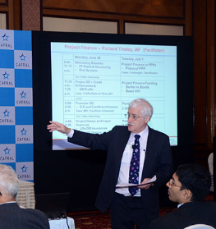
Case Study - Funding
Enron - Subic Bay, Philippines
Philippines
Government
Equip’t Cos.
Warranties
Enron Power
Operating Co.
Completion
Guarantee
Fluor Daniel
EPC
Enron Power
Phils. Op’g Co.
Enron
Corp.
15-year
BOT
Concession
Turnkey
Construction
Contract
Performance
Undertaking
O&M
Agreement
Enron Subic
Power Corp
Napocor
Supply
Fuel Free
113MW
Subic
Power
Corp.
Ground
Lease
65%
Enron Power
Philippines Corp
Buyout
Rights
Capacity Charge
O&M Charge
Energy Charge
PPA
35%
Philippine
Investors
Insurances
US$105 million, 15-year Notes

Slide 81
113 MW Diesel Generator Power Station
Subic Bay, Philippines
Sources of Funds:
Notes $ 105 M
Subordinated Note Enron 7
Equity of Sponsor 28
Working Capital 2
TOTAL $ 142
Uses of Funds:
Turnkey Contractor $ 112 M
Bonus to Turnkey Contractor 7
Development and other related costs and Fees 14
Pre operating, Start-up and Commissioning Costs 3
IDC 4
Working Capital Loan 2
TOTAL $ 142
First, compute the cost per kW (113 kW)
Cost is USD 1,250/kW
True Equity Finance, Not 28 Million

Slide 82
Case 1: Enron Subic
Debt Service with PMT
PMT (9.5%,15,-105) = 13.4 USD million/year
Summary
  Financial Close: 1993 (First Round)
  Commercial Operation: 1994
  PPA Agreement: 15 Years; Guarantee by Government
  Bonds: $105 Million
    Maturity 15 Years
    Repayment Level
    Interest Rate 9.5% (3.68% spread to Treasury)
    Minimum DSCR 1.37
  Completion Guarantee/Liquidated Damages
  Capacity Charge $21.6/kW/Month

Slide 83
BOT/PPA Contract
Capacity Payment: 21.6 x 113 x 12 = USD 29.3 million
EPC Payback: 112/29.3 = 3.8 years
Cash After Debt Service: 29.3 – 13.4 = 15.9
15-year BOT and toll process
113 MW Capacity
EPC Cost USD 112 Million
NAPOCOR (government owned generation company) to supply fuel & take electricity - no fuel availability risk
Capacity fee $21.6/kW/month on available capacity
Capacity fee is dollar denominated – no direct foreign exchange risk, overseas a/c
O&M fixed fee and energy fee is in Peso - $4.56/kW/Month
heat rate penalty & bonuses
buy out rights @ NPV capacity fees- late payment, change of BOT law, war, etc.
Equity Payback with Distorted Equity: 28/15.9 = 1.76 Years

Slide 84
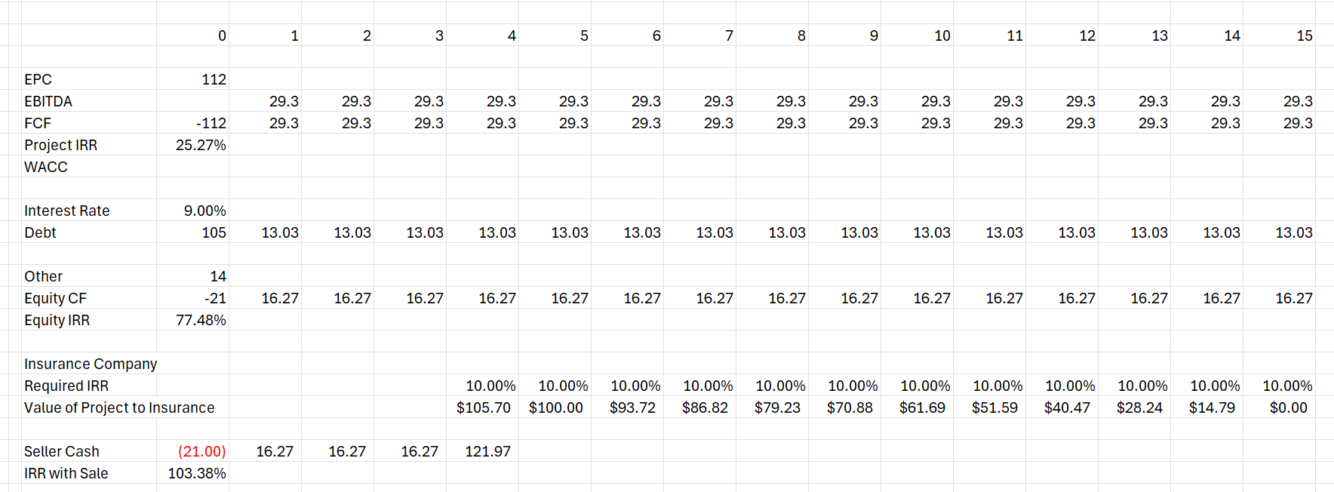
Simple Model
Do not be intimidated

Slide 85
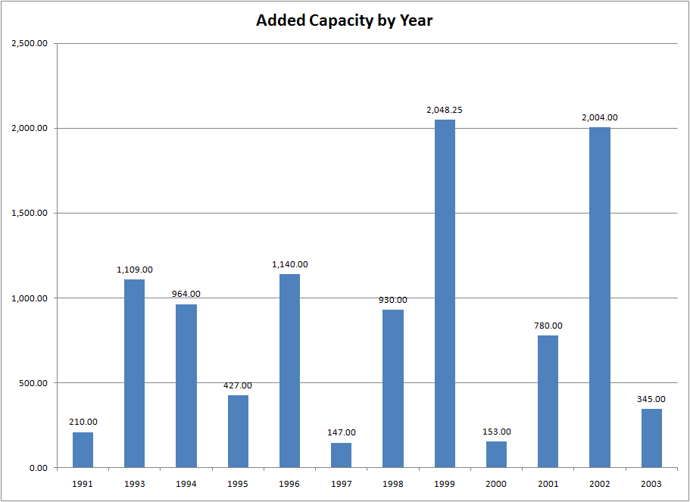
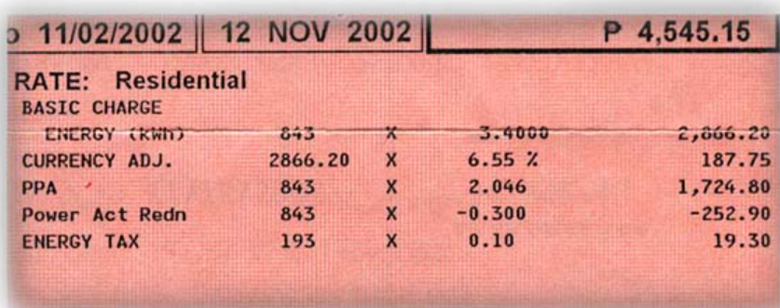
Capacity was Added over Many Years in Philippines
Electric Bill showing PPA price

Slide 86
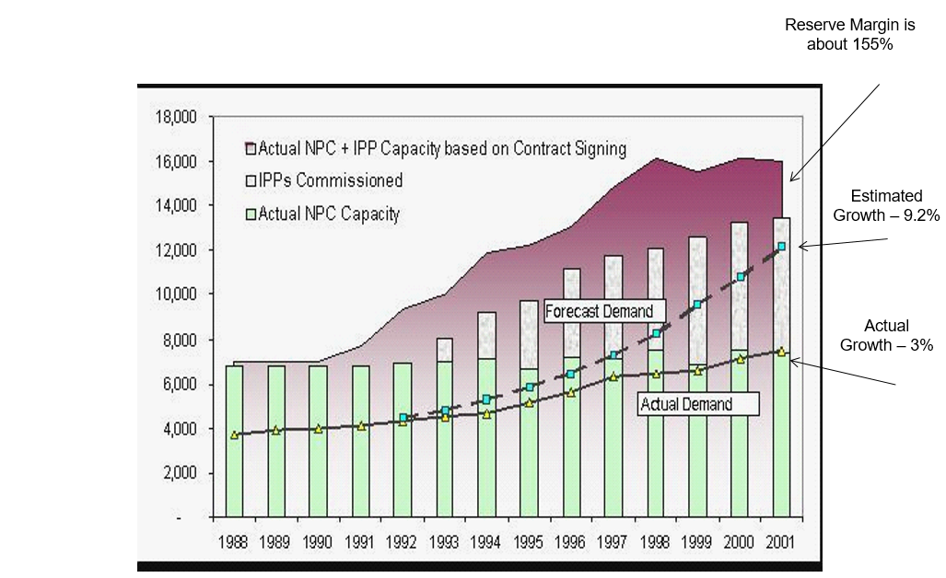
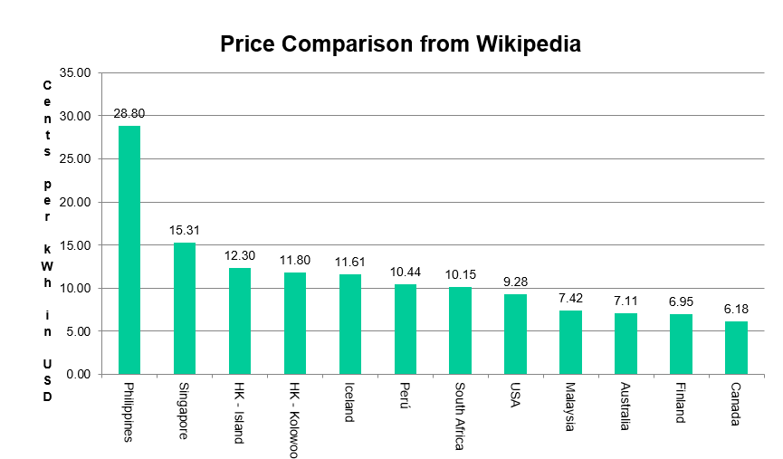
Philippines Results
.

Slide 87
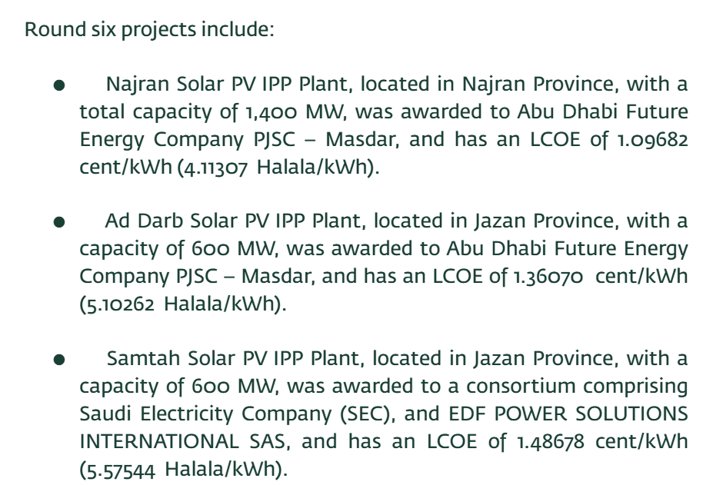
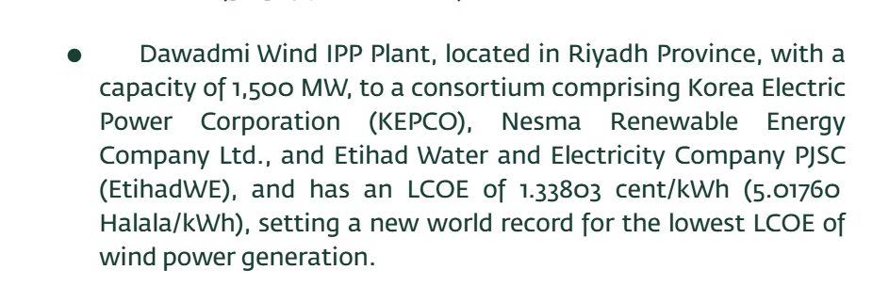
Counter Example – Saudi Wind and Solar Projects
From principal buyer
https://powersaudiarabia.com.sa/web/index.html
https://pb.com.sa/the-principal-buyer-signed-power-purchase-agreements-for-seven-new-renewable-energy-projects/

Slide 88
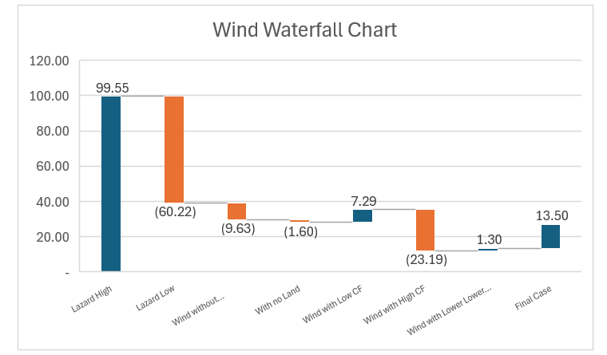
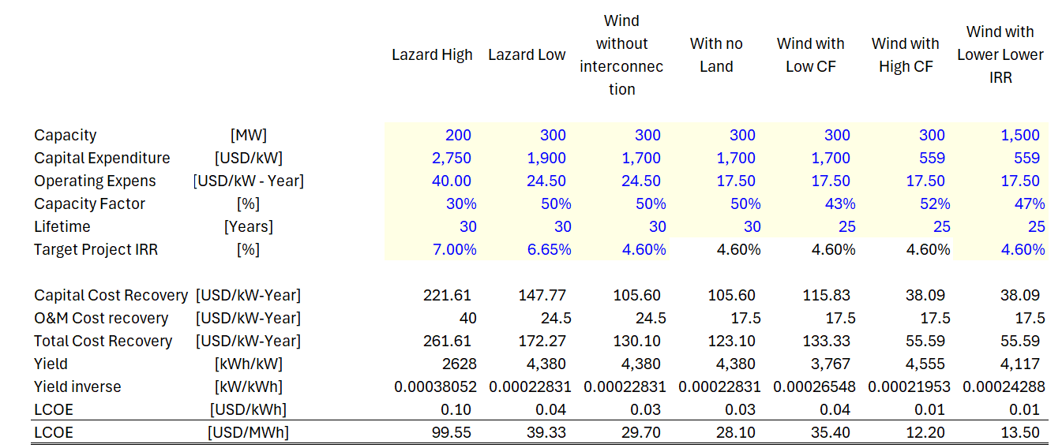
Wind Example – Lazard versus Saudi
Explaining the Low LCOE

Slide 89




The Core Contract Failures
Crippling Deficits
Exorbitant Variations
Rigidity & Risks
Extreme monopolies lock the hospital trust into rigid, long-term exclusivity agreements, resulting in astronomical bills for trivial handiwork and minor repairs.
Mandatory unitary charges, highly insulated from NHS spending cuts, aggressively drain core operating budgets and compound trust deficits year-on-year.
Inflexible contractual parameters delay infrastructure adaptation, while legal disputes slow down crucial remedies for core building safety issues.

Slide 90


Legally Binding Deficits
The Unitary Charge Mechanism
(Frontline Impact)
The trust must pay a massive, contractually locked annual fee to private partners just to maintain facility "availability".
Board papers directly attribute the "premium cost of PFI" as a fundamental structural driver of the trust's financial deficit.
These charges are strictly legally insulated from broader NHS spending cuts, indexing directly with inflation.
Core budgets are forcefully diverted from frontline clinical staff and bed capacity to satisfy debt servicing lines.
Under PFI debt terms, the public sector often ends up paying multiple times the actual capital construction cost.
Inflexibility prevents dynamic shifting of services toward community or modern outpatient care settings.

Slide 91
Tameside Hospital Default
The idea of a default or financial restructuring under a "Consort Healthcare" contract comes from a high-profile case of Tameside.
A project entity called Consort Healthcare (Tameside) Plc—which runs the PFI contract for the Tameside and Glossop Integrated Care NHS Foundation Trust—suffered major financial distress. Following severe structural and fire safety defects, that specific NHS Trust successfully hit the Tameside project company with roughly £9 million in performance deductions, pushing it to the brink of cash-flow insolvency. That entity had to launch a pioneering High Court restructuring plan to compromise its liabilities.

Slide 92
Financial Engineering Levers
Aggressive Subordinated Junior Debt
Sponsors structured the "10% equity slice" as 1% pure equity and 9% shareholder loans. By charging internal interest rates of 12% to 18% on this junior debt, they channeled tax-deductible cash out of the SPV before corporate tax liabilities triggered.
Operational Efficiency Stripping
Special Purpose Vehicles (SPVs) aggressively sub-contracted facilities management services (cleaning, catering, security) at steep discounts, pocketing the vast operational margin between the sub-contracts and the NHS Unitary Charge.
Early Capital Recycling
By selling operational project shares to highly liquid secondary market infrastructure funds, initial construction sponsors successfully unlocked and recycled high-yielding capital early, boosting their portfolio-level IRRs.

Slide 93
The Wider Policy Legacy
.
"The high returns to equity holders, which were heavily insulated from risk once the buildings became operational, created a deep misalignment with public interest. This systematic transfer of wealth is what doomed the PFI brand."
“
”
— House of Commons Treasury Committee Report on PFI

Slide 94
Part 3:1995 - 2010
Merchant Period

Slide 95
Concept of Merchant Power
In the late 1990’s and early 2000’s, the idea of allowing electricity generating plants to be developed without contracts was implemented in many electricity markets.
Economists who love markets argued that if investors develop projects without contracts, that the investors have a strong incentive to evaluate future market conditions and the type of investments that are most efficient in a market.
  Investors would be rewarded for adding the right kind of capacity at the right time and if they operate the capacity efficiently over the life of the investment.
  The cost of capital applied to plants build on a merchant basis would reflect the true risks faced by the technology.
  The suggestion of investment derived from merchant prices rather than availability agreements was that the government or utility companies who were off-takers should not force consumers to take the risk of over-supply or requesting the wrong kind of capacity.
  If the investor incurs the financial penalty from taking over-supply risk, the incentives from potentially losing money will result in them making better decisions than the

Slide 96
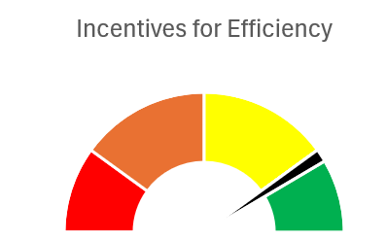
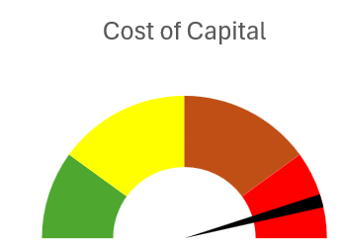
Merchant Market Question: Do Higher Risks to Merchant Investors Mean Lower Risk to Consumers
Current
  Risks of Renewable Energy Driven More by Gas Prices than for Gas Prices
  Gas Price Natural Hedge
  What if All Plants were Renewable Backed Up with Storage

Slide 97
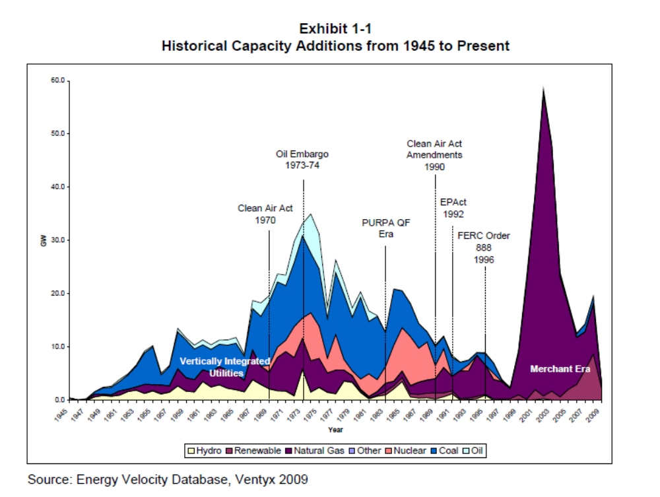
Merchant Power Boom
A merchant boom period occurred somewhere around the late 1990’s.
During the merchant period, electricity projects were developed and constructed with no revenue contracts whatsoever, raising the fundamental question of whether contracts are really necessary to construct capital intensive investments and/or whether economically efficient outcomes can be realized without any risk allocation.
The merchant boom period coincided with dramatic efficiency in natural gas plants (which are relatively less capital-intensive than other types of generating plants) as illustrated in the accompanying chart.
Oil and other resource extraction projects have been financed without long-term government related contracts and real estate projects have been developed without locking-in rental rates (oil projects often do use price hedges).

Slide 98
Uses of Merchant Prices in Contract Analysis
Plants built on a merchant basis without a contract have come along with a higher cost of capital than the cost-plus model or the availability PPA model.
Primary focus address the trade-off between increased cost of capital from increased risk versus increased incentives to operate efficiently.
Why should we include discussion of merchant power when the subject of the chapter is contracts.
Related marginal cost and merchant price issues are involved in various aspects of contracts involving questions of:
  merchant tail,
  using merchant prices in measuring penalties
  negative merchant prices limiting generation
  measuring liquidated damages with merchant prices.

Slide 99
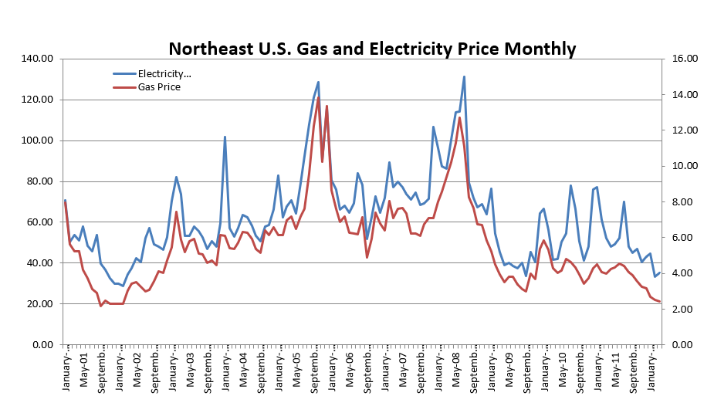

Monthly Electricity and Gas Prices – Higher Correlation
Reasons for understanding merchant prices even if you are not working on merchant investments

Slide 100


Changes in Merchant Prices with Increased Solar
Increased volatility and reduction in the price during solar hours
Spain Prices

Slide 101


Monthly Gas Price and Electric Price

Slide 102



Illustration of Different Supply Curves (Sorting or Stacking Variable Costs)
Three different supply curves with different mixes of capacity, different gas prices, different heat rates and other factors are illustrated below.
The danger for cash flow on a plant is if the plant is part of a long stretch of flat costs. At the flat area the price is equal to the cost and there is no margin. This is the danger of large surplus capacity
Dangerous Area – Compete without making a margin

Slide 103
Question on Merchant Production
Do you believe that there is some kind of inherent lower risk for thermal plants than for renewable energy or nuclear

Slide 104
Concept of How Renewable Energy Affects Merchant Prices
Treat renewable power that is not controllable as a reduction in demand
Illustration with net demand for thermal production
Illustration of Single Day Power Price in France

Slide 105



Current and Future Markets
Current – Driven by Gas Prices
Future – Driven by Resource and Storage Cost. Sunlight hours; solar only; non-sun hours; storage + solar

Slide 106
Results of Merchant Price Investments

Slide 107
Merchant Prices Benefits
Benefits of Competitive System
  Private entities incur risks for not building the correct mix and amount of capacity. It is the only model where investors must deal with demand and fuel price risks that are inherent in production of electric power.
  Market prices create a transparent process where investors do not concentrate resources on gaming the system, negotiating uneconomic contracts or bribing officials.
  Prices move according to supply and demand where prices fall when demand falls and they rise when demand rises. All of the other systems have the opposite effect (for example with over-supply, prices go up).
  Can attract foreign capital

Slide 108
Full Competition - Problems
Problems
  Exercise of market power allows companies to extract high profits, play games and leads to inefficient outcomes.
  Cost of capital increased in this model, making renewable investments very difficult.
  Very difficult to build long-lead time plants such as nuclear plants.
  Market will not result in optimal investment decisions given the dramatic changes in value of electricity plants.
  Market prices can be very volatile.
  Benefits do not flow to consumers as suppliers lobby for capacity payments and other items that keep prices high in depressed markets
  California

Slide 109


UK Oversupply in Merchant Market

Slide 110


AES Drax Bond Rating TimeLine
Rating Action 25 JUL 2000 MOODY'S ASSIGNS (P)Baa3 RATING TO AES DRAX HOLDINGS LIMITED AND (P) Ba2 TO AES DRAX ENERGY LIMITED PROJECT FINANCE BONDS
Rating Action 20 APR 2001 MOODY'S CONFIRMS AES DRAX'S DEBT RATINGS; CHANGES OUTLOOK TO NEGATIVE
Rating Action 7 DEC 2001 MOODY'S DOWNGRADES AES DRAX HOLDINGS Ltd BONDS AND INPOWER Ltd BANK LOAN FROM Baa3 TO Ba1, AND AES DRAX ENERGY Ltd NOTES FROM Ba2 TO B1
Rating Action 1 MAR 2002 MOODY'S PUTS AES DRAX ENERGY LTD HIGH YIELD NOTES RATED B1 ON REVIEW FOR DOWNGRADE
Rating Action 13 AUG 2002 MOODY'S PLACES Ba1 DEBT RATINGS OF AES DRAX HOLDINGS LTD AND INPOWER LTD, AND B1 RATINGS OF AES DRAX ENERGY LTD ON REVIEW FOR DOWNGRADE
Rating Action 21 AUG 2002 MOODY'S DOWNGRADES DEBT RATINGS OF AES DRAX HOLDINGS LtD, INPOWER LtD, AND AES DRAX ENERGY LtD
Rating Action 14 OCT 2002 MOODY’S DOWNGRADES DEBT RATINGS OF INPOWER LTD AND AES DRAX HOLDINGS LTD TO Caa1, AND DEBT RATINGS OF AES DRAX ENERGY LTD TO Ca. ALL RATINGS ARE LEFT ON REVIEW FOR FURTHER DOWNGRADE
Rating Action 7 NOV 2002 MOODY'S DOWNGRADES DEBT RATINGS OF INPOWER LTD AND AES DRAX HOLDINGS LTD TO Caa2, AND DEBT RATINGS OF AES DRAX ENERGY LTD TO C
Rating Action 19 JAN 2004 MOODY’S WITHDRAWS RATINGS ON DRAX POWER PROJECT

Slide 111


Crash of Merchant Power

Slide 112

Defaults without Contracts

Slide 113


Price History During the California Crisis

Slide 114

Prices versus Marginal Cost

Slide 115

Physical Withholding
Price volatility was affected by plant outages that were in part driven by problems with IPP contracts
suppliers began offering less power to the daily auctions at the Power Exchange and at higher prices. On the afternoon of June 28, for example, prices climbed to $750 a megawatt-hour, four to five times as high as on similarly hot days in the summer of 1999. Power Exchange investigators later concluded that all of the power-plant operators -- Dynegy, Williams, Duke Energy Corp., Reliant Energy Inc. and Mirant Corp. -- as well as marketers such as Enron had at times withheld electricity from its daily auctions. The suppliers may have tried to sell the power to the ISO or out-of-state buyers, hoping to fetch a higher price. Or, they may have idled the plants, hoping to induce a scarcity that would drive prices even higher.

Slide 116

Status of Merchant Markets
Merchant Markets Exist
Using Markets with Volatile Prices and No Capacity Payments to Build Capacity is Rare
Continued Problems
  Texas Winter Outage
  Turkey Investments
  Price Spikes
Electricity and Government Intervention
  Renewable Energy
  Gas Supply and Ukraine
  Nuclear Power
  Whales and Wind Power

Slide 117
2010’s, Renewable Energy and
Feed-in Tariffs
All Output Purchased and Control of Output is Investor and not Off-taker

Slide 118


Solar History: 2000’s and Feed-in Tariffs - German Solar Feed-In Tariffs and Managing Risk
The left-hand scale represents feed-in tariffs meaning that if you put a meter next to your solar project and record the MWH generation, you get paid for that generation. The right-hand graph shows market prices (with correlation to gas prices). The y-scale is the same for both graphs. Comparing the blue bars on the left to the blue line on the right illustrates the magnitude of the subsidy in the feed-in tariff.
The feed-in tariffs were very simple contracts enabling companies to secure financing. The feed-in tariffs were supposed to encourage cost declines from scale, and they worked very well. There have been solar projects with contracts of around 1 Euro cent per kWh

Slide 119


Difference Between Contract Prices for Renewable Energy and Dispatchable Plants
In a dispatchable coal plant, gas plant, nuclear plant the operator controls the amount of electricity that is produced by the plant.
In a renewable project, the amount of output comes from upstairs – wind for wind projects, solar radiation for solar projects and rainfall for hydro projects.
For a dispatchable plant (except for merchant plants discussed below), the amount of production is controlled by the buyer and not the seller for the plant
If you are stupid enough to build your wind farm next to a tree, then you should realize a lower return than somebody who does not do something so stupid. This demonstrates that investors in renewable energy must take generation risk to encourage efficient development of projects. Taking resource risks makes renewable energy projects inherently more risky than dispatchable projects in a PPA context

Slide 120

Renewable Project Finance Diagram
Big Difference is output risk where there is uncertainty for volumes sold.

Slide 121


Revolution in Solar Module Prices and the Price of Polysilicon

Slide 122


How to Encourage Renewable Energy
Tariffs with Single Price (Feed-in and PPA bids)
Initial Subsidy (Joke about coal producing electricity from coal; solar from subsidies)
Merchant not selected
Capacity payment does not make sense
Output based contract; shorter life than economic life; no inflation risk

Slide 123


Risk Allocation with Availability and Output Projects

Slide 124

Average Solar by Year – Little Variation
You can see the lack of variation in solar from year to year.
Standard deviation allows you to compute P90 with NORINV.
This is not meant to be too technical
This risk is easy, and it is mean reverting.
The technical risks discussed next are much more important

Slide 125


Offshore Wind by Year in Oman

Slide 126


Wind Resource and Power Curves
For wind, there is more uncertainty in volumes and in cash flow because the relationship between the resource (wind speed) and the output is not linear.
Further, being able to get precise numbers on wind speeds is more difficult than for solar.
Wind speed data now available on PVGIS

Slide 127
Nightmare Graph and Missing the P90 – Fitch Report
Question
Which is the P50
Which is P90
Which is Actual

Slide 128
Forecast of Traffic Volumes
Traffic study was performed by Wilbur Smith – well known forecasting company for traffic studies.
  Studied traffic across the tunnel from 1964-1985
  Interviewed Ferry companies and asked “complex questions that we did not understand.”
  Overall prediction of traffic was reasonable, but did not forecast bloody price war.
Similarly, Warburg said it expected the number of passengers crossing the channel to jump to 125 million in 2003 from 76.5 million last year. The tunnel would provide almost all the growth.
S. G. Warburg Securities, one of Eurotunnel's investment banks, said in a report issued several months ago that it expected the number of cars crossing the channel to increase to 12.9 million in 2003 from 5.3 million in 1993, when they were all carried by ferry, with 7 million of the increased numbers representing travel via the tunnel.

Slide 129

Eurotunnel Forecasts and Actual

Slide 130


Projected and Forecast Traffic and Revenues

Slide 131

Eurotunnel – Price and Traffic Estimates
Not only did P&O not fade away, as Eurotunnel had thought likely, it fought back with better ships and lower prices, retaining the loyalty of passengers who had been forecast to switch to the tunnel.
Another blow to Eurotunnel was the unexpected emergence of no-frills airlines, offering rock-bottom prices on short-haul trips to a wide range of European destinations.

Slide 132
Volume and Interest Rate Risk -- Mexico Tollways
Project Cost: $2.4 billion; Sponsor: Government of Mexico
An unsuccessful toll road program, with government having to bail out the concessionaires and in effect re-nationalize the roads.
Between 1989 and 1994 the government awarded 52 concessions to build 5,500 km of private toll roads at combined cost of $13 billion, or roughly 5% of GDP. But the ambitious program was soon shown to be a failure. The private sponsors had little choice but to finance them with expensive short-term floating-rate debt that led to some of the world's highest tolls. The Mexico City-Acapulco road, for example, cost the peso equivalent of 30 cents a mile, or more than ten times the cost of the New Jersey Turnpike in the U.S.
The high prices left traffic volumes far short of projections, especially since Mexican law required free alternative roads be available next to each new toll road. With low revenues and 26% cost overruns, the three main operators soon ran into trouble meeting their debt obligations, then saw the situation grow worse with the December 1994 peso crisis that caused local interest rates to rise to more than 100% a year. The August 1997 restructuring program bailed out the 23 most troubled concessions, with the government agreeing to take over operations, reduce tolls by 15% for cars and 30% for trucks, and issue new bonds to cover the operators' remaining debt obligations.

Slide 133
S&P Start Up Tollroads Study
32 Tollroads Surveyed
Year 1 Traffic Volumes = 73% Forecast*
* 2003 S&P Study Update results for 68 Tollroads was 74%
 | Scope by: Banks | Scope by: Others | JPMorgan (1996)
Minimum | 45% | 31% | 18%
Average | 82% | 66% | 58%
Maximum | 108% | 119% | 117%

Slide 134

Relying on Complicated Models without Doing a Back of the Envelope Check
Many models are highly complex these days. One example is traffic studies that measure the number of trips on every single road in an area and then attempt to project the number of people who will use a toll road. Another example is electricity market studies that project the hourly production of every plant in a country for twenty or thirty years. These forecasts should be checked as illustrated by the errors made in traffic forecasts:
Simple Checks:
What is the total revenues people are supposed to pay for the toll road – in one study, people were expected to pay $7,000 per year.
What is the market share of the toll road. In one study, a road that was unrealistically expected to capture 60% of airport traffic.
What is the price elasticity of toll road users. In one study, traffic growth was projected even though real toll rates double.

Slide 135


Other Cases – Traffic Problems with Alternative
Where is the traffic in pictures that were part of the presentation
May 8, 2007

Slide 136

Case Study of Toll-Road in Un-congested Area
  January 25, 2005, Henrico County adopted HH Hunt Corp.’s plan to build an urban mixed-use development
  3,209 planned housing units on 1,185 acre site
  31 acres to be used for commercial space
  WF Developer will finance and build the access roads / ramps
  Developments other than Wilton Farm are occurring in the area.
WF
Note the lack of development around the parkway and the potential for future development.

Slide 137

Transurban versus Original Forecast – Average Annual Traffic
This slide shows the traffic volume expressed as average annual daily transactions in the Halcrow report versus the original WSA study. (The original study made two projections – one assuming a $1.50 toll and another assuming a $2.50 toll).

Slide 138

Example of Simple Checks from Traffic Studies
While the development prospects of Wilton Farm are positive, the trip generation and revenue generation from the housing development is more questionable.
The adjacent table shows that the number of trips and the amount of revenue that households are assumed to generate -- $5,000 per year is high and will be difficult to realize.

Slide 139

Use of Ratios Different Ratios in Different Industries: DSCR and Credit Ratings in Project Finance
Target rating of BBB-
Target DSCR or LLCR
Example of Toll-roads

Slide 140
Convincing Yourself That Unrealistic Optimistic Forecasts Will Occur – Firehouse Effect
It seems obvious that the base case should represent likely comments rather than optimistic or best case estimates. However, models often represent optimistic rather than likely outcomes. The Firehouse effect – Fireman with too much time agree on many things that an outside, impartial observer would find ludicrous.
Examples:
  LBO’s: Some transactions were based on assumptions that companies could achieve levels of performance – revenue growth, operating margins, capital utilization – never before achieved. Buyers had no concrete plans.
  Yet as the number of participants in the hot market increased, discipline declined. The swelling ranks of LBO firms bid up prices for takeover prospects encouraged by investment bankers, who stood to reap large advisory fees, as well as with the help of commercial bankers, who were willing to support aggressive financing plans.
  S&P
  Financial projections …are probably inherently skewed toward successful results...hiding the true technical and operating risks inherent in many projects..."

Slide 141


Short-fall and Excess Energy in Renewable PPA

Slide 142

Does Capacity Shortfall Make Sense in Single Price PPA
Example of language for shortfall in capacity
How measure capacity for solar, wind and hydro
For solar capacity, need a flash test on panels
For wind, use the power curve
If do not reach capacity, investor already realizes penalty from not selling the output.
Example of transferring language when it does not make sense

Slide 143
Results of Output Contracts
Spanish Problem with FIT
Too Easy to Make Money with FIT
Oversupply of Solar in India
Successful Low Bids
Country Risk with Off-shore Wind
Problems in Developing Hydro and other Renewable Projects in Africa

Slide 144
Availability Incentives and Availability Liquidated Damage

Slide 145
Different Ways to Compute Availability Payment
Providing incentives for a project to be available is a fundamental element of project finance and contracts.
Penalties for a plant not having optimal availability can be structured using liquidated damages, reduced capacity payments or other penalty mechanisms.
Capacity Payment come from financing costs, they do not come from off-taker costs as was the case with delay liquidated damages.
This method is commonly used but it is silly because the penalty has nothing to do with the off-taker cost as is the case with delay liquidated damages.
Example:
  In mini-grid people do not use electricity in the middle of the night
  Plant could have an outage, and capacity payments are reduced, but there is no cost to this plant outage
  Alternatively, plant could have and outage when electricity is used for production and people in hospital. Here the same penalty could apply but the true cost of the outage to the off-taker is very high.

Slide 146

Capacity Charge Example
In many contracts, there is a penalty for the plant not being available from formulas that seem to be fancy and complicated.
These formulas are derived from the capacity payment, which has nothing to do with the off-taker costs of the outage.
The formulas seem intuitive and they are relatively simple to apply, but they are irrelevant.
If the cost of being unavailable changes because of fuel costs; because of capacity in the region or for other reasons, there are no incentives for the investor to improve availability or to reduce maintenance expenditures.

Slide 147



Example of Availability Penalties Summer and Winter Penalties
Issue with this type of contract.
The DF factor corresponds to the capacity payment. This may be more or less that the true cost of availability.
The contracted average availability should be derived from minimizing cost
Summer Penalties are Higher than Winter Penalties. Illustrates that the penalties should correspond to the cost of the off-taker in PPP Contracts

Slide 148




Availability Deductions from Capacity Payment

Slide 149

Hypothetical Case for Analysis of Availability Cost
A hypothetical case where a power plant is built next to a remote petrochemical facility located far from the power grid can be used to consider availability issues in contracts.
The cost of the electricity plant being unavailable is very high, because if there is no electricity the petrochemical facility will not produce any output and the value of the lost output dwarfs the cost of electricity.
The electricity production could be separated into smaller units and added units could be constructed to increase reliability. In this case, if one plant was unavailable, there would be other plants that could replace the unavailable plant.
When the plant is designed, the potential for multiple outages would have to be assessed.
Once the electricity plant begins operation, added maintenance could be performed on each unit to make sure individual plant availability of the smaller units is very high.
This redundancy and extra maintenance has a high cost, and contracts should provide incentives for to keep the plants maintained.
This contrasts with other situations where the off-taker already has a large portfolio of plants and the cost of being unavailable is a lot less.

Slide 150

Availability Incentives and Risk in Capacity Payment
To illustrate issues with penalties for being unavailable, including changes in the cost of a plant being unavailable, the periods of the year a plant is unavailable and the costs to the investor of increasing available, a hypothetical example analogous to the delay case can be used.
In this case, different levels of availability are assumed. It is impossible to achieve 100% reliability and the cost to the investor declines with lower availability. It is assumed that the cost to the off-taker is not linear and increases with lower availability, which could be due to the cost of replacing more and more capacity.

Slide 151


Nuances and Approximations in LD Measurement for Availability
As was the case with delay damages, the correct liquidated damage is computed once the optimal target is set as illustrated in a similar graph to the cost of delay with lines representing the off-taker cost and the investor cost.
The cost to the off-taker from being unavailable is shown as the orange line and can continually change. If the plant has better efficiency than other plants, the cost to the off-taker can change every day.
Further, the off-taker cost that defines liquidated damage should change with different levels of availability. If new options for enhancing reliability become available, the investor cost could be reduced which suggests the target should be changed before which the liquidated damage applies.

Slide 152
Setting Targets and Penalties
The "Gold-Plating" vs. Skimping Dilemma
Skimping: Private operators are incentivized to sweat the assets and defer lifecycle replacements to save money, leading to operational friction (e.g., hospital wards closing temporarily due to frequent AC breakdowns).
Gold-Plating: Conversely, because the private partner has to hit strict availability targets to avoid heavy performance penalties, they might over-engineer the lifecycle schedule, replacing perfectly good systems prematurely just to eliminate any risk of operational failure.
In theory this dilemma is resolved with appropriate targets and penalties

Slide 153
Complex Liquidated Damages and Financing Cost
One could imagine revising the liquidated damages on a periodic basis in order to improve the incentives.
This brings up the classic issues involving the trade-off between achieving low cost of capital and better incentives.
Changing the availability targets could affect the ability to finance the project with debt.
For example, changing targets may prompt bankers to require a higher DSCR with would be evidence of an increased cost of capital.
As with other issues, there is no easy answer, but it is useful to think about the different aspects of the issue when negotiating contracts or having discussions between different parties.

Slide 154
Hospital PPP: The "Handback" Clause
PPP contracts feature strict Handback Requirements. In Year 25 or 30, the private partner cannot just hand over a dilapidated building.
The contract stipulates the asset must have a remaining residual life (e.g., "the roof must have at least 10 years of residual life upon handback").
If the SPV skimped on lifecycle spending in Years 15–23 to maximize investor dividends, they face massive financial penalties or must inject huge capital at the eleventh hour to bring the asset up to code.

Slide 155
The Anatomy of an Availability Failure
Imagine a scenario at a typical PFI hospital where a water pipe bursts at 2:00 AM, flooding a core Operating Theatre and knocking out the electricity.
Step 1: The Helpdesk Trigger
  The hospital staff immediately call the PFI Special Purpose Vehicle (SPV)'s centralized 24/7 Helpdesk. The moment the call is logged, two contractual clocks start ticking simultaneously:
  The Response Time Clock: The time the provider has to get an engineer on-site (e.g., must respond within 15 minutes for an emergency).
  The Rectification Time Clock: The total time allowed to fix the issue before financial penalties begin to accrue (e.g., 2 hours for a critical clinical area).
Step 2: Defining "Unavailability"
Under the contract, the Operating Theatre is legally classified as "Unavailable" because it breaches the mandatory Availability Criteria outlined in the agreement. To be considered available, a room must pass three distinct tests:
  Access: Can staff and patients safely get into the room? (No, it's flooded).
  Safety: Does it comply with statutory safety laws? (No, standing water with exposed electrical grids).
  Environment: Are temperature, lighting, humidity, and medical gases functioning? (No, the power is out).
Step 3: Calculating the Deduction Formula
  If the provider fails to dry the room and restore power within the 2-hour rectification window, the PayMech formula triggers. The deduction isn't a random fine; it is an exact mathematical calculation subtracted directly from the hospital's next monthly Unitary Charge invoice:
Deduction = Unit Functional Valuation times Weighting Factor times Duration of Unavailability
Unit Functional Valuation: The baseline "rental" cost of that specific space per hour.
Weighting Factor: A multiplier based on how critical the room is to hospital operations.

Slide 156

Critical versus Essential versus Support

Slide 157
Output Specification
A PFI agreement contains an incredibly detailed document called the Output Specification. Instead of telling the contractor how to do their job, it specifies the result required. If that result is not met, a service failure occurs.
Failures generally fall into two categories:
Availability Failures: A physical space is completely unusable for its intended purpose (e.g., a hospital operating theatre is too cold to perform surgery, or a school classroom has a leaking roof).
Performance Failures: A service is still operational but falls below the required standard (e.g., the catering team serves school lunch 45 minutes late, or a broken door lock isn't fixed within the 4-hour emergency window).
Each specific failure is assigned a predetermined weight of points based on its severity. For example, a late lunch might equal 5 SFPs, while a critical medical gas failure in an ICU might equal 500 SFPs.

Slide 158
Ratcheting (Repeated Failures)
Many PFI contracts include a ratcheting mechanism. If the contractor fails the same performance metric repeatedly, the SFPs multiply.
Example: If a security gate fails to lock on Monday, it triggers 10 SFPs. If it is still broken on Tuesday, the contract might dictate it triggers 20 SFPs, and 40 SFPs on Wednesday. This stops the contractor from simply accepting a minor flat-rate fine to avoid doing expensive repairs.
To keep the system balanced, availability contracts feature two critical guardrails:
The Ratchet Mechanism: If a room becomes unavailable repeatedly (e.g., the same heating system breaks down three times in a single month), the PayMech includes a "ratchet" that doubles or triples the deduction amount for chronic failures to prevent the provider from treating minor penalties as an acceptable cost of doing business.
The Ratchet Cap: Conversely, to ensure the project remains bankable, the maximum cumulative deductions inside any single month or year are typically capped at 100% of the service fee. This guarantees that a catastrophic failure cannot create an infinite debt spiral that immediately bankrupts the provider, keeping the facility operational while repairs are made.

Slide 159
The Financial and Legal Consequences of SFPs
At the end of each month, the total tally of Service Failure Points is plugged into the project's financial payment mechanism. This triggers a series of escalating contractual remedies:
Level 1: Availability and Performance Deductions
The primary consequence of SFPs is direct financial loss. The total points are converted into a monetary deduction via a formula predefined in the contract. This money is withheld from the government's monthly Unitary Charge payment to the Special Purpose Vehicle (SPV).
Level 2: Increased Monitoring & Warning Notices
If the contractor crosses a certain point threshold within a rolling 3- or 6-month period, they trigger an Increased Monitoring Phase. The private contractor must pay out-of-pocket for independent auditors or public sector staff to closely track their work until performance improves. The public authority will also issue formal Warning Notices.
Level 3: Contractor Replacement (Step-In Rights)
Because the SPV (the corporate shell holding the contract) usually subcontracts the actual work to a Facilities Management (FM) company, crossing a critical SFP threshold allows the SPV investors to fire the FM company. The investors will "step in" and replace the contractor to save the project before the government shuts it down completely.
Level 4: Project Default and Termination
If the total number of SFPs hits an absolute ceiling—representing an existential failure to maintain the public asset—it constitutes a Contractor Default. The public authority has the right to terminate the entire 30-year PFI contract, evict the private consortium, take back the asset, and sue the investors for damages.

Slide 160

Weighting Example – PPP Hospital Example

Slide 161
Nuanced Issue in Output Contracts
Adjustment to Price for Performance Ratio

Slide 162

Performance Ratio Penalty
Solar projects contracts may have a performance ratio penalty that one may think is analogous to the availability penalty. Similar adjustments could be made for wind projects, where various are similar to the performance ratio.
For output-based projects, it can be more difficult to carefully design incentives as single price contracts already have implicit incentives because of variation in output.
It may be the case that changes in output that correspond investments in performance may already be too high.

Slide 163

Understanding the Performance Ratio
Performance Ratio is in simple terms, uncontrollable solar from upstairs relative to amount of solar that is produced.
Things that investor can control
  Type of panels
  Loss from wiring
  Cleaning of panels

Slide 164


kWp Benchmark from STC – 1000 Watts/m2 and 25°
In most projects, you have some kind of benchmark to measure capital costs
For example, in real estate, the cost per square meter
In solar the amount you produce depends on sunlight and how you configure the solar project.
Standard Testing Condition (STC) is used with a flash test to create a benchmark test for a panel (kWp or kWdc).

Slide 165

Solar, Temperature and Performance Ratio
Temperature coefficient
Note that 20 to 30 degrees above the ambient temperature

Slide 166


Complicated Calculations of Performance Ratio
Note the definition of Yr from STC
Need to adjust for temperature in calculation
My definition
Denominator – capacity factor if had 25 degrees and irradiation that is on the plane
Numerator – Actual capacity factor

Slide 167

Costs and Benefits of Cleaning Panels
To demonstrate incentives for the performance ratio, consider the case of cleaning solar panels.
In an analogous manner to evaluating plant availability, one could compute the optimal timing of cleaning panels and the technology to clean panels.
Cleaning the panels two times per day with manual labour would be something analogous to achieving 100% availability. One could be a cost function that has a curved shape as the more and more you clean the panels, there is a declining marginal benefit in terms of energy saved (diminishing return).
You could also compute the value of energy produced by the panels. The value of the energy could be derived from the marginal cost or merchant price during the sunlight hours.

Slide 168

Questions About Implicit and Explicit Incentives and Payments in Single Price Contracts
  Would you Clean Panels More if the Single Price in the PPA was Very High or Very Low (If the PPA price was high, you would want to clean the panels more).
  Does the Incentive to Clean Panels Correspond to the Incentives of the Off-taker (the off-taker would rather the low cost solar cleans the panels)
  Is there a theoretical solution like there is with availability liquidated damages.
  Can merchant prices be used in incentives

Slide 169


Incentives for Performance Ratio in Solar Power
The loss from not cleaning panels depends on the price in the contract. If the price for the solar project is high, the incentive to clean the panels is also high because a small loss in output causes a big loss in revenues. On the other hand, if the price of the solar is low, there is less incentive to clean panels.

Slide 170
Distortion in Incentives from Output Projects
To illustrate how the incentives are distorted in output-based contracts, reviewing feed-in tariffs that were used to encourage the industry to grow.
The graph of prices per kWh for solar power for the first feed-in tariffs was 45 Euro cents per kWh and it has come down to 1.2 Euro cents in some countries and somewhere around 5 Euro cents per kWh in German.
If you owned one of the old projects that had a high price and also a new project. You would have an incentive to always keep the panels cleaned and you would have an incentive to do anything else you can to increase the output of the projects such as increasing the size of inverters and minimizing the wiring losses. You may even cut down trees that are nearby and put tin foil below the panels if the panels have bifacial capability meaning that cells are on the bottom of the panels.
These increases in output would be very expensive for the off-taker as the revenues would be high.
For contracts with a low price, the situation is the inverse. There is less incentive improve the efficiency when the off taker would prefer that these projects would increase their output.

Slide 171
Does Added Penalty Make Sense
It would be difficult to impose methods with incentives that apply the off-taker cost from power in the market. A possible method that is not applied would be to set a target performance ratio would be the basis for measuring output for revenues. If the output is increased or decreased relative to this performance ratio, the revenues could be adjusted by something like the formula below. This is probably not realistic and certainly has not been applied, but it is instructive as a basis of items in a contract such as allowing the implementation of tracking or replacing panels with bi-facial panels. In the formulas, PR means the performance ratio. The incentive revenues could be positive or negative and depends on establishment of the target performance ratio.
Base Revenues = Solar Irradiation Measured x Target PR x Single Price
Incentive Revenues = (Actual Output – Output at Target PR) x Market Price

Slide 172
Target Efficiency in Contracts

Slide 173
Mechanics of Target Efficiency versus Alternatives
You want to completely separate costs that are controllable by the investor and related entities such as the O&M contractor from costs that are not controllable like worldwide fuel prices.
Fuel cost depends on uncontrollable fuel price and controllable efficiency (heat rate)
Fuel Cost Recoverable = Actual Fuel Price x Target Efficiency x Amount of Energy
  If the target efficiency equals the actual efficiency, the investor and the lender will not be affected by the change in fuel price.
  But if the actual efficiency differs from the target efficiency the impact of the actual versus the target efficiency is affected by the fuel cost and the actual dispatch.
Provisions for target heat rates in thermal power plants or target efficiency measures are different from liquidated damages or penalties on the capacity payment.
Target efficiency can receive different treatment because the efficiency ratios directly affect revenue while actual efficiency drives costs.

Slide 174
Penalty or Bonus from Target Efficiency
For electricity plants that use thermal energy (natural gas, coal, oil), revenue contracts (PPA’s) require bidding a target heat rate which measures the efficiency of the plant.
Use a simple equation where the total fuel expenditure that must be recovered in prices is the commodity price of fuel multiplied by the efficiency and the actual capacity used. The recoverable amount is from the target efficiency while the fuel cost is the actual (in this case the efficiency is the reciprocal of the typical efficiency measure where a higher number implies worse efficiency).
In the equations below, the penalty does not depend on computing a liquidated damage.
Actual Fuel Cost = Actual Fuel Price x Actual Efficiency x Actual Capacity Used
Fuel Cost Recoverable = Actual Fuel Price x Target Efficiency x Actual Capacity Used
Penalty/Bonus = (Target Efficiency – Actual Efficiency) x Actual Fuel Price x Actual Capacity

Slide 175
Incentive to Bid at Target Efficiency
When looking at this formula, you may think that there can be an incentive to bid with an efficiency more that is expected to be actual. You may have more of a chance of winning the bid, or, in terms of heat rate, bid a lower heat rate than the actual expected heat rate.
This would not be a good strategy because if the actual efficiency is worse than the target efficiency, then whenever the plant produces energy, it loses money. Further, if the actual fuel cost is higher or the dispatch is higher, the losses from the optimistic optimizing efficiency are larger.
Instead, you could bid a target heat rate that is lower than higher than the expected actual. In this case, the investor would have less chances of winning the bid. Further, as the dispatch is driven by the target heat rate rather than the actual heat rate, when you bid a low efficiency, you would be dispatched at less than you would if the actual efficiency is used.

Slide 176
Case 1: Bid Target Efficiency Better than Actual Efficiency
In the formula, pretend the actual heat rate is 7.0 MMBTU/MWH and you bid 6.5 MMBTU/MWH
If the gas price is USD 10/MMBTU
Capacity for one Hour, 1,000 MW
Gain of Loss = Actual Fuel Price x Actual Dispatch x (Target HR - Actual HR)
Gain of Loss = 10 USD/MMBTU x 1,000 MW x (6.5 MMBTU/MW – 7.0 MMBTU/MW)
Gain of Loss = 10,000 USD x MW/MMBTU x (- .5 MMBTU/MW)
Loss = USD 5,000 for One Hour
Will be dispatched on target heat rate of 6.5 MMBTU/MWH
Dispatch more because lower target heat rate; means more losses
Maybe more chance of winning bid, but lose when plant is dispatched

Slide 177
Case 2: Bid Target Efficiency Better than Actual Efficiency
In the formula, pretend that the actual is 6.5 MMBTU/MWH and you bid a worse heat rate of 7.0 MMBTU/MWH
If the gas price is USD 10/MMBTU
Capacity for one Hour, 1,000 MW
Gain of Loss = Actual Fuel Price x Actual Dispatch x (Target HR - Actual HR)
Gain of Loss = 10 USD/MMBTU x 1,000 MW x (6.5 MMBTU/MW - 7.0 MMBTU/MW)
Gain of Loss = 10,000 USD x MW/MMBTU x (.5 MMBTU/MW)
Gain = USD 5,000 for One Hour
Will be dispatched on target heat rate of 7.0 MMBTU/MWH; if the last plant to dispatch has a heat rate of 6.7 MMBTU/MWH, the plant will not be dispatched.
Dispatch less because higher target heat rate; means less gains
Less chance of winning the bid

Slide 178

Example of Target Heat Rate with Changing Prices
The method of using target heat rates also provides incentives for changes in operation over the life of the project.
To see how this works, you can think about the dramatic increase in gas prices that occurred in 2022 after the invasion of Ukraine. The graph illustrates the dramatic increase in natural gas prices which spiked at about USD 80/MMBTU.
With the increase gas prices there should be a very strong incentive to do whatever engineering enhancements possible to increase efficiency (this is an idea of merchant pricing).
Using the formulas above that incorporate the actual fuel price, the advantage of improving the heat rate is correctly much more pronounced with the higher natural gas price as the recovery is based on the target heat rate (although ultimate consumers do not receive benefits from the improvement in the heat rate).
One could extend the discussion to availability targets and other operating characteristics. For an efficient plant the incentives to improve availability when the gas price is very high should be strong. The liquidated damage structure does not provide flexible incentives because the damage calculations are fixed and do not change with market conditions

Slide 179

LCOE in Bids with Different Efficiency and Capacity Charge
Example demonstrating bid with target heat rate versus capacity price and fixed O&M price.
Assessment of bid depends on fuel price and capacity factor.
With lower fuel price and capacity factor, the fixed cost is more important
With higher fuel price and capacity factor, the heat rate is more important

Slide 180

Incentives with Target Efficiency
In the formulas below you can use an efficiency percent of something like 55%. In terms of a heat rate expressed in BTU/kWh (something like 6,500 is 3,412/6,500 = 52.5%)
Fuel Cost Recoverable = Actual Fuel Price x Target Efficiency x Actual Capacity Dispatch
Fuel Cost Incurred = Actual Fuel Price x Actual Efficiency x Actual Capacity Dispatched
Gain or Loss from Efficiency = Fuel Cost Recoverable – Fuel Cost Incurred
Gain of Loss = Actual Fuel Price x Actual Dispatch x (Actual Efficiency - Target Efficiency)
Bid Evaluation by Off-taker: Levelized Cost for Evaluating Bid Based on Target Efficiency

Slide 181
Performance Provisions in Supply Contracts

Slide 182
Illustrate Risks of Volume and Performance
Volumes depend on resource, power curve, availability
Off-taker: Want strong off-taker with inactive to honor contract
Volumes Depend on Power Curve, Availability
PPA with Single Price
Power Curve and Availability Test
Availability and Power Curve Guarantee
EPC Contractor: Want Strong Record and Finances
Special Purpose Vehicle: Bond Rating of BBB-
O&M Contractor
EPC: Fixed Price Contract with LD
O&M Agreement

Slide 183

Performance Liquidated Damage
Can construct liquidated damage in the manner that liquidated damage is structured for the PPA agreement

Slide 184

Siemens Gamesa and Payment for Guarantees
Based on the current work of our lawyers with Siemens Gamesa customers, it is likely that wind turbine operators may be entitled to higher claims for damages than according to Siemens Gamesa’s contractual agreements. This applies particularly to loss of profit caused by defects in already installed wind turbines and as well as by delay in delivery. This depends on the governing law of the specific case.
Contractual agreements with Siemens Gamesa contain limitations and exclusions of liability, as well as liquidated damages for delay. However, doubts arise about the validity of these provisions of Siemens Gamesa’s General Terms and Conditions, with the national statutory law likely to take precedence. If for example in Germany the statutory law provisions, i.e. the provisions of the German Civil Code (BGB), apply, Siemens Gamesa could be liable to a much greater extent than stipulated in the contractual provisions. There are similar results in many other jurisdictions.

Slide 185

Penalty Calculation for Power Curve Performance
.

Slide 186



Performance Ratio Test for Solar
.

Slide 187

EPC Provisions – Guaranteed Capacity and Performance for Solar Plant
Need to test panels at COD
Risk of Degradation in output.
Unlike test for thermal plant

Slide 188
LD on Heat Rate in Supply Agreement
Determining any liquidated damages related to Commercial Net Heat Rate, Commercial Net Heat Rate shall be averaged (with separate averages for natural gas and fuel oil) for the six Units (based upon the final Performance Tests for each Unit) as adjusted for transformer losses, auxiliary loads and balance of plant restrictions determined during the tests for Plant Commercial Operation, and liquidated damages, if any, shall be computed based upon the per Unit average Commercial Net Heat Rate for natural gas and fuel oil.
Prior to the computation of liquidated damages for net heat rate of the entire Plant, Contractor shall, at such times as are provided in this Agreement, pay to Owner liquidated damages of
  FIVE THOUSAND EIGHT HUNDRED SIXTY DOLLARS ($5,860) per BTU/KW-HR for each BTU/KW-HR that the net heat rate of a Unit exceeds Ten Thousand Six Hundred Eighty-Three (10,683) BTU/KW-HR (HHV) when operated on natural gas,
  plus, NINE HUNDRED FIFTY DOLLARS ($950) per BTU/KW-HR for each BTU/KW-HR that the net heat rate of a Unit exceeds Ten Thousand Eight Hundred Twenty-One (10,821) BTU/KW-HR (HHV) when operated on fuel oil, as measured in the most recent Performance Tests for such Unit.
Contractor shall have the right to retest. Contractor's total aggregate liability for liquidated damages shall not exceed twenty-two- and one-half percent (22 1/2%) of the Guaranteed Lump Sum Price.

Slide 189
What is a Good Way to Compute Penalty
Heat Rate value depends on fuel price and capacity factor
Can you be flexible

Slide 190

Simulation from Example
Theoretical penalty with gas price and capacity factor

Slide 191

Worse Case Simulation from Example
Theoretical penalty with gas price and capacity factor

Slide 192
Real World Problems with EPC Contracts – Case 1, Samsung
Samsung Constructed a Combined Cycle Plant
Aggressive Bid on Contract Heat Rate
Allowed Band in EPC Contract of up to 1% Increase in Heat Rate
Met the Heat Rate in the Test. Turning knobs issue
Actual Heat Rate is 1.5% above Contract Heat Rate
Causes at Dramatic Reduction in the Financial Performance because Gas Price is about USD 5/MMBTU and fuel cost is much higher than the capacity charge.
Looking at spending about USD 80 million for compressor to improve the heat rate.

Slide 193
Performance Provisions in O&M Agreements

Slide 194

Provisions of Liquidated Damage
In this case the off-taker is the SPV (the project company in the contract). Clearly the liquidated damage is not the off-taker cost.
Note the liquidated damages are 30% of the lost revenues, not 100%.
There is also a provision for bonus payments.
Is this enough incentive. Use example of cleaning panels and the cost.

Slide 195

Example of Terms of O&M Contract
Reference to PPA
Tariff directly from PPA
Divide the bonus
Don’t divide Penalties

Slide 196

Payment in O&M Contract

Slide 197
O&M Contract Timing
Term of the O&M Agreement begins on the date of execution of the O&M Agreement and terminates on the earlier of (i) termination of the PPA; and (ii) the 20th anniversary of PCOD.
The Term is divided into periods:
Mobilization Period: Period from the Mobilization Date through the Day before the Commercial Operation Date.
Early Operating Period: From COD through PCOD.
Project Operating Period: Period from the PCOD through and the last end of the term.

Slide 198
Incentives in O&M Contract
Fuel Incentive – If the actual consumption of natural gas is lower than estimated in the fuel model, the SPV shall pay the O&M contractor a fuel Incentive payment equal to some percent of energy charge in the PPA . This will be subject to an annual cap.
If gas consumption is higher than estimated, the O&M contractor will pay to the SPV an amount equal to 25% of the energy charge component, subject to an annual cap.
If the actual capacity payments of the SPV exceed the projected capacity payments revenues, the SPV will pay the Operator an Energy Availability Incentive Payment equivalent to 20% of the additional revenue. There is a similar mechanism if the capacity payments are below the project payments

Slide 199
Warranty Periods

Slide 200

Warranty Period
Warranty period: The supplier must replace any defective component with new or refurbished components.
Supplier bears all of the costs and expenses associated with corrections, including necessary disassembly, transportation and reassembly (but not the effect on production or availability).
Fundamental formula:
Premium vs Probability x Loss

Slide 201

Warranty Periods and Project Finance Timing

Slide 202

Warranty Period and Long-term Service Agreements
Compare timelines and milestones in project finance to a relationship with a dating period, engagement period and a long-lasting marriage.
One of the points is that until you move in together after signing the marriage contract, you don’t really know how things will work (maybe having children and financial pressures as well).
Hypothetically, if you could have a warranty period to see if things are working and have somebody (maybe a psychologist) resolve the problems if they are not, you could be more confident that the marriage will work.
Further, over the period in which you are working on the engagement and the duration of the marriage there may be some change orders that have a cost to one of the parties to the marriage (maybe he should do the dishes after she got a job). For a project finance transaction there can be analogous issues with a warranty period and change orders, the subjects of this section..

Slide 203

Warranty and Banks
.

Slide 204
Warranty Period and Maintenance
The performance of equipment during the warranty period can be affected by the manner in which maintenance is performed.
This implies that maintenance should be performed and/or verified by the equipment supplier or the EPC contractor, so the suggestion cannot be made that the equipment is not working because of bad maintenance.
If the equipment fails because of poor maintenance performed by another party, there can be disputes as to the reason for the failure. If there is a third-party maintenance provider, the contract will probably mandate that the supplier may have the right to inspect all and confirm compliance with the maintenance.

Slide 205


Warranty Period versus Defects Period
.

Slide 206

O&M Contract Penalties and Incentives

Slide 207
Change Orders and Scope Changes

Slide 208


Change Orders
Change orders formalize modifications triggered by design errors, unforeseen site conditions, owner-requested additions, material substitutions, or regulatory changes discovered after signing.
Change Orders are legally binding documents.
To limit the negative effects from cost over-runs in both the construction period and the operation period coming from change orders, the original writing of the contract is essential.
Reason for the required change
  Investor
  Force Majure
  Regulation

Slide 209
Aspects of Change Orders
Defining whether a contract change or a legitimate change order actually exists, allowing for the fact that not every owner request is a change order. This means that normal contract changes without changing price and the scope that is clearly included does not warrant a change order no matter how the owner frames the request.
Defining which party determines whether a change order exists, for example after writing a request, is it supplier alone that determines that the request is a change order or is the request part of the overall commitment to construct or operate the facility.
Defining the scope of work is after a change order is received and whether the scope of work can be subject to discussion, or is it only the supplier who can estimate the work involved as a result of the change order.
Defining with the right pricing method when a change order is defined. Change orders can be priced using: (1) lump sum (a fixed price for a defined scope); (2) unit pricing (cost per measurable unit of work), (3) time and materials (actual labor and material costs plus markups), (4) subcontractor cost plus a markup; or (5) a market test.
The amounts charged for a change order can vary depending on what caused the change order including purchaser requested changes, force majeure or a change law.

Slide 210
Example of Pricing For Change Orders (Disguised Name) – What do you think about 30%
When Purchaser is entitled to a Scope Change Order, then Taylor Swift may provide Purchaser with its proposed adjustments in writing, together with such estimates, calculations and other data as may be reasonably required by Purchaser to evaluate such proposal. Unless otherwise agreed by Purchaser and Swift in writing, proposed adjustments to the Contract Price shall be on a fixed-price basis.
Any services, including engineering services and project management, provided by Taylor Swift, but not including the cost of components and materials, shall be charged at Taylor Swifts’ standard rates in effect at the time of the performance of such services; and
Engineering and other services and repairs provided by any Subcontractor shall be charged at Taylor Swifts’ actual direct cost, plus thirty percent (30%); and
Components, equipment or materials for the Unit manufactured by or for Taylor Swift shall be charged at the then current market price for such components, equipment or materials; and
Any components, equipment or materials not covered by subsection (c) above shall be charged at Taylor Swifts’ actual direct cost, plus thirty percent (30%).

Slide 211
UK Lock in Hospital
Anatomy of a Failed PPP:
The Blackburn Hospital PFI
Ultimately over the long period of a project finance contract a lot of things will change, and the general idea of change orders and other contract elements is that some flexibility is desirable.
A case that illustrates this is change orders for a project financed hospital in the UK named the Royal Blackburn Hospital.
The private hospital named had a 30-year maintenance contract as well as the finance contract.
Under the maintenance contract, the hospital was billed £486.54 to change a single door lock and £47.48 just to cut a single replacement key which must have been associated with some language in the contract.
The contractor also billed the hospital £398.30 just to fit a standard wall connection (like a socket for electricity).
By comparison, at another hospital, changing a lock cost £15.09.
This change order caused a scandal and the negative press ultimately cost a lot more than the lock. "The public sector has allowed itself to be taken for a ride ... changes during a 25- to 30-year PFI contract are inevitable, but they should not be costing the taxpayer an arm and a leg..

Slide 212
Anatomy of a Failed PPP:
The Blackburn Hospital PFI
A detailed case study exploring cost inefficiencies, structural rigidity, safety concerns, and the ultimate obsolescence of early 2000s Private Finance Initiative models in the NHS.

Slide 213

Exorbitant Variation Costs
The "Key and Lock" Scandal
£486
Highlighted directly by the UK National Audit Office (NAO) on PFI efficiency, the private consortium held a strict monopoly over any minor modifications or physical maintenance on-site.
COST TO CHANGE A SINGLE LOCK
Standard replacement keys ranged from £4.26 to £47.48. Because hospital staff lack the commercial or legal right to employ local contractors, the trust was forced to pay massive premium penalties for routine tasks.

Slide 214


Eurotunnel Cost Overrun
The rolling stock for the shuttle trains was let on a procurement basis. TML would manage their acquisition on behalf of Eurotunnel and be paid a percentage fee for this service.
Scope Changes from Government – Safety standards of navettes and other risks
Definition of who bears responsibility and risk allocation
A form of political risk; politically sensitive deadlines; managers with political experience rather than technical experience

Slide 215
Problems with Eurotunnel
The Eurotunnel project includes many classic valuation issues in addition to the focus of applying optimistic assumptions from consultant studies related to construction costs and traffic projections. These problems included distorted incentives because of the corporate structure, limited experience and reputation of equity investors, conflicts with the government and use of unconventional equipment:
  First, a consortium of ten construction companies named TML that owned the majority of the shell company that was created for bidding on the concession. This shell company signed construction contracts even though TML eventually only owned a tiny fraction of investment, presenting a dramatic conflict of interest. Problems with the construction contracts led to many construction over-runs and delays.
  Second, the equity providers (mainly small French investors) did not have the wherewithal to evaluate the project economics provide assurance that somebody who gets paid after lenders could check the key valuation assumptions. With hindsight, partially because of weak sponsors, the managers of Eurotunnel neither negotiated effectively with bankers nor with TML nor did they seem to have the best interests of shareholders in mind.
  Third, relationships between Eurotunnel and the governments of Britain and France were not aligned properly. Even though the project was directly related to the government activities – government owned railways operated the trains, the 55-year concession period was defined by the government, the project was awarded by the government, and the government defined the safety requirements, there was no direct or indirect financial support from the French or British governments.
  Fourth, the complexity of the ventilation systems, the shuttles, the toll plazas, the electricity requirements and other items introduced risk that could not be gauged by evaluating the cost and performance of other projects.

Slide 216
Over-riding Problem with Construction and Revenue Estimates – Hiding Behind Experts
Les dirigeants d’Eurotunnel ont toujours eu l’habitude de se retrancher derrière les cabinets de consultants et les experts pour ne pas endosser eux-mêmes la responsabilité de leurs affirmations”
  meaning that the leaders of Eurotunnel always had the habit of hiding behind the consultants so that they did not have to take responsibility.
Cette histoire montre a quel point il est dangereux de confire son destin a des model mathématiques.
  This story shows at what point it is dangerous to put your destiny in the hands of mathematical models.
The question of whether cost over-runs were the fault of government requirements or were the fault of consultants coming up with solutions that were too complex.

Slide 217
Other Provisions

Slide 218
Termination Clauses
Generally designed to repay senior lenders in case of PPA termination
  Exception may be where termination occurs because of default on debt. Here the off-taker may have the option to buy-out facility and repay the entire senior debt
Ownership of off-taker (government percent)
Credit rating of the off-taker declines
Alternative termination valuation depending on causes for termination:
  Payment of senior debt claims and termination costs only
  Payment of senior debt plus equity contributions (pre-PCOD)
  Payment of senior debt plus compounded rate of return on 12% on equity contributions

Slide 219
Billing and Metering
Cost of working capital
Meter Location
Sun or Wind Measurement

Slide 220

Force Majure
Somebody must be responsible
  Investor
  Off-taker
  Insurance

Slide 221

Example of Termination Clause

Slide 222

Metering
.

Slide 223

Example of Arbitration Language

Slide 224
Case Study:
Contract Structure for
Battery Storage and Renewable

Slide 225
Four Models for Storage PPA
Case 1: Solar PPA (output) plus Battery PPA (availability)
Case 2: Solar plus Storage to Meet Defined Demand (output)
Case 3: Customer Analysis for Independence from Grid (surplus sales, deficit purchases)
Case 4: Mini-grid with Solar and Battery

Slide 226



Capacity and Storage of Batteries - Think of a Battery Like a Water Tower or a Warehouse
kwh
The pipe is the capacity at any instant. If this pipe capacity is 100 kW, then in one hour, the maximum that can be charged or delivered in one single hour is 100 kWh
The storage tank is the number of hours that be stored and then delivered. It is measured in kWh. If the capacity is 100 kW and the storage is 4 hours, then the kWh is 400 kWh.
Bigger Spout gives faster water
kw
In the warehouse, the movement in and out is the capacity (kW) – how many boxes in and out. The time in storage is kWh – you need the space for the boxes.

Slide 227


Battery Costs
Find battery costs in China from Shanghai Metal Exchange.

Slide 228


World-wide Battery Costs
.
Total capacity: 8,000,000 kWh
Total Cost: 1,160,000,000
Cost/kWh: USD 145/kWh

Slide 229


Batteries for Ancillary Services and Load Shifting
.

Slide 230

Contract Issues from Case 1 (Solar and Battery PPA)
Issue of targets for availability, degradation, round trip efficiency
Off-taker controls battery characteristics like availability PPA
Cycles controlled by off-taker
Cycles affect
  Battery life
  Degradation
Options for cycles
  Estimate the number of cycles
  Limit number of cycles
  Impose a variable energy charge

Slide 231
Case 1: Battery plus Solar PPA
Off-taker has control of Battery
  Suggests capacity payment and not output based
  Could use batteries for ancillary services
  Could use batteries for load shifting
  Some control of number of cycles
Different ways to Handle Degradation
  Allow some decrease as part of PPA
  Require Augmentation
  Degradation depends on usage
How should penalties and bonuses be established for
  Available Capacity
  Round trip efficiency

Slide 232



Pricing in PPA and Back of Envelope
Should there be a variable charge.
Is overhaul that is a function of hours a variable or fixed cost

Slide 233

Capacity Payment Formula – PPA 1
Use capacity because of 1 hour duration battery

Slide 234

Pricing in a PPA Contract for Batteries – PPA Number 3
Capacity based – No discussion of a variable energy charge
This is MW of capacity and not MWH

Slide 235

Limit on Cycles in PPA – Does this Make Sense
Example of limits on Cycles
If there are less cycles, the investor gains a lot because the life of the battery is extended
Off-taker cannot use the battery in the optimal manner

Slide 236

Case 2: Battery Plus Storage to Meet Electricity
Compute the amount of Battery Storage plus Solar from hourly analysis of solar, load and battery capacity. Adjust solar and battery capacity. Investor optimizes amount of solar and storage.
Find the file on the website

Slide 237


Case 2: Illustration of Hourly Analysis
Illustration of dispatch

Slide 238

Case 2: Contract Theory for Target Supply Case
Should investor take risk of merchant pricing
  Can the storage capacity be adjusted based on negative prices
  Is the risk too great from merchant prices with surplus capacity
How should penalties be computed
  If use merchant pricing, risks increase
  Value depends on natural gas prices

Slide 239
Case 3: Customer Analysis
Build storage and solar to reduce high prices in Jamacia
Risk of tariff changes and net metering
Largely avoid merchant issues as risk from cost of battery and solar
Can private investor create a flat PPA price
  Who takes risk of under or over solar capacity
  How is load covered
  Inflation adjustments

Slide 240

Case 3: Customer Investment
Size solar and battery to meet load. Compute savings versus retail rates

Slide 241
Case 3: Contract Issues
Investor could sign PPA with Customer
  Fixed PPA price
  Share of Savings
If fixed PPA Rate
  Require some inventive for availability, degradation etc.
  Could be similar to other models
If share of savings
  Need hypothetical utility rate
  Investor responsible for battery operating risks and degradation
  Need high rates to justify

Slide 242

Case 4: Mini-Grid
Tariff for Power
Target Unserved Energy
Achieving Low Cost

Slide 243
Case 4: Contract Issues in Mini-grid
Ability to Change Rates
Replacement of Equipment
Grants and Replacement for Degradation
Grants and Replacement of Equipment at End of Life
Risks of Initial Customer Sign-ups
Too Many Risks for Private Investor at Start-up

Slide 244
Case Study
Nuclear Plants and RAB Model

Slide 245
Case Study of Rate Base Regulation for Nuclear Plants in UK
Back to Ancient forms of Regulation and Contracts
  Importance of Cost of Capital
  Computing Levelised Cost Model of Nuclear with Different Economic Models
  Example of UAE Nuclear based on PPA and Public/Private Partner Structure
  Alternative RAB Model in UK and Low Cost of Capital Objective

Slide 246

Capital Cost of Nuclear
.

Slide 247


PPP Project Example – Versus Corporate Finance or Government Ownership
Draw diagram of PPP project in nuclear power
.
18%/82% Private/Public
ECP Contract – Private
O&M Public
Debt 20% EXIM/80% Govt
.
.
.
.

Slide 248
Exercise: Draw a Diagram of UAE Project
.
EWEC – Off-taker State Owned by UAE
ENEC – Performs O&M without Contract, Cost plus
(EPC Contractor)
ENEC - Special Purpose Vehicle:
Lenders (EPC related and Government)
Equity Investor (Financed by EBL)
Government of UAE – 82%
(EPC Contractor) – 18%
UAE Government (15 Billion)
EXIM

Slide 249
Contract Nuance 4: Adjustments for Commodity Prices During Construction

Slide 250
Contract Nuances: Commodity Price Changes Over Long Construction Period
Basic Idea of Fixed EPC Price
For Short-term Projects Not a Big Idea
Mechanical Problems of Applying Different Indices

Slide 251

Fixed Contract Price in EPC Contract

Slide 252

Nuance: Adjustments to Construction Cost
Increase in Risk from Cement, Steel and other prices
Price risk does not provide incentives
Variability in prices
Example in Financial Model

Slide 253

Construction Adjustment Nuance: Example from ENEC Financial Model
.

Slide 254
Nuance 5: Inflation Adjustments in PPA

Slide 255
Pretend you are Lender, Consumer, Investor
Would you want the cash flow to change when the inflation rate changes

Slide 256
Inflation Risks to Different Parties
Issue – Should total price including the capacity payment increase with inflation
Mechanics – Create and inflation index from a given date from and objective source
Investors – Nominal return changes, but real return is constant
Off-taker – Initial price is lower, but price increases
Lenders – Almost always get paid for nominal and not real interest
Lenders – Causes average loan life to increase if sculpt
Lenders – Like hedged interest rate with fixed price
Potential Solutions
  Inflation Sensitive Interest Rates and Repayment
  Sculpting with negative repayments
  Frequent Re-financing

Slide 257

Don’t be Intimidated by Language, Single Price PPA with Inflation

Slide 258

Inflation Risk and Cost of Capital
Do you think a risk-free bond should always get less return (have a lower cost of capital) than equity risk
How big is inflation risk for investors
Can you think about innovative solutions

Slide 259

Different Revenue Patterns from RAB, CFD and Inflation Adjusted CFD
.
All of lines have the same nominal LCOE over the long-run
The most representative price is the inflation adjusted price

Slide 260


Real versus Nominal Capacity Payment with Different Project Lives
Same cost and return assumptions
46% reduction in initial price with 70-year life
21% reduction in initial price with 20-year life
Difference is more extreme with Gas Plant where fuel increases with inflation

Slide 261



Even more Extreme – Adjust for Interest Rates
To minimize the cost of capital, you could make an adjustment for variable rates and use variable rates in financing the nuclear plant.
Over the long-run variable rates have a lower cost than fixed rates for the simple reason that long-term fixed rates have an inflation premium
You would like to remove inflation risk from the debt and equity cost of capital
37% Increase from lower price with varying rate

Slide 262
Financing During Construction

Slide 263

Return of Rate Base Regulation – British Nuclear with CWIP in Rate Base
Sizewell Nuclear Plant

Slide 264

Low Cost of Capital Objective in RAB

Slide 265

Funding of Sizewell

Slide 266

Revenue Requirement from Classic RAB
.
Price Declines, IRR Achieved

Slide 267

Revenue from CfD with and Without Inflation
.
Same IRR with Different Prices

Slide 268

RAB LCOE versus without RAB
.
Reduction in Price from Financing with RAB

Slide 269

Exchange Rate Adjustments
Exchange rate adjustments can produce similar results as inflation adjustments
Exchange rate adjustments have had negative results because of variation from PPP (not public private partnerships but purchasing power parity)

Slide 270
Simple Rule about Economics
If the contracts do not make economic sense, the off-taker will try to get out of the contracts
Examples
  REC for wind farm in California
  Enron Dabhol Plant
The fancy word CfD or contracts for difference is derived from LCOE
LCOE also used in bid evaluation
LCOE known as total cost of operation in other industries

Slide 271


Dabhol Case Study

Slide 272

Contract Risk and Dahbol
Investment in a $3 billion, 10-year liquefied natural gas power plant development project, was the largest development project and the single largest direct foreign investment in India’s history.
Begun in 1992, the Dabhol power plant near India’s financial capital of Bombay in Maharashtra state was to have gone online by 1997. It was supposed to supply energy-hungry India with more than 2,000 megawatts of electricity, about one-fifth the new energy needed by India each year.
In a joint venture with U.S. companies General Electric and Bechtel, Enron created an Indian subsidiary, Dabhol Power Co. DPC, which was 65 percent owned by Enron, was to build the power plant. Enron was to develop and operate the plant. Bechtel was to design and construct it, with GE supplying the equipment.
Enron brokered a deal with Qatar to provide the Dabhol plant 2.5 million tons of liquefied natural gas per year for 25 years, starting in 1997.

Slide 273
Comments from Harvard Case Study
This project is new-it's definitely a pioneer and as a result the policies and approvals are still evolving. But precisely because of its pioneer status and government interest at the top, many in India feel that this project has moved quite rapidly.
Judging from our Philippines experience, the first project through certainly paves the way. The first one is like a "baptism" for the country-after that you can use boilerplate documents; people are educated about the process .... The fact is that we've already invested $13.2 million with Bechtel and GE on this project, so we're very committed .... If we didn't believe in this project and the importance of it to India, we wouldn't be doing it. We believe in the goal of cheap power in abundance for India ....
The stakes are high for India too. By having three large American companies involved, issues of national pride and the sincerity of economic reform naturally arise .... This project is really important for India. It symbolizes that real change has occurred, that they can get it done. Foreign investment will follow as will greater economic growth. This is a bellwether project. Other projects are being held up to see what happens here. If it can't happen here-with the most respectable sponsors, with independent fuel supply, and the most financially stable state-can it happen anywhere in India?

Slide 274
Where did Rebecca Mark Get her MBA
As they inched along the traffic jam of Bombay taxi cabs on Marine Drive, Rebecca Mark and Joe Sutton reflected upon the intense negotiation efforts of the past year and what had been accomplished. Their company, Enron Development Corporation, EDC, the development arm of the Enron Corporation, had been attempting entry into the potentially huge Indian market. EDC was headed by Rebecca Mark, its youthful, energetic president and CEO. She summed up her philosophy and mission:
We are a very eclectic bunch with some ex-military people and some ex-entrepreneurs. We are brought together with a certain amount of missionary zeal which I think you have to have in this business. It demands so much of you all the time that you really have to believe in what you are doing. I think for us that missionary zeal has three parts – first, that these projects are good for the country. They get the economy moving by bringing in power and they bring in investment. Second, these plants are environmentally safe and without equal when you consider other options of coal or nuclear power. Third, we are brining a market mentality and spreading the privatization gospel in countries that desperately need this kind of thinking. We are in the business of doing deals. This deal mentality is central to what we do. It’s never a question of finding deals but of finding the kind of deals we like to do. We like to be pioneers.

Slide 275

Including Externalities
Variable Cost can (should) include cost/MWH of greenhouse gasses
For CO2 easy to compute
  Tons CO2/MWH
  Cost/Ton
  Cost per MWH
  Find on Internet
For natural gas should include the cost of leakage
Could be other externalities
  Cost of Accidents
  Effects on Employment

Slide 276
Part 3
Provisions Other Than Price in Contracts

Slide 277
Same General Point about Cost of Capital and Incentives
Central Point:
Tradeoff between:
Cost of imposing risk with cost of capital increase
And
Incentives to construct and operate efficiently
Contract with Low Penalties
Contract with High Penalties

Slide 278
Numbers in Project Contracts other than Price
Target Date
Liquidated damage for Delay
Target Availability
Liquidated Damage or Other Penalties for Unavailability
Target Performance Ratio
Target Heat Rate
Performance Penalty in Supply Contracts
Warranty Period

Slide 279
Introduction to Non-Price Provisions of Contracts
Contracts in a project finance transaction contain a number of targets, penalties (called liquidated damages) and bonuses that guide how the project should perform. If the targets are not set correctly and/or the penalties or bonuses are not set according to costs incurred by society, the benefits of project finance can diminish.
This part addresses provisions in contracts other than the setting of price.
Issues include:
  Whether details of the contract provisions that establish targets make sense;
  Whether penalties and bonuses are set to appropriate levels;
  Whether tests of performance and the related compensation are adequate;
  Whether parties to the contract can live up to obligations (and not go bankrupt).

Slide 280
Objectives and Ideas
Do not to work through every provision in a contract and/or to discuss particular contract language.
Understand the theory of how different liquidated damage numbers can be derived;
How targets in contracts should be established;
How changes that occur after the contract is in place should be managed;
How incentives for performance should be measured in contracts other than the price contract.

Slide 281
Liquidated Damage for Delay

Slide 282
Liquidated Damage Theory and Targets
Different kinds of provisions to provide incentives and resolve problems include:
(1) liquidated damages
(2) targets for timing availability and other items,
(3) targets for achieving efficiency different from liquidated damages,
(4) valuation formulas for performance targets in contracts with suppliers
(5) adjustments for change orders should be understood.
It is easy to get lost in the contract provisions without taking a step back and thinking about why the structure of provisions are different; the theory of how the numbers and dates in the contracts should be established and how problems can arise from inappropriate terms can cause problems.

Slide 283

Legal Rule for Liquidated Damage
Seller agrees that liquidated damages represent are genuine pre-estimate of damage the off-taker would experience as a result of failure to achieve the commercial operations date.
Why does this make sense
How can the damages be computed
How is the target commercial operation computed

Slide 284

Difficult of Impossible to Compute Liquidated Damages
Note that acknowledged that “difficult or impossible to determine with absolute precision the amount of damages”
This does not mean that you should not think about how damages work in theory

Slide 285

Example of Delay Penalty in PPA Contract
Example of liquidated damages with the amounts for liquidated damage.
Define timing of liquidated damage
Note how again discuss that the LD is from the off-taker cost

Slide 286
Exact Computations of Liquidated Damages and Other Items
Exact definition of quantifying exact terms is not realistic.
The difficulty in computing precise numbers does not mean that the theory should be ignored.
  For example, language in a price contract may include a provision that liquidated damages are derived from the off-taker cost. Then, the liquidated damage of something like USD 500 per MW-day is stated as the penalty for missing the target in-service date.
  But when you ask somebody who worked on the contract exactly how the 500 figure is computed, I doubt you would get some kind of careful analysis of the marginal costs (or merchant prices) of the delay in the operation date, net of the cost savings from not paying prices on the contract.
If you have some kind of idea of how the liquidated damages in theory should be computed, you can be better at negotiating, discussing, analyzing and interpretation of contracts.

Slide 287
Targets and Liquidated Damage
For evaluating liquidated damages, targets are part of the process.
Just about any target is founded either explicitly or implicitly using a cost trade-off between the investor and the off taker – not just the off-taker
Understanding the establishment of liquidated damages in contracts can be understood only if the evaluation is made together with targets.
Targets include things like the target in-service date, target availability, target degradation, target round trip efficiency, target capacity, target efficiency and other items. Some of the targets are directly included in a bid like the target efficiency. In terms of computing liquidated damages, you could write a very simple equation (not like the equations in a contract). The relationship between targets and penalties is illustrated.
If Actual Date is After Target Date, Penalty = Liquidated Damage per Day x Delay Days

Slide 288

Example for Analysis of Targets and Liquidated Damage
Assume that the cost increases in a linear basis
Assume the cost of different dates can be understood from EPC Contractor

Slide 289


Cost Trade-offs and Minimizing Total Cost
Find the minimum cost
When the derivative of total cost equals zero
Liquidated damage is orange line after the target is reached

Slide 290
Liquidated Damages and Late Flights
Airplane must be on the ground
Penalties from passenger standpoint
Cost of achieving too aggressive targets
What happens if the delay cost is too high

Slide 291


Issues in Computing Off-taker Cost
Costs of delay to off-taker
  Start with short-run marginal cost (graph of supply curve)
  Could include increase in probability of unserved energy with delay
  Could include environmental benefits lost from delay
  Not necessarily linear
Benefits of delay to off-taker
  Don’t have to pay PPA price
  Will have energy and/or capacity at the end of the life
Conceptually can compute and back out implied marginal cost
  USD 300/MW-day
  Hours of solar – 6.5 hours
  Net cost delay cost per hour (net of PPA) = USD 300/6.5 = USD 46.15/MWH
  Add the cost of the PPA (e.g. USD 30/MWH) to get the implied marginal cost = 76.15/MWH

Slide 292
ICOD versus PCOD
How much should the revenues for ICOD before PCOD be adjusted
Typical case is that pre-cod revenues receive less than post COD revenues
Understand this because maybe the system planning was done with the COD date and there is more value from diminished loss of load probability
But does renewable really affect VOLL (value of lost load) because it is fundamentally not predictable
Should be based on season and be relative to marginal cost of the system (like the inverse of liquidated damage, recall LD from MW-day to MW-hour with capacity factor)

Slide 293
Why Only Off-taker Cost in Liquidated Damages and not Investor Cost
Once target is established,
  Any change in the investor cost is already born by him
  Example
    Investor cost dramatically declines for some reason
    Target optimum date would be delayed
    Better for target to save money on delay and extend the target date
    The target COD has been re-optimized with revised investor cost
  In the example, the investor cost is already accounted for because the investor pays the costs
  As the investor pays the cost, there is no necessity for an additional penalty

Slide 294
Liquidated Damage in EPC Contract
Ultimately the EPC contractor is responsible for the construction costs and if the off-taker imposes liquidated damages to the SPV as part of the price contract (the PPA), then the liquidated damages are directly transferred to the EPC contract.
But this is not the end of the process. The delay has an additional cost to the SPV which is not part of the penalty imposed by the off-taker. This cost to the SPV which is not part of the liquidated damage penalties in the PPA is the financing cost. For the EPC contract, the SPV is the buyer (like the off-taker) and the liquidated damage is computed from the SPV cost which includes the financing cost.
As with calculation of liquidated damage for the cost of the off-taker delay, calculations can be ambiguous. A financial model can be created with and without the construction delay to measure the financial effect on the SPV. The ambiguity comes into play because the effect on the SPV finances could be computed from the increase in interest during construction or alternatively the amount of the added liquidated damage could be derived from the amount needed to achieve the equity IRR that would have existed if there was no delay.

Slide 295
Back-to-Back Contracts with Liquidated Damage
Off-taker
PPA Contract
Four-Part Tariff
Fixed Capacity Charge at Fin Close
LD Penalty for Delay Risk
Contract O&M Charge
Contract Heat Rate
Availability Penalty
Special Purpose Vehicle – Incurs LD from PPA and Effects of Debt
Contract with Guaranteed Heat Rate and Availability Penalty
and Fixed Fee
O&M Contractor
EPC Contractor
Back-to-Back Plus Financial Cost
Fixed Price Contract with LD
Loan Agreement with Target DSCR
Lender
Equity Investor

Slide 296

Delay Liquidated Damage in EPC Contract – Off-taker Penalty Plus the Financing Cost; Not Exactly Back-to-Back
Cost to investor includes cost of delay from financing cost
Could target IRR
Could target DSCR
This cost should be included in the investor cost when the target date is established (i.e. include the estimate from the EPC provider from things like overtime and also the financing cost)

Slide 297
Real World Case 2, Sino Hydro
Sino Hydro was late in constructing a combined cycle plant by 5 months. The liquidated damage per day was about USD 200 per MW-day resulting in cost of about USD 15 million.
Sino Hydro claimed the delay was caused by weather and refused to pay the liquidated damage (bonding, total cost of project was about 265 million)
Now in arbitration. Sino Hydro and IPP appoint one arbiter. The two pick a third.
Also heat rate problem with 1% band and actual is worse, particularly at low loading levels.
Solutions. Put in solar panels – reduce fuel cost and keep the capacity the same. Alternatively get higher pressure gas from pipeline.

Slide 298
Equity Investors Financial Performance

Slide 299
Sponsor Analysis
Balfour Beatty plc is an international infrastructure group based in the United Kingdom with capabilities in construction services, support services and infrastructure investments. A constituent of the FTSE 250 Index, the company is active across the UK, US and Hong Kong.
For a time, Balfour Beatty's activities were dominated by two domestic sectors: power stations and the railways. It also opted to develop its presence as contractor within various power and civil engineering projects. Throughout the 1970s, Balfour Beatty expanded its presence in the road construction sector through schemes such as the M73 motorway and the Glasgow Inner Ring Road. Between 1986 and 1995, Balfour Beatty operated Balfour Beatty Homes; after a collapse of the housing market, Balfour Beatty Homes was renamed Clarke Homes and then sold to Westbury. During the 2000s, the company's business strategy diversified from the construction of infrastructure alone towards the financing, operation, design and management functions. Balfour Beatty also pursued a strategy of growth via acquisition, primarily in the United Kingdom and North America, including Mansell plc, Birse Group, Rok plc, Centex Construction, Parsons Brinckerhoff.

Slide 300
Financial Comparison
BYG.F Bouygues SA
MTO.L Mitie Group plc
BBY.L Balfour Beatty plc
KIE.L Kier Group plc
BWY.L Bellway plc
GFRD.L Galliford Try Holdings plc
FGP.L FirstGroup plc
BAB.L Babcock International Group PLC

Slide 301

Balfour Beatty ROE and Price to Book
.

Slide 302

ROE, ROIC and Growth
.

Slide 303

Credit Ratios

Slide 304

Bouygues Returns and Value
.

Slide 305

Bouygues Debt Profile
.

Slide 306

Mitie Group – O&M
.

Slide 307
Provocative Statements (to make you angry but think)
Some Examples
I don’t work for a big company so I can say this
Please do not worry about the terms (like CfD) yet

Slide 308
The Value of the Term in a PPA (years) is Measured Incorrectly and Generally Too Short
Should a Solar PPA have a 15-year, 20-year, 30-year or 40-year PPA
Because of distortions in the IRR, the value of longer PPAs can be dramatically understated.
You can be creative and add options for the case when the plant becomes uneconomic at the end of its life. The PPA can include different options to cease operations and cease PPA payments (when the benefits of the plant are less than the variable operating cost of the plant).

Slide 309
A Merchant Tail for Offshore Wind is Bad Policy By Increasing Risk (Cost of Capital) with No Benefit
Adding merchant risk when nothing can be changed with merchant prices just makes the initial part of the contract more expensive for consumers

Slide 310
You May Proudly be Able to Create a Risk Allocation Matrix, but Many Cannot Say Exactly What is Wrong by Allocating Risks Badly
We will work through risk allocation, but you must also think about what can go wrong if you do not allocate risks properly.
What happens if you allocate a risk that is not controllable.

Slide 311
Not Including Inflation in Capacity Charges has Been a Disaster for Nuclear Plants
The cost of bread will not be the same in sixty years as it is today. We will work through issues with nuclear plants.
Fuel is allowed to inflate for a natural gas plant, but not nuclear capacity payments
It is even better to take inflation risk out of the cost of debt capital which further reduces prices.

Slide 312
Not Including Inflation in Prices for Renewable Contracts is Driven by Rigid Behaviour of Lenders
We will understand why banks desire flat nominal prices and see why they can be more flexible.
It makes economic sense to increase prices with inflation, but this is not a common practise because banks cannot get creative with structuring.

Slide 313
Measuring the True Variable Costs in a Capacity Payment Contract Should not Be Manipulated or Measured Simplistically
We will work through the question of whether it can be an effective strategy to move costs around in a bid.
Variable costs include the cost of a shortened life and can include major overhauls. If variable costs are classified as fixed costs, distortions that harm the economics of the project can occur.

Slide 314
Merchant Prices have Missed their Most Basic Objective
Merchant markets without capacity payments have resulted in major overbuilds or underbuilds, exactly the problem they were meant to avoid.

Slide 315
CfD (Contract for Difference) is a fancy way of using a flat PPA price
Setting a CfD price, you may call this a strike price, is entirely different from setting the price of a forward swap contract.

Slide 316
Despite Fancy Language, a Corporate PPA is Fundamentally the same as Other PPA’s
A corporate PPA may use CfD, deemed energy, CPPA and other terms. They are fundamentally the same as other PPAs.
ECA’s (energy conversion agreements) are not fundamentally more different than capacity payments.

Slide 317
If a Solar Project is Not Compensated During Periods of Negative or Zero Merchant Prices, it is Essentially a Merchant Project
There have been dramatic changes in merchant markets with for example, more than 18% of hours at zero of negative prices for solar and when solar should be disconnected from the grid.

Slide 318
Developing an Efficient Bidding Process is the Most Important Element for an Off-taker
We will see this with a couple of case studies.

Slide 319
Adjustments Should be Made for Lithium Prices During Construction in Battery PPAs
We will discuss nuances around whether prices should be fixed or whether there should be adjustments during the construction period.
Asking investors to accept the risk of volatile Lithium prices does not make sense.

Slide 320
Putting a Limit on Cycles in a Battery PPA is Idiotic
We will see that the treatment of cycles in battery PPAs is crude and that contracts which put a limit on how batteries can be used (limiting the number of cycles) distort the economics of battery storage.

Slide 321
Claiming that There is Only One Way to Structure a Battery Contract Means that You Have Not Thought About it Much
You can structure BESS as either a capacity payment contract or an energy-based contract or as a corporate PPA measured against retail prices.
Each contract design includes different risks (different required IRRs).

Slide 322
Understanding Sizing of Battery Capacity can be Done by Imagining an Upside-Down Bottle
If there are six hours of solar (25% capacity factor x 24 hours), then you need 18 hours of storage that you must have in batteries one way or another for round the clock demand (a bit less maybe).

Slide 323
Classic Measures of LCOE are So Distorted They Have Little to do with Costs of Alternative Supply
Unless LCOE corrects for adjustments for inflation, true cost of capital, taxes and degradation mean that LCOE the answer will be distorted.
The LCOE measurement can be fine for evaluating the relative cost of alternatives but not the absolute cost.

Slide 324
If a Plant is Fundamentally Not Economic, the PPA May Work for a While it Will Probably Fail
If the correctly measured LCOE is too high for a project (because of a high IRR, a high cost or a bad technology), the government will figure out that it is paying too much one day no matter how well contracts are written.

Slide 325
There is not Only One Way to Design Availability and Efficiency Penalties
You can make the availability penalties directly related to capacity payments. This means you are using the investor cost and not the off-taker cost.
Deductions from payments are not as good as carefully designed liquidated damages.

Slide 326
In Theory, Liquidated Damages and Other Penalties Should be Adjusted over Time
How crazy is it to assume things do not change over the long lifetime of a PPA contract
The delay liquidated damage should be adjusted for the season
The optimal way to design availability penalties is with different penalties depending on the cost. But this can increase risk and may not be optimal (e.g. high gas prices after attack on Ukraine).

Slide 327
Putting Performance Ratio Penalties into Solar PPAs can Double Count and Distort Incentives
Investors already lose if performance is not met. Another performance penalty can double count penalties and lead to overinvestment

Slide 328
Accepting Long Warranty Periods is Expensive Because of O&M Restrictions. With Experience they are Less Necessary
We will see that long warranty periods can require limitations on O&M. If you can be confident about performance with experience, the warranty period can be shorter.

Slide 329
It is Doubtful that the Value of Renewable Energy Before COD is Less than the Value after COD
Putting discounts on energy produced before PCOD (for example, 75%) increases the cost for energy after COD and distorts bidding without benefits in capacity planning.

Slide 330
Change Orders Must be Flexible and Allow Market Tests
Scope changes can ruin projects for investors. The language in change orders must not limit flexibility as over the life of a project things completely change.

Slide 331
In O&M Contracts there is No Fundamental Reason for Making Liquidated Damages Less than PPA Penalties
We will see that O&M contracts do not fully transfer penalties that are in PPA contracts O&M contractor. This limits the incentives of the O&M contractor to perform.

Slide 332
Many Tricks and Issues for Financing (Development Fees, DSCR Convert, Re-financing, Project Sale, P90 Measurement)
We will discuss a number of nuanced issues associated with financing on the last day; not just the standard IRR/DSCR stuff.

