Slide 1
Project Finance for European Investment Bank – Advanced

Slide 2
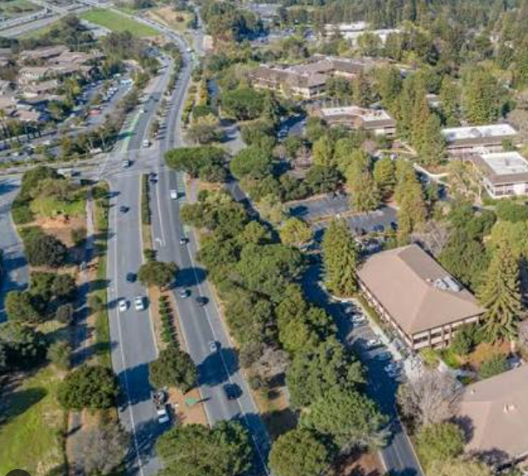
Advanced Project Finance Introduction
Potential Subjects
Nuanced Financial Issues
Alternative Debt Structuring
Cost and Benefits of Credit Enhancements
Detailed and Tricky Contract Issues
Technical Issues in Priority Projects Like Energy Storage, Rail Transport, Hydrogen
Understanding Political Issues with Project Finance

Slide 3
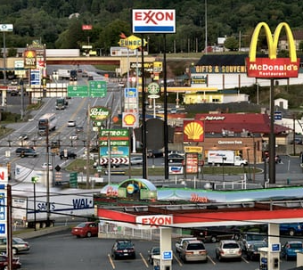

Foundations versus Advanced Course for EIB
Advanced Course
  Fewer Participants
  More Flexible Structure
  Discussion of Specific Cases
  Analysis of Underlying Theory
  Time Period Between
  More Time
EIB versus EIF
  Fundamental Investment Principles
  Difficulty in measuring performance
  Difficulty in analysis of start-up and venture capital
  Difficulty in assessing return
  Difficulty in assessing credit

Slide 4
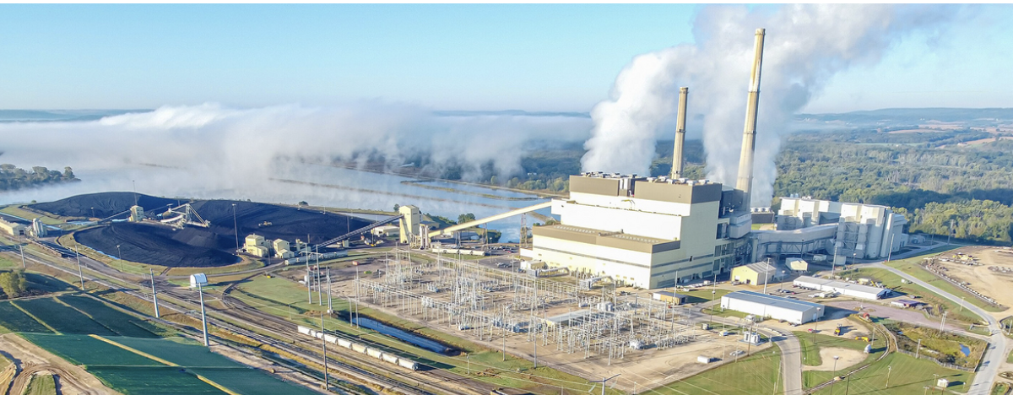

Previous Advanced Project Finance
Details of particular project finance cases
  Technical details of renewable energy
  Risk issues from negative prices
  Potential structuring issues in cases
  Valuation of project with risk changes
  Practical modelling issues
Advanced financial structuring
  Use of cash sweeps with volatile cash flows
  Measurement of probability of default and loss probability
  Recent changes in project finance features for transport
  Understanding tricks in structuring project finance transactions
  Actual Model Large Model Review
Project Finance contracts
  Understanding contracting principles
  Output versus availability contracts
  Spot or merchant pricing
  Battery storage contracts
  Liquidated damages and other contract incentives

Slide 5


Preparation for EIF Course – Think About Things Differently than Day to Day
Analysis of Funds with Listed Stock Prices
  Benchmark Stable Companies
  Benchmark General Companies
  Renewable Energy Yield Cos
  Venture Capital Funds
Return Analysis
  Inflation and Bonds
  Returns in Different Periods
  Returns and GDP
Consolidation of Projects into Fund
  Illustration of Consolidation in Different Stages
  Effect of timing on return measurement
  Scenarios with Different valuation statistics
Detailed Contract Analysis (Classic Project Finance)
  Output and Availability
  Merchant Risks
  Battery Contracts

Slide 6

How do I consolidate individual projects to a fund model
Where to find the materials

Slide 7
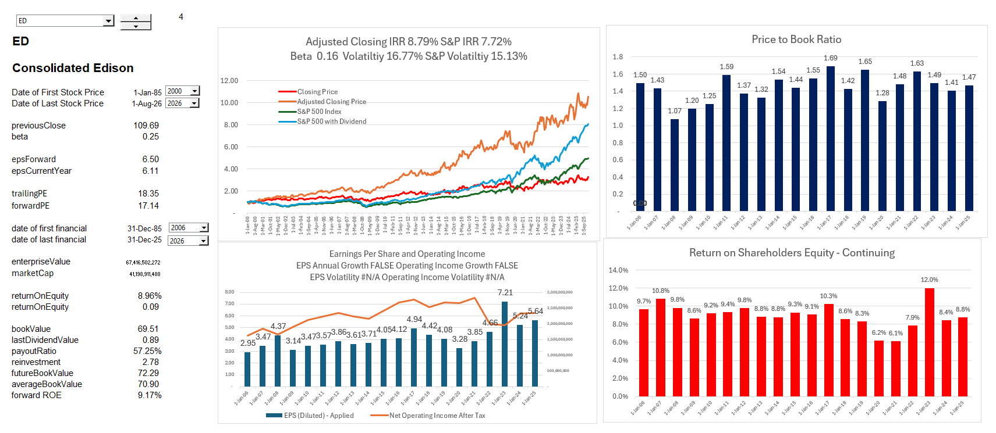
Introduction – Financial Analysis Stable Company
Stock Price Growth, Price to Book Ratio and Earnings Growth

Slide 8
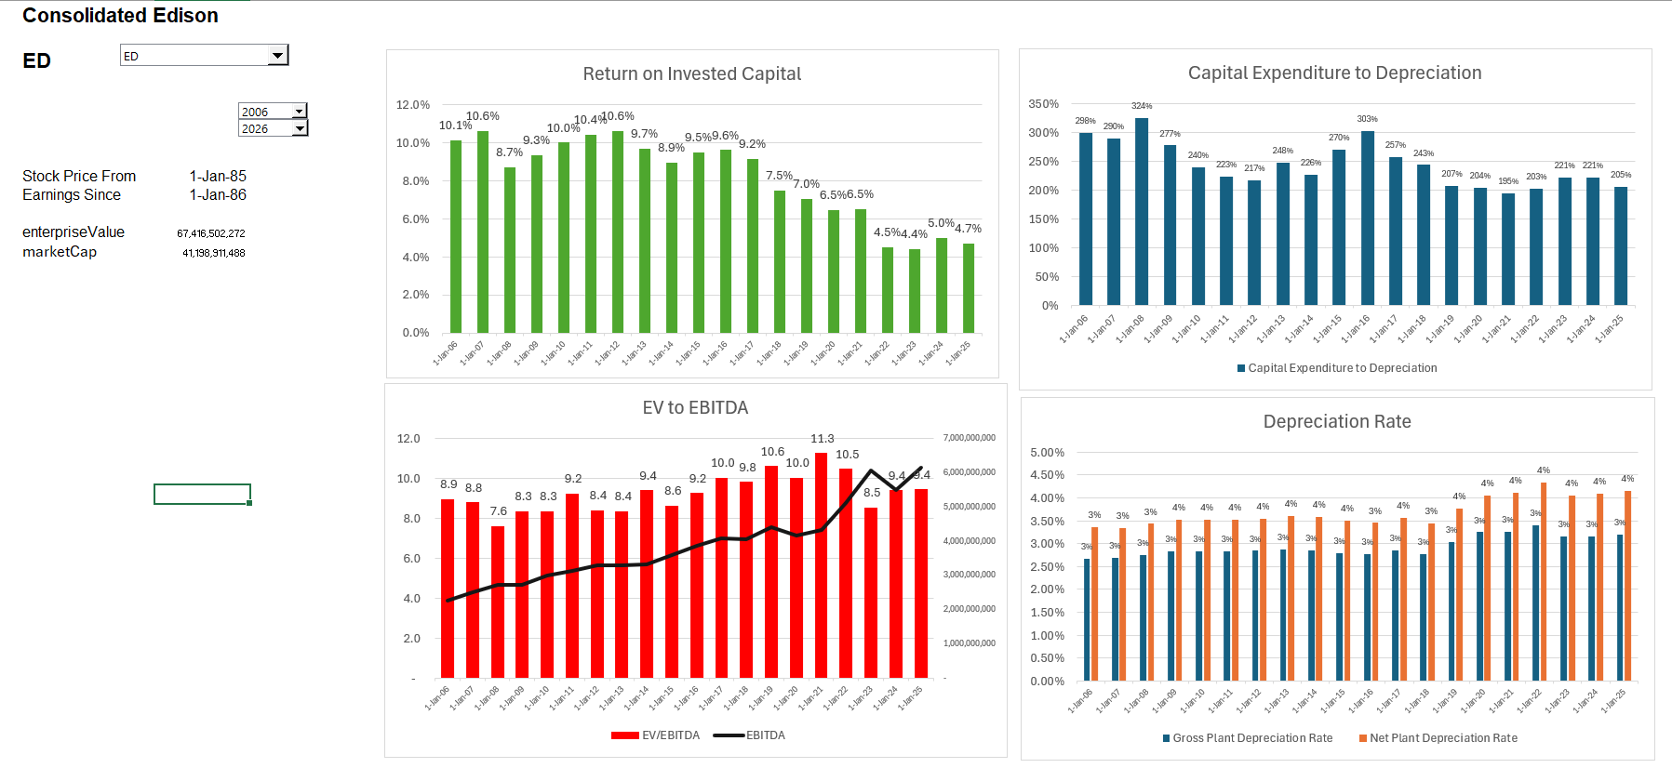
What Does a Stable Company Mean
.

Slide 9
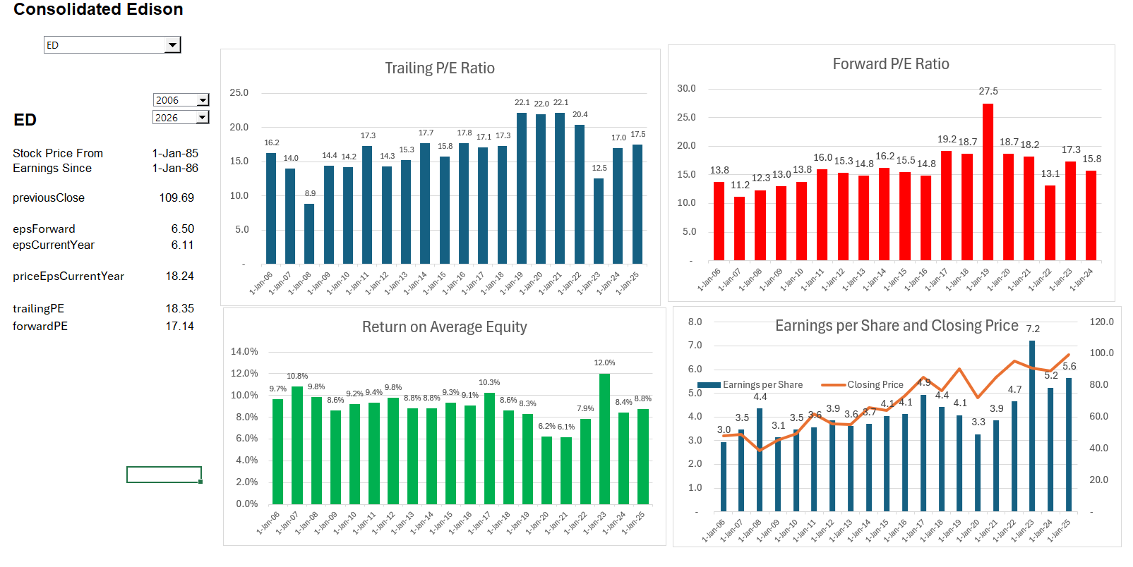
Valuation Ratios for Stable Company
.

Slide 10
Valuation Formulas
Wealth Growth = Savings Percent x Return on Savings
Wealth Growth = Savings Percent x Return on Investment
Value = D₁/(k-g)
Growth (g) = ROE x (1-DPO)
DPO = 1 – g/ROE
Value = (E₁ x DPO)/(k-g)
Value = E₁ x (1-g/ROE)/(k-g)

Slide 11
Other Related Formulas
The P/E ratio: [P/EPS₁= (1-g/ROE)/(k-g)]. This comes from defining Value as P and dividing the equation by EPS.
The cost of capital: [k=E₁ /P x (1-g/ROE) – g]. This comes from re-arranging the equation and demonstrates how cost of capital can be derived from expected cash flow.
The enterprise value: [EV = NOPAT₁ x (1-g/ROIC)/(WACC-g)]. This is the same formula as above, but earnings is replaced by earnings before financing (still after tax), return is replaced by return on invested capital, and the cost of equity is replaced by the overall cost of capital for both debt and equity that finance the total investment.
EV as a Function of Invested capital: [EV= Invested Capital ₀ * ROIC₁ x (1-g/ROIC)/(WACC-g)]. This formula is the same as above except that income (NOPAT) is replaced by = Invested Capital ₀ * ROIC₁.
The price to book: [P/B = (ROE-g)/(k-g)]. This comes from the equation that income = ROE x Book Value of Investment. When the ROE = k, the top and the bottom of the equation are the same and the price to book is 1.0. This implies that if you find companies that have a price to book of 1.0 with a consistent return, this return is about the same as the cost of capital.
The WACC: [WACC = EV/Invested Capital * (1-g/ROIC) – g]. This is like the formula for k above but allows you to derive the WACC.

Slide 12
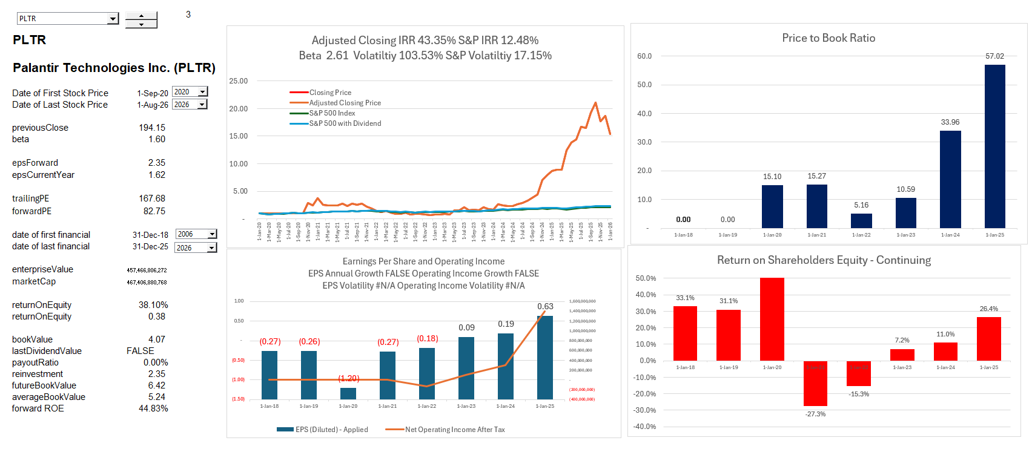
Introduction – Valuation of High Growth Company
.

Slide 13
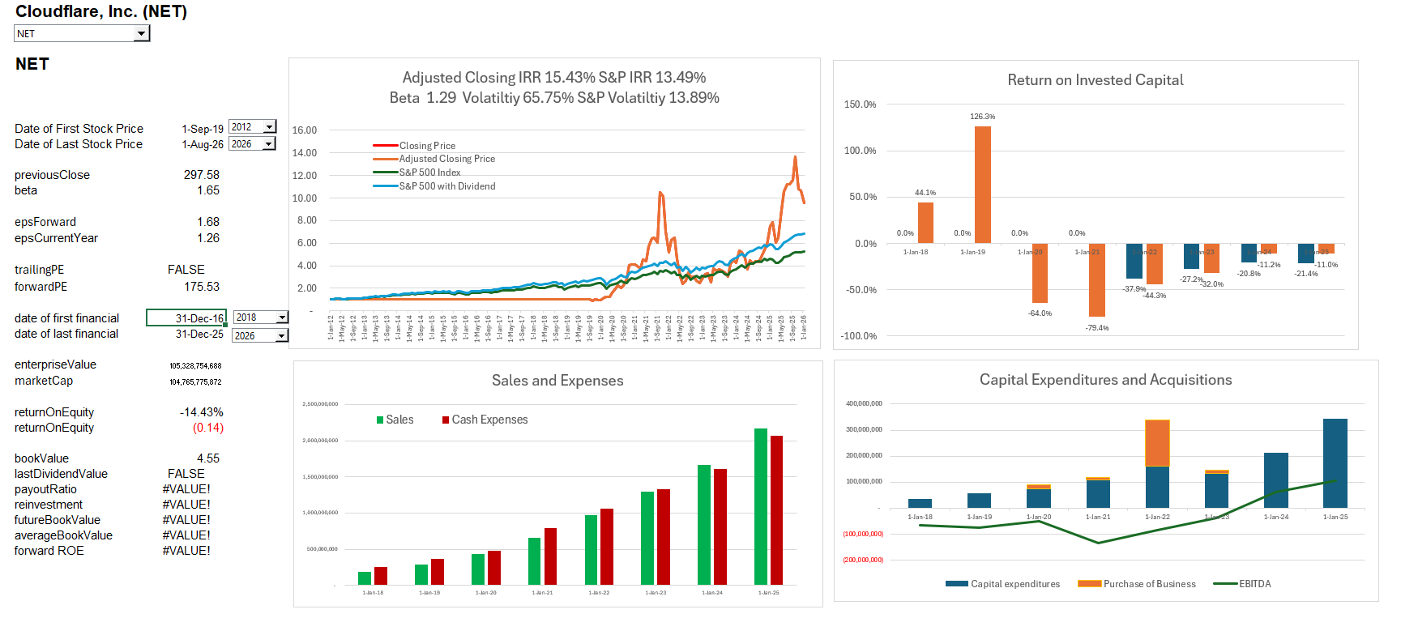
Valuation of High Tech Company
.

Slide 14
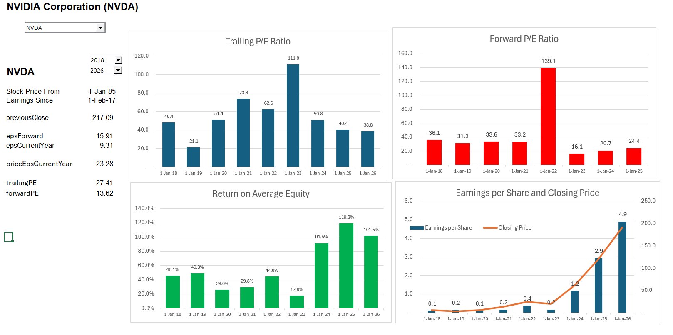
NVIDIA Valuation

Slide 15
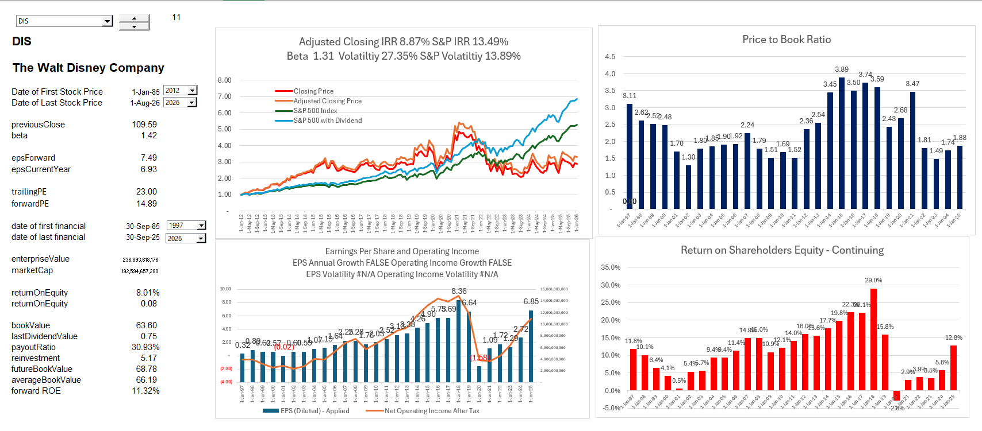
Dow Jones 30 Company Valuation

Slide 16
Valuation of Project versus Fund

Slide 17

Family is Like a Corporation; Person is Like Project Finance – How would Value the Family
Potential for Next Generation as a Guide for the Performance History of Prior Generation
Person is the project
Entire Family is the Corporation
Success of a family depends on the success of individuals in the family
Terminal Value of Future Generations Difficult to Compute – Comes from Potential from Future Generations

Slide 18
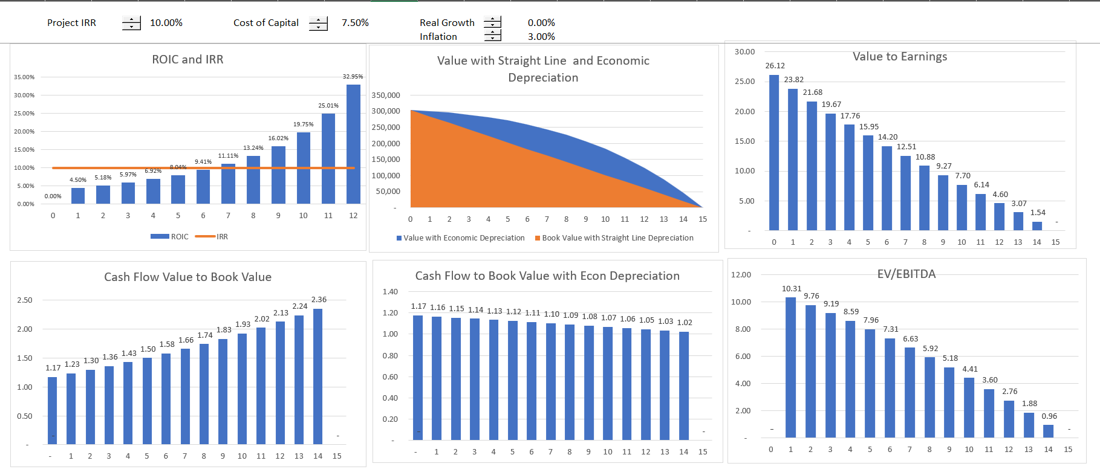
Project versus Fund Analysis
Project Finance Analysis and Measuring Return

Slide 19
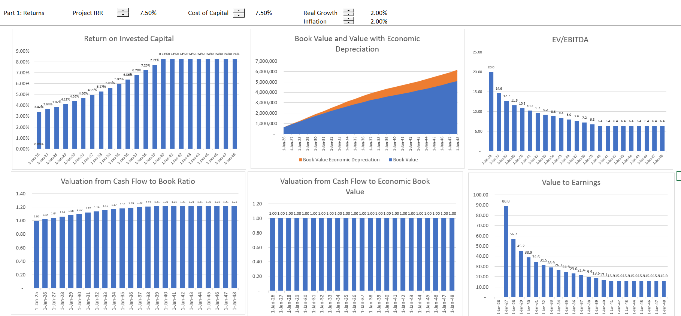
Introduction – Consolidation of Projects to a Fund

Slide 20
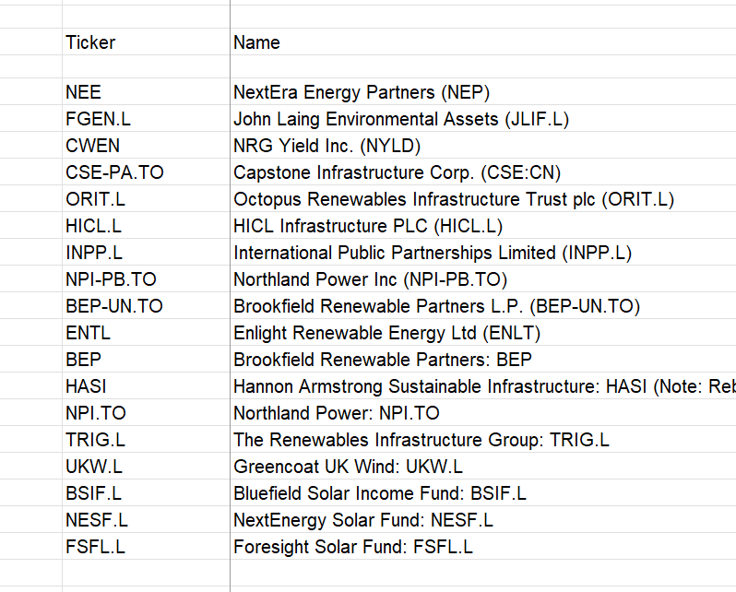
Data on Renewable Fund
.

Slide 21
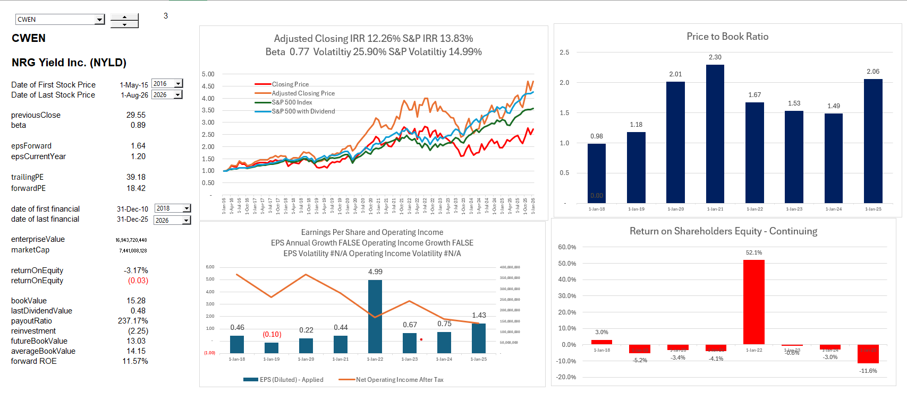
Fund – Dividends and Cash versus Return
.

Slide 22
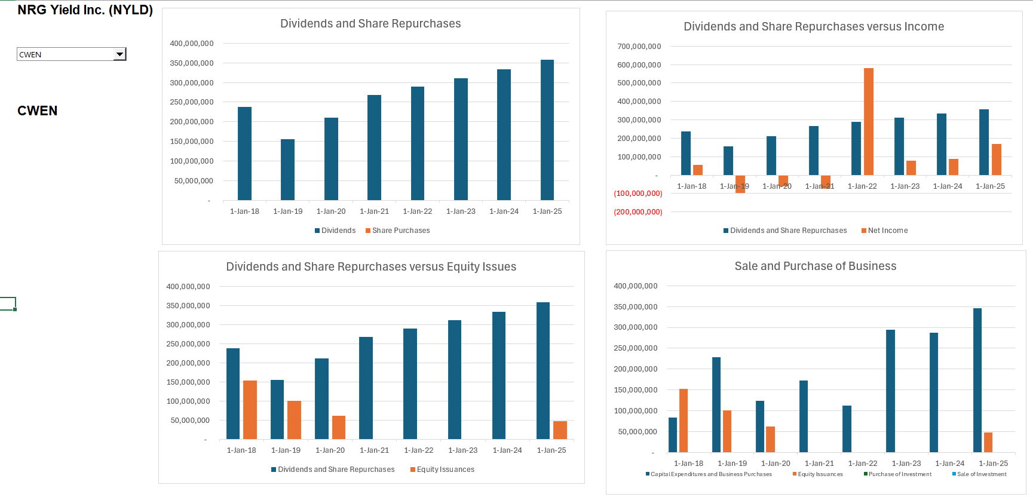
Stable of Dividends from Renewable Fund
.

Slide 23
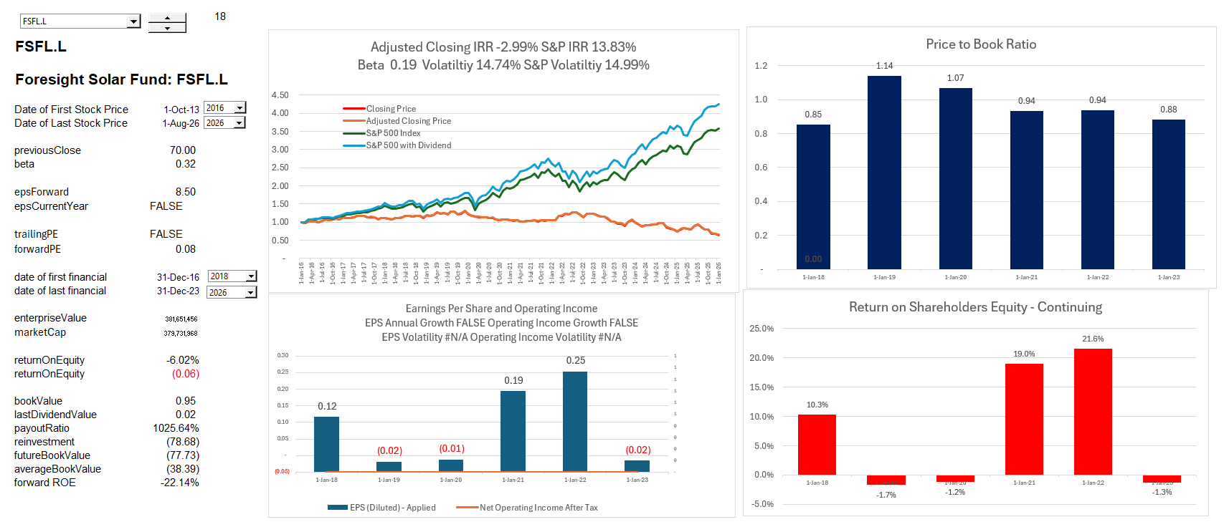
Share Price from Solar Fund
.

Slide 24
Venture Capital Fund

Slide 25
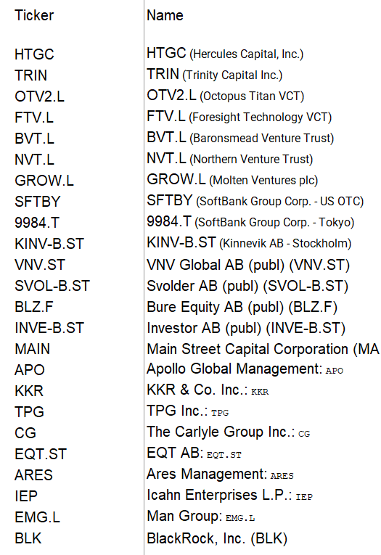
Funds Related to Venture Capital
.

Slide 26
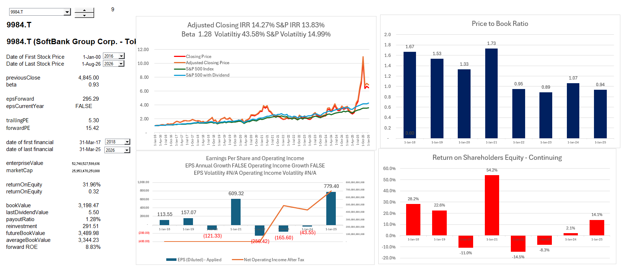
Soft Bank Example
,

Slide 27
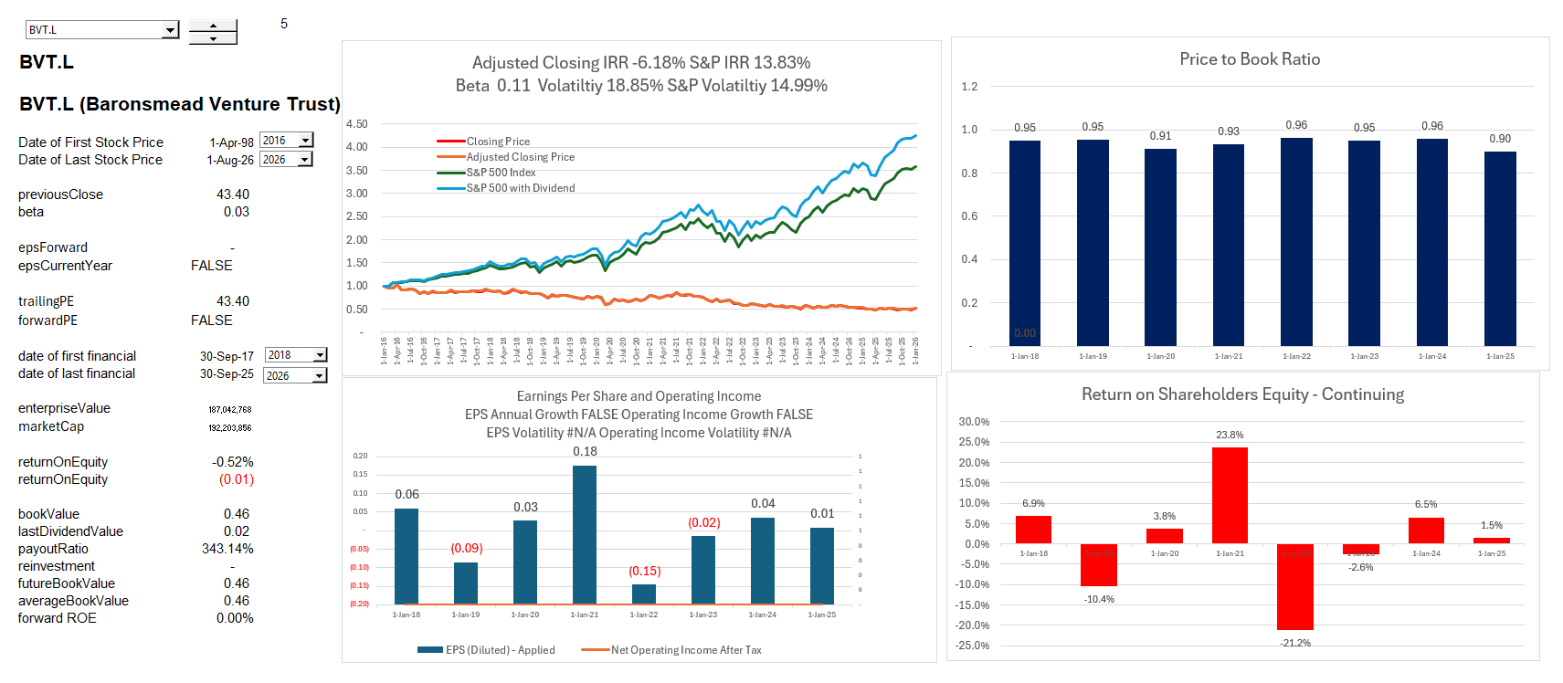
Trust in London
Price to Book Ratio

Slide 28
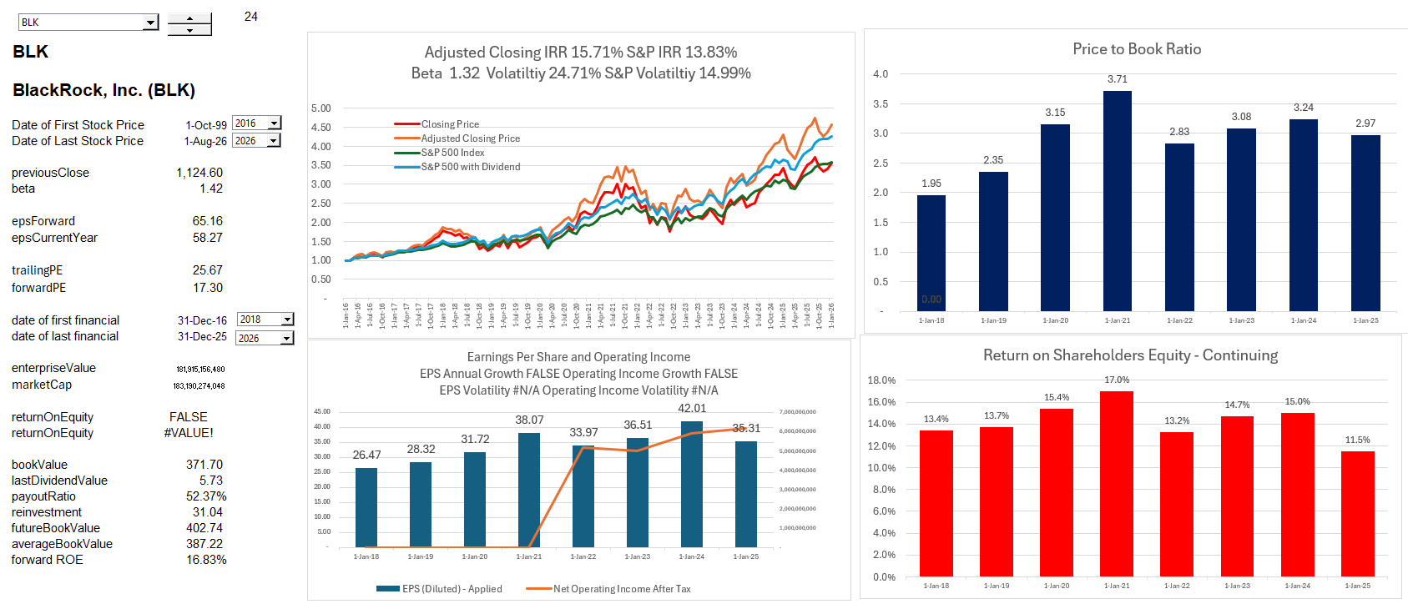
BlackRock
.

Slide 29
Analysis of Returns

Slide 30

Value Driver Formula and McKinsey Book
Value depends on return, risk and growth
Value = Earnings x (1-growth)/(WACC – Growth)

Slide 31
McKinsey and Praise of Monopoly Profit
“In addition to higher returns in the United States, P/E and market-to-book ratios have been significantly higher for the U.S. market when compared with Europe and key Asian markets … [P]erformance differences can explain much of the difference in valuation, particularly in the case of return on capital. U.S. companies, for example, consistently earned higher returns on capital than companies in Europe and Asia… We see this as further proof that economic fundamentals drive stock markets.”
Argument of higher returns – examples, returns from selling toothpaste, food and medicine
Returns come from higher prices and monopoly profits
Higher returns do yield higher market-to-book (price to earnings) but not higher P/E ratios

Slide 32
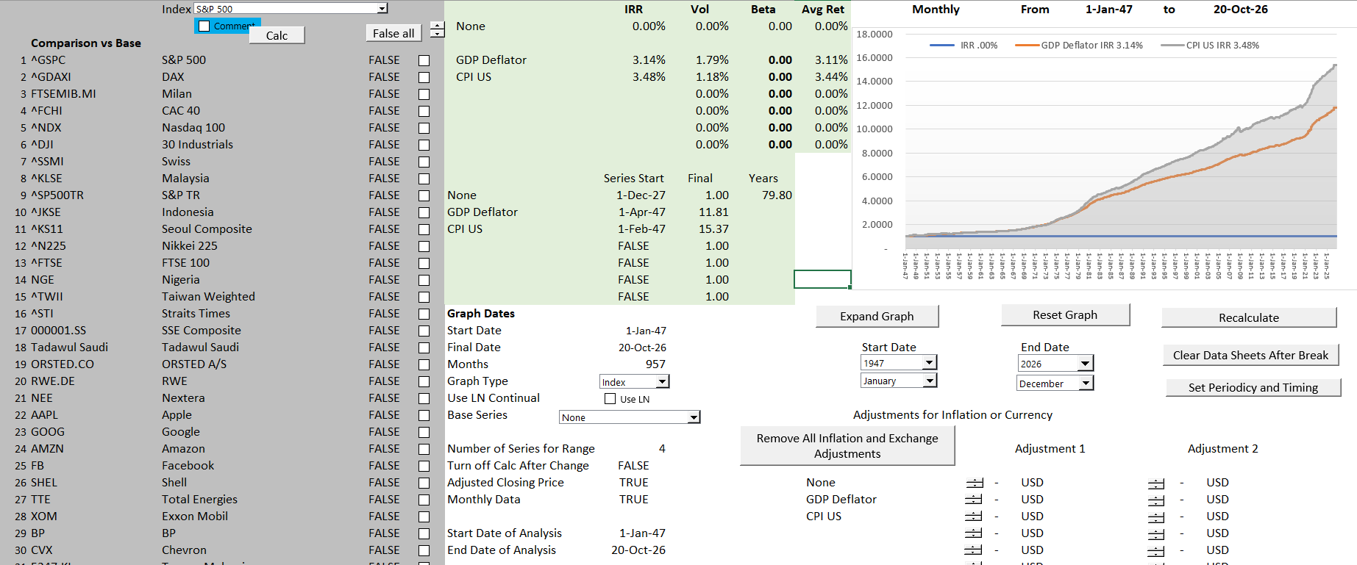
Start with Inflation – Rate of Inflation is IRR
Introduction to tool

Slide 33
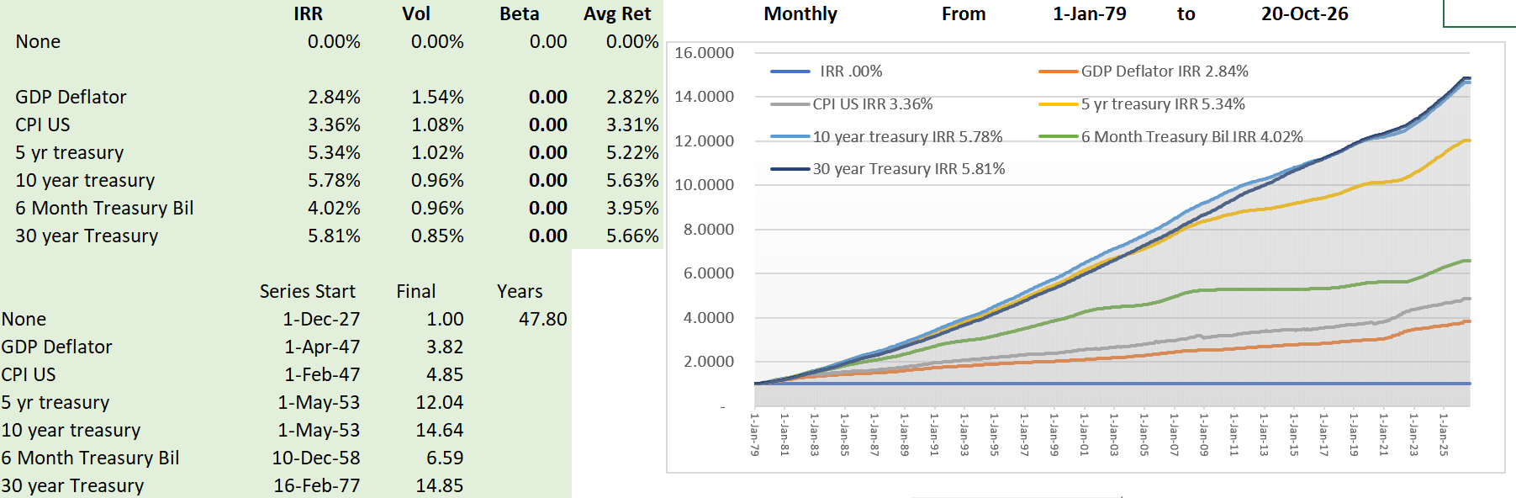
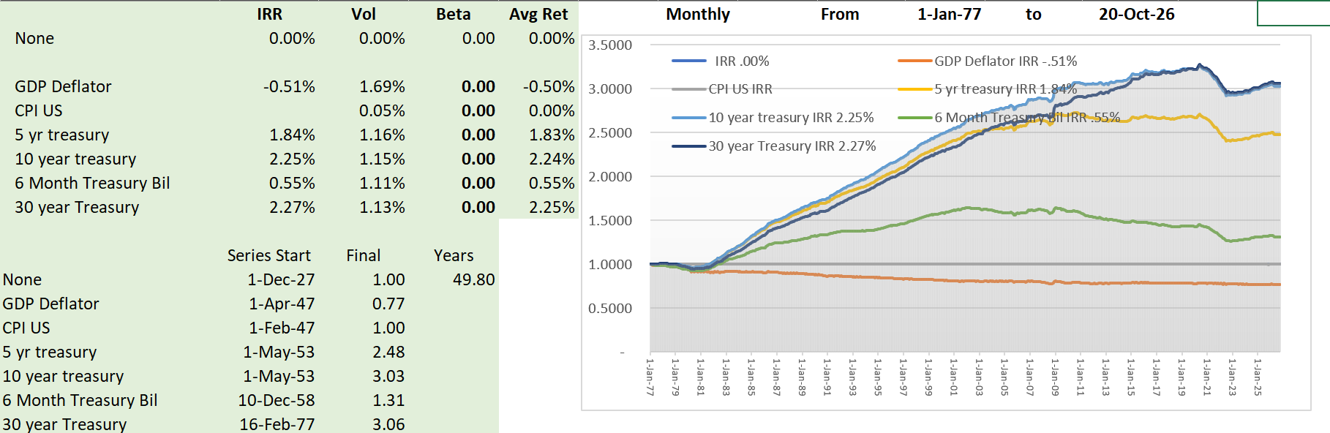
Interest Rates versus Inflation
.

Slide 34
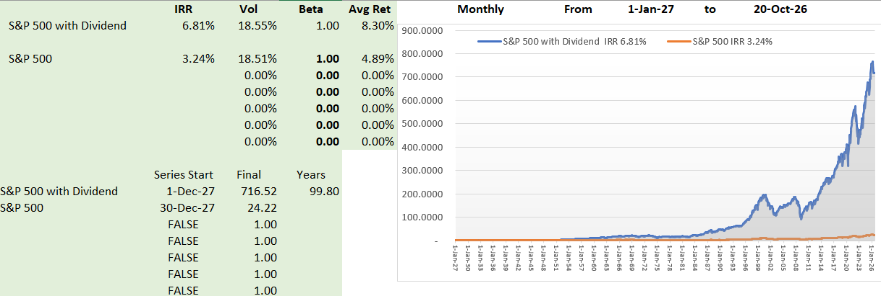
Real Returns for Market
.

Slide 35
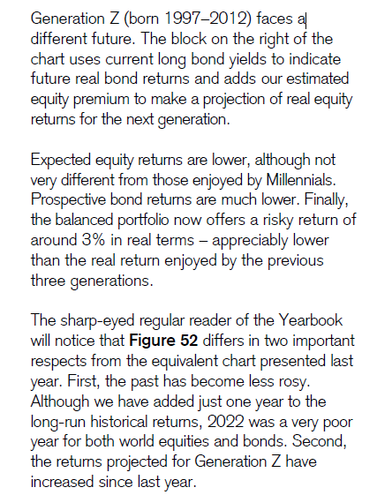
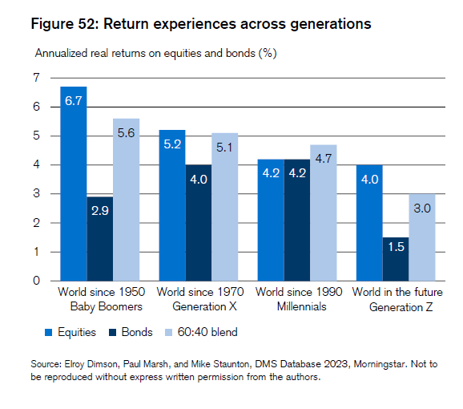
Expected Equity Premium of 2.5% - Much Lower than Historic

Slide 36

Craziness of Assuming High Equity Market Premiums (Damodoran)
Comments on high equity market premium
The key insight, which draws on earlier work by a number of authors, was that aggregate corporate profits cannot grow indefinitely much faster—or much slower—than GDP. (And as Herbert Stein was fond of reminding us, any economic trend that cannot continue forever will not.) If profits grow faster than GDP, they eventually take over the economy, leaving nothing for labour, government, natural resource owners, or other claimants. If profits grow more slowly than GDP, they eventually disappear, and businesses will have no profit motive to continue operating. Thus, in the very long run, the ratio of profits to GDP is roughly constant.
Rethinking the Equity Risk Premium

Slide 37
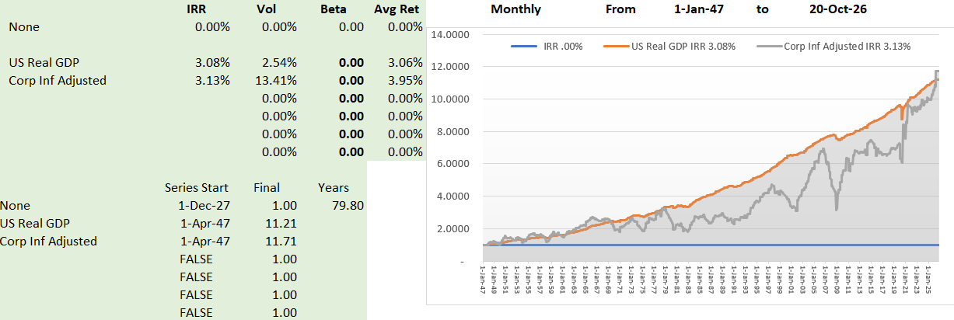
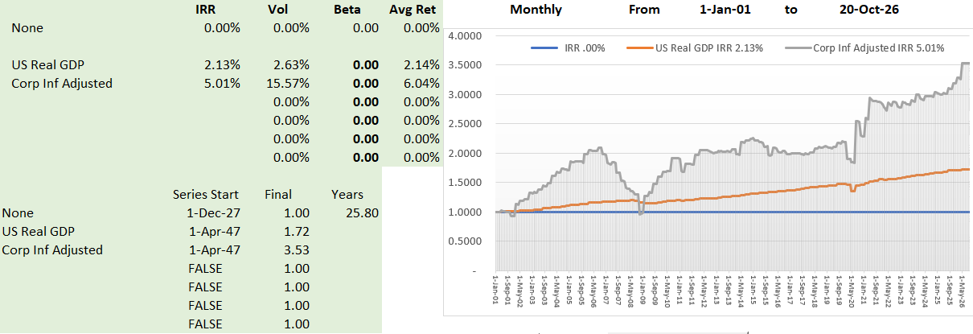
GDP and Corporate Profits
.

Slide 38
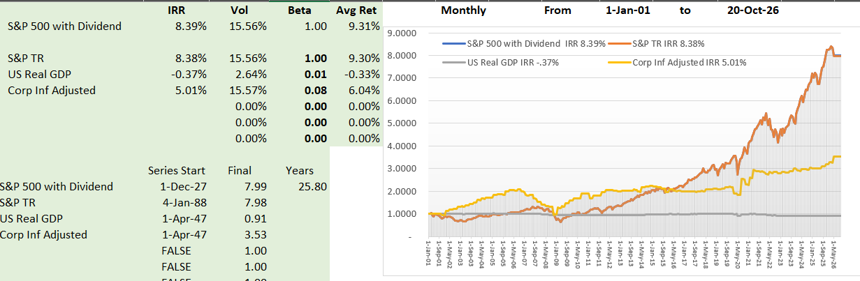
Current Equity Market and Economic Growt
.

Slide 39
Now Questions to You

Slide 40
First Questions
Why your comments are so important
  Split of course into two parts (second session)
  My age and why I am lucky
  Flexibility and structure of the course
Types of funds
  Equity or debt
  Venture Capital/Defense/Innovation
  Climate/Energy/Sustainability
  Small Business
General Issues
  Measuring performance
  Measuring value of fund
  Measuring value of investments in fund
  Measuring the credit risk of a fund
Theoretical issues
  Return – meaning, alternative measures, reasonable amounts
  Value – relative to investment, multiples, funds
  Credit – ratios, probability, credit rating

Slide 41
Specific Questions
Do you want to spend time looking at performance (ROIC and ROE) in funds and related valuation
  Understanding performance measures
  Understanding valuation measures
  Mechanics of consolidation
  Interpretation of consolidated results
Do you want to contrast project finance with corporate finance
  Corporate finance statistics
  Financial review of publicly traded funds
  Corporate valuation versus project valuation
  Loans to corporation versus projects
  Implications for investing in funds
Do you want to study the performance and valuation of publicly traded funds
  Financial ratios available
  Case studies
  Types of listed funds
  Mechanics of acquiring and interpreting data

Slide 42
Questions for You Continued
Do you want study particular cases
  Cases of renewable energy
  Cases of availability projects like hospitals, trains electricity busses
  Cases of batteries
Do you want to Evaluate Contracts which are Central to Project Finance
  Overview
  Detail Contracts
  Principles and Risks Inherent in Contracts
  Contracts for Particular Businesses

Slide 43
Advanced Project Finance Subjects
More Nuanced and Advanced Financial Analysis
  Problems with IRR in measuring economics
  Costs and benefits of credit enhancements (cash sweeps)
  Use of LLCR and PLCR in Structuring and Credit
  Debt Structuring with Changing DSCR, Negative Repayment
  Use of Government Supported Subordinated Debt
  Development Fees and Risk Changes over Life
  Management of Varying Cash Flow with Cash Sweep
  Equity Bridge Loans
  Maintenance Reserve Accounts and DSRA with Alternative Structures
  Mini-perm Loans and Re-financing
  Contract challenges and incentives for Batteries
  Alternative forms of concessional financing
  Policy Issues and Incentives in Contracting (Batteries, Merchant in Offshore Wind, Hydrogen)
More Modelling Detail
  What are advanced modelling
  Review of monster models
  Hands-on exercises for unconventional structuring issues
  Complexity in measuring return and risk

Slide 44
Notes on Financial Model for Teaching
Financial Model in Transaction
  Tests whether all of the contracts including the loan agreement work in terms of financial ratios
  Used for risk analysis to test downside cases and assure the lenders get paid
  Puts all of the technical data together with the financing data to assess the economics of a project
  Is a database of the meaningful data for the project
Financial Model as a Teaching Tool
  Advisors do the model for you and even the scenarios; that does not mean that having some modelling skill is not useful.
  Demonstrates the how project finance concepts work (e.g. DSCR Target and Volatility)
  Isolate on issue to understand impacts on investors, lenders and society
  Used to present nuanced issues
  Demonstrates issues in case studies
Teaching with financial model exercises to illustrate debt structure theory and risk analysis
  Make absolutely you understand why we are using the model and explain concepts first
  Do you want to work through equations or only use the models to illustrate impacts

Slide 45
Value of Your Time
Stress and Time
Extra Slides
Flexibility and Cases
Depends on your requests
Excel Efficiency and Learning

Slide 46
Not Just a Diagram – Illustrate Risks
Each contract can have many nuances with penalties, bonuses, default clauses, termination.
Off-taker: Want strong off-taker with inactive to honor contract
Write down notes associated with each contract and if a contract does not exist, how the cash flow volatility can be addressed.
EPC Contractor: Want Strong Record and Finances
Price Risk or Volume Risk or Both or None (Availability)
EPC: Fixed Price Contract with LD
Supplier: Need to Understand Economics and Supply Curve
Special Purpose Vehicle: Bond Rating of BBB-
O&M Contractor
Supply Agreement
O&M Agreement
Loan Agreement – Draws Green; Debt Service Red
Banks Like Strong Sponsors. Sponsors want EIRR
Shareholder Agreement
Lenders:
Lenders want DSCR (LLCR, PLCR)
Invest with paid in cap; payback dividends
Invest with draws; payback debt service

Slide 47
Case Studies, Risk Matrix- Group Discussion (1)
Risk | Description | Proposed Allocation | Possible Mitigation
Availability Risk
Completion Risk
Cost Overrun Risk

Slide 48
Outline and Case Studies - 1
Resource Case
  Risk Issues – Resource Project
  Distortions in Measuring IRR
  Issues with DSCR, LLCR, PLCR
  Risk Analysis with Alternative Structures
Off-shore Wind and Orsted
  General Risk Issues and Pricing for Renewable Energy
  Development Costs and Risks
  Nuances of Debt Structuring
  Contracts and Political Risk
PPP Case, Cash Waterfall, Cash Sweep and Re-financing
  Traffic Risk and Minimum Guarantee
  Cash Flow waterfall and Credit Protections
  Cash Sweeps for Volatile Cash Flow
  Cash Sweeps for Re-structuring Debt after COD
  Re-financing
  Mini-perm
Hydrogen Case, Subordinated Debt and Concessional Finance
  Background on Hydrogen
  Contract for Difference
  Use of Subordinated Debt and Other Incentives
  Potential for Re-financing and Mini-Perm
Different patterns of cash flow

Slide 49
Outline and Case Studies - 2
Battery Case and Contracts
  Background on Batteries for Electricity Storage
  Battery Characteristics
  Battery PPA Overview
  Pricing in Battery PPA
  Liquidated Damages in PPA
Review of Actual Model
  Removing Intimidation of Model
  Understand the Model Structure
  Reviewing Formulas in the Model to Evaluate IRR

Slide 50
Issue 1: Performance Evaluation and IRR Issues and DSCR

Slide 51
Example of Performance Question
You receive actual cash flows that are different from the cash flow that was expected
How would you assess this difference in cash flow on rate of return and value

Slide 52
Why is Return so Important
Fundamental definition of investment
Return and growth
Accounting return (ROIC) versus cash flow return (IRR)

Slide 53
Biggest Problems in Corporate Finance
The biggest item of value in a corporate DCF analysis is the terminal value as a corporation is assumed to last indefinitely (forever).
  In the long-term future, all of the management will be replaced
  In the long-term future, all of the current products will be obsolete
  In the long-term, all existing assets (except land) will be retired
  Value in the long-term comes from the ability of management to earn returns above the cost of capital; why should we assume management can continually earn high returns on new projects
A really big problem in corporation is what WACC to use in valuation
  Assuming a constant WACC is crazy
  Everybody has different opinions about what the equity risk premium and the beta are, leading to dramatic differences in WACC
  There continue to be problems with valuing the tax shield from interest in WACC and debates about un-levering and re-levering Beta and adjusted net present value
Another big problem in corporate finance is interpreting EPS, ROE and ROIC along with P/E, EV/EBITDA and Price to Book Ratio
  When companies are growing fast, the ROE and ROIC will be lower than the equity or project IRR while when companies are not investing the reverse will be true
  The value impacts of this can be resolved with project finance analysis.

Slide 54
These Problems Do Not Exist in Project Finance
Value a project over its life and don’t need terminal value
Discount rate changes, but stable discount rate for a mature project can be established from transactions (when your children become mature, you know their value)
Most of the cost of capital comes from debt and the mature equity cost of capital is a bit above (or even below) the interest rate
Problems: Irrelevant to use ROIC, ROE, EV/EBITDA, P/E – this makes these ratios irrelevant in fast growing or fast declining corporations. It may be depressing, but this can make just about all financial statement analysis irrelevant for corporate valuation.
Market to Book Value can be assessed by the ability to earn returns above the cost of capital.
  Book Value (without write-offs) is the equity value on the balance sheet
  Cash Flow from Book Value at Cost of Capital can be computed with PMT
  Cash Flow from Premium Above Book Value can be computed with PMT and Higher Interest Rate
  Theoretical Price to Book Ratio can be computed from PV

Slide 55
Model Analysis with FAST Principles
Modelling of energy projects sometimes uses something called FAST principles. I really do not like these silly acronyms, but it can be a way to discuss the models.
F – Flexible; the model should be flexible so that you can change scenarios, look at different valuation techniques; change the timelines for individual projects and so forth.
A – Accurate; The model should contain audit tests and an audit page that verifies the mechanics of the model are accurate.
S – Structured; The model should be structured in a logical way beginning with how the project works and moving to project cash flows. Debt and equity cash flow should be computed after the project cash flow is established.
T – Transparent; The model equations should be short and simple and easy to understand. Somebody picking up the model should be able to understand the model in short order.
I believe the model developed by the PE firm violated these principles.

Slide 56
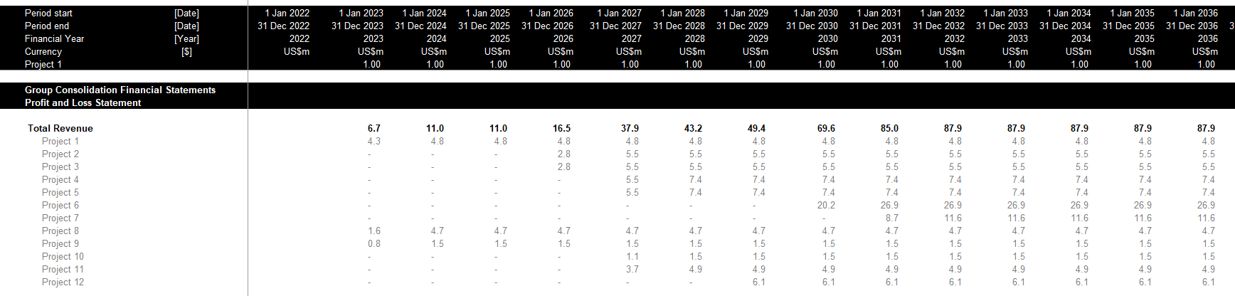
Flexibility – Adding New Projects
Perhaps I am obsessed with the idea of presenting projects in a separate sheet and then having the option to consolidate the projects.
Assume a new project is added to the portfolio. Using the method in the PE model and illustrated above, you would have to go into the consolidation file and copy each of the formulas (e.g., revenues, operating expenses). You would have to add rows evaluate whether the prior row is appropriate for the new project.
If you used the method for making a new sheet for each project the process would be much more flexible.

Slide 57
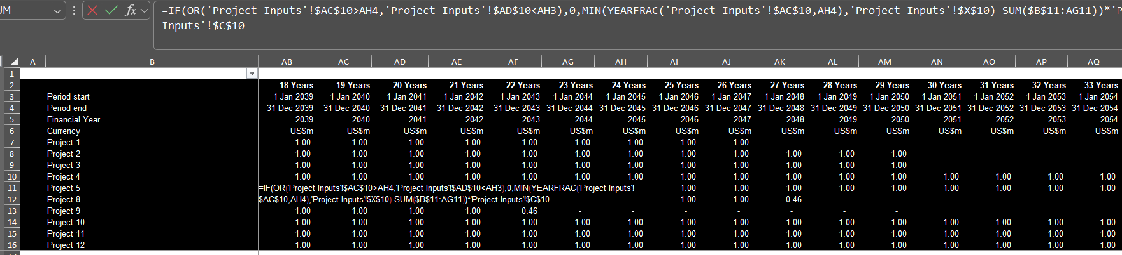
Flexibility – Equations Across the Sheet
Note in the timelines that there are blanks at in some of the columns implying that the formulas are not consistent. This is of course a horrible practice.
Long formulas are perhaps the worst crime both in terms of transparency and in terms of making the model flexible. This crime is in the flags which are crucial to a model.

Slide 58
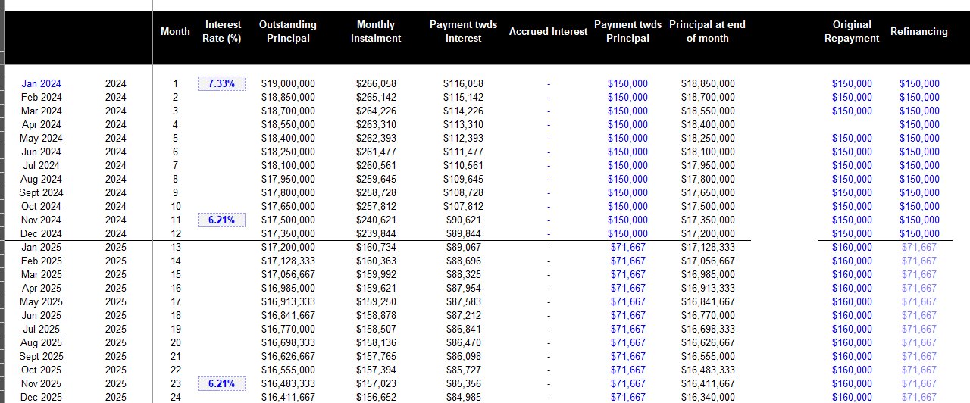
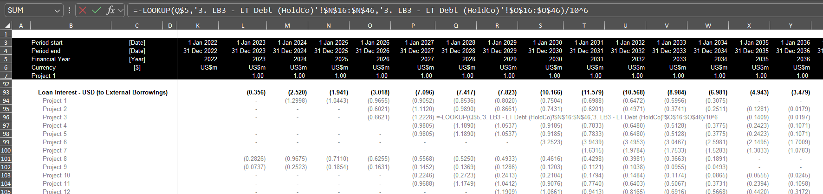
Model Accuracy
The model as provided did not have accuracy tests. Perhaps just as bad, it did not have sum columns to the left of the equations.
In the example below the loan interest is computed from a different sheet where the debt is shown in vertical columns. A much better and obvious way to evaluate the debt is to show the opening and closing balance and to assure that the debt drawdowns equal the debt repayments.

Slide 59
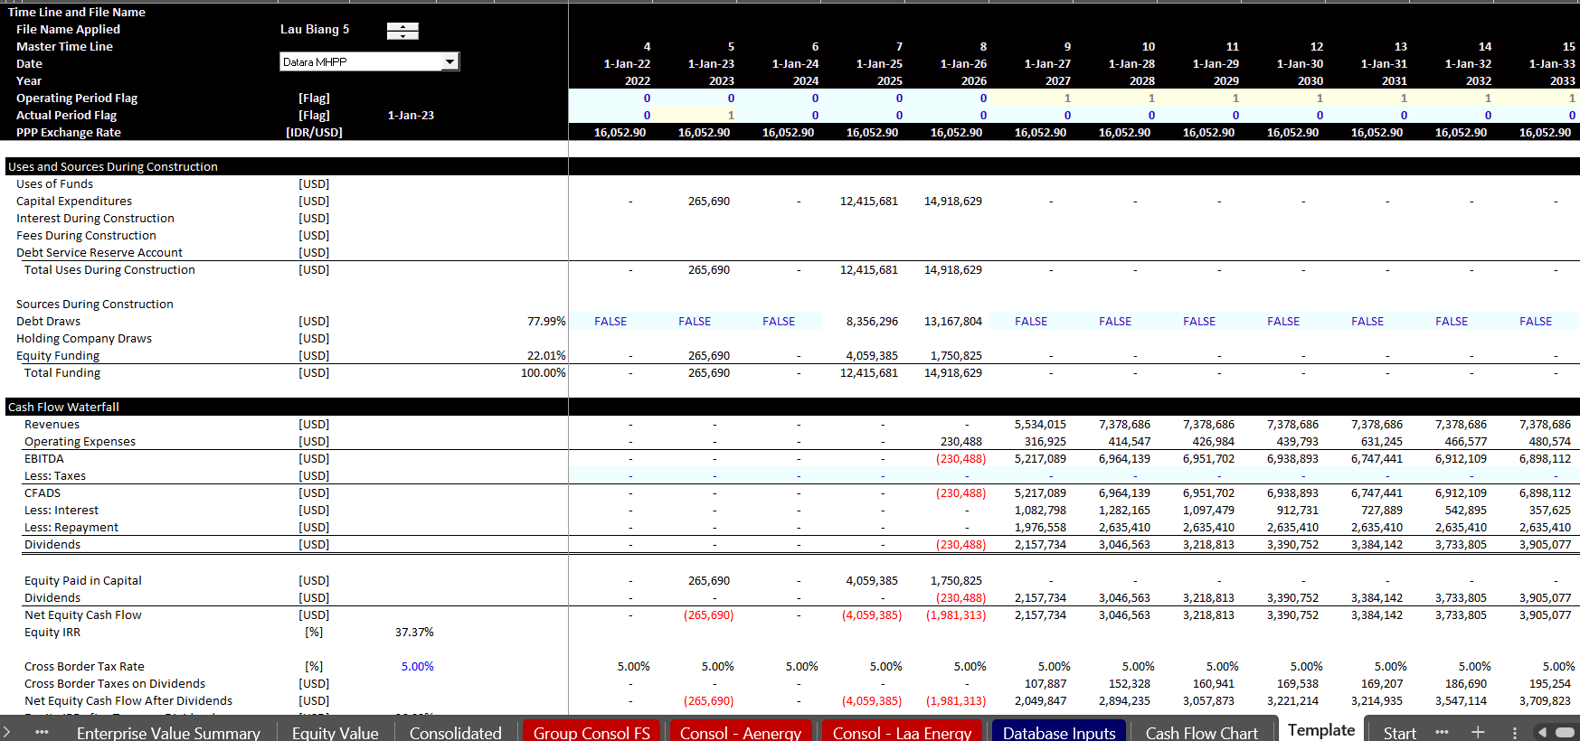
Model Structure
The model provided did not include a sources and uses display during construction and a cash flow waterfall after construction. Whether or not you apply project finance, a cash flow analysis of what happens before and after the operation period is essential.
The screenshot below illustrates an extract from the model with the cash flow analysis.

Slide 60
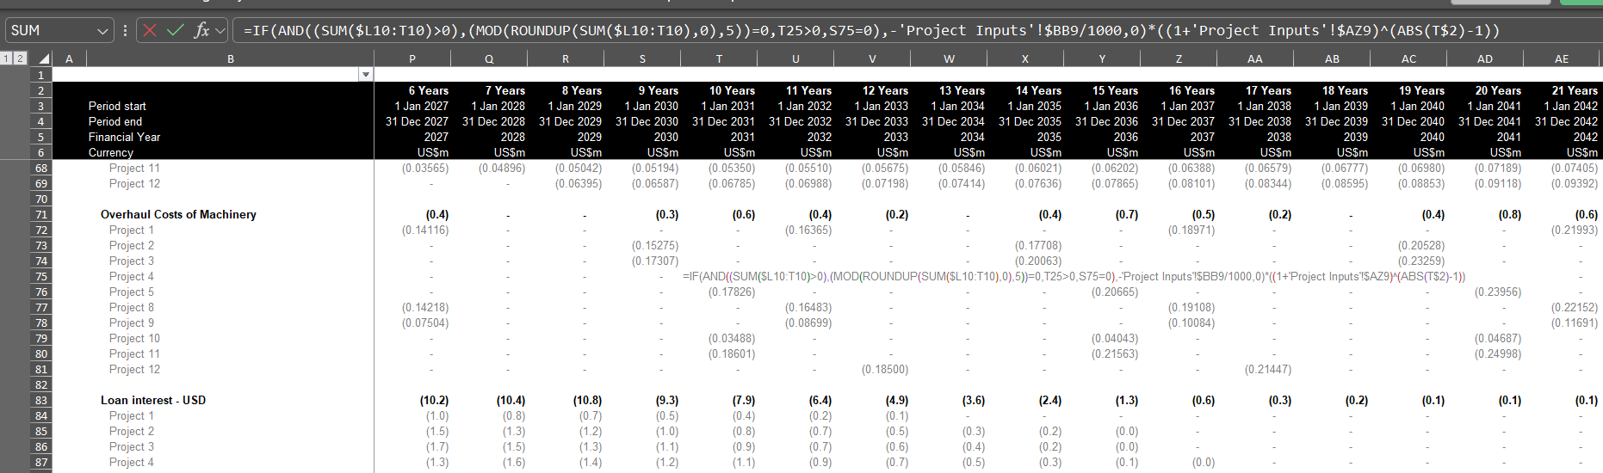
Model Transparency
There are many examples of very long formulas in the model which is the biggest problem. These formulas do not cause problems in the base case, but they could result in difficult issues when things change.
It is poor practice to refer to different sheets in the model

Slide 61
Consolidation of Projects with Simple Case
Compute Common Timeline
  Monthly Timeline
  Creates Large Model
Make InputC type Sheet with Projects
  Inputs can be flexible
  Must be in consistent format across projects
Use Model as Template
Create a Loop that changes the code number and copies template file to new sheet
  Start at End
  Create a Blank Start and End Sheet
  Start at the End of the Loop
  Demonstrate that you can change the template file
Create a macro to delete sheets between start and end sheet
  Again, start at the end

Slide 62
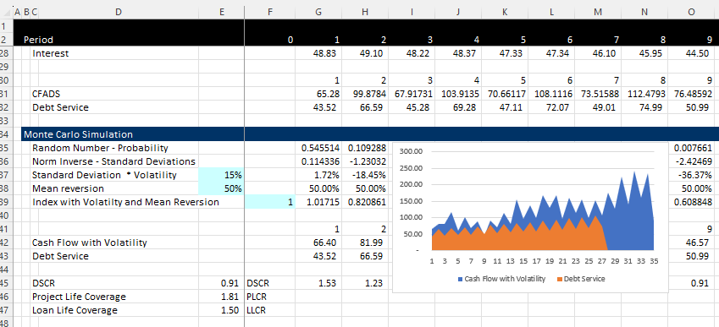
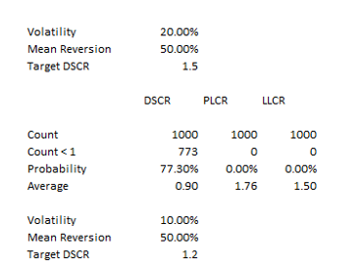
Monte Carlo Simulation as Illustration of Project Finance
Structure the Debt
Simulation with Volatility
Volatility and Mean Reversion Equations
  CF1 = Cf0 + CF0 * Rand x Volatility
  CF1 = Cf0 + CFO * Normal Inverse (Rand()) * Volatility
  With Mean Reversion
  CF1 = CF0 + (Mean – CF0) * Mean Reversion Factor + Volatility from Above
Results

Slide 63
Understanding of DSCR, LLCR and PLCR
(DSCR-1)/DSCR = Break Even Cash Flow
All ratios are measures of buffer and driven by possibility of decline in cash flow
  Example
    DSCR = CFADS/DS
    CFADS 150
    Debt Service 100
    DSCR 1.5
  How much can cash go down before cannot meet debt service: 150-100 = 50
  How much can cash go down in percent : 50/150 = 33.33%
  Formula for minimum break-even: (1.5-1)/1.5 = 33.33%
LLCR measures break-even over the entire debt life (it is possible that DSCR is below 1)
  LLCR = NPV (CFADS ll)/NPV of DS (NPV of DS = Loan at COD)
  How much can cash flow go down before cannot pay off loan at end of the loan life
    LLCR = 1.6
    Break-even over loan life (1.6-1)/1.2 = 37.5%
PLCR measures the break-even over the entire life and give the value of the tail
  PLCR = NPV (CFADS pl)/NPV of DS (NPV of DS = Loan at COD)
  How much can cash flow go down before cannot pay off loan at end of the loan life
    PCR = 2.0
    Break-even over loan life (2-1)/2 = 50%
Formulas work if there is a 100% cash flow sweep

Slide 64
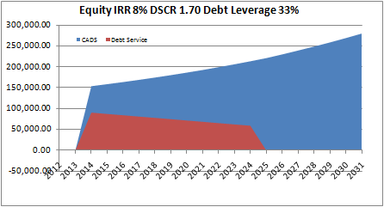
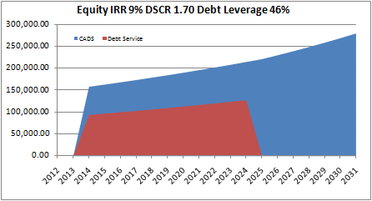
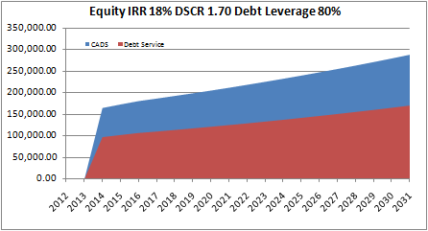
DSCR versus LLCR versus PLCR and Sculpting
Level Payment and Tail
Min DSCR < LLCR < PLCR
Sculpting and Tail
DSCR = LLCR < PLCR
Sculpting and No Tail
DSCR = LLCR = PLCR

Slide 65
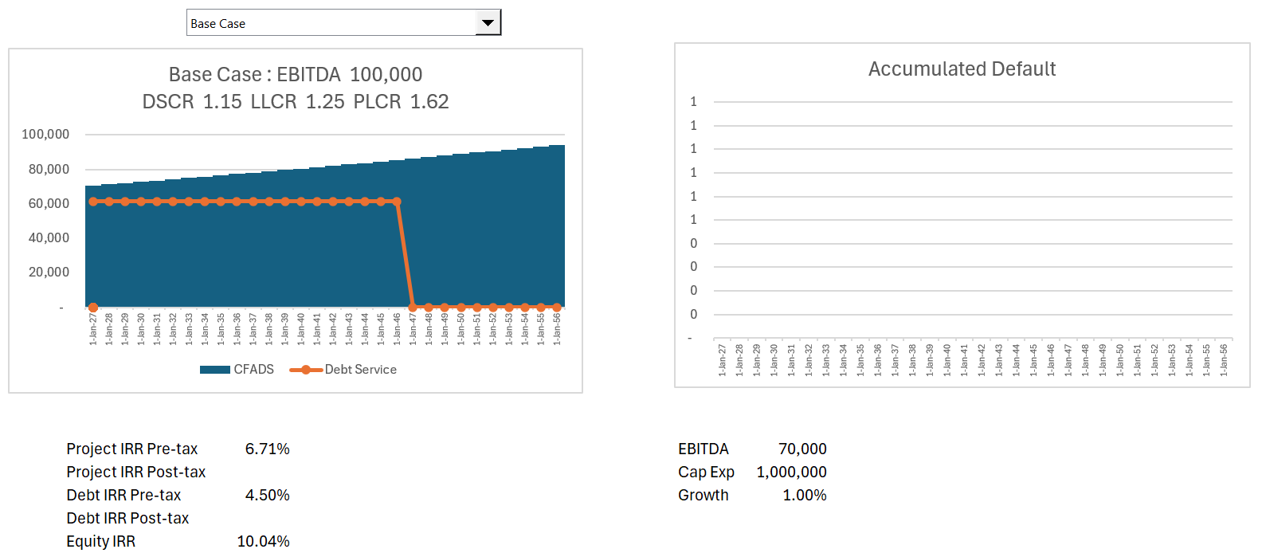
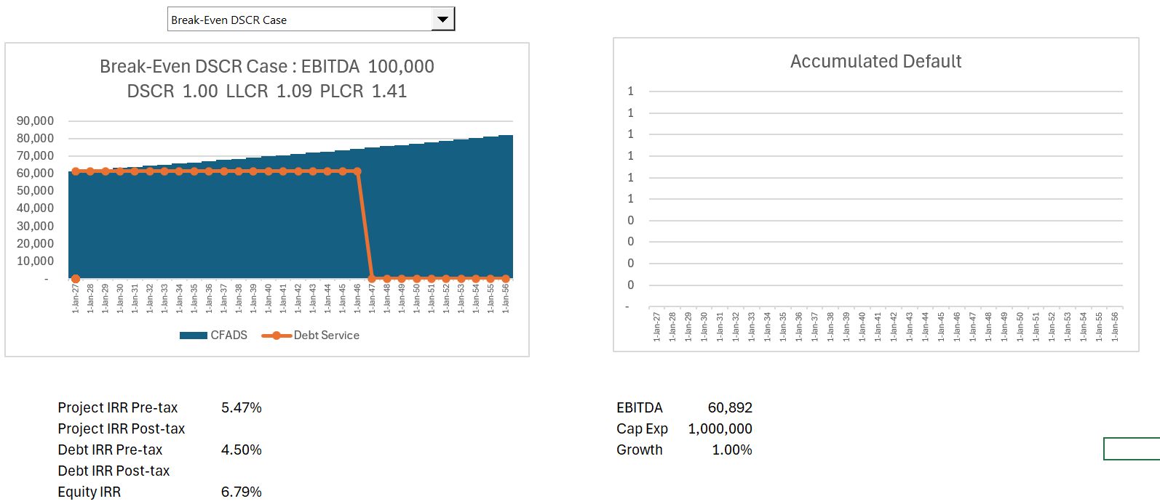
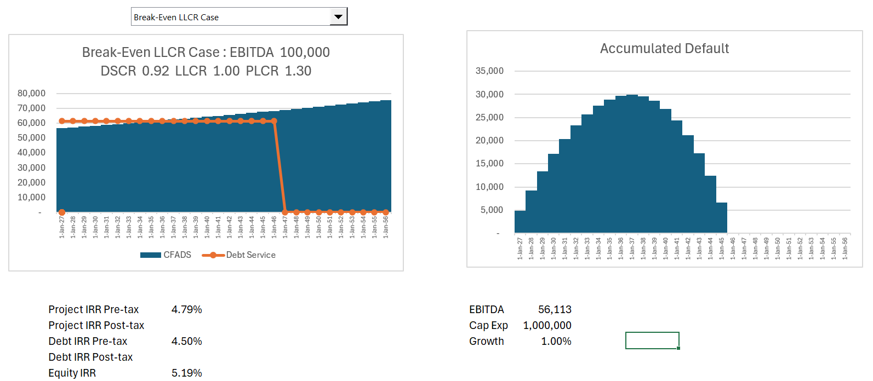
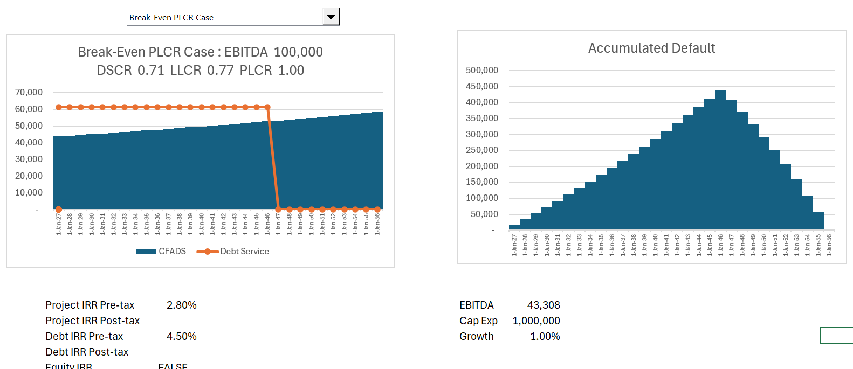
Illustration of Cases
Break Even % = (LLCR-1)/LLCR, (DSCR-1)/DSCR etc.

Slide 66
Mean Reversion and Use of Monte Carlo (it is easy) to Demonstrate Probability of Loss

Slide 67
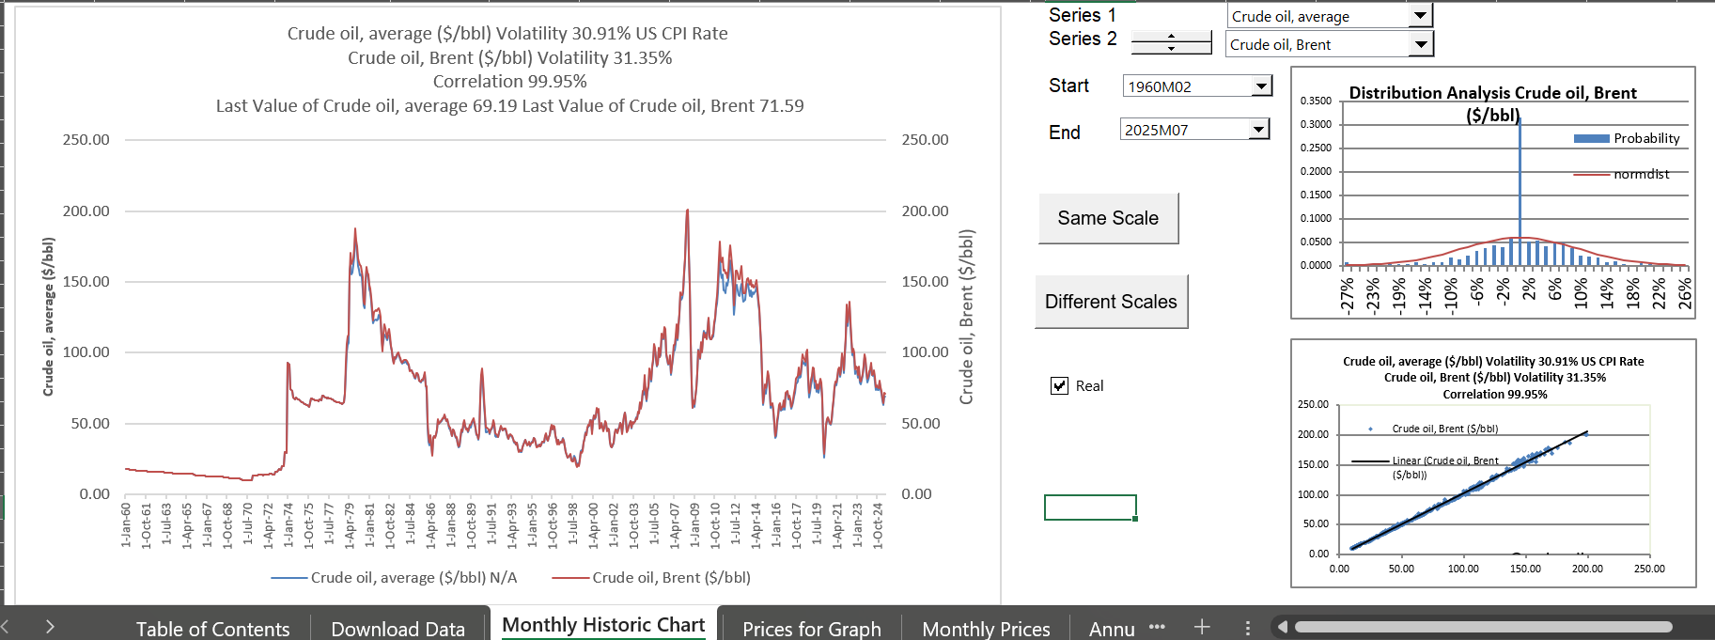
Oil Price from Database File
.

Slide 68
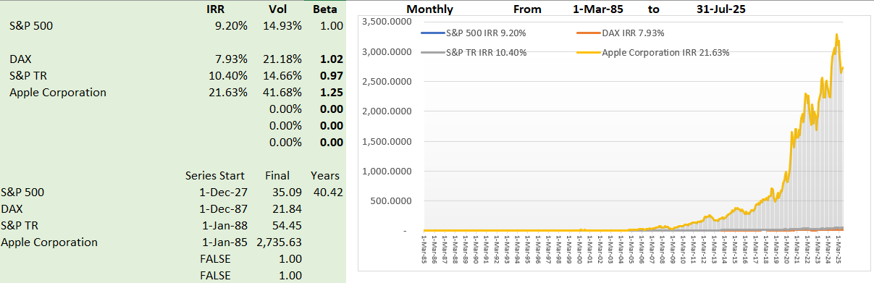
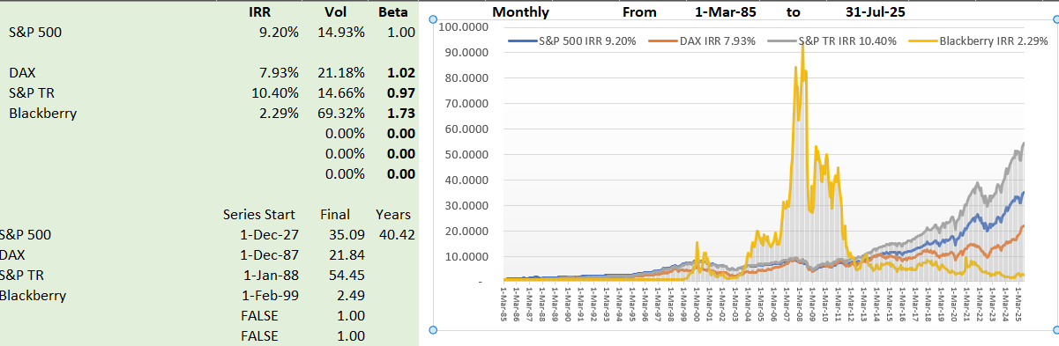
Illustration of Non-Mean Reverting
Blackberry Price and Apple Price
Volatility driven by fashion, changes in technology, one-time non-recurring events.
Volatility of one year, three-year, five-year

Slide 69
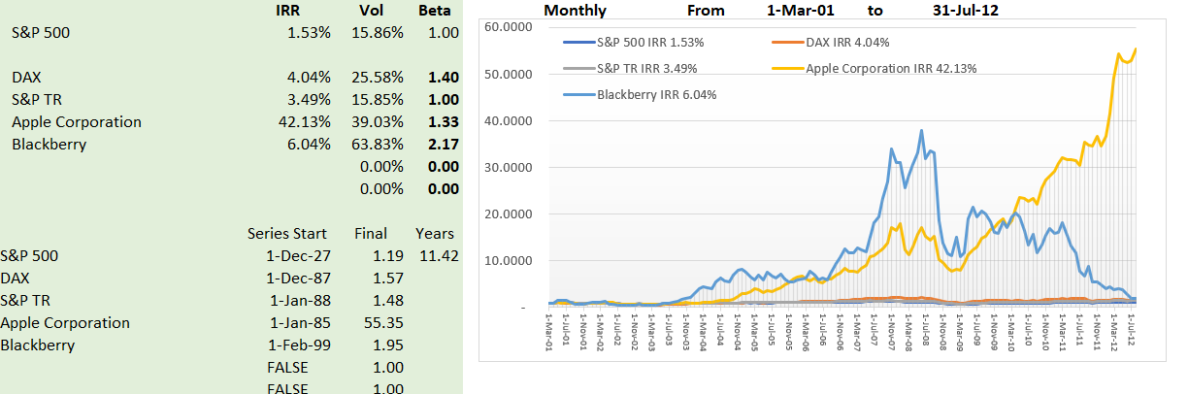
Non-Mean Reverting Series - Blackberry and Apple
Blackberry Price and Apple Price
Volatility driven by fashion, changes in technology, one-time non-recurring events.
Volatility of one year, three-year, five-year does not diminish

Slide 70
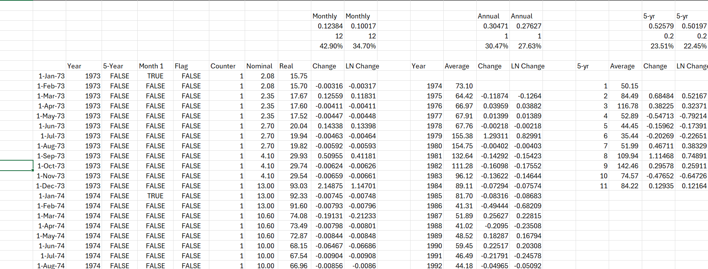
Illustration of Mean Reverting Cash Flows – Commodity Prices Except Change in Oil Prices in 1973
Volatility of prices for 1-year, 5-years, 10-years

Slide 71
Session 3 – Default and Implementation of Monte Carlo Simulation

Slide 72
Default Studies
Probability of Loss = Probability of Default x Loss Given Default
Measure with Default at Loan Life or LLCR or PLCR
For project finance, loss given default is relatively low

Slide 73
Expected Loss Can Be Broken Down Into Three Components
Credit Spread must cover the expected loss and is driven by probability of default x loss given default
Borrower Risk
Facility Risk Related
EXPECTED LOSS
$$
Probability of Default
(PD)
%
Loss Severity
Given Default
(Severity)
%
Loan Equivalent
Exposure
(Exposure)
$$
=
x
x
What is the probability of the counterparty defaulting?
If default occurs, how much of this do we expect to lose?
If default occurs, how much exposure do we expect to have?
The focus of grading tools is on modeling PD

Slide 74
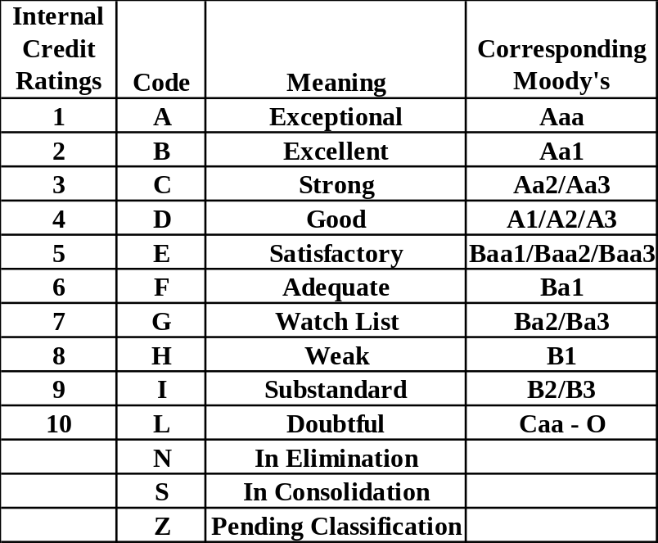
Measurement of Credit Risk with Rating Systems – How Do you Come Up with Good Rating
Map of Internal Ratings to Public Rating Agencies
Investment Grade
Junk

Slide 75

Project Finance ties to BBB- (Baa3)
Investment Grade
Junk

Slide 76

Default Studies – Probability of DSCR Below 1
.

Slide 77

Useless but Interesting Chart on PD

Slide 78

Use of Ratios Different Ratios in Different Industries: DSCR and Credit Ratings in Project Finance
Target rating of BBB-
Target DSCR or LLCR
Example of Toll-roads

Slide 79


S&P Study of PD and LGD for Project Finance
There is not much data, but the data shows that the LGD is very high for project finance. This is logical given the long-term nature of the assets.

Slide 80

Project Finance Defaults
A lot of merchant plants in US. Note the initial rating of BBB-

Slide 81

S&P Recovery Rates
LGD for Defaults – Not much data

Slide 82

Project Finance is Unfair to Africa
Credit spreads are much higher in Africa, but compute the ratio of defaults to loans.
For U.S. the ratio is 32/21 or 1.53.
For Africa the ratio is 3/8 = .375.

Slide 83
Session 4: Valuation

Slide 84
Assignment
Valuation should be done using DDM methodology (equity value and enterprise value), alongside relevant returns and key sensitivities that a prospective buyer might look at
  Use your discretion on which sensitivities to highlight
  For pricing the asset, you are expected to triangulate between precedent transactions and the bottom-up rate derived using CAPM methodology (for the CAPM buildup specifically, you’re allowed to do desktop research and are encouraged to make sensible assumptions as needed), and include relevant build-ups in the files
  For the returns analysis, assume a 7-year hold period with a prudent yield compression between entry and exit discount rates
Illustrative precedent transactions
  No. Size (MW) Technology Year
  Implied exit discount rate (USD)
    1 350 Solar 2023 9.0%
    2 150 Wind 2022 11.0%
    3 180 Solar & Wind 2022 9.0%
    4 225 Wind 2022 10.0%
    5 200 Solar 2021 8.0%

Slide 85

Start with Basic Valuation
Timeline and Discounting
In project finance no need for the big problem of terminal value

Slide 86




Project Finance and Changing Risk
Before COD, cash flow is presented in the sources and uses statement
After COD, cash flow is presented in the cash flow waterfall and the last line is dividends
Father of the bride makes commitment to pay for wedding
Commitment Fee
Date at which you realize that the wedding is working or is a complete disaster
Development is Dating period. Probability of failure is high
Pay for Wedding with Other peoples’ money
Pay your Bills and re-structure your life. Stuck with PPA type contract. May default.
FC is making promises (that you may not keep)
COD is Wedding Date
Decommissioning Date

Slide 87
Reasons for Risk Reduction After a Couple Years of Operation
Examples of Risk Resolution After A Couple of Years of Operation
  Finished with Development Risk – Big Probability of Failure
  Finished with Financing – Things May Not Work Out
  Finished with Construction – Many Things Can Go Wrong
  Establish Historic Volumes – Test Whether Base Estimates are Wrong
  Establish Ability to Collect Revenues – Political Risk Resolved
  Establish O&M Expenses from History – E.g. Evaluate Insurance Expenses
How much more of a return do you need for taking these risks. Anybody who says that you can find this from

Slide 88

Back to Assignment - Triangulation
Comments in Assignment
What does DDM methodology
More sensible process
  Start at end with stable cash flows
  Select reasonable holding period as short as possible
  Make reasonable assessment of required yield
  Use goal seek to find the price with IRR that includes sale

Slide 89

Process of Adjusted for Risk Changes
Start at the End with Target Equity IRR for Stable IRR
Set PPA with Higher IRR
Use Flags to Test Exit and Holding Period
Compute Exit and Holding Company Valuation with Discount Rate
Why Cannot Compute Terminal Value because of Distortions from EV/EBITDA or P/E Ratio
Evaluate the IRR with Compression between Initial Discount and Exit Discount Rate

Slide 90

Assumptions for Transaction
In InputC, put in some synergies (not very credible for projects)
Allow Valuation from Pre-tax project cash flow, After-tax project cash flow, Equity cash flow with different discount rates.
If purchasing projects from Orsted and companies without project finance, use project cash flow and assume financing
Incorporate re-financing where debt size comes from the present value of debt service and debt sculpting.

Slide 91

Timing Problem with Valuation
Nice thing about valuation – no terminal value
Nice thing about valuation – objective discount rates

Slide 92
Section 1: Nuances of IRR and DSCR
Petrozuata Case Study

Slide 93
Nuances of IRR and Debt Service Coverage
Understanding that IRR is Growth Rate with Assumed Re-financing
How IRR has Taken Over the World
A Little Modelling
Reconciliation of IRR and Growth with Modelling Exercise
Break-Even Oil Price with DSCR
Understanding Loss Given Default and Probability of Default
Break-Even with LLCR and PLCR

Slide 94
Case 1: Petrozuata
Petrozuata
  Famous HBS Case
  Interesting to Review in Light of Current Events
  Shows Project Finance and Understanding of the World
  Balancing of Investor and Consumer in the Economy
  Demonstrates Problems with Financial Education (in US MBA)
Project Finance
  How would you assess the cost structure as background for risks
  What are risks and what would you do for a risk matrix
  Re-structure the project diagram
  What would you do first when you receive the case
  From credit perspective, what ratio would you use and how
  From Investor perspective what are nuances with IRR and measuring profit
  General discussion of resource projects
Financial Modelling
  Familiarizing with project finance partner program
  Computation of key ratios

Slide 95

HBS Case Study
Read through case study – what would you look for

Slide 96

Diagram of Facilities
This shows the location of facilities
Heavy oil is analogous to mining
The upgrader is similar to a refiner

Slide 97


Petroleos de Venezuela (PDVsa) Perspective

Slide 98

Key Exhibits to in Case Study
Understand construction period

Slide 99

Cash Collection in Petrozuata

Slide 100
Revised Diagram
Conoco US Refinery
PDVSA
Refinery
Conoco
Venezuela Govt - Royalty
Conoco
Purchase Agreement
Oil Price
Opening of Orinoco Belt Agreement
Royalty 1%; Tax 34%
EPC Contracts
Venezuela Govt - Tax
SPV – Petrozuata
BBB+
Exploration
O&M
Conoco, PDVSA
Loan Agreement, Inter Creditor
Shareholder Agreement
Bonds
Conoco 51%
Bank Debt
PDVSA 49%

Slide 101

Post Construction – What to Compute
Convert to financial model
Historic oil price comparison

Slide 102
Financing Process
Banks responded with $5 billion in bids
With bank debt, could do “road show” for the public debt
Because of favorable response in bond market, raised more than expected from banks and used $450 million in bank debt.
Tranches of public debt
  $300 million 12-year maturity at 130 over treasuries (7.63%)
  $625 million 20-year maturity at 145 over treasuries (8.22%)
  $75 million 25-year bullet bonds at 160 over treasuries (8.73%)
Tranches of bank debt
  $200 million 14-year maturity at 220 basis points
  $250 million 12-year maturity at 208 basis points.
Bonds purchased by investment advisors, insurance companies, mutual funds, pension funds and individuals.

Slide 103

Cost of Capital
Evaluation of cost of capital and bias in financial evaluation

Slide 104
Financing
1997 Americas Project Finance Deal of the Year (IFLR)
1997 Project Finance Deals of the Year (Institutional Investor)
1997 Americas Oil & Gas/Petrochemicals Deal of the Year (PFI)
The project is a stunning achievement for the sponsors and for Venezuela” (Oil and Gas Journal)
“The deal attracted rave reviews across the project finance industry. Scores of bankers not even involved in the deal refer to it as the best ever done in project finance” (Euro week)
“Petrozuata’s feat in raising funds is nothing short of amazing. In terms of the amounts taken from both the bank and bond markets, the tenors achieved, pricing and the structure of the project itself, the package has no parallel (IFR)
“Petrozuata Finance … bulldozed over previous boundaries for bond maturities and deal size in the Rule 144A market, showcasing the growing ability of stronger-rated credits to borrow without political risk insurance.

Slide 105

Article on Project
.

Slide 106

Teaching Note
.

Slide 107
Fitch Downgrade in 2006
NEW YORK--(BUSINESS WIRE)--May 11, 2006--Fitch has downgraded to 'B+' from 'BB' the ratings that apply to four Venezuelan heavy oil strategic associations: Petrozuata, Cerro Negro, Sincor, and Hamaca. The ratings are placed on Rating Watch Negative.
The National Assembly amended the organic hydrocarbons law to impose a new oil extraction tax of 33.33%. The tax is calculated on the same basis as the oil royalty, and the royalty of 16.66% that applies to the strategic associations is deducted from the tax. Effectively, remittances payable to the government on the value of crude at the well head are doubled. Royalties were previously raised ahead of expectations in 2004 from a preferential rate of 1% to 16.66% in 2004. The agreed 1% rate was adopted in the 1990s to incentivize private development of the Orinoco Basin reserves at a time of prolonged weakness in oil prices and in recognition of Venezuela's need to improve its oil producing infrastructure.
The government has also announced its intention of increasing from 34% to 50% the corporate income tax applicable to the strategic associations. Fitch anticipates that the much heavier royalty and tax burdens combined with the deleterious effect of persistent double-digit inflation in Venezuela will substantially diminish cash flows available for debt service. In its oil price deck, Fitch expects a gradual return to the long-term historical average in the mid-US$20s per barrel for West Texas Intermediate by 2009. Despite the operational success of the projects and the benefit of unexpectedly high oil prices, royalty and tax remittances reduced project revenue in 2005 by an average of 40% from 2004.

Slide 108
Use of Case to Address IRR and Profit from Investor Perspective

Slide 109

Real World Minimum Acceptable Target IRR
In practice there is no CAPM and certainly no un-levering and re-levering of Beta (see the discussion at the end).
In practice, equity IRR is used rather than project IRR as a target (this makes sense in theory as project finance implicitly adjusts for risk
In practice, and there are general standards for target IRR on buying and selling of projects. These standards have change over time. Pre-Covid for projects in Europe with a few years of history, equity IRR targets were as low as 4%.
I have been told stories of insurance company executives and pension plan managers going around Europe holding suitcases of cash to buy solar and wind projects with operating history.

Slide 110

Reconciliation of IRR and ROE
IRR and ROE are the same over the long-run.
ROE you can compute.
IRR is known only after the entire project is finished.

Slide 111
Process for Evaluating Cost of Capital and Required Price
Step 1: Start at end after stable period with required return for buyer
  Can get data from transactions
  If not can add a little bit to the interest rate
Step 2: Decide on a reasonable holding period
  Should have some history
  The shorter the period the higher the returns
Step 3: Make an estimate of how much higher an IRR you need for taking resolved risks
  Risks are development risks, construction over-run and delay, volume estimation, operating and maintenance levels etc.
  To think you can somehow quantify these risks with the Capital Asset Pricing Model and Beta is ridiculous
  For example, add 4% for initial risk to get the target equity IRR
Step 4: Run goal seek for price with target IRR
  Go to the portion of the model with the IRR after the plant sale and the holding period
  Compute the NPV of the holding period cash flow using the target IRR from Step 3
  Use goal seek to find price to meet the target return that covers these risks

Slide 112
Example of Valuation with Implied Exit Discount Rates
Valuation should be done using DDM methodology (equity value and enterprise value), alongside relevant returns and key sensitivities that a prospective buyer might look at
  For pricing the asset, you are expected to triangulate between precedent transactions and the bottom-up rate derived using CAPM methodology (for the CAPM buildup specifically, you’re allowed to do desktop research and are encouraged to make sensible assumptions as needed), and include relevant build-ups in the files
  For the returns analysis, assume a 7-year hold period with a prudent yield compression between entry and exit discount rates
Illustrative precedent transactions
  No. Size (MW) Technology Year
  Implied exit discount rate (USD)
    1 350 Solar 2023 9.0%
    2 150 Wind 2022 11.0%
    3 180 Solar & Wind 2022 9.0%
    4 225 Wind 2022 10.0%
    5 200 Solar 2021 8.0%

Slide 113
Use of Petrozuata Case to Address DSCR, LLCR, PLCR and Mean Reversion

Slide 114
Case 2: Debt Structuring Details
Orsted and Offshore Wind

Slide 115
Structuring Issues in Offshore Wind Case
Background on Renewable Energy and Wind
Financing and Recovery of Development Costs
Debt to Capital versus DSCR for Debt Size
Credit Spreads
Changing DSCR and Sculpting
Problem of Negative Repayment (Computed Debt Service < Interest)
Mini-Perm and Re-financing
DSRA with Cash or Letter of Credit

Slide 116

Orsted Story – Desire to Have 50% of Off-Shore Development
One of the few companies in renewable energy that does not finance on a project finance basis (mainly wind but also some solar)
Was an incredibly valuable company with among the highest price to book ratios in the industry
Had a disastrous experience with projects in the U.S. that illustrates risks and value drivers in the industry.
Comments from investors demonstrate how valuations are made in practice
Even though not project financed, financing driven by debt financing at BBB level
Includes data on wind resource risk and data subsidy schemes
Because of impairment write-off, you can get insights to valuation
Current Operating Generation Capacity is 12.7 GW of which 5.2 GW is off-shore
Orsted’s stock price fell by 79% from 1243 Dkk to 133 Dkk

Slide 117


Offshore Wind versus Nuclear

Slide 118

Renewable Project Finance Diagram
Big Difference is output risk where there is uncertainty for volumes sold.

Slide 119
Background on Renewable Energy

Slide 120


Solar History: 2000’s and Feed-in Tariffs - German Solar Feed-In Tariffs and Managing Risk
The left-hand scale represents feed-in tariffs meaning that if you put a meter next to your solar project and record the MWH generation, you get paid for that generation. The right-hand graph shows market prices (with correlation to gas prices). The y-scale is the same for both graphs. Comparing the blue bars on the left to the blue line on the right illustrates the magnitude of the subsidy in the feed-in tariff.
The feed-in tariffs were very simple contracts enabling companies to secure financing. The feed-in tariffs were supposed to encourage cost declines from scale, and they worked very well. There have been solar projects with contracts of around 1 Euro cent per kWh

Slide 121


Revolution in Solar Module Prices and the Price of Polysilicon

Slide 122


Examples of Low Solar Prices
To see how far things have come, there are many projects now that are lower than 2 USD cents per kWh.

Slide 123

Dramatic Bids for On-Shore Wind (Bloomberg)
There are dramatic low-cost projects
Depends a lot on the capacity factor
Low Costs Drive by Capacity Factor Differences
Estimating Capacity More Difficult

Slide 124


Difference Between Contract Prices for Renewable Energy and Dispatchable Plants
In a dispatchable coal plant, gas plant, nuclear plant the operator controls the amount of electricity that is produced by the plant.
In a renewable project, the amount of output comes from upstairs – wind for wind projects, solar radiation for solar projects and rainfall for hydro projects.
For a dispatchable plant (except for merchant plants discussed below), the amount of production is controlled by the buyer and not the seller for the plant
If you are stupid enough to build your wind farm next to a tree, then you should realize a lower return than somebody who does not do something so stupid. This demonstrates that investors in renewable energy must take generation risk to encourage efficient development of projects. Taking resource risks makes renewable energy projects inherently more risky than dispatchable projects in a PPA context

Slide 125


Estimation of Production with Resource Study
For any renewable energy project, a resource analysis is made. For wind projects this is based on an assessment of local wind speed and the wind power curve.
The output from a resource study can be expressed as a capacity factor (average/maximum). In the example, 340.3 x 1000/8760 is the average and this average divided by the 94 capacity gives the capacity factor.
The resource study also gives probabilities of downside cases which is essential for banks. The P99 one year capacity factor is 31.1%

Slide 126
Nightmare Graph and Missing the P90 – Fitch Report
This is one of my favorite graphs showing the P50, P90 and the actual data.
In theory the P90 should be below the P50 level only for one year out of 10.
In the graph it is below the P50 in just about every month and by a large margin.
This shows that estimation of the P90 was completely flawed

Slide 127


First Step on Resource Study – Match the Wind Speed and the Power Curve
The capacity factor can be computed by matching the wind speed with the power curve for each hour of the period used. The x-axis in both graphs is the wind speed in meter per second. When the wind speed is in the steep portion of the power curve, small changes in wind speed can result in large changes in capacity factor. Innovation that produces different power curves can have a big effect on capacity factor.
Note that normal distribution produces negative values

Slide 128

Selected Graphs of Historic Capacity Factors for Orsted Projects – Mean Reverting Case
I have used the data provided by Orsted to compute and present capacity factors for different cases. This data highlights financial risks that investors are concerned about. The first case for an off-shore plant in the UK with a lot of history demonstrates a situation that should not be of concern. There is variation in the capacity factor, but this variation does not have a trend, and it is mean reverting. For valuation you should be much less concerned about mean reverting cash flow.

Slide 129

Drop Off in Capacity Factor for German Project
The second example I use is a case of a German project. If you were making a valuation of the project, would you use the average or the recent data (I would use the recent data). There has been discussion of global warming having an important effect on wind speeds in different locations.
Note that the lower capacity factor in the initial year is expected.
This worrisome trend appears in other German projects as well.
The lower capacity factor could also be the result of transmission constraints.

Slide 130


Denmark Off-shore Projects
The adjacent graphs show capacity factors for two projects in Denmark. These projects also demonstrate a downward trend for the past three or four years.
The kind of drop off in production could lead to the exposure that Orsted had for overproduction in the hedge contracts.
Needless to say, when making forecasts for M&A analysis you should ask detailed questions about the historic achieved capacity factors and whether factors other than wind speeds are driving the trends.

Slide 131

Pricing Regimes for Orsted’s Non-UK Offshore Wind Projects
After disaster with the Ocean Wind Project, Orsted just began publishing prices for different projects. Most of the projects have feed-in tariffs. Note that the highest prices are in Taiwan and in US (in Taiwan the capacity factor is low). The lowest prices are the recent fixed price contracts in Poland. Most contracts have some merchant price exposure.

Slide 132

UK Renewable Obligation Certificates (ROC) and CFD
The UK attempted to base subsidies from a market basis where suppliers are given targets and the subsidy required to meet the target is applied to different renewable energy projects. As different renewable energy technologies have different costs, the amount of ROC’s depends on the type of technology. The table shows the renewable energy subsidy (which is above the market price) for different periods.
The UK has moved to a bidding system where total prices are fixed (with inflation indexes). The fixed prices are like forward prices and termed contracts for differences discussed below.

Slide 133

Case Study: Merkur Offshore Wind Farm
Merkur is an offshore wind farm located c.50km off the German coast, with construction commencing in 2016
Total Capex Eur 1.7 billion
The project uses 66 turbines (6MW each) from General Electric ("GE"), reaching a total capacity of c.400MW)
With enough clean energy to power around 500k households per year, Merkur is one of the largest German offshore projects, benefitting from a fixed 10-year tariff
Consortium group:
    Partners Group acted as the consortium lead, investing 50% of equity
    InfraRed (25%) DEME (12.5%), the French State via Ademe (6.25%), and GE (6.25%)
https://www.youtube.com/watch?v=5IbWNX5L3GU

Slide 134
Case Study of Single Project

Slide 135
Case Study: Merkur Offshore Wind Farm
What was the investment rationale?
Total contract length = 20 years then fully merchant without the floor remuneration
Regulated revenues:
  Project Merkur benefits from a fully-regulated, government-backed fixed tariff regime 184 Eur/MWh in the first 8 years
  149 Eur/MWH for the next 2.2 years
  Floor of 39 Eur/MWh in the 9.8 years thereafter
Aligned consortium:
Experienced partners and strong alignment of interest (both contractors (DEME – civil engineering balance of plant and GE – turbine) involved committed 12.5% of the equity, respectively)

Slide 136
Merkur Offshore Wind Farm: Deal Merits & Risk Assessment
Alignment of interest of shareholders: DEME & GE committed 12.5% equity each inc operation period
Secured and operational grid connection
Construction:
  No development risk as it was ready to build with all permits in place
  Construction ready as engineering and design work was already on-going
Revenues:
  10.2-year feed in tariff (split into a higher and lower band)
Capital protection: Capital plus a return is covered during FiT period
Financing:
  Debt 70 / Equity 30
  Re-leveraging upside: project financing paid back in 10.2 years
  KFW support but requires “paid in first equity schedule”

Slide 137
Merkur Offshore Wind Farm: Deal Merits & Risk Assessment
Construction risk:
  Dual contracting approach which means only two interfaces: DEME will provide balance of plant (BoP) and Alstom/GE supply and maintenance of turbines
  Counterparty risk reduced due to balance sheet of DEME (Eur 2.9 b) and GE energy w GE company guarantee (AA rated)
  Major LDs and contractor guarantees for cost overruns
  Delays risk assessments done, but none of the delays would breach lock-up or default covenant for senior debt lending
Operation risks:
  LDs for delays and PG allowed for Base case reserve (contingency) to cover first losses that are not in the LDs
  Interface risks have LDs for up to 180 days of foregone revenue + Base case reserve
  Fixed fee O&M contract for 15 years with option to extend (reduction of 2-4% at the time of PG/InfraRed purchase)
Wind and Weather risks:
  P75 reduces overall IRR compared to P50 base case
  Two wind studies done with only a 0.3% difference between the two
  Weather during construction fully transferred to EPC contractors (within LD limits)

Slide 138
Merkur Offshore Wind Farm: Deal Merits & Risk Assessment
Environmental risk:
  NGO challenging permit (typical for all other RE farms)
  If Germany were to revoke the FiT, international law arbitration under the Energy Charter Treaty to which Germany is a signatory
Merchant risk:
  Floor tariff post initial 10.2 years until year 20 would allow investor to recover costs (under a P50 scenario which assumes closure of the park and dismantling after 14 years)
Technology / other risks:
  Only one benchmark project in France (Haliade at Le Carnet)
  Issues related to BoP to ensure that vessels are robust enough to allow for all weather pilon installation
  Negotiated additional vessels at no cost if construction ends quicker by two months, but also possibility to lease other vessels at pre-determined rates (in case of delays or acceleration of construction costs)

Slide 139
Orsted Case and Dramatic Fall

Slide 140
Basic Question about Orsted Write-off for New Jersey Project
How could you spend USD 3.5 billion and then take another hit of USD 2.1 billion in cancellation fees on a project where the total cost was about 6.8 billion.
Possible theories
  Orsted explanation – big difficulty securing vessels on time along large inflation in capital expenditures and difficulty in securing labor. Problem – this is supposed to be what Orsted is really good at – it is supposed to have subcontracts and understand the risks of delays.
  Orsted is running out of financing capacity to fund projects and is over-stretched from a capital raising perspective
  Orsted has been over-aggressive in bidding for projects that do not generate a return and/or revised estimation of the capacity factor and generation (never mentioned by Orsted management)
Question from Morgan Stanley
You seemed to have two very late-notice disappointments from suppliers on foundations and vessels during 2023, which, of course, was very surprising for a developer with such a strong track record such as yourselves.
Orsted Response
We got information, that first 20 monopiles and then a significant additional delay on a vessel, this was something which was new information to us. And that is where we’re saying the monopile facility was new, but during the conversations we’ve had with the supplier, we were not led to believe that this was an impact that was likely to happen to this scale.

Slide 141



Orsted’s Cancellation and Write-off
The table below shows parts of the loss for abandoning the Ocean Wind project and other U.S. projects. The loss includes amounts spent on the project and liabilities for cash cancellation fees.
Why didn’t Orsted pull the plug much earlier

Slide 142

More Specific Explanation of Ocean Wind
So, what has happened, especially in Ocean Wind 1, which also under supply chain changes have been by far the bulk of these. Is that we have seen with centered, unfortunately around the vessels again, further significant delays on vessel availability, which in a project that was without any further float, meant that the delay of the overall project due to lacking backup vessel availability in the entire market, has now meant that it would implicate a multi-year delay of the entire project. What that would mean is that due to this significant additional delay caused by these supply chain delays, we would be in a situation where we would need to go out and recontract all or very large scopes of the project at expectedly higher prices. It meant massive impacts because of the uncertainty of needing to go out and recontract many of the scopes in Ocean Wind 1. That is why it is such a massive impact.
On the Ocean Wind 1 project, we had a book value of 13 billion DKK at the end of Q3 (about 2 billion USD). So, that's roughly what we've spent on that project. We are having a large cancellation fee from, from walking away from this project. But at the same time, we are also not having to spend the large Capex on this project, which should give a relief on the on the capital structure in the shorter term.
Now remember it differs a lot depending on what region you are in, what project it is that you are looking into, what scope it is. So, there's a lot of different metrics here. But I think if we talk the remaining larger US projects, I think the indications that we've been giving before is the roughly 6 million USD per megawatt.

Slide 143
Comment by Investor on Orsted and Any Corporation as Sum of Projects
The following is a statement from and investor about the value of existing assets versus the speculative value of development assets in an earnings conference call.
Analysts on this call probably get the same question I get every day. That question is what is the the valuation of Orsted’s existing assets? And I'm sure you get similar questions, but the question tells you something. It tells you that investors do understand that you have a portfolio of operating assets that are valuable.
But what investors are not buying is the conditional stuff (related to the development of new assets). Investors do not like to hear we (Orsted) hope to build this if type thing, if we get the tax credit, if we get a bump in the tax credit, if we can negotiate better terms, etcetera. So, I feel like if you guys in your strategy update can come with a base plan that is really dependable and is as reliable as people think the existing constructed assets are, and I think you'll get credit for that. And what I hope you'll be able to do is, is take away any pieces of it where there's still an uncertainty or something that people have to buy into a belief. Because it seems to me that the share price at the moment is telling us that nobody wants to believe in any of those kind of development uncertainties anymore.
Translation:
It is absurd when making a valuation of a portfolio of assets to assume a constant cost of capital.
Any corporation is a portfolio of assets

Slide 144

Back of Envelope Value Calculations for Abandonment
How would you make an analysis of the value lost from abandonment of the project relative to the amount earned above the cost of capital on the equity invested in all of the other projects. My calculation shows that the loss on the abandonment and cancellation fees exceeds the amount Orsted could earn on all of its other projects. It is more difficult to make simple calculations using PMT, PV and WACC concepts.
Steps to compute
  Levelised income on the equity balance from WACC calculations
  PV of income at the cost of equity allows premium calculation
Political risk in USA wiped out all of the economic profit on Orsted’s other projects.

Slide 145
Project Finance Structuring in Offshore Wind Case

Slide 146
Debt Sizing: Including Items in Project Cost that do not Involve Cash Outflow
Accounting allocations to the project can have large effects on the equity IRR through debt sizing derived from the debt to capital ratio.
If the DSCR drives debt sizing, the accounting allocations, fee allocations and other adjustments have no effect on the equity IRR.
Accounting allocations and non-cash contributions can change the structure of returns when multiple investors are involved in the project. If one party is allowed to include non-cash allocations as the basis for his investment, his return is much higher.
Depending on the manner in which project costs are accounted for, multiple investors pay debt service and receive dividends, but the investor who did not invest as much cash effectively borrows less relative to the cash investment.

Slide 147



Risk Analysis – Skin in Game versus Safety Buffer
Equity Skin in Game
Buffer to Make Sure No Problems

Slide 148
Debt Sizing – Key Philosophical Question
Debt to Capital Ratio – Trust sponsor to be smart enough to not invest in a bad project. Make sure the sponsor is taking downside risk. With no cash invested in the project, there is only upside potential, and the sponsor will not care about downside evaluation. The test is historic investment and do not have to look forward.
The notion of DSCR implies that you are smart enough to make a forecast. If you really believe your forecast and even variation around your forecast, you can back into the debt from the DSCR. This is the notion of negotiated base case and downside for evaluating DSCR.
Limit the debt to assure equity is in project and the value of the project is above the debt

Slide 149
Reconciling Debt to Capital with DSCR
Cash Flow results in too high DSCR meaning that you have debt to cap constraint
Increase the project cost WITHOUT spending money on things like land value
Yes
After you are finished with the term sheet it looks like the DSCR constraint and the debt to capital constraint give you the same answer. This could be because of the process.
No
Try to increase tenor to reduce increase the DSCR

Slide 150
Which Constraint is in Place
Items have an effect on whether the debt to capital constraint or the debt to capital constraint applies:
Need to Understand that NPV of Debt Service is Loan Value
  High Project IRR → More Likely Debt to Constraint;
  Long Tenor → More Likely Debt to Capital Constraint;
  Sculpting → More Likely Debt to Capital Constraint;
  Low Interest Rate → Morel Likely Debt to Capital Constraint.
  Low Project IRR → More Likely DSCR Constraint;
  Short Tenor → More Likely DSCR Constraint;
  Level Payment → More Likely DSCR Constraint;
  High Interest Rate → More Likely DSCR Constraint

Slide 151
Model with Debt Sculpting
Input Minimum DSCR
Compute Target Debt Service
Compute PV of Debt Service
Use PV of Debt Service as Debt in Sources and Uses
Compute PV of CFADS
LLCR for Max Debt to Cap is PV of CFADS divided by Cost * Debt/Cap

Slide 152
Three DSCR’s in Solar Case
Distributions
  Make any distribution unless such distribution is made from Distributable Cash and on a Distribution Date; if the Average Annual DSCR calculated as of the Repayment Date immediately preceding such Distribution Date is less than 1.20 to 1.00, or
  the Average Annual Projected DSCR (based upon the Term Conversion Date Base Case Projections but updated for actual operating performance of the Project through the applicable Repayment Date) calculated as of the Repayment Date immediately preceding such Distribution Date, is less than 1.20 to 1.00;
Financial Covenants (Default)
  Permit the Average Annual DSCR as of the last day of any Quarterly Date commencing from the first Repayment Date to be less than 1.10 to 1.00 or
  Permit the Average Annual Projected DSCR (based upon the Term Conversion Date Base Case Projections but updated for actual operating performance of the Project through the applicable Repayment Date) calculated as of the Repayment Date immediately preceding such Distribution Date, as of the last day of any Quarterly Date commencing from the first Repayment Date to be less than 1.10 to 1.00;
Minimum Term Conversion Date Debt Service Coverage Ratio
  a minimum Average Annual Projected Debt Service Coverage Ratio for the twelve (12) month period of 1.35 to 1 on a P50 Production Level during years 1 through 9, and,
  1.00 to 1 under a P99 Production Level during years 1 through 9 of the amortization schedule.

Slide 153

Risk Analysis in Solar Projects

Slide 154
Three DSCR’s in Solar Case
Distributions
  Make any distribution unless such distribution is made from Distributable Cash and on a Distribution Date; if the Average Annual DSCR calculated as of the Repayment Date immediately preceding such Distribution Date is less than 1.20 to 1.00, or
  the Average Annual Projected DSCR (based upon the Term Conversion Date Base Case Projections but updated for actual operating performance of the Project through the applicable Repayment Date) calculated as of the Repayment Date immediately preceding such Distribution Date, is less than 1.20 to 1.00;
Financial Covenants (Default)
  Permit the Average Annual DSCR as of the last day of any Quarterly Date commencing from the first Repayment Date to be less than 1.10 to 1.00 or
  Permit the Average Annual Projected DSCR (based upon the Term Conversion Date Base Case Projections but updated for actual operating performance of the Project through the applicable Repayment Date) calculated as of the Repayment Date immediately preceding such Distribution Date, as of the last day of any Quarterly Date commencing from the first Repayment Date to be less than 1.10 to 1.00;
Minimum Term Conversion Date Debt Service Coverage Ratio
  a minimum Average Annual Projected Debt Service Coverage Ratio for the twelve (12) month period of 1.35 to 1 on a P50 Production Level during years 1 through 9, and,
  1.00 to 1 under a P99 Production Level during years 1 through 9 of the amortization schedule.

Slide 155


Pre-and Post COD Analysis
Pre-Cod
Post-Cod

Slide 156
Term Coverage Ratio in Solar Case
“Minimum Term Conversion Date Debt Service Coverage Ratio” means,
  a minimum Average Annual Projected Debt Service Coverage Ratio for the twelve (12) month period of:
  1.35 to 1 on a P50 Production Level during years 1 through 9, and
  1.00 to 1 under a P99 Production Level during years 1 through 9 of the amortization schedule.

Slide 157


Sculpting versus Equal Installment with DSCR Constraint
Note the big increase in IRR with the DSCR constraint – because of the larger debt size. Recall that can effectively make the DSCR constraint be in place

Slide 158
Sculpting Equations - Basic
One of the main ideas about the repayment process in project finance is that the modelling is much more effective when you combine formulas with other excel techniques. If you try and solve these things with a brute force method that uses a copy and paste method or goal seek things will get very messy. Formulas used for repayment and debt sizing are listed below: The fundamental two sculpting formulas are:
(1) Target Debt Service Per Period = CFADS/DSCR
(2) Debt Amount at COD = PV(Interest Rate, Target Debt Service)
Non-Constant Interest Rates
However this is by no means the only formula you should use when working on repayment. In cases when the interest rate changes, a simple present value formula cannot be used. Instead, an interest rate index can be created that accounts for prior interest rate changes as follows:
(3) Int Rate Index(t) = Int Rate Indext-1 x (1+Interest Rate(t))
(4) Debt Amount at COD = ∑ Debt Service(t)/Interest Rate Index(t)

Slide 159
Sculpting Equations with Debt to Capital Constraint
Use of LLCR when there is a Target Debt to Capital constraint that drives the amount of the debt. If the debt is being sized by the debt to capital ratio, a higher DSCR must be used.
This raises the issue of how to compute sculpted debt repayments when debt is sized with the debt to capital ratio and the DSCR is not from the DSCR constraint.
When the Debt is Sized by Debt to Capital the LLCR can be used to size the debt, because with sculpting, the DSCR = LLCR. Formulas in this case include:
(5) Target Debt Service(t) = CF(t)/LLCR
(6) LLCR = NPV(Interest Rate, CFADS)/Max Debt from Debt to Capital
(7) DSCR Applied = MAX(Target DSCR,LLCR with Max Debt)

Slide 160
Sculpting Equations with LC Fees
Adjusting Sculpting Equations for Debt Fees: Debt fees such as the fee on a letter of credit is part of debt service. To include the fees in the sculpting equations, you should subtract the fees when you compute the net present value of debt, as the fees reduce the amount of debt service that can be supported by cash flow. To make the sculpting work you should also make the repayment lower by the fees as shown below:
(14) Repayment = CFADS/DSCR - Interest - Fees
(15) Debt = NPV(Interest Rate, Debt Service-fees)
Debt = NPV(rate, Debt Service) - NPV(rate, Fees)
Note Debt Service in the above equation means debt service without fees and debt is reduced by PV of fees
Adjusting LLCR for Debt Fees: The sculpting analyses include calculation of the LLCR to evaluate whether the debt to capital constraint is driving the constraint. In this case the PV of CFADS is not the correct numerator for the analysis. Instead, the PV of the LC fees should be added to the denominator of the LLCR as follows:
(16) LLCR = PV(CFADS)/(Debt + PV of LC Fees), where
(17) Debt = Project Cost x Debt to Capital

Slide 161
Sculpting with DSRA as Final Payment
Sculpting and Changes in the DSRA balance including Final Repayment
After working through letters of credit for the DSRA, taxes, interest income and other factors that cause difficult circular references, the final subject addressed is using the DSRA to repay debt.
A similar result occurs when changes in the DSRA are included in CFADS. Incorporating these changes in a financial model without massive circularity disruptions can be tricky, but it can be solved by separately computing the present value of changes in the DSRA.
Changes in the DSRA can be modelled using the following equations:
(18) Debt Adjustment = PV(Interest Rate, Change in DSRA/DSCR)
(19) Repayment = Repayment from Normal Sculpting + Change in DSRA/DSCR

Slide 162
Debt Sculpting, DSCR Formula and Negative Repayment
Start with the basic formula:
  DSCR = CFADS/DS
  DS = CFADS/DSCR
  DS = Interest + Repayment
It is possible that in this formula the repayment will be negative when interest is greater than debt service
In this case there are a couple things you can do.
  You can set up a cash reserve account to cover the interest
  You can use the cash reserve withdraws to cover the repayment
  In this case there is higher repayment (non-negative) and the tenure of the debt declines
  If the CFADS includes only the cash for repayment, the DSCR is below the target
Solution
  Amount withdrawn from the reserve account uses the formula
  CFADS = EBITDA – Taxes + Amount Withdrawn from Reserve
  Target CFADS = Debt Service x DSCR
  Debt Service = Interest Expense
  (EBITDA – Taxes + Amount Withdrawn) = Interest * DSCR
  Amount of Reserve Withdrawn = Interest * DSCR – EBITDA + Taxes
  Note the extra amount results in dividends like the normal situation

Slide 163




Summary of Results
Case with allowing negative repayment

Slide 164
Infrastructure Case, Varying Cash Flows and Cash Flow Sweep

Slide 165
Issues in PPP and Traffic Case
Minimum Traffic Guarantee
Conditions when Cash Sweep Makes Sense
Credit Protections in Cash Waterfall
Cash Flow Waterfall and Credit Protection
Use of Cash Sweep to Adjust Tail

Slide 166

Traffic Studies
Many infrastructure projects depend on highly complex models that measure the number of trips on every single road in an area and then attempt to project the number of people who will use a toll road. These forecasts have turned out to widely off in many cases where the road is supposed to create economic activity.

Slide 167


Illustration of Government Comparator versus PPP procurement

Slide 168

Case Study of Toll-Road in Un-congested Area
  January 25, 2005, Henrico County adopted HH Hunt Corp.’s plan to build an urban mixed-use development
  3,209 planned housing units on 1,185 acre site
  31 acres to be used for commercial space
  WF Developer will finance and build the access roads / ramps
  Developments other than Wilton Farm are occurring in the area.
WF
Note the lack of development around the parkway and the potential for future development.

Slide 169
Introduction to Toll Roads and Traffic Studies
Standard and Poors:
Unlike other infrastructure projects where provision of services is monopolistic in nature of demand risks are mitigated by contracts by a know, credit-worthy off-taker, toll roads and their operators increasingly will be exposed to users that are sensitive to time-value tradeoffs and underlying economic variables.
Translation
How much market share can a toll-road take from other roads because one can travel faster. This market share analysis must consider the increased cost of the travel on toll-roads versus free roads.

Slide 170
Volume Risk in Tollways – Traffic Studies
Independent studies are used to measure expected and minimum throughput for tollway, port, railway, or other land transportation project.
Issues to be evaluated include:
  The monopoly position
  competing roads, railways etc.
Projects holding concessions for the provision of basic services such as water, toll roads, airports and other transport services will have to provide services at fees competitive to other alternatives.
That expensive tolls for bridges and roads have the effect of diverting traffic to more time-consuming, but cheaper alternative routes, illustrates this risk.

Slide 171
Volume and Interest Rate Risk -- Mexico Tollways
Project Cost: $2.4 billion; Sponsor: Government of Mexico
An unsuccessful toll road program, with government having to bail out the concessionaires and in effect re-nationalize the roads.
Between 1989 and 1994 the government awarded 52 concessions to build 5,500 km of private toll roads at combined cost of $13 billion, or roughly 5% of GDP. But the ambitious program was soon shown to be a failure. The private sponsors had little choice but to finance them with expensive short-term floating-rate debt that led to some of the world's highest tolls. The Mexico City-Acapulco road, for example, cost the peso equivalent of 30 cents a mile, or more than ten times the cost of the New Jersey Turnpike in the U.S.
The high prices left traffic volumes far short of projections, especially since Mexican law required free alternative roads be available next to each new toll road. With low revenues and 26% cost overruns, the three main operators soon ran into trouble meeting their debt obligations, then saw the situation grow worse with the December 1994 peso crisis that caused local interest rates to rise to more than 100% a year. The August 1997 restructuring program bailed out the 23 most troubled concessions, with the government agreeing to take over operations, reduce tolls by 15% for cars and 30% for trucks, and issue new bonds to cover the operators' remaining debt obligations.

Slide 172
S&P Start Up Tollroads Study
32 Tollroads Surveyed
Year 1 Traffic Volumes = 73% Forecast*
 | Scope by: Banks | Scope by: Others | JPMorgan (1996)
Minimum | 45% | 31% | 18%
Average | 82% | 66% | 58%
Maximum | 108% | 119% | 117%

Slide 173
Use of Ratios Different Ratios in Different Industries: DSCR and Credit Ratings in Project Finance
Target rating of BBB-
Target DSCR or LLCR
Example of Toll-roads

Slide 174
Example of Cash Flow Priority
All revenues accrued on and after the Commercial Operation Date will be deposited with the Trustee into the Operating Revenue Account. The Trustee will withdraw amounts on a monthly basis and make deposits in the following priority, but only to the extent funds are then available in the Operating Revenue Account:
  (1) the operations and maintenance expenses for the Project for such month, subject to certain limitations;
  (2) the Tax Equalization Account
  (3) (A) an amount that will not be less than the amount of interest on the Bonds to become due on such Interest Payment Date, and (B) an amount that will not be less than the amount of principal or sinking fund payment to become due on such principal or sinking fund payment date;
  (4) an amount, if any, sufficient to cause the amount on deposit in the Debt Service Reserve Account to equal the Debt Service Reserve Account Requirement;
  (5) an amount, if any, sufficient to pay amounts due pursuant to the Working Capital Facility;
  (6) an amount equal to the balance of the Operating Revenue Account shall be deposited into the Surplus Account and will be transferred monthly to the Operating Revenue Account.

Slide 175
Example of Lock-up and Cash Flow
Amounts in the Surplus Account will be annually transferred on the first business day of January to the Distribution Account and distributed to the Partnership within 90 days thereafter if:
  the Debt Service Coverage Ratio for the Project is equal to or exceeds 1.20 to 1.00 for the calendar year preceding the distribution date and is projected to be equal to or exceed 1.20 to 1.00 for the current calendar year;
  the Partnership does not have knowledge, or could not reasonably be expected to have knowledge, of the occurrence and continuance of an event of default …;
  Working Capital Facility and the Waste Supply Support Facility have been fully restored.
If not so distributed, amounts in the Distribution Account shall revert to the Surplus Account.

Slide 176
Theory of Lock-up and Cash Flow Sweep
Cash Lock-up (dividend lock-up, cash trap) is a “bad time” covenant. It stops dividends when there is not much cash left anyway.
Cash lock-up – if things are getting bad, do not allow dividends and try to get a little more protection for things getting even worse.
Program lock-ups from historic DSCR with a switch variable. Prospective lock-ups cause a circular reference that is probably not worth solving.
Cash sweeps can be though of as a “good time” covenant. They can limit dividends when there is a lot of cash available and protect the lender for later periods when there is less cash.
Cash sweeps are programmed with MAX/MIN functions and sub-totals
  MAX so the sweep occurs only when cash flow is positive
  MIN to make sure you do not sweep too much cash flow
It would not make sense to have some formula for a cash sweep that prepays debt when some low level of DSCR occurs – this is redundant with the lock-up. Ratios like Debt/EBITDA make work better.

Slide 177
Volatility and Risk Reduction from Cash Flow Sweeps
A cash sweep covenant only makes sense in situations where the cash flow is volatile and/or there are potential downward trends in prices.
  Think about a sudden 2008 type decline in cash flow. Lenders do not like to have paid dividends only to later have a default
  If cash flow is always low there is no cash flow to sweep anyway. Here the sweep will not help.
  If cash flow is always high, there is no need for the cash sweep.
To assess the effectiveness of the covenant, cases that incorporate realistic price volatility and potential price trends must be run in the model.

Slide 178

Example of Risk and Return Analysis for Cash Flow Sweep
Sweeps really help when there is a sudden decline in cash flow – when you would have paid dividends otherwise. A sweep would have reduced the default in the example below.
Dividends
Default
Default
Repayment of default

Slide 179
Economic and Financial Analysis of Cash Sweeps, Reserve Accounts and Covenants
Cash sweeps, reserve accounts and covenants can have negative effects on the equity IRR of a project.
Methods to consider the risk benefits to the bank versus the costs to sponsors are addressed.
Mechanics of cash sweep with different triggers and theory of what kinds of transactions would be relevant for cash sweep (e.g. hydro but not solar because of volatility) are addressed.
The theory of what kind of triggers make sense (Debt/EBITDA but not DSCR and operational triggers).
Contrast between cash sweeps and cash trap covenants. As with other issues, the effects of cash sweeps on equity returns should be addressed with and without re-financing assumptions.

Slide 180
DSRA and Liquidity
DSRA is built to get liquidity into the project because holding cash is very expensive – often 6 months of debt service which is arbitrary
  Return on cash is about zero and opportunity cost of funds is equity or debt IRR
You can sometimes use a letter of credit instead of cash.
  Letter of credit should have a parent guarantee
  Paying an LC fee costs much less than the opportunity cost of funds
If debt size is driven by the DSCR and not the debt to capital, then the DSRA is funded by equity and not debt. This is because the level of debt is given.
If the debt to capital is high and the equity contribution is low, the DSRA can be very costly to the equity IRR because of high debt service and low equity.

Slide 181


Use of LC Instead of the DSRA
The example below shows that with a high debt to capital ratio driven by sculpting and a high IRR, the DSRA in LC can make a big difference to the equity IRR – 11.96% to 14.92% as shown below.

Slide 182
DSRA as LC in Solar Case
“Acceptable DSR Letter of Credit”
issued by a financial institution whose long-term senior unsecured debt is rated at least “A-” by S&P and “A3” by Moody’s,
naming Administrative Agent on behalf of the Lenders as the beneficiary, and
including provisions that
  (i) such letter of credit shall automatically renew upon the expiration
  (ii) if no agreement for a renewal or replacement of the letter of credit has been made after the long-term senior unsecured debt rating of the financial institution that provides the letter of credit is downgraded below “A-” by S&P or “A3” by Moody’s, the stated amount of the letter of credit shall be automatically drawn and the proceeds automatically deposited in the Debt Service Reserve Account.
Letter of credit
  (A) shall have an initial expiration date of at least one year after issuance,
  (B) shall not impose on Borrower any obligation to reimburse drawing payments, and
  (C) shall be issued in a face amount equal to amounts required to be retained in the Debt Service Reserve Account.

Slide 183
Debt Service Reserve Language
On the Closing Date, an amount equal to 10% of the original principal amount of the Bonds will be deposited in the Debt Service Reserve Account of the Debt Service Reserve Fund from the proceeds of the Bonds.
The amounts in the Debt Service Reserve Account will be used only for the purpose of making payments into the related Interest Subaccounts, the Principal Subaccounts and Sinking Fund Installment Subaccounts for the Bonds
If a disbursement is made under a Debt Service Reserve Account Facility, the Trustee shall apply amounts transferred from the Operating Revenue Account to the applicable Debt Service Reserve Account to either cause the reinstatement of the maximum limits of such Debt Service Reserve Account Facility. The Trustee will apply moneys on deposit in a Debt Service Reserve Account prior to any drawing on any Debt Service Reserve Account Facility.
In the event that any amount shall be withdrawn from a Debt Service Reserve Account for payments into an Interest Subaccount, Principal Subaccount or Sinking Fund Installment Subaccount or there exists a deficiency in a Debt Service Reserve Account which is to be reinstated, such withdrawals shall be subsequently restored from Revenues available on a pro rata basis after all required payments have been made into such Interest Subaccount.

Slide 184
Hydrogen Case
Contract for Difference
Subordinated Debt

Slide 185
Issues in Hydrogen Case
Background on Hydrogen
Contract for Difference
Use of Subordinated Debt and Other Incentives
Potential for Re-financing and Mini-Perm

Slide 186






Dream of Green Hydrogen

Slide 187

Hydrogen Colours

Slide 188

Hydrogen Chemistry
The most common method of making hydrogen today is steam methane reformation (SMR). The process combines methane (from natural gas) and water at very high temperatures (about 900°C) to produce a mix of carbon monoxide, carbon dioxide (CO2) and hydrogen.
For SMR grey, the reaction is represented by this equilibrium:
        CH4 + H2O ⇌ CO + 3 H2.
Electrolysis is the green alternative:
Alkaline electrolysis and Proton Exchange Membrane are established technologies.
Fuel Cells for Transport and Electricity Storage
Fuel Cells Use Hydrogen as an input and produce
Fuel cell and electrolysis is not a new topic. Invented by William Grove in 1839
2014 Commercialized fuel cell vehicle by Toyota

Slide 189



Steam Methane Reforming – Grey (Bad) Hydrogen
Use Natural Gas
CO2 Must be Produced
In Refinery or Steel Plant
Less Downstream

Slide 190


Green Hydrogen from Electrolysis
Converting water into hydrogen has been around for a long time
Need stack which is coated with platinum and depends on the platinum price
Until recently, smallest SMR is bigger than largest electrolyzer
You can make the electrolyzes modular
Question about economies of scale
Efficiency is 60% for both electrolysis and for the fuel cell.
Efficiency = output/Input
Output is 33.33 kWh/kg
60% = 55.55 kWh/kg

Slide 191

Very Little Green versus Grey Hydrogen - .1% of Ammonia

Slide 192


Green Hydrogen - Electrolysis from Proton Membrane
Illustration of Electrolysis
Platinum
Key Modelling and Economic Issue – Stack has a life that is different than the other equipment
Stack

Slide 193



Alkaline and Proton Membrane

Slide 194


Operation of Fuel Cell – Reverse of Electrolysis
Hydrogen is input and produces electric current. No Carbon Produced
Same as issue with the life of the stack – like the life of a battery that depends on the number of cycles

Slide 195
Part 1b: Overview of Green and Blue Hydrogen – Cost Structure and Efficiency

Slide 196


Important to Understand Basic Energy Conversions – kWh/kg = 33.33 as Hydrogen Output

Slide 197


IEA, Benchmarks and Economics
Convert kWe to kWh2 using 33.33 kWh/kg energy conversion
Electrolyzer based on kWe using efficiency reduction
Blue and grey hydrogen based on kWh2
Largest uncertainty on cost is from Electrolyzer

Slide 198

Some Basics of Efficiency Conversions
Multiply kWh/kg by USD/kWh or MMBTU/kg by USD/MMBTU
Energy Content of H2 in kWh 33.33 kWh/kg
Conversion from kwh to BTU 3,412 BTU/kWh
Energy Content of H2 in BTU 113,721 BTU/kg
IEA Data
  Electrolyzer Efficiency – 64%
  SMR Grey Efficiency per IEA – 76%
  SMR Blue Efficiency per IEA – 69%
Need Ratios to Output – kWh/kg or MMBTU/kg
Need these because fuel is USD/kWh or USD/MMBTU
Electrolyzer → 33.33/.64 = 52.07 kWh/kg
SMR Grey → .113721/.76 = .1496 MMBTU/kg
SMR Blue → .113721/.69 = .1648 MMBTU/kg

Slide 199

Estimate of Capital Expenditures – No Economies of Scale
SOEC is Solid Oxide
Note the cost of USD 650/kW with a very wide range in the efficiency
Note also that ALK dominates in terms of cost and efficiency

Slide 200


Electrolyzer Cost
Example of Electrolyzer Proposal
$47,840,000/200,000 = 239.2/kW

Slide 201


Egypt Proposal - Continued
Efficiency
40,000 m3
.08988 kg/m3
3595 kg
200,000/3595=55.63 kWh/kg

Slide 202






How Much Natural Gas and Emissions to a km using SMR – Grey or Blue
More natural gas used for electric car.
If avoid 90% of emissions from natural gas are reduced, the emissions are much less.
Natural gas use is 12,800 per BTU versus
13,160
Get from efficiency of electrolyzer, efficiency of car, efficiency of electricity and efficiency of battery
.16 MMBTU/kg .008 kg/1 km .00128 MMBTU/km
Heat Rate 7,000 BTU/kWh .188 kWh/km 80% Efficiency .001316 MMBTU/km

Slide 203
Problem of Green Hydrogen – Proven Technology
Parameters that cannot now be guaranteed with a contract
  Efficiency
  Degradation
  Cost of Replacing the Stack
  Time period for Replacing the Stack
Other Problems
  As a very small molecule, Hydrogen can easily escape
  Hydrogen is so light and need to store a lot to get energy
  Hydrogen filling and delivery
  Hydrogen infrastructure for transport
  Escaped Hydrogen can aggravate greenhouse gas when combines with other gasses

Slide 204

Contract for Difference
Note the change in the required price with the capacity factor.
This is dramatically aggravated with higher capital costs.

Slide 205




Ammonia
A big use of Hydrogen is Making Ammonia for Fertilizer

Slide 206

Levelized Cost of Green Ammonia

Slide 207
Storage Case 1 – Does Not Make Sense

Slide 208

Storage Case 2: Need Hydrogen and Better to Store Hydrogen in Cask than Electricity in Lithium

Slide 209
Part 4: Life Span and Capital Expenditure Requirements

Slide 210


Existing Grey Ammonia in Europe

Slide 211

Dramatic Reduction in the Cost of Electrolyzer
Cost per kWe – note the SMR is adjusted by kWh2 to kWe.
Could argue that SMR is less relevant because may not build new SMR

Slide 212


Simulation of Electrolyzer with Solar and Wind
Illustrate the issue with hourly data from the case above with the hourly capacity factor.
Demonstrates the problem of over capacity from renewable in particular hours.
Issue of how much you can sell surplus power.

Slide 213
Re-financing in Hydrogen Case

Slide 214
Re-financing Introduction
Every project has the possibility to increase equity returns through re-financing
Re-financing is a real option without a cost if there is no pre-payment penalty (except for fees on new debt)
As with any option, the value of the option is driven by uncertainty – there is uncertainty with respect to when the re-financing occurs, the parameters of the re-financing, the credit spreads and the amount of the re-financing
The re-financing option has much much more value when the initial tenor is short.

Slide 215
Philosophy and Re-financing
An argument against the dramatic effects of re-financing is that the length of the debt is a very strong signal – like a stamp of approval – that the project has reasonable risk.
  If one project obtains an advantageous financing at the financial close, why would the project not also receive better terms in re-financing.
If the short tenure is just a reflection of market conditions in a country or the necessity to establish historic results.
There are many possibilities about how re-financing could occur and sensitivity analysis can be performed.

Slide 216


Re-financing Case 1 – Multiple Re-financings
If there are multiple re-financings, the effect of the tenure on the IRR is dramatically reduced as shown in the two tables below.

Slide 217


Re-financing Case 2 – Later Refinancing
This scenario shows that if the re-financing occurs later there is a smaller effect because higher dividends occur in early years. The table shows Equity IRR

Slide 218
Mini-perms
Matching the tenor of repayment to the life of the project and even considering terminal value in the repayment in the context of both achieving a higher DSCR and an improved equity IRR.
Problems with multi-lateral agencies that allow long-term maturity can be contrasted with commercial banks and bond financing that may be more flexible and sometimes could have lower costs.
Specifically, the effects of hard and soft mini-perms on the profitability of a project along with the difficult problem of required re-financing assumptions.
How the DSRA could be used to re-finance debt at end of loan life and how potential terminal value can be used to justify partial bullet repayment at end of loan.

Slide 219
A Little Theory about Valuation and Risk of Projects
Valuation theory with respect to projects generally involves risk reduction as a project progresses through phases.
In Europe, there are many stories (but not much data) about how insurance companies purchase existing projects with operating history and are willing to accept equity IRR’s as low as 5-6%.
The idea behind a low cost of capital for mature projects is the following:
  During the development stage, expenditures occur with large risks associated with permitting, problematic wind studies, construction cost over-runs, ability to secure tariffs etc. The required equity IRR during the development stage can be 15% to account for the project not being successfully methods.
  Once the development is finished or in late stages, the risk is reduced by a large margin. However there are still risks associated with successfully completing construction at budget and on time. The reduced risk during the construction phase may reduce the required equity IRR to something like 12%
  After construction, the remaining risk for a project with a fixed price contract is that the estimated wind production will not be met. Given this risk, the discount risk is still above the cost of capital for bonds and may be in the range of 8-10%.
  Once operating history is available, the risk is not much higher than the debt cost or the interest rate on long-term bonds. With bonds yielding below 3%, a return of 6% provides a good premium for risk.

Slide 220

Equity Returns and Re-Financing

Slide 221
Capital Requirements and Mini-Perms
Capital Requirements.
If any Lender determines
  (i) any Change of Law affects the amount of capital required or expected to be maintained
  and (ii) the amount of capital maintained by such Lender must be increased as a result of such Capital Adequacy Requirement (taking into account such Lender’s policies with respect to capital adequacy)
Borrower shall pay such amounts as such Lender shall reasonably determine are necessary to compensate such Lender for such reasonably increased costs to such Lender of such increased capital.

Slide 222
Mini-Perm Example
Term Loan Principal Scheduled Payments. Borrower shall repay to Administrative Agent, for the account of each Lender, the aggregate unpaid principal amount of the Term Loans made by such Lender in installments payable on each Repayment Date in accordance with the Amortization Schedule set forth below, together with any remaining unpaid principal, interest, fees and costs due and payable on the Term Loan Maturity Date. The Parties hereto acknowledge and agree that the Amortization Schedule set forth below shows the amount of each installment payment of the Term Loans to be made on each Repayment Date:
Amortization Schedule
Quarterly Payments | Amount
1-4 | $102,600
5-8 | $111,400
9-12 | $118,500
13-16 | $128,000
17-20 | $136,000
21-24 | $146,250
25-28 | $157,000
29-32 | $168,250
33-36 | $180,000
Term Loan Maturity Date | $5,508,000

Slide 223

Mini-Perm Assumptions in Solar Case
Some kind of re-financing assumption must be made.

Slide 224

Mini-Perm and Re-financing Assumption

Slide 225

Credit Analysis of Mini-Perm
To evaluate the effects of being unable to re-finance a cash sweep assumption can be used.
You can then see how low a variable can go before the loan will not be re-paid.

Slide 226
Mini-Perm Extension
Term Loan Maturity Date Extension.
The Borrower may:
  not sooner than twelve (12) months and,
  not later than six (6) months prior to the then-current Term Loan Maturity Date
Request that the Term Loan Maturity Date be extended for an additional period selected by Borrower of up to an additional five (5) years (an “Extension Request”).
Borrower and the Lenders mutually agree to alternate terms and conditions not later than four (4) months prior to the then-current Term Loan Maturity Date
No Lender shall have any obligation to agree to have any of its Term Loans extended pursuant to any Extension Request.
To the extent that not all Lenders approve an Extension Request, the Borrower shall have the right to replace each Lender that voted not to approve such Extension Request, and add as “Lenders”
On the then-current Term Loan Maturity Date, the Borrower shall repay each non-consenting Lender its Proportionate Share of the Term Loans.

Slide 227
Subordinated Debt and Other Tools to Encourage Investment
Hydrogen Case

Slide 228
Issues
PPP projects
Protection of Senior Debt
Alternative Ways to Support Investments
Computing EIRR

Slide 229
Case 5: Project Contracts
Battery Case

Slide 230
Issues
What to Look For in Documents
  Pricing Formulas
  Penalties and Bonus
  Liquidated Damage and Transfer
  Key Terms
Battery Characteristics and Project Contracts
Capacity versus Output Project
Pricing Formulas
Concept of Liquidated Damage and Examples
Economics of Availability Penalties and Degradation Targets
Issues in Allocating Costs of Degradation and Augmentation to Parties

Slide 231
Background on Batteries for Electricity Storage

Slide 232

Duck Curve and Solar
.

Slide 233

California Duck Diagram and More Extreme Need for Ramping and Spinning Reserve

Slide 234


Results of Dispatch for Nagonha
For the Nagonha case, the sizing of the system was relatively small relative to the demand. This is illustrated by the two graphs below where there was not sufficient solar and battery capacity to meet 24-hour demand in periods with relatively low solar. Note that in July there is a lot of purple area represented by required diesel capacity.

Slide 235

Temperature and Electricity Usage for Battery
As further illustration of the data collected by Enabel, the excerpt below shows that the temperature in the battery cabinet was tabulated and managed.

Slide 236


Results of Simulated State of Charge for the Nagonha Case
For the Nagonha case unlike other cases, the state of charge can decline to the minimum state of charge. We have used the same example months as in the prior dispatch examples. As mentioned elsewhere, the quality of data collected and funded by Enabel can be used to simulate alternative potential operations.

Slide 237
Battery Use Case
Analysis

Slide 238

Time and Batteries
.

Slide 239


Section 1, Part 7 – Myth of Using Batteries for Multiple Uses
South Africa Mine Case

Slide 240
Batteries for Ancillary Services

Slide 241

Hourly May Mask Shorter Term Variability
Note the variation in the solar irradiation.

Slide 242
Case of Short-term Ancillary Services
Recall the firming of solar.
Assume limited storage for short-term fluctuations – 10% of Solar
Use a higher cost to reflect the higher kW relative to kWh – Assume $450/kWh to $550/kWh depending on the hours or minutes of storage.
Assume a lifespan of 10 years (discussion of the number of full cycles).
Use alternative storage amounts ranging from 15 minutes to two hours.
Assume the battery capacity is ½ of the solar project.

Slide 243


Ancillary Services, Duration and Cycles

Slide 244

Use Case is Something Like Two Rainy Day Case
.
You need a lot of battery storage to meet the rainy days

Slide 245

Illustration of Surplus Solar and Flat Loads
.

Slide 246

Battery Capacity and a Water Tower
The issue of capacity is illustrated by picture of a water tower below. The capacity to charge or discharge in an instant is illustrated by the pipe leading up to the storage tank.
The amount of energy from one charge is illustrated by the size of the tank.
Think of the pipe as how long it takes to discharge

Slide 247


Capacity and Storage of Batteries - Think of a Battery Like a Water Tower or a Warehouse
The pipe is the capacity at any instant. If this pipe capacity is 100 kW, then in one hour, the maximum that can be charged or delivered in one single hour is 100 kWh
kwh
The storage tank is the number of hours that be stored and then delivered. It is measured in kWh. If the capacity is 100 kW and the storage is 4 hours, then the kWh is 400 kWh.
Bigger Spout gives faster water
kw
In the warehouse, the movement in and out is the capacity (kW) – how many boxes in and out. The time in storage is kWh – you need the space for the boxes.

Slide 248

Different Capacity and Energy of Different Batteries
Hours of storage is kWh/kW
Compute the kW/kWh
Need to Charge Fast
Length of Storage more Important

Slide 249
Characteristic 1:
Battery Cost

Slide 250

Recent Cell Price Price

Slide 251

Range in Cost from Lazard
.

Slide 252

Lithium and Cobalt Prices

Slide 253
Characteristic Number 2
Operating Life and Cycle

Slide 254
Section 2, Part 2 – Battery Lifespan
Importance of Lifespan Issue
What is a cycle
Depends on number of cycles
Battery life management

Slide 255

Definition of Cycle in RFP/PPA
India RFP

Slide 256

Lifespan from RFP and PPA
12 or 10 years

Slide 257
Life and Number of Discharge Cycles
The lithium-ion battery works on ion movement between the positive and negative electrodes.
In theory such a mechanism should work forever.
Cycling, elevated temperature and aging decrease the performance over time.

Slide 258
Battery Characteristic 3:
Operation and Maintenance

Slide 259

O&M Components
.

Slide 260

O&M Cost From Lazard

Slide 261
Characteristic Number 3
Degradation

Slide 262

Section 2, Part 4 – Battery Degradation
Battery Degradation
Changes in Degradation over Time
Degradation and end of life

Slide 263
Degradation, Depth of Discharge and Usable Capacity
How many kWh per cycle can be used by the battery?
Meaning how many kWh can be discharged from the storage.
The usable capacity of the battery storage degrades (decreases) the more frequently the battery is used. Depending on the number of cycles, degradation is between 2% and 4% per year.
The usable capacity differs from the nominal capacity or gross capacity because depth of discharge (DoD) limits the nominal capacity.
You can calculate the usable capacity by multiplying the nominal capacity and discharging depth (in%).

Slide 264

Degradation and Age
Compute the implied annual degradation

Slide 265

Degradation from Age and Cycling
For the annual battery degradation, the calendar capacity loss contributes more to the total capacity loss than the cycling capacity loss. The battery degradation can largely increase the energy consumption and GHG emissions of EV per km driven.

Slide 266

Implied Degradation and Augmentation from India RFP
Compute the annual degradation
Annual degradation
.7 = (1-annual) ^ (12)
.7 ^ (1/12) = 1 – annual
Annual = 1 - .7 ^ (1/12)
Annual =

Slide 267

Degradation, Cycles and Battery Life
.

Slide 268


Degradation in PPA
.

Slide 269
Operating Characteristic 5
Round Trip Efficiency

Slide 270
Roundtrip Efficiency
Efficiency is the charging and discharging efficiency or losses during cycle use. The kWh capacity is measured at the discharge.
The transfer of energy from one form to another (in the case of batteries from electrical to chemical energy) will always result in some losses.
Generally, charge/discharge losses from a lead-acid based battery is close to 20%
Most new lithium-based batteries can be as low as 2% but generally in the 5-8% range.

Slide 271

Differences in Battery Efficiency

Slide 272
Characteristic 5
Depth of Discharge

Slide 273

Tradeoffs between Cost, Life and Depth of Discharge

Slide 274
PPA Agreements with Renewable and Batteries

Slide 275


Can you Add Revenue Streams
Capacity Price and Artificial Markets
  When capacity is available, you can receive revenues no matter whether you use the capacity for revenues, this can be added
  Some ancillary services may be like capacity where if you have the service available, you can earn money whether you use the capacity to produce energy
Think of Firemen (Firehouse Effect)
  You pay them and need them to be ready
  But if they are putting out a fire, they cannot be used for another fire
  They receive capacity payments and must be available
  You cannot really pay them on the volume of fires the

Slide 276

PPA Example 1
.

Slide 277
PPA Issues from Examples
Risks of construction over-run to investors
Risks of O&M to investors
Risks of initial capacity in performance test
Should capacity be required or should it be allowed to degrade
Should capacity price be based on the kW of capacity or on the kWh of storage
Should risks of round-trip efficiency be allocated to battery investors
Should risks of degradation rate be allocated to investors
Should the risks of lifespan be allocated to investors
If buyer controls the cycles and operation, the degradation is affected
Could address with augmentation
Derivation of optimal LD charges that are not treated like random penalties

Slide 278

Comment About PPAs
Ensure that the PPA financial section includes different costs and how they should be calculated for various ancillary service functions that the BESS is capable of providing (for e.g., frequency & voltage management, spinning reserve, load shifting, etc).
Could define cycles which lowers degradation risk - Entergy

Slide 279

Use of Batteries Discussion in PPA
Kazakhstan Buyer in the PPA can use the battery however it wants to.

Slide 280


Functions Defined in Scope Book
.

Slide 281


Control of Charge and Discharge to Buyer and not the Seller
.
Variable cost of increased cycles issue
Is there a counting of the number of cycles
Is there a limit on cycles to replace variable cost

Slide 282
Output and Available Capacity in PPA (Take or Pay versus Take and Pay)

Slide 283



PPA 1 – Storage Capacity in MW
.
Should this be adjusted for the minimum state of charge

Slide 284



PPA Introduction
.

Slide 285


Capacity Adjusted for Target Degradation – PPA 1
Contracted capacity is reduced by the degradation of 2%.
If the degradation is more than the investor takes the risk.
Understand the difference between actual and target
Degradation is affected by the cycles that are used

Slide 286


Power Rating, RT and Storage in PPA Number 2
.

Slide 287

Quantity of Capacity as the Basis for Capacity Payment – PPA Number 3
India example
Compute the round-trip efficiency
Note the guaranteed round-trip efficiency

Slide 288


Guaranteed Power, RT and Storage Capacity with Liquidated Damages

Slide 289

Performance Tests and Penalties in Entergy PPA – Not Penalty for both kW and kWh
.
Note that there is a penalty for both capacity kW and storage kWh

Slide 290



Performance Test in Entergy Contract
Seller pays for the performance test

Slide 291

Capacity Documentation and Monitoring
Documenting base of capacity

Slide 292
Pricing in Battery PPA

Slide 293
Section 5, Part 4 – Pricing of Batteries in PPA Contracts -- Examples
Capacity Payments
Minimum Cycles
Variable Energy Charges
Example of Language
Research on alternative practices in different countries (dispatch of batteries in PPA agreements, battery requirements in renewable PPAs; structure of tolling contracts; financing of batteries by electricity distribution companies).
Data availability on Battery Storage PPA Agreements
Case Study on PPA Agreements – Entergy Case

Slide 294

Pricing of Energy and Capacity – PPA 1
Energy Charge from metered energy for solar and available storage capacity.

Slide 295

Capacity Payment Formula – PPA 1
Use capacity because of 1 hour duration battery

Slide 296



Pricing in PPA and Back of Envelope
Should there be a variable charge.
Is overhaul that is a function of hours a variable or fixed cost

Slide 297

Pricing in a PPA Contract for Batteries – PPA Number 3
Capacity based – No discussion of a variable energy charge
This is MW of capacity and not MWH

Slide 298

Pricing in PPA Contract with Batteries
.

Slide 299

Documentation of Charging and Discharging
From RFP

Slide 300
Liquidated Damages

Slide 301

Liquidated Damage for Capacity Availability – PPA 1
.

Slide 302

Amount of Liquidated Damage – PPA Number 1
Seems to have a large penalty on degradation more than 2% allowed
$ 44/MW-year or .044 per kW year

Slide 303

Capacity Penalty – PPA Number 3
India RFP
Lose more than the capacity payment

Slide 304

Performance Bond Example
Example from India

Slide 305


Liquidated Damage for Delay in PPA 2
.

Slide 306

Liquidated Damage Amount per Day – PPA 2
.

Slide 307

Liquidated Damage for Delay – PPA 3 (India RFP)
Classic

Slide 308
Section 5, Part 5 – Liquidated Damages, Incentives and Other Charges in PPAs with Batteries
Data measurement of capacity and availability in PPA
Availability KPI’s in PPA agreements and liquidated damages for missing availability targets
Efficiency KPI’s in PPA agreements and liquidated damages for missing targets
Degradation and Augmentation KPI’s and requirements in PPA’s and how to structure capacity requirements in PPA’s
PPA price mechanisms Alterative pricing for batteries – Capacity payment; Pay-as-produced, Limits on Cycles, Correspondence with supply contracts
Batteries in the context of Physical and Virtual PPAs for renewable energy such as corporate PPAs for datacenters and other non-utility consumers.

Slide 309
Case 6: Evaluation of Large Project Finance Model

Slide 310
Appendix

Slide 311
Family is Like a Corporation; Person is Like Project Finance – How would Value the Family
Success of a family depends on the success of individuals in the family
Person is the project going through different phases
Potential for Next Generation as a Guide for the Performance History of Prior Generation
Entire Family is the Corporation
Terminal Value of Future Generations Difficult to Compute – Comes from Potential from Future Generations

Slide 312

Problems that Make Corporate Finance into Magic Portion and a Bad wat to Evaluate Investments
The biggest item of value in a corporate DCF analysis is the terminal value as a corporation is assumed to last indefinitely (forever).
  In the long-term future, all of the management will be replaced
  In the long-term future, all of the current products will be obsolete
  In the long-term, all existing assets (except land) will be retired
  Value in the long-term comes from the ability of management to earn returns above the cost of capital; why should we assume management can continually earn high returns on new projects
A really big problem in corporation is what WACC to use in valuation
  Assuming a constant WACC or that all risk can be stuffed into one beta statistic is absurd
  Everybody has different opinions about what the equity risk premium and the beta are, leading to dramatic differences in WACC
  There continue to be problems with valuing the tax shield from interest in WACC and debates about un-levering and re-levering Beta and adjusted net present value
Another big problem in corporate finance is interpreting EPS, ROE and ROIC along with P/E, EV/EBITDA and Price to Book Ratio
  When companies are growing fast, the ROE and ROIC will be lower than the equity or project IRR while when companies are not investing the reverse will be true
  With straight line depreciation, earnings are distorted, and income is too low when companies grow and then too high when companies contract.

Slide 313
Three Big Problems in Corporate Finance that are Resolved with Project Finance
Corporate Finance Magic Potion
The biggest item of value in a corporate DCF analysis is the terminal value which is modelled using a simplistic formula when the problem is philosophy.
Risk and Cost of Capital Analysis in DCF or Alternative is Stuffed into Beta, an unproven theory with many ambiguities
Financial Ratios Underlying Value Including EPS, ROE and ROIC along with P/E, EV/EBITDA are Distorted by Asset Age, Write-offs, Accounting Conventions
Why Project Finance is Better
You don’t compute terminal value; as you are measuring risk and cash flow for a single asset, you just need the discount rate.
You do not waste time with beta, CAPM or WACC; instead, you look to implied minimum target IRRs in purchases and sales of other projects, and you realize that the cost of capital is mainly debt.
You do not worry about ratios that come from financial statements, but instead, you focus on cash flow which drives the IRR and the DSCR

Slide 314
Radical Idea: The Best Way to Evaluate Corporate Value is to Understand Individual Investments in the Portfolio using Project Finance Analysis
To begin the discussion, I note that any corporation is a portfolio of different investments.
An investment is anything that costs you something and you have to wait to receive benefits – you may only have to wait one day, but the benefits are uncertain relative to the cost.
The investments could be factories, advertising, an internet website, investments in R&D, training of employees and many other things and you want to test whether the benefits of each investment exceed the cost of the investment.
The way I think about this portfolio of investments is a family tree where the family has a history and may last for many generations into the future.
If we for some reason want to value the family, we would need to not only value the current generation, but also future generations that will be there long after we are gone.

Slide 315

Theoretical, Mythical Valuation of a Corporation using Project Finance Concepts
Existing Investments
  Compute the remaining cash flow of each investment made by a corporation.
  Value the cash flow of each investment using objective data on target IRR’s of sellers in competitive bidding transactions and account for the stage of development of the investment (e.g. development of new investment is valued like venture capital).
  The value of each investment is derived from the IRR relative to the minimum target IRR in transactions which is the cost of capital
Prospective Investments
  Somehow know the project IRR on new investments relative to the cost of capital.
  The ability to earn a return above the cost of capital depends on some kind of unique management ability to differentiate products or other monopoly power.
  Somehow know the potential for growth in new investments that earn returns above the cost of capital
In a mythical perfect world, a bank would establish the viability of each investment and valuation would be made from equity cash flows.
In this perfect mythical world, you could make a reasonable assessment about the IRR versus the growth rate of new investments where the only factor that really drives value is the skills of management

Slide 316
These Problems Do Not Exist in Project Finance
Value a project over its life and don’t need terminal value
Discount rate changes, but stable discount rate for a mature project can be established from transactions (when your children become mature, you know their value)
Most of the cost of capital comes from debt and the mature equity cost of capital is a bit above (or even below) the interest rate
Problems: Irrelevant to use ROIC, ROE, EV/EBITDA, P/E – this makes these ratios irrelevant in fast growing or fast declining corporations. It may be depressing, but this can make just about all financial statement analysis irrelevant for corporate valuation.
Market to Book Value can be assessed by the ability to earn returns above the cost of capital.
  Book Value (without write-offs) is the equity value on the balance sheet
  Cash Flow from Book Value at Cost of Capital can be computed with PMT
  Cash Flow from Premium Above Book Value can be computed with PMT and Higher Interest Rate
  Theoretical Price to Book Ratio can be computed from PV

Slide 317

Stable Company EV/EBITDA, ROIC and Project IRR
.

Slide 318

Return and Price to Book Ratio for Oil Companies
Look at Equity IRR -- Seems to require about 15% to 18% to generate value of 2.0 to 2.5x value relative to the investment. Note that the beta is .9

