Slide 1
General Points
I have decided to be provocative and a little controversial
I ask some questions just to see if you are there
I will have a discussion period after each session where you can argue with me
Nuances in Contracts are the most interesting
Understand the theory rather underlying contracts rather than contract language
Learn how we got to various contract structures
Make sure understand the “why” of contracts and where contracts can produce negative impacts
Evaluate in the context of current trends in merchant prices and in battery storage
Global thinking with off-taker perspective, bank perspective, EPC contractor perspective

Slide 2
Biggest Rule
I beg you to interrupt
I also want to make it through the materials
Discussion Period
In the discussion period it would be wonderful to discuss your examples

Slide 3
Not Reading Detailed Contract Language
If you negotiate or review contracts,
the idea is not to focus on reading and writing detailed contact provisions
Focus on underlying reasons that contract provisions are included and what contract provisions make most sense for the overall efficiency of the contracts.
Prompt you to think about different contract structures from a policy perspective, to provide a context for negotiation and to consider the effects on the counter party to the contract.

Slide 4
Simplified Course Outline
Day 1, Part 1: Introduction, Context of Capital Intensity, Contract Objectives and Capacity Payment PPAs
Day 1, Part 2: PPA Life Issues, Merchant Power, Contracts for Differences and Swap Contracts
Day 2, Part 1: Renewable Energy Output Contracts, Deemed Energy, Alternative Contracts for Storage plus Solar
Day 2, Part 2: Nuances with Inflation in Contracts, Issues in Financing Nuclear Power, Levelised Cost of Electricity
Day 3, Part 1: Liquidated Damages for Delay, Availability Incentives, Performance Ratio Adjustments in Off-take Contracts
Day 3, Part 2: Target Efficiency Ratios, Performance Tests in Contracts, Warranties, Change Orders and Changes in Scope
Day 4, Part 1: Project Finance and Project Finance Agreements
Day 4, Part 2: Risk and Return in Project Finance Analysis, DSCR and Equity IRR Targets and Term Sheet

Slide 5
Pre-Reading, Resources
Four Chapters for Four Sessions
  Chapter 19 on Contracts, Risk Allocation and Cost of Capital
  Chapter 11 on Levelised Cost of Electricity and Contract for Differences
  Chapter 20 on Targets and Liquidated Damages
  Chapter 16 on Project Finance Theory

Slide 6
Pre-Course Questions
What kinds of technology
How much have you worked on contracts already
What is your role

Slide 7
PPA Strategy
Modules of the course will address the mechanics and strategic implications of alternative contract structures and techniques to assess the risk assessment and allocation of the contracts.
Analysis of different PPA contracts involves a variety of economic, financial, policy and legal subjects ranging from assessing the price and provisions of power purchase agreements to evaluating merchant power prices to understanding how power contract provisions affect debt structuring.
Selected modelling exercises can be used to demonstrate the effect of nuances in PPA contracts.

Slide 8
General Subjects
The subjects suggested comprise an effective way to understand the principles and the nuances of PPA contracts. We have elaborated a little on each of the subjects as shown in the list below. The detailed outline presents specific theoretical points, case studies and contract terms.
  Key Commercial Terms, History of PPA Contracts and Objectives of Project Finance Background on Corporate PPA contracts compared to traditional PPA contracts
  Responsibilities of Different Parties and Connection Between Contracts
  Tariff Types – Single Price, Four- or Five-Part Tariff, Merchant Prices
  Capacity and Energy Charges – Difference in Risk Structure for Contracts in PPA
  Project Execution – Performance Tests, Warranties, Change Orders
  Bankability and Risks that Are Difficult for Bankers
  Billing, Payment and Other Provisions of PPA and Other Contracts

Slide 9
Pre-course
Whilst the outline discusses technical subjects and delivery structure during the course, we emphasize that our experience in teaching virtual and in-person tailored courses to different audiences has demonstrated the importance of pre-course and post-course activity.
For virtual courses we send individual messages to participants and if possible, we try to schedule virtual meetings. These meetings and surveys are used to understand the background and interests of participants and to promote participation during the class sessions. To encourage participants to continue learning after the course, participants are provided with sources to detailed videos and a resource library which reviews the subjects and addresses more detailed concepts.

Slide 10
Provocative Statements (to make you mad but think)
Some Examples
I don’t work for a big company so I can say this

Slide 11
The Value of the Term in a PPA is Measured Incorrectly
Because of distortions in the IRR, the value of longer PPAs can be dramatically understated

Slide 12
Not Including Inflation in Capacity Charges has Been a Disaster for Nuclear Plants

Slide 13
Putting a Limit on Cycles in a Battery PPA is Idiotic

Slide 14
Part 1 of Session # 1: Key Commercial Terms, History of PPA Contracts and Objectives of Project Finance

Slide 15
Outline of Issues for Price Contracts
General Discussion of Risks Facing Electric Generation Investments with no Contracts
Capital Intensity of Electricity Generation
Effects of Risk and Return on Capital Intensive Investments
Large Effects of Changes in Risk and Return on Capital Intensive Investments
Fundamental Aspects of Contracts
  Allocate Risk Between Parties
  Provide Incentives
Risk and Incentives in Cost Plus Model
Risk and Incentives in Availability/Capacity Payment Model
Risk and Incentives in Merchant Model
Risk and Incentives in Output Model
Nuanced issues with individual contracts

Slide 16
Nuanced Issues in Pricing of Contracts
PPA Life Nuance
Inflation Adjustment Nuance
Transmission Constraint Nuance
Deemed Energy Nuance
Nuance in Price Changes for Construction Cost Adjustment
Nuance of Fixed and Variable O&M Bidding

Slide 17
Contract Role
You will probably be involved with either negotiating contracts and/or performing financial analysis on a series of different contracts including the purchased power agreement (PPA), the engineering, procurement and construction agreement (EPC), the operation and maintenance agreement (O&M), the loan agreement, the shareholders agreement, the long-term supply agreement and other agreements.
Look at different perspectives: Most fundamental idea of negotiation – understand perspective of the other party
Perhaps the off-taker (the government, public utility or other corporation that purchases the output).
Perspective of the owner or stockholder of the special company set-up in project finance (the SPV).
The lender to a project finance transaction and evaluate the risks that are created by contracts, as risks are purposefully added to the project to create incentives.
Perspective of construction companies, operation and maintenance companies or other companies that provide services to the project.

Slide 18
Diagram of Who Incurs Risk and Contract Structure
Flow of Risk from Contracts
Off-taker Risk – Total Risks Minus Risks Allocated with PPA Contract
Investor Risk – Risk Retained by SPV and Not Transferred to Suppliers
Contractor Risk – Risk Associated with Constructing the Plant and Operating the Plant
Flow of Money with Contracts
Ultimate Consumer (society) Wants low prices
Special Purpose Vehicle (SPV), Shell company that signs contracts
EPC Contractor Wants to profit from efficient construction
O&M Contractor Wants to profit from efficient operation
Off-taker - Pays for Output through PPA Contract
Equity Investor (Sponsor/Developer) Wants High Return Relative to Risk
Debt Investor (Lender) Wants to be paid back

Slide 19
Terminology and Contract Parties
SPV – Separate Corporation that Signs the Contracts
Off-taker – Utility company, government or corporation (corporate PPA)
Ultimate Consumer – Who ultimately pays electricity prices and has risks
Investor – Sponsor or developer; company that makes equity investment
Lender – Commercial bank, development bank, bond
Supplier – EPC or O&M provider (O&M could be investor)

Slide 20
Background on PPA Contracts in for Power Generation with Risk Allocation and a History of Rational for Risk Allocation Through Contracts.
Background on PPA Contracts in for Power Generation with Risk Allocation and a History of Rational for Risk Allocation Through Contracts.
  Context of Capital Intensity
  Original Reason for PPA Availability Contracts in 1970’s and 1980’s
  Merchant Power Phase – Objectives and Results
  Renewable Energy Contracts and Resource Risk
  Battery Contracts and Problems of Merchant Over-supply
Understand overall policy leads to similar issues with individual contracts

Slide 21
Starting Point – Define Capital Intensity As Characteristic of Electricity Generating Assets

Slide 22

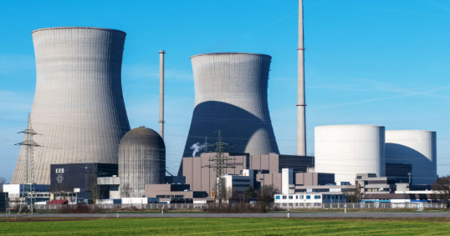
Which is More Capital Intensive
Vegetable Stand: If this doesn’t work, he can go do something else.
Nuclear Plant: If we want to recover the costs of this over a couple of years, the fares people will pay would be extremely high.
Which is more capital-intensive and which is more sensitive to the cost of capital

Slide 23
Capital Intensity Defined by Two Things
Capital Intensity Must be Relative
Capital Intensity Defined by Two Things
  Lifetime of Assets
  Capital Expenditures Relative to Operating Expenses

Slide 24
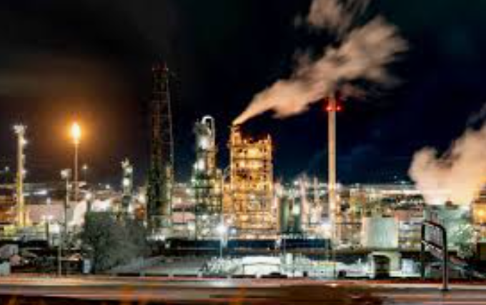
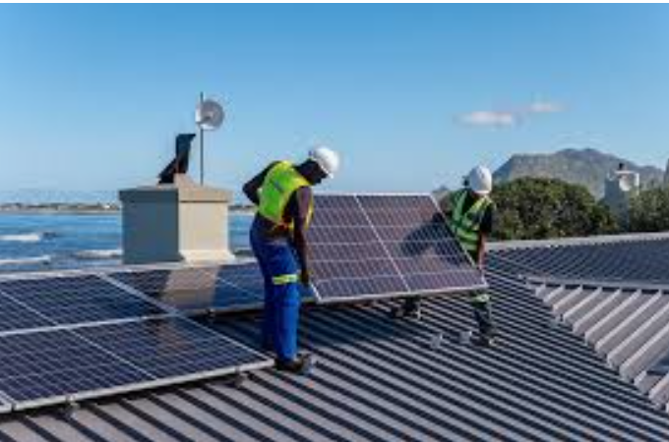
Capital Intensity – Refinery versus Roof-top Solar and Importance of Financing
Which is more capital-intensive and which is more sensitive to the cost of capital

Slide 25
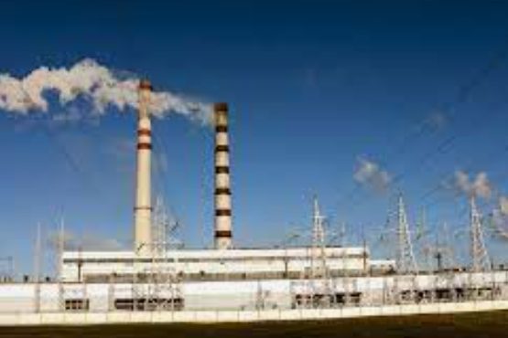

Capital Intensity – Hydro versus Natural Gas
Which is more capital-intensive and which is more sensitive to the cost of capital

Slide 26
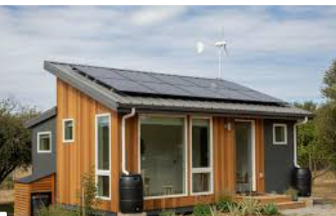
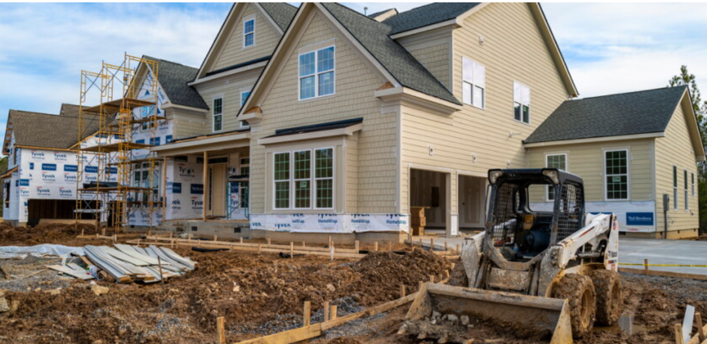
Capital Intensity – Energy Efficient House and Large House
Which is more capital-intensive and which is more sensitive to the cost of capital

Slide 27
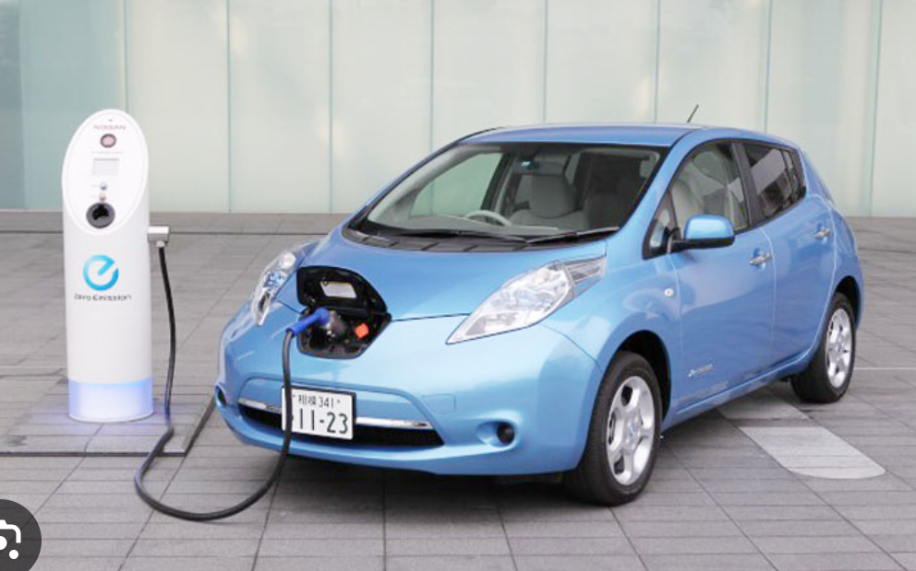

Which is more Capital-Intensive Electric or Internal Combustion
Which is more capital-intensive and which is more sensitive to the cost of capital

Slide 28
Two Things for Defining Capital Intensity
Throughout the course, emphasize that there are two things that define any investment
  Capital Expenditures
  Operating Cost
  Lifetime of Investment
Capital Intensity
  Factor 1 – Operating Cost Low Relative to Capital Expenditures
  Factor 2 – Long Life
Technical Definition of Capital Intensity
  Capital Intensity = Capital Expenditures/Revenue
  Useless definition

Slide 29
Point 2 – Capital Intensity and Risk

Slide 30
Risks of Investments
Market Risks that Affect Price and Margin
  Obsolescence - Better Technology becomes available
  Demand - Reduction in overall industry demand
  Surplus Capacity - Too many players come into the market
  Commodity Prices - Steel or Fuel prices skyrocket
  Macro economic - Inflation jumps, interest rates decline, exchange rates fluctuate
Risks of Managing Investment
  Poor Construction Management - bad management leads to over-runs, delays and poor performance
  Poor Operation Management - bad management leads to inefficiency and high cost

Slide 31
General Discussion of Risks without Contract Mitigation
Think of a railway, a toll road, a hospital, a pipeline, an electric transmission line or a hydroelectric generating plant.
The asset life is long and recovering the up-front capital expenditures takes decades.
Over this long period:
  technological innovations can render the asset obsolete (as with the efficiency of natural gas plants rendering older plants uneconomic),
  costs of the capital expenditures can fall dramatically (as with solar equipment),
  demand can drop profoundly (as with land line telecom),
  new entrants can come to the markets and create over-capacity (as with the merchant capacity boom in the early 2000’s)
  Development and other risks can render investments that are crucial for the economy difficult or expensive to finance.
  Financing cost of new plants that define marginal cost can change

Slide 32
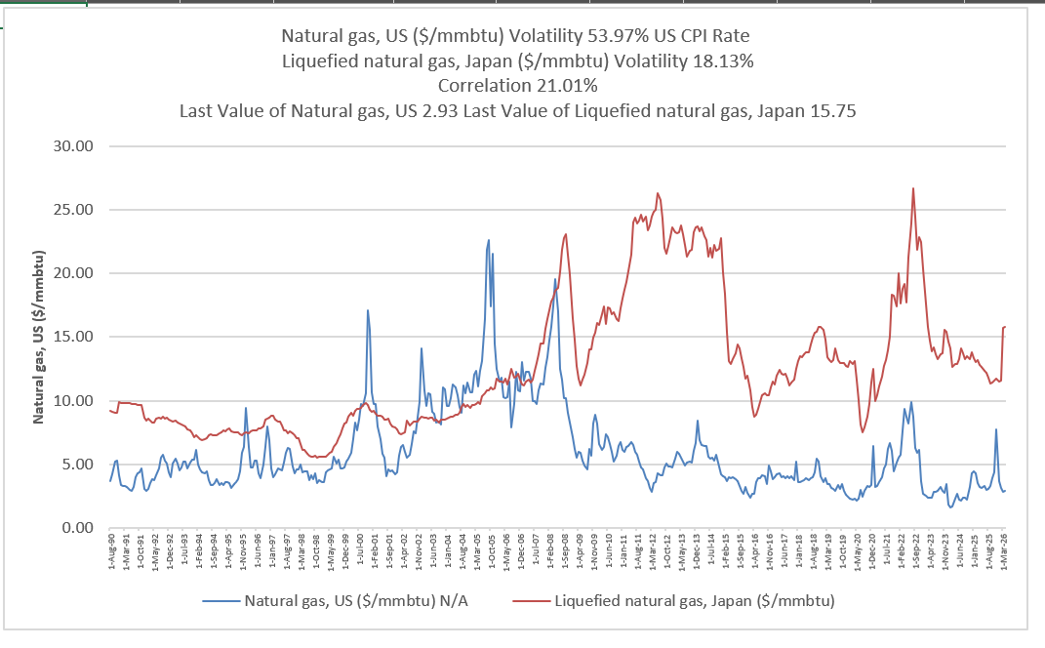
General Risks Facing a Nuclear Plant
Example, exposure to natural gas prices
O&M Expenses are low relative to revenues, so not economic to close plant
Cannot wait for plant to end its life and decide not to replace asset
Cannot move plant

Slide 33
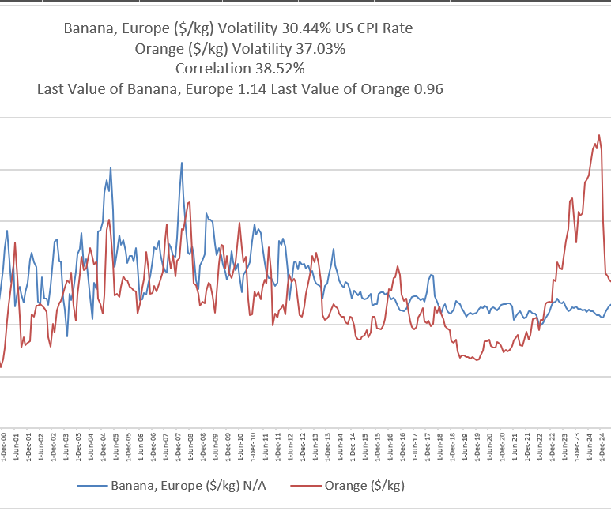
General Risks Facing Vegetable Vendor
Assume that margins change because of price
Assume surplus capacity
Could decide not to replace cart
Could abandon cart and try something else
Could move to different location

Slide 34
Capital Intensity and Rate of Return

Slide 35
Basic Idea that Greater Risk and Greater Require Return
Obvious points about risk and return
if investors in the nuclear plant and in the vegetable-stand incur all of the market risks, the required rate of return before and investment is made will obviously be higher for the nuclear plant.
Concepts of Beta and CAPM do not help
For project finance, the terms of the debt including the size of the debt and the length of the debt are the best indications of risk.
  With higher risk will be more difficult to get debt financing over life
  With higher risk will have higher required return on equity

Slide 36
Any Investment has at Minimum Three Things and a Rate of Return
Revenues Realized
Construction Period
Operating Life
Capital Investments
Return on Investment from Cash Flow versus Capital Expenditure
Operating Expenses
Terms for return (Benefit versus Cost) -- Project IRR, Unlevered Pre-tax IRR, Ungeared IRR, Pre-tax Project IRR

Slide 37
Rate of Return is More Important for Capital Intensive Investments
Whether or not the risk is different for a capital-intensive asset than for a non-capital-intensive asset,
The effect of the cost of capital and rate of return is more important on the ultimate price is more important for the capital-intensive asset than for than the non-capital-intensive assets.
More of the overall price comes from the recovery of capital expenditure over time.
As the capital-intensive asset has higher capital expenditure relative to operating cost, the cost of capital multiplied by the asset base will be more important.
If the amount of capital expenditure relative to the operating expense is the same, the cost of capital will be more important for the longer-lived assets.

Slide 38
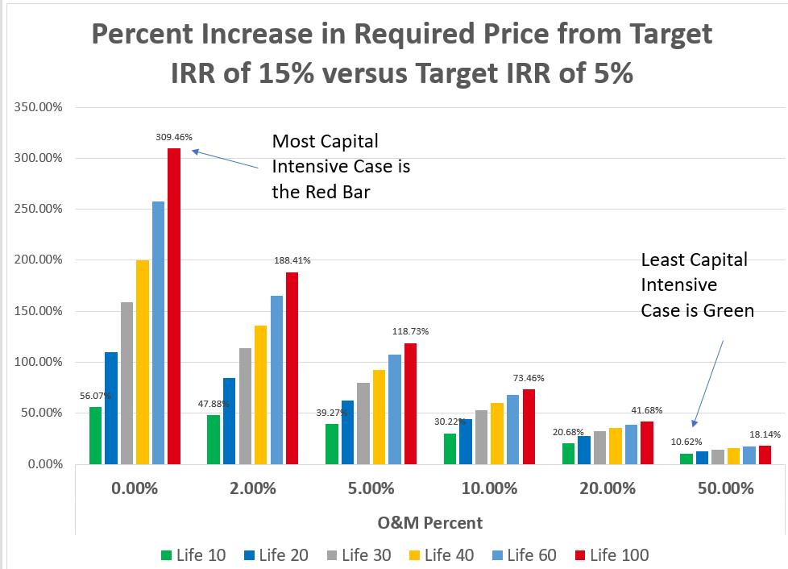
Capital Intensity and Effect of Higher Required IRR
.

Slide 39
Why the Rate of Return is Affected by Economic Life
Even if the risk is not different for a capital-intensive asset than for a non-capital-intensive asset, the effect of the cost of capital and rate of return is more important on the ultimate price for the capital-intensive asset.
More of the overall price comes from the recovery of the un-recovered capital expenditure balance over time (excluding the recovery of capital).
A capital-intensive asset has higher capital expenditure relative to operating cost, the cost of capital multiplied by the asset base will be more important in the price.
If the amount of capital expenditure relative to the operating expense is the same, the cost of capital will be more important for the longer-lived assets.
More of the price is associated with return on capital and less with return of capital for the longer-lived asset. Return of capital (depreciation) is the same, but the return on capital is more because capital is outstanding for a longer period. Consider an asset with a two-year life versus an asset with a twenty-year asset. For the two-year asset, by the second year, the capital recovery declines in half. For the ten-year asset, the recovery will decline by 10%, and the capital expenditure will be outstanding for a longer period.

Slide 40
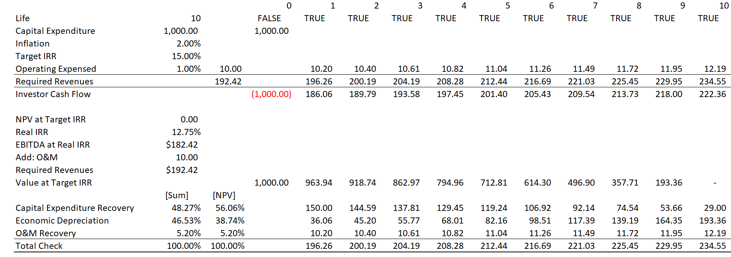
Illustration of Scenarios with 15% Rate of Return
The table below illustrates how prices can be measured from different assets. A formula can be used to establish recovery for capital expenditures and recovery for operating expense with different assumptions for economic life, return earned and inflation. The first case illustrates a 10-year economic life with a 15% rate of return.
This is like LCOE
Like three parts of multi-part tariff

Slide 41
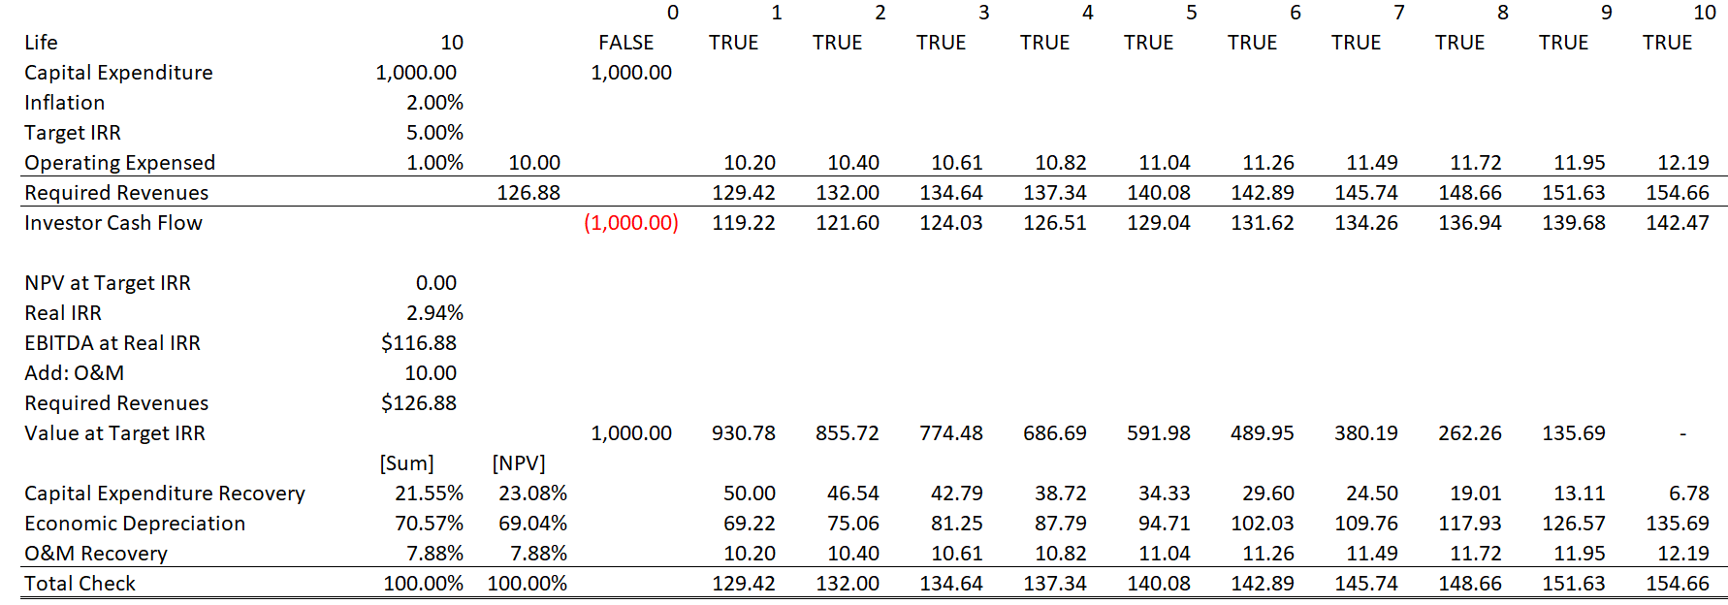
Illustration of Scenarios with 5% Rate of Return
The table below illustrates how prices change when a 5% rate of return is used. The price declines from 192 to 126. This price decline is driven by the return and return of capital.
Depreciation does not depend on return
Note the lower capital expenditure recovery

Slide 42
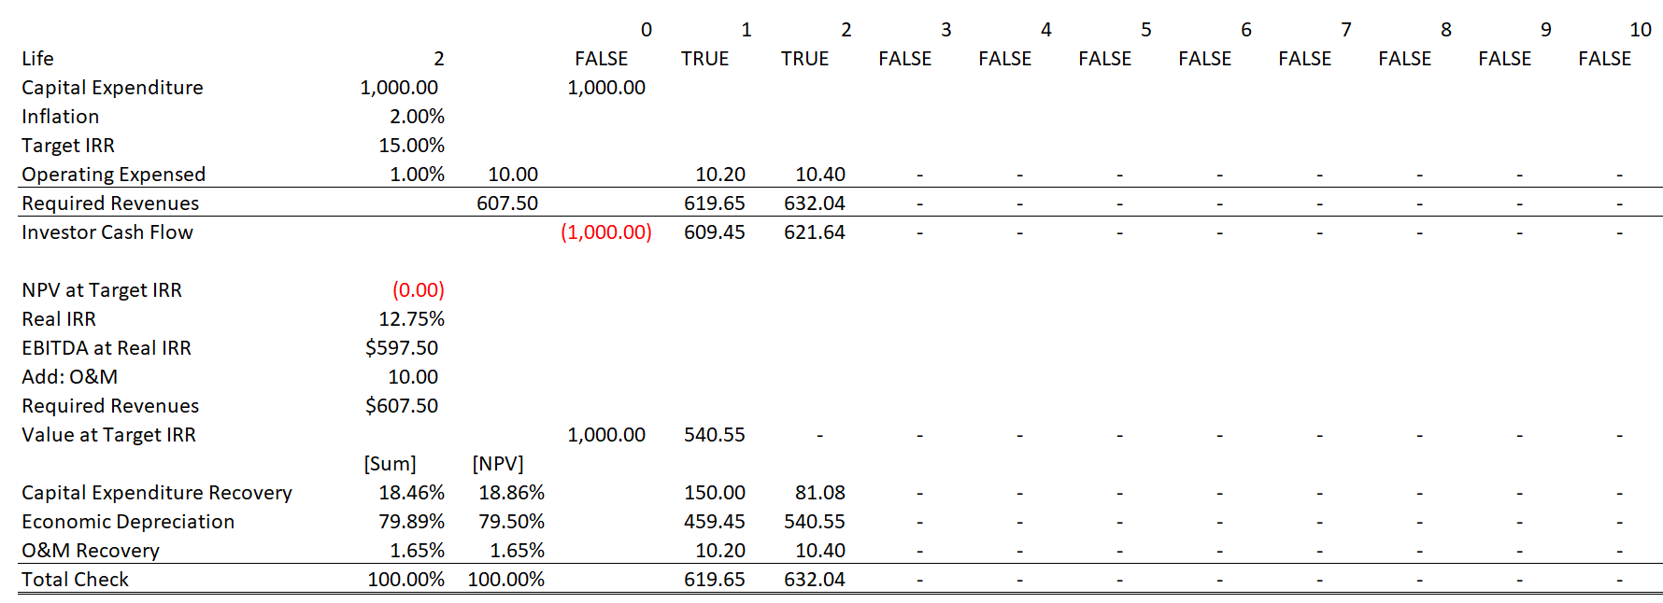
Illustration of Scenarios with 15% Rate of Return – 2-year life
The table below illustrates a case with an asset that only lasts 2 years and a return of 15% Even though the return is high, the percent of recovery related to return is much lower.
Even Lower Capital Expenditure Recovery

Slide 43
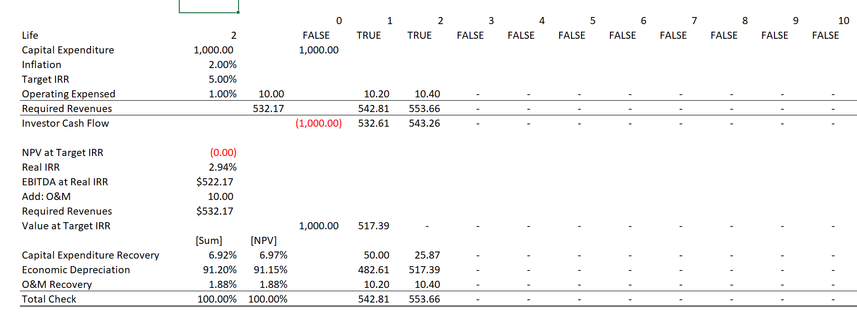
Illustration of Scenarios with 5% Rate of Return – 2-year life
The table below illustrates a case with an asset that only lasts 2 years and a return of 15% Even though the return is high, the percent of recovery related to return is much lower.
Lowest Capital Expenditure Recovery

Slide 44
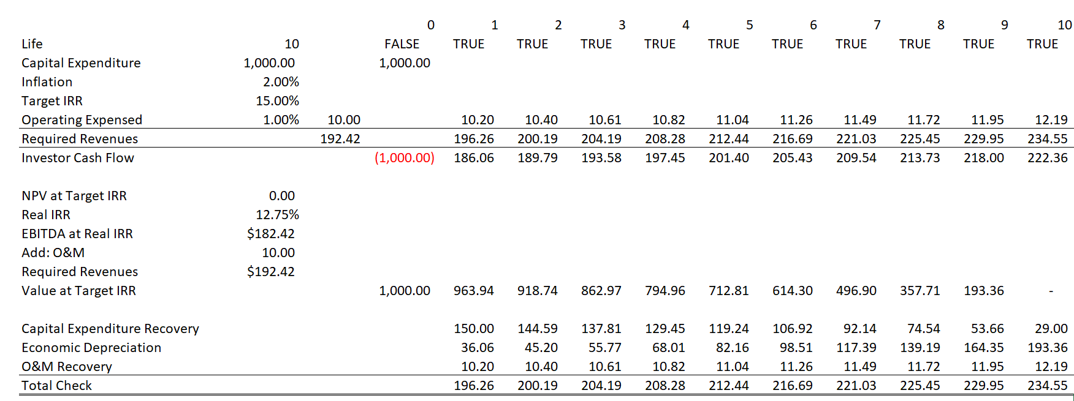
Illustration of Scenarios with Rate of Return
The table below illustrates how prices can be measured from different assets. A formula can be used to establish recovery for capital expenditures and recovery for operating expense with different assumptions for economic life, return earned and inflation. The first case illustrates a 10-year economic life with a 15% rate of return.

Slide 45
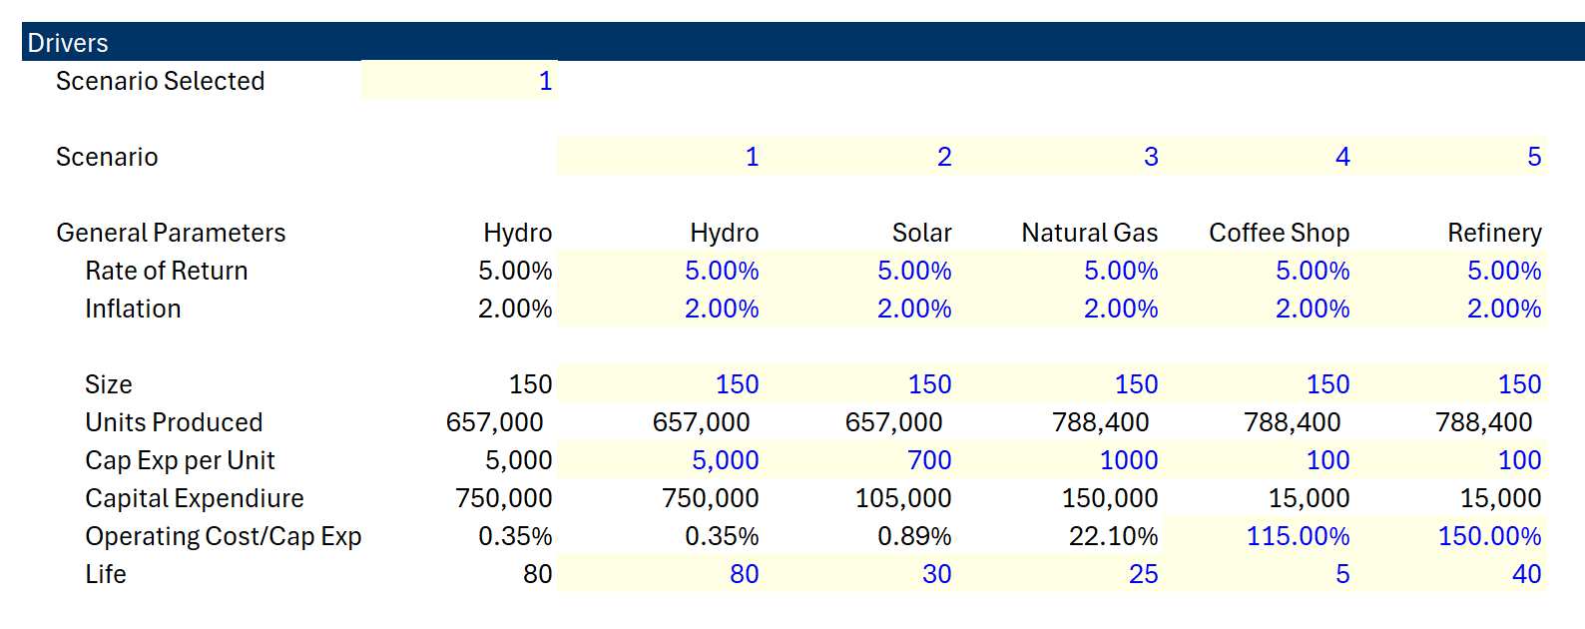
Capital Intensity Definitions and Returns
Which asset has the highest capital intensity, and which has lowest capital intensity
Capital Intensity Depends
  Operating Expenses to Capital Expenditures
  Asset Life
  Rate of Return

Slide 46
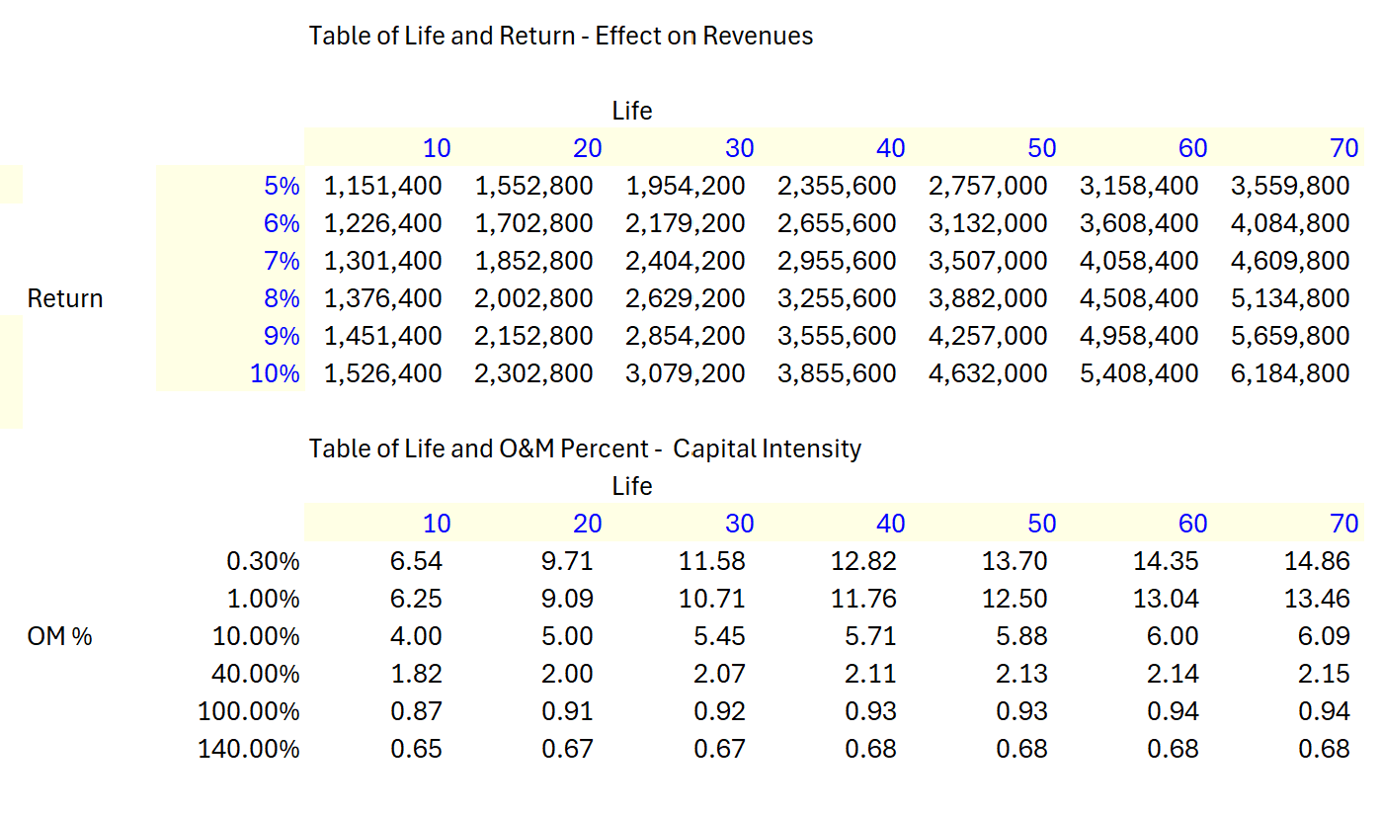
Capital Intensity and Life and Operating Expense
Data Tables Demonstrating Capital Intensity
With 70-year life, the revenues doubles; with the 10-year life the increase in revenues is much less.
Capital Intensity as Assets Divided by Revenues

Slide 47
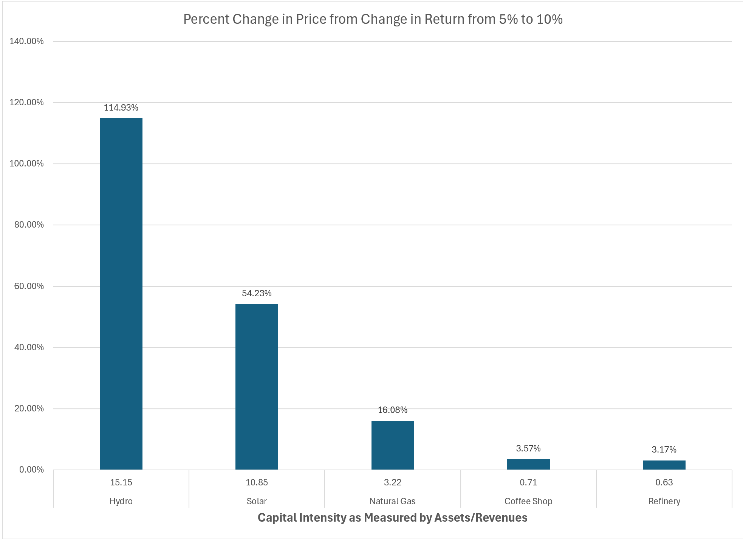
Capital Intensity Graph and Effect of Changes in Overall Return
If you can keep returns lower for capital intensive assets, the effect on prices or costs to the government is dramatic.

Slide 48
Effects of Financing on Bid Price – Capital Intensive
Pillar 1: Effects of Lower Cost of Capital on the Cost Consumers Pay – Levelized Cost of Electricity

Slide 49
Capital Intensity – Why Relevant to Contracts
When you structure contracts, you affect the rate of return
Trying to derive a formula (Capital Expenditures/Revenues) is silly
Associated with Investment not a corporation
Any investment has three characteristics
  Capital Expenditures
  Operating Expenditures (including fuel)
  Lifetime
  Revenues that cover capital expenditures and operating expenditures and produce a return (IRR)

Slide 50
Key Commercial Terms, History of PPA Contracts and Objectives of Project Finance

Slide 51
Objectives of Pricing Contracts
Analysis of pricing contracts for infrastructure involves questions about:
how to set contract prices in different circumstances;
what kind of risk transfer between the parties is efficient;
whether one party is benefiting at the expense of the other party.
In creating an economically efficient project, the way contracts are developed and negotiated can result in projects that produce results that are good for both the contracting parties and the overall society.
Contracts that are badly structured can have the opposite effect.

Slide 52
Background on PPA Contracts in for Power Generation with Risk Allocation and a History of Rational for Risk Allocation Through Contracts.
Background on PPA Contracts in for Power Generation with Risk Allocation and a History of Rational for Risk Allocation Through Contracts.
  Original Reason for PPA Contracts in 1970’s and 1980’s
  Natural Gas and Results of Early Contracts
  Merchant Power Phase – Objectives and Results
  Renewable Energy Contracts and Resource Risk
  Battery Contracts

Slide 53
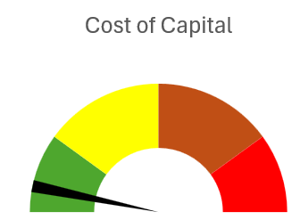
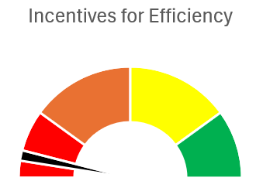
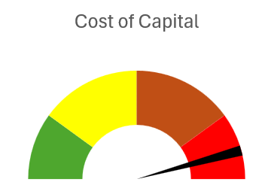
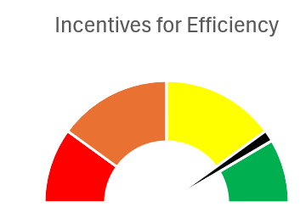
Why so much about cost of capital
Central Point:
Tradeoff between:
Cost of imposing risk with cost of capital increase
And
Incentives to construct and operate efficiently
Implicit Contract in Cost Plus
Merchant Power – No PPA

Slide 54
Limited Risk Transferred – More Retained by Off-taker
Flow of Risk from Contracts
Off-taker Risk – Total Risks Minus Risks Allocated with PPA Contract
Limited risk Transferred
Investor Risk – Risk Retained by SPV and Not Transferred to Suppliers
Contractor Risk – Risk Associated with Constructing the Plant and Operating the Plant
Flow of Money with Contracts
Ultimate Consumer (society) Wants low prices
Special Purpose Vehicle (SPV), Shell company that signs contracts
EPC Contractor Wants to profit from efficient construction
O&M Contractor Wants to profit from efficient operation
Off-taker - Pays for Output through PPA Contract
Equity Investor (Sponsor/Developer) Wants High Return Relative to Risk
Debt Investor (Lender) Wants to be paid back

Slide 55
High Risk Transfer with Merchant Prices
Flow of Risk from Contracts
Off-taker Risk – Total Risks Minus Risks Allocated with PPA Contract
Investor Risk – Risk Retained by SPV and Not Transferred to Suppliers
All risk Transferred
Contractor Risk – Risk Associated with Constructing the Plant and Operating the Plant
Flow of Money with Contracts
Ultimate Consumer Pays Merchant Prices; Benefit from low prices with over-capacity and new technologies
Special Purpose Vehicle (SPV), Shell company that signs contracts
EPC Contractor Wants to profit from efficient construction
O&M Contractor Wants to profit from efficient operation
Merchant Market Prices
Equity Investor (Sponsor/Developer) Wants High Return Relative to Risk
Debt Investor (Lender) Wants to be paid back

Slide 56
Some Risks of Capital-Intensive Investments for Essential Infrastructure; Should Government Intervene to Lower Risk
Technological Obsolescence
  prices would have to be very high for investors to accept the risks new innovations coming into the market. An investor would want the price to cover capital expenditures over a relatively short period of time.
Over-capacity.
  The risks of over-capacity are high in a market where assets are not regularly replaced because you may have to wait a long time until demand increases sufficiently to resolve the surplus capacity.
Declining volume
  Volumes cannot be managed by investors (patients coming to the hospital, natural gas travelling through a pipeline, electricity dispatched by a central authority as function of a portfolio of plants, changes in environmental rules affecting the project). If the constructor and the operator of a hospital takes risks of the number of sick people in the area as well as risks of others building hospitals nearby resulting in over capacity of beds, the risk and the cost of the hospital increase from the perspective of the private investor. If the government or a large corporation has made the decision to build the hospital (not the company who is constructing and operating the facility).
Changes in Cost over Construction Period
  As cost of capital is so important, if the real cost of capital changes, investors will be exposed to the risk

Slide 57
Risk versus Incentives in Market Structure and Individual Contract Elements
Discussing overall market structure schemes with different risk structure and different contract schemes leads into discussion of contract issues associated with particular contract elements.
The policy questions associated with overall market structure are a macro version of the microcosm of issues associated with nuances related to particular questions in contracts.
These issues involve capacity versus output contracts, treatment of inflation, compensation for deemed energy, merchant tail, adjustment for commodity price changes during construction, variable and fixed cost compensation.

Slide 58
Overview of Electricity Generation Financing
History highlights the same kind of risk and return trade-offs that are integral to analysis of detailed provisions of contracts.
  For example, an issue may arise regarding whether the investor (and subsequently the EPC contractor) should be insulated from changes in the cement and steel price over a long construction period. The question of whether such a provision should be included boils down to similar questions of risk versus incentives that have driven different government policy.
  The electricity generation industry is used to illustrate issues of risk and cost of capital objectives versus incentives to operate efficiently.
Similar histories could be used for large transport projects that were once entirely government owned and, in some cases went through an availability stage and a stage when investors accepted traffic risk.
The history of the trade-off between achieving low cost financing and incentives to operate efficiently, the history of financing generating assets can be classified into different periods.
  The first period transferring virtually all risk to ultimate consumer.
  The second period transfers selected risks using contracts that allocated selected risks like construction over-runs, delays and efficiency to investors.
  The third period transferred imposed merchant prices by allocating even more risks to investors related to market supply and demand.
  The fourth period using output-based contracts for renewable energy moves back from merchant risks.

Slide 59
Project Finance History
Some Historic Perspective would be good
Part 1: 1945 to 1973
Les Trente Gloriouses or MAGA
Regulatory Scheme – Cost Plus Regulation with WACC

Slide 60
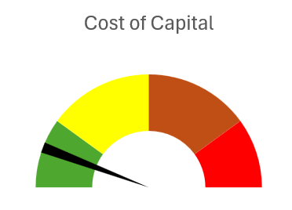
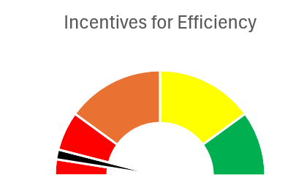
Policy Option 1 – Cost-plus Regulation or State Ownership
Cost of capital versus Incentives
  In contract provisions
  In policy options
Cost plus regulation or government ownership
Illustrate with speedometer of cost of capital and incentives

Slide 61
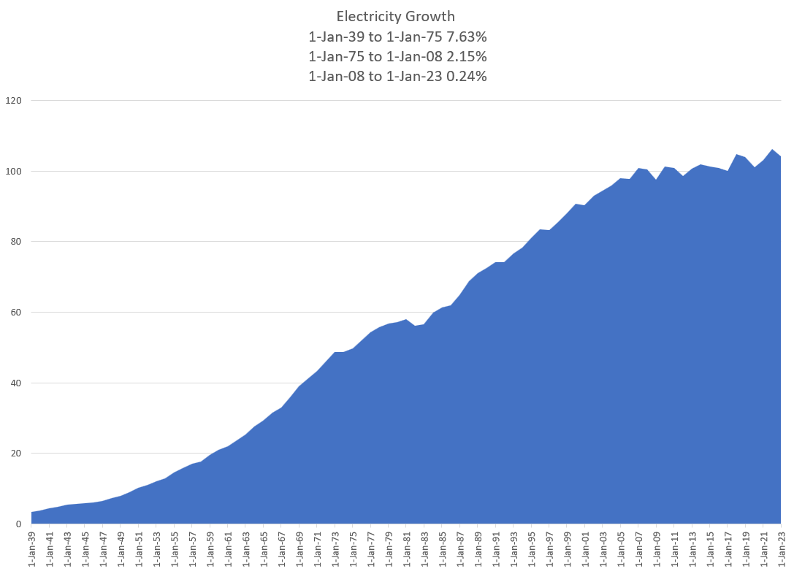

Les Trente Glorieouses and MAGA or MUBA – 1945 to 1973
Appliances and Bigger Houses
  Washing Machine
  Dryer
  Fridge
  Electric Stove
  More Lights
  Air Conditioning
  Radio and Television
Why is this introduction relevant for Project Finance Analysis. Demonstrates classic corporate finance. Companies want to get back to the low risk from cost plus model with WACC.
You will see that this analysis cannot be applied to companies like Orsted that are not stable.

Slide 62
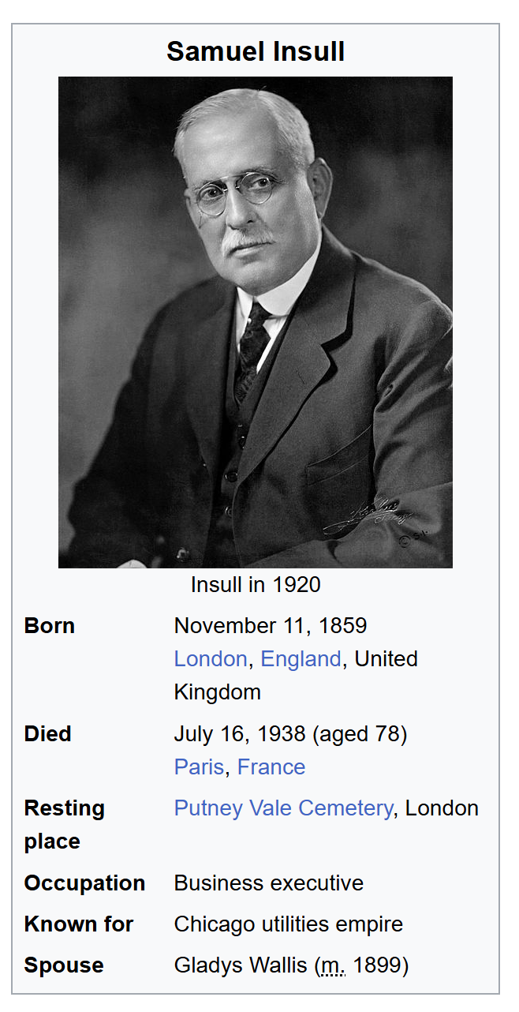
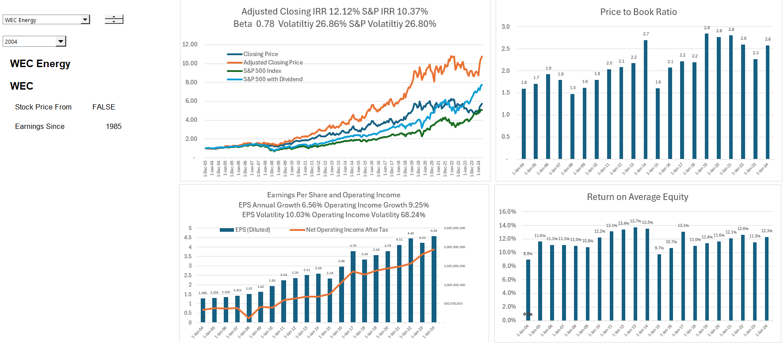
A Boring Utility Company and MUBA (Make Utilities Boring Again)
Ability to finance long-term assets from guaranteed cost recovery and from allowed monopoly position.
12% return on equity produces market values relative to investment of well more than 2 suggesting that the cost of capital is far below 12%.

Slide 63
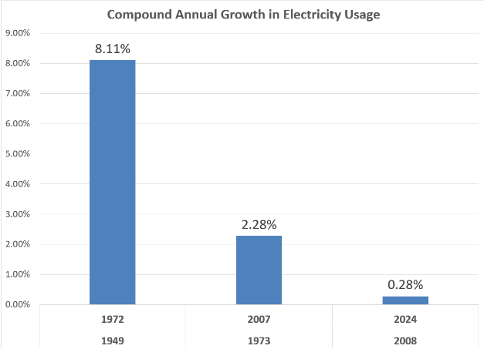
Growth in Electricity Demand
It may be difficult for a young person to think about life before refrigerators, washing machines, television sets, vacuum cleaners, electric/gas stoves, dishwashers and other electric appliances. Use of these appliances grew exponentially after World War II requiring electricity plants that were primarily fuelled by fossil fuels including oil.
Demand growth and economies of scale implied that government ownership or a system of regulated prices which transferred risks to consumers was not controversial as prices of electricity were falling in real terms. GE (prior to Neutron Jack Welch taking control) was the one of the most important industrial companies in the world and private utility companies with stable dividends composed of a large fraction of market capitalization.

Slide 64
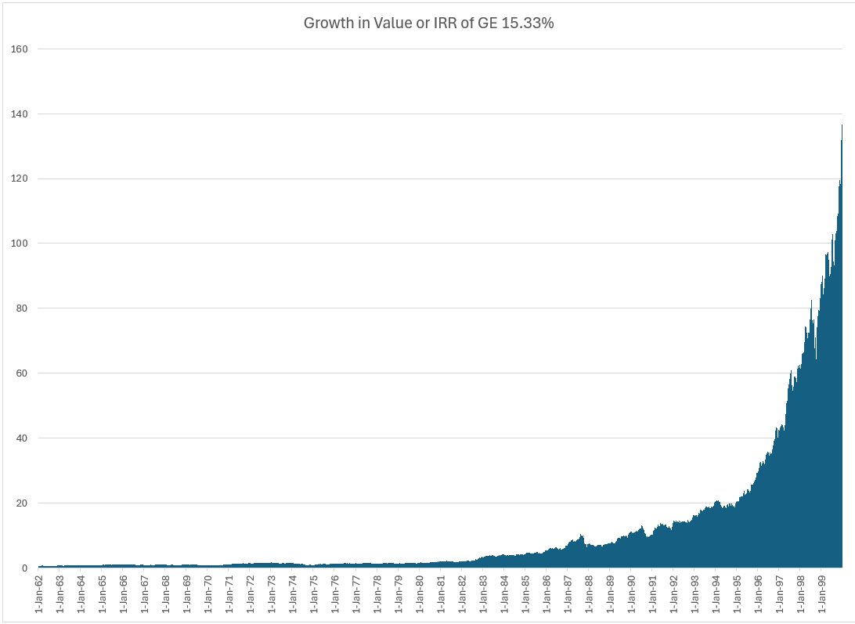
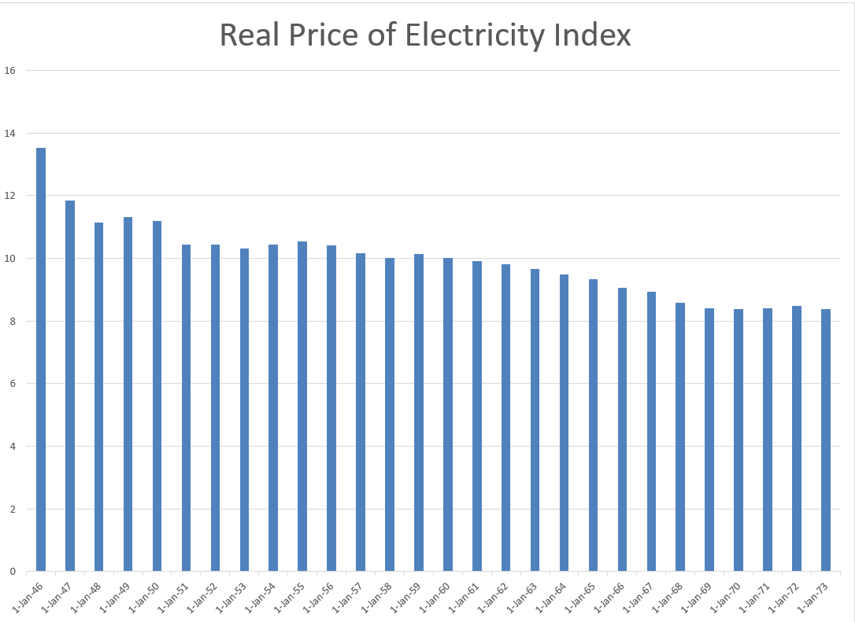
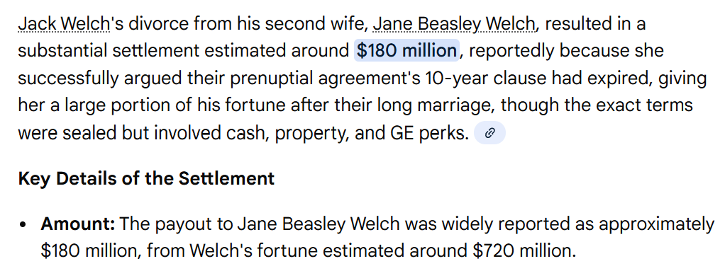

GE and Electricity
GE is most valuable company in the world – Note what a 15% growth rate means from compounding over a long period of time,
High Growth and economies of scale allowed declining real cost. Larger networks and larger coal plants.
Natural monopoly and cost-plus regulation or government ownership – No incentives for cost control of capital expenditures or operating costs.
Financed from with Corporate Guarantees
Long-term Financing from Regulatory Assurances

Slide 65
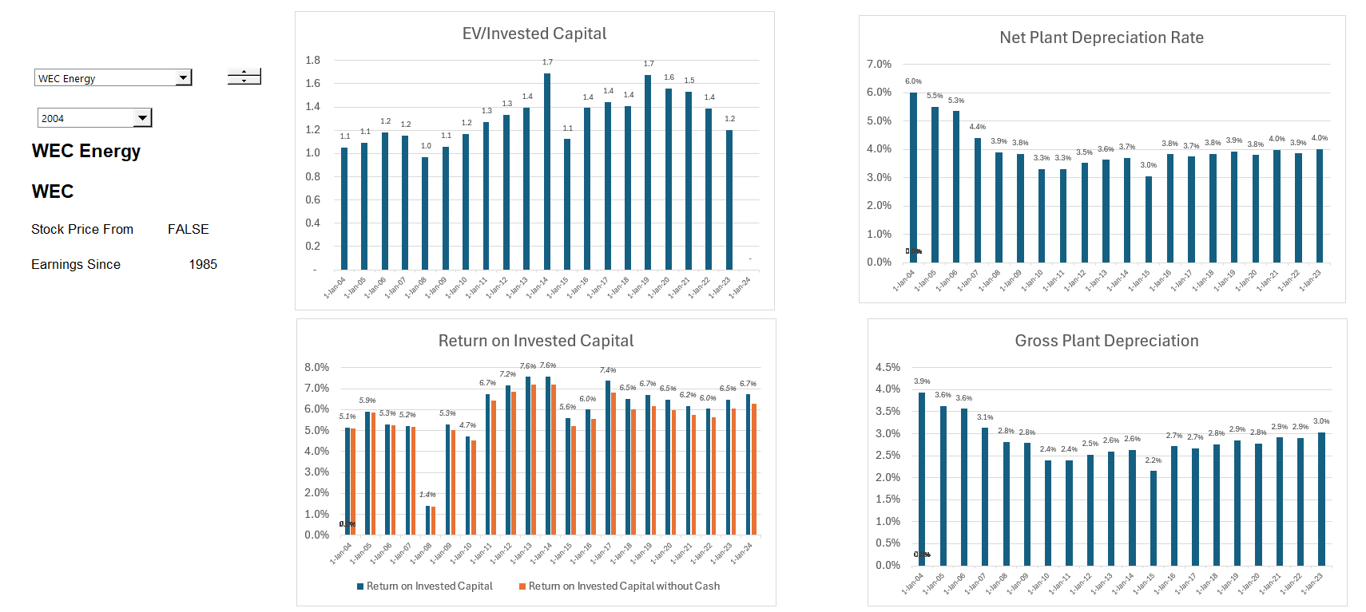
Boring Utility Company Earning Much Lower Returns – ROIC Perspective
Valuation can be made from stable multiples, DCF and maybe CAPM. Could apply valuation formulas P/B = (ROE-g)/(k-g). Cost plus regulation. But cannot apply to renewable companies like Orsted

Slide 66
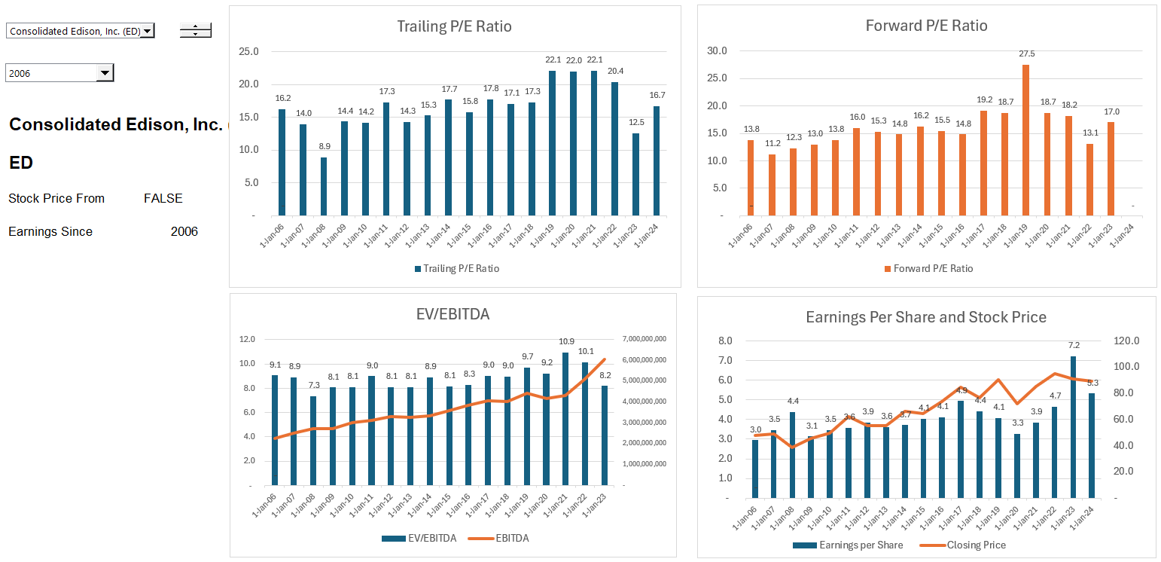
Relatively Stable Multiples of Earnings and EBITDA for Boring Utility Companies

Slide 67
Part 2: 1980’s
Capital Expenditure Over-runs; Low Efficiency, Independent Power Producers and PPA Agreements
Introduction to PPA Regulatory Scheme
Introduction to Output versus Availability
Inefficient to Impose Risks on Investor (including contractor) that cannot be controlled
Example of Toll Traffic

Slide 68
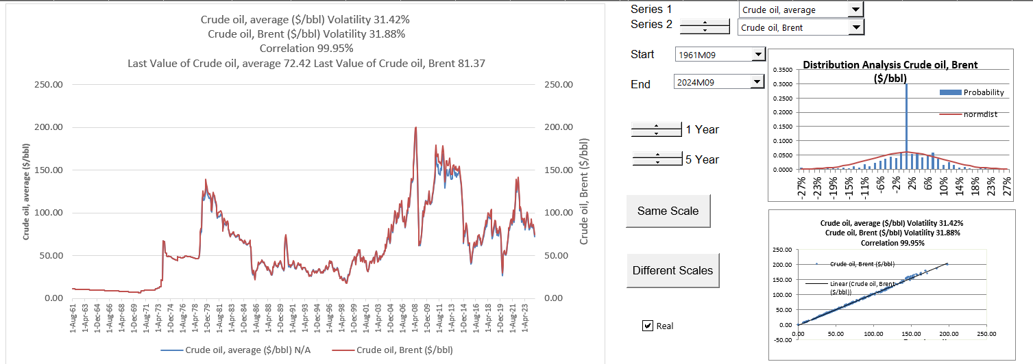
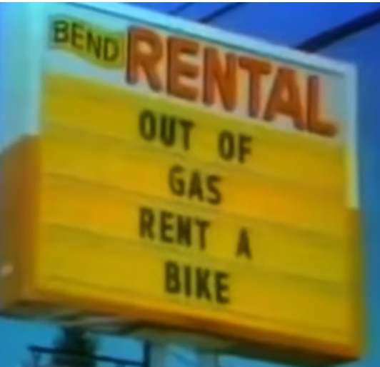
Part 2: 1973 Energy Crisis and End of Declining Real Prices
Dramatic Oil Shock of 1973 ended the Trente Gloriouses. Led to more nuclear power and first thinking about renewable energy.

Slide 69
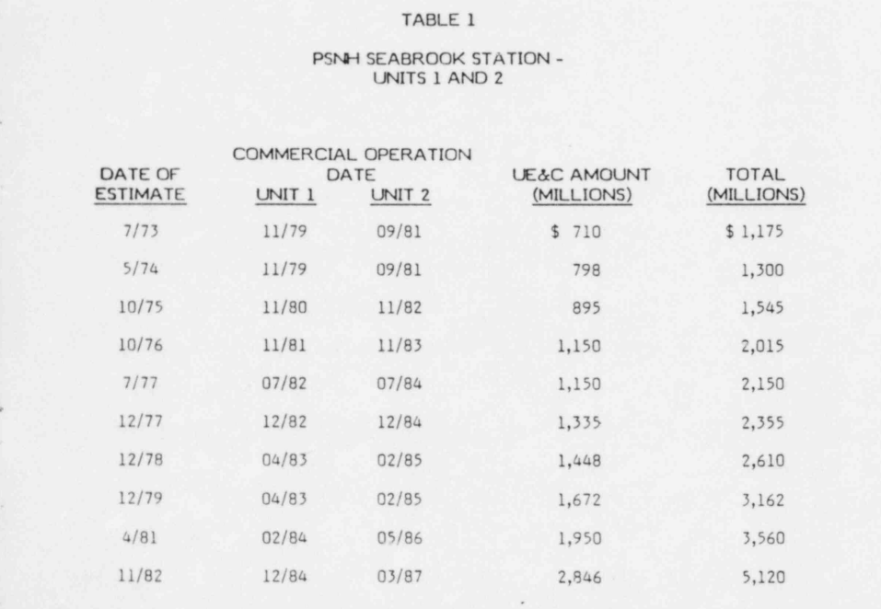
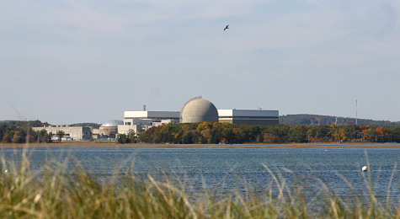
Part 2: 1980’s and Cost Increases and Cost Over-runs
Seabrook nuclear plant in US. (I understand that Denmark was considering nuclear power as well).
Enough of the cost-plus regulatory scheme. Let companies bid and hold them to their cost estimates – if costs increase, you cannot increase prices, and multiple companies can build assets.

Slide 70
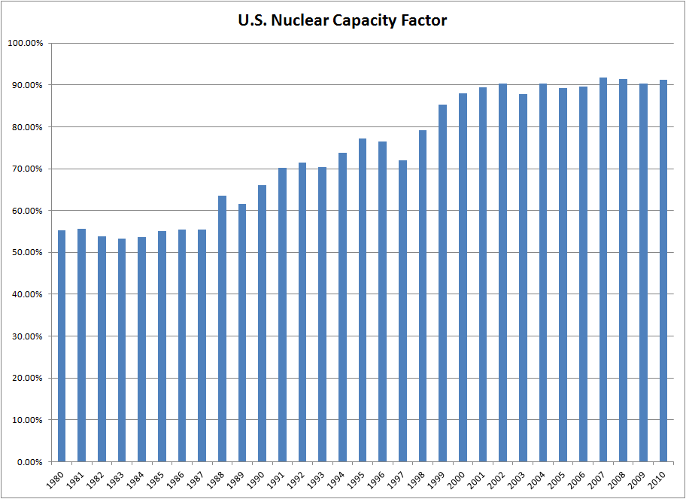
U.S. Nuclear Capacity Factor
Availability problems with nuclear power
Simply demonstrates that there were availability problems with the cost-plus model where there was little incentive to improve reliability
This could be due to new plants coming on-line and simple pressure by regulation

Slide 71

Reaction to Nuclear Plant Cost Increases – Throwing Monopoly Money at Government Regulators
Reasons for Cost Increases
  Demand for Construction Materials
  High Inflation after Oil Shock
  Strict Regulation and Safety Concerns
  Just plain inefficiency and waste
Cost Plus Model
  Front-end loading of price
  No incentives for efficient management
  Little planning with assured prices
  Cost of capital increases
  Declining bond ratings

Slide 72
Availability and Multi-Part
Contracts

Slide 73




Projects Depend on Who Controls the Output
What is the contract structure for each
Solar or Wind
Dispatchable Plant or Battery
A single price is where an electric generating plant would be paid a flat price for each unit of electricity that is sold.
This can be referred to as output-based plant.
For an electricity plant whose output is controlled by the off-taker who dispatches all the plants as part of a portfolio, the developer has no control over the actual volume.

Slide 74


Availability Projects without Output Risk and Notion of Not No Control of Output – Would you pay firemen only when they put out fires
Capacity Price and Artificial Markets
  When capacity is available, you can receive revenues no matter whether you use the capacity for revenues, this can be added
  Some ancillary services may be like capacity where if you have the service available, you can earn money whether you use the capacity to produce energy
Think of Firemen (Firehouse Effect)
  You pay them and need them to be ready
  But if they are putting out a fire, they cannot be used for another fire
  They receive capacity payments and must be available
  You cannot really pay them on the volume of fires the
Firehouse Effect from being Available

Slide 75
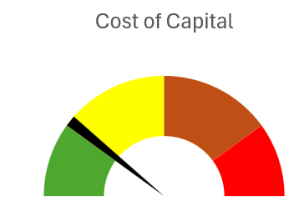
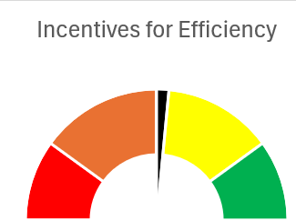
General Allocation in Initial Capacity-based PPA Contracts
Allocate to Investor (Sponsor/Developer and Lender)
Objective
  High Return (IRR)
  Safe Cash Flow
Off-taker (Government, Private Utility Company or Corporation)
Objective
  Low cost
  Strong Incentives

Slide 76

Is a Rental Car an Availability or Output Contract
Step 1 – Off-taker versus Investor
Who is the off-taker when sign a rental car agreement
Risks controlled by off-taker
Risks of general economic conditions
Risks in the way the machine operates
Step 2 – Allocate to Contractors
Allocate risks in contracts to parties that can control the risk
Back-to-back contracts
If the rental car charged a fixed price for the period, then you would have an incentive to drive a lot because you do not have to pay for fuel.
If the rental car has only a variable cost with mileage and no fixed charge, could rent just for a very short trip and pay almost nothing.
Rental car company cannot control how much you drive

Slide 77

Risk Allocation in Rental Car Agreements
Unlimited miles versus mileage based contracts
Risk Allocated to Off-takers – You as Renters
  Fuel Price Risk – Return the Car Full
  Risk of Scratches on the Car
  Risk of Usage per Rental – Capacity Payment
Risk Taken to Sponsors – Rental Car Company
  Operation and Maintenance
  Utilization Risk
  Availability Risk (Car Must Work)
When you go to a rental car company and sign a contract.
Is this a take or pay or take and pay contract
Does the contract have a capacity payment
Does the contract have a multi-part price
Does the contract make sense

Slide 78
Response to Nuclear Power Boom – Carefully Managed Availability
Each contract can have many nuances with penalties, bonuses, default clauses, termination.
Off-taker: Want strong off-taker with inactive to honor contract
Write down notes associated with each contract and if a contract does not exist, how the cash flow volatility can be addressed.
EPC Contractor: Want Strong Record and Finances
Price Risk or Volume Risk or Both or None (Availability)
EPC: Fixed Price Contract with LD
Supplier: Need to Understand Economics and Supply Curve
Special Purpose Vehicle: Bond Rating of BBB-
O&M Contractor
Supply Agreement
O&M Agreement
Loan Agreement – Draws Green; Debt Service Red
Banks Like Strong Sponsors. Sponsors want EIRR
Shareholder Agreement
Lenders:
Lenders want DSCR (LLCR, PLCR)
Invest with paid in cap; payback dividends
Invest with draws; payback debt service

Slide 79
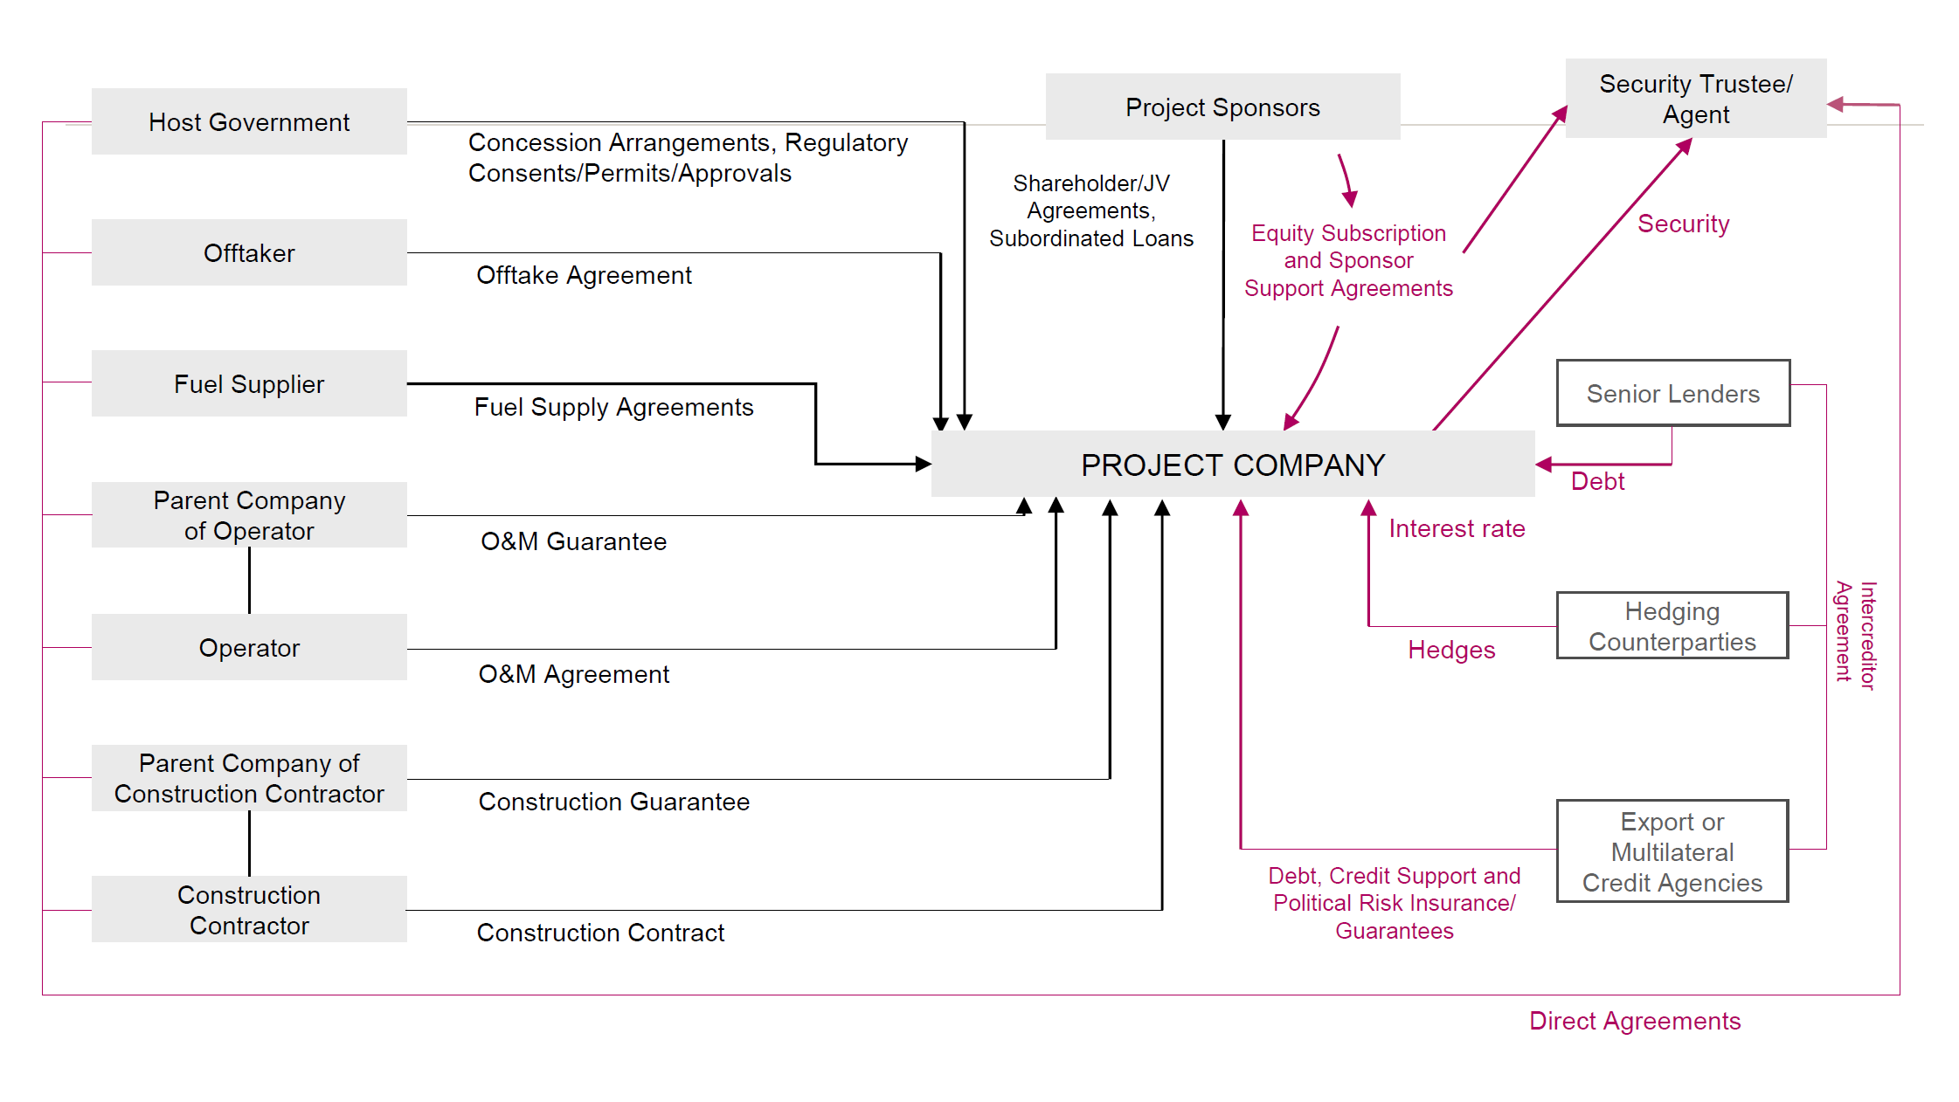
Detailed Project Contracts
Diagram from Law Firm

Slide 80
Back-to-Back Contracts with Availability
Off-taker
EPC Contractor
PPA Contract
Four-Part Tariff
Fixed Capacity Charge at Fin Close
LD Penalty for Delay Risk
Contract O&M Charge
Contract Heat Rate
Availability Penalty
Fixed Price Contract with LD
Fuel Supply
Fuel Index
Fuel Supply Contract with Index Corresponding to PPA
Special Purpose Vehicle
Contract with Guaranteed Heat Rate and Availability Penalty
and Fixed Fee
O&M Contractor
Shareholder Agreement
Loan Agreement
Sponsors
Lenders
Letter of Credit for Equity Cash

Slide 81
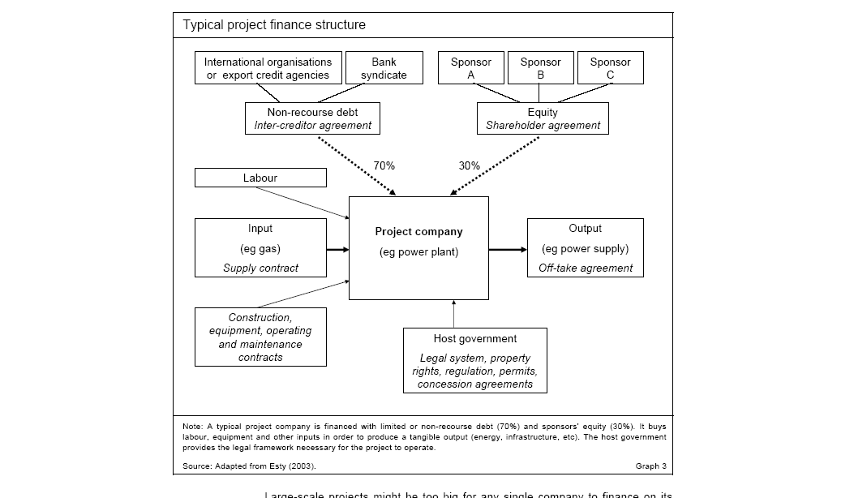
What are Problems with this Diagram from HBS
Not showing contracts
Not showing where money coming from
Not starting with PPA

Slide 82
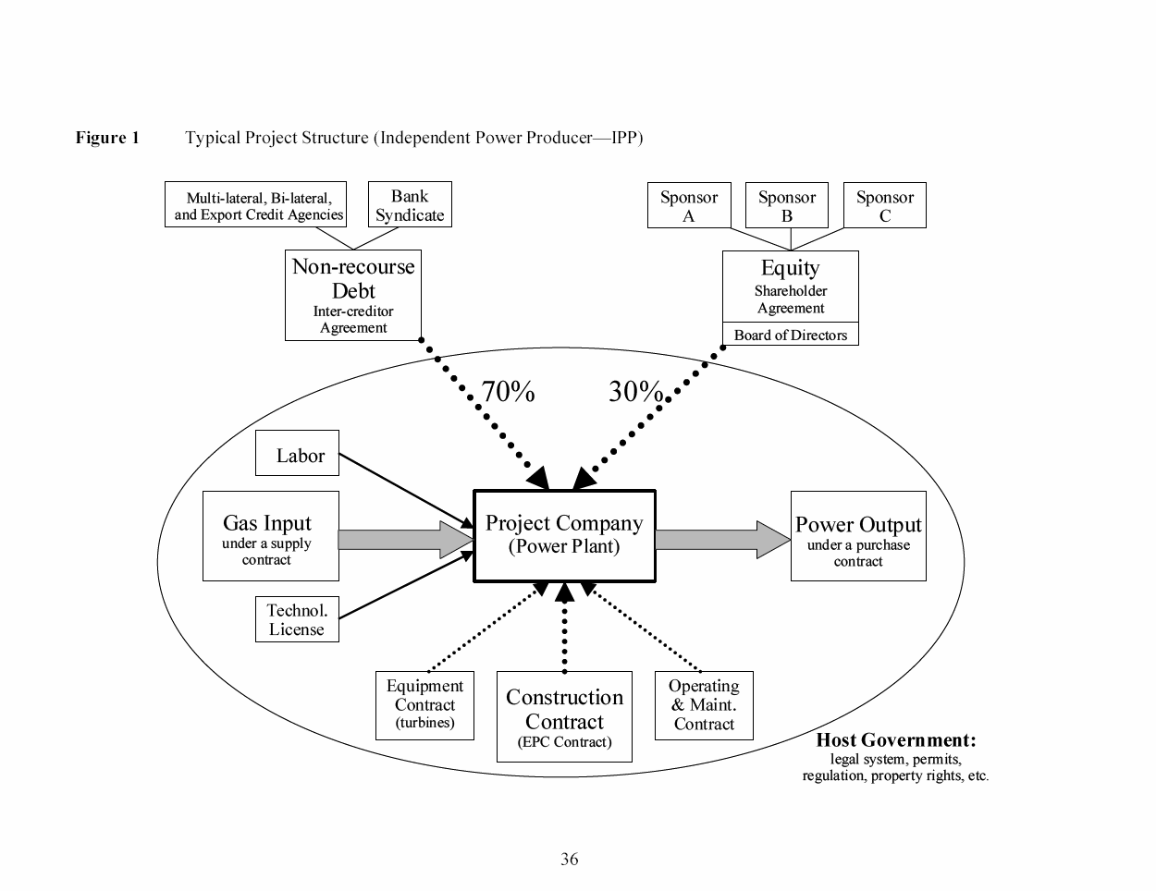
What is Good and Bad about this Diagram
Debt is serviced entirely via cash flow through the project and the SPV This structure exposes the lenders to significant risks. If something goes wrong, their recourse against the sponsor, with its typically larger balance sheet, will be limited or none.
The loan is structured so that bankers can step into and take over the project if things were to go wrong, a so-called step-in right. This process is also called ‘ring-fencing.’
Ring-Fence

Slide 83
Project Participant Overview – This one is horrible
Exercise:
Revise the diagram assuming that there is a minimum traffic guarantee; that toll rates are established with the CDOT with inflation adjustments; that the O&M contracts have incentives to re-surface the road every seven years; that the loan is 70% of the project with a DSCR of 1.4x; and finally, that the project has subordinated debt from the government and there are two different sponsors.
Public Authority (CDOT)
Debt
Investors
Special Purpose Vehicle
(SPV)
Design-Build Contractor
Equity Investors
Operations & Maintenance Contractor
Toll Road Users

Slide 84
Notion of Independent Power Projects, Risk Allocation and PPA
With nuclear cost increases and price of oil increases, cost plus and WACC model considered a poor approach.
Bidding systems where companies competed to provide generating capacity (no longer belief in economies of scale for generation). Idea that companies bid down to their cost of capital.
Bid on long-term fixed price contracts (same as today) – purchased power agreements (PPA’s) were designed to allocate risks under control of investor (construction cost, construction timing, fixed operating cost, plant efficiency, plant availability). Costs that could not be controlled – fuel cost and amount of generation required were allocated to investors.
Once investor takes risk, the risk can be allocated to a company that takes construction risk, a company that guarantees plant efficiency, a company that provides operation and maintenance.
The risk allocation to third parties (off-takers) led to project finance where lenders verified fixed construction costs, operation costs and technical aspects of plant efficiency and availability.
Risks remaining with purchaser – fuel price, generation (maybe inflation)
Risks taken by investor and allocated – construction cost, construction timing, efficiency, availability, operating cost except fuel
Risks allocated from investor to contractors who provide fixed prices and absorb penalties for efficiency and availability

Slide 85
Risk Allocation Part 1: Allocation between IPP Investor and the Off-taker for Dispatchable Plant
Risk to Be Allocated
Generation Level from Changes in Demand
Generation Level from Changes in Plant Availability
Cost Over-Run
Construction Delay
Plant Efficiency (Heat Rate)
Change in Fuel Price
Change in Real O&M Cost
Change in Inflation Rate
Change in Interest Rates and Cost of Capital
Investor or Off-taker Risk
.
.
.
.
.
.
.
.
.

Slide 86
Risk Allocation Part 2: Investor Risks to Different Contracts for the SPV
Contract Mitigation
EPC Contract with Fixed Price and LD (LSTK)
O&M and EPC Contract
O&M Contract and EPC LD Provision
O&M Contract
Capacity Charge/Month; 4 Part PPA Contract
Swap Contract (Fix Rates)
IPP Risks
Cost of Project, Time Delay and Technology Parameters
Availability Penalty in PPA
Efficiency or Heat Rate Risk
O&M cost Risk – Real
Independence of Generation Risk
Interest Rate Fluctuation

Slide 87
The Way You Get to Risk Allocation: Four or More-Part Tariff in Availability
A feature of pricing in availability-based contracts is distinguishing between fixed and variable costs in the pricing structure.
Fundamental idea – fixed and variable cost; some variable cost cannot be controlled; some costs vary with inflation and exchange rate fluctuations.
  One price component is the fixed capacity or availability payment.
  Another component covers fuel expense where the price of fuel varies with some kind of market index.
  A third price component covers fixed costs such as regular maintenance, cost of security and administration.
  The final component is variable operation and maintenance cost which seems to cover things like the cost of chemicals and water for operating a plant and the increased costs of from running the plant.
  A nuance is related to operating cost of starting the plant, which can be an additional price component that is not fixed and not variable.

Slide 88
Drivers and Profit and Loss Statement - Dispatchable
Cost Driver
Cost x Carrying Charge + Fuel Cost + Variable O&M + Fixed O&M
Fuel Cost – HR x Gen x Fuel Pr
Variable and Fixed O&M
Capacity Charge Revenue (€/kW-year x kW)
Portion of Capacity Charge
Portion of Capacity Charge
Portion of Capacity Charge
Portion of Capacity Charge
Profit and Loss Account
Total Revenue from Four-Part Tariff
Fuel Expense
Fixed and Variable O&M Expense
EBITDA (Operating Margin)
Depreciation
Taxes
Interest
Net Income

Slide 89
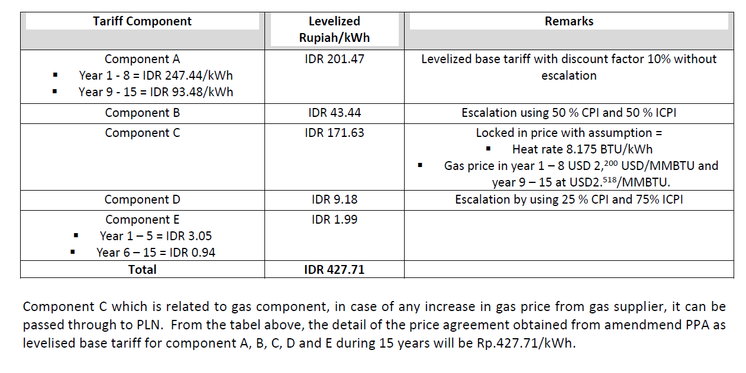
Four Part Tariff Example
Note that kWh can be based on 24 hours or capacity can be kw-month or kw-day or kw-day

Slide 90
Nuanced Issue 1: PPA Term

Slide 91
Make and Argument for Long-term or Short-term PPAs
What is the definition of IRR
What is the effect of IRR with longer PPA terms
What is really wrong with the IRR

Slide 92
How Long Should the PPA Life Be to Promote Low Cost
Arguments for Short PPA Term
  Off-taker can revise pricing and terms from current conditions
  Case 1: Do not need plant – will not have to renew
  Case 2: Need plant – can negotiate
  Argument that bidder will be aggressive with assumed renewal
  Can justify the economics of the plant with merchant pricing
Arguments for Long PPA Term
  Investor assigns more risk for things like technology risk
  No incentive advantage from longer-term
  Potential for double recovery

Slide 93
Efficient Length of Contract
Cost and benefit of different contract length
  Seems to show that longer PPA term is not a big deal
  Why is this more important in Africa
For many projects the length of the contract is less than the probable economic life, implying that there is some kind of value to the project after the contract is complete.
For other projects, there may be a designed period after the initial term of the contract when the projects are to incur some kind of spot prices.
In other cases, there may be specific options to extend the contracts with defined pricing terms.
Corporate PPAs have Shorter contracts
  Tax issues
  Credit Quality of Corporate Off-taker

Slide 94
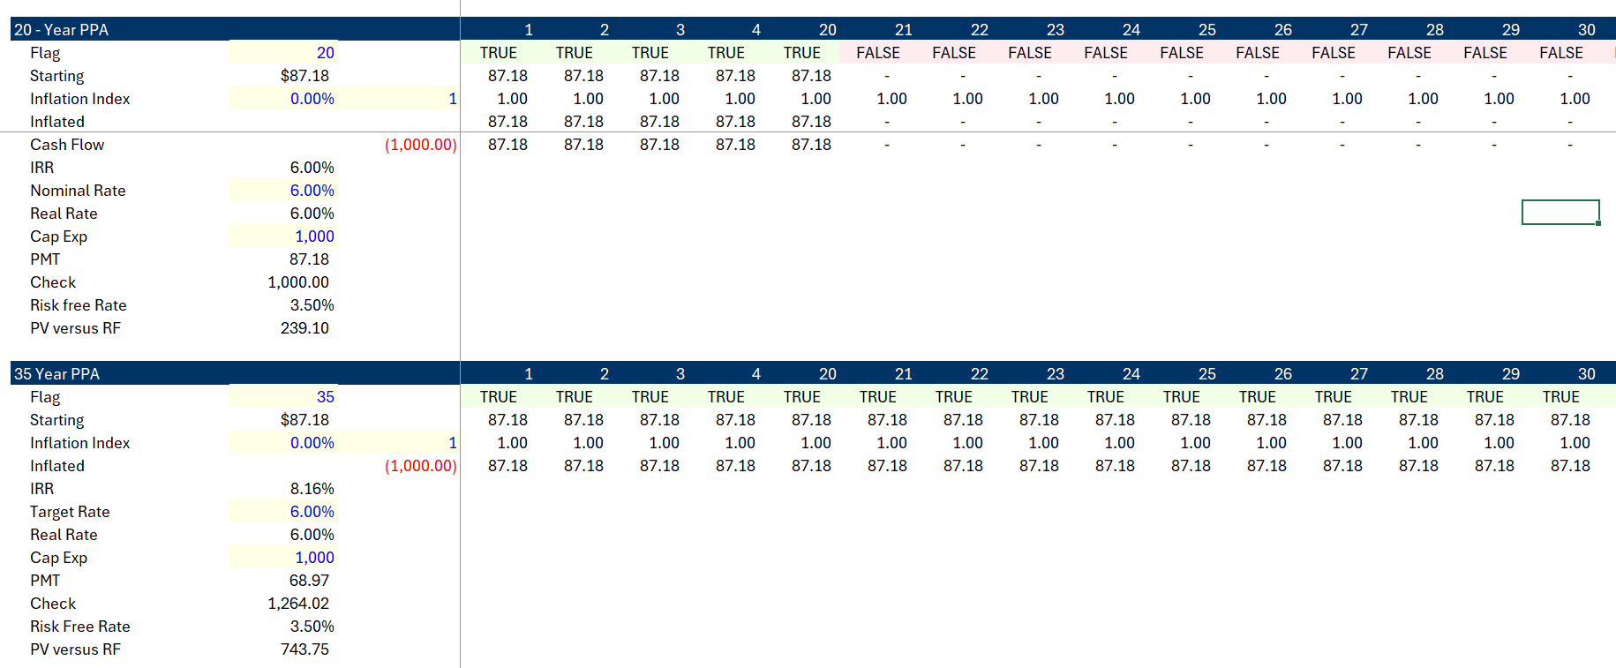
Case 1: Relatively Low IRR; No Terminal Value Assigned
.
Increases the IRR from 6% to 8.16%. Increases premium versus Rf by more

Slide 95
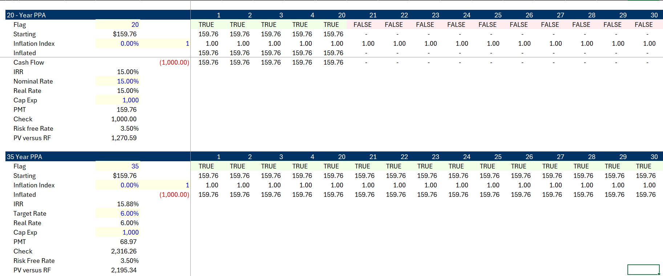
Case 2: High IRR – IRR should not be God
The IRR increases by smaller amount, but the value versus a risk-free security doubles

Slide 96
One-year Contract Absurdity
I recall a question from somebody in India about whether contracts could have a one-year term.
When you think about this from the perspective of an investor, making a series of short-term contracts would mean that technological obsolesce risk and the risk of changes in the price of the equipment would be taken by the developer.
Imposing the risk of cost changes and obsolescence risk could be taken by the developer/sponsor, but accepting the risk of changes in the market outside of the control of investors and which cannot be transferred to other contractors such as the EPC contractor or the O&M contractor would have dramatic effects on the price in the contract and the ability of the developer to raise debt.

Slide 97
Economic Life of 40 years versus Contract term of 20 years
When bidding on this contract, the investor would make some kind of terminal value assumption which increases the cash flow.
This assumed terminal value reduces the required cash flow for the initial contract term as part of the IRR is earned from the terminal value.
At the end of the contract term, the project may continue to be necessary for the off-taker, and the off-taker could choose between a new contract for our existing project or pay contract prices associated with a new project.
With inflation in costs, this could mean that the terminal value would be a relatively high portion of the overall project cash flow.
On the other hand, if new projects have lower cost and/or our project is no longer necessary and/or if new projects are more efficient after 20 years, the terminal value could be nothing.
This means that if the contract term is less than the life, the developer/sponsor is forced to take risks of what could happen in twenty years, something it has no control over. If the developer/sponsor were rational, it would place a large risk premium on the terminal value and the reduction in the value of the new contract would not be too much (it is possible that in order to win the bid the contractor would make optimistic forecasts).
If the contract term is longer, it implies that the developer/sponsor would take the risk of forecasting the project life. Further, the longer life limits the ability of the off-taker from taking advantage of more efficient technologies and lower capital expenditures.

Slide 98
PPA Life and Merchant Tail
Instead of assuming that a new contract is signed, some projects assume that the project will sell output into some kind of spot market.
This is the case with some wind farms and with corporate PPA’s.
In electricity this structure is known as a merchant tail.
The idea of demonstrating that the project can produce in merchant markets seems to encourage developers with skill in forecasting markets.
As with the shorter contract period, the developer/sponsor will not be able to influence what happens at the end of the contract period.
As with the short contract period, one can assert that this uncertainty will tend to increase the price of the initial contact, impose risks on the developer and will lead to a higher price for the initial contract period.

Slide 99
Nuanced Issue 2:
Fixed and Variable Cost in Biding

Slide 100
Question: Should you Always Bid Actual Fixed and Variable Cost
Related question: What is fixed cost and what is variable cost
Related question: Is there more risk for fixed or variable cost

Slide 101
Risks of Fixed and Variable Cost
In competitive markets, the structure of fixed and variable costs can affect the risk of a company. In general, fixed costs increase risk (operating leverage) profits are more sensitive to changes in sales volumes.
  A company that has more fixed cost relative to variable cost can provide upside for equity upside if volume sales increase. For example, if a company is optimistic about its prospects, it may hire their own employees rather than using consultants.
  On the other hand, lenders may prefer variable costs because the downside is protected (sadly, they like it when employees are variable cost and can be eliminated in economic downturns).
In an availability contract, the risk associated with fixed cost versus variable costs are removed and an incentive is provided for the investor to optimise costs given the expected generation.
  The availability structure removes risk differences between fixed and variable costs as investors are compensated for both costs.
  Assume the off-taker believes a certain level of generation will occur from its analysis of dispatch, demand, new capacity and other factors. This level of generation may be the indicated generation used by the off-taker in assessing the bid,
    The total bid for capacity and fixed operation price are assessed directly
    The fuel expenses and variable operating costs are assessed using assumed generation.

Slide 102
LCOE for Bid in Capacity Payment
Components of LCOE
  Capacity Payment x Capacity from Bidder
  Fixed O&M from Bidder
  Variable O&M from Bidder x Generation from Off-taker
  Fuel Cost from Off-taker x Efficiency from Bidder x Generation from Off-taker
  Add up four costs
  Account for generation changes
  Account for discount rate
  PV of Revenues from adding components/PV of Generation

Slide 103
What Happens if Estimate Fixed and Variable Costs Inconsistent with Actual Cost
Bid fixed cost when true cost is variable
  Under some generation condition
    Fixed cost recovered equals fixed cost incurred
    Variable Cost recovered equals variable cost incurred
  If generation from off-taker is higher
    Collect more fixed than fixed incurred
    Variable cost collected will be less than the actual variable costs incurred
    Cash flow and return will be lower than if costs were calibrated
  If generation from off-taker is higher
    Collect more fixed than fixed costs incurred
    Variable cost collected will be more than fixed costs recovered
    Cash flow and return will be higher
  Risk to investors from cash flow variability increases
  Incentive to bid true fixed and variable cost

Slide 104
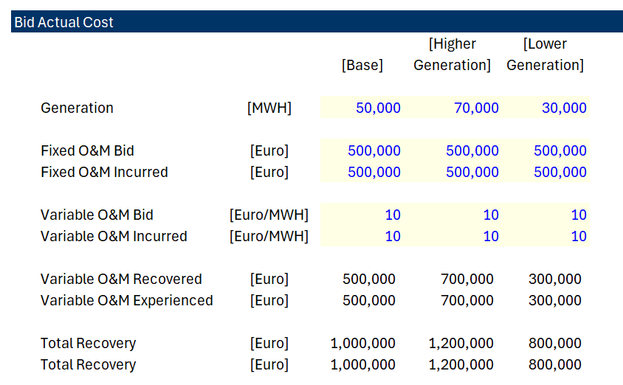
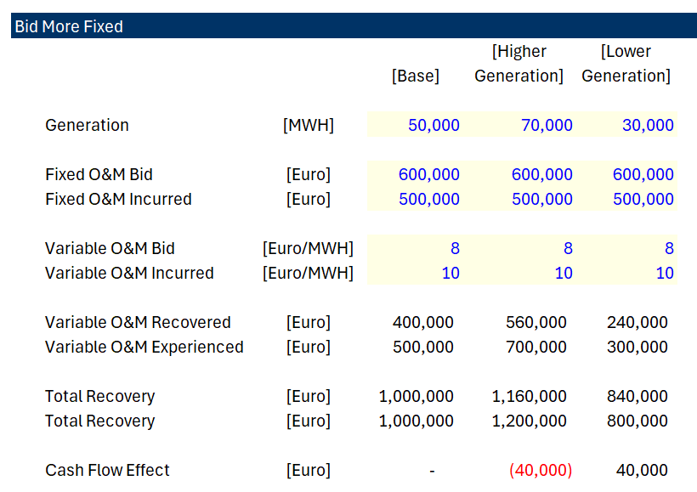
Example of Bidding Differently than Actual Cost – Seems to Increase Risk
.
If investor believes off-taker did not estimate bid correctly, an alternative bidding strategy could be justified. For example, more renewable lowers generation.
Bid Higher Fixed and Lower Variable

Slide 105
Nuance in Bidding when Investor Believes Generation will Change
Fixed cost and variable cost different from actual expected cost
Much of this chapter is about discussing nuances and exceptions.
Pretend that the investor believes the generation expected by the off-taker is overstated as new renewable capacity will enter the market and/or demand will decrease.
If generation is reduced relative to the amount used in the levelised cost bid assessment, then less fixed cost and more variable cost will ultimately be profitable (the third column in the table).
The investor can bid artificial higher fixed cost and lower variable cost relative to what is expected as in the third column and realize the saving.

Slide 106
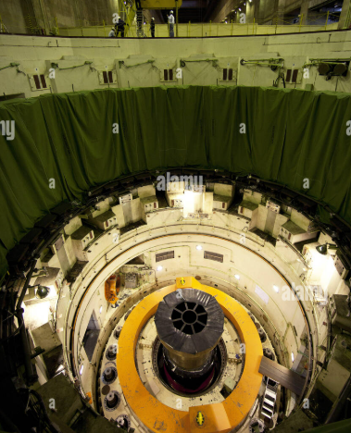
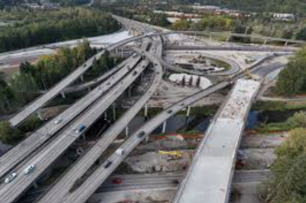
Question: Are These Costs Fixed or Variable
Plant Overhaul Cost Re-surfacing Cost

Slide 107
Results of PPA (Single Buyer) Model

Slide 108


1980’s Independent Power and Incentives (Plant Availability)
Plant Availability has dramatically improved from about 60% in 1993-1994 to 75-80%.
Leads to independent power producers and contracts that provided rewards and penalties for particular risks – capital expenditure cost over-runs and power plant availability
Project finance and back-to-back contracts to limit risk to banks and allow low cost of capital
No output risk (cash flow is independent of amount produced with is given by off-taker) designed with a capacity charge

Slide 109
Mixed Results
Results of the availability contracts have arguably been mixed in terms of both the direct cost of EPC and operating and maintenance contracts as well as in achieving a low cost of capital and corresponding prices to ultimate consumers.
The concept of focused incentives and competitive bids to achieve a low cost of capital has merit.
Enron cases in the Philippines and in India demonstrate potential problems.
  Effective competitive bidding was not applied;
  Equity returns were very high;
  Constraints from lenders limited operating flexibility;
  Prices were not adjusted for inflation;
  Projects such as nuclear plants with long construction periods and long lives were not financed.
  The government and/or off-taker made inefficient decisions that resulted in over-capacity and the wrong type of capacity.
  Profits made by EPC and operation and maintenance companies, particularly for developing companies were very high.

Slide 110
Problems with Availability Structure
Question about true competitive bidding
Question about earned equity returns
Question about constraints from lenders
Question about inflation adjustments
Question about ability to finance projects with long construction periods
Question about government decisions for amount and type of capacity
Question about profits earned by EPC and O&M Providers

Slide 111
Issue of PPA Effectiveness
How would you test the effectiveness of the regulatory model versus PPA contracts
  Whether the right amount of capacity is built by IPPs
  Whether prices decline from levels that existed under government ownership/regulation
  Whether the efficiency gains and the competitive bidding produces lower costs to consumers
  It is impossible to really quantify the benefits of the PPA model relative to the government ownership/cost plus regulation model

Slide 112
Philippines Contracts – Extreme Example
Frequent brown outs ranging from 2 to 12 hour daily in early 1991.
Cancelled 625 MW Batam Nuclear plant when it was almost complete.
Projected growth in electricity demand requires commissioning of new plants and rehabilitation of old plants.
State-owned Generating Company was NAPCOR; Approx. 72% of NAPCOR’s capacity is in Luzon.
Frequent closure of existing plants due to deterioration of oil-based plants.
Failure to undertake regular maintenance of certain plants
Postponed maintenance due to insufficient power reserve
The S&P bond rating for the Philippines was BB
The World Bank estimated that power outages in 1990 reduced economic output in Metro Manila alone by $2.4 billion.

Slide 113

Case Study - Funding
Enron - Subic Bay, Philippines
Philippines
Government
Equip’t Cos.
Warranties
Enron Power
Operating Co.
Completion
Guarantee
Fluor Daniel
EPC
Enron Power
Phils. Op’g Co.
Enron
Corp.
15-year
BOT
Concession
Turnkey
Construction
Contract
Performance
Undertaking
O&M
Agreement
Enron Subic
Power Corp
Napocor
Supply
Fuel Free
113MW
Subic
Power
Corp.
Ground
Lease
65%
Enron Power
Philippines Corp
Buyout
Rights
Capacity Charge
O&M Charge
Energy Charge
PPA
35%
Philippine
Investors
Insurances
US$105 million, 15-year Notes

Slide 114
113 MW Diesel Generator Power Station
Subic Bay, Philippines
Sources of Funds:
Notes $ 105 M
Subordinated Note 7
Equity of Sponsor 28
Working Capital 2
TOTAL $ 142
Uses of Funds:
Turnkey Contractor $ 112 M
Bonus to Turnkey Contractor 7
Development and other related costs and Fees 14
Pre operating, Start-up and Commissioning Costs 3
IDC 4
Working Capital Loan 2
TOTAL $ 142
First, compute the cost per kW (113 kW)
Cost is USD 1,250/kW
True Equity Finance, Not 28 Million

Slide 115
Case 1: Enron Subic
Debt Service with PMT
PMT (9.5%,15,-105) = 13.4 USD million/year
Summary
  Financial Close: 1993 (First Round)
  Commercial Operation: 1994
  PPA Agreement: 15 Years; Guarantee by Government
  Bonds: $105 Million
    Maturity 15 Years
    Repayment Level
    Interest Rate 9.5% (3.68% spread to Treasury)
    Minimum DSCR 1.37
  Completion Guarantee/Liquidated Damages
  Capacity Charge $21.6/kW/Month

Slide 116
BOT/PPA Contract
Capacity Payment: 21.6 x 113 x 12 = USD 29.3 million
EPC Payback: 112/29.3 = 3.8 years
Cash After Debt Service: 29.3 – 13.4 = 15.9
15-year BOT and toll process
113 MW Capacity
EPC Cost USD 112 Million
NAPOCOR (government owned generation company) to supply fuel & take electricity - no fuel availability risk
Capacity fee $21.6/kW/month on available capacity
Capacity fee is dollar denominated – no direct foreign exchange risk, overseas a/c
O&M fixed fee and energy fee is in Peso - $4.56/kW/Month
heat rate penalty & bonuses
buy out rights @ NPV capacity fees- late payment, change of BOT law, war, etc.
Equity Payback with Distorted Equity: 28/15.9 = 1.76 Years

Slide 117


Capacity was Added over Many Years in Philippines
Electric Bill showing PPA price

Slide 118


Philippines Results
.

Slide 119
End of Session 1 for First Day
10-15 Minute Break

Slide 120
Start of Day, Part 2
Day 1, Part 2: PPA Life Issues, Merchant Power, Contracts for Differences and Swap Contracts

Slide 121
Part 3:1995 - 2010
Merchant Period

Slide 122
Concept of Merchant Power
In the late 1990’s and early 2000’s, the idea of allowing electricity generating plants to be developed without contracts was implemented in many electricity markets.
Economists who love markets argued that if investors develop projects without contracts, that the investors have a strong incentive to evaluate future market conditions and the type of investments that are most efficient in a market.
  Investors would be rewarded for adding the right kind of capacity at the right time and if they operate the capacity efficiently over the life of the investment.
  The cost of capital applied to plants build on a merchant basis would reflect the true risks faced by the technology.
  The suggestion of investment derived from merchant prices rather than availability agreements was that the government or utility companies who were off-takers should not force consumers to take the risk of over-supply or requesting the wrong kind of capacity.
  If the investor incurs the financial penalty from taking over-supply risk, the incentives from potentially losing money will result in them making better decisions than the

Slide 123


Merchant Market Question: Do Higher Risks to Merchant Investors Mean Lower Risk to Consumers
Current
  Risks of Renewable Energy Driven More by Gas Prices than for Gas Prices
  Gas Price Natural Hedge
  What if All Plants were Renewable Backed Up with Storage

Slide 124
Merchant Power Boom
A merchant boom period occurred somewhere around the late 1990’s.
During the merchant period, electricity projects were developed and constructed with no revenue contracts whatsoever, raising the fundamental question of whether contracts are really necessary to construct capital intensive investments and/or whether economically efficient outcomes can be realized without any risk allocation.
The merchant boom period coincided with dramatic efficiency in natural gas plants (which are relatively less capital-intensive than other types of generating plants) as illustrated in the accompanying chart.
Oil and other resource extraction projects have been financed without long-term government related contracts and real estate projects have been developed without locking-in rental rates (oil projects often do use price hedges).

Slide 125
Uses of Merchant Prices in Contract Analysis
Plants built on a merchant basis without a contract have come along with a higher cost of capital than the cost-plus model or the availability PPA model.
Primary focus address the trade-off between increased cost of capital from increased risk versus increased incentives to operate efficiently.
Why should we include discussion of merchant power when the subject of the chapter is contracts.
Related marginal cost and merchant price issues are involved in various aspects of contracts involving questions of:
  merchant tail,
  using merchant prices in measuring penalties
  negative merchant prices limiting generation
  measuring liquidated damages with merchant prices.

Slide 126


Monthly Electricity and Gas Prices – Higher Correlation
Reasons for understanding merchant prices even if you are not working on merchant investments

Slide 127


Monthly Gas Price and Electric Price

Slide 128



Illustration of Different Supply Curves
Three different supply curves with different mixes of capacity, different gas prices, different heat rates and other factors are illustrated below.
The danger for cash flow on a plant is if the plant is part of a long stretch of flat costs. At the flat area the price is equal to the cost and there is no margin. This is the danger of large surplus capacity
Dangerous Area – Compete without making a margin

Slide 129
Why Gas Plants have a Natural Hedge and Renewable or Nuclear does not have Natural Hedge
Simple example with market heat rate
Gas Plant scenario with high and low gas prices
Gas Plant with periods of non-production

Slide 130
Question on Merchant Production
Do you believe that there is some kind of inherent lower risk for thermal plants than for renewable energy or nuclear

Slide 131


Changes in Merchant Prices with Increased Solar
Increased volatility and reduction in the price during solar hours
Spain Prices

Slide 132
Concept of How Renewable Energy Affects Merchant Prices
Treat renewable power that is not controllable as a reduction in demand
Illustration with net demand for thermal production
Illustration of Single Day Power Price in France

Slide 133


Current and Future Markets
Current – Driven by Gas Prices
Future – Driven by Resource and Storage Cost. Sunlight hours; solar only; non-sun hours; storage + solar

Slide 134
Forward Contracts in Merchant Power

Slide 135

Example of Swap Contract
Debt has fixed repayment that is known by a contract
The balance of debt is known
A contract for fixing interest rates can be written as the swap if interest rates are floating
Can use forward interest rates to fix the swap – easy to derive the implied short-term rates from two long-term bonds (e.g. 9 year and 10-year bond).
Diagrams with paying variable rate and receiving fixed price

Slide 136
Contrast Interest Rate Swap and Contract for Wind Power
Interest Rates:
  Know the notional amount
  Find a counter party or derive forward rates
  Can do all sorts of hedges
Wind Project
  Do not know the hour of the production
  Can find somebody who will hedge prices given the output
  This is where you can use contracts for differences rather than swap

Slide 137
Difference between a Standard Forward Swap and Contract for Difference
We discussed Contracts for Differences above in the context of UK and Polish projects. In these forward contracts the settlement is made based on production which can vary. The price is assured no matter what is the production. Classic forward contracts like interest rate swaps are different because they have fixed notional volumes which allows the counter party to evaluate prices without the price variation. Orsted’s hedging uses forward or swap contracts where notional volume is fixed.
Forward Contract (Swap)
Contract for Difference
Contract settles on the difference between a fixed forward price and the merchant price
Contract has defined term
Contract based on a notional amount like and interest rate swap or a forward exchange rate contract
Contract settles on the difference between a fixed forward price and the merchant price
Contract has defined term
Contract based on production at a power project where the amount of output is not fixed

Slide 138


Counter Parties, Swap Contract and Exposure
The example below shows the danger of hedging without production. There is no notional amount.
Fixed price is 40
Merchant Price is 5
Production is Notional amount of 100
Sell at Merchant price and receive 500
Receive Settlement of 35 x 100 or 3,500
Receive Total of 40,000
Fixed price is 40
Merchant Price is 200
Production is 0
Pay Settlement of 160 x 100 or 160,000
No offset from selling notional amount of power because none is produced

Slide 139


Forward Merchant Prices, Natural Gas Prices and Market Heat Rates
The graphs below are intended to illustrate how a trader could evaluate future electricity prices. As electricity is driven by natural gas and as natural gas can be stored, the forward prices for natural gas are stable as shown on the left-hand side graph.
Electricity prices can be evaluated relative to natural gas prices using the formula: Heat Rate = Electric Price/Natural Gas Price. The right-hand side graph shows that the implied heat rate in France and Denmark. For France it is quite stable. The forward price could then be evaluated as: Forward Price = HR x Gas Price. For Denmark the heat rate is much more variable and more difficult for the trader to evaluate.

Slide 140

Mechanics of Swap Contract with 5 x 16 Block
Imagine that you arrange a swap contract
Lock in gas price from forward market
Have a counter party that wants to fix prices for block
  Could be a data center that needs power
  Usage of power does not depend on the sun shining

Slide 141

Swap Contract When Dispatch Different than Contract
Renewable Example with under production. Probable that price will be high.
Note that recover less than the price in the swap contract because have to purchase from the market.

Slide 142

Swap Contract When Dispatch Different than Contract
Renewable Example with over production. Probable that price will be low.
Note that recover less than the price in the swap contract because have to purchase from the market.

Slide 143


Difference between Swap and CdF – Notional Settlement
.

Slide 144

Contract for Difference
Contract for difference depends on fixed price with flexible volume
Just like a PPA contract with a fixed price

Slide 145


Orsted Merchant Exposure and Hedging
The Orsted illustrates difficulties in hedging merchant prices with power generation that does not produce power at predictable times. The excerpts from Orsted’s financial statements have some background on Orsted’s hedging and merchant exposure. The right-hand slide shows that the merchant exposure is about 20% of generation. The left-hand slide shows historic and forward prices. Note that at the beginning of the chart prices for the U.S. and Europe were similar and that they have dramatically diverged after Russia’s invasion of Ukraine. Subsequent slides discuss the mechanics of hedging and how Orsted to a loss from over-hedging.

Slide 146


Orsted Exposure to Fixed Volume Swaps and CfD with Flexible Volumes
The chart below shows how the exposure to merchant prices is hedged. The chart shows the percent of exposure to merchant prices that is hedged. This is further split between the percent that is hedged with swap contracts with fixed notional amounts and the amount that is hedged with CfD’s which can also be termed a PPA with a fixed price (I don’t think this is really hedging merchant price risk). Note that corporate PPA’s can use a third party to hedge the risk with a CfD in the on-shore category.

Slide 147

Orsted Losses from Over-Hedging
Orsted Comment:
Also, we saw negative effects from volume-related over-hedging. When we hedge our future power generation, we try to take into account the difference between the price we will receive from our power generation and the price our hedges will be settled at, i.e. what we describe as intermittency. In addition to cater for intermittency, when we enter into hedges years in advance, we have entered into trades to mitigate the more near-term risk of even higher price differences between peak and off-peak periods over the '22-'23 winter period.
Over-hedging Defined by Orsted
Misalignment between volume of actual production versus volume that was hedged. Potential causes include delayed ramp-up and low wind
Presumably, Orsted is producing when the prices are zero and collects a settlement to receive a fixed price. But if there is no production when the prices are high, the settlement must be paid. If the production were constant, the hedge would work.

Slide 148
Merchant Prices Benefits
Benefits of Competitive System
  Private entities incur risks for not building the correct mix and amount of capacity. It is the only model where investors must deal with demand and fuel price risks that are inherent in production of electric power.
  Market prices create a transparent process where investors do not concentrate resources on gaming the system, negotiating uneconomic contracts or bribing officials.
  Prices move according to supply and demand where prices fall when demand falls and they rise when demand rises. All of the other systems have the opposite effect.
  Can attract foreign capital

Slide 149
Results of Merchant Price Investments

Slide 150
Full Competition - Problems
Problems
  Exercise of market power allows companies to extract high profits, play games and leads to inefficient outcomes.
  Cost of capital increased in this model, making renewable investments very difficult.
  Very difficult to build long-lead time plants such as nuclear plants.
  Market will not result in optimal investment decisions given the dramatic changes in value of electricity plants.
  Market prices can be very volatile.
  Benefits do not flow to consumers as suppliers lobby for capacity payments and other items that keep prices high in depressed markets
  California

Slide 151
UK Oversupply in Merchant Market

Slide 152


AES Drax Bond Rating TimeLine
Rating Action 25 JUL 2000 MOODY'S ASSIGNS (P)Baa3 RATING TO AES DRAX HOLDINGS LIMITED AND (P) Ba2 TO AES DRAX ENERGY LIMITED PROJECT FINANCE BONDS
Rating Action 20 APR 2001 MOODY'S CONFIRMS AES DRAX'S DEBT RATINGS; CHANGES OUTLOOK TO NEGATIVE
Rating Action 7 DEC 2001 MOODY'S DOWNGRADES AES DRAX HOLDINGS Ltd BONDS AND INPOWER Ltd BANK LOAN FROM Baa3 TO Ba1, AND AES DRAX ENERGY Ltd NOTES FROM Ba2 TO B1
Rating Action 1 MAR 2002 MOODY'S PUTS AES DRAX ENERGY LTD HIGH YIELD NOTES RATED B1 ON REVIEW FOR DOWNGRADE
Rating Action 13 AUG 2002 MOODY'S PLACES Ba1 DEBT RATINGS OF AES DRAX HOLDINGS LTD AND INPOWER LTD, AND B1 RATINGS OF AES DRAX ENERGY LTD ON REVIEW FOR DOWNGRADE
Rating Action 21 AUG 2002 MOODY'S DOWNGRADES DEBT RATINGS OF AES DRAX HOLDINGS LtD, INPOWER LtD, AND AES DRAX ENERGY LtD
Rating Action 14 OCT 2002 MOODY’S DOWNGRADES DEBT RATINGS OF INPOWER LTD AND AES DRAX HOLDINGS LTD TO Caa1, AND DEBT RATINGS OF AES DRAX ENERGY LTD TO Ca. ALL RATINGS ARE LEFT ON REVIEW FOR FURTHER DOWNGRADE
Rating Action 7 NOV 2002 MOODY'S DOWNGRADES DEBT RATINGS OF INPOWER LTD AND AES DRAX HOLDINGS LTD TO Caa2, AND DEBT RATINGS OF AES DRAX ENERGY LTD TO C
Rating Action 19 JAN 2004 MOODY’S WITHDRAWS RATINGS ON DRAX POWER PROJECT

Slide 153

Crash of Merchant Power

Slide 154

Defaults without Contracts

Slide 155

Price History During the California Crisis

Slide 156

Prices versus Marginal Cost

Slide 157
Physical Withholding
Price volatility was affected by plant outages that were in part driven by problems with IPP contracts
suppliers began offering less power to the daily auctions at the Power Exchange and at higher prices. On the afternoon of June 28, for example, prices climbed to $750 a megawatt-hour, four to five times as high as on similarly hot days in the summer of 1999. Power Exchange investigators later concluded that all of the power-plant operators -- Dynegy, Williams, Duke Energy Corp., Reliant Energy Inc. and Mirant Corp. -- as well as marketers such as Enron had at times withheld electricity from its daily auctions. The suppliers may have tried to sell the power to the ISO or out-of-state buyers, hoping to fetch a higher price. Or, they may have idled the plants, hoping to induce a scarcity that would drive prices even higher.

Slide 158

Status of Merchant Markets
Merchant Markets Exist
Using Markets with Volatile Prices and No Capacity Payments to Build Capacity is Rare
Continued Problems
  Texas Winter Outage
  Turkey Investments
  Price Spikes
Electricity and Government Intervention
  Renewable Energy
  Gas Supply and Ukraine
  Nuclear Power
  Whales and Wind Power

Slide 159
End of Second Session for First Day
End of First Day

Slide 160
Start of Second Day
Day 2, Part 1: Renewable Energy Output Contracts, Deemed Energy, Alternative Contracts for Storage plus Solar

Slide 161
Nuance 3: Deemed Energy and
Negative Prices

Slide 162

Debate About Deemed Energy
Arguments for allowing deemed energy to be recovered from the off-taker are that the developer cannot control transmission problems that arise from the off-taker.
Alternatively, an argument can be made that the developer cannot control risks of other producers coming into the market that results in an over-supply and negative prices.
Arguments for not allowing deemed energy to be compensated for the developer is that an oversupply of power in regions where there is insufficient transmission capacity should have been part of the evaluation of where to build the solar farm in the first place.
Should the investor put investments where there is sufficient transmission
Should the investor have to predict others who will over-invest and cause a transmission constraint
Does increase in transmission risk provide any incentive benefits

Slide 163
Question On Transmission and Deemed Energy
Should the investor or the off-taker take risk of transmission constraints
Should the investor take the risk of negative prices

Slide 164

Who Should Take the Risk of Constrained Operation
Similar to transmission risk
If off-taker wants more solar power should risk increase

Slide 165

Changes in Merchant Prices with Renewable Energy
Read the language carefully from corporate PPA.
Note protecting the buyer and not the seller
Work through example with price of -100
Pays the CfD

Slide 166
2010’s, Renewable Energy and
Feed-in Tariffs
All Output Purchased and Control of Output is Investor and not Off-taker

Slide 167


Solar History: 2000’s and Feed-in Tariffs - German Solar Feed-In Tariffs and Managing Risk
The left-hand scale represents feed-in tariffs meaning that if you put a meter next to your solar project and record the MWH generation, you get paid for that generation. The right-hand graph shows market prices (with correlation to gas prices). The y-scale is the same for both graphs. Comparing the blue bars on the left to the blue line on the right illustrates the magnitude of the subsidy in the feed-in tariff.
The feed-in tariffs were very simple contracts enabling companies to secure financing. The feed-in tariffs were supposed to encourage cost declines from scale, and they worked very well. There have been solar projects with contracts of around 1 Euro cent per kWh

Slide 168


Difference Between Contract Prices for Renewable Energy and Dispatchable Plants
In a dispatchable coal plant, gas plant, nuclear plant the operator controls the amount of electricity that is produced by the plant.
In a renewable project, the amount of output comes from upstairs – wind for wind projects, solar radiation for solar projects and rainfall for hydro projects.
For a dispatchable plant (except for merchant plants discussed below), the amount of production is controlled by the buyer and not the seller for the plant
If you are stupid enough to build your wind farm next to a tree, then you should realize a lower return than somebody who does not do something so stupid. This demonstrates that investors in renewable energy must take generation risk to encourage efficient development of projects. Taking resource risks makes renewable energy projects inherently more risky than dispatchable projects in a PPA context

Slide 169

Renewable Project Finance Diagram
Big Difference is output risk where there is uncertainty for volumes sold.

Slide 170


Revolution in Solar Module Prices and the Price of Polysilicon

Slide 171


How to Encourage Renewable Energy
Tariffs with Single Price (Feed-in and PPA bids)
Initial Subsidy (Joke about coal producing electricity from coal; solar from subsidies)
Merchant not selected
Capacity payment does not make sense
Output based contract; shorter life than economic life; no inflation risk

Slide 172

Average Solar by Year – Little Variation
You can see the lack of variation in solar from year to year.
Standard deviation allows you to compute P90 with NORINV.
This is not meant to be too technical
This risk is easy, and it is mean reverting.
The technical risks discussed next are much more important

Slide 173


Offshore Wind by Year in Oman

Slide 174


Wind Resource and Power Curves
For wind, there is more uncertainty in volumes and in cash flow because the relationship between the resource (wind speed) and the output is not linear.
Further, being able to get precise numbers on wind speeds is more difficult than for solar.
Wind speed data now available on PVGIS

Slide 175


Risk Allocation with Availability and Output Projects

Slide 176
Results of Output Contracts
Spanish Problem with FIT
Too Easy to Make Money with FIT
Oversupply of Solar in India
Successful Low Bids
Country Risk with Off-shore Wind
Problems in Developing Hydro and other Renewable Projects in Africa

Slide 177
Case Study:
Contract Structure for
Battery Storage and Renewable

Slide 178
Four Models for Storage PPA
Case 1: Solar PPA (output) plus Battery PPA (availability)
Case 2: Solar plus Storage to Meet Defined Demand (output)
Case 3: Customer Analysis for Independence from Grid (surplus sales, deficit purchases)
Case 4: Mini-grid with Solar and Battery

Slide 179


Capacity and Storage of Batteries - Think of a Battery Like a Water Tower or a Warehouse
kwh
The pipe is the capacity at any instant. If this pipe capacity is 100 kW, then in one hour, the maximum that can be charged or delivered in one single hour is 100 kWh
The storage tank is the number of hours that be stored and then delivered. It is measured in kWh. If the capacity is 100 kW and the storage is 4 hours, then the kWh is 400 kWh.
Bigger Spout gives faster water
kw
In the warehouse, the movement in and out is the capacity (kW) – how many boxes in and out. The time in storage is kWh – you need the space for the boxes.

Slide 180


Battery Costs
Find battery costs in China from Shanghai Metal Exchange.

Slide 181


Batteries for Ancillary Services and Load Shifting
.

Slide 182
Case 1: Battery plus Solar PPA
Off-taker has control of Battery
  Suggests capacity payment and not output based
  Could use batteries for ancillary services
  Could use batteries for load shifting
  Some control of number of cycles
Different ways to Handle Degradation
  Allow some decrease as part of PPA
  Require Augmentation
  Degradation depends on usage
How should penalties and bonuses be established for
  Available Capacity
  Round trip efficiency

Slide 183



Pricing in PPA and Back of Envelope
Should there be a variable charge.
Is overhaul that is a function of hours a variable or fixed cost

Slide 184

Capacity Payment Formula – PPA 1
Use capacity because of 1 hour duration battery

Slide 185

Pricing in a PPA Contract for Batteries – PPA Number 3
Capacity based – No discussion of a variable energy charge
This is MW of capacity and not MWH

Slide 186
Limit on Cycles in PPA
Example of limits on Cycles

Slide 187

Contract Issues from Case 1 (Solar and Battery PPA)
Issue of targets for availability, degradation, round trip efficiency
Off-taker controls battery characteristics like availability PPA
Cycles controlled by off-taker
Cycles affect
  Battery life
  Degradation
Options for cycles
  Estimate the number of cycles
  Limit number of cycles
  Impose a variable energy charge

Slide 188

Case 2: Battery Plus Storage to Meet Electricity
Compute the amount of Battery Storage plus Solar from hourly analysis of solar, load and battery capacity. Adjust solar and battery capacity. Investor optimizes amount of solar and storage.
Find the file on the website

Slide 189


Case 2: Illustration of Hourly Analysis
Illustration of dispatch

Slide 190

Case 2: Contract Theory for Target Supply Case
Should investor take risk of merchant pricing
  Can the storage capacity be adjusted based on negative prices
  Is the risk too great from merchant prices with surplus capacity
How should penalties be computed
  If use merchant pricing, risks increase
  Value depends on natural gas prices

Slide 191
Case 3: Customer Analysis
Build storage and solar to reduce high prices in Jamacia
Risk of tariff changes and net metering
Largely avoid merchant issues as risk from cost of battery and solar
Can private investor create a flat PPA price
  Who takes risk of under or over solar capacity
  How is load covered
  Inflation adjustments

Slide 192

Case 3: Customer Investment
Size solar and battery to meet load. Compute savings versus retail rates

Slide 193
Case 3: Contract Issues
Investor could sign PPA with Customer
  Fixed PPA price
  Share of Savings
If fixed PPA Rate
  Require some inventive for availability, degradation etc.
  Could be similar to other models
If share of savings
  Need hypothetical utility rate
  Investor responsible for battery operating risks and degradation
  Need high rates to justify

Slide 194

Case 4: Mini-Grid
Tariff for Power
Target Unserved Energy
Achieving Low Cost

Slide 195
Case 4: Contract Issues in Mini-grid
Ability to Change Rates
Replacement of Equipment
Grants and Replacement for Degradation
Grants and Replacement of Equipment at End of Life
Risks of Initial Customer Sign-ups
Too Many Risks for Private Investor at Start-up

Slide 196
Break for Second Day
Day 2, Part 2: Nuances with Inflation in Contracts, Issues in Financing Nuclear Power, Levelised Cost of Electricity

Slide 197
Case Study
Nuclear Plants and RAB Model

Slide 198
Case Study of Rate Base Regulation for Nuclear Plants in UK
Back to Ancient forms of Regulation and Contracts
  Importance of Cost of Capital
  Computing Levelised Cost Model of Nuclear with Different Economic Models
  Example of UAE Nuclear based on PPA and Public/Private Partner Structure
  Alternative RAB Model in UK and Low Cost of Capital Objective

Slide 199

Capital Cost of Nuclear
.

Slide 200


PPP Project Example – Versus Corporate Finance or Government Ownership
Draw diagram of PPP project in nuclear power
.
18%/82% Private/Public
ECP Contract – Private
O&M Public
Debt 20% EXIM/80% Govt
.
.
.
.

Slide 201
Exercise: Draw a Diagram of UAE Project
.
EWEC – Off-taker State Owned by UAE
ENEC – Performs O&M without Contract, Cost plus
(EPC Contractor)
ENEC - Special Purpose Vehicle:
Lenders (EPC related and Government)
Equity Investor (Financed by EBL)
Government of UAE – 82%
(EPC Contractor) – 18%
UAE Government (15 Billion)
EXIM

Slide 202
Contract Nuance 4: Adjustments for Commodity Prices During Construction

Slide 203
Contract Nuances: Commodity Price Changes Over Long Construction Period
Basic Idea of Fixed EPC Price
For Short-term Projects Not a Big Idea
Mechanical Problems of Applying Different Indices

Slide 204

Fixed Contract Price in EPC Contract

Slide 205

Nuance: Adjustments to Construction Cost
Increase in Risk from Cement, Steel and other prices
Price risk does not provide incentives
Variability in prices
Example in Financial Model

Slide 206

Construction Adjustment Nuance: Example from ENEC Financial Model
.

Slide 207
Nuance 5: Inflation Adjustments in PPA

Slide 208
Pretend you are Lender, Consumer, Investor
Would you want the cash flow to change when the inflation rate changes

Slide 209
Inflation Risks to Different Parties
Issue – Should total price including the capacity payment increase with inflation
Mechanics – Create and inflation index from a given date from and objective source
Investors – Nominal return changes, but real return is constant
Off-taker – Initial price is lower, but price increases
Lenders – Almost always get paid for nominal and not real interest
Lenders – Causes average loan life to increase if sculpt
Lenders – Like hedged interest rate with fixed price
Potential Solutions
  Inflation Sensitive Interest Rates and Repayment
  Sculpting with negative repayments
  Frequent Re-financing

Slide 210

Don’t be Intimidated by Language, Single Price PPA with Inflation

Slide 211

Inflation Risk and Cost of Capital
How big is inflation risk for investors
Can you think about innovative solutions

Slide 212

Different Revenue Patterns from RAB, CFD and Inflation Adjusted CFD
.
All of lines have the same nominal LCOE over the long-run
The most representative price is the inflation adjusted price

Slide 213


Real versus Nominal with Different Project Lives
Same cost and return assumptions
36% reduction in initial price with 70-year life
11% reduction in initial price with 20-year life

Slide 214
Financing During Construction

Slide 215

Return of Rate Base Regulation – British Nuclear with CWIP in Rate Base
Sizewell Nuclear Plant

Slide 216

Low Cost of Capital Objective in RAB

Slide 217

Funding of Sizewell

Slide 218

Revenue Requirement from Classic RAB
.
Price Declines, IRR Achieved

Slide 219

Revenue from CfD with and Without Inflation
.
Same IRR with Different Prices

Slide 220

RAB LCOE versus without RAB
.
Reduction in Price from Financing with RAB

Slide 221
Importance, Nuances and Calculation of the Levelised Cost of Electricity

Slide 222
Simple Rule about Economics
If the contracts do not make economic sense, the off-taker will try to get out of the contracts
Examples
  REC for wind farm in California
  Enron Dabhol Plant
The fancy word CfD or contracts for difference is derived from LCOE
LCOE also used in bid evaluation
LCOE known as total cost of operation in other industries

Slide 223


Dabhol Case Study

Slide 224
Contract Risk and Dahbol
Investment in a $3 billion, 10-year liquefied natural gas power plant development project, was the largest development project and the single largest direct foreign investment in India’s history.
Begun in 1992, the Dabhol power plant near India’s financial capital of Bombay in Maharashtra state was to have gone online by 1997. It was supposed to supply energy-hungry India with more than 2,000 megawatts of electricity, about one-fifth the new energy needed by India each year.
In a joint venture with U.S. companies General Electric and Bechtel, Enron created an Indian subsidiary, Dabhol Power Co. DPC, which was 65 percent owned by Enron, was to build the power plant. Enron was to develop and operate the plant. Bechtel was to design and construct it, with GE supplying the equipment.
Enron brokered a deal with Qatar to provide the Dabhol plant 2.5 million tons of liquefied natural gas per year for 25 years, starting in 1997.

Slide 225
Comments from Harvard Case Study
This project is new-it's definitely a pioneer and as a result the policies and approvals are still evolving. But precisely because of its pioneer status and government interest at the top, many in India feel that this project has moved quite rapidly.
Judging from our Philippines experience, the first project through certainly paves the way. The first one is like a "baptism" for the country-after that you can use boilerplate documents; people are educated about the process .... The fact is that we've already invested $13.2 million with Bechtel and GE on this project, so we're very committed .... If we didn't believe in this project and the importance of it to India, we wouldn't be doing it. We believe in the goal of cheap power in abundance for India ....
The stakes are high for India too. By having three large American companies involved, issues of national pride and the sincerity of economic reform naturally arise .... This project is really important for India. It symbolizes that real change has occurred, that they can get it done. Foreign investment will follow as will greater economic growth. This is a bellwether project. Other projects are being held up to see what happens here. If it can't happen here-with the most respectable sponsors, with independent fuel supply, and the most financially stable state-can it happen anywhere in India?

Slide 226
Comments from Harvard Case Study
This project is new-it's definitely a pioneer and as a result the policies and approvals are still evolving. But precisely because of its pioneer status and government interest at the top, many in India feel that this project has moved quite rapidly.
Judging from our Philippines experience, the first project through certainly paves the way. The first one is like a "baptism" for the country-after that you can use boilerplate documents; people are educated about the process .... The fact is that we've already invested $13.2 million with Bechtel and GE on this project, so we're very committed .... If we didn't believe in this project and the importance of it to India, we wouldn't be doing it. We believe in the goal of cheap power in abundance for India ....
The stakes are high for India too. By having three large American companies involved, issues of national pride and the sincerity of economic reform naturally arise .... This project is really important for India. It symbolizes that real change has occurred, that they can get it done. Foreign investment will follow as will greater economic growth. This is a bellwether project. Other projects are being held up to see what happens here. If it can't happen here-with the most respectable sponsors, with independent fuel supply, and the most financially stable state-can it happen anywhere in India?

Slide 227



Contract for Differences (CFD) and Levelized Cost of Electricity (LCOE)
Importance of measuring cost of different alternatives.
Comes down to measuring cost of capital expenditures and operating expenditures separated into fixed operating costs and variable operating costs.
Measure the total costs relative to the amount produced.
In non-electricity industries compute the total cost of ownership.
Always depends on cost of capital, inflation and taxes

Slide 228
Calculation of LCOE
Four Equations – Produce the same value
  Theoretical Discount Rate – Pre-tax target IRR
  Classic Equation: LCOE = PV of Revenues/PV of Generation
  Similar Equation: LCOE = (Capital Expenditures + PV of O&M)/PV of Generation
  Conceptual Equation: LCOE = Weighted Average Price where weights are discount rate, generation
  Value Driver Equation: LCOE =
    (Capacity Cost + Fuel Cost + Variable O&M + Fixed O&M)/kWh where
  Capacity Cost in Equation: Capacity Cost =
    PMT(Discount Rate, Economic Life, FV of Cap Exp)

Slide 229

Nuances in LCOE Calculation
Nuances are essential
  Real versus nominal LCOE
  Taxes in LCOE
  Financing Assumptions
  Cost of Capital

Slide 230


Lazard LCOE
Famous Lazard study is biased against capital intensive technologies

Slide 231

Effect of Financial Assumptions on LCOE
.

Slide 232

LCOE of Different Technologies
Cost depend on use cases

Slide 233

LCOE of Battery and Solar
Big Question for Electricity – Cost of Storage and Solar

Slide 234

Including Externalities
Variable Cost can (should) include cost/MWH of greenhouse gasses
For CO2 easy to compute
  Tons CO2/MWH
  Cost/Ton
  Cost per MWH
  Find on Internet
For natural gas should include the cost of leakage
Could be other externalities
  Cost of Accidents
  Effects on Employment

Slide 235
End of Day 2

Slide 236
Start of Day 3
Day 3, Part 1: Liquidated Damages for Delay, Availability Incentives, Performance Ratio Adjustments in Off-take Contracts

Slide 237
Part 3
Provisions Other Than Price in Contracts

Slide 238
Same General Point about Cost of Capital and Incentives
Central Point:
Tradeoff between:
Cost of imposing risk with cost of capital increase
And
Incentives to construct and operate efficiently
Contract with Low Penalties
Contract with High Penalties

Slide 239
Numbers in Project Contracts other than Price
Target Date
Liquidated damage for Delay
Target Availability
Liquidated Damage or Other Penalties for Unavailability
Target Performance Ratio
Target Heat Rate
Performance Penalty in Supply Contracts
Warranty Period

Slide 240
Introduction to Non-Price Provisions of Contracts
Contracts in a project finance transaction contain a number of targets, penalties (called liquidated damages) and bonuses that guide how the project should perform. If the targets are not set correctly and/or the penalties or bonuses are not set according to costs incurred by society, the benefits of project finance can diminish.
This part addresses provisions in contracts other than the setting of price.
Issues include:
  Whether details of the contract provisions that establish targets make sense;
  Whether penalties and bonuses are set to appropriate levels;
  Whether tests of performance and the related compensation are adequate;
  Whether parties to the contract can live up to obligations (and not go bankrupt).

Slide 241
Objectives and Ideas
Do not to work through every provision in a contract and/or to discuss particular contract language.
Understand the theory of how different liquidated damage numbers can be derived;
How targets in contracts should be established;
How changes that occur after the contract is in place should be managed;
How incentives for performance should be measured in contracts other than the price contract.

Slide 242
Liquidated Damage for Delay

Slide 243
Liquidated Damage Theory and Targets
Different kinds of provisions to provide incentives and resolve problems include:
(1) liquidated damages
(2) targets for timing availability and other items,
(3) targets for achieving efficiency different from liquidated damages,
(4) valuation formulas for performance targets in contracts with suppliers
(5) adjustments for change orders should be understood.
It is easy to get lost in the contract provisions without taking a step back and thinking about why the structure of provisions are different; the theory of how the numbers and dates in the contracts should be established and how problems can arise from inappropriate terms can cause problems.

Slide 244

Legal Rule for Liquidated Damage
Seller agrees that liquidated damages represent are genuine pre-estimate of damage the off-taker would experience as a result of failure to achieve the commercial operations date.
Why does this make sense
How can the damages be computed
How is the target commercial operation computed

Slide 245

Difficult of Impossible to Compute Liquidated Damages
Note that acknowledged that “difficult or impossible to determine with absolute precision the amount of damages”
This does not mean that you should not think about how damages work in theory

Slide 246

Example of Delay Penalty in PPA Contract
Example of liquidated damages with the amounts for liquidated damage.
Define timing of liquidated damage
Note how again discuss that the LD is from the off-taker cost

Slide 247
Exact Computations of Liquidated Damages and Other Items
Exact definition of quantifying exact terms is not realistic.
The difficulty in computing precise numbers does not mean that the theory should be ignored.
  For example, language in a price contract may include a provision that liquidated damages are derived from the off-taker cost. Then, the liquidated damage of something like USD 500 per MW-day is stated as the penalty for missing the target in-service date.
  But when you ask somebody who worked on the contract exactly how the 500 figure is computed, I doubt you would get some kind of careful analysis of the marginal costs (or merchant prices) of the delay in the operation date, net of the cost savings from not paying prices on the contract.
If you have some kind of idea of how the liquidated damages in theory should be computed, you can be better at negotiating, discussing, analyzing and interpretation of contracts.

Slide 248
Targets and Liquidated Damage
For evaluating liquidated damages, targets are part of the process.
Just about any target is founded either explicitly or implicitly using a cost trade-off between the investor and the off taker – not just the off-taker
Understanding the establishment of liquidated damages in contracts can be understood only if the evaluation is made together with targets.
Targets include things like the target in-service date, target availability, target degradation, target round trip efficiency, target capacity, target efficiency and other items. Some of the targets are directly included in a bid like the target efficiency. In terms of computing liquidated damages, you could write a very simple equation (not like the equations in a contract). The relationship between targets and penalties is illustrated.
If Actual Date is After Target Date, Penalty = Liquidated Damage per Day x Delay Days

Slide 249

Example for Analysis of Targets and Liquidated Damage
Assume that the cost increases in a linear basis
Assume the cost of different dates can be understood from EPC Contractor

Slide 250


Cost Trade-offs and Minimizing Total Cost
Find the minimum cost
When the derivative of total cost equals zero
Liquidated damage is orange line after the target is reached

Slide 251
Issues in Computing Off-taker Cost
Costs of delay to off-taker
  Start with short-run marginal cost (graph of supply curve)
  Could include increase in probability of unserved energy with delay
  Could include environmental benefits lost from delay
  Not necessarily linear
Benefits of delay to off-taker
  Don’t have to pay PPA price
  Will have energy and/or capacity at the end of the life
Conceptually can compute and back out implied marginal cost
  USD 300/MW-day
  Hours of solar – 6.5 hours
  Net cost delay cost per hour (net of PPA) = USD 300/6.5 = USD 46.15/MWH
  Add the cost of the PPA (e.g. USD 30/MWH) to get the implied marginal cost = 76.15/MWH

Slide 252
Why Only Off-taker Cost in Liquidated Damages and not Investor Cost
Once target is established,
  Any change in the investor cost is already born by him
  Example
    Investor cost dramatically declines for some reason
    Target optimum date would be delayed
    Better for target to save money on delay and extend the target date
    The target COD has been re-optimized with revised investor cost
  In the example, the investor cost is already accounted for because the investor pays the costs
  As the investor pays the cost, there is no necessity for an additional penalty

Slide 253
Liquidated Damage in EPC Contract
Ultimately the EPC contractor is responsible for the construction costs and if the off-taker imposes liquidated damages to the SPV as part of the price contract (the PPA), then the liquidated damages are directly transferred to the EPC contract.
But this is not the end of the process. The delay has an additional cost to the SPV which is not part of the penalty imposed by the off-taker. This cost to the SPV which is not part of the liquidated damage penalties in the PPA is the financing cost. For the EPC contract, the SPV is the buyer (like the off-taker) and the liquidated damage is computed from the SPV cost which includes the financing cost.
As with calculation of liquidated damage for the cost of the off-taker delay, calculations can be ambiguous. A financial model can be created with and without the construction delay to measure the financial effect on the SPV. The ambiguity comes into play because the effect on the SPV finances could be computed from the increase in interest during construction or alternatively the amount of the added liquidated damage could be derived from the amount needed to achieve the equity IRR that would have existed if there was no delay.

Slide 254
Back-to-Back Contracts with Availability
Off-taker
PPA Contract
Four-Part Tariff
Fixed Capacity Charge at Fin Close
LD Penalty for Delay Risk
Contract O&M Charge
Contract Heat Rate
Availability Penalty
Special Purpose Vehicle – Incurs LD from PPA and Effects of Debt
Contract with Guaranteed Heat Rate and Availability Penalty
and Fixed Fee
O&M Contractor
EPC Contractor
Back-to-Back Plus Financial Cost
Fixed Price Contract with LD
Loan Agreement with Target DSCR
Lender
Equity Investor

Slide 255

Delay Liquidated Damage in EPC Contract – Off-taker Penalty Plus the Financing Cost; Not Exactly Back-to-Back
Cost to investor includes cost of delay from financing cost
Could target IRR
Could target DSCR
This cost should be included in the investor cost when the target date is established (i.e. include the estimate from the EPC provider from things like overtime and also the financing cost)

Slide 256
Real World Case 2, Sino Hydro
Sino Hydro was late in constructing a combined cycle plant by 5 months. The liquidated damage per day was about USD 200 per MW-day resulting in cost of about USD 15 million.
Sino Hydro claimed the delay was caused by weather and refused to pay the liquidated damage (bonding, total cost of project was about 265 million)
Now in arbitration. Sino Hydro and IPP appoint one arbiter. The two pick a third.
Also heat rate problem with 1% band and actual is worse, particularly at low loading levels.
Solutions. Put in solar panels – reduce fuel cost and keep the capacity the same. Alternatively get higher pressure gas from pipeline.

Slide 257
Availability Incentives and Availability Liquidated Damage

Slide 258
Different Ways to Compute Capacity Payment
Providing incentives for a project to be available is a fundamental element of project finance and contracts.
Penalties for a plant not having optimal availability can be structured using liquidated damages, reduced capacity payments or other penalty mechanisms.
Capacity Payment come from financing costs, they do not come from off-taker costs as was the case with delay liquidated damages.
This method is commonly used but it is silly because the penalty has nothing to do with the off-taker cost as is the case with delay liquidated damages.
Example:
  In mini-grid people do not use electricity in the middle of the night
  Plant could have an outage, and capacity payments are reduced, but there is no cost to this plant outage
  Alternatively, plant could have and outage when electricity is used for production and people in hospital. Here the same penalty could apply but the true cost of the outage to the off-taker is very high.

Slide 259

Capacity Charge Example
In many contracts, there is a penalty for the plant not being available from formulas that seem to be fancy and complicated.
These formulas are derived from the capacity payment, which has nothing to do with the off-taker costs of the outage.
The formulas seem intuitive and they are relatively simple to apply, but they are irrelevant.
If the cost of being unavailable changes because of fuel costs; because of capacity in the region or for other reasons, there are no incentives for the investor to improve availability or to reduce maintenance expenditures.

Slide 260



Example of Availability Penalties Summer and Winter Penalties
Issue with this type of contract.
The DF factor corresponds to the capacity payment. This may be more or less that the true cost of availability.
The contracted average availability should be derived from minimizing cost
Summer Penalties are Higher than Winter Penalties. Illustrates that the penalties should correspond to the cost of the off-taker in PPP Contracts

Slide 261




Availability Deductions from Capacity Payment

Slide 262

Hypothetical Case for Analysis of Availability Cost
A hypothetical case where a power plant is built next to a remote petrochemical facility located far from the power grid can be used to consider availability issues in contracts.
The cost of the electricity plant being unavailable is very high, because if there is no electricity the petrochemical facility will not produce any output and the value of the lost output dwarfs the cost of electricity.
The electricity production could be separated into smaller units and added units could be constructed to increase reliability. In this case, if one plant was unavailable, there would be other plants that could replace the unavailable plant.
When the plant is designed, the potential for multiple outages would have to be assessed.
Once the electricity plant begins operation, added maintenance could be performed on each unit to make sure individual plant availability of the smaller units is very high.
This redundancy and extra maintenance has a high cost, and contracts should provide incentives for to keep the plants maintained.
This contrasts with other situations where the off-taker already has a large portfolio of plants and the cost of being unavailable is a lot less.

Slide 263

Availability Incentives and Risk in Capacity Payment
To illustrate issues with penalties for being unavailable, including changes in the cost of a plant being unavailable, the periods of the year a plant is unavailable and the costs to the investor of increasing available, a hypothetical example analogous to the delay case can be used.
In this case, different levels of availability are assumed. It is impossible to achieve 100% reliability and the cost to the investor declines with lower availability. It is assumed that the cost to the off-taker is not linear and increases with lower availability, which could be due to the cost of replacing more and more capacity.

Slide 264


Nuances and Approximations in LD Measurement for Availability
As was the case with delay damages, the correct liquidated damage is computed once the optimal target is set as illustrated in a similar graph to the cost of delay with lines representing the off-taker cost and the investor cost.
The cost to the off-taker from being unavailable is shown as the orange line and can continually change. If the plant has better efficiency than other plants, the cost to the off-taker can change every day.
Further, the off-taker cost that defines liquidated damage should change with different levels of availability. If new options for enhancing reliability become available, the investor cost could be reduced which suggests the target should be changed before which the liquidated damage applies.

Slide 265
Complex Liquidated Damages and Financing Cost
One could imagine revising the liquidated damages on a periodic basis in order to improve the incentives.
This brings up the classic issues involving the trade-off between achieving low cost of capital and better incentives.
Changing the availability targets could affect the ability to finance the project with debt.
For example, changing targets may prompt bankers to require a higher DSCR with would be evidence of an increased cost of capital.
As with other issues, there is no easy answer, but it is useful to think about the different aspects of the issue when negotiating contracts or having discussions between different parties.

Slide 266
Nuanced Issue in Output Contracts
Adjustment to Price for Performance Ratio

Slide 267

Performance Ratio Penalty
Solar projects contracts may have a performance ratio penalty that one may think is analogous to the availability penalty. Similar adjustments could be made for wind projects, where various are similar to the performance ratio.
For output-based projects, it can be more difficult to carefully design incentives as single price contracts already have implicit incentives because of variation in output.
It may be the case that changes in output that correspond investments in performance may already be too high.

Slide 268

Understanding the Performance Ratio
Performance Ratio is in simple terms, uncontrollable solar from upstairs relative to amount of solar that is produced.
Things that investor can control
  Type of panels
  Loss from wiring
  Cleaning of panels

Slide 269


kWp Benchmark from STC – 1000 Watts/m2 and 25°
In most projects, you have some kind of benchmark to measure capital costs
For example, in real estate, the cost per square meter
In solar the amount you produce depends on sunlight and how you configure the solar project.
Standard Testing Condition (STC) is used with a flash test to create a benchmark test for a panel (kWp or kWdc).

Slide 270

Solar, Temperature and Performance Ratio
Temperature coefficient
Note that 20 to 30 degrees above the ambient temperature

Slide 271


Complicated Calculations of Performance Ratio
Note the definition of Yr from STC
Need to adjust for temperature in calculation
My definition
Denominator – capacity factor if had 25 degrees and irradiation that is on the plane
Numerator – Actual capacity factor

Slide 272

Costs and Benefits of Cleaning Panels
To demonstrate incentives for the performance ratio, consider the case of cleaning solar panels.
In an analogous manner to evaluating plant availability, one could compute the optimal timing of cleaning panels and the technology to clean panels.
Cleaning the panels two times per day with manual labour would be something analogous to achieving 100% availability. One could be a cost function that has a curved shape as the more and more you clean the panels, there is a declining marginal benefit in terms of energy saved (diminishing return).
You could also compute the value of energy produced by the panels. The value of the energy could be derived from the marginal cost or merchant price during the sunlight hours.

Slide 273
Questions About Implicit and Explicit Incentives and Payments in Single Price Contracts
  Would you Clean Panels More if the Single Price in the PPA was Very High or Very Low (If the PPA price was high, you would want to clean the panels more).
  Does the Incentive to Clean Panels Correspond to the Incentives of the Off-taker (the off-taker would rather the low cost solar cleans the panels)
  Is there a theoretical solution like there is with availability liquidated damages.
  Can merchant prices be used in incentives
Abu Dhabi Insert

Slide 274


Incentives for Performance Ratio in Solar Power
The loss from not cleaning panels depends on the price in the contract. If the price for the solar project is high, the incentive to clean the panels is also high because a small loss in output causes a big loss in revenues. On the other hand, if the price of the solar is low, there is less incentive to clean panels.

Slide 275
Distortion in Incentives from Output Projects
To illustrate how the incentives are distorted in output-based contracts, reviewing feed-in tariffs that were used to encourage the industry to grow.
The graph of prices per kWh for solar power for the first feed-in tariffs was 45 Euro cents per kWh and it has come down to 1.2 Euro cents in some countries and somewhere around 5 Euro cents per kWh in German.
If you owned one of the old projects that had a high price and also a new project. You would have an incentive to always keep the panels cleaned and you would have an incentive to do anything else you can to increase the output of the projects such as increasing the size of inverters and minimizing the wiring losses. You may even cut down trees that are nearby and put tin foil below the panels if the panels have bifacial capability meaning that cells are on the bottom of the panels.
These increases in output would be very expensive for the off-taker as the revenues would be high.
For contracts with a low price, the situation is the inverse. There is less incentive improve the efficiency when the off taker would prefer that these projects would increase their output.

Slide 276
Does Added Penalty Make Sense
It would be difficult to impose methods with incentives that apply the off-taker cost from power in the market. A possible method that is not applied would be to set a target performance ratio would be the basis for measuring output for revenues. If the output is increased or decreased relative to this performance ratio, the revenues could be adjusted by something like the formula below. This is probably not realistic and certainly has not been applied, but it is instructive as a basis of items in a contract such as allowing the implementation of tracking or replacing panels with bi-facial panels. In the formulas, PR means the performance ratio. The incentive revenues could be positive or negative and depends on establishment of the target performance ratio.
Base Revenues = Solar Irradiation Measured x Target PR x Single Price
Incentive Revenues = (Actual Output – Output at Target PR) x Market Price

Slide 277
Break for Day 3
Day 3, Part 2: Target Efficiency Ratios, Performance Tests in Contracts, Warranties, Change Orders and Changes in Scope

Slide 278
Target Efficiency in Contracts

Slide 279
Mechanics of Target Efficiency versus Alternatives
You want to completely separate costs that are controllable by the investor and related entities such as the O&M contractor from costs that are not controllable like worldwide fuel prices.
Fuel cost depends on uncontrollable fuel price and controllable efficiency (heat rate)
Fuel Cost Recoverable = Actual Fuel Price x Target Efficiency x Amount of Energy
  If the target efficiency equals the actual efficiency, the investor and the lender will not be affected by the change in fuel price.
  But if the actual efficiency differs from the target efficiency the impact of the actual versus the target efficiency is affected by the fuel cost and the actual dispatch.
Provisions for target heat rates in thermal power plants or target efficiency measures are different from liquidated damages or penalties on the capacity payment.
Target efficiency can receive different treatment because the efficiency ratios directly affect revenue while actual efficiency drives costs.

Slide 280
Penalty or Bonus from Target Efficiency
For electricity plants that use thermal energy (natural gas, coal, oil), revenue contracts (PPA’s) require bidding a target heat rate which measures the efficiency of the plant.
Use a simple equation where the total fuel expenditure that must be recovered in prices is the commodity price of fuel multiplied by the efficiency and the actual capacity used. The recoverable amount is from the target efficiency while the fuel cost is the actual (in this case the efficiency is the reciprocal of the typical efficiency measure where a higher number implies worse efficiency).
In the equations below, the penalty does not depend on computing a liquidated damage.
Actual Fuel Cost = Actual Fuel Price x Actual Efficiency x Actual Capacity Used
Fuel Cost Recoverable = Actual Fuel Price x Target Efficiency x Actual Capacity Used
Penalty/Bonus = (Target Efficiency – Actual Efficiency) x Actual Fuel Price x Actual Capacity

Slide 281
Incentive to Bid at Target Efficiency
When looking at this formula, you may think that there can be an incentive to bid with an efficiency more that is expected to be actual. You may have more of a chance of winning the bid, or, in terms of heat rate, bid a lower heat rate than the actual expected heat rate.
This would not be a good strategy because if the actual efficiency is worse than the target efficiency, then whenever the plant produces energy, it loses money. Further, if the actual fuel cost is higher or the dispatch is higher, the losses from the optimistic optimizing efficiency are larger.
Instead, you could bid a target heat rate that is lower than higher than the expected actual. In this case, the investor would have less chances of winning the bid. Further, as the dispatch is driven by the target heat rate rather than the actual heat rate, when you bid a low efficiency, you would be dispatched at less than you would if the actual efficiency is used.

Slide 282
Case 1: Bid Target Efficiency Better than Actual Efficiency
In the formula, pretend the actual heat rate is 7.0 MMBTU/MWH and you bid 6.5 MMBTU/MWH
If the gas price is USD 10/MMBTU
Capacity for one Hour, 1,000 MW
Gain of Loss = Actual Fuel Price x Actual Dispatch x (Target HR - Actual HR)
Gain of Loss = 10 USD/MMBTU x 1,000 MW x (6.5 MMBTU/MW – 7.0 MMBTU/MW)
Gain of Loss = 10,000 USD x MW/MMBTU x (- .5 MMBTU/MW)
Loss = USD 5,000 for One Hour
Will be dispatched on target heat rate of 6.5 MMBTU/MWH
Dispatch more because lower target heat rate; means more losses
Maybe more chance of winning bid, but lose when plant is dispatched

Slide 283
Case 2: Bid Target Efficiency Better than Actual Efficiency
In the formula, pretend that the actual is 6.5 MMBTU/MWH and you bid a worse heat rate of 7.0 MMBTU/MWH
If the gas price is USD 10/MMBTU
Capacity for one Hour, 1,000 MW
Gain of Loss = Actual Fuel Price x Actual Dispatch x (Target HR - Actual HR)
Gain of Loss = 10 USD/MMBTU x 1,000 MW x (6.5 MMBTU/MW - 7.0 MMBTU/MW)
Gain of Loss = 10,000 USD x MW/MMBTU x (.5 MMBTU/MW)
Gain = USD 5,000 for One Hour
Will be dispatched on target heat rate of 7.0 MMBTU/MWH; if the last plant to dispatch has a heat rate of 6.7 MMBTU/MWH, the plant will not be dispatched.
Dispatch less because higher target heat rate; means less gains
Less chance of winning the bid

Slide 284

Example of Target Heat Rate with Changing Prices
The method of using target heat rates also provides incentives for changes in operation over the life of the project.
To see how this works, you can think about the dramatic increase in gas prices that occurred in 2022 after the invasion of Ukraine. The graph illustrates the dramatic increase in natural gas prices which spiked at about USD 80/MMBTU.
With the increase gas prices there should be a very strong incentive to do whatever engineering enhancements possible to increase efficiency (this is an idea of merchant pricing).
Using the formulas above that incorporate the actual fuel price, the advantage of improving the heat rate is correctly much more pronounced with the higher natural gas price as the recovery is based on the target heat rate (although ultimate consumers do not receive benefits from the improvement in the heat rate).
One could extend the discussion to availability targets and other operating characteristics. For an efficient plant the incentives to improve availability when the gas price is very high should be strong. The liquidated damage structure does not provide flexible incentives because the damage calculations are fixed and do not change with market conditions

Slide 285

LCOE in Bids with Different Efficiency and Capacity Charge
Example demonstrating bid with target heat rate versus capacity price and fixed O&M price.
Assessment of bid depends on fuel price and capacity factor.
With lower fuel price and capacity factor, the fixed cost is more important
With higher fuel price and capacity factor, the heat rate is more important

Slide 286

Incentives with Target Efficiency
In the formulas below you can use an efficiency percent of something like 55%. In terms of a heat rate expressed in BTU/kWh (something like 6,500 is 3,412/6,500 = 52.5%)
Fuel Cost Recoverable = Actual Fuel Price x Target Efficiency x Actual Capacity Dispatch
Fuel Cost Incurred = Actual Fuel Price x Actual Efficiency x Actual Capacity Dispatched
Gain or Loss from Efficiency = Fuel Cost Recoverable – Fuel Cost Incurred
Gain of Loss = Actual Fuel Price x Actual Dispatch x (Actual Efficiency - Target Efficiency)
Bid Evaluation by Off-taker: Levelized Cost for Evaluating Bid Based on Target Efficiency

Slide 287
Performance Provisions in Supply Contracts

Slide 288
Illustrate Risks of Volume and Performance
Volumes depend on resource, power curve, availability
Off-taker: Want strong off-taker with inactive to honor contract
Volumes Depend on Power Curve, Availability
PPA with Single Price
Power Curve and Availability Test
Availability and Power Curve Guarantee
EPC Contractor: Want Strong Record and Finances
Special Purpose Vehicle: Bond Rating of BBB-
O&M Contractor
EPC: Fixed Price Contract with LD
O&M Agreement

Slide 289

Performance Liquidated Damage
Can construct liquidated damage in the manner that liquidated damage is structured for the PPA agreement

Slide 290

Siemens Gamesa and Payment for Guarantees
Based on the current work of our lawyers with Siemens Gamesa customers, it is likely that wind turbine operators may be entitled to higher claims for damages than according to Siemens Gamesa’s contractual agreements. This applies particularly to loss of profit caused by defects in already installed wind turbines and as well as by delay in delivery. This depends on the governing law of the specific case.
Contractual agreements with Siemens Gamesa contain limitations and exclusions of liability, as well as liquidated damages for delay. However, doubts arise about the validity of these provisions of Siemens Gamesa’s General Terms and Conditions, with the national statutory law likely to take precedence. If for example in Germany the statutory law provisions, i.e. the provisions of the German Civil Code (BGB), apply, Siemens Gamesa could be liable to a much greater extent than stipulated in the contractual provisions. There are similar results in many other jurisdictions.

Slide 291

Penalty Calculation for Power Curve Performance
.

Slide 292



Performance Ratio Test for Solar
.

Slide 293

EPC Provisions – Guaranteed Capacity and Performance for Solar Plant
Need to test panels at COD
Risk of Degradation in output.
Unlike test for thermal plant

Slide 294
LD on Heat Rate in Supply Agreement
Determining any liquidated damages related to Commercial Net Heat Rate, Commercial Net Heat Rate shall be averaged (with separate averages for natural gas and fuel oil) for the six Units (based upon the final Performance Tests for each Unit) as adjusted for transformer losses, auxiliary loads and balance of plant restrictions determined during the tests for Plant Commercial Operation, and liquidated damages, if any, shall be computed based upon the per Unit average Commercial Net Heat Rate for natural gas and fuel oil.
Prior to the computation of liquidated damages for net heat rate of the entire Plant, Contractor shall, at such times as are provided in this Agreement, pay to Owner liquidated damages of
  FIVE THOUSAND EIGHT HUNDRED SIXTY DOLLARS ($5,860) per BTU/KW-HR for each BTU/KW-HR that the net heat rate of a Unit exceeds Ten Thousand Six Hundred Eighty-Three (10,683) BTU/KW-HR (HHV) when operated on natural gas,
  plus, NINE HUNDRED FIFTY DOLLARS ($950) per BTU/KW-HR for each BTU/KW-HR that the net heat rate of a Unit exceeds Ten Thousand Eight Hundred Twenty-One (10,821) BTU/KW-HR (HHV) when operated on fuel oil, as measured in the most recent Performance Tests for such Unit.
Contractor shall have the right to retest. Contractor's total aggregate liability for liquidated damages shall not exceed twenty-two- and one-half percent (22 1/2%) of the Guaranteed Lump Sum Price.

Slide 295
What is a Good Way to Compute Penalty
Heat Rate value depends on fuel price and capacity factor
Can you be flexible

Slide 296

Simulation from Example
Theoretical penalty with gas price and capacity factor

Slide 297

Worse Case Simulation from Example
Theoretical penalty with gas price and capacity factor

Slide 298
Real World Problems with EPC Contracts – Case 1, Samsung
Samsung Constructed a Combined Cycle Plant
Aggressive Bid on Contract Heat Rate
Allowed Band in EPC Contract of up to 1% Increase in Heat Rate
Met the Heat Rate in the Test. Turning knobs issue
Actual Heat Rate is 1.5% above Contract Heat Rate
Causes at Dramatic Reduction in the Financial Performance because Gas Price is about USD 5/MMBTU and fuel cost is much higher than the capacity charge.
Looking at spending about USD 80 million for compressor to improve the heat rate.

Slide 299
Performance Provisions in O&M Agreements

Slide 300

Provisions of Liquidated Damage
In this case the off-taker is the SPV (the project company in the contract). Clearly the liquidated damage is not the off-taker cost.
Note the liquidated damages are 30% of the lost revenues, not 100%.
There is also a provision for bonus payments.
Is this enough incentive. Use example of cleaning panels and the cost.

Slide 301

Example of Terms of O&M Contract
Reference to PPA
Tariff directly from PPA
Divide the bonus
Don’t divide Penalties

Slide 302

Liquidated Damages in O&M Agreement

Slide 303

Payment in O&M Contract

Slide 304
O&M Contract Timing
Term of the O&M Agreement begins on the date of execution of the O&M Agreement and terminates on the earlier of (i) termination of the PPA; and (ii) the 20th anniversary of PCOD.
The Term is divided into periods:
Mobilization Period: Period from the Mobilization Date through the Day before the Commercial Operation Date.
Early Operating Period: From COD through PCOD.
Project Operating Period: Period from the PCOD through and the last end of the term.

Slide 305
Incentives in O&M Contract
Fuel Incentive – If the actual consumption of natural gas is lower than estimated in the fuel model, the SPV shall pay the O&M contractor a fuel Incentive payment equal to some percent of energy charge in the PPA . This will be subject to an annual cap.
If gas consumption is higher than estimated, the O&M contractor will pay to the SPV an amount equal to 25% of the energy charge component, subject to an annual cap.
If the actual capacity payments of the SPV exceed the projected capacity payments revenues, the SPV will pay the Operator an Energy Availability Incentive Payment equivalent to 20% of the additional revenue. There is a similar mechanism if the capacity payments are below the project payments

Slide 306
Warranty Periods

Slide 307

Warranty Periods and Project Finance Timing

Slide 308

Warranty Period and Long-term Service Agreements
Compare timelines and milestones in project finance to a relationship with a dating period, engagement period and a long-lasting marriage.
One of the points is that until you move in together after signing the marriage contract, you don’t really know how things will work (maybe having children and financial pressures as well).
Hypothetically, if you could have a warranty period to see if things are working and have somebody (maybe a psychologist) resolve the problems if they are not, you could be more confident that the marriage will work.
Further, over the period in which you are working on the engagement and the duration of the marriage there may be some change orders that have a cost to one of the parties to the marriage (maybe he should do the dishes after she got a job). For a project finance transaction there can be analogous issues with a warranty period and change orders, the subjects of this section..

Slide 309
Warranty Period
Warranty period: The supplier must replace any defective component with new or refurbished components.
Supplier bears all of the costs and expenses associated with corrections, including necessary disassembly, transportation and reassembly (but not the effect on production or availability).

Slide 310
Warranty Period and Maintenance
The performance of equipment during the warranty period can be affected by the manner in which maintenance is performed.
This implies that maintenance should be performed and/or verified by the equipment supplier or the EPC contractor, so the suggestion cannot be made that the equipment is not working because of bad maintenance.
If the equipment fails because of poor maintenance performed by another party, there can be disputes as to the reason for the failure. If there is a third-party maintenance provider, the contract will probably mandate that the supplier may have the right to inspect all and confirm compliance with the maintenance.

Slide 311


Warranty Period versus Defects Period
.

Slide 312

O&M Contract Penalties and Incentives

Slide 313
Change Orders and Scope Changes

Slide 314


Change Orders
Change orders formalize modifications triggered by design errors, unforeseen site conditions, owner-requested additions, material substitutions, or regulatory changes discovered after signing.
Change Orders are legally binding documents.
To limit the negative effects from cost over-runs in both the construction period and the operation period coming from change orders, the original writing of the contract is essential.
Reason for the required change
  Investor
  Force Majure
  Regulation

Slide 315
Aspects of Change Orders
Defining whether a contract change or a legitimate change order actually exists, allowing for the fact that not every owner request is a change order. This means that normal contract changes without changing price and the scope that is clearly included does not warrant a change order no matter how the owner frames the request.
Defining which party determines whether a change order exists, for example after writing a request, is it supplier alone that determines that the request is a change order or is the request part of the overall commitment to construct or operate the facility.
Defining the scope of work is after a change order is received and whether the scope of work can be subject to discussion, or is it only the supplier who can estimate the work involved as a result of the change order.
Defining with the right pricing method when a change order is defined. Change orders can be priced using: (1) lump sum (a fixed price for a defined scope); (2) unit pricing (cost per measurable unit of work), (3) time and materials (actual labor and material costs plus markups), (4) subcontractor cost plus a markup; or (5) a market test.
The amounts charged for a change order can vary depending on what caused the change order including purchaser requested changes, force majeure or a change law.

Slide 316
Example of Pricing For Change Orders (Disguised Name) – What do you think about 30%
When Purchaser is entitled to a Scope Change Order, then Taylor Swift may provide Purchaser with its proposed adjustments in writing, together with such estimates, calculations and other data as may be reasonably required by Purchaser to evaluate such proposal. Unless otherwise agreed by Purchaser and Swift in writing, proposed adjustments to the Contract Price shall be on a fixed-price basis.
Any services, including engineering services and project management, provided by Taylor Swift, but not including the cost of components and materials, shall be charged at Taylor Swifts’ standard rates in effect at the time of the performance of such services; and
Engineering and other services and repairs provided by any Subcontractor shall be charged at Taylor Swifts’ actual direct cost, plus thirty percent (30%); and
Components, equipment or materials for the Unit manufactured by or for Taylor Swift shall be charged at the then current market price for such components, equipment or materials; and
Any components, equipment or materials not covered by subsection (c) above shall be charged at Taylor Swifts’ actual direct cost, plus thirty percent (30%).

Slide 317
UK Lock in Hospital
Anatomy of a Failed PPP:
The Blackburn Hospital PFI
Ultimately over the long period of a project finance contract a lot of things will change, and the general idea of change orders and other contract elements is that some flexibility is desirable.
A case that illustrates this is change orders for a project financed hospital in the UK named the Royal Blackburn Hospital.
The private hospital named had a 30-year maintenance contract as well as the finance contract.
Under the maintenance contract, the hospital was billed £486.54 to change a single door lock and £47.48 just to cut a single replacement key which must have been associated with some language in the contract.
The contractor also billed the hospital £398.30 just to fit a standard wall connection (like a socket for electricity).
By comparison, at another hospital, changing a lock cost £15.09.
This change order caused a scandal and the negative press ultimately cost a lot more than the lock. "The public sector has allowed itself to be taken for a ride ... changes during a 25- to 30-year PFI contract are inevitable, but they should not be costing the taxpayer an arm and a leg..

Slide 318
Eurotunnel Cost Overrun
The rolling stock for the shuttle trains was let on a procurement basis. TML would manage their acquisition on behalf of Eurotunnel and be paid a percentage fee for this service.
Scope Changes from Government – Safety standards of navettes and other risks
Definition of who bears responsibility and risk allocation
A form of political risk; politically sensitive deadlines; managers with political experience rather than technical experience

Slide 319
Problems with Eurotunnel
The Eurotunnel project includes many classic valuation issues in addition to the focus of applying optimistic assumptions from consultant studies related to construction costs and traffic projections. These problems included distorted incentives because of the corporate structure, limited experience and reputation of equity investors, conflicts with the government and use of unconventional equipment:
  First, a consortium of ten construction companies named TML that owned the majority of the shell company that was created for bidding on the concession. This shell company signed construction contracts even though TML eventually only owned a tiny fraction of investment, presenting a dramatic conflict of interest. Problems with the construction contracts led to many construction over-runs and delays.
  Second, the equity providers (mainly small French investors) did not have the wherewithal to evaluate the project economics provide assurance that somebody who gets paid after lenders could check the key valuation assumptions. With hindsight, partially because of weak sponsors, the managers of Eurotunnel neither negotiated effectively with bankers nor with TML nor did they seem to have the best interests of shareholders in mind.
  Third, relationships between Eurotunnel and the governments of Britain and France were not aligned properly. Even though the project was directly related to the government activities – government owned railways operated the trains, the 55-year concession period was defined by the government, the project was awarded by the government, and the government defined the safety requirements, there was no direct or indirect financial support from the French or British governments.
  Fourth, the complexity of the ventilation systems, the shuttles, the toll plazas, the electricity requirements and other items introduced risk that could not be gauged by evaluating the cost and performance of other projects.

Slide 320
Over-riding Problem with Construction and Revenue Estimates – Hiding Behind Experts
Les dirigeants d’Eurotunnel ont toujours eu l’habitude de se retrancher derrière les cabinets de consultants et les experts pour ne pas endosser eux-mêmes la responsabilité de leurs affirmations”
  meaning that the leaders of Eurotunnel always had the habit of hiding behind the consultants so that they did not have to take responsibility.
Cette histoire montre a quel point il est dangereux de confire son destin a des model mathématiques.
  This story shows at what point it is dangerous to put your destiny in the hands of mathematical models.
The question of whether cost over-runs were the fault of government requirements or were the fault of consultants coming up with solutions that were too complex.

Slide 321
Other Provisions

Slide 322
Termination Clauses
Generally designed to repay senior lenders in case of PPA termination
  Exception may be where termination occurs because of default on debt. Here the off-taker may have the option to buy-out facility and repay the entire senior debt
Ownership of off-taker (government percent)
Credit rating of the off-taker declines
Alternative termination valuation depending on causes for termination:
  Payment of senior debt claims and termination costs only
  Payment of senior debt plus equity contributions (pre-PCOD)
  Payment of senior debt plus compounded rate of return on 12% on equity contributions

Slide 323
Billing and Metering
Cost of working capital
Meter Location
Sun or Wind Measurement

Slide 324

Example of Termination Clause

Slide 325
Session 4: Project Finance and Lender Financing

Slide 326
Objectives
The course is not necessarily meant to be immediately practical to your daily job. The more important idea is to understand the basis for various ideas in project finance.
Underlying ideas behind ideas when working on transactions rather than details
  What is the most fundamental goal
  What is the essence of project finance
  How does project finance relate to fundamental economic and societal questions
  How can long-term assets be financed and also provide incentives for efficient operation
  How should government policy issues associated with project finance investments be evaluated
Analysis of project finance
  Why is everybody so obsessed with IRR
  What is the meaning of DSCR and why are people so obsessed with the ratio
  How can the ideas be converted into structuring of loans
  How can we define major risks of a project and address those risks in contracts and debt structure
  What if anything can we do to manage risk after the project documents are signed
  How can be understand, use and not be intimidated by project finance models
  How do risks change as a project moves from through different phases
  Who are parties to project finance and

Slide 327
Learning Objectives - 1
Critical learnings:
    Identify the key risks in a project and how to handle and structure them including the use of risk sharing contracts.
    Define the essential parameters and logic flow for a robust project finance model. For example: financial model role of a model in assessing the overall financial feasibility of a project.
    Implications when dealing with projects such as green hydrogen or battery, technology, extraction and other related uncertainties
    Understand the foundations of the Project Finance industry, recent developments and trends
    Define the stages in the structuring and negotiation of key commercial and financial terms particularly as they relate to issues involving blended financing and Government Support

Slide 328
Notes on Financial Model
Financial Model in Transaction
  Tests whether all of the contracts including the loan agreement work in terms of financial ratios
  Used for risk analysis to test downside cases and assure the lenders get paid
  Puts all of the technical data together with the financing data to assess the economics of a project
  Is a database of the meaningful data for the project
Financial Model as a Teaching Tool
  Demonstrates the how project finance concepts work (e.g. DSCR and Volatility)
  Isolate on issue to understand impacts on investors, lenders and society
  Used to present nuanced issues
  Demonstrates issues in case studies

Slide 329
Outline
Project Finance Overview
  What is Finance, Investment, Rate of Return
  What is the Definition and the Essence of Project Finance
  Model Introduction and Capital Intensity
IRR and DSCR to Define Rate of Return and Risk in Project Finance
  Petrozuata and Ras Laffan Case Study
  Project Diagram and Risks
  Exercise on Computing IRR and DSCR
History of Project Finance and Risk Allocation
  Financing Long-term Capital-Intensive Assets – Sam Insull
  Providing Incentives in Financing – Availability Model
  Resource and Output Risk – Renewable and Traffic
  Merchant Risk – Incentives to Optimize Capacity Building
Current Project Finance and Renewable Energy
  Overview of Renewable Energy
  Risks and Contracts in Renewable Energy
  Debt Structuring and Term Sheet
Infrastructure and PPP

Slide 330
Session 1: What is Finance and What is an Investment

Slide 331
What is an Investment
The important thing about finance is that it guides you to make the right kind of investments that will ultimately make a society better off.
But what is an investment
  It is something where you have to incur a cost and then wait for benefits.
  It is all about time and not even necessarily about money
  Whenever you have to wait, there is uncertainty
Examples of investment
  Capital Expenditure for a project
  Spending money for sports betting
  Creating a new website for your company
  Hiring employees to study AI
  Government investing in basic research on the origins of life
  Writing a book
  Having a child
Question:
  Despite what you may hear on a YouTube advertisement, can you think of and investment gaining future benefits (happiness) without making an investment.

Slide 332
What is Return on an Investment
Making the correct investment that is best for you and for society is measured by the return on investment. Any return is a measure of the future benefits received compared to the investment made.
Assessment of the rate of return boils down to a cost and benefit analysis.
  The cost is the investment made
  The benefit is the future benefits received
  The ratio of benefits to costs measure the efficacy of an investment.
  The return to society can be different than the return to investors
  In project finance an economic return can be computed that accounts for things like carbon emissions, land use, increased employment, personal productivity and other factors.

Slide 333
Any Investment has at Minimum Three Things and a Rate of Return
Revenues Realized
Capital Investments
Return on Investment from Cash Flow versus Capital Expenditure
Operating Expenses
Project IRR, Unlevered Pre-tax IRR, Ungeared IRR, Pre-tax Project IRR

Slide 334

Not as Sexy as a New Version of TikTok, but Very Important to Society
Remember that the ultimate objective of finance is to provide the basis for assessing whether investments make sense for a company and/or a society
Maybe not “criminal justice” which encourages new jails

Slide 335
Definition of Project Finance and Concepts
Definition of project finance and how it differs from corporate, asset and object finance;
  How is this different from other lending, what does non-recourse or limited recourse actually mean and who guarantees;
  Use of special purpose vehicle structures, how this looks in a project structure and why are they needed;
  When project finance can be an effective solution;
  Timelines, i.e. what happens and when;
  Overall contractual architecture in structured non-recourse transactions (for example renewable energy projects) and how does this differ from traditional Public Private Partnerships (PPPs);
  Recent trends on the use of project finance and the links with PPPs.

Slide 336
Section 1a. Definition of Project Finance

Slide 337

Project Finance Definition in HBS Cases
Finnerty
… the raising of funds on a limited or nonrecourse basis to finance and economically separable capital investment in which the providers of the funds look primarily to the cash flow from the project as the source of funds to service their loans and provide the return of and return on their equity invested in the project.
Terms in definition
  Limited or nonrecourse
  SPV – economically separable investment
  DSCR – key measure of risk of default
  IRR - Return on and of equity

Slide 338
More Definitions
Project financing is a loan structure that relies primarily on the project's cash flow for repayment, with the project's assets, rights, and interests held as secondary collateral.
… financing of a particular economic unit in which a lender is satisfied to look initially to the cash flow and earnings of that project economic unit as the source of funds from which a loan will be repaid and to the assets of the economic unit as collateral for the loan.
Project finance involves the creation of a legally independent project company financed with nonrecourse debt (and equity from one or more corporate entities known as sponsoring firms) for the purpose of financing investment in a single purpose capital asset, usually with a limited life.
Investopedia, definition of project finance
Nevitt, P.K. and Fabozzi F, Euromoney, Project Financing, 7th Edition, London

Slide 339
What is Project Finance?
Project finance refers to how an infrastructure project is structured where:
  Future project revenues pay back the initial money invested, and
  Investors are subject to limitations on losses in the event of project non-performance.
Nothing about cash flow; Nothing about single asset
  Technical Definition:
  Project finance is used to refer to a non-recourse or limited recourse debt financing structure in which debt, equity and credit enhancement are combined for the construction and operation or the refinancing of a particular facility in a capital-intensive industry.

Slide 340



Which is a Better Way to Assess the Value of an Investment – Two Presentations to the Board
Value and Risk Verified by Investors Outside of the Company
  Bank Puts money into the company
  Makes sure the money will be paid back
  Crucial stamp of approval

Slide 341


Risk Measured by Bank from Cash Flow Forecast DSCR with High and Low Risk
High Risk Cash Flows
Low Risk Cash Flows
High Risk Project has higher margin, shorter-term and declining debt service. Low risk has flat debt service, and longer-term and higher IRR on Equity

Slide 342

Why is Non-Recourse and No Parent Support so Important In Essence of Project Finance
No parent guarantees (your children cannot send and email and receive your financial support like my daughter).
From a valuation and from a loan perspective a project must be economically viable and evaluated on a standalone basis. In corporate finance and regular old capital budgeting there is no such test.
Philosophical question – is a child with a lot of parent support able to perform better than one with none.
If you know there is a rich parent behind you, can you use this even if there is no direct promise.

Slide 343

Language of Term Sheet Illustrating Parent Support
Why do they write sentences like this.
How would you read and interpret this if you were trying to understand the term for the first time.
What does it have to do with non-recourse financing.

Slide 344


Example of Lender Analysis which Uses Data not Available to Equity Investor
Key Credit Concerns and Verification with Independent Engineer
Use of Alternative Parameters from Experience

Slide 345
The Essence of Project Finance
Revenues Realized
Go Around the Bend and Assure that Risks are Mitigated or Reasonable.
If all of the risks are acceptable and produce reasonable cash flow relative to the amount paid on debt, the lenders will put a lot of money into the project.
Reputation of the equity sponsors is important even if the loan is non-recourse.
Note the IRR and the DSCR from cash flow as the performance metrics for the project.
Start
Capital Investments
Operating Expenses
Special Purpose Vehicle:
Project IRR
End
Lenders Receive Debt Service and Invest Debt
DSCR
Equity Sponsors Receive Dividends and Invest Equity – Equity IRR
Project Finance is a method of financing where the costs and benefits of long-term capital-intensive assets can be assessed from the structuring of debt by lenders. Structuring of debt considers the cash flow derived directly from the asset (non-recourse). Project finance typically involves management of risks through a series of contracts where risks are designed to provide incentives for project parties to efficiently manage construction and operation of a project. Project finance can low cost of capital with transparent and manageable risks and demonstration of support from lenders.

Slide 346

Simple Example of Credit Analysis in Corporate Finance and Project Finance
Illustration of re-financing risk in corporate loans versus DSCR in project finance.

Slide 347
Risk Analysis in Project Finance Models
Project finance analysis to a large degree involves identifying, allocating and mitigating risk. One must therefore be able first to identify risks and then to measure how effective the contracts and other mitigating factors (covenant, debt service reserve, liquidated damage) are in managing risk.
Project Finance Adage:
  At the beginning of the project
    Lender has the money
    Developer has the experience
  At the end of the project
    Developer has the money
    Lender has the experience

Slide 348

In Project Finance, Risk is Managed to Achieve BBB- (Baa3)
Example, the DSCR of 1.20 x for a solar project should have and footnote to be on a BBB equivalent.
Why BBB- and not AA
Why BBB- and not BB-

Slide 349
Subjects for Key Parties, Contracts, Lenders and Equity Investors
Project company/borrower (IRR);
  Industrial Sponsors and Financial Sponsors: key differences and how do they interact, e.g. shareholders agreement etc;
  Construction contractors (EPC and margins);
  Operator;
  Suppliers; purchasers/off-takers;
  Government role, government as a counterparty, government as a host etc
Risk-return and what it means (Required Equity IRR);
  Third party equity investors (IRR for Mature Project);
  Lenders banks and other sources (DSCR, LLCR, PLCR);
  Multilateral banks and export credit agencies;
Different teams: legal team; finance team; financial adviser; model auditor; insurers; tax and accounting advisers; environmental consultant.

Slide 350
Equity Valuation in Project Finance –
The IRR

Slide 351

Valuation of Projects and IRR
Project is typically valued with IRR
Different IRRs
  Project IRR pre-tax
  Project IRR after-tax
  Debt IRR pre-tax
  Equity IRR – Overall
  EBL or Shareholder Debt IRR
  Pure Equity IRR
  IRR with and without Development Fee
  Holding Company IRR
IRR has taken over the world
Need to Understand the Nuances of the IRR

Slide 352

IRR from Investing in a Stock and Yahoo Finance Adjusted Stock Price
People who want to get rich, care about one thing. That is, how fast will your money grow and can it keep growing over a long period

Slide 353

Compute IRR for Stocks and Prove the IRR is the Growth Rate
Understand why investors care so much about IRR
IRR on Stocks using S&P 500

Slide 354
Project IRR, Debt IRR and Equity IRR Interpretation
The debt IRR can be computed from the perspective of debt holders. The debt drawdowns are the negative cash flow while the debt service including interest and principal are positive cash flows. The fees should be included as cash flow. The debt IRR can be called the effective interest rate or the all-in rate.
The project IRR is an effective statistic for evaluating the overall competitiveness of a project. If the project IRR is very high, you should ask questions about why others cannot create similar projects and charge a lower price. If the project IRR is below the cost of debt, you should ask why the project is occurring.
The equity IRR is the focus of investors because it reflects money taken out of their pocket relative to dividends received. In structuring debt terms such as a cash sweep or the debt to capital, the equity IRR can be used to understand the perspective of the sponsor.

Slide 355

Exercise: Computing the IRR and Growth for Amazon; Understanding the Effect of Small IRR Differences over Long Periods of Time
Open File on Stock Prices and Economic Indicators from the Drop Box
Compute the IRR with dates using XIRR and assuming dividends are re-invested
Compute the daily compound growth rate as g = (End/Start)^(1/Days) – 1 and then annualize using (1+Daily Growth)^365-1
This demonstrates that XIRR is based on a daily rate

Slide 356

IRR as Growth Rate in Cash Flow in a Project Finance Model
Hypothetical Investment Account

Slide 357

Real World Minimum Acceptable Target IRR
In practice there is no CAPM and certainly no un-levering and re-levering of Beta (see the discussion at the end).
In practice, equity IRR is used rather than project IRR as a target (this makes sense in theory as project finance implicitly adjusts for risk
In practice, and there are general standards for target IRR on buying and selling of projects. These standards have change over time. Pre-Covid for projects in Europe with a few years of history, equity IRR targets were as low as 4%.
I have been told stories of insurance company executives and pension plan managers going around Europe holding suitcases of cash to buy solar and wind projects with operating history.

Slide 358
Lender in Project Finance and Assessment of Risk – The DSCR

Slide 359
What Makes it Possible to Lend Long-term to Single Assets
Discussed the importance of debt financing in raising money for project financed assets.
To achieve low cost of capital, the debt tenure of must be long (otherwise the DSCR will be too low).
Cannot have debt that has a bullet repayment that is supported by a portfolio of assets owned by a corporation.
Projects must have contacts and/or mean reverting cash flow to support long-term debt.
Use the formula: PV of Debt Service at Interest Rate = Debt

Slide 360


Technical DSCR Definitions
Debt Service
Coverage Ratio (DSCR)
Loan Life
Coverage Ratio (LLCR)
  $$LLCR=\frac{\begin{aligned}NPV of remaining \\ CFADS over loan life\end{aligned}}{Debt Balance}$$
Debt Balance is PV of Debt Service, so LLCR is DSCR in terms of PV.
Use PV of Debt Service because current cash flow is better than future cash flow
  $$DSCR=\frac{CFADS}{Debt Service}$$
          Where:
          Debt Service = principal repayments + interest
          Where:
          Discount rate for NPV= cost of debt
Debt Service Coverage Ratio (DSCR) determines debt borrowing capacity
Remainder of CFADS after debt service is the amount available for equity distributions
DSCR = 1.0x means there is exactly enough cash available to repay project debt
Loan Life Coverage Ratio (LLCR) measures the number of times available future cash can repay the outstanding debt balance
LLCR = 1.0x means there is exactly enough future cash available to pay off the debt balance

Slide 361
Start with Risk Question
A couple of weeks ago, a very nice man asked me the following question. Which is riskier:
  A solar project
  A wind project
  A battery project
My normal response would have been a bunch of gobbledegook about the variability of wind compared to solar, whether batteries are proven technology over their lifetime; uncertainty in battery parameters of degradation, round-trip efficiency and state of charge …
Somebody who just completed an MBA program would try to find companies that only develop solar projects; companies that only own wind projects and companies that are only involved in the ownership of batteries. Then I suppose you could try to find betas for these companies. All of this would not be possible. But then you would have to un-lever the beta and re-lever the beta after you could get into arguments about whether the beta should be computed from daily, weekly or monthly stock price data and whether the beta should be mean reverted with the arbitrary two-third and one-third adjustment made in an academic article by Professor Bloom in the 1970’s.
How utterly ridiculous. Can you think of anything better.

Slide 362

New York Meeting, Google Maps and Assessing the Risk of Being Late

Slide 363


Which is More Important – DSCR or Debt to Capital
Maximum Debt to Capital Constraint
Minimum DSCR Constraint

Slide 364
Cash Flow Available for Debt Service (CFADS); It is what the Definition Says it is
Toll Road Mini Case
          $$CFADS =Revenue−Operating Costs±Working Capital Adj$$
What is missing from the formula
What about changes in DSRA
CFADS represents periodic net revenue available to repay initial financing of capital expenditures from the construction period
Once operating costs are accounted for, remaining money must be used to repay debt, followed by equity distributions
CFADS is the single-most important metric for evaluating the likelihood of senior debt repayment

Slide 365
You Can Go the Other Way to Find the DSCR
Formulas for Break-Even: Say that you want to know how big the DSCR should be to cover for an availability payment that could be reduced by 20%.
The formulas below are for DSCR; you could also use LLCR and PLCR
  DSCR = Cash Flow/Debt Service
  Example: DSCR = 1.5 = 150/100
  This means the cash flow break even is 50/150 = 1/3 = 33%
  Break-even cash flow = (DSCR-1)/DSCR
  BE = (DSCR-1)/DSCR
  BE x DSCR = DSCR – 1
  DSCR – BE x DSCR = 1
  DSCR * (1-BE) = 1
  DSCR = 1/(1-BE) or 1/.667 or 1.50
Note: Be careful with fixed costs. If a project has fixed costs you have to make a more complex formula

Slide 366

Equity IRR, Debt Financing Theory and Project Finance
Miller and Modigliani and APV
Debt Level and Risk in Project Finance
Un-gear and Re-gear Beta is ridiculous in project finance (and maybe in any finance). This is because the debt level defines the level of risk and not the other way around
Why Equity IRR rather than Project IRR is used in project finance. For example, a risky project has less debt that would imply a lower equity IRR if the project IRR was the same. But the project IRR should be higher because of the higher risk, and the lower debt offsets this risk leading to a similar equity IRR
Problem with cash on the balance sheet
Much bigger problem if cash is invested at the beginning because of IRR mathematics – if the cash must be financed by equity and not a mixture of debt and equity.
This is one of the issues that arise with putting a cash reserve on the balance sheet to resolve the interest expense versus debt service problem

Slide 367

Project Finance, Dividends and the Key Graph for Debt Structure
Dividends (without cash sweep or cash trap) serve two purposes. One is to get the IRR; the second is to provide a buffer to lenders
Should dividends occur if interest is above debt service
Without dividends the IRR will be low (remember the IRR mathematics)
Dividends are needed for CFADS buffer
If extra cash is put in a reserve account and it just meets the debt service, there will be no buffer.
The formula: Debt Service = CFADS/DSCR
  can be reversed to Debt Service * DSCR = CFADS
  If the repayment is zero, you can use the formula to derive how much of a cash reserve is necessary

Slide 368
Risk Allocation Part 2: Investor Risks to Different Contracts for the SPV
Contract Mitigation
EPC Contract with Fixed Price and LD (LSTK)
O&M and EPC Contract
O&M Contract and EPC LD Provision
O&M Contract
Capacity Charge/Month; 4 Part PPA Contract
Swap Contract (Fix Rates)
IPP Risks
Cost of Project, Time Delay and Technology Parameters
Availability Penalty in PPA
Efficiency or Heat Rate Risk
O&M cost Risk – Real
Independence of Generation Risk
Interest Rate Fluctuation

Slide 369
Part 1: The Foundations, Objectives and Pillars of Project Finance

Slide 370

We Will Keep Coming Back to Some Key Objectives of Project Finance
Four Pillars of Project Finance
Minimizing cost of capital for capital intensive long-term investments through use of competitive bidding resulting low prices for in transport, water, electricity and other services.
Financing the project primarily with lenders (organizations with no direct stake in the ownership and development of the project) who will carefully and objectively evaluate risks and assure the project and will assure the project makes sense from a technical and economic perspective.
Using of price, construction and operation contracts that are structured with private entities to provide incentives for efficient construction and operations while not imposing uncontrollable risks on the private companies that increase cost of capital.
Structuring bids, limiting technologies, defining project parameters -- to encourage development of investments that incorporate positive externalities and betterment of society.

Slide 371
Project Finance Analysis Other than Four Pillars
The fundamental problem resolved by project finance is raising money for an asset that will last a very long time.
The pillars above cover key objectives to enable long-term financing, but not all aspects of project finance.
Aspects of project not in the pillars are the use of IRR and DSCR to evaluate return and risk, changes in the value of a project over its life; upsides in project finance; the manner in which cash flows require mean reversion and/or contracts.

Slide 372
Part 1: What is Finance and
What is an Investment

Slide 373
What is an Investment
The important thing about finance is that it guides you to make the right kind of investments that will ultimately make a society better off.
But what is an investment
  It is something where you have to incur a cost and then wait for benefits.
  It is all about time and not even necessarily about money
  Whenever you have to wait, there is uncertainty
Examples of investment
  Capital Expenditure for a project
  Spending money for sports betting
  Creating a new website for your company
  Hiring employees to study AI
  Government investing in basic research on the origins of life
  Writing a book
  Having a child
Question:
  Despite what you may hear on a YouTube advertisement, can you think of and investment gaining future benefits (happiness) without making an investment.

Slide 374
What is Return on an Investment and What is Cost of Capital
Making the correct investment that is best for you and for society is measured by the return on investment. Any return is a measure of the future benefits received compared to the investment made.
Assessment of the rate of return boils down to a cost and benefit analysis.
  The cost is the investment made
  The benefit is the future benefits received
  The ratio of benefits to costs measure the efficacy of an investment.
  The return to society can be different than the return to investors
  In project finance an economic return can be computed that accounts for things like carbon emissions, land use, increased employment, personal productivity and other factors.

Slide 375
What is not and Investment with a Return to Evaluate Costs and Benefits
A company spending money on advertising
Gambling on a football match
Going for a jog in the morning
Inheriting Money
Buying a Stock
Decision by Napoleon to Invade Russia
Buying a coffee
A company making a decision to merge with another company
A private equity company selling off a company
A country finding an off-shore oil and gas field
Receiving a dividend
A city deciding to abandon trams in favor of car traffic
An industrial policy to develop green hydrogen

Slide 376
Pillar 1 of Project Finance Capital
Intensity and Importance of Cost of Capital being Close to Rate of
Return

Slide 377
Not as Sexy as a New Version of TikTok, but Very Important to Society
Remember that the ultimate objective of finance is to provide the basis for assessing whether investments make sense for a company and/or a society
Maybe not “criminal justice” which encourages new jails
What is the difference between these business activities and activities like a local restaurant, a software venture, a bakery, hair-dresser, clothes designer

Slide 378
Effect of Capital Intensity and Cost of Capital on Prices People Pay for Essential Services
Something that is pretty obvious → if you have a bigger capital investment, the cost of capital and the return on capital matter more.
An old idea – Separate revenue into capital expenditure recovery and operating expense recovery
  Total Revenue (price to consumers) =
    Capital Recovery Component + Operating Expense Recovery Component
  Capital Recovery = Capital Expenditures x Cost of Capital + Depreciation
  Operating Expense = Operating Expense Recovery
If the Cost of Capital is Higher, what happens to Price
If one project has higher capital than another project (but lower expenses), what is the effect on consumer prices

Slide 379
The Night Before and Pillar 1
In modern project finance revenues and prices are generally structured with a competitive bid process (it is of course possible to have competitive bidding without project finance).
The implied objective of competitive bidding is that the price to consumers and cost of capital will be as low as possible – meaning the investor return is something close to its cost of capital.
I ask about the “night before.” This is when people who have been working on developing projects for many months and have discussions with the chief financial officer about the acceptable IRR just before making the bid. I imagine (I think correctly) a phone call between the developers and the CFO where the developer tells the CFO that unless you lower the IRR requirement, we will lose the bid.
What this night before is doing is establishing the lowest acceptable rate of return in the context of the risk of the project which is the definition of cost of capital.

Slide 380
Pillar 2:
Classic Definition of Project
Finance as Debt, Project Finance
Terms and Risk Verification

Slide 381
Definition of Project Finance and Concepts
In this section I focus on lender analysis in project finance and how it differs from corporate, asset and object finance;
  How is this different from other lending, what does non-recourse or limited recourse actually mean and who guarantees;
  Use of special purpose vehicle structures, how this looks in a project structure and why are they needed;
  When project finance can be an effective solution;
  Timelines, i.e. what happens and when;
  Overall contractual architecture in structured non-recourse transactions (for example renewable energy projects) and how does this differ from traditional Public Private Partnerships (PPPs);
  Recent trends on the use of project finance and the links with PPPs.

Slide 382
Project Finance Definition in HBS Cases
J.D. Finnerty
… the raising of funds on a limited or nonrecourse basis to finance an economically separable capital investment in which the providers of the funds look primarily to the cash flow from the project as the source of funds to service their loans and provide the return of and return on their equity invested in the project.
Terms in definition
  Limited or nonrecourse
  SPV – economically separable investment
  DSCR – key measure of risk of default
  IRR - Return on and of equity

Slide 383
Terms in Finnerty Definition
The first term is nonrecourse debt.
  I define the notion of nonrecourse as analogous to the lack of ability achieve guarantees from your parents where you cannot send an email to them and ask for money. Getting money from your parents is a parent guarantee is recourse, which is the opposite of nonrecourse.
The second is separable capital investment.
  The idea of a separable investment means that an asset can have different investors, and its cash flow can be measured on distinct financial statements. The separable investment can be called a special purpose vehicle, which is simply a corporation set-up to own the asset. This allows bank financing specifically associated with the project cash flow.
The third term are the two words, cash flow.
  By including the notion of cash flow in the project finance definition (contrasted to earnings per share that are affected by depreciation, impairment charges other accounting adjustments), Finnerty’s definition emphasizes the way cash flow can directly be used in project finance.
The fourth item involves the ability to service loans.
  Servicing debt introduces the notion that in project finance, the debt service – the interest and repayment on debt – is directly related to cash flow.

Slide 384
More Definitions
Definition Two: Project financing is a loan structure that relies primarily on the project's cash flow for repayment, with the project's assets, rights, and interests held as secondary collateral.
Definition Three: Financing of a particular economic unit in which a lender is satisfied to look initially to the cash flow and earnings of that project economic unit as the source of funds from which a loan will be repaid and to the assets of the economic unit as collateral for the loan.
Definition Four: Project finance involves the creation of a legally independent project company financed with nonrecourse debt (and equity from one or more corporate entities known as sponsoring firms) for the purpose of financing investment in a single purpose capital asset, usually with a limited life.
Definition Five: Project finance is used to refer to a non-recourse or limited recourse debt financing structure in which debt, equity and credit enhancements are combined for the construction and operation or refinancing of a particular facility in a capital-intensive industry.
Investopedia, definition of project finance
Nevitt, P.K. and Fabozzi F, Euromoney, Project Financing, 7th Edition, London

Slide 385
More Terms from the Project Finance Definitions
The term “loan structure that relies on cash flow” implies a loan structure where the debt service mimics projected cash flow and implies something named debt sculpting where the repayment of debt goes up and down with the expected cash flow patterns of the project.
The term “secondary collateral” is the value of a project that can potentially be realized through sale of the asset. This concept is not important in project finance because the value of a project comes from cash flow.
The term “sources of funds” points to the idea of cash flow and that the essence of evaluating project finance are two cash flow statements. The first is the sources of cash flow that are paid for constructing the assets while the second is the cash flow returned to investors after operation starts.
The term “legally independent project company” emphasizes the notion that the special purpose company can have different investors is the company that repays debt.

Slide 386
More Terms from the Project Finance Definitions
The term “sponsoring firms” simply refers to the investors in a project. Investors in a public corporation may add up to millions. In project finance there are just a couple of partners.
The term “limited life” in project finance means what is says, but it is important because cash flow analysis can be made over the entire life of a project. The amount of time between the end of the limited life and the end of debt term is called the tail.
The term “credit enhancements” refer to mechanisms that protect debt through limiting dividends. These credit enhancements include covenants that do not allow dividends when ratios fall below a certain level; covenants to repay debt early instead of paying dividends (cash flow sweeps); and cash held on the balance sheet to provide cash in emergency situations.
The term “refinancing” refers to re-paying exiting debt (generally before the end of the term of the debt) and replacing the existing debt with new debt that has better terms.

Slide 387
Problems with the Project Finance Definition: Aspects of Project Finance Other than Debt Ignored
All the definitions miss the pillars of project finance related to:
  encouraging efficient construction and operation using contracts;
  the essential point of achieving low prices for consumers and low returns relative to cost of capital through bidding;
  Explicitly managing externalities through disqualifying certain projects and encouraging others.

Slide 388
Which is a Better Way to Assess the Value of an Investment – Two Presentations to the Board
Value and Risk Verified by Investors Outside of the Company
  Bank Puts money into the company
  Makes sure the money will be paid back
  Crucial stamp of approval

Slide 389
In Project Finance, Risk is Managed to Achieve BBB- (Baa3)
Example, the DSCR of 1.20 x for a solar project should have and footnote to be on a BBB equivalent.
Why BBB- and not AA
Why BBB- and not BB-
Understand the key difference between corporate finance where risk is given and the amount of debt increases or decreases risk versus project finance where you start with risk and back into the amount of debt to give a similar risk profile.

Slide 390
Risk Measured by Bank from Cash Flow Forecast DSCR with High and Low Risk
High Risk Cash Flows
Low Risk Cash Flows
High Risk Project has higher margin, shorter-term and declining debt service. Low risk has flat debt service, and longer-term and higher IRR on Equity

Slide 391
Why is Non-Recourse and No Parent Support so Important In Essence of Project Finance
No parent guarantees (your children cannot send and email and receive your financial support like my daughter).
From a valuation and from a loan perspective a project must be economically viable and evaluated on a standalone basis. In corporate finance and regular old capital budgeting there is no such test.
Philosophical question – is a child with a lot of parent support able to perform better than one with none.
If you know there is a rich parent behind you, can you use this even if there is no direct promise.

Slide 392
The Real Import of Nonrecourse
The example of parental support (a term used in project finance) makes you understand that the real import of nonrecourse financing is that a project must be able to be viable on a standalone basis.
Now think about nonrecourse and investment assessment. Not only do you have a third party assessing the viability of a long-term investment; this assessment of is made on a pure basis where the risks and the economic viability are directly evaluated.
Question: Without nonrecourse provisions in project finance debt, would the example of the two people making presentations be relevant

Slide 393
Language of Term Sheet Illustrating Parent Support
Why do they write sentences like this.
How would you read and interpret this if you were trying to understand the term for the first time.
Under which scenario is the loan partial recourse and under which scenario is it full recourse.

Slide 394
The Essence of the Verification Pillar of Project Finance
Revenues Realized
Go Around the Bend and Assure that Risks are Mitigated or Reasonable.
If all of the risks are acceptable and produce reasonable cash flow relative to the amount paid on debt, the lenders will put a lot of money into the project.
Reputation of the equity sponsors is important even if the loan is non-recourse.
Note the IRR and the DSCR from cash flow as the performance metrics for the project.
Start
Capital Investments
Operating Expenses
Special Purpose Vehicle:
Project IRR
End
Lenders Receive Debt Service and Invest Debt
DSCR
Equity Sponsors Receive Dividends and Invest Equity – Equity IRR
Project Finance is a method of financing where the costs and benefits of long-term capital-intensive assets can be assessed from the structuring of debt by lenders. Structuring of debt considers the cash flow derived directly from the asset (non-recourse). Project finance typically involves management of risks through a series of contracts where risks are designed to provide incentives for project parties to efficiently manage construction and operation of a project. Project finance can low cost of capital with transparent and manageable risks and demonstration of support from lenders.

Slide 395
Simple Example of Credit Analysis in Corporate Finance and Project Finance
Illustration of re-financing risk in corporate loans versus DSCR in project finance.

Slide 396
Risk Analysis in Project Finance Models
Project finance analysis to a large degree involves identifying, allocating and mitigating risk. One must therefore be able first to identify risks and then to measure how effective the contracts and other mitigating factors (covenant, debt service reserve, liquidated damage) are in managing risk.
Project Finance Adage:
  At the beginning of the project
    Lender has the money
    Developer has the experience
  At the end of the project
    Developer has the money
    Lender has the experience

Slide 397
Pillar 3:
Contract Structures to Encourage Efficiency and Key Parties in a
Project Finance

Slide 398
Contract Pillar
Some kind of contract structure is almost universal in project finance, although project finance such as merchant electric power and resource project finance has been applied without revenue contracts (which were supported by assumed mean reversion in commodity prices).
Contracts between the SPV and government agencies or other private companies create stable cash flow, mitigating the risk of technological obsolescence.
It is possible to structure an investment with a lot of contracts that impose targeted risks on investor without project finance debt, meaning that some kinds of contracts are necessary for project finance, but contracts do not mean investments will be project financed. Just as important as providing stable cash flow that is necessary for financing long-term investments, contracts can be used to explicitly impose targeted risks to provide private companies with an incentive to construct and operate projects in efficient manner.

Slide 399
Pillar 3 of Project Finance – Private Companies with Contracts to Encourage Efficiency
Pillar number 3 is using of price, construction and operation contracts that are structured with private entities to provide incentives for efficient construction and operations while not imposing uncontrollable risks on the private companies that increase cost of capital.
It is possible to structure an investment with a lot of contracts that impose targeted risks on investor without project finance debt. This is similar to pillar number one that involves achieving a low cost of capital through competitive bidding which does not necessitate a particular financing structure.
Putting all of the pillars together – bidding, financing and contract structuring -- is what makes project finance a unique and potentially effective tool of economic policy.

Slide 400
Contracts with Incentives and the History of Project Finance
The history of project finance was in large part due to coming up with a way to incentivize private investors to accept construction cost risk, construction delay risk, plant performance risk, operating cost and other risks that could be accepted by investors.
In order to be able to provide these incentives, and also encourage competitive bidding, there should in theory be projects that were created from relatively small companies and with different kind of partnerships.
These companies needed to be separable companies (SPV’s) with the ability to sign different contracts to further impose risks on parties that are qualified to take the risks such as Engineering, Procurement and Construction (EPC) companies.
This separability the investment could in turn lead to financing of the projects.

Slide 401
Subjects for Key Parties, Contracts, Lenders and Equity Investors
Project company/borrower (IRR);
  Industrial Sponsors and Financial Sponsors: key differences and how do they interact, e.g. shareholders agreement etc.;
  Construction contractors (EPC and margins);
  Operator;
  Suppliers; purchasers/off-takers;
  Government role, government as a counterparty, government as a host etc
Risk-return and what it means (Required Equity IRR);
  Third party equity investors (IRR for Mature Project);
  Lenders banks and other sources (DSCR, LLCR, PLCR);
  Multilateral banks and export credit agencies;
Different teams: legal team; finance team; financial adviser; model auditor; insurers; tax and accounting advisers; environmental consultant.

Slide 402
Economic Theory of Contracts
Take a step back and think about what contracts really do:
  Contracts manage the risk structure between the parities to provide incentives to operate efficiently. If you have no contract, you may have more variation in your cash flows or something else
    Things that vary for which you can have hedging contracts
      Commodity and electricity prices
      Interest Rates
      Inflation Rates
  Generally, but not always, with hindsight, one party will be better off, and the other will be worse off by locking prices or other things in.
    If you sign a contract for a loan on your house with a fixed interest rate, you may be happy if the interest rate rises but sad if it declines
    If you sign a contract for life insurance and you die later, you lose on the contract, and the insurance company wins
    If you sign a contract for buying solar power, you may be sad if the price of solar power goes down but happy if the solar price goes up.
  Contracts should encourage parties to behave well, and in economic terms they should manage things efficiently and not waste money
  Liquidated damages like warranties when you buy something – you will pay extra for the warranty on your phone from the likelihood of you damaging the phone and what is covered. The economics of a warranty depend on the buyer value,

Slide 403
Explaining Project Finance with Diagrams to Demonstrate Contracts and Risks
You would like the diagram to give you a picture of the risk of the project and highlight issues with contracts
  SPV is a separate corporation in the middle
  SPV signs a lot of contracts that should be illustrate with solid lines
  The contracts should be labeled (e.g. concession contract, EPC contract, PPA contract, O&M contract, Loan Agreement, Shareholders agreement)
  Different levels of support from parent (non-recourse is no support)
  Contracts should be consistent with each other
  Diagram should show direction of money and start with revenues (no revenues, no project)
  Quality of off-takers should be shown on the diagram in the circles
  Insurances and guarantees should can be demonstrated

Slide 404
Start with Revenues and Risks from Revenues – General Categories from Revenue Generation
Different types of revenues in project finance
  Price Risk and Volume Risk from Demand
    Real Estate
    Technology
    Rehabilitation and some health care
  Price Risk but Limited Demand Risk
    Commodity Price – Oil and Gas
    Refinery and Mining
  Volume Risk but Limited Price Risk
    Infrastructure – Toll roads and bridges
    Infrastructure – Airports
    Renewable Energy with Resource Risk
  Availability Risk – No Price or Volume Risk
    Dispatchable Power Plants – IPP, BOT, BOOT
    Hospitals, Schools, Prisons – PPP, Availability Payment
    Availability Bases Toll Roads – Availability Projects

Slide 405
Philosophy of Pillar 3 - Imposing Controllable Risks in Contracts
As with other subjects, when you work on a project finance transaction you can get lost in the language and the details of the contracts.
  Maybe you can work carefully on a formula in the contracts
  Maybe you assure that the language of the contracts addresses details that could potentially become an issue.
General theory of contracts
  Provide incentives to private companies to be efficient.
  Contracts should not be structured where risks that cannot be controlled by the private companies as allocation of such risks does nothing other than increase the cost of capital without encouraging efficient behavior.
  Examples of such contract provisions are imposing the risk of oil price changes; inflation rate variation; uncontrollable output such as traffic; and exchange rate fluctuations on the private investor.

Slide 406
More Comprehensive Diagram of Project Finance and Parties
The diagram on the next slide is illustration of a transaction that is part of a project finance model.
The diagram shows the flow of cash (the green arrows) where the quantity produced comes from the sun with not contract.
The price has a contract with a government agency (the yellow box) in Nigeria that in turn receives revenues from electricity distribution companies that have poor financial conditions. The EPC and O&M contracts and off-takers are illustrated in a similar way.
Risks associated with these projects that ultimately affect the cash flow of the SPV could be listed. The SPV oval is shown with the project IRR. This can be used to evaluate the reasonableness of the price contract.
Finally, the funding from debt and equity is illustrated with the key financial ratios – the equity IRR and the DSCR. The diagram also shows the expected cash flow relative to the debt service. This means the diagram should demonstrate the ability of the contractor to meet the terms of the contract. In the diagram below, the important contracts; how the contracts interact, what are the risks, who takes the risks.

Slide 407

Diagram from Financial Model
Comprehensive diagram illustrating off-takers, contracts, returns, cash flow

Slide 408
Pillar 4: Consideration of Items in
Project that Are Not Measured by
Private Investor Return or Risk Assessment by Lender

Slide 409

Example of Investments – Christopher Columbus
Cost of Investment
  Three Ships for about USD 3 Million
Financing of Investment
  Public Private Partnership
Forecast of Investment
  Distance from Portugal to India from estimates of the diameter of the earth
Risks of Investment
  Shipwreck, Mutiny, Voyage will take too long
You could think about computing the economic IRR of Columbus’ voyage, but I think it would be almost impossible to get your head around the societal costs and benefits and even make a vague estimate. Benefits could include starting the "Age of Discovery," providing massive wealth and new commodities for Europe; introducing crops like the potato and maize to the old world; allowing Spain to become a global superpower. On the other hand, the societal costs were devastating – genocide of indigenous peoples killing many millions; initiation of the transatlantic slave trade; the brutality and extreme violence of the conquistadors; the ecological impact of invasive species and livestock that permanently altered the American ecosystem.

Slide 410

Example of Investment - NVIDA
Cost of Investment
  Acquisitions and Internal Development in beginning In 2006
Financing of Investment
  Public offering and cash from gaming chips
Forecast of Investment
  Finding an application for the faster calculation chips
Risks of Investment
  Faster calculation chips not needed for most applications
Externalities of Investment

Slide 411

Example of Investment Externalities – Leaf Blower
Cost of Investment
Financing of Investment
Forecast of Investment
Risks of Investment
Externalities of Investment – Positive
Externalities of Investment - Negative

Slide 412


Calculation of EIRR
Actual case
Project to bring electricity to villages in Mozambique through the use of solar power plus batteries. To quantify the environmental effects of the renewable energy, we quantified the value of the reduced emissions in the EIRR and put a price on them. To measure the effects of having electricity to promote irrigation and other uses, we evaluated the price that people and businesses are willing to pay for electricity when the electricity is not available, called the shadow price. This price that people are willing to pay could be derived from the amount people in Nigeria pay for electricity outages by having a back-up generator and the associated fuel.

Slide 413
Parties to Transaction and Two Statistics in Project Finance:
IRR and DSCR

Slide 414
Equity Valuation in Project for Investors
Finance – The IRR

Slide 415
Project IRR, Debt IRR and Equity IRR Interpretation
The debt IRR can be computed from the perspective of debt holders. The debt drawdowns are the negative cash flow while the debt service including interest and principal are positive cash flows. The fees should be included as cash flow. The debt IRR can be called the effective interest rate or the all-in rate.
The project IRR is an effective statistic for evaluating the overall competitiveness of a project. If the project IRR is very high, you should ask questions about why others cannot create similar projects and charge a lower price. If the project IRR is below the cost of debt, you should ask why the project is occurring.
The equity IRR is the focus of investors because it reflects money taken out of their pocket relative to dividends received. In structuring debt terms such as a cash sweep or the debt to capital, the equity IRR can be used to understand the perspective of the sponsor.

Slide 416
IRR had Taken over the World – Calling it BS is Absurd
Project is typically valued with IRR
Different IRRs
  Project IRR pre-tax
  Project IRR after-tax
  Debt IRR pre-tax
  Equity IRR – Overall
  EBL or Shareholder Debt IRR
  Pure Equity IRR
  IRR with and without Development Fee
  Holding Company IRR

Slide 417

Calculating the IRR by Hand
Compute IRR by Hand without Excel
Compute IRR for one year – I will check your result with excel
Compute IRR for construction and three year with your phone – I will check your result with excel

Slide 418
IRR from Investing in a Stock and Yahoo Finance Adjusted Stock Price
People who want to get rich, care about one thing. That is, how fast will your money grow and can it keep growing over a long period

Slide 419
Compute IRR for Stocks and Prove the IRR is the Growth Rate
Understand why investors care so much about IRR
IRR on Stocks using S&P 500

Slide 420
Exercise: Computing the IRR and Growth for Amazon; Understanding the Effect of Small IRR Differences over Long Periods of Time
Open File on Stock Prices and Economic Indicators from the Drop Box
Compute the IRR with dates using XIRR and assuming dividends are re-invested
Compute the daily compound growth rate as g = (End/Start)^(1/Days) – 1 and then annualize using (1+Daily Growth)^365-1
This demonstrates that XIRR is based on a daily rate

Slide 421
IRR as Growth Rate in Cash Flow in a Project Finance Model
Hypothetical Investment Account

Slide 422
Real World Minimum Acceptable Target IRR
In practice there is no CAPM and certainly no un-levering and re-levering of Beta (see the discussion at the end).
In practice, equity IRR is used rather than project IRR as a target (this makes sense in theory as project finance implicitly adjusts for risk
In practice, and there are general standards for target IRR on buying and selling of projects. These standards have change over time. Pre-Covid for projects in Europe with a few years of history, equity IRR targets were as low as 4%.
I have been told stories of insurance company executives and pension plan managers going around Europe holding suitcases of cash to buy solar and wind projects with operating history.

Slide 423
Lender in Project Finance and
Assessment of Risk – The DSCR

Slide 424
What Makes it Possible to Lend Long-term to Single Assets
Discussed the importance of debt financing in raising money for project financed assets.
To achieve low cost of capital, the debt tenure of must be long (otherwise the DSCR will be too low).
Cannot have debt that has a bullet repayment that is supported by a portfolio of assets owned by a corporation.
Projects must have contacts and/or mean reverting cash flow to support long-term debt.
Use the formula: PV of Debt Service at Interest Rate = Debt

Slide 425
Technical DSCR Definitions
Debt Service
Coverage Ratio (DSCR)
Loan Life
Coverage Ratio (LLCR)
  $$LLCR=\frac{\begin{aligned}NPV of remaining \\ CFADS over loan life\end{aligned}}{Debt Balance}$$
Debt Balance is PV of Debt Service, so LLCR is DSCR in terms of PV.
Use PV of Debt Service because current cash flow is better than future cash flow
  $$DSCR=\frac{CFADS}{Debt Service}$$
          Where:
          Debt Service = principal repayments + interest
          Where:
          Discount rate for NPV= cost of debt
Debt Service Coverage Ratio (DSCR) determines debt borrowing capacity
Remainder of CFADS after debt service is the amount available for equity distributions
DSCR = 1.0x means there is exactly enough cash available to repay project debt
Loan Life Coverage Ratio (LLCR) measures the number of times available future cash can repay the outstanding debt balance
LLCR = 1.0x means there is exactly enough future cash available to pay off the debt balance

Slide 426
Start with Risk Question
A couple of weeks ago, a very nice man asked me the following question. Which is riskier:
  A solar project
  A wind project
  A battery project
My normal response would have been a bunch of gobbledegook about the variability of wind compared to solar, whether batteries are proven technology over their lifetime; uncertainty in battery parameters of degradation, round-trip efficiency and state of charge …
Somebody who just completed an MBA program would try to find companies that only develop solar projects; companies that only own wind projects and companies that are only involved in the ownership of batteries. Then I suppose you could try to find betas for these companies. All of this would not be possible. But then you would have to un-lever the beta and re-lever the beta after you could get into arguments about whether the beta should be computed from daily, weekly or monthly stock price data and whether the beta should be mean reverted with the arbitrary two-third and one-third adjustment made in an academic article by Professor Bloom in the 1970’s.
How utterly ridiculous. Can you think of anything better.

Slide 427
New York Meeting, Google Maps and Assessing the Risk of Being Late
How much extra time would you leave for an important meeting

Slide 428
Which is More Important – DSCR or Debt to Capital
Maximum Debt to Capital Constraint
Minimum DSCR Constraint

Slide 429
Cash Flow Available for Debt Service (CFADS); It is what the Definition Says it is
Toll Road Mini Case
          $$CFADS =Revenue−Operating Costs±Working Capital Adj$$
What is missing from the formula
What about changes in DSRA
CFADS represents periodic net revenue available to repay initial financing of capital expenditures from the construction period
Once operating costs are accounted for, remaining money must be used to repay debt, followed by equity distributions
CFADS is the single-most important metric for evaluating the likelihood of senior debt repayment

Slide 430
You Can Go the Other Way to Find the DSCR
Formulas for Break-Even: Say that you want to know how big the DSCR should be to cover for an availability payment that could be reduced by 20%.
The formulas below are for DSCR; you could also use LLCR and PLCR
  DSCR = Cash Flow/Debt Service
  Example: DSCR = 1.5 = 150/100
  This means the cash flow break even is 50/150 = 1/3 = 33%
  Break-even cash flow = (DSCR-1)/DSCR
  BE = (DSCR-1)/DSCR
  BE x DSCR = DSCR – 1
  DSCR – BE x DSCR = 1
  DSCR * (1-BE) = 1
  DSCR = 1/(1-BE) or 1/.667 or 1.50
Note: Be careful with fixed costs. If a project has fixed costs you have to make a more complex formula

Slide 431
Equity IRR, Debt Financing Theory and Project Finance
Miller and Modigliani and APV
Debt Level and Risk in Project Finance
Un-gear and Re-gear Beta is ridiculous in project finance (and maybe in any finance). This is because the debt level defines the level of risk and not the other way around
Why Equity IRR rather than Project IRR is used in project finance. For example, a risky project has less debt that would imply a lower equity IRR if the project IRR was the same. But the project IRR should be higher because of the higher risk, and the lower debt offsets this risk leading to a similar equity IRR
Problem with cash on the balance sheet
Much bigger problem if cash is invested at the beginning because of IRR mathematics – if the cash must be financed by equity and not a mixture of debt and equity.
This is one of the issues that arise with putting a cash reserve on the balance sheet to resolve the interest expense versus debt service problem

Slide 432
Project Finance, Dividends and the Key Graph for Debt Structure
Dividends (without cash sweep or cash trap) serve two purposes. One is to get the IRR; the second is to provide a buffer to lenders
Should dividends occur if interest is above debt service
Without dividends the IRR will be low (remember the IRR mathematics)
Dividends are needed for CFADS buffer
If extra cash is put in a reserve account and it just meets the debt service, there will be no buffer.
The formula: Debt Service = CFADS/DSCR
  can be reversed to Debt Service * DSCR = CFADS
  If the repayment is zero, you can use the formula to derive how much of a cash reserve is necessary

Slide 433
Review
Finance is about cost and uncertain future benefits for investment decisions
  Investment in this course – uncertain benefits
  Measurement of risk in finance
  IRR is growth but distorted.
    As Lenders do you need to even look at IRR
    Small Differences in IRR for Long-term Projects
    Can you use the IRR to evaluate risks of project
    What is project IRR, debt IRR and equity IRR
  DSCR as measure of risk
    Definition of DSCR
    Structuring and Risk Analysis in Project Finance
    Debt Structuring Around Expected Cash Flow
    Formula for how low measures break-even depending on volatility of cash flow
    Downside Analysis and DSCR

Slide 434
Part 3: Different Contract Structures and Revenue Risk

Slide 435
Outline
Foundations, Objectives and Pillars of Project Finance
  Overview of project finance objectives and what makes project finance different from corporate finance
  Cost of Capital and Financing Long-term Assets
  Lending in Project Finance and Project Financing Terms (what does nonrecourse mean)
  Contracts in Project Finance and the SPV
  Benefits of Project Finance to Society and Effectiveness of Project Finance
Key Parties in Project Finance and Metrics Used by Parties in Assessing Rate of Return and Risk
  Project Diagram with SPV, Sponsor, Lender, EPC, Operator and Illustration of Risks
  Sponsors Assessing Risk/Return with IRR
  Lenders Assessing Risk with DSCR and Variants
  Petrozuata and Ras Laffan Case Study
Contracts to Allocate Risk and Assure Revenue Stability - History of Project Finance and Risk Allocation
  History of Financing Long-term Capital-Intensive Assets and Development of Project Finance with Risk Allocation
  Differences in Contract Structures; Sectoral Contracts, Availability/Output Contracts and PPP’s
  Contract renegotiation and Migration
  Case Study – Dabhol in India
Stages of Project Finance from Feasibility to Boring Project
  Risk Diagram and Risk Reduction from Development to Maturity for Different Projects
  Financial Close after Development Stage and Term Sheet
  Risks and Contracts in Renewable Energy
  Case Study - Eurotunnel

Slide 436
Part 4: Project Finance Timeline and Risk Changes

Slide 437
Outline
Foundations, Objectives and Pillars of Project Finance
  Overview of project finance objectives and what makes project finance different from corporate finance
  Cost of Capital and Financing Long-term Assets
  Lending in Project Finance and Project Financing Terms (what does nonrecourse mean)
  Contracts in Project Finance and the SPV
  Benefits of Project Finance to Society and Effectiveness of Project Finance
Key Parties in Project Finance and Metrics Used by Parties in Assessing Rate of Return and Risk
  Project Diagram with SPV, Sponsor, Lender, EPC, Operator and Illustration of Risks
  Sponsors Assessing Risk/Return with IRR
  Lenders Assessing Risk with DSCR and Variants
  Petrozuata and Ras Laffan Case Study
Contracts to Allocate Risk and Assure Revenue Stability - History of Project Finance and Risk Allocation
  History of Financing Long-term Capital-Intensive Assets and Development of Project Finance with Risk Allocation
  Differences in Contract Structures; Sectoral Contracts, Availability/Output Contracts and PPP’s
  Contract renegotiation and Migration
  Case Study – Dabhol in India
Stages of Project Finance from Feasibility to Boring Project
  Risk Diagram and Risk Reduction from Development to Maturity for Different Projects
  Financial Close after Development Stage and Term Sheet
  Risks and Contracts in Renewable Energy
  Case Study - Eurotunnel

Slide 438
Timeline Subjects
Project identification;
Project definition & feasibility study;
Competition;
Contract negotiation;
Financial competition/commitments;
Financial due diligence;
Contractual structure of a Request for Proposals (RFP) and implications to achieve financial close
Linkages between these different stages and how they all fit together.

Slide 439




Project Finance and Changing Risk
Before COD, cash flow is presented in the sources and uses statement
After COD, cash flow is presented in the cash flow waterfall and the last line is dividends
Father of the bride makes commitment to pay for wedding
Commitment Fee
Development is Dating period. Probability of failure is high
Pay for Wedding with Other people's money
Pay your Bills and re-structure your life. Stuck with PPA type contract. May default.
FC is just after engagement date
COD is Wedding Date
Decommissioning Date

Slide 440
P90 and DSCR
General idea of DSCR
  DSCR = CFADS/Debt Service
  Example 150/100 = 1.5x
  Does not mean that cash flow can decrease by 50% and no default
  Reduction in CFADS to break even – 50
  Cash Flow 150
  Percent reduction 50/150 = 1/3 = 33%
  General Formula: Break Even → 50/150 or (DSCR – 1)/DSCR
  Relation to P90, P90/P50 = X %

Slide 441

Risks Other Than Resource Risk
Availability Risk
Technical Risk
O&M Risk
Transmission Risk
Environmental Risk
Political Risk
Degradation Risk
The resource study also gives probabilities of downside cases which is essential for banks. The P99 one year capacity factor is 31.1%

Slide 442

Mean Square Error – Exercise, Compute it
Compute the square of the component
Sum the Squares of the components
Take the Square Root of the Sum

Slide 443
Final Point
In working through the history, one thing has not changed:
Tradeoff between:
  Obtaining a low cost of capital through taking risk away from investors
      And
  Imposing risk on investors to encourage efficient behaviour

Slide 444
Sponsor Analysis

Slide 445
Sponsor Analysis
Balfour Beatty plc is an international infrastructure group based in the United Kingdom with capabilities in construction services, support services and infrastructure investments. A constituent of the FTSE 250 Index, the company is active across the UK, US and Hong Kong.
For a time, Balfour Beatty's activities were dominated by two domestic sectors: power stations and the railways. It also opted to develop its presence as contractor within various power and civil engineering projects. Throughout the 1970s, Balfour Beatty expanded its presence in the road construction sector through schemes such as the M73 motorway and the Glasgow Inner Ring Road. Between 1986 and 1995, Balfour Beatty operated Balfour Beatty Homes; after a collapse of the housing market, Balfour Beatty Homes was renamed Clarke Homes and then sold to Westbury. During the 2000s, the company's business strategy diversified from the construction of infrastructure alone towards the financing, operation, design and management functions. Balfour Beatty also pursued a strategy of growth via acquisition, primarily in the United Kingdom and North America, including Mansell plc, Birse Group, Rok plc, Centex Construction, Parsons Brinckerhoff.

Slide 446


The PFI Return Gap
Target Business Case (12%–15%)
Actual Secondary Returns (15%–30%)
•
Initial Projection: Bids were financial-engineered to show nominal post-tax equity IRRs in the 12% to 15% range.
•
Risk De-escalation: Once construction successfully concluded, physical asset risk effectively dropped to zero.
•
Risk Justification: Proponents argued high returns rewarded sponsors for carrying heavy construction and long-term delivery risks.
•
Equity Flipping: Original sponsors systematically flipped their stakes to specialized secondary infrastructure funds (e.g., HICL).
•
Public Assumption: NHS Trusts signed agreements under the belief that private-sector yields were locked in at these moderate levels.
•
Widespread Excess: Audits mapped actualized operational-phase transaction IRRs averaging an extraordinary **28%**.

Slide 447

Refinancing Windfalls
Leveraging Lower Operational Risks
During a PFI's early bidding stage, sponsors secured senior debt at higher interest rates due to perceived construction risk.
28%
Once the hospital opened, the low-risk nature of state-backed unitary charges allowed consortia to refinance senior debt with commercial banks at much cheaper margins and longer tenors.
AVERAGE ACTUALIZED SECONDARY IRR
The vast cash savings generated by lower debt payments were instantly swept to equity holders via special dividends, hyper-inflating the actualized IRR.

Slide 448
Financial Comparison
BYG.F Bouygues SA
MTO.L Mitie Group plc
BBY.L Balfour Beatty plc
KIE.L Kier Group plc
BWY.L Bellway plc
GFRD.L Galliford Try Holdings plc
FGP.L FirstGroup plc
BAB.L Babcock International Group PLC

Slide 449

Balfour Beatty ROE and Price to Book
.

Slide 450

ROE, ROIC and Growth
.

Slide 451

Credit Ratios

Slide 452

Bouygues Returns and Value
.

Slide 453

Bouygues Debt Profile
.

Slide 454

Mitie Group – O&M
.

