Slide 1
Introduction to Pillars of Project Finance

Slide 2
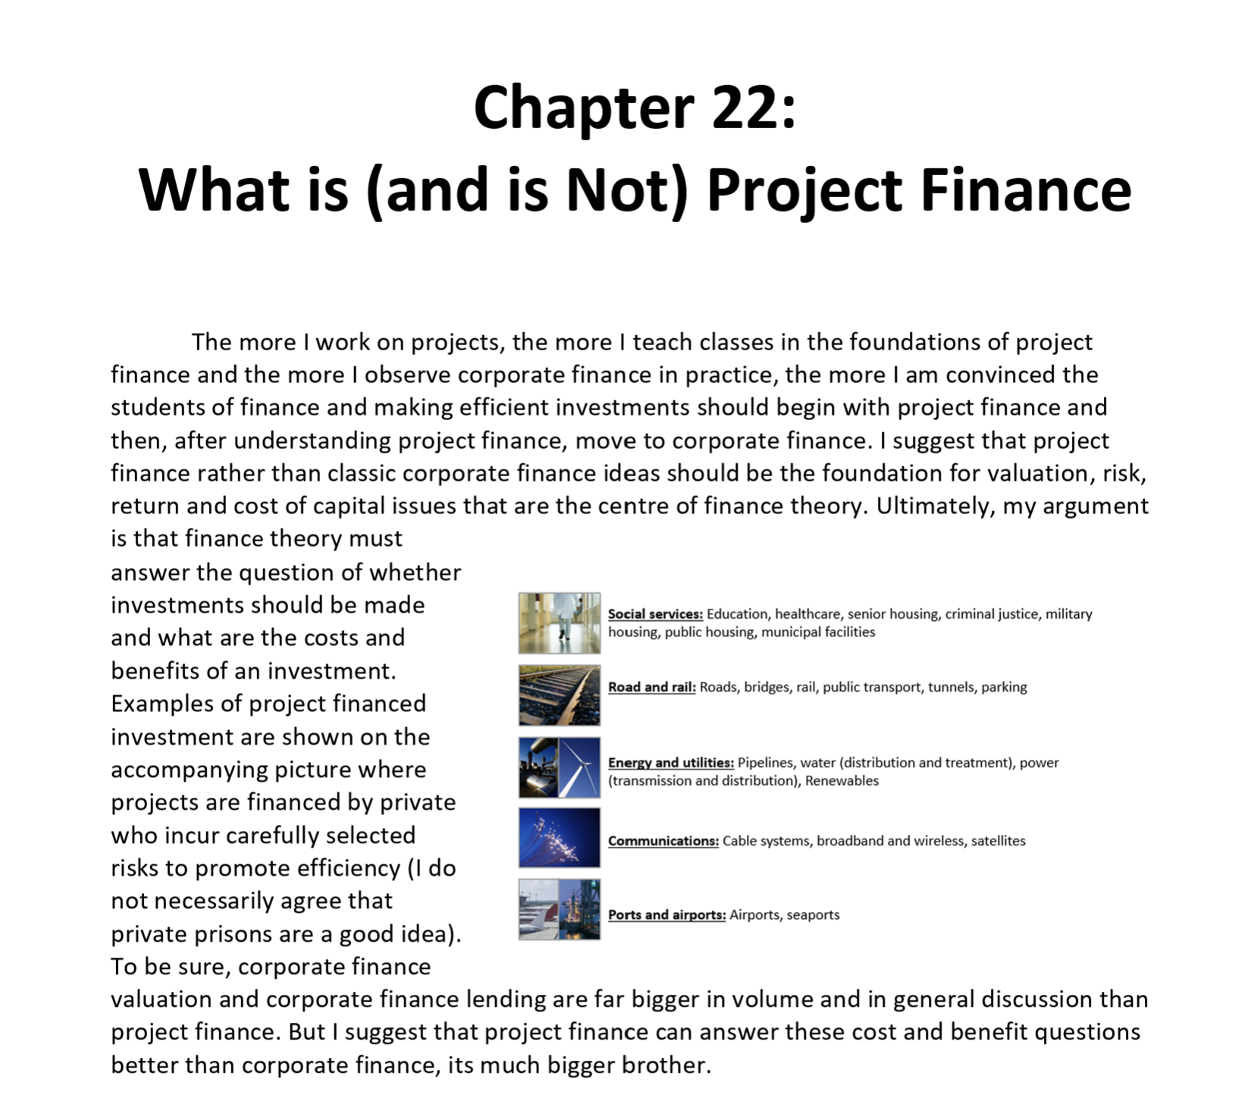

Ideas and Key Takeaways from Case Studies
What should you know about financial modelling
  Don’t be afraid of documents
  How much should you understand documents and analysis from financial advisor
  Uses of Models other than to evaluate the loan – demonstrate concepts
  Does the model really quantify the key issue

Slide 3
Project Finance Subjects
Extreme ideas about the essence of project finance and why project finance is better than corporate finance
Why risk and return comes down to two ratios in project finance – IRR and DSCR
Term sheet and understanding that DSCR is the driver and debt to capital is just a constraint
Strategy (games) if debt to capital is a constraint

Slide 4

Some Key Objectives of Project Finance
Four Pillars of Project Finance
Minimizing cost of capital for capital for intensive long-term investments through use of competitive bidding resulting low prices for in transport, water, electricity and other services.
Financing the project primarily with lenders (organizations with no direct stake in the ownership and development of the project) who will carefully and objectively evaluate risks and assure the project and will verify the project makes sense from a technical and economic perspective.
Using of price, construction and operation contracts that are structured with private entities to provide incentives for efficient construction and operations while not imposing uncontrollable risks on the private companies that increase cost of capital.
Structuring bids, limiting technologies, defining project parameters -- to encourage development of investments that incorporate positive externalities and betterment of society.

Slide 5
Session 1: What is Finance and What is an Investment

Slide 6
What is an Investment
The important thing about finance is that it guides you to make the right kind of investments that will ultimately make a society better off.
But what is an investment
  It is something where you have to incur a cost and then wait for benefits.
  It is all about time and not even necessarily about money
  Whenever you have to wait, there is uncertainty
Examples of investment
  Capital Expenditure for a project
  Spending money for sports betting
  Creating a new website for your company
  Hiring employees to study AI
  Government investing in basic research on the origins of life
  Writing a book
  Having a child
Question:
  Despite what you may hear on a YouTube advertisement, can you think of and investment gaining future benefits (happiness) without making an investment.

Slide 7
What is Return on an Investment and What is Cost of Capital
Making the correct investment that is best for you and for society is measured by the return on investment. Any return is a measure of the future benefits received compared to the investment made.
Assessment of the rate of return boils down to a cost and benefit analysis.
  The cost is the investment made
  The benefit is the future benefits received
  The ratio of benefits to costs measure the efficacy of an investment.
  The return to society can be different than the return to investors
  In project finance an economic return can be computed that accounts for things like carbon emissions, land use, increased employment, personal productivity and other factors.

Slide 8
What is not and Investment with a Return to Evaluate Costs and Benefits
A company spending money on advertising
Gambling on a football match
Going for a jog in the morning
Inheriting Money
Buying a Stock
Decision by Napoleon to Invade Russia
Buying a coffee
A company making a decision to merge with another company
A private equity company selling off a company
A country finding an off-shore oil and gas field
A city deciding to abandon trams in favor of car traffic
An industrial policy to develop green hydrogen

Slide 9
Finance is About Measuring Benefits and Costs of an Investment
Not just capital expenditures
A series of investments continually made

Slide 10
Rate of Return is the Fundamental Statistic in Measuring Costs and Benefits
Costs – Initial Investment
Benefits – Cash Flow or Income
Accounting Rate of Return = Income/Accumulated Investment
Cash Flow Rate of Return = Growth Rate in Cash Flow Relative to Initial Investment

Slide 11
Any Investment has at Minimum Three Things and a Rate of Return
Operating Period
Revenues Realized
Investment Period
Capital Investments
Return on Investment from Cash Flow versus Capital Expenditure
Operating Expenses
Project IRR, Unlevered Pre-tax IRR, Ungeared IRR, Pre-tax Project IRR

Slide 12
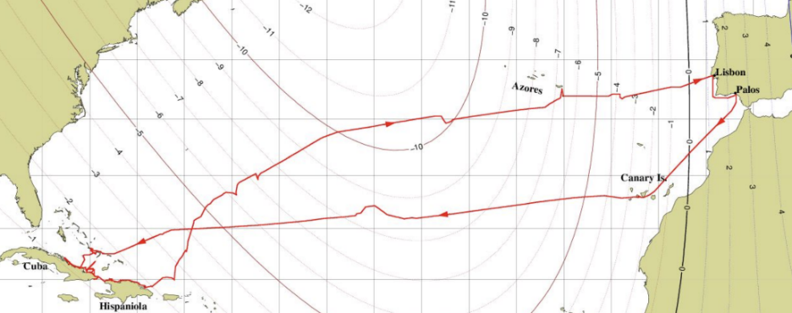
Example of Investments – Christopher Columbus
Cost of Investment
  Three Ships for about USD 3 Million
Financing of Investment
  Public Private Partnership
Forecast of Investment
  Distance from Portugal to India from estimates of the diameter of the earth
Risks of Investment
  Shipwreck, Mutiny, Voyage will take too long
You could think about computing the economic IRR of Columbus’ voyage, but I think it would be almost impossible to get your head around the societal costs and benefits and even make a vague estimate. Benefits could include starting the "Age of Discovery," providing massive wealth and new commodities for Europe; introducing crops like the potato and maize to the old world; allowing Spain to become a global superpower. On the other hand, the societal costs were devastating – genocide of indigenous peoples killing many millions; initiation of the transatlantic slave trade; the brutality and extreme violence of the conquistadors; the ecological impact of invasive species and livestock that permanently altered the American ecosystem.
Investment Committee Presentation
Public/Private Financing
Return on Investment from Gold
Incentives in contracts
Externalities

Slide 13

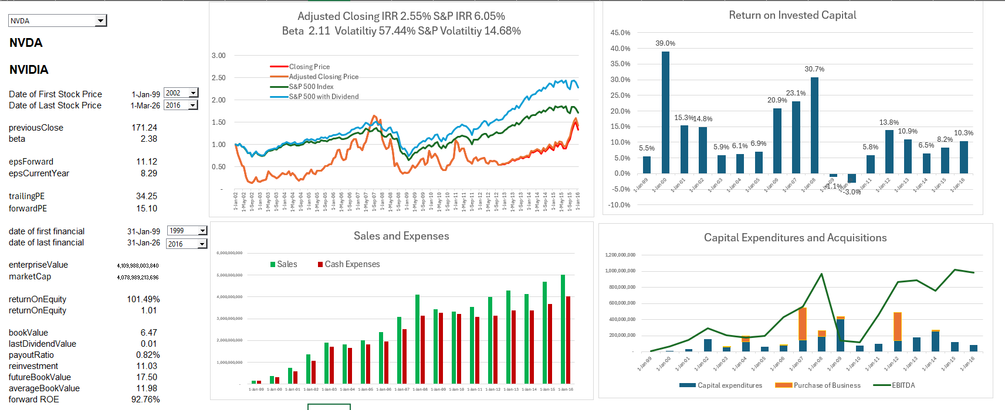
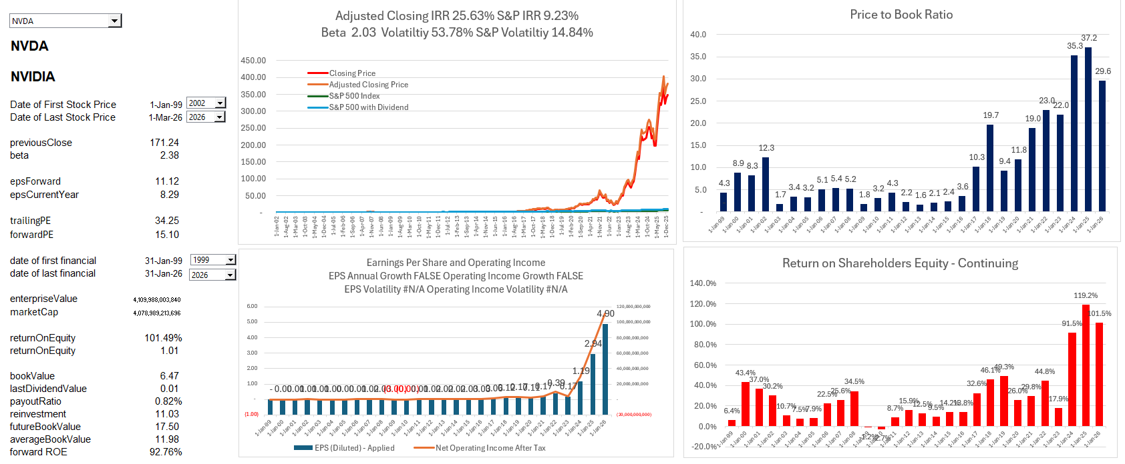
Example of Investment - NVIDA
Cost of Investment
  Acquisitions and Internal Development in beginning In 2006
Financing of Investment
  Public offering and cash from gaming chips
Forecast of Investment
  Finding an application for the faster calculation chips
Risks of Investment
  Faster calculation chips not needed for most applications
Externalities of Investment

Slide 14
Why Corporate Finance is Crap
Assumption of constant WACC and risk not changing
Measuring cost of capital and risk with beta
Computing equity market premium and not assessing the ability of companies to grow faster than the overall economy
Suggesting forever valuation can be derived from a simple formula CF1/(WACC-g)
Equity cost increasing with more debt, not the other way around where debt defines risk
Computing the most fundamental statistic – rate of return – is distorted (old asset has higher rate of return and many accounting issues)
Making forecast assumptions for a large corporation with multiple assets is not reasonable
When reviewing financial statements, you cannot see the profitability of new projects which indicates long-term value
Lenders do not really know whether cash flow is sufficient to repay debt; instead, they rely on the reputation of the company using statistics like Debt/EBITDA which a less precise than the DSCR

Slide 15
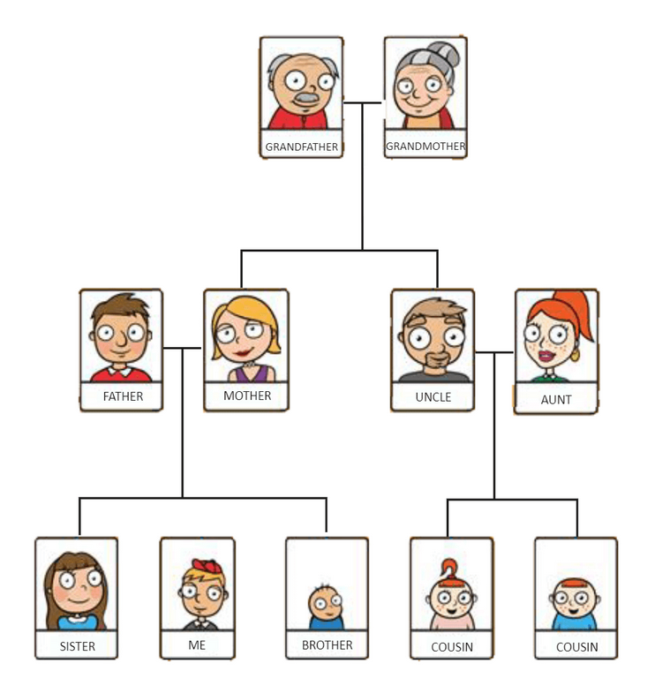
Family is Like a Corporation; Person is Like Project Finance – How would Value the Family
Success of a family depends on the success of individuals in the family
Person is the project going through different phases
Potential for Next Generation as a Guide for the Performance History of Prior Generation
Entire Family is the Corporation
Terminal Value of Future Generations Difficult to Compute – Comes from Potential from Future Generations

Slide 16
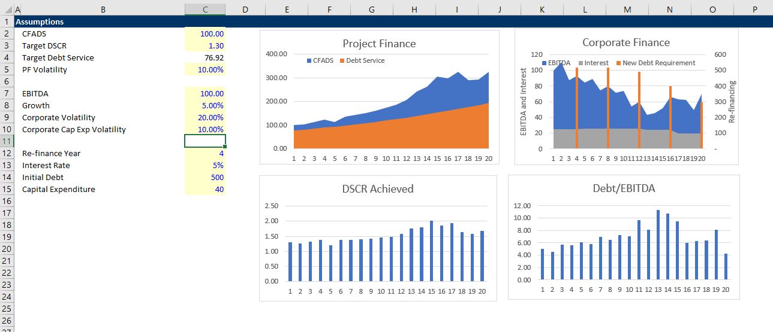
Simple Example of Credit Analysis in Corporate Finance and Project Finance
Illustration of re-financing risk in corporate loans versus DSCR in project finance.

Slide 17
The Night Before and Pillar 1
In modern project finance revenues and prices are generally structured with a competitive bid process (it is of course possible to have competitive bidding without project finance).
The implied objective of competitive bidding is that the price to consumers and cost of capital will be as low as possible – meaning the investor return is something close to its cost of capital.
I ask about the “night before.” This is when people who have been working on developing projects for many months and have discussions with the chief financial officer about the acceptable IRR just before making the bid. I imagine (I think correctly) a phone call between the developers and the CFO where the developer tells the CFO that unless you lower the IRR requirement, we will lose the bid.
What this night before is doing is establishing the lowest acceptable rate of return in the context of the risk of the project which is the definition of cost of capital.

Slide 18
Pillar 2:
Classic Definition of Project Finance as Debt, Project Finance Terms and Risk Verification

Slide 19
Definition of Project Finance and Concepts
In this section I focus on lender analysis in project finance and how it differs from corporate, asset and object finance;
  How is this different from other lending, what does non-recourse or limited recourse actually mean and who guarantees;
  Use of special purpose vehicle structures, how this looks in a project structure and why are they needed;
  When project finance can be an effective solution;
  Timelines, i.e. what happens and when;
  Overall contractual architecture in structured non-recourse transactions (for example renewable energy projects) and how does this differ from traditional Public Private Partnerships (PPPs);
  Recent trends on the use of project finance and the links with PPPs.

Slide 20

Project Finance Definition in HBS Cases
J.D. Finnerty
… the raising of funds on a limited or nonrecourse basis to finance an economically separable capital investment in which the providers of the funds look primarily to the cash flow from the project as the source of funds to service their loans and provide the return of and return on their equity invested in the project.
Terms in definition
  Limited or nonrecourse
  SPV – economically separable investment
  DSCR – key measure of risk of default
  IRR - Return on and of equity

Slide 21
Terms in Finnerty Definition
The first term is nonrecourse debt.
  I define the notion of nonrecourse as analogous to the lack of ability achieve guarantees from your parents where you cannot send an email to them and ask for money. Getting money from your parents is a parent guarantee is recourse, which is the opposite of nonrecourse.
The second is separable capital investment.
  The idea of a separable investment means that an asset can have different investors, and its cash flow can be measured on distinct financial statements. The separable investment can be called a special purpose vehicle, which is simply a corporation set-up to own the asset. This allows bank financing specifically associated with the project cash flow.
The third term are the two words, cash flow.
  By including the notion of cash flow in the project finance definition (contrasted to earnings per share that are affected by depreciation, impairment charges other accounting adjustments), Finnerty’s definition emphasizes the way cash flow can directly be used in project finance.
The fourth item involves the ability to service loans.
  Servicing debt introduces the notion that in project finance, the debt service – the interest and repayment on debt – is directly related to cash flow.

Slide 22
More Definitions – Do Not See the Beauty of Project Finance
Definition Two: Project financing is a loan structure that relies primarily on the project's cash flow for repayment, with the project's assets, rights, and interests held as secondary collateral.
Definition Three: Financing of a particular economic unit in which a lender is satisfied to look initially to the cash flow and earnings of that project economic unit as the source of funds from which a loan will be repaid and to the assets of the economic unit as collateral for the loan.
Definition Four: Project finance involves the creation of a legally independent project company financed with nonrecourse debt (and equity from one or more corporate entities known as sponsoring firms) for the purpose of financing investment in a single purpose capital asset, usually with a limited life.
Definition Five: Project finance is used to refer to a non-recourse or limited recourse debt financing structure in which debt, equity and credit enhancements are combined for the construction and operation or refinancing of a particular facility in a capital-intensive industry.
Investopedia, definition of project finance
Nevitt, P.K. and Fabozzi F, Euromoney, Project Financing, 7th Edition, London

Slide 23
More Terms from the Project Finance Definitions
The term “loan structure that relies on cash flow” implies a loan structure where the debt service mimics projected cash flow and implies something named debt sculpting where the repayment of debt goes up and down with the expected cash flow patterns of the project.
The term “secondary collateral” is the value of a project that can potentially be realized through sale of the asset. This concept is not important in project finance because the value of a project comes from cash flow.
The term “sources of funds” points to the idea of cash flow and that the essence of evaluating project finance are two cash flow statements. The first is the sources of cash flow that are paid for constructing the assets while the second is the cash flow returned to investors after operation starts.
The term “legally independent project company” emphasizes the notion that the special purpose company can have different investors is the company that repays debt.

Slide 24
More Terms from the Project Finance Definitions
The term “sponsoring firms” simply refers to the investors in a project. Investors in a public corporation may add up to millions. In project finance there are just a couple of partners.
The term “limited life” in project finance means what is says, but it is important because cash flow analysis can be made over the entire life of a project. The amount of time between the end of the limited life and the end of debt term is called the tail.
The term “credit enhancements” refer to mechanisms that protect debt through limiting dividends. These credit enhancements include covenants that do not allow dividends when ratios fall below a certain level; covenants to repay debt early instead of paying dividends (cash flow sweeps); and cash held on the balance sheet to provide cash in emergency situations.
The term “refinancing” refers to re-paying exiting debt (generally before the end of the term of the debt) and replacing the existing debt with new debt that has better terms.

Slide 25
Problems with the Project Finance Definition: Aspects of Project Finance Other than Debt Ignored
All the definitions miss the pillars of project finance related to:
  encouraging efficient construction and operation using contracts;
  the essential point of achieving low prices for consumers and low returns relative to cost of capital through bidding;
  Explicitly managing externalities through disqualifying certain projects and encouraging others.

Slide 26
Non-Recourse Debt is a Beautiful Thing
That is how we get a real test of an investment

Slide 27

Why is Non-Recourse and No Parent Support so Important In Essence of Project Finance
No parent guarantees (your children cannot send and email and receive your financial support like my daughter).
From a valuation and from a loan perspective a project must be economically viable and evaluated on a standalone basis. In corporate finance and regular old capital budgeting there is no such test.
Philosophical question – is a child with a lot of parent support able to perform better than one with none.
If you know there is a rich parent behind you, can you use this even if there is no direct promise.

Slide 28
The Real Import of Nonrecourse
The example of parental support (a term used in project finance) makes you understand that the real import of nonrecourse financing is that a project must be able to be viable on a standalone basis.
Now think about nonrecourse and investment assessment. Not only do you have a third party assessing the viability of a long-term investment; this assessment of is made on a pure basis where the risks and the economic viability are directly evaluated.
Question: Without nonrecourse provisions in project finance debt, would the example of the two people making presentations be relevant

Slide 29



Which is a Better Way to Assess the Value of an Investment – Two Presentations to the Board
Value and Risk Verified by Investors Outside of the Company
  Bank Puts money into the company
  Makes sure the money will be paid back
  Crucial stamp of approval

Slide 30
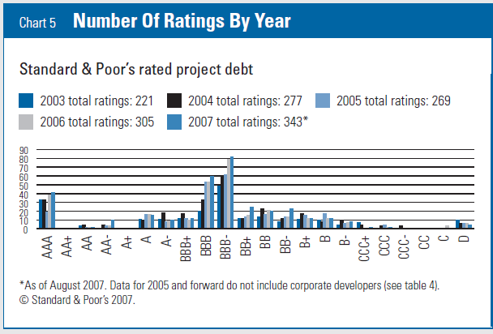
In Project Finance, Risk is Managed to Achieve BBB- (Baa3)
Example, the DSCR of 1.20 x for a solar project should have and footnote to be on a BBB equivalent.
Why BBB- and not AA
Why BBB- and not BB-
Understand the key difference between corporate finance where risk is given and the amount of debt increases or decreases risk versus project finance where you start with risk and back into the amount of debt to give a similar risk profile.

Slide 31
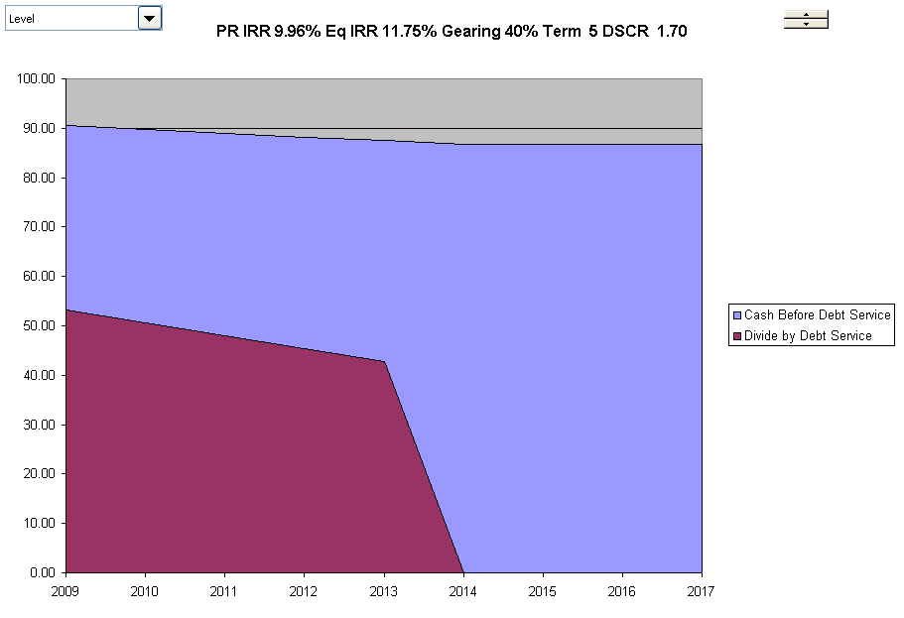
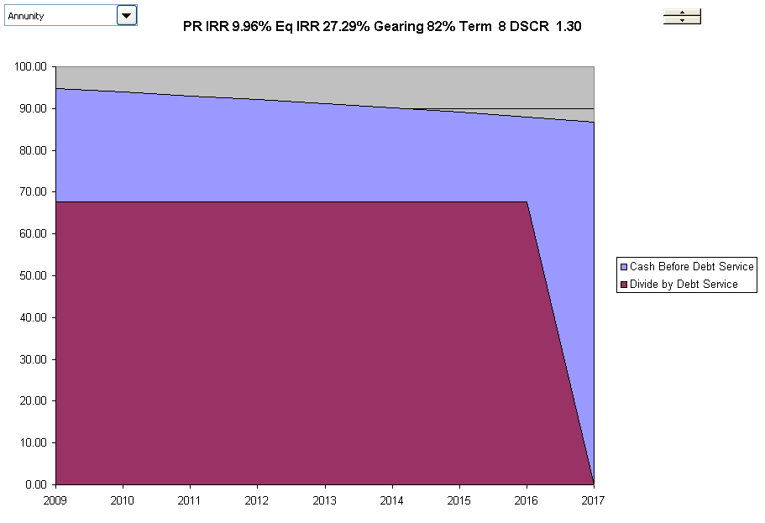
Risk Measured by Bank from Buffers on Cash Flow Forecast DSCR with High and Low Risk
High Risk Cash Flows
Low Risk Cash Flows
High Risk Project has higher margin, shorter-term and declining debt service. Low risk has flat debt service, and longer-term and higher IRR on Equity

Slide 32
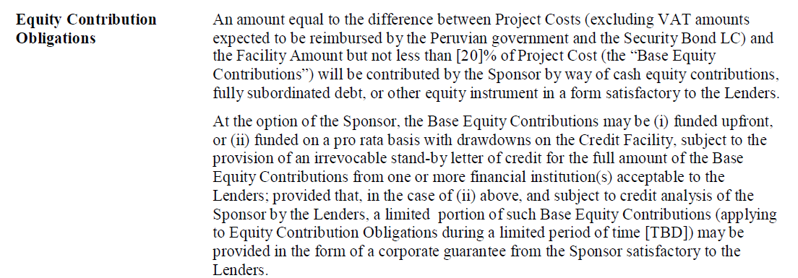
Language of Term Sheet Illustrating Parent Support
Why do they write sentences like this.
How would you read and interpret this if you were trying to understand the term for the first time.
Under which scenario is the loan partial recourse and under which scenario is it full recourse.

Slide 33
The Essence of the Verification Pillar of Project Finance
Revenues Realized
Go Around the Bend and Assure that Risks are Mitigated or Reasonable.
If all of the risks are acceptable and produce reasonable cash flow relative to the amount paid on debt, the lenders will put a lot of money into the project.
Reputation of the equity sponsors is important even if the loan is non-recourse.
Note the IRR and the DSCR from cash flow as the performance metrics for the project.
Start
Capital Investments
Operating Expenses
Special Purpose Vehicle:
Project IRR
End
Lenders Receive Debt Service and Invest Debt
DSCR
Equity Sponsors Receive Dividends and Invest Equity – Equity IRR
Project Finance is a method of financing where the costs and benefits of long-term capital-intensive assets can be assessed from the structuring of debt by lenders. Structuring of debt considers the cash flow derived directly from the asset (non-recourse). Project finance typically involves management of risks through a series of contracts where risks are designed to provide incentives for project parties to efficiently manage construction and operation of a project. Project finance can low cost of capital with transparent and manageable risks and demonstration of support from lenders.

Slide 34
Risk Analysis in Project Finance Models
Project finance analysis to a large degree involves identifying, allocating and mitigating risk. One must therefore be able first to identify risks and then to measure how effective the contracts and other mitigating factors (covenant, debt service reserve, liquidated damage) are in managing risk.
Project Finance Adage:
  At the beginning of the project
    Lender has the money
    Developer has the experience
  At the end of the project
    Developer has the money
    Lender has the experience

Slide 35
Ras Laffan and Petrozuata
Structure, IRR, DSCR

Slide 36
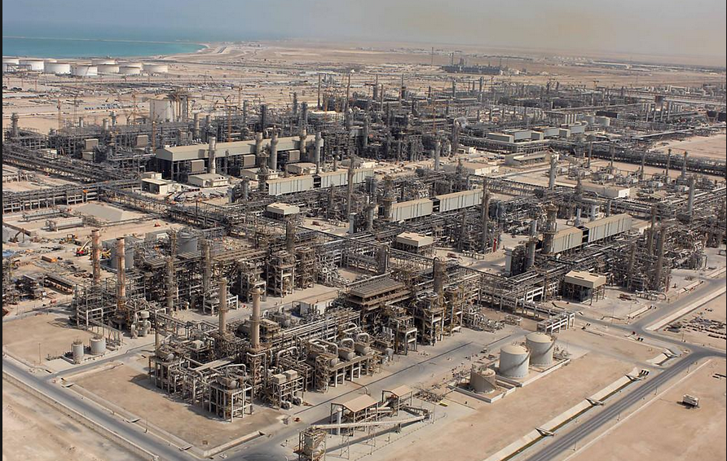
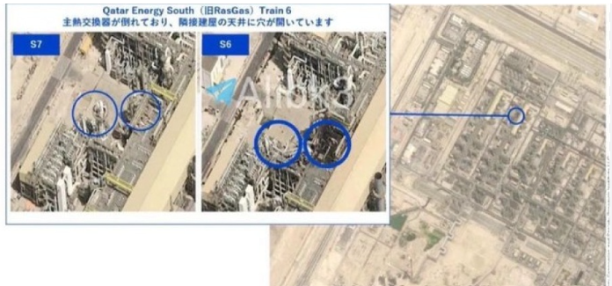
Ras Laffan in Qatar - 1996 COD

Slide 37
Issues to Discuss – Ras Laffan
Read the Pre-Sale Report – The Strengths
  Could Qatar have hosted the world cup without project finance
  Simulate the importance of Exxon
  List the risks and mitigations
  Could there have been more problems if the State of Qatar was not the biggest sponsor
  Contrast project finance with State Ownership
Open the Model
  Why do the fundamental economics of the project work or do not work
  What notes would you put in the diagram
  How do you think the break-even gas price was computed – DSCR, LLCR or PLCR

Slide 38
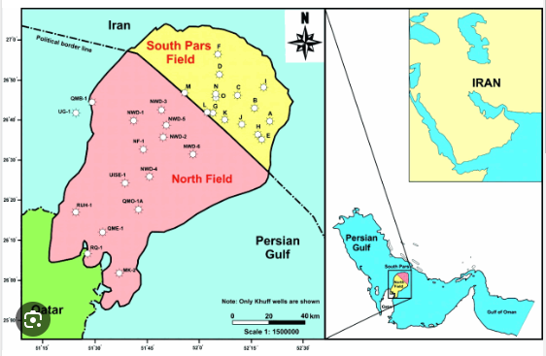
Illustration of Gas Lake Under the Gulf
What is the South Pars gas field?
South Pars is part of the world’s largest natural gas reserves, located offshore in the Persian Gulf. It is shared between Iran and Qatar, which calls its part of it the North Dome.
Cost of production of natural gas is low
The entire ​gas field contains an estimated 1,800 trillion cubic feet of usable gas — enough to ​supply the world’s needs for 13 years.

Slide 39
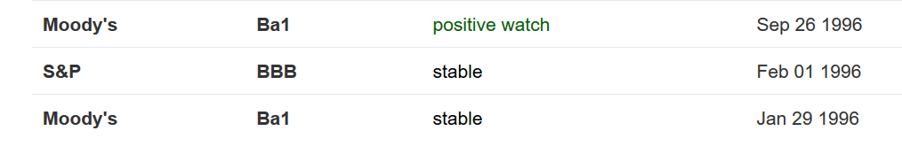
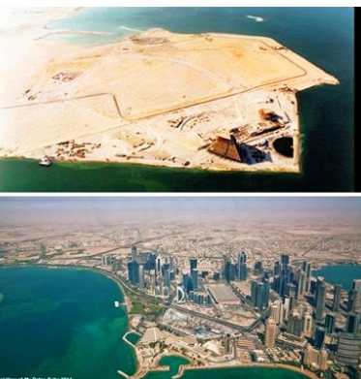
Country of Qatar Background before and After Project
Imagine you were from the government of Qatar, and you asked to for billions of dollars in loans to build LNG facilities.

Slide 40
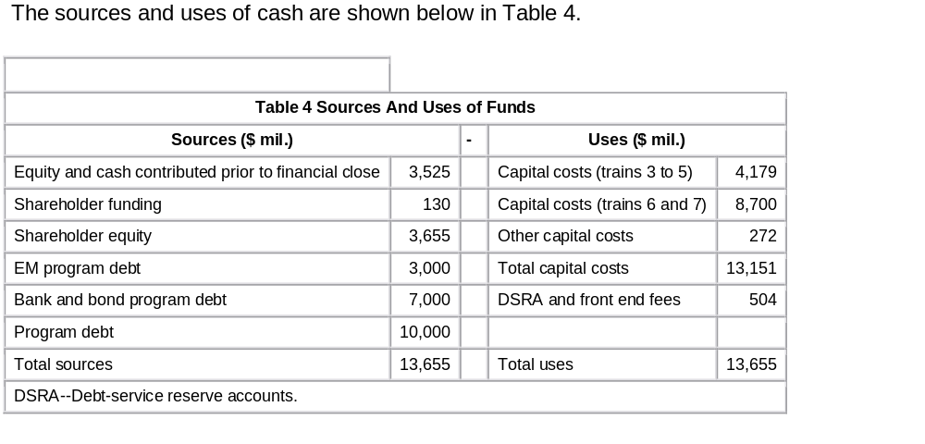
Example: Ras Laffan Liquified Gas Company (Ras Gas) – Two Trains
Summary of Original Transaction
  Project: Two LNG Trains and cost of developing natural gas reserves
    Cost $3.4 billion
    5.2 millions of tons per annum
Equity Sponsors
    70% State of Qatar
    30% Mobil Oil
EPC Construction Contracts
  JCG/MW Kellogg for LNG Trains and on-shore facilities
  McDermott-EPTM/Chiyoda for off-shore platforms
  Saipan for off-shore pipeline connection
Now there are 14 trains

Slide 41
Ras Laffan Liquified Gas Company
Financing of $3.4 Billion
  $850 million in Equity
  $465 million supported by US EXIM
  $250 million supported by UK ECGD
  $185 million supported by Italy’s SACE
  $450 million uninsured loan from commercial banks
  $1,200 million from bond markets
    10-year and 17-year maturity
    Rated BBB+ by S&P
    Rated A3 by Moody’s
Revenue Contracts
  25-year contract with Korea Gas Corporation for output of one train
  Korean Gas Corporation built receiving facilities and purchased ships ($3.1 billion)
Relatively unconventional technology, no projects in the country and can achieve bond rating better than country rating

Slide 42
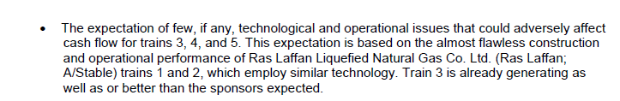
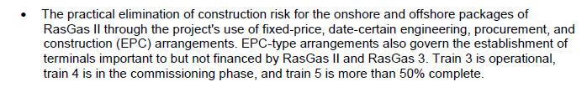



Use Snipping Tool to Fill in Items from Pre-Sale Report
Proven (boring) technology
Construction Cost Over-Run Risk
Supply Risk
Volume Risk
Price Risk

Slide 43
Financing Terms and Risks
Phase 1 Financial Structuring
  Cash flows from Trains 3-4 to support Phase 1 debt
  Essentially a financing of Trains 3-4 to fund expansion
Phase 1 Financing Key Risks
  Train 3-4 Operations
  Shipping and Access to Markets
  Revenue Risk (Price x Volume)
Terms
  Series A Bonds (15-yr): LIBOR + 97 bp
  Series B Bonds (22-yr): LIBOR + 130 bp
  International Banks: LIBOR + 45-65 bp
    Up-front Fee (Arranger Fee) = 60 bp
    Commitment Fee = 20 bp p.a.
Phase 2 Scope: Completion of Train 6 and Fund Construction of Train 7
  Estimated Debt: US$5.4 billion (Will likely require completion guarantees)
Track record
Shipping contracted
Sale & Purchase Agreements in place with creditworthy counterparties (Petronet, Edison, Endesa)

Slide 44
Exercise: Draw a Diagram of the Ras Laffan Project
.
Ras Laffan
Special Purpose Vehicle: Bond Rating of A-

Slide 45
Ras Laffan Diagram
Off-taker: Korea and Japan Utility Companies: Want strong off-taker with inactive to honor contract
EPC Contractor: Kellogg with Strong Record and Finances
Price of Gas Linked to Oil Price
Off-take Contract with minimum supply
EPC: Fixed Price Contract with LD
Special Purpose Vehicle: Bond Rating of A-
O&M Contractor
Supplier: Need to Understand Economics and Supply Curve
O&M Contractor
Supply Agreement
O&M Agreement
Loan Agreement – Draws Green; Debt Service Red
Sponsors: Want strong sponsor:
Mobil
State
Shareholder Agreement
Lenders:
Issued bonds and debt with long tenor and low rates
Lenders:
Issued bonds and debt with long tenor and low rates

Slide 46
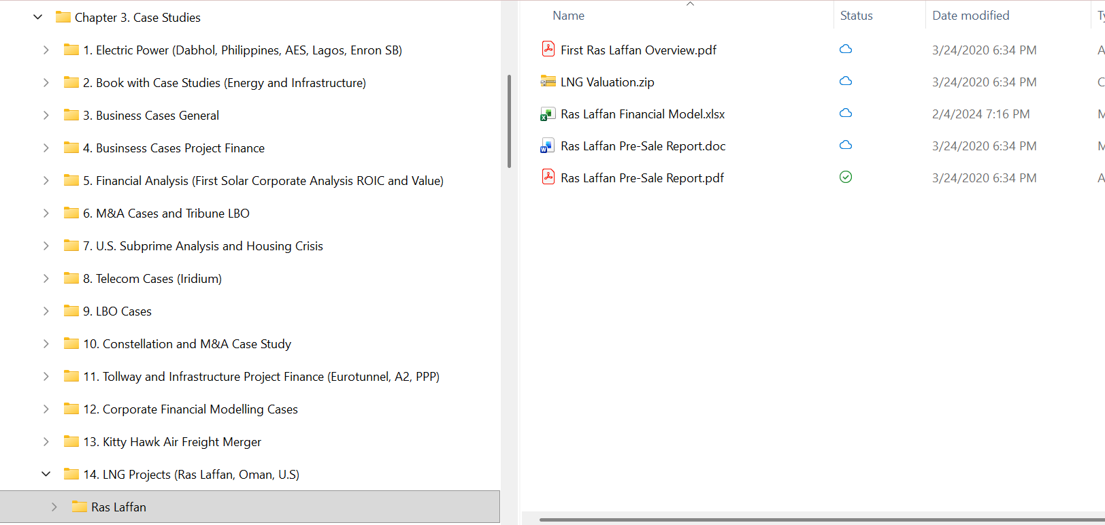
Open the Financial Model
Use the financial model to quantify risks
  Present and discuss the cost structure
  Break-even Oil Price
Volume Risk
Price Risk

Slide 47
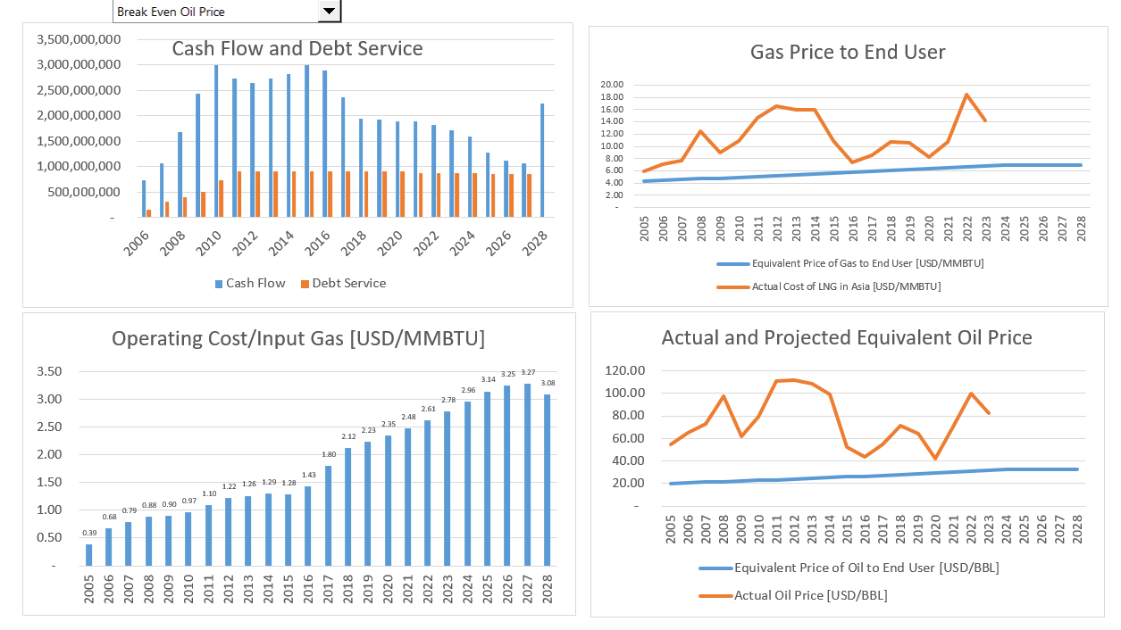
Financial Model – Assumptions from Financing Documents
.

Slide 48
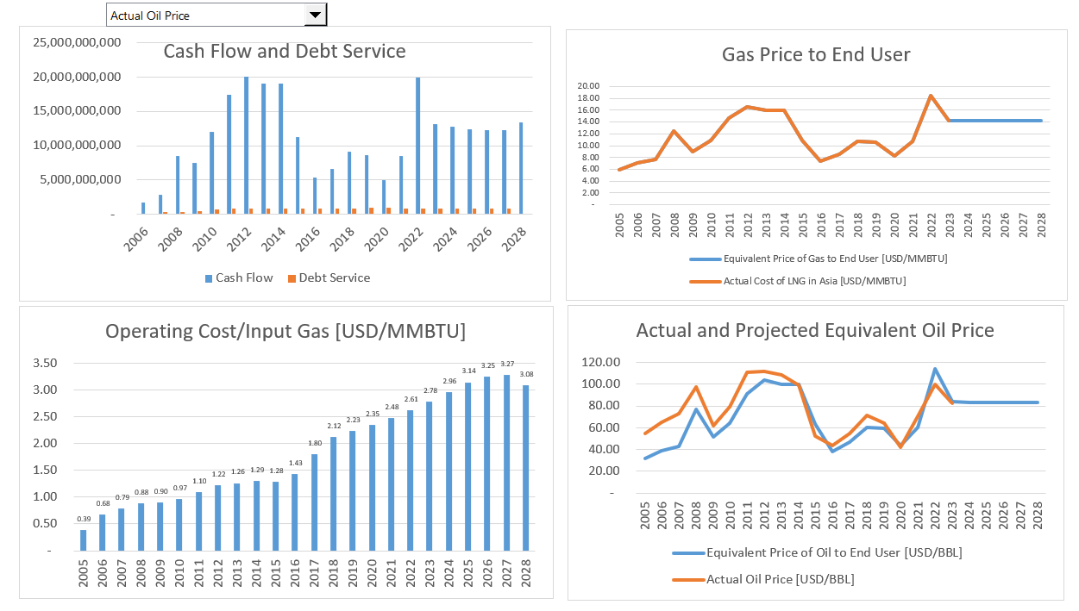
Financial Model with Actual Gas/Oil Price
How much Cash Flow Relative to Investment
.

Slide 49
Section 2:
Two Statistics in Project Finance:
IRR and DSCR

Slide 50
Equity Valuation in Project Finance –
The IRR

Slide 51
Project IRR, Debt IRR and Equity IRR Interpretation
The debt IRR can be computed from the perspective of debt holders. The debt drawdowns are the negative cash flow while the debt service including interest and principal are positive cash flows. The fees should be included as cash flow. The debt IRR can be called the effective interest rate or the all-in rate.
The project IRR is an effective statistic for evaluating the overall competitiveness of a project. If the project IRR is very high, you should ask questions about why others cannot create similar projects and charge a lower price. If the project IRR is below the cost of debt, you should ask why the project is occurring.
The equity IRR is the focus of investors because it reflects money taken out of their pocket relative to dividends received. In structuring debt terms such as a cash sweep or the debt to capital, the equity IRR can be used to understand the perspective of the sponsor.

Slide 52
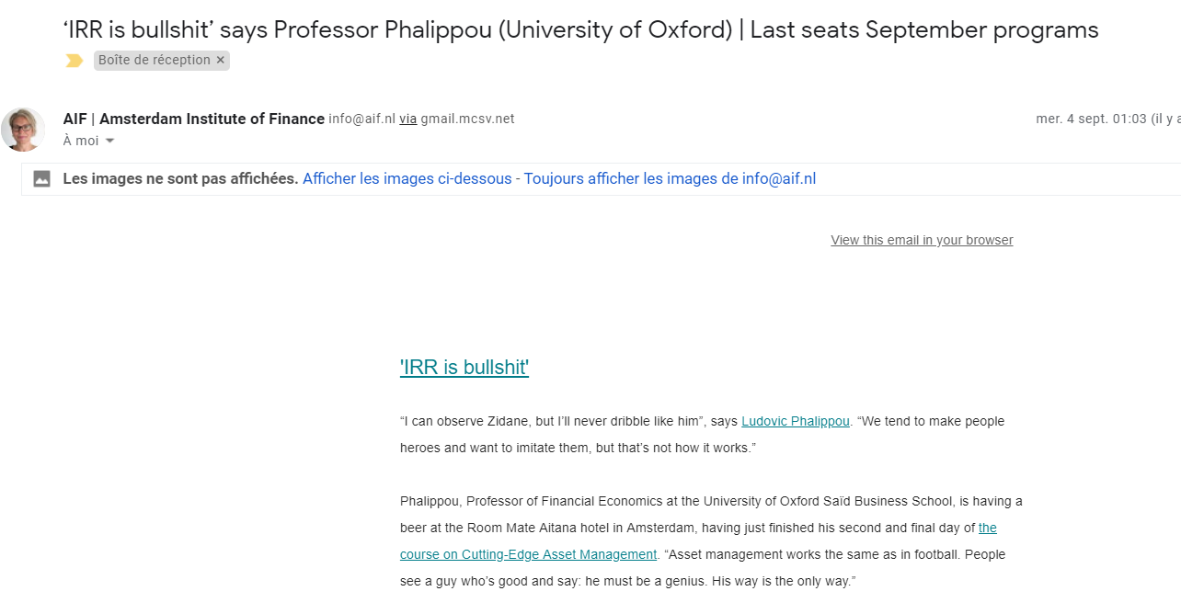
IRR had Taken over the World – Calling it BS is Absurd
Project is typically valued with IRR
Different IRRs
  Project IRR pre-tax
  Project IRR after-tax
  Debt IRR pre-tax
  Equity IRR – Overall
  EBL or Shareholder Debt IRR
  Pure Equity IRR
  IRR with and without Development Fee
  Holding Company IRR

Slide 53
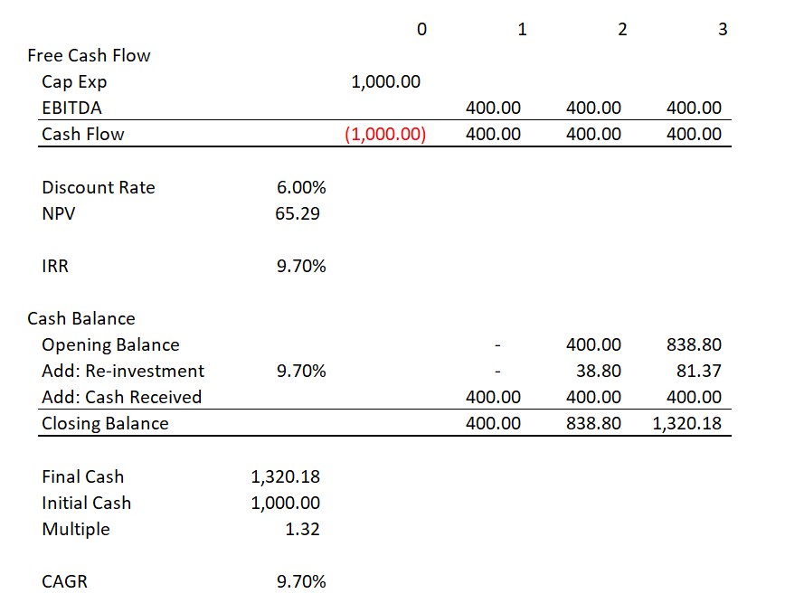
Calculating the IRR by Hand
Compute IRR by Hand without Excel
Compute IRR for one year – I will check your result with excel
Compute IRR for construction and three year with your phone – I will check your result with excel

Slide 54
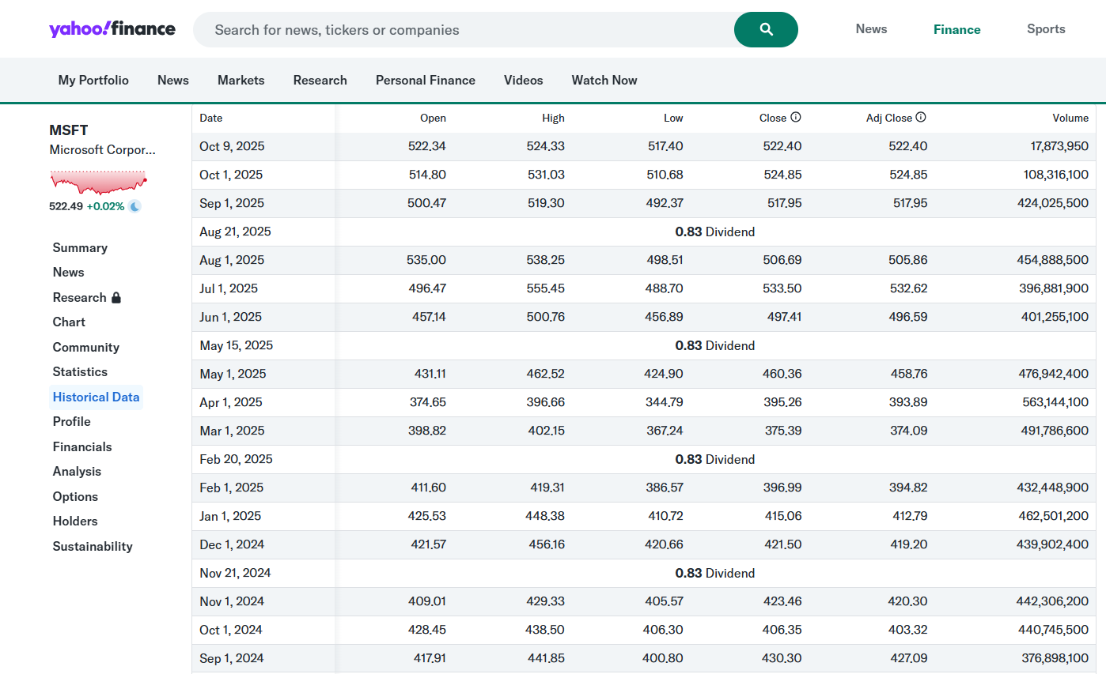
IRR from Investing in a Stock and Yahoo Finance Adjusted Stock Price
People who want to get rich, care about one thing. That is, how fast will your money grow and can it keep growing over a long period

Slide 55
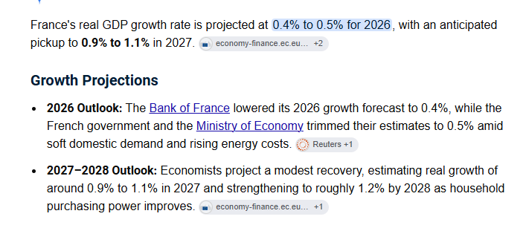
What Kind of IRR is Reasonable
Most fundamental and controversial idea:
The key insight, which draws on earlier work by a number of authors, was that aggregate corporate profits cannot grow indefinitely much faster—or much slower—than GDP. (And as Herbert Stein was fond of reminding us, any economic trend that cannot continue forever will not.) If profits grow faster than GDP, they eventually take over the economy, leaving nothing for labour, government, natural resource owners, or other claimants. If profits grow more slowly than GDP, they eventually disappear, and businesses will have no profit motive to continue operating. Thus, in the very long run, the ratio of profits to GDP is roughly constant.
Think about EDF
  EDF uses money from the people of France to make Investments
  Supposedly the well being of people in France grows with the economy
  If EDF makes investments that grow as much as the economy then the EDF investments are a wash from the perspective of people in France
  If EDF makes investments that grow more, than the people will be better off

Slide 56
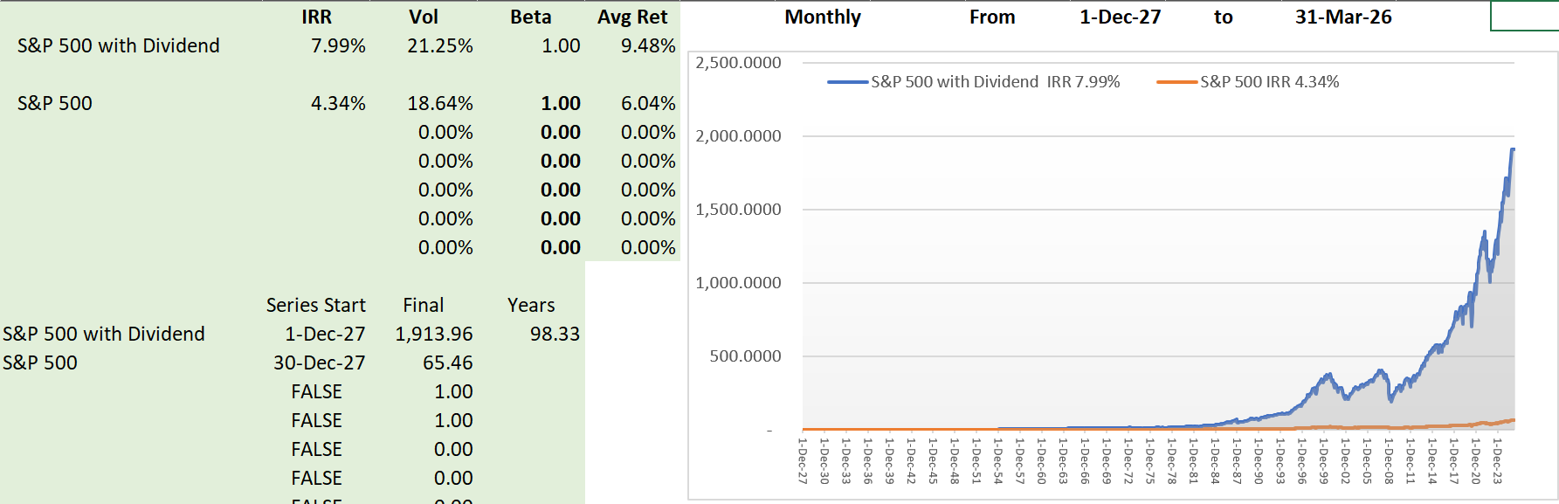
Compute IRR for Stocks and Prove the IRR is the Growth Rate
Understand why investors care so much about IRR
IRR on Stocks using S&P 500

Slide 57
Alternative – Look at Actual Growth Rates in GDP and in Stocks in Real Terms
Silly to look too long
Silly to look too short
Look at 20-year periods (invest at the beginning, see where you are at the end of 20 years)

Slide 58
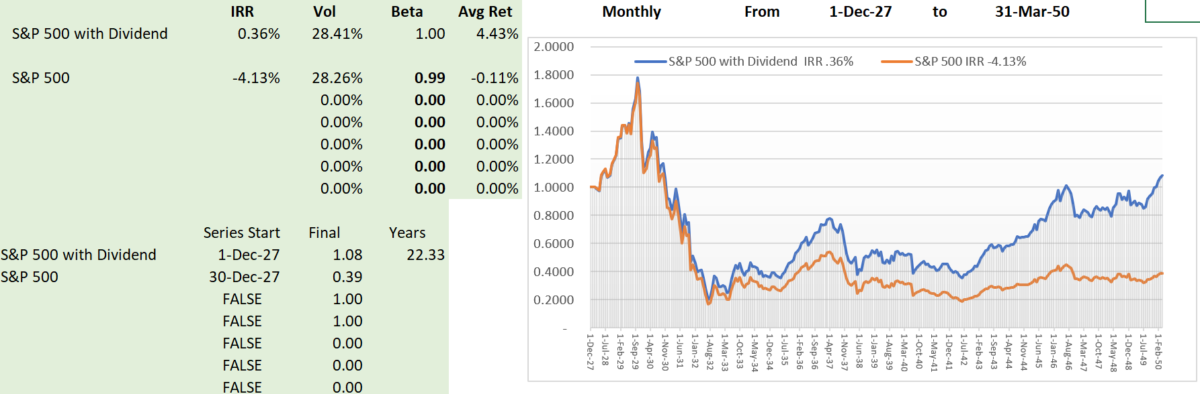
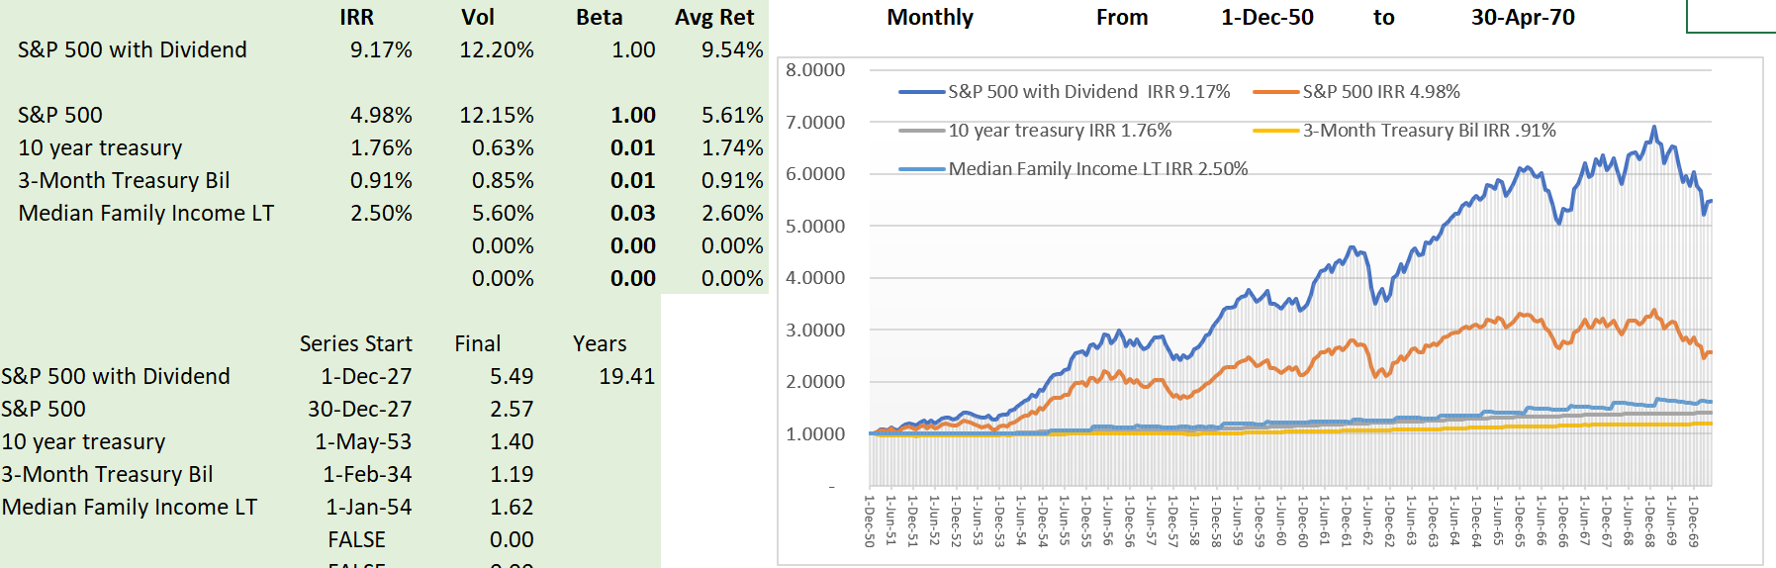
Growth in Stocks Adjusted for Inflation
First two periods – all of the growth rates are real growth (without inflation)
Silly idea that in the very long term, stock prices will adjust to required returns
Second period is incredible

Slide 59
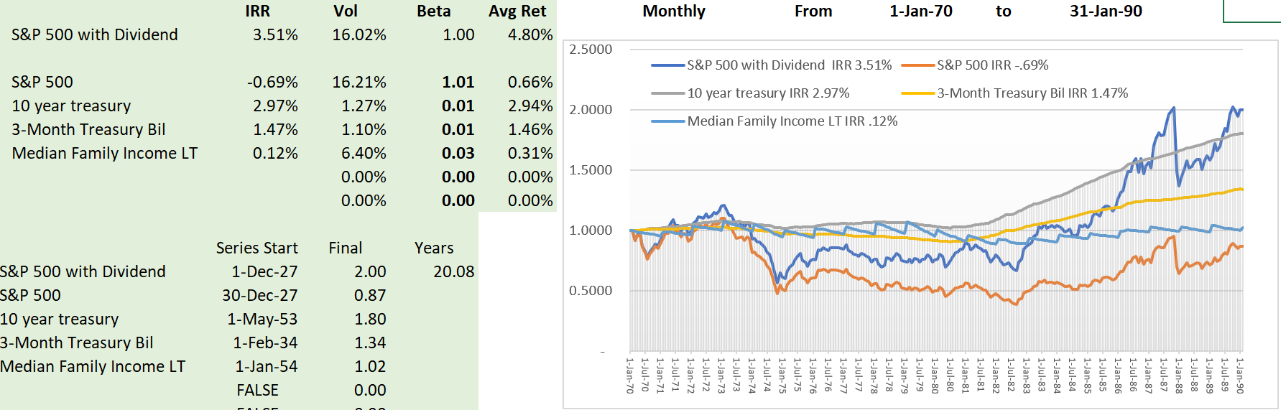
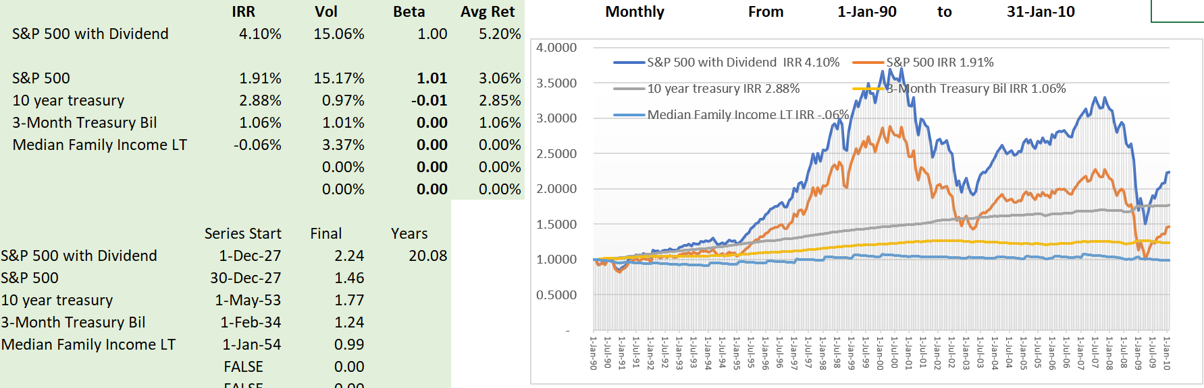
Next Periods Two Periods Not as Good
Oil Crisis, Dot Com Bubble, 2008 Financial Crisis
Median family income lagging

Slide 60
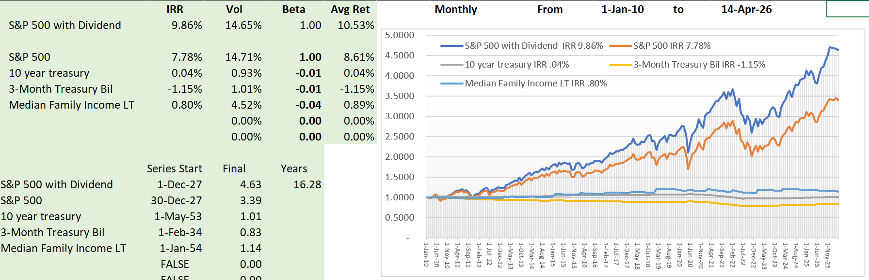
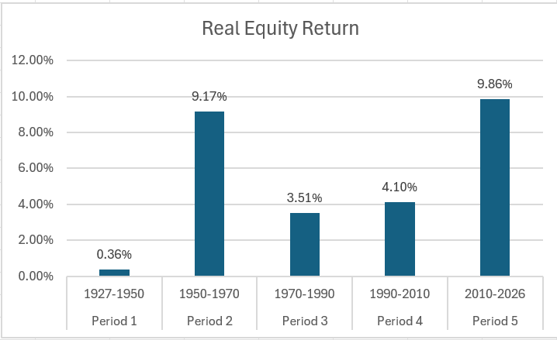
Final Period – Is this Sustainable
Real rates of return extremely high
Difference between stock growth and growth in income very high

Slide 61
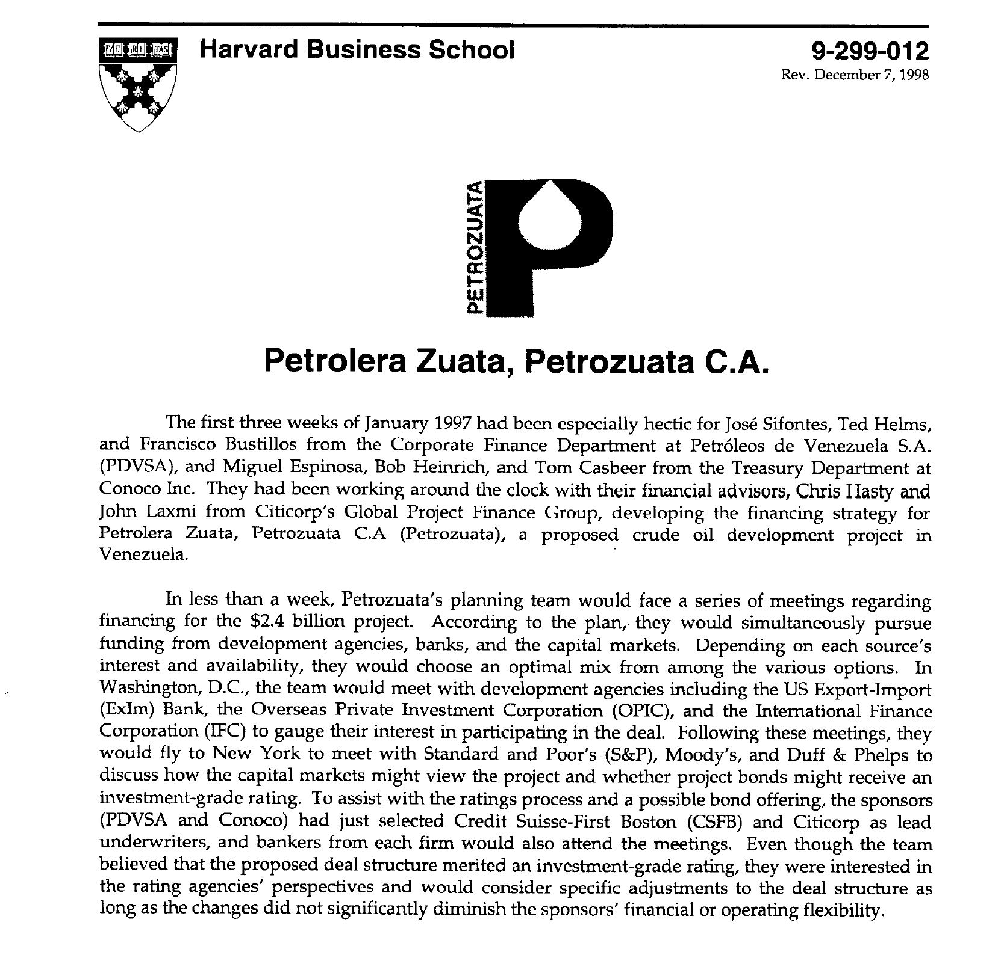
HBS Case Study
Read through case study – what would you look for

Slide 62
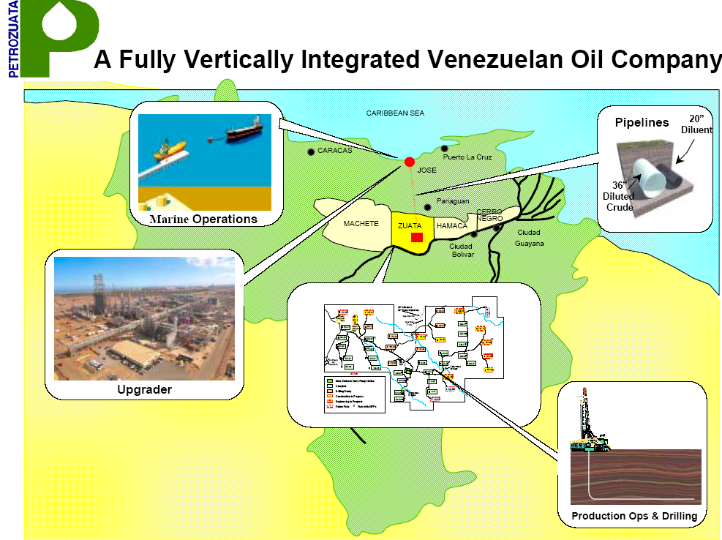
Diagram of Facilities
This shows the location of facilities
Heavy oil is analogous to mining
The upgrader is similar to a refiner

Slide 63
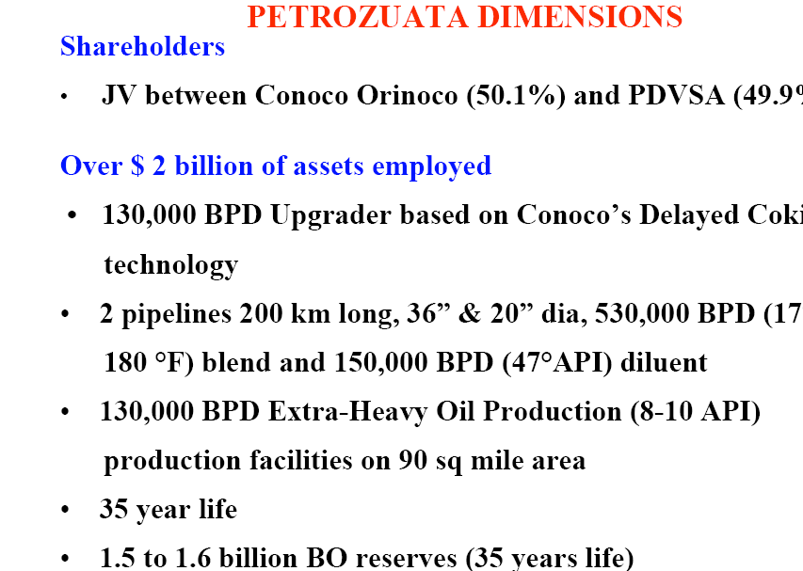
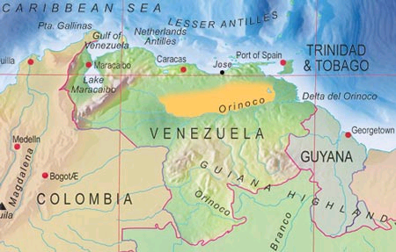
Petroleos de Venezuela (PDVsa) Perspective

Slide 64
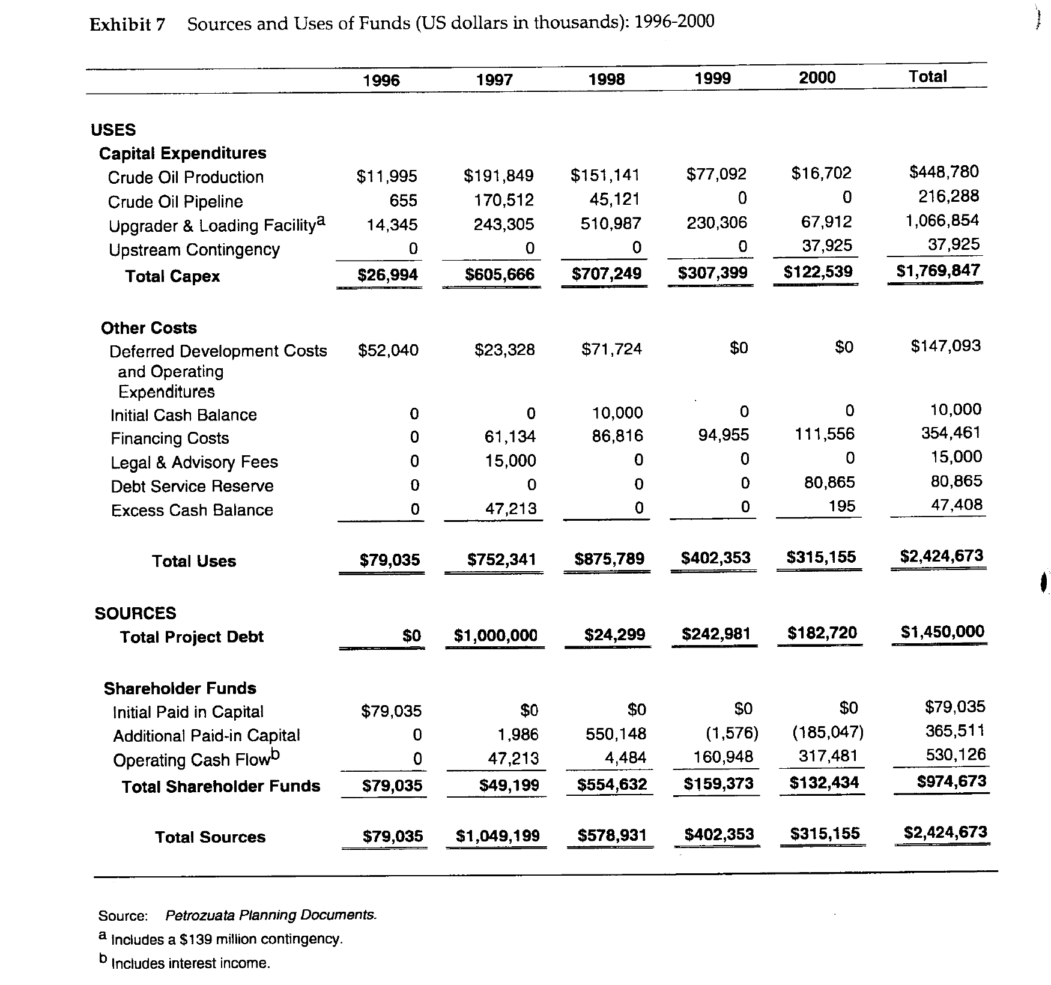
Key Exhibits to in Case Study
Understand construction period
Compute the Debt to Capital Ratios
How did the paid in capital affect the IRR

Slide 65
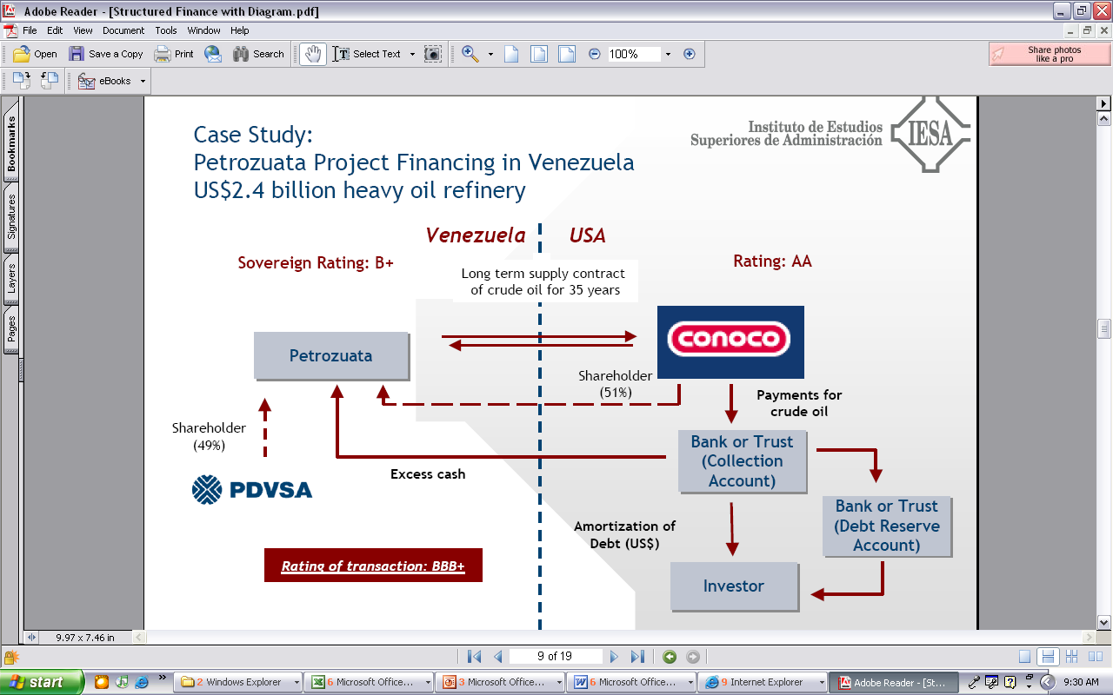
Cash Collection in Petrozuata

Slide 66
Petrozuata Revised Diagram
Conoco US Refinery
PDVSA
Refinery
Conoco
Venezuela Govt - Royalty
Conoco
Purchase Agreement
Oil Price
Opening of Orinoco Belt Agreement
Royalty 1%; Tax 34%
EPC Contracts
Venezuela Govt - Tax
SPV – Petrozuata
BBB+
Exploration
O&M
Conoco, PDVSA
Loan Agreement, Inter Creditor
Shareholder Agreement
Bonds
Conoco 51%
Bank Debt
PDVSA 49%

Slide 67
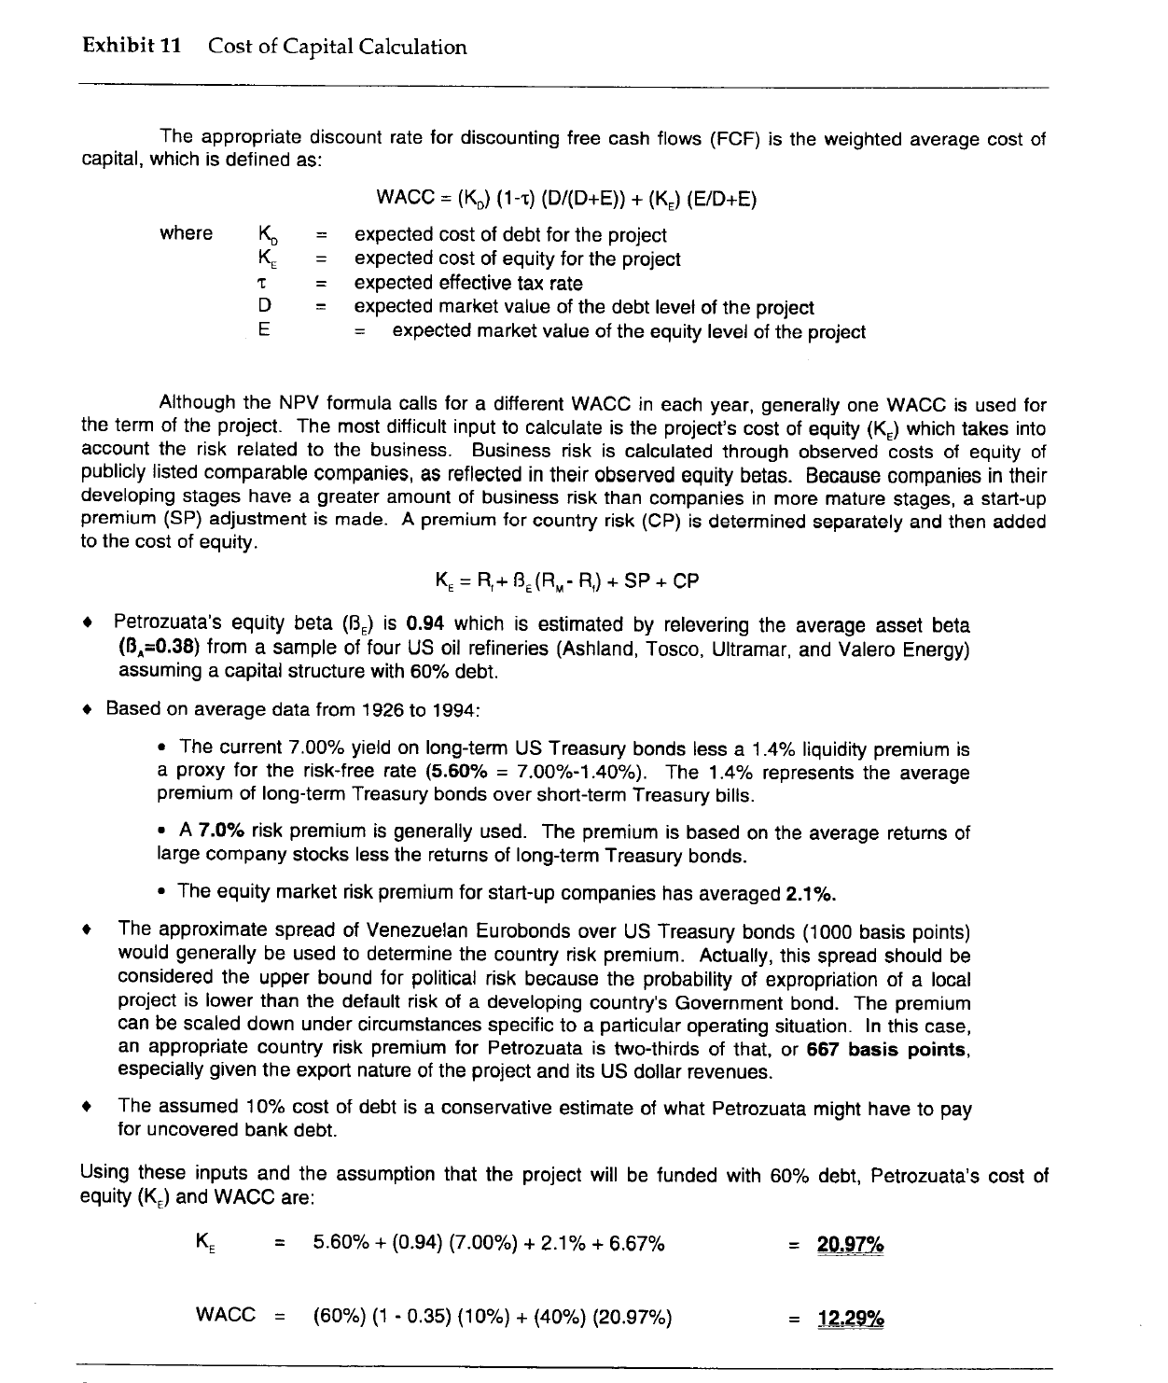
Cost of Capital
Evaluation of cost of capital and bias in financial evaluation
What does 20.97% mean if it is compounded over 35 years.

Slide 68
Financing Process – A big success
Banks responded with $5 billion in bids
With bank debt, could do “road show” for the public debt
Because of favorable response in bond market, raised more than expected from banks and used $450 million in bank debt.
Tranches of public debt
  $300 million 12-year maturity at 130 over treasuries (7.63%)
  $625 million 20-year maturity at 145 over treasuries (8.22%)
  $75 million 25-year bullet bonds at 160 over treasuries (8.73%)
Tranches of bank debt
  $200 million 14-year maturity at 220 basis points
  $250 million 12-year maturity at 208 basis points.
Bonds purchased by investment advisors, insurance companies, mutual funds, pension funds and individuals.
Questions: What made the debt successful. Was project finance necessary; could the project work without project finance.

Slide 69
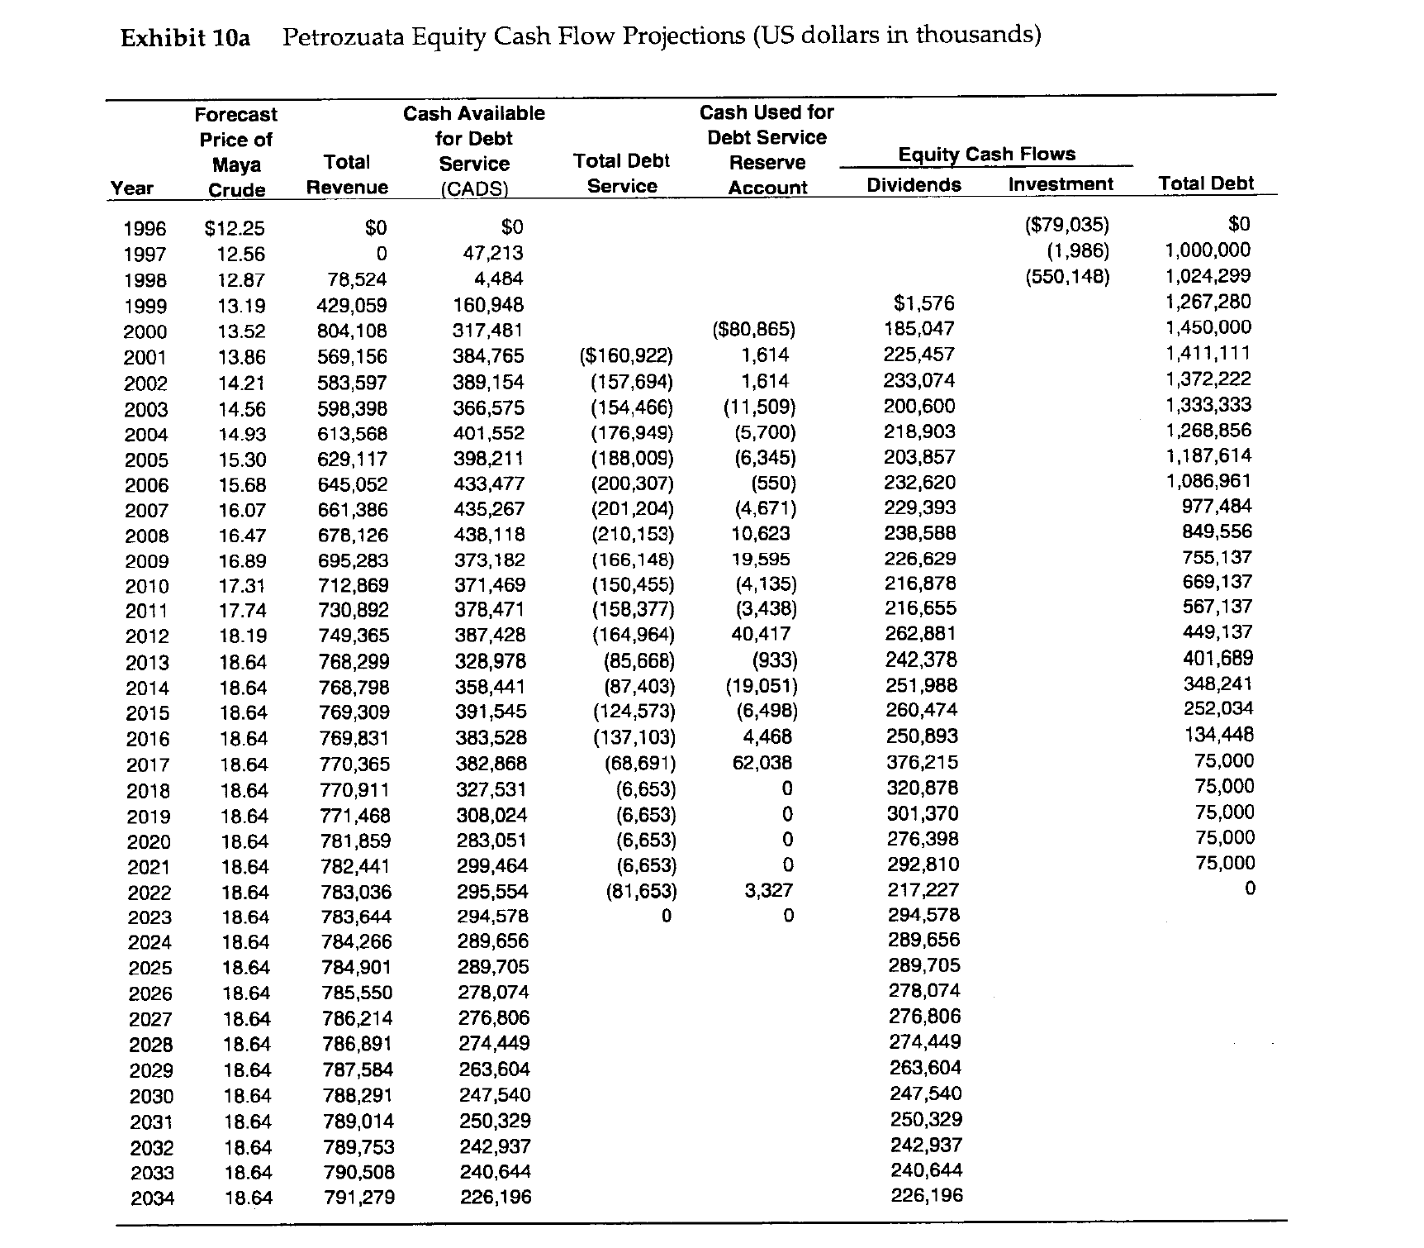
Post Construction – What to Compute
Convert to financial model
Historic oil price comparison

Slide 70
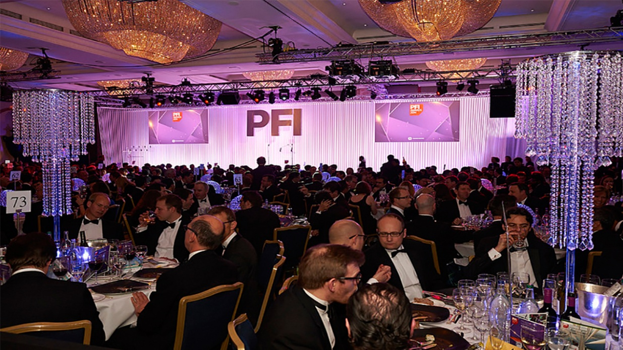
Petrozuata Won the Academy Award of Project Finance
1997 Americas Project Finance Deal of the Year (IFLR)
1997 Project Finance Deals of the Year (Institutional Investor)
1997 Americas Oil & Gas/Petrochemicals Deal of the Year (PFI)
The project is a stunning achievement for the sponsors and for Venezuela” (Oil and Gas Journal)
“The deal attracted rave reviews across the project finance industry. Scores of bankers not even involved in the deal refer to it as the best ever done in project finance” (Euro week)
“Petrozuata’s feat in raising funds is nothing short of amazing. In terms of the amounts taken from both the bank and bond markets, the tenors achieved, pricing and the structure of the project itself, the package has no parallel (IFR)
“Petrozuata Finance … bulldozed over previous boundaries for bond maturities and deal size in the Rule 144A market, showcasing the growing ability of stronger-rated credits to borrow without political risk insurance.

Slide 71
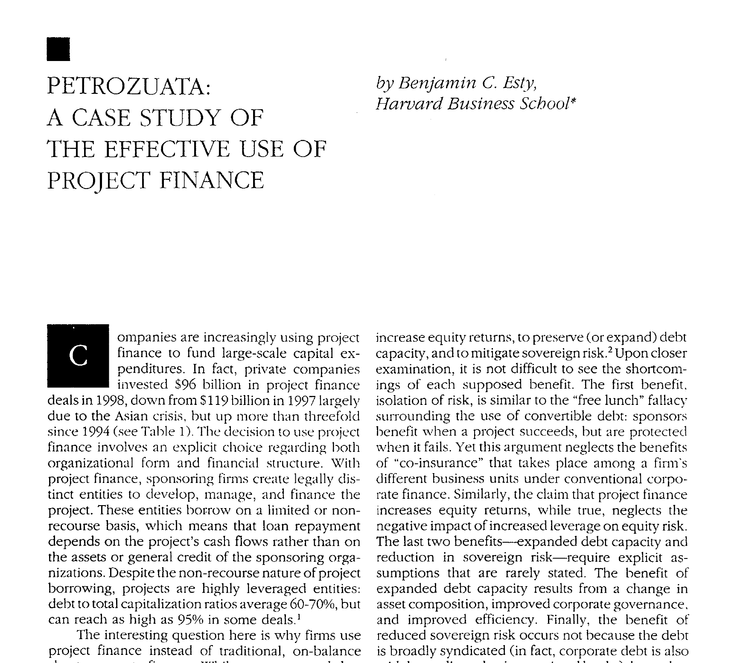
Article on Project
.

Slide 72
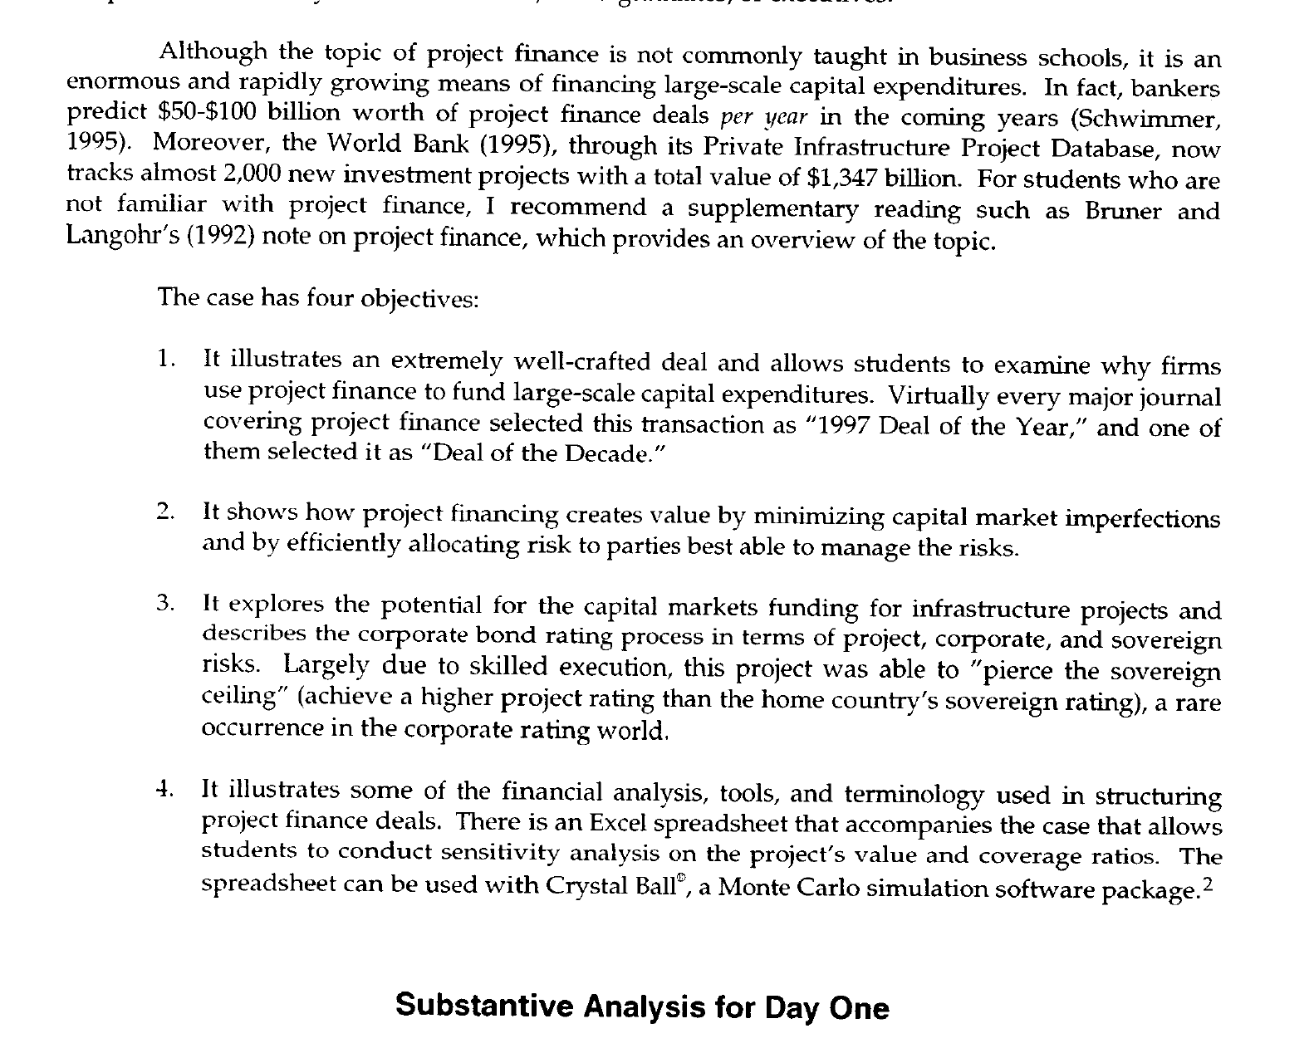
Teaching Note
.

Slide 73
Change in Risk and IRR

Slide 74




Project Finance and Changing Risk
Before COD, cash flow is presented in the sources and uses statement
After COD, cash flow is presented in the cash flow waterfall and the last line is dividends
Father of the bride makes commitment to pay for wedding
Commitment Fee
Development is Dating period. Probability of failure is high
Pay for Wedding with Other peoples money
Pay your Bills and re-structure your life. Stuck with PPA type contract. May default.
FC is just after engagement date
COD is Wedding Date
Decommissioning Date

Slide 75
What Makes it Possible to Lend Long-term to Single Assets
Discussed the importance of debt financing in raising money for project financed assets.
To achieve low cost of capital, the debt tenure of must be long (otherwise the DSCR will be too low).
Cannot have debt that has a bullet repayment that is supported by a portfolio of assets owned by a corporation.
Projects must have contacts and/or mean reverting cash flow to support long-term debt.
Use the formula: PV of Debt Service at Interest Rate = Debt

Slide 76
How Can We Resolve the Problem that IRR and NPV do Not Account for Risk Reductions
Projects move from venture capital like investments to safe investments
Assume an insurance company or a pension fund wants to buy the asset when the risk decreases
This can be called compression
Model the value of the project over time with a changing target IRR (minimum target IRR is the definition of cost of capital)
Model different assumed sale dates (better to sell early)
Compute the IRR with a sale date

Slide 77
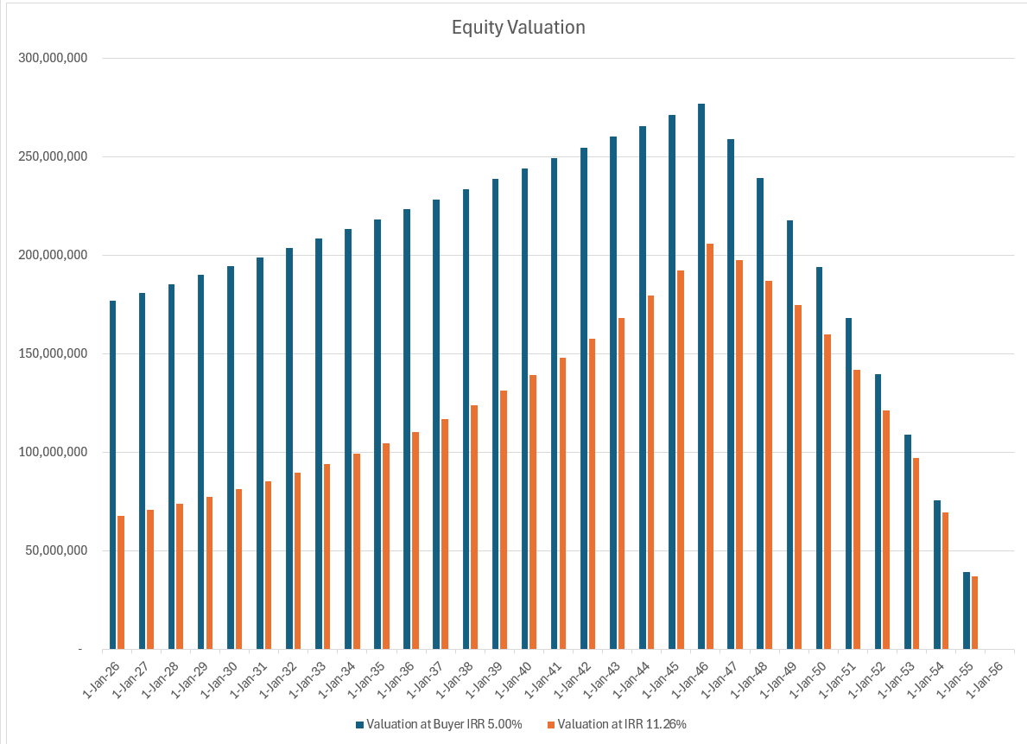
Illustration of Change in Value with and without Change in Risk
The value changes over time for equity – it increases as debt is repaid because the dividends have more value.
It decreases as the plant ages

Slide 78
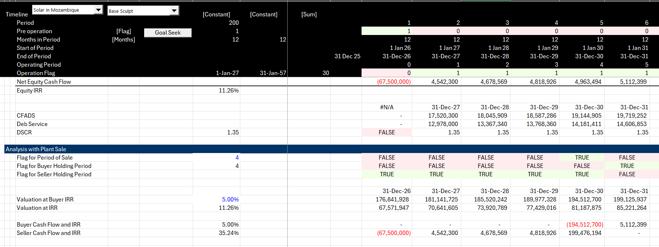
IRR from Buyer and Seller Perspective
Note the dramatic increase in the seller IRR because of declining risk

Slide 79
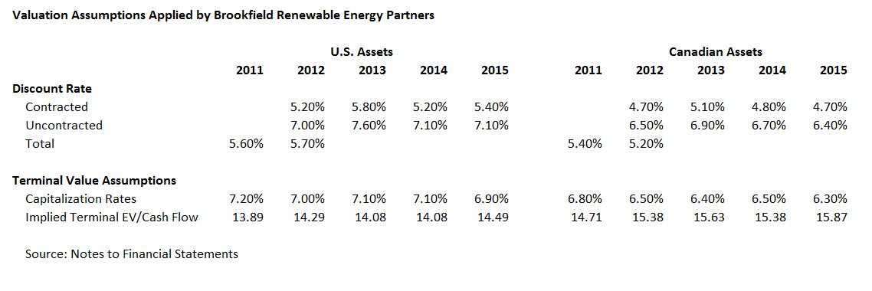
Verification of Cost of Capital from Published Data in Yieldco Reports
As part of this task we have reviewed detailed financial data of Yieldco’s including prospectuses and annual financial reports. One of the last companies that we investigated was Brookfield Renewable Energy Partners (BEP). In its notes to financial statements, discount rates that are applied to both contractual cash flows and non-contracted cash flows in asset valuation are presented. It is assumed that the cost of capital represents after tax cost of capital although this is not specified in the report.

Slide 80
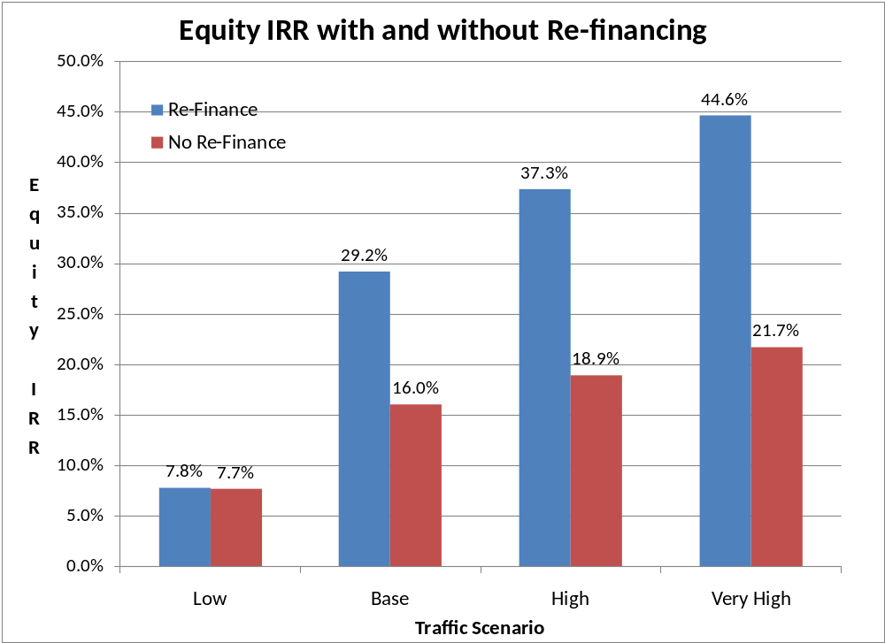
Equity Returns and Re-Financing

Slide 81
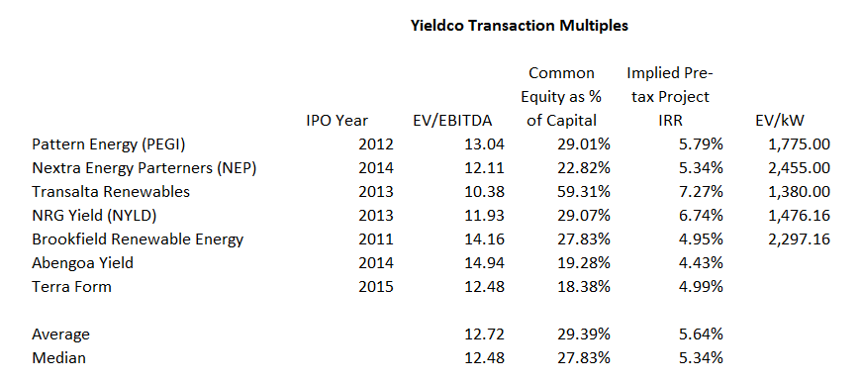
Transaction Multiples from Yieldco IPO’s
For valuation of assets the most relevant multiple is the EV/EBITDA ratio. This is because the EBITDA is not affected by financing and because the EV/EBITDA ratio can be computed from IPO’s of Yieldco’s. For Yieldco projects that have minimal capital expenditures and small or no growth in cash flow, the EV/EBITDA can be used to derive an implied pre-tax IRR and an overall cost of capital (this is further explained in the appendix). The IRR’s from this analysis are lower than the low case pre-tax cost of capital assumption.

Slide 82
Switch to DSCR

Slide 83
The DSCR is One Measure of Risk that Makes Sense in Your Life
Other measures – beta, value at risk, volatility, alpha are not intuitive and are just magic potion

Slide 84
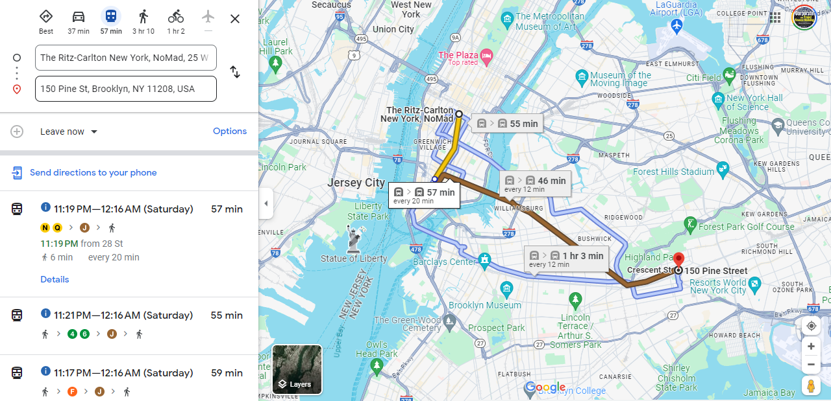
New York Meeting, Google Maps and Assessing the Risk of Being Late
How much extra time would you leave for an important meeting

Slide 85
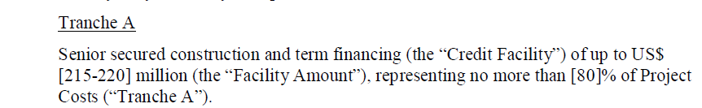

Which is More Important – DSCR or Debt to Capital
Maximum Debt to Capital Constraint
Minimum DSCR Constraint

Slide 86

Five Parts of Debt
Any debt has the following parts in deriving the structure
Debt Size
Funding Pre-COD
Repayment Post-COD
Interest and Fees Paid
Other Features to Improve Ability to Repay including covenants, DSRA and cash sweep

Slide 87
Cash Flow Available for Debt Service (CFADS); It is what the Definition Says it is
Toll Road Mini Case
          $$CFADS =Revenue−Operating Costs±Working Capital Adj$$
What is missing from the formula
What about changes in DSRA
CFADS represents periodic net revenue available to repay initial financing of capital expenditures from the construction period
Once operating costs are accounted for, remaining money must be used to repay debt, followed by equity distributions

Slide 88
You Can Go the Other Way to Find the DSCR
Formulas for Break-Even: Say that you want to know how big the DSCR should be to cover for an availability payment that could be reduced by 20%.
The formulas below are for DSCR; you could also use LLCR and PLCR
  DSCR = Cash Flow/Debt Service
  Example: DSCR = 1.5 = 150/100
  This means the cash flow break even is 50/150 = 1/3 = 33%
  Break-even cash flow = (DSCR-1)/DSCR
  BE = (DSCR-1)/DSCR
  BE x DSCR = DSCR – 1
  DSCR – BE x DSCR = 1
  DSCR * (1-BE) = 1
  DSCR = 1/(1-BE) or 1/.667 or 1.50
Note: Be careful with fixed costs. If a project has fixed costs you have to make a more complex formula

Slide 89

Equity IRR, Debt Financing Theory and Project Finance
Miller and Modigliani and APV
Debt Level and Risk in Project Finance
Un-gear and Re-gear Beta is ridiculous in project finance (and maybe in any finance). This is because the debt level defines the level of risk and not the other way around
Why Equity IRR rather than Project IRR is used in project finance. For example, a risky project has less debt that would imply a lower equity IRR if the project IRR was the same. But the project IRR should be higher because of the higher risk, and the lower debt offsets this risk leading to a similar equity IRR
Problem with cash on the balance sheet
Much bigger problem if cash is invested at the beginning because of IRR mathematics – if the cash must be financed by equity and not a mixture of debt and equity.
This is one of the issues that arise with putting a cash reserve on the balance sheet to resolve the interest expense versus debt service problem

Slide 90
Sculpting Equations - Basic
One of the main ideas about the repayment process in project finance is that the modelling is much more effective when you combine formulas with other excel techniques. If you try and solve these things with a brute force method that uses a copy and paste method or goal seek things will get very messy. Formulas used for repayment and debt sizing are listed below: The fundamental two sculpting formulas are:
(1) Target Debt Service Per Period = CFADS/DSCR
(2) Debt Amount at COD = PV(Interest Rate, Target Debt Service)
Non-Constant Interest Rates
However this is by no means the only formula you should use when working on repayment. In cases when the interest rate changes, a simple present value formula cannot be used. Instead, an interest rate index can be created that accounts for prior interest rate changes as follows:
(3) Int Rate Index(t) = Int Rate Indext-1 x (1+Interest Rate(t))
(4) Debt Amount at COD = ∑ Debt Service(t)/Interest Rate Index(t)

Slide 91
Sculpting Equations with Debt to Capital Constraint
Use of LLCR when there is a Target Debt to Capital constraint that drives the amount of the debt. If the debt is being sized by the debt to capital ratio, a higher DSCR must be used.
This raises the issue of how to compute sculpted debt repayments when debt is sized with the debt to capital ratio and the DSCR is not from the DSCR constraint.
When the Debt is Sized by Debt to Capital the LLCR can be used to size the debt, because with sculpting, the DSCR = LLCR. Formulas in this case include:
(5) Target Debt Service(t) = CF(t)/LLCR
(6) LLCR = NPV(Interest Rate, CFADS)/Max Debt from Debt to Capital
(7) DSCR Applied = MAX(Target DSCR,LLCR with Max Debt)

Slide 92
Sculpting Equations with LC Fees
Adjusting Sculpting Equations for Debt Fees: Debt fees such as the fee on a letter of credit is part of debt service. To include the fees in the sculpting equations, you should subtract the fees when you compute the net present value of debt, as the fees reduce the amount of debt service that can be supported by cash flow. To make the sculpting work you should also make the repayment lower by the fees as shown below:
(14) Repayment = CFADS/DSCR - Interest - Fees
(15) Debt = NPV(Interest Rate, Debt Service-fees)
Debt = NPV(rate, Debt Service) - NPV(rate, Fees)
Note Debt Service in the above equation means debt service without fees and debt is reduced by PV of fees
Adjusting LLCR for Debt Fees: The sculpting analyses include calculation of the LLCR to evaluate whether the debt to capital constraint is driving the constraint. In this case the PV of CFADS is not the correct numerator for the analysis. Instead, the PV of the LC fees should be added to the denominator of the LLCR as follows:
(16) LLCR = PV(CFADS)/(Debt + PV of LC Fees), where
(17) Debt = Project Cost x Debt to Capital

Slide 93
Sculpting with DSRA as Final Payment
Sculpting and Changes in the DSRA balance including Final Repayment
After working through letters of credit for the DSRA, taxes, interest income and other factors that cause difficult circular references, the final subject addressed is using the DSRA to repay debt.
A similar result occurs when changes in the DSRA are included in CFADS. Incorporating these changes in a financial model without massive circularity disruptions can be tricky, but it can be solved by separately computing the present value of changes in the DSRA.
Changes in the DSRA can be modelled using the following equations:
(18) Debt Adjustment = PV(Interest Rate, Change in DSRA/DSCR)
(19) Repayment = Repayment from Normal Sculpting + Change in DSRA/DSCR

Slide 94
Debt Sculpting, DSCR Formula and Negative Repayment
Start with the basic formula:
  DSCR = CFADS/DS
  DS = CFADS/DSCR
  DS = Interest + Repayment
It is possible that in this formula the repayment will be negative when interest is greater than debt service
In this case there are a couple things you can do.
  You can set up a cash reserve account to cover the interest
  You can use the cash reserve withdraws to cover the repayment
  In this case there is higher repayment (non-negative) and the tenure of the debt declines
  If the CFADS includes only the cash for repayment, the DSCR is below the target
Solution
  Amount withdrawn from the reserve account uses the formula
  CFADS = EBITDA – Taxes + Amount Withdrawn from Reserve
  Target CFADS = Debt Service x DSCR
  Debt Service = Interest Expense
  (EBITDA – Taxes + Amount Withdrawn) = Interest * DSCR
  Amount of Reserve Withdrawn = Interest * DSCR – EBITDA + Taxes
  Note the extra amount results in dividends like the normal situation

Slide 95




Summary of Results
Case with allowing negative repayment

Slide 96

Project Finance, Dividends and the Key Graph for Debt Structure
Dividends (without cash sweep or cash trap) serve two purposes. One is to get the IRR; the second is to provide a buffer to lenders
Should dividends occur if interest is above debt service
Without dividends the IRR will be low (remember the IRR mathematics)
Dividends are needed for CFADS buffer
If extra cash is put in a reserve account and it just meets the debt service, there will be no buffer.
The formula: Debt Service = CFADS/DSCR
  can be reversed to Debt Service * DSCR = CFADS
  If the repayment is zero, you can use the formula to derive how much of a cash reserve is necessary

Slide 97



Risk Analysis – Skin in Game versus Safety Buffer
Equity Skin in Game
Buffer to Make Sure No Problems

Slide 98


Sculpting versus Equal Installment with DSCR Constraint
Note the big increase in IRR with the DSCR constraint – because of the larger debt size. Recall that can effectively make the DSCR constraint be in place

Slide 99
Which Constraint is in Place
Items have an effect on whether the debt to capital constraint or the debt to capital constraint applies:
Need to Understand that NPV of Debt Service is Loan Value
  High Project IRR → More Likely Debt to Constraint;
  Long Tenor → More Likely Debt to Capital Constraint;
  Sculpting → More Likely Debt to Capital Constraint;
  Low Interest Rate → Morel Likely Debt to Capital Constraint.
  Low Project IRR → More Likely DSCR Constraint;
  Short Tenor → More Likely DSCR Constraint;
  Level Payment → More Likely DSCR Constraint;
  High Interest Rate → More Likely DSCR Constraint

Slide 100


Pre-and Post COD Analysis
Pre-Cod
Post-Cod

Slide 101
Tricks to get to DSCR

Slide 102

Development Fee Theory
Development fees can be a percent of project cost or a multiple of the amount spent on development.
This yields big profits to developers when the notice to proceed occurs and can be a cash outflow for the sponsor. The big profit accounts for the low probability of success during development.
If the developer and the sponsor are the same, this profit is not a cash outflow from the perspective of the project.
Better to put development fees into cost with debt to capital constraint

Slide 103
Debt Sizing: Including Items in Project Cost that do not Involve Cash Outflow
Accounting allocations to the project can have large effects on the equity IRR through debt sizing derived from the debt to capital ratio.
If the DSCR drives debt sizing, the accounting allocations, fee allocations and other adjustments have no effect on the equity IRR.
Accounting allocations and non-cash contributions can change the structure of returns when multiple investors are involved in the project. If one party is allowed to include non-cash allocations as the basis for his investment, his return is much higher.
Depending on the manner in which project costs are accounted for, multiple investors pay debt service and receive dividends, but the investor who did not invest as much cash effectively borrows less relative to the cash investment.

Slide 104
Debt Sizing: Profits from EPC Contractors or O&M Contractor when Investor is also Contractor
If the EPC profits do not affect the debt size and there is only one investor, placing profits at the EPC contractor level or the investor level does not influence overall returns (i.e. if DSCR drives debt size).
Depending on whether the debt to capital constraint applies or there are multiple investors, EPC profits can increase equity IRR (by increasing the debt size).
Cash Flow Waterfall and issues associated with including profits in O&M contract rather than in SPV cash flow. Profits on the O&M contract versus including O&M costs at the SPV level can affect the distribution of dividends as the O&M fee is paid before debt service.

Slide 105
O&M Contractor is Sponsor
Off-taker: Korea and Japan Utility Companies: Want strong off-taker with inactive to honor contract
Profits to O&M Reduce the SPV Cash Flow. O&M paid before debt service
Off-take Contract with minimum supply but no fixed price
Special Purpose Vehicle: Bond Rating of A-
O&M Contractor
O&M Agreement
Sponsors: Want strong sponsor:
Mobil
State
Loan Agreement
Lenders:
Issued bonds and debt with long tenor and low rates

Slide 106
Adjustments for Development Fee
Add Development Fee to Sources and Uses
Adjust the Equity IRR for Development Fees Received
Adjust Model to have Debt to Capital Constraint
Use Goal Seek to Compute Development Fees

Slide 107

Solar Development Fees
How much is the padding; What is debt to capital without the added costs

Slide 108

Project IRR with Development Costs

Slide 109
DSRA and Tricks

Slide 110
DSRA and Liquidity
DSRA is built to get liquidity into the project because holding cash is very expensive – often 6 months of debt service which is arbitrary
  Return on cash is about zero and opportunity cost of funds is equity or debt IRR
You can sometimes use a letter of credit instead of cash.
  Letter of credit should have a parent guarantee
  Paying an LC fee costs much less than the opportunity cost of funds
If debt size is driven by the DSCR and not the debt to capital, then the DSRA is funded by equity and not debt. This is because the level of debt is given.
If the debt to capital is high and the equity contribution is low, the DSRA can be very costly to the equity IRR because of high debt service and low equity.

Slide 111


Use of LC Instead of the DSRA
The example below shows that with a high debt to capital ratio driven by sculpting and a high IRR, the DSRA in LC can make a big difference to the equity IRR – 11.96% to 14.92% as shown below.

Slide 112
DSRA as LC in Solar Case
“Acceptable DSR Letter of Credit”
issued by a financial institution whose long-term senior unsecured debt is rated at least “A-” by S&P and “A3” by Moody’s,
naming Administrative Agent on behalf of the Lenders as the beneficiary, and
including provisions that
  (i) such letter of credit shall automatically renew upon the expiration
  (ii) if no agreement for a renewal or replacement of the letter of credit has been made after the long-term senior unsecured debt rating of the financial institution that provides the letter of credit is downgraded below “A-” by S&P or “A3” by Moody’s, the stated amount of the letter of credit shall be automatically drawn and the proceeds automatically deposited in the Debt Service Reserve Account.
Letter of credit
  (A) shall have an initial expiration date of at least one year after issuance,
  (B) shall not impose on Borrower any obligation to reimburse drawing payments, and
  (C) shall be issued in a face amount equal to amounts required to be retained in the Debt Service Reserve Account.

Slide 113
Debt Service Reserve Language
On the Closing Date, an amount equal to 10% of the original principal amount of the Bonds will be deposited in the Debt Service Reserve Account of the Debt Service Reserve Fund from the proceeds of the Bonds.
The amounts in the Debt Service Reserve Account will be used only for the purpose of making payments into the related Interest Subaccounts, the Principal Subaccounts and Sinking Fund Installment Subaccounts for the Bonds
If a disbursement is made under a Debt Service Reserve Account Facility, the Trustee shall apply amounts transferred from the Operating Revenue Account to the applicable Debt Service Reserve Account to either cause the reinstatement of the maximum limits of such Debt Service Reserve Account Facility. The Trustee will apply moneys on deposit in a Debt Service Reserve Account prior to any drawing on any Debt Service Reserve Account Facility.
In the event that any amount shall be withdrawn from a Debt Service Reserve Account for payments into an Interest Subaccount, Principal Subaccount or Sinking Fund Installment Subaccount or there exists a deficiency in a Debt Service Reserve Account which is to be reinstated, such withdrawals shall be subsequently restored from Revenues available on a pro rata basis after all required payments have been made into such Interest Subaccount.

Slide 114
Mean Reversion and Use of Monte Carlo (it is easy) to Demonstrate Probability of Loss

Slide 115


Monte Carlo Simulation as Illustration of Project Finance
Structure the Debt
Simulation with Volatility
Volatility and Mean Reversion Equations
  CF1 = Cf0 + CF0 * Rand x Volatility
  CF1 = Cf0 + CFO * Normal Inverse (Rand()) * Volatility
  With Mean Reversion
  CF1 = CF0 + (Mean – CF0) * Mean Reversion Factor + Volatility from Above
Results

Slide 116
Understanding of DSCR, LLCR and PLCR
(DSCR-1)/DSCR = Break Even Cash Flow
All ratios are measures of buffer and driven by possibility of decline in cash flow
  Example
    DSCR = CFADS/DS
    CFADS 150
    Debt Service 100
    DSCR 1.5
  How much can cash go down before cannot meet debt service: 150-100 = 50
  How much can cash go down in percent : 50/150 = 33.33%
  Formula for minimum break-even: (1.5-1)/1.5 = 33.33%
LLCR measures break-even over the entire debt life (it is possible that DSCR is below 1)
  LLCR = NPV (CFADS ll)/NPV of DS (NPV of DS = Loan at COD)
  How much can cash flow go down before cannot pay off loan at end of the loan life
    LLCR = 1.6
    Break-even over loan life (1.6-1)/1.2 = 37.5%
PLCR measures the break-even over the entire life and give the value of the tail
  PLCR = NPV (CFADS pl)/NPV of DS (NPV of DS = Loan at COD)
  How much can cash flow go down before cannot pay off loan at end of the loan life
    PCR = 2.0
    Break-even over loan life (2-1)/2 = 50%
Formulas work if there is a 100% cash flow sweep

Slide 117



DSCR versus LLCR versus PLCR and Sculpting
Level Payment and Tail
Min DSCR < LLCR < PLCR
Sculpting and Tail
DSCR = LLCR < PLCR
Sculpting and No Tail
DSCR = LLCR = PLCR

Slide 118




Illustration of Cases
Break Even % = (LLCR-1)/LLCR, (DSCR-1)/DSCR etc.

Slide 119

Non-Mean Reverting Series - Blackberry and Apple
Blackberry Price and Apple Price
Volatility driven by fashion, changes in technology, one-time non-recurring events.
Volatility of one year, three-year, five-year does not diminish

Slide 120

Illustration of Mean Reverting Cash Flows – Commodity Prices Except Change in Oil Prices in 1973
Volatility of prices for 1-year, 5-years, 10-years

Slide 121

Default Studies – Probability of DSCR Below 1
.

Slide 122

Drop Off in Capacity Factor for German Project
The second example I use is a case of a German project. If you were making a valuation of the project, would you use the average or the recent data (I would use the recent data). There has been discussion of global warming having an important effect on wind speeds in different locations.
Note that the lower capacity factor in the initial year is expected.
This worrisome trend appears in other German projects as well.
The lower capacity factor could also be the result of transmission constraints.

Slide 123


Denmark Off-shore Projects
The adjacent graphs show capacity factors for two projects in Denmark. These projects also demonstrate a downward trend for the past three or four years.
The kind of drop off in production could lead to the exposure that Orsted had for overproduction in the hedge contracts.
Needless to say, when making forecasts for M&A analysis you should ask detailed questions about the historic achieved capacity factors and whether factors other than wind speeds are driving the trends.

Slide 124
Volatility and Risk Reduction from Cash Flow Sweeps
A cash sweep covenant only makes sense in situations where the cash flow is volatile and/or there are potential downward trends in prices.
  Think about a sudden 2008 type decline in cash flow. Lenders do not like to have paid dividends only to later have a default
  If cash flow is always low there is no cash flow to sweep anyway. Here the sweep will not help.
  If cash flow is always high, there is no need for the cash sweep.
To assess the effectiveness of the covenant, cases that incorporate realistic price volatility and potential price trends must be run in the model.

Slide 125

Example of Risk and Return Analysis for Cash Flow Sweep
Sweeps really help when there is a sudden decline in cash flow – when you would have paid dividends otherwise. A sweep would have reduced the default in the example below.
Dividends
Default
Default
Repayment of default

Slide 126
Economic and Financial Analysis of Cash Sweeps, Reserve Accounts and Covenants
Cash sweeps, reserve accounts and covenants can have negative effects on the equity IRR of a project.
Methods to consider the risk benefits to the bank versus the costs to sponsors are addressed.
Mechanics of cash sweep with different triggers and theory of what kinds of transactions would be relevant for cash sweep (e.g. hydro but not solar because of volatility) are addressed.
The theory of what kind of triggers make sense (Debt/EBITDA but not DSCR and operational triggers).
Contrast between cash sweeps and cash trap covenants. As with other issues, the effects of cash sweeps on equity returns should be addressed with and without re-financing assumptions.

Slide 127
Refinancing

Slide 128
Philosophy and Re-financing
An argument against the dramatic effects of re-financing is that the length of the debt is a very strong signal – like a stamp of approval – that the project has reasonable risk.
  If one project obtains an advantageous financing at the financial close, why would the project not also receive better terms in re-financing.
If the short tenure is just a reflection of market conditions in a country or the necessity to establish historic results.
There are many possibilities about how re-financing could occur and sensitivity analysis can be performed.

Slide 129


Re-financing Case 1 – Multiple Re-financings
If there are multiple re-financings, the effect of the tenure on the IRR is dramatically reduced as shown in the two tables below.

Slide 130


Re-financing Case 2 – Later Refinancing
This scenario shows that if the re-financing occurs later there is a smaller effect because higher dividends occur in early years. The table shows Equity IRR

Slide 131
Mini-perms
Matching the tenor of repayment to the life of the project and even considering terminal value in the repayment in the context of both achieving a higher DSCR and an improved equity IRR.
Problems with multi-lateral agencies that allow long-term maturity can be contrasted with commercial banks and bond financing that may be more flexible and sometimes could have lower costs.
Specifically, the effects of hard and soft mini-perms on the profitability of a project along with the difficult problem of required re-financing assumptions.
How the DSRA could be used to re-finance debt at end of loan life and how potential terminal value can be used to justify partial bullet repayment at end of loan.

Slide 132
A Little Theory about Valuation and Risk of Projects
Valuation theory with respect to projects generally involves risk reduction as a project progresses through phases.
In Europe, there are many stories (but not much data) about how insurance companies purchase existing projects with operating history and are willing to accept equity IRR’s as low as 5-6%.
The idea behind a low cost of capital for mature projects is the following:
  During the development stage, expenditures occur with large risks associated with permitting, problematic wind studies, construction cost over-runs, ability to secure tariffs etc. The required equity IRR during the development stage can be 15% to account for the project not being successfully methods.
  Once the development is finished or in late stages, the risk is reduced by a large margin. However there are still risks associated with successfully completing construction at budget and on time. The reduced risk during the construction phase may reduce the required equity IRR to something like 12%
  After construction, the remaining risk for a project with a fixed price contract is that the estimated wind production will not be met. Given this risk, the discount risk is still above the cost of capital for bonds and may be in the range of 8-10%.
  Once operating history is available, the risk is not much higher than the debt cost or the interest rate on long-term bonds. With bonds yielding below 3%, a return of 6% provides a good premium for risk.

Slide 133
Equity Returns and Re-Financing

Slide 134
Mini-Perm Example
Term Loan Principal Scheduled Payments. Borrower shall repay to Administrative Agent, for the account of each Lender, the aggregate unpaid principal amount of the Term Loans made by such Lender in installments payable on each Repayment Date in accordance with the Amortization Schedule set forth below, together with any remaining unpaid principal, interest, fees and costs due and payable on the Term Loan Maturity Date. The Parties hereto acknowledge and agree that the Amortization Schedule set forth below shows the amount of each installment payment of the Term Loans to be made on each Repayment Date:
Amortization Schedule
Quarterly Payments | Amount
1-4 | $102,600
5-8 | $111,400
9-12 | $118,500
13-16 | $128,000
17-20 | $136,000
21-24 | $146,250
25-28 | $157,000
29-32 | $168,250
33-36 | $180,000
Term Loan Maturity Date | $5,508,000

Slide 135

Mini-Perm
Start with Amortisation Profile – this is what drives the debt size.
Compute debt size form Amortisation period

Slide 136

Mini-Perm Assumptions in Solar Case
Some kind of re-financing assumption must be made.

Slide 137

Mini-Perm and Re-financing Assumption

Slide 138

Credit Analysis of Mini-Perm
To evaluate the effects of being unable to re-finance a cash sweep assumption can be used.
You can then see how low a variable can go before the loan will not be re-paid.

Slide 139
Mini-Perm Extension
Term Loan Maturity Date Extension.
The Borrower may:
  not sooner than twelve (12) months and,
  not later than six (6) months prior to the then-current Term Loan Maturity Date
Request that the Term Loan Maturity Date be extended for an additional period selected by Borrower of up to an additional five (5) years (an “Extension Request”).
Borrower and the Lenders mutually agree to alternate terms and conditions not later than four (4) months prior to the then-current Term Loan Maturity Date
No Lender shall have any obligation to agree to have any of its Term Loans extended pursuant to any Extension Request.
To the extent that not all Lenders approve an Extension Request, the Borrower shall have the right to replace each Lender that voted not to approve such Extension Request, and add as “Lenders”
On the then-current Term Loan Maturity Date, the Borrower shall repay each non-consenting Lender its Proportionate Share of the Term Loans.

