Slide 1
Introduction

Slide 2
Teaching Style
Participants will work through analysis of different renewable technologies
  Resource analysis
  Financing
  Risk Analysis
  LCOE and Pricing
  Construct renewable analysis with financial models
    Three Associated Workbooks on the Website
    Long-term Resource Analysis, One-year Resource Analysis and LCOE/Financial Model
  Evaluate comprehensive project finance models
  Put emphasis on practical techniques with current data from MENA.

Slide 3
I Want to Know Your Priorities
Very Brief Overview of Outline
Introductions
  Objectives
  Experience
  Desired Course Style (hands on)
  I need to Listen Carefully
  You are not in Prison
Flexibility with Case Studies
Financial Models – getting your hands dirty to understand concepts

Slide 4
General Idea 1 – Technical Details
You should know the technical details before making an economic or financial analysis that assesses risk and required return

Slide 5
Notes on Financial Model
Financial Model in Transaction
    Tests whether all of the contracts including the loan agreement work in terms of financial ratios
    Used for risk analysis to test downside cases and assure the lenders get paid
    Puts all of the technical data together with the financing data to assess the economics of a project
    Is a database of the meaningful data for the project
Financial Model as a Teaching Tool
    Demonstrates the how project finance concepts work (e.g. DSCR and Volatility)
    Isolate on issue to understand impacts on investors, lenders and society
    Used to present nuanced issues
    Demonstrates issues in case studies

Slide 6
Course Outline
Solar and Value Drivers, Appropriate Levelized Cost of Electricity (“LCOE”) Calculation and Reconciliation of LCOE with a Financial Model
Wind and Solar Resource Risk Analysis of Uncertainty (P90, P95 etc.)
Project Finance Discussion, Debt Structuring, Debt Sizing and Off-Shore Wind Case Study
Project Finance More Advanced Theory, Analysis and Nuances -- Development Fees, Re-Financing and Asset Sale Upsides
Case Study of Battery Storage and Renewable Energy in the Context of Alternative Use Cases
PPA Contract Theory and Analysis for Standalone Renewable Projects versus Battery Storage
Risk Analysis and Integrated Modelling of Storage Plus Renewable with Analysis of Actual Finance Models
Hydrogen and Integrated Analysis of Renewable, Storage and Ammonia Production

Slide 7
Project Finance for Renewable Energy

Slide 8
Objectives
Incorporate storage and battery analysis in analysis of renewable energy from an energy storage perspective and from an ancillary service point of view
Learn practical tools to analyse renewable energy including efficient tools to work with wind, hydro and solar data:
  Creating flexible scenario and sensitivity analysis to evaluate resource risk, construction risk, O&M risk and debt structuring
  Developing techniques to resolve circular references related to funding debt and sculpting debt without copy and paste macros
Identify the implications of project finance features in the context of renewable energy (sculpting, debt funding, debt size, DSCR, DSRA, debt tenor, re-financing) on costs and equity returns from renewable energy
Develop efficient ways to quickly compute the levelised electricity cost of different technologies using carrying charge factors and alternative financial models
Work through resource assessments and compute probability of achieving different levels of production (P90, P75 etc.) using hands-on exercises for different types of projects in order to effectively review consulting studies
Create flexible and transparent financial models of renewable energy from A-Z that incorporate resource risk, financing structure, tax treatments, alternative pricing policies and other factors.
Evaluate the economics of renewable energy (including ancillary services) in the context of merchant markets and review the structure of corporate PPA contracts

Slide 9
Some Provocative Comments
As Bankers you have better information than developers themselves
Do not get fooled by P90 which is just and old-fashioned downside case
Understand models and don’t go crazy with complex models
Work through technical data so that you can understand the risks and the terminology
The best place to get real data on costs is from inputs to financial models
The US has more political risk than Middle Eastern Countries
You cannot understand storage costs and strategies without getting you hands dirty with hourly data on solar, loads and exiting plants
To get a PPA right and understand how it affects risks, do not copy language from other PPA’s but instead understand costs and incentives in the context of MENA

Slide 10
Some Provocative Comments (Continued)
Don’t make things seem complex by using big words – the issue with ancillary services is show fast can thermal plants react to sudden changes in wind or solar output that do not have the inertia of thermal plants.
Don’t use general statements about how wind and solar together can diversify and lessen the need for ancillary services. Instead, get you hands dirty with PVGIS where you can do the analysis by yourself.
A banker or a lawyer is so much better if he or she understands the underlying economics and technical aspects of what is in the contracts (i.e. batteries, solar or wind)
With renewable and battery, you cannot do analysis using the old methods
Simple is difficult and more important

Slide 11
Concentrate on Numbers
There are many biases in analysis of renewable energy and storage
Some want the answer and make general statements
Some make aggressive assumptions to support a case
The objective here is simple
  Find real data on costs, production and other parameters
  Develop unbiased analysis of alternatives
  Keep the analysis as simple as possible
  Focus on drivers of cost and output
Not somebody who tells you that batteries are going to solve problems in the world without telling you how much they cost and how much they degrade
How you present the data is a big deal

Slide 12
Course Outline and Teaching Style – Be Mean Now and Not After the Course
This is not a university course – keep guiding me as to what you want
It is important to not be overly structured and focus on what you want (e.g. how much hands-on financial modelling)
Please comment on the course before it is too late.
Please interrupt with any question or comment.
You need breaks to avoid torture.
Follow-up research and practice

Slide 13
Big Points about Renewable
Dramatic change in the cost of Solar and Batteries
Change in the productivity of Wind
Financing with output risk rather than availability risk for dispatchable plants

Slide 14
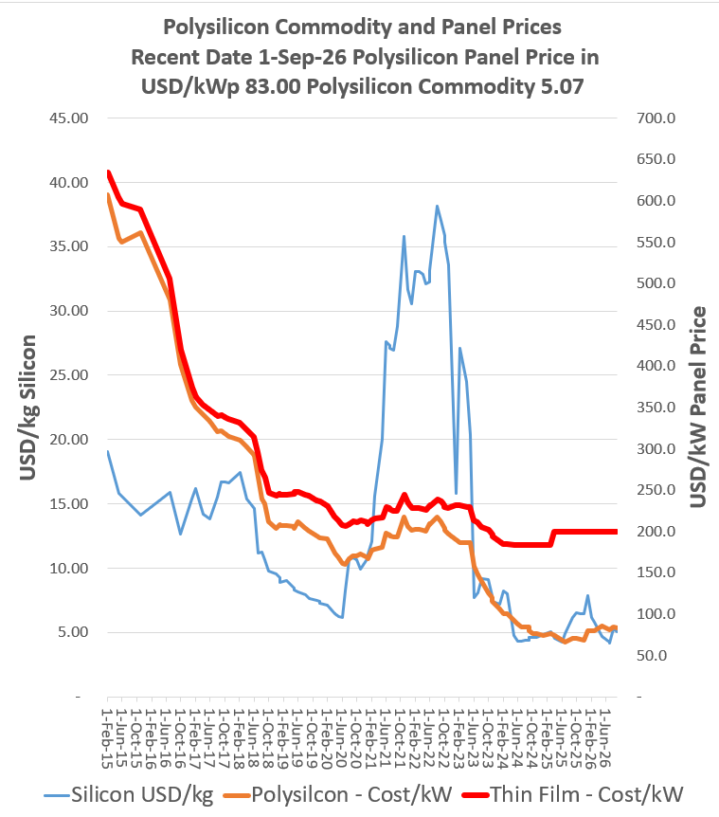
Context of Revolution in Solar Costs and Battery Costs
.
Without this dramatic decline we would still be talking about thermal plants

Slide 15




Renewable Projects Depend Output that Cannot be Controlled
Solar or Wind
Battery

Slide 16


Battery and Firemen versus Truck Drivers – There is no Volume Guarantee on Renewable
Capacity Price and Artificial Markets
  When capacity is available, you can receive revenues no matter whether you use the capacity for revenues, this can be added
  Some ancillary services may be like capacity where if you have the service available, you can earn money whether you use the capacity to produce energy
Think of Firemen (Firehouse Effect)
  You pay them and need them to be ready
  But if they are putting out a fire, they cannot be used for another fire
  They receive capacity payments and must be available
  You cannot really pay them on the volume of fires the

Slide 17
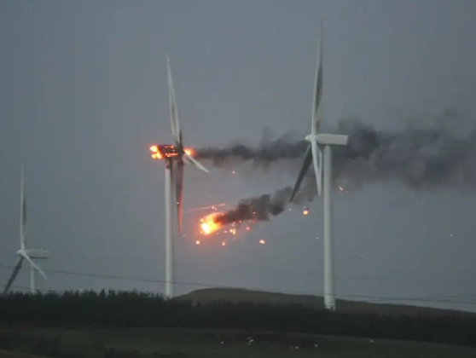

Availability versus Utilization
Availability – pay when the plant is available
Utilization – paid when you use the plant

Slide 18
Independent Power and Targeted Risk Allocation with Contracts Signed at Financial Close
Orsted did not have the discipline imposed by project finance. But there are costs of risk allocation. Which model is better.
Each contract can have many nuances with penalties, bonuses, default clauses, termination.
Off-taker: Want strong off-taker with inactive to honor contract
EPC Contractor: Want Strong Record and Finances
Price Risk from Plant Performance and Efficiency targets
EPC: Fixed Price Contract with LD
Supplier: Need to Understand Economics and Supply Curve
aa
Special Purpose Vehicle: Bond Rating of BBB-
O&M Contractor
Supply Agreement
O&M Agreement
Shareholder Agreement
Loan Agreement – Draws Green; Debt Service Red
Banks Like Strong Sponsors. Sponsors want EIRR
Lenders:
Lenders want DSCR (LLCR, PLCR)
Invest with paid in cap; payback dividends
Invest with draws; payback debt service

Slide 19

Renewable Project Finance Diagram
Big Unknown is the estimate of resource that is not known
Subsidy paid by ratepayers
Government or Utility Company Off-taker
Contract with subsidy scheme and merchant
Volume Risk from Variable Wind Resource
EPC Contractor: Want Strong Record and Finances
EPC: Fixed Price Contract with LD
Special Purpose Vehicle: Bond Rating of BBB-
O&M Contractor, also often investor
O&M Agreement
Shareholder Agreement
Loan Agreement – Draws Green; Debt Service Red
Banks Like Strong Sponsors. Sponsors want EIRR
Lenders:
Lenders want DSCR (LLCR, PLCR)
Invest with paid in cap; payback dividends
Invest with draws; payback debt service

Slide 20
Part 1: Renewable Economics and Value Drivers

Slide 21
Websites to Review
PVGIS (fantastic hourly data)
  Find the best and worst place in Jamica
  Download hourly data
World Wind Map
  What is windspeed in locations in meters per second
  Global Wind Atlas
PVInsights
  What is current price of panels
Lazard LCOE (this is no good)
  Find the cost assumptions
Solar Project Finance Model

Slide 22
Review of Solar and Wind as the Basis for Evaluation of Storage
The technical detail is not so hard - Enough to ask questions

Slide 23
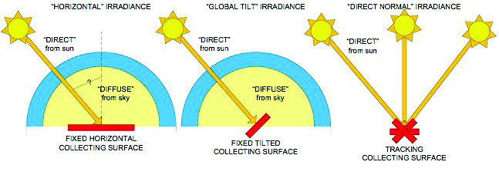
Measuring Irradiance

Slide 24
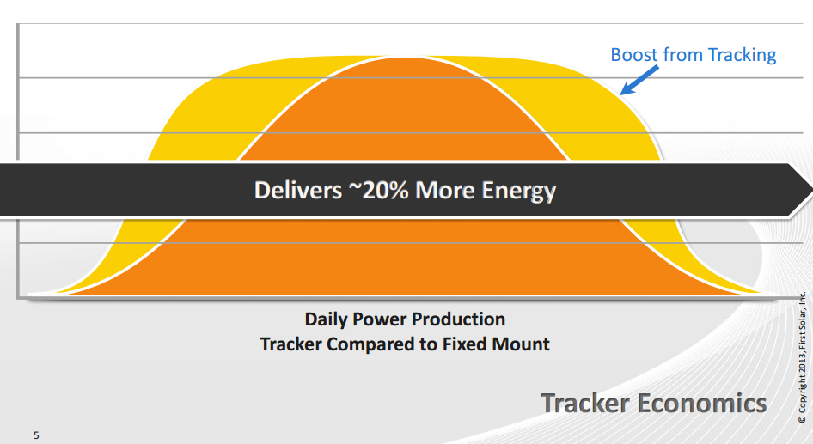
Adjustments for Tilt and for Tracking

Slide 25
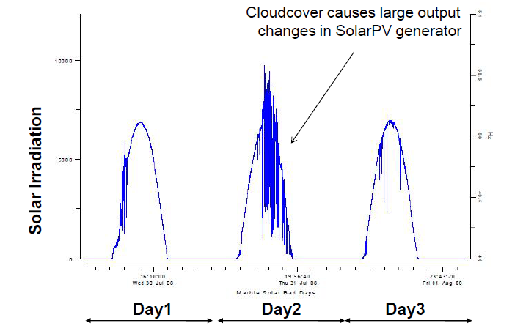
Cloud Cover and PV Generation

Slide 26
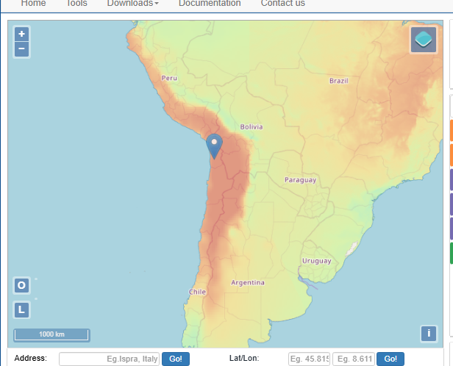
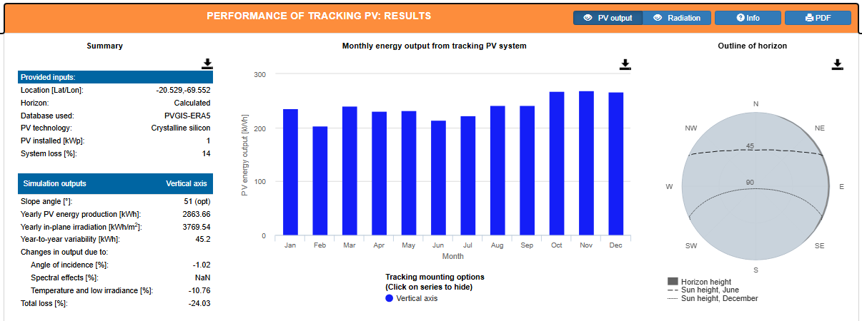
Start with Data – Best Solar Places
Chile; What is yield and what is capacity factor
In plane radiation of 3,769 for a capacity factor of 43%

Slide 27
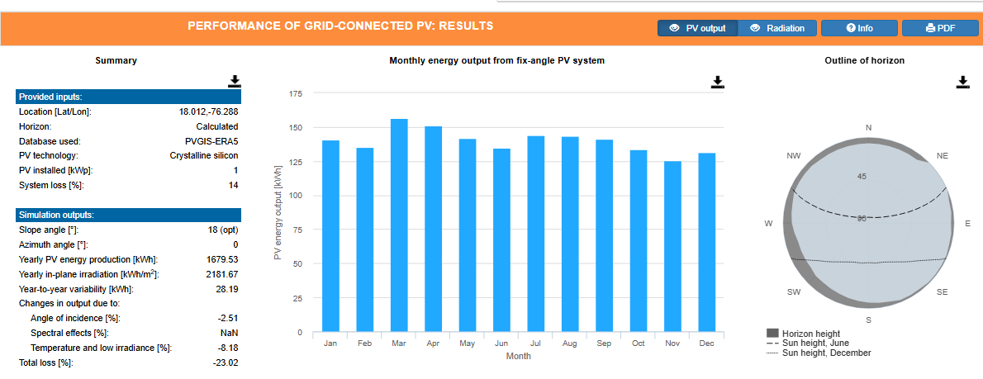
In-Plane Radiation without Tracking
kWh/kWp gives hours annual hours. Hours divided by 8760 gives capacity factor
In plane radiation is 2181 kWh/m2 per year. 2,181 kwh is 2,181,000 watts per m2. Dividing by 8,760 gives you 249 watts per hour on average. As the standard definition o of maximum capacity is 1,000 watts/m2, this gives you a capacity factor of 2,181/8760 = 24.89%

Slide 28
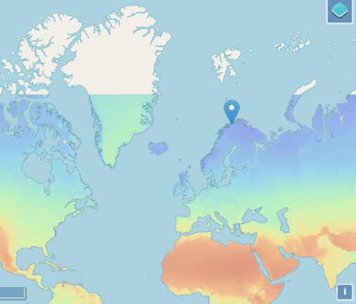
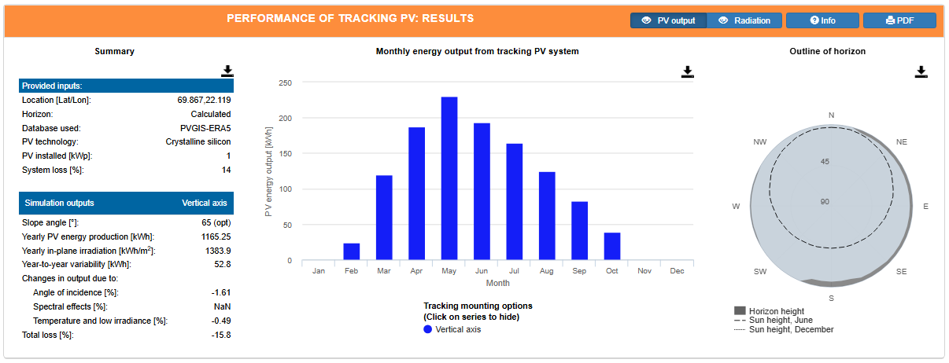
Contrast with
Norway with Tracking
The capacity factor is 15.8%

Slide 29
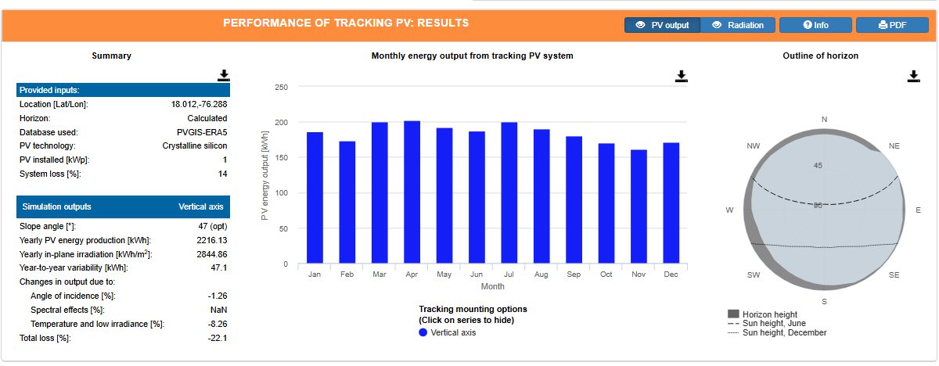
Tracking Increase Relative to Fixed with Tilt
.
In Plane Radiation 2,845 per year in kWh per m2. Capacity Factor of 32.47% from 2845/8760. This is a 30% increase in the amount of sunlight that hits the panel

Slide 30
File with Long-term
Hourly Data and
File with One-year

Slide 31
Use PVGIS to Get Data
Provides hourly data for different places
Try off-shore Korea and Mozambique
Provides hourly data since 2005 up to 2023
Adjust dates by adding 1/24 to prior date
Use LOOKUP and SUMIF to summarize the data
Present alternative time periods for data with the NA() function
Use Spinner buttons to show different months and years

Slide 32

General From World Wind Map
Fun to play with, but only this instant
Google world wind map
Change to meters per second

Slide 33
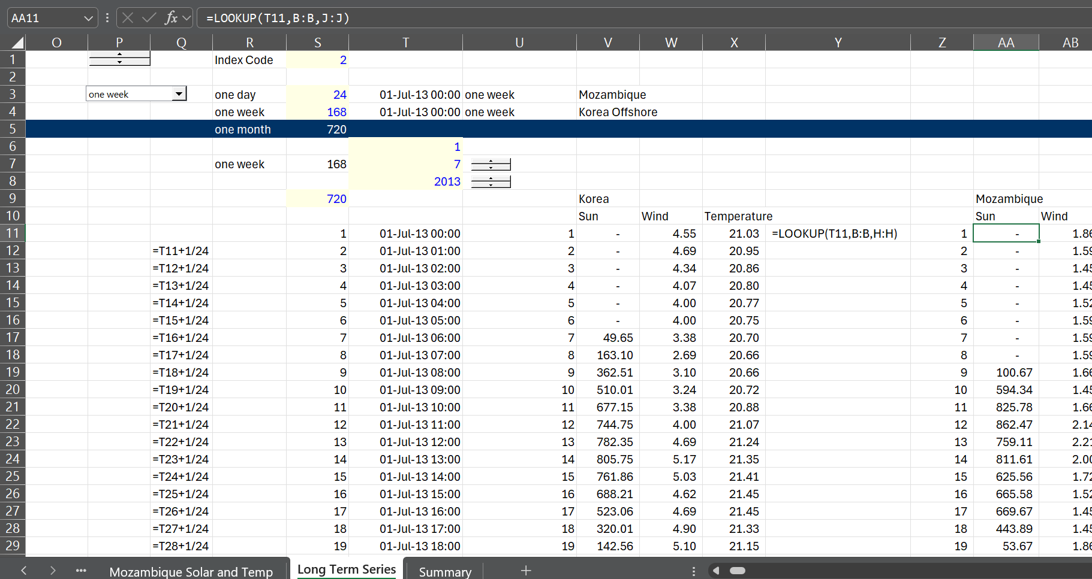
Adjustment for Presentation of Data
Area of sheet for presentation of one day, one week or one month of data
Use the date, adjust for GMT and add 1/24 for hours

Slide 34
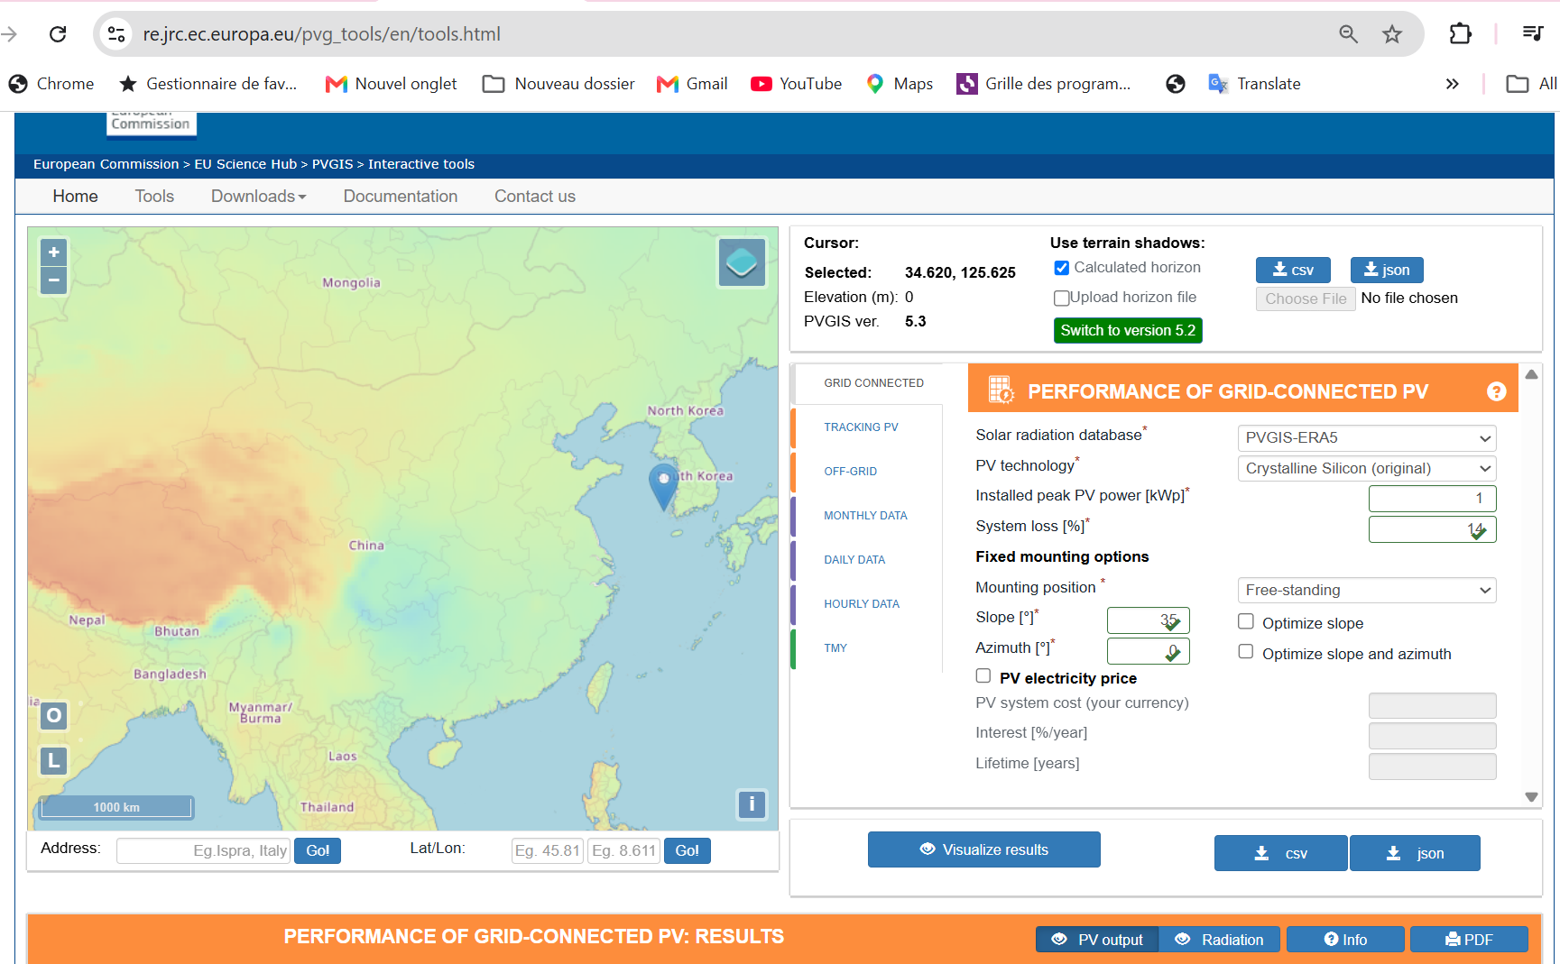
Example Sites in from PVGIS
Open PVGIS
Offshore in Korea

Slide 35
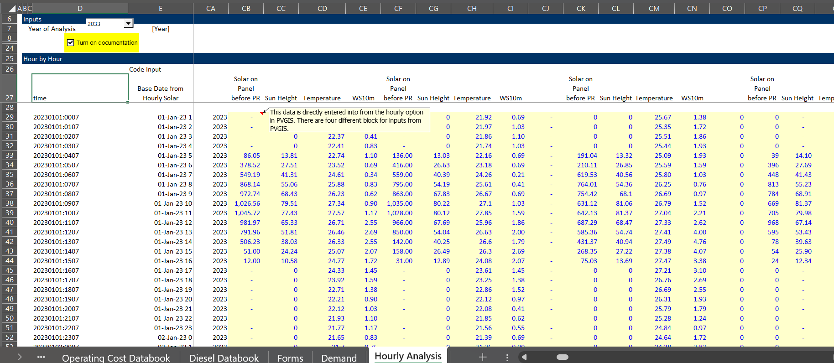
Data on Hourly Irradiation
The data input locations in the model were somewhat clear in the prior analysis. The screenshot below shows the hourly irradiation data from PVGIS for different locations is used. We have used the latest year from the PVGIS data.

Slide 36
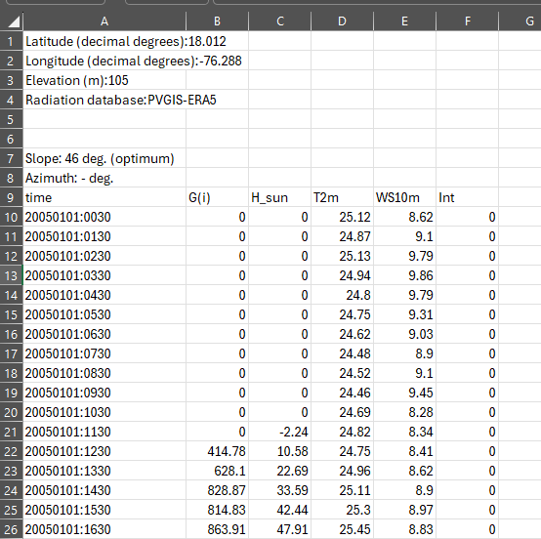
Quick Demonstration of Understanding Solar Power with Hourly Solar Date (Irradiation per m2)
Raw data
G(i) is radiation
H_Sun is height of sun
T2m is ambient temperature
WS10 m is wind speed
Could evaluate solar and impact of temperature
Could compare wind to solar by hour
Coud evaluate variation in solar by hour
Could evaluate variation by year

Slide 37
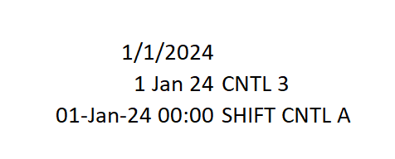
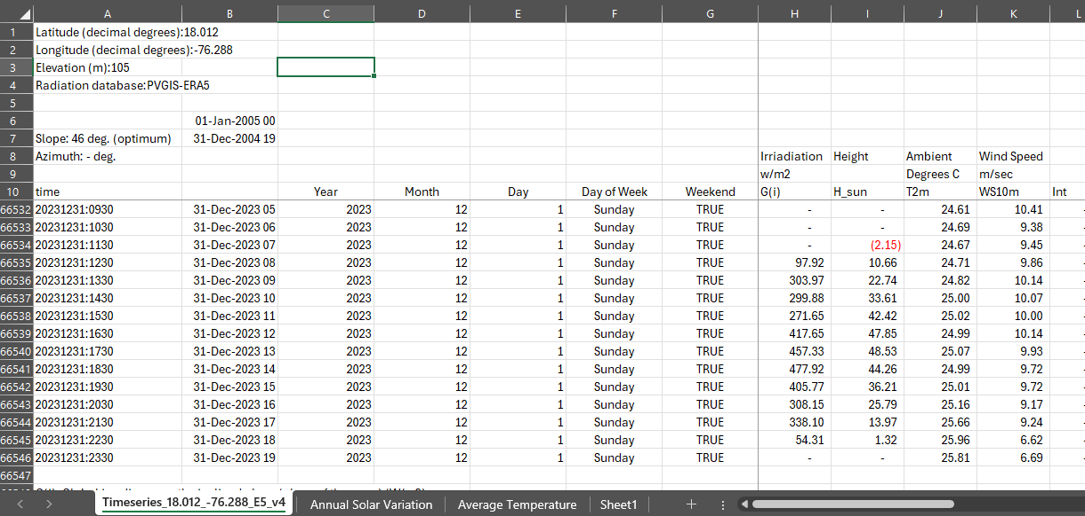
Even as a Banker, the First thing I do is look at hourly solar data and get dates
Once you get the dates right you can do a lot.
Use Generic Macro for Date Format and 1/24 for increment
Use Lookup function to compare dates and understand variability

Slide 38
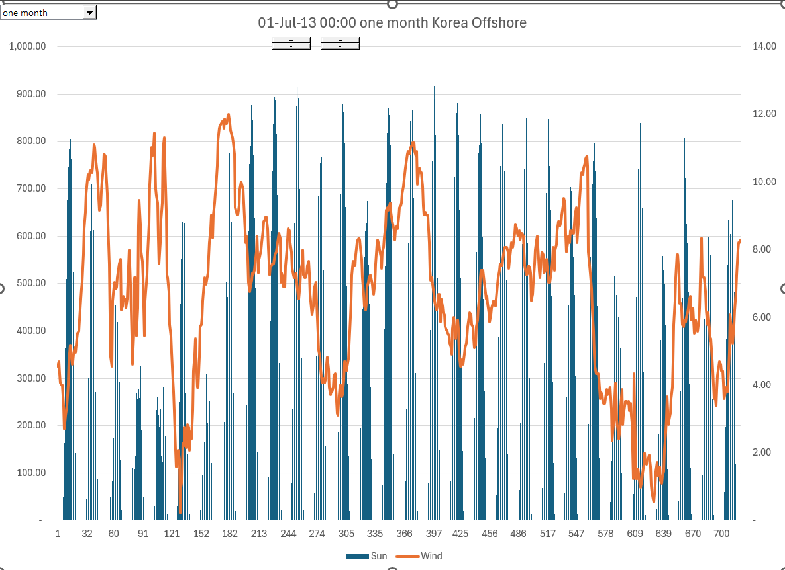
Use of LOOKUP and NA function for Graphs
Presentation can sometimes for one day, one, week or one year.
The dropdown box from the developer lets us look at solar and wind data for different periods from the hourly data.
Graph for one month. Note the irradiation level is not 1000

Slide 39
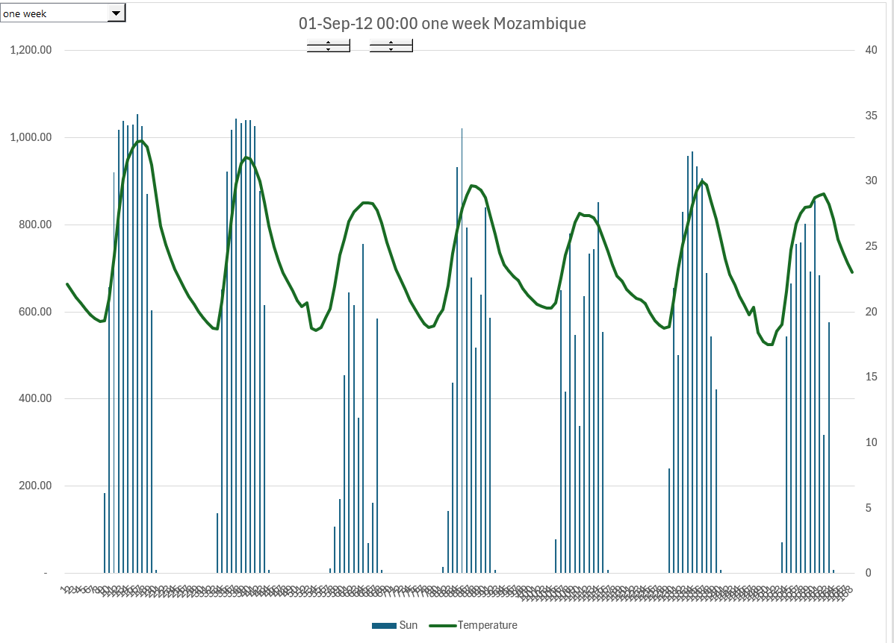
Use of Index Function to Change the Graph
In this example present Mozambique data for one week and for a different year with the spinner boxes
Note how the solar production is often around 1,000 watts/m2

Slide 40
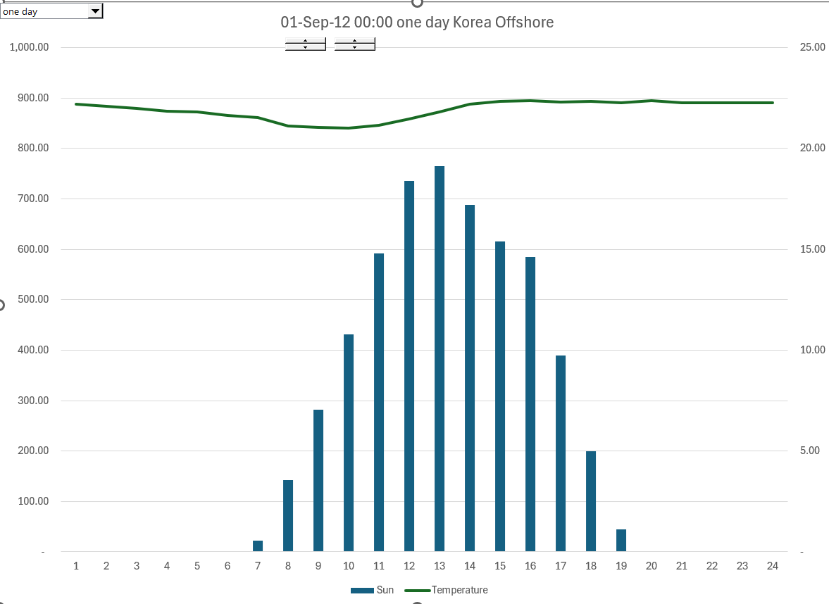
We could also change to one day for different presentations – this is used for battery and solar
Example of one day graph for Korea solar and temperature
Again, this is with LOOKUP and NA

Slide 41
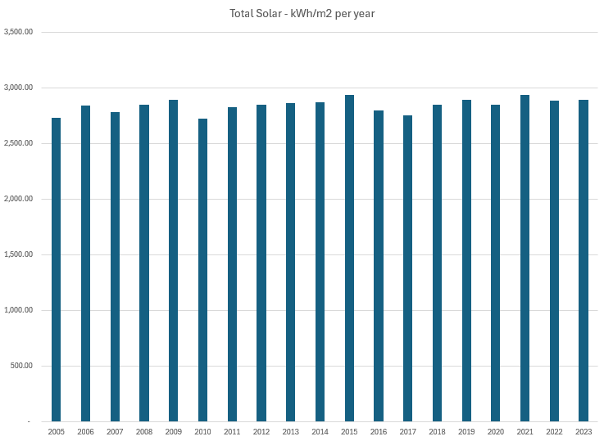
Average Solar by Year – Little Variation
With the long-term data you can compute the variation in solar per year
You can see the lack of variation in solar from year to year.
Standard deviation allows you to compute P90 with NORMSIM.
This is not meant to be too technical
This risk is easy, and it is mean reverting.
The technical risks discussed next are much more important

Slide 42
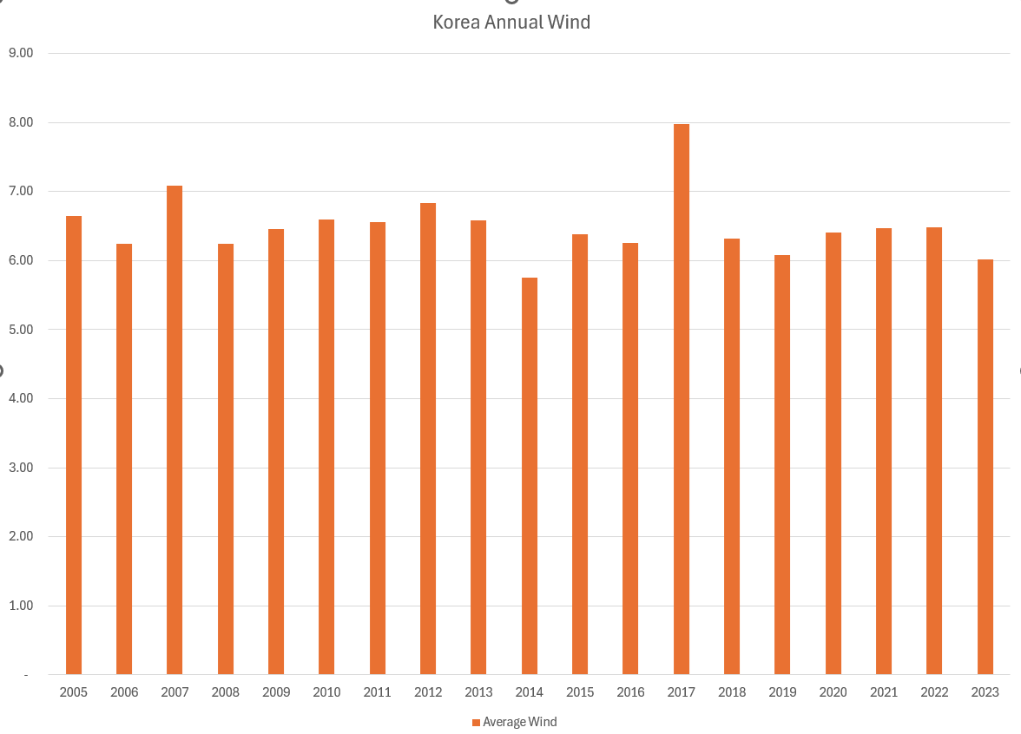
Long-term Wind Data for Off-shore Korea
This time we used the AVERAGEIF
Note that there is more variation in wind than for solar

Slide 43
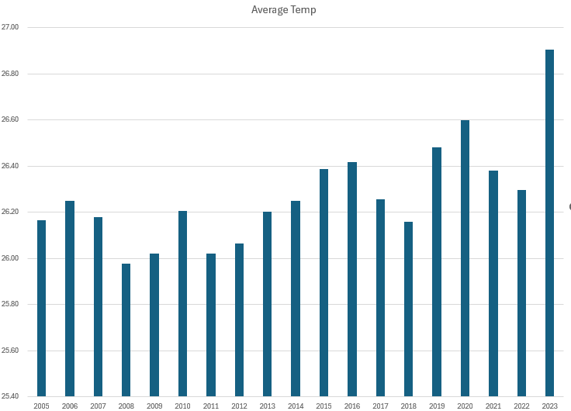
Average Temperature by Year
Get the temperature data from PVGIS and use AverageIF
You cannot control the temperature, but you can control the temperature coefficient by using different types of panels.

Slide 44
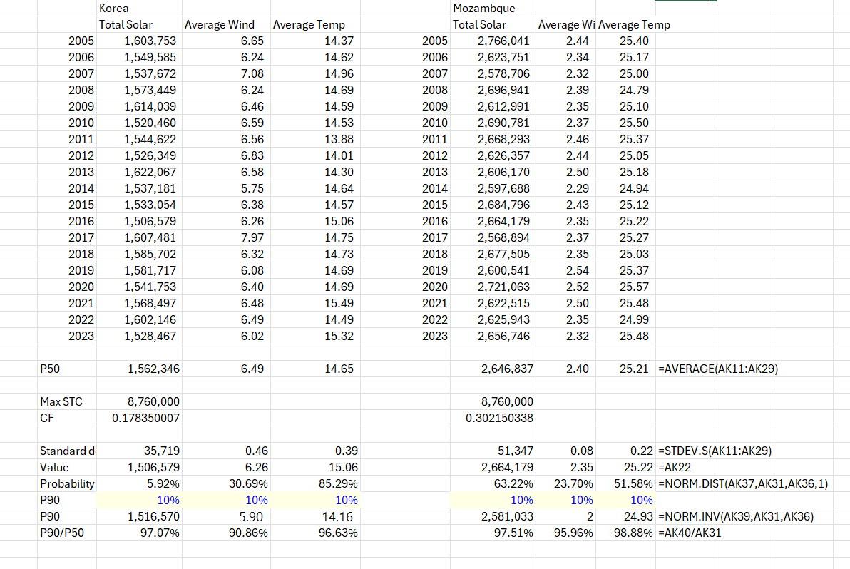
Using Long-term Data for Standard Deviation and for Computing P90 or Other P values
Standard Deviation to compute P90
Note the Norminv formula to compute the P90

Slide 45
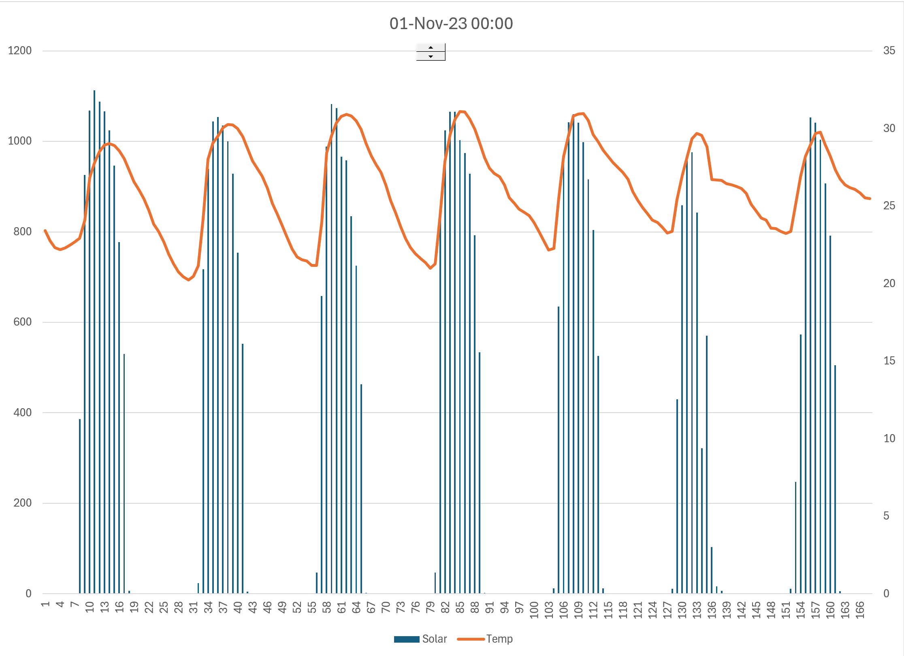
Solar Patterns
Note the stability in the resource in the desert. Note also that each hour the irradiation is near 1,000.
This does not mean the solar is at capacity because it is a lot hotter than 25 degrees.
The capacity of the solar panels measured at STC (kWp) is never obtained.

Slide 46
Solar Technical Details

Slide 47
Definition of Capacity - Solar, STC and Capacity Factor
Understand that with non-controllable quantity, you cannot define capacity in the same way as with something you can control like the speed of a car
  Creates confusion with kWp and kWac
  Work through efficiency and capacity factor
  Begin with the irradiation in watts/m2 which does not have adjustments for losses and temperature
  Understand capacity factor and yield as average divided by maximum. You can compute the capacity factor before adjustments for performance ratio.

Slide 48

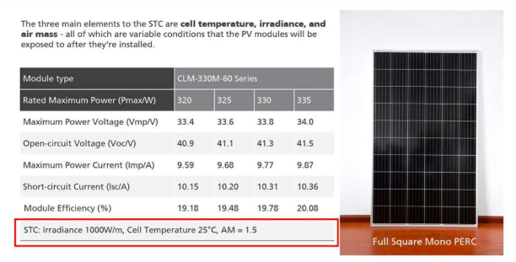
kWp Benchmark from STC – 1,000 Watts/m2 and 25°
In most projects, you have some kind of benchmark to measure capital costs
For example, in real estate, the cost per square meter
In solar the amount you produce depends on sunlight and how you configure the solar project.
Standard Testing Condition (STC) is used with a flash test to create a benchmark test for a panel (kWp or kWdc).

Slide 49


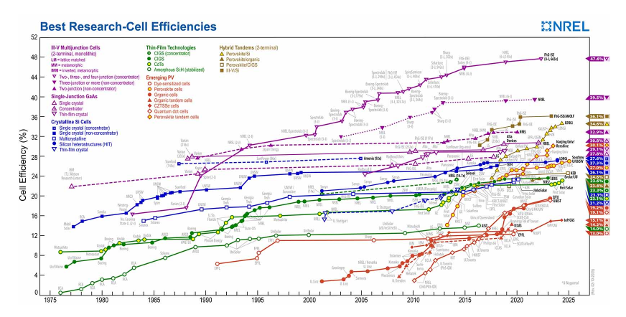
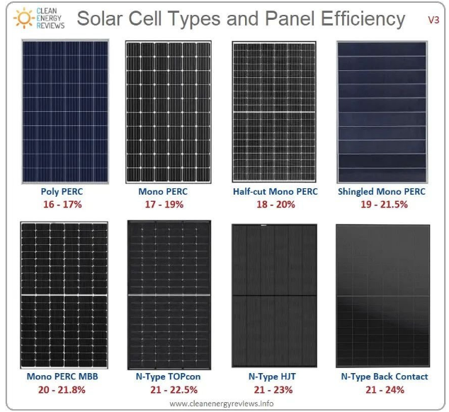
Confusion with Importance of Efficiency of Solar Panels
Consider a building. Pretend you can build a building with 10 floors or 20 floors
You could call the building with 20 floors more efficient from the standpoint of the land below.
But if you have to pay twice as much for the 20 floors as the 10 floors, the efficiency does not make the building more economic.
This is the same general idea with solar power.

Slide 50
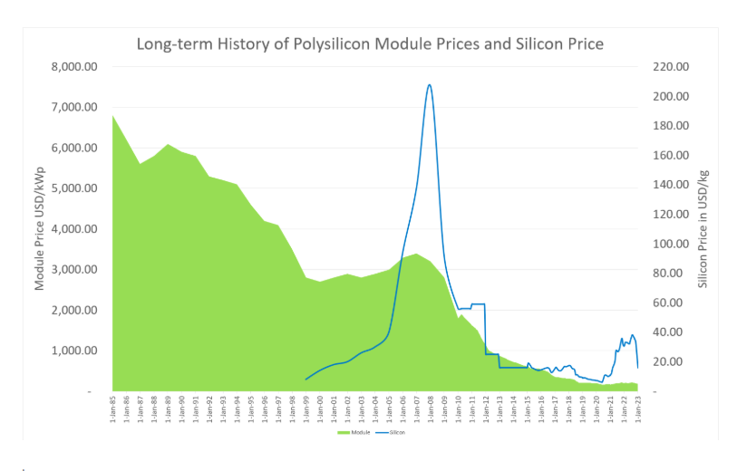
Long-term Price for Solar
Why efficiency does not matter very much
If less efficient lower price. Price is on output
Efficiency affect land

Slide 51
STC as Capacity – Demonstrate that when you pay for output and not input, the economics not affected
Low Efficiency
STC 1000 Watt/m2
Efficiency 16%
Production at 1000 W – 160 W
Cost per kW - $100
Total Cost for 1 kW= 160,000
Purchase 1000 watts = 1kW
Production at STC Hour = 160 watts
Cost of 160 watts = 160,000
High Efficiency
STC 1000 Watt/m2
Efficiency 24%
Production at 1000 W – 240 W
Cost per kW - $100
Total Cost for 1 kW = 240,000
Purchase 1,000 watts = 1 kW
Production at STC Hour = 240 watts
Cost of 240 watts = 240,000
Capacity factor and yield can be based on the kWp after efficiency which would be the same as if you used irradiation. For example, if the irradiation for four days is 0, 500, 1000 and 500. The average is 2000/4 or 500 or a capacity factor of 50%. If all of the numbers are multiplied by the efficiency, the capacity factor is the same.

Slide 52
Solar Performance Ratio
Think about questions to ask
Don’t be afraid of sounding stupid

Slide 53
General Idea about Performance Ratio
How much from coming up above that cannot be controlled
Relative to
Controllable output from panel type, cleaning panel, wiring configuration, inverter size
Performance Ratio = Final Output/Non-controllable Output

Slide 54
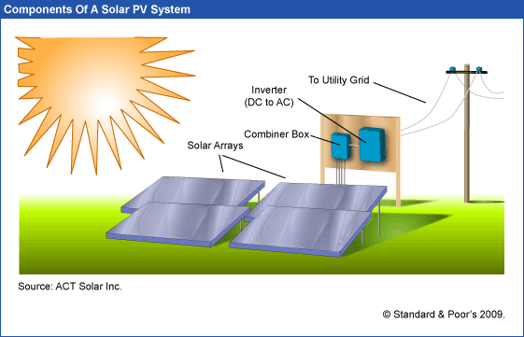
What you Can and Cannot Control – For Thinking about the Performance Ratio
Sunlight, clouds, earth position – things that come from above. In-plane irradiation (effective irradiance on collectors)
Capacity Factor of Generation to Grid relative to kWp
Performance Ratio is final output including controllable and non-controllable divided by the non-controllable from above
Controllable – type of panels, cleaning, wiring, inverter size, tracking …

Slide 55
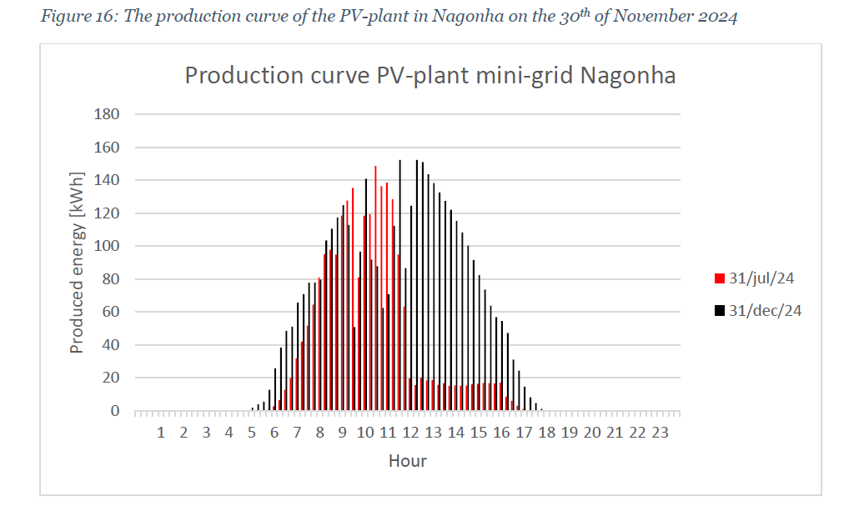
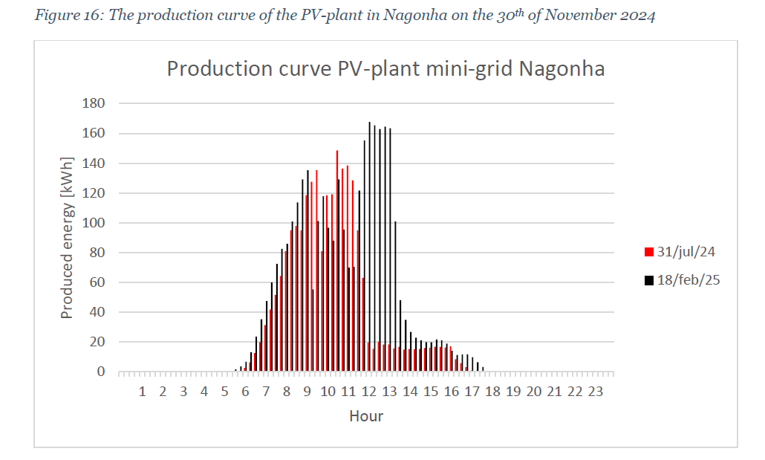
Hourly Solar Production in Nagonha and Performance Ratio
Will correlate this with PVGIS to derive the performance ratio. Note that there was too much solar in the early period relative to the battery, but this was resolved with the increase in load. Note also that in July 2024, there is too much solar relative to the battery but in December, all of the solar is used to charge the battery.
The level of solar production in February 2025 can be used to gauge an approximate performance ratio during the peak hours. Production is about 165 kW, and the capacity of the solar project is 200 kWp. This implies a performance ratio of 82.5% during the peak hours.

Slide 56
Don’t be Intimidated by PVSYST

Slide 57
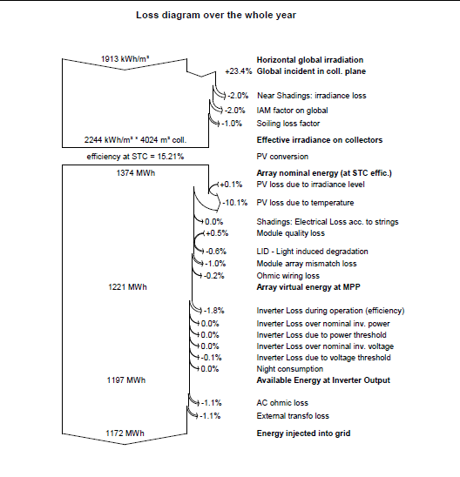
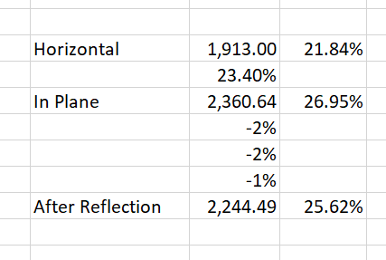
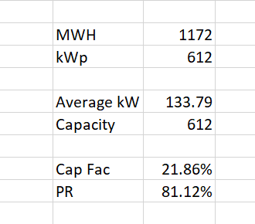
Loss Diagram Illustration – See that there is a lot of uncertainty in estimating the performance ratio
Convert loss diagram into capacity factor and compare different cases.
Difficult to compute performance ratio from these diagrams.
Generally, the loss due to temperature is the largest loss factor.
Important is temp

Slide 58
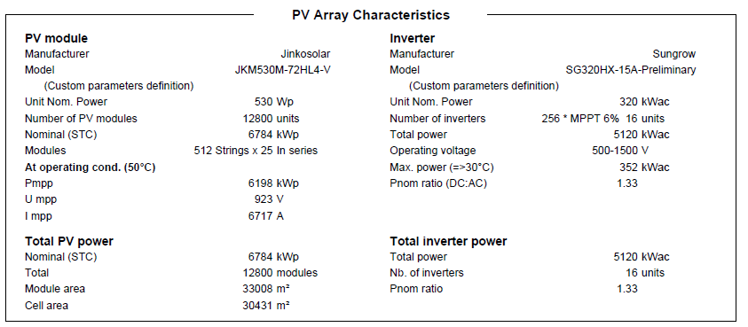
Inputs from PVSYST Example and Football Field
5,120 MWac
6,784 MWp
75% Ratio of AC to DC
Could make this to be 100%
Why not
Don’t get intimidated by PVSYST, can ask questions
33,008 meters for 6.784 MWp or 33,008/6.784; 4,865 m2 per MWp; Football field assumptions – 50 x 150 meters = 7,500 m2.
1 MW is 4865/7,500 = .64% of a football field. Or, 7,500/4865 = 1.54 means a football field gives you 1.54 MWp.
6,000 kWh per house per year. 1.5 MW x 20% x 8760 is the MWh production from a football field – 2,628 MWh. This gives you 438 homes from a football field

Slide 59
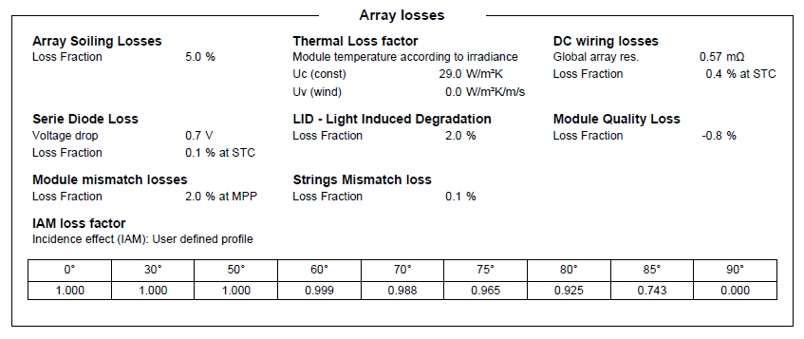
Loss Factors in PVSYST for the Performance Ratio
To understand solar, I think you should replicate PVSYST by yourself.
You need data on the various loss factors, the temperature coefficient and the AC/DC Ratio
Note the soiling loss – depends on how you clean the panels

Slide 60
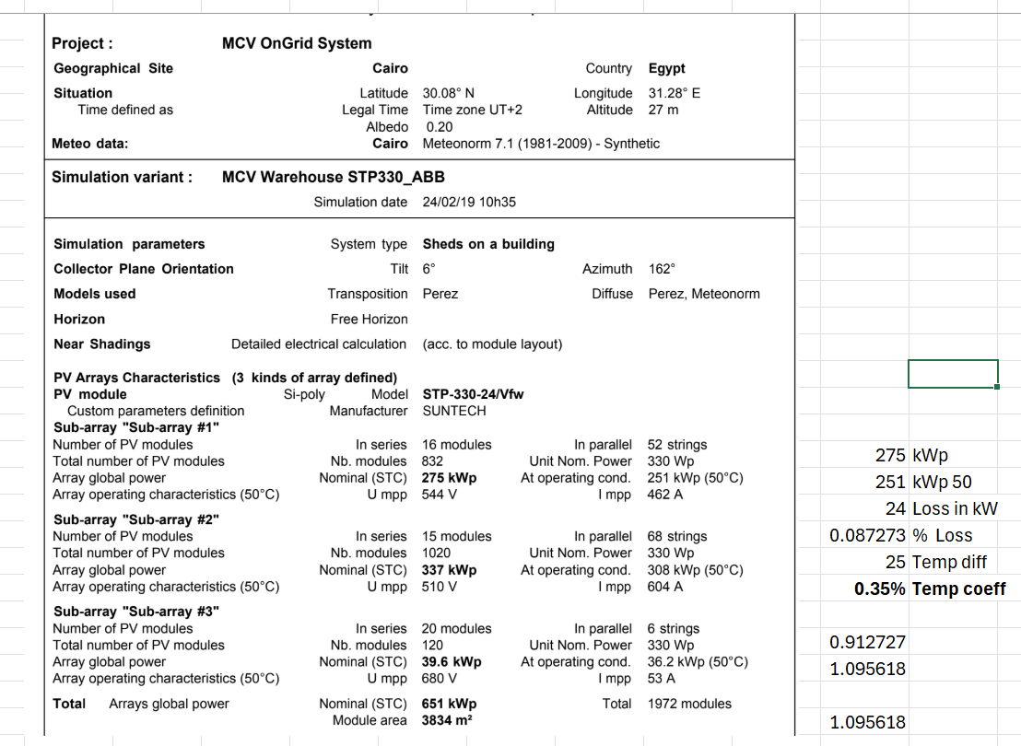
Deriving Temperature Coefficient from PVSYST
,
PVSYST which is commonly used for forecasting shows the capacity at different temperatures

Slide 61
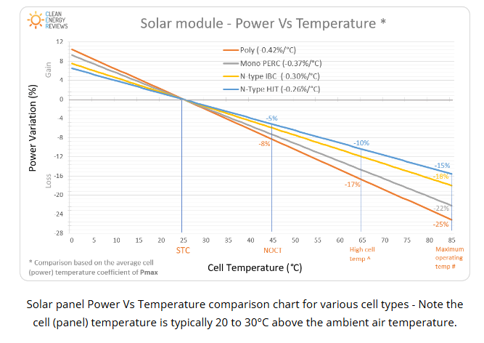
Solar, Temperature and Performance Ratio
Temperature coefficient. Understand that % change for temperature change versus 25 degrees
Example – Poly; if one degree higher, lose .42% of output
Note that 20 to 30 degrees above the ambient temperature

Slide 62
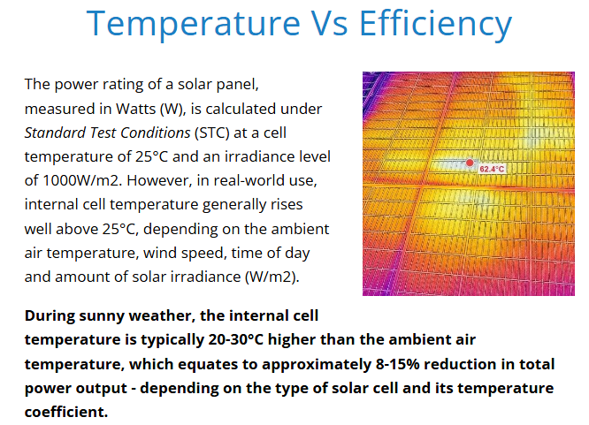
Idea that cannot use Ambient Temperature
.
Homer uses 3% of Irradiation in w/m2 as temperature adjustment

Slide 63
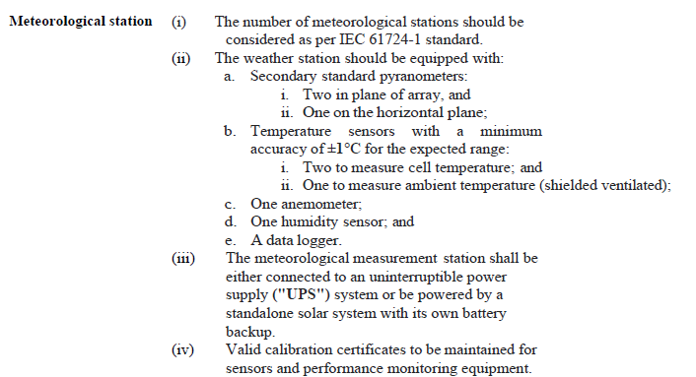
Detailed Weather Measurement in PPA – You can monitor the Temperature on the Panel
This technical detail is part of a PPA. Note the temperature of the Cell and the ambient temperature.

Slide 64
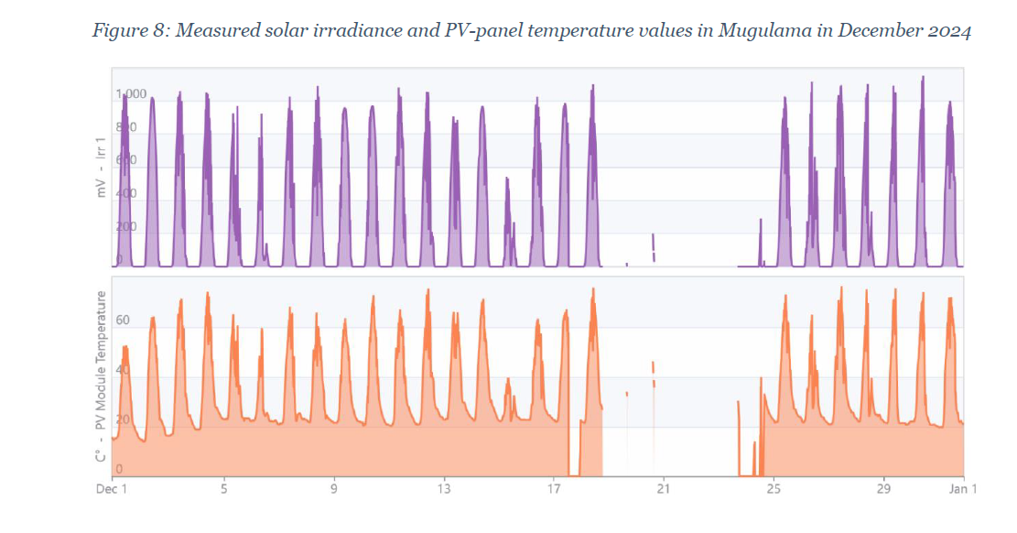
Irradiation Benchmark
Note how the temperature on the PV panel reaches a lot more than 60 degrees. This is discussed in the Appendix.

Slide 65
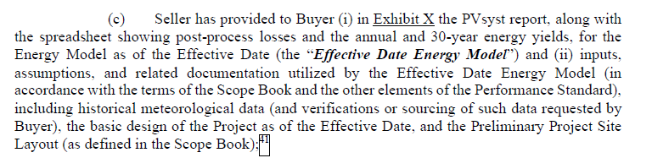
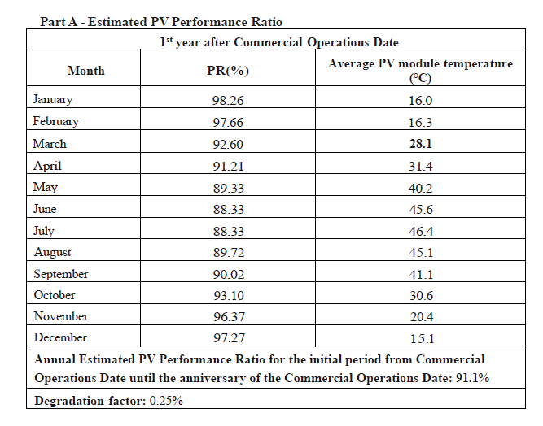
Providing PVSYST Report in PPA – Note that uses PV Module Temperature and not Ambient
.
As a banker, you could ask why the performance ratio is so high. You do not have to be a super technical expert to ask the question.

Slide 66
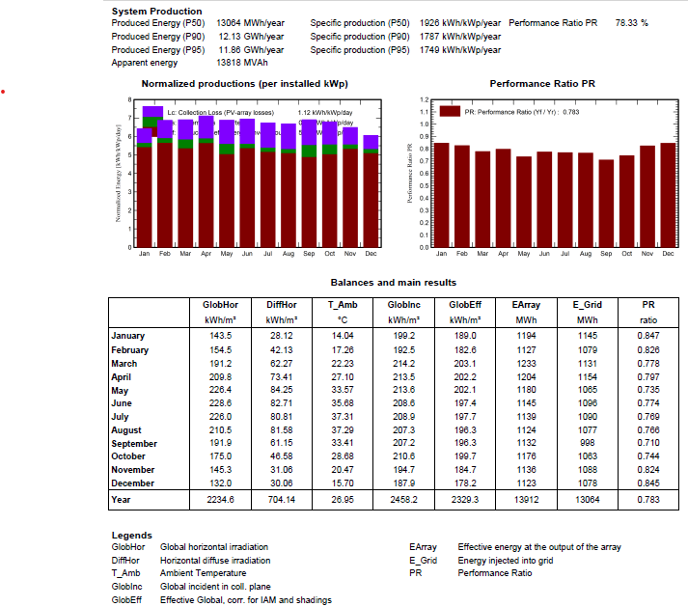
Performance Ratio by Month
Capacity for Radiation on Plane – 2,458 kWh per m2. With STC of 1,000 the capacity factor is 28.06%
Final Capacity factor. Generation kWh is 13,064. Capacity in MWP is 6,784, Average Production is 1,491 kWh. Capacity Factor is 21.97%.
Performance Ratio is Final Capacity Factor Divided by Gross or
21.97% divided by 28.06% or 78.3%
.

Slide 67
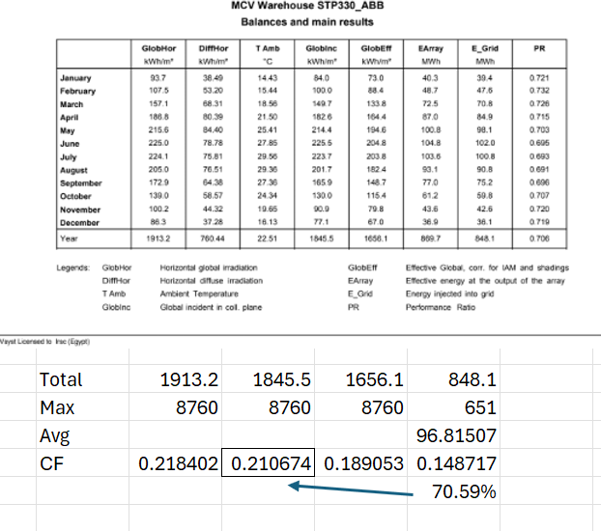
Deriving the Performance Ratio from PVSYST
Can use the solar the hits the panel, called the collector and then compute the capacity factor without temperature loss, without soiling, without shading and then the final capacity sent to the grid.
The capacity factor is the yield (kwh/kWp) which is hours divided by 8760 if annual data is used.
For the last column, the capacity factor is the average for the year divided by the max (the max is from STC which is 1000 watts per m2, 25 degrees

Slide 68
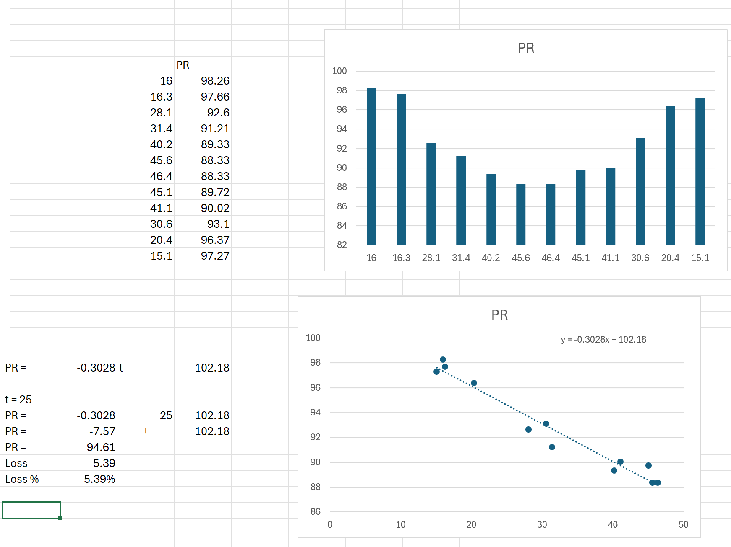
Analysis of PR and Temperature
Use x-y graph and equation to derive losses. Then you as bankers can ask questions and benchmark the data.
What questions would you ask
Derive the performance ratio at 25 degrees and then compute losses.
With temperature coefficient, you can see why AC capacity is less than DC capacity because 1,000 w/m2 and 25 degrees is a fiction

Slide 69
Detailed Formulas for Solar with Performance Ratio
Soiling Losses = Soiling Percent x In Plane Radiation
Net In Plance radiation = Gross In-plane Radiation – Soiling Losses
Pantel Temperatre Adjustment = 3% x Gross In Plane Radiation
Temperature on Pantel = Temperature + Panel Adjustment Temperature
Temperature versus STC Temperature = Temperature – Temperature on Panel
Efficiency Effect of Temp = Temperature Coefficient x Temperature Difference
Temperature Effect = Efficiency Adjustment * In Plane Radiation
Subtotal = Irritation – Losses – Temperature Effect
Other Losses = Other Loss Percent x Other Loss Percent
Subtotal = subtotal – Other Losses
Irradiation STC = 1000
AC/DC ratio = AC percent x ADC
Output before Loss = Minimum (AC Output, subtotal)
Inverter Loss = Output before loss x Inverter Loss Percent
Compute financial capacity factor as percent of STC

Slide 70
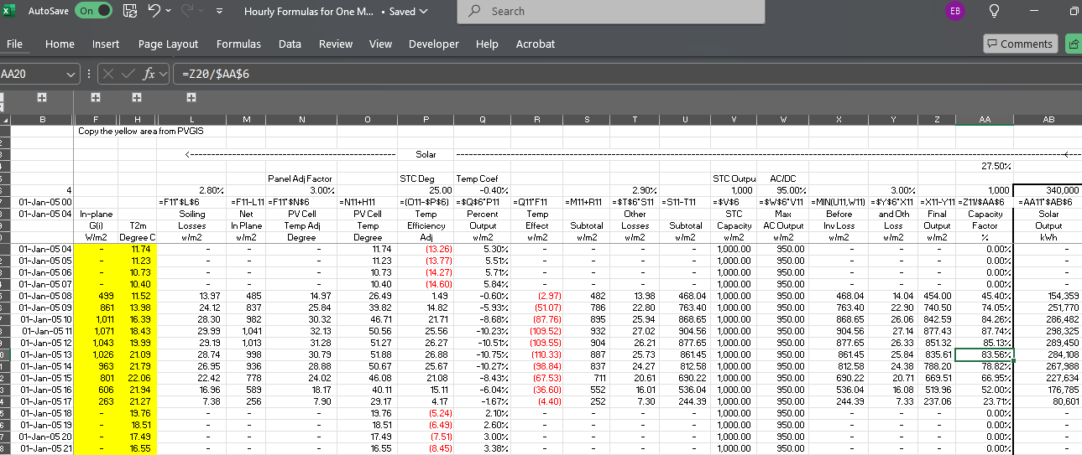
Capacity Factor for Solar with Performance Ratio and Temperature - Equations
Homer uses 3% of Irradiation in w/m2 as temperature adjustment

Slide 71
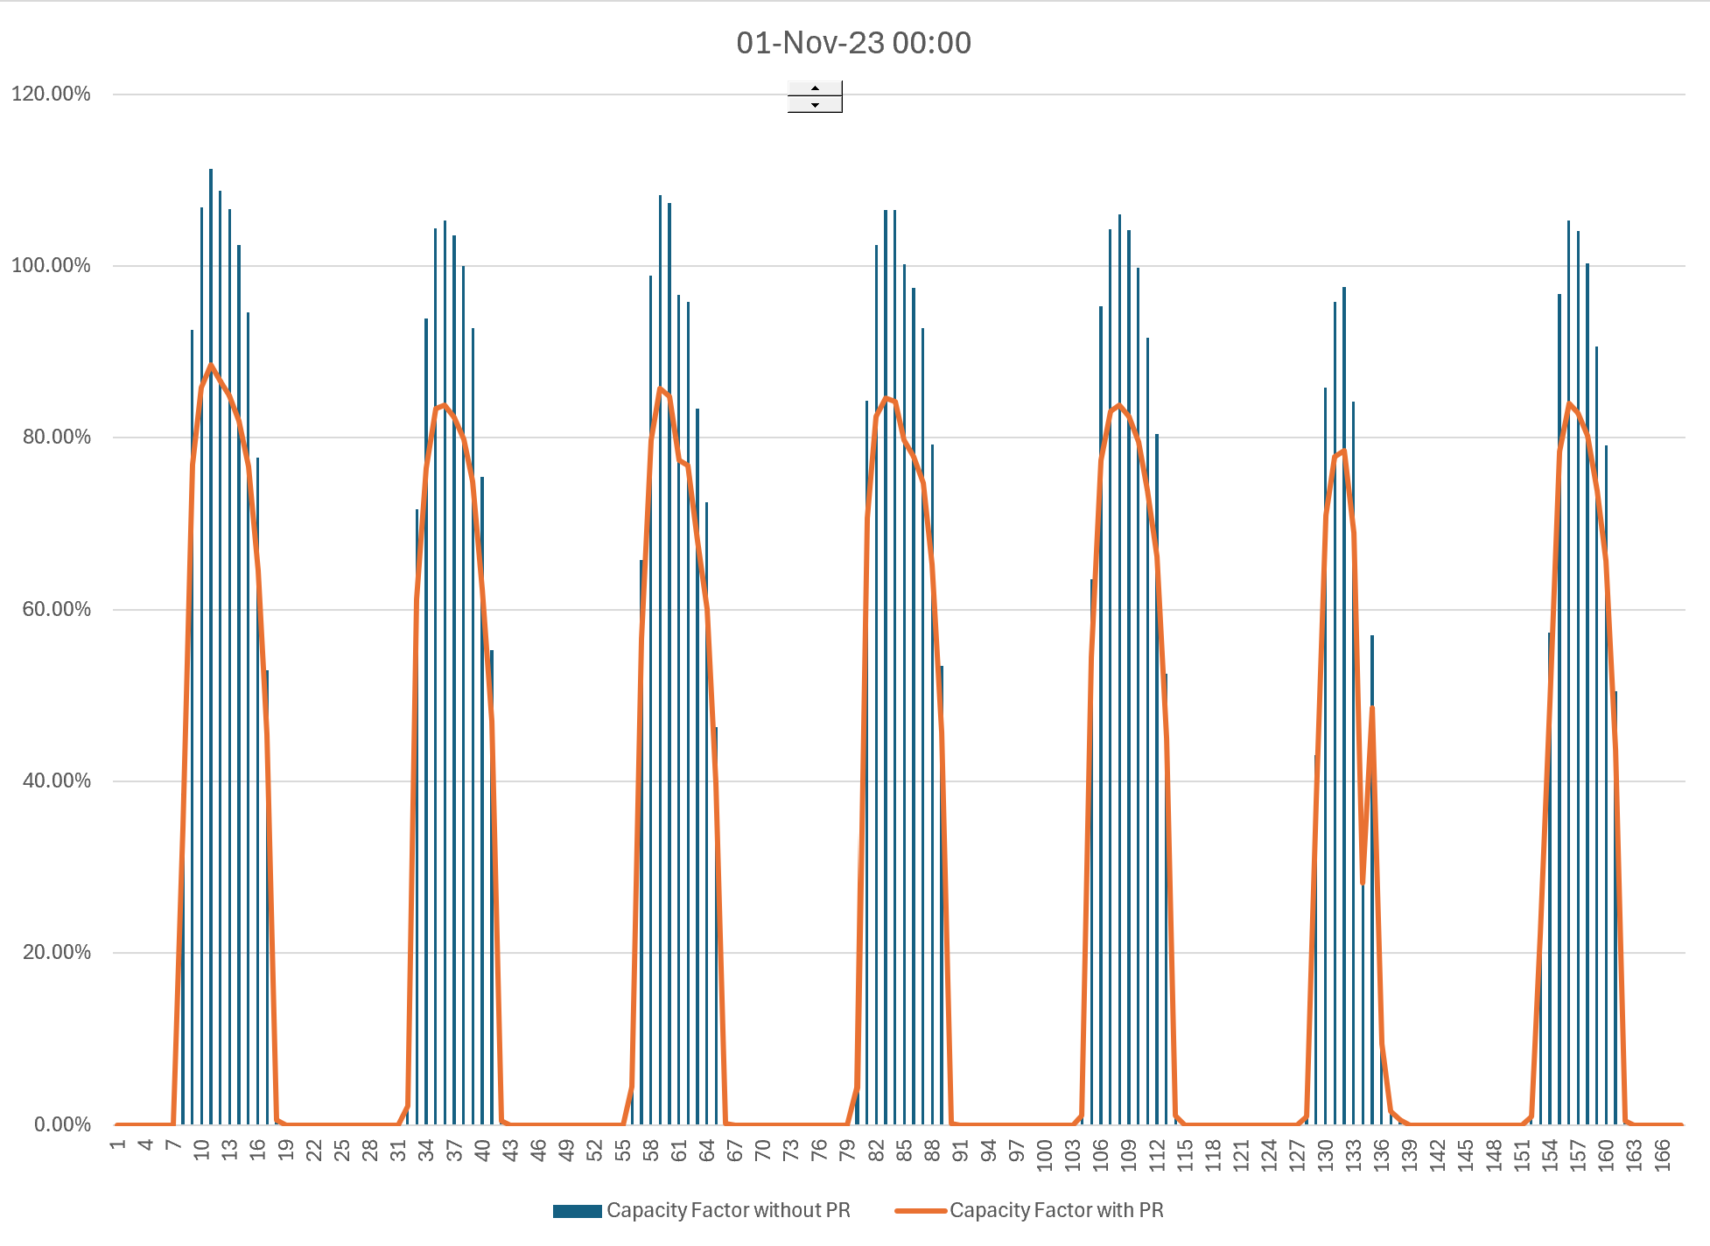
Capacity Factor with and without PR
.
With temperature coefficient, you can see why AC capacity is less than DC capacity because 1,000 w/m2 and 25 degrees is a fiction

Slide 72
Incorporate Detail of Solar
Add 15 columns
Soiling Loss Assumption: 2.8%
Factor for Increase in Temperature on Panel (% of irradiation) – 3%
Temperature Coefficient Percent Efficiency/(Panel Temp-25): -.41%
Other Wiring Losses: 2.9%
AC to DC ratio: 80%
Inverter Losses: 3%
Exercise – play around with 3% temperature adjustment, loss ratio and the temperature coefficient and be able to question the PR of the developer.

Slide 73
Technical Analysis: Wind - Details

Slide 74
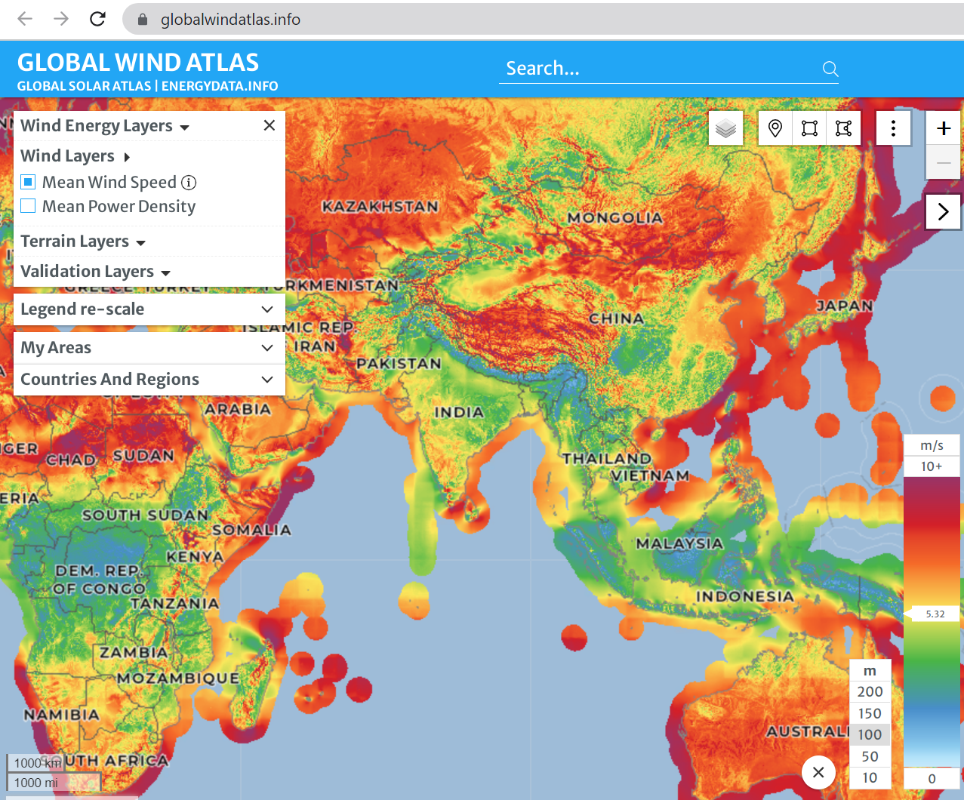
Global Wind Atlas
Difficult to work with and controversial.
See the average annual wind speeds

Slide 75

Solar and Wind in Oman (Wind is Offshore)
More changes without constant pattern for wind
Go to the single year file to work with the data.
The dream would be that there is a negative correlation between wind and solar

Slide 76

Offshore Wind in Pacific
Off-shore depth

Slide 77

Met Mast off-shore
Need to acquire local wind speeds
Cannot do this for multiple years

Slide 78
Wind Capacity Factor and Production
Compute wind at higher heights using wind shear
Combine the wind after wind shear with the power curve for capacity factor
Multiply the capacity factor by the assumed capacity to calculate generation
Adjust the generation for losses from wake effect etc.

Slide 79


Relationship between Resource (Wind or Solar) and Energy Output – Understand Power Curve
Solar is Linear and Wind has Curve – Power Curve. The non-linear aspect of power curve is key to wind. Small differences in power curve can have big effects on wind production.

Slide 80

Power Curve Sample – Finding data from a website called “thewindpower.net”

Slide 81

Example of Different Power Curves
Wind Speed and Capacity. Use website www.thewindpower.com

Slide 82

Power Curves Expressed as Percent of Capacity
Different Power Curves have different cut-out speeds
Divide data in wind speed by the capcity
Express as a percent of capacity because cost is expressed in USD per kW of capacity
Should pay more per kW of capacity if the power curve is higher

Slide 83

Selected Power Curves
Can be a large difference in power curves – best depends on wind speed

Slide 84

Power Curve Normalisation
http://www.thewindpower.net
Power curve can be expressed as a percent of the maximum capacity.

Slide 85

Using Interpolate Instead of Lookup
There is a file named generic macros
In this file you can get a colouring menu
When you go to Import functions, you can get a function that allows you to interpolate between wind speeds on the power curve

Slide 86

Wind Shear Adjustment
Height in meters versus wind speed in meters/second
Z2 and z1 are the height in meters
Speed = (100/10)^.143 x 10 Meter Speed
Wind Speed high height = Wind Speed low x (height/low) ^ Alpha

Slide 87

Calculation of Wind Shear Exponent
.
Calculation of Wind Shear Factor Using Logs – the difference in wind speed on the top in the numerator and the height in the denominator.
Alpha is the log of wind ratio divided by the log of height ratio
v2 is wind speed at high height
Z2 and z1 are the height in meters
10 meter 5.13
100 meter 8.21
Begin with 1/7 power law – alpha = .142; but not good enough for site specific applications

Slide 88




300 Meter Wind Turbines
.

Slide 89

Example of Wind Study and Height
Uncertainty in measuring
Test the alpha at different heights. First compute the alpha as log of wind ratio divided by log of height ratio.
Then test whether the ratio of height raised to the power

Slide 90

Changing Alpha from Wind Study
Check of mathematics

Slide 91



Get the 10 meter and different heights
Latitude 18.7333729
Longitude 56.372223

Slide 92

Wind Shear Estimates
Alpha = .17
v2 =8
v1 = 6
z2 = 100
z1 = 50
Derive the alpha from the chart below
The colours are wrong here

Slide 93

Errors in Wind Shear
Wind shear is the variation of wind speed with elevation. It is important to understand because it directly impacts the power available at different wind turbine hub heights.
For the site with the most complex terrain, the average annual wind shear varied up to 7% between different years.
For fairly flat terrain, many investigators have used the one-seventh power law, where α = 1/7 = .143

Slide 94

Estimation of Production after Losses with Resource Study – Analogous to Performance Ratio
For any renewable energy project, a resource analysis is made. For wind projects this is based on an assessment of local wind speed and the wind power curve.
The output from a resource study can be expressed as a capacity factor (average/maximum). In the example, 340.3 x 1000/8760 is the average and this average divided by the 94 capacity gives the capacity factor.
The resource study also gives probabilities of downside cases which is essential for banks. The P99 one year capacity factor is 31.1%

Slide 95

Estimation of Wind Capacity Factor
From study of wind in Jamica

Slide 96

Calculation of Hourly Wind Production
Note the capacity factor after the wake and other losses.

Slide 97
Lessons from Orsted Case Off-shore Wind Case from USA Project Loss

Slide 98
What Caused Downfall of Orsted
Did not have risks hedged with contracts after financial close. Not project financed
Agreed on PPA prices without securing fixed price contracts
Major increase in demand for offshore materials from German offshore wind after Ukraine war and from US offshore expansion after the IRA law
Political risk from US and desire for using natural gas
Low wind capacity factors in Europe
Declining Merchant Prices for Merchant Tail

Slide 99



Orsted’s Cancellation and Write-off
The table below shows parts of the loss for abandoning the Ocean Wind project and other U.S. projects. The loss includes amounts spent on the project and liabilities for cash cancellation fees.
Why didn’t Orsted pull the plug much earlier

Slide 100
Comment by Investor on Orsted and Any Corporation as Sum of Projects
The following is a statement from and investor about the value of existing assets versus the speculative value of development assets in an earnings conference call.
Analysts on this call probably get the same question I get every day. That question is what is the the valuation of Orsted’s existing assets? And I'm sure you get similar questions, but the question tells you something. It tells you that investors do understand that you have a portfolio of operating assets that are valuable.
But what investors are not buying is the conditional stuff (related to the development of new assets). Investors do not like to hear we (Orsted) hope to build this if type thing, if we get the tax credit, if we get a bump in the tax credit, if we can negotiate better terms, etcetera. So, I feel like if you guys in your strategy update can come with a base plan that is really dependable and is as reliable as people think the existing constructed assets are, and I think you'll get credit for that. And what I hope you'll be able to do is, is take away any pieces of it where there's still an uncertainty or something that people have to buy into a belief. Because it seems to me that the share price at the moment is telling us that nobody wants to believe in any of those kind of development uncertainties anymore.
Translation:
It is absurd when making a valuation of a portfolio of assets to assume a constant cost of capital.
Any corporation is a portfolio of assets

Slide 101

Pricing Regimes for Orsted’s Non-UK Offshore Wind Projects
After disaster with the Ocean Wind Project, Orsted just began publishing prices for different projects. Most of the projects have feed-in tariffs. Note that the highest prices are in Taiwan and in US (in Taiwan the capacity factor is low). The lowest prices are the recent fixed price contracts in Poland. Most contracts have some merchant price exposure.

Slide 102

UK Renewable Obligation Certificates (ROC) and CFD
The UK attempted to base subsidies from a market basis where suppliers are given targets and the subsidy required to meet the target is applied to different renewable energy projects. As different renewable energy technologies have different costs, the amount of ROC’s depends on the type of technology. The table shows the renewable energy subsidy (which is above the market price) for different periods.
The UK has moved to a bidding system where total prices are fixed (with inflation indexes). The fixed prices are like forward prices and termed contracts for differences discussed below.

Slide 103

Selected Graphs of Historic Capacity Factors for Orsted Projects – Mean Reverting Case
I have used the data provided by Orsted to compute and present capacity factors for different cases. This data highlights financial risks that investors are concerned about. The first case for an off-shore plant in the UK with a lot of history demonstrates a situation that should not be of concern. There is variation in the capacity factor, but this variation does not have a trend, and it is mean reverting. For valuation you should be much less concerned about mean reverting cash flow.

Slide 104

Drop Off in Capacity Factor for German Project
The second example I use is a case of a German project. If you were making a valuation of the project, would you use the average or the recent data (I would use the recent data). There has been discussion of global warming having an important effect on wind speeds in different locations.
Note that the lower capacity factor in the initial year is expected.
This worrisome trend appears in other German projects as well.
The lower capacity factor could also be the result of transmission constraints.

Slide 105
Link to European Market Prices
Now you can go to the link https://ember-energy.org/data/european-wholesale-electricity-price-data/

Slide 106
Risk Analysis for Wind and Solar for Credit and P Values

Slide 107
Objectives of Section
Historically, big risk is resource risk because of no off-setting contracts
Other important risks are merchant price risk, transmission risk
Lenders very concerned about technical risk
Structuring contracts around risk and project characteristics
Structuring loan agreement around risk
Understanding the P90 or other P and what it measures
What does DSCR on P90 mean
Can risks really be boiled down to probability statistics
Evaluation of technical risks
Wouldn’t it be fantastic if you could just get a downside case from pure objective mathematics

Slide 108


Example of Lender Analysis which Uses Data not Available to Equity Investor
Key Credit Concerns and Verification with Independent Engineer
Use of Alternative Parameters from Experience

Slide 109
Nightmare Graph and Missing the P90 – Fitch Report

Slide 110
Don’t Be Afraid to Compute P90 Yourself
Then understand the biases in the statistic
Then understand how the statistic can be manipulated
Why is the statistic so important to bankers
It gives you a supposedly objective downside case

Slide 111
Mathematics of P90
Step 1: Compute Standard Deviation
Step 2: Use NORMINV in excel to compute P90 from standard deviation
Step 3: Use Mean Squared Error to Compute Multiple Standard Deviations
Mathematical Principles
  Everything depends on the standard deviation
  Standard deviation is computed for different components
  Some parts of standard deviation are straightforward
  Some components of standard deviation are more judgmental
  Basic Statistical Idea
    If variation is independent, you cannot add depreciation
    You can use Mean Square Error
    Step 1: Square each standard depreciation
    Step 2: Add the squares of standard deviation
    Step 3: Once, you have the sum, take the square root
    Step 4: The square root is the combined standard deviation
  Once you have the standard deviation, use NORMINV
    NORMINV takes probability, mean and standard deviation
    Mean is the P50
  Philosophic issue
    Can you really boil down risks to a standard deviation

Slide 112

Everything Driven by Standard Deviation – Derive the Standard Deviation
Once you have standard deviation, you can compute any P value with NORMINV

Slide 113

Understand Components of Standard Deviation with Mean Squared Error
The math is not the major conclusion.
The major conclusion is how in the heck do you measure standard deviation of correlation etc.

Slide 114
Idea of P90 1 Year versus P90 20 Year
Remove mean reverting items from risk
If you get the modelling errors wrong, they are wrong forever
If you get the movements from one year to another year wrong, the risk is not that bad. It is mean reverting
A fundamental idea of thinking about risk

Slide 115

1-year and 10-year P90, P50 etc.

Slide 116

Computation of 1-year and 10-year
Note that the only change is the standard deviation of the 1-year and the 10-year and the 20-year wind speed variation (wonder how 10-year and 20-year standard deviation can be computed)

Slide 117
P90 and DSCR
General idea of DSCR
  DSCR = CFADS/Debt Service
  Example 150/100 = 1.5x
  Does not mean that cash flow can decrease by 50% and no default
  Reduction in CFADS to break even – 50
  Cash Flow 150
  Percent reduction 50/150 = 1/3 = 33%
  General Formula: Break Even → 50/150 or (DSCR – 1)/DSCR
  Relation to P90, P90/P50 = X %

Slide 118
Risks Other Than Resource Risk
Availability Risk
Technical Risk
O&M Risk
Transmission Risk
Environmental Risk
Political Risk
Degradation Risk
The resource study also gives probabilities of downside cases which is essential for banks. The P99 one year capacity factor is 31.1%

Slide 119

On-Site and Simulated Solar Power
Compute standard deviation
Compute the P50 versus P90
Compute the debt capacity with 20 year debt
Compute P50 for P90 for wind versus solar

Slide 120

Where Uncertainty Comes From – Not Just Variation Year to Year
Risk of getting the starting point wrong
First, there may be different solar resource estimates from different models
How would you account for this in the P90

Slide 121

Availability Risk of Solar

Slide 122

Mean Square Error – Exercise, Compute it
Compute the square of the component
Sum the Squares of the components
Take the Square Root of the Sum

Slide 123

Interpreting P90 for Solar – Is Degradation that Occurs Annually the Same as other Variation
Derive standard deviation
Compute P90

Slide 124

Example of Aggressive P90
The difference between P50 and P90
P90 only 96.47% below P50. Low std deviation

Slide 125

Compute P Levels from Uncertainty
Convert Percent to kWh
Use Norminv
First calculation is the P90/P50 which is 91.1%
Second calculation is the standard deviation and computing standard deviation divided by average

Slide 126

P50 and P99 in Solar Case
Evaluate the P50 and P99 using the DSCR criteria.

Slide 127


Example of Sources of Uncertainty

Slide 128

Risk of Noise from Turbines
The amount of noise from turbines can be measured and guaranteed, unlike the flicker example

Slide 129

Risks from Avian Issues
Problems of birds can reduce the output of turbines.
  Example in France when must stop turbines during bird migration
  Example in Canada with reduction in generation and also costs for scientists

Slide 130
Additional Risks: Transmission Capacity
Best Wind Sites not Located in Load Centres
  Wind Producer may be responsible for transmission
  Examples of curtailment
    Lake Turkana
    Oklahoma
  Low Merchant Prices in Transmission Constrained Areas
    Example: Montana and Off-peak Prices
NL has priority dispatch for RES. In addition, in case of curtailment compensation is paid. So far, curtailment is seemingly not an issue in NL.

Slide 131
Additional Risk: Partial Exposure to Merchant Power Price
History of Merchant Power and Merchant Power Problems at the Turn of the Century
Debt Structuring with Merchant Power Risk
Examples of Merchant Power Risk in PPA Contracts

Slide 132
Additional Risks: Shadow Flicker
What is shadow flicker in wind and is it a big deal
Shadow flicker is the intermittent shadow casted by the moving wind blades of a wind turbine. The extent of its impact depends on the latitude of the project, time of the day, time of the year, turbine height, blade length, distance between the impacted dwelling and the turbine, the window placement of the dwelling etc.
Depends on the project and buildings in the vicinity and the rules & regulations. Some projects need to stop turbines for specific times for shadow flicker reasons.
Certain governing bodies have clear regulations on shadow flicker, e.g. max number of shadow hours casted at a dwelling. Even if there is no clear written regulations, residence (participating or not participating in the project) can express concerns during public comment period of a permitting process if there is one. Shadow flicker can be modeled using commercially available software like wind pro.

Slide 133
Counter Party Risk and O&M Contracts
Replacement of the EPC/maintenance contractor --Consider a case where the turbine manufacturer/supplier will build the wind farm (EPC contract, full scope) and will also maintain it (the turbines, maintenance agreement).
  Is the turbine manufacturer/supplier easy to replace (for example in case of bankruptcy)?
  Can a replacement turbine manufacturer/supplier maintain the current installed turbines and replace its parts?
  Or, are parts and turbines very (brand) specific and do they need to install their own turbines (or even windmills)?
  Do these turbine manufacturers/suppliers use parts from subcontractors or is everything designed and built in-house and very specific?

Slide 134

DSCR to Accept 90% or 99% Uncertainty
The total of individual simulations has the MSE when the variables are independent

Slide 135

Compare the P50 versus P99 to DSCR from Wind Study
The difference between P50 and P99

Slide 136
Financial Modelling with IRR and DSCR

Slide 137
Starting Points of Understanding a Financial Model
The idea is to not be intimidated by reading a large financial model
First point – Create an InputC page so you can easily change anything in the model
Second point – Create a flexible timeline with equations like 1=1 or NOT(true)=False or AND(1,0) = 0

Slide 138

Example of InputC
Make it easy to insert new scenarios
Use conditional formatting
Use the INDEX function to make selection
Use conditional formatting to show selection

Slide 139

Example of Timeline
Use simple formulas
Key is the separation of pre-COD and post-COD

Slide 140
IRR has Taken Over – So the Big Question
What is all of this business with the IRR anyway
What does the IRR Actually Measure

Slide 141
Bad Answer 1
IRR is the discount rate that makes the NPV equal zero.
True, but does the CEO like one project over another project because he says that the discount rate to make the NPV equal to zero for one project is better than another project

Slide 142
Bad Answer 2
The IRR is the rate of return.
The word IRR has rate of return in it. You are doing nothing other than re-stating the definition.
It is saying that the plane is late because it is delayed

Slide 143

Real World Minimum Acceptable Target IRR
In practice there is no CAPM and certainly no un-levering and re-levering of Beta (see the discussion at the end).
In practice, equity IRR is used rather than project IRR as a target (this makes sense in theory as project finance implicitly adjusts for risk
In practice, and there are general standards for target IRR on buying and selling of projects. These standards have change over time. Pre-Covid for projects in Europe with a few years of history, equity IRR targets were as low as 4%.
I have been told stories of insurance company executives and pension plan managers going around Europe holding suitcases of cash to buy solar and wind projects with operating history.

Slide 144
IRR is Growth Rate, but With Asterix
For LBO (ENS), the calculation is clear – without dividends between when you make the initial investment and the time when you sell the investment the IRR is the same as the growth rate

Slide 145

LBO and Growth Rate
.
Growth Rate is 20% for the 1,000 over 10 years (1.2)^5 x 1000.
This produces 20% IRR for the investment
Note there are no dividends

Slide 146


Amazon and Growth Rate
Amazon stock price growth with dividends.
Amazon’s IRR was about 25%

Slide 147

Problem with Dividends in IRR
Unlike the LBO example, in project finance there are continuing dividends
The IRR is still the growth rate, but this time, the IRR only works as the growth rate if dividends are assumed to be re-invested at the same rate as the IRR as shown in the example below
IRR from Cash Flow
IRR from the growth rate

Slide 148

Crazy Results for High IRR and Long-term
Because of the re-investment rate assumption which implicitly assumes that cash flows are discounted at the IRR itself, for long-term investments with a high IRR, the value of the long-term cash flow is very low. This does not reflect the true value of long-term versus short-term investments.
The data table below illustrates that the IRR increases by a small amount when the IRR is high and the life is long
No change for difference in life

Slide 149

MIRR is not a Good Solution
You can compute something called the MIRR in excel, but this calculation doesn’t give you a sensible result because the re-investment assumption you input will be similar to the resulting MIRR.
So, you input an assumption and, in the end, the output return is about the same as the input assumption
This is demonstrated in the data table below. A data table is computed by carefully setting up scenarios in a row and/or a column and putting an output variable between the row and the column scenarios.

Slide 150

One Solution: Compute the Premium Relative to the Risk-Free Rate
A fundamental idea of finance is measuring risk from a basis of a risk-free rate
Importantly, a long-term bond yield does not provide a good indication of the risk-free rate because of risk associated with changes in the rate of inflation
To compute this, calculate the NPV at the risk-free Rate of cash flow after the project begins producing cash flow
Compare this value to the FV of the investment at the start of the project operation
The table below illustrates how this works.
Effect of plant life completely changes

Slide 151

Why WACC is What Absolute Complete Crap – Does not account for changing risk

Slide 152
How Can We Resolve the Problem that IRR and NPV do Not Account for Risk Reductions
Projects move from venture capital like investments to safe investments
Assume an insurance company or a pension fund wants to buy the asset when the risk decreases
This can be called compression
Model the value of the project over time with a changing target IRR (minimum target IRR is the definition of cost of capital)
Model different assumed sale dates (better to sell early)
Compute the IRR with a sale date

Slide 153

Illustration of Change in Value with and without Change in Risk
The value changes over time for equity – it increases as debt is repaid because the dividends have more value.
It decreases as the plant ages

Slide 154

IRR from Buyer and Seller Perspective
Note the dramatic increase in the seller IRR because of declining risk

Slide 155
Risk Analysis and Financial Models
Evaluation of Financing and Integrated Financial Models of Battery Systems is more around risk analyses and not really around financial analysis and modelling in relation to energy storage as the title implies. Can this section be modified to also include how a utility should go about doing the financial analysis and modelling so that the appropriate cost parameters be included in the PPA.

Slide 156
Debt Parameters in Model
Look at Term Sheet on website for max debt to capital and min DSCR
See the slide below for debt size
See the discussion on the debt tenor

Slide 157
What About the DSCR – Why is That Such a Big Deal for Bankers
It is the best real-world measure of risk with buffers
Your alarm clock every day
Waiting room for Teams
Your mortgage payment, or rent compared to your salary
How early should you arrive at the bus stop
How much time in transit between flights
How early for a meeting with your boss

Slide 158

Key Debt Terms – Why Don’t They Put this in Another Sheet
Graph tells you – Cash pattern, DSCR, Tail, Value of debt (brown area), dividends (blue area), (need dividends to give bankers a DSCR buffer and to give a reasonable return).

Slide 159

New York Meeting, Google Maps and Assessing the Risk of Being Late

Slide 160


Which is More Important – DSCR or Debt to Capital
Maximum Debt to Capital Constraint
Minimum DSCR Constraint

Slide 161
Three DSCR’s in Solar Case
Distributions
  Make any distribution unless such distribution is made from Distributable Cash and on a Distribution Date; if the Average Annual DSCR calculated as of the Repayment Date immediately preceding such Distribution Date is less than 1.20 to 1.00, or
  the Average Annual Projected DSCR (based upon the Term Conversion Date Base Case Projections but updated for actual operating performance of the Project through the applicable Repayment Date) calculated as of the Repayment Date immediately preceding such Distribution Date, is less than 1.20 to 1.00;
Financial Covenants (Default)
  Permit the Average Annual DSCR as of the last day of any Quarterly Date commencing from the first Repayment Date to be less than 1.10 to 1.00 or
  Permit the Average Annual Projected DSCR (based upon the Term Conversion Date Base Case Projections but updated for actual operating performance of the Project through the applicable Repayment Date) calculated as of the Repayment Date immediately preceding such Distribution Date, as of the last day of any Quarterly Date commencing from the first Repayment Date to be less than 1.10 to 1.00;
Minimum Term Conversion Date Debt Service Coverage Ratio
  a minimum Average Annual Projected Debt Service Coverage Ratio for the twelve (12) month period of 1.35 to 1 on a P50 Production Level during years 1 through 9, and,
  1.00 to 1 under a P99 Production Level during years 1 through 9 of the amortization schedule.

Slide 162


DSCR for Solar PV from Fitch

Slide 163

Inputs for Debt Financing – Separate Page
Want to run operating scenarios against different financing structures

Slide 164

More Complex Conditional Formatting
For both change in variable and illustration of the scenario
Avoids complex Index functions that are common

Slide 165


Pre-and Post COD Analysis
Pre-Cod
Post-Cod

Slide 166
Why is the key target Equity IRR and not Project IRR
You care about how much money you take out of your pocket, not some mythical amount of money that comes from both equity and debt investors
In project finance with non-recourse, lenders do something very important, they gauge the risk for you – the more debt and longer the debt, the lower the risk of cash flow
If you do not get this and use WACC, you do not understand the essence of project finance

Slide 167
Rule Number 1 – Project IRR must be greater than the Interest Rate
If Overall Project IRR < Interest Rate, Equity IRR always less than the project IRR
Cannot play tricks with financing with really low project IRR
If Overall Project IRR = Interest Rate, Equity IRR is always the same as the project IRR
Still cannot play tricks
If Overall Project IRR > Interest Rate
Can play all sorts of tricks
This should be after tax project IRR and after-tax interest rate

Slide 168
Games Developers Can Play with Debt Sizing
Try to show high P90 cash flow with small standard deviation
Optimistic estimate of cash flow
Get max debt size from P90 and then work on debt to capital constraint
Put in things like development fee, DSRA that will switch to LC, owners costs, EPC premium
These things increase the project cost without costing real cash

Slide 169

Debt Size with DSCR and Debt to Capital
Illustration of alternative debt sizing
If debt to capital is constraint, pad the costs with alternative things
E.g. DSRA cash changing to DSRA with LC

Slide 170

Risk Analysis in Solar Projects

Slide 171

Other Inputs – Price Calculation, Required IRR and Finance Inputs
Focus less on detailed finance than a detailed financial models.
Will compute price from the required IRR as in the LCOE

Slide 172
Term Coverage Ratio in Solar Case
“Minimum Term Conversion Date Debt Service Coverage Ratio” means,
  a minimum Average Annual Projected Debt Service Coverage Ratio for the twelve (12) month period of:
  1.35 to 1 on a P50 Production Level during years 1 through 9, and
  1.00 to 1 under a P99 Production Level during years 1 through 9 of the amortization schedule.

Slide 173


Fundamental Effect of Debt Tenure with Debt to Capital Constraint

Slide 174
Sculpting Equations - Basic
One of the main ideas about the repayment process in project finance is that the modelling is much more effective when you combine formulas with other excel techniques. If you try and solve these things with a brute force method that uses a copy and paste method or goal seek things will get very messy. Formulas used for repayment and debt sizing are listed below: The fundamental two sculpting formulas are:
(1) Target Debt Service Per Period = CFADS/DSCR
(2) Debt Amount at COD = PV(Interest Rate, Target Debt Service)
Non-Constant Interest Rates
However, this is by no means the only formula you should use when working on repayment. In cases when the interest rate changes, a simple present value formula cannot be used. Instead, an interest rate index can be created that accounts for prior interest rate changes as follows:
(3) Int Rate Index(t) = Int Rate Indext-1 x (1+Interest Rate(t))
(4) Debt Amount at COD = ∑ Debt Service(t)/Interest Rate Index(t)

Slide 175
Sculpting Equations with Debt to Capital Constraint
Use of LLCR when there is a Target Debt to Capital constraint that drives the amount of the debt. If the debt is being sized by the debt to capital ratio, a higher DSCR must be used.
This raises the issue of how to compute sculpted debt repayments when debt is sized with the debt to capital ratio and the DSCR is not from the DSCR constraint.
When the Debt is Sized by Debt to Capital the LLCR can be used to size the debt, because with sculpting, the DSCR = LLCR. Formulas in this case include:
(5) Target Debt Service(t) = CF(t)/LLCR
(6) LLCR = NPV(Interest Rate, CFADS)/Max Debt from Debt to Capital
(7) DSCR Applied = MAX(Target DSCR,LLCR with Max Debt)

Slide 176
Sculpting Equations with LC Fees
Adjusting Sculpting Equations for Debt Fees: Debt fees such as the fee on a letter of credit is part of debt service. To include the fees in the sculpting equations, you should subtract the fees when you compute the net present value of debt, as the fees reduce the amount of debt service that can be supported by cash flow. To make the sculpting work you should also make the repayment lower by the fees as shown below:
(14) Repayment = CFADS/DSCR - Interest - Fees
(15) Debt = NPV(Interest Rate, Debt Service-fees)
Debt = NPV(rate, Debt Service) - NPV(rate, Fees)
Note Debt Service in the above equation means debt service without fees and debt is reduced by PV of fees
Adjusting LLCR for Debt Fees: The sculpting analyses include calculation of the LLCR to evaluate whether the debt to capital constraint is driving the constraint. In this case the PV of CFADS is not the correct numerator for the analysis. Instead, the PV of the LC fees should be added to the denominator of the LLCR as follows:
(16) LLCR = PV(CFADS)/(Debt + PV of LC Fees), where
(17) Debt = Project Cost x Debt to Capital

Slide 177


Sculpting versus Equal Installment with DSCR Constraint
Note the big increase in IRR with the DSCR constraint – because of the larger debt size. Recall that can effectively make the DSCR constraint be in place

Slide 178
Sculpting Equations with Debt to Capital Constraint
Use of LLCR when there is a Target Debt to Capital constraint that drives the amount of the debt. If the debt is being sized by the debt to capital ratio, a higher DSCR must be used.
This raises the issue of how to compute sculpted debt repayments when debt is sized with the debt to capital ratio and the DSCR is not from the DSCR constraint.
When the Debt is Sized by Debt to Capital the LLCR can be used to size the debt, because with sculpting, the DSCR = LLCR. Formulas in this case include:
(5) Target Debt Service(t) = CF(t)/LLCR
(6) LLCR = NPV(Interest Rate, CFADS)/Max Debt from Debt to Capital
(7) DSCR Applied = MAX(Target DSCR,LLCR with Max Debt)

Slide 179
Sculpting Equations with LC Fees
Adjusting Sculpting Equations for Debt Fees: Debt fees such as the fee on a letter of credit is part of debt service. To include the fees in the sculpting equations, you should subtract the fees when you compute the net present value of debt, as the fees reduce the amount of debt service that can be supported by cash flow. To make the sculpting work you should also make the repayment lower by the fees as shown below:
(14) Repayment = CFADS/DSCR - Interest - Fees
(15) Debt = NPV(Interest Rate, Debt Service-fees)
Debt = NPV(rate, Debt Service) - NPV(rate, Fees)
Note Debt Service in the above equation means debt service without fees and debt is reduced by PV of fees
Adjusting LLCR for Debt Fees: The sculpting analyses include calculation of the LLCR to evaluate whether the debt to capital constraint is driving the constraint. In this case the PV of CFADS is not the correct numerator for the analysis. Instead, the PV of the LC fees should be added to the denominator of the LLCR as follows:
(16) LLCR = PV(CFADS)/(Debt + PV of LC Fees), where
(17) Debt = Project Cost x Debt to Capital

Slide 180
Mini-perms
Matching the tenor of repayment to the life of the project and even considering terminal value in the repayment in the context of both achieving a higher DSCR and an improved equity IRR.
Problems with multi-lateral agencies that allow long-term maturity can be contrasted with commercial banks and bond financing that may be more flexible and sometimes could have lower costs.
Specifically, the effects of hard and soft mini-perms on the profitability of a project along with the difficult problem of required re-financing assumptions.
How the DSRA could be used to re-finance debt at end of loan life and how potential terminal value can be used to justify partial bullet repayment at end of loan.

Slide 181
Re-financing Conclusions
Not being “allowed” to consider re-financing is silly.
Consider a variety of re-financing possibilities with scenario analysis
Re-financing can dramatically change the implications of interest rates and tenures.
Re-financing a particularly important issue for cases where the loan tenure is a lot shorter than the project life.

Slide 182
A Little Theory about Valuation and Risk of Projects
Valuation theory with respect to projects generally involves risk reduction as a project progresses through phases.
In Europe, there are many stories (but not much data) about how insurance companies purchase existing projects with operating history and are willing to accept equity IRR’s as low as 5-6%.
The idea behind a low cost of capital for mature projects is the following:
  During the development stage, expenditures occur with large risks associated with permitting, problematic wind studies, construction cost over-runs, ability to secure tariffs etc. The required equity IRR during the development stage can be 15% to account for the project not being successfully methods.
  Once the development is finished or in late stages, the risk is reduced by a large margin. However there are still risks associated with successfully completing construction at budget and on time. The reduced risk during the construction phase may reduce the required equity IRR to something like 12%
  After construction, the remaining risk for a project with a fixed price contract is that the estimated wind production will not be met. Given this risk, the discount risk is still above the cost of capital for bonds and may be in the range of 8-10%.
  Once operating history is available, the risk is not much higher than the debt cost or the interest rate on long-term bonds. With bonds yielding below 3%, a return of 6% provides a good premium for risk.

Slide 183
Re-financing and Early Project Sale
Timing strategies and sales value. How different types of projects have differences in risk reduction over time, and why wind projects probably have more of a risk reduction than other electricity projects. Show how the effects of changing risk and selling to a Yieldco can be demonstrated with measuring IRR over time with changing buyer IRRs. Demonstrate how optimal holding periods can be computed with various IRR hurdle rate assumptions.

Slide 184

Mini-Perm
Start with Amortisation Profile – this is what drives the debt size.
Compute debt size form Amortisation period

Slide 185
Mini-Perm Example
Term Loan Principal Scheduled Payments. Borrower shall repay to Administrative Agent, for the account of each Lender, the aggregate unpaid principal amount of the Term Loans made by such Lender in installments payable on each Repayment Date in accordance with the Amortization Schedule set forth below, together with any remaining unpaid principal, interest, fees and costs due and payable on the Term Loan Maturity Date. The Parties hereto acknowledge and agree that the Amortization Schedule set forth below shows the amount of each installment payment of the Term Loans to be made on each Repayment Date:
Amortization Schedule
Quarterly Payments | Amount
1-4 | $102,600
5-8 | $111,400
9-12 | $118,500
13-16 | $128,000
17-20 | $136,000
21-24 | $146,250
25-28 | $157,000
29-32 | $168,250
33-36 | $180,000
Term Loan Maturity Date | $5,508,000

Slide 186


Run the Financing Scenarios and Equity IRR
Create a little macro and illustrate the effect of financing

Slide 187
LCOE Mechanics
Understanding the
Competitiveness and
Drivers of Value for Renewable Energy

Slide 188
The Big Question for Electricity
Which is more economic:
Nuclear Plant (must have low cost of capital and inflation adjustment)
Off-shore Wind (would not serve a data center)
Natural Gas (must make forecast of natural gas and emission cost)
Solar + Battery (Must size the batteries and solar)

Slide 189
Answer the Question with LCOE
Be careful with LCOE
Use the Real and not Nominal LCOE
Adjust for plant life for different parts
Adjust for degradation
Adjust for construction period
Be very careful with cost of capital for capital intensive assets

Slide 190
Overview of Section
Understand Economic Costs and Benefits with Levelised Cost of Electricity (LCOE)
  Taking away mystery of LCOE
  Drivers of LCOE
  Reconciliation of LCOE and Simple Financial Model
  Nuances of LCOE
  Importance of Cost of Capital and Project Financing
  Using LCOE to Evaluate Costs and Benefits of Renewable Energy

Slide 191
Capital Intensity and Rate of Return

Slide 192


General Risks Facing a Nuclear Plant
Example, exposure to natural gas prices
O&M Expenses are low relative to revenues, so not economic to close plant
Cannot wait for plant to end its life and decide not to replace asset
Cannot move plant

Slide 193


General Risks Facing Vegetable Vendor
Assume that margins change because of price
Assume surplus capacity
Could decide not to replace cart
Could abandon cart and try something else
Could move to different location

Slide 194
Basic Idea that Greater Risk and Greater Require Return
Obvious points about risk and return
if investors in the nuclear plant and in the vegetable-stand incur all of the market risks, the required rate of return before and investment is made will obviously be higher for the nuclear plant.
Concepts of Beta and CAPM do not help
For project finance, the terms of the debt including the size of the debt and the length of the debt are the best indications of risk.
  With higher risk will be more difficult to get debt financing over life
  With higher risk will have higher required return on equity

Slide 195
Any Investment has at Minimum Three Things and a Rate of Return
Revenues Realized
Construction Period
Operating Life
Capital Investments
Return on Investment from Cash Flow versus Capital Expenditure
Operating Expenses
Terms for return (Benefit versus Cost) -- Project IRR, Unlevered Pre-tax IRR, Ungeared IRR, Pre-tax Project IRR

Slide 196
Rate of Return is More Important for Capital Intensive Investments
Whether or not the risk is different for a capital-intensive asset than for a non-capital-intensive asset,
The effect of the cost of capital and rate of return is more important on the ultimate price is more important for the capital-intensive asset than for than the non-capital-intensive assets.
More of the overall price comes from the recovery of capital expenditure over time.
As the capital-intensive asset has higher capital expenditure relative to operating cost, the cost of capital multiplied by the asset base will be more important.
If the amount of capital expenditure relative to the operating expense is the same, the cost of capital will be more important for the longer-lived assets.

Slide 197

Capital Intensity and Effect of Higher Required IRR
.

Slide 198
Why the Rate of Return is Affected by Economic Life
Even if the risk is not different for a capital-intensive asset than for a non-capital-intensive asset, the effect of the cost of capital and rate of return is more important on the ultimate price for the capital-intensive asset.
More of the overall price comes from the recovery of the un-recovered capital expenditure balance over time (excluding the recovery of capital).
A capital-intensive asset has higher capital expenditure relative to operating cost, the cost of capital multiplied by the asset base will be more important in the price.
If the amount of capital expenditure relative to the operating expense is the same, the cost of capital will be more important for the longer-lived assets.
More of the price is associated with return on capital and less with return of capital for the longer-lived asset. Return of capital (depreciation) is the same, but the return on capital is more because capital is outstanding for a longer period. Consider an asset with a two-year life versus an asset with a twenty-year asset. For the two-year asset, by the second year, the capital recovery declines in half. For the ten-year asset, the recovery will decline by 10%, and the capital expenditure will be outstanding for a longer period.

Slide 199

Illustration of Scenarios with 15% Rate of Return
The table below illustrates how prices can be measured from different assets. A formula can be used to establish recovery for capital expenditures and recovery for operating expense with different assumptions for economic life, return earned and inflation. The first case illustrates a 10-year economic life with a 15% rate of return.
This is like LCOE
Like three parts of multi-part tariff

Slide 200

Illustration of Scenarios with 5% Rate of Return
The table below illustrates how prices change when a 5% rate of return is used. The price declines from 192 to 126. This price decline is driven by the return and return of capital.
Depreciation does not depend on return
Note the lower capital expenditure recovery

Slide 201

Illustration of Scenarios with 15% Rate of Return – 2-year life
The table below illustrates a case with an asset that only lasts 2 years and a return of 15% Even though the return is high, the percent of recovery related to return is much lower.
Even Lower Capital Expenditure Recovery

Slide 202

Illustration of Scenarios with 5% Rate of Return – 2-year life
The table below illustrates a case with an asset that only lasts 2 years and a return of 15% Even though the return is high, the percent of recovery related to return is much lower.
Lowest Capital Expenditure Recovery

Slide 203

Illustration of Scenarios with Rate of Return
The table below illustrates how prices can be measured from different assets. A formula can be used to establish recovery for capital expenditures and recovery for operating expense with different assumptions for economic life, return earned and inflation. The first case illustrates a 10-year economic life with a 15% rate of return.

Slide 204

Capital Intensity Definitions and Returns
Capital Intensity Depends
  Operating Expenses to Capital Expenditures
  Asset Life
  Rate of Return
Which asset has the highest capital intensity, and which has lowest capital intensity

Slide 205

Capital Intensity and Life and Operating Expense
Data Tables Demonstrating Capital Intensity
With 70-year life, the revenues doubles; with the 10-year life the increase in revenues is much less.
Capital Intensity as Assets Divided by Revenues

Slide 206

Capital Intensity Graph and Effect of Changes in Overall Return
If you can keep returns lower for capital intensive assets, the effect on prices or costs to the government is dramatic.

Slide 207


Effects of Financing on Bid Price – Capital Intensive
Pillar 1: Effects of Lower Cost of Capital on the Cost Consumers Pay – Levelized Cost of Electricity

Slide 208
Mechanics of LCOE

Slide 209



Contract for Differences (CFD) and Levelized Cost of Electricity (LCOE)
Importance of measuring cost of different alternatives.
Comes down to measuring cost of capital expenditures and operating expenditures separated into fixed operating costs and variable operating costs.
Measure the total costs relative to the amount produced.
In non-electricity industries compute the total cost of ownership.
Always depends on cost of capital, inflation and taxes

Slide 210
Calculation of LCOE
Four Equations – Produce the same value
  Theoretical Discount Rate – Pre-tax target IRR
  Classic Equation: LCOE = PV of Revenues/PV of Generation
  Similar Equation: LCOE = (Capital Expenditures + PV of O&M)/PV of Generation
  Conceptual Equation: LCOE = Weighted Average Price where weights are discount rate, generation
  Value Driver Equation: LCOE =
    (Capacity Cost + Fuel Cost + Variable O&M + Fixed O&M)/kWh where
  Capacity Cost in Equation: Capacity Cost =
    PMT(Discount Rate, Economic Life, FV of Cap Exp)

Slide 211

Nuances in LCOE Calculation
Nuances are essential
  Real versus nominal LCOE
  Taxes in LCOE
  Financing Assumptions
  Cost of Capital

Slide 212


Lazard LCOE
Famous Lazard study is biased against capital intensive technologies

Slide 213

Effect of Financial Assumptions on LCOE
Create chart like this with waterfall option in excel (set-up base and increment)
.

Slide 214

LCOE of Different Technologies
Cost depend on use cases

Slide 215


LCOE of Battery and Solar
Big Question for Electricity – Cost of Storage and Solar

Slide 216
Start with LCOE and History of Solar Power

Slide 217

Extremely High Rates in Initial German Solar Feed-In Tariffs
Was this good government policy. Idea to make very simple tariff to finance projects and then achieve scale.

Slide 218

German Tariffs for Alternative Sizes of PV

Slide 219




Example of Feed-in Tariff Calculation
Note the return on equity target of 11.5%

Slide 220

Context of Subsided Prices – Compare 45 Euro/kWh with Merchant Prices of about 3 Euro Cents
Demonstrates that the economics of solar power can be driven by natural gas prices

Slide 221

Dubai 6 Cents per kWh in 2015

Slide 222


Examples of Very Low Solar Prices
To see how far things have come, there are many projects now that are lower than 2 USD cents per kWh.

Slide 223

Low-Cost Solar Example
Assume that there is inflation in the tariff

Slide 224

Demonstration of Solar Cost per MWH
Part 1: Assumptions with set-up for solar power (zero out the battery)
Battery Capacity is zero so focus on solar

Slide 225

Financial Model in LCOE Analysis for Method 2
.

Slide 226

Computation of LCOE for Solar (High-Cost Base Case)
LCOE calculation summary

Slide 227

Waterfall Graph for Solar LCOE (During Sunlight Hours)
Demonstrates range of costs
Y-scale is real LCOE

Slide 228

Wind Project
.

Slide 229
Solar versus Natural Gas (Solar versus Variable Cost of Natural Gas)

Slide 230
LCOE Estimates for Discussed Later
.

Slide 231

Natural Gas Price History – US versus Asia
.

Slide 232

Effect of Fuel Cost on LCOE
The effect of the fuel cost is dramatic
Can assess variable cost of gas versus total cost of solar
Explains why Data Centers are in Texas and Louisiana

Slide 233

Levelised Cost of Dispatchable Plants and Variable Cost
Comparison of real LCOE for Renewable with Fuel Prices/kWh
.

Slide 234

Example of LCOE versus Electric Bill
Focus on variable charges

Slide 235

Including Externalities
Variable Cost can (should) include cost/MWH of greenhouse gasses
For CO2 easy to compute
  Tons CO2/MWH
  Cost/Ton
  Cost per MWH
  Find on Internet
For natural gas should include the cost of leakage
Could be other externalities
  Cost of Accidents
  Effects on Employment

Slide 236

Inclusion of Emissions in LCOE
.

Slide 237

Emissions with Methane
We had to ask two times

Slide 238

Total Emission Cost of Gas
.

Slide 239

Natural Gas Cost for Combined Cycle Including Capacity Cost
The levelised cost analysis is shown below for natural gas where the emissions costs and the fuel cost was included.
Demonstrates the Emission Case.

Slide 240

Waterfall Graph of Natural Gas LOCE
Note the dramatic effect of the difference in natural gas prices

Slide 241
Case Study
Nuclear Plants and RAB Model

Slide 242
Case Study of Rate Base Regulation for Nuclear Plants in UK
Back to Ancient forms of Regulation and Contracts
  Importance of Cost of Capital
  Computing Levelised Cost Model of Nuclear with Different Economic Models
  Example of UAE Nuclear based on PPA and Public/Private Partner Structure
  Alternative RAB Model in UK and Low Cost of Capital Objective

Slide 243

Capital Cost of Nuclear
.

Slide 244


PPP Project Example – Versus Corporate Finance or Government Ownership
Draw diagram of PPP project in nuclear power
.
18%/82% Private/Public
ECP Contract – Private
O&M Public
Debt 20% EXIM/80% Govt
.
.
.
.

Slide 245
Exercise: Draw a Diagram of UAE Project
.
EWEC – Off-taker State Owned by UAE
ENEC – Performs O&M without Contract, Cost plus
(EPC Contractor)
ENEC - Special Purpose Vehicle:
Equity Investor (Financed by EBL)
Lenders (EPC related and Government)
Government of UAE – 82%
(EPC Contractor) – 18%
UAE Government (15 Billion)
EXIM

Slide 246

Nuclear LCOE
Assumptions

Slide 247
Alternative Method – PV of Revenue/PV Generation
.

Slide 248
LCOE Method 3
Compute the PV of O&M cost and Decommissioning Cost at relevant discount rates

Slide 249
Nuclear LCOE with Different Assumptions
The cost of capital and inflation are the big drivers.

Slide 250
Adjustments for Commodity Prices During Construction

Slide 251
Contract Nuances: Commodity Price Changes Over Long Construction Period
Basic Idea of Fixed EPC Price
For Short-term Projects Not a Big Idea
Mechanical Problems of Applying Different Indices

Slide 252
Fixed Contract Price in EPC Contract

Slide 253
Nuance: Adjustments to Construction Cost
Increase in Risk from Cement, Steel and other prices
Price risk does not provide incentives
Variability in prices
Example in Financial Model

Slide 254
Construction Adjustment Nuance: Example from ENEC Financial Model
.

Slide 255
Current Issue – Lithium Prices and Batteries
Should the PPA on a Battery be adjusted for Lithium prices

Slide 256
Inflation Adjustments in PPA

Slide 257
Pretend you are Lender, Consumer, Investor
Would you want the cash flow to change when the inflation rate changes

Slide 258
Inflation Risks to Different Parties
Issue – Should total price including the capacity payment increase with inflation
Mechanics – Create and inflation index from a given date from and objective source
Investors – Nominal return changes, but real return is constant
Off-taker – Initial price is lower, but price increases
Lenders – Almost always get paid for nominal and not real interest
Lenders – Causes average loan life to increase if sculpt
Lenders – Like hedged interest rate with fixed price
Potential Solutions
  Inflation Sensitive Interest Rates and Repayment
  Sculpting with negative repayments
  Frequent Re-financing

Slide 259
Don’t be Intimidated by Language, Single Price PPA with Inflation

Slide 260
Inflation Risk and Cost of Capital
How big is inflation risk for investors
Can you think about innovative solutions

Slide 261
Different Revenue Patterns from RAB, CFD and Inflation Adjusted CFD
.
All of lines have the same nominal LCOE over the long-run
The most representative price is the inflation adjusted price

Slide 262
Real versus Nominal with Different Project Lives
Same cost and return assumptions
36% reduction in initial price with 70-year life
11% reduction in initial price with 20-year life

Slide 263
Financing During Construction

Slide 264
Return of Rate Base Regulation – British Nuclear with CWIP in Rate Base
Sizewell Nuclear Plant

Slide 265
Low Cost of Capital Objective in RAB

Slide 266
Funding of Sizewell

Slide 267
Revenue Requirement from Classic RAB
.
Price Declines, IRR Achieved

Slide 268
Revenue from CfD with and Without Inflation
.
Same IRR with Different Prices

Slide 269
RAB LCOE versus without RAB
.
Reduction in Price from Financing with RAB

Slide 270
Battery and Solar
The most complex case

Slide 271
Section 3: Computation of Levelised Cost of Electricity with Battery Storage for Different Use Cases
Alternative battery cases including Ancillary Services, Peaker Replacement, Movement of Power to Nighttime Peak and Base Load Case.
Inclusion of batteries in LCOE with different assumptions for battery cost, battery life, battery degradation, battery round trip efficiency and battery dispatch
Case exercise with solar use case and battery implemented for ancillary services
Dispatch of Batteries in Alternative Contexts and Effects on LCOE
Risk Evaluation Using Break-Even and Sensitivity Analysis

Slide 272
O&M Costs and Capital Expenditures
.

Slide 273
Can Get Solar at 2 US Cents per kWh so why can’t Jamica
Uzbekistan proof of solar power cost
Uzbekistan sovereign rating
Uzbekistan solar power resource

Slide 274
EPC Contractors to Achieve Low Cost
Contractors for solar and battery listed in PPA.

Slide 275
We will demonstrate how to make a relatively simple analysis of the LCOE – Not much excel
Calculation of the cost of different alternatives with simple LCOE
Open the File named LCOE Analysis

Slide 276
LCOE So Far With More Advanced Equations
.
The more advanced equations include real versus nominal and degradation

Slide 277
Reconcile LCOE with Financial Model - Lazard
.

Slide 278
Financial Model for Storage
Note the debt to capital ratio and the high cost of capital
.

Slide 279
It Should be Obvious that One Should Compare LCOE of Renewable and Thermal Plants
If you build a solar project the LCOE is the effective amount you pay for the solar project is the amount for when you use the solar project.
Assume that you still need the combined cycle or the heavy oil plant to meet load at night and when the sun does not shine.
You could then do economic analysis by comparing only the variable cost of operating the thermal dispatchable plant per kWh with the total cost of the solar project.
You should be very careful with variable O&M costs of thermal as there will be more starts and stops
This kind of analysis works if the thermal plants are running during the time that solar or wind is producing power. It does not work if the plants are turned off and batteries are necessary for allowing the plants to turn on and off.
When there is more renewable energy, you need to understand how the thermal plants will work.

Slide 280
Financial Models for Batteries and Renewable Energy
Financial Model versus LCOE Driver Analysis
  Should reconcile
  Taxes can be included
  Replacement with different lives is an issue
  Detailed finance costs and cost of capital
  Reconcile different methods to compute LCOE
Presentation of Financial Model
  Show the LCOE and sensitivity
  Evaluate different strategies
  Evaluate risks of different strategies
  Show the prices and financial results
Understand corporate versus project finance model

Slide 281
Computation of Levelised Cost of Electricity with Battery Storage for Different Use Cases

Slide 282
Integrated Demand and Supply Necessary to Understand Battery Usage

Slide 283
Start with Demand
Solar during daylight + extra solar + battery discharge into demand

Slide 284
Combine Loads with Solar – Jamica Loads
.

Slide 285
Chicago versus Jamica Loads – No Longer Better to Have Flat Loads
.

Slide 286
Example of Load Data - Predictable and Different Patterns Around the World

Slide 287
Malaysia Hourly Load versus Chicago

Slide 288
Example: Addition of Loads and Capacity to the Analysis
Assume weekday and weekend Loads Continue
Multiply Load Percentages by Total Load
Analysis for One Year
Solar is Capacity Factor x Capacity Factor
Solar is Reduced by Simple Performance Ratio
Wind Uses a Wind Shear Exponent to Get to 100 Meters
Wind Uses a Good Power Curve and 5% Losses
Evaluate Thermal Variation and Requirement

Slide 289
Graph of Dispatch without Renewable – One Week – Demand on Top and Dispatch
.

Slide 290
Battery Use Case
Analysis

Slide 291
Time and Batteries
.

Slide 292
Section 1, Part 7 – Myth of Using Batteries for Multiple Uses
South Africa Mine Case

Slide 293
General Idea of Battery Use Cases
Think about a car
You would get a different car or no car
If you lived in the city where you can take the metro
If you lived in the suburbs and have to drive to get coffee
If you need to drive yourself to work but nothing else
If you have a large family in California
For each of these use cases you may have a different car
The same is for batteries

Slide 294
Use Case 1 – Tariff Arbitrage

Slide 295
South Africa Tariffs – Very Big Difference between On-peak vs Off-Peak
What kind of battery storage to charge off-peak and discharge on-peak
.

Slide 296
South Africa Bill for Different Periods
.

Slide 297
Move Power to Off-Peak
Load profile to Move

Slide 298
Need Hourly Data for Battery
Require a battery for the entire period
.

Slide 299
Battery Simulation with opening balance and closing balance
.

Slide 300
Equations for Battery without State of Charge Limitations
Starting Balance (MWh)
Add: Charging subject to Maximum Capacity (MW)
Less: Losses from Round Trip Efficiency (MW)
Less: Discharge subject to Battery Balance (MW)
Closing Balance (MWh)
Define capacity as MWh
Can make limit on MW charge and discharge
Can use to evaluate best size of battery

Slide 301
Cost and Benefit Analysis – Cannot Combine the Frequency and the Storage Savings
Compare the Cost and the Savings
Frequency Problems at Mine and Lose Power
Value of Frequency versus On and Off Peak

Slide 302
Use Case 2: Batteries for Ancillary Services

Slide 303
General Discussion of Ancillary Reserves
Ancillary services are generators or other service providers that are synchronized to the grid and are able to rapidly increase output in three major categories: contingency, regulation, and flexibility reserves.
The contingency reserve requirement is assumed to be constant for all hours of the year and corresponds to a spinning reserve equal to about 3% of peak load and about 4.5% of the average load.
Another way to think of “spinning reserves” are the backup or redundancy built into the grid. Basically, we slightly overbuild the total generation needed so the grid can be provided with ancillary services making good quality power possible.

Slide 304
Ancillary Services and Time Requirements for Batteries
Somebody’s chart on how you need to balance things for electricity

Slide 305
Storage Diagram
.

Slide 306
Hourly May Mask Shorter Term Variability
Note the variation in the solar irradiation.

Slide 307
Illustration of Load, Solar (Yellow) and Dispatchable (Brown) VRE is Renewable Energy
Line is demand and need some battery and have some solar curtailment

Slide 308
Case of Short-term Ancillary Services
Recall the firming of solar.
Assume limited storage for short-term fluctuations – 10% of Solar
Use a higher cost to reflect the higher kW relative to kWh – Assume $450/kWh to $550/kWh depending on the hours or minutes of storage.
Assume a lifespan of 10 years (discussion of the number of full cycles).
Use alternative storage amounts ranging from 15 minutes to two hours.
Assume the battery capacity is ½ of the solar project.

Slide 309
Time for Ramping Plant and Need of Batteries for Ancillary Service
.

Slide 310
Ancillary Services, Duration and Cycles

Slide 311
What Really are Ancillary Services
Which are affected by wind and solar

Slide 312
Ancillary Service Example

Slide 313
Ancillary Service Example

Slide 314
Value of Ancillary Service – Measure in Amount per kW-year and not per kWh
For a battery entering service in 2021 in the California ISO, PA Consulting projects a decline in ancillary service revenues:
  Over $70/kW-year in 2021,
  Just over $10/kW-year by 2027
  as California’s regulation and spinning reserve markets become increasingly saturated with new battery storage.

Slide 315
Ramp Requirement and Increased Renewables

Slide 316
Variance in Estimated Cost of Ancillary Services

Slide 317
Comment – Extended Outages
A case comparison for long duration batteries during extended outages such as 8 hours or more.
Assume that this is like a peaking plant case
Could build a diesel plant or combustion turbine that will operate rarely
Need an assumption about capacity factor of peaking plants because of tradeoff between capital costs and energy costs. We make sensitivity.

Slide 318
Levelized Solar Cost with Two Hour Battery for Ancillary Service
.
These cases are all less than the fuel cost of the combined cycle plant

Slide 319
Use Case 3:
Load Shifting Use Case

Slide 320

Illustration of Jamica for a Week with some Solar
.

Slide 321

Simulation of Load, Battery and Diesel for One Day in Micro Grid
Another graph allows illustration of one day. In this case there was a constraint on either the solar capacity or the battery capacity that does not allow Note that not enough batter plus solar to meet the demand. The model includes sensitivity factors on solar and battery to optimize the surplus solar used to charge the battery to meet the demand.
Surplus solar used to charge the battery

Slide 322


Results of Dispatch for Nagonha
For the Nagonha case, the sizing of the system was relatively small relative to the demand. This is illustrated by the two graphs below where there was not sufficient solar and battery capacity to meet 24-hour demand in periods with relatively low solar. Note that in July there is a lot of purple area represented by required diesel capacity.

Slide 323

Duck Curve and Solar
.

Slide 324

California Duck Diagram and More Extreme Need for Ramping and Spinning Reserve

Slide 325

Duck Curve and Prices – Peaker Application

Slide 326

Example of Economics – 2.7 Hour Battery to Address the Duck Curve
Alternative is to have gas capacity available and running the whole time

Slide 327


Jamica Solar from IRP

Slide 328
Comment on BESS Mimicking Baseload
Cost feasibility of battery storage providing energy for more than 8 hours such that a combination of solar plus BESS can mimic a baseload system.
I love this question
Cost of Batteries with Long-term Storage
  24 Hours in a day
  Hours of Solar: Capacity Factor x 24 hours
  Target Hours of Added Generation
  Battery Hours = Added Generation Hours
  Adjustments for Round Trip Efficiency – More Solar
  Adjustments for State of Charge – More Battery Capacity

Slide 329
Ultimate Question – Can Solar and Battery Compete with other Technologies
.
We will work through this and understand both the mechanics and the implications

Slide 330
Peaker Use Case

Slide 331

Use Case is Something Like Two Rainy Day Case
.
You need a lot of battery storage to meet the rainy days

Slide 332
Assumptions for Peaker Case
Cost of Batteries with Long-term Storage
  Compute the Levelised Cost of a Peaker with ADO in Three Capacity Factor Cases; 3%, 5%, 10% and 15%
  Compute Required Discharge of a Battery for the Three Cases – Adjust for Round Trip Efficiency and State of Charge
  Battery kWh = Added kWh for Peaker
  Adjustments for Round Trip Efficiency – More Solar
  Adjustments for State of Charge – More Battery Capacity

Slide 333
Peaker Case Demonstrates Back of Envelope Case
A good traditional exercise in comparing fixed and variable costs
Forces you to think about batteries with low number of cycles
To get eight hours of battery you could use two four-hour batteries
For Battery with low cycles
  Long Life (20 years)
  Lower Cost with more storage (USD 300/kWh)
  Round Trip Efficiency does not matter if can charge in a flexible manner before outage
For the Peaker, use the most expensive fuel (ADO) and assume a relatively low capital cost
Do not consider cost analysis with effects of transmission and distribution

Slide 334

Comparison with Conventional Peaking Plants

Slide 335

Meet High Sudden Prices – Must Be Charged

Slide 336
Battery Characteristics
LCOE of Renewable
Plus Battery

Slide 337
Session 2: Battery Characteristics and Economic Analysis
Cost as a Function of both Storage Capacity and Charging/Discharging
Battery Lifespan Driven by the Number of Cycles
Operating and Maintenance Cost of Batteries
Battery Degradation
Round Trip Efficiency
State of Charge
These factors are necessary to carefully compute the LCOE of renewable plus storage in different cases

Slide 338

Battery Characteristics

Slide 339
Battery Capacity Measured with Storage and Measured with Instant Input and Output

Slide 340

Capacity in kWh
You can multiply the voltage by the hertz

Slide 341

Battery Size for Ancillary Service
With AES developed a 2-MW, 500-kWh system with the capability of producing 1,000 amps at 1,000 volts that was designed and built to fit inside two 53-foot trailers for ancillary services

Slide 342

Picture of Large Lithium Facility in U.S.

Slide 343

High Battery Cost Jamaica
Cost per kW and per kWh
What is the Cost per kWh
27 million
16.6 MWH
27,000
16.6 kWh
1,626 USD/kWh

Slide 344

Equipment for Storage

Slide 345

Battery Components
.

Slide 346

Elephant in the Room
In can be cloudy for many days or it can be dark in the winter for weeks. You would need much more than a few hours of storage.

Slide 347
Diagram of Battery Capacity, Storage and Energy
The diagram below of a water tower illustrates the issue of capacity storage and energy. In determining how much storage or ancillary service you need, should you use:
  The maximum amount of electricity that can be sent to the battery or drawn from the battery at any instant, measured in kW.
  The maximum amount of energy that you can take from the battery – the discharge -- over a cycle (e.g., a day) measured in kW x time of discharge or kWh
  The maximum amount of energy that you can send to the battery over a cycle – the charge – measured again in kWh.

Slide 348

Battery Capacity and a Water Tower
The issue of capacity is illustrated by picture of a water tower below. The capacity to charge or discharge in an instant is illustrated by the pipe leading up to the storage tank.
The amount of energy from one charge is illustrated by the size of the tank.
Think of the pipe as how long it takes to discharge

Slide 349



Capacity and Storage of Batteries - Think of a Battery Like a Water Tower or a Warehouse
The pipe is the capacity at any instant. If this pipe capacity is 100 kW, then in one hour, the maximum that can be charged or delivered in one single hour is 100 kWh
kwh
The storage tank is the number of hours that be stored and then delivered. It is measured in kWh. If the capacity is 100 kW and the storage is 4 hours, then the kWh is 400 kWh.
Bigger Spout gives faster water
kw
In the warehouse, the movement in and out is the capacity (kW) – how many boxes in and out. The time in storage is kWh – you need the space for the boxes.

Slide 350

Different Capacity and Energy of Different Batteries
Hours of storage is kWh/kW
Compute the kW/kWh
Need to Charge Fast
Length of Storage more Important

Slide 351

How Much Battery Storage Relative to Solar Do you Need to Meet Round the Clock (RTC) Data Center Requirements
Need to store all of the power, don’t worry about the hours
.

Slide 352
Now Work Through the Hour-by-Hour Charge and Discharge
Start with solar hourly production
Assume meet round the clock demand for data center
Assume a level of demand (1,000 MW)
Enter solar capacity above required use in day (e.g. 25% = .25 x 24 = 6hrs)
Put enough storage to meet demand for 24 hours: 24-6 = 18 hours
Added solar capacity 18/6 = 3,000 kW or 3,000 x 6 hrs = 18,000 of storage
This does not assume round trip efficiency or min state of charge

Slide 353

Inputs for Battery LCOE with Cost
Note the costs moving from low cost to high cost.

Slide 354

Battery Dispatch in Hourly Analysis
Example of battery dispatch

Slide 355
Results with Met Demand, Unserved Energy, Surplus Solar
Illustrates the unserved over the year.
Cannot avoid some surplus solar, when there is too much solar and the battery is fully charged.

Slide 356
Characteristic 1:
Details of Battery Cost

Slide 357
Section 2, Part 1 – Battery Cost Trends and Information
Big Theme – Difficulty of Finding Reliable Information on Battery Cost
Trends in Capital Costs and Learning
Contracts for battery capacity with guaranteed life and capacity
Cost of warranties
Adjustments and Distortions from Required Augmentation to Meet Capacity Requirements

Slide 358


World-wide Battery Costs
.
Total capacity: 8,000,000 kWh
Total Cost: 1,160,000,000
Cost/kWh: USD 145/kWh

Slide 359
Cost of German Battery 2026
Total cost of battery
.

Slide 360
Recent Cell Price Price

Slide 361
Components of Battery Cost
Note in this slide that the duration is one hour

Slide 362
Cost per kWh of Batteries
Benchmark is cost per level of storage rather than the cost per level of capacity as with other technologies.
For the same level of storage, if you have relatively more capacity, the cost should be higher because of fixed costs.
Costs of retail storage at households per kWh are more than large storage systems for lithium batteries

Slide 363
Range in Cost from Lazard
Cost much higher than cost from China
.

Slide 364
Historic and Projected Price of Lithium

Slide 365
Lithium and Cobalt Prices
Use AI to Get Data

Slide 366
Data on Battery Prices – Shanghai Metals Exchange
.

Slide 367
Downloading Battery Data From Shanghai Exchange
.

Slide 368
2019 Estimated Costs for 4 hour and 1 hour Battery
Cost is higher for shorter duration battery
378 for 4 hour and 541 for one hour.
Slope and Intercept

Slide 369
Battery Costs and Duration
Battery costs vary significantly by system specifications
For modeling purposes, costs are commonly broken into two categories
  Costs that scale with power (“capacity”), quoted in $/kW
  Costs that scale with energy (“duration”), quoted in $/kWh
Battery modules are the largest and best understood component of system cost and the one that scales most linearly with duration
  Each kWh of duration adds around $300 today, but is declining rapidly
Fixed capacity cost including inverter and interconnection varies significantly by report
  For storage paired with solar, these costs may be minimal
Utility-scale 4-hr Battery Cost by Component
Utility-scale Battery Cost by Duration

Slide 370
Cost of Cobalt and Lithium Batteries
This is the metal driving li-ion's high cost far more than lithium itself.
Cobalt acts as the negative cathode of a lithium battery and makes up a much larger portion of the battery by volume.
Cobalt is a lot harder to get than lithium.
This is because the metal is largely mined as a byproduct of other metal mining operations. Because of this, there are a limited number of mines that safely and reliably produce the metal.
That puts the world's supplies in a pretty risky position...
The vast majority of the world's cobalt supply comes from the Democratic Republic of Congo. Last year, the region produced 66,000 tons of cobalt. The next-largest producer, China, followed with just 7,700 tons for the year.

Slide 371
Characteristic Number 2
Operating Life and Cycle

Slide 372
Section 2, Part 2 – Battery Lifespan
Importance of Lifespan Issue
What is a cycle
Depends on number of cycles
Battery life management
Total Lifetime cycles divided by
Cycles per year

Slide 373
Lifespan and Cycles
Lithium batteries generally last longer and perform better than other types of batteries. Like lead-acid batteries, for example.
Lithium batteries currently have the longest lifespan of all available deep-cycle batteries. Many can last between 3,000 and 5,000 partial cycles. For comparison, lead-acid batteries typically give 500 -1,000 partial cycles.
Partial cycles refer to draining the battery and then recharging it. If you charge the battery and then discharge it at half its capacity, that would be a half cycle. Let’s consider a side-by-side or boat powered by a lithium battery that’s recharged once a day. This means that the battery should last for more than 3,000 days, which is over eight years. (3,000/365=8.22)
That’s a fantastic lifespan! By doing a few calculations, you can get a better feel for how long lithium batteries can last for you.

Slide 374
What is a Cycle

Slide 375
Definition of Cycle in RFP/PPA
India RFP

Slide 376
Lithium Battery for Storage and Augmentation

Slide 377
Lifespan from RFP and PPA
12 or 10 years

Slide 378
Old Slide on Battery Problems
Some Estimates of Battery Life
.

Slide 379
Life and Number of Discharge Cycles
The lithium-ion battery works on ion movement between the positive and negative electrodes.
In theory such a mechanism should work forever.
Cycling, elevated temperature and aging decrease the performance over time.

Slide 380
Degradation and Life
Can compute that annual degradation from this table.

Slide 381
Battery Life of Laptop
The battery doesn’t hold a charge
On average, a laptop battery has a lifespan of between two and four years (around 1,000 full charges). Total lifespan depends on the battery type, how you treat the computer, and how often you use your laptop. Additionally, using demanding software programs, your computer reaching high temperatures, or long periods of non-use can cause the battery to lose capacity more quickly.
Batteries slowly degrade over time and with each charge-recharge cycle. To combat this, HP laptops are designed to discharge a small amount of power after fully charging. The battery starts to charge again when the charge drops to 95%.
Also, factors like display brightness, backlit keyboard, processing speed, and using external storage can have an impact on how long your charge lasts in the long term. Some users will even find that after a few years, their laptops no longer hold a charge at all.
You do have the option of buying a new battery for your laptop as well. However, if your laptop is older, chances are it has issues that go beyond battery life, so it may make more sense to buy a new laptop.

Slide 382
Life of Cell Phones and Cycles

Slide 383
Battery and Cycle Life for Storage Applications
Home solar battery units last anywhere between 5 and 15 years.
Under NREL's scenarios, an energy storage system is expected to last between seven and 10 years. "Without active thermal management, 7 years lifetime is possible provided the battery is cycled within a restricted 47% DOD operating range. With active thermal management, 10 years lifetime is possible provided the battery is cycled within a restricted 54% operating range,"
This means that if you decide to install a solar battery today, it’s almost certain you’ll need a replacement in the future to match the 20- to 30-year lifespan of your solar power system.
The life expectancy of a solar battery is mostly determined by its usage cycles. Most solar batteries are generally deep-cycle batteries, which allows them to discharge up to 80% of their stored energy before recharging.

Slide 384
Battery Life, Discharge and Depth of Discharge
Anyone who checks the analysis in greater detail recognizes that the price advantage of the lithium product is primarily due to the high number of cycles of 6,000 specified cycles (at 365 days, about 16 years).
These cycles are not guaranteed in the warranty terms. So, the question arises, what are 6,000 cycles good for if the manufacturer does not guarantee for them?
An analysis rates the lithium product at 3,650 cycles.
For larger off-grid systems lead-acid batteries are still one of the most trusted options as they are a well proven technology with a correctly designed system typically lasting 10-15 years.
Lithium-ion batteries on the other hand have cycles of between 1,000 and 4,000 cycles.
4,000 cycles/365 days = 10.9 years

Slide 385
Life Comments from DOE Report
A range of cycle estimates was provided throughout the literature for lithium-ion of up to nearly 6,000 cycles with lower DOD (DiOrio et al., 2015; Greenspon, 2017). (6000/365=16 years).
  The analysis conducted here estimates that lithium-ion LFP can typically provide 2,000 cycles at 80% DOD, while NMC systems provide 1,200 cycles for the same DOD, due to positive electrode dissolution and associated increased capacity loss at the negative electrode. In the next phase, more detailed cycle life data for LFP and NMC chemistries will be obtained. For example, based on 70% capacity at end of life, lithium-ion batteries have demonstrated a cycle life of approximately 8,000 cycles at 80% DOD (R. B. Wright & Motloch, 2001).
The calendar life of lithium-ion batteries ranges with some stating > 5 years or as high as 20 years (R. B. Wright & Motloch, 2001) and others in the range of 5-15 years (Dubarry, Qin, & Brooker, 2018).
This report estimates a 10-year calendar life at 80% DOD, also assuming 5% of that time will also be allocated to downtime. A cycle life of 2,000 cycles for LFP and 1,200 for NMC is assumed with a 5% increase in total cycles each by 2030.

Slide 386
IEA Assumptions
Note the shorter life for batteries assumed by IEA

Slide 387
Comparison with Useful Life - MIT
Lifetime cycles dramatically more

Slide 388
Battery Life, Temperature and Charges
Temperature is a very important factor in the performance of batteries or power storage.
Narrow temperature windows for lead batteries +15 ° to + 25 ° Celsius or + 10 ° to + 30 ° Celsius limit the performance. As the temperatures get cooler, the capacity of the power storage decreases.
A study shows that lead-acid battery life is reduced by 50% when the temperature is 8.3 ° C above the specification level. There are serious increases in costs if the battery is working in high temperature ranges.
Each battery is basically a crystalline structure.
  Each time you charge the battery; you add an electron or remove one from this structure.
  The fact that you modify the structure time and time again means you weaken it.
  You could compare it with bending a metal plate over and over again. At a given point, the plate will tear”

Slide 389
Battery Characteristics
Operation and Maintenance

Slide 390
Section 2, Part 3 – Operation and Maintenance Cost
Costs of Batteries in Caribbean versus other Areas of the World
Costs of Cooling
Other Costs
Inclusion of Augmentation in Operating Costs
Sources of Information from Published Sources and Financial Models
Analysis of full O&M costs for battery energy storage systems (i.e. not just auxiliary power for cooling and servicing).
Best way to answer this is to examine financial models

Slide 391
Temperature and Electricity Usage for Battery
As further illustration of the data collected by Enabel, the excerpt below shows that the temperature in the battery cabinet was tabulated and managed.

Slide 392
O&M Cost From Lazard
Fixed cost of storage measured with USD/kWh

Slide 393
O&M Costs
O&M Costs from DOE. With cost per kW can compare to the solar O&M. Careful with the variable cost per O&M – the cost of one cycle or the cost across the year.

Slide 394
O&M Components
.

Slide 395
Modelling of Battery and Renewable as Baseload
Very Useful Use Case to think about the world
Question was for Solar without wind
Compute hours of solar per day
Derive remaining hours with battery
Account for RTE and minimum SOC
Evaluate Sensitivity
Note that Ancillary Service Battery is Not Added

Slide 396
Characteristic Number 3
Degradation

Slide 397

Section 2, Part 4 – Battery Degradation
Battery Degradation
Changes in Degradation over Time
Degradation and end of life

Slide 398
Degradation, Depth of Discharge and Usable Capacity
How many kWh per cycle can be used by the battery?
Meaning how many kWh can be discharged from the storage.
The usable capacity of the battery storage degrades (decreases) the more frequently the battery is used. Depending on the number of cycles, degradation is between 2% and 4% per year.
The usable capacity differs from the nominal capacity or gross capacity because depth of discharge (DoD) limits the nominal capacity.
You can calculate the usable capacity by multiplying the nominal capacity and discharging depth (in%).

Slide 399
Degradation
Different batteries have different degradation.

Slide 400
Degradation and Age
Compute the implied annual degradation

Slide 401
Questions Regarding Degradation
Traditional lithium ion-batteries begin to degrade after a few hundred cycles of fully charging and fully discharging, or 1,000 cycles at most.

Slide 402
Degradation from Age and Cycling
For the annual battery degradation, the calendar capacity loss contributes more to the total capacity loss than the cycling capacity loss. The battery degradation can largely increase the energy consumption and GHG emissions of EV per km driven.

Slide 403
Implied Degradation and Augmentation from India RFP
Compute the annual degradation
Annual degradation
.7 = (1-annual) ^ (12)
.7 ^ (1/12) = 1 – annual
Annual = 1 - .7 ^ (1/12)
Annual =

Slide 404
Degradation, Cycles and Battery Life
.

Slide 405
Degradation in PPA
.

Slide 406
Modelling Degradation in LCOE Calculation
Can model as the inverse of inflation
Adjusted IRR = (1+Base IRR)/(1-Degradation)
Also need an adjustment to O&M cost because the same O&M cost results in less production
Can use the formula
Adjustment Factor = PV(Adjusted IRR, Life, -1)/PV(Base IRR, Life, -1)

Slide 407
Operating Characteristic 5
Round Trip Efficiency

Slide 408
Roundtrip Efficiency
Efficiency is the charging and discharging efficiency or losses during cycle use. The kWh capacity is measured at the discharge.
The transfer of energy from one form to another (in the case of batteries from electrical to chemical energy) will always result in some losses.
Generally, charge/discharge losses from a lead-acid based battery is close to 20%
Most new lithium-based batteries can be as low as 2% but generally in the 5-8% range.

Slide 409
Implications for Round Trip Efficiency and Analysis
If the round-trip efficiency is 90% then to get 100 MWH you need to have 100/.9 0r 111.11 MWH of solar produced
You need also to increase the capacity of the battery to be able to input the energy
The minimum constraint on the kWh capacity should account for the round-trip efficiency

Slide 410
Differences in Battery Efficiency

Slide 411
Round Trip Efficiency

Slide 412
Round Trip Efficiency in DOE Report
With respect to RTE (round trip efficiency), the literature typically provided estimates between 77-98% (Aquino et al., 2017; DiOrio et al., 2015; EASE, 2016; Greenspon, 2017).
PNNL (U.S. DOE) testing of grid-scale batteries in the past yielded an AC-AC RTE of:
  83–87% over 1.5 years of testing,
  RTE for a battery > 5 years old was only 81%.
A system RTE of 86% was used in this work.

Slide 413
Depth of Discharge

Slide 414
Results of Simulated State of Charge for the Nagonha Case
For the Nagonha case unlike other cases, the state of charge can decline to the minimum state of charge. We have used the same example months as in the prior dispatch examples. As mentioned elsewhere, the quality of data collected and funded by Enabel can be used to simulate alternative potential operations.

Slide 415
Depth of Discharge
Depth of discharge affects the economics of a battery if the capacity stated in gross input kWh does not reflect the limitation.

Slide 416
Depth of Discharge and Lifetime in Cycles
Divide the cycles by 365
10,000/365=27 years

Slide 417
Depth of Discharge Limit
Should be included in excel table

Slide 418
Tradeoffs between Cost, Life and Depth of Discharge

Slide 419
Modelling Degradation in LCOE Calculation
Can model as the inverse of inflation
Adjusted IRR = (1+Base IRR)/(1-Degradation)
Also need an adjustment to O&M cost because the same O&M cost results in less production
Can use the formula
Adjustment Factor = PV(Adjusted IRR, Life, -1)/PV(Base IRR, Life, -1)

Slide 420
Final LCOE Calculation

Slide 421
Results with High and Low Cost
Dramatic Different Results for Different scenarios

Slide 422
Waterfall Diagram of Battery + Solar LCOE
Effect of cost, capacity factor

Slide 423
Battery Characteristics from Financial Models

Slide 424
Example of Simple Battery Model
Demonstrates crazy assumptions about batteries

Slide 425
Compute Key Valuation Drivers for Battery
From modelling test
Note the capacity charge
15-year life
Cost of 12 million for 10x4
USD 300 per kWh

Slide 426
Qcells Case
From Case Exercise
Cap Exp per kWh

Slide 427
US Comprehensive Model in California
.
Assume per year
Cost is very low

Slide 428
US Model for Solar and Battery
.

Slide 429
Total Capital Expenditures
.
Battery Cost – 306,827
MWH – 800
Cost per kWh -- $ 383.5

Slide 430
Mongolia Cost 2020
.

Slide 431
Mongolia Cost Components
.

Slide 432
Example – Start with Solar and Note Assumption of Long Battery Life

Slide 433
Example of Battery Cost – Part 1
Note the lifetime and the battery duration
Also note the oversize

Slide 434
Example of Battery Cost – Part 2
Most of the cost is the battery management cost

Slide 435
O&M Cost
O&M cost 1.06% of total capital expenditure

Slide 436
Cost Targets for Flow Batteries
Capital costs for Flow Batteries are expected to be broadly similar to lithium-ion costs over the long term and at similar scale.
Most flow battery companies have $100 / kwh capital cost as a target in their minds or one that they’ve publicly talked about. (ARPA-E has used $100 / kwh as a target.)
Because a flow battery or compressed air system lasts for so many more cycles, the overall cost of electricity is likely to be many times lower.

Slide 437
PPA Agreements with Renewable and Batteries

Slide 438
PPA Example 1
.

Slide 439
PPA Example 2
.

Slide 440
PPA Example 3
.

Slide 441
PPA Issues from Examples
Risks of construction over-run to investors
Risks of O&M to investors
Risks of initial capacity in performance test
Should capacity be required or should it be allowed to degrade
Should capacity price be based on the kW of capacity or on the kWh of storage
Should risks of round-trip efficiency be allocated to battery investors
Should risks of degradation rate be allocated to investors
Should the risks of lifespan be allocated to investors
If buyer controls the cycles and operation, the degradation is affected
Could address with augmentation
Derivation of optimal LD charges that are not treated like random penalties

Slide 442
Comment About PPAs
Ensure that the PPA financial section includes different costs and how they should be calculated for various ancillary service functions that the BESS is capable of providing (for e.g., frequency & voltage management, spinning reserve, load shifting, etc).
Could define cycles which lowers degradation risk - Entergy

Slide 443
Use of Batteries Discussion in PPA
Kazakhstan Buyer in the PPA can use the battery however it wants to.

Slide 444
Functions Defined in Scope Book
.

Slide 445
Control of Charge and Discharge to Buyer and not the Seller
.
Variable cost of increased cycles issue
Is there a counting of the number of cycles
Is there a limit on cycles to replace variable cost

Slide 446
Output and Available Capacity in PPA (Take or Pay versus Take and Pay)

Slide 447
PPA 1 – Storage Capacity in MW
.
Should this be adjusted for the minimum state of charge

Slide 448
PPA Introduction
.

Slide 449
Capacity Adjusted for Target Degradation – PPA 1
Contracted capacity is reduced by the degradation of 2%.
If the degradation is more than the investor takes the risk.
Understand the difference between actual and target
Degradation is affected by the cycles that are used

Slide 450
Power Rating, RT and Storage in PPA Number 2
.

Slide 451
Quantity of Capacity as the Basis for Capacity Payment – PPA Number 3
India example
Compute the round-trip efficiency
Note the guaranteed round-trip efficiency

Slide 452
Guaranteed Power, RT and Storage Capacity with Liquidated Damages

Slide 453
Performance Tests and Penalties in Entergy PPA – Not Penalty for both kW and kWh
.
Note that there is a penalty for both capacity kW and storage kWh

Slide 454
Performance Test in Entergy Contract
Seller pays for the performance test

Slide 455
Capacity Documentation and Monitoring
Documenting base of capacity

Slide 456
Pricing in Battery PPA

Slide 457
Section 5, Part 4 – Pricing of Batteries in PPA Contracts -- Examples
Capacity Payments
Minimum Cycles
Variable Energy Charges
Example of Language
Research on alternative practices in different countries (dispatch of batteries in PPA agreements, battery requirements in renewable PPAs; structure of tolling contracts; financing of batteries by electricity distribution companies).
Data availability on Battery Storage PPA Agreements
Case Study on PPA Agreements – Entergy Case

Slide 458
Pricing of Energy and Capacity – PPA 1
Energy Charge from metered energy for solar and available storage capacity.

Slide 459
Capacity Payment Formula – PPA 1
Use capacity because of 1 hour duration battery

Slide 460
Pricing in PPA and Back of Envelope
Should there be a variable charge.
Is overhaul that is a function of hours a variable or fixed cost

Slide 461
Pricing in a PPA Contract for Batteries – PPA Number 3
Capacity based – No discussion of a variable energy charge
This is MW of capacity and not MWH

Slide 462
Pricing in PPA Contract with Batteries
.

Slide 463
Documentation of Charging and Discharging
From RFP

Slide 464
Liquidated Damages

Slide 465
Liquidated Damage for Capacity Availability – PPA 1
.

Slide 466
Amount of Liquidated Damage – PPA Number 1
Seems to have a large penalty on degradation more than 2% allowed
$ 44/MW-year or .044 per kW year

Slide 467
Capacity Penalty – PPA Number 3
India RFP
Lose more than the capacity payment

Slide 468
Performance Bond Example
Example from India

Slide 469
Liquidated Damage for Delay in PPA 2
.

Slide 470
Liquidated Damage Amount per Day – PPA 2
.

Slide 471
Liquidated Damage for Delay – PPA 3 (India RFP)
Classic

Slide 472
Section 5, Part 5 – Liquidated Damages, Incentives and Other Charges in PPAs with Batteries
Data measurement of capacity and availability in PPA
Availability KPI’s in PPA agreements and liquidated damages for missing availability targets
Efficiency KPI’s in PPA agreements and liquidated damages for missing targets
Degradation and Augmentation KPI’s and requirements in PPA’s and how to structure capacity requirements in PPA’s
PPA price mechanisms Alterative pricing for batteries – Capacity payment; Pay-as-produced, Limits on Cycles, Correspondence with supply contracts
Batteries in the context of Physical and Virtual PPAs for renewable energy such as corporate PPAs for datacenters and other non-utility consumers.

Slide 473
LCOE of Renewable
Plus Battery

Slide 474
Summary of Financial Model Results
Importance of presentation
Select different supply options to meet demand
See the results in terms of electricity price and explain electricity price with LCOE

Slide 475
Alternative Load Profile
Different load profile with more load after solar
More storage and can see the cost

Slide 476
Case with Increase in Battery Cost to $400/kWh
.The total LCOE Increases 24.36 cents per kWh

Slide 477
Optimistic Case
Cost Decreases all the way down to 6.7 cents per kWh
IRR decreased to 6%
Battery Cost USD 200/kWh
Battery Life 20 years
Degradation 1.8%

Slide 478
Solar Plus Battery – Big Range in LCOE
Once you have the costs you can add in the two components of solar cost and the total amount of energy to derive the cost per kWh. The round-trip efficiency is used to increase the cost of the solar power which comes from the levelised cost of solar power.

Slide 479
Cost for Baseload with 18 Hour Battery
In this scenario, there is enough battery capacity to meet the full load.

Slide 480
Detailed Use Cases
Batteries with Simulation

Slide 481
Different Services of Batteries (World Bank)
Peak load shifting - storing electricity at times when it has lower value and discharging when it has higher economic value. This can be at grid, transmission, distribution or consumer levels, with typical time frames of several hours or more each day. It is increasingly deployed at VRE projects, where it may also serve to reduce curtailment, and offer firmer energy contracts. In the typical application, there is often one charging and one discharging cycle per day.
Peaking or firm capacity - where a BESS is installed expressly for the purpose of avoiding conventional thermal peaking capacity that is used only for a few hours of system peak every day. More broadly BESS may provide significant capacity when used for peak load shifting on a stand-alone basis or as part of a PV + BESS project, though it depends on duration and the rest of the system

Slide 482
Battery Services (World Bank)
Congestion management and deferral of network investments: Batteries located near VRE resources can be useful in managing the loading of transmission lines by storing energy including surplus renewable energy, that cannot be otherwise transferred due to inadequate transfer capability and releasing them at a later period when the line is not fully loaded. Alternatively, batteries located near load centers may reduce the peak demand on transmission or distribution lines and may be useful in deferring network upgrades including both transformer and line upgrades that would otherwise be needed.
Provision of ancillary services, which include frequency control, and the provision of operating reserves (spinning and non-spinning). Note: some newer service like ramping discussed above may be classified as ancillary services.
Smoothing and ramping – both use the same principle as load shifting, but for smoothing is at much shorter time intervals (typically seconds to minutes) due variations in output of wind (due wind speed variations on these timescales) or PV (e.g. due to cloud cover or rain). For this application BESS may undergo perhaps hundreds of partial cycles a day – and consequently may requires different battery performance (or possibly technology).

Slide 483
Formulas for Basic Battery Balance
Surplus Solar = Max(Solar – Load,0)
Deficit Solar = Max(Load – Solar,0)
Define Battery Capacity in MW as Peak Load
Define Battery Capacity in MWh as Capacity in MW x Duration
Maximum Charge in Hour = Capacity MWH – Opening Balance MWH
Maximum Discharge in Hour = Opening Balance MWH
Charge in Hour = Min(Maximum Charge, Surplus Solar)
Discharge in Hour = Min(Maximum Discharge, Deficit Solar)
Solar for Load = Min (Solar, Load)
Wasted Solar = Solar – Solar for Load – Solar for Charge
Unserved = Load – Load for Solar - Discharge

Slide 484
Computation of Battery Balance
.

Slide 485
More Detailed Analysis
Include round trip efficiency and added solar for charging
Include minimum state of charge which reduces the amount of discharge allowed
Include wind to evaluate unserved energy and different duration scenarios
Equations
  Efficiency Loss = charging without efficiency loss from surplus – loss rate x charging
  Minimum Charge = total capacity of battery * minimum charge rate
  Maximum Discharge = Opening balance – minimum charge
  Discharge = Minimum(Maximum Discharge, Deficit Energy)
  Unserved Energy = Load – Solar – Discharge + Solar Loss from RTE
  Wasted Solar = Solar Production – Solar for Load – Solar for Charge – Loss from RTE

Slide 486
Balance of Battery Calculations on Hourly Basis
.

Slide 487
Example of Dispatch

Slide 488
Financial Modelling

Slide 489
One Day Worst Case for Battery Characteristics
Battery Worst Case

Slide 490
Case of No Solar or Battery in Microgrid
The screenshots of the summary pages shown below demonstrate how you may present the results of your analysis. The general idea is that load after solar production must be derived from somewhere. In the microgrid case, the load could be met by paying for diesel power, producing solar power, or using of batteries (that really moves the loads around). The costs of meeting load from diesel power; from solar power; or from batteries is shown on the summary page. In the first example, there is only load with a picture of the load on the bottom left of the summary page. Note that the total annual cost of this alternative is 745,600 per year for energy of 3,402 MWH. There is no cost for the battery or for the solar panels. Importantly, the load is mainly during the night.

Slide 491
Case with Only Solar Power
The second case is a case where solar power is added to the microgrid. Solar power is very advantageous, but the problem is that the solar power is not used when most of the electricity is needed. The advantage of solar power can be evaluated by comparing the real LCOE of solar power with the energy cost of the diesel power. It may be beneficial to put more solar capacity into the system than the peak load depending on the cost of solar power and the pattern of the sunlight. You can press the button to optimize the amount of the solar power. In the case below, the optimal solar power is 400.

Slide 492
Microgrid Case with Solar and Battery
The case with non-coincident load (i.e. load that has a different pattern to the solar pattern) along with batteries and with solar capacity is shown below. In this case the surplus solar power can be moved to the night time hours. In this case the optimize saving for the diesel versus the surplus solar power must be high enough to cover the cost of the battery. As with other cases you can optimize the size of the solar capacity, the size of the battery and the operation of the battery.

Slide 493
Debt and Equity Structuring of Renewable Energy

